Slide 1
Chapter 40
The Reproductive System

Slide 2
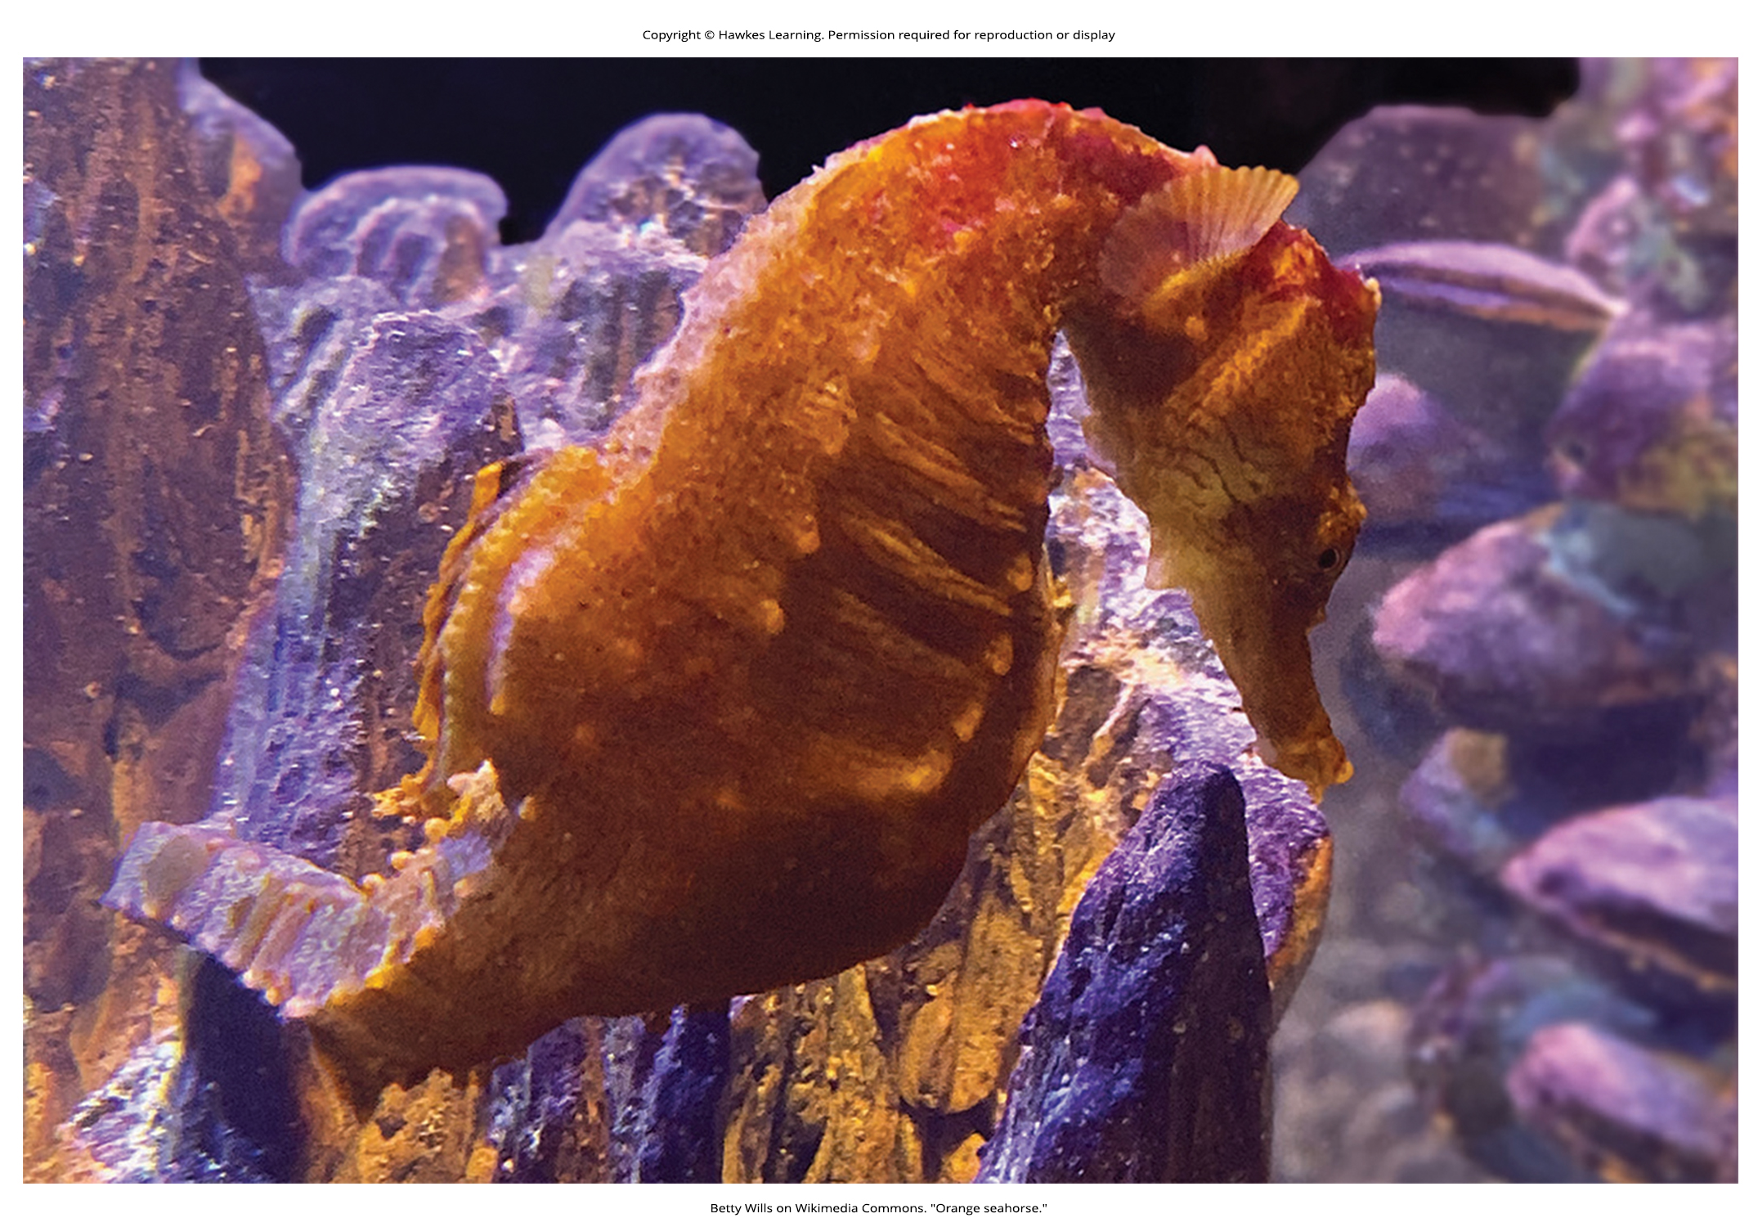
Lesson 40.1 Figure 1

Slide 3
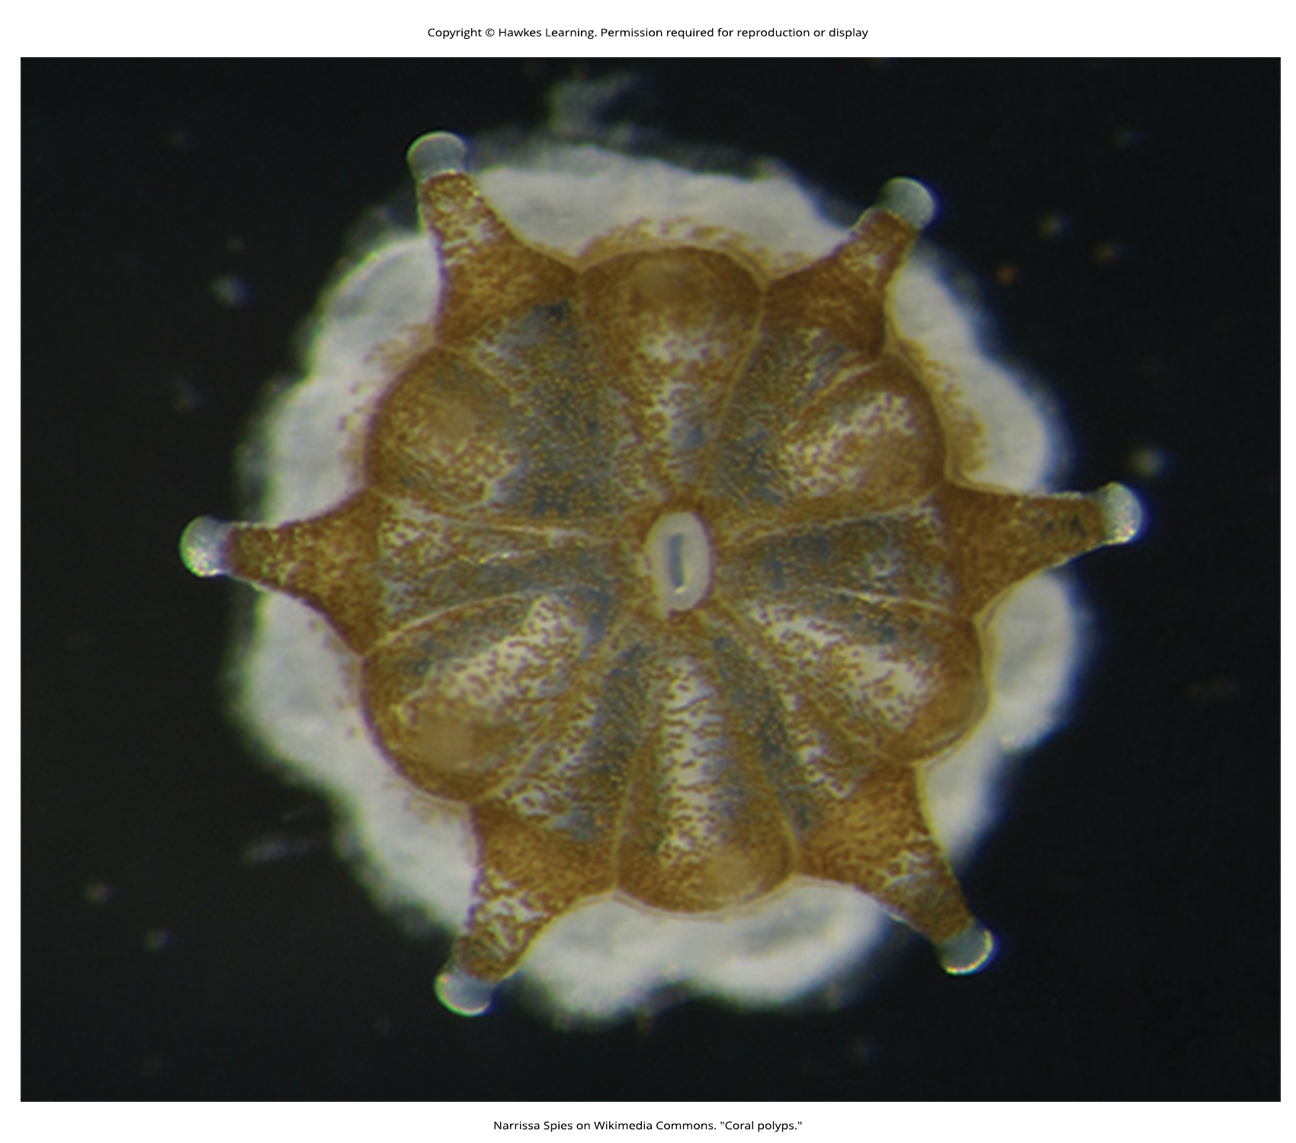
Lesson 40.1 Figure 2

Slide 4
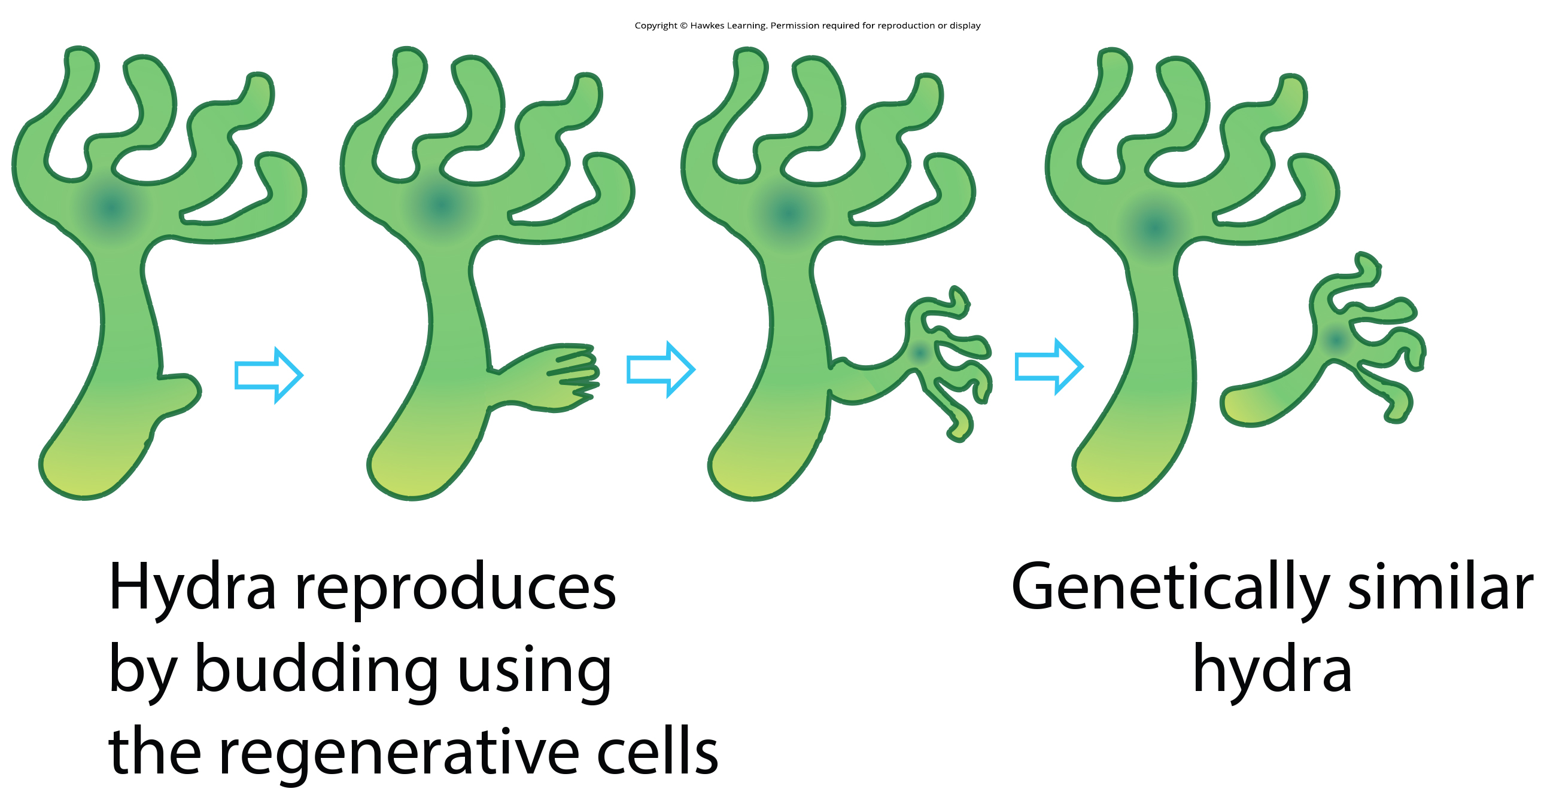
Lesson 40.1 Figure 3

Slide 5
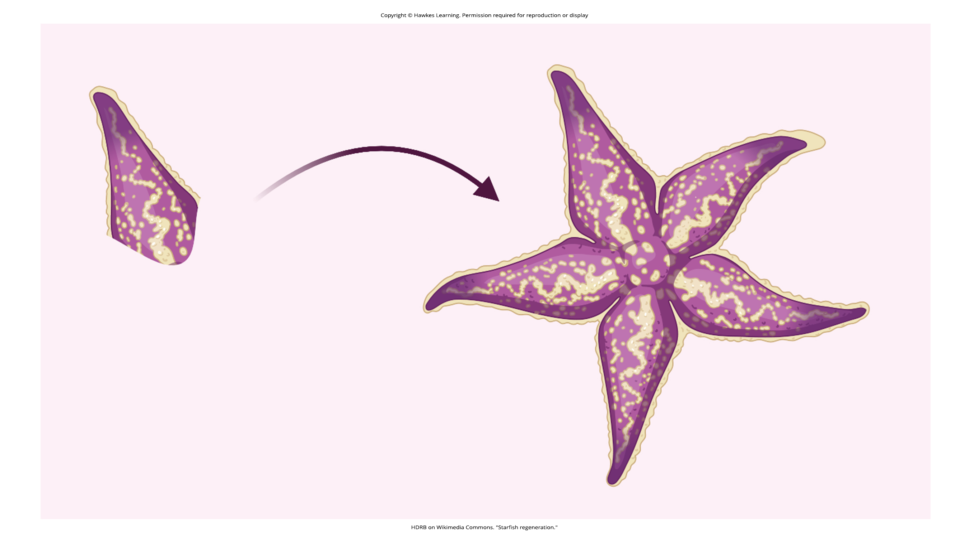
Lesson 40.1 Figure 4

Slide 6
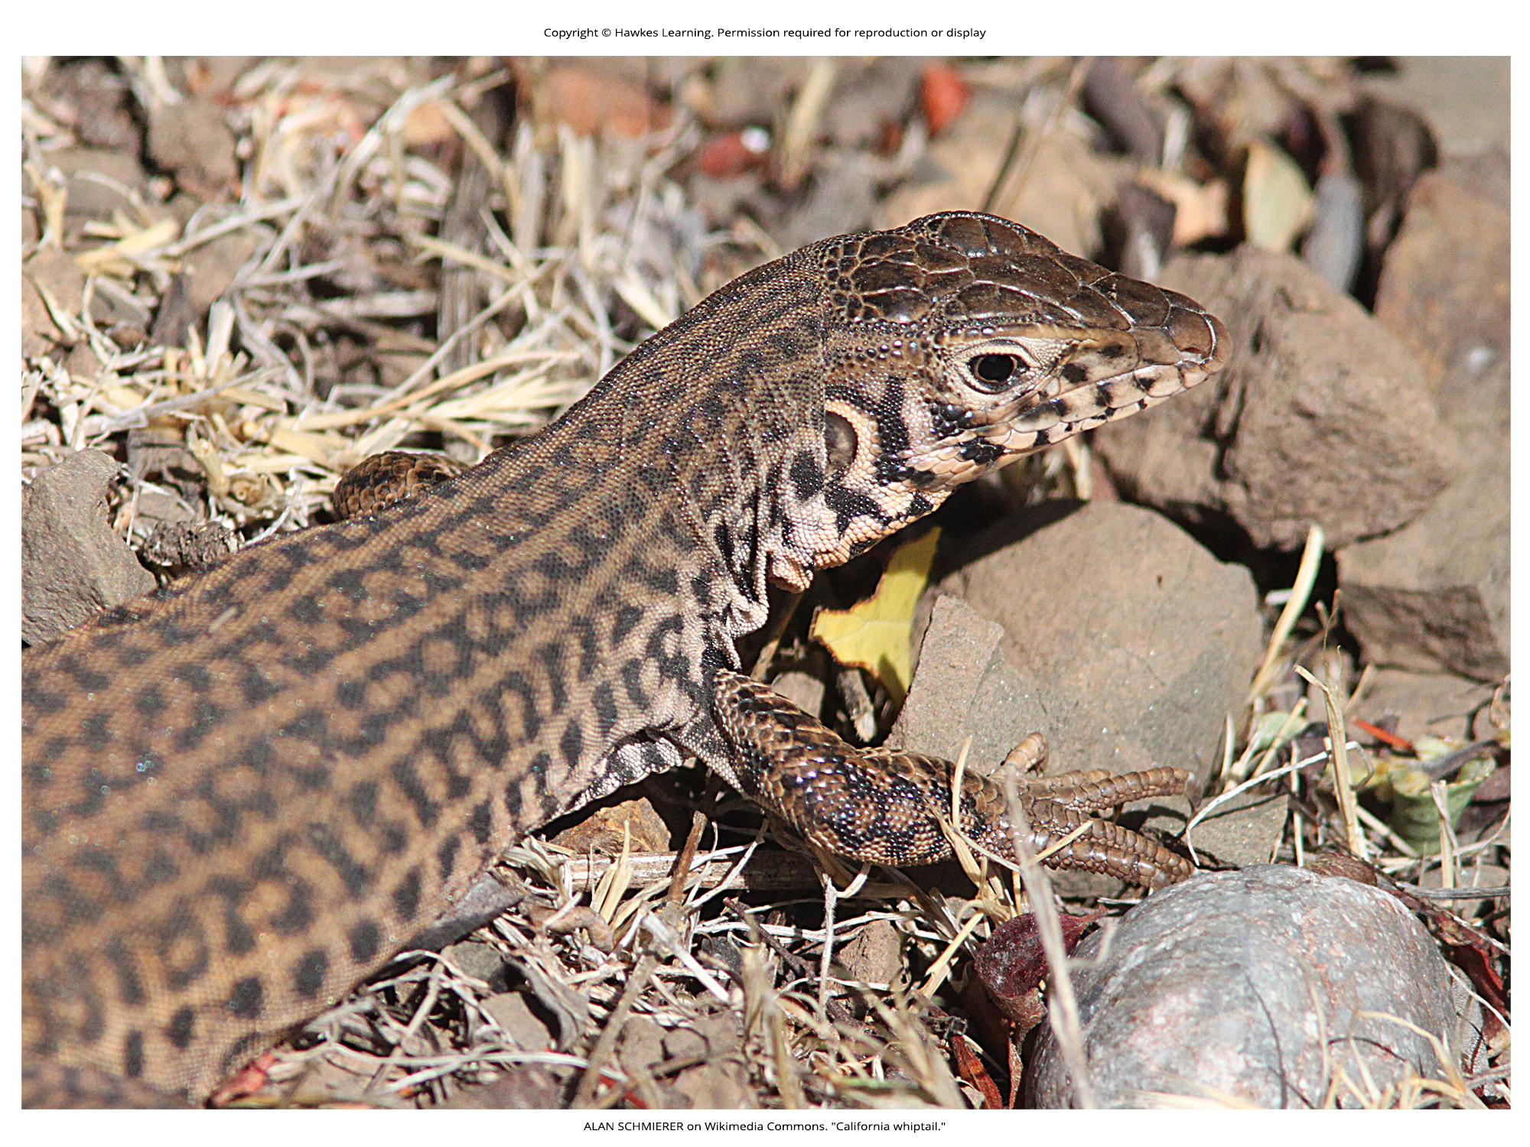
Lesson 40.1 Figure 5

Slide 7
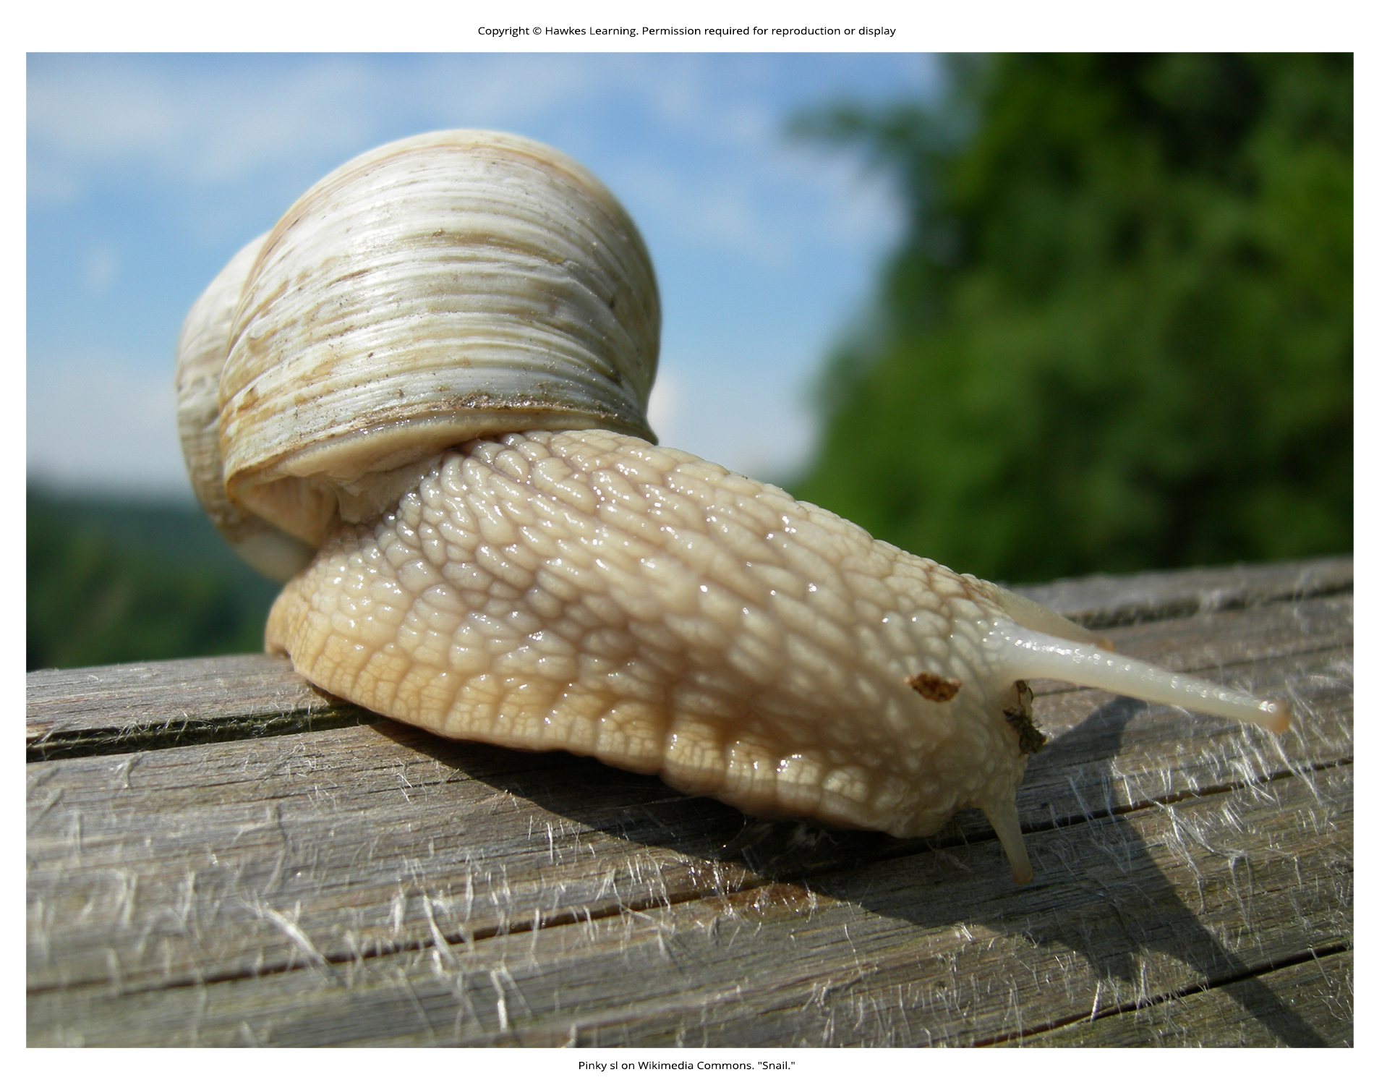
Lesson 40.1 Figure 6

Slide 8
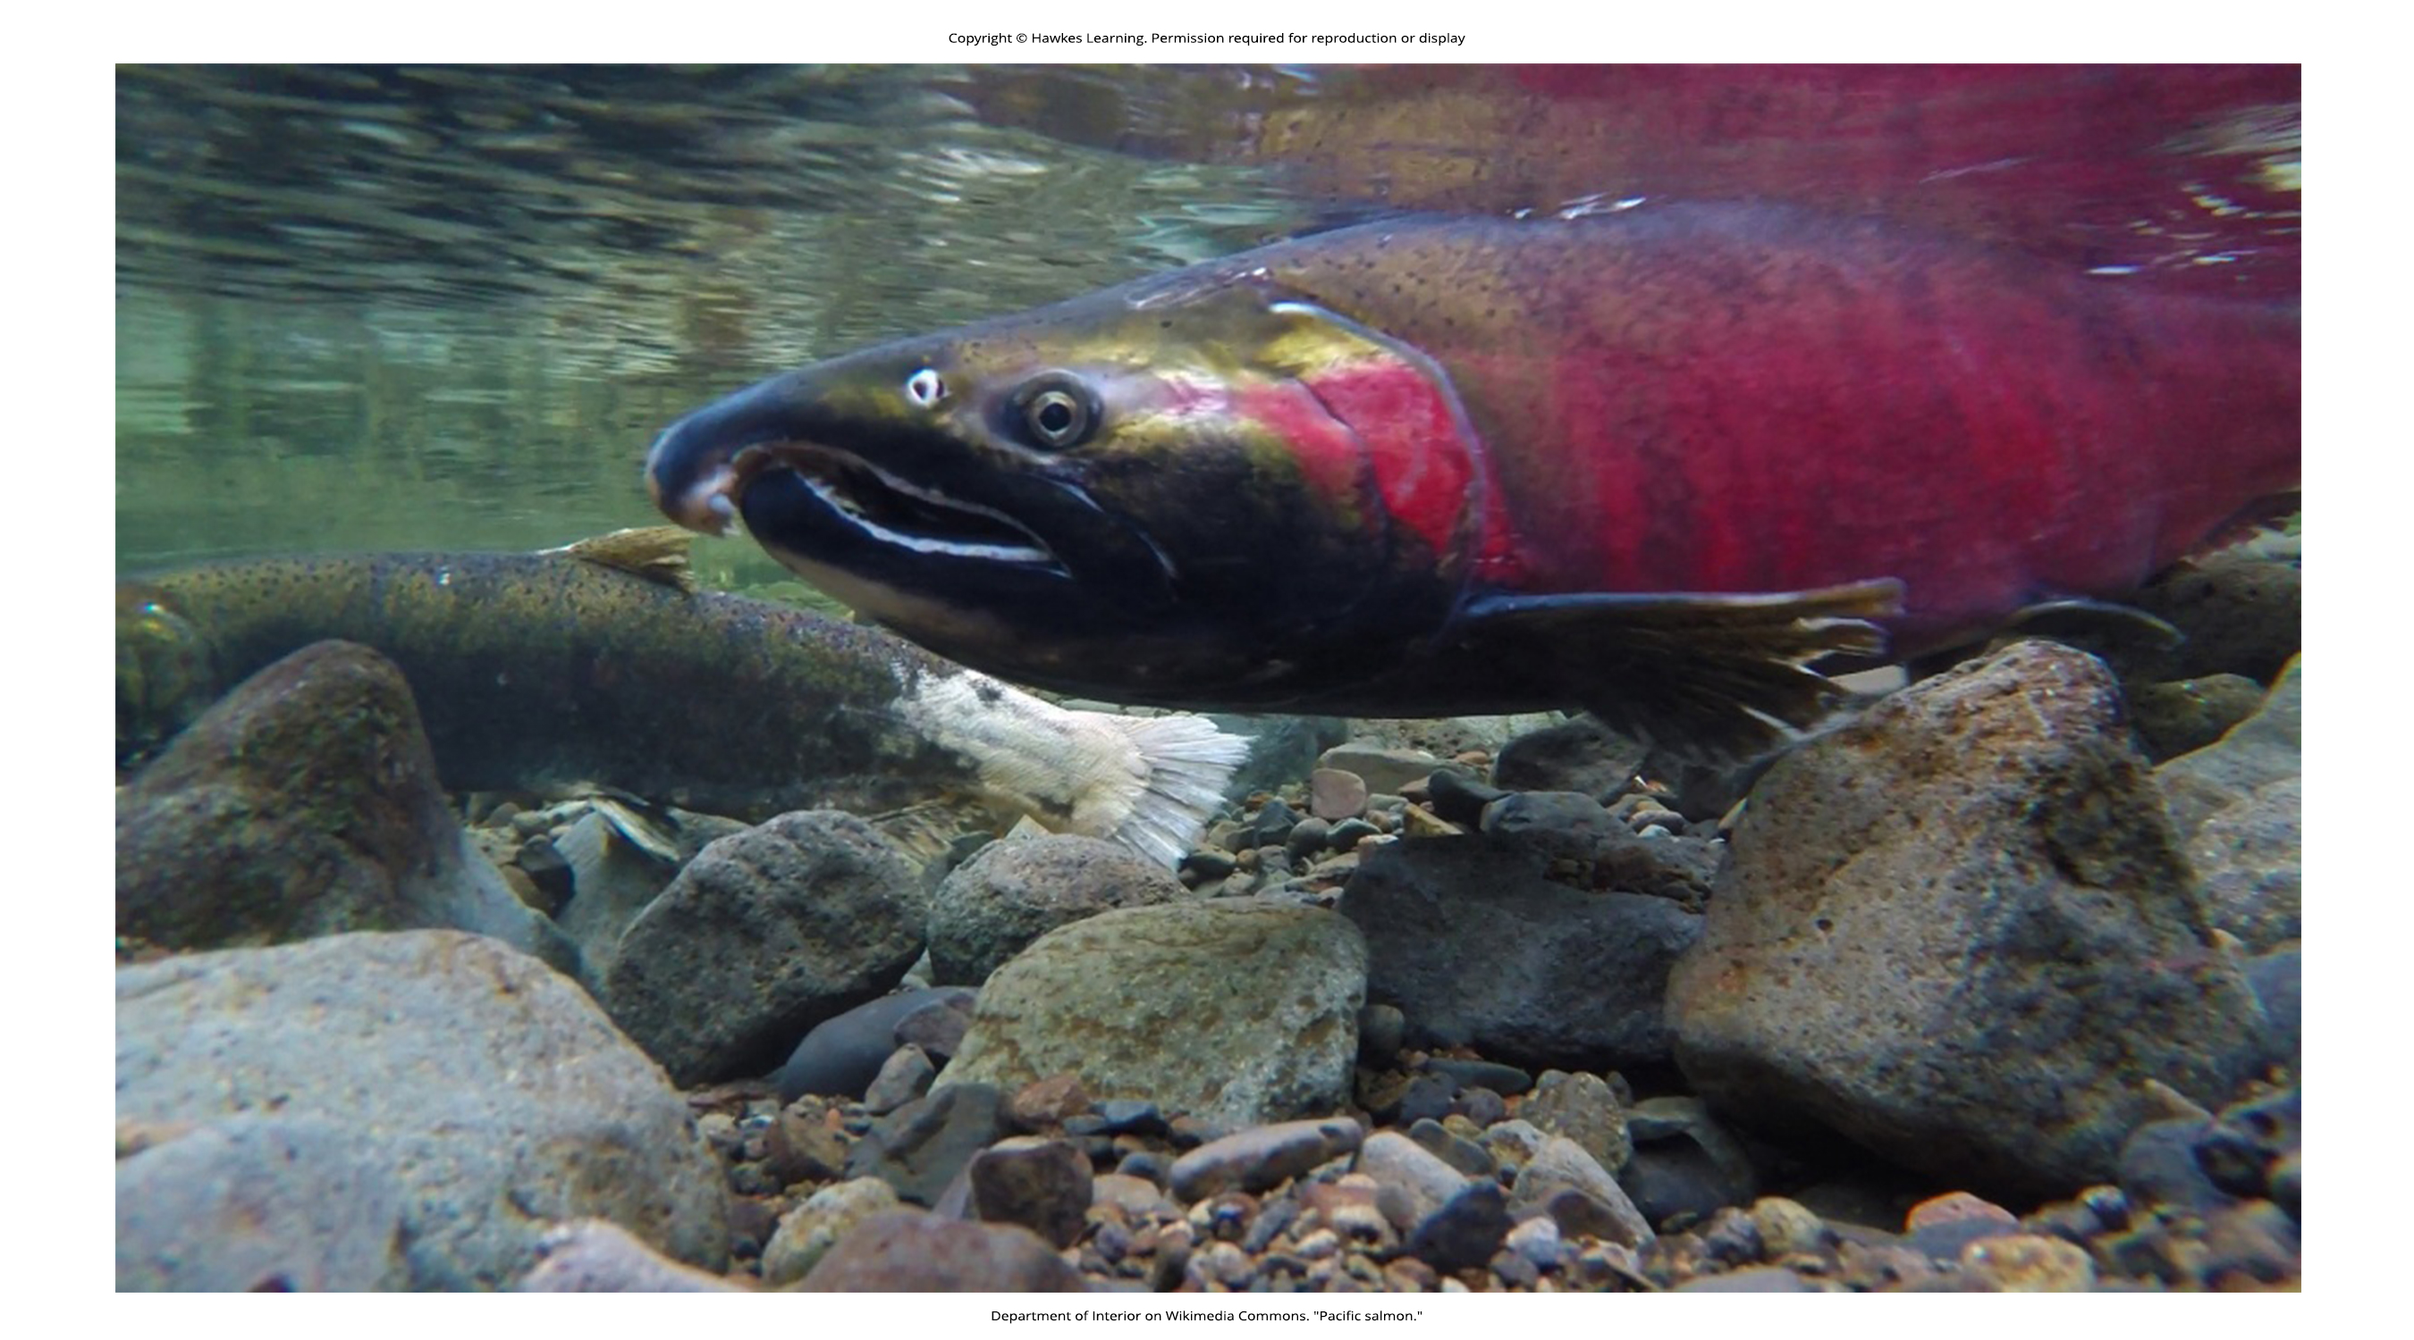
Lesson 40.1 Figure 7

Slide 9
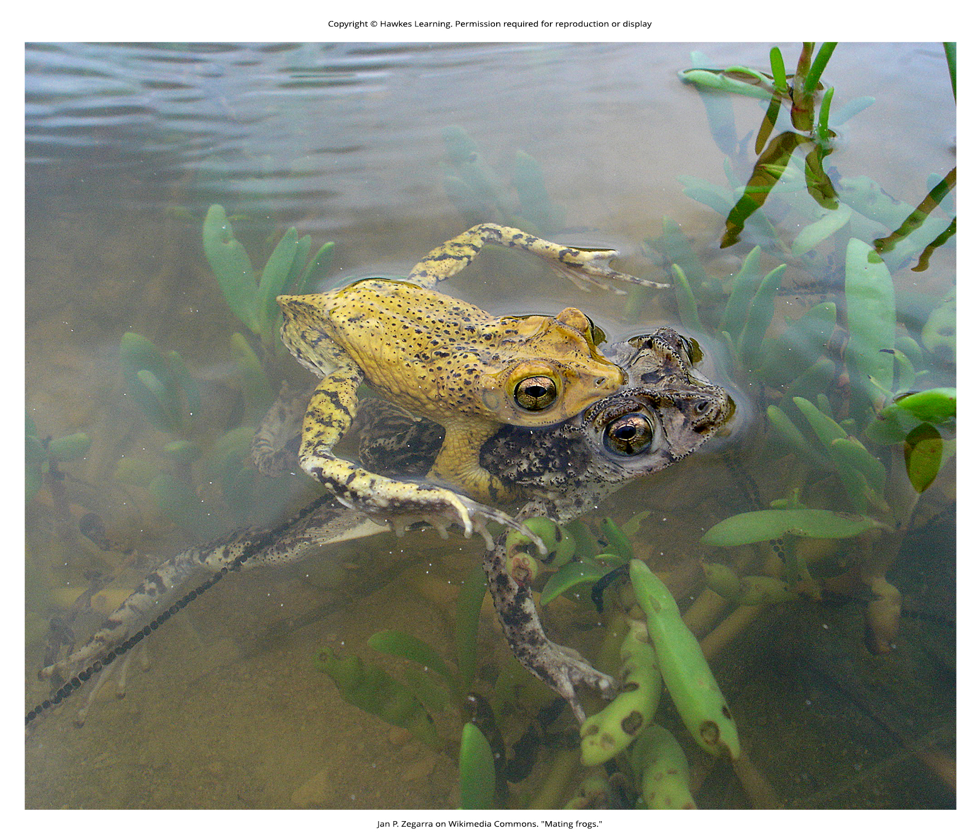
Lesson 40.1 Figure 8

Slide 10
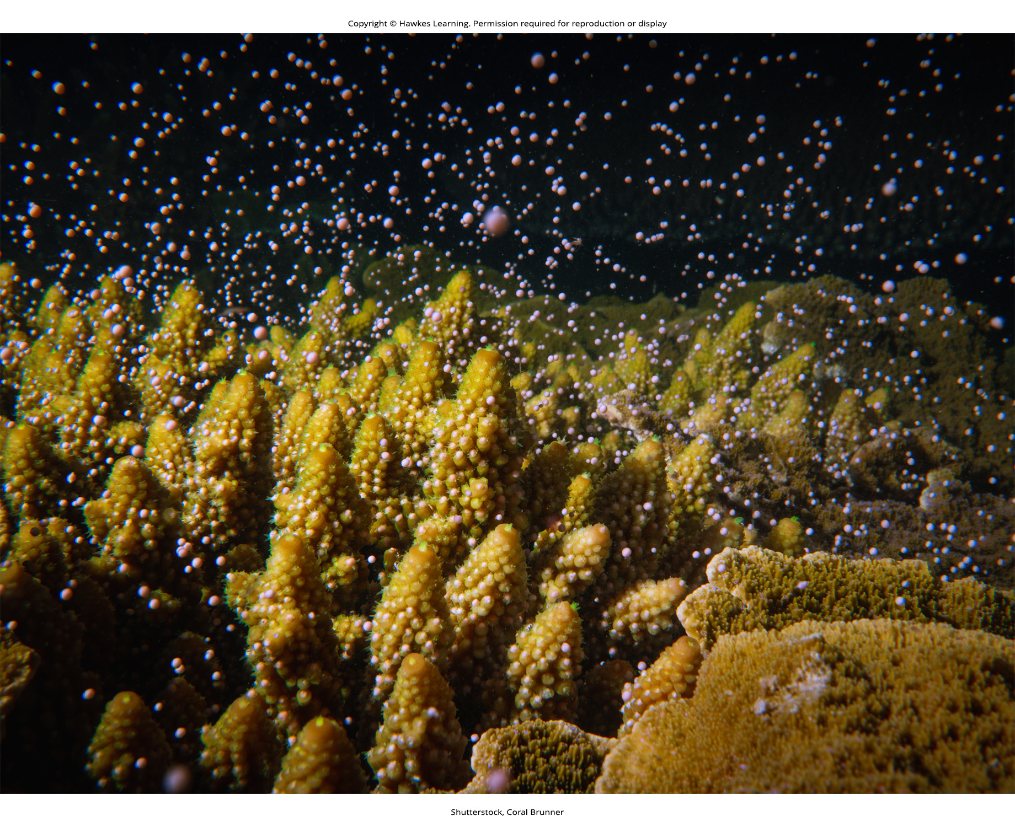
Lesson 40.1 Figure 9

Slide 11
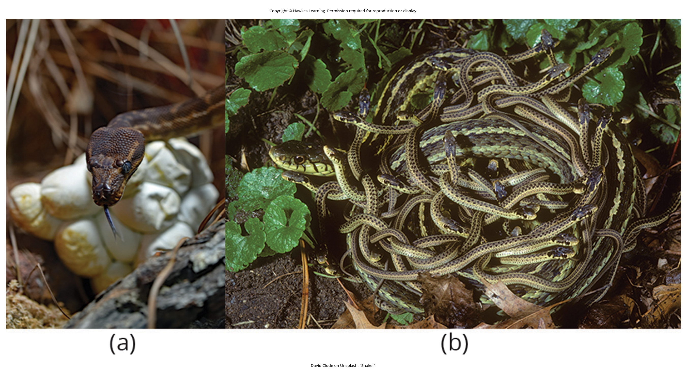
Lesson 40.1 Figure 10

Slide 12
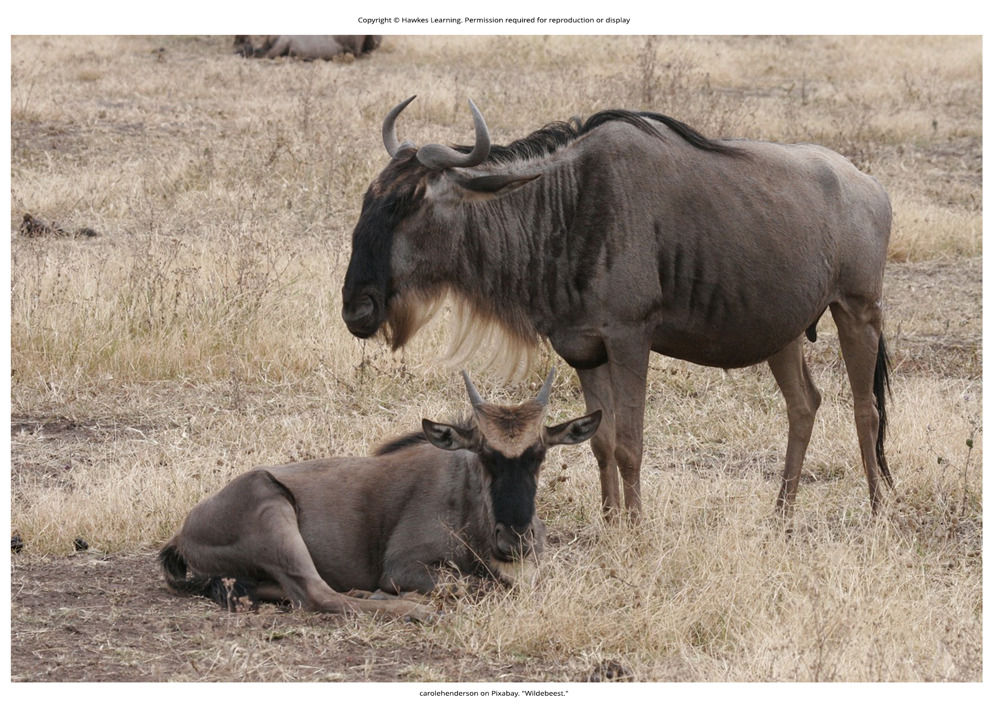
Lesson 40.1 Figure 11

Slide 13
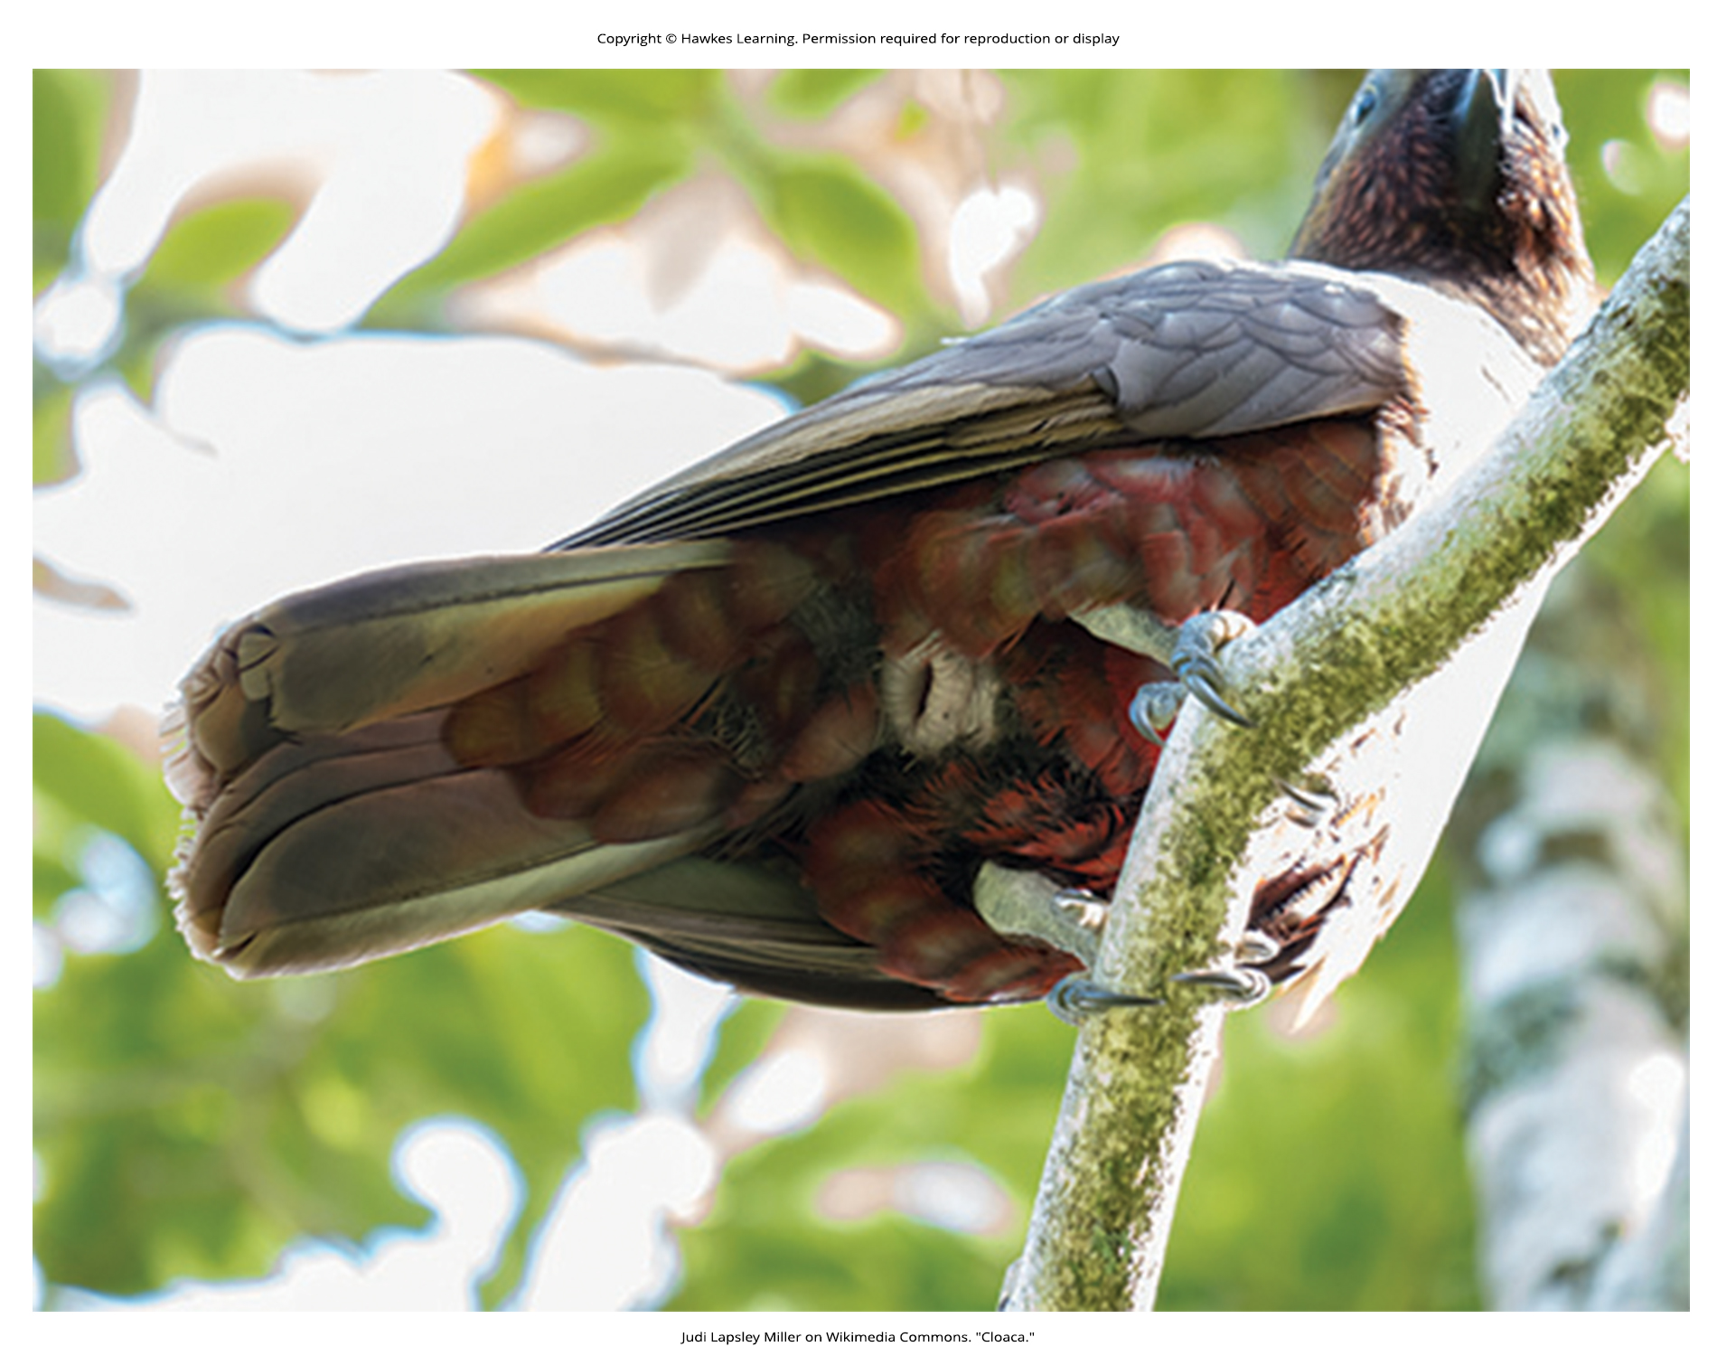
Lesson 40.1 Figure 12

Slide 14
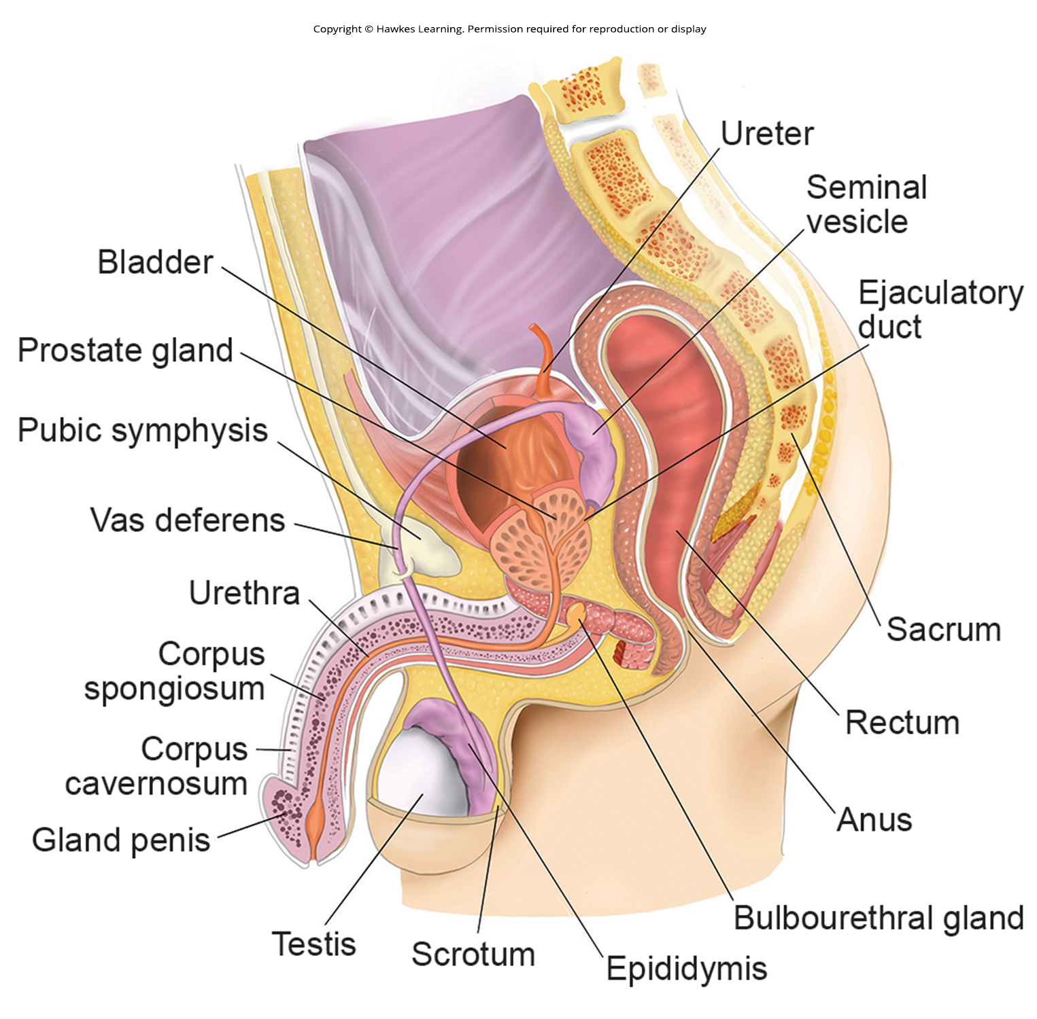
Lesson 40.2 Figure 1

Slide 15
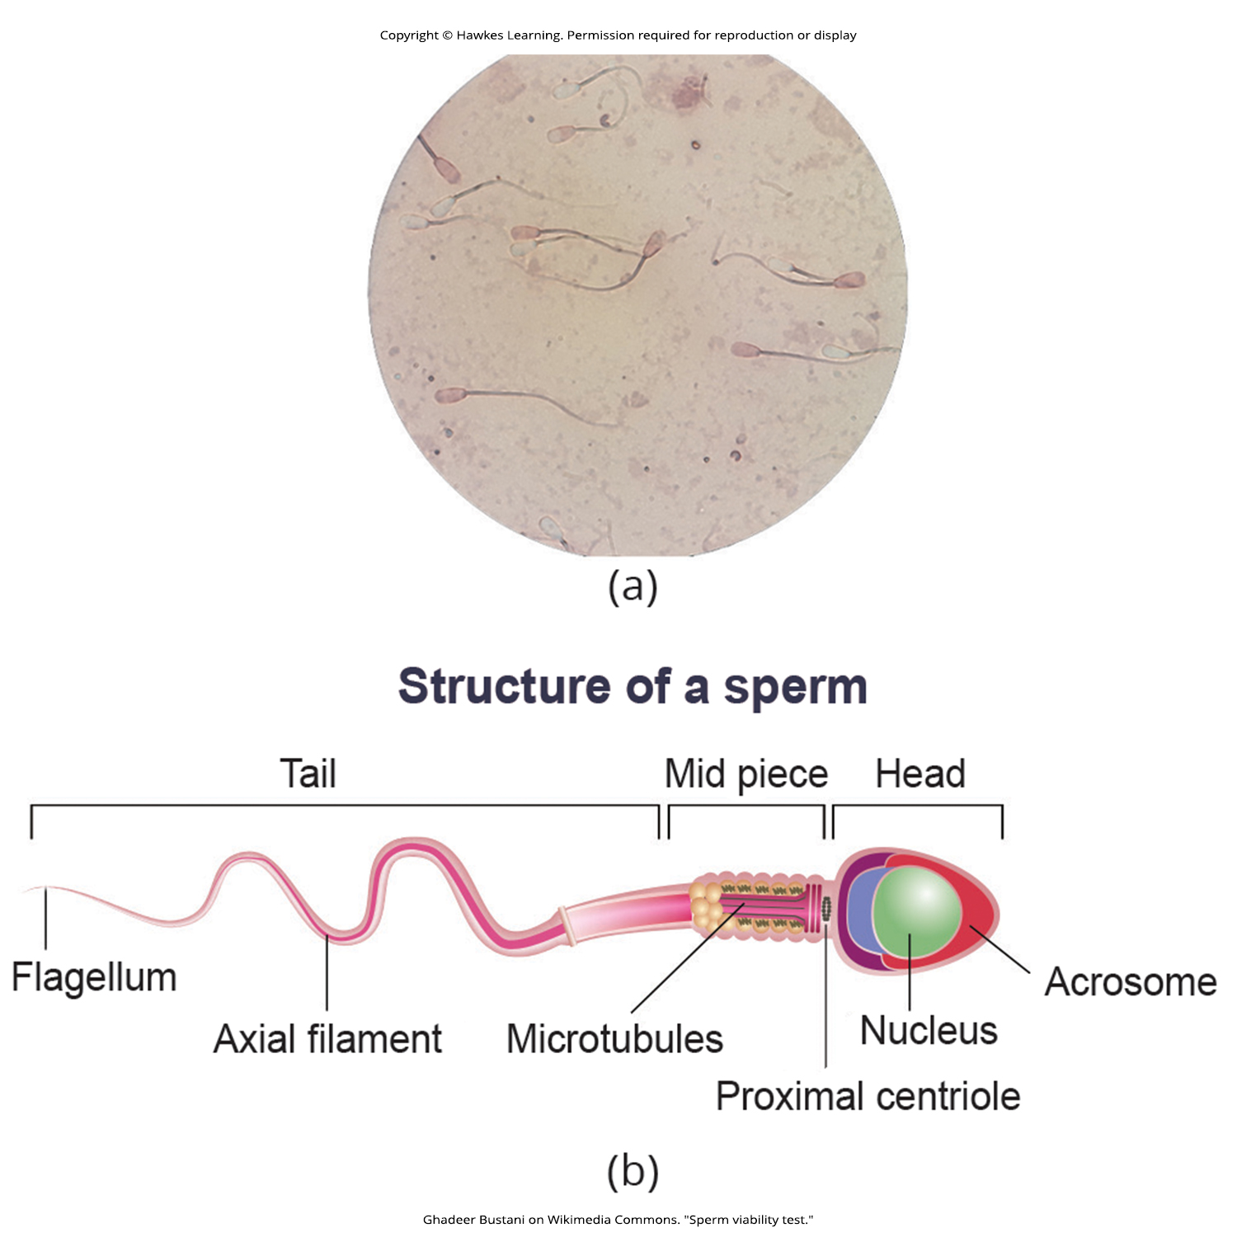
Lesson 40.2 Figure 2

Slide 16
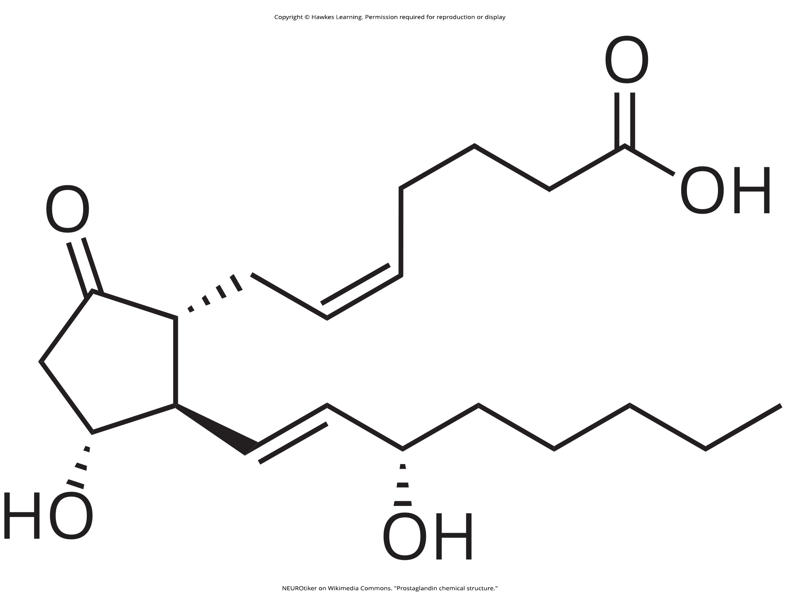
Lesson 40.2 Figure 3

Slide 17
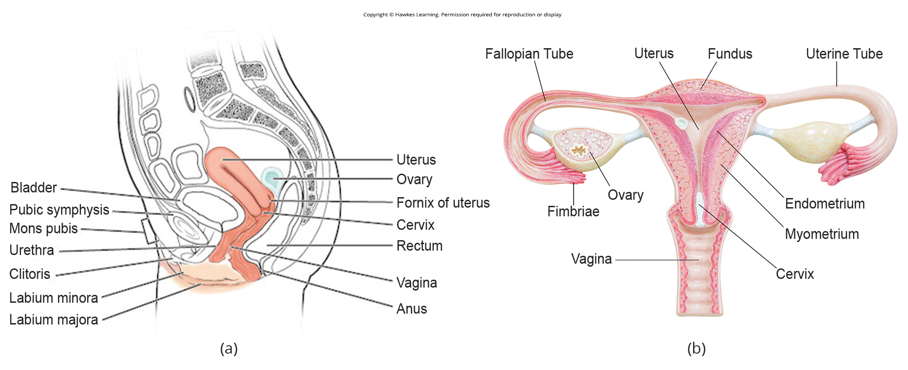
Lesson 40.2 Figure 4

Slide 18
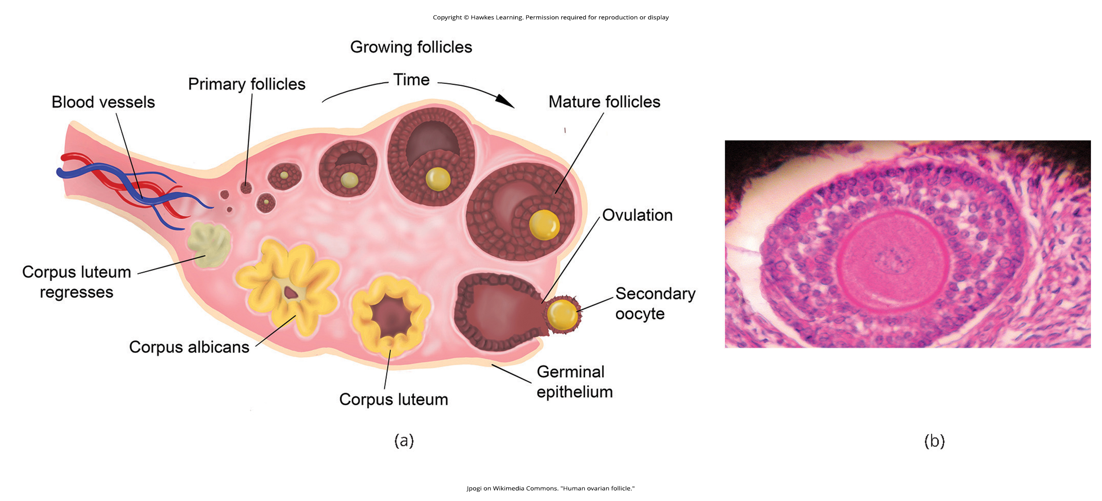
Lesson 40.2 Figure 5

Slide 19
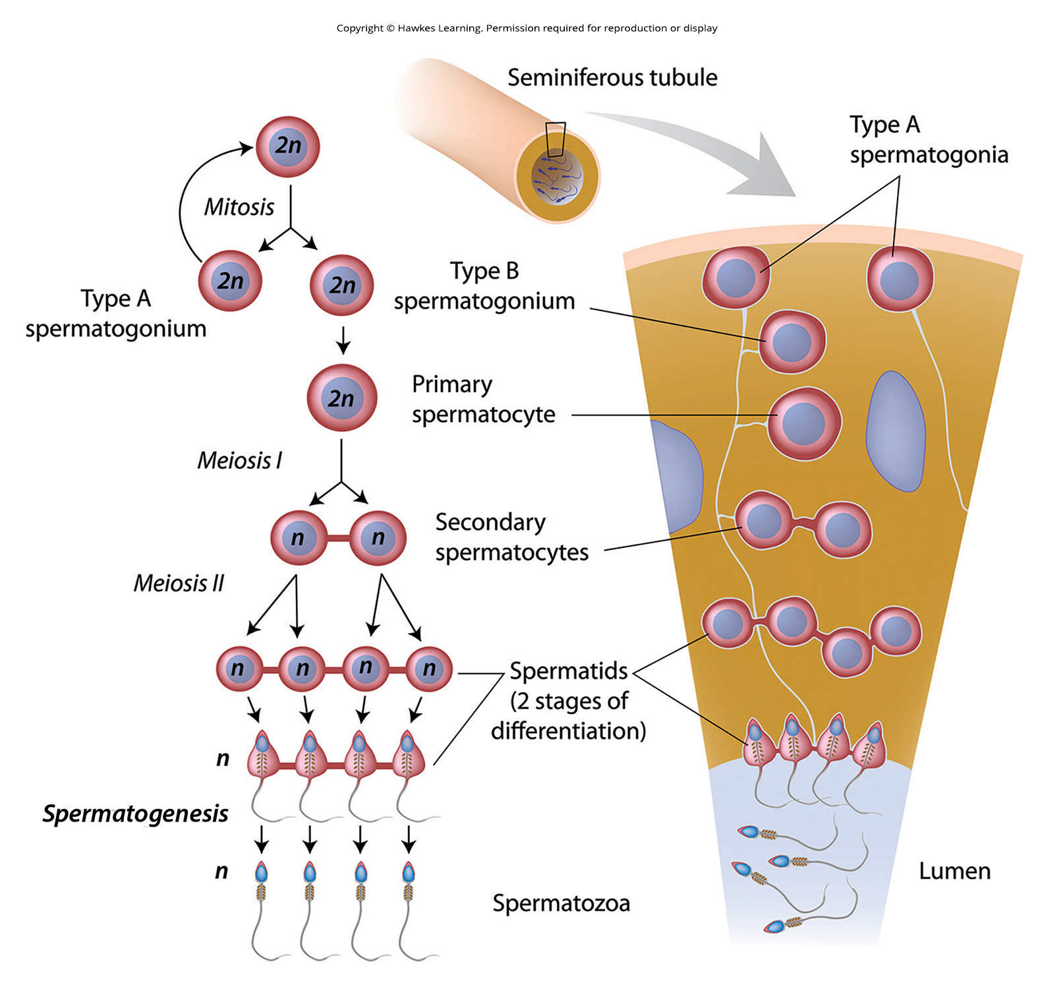
Lesson 40.2 Figure 6

Slide 20
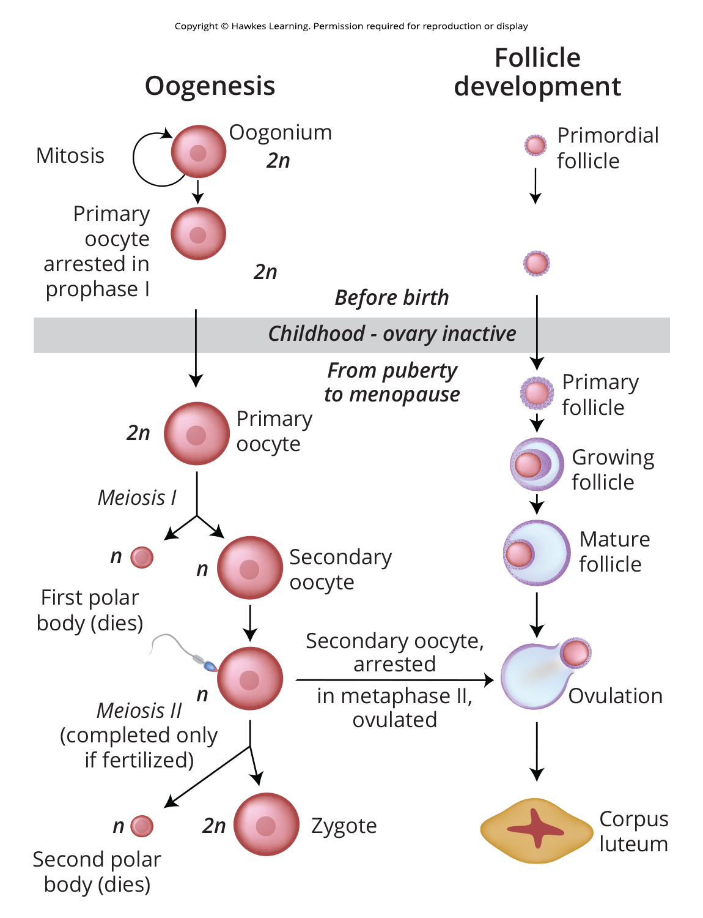
Lesson 40.2 Figure 7

Slide 21
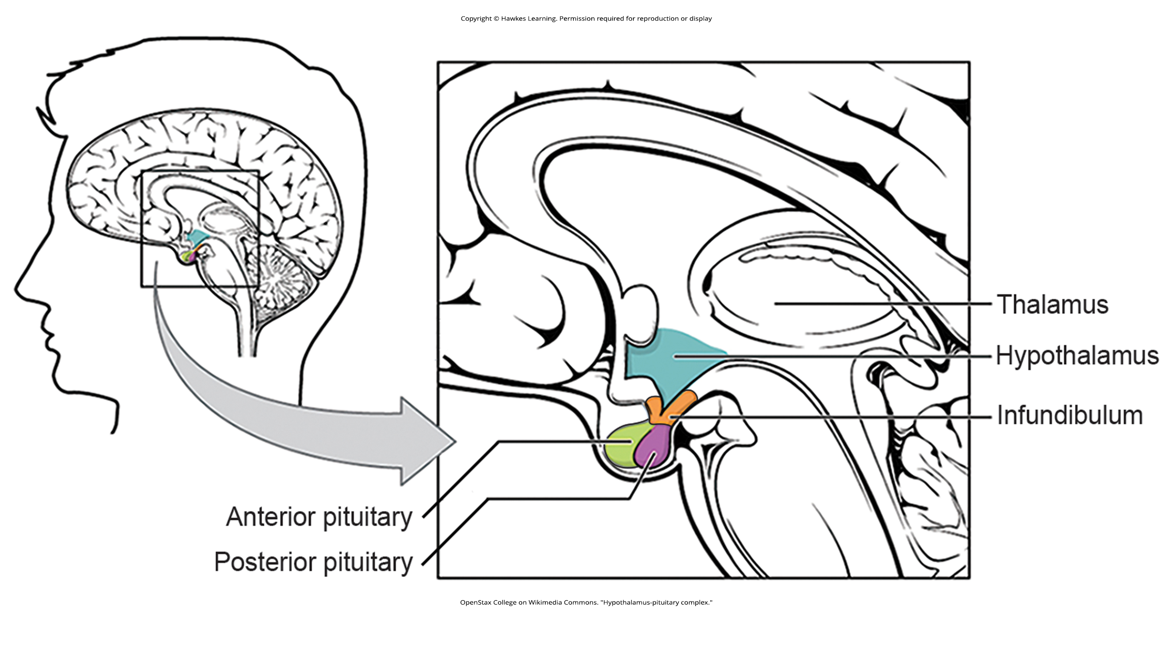
Lesson 40.3 Figure 1

Slide 22
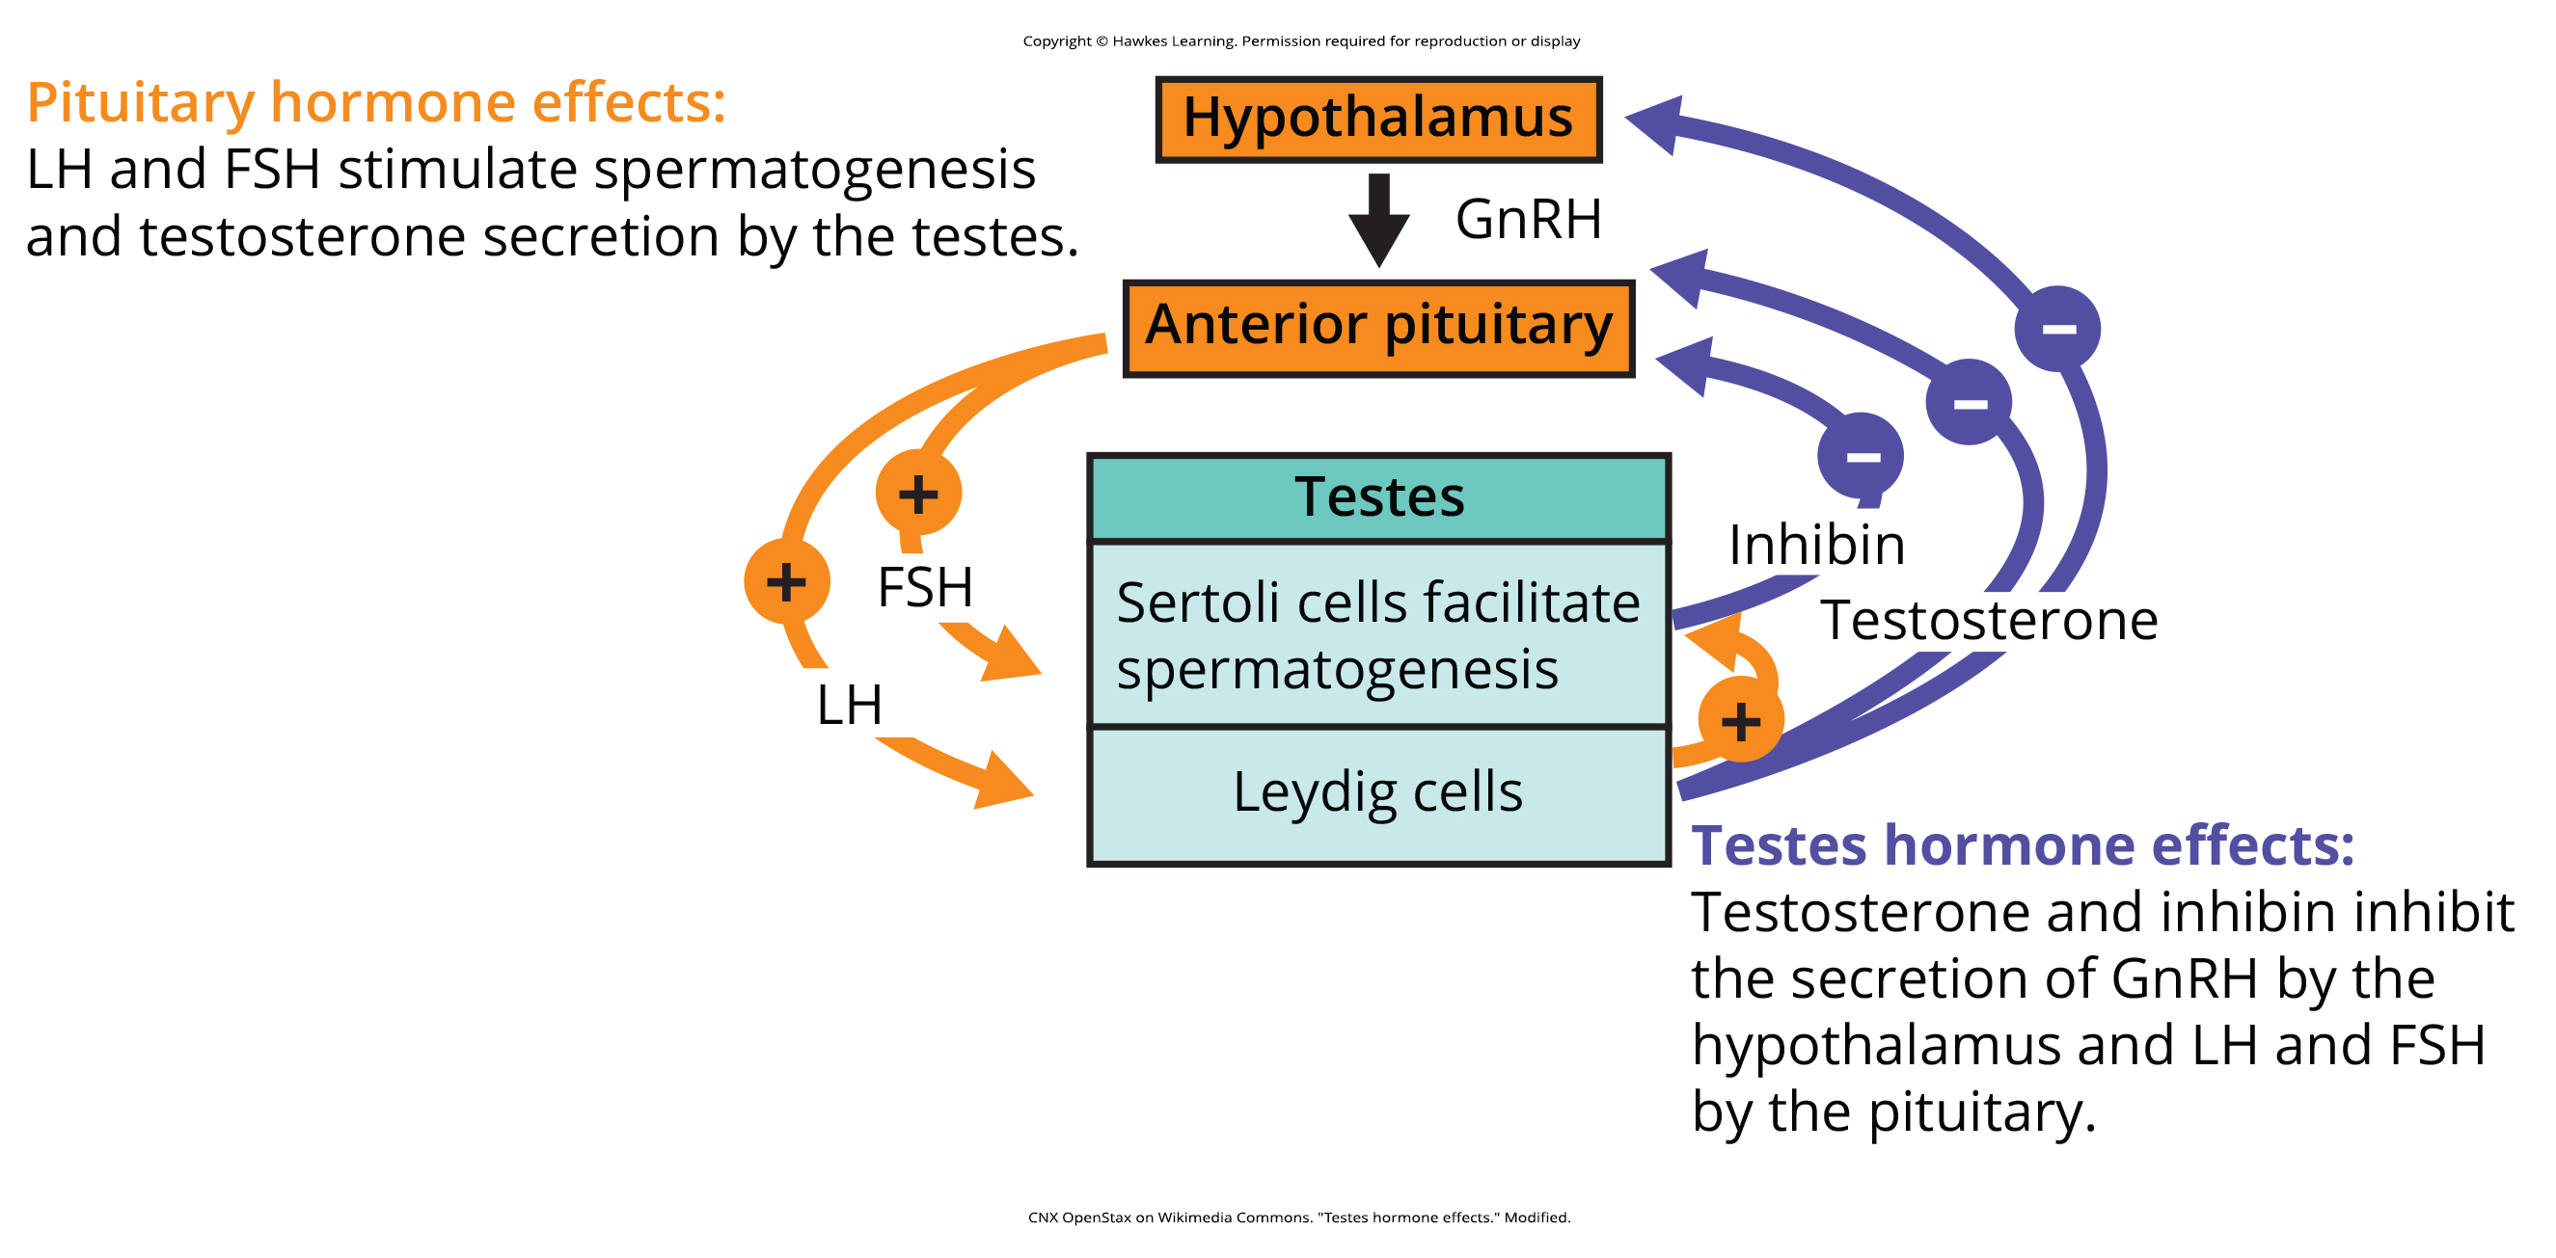
Lesson 40.3 Figure 2

Slide 23
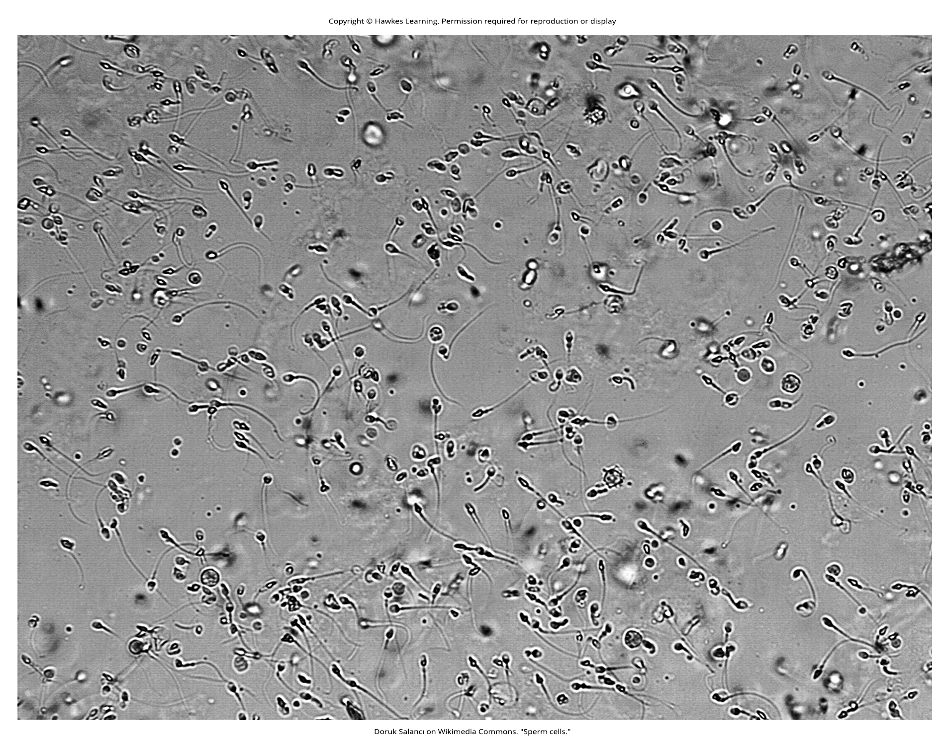
Lesson 40.3 Figure 3

Slide 24
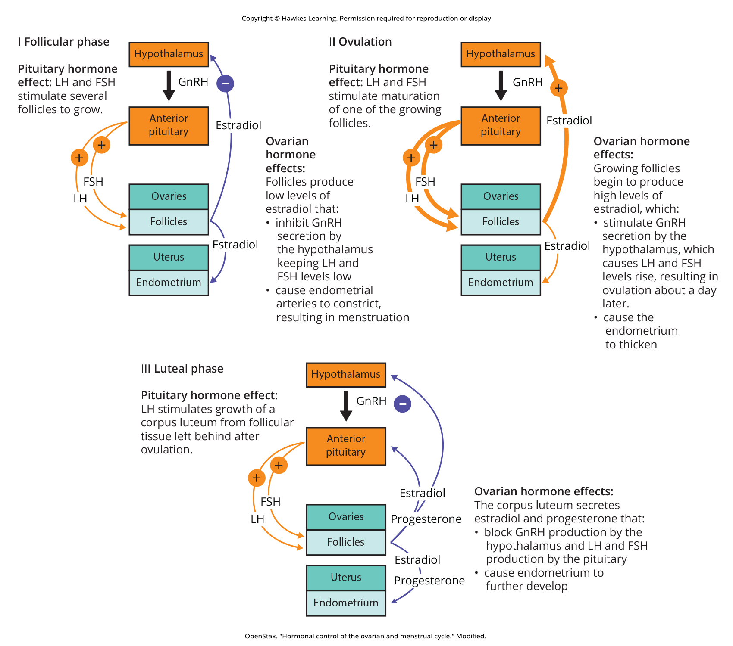
Lesson 40.3 Figure 4

Slide 25
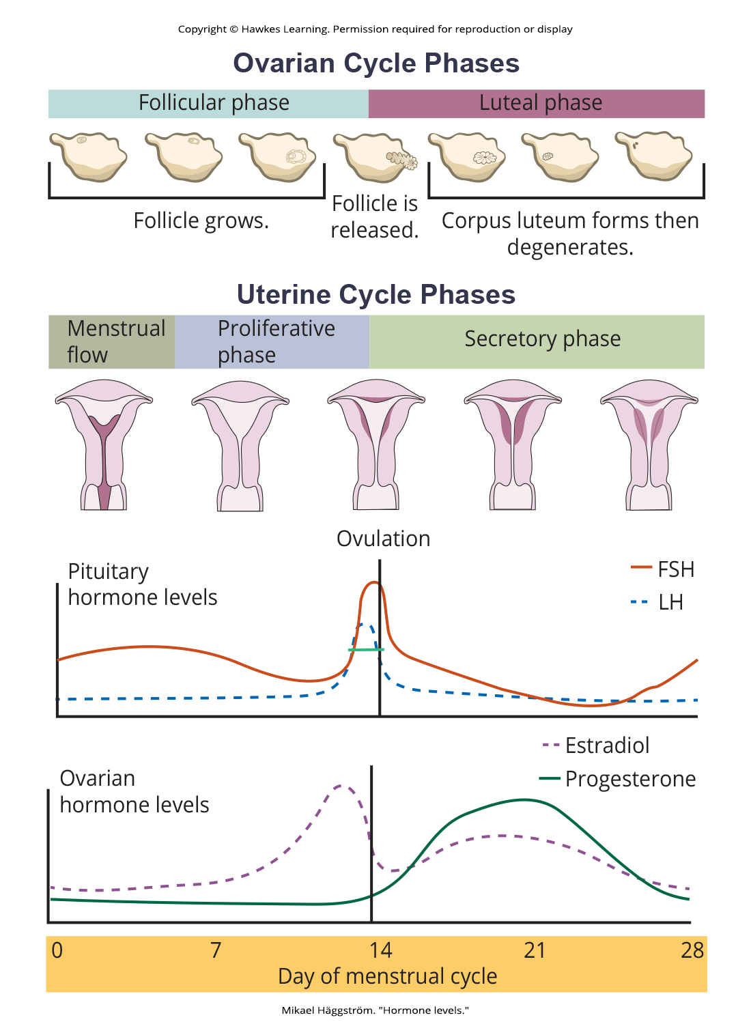
Lesson 40.3 Figure 5

Slide 26
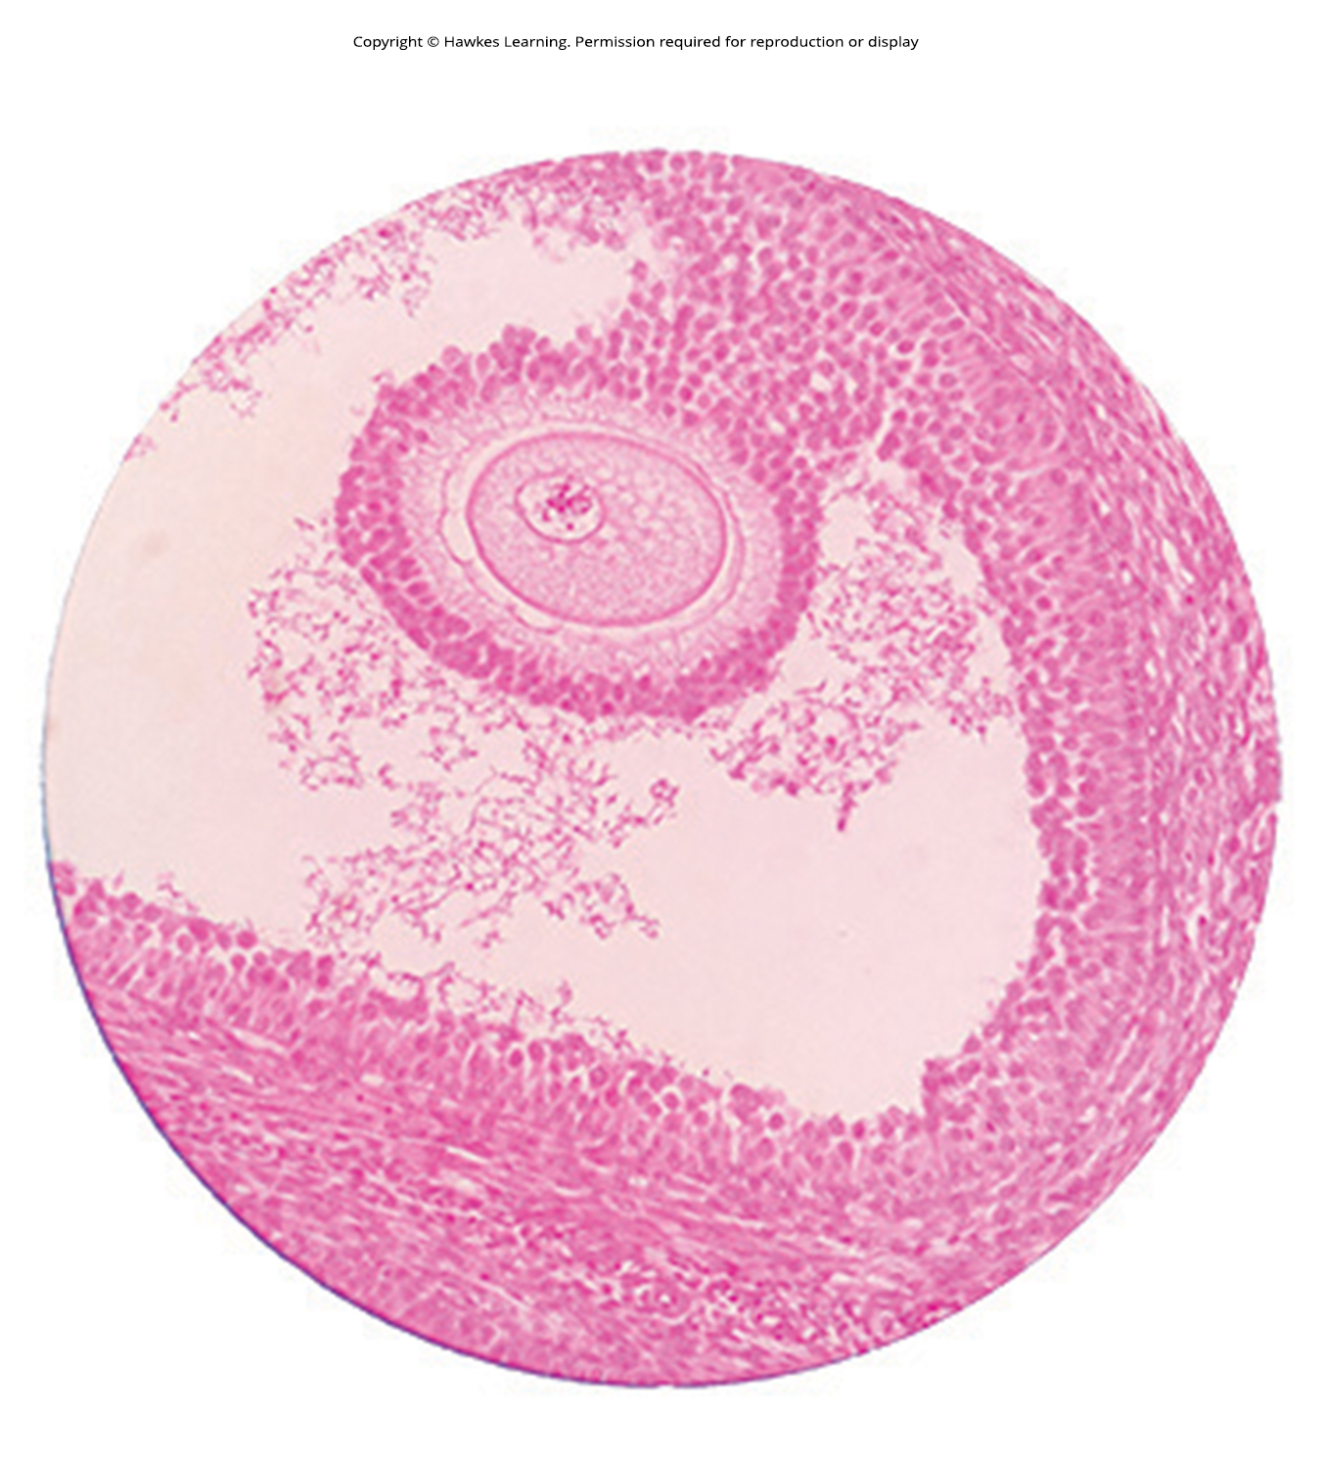
Lesson 40.3 Figure 6

Slide 27
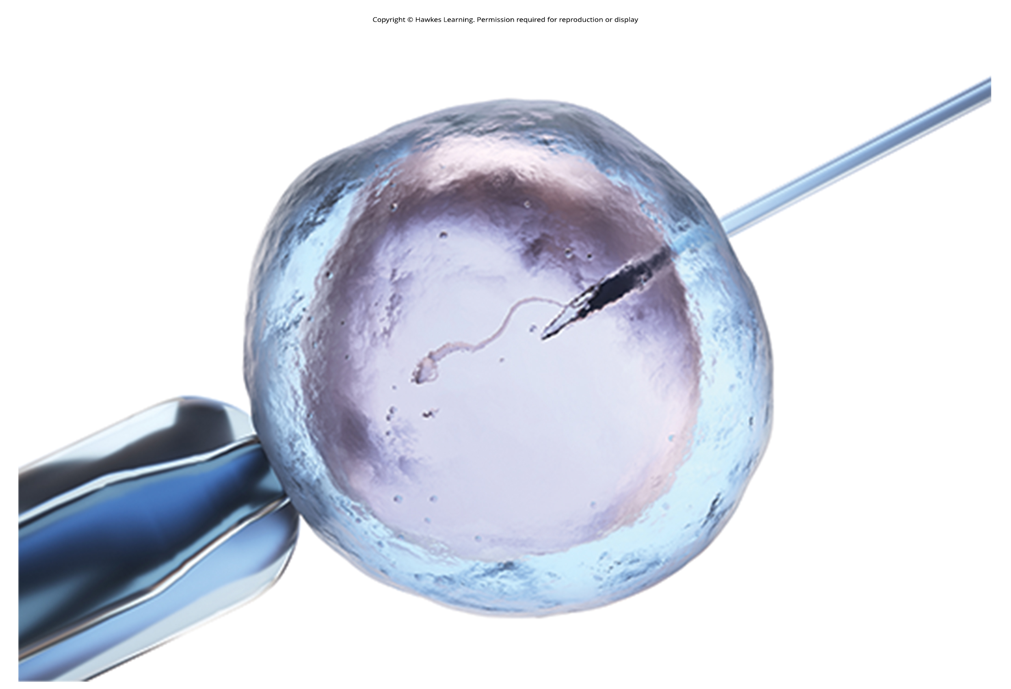
Lesson 40.3 Figure 7

Slide 28
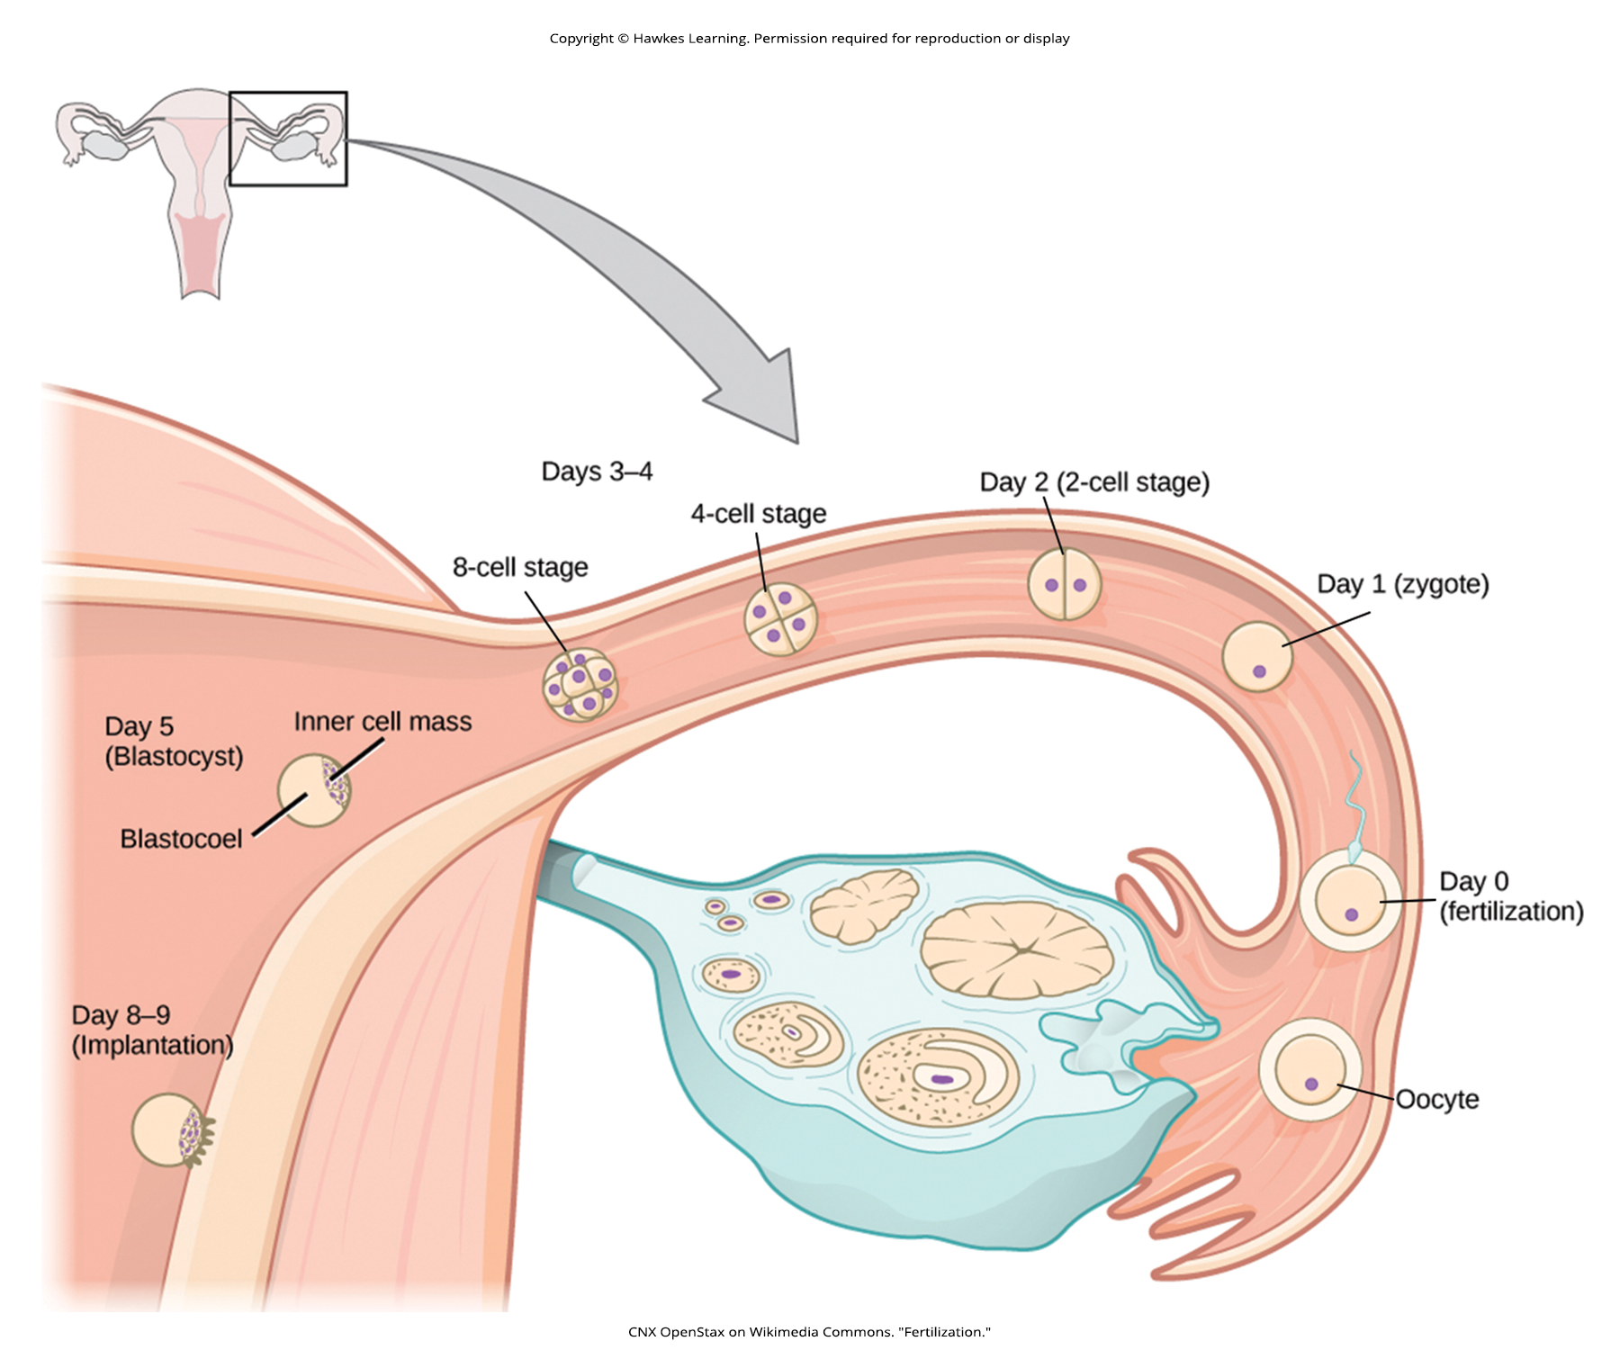
Lesson 40.4 Figure 1

Slide 29
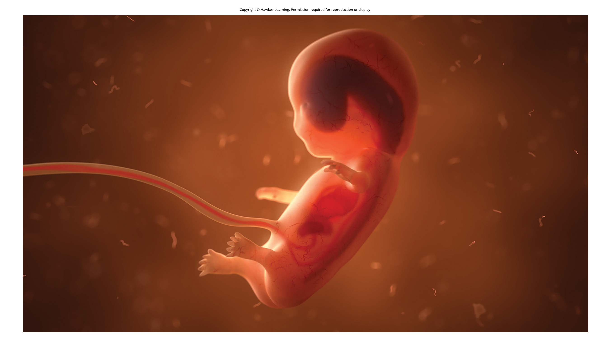
Lesson 40.4 Figure 2

Slide 30
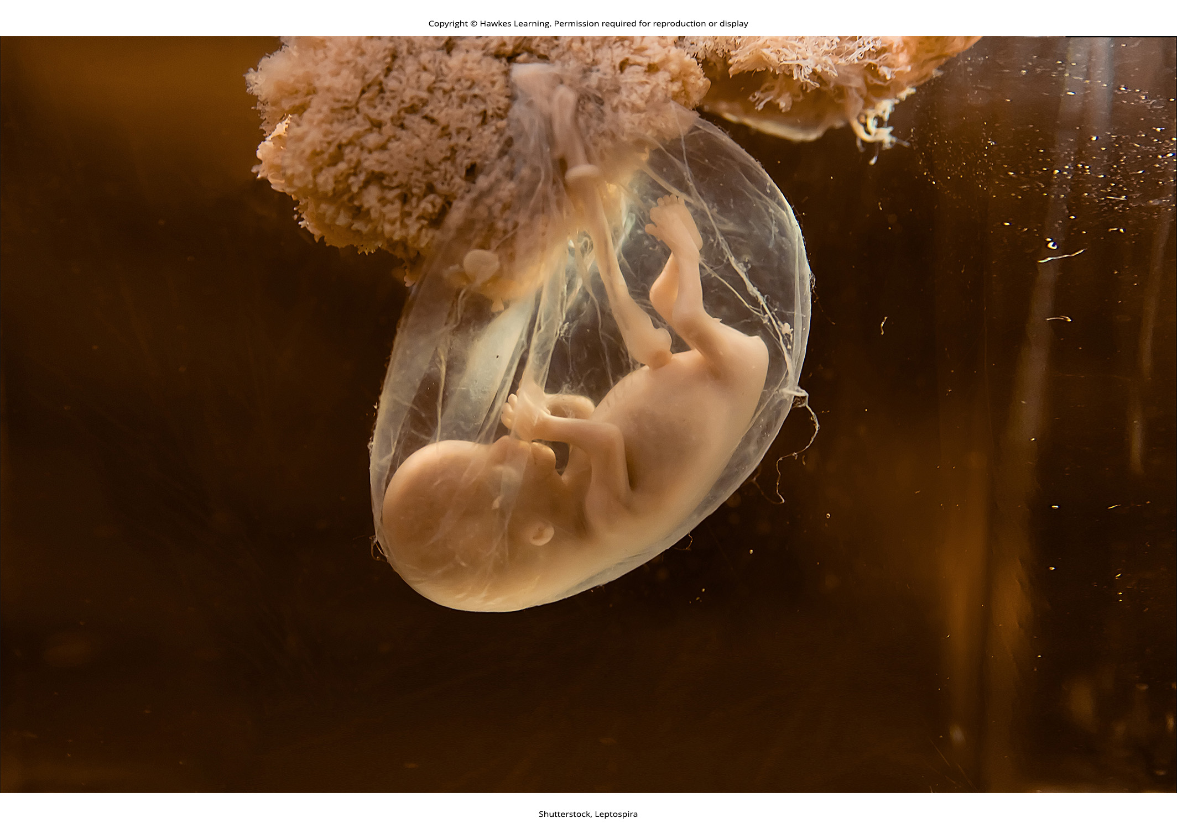
Lesson 40.4 Figure 3

Slide 31
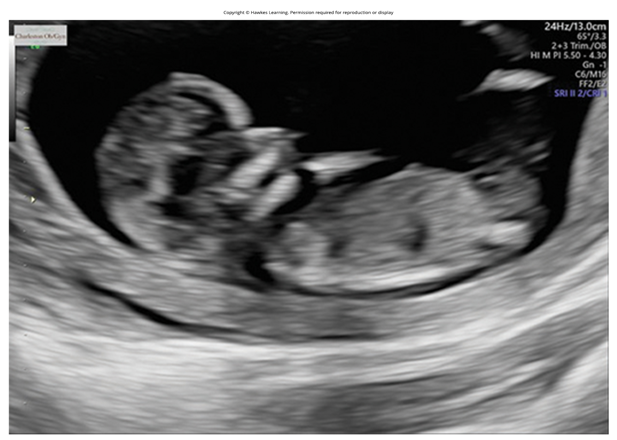
Lesson 40.4 Figure 4

Slide 32
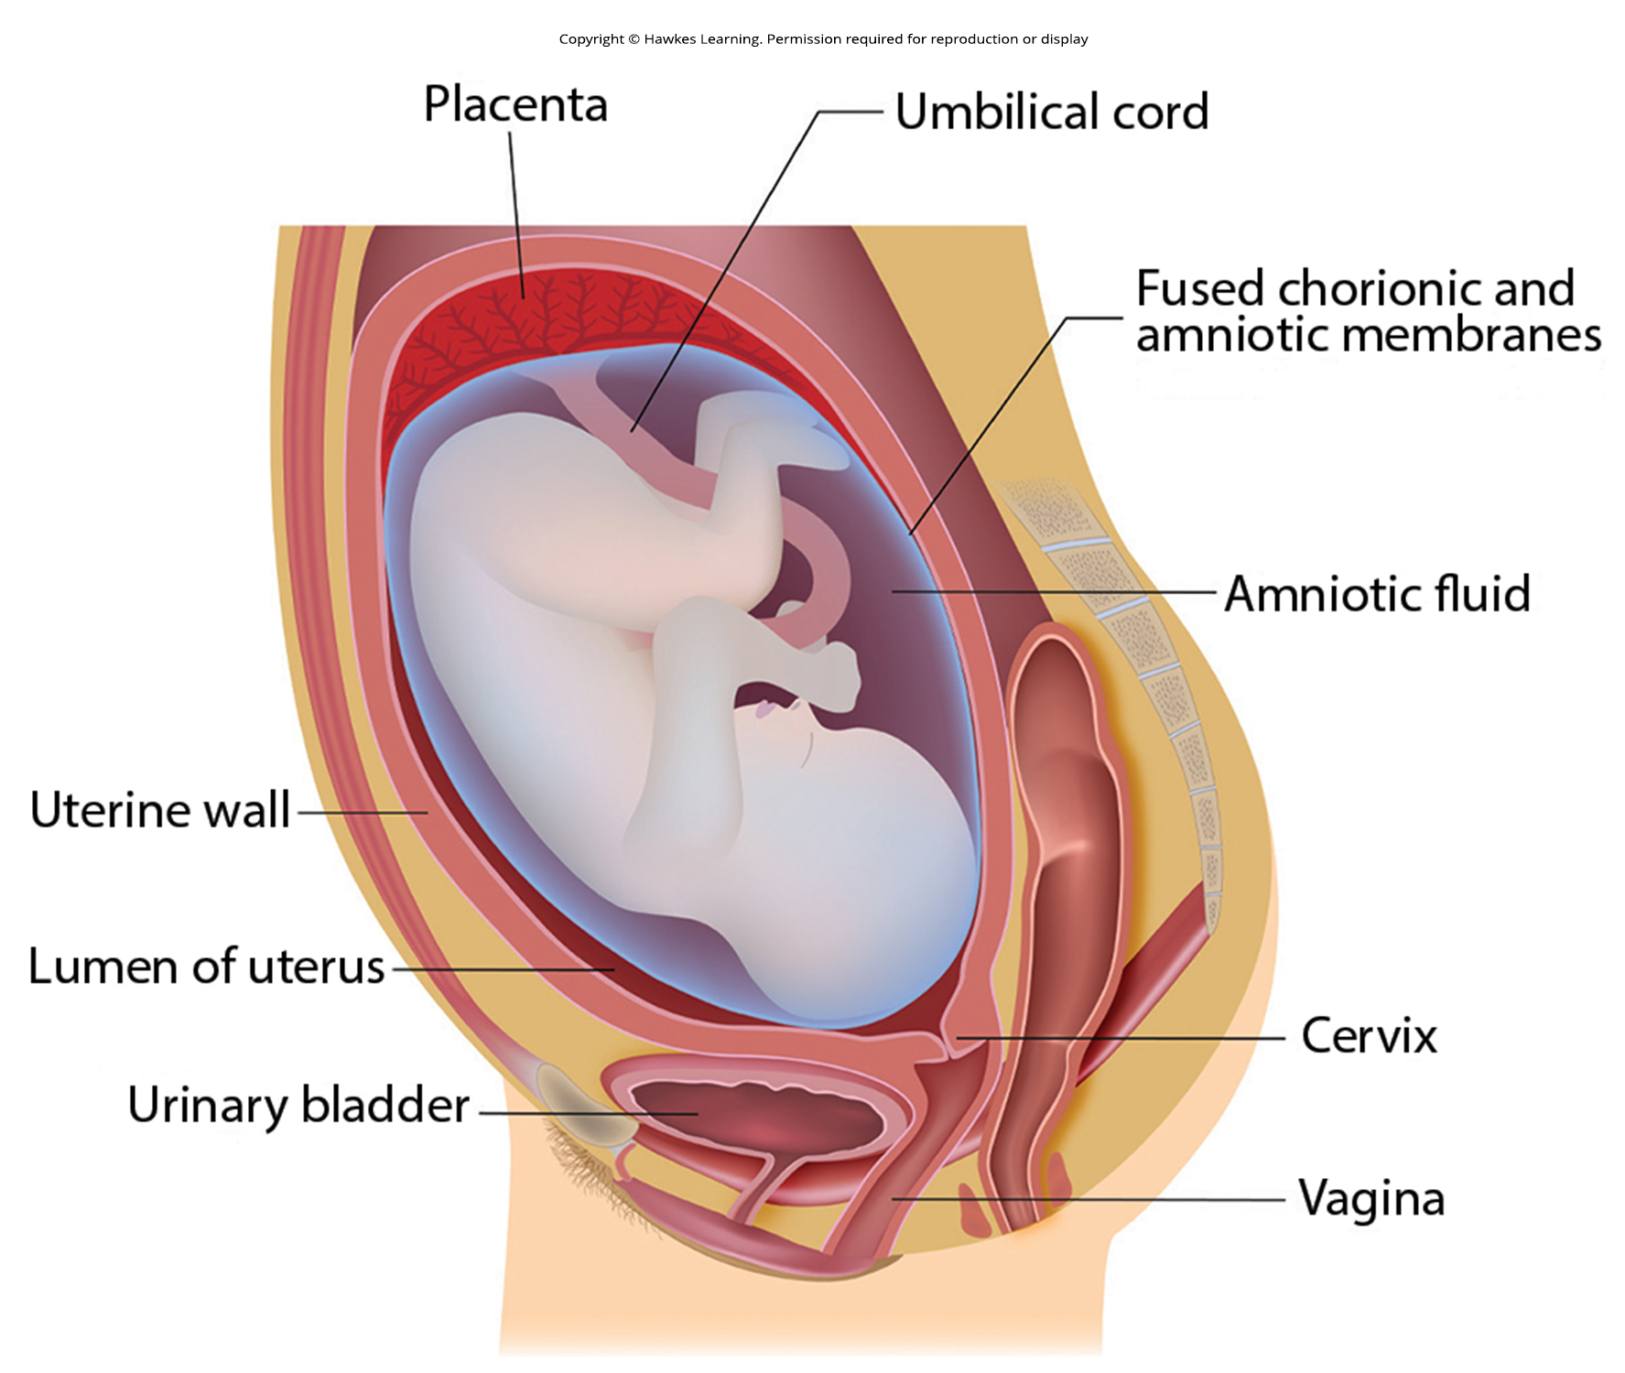
Lesson 40.4 Figure 5

Slide 33
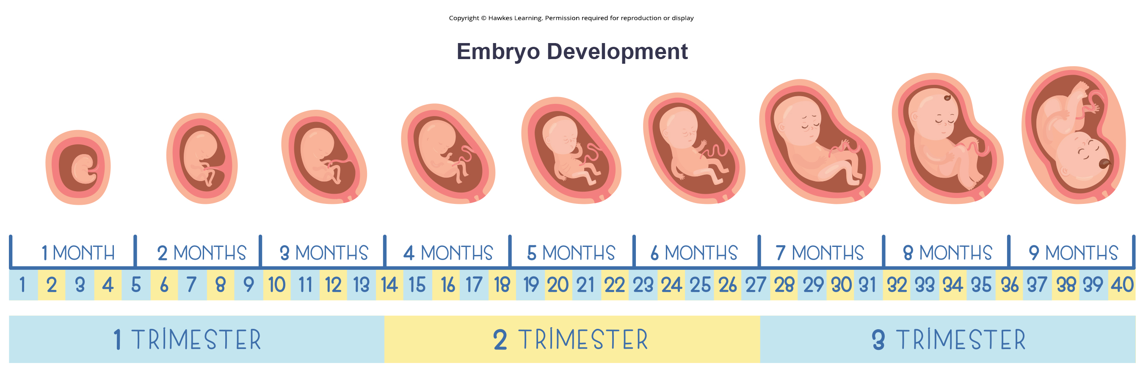
Lesson 40.4 Figure 6

Slide 34
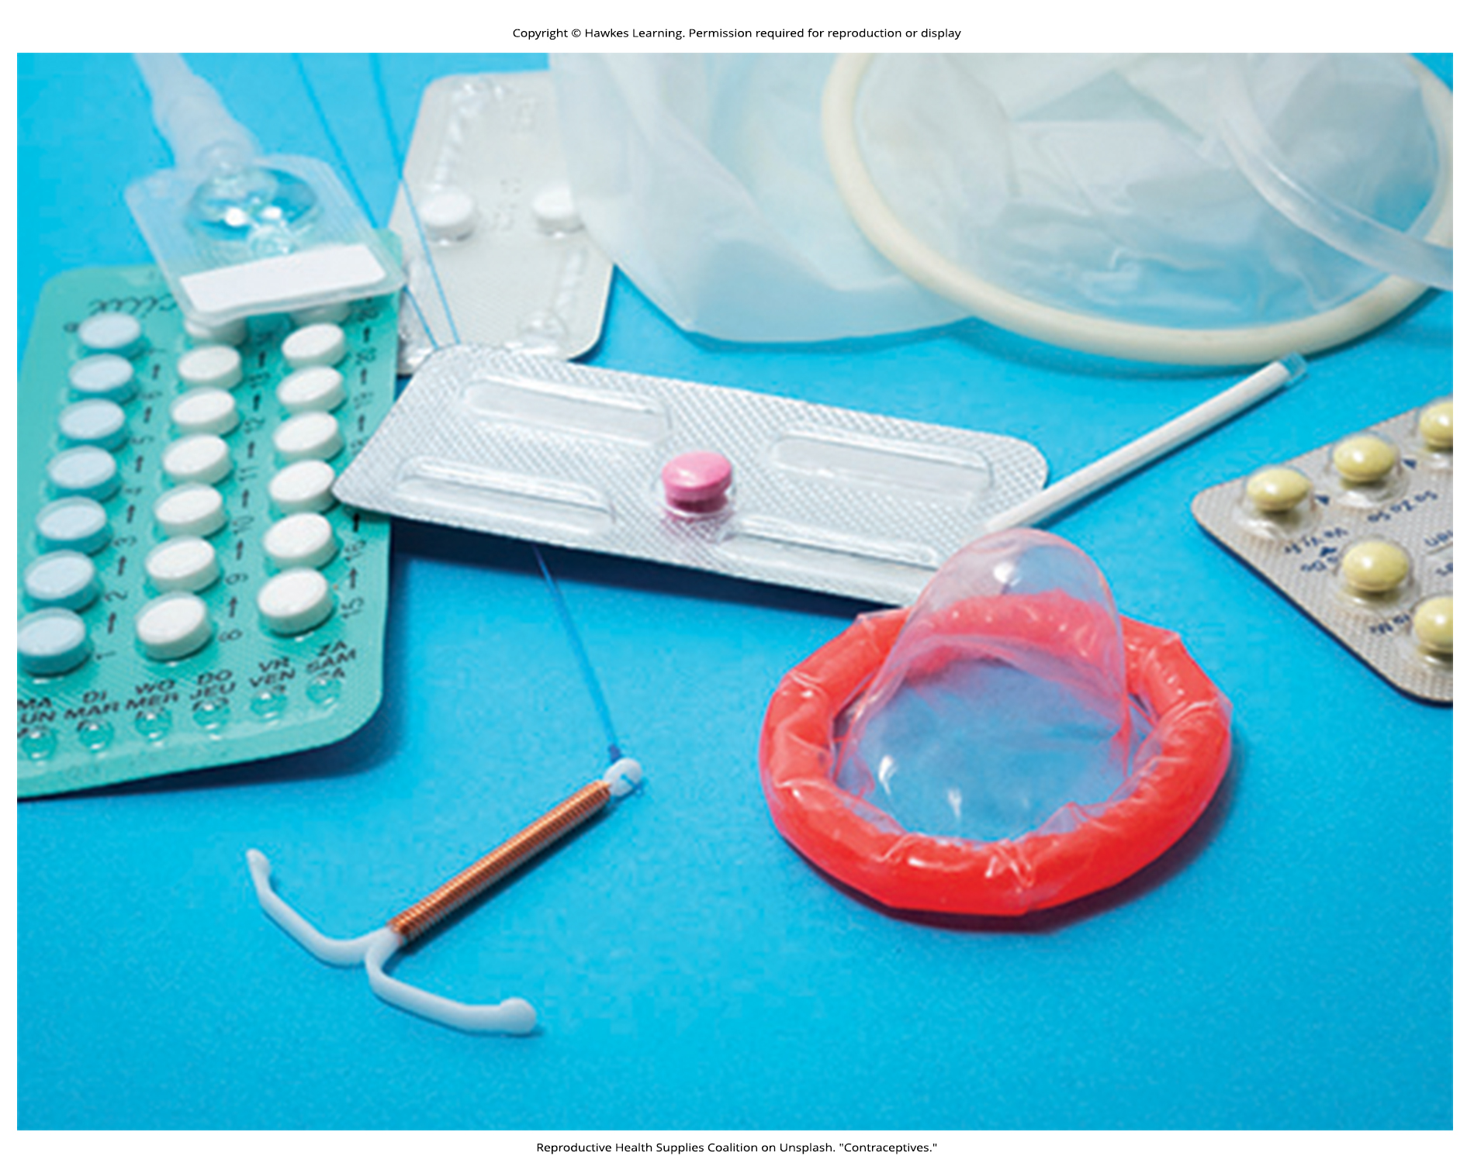
Lesson 40.4 Figure 7

Slide 35
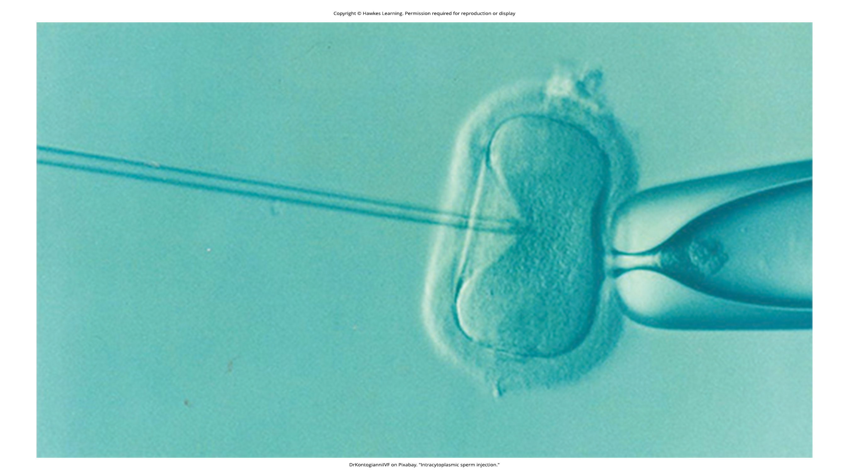
Lesson 40.4 Figure 8

Slide 36
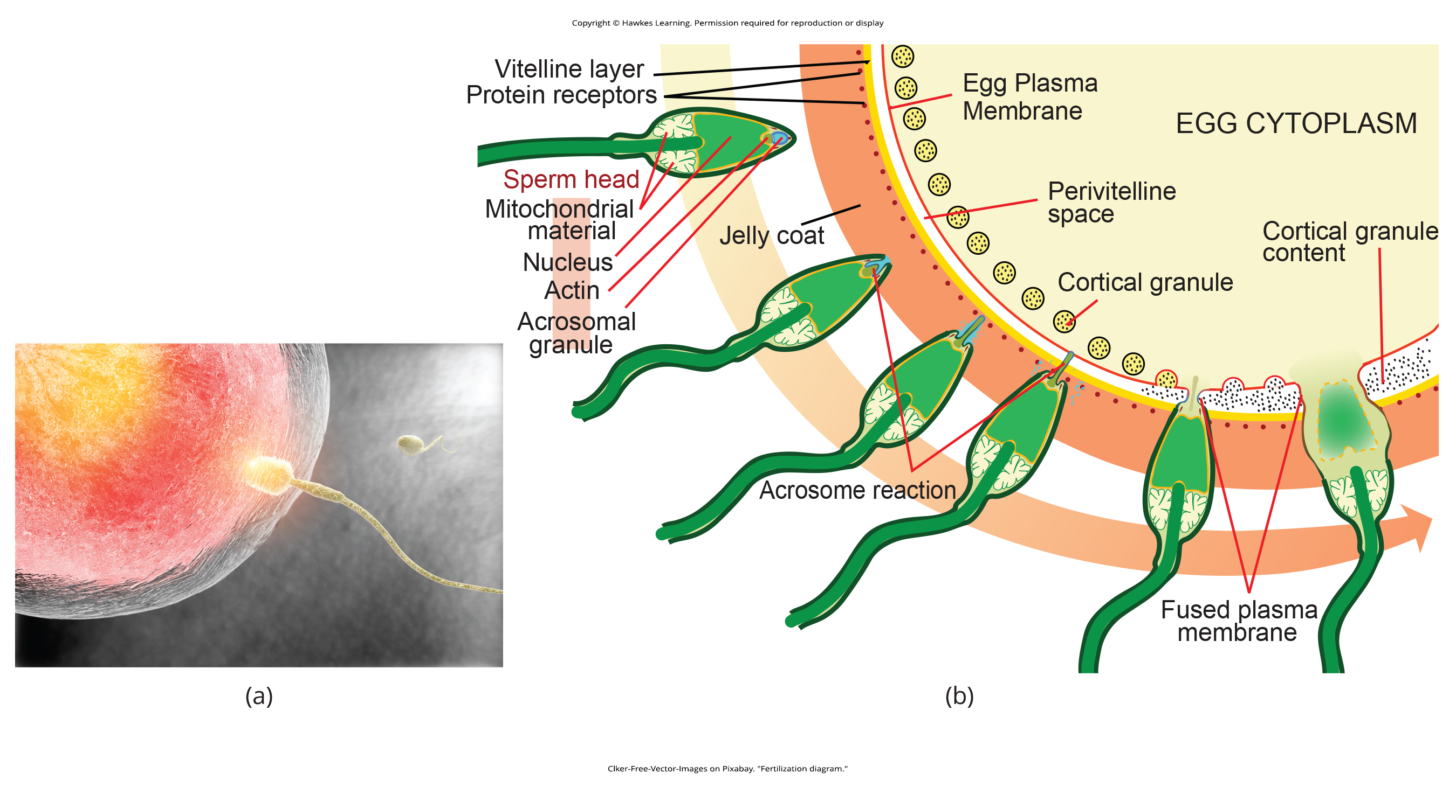
Lesson 40.5 Figure 1

Slide 37
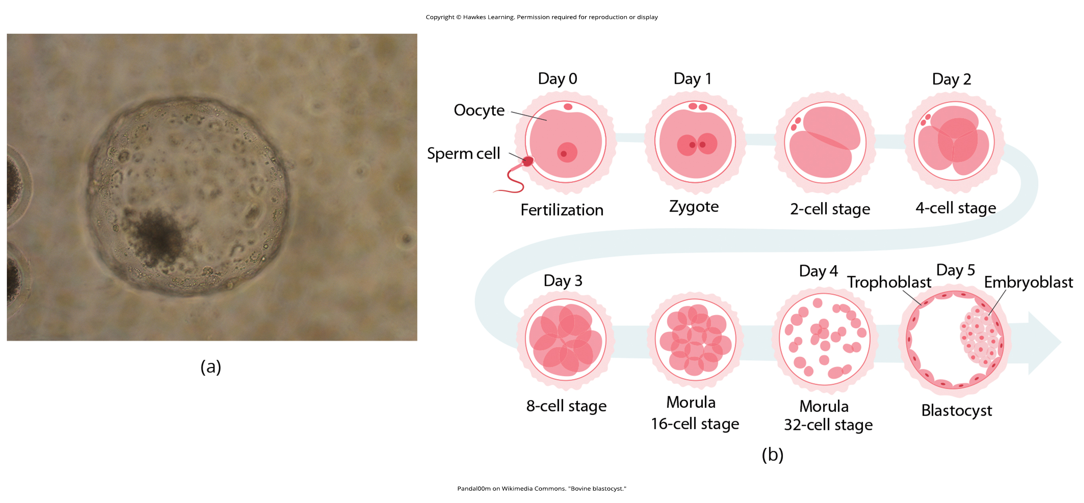
Lesson 40.5 Figure 2

Slide 38
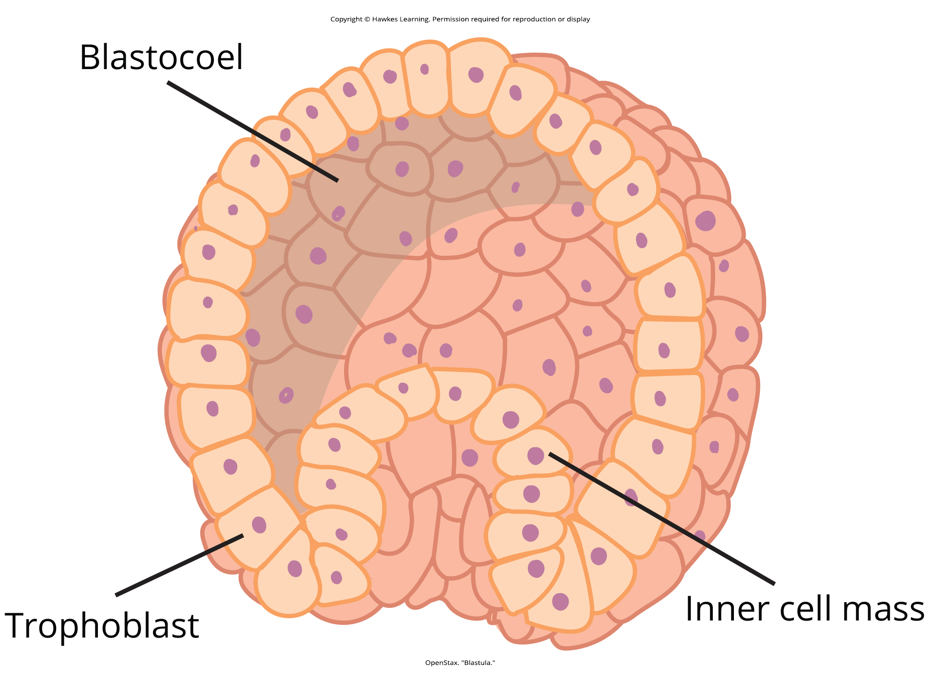
Lesson 40.5 Figure 3

Slide 39
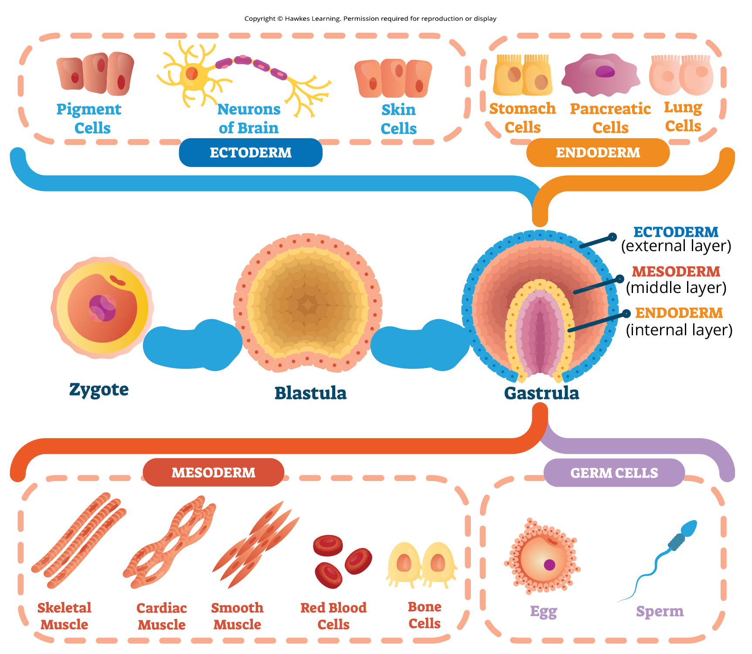
Lesson 40.5 Figure 4

Slide 40
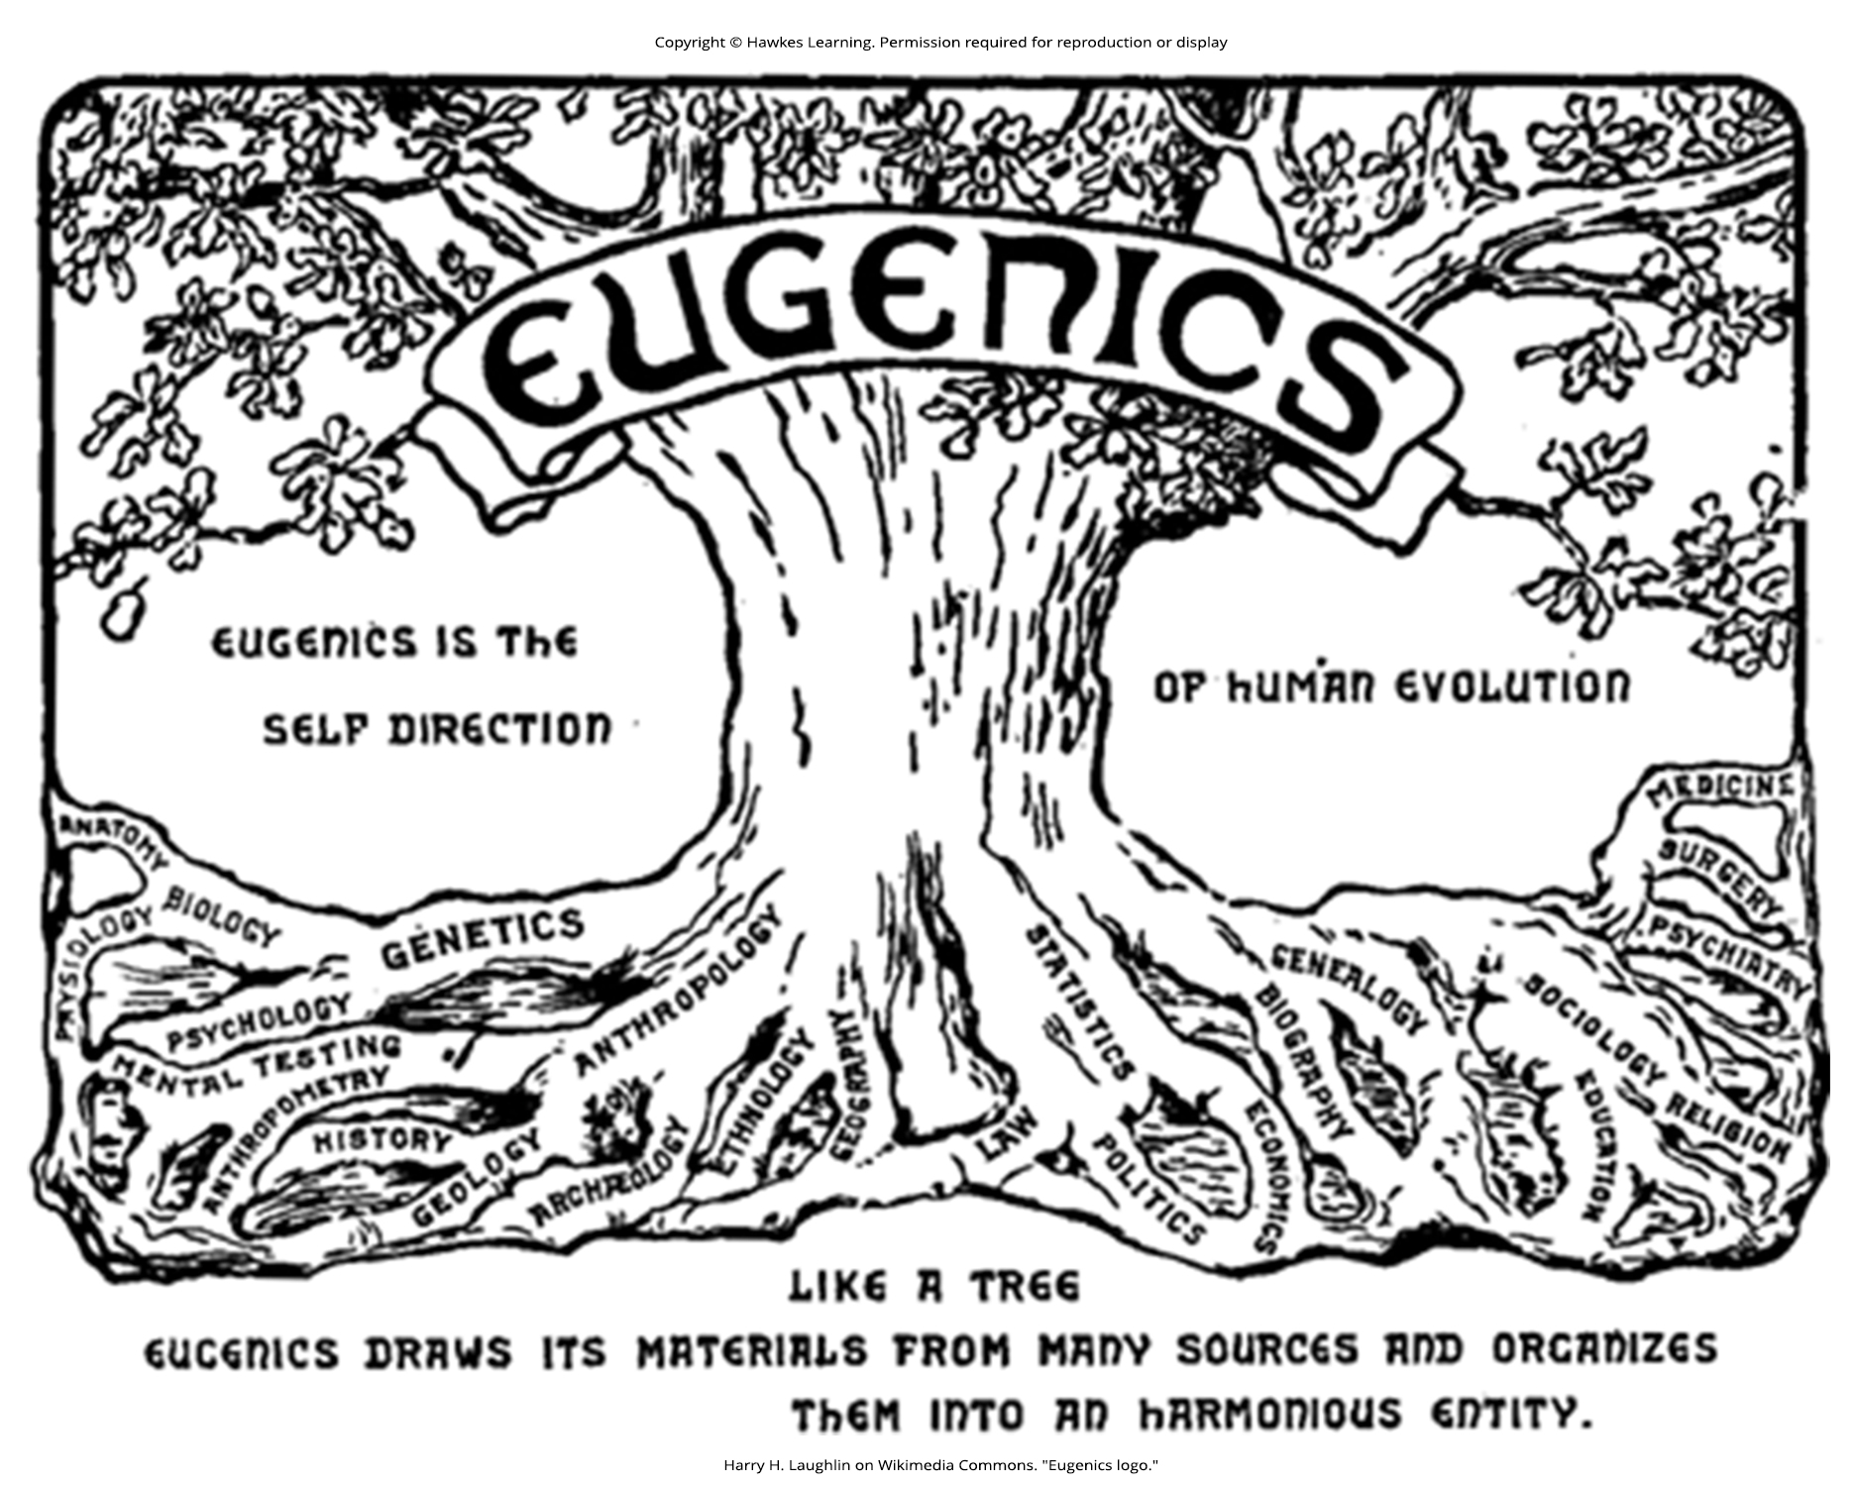
Lesson 40.5 Figure 5

Slide 41
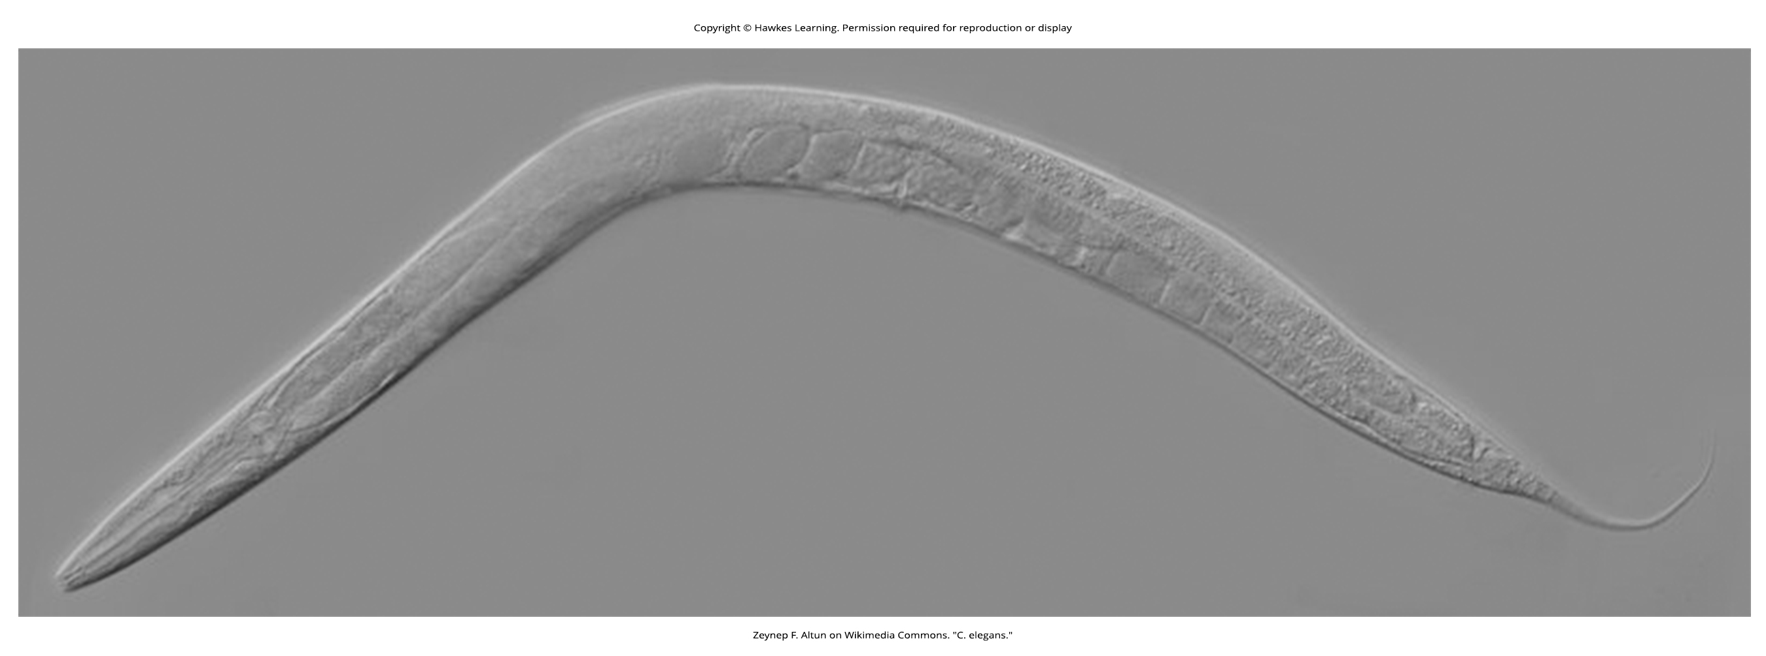
Lesson 40.5 Figure 6

Slide 42
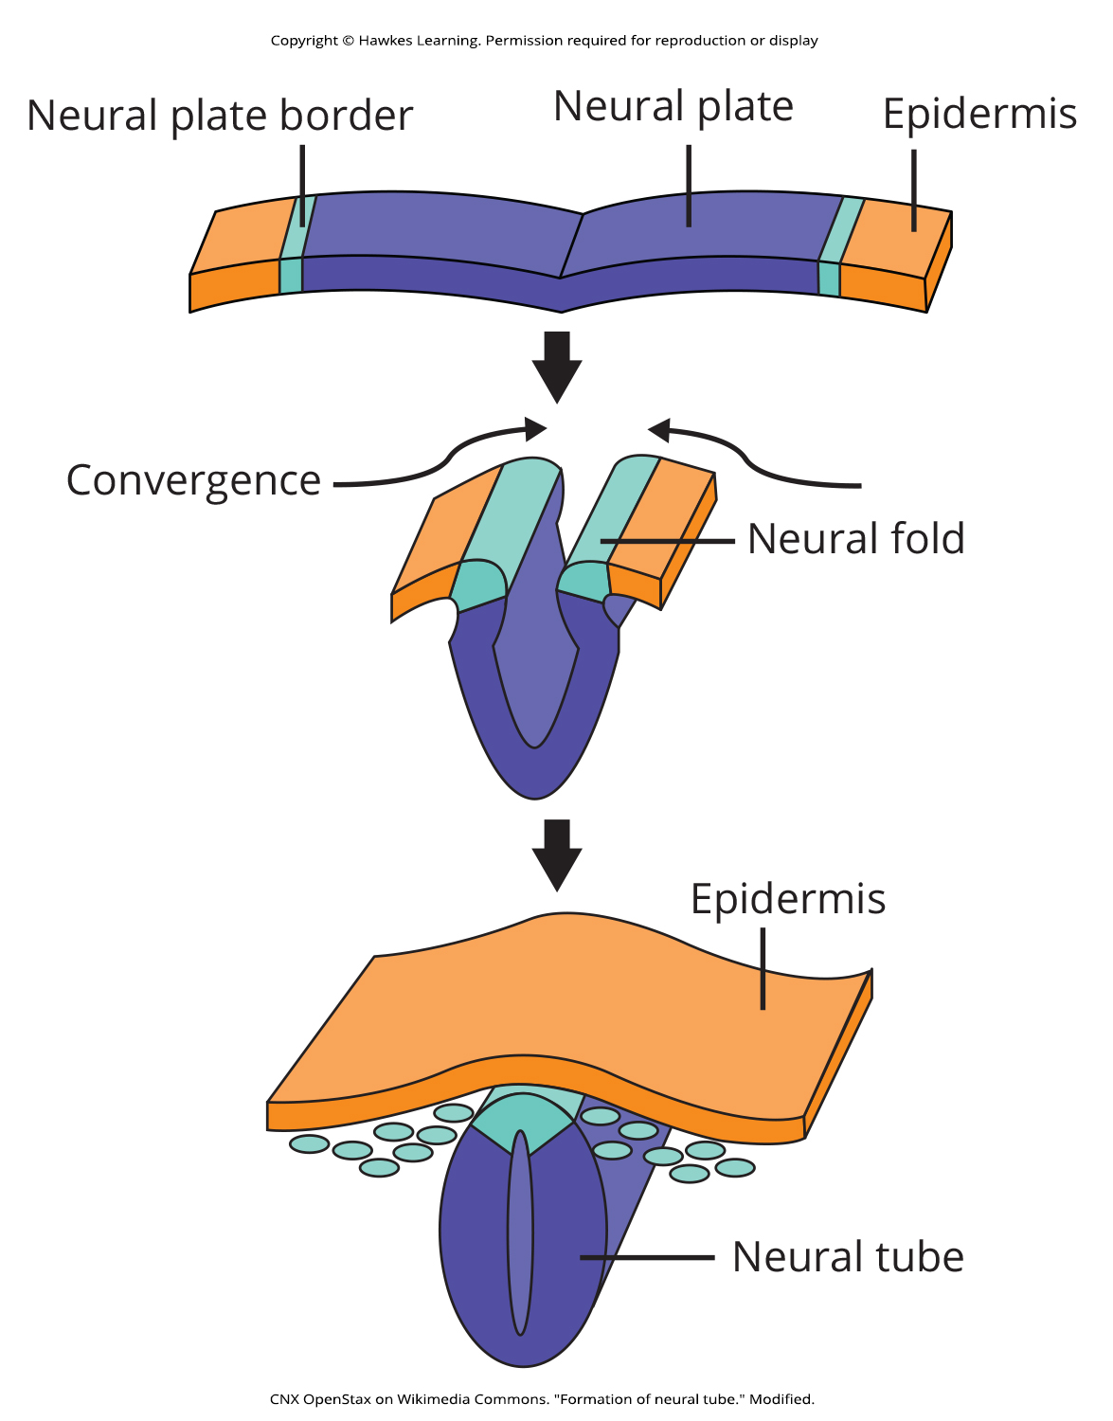
Lesson 40.5 Figure 7

Slide 43
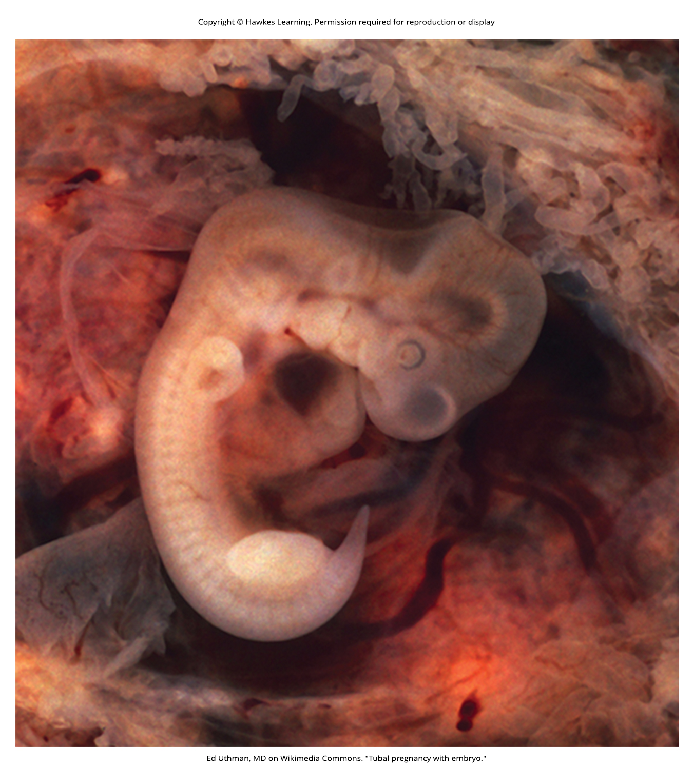
Lesson 40.5 Figure 8

Slide 44
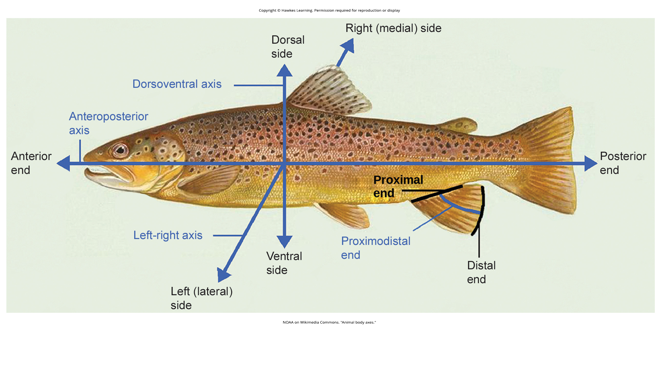
Lesson 40.5 Figure 9

Slide 45
Hawkes Learning – End of PowerPoint

