Slide 1
Chapter 41
Sensory Systems

Slide 2
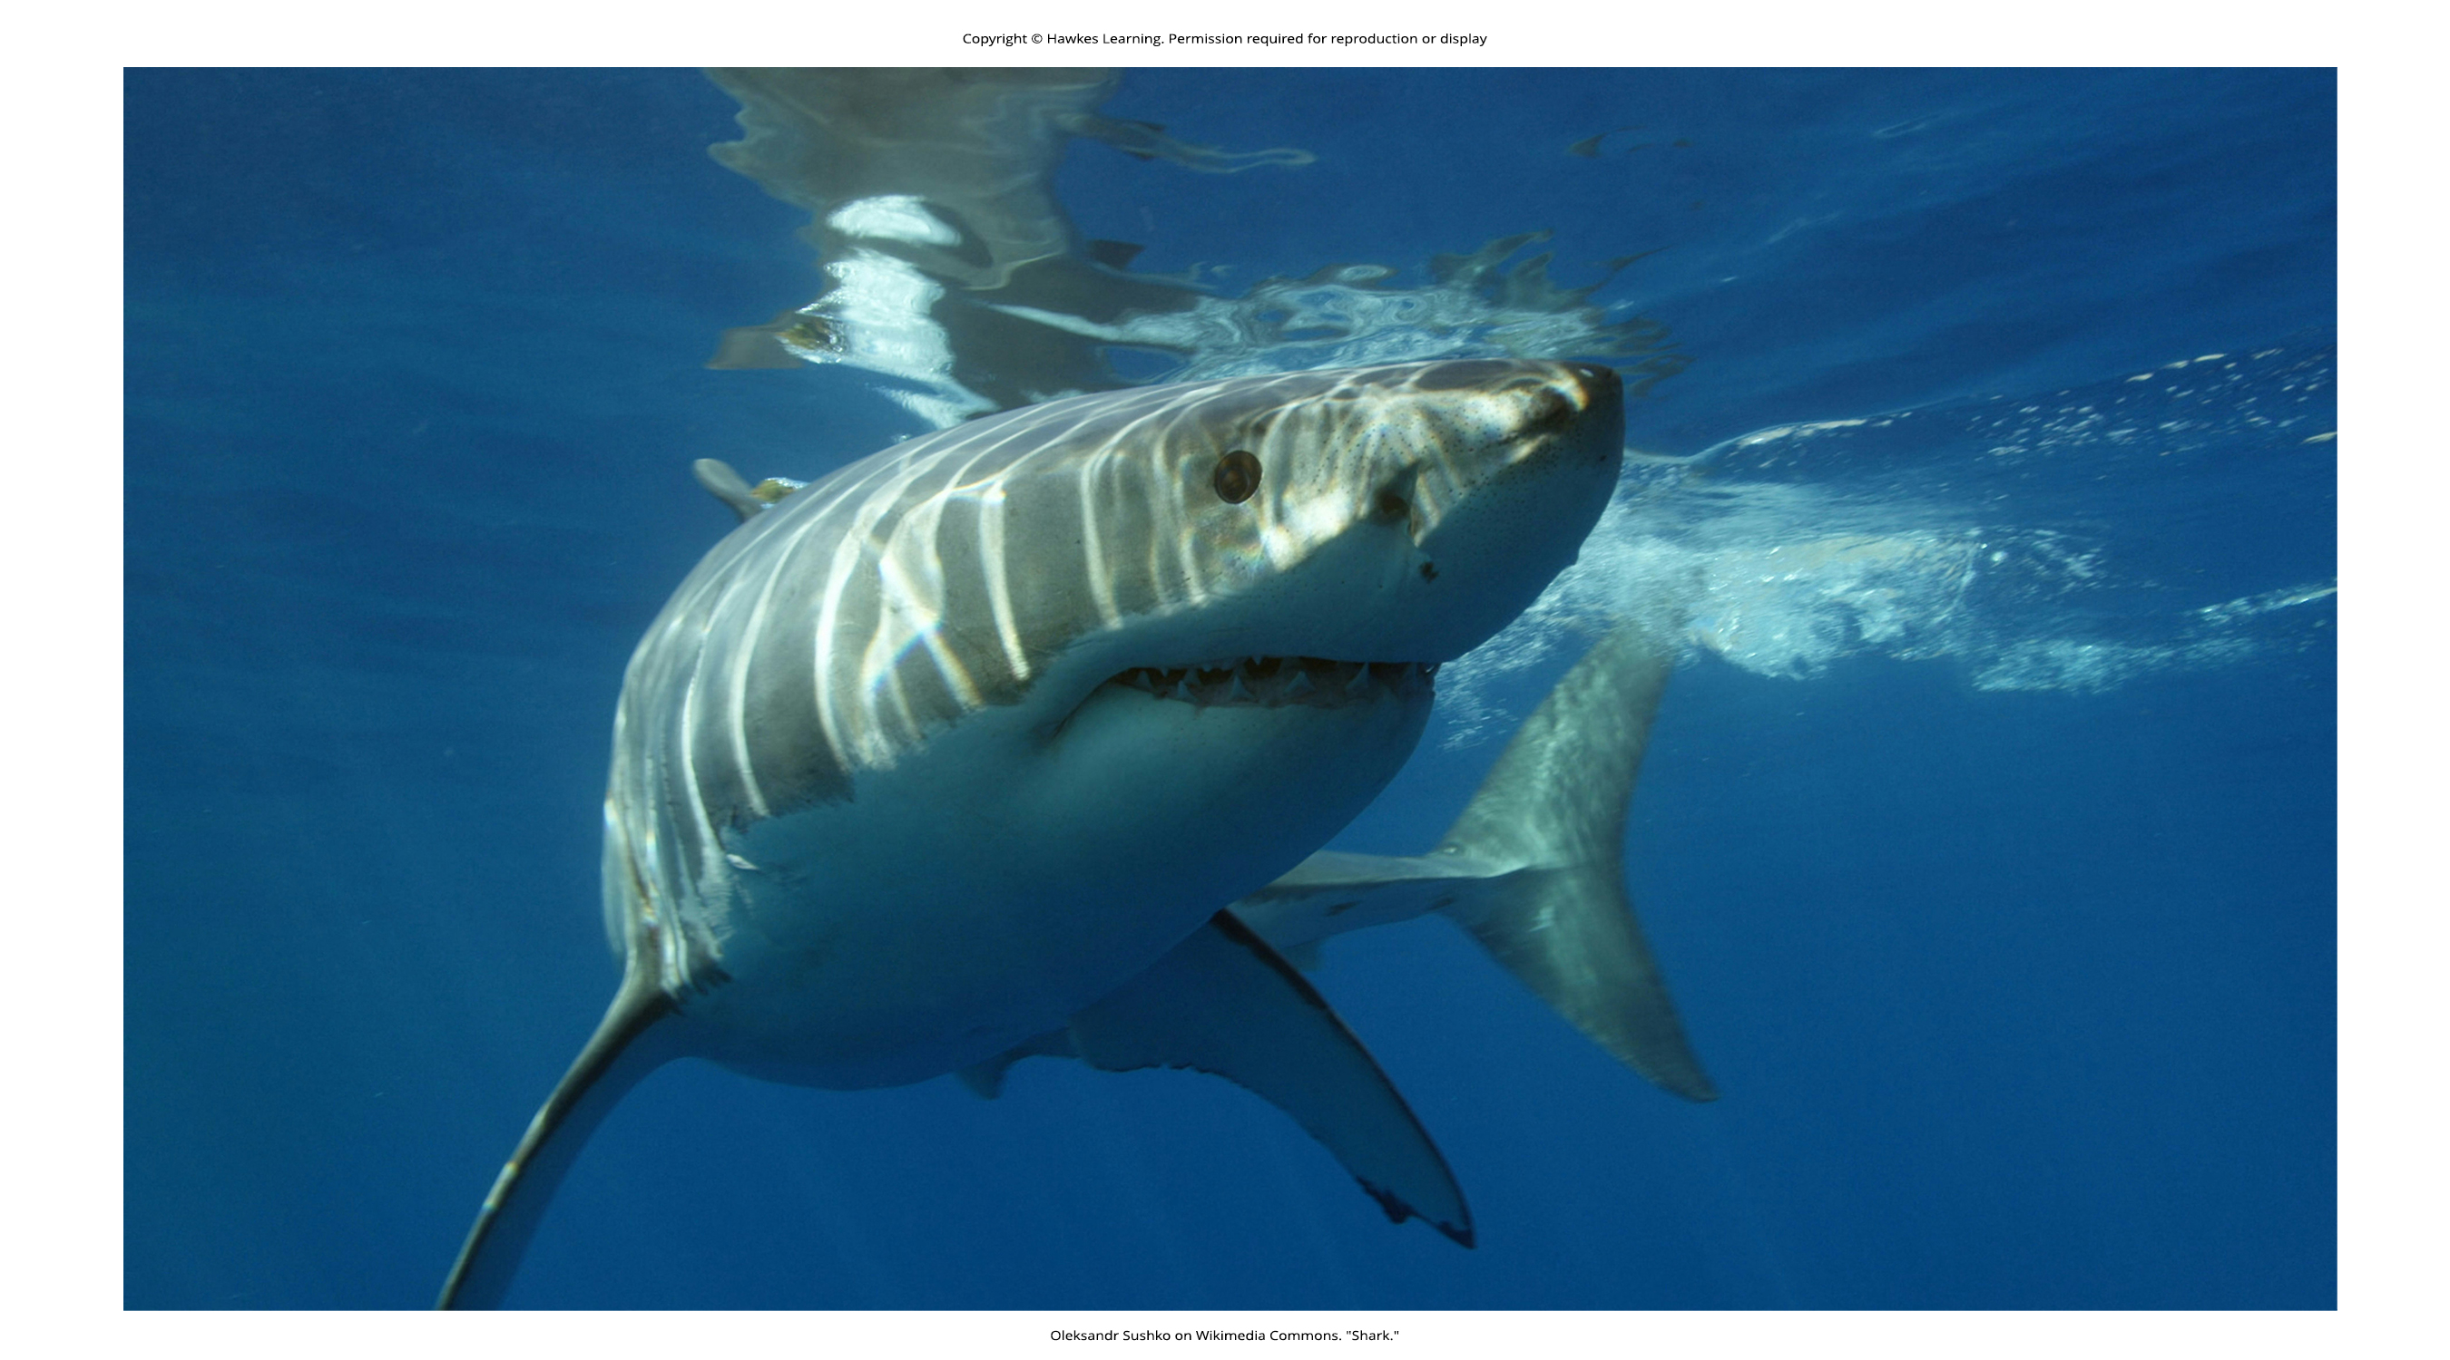
Lesson 41.1 Figure 1

Slide 3

Lesson 41.1 Figure 2

Slide 4

Lesson 41.1 Figure 3

Slide 5
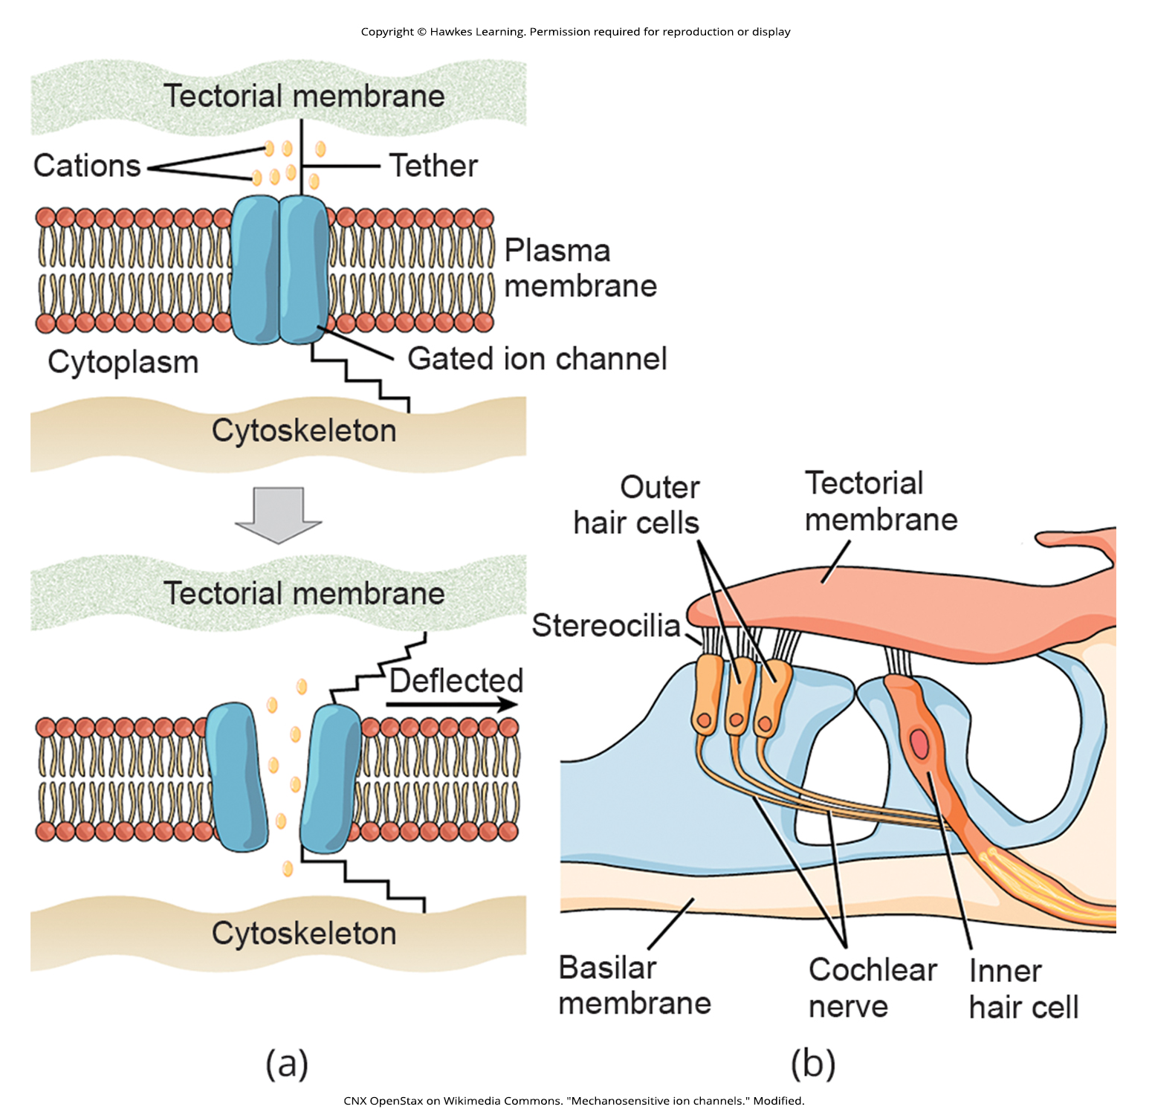
Lesson 41.1 Figure 4

Slide 6
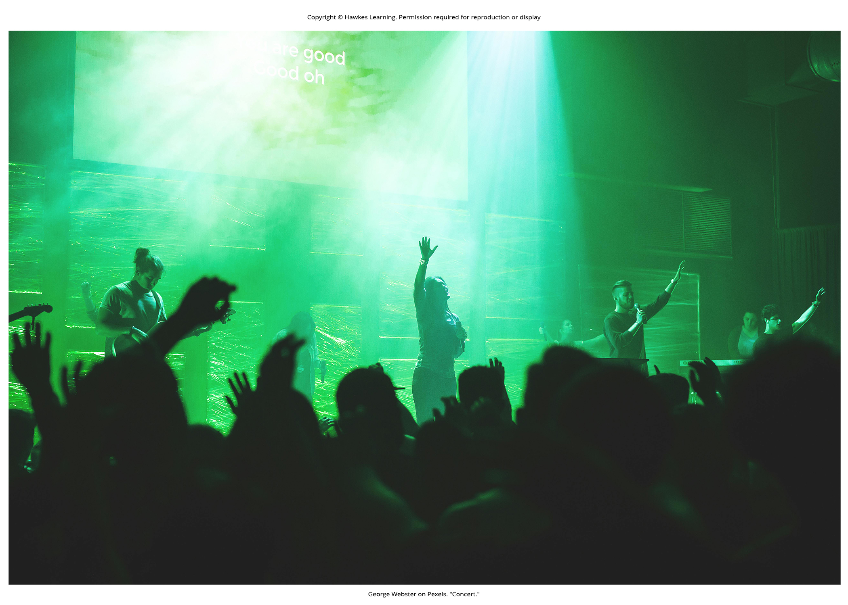
Lesson 41.1 Figure 5

Slide 7
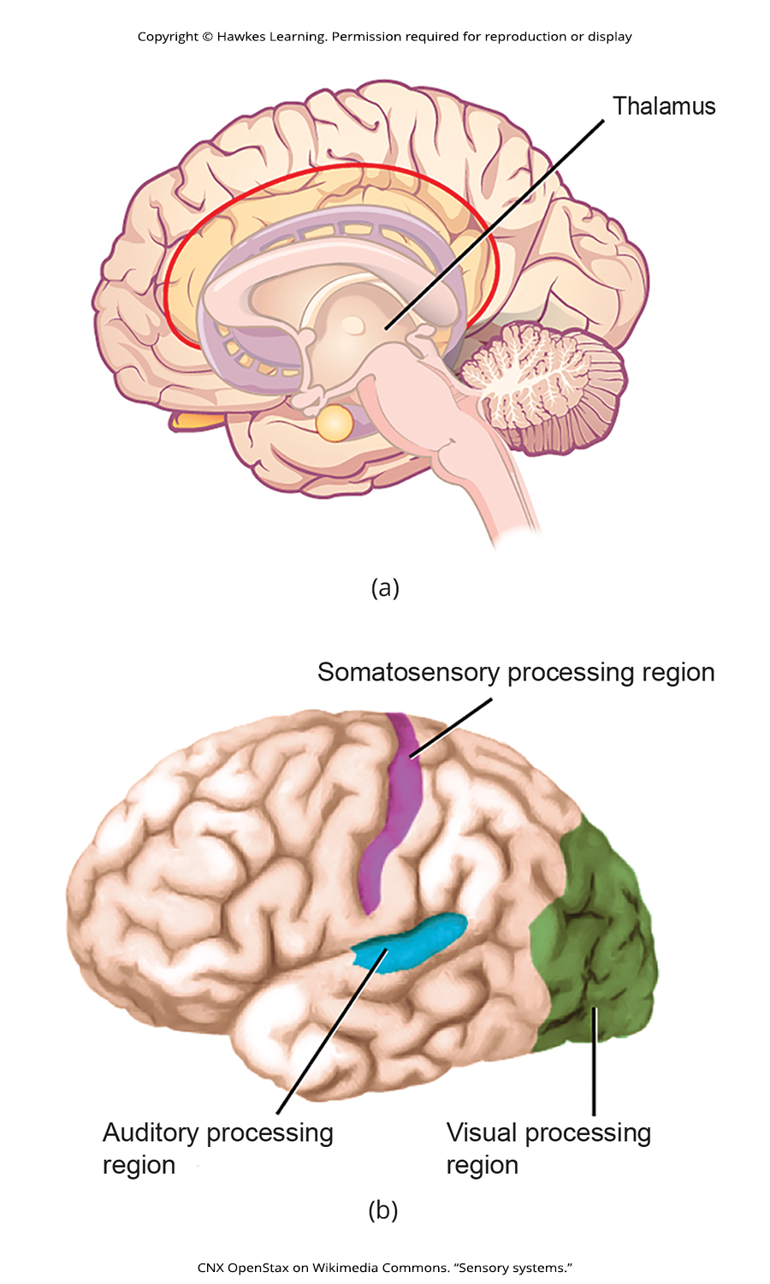
Lesson 41.1 Figure 6

Slide 8
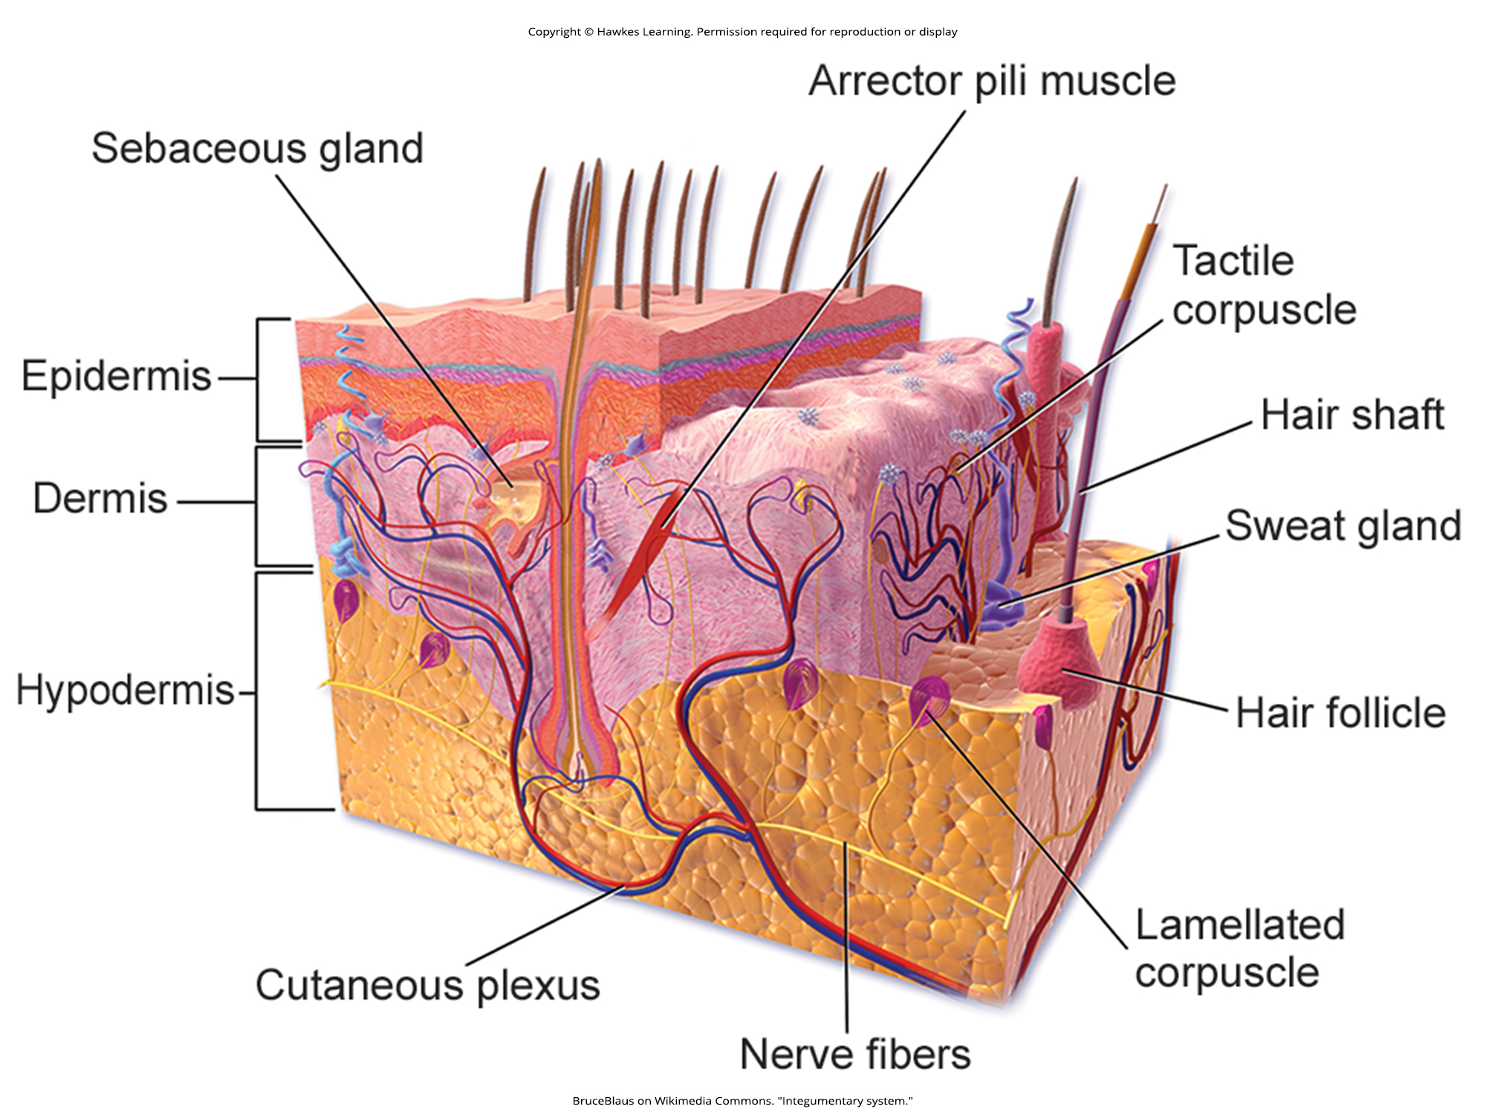
Lesson 41.2 Figure 1

Slide 9
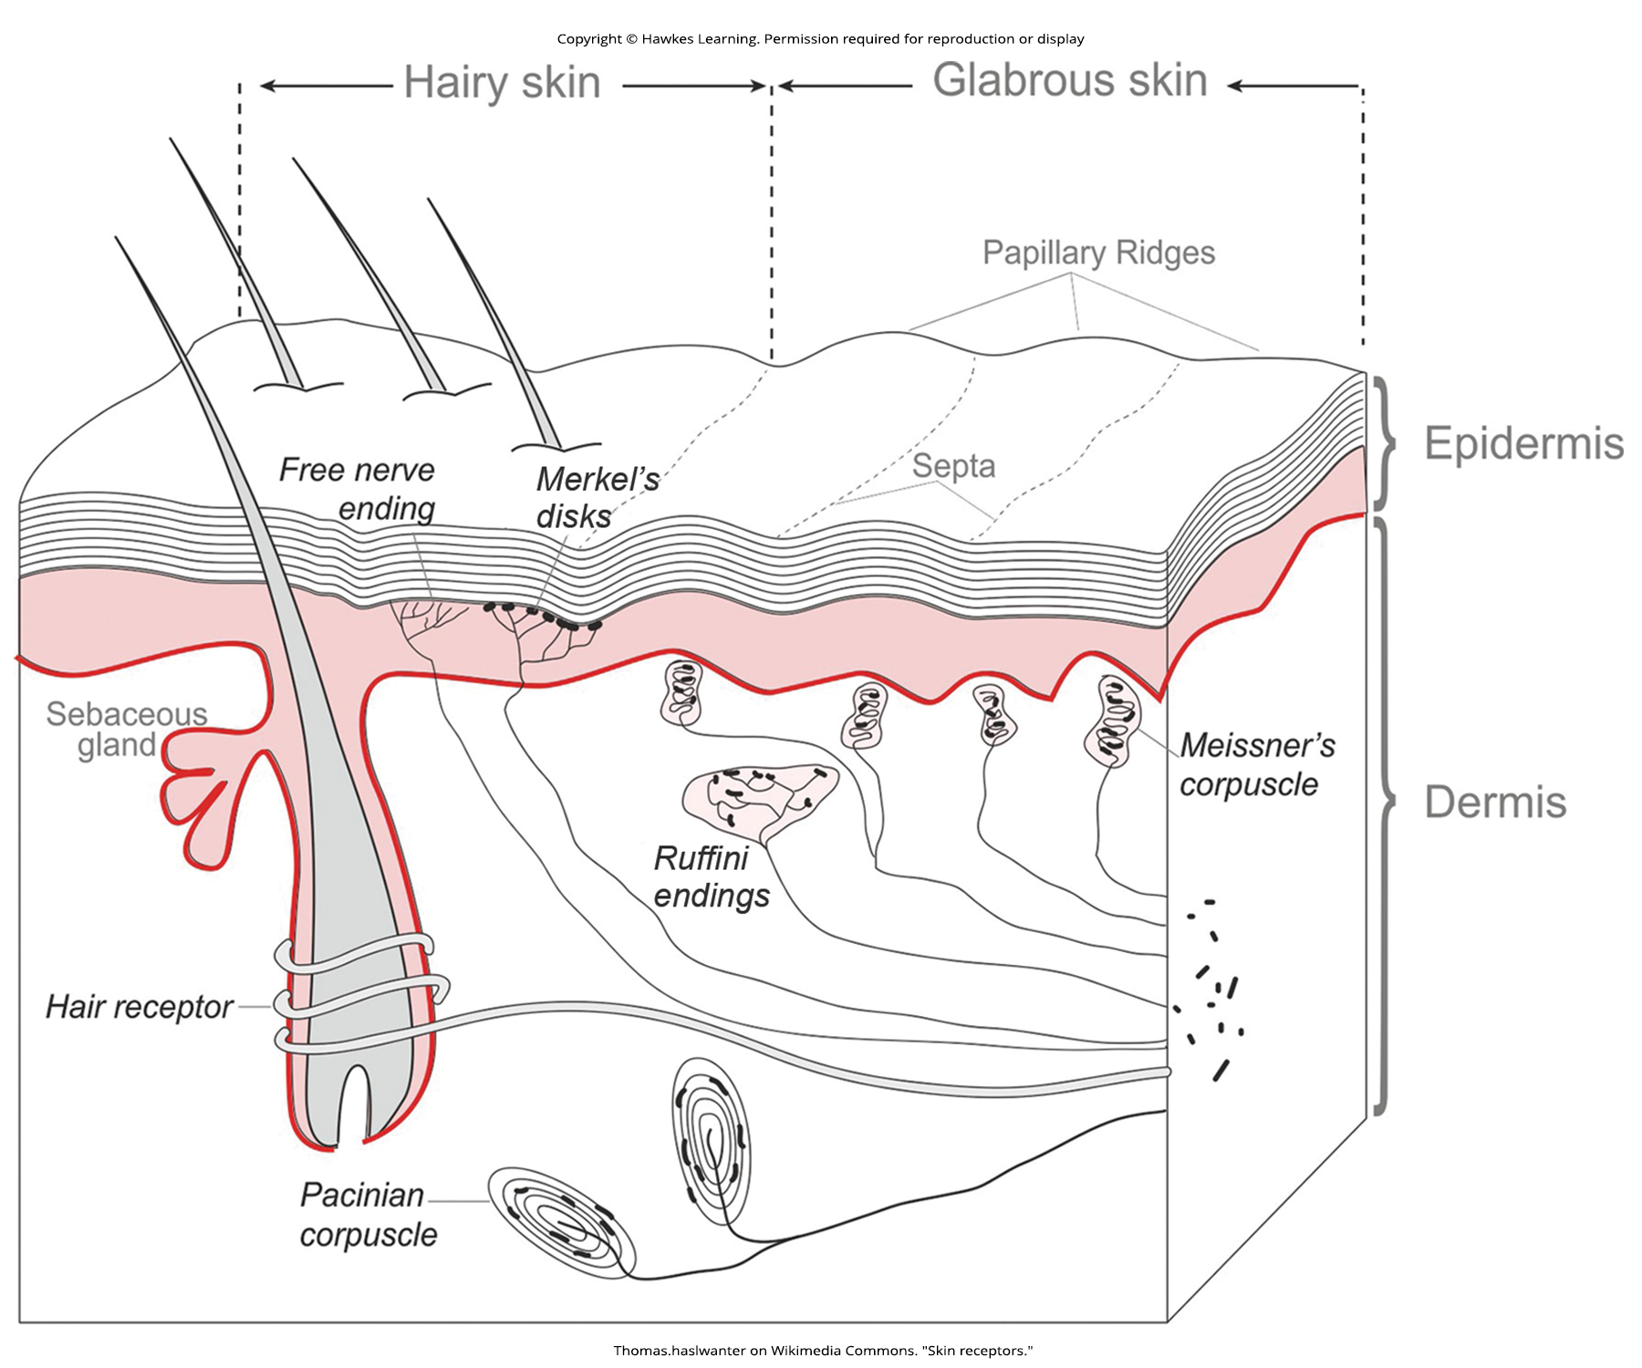
Lesson 41.2 Figure 2

Slide 10
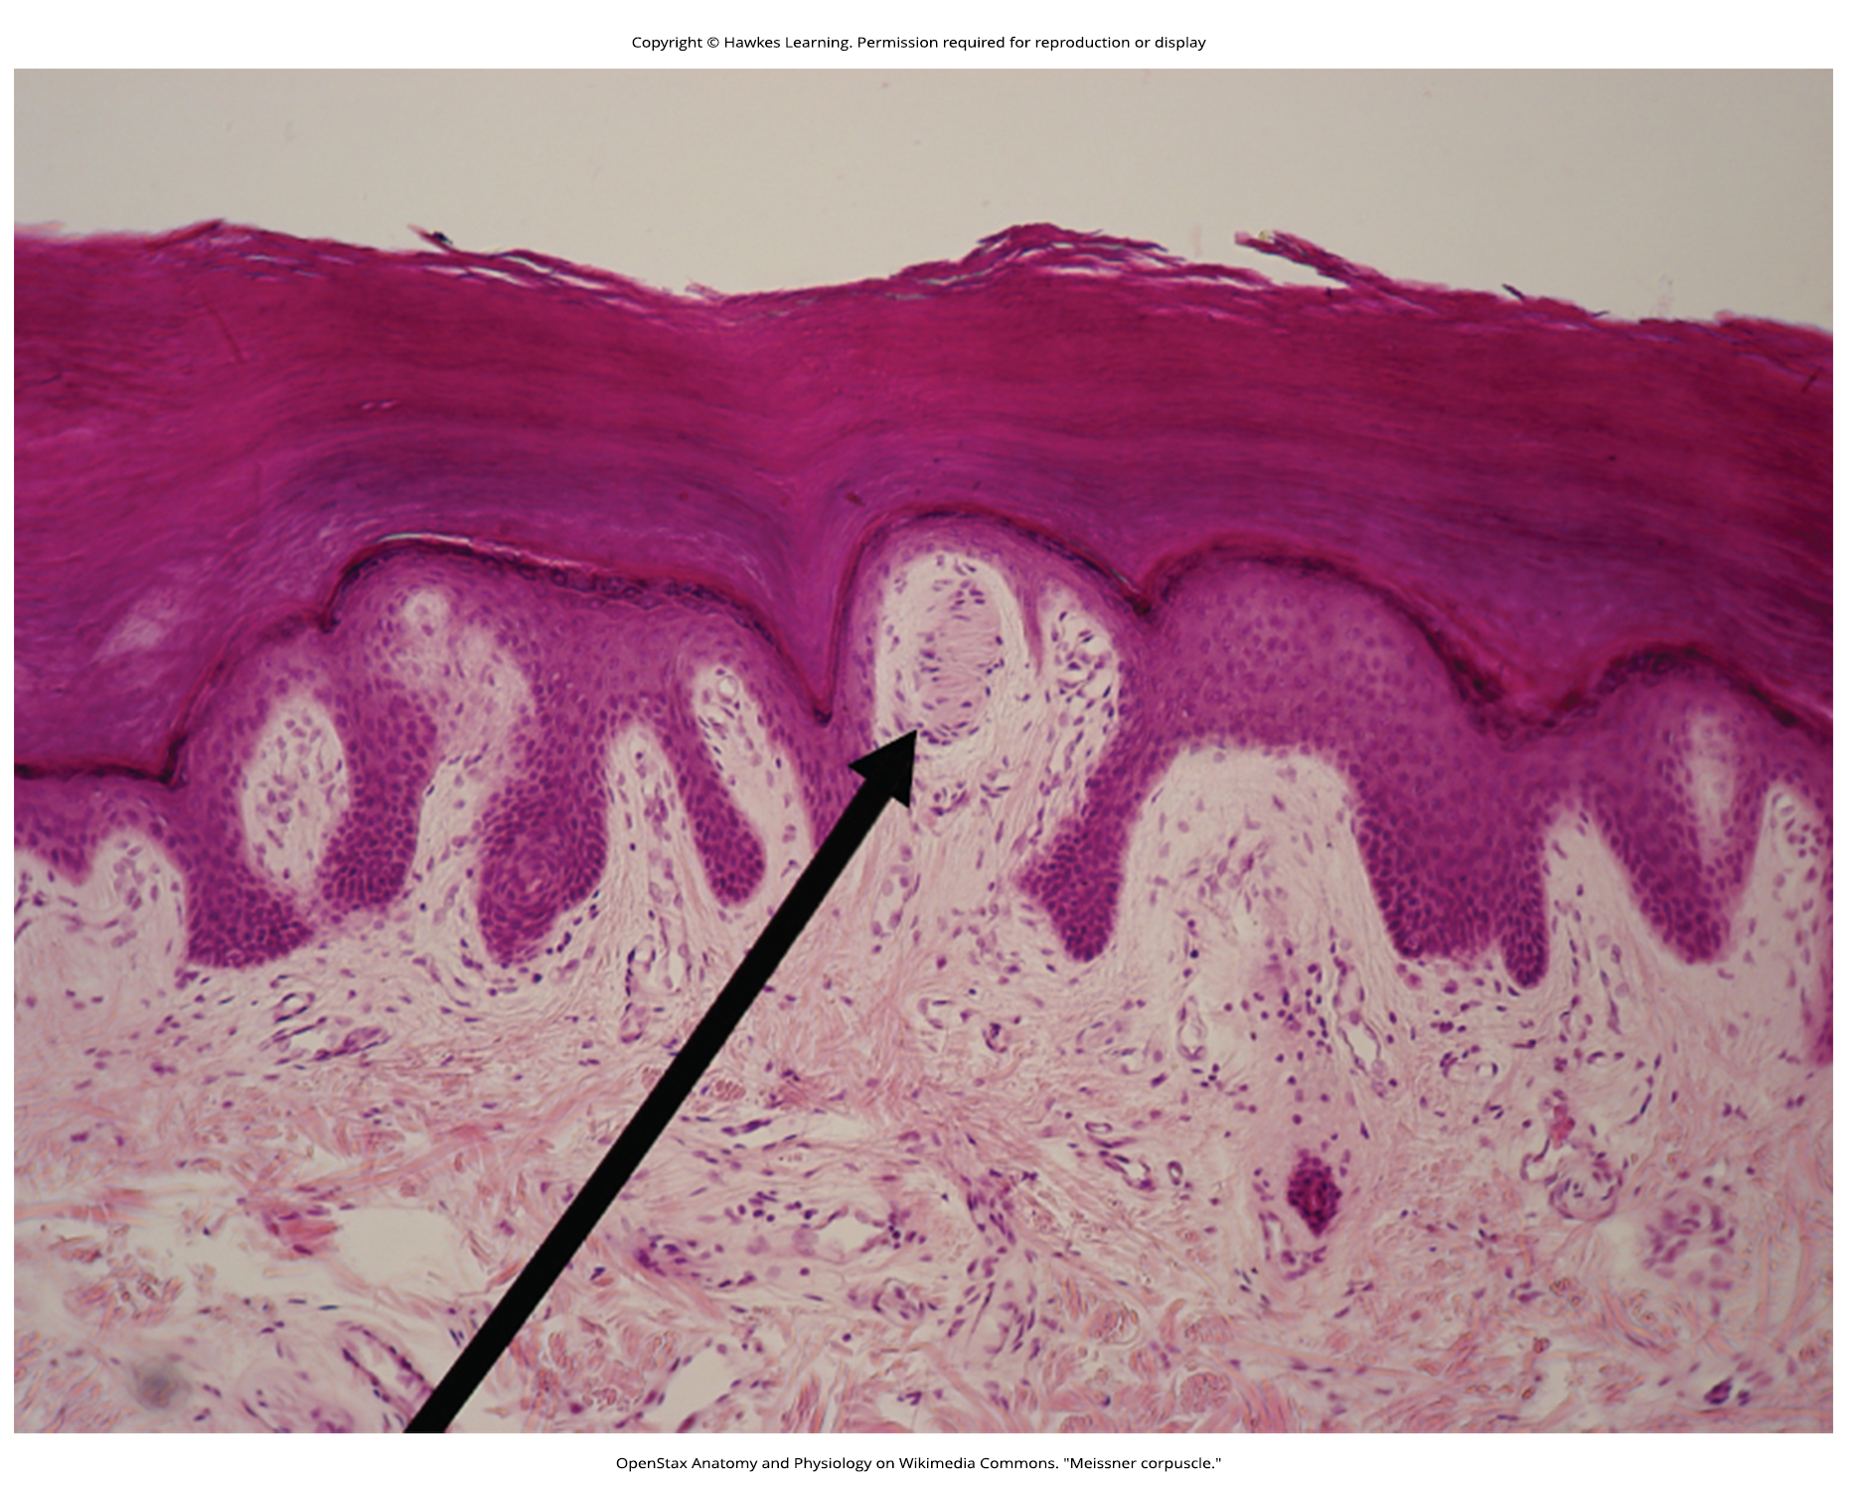
Lesson 41.2 Figure 3

Slide 11
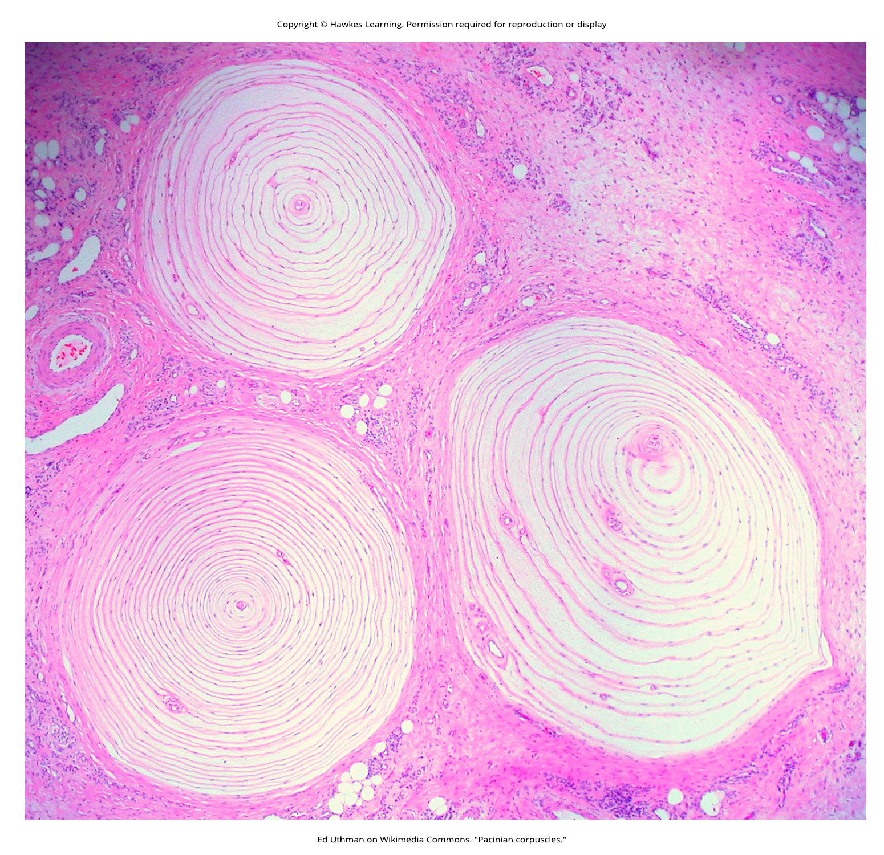
Lesson 41.2 Figure 4

Slide 12
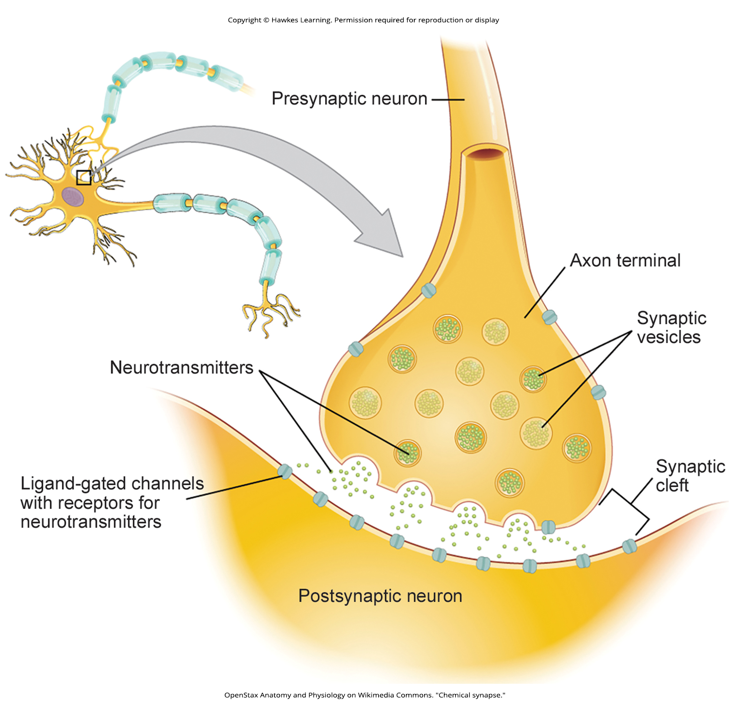
Lesson 41.2 Figure 5

Slide 13
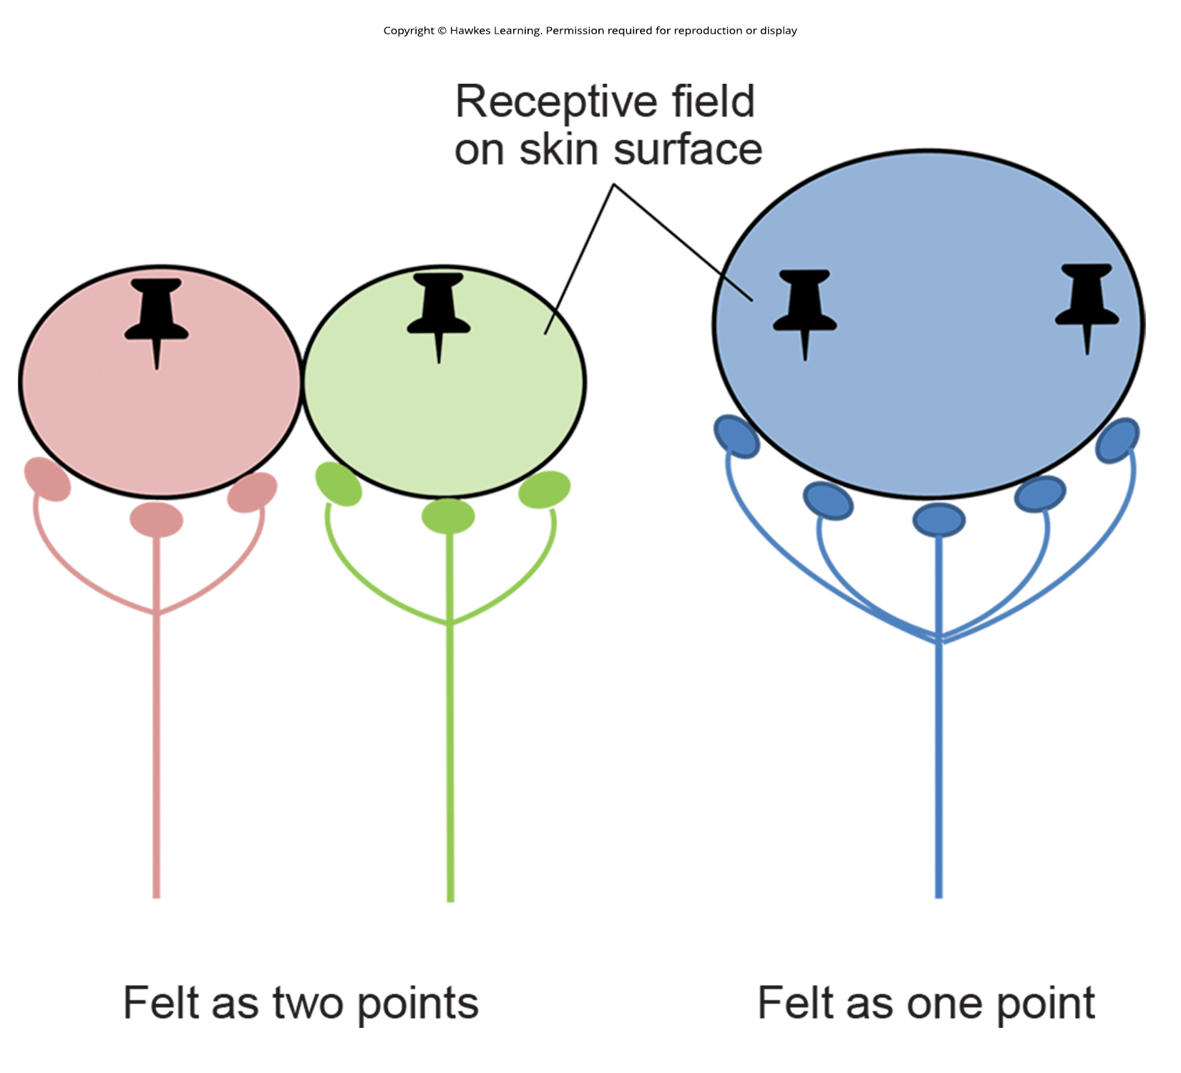
Lesson 41.2 Figure 6

Slide 14
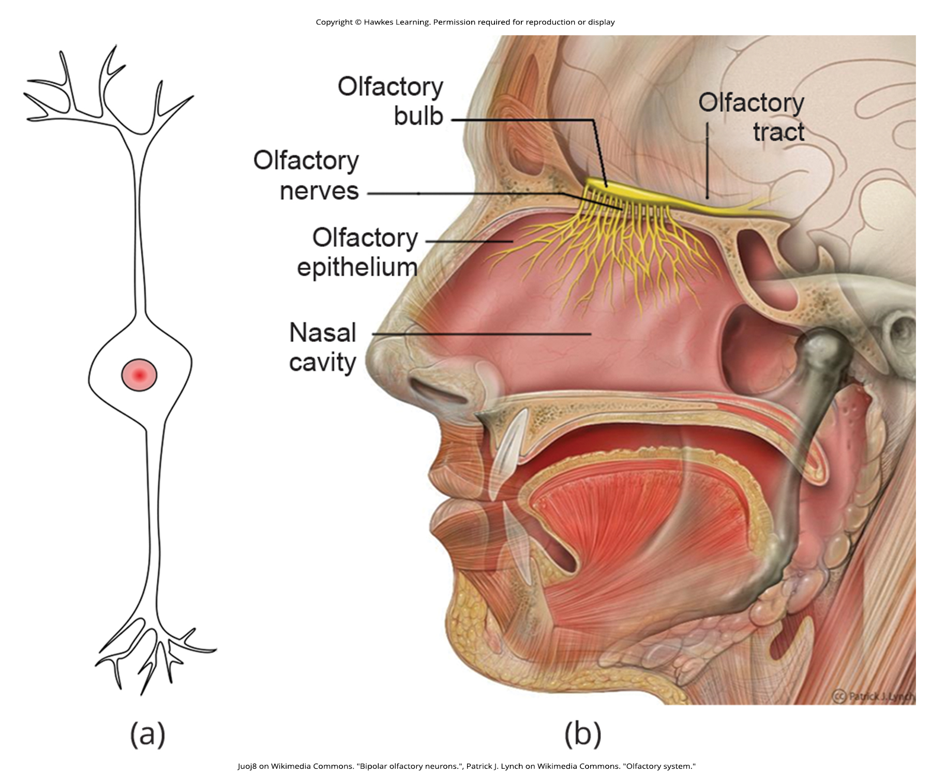
Lesson 41.3 Figure 1

Slide 15
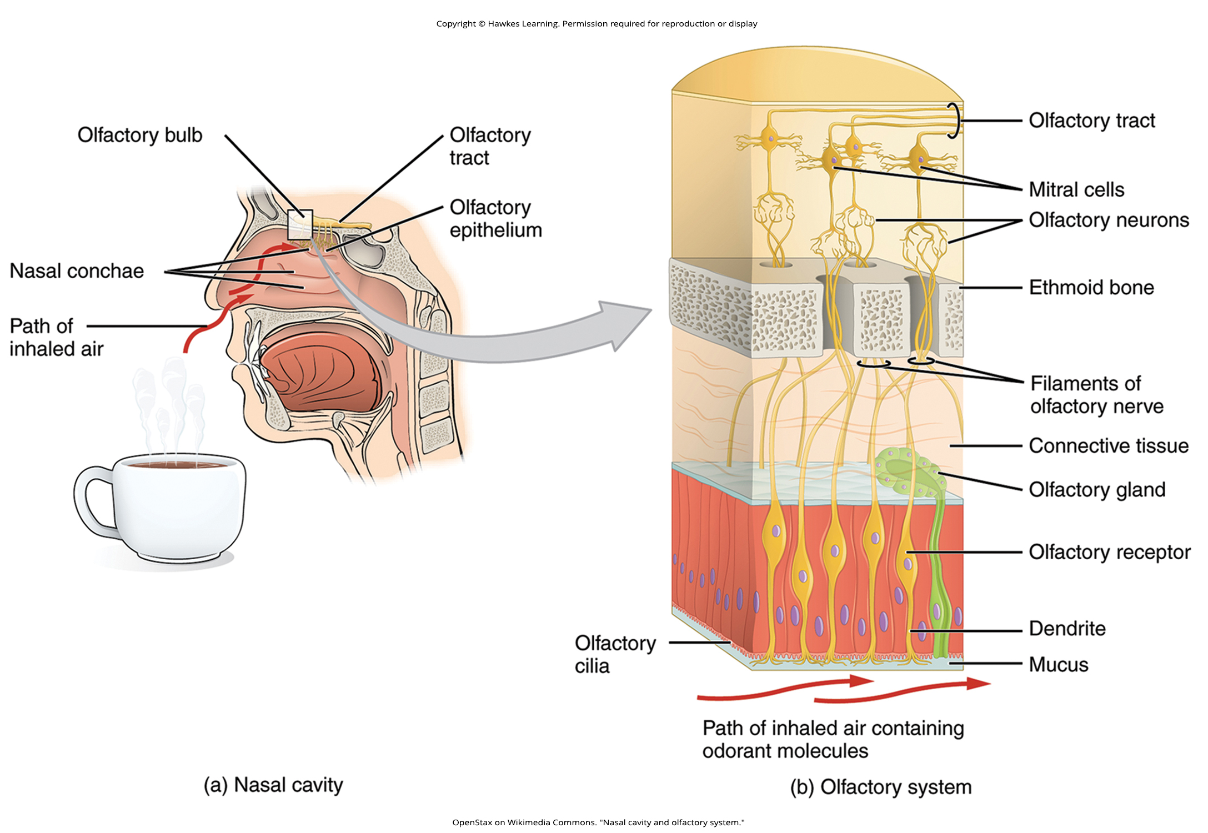
Lesson 41.3 Figure 2

Slide 16
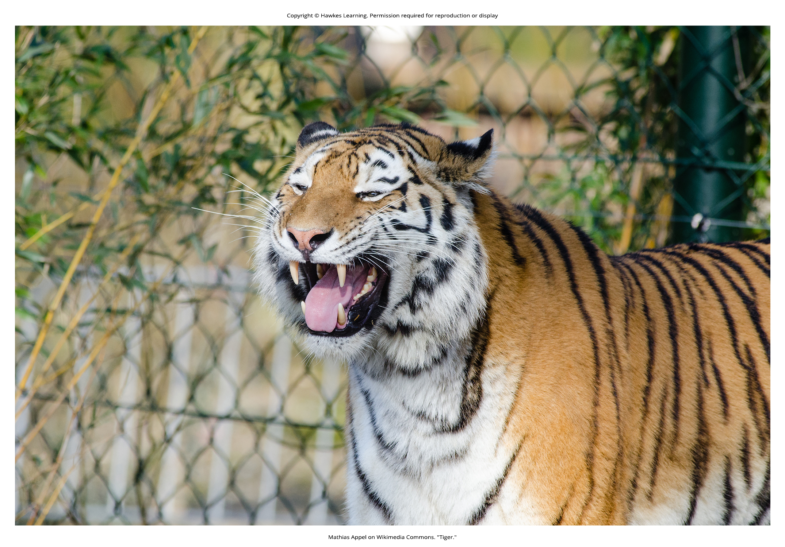
Lesson 41.3 Figure 3

Slide 17
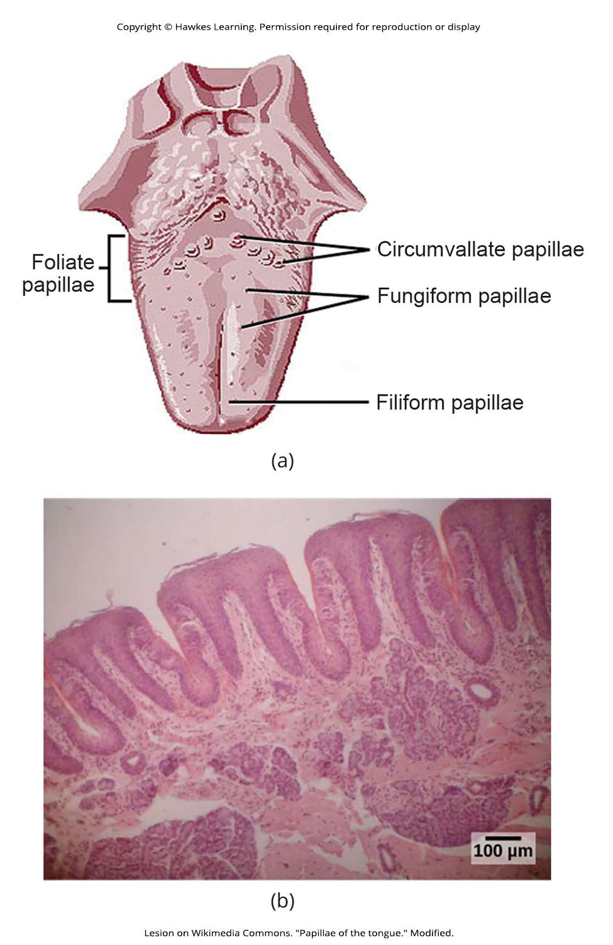
Lesson 41.3 Figure 4

Slide 18
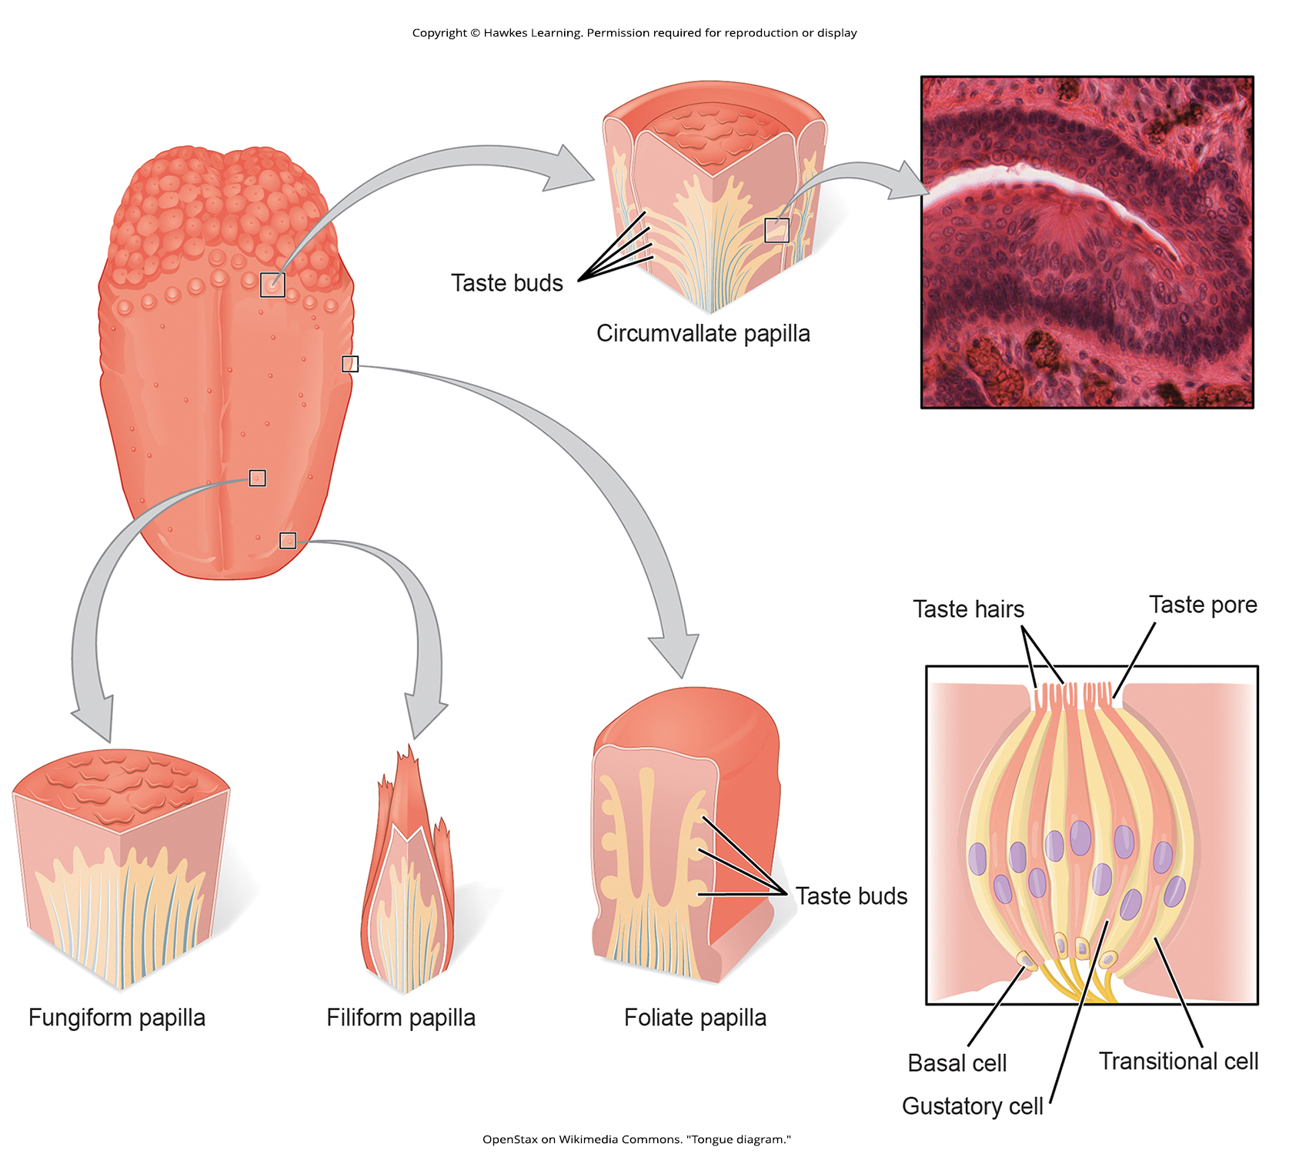
Lesson 41.3 Figure 5

Slide 19
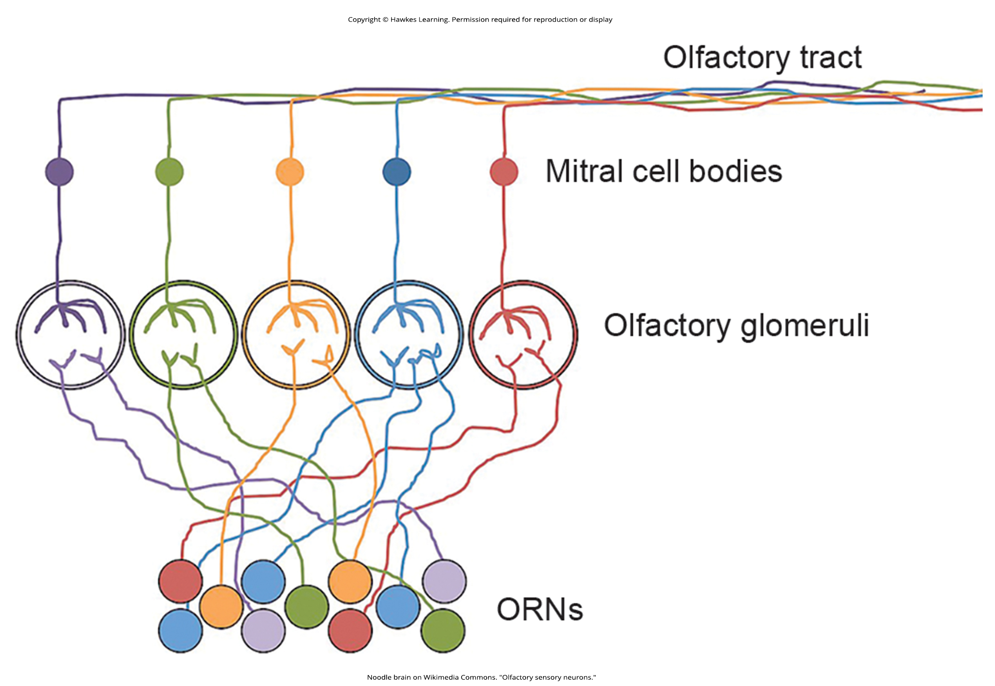
Lesson 41.3 Figure 6

Slide 20
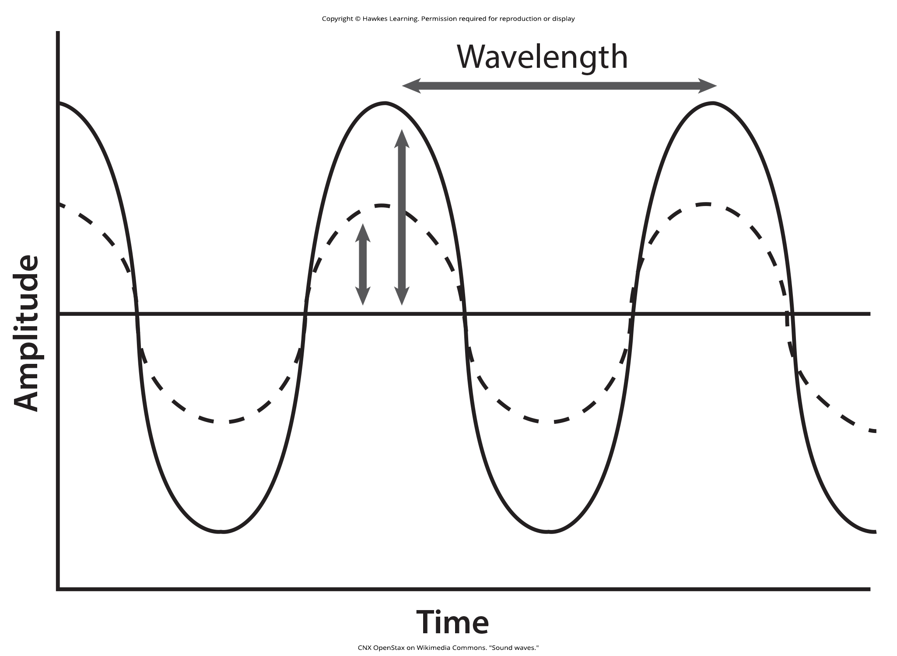
Lesson 41.4 Figure 1

Slide 21
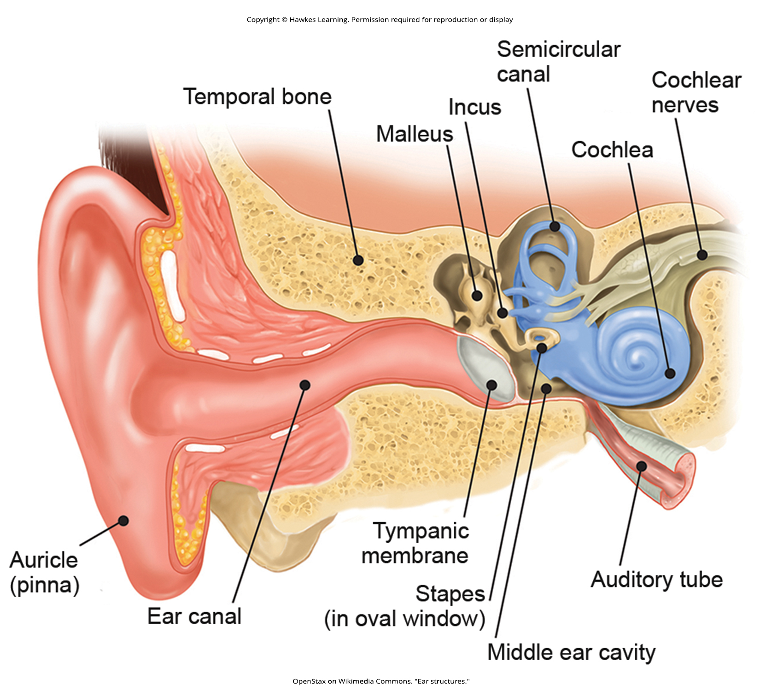
Lesson 41.4 Figure 2

Slide 22
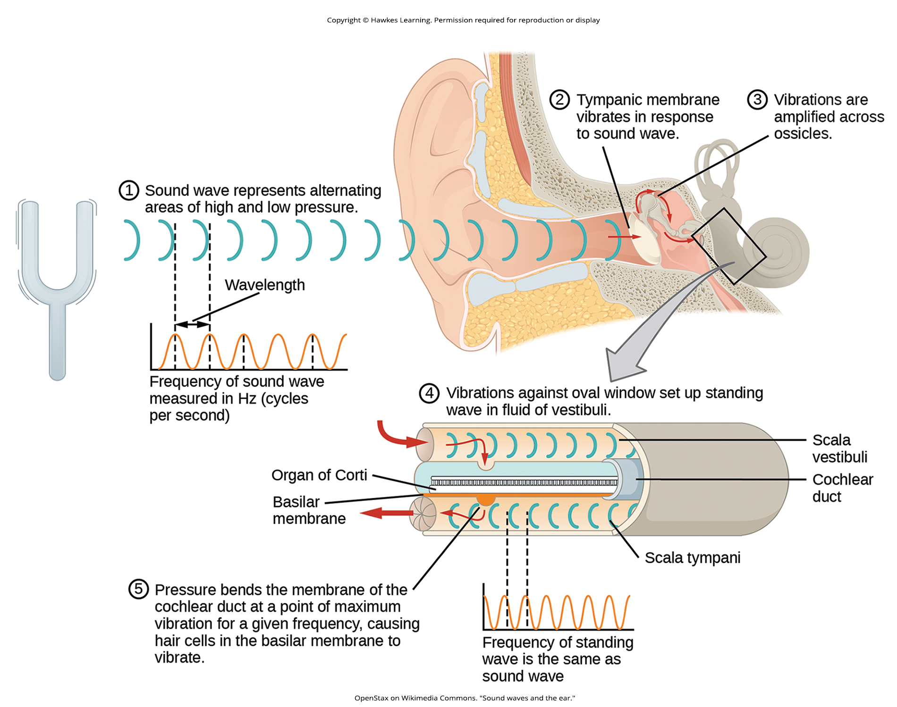
Lesson 41.4 Figure 3

Slide 23
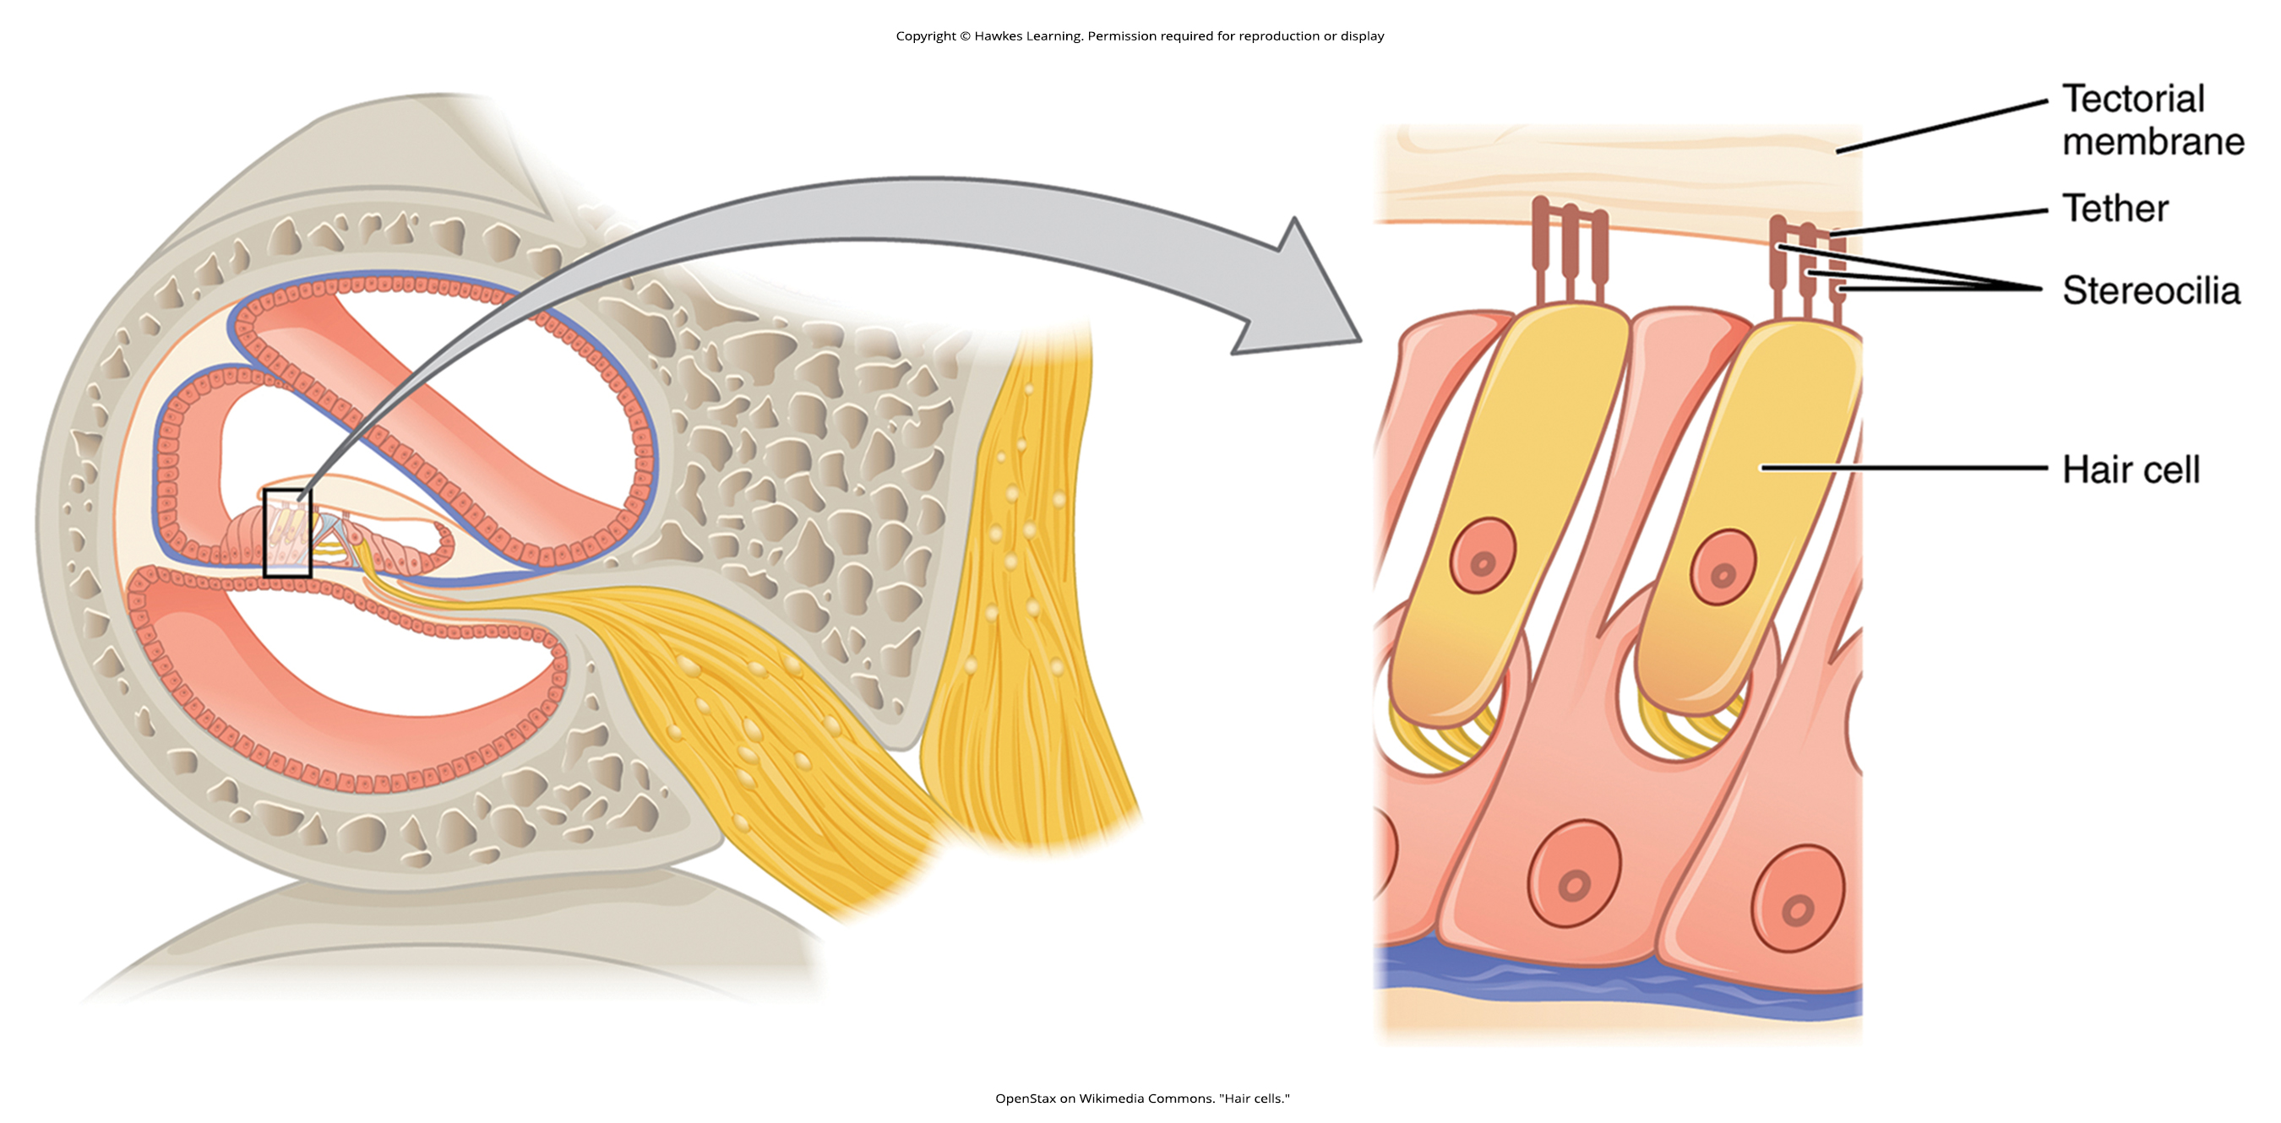
Lesson 41.4 Figure 4

Slide 24
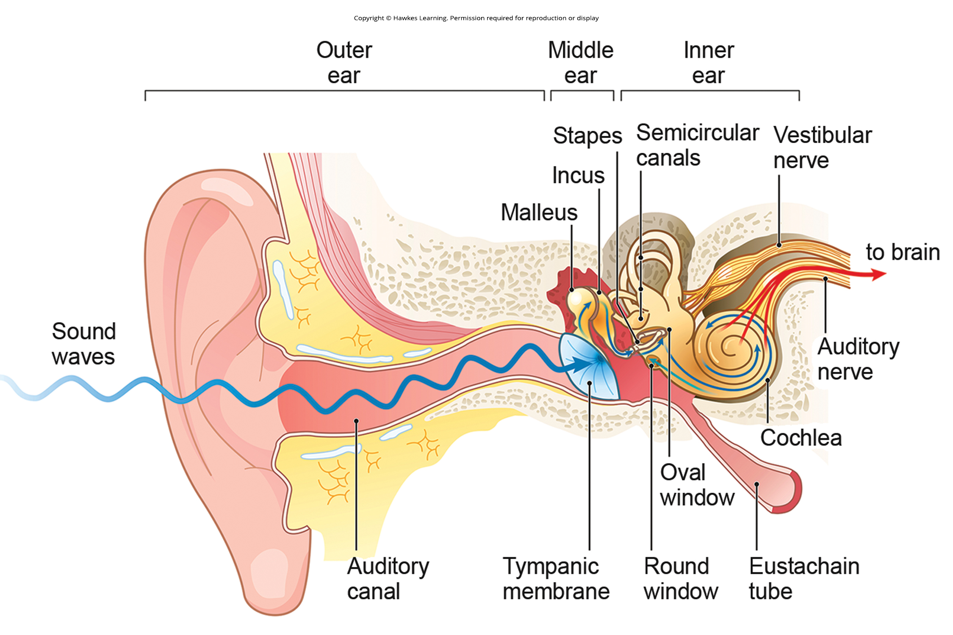
Lesson 41.4 Figure 5

Slide 25
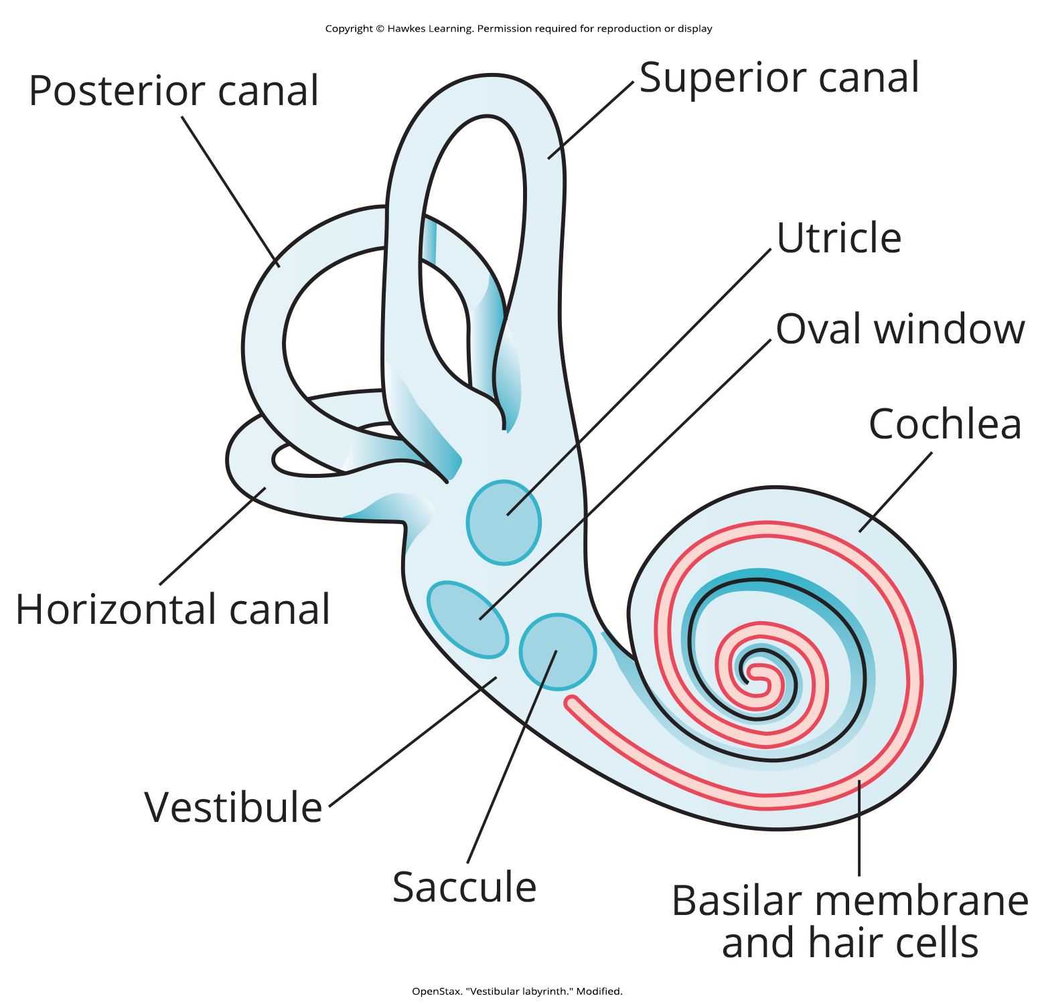
Lesson 41.4 Figure 6

Slide 26
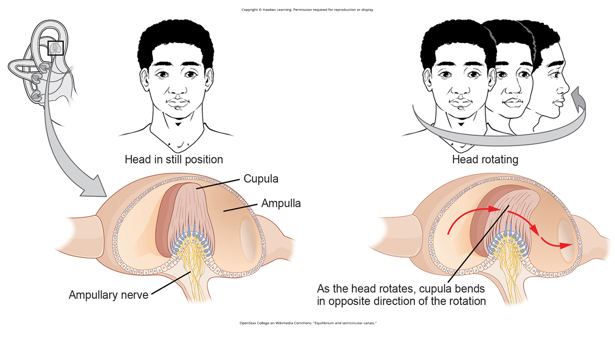
Lesson 41.4 Figure 7

Slide 27
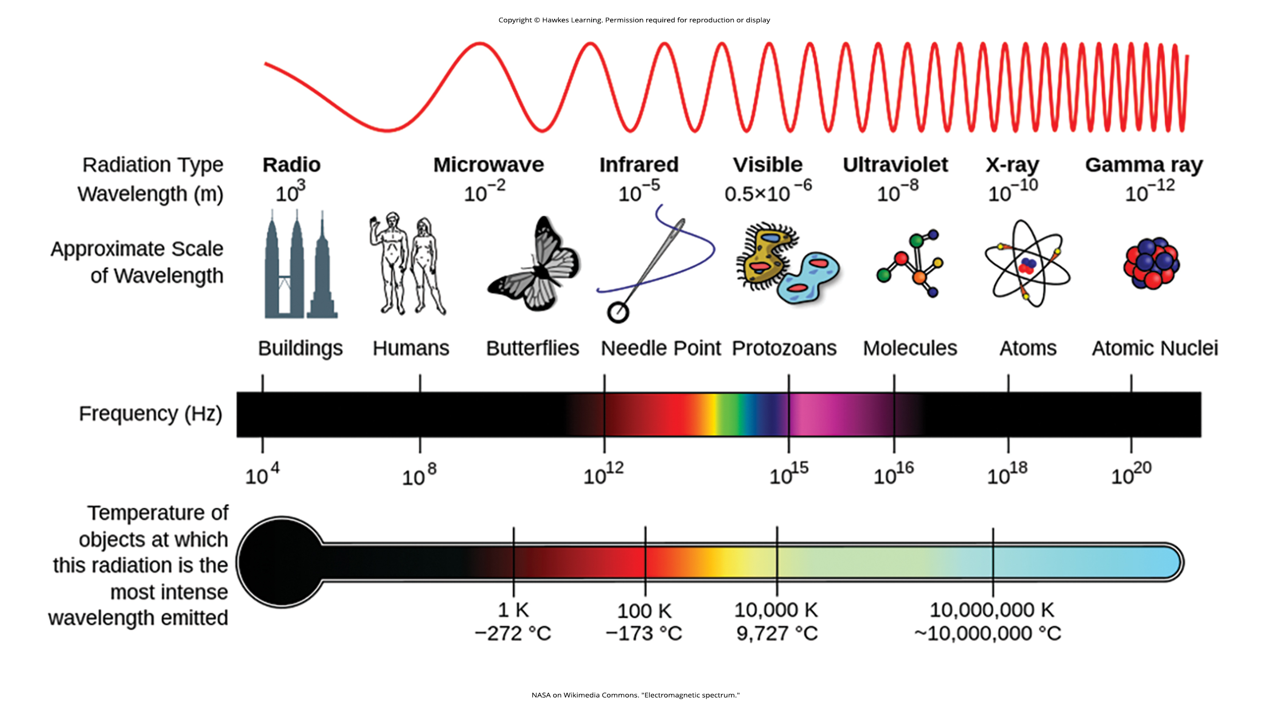
Lesson 41.5 Figure 1

Slide 28
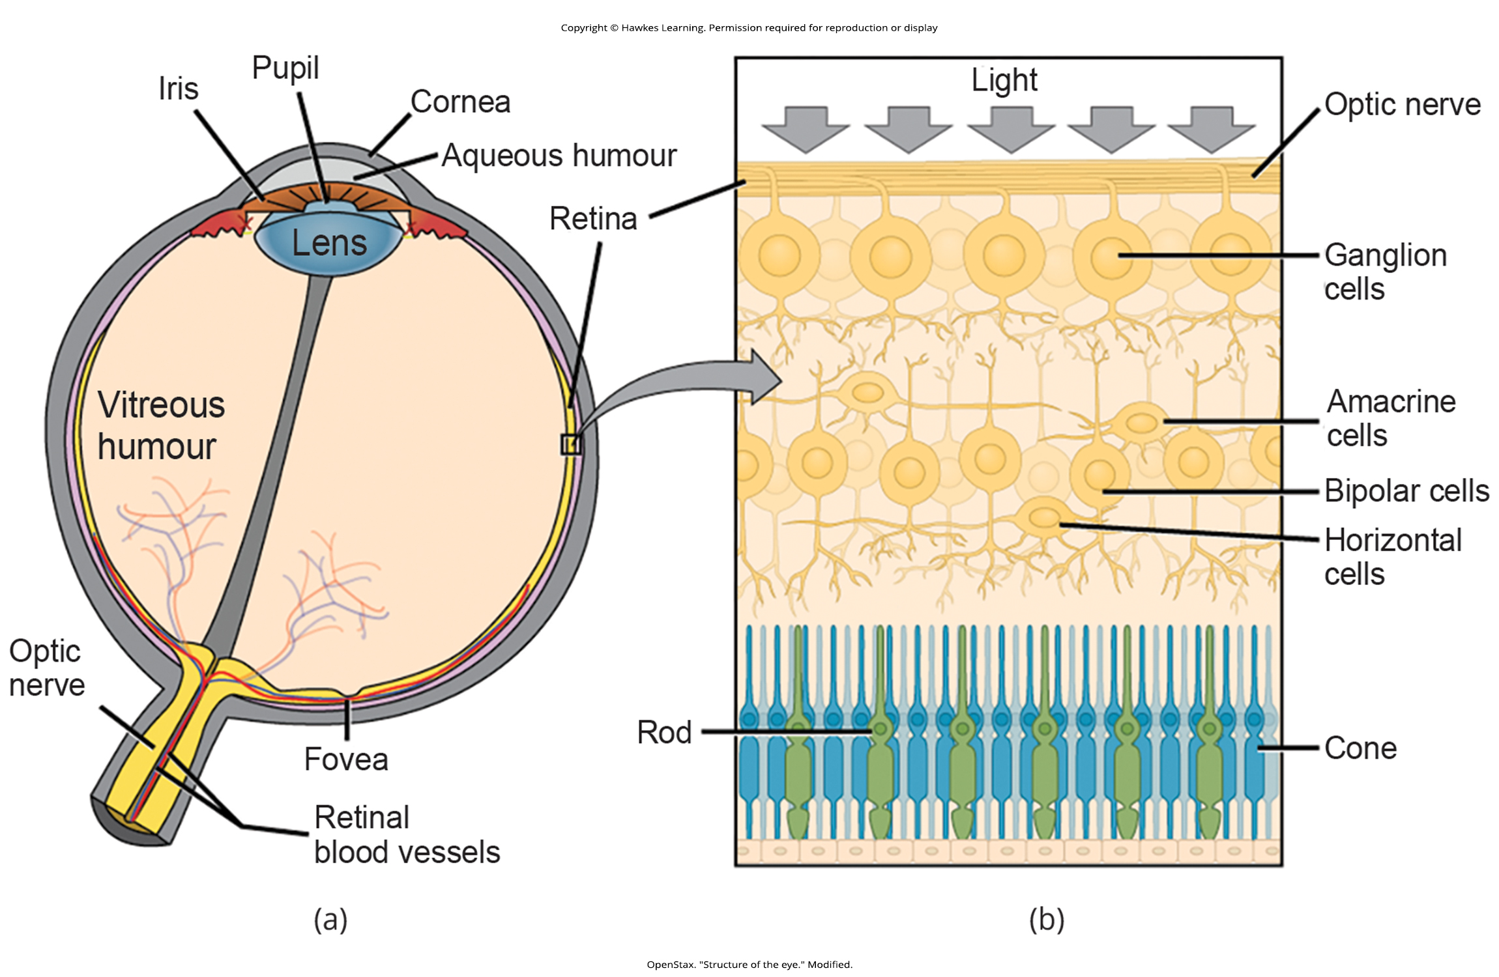
Lesson 41.5 Figure 2

Slide 29
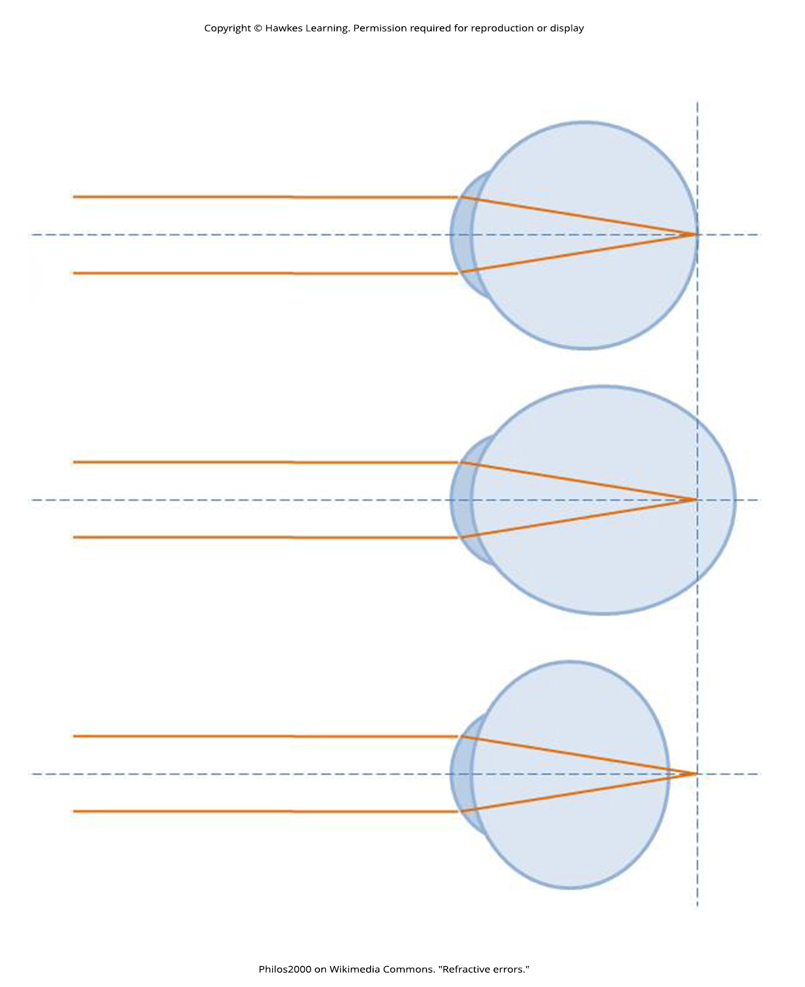
Lesson 41.5 Figure 3

Slide 30
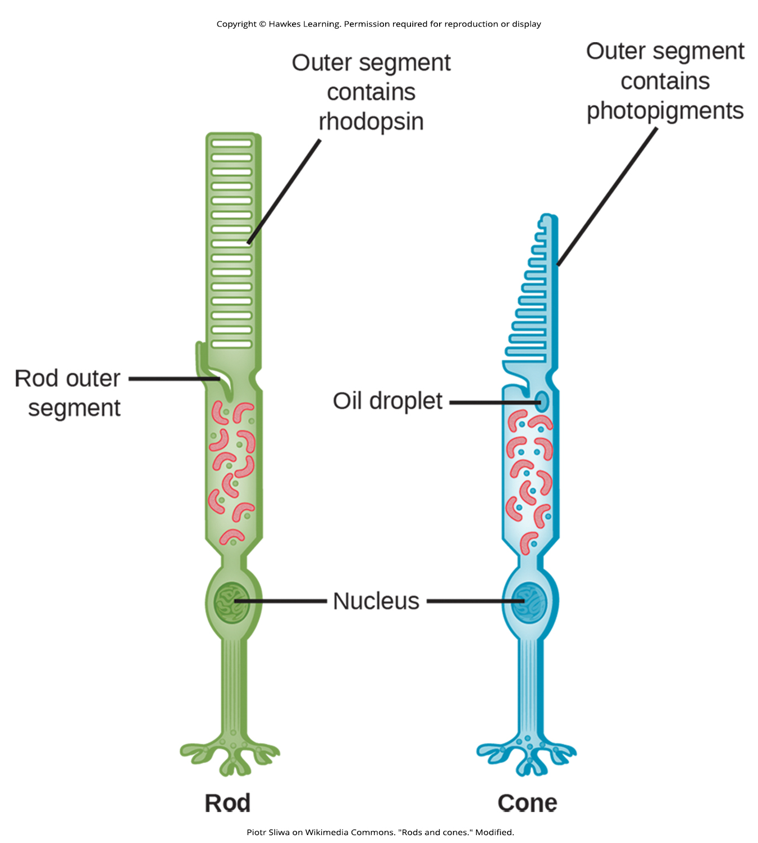
Lesson 41.5 Figure 4

Slide 31
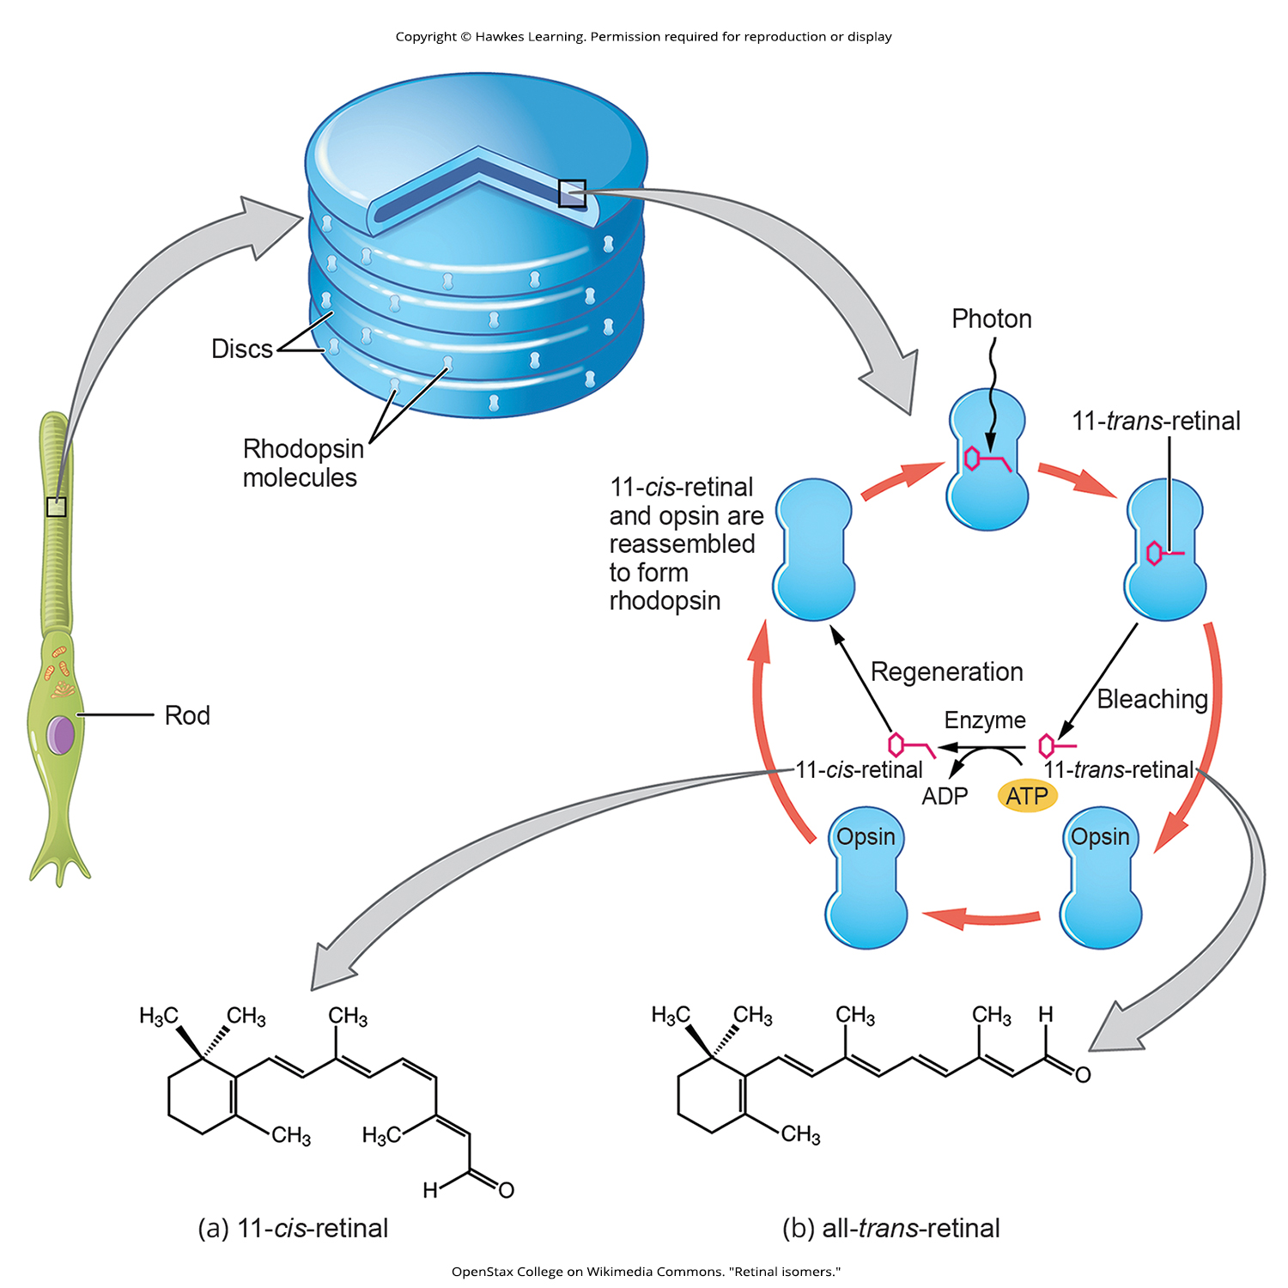
Lesson 41.5 Figure 5

Slide 32
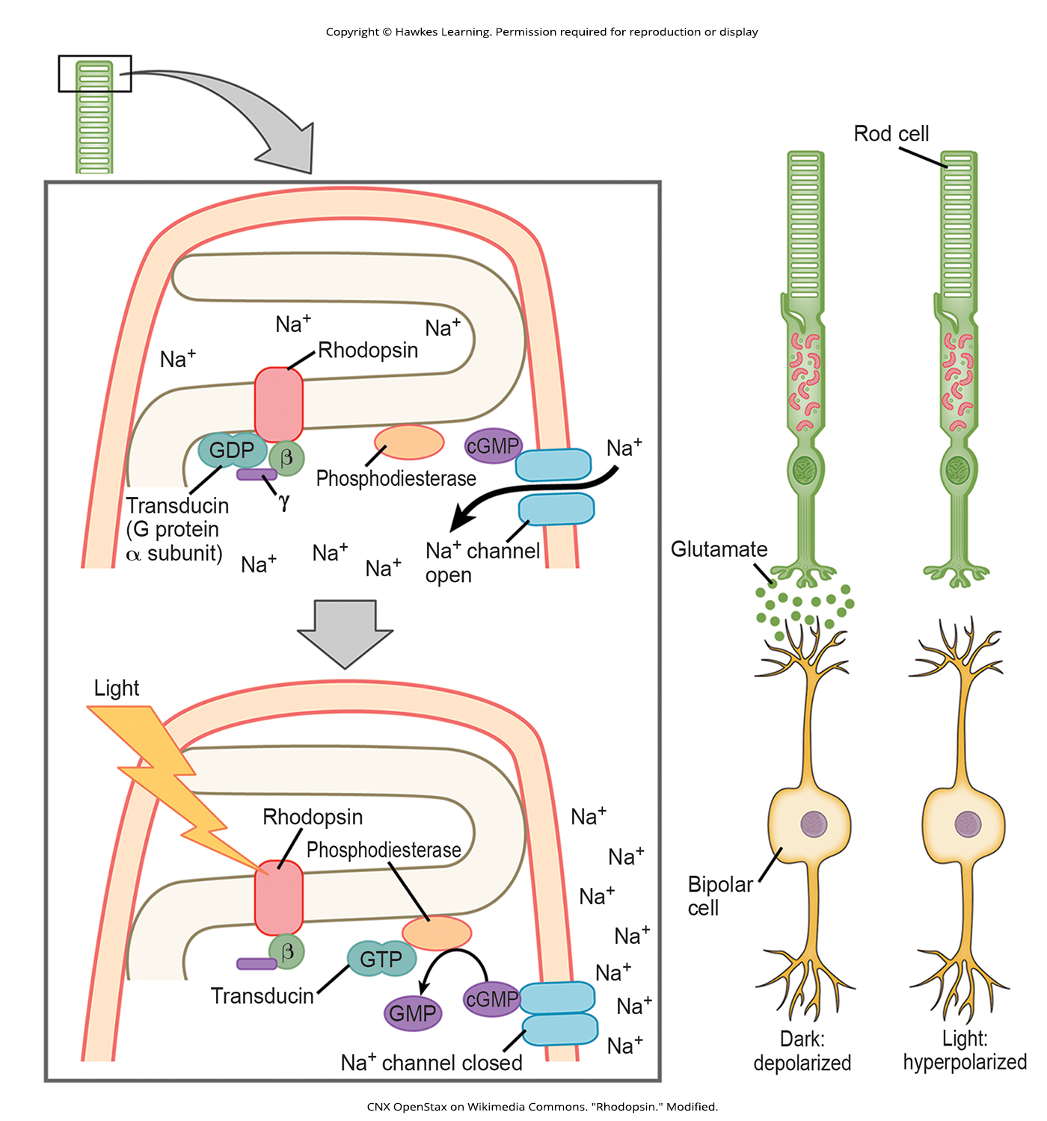
Lesson 41.5 Figure 6

Slide 33
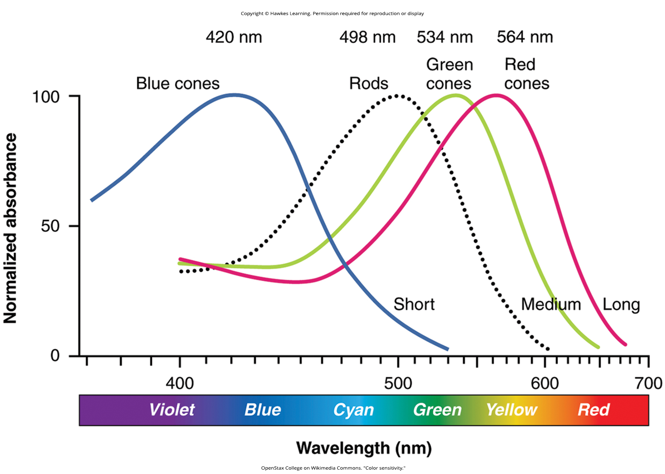
Lesson 41.5 Figure 7

Slide 34
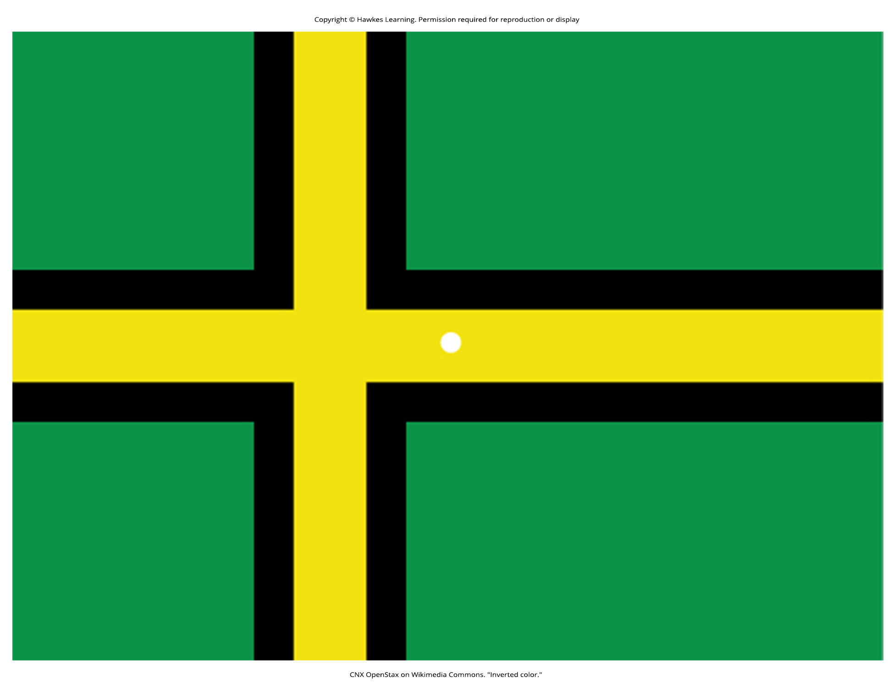
Lesson 41.5 Figure 8

Slide 35
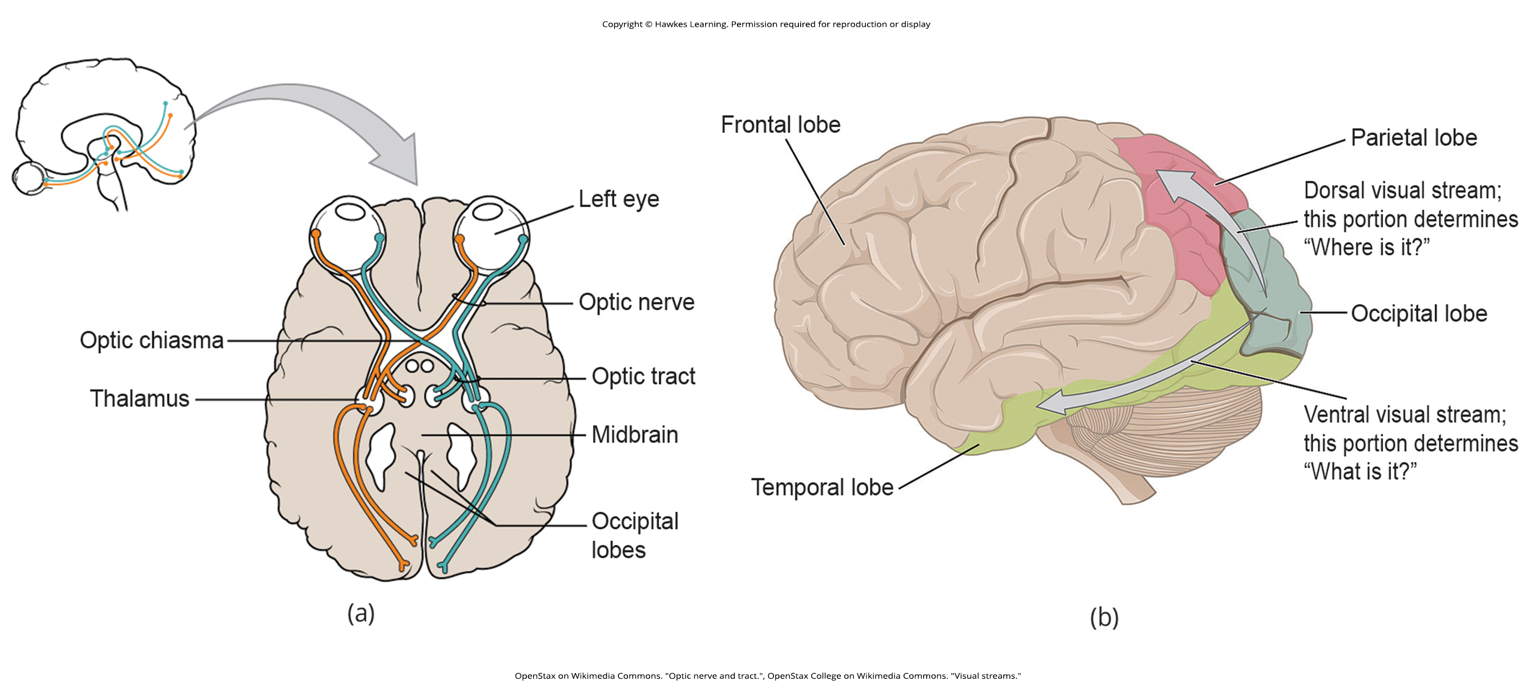
Lesson 41.5 Figure 9

Slide 36
Hawkes Learning – End of PowerPoint

