Slide 1
Chapter 43
The Musculoskeletal System

Slide 2
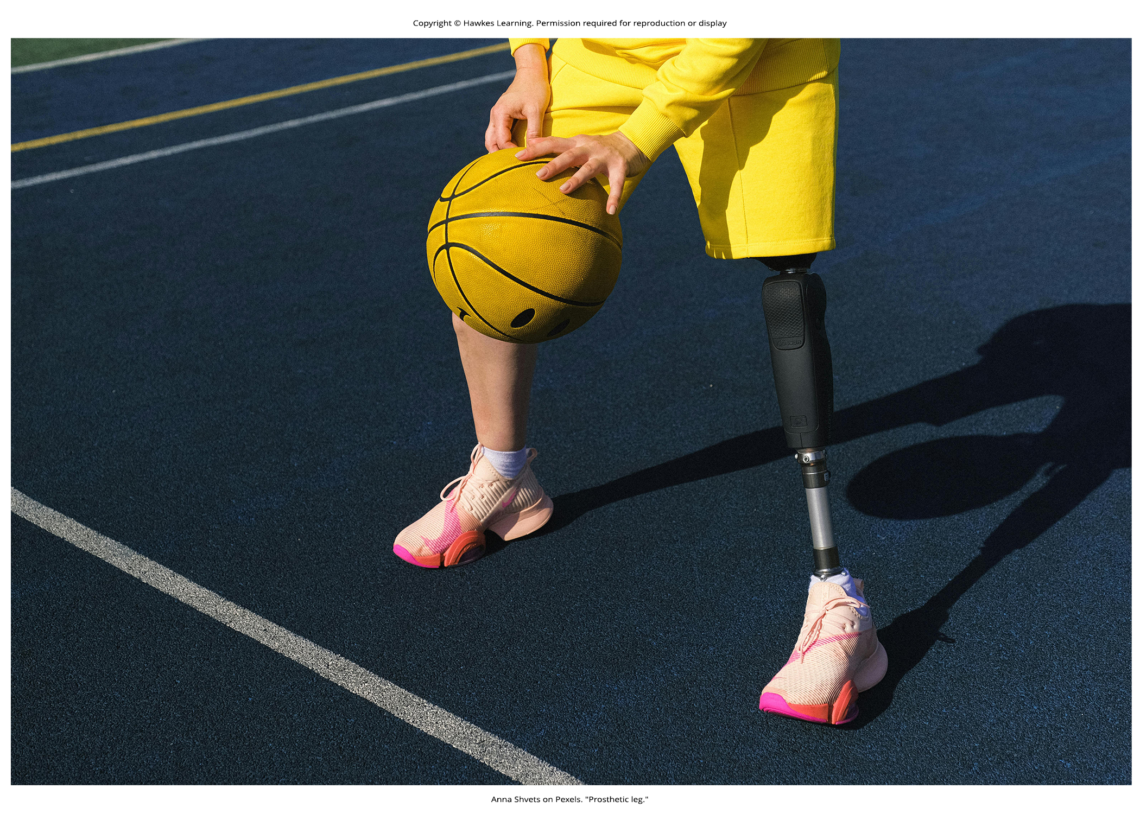
Lesson 43.1 Figure 1

Slide 3
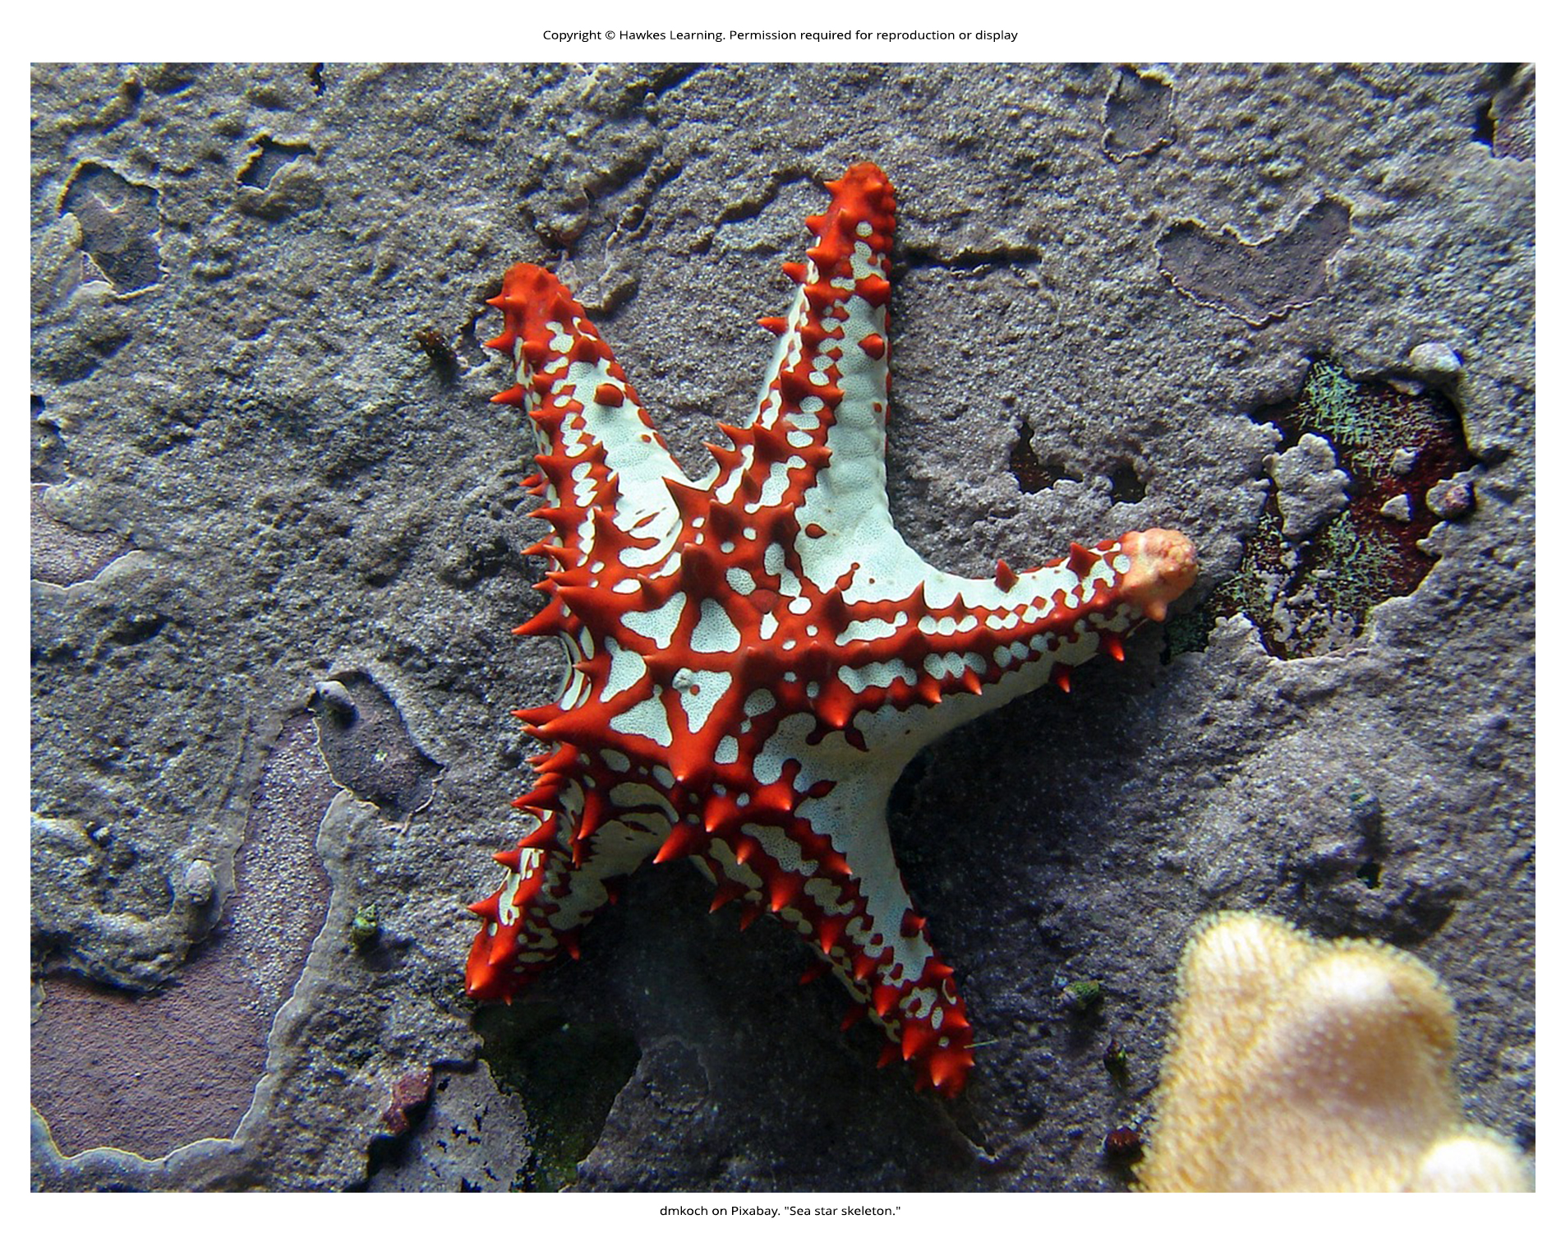
Lesson 43.1 Figure 2

Slide 4
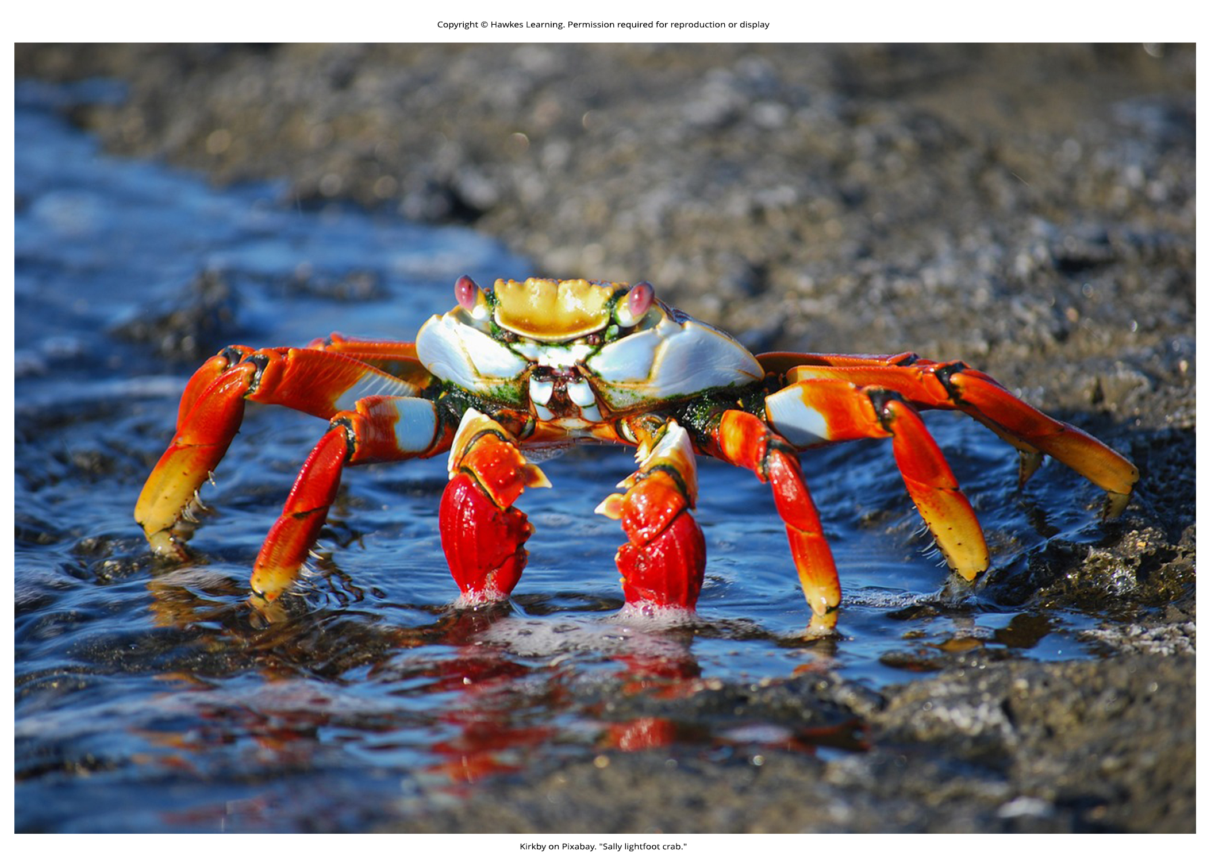
Lesson 43.1 Figure 3

Slide 5
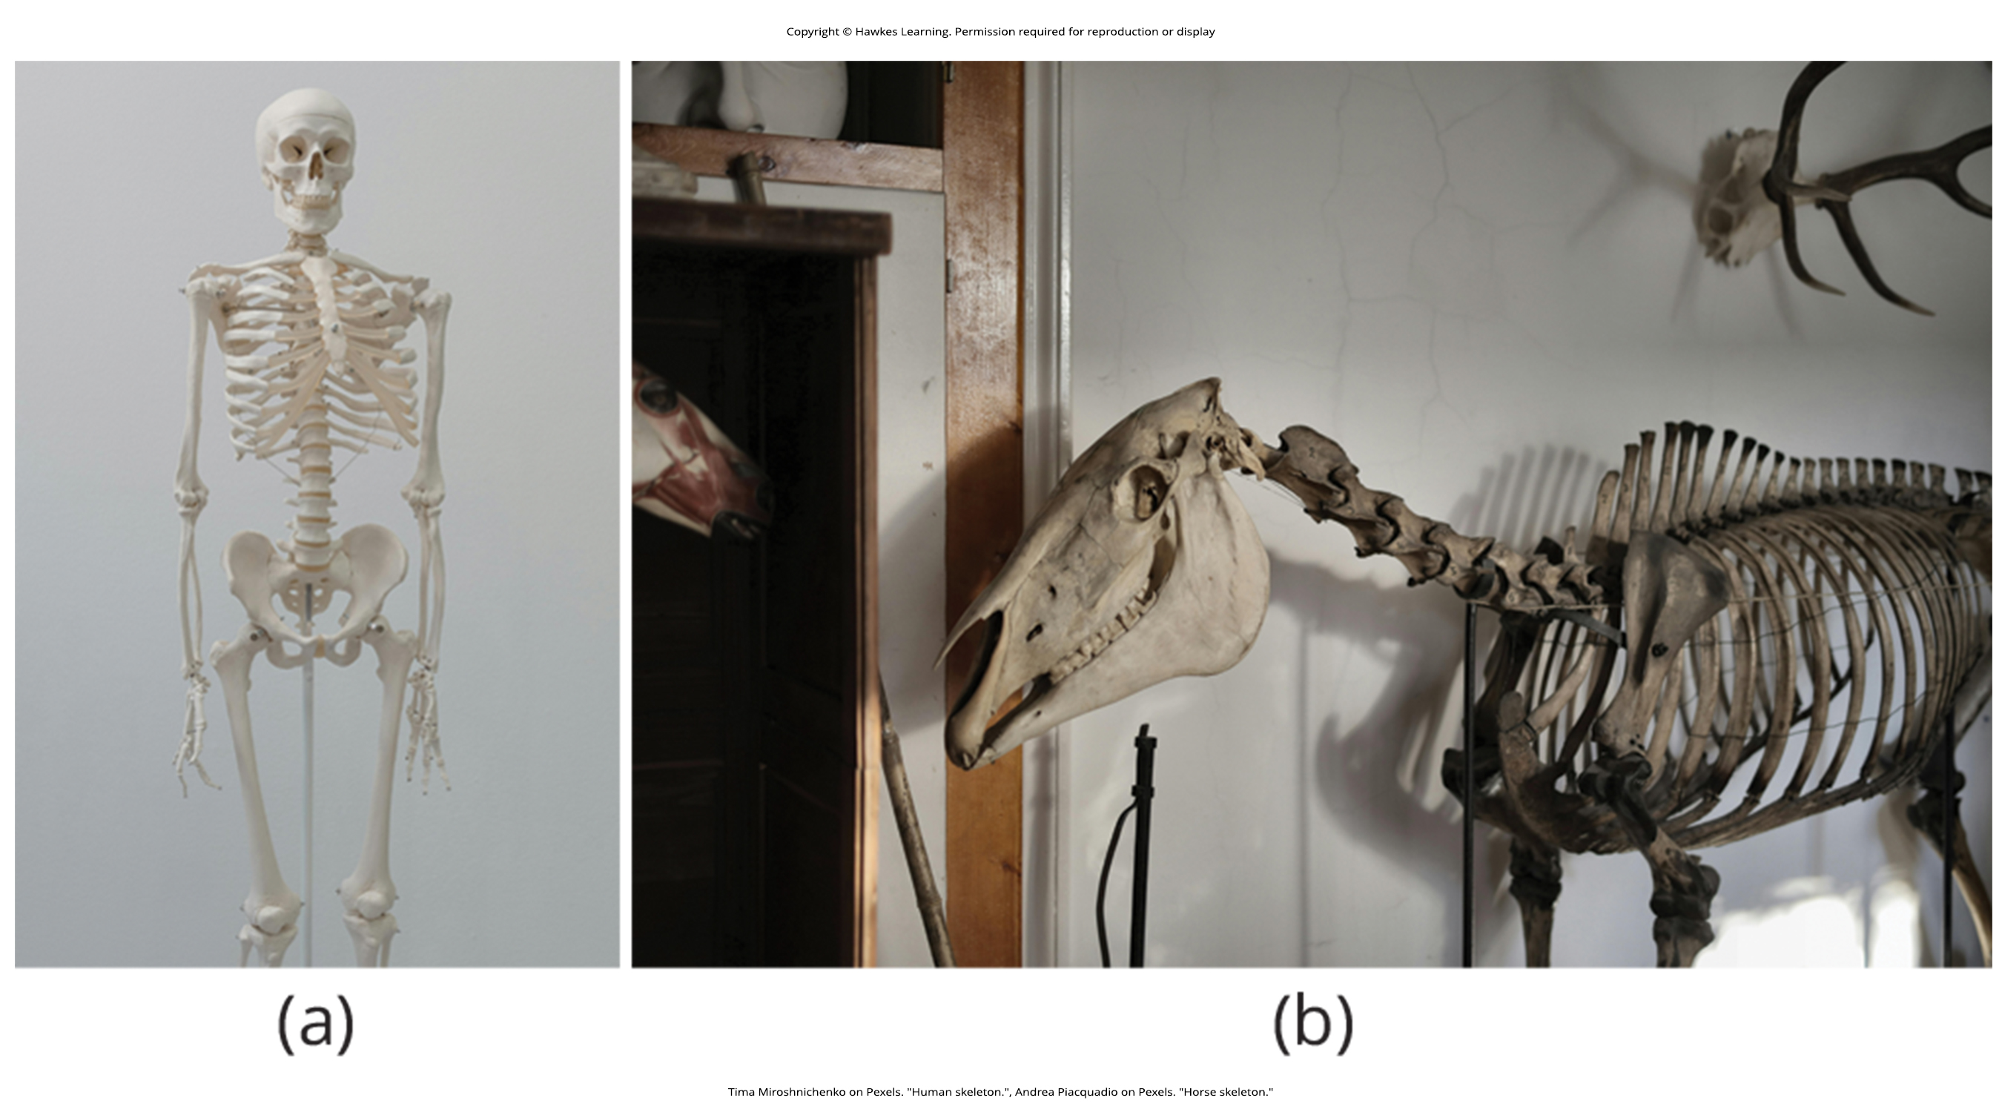
Lesson 43.1 Figure 4

Slide 6
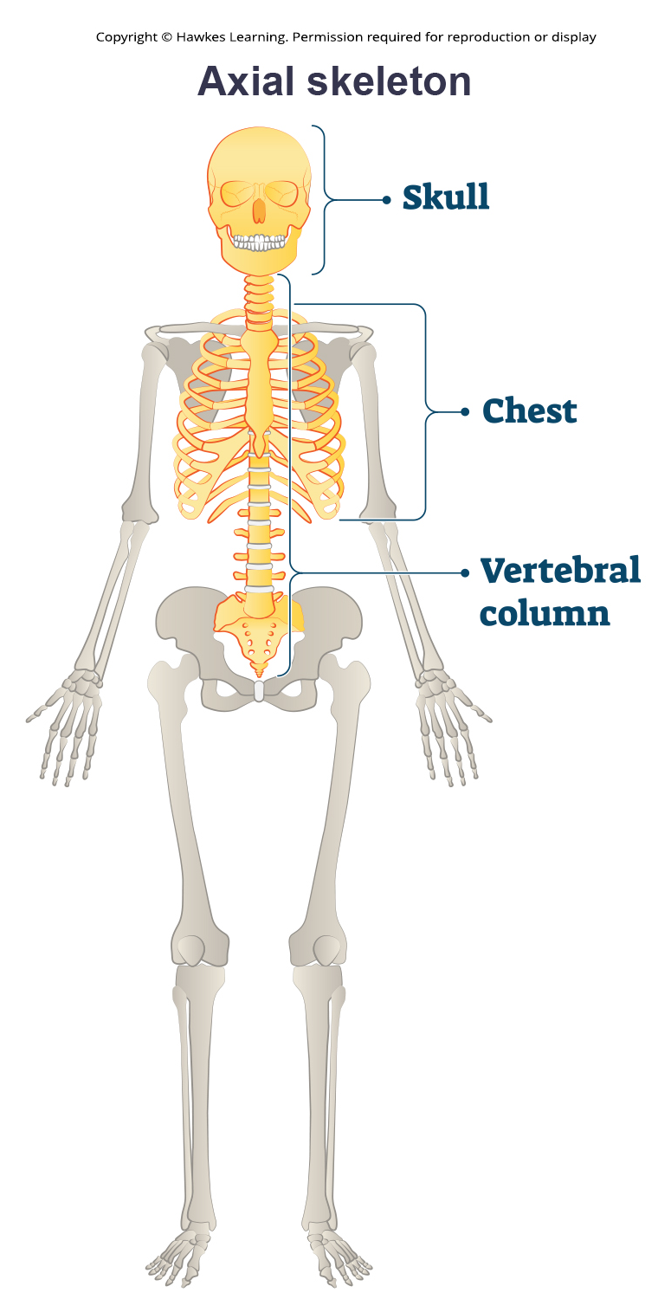
Lesson 43.1 Figure 5

Slide 7
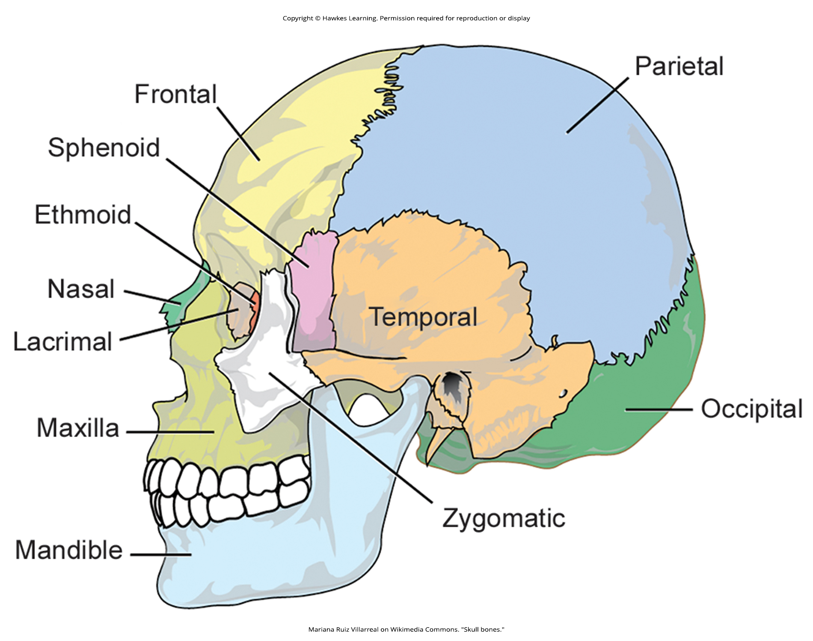
Lesson 43.1 Figure 6

Slide 8
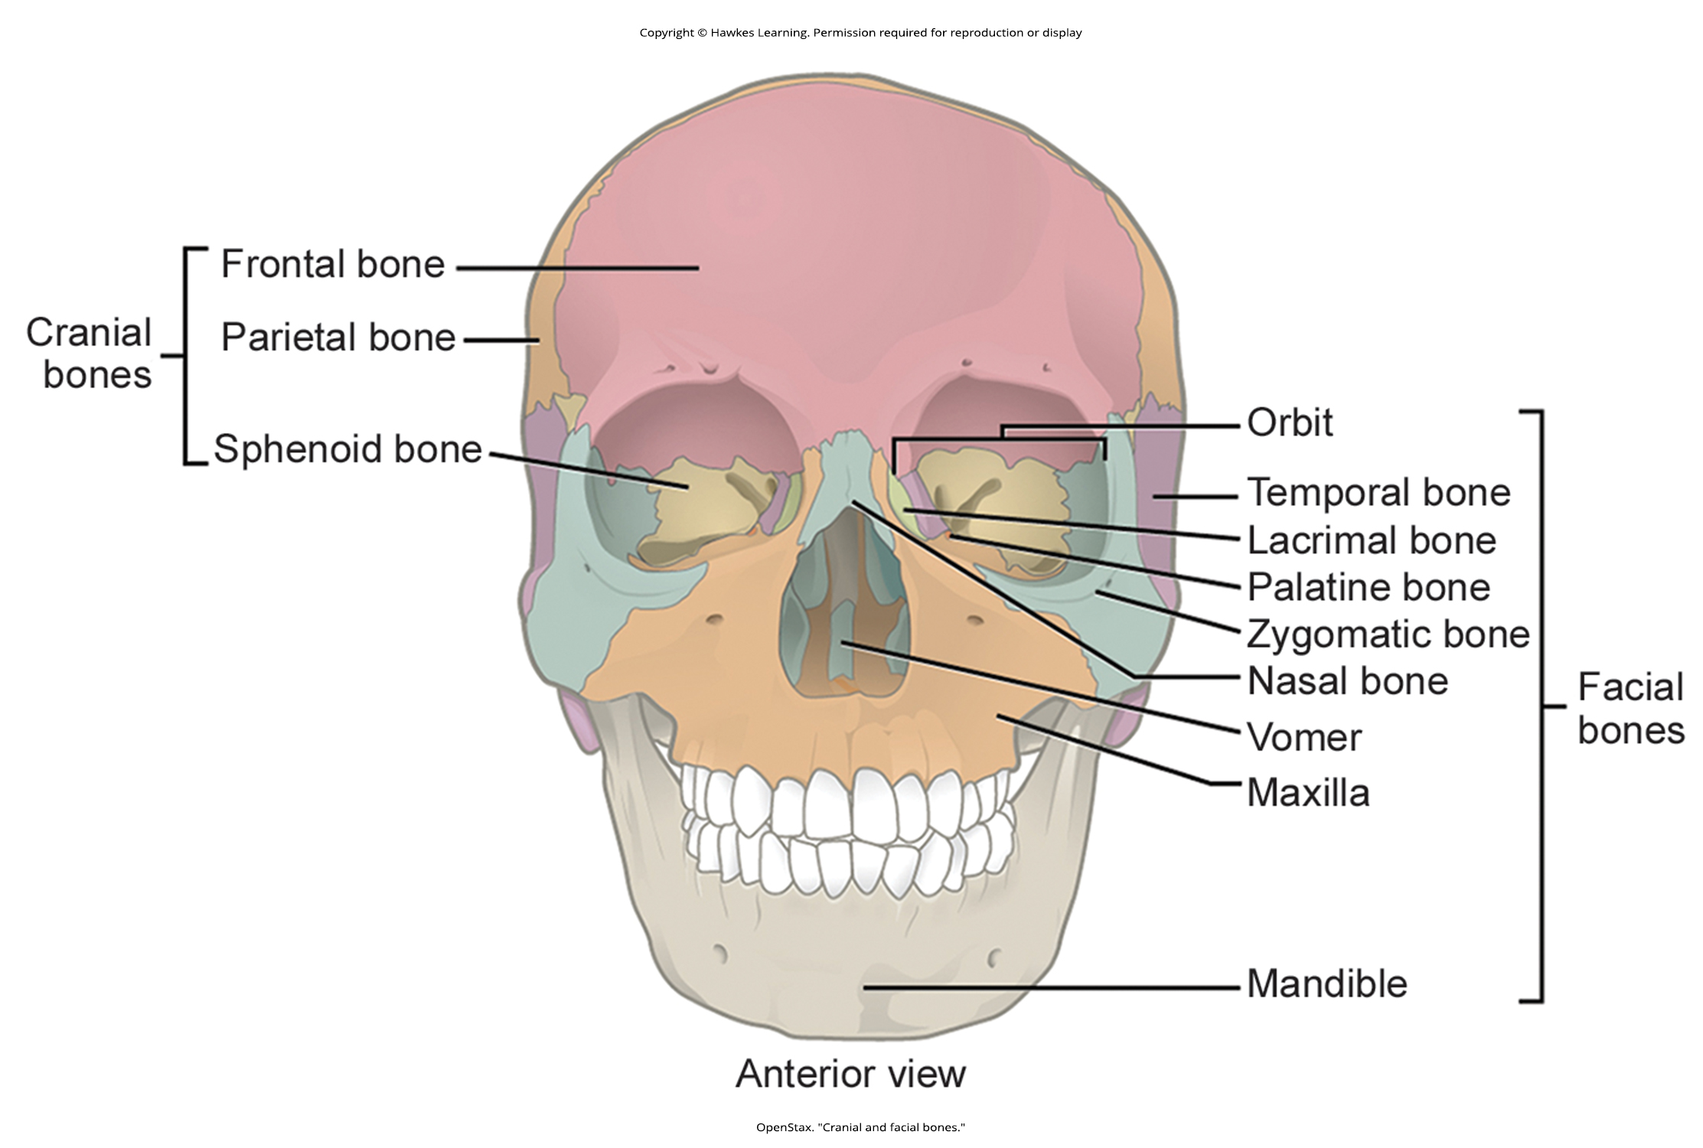
Lesson 43.1 Figure 7

Slide 9
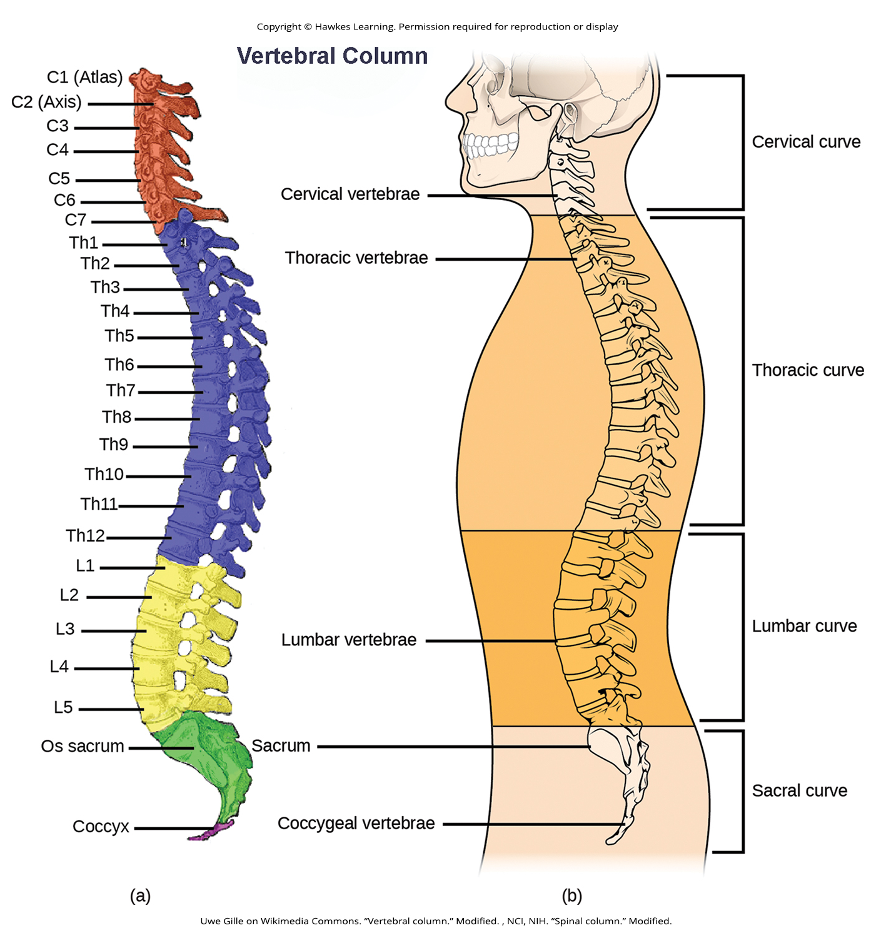
Lesson 43.1 Figure 8

Slide 10
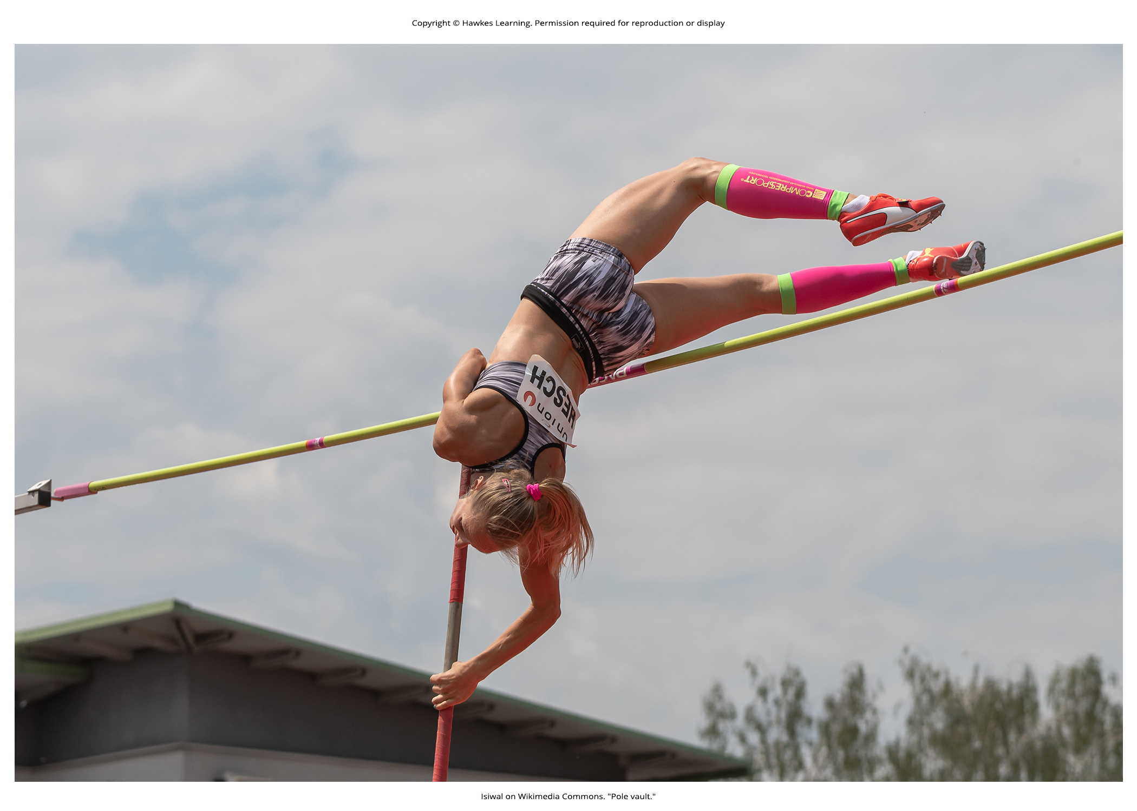
Lesson 43.1 Figure 9

Slide 11
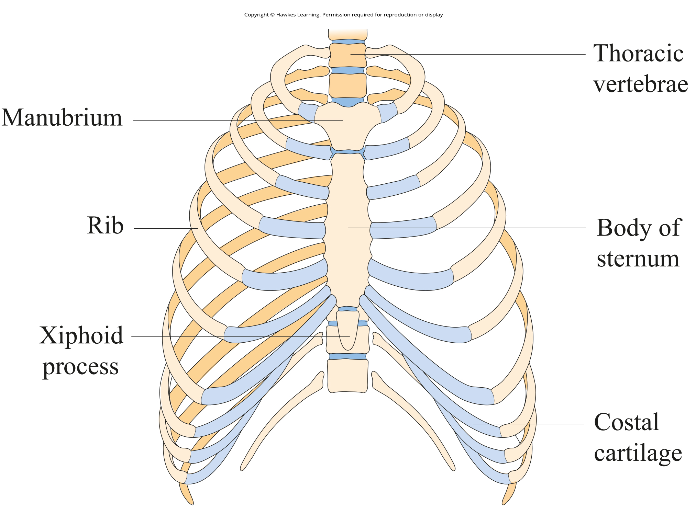
Lesson 43.1 Figure 10

Slide 12
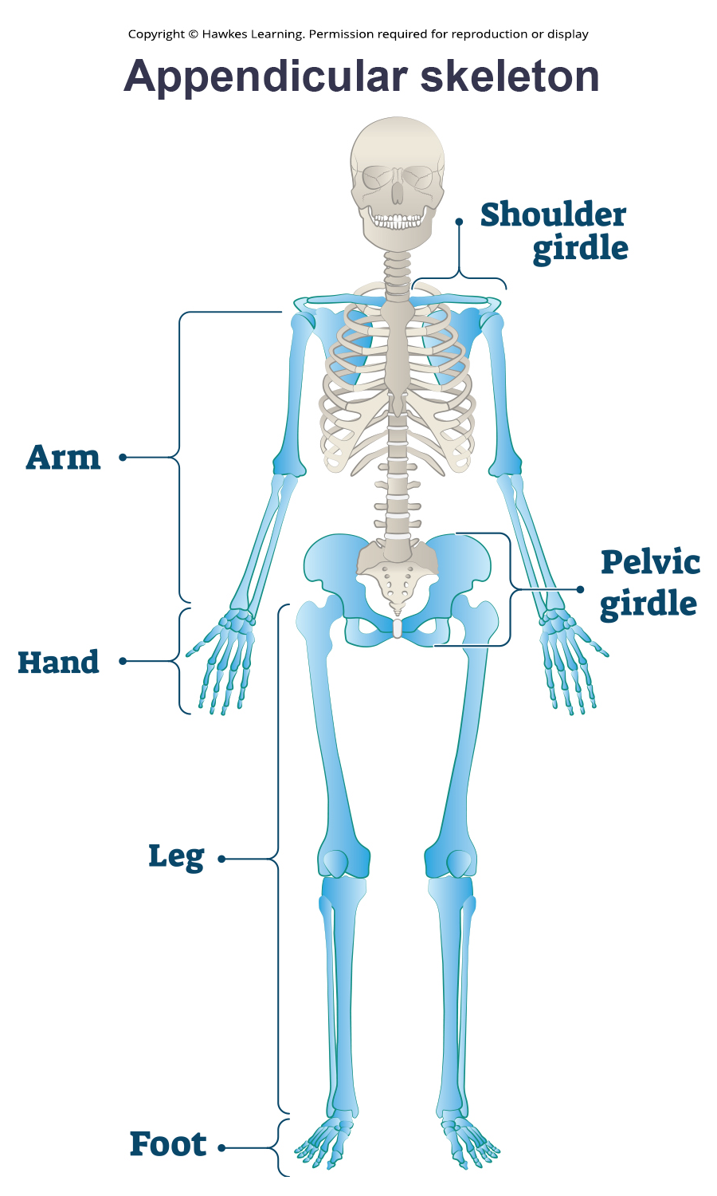
Lesson 43.1 Figure 11

Slide 13
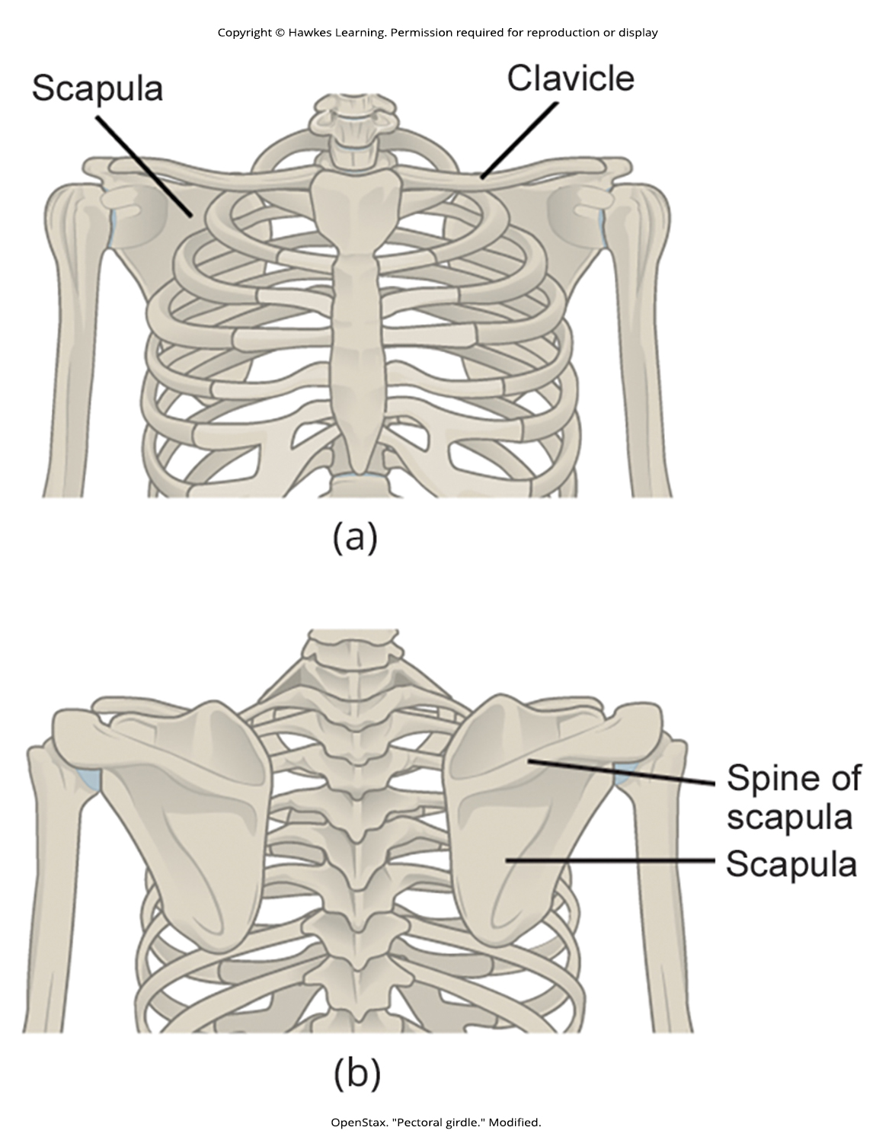
Lesson 43.1 Figure 12

Slide 14
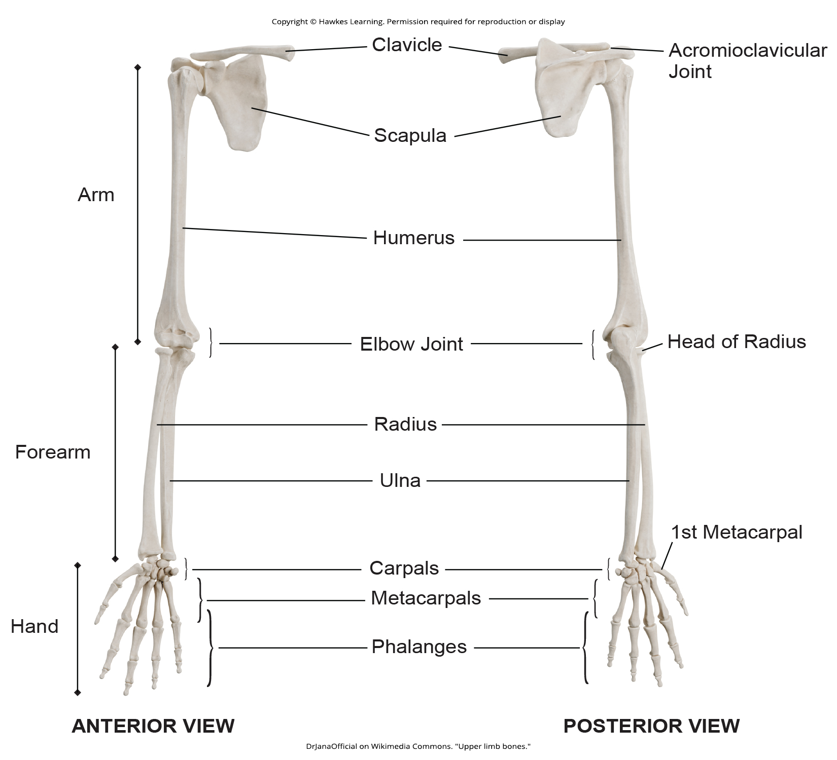
Lesson 43.1 Figure 13

Slide 15
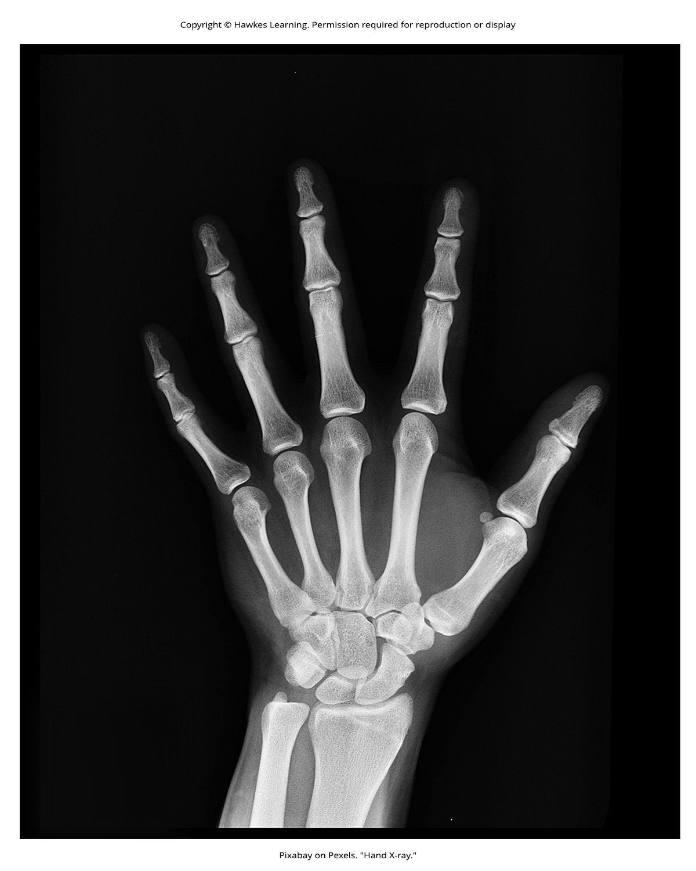
Lesson 43.1 Figure 14

Slide 16
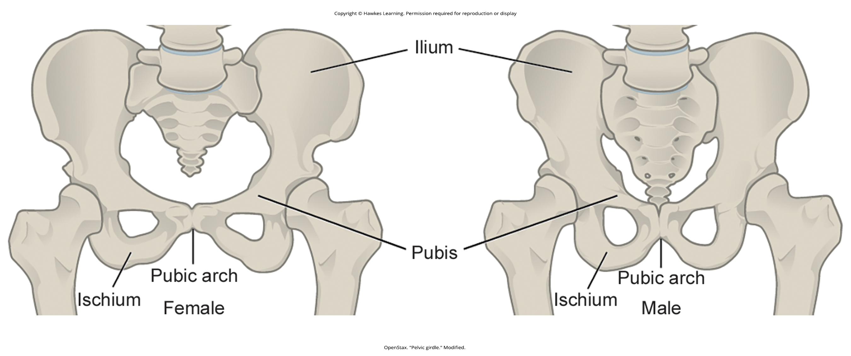
Lesson 43.1 Figure 15

Slide 17
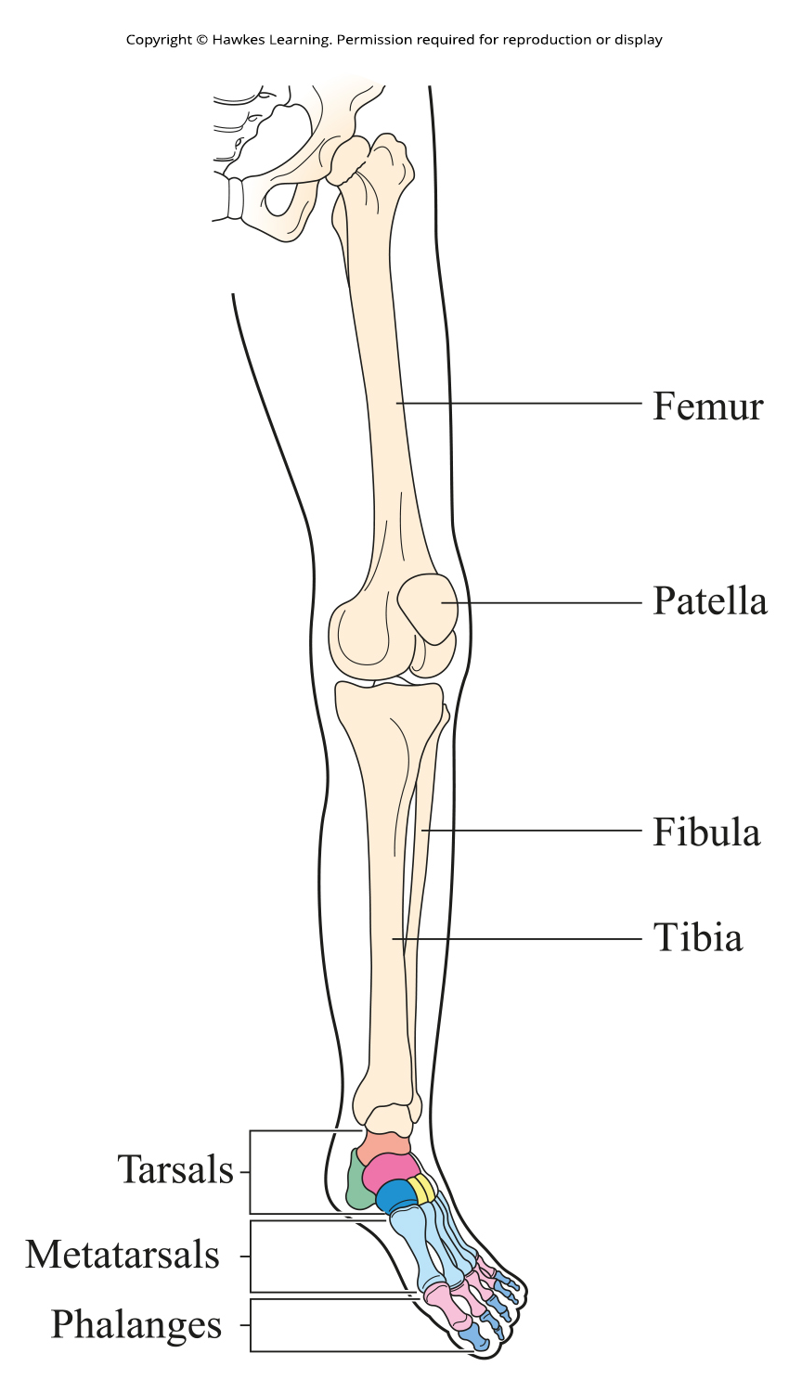
Lesson 43.1 Figure 16

Slide 18
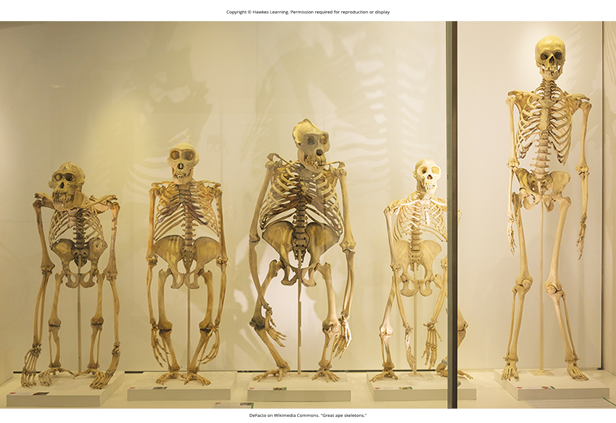
Lesson 43.1 Figure 17

Slide 19
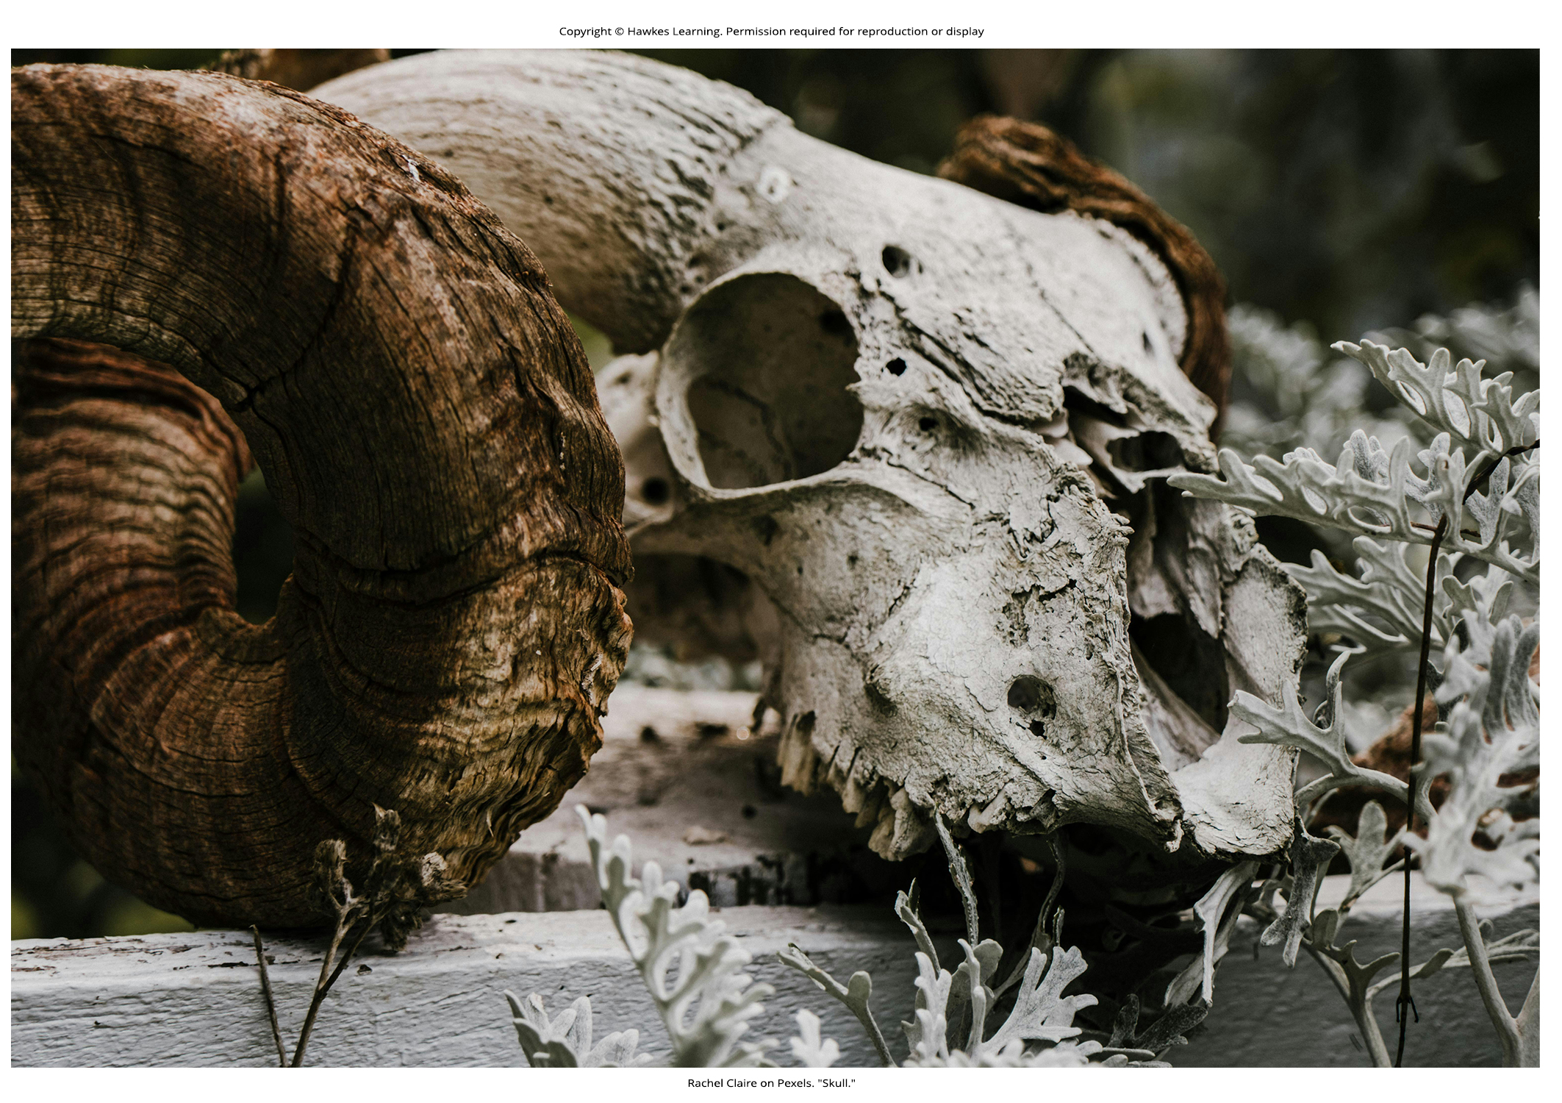
Lesson 43.2 Figure 1

Slide 20
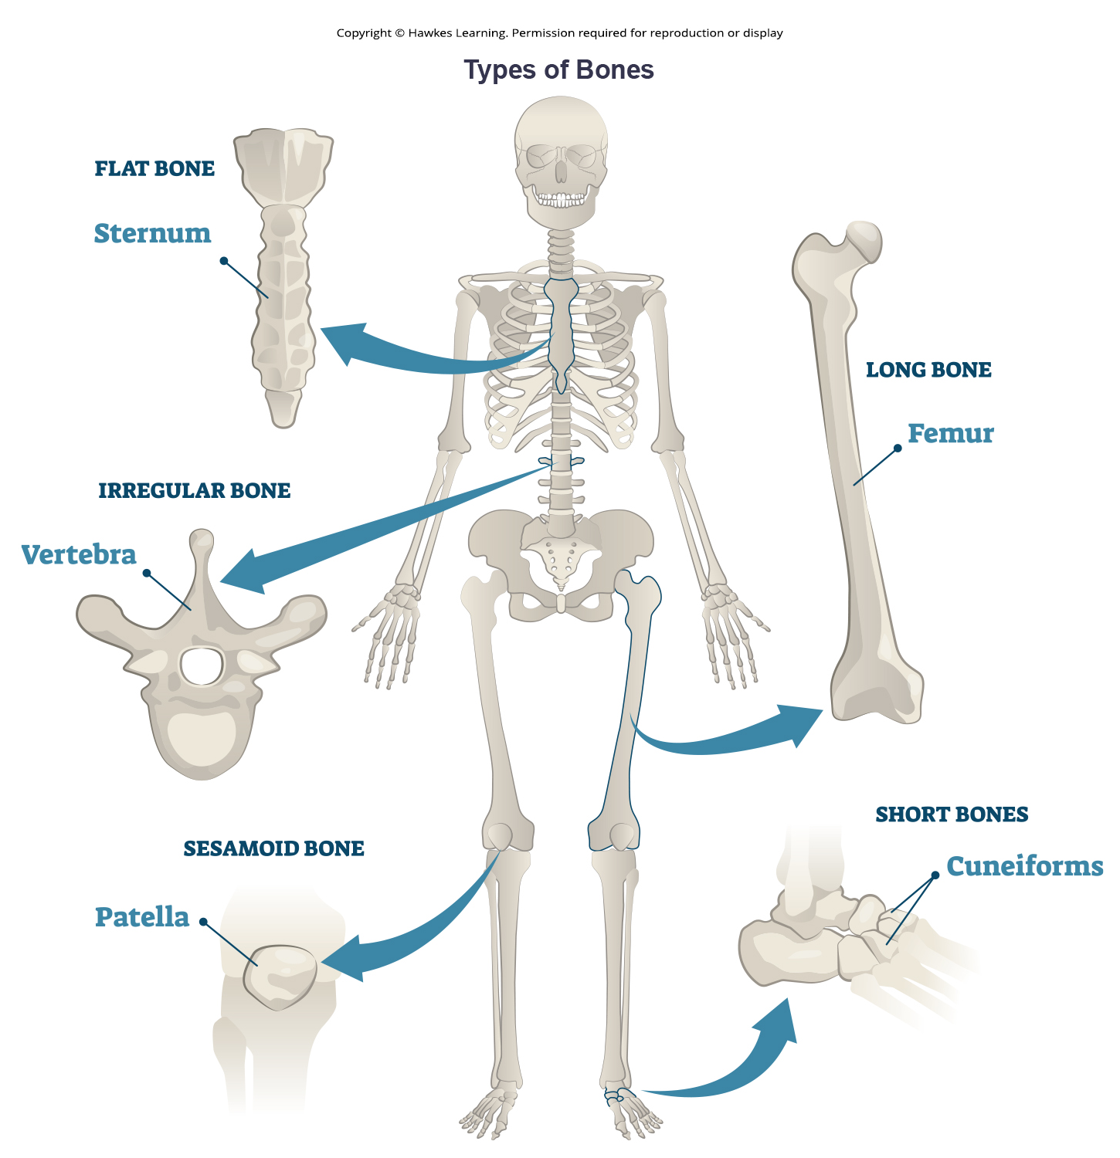
Lesson 43.2 Figure 2

Slide 21
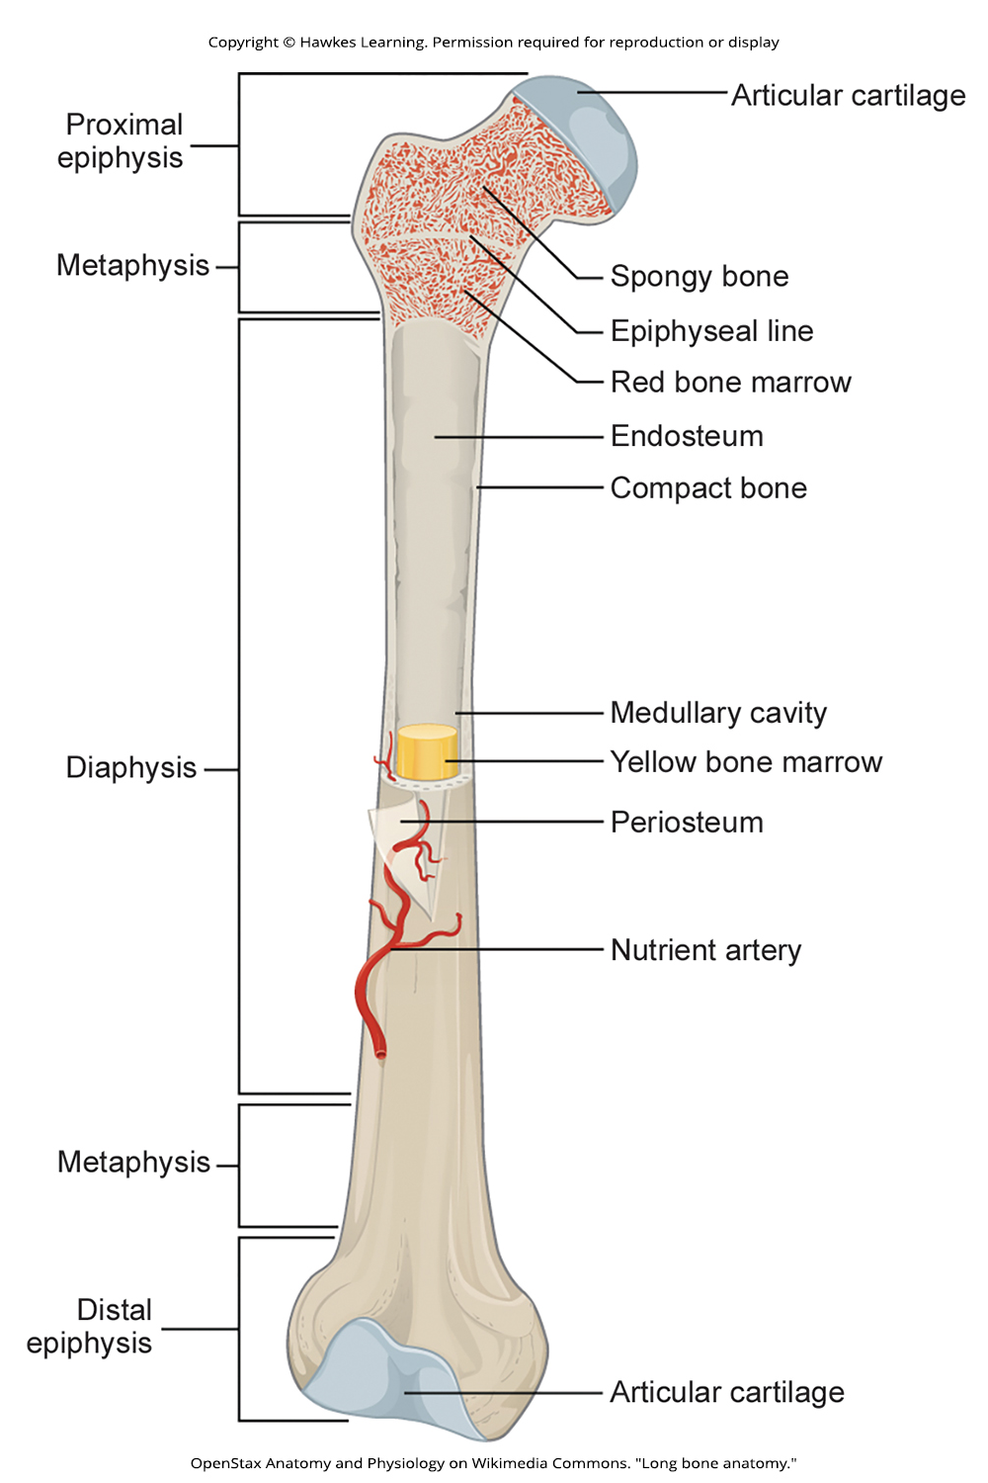
Lesson 43.2 Figure 3

Slide 22
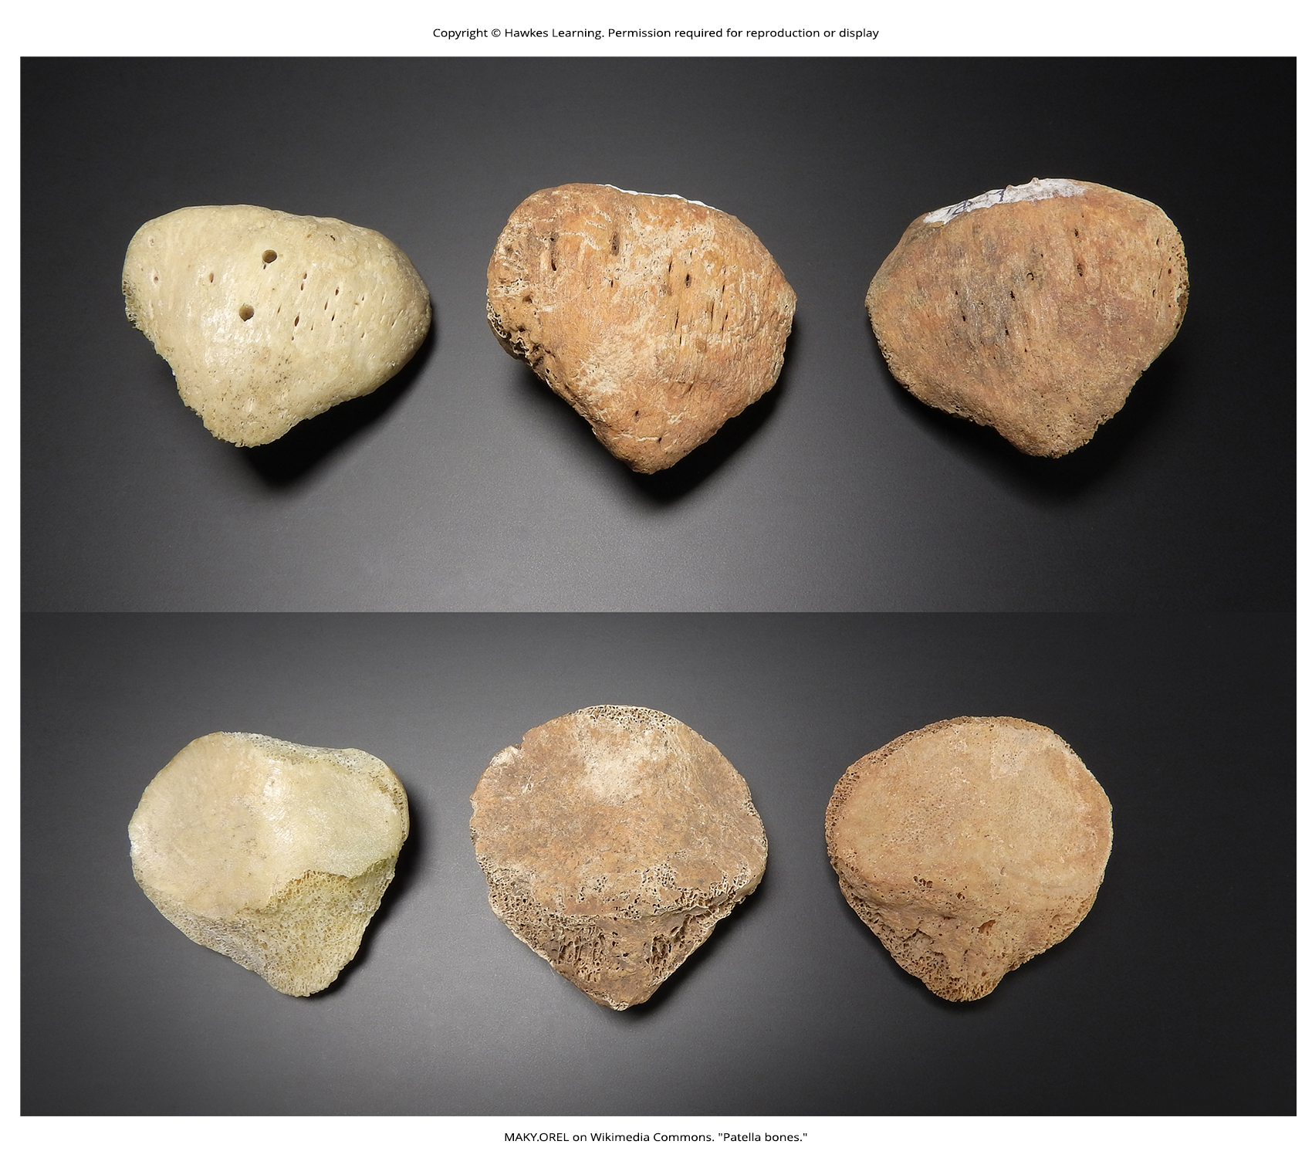
Lesson 43.2 Figure 4

Slide 23
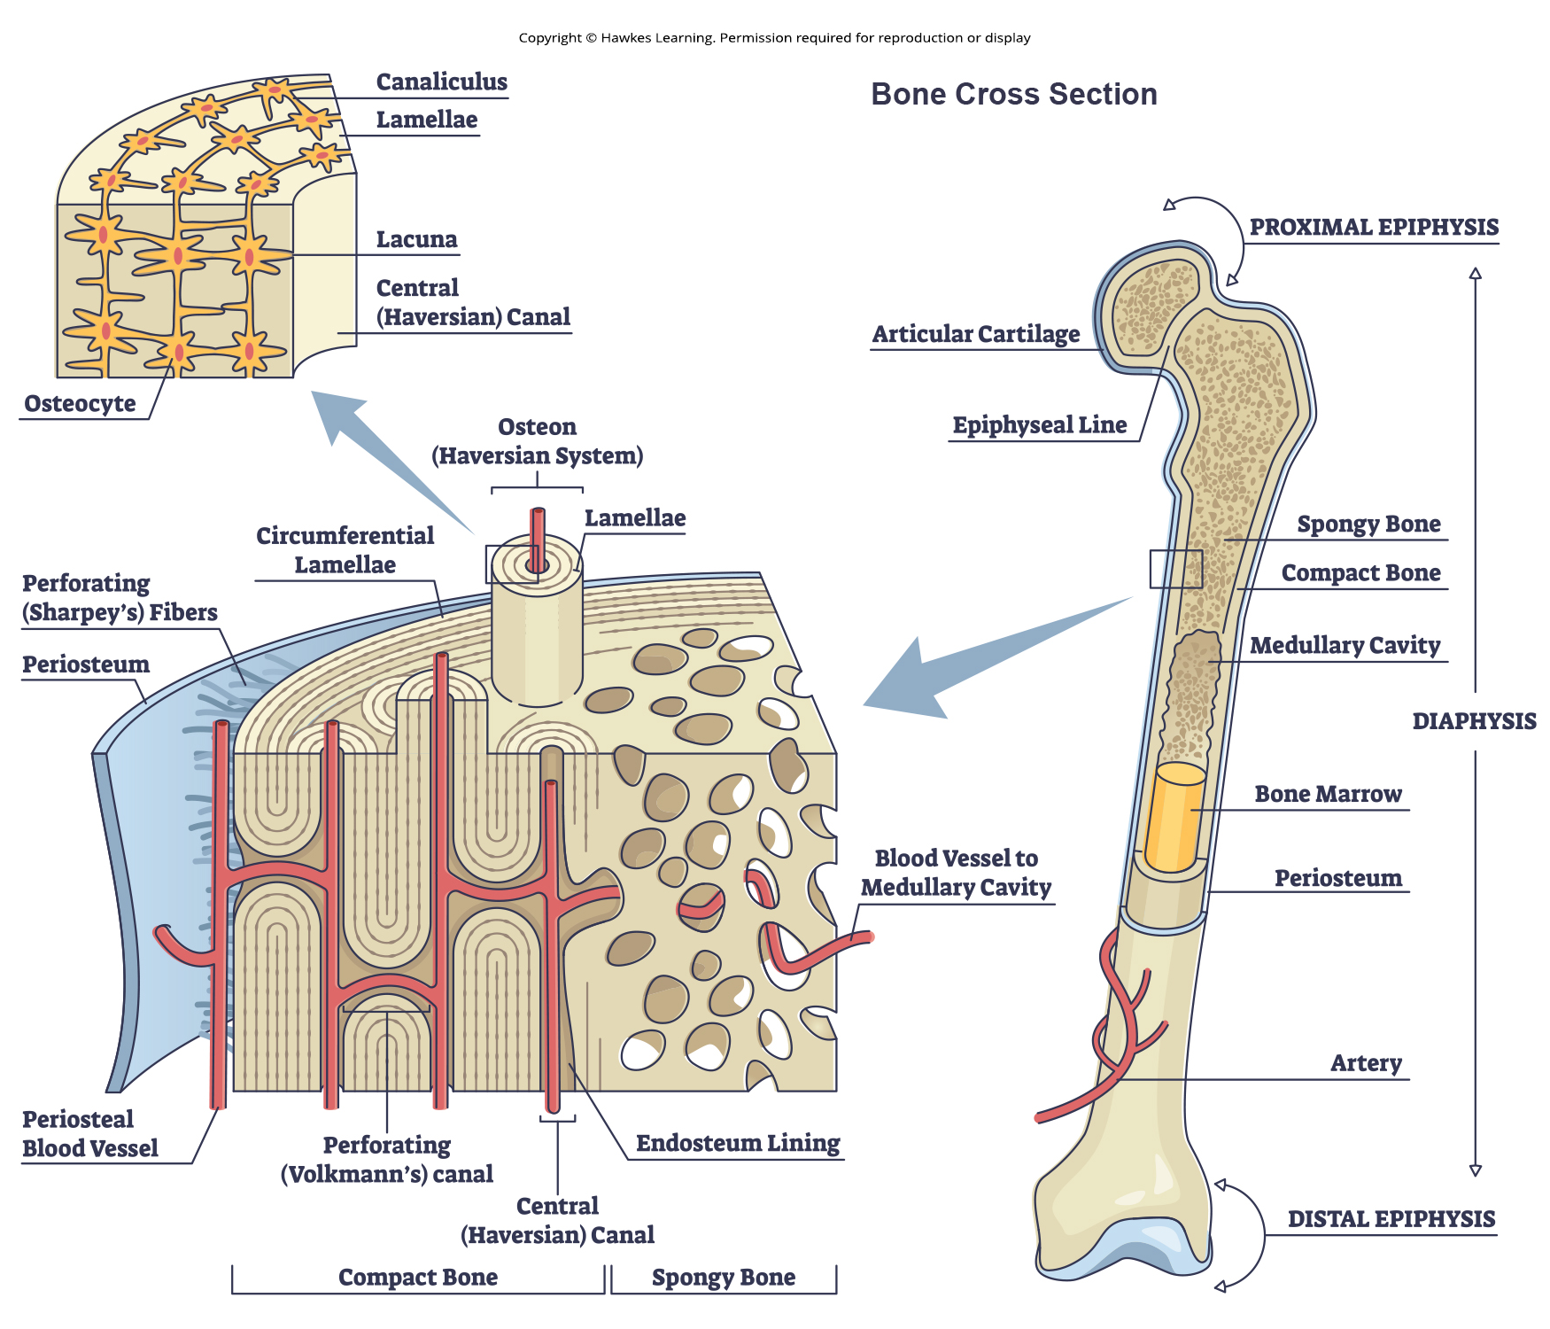
Lesson 43.2 Figure 5

Slide 24
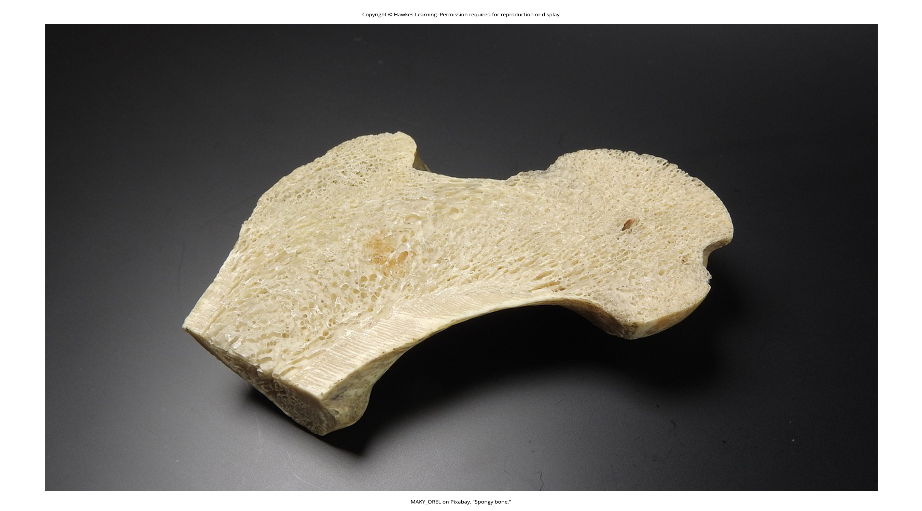
Lesson 43.2 Figure 6

Slide 25
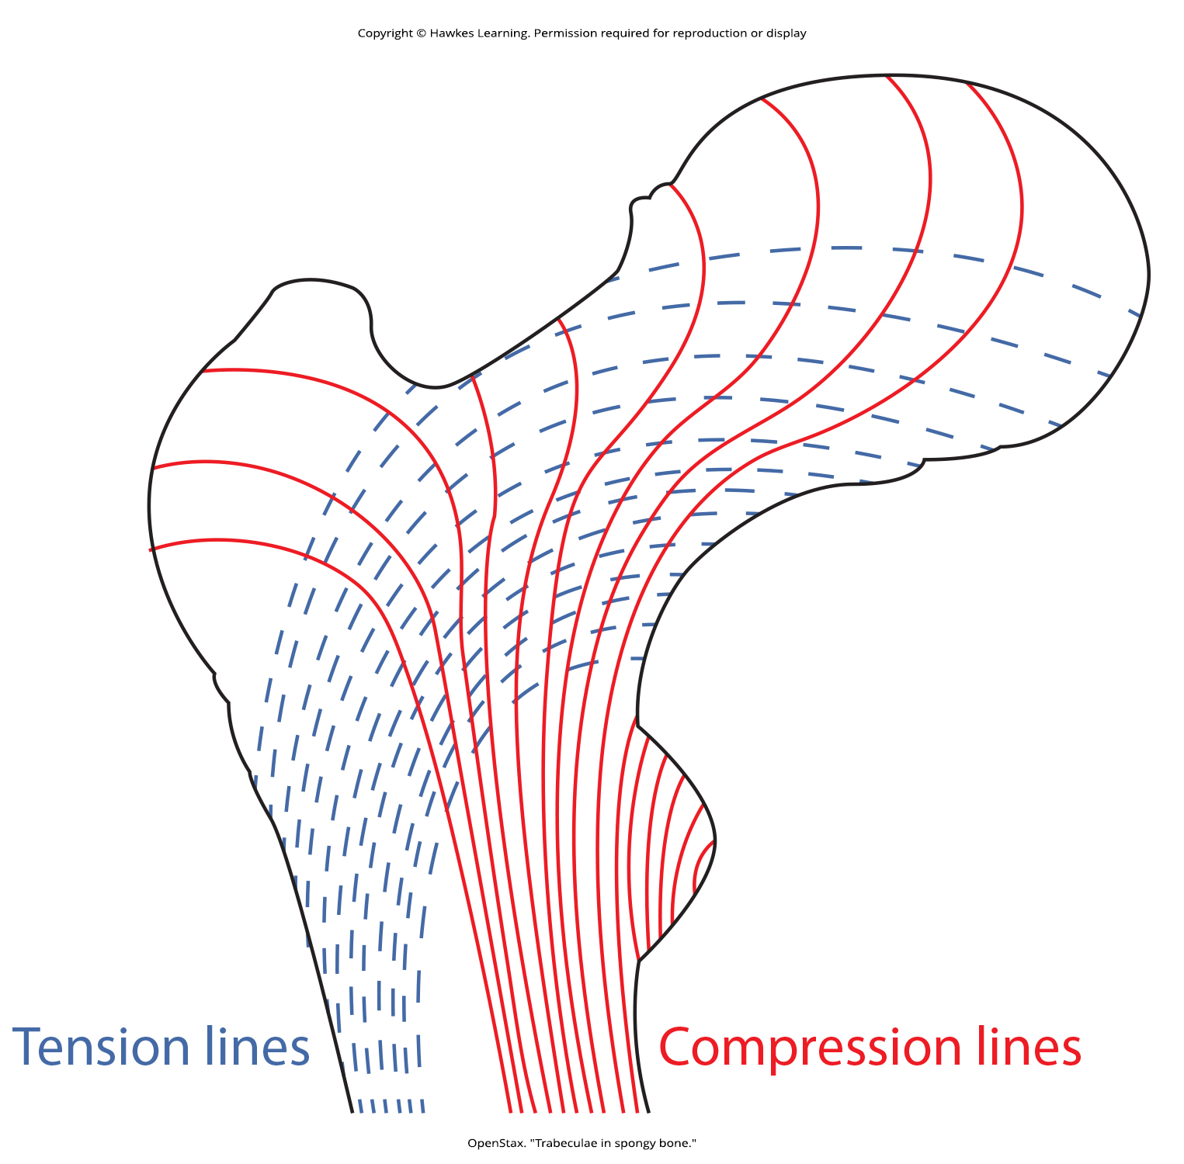
Lesson 43.2 Figure 7

Slide 26
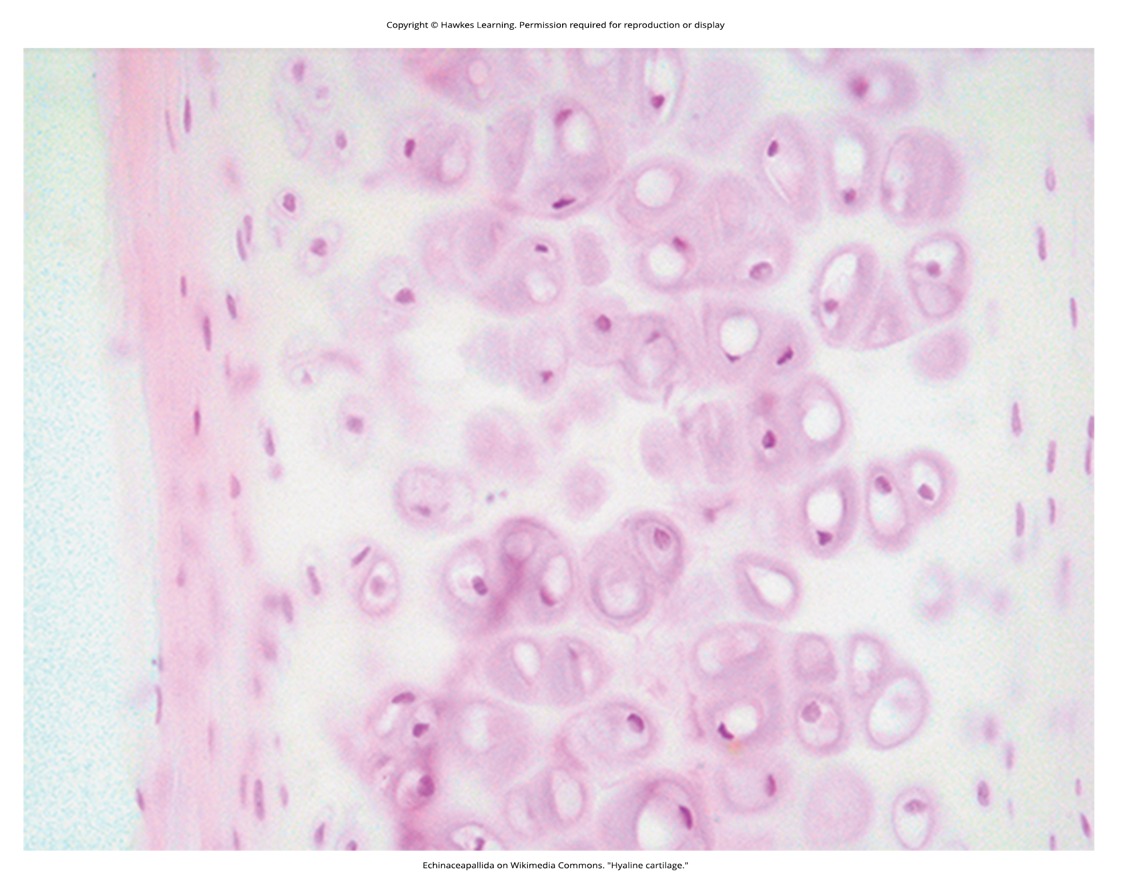
Lesson 43.2 Figure 8

Slide 27
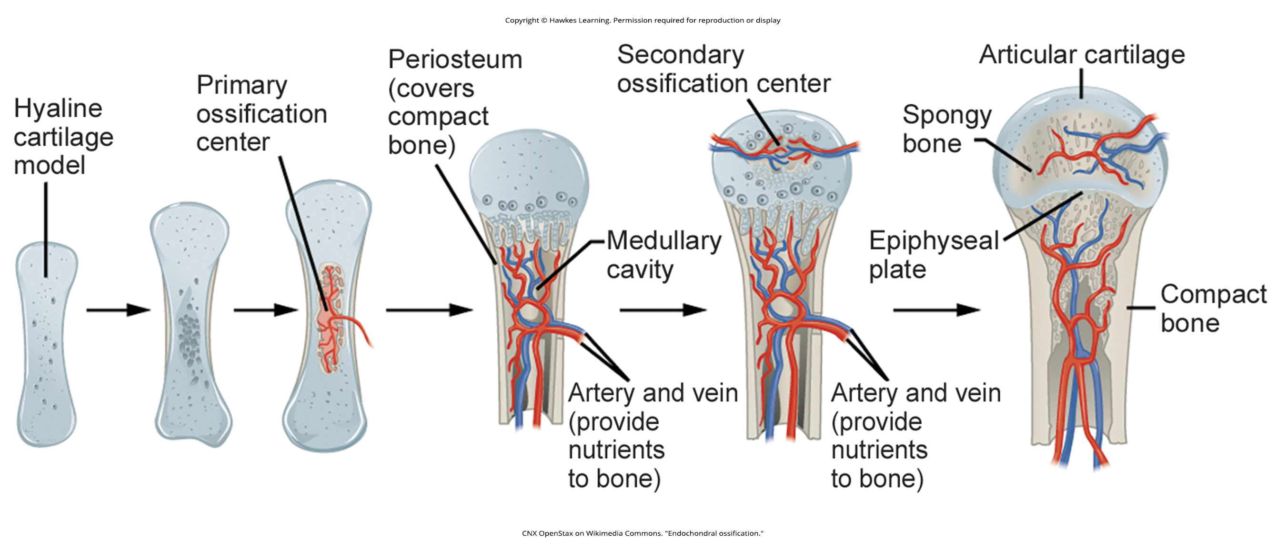
Lesson 43.2 Figure 9

Slide 28
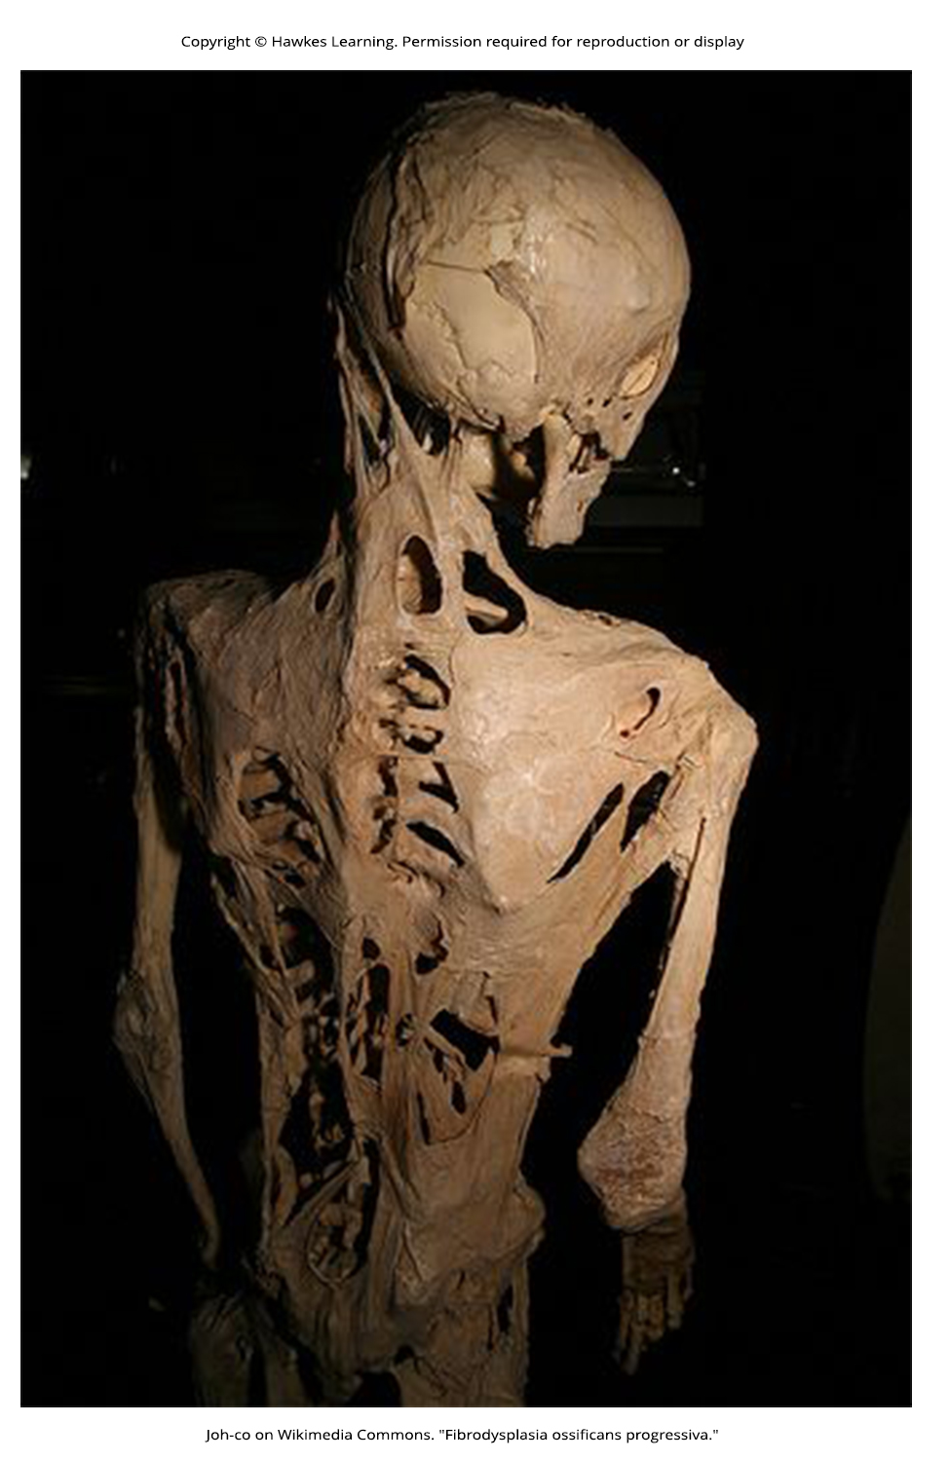
Lesson 43.2 Figure 10

Slide 29
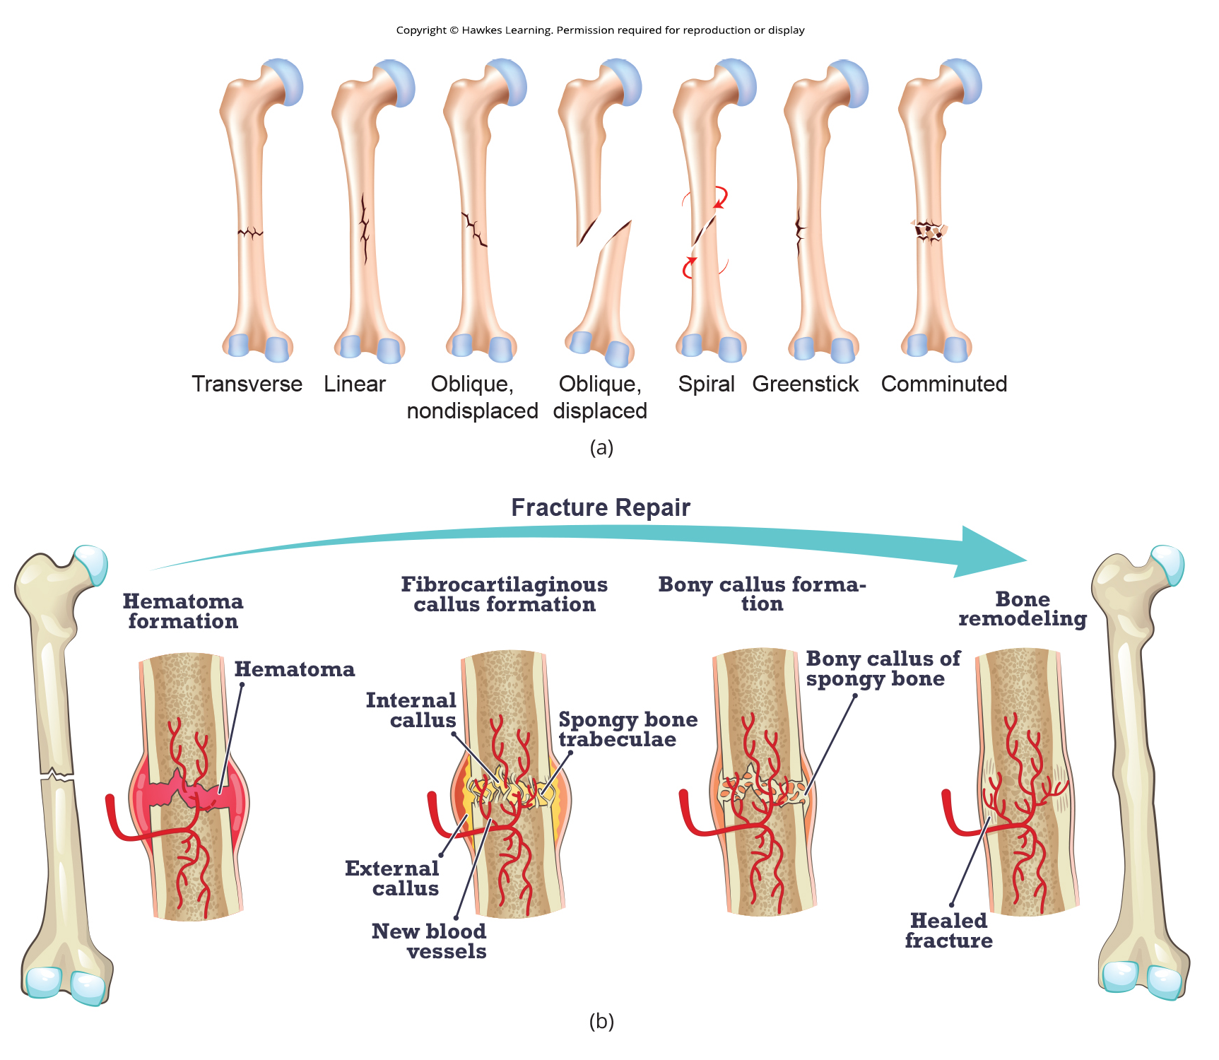
Lesson 43.2 Figure 11

Slide 30
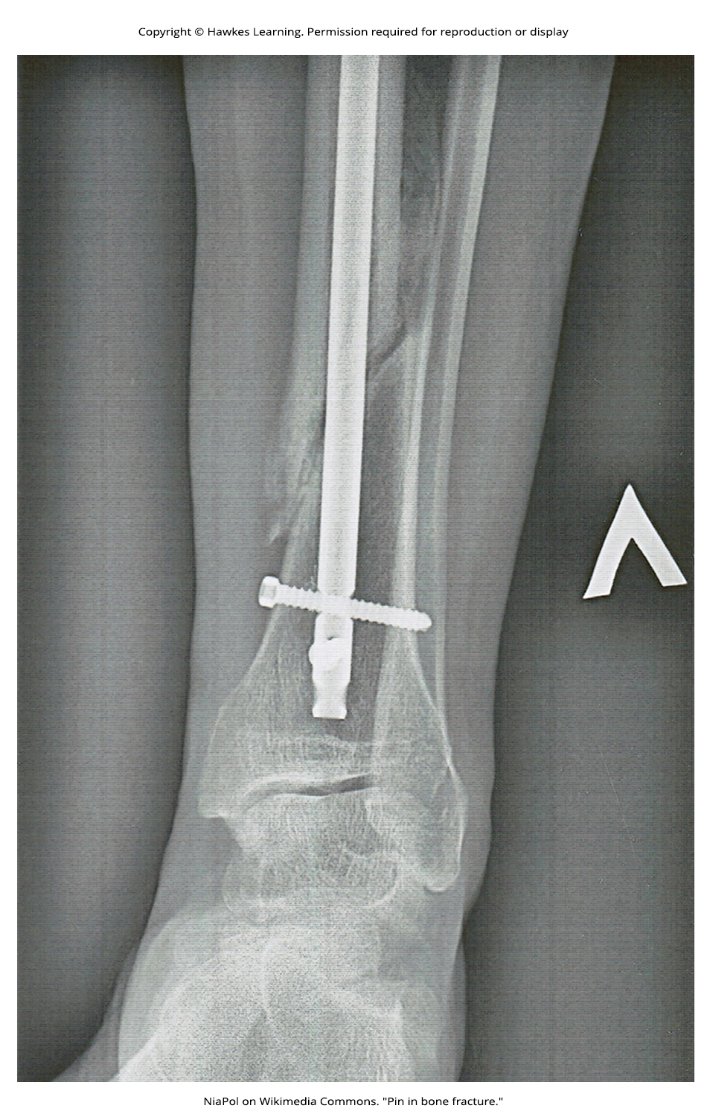
Lesson 43.2 Figure 12

Slide 31
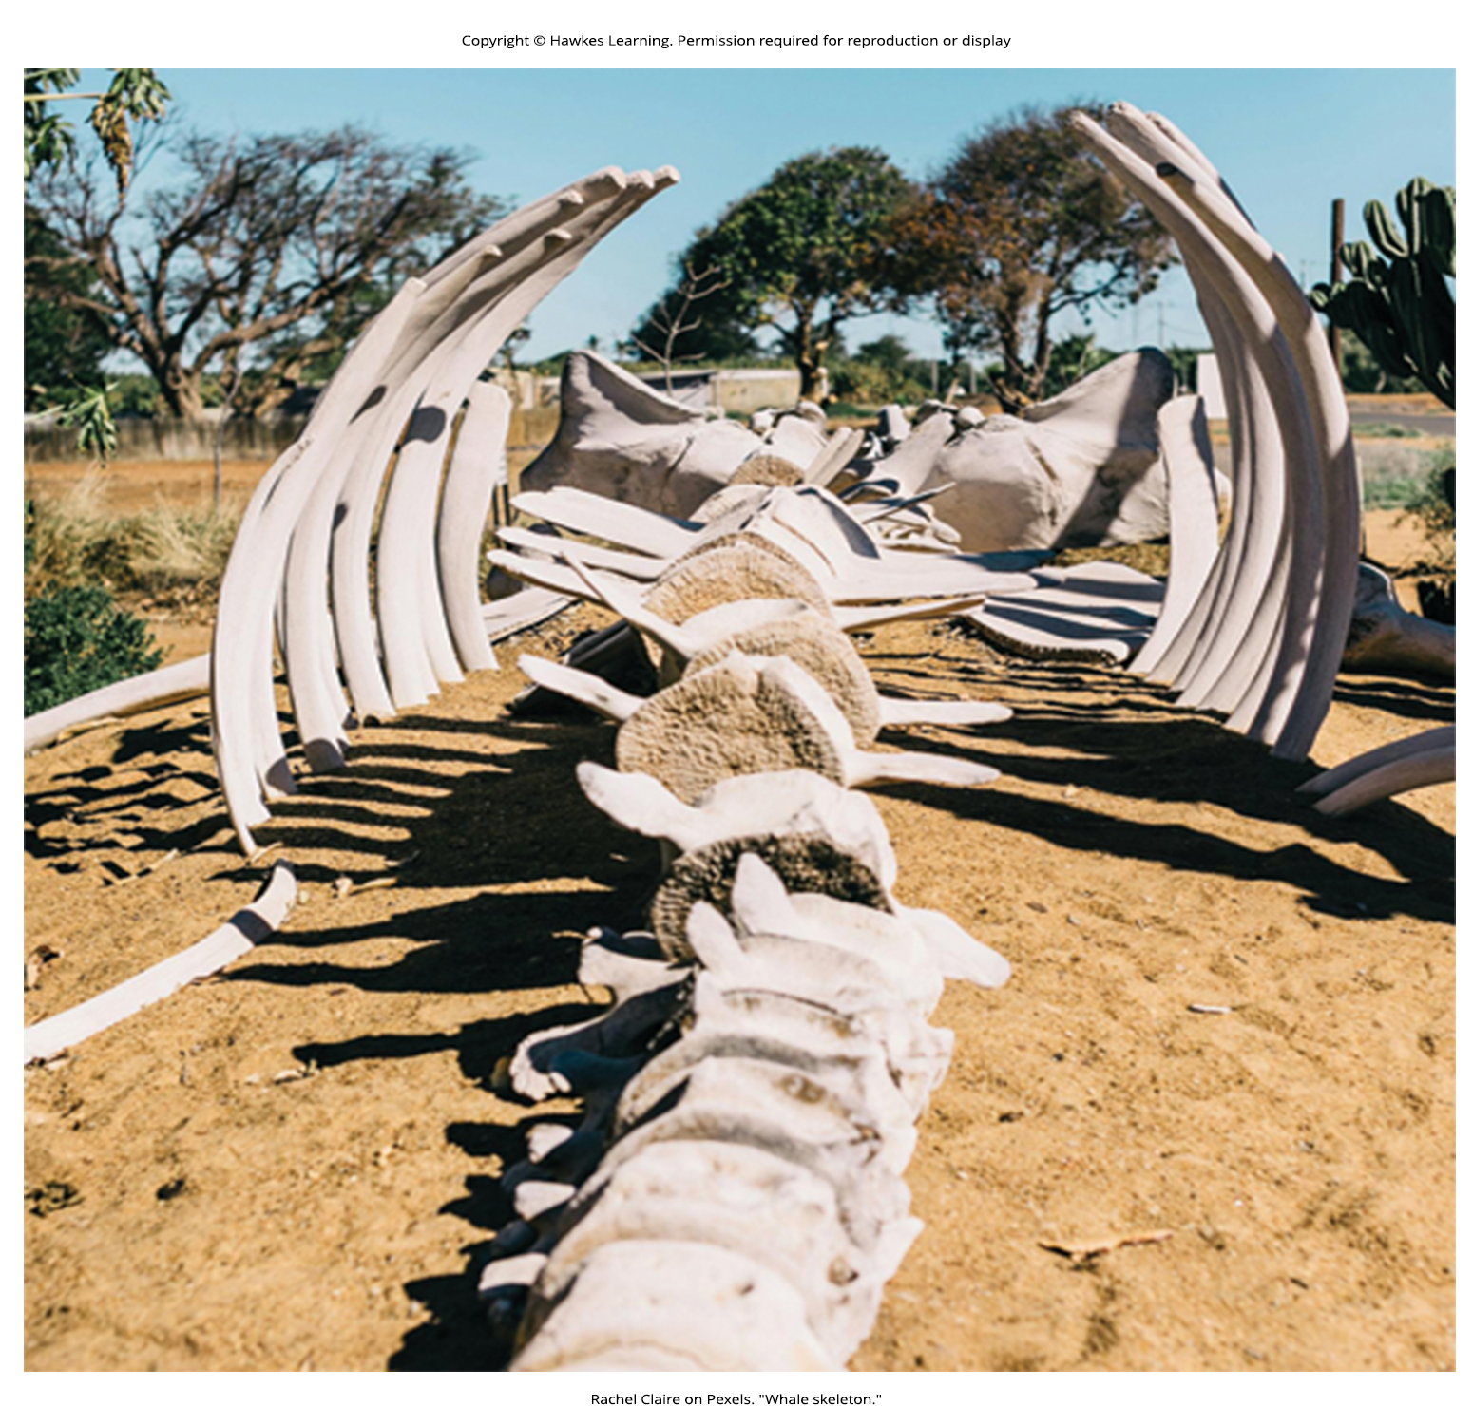
Lesson 43.3 Figure 1

Slide 32
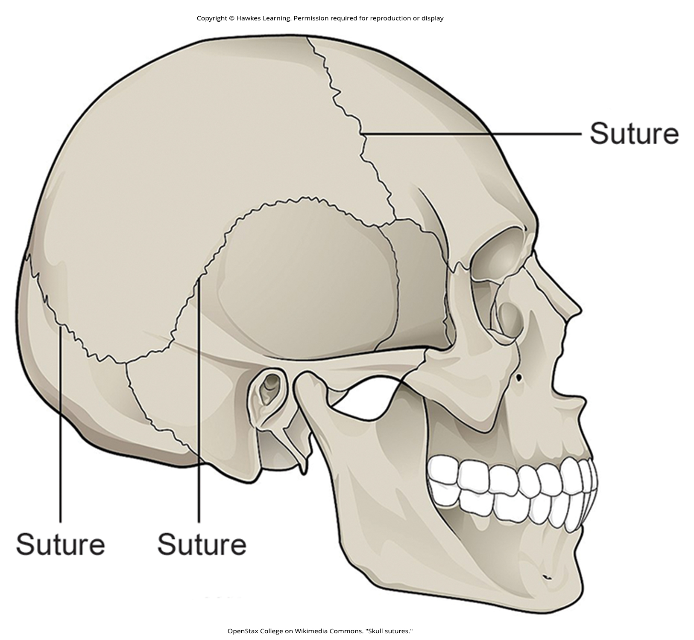
Lesson 43.3 Figure 2

Slide 33
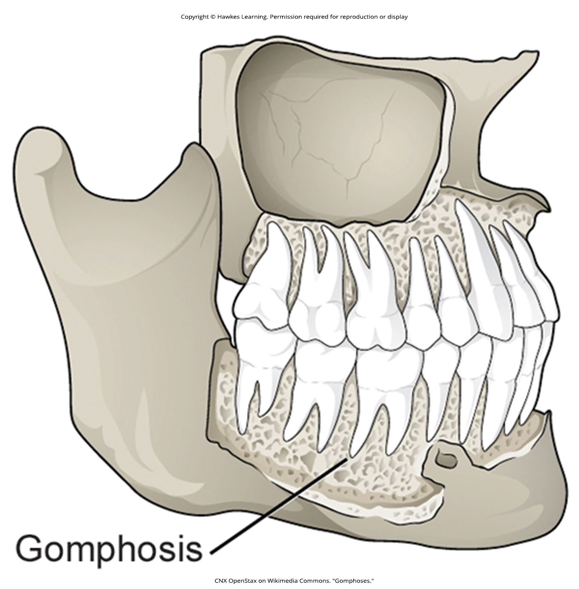
Lesson 43.3 Figure 3

Slide 34
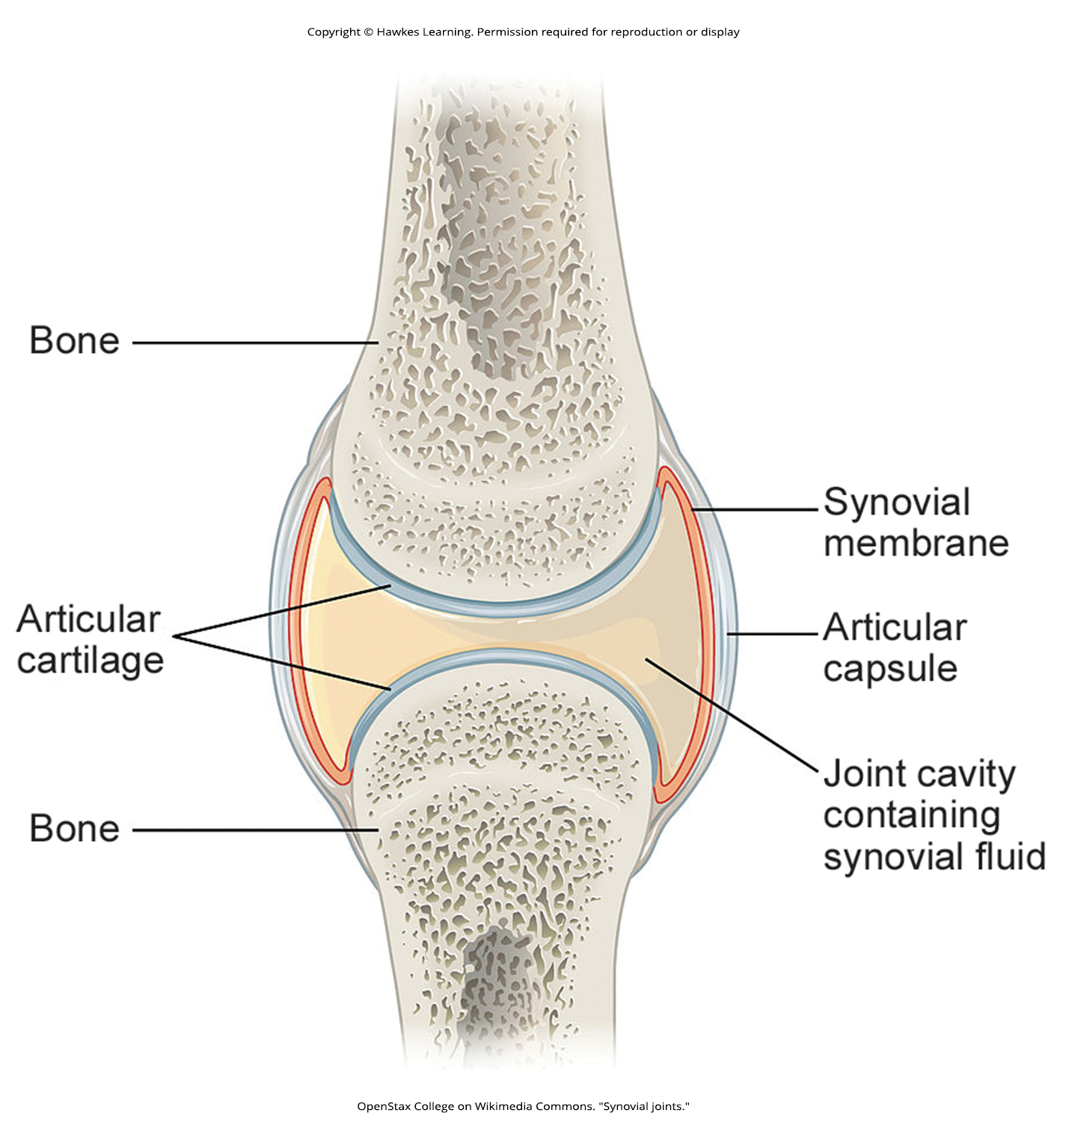
Lesson 43.3 Figure 4

Slide 35
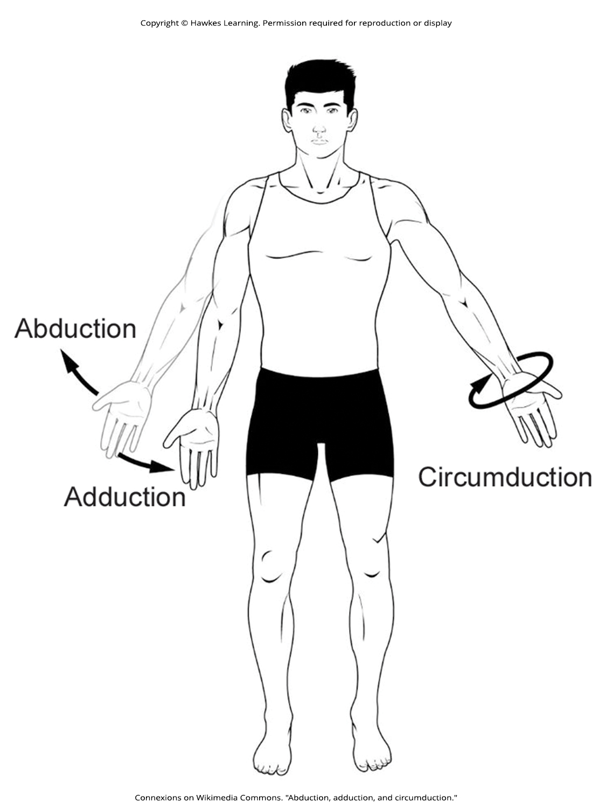
Lesson 43.3 Figure 5

Slide 36
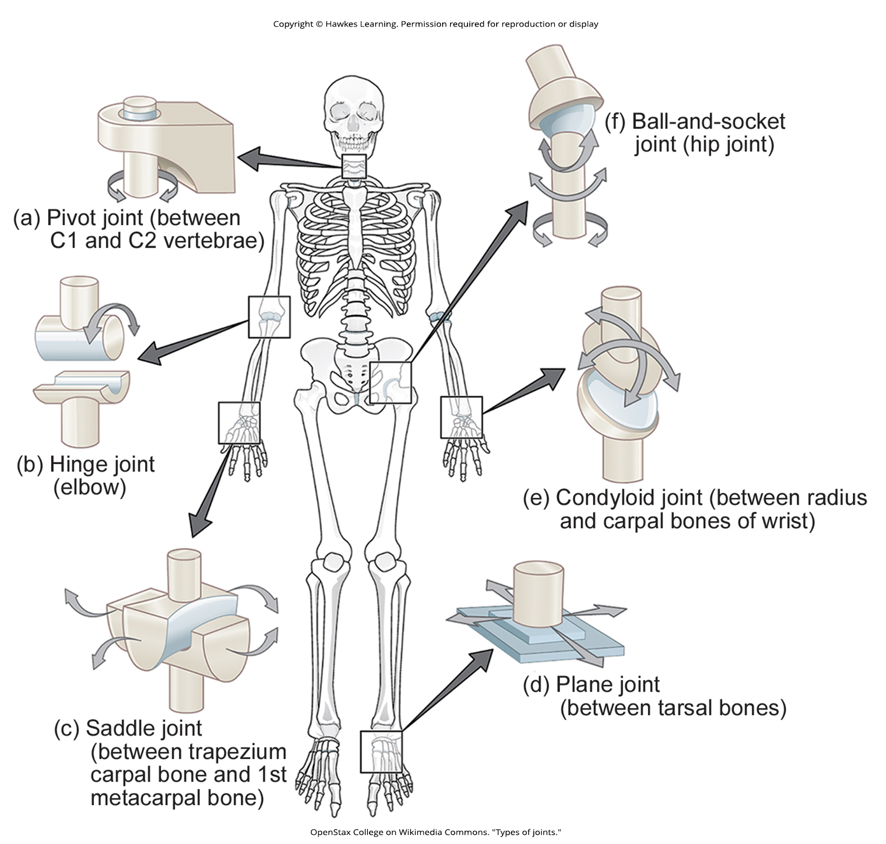
Lesson 43.3 Figure 6

Slide 37
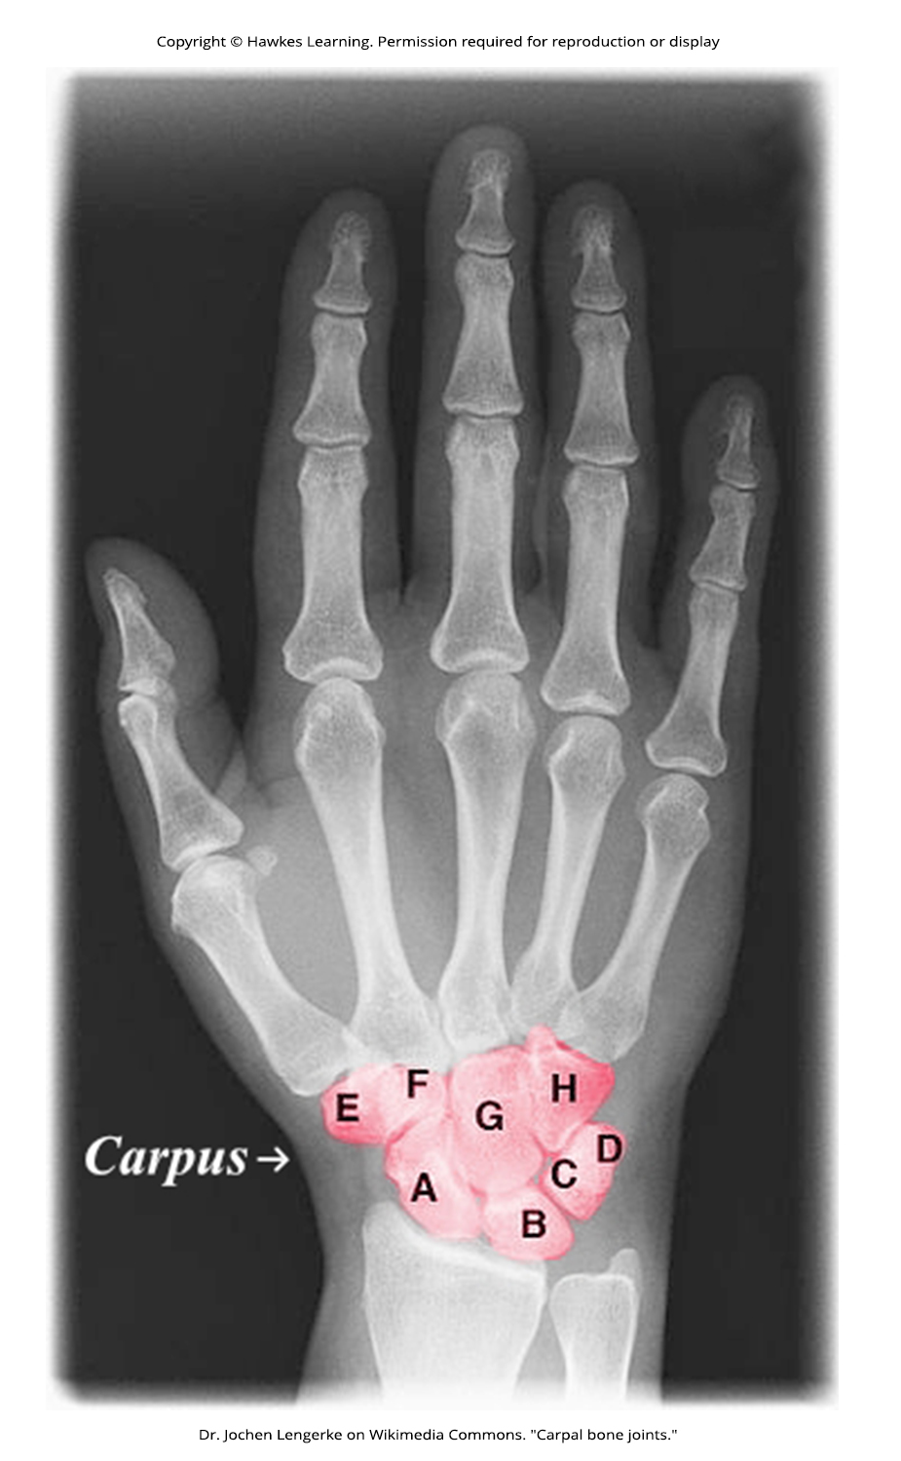
Lesson 43.3 Figure 7

Slide 38
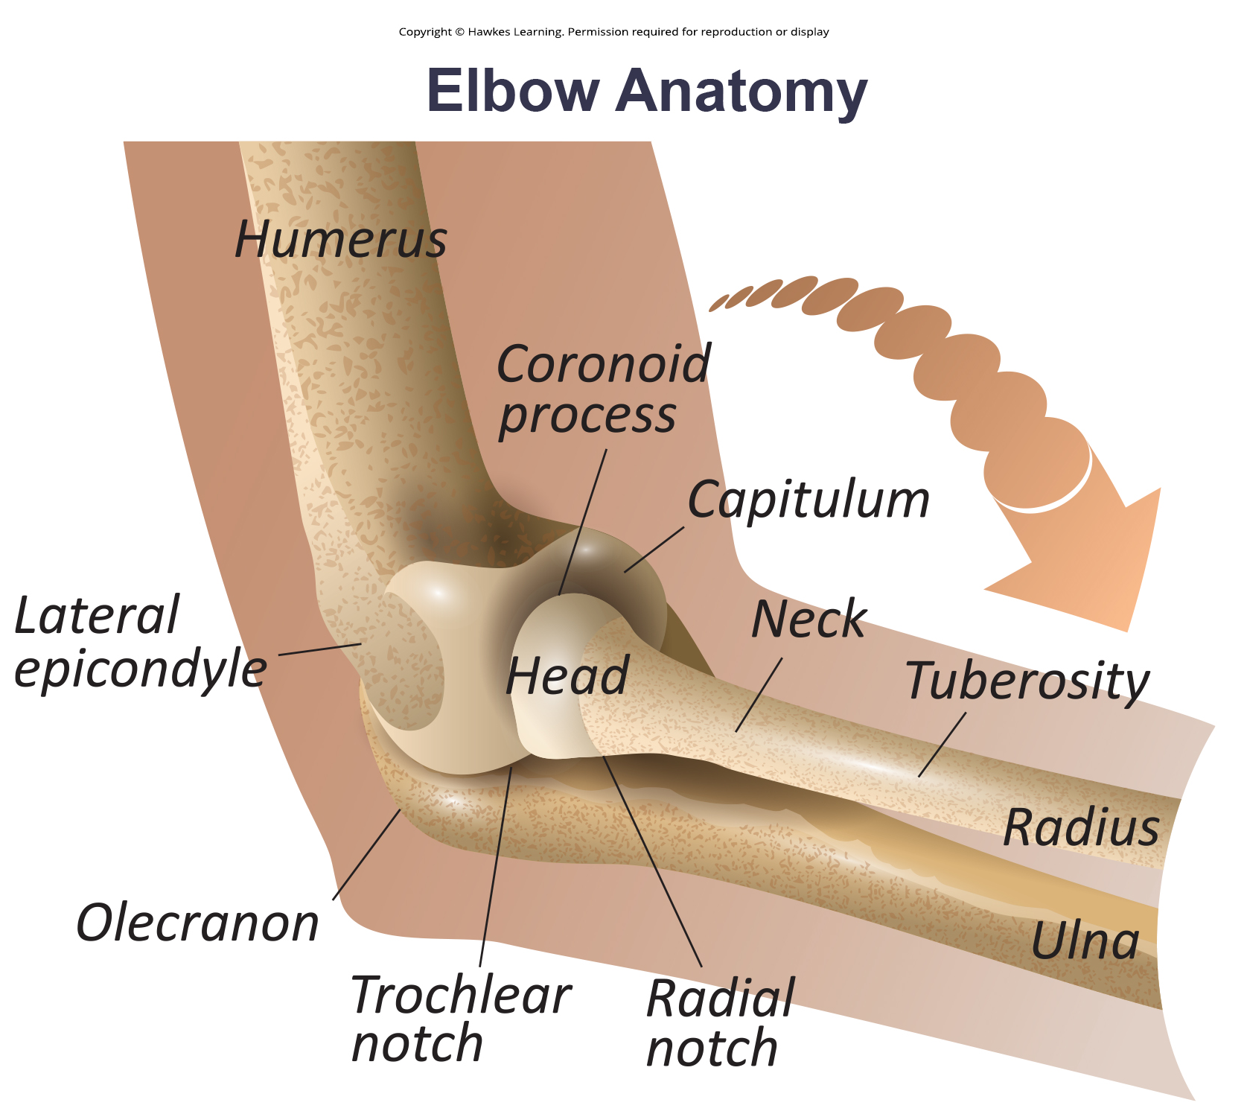
Lesson 43.3 Figure 8

Slide 39
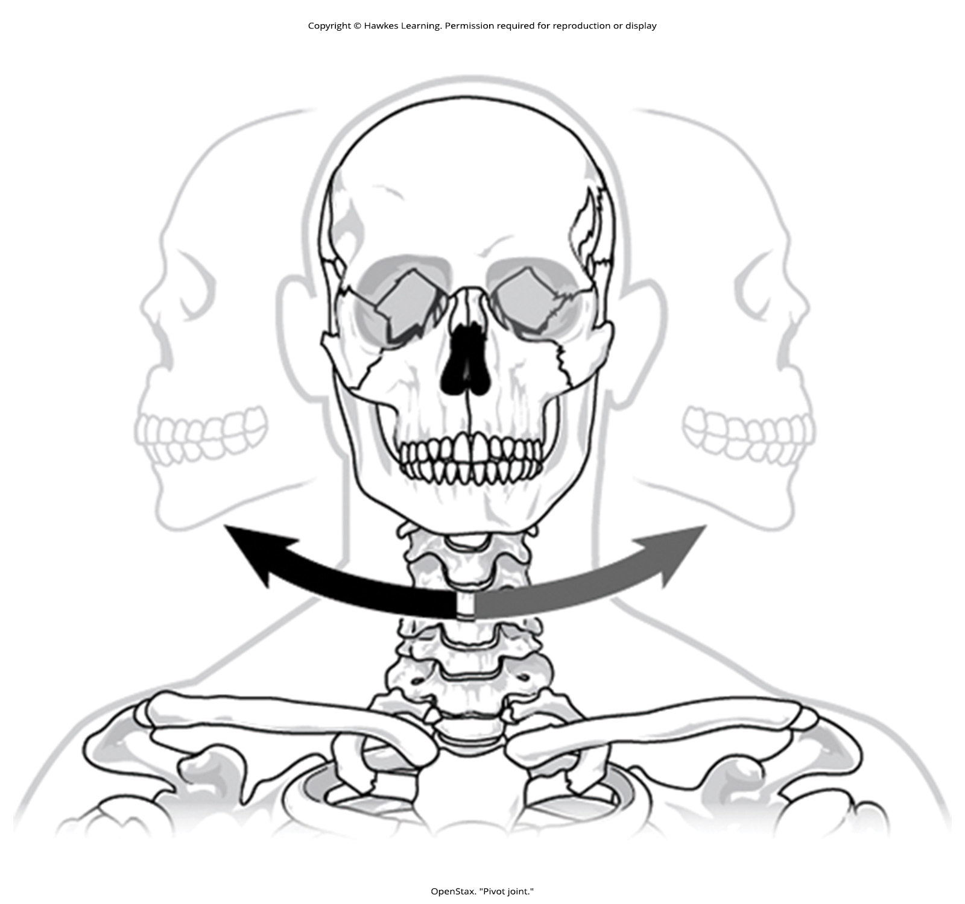
Lesson 43.3 Figure 9

Slide 40
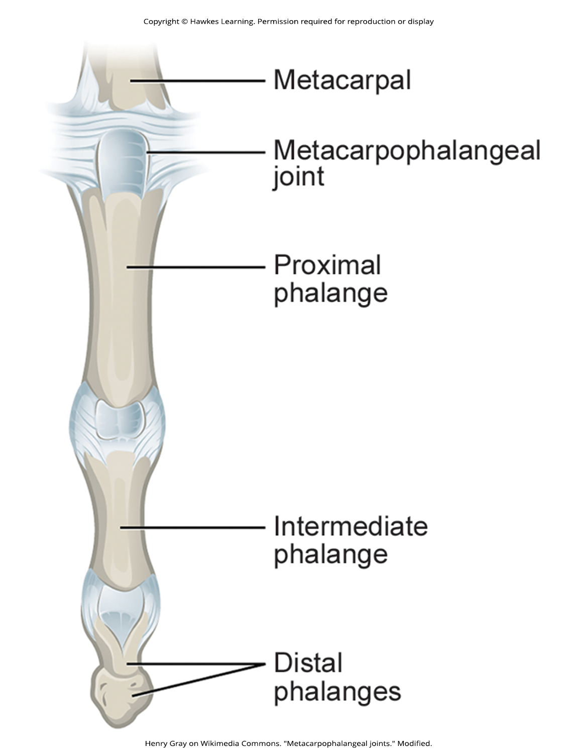
Lesson 43.3 Figure 10

Slide 41
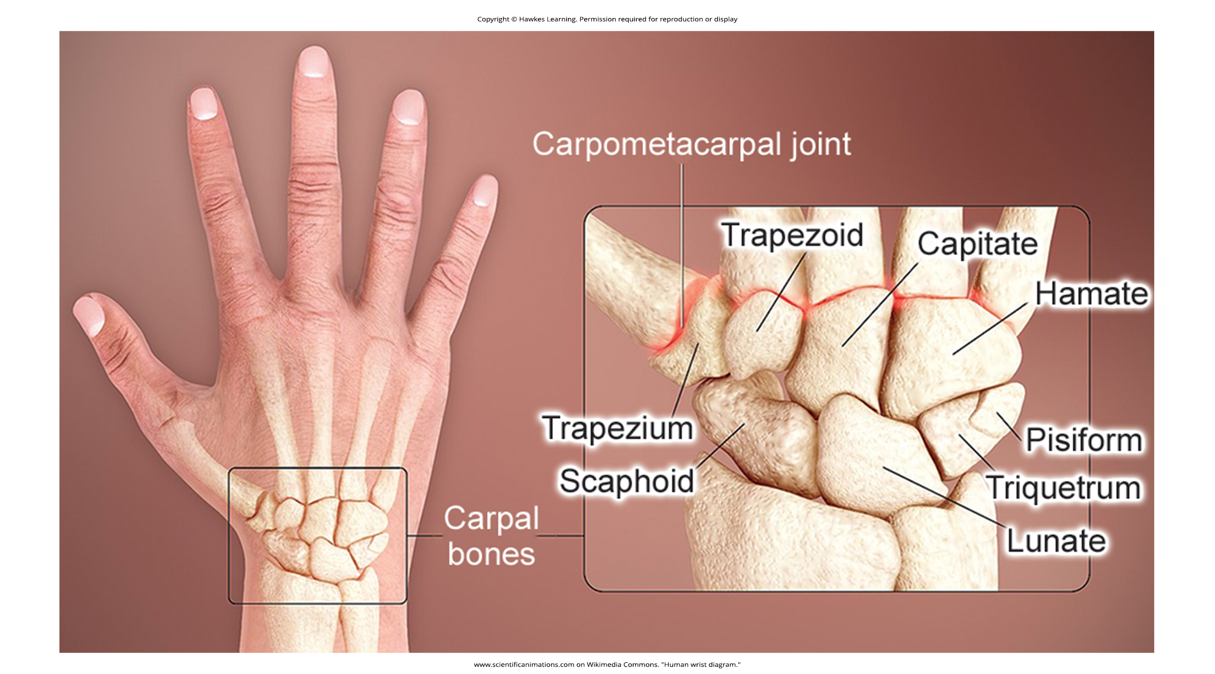
Lesson 43.3 Figure 11

Slide 42
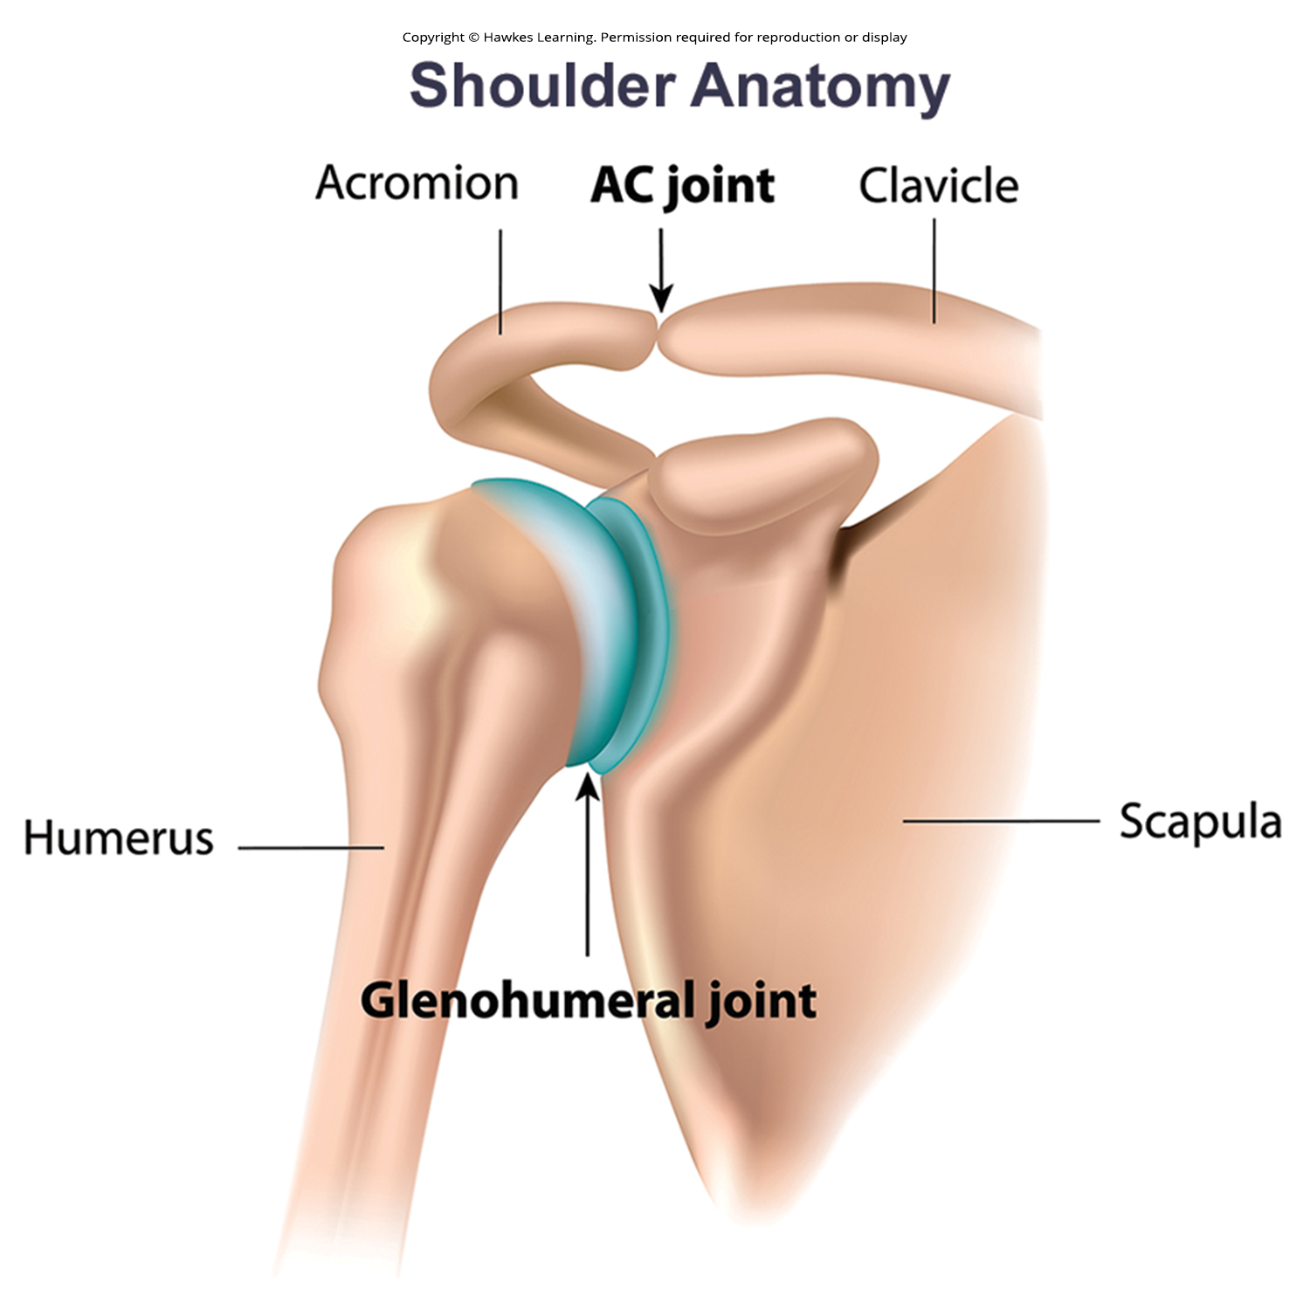
Lesson 43.3 Figure 12

Slide 43
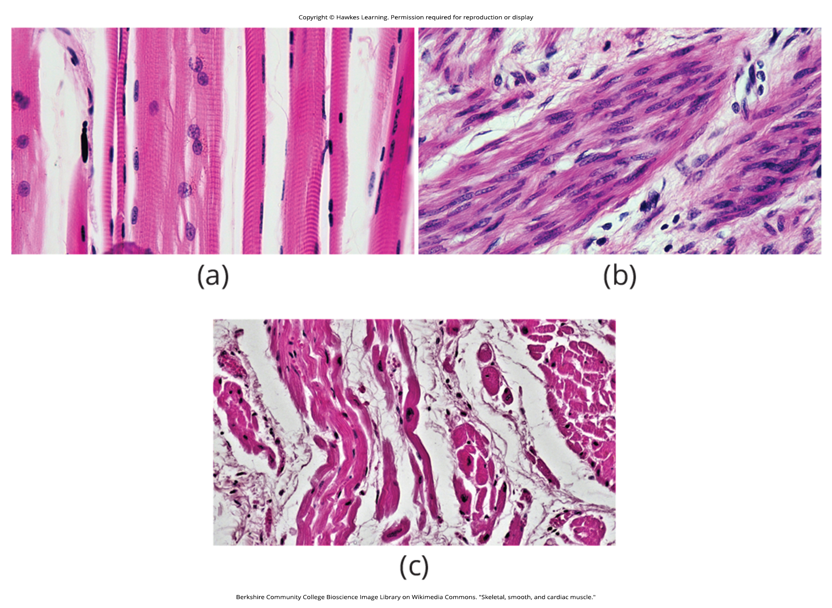
Lesson 43.4 Figure 1

Slide 44
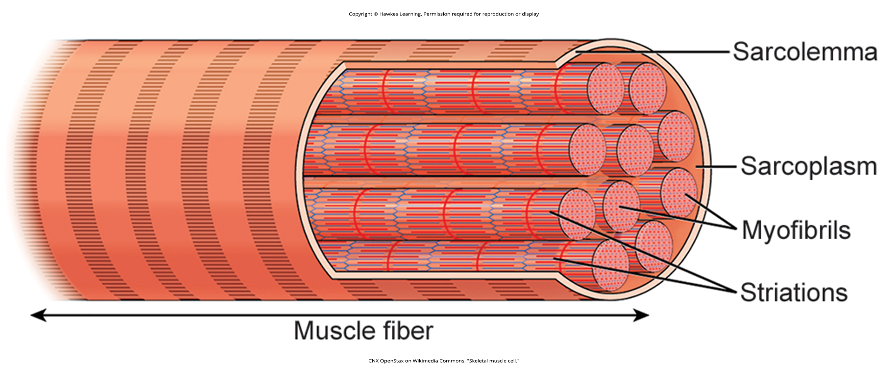
Lesson 43.4 Figure 2

Slide 45
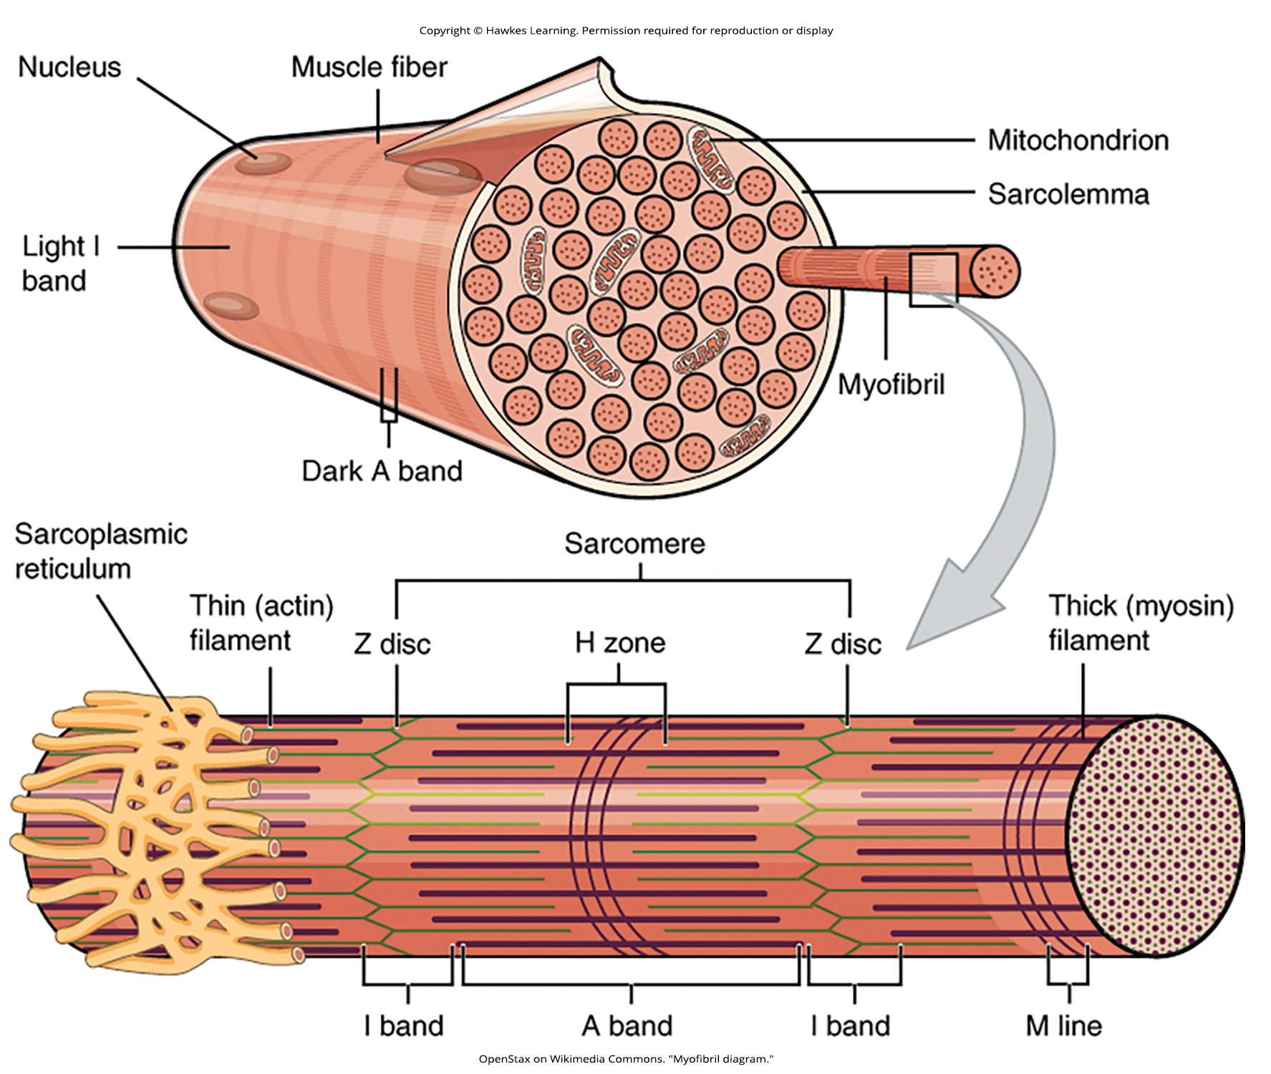
Lesson 43.4 Figure 3

Slide 46
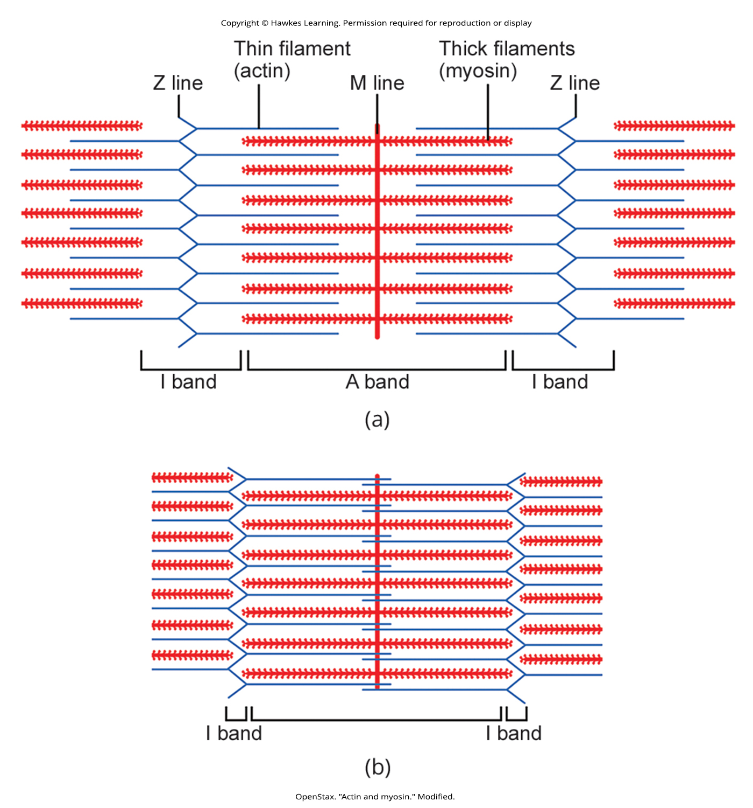
Lesson 43.4 Figure 4

Slide 47
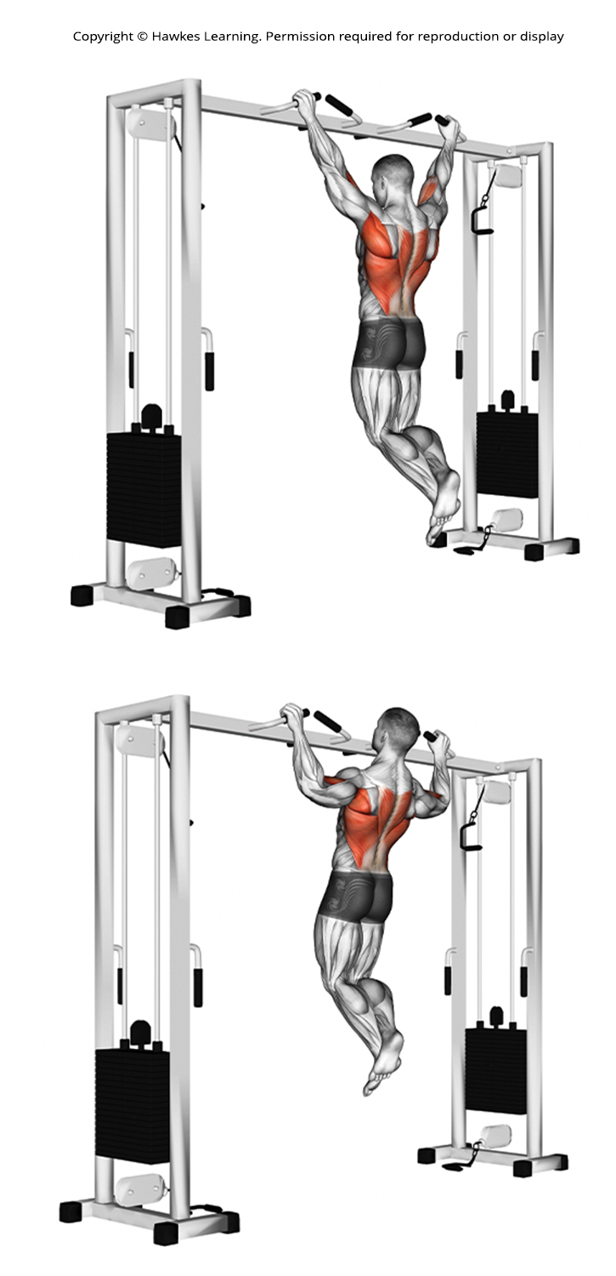
Lesson 43.4 Figure 5

Slide 48
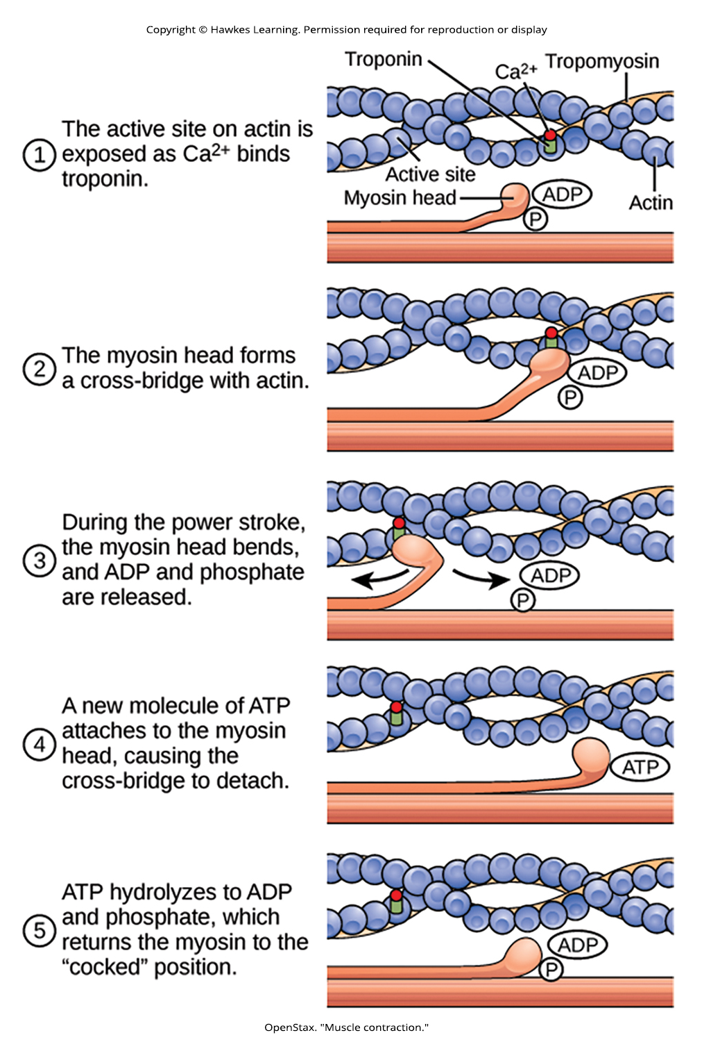
Lesson 43.4 Figure 6

Slide 49
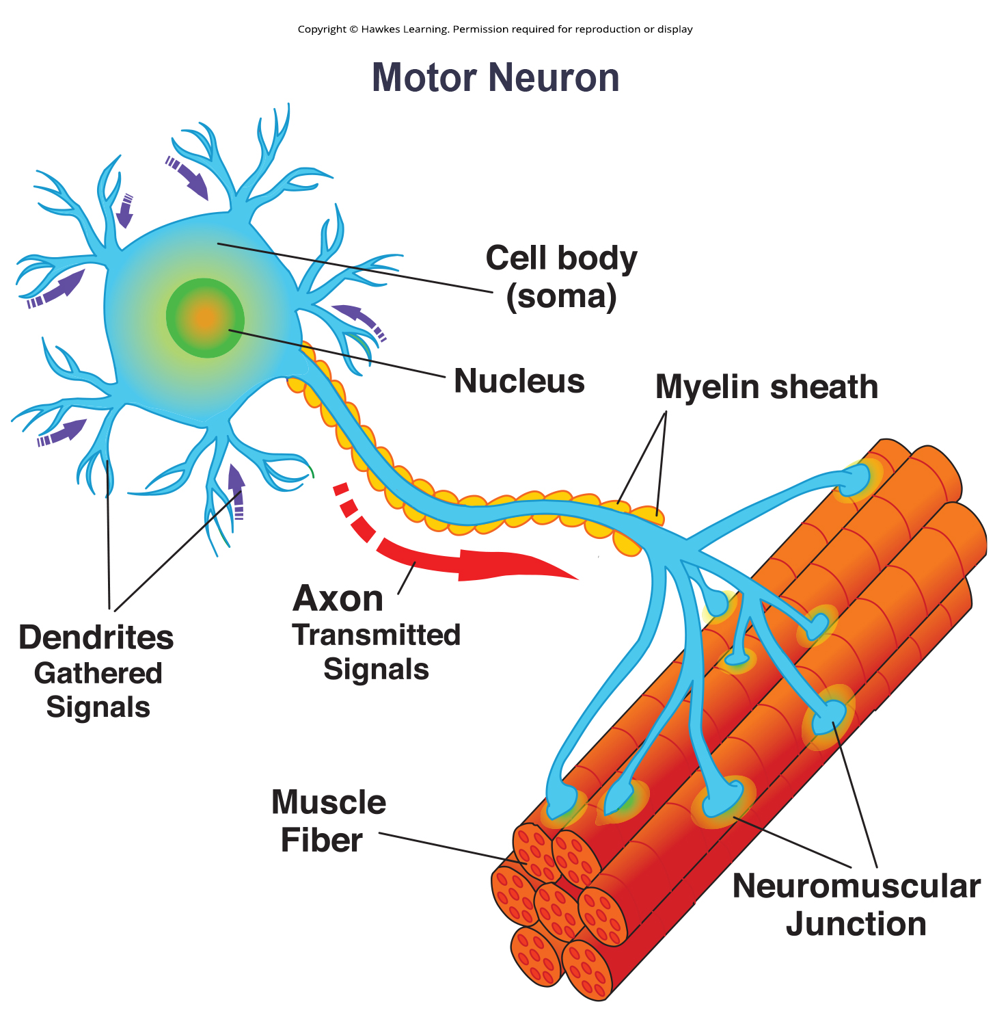
Lesson 43.4 Figure 7

Slide 50
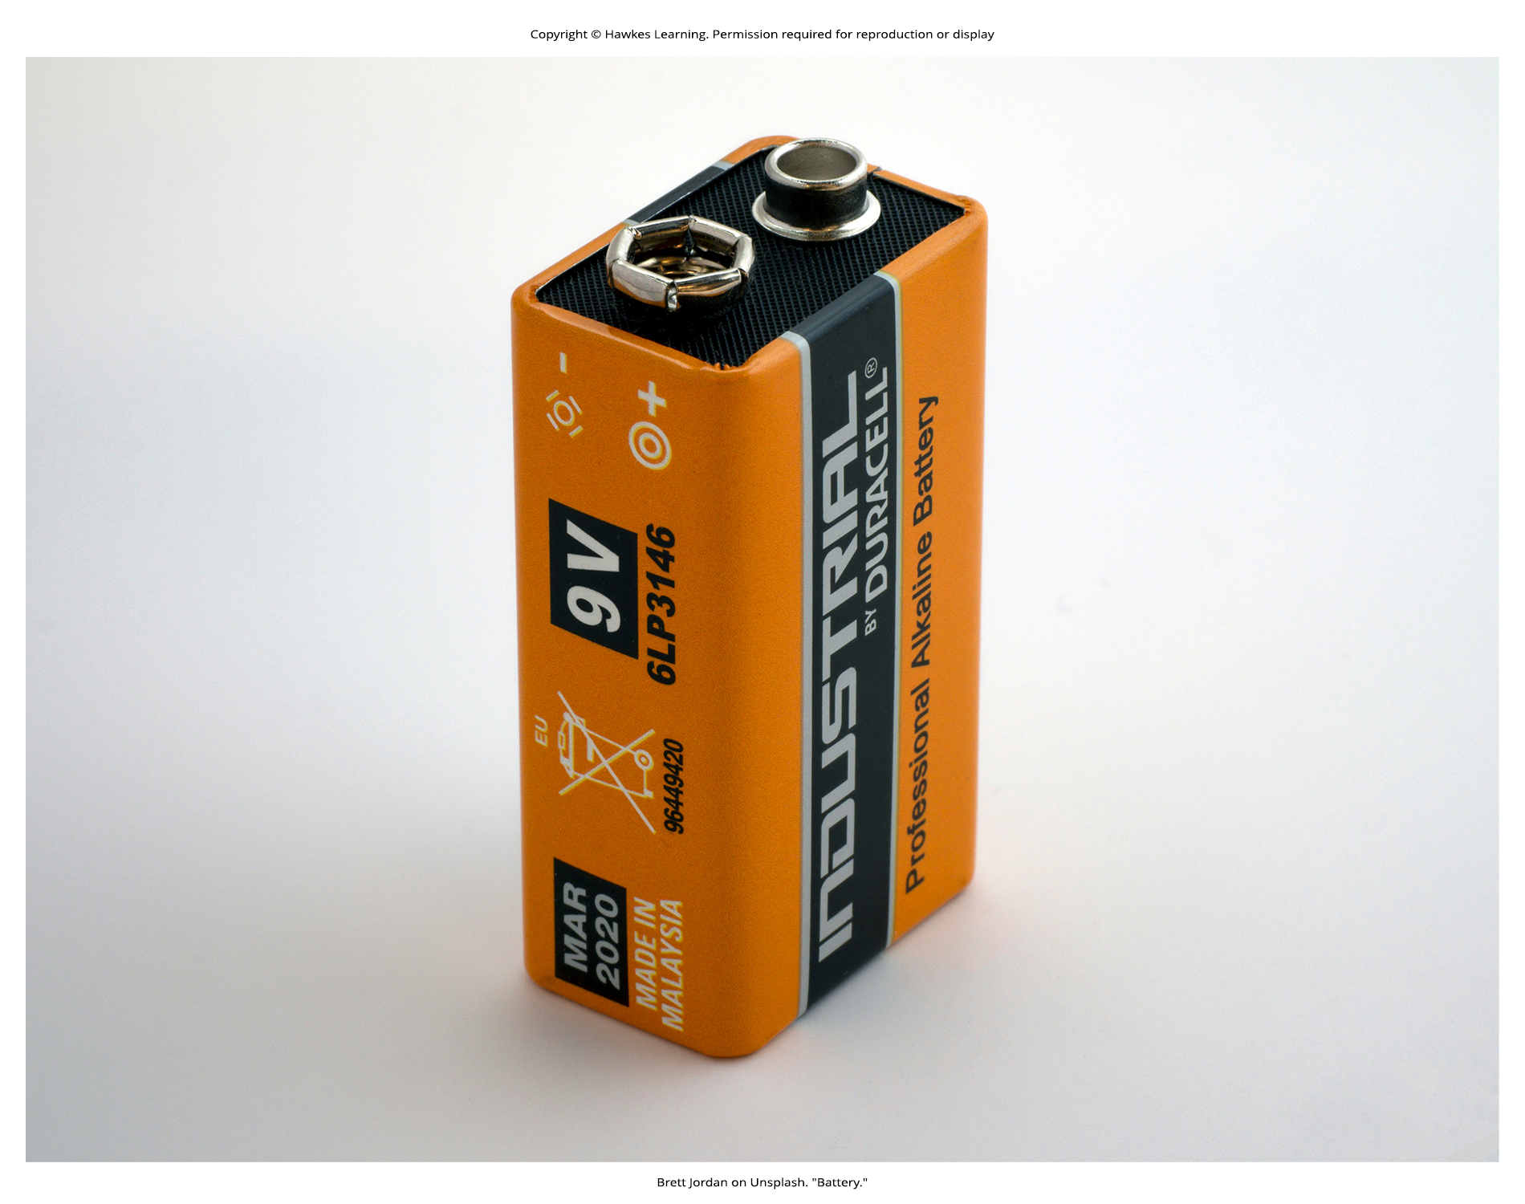
Lesson 43.4 Figure 8

Slide 51
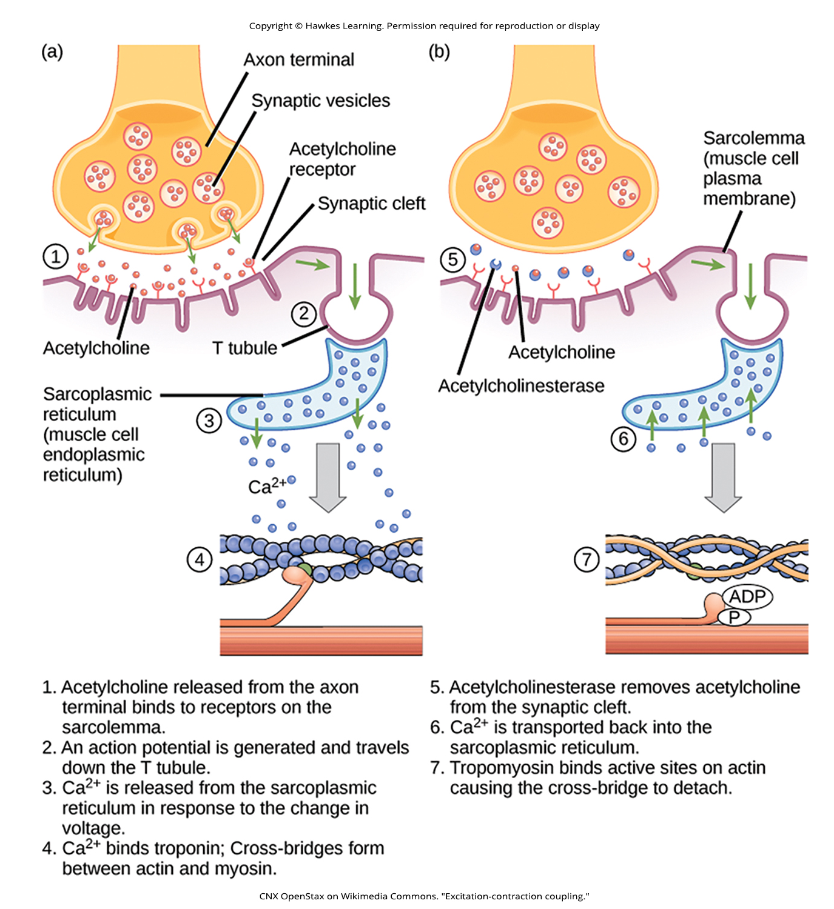
Lesson 43.4 Figure 9

Slide 52

Lesson 43.4 Figure 10

Slide 53
Hawkes Learning – End of PowerPoint

