Slide 1
Chapter 44
Ecology and the Biosphere

Slide 2
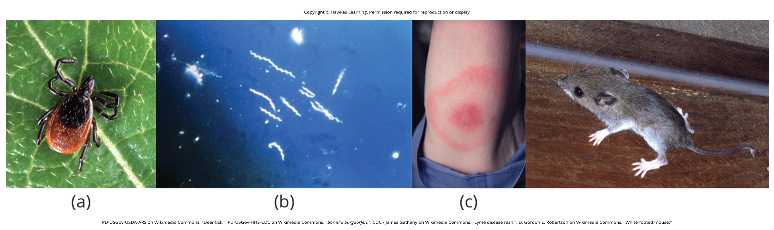
Lesson 44.1 Figure 1

Slide 3
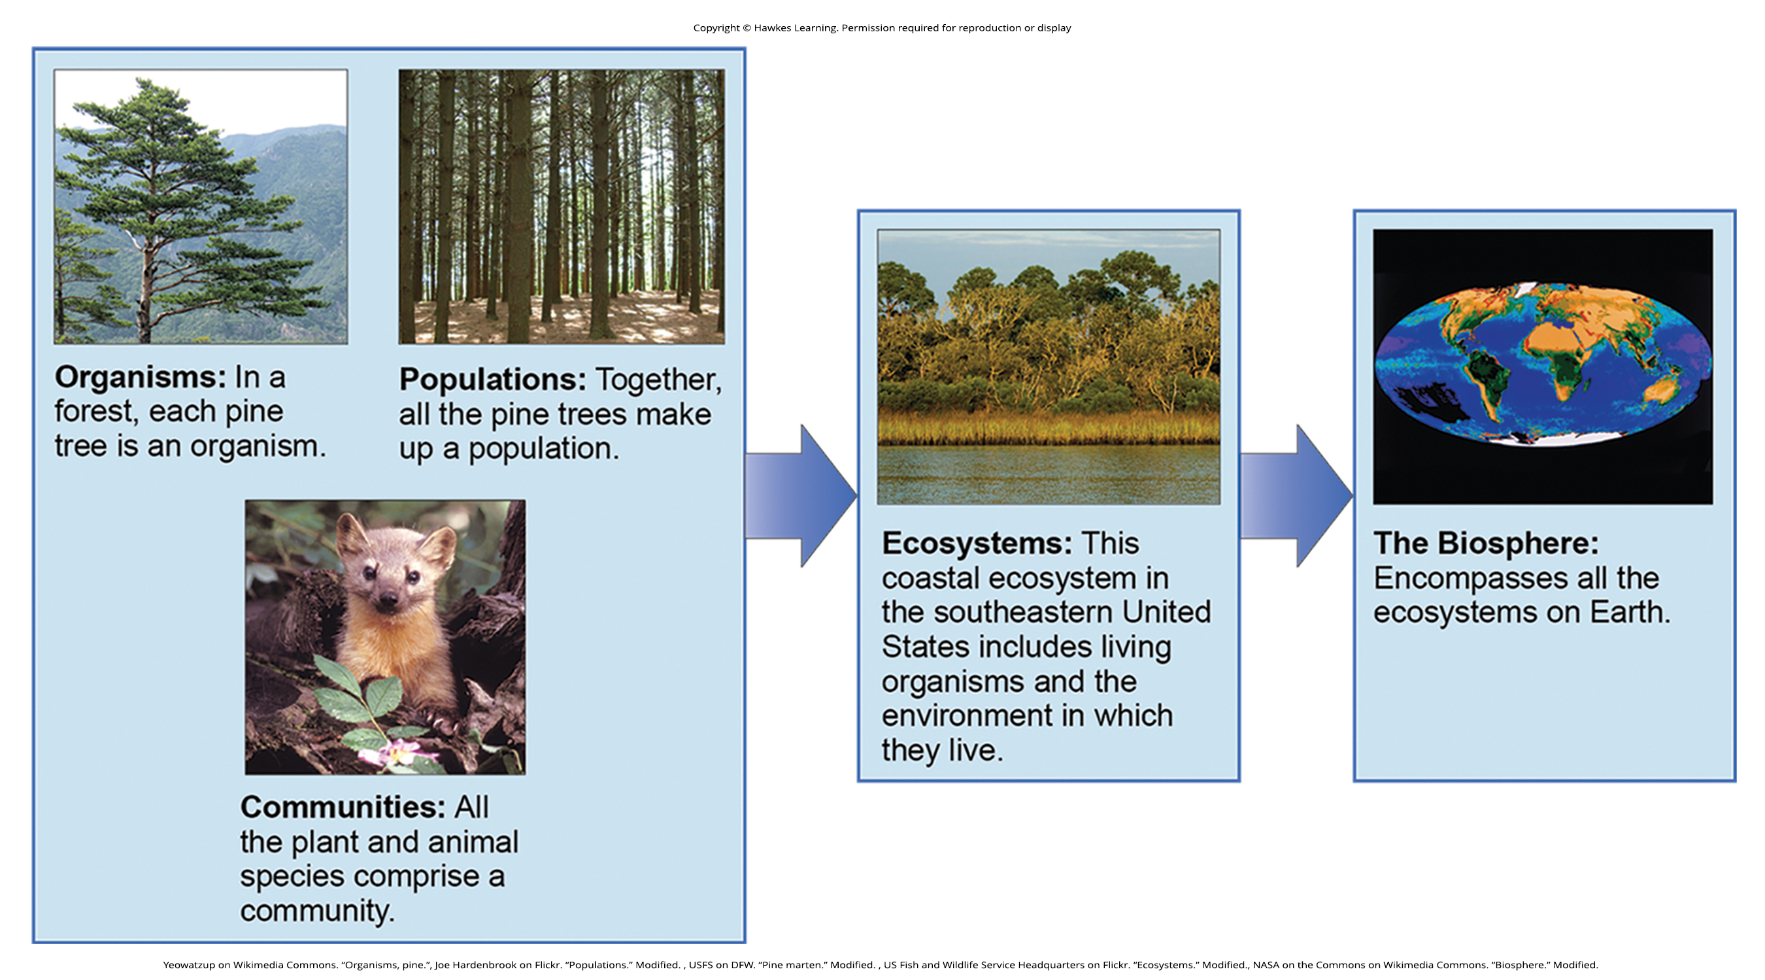
Lesson 44.1 Figure 2

Slide 4
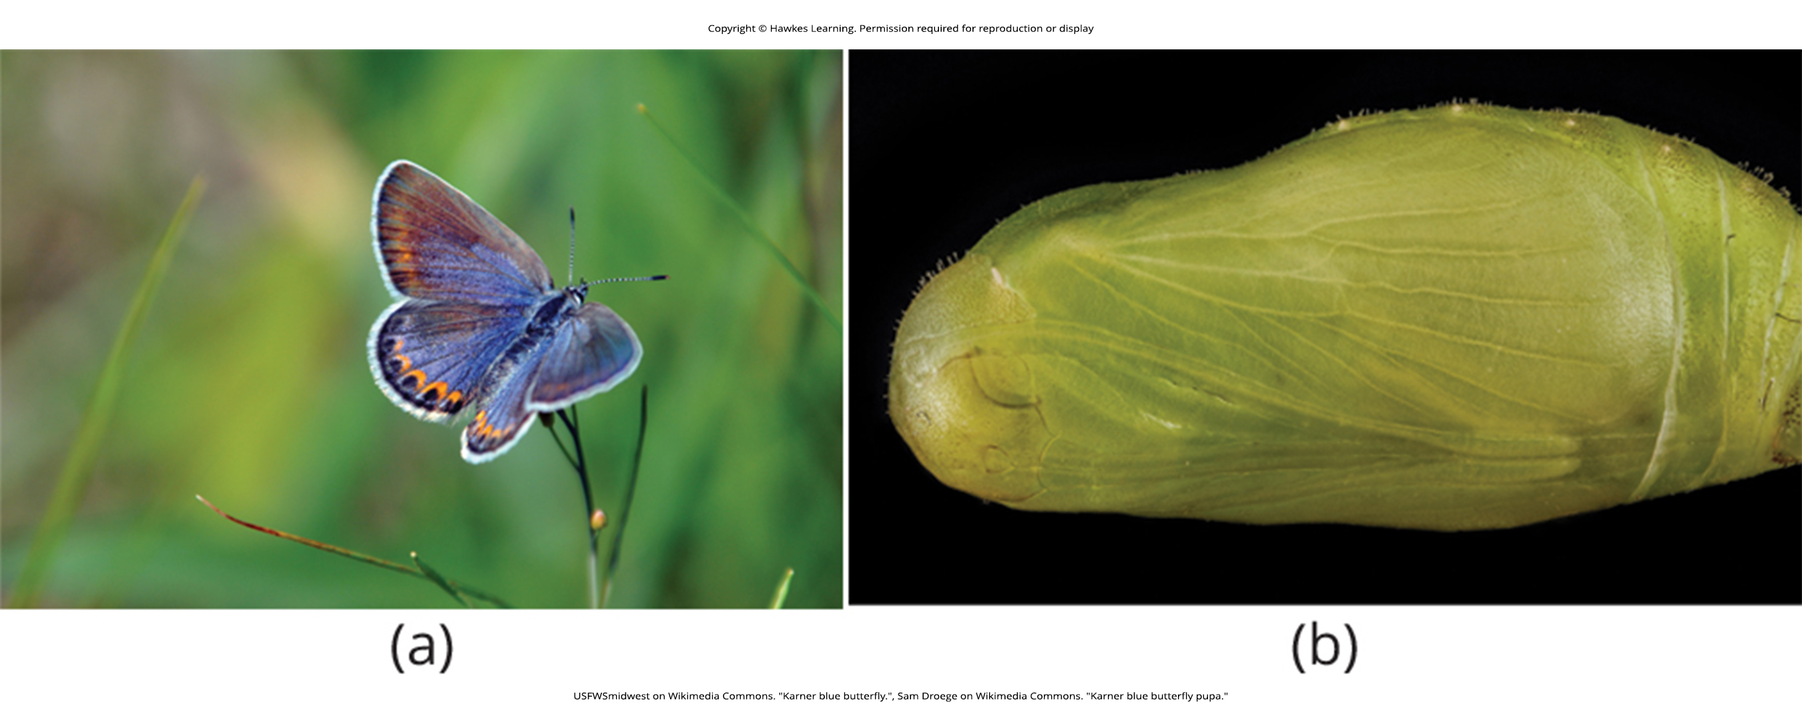
Lesson 44.1 Figure 3

Slide 5
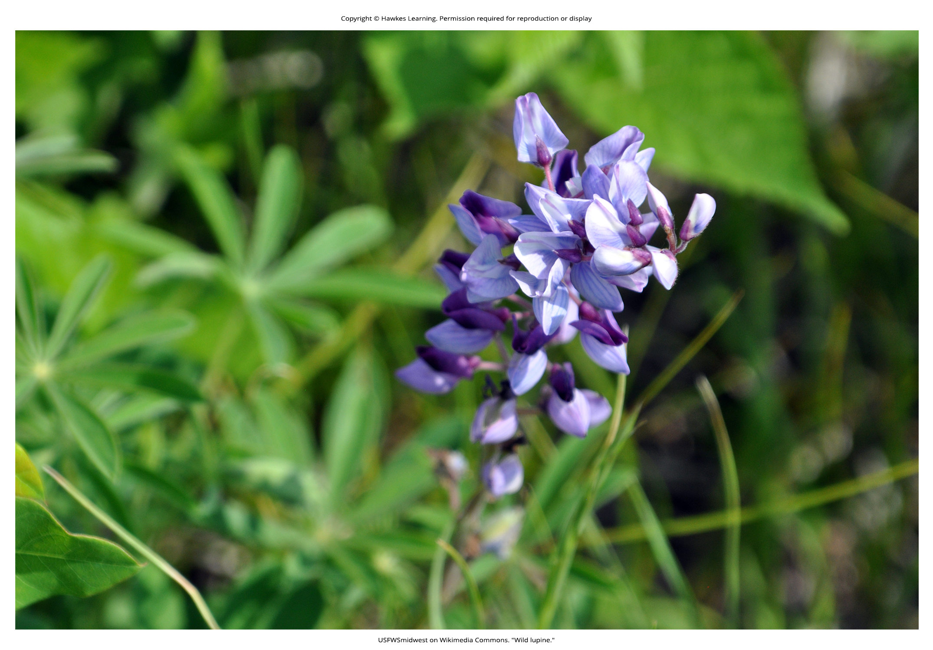
Lesson 44.1 Figure 4

Slide 6
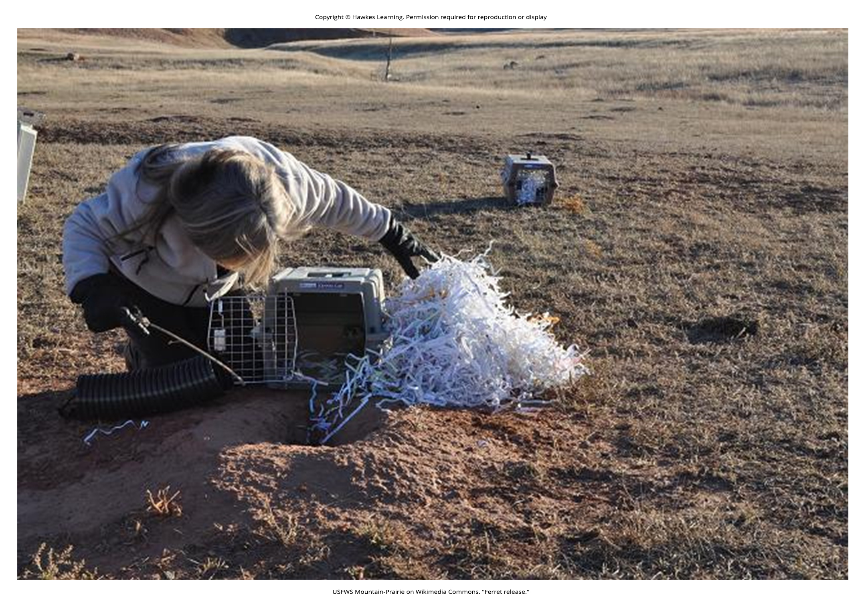
Lesson 44.1 Figure 5

Slide 7
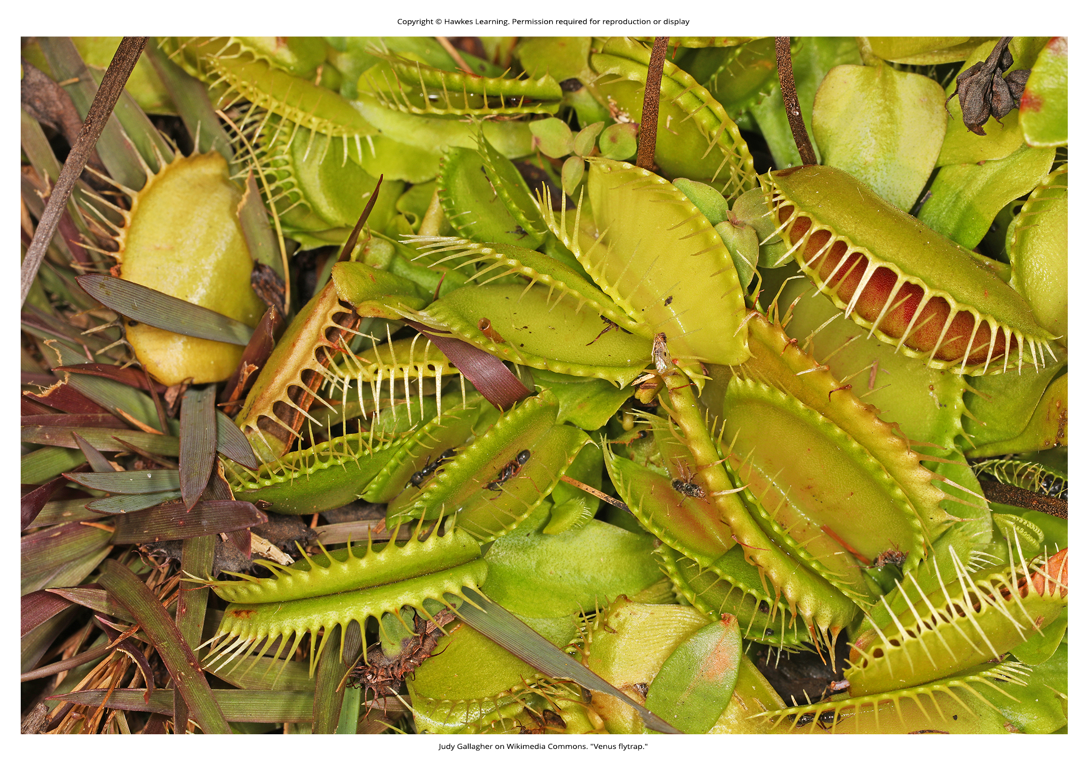
Lesson 44.2 Figure 1

Slide 8
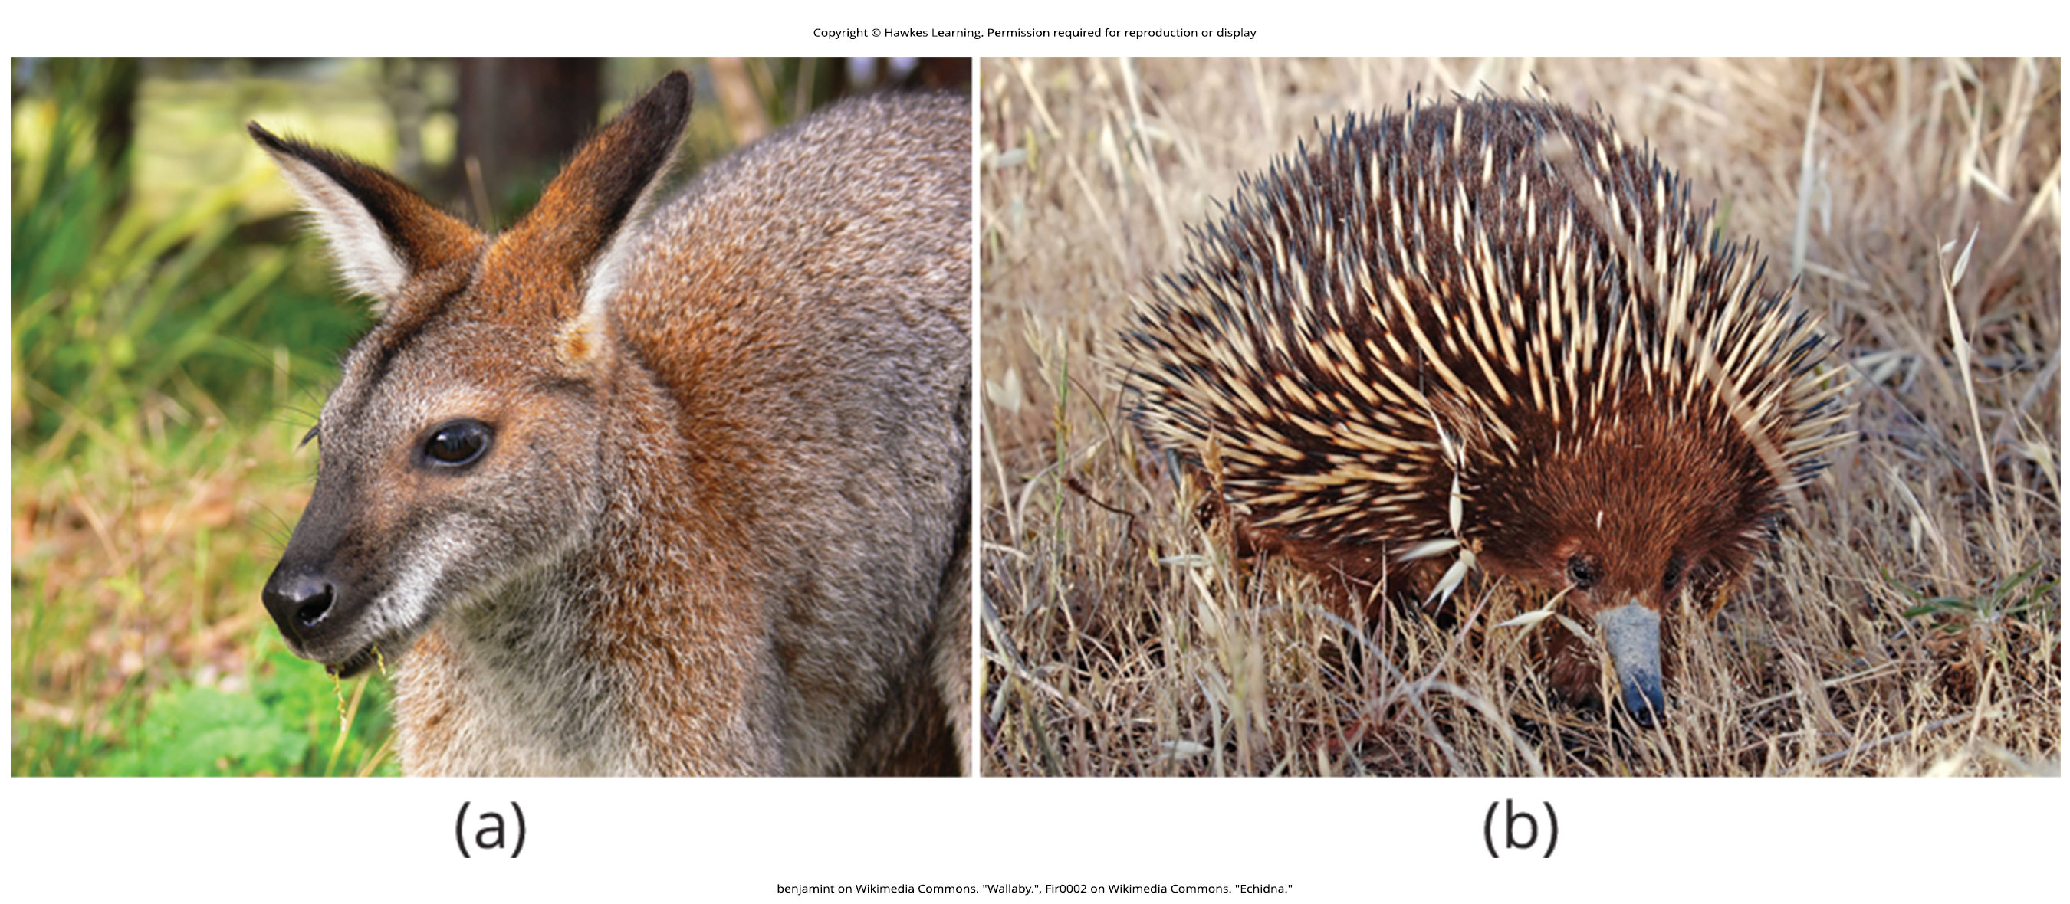
Lesson 44.2 Figure 2

Slide 9
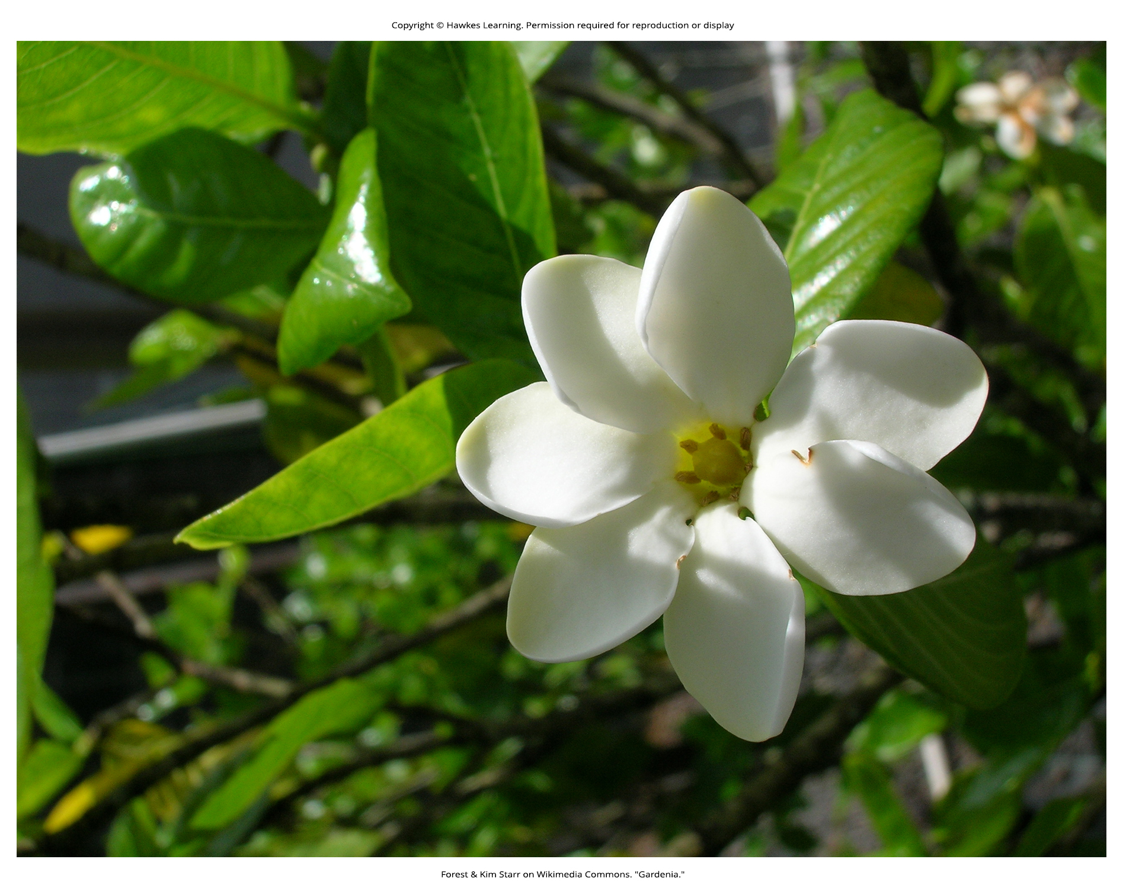
Lesson 44.2 Figure 3

Slide 10
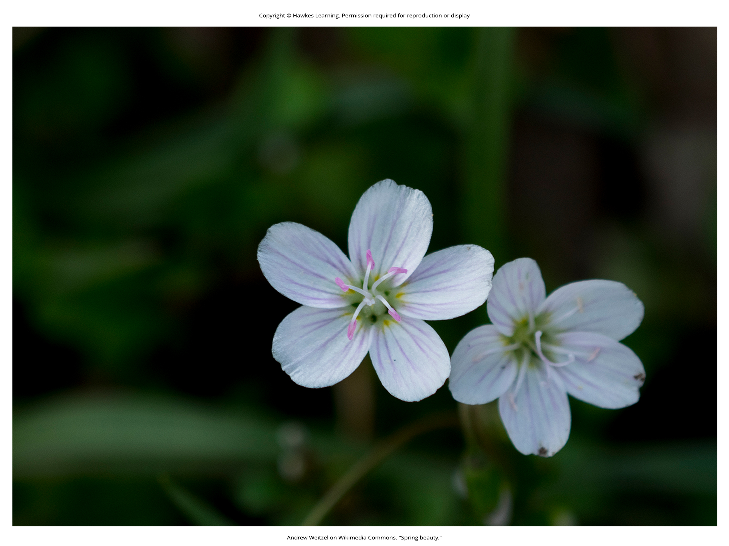
Lesson 44.2 Figure 4

Slide 11
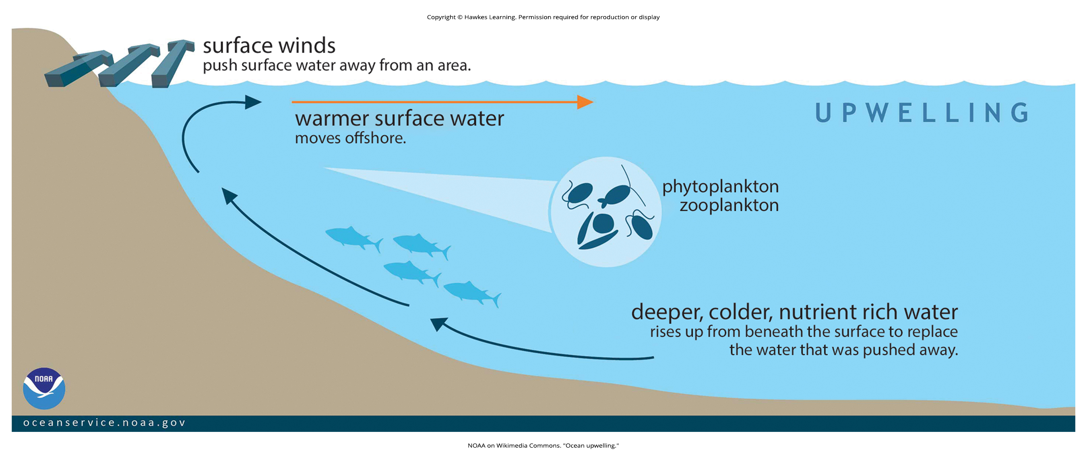
Lesson 44.2 Figure 5

Slide 12
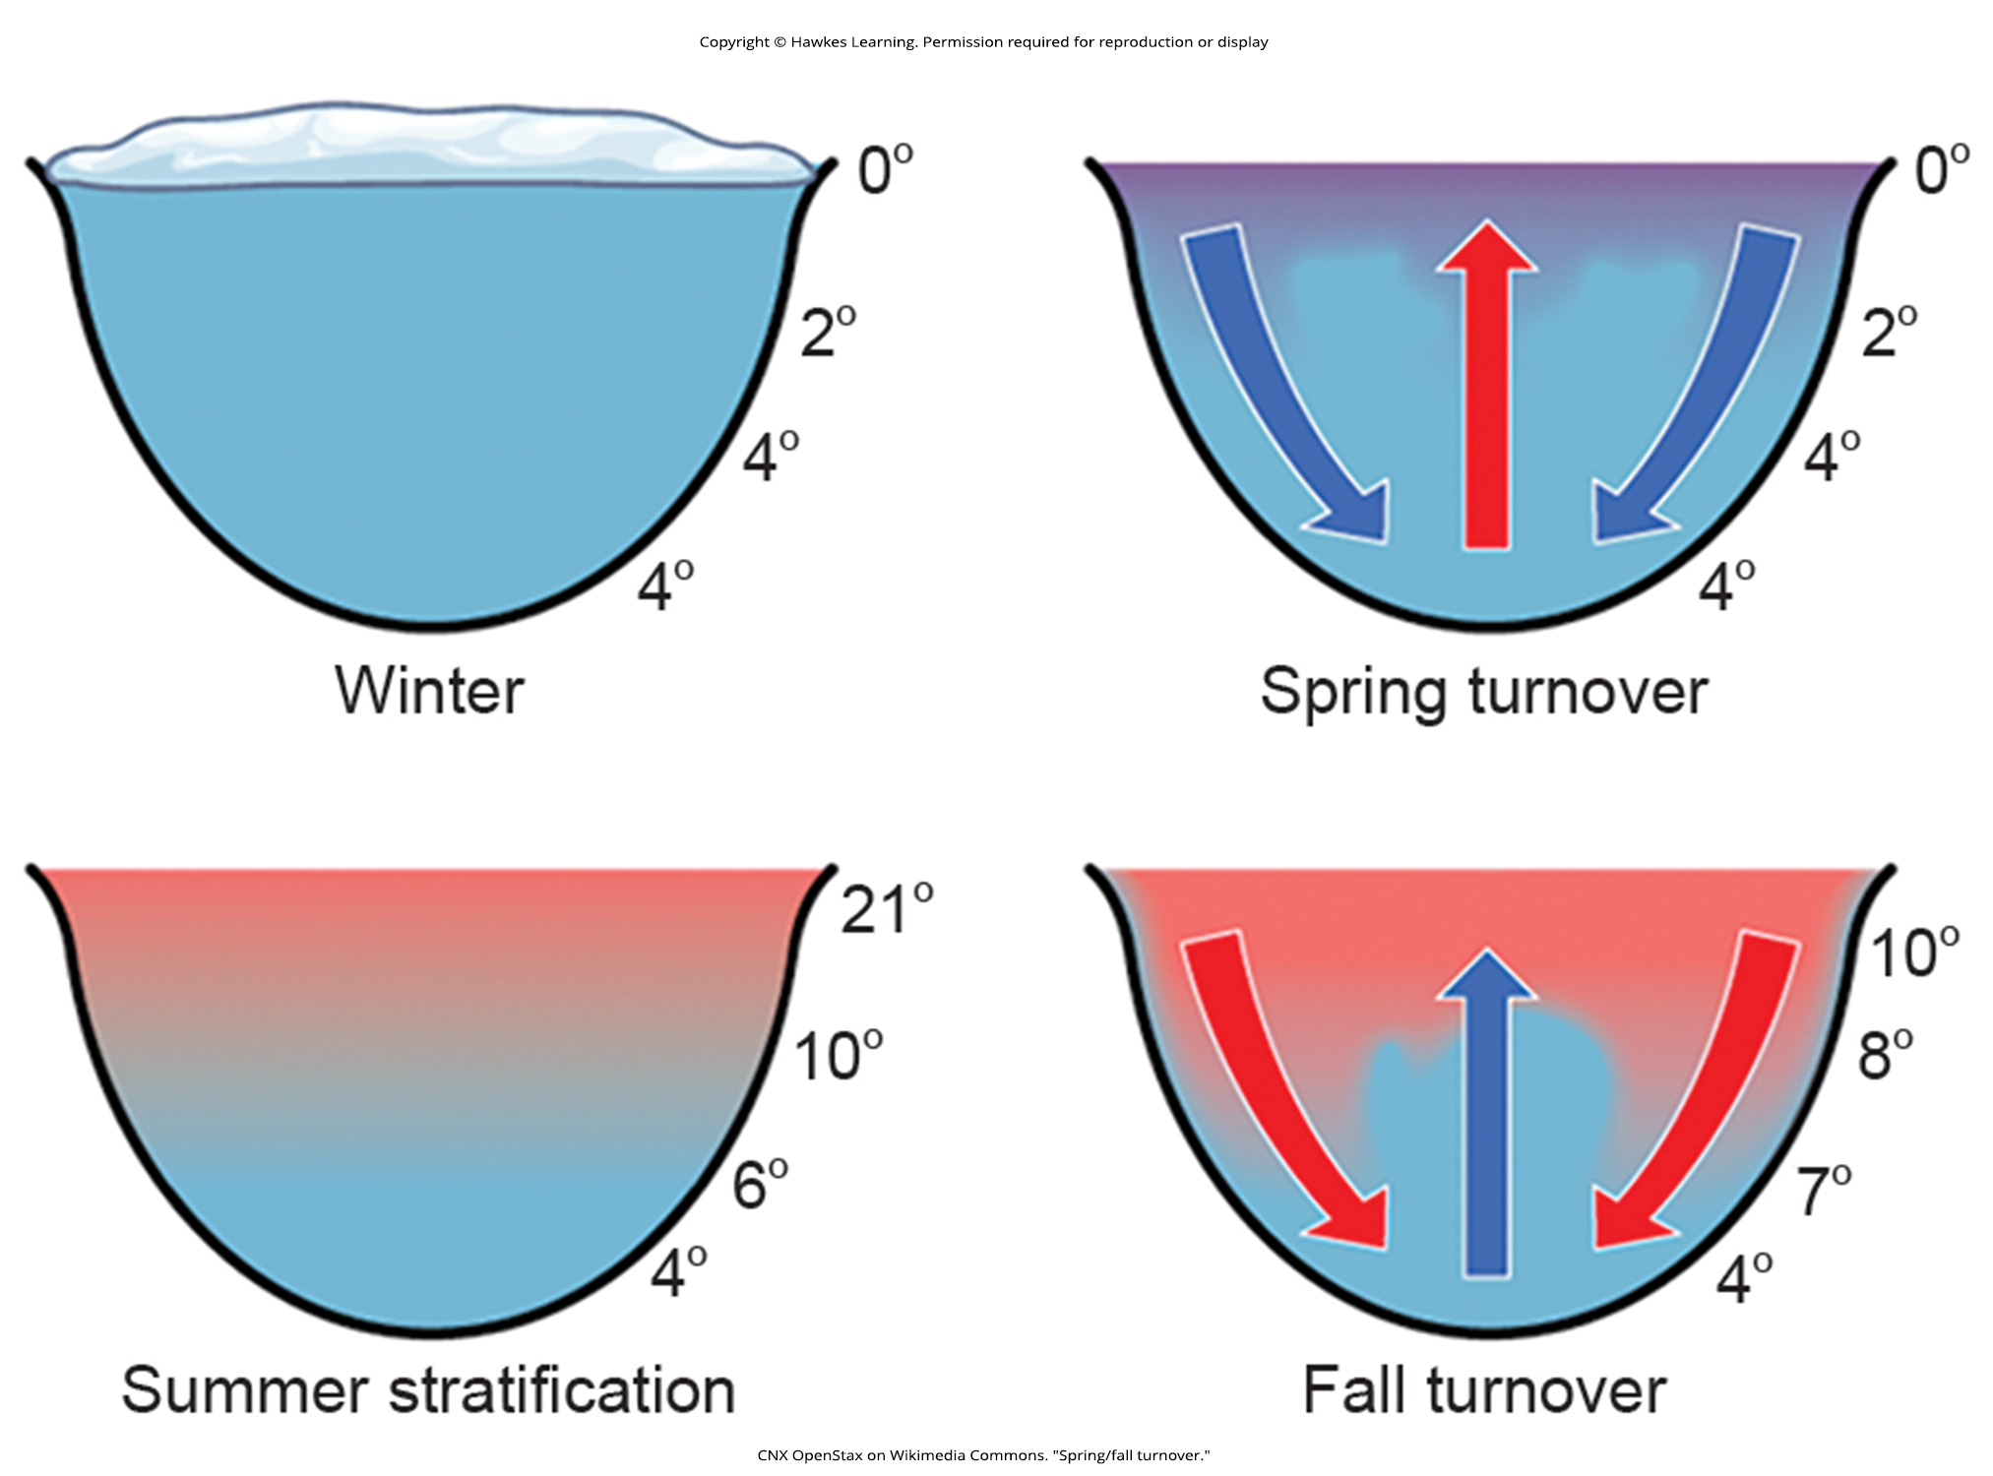
Lesson 44.2 Figure 6

Slide 13
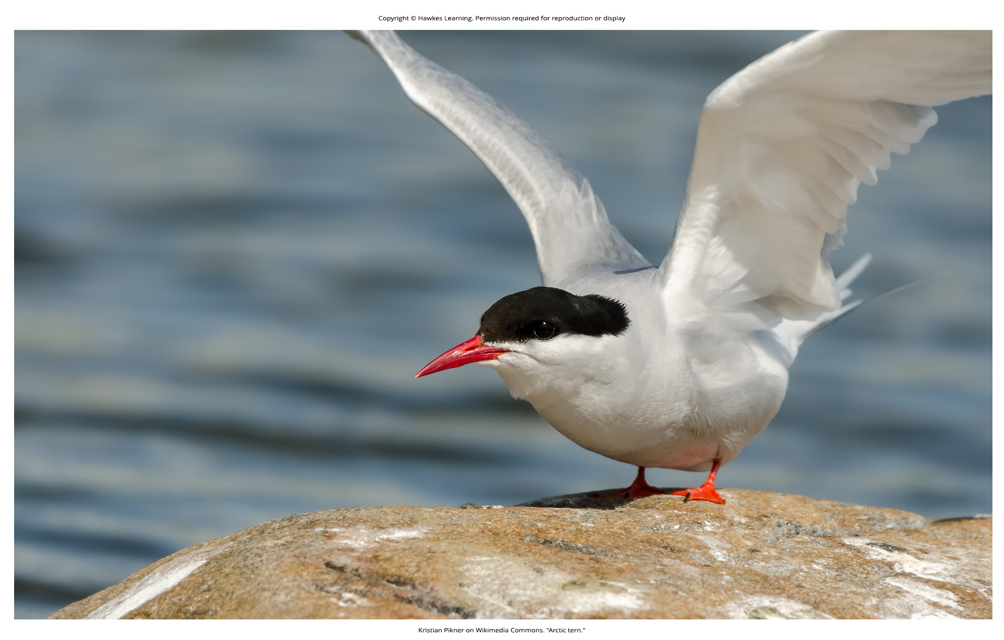
Lesson 44.2 Figure 7

Slide 14
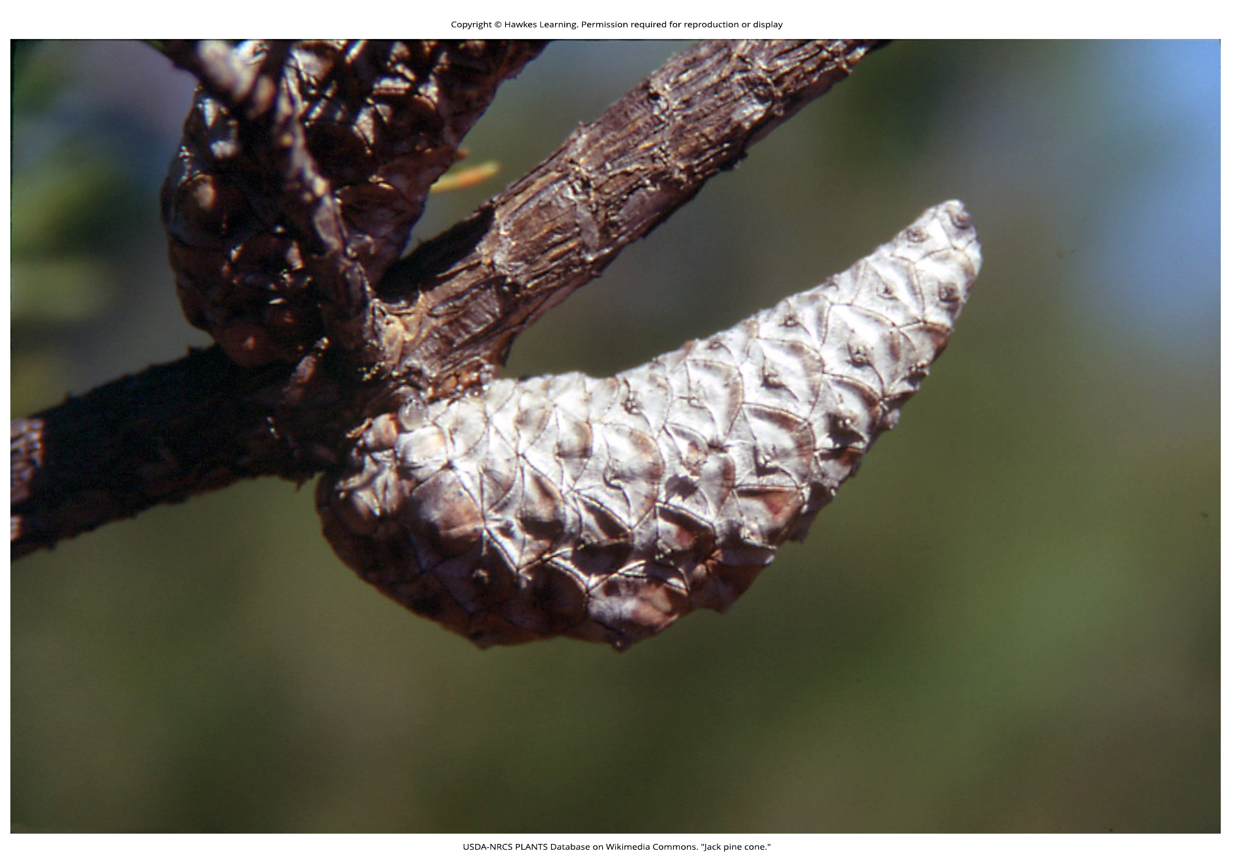
Lesson 44.2 Figure 8

Slide 15
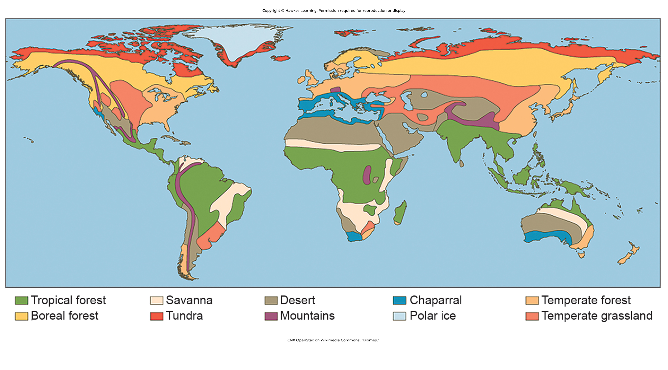
Lesson 44.3 Figure 1

Slide 16
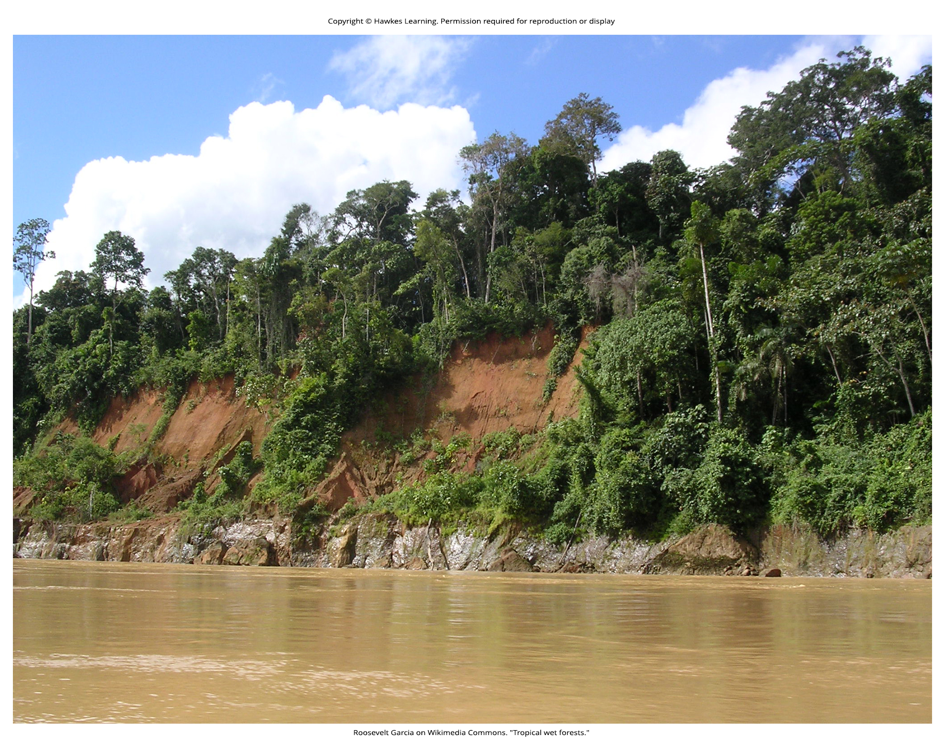
Lesson 44.3 Figure 2

Slide 17
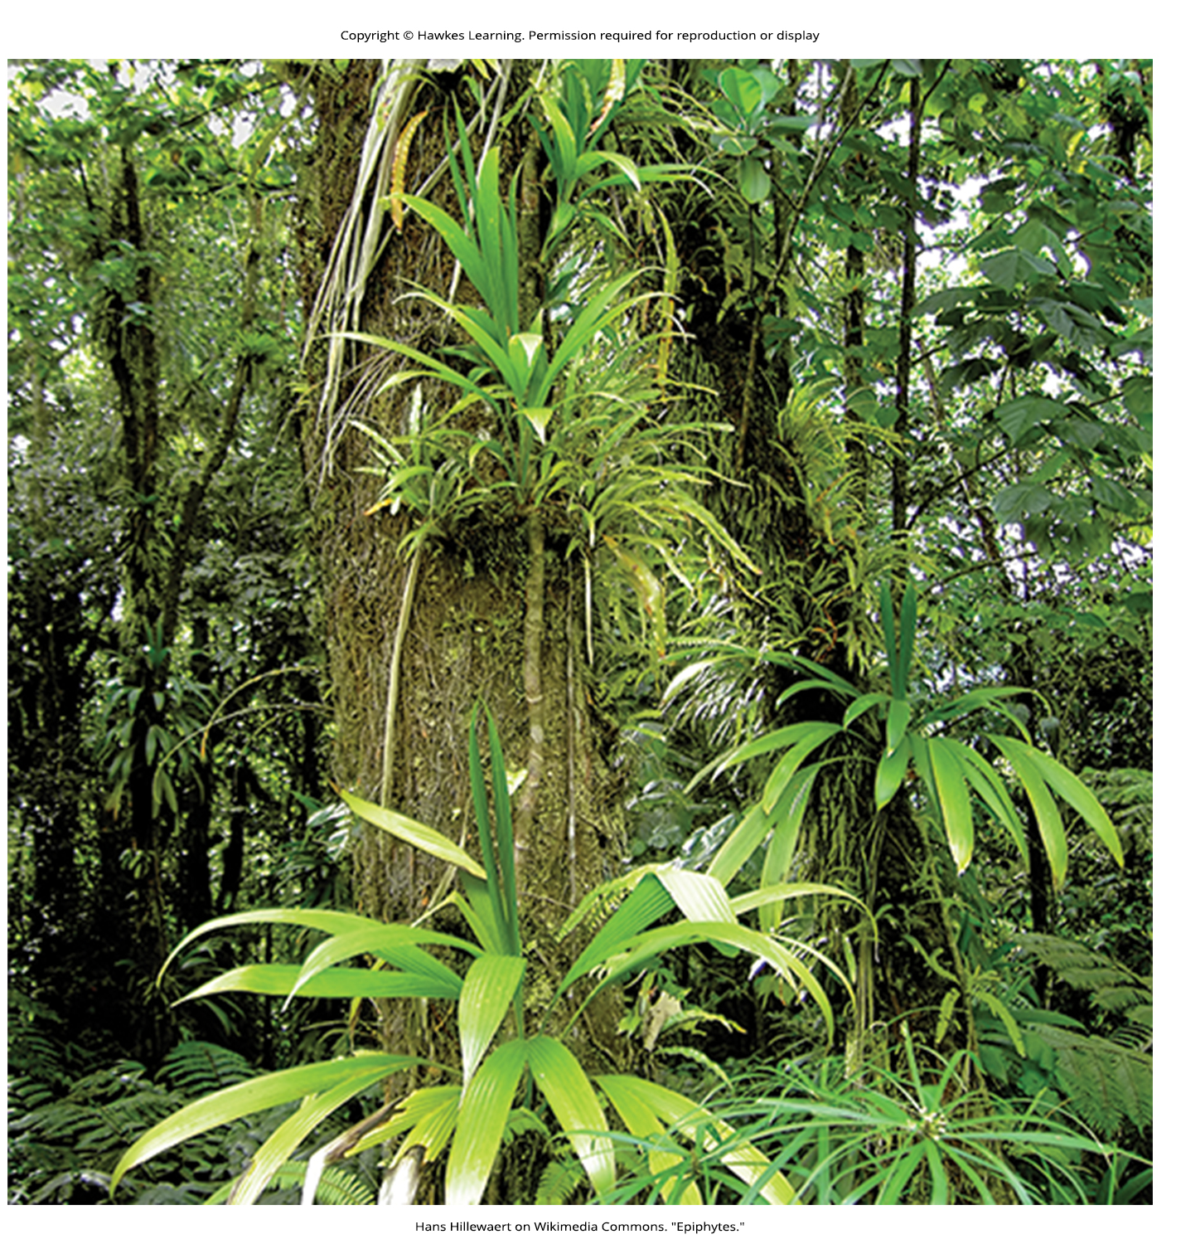
Lesson 44.3 Figure 3

Slide 18
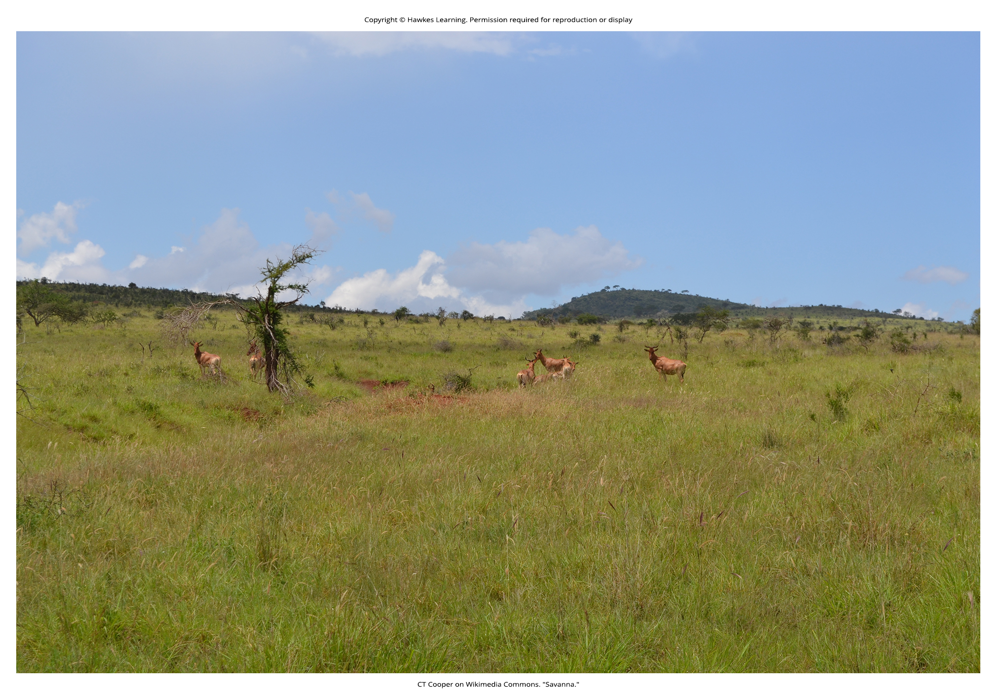
Lesson 44.3 Figure 4

Slide 19
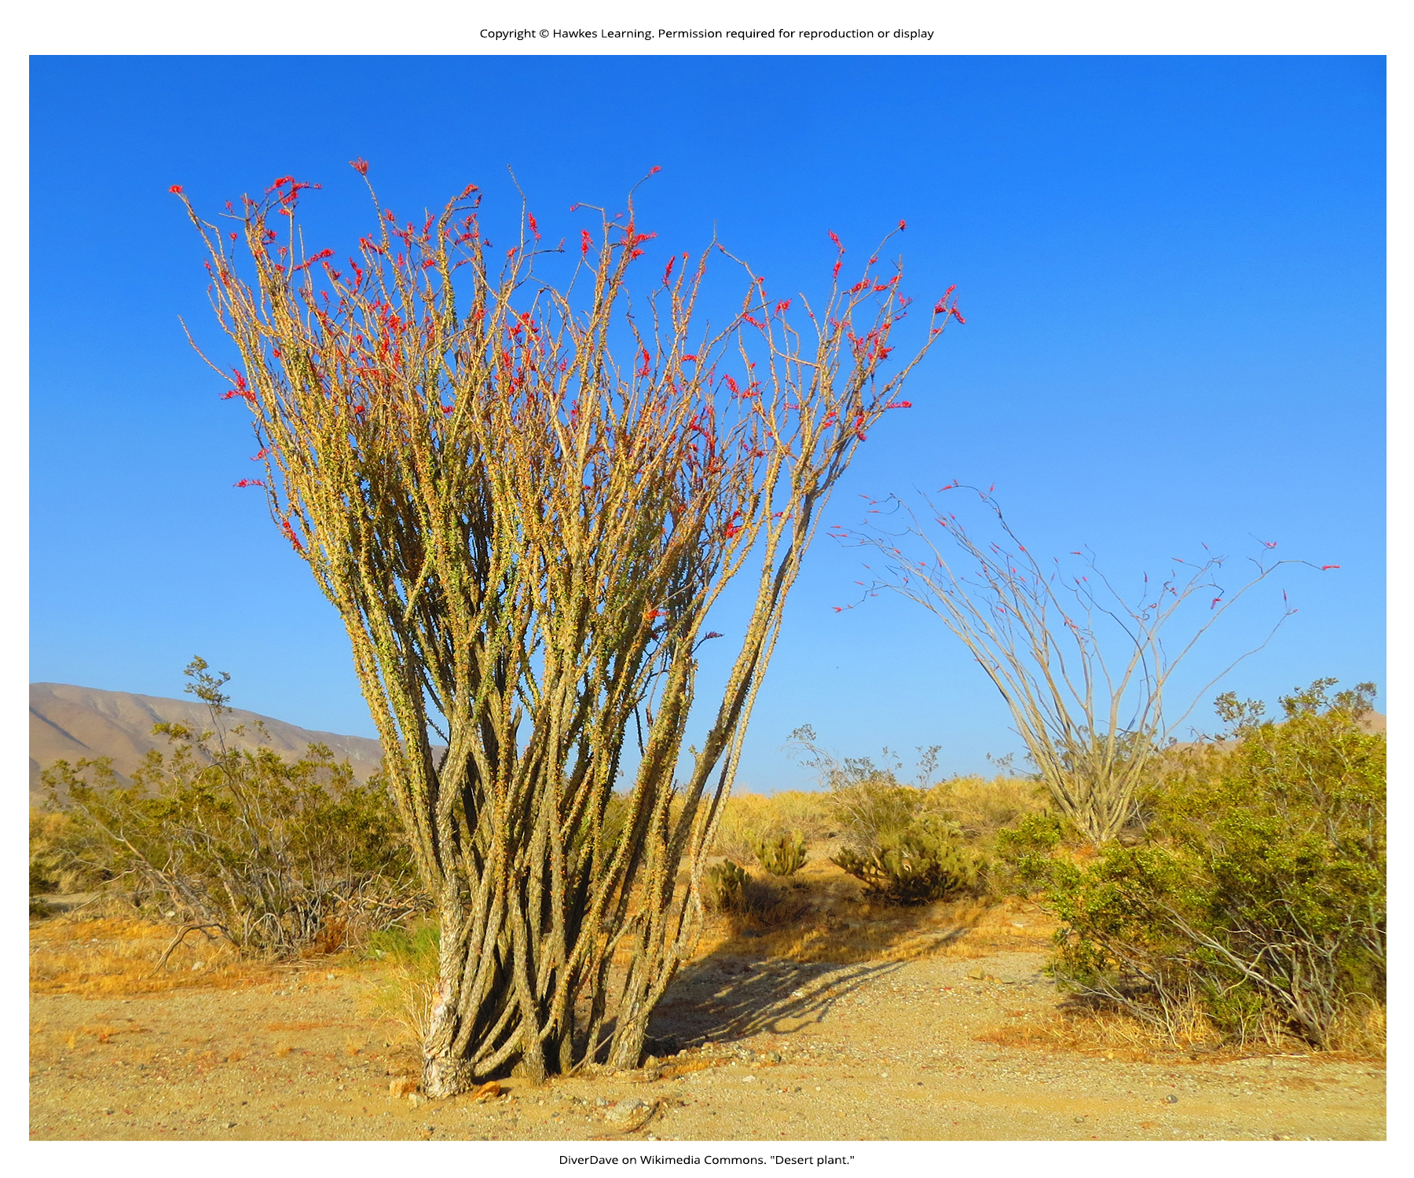
Lesson 44.3 Figure 5

Slide 20
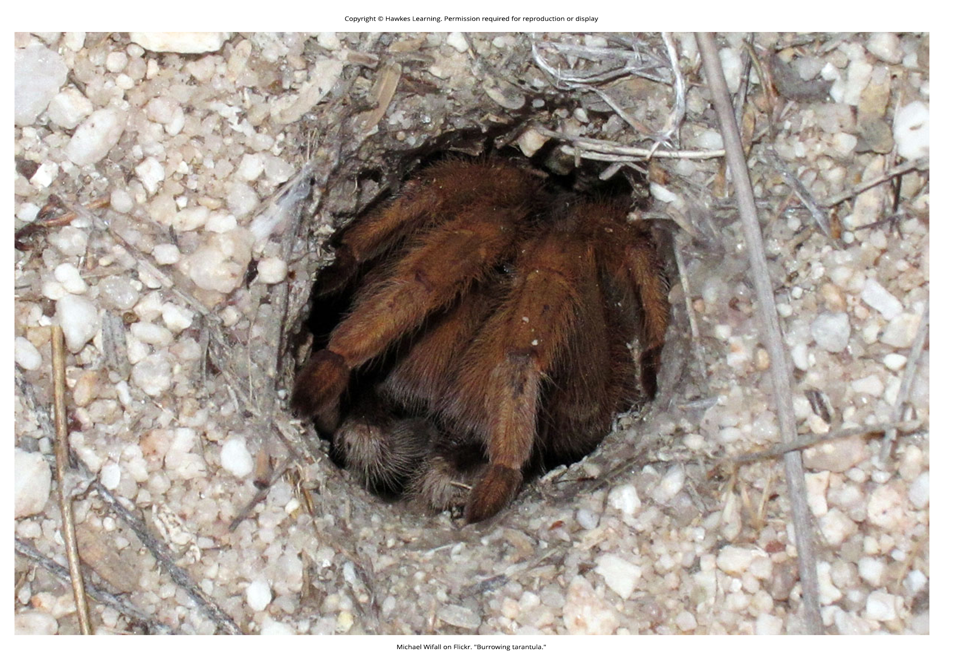
Lesson 44.3 Figure 6

Slide 21
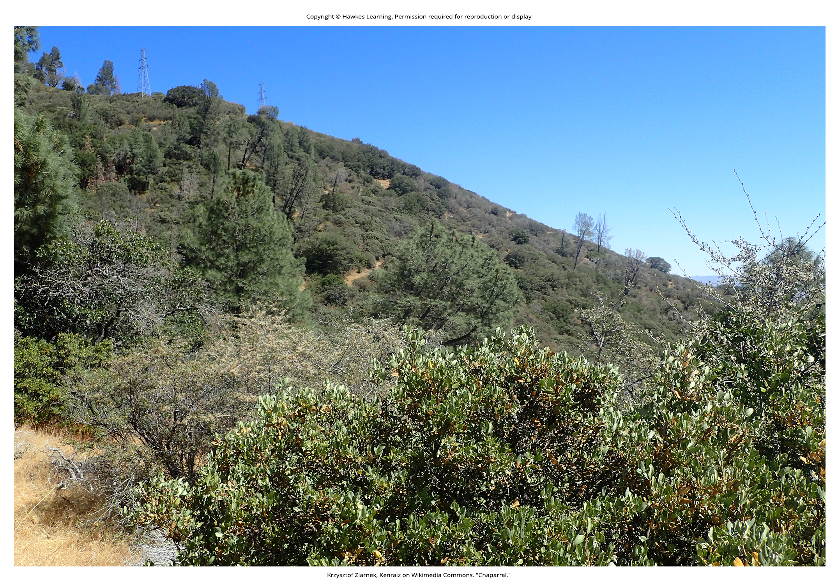
Lesson 44.3 Figure 7

Slide 22
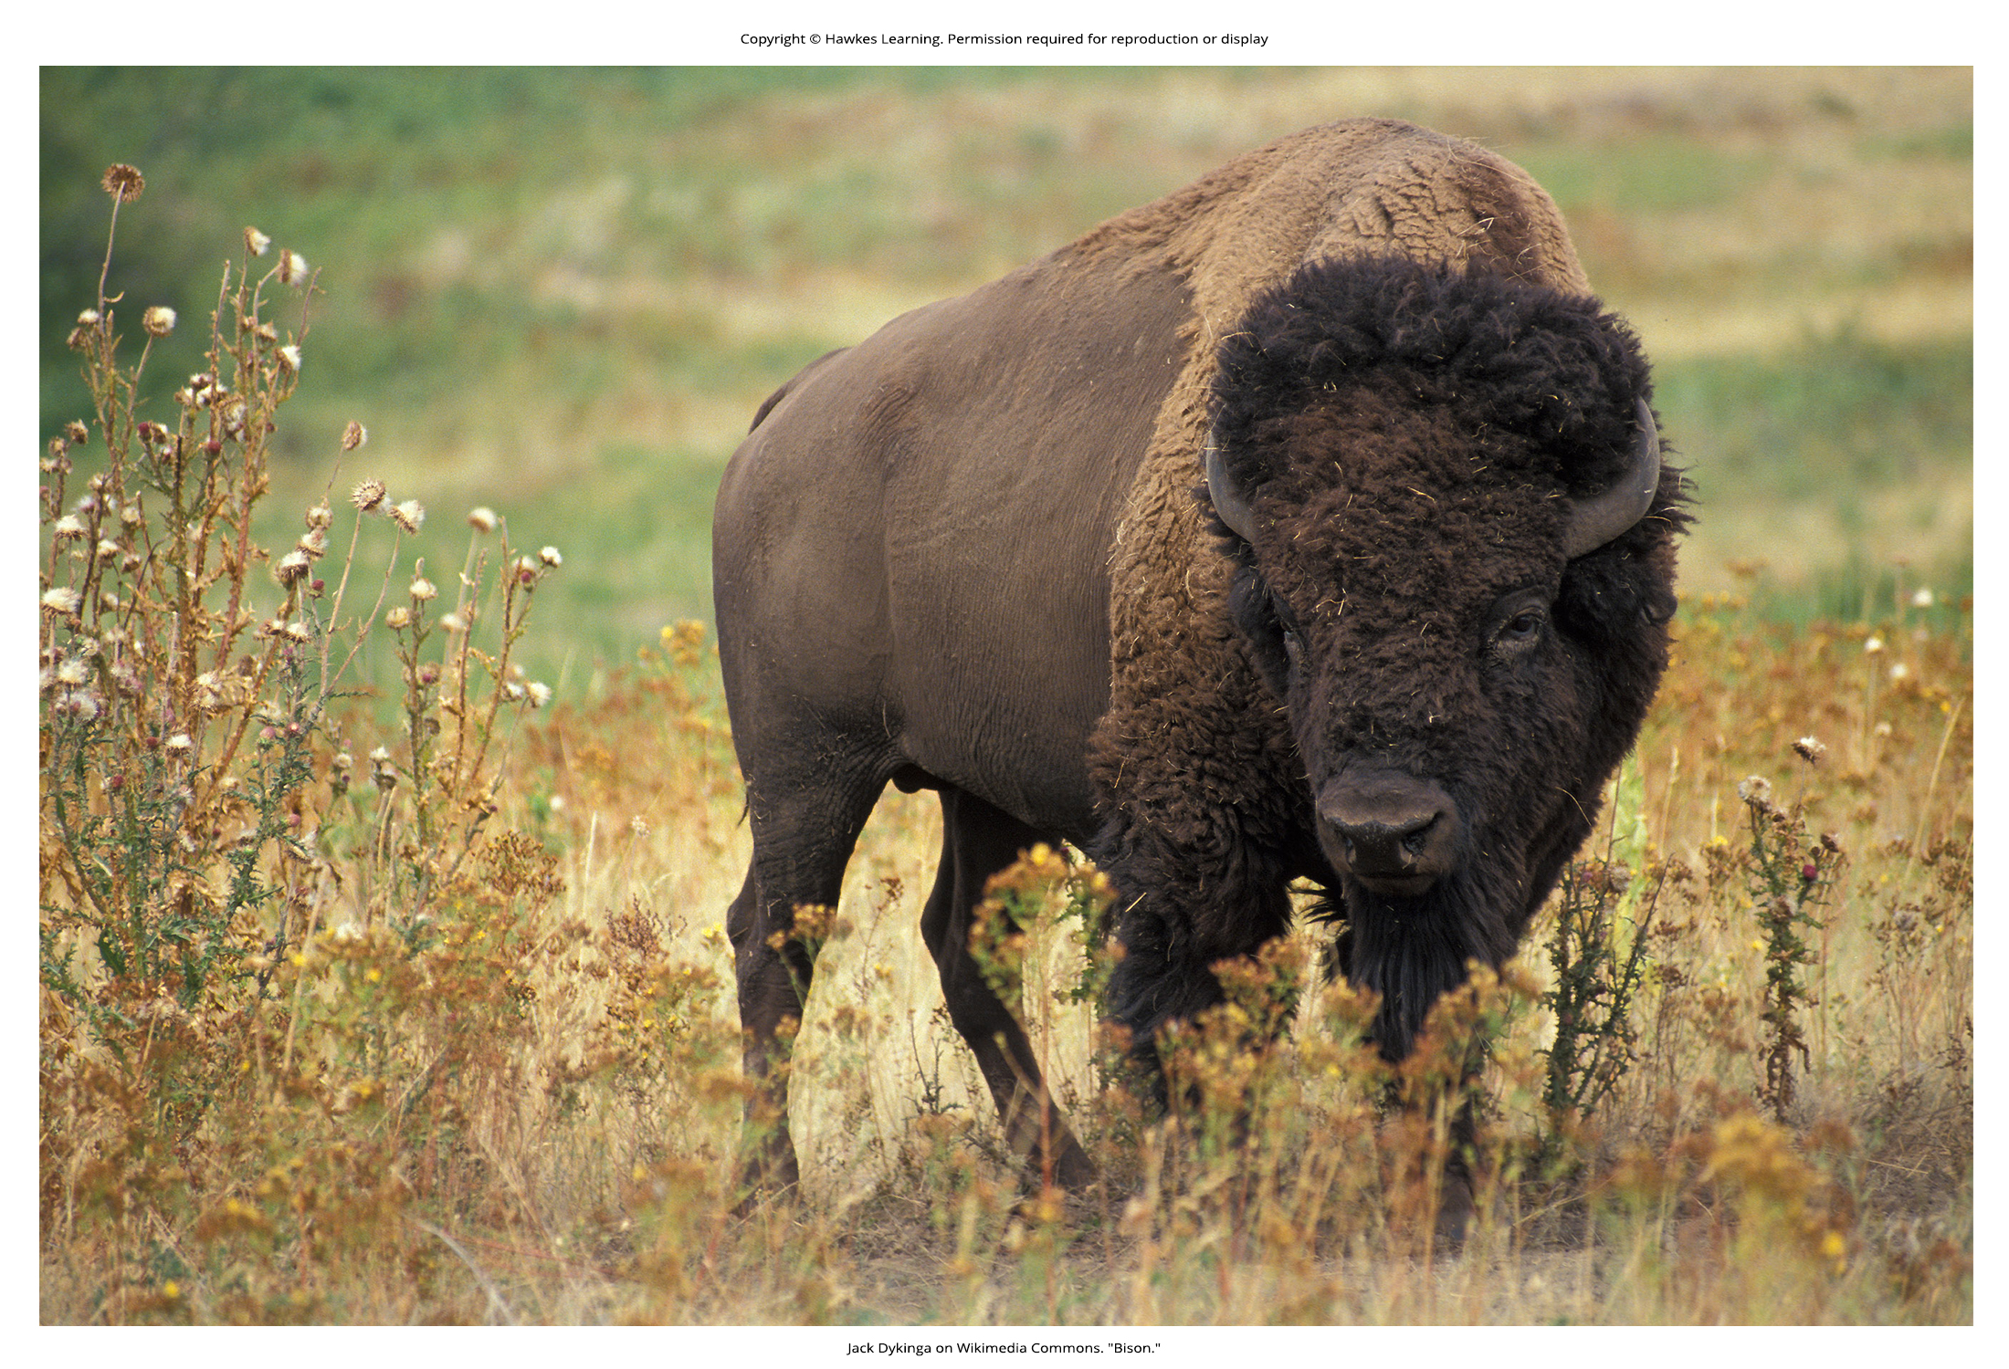
Lesson 44.3 Figure 8

Slide 23
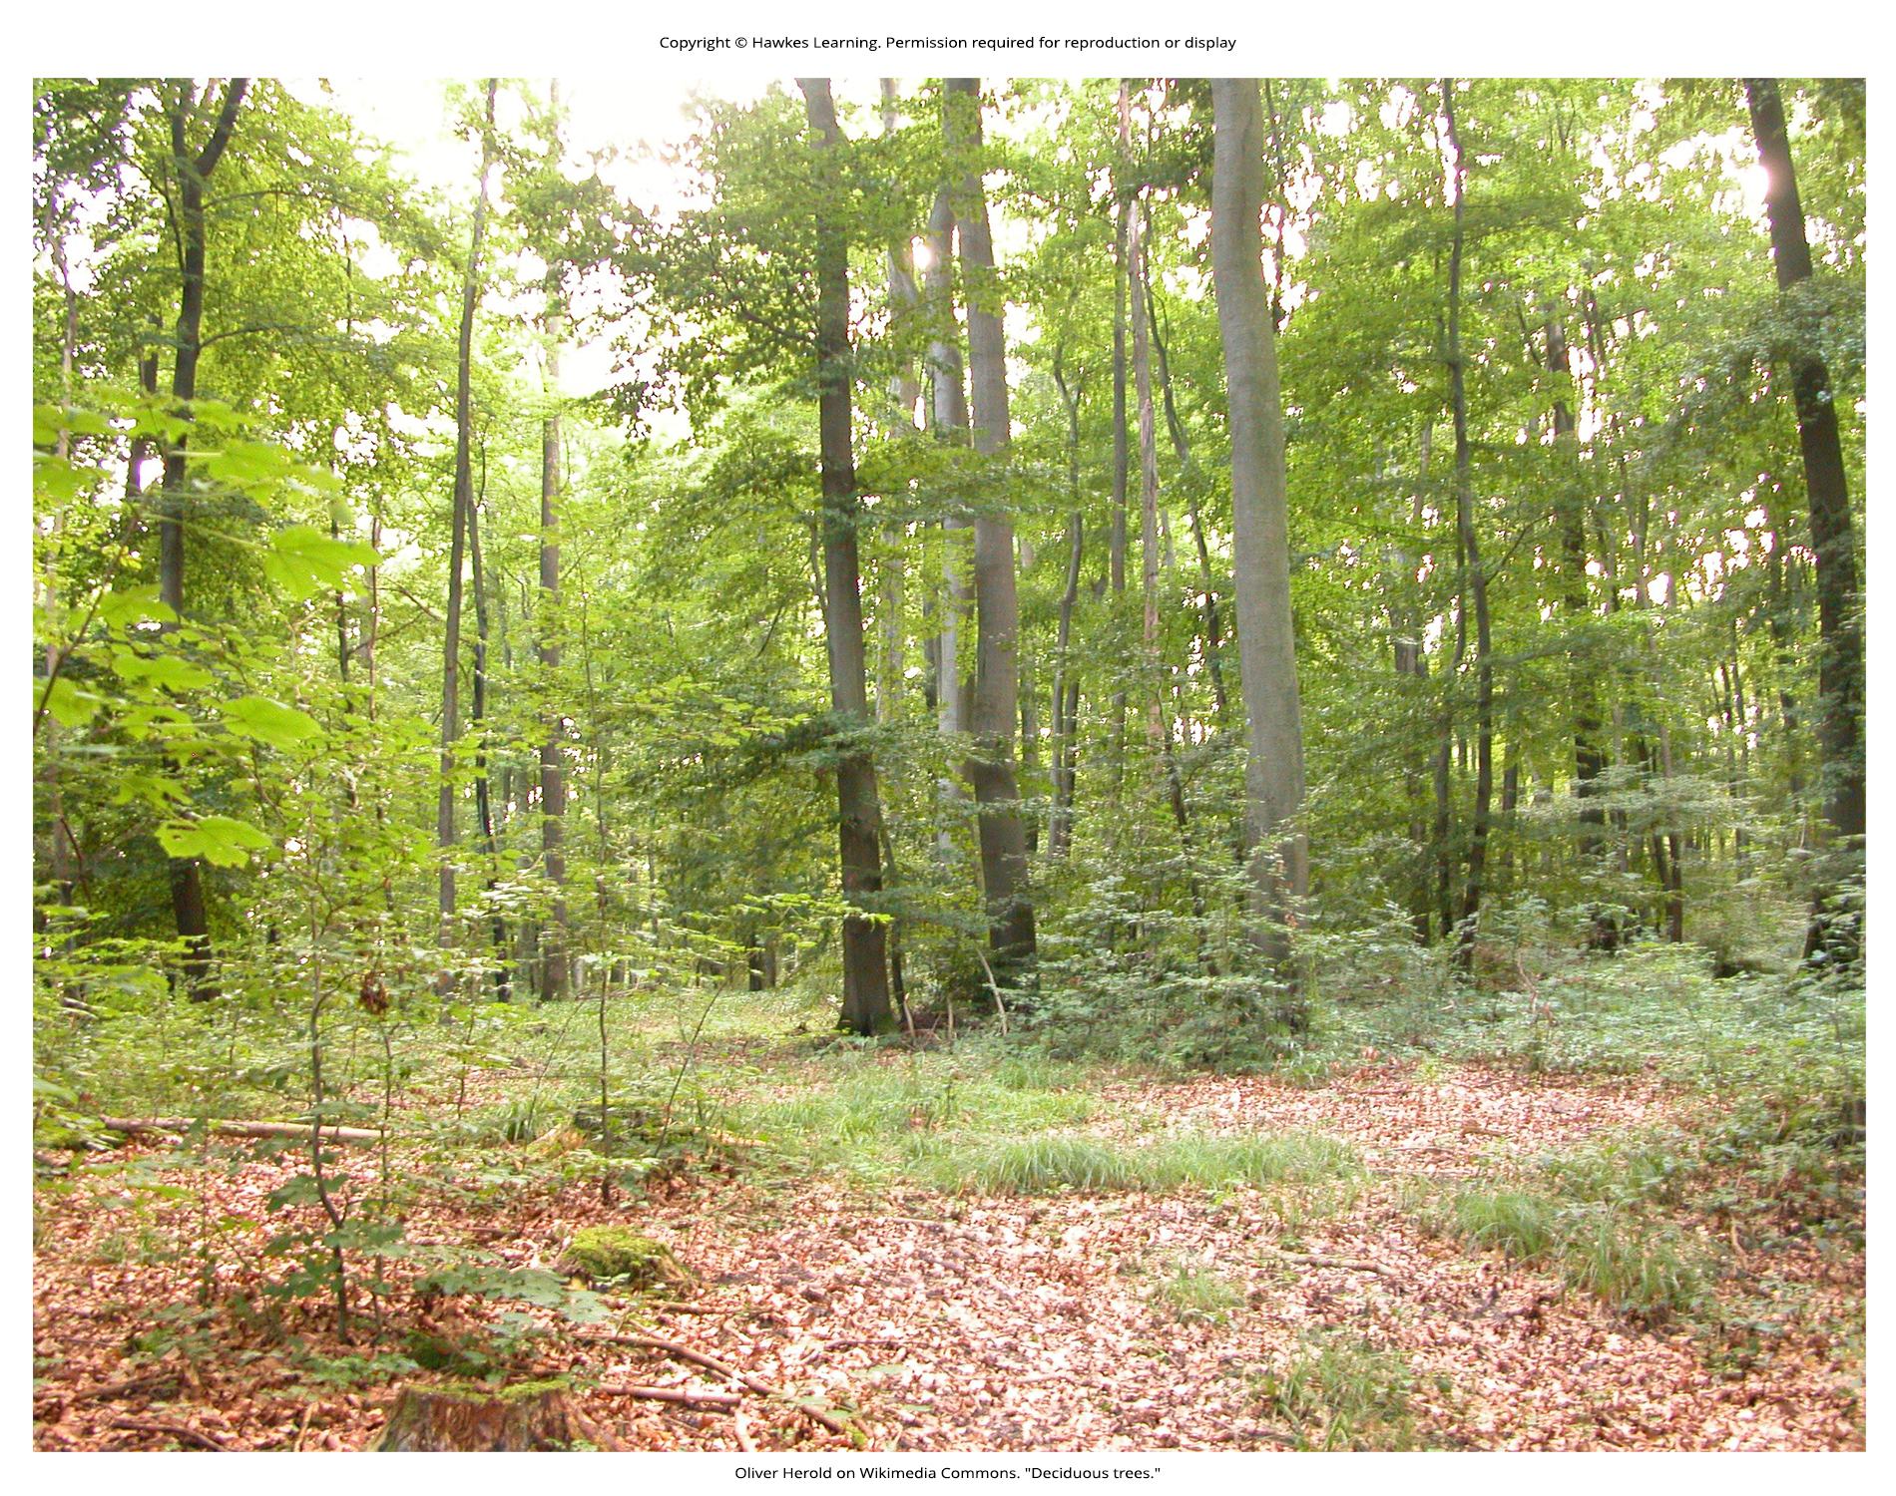
Lesson 44.3 Figure 9

Slide 24
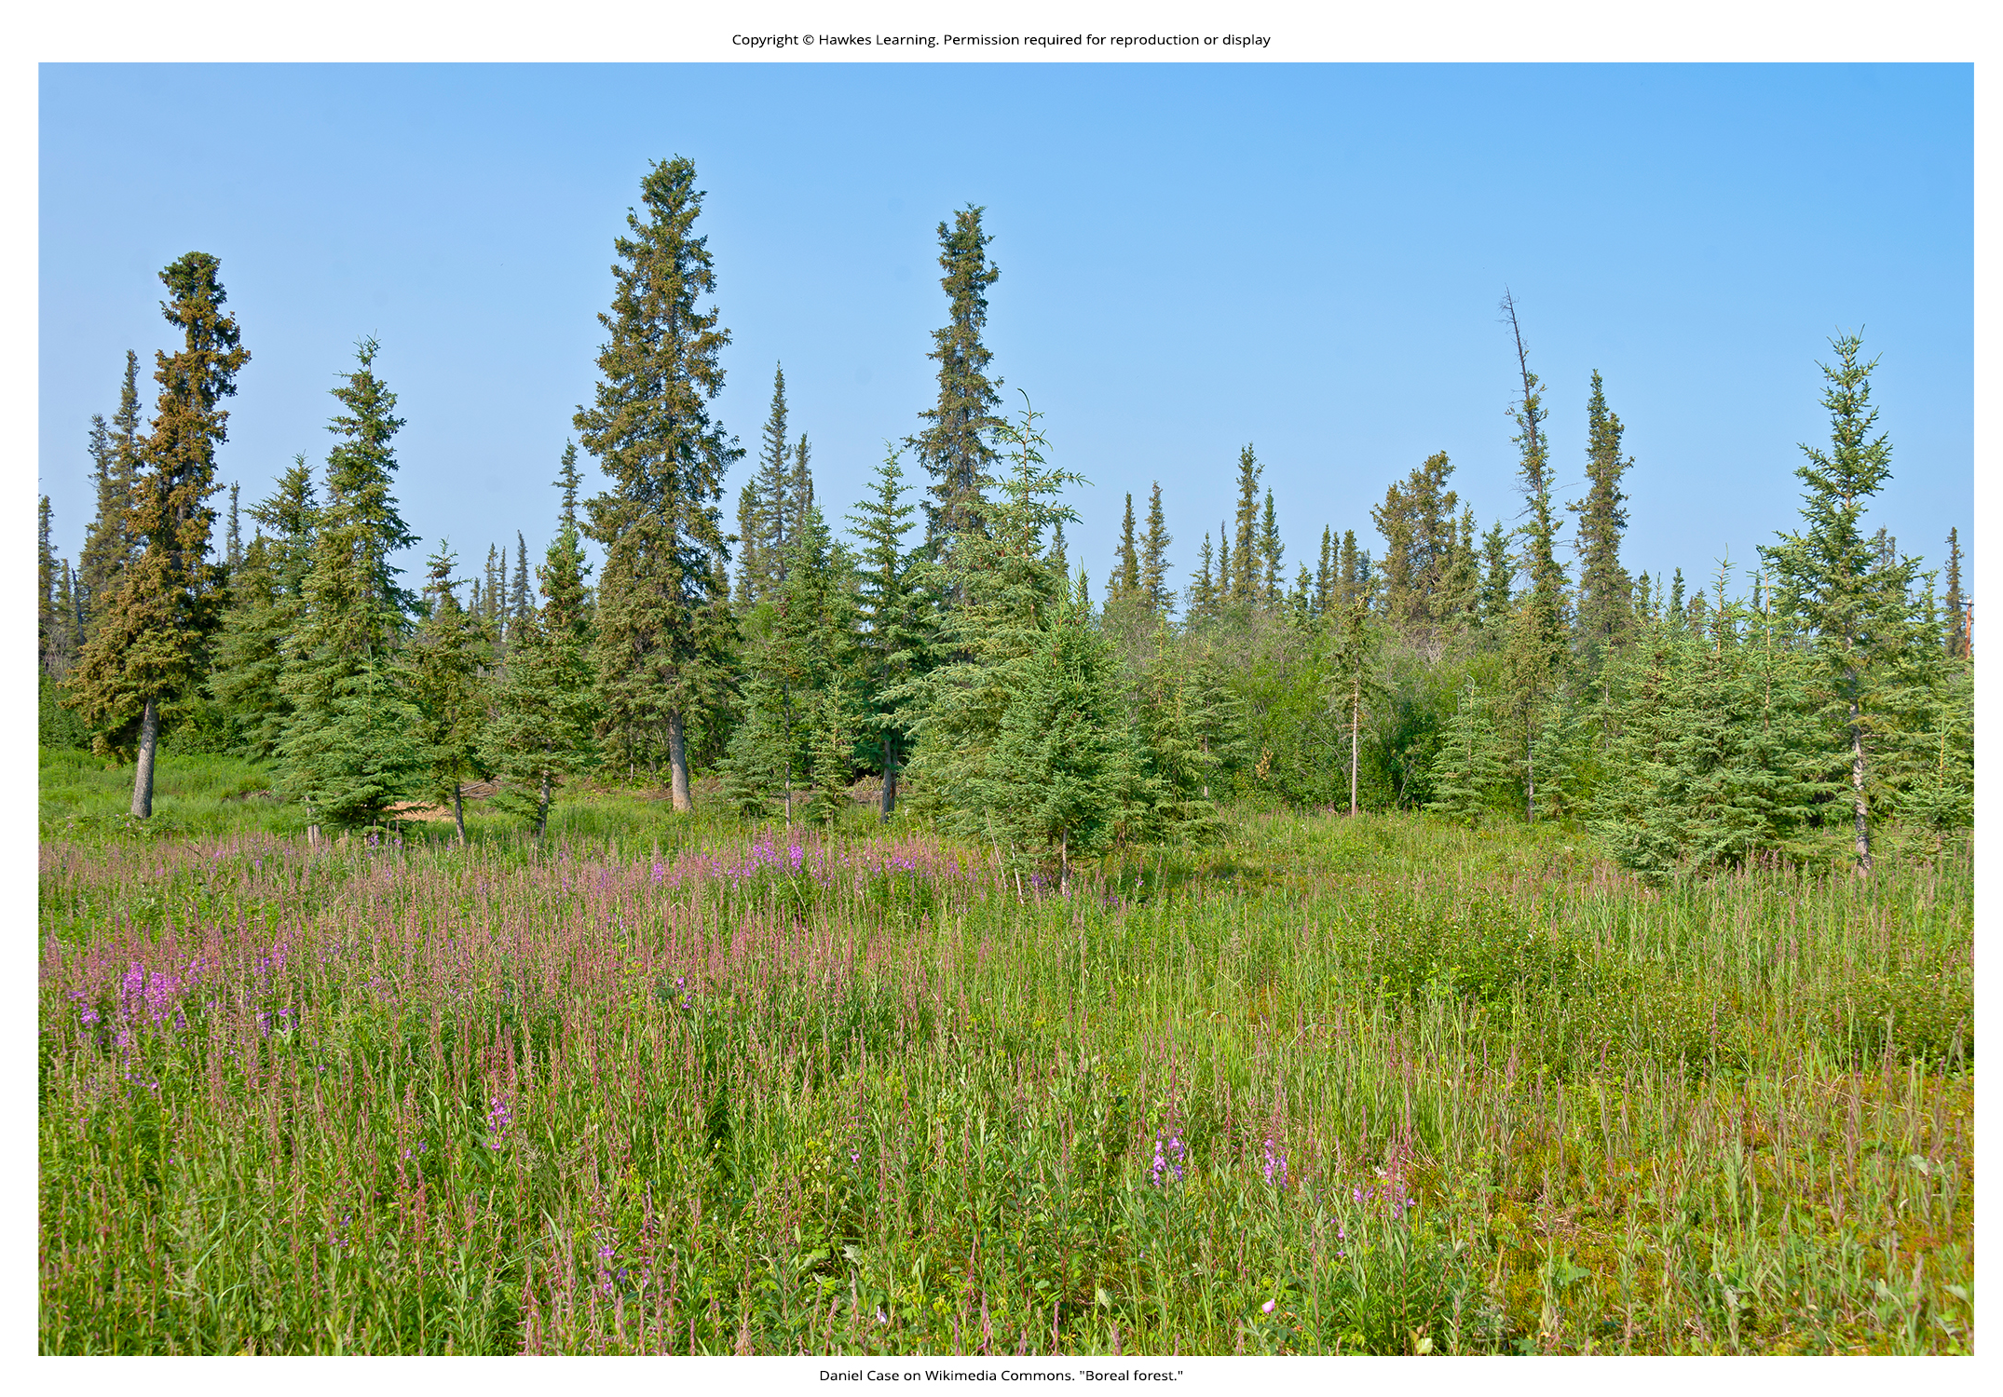
Lesson 44.3 Figure 10

Slide 25
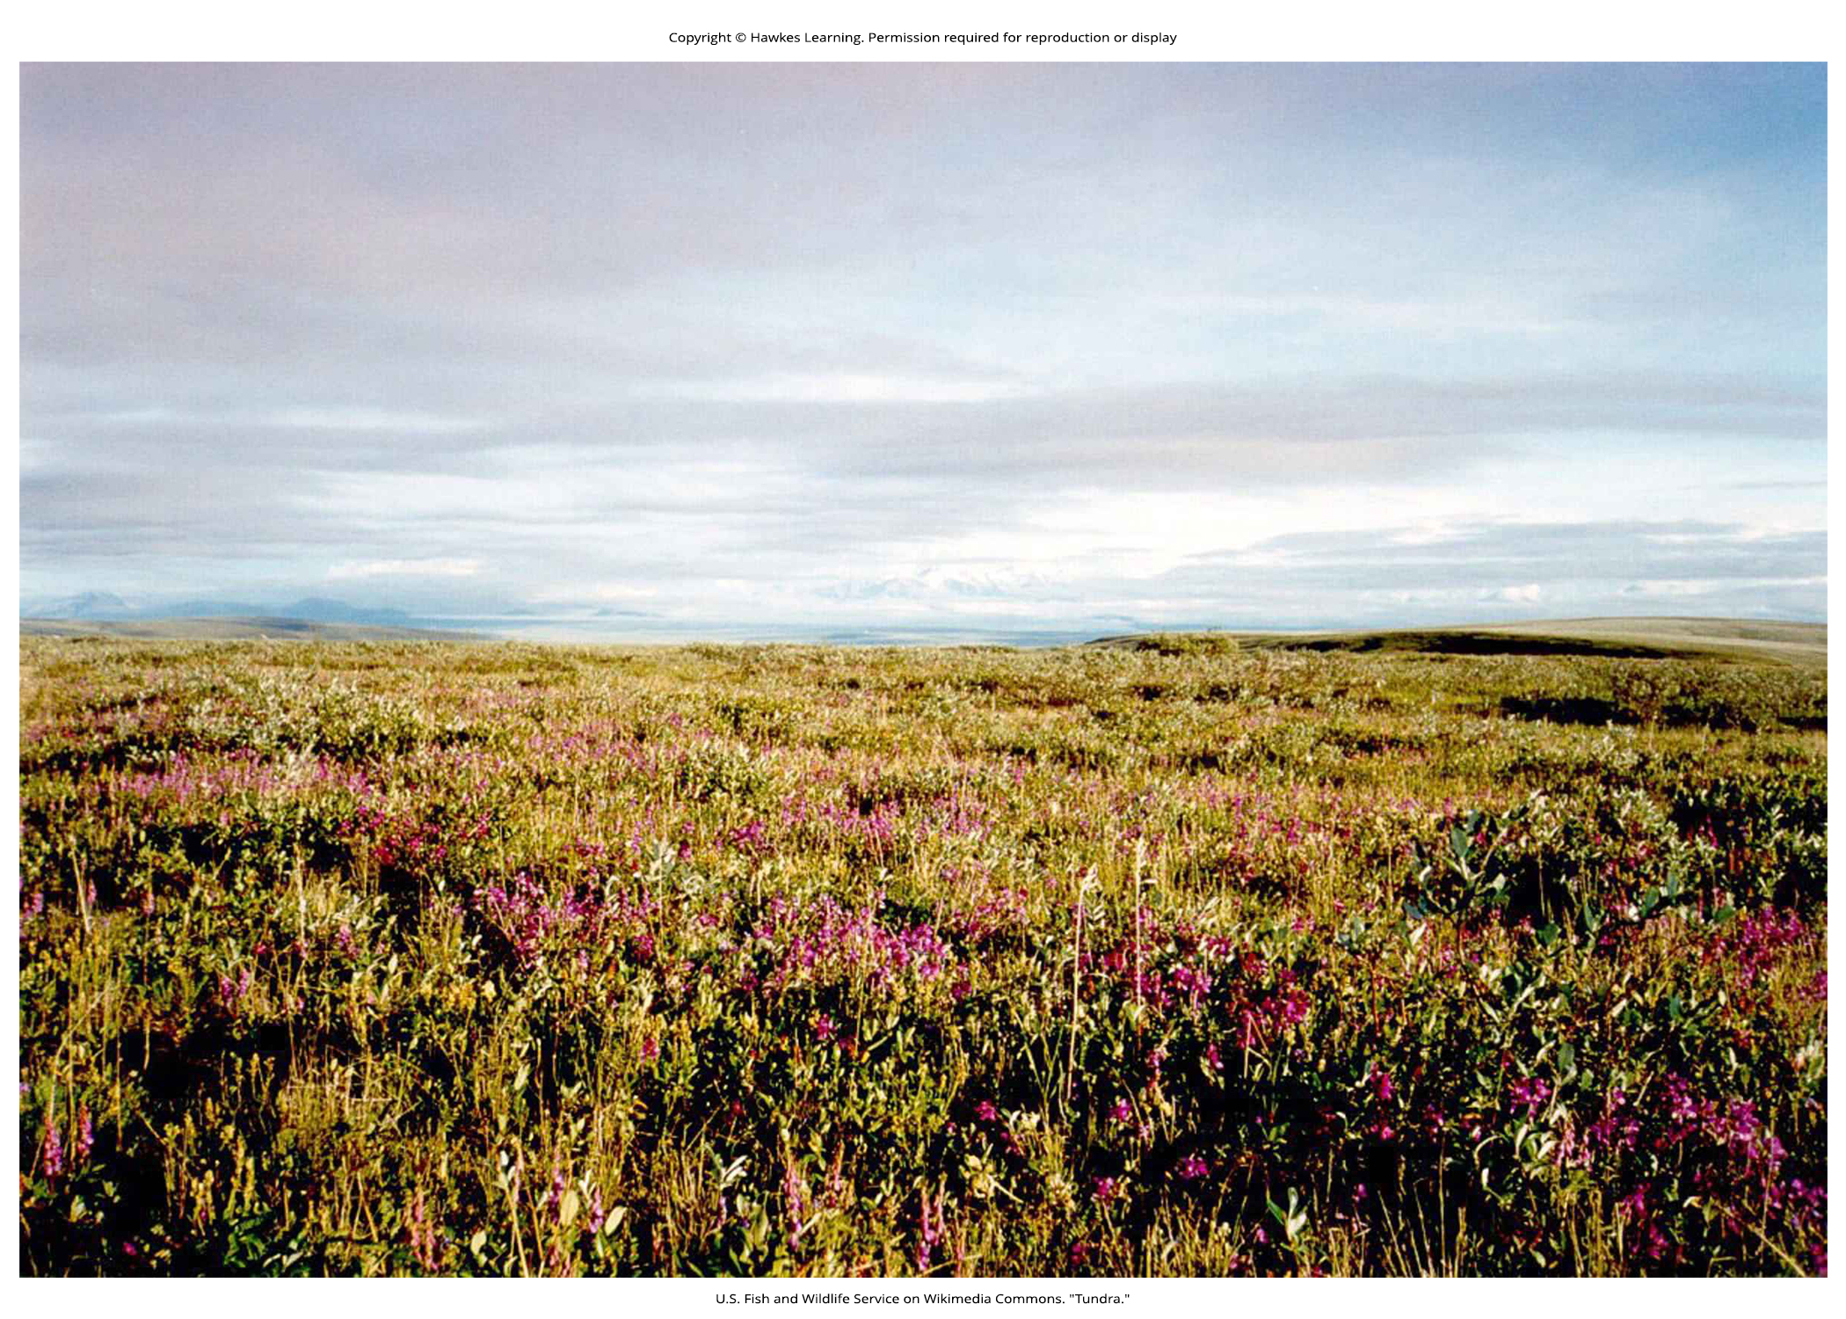
Lesson 44.3 Figure 11

Slide 26
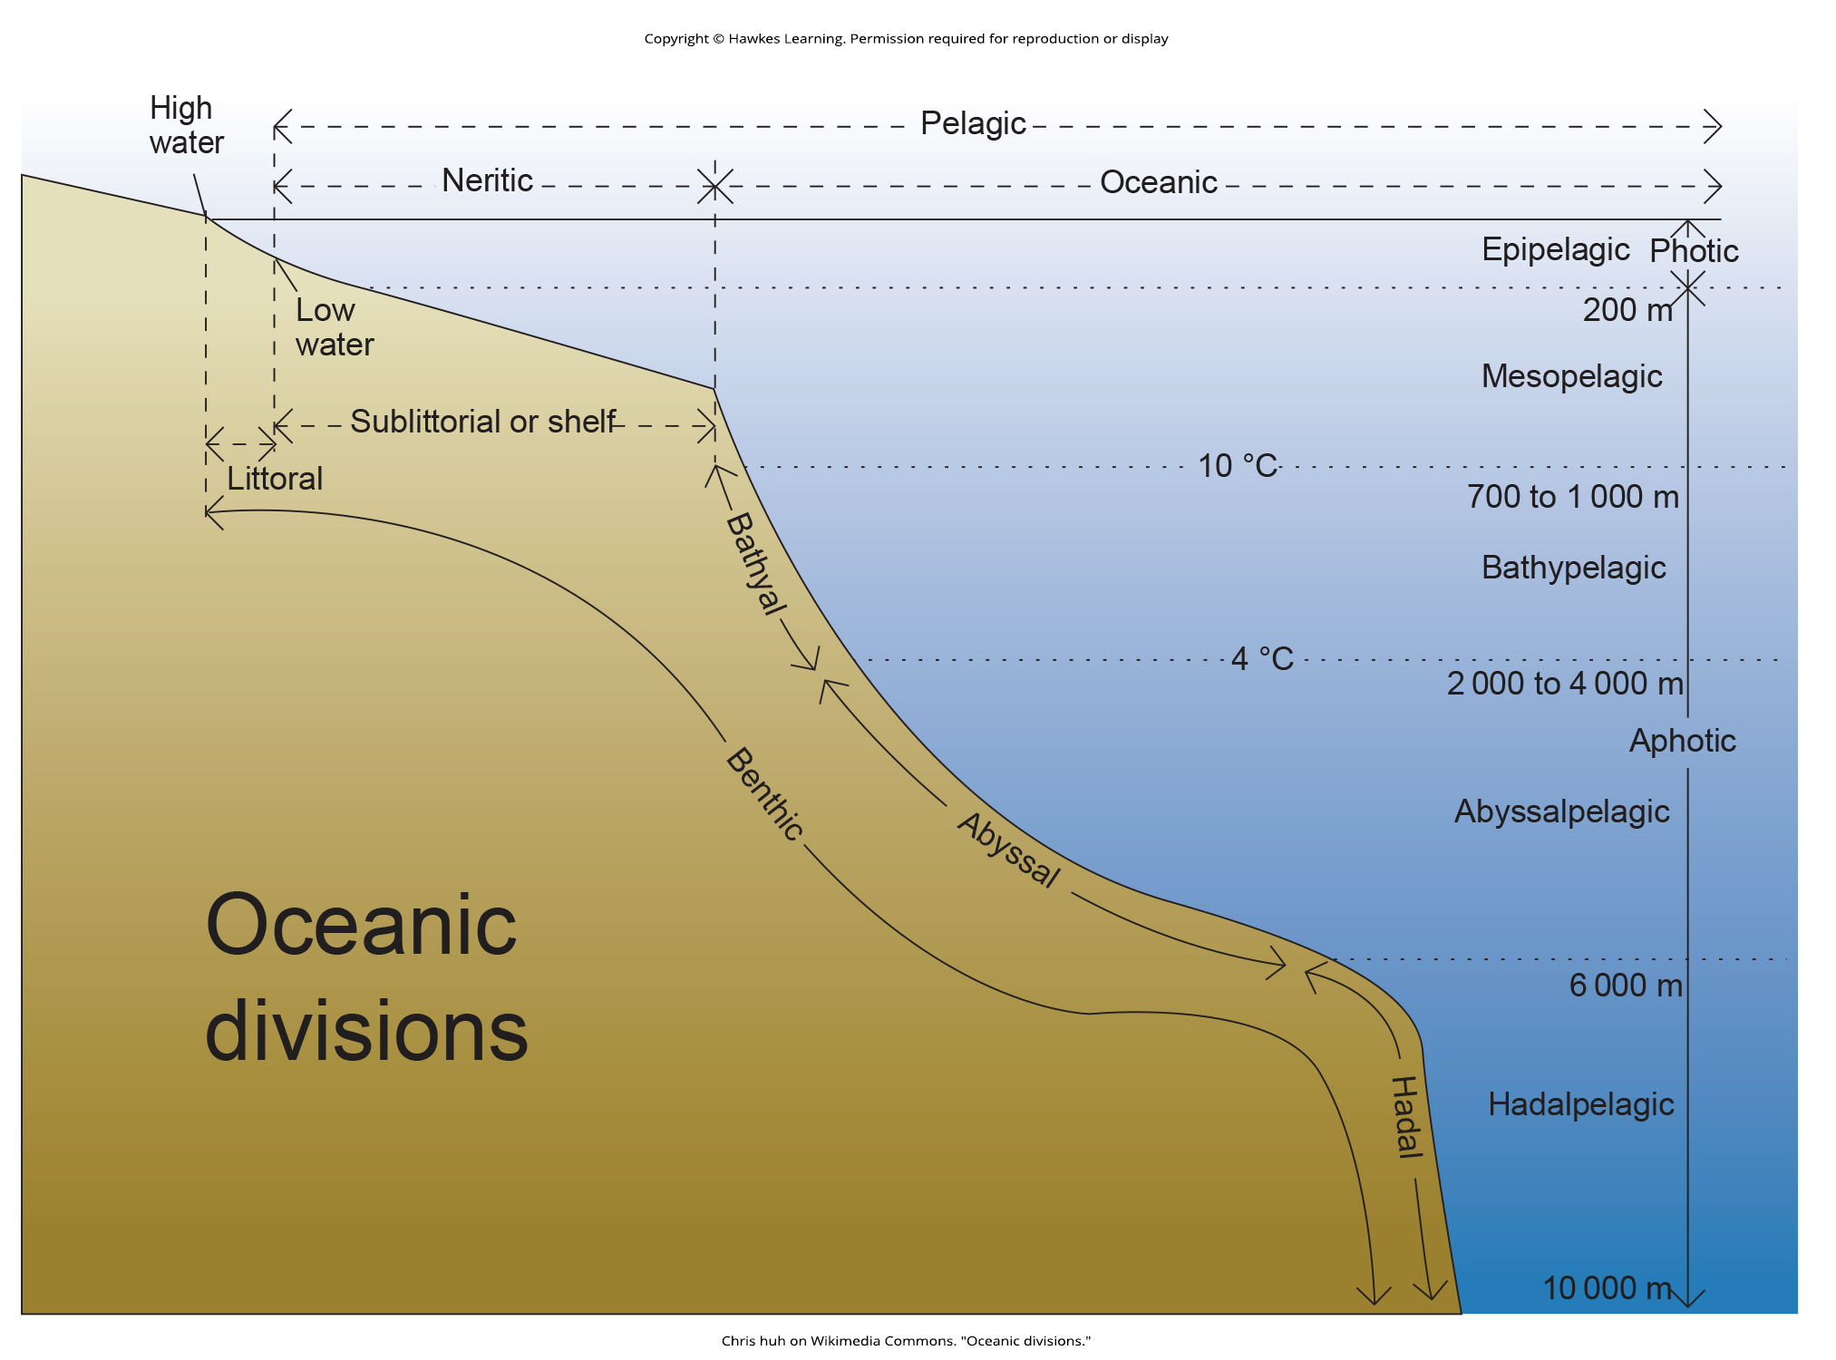
Lesson 44.4 Figure 1

Slide 27
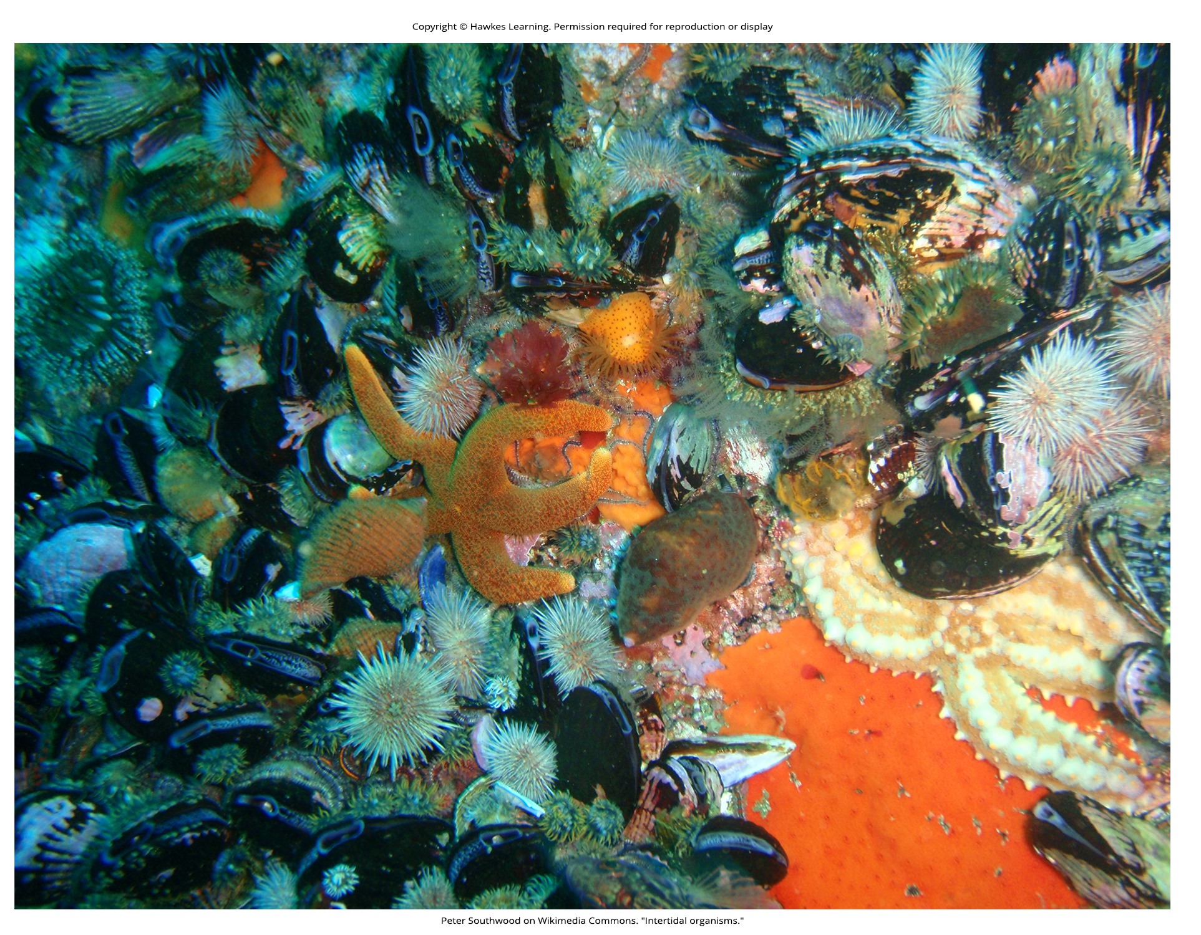
Lesson 44.4 Figure 2

Slide 28
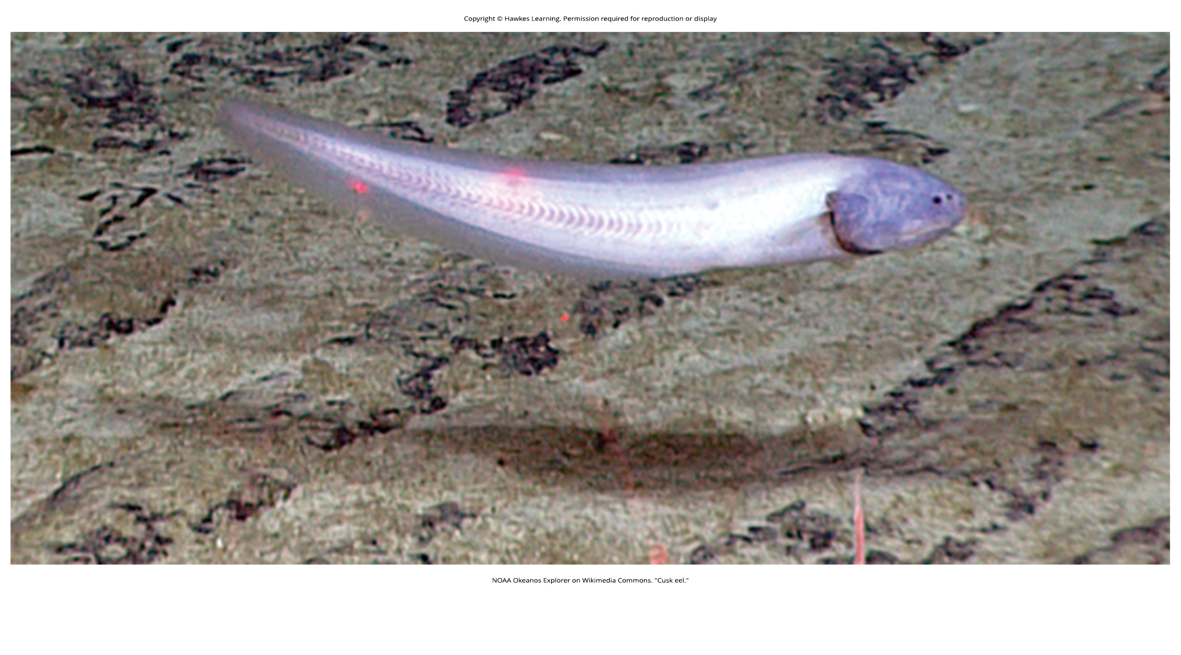
Lesson 44.4 Figure 3

Slide 29
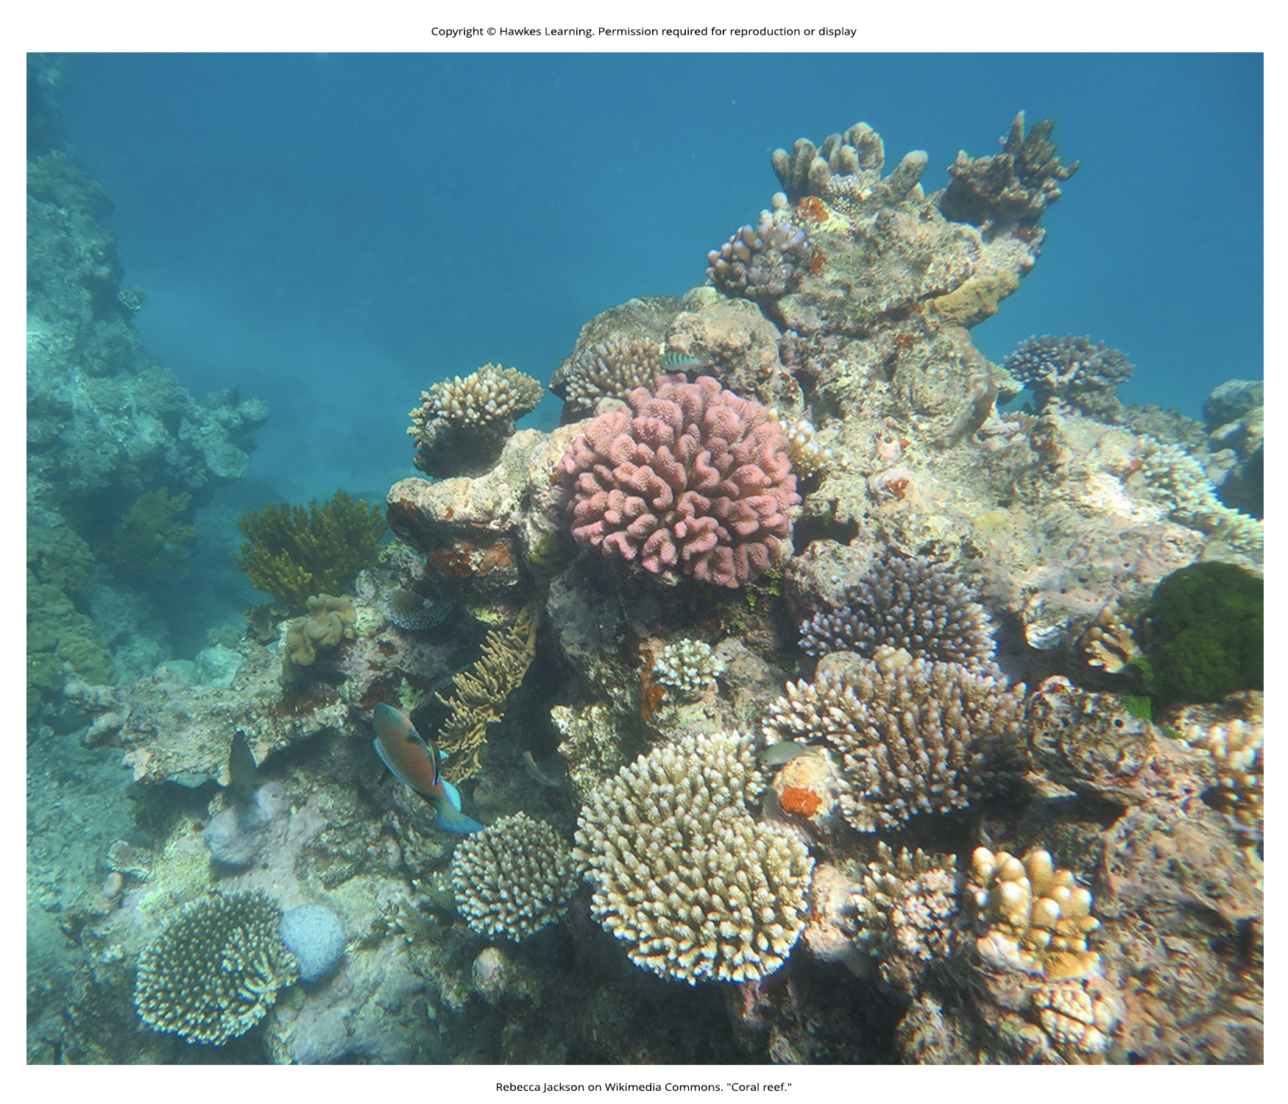
Lesson 44.4 Figure 4

Slide 30
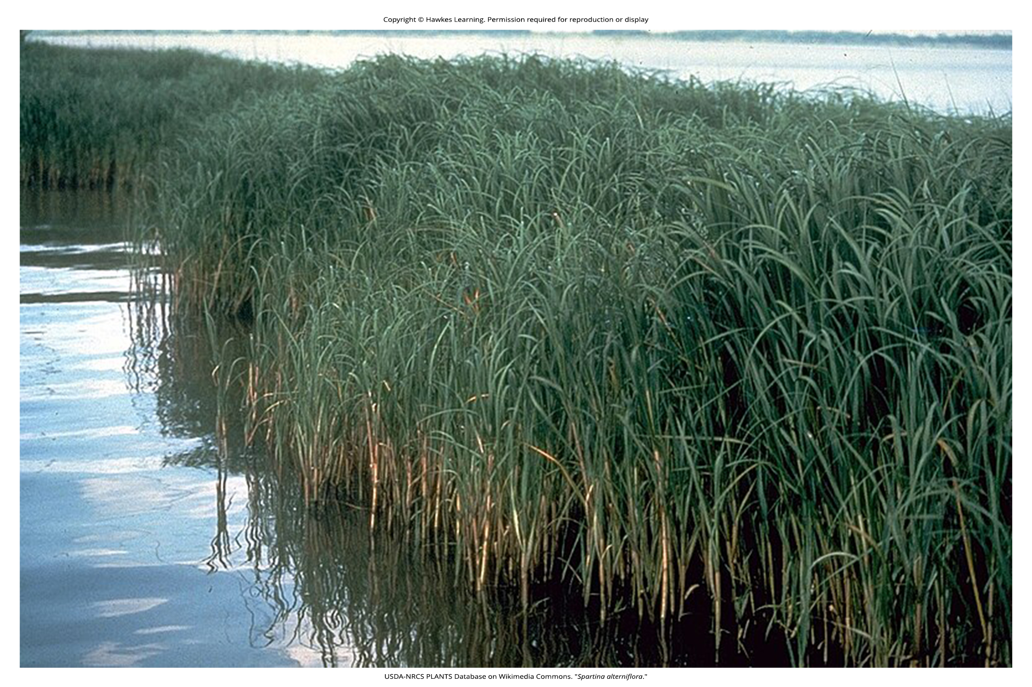
Lesson 44.4 Figure 5

Slide 31
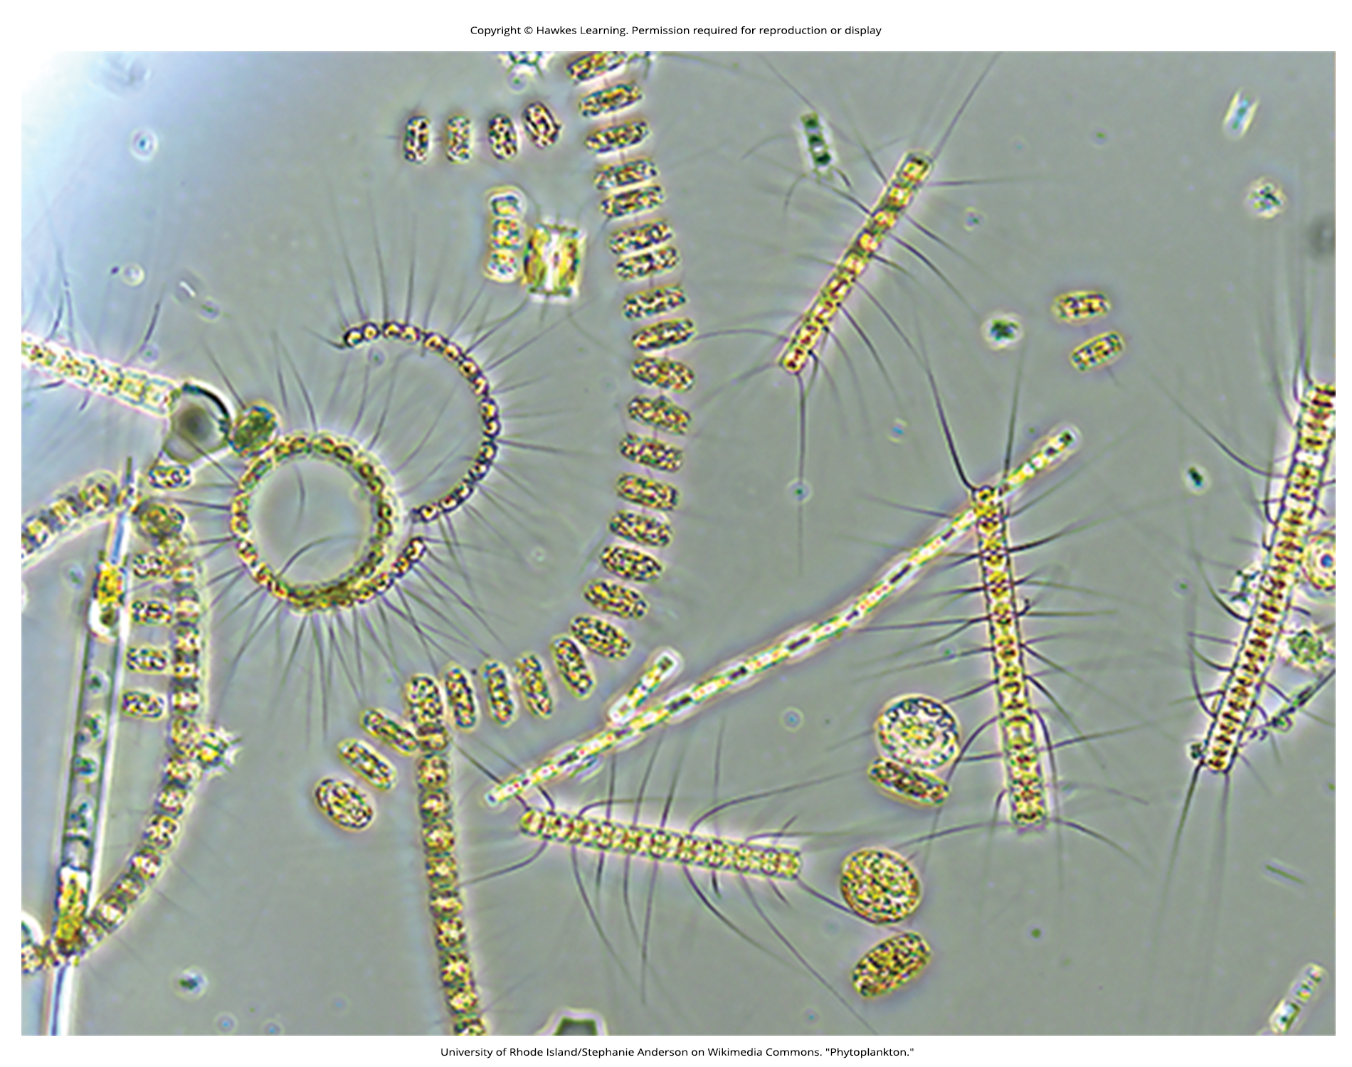
Lesson 44.4 Figure 6

Slide 32
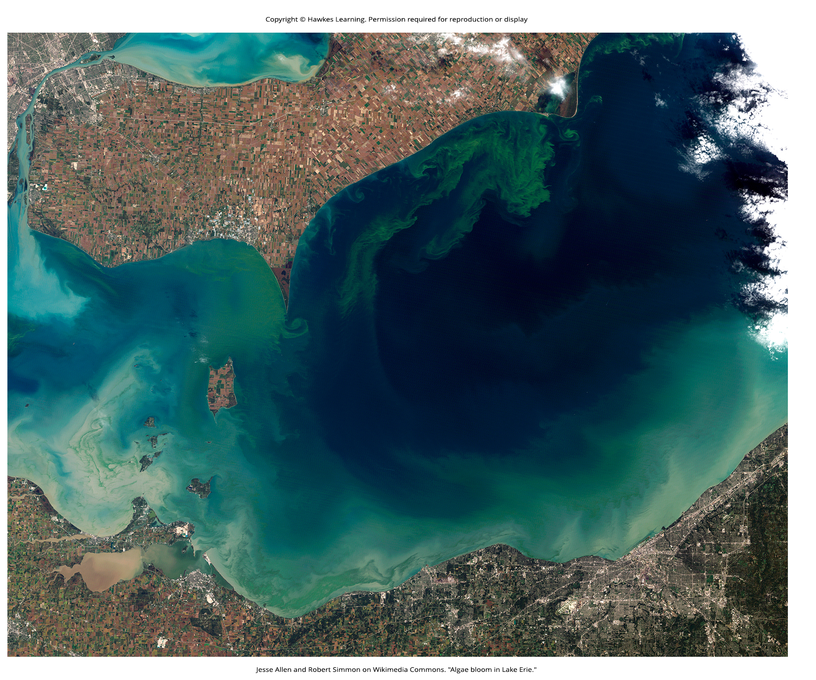
Lesson 44.4 Figure 7

Slide 33
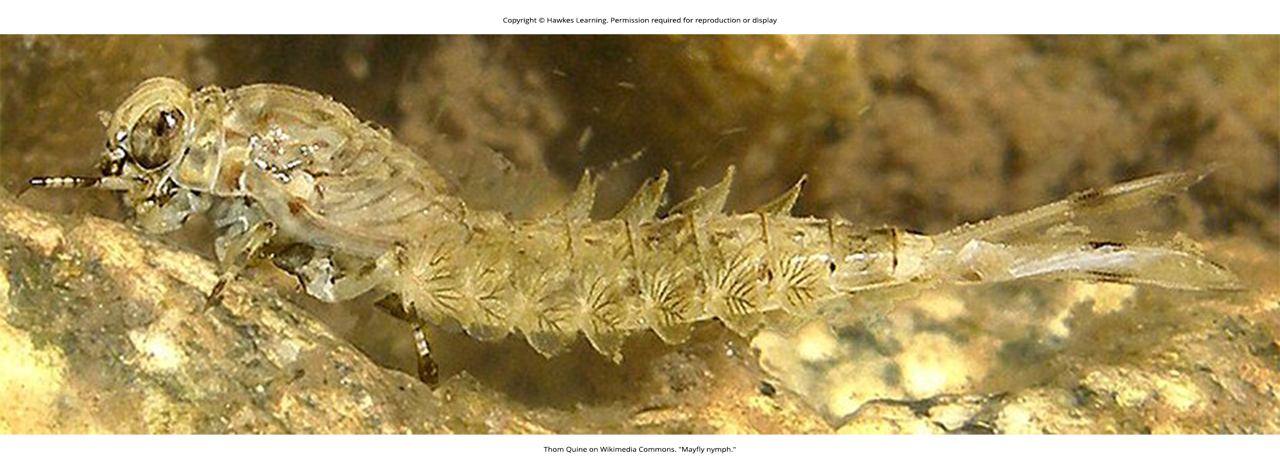
Lesson 44.4 Figure 8

Slide 34
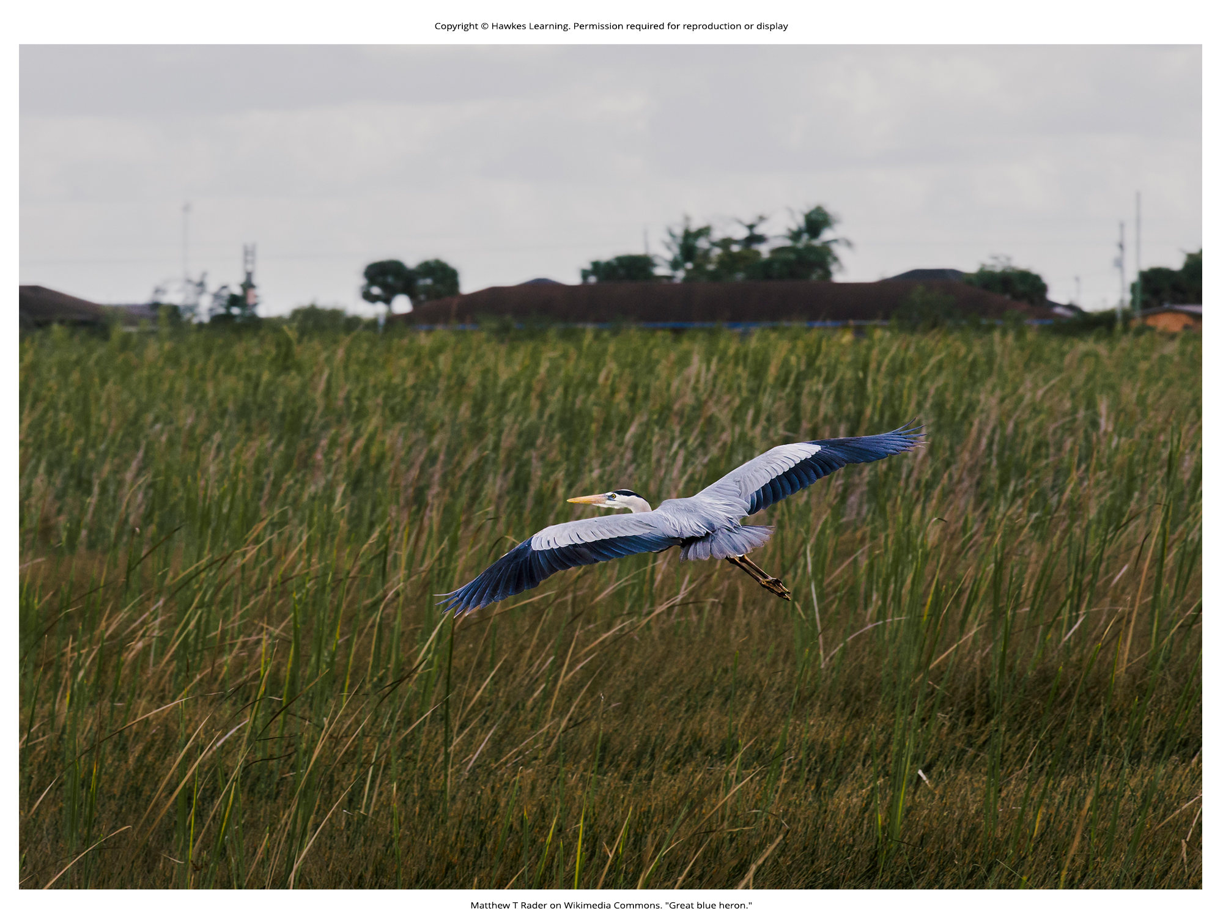
Lesson 44.4 Figure 9

Slide 35
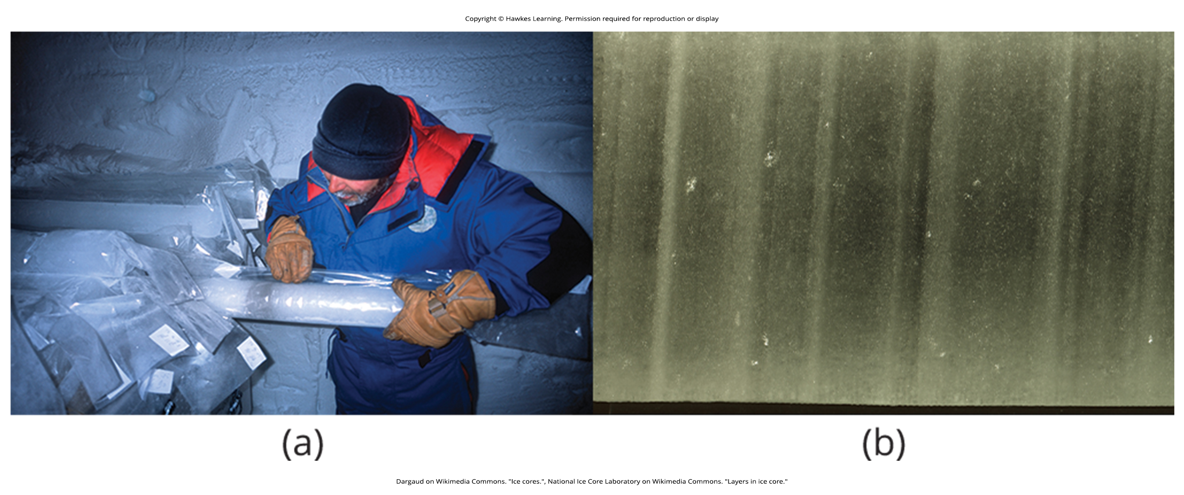
Lesson 44.5 Figure 1

Slide 36
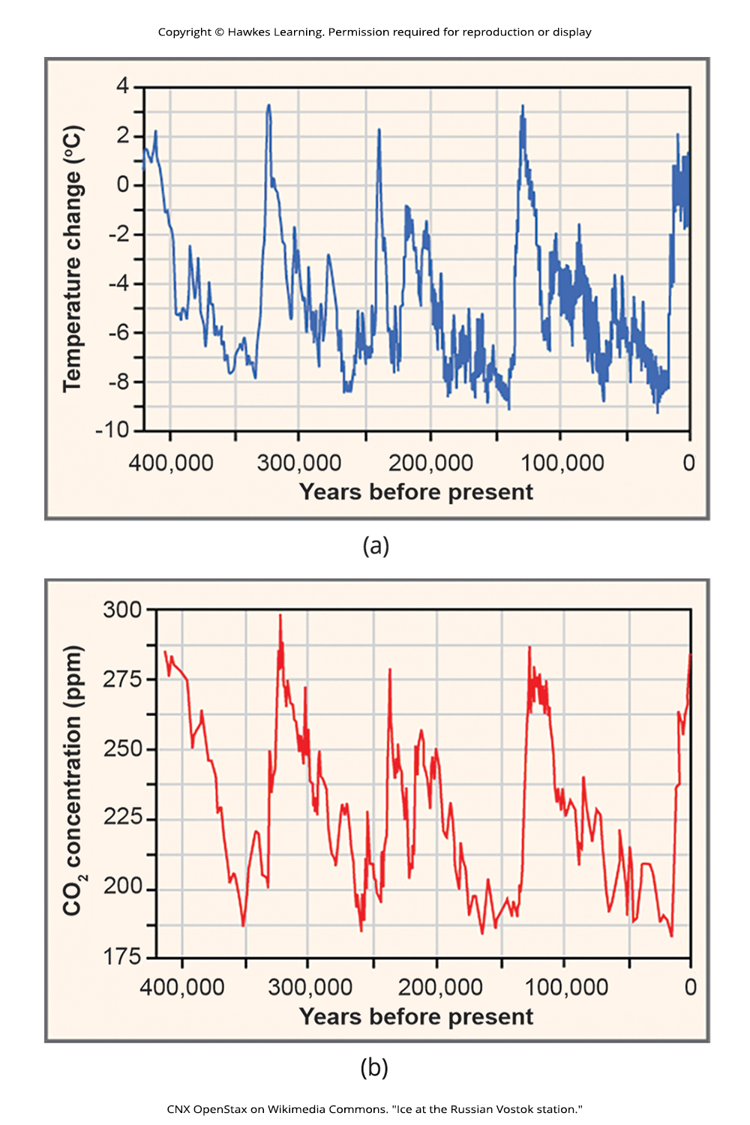
Lesson 44.5 Figure 2

Slide 37
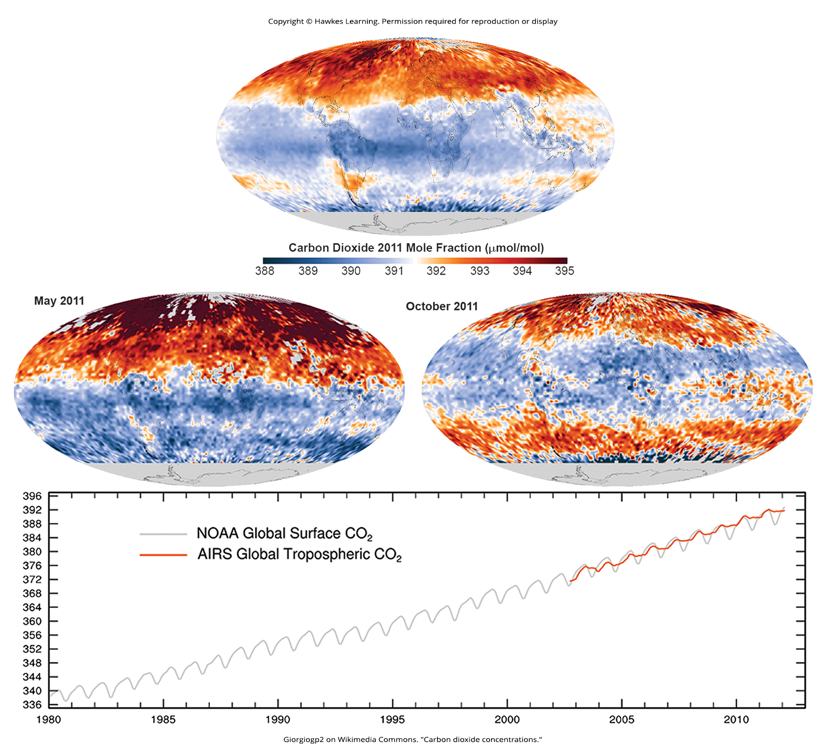
Lesson 44.5 Figure 3

Slide 38
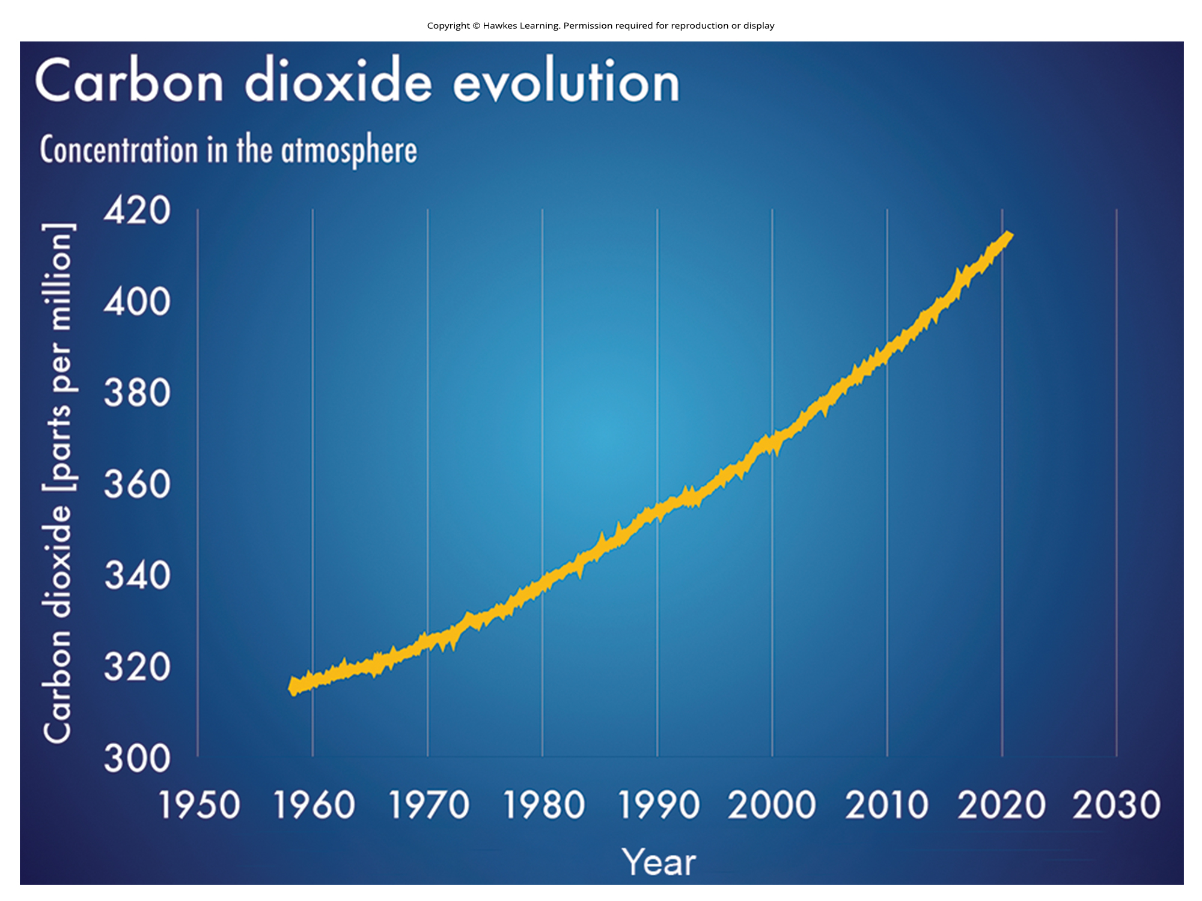
Lesson 44.5 Figure 4

Slide 39
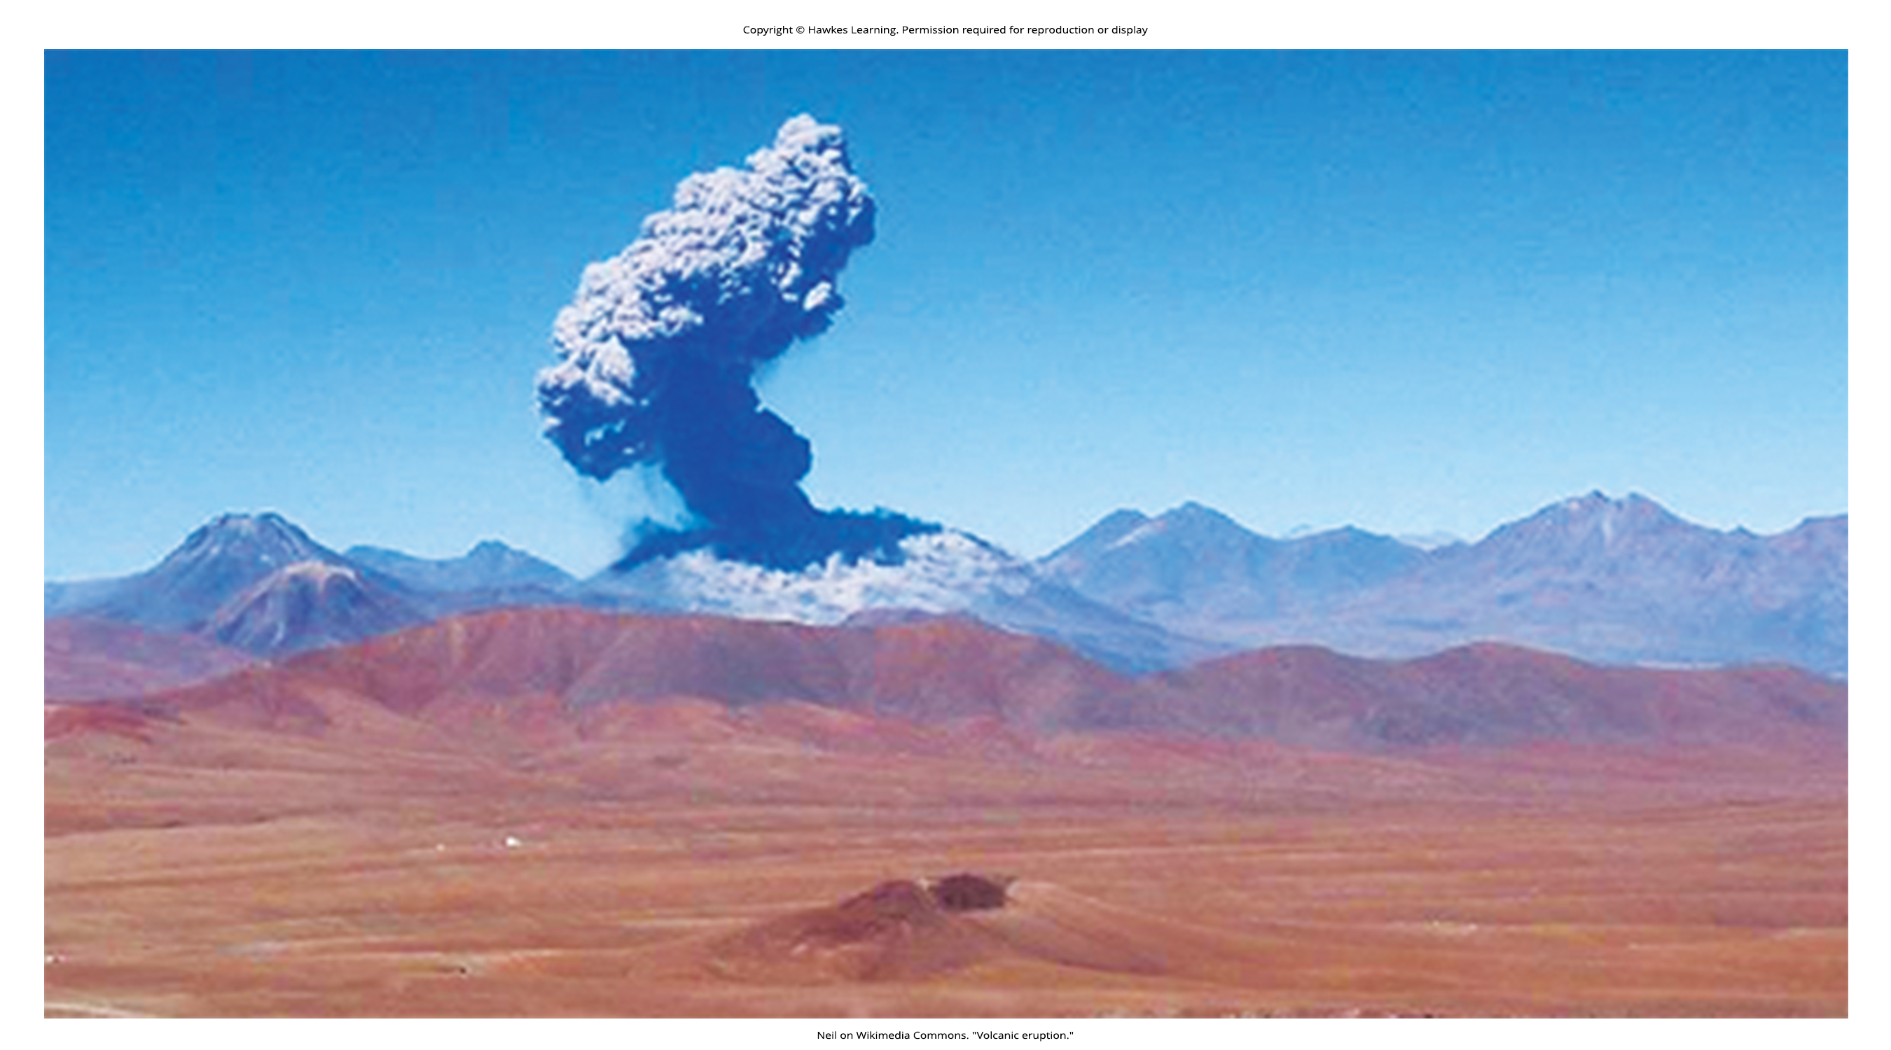
Lesson 44.5 Figure 5

Slide 40
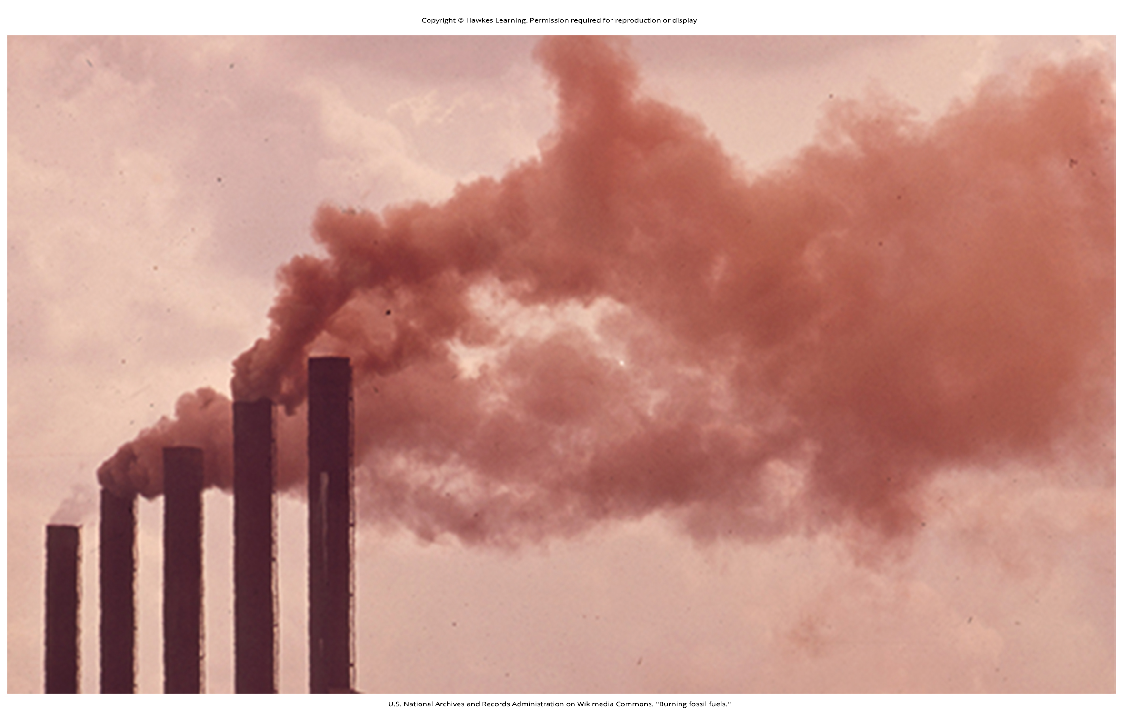
Lesson 44.5 Figure 6

Slide 41
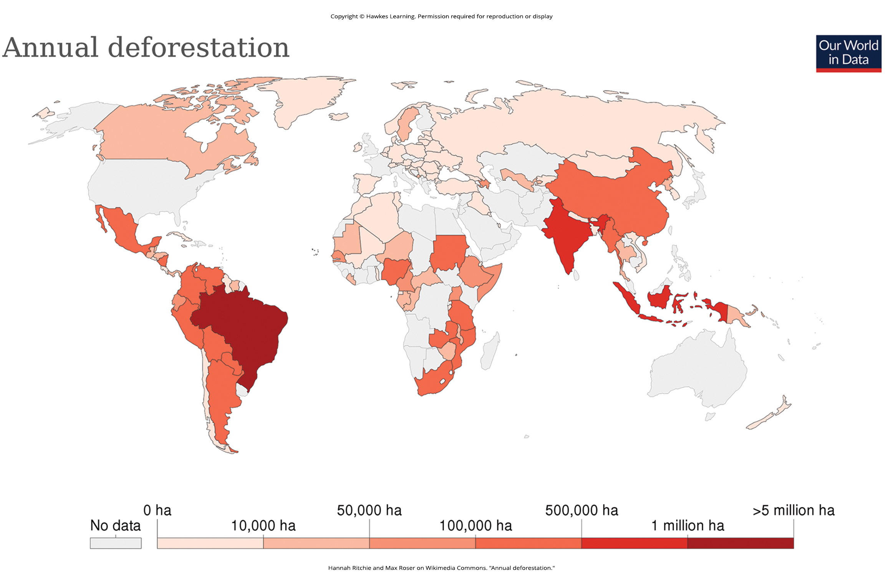
Lesson 44.5 Figure 7

Slide 42
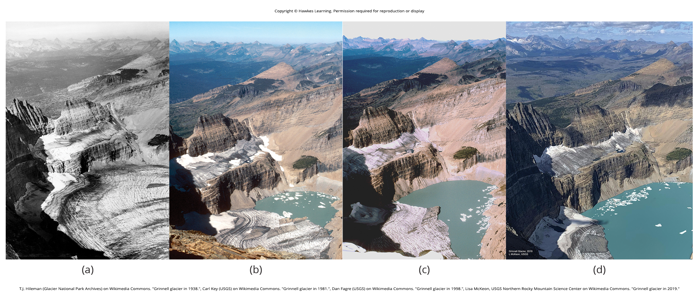
Lesson 44.5 Figure 8

Slide 43
Hawkes Learning – End of PowerPoint

