Slide 1
Chapter 45
Population and Community

Slide 2
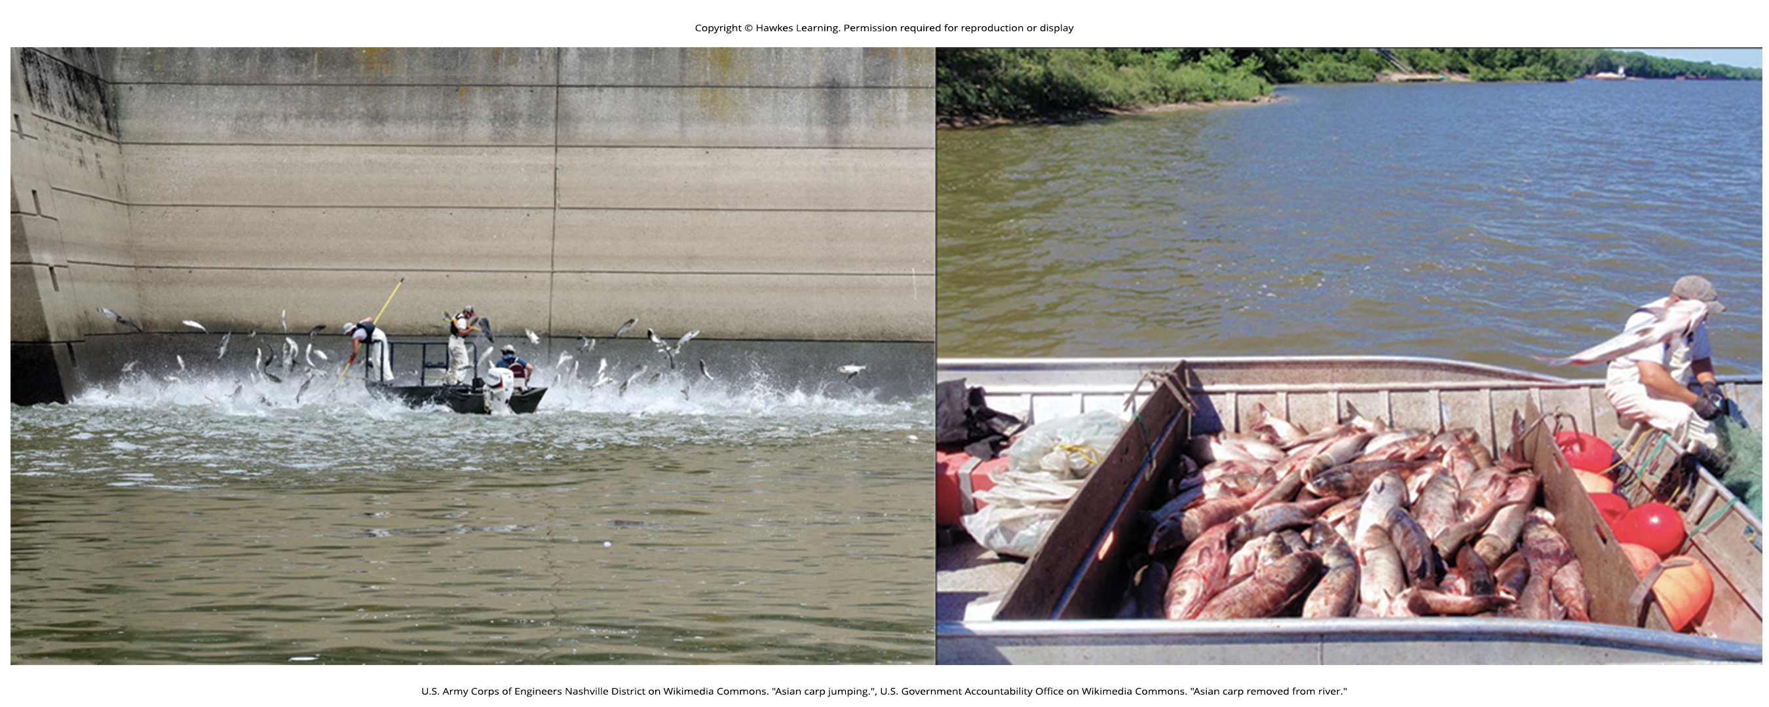
Lesson 45.1 Figure 1

Slide 3
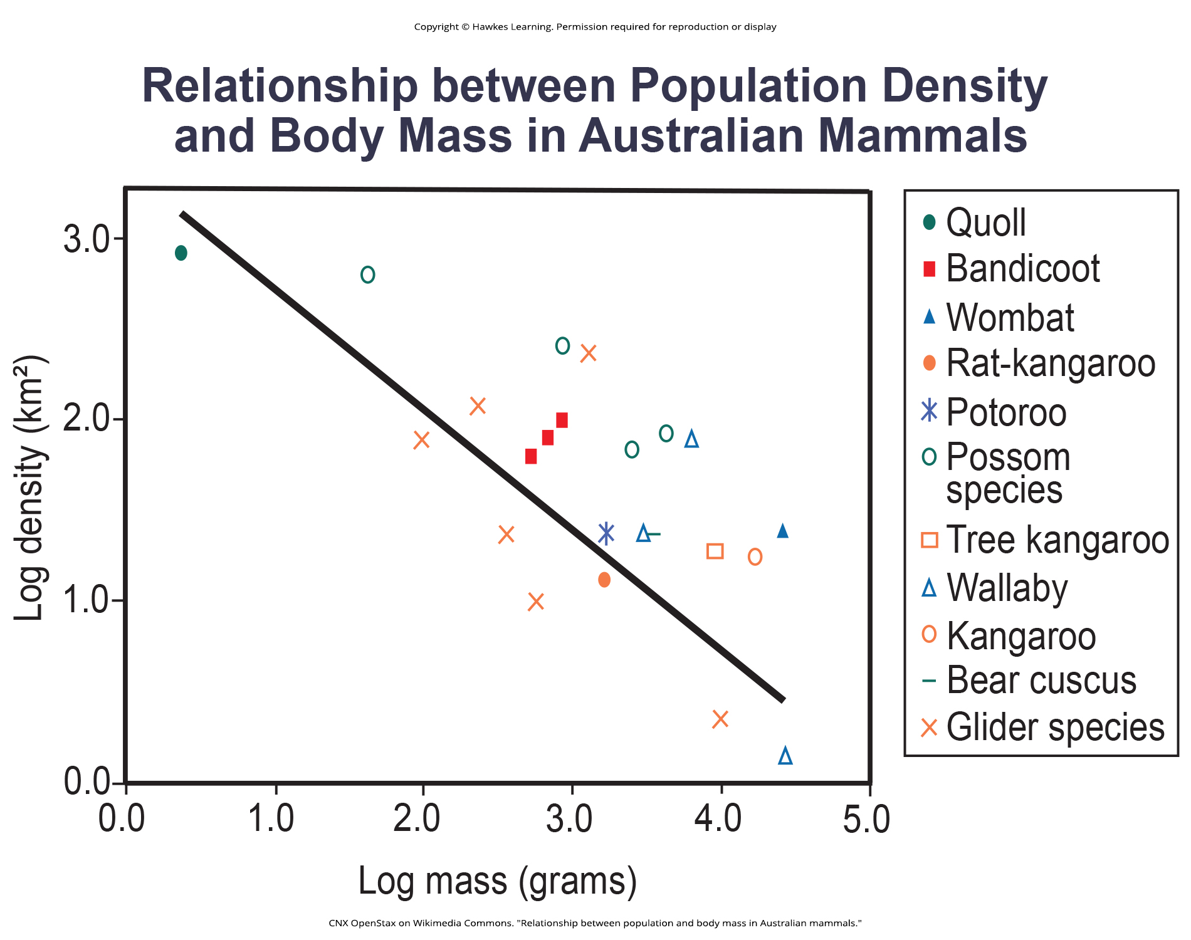
Lesson 45.1 Figure 2

Slide 4
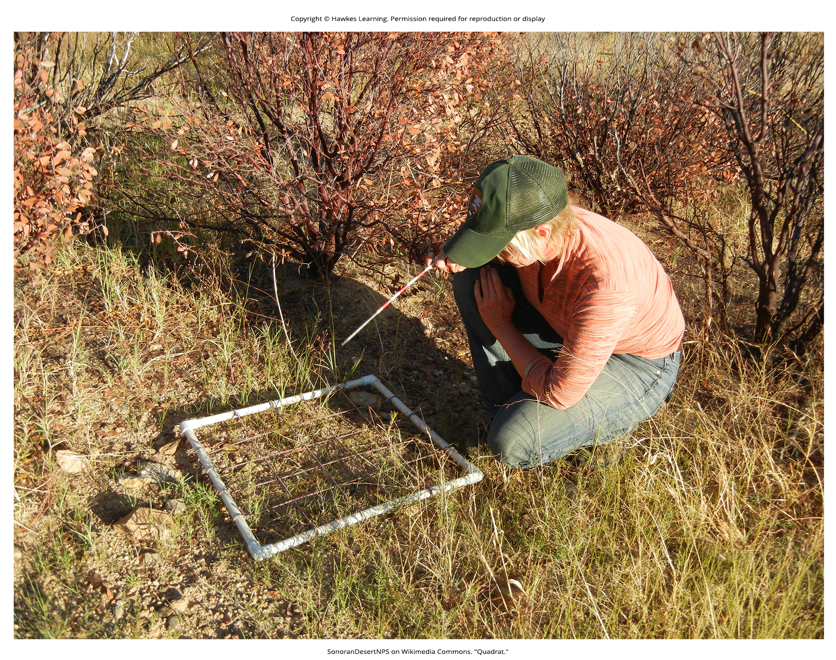
Lesson 45.1 Figure 3

Slide 5
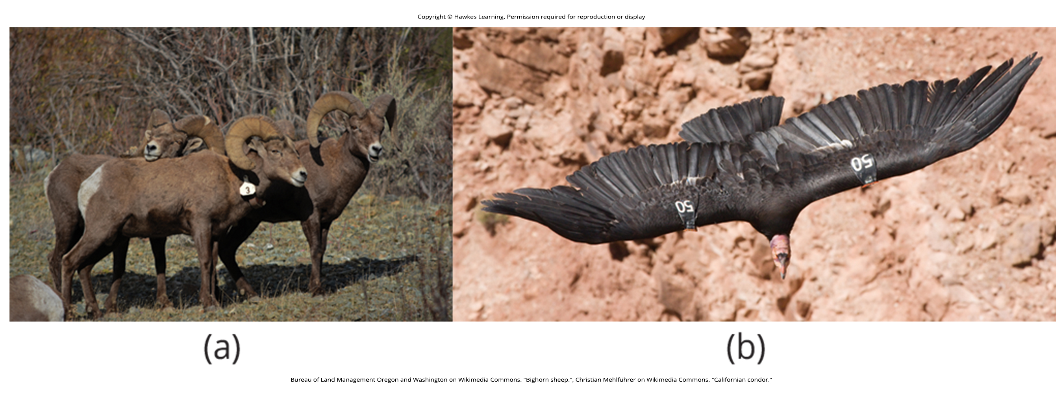
Lesson 45.1 Figure 4

Slide 6
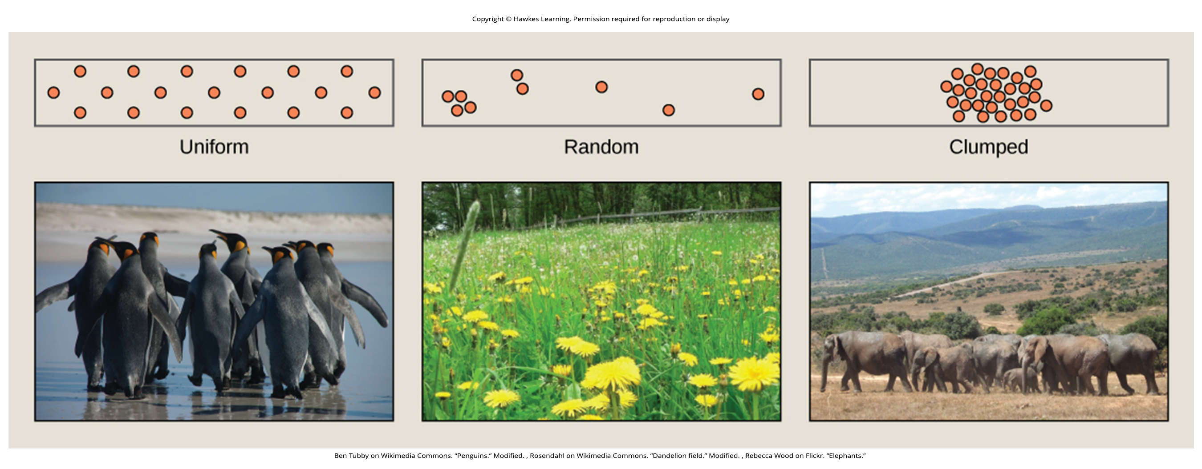
Lesson 45.1 Figure 5

Slide 7
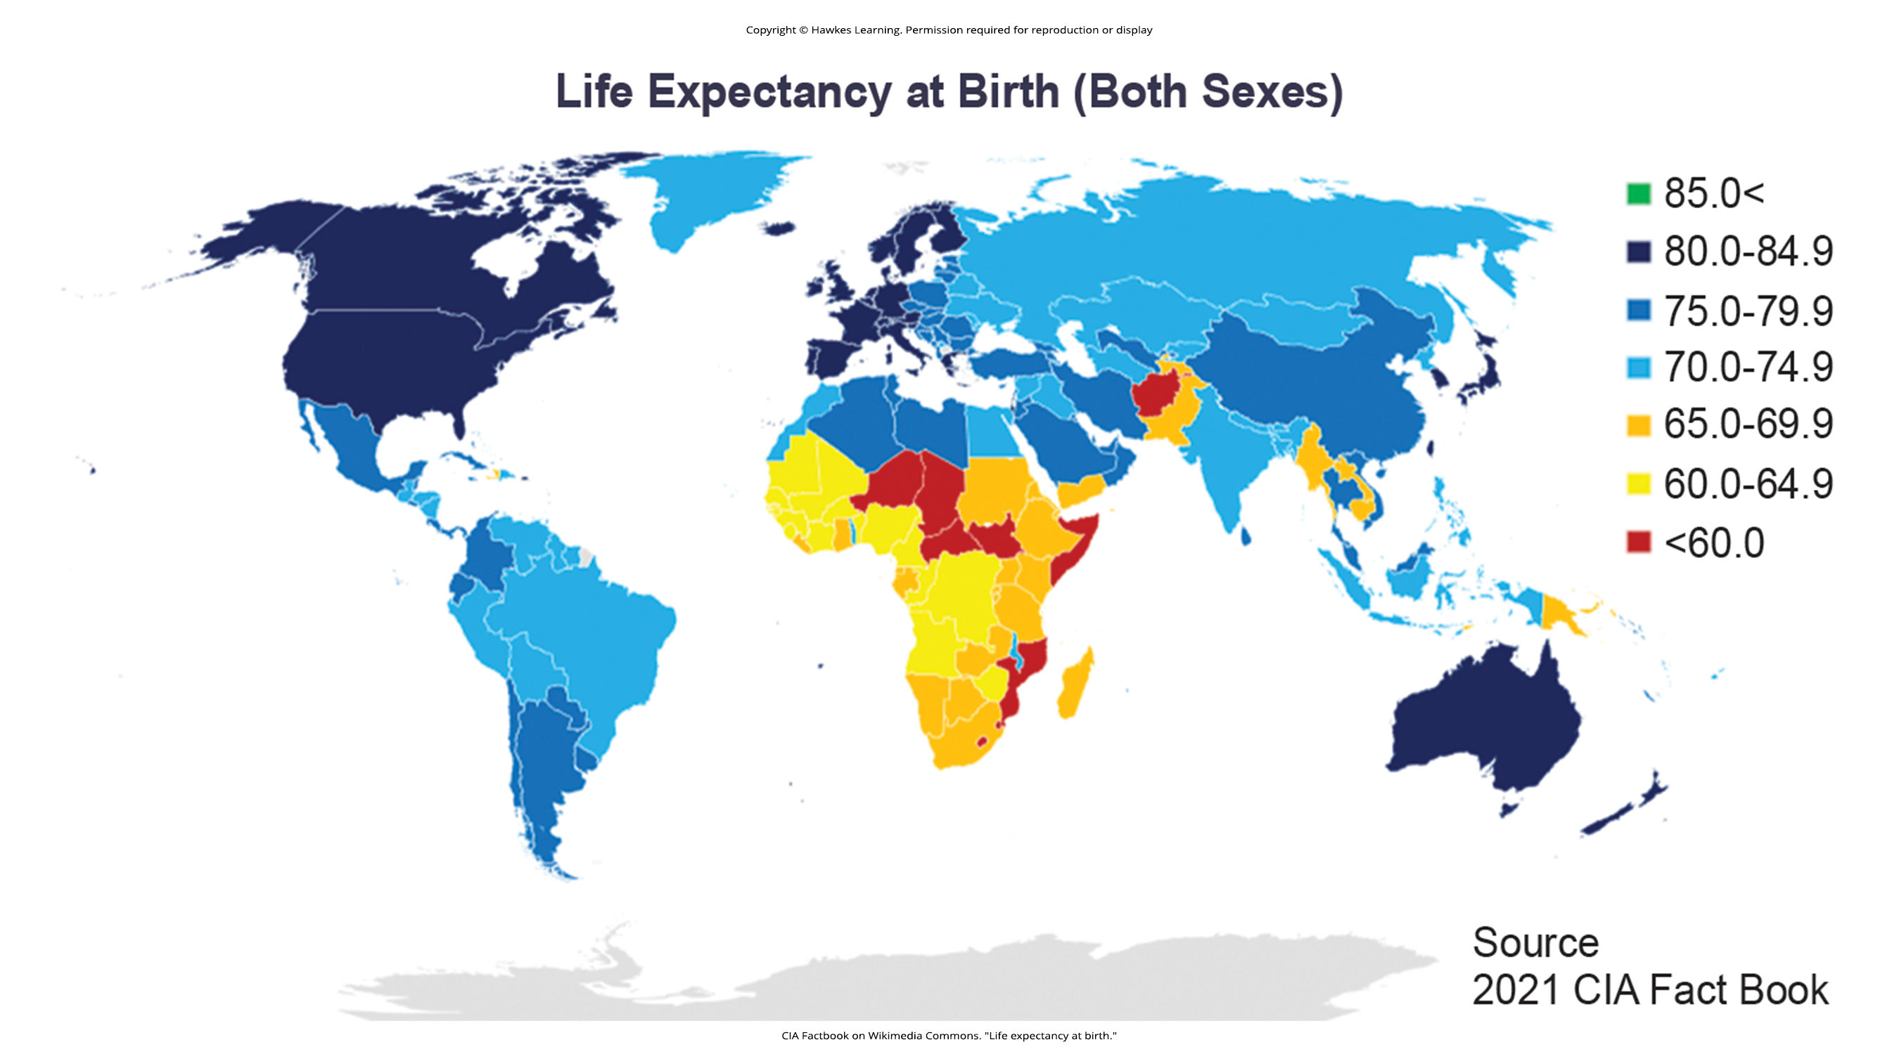
Lesson 45.1 Figure 6

Slide 8
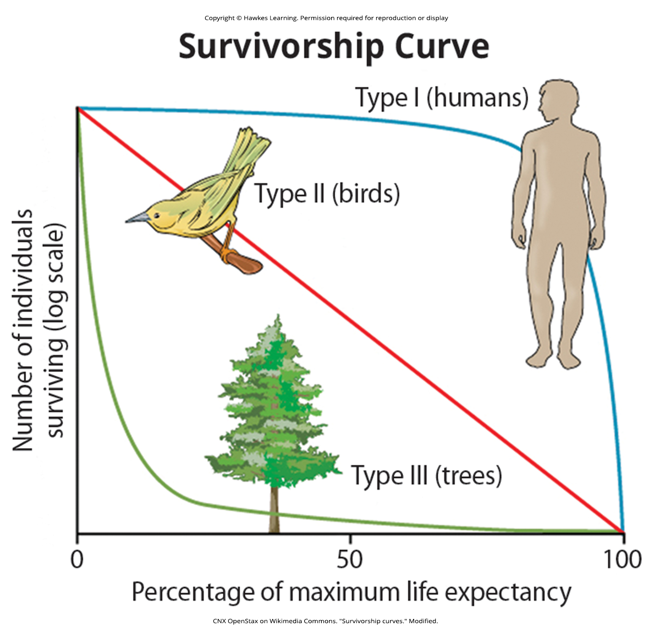
Lesson 45.1 Figure 7

Slide 9
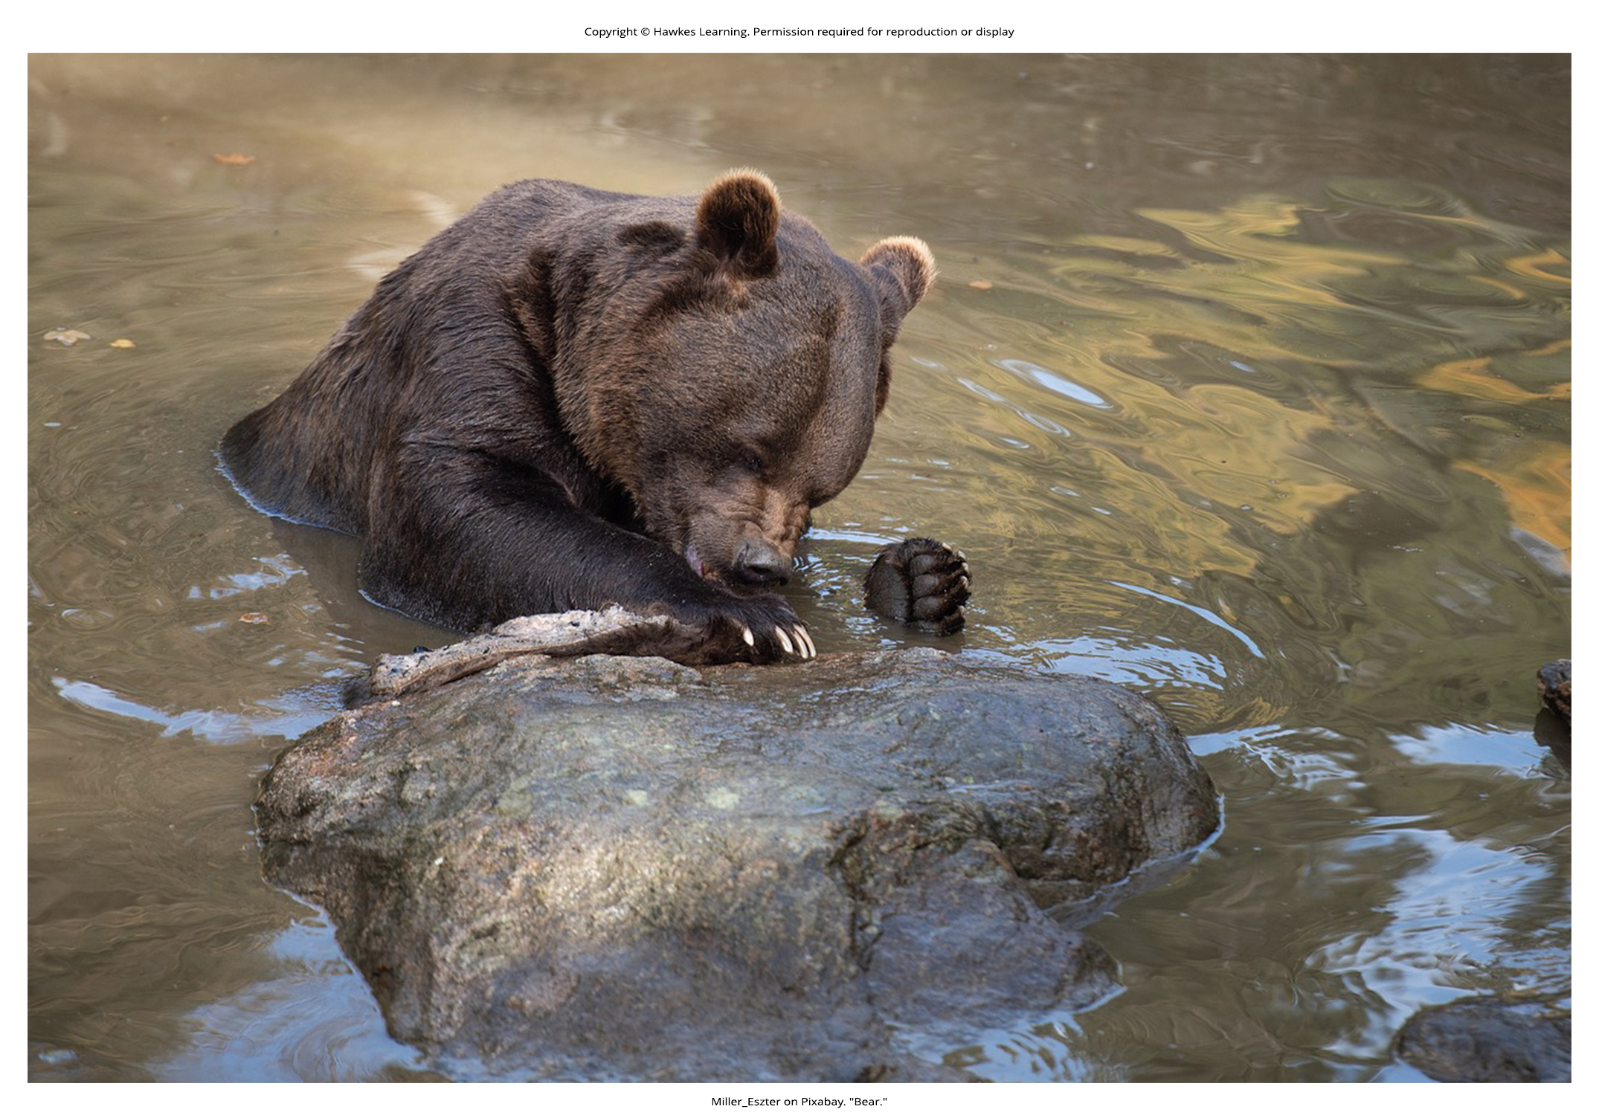
Lesson 45.2 Figure 1

Slide 10

Lesson 45.2 Figure 2

Slide 11
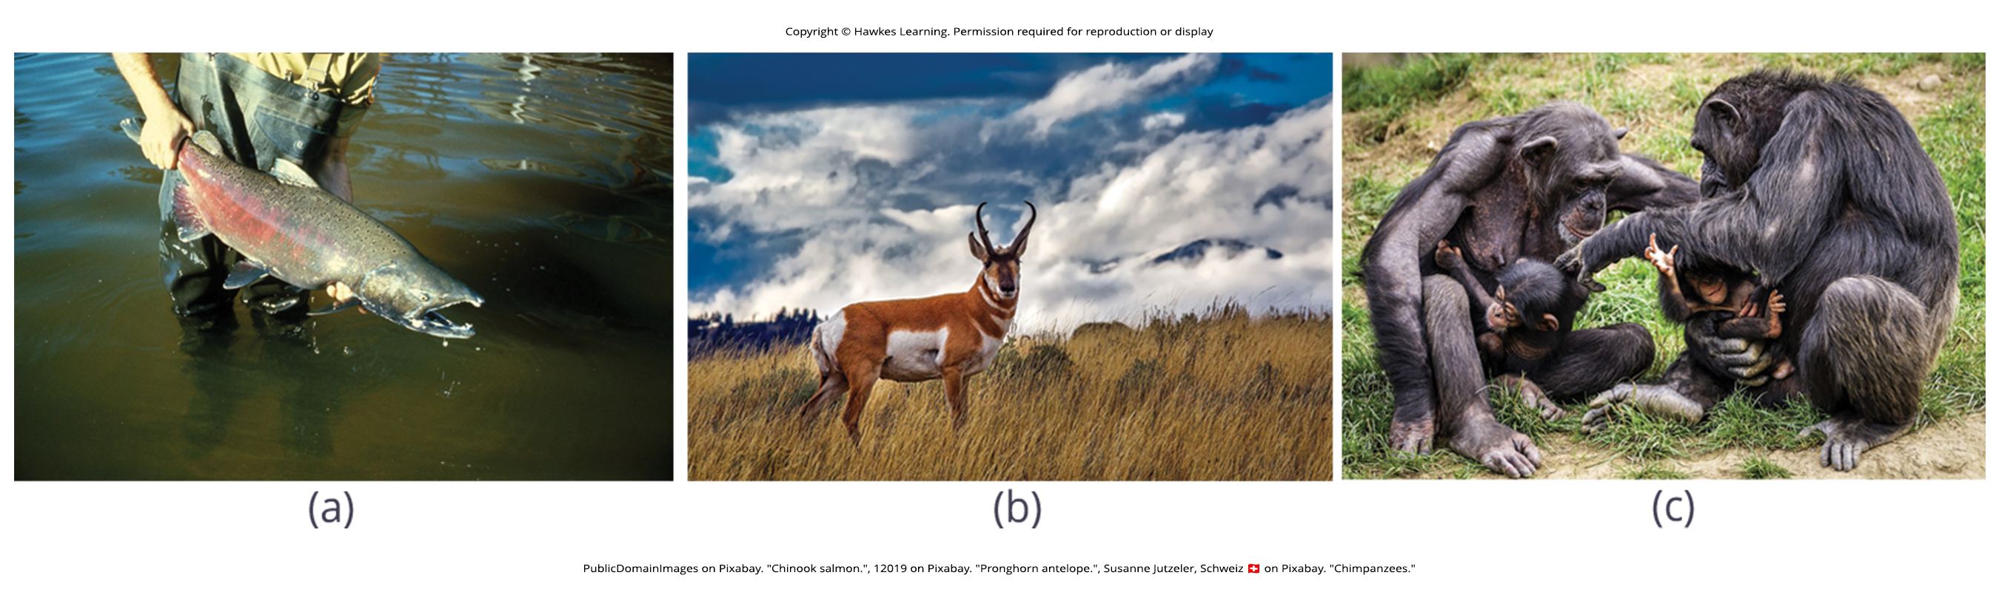
Lesson 45.2 Figure 3

Slide 12
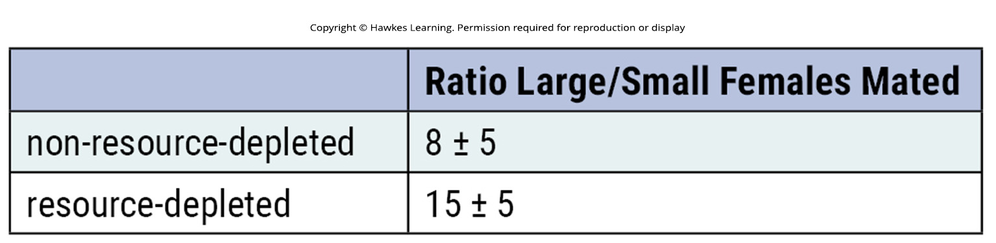
Lesson 45.2 Figure 4

Slide 13
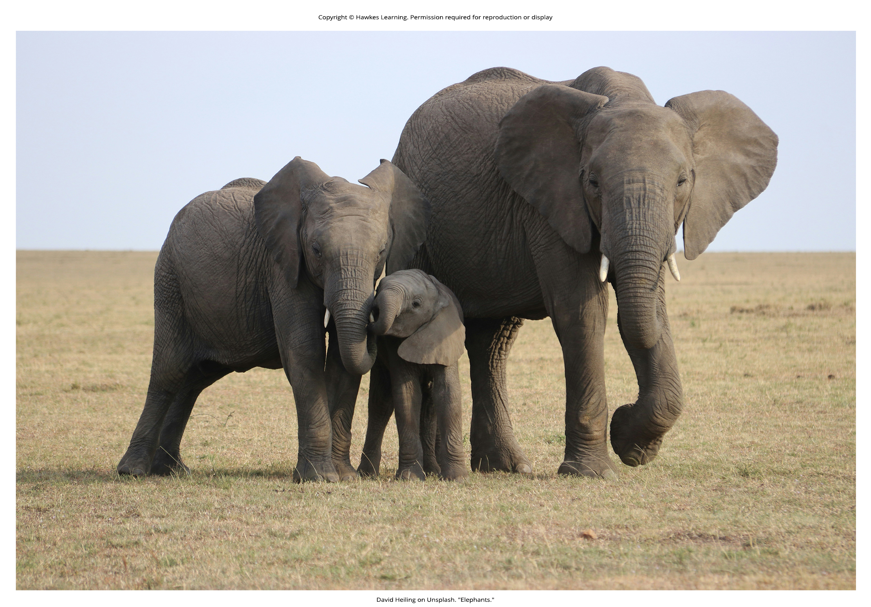
Lesson 45.2 Figure 5

Slide 14
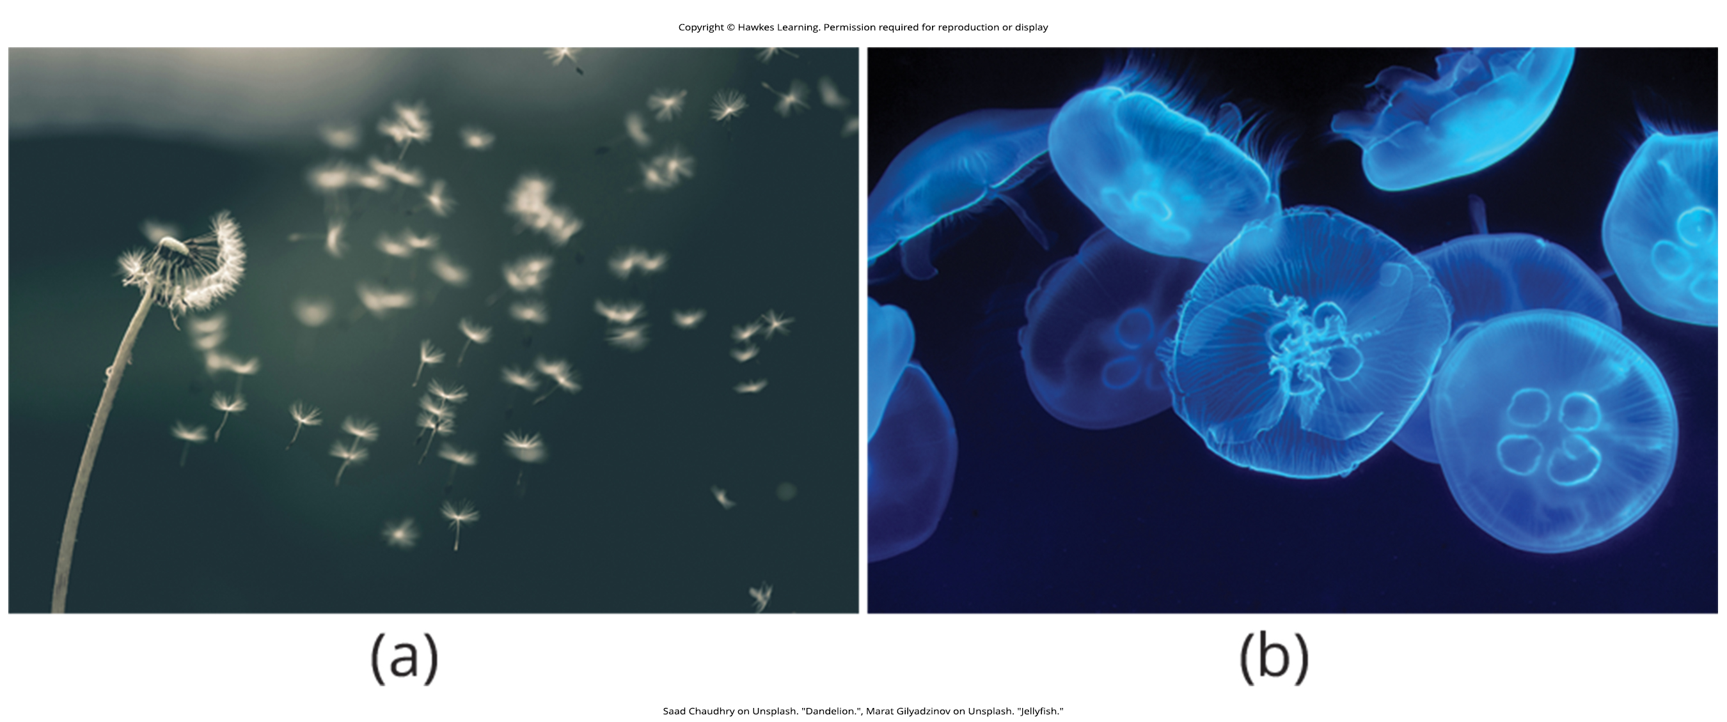
Lesson 45.2 Figure 6

Slide 15
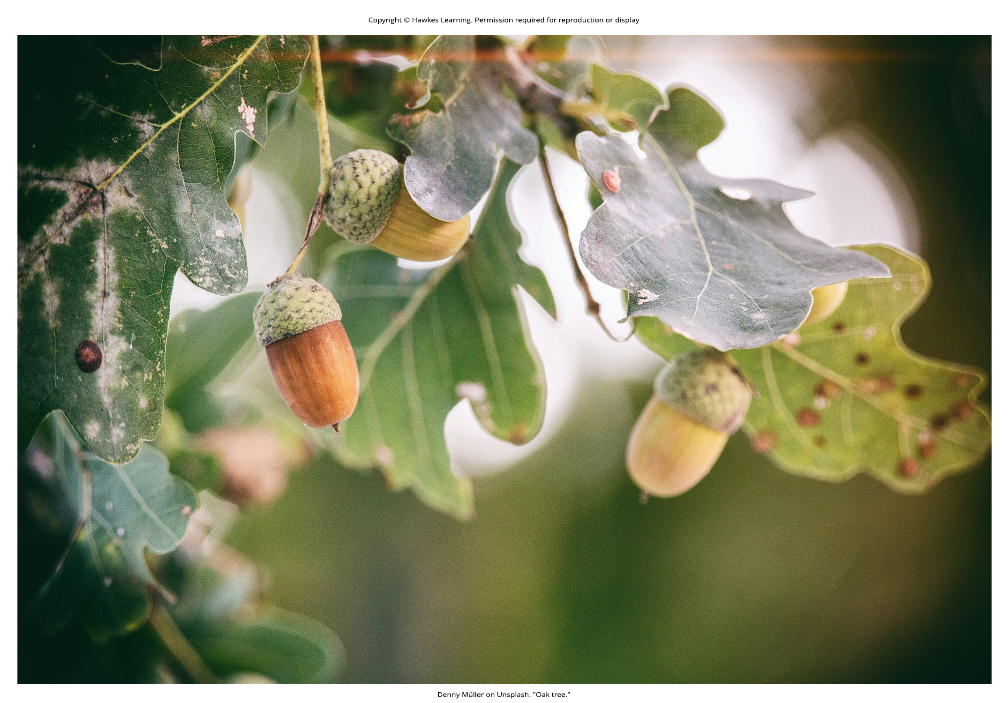
Lesson 45.2 Figure 7

Slide 16
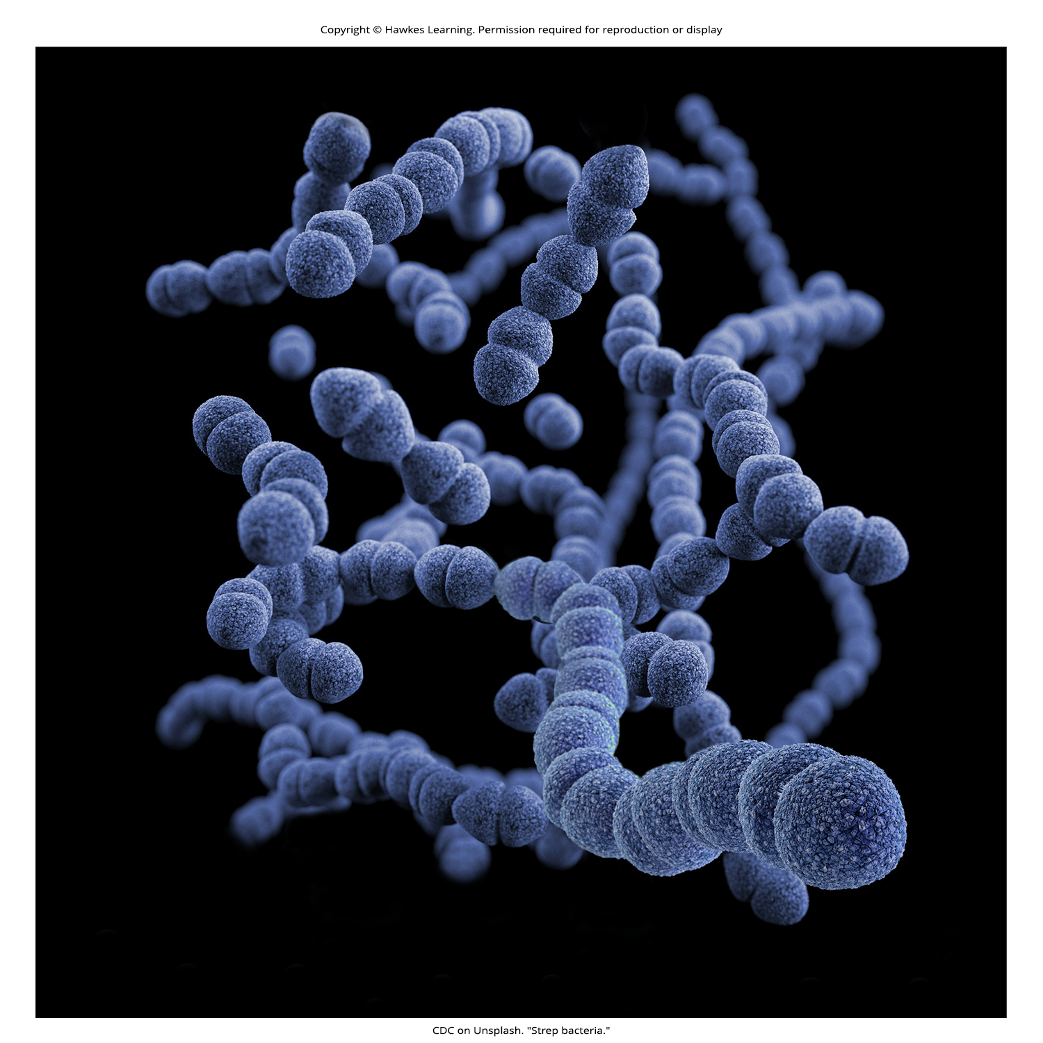
Lesson 45.3 Figure 1

Slide 17
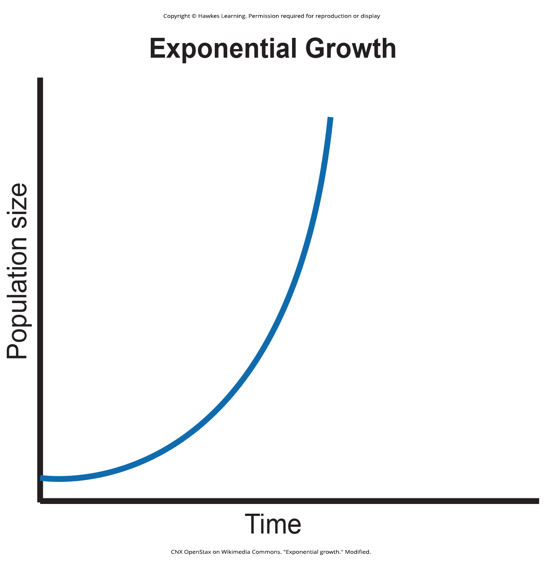
Lesson 45.3 Figure 2

Slide 18
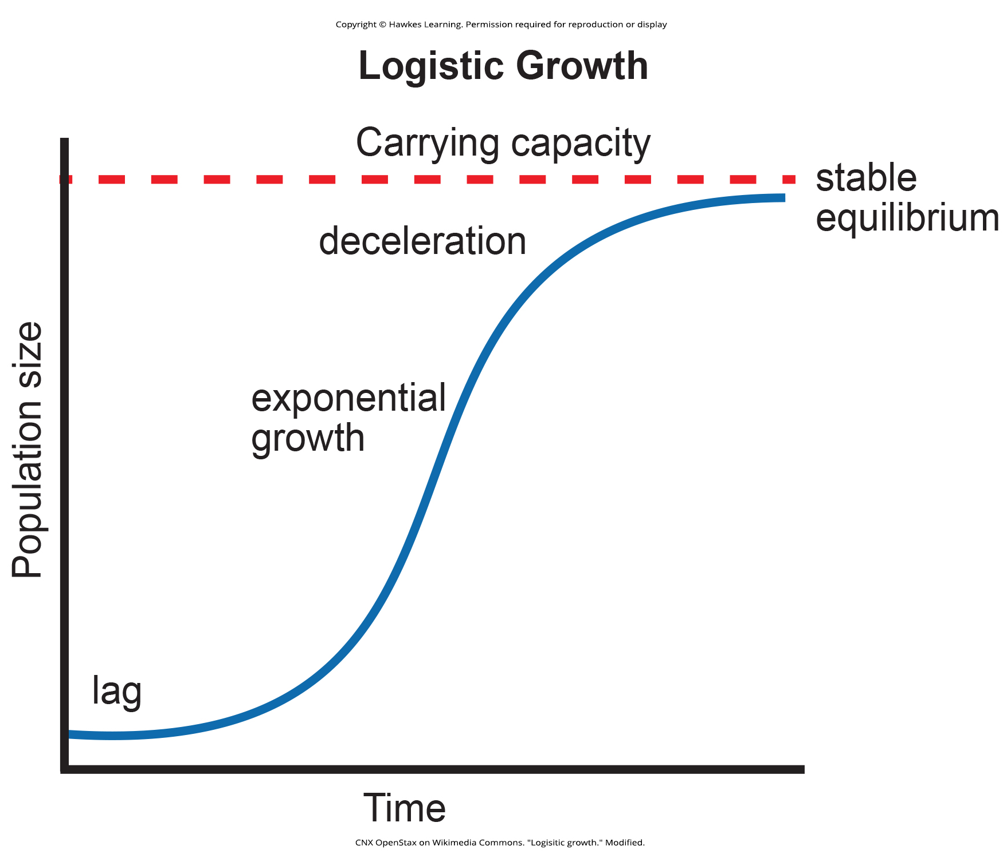
Lesson 45.3 Figure 3

Slide 19
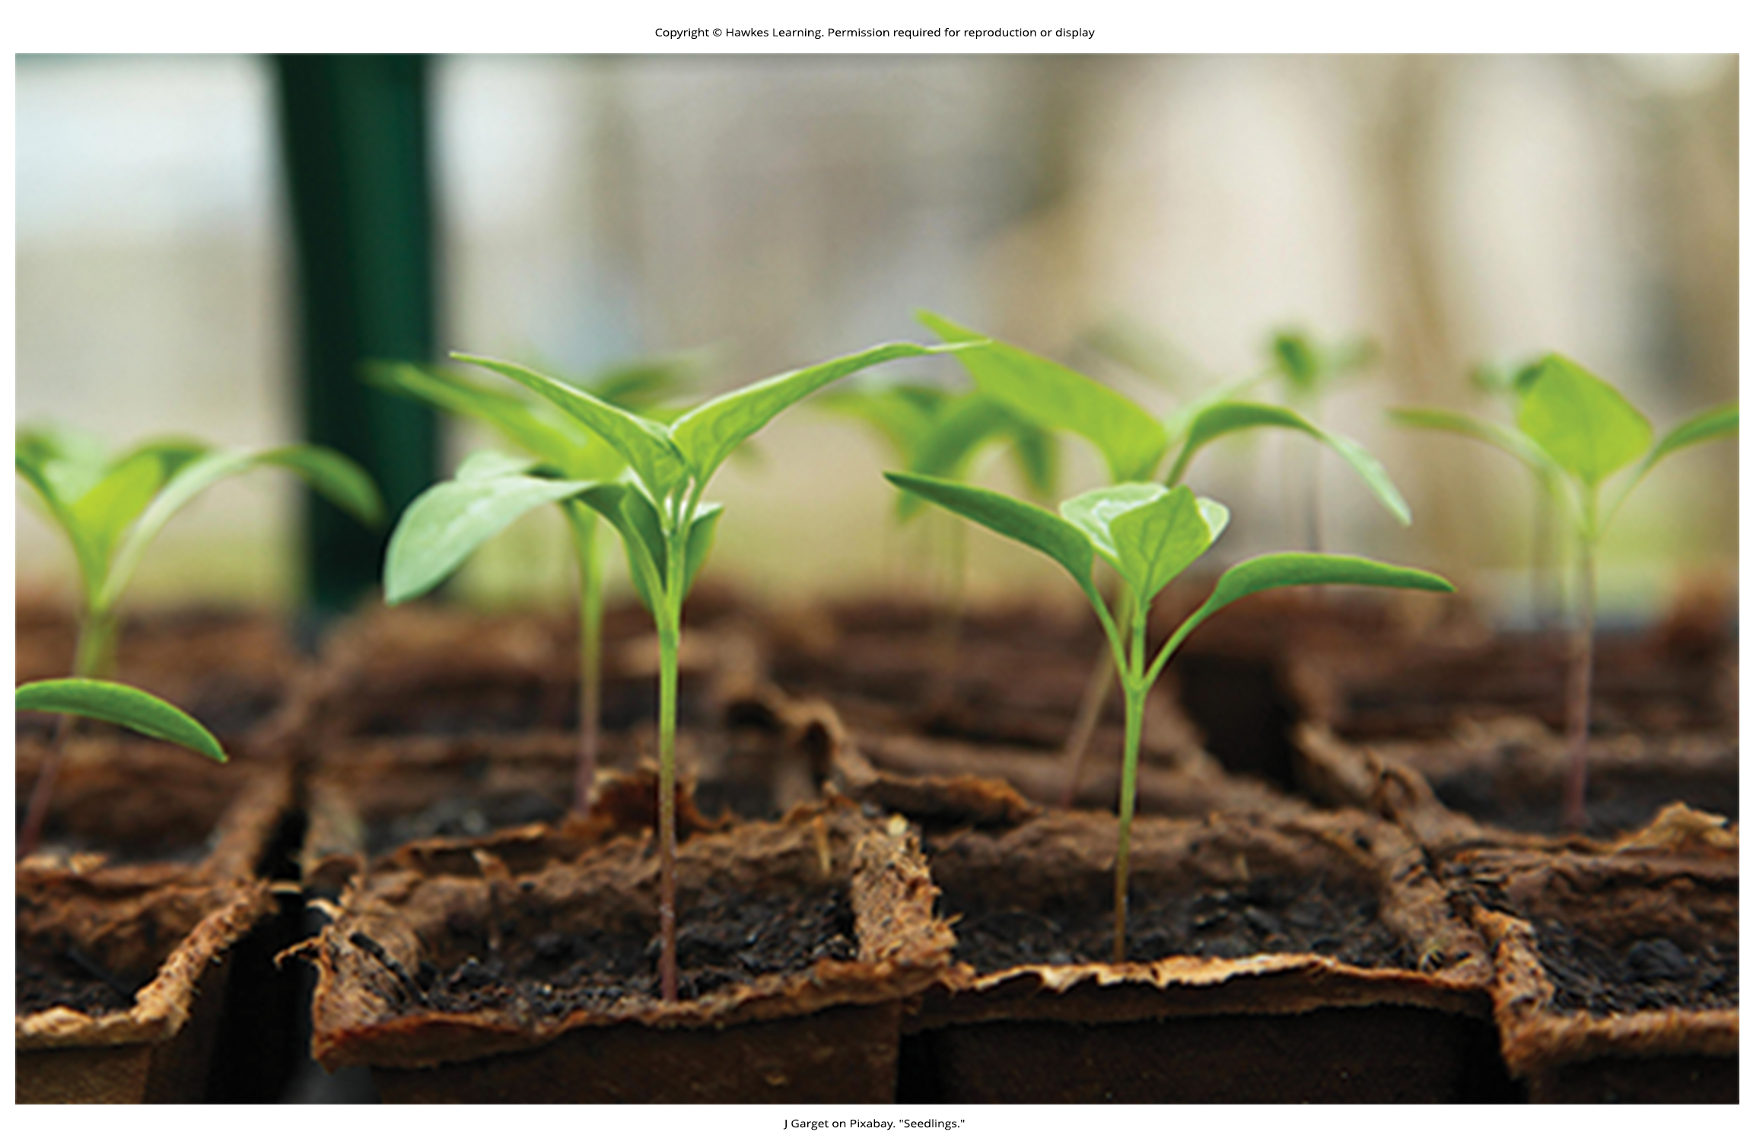
Lesson 45.3 Figure 4

Slide 20
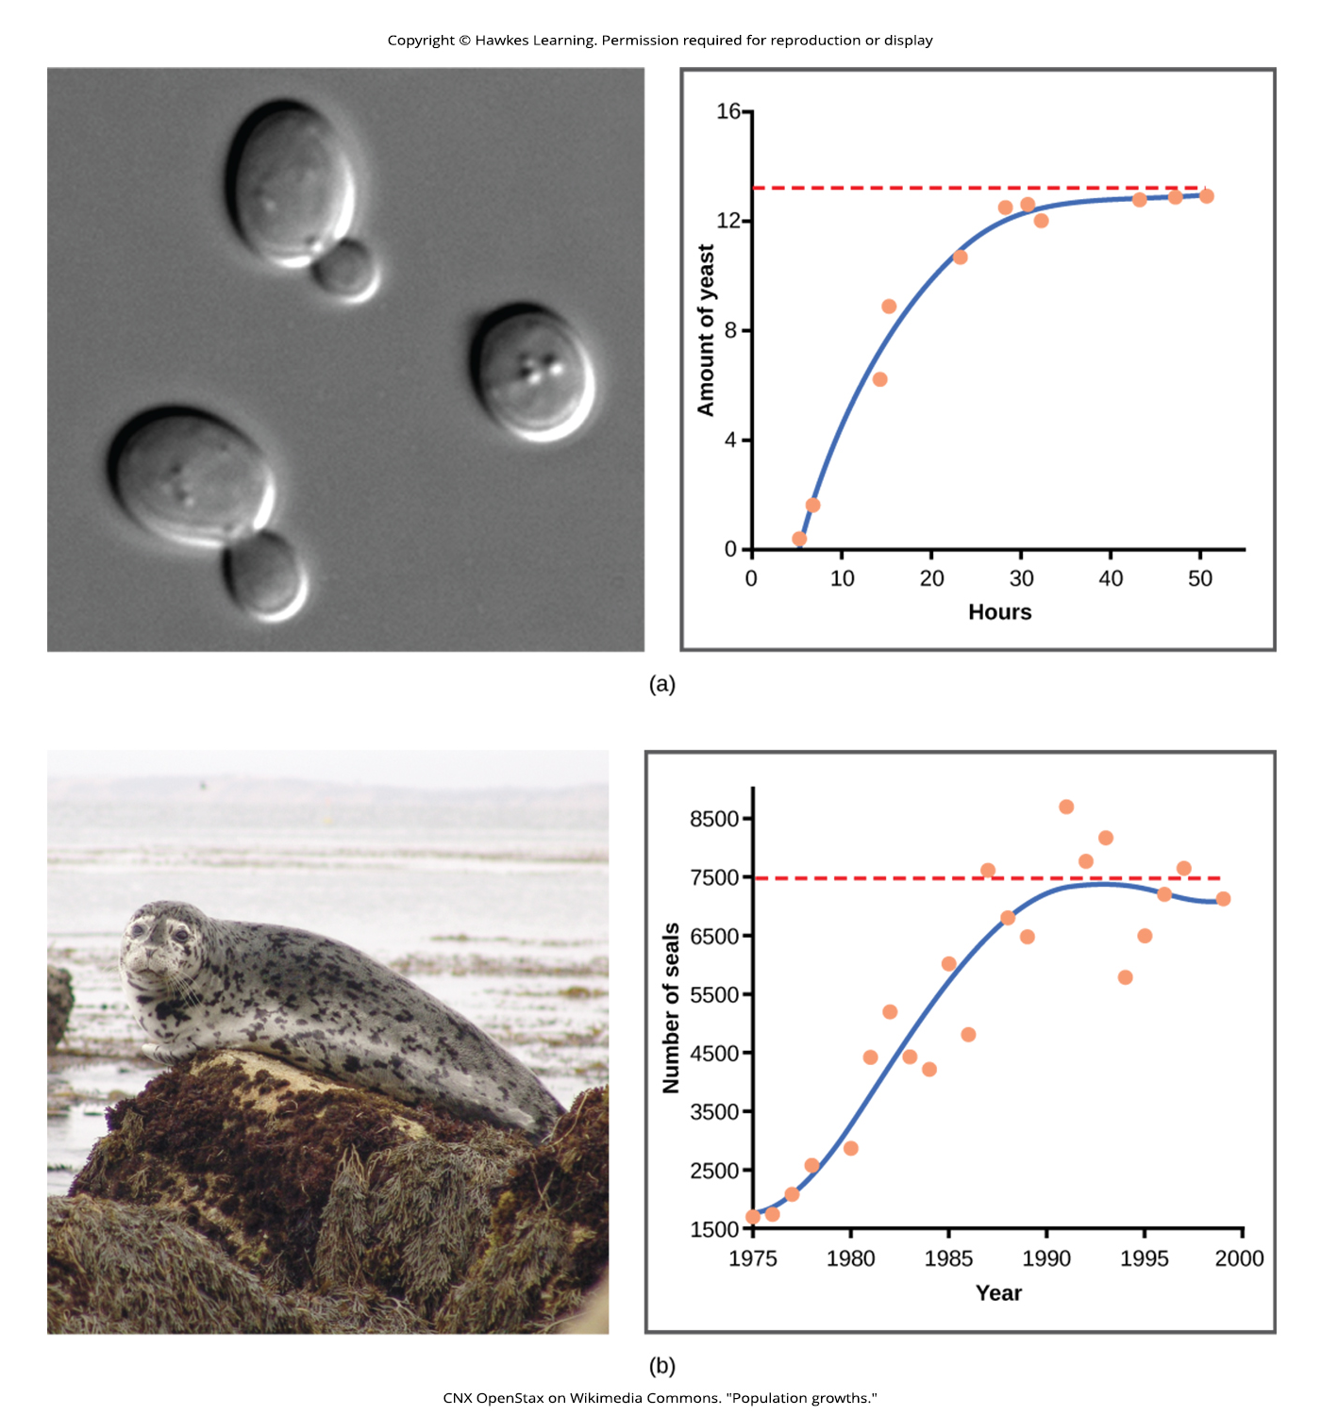
Lesson 45.3 Figure 5

Slide 21
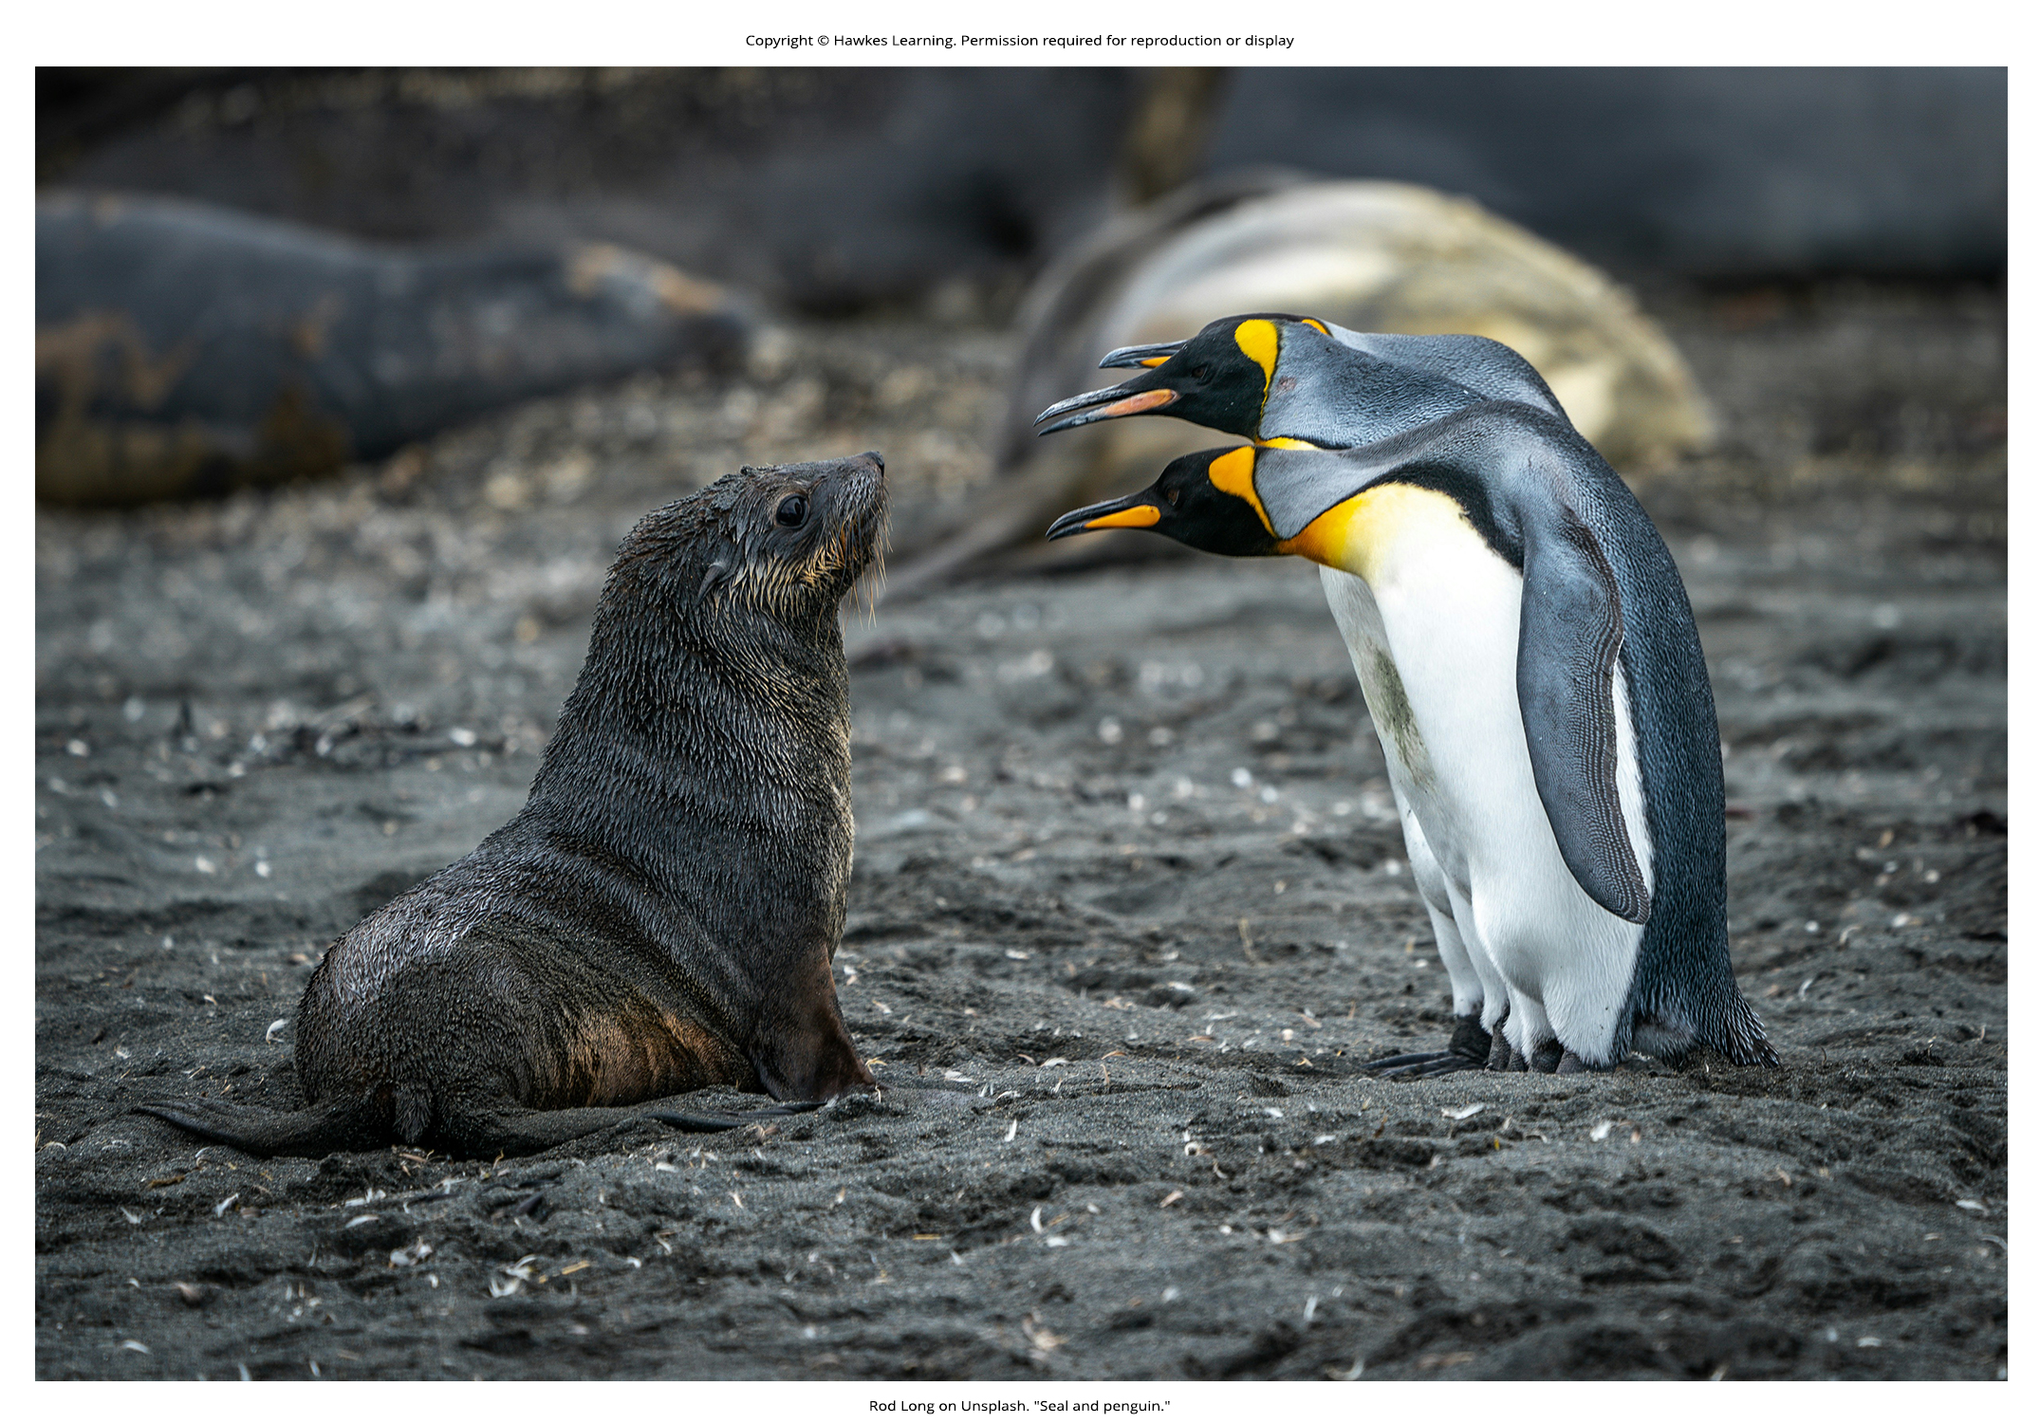
Lesson 45.3 Figure 6

Slide 22
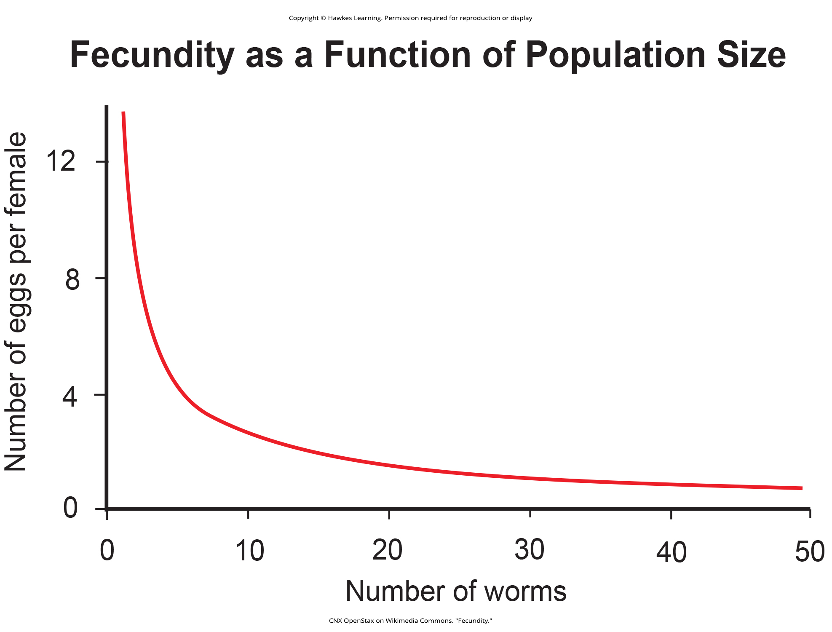
Lesson 45.3 Figure 7

Slide 23
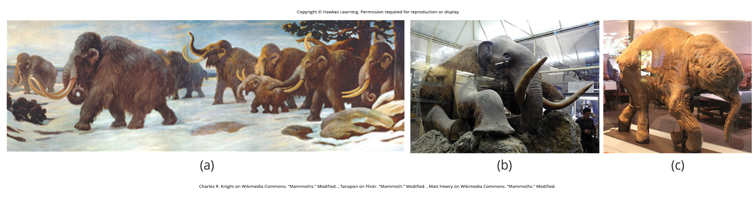
Lesson 45.3 Figure 8

Slide 24
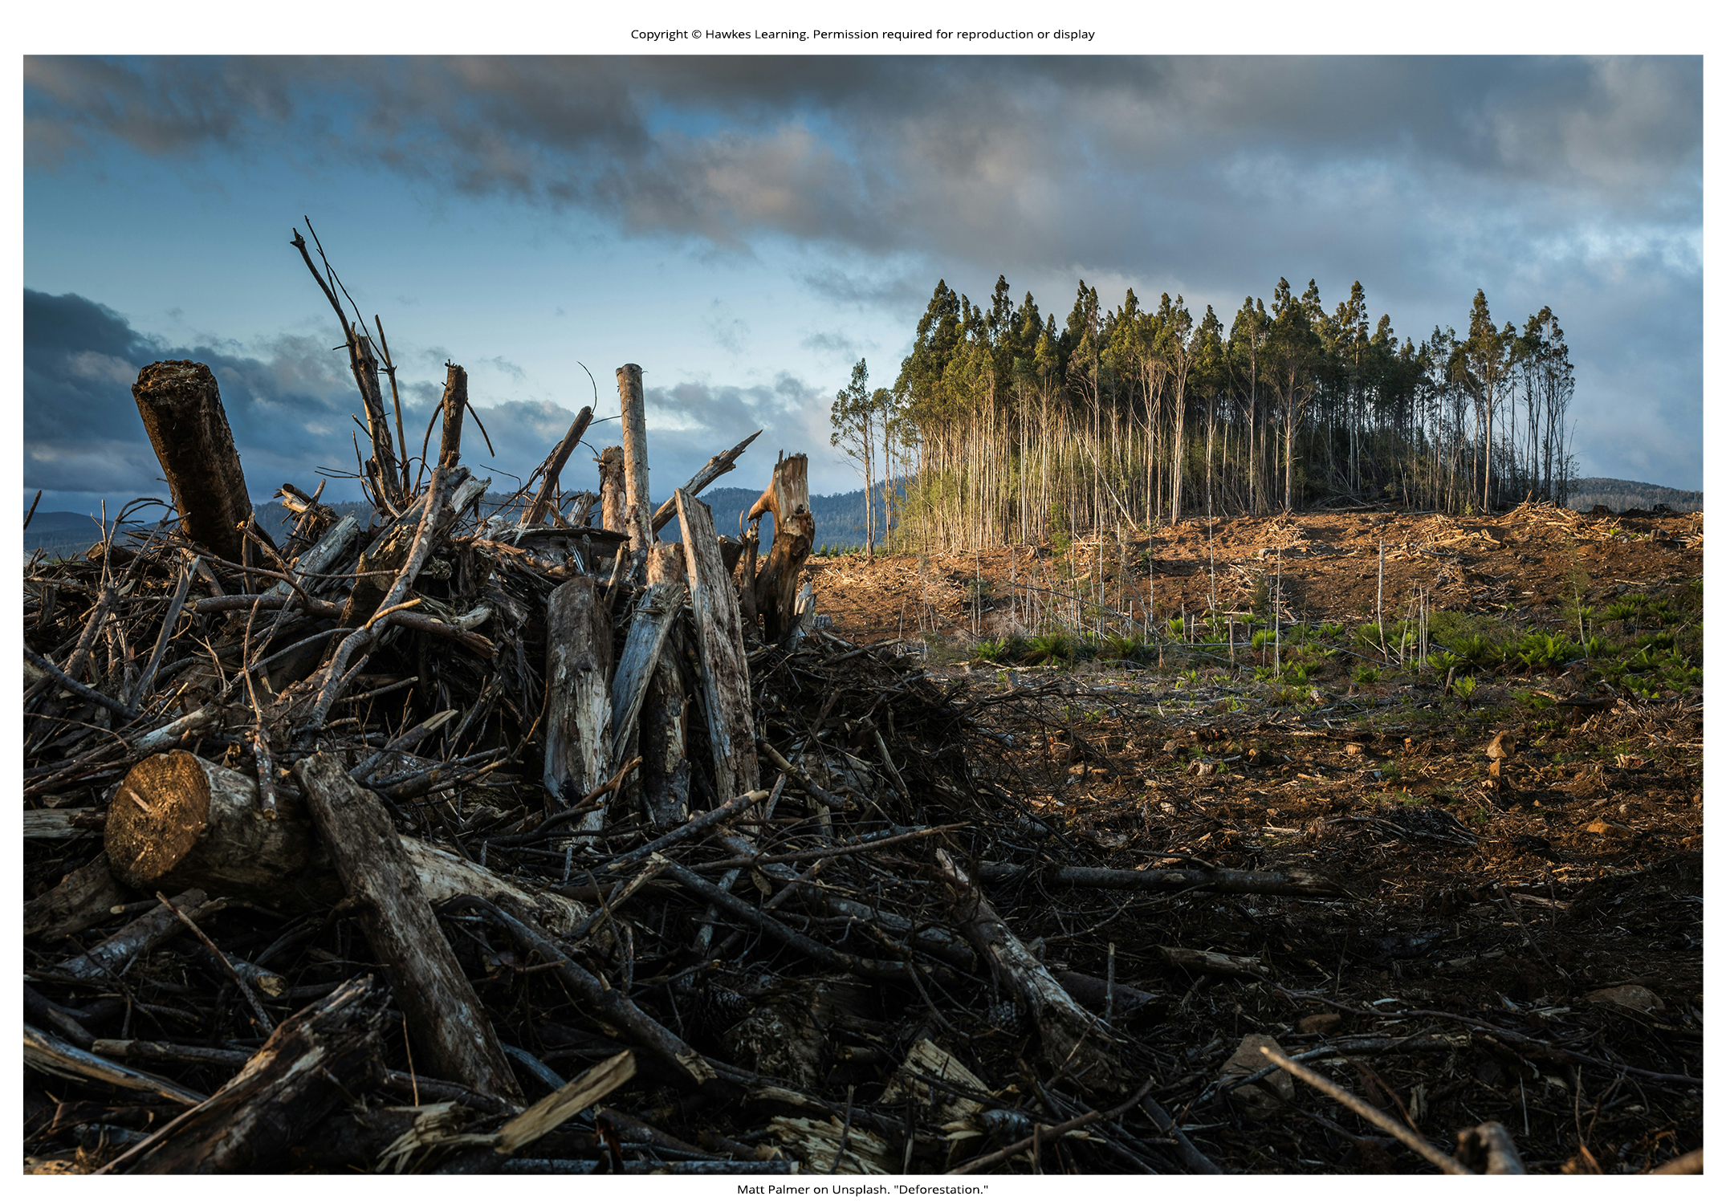
Lesson 45.3 Figure 9

Slide 25
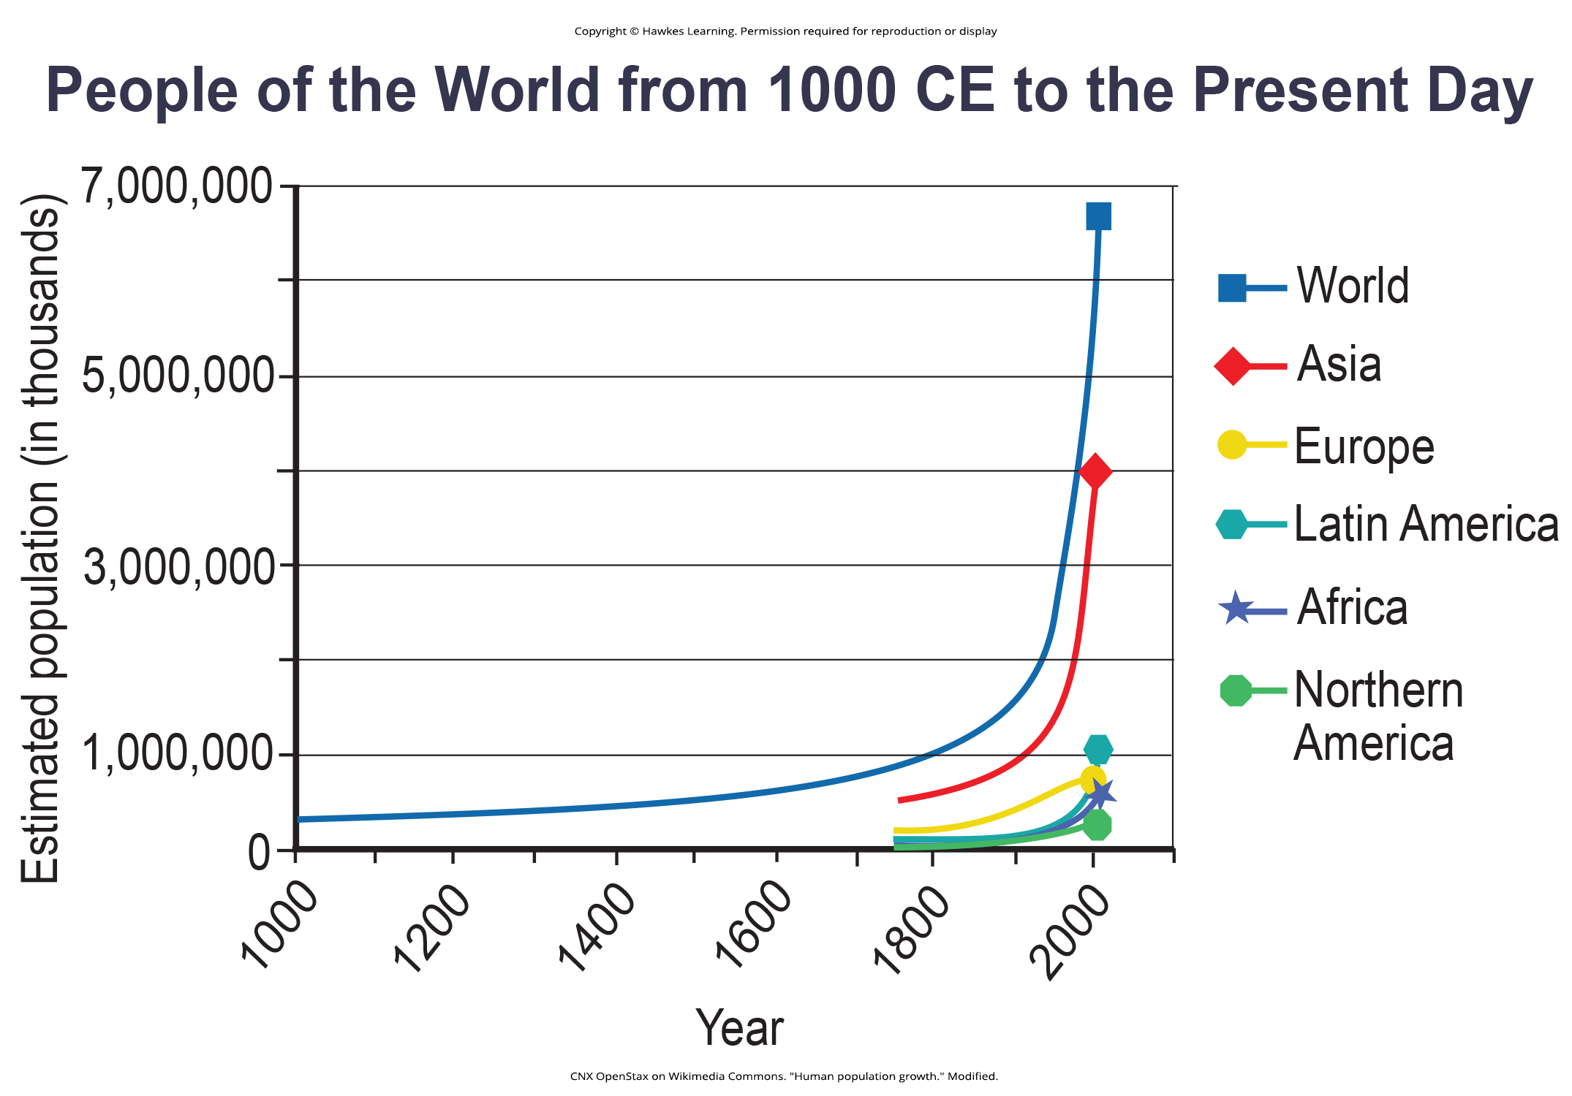
Lesson 45.3 Figure 10

Slide 26
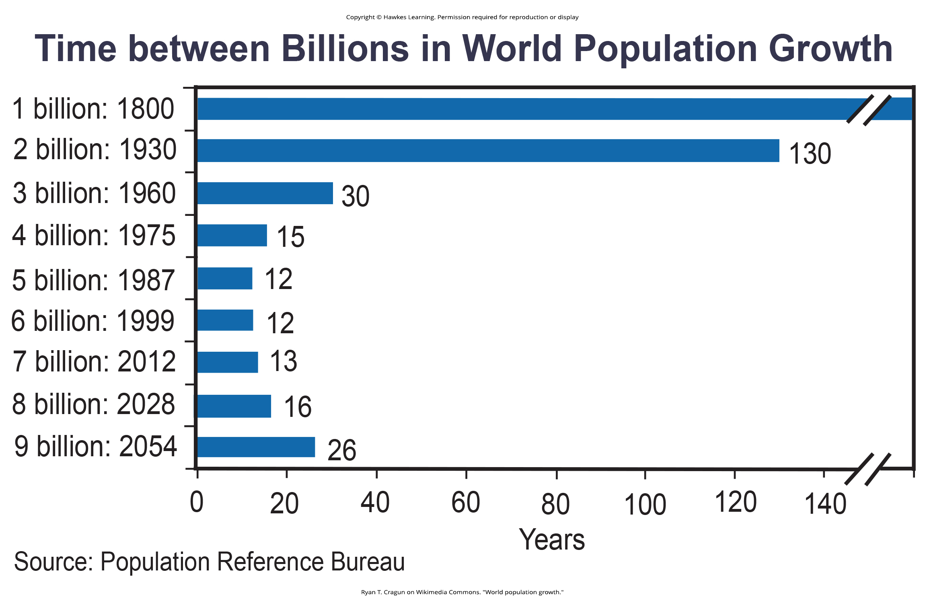
Lesson 45.3 Figure 11

Slide 27

Lesson 45.3 Figure 12

Slide 28
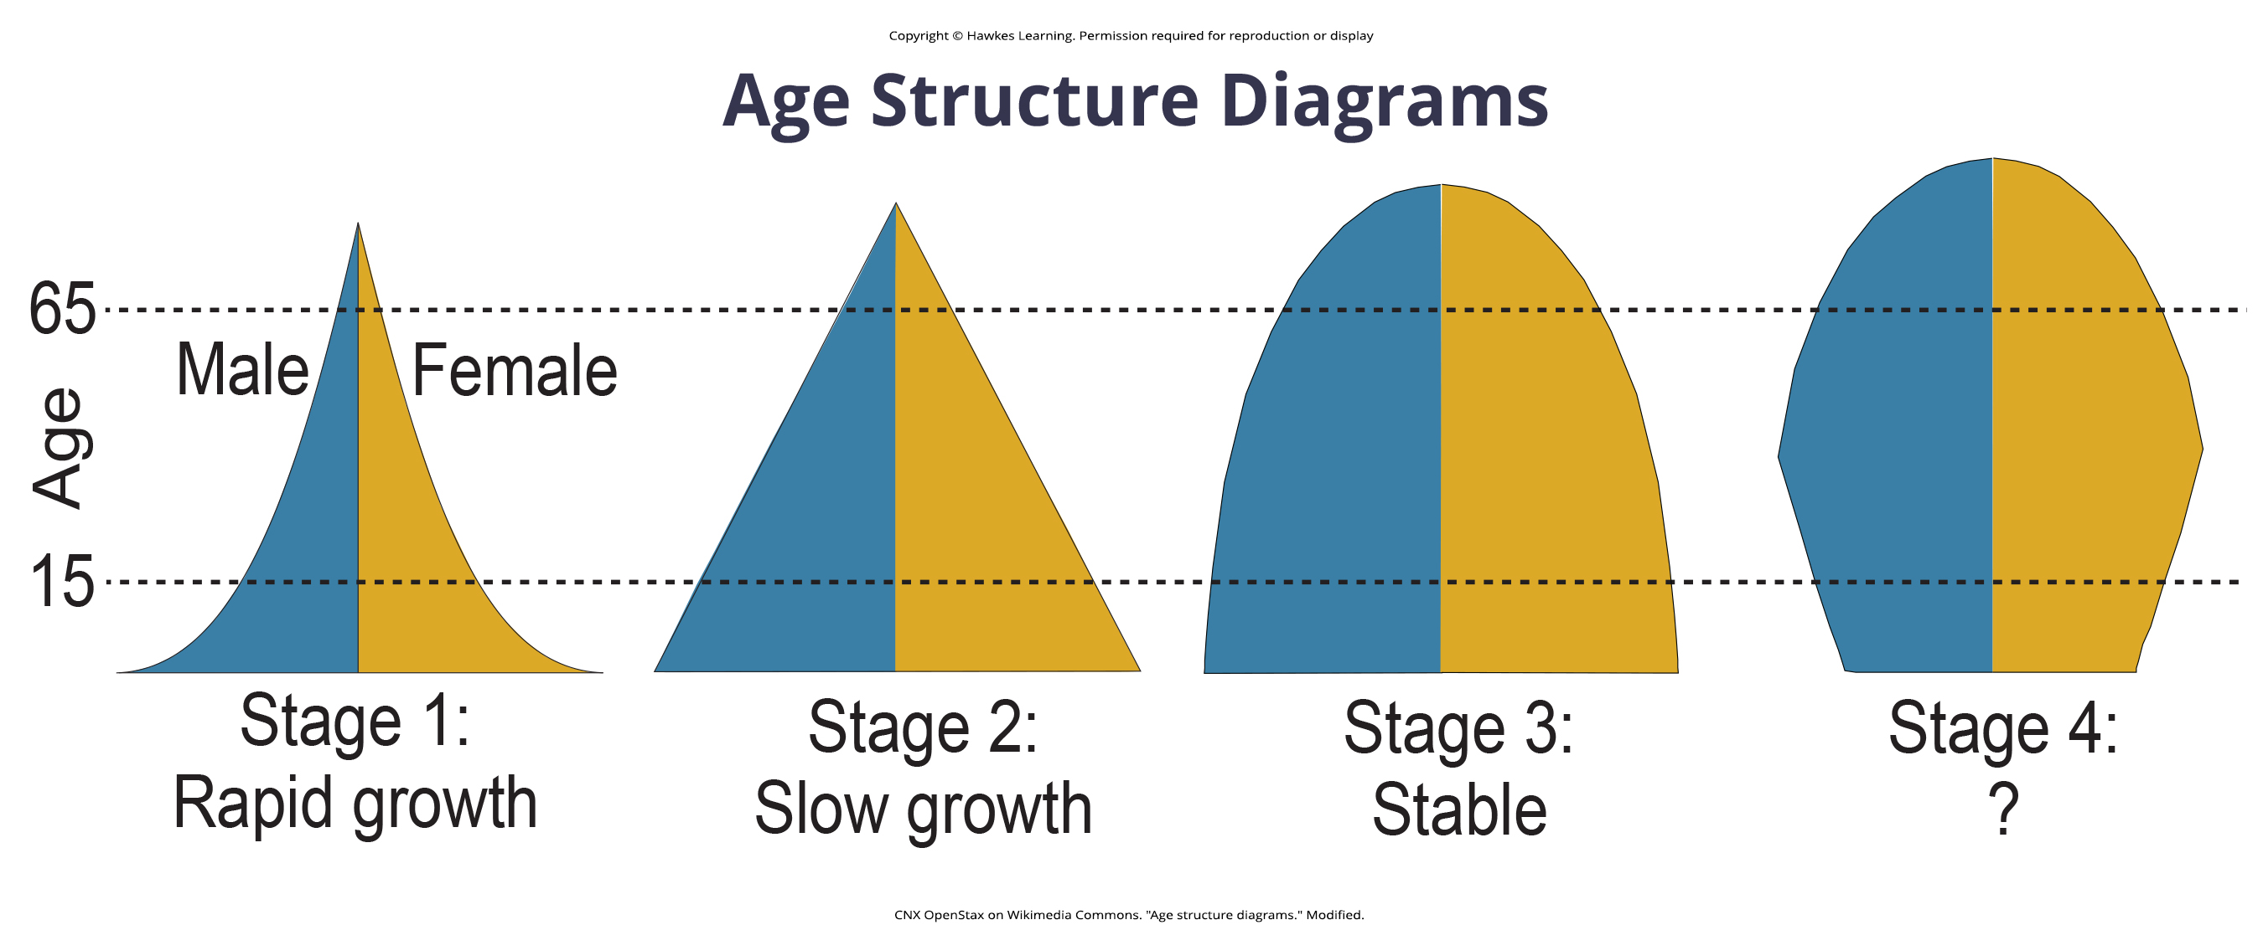
Lesson 45.3 Figure 13

Slide 29
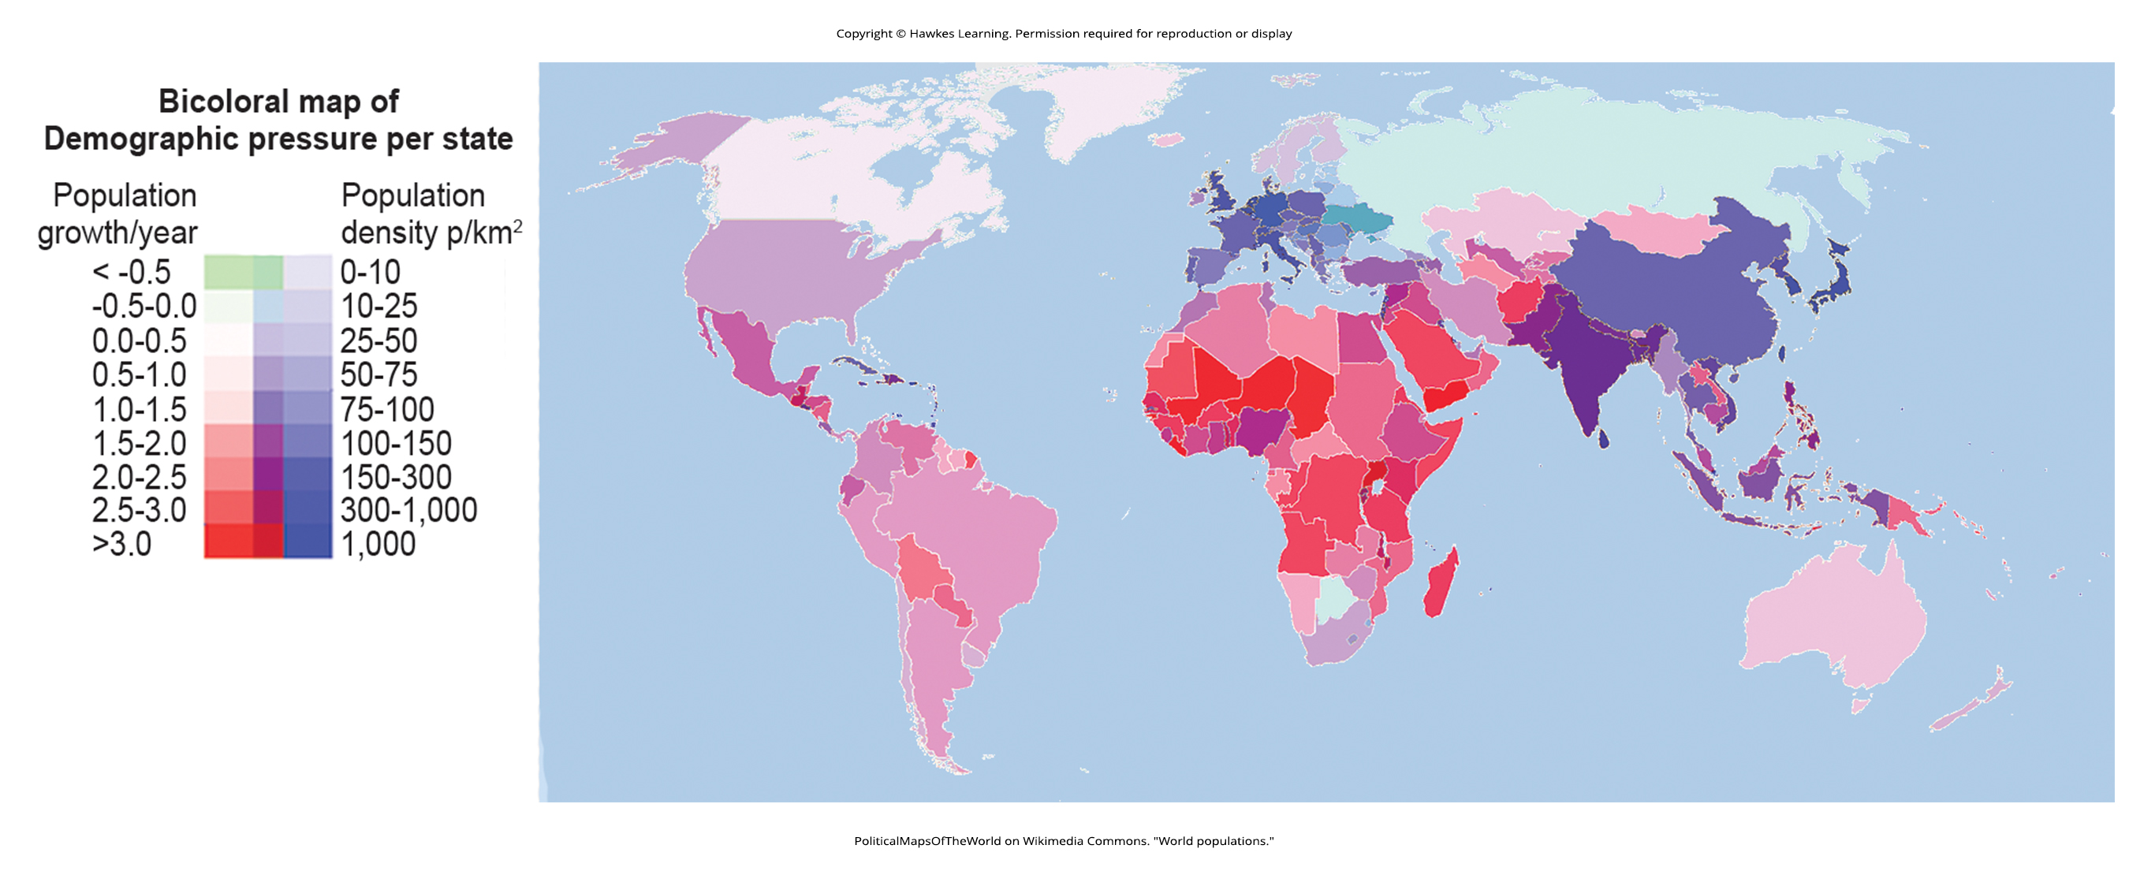
Lesson 45.3 Figure 14

Slide 30
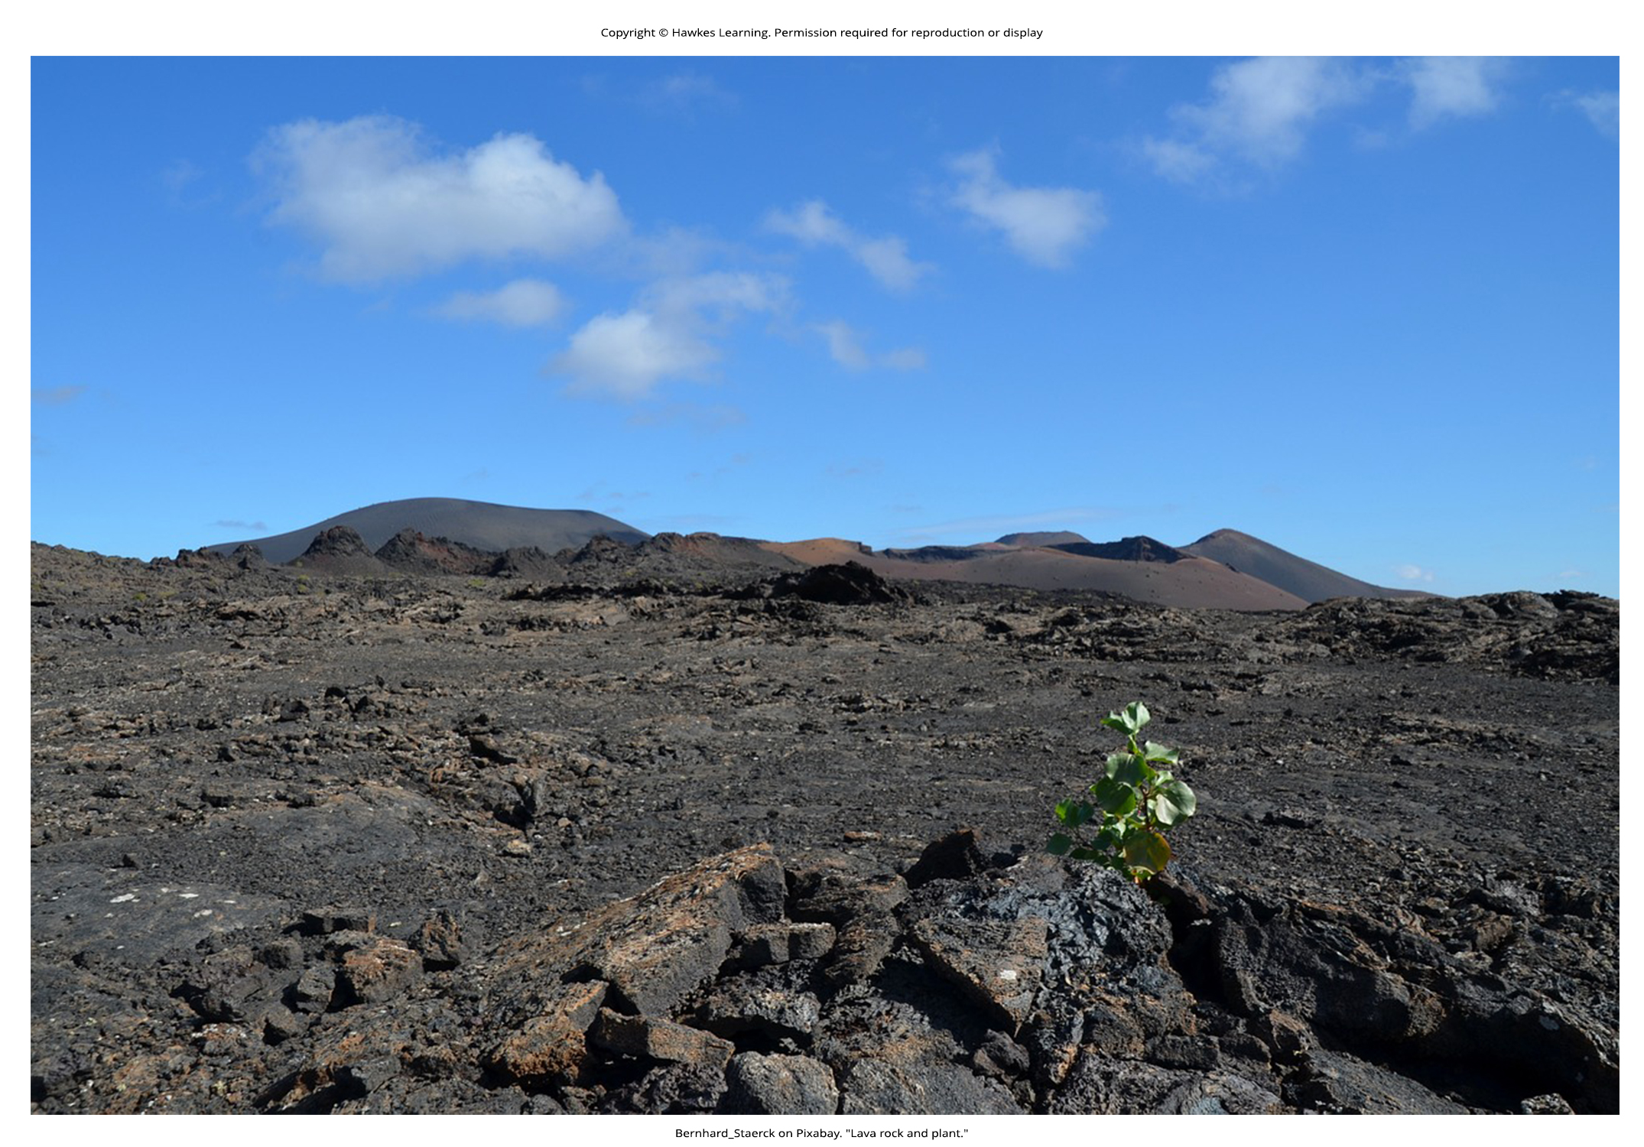
Lesson 45.4 On Your Own Figure 1

Slide 31
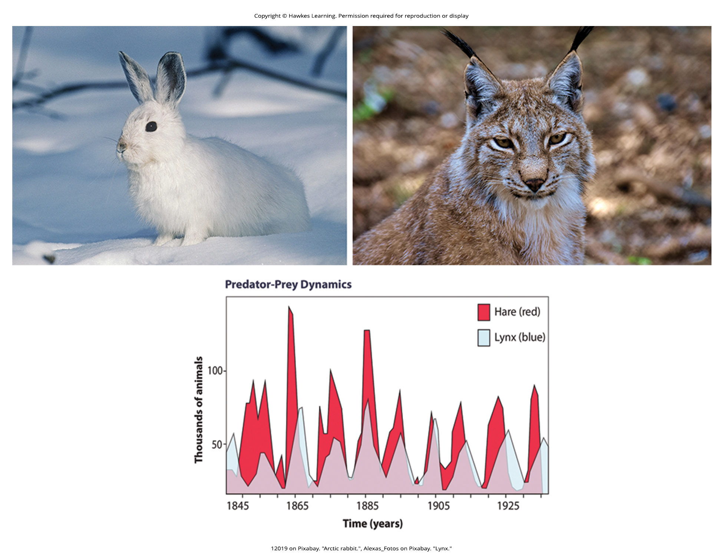
Lesson 45.4 Figure 1

Slide 32
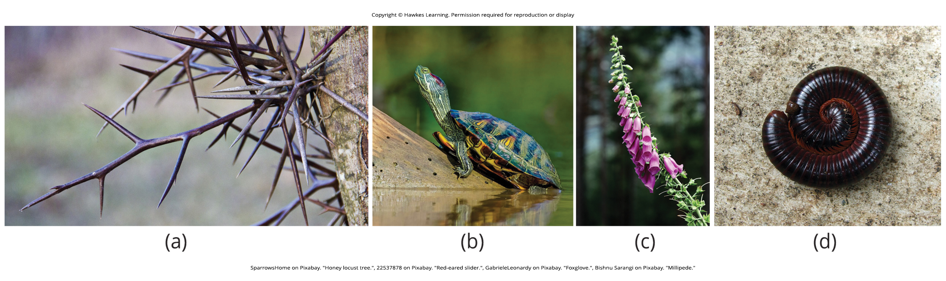
Lesson 45.4 Figure 2

Slide 33
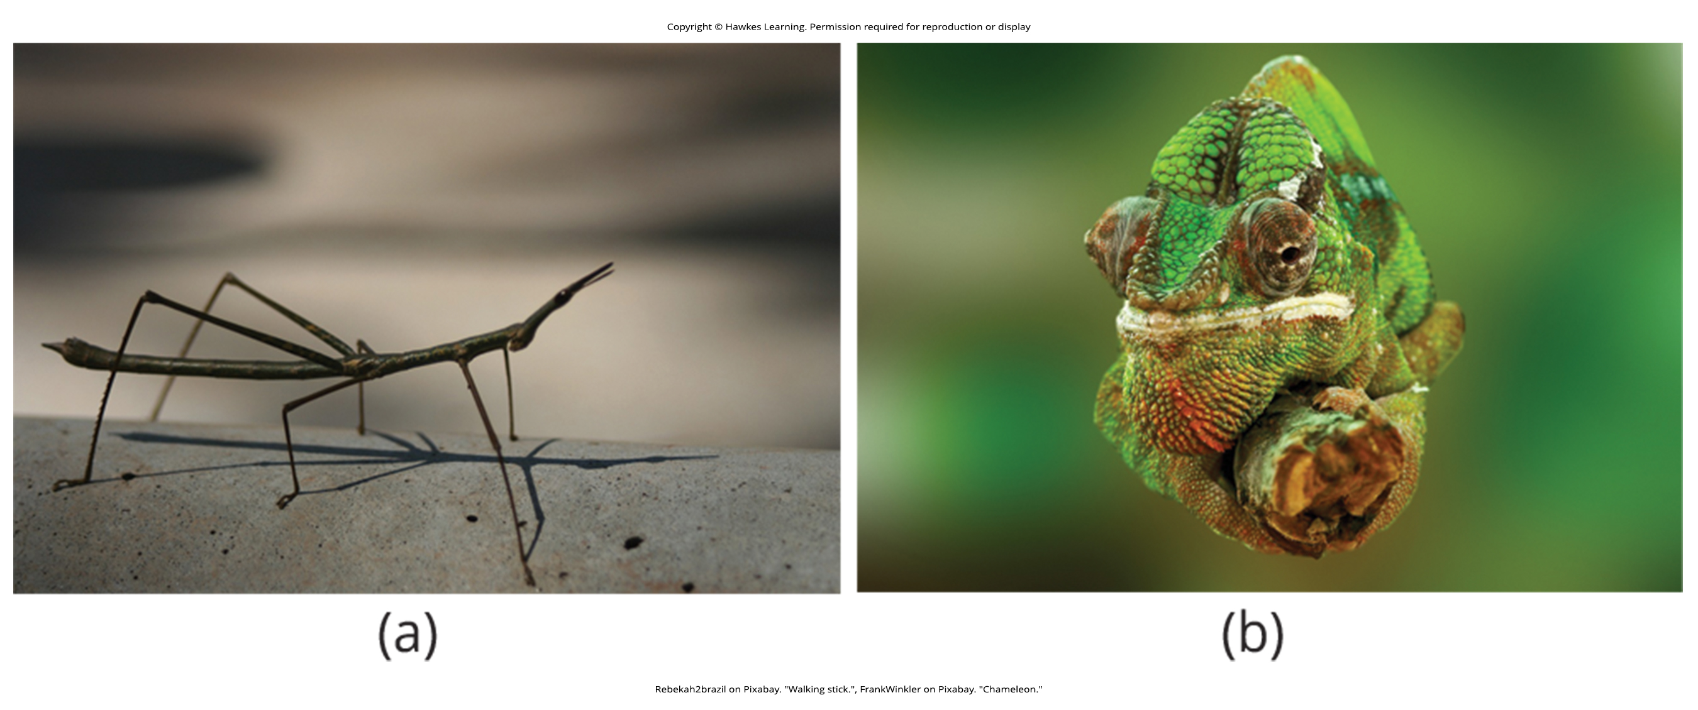
Lesson 45.4 Figure 3

Slide 34
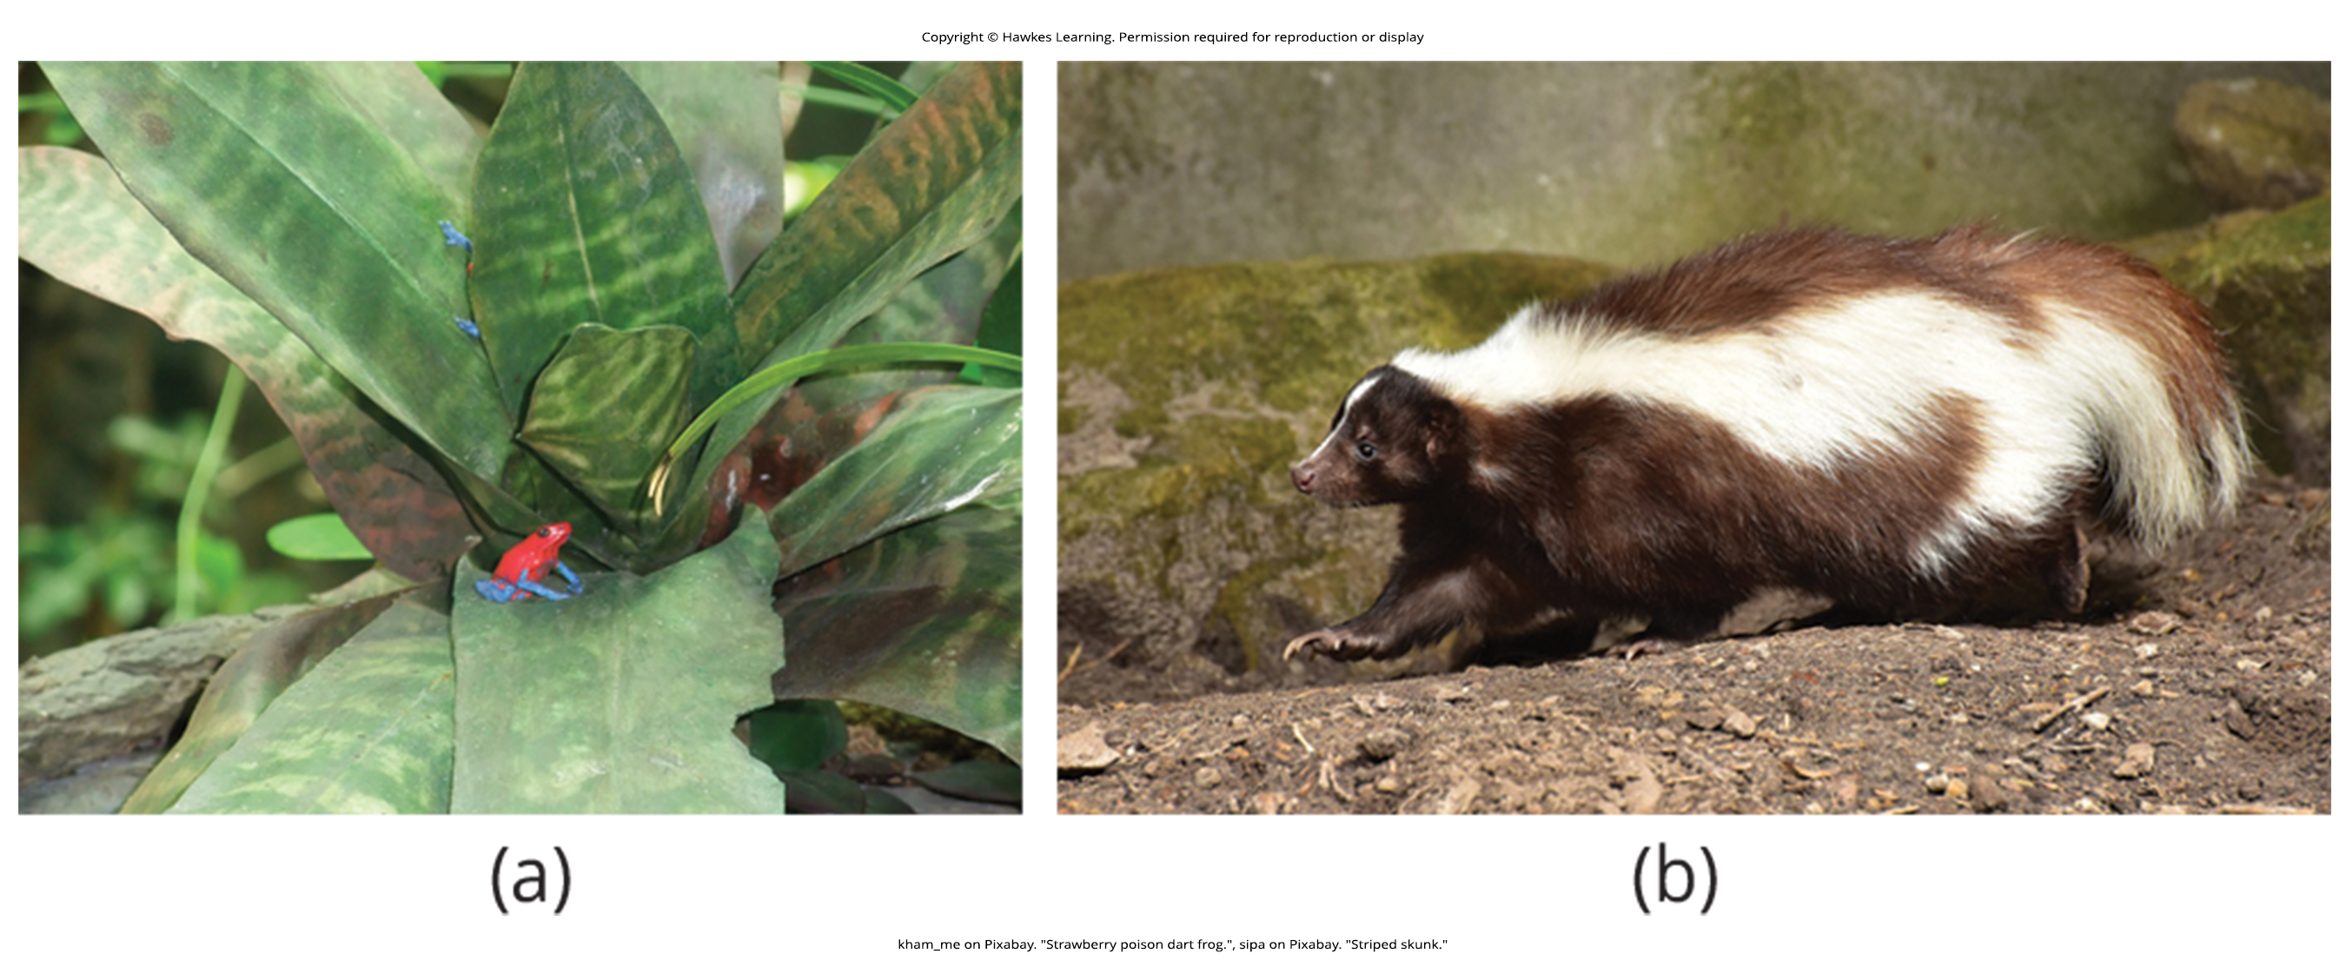
Lesson 45.4 Figure 4

Slide 35
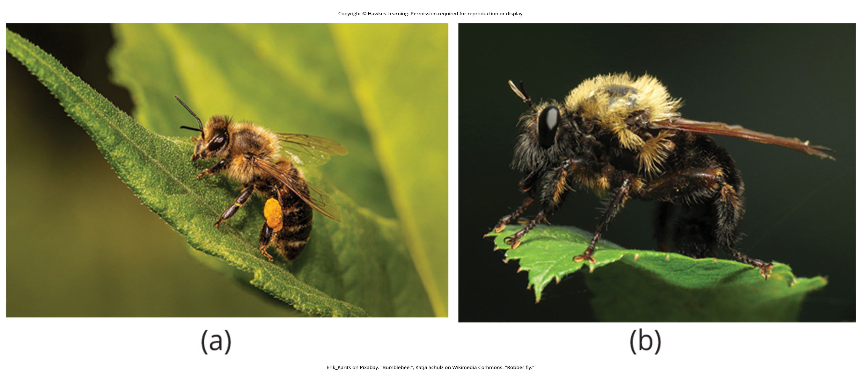
Lesson 45.4 Figure 5

Slide 36
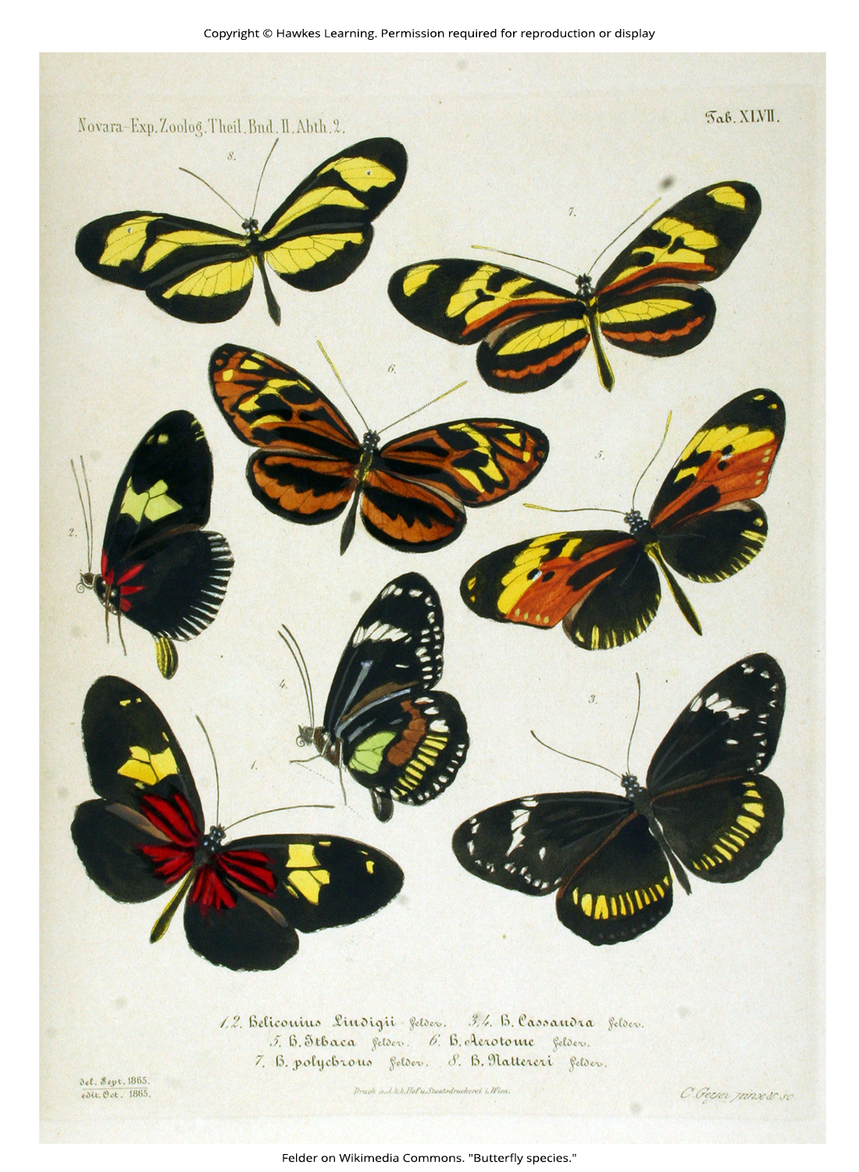
Lesson 45.4 Figure 6

Slide 37
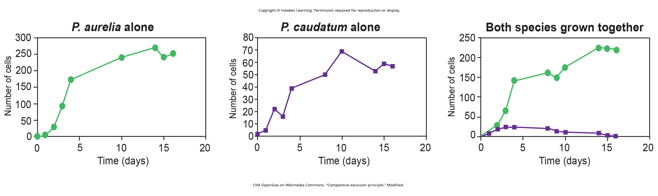
Lesson 45.4 Figure 7

Slide 38
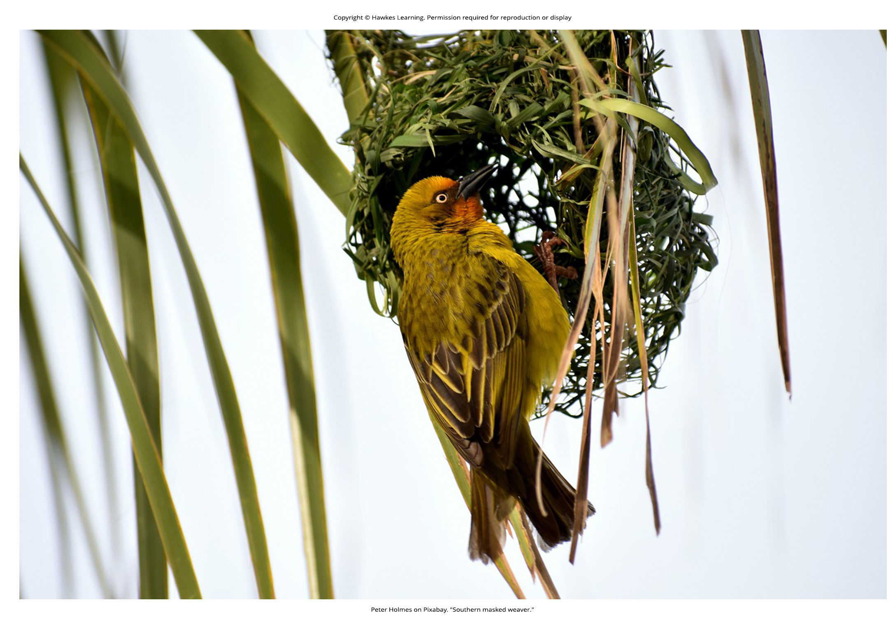
Lesson 45.4 Figure 8

Slide 39
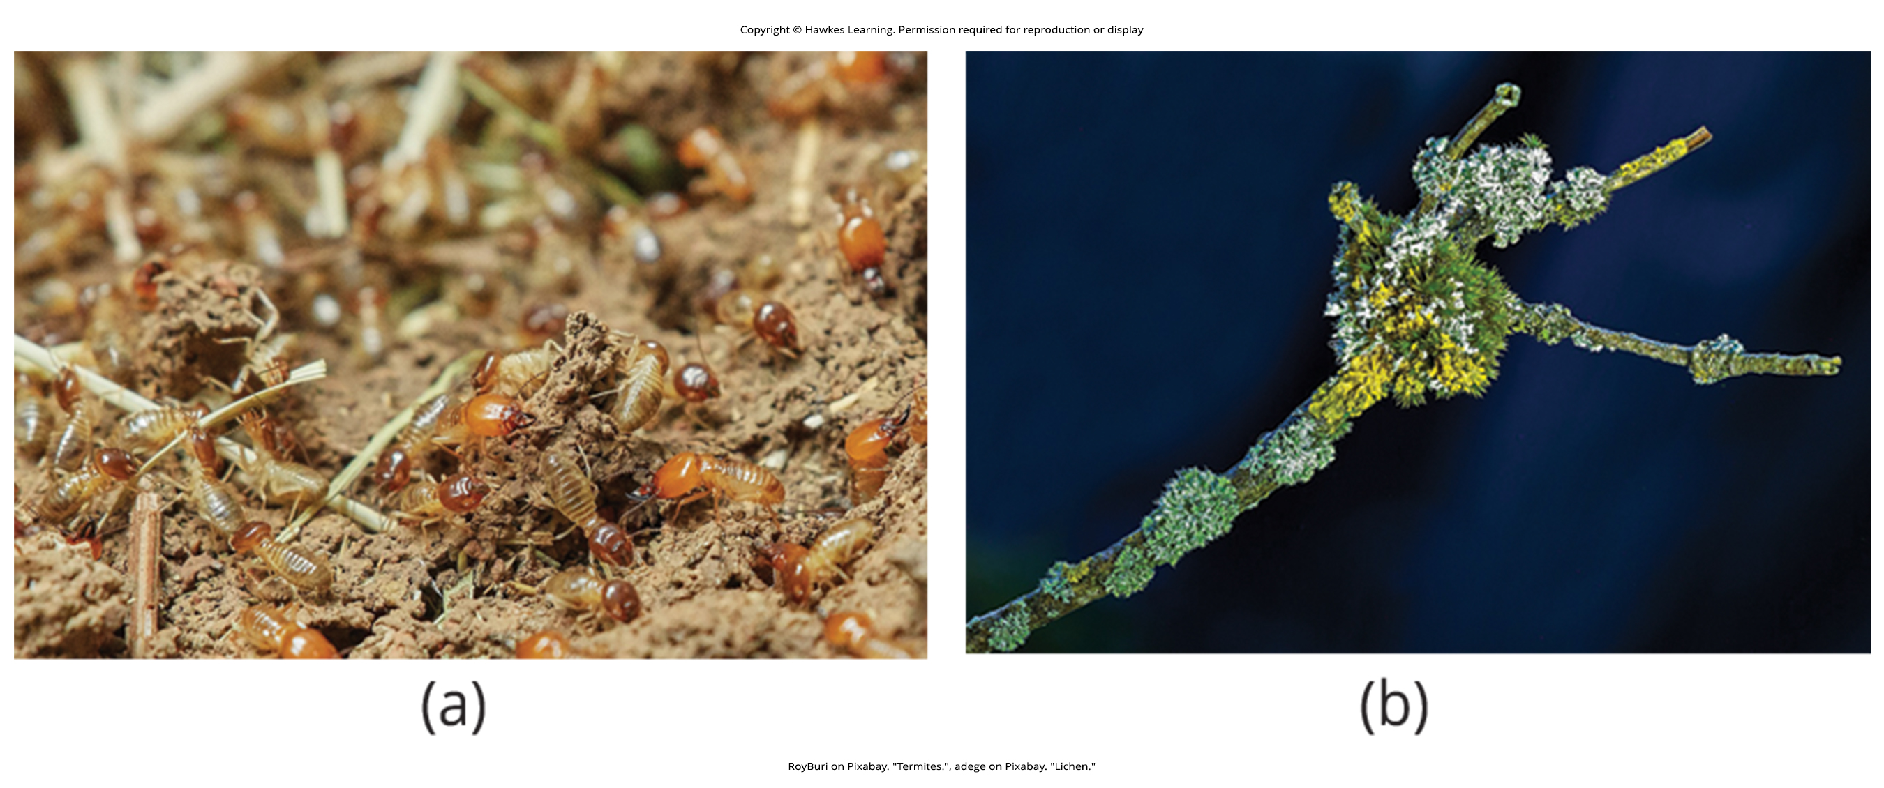
Lesson 45.4 Figure 9

Slide 40
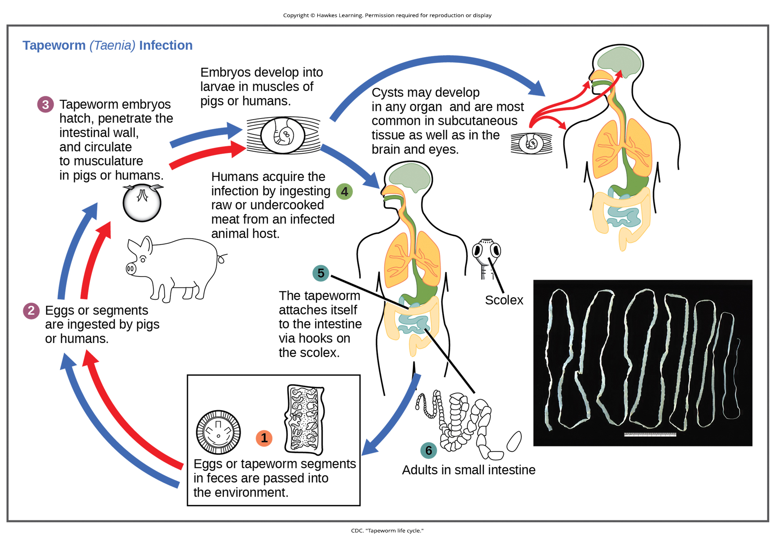
Lesson 45.4 Figure 10

Slide 41
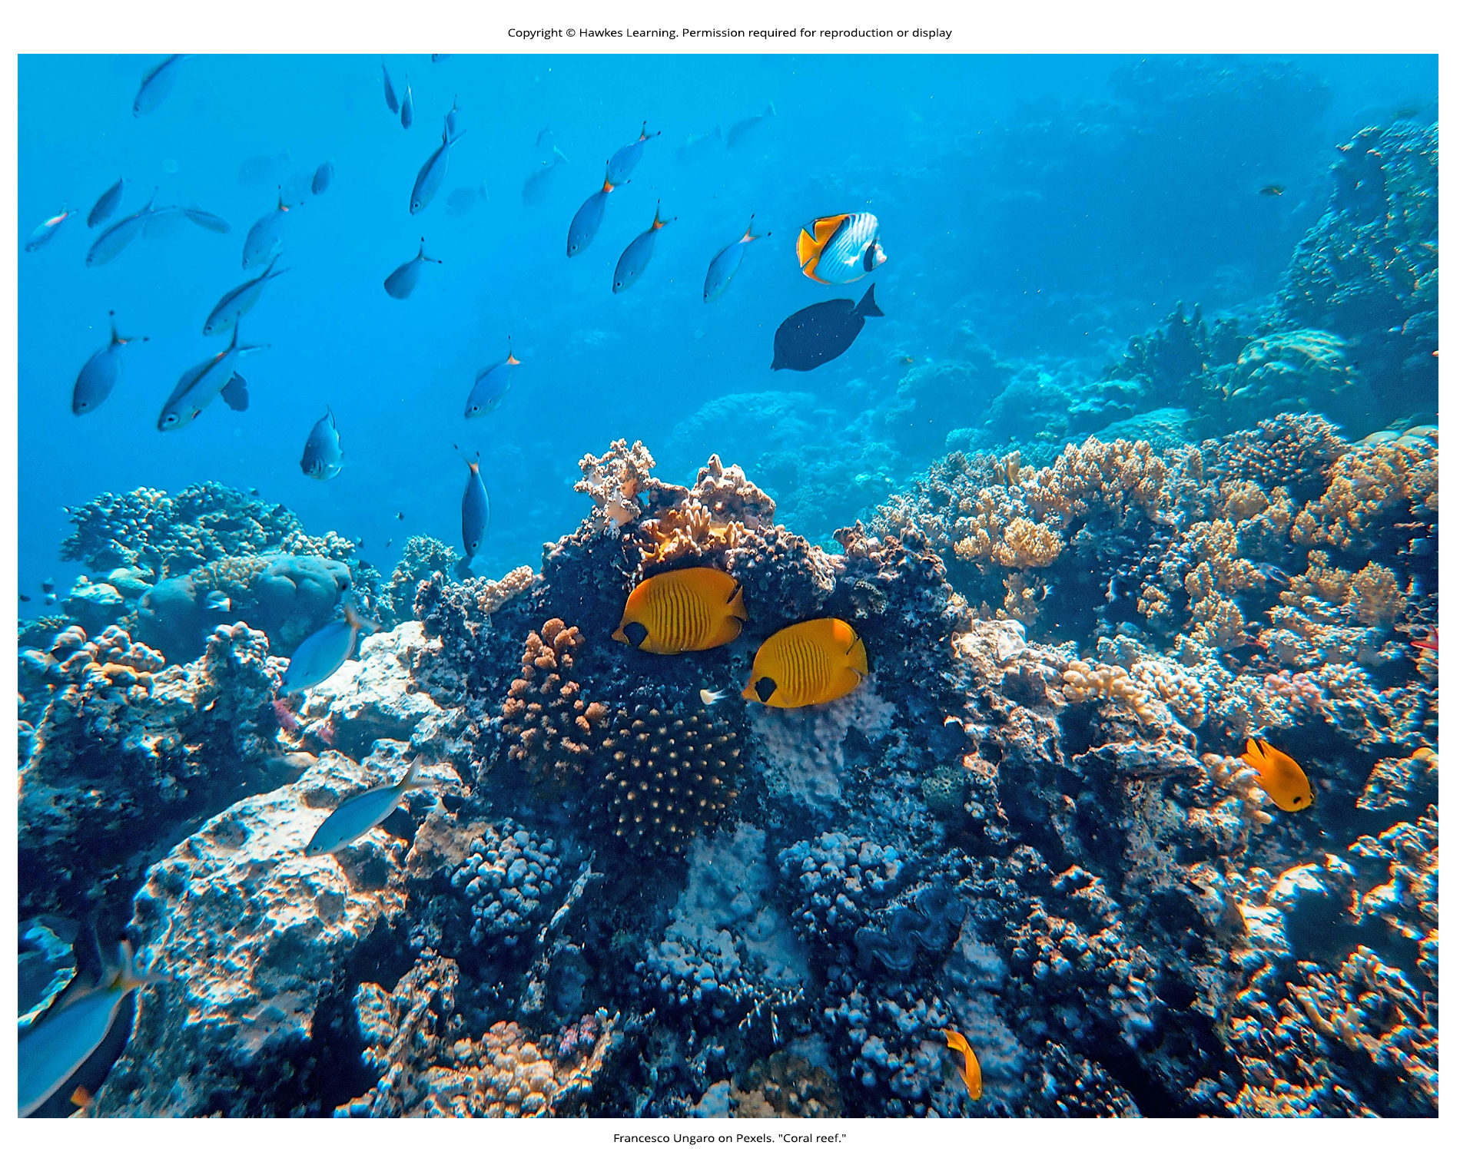
Lesson 45.4 Figure 11

Slide 42
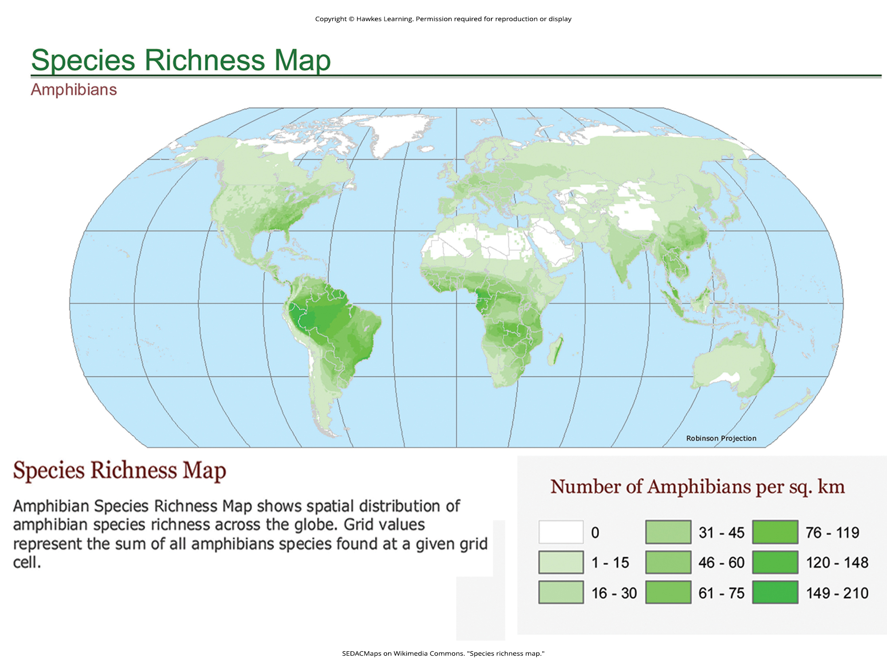
Lesson 45.4 Figure 12

Slide 43
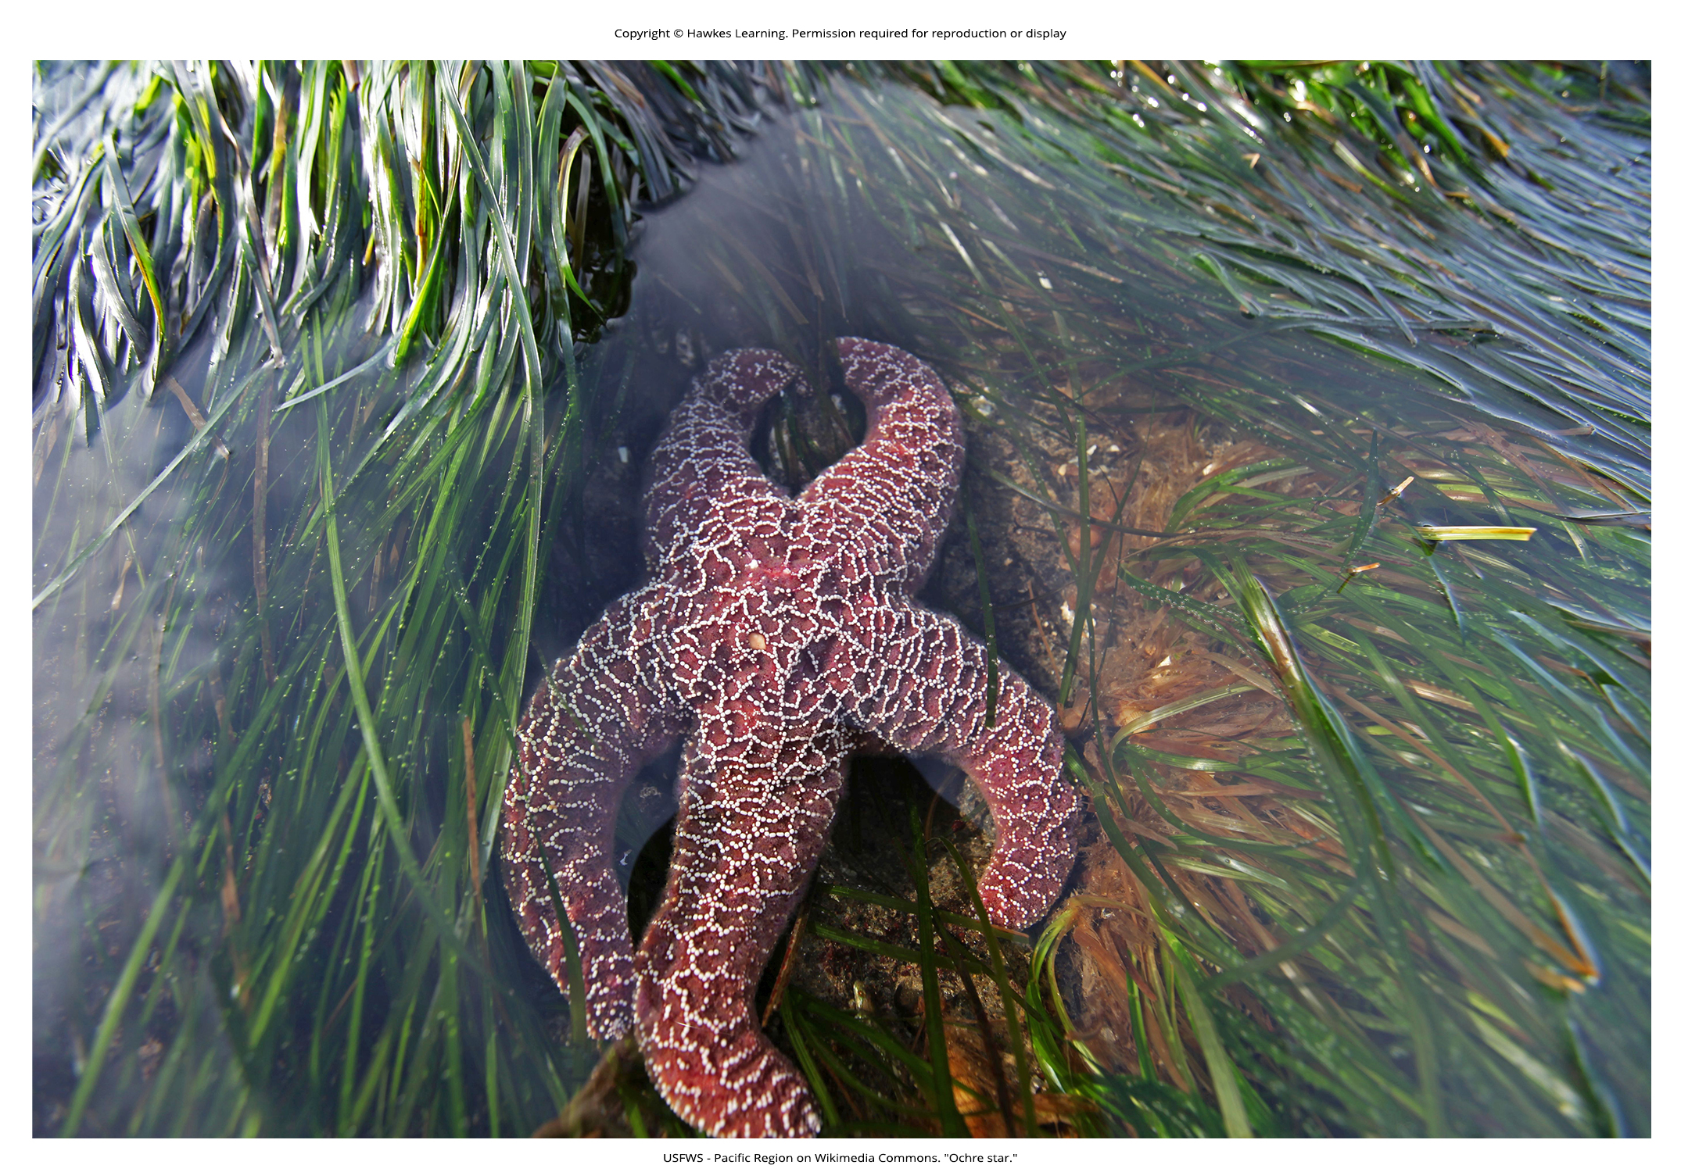
Lesson 45.4 Figure 13

Slide 44
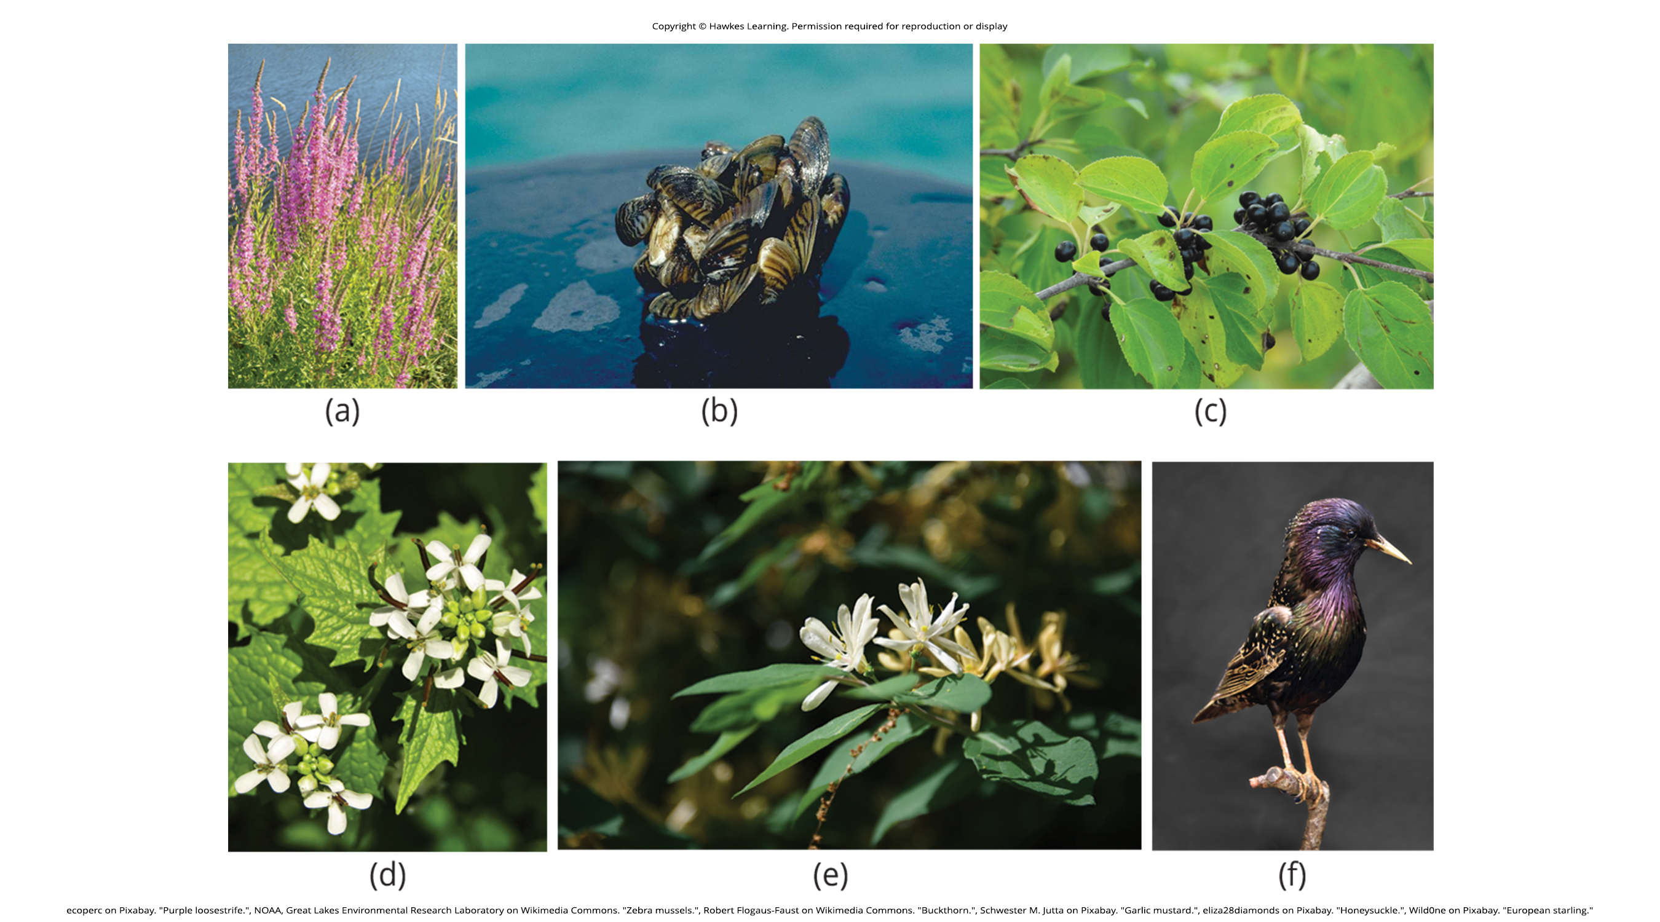
Lesson 45.4 Figure 14

Slide 45
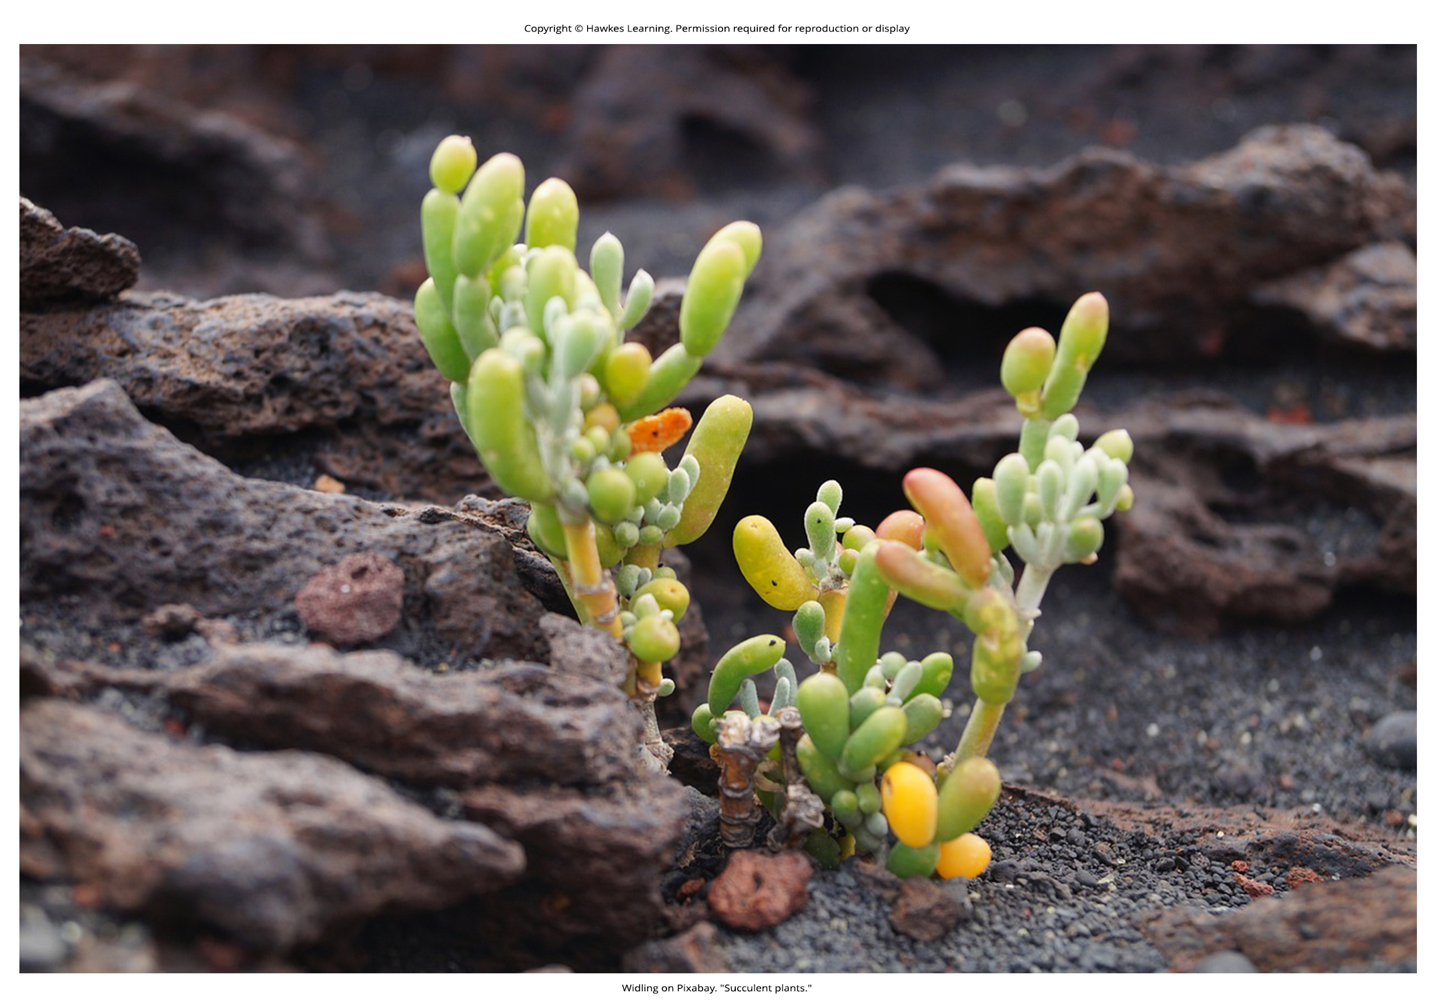
Lesson 45.4 Figure 15

Slide 46
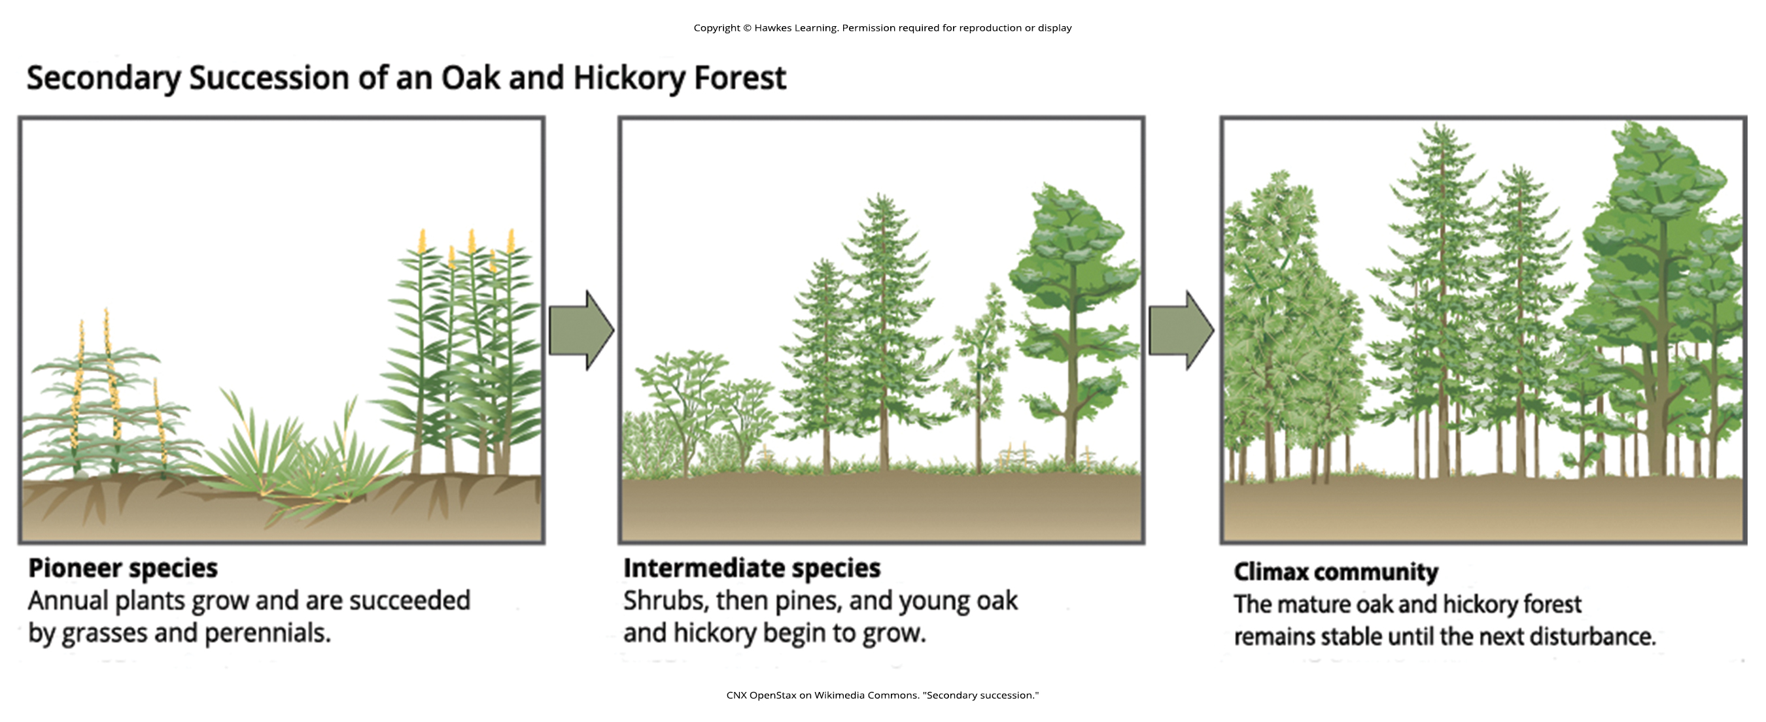
Lesson 45.4 Figure 16

Slide 47
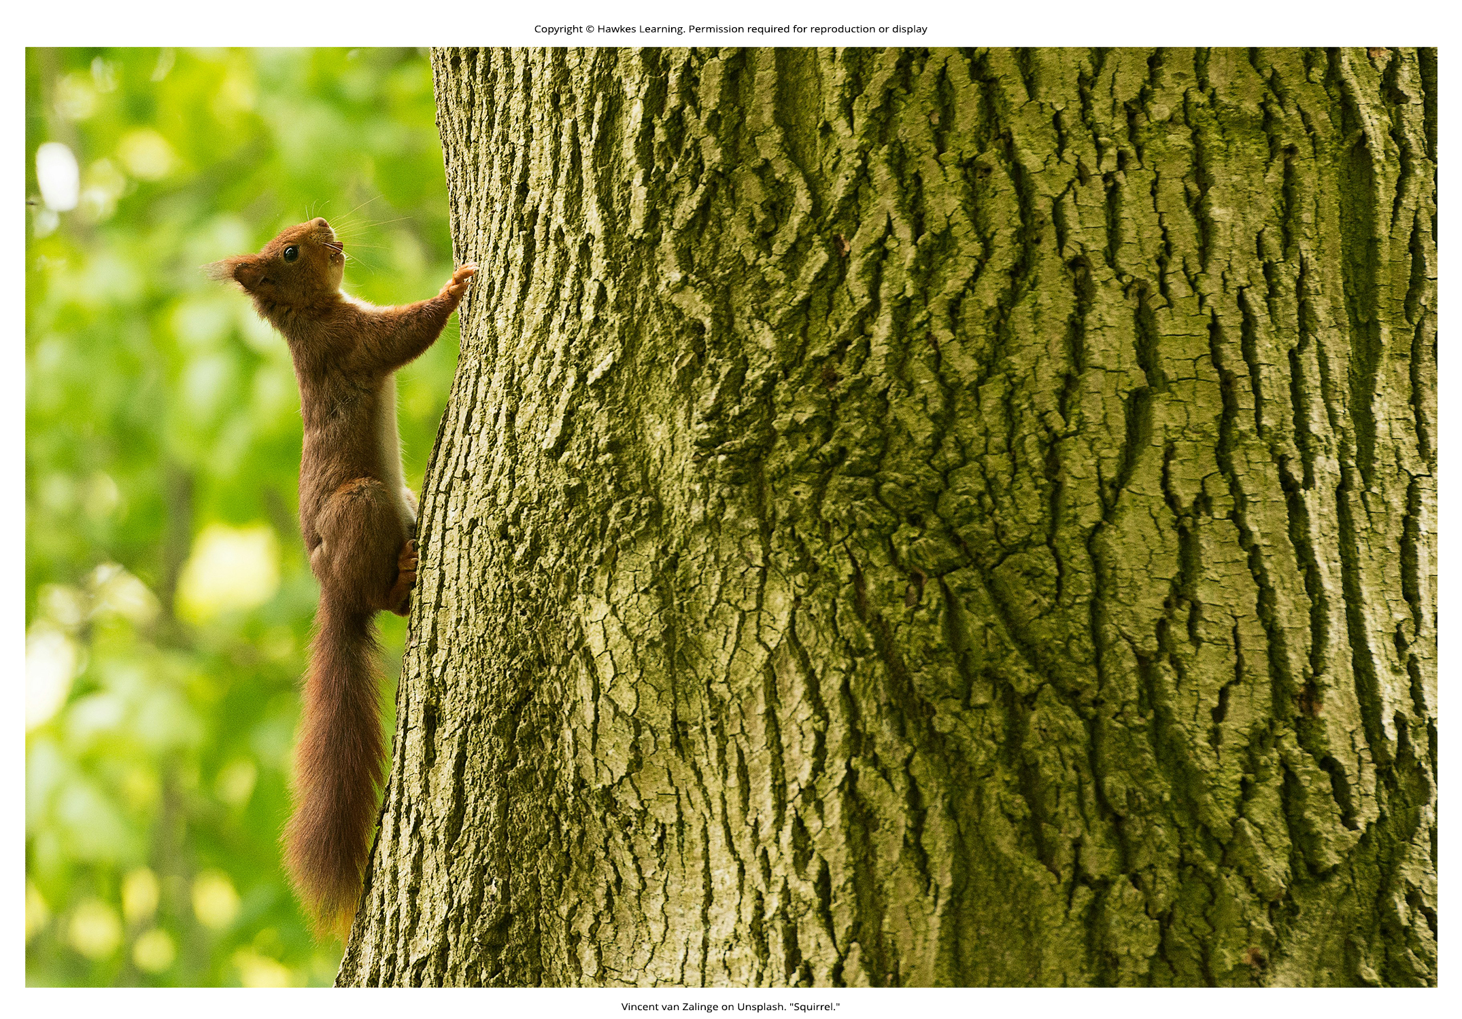
Lesson 45.5 Figure 1

Slide 48
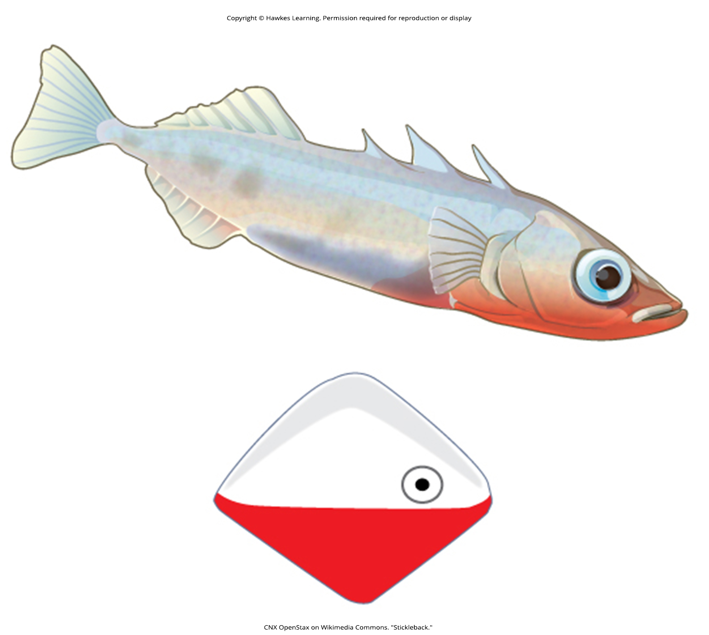
Lesson 45.5 Figure 2

Slide 49
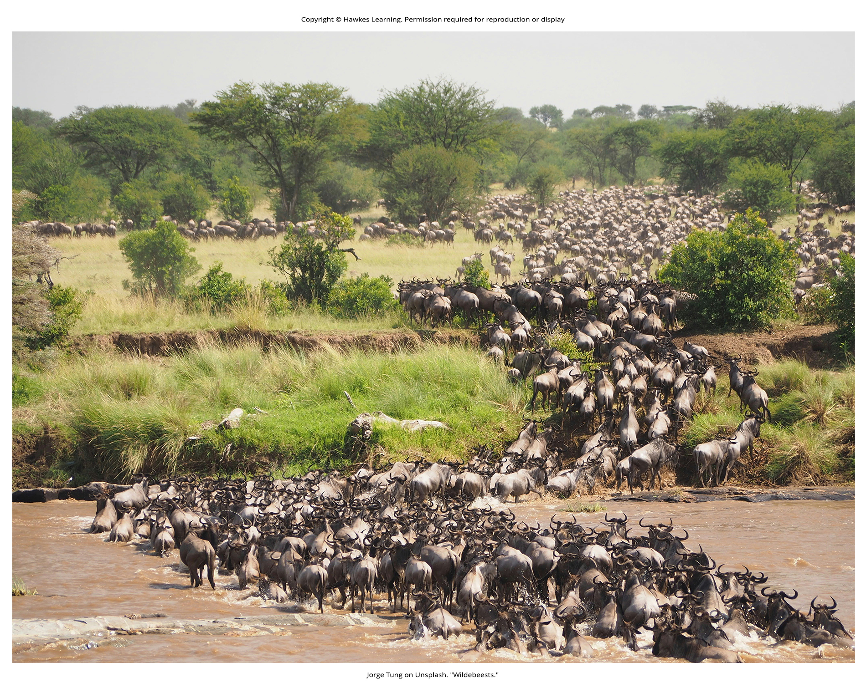
Lesson 45.5 Figure 3

Slide 50
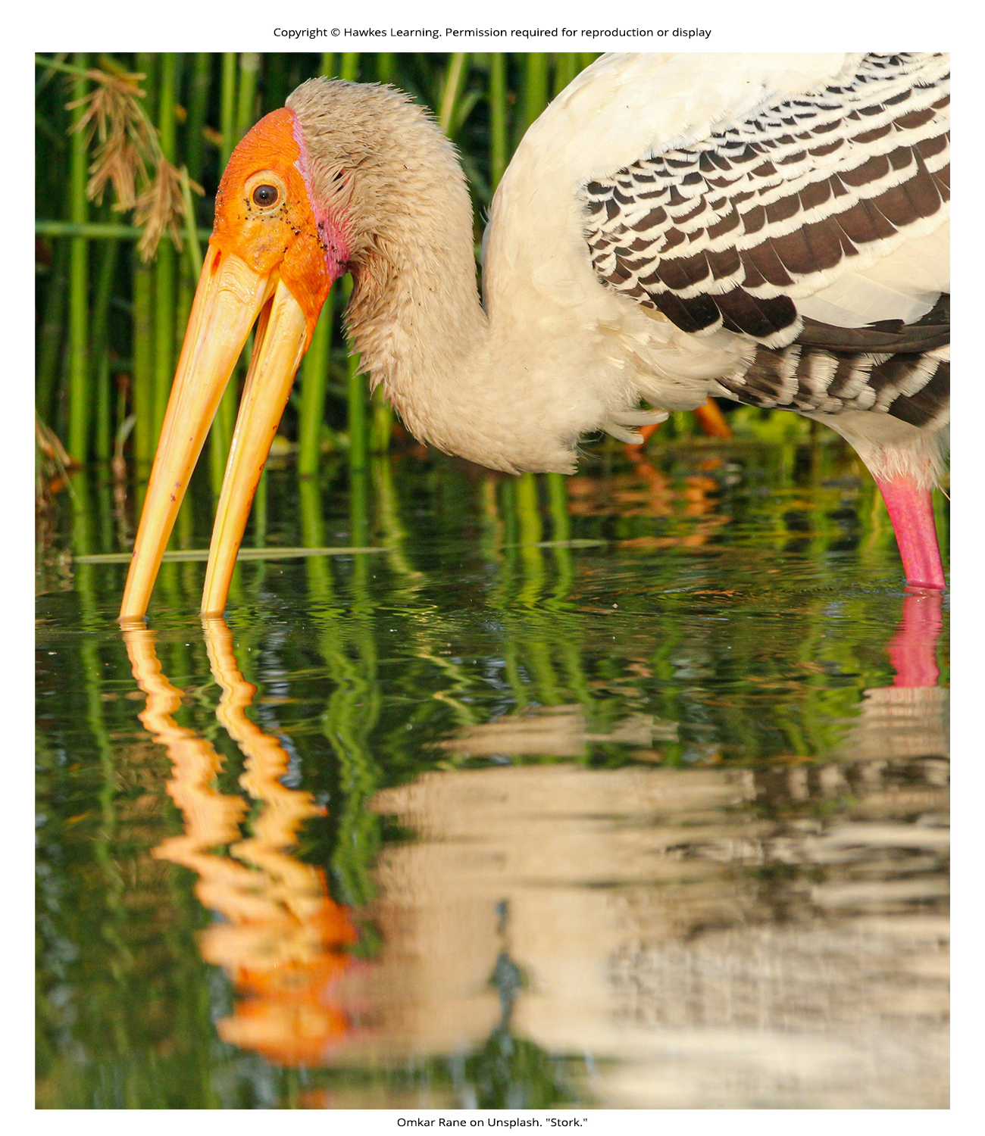
Lesson 45.5 Figure 4

Slide 51
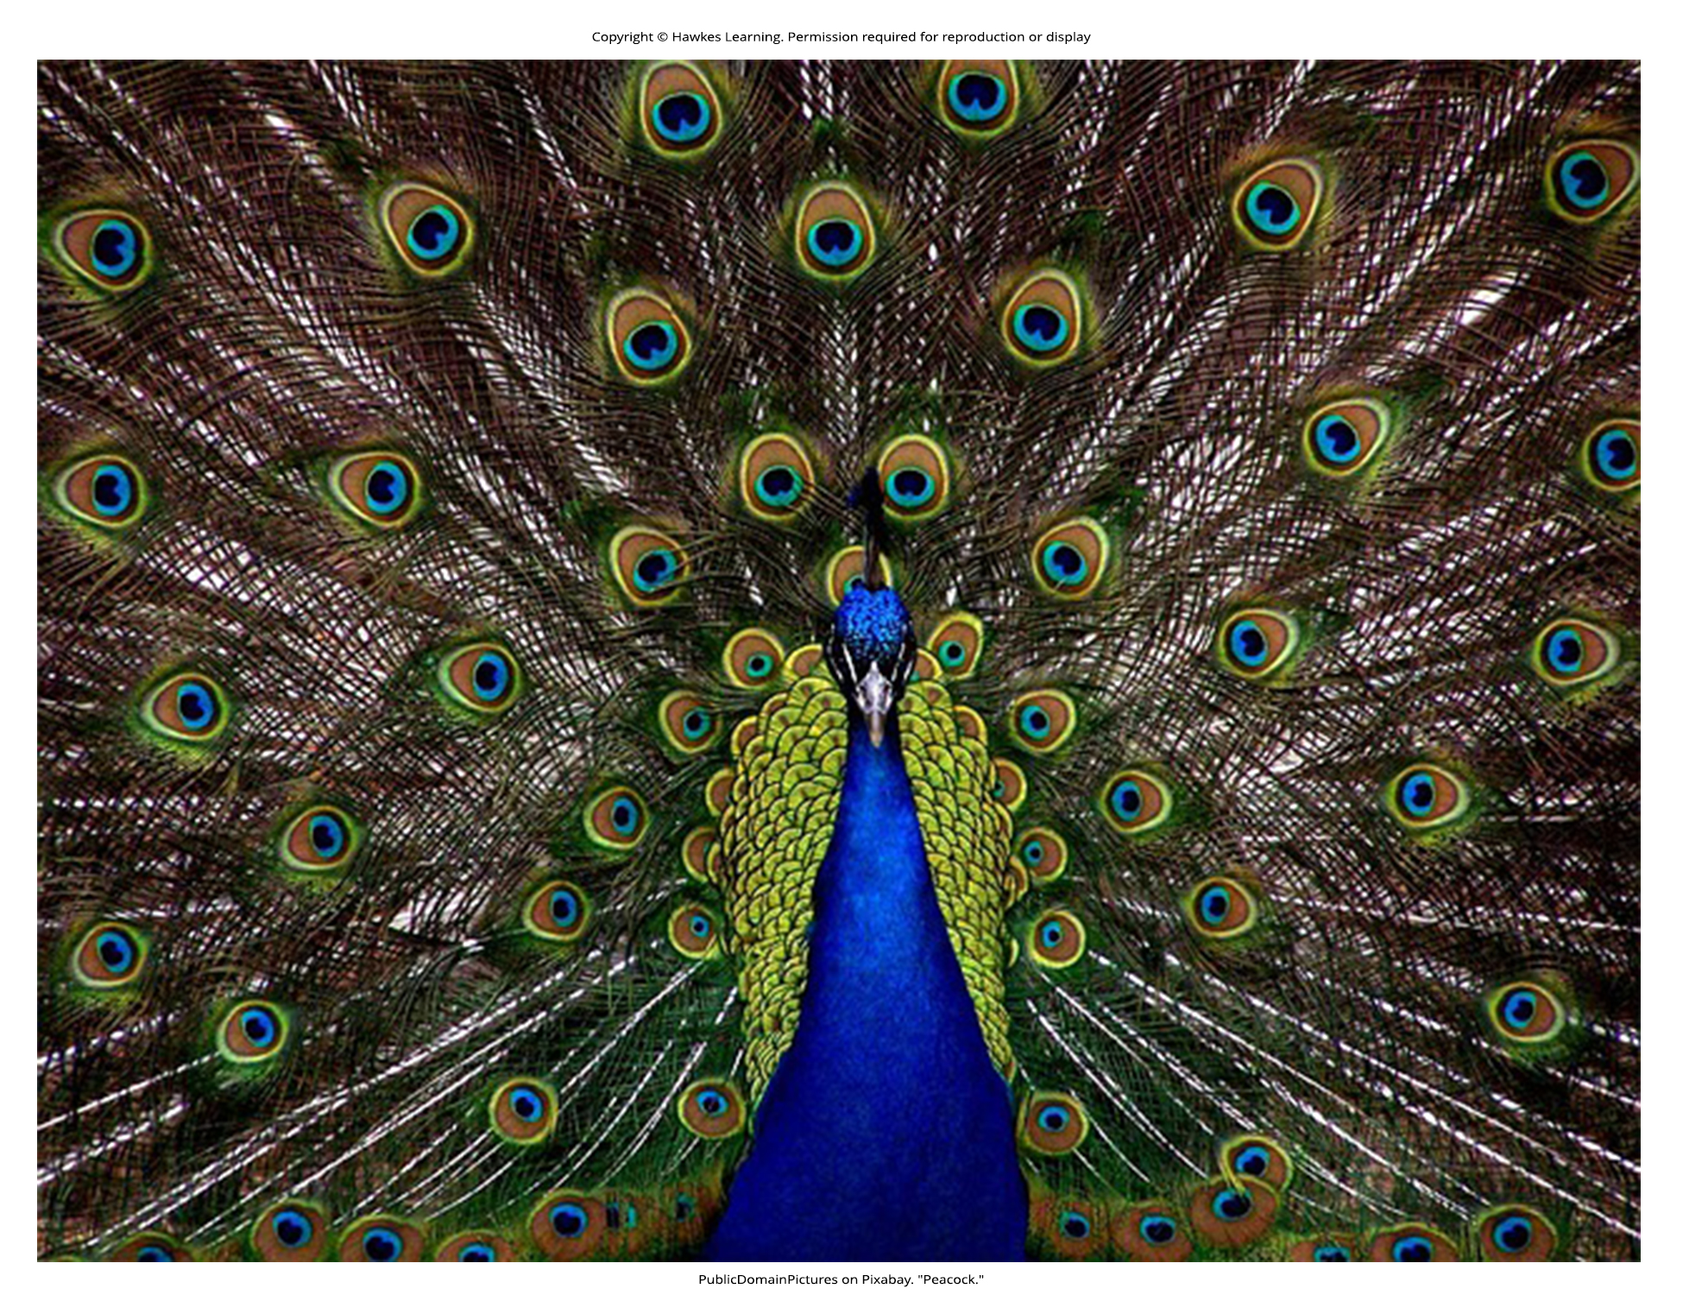
Lesson 45.5 Figure 5

Slide 52
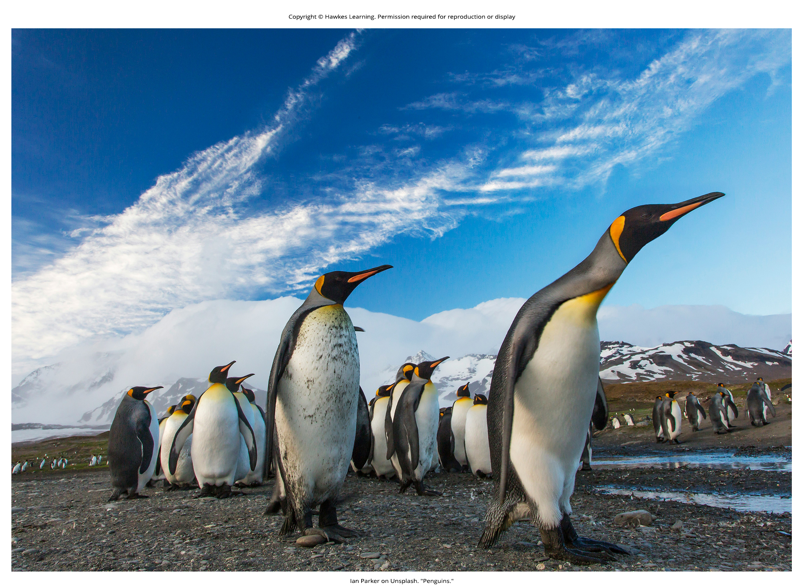
Lesson 45.5 Figure 6

Slide 53
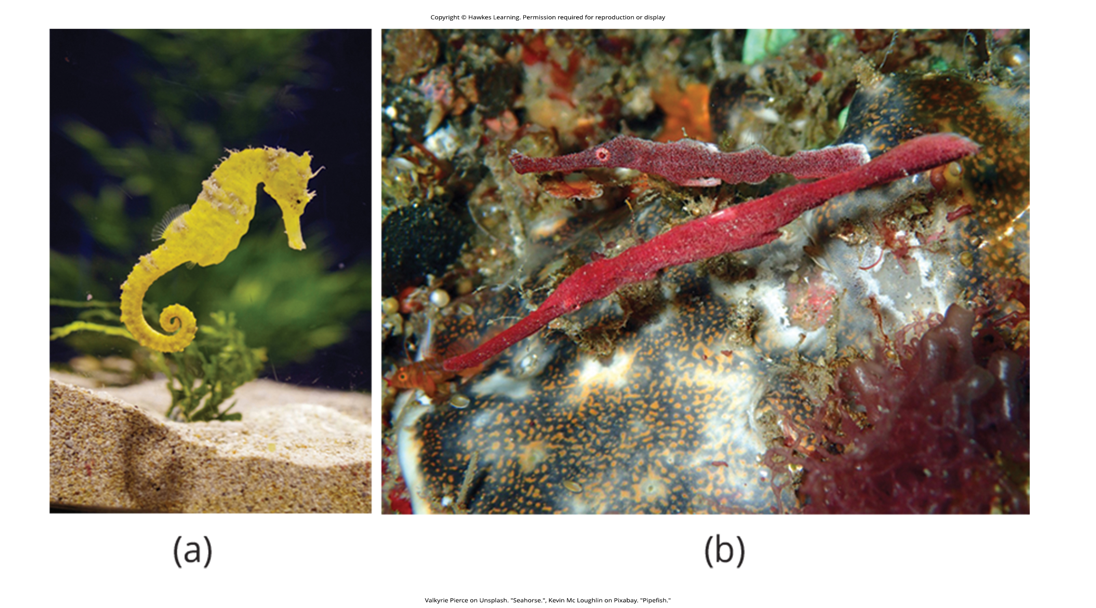
Lesson 45.5 Figure 7

Slide 54

Lesson 45.5 Figure 8

Slide 55

Lesson 45.5 Figure 9

Slide 56

Lesson 45.5 Figure 10

Slide 57

Lesson 45.5 Figure 11

Slide 58

Lesson 45.5 Figure 12

Slide 59

Lesson 45.5 Figure 13

Slide 60
Hawkes Learning – End of PowerPoint

