Slide 1
Chapter 47
Conservation Biology and Biodiversity

Slide 2
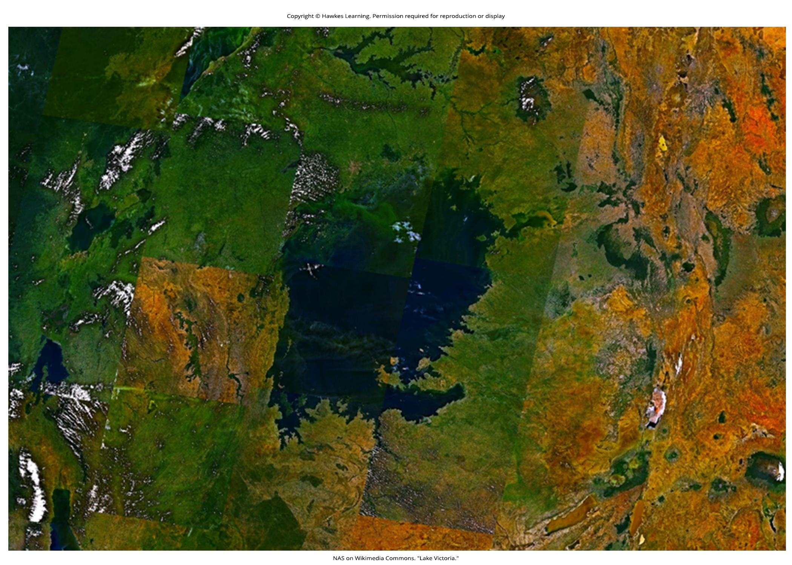
Lesson 47.1 Figure 1

Slide 3
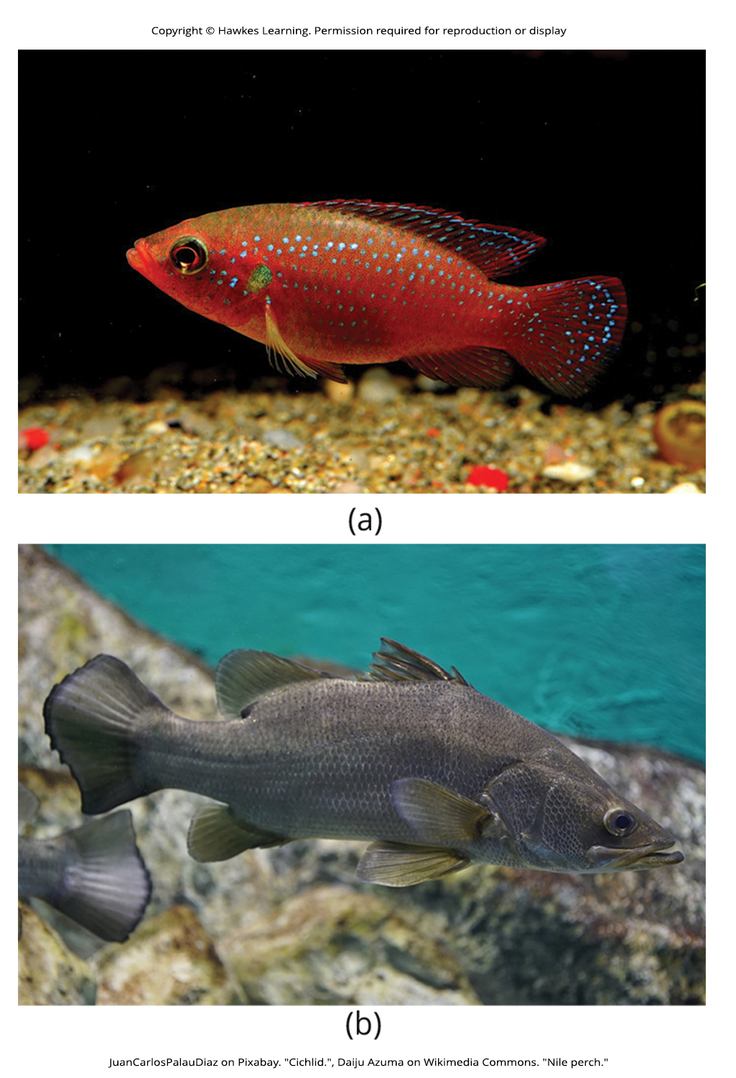
Lesson 47.1 Figure 2

Slide 4
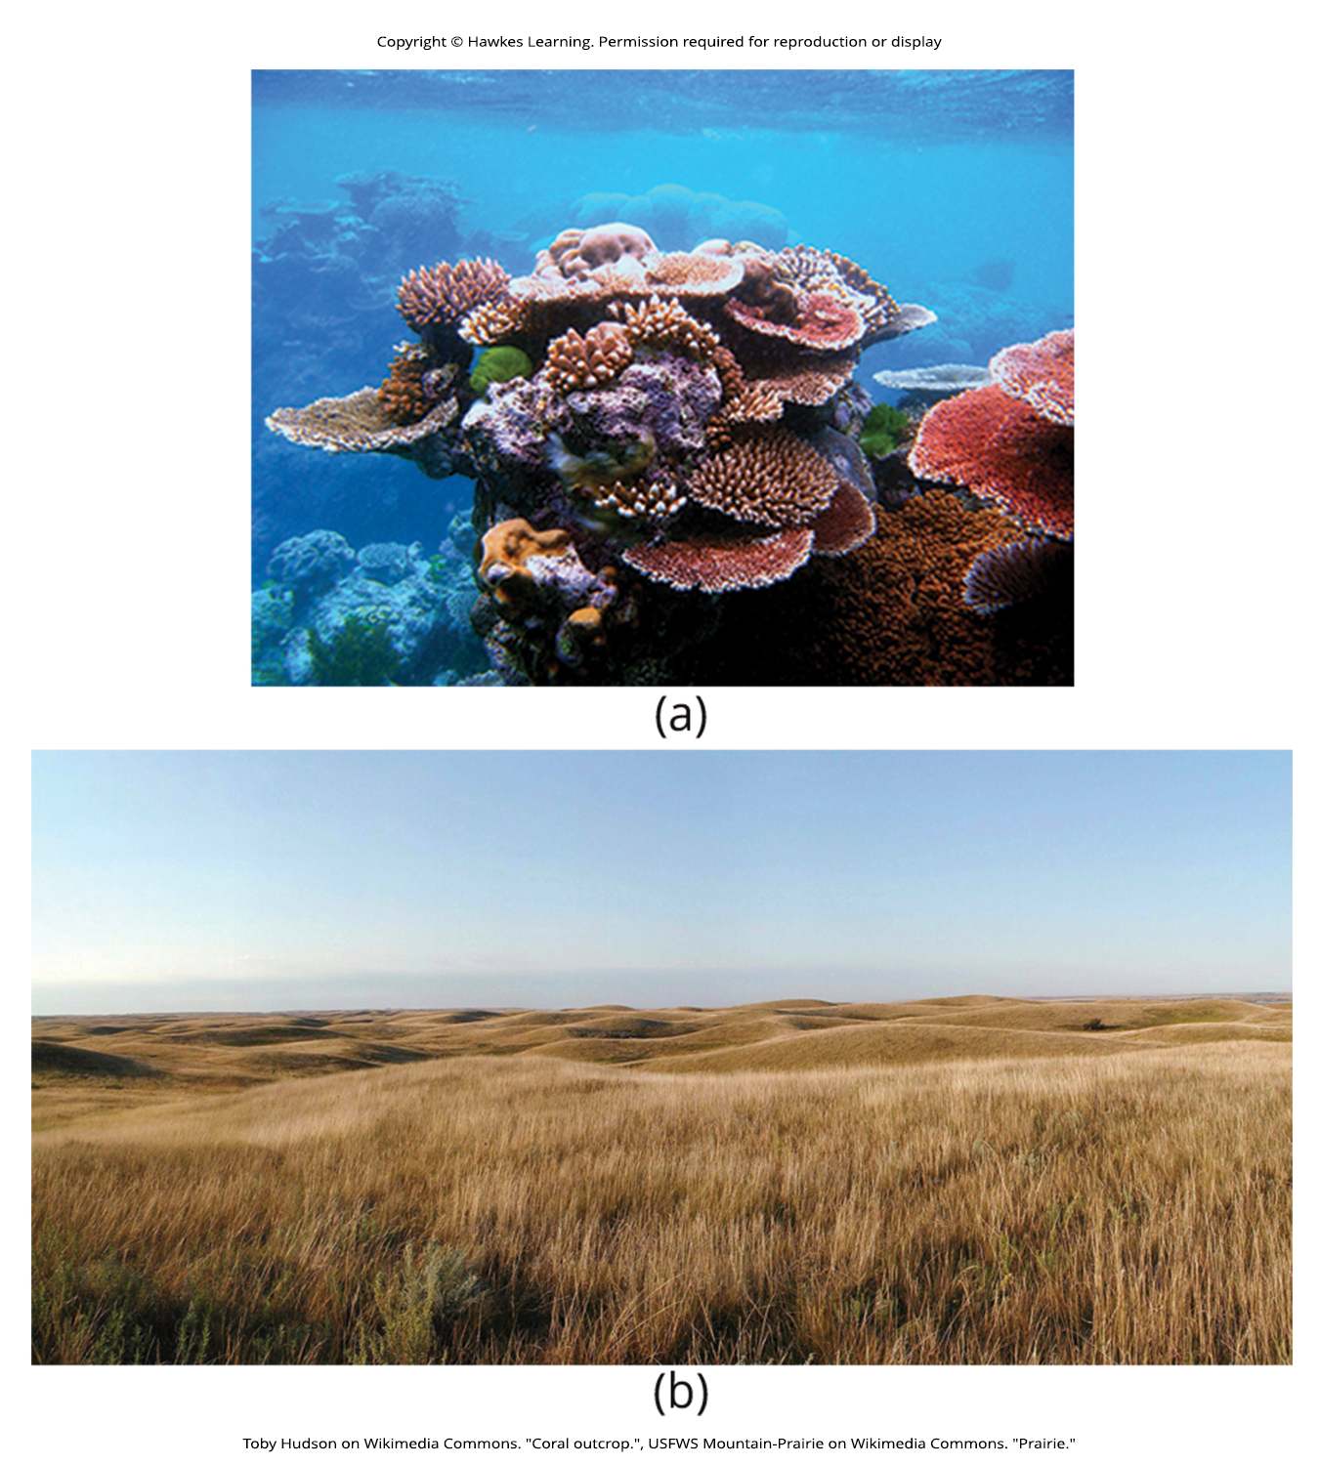
Lesson 47.1 Figure 3

Slide 5
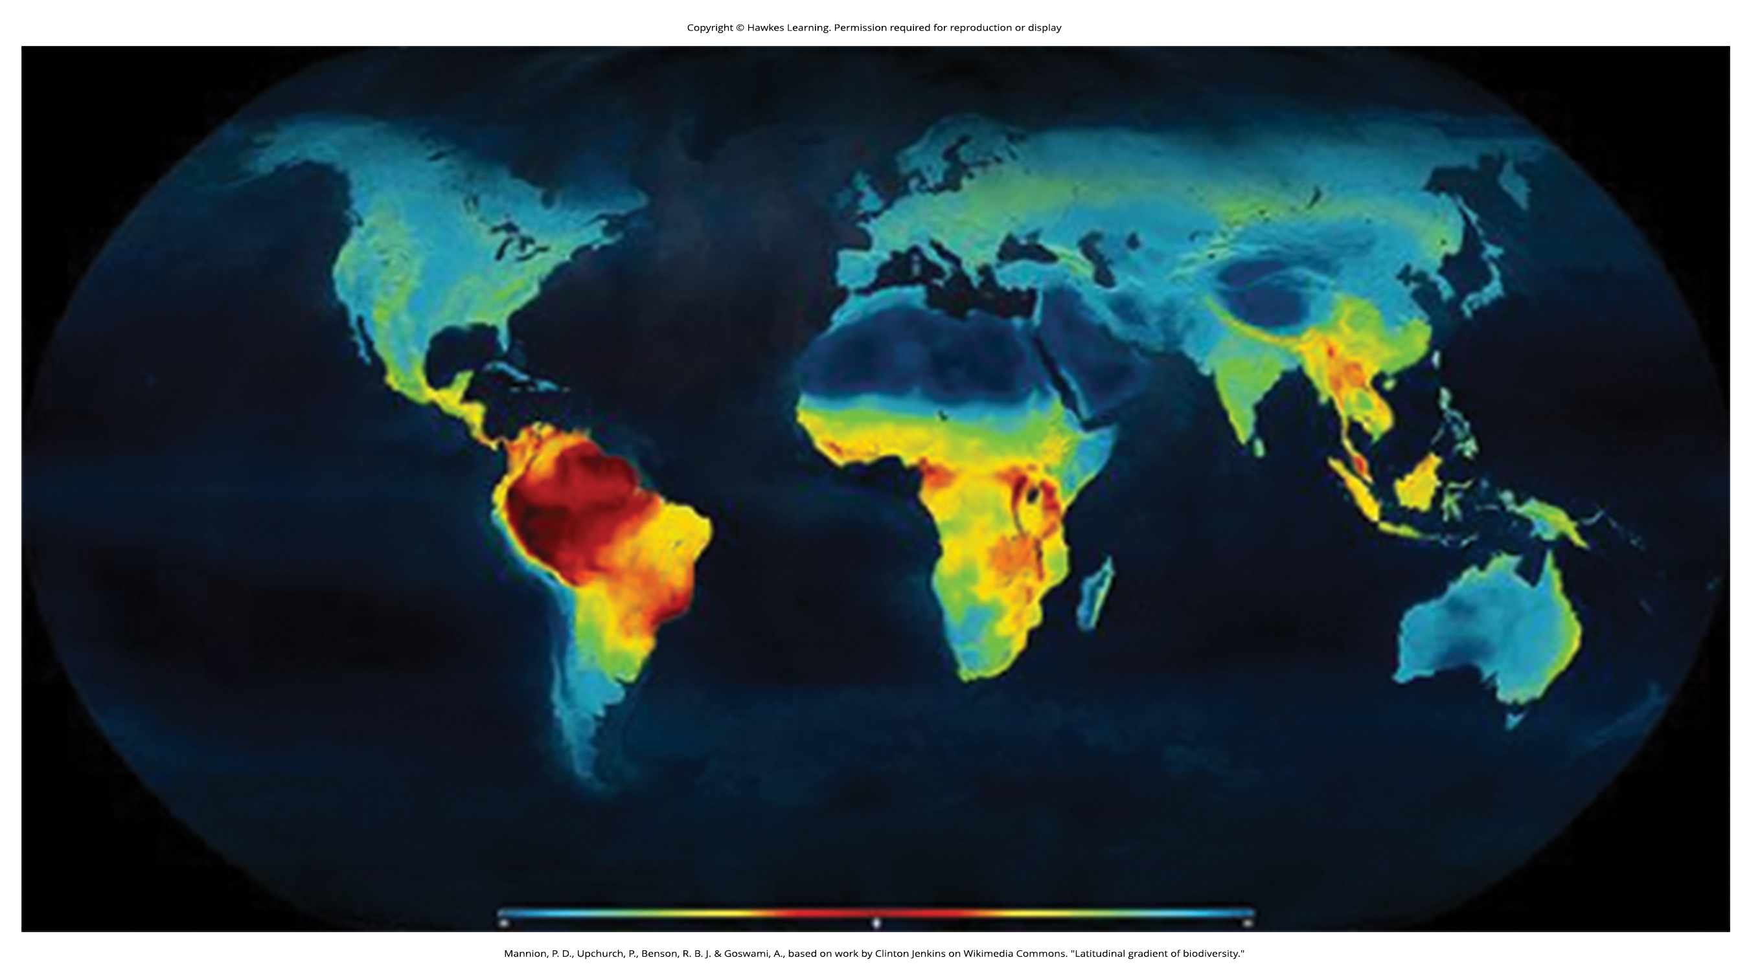
Lesson 47.1 Figure 4

Slide 6
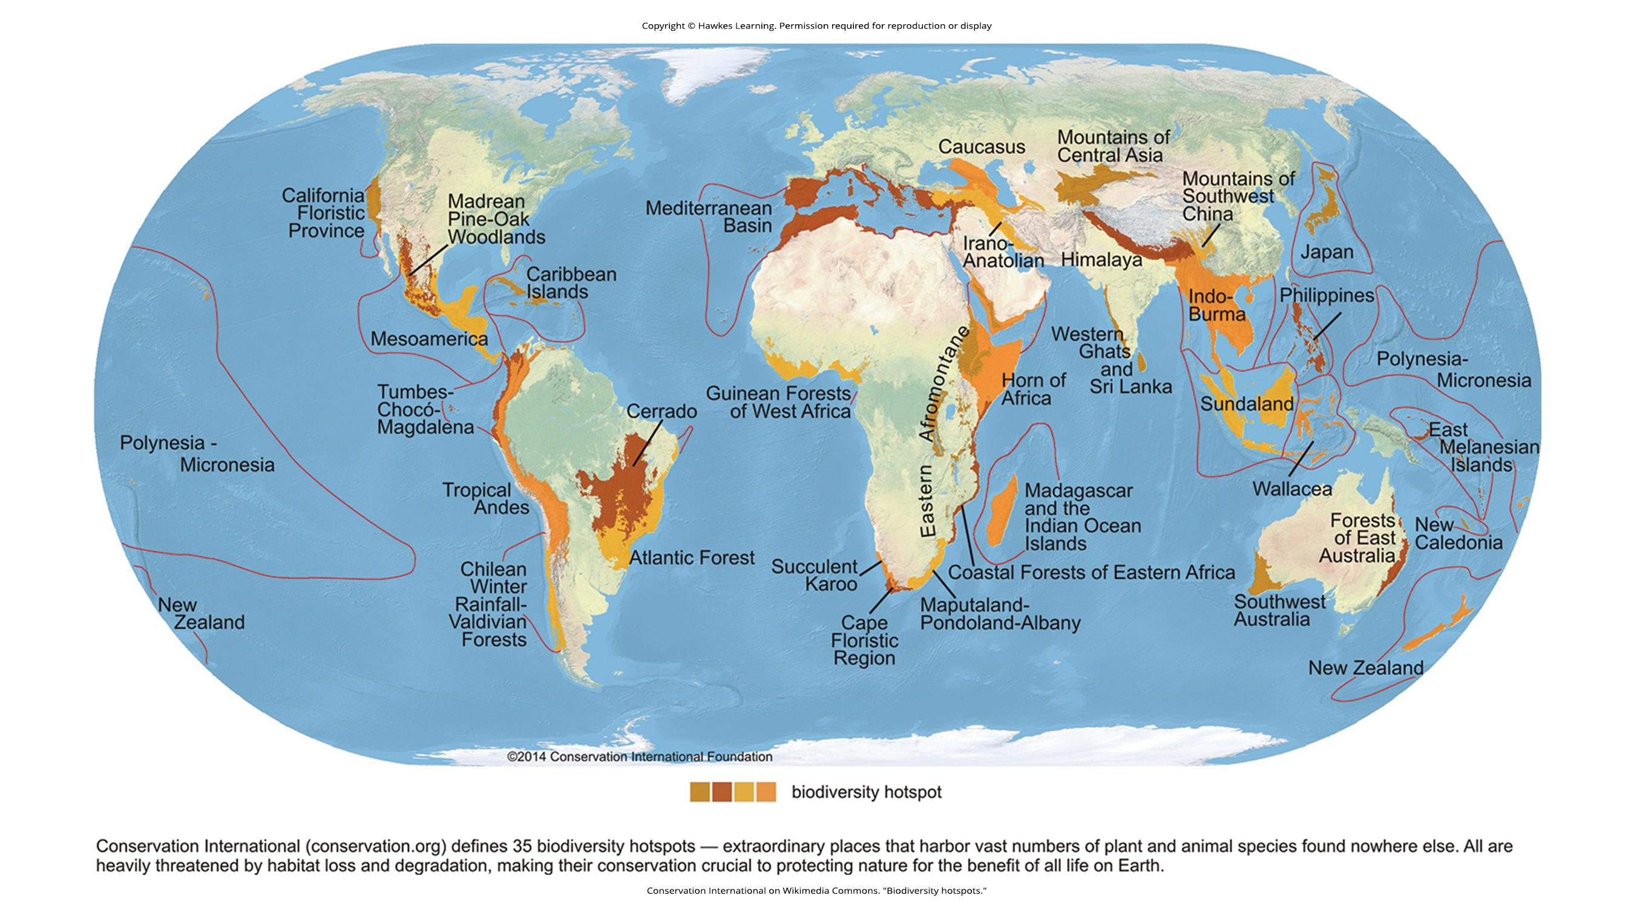
Lesson 47.1 Figure 5

Slide 7
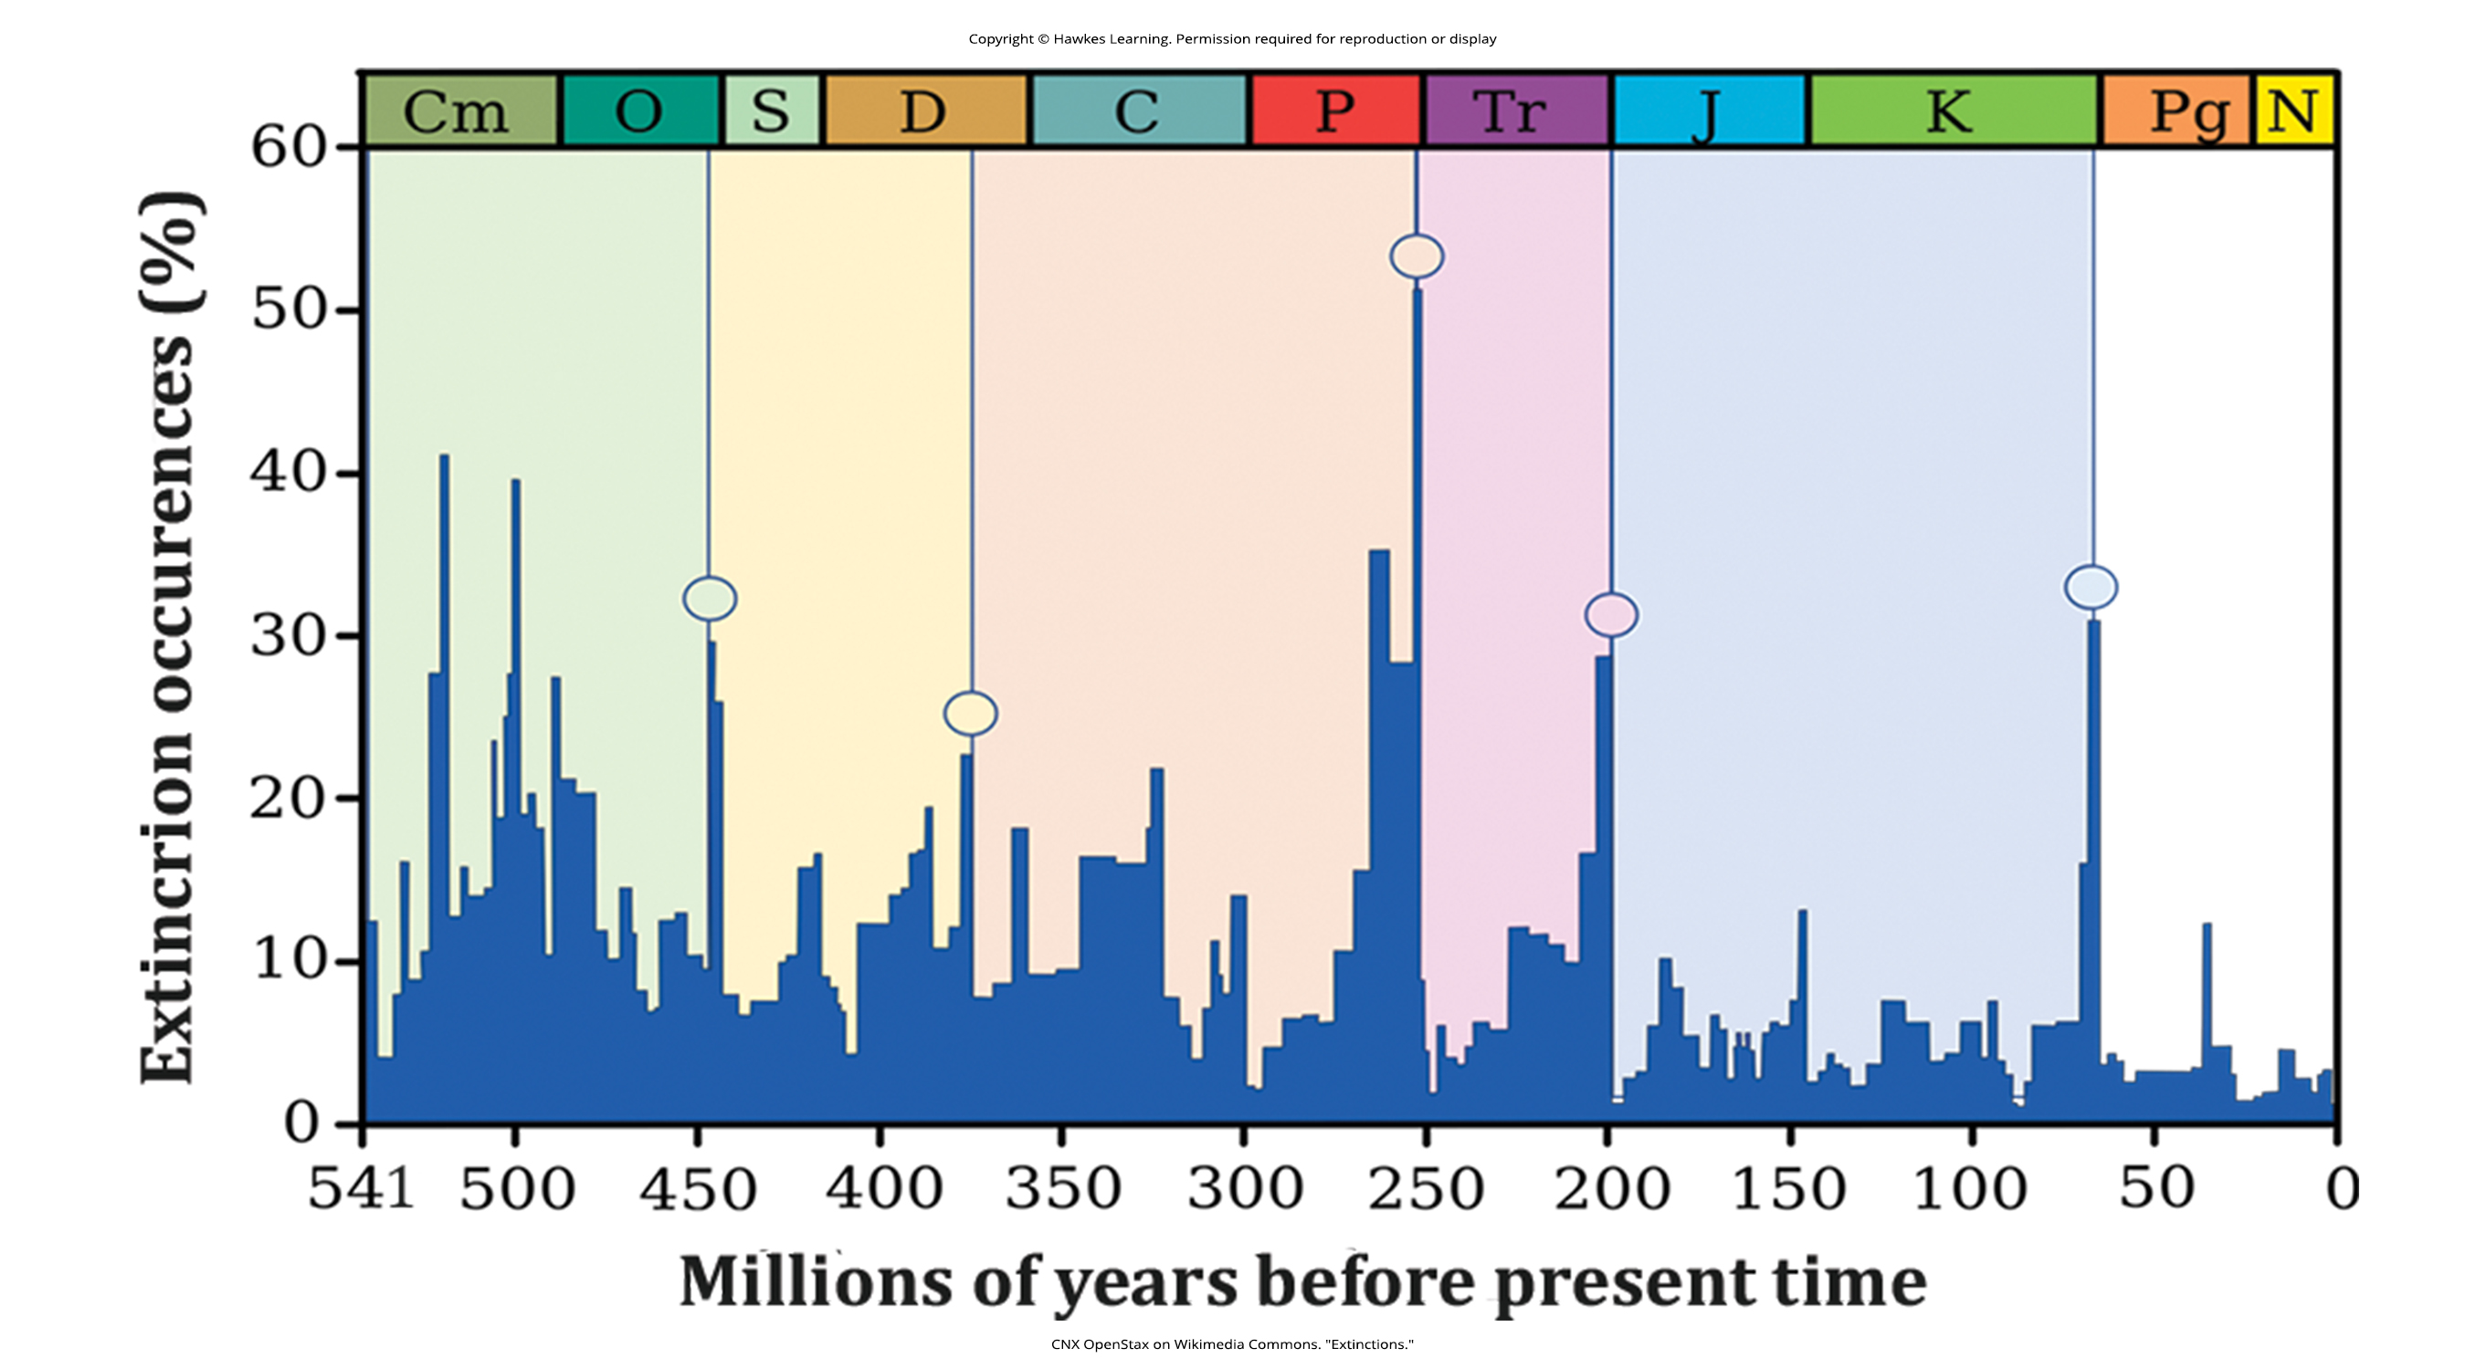
Lesson 47.1 Figure 6

Slide 8
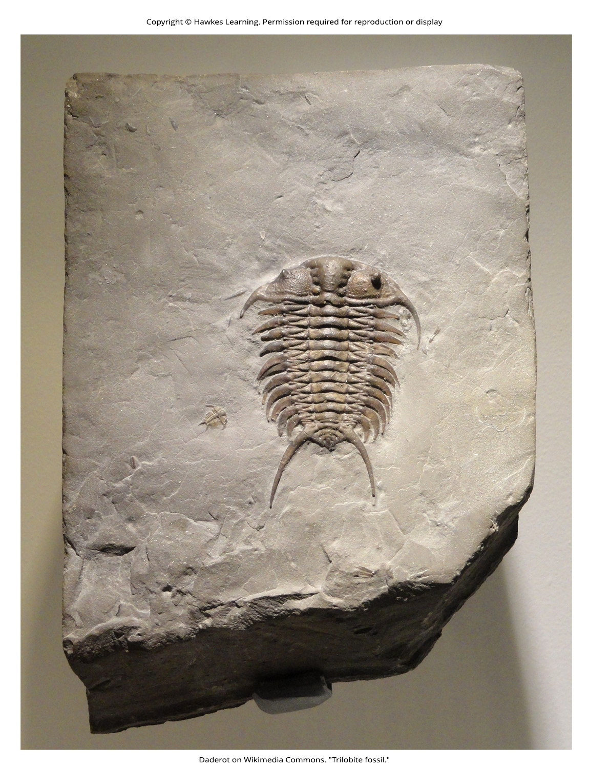
Lesson 47.1 Figure 7

Slide 9
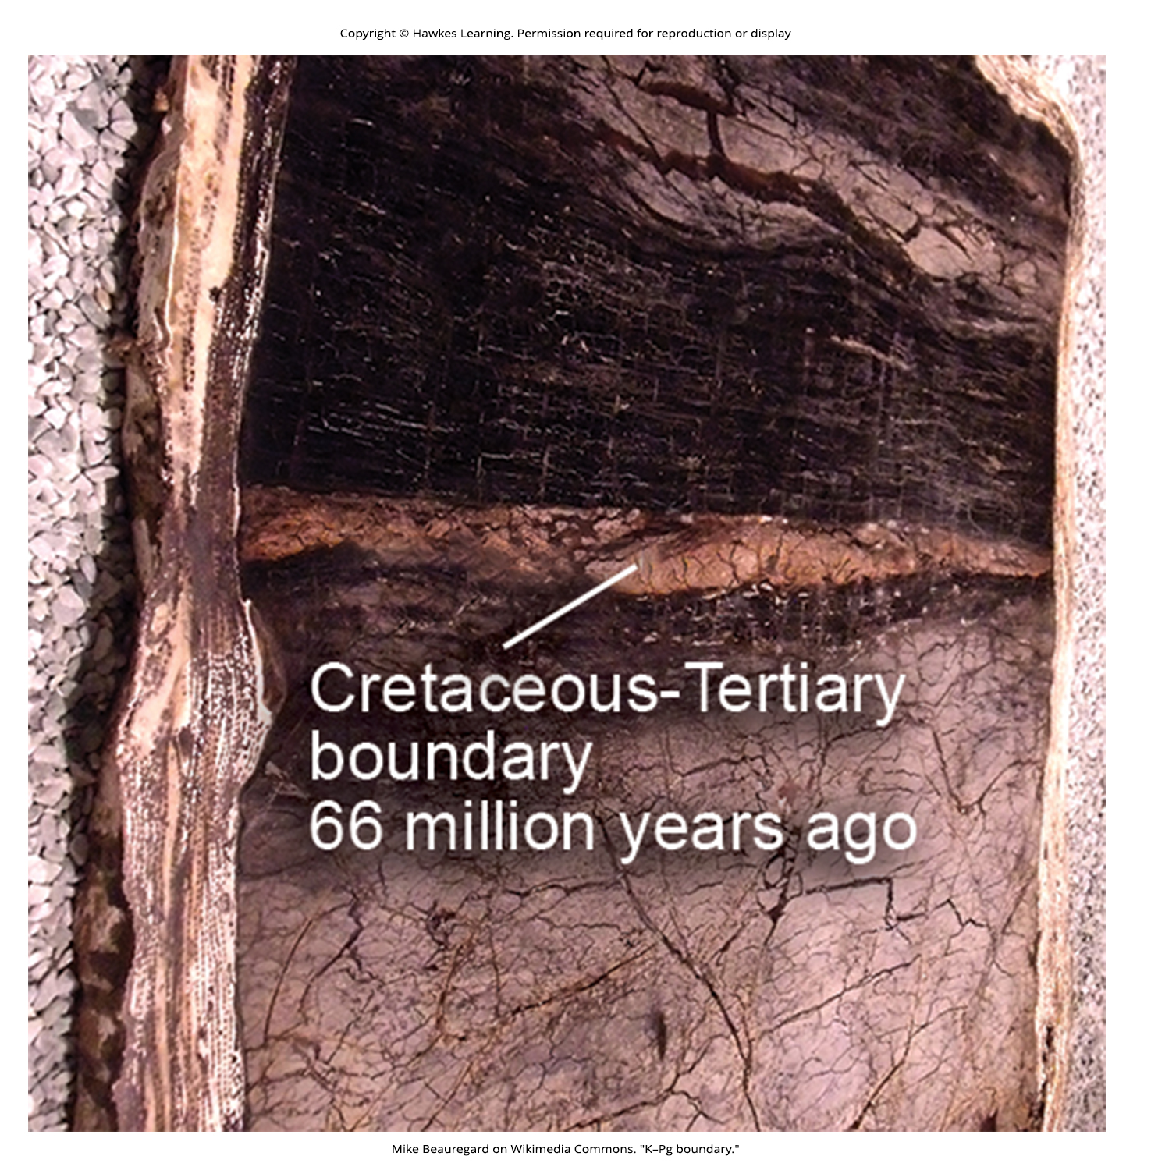
Lesson 47.1 Figure 8

Slide 10
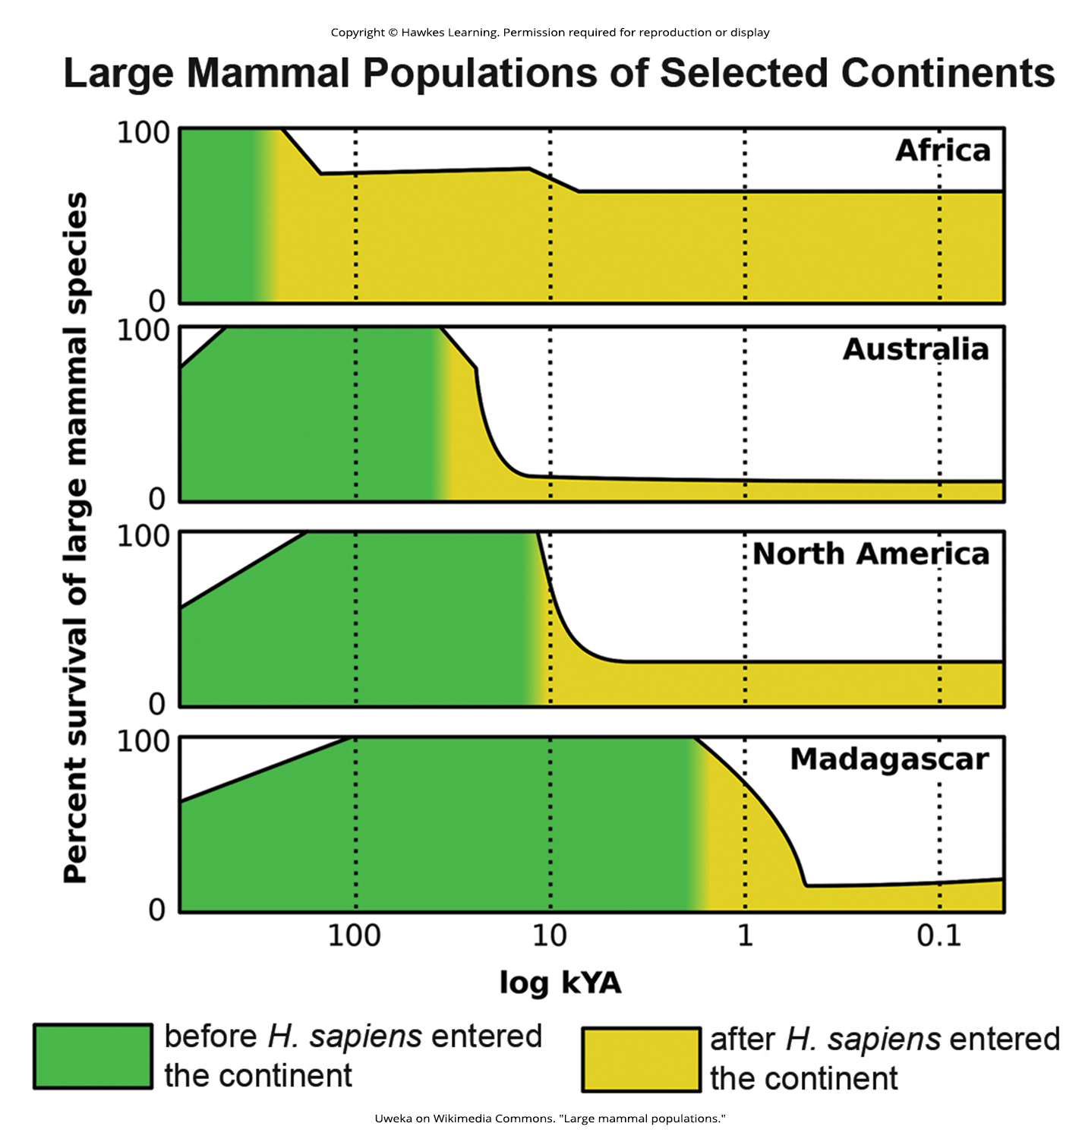
Lesson 47.1 Figure 9

Slide 11
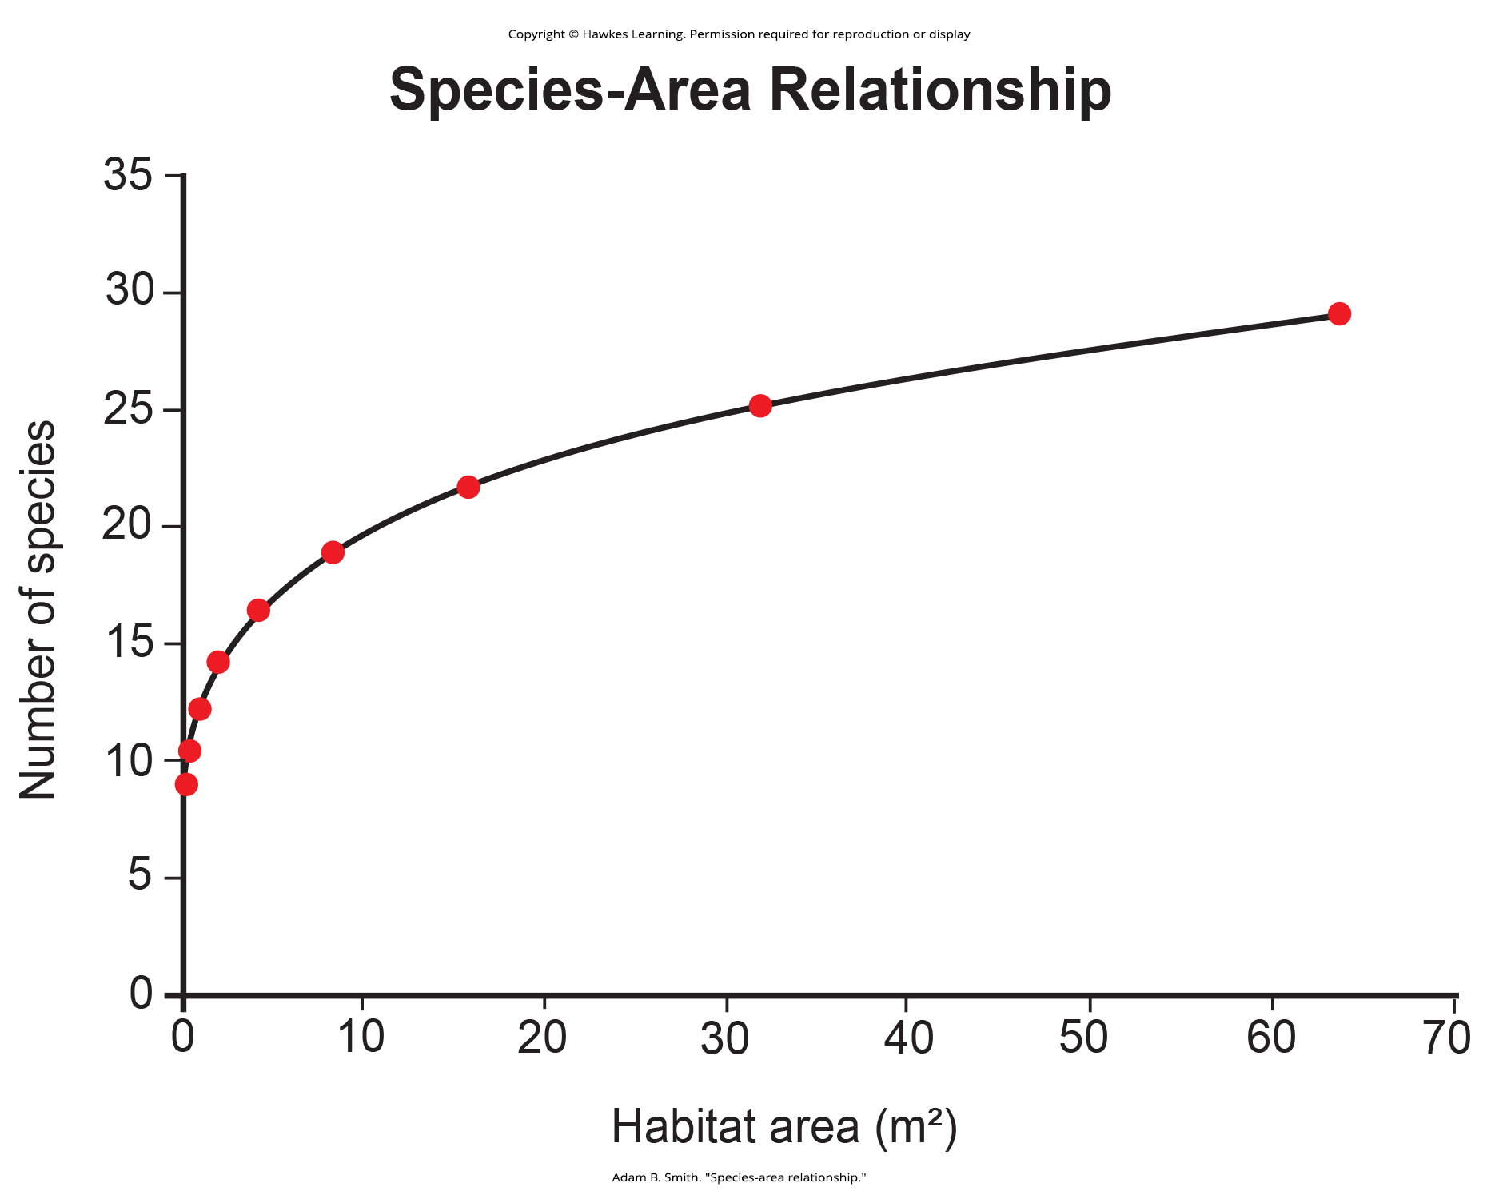
Lesson 47.1 Figure 10

Slide 12
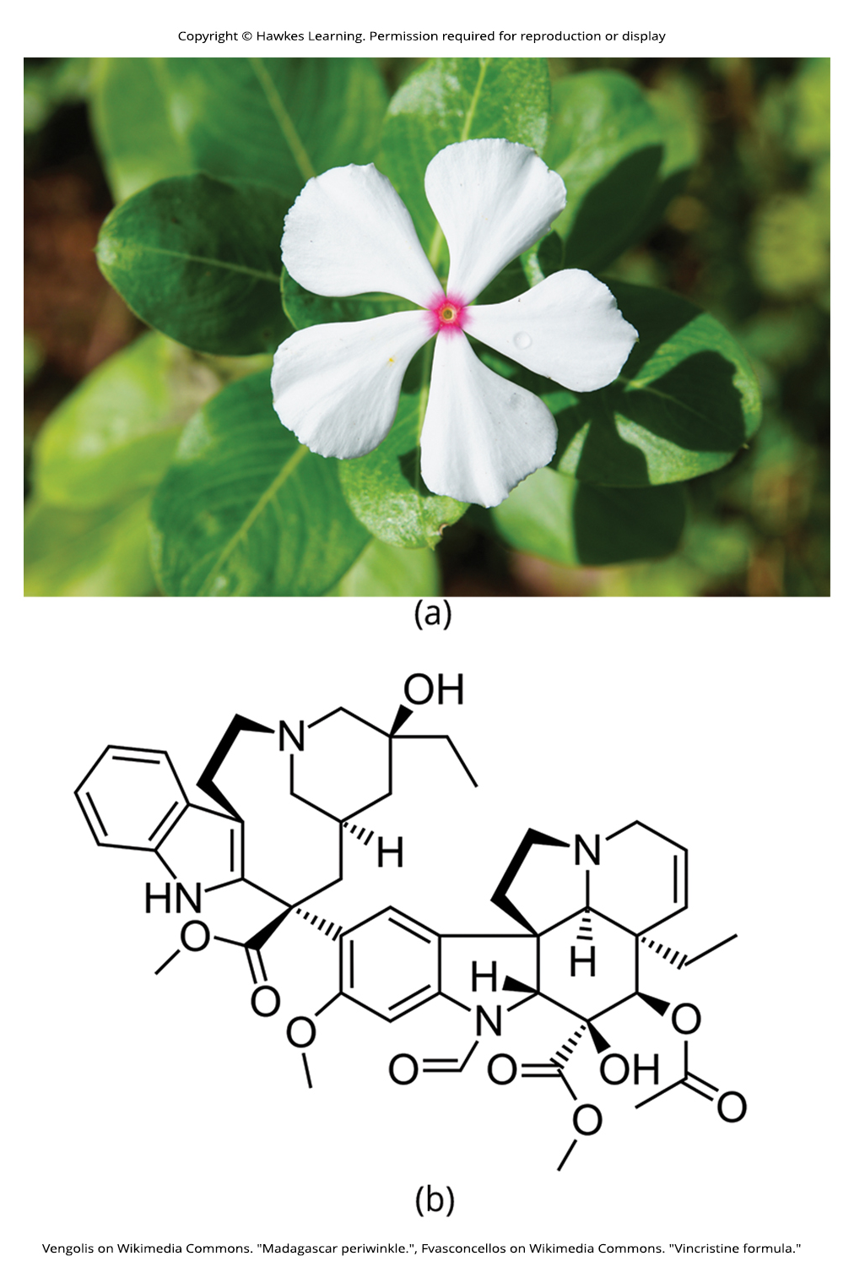
Lesson 47.2 Figure 1

Slide 13
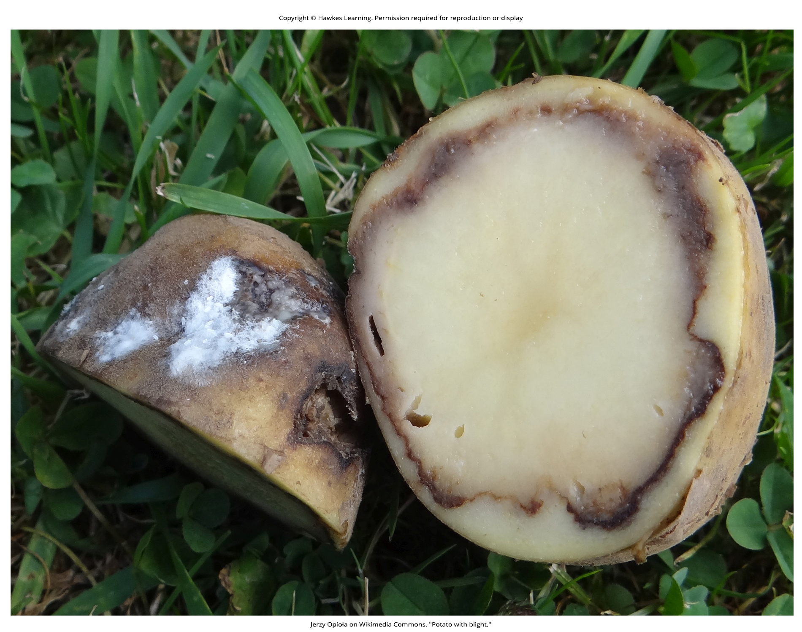
Lesson 47.2 Figure 2

Slide 14
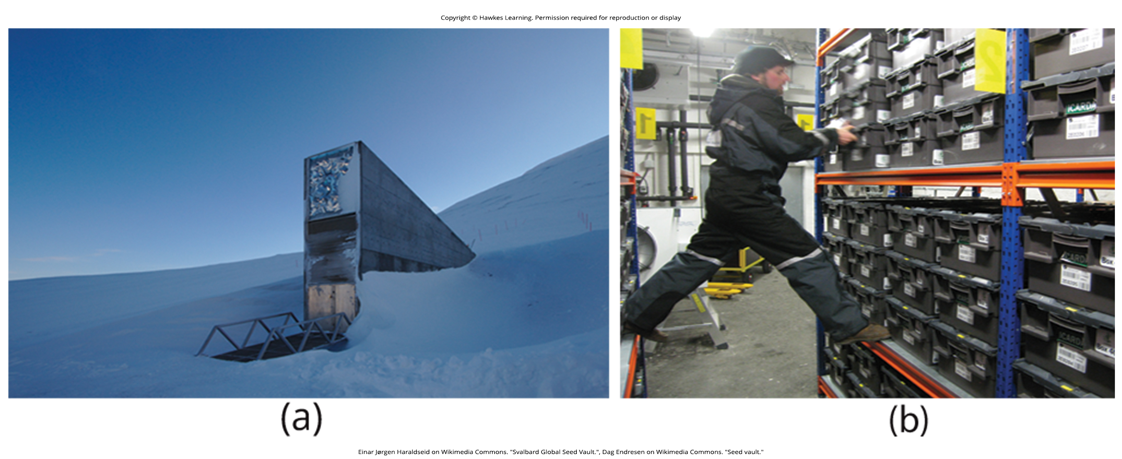
Lesson 47.2 Figure 3

Slide 15
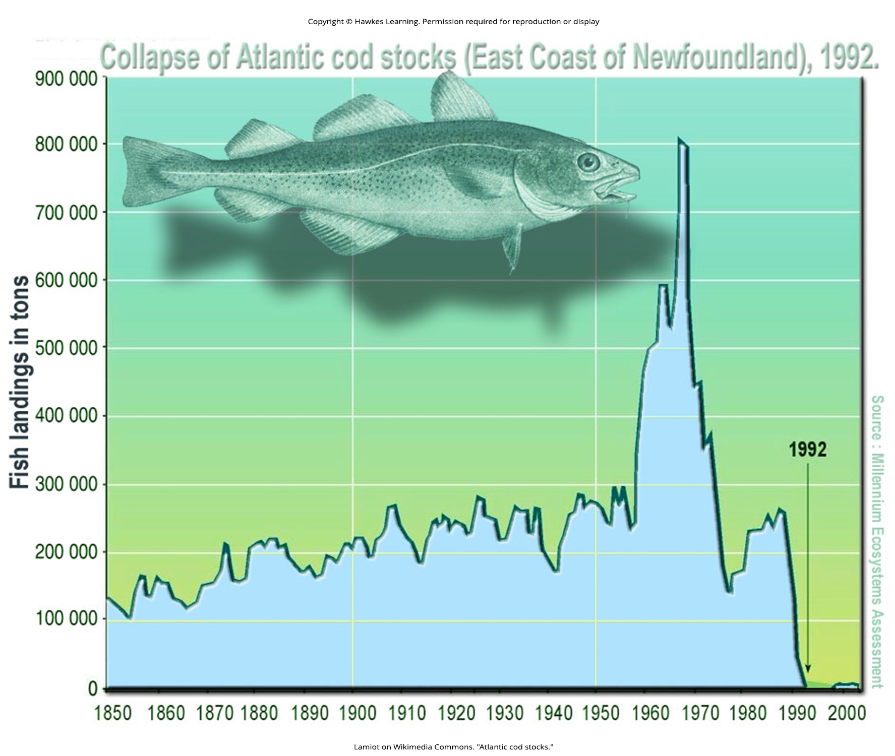
Lesson 47.2 Figure 4

Slide 16
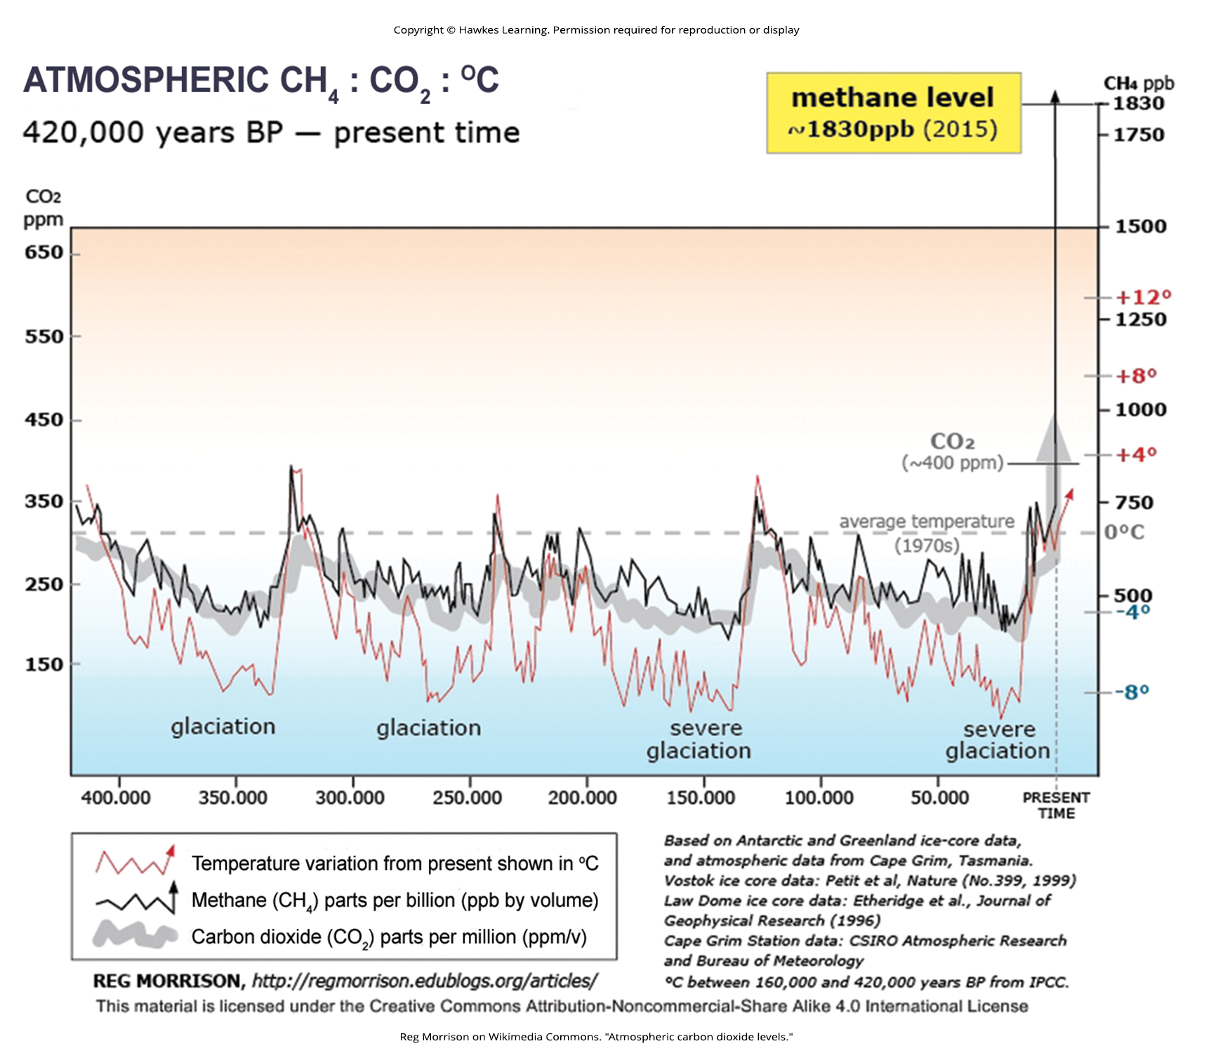
Lesson 47.3 Figure 1

Slide 17
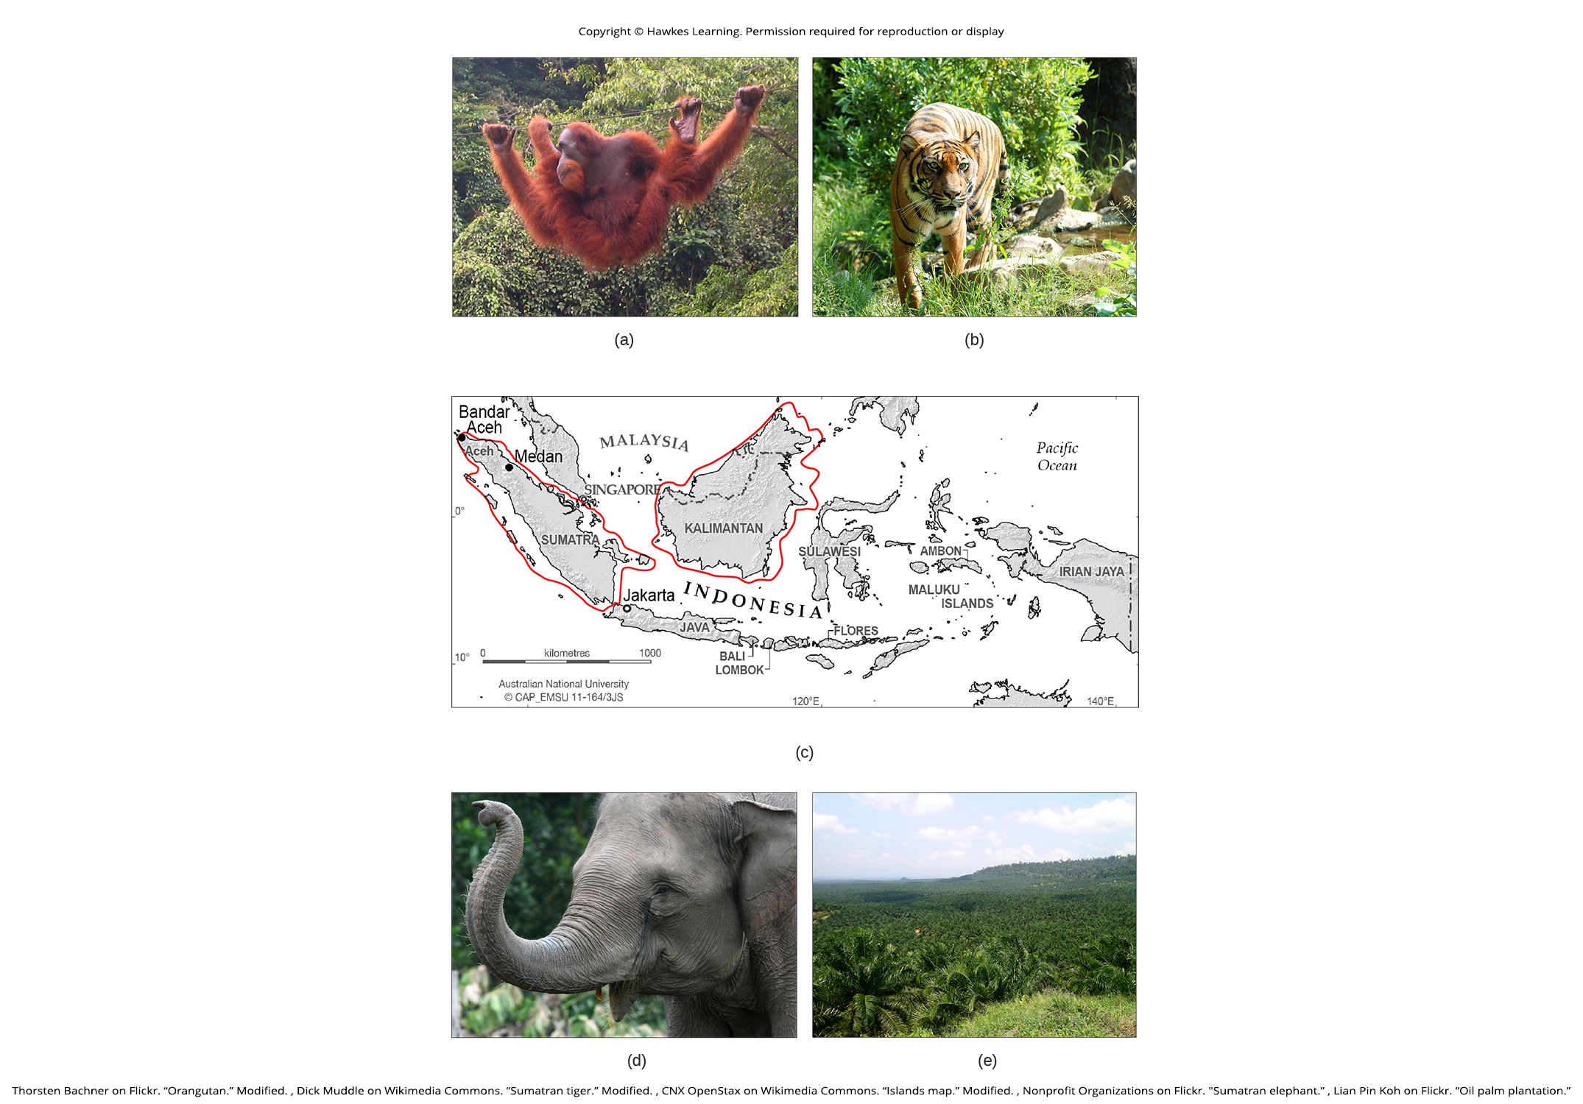
Lesson 47.3 Figure 2

Slide 18
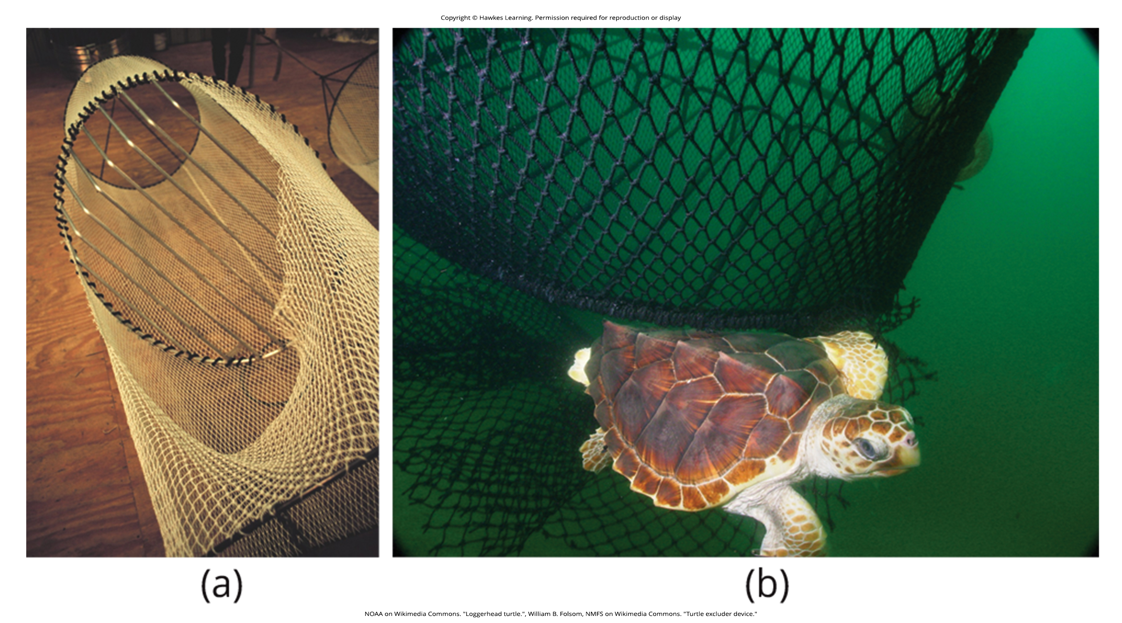
Lesson 47.3 Figure 3

Slide 19
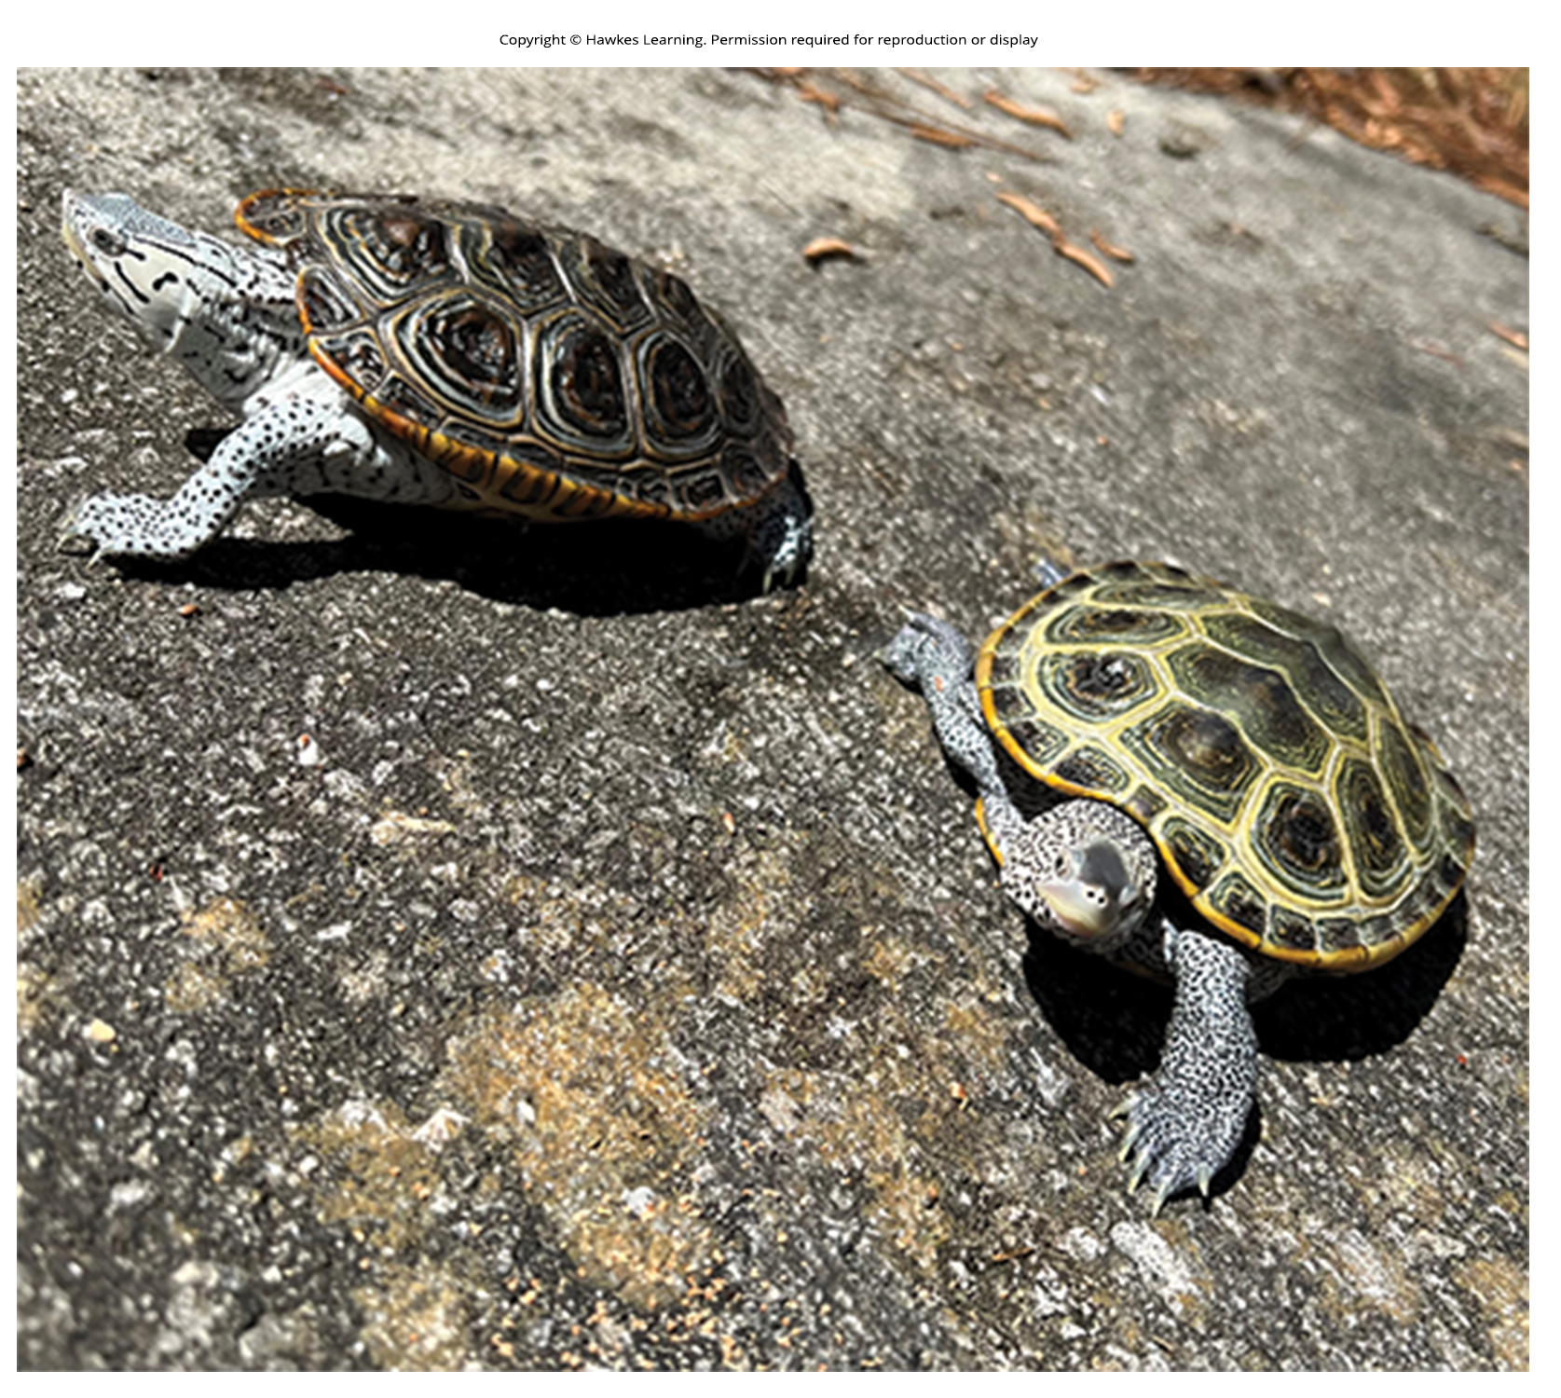
Lesson 47.3 Figure 4

Slide 20
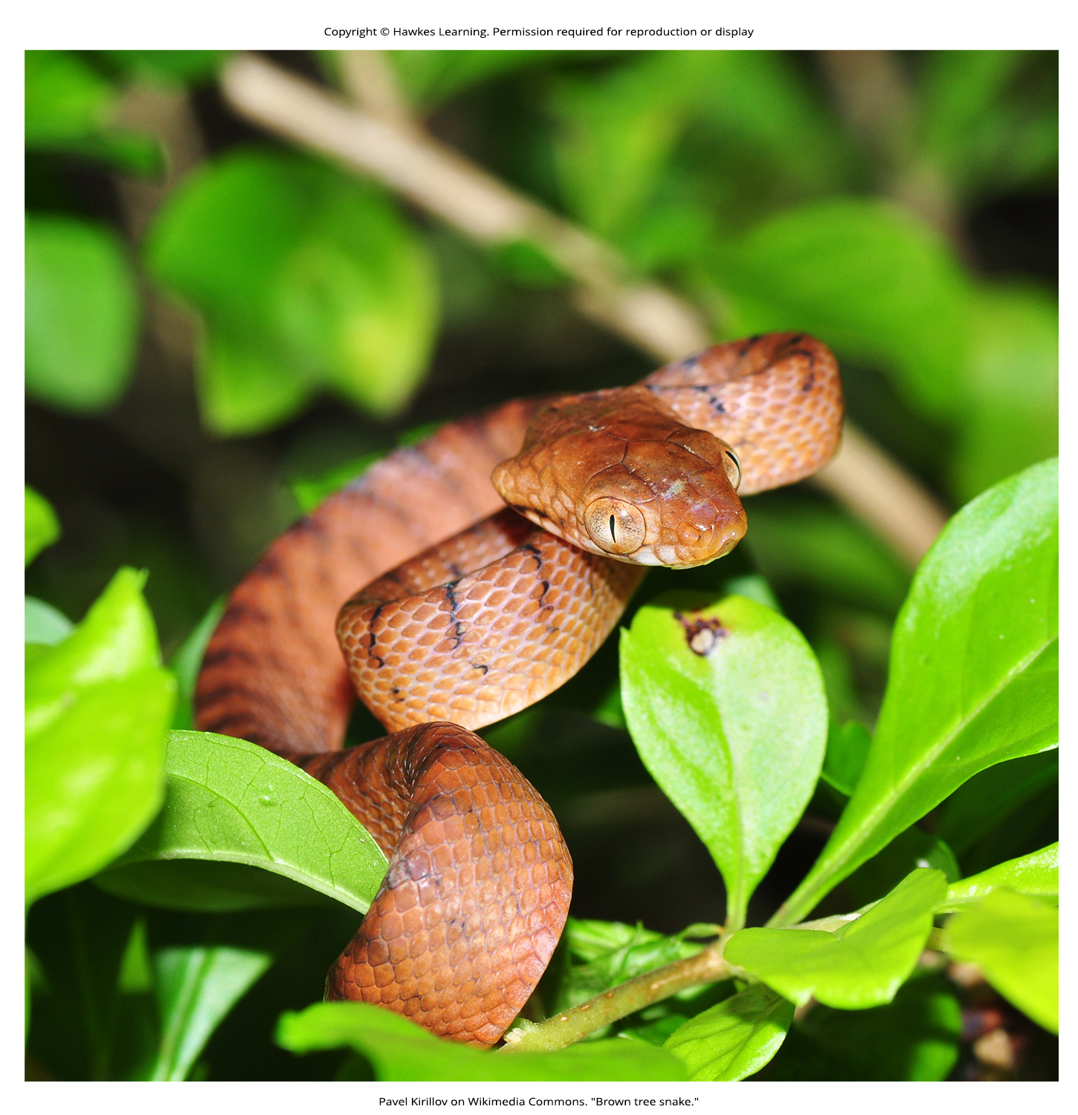
Lesson 47.3 Figure 5

Slide 21
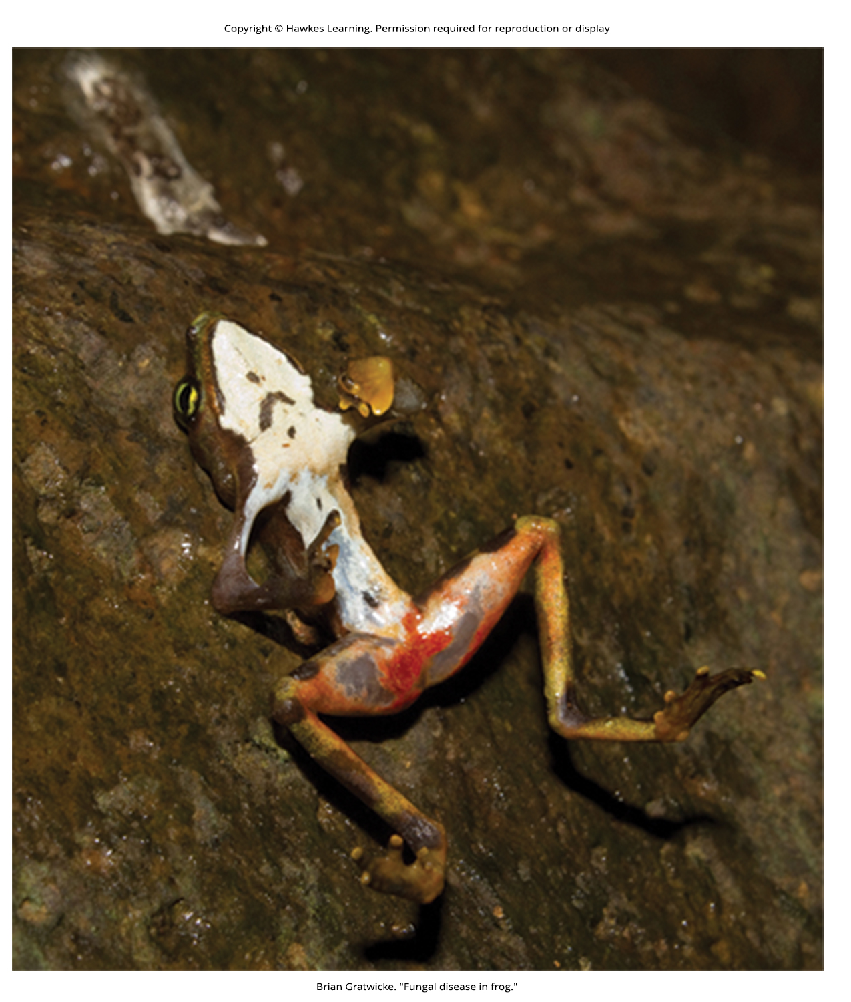
Lesson 47.3 Figure 6

Slide 22
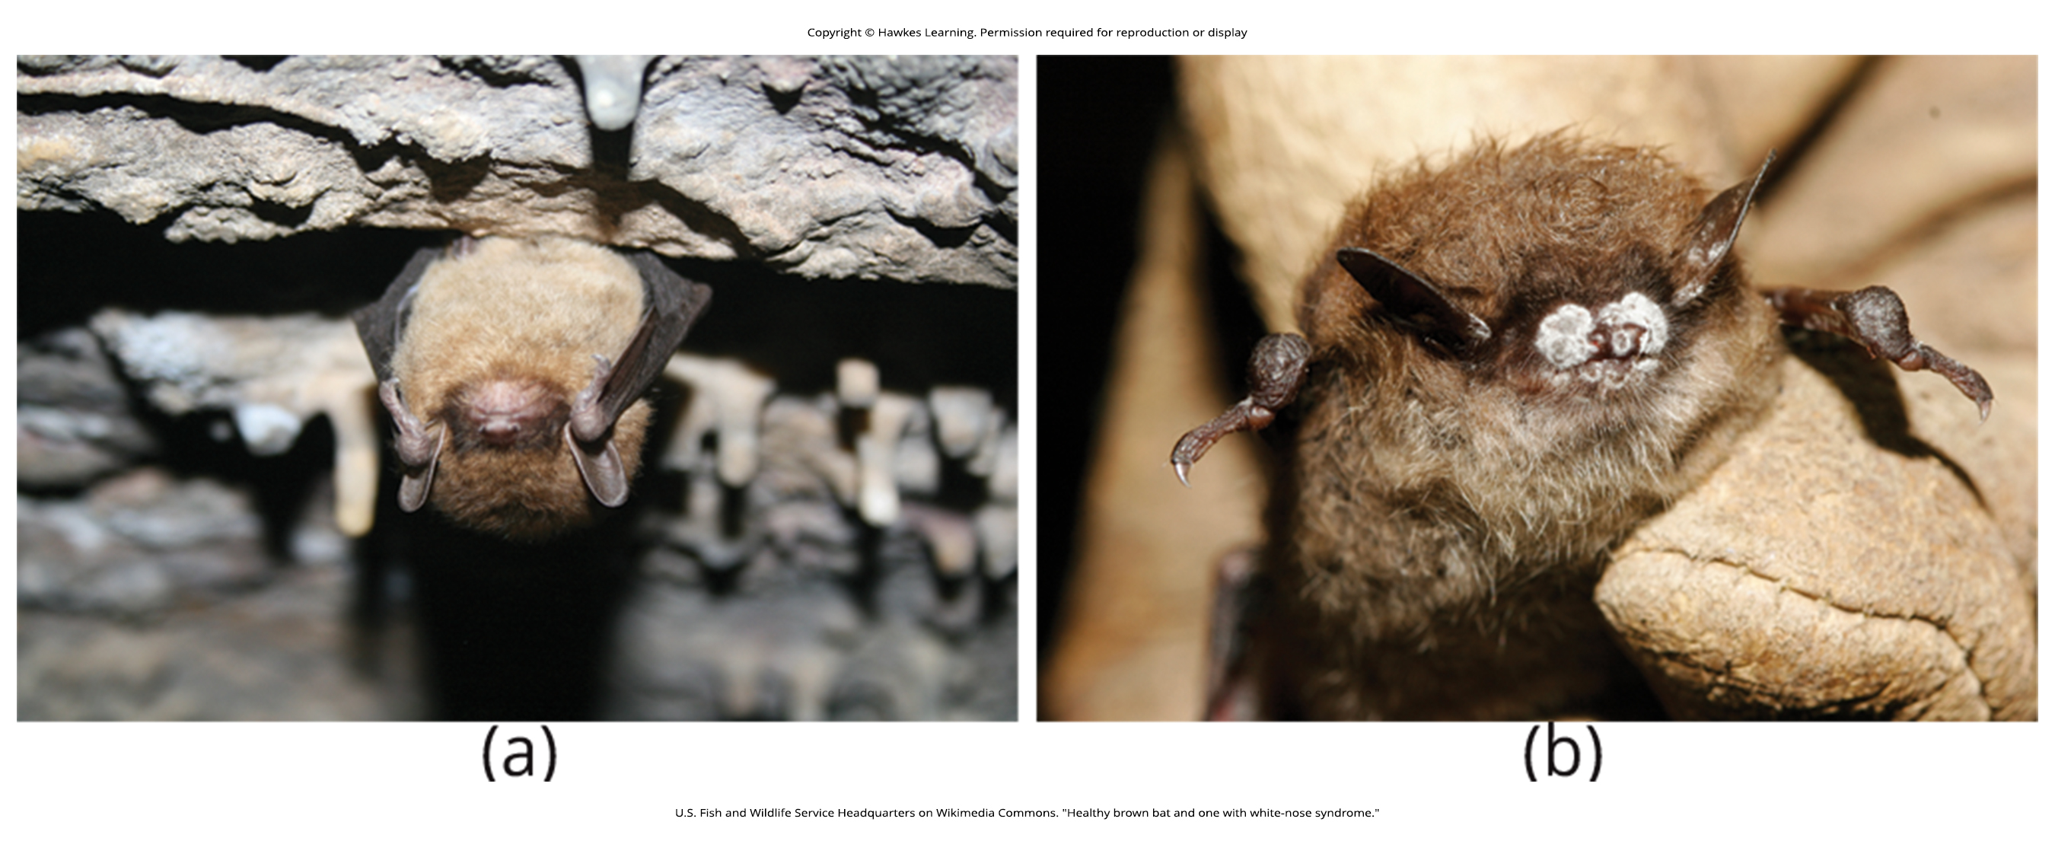
Lesson 47.3 Figure 7

Slide 23
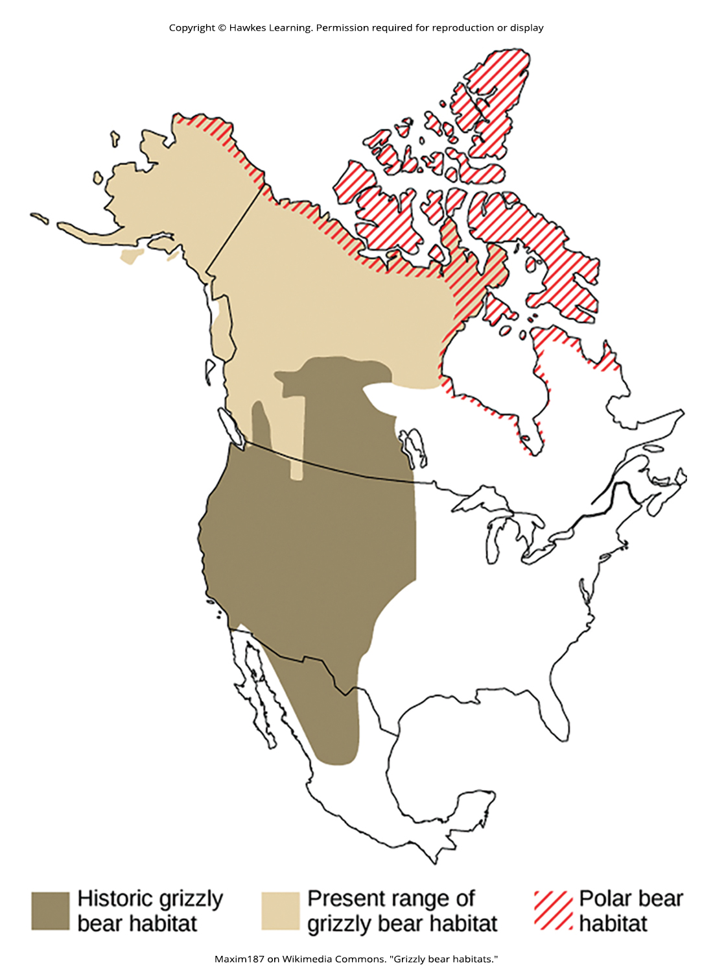
Lesson 47.3 Figure 8

Slide 24
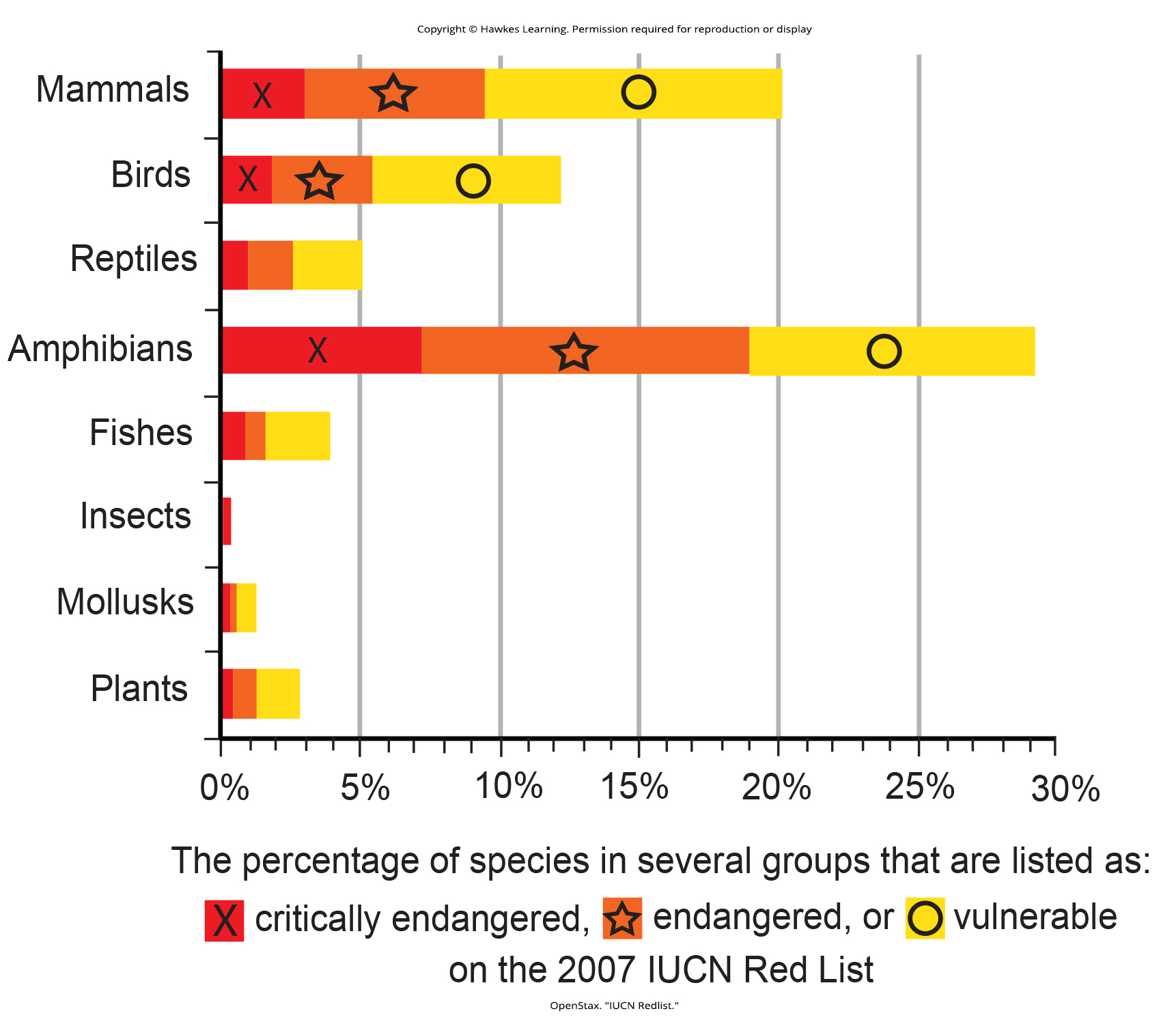
Lesson 47.4 Figure 1

Slide 25
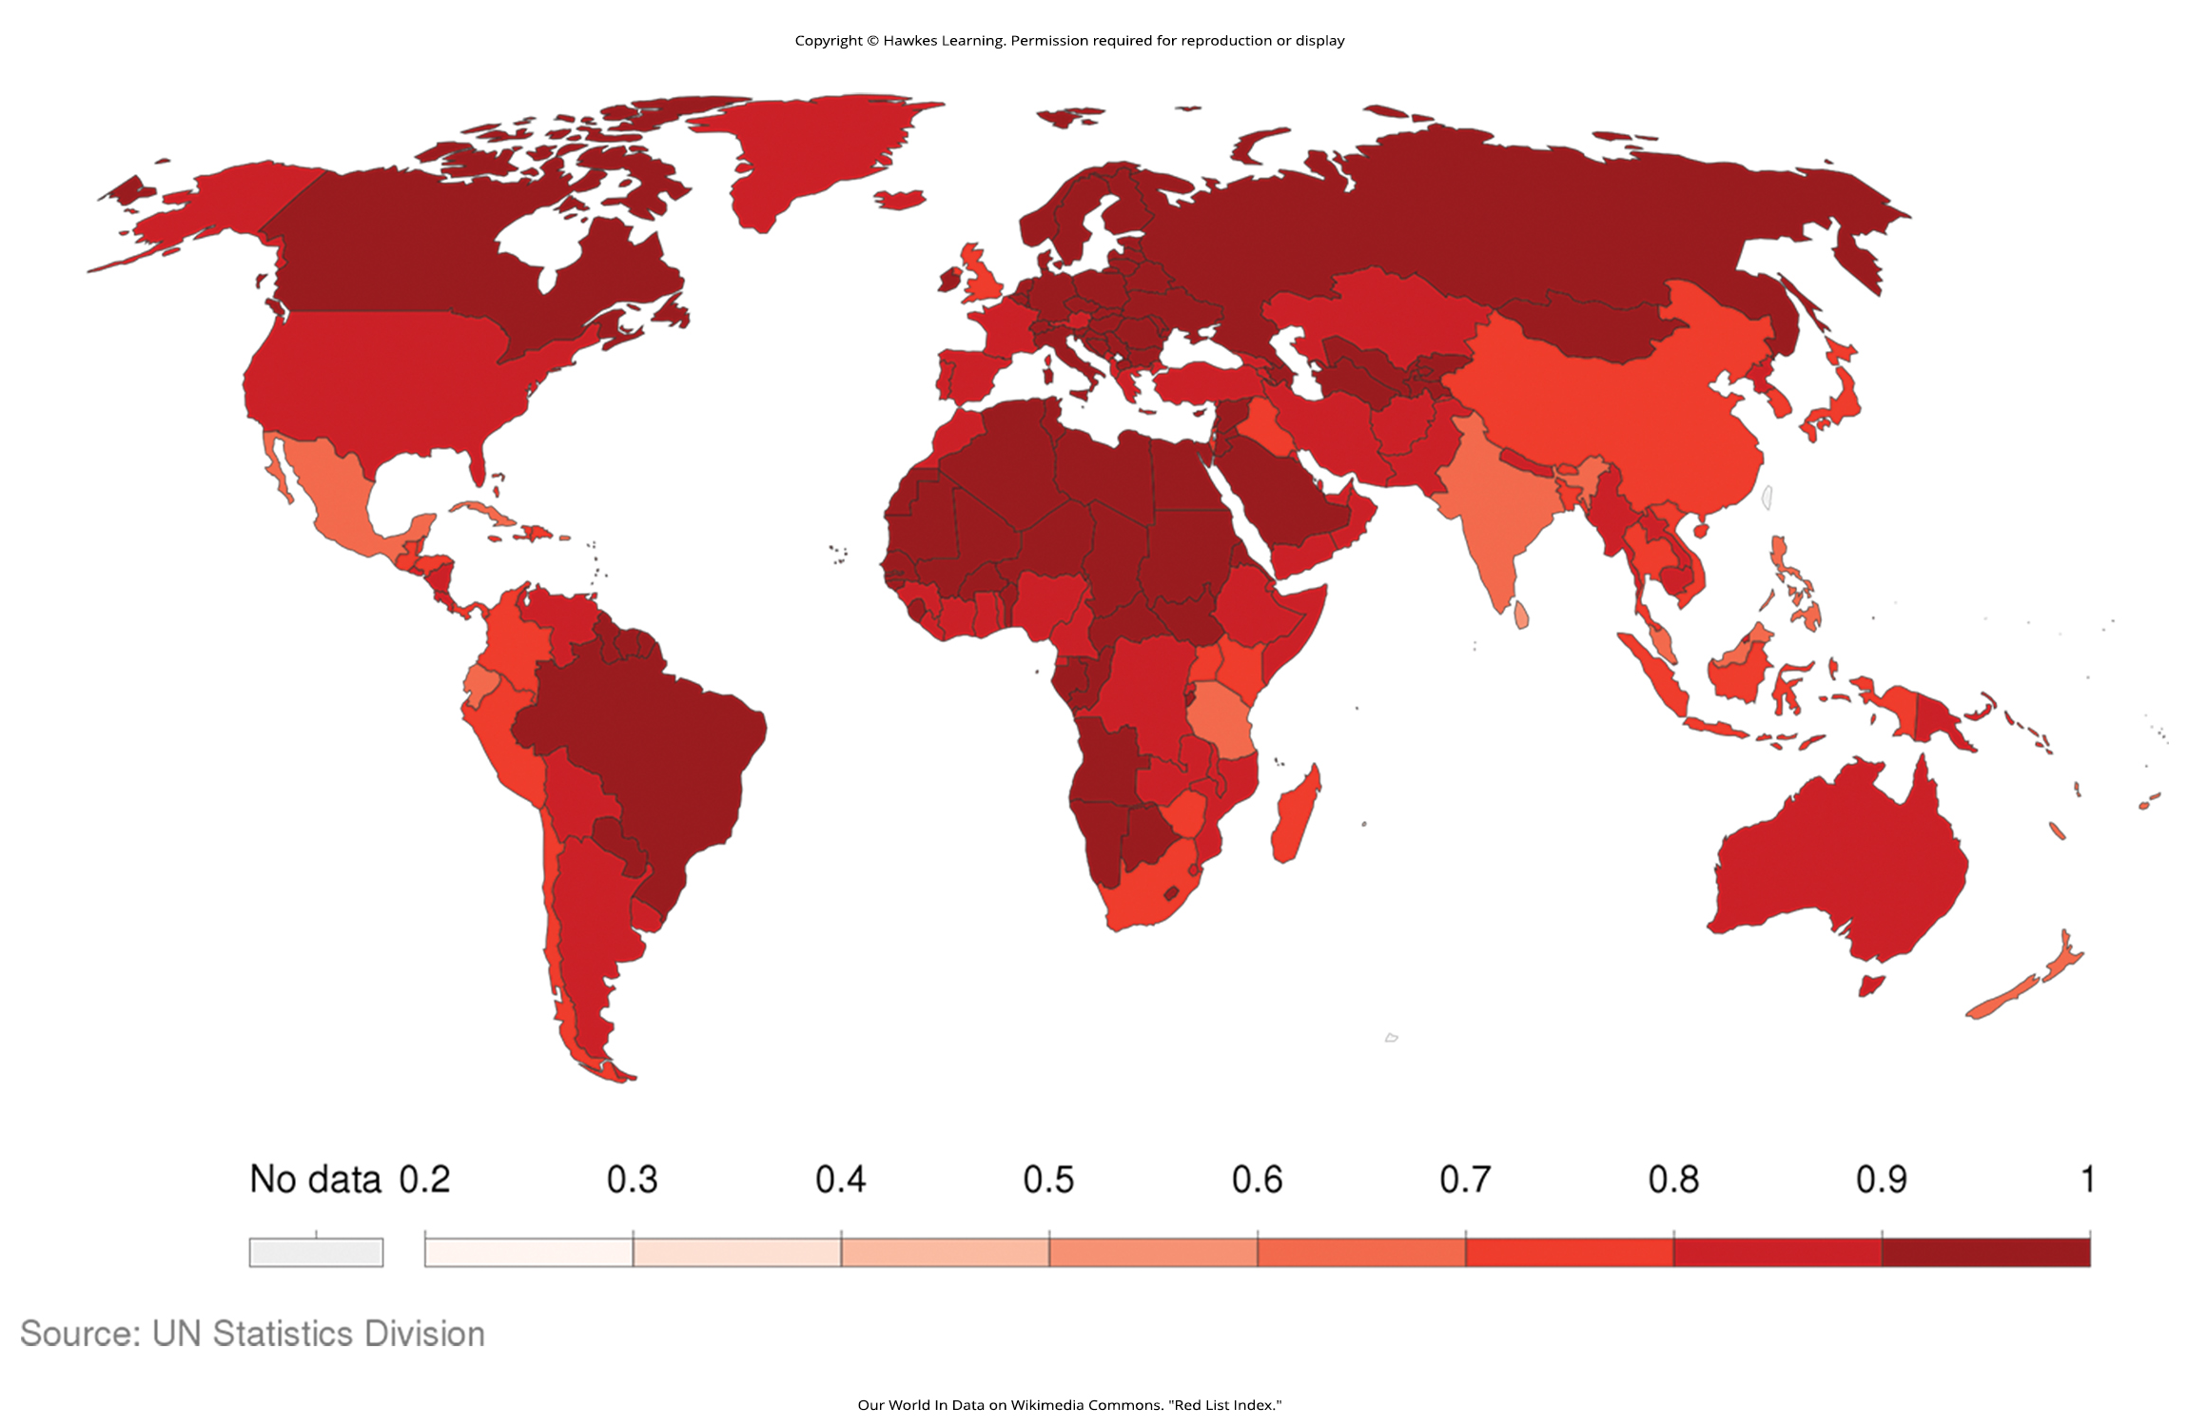
Lesson 47.4 Figure 2

Slide 26
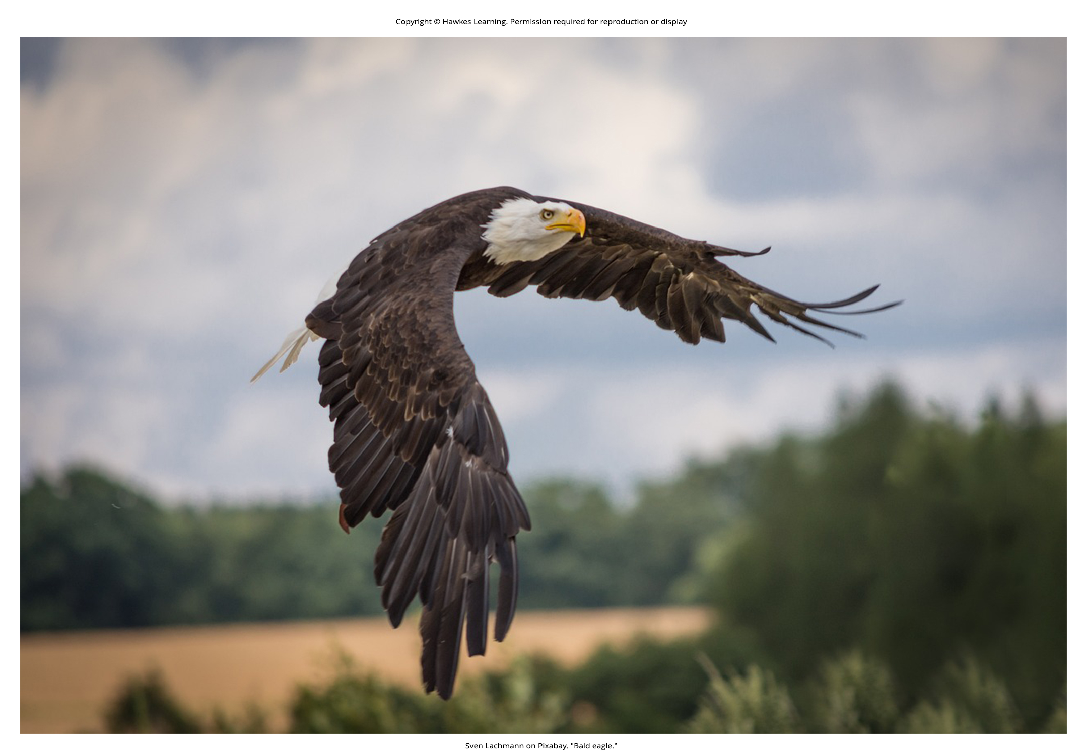
Lesson 47.4 Figure 3

Slide 27
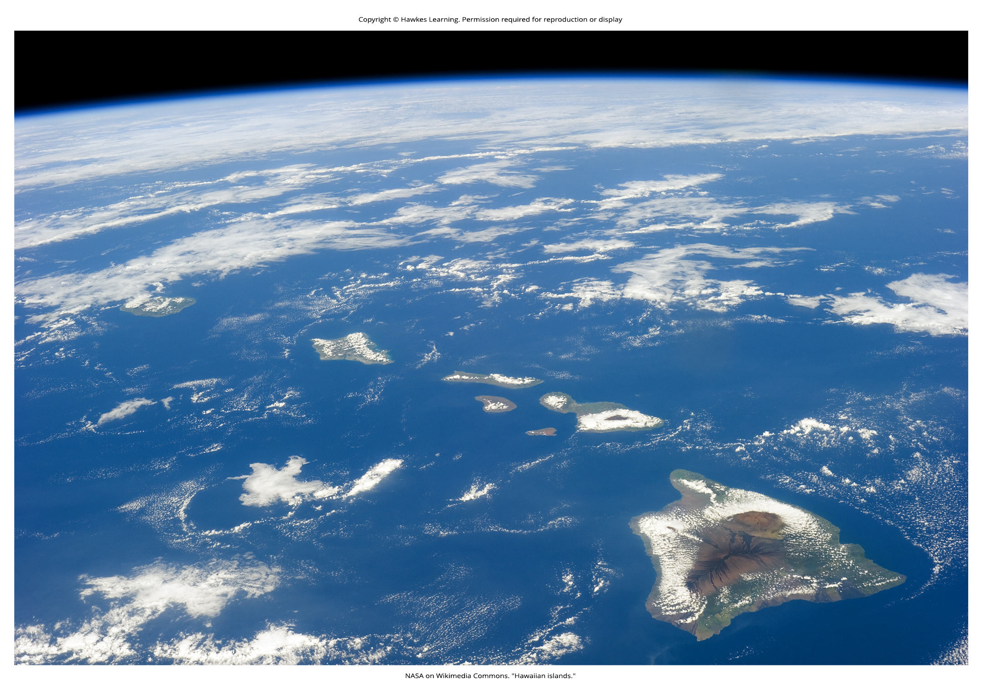
Lesson 47.4 Figure 4

Slide 28
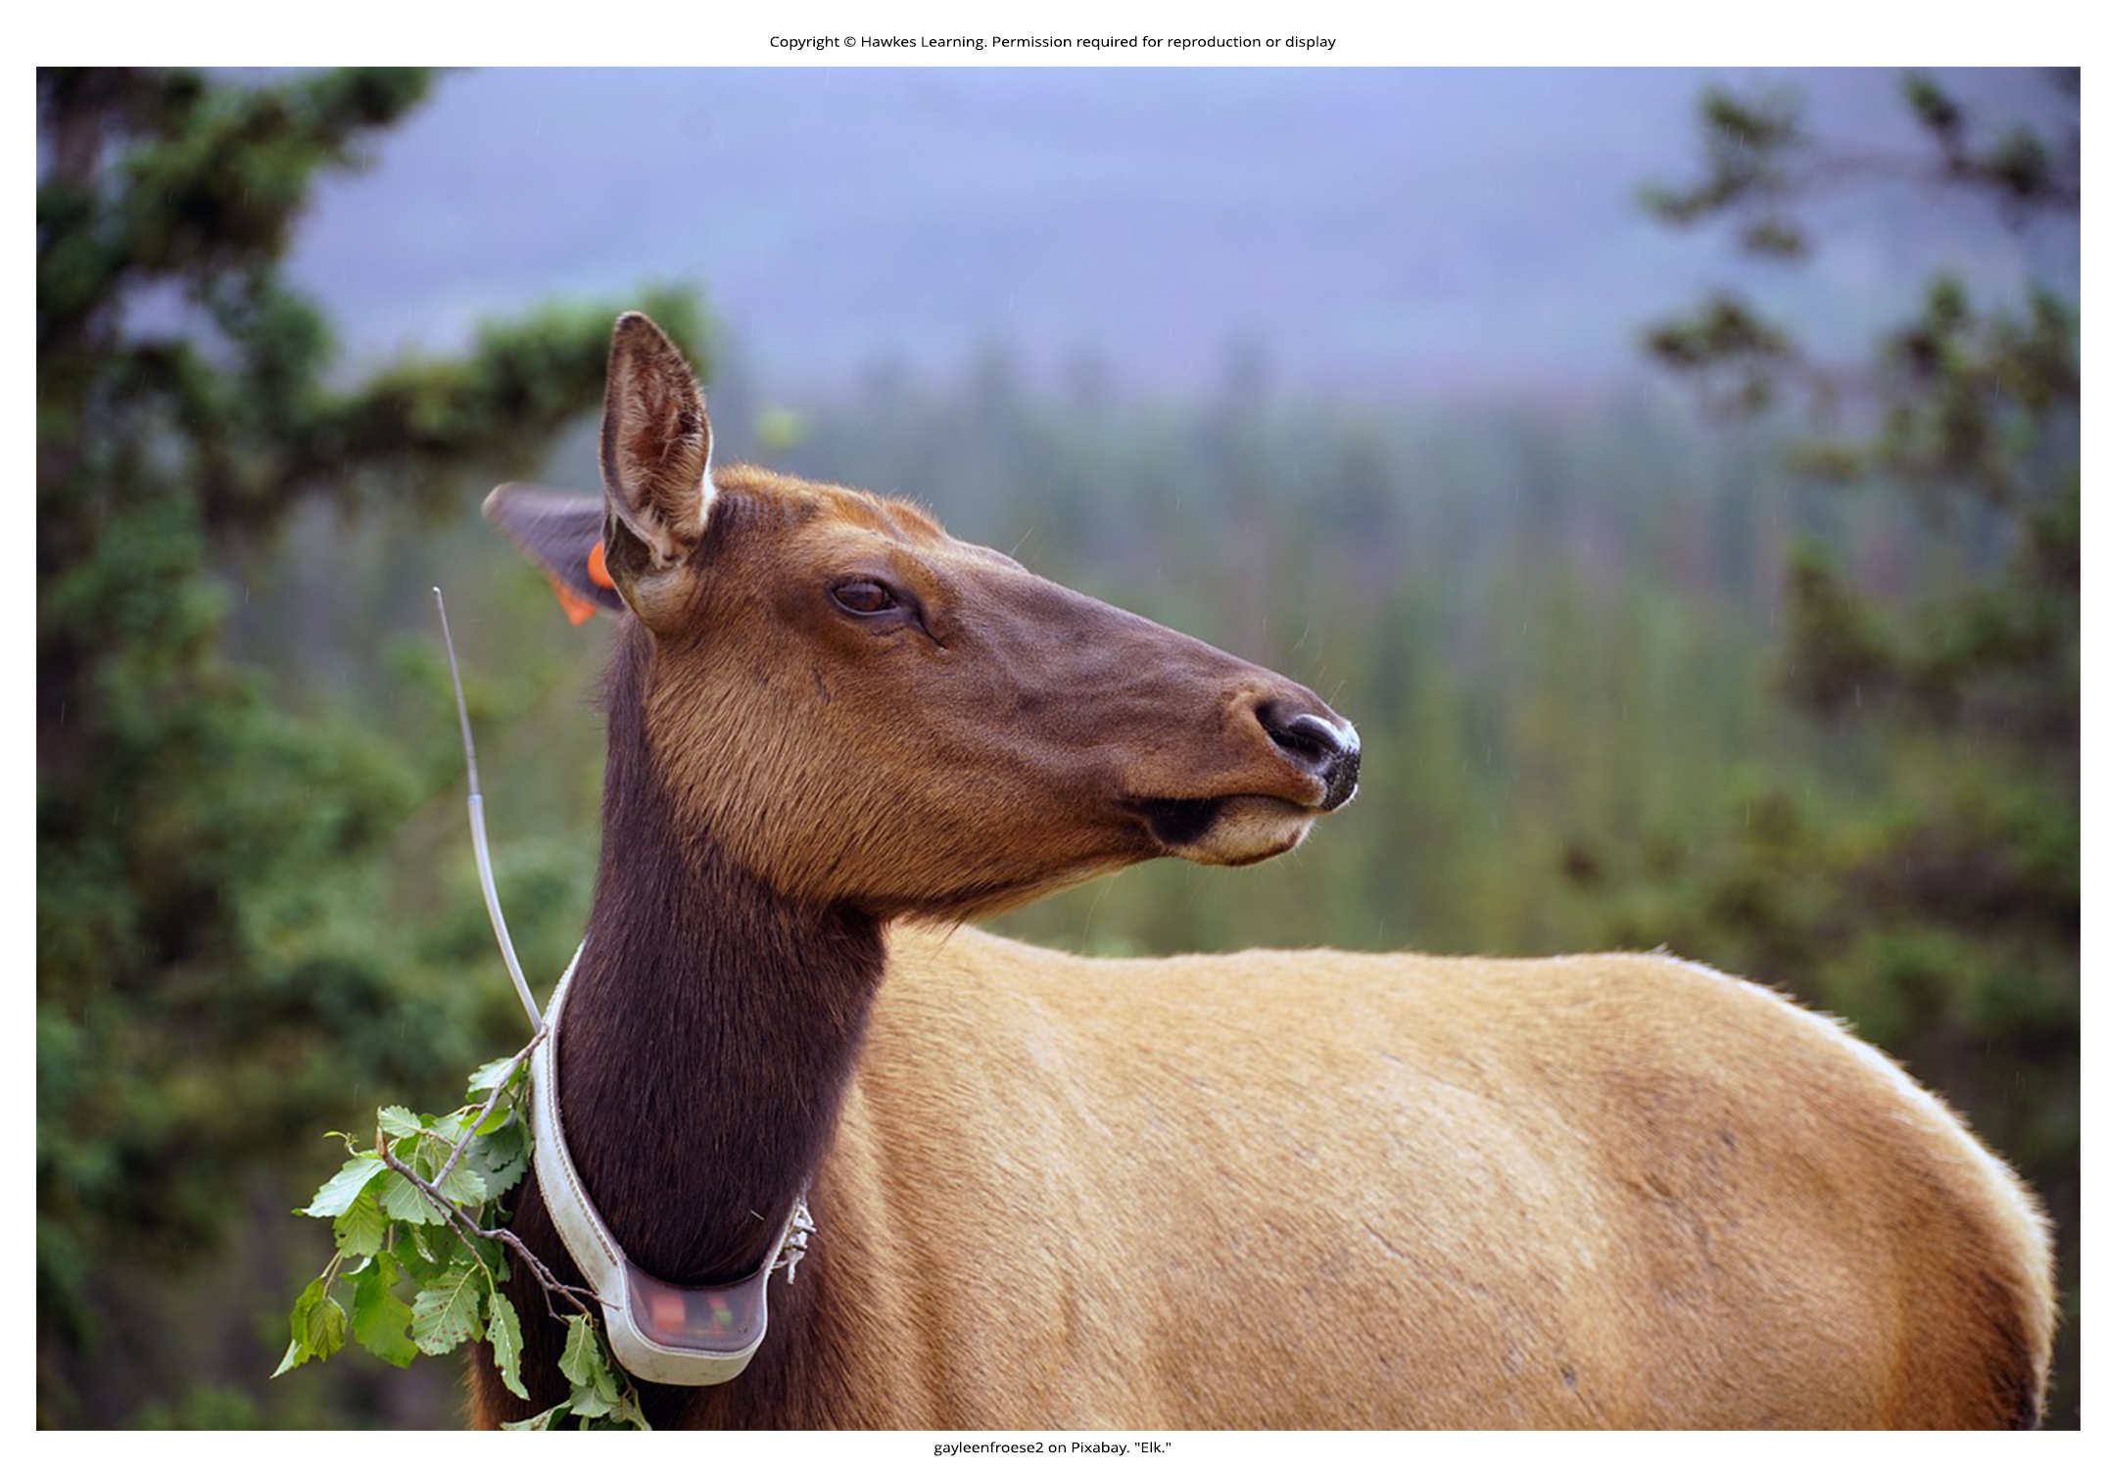
Lesson 47.4 Figure 5

Slide 29
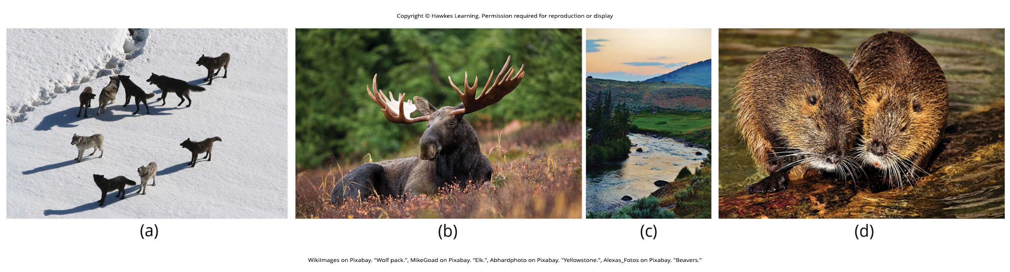
Lesson 47.4 Figure 6

Slide 30
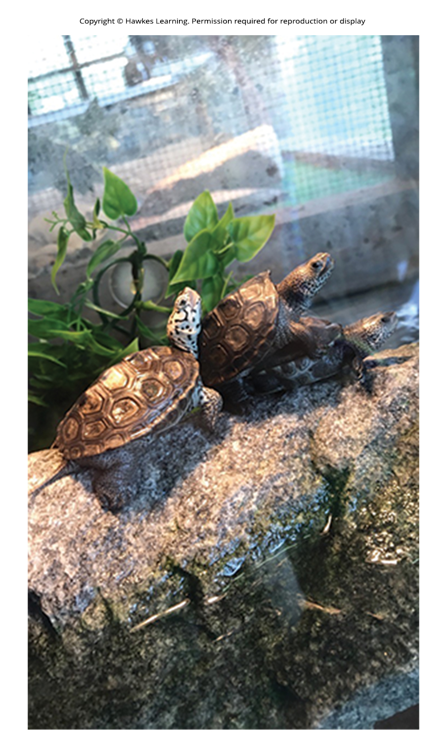
Lesson 47.4 Figure 7

Slide 31
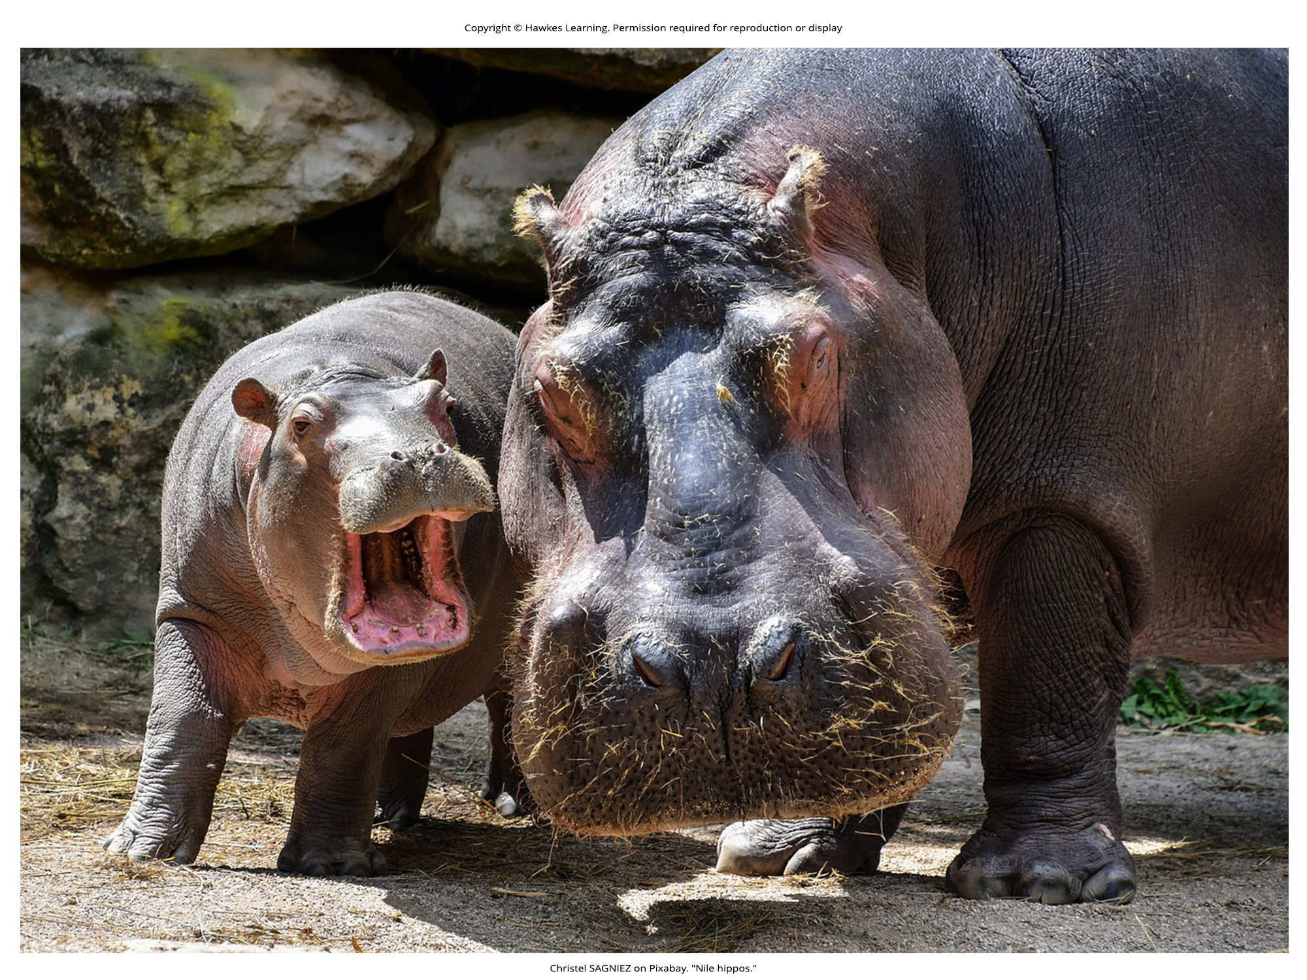
Lesson 47.4 Figure 8

Slide 32
Hawkes Learning – End of PowerPoint

