Slide 1
Chapter 5
Structure and Function of Membranes

Slide 2
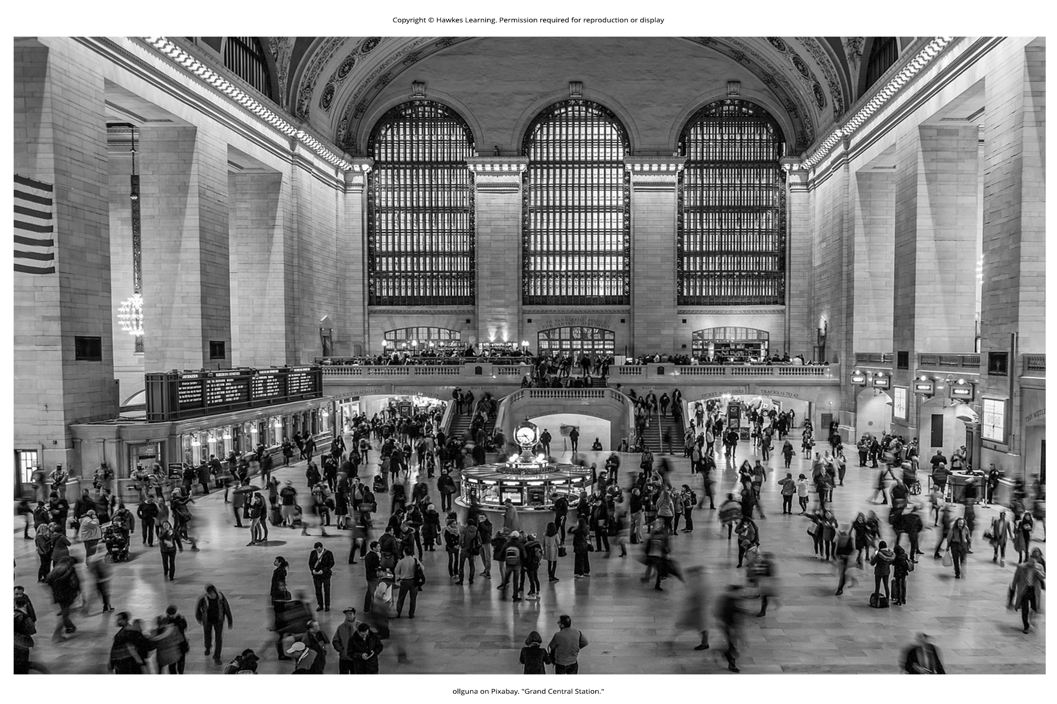
Lesson 5.1 Figure 1

Slide 3
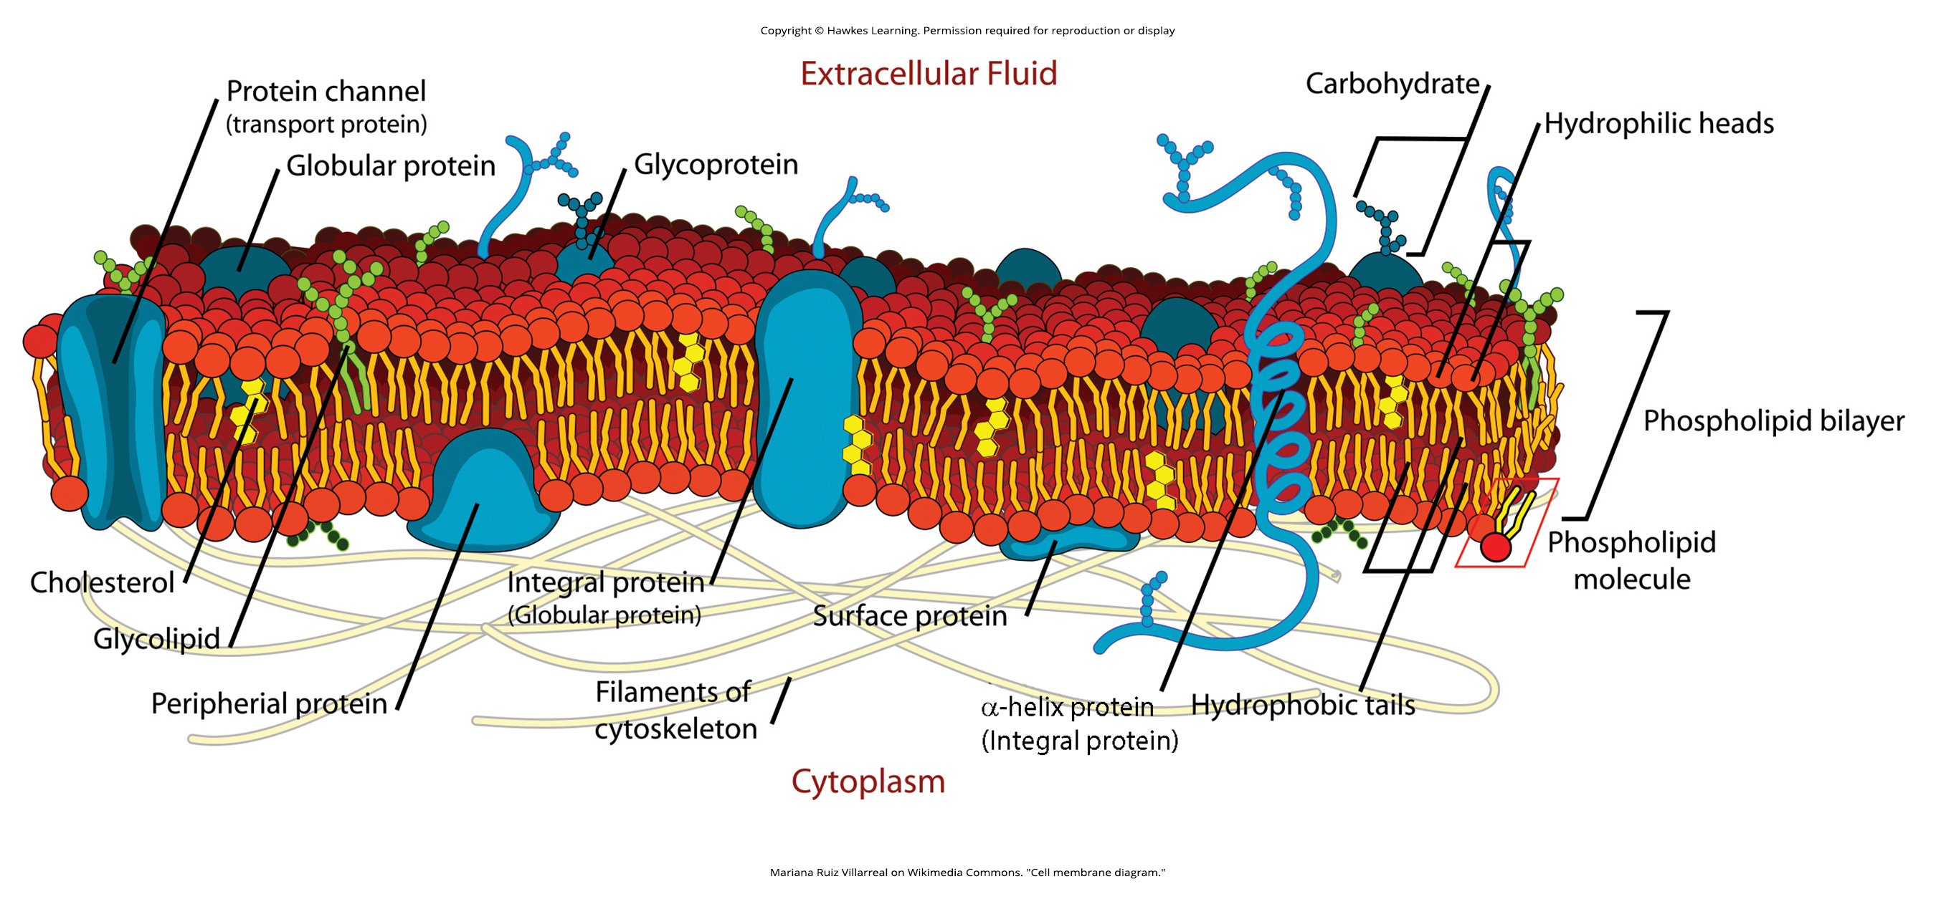
Lesson 5.1 Figure 2

Slide 4
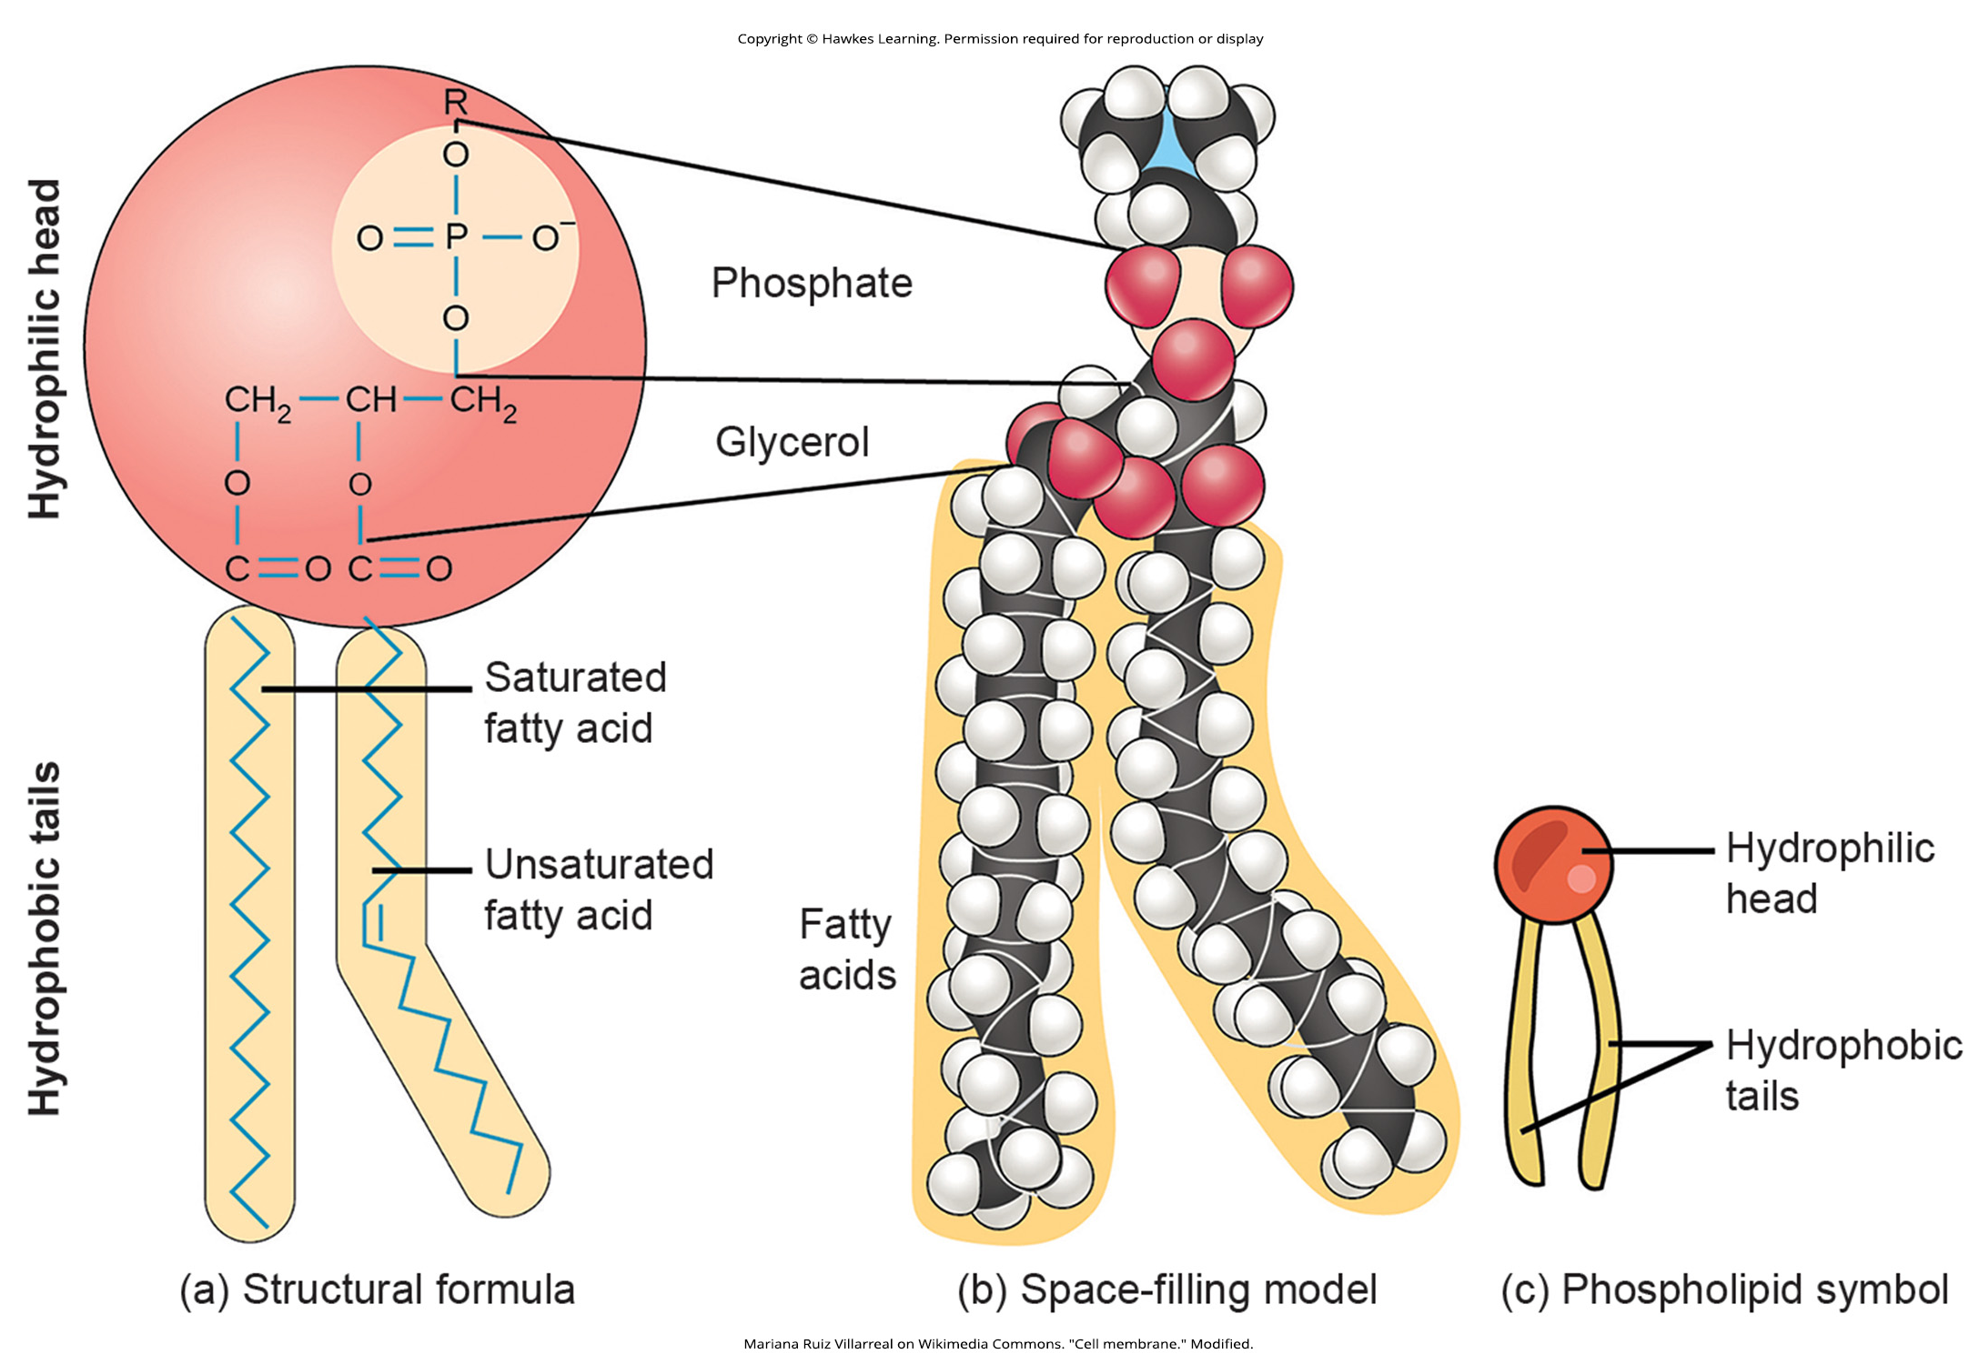
Lesson 5.1 Figure 3

Slide 5
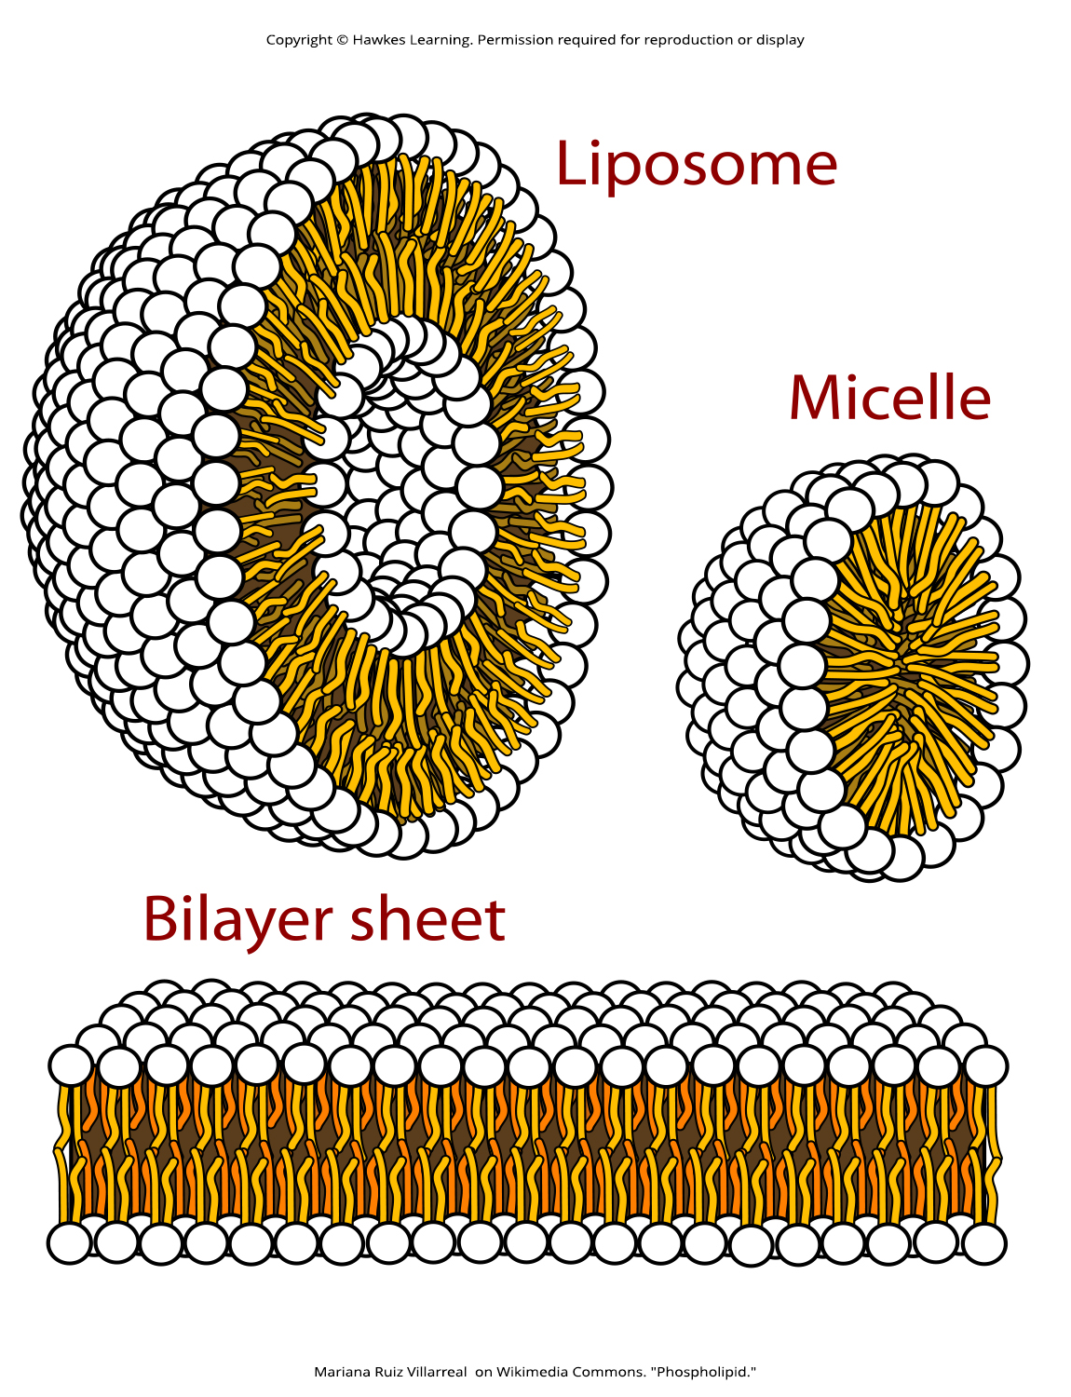
Lesson 5.1 Figure 4

Slide 6
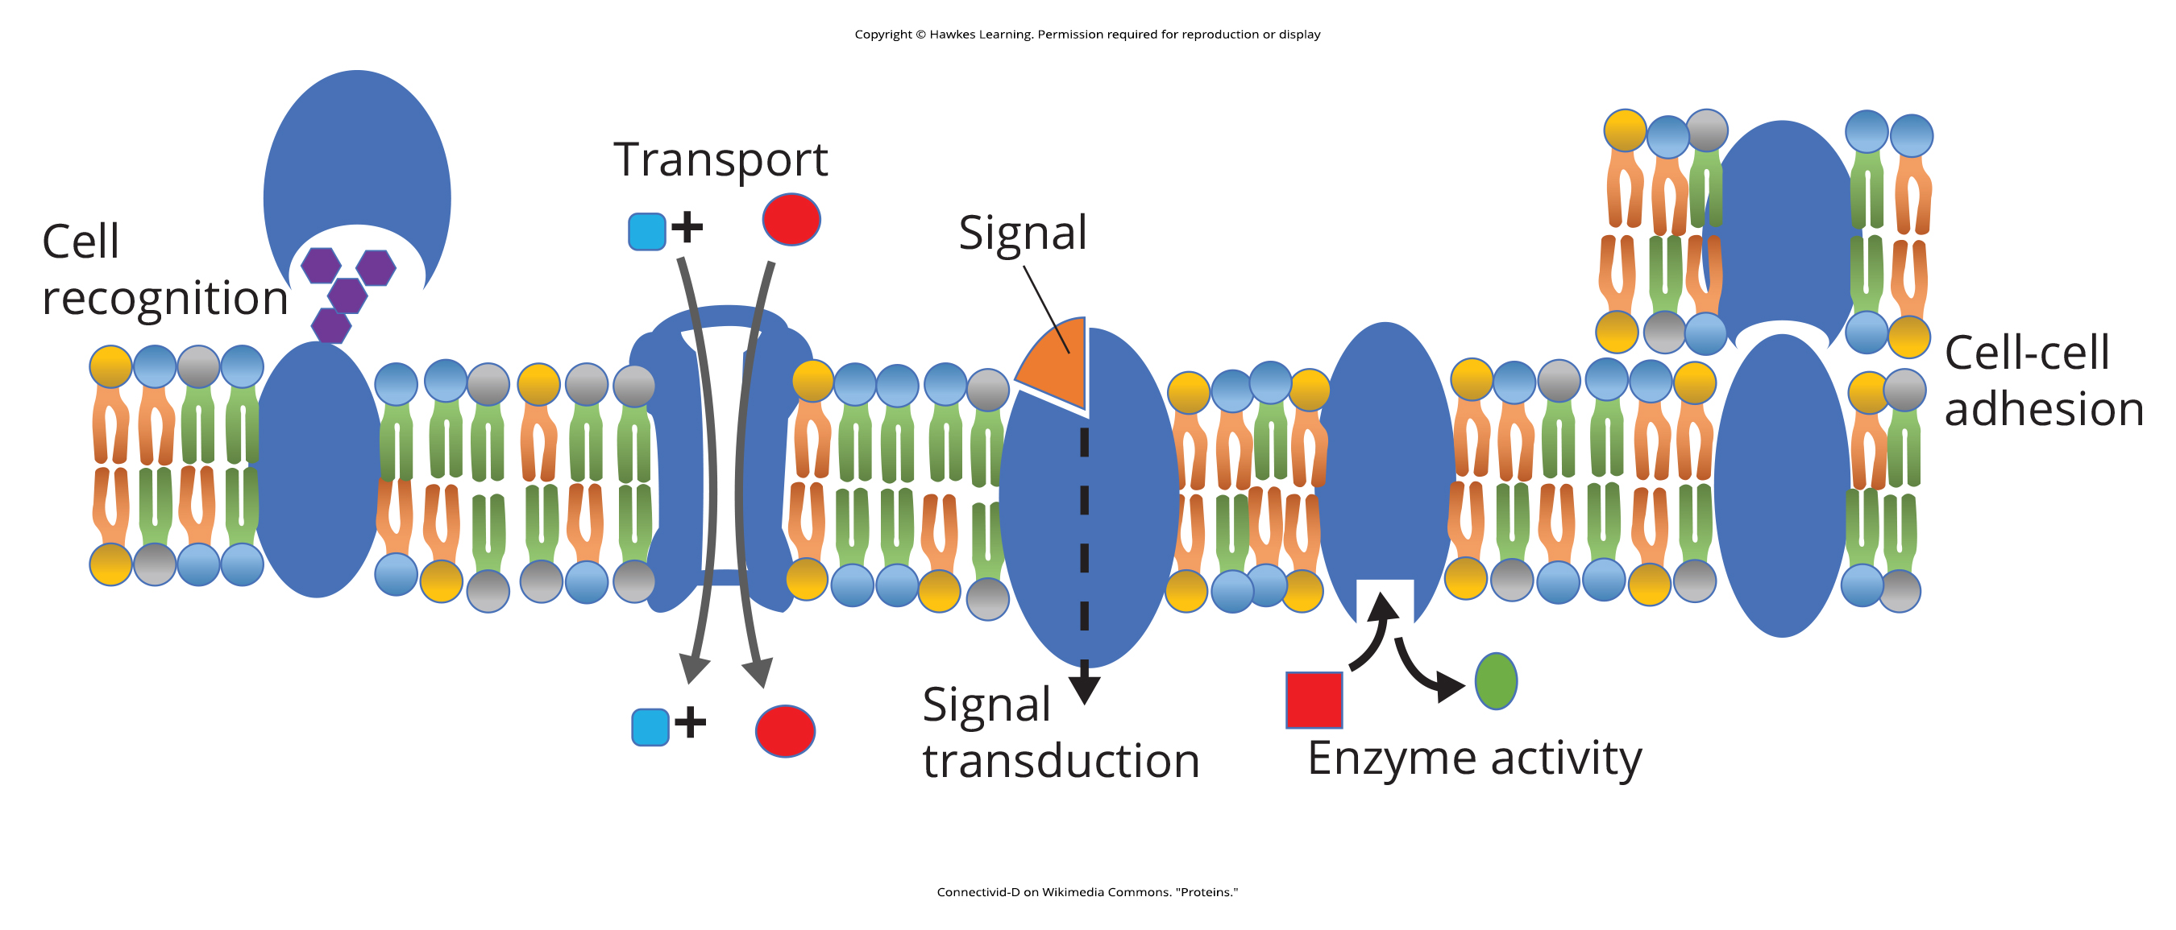
Lesson 5.1 Figure 5

Slide 7
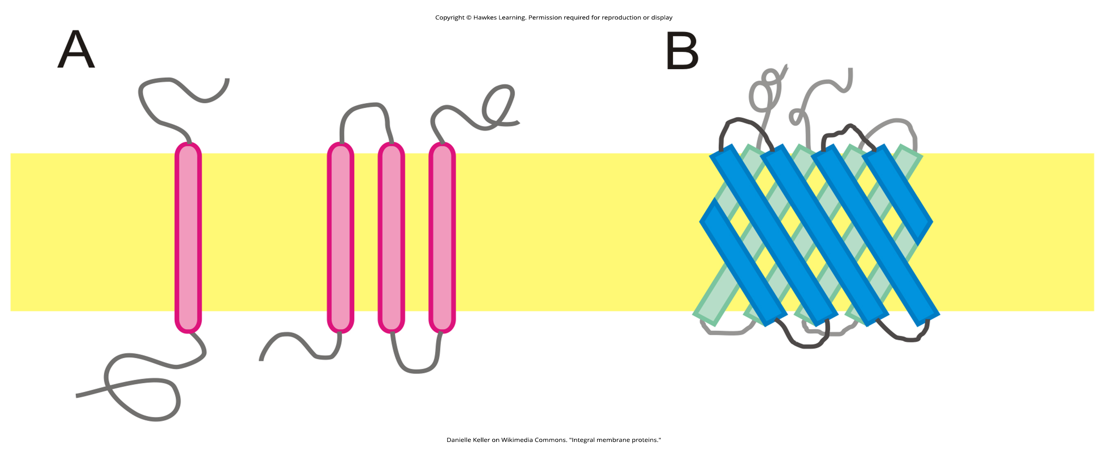
Lesson 5.1 Figure 6

Slide 8
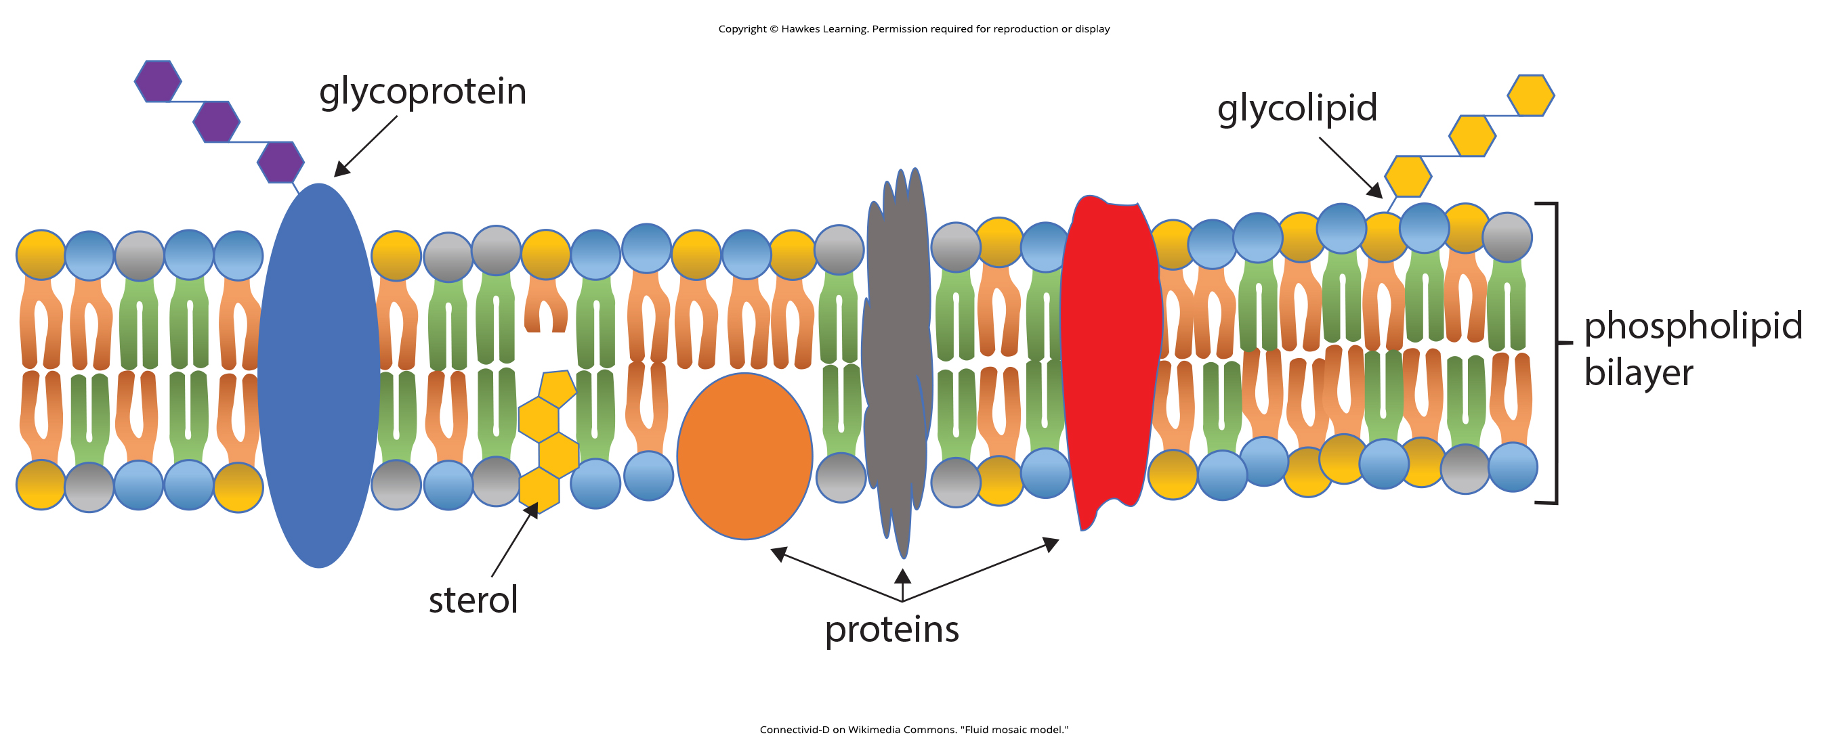
Lesson 5.1 Figure 7

Slide 9
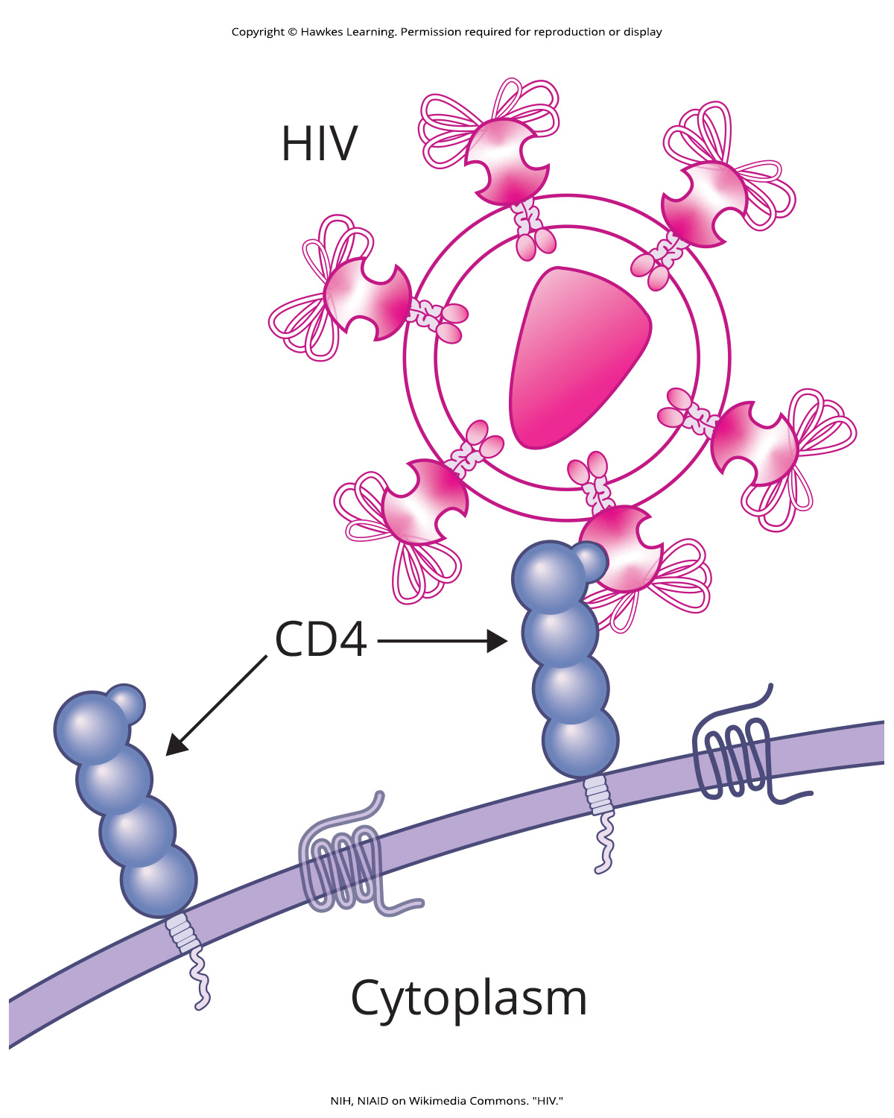
Lesson 5.1 Figure 8

Slide 10
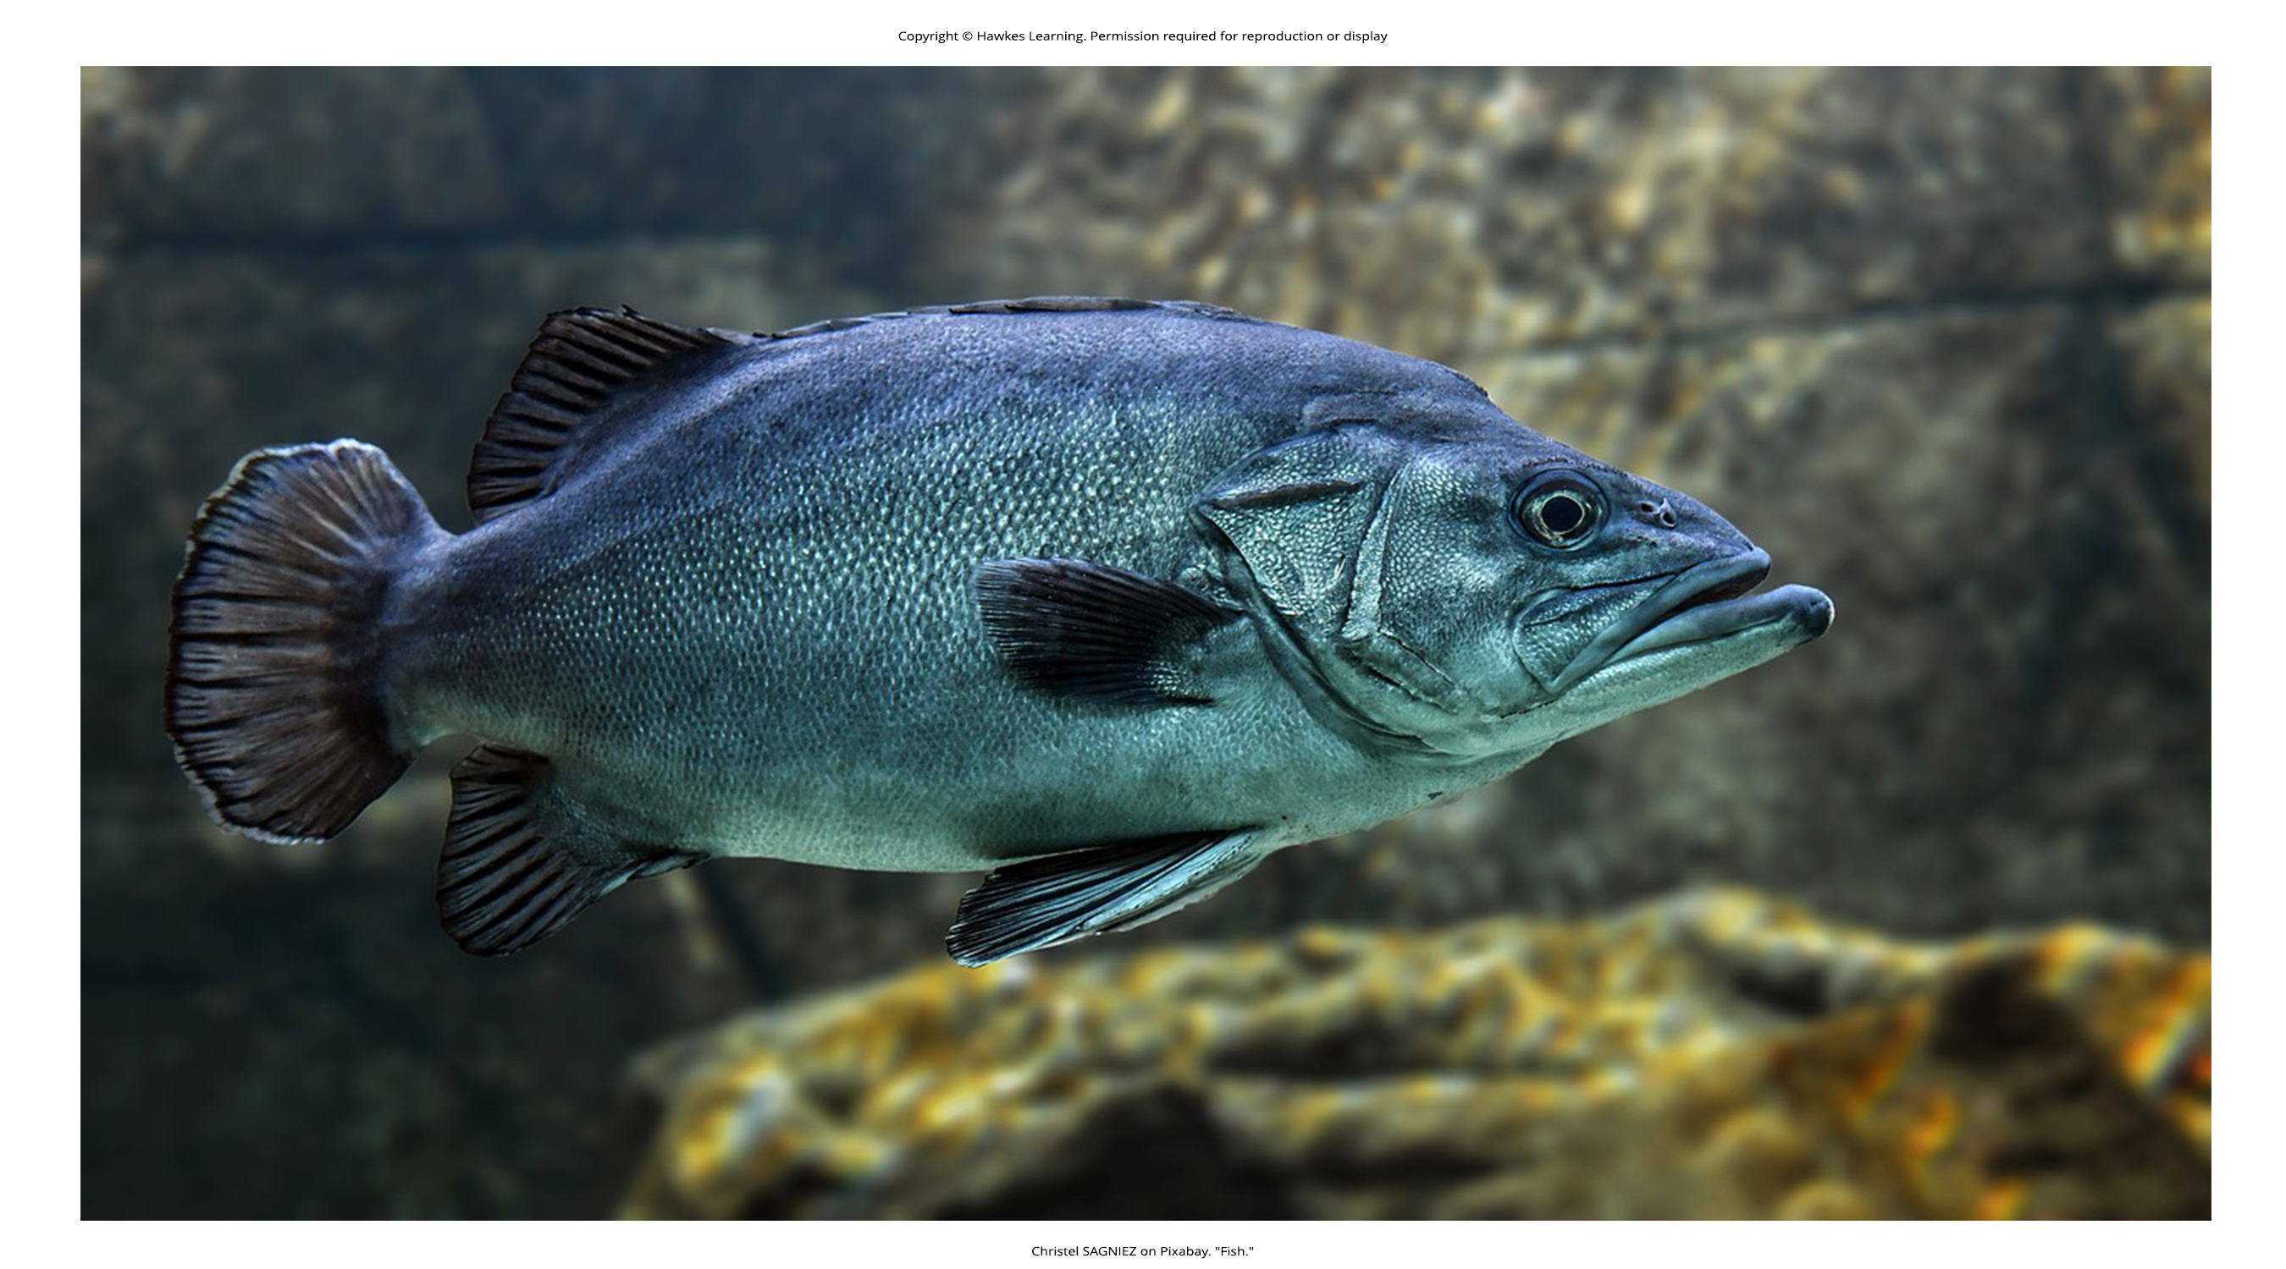
Lesson 5.1 Figure 9

Slide 11
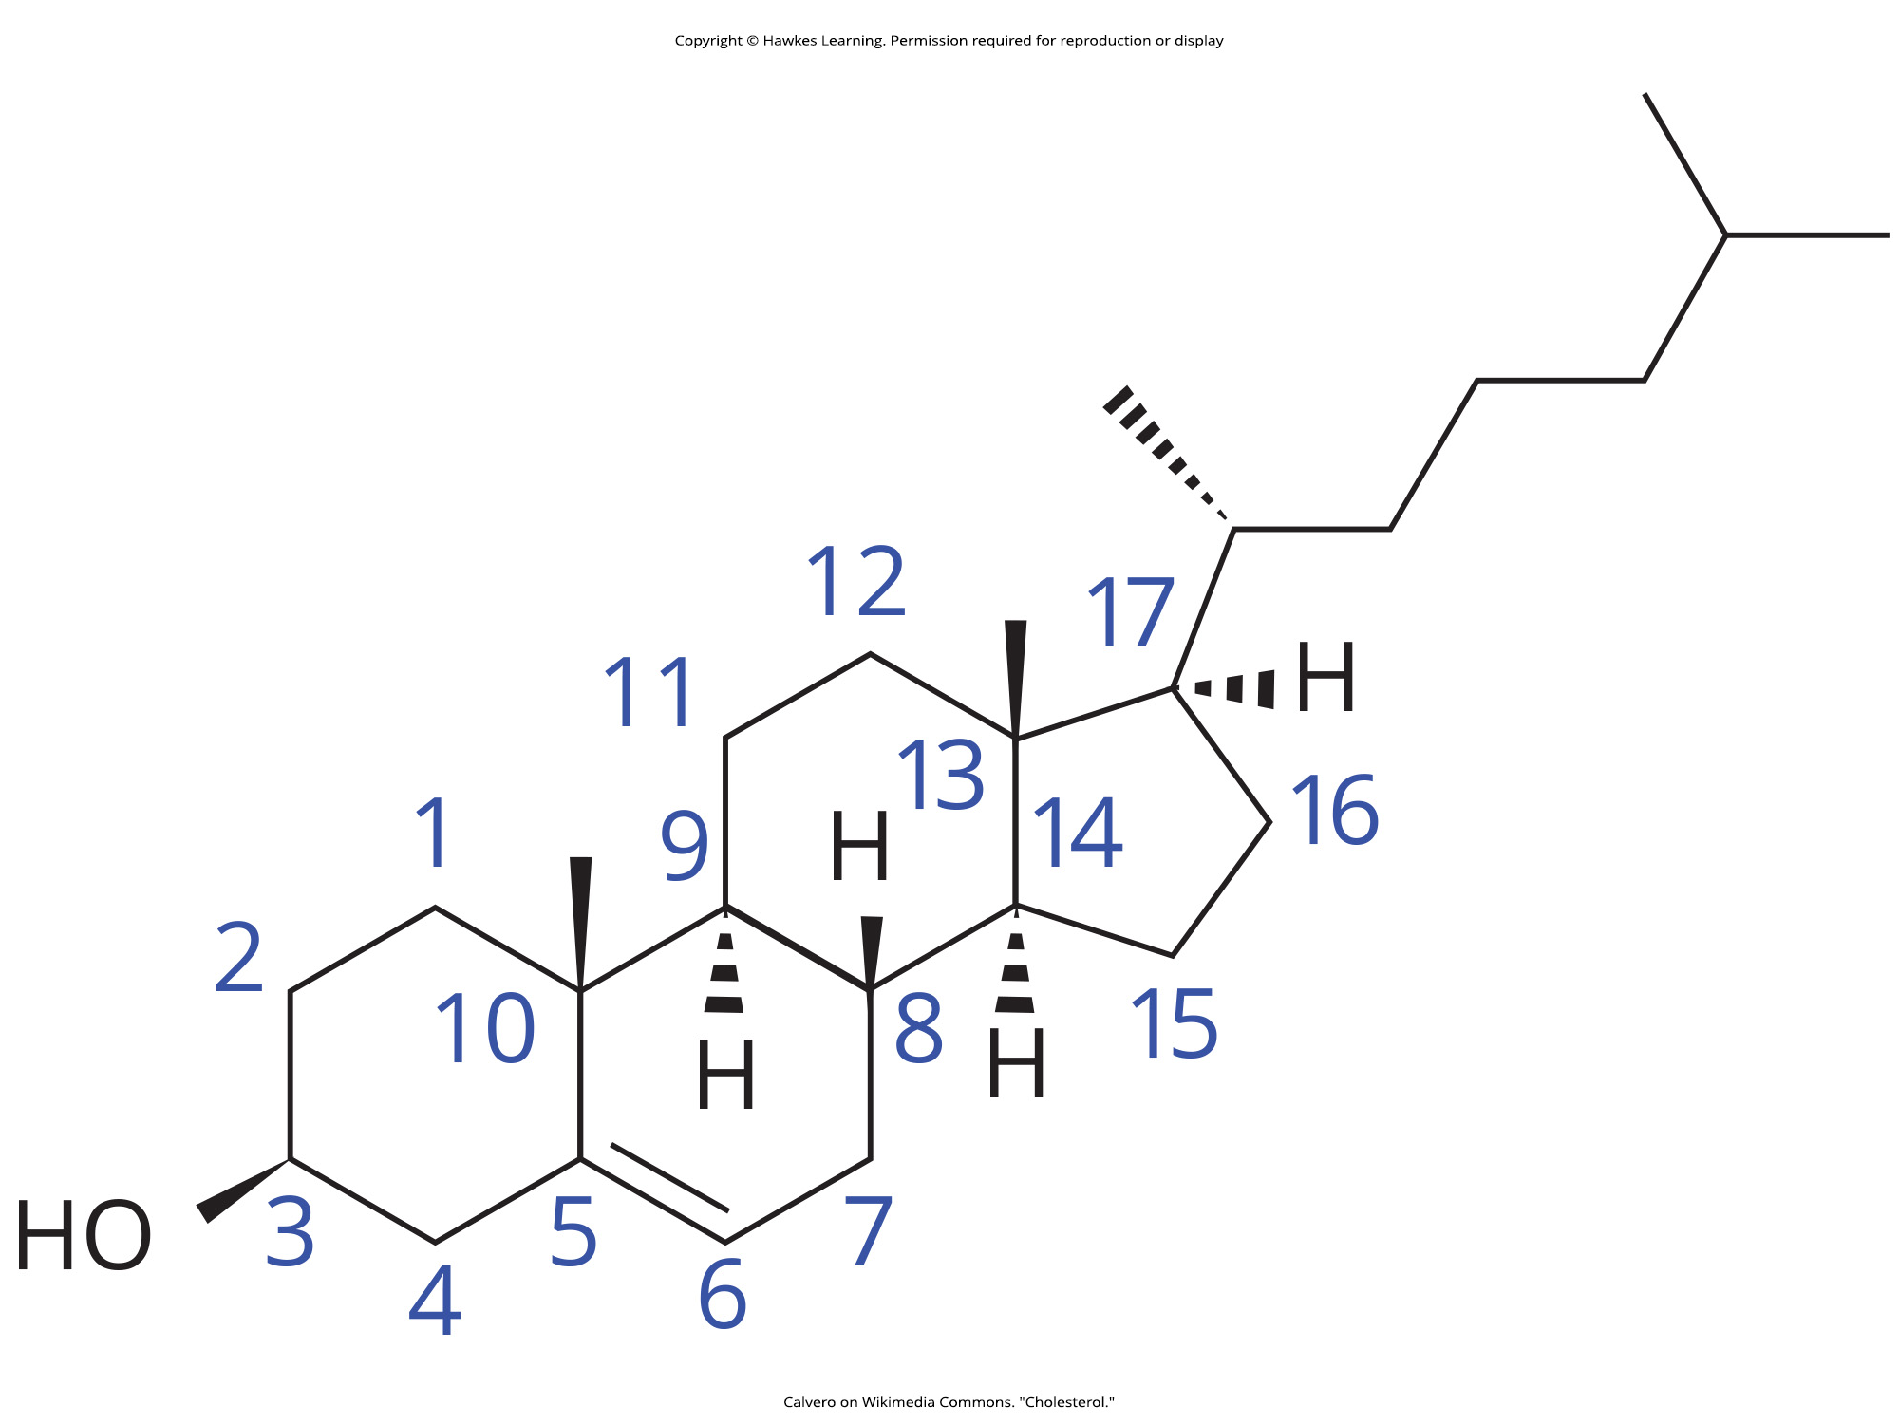
Lesson 5.1 Figure 10

Slide 12
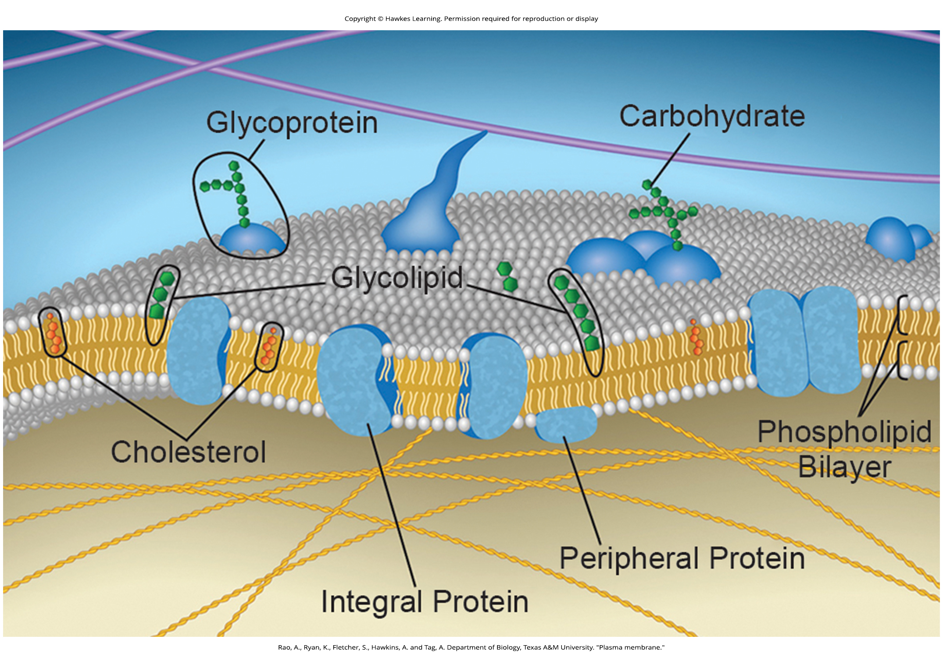
Lesson 5.2 Figure 1

Slide 13
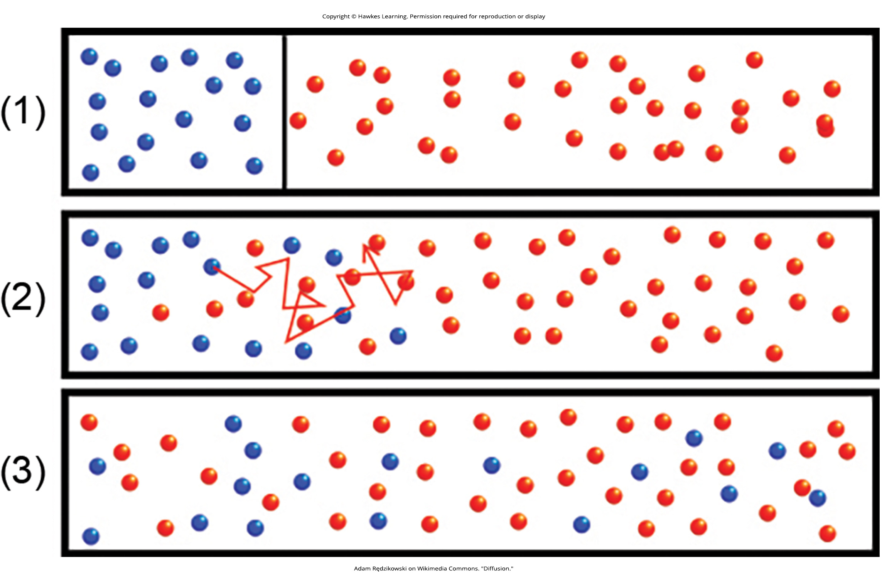
Lesson 5.2 Figure 2

Slide 14
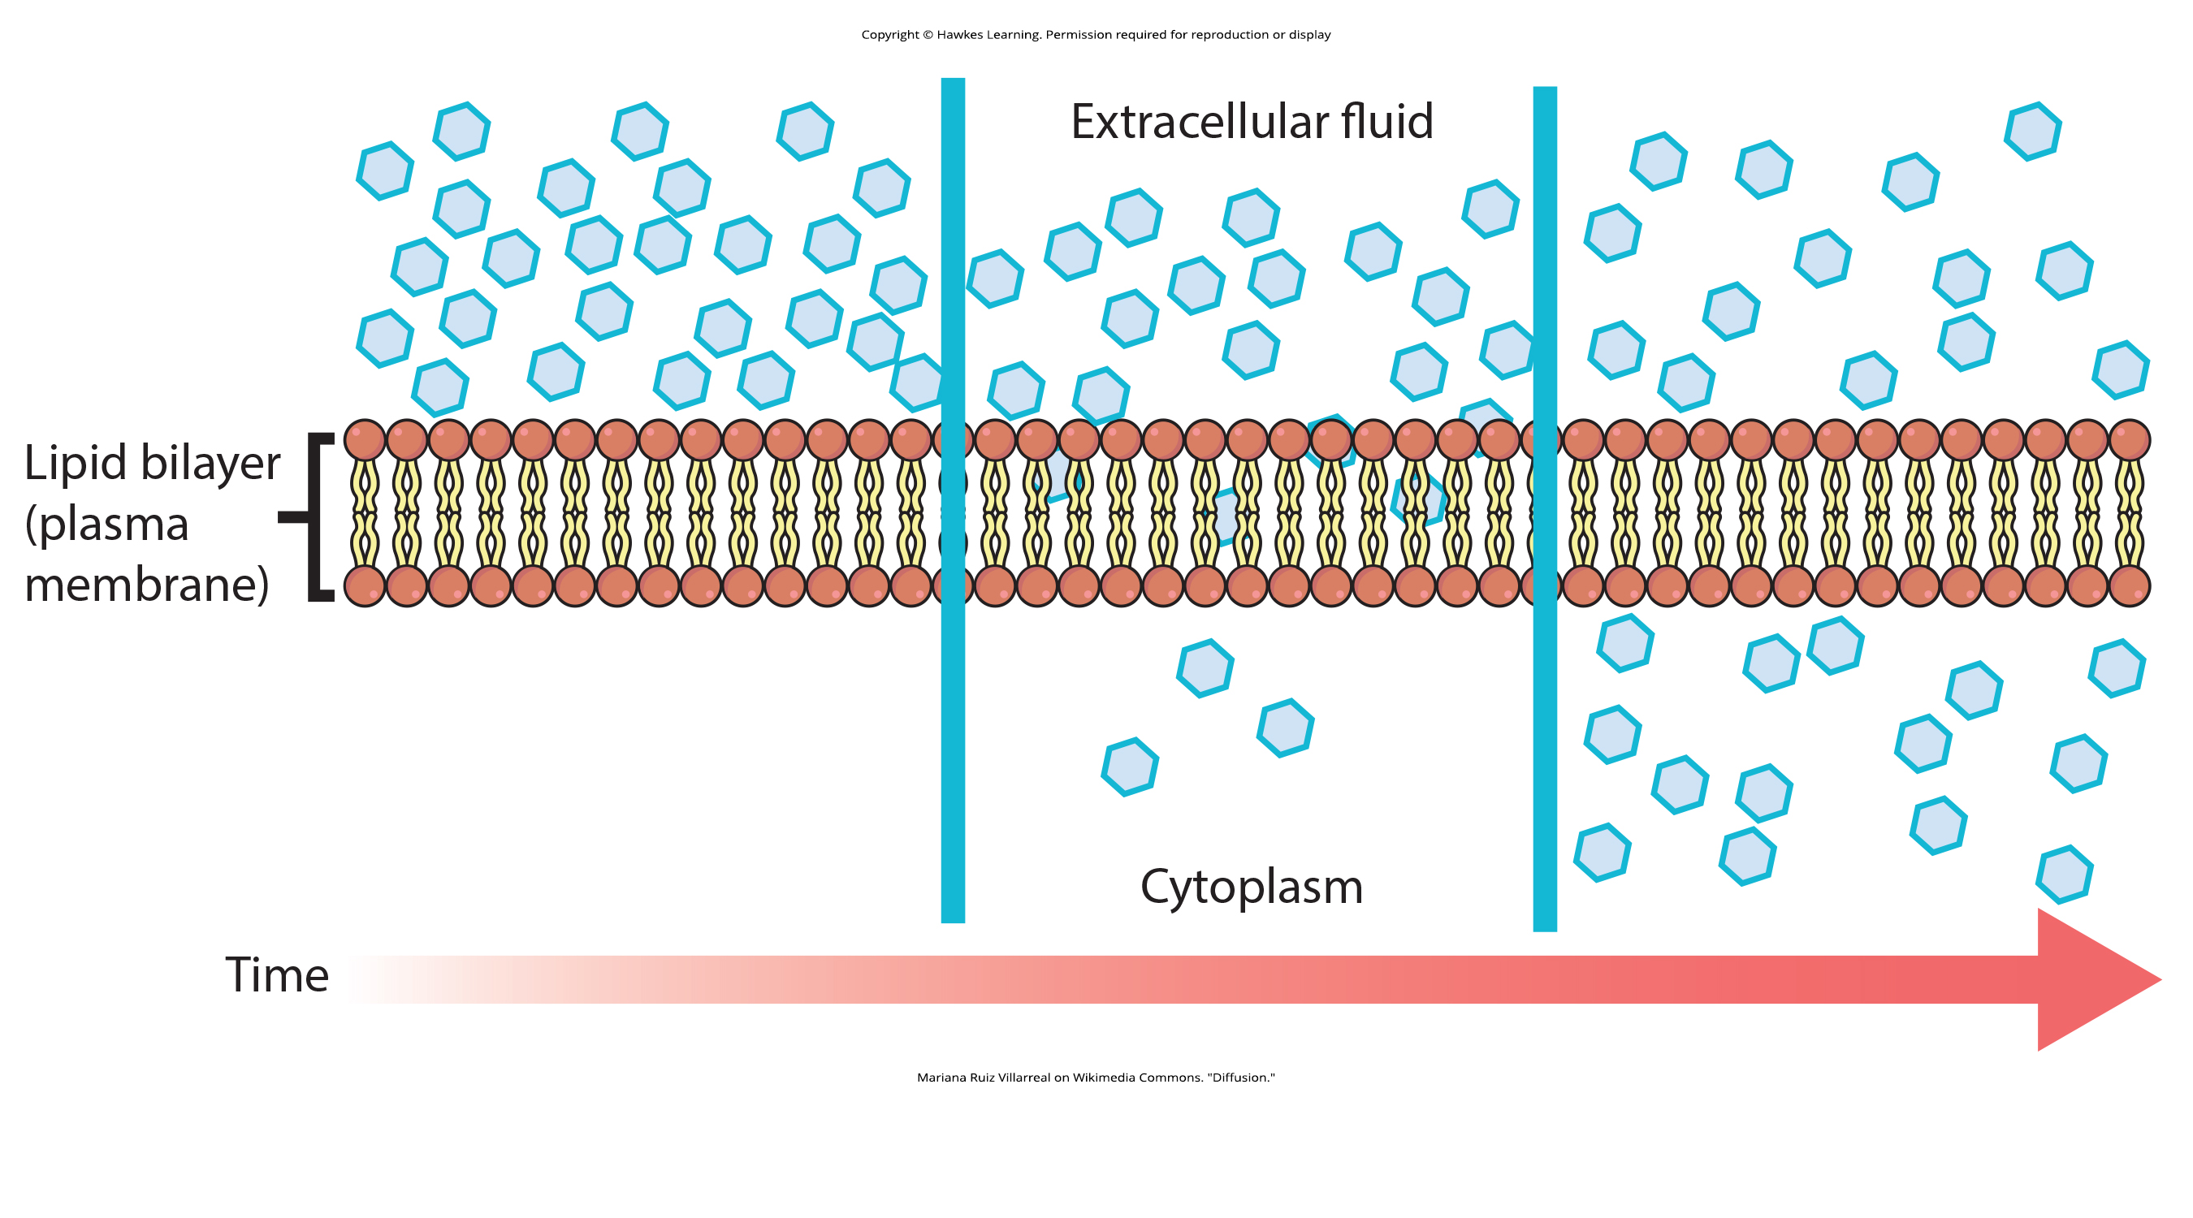
Lesson 5.2 Figure 3

Slide 15
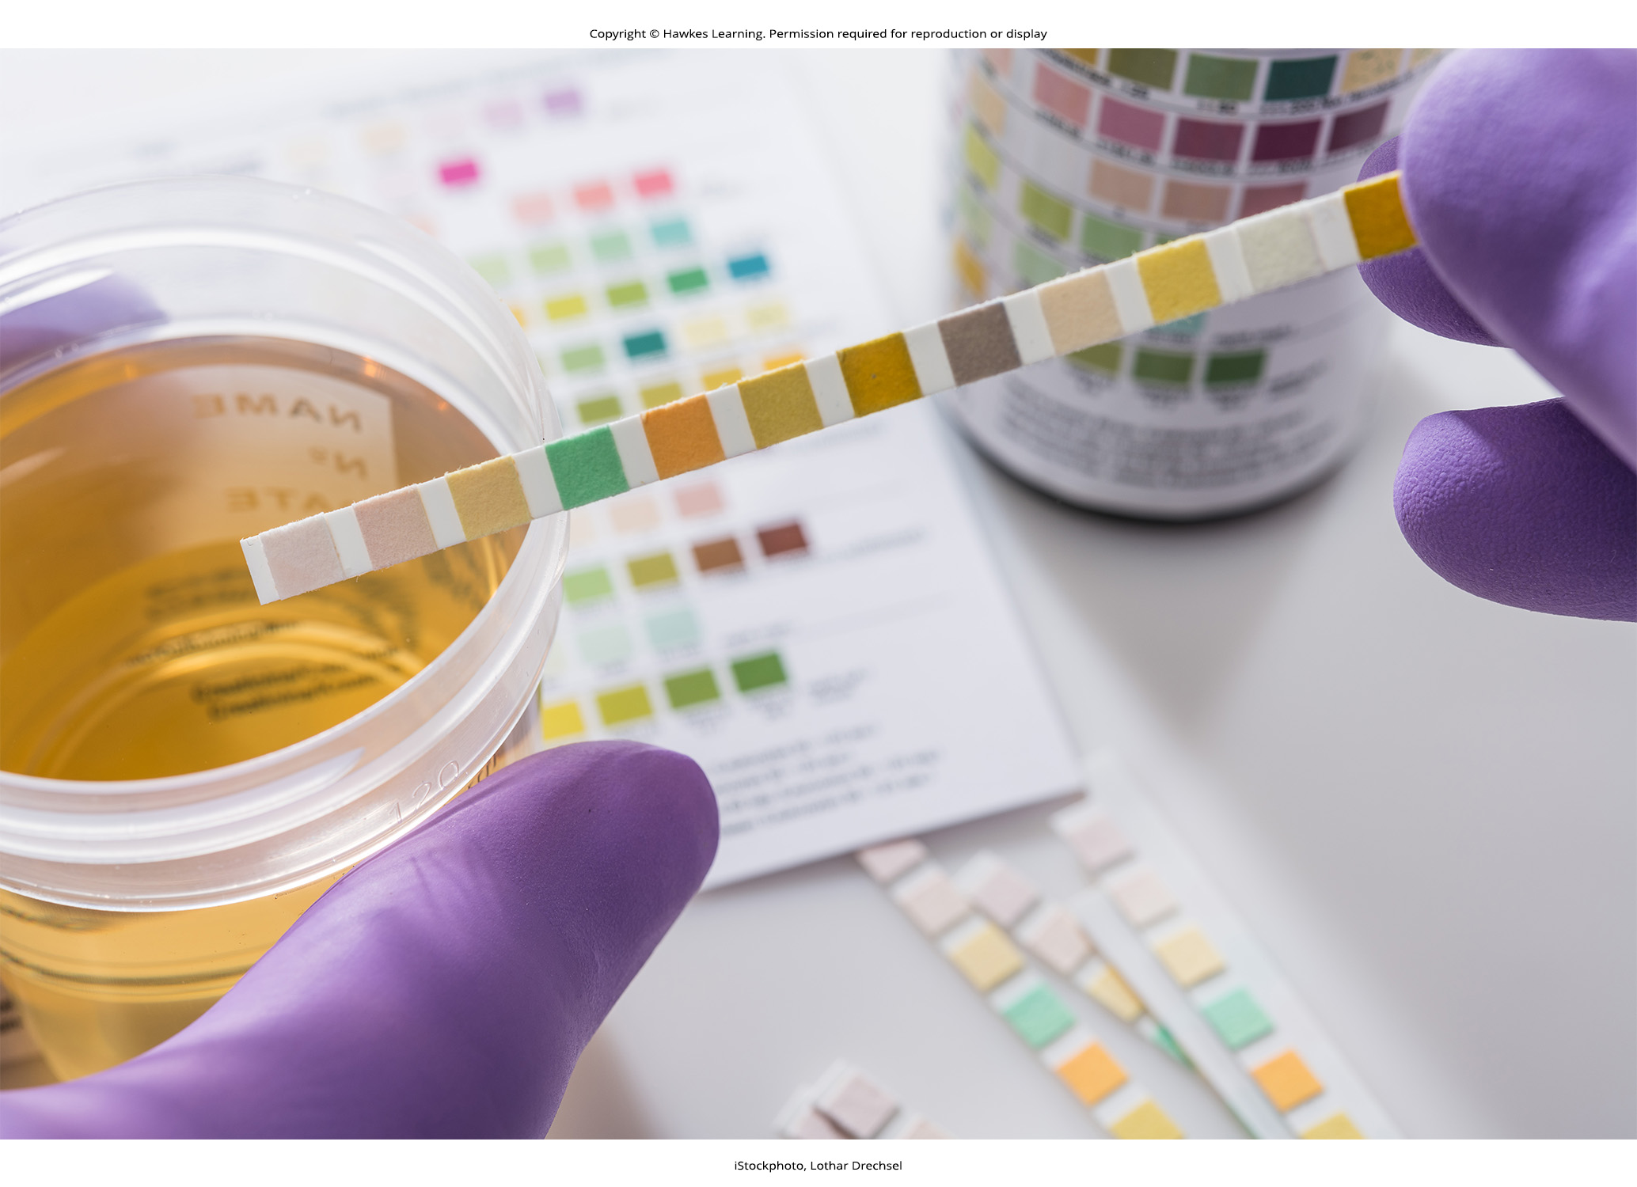
Lesson 5.2 Figure 4

Slide 16
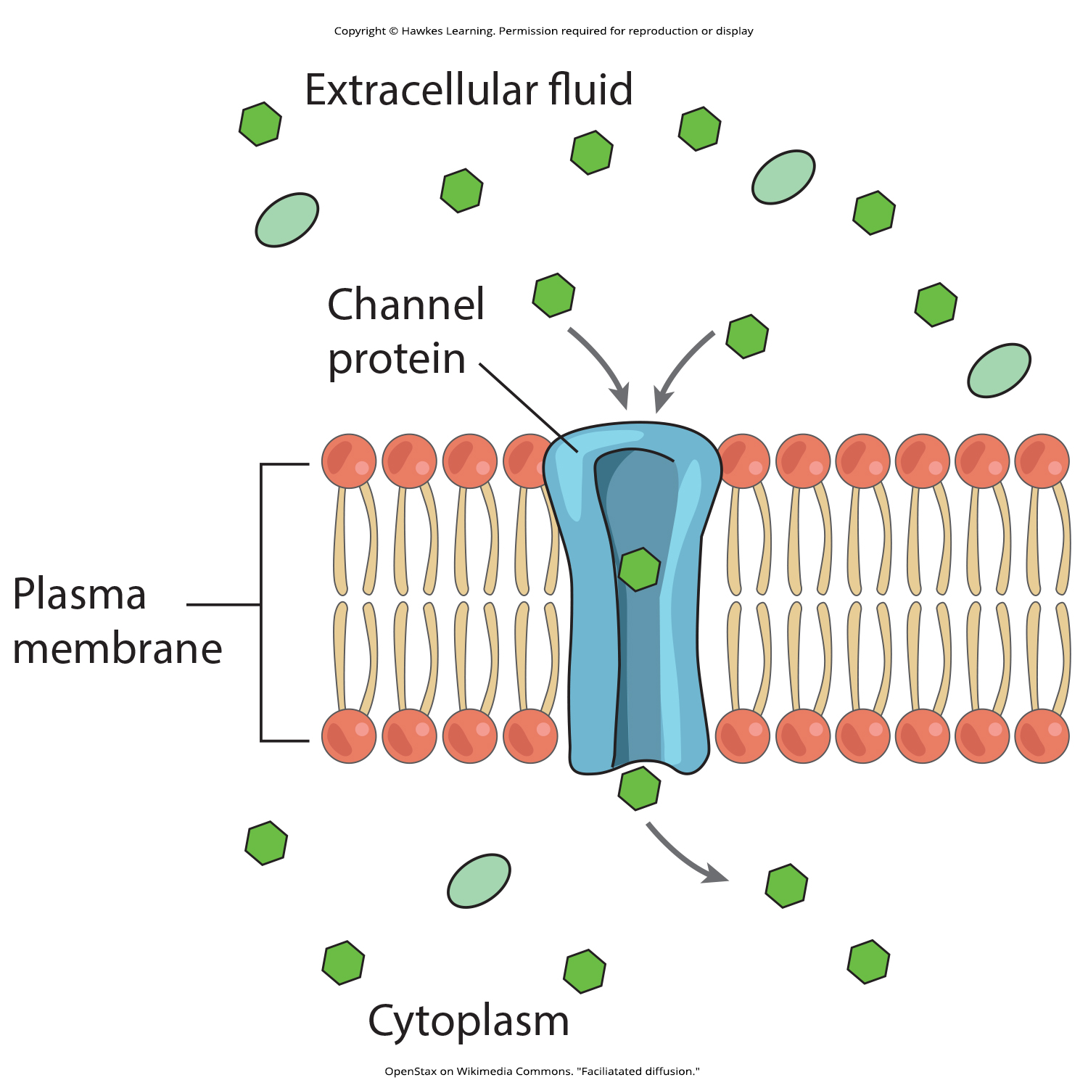
Lesson 5.2 Figure 5

Slide 17
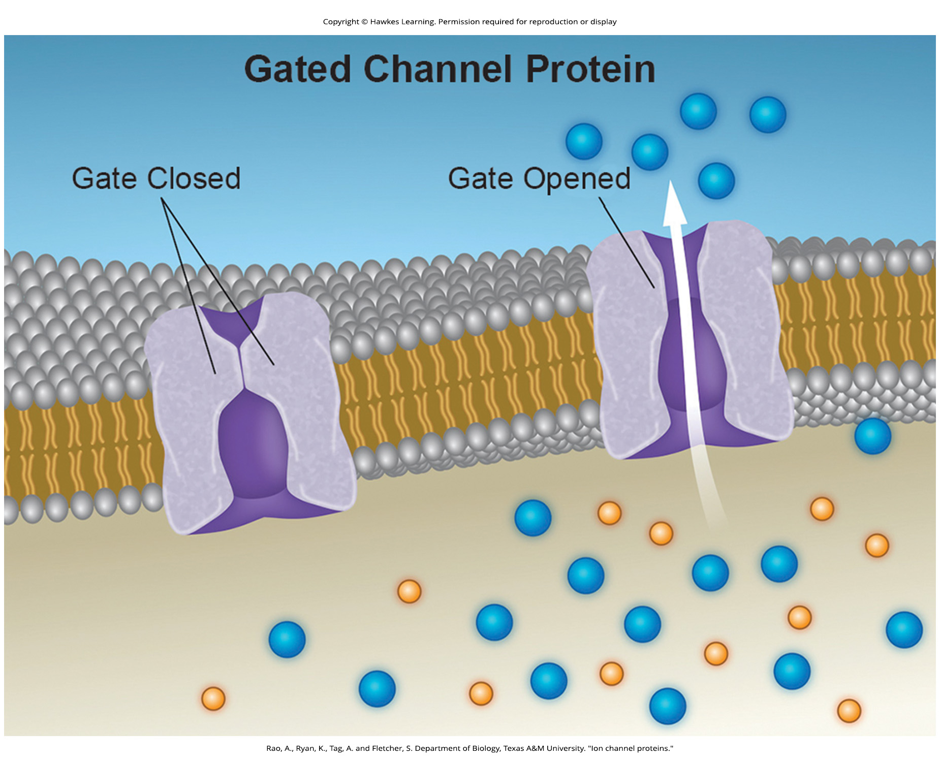
Lesson 5.2 Figure 6

Slide 18
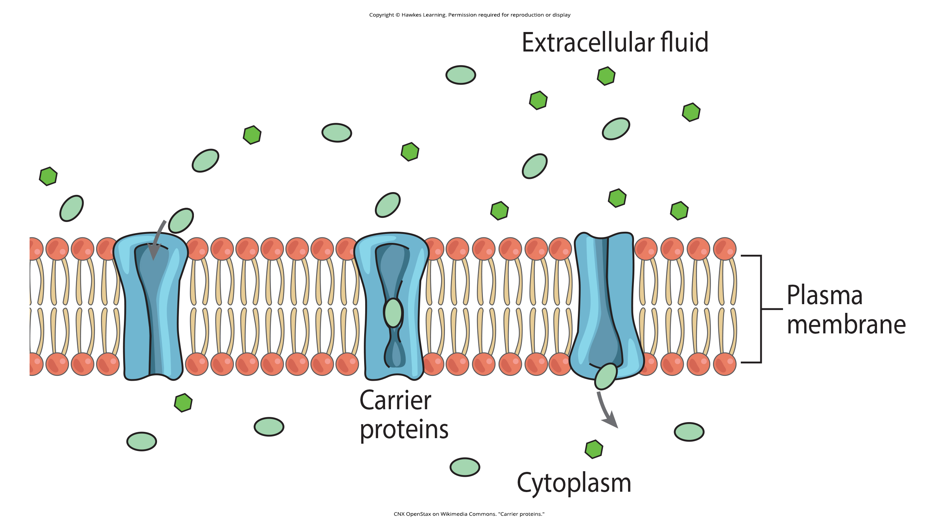
Lesson 5.2 Figure 7

Slide 19
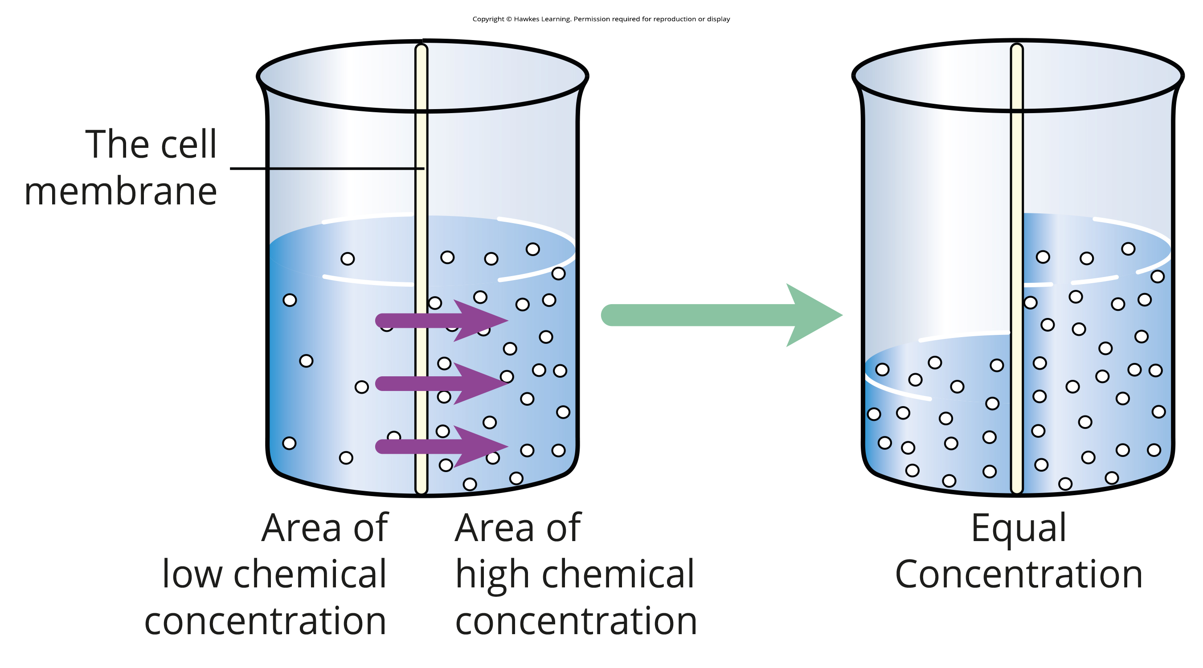
Lesson 5.2 Figure 8

Slide 20
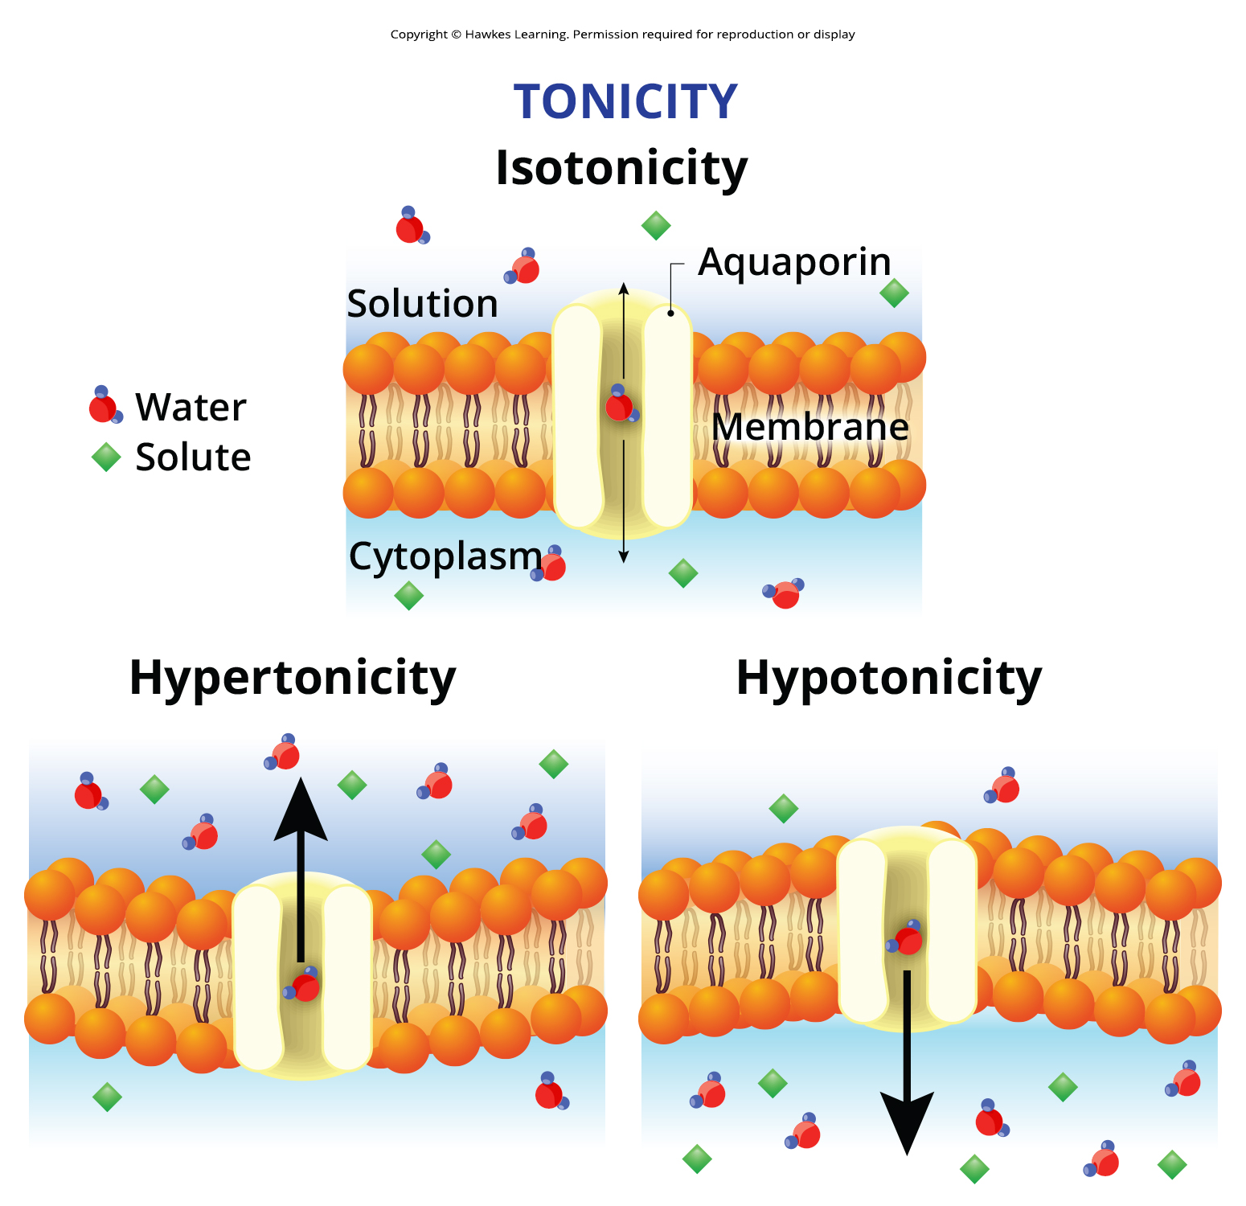
Lesson 5.2 Figure 9

Slide 21
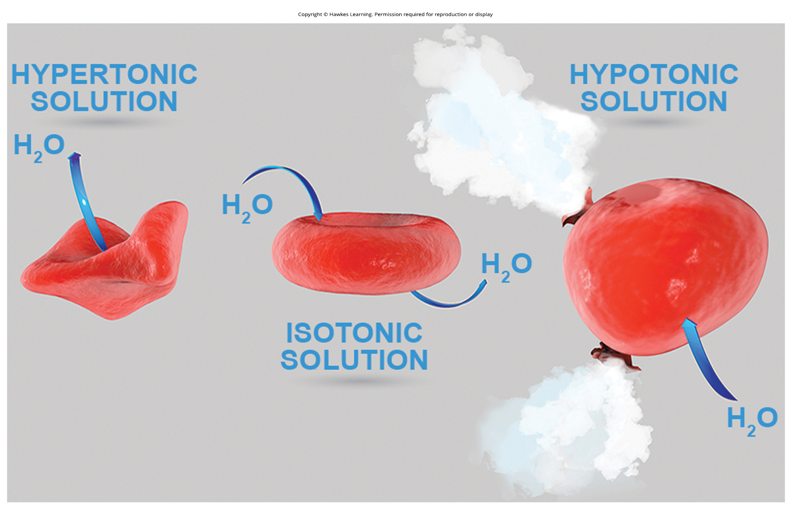
Lesson 5.2 Figure 10

Slide 22
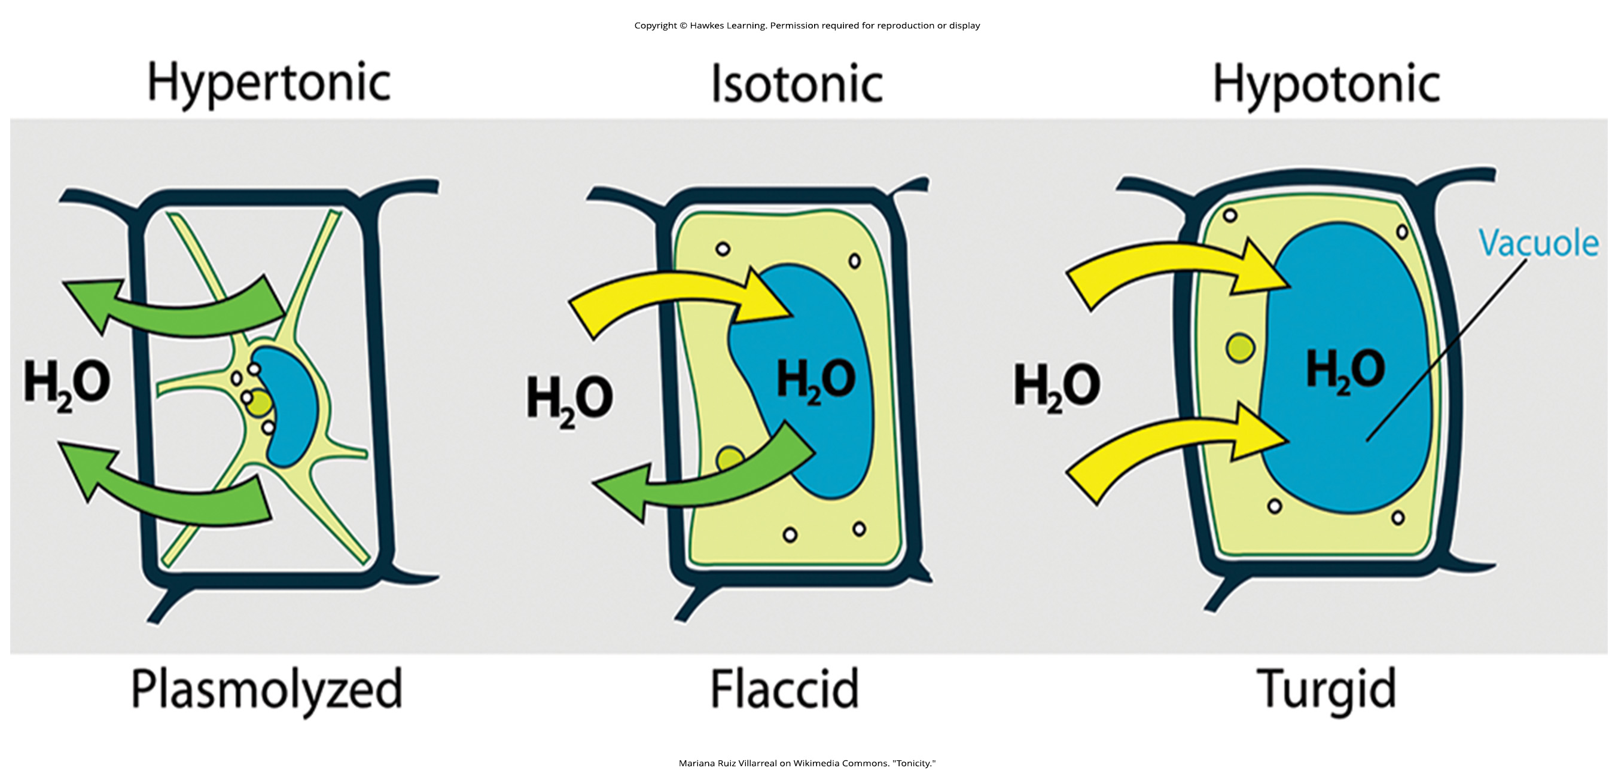
Lesson 5.2 Figure 11

Slide 23
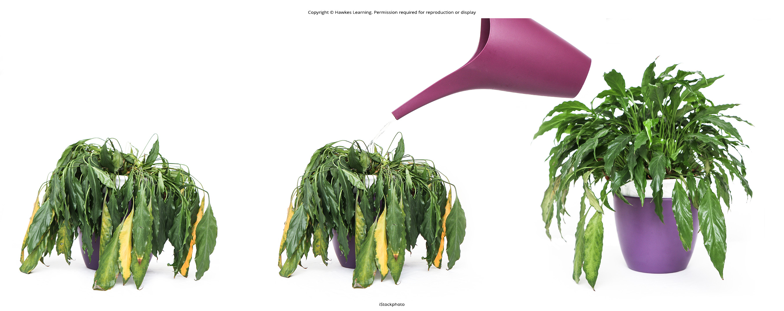
Lesson 5.2 Figure 12

Slide 24
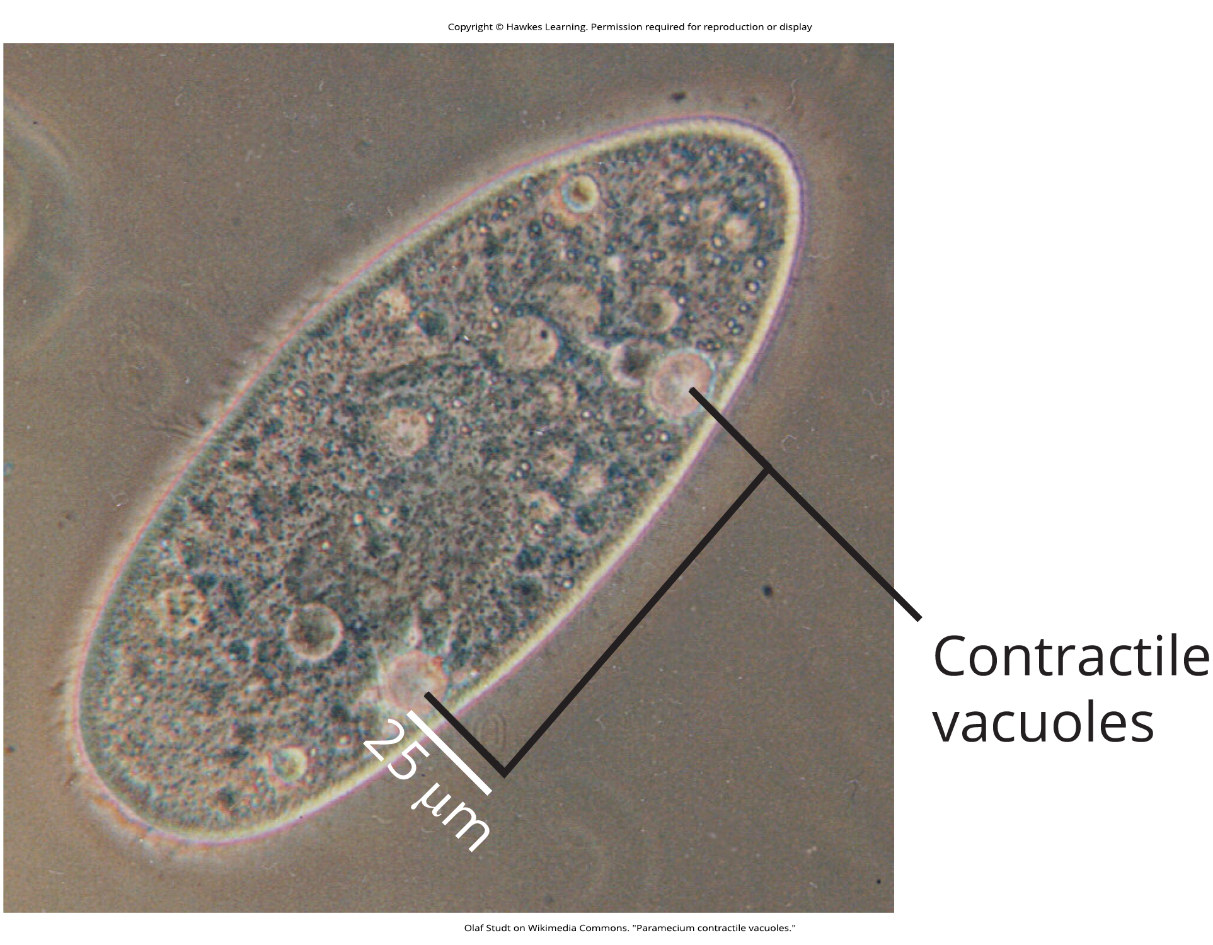
Lesson 5.2 Figure 13

Slide 25
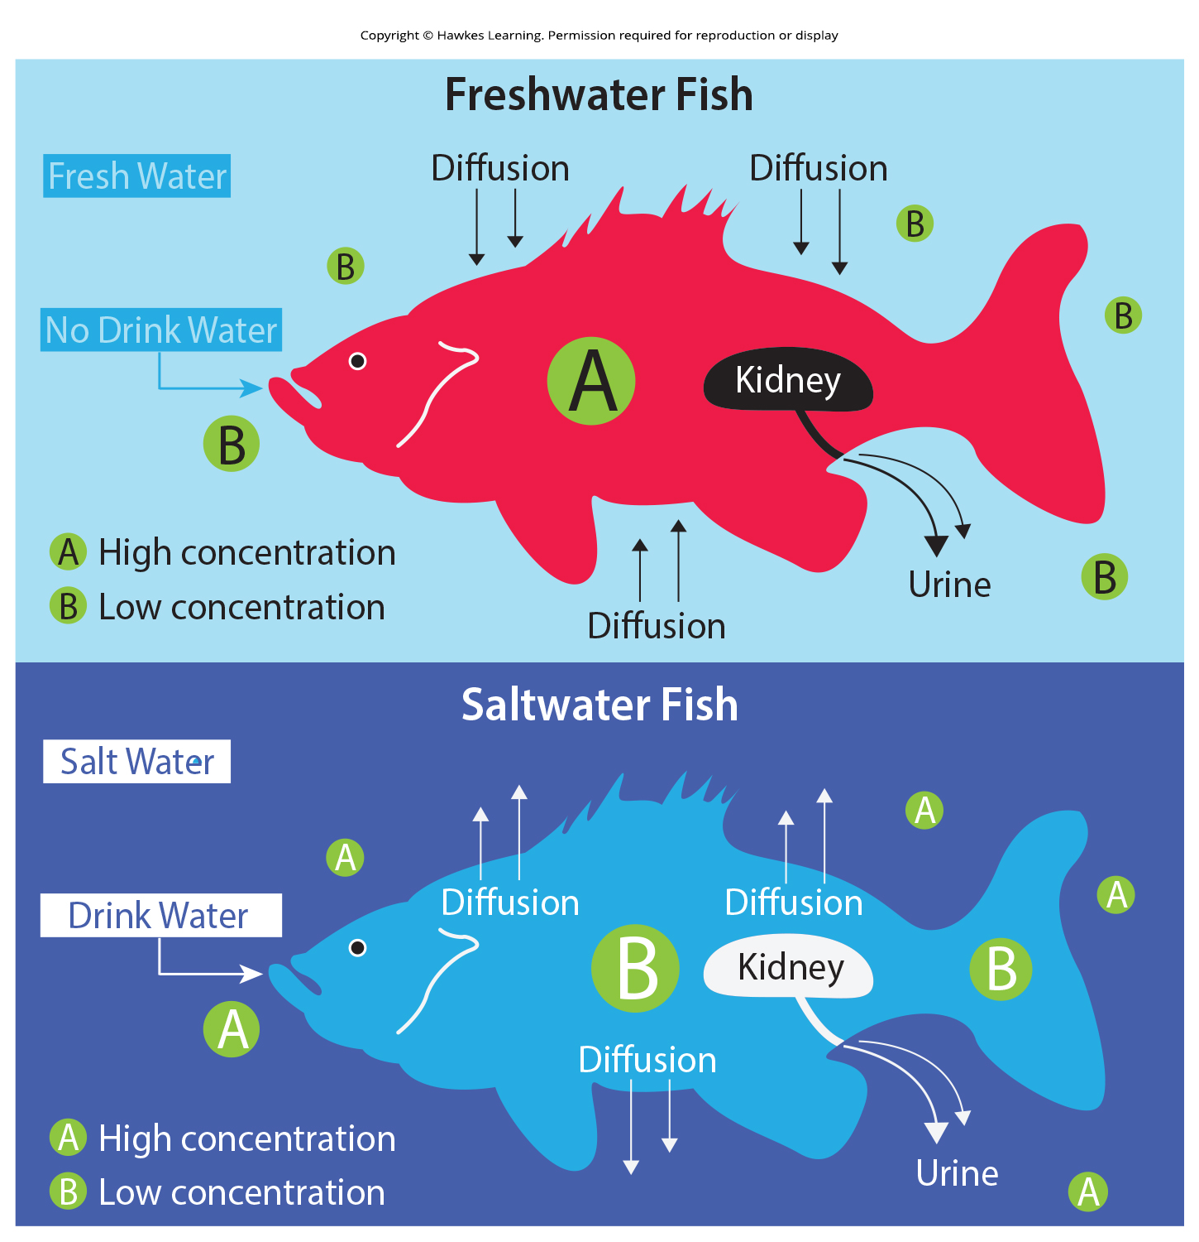
Lesson 5.2 Figure 14

Slide 26
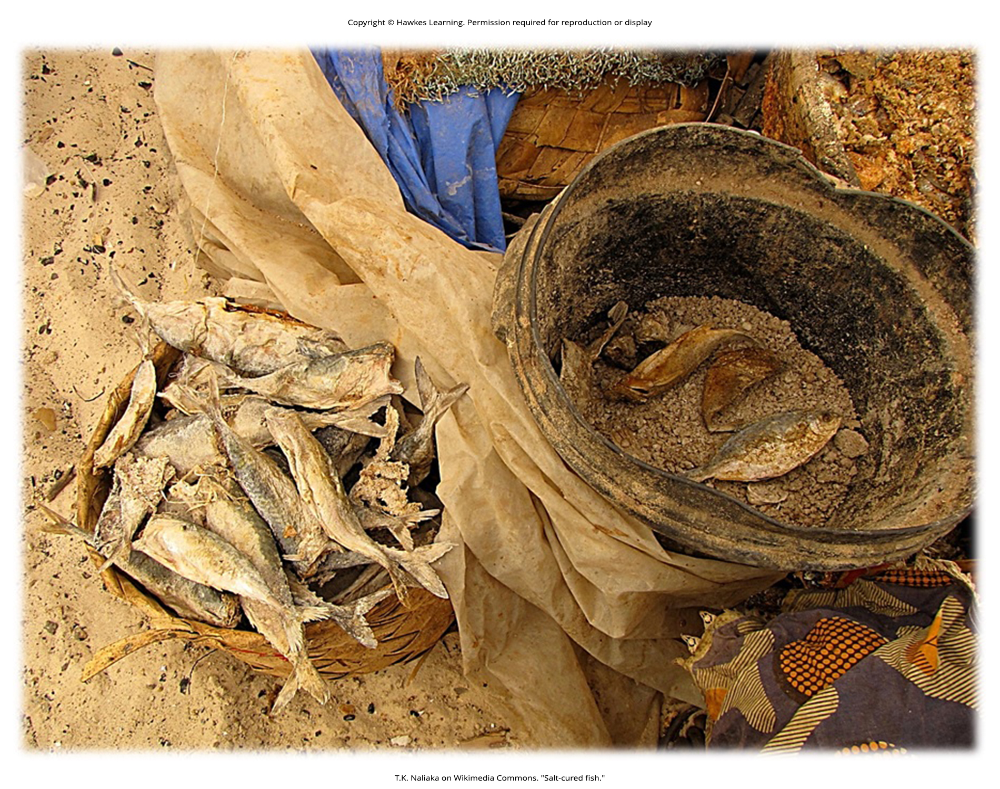
Lesson 5.2 Figure 15

Slide 27

Lesson 5.3 Figure 1

Slide 28
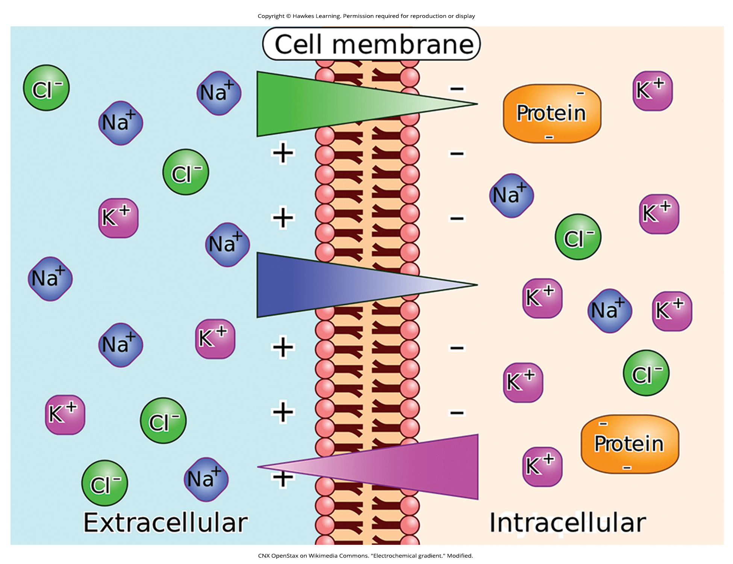
Lesson 5.3 Figure 2

Slide 29
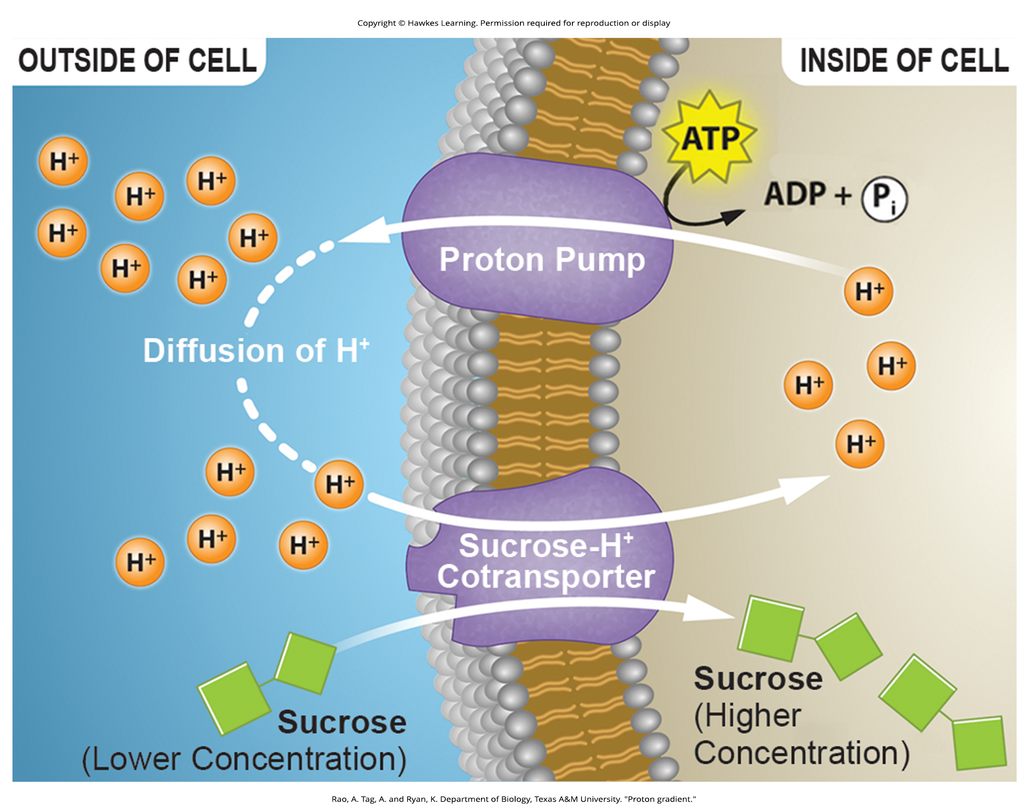
Lesson 5.3 Figure 3

Slide 30
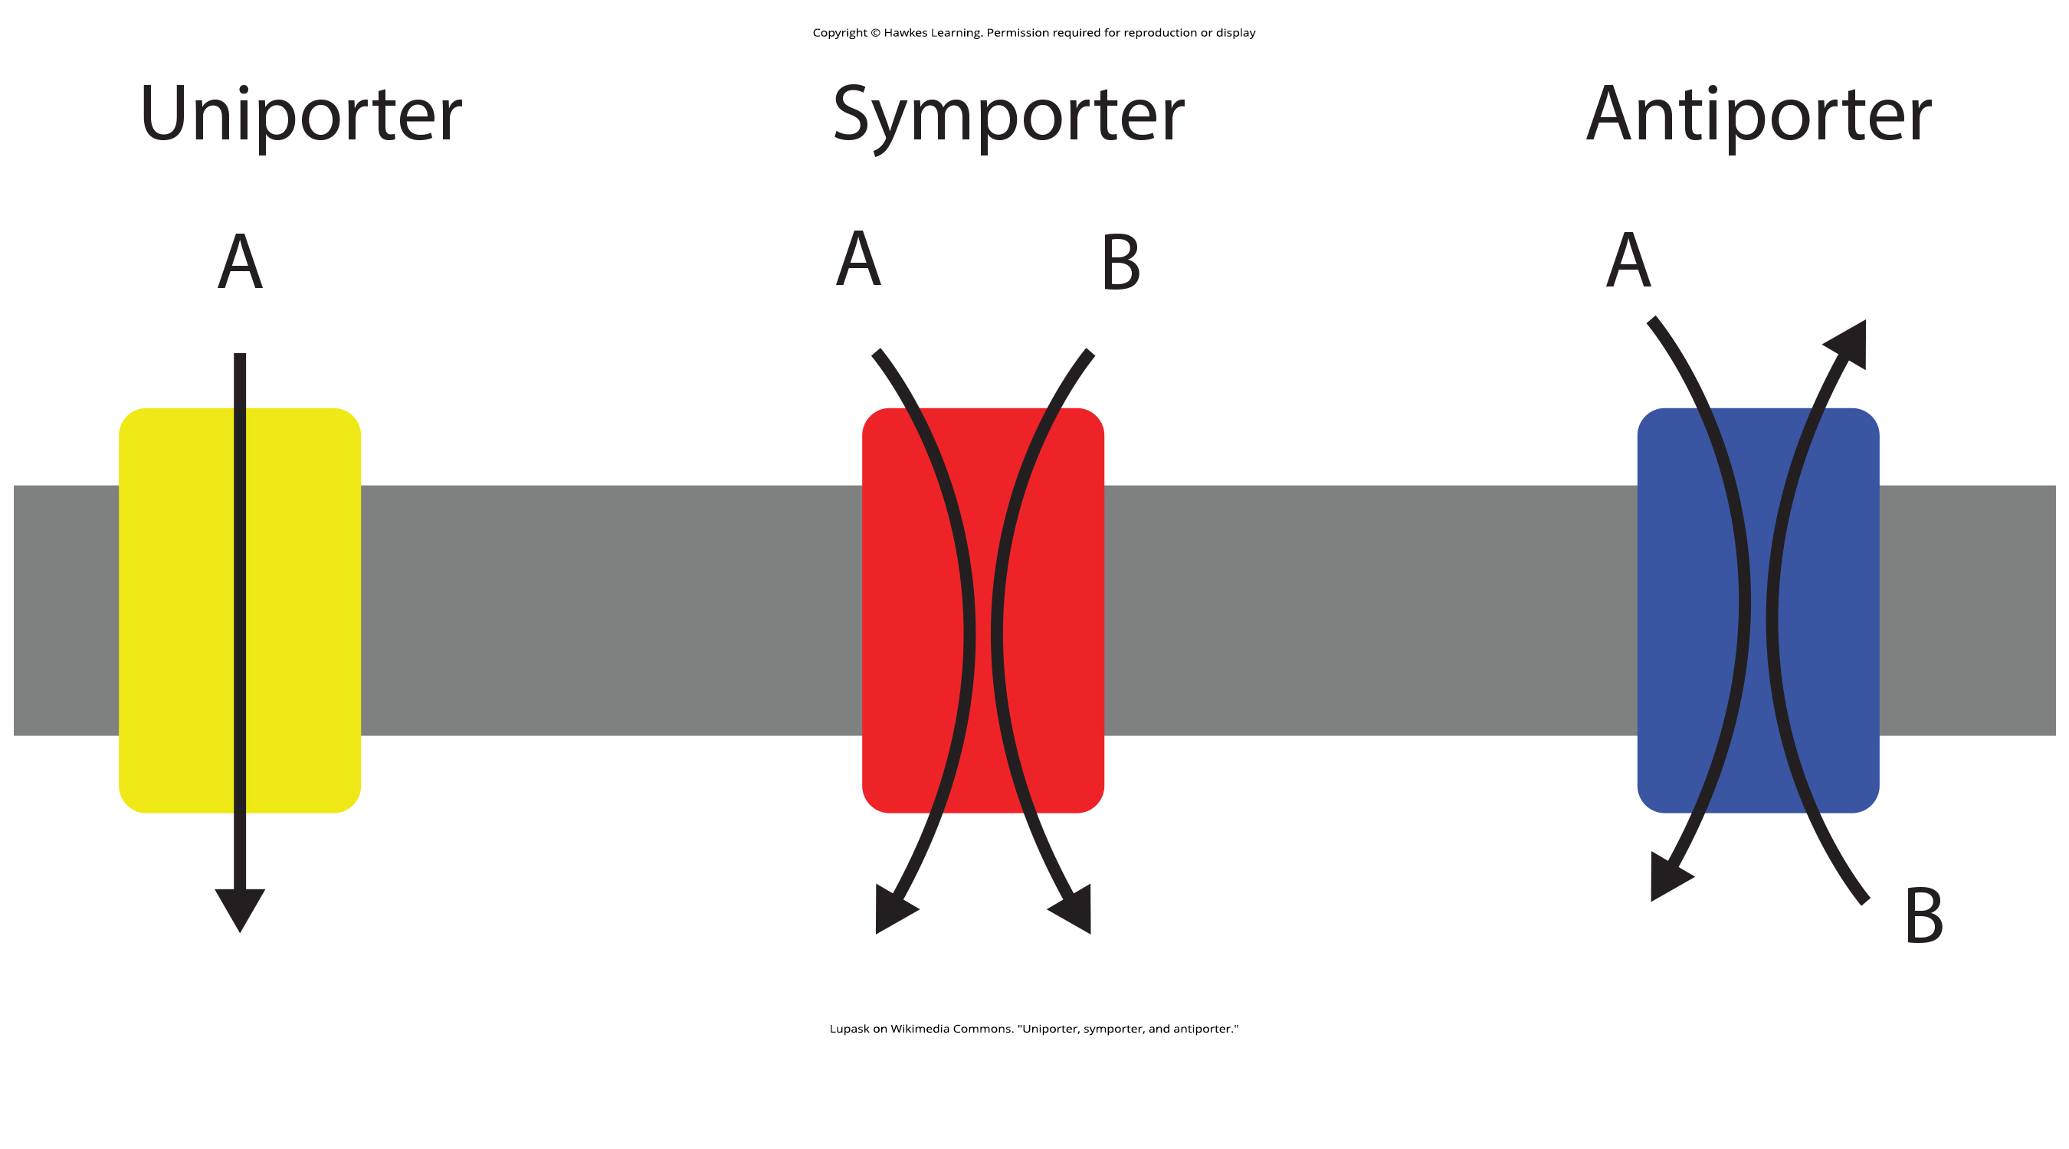
Lesson 5.3 Figure 4

Slide 31
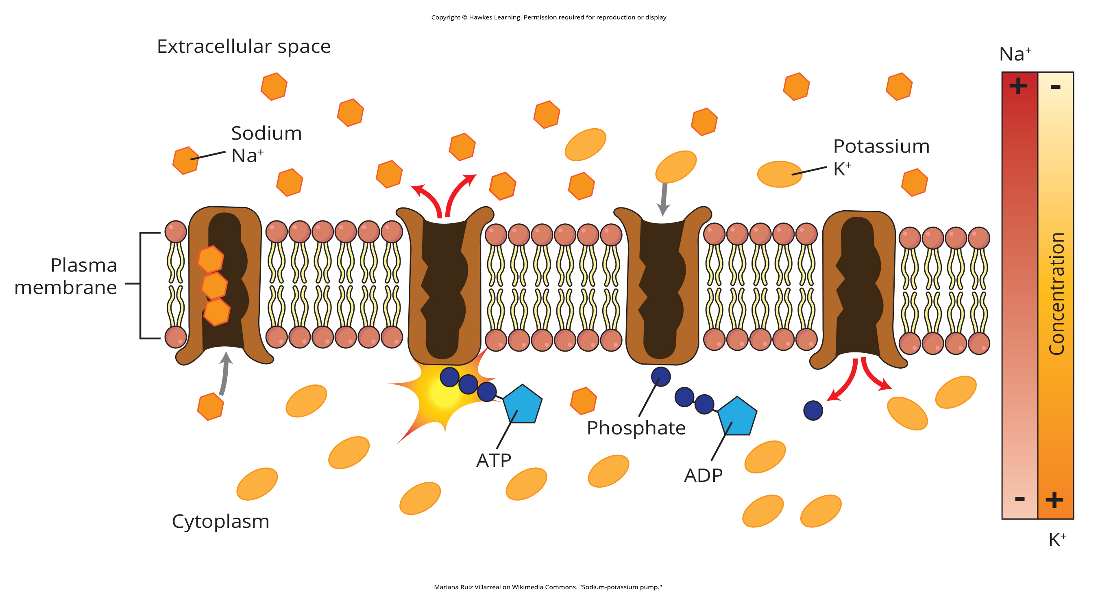
Lesson 5.3 Figure 5

Slide 32
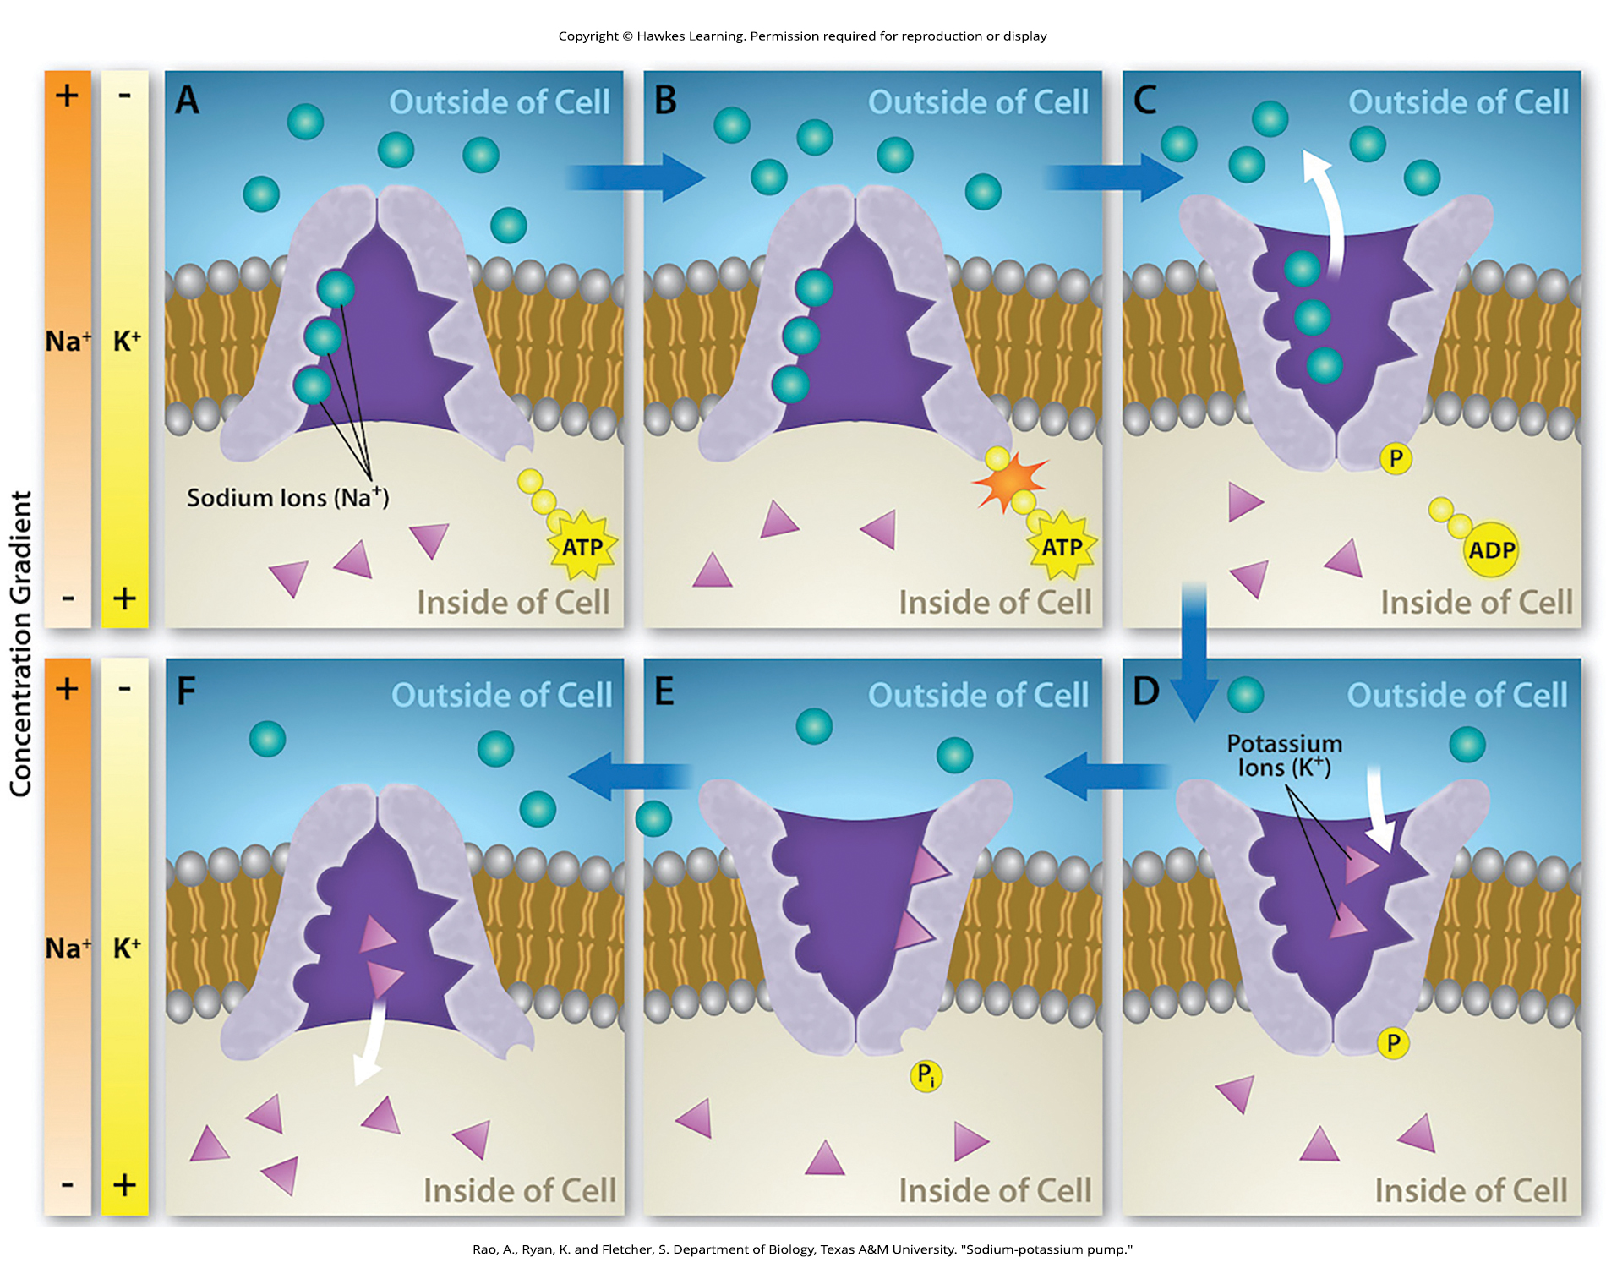
Lesson 5.3 Figure 6

Slide 33
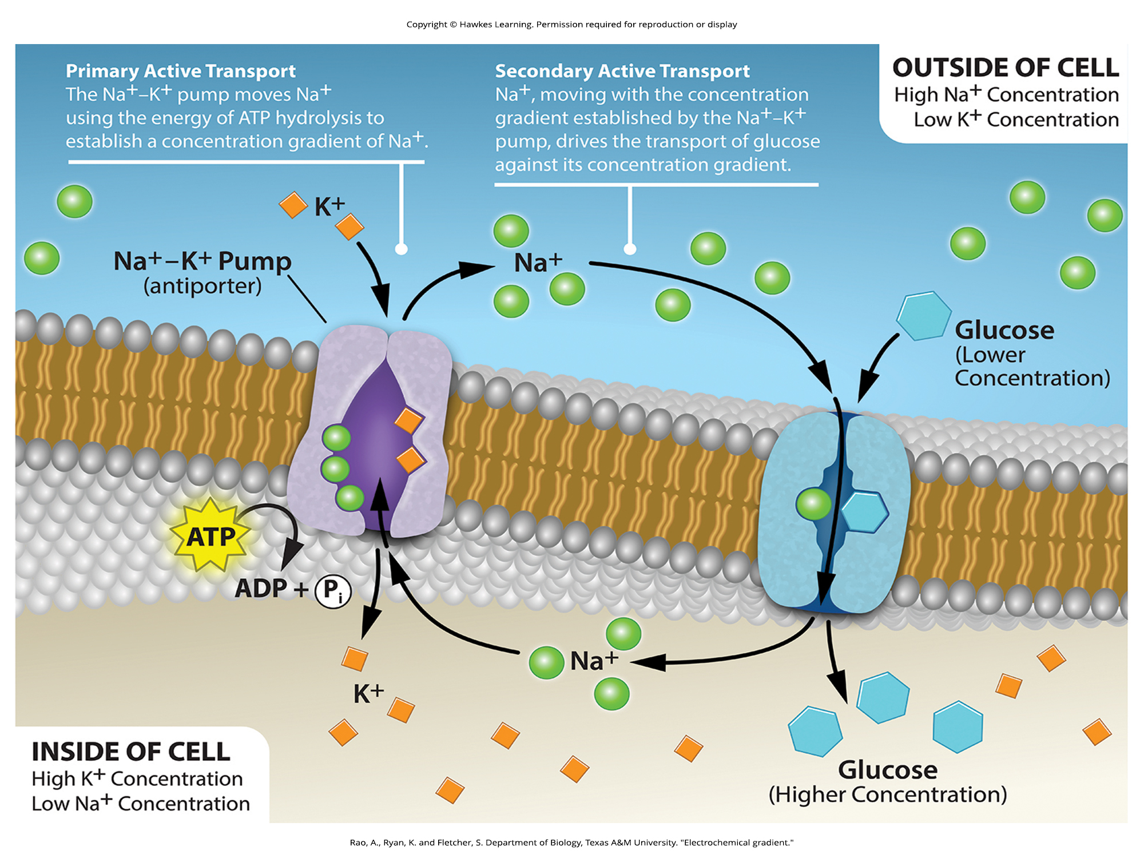
Lesson 5.3 Figure 7

Slide 34
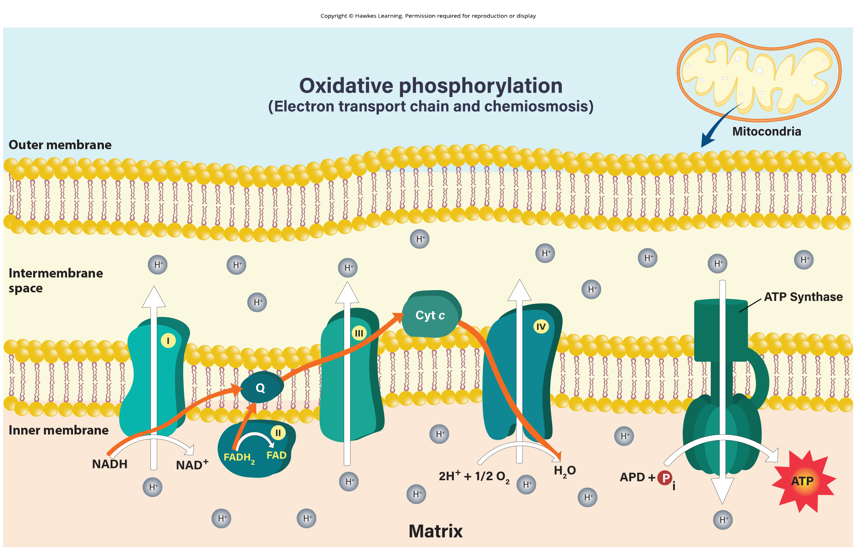
Lesson 5.3 Figure 8

Slide 35
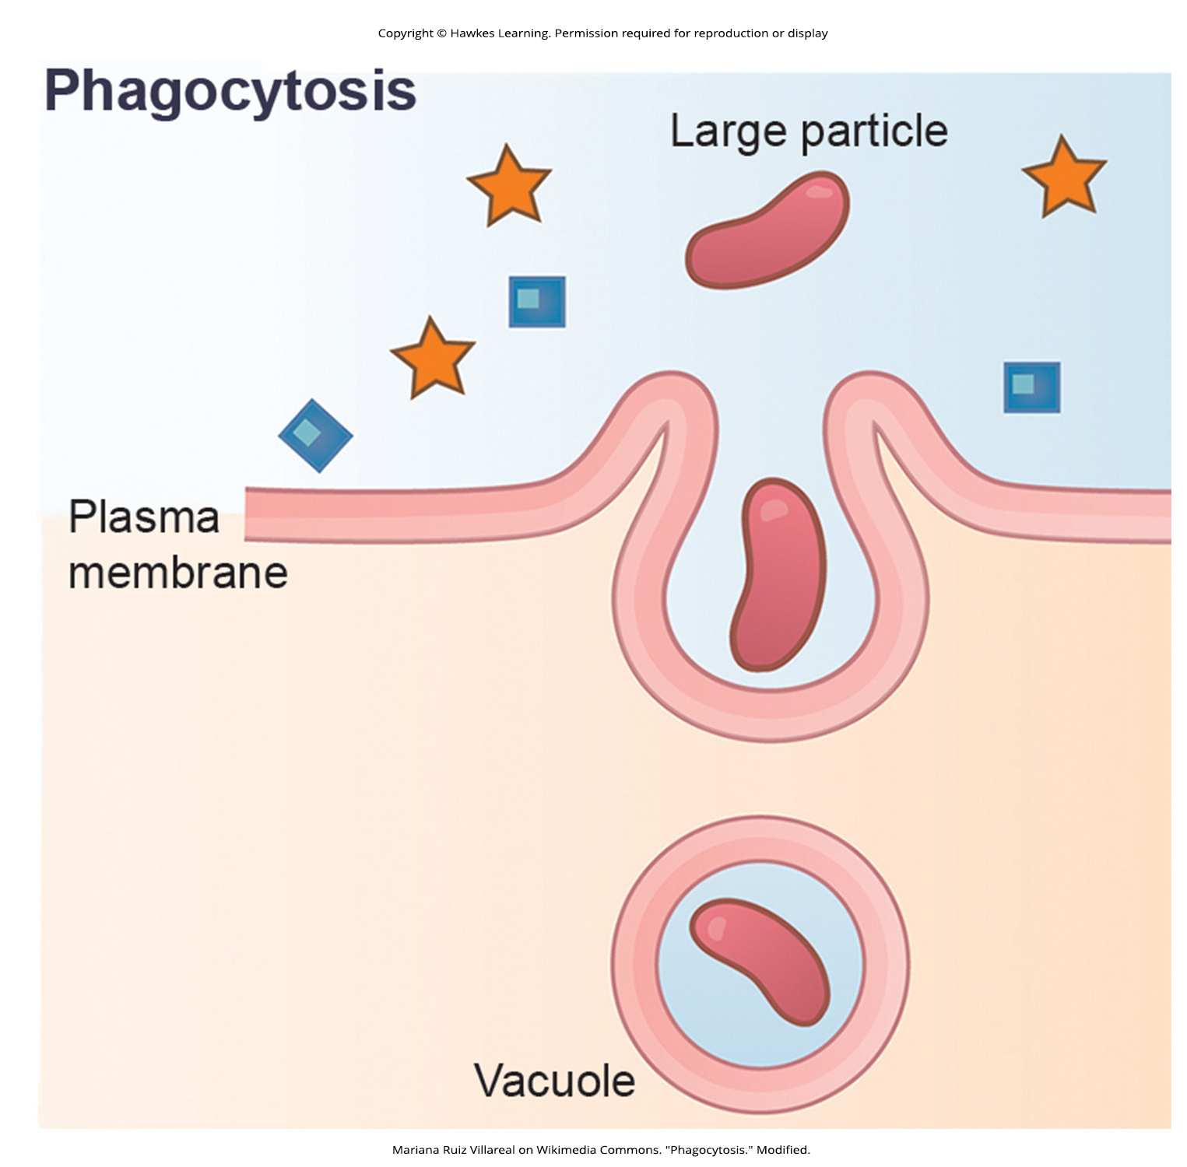
Lesson 5.4 Figure 1

Slide 36
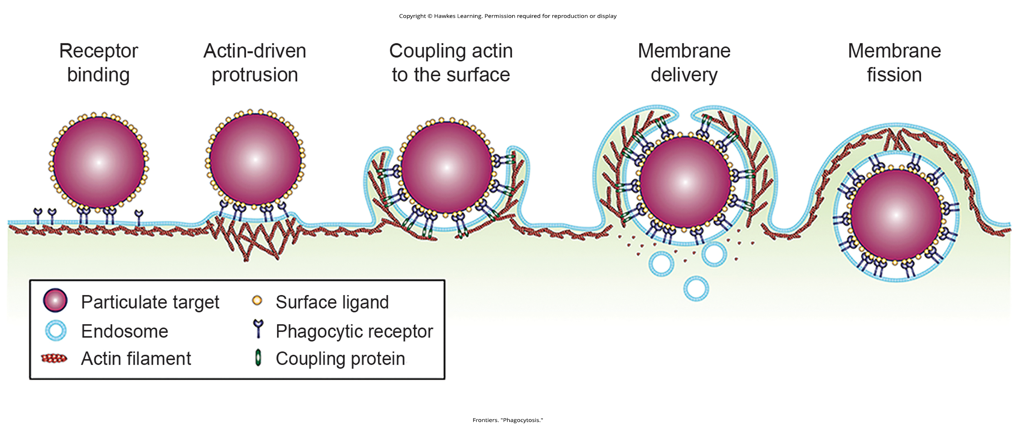
Lesson 5.4 Figure 2

Slide 37
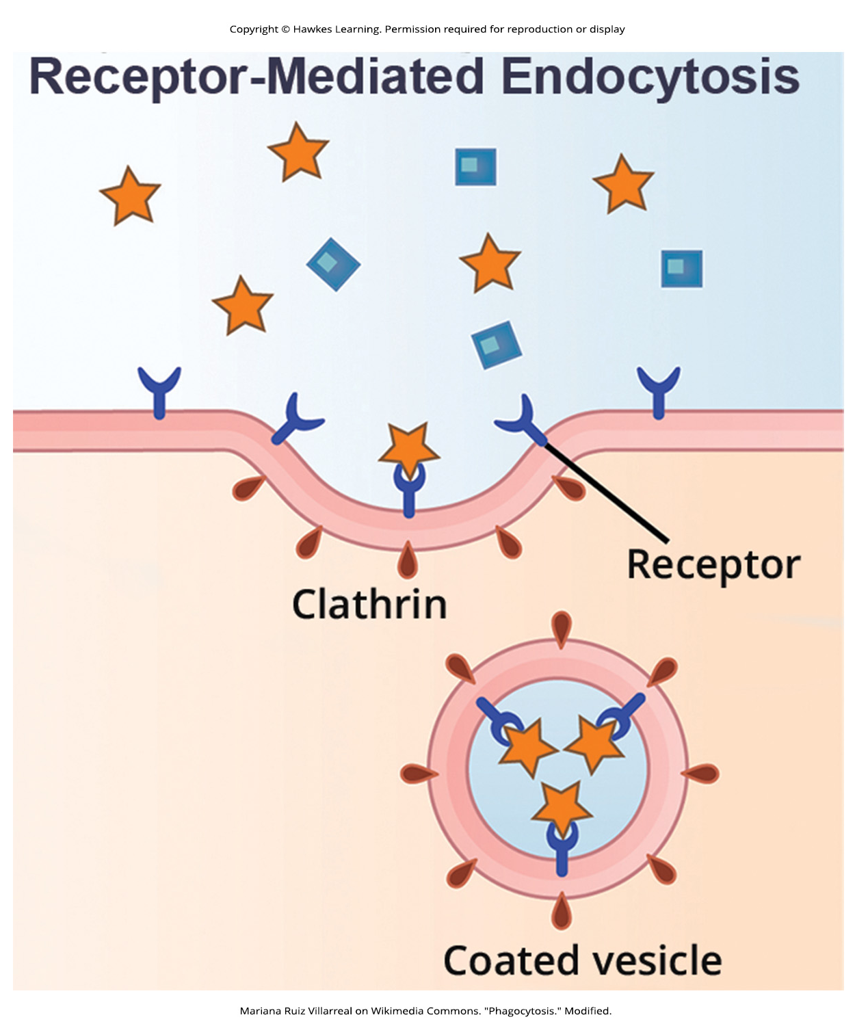
Lesson 5.4 Figure 3

Slide 38
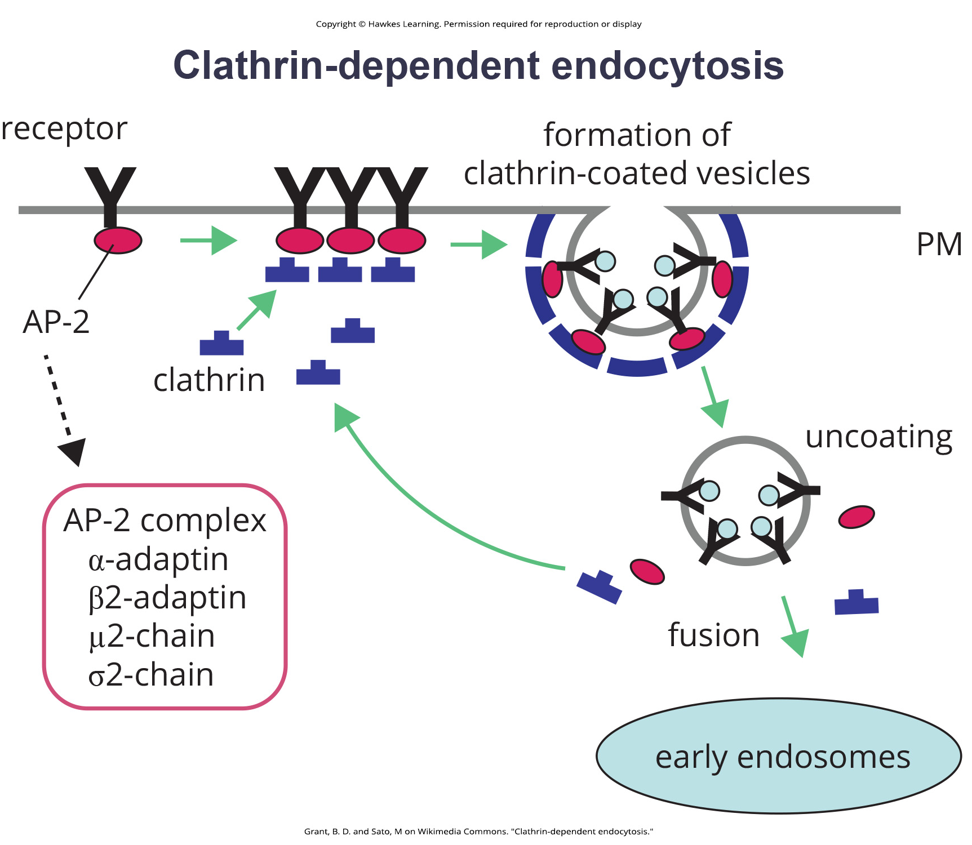
Lesson 5.4 Figure 4

Slide 39
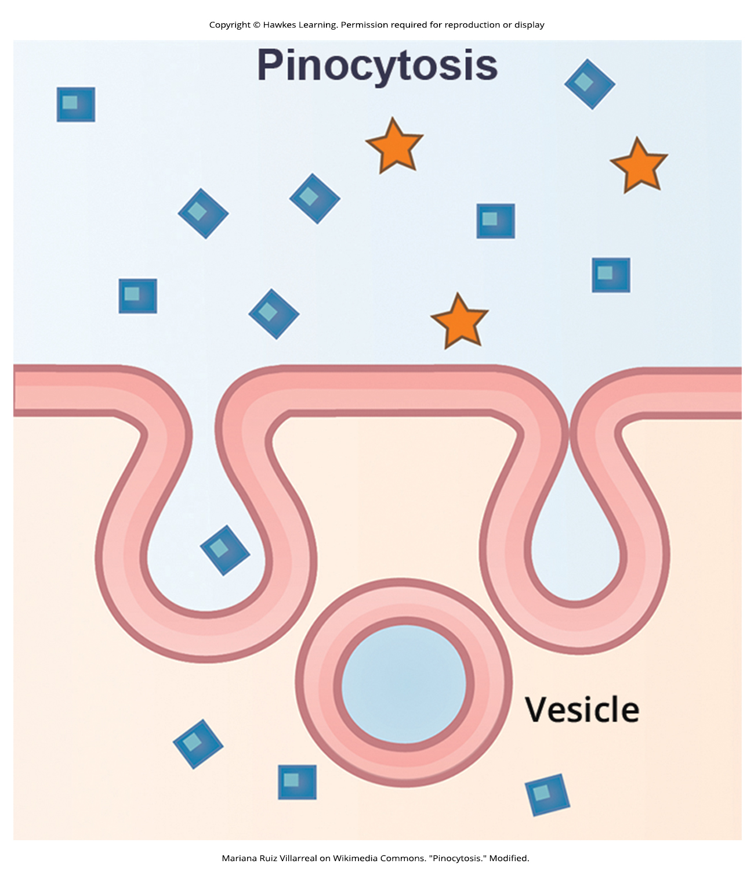
Lesson 5.4 Figure 5

Slide 40
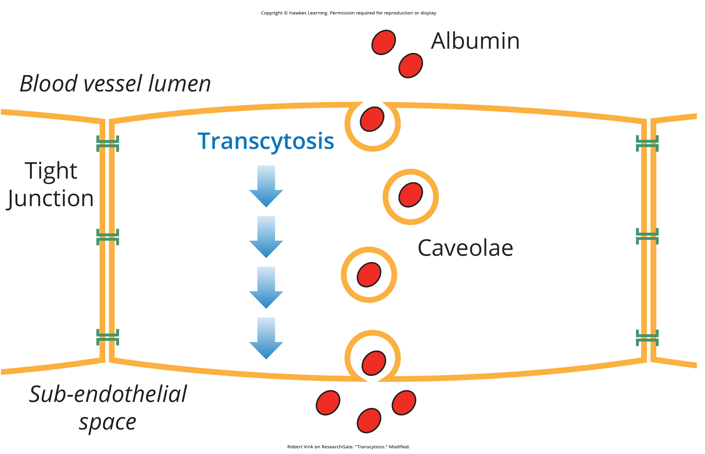
Lesson 5.4 Figure 6

Slide 41
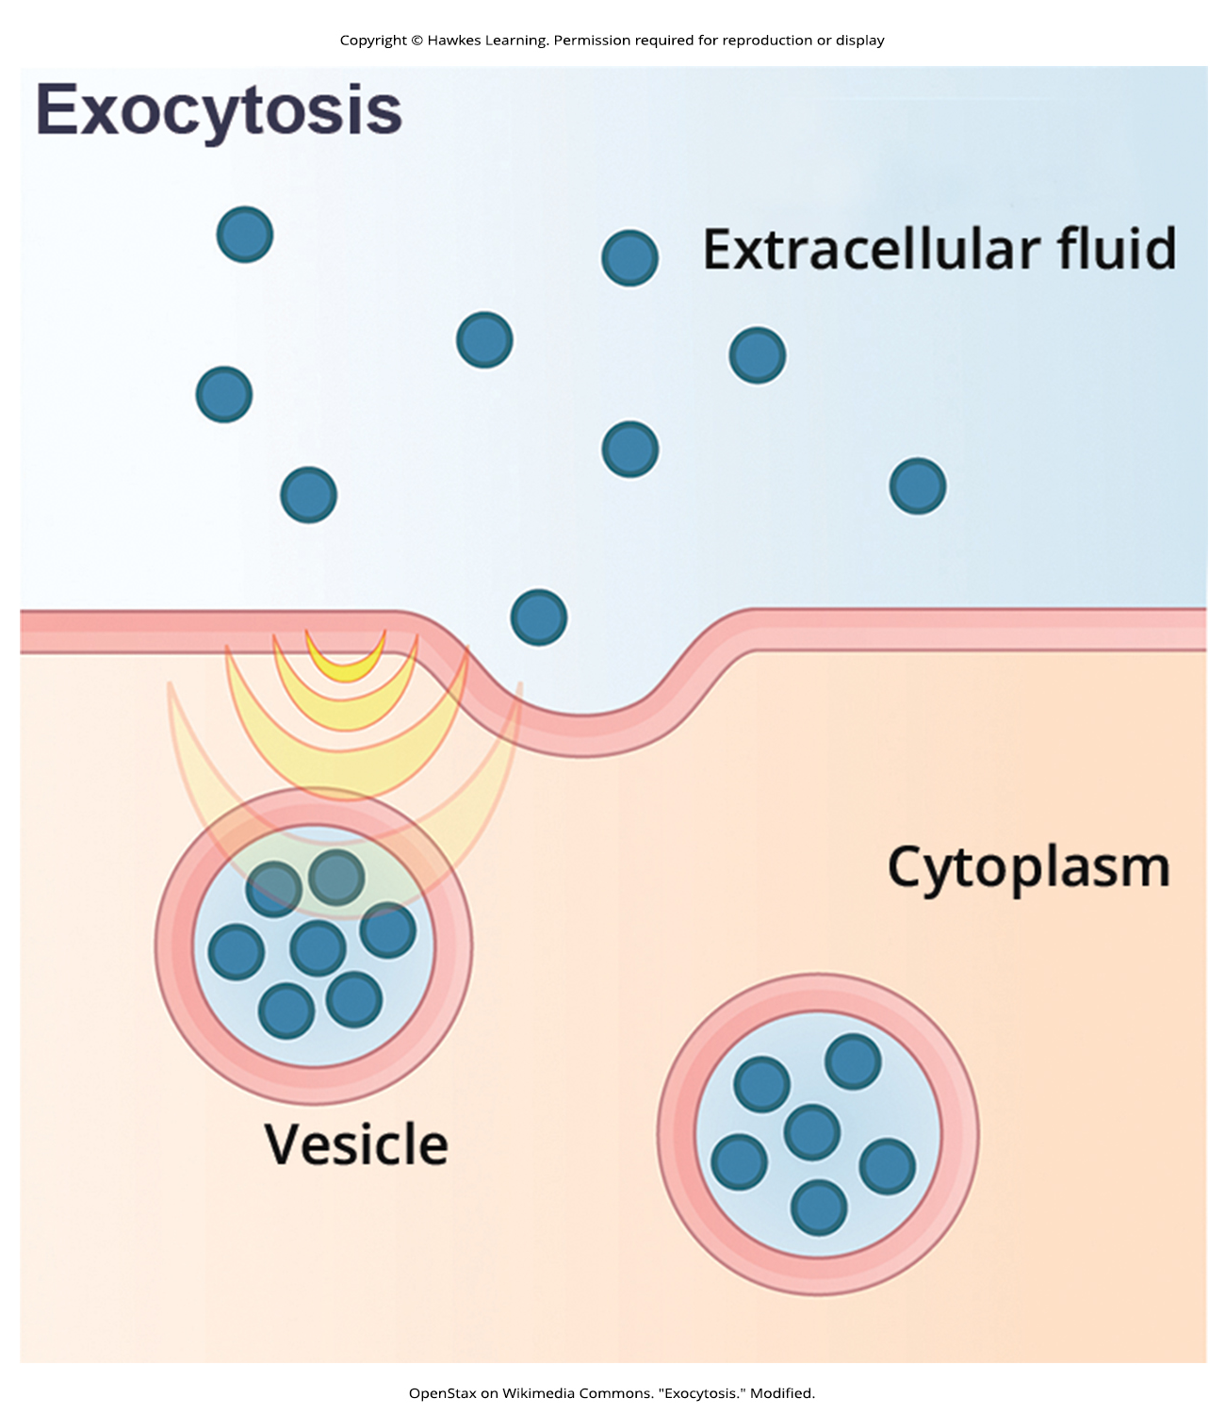
Lesson 5.4 Figure 7

Slide 42
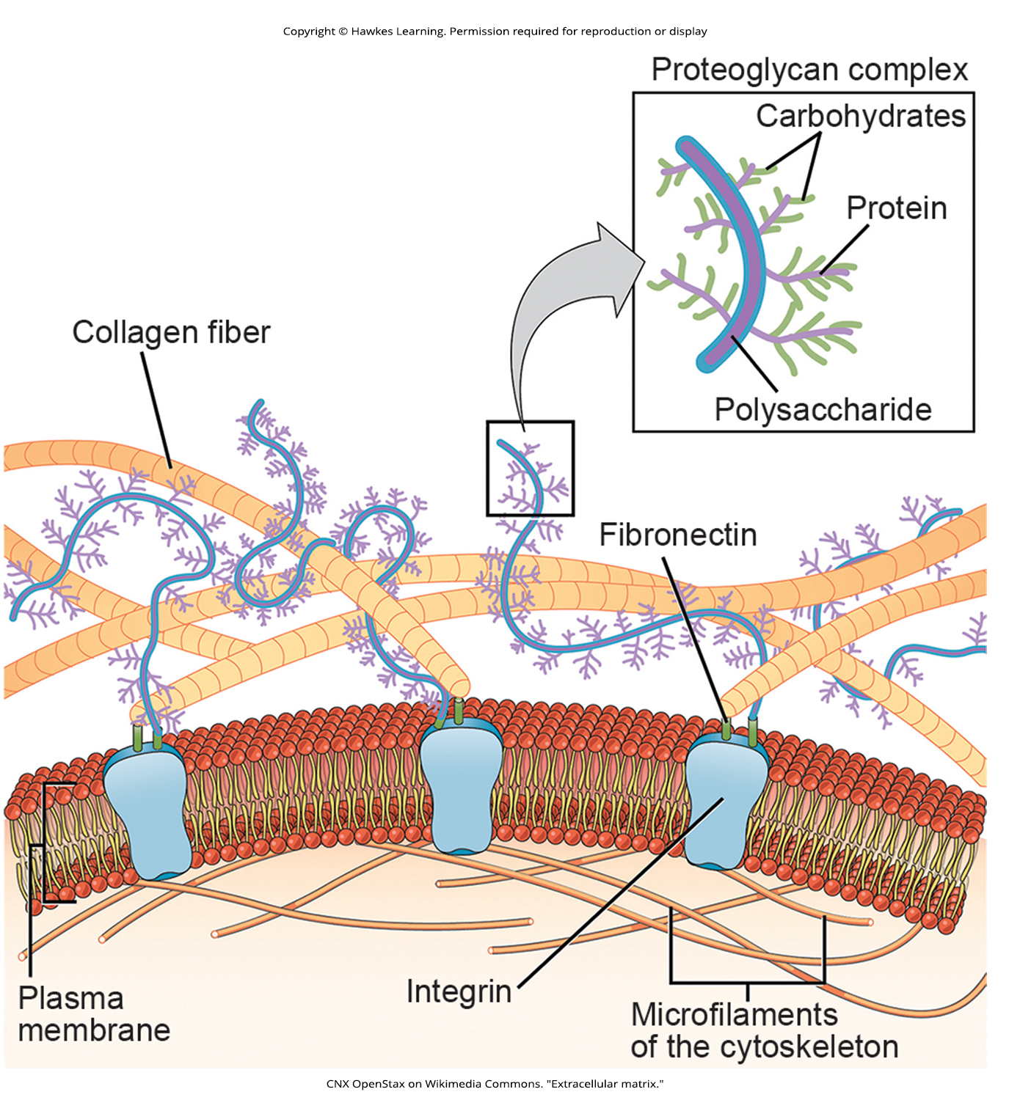
Lesson 5.5 Figure 1

Slide 43
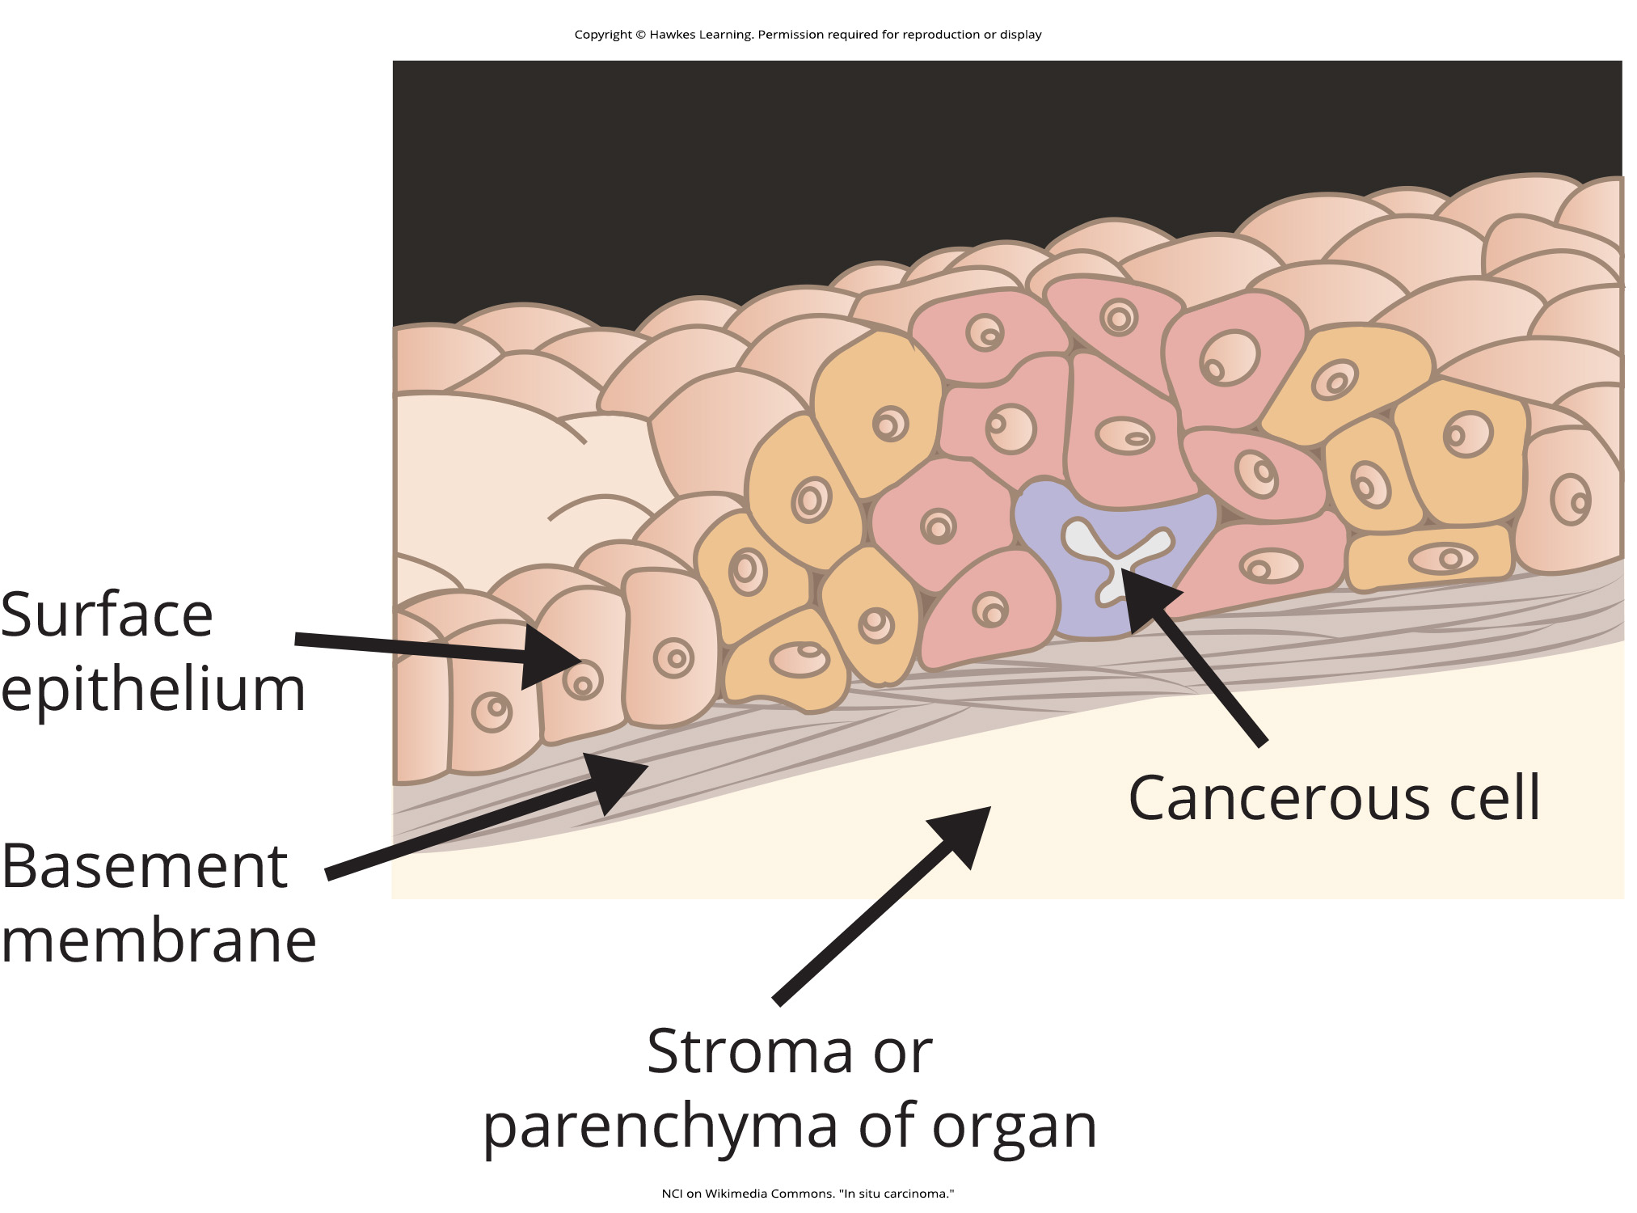
Lesson 5.5 Figure 2

Slide 44
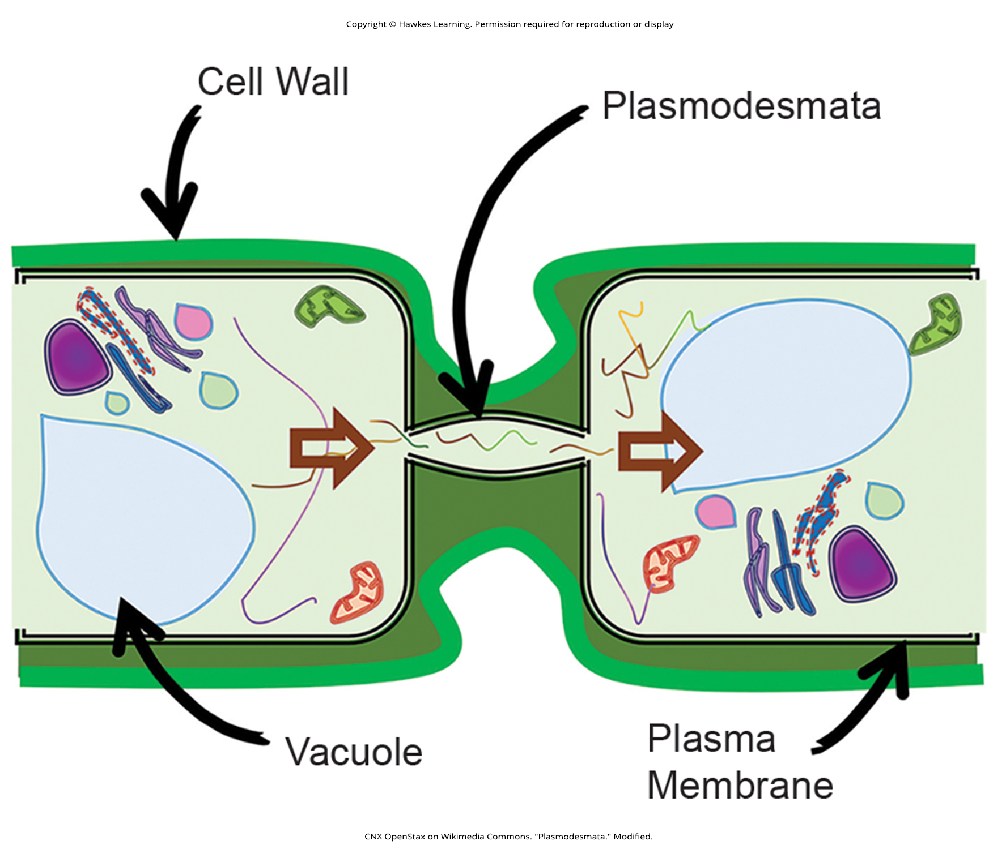
Lesson 5.5 Figure 3

Slide 45
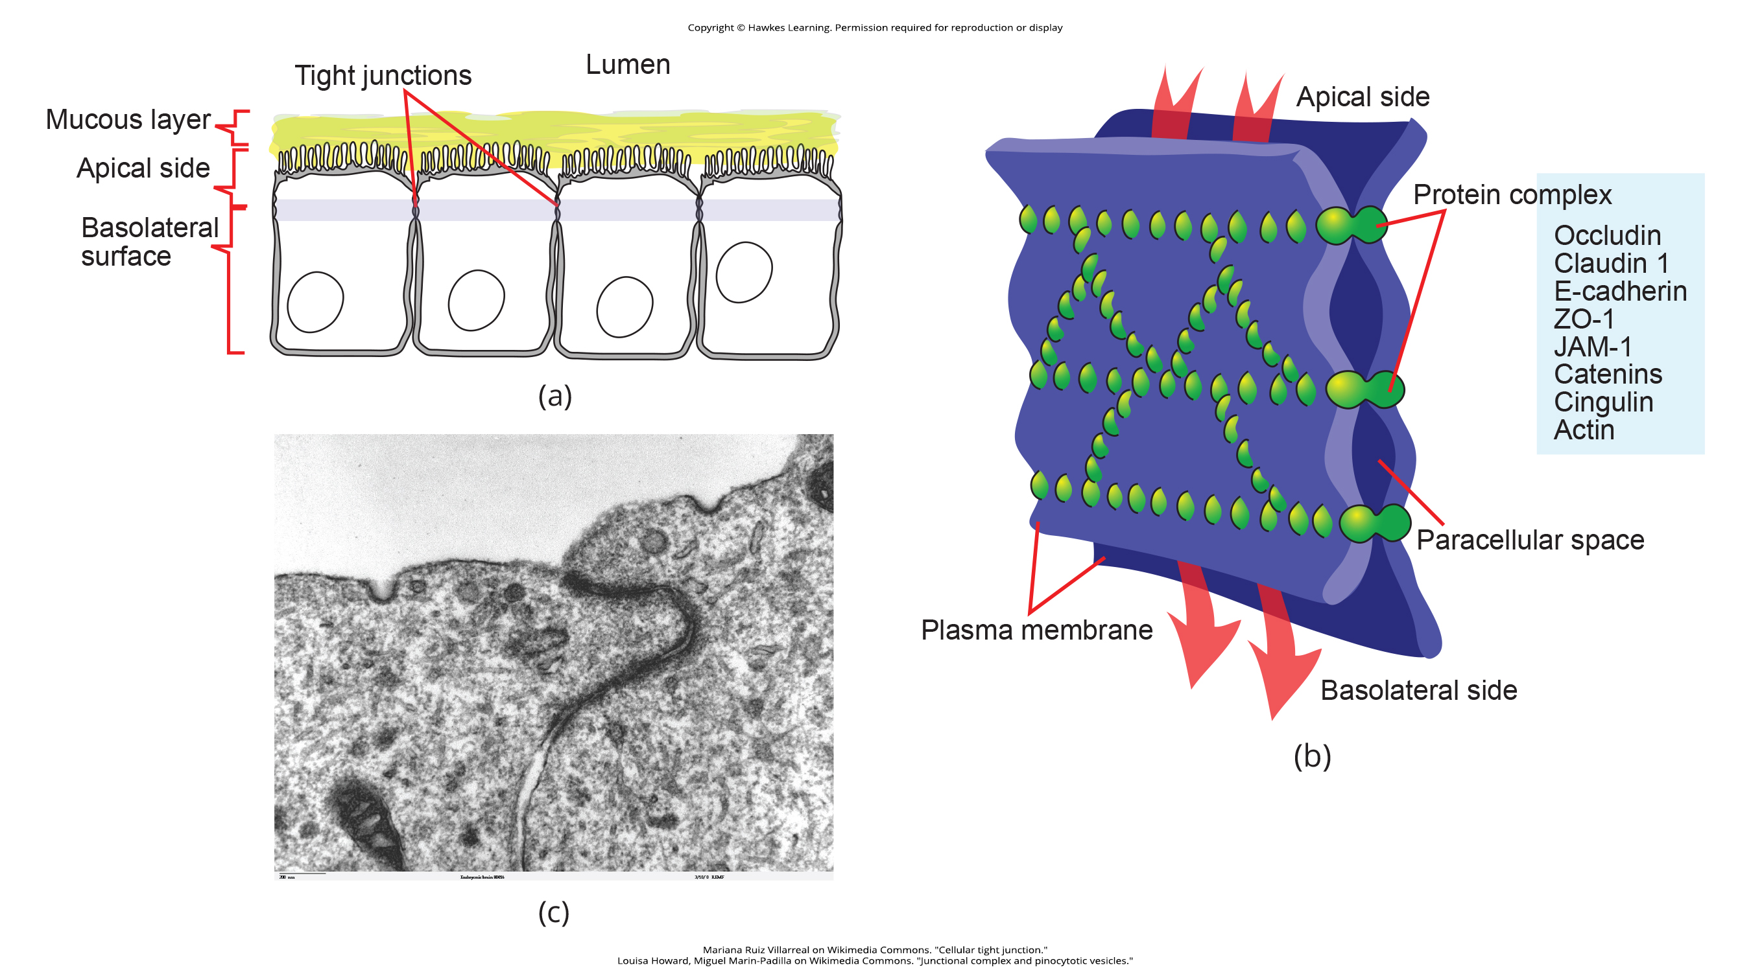
Lesson 5.5 Figure 4

Slide 46
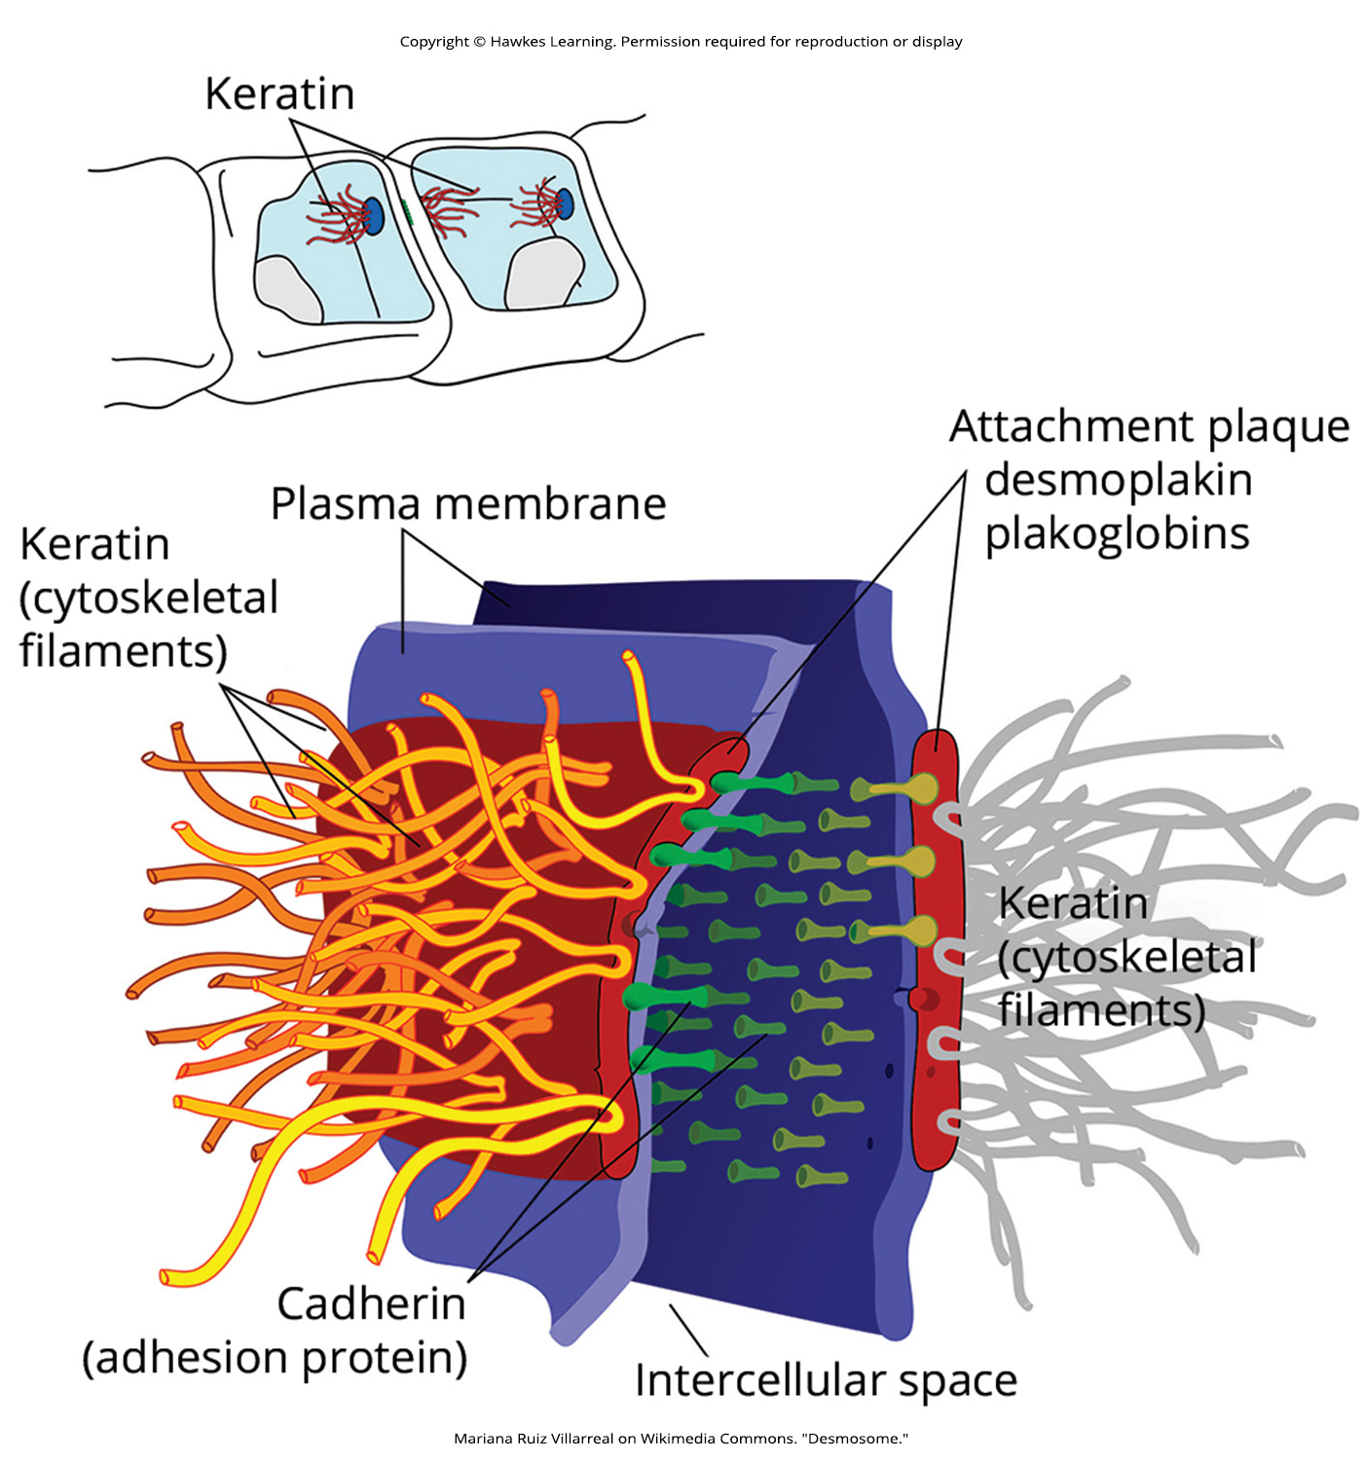
Lesson 5.5 Figure 5

Slide 47
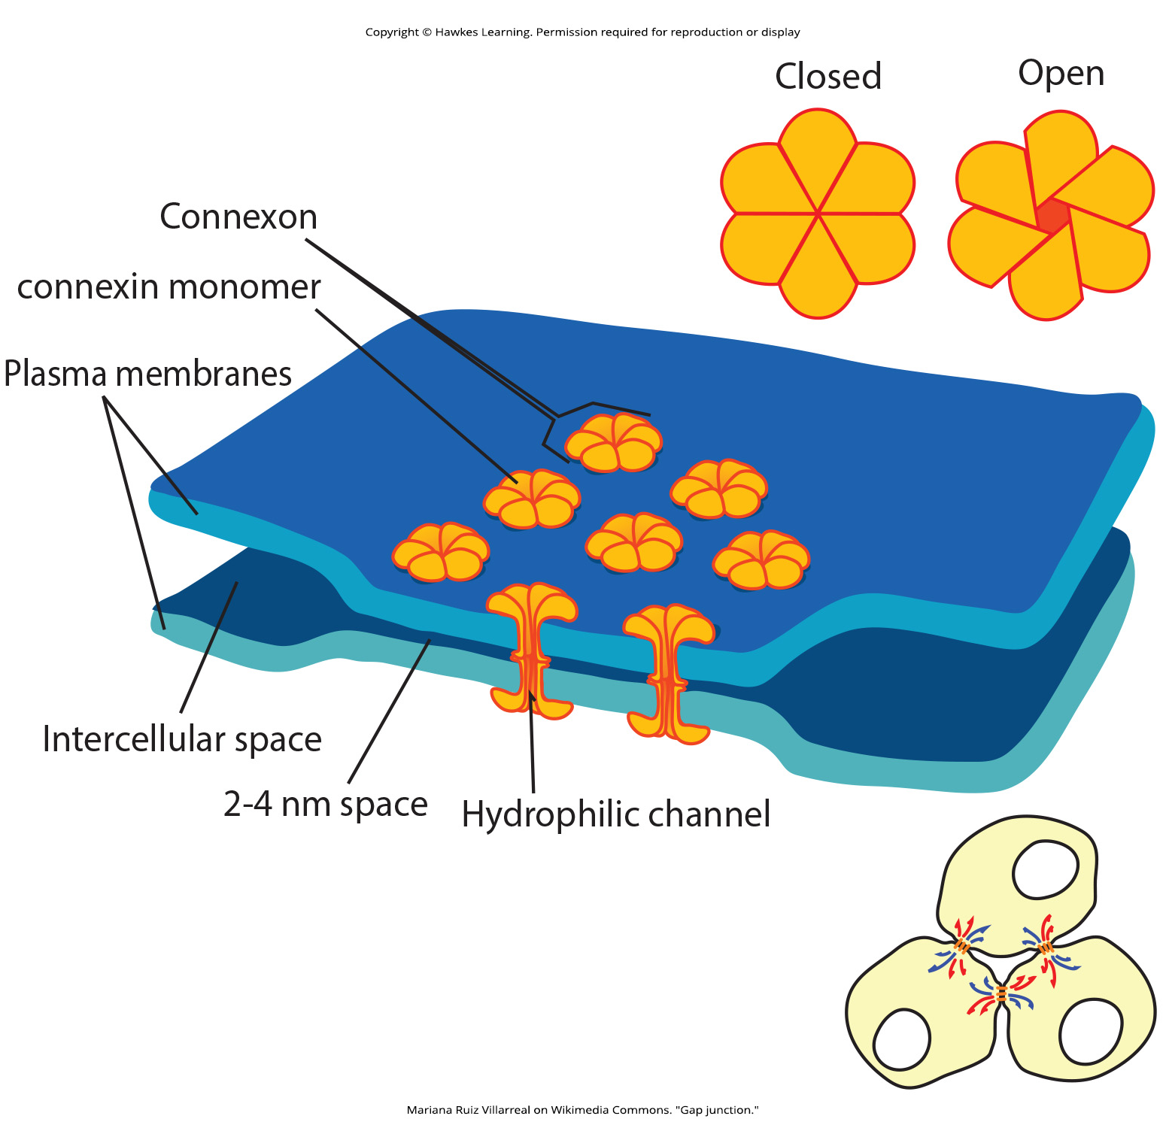
Lesson 5.5 Figure 6

Slide 48
Hawkes Learning – End of PowerPoint

