Slide 1
Chapter 9
Cell Communication

Slide 2

Lesson 9.1 Figure 1

Slide 3
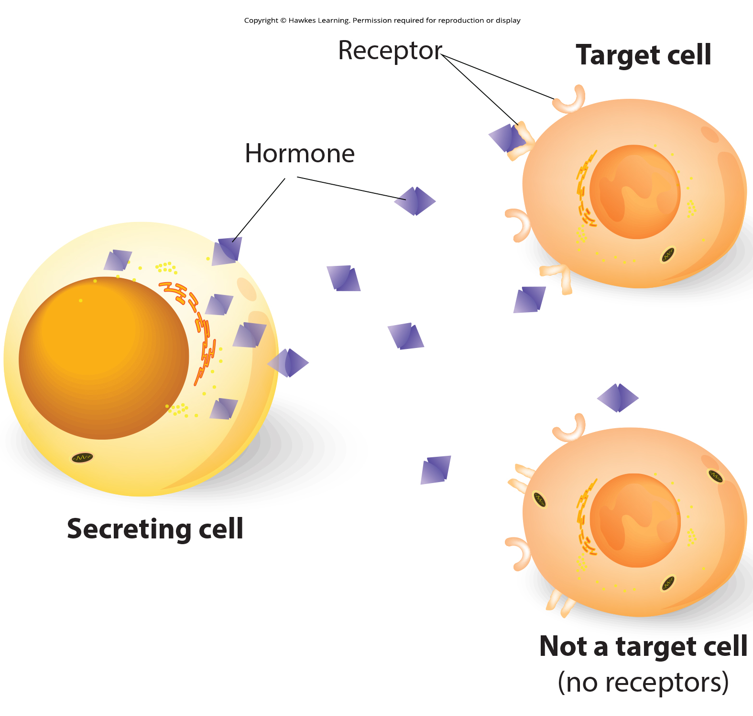
Lesson 9.1 Figure 2

Slide 4
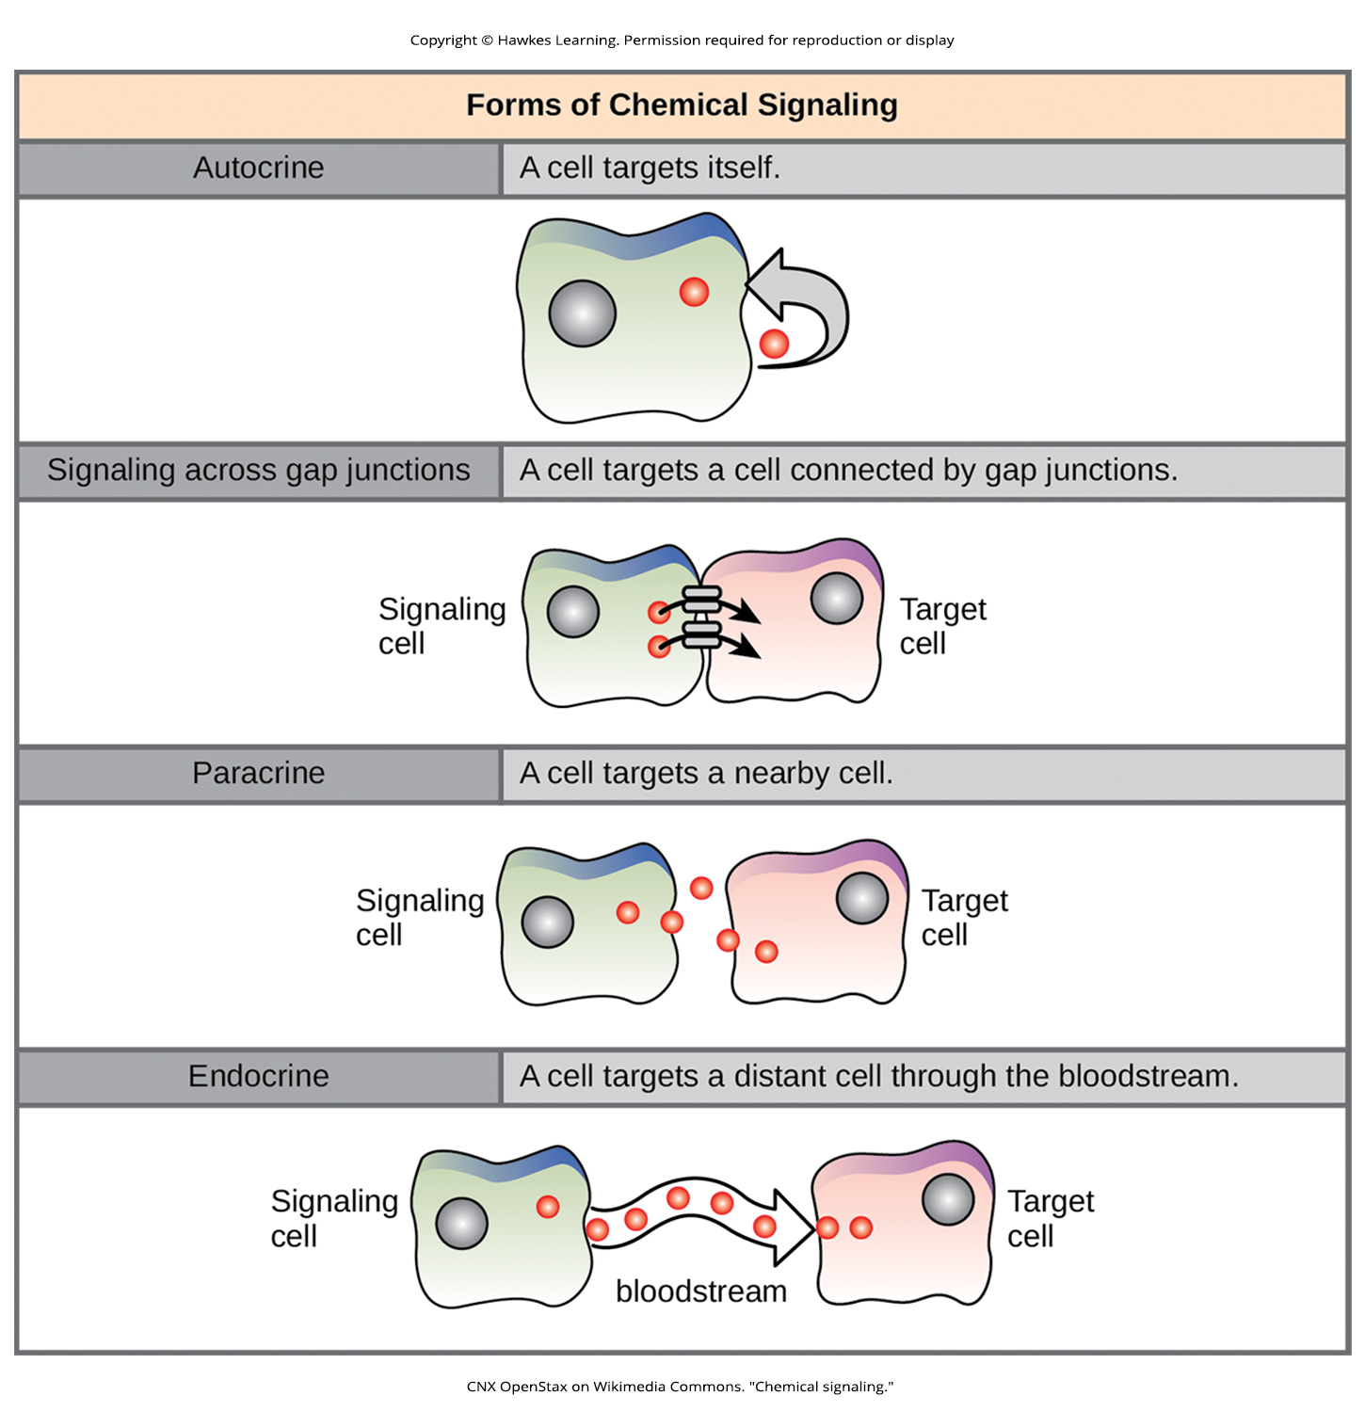
Lesson 9.1 Figure 3

Slide 5
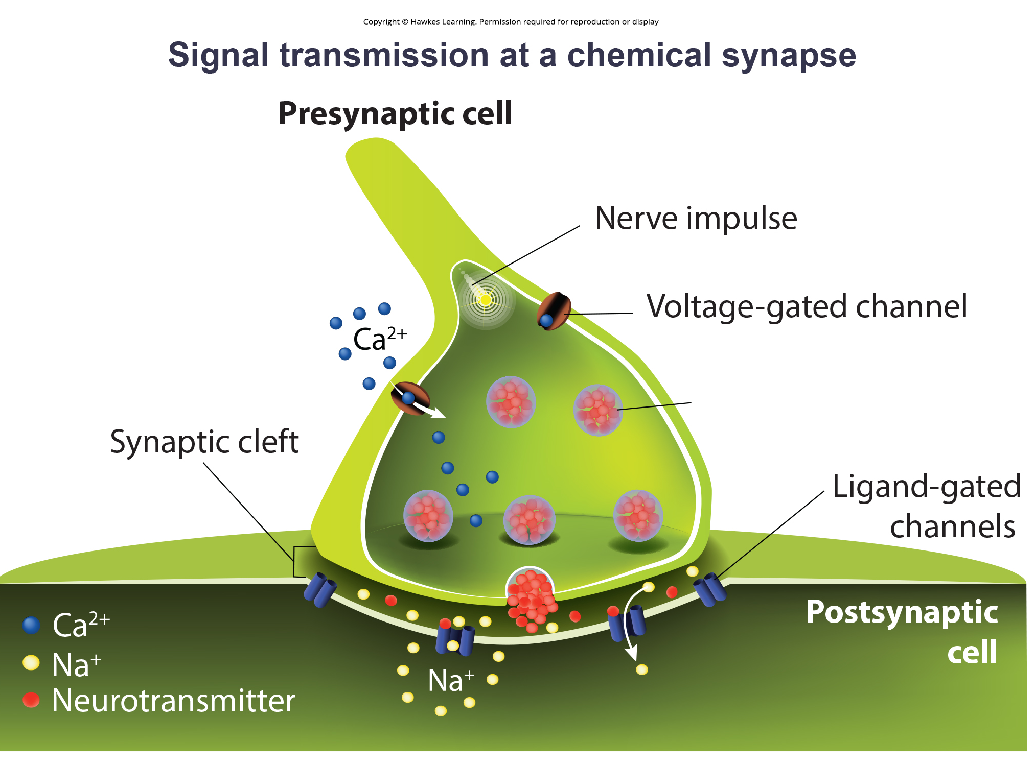
Lesson 9.1 Figure 4

Slide 6
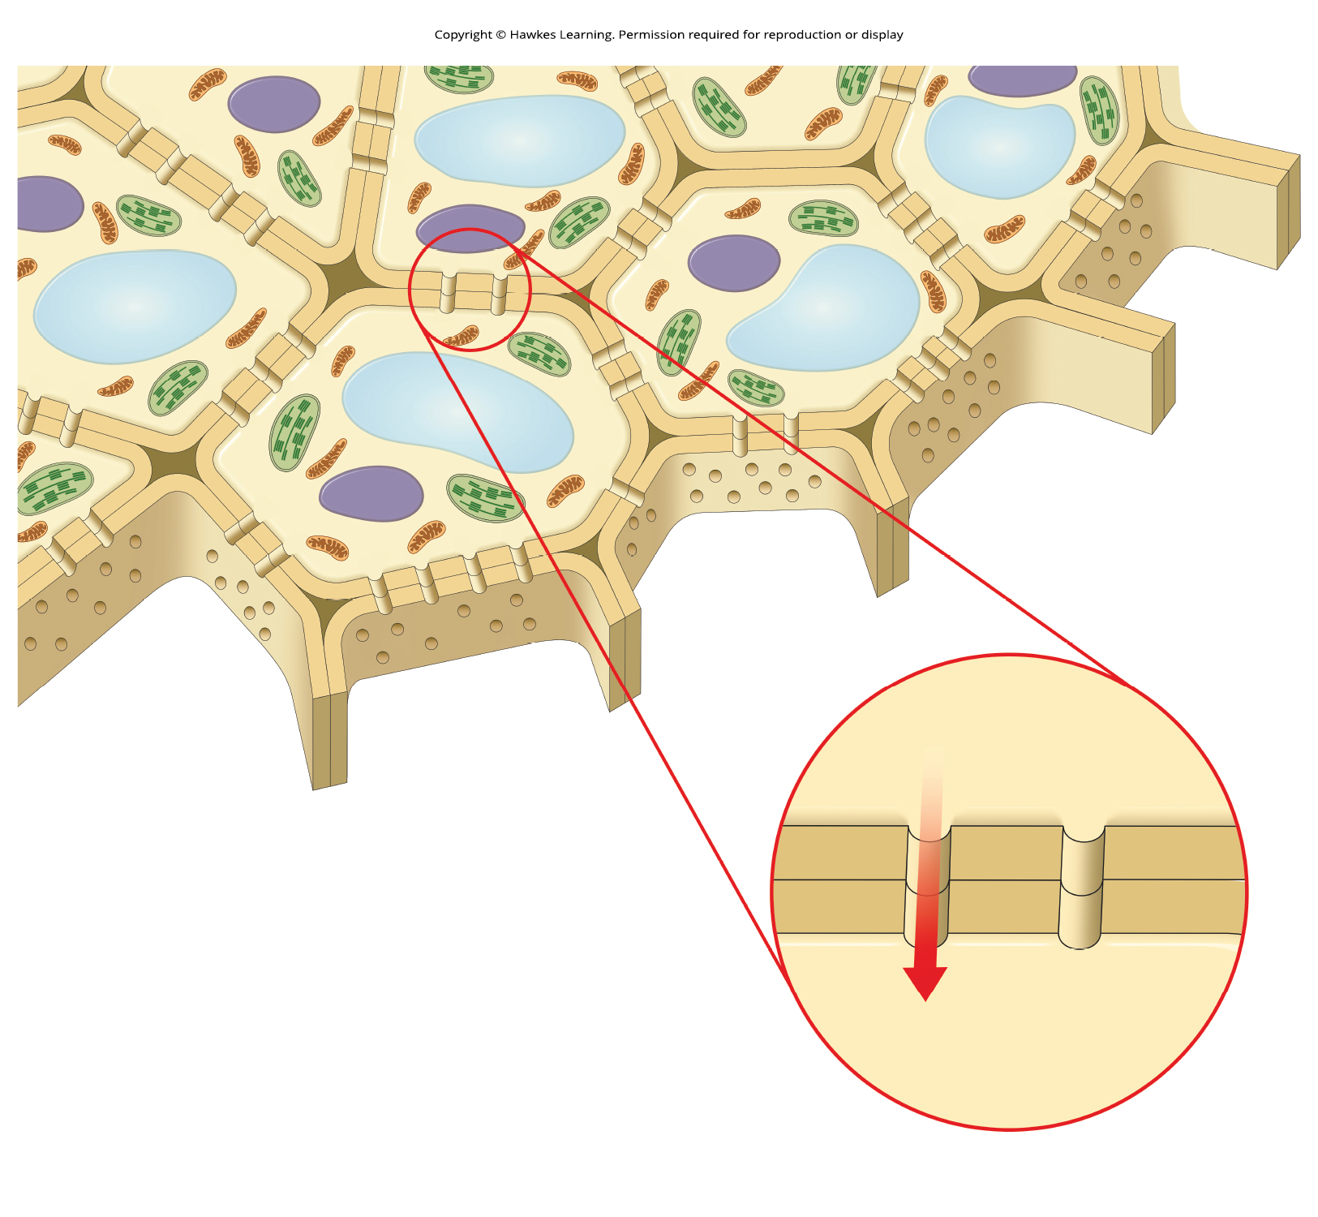
Lesson 9.1 Figure 5

Slide 7
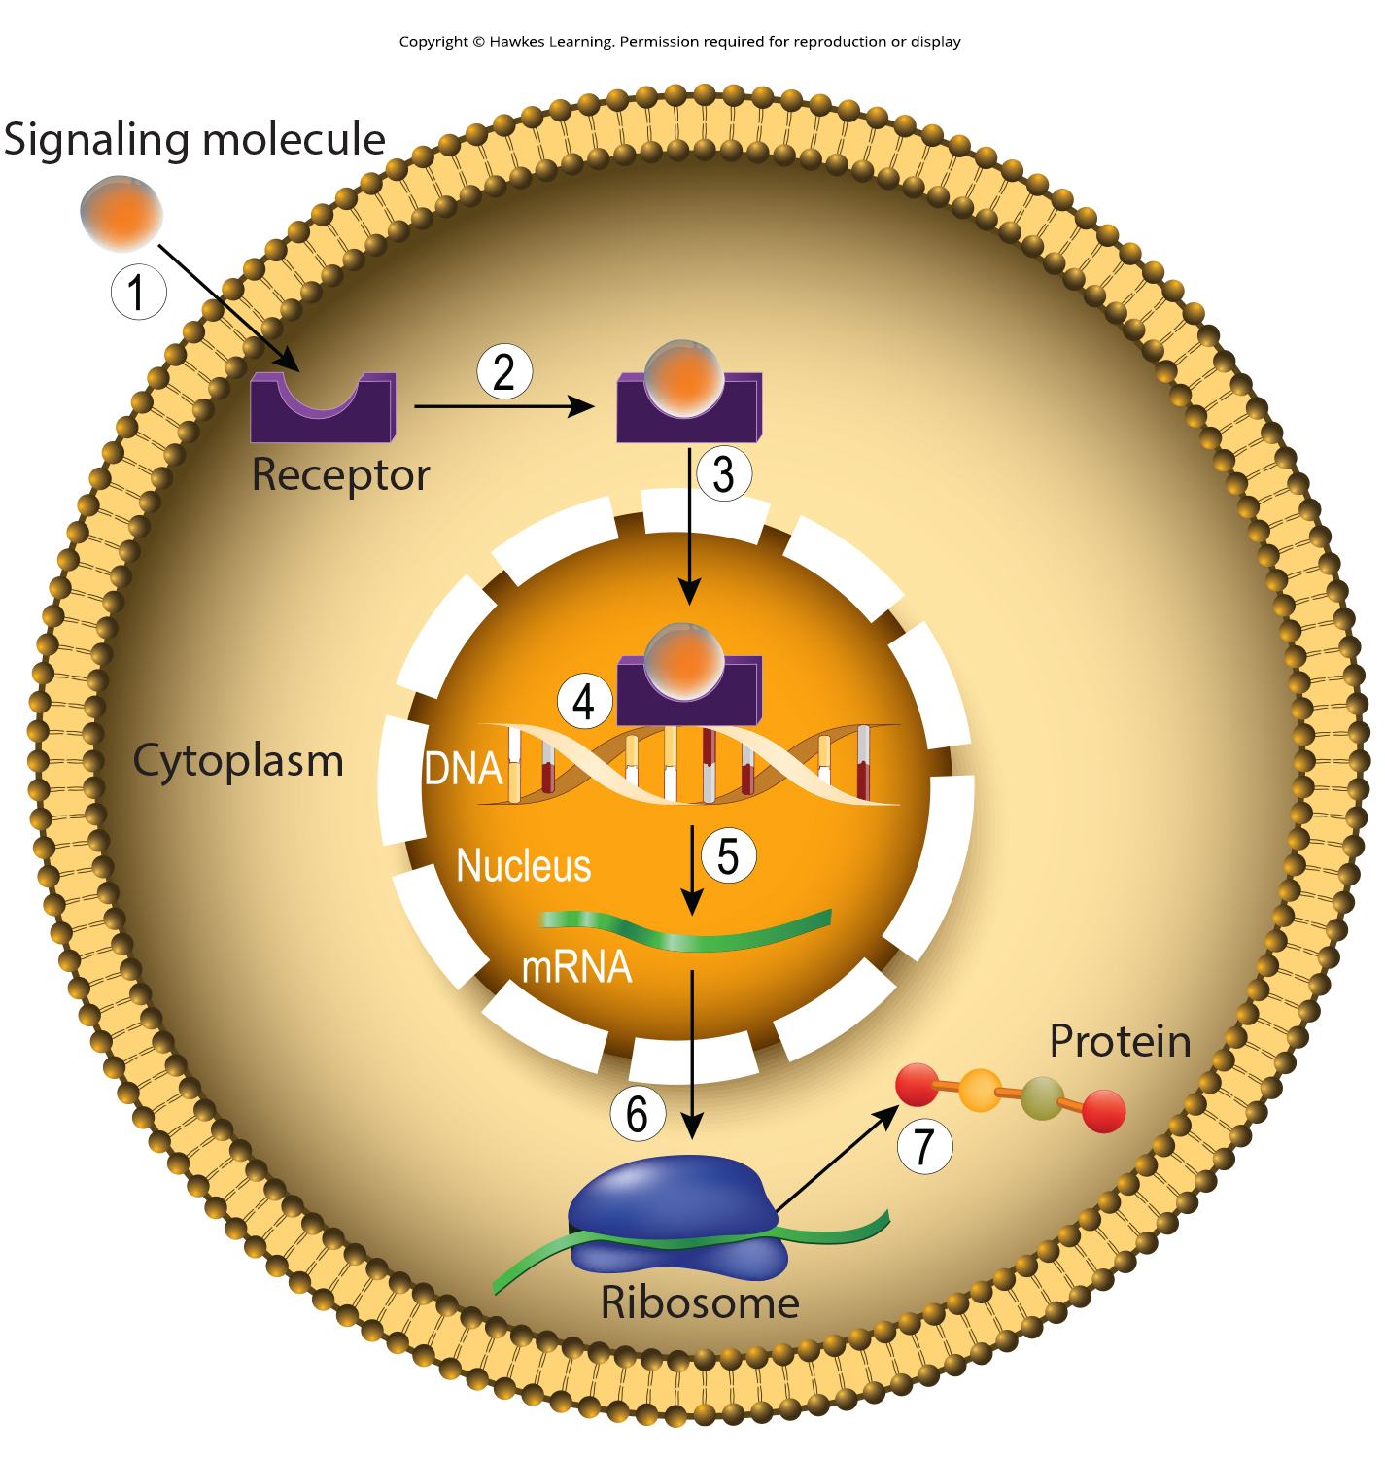
Lesson 9.1 Figure 6

Slide 8
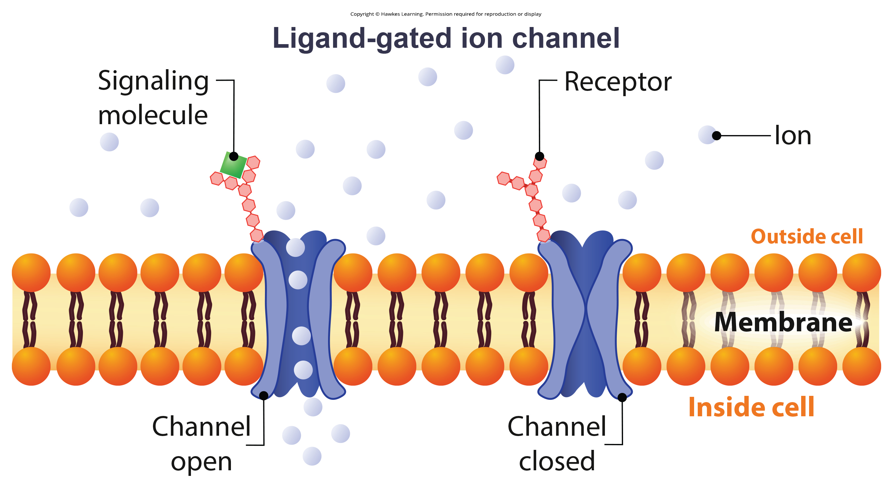
Lesson 9.1 Figure 7

Slide 9
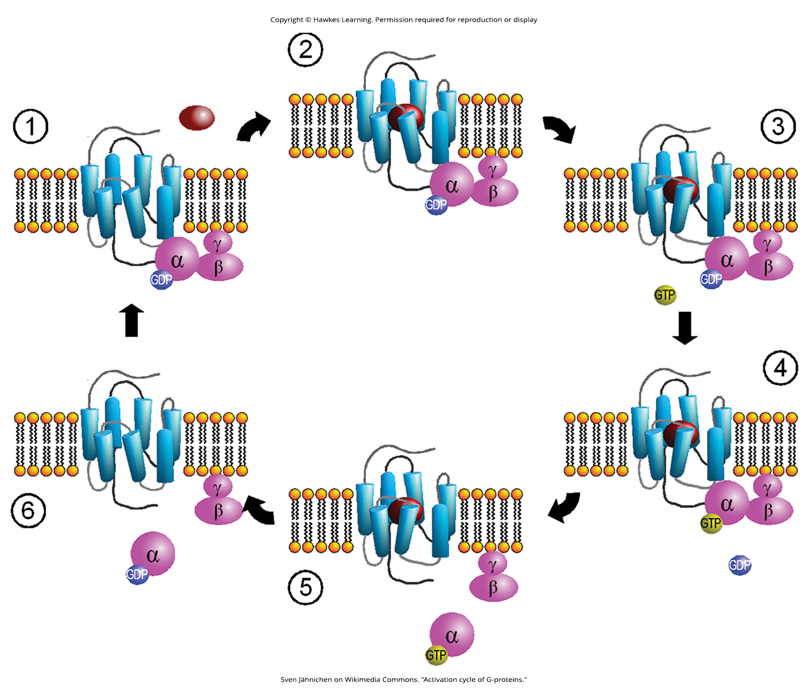
Lesson 9.1 Figure 8

Slide 10
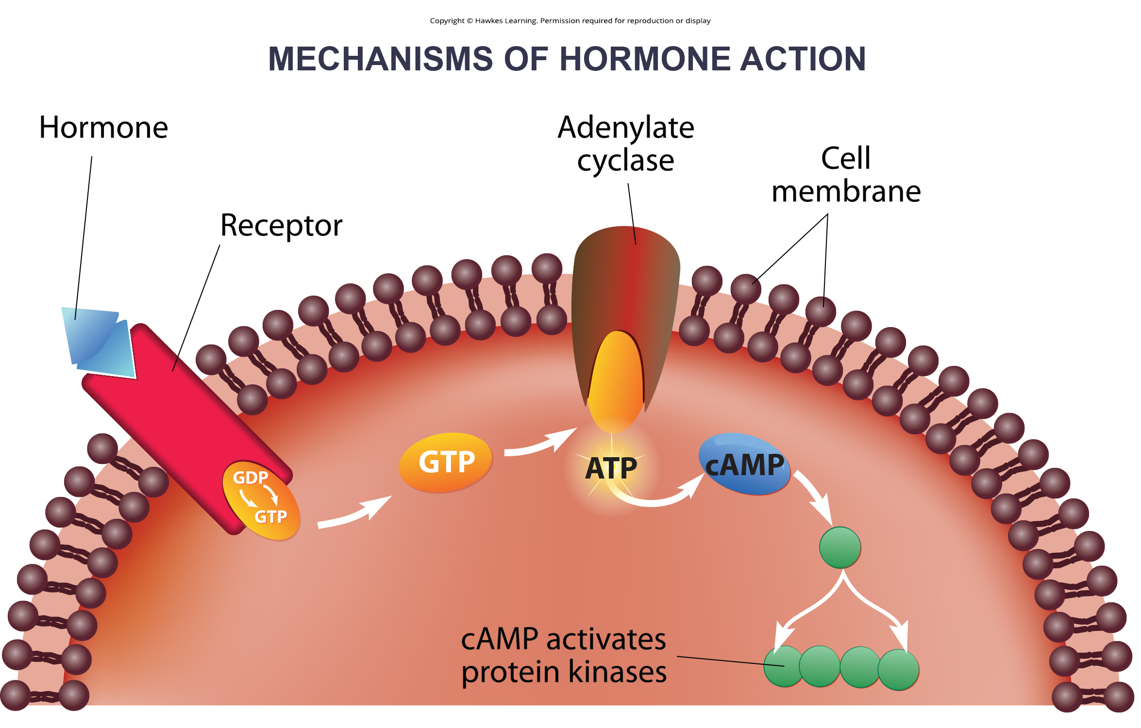
Lesson 9.1 Figure 9

Slide 11
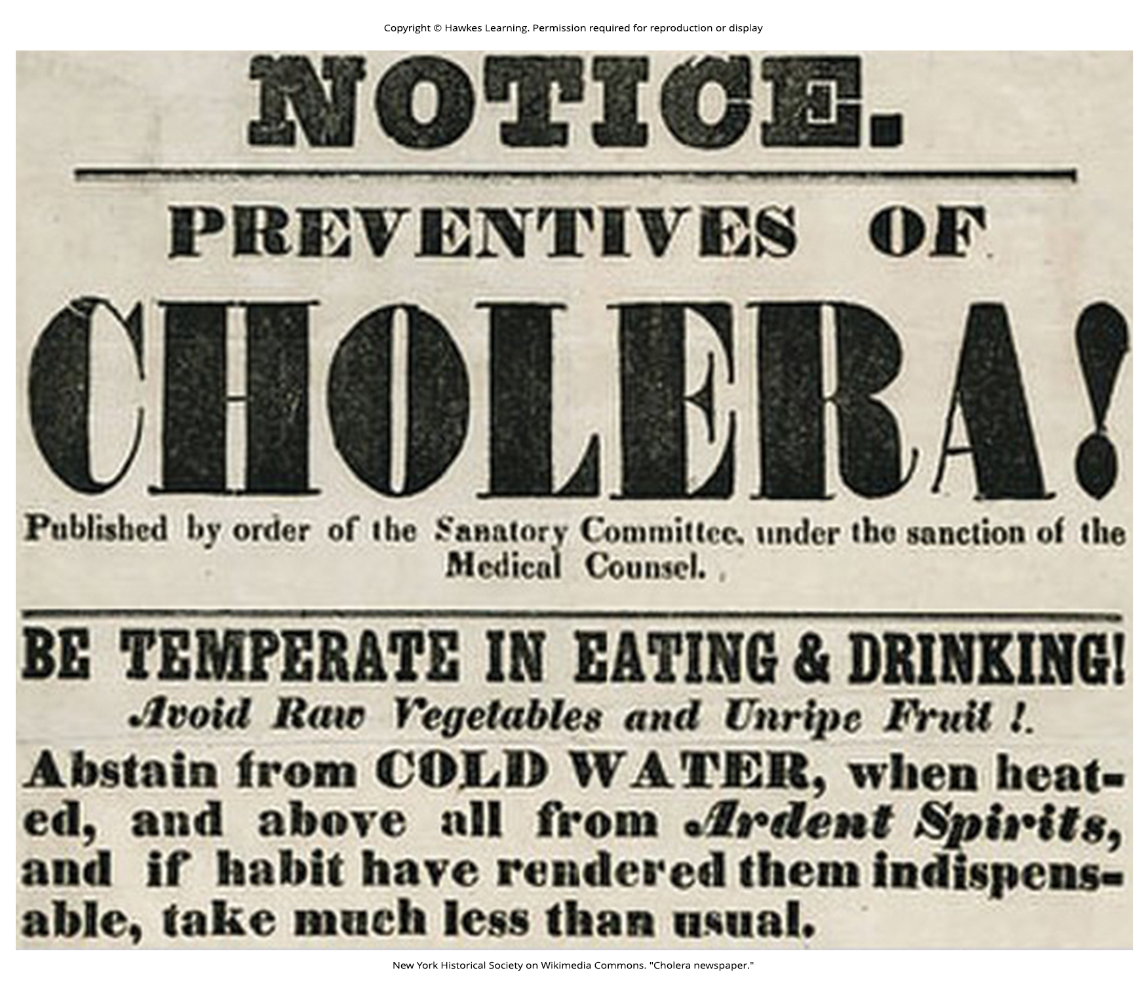
Lesson 9.1 Figure 10

Slide 12
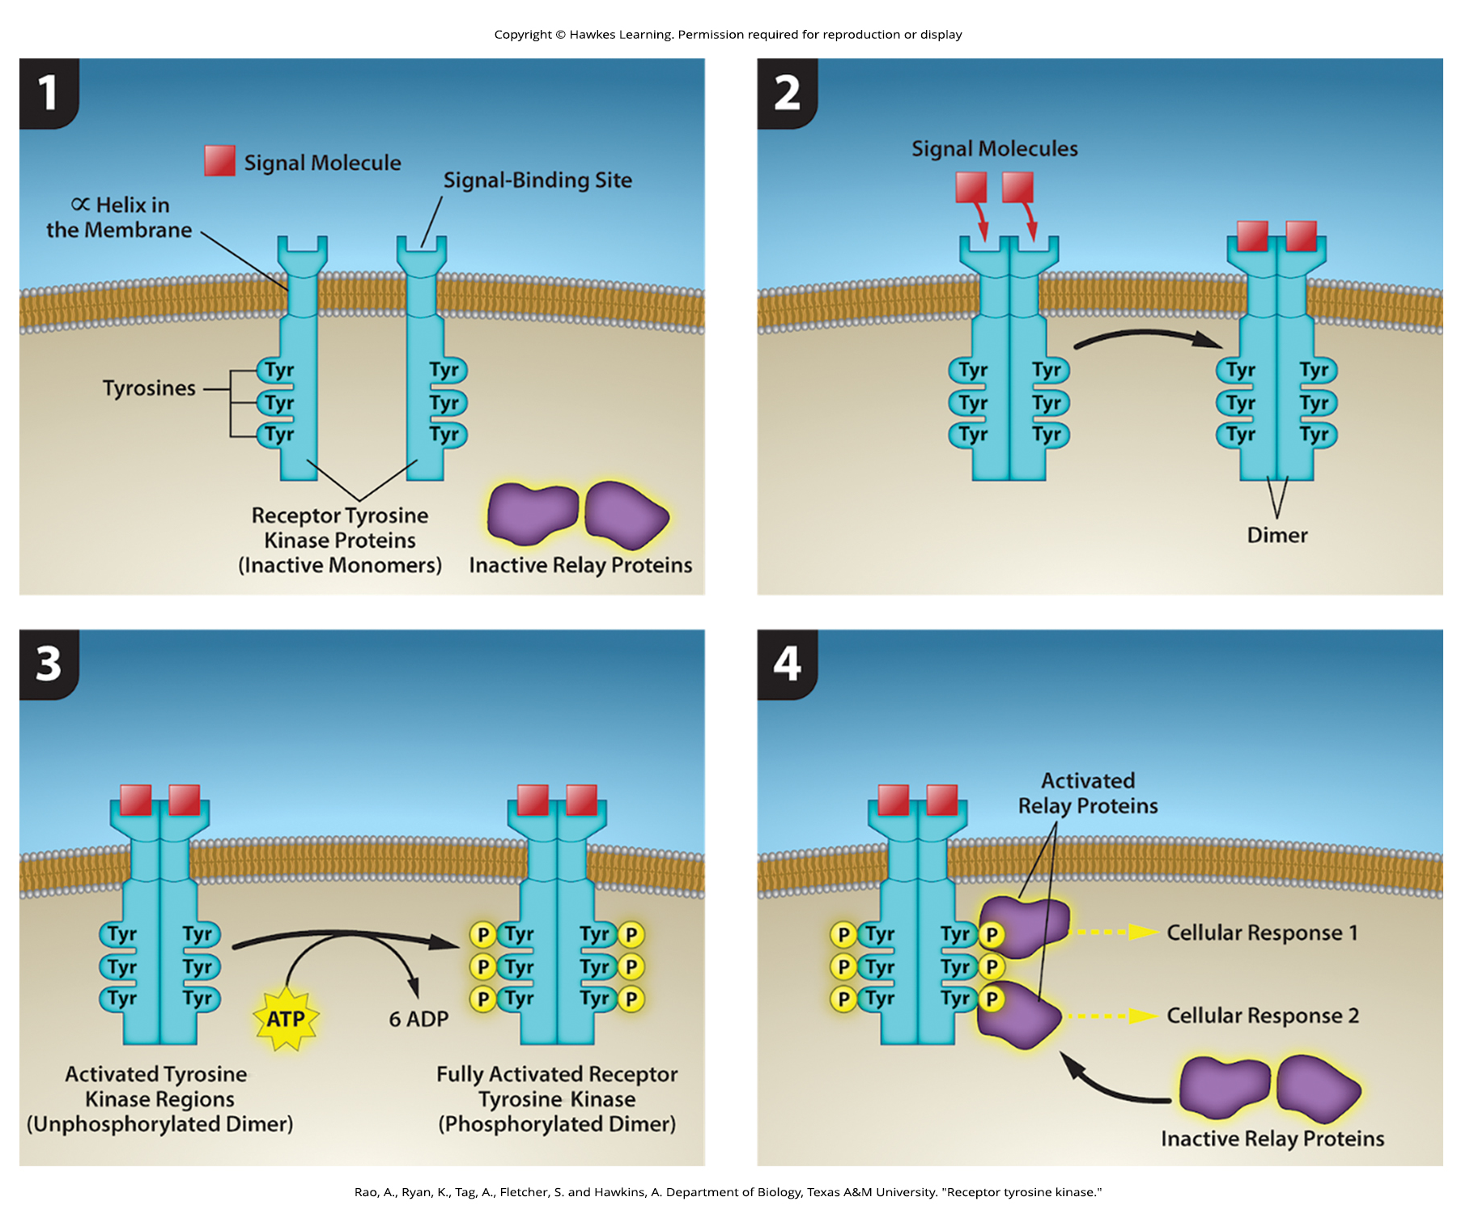
Lesson 9.1 Figure 11

Slide 13
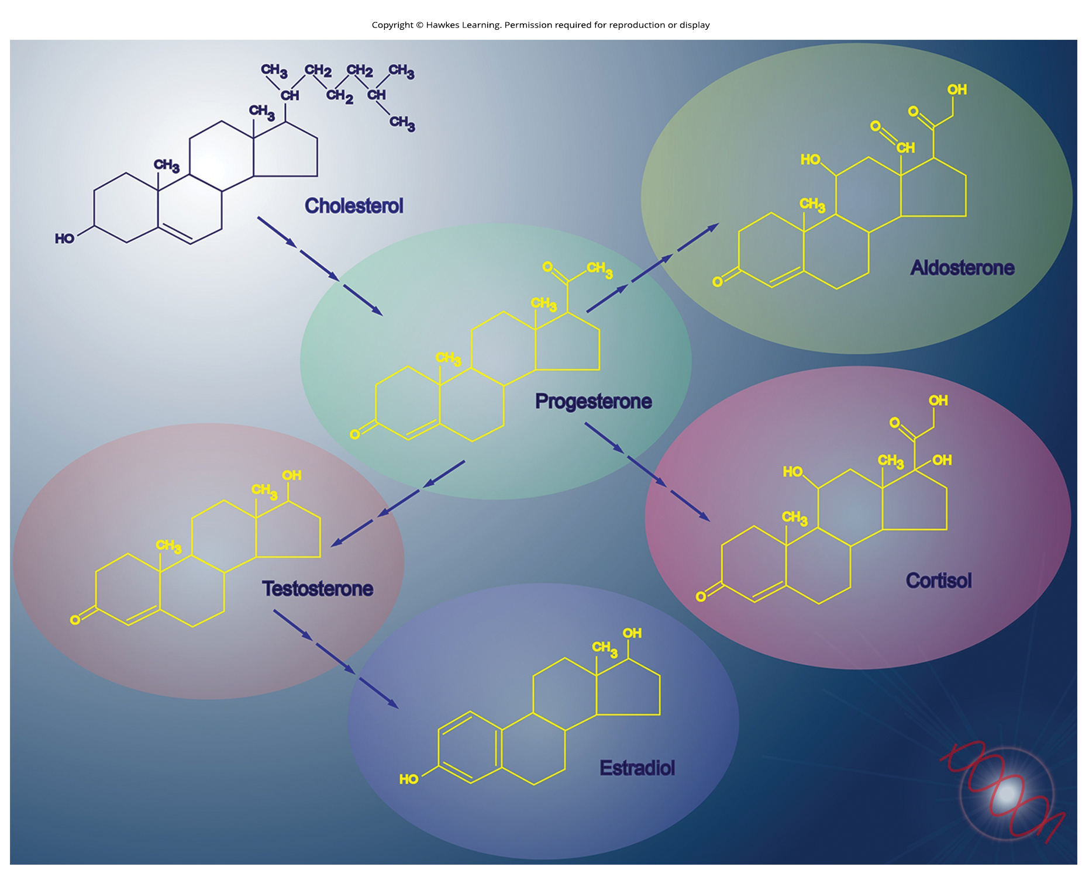
Lesson 9.1 Figure 12

Slide 14
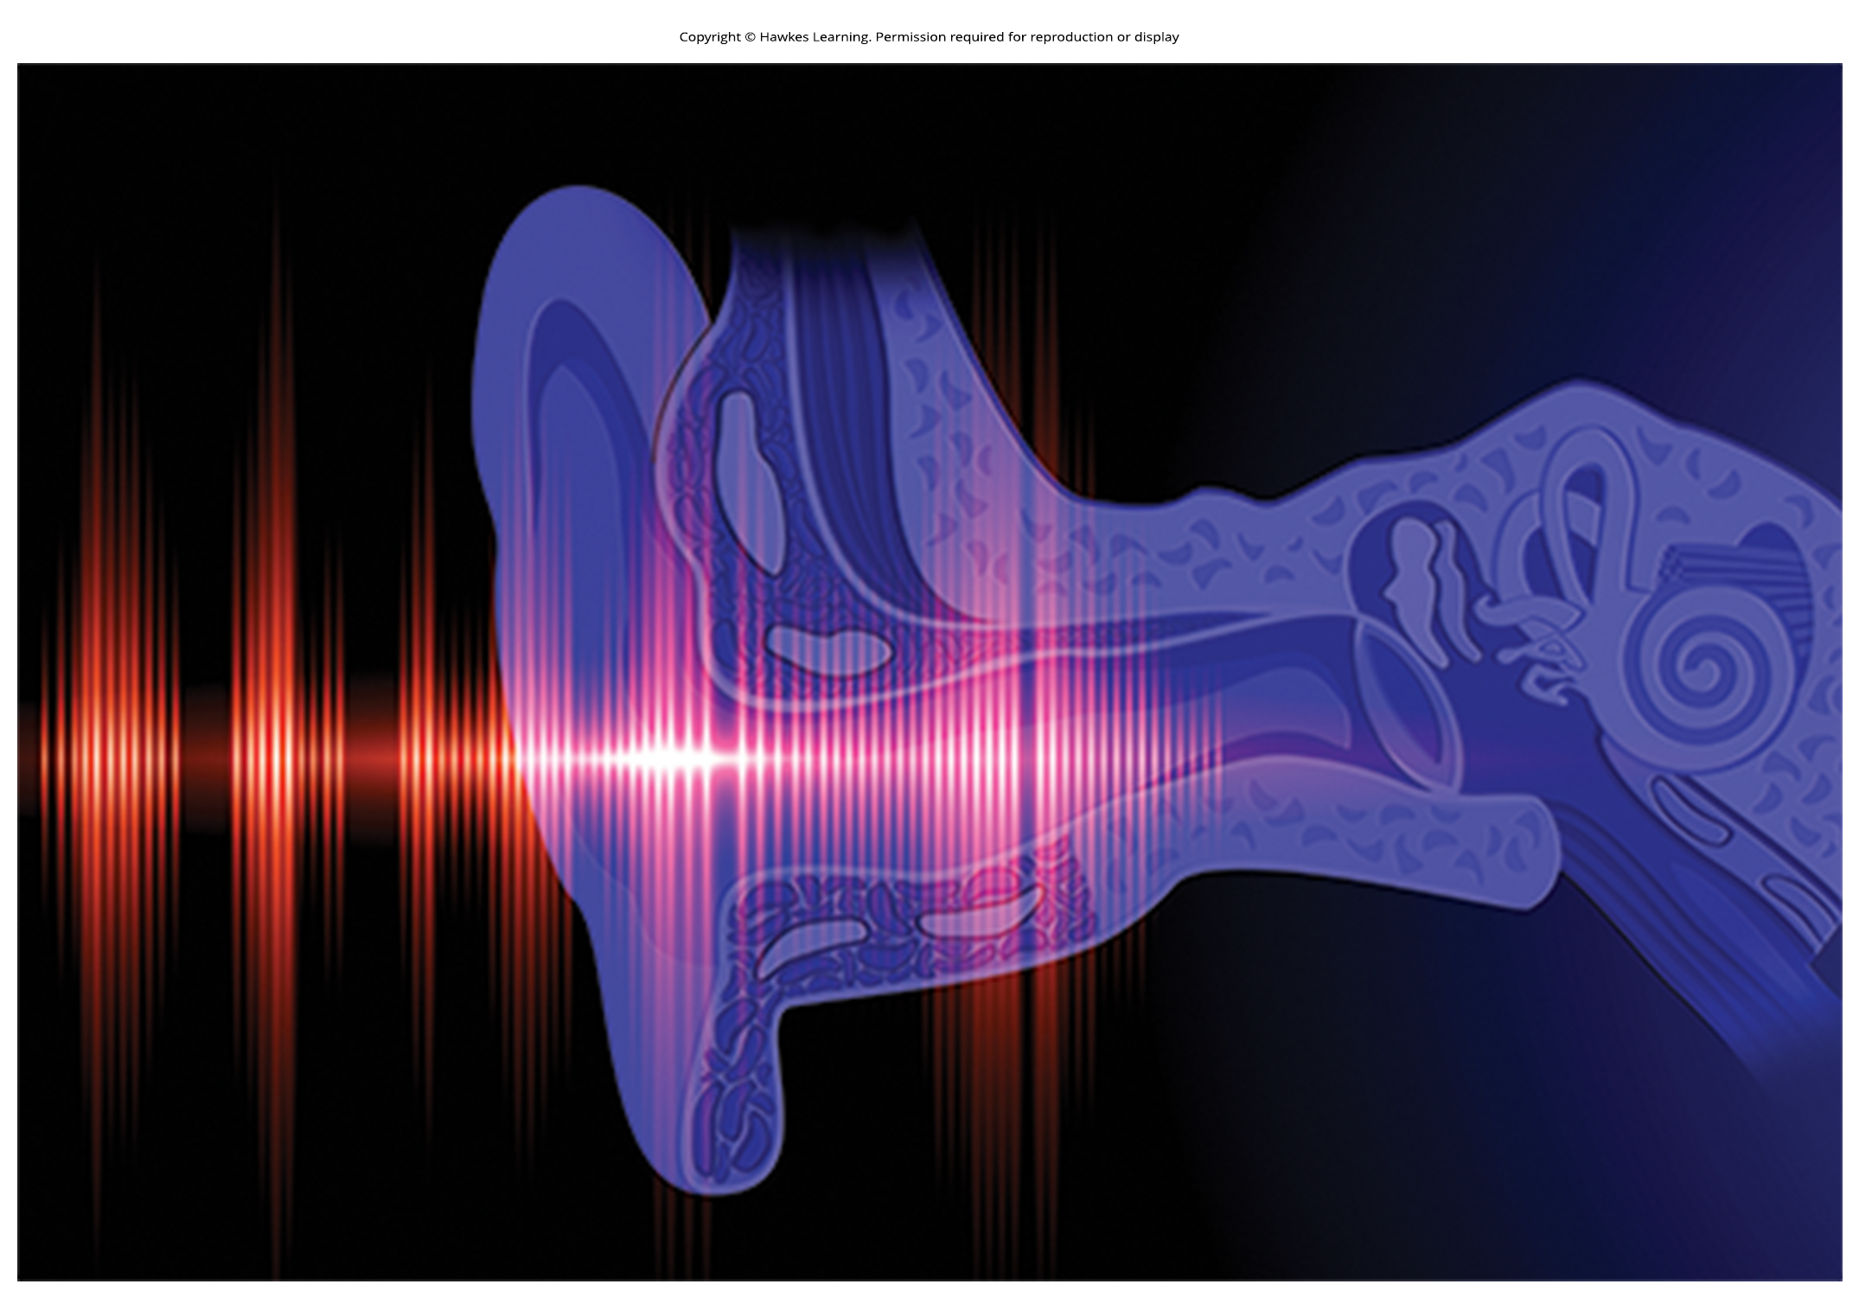
Lesson 9.2 Figure 1

Slide 15
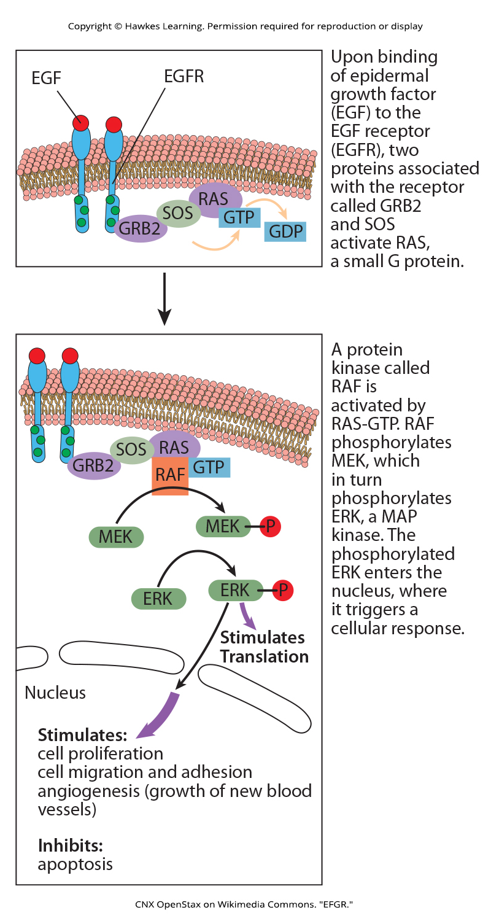
Lesson 9.2 Figure 2

Slide 16
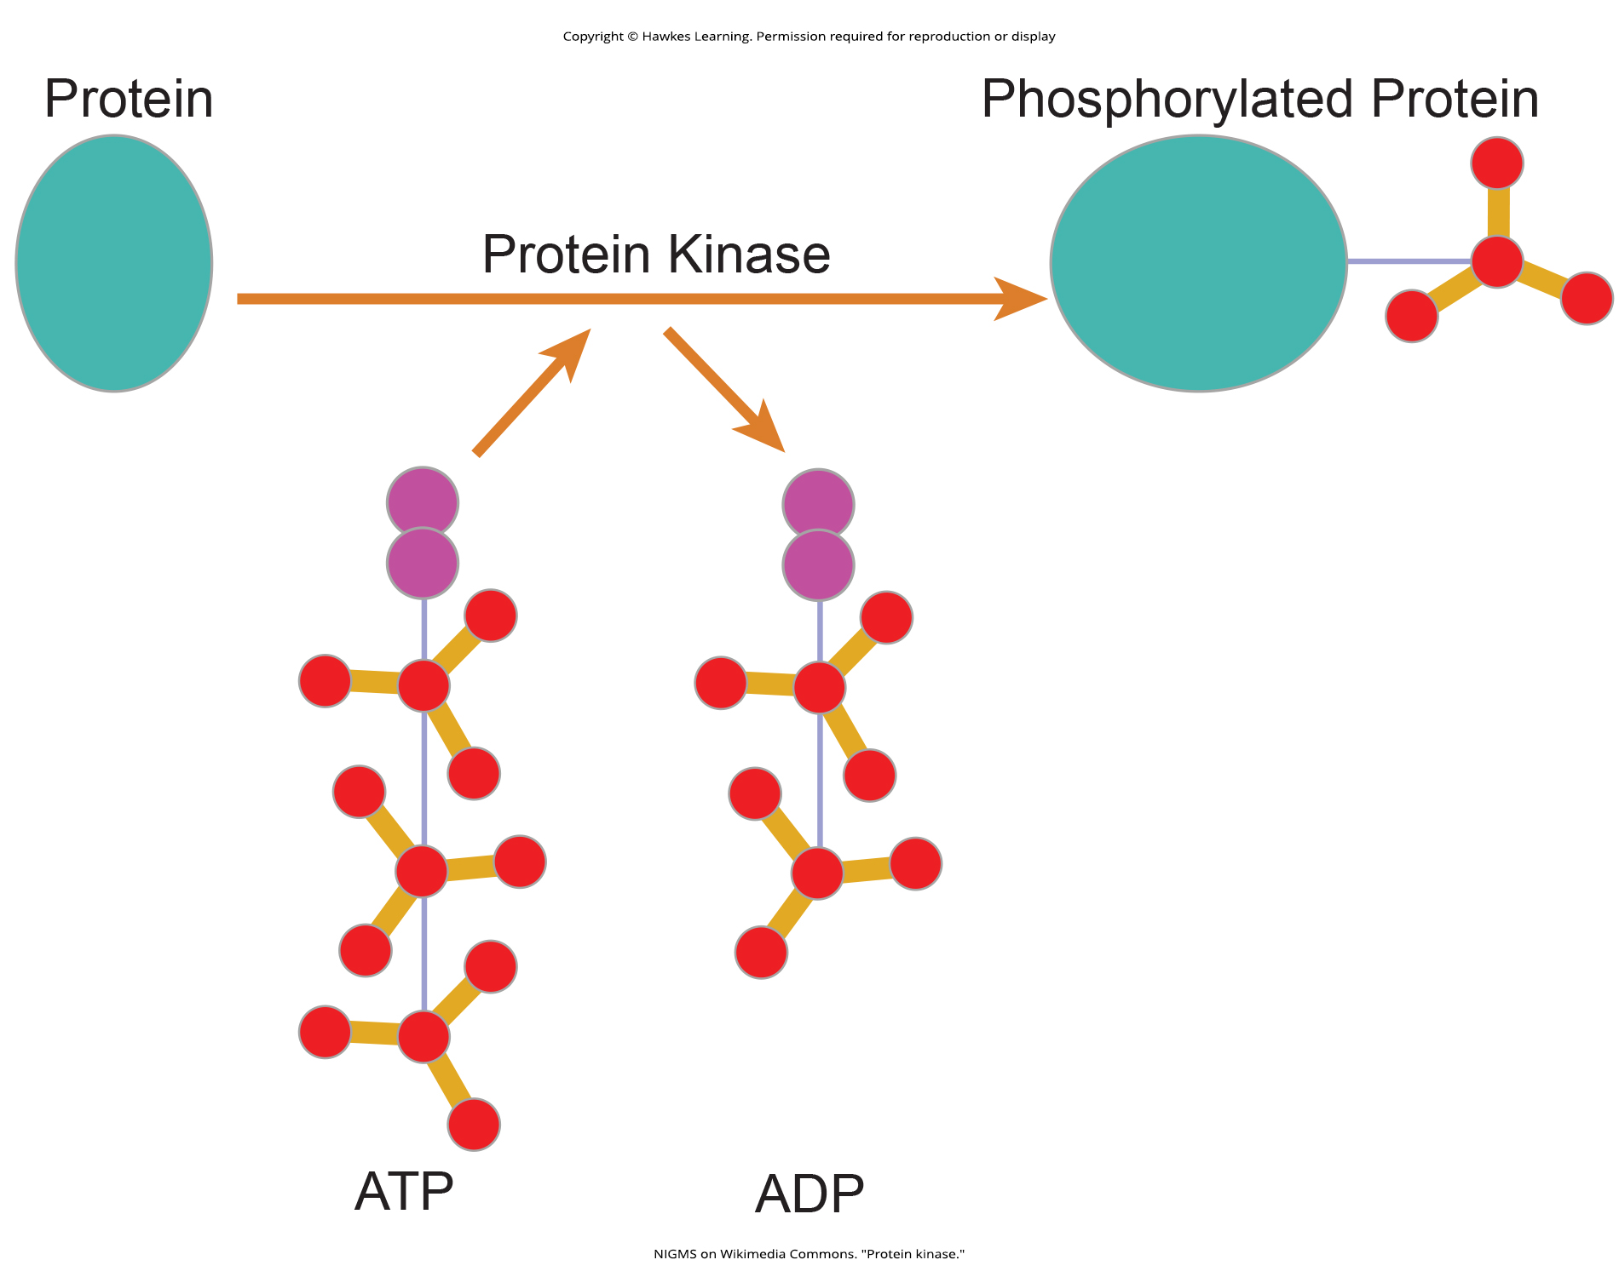
Lesson 9.2 Figure 3

Slide 17
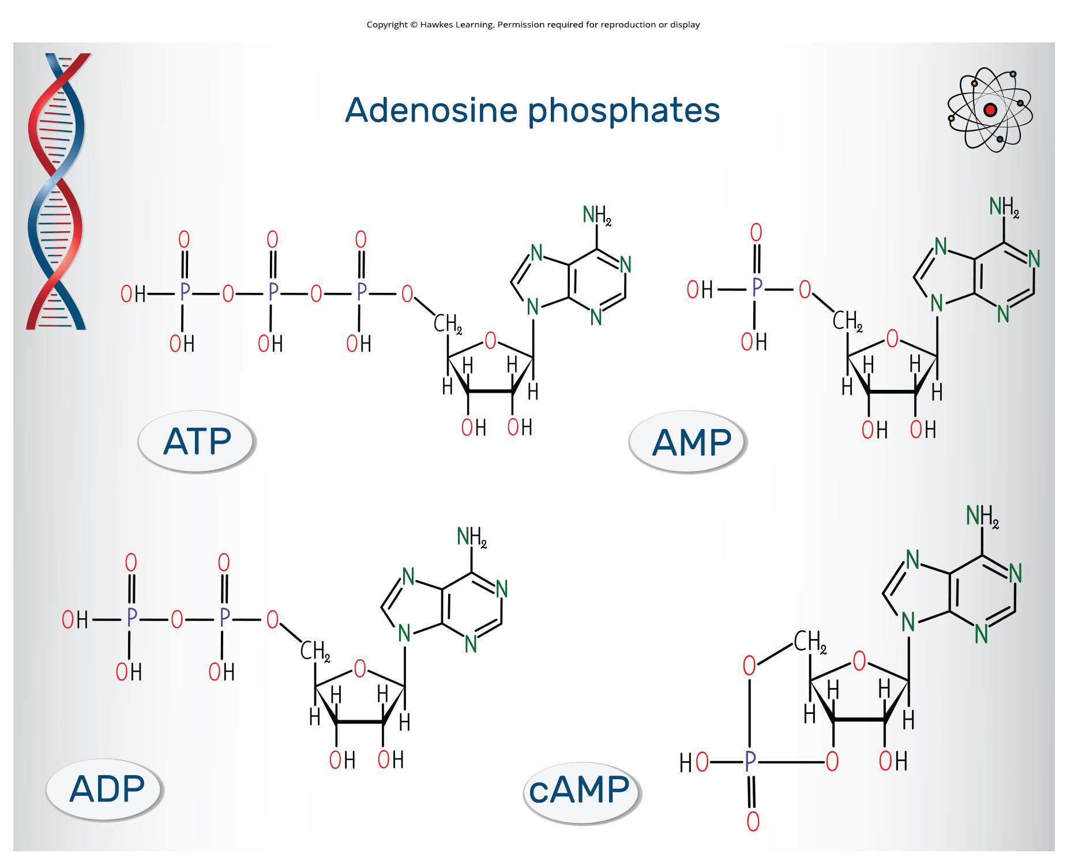
Lesson 9.2 Figure 4

Slide 18
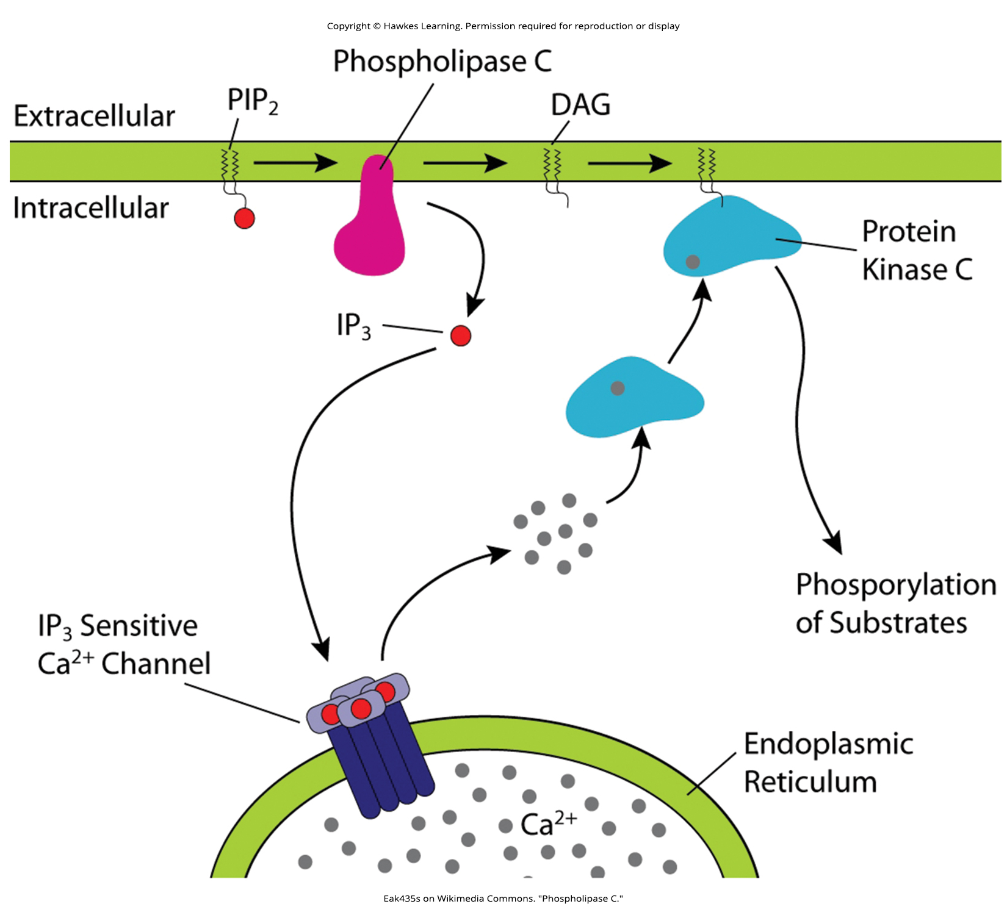
Lesson 9.2 Figure 5

Slide 19
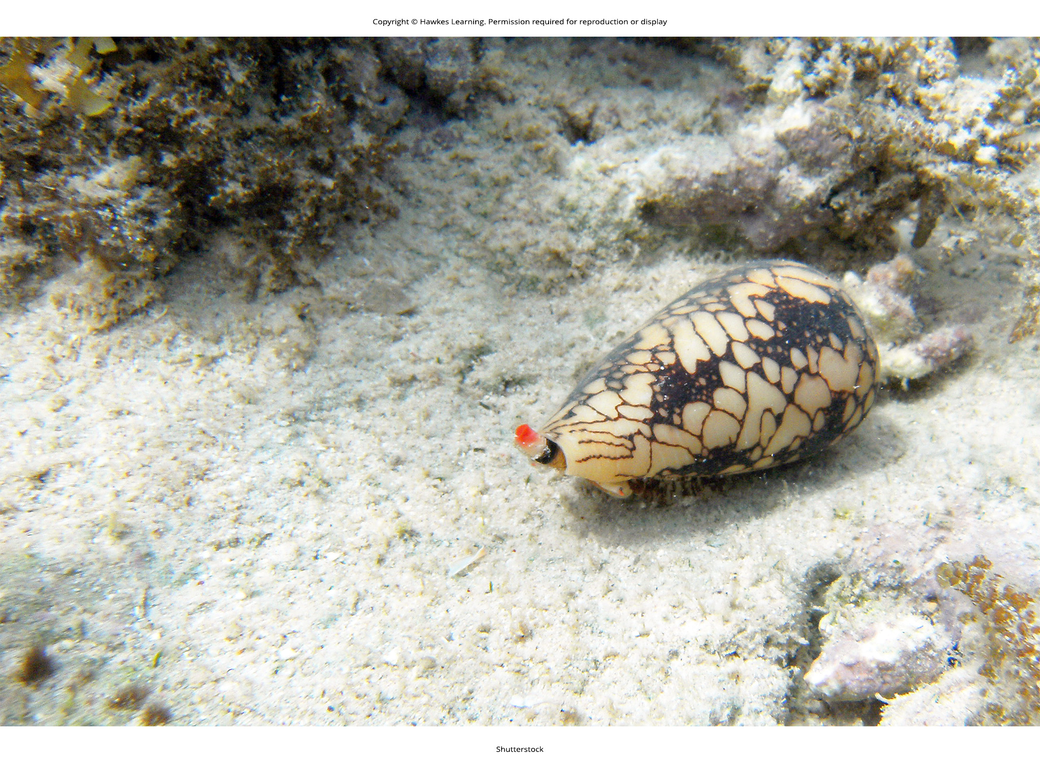
Lesson 9.2 Figure 6

Slide 20
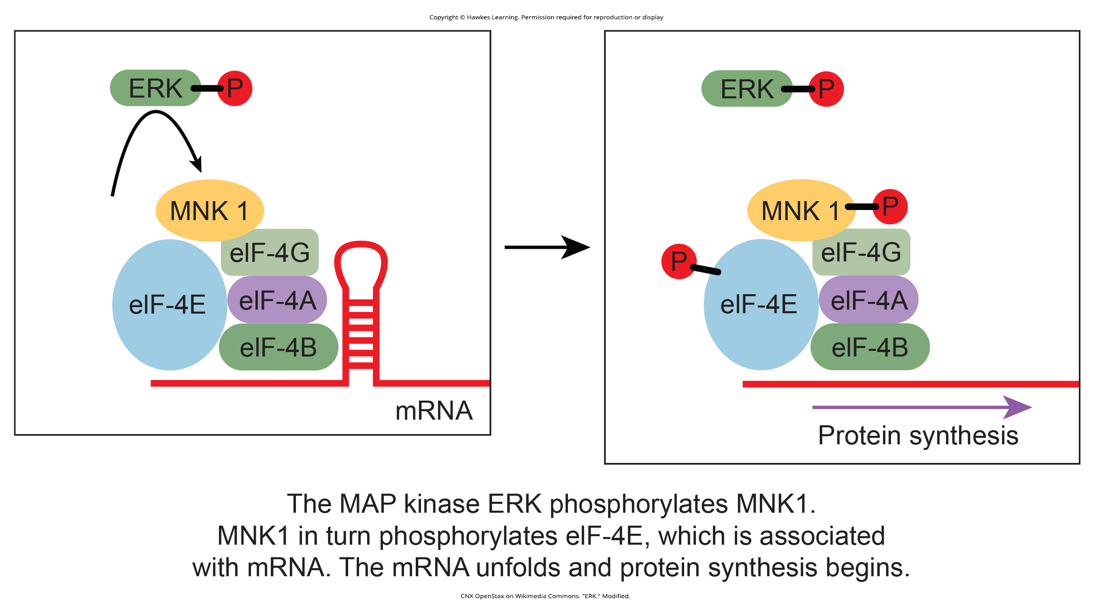
Lesson 9.3 Figure 1

Slide 21
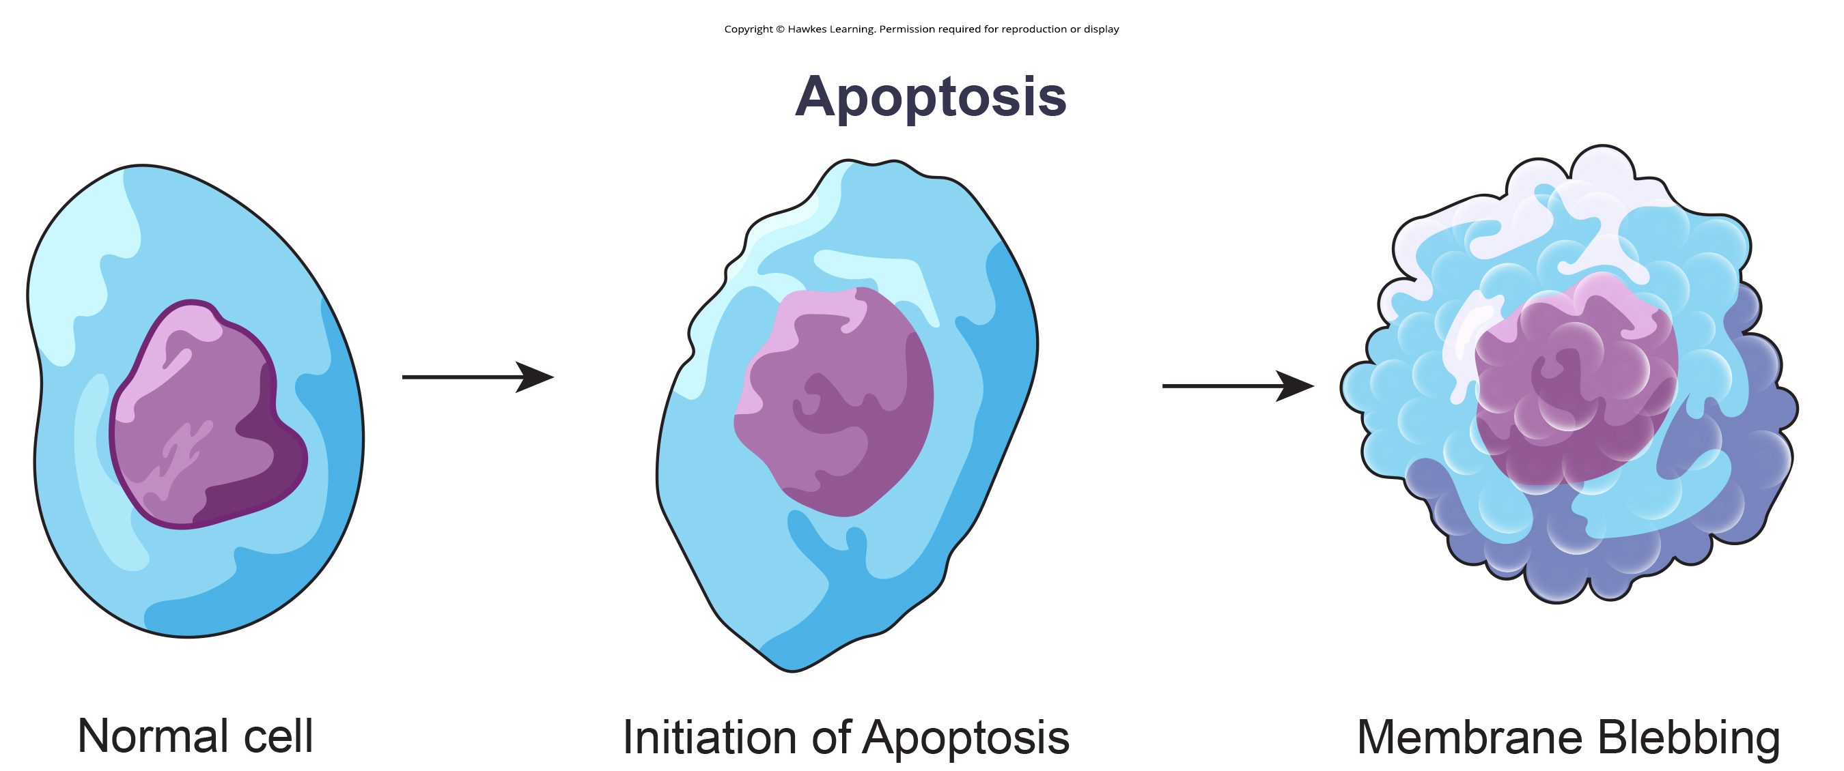
Lesson 9.3 Figure 2

Slide 22
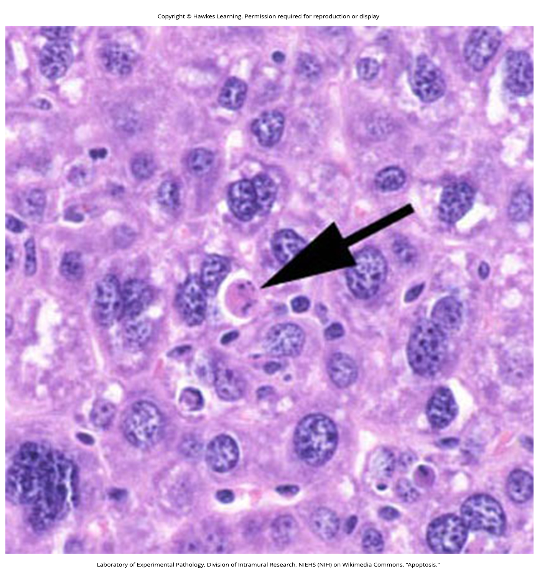
Lesson 9.3 Figure 3

Slide 23
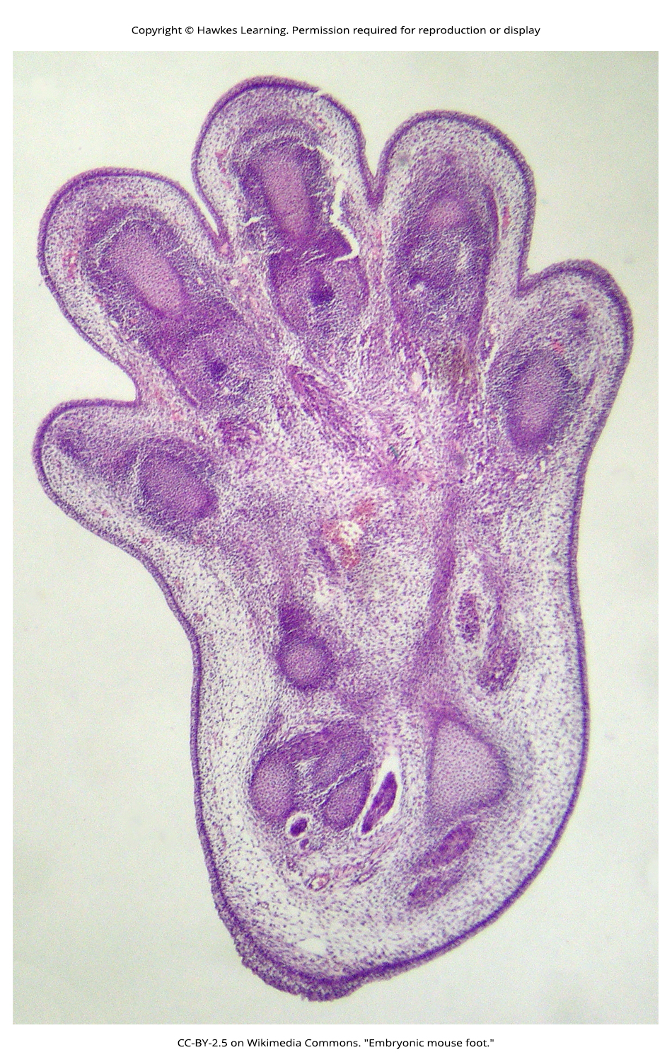
Lesson 9.3 Figure 4

Slide 24
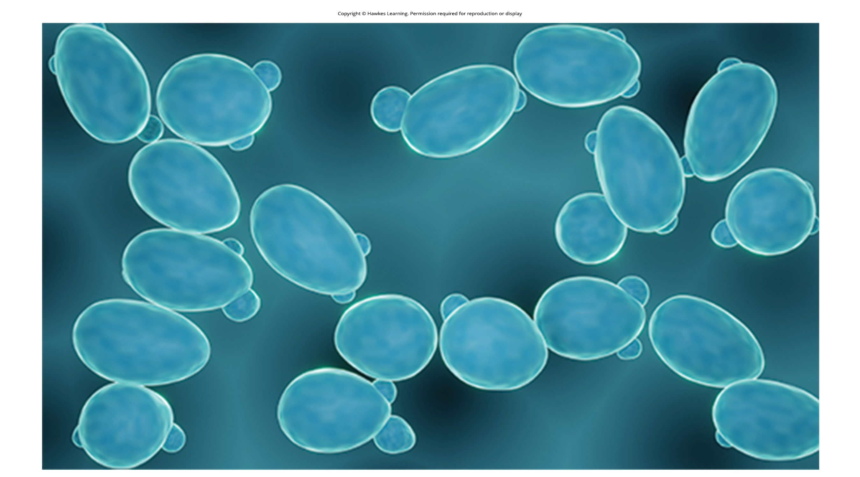
Lesson 9.4 Figure 1

Slide 25
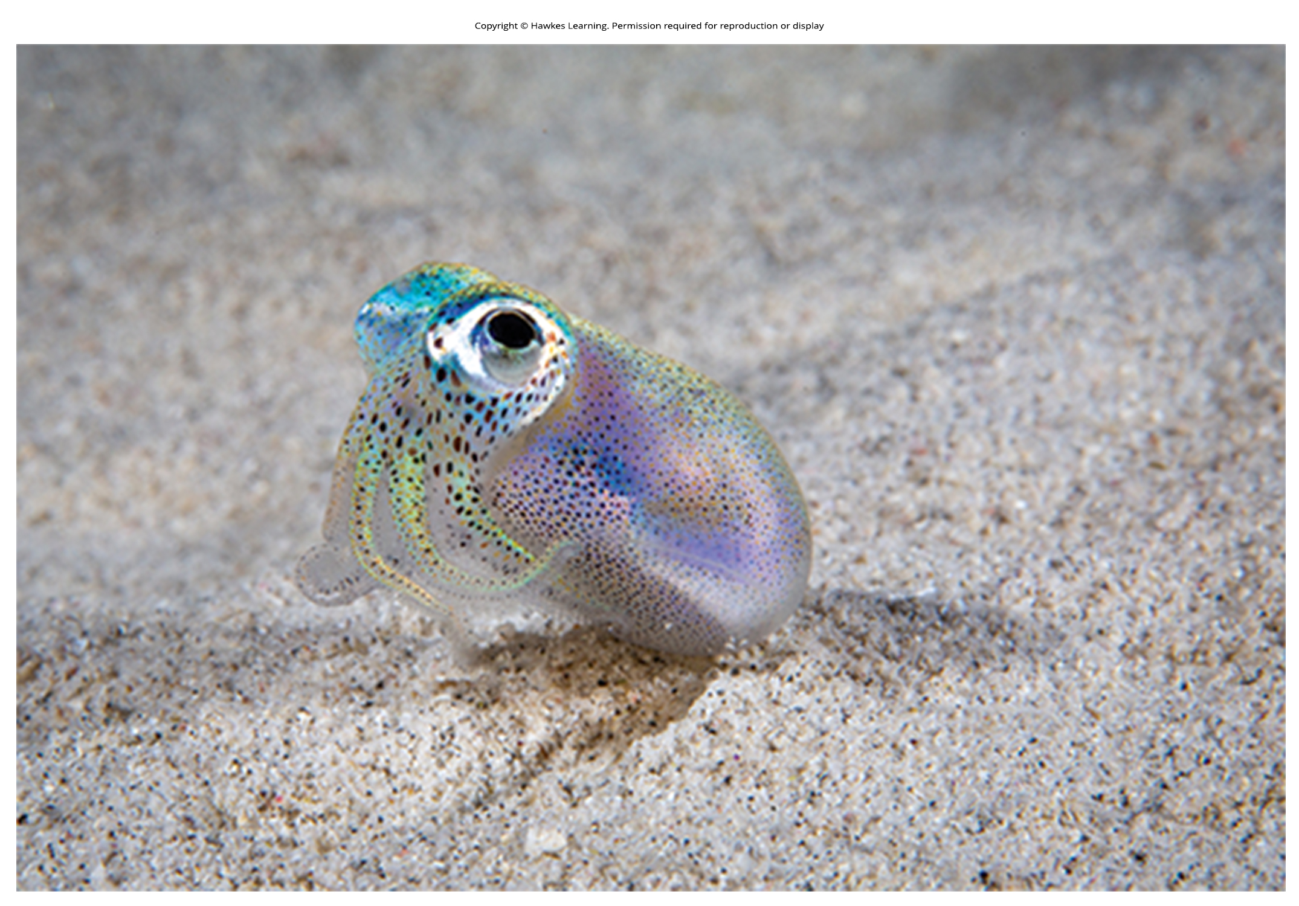
Lesson 9.4 Figure 2

Slide 26
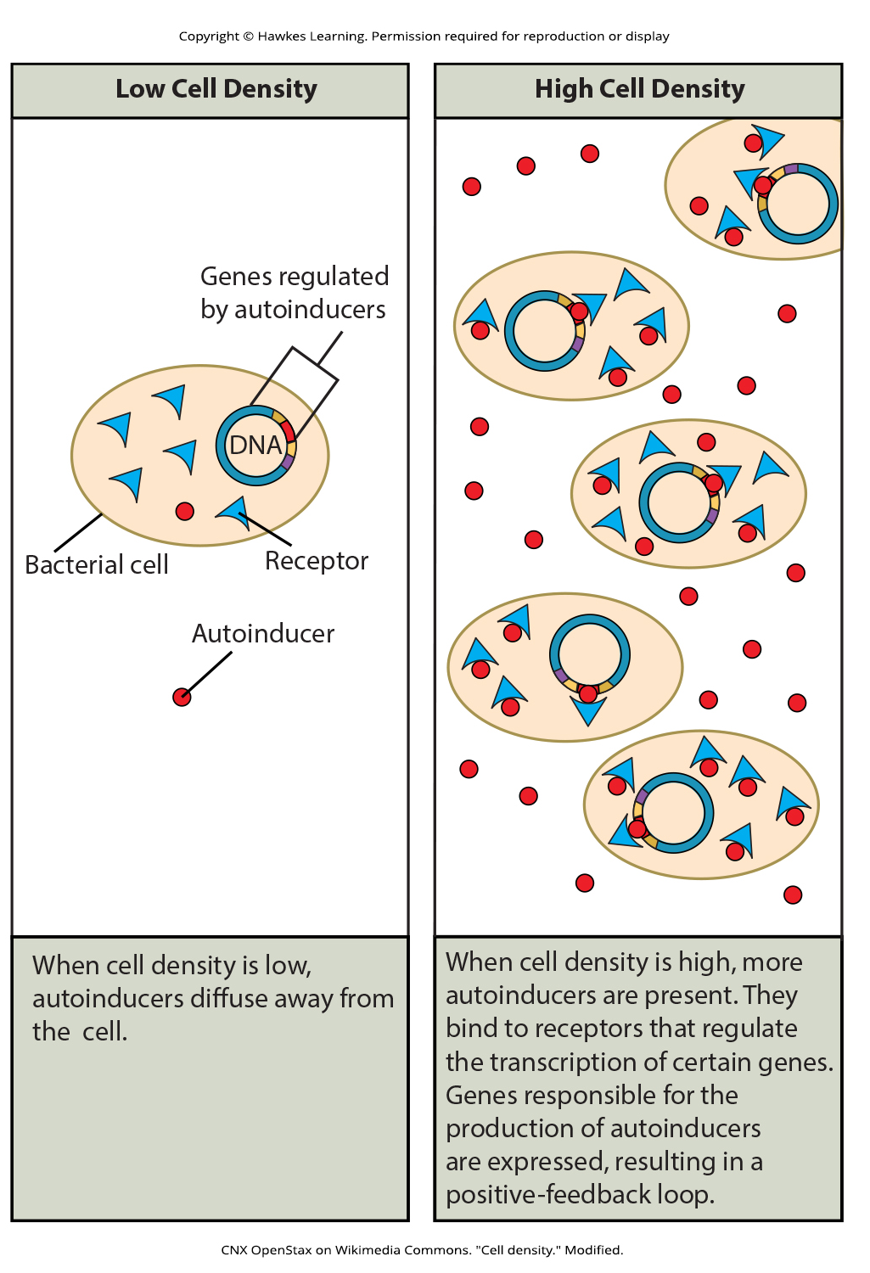
Lesson 9.4 Figure 3

Slide 27
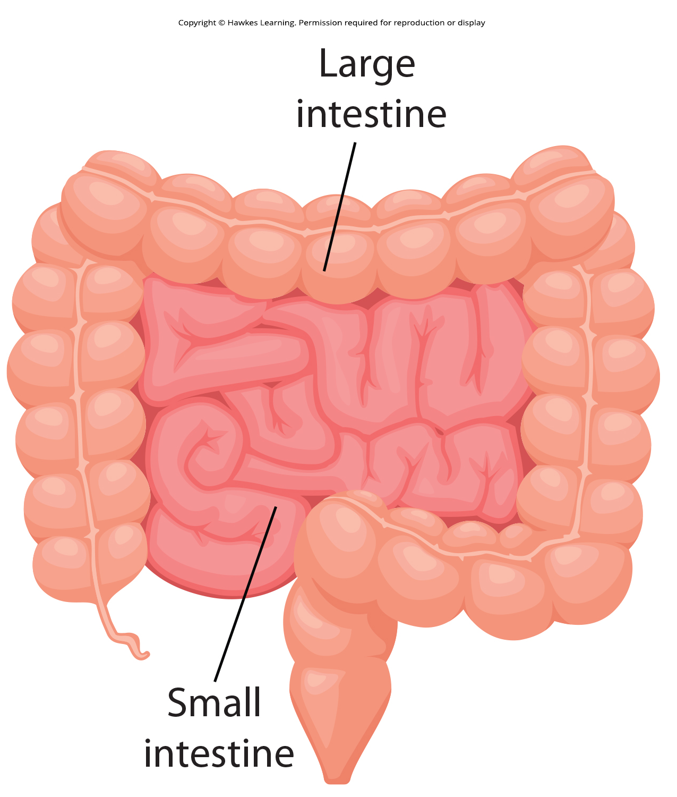
Lesson 9.4 Figure 4

Slide 28
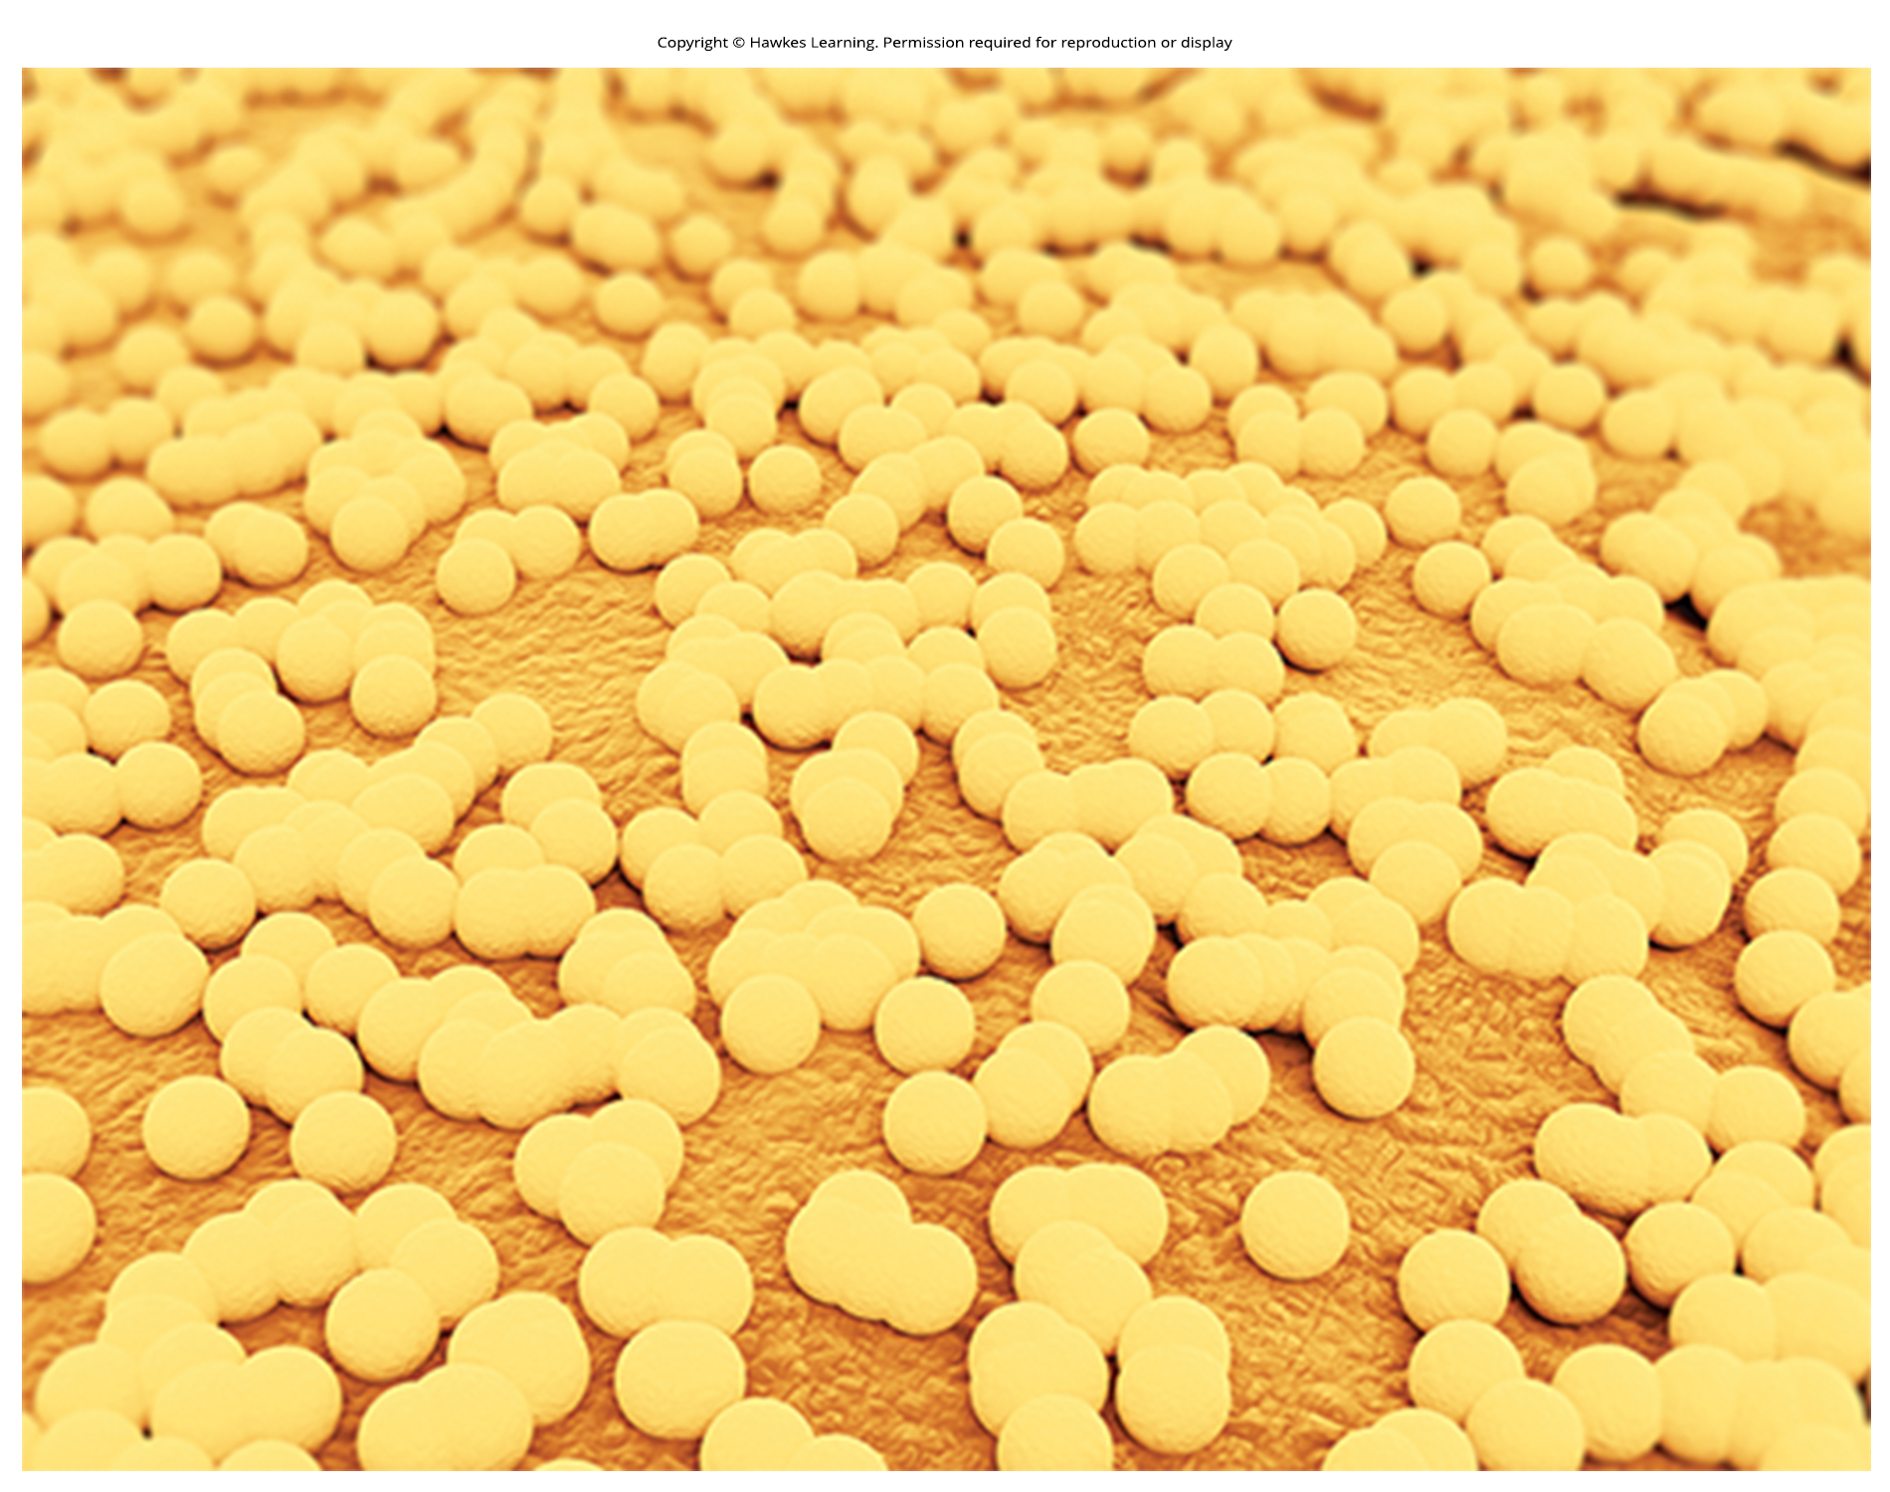
Lesson 9.4 Figure 5

Slide 29
Hawkes Learning – End of PowerPoint

