Slide 1
Chapter 1
The Nature of Biology

Slide 2
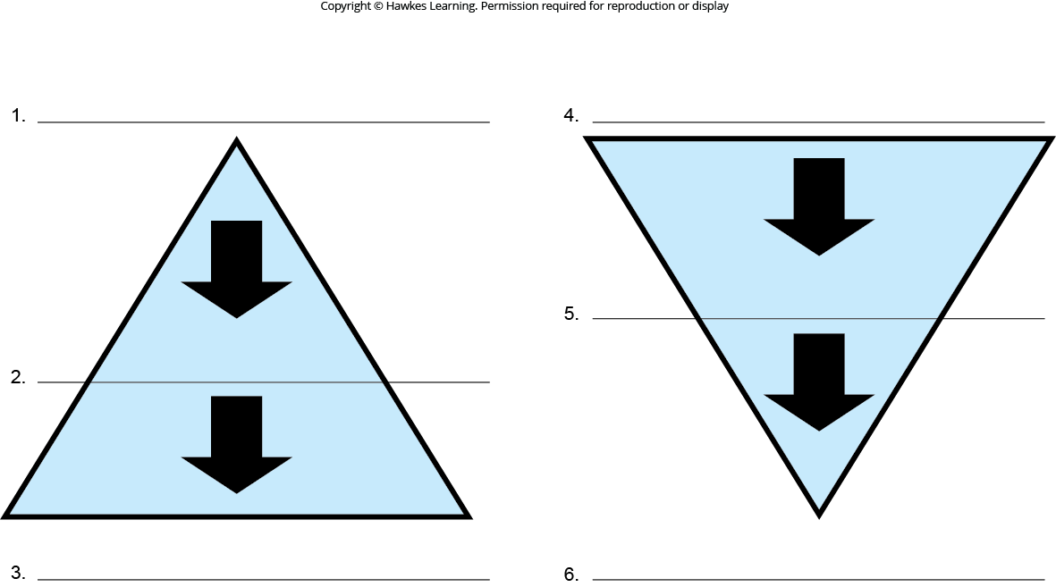
Lesson 1.1 Figure 5 - Numbered

Slide 3
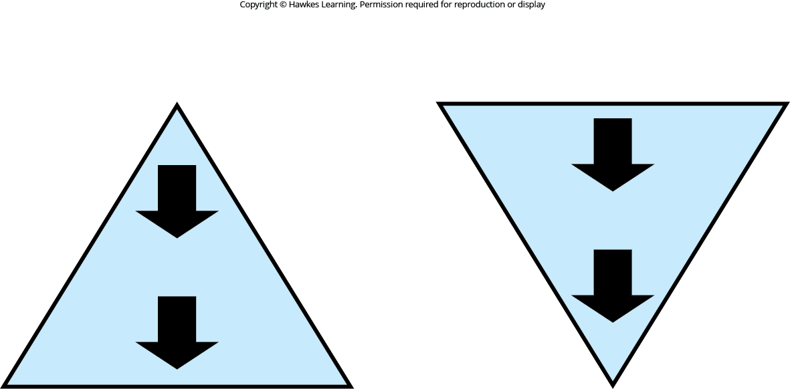
Lesson 1.1 Figure 5

Slide 4
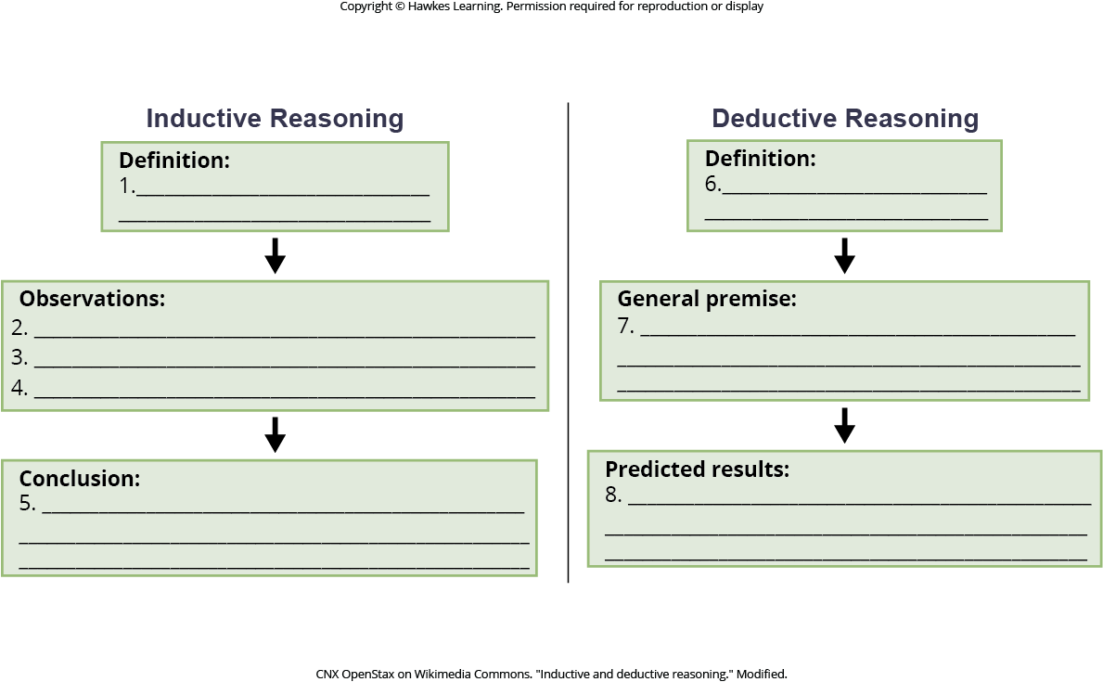
Lesson 1.1 Figure 6 - Numbered

Slide 5
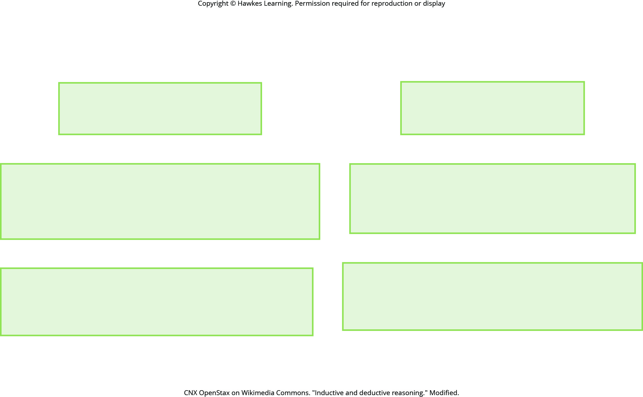
Lesson 1.1 Figure 6

Slide 6
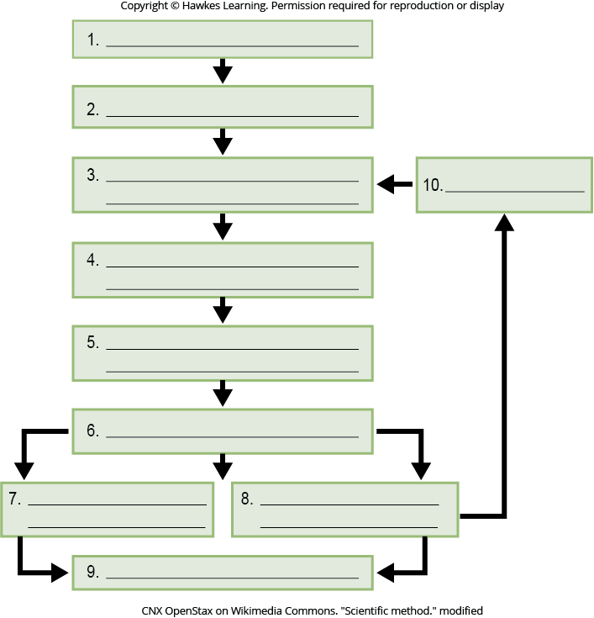
Lesson 1.1 Figure 8 – Numbered

Slide 7

Lesson 1.1 Figure 8

Slide 8
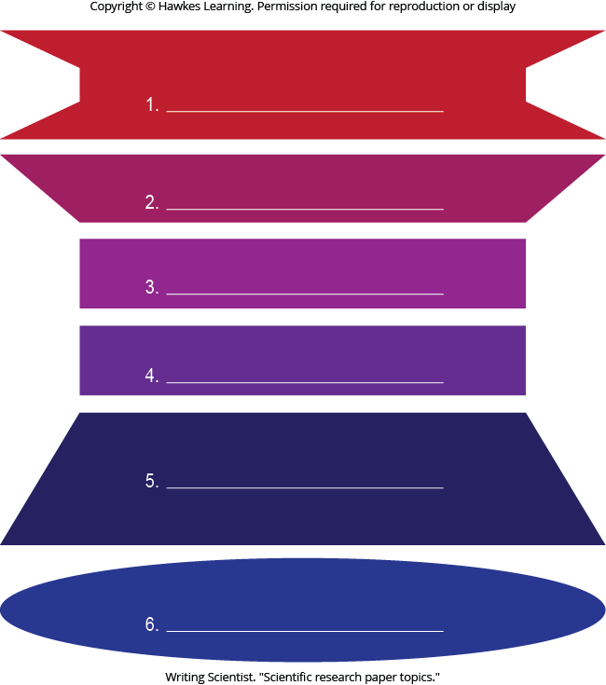
Lesson 1.1 Figure 12 - Numbered

Slide 9

Lesson 1.1 Figure 12

Slide 10
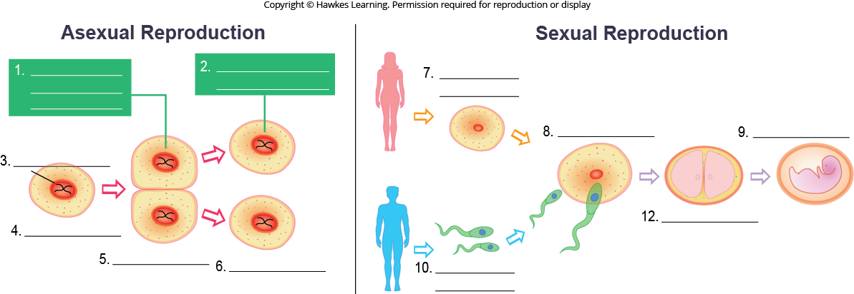
Lesson 1.2 Figure 3 - Numbered

Slide 11
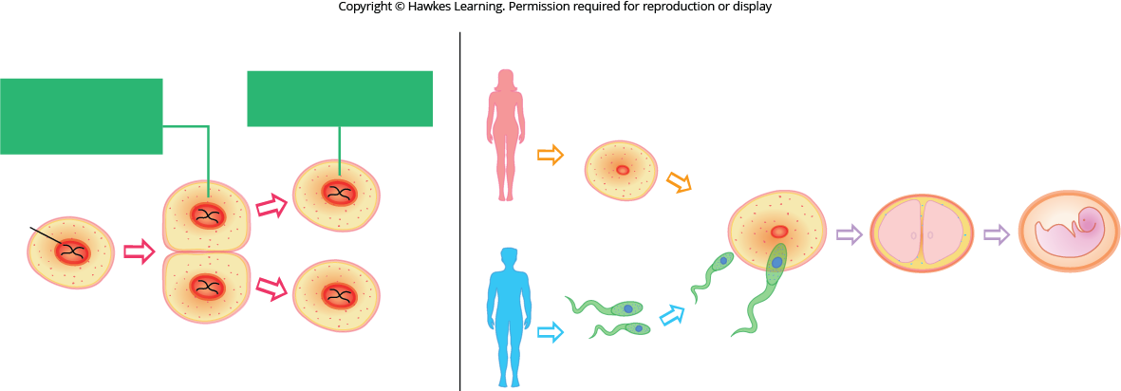
Lesson 1.2 Figure 3

Slide 12
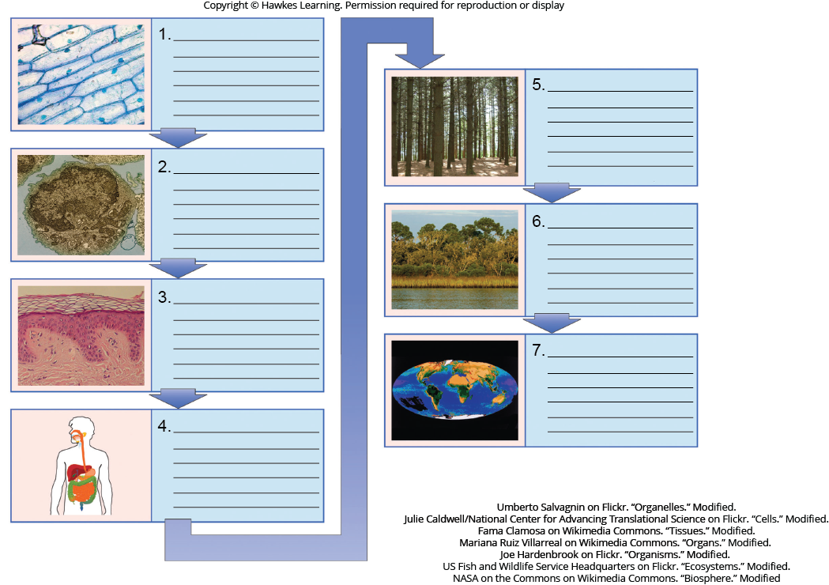
Lesson 1.2 Figure 9 - Numbered

Slide 13
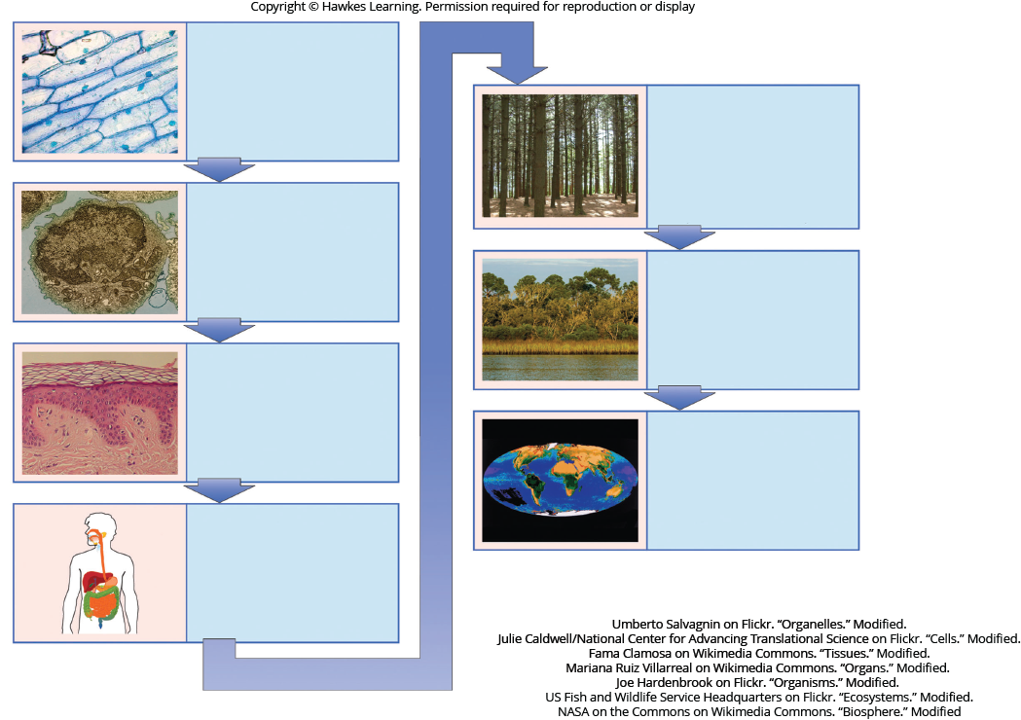
Lesson 1.2 Figure 9

Slide 14
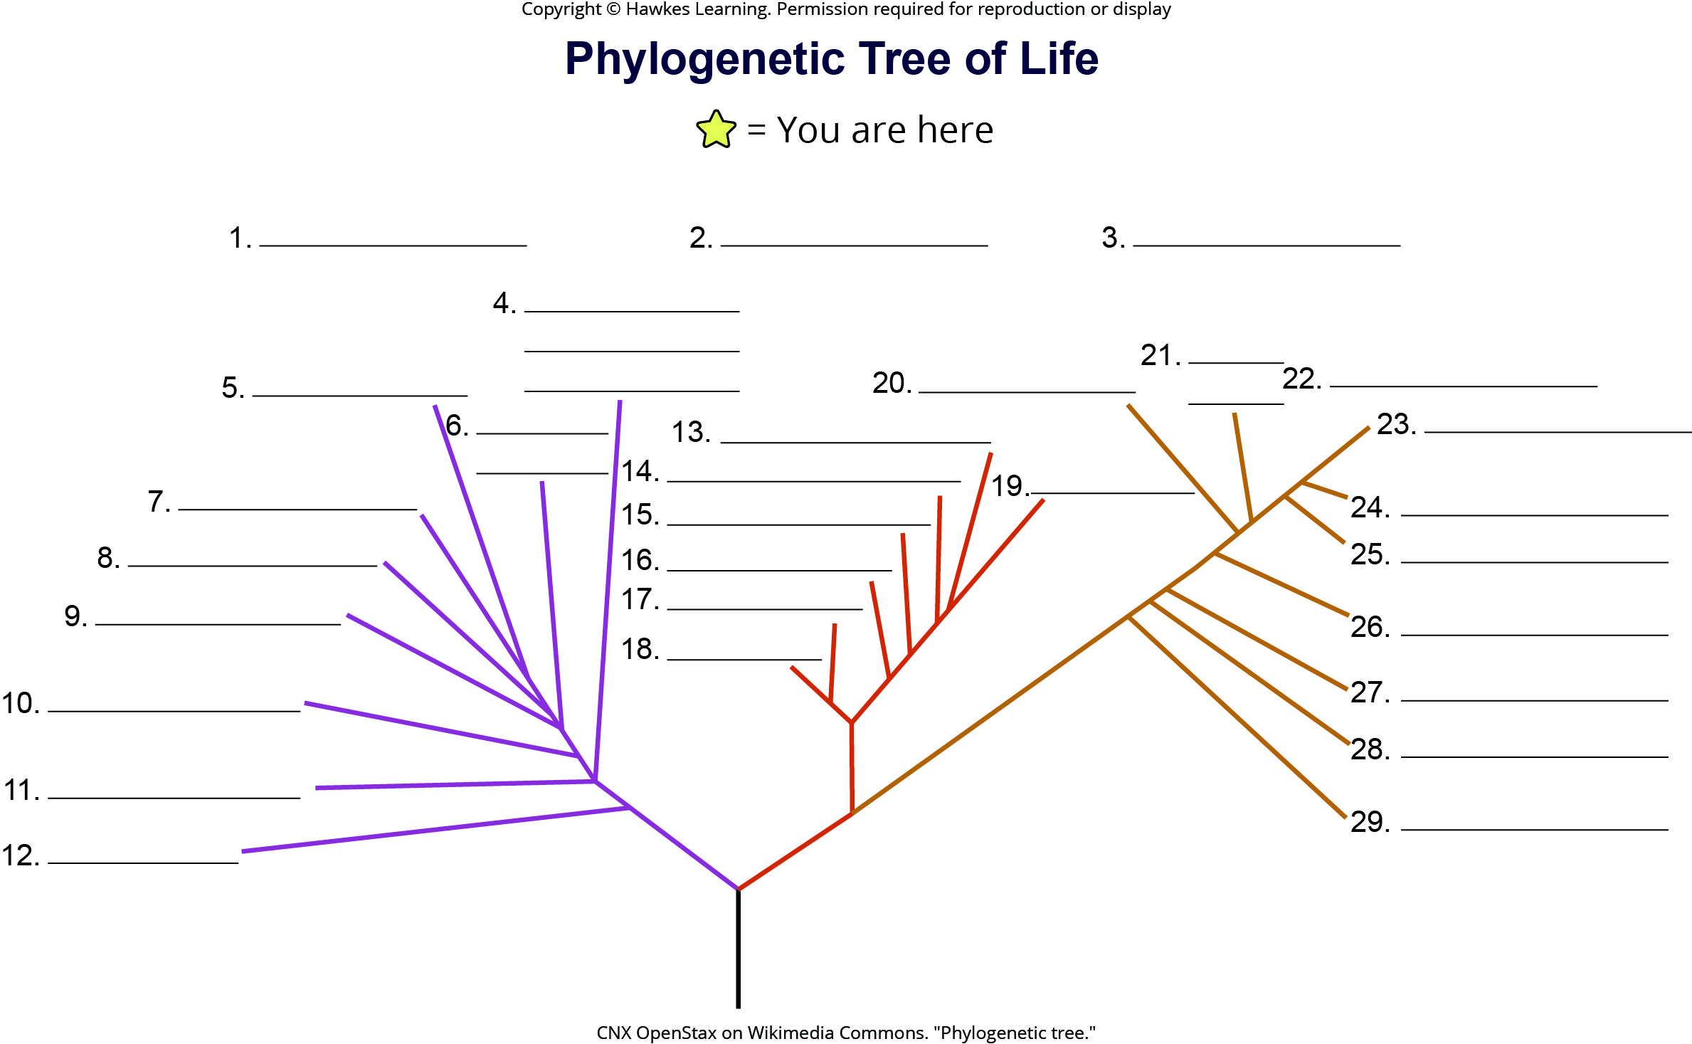
Lesson 1.2 Figure 10 - Numbered

Slide 15
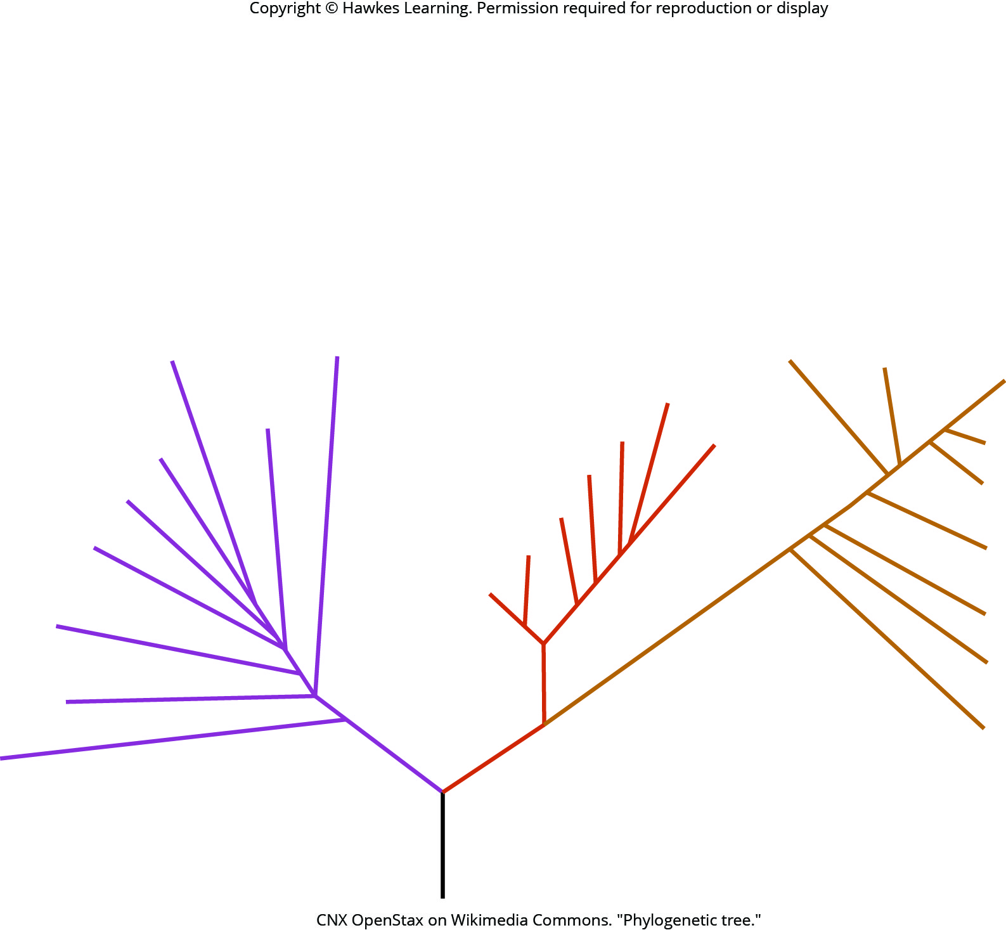
Lesson 1.2 Figure 10

Slide 16
Hawkes Learning – End of PowerPoint

