Slide 1
Chapter 11
Meiosis and Sexual Reproduction

Slide 2
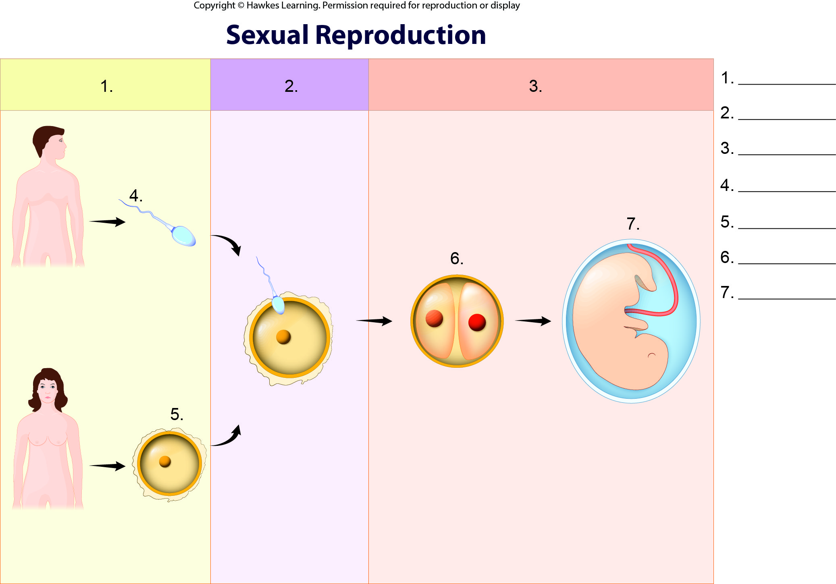
Lesson 11.1 Figure 2 - Numbered

Slide 3
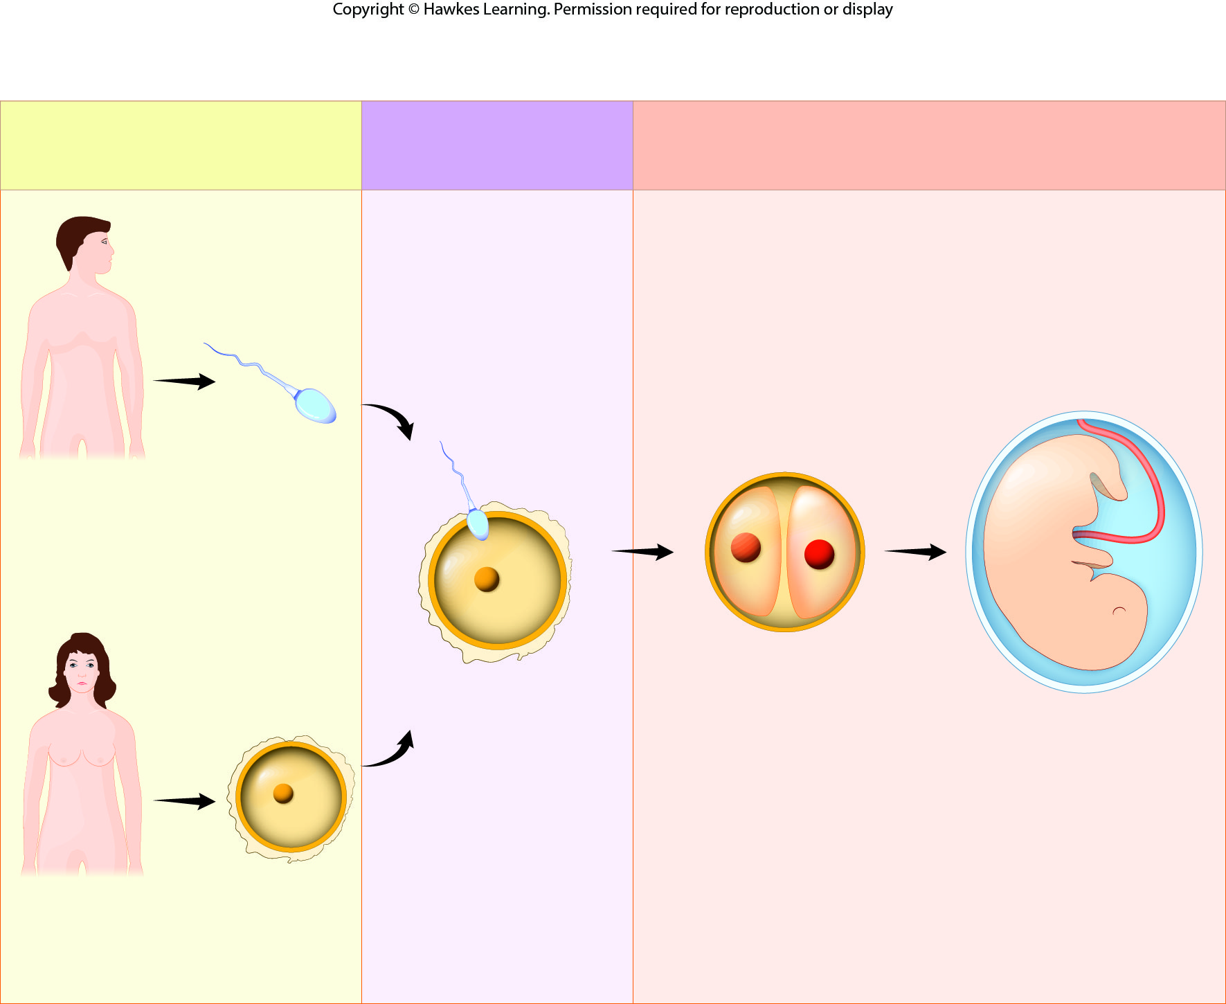
Lesson 11.1 Figure 2

Slide 4
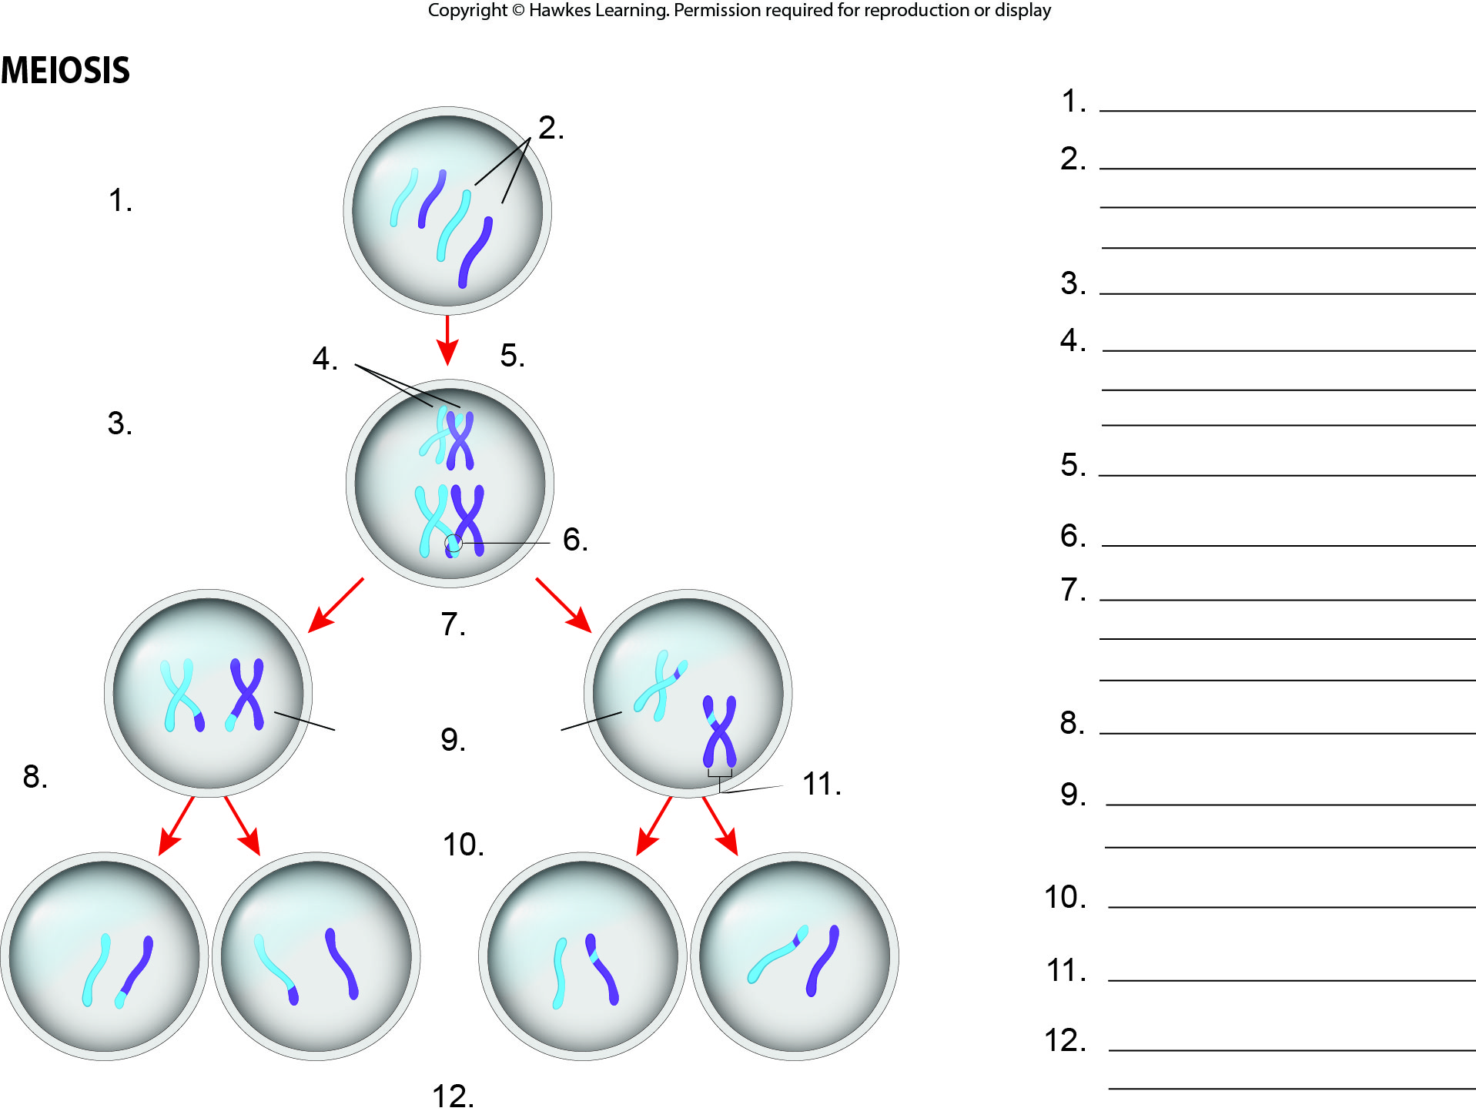
Lesson 11.1 Figure 3 - Numbered

Slide 5
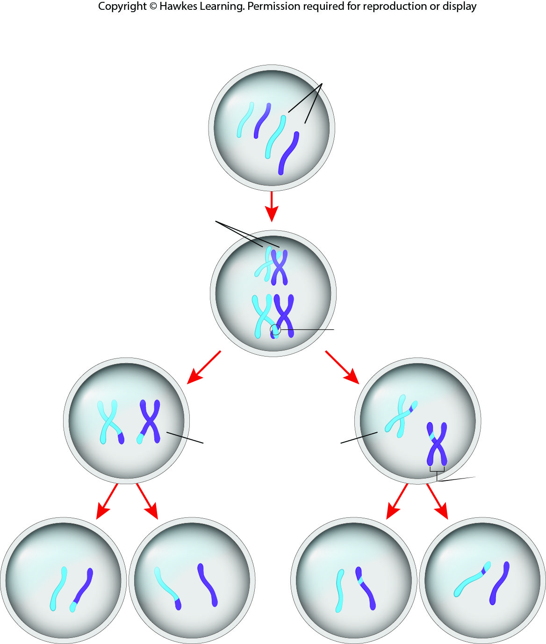
Lesson 11.1 Figure 3

Slide 6
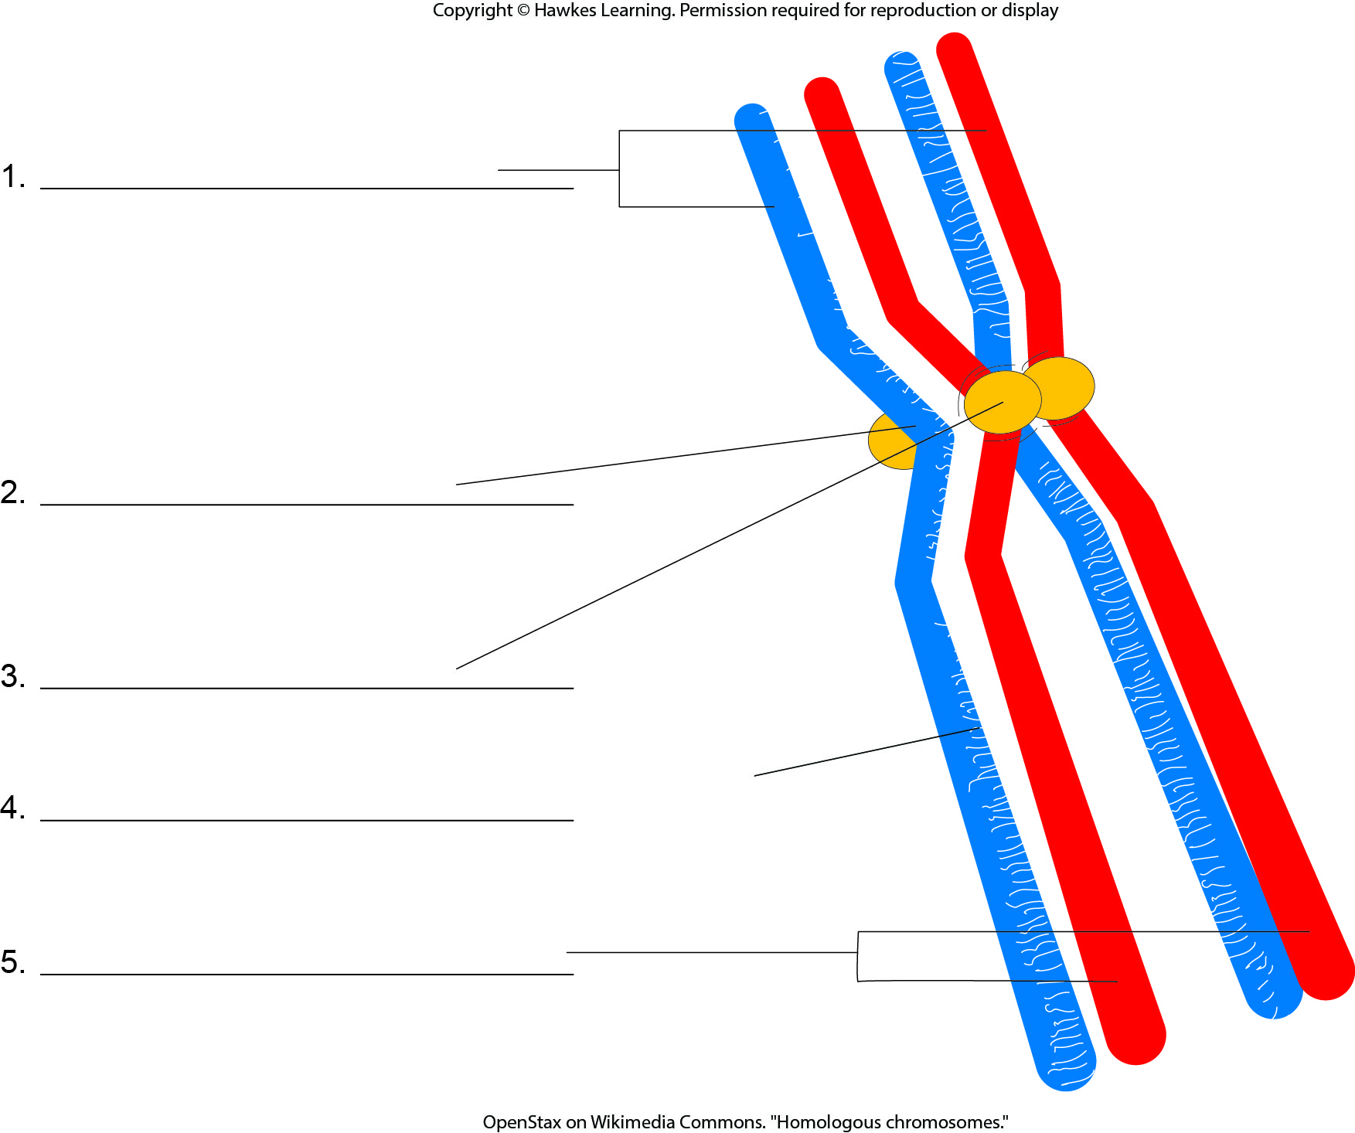
Lesson 11.1 Figure 4 - Numbered

Slide 7
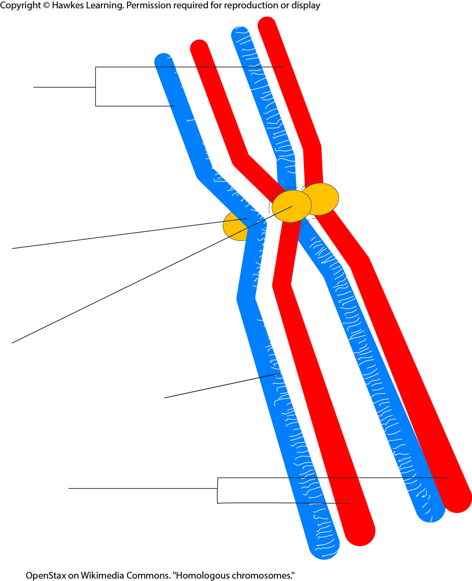
Lesson 11.1 Figure 4

Slide 8
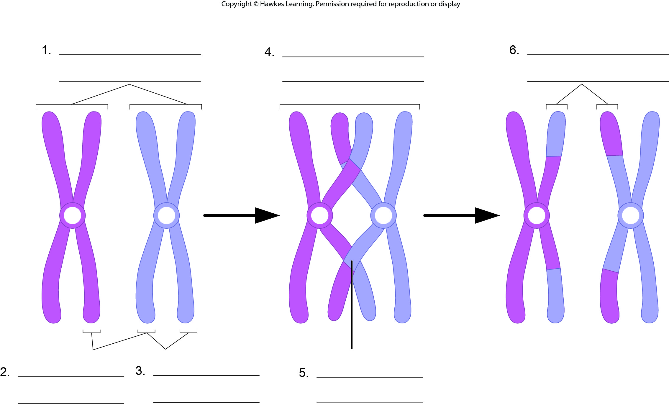
Lesson 11.1 Figure 5 - Numbered

Slide 9
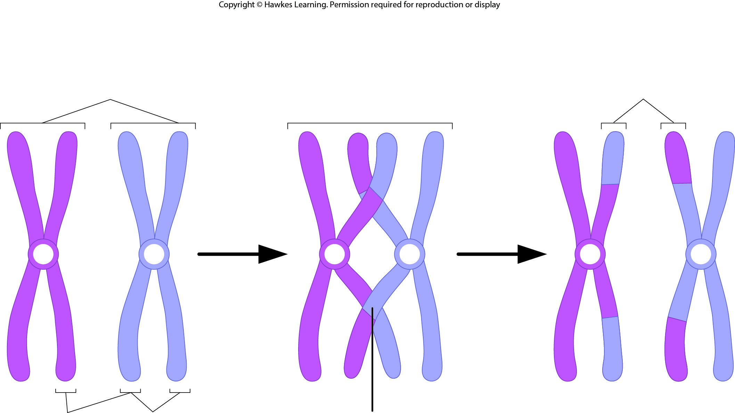
Lesson 11.1 Figure 5

Slide 10
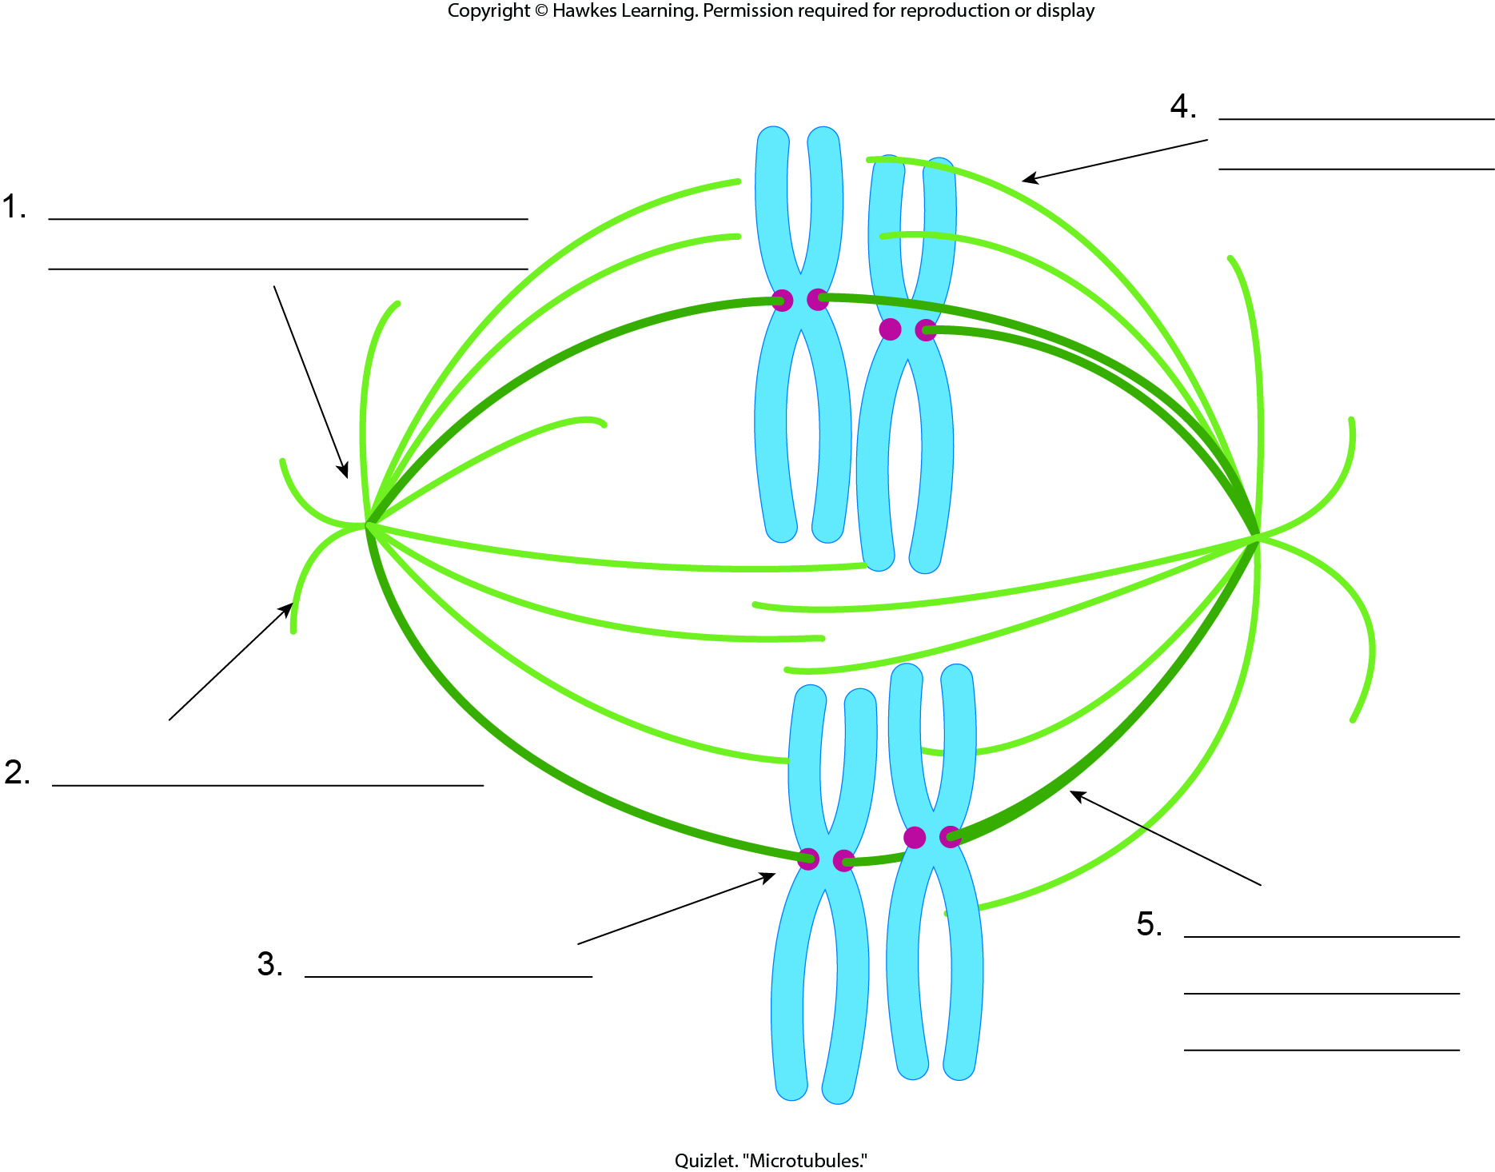
Lesson 11.1 Figure 6 - Numbered

Slide 11
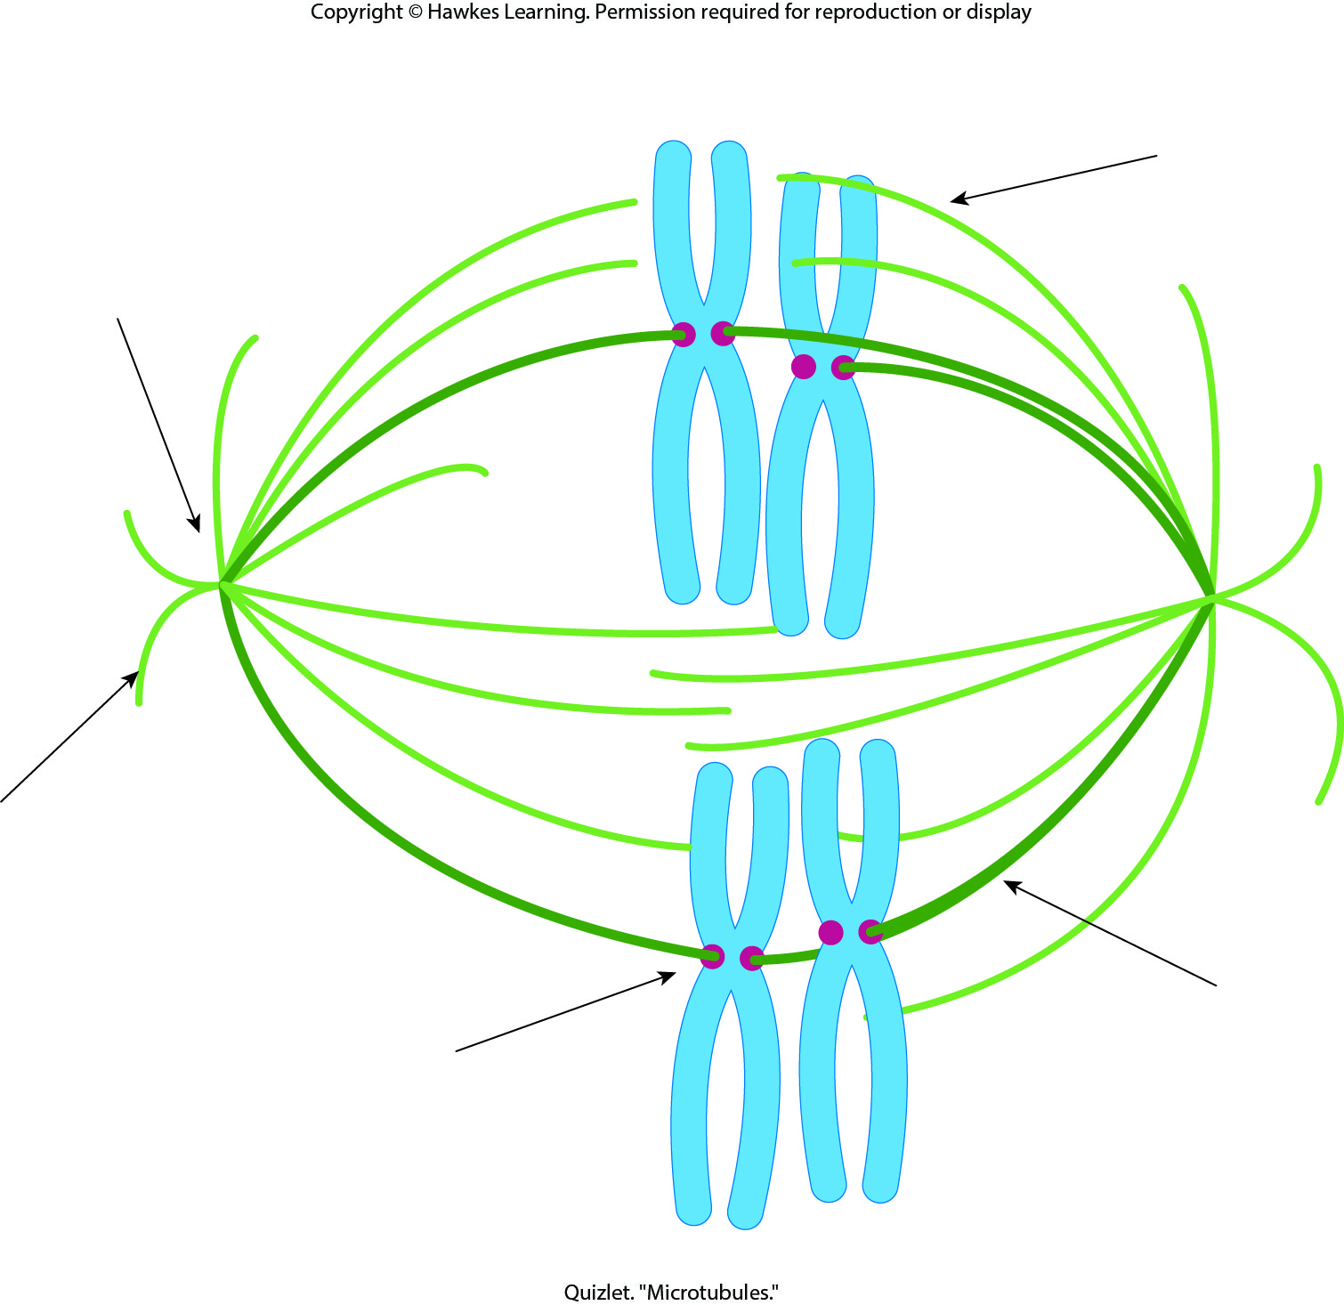
Lesson 11.1 Figure 6

Slide 12
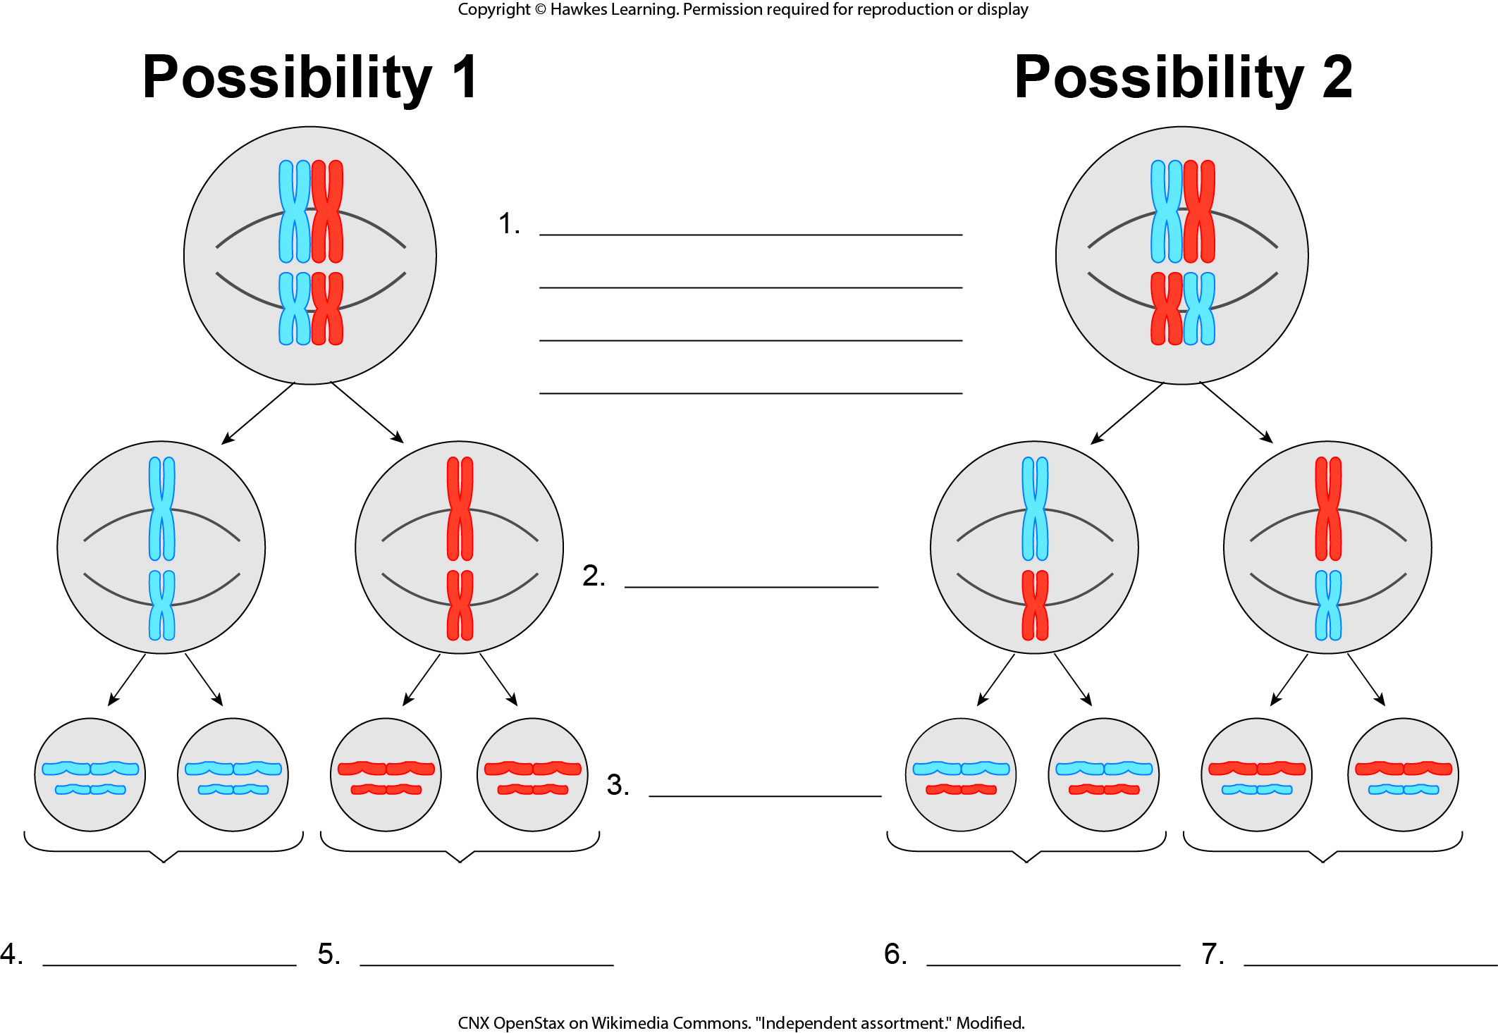
Lesson 11.1 Figure 7 - Numbered

Slide 13
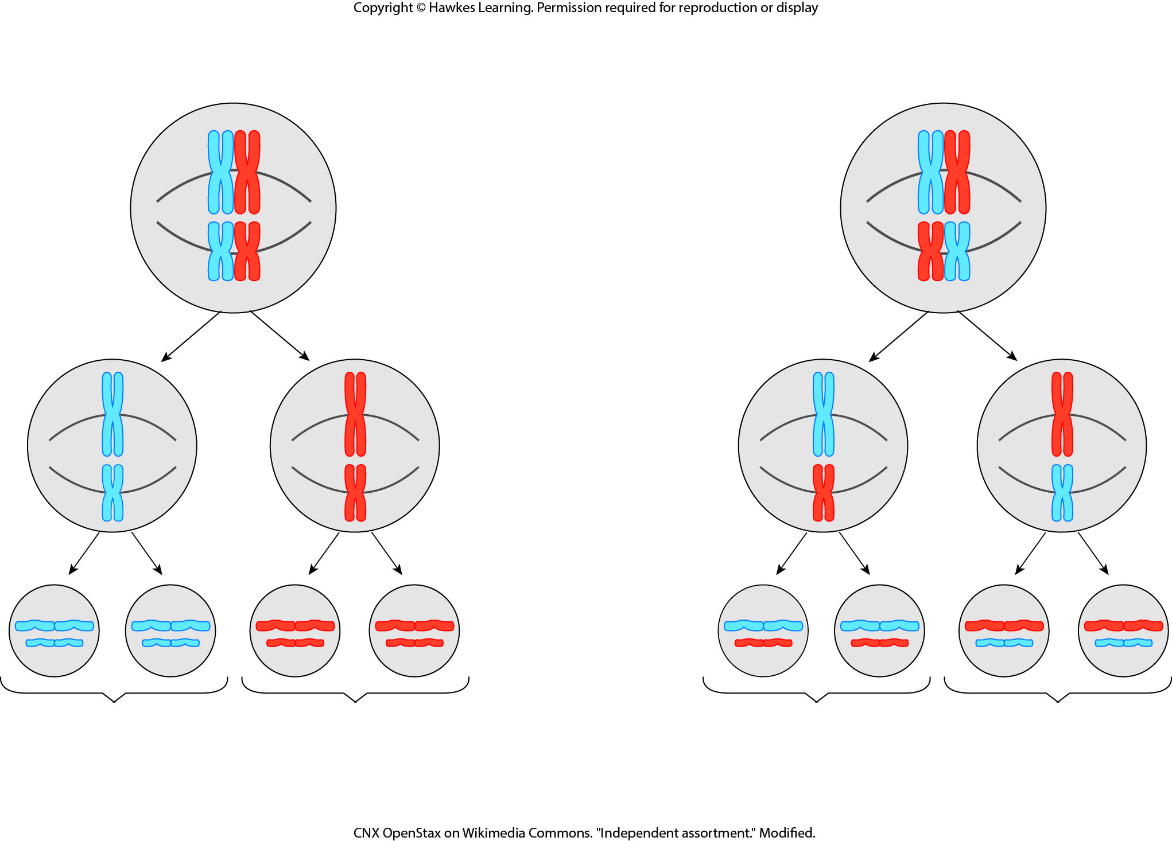
Lesson 11.1 Figure 7

Slide 14
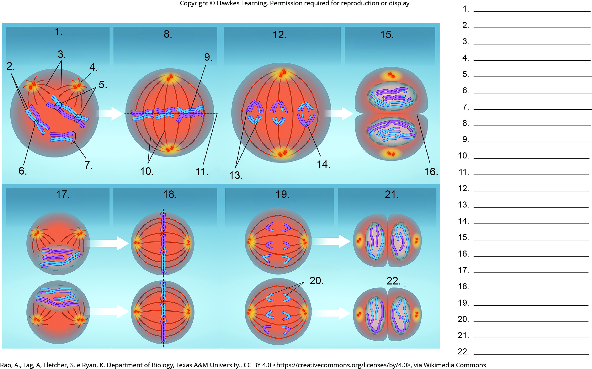
Lesson 11.1 Figure 8 - Numbered

Slide 15
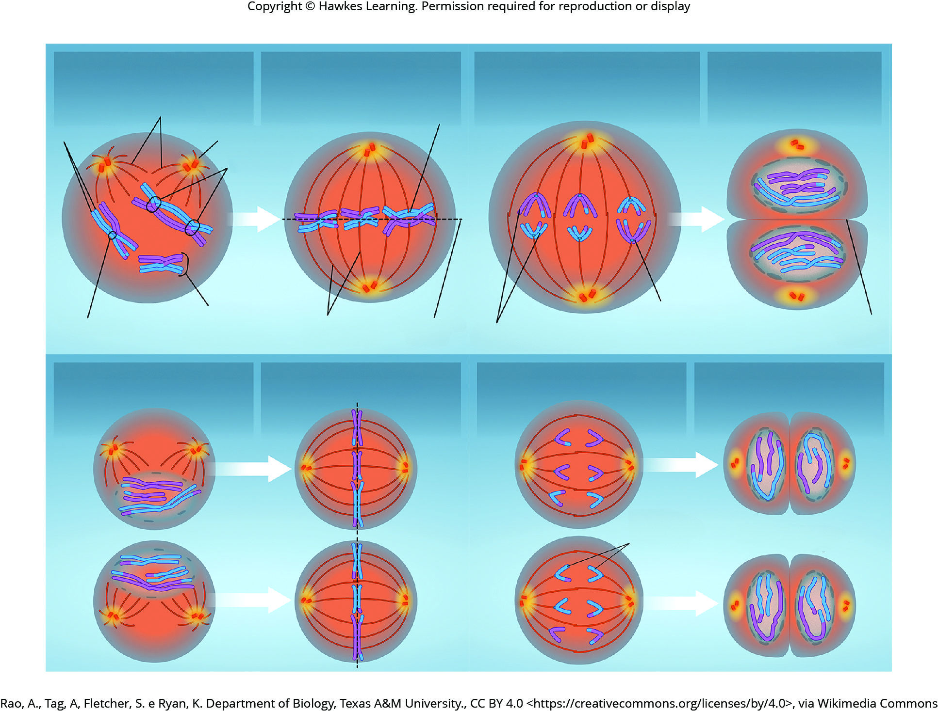
Lesson 11.1 Figure 8

Slide 16
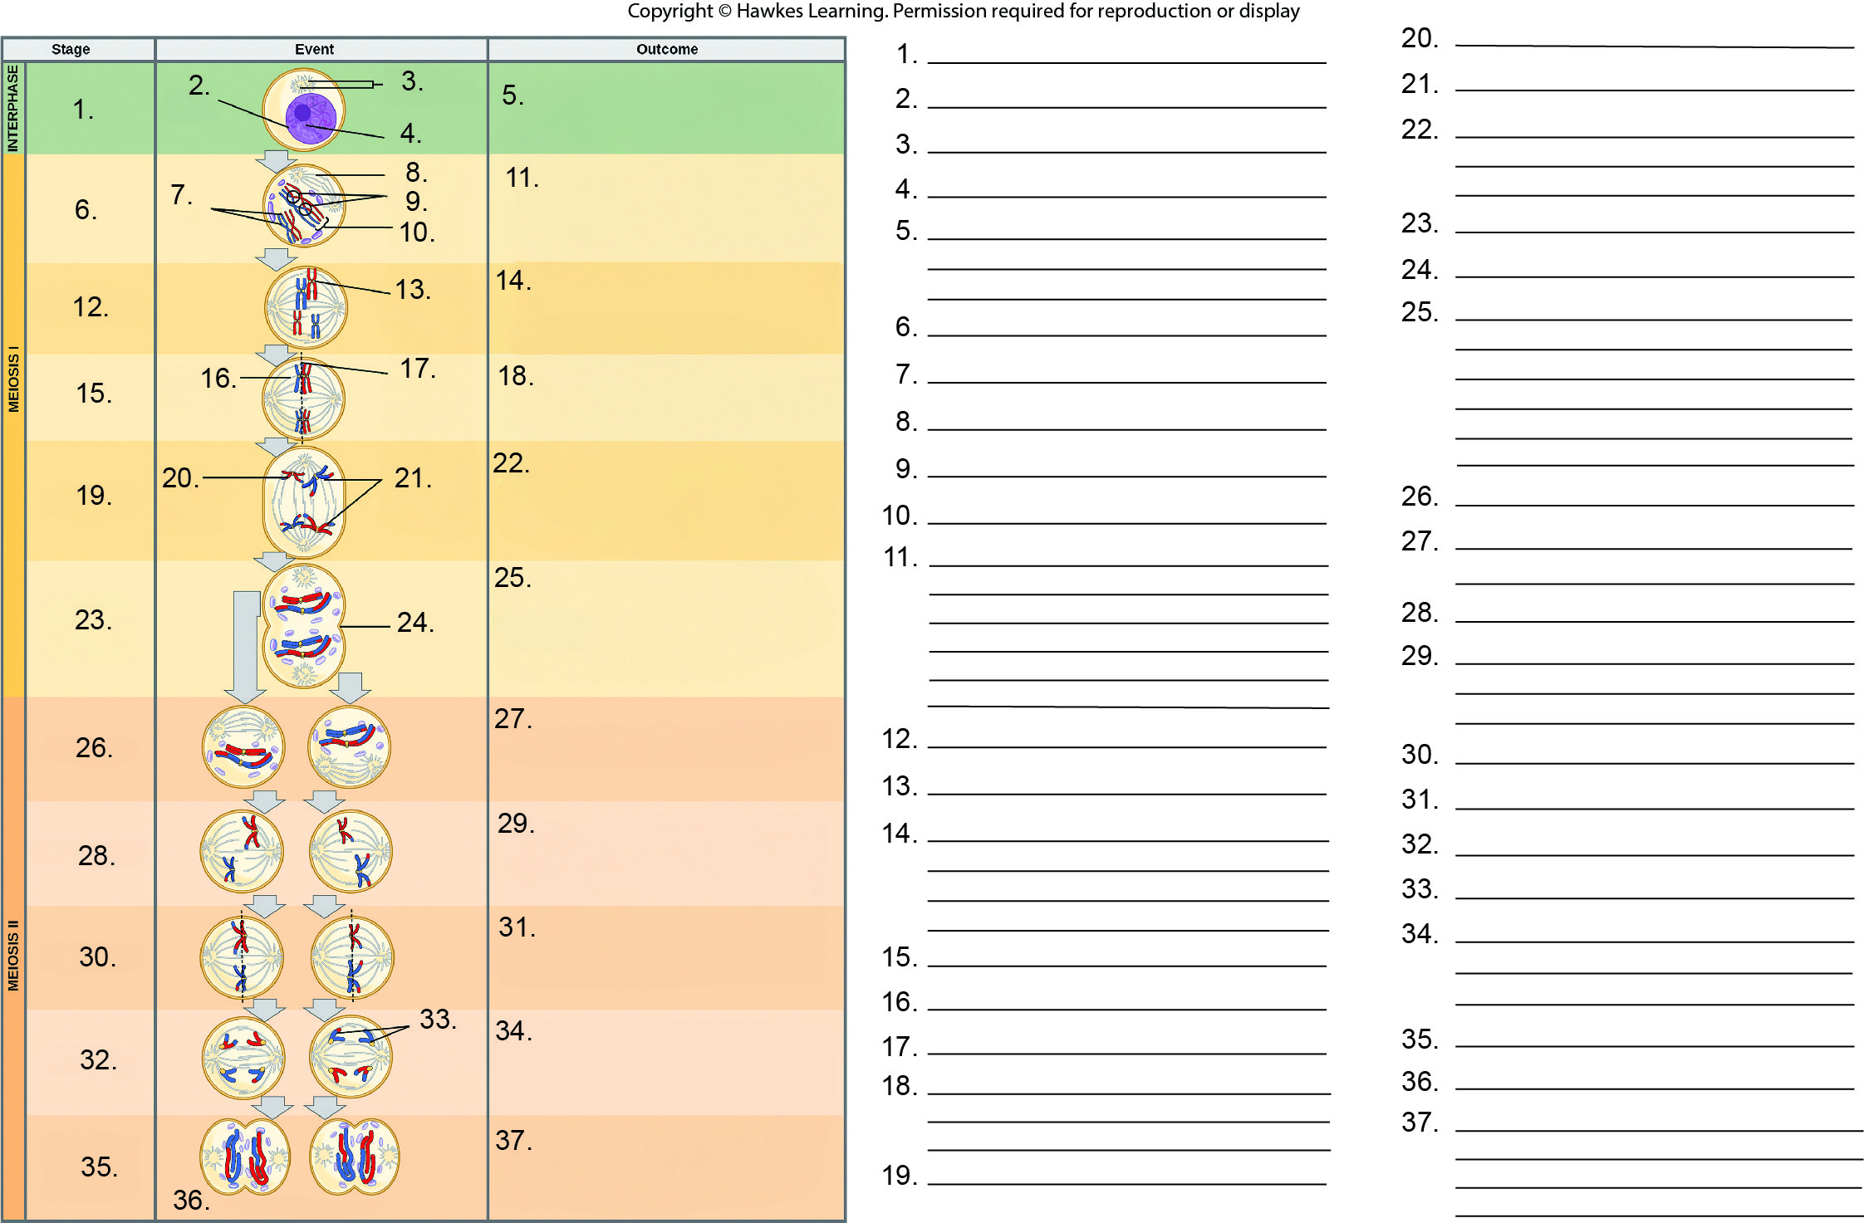
Lesson 11.1 Figure 9 - Numbered

Slide 17
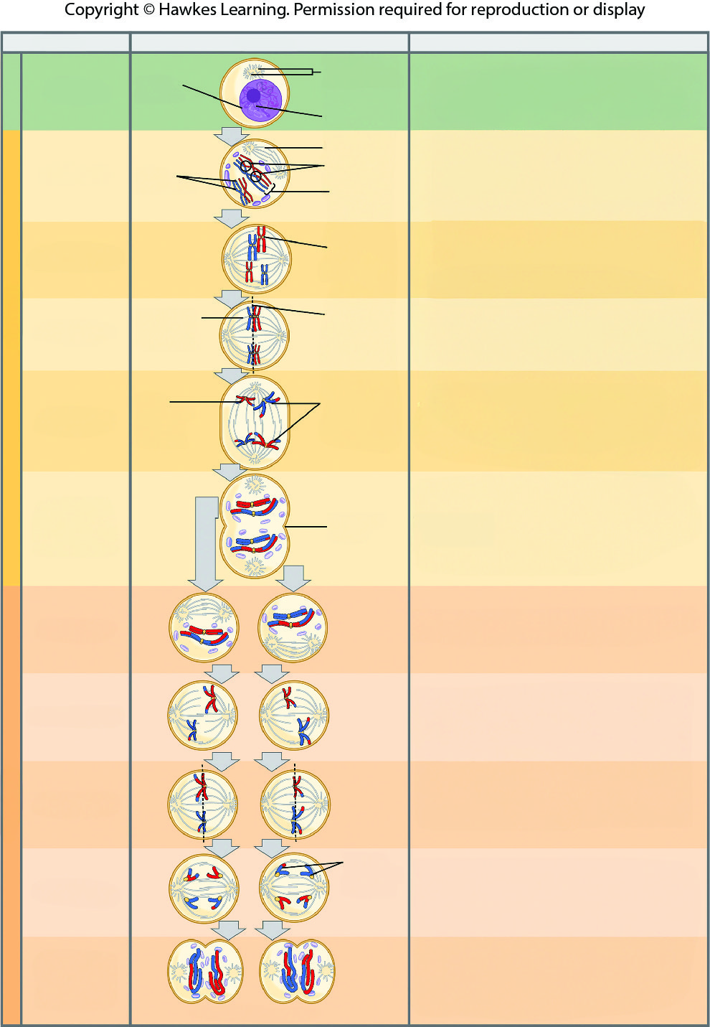
Lesson 11.1 Figure 9

Slide 18
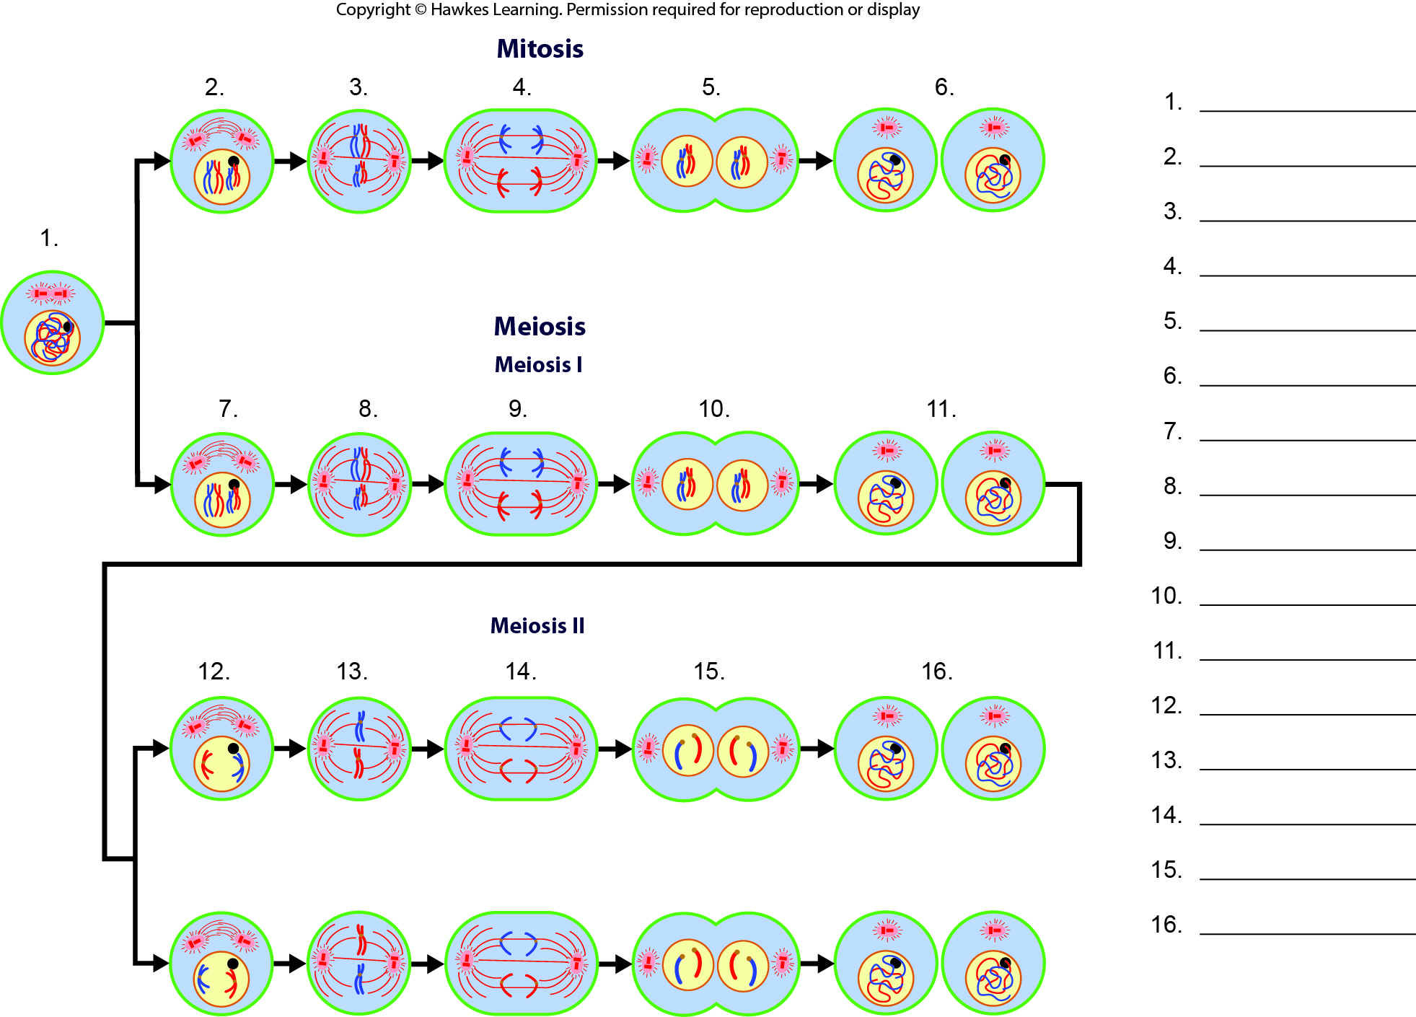
Lesson 11.1 Figure 10 - Numbered

Slide 19
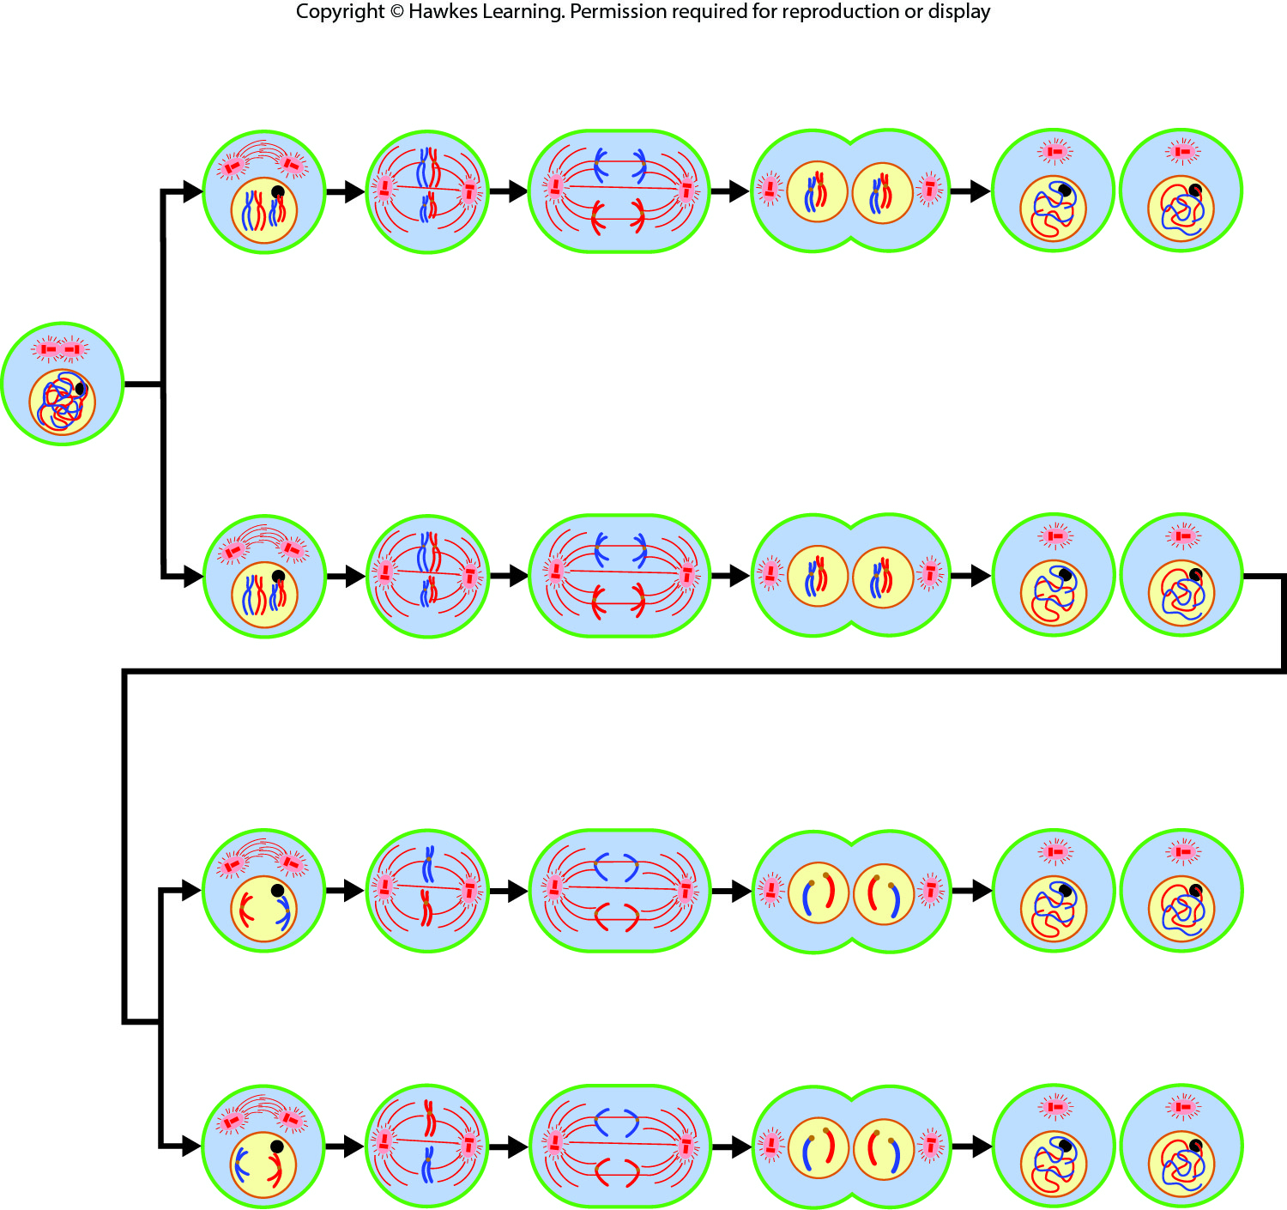
Lesson 11.1 Figure 10

Slide 20
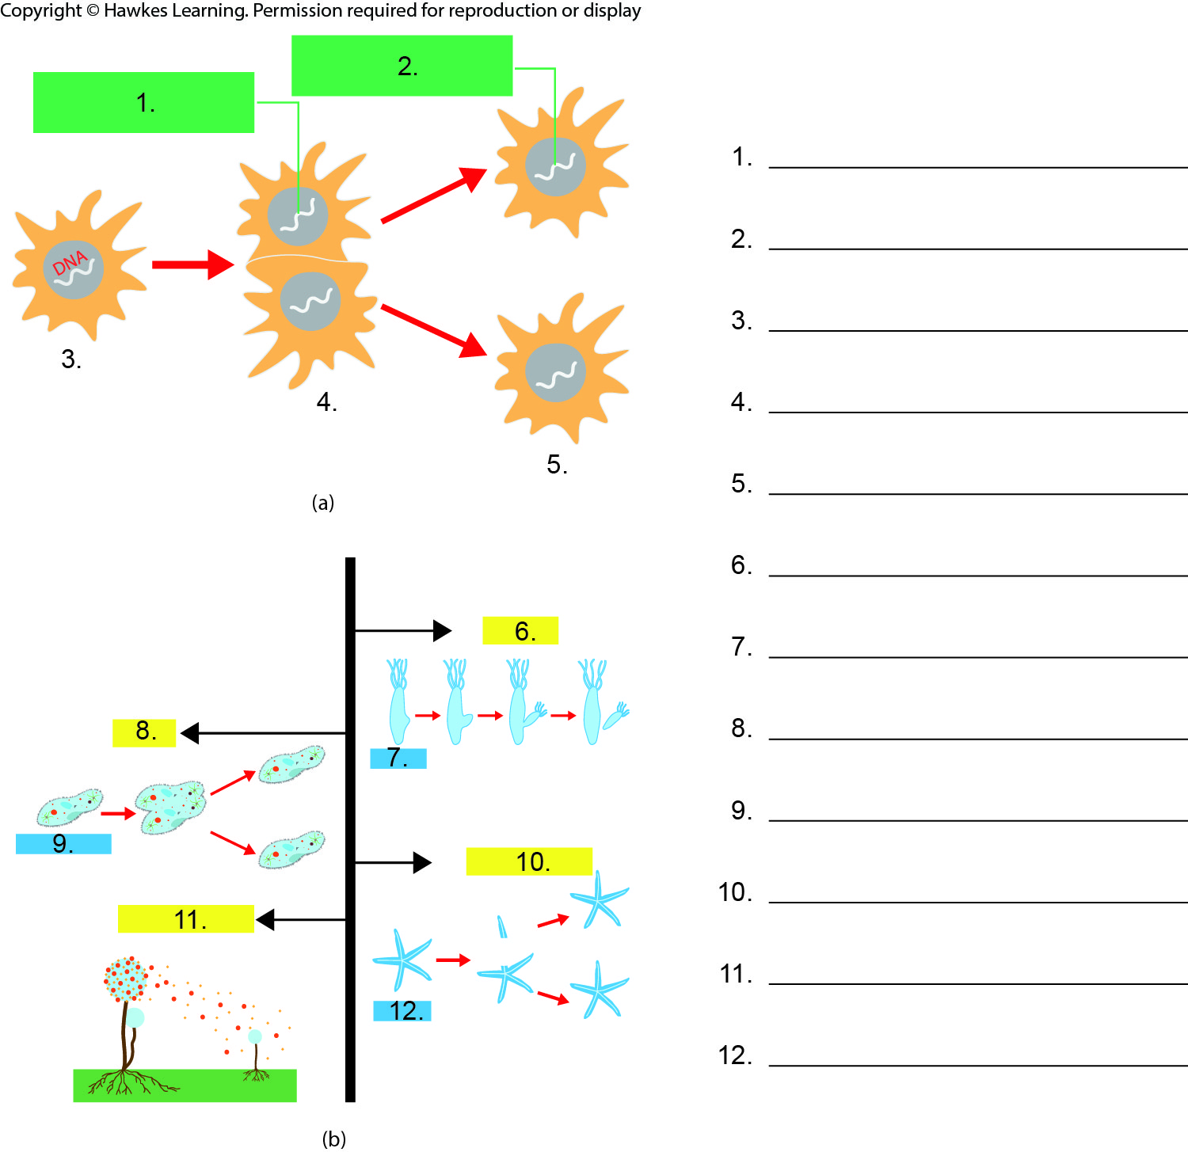
Lesson 11.2 Figure 1 - Numbered

Slide 21
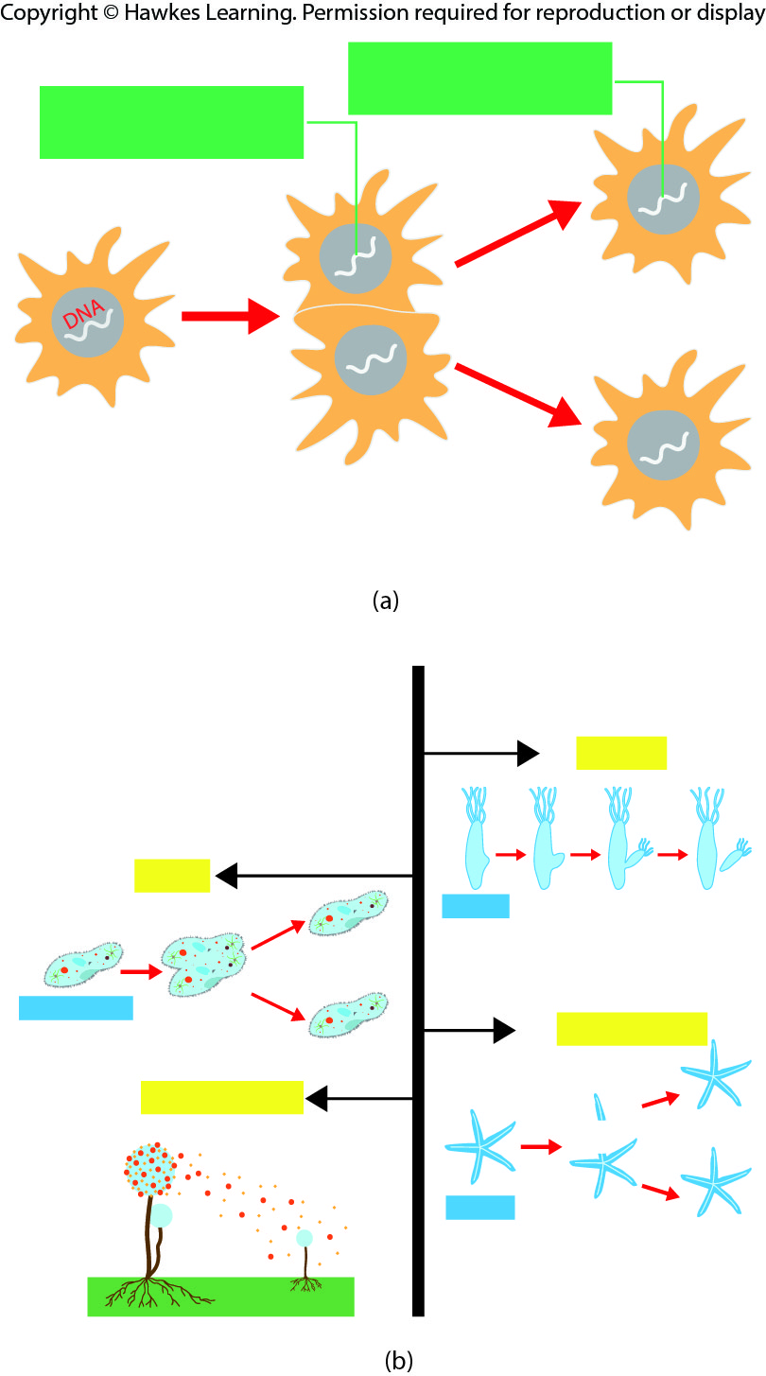
Lesson 11.2 Figure 1

Slide 22
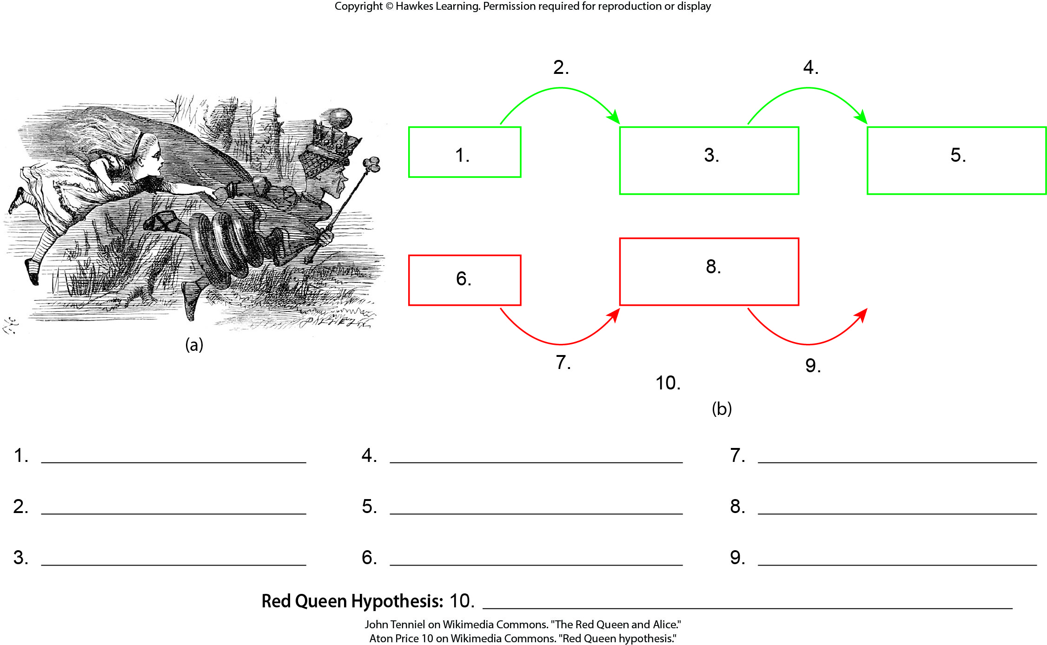
Lesson 11.2 Figure 2 - Numbered

Slide 23

Lesson 11.2 Figure 2

Slide 24
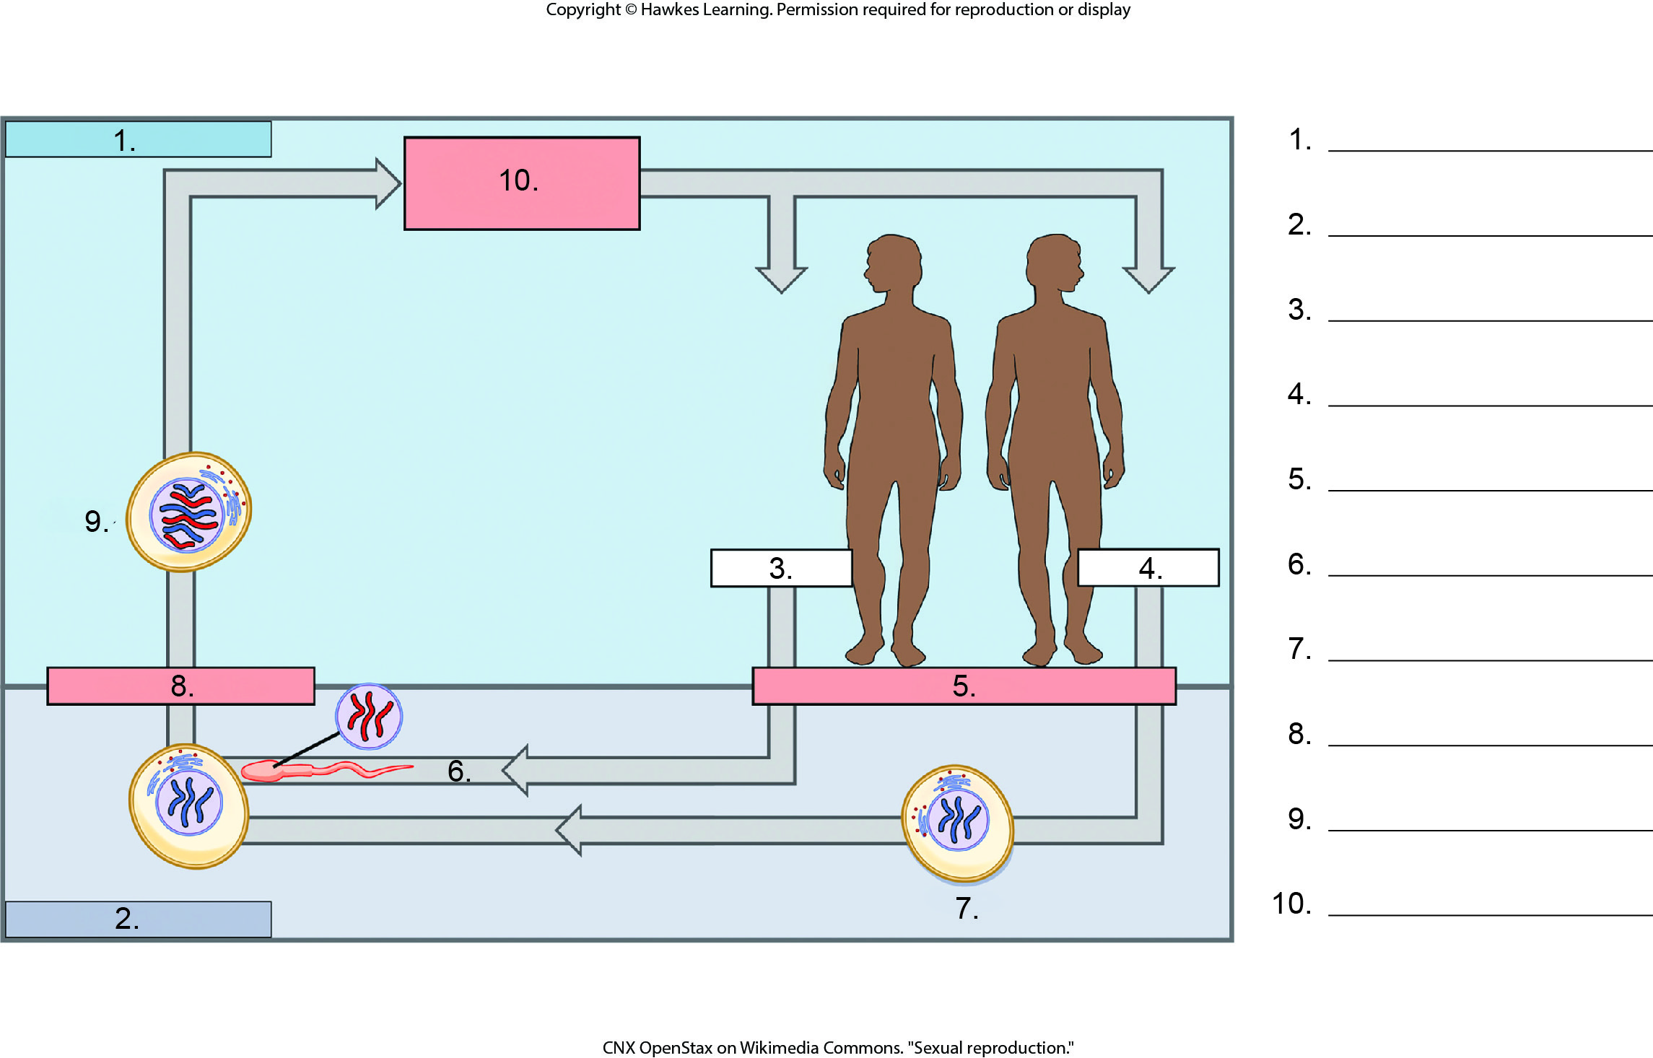
Lesson 11.2 Figure 3 - Numbered

Slide 25
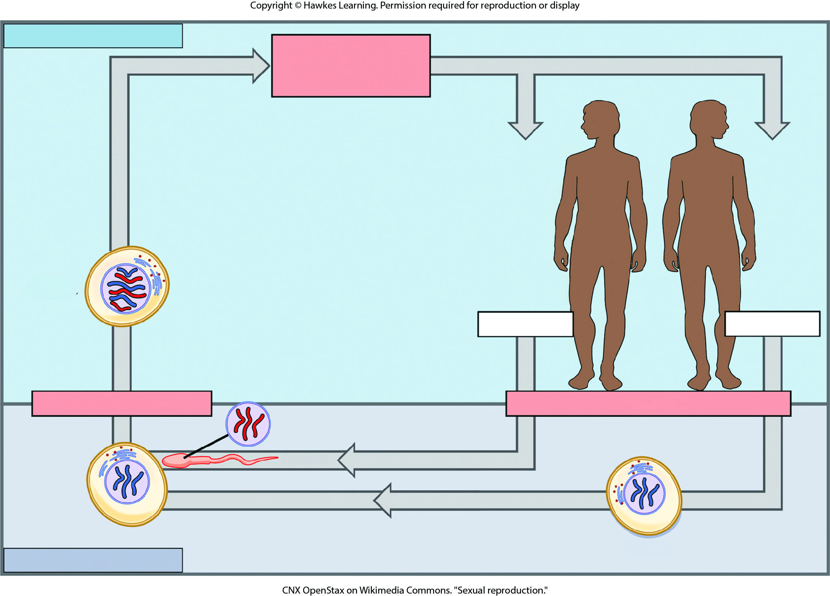
Lesson 11.2 Figure 3

Slide 26
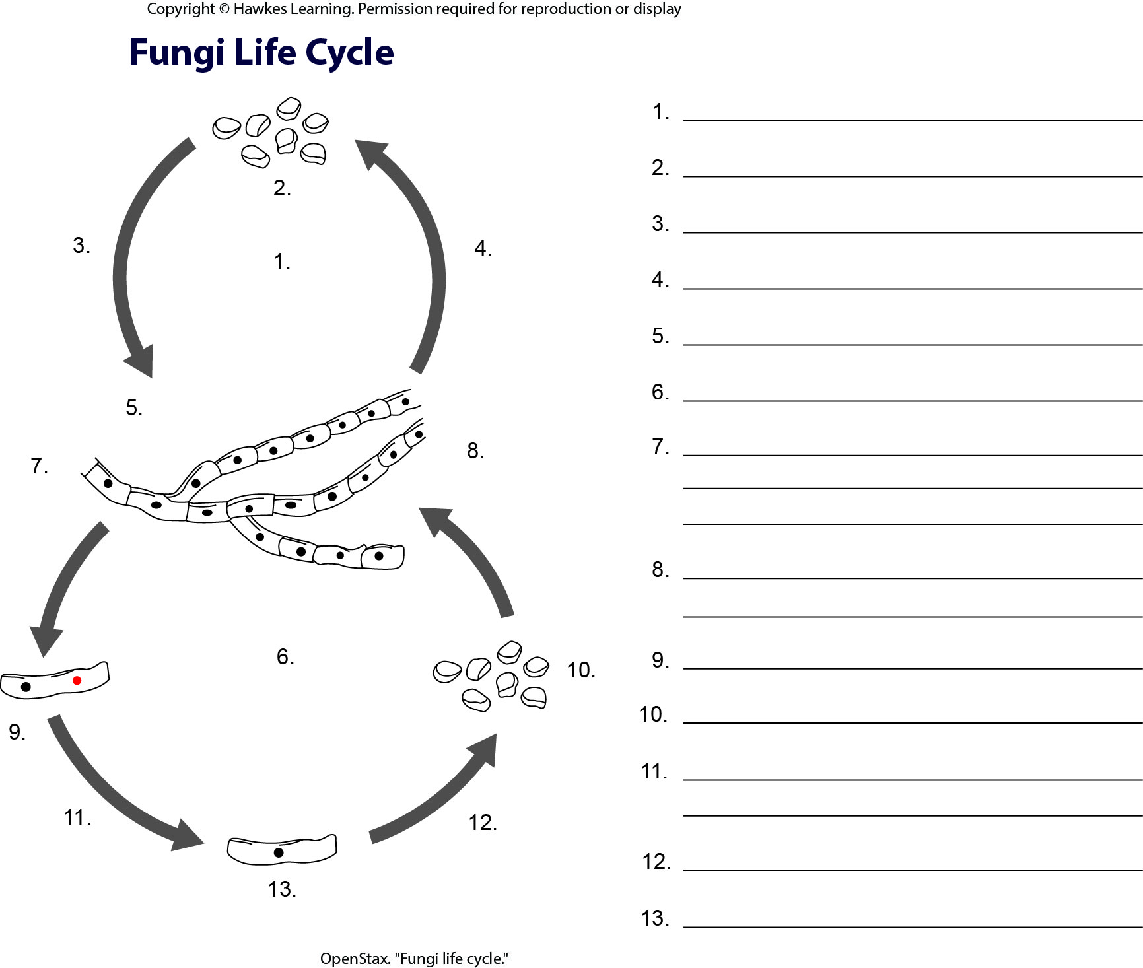
Lesson 11.2 Figure 4 - Numbered

Slide 27
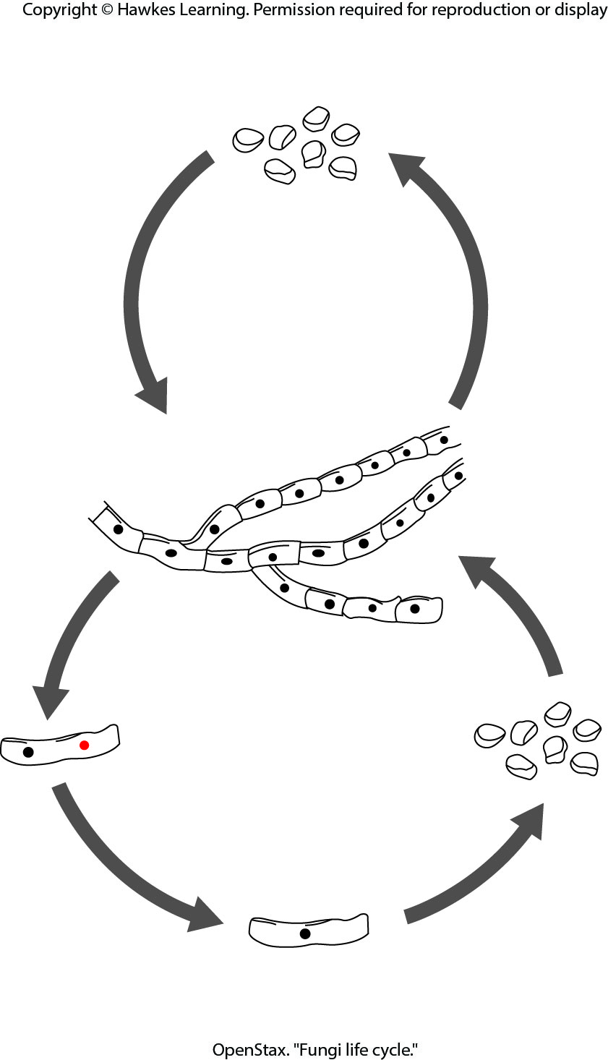
Lesson 11.2 Figure 4

Slide 28
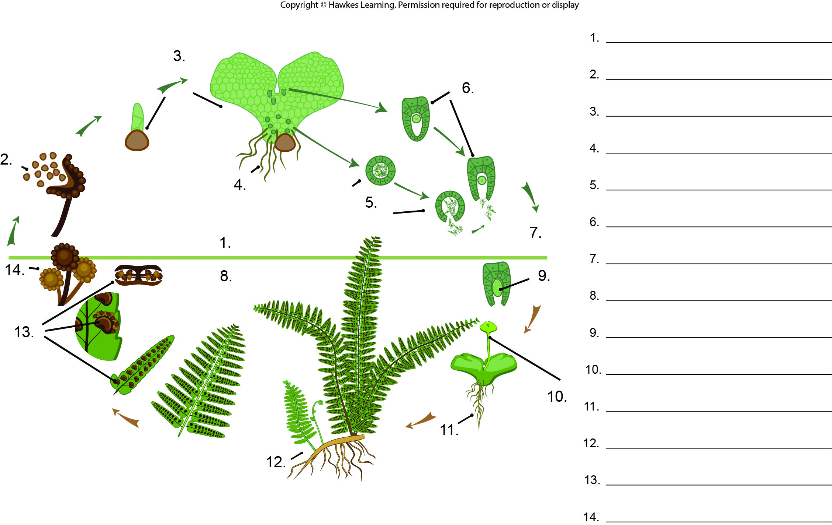
Lesson 11.2 Figure 5 - Numbered

Slide 29
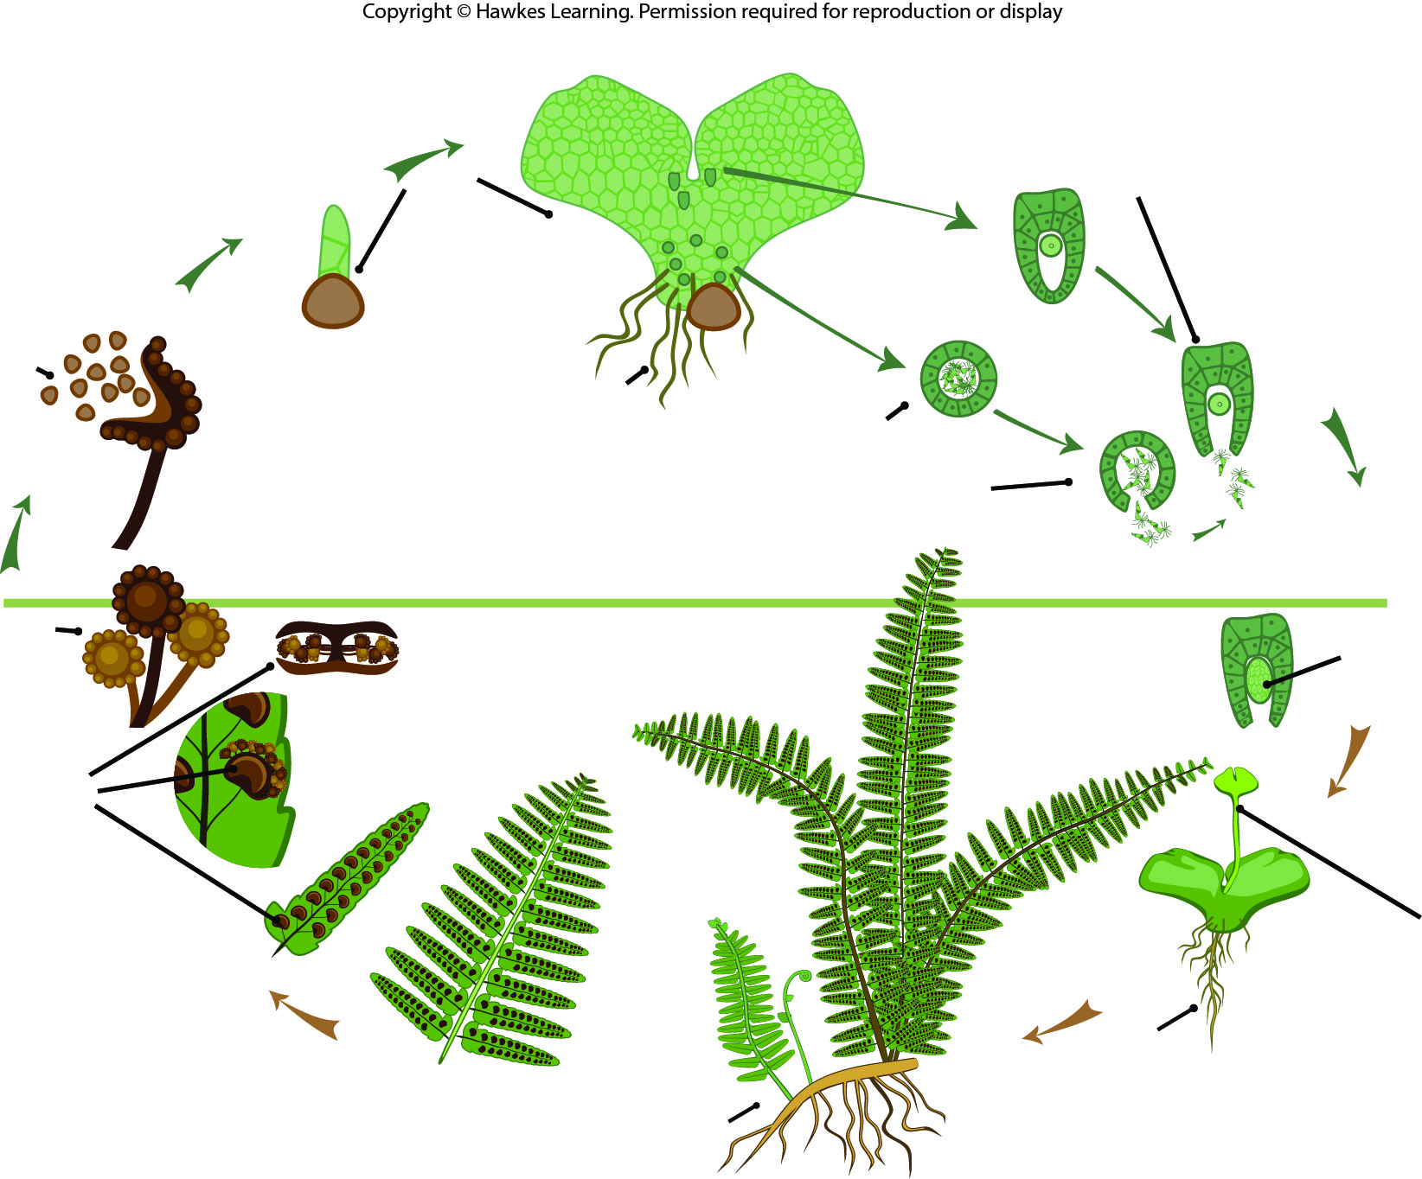
Lesson 11.2 Figure 5

Slide 30
Hawkes Learning – End of PowerPoint

