Slide 1
Chapter 12
Mendelian Genetics

Slide 2
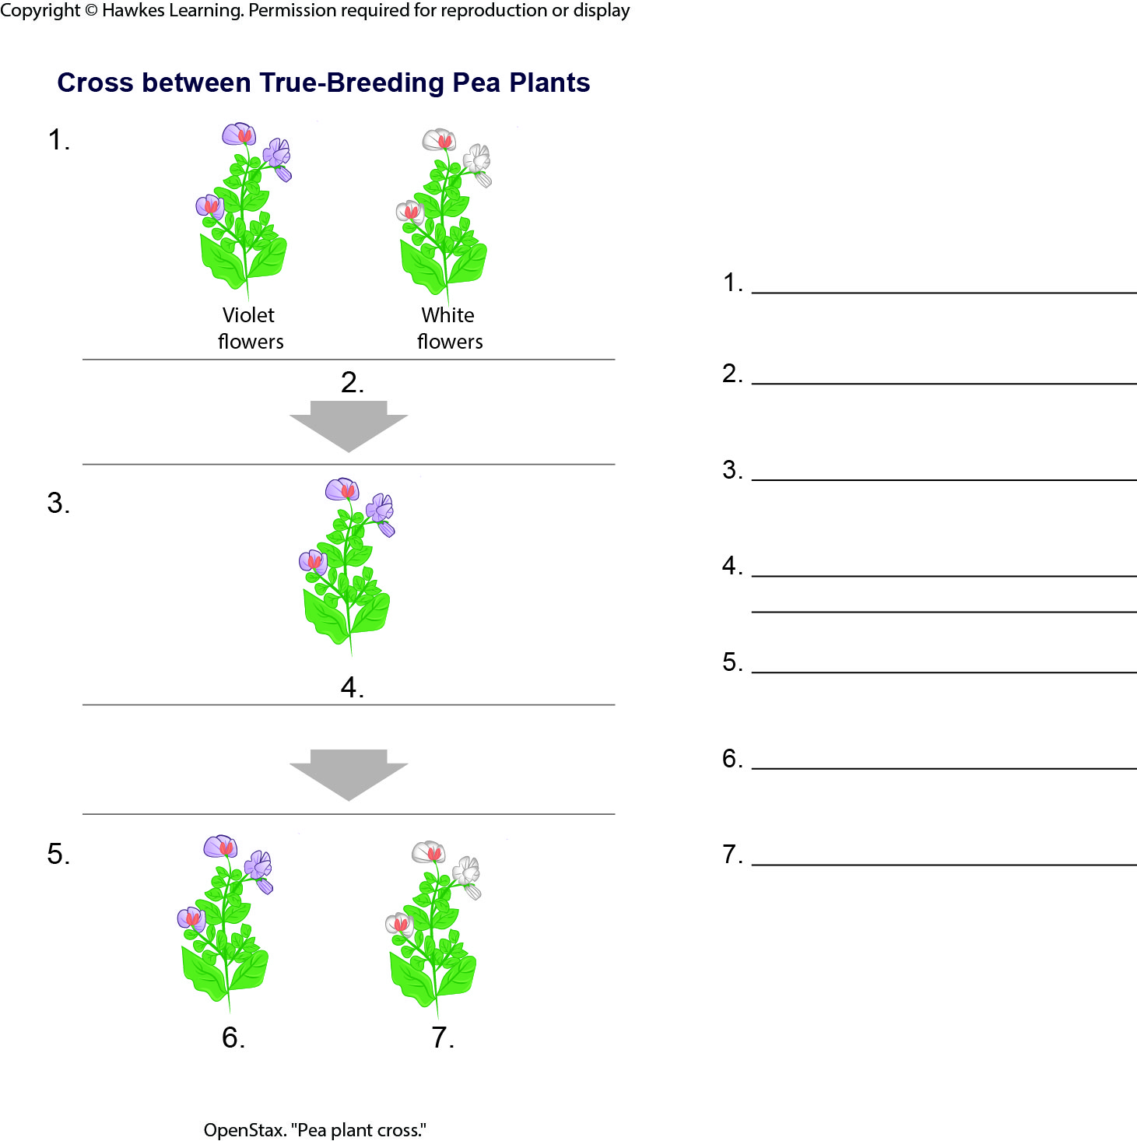
Lesson 12.1 Figure 3 - Numbered

Slide 3
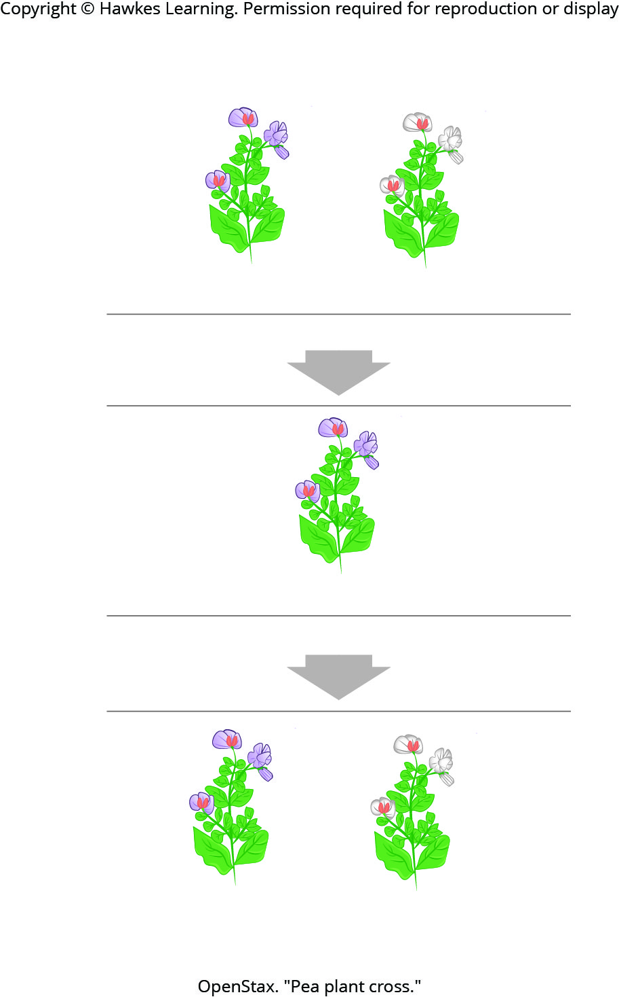
Lesson 12.1 Figure 3

Slide 4
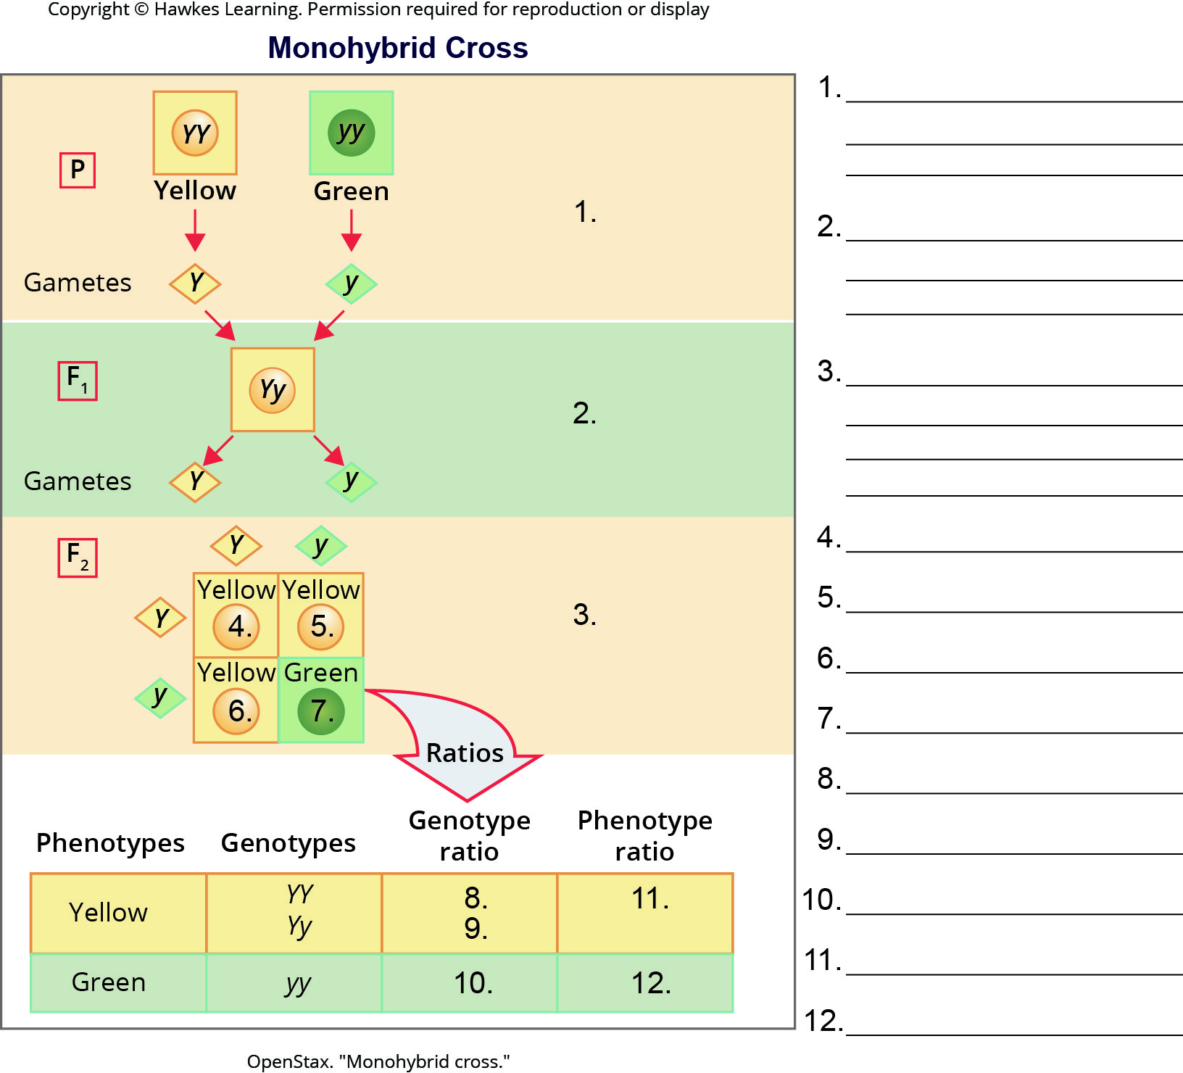
Lesson 12.2 Figure 1 - Numbered

Slide 5
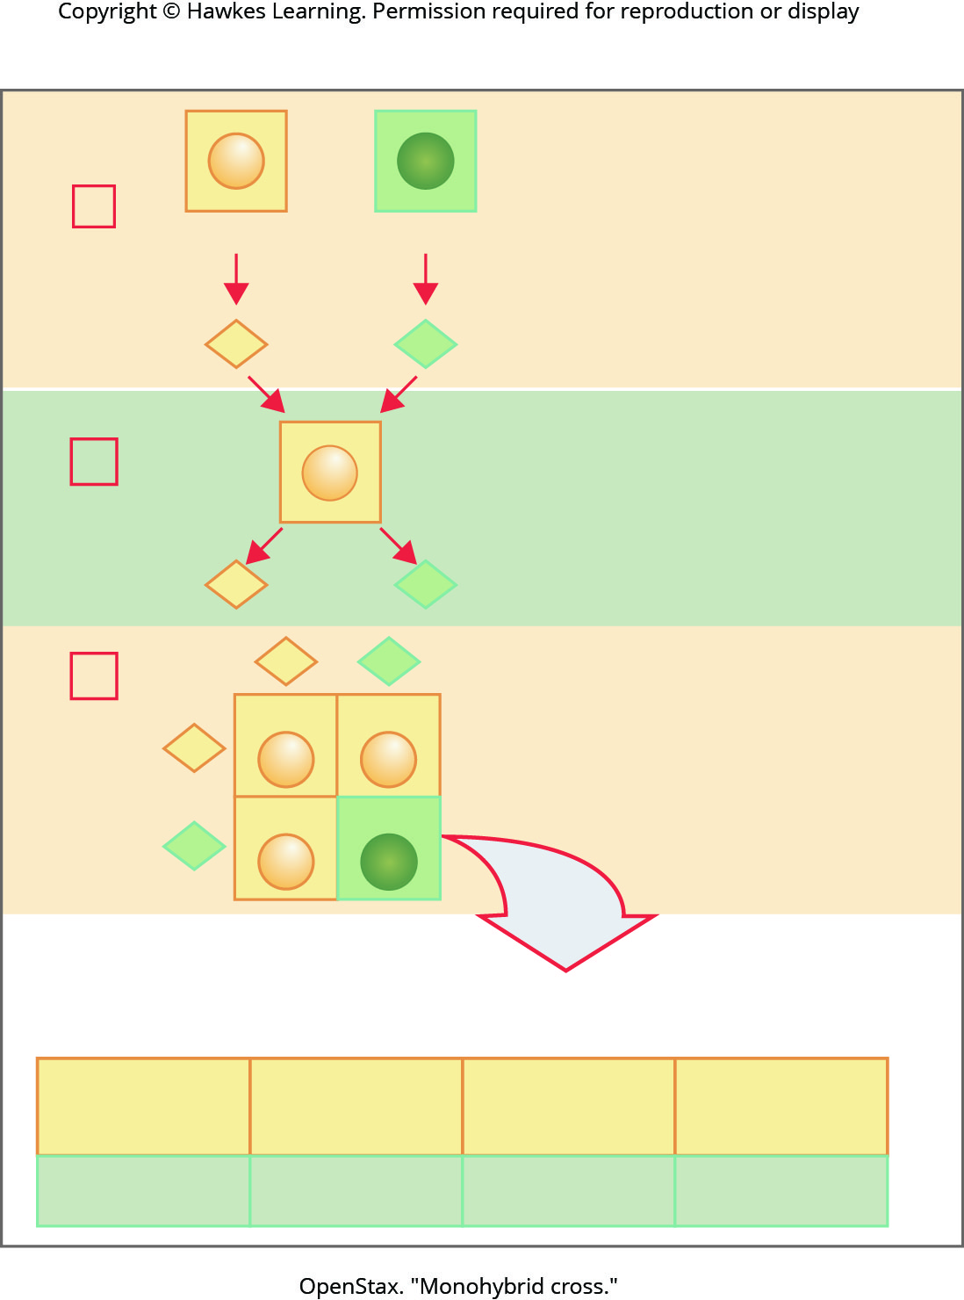
Lesson 12.2 Figure 1

Slide 6
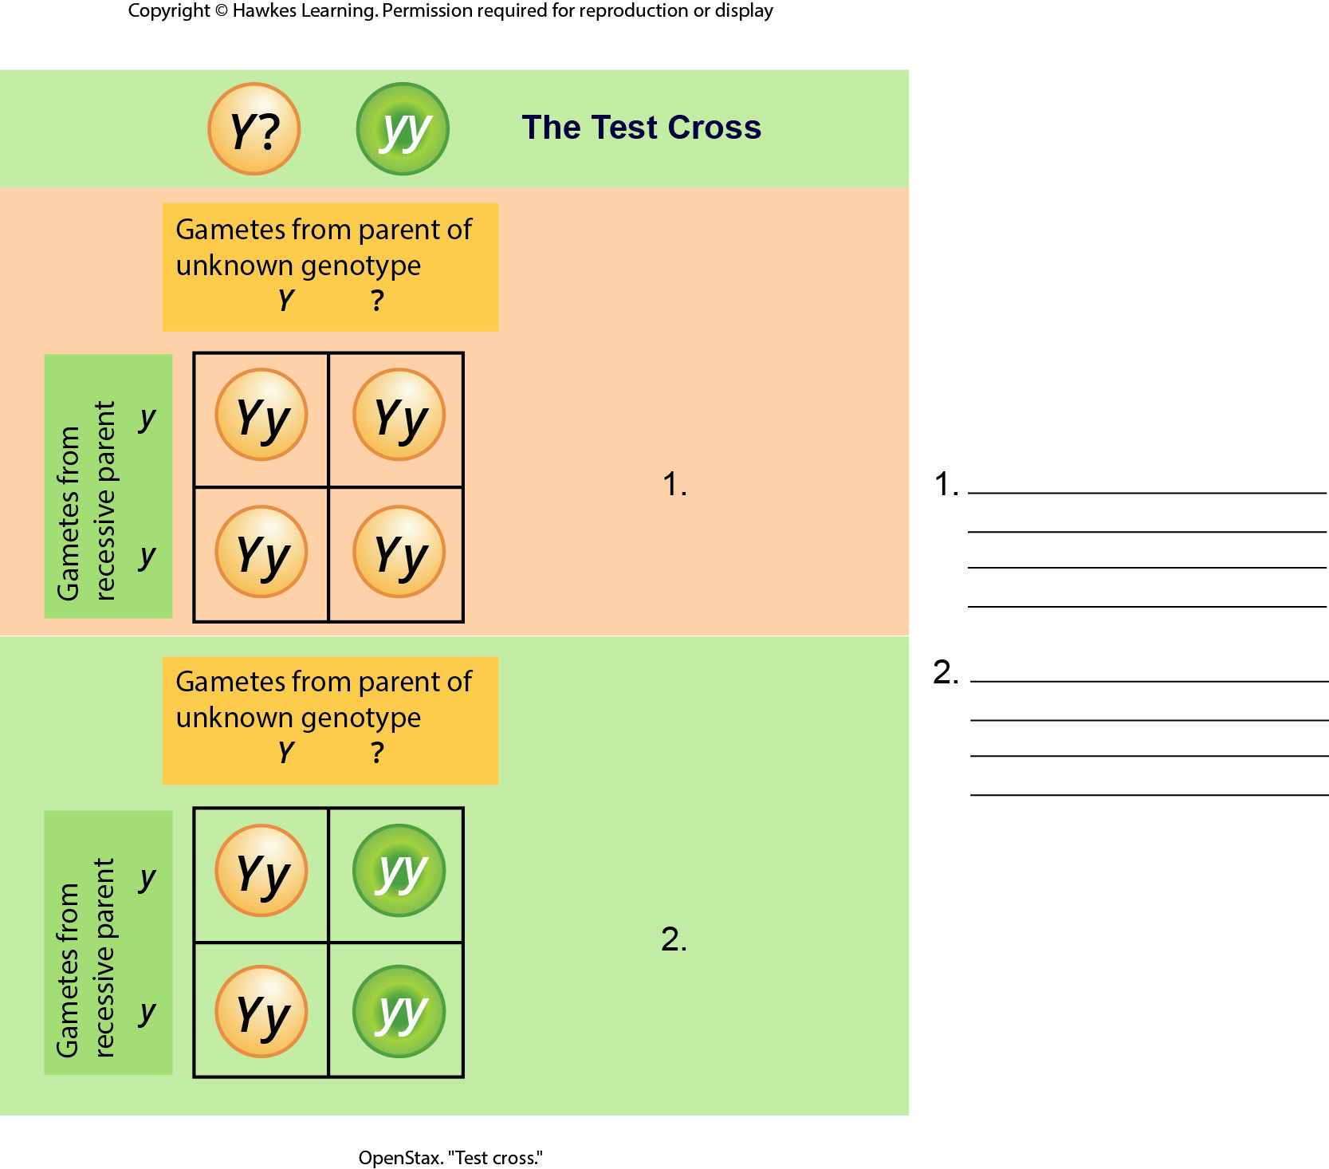
Lesson 12.2 Figure 2 - Numbered

Slide 7
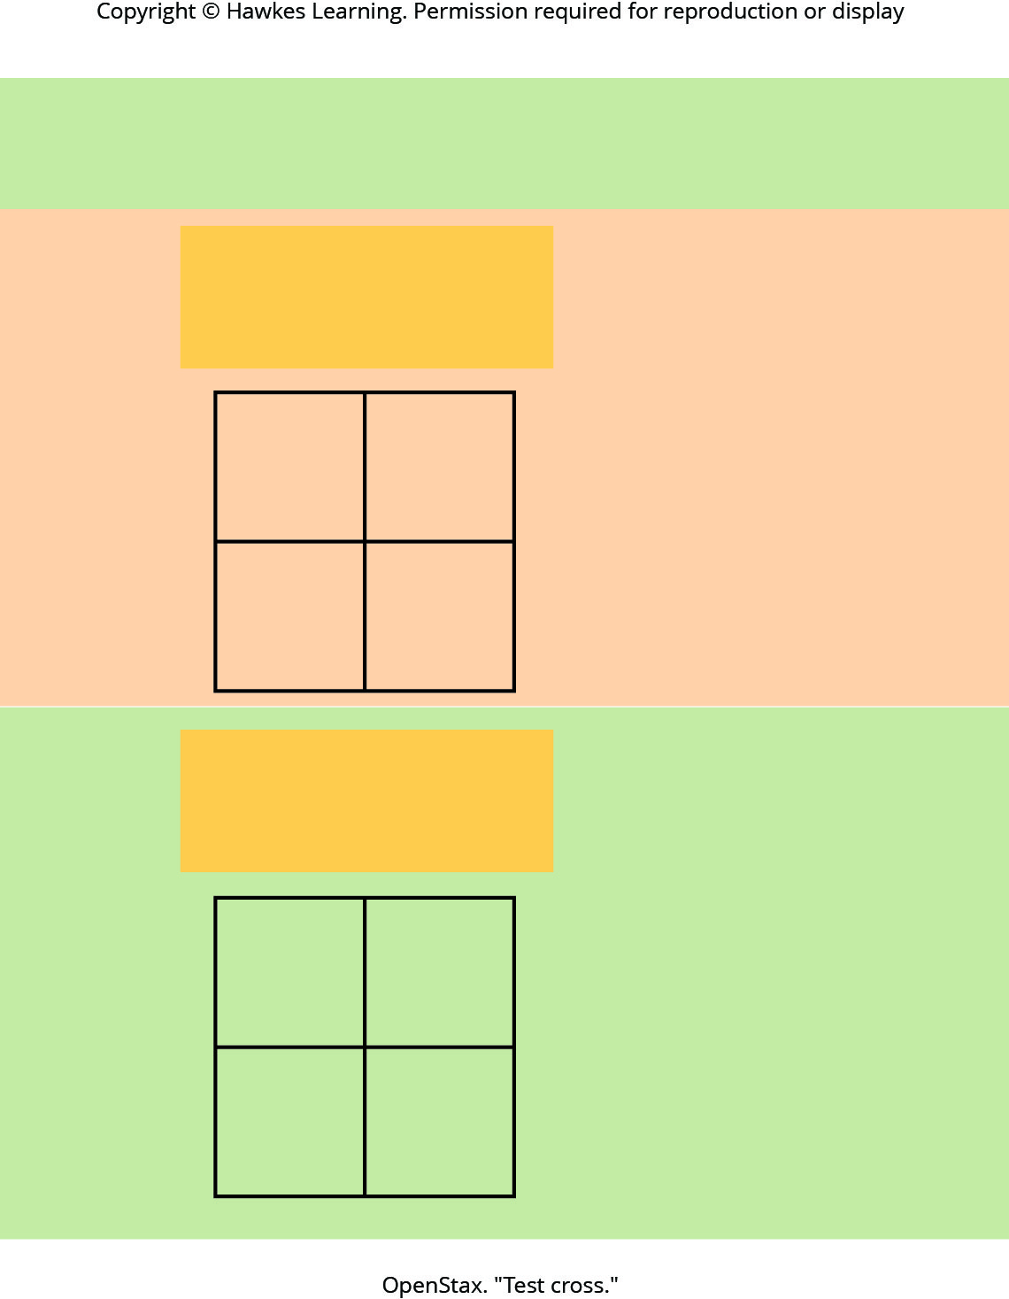
Lesson 12.2 Figure 2

Slide 8
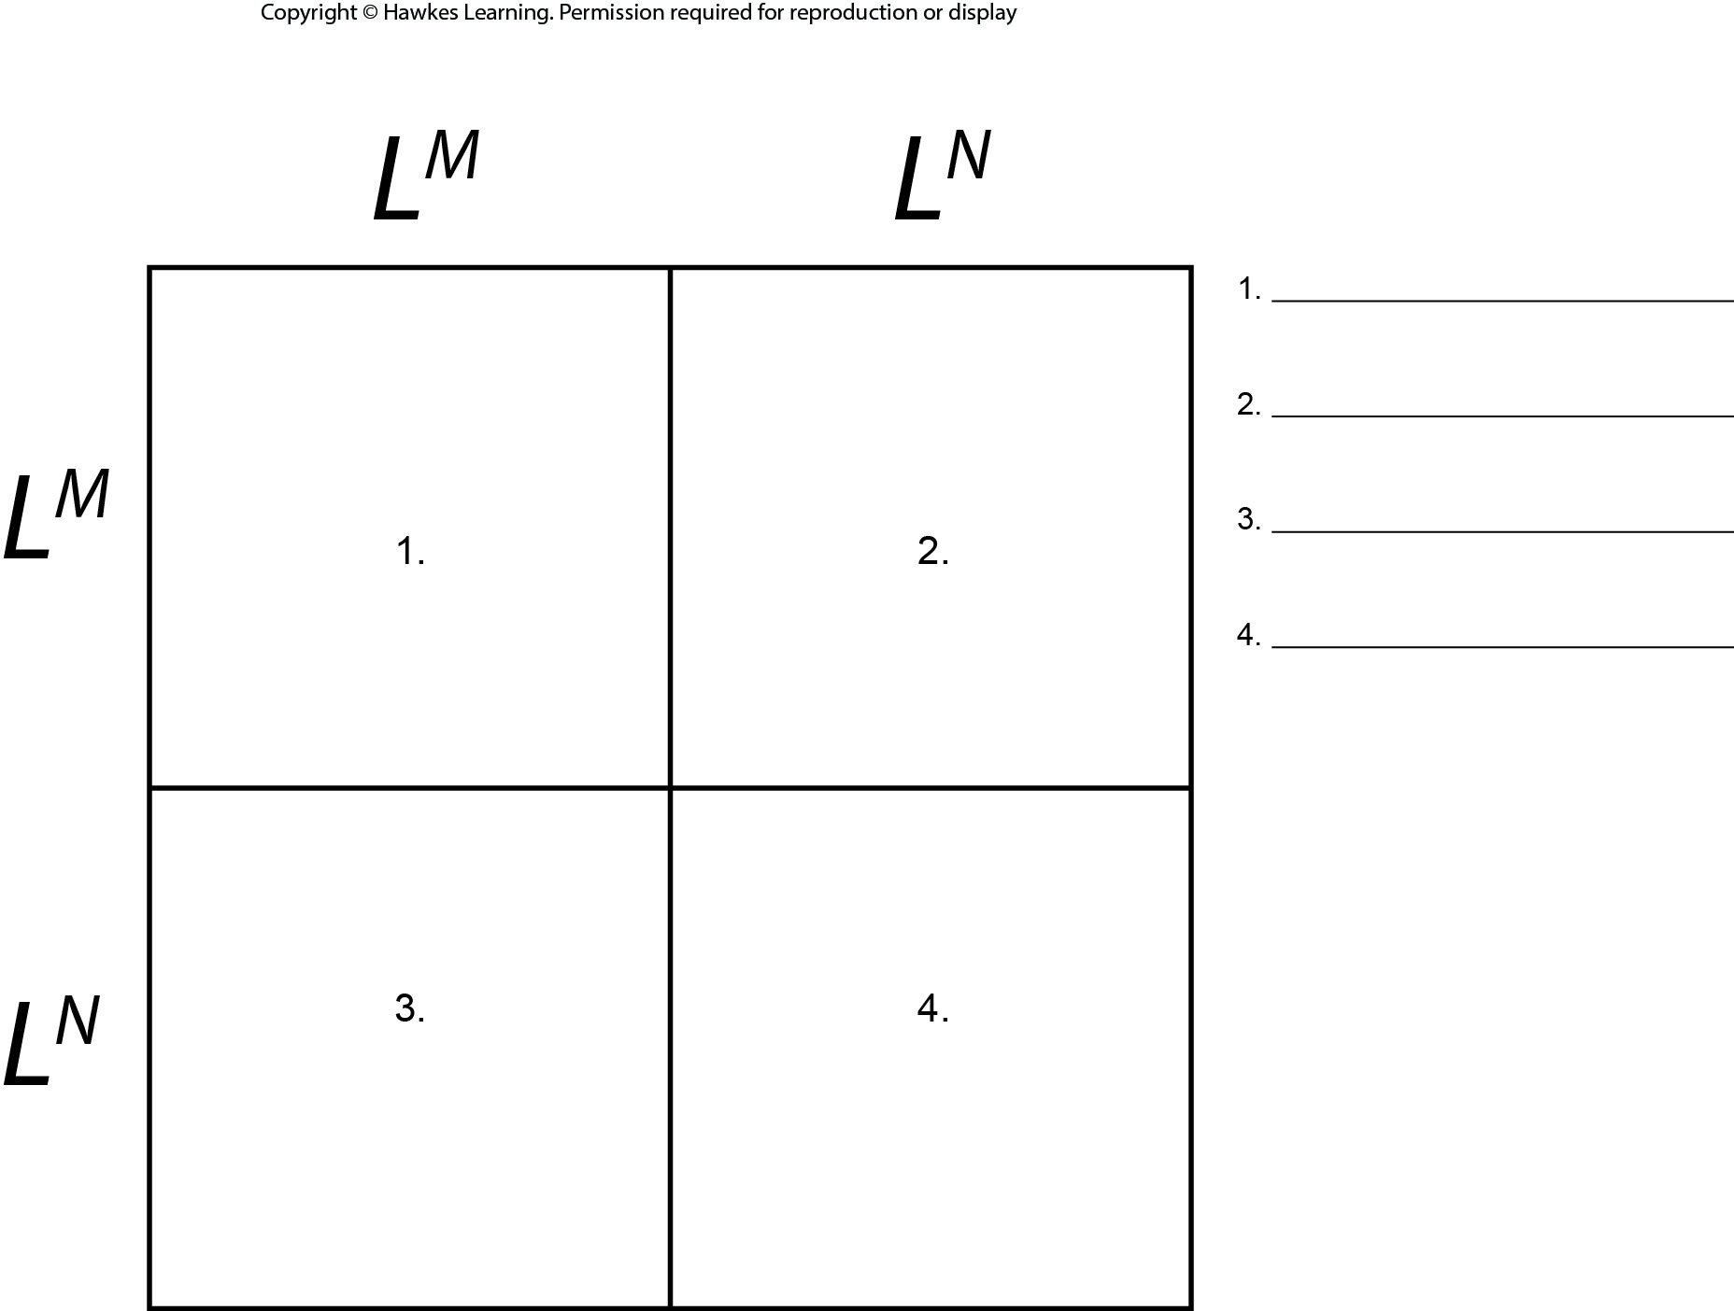
Lesson 12.2 Figure 5 - Numbered

Slide 9

Lesson 12.2 Figure 5

Slide 10
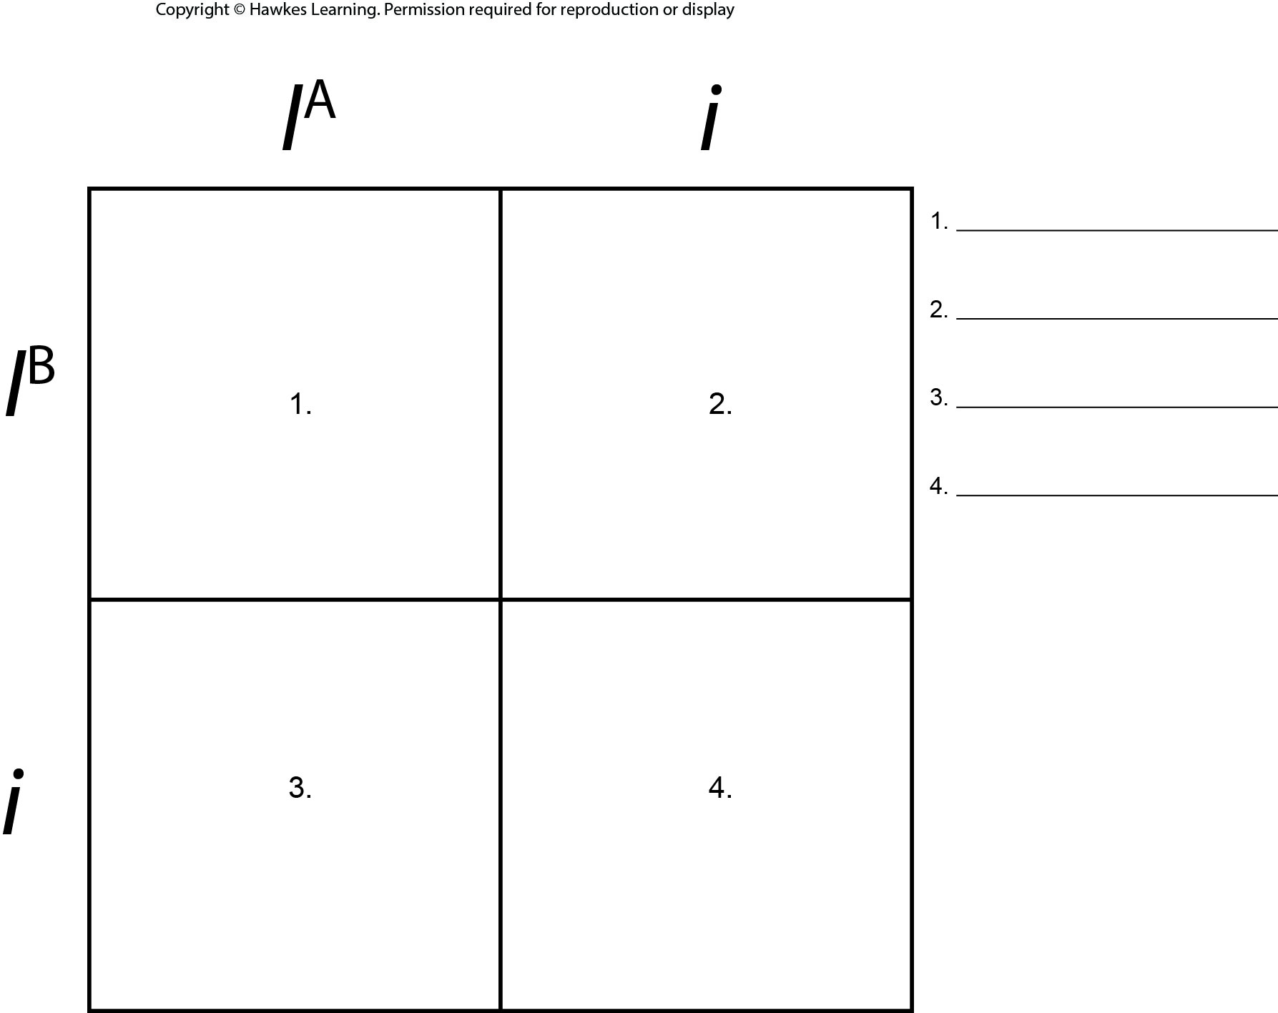
Lesson 12.2 Figure 6 - Numbered

Slide 11

Lesson 12.2 Figure 6

Slide 12
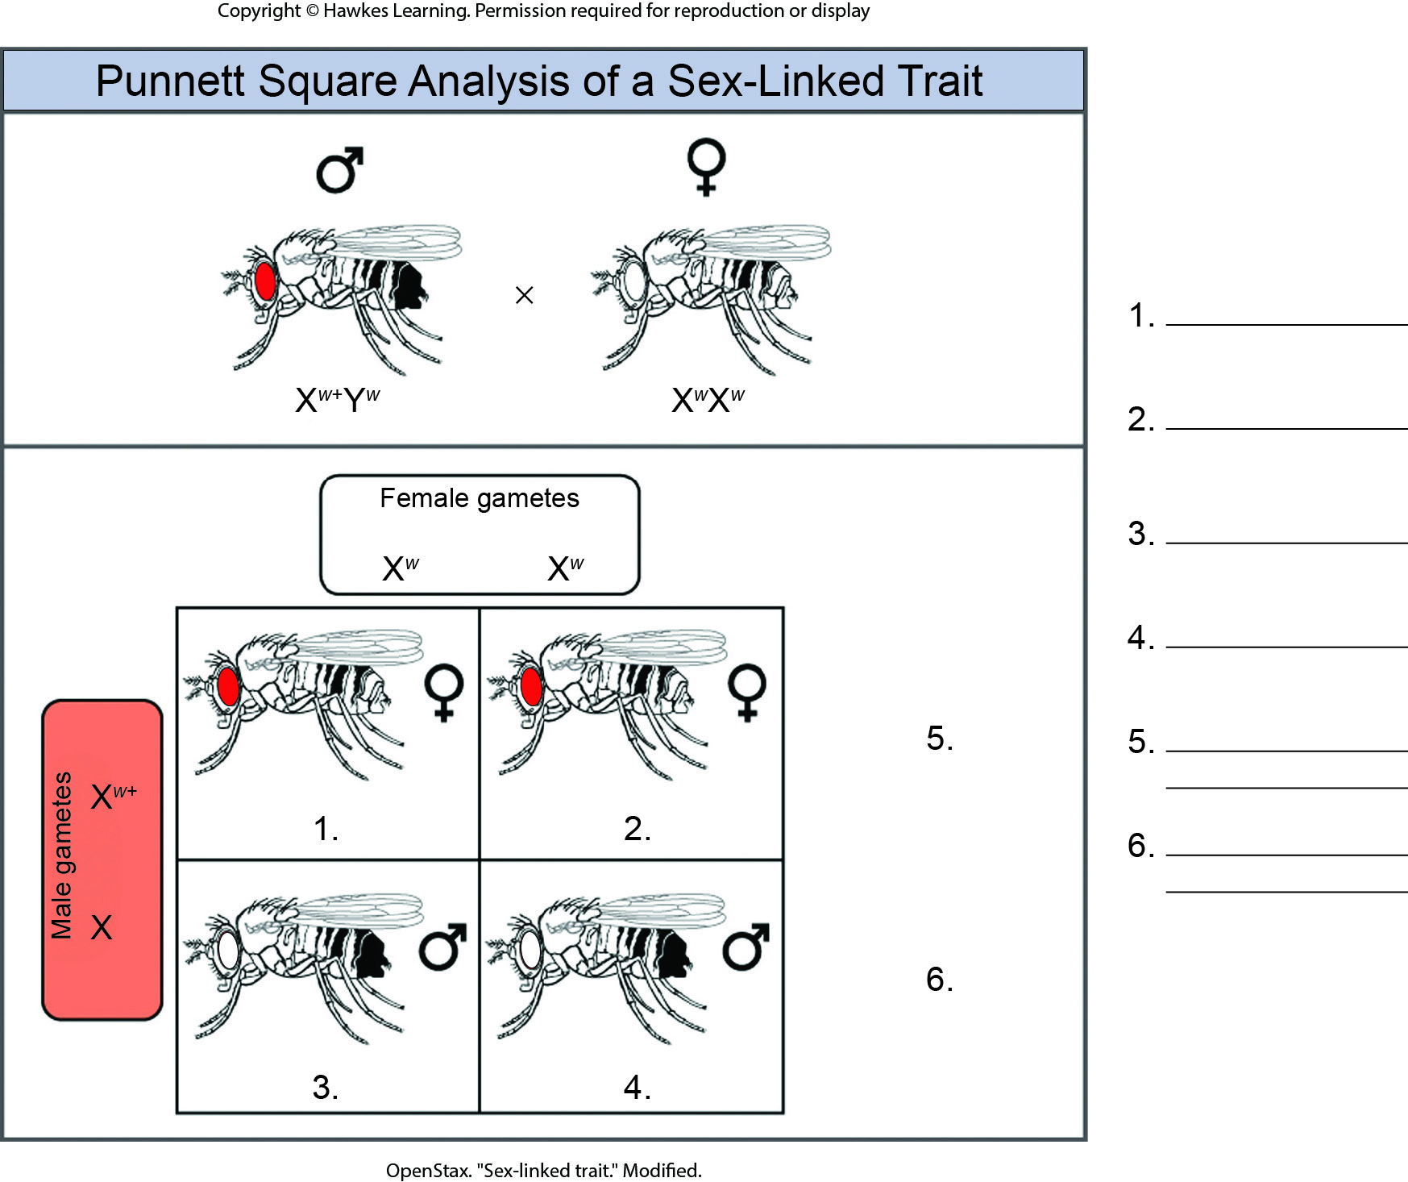
Lesson 12.2 Figure 11 - Numbered

Slide 13
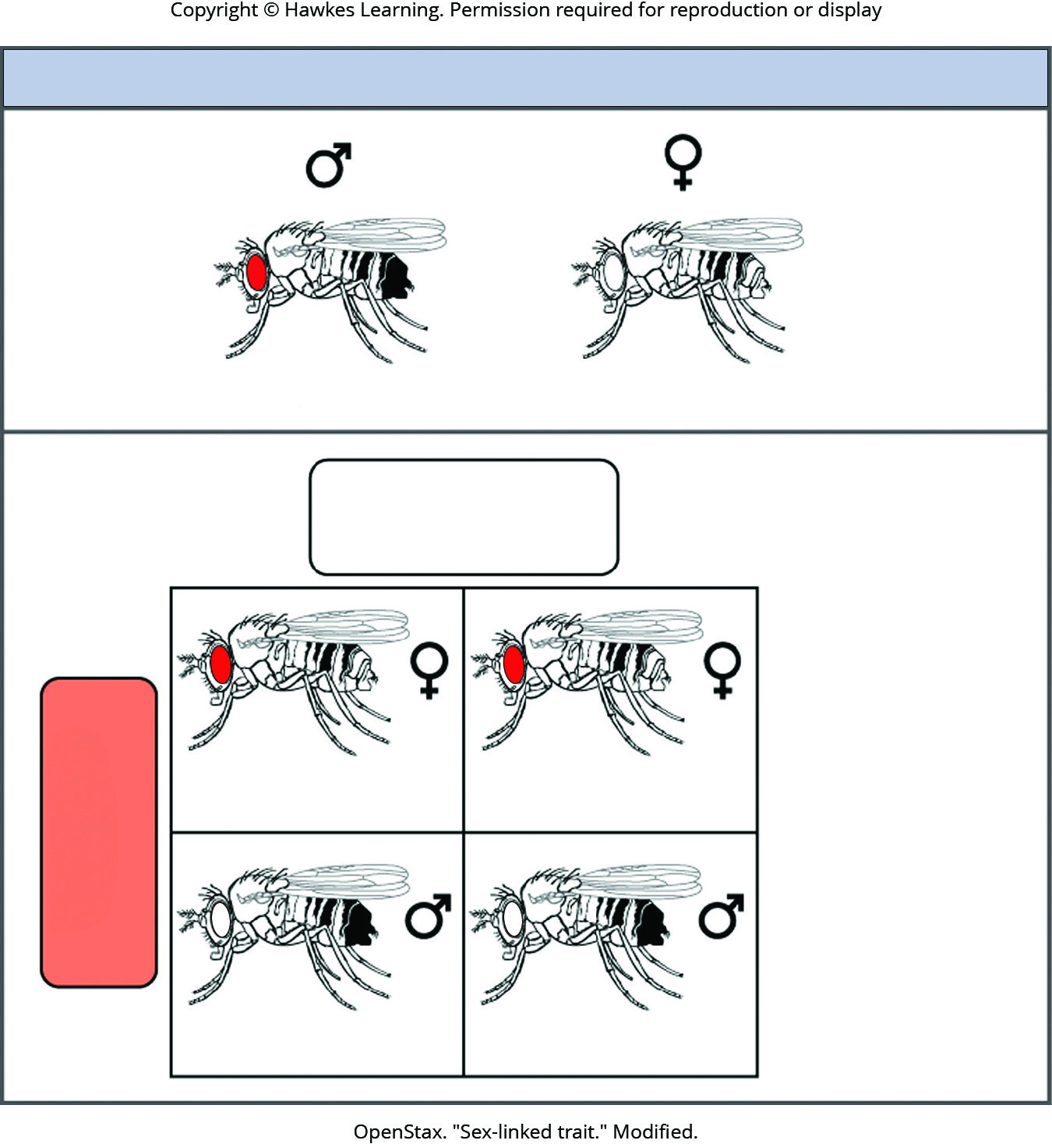
Lesson 12.2 Figure 11

Slide 14
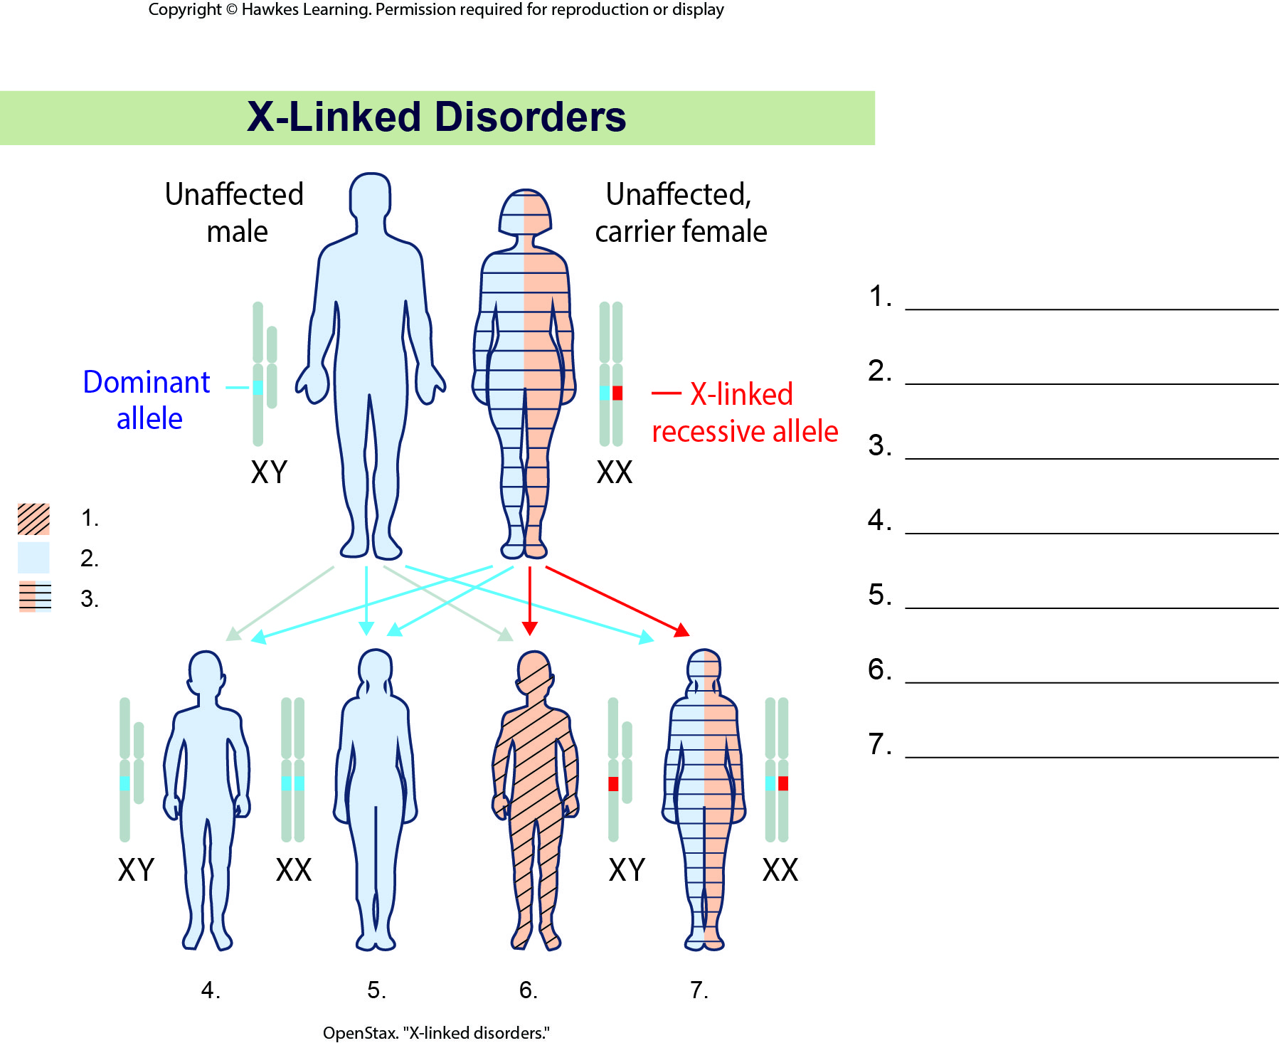
Lesson 12.2 Figure 12 - Numbered

Slide 15
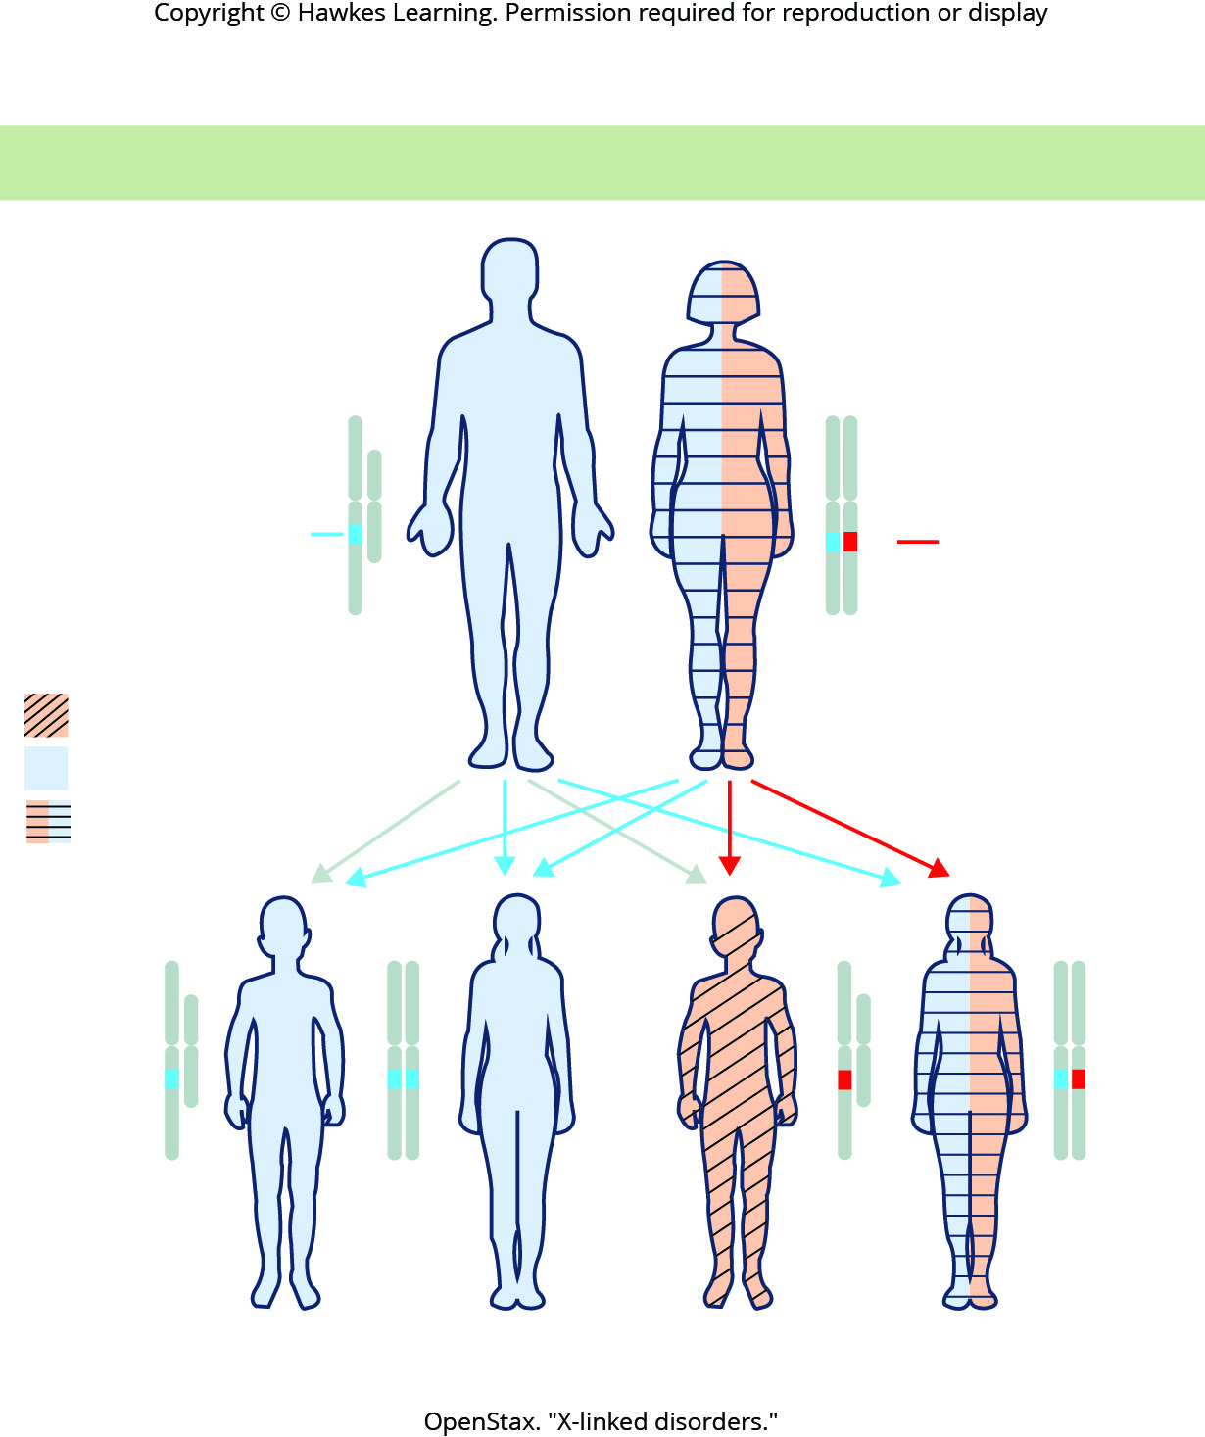
Lesson 12.2 Figure 12

Slide 16
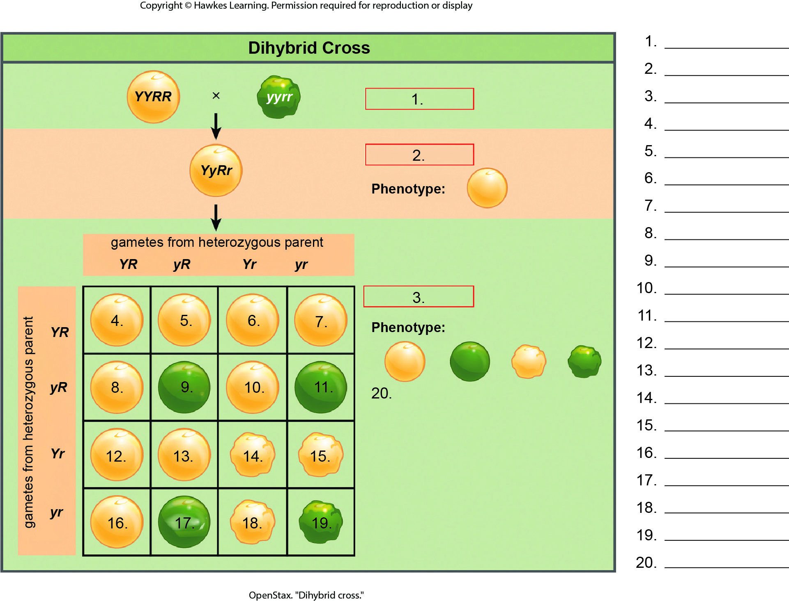
Lesson 12.3 Figure 2 - Numbered

Slide 17
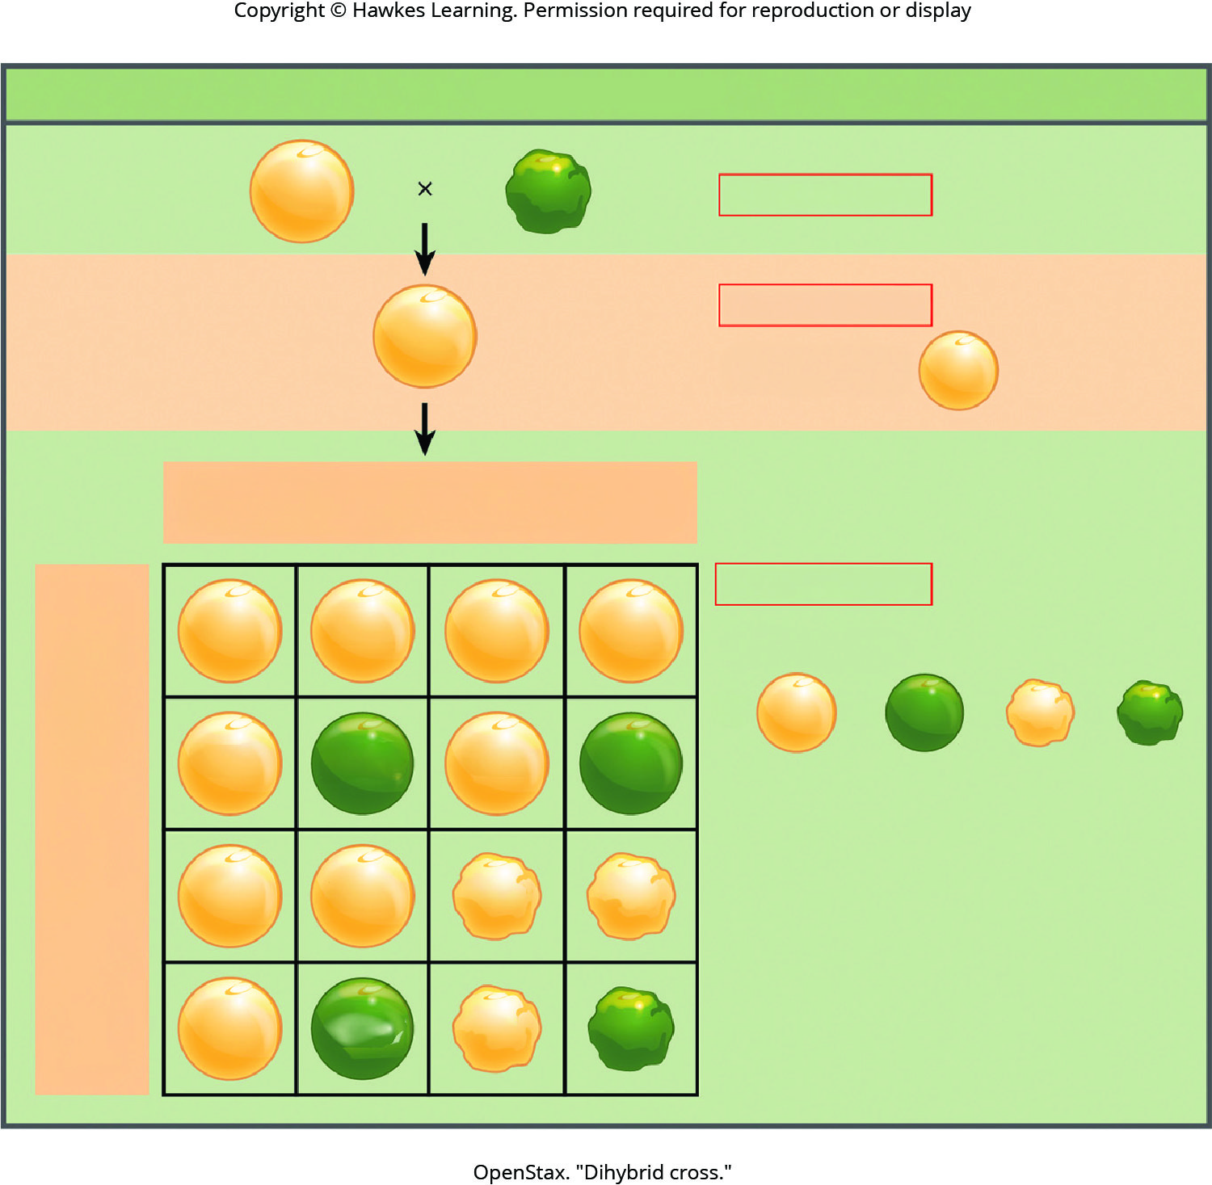
Lesson 12.3 Figure 2

Slide 18
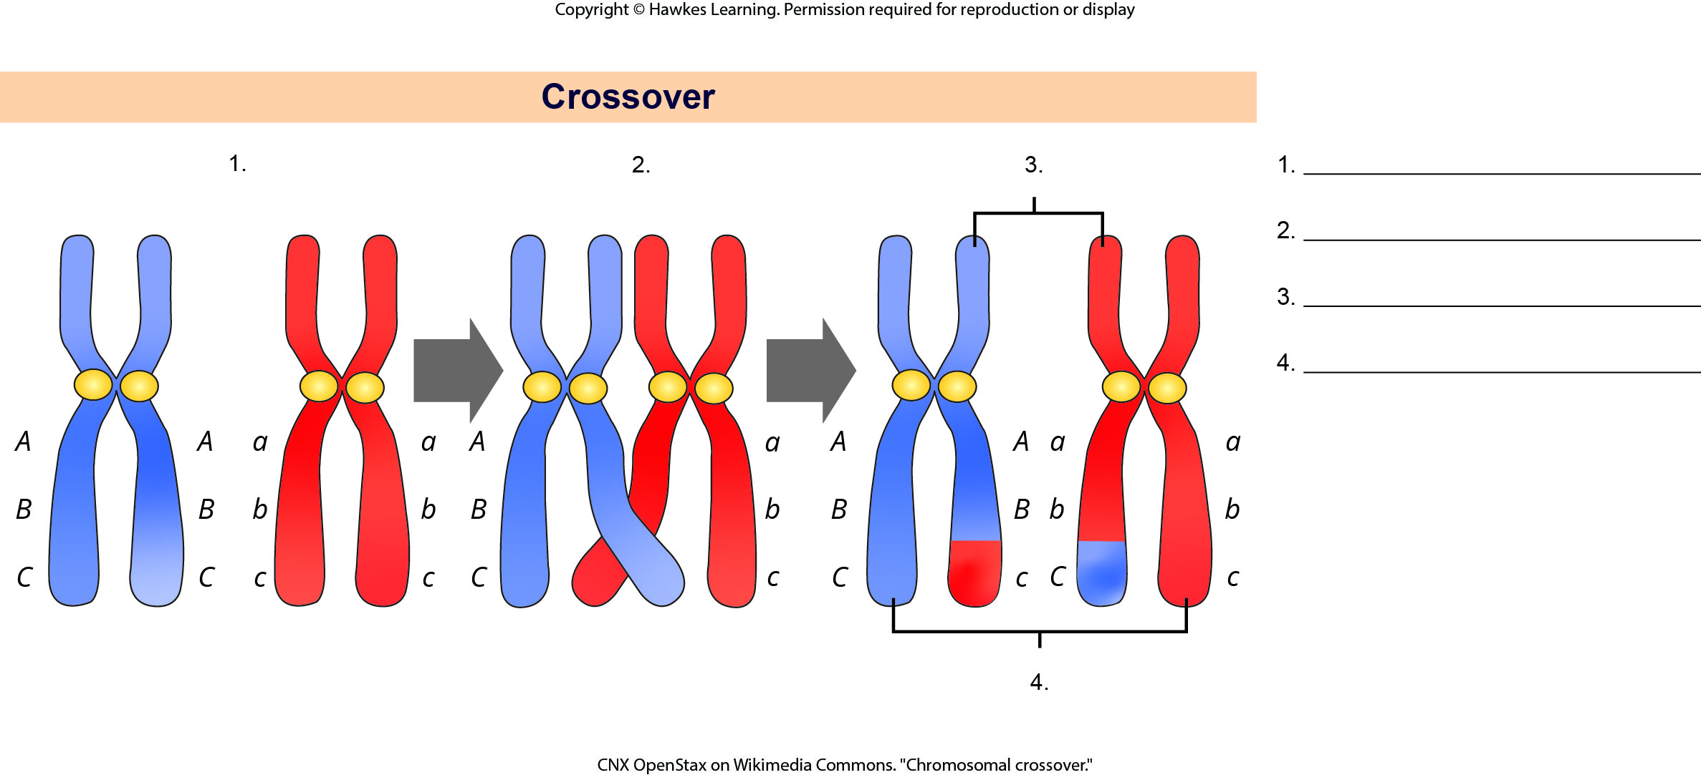
Lesson 12.3 Figure 4 - Numbered

Slide 19
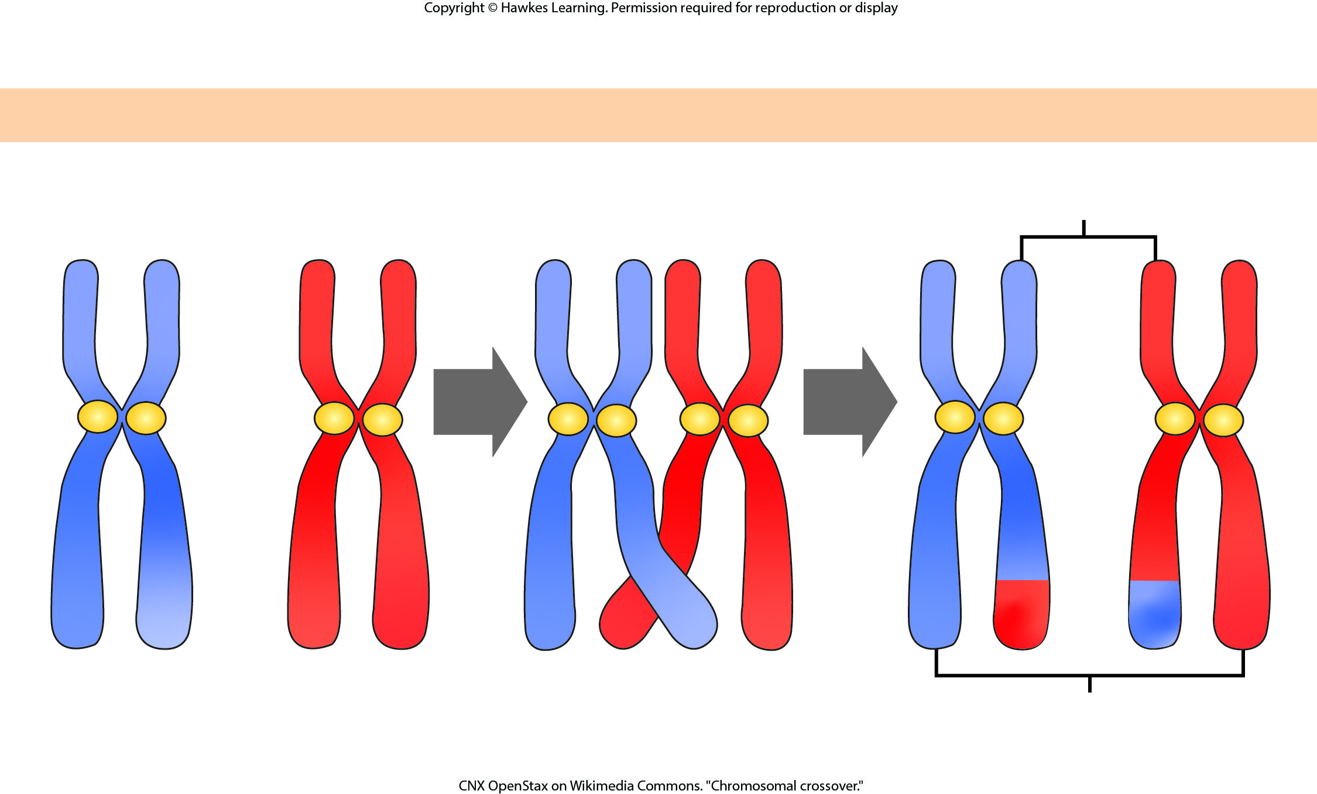
Lesson 12.3 Figure 4

Slide 20
Hawkes Learning – End of PowerPoint

