Slide 1
Chapter 13
Modern Genetics and Inheritance

Slide 2
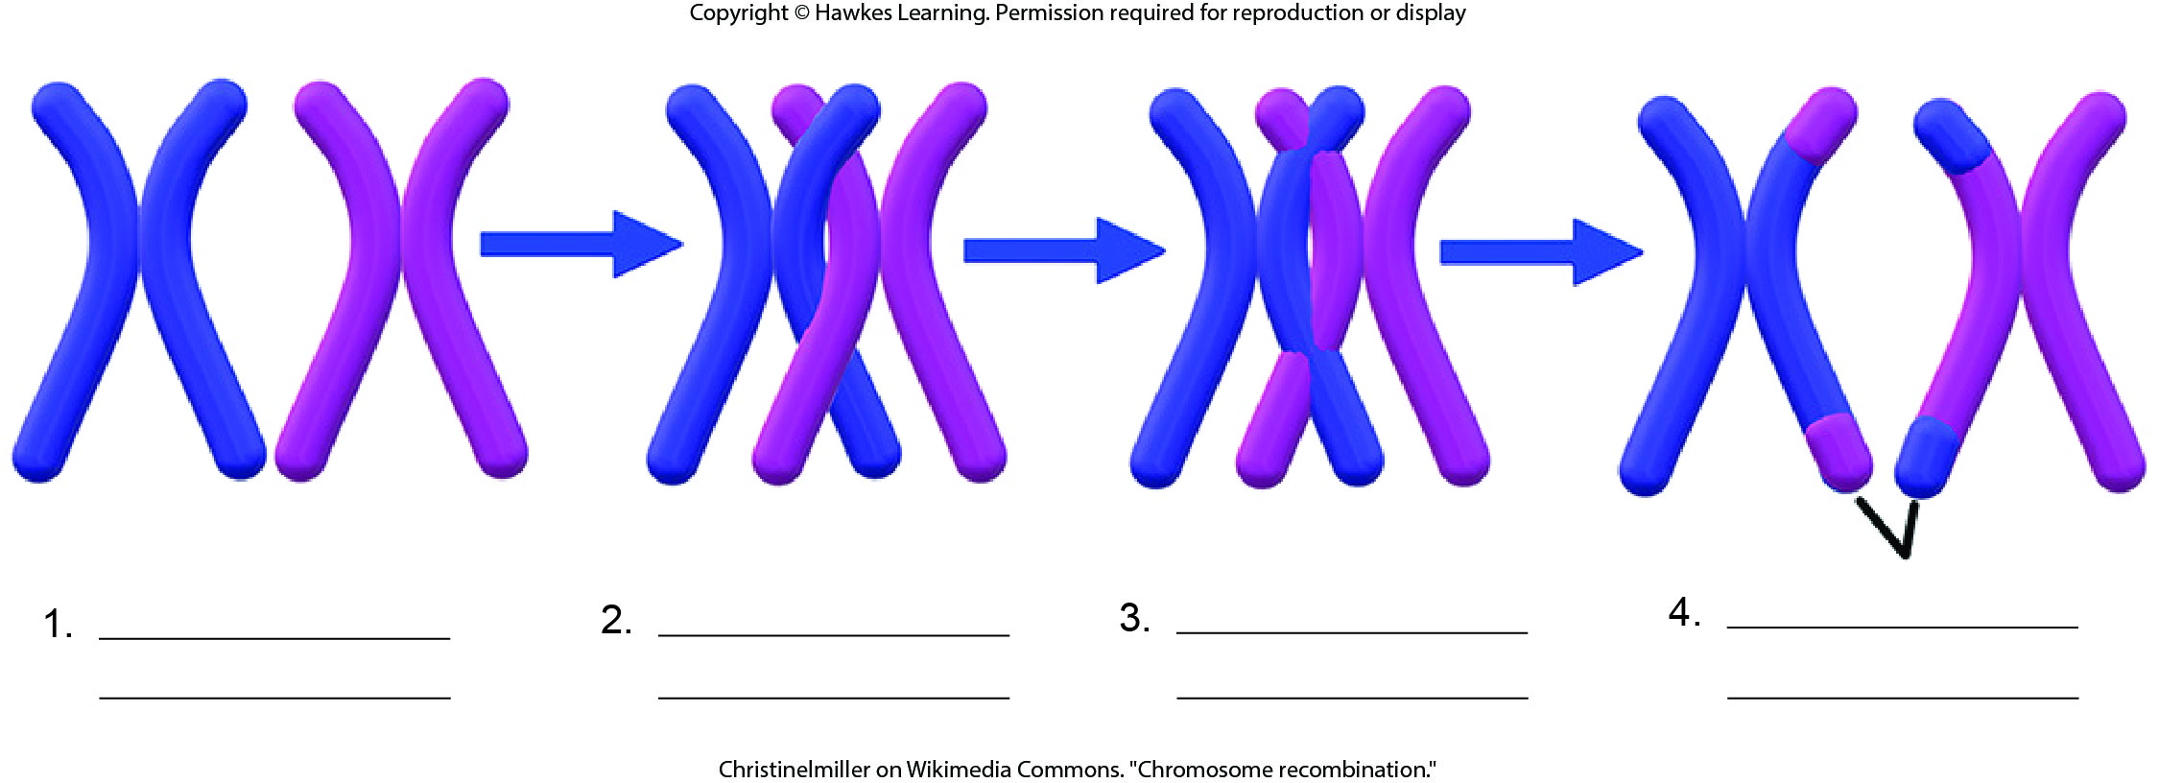
Lesson 13.1 Figure 4 - Numbered

Slide 3
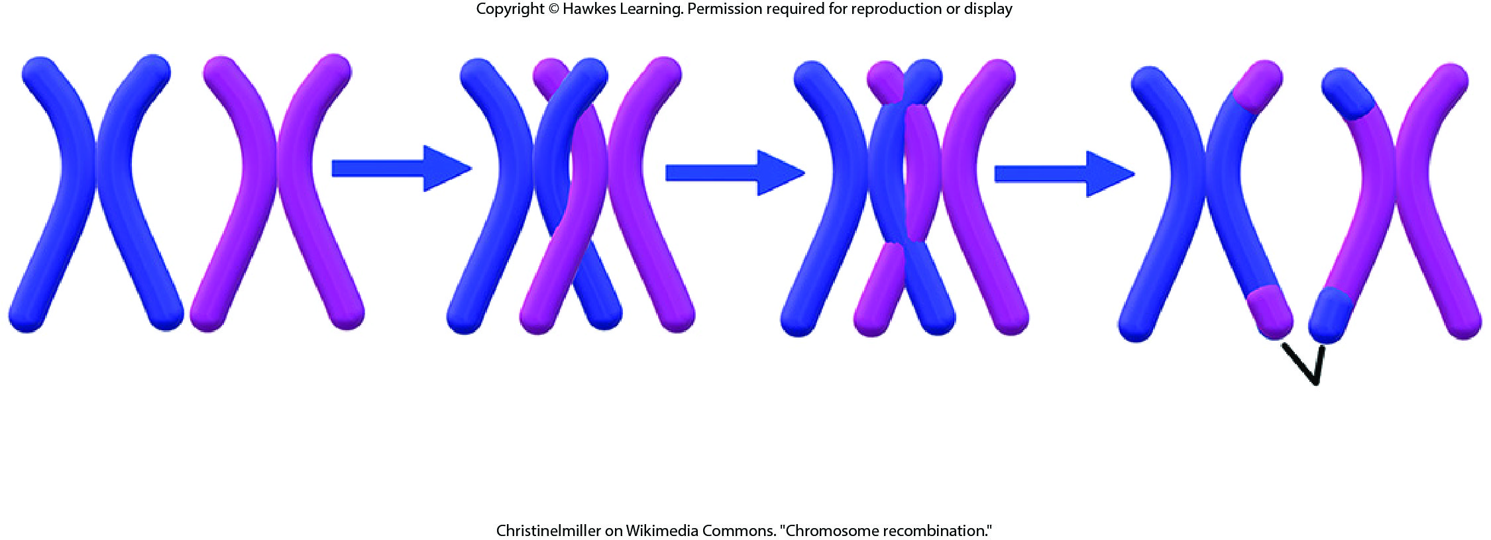
Lesson 13.1 Figure 4

Slide 4
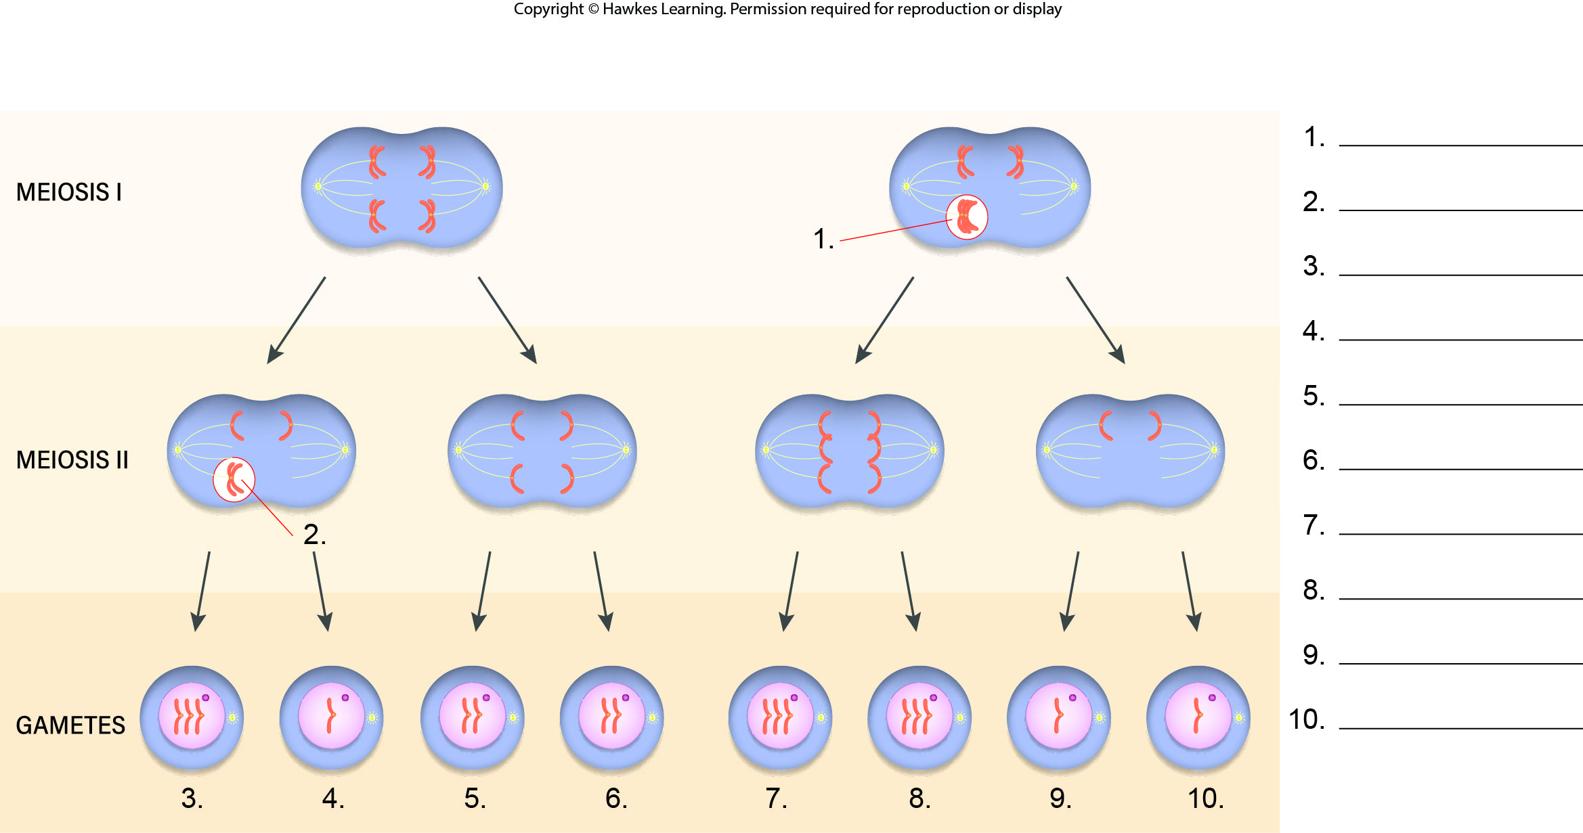
Lesson 13.2 Figure 3 - Numbered

Slide 5
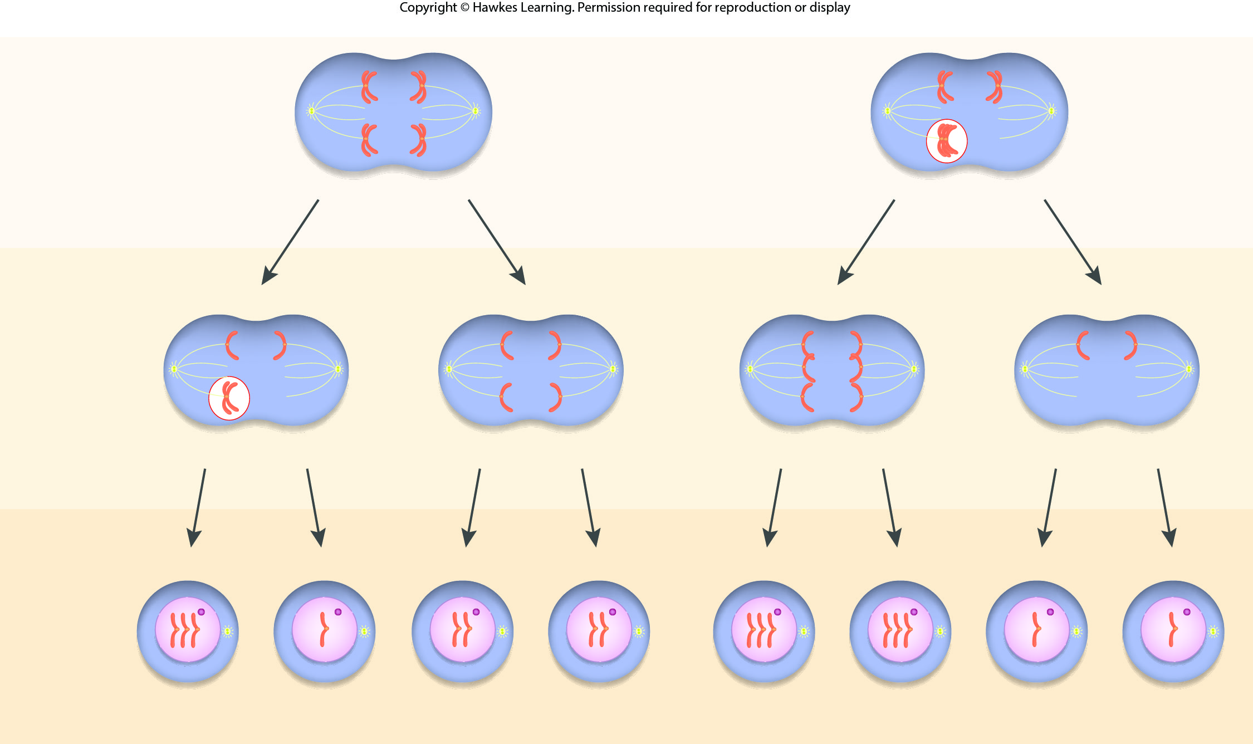
Lesson 13.2 Figure 3

Slide 6
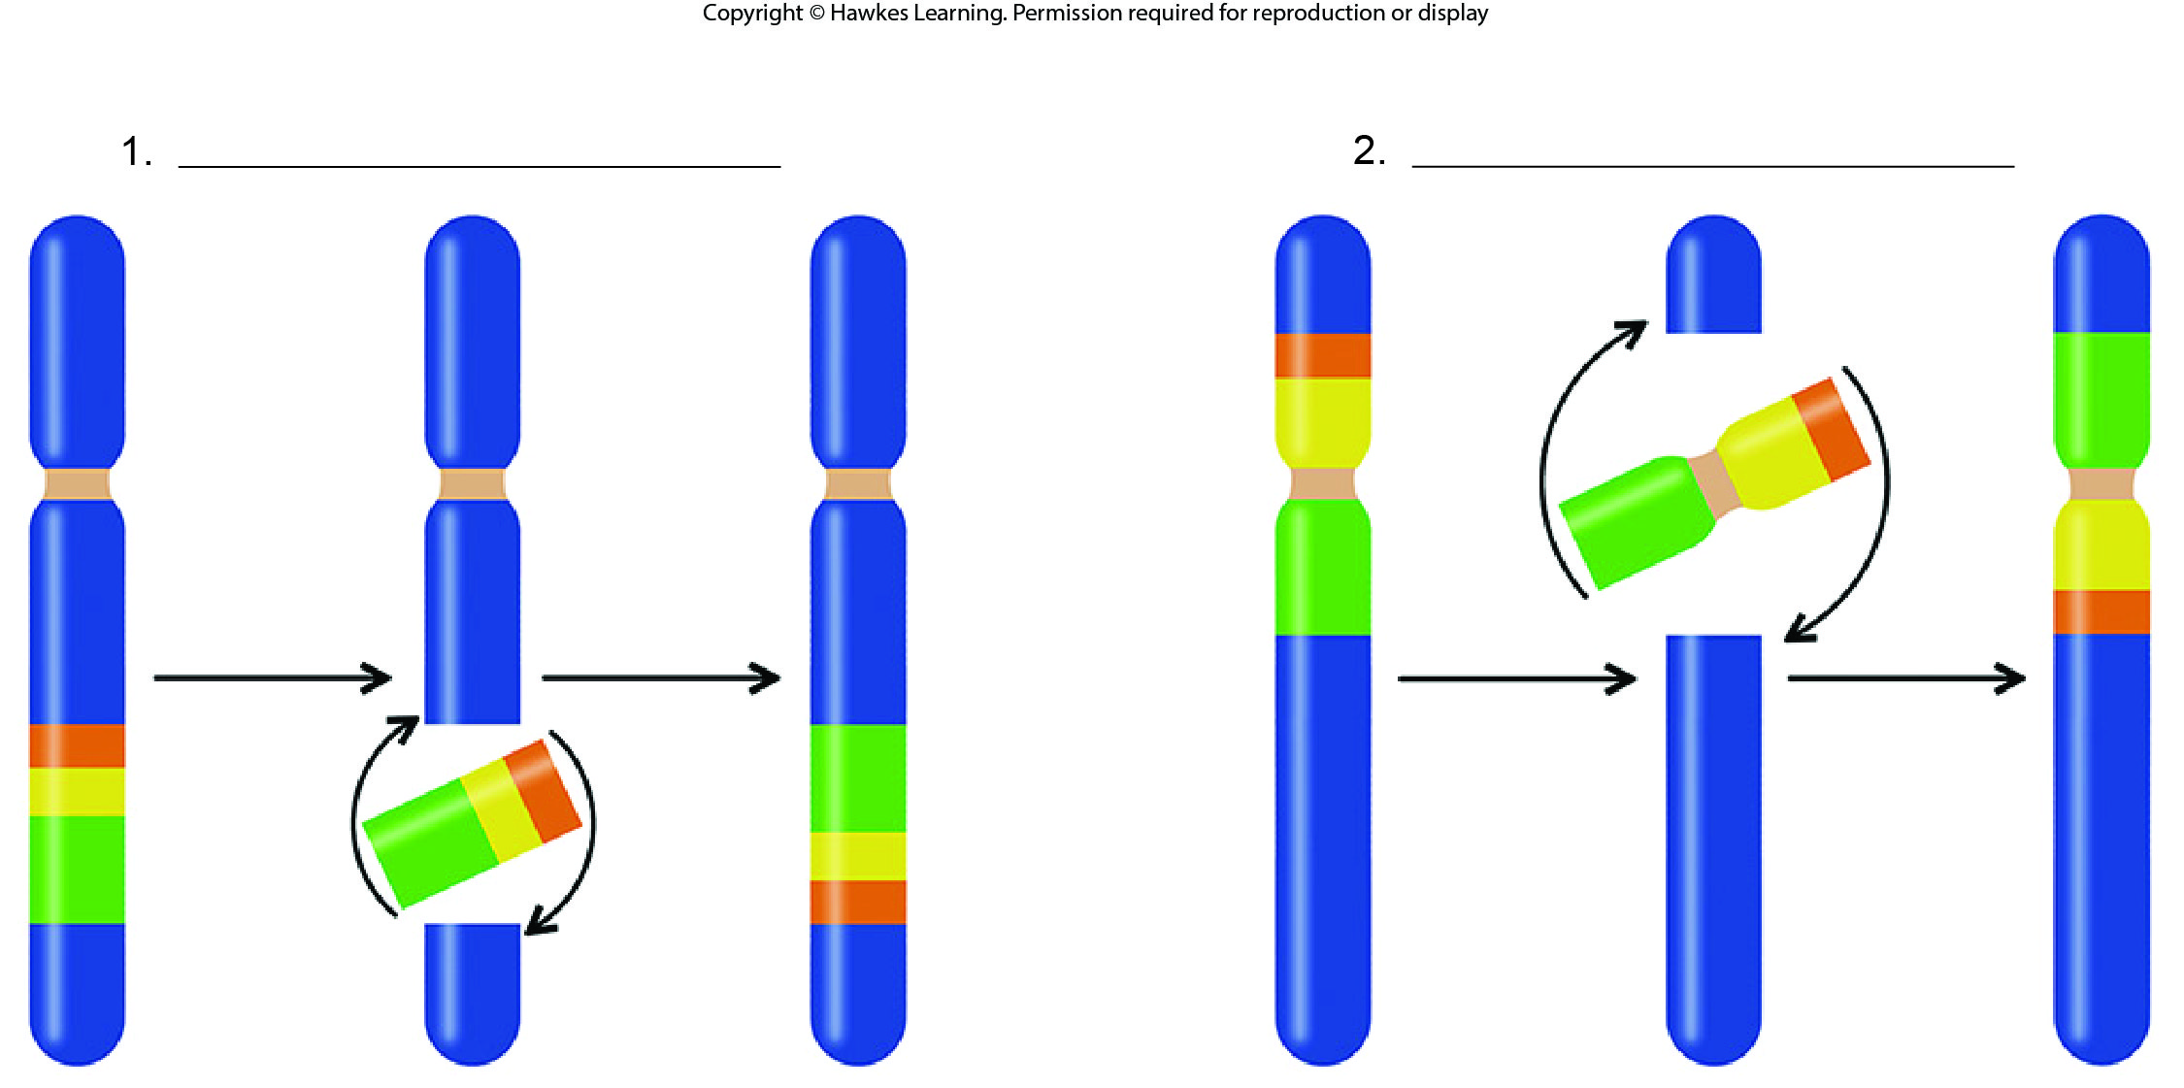
Lesson 13.2 Figure 10 - Numbered

Slide 7

Lesson 13.2 Figure 10

Slide 8
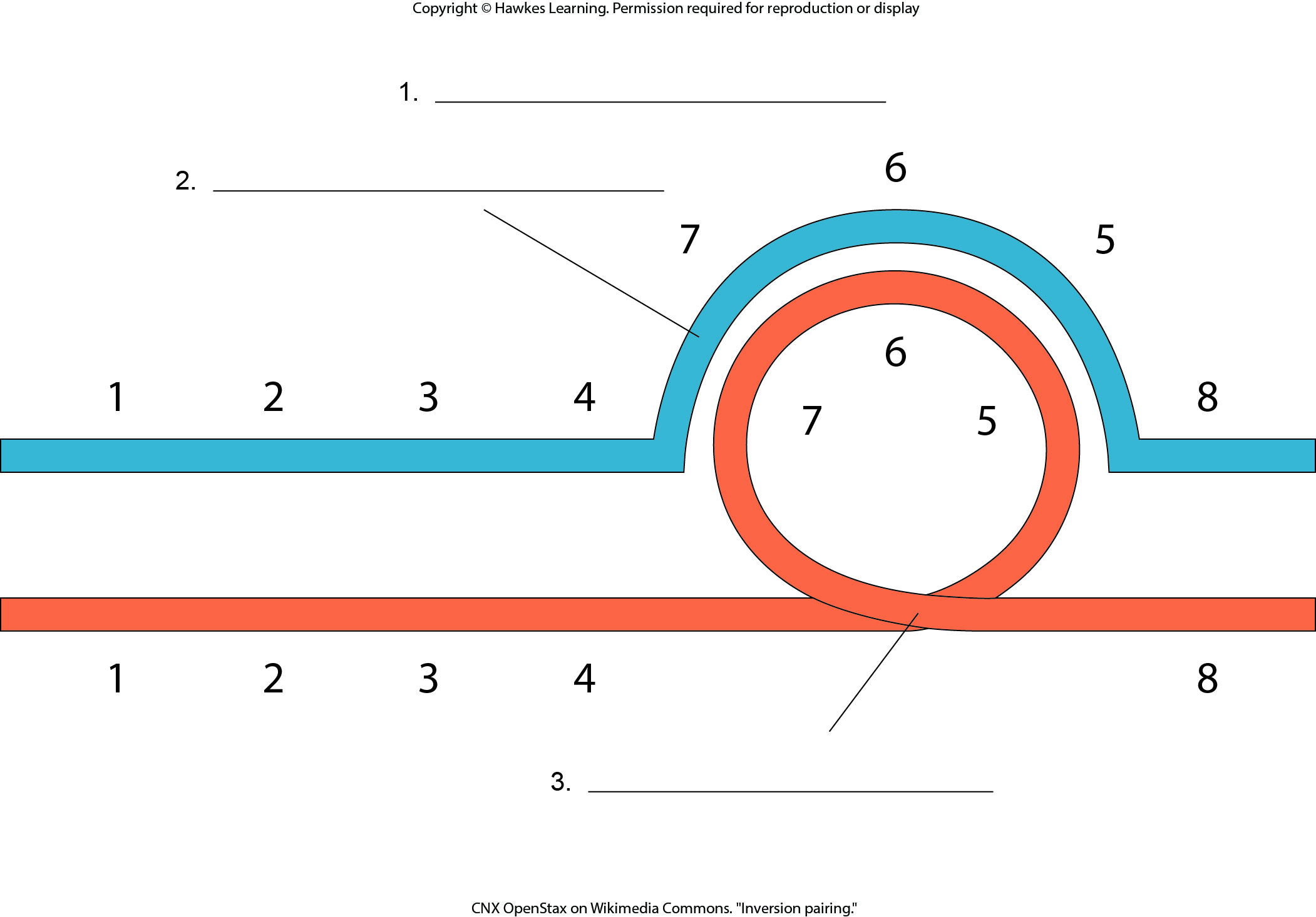
Lesson 13.2 Figure 11 - Numbered

Slide 9

Lesson 13.2 Figure 11

Slide 10
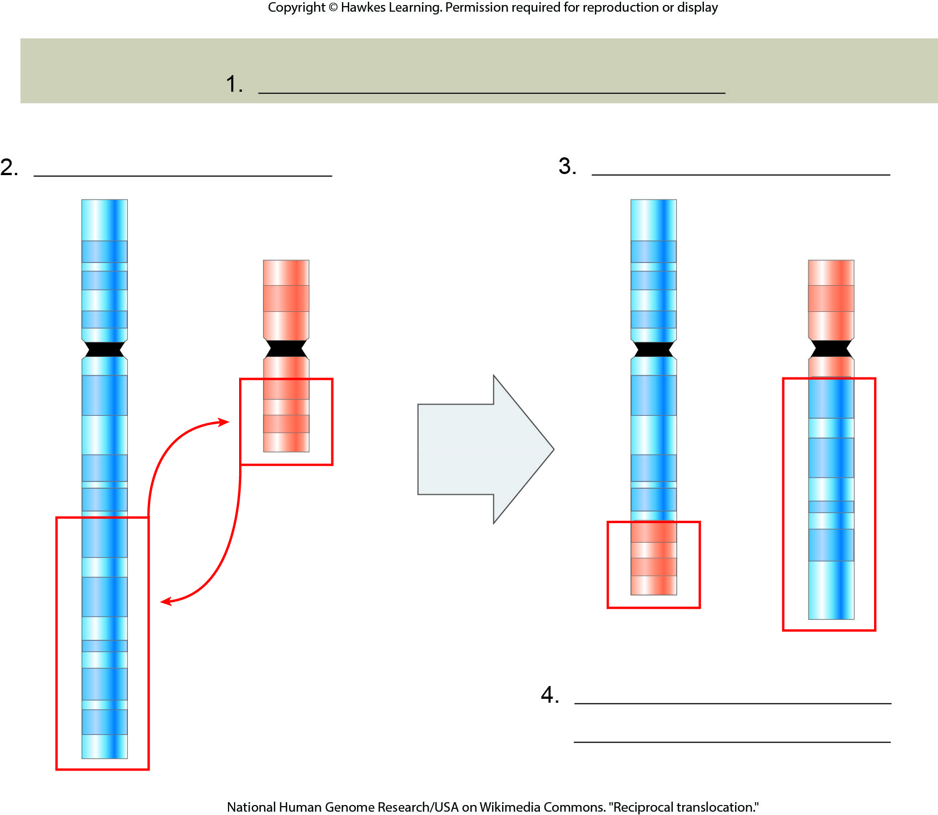
Lesson 13.2 Figure 12 - Numbered

Slide 11
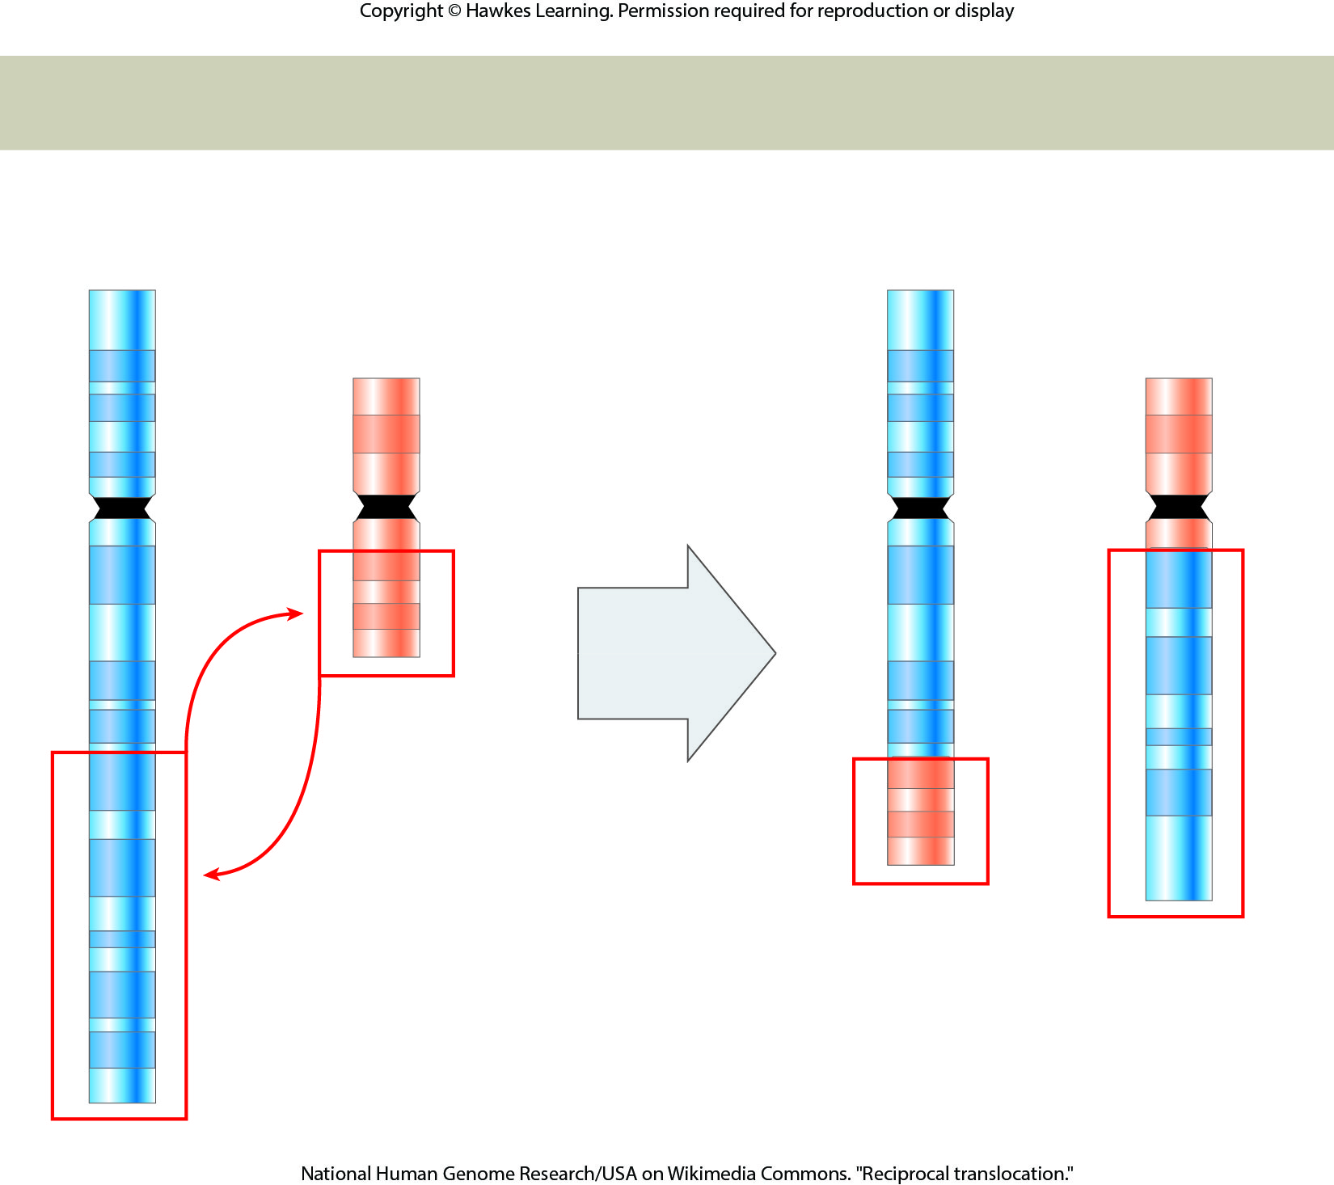
Lesson 13.2 Figure 12

Slide 12
Hawkes Learning – End of PowerPoint

