Slide 1
Chapter 15
Genes and Proteins

Slide 2
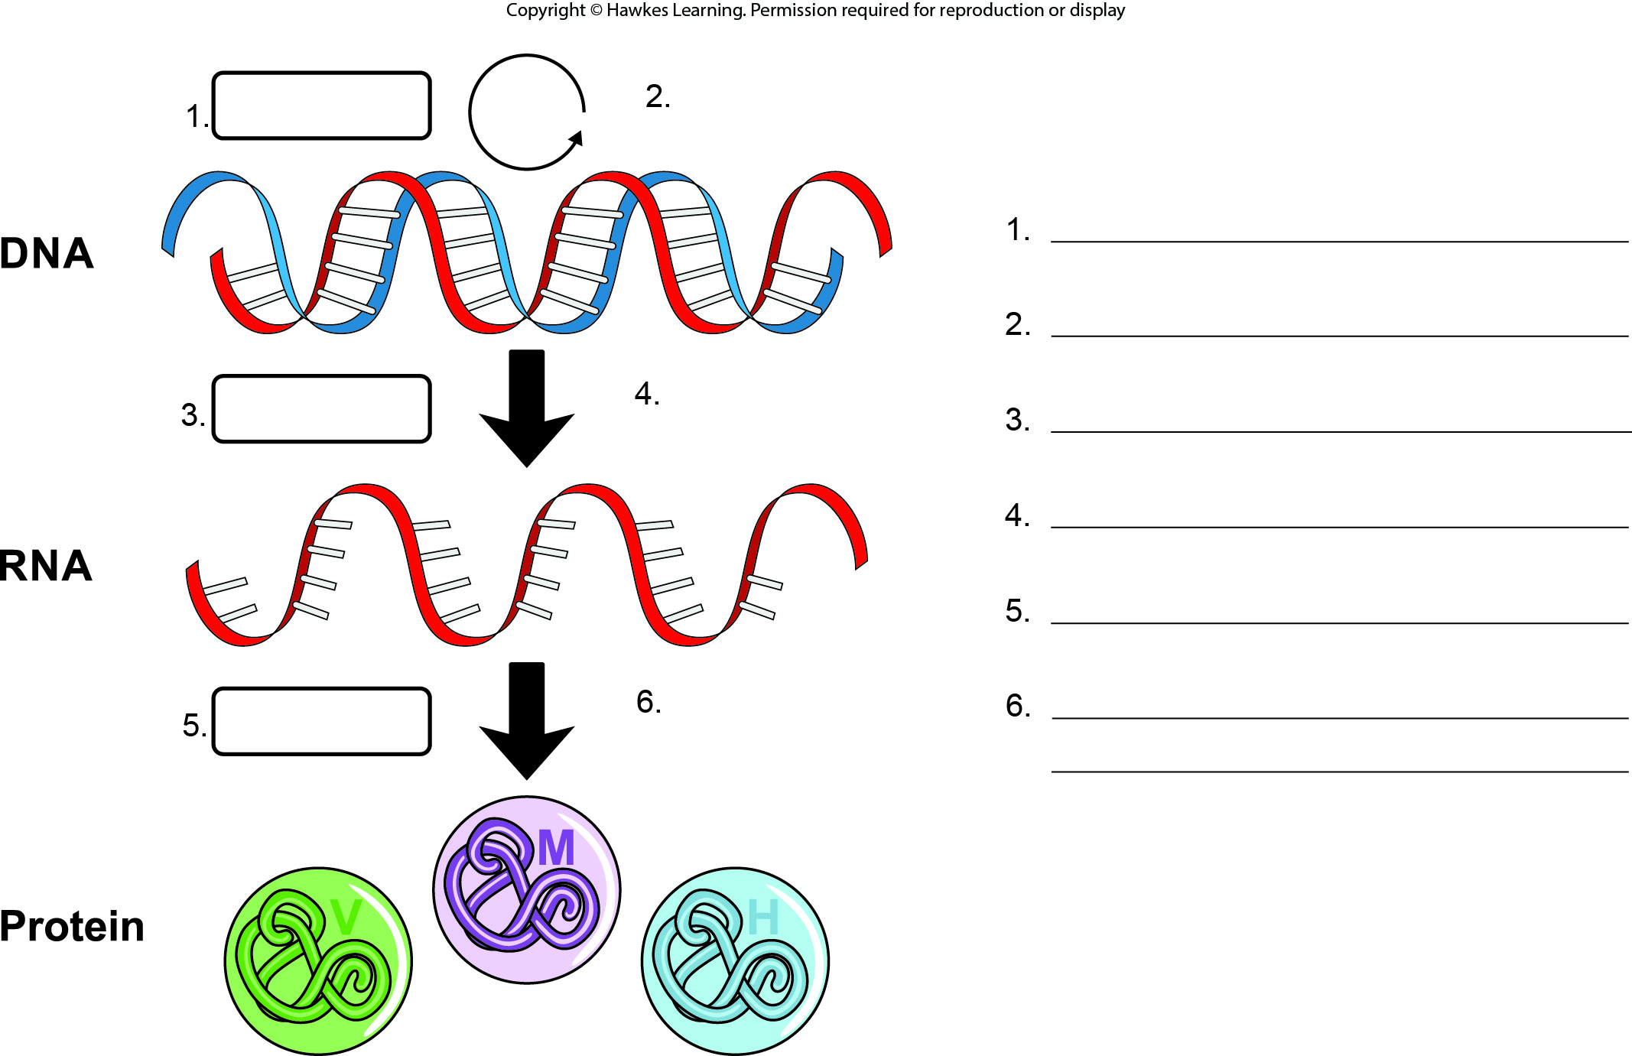
Lesson 15.1 Figure 1 - Numbered

Slide 3
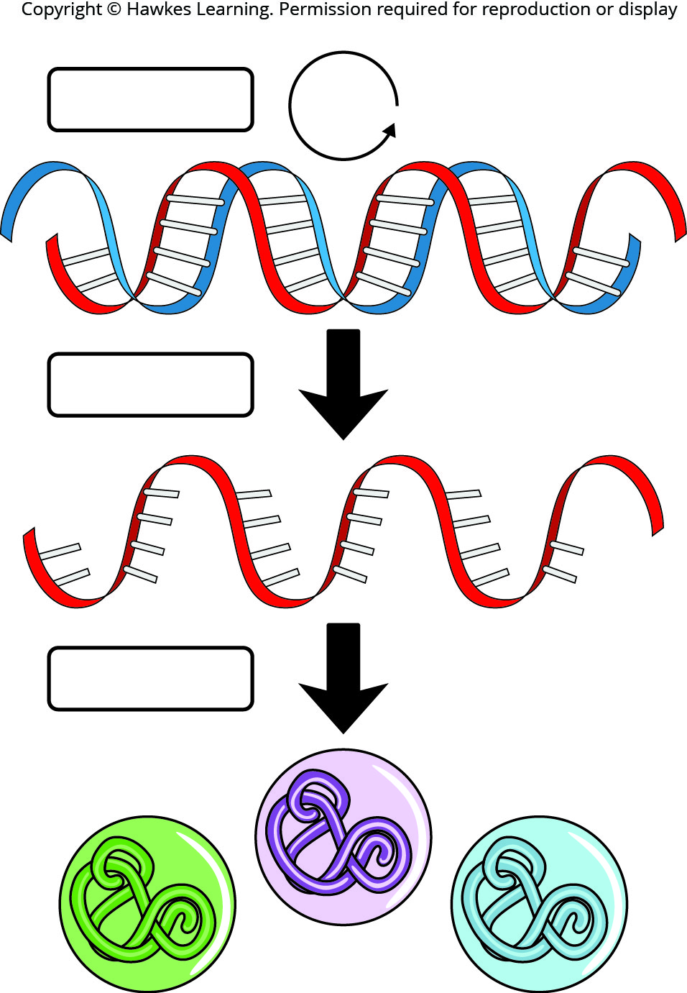
Lesson 15.1 Figure 1

Slide 4
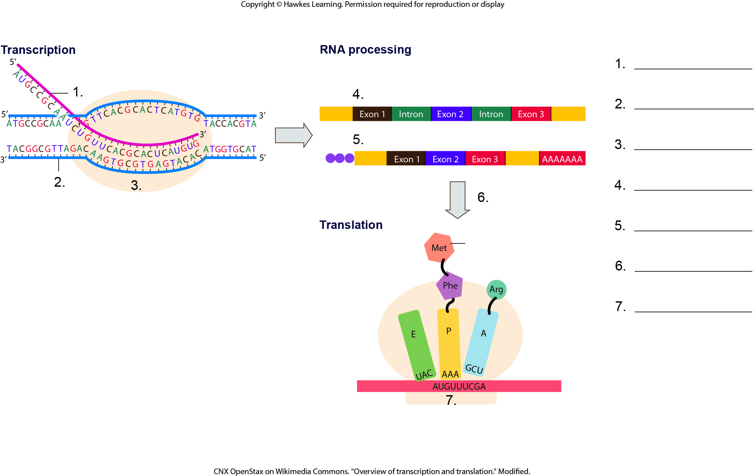
Lesson 15.1 Figure 3 - Numbered

Slide 5
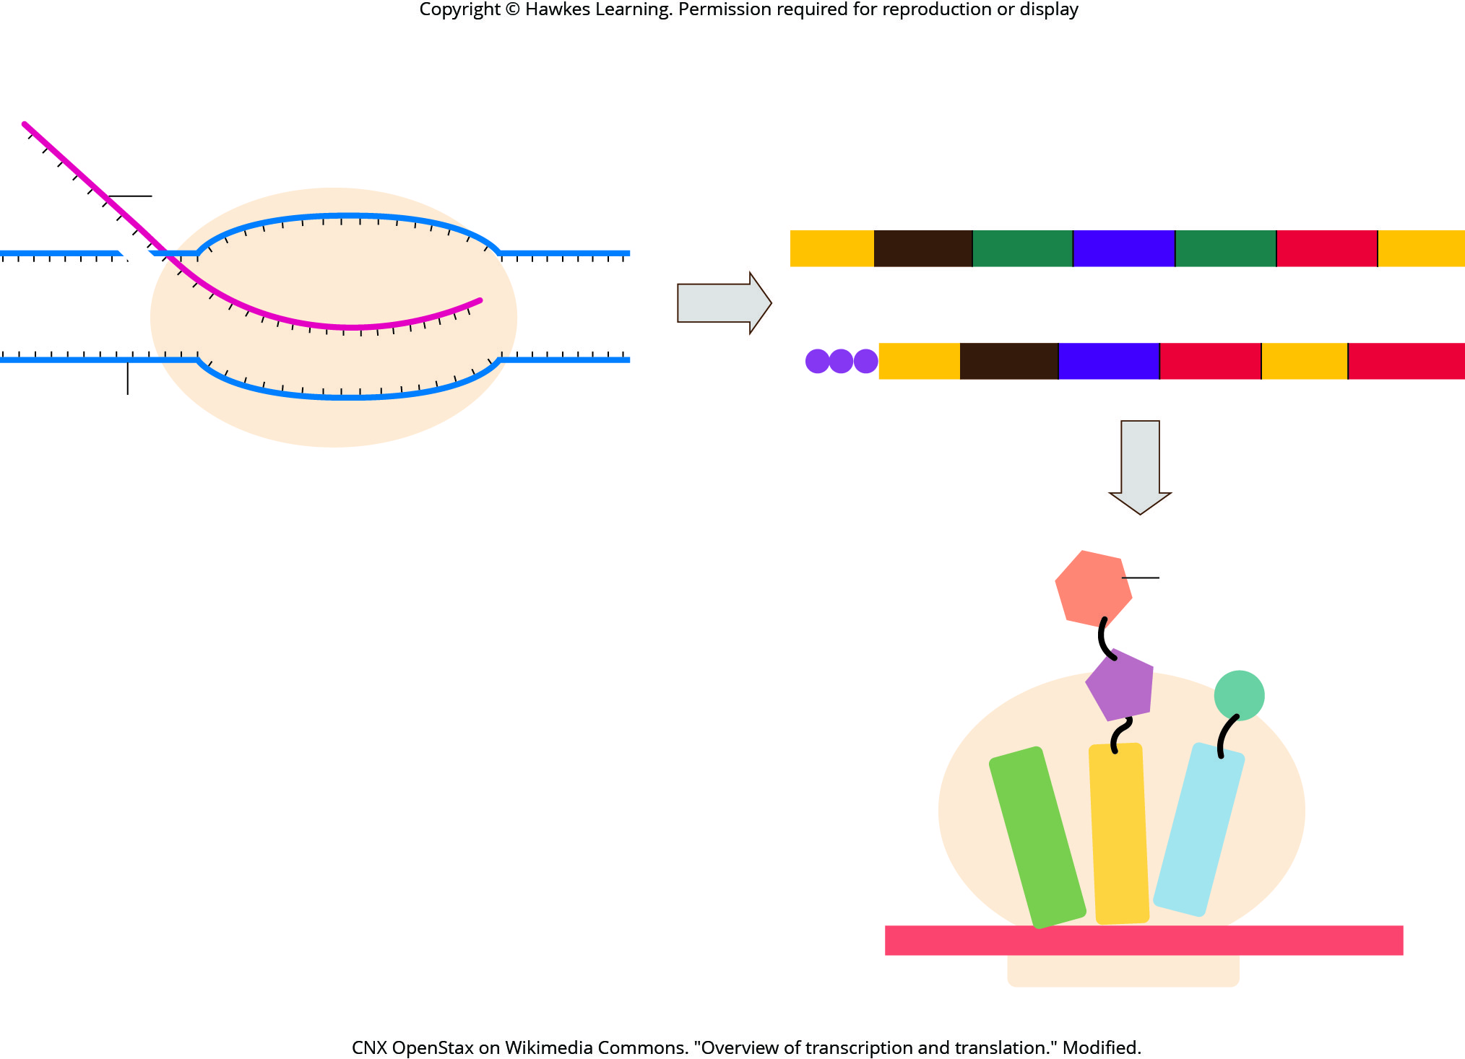
Lesson 15.1 Figure 3

Slide 6
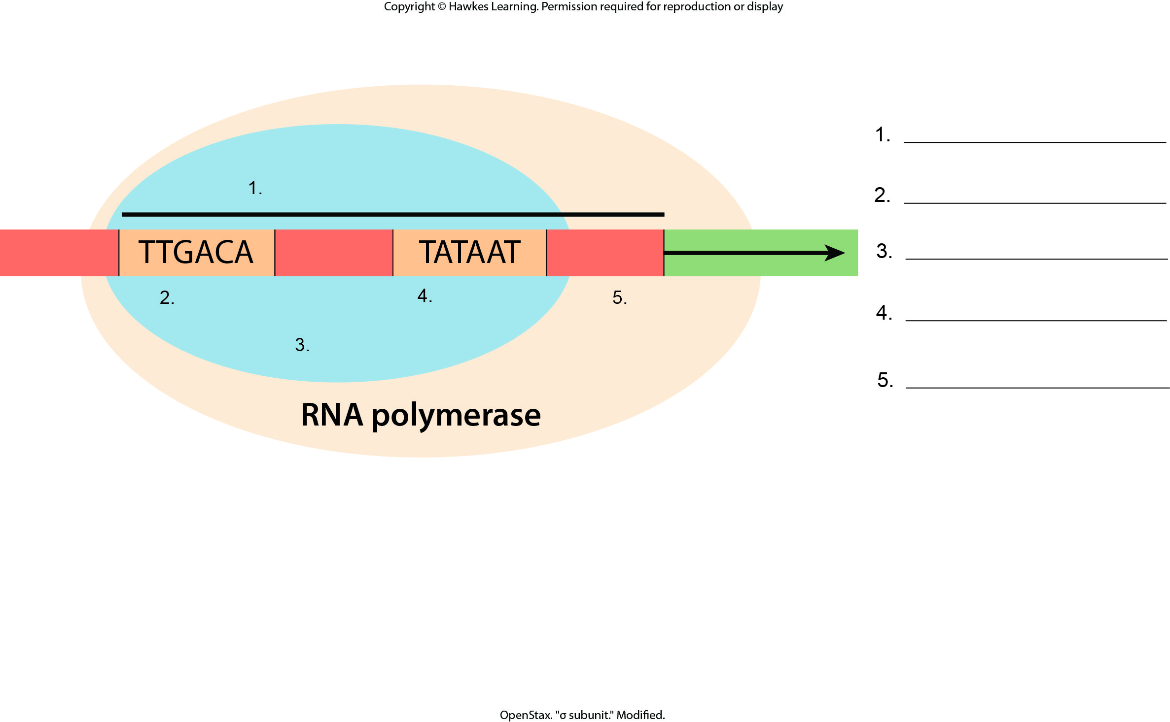
Lesson 15.2 Figure 3 - Numbered

Slide 7
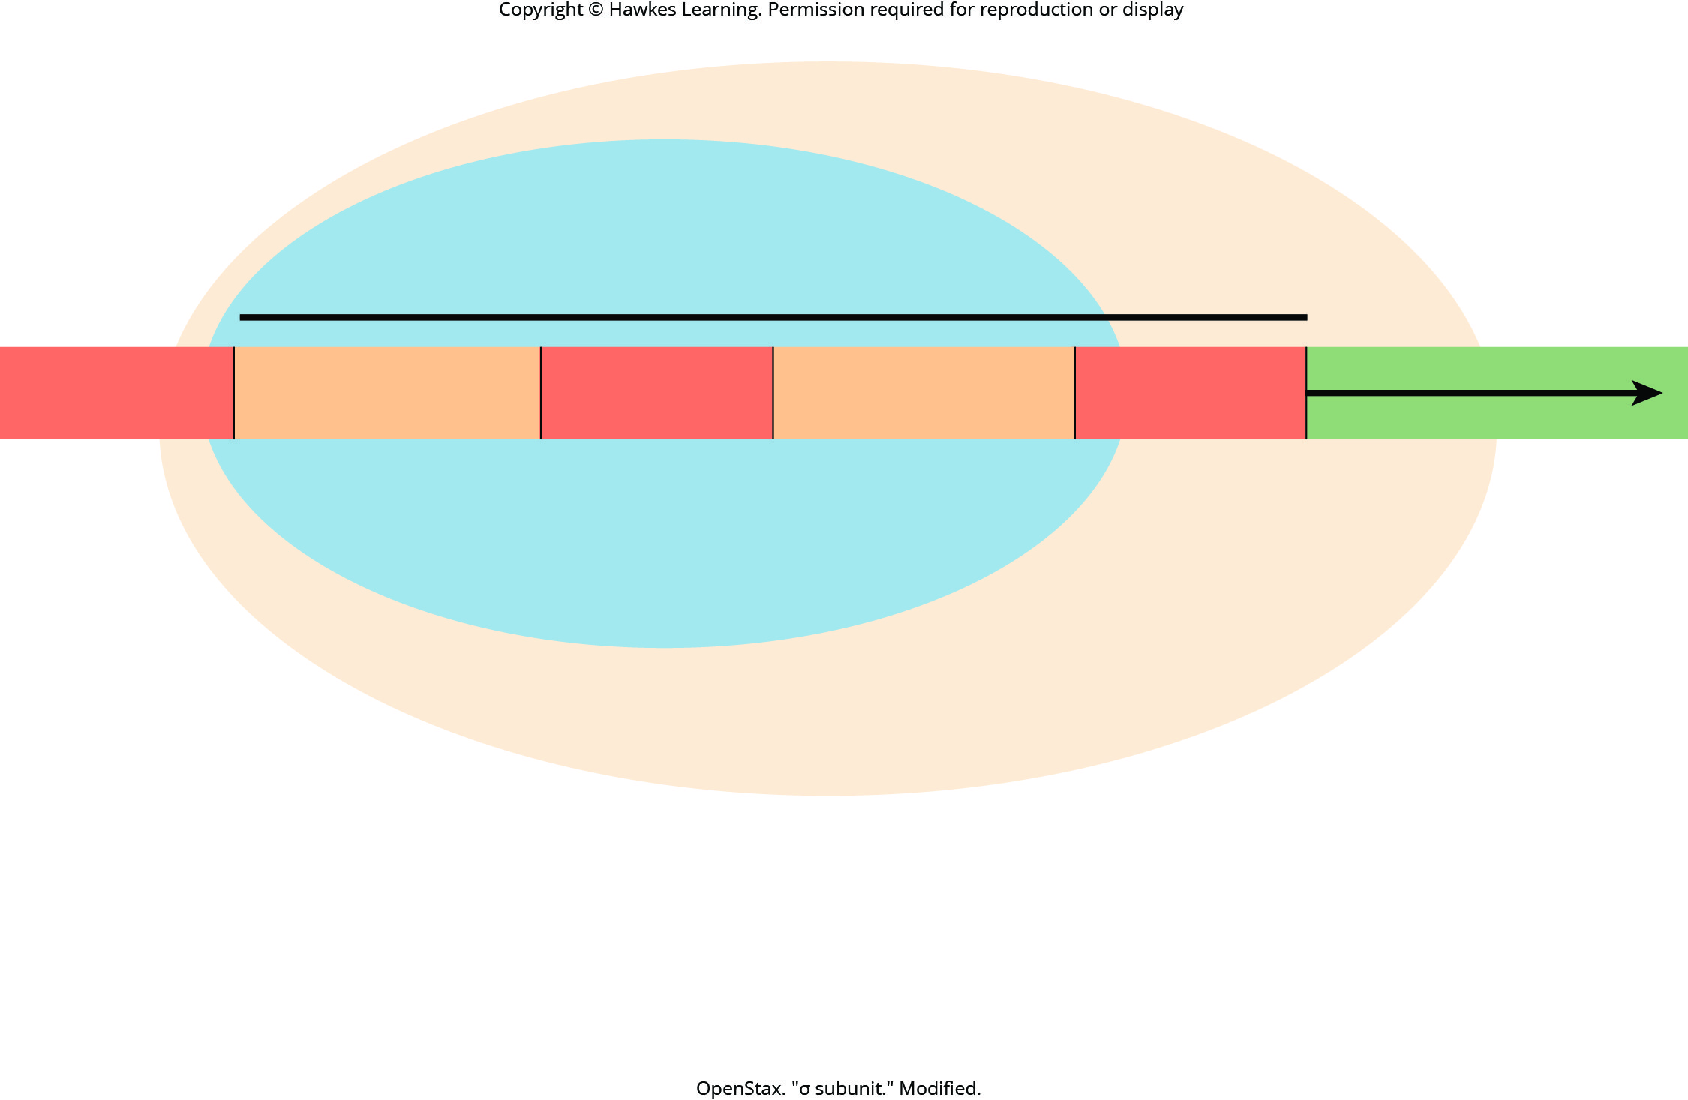
Lesson 15.2 Figure 3

Slide 8
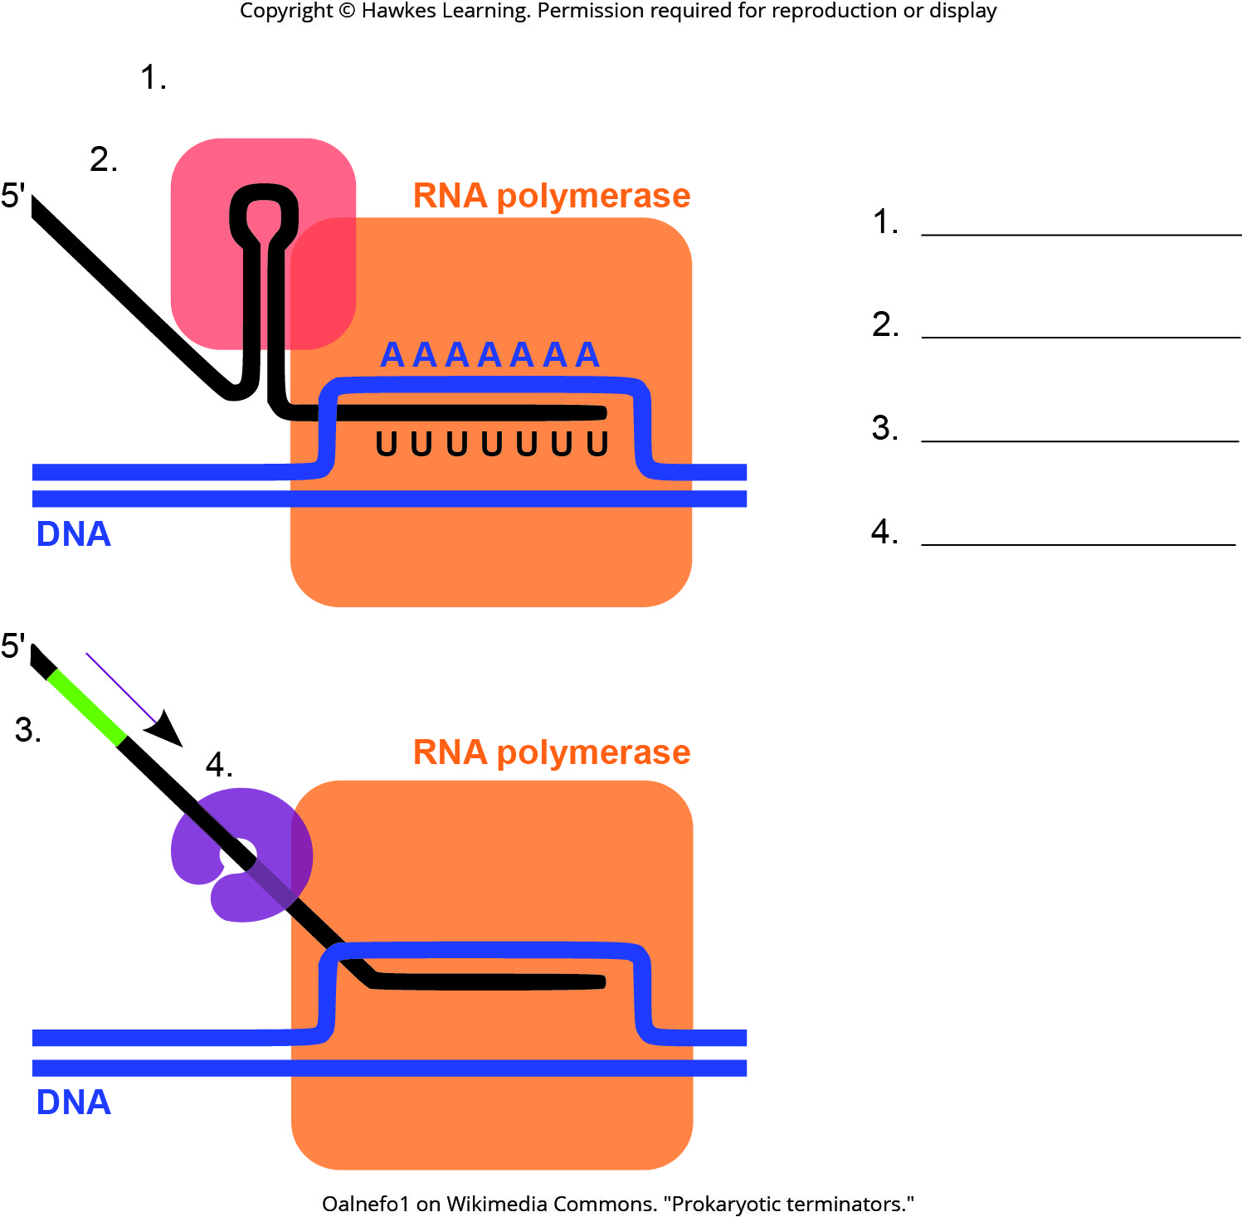
Lesson 15.2 Figure 4 - Numbered

Slide 9
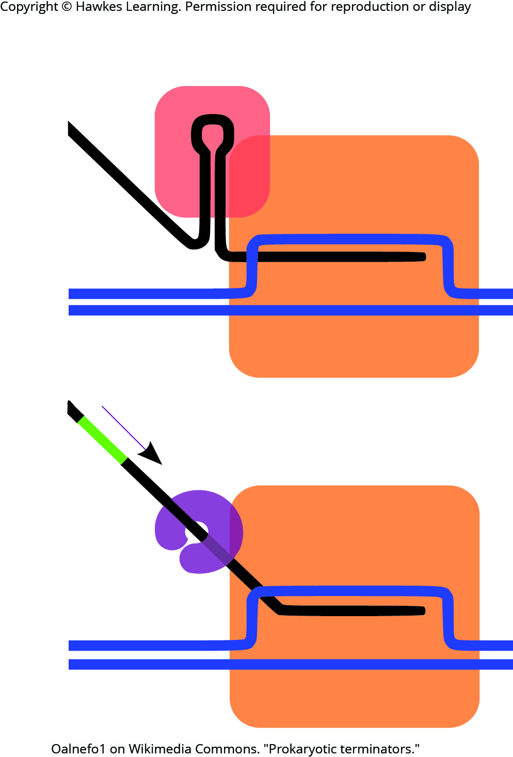
Lesson 15.2 Figure 4

Slide 10
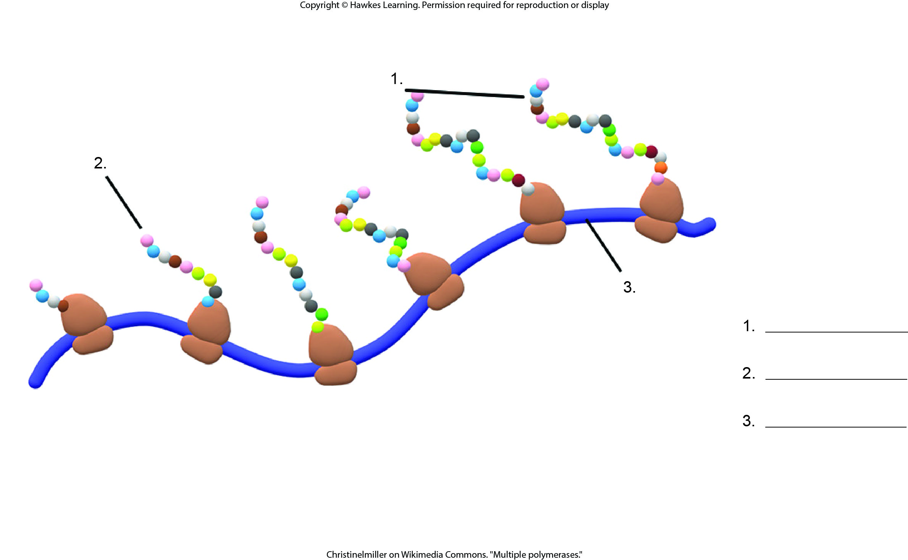
Lesson 15.2 Figure 5 - Numbered

Slide 11
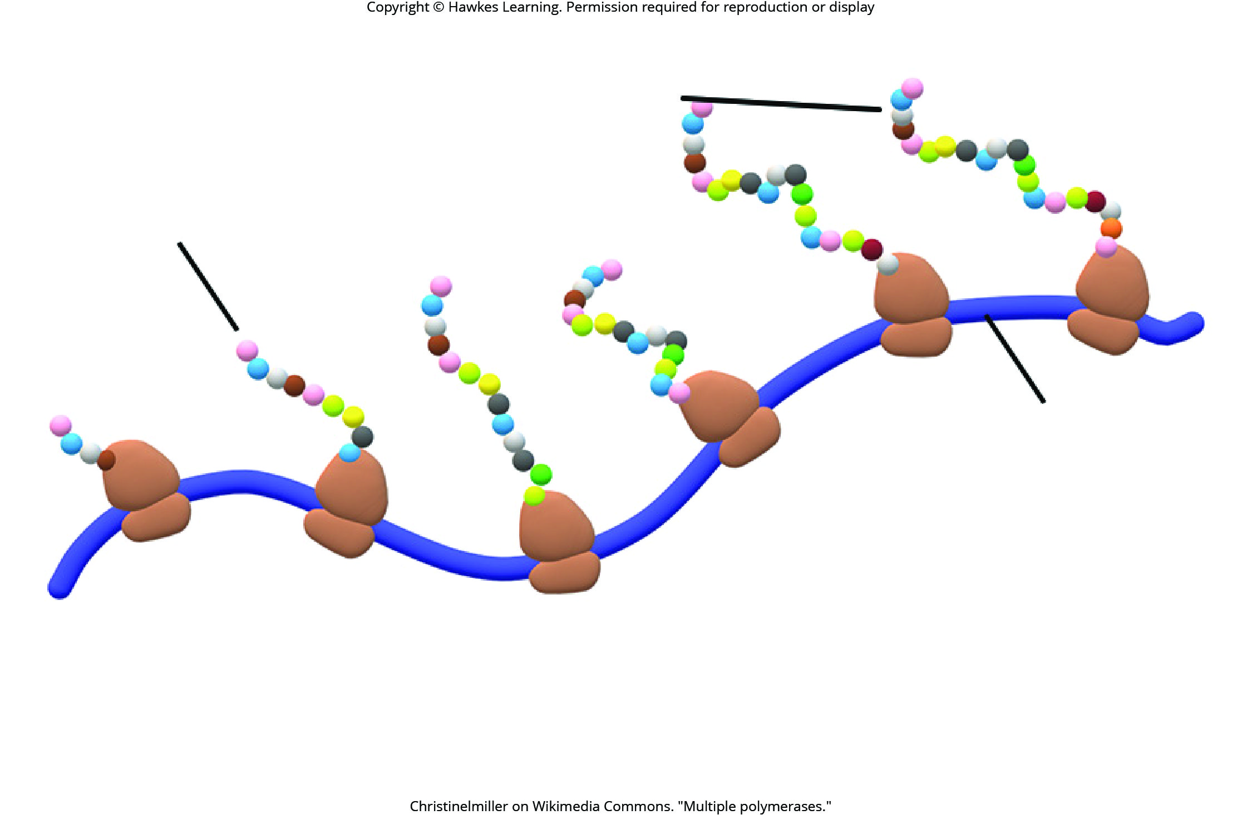
Lesson 15.2 Figure 5

Slide 12
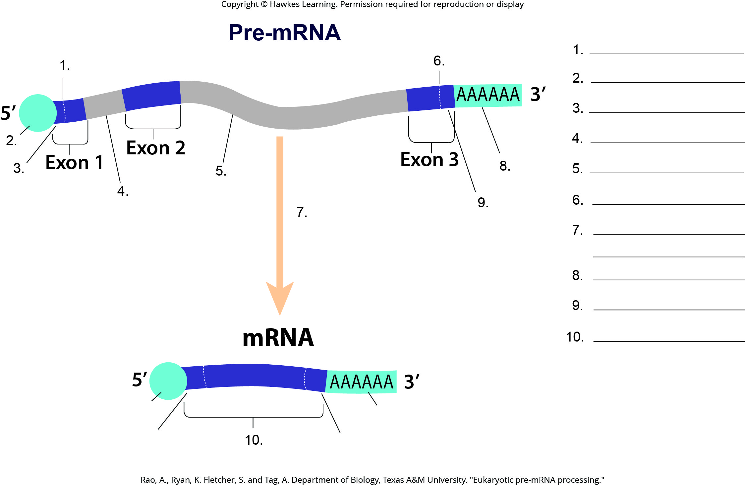
Lesson 15.4 Figure 1 - Numbered

Slide 13
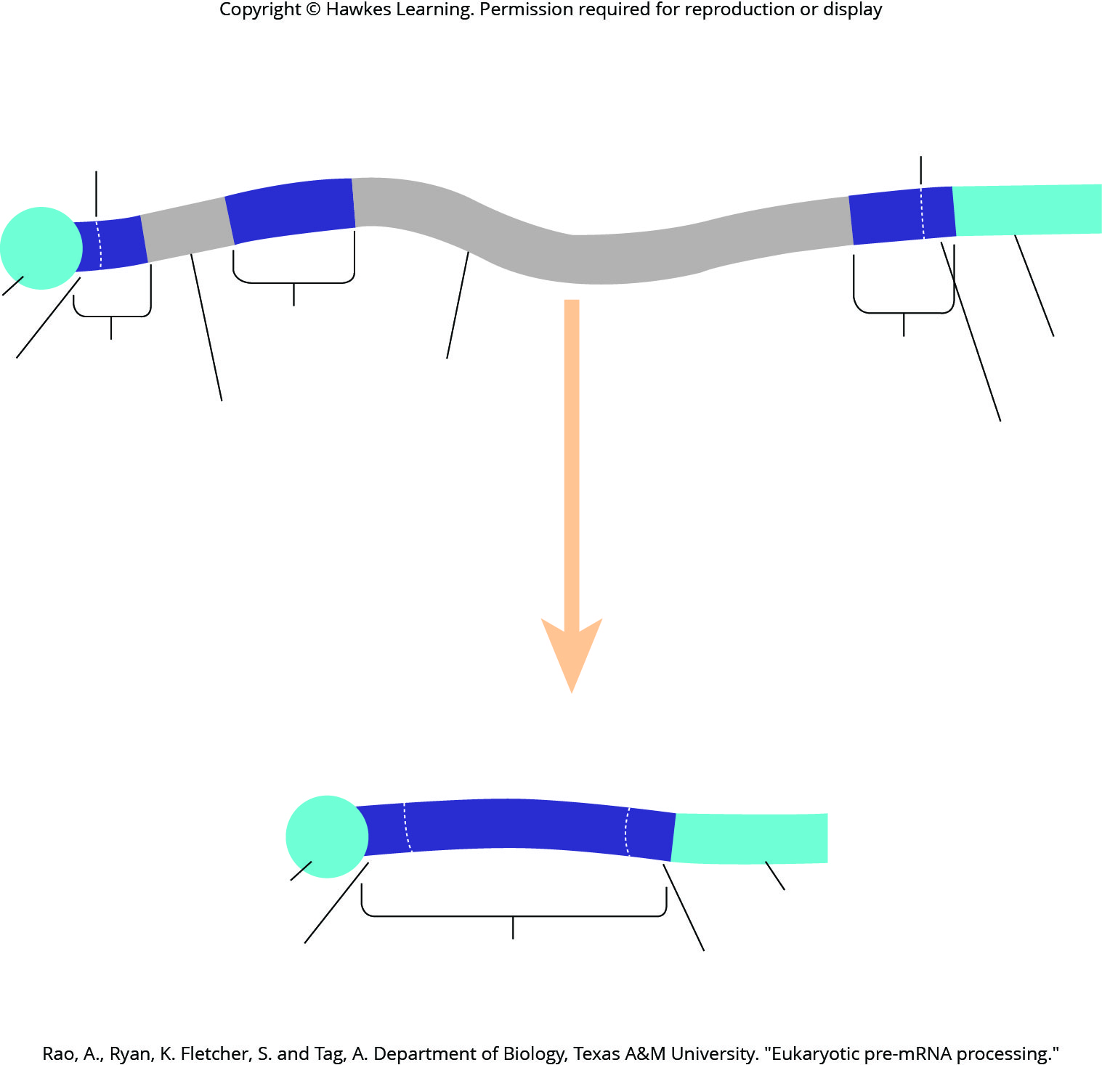
Lesson 15.4 Figure 1

Slide 14
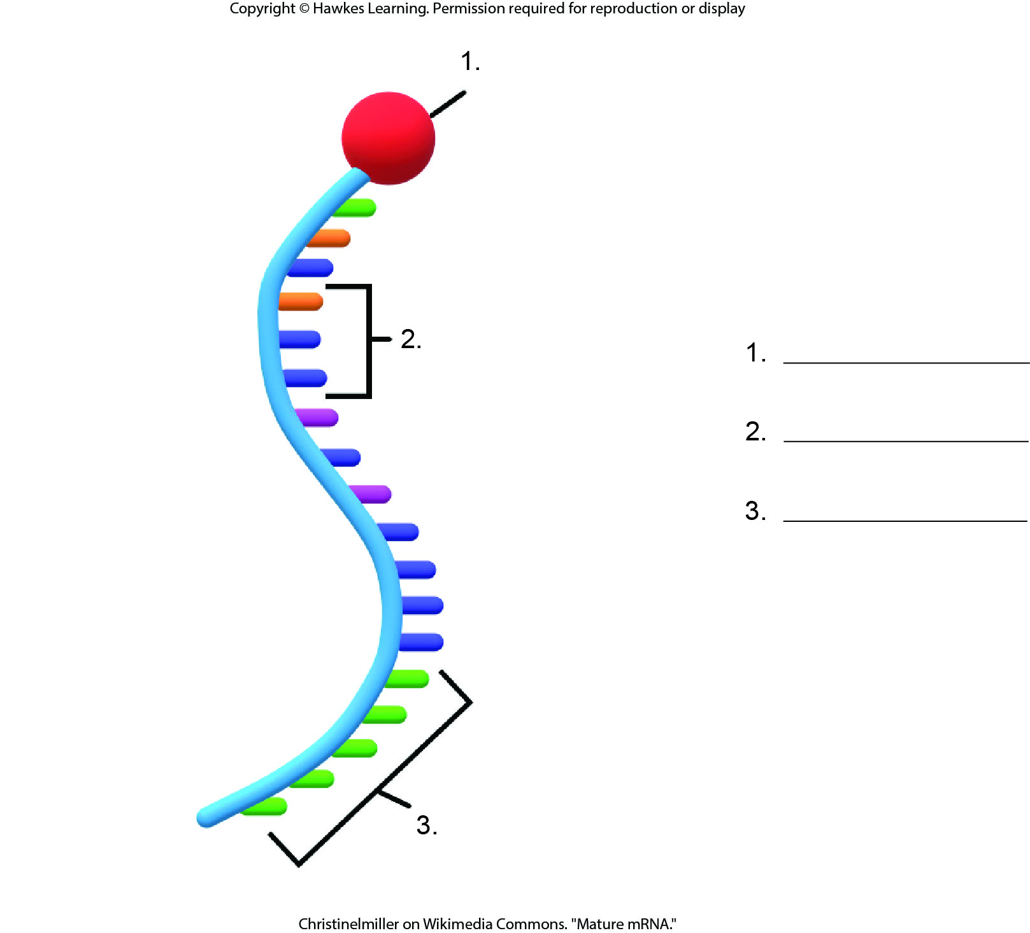
Lesson 15.4 Figure 3 - Numbered

Slide 15
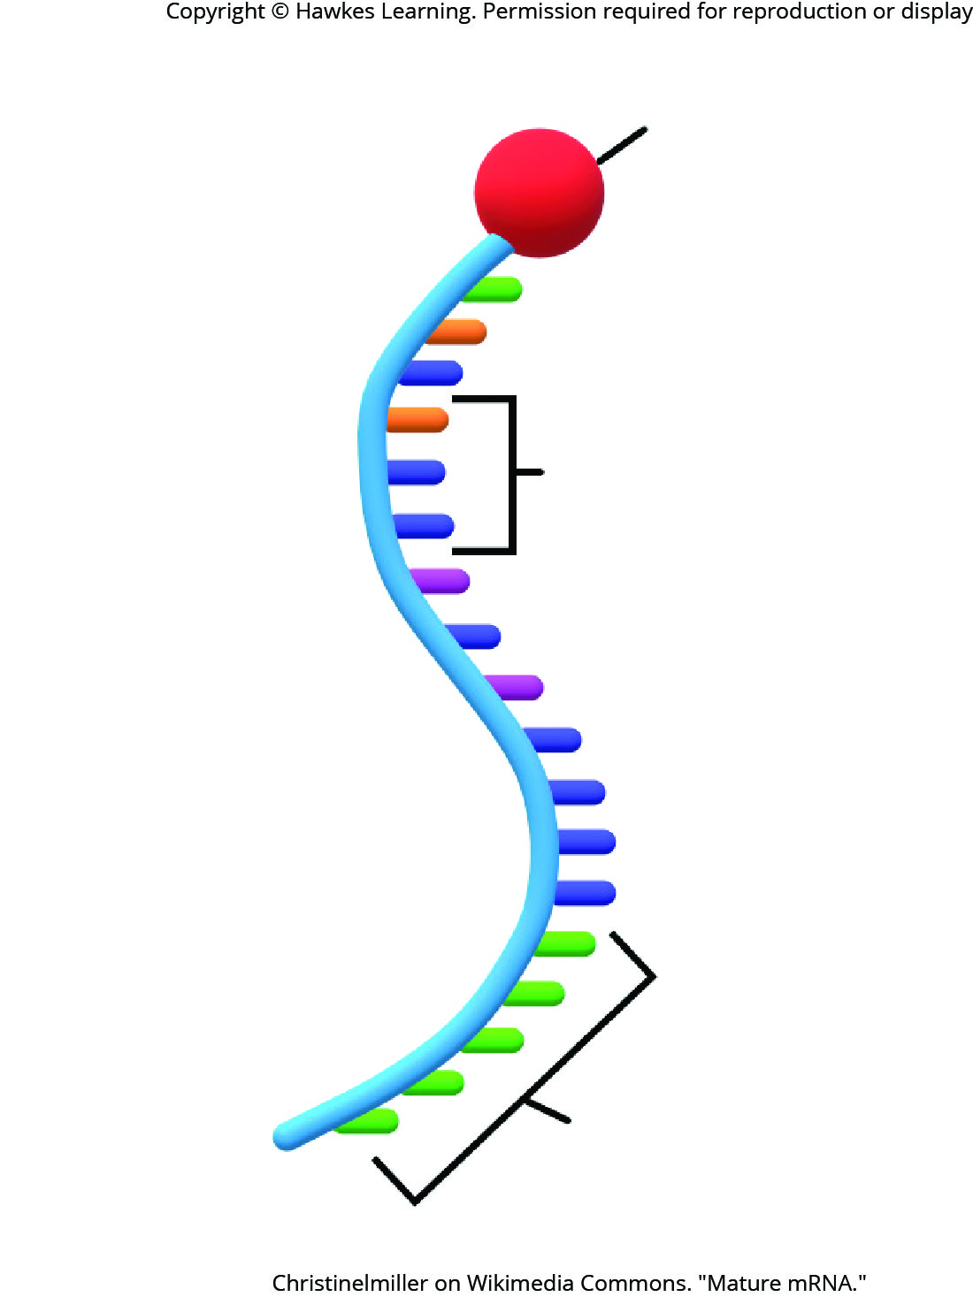
Lesson 15.4 Figure 3

Slide 16
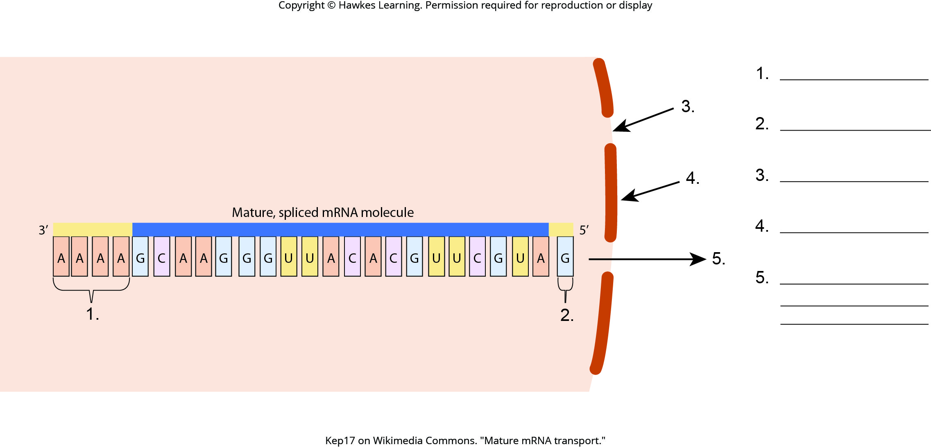
Lesson 15.4 Figure 4 - Numbered

Slide 17
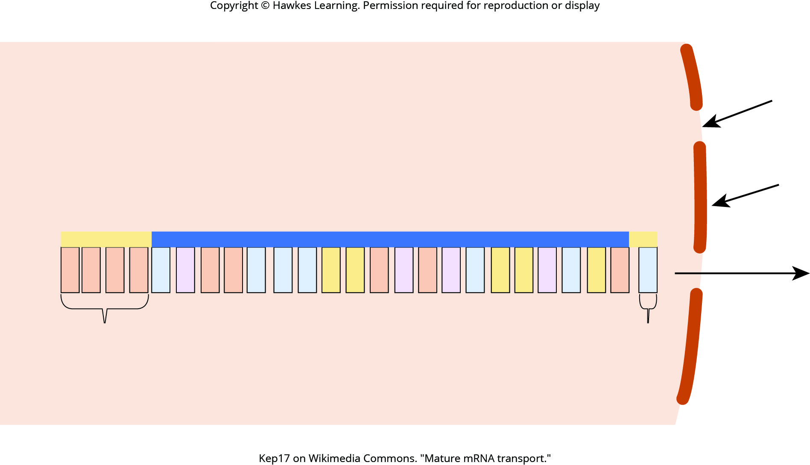
Lesson 15.4 Figure 4

Slide 18
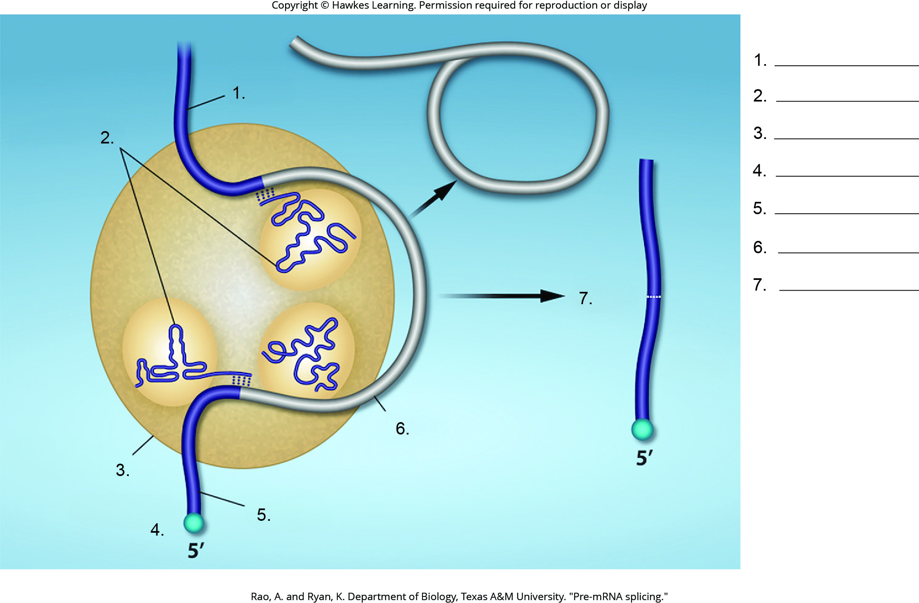
Lesson 15.4 Figure 5 - Numbered

Slide 19
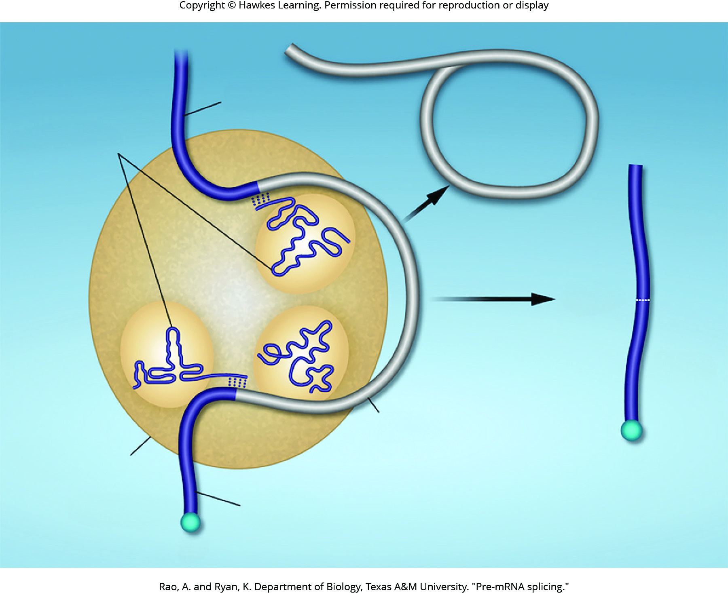
Lesson 15.4 Figure 5

Slide 20
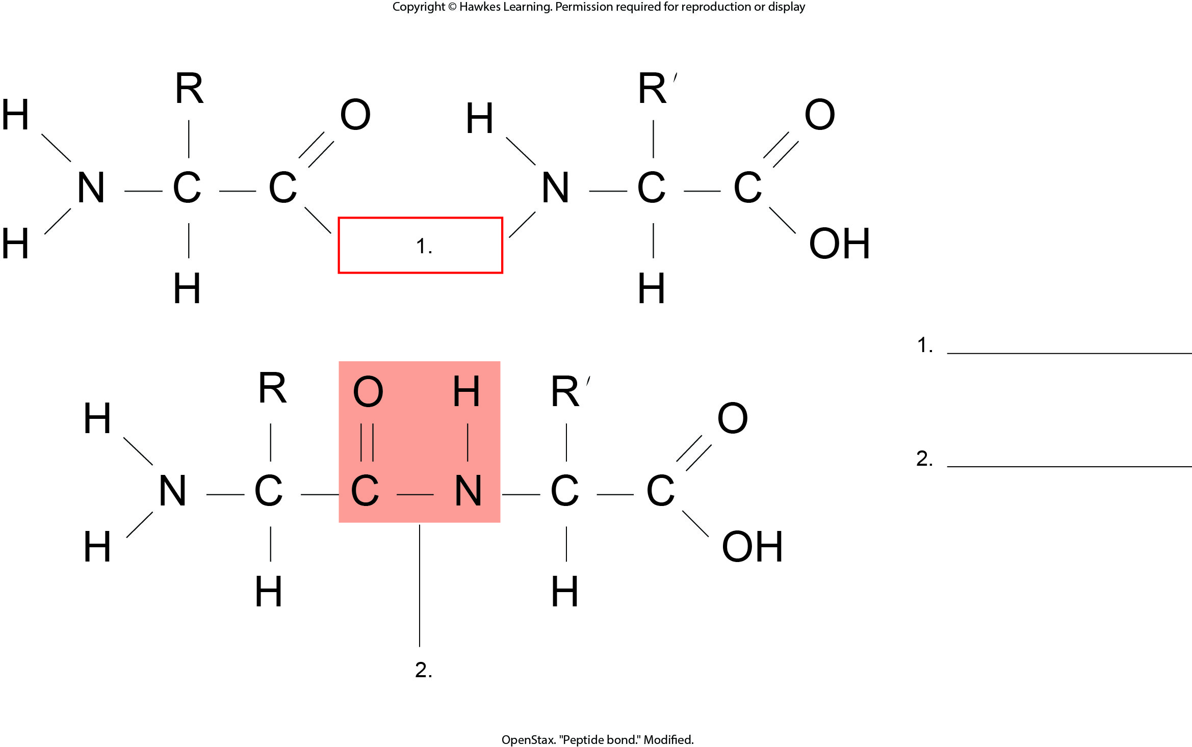
Lesson 15.5 Figure 1 - Numbered

Slide 21
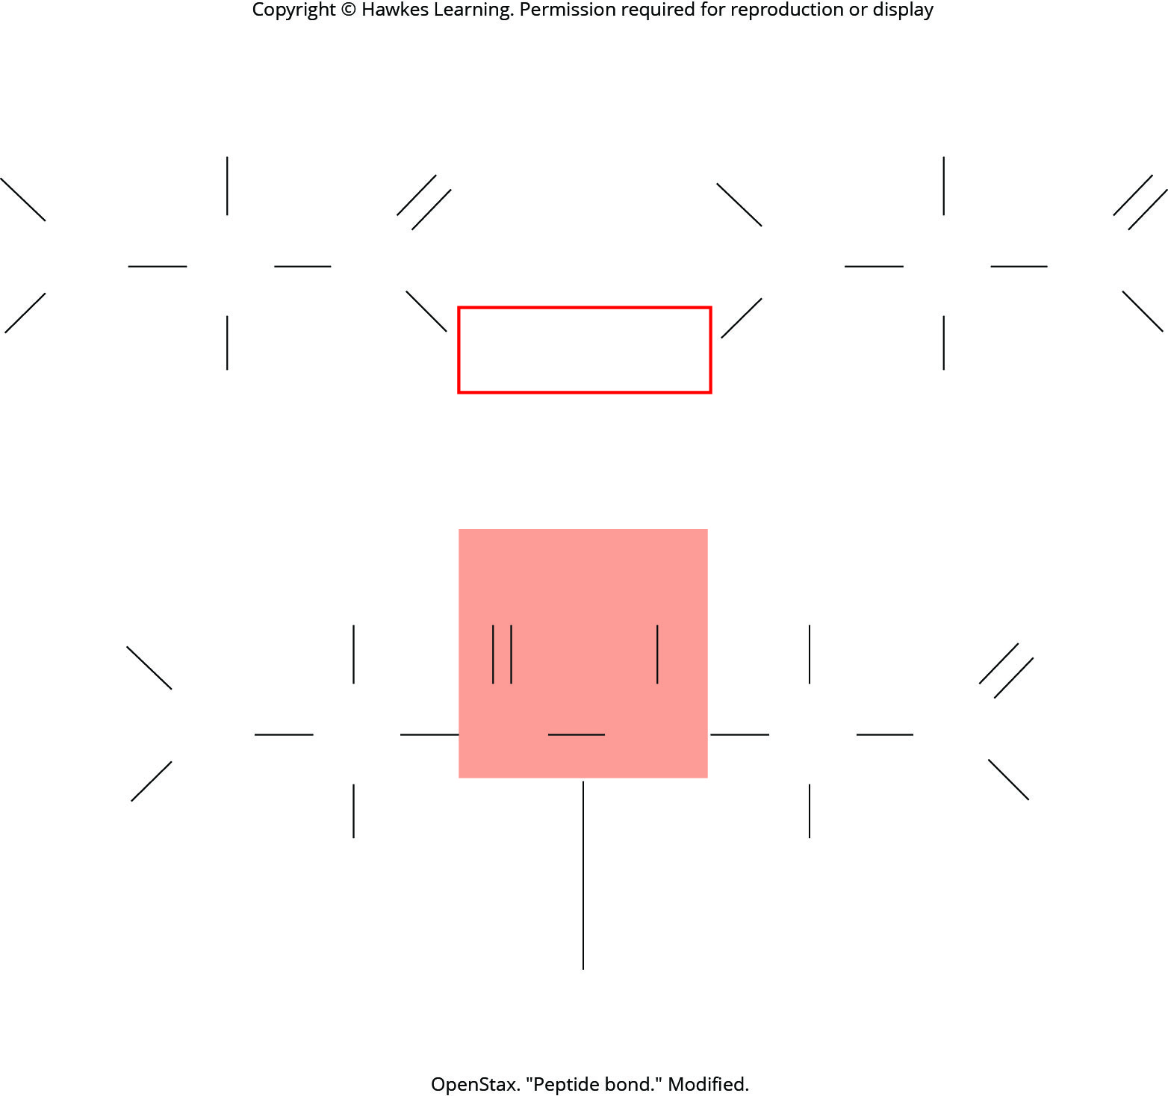
Lesson 15.5 Figure 1

Slide 22
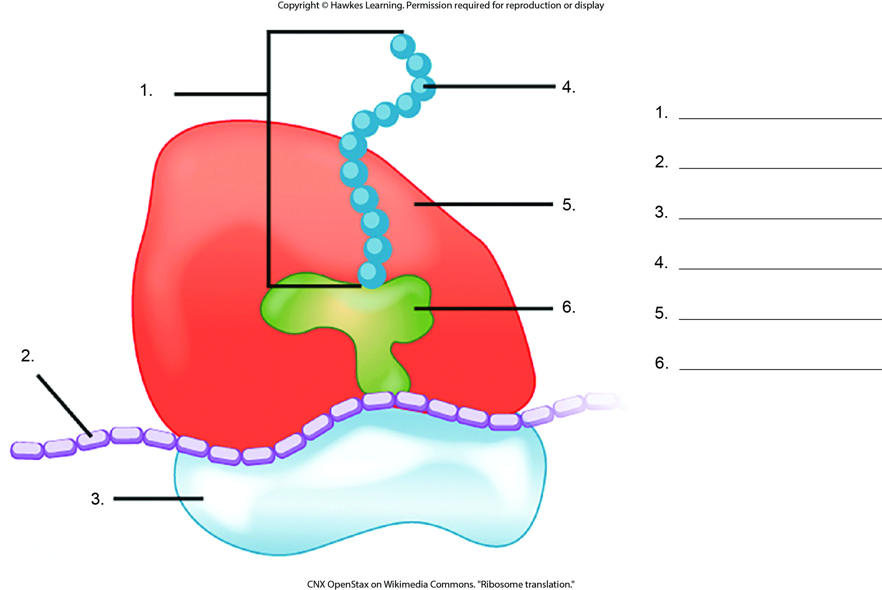
Lesson 15.5 Figure 2 - Numbered

Slide 23
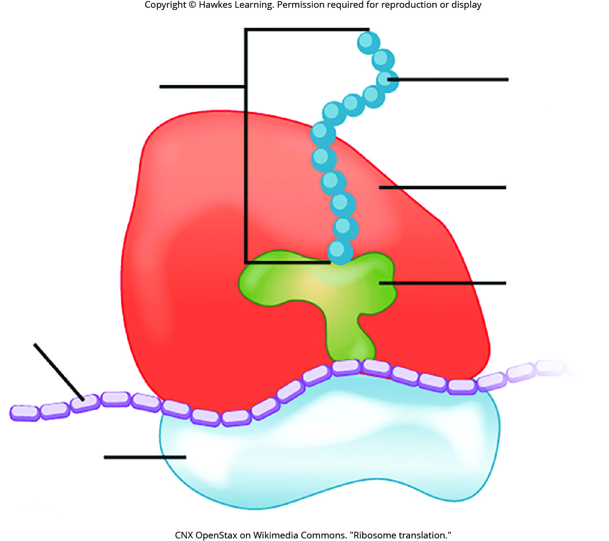
Lesson 15.5 Figure 2

Slide 24
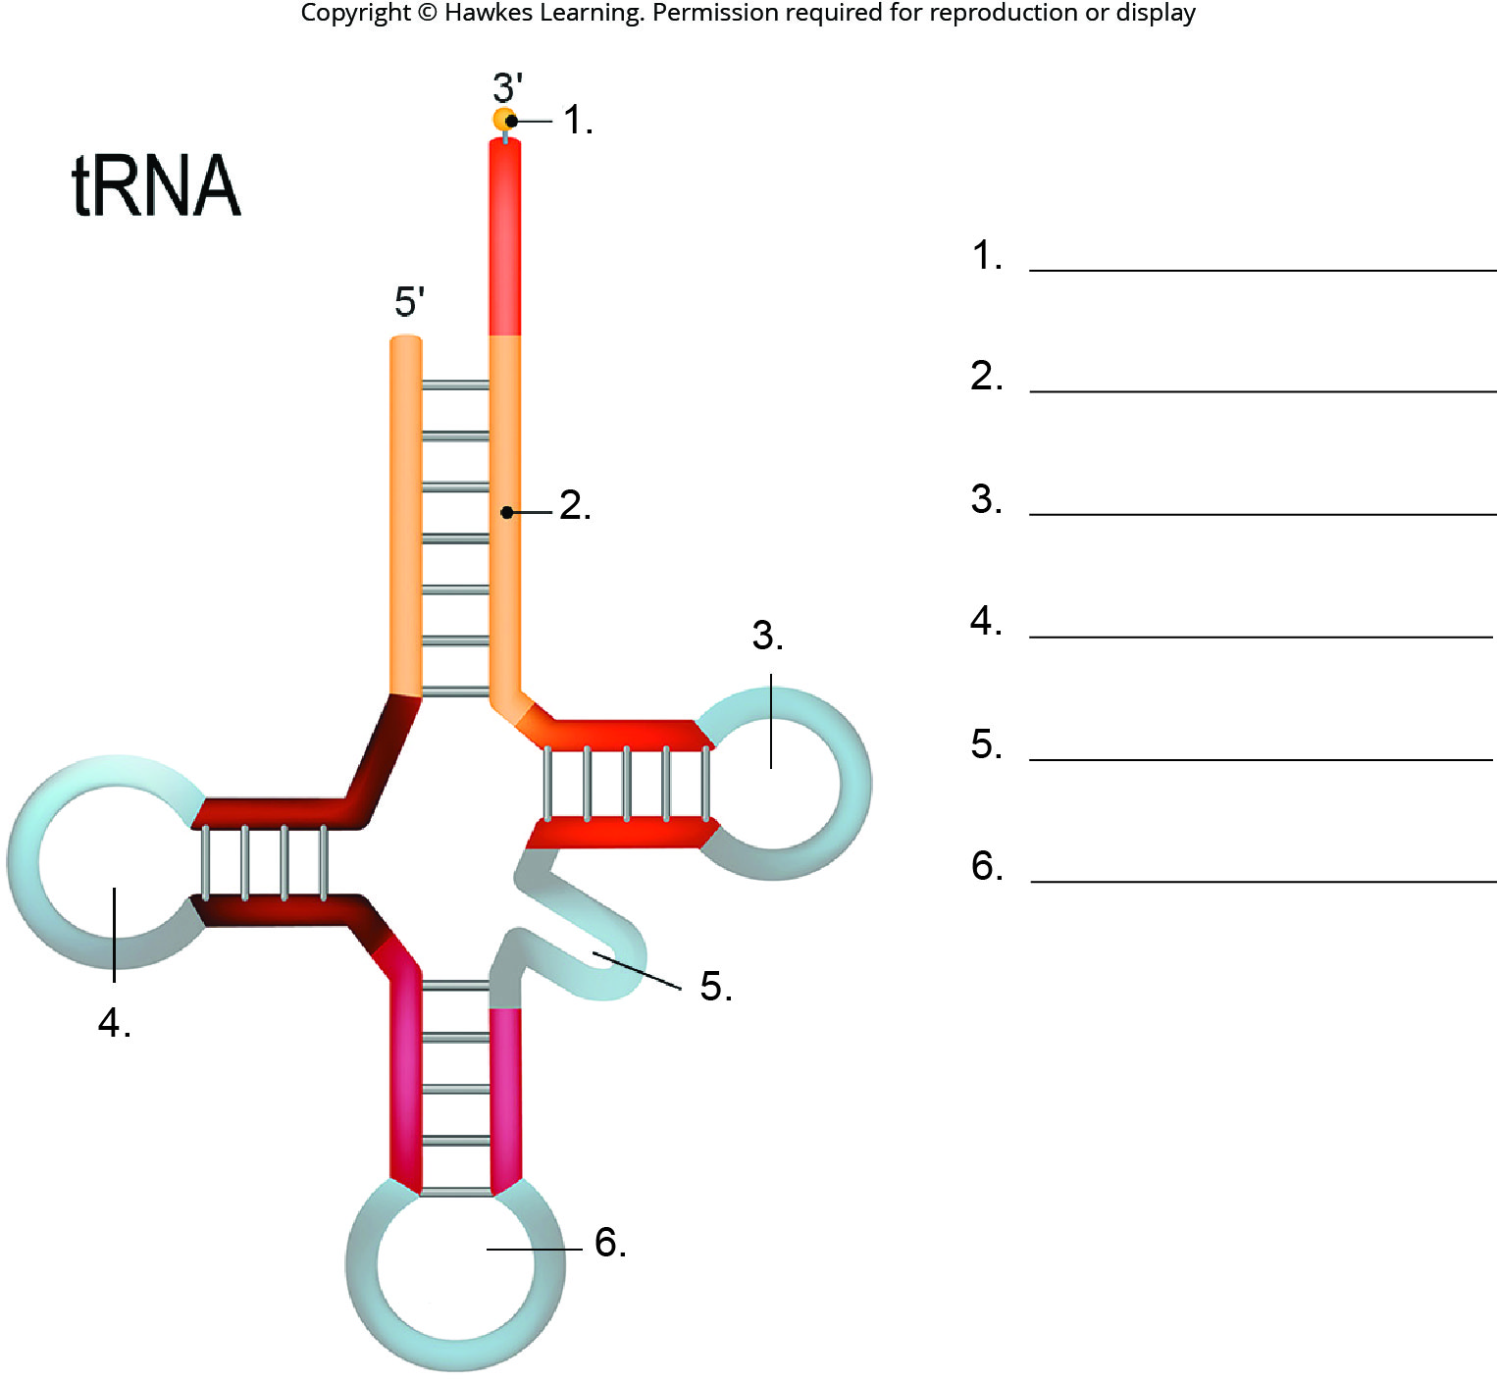
Lesson 15.5 Figure 3 - Numbered

Slide 25
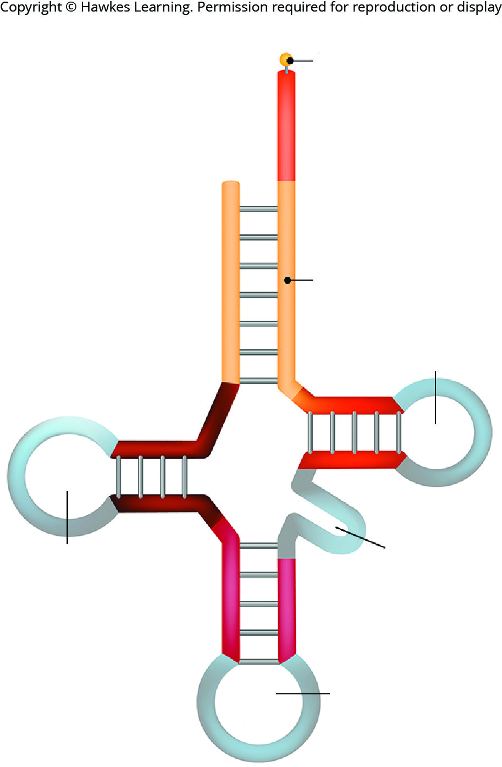
Lesson 15.5 Figure 3

Slide 26
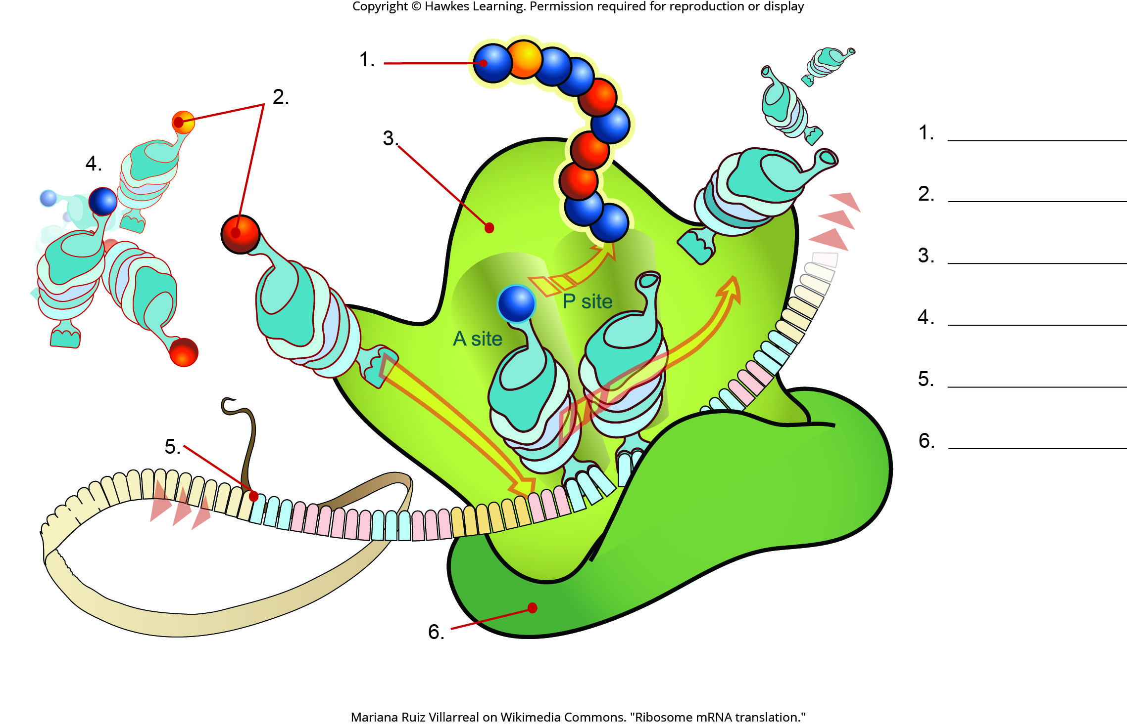
Lesson 15.5 Figure 4 - Numbered

Slide 27
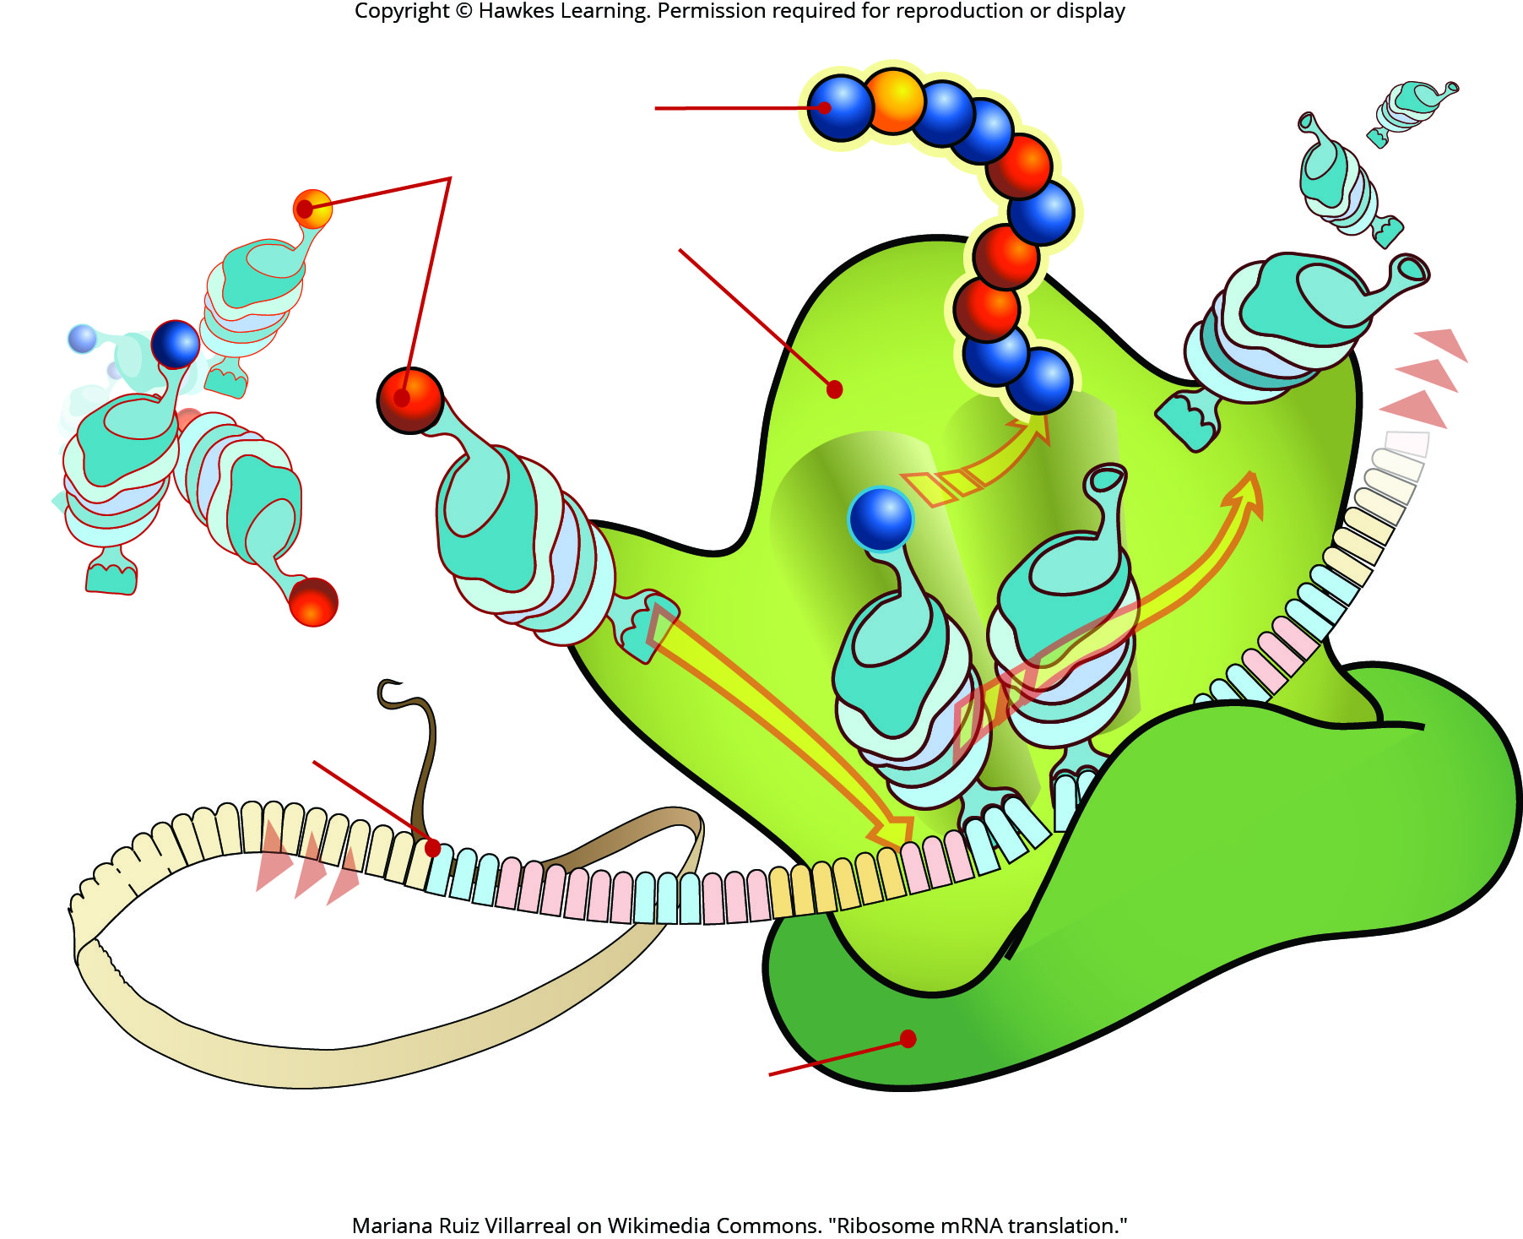
Lesson 15.5 Figure 4

Slide 28
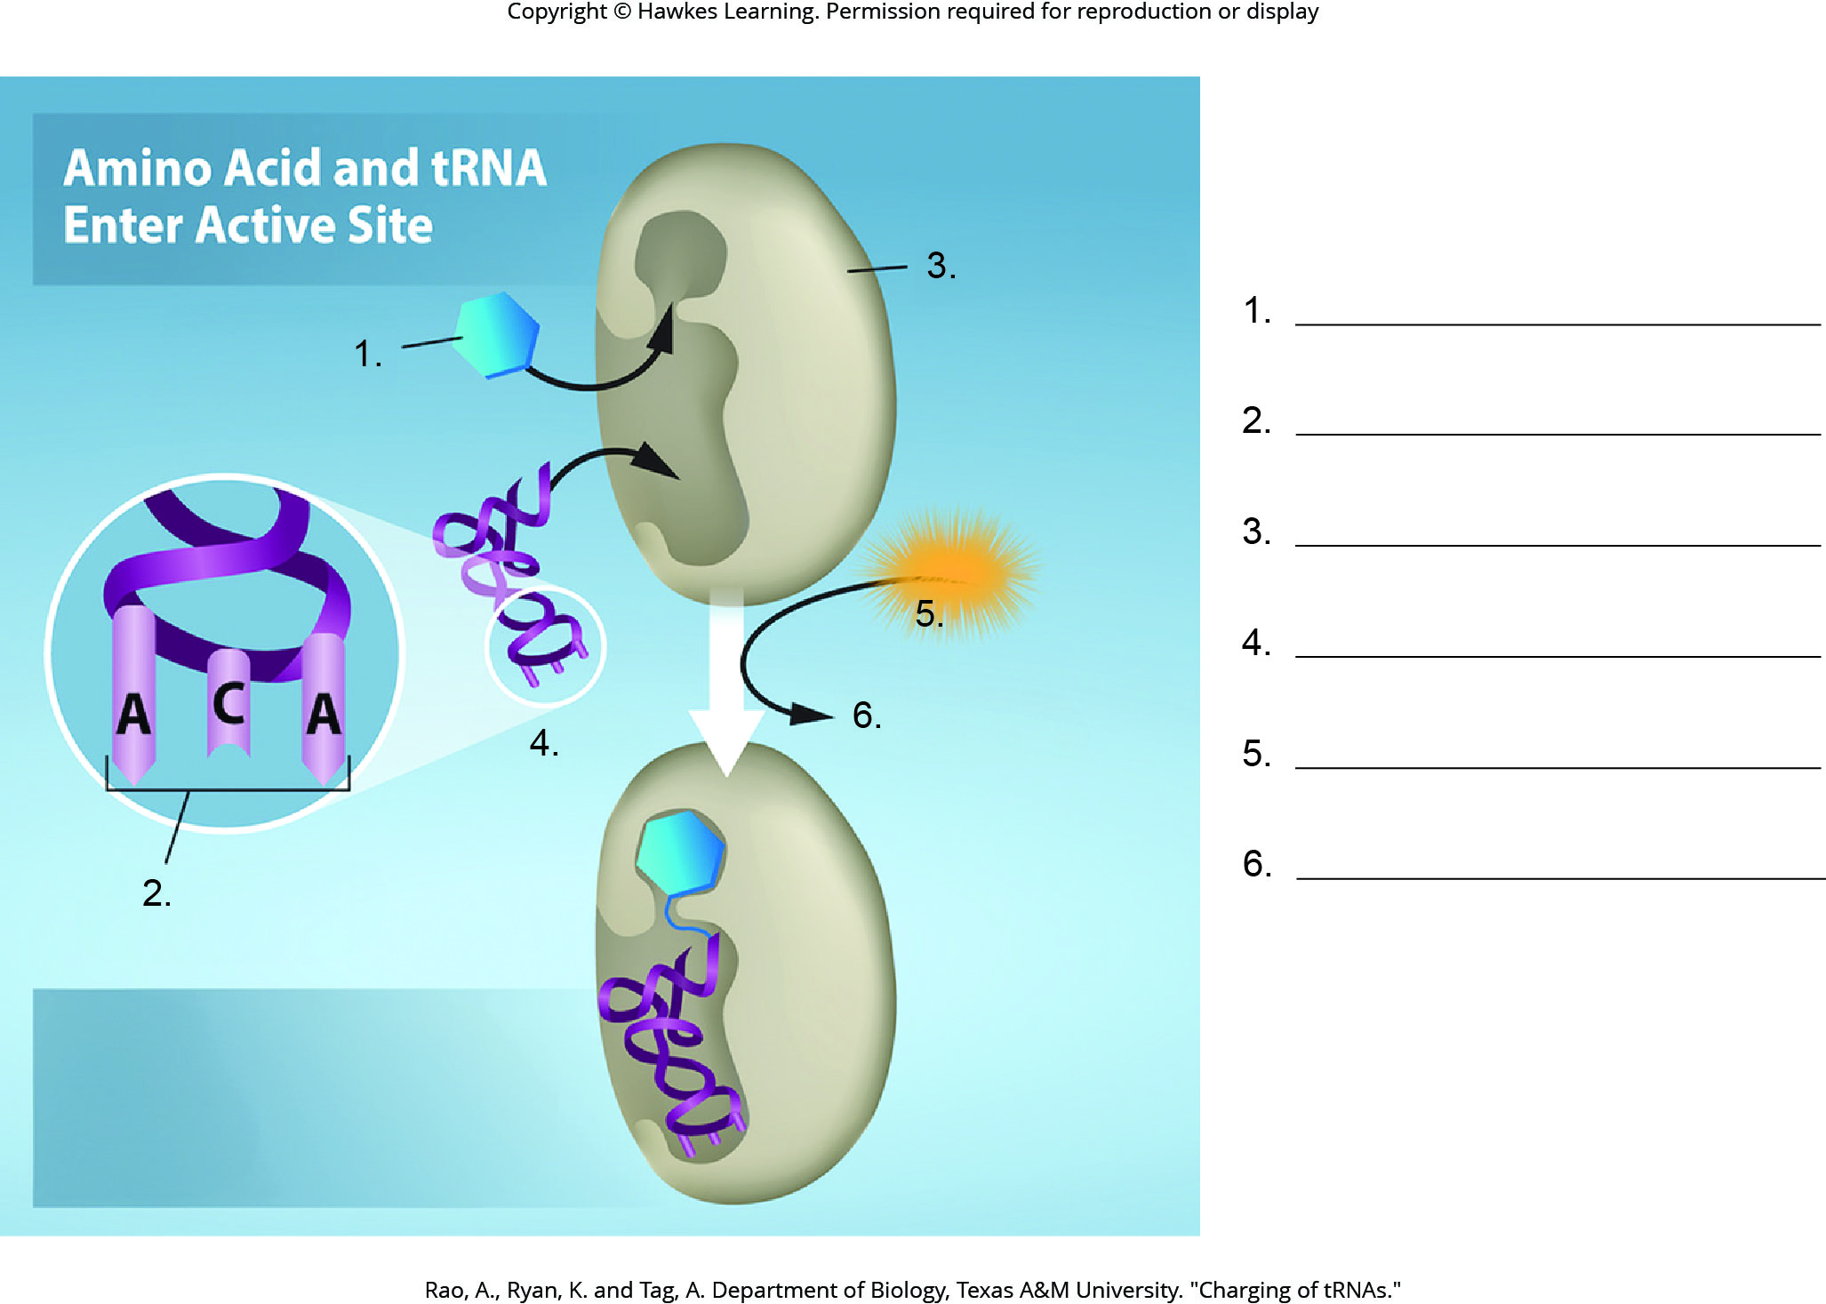
Lesson 15.5 Figure 5 - Numbered

Slide 29
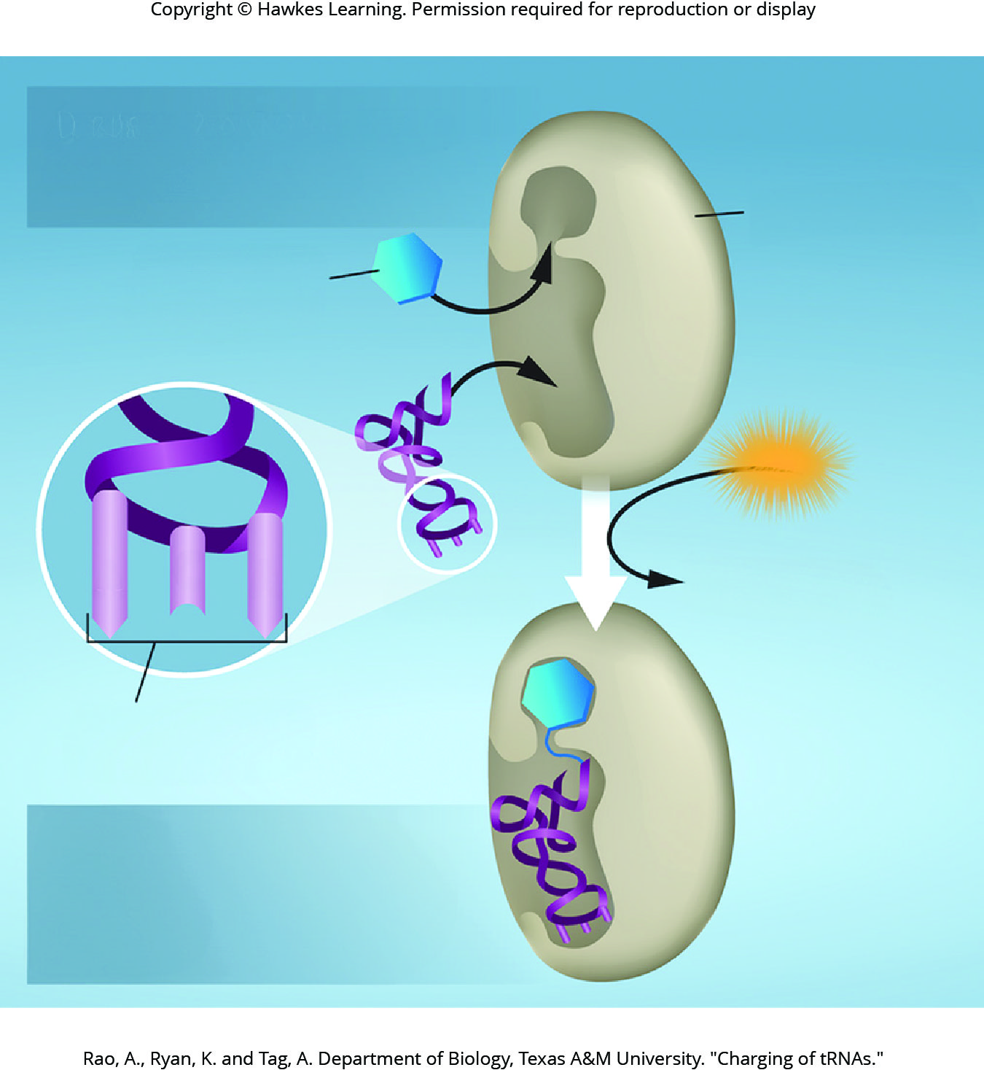
Lesson 15.5 Figure 5

Slide 30
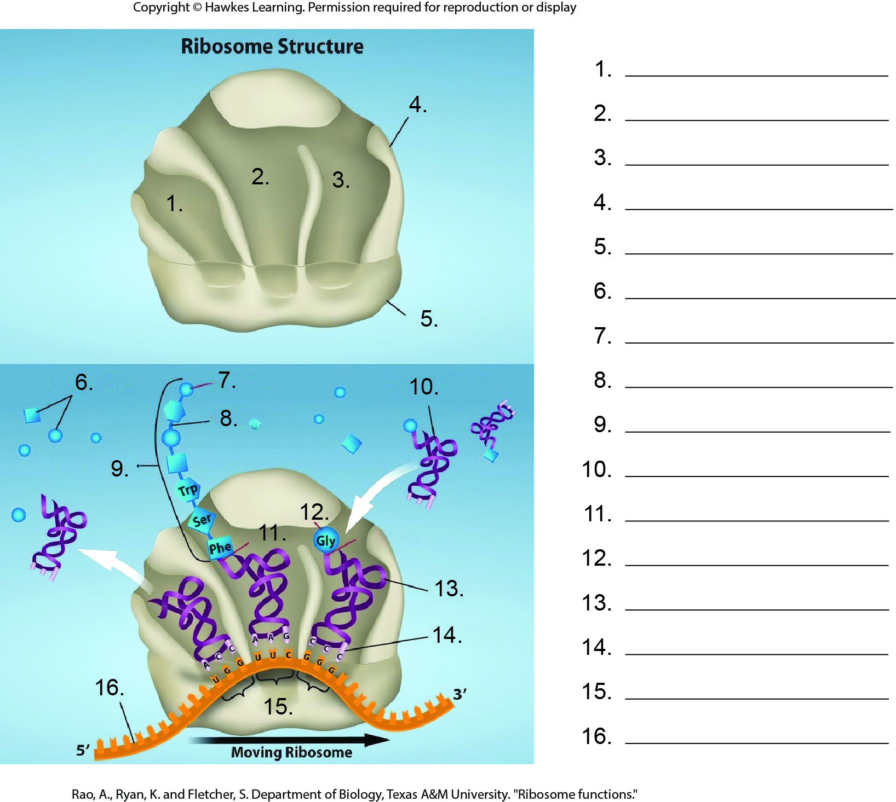
Lesson 15.5 Figure 6 - Numbered

Slide 31
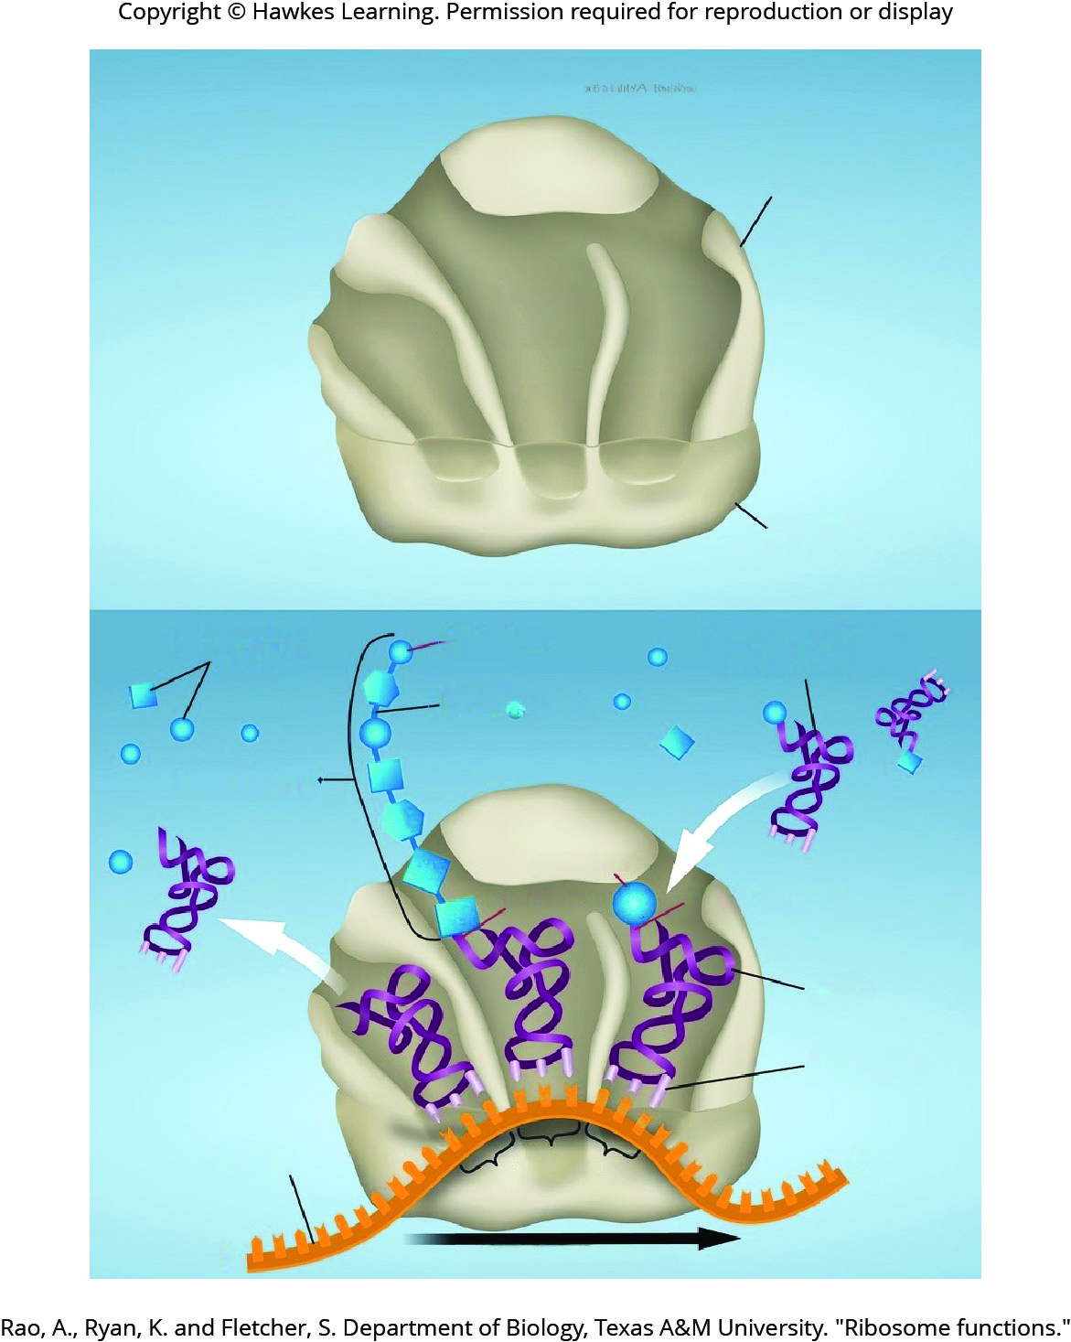
Lesson 15.5 Figure 6

Slide 32
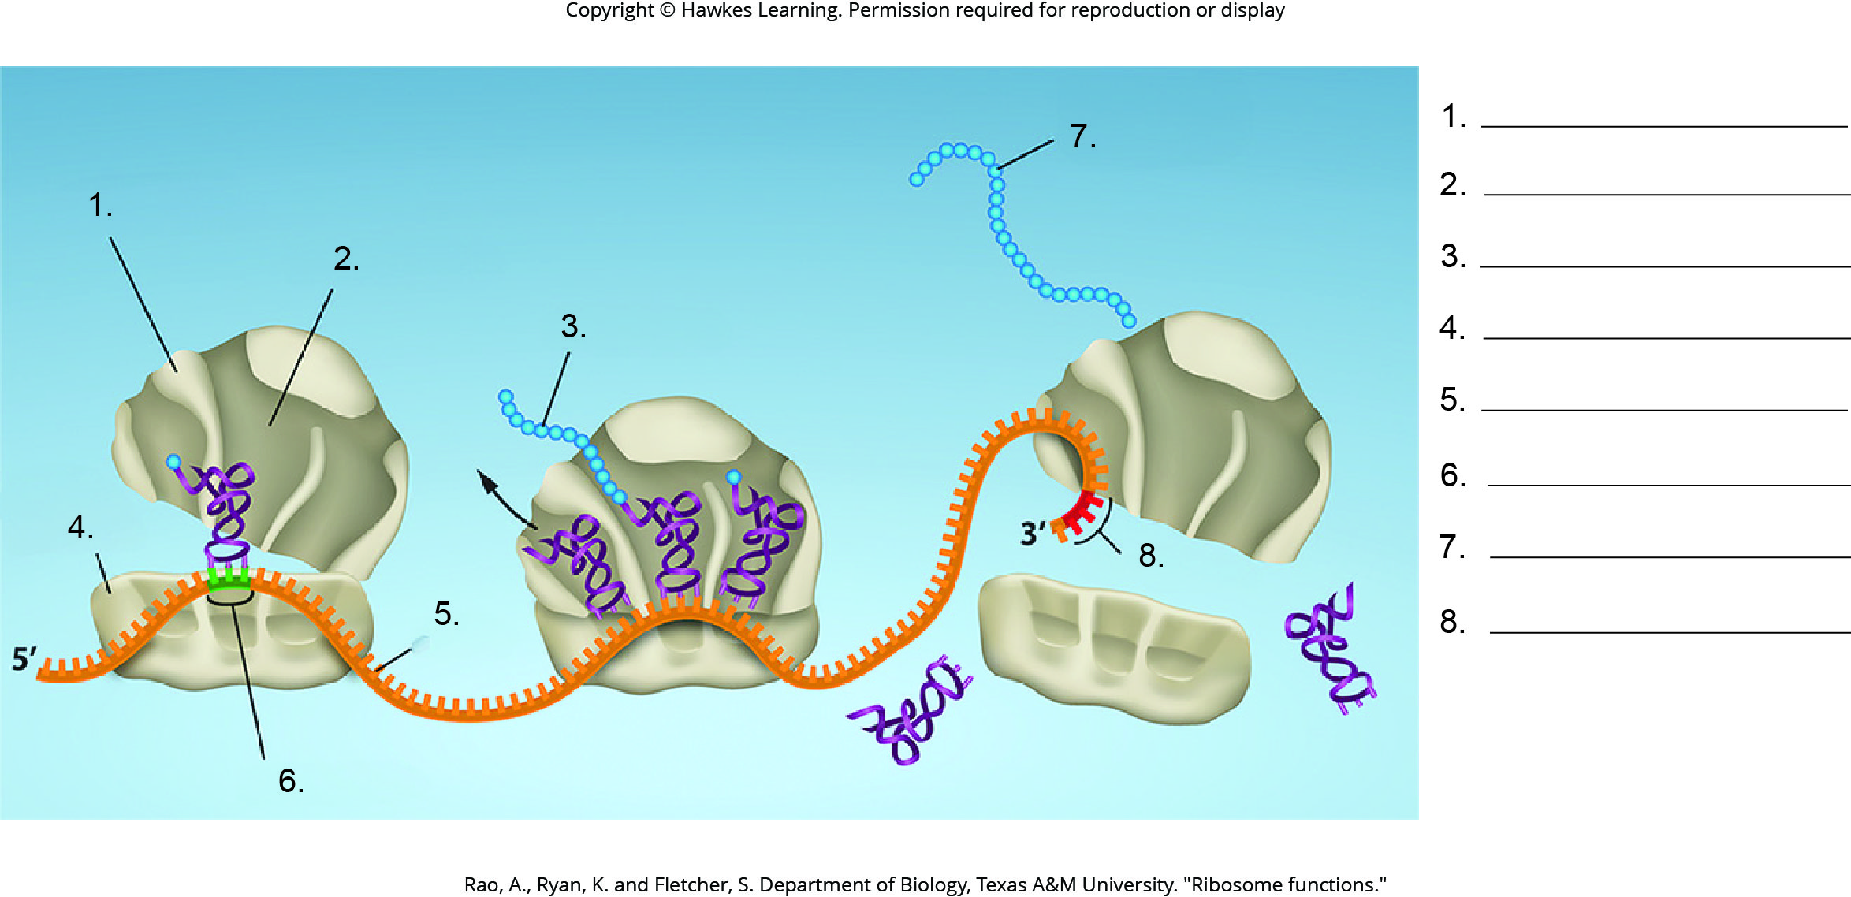
Lesson 15.5 Figure 7 - Numbered

Slide 33
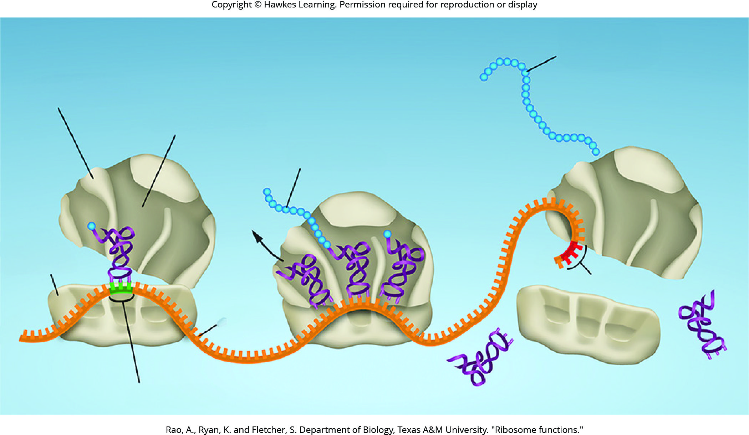
Lesson 15.5 Figure 7

Slide 34
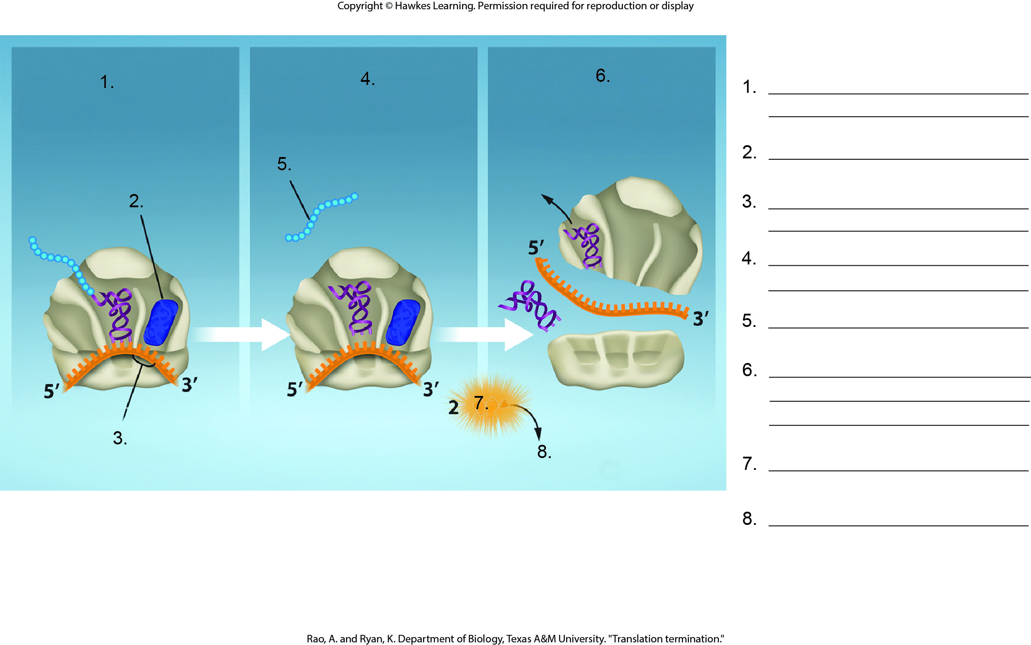
Lesson 15.5 Figure 8 - Numbered

Slide 35
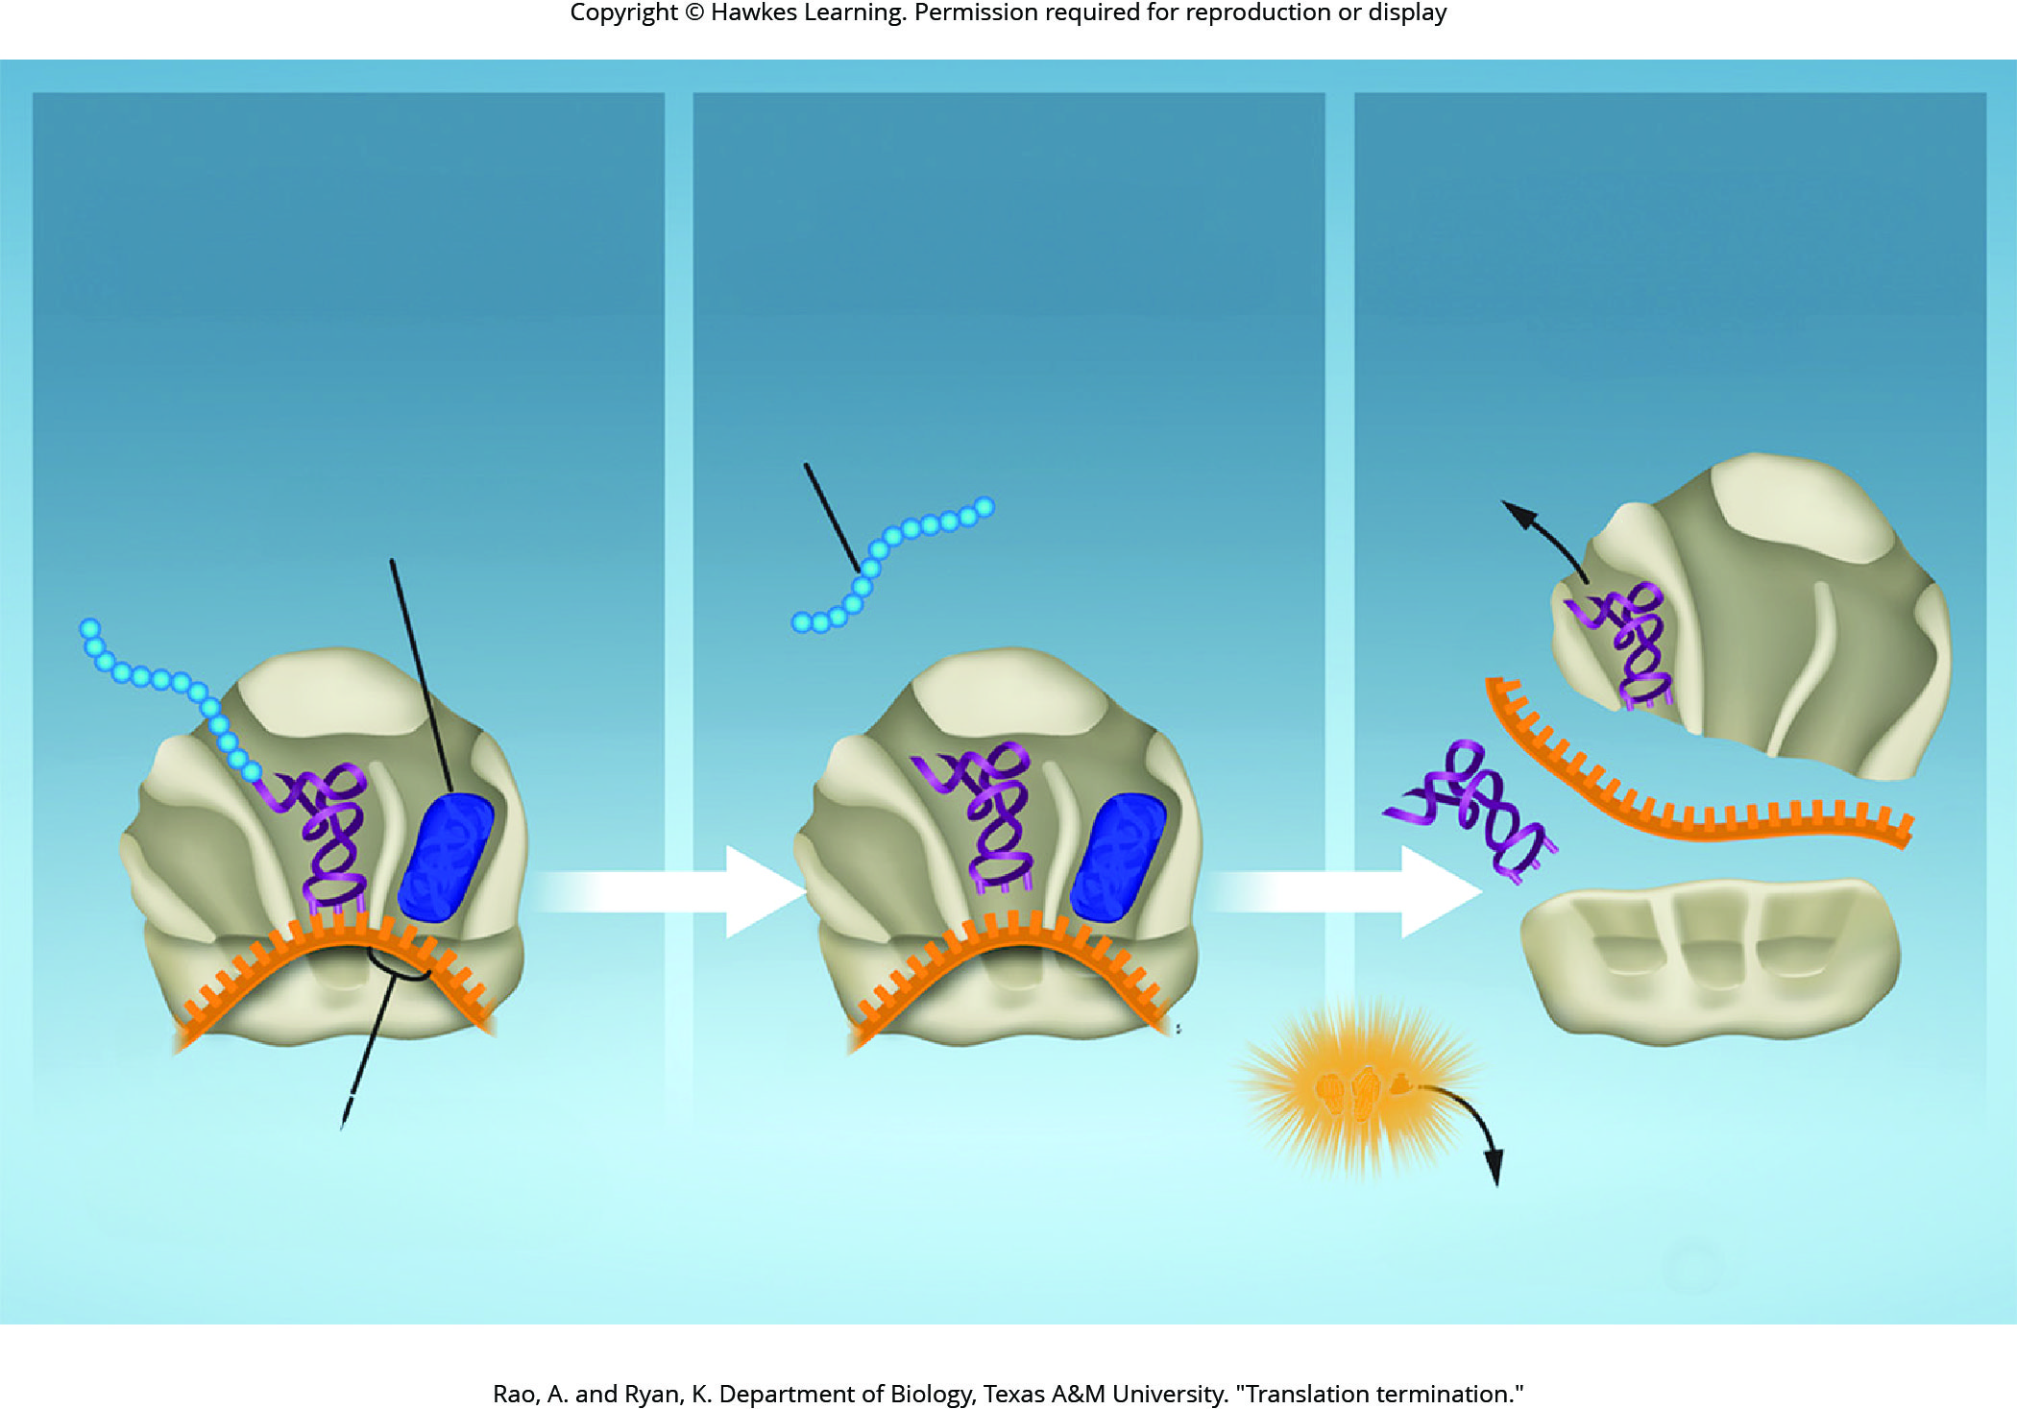
Lesson 15.5 Figure 8

Slide 36
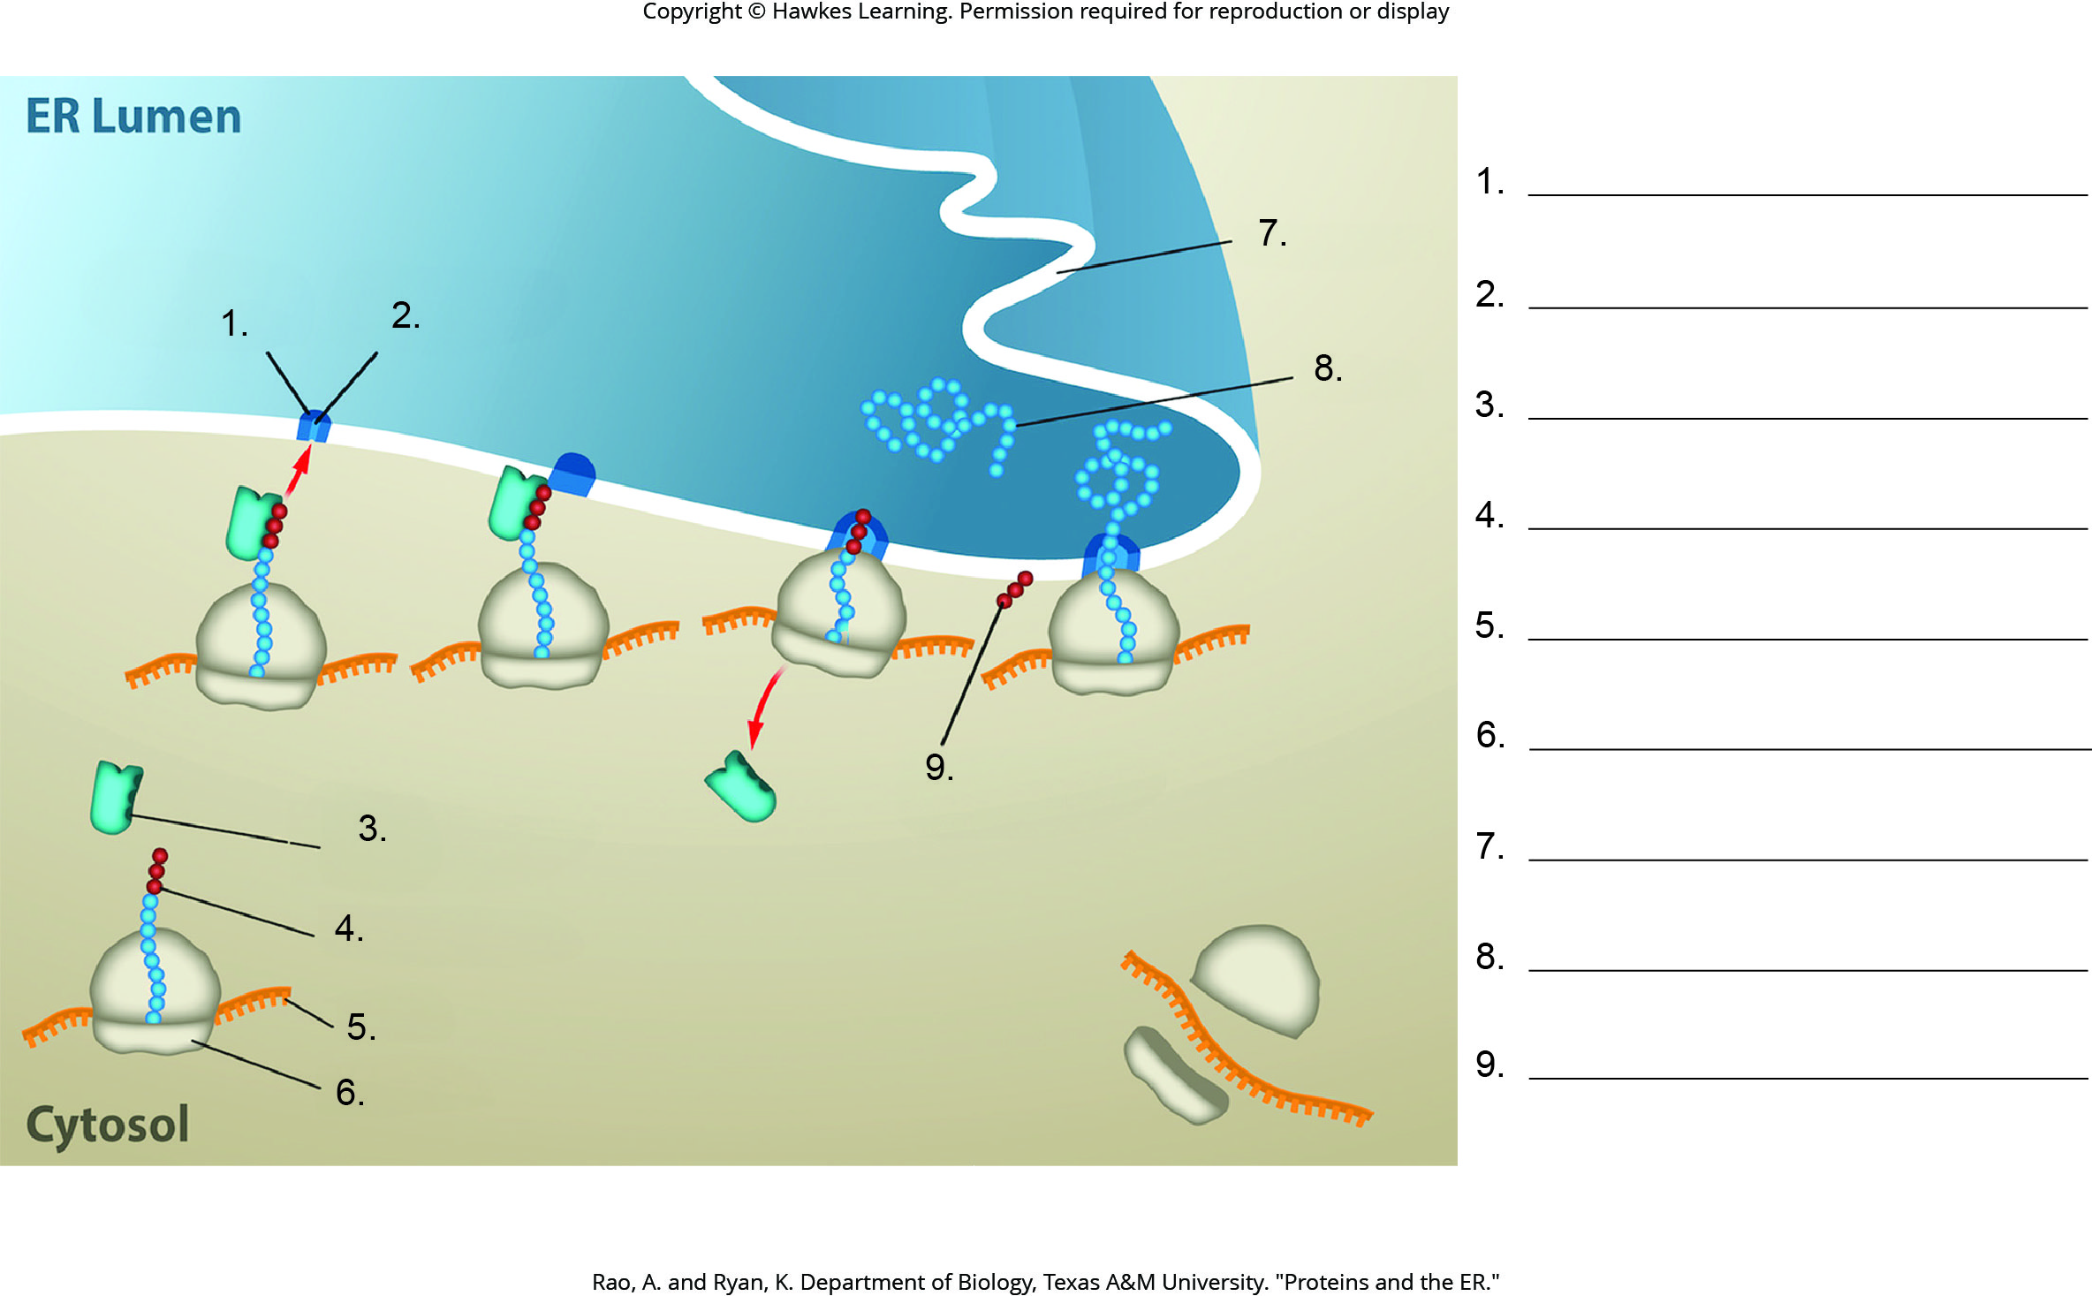
Lesson 15.5 Figure 9 - Numbered

Slide 37
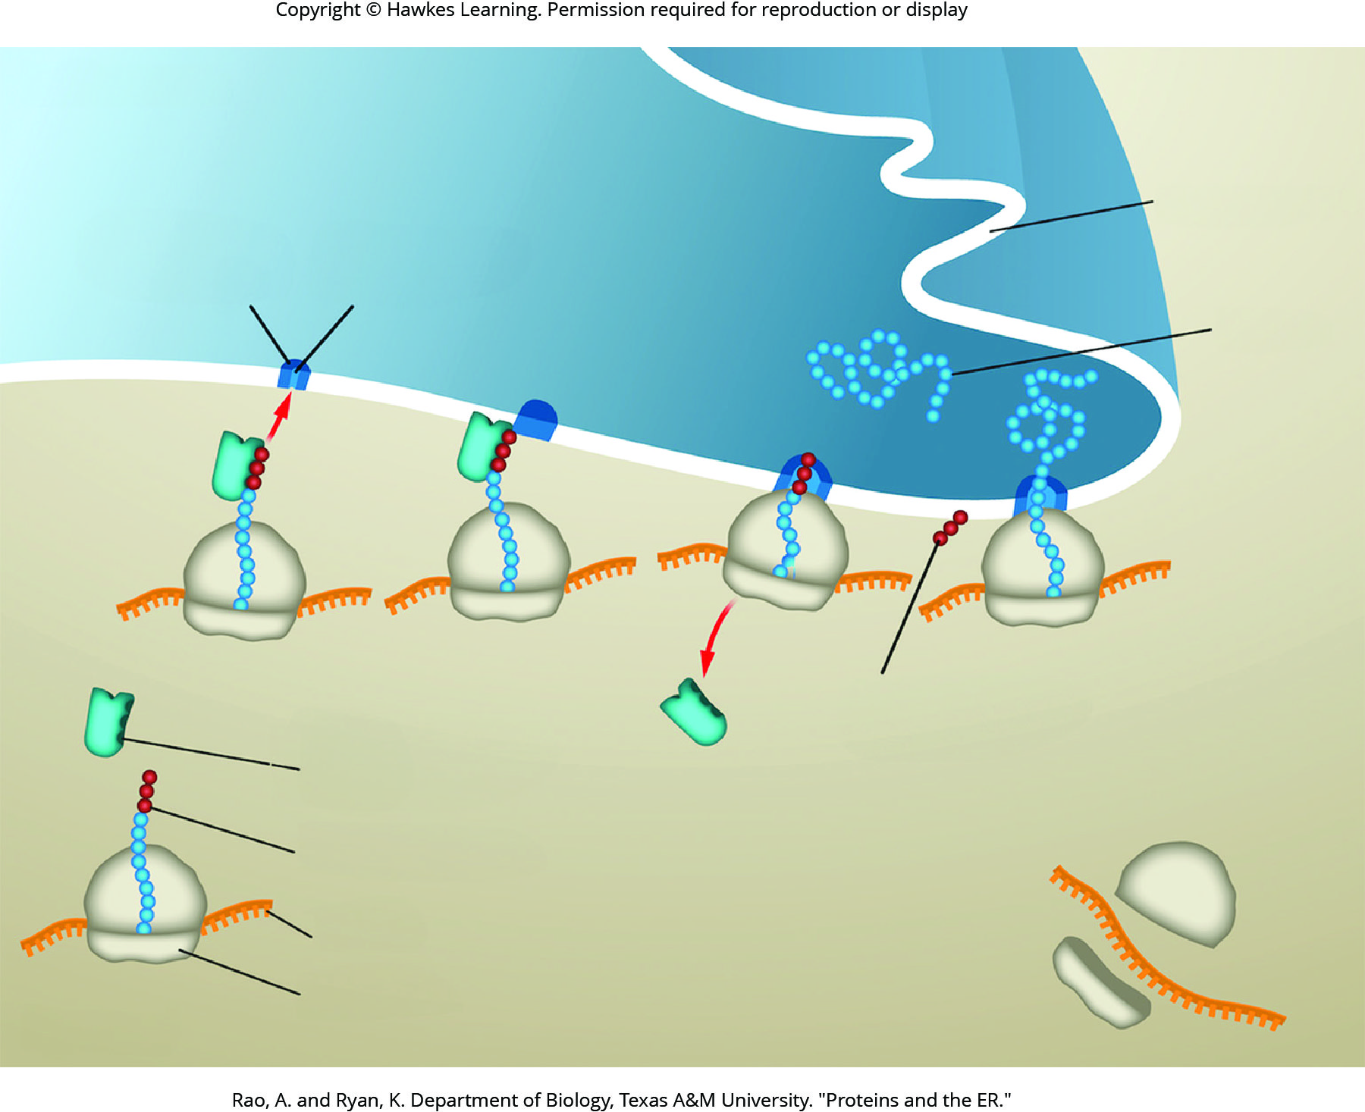
Lesson 15.5 Figure 9

Slide 38
Hawkes Learning – End of PowerPoint

