Slide 1
Chapter 17
Biotechnology and Genomics

Slide 2
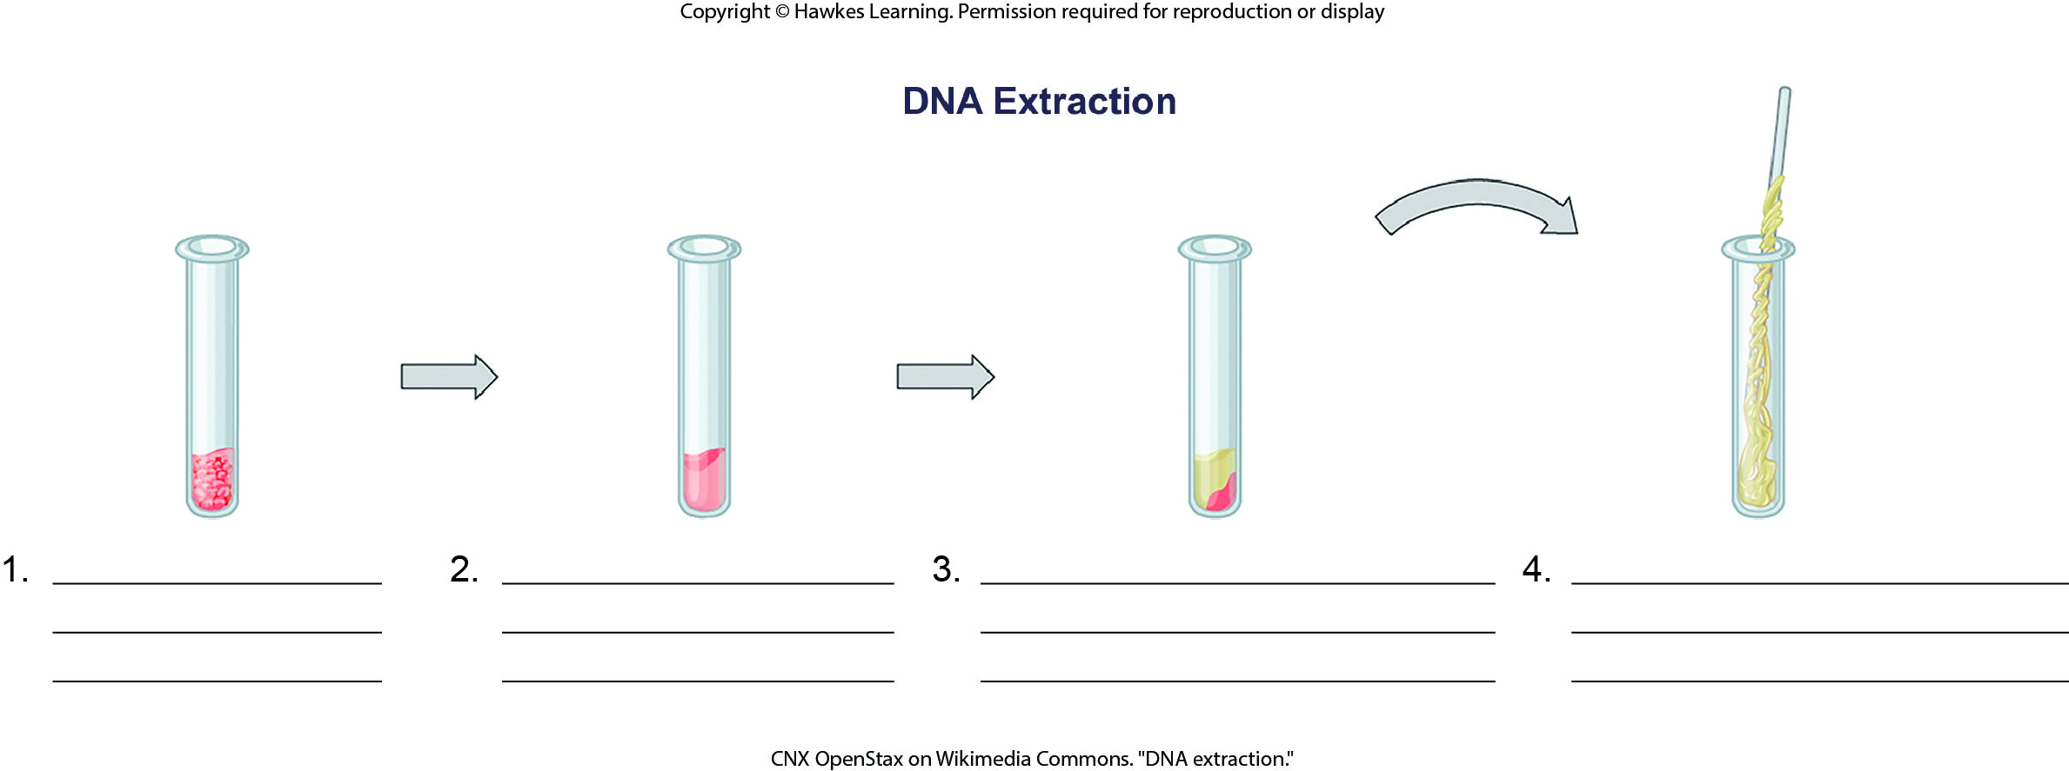
Lesson 17.1 Figure 3 - Numbered

Slide 3
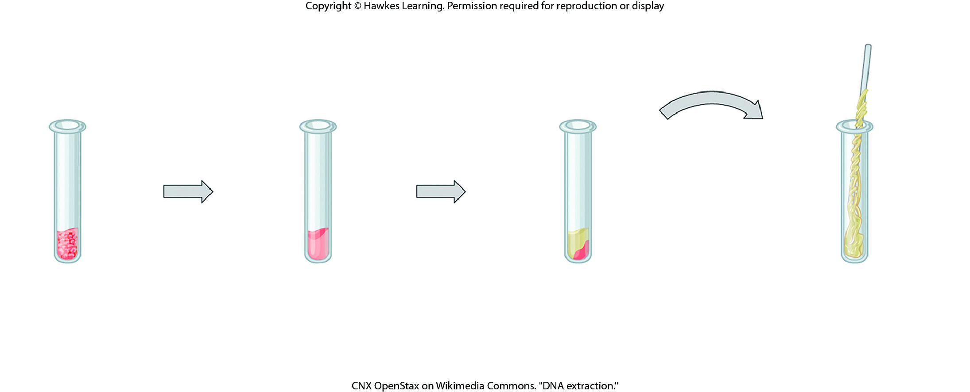
Lesson 17.3 Figure 3

Slide 4
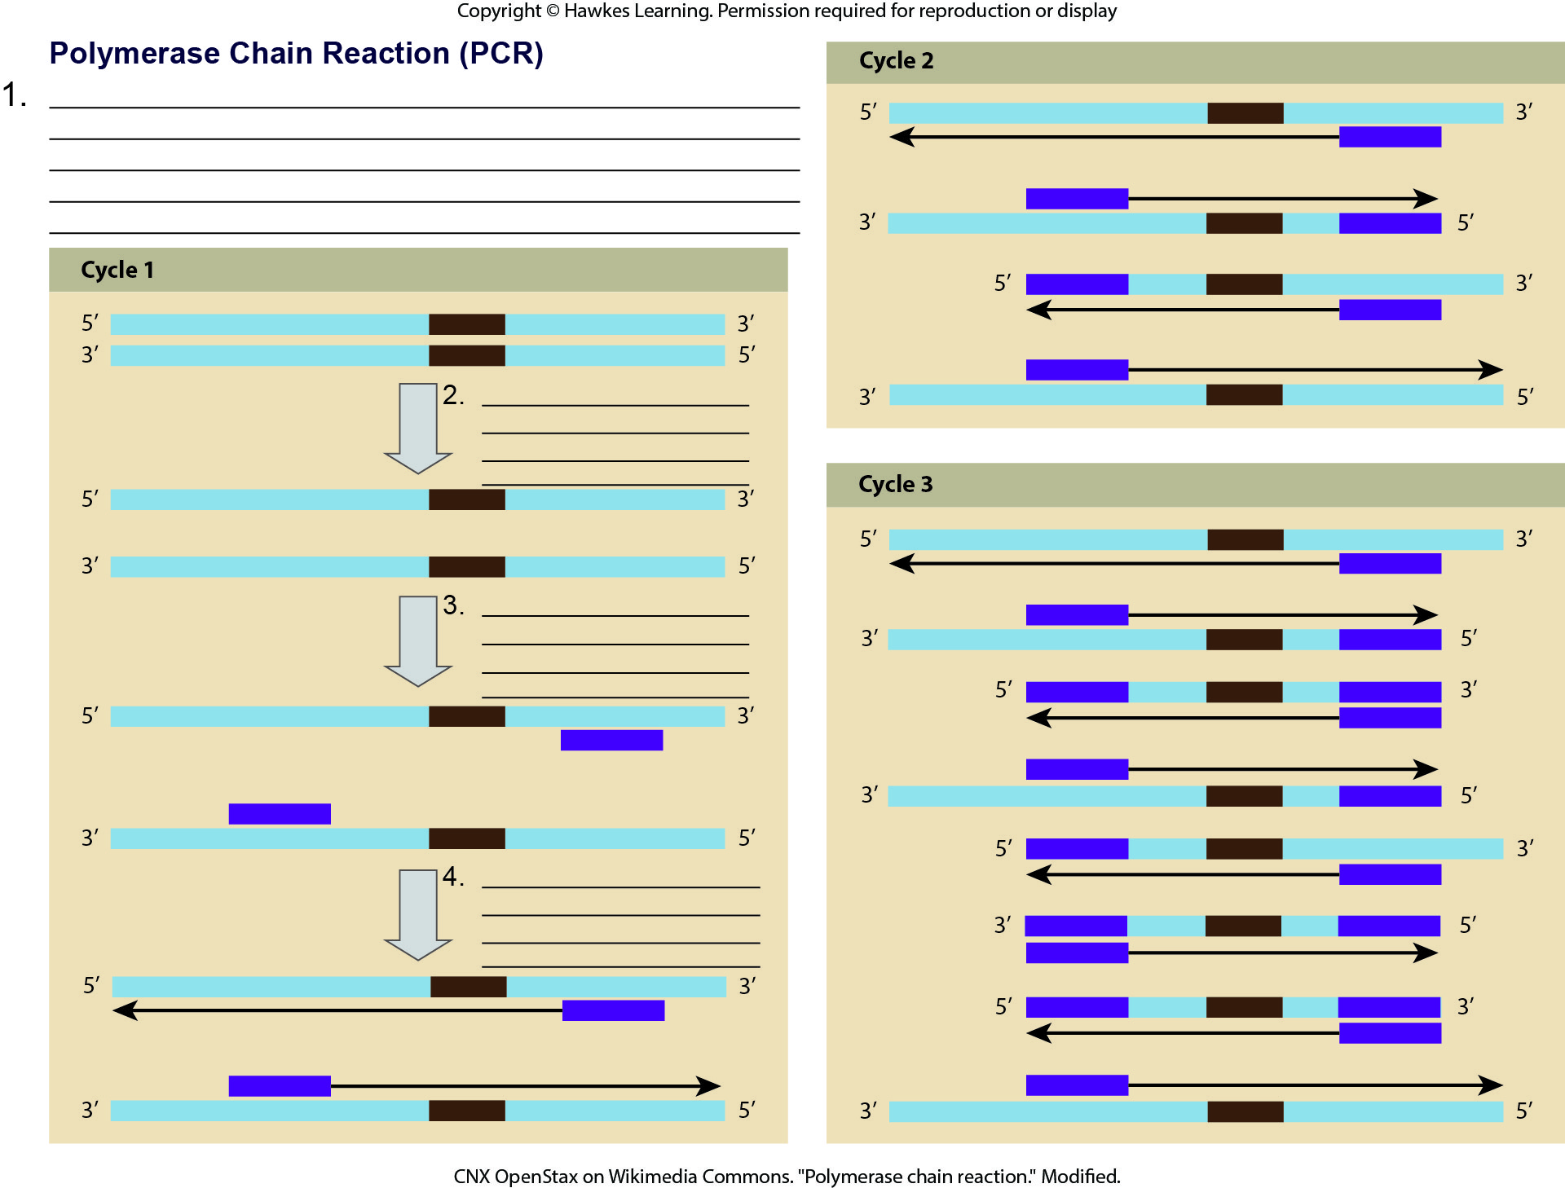
Lesson 17.1 Figure 5 - Numbered

Slide 5
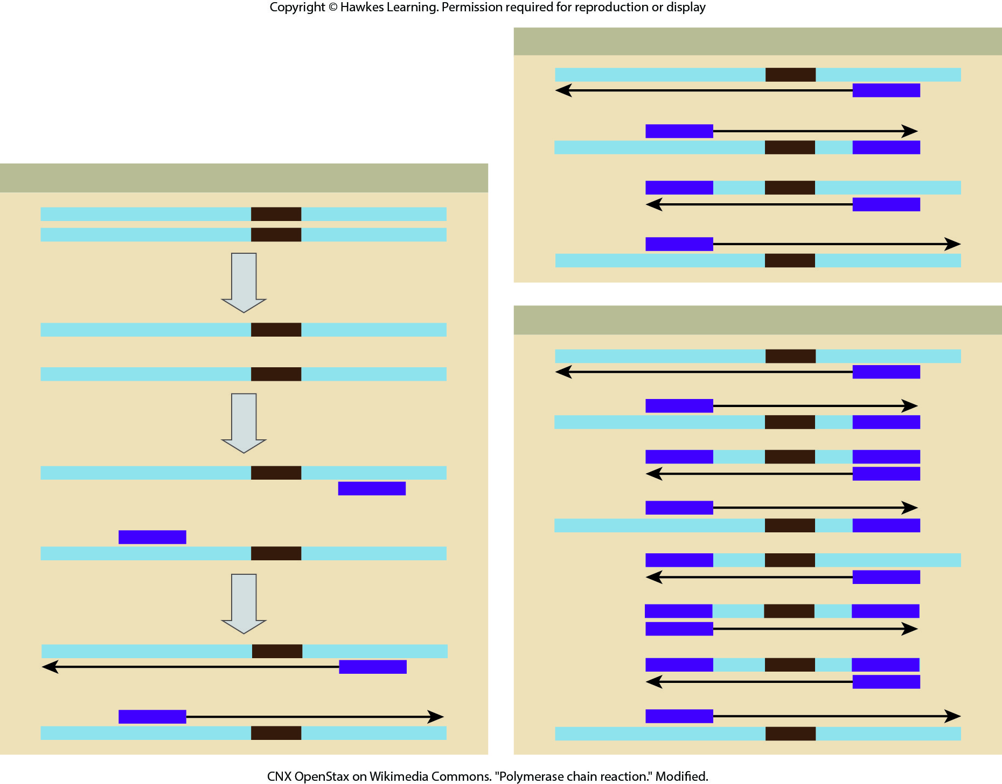
Lesson 17.1 Figure 5

Slide 6
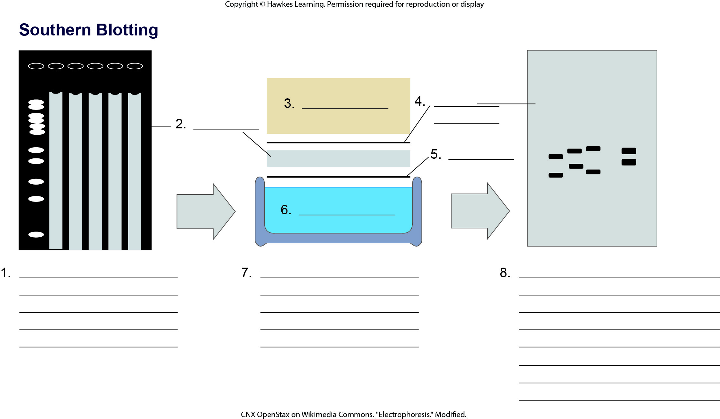
Lesson 17.1 Figure 6 - Numbered

Slide 7
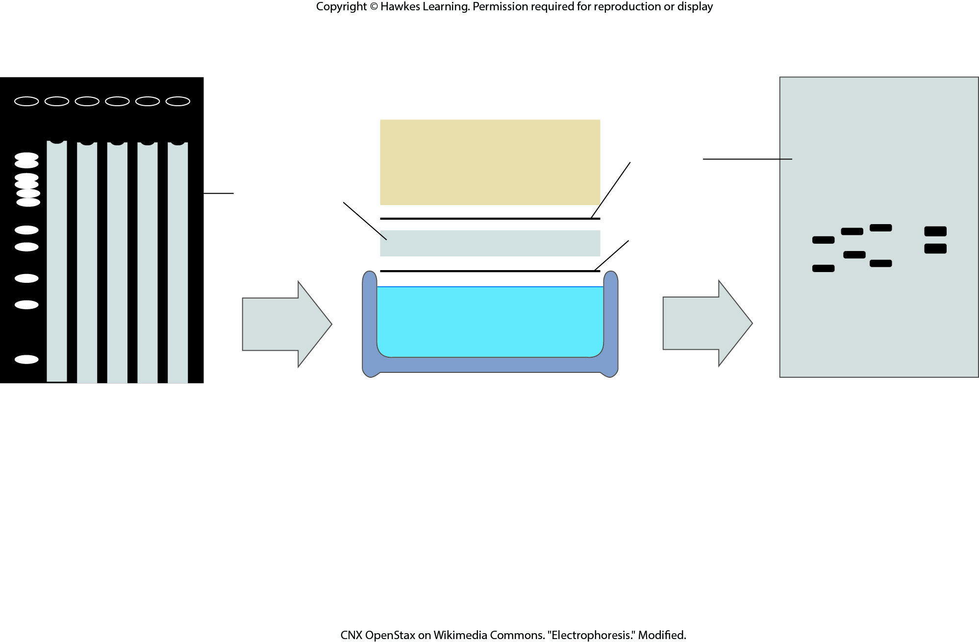
Lesson 17.1 Figure 6

Slide 8
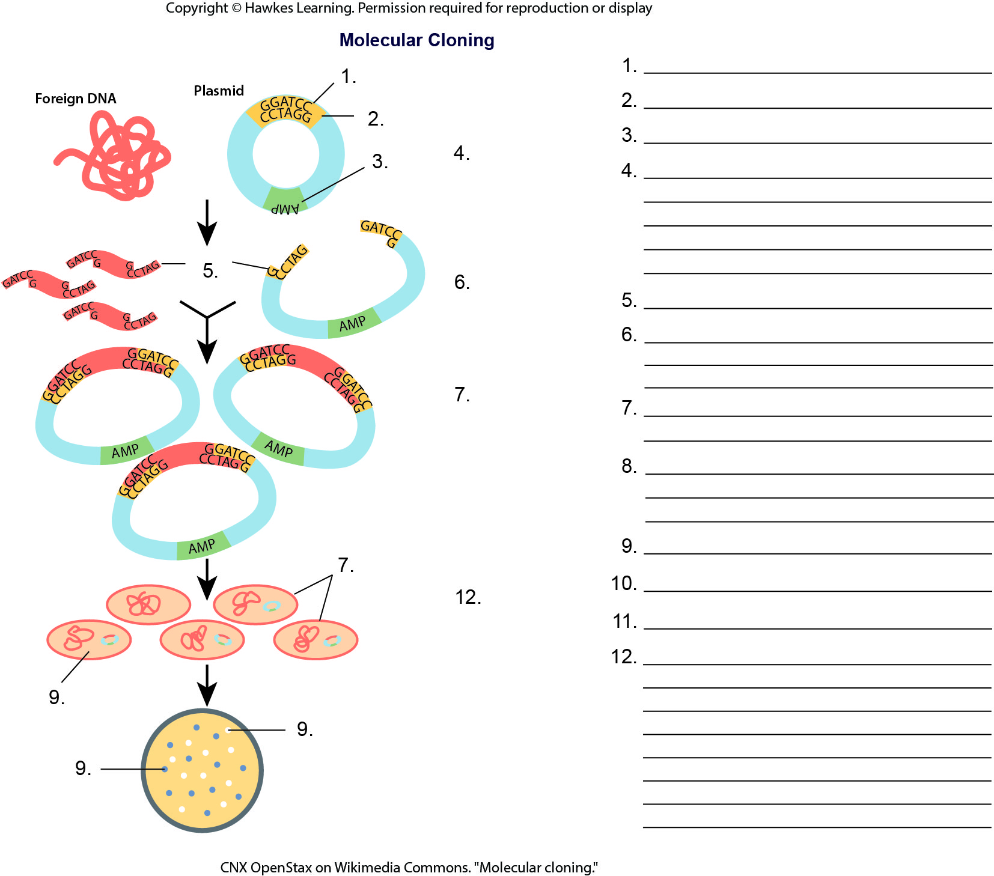
Lesson 17.1 Figure 7 - Numbered

Slide 9
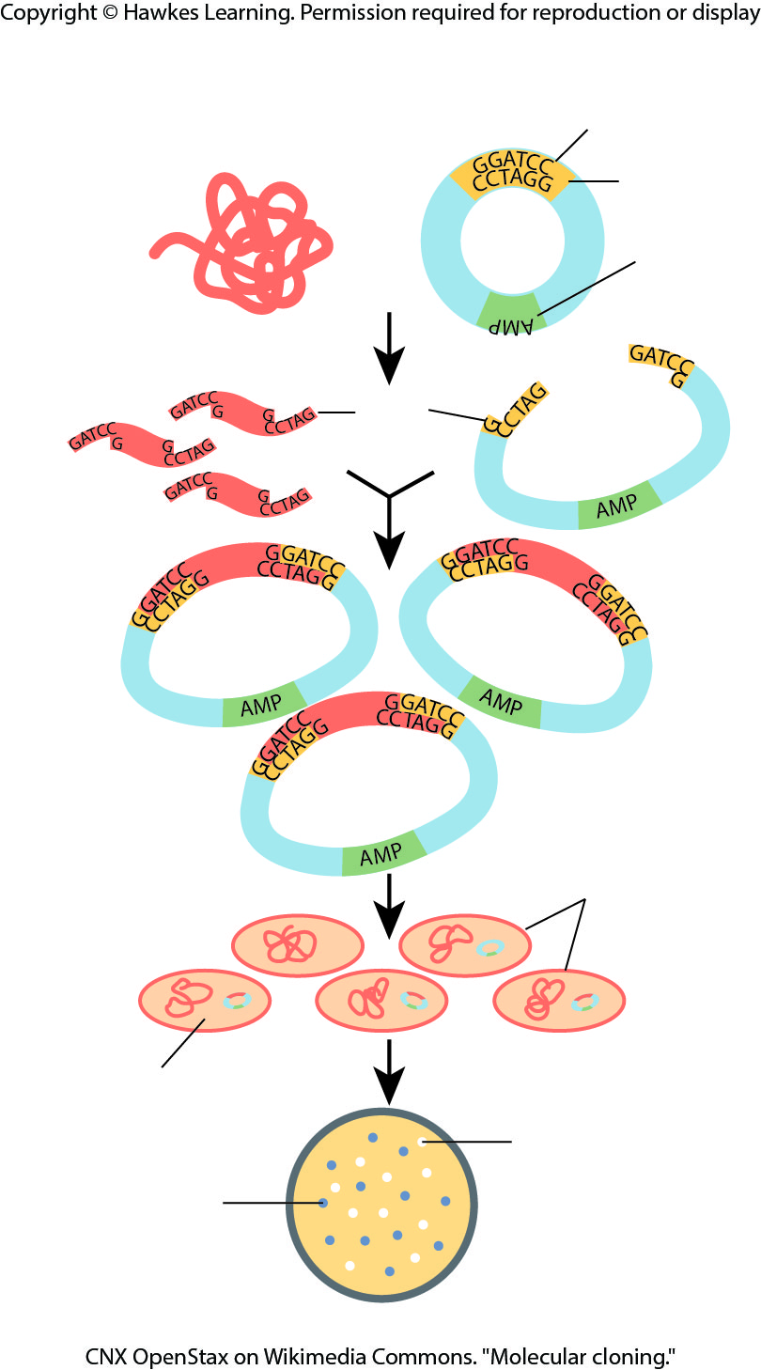
Lesson 17.1 Figure 7

Slide 10
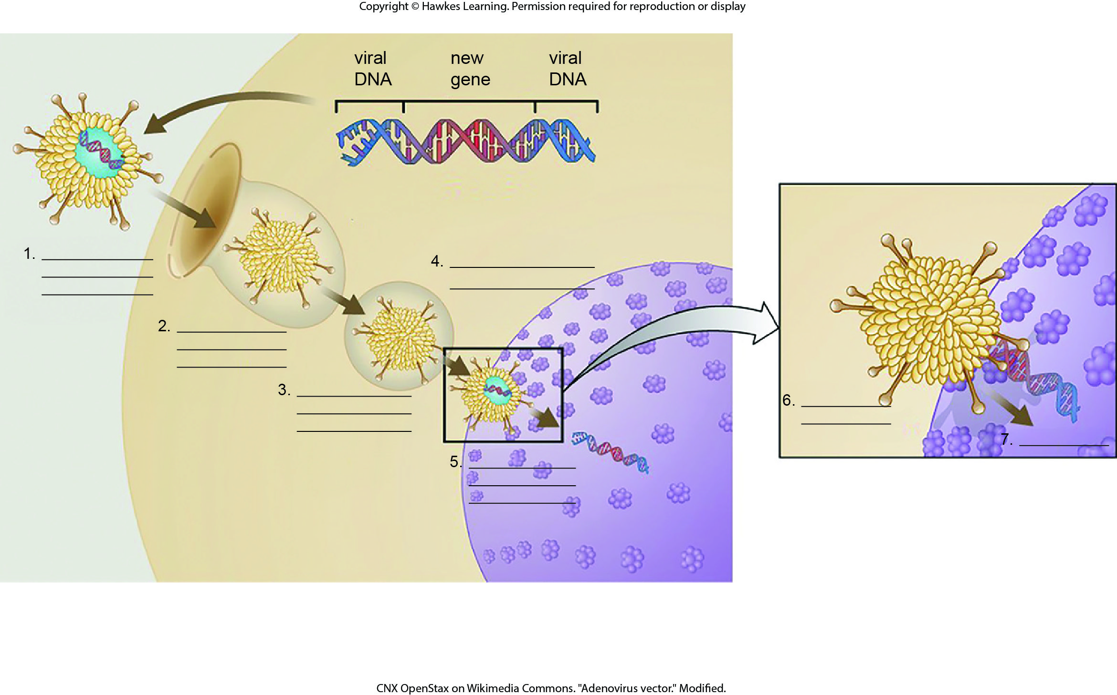
Lesson 17.1 Figure 10 - Numbered

Slide 11

Lesson 17.1 Figure 10

Slide 12
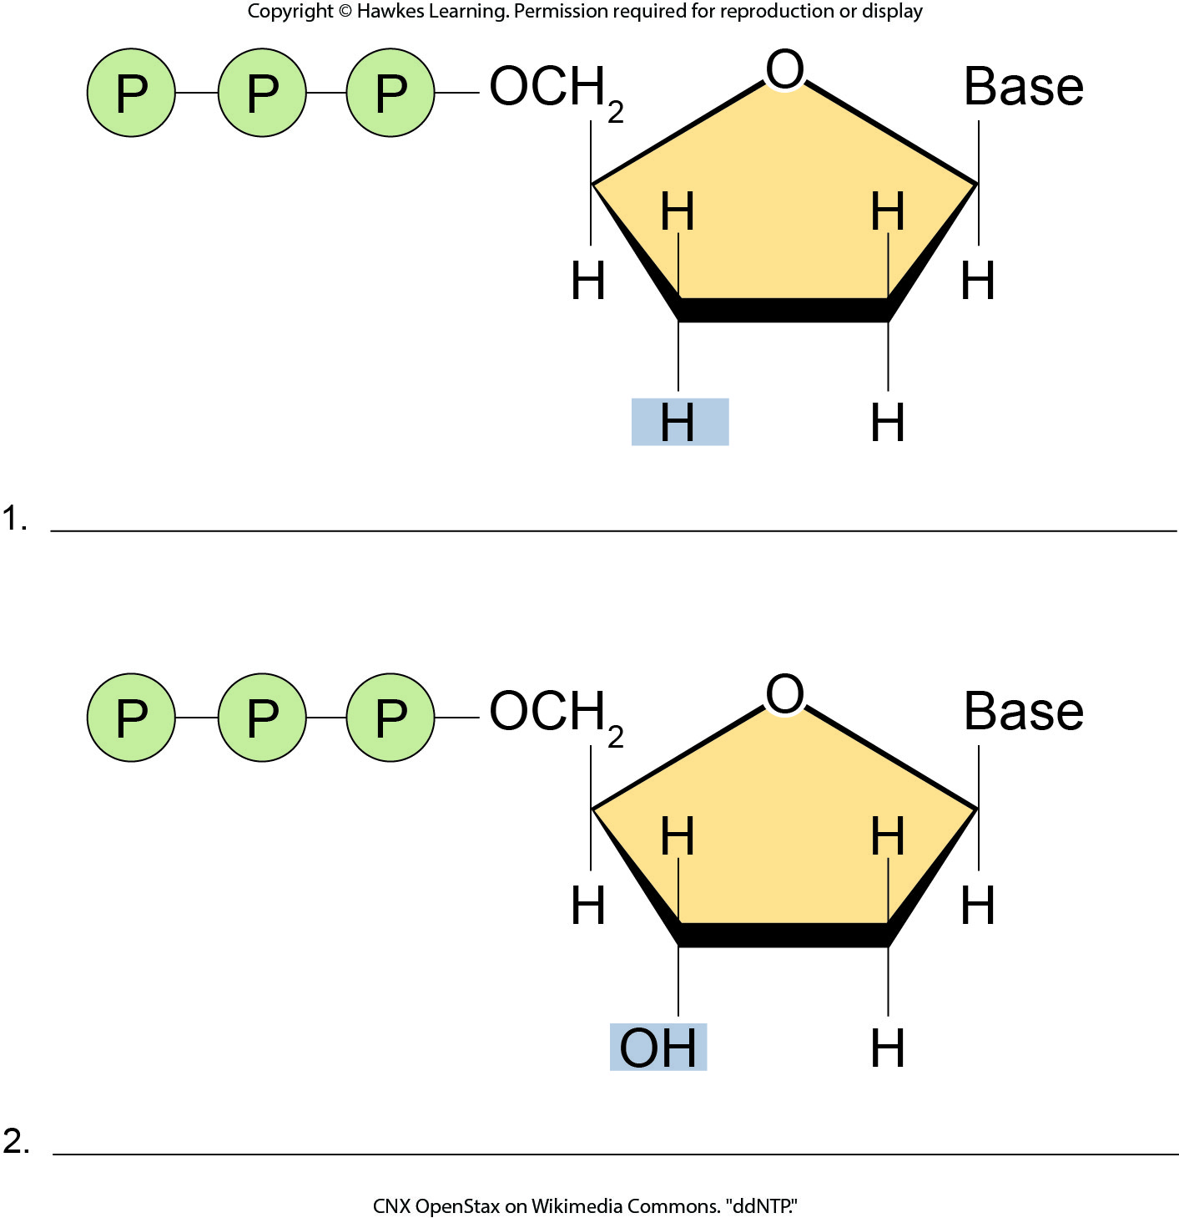
Lesson 17.2 Figure 5 - Numbered

Slide 13
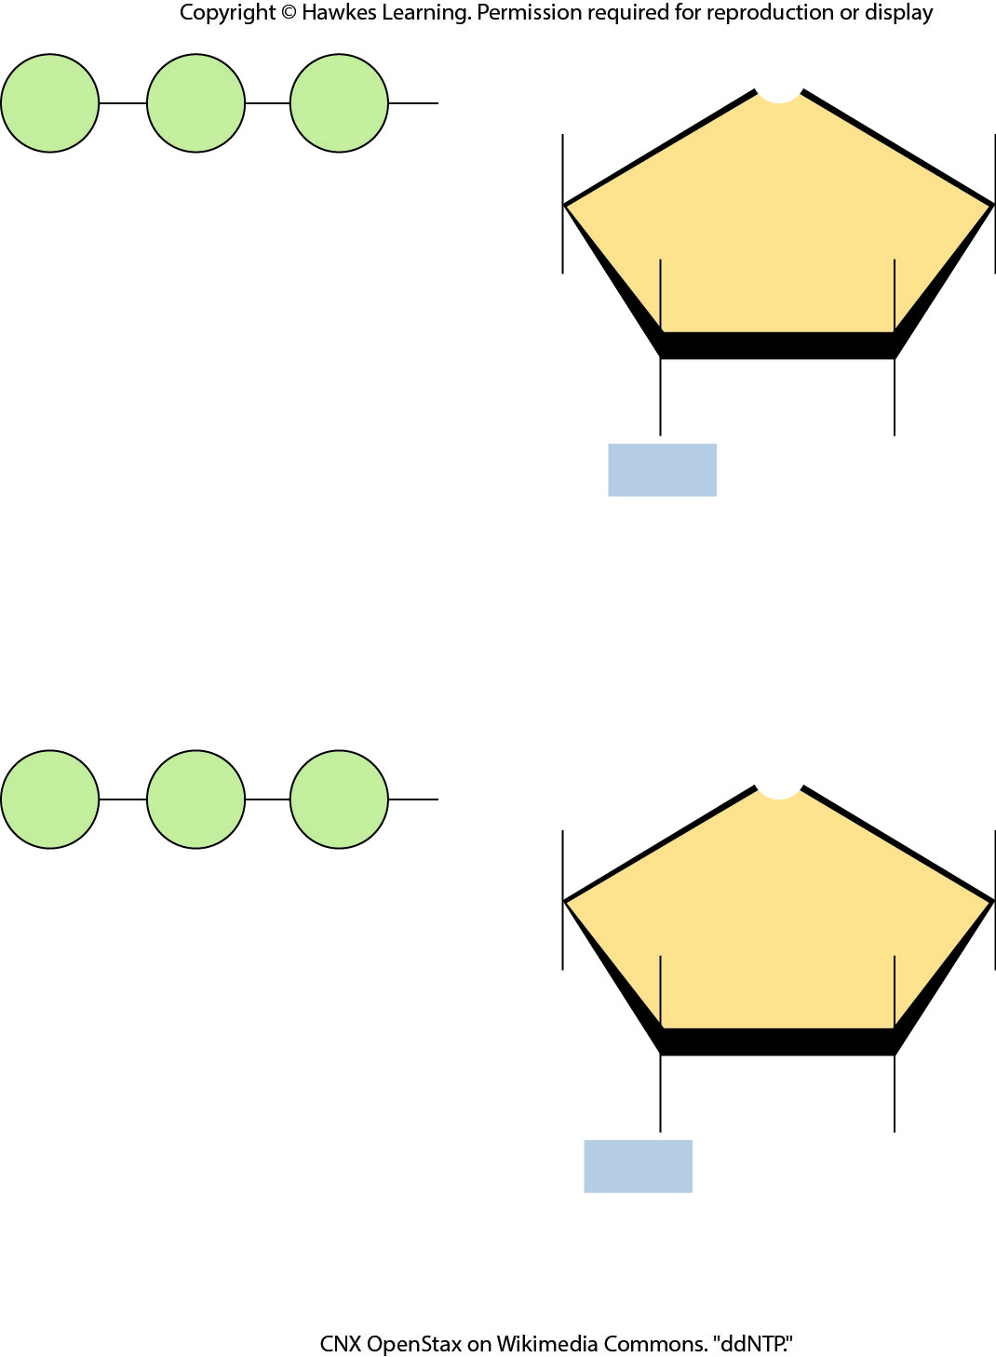
Lesson 17.2 Figure 5

Slide 14
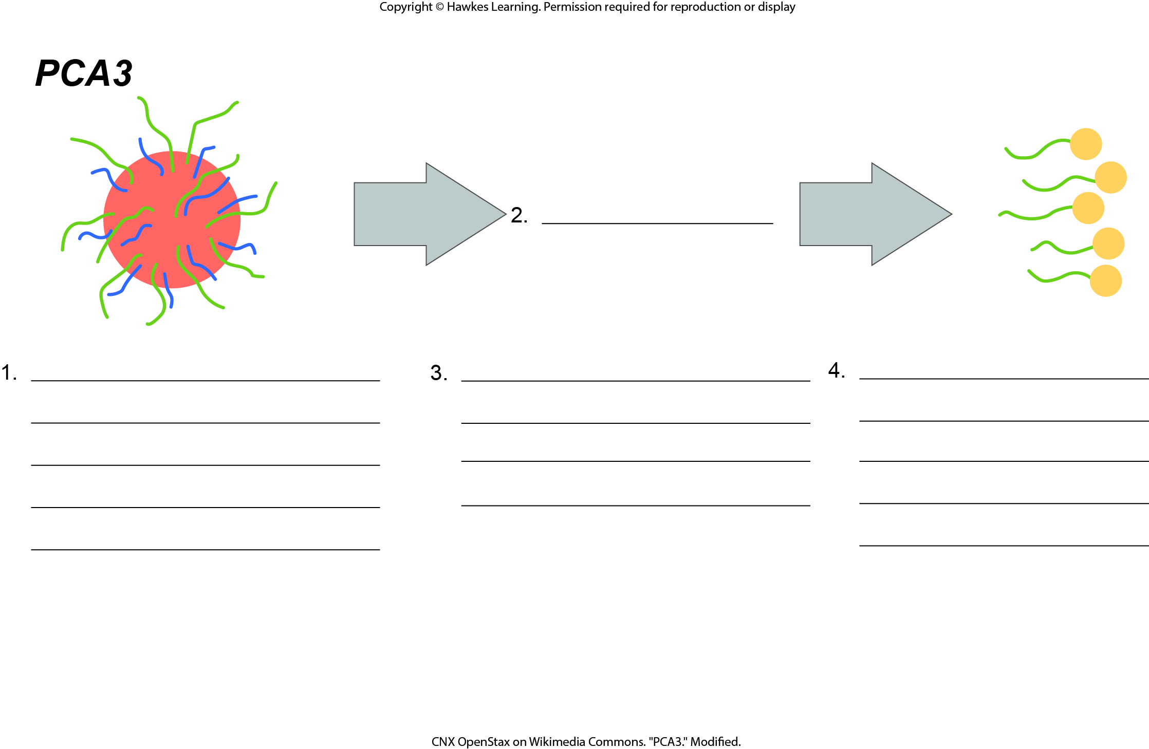
Lesson 17.3 Figure 2 - Numbered

Slide 15
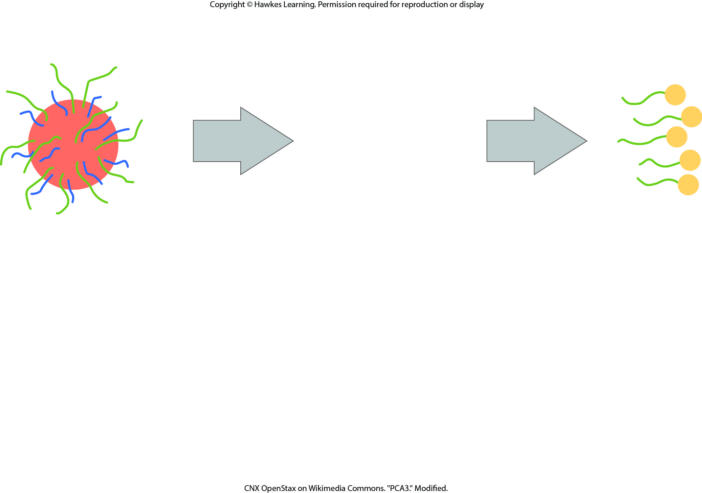
Lesson 17.3 Figure 2

Slide 16
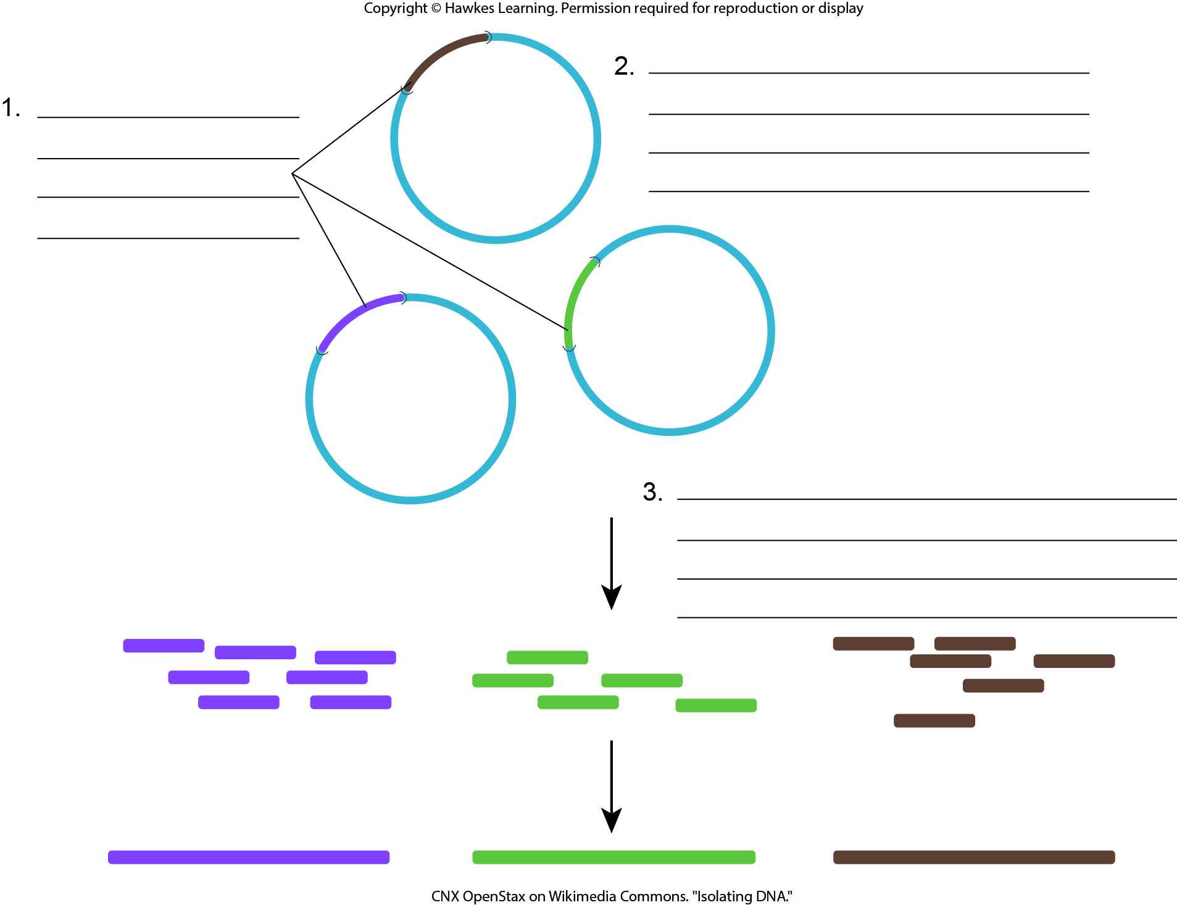
Lesson 17.3 Figure 3 - Numbered

Slide 17
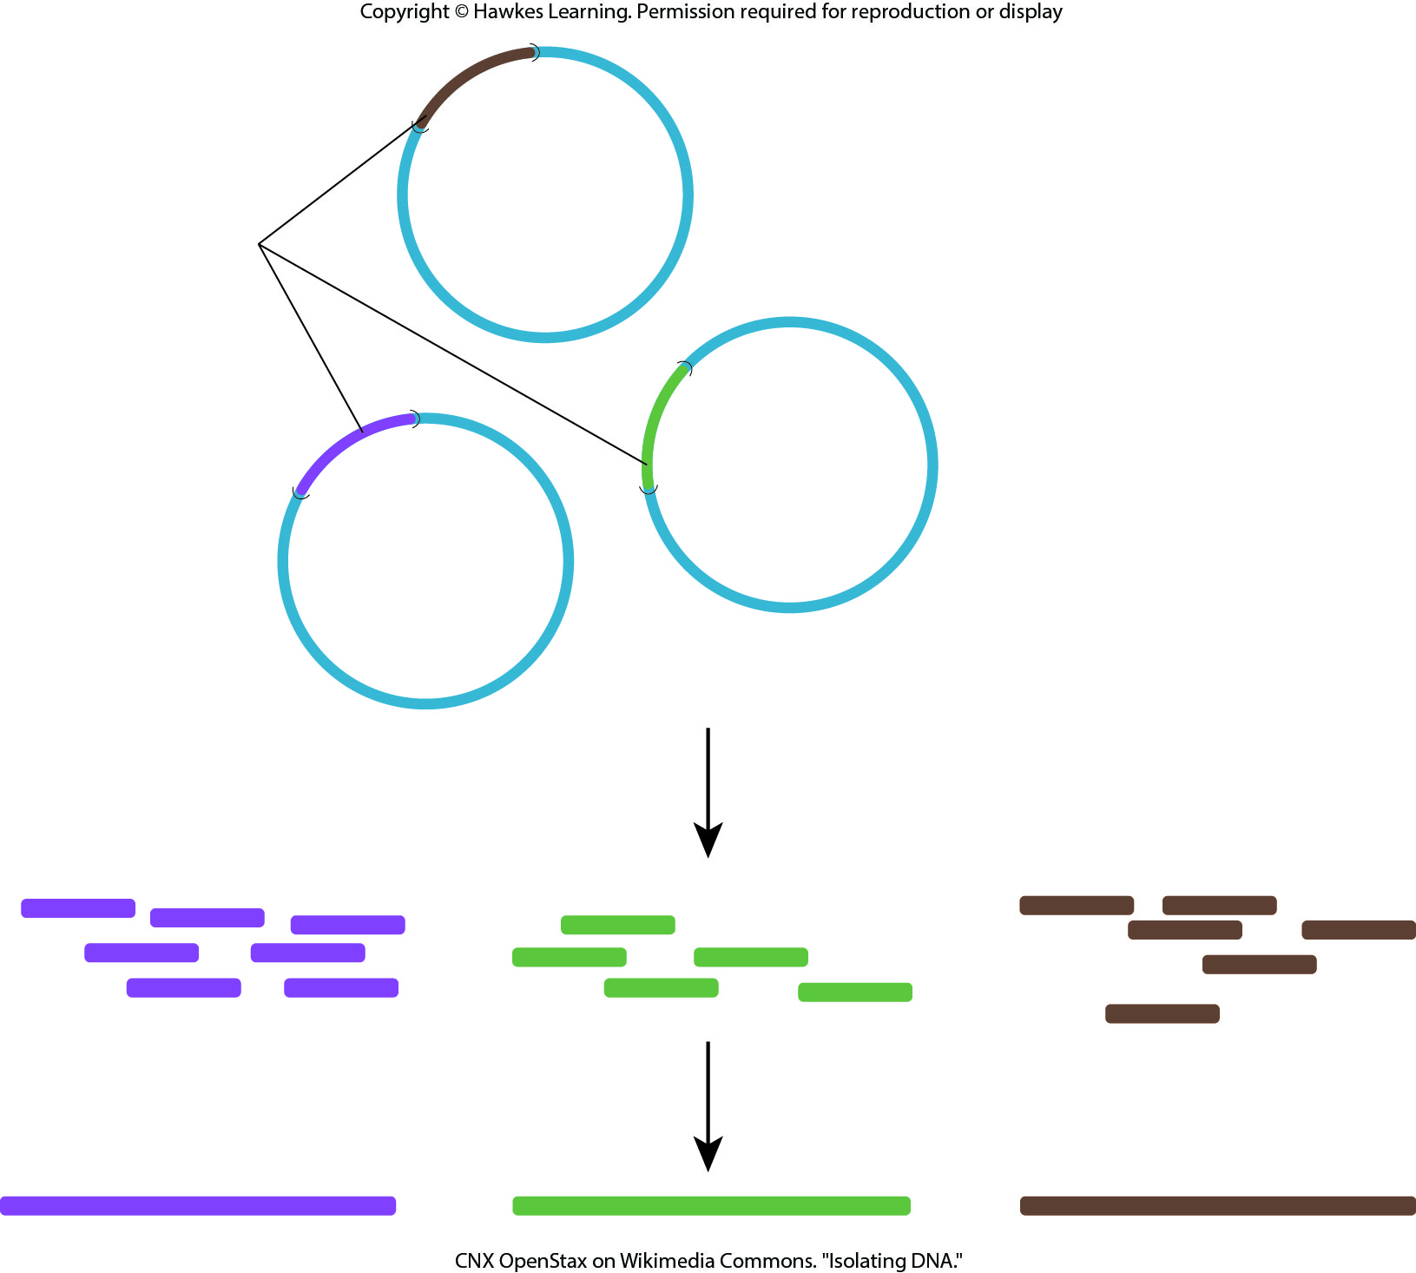
Lesson 17.3 Figure 3

Slide 18
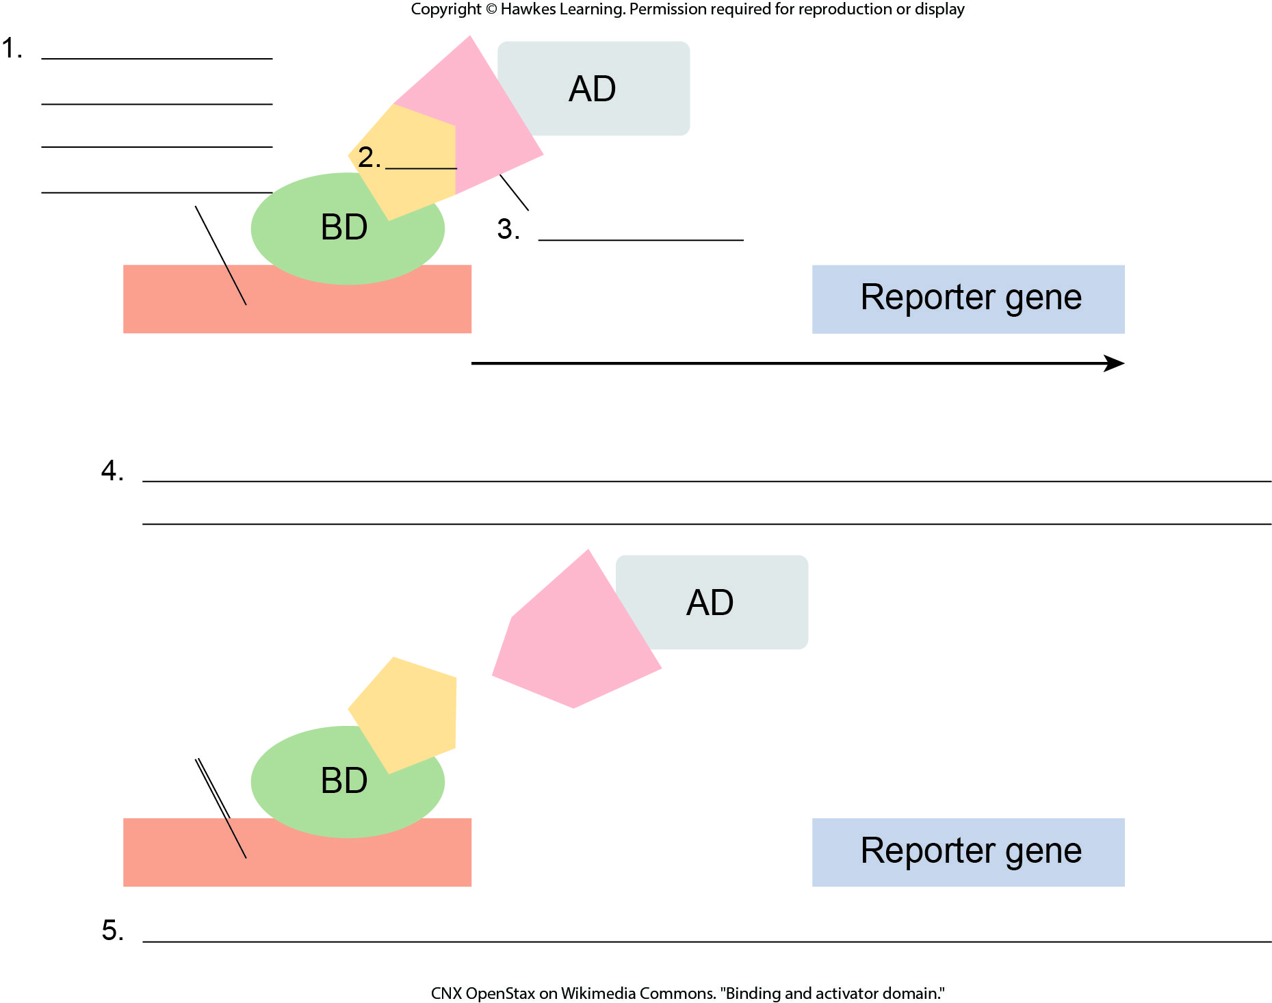
Lesson 17.3 Figure 6 - Numbered

Slide 19
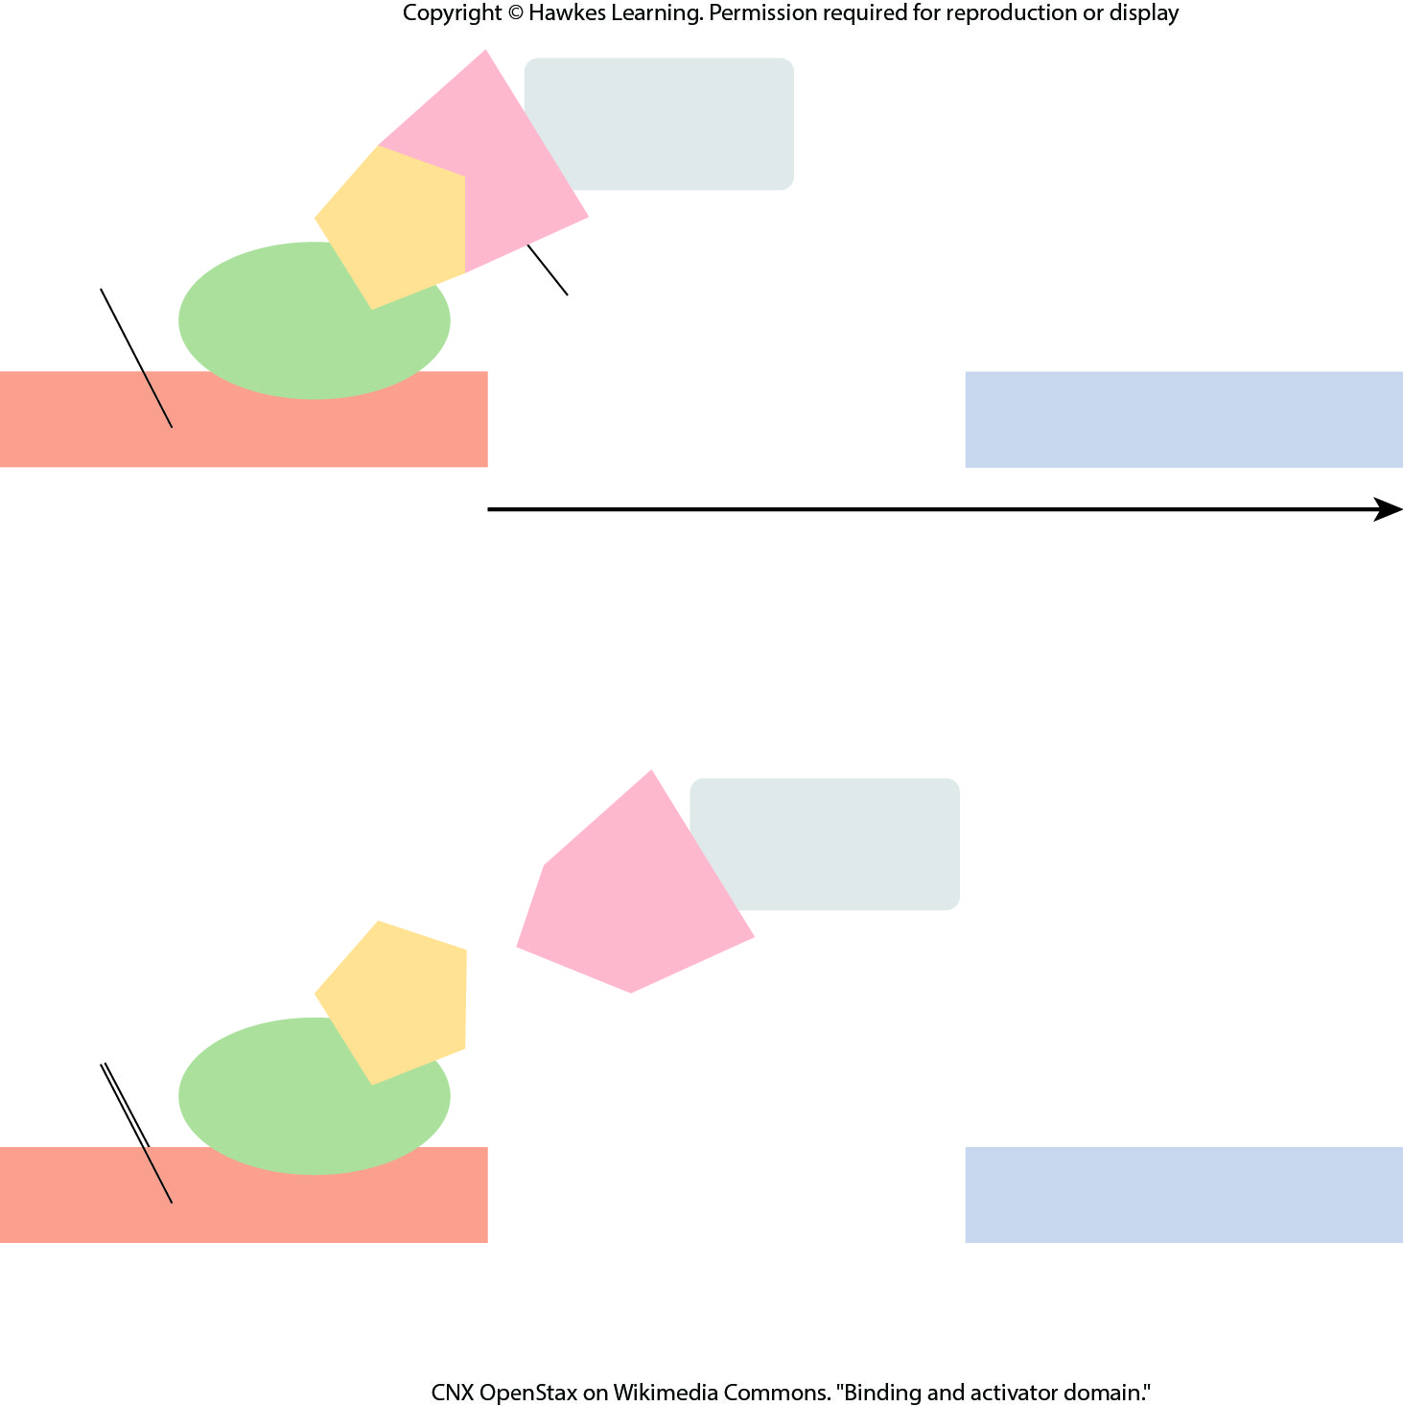
Lesson 17.3 Figure 6

Slide 20
Hawkes Learning – End of PowerPoint

