Slide 1
Chapter 18
Evolution and the Origin of the Species

Slide 2
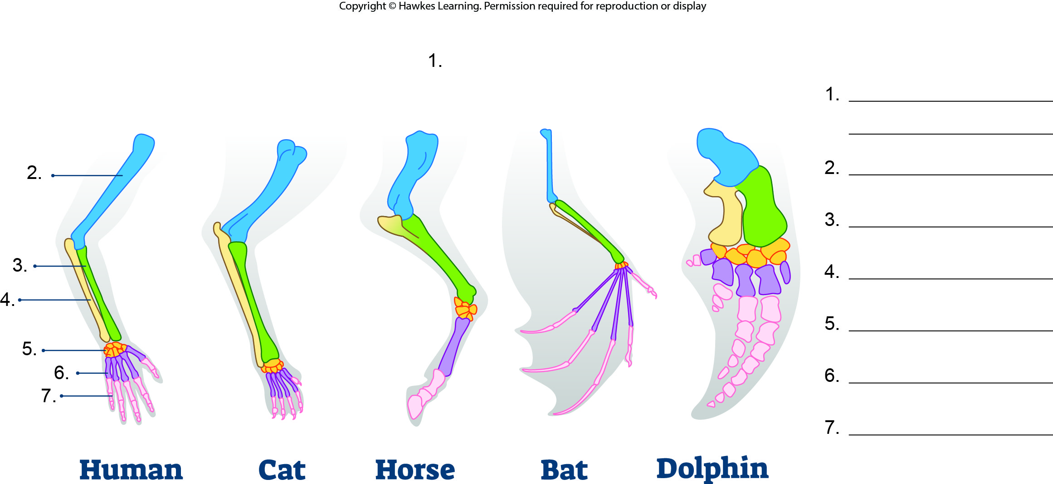
Lesson 18.1 Figure 10 - Numbered

Slide 3
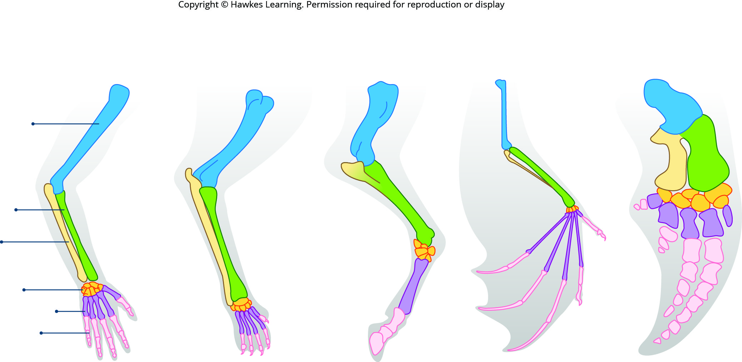
Lesson 18.1 Figure 10

Slide 4
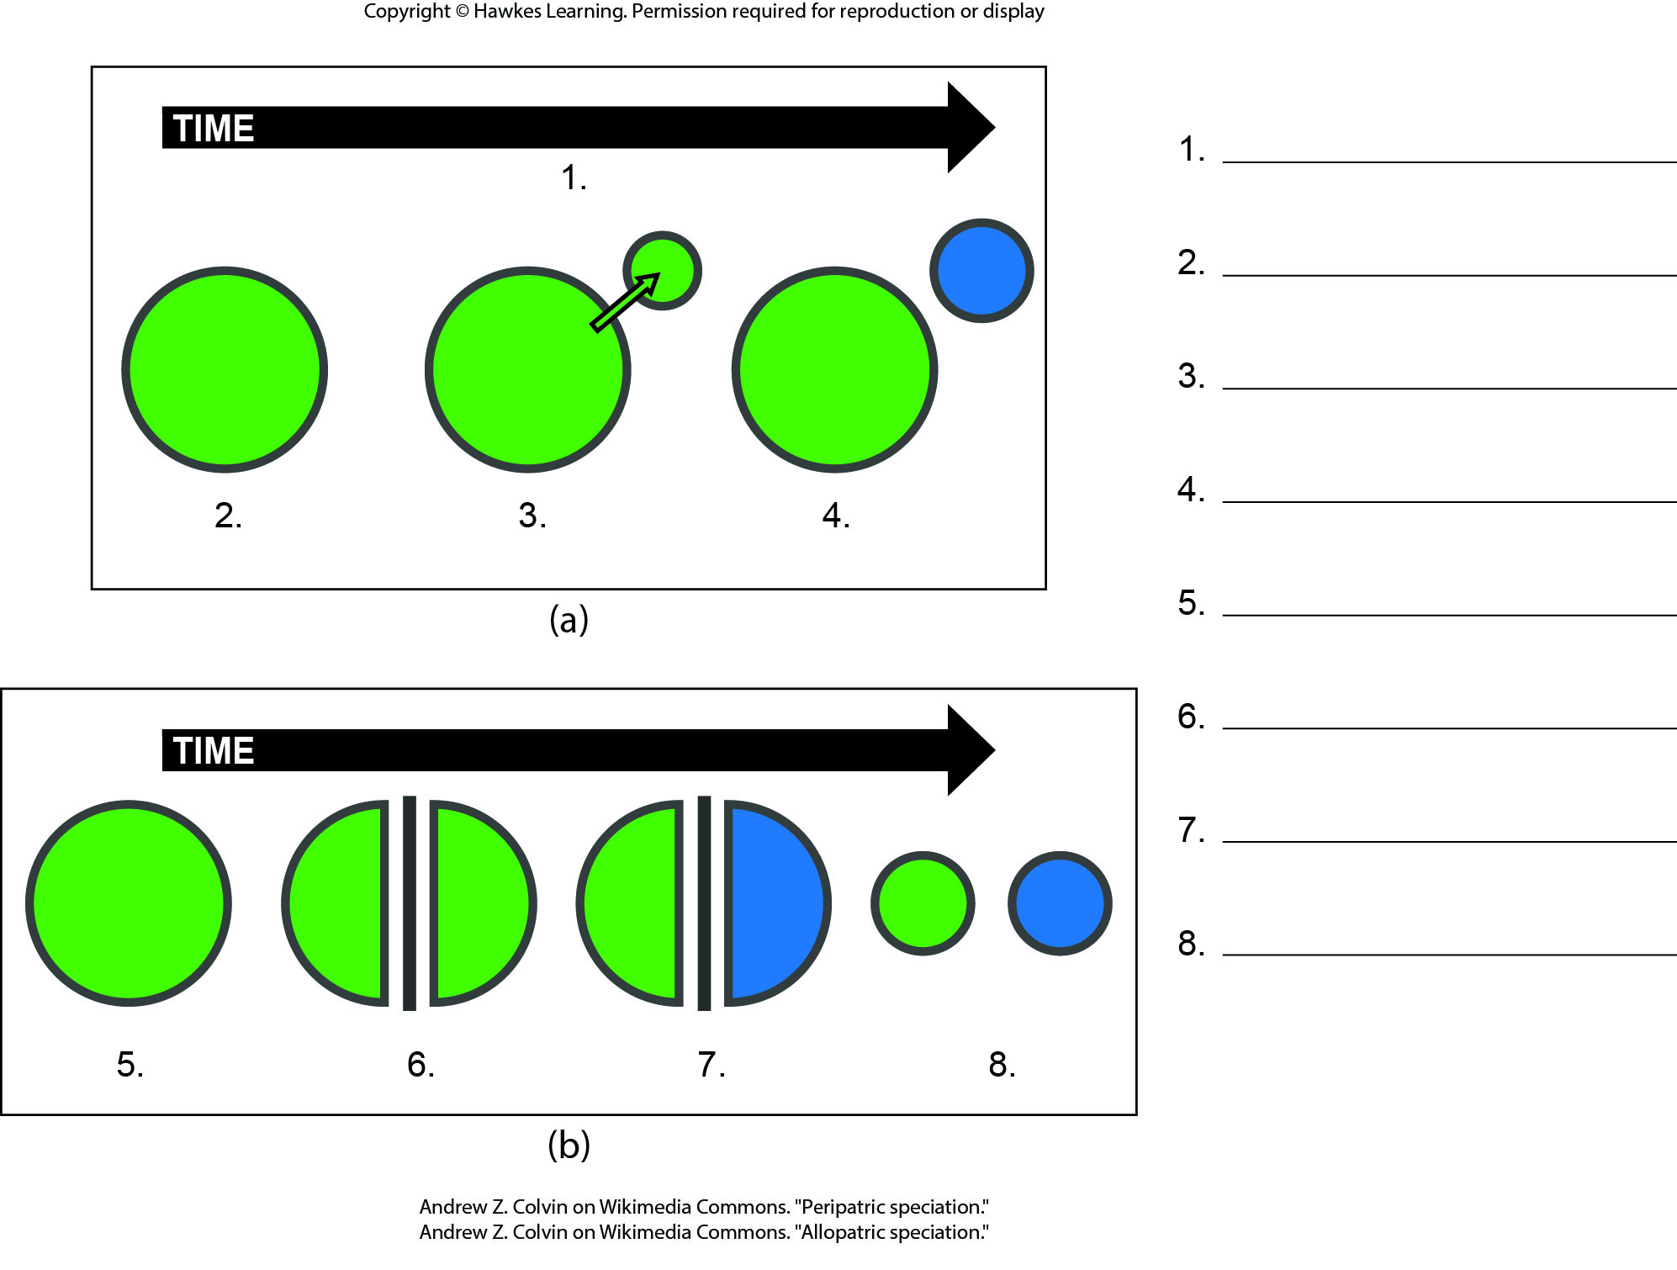
Lesson 18.2 Figure 4 - Numbered

Slide 5
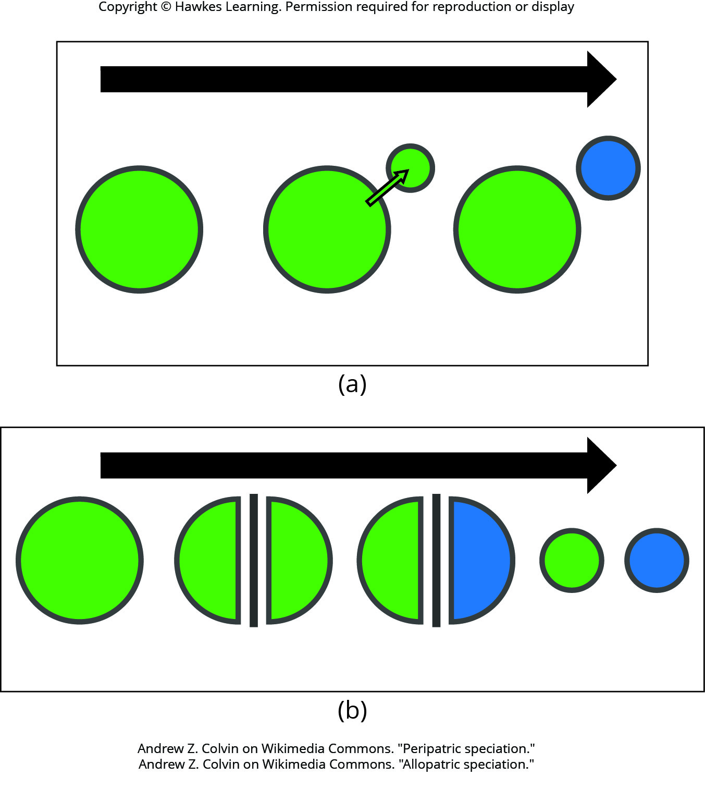
Lesson 18.2 Figure 4

Slide 6
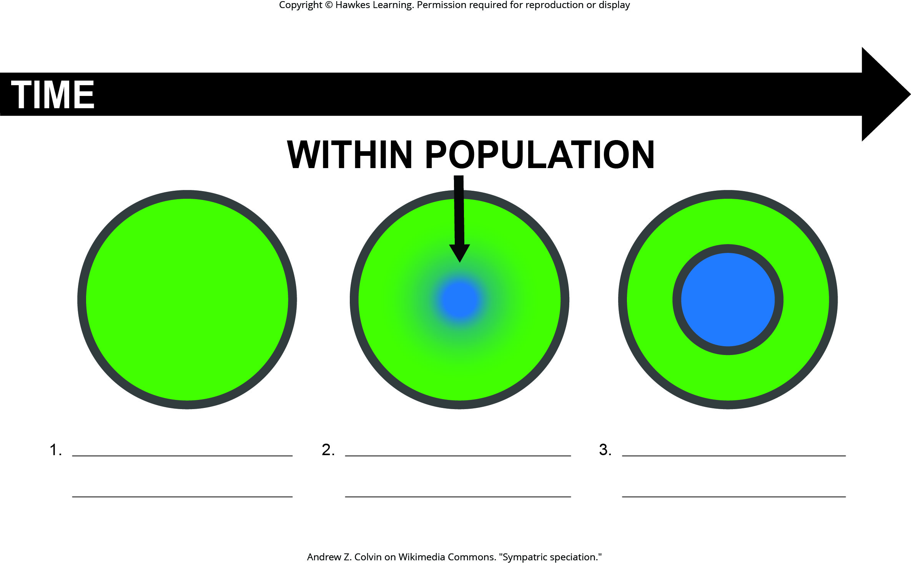
Lesson 18.2 Figure 7 - Numbered

Slide 7
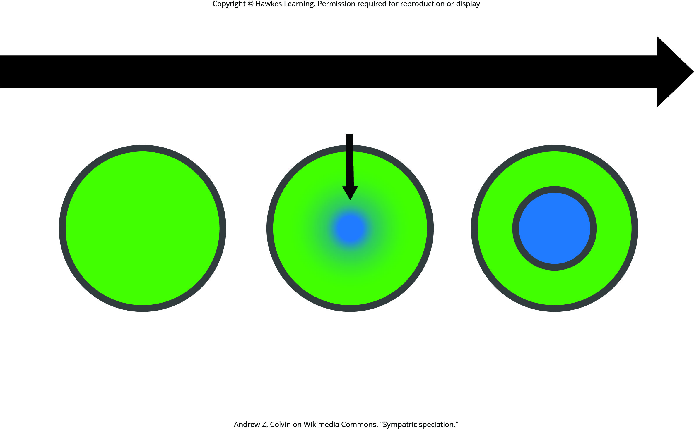
Lesson 18.2 Figure 7

Slide 8
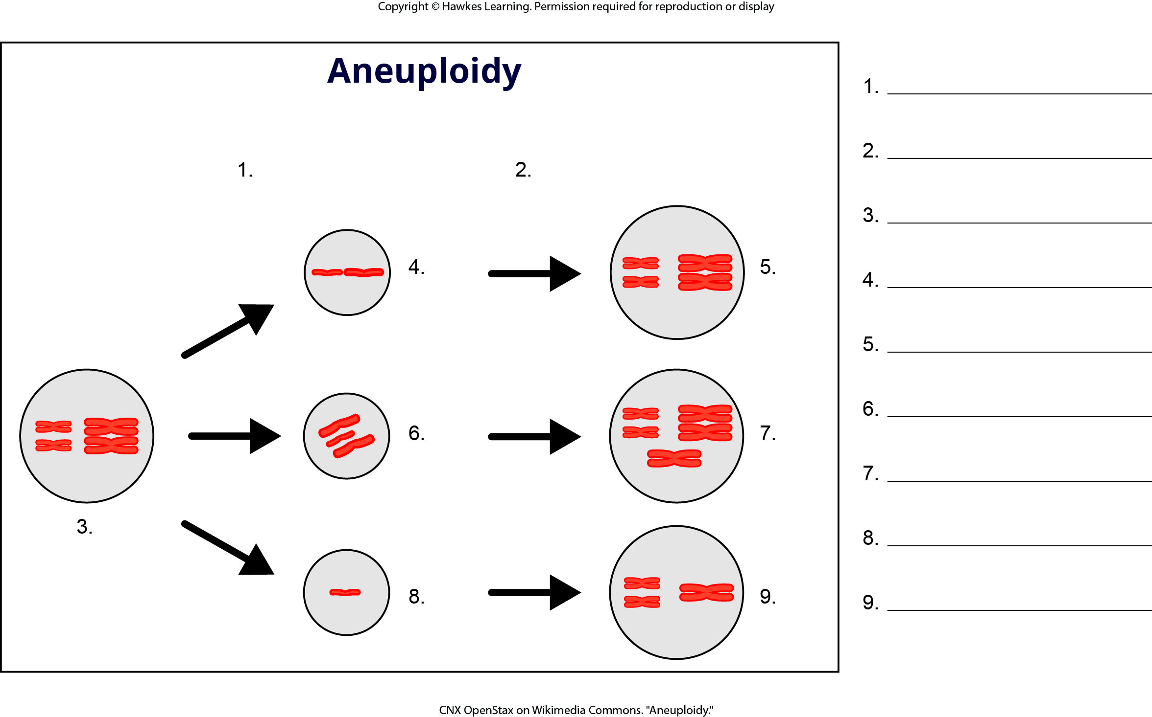
Lesson 18.2 Figure 8 - Numbered

Slide 9
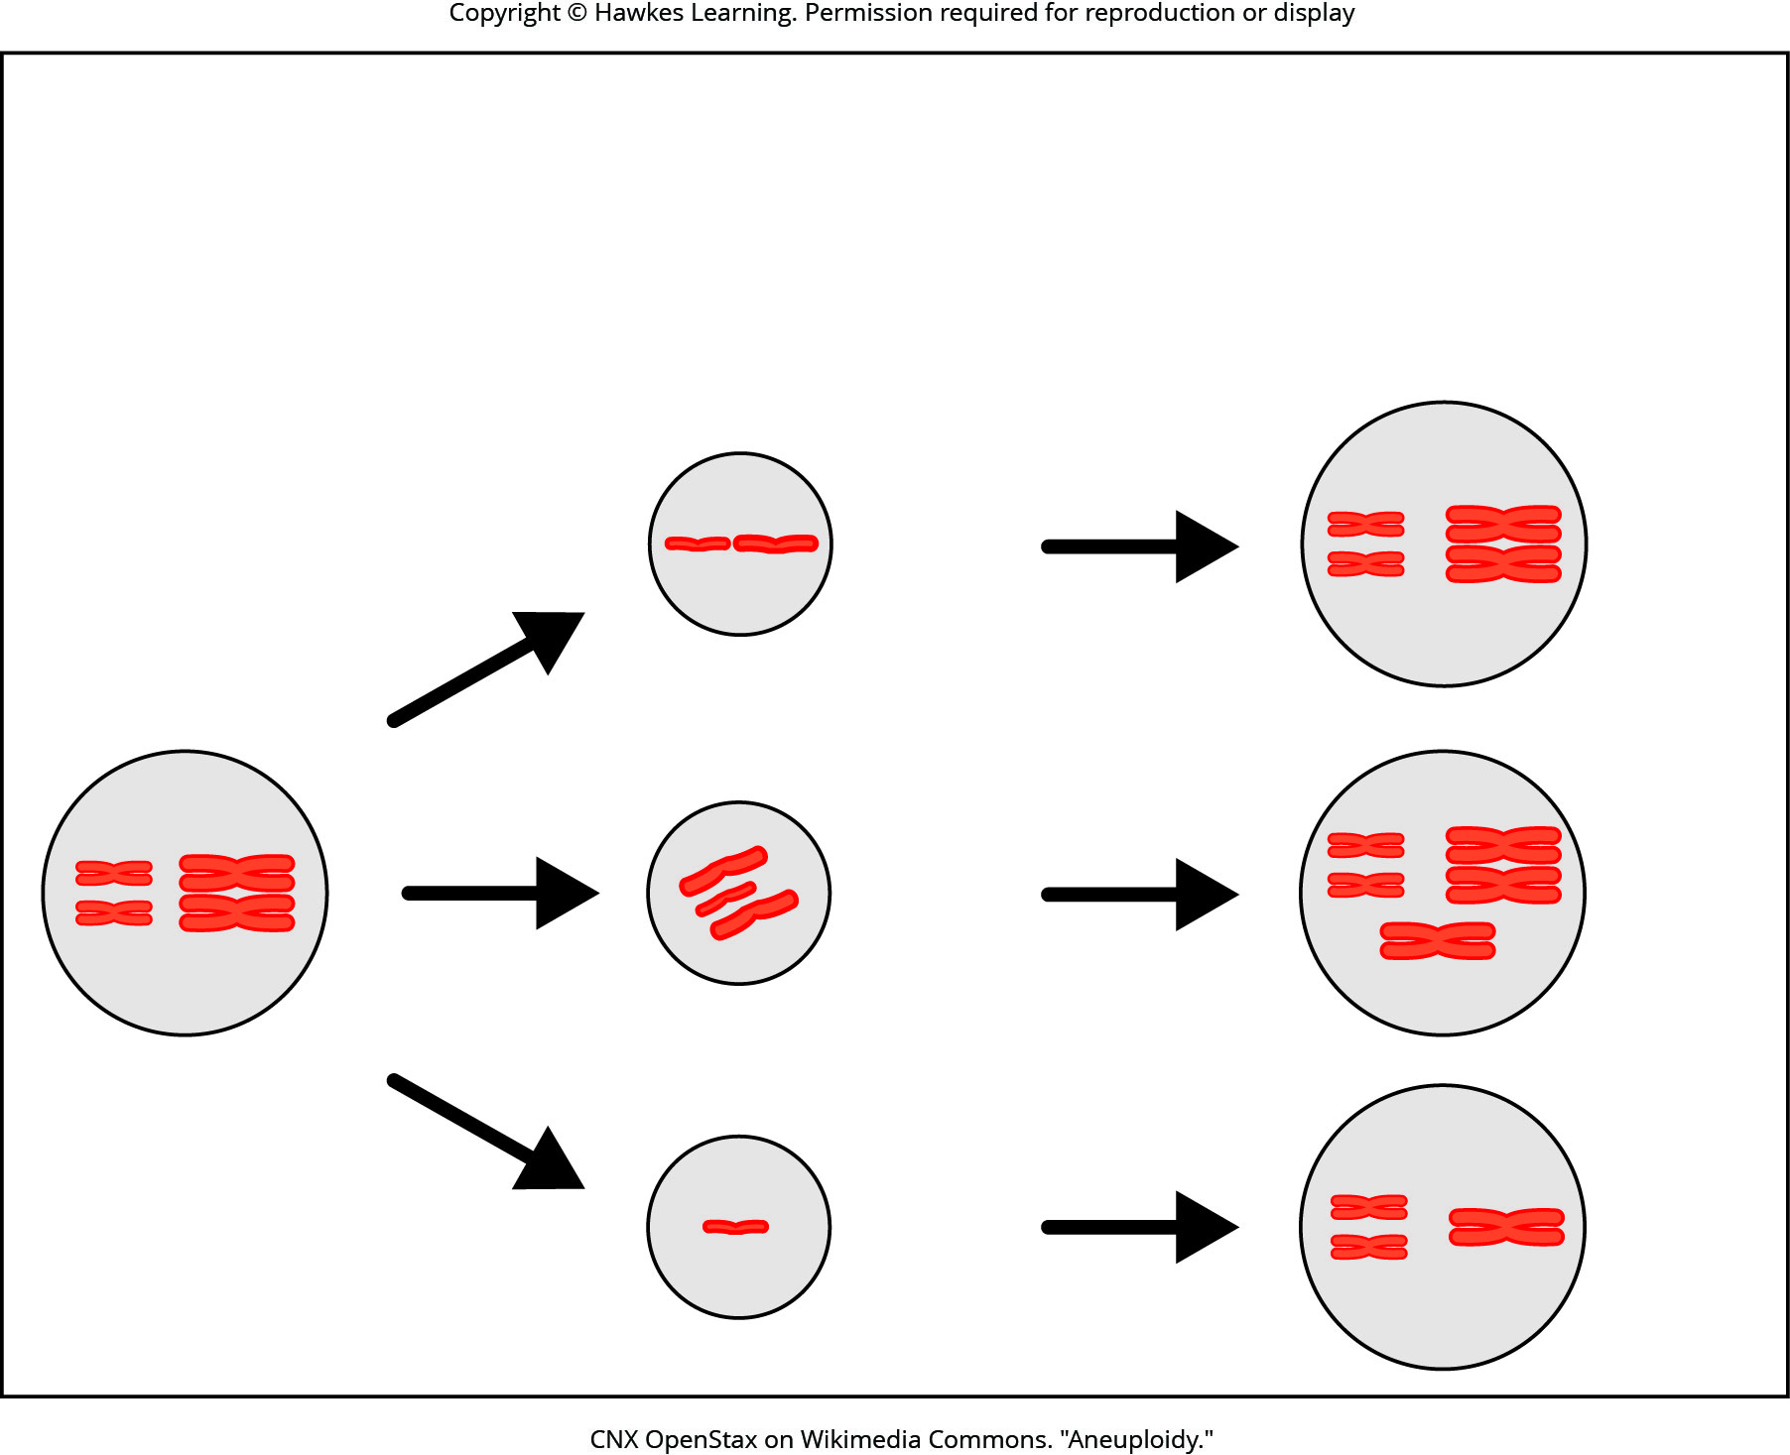
Lesson 18.2 Figure 8

Slide 10
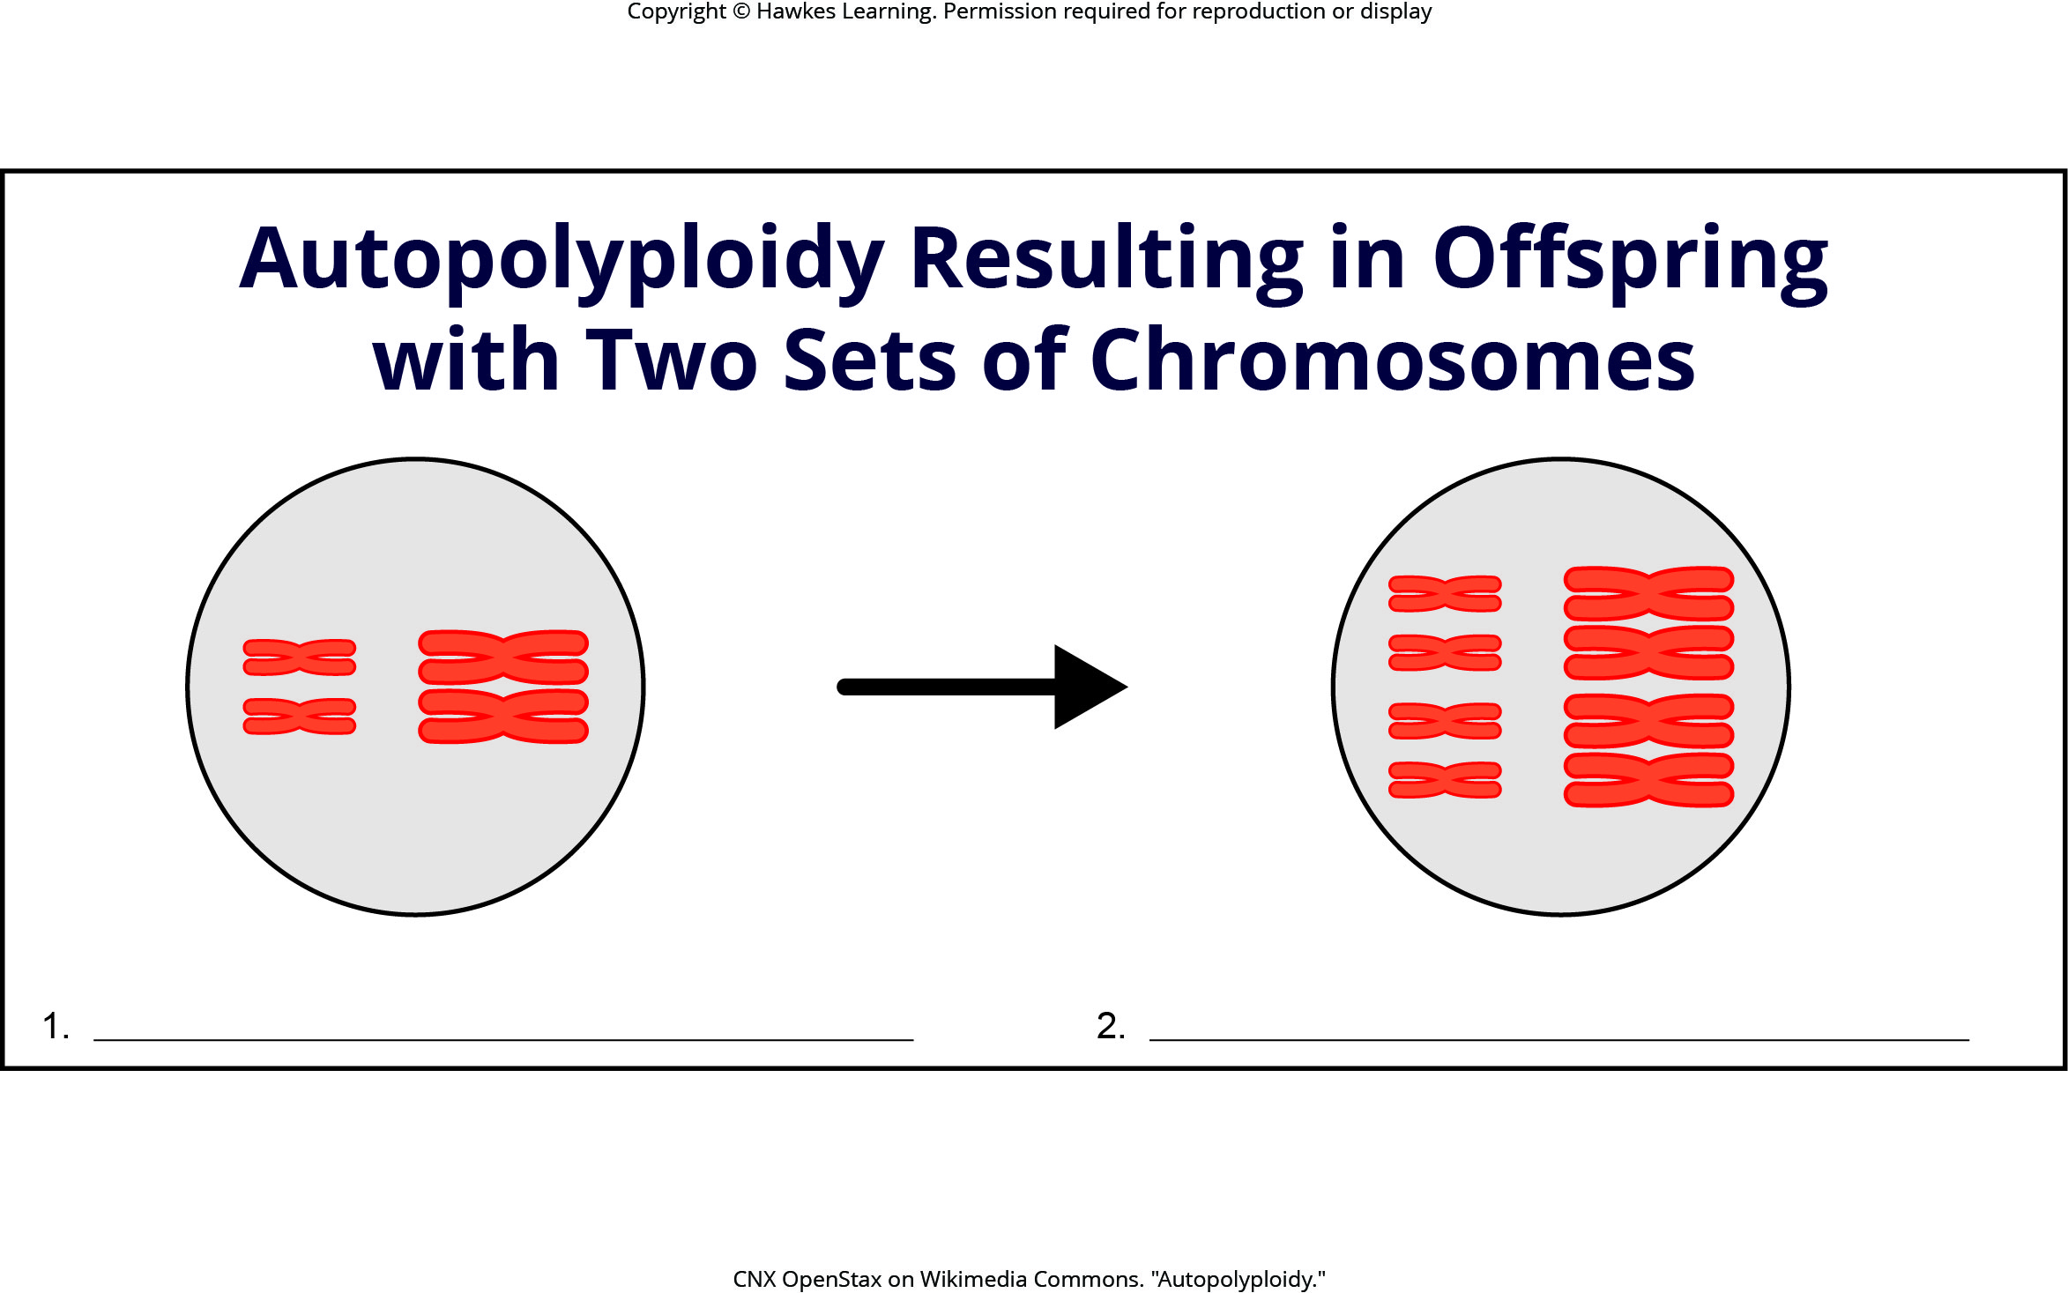
Lesson 18.2 Figure 9 - Numbered

Slide 11
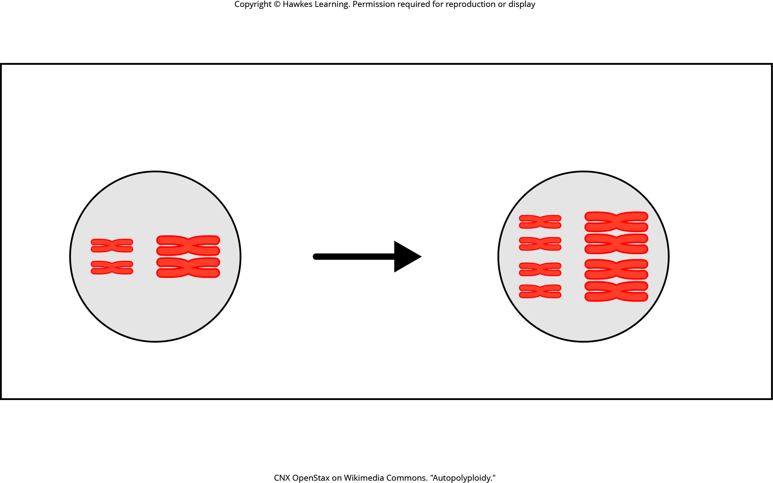
Lesson 18.2 Figure 9

Slide 12
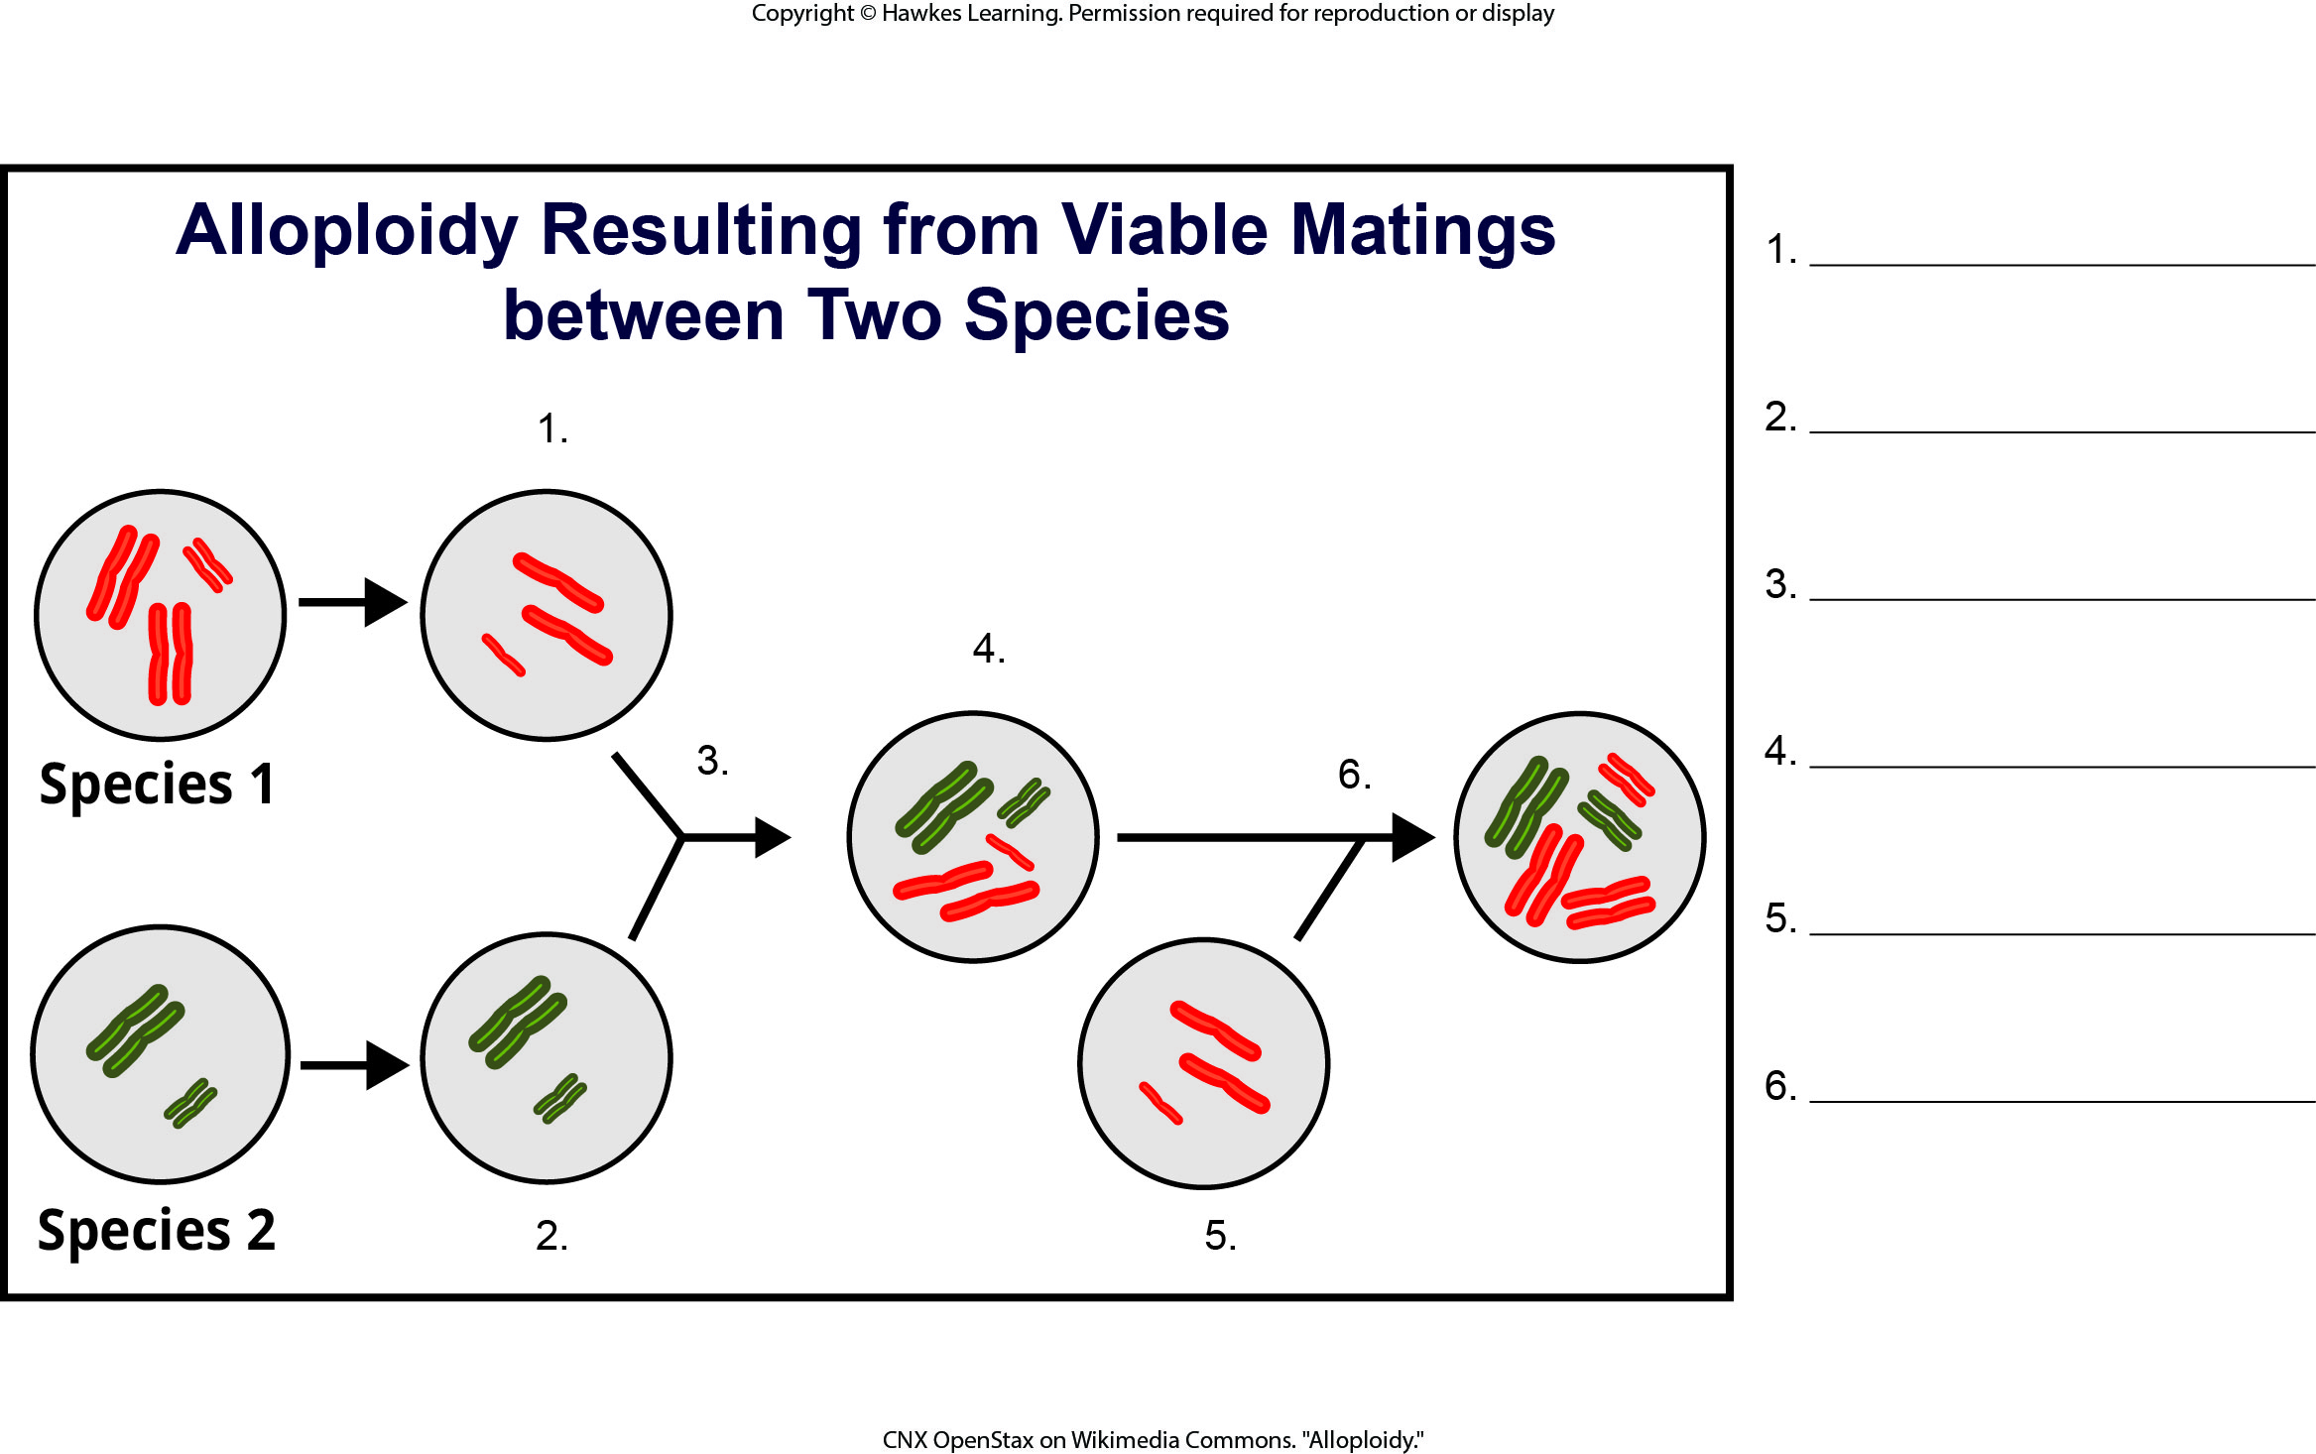
Lesson 18.2 Figure 10 - Numbered

Slide 13
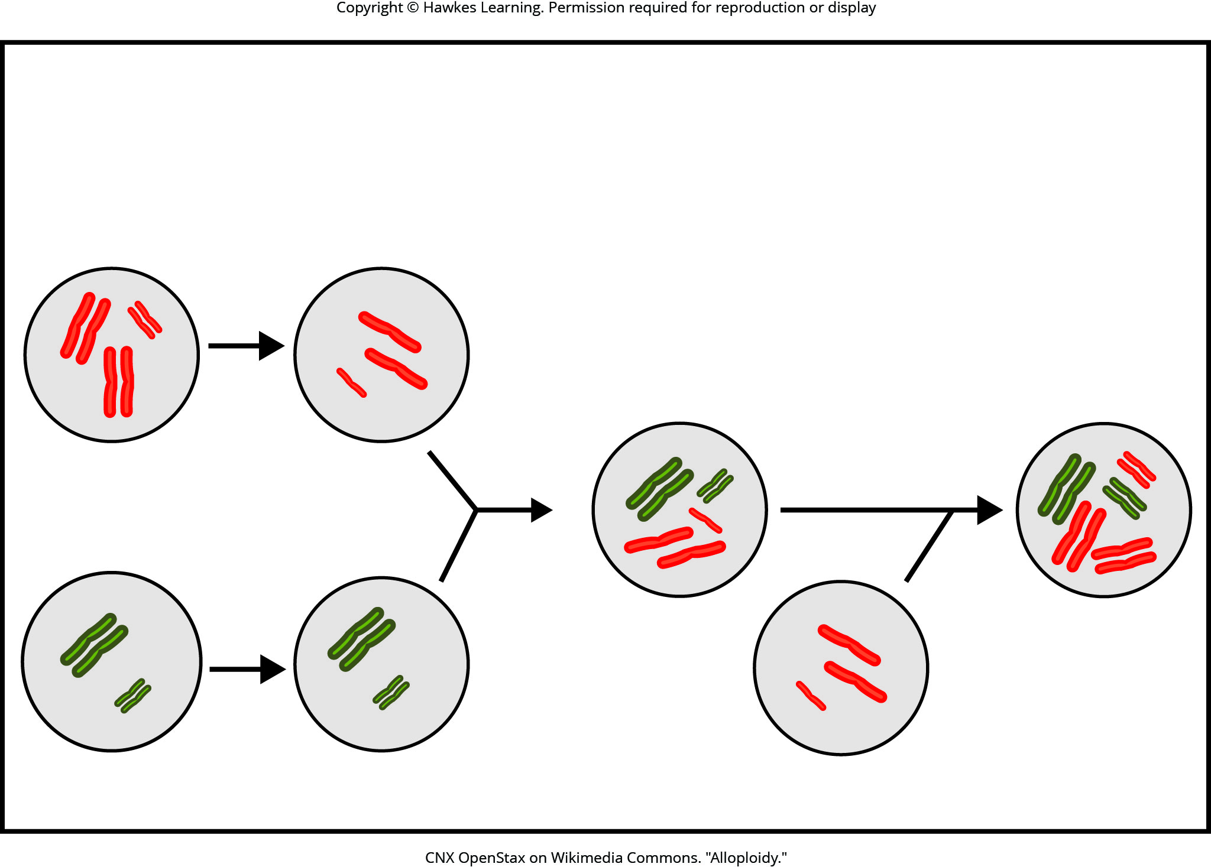
Lesson 18.2 Figure 10

Slide 14
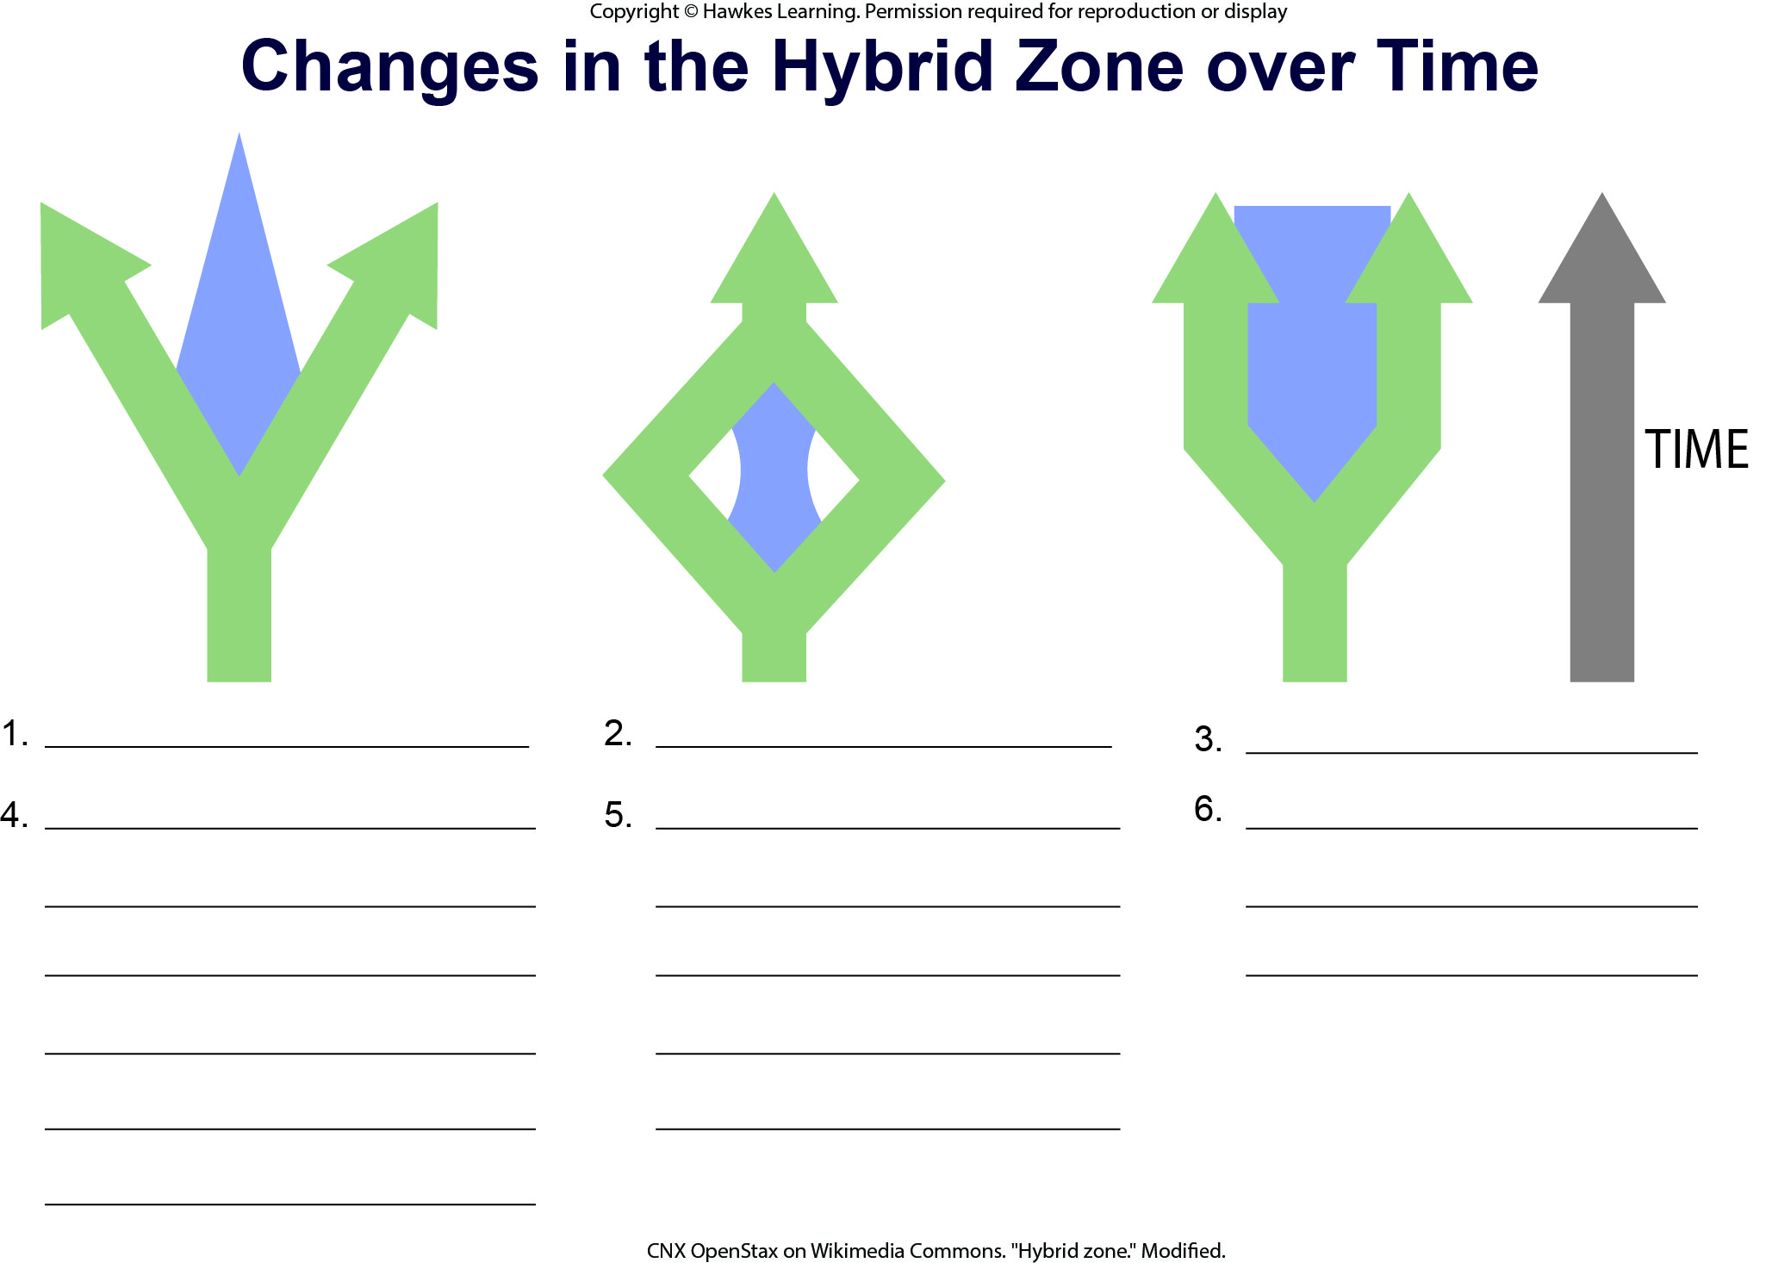
Lesson 18.3 Figure 1 - Numbered

Slide 15
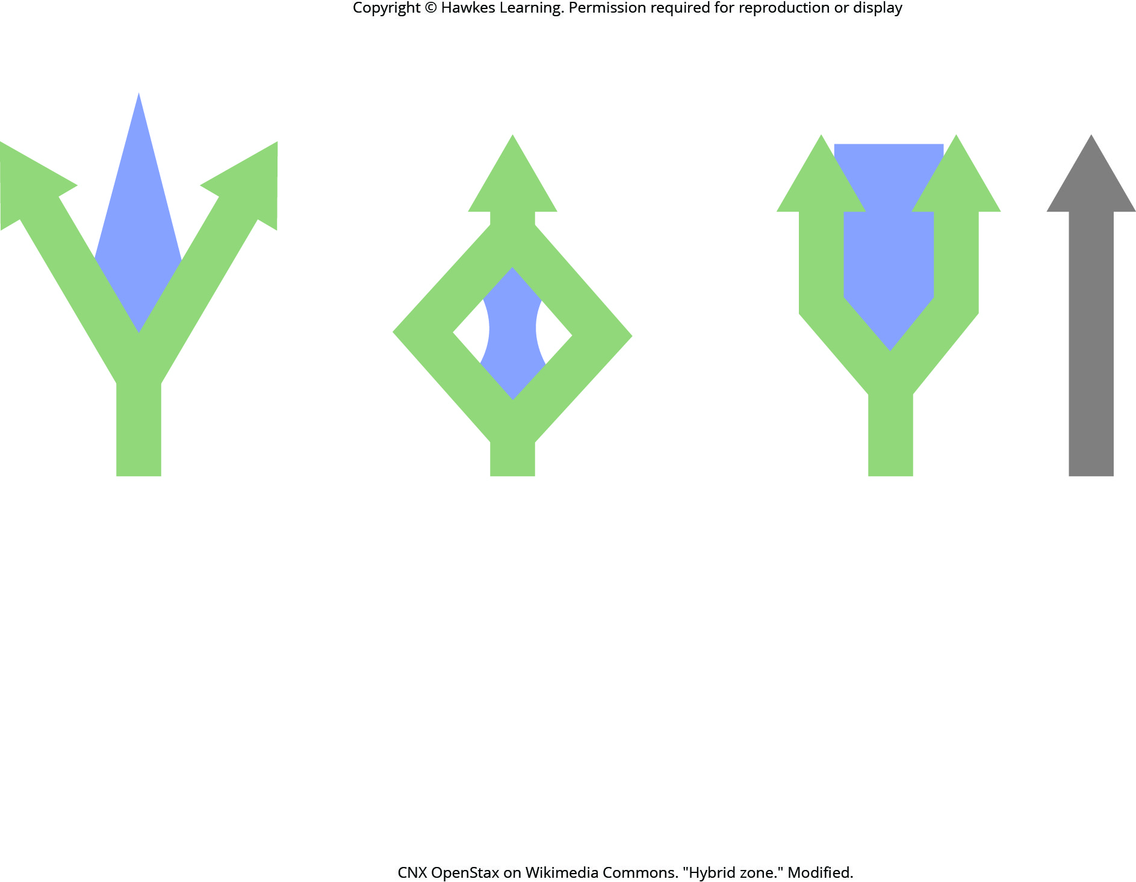
Lesson 18.3 Figure 1

Slide 16
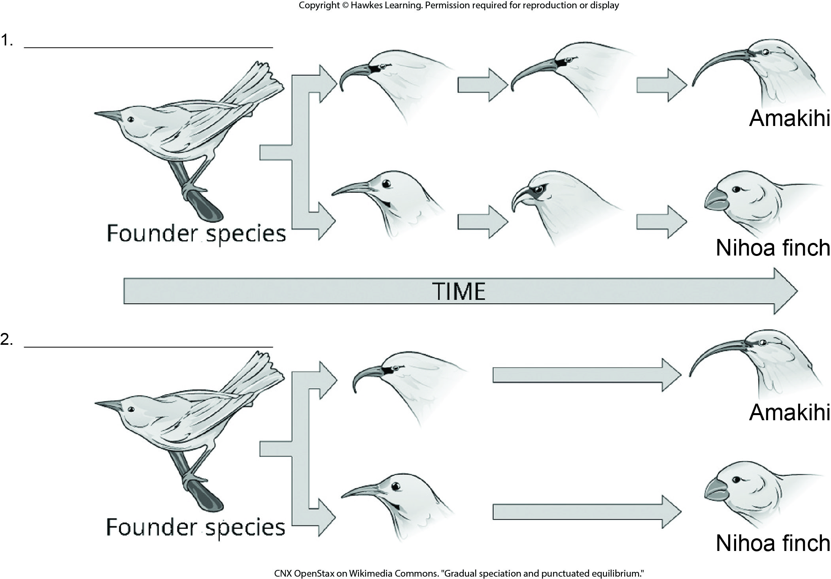
Lesson 18.3 Figure 2 - Numbered

Slide 17
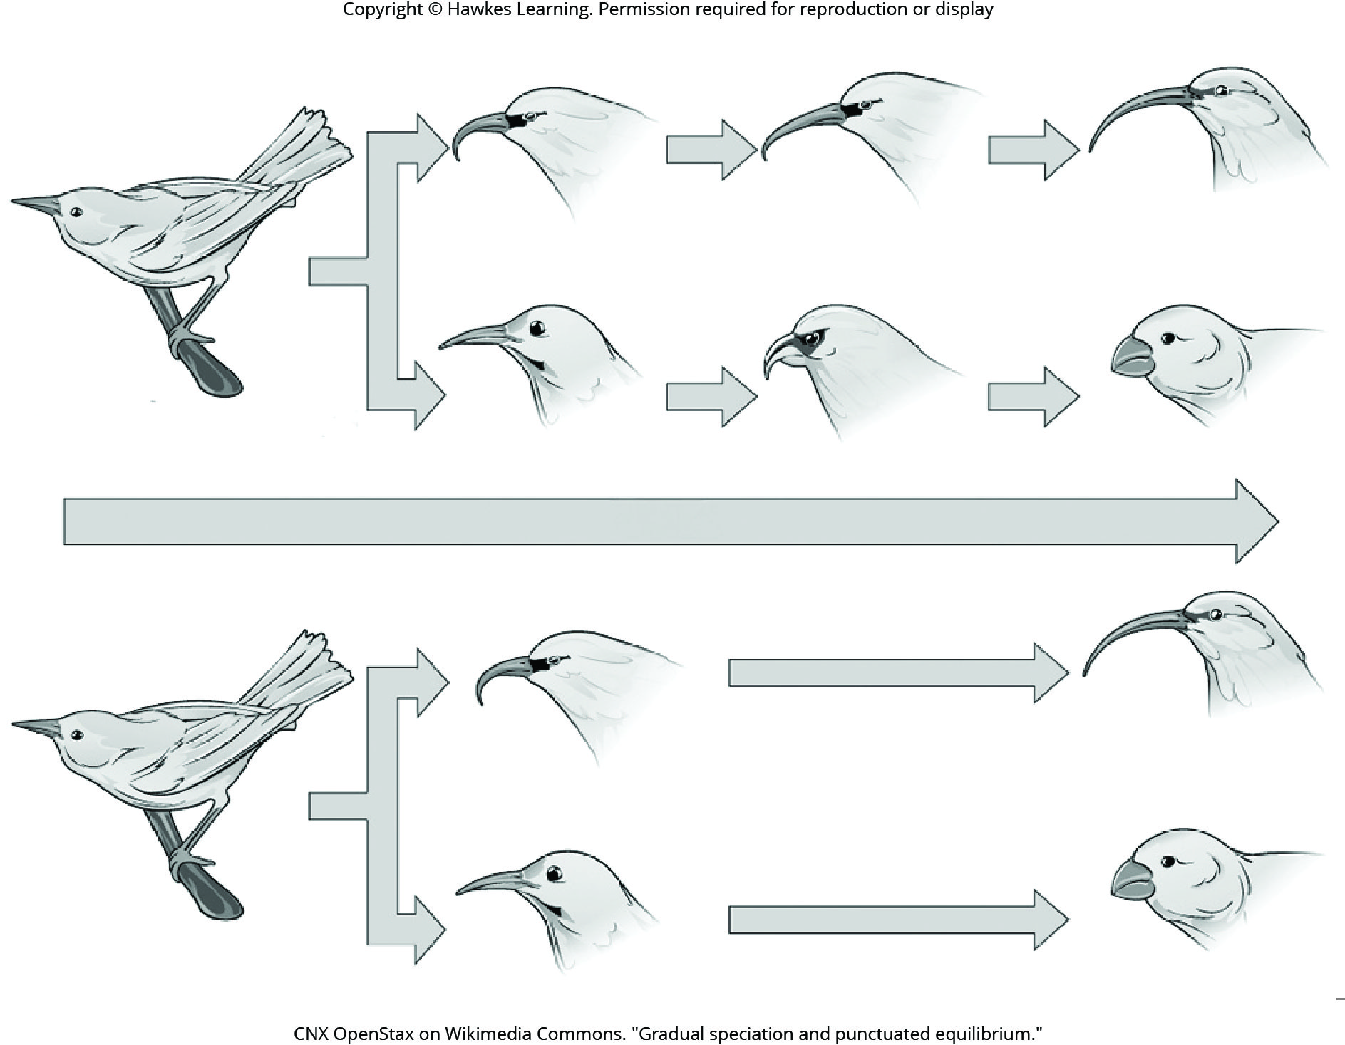
Lesson 18.3 Figure 2

Slide 18
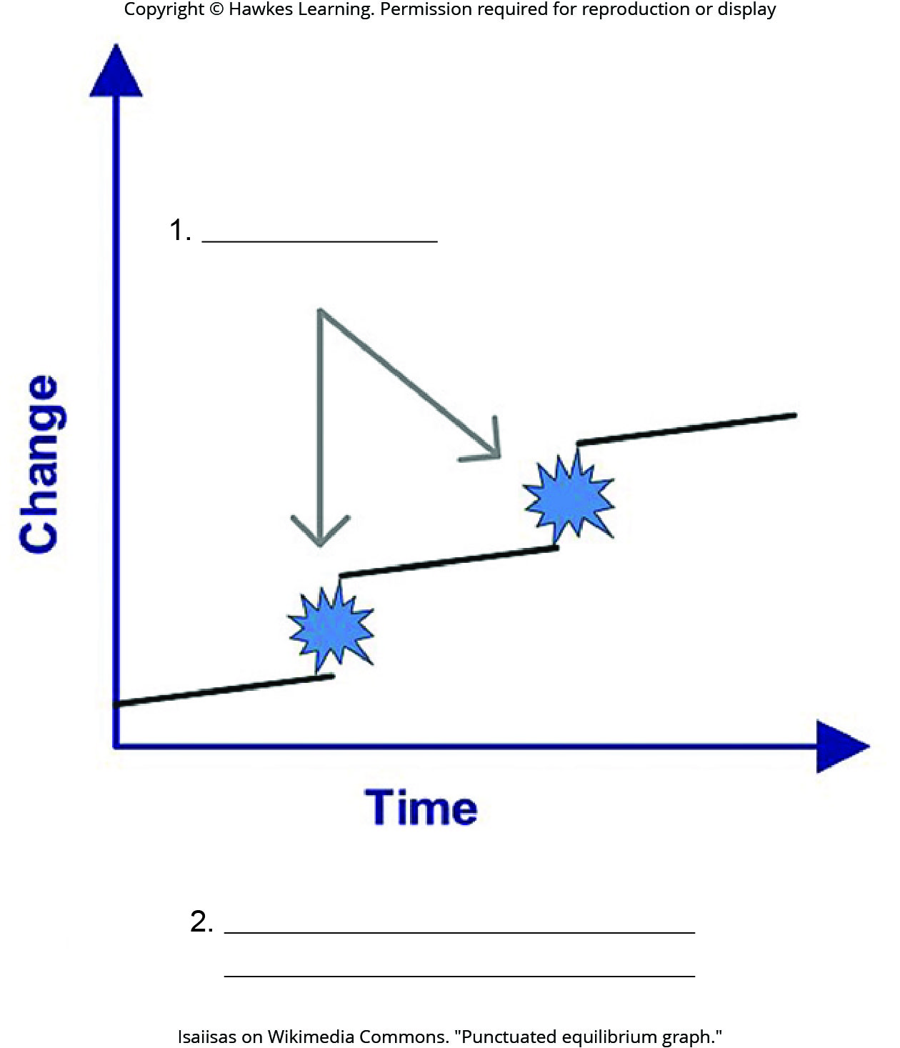
Lesson 18.3 Figure 3 - Numbered

Slide 19
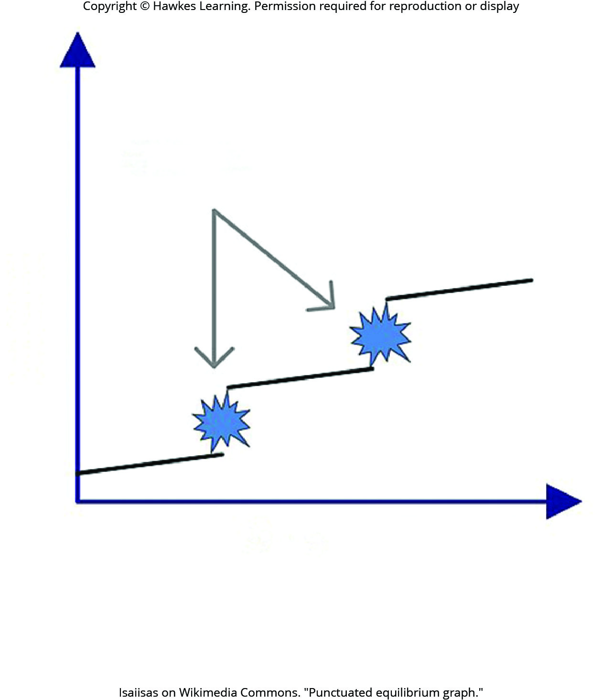
Lesson 18.3 Figure 3

Slide 20
Hawkes Learning – End of PowerPoint

