Slide 1
Chapter 19
The Evolution of Populations

Slide 2
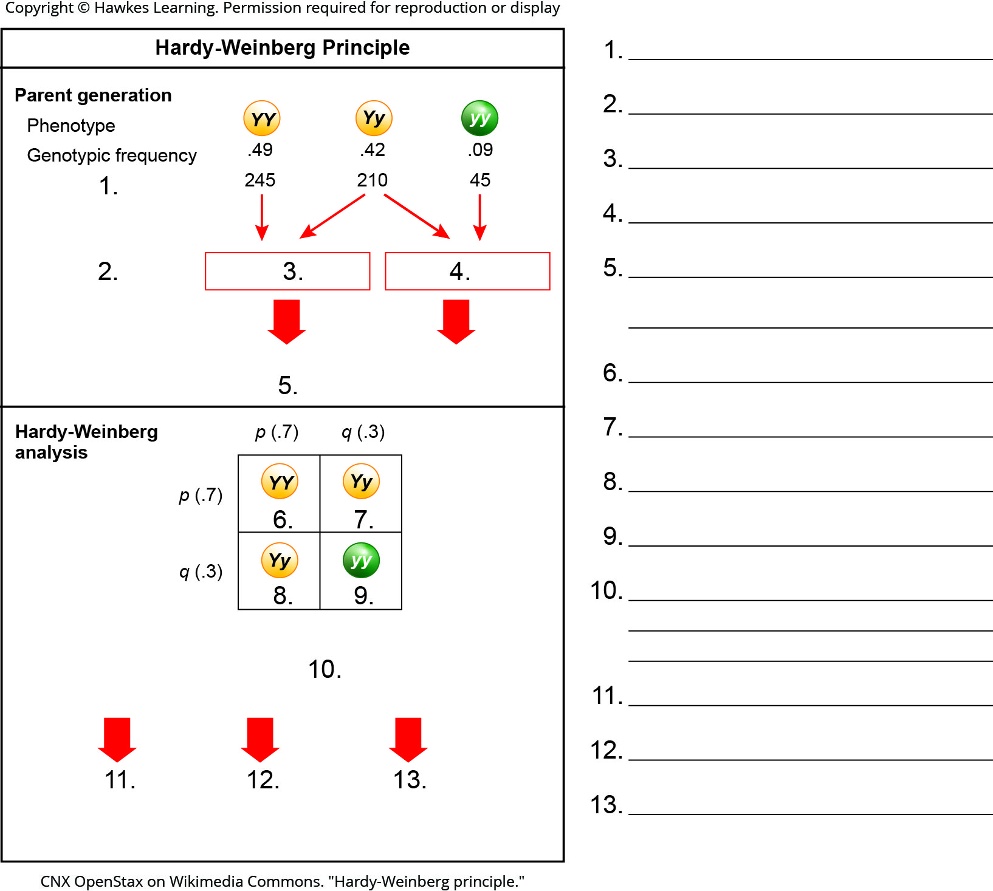
Lesson 19.1 Figure 4 - Numbered

Slide 3
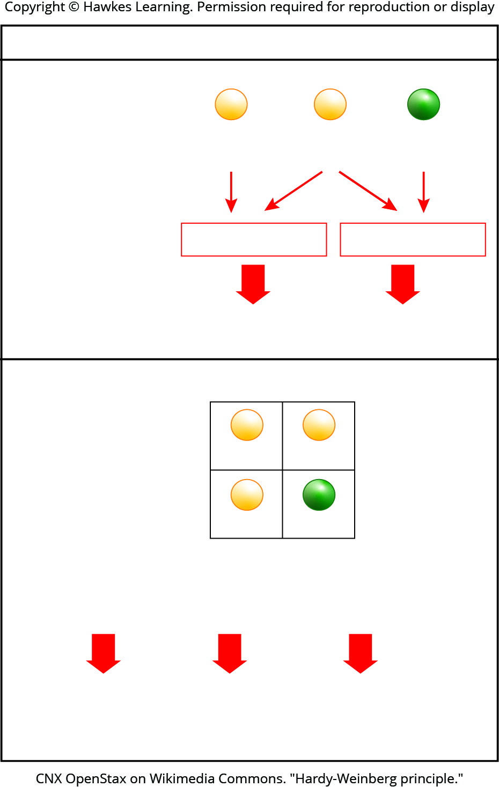
Lesson 19.1 Figure 4

Slide 4
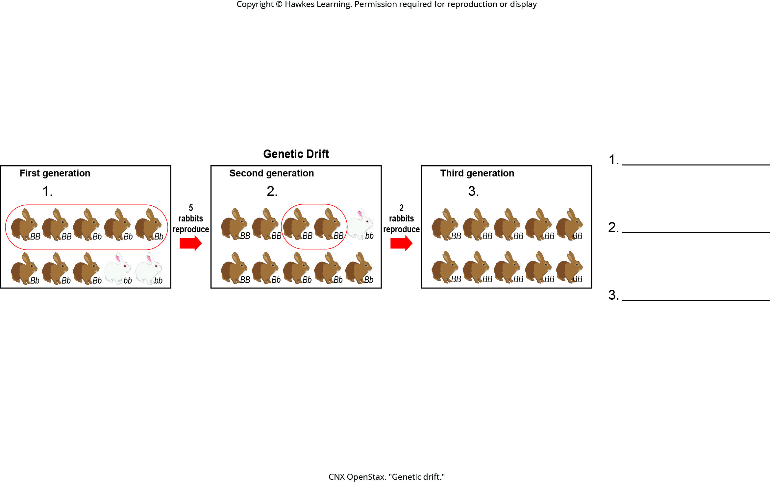
Lesson 19.2 Figure 2 - Numbered

Slide 5
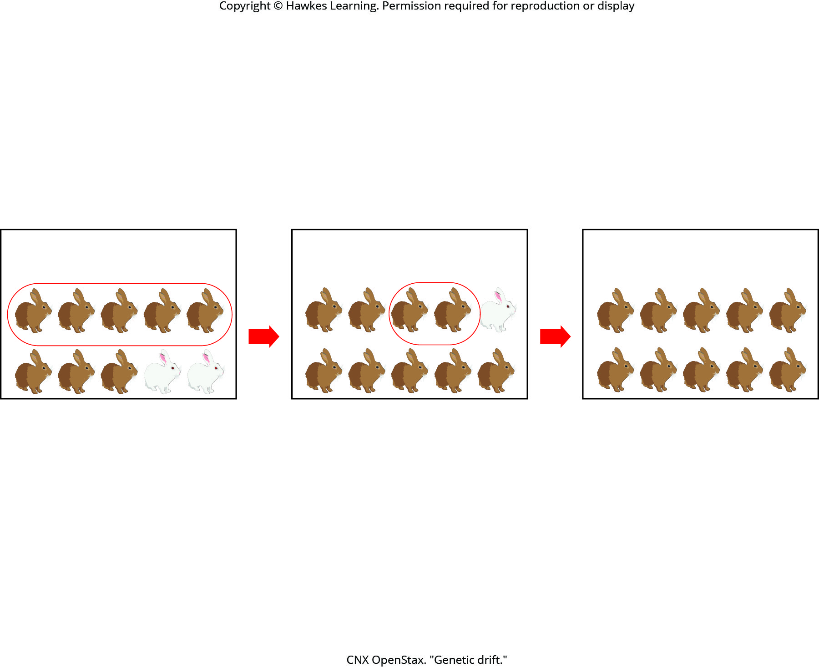
Lesson 19.2 Figure 2

Slide 6
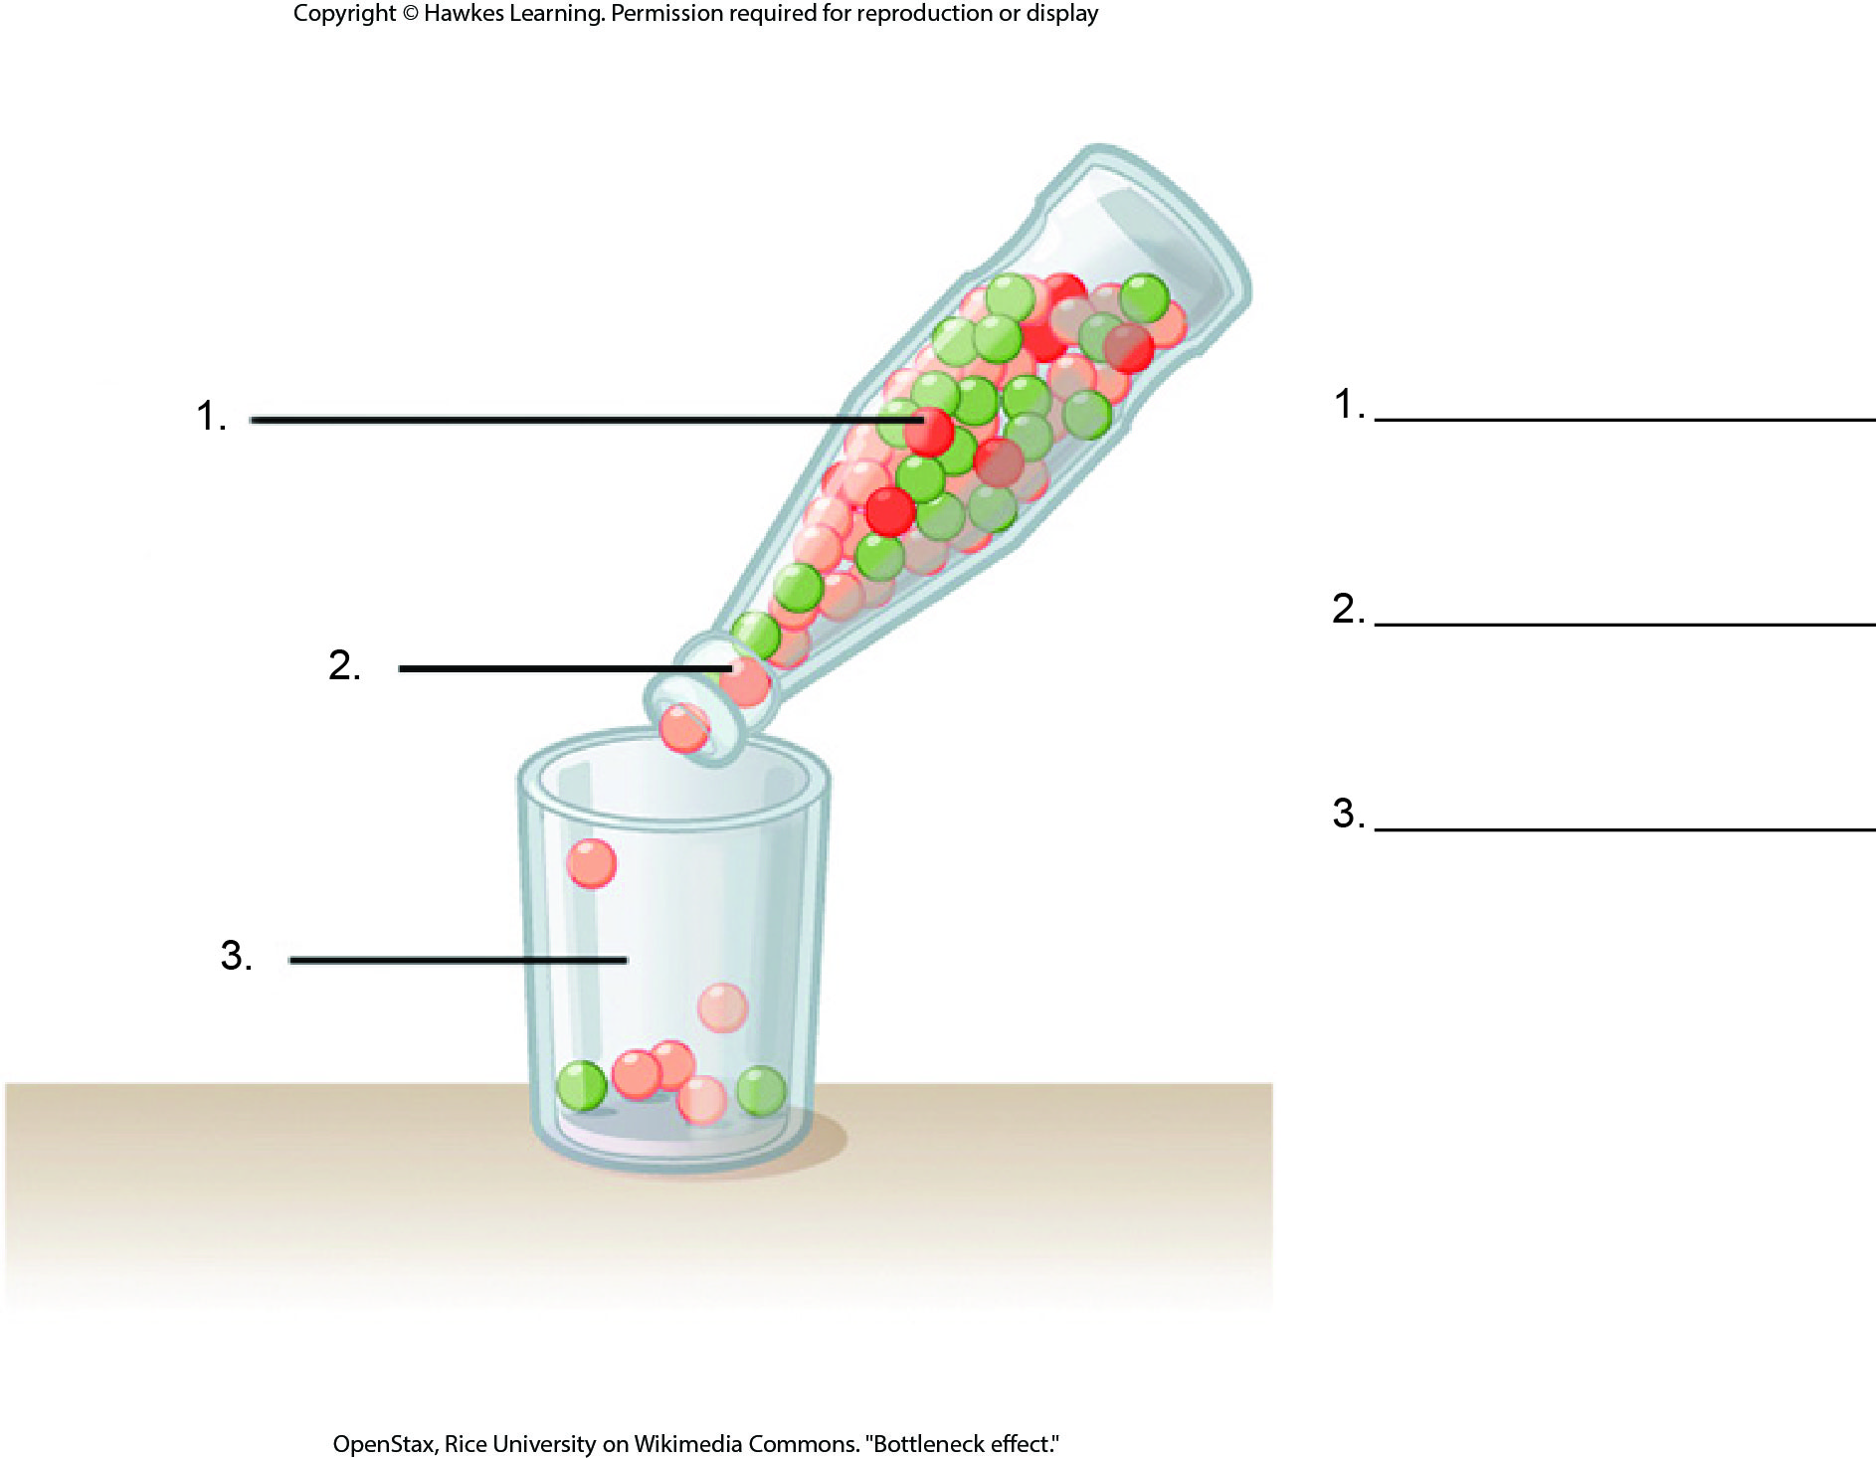
Lesson 19.2 Figure 3 - Numbered

Slide 7
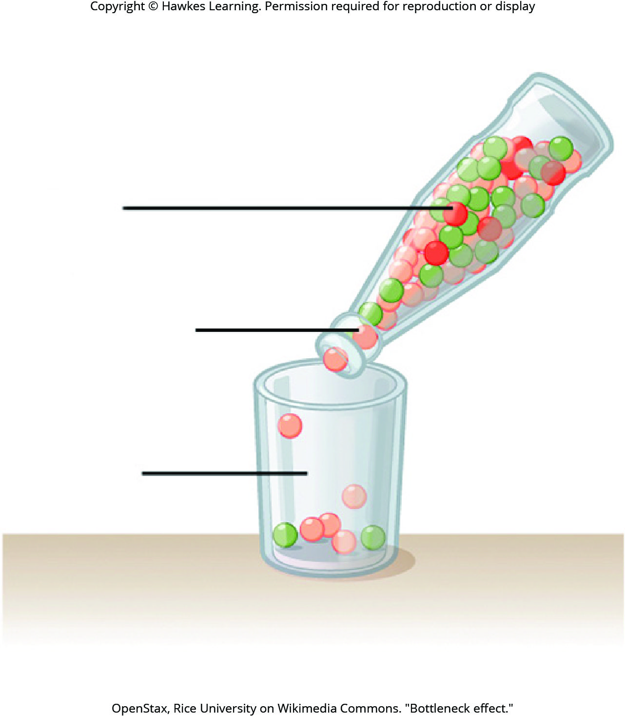
Lesson 19.2 Figure 3

Slide 8
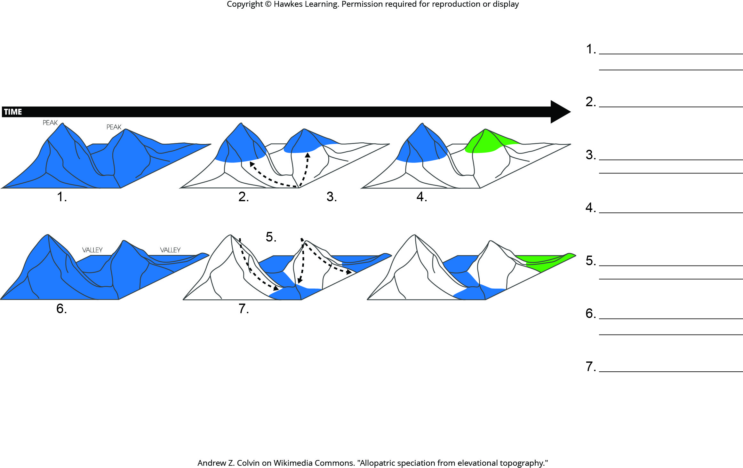
Lesson 19.2 Figure 7 - Numbered

Slide 9
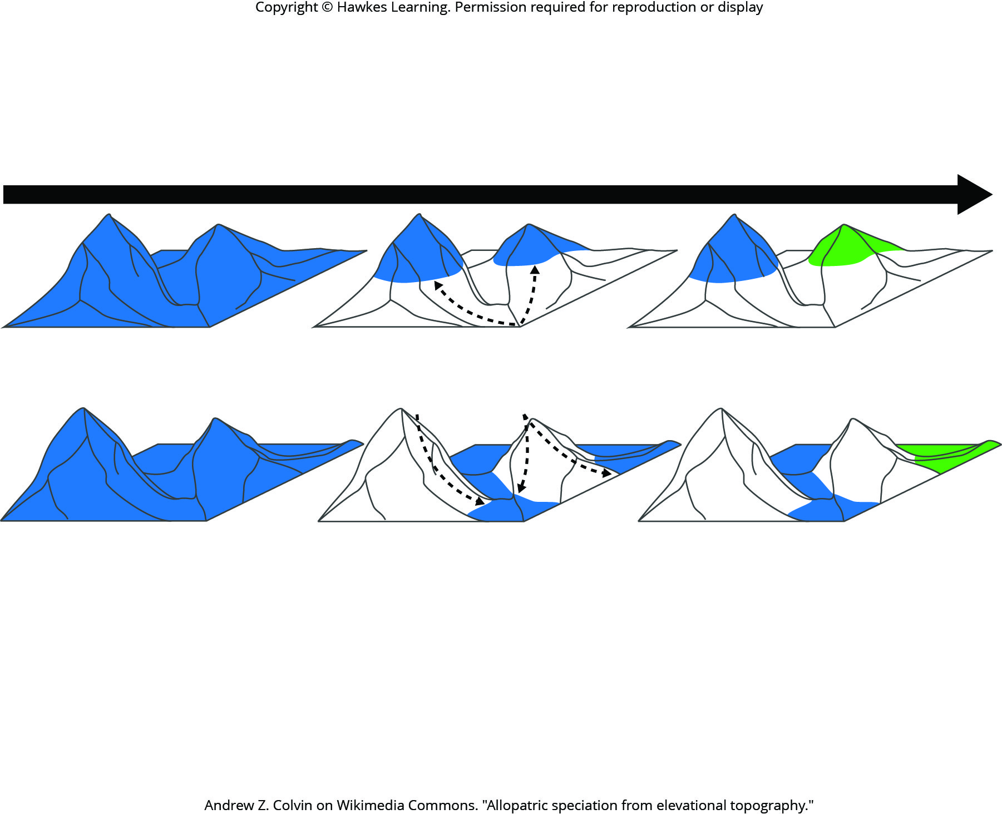
Lesson 19.2 Figure 7

Slide 10
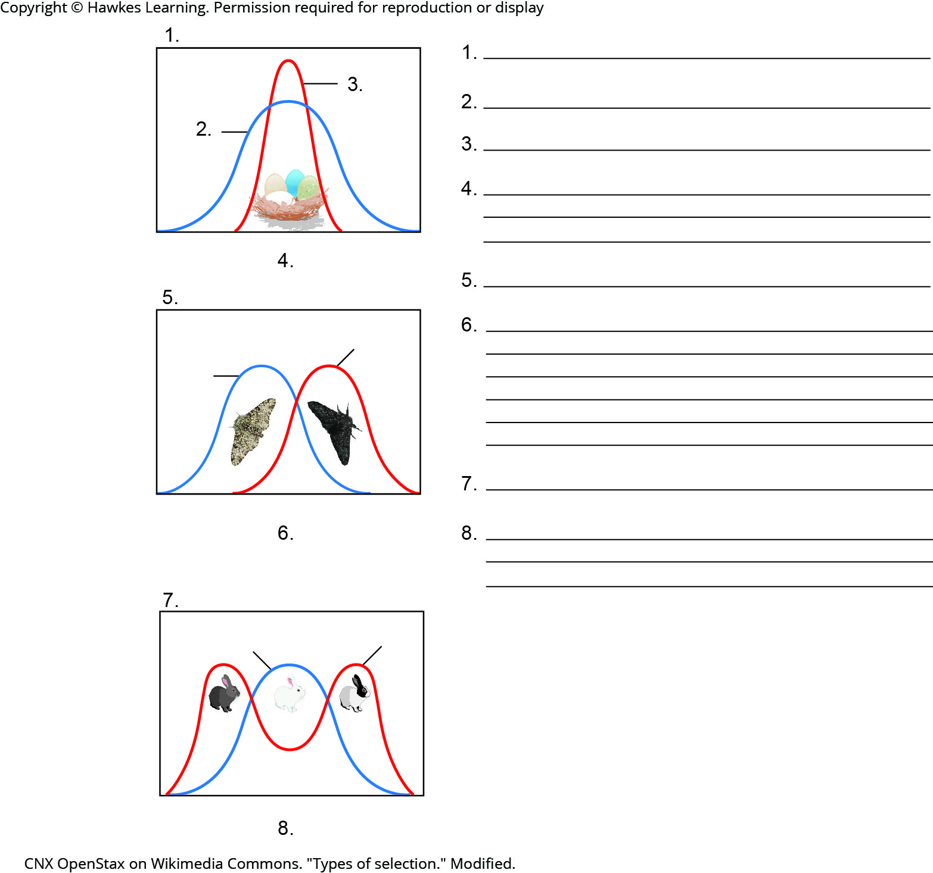
Lesson 19.3 Figure 2 - Numbered

Slide 11
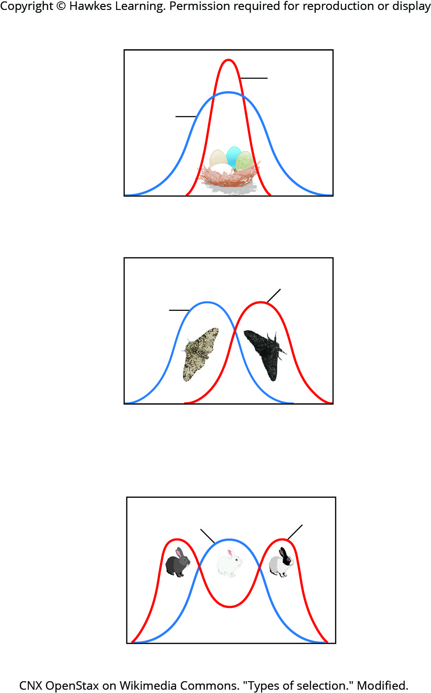
Lesson 19.3 Figure 2

Slide 12
Hawkes Learning – End of PowerPoint

