Slide 1
Chapter 2
Basic Chemistry for Biology

Slide 2
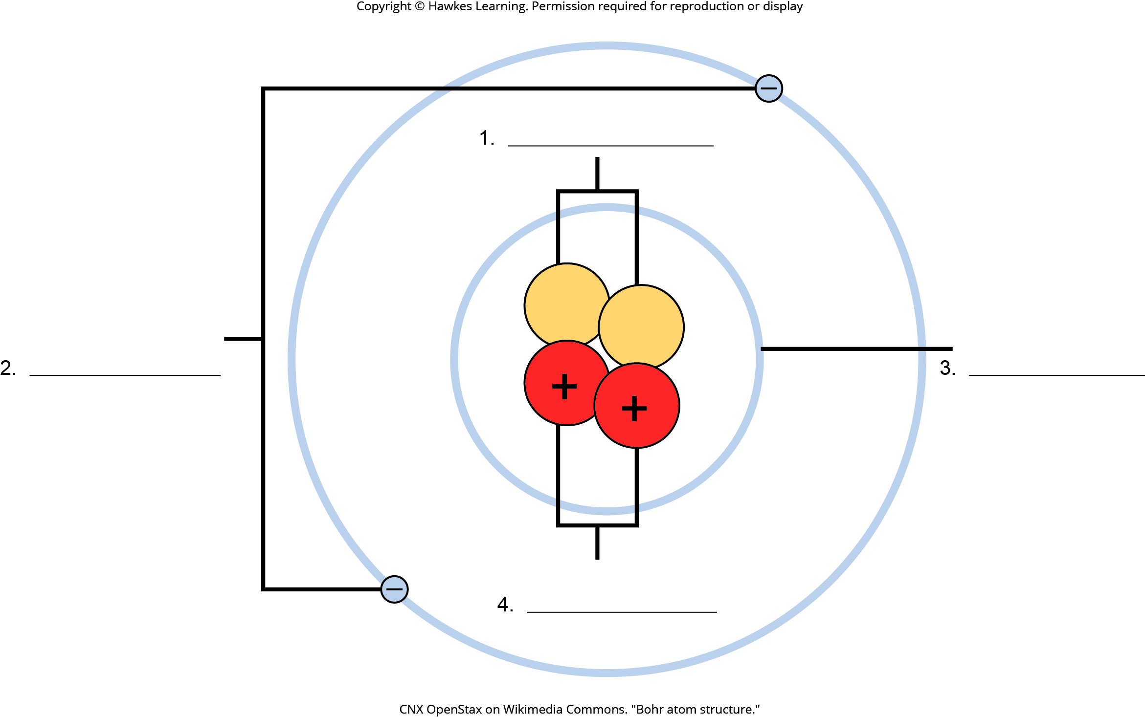
Lesson 2.1 Figure 1 - Numbered

Slide 3
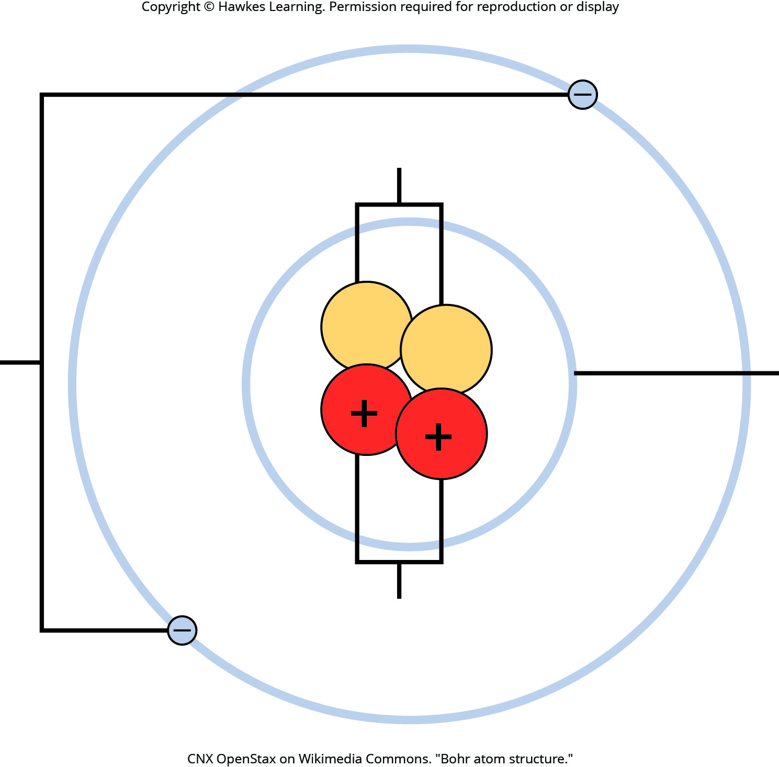
Lesson 2.1 Figure 1

Slide 4
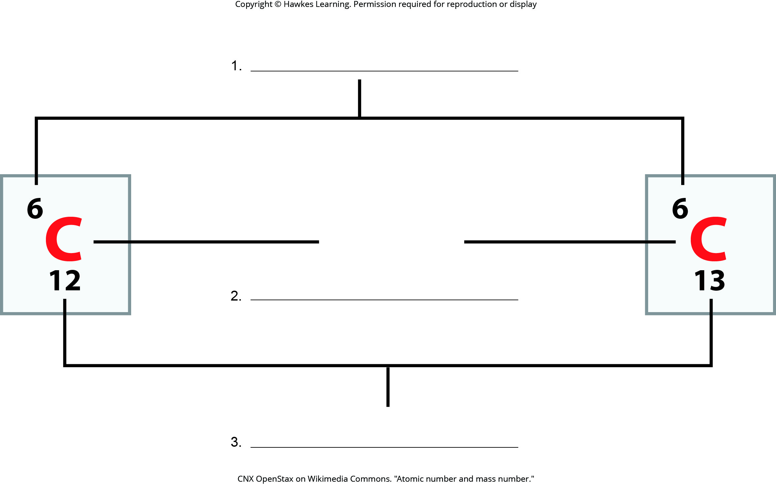
Lesson 2.1 Figure 2 - Numbered

Slide 5
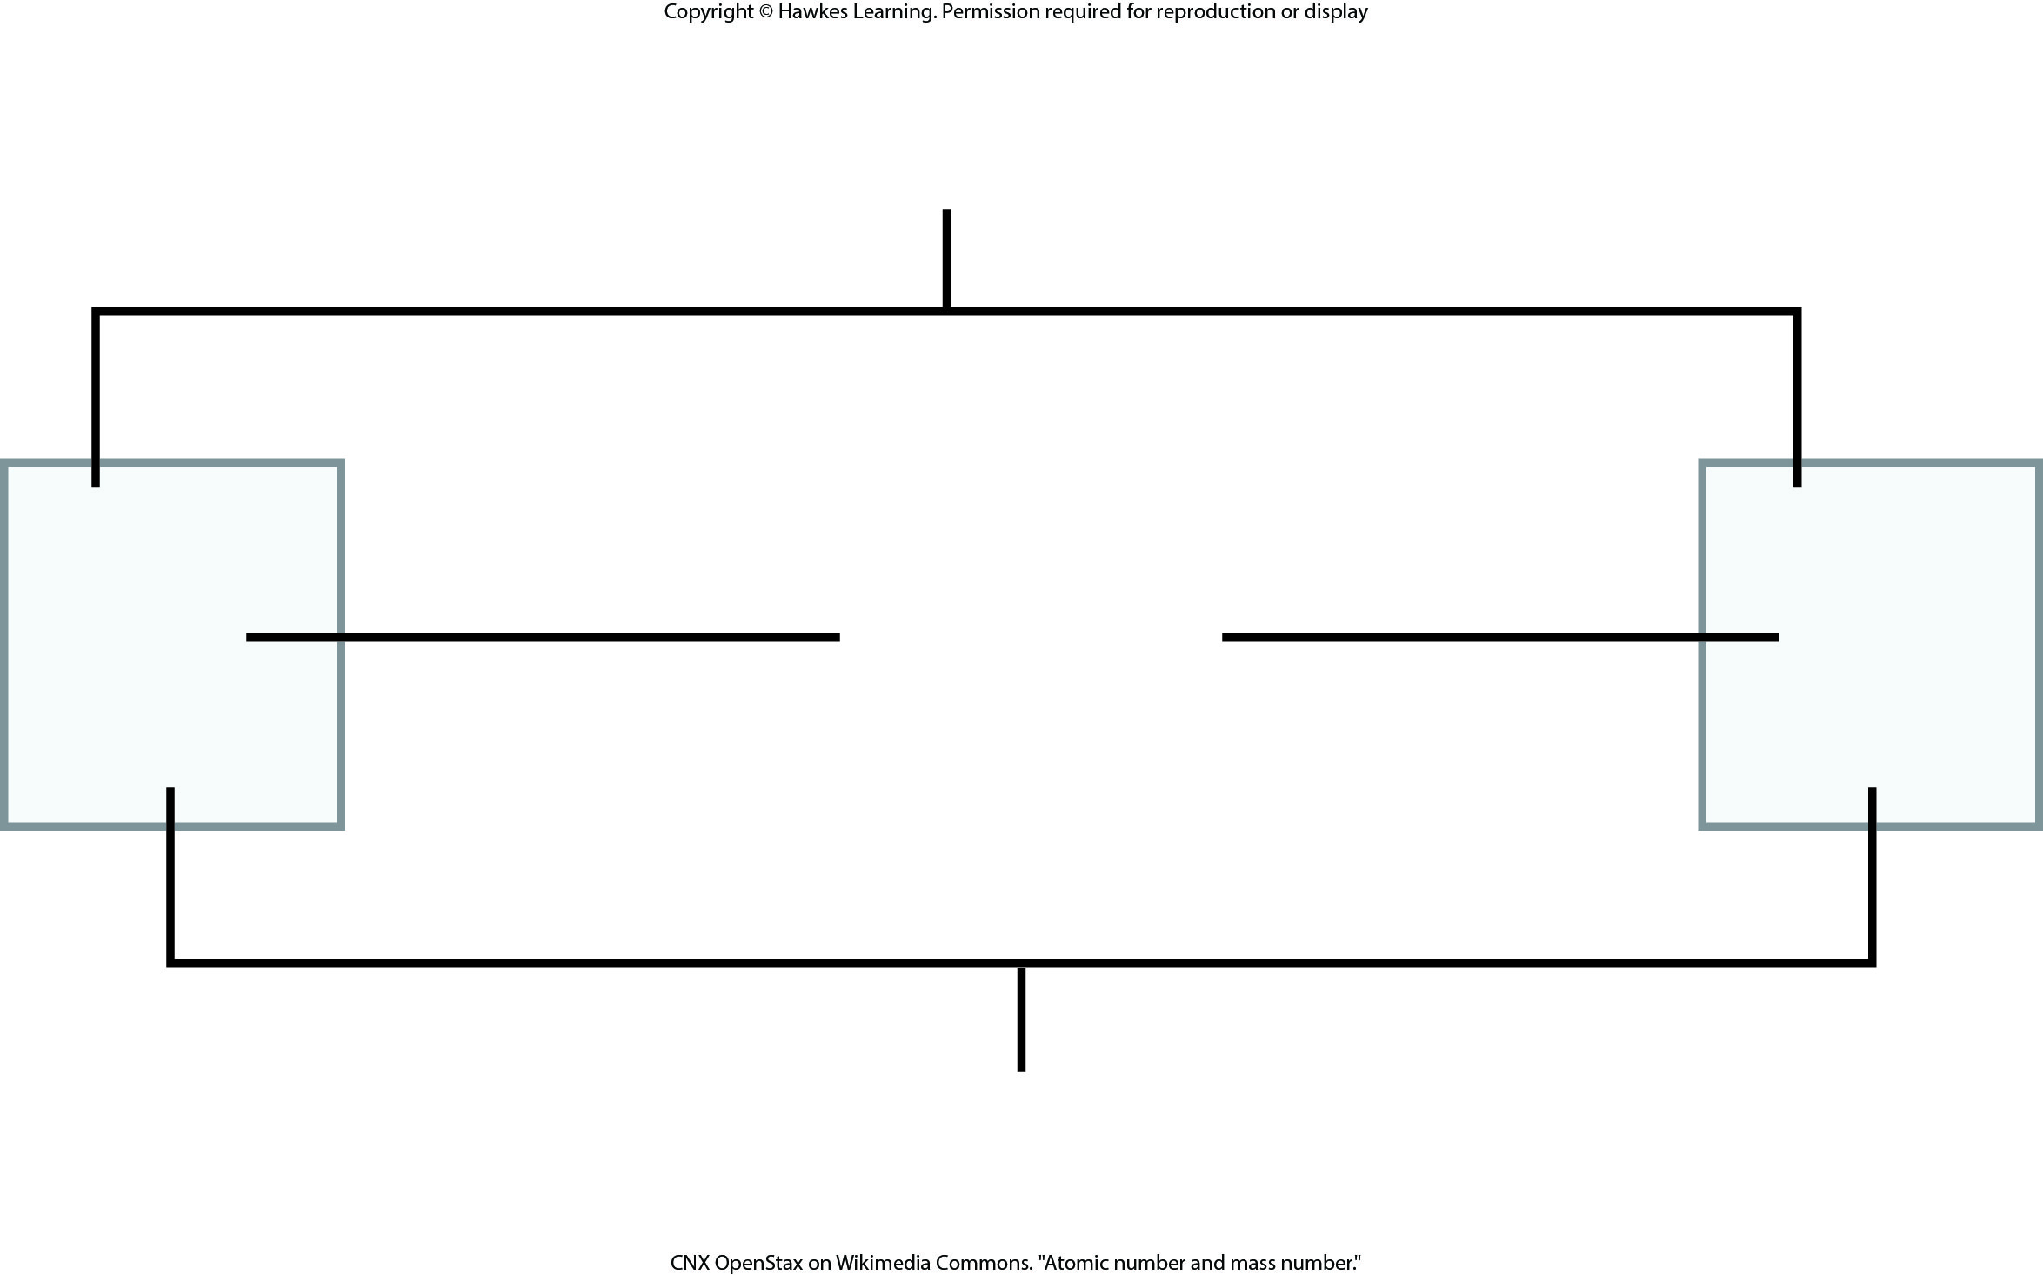
Lesson 2.1 Figure 2

Slide 6
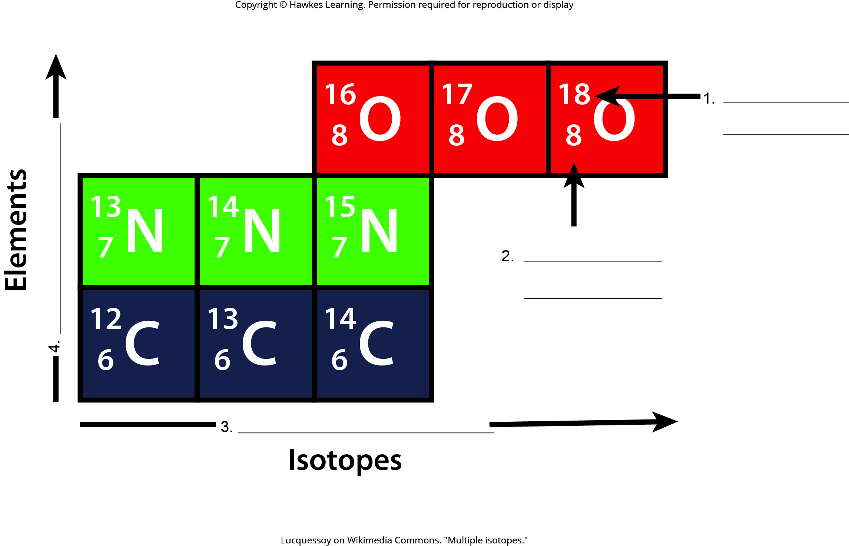
Lesson 2.1 Figure 3 - Numbered

Slide 7
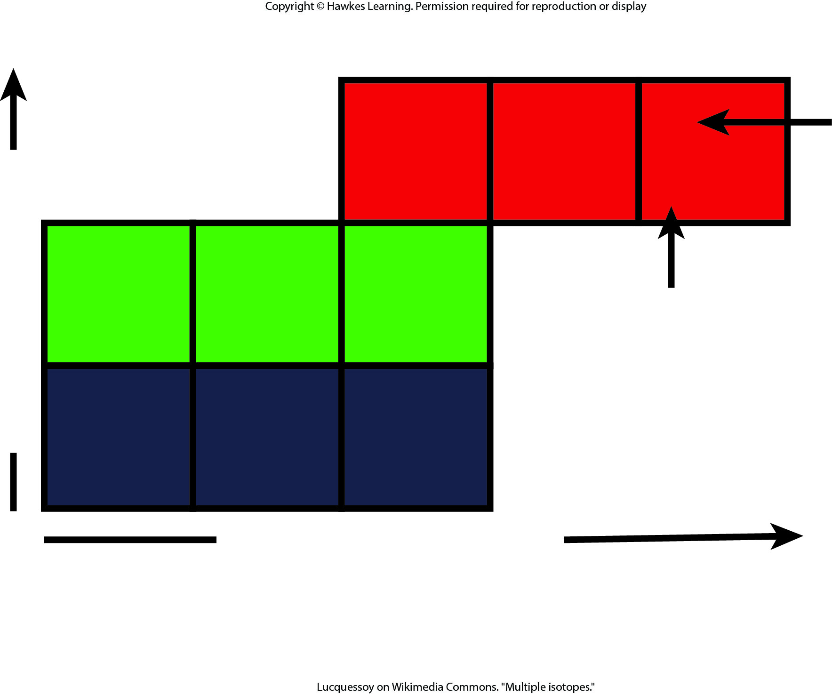
Lesson 2.1 Figure 3

Slide 8
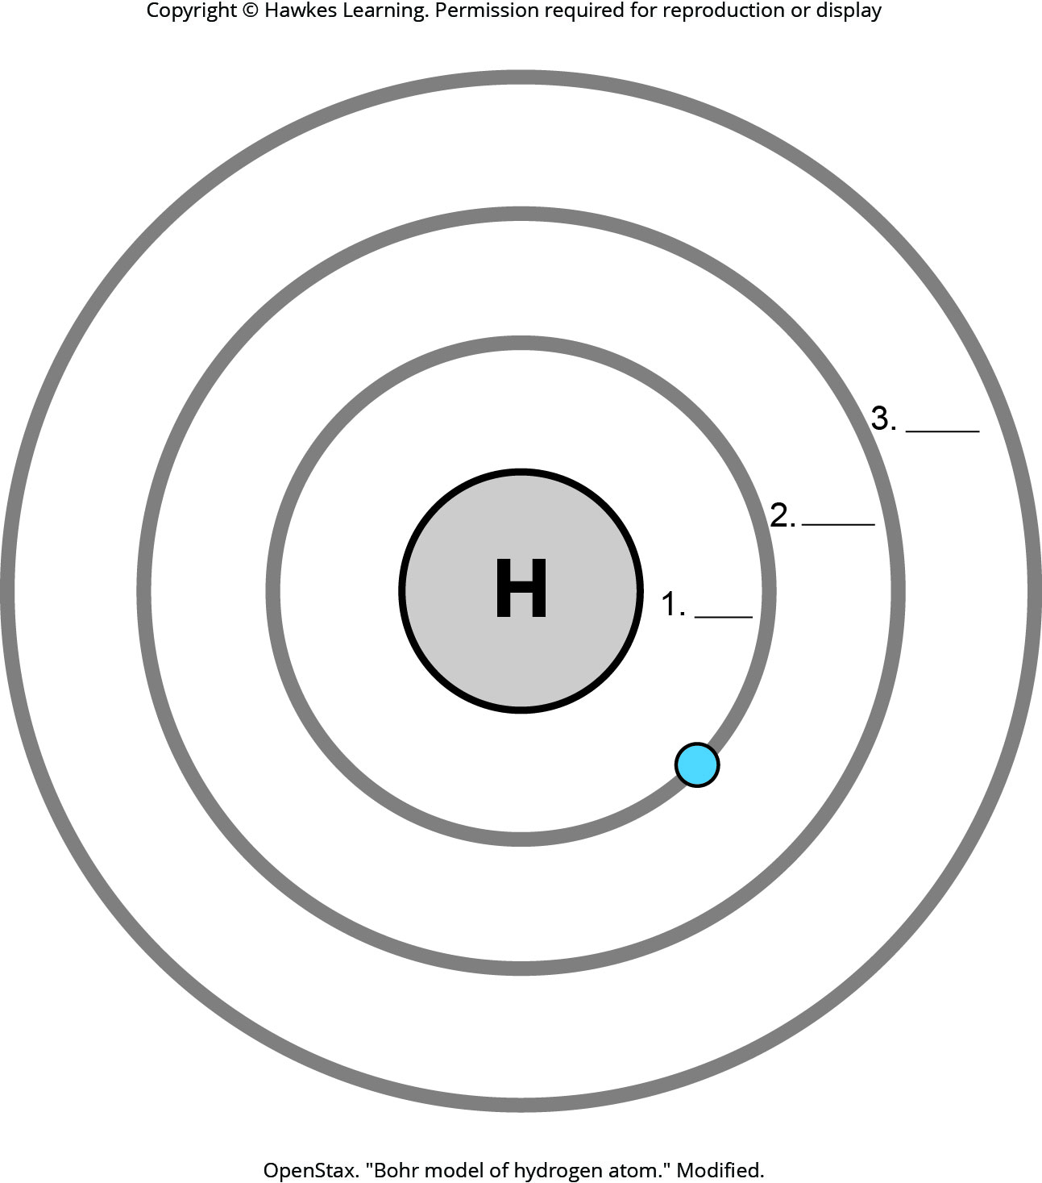
Lesson 2.1 Figure 6 - Numbered

Slide 9
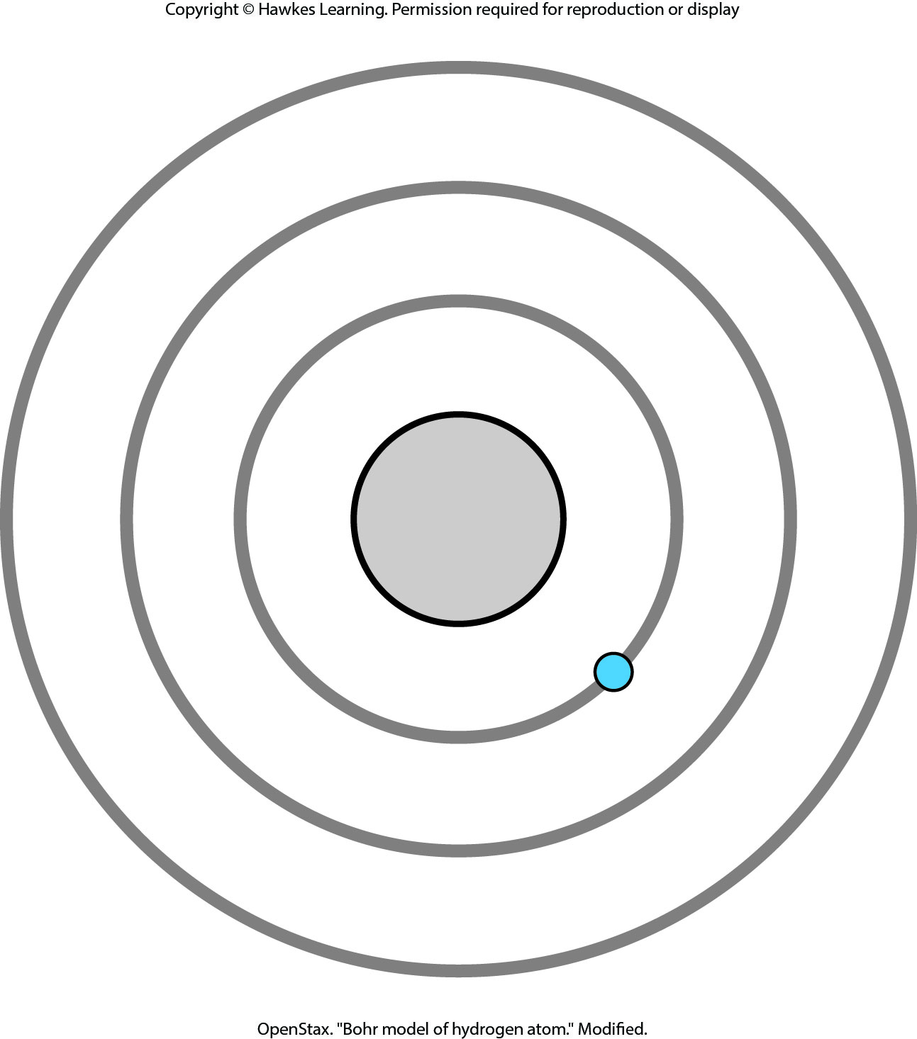
Lesson 2.1 Figure 6

Slide 10
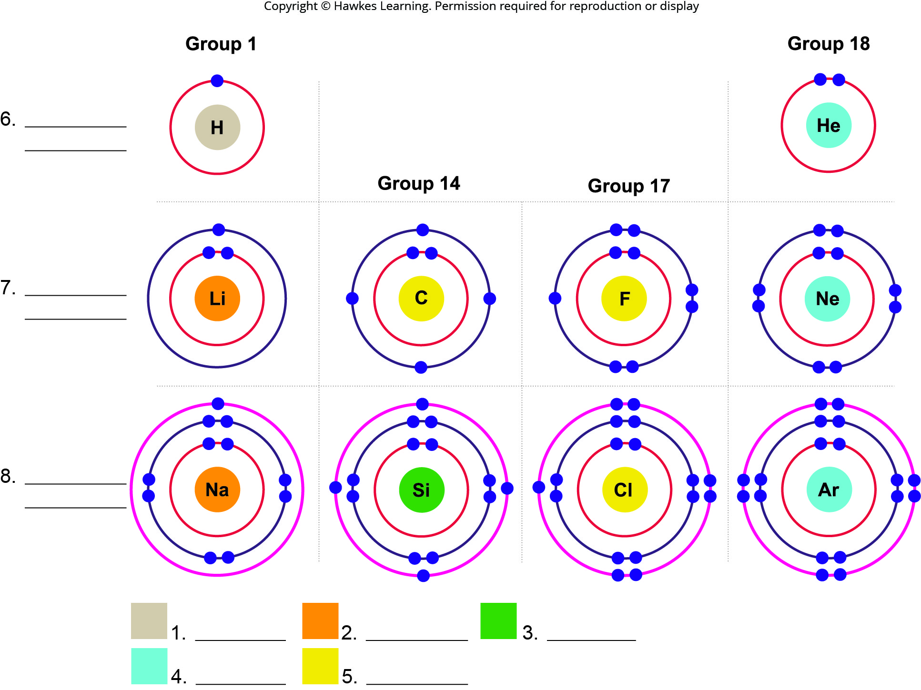
Lesson 2.1 Figure 7 - Numbered

Slide 11
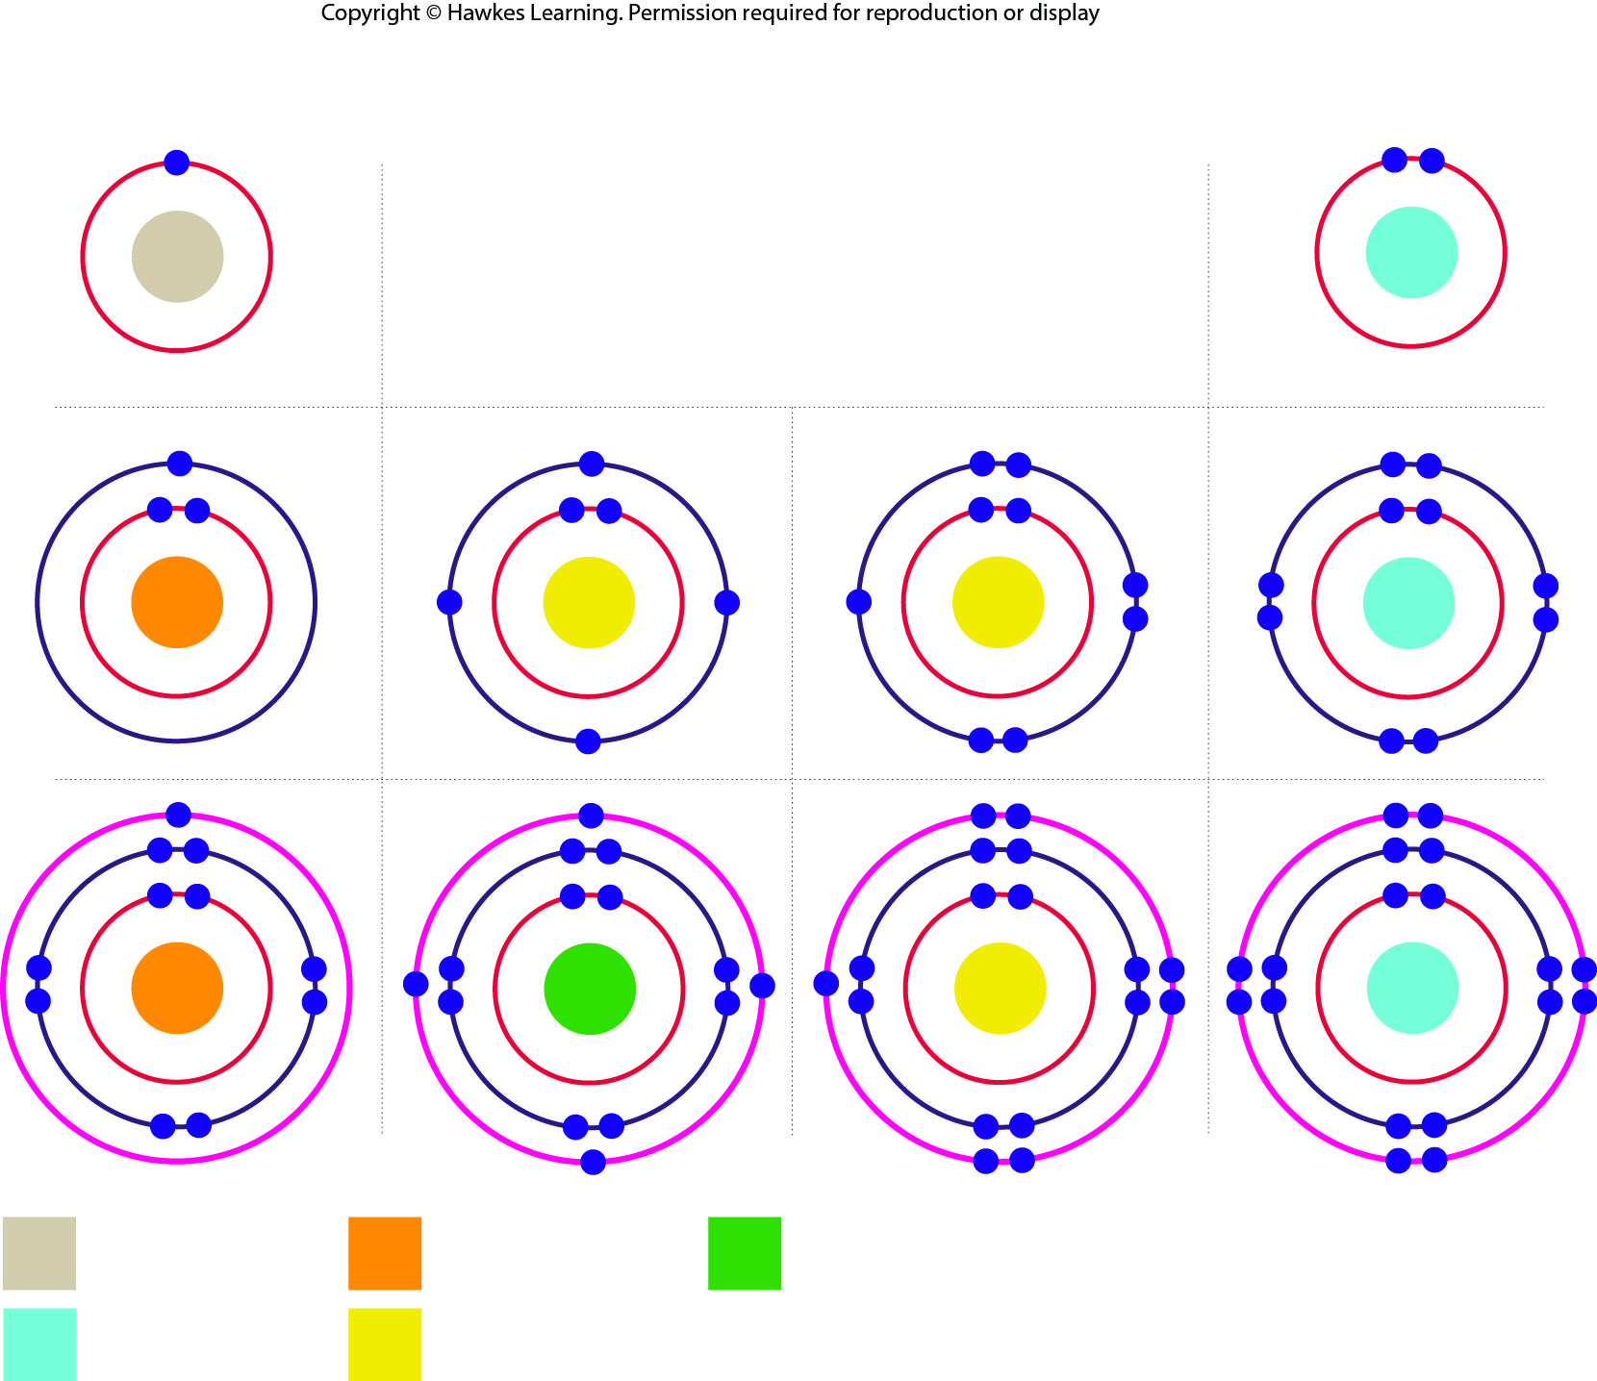
Lesson 2.1 Figure 7

Slide 12
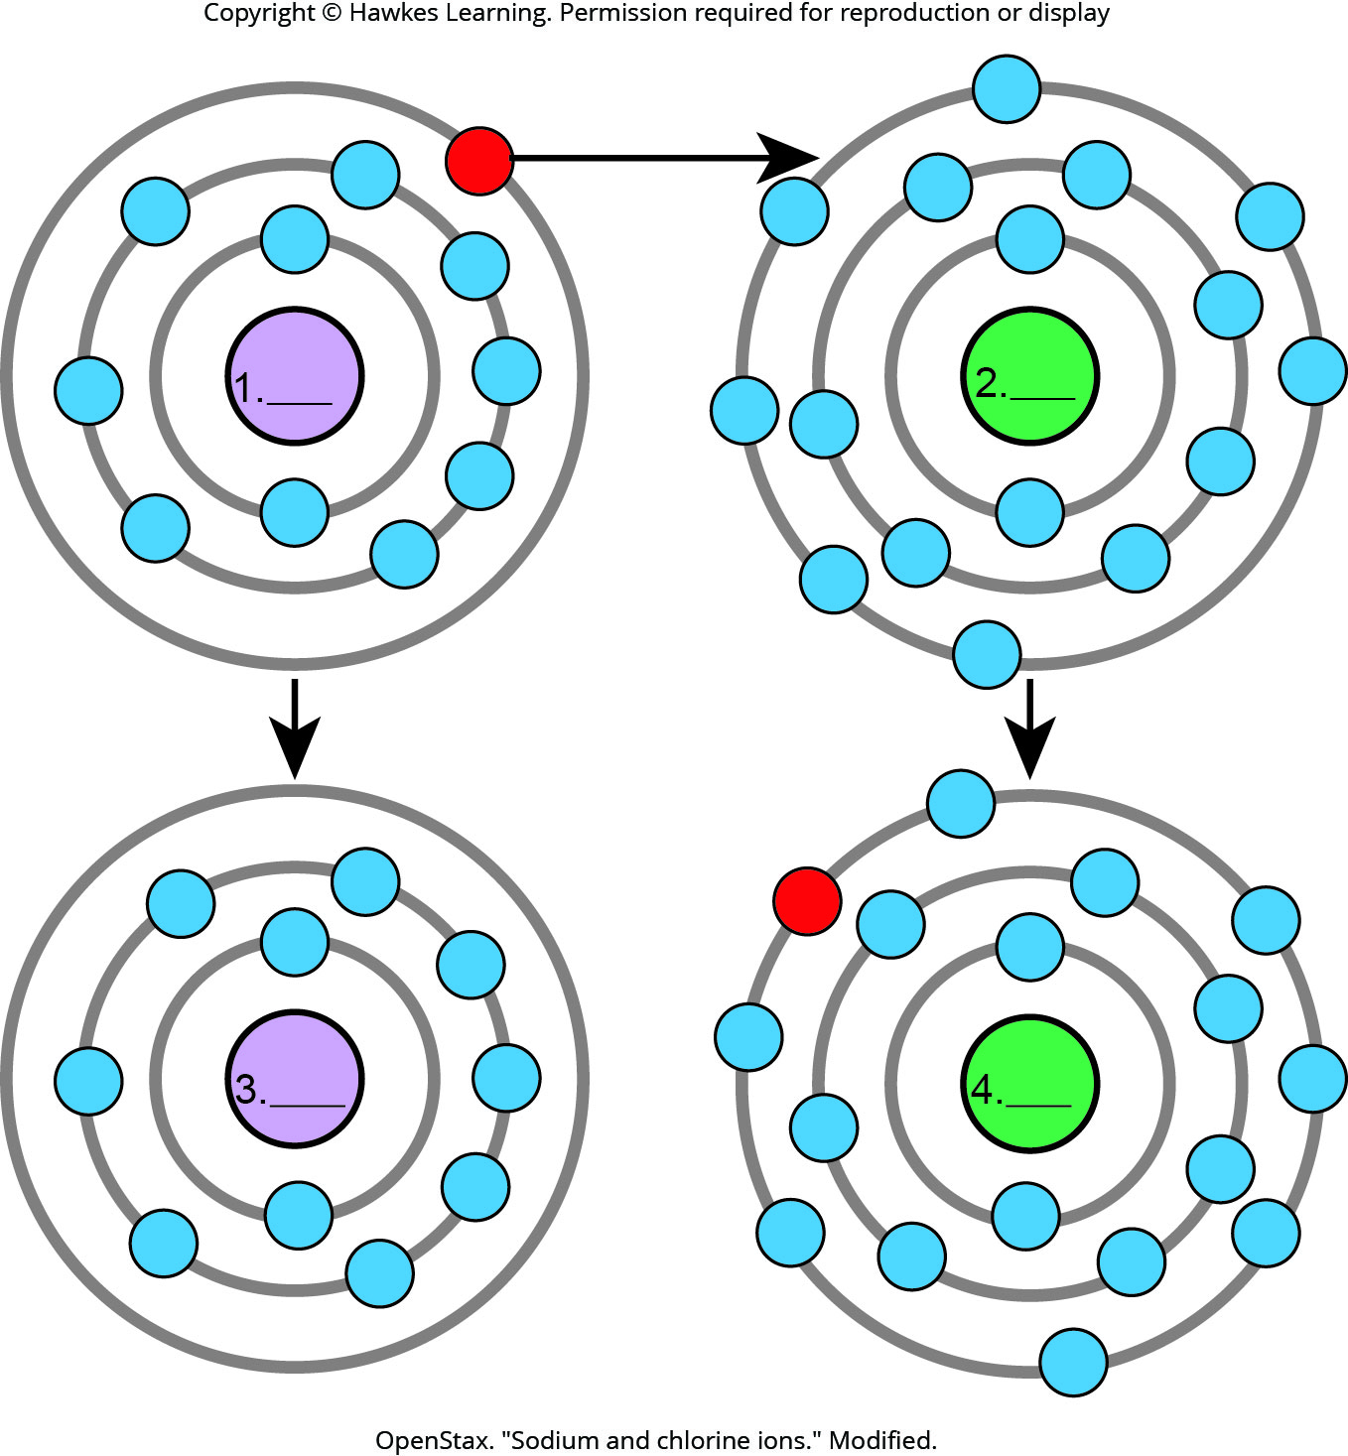
Lesson 2.1 Figure 8 - Numbered

Slide 13

Lesson 2.1 Figure 8

Slide 14
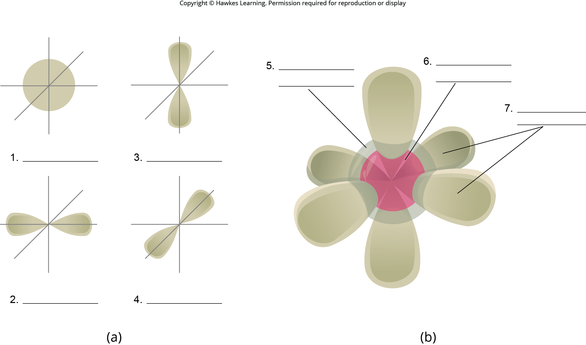
Lesson 2.1 Figure 9 - Numbered

Slide 15
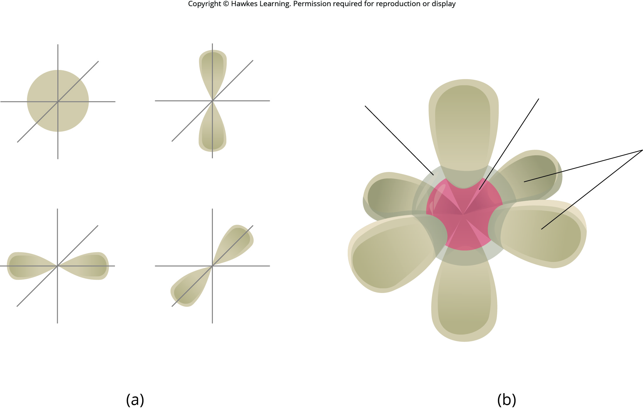
Lesson 2.1 Figure 9

Slide 16
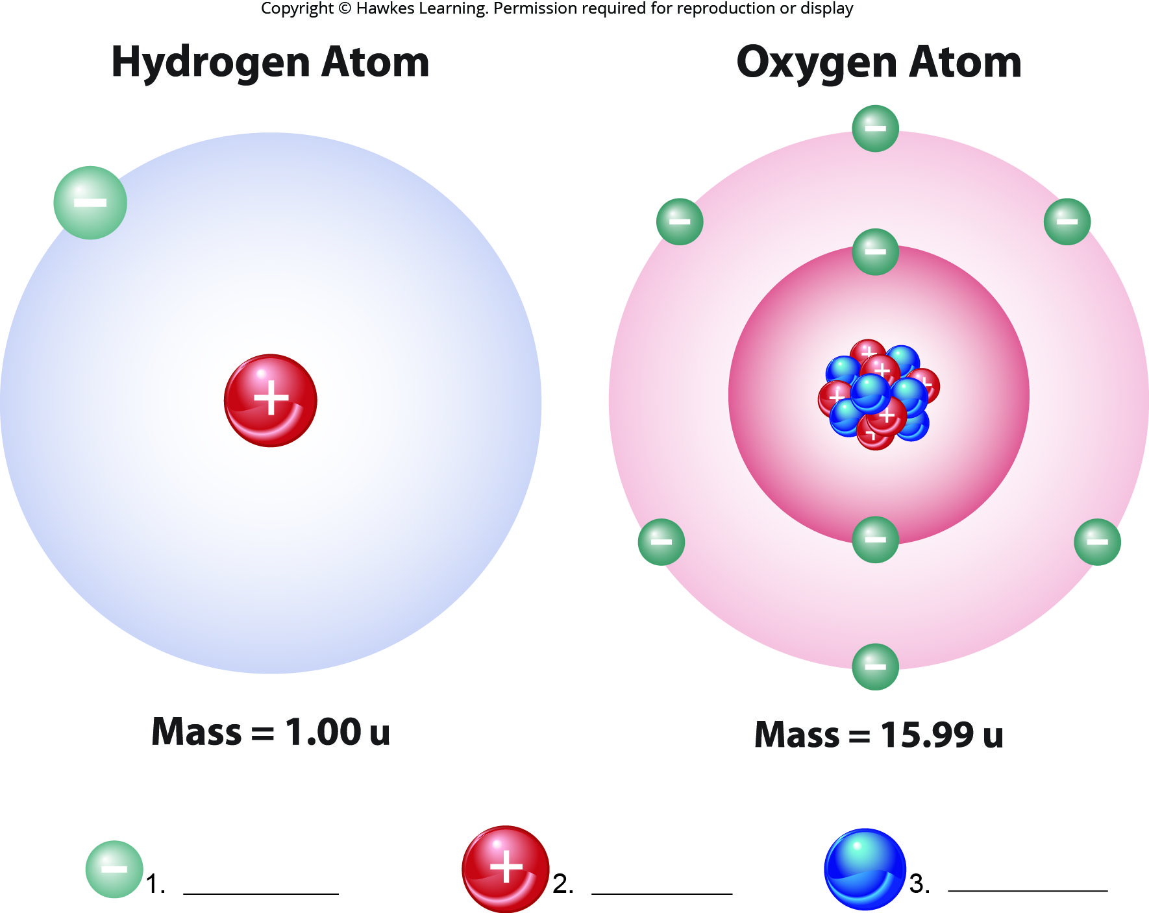
Lesson 2.1 Figure 10 - Numbered

Slide 17
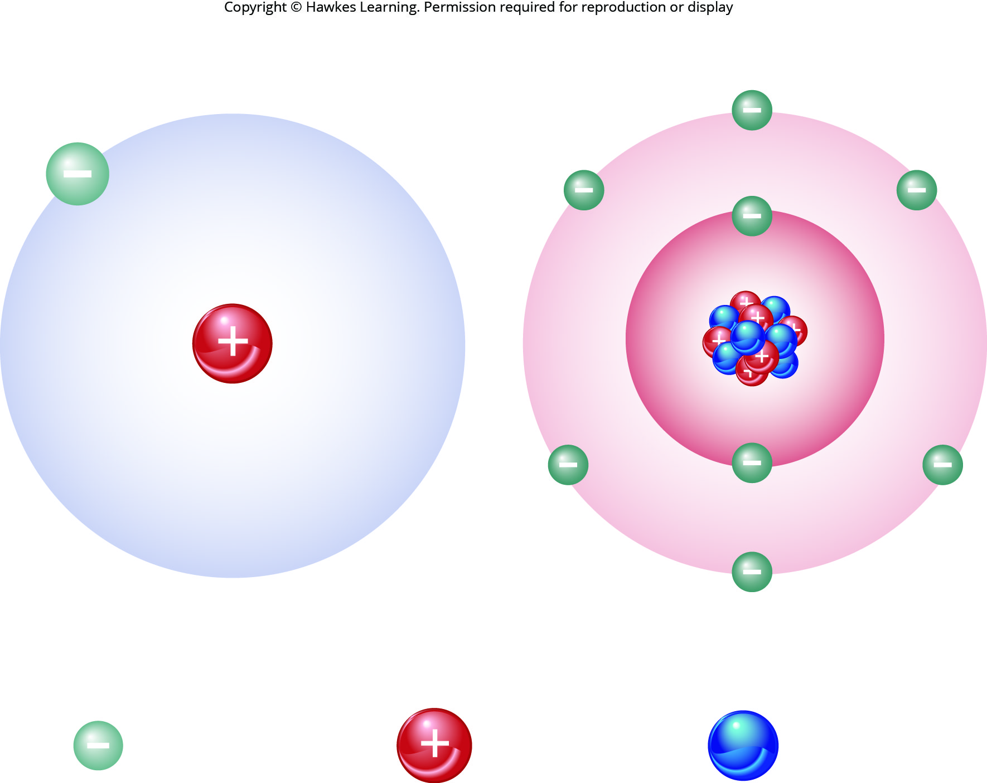
Lesson 2.1 Figure 10

Slide 18
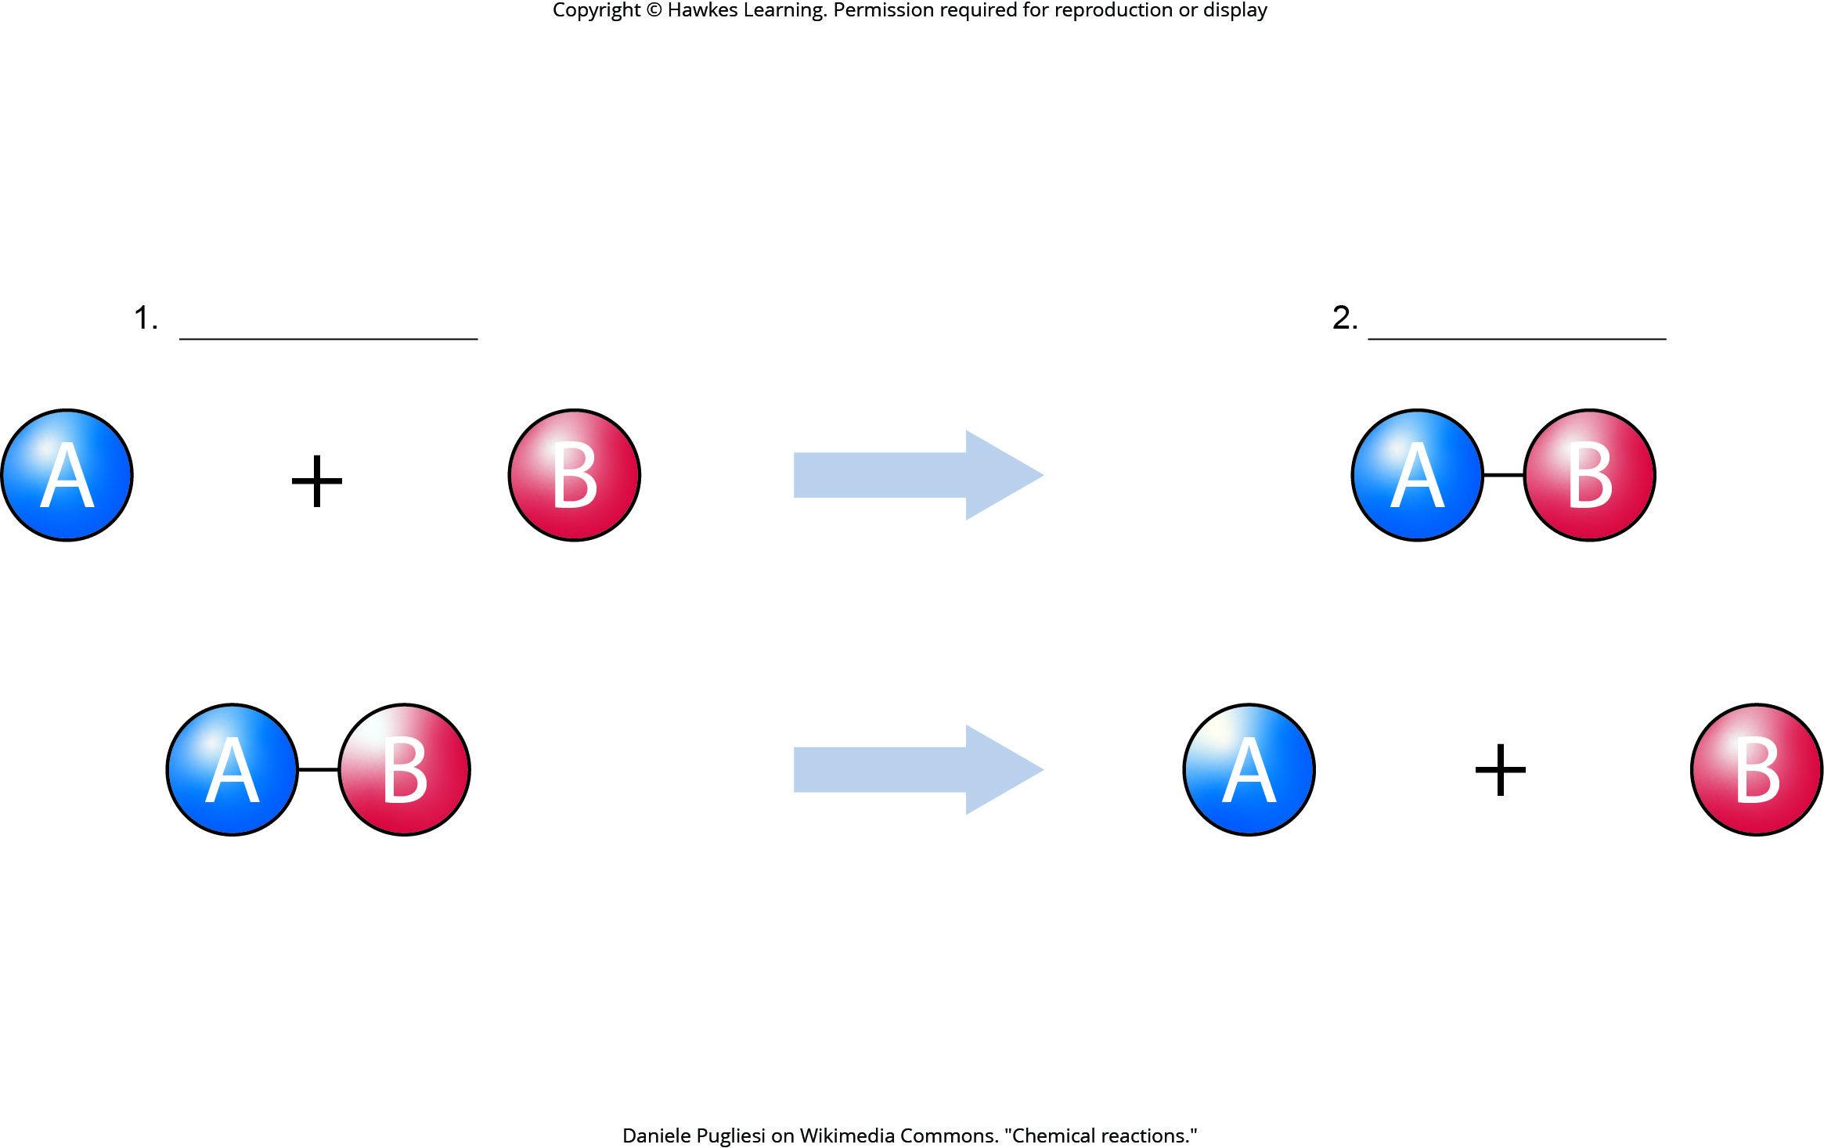
Lesson 2.1 Figure 11 - Numbered

Slide 19
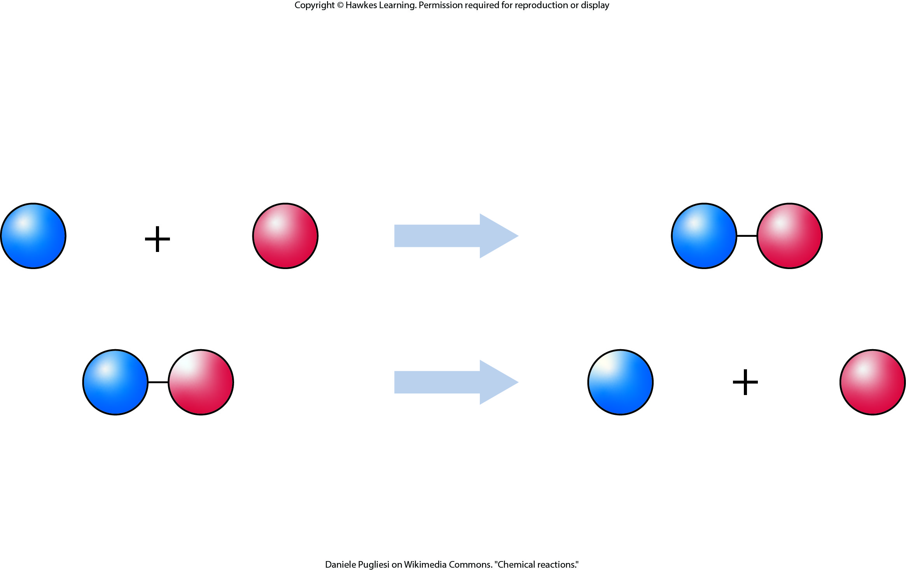
Lesson 2.1 Figure 11

Slide 20
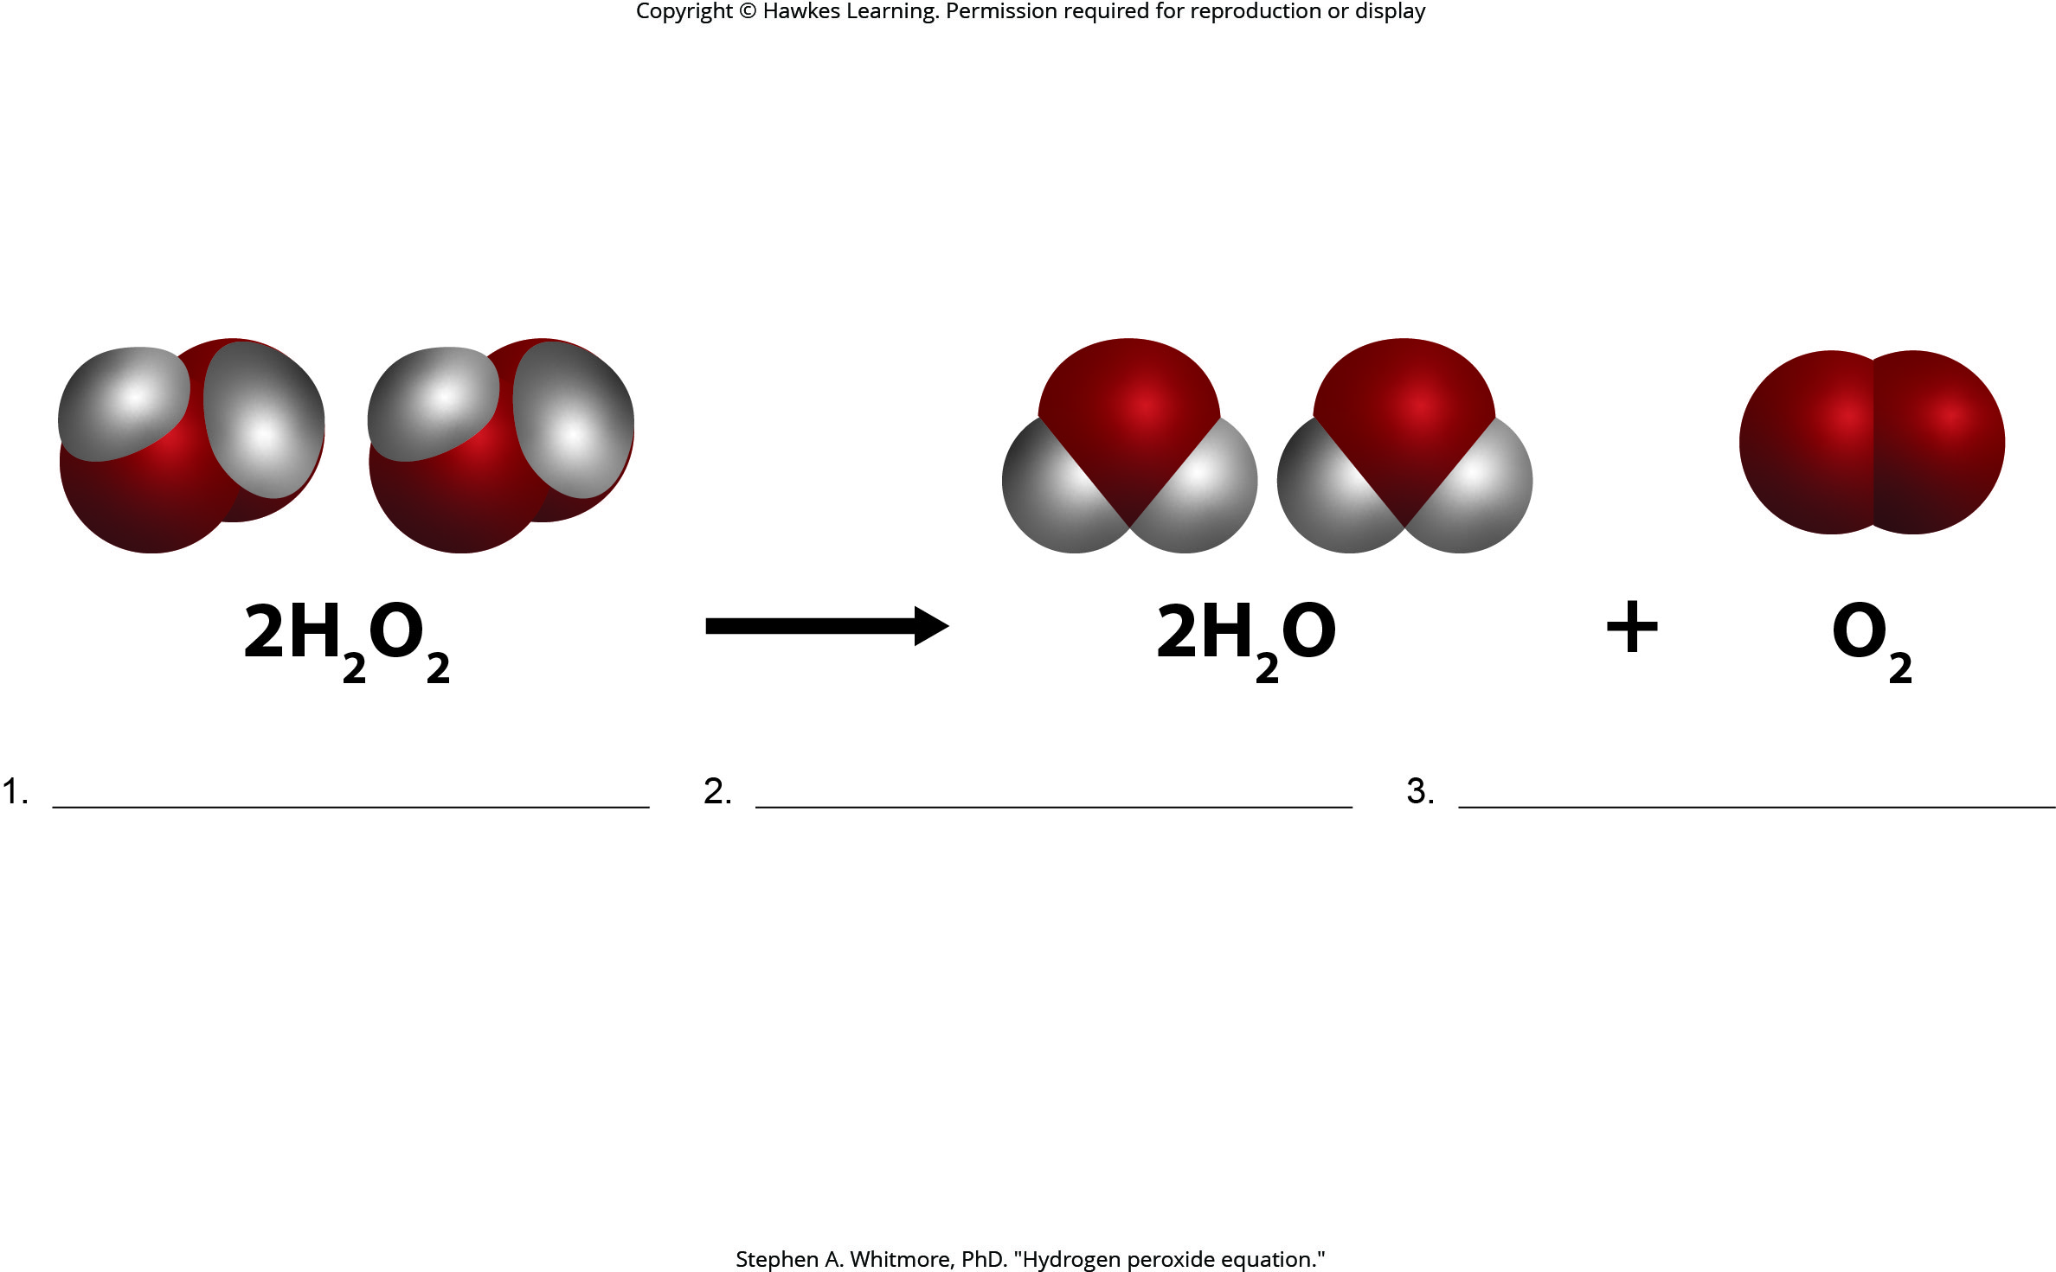
Lesson 2.1 Figure 12 - Numbered

Slide 21
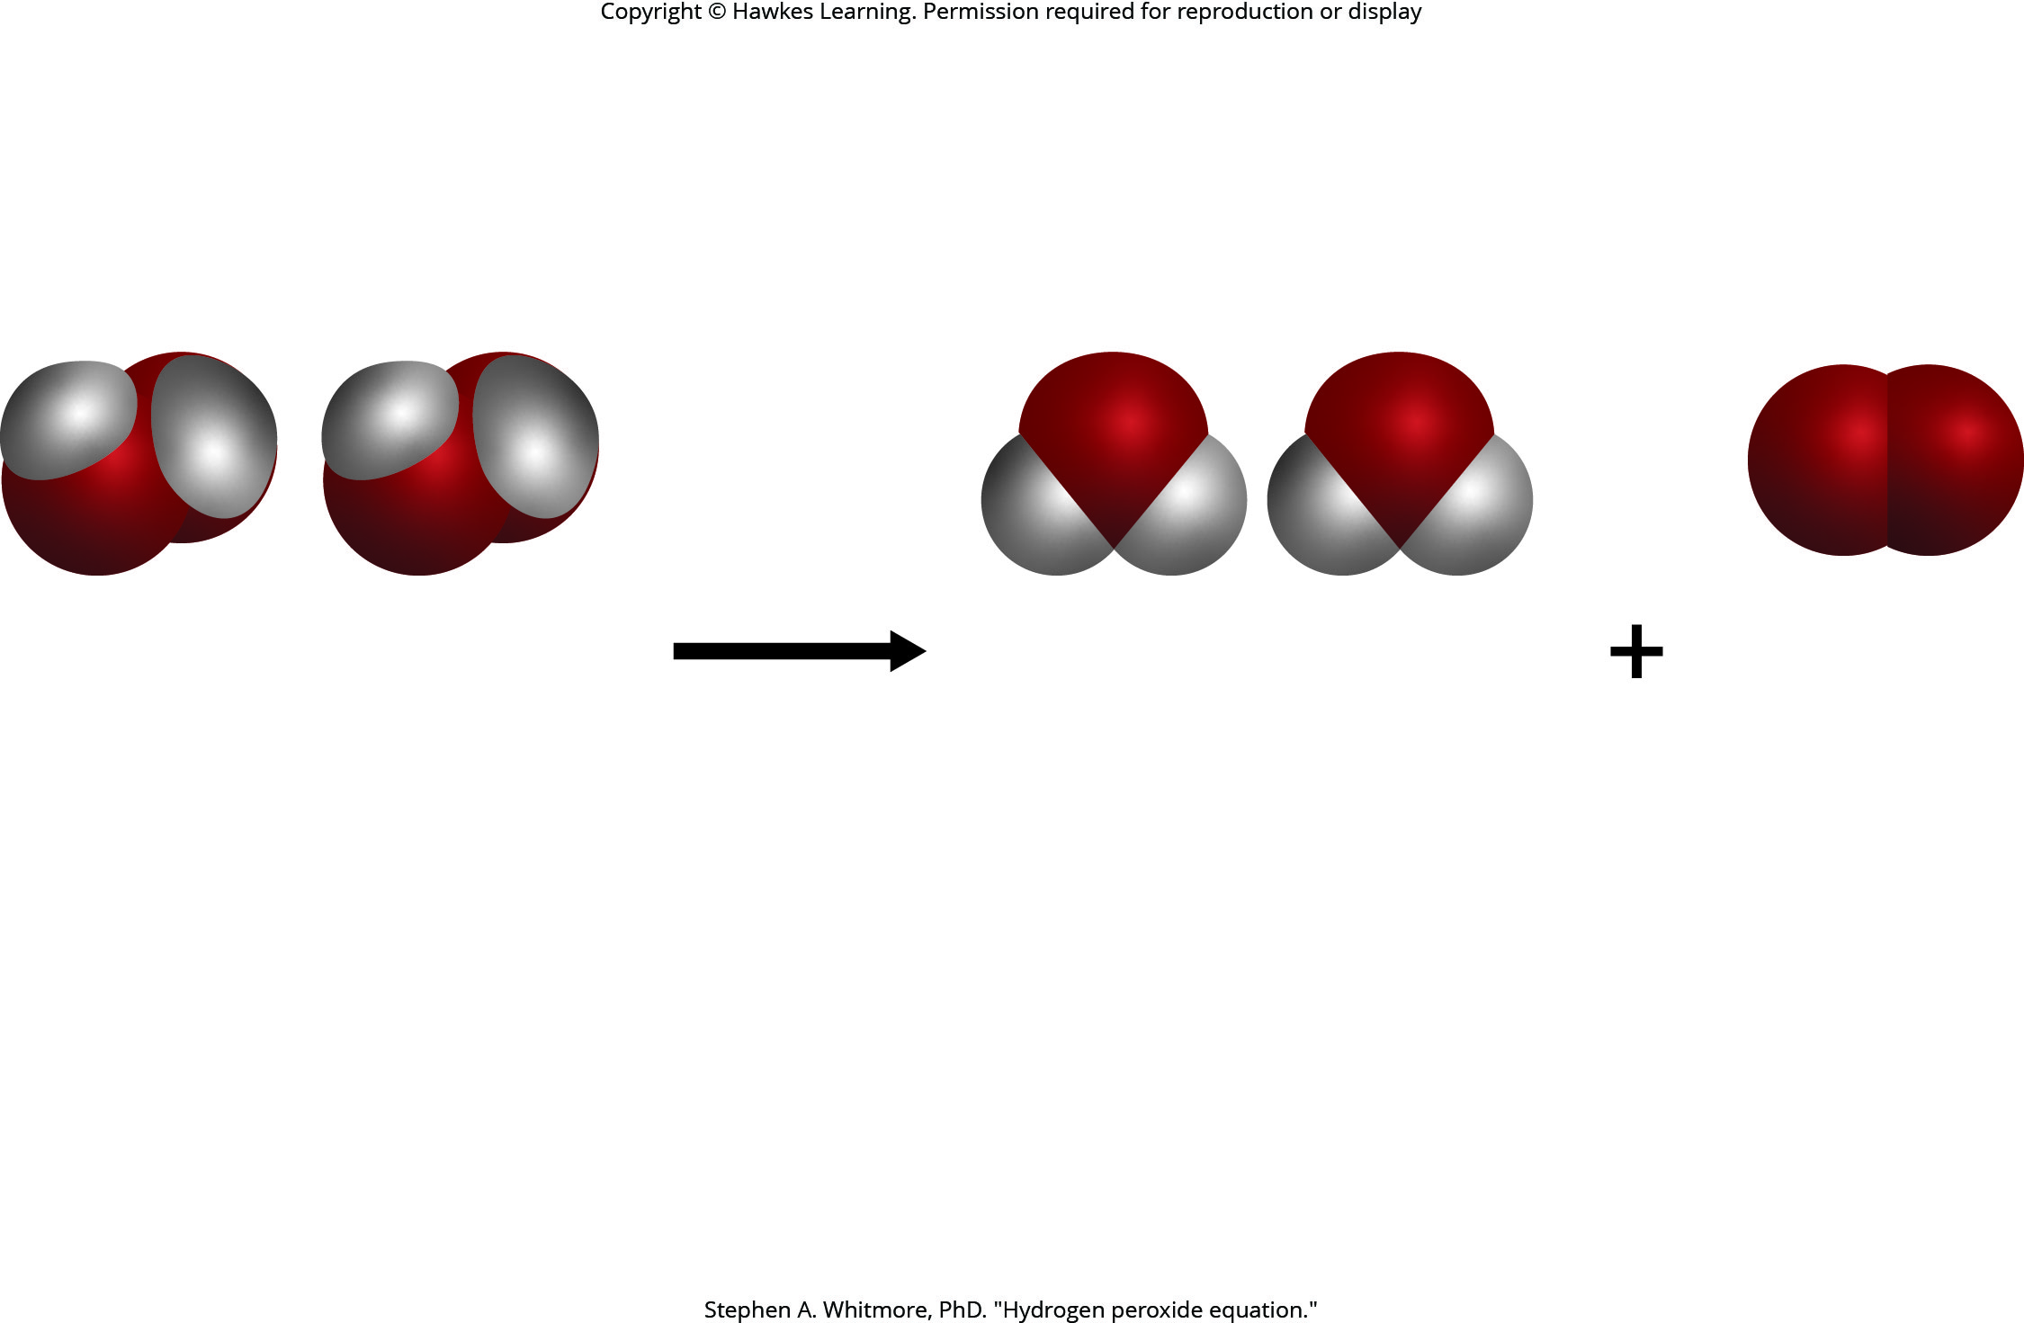
Lesson 2.1 Figure 12

Slide 22
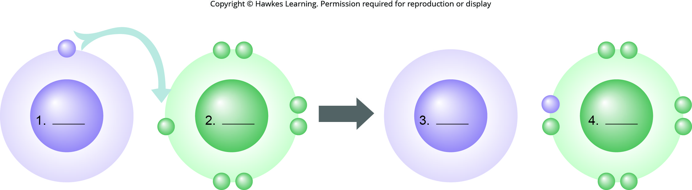
Lesson 2.1 Figure 14 - Numbered

Slide 23

Lesson 2.1 Figure 14

Slide 24
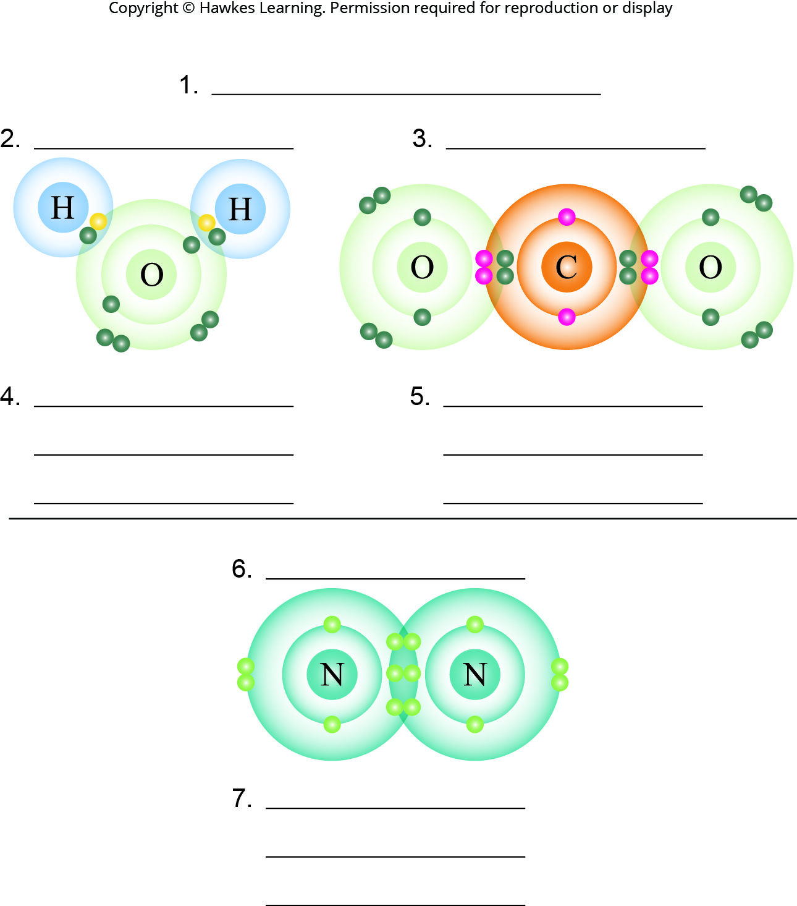
Lesson 2.1 Figure 15 - Numbered

Slide 25
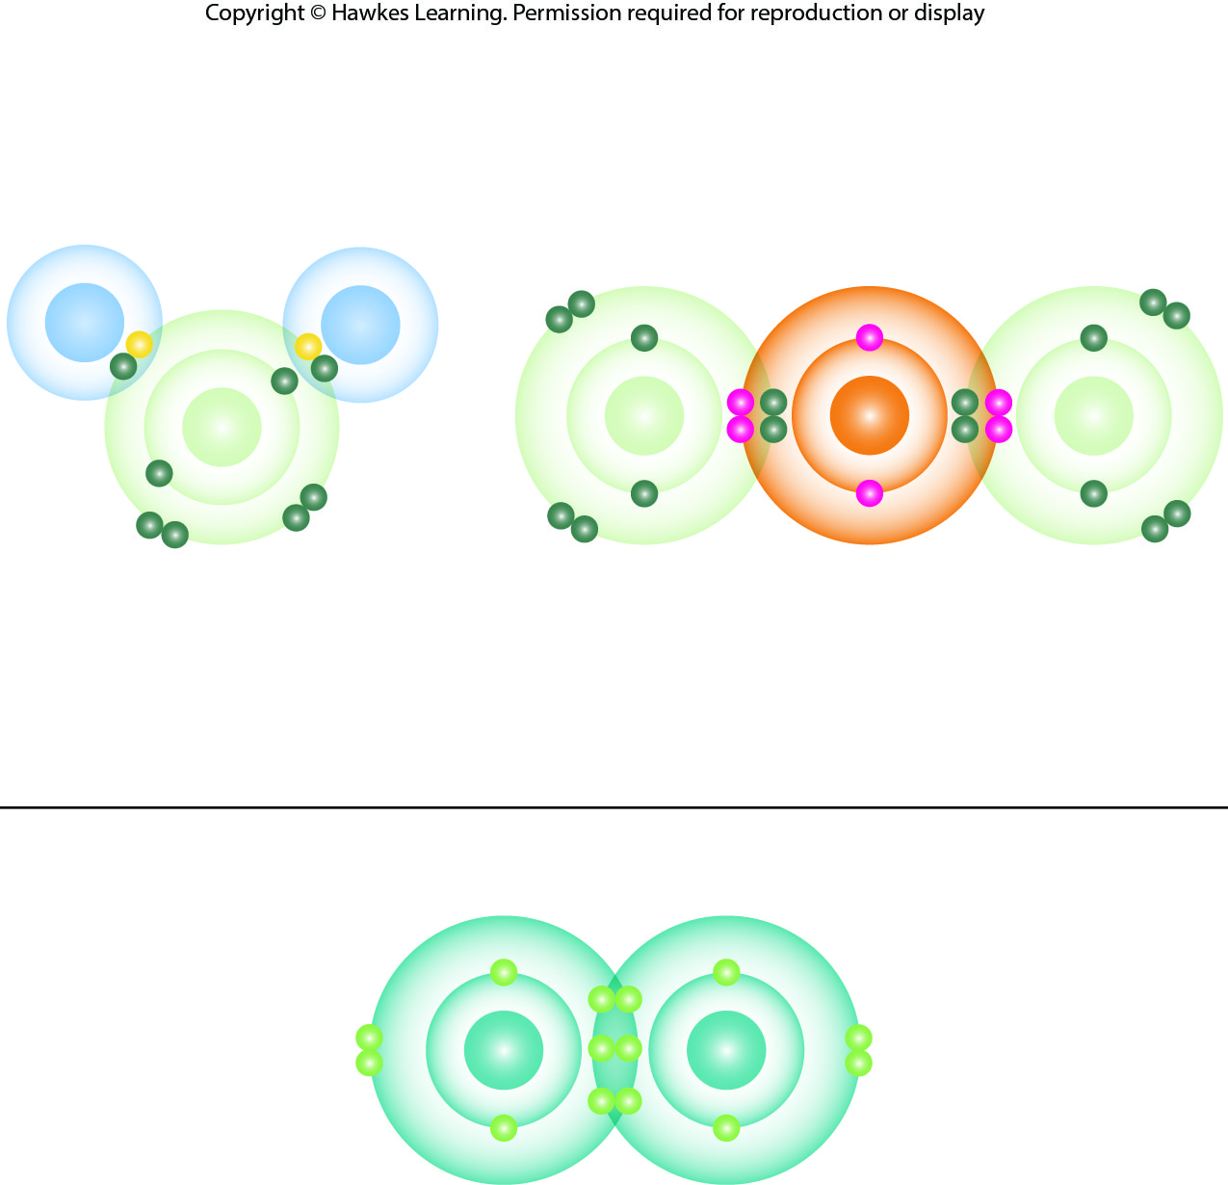
Lesson 2.1 Figure 15

Slide 26
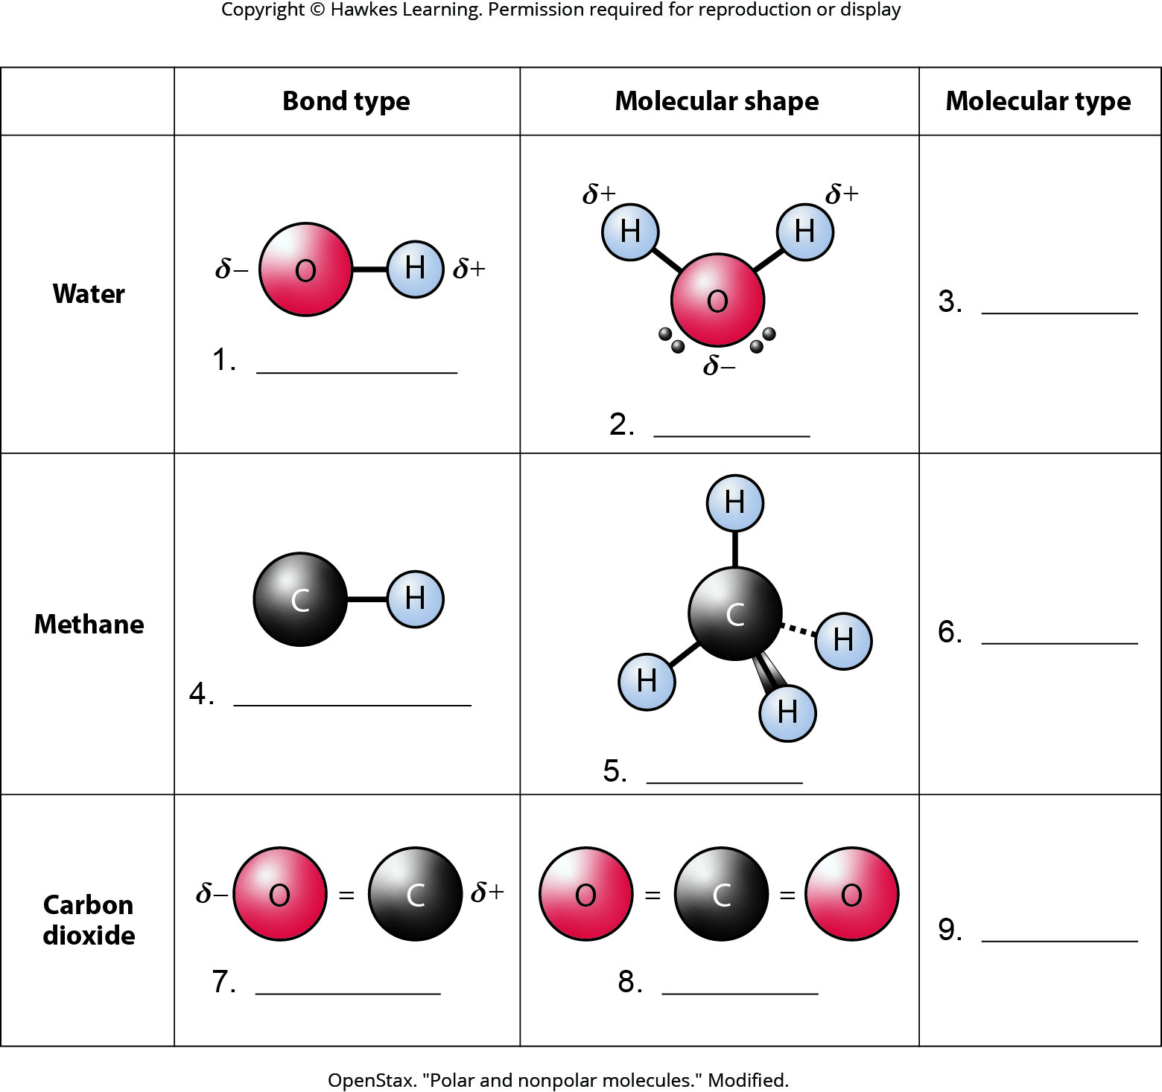
Lesson 2.1 Figure 16 - Numbered

Slide 27
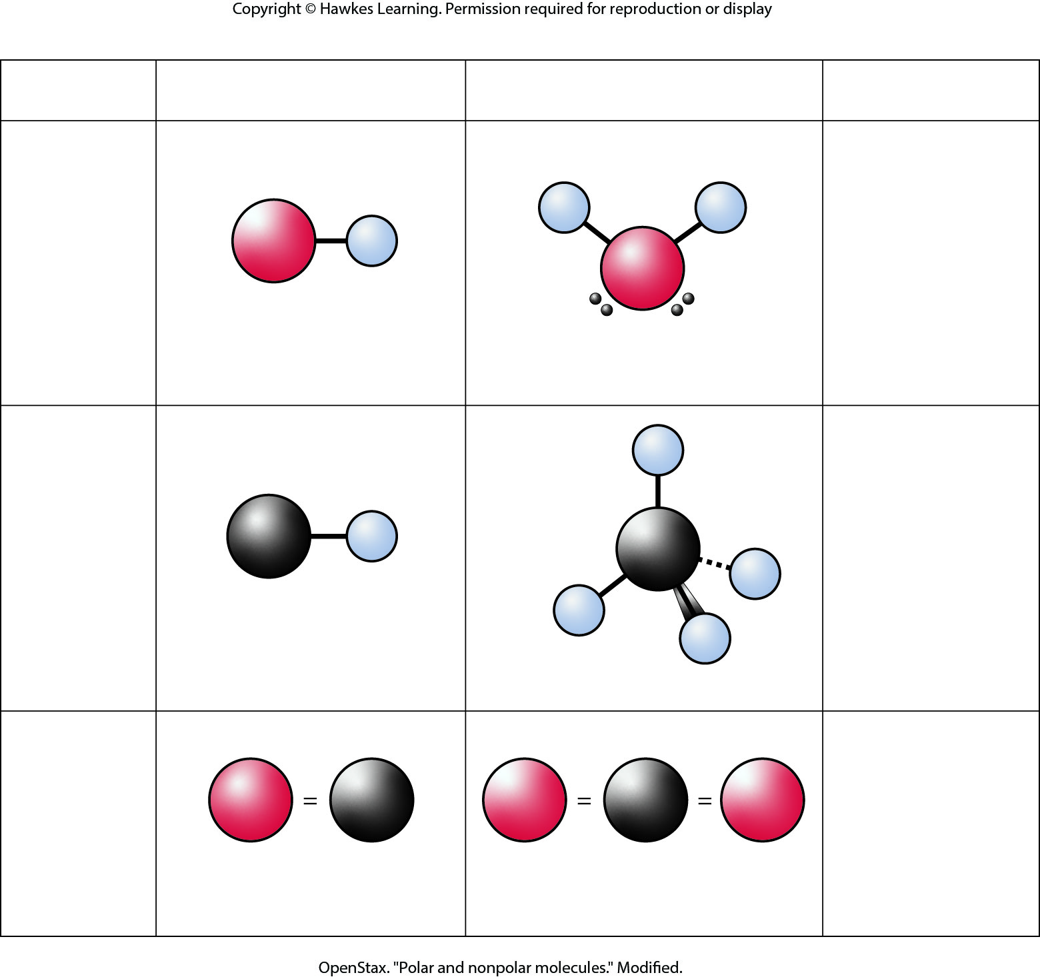
Lesson 2.1 Figure 16

Slide 28
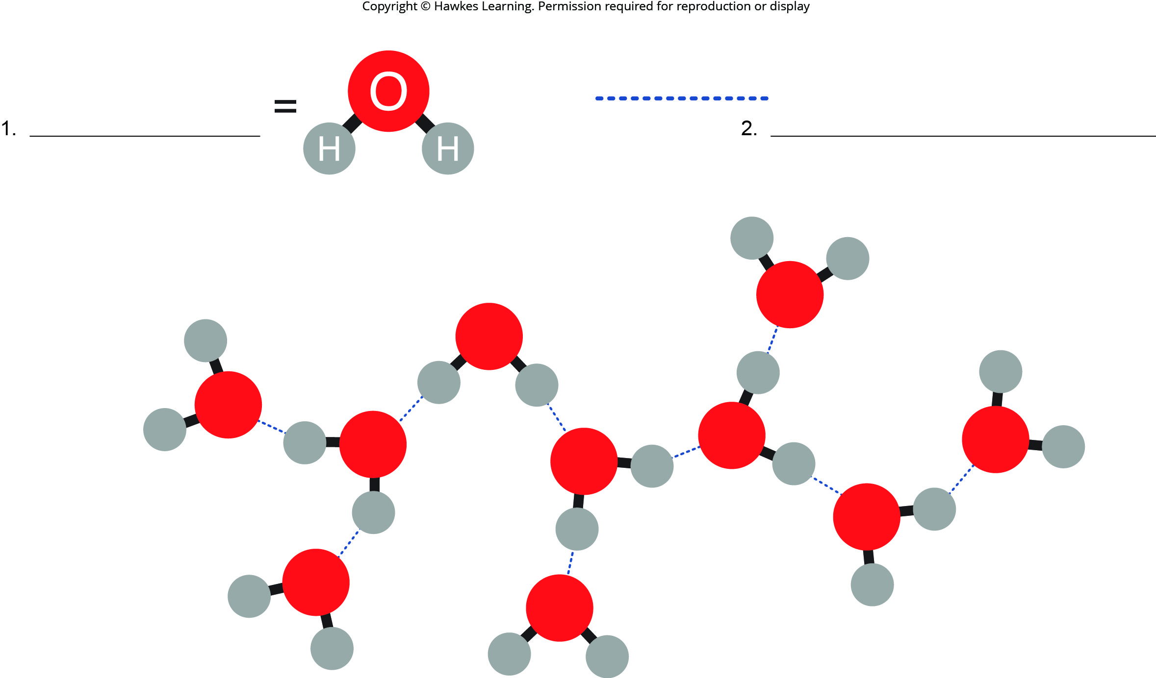
Lesson 2.1 Figure 17 - Numbered

Slide 29
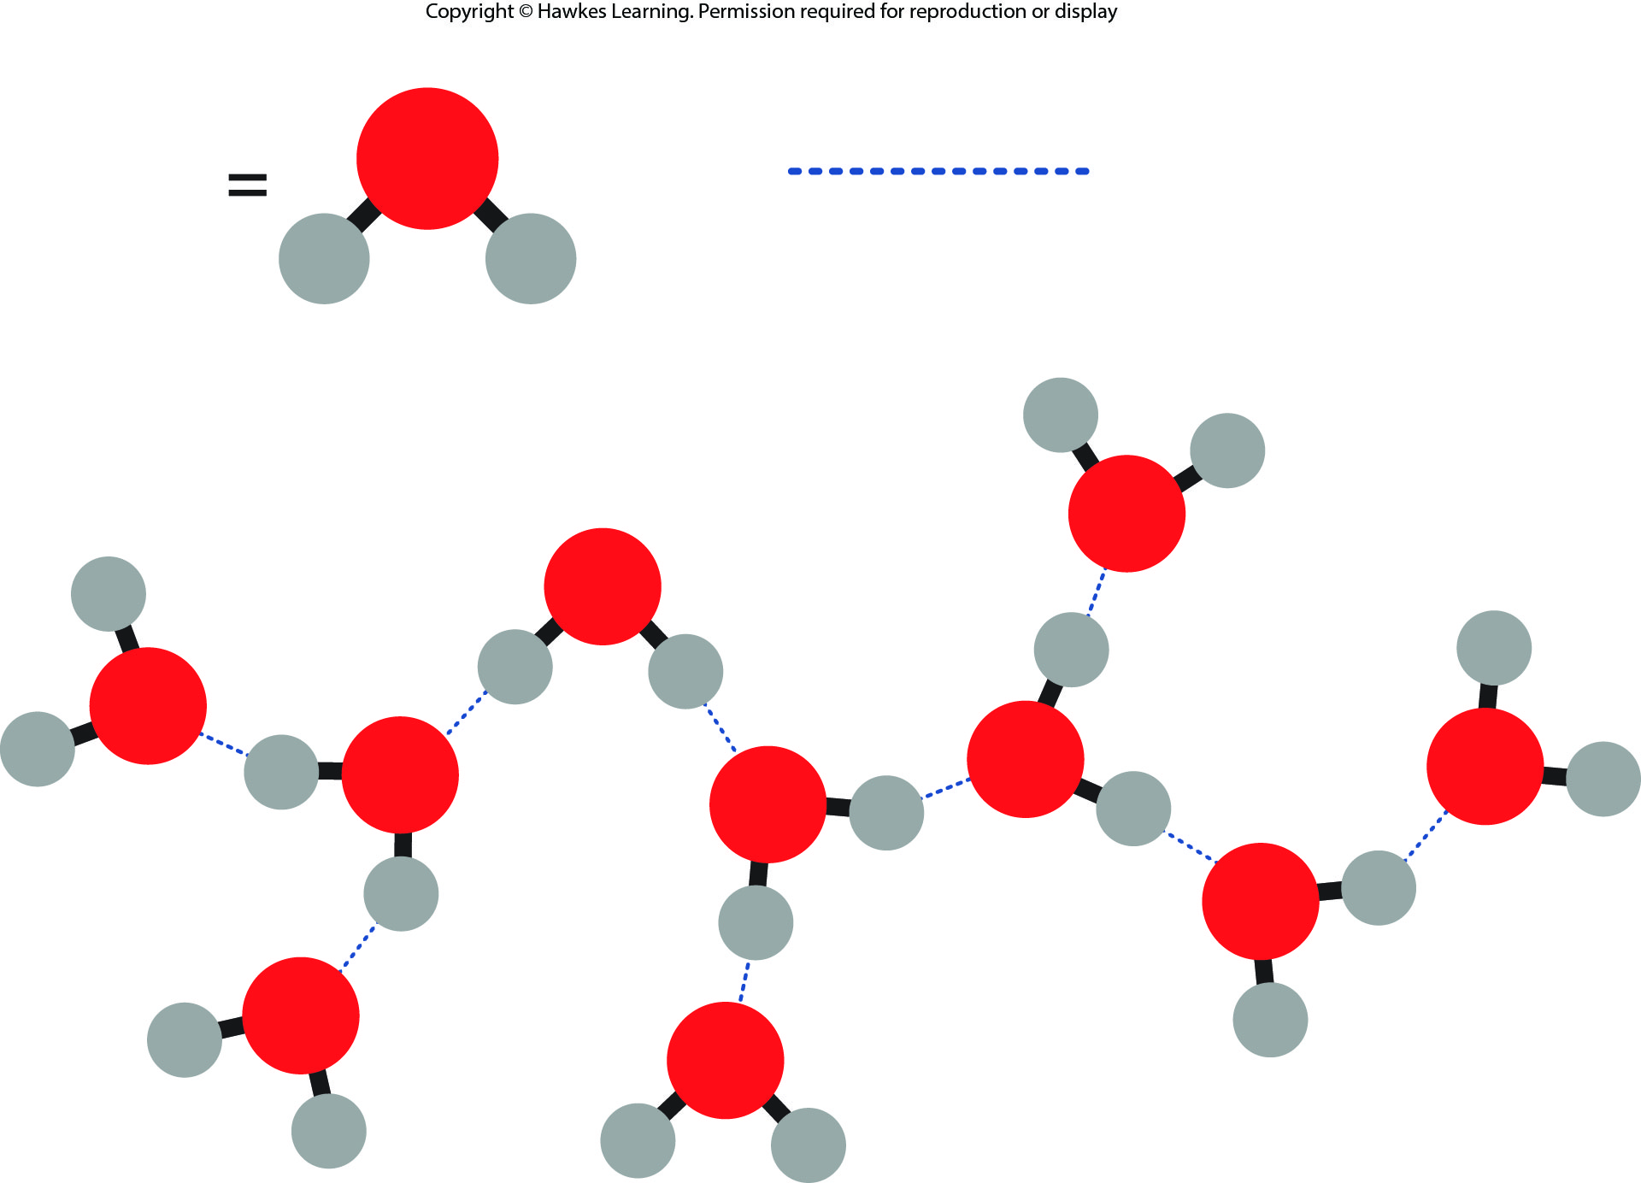
Lesson 2.1 Figure 17

Slide 30
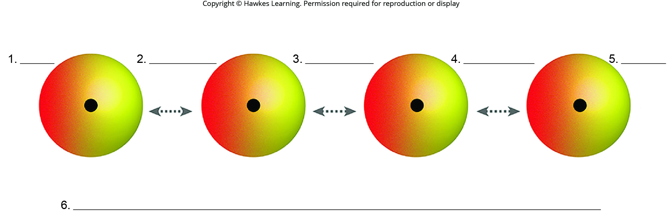
Lesson 2.1 Figure 18 - Numbered

Slide 31
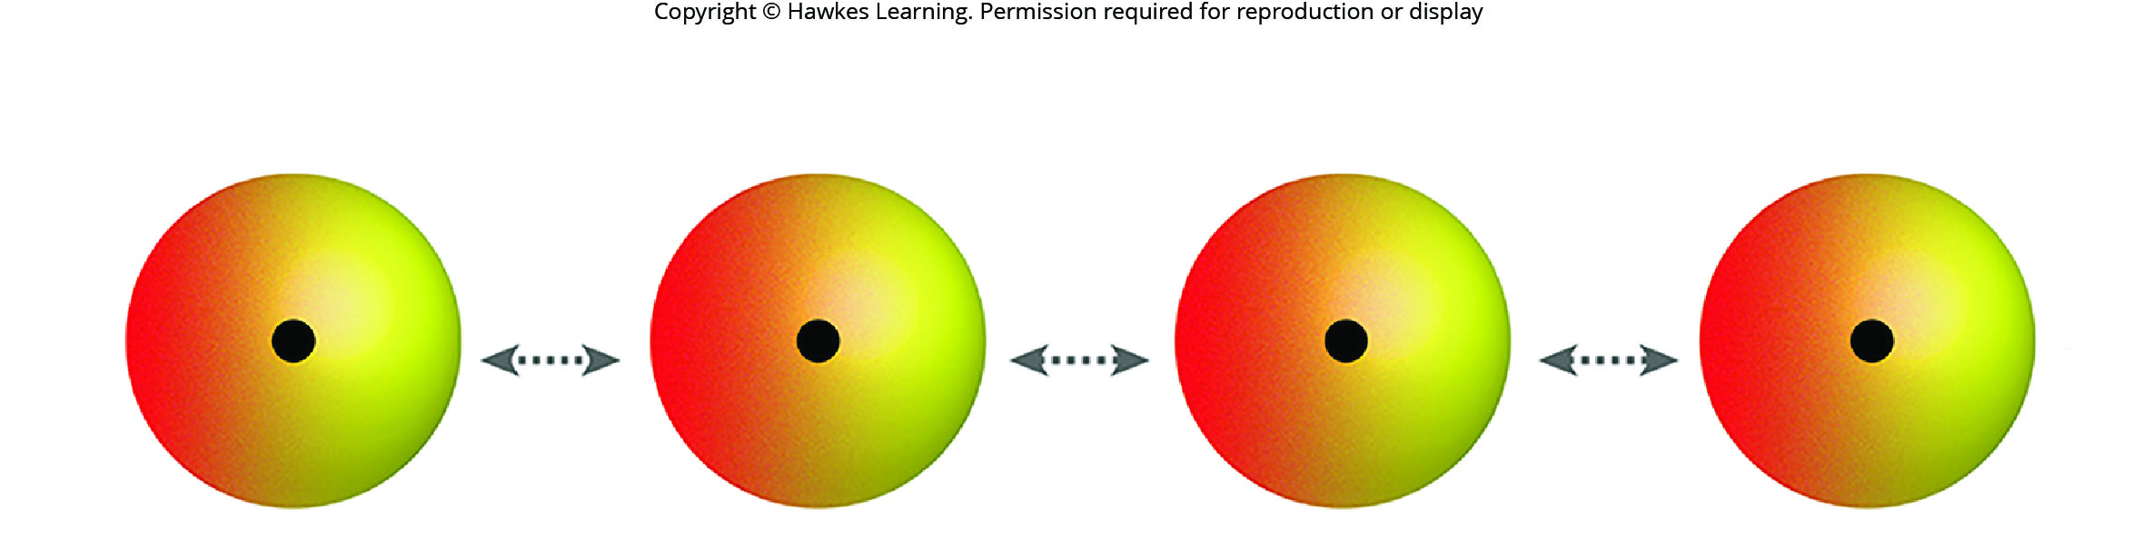
Lesson 2.1 Figure 18

Slide 32
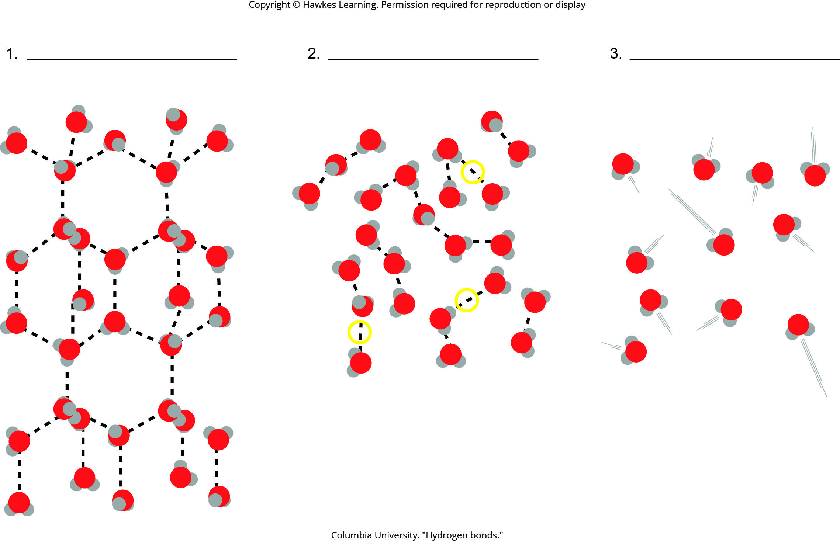
Lesson 2.2 Figure 2 - Numbered

Slide 33
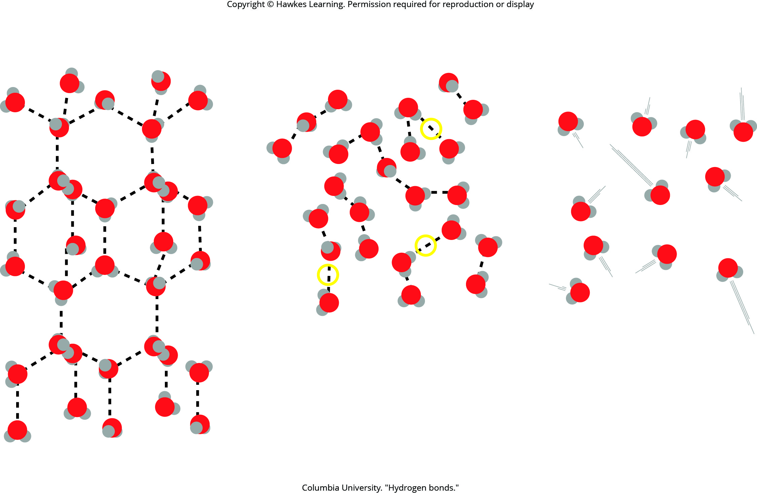
Lesson 2.2 Figure 2

Slide 34
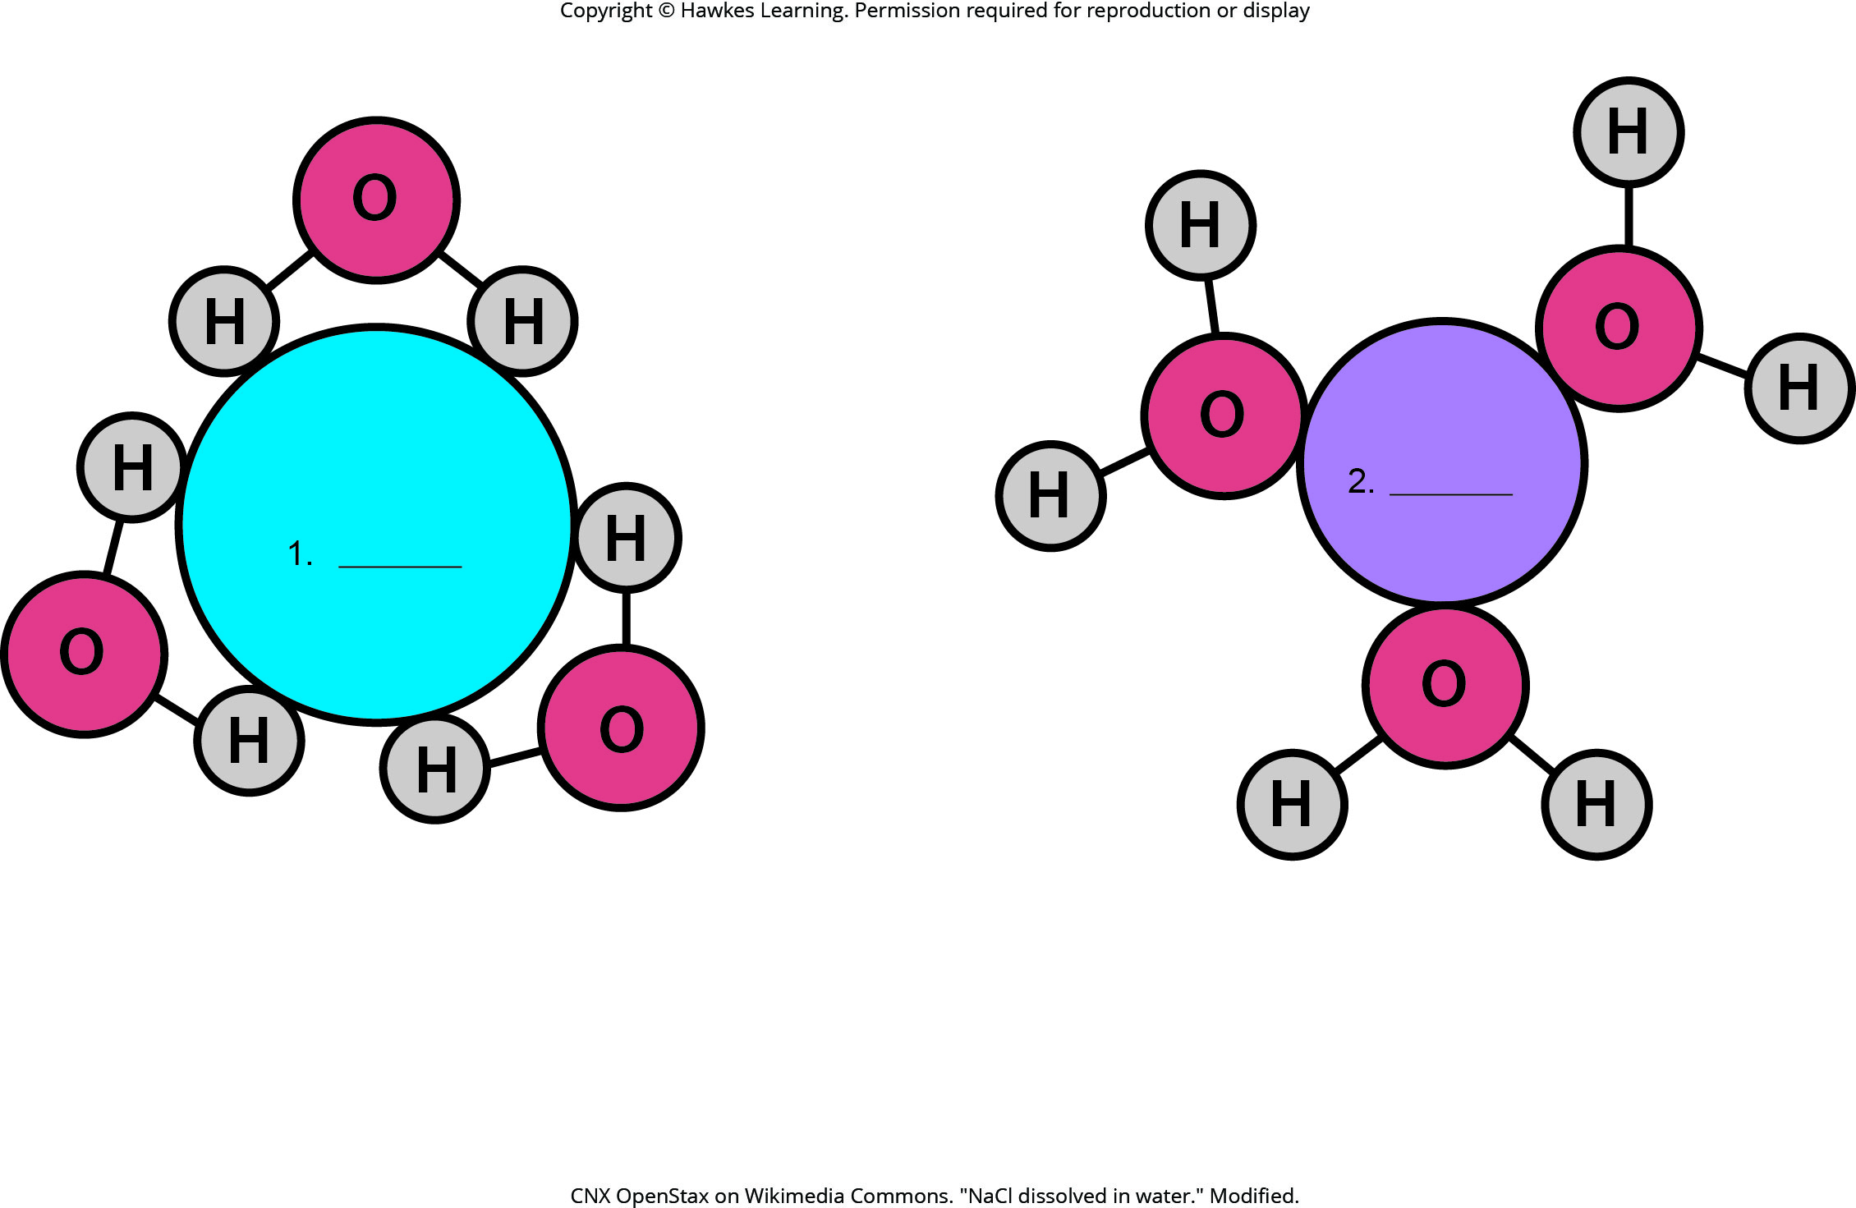
Lesson 2.2 Figure 4 - Numbered

Slide 35

Lesson 2.2 Figure 4

Slide 36
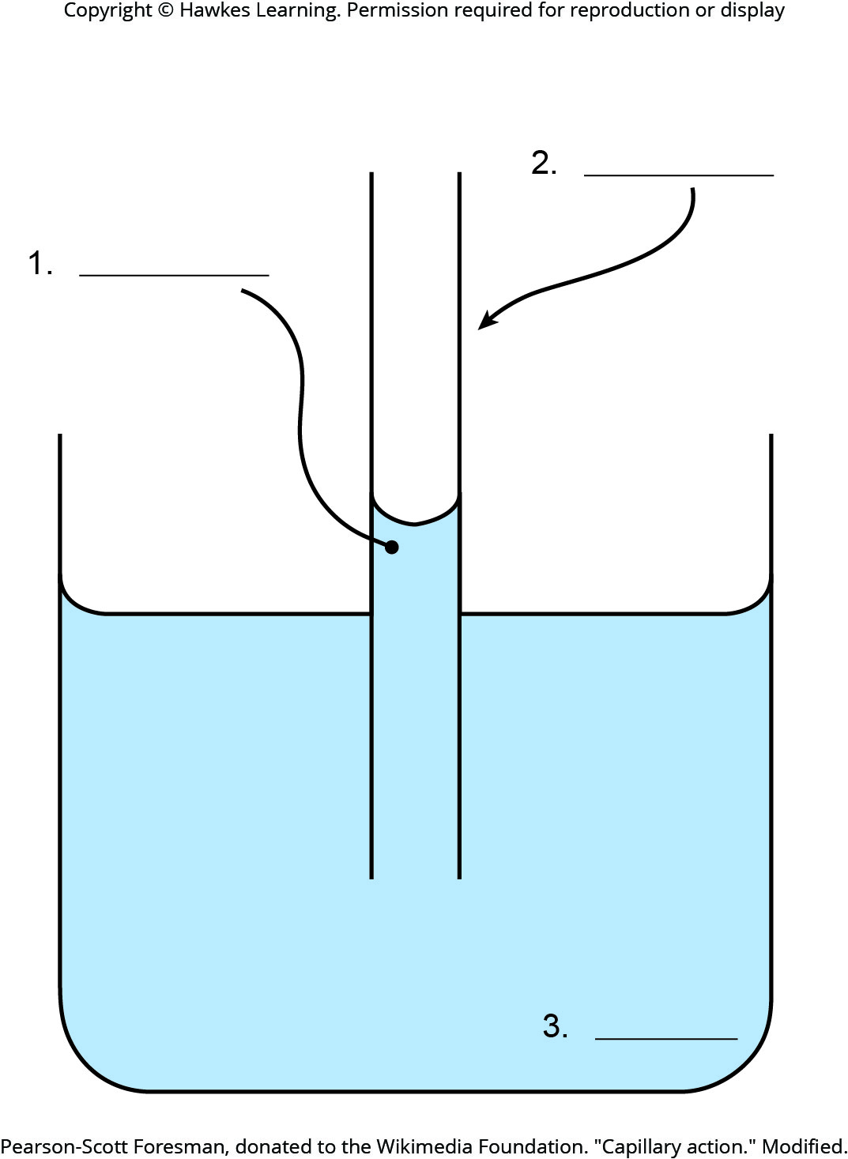
Lesson 2.2 Figure 6 - Numbered

Slide 37
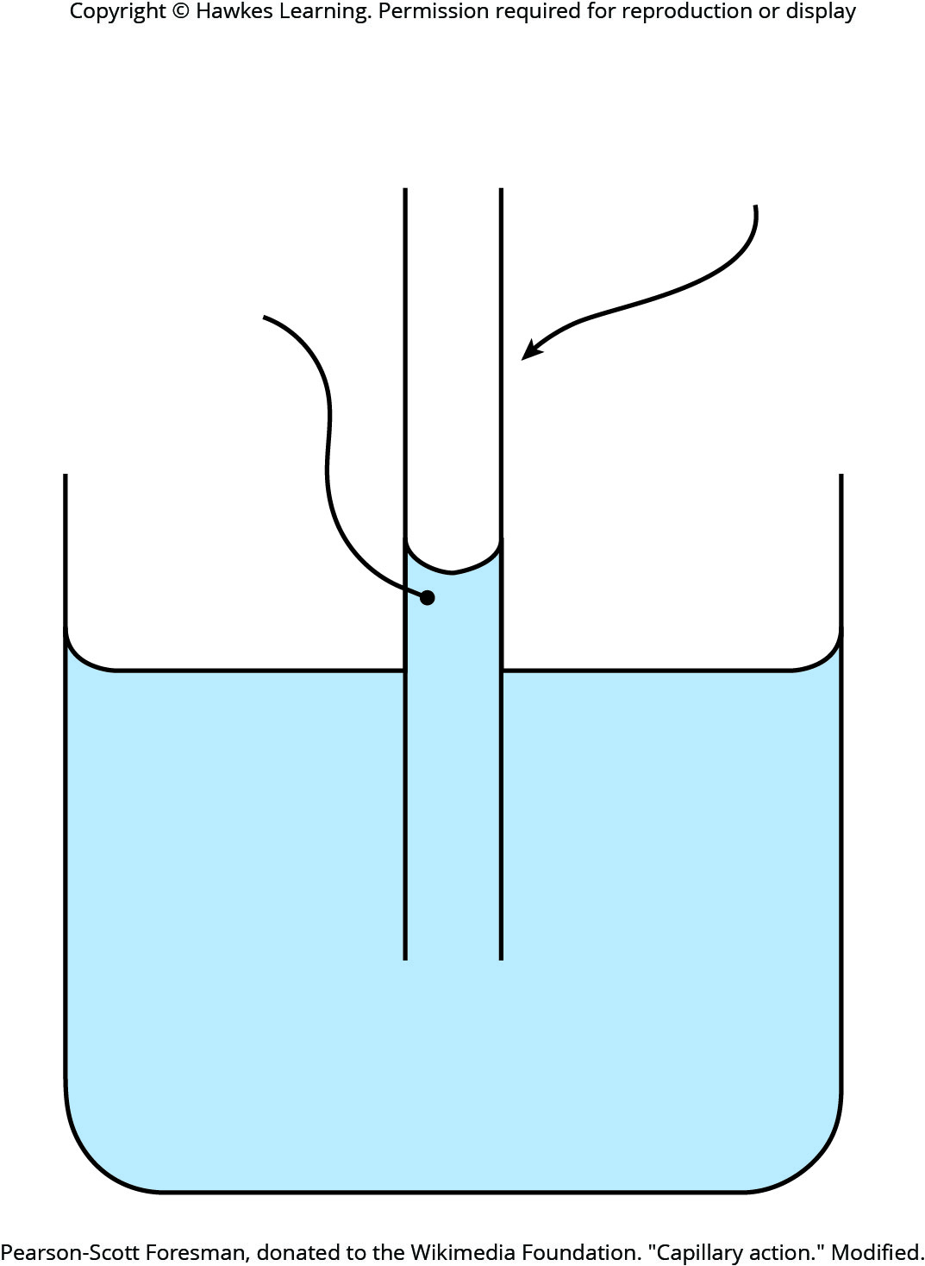
Lesson 2.2 Figure 6

Slide 38
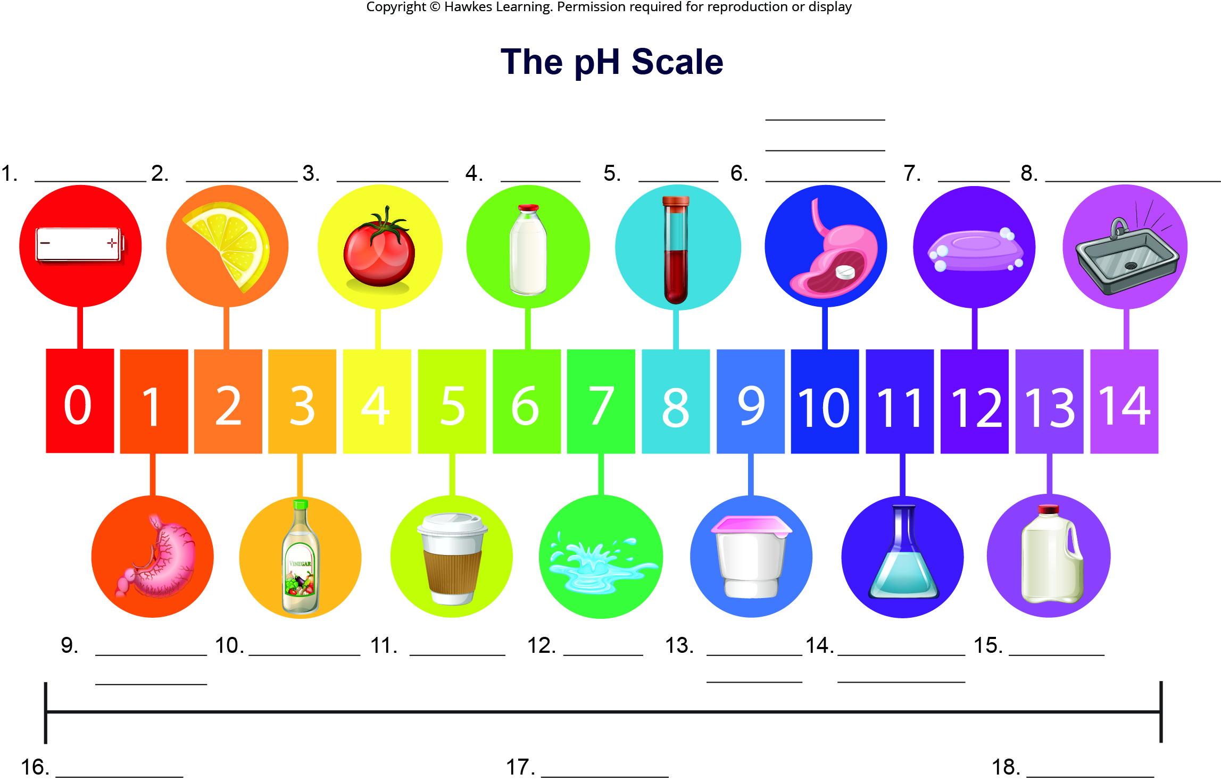
Lesson 2.2 Figure 8 - Numbered

Slide 39
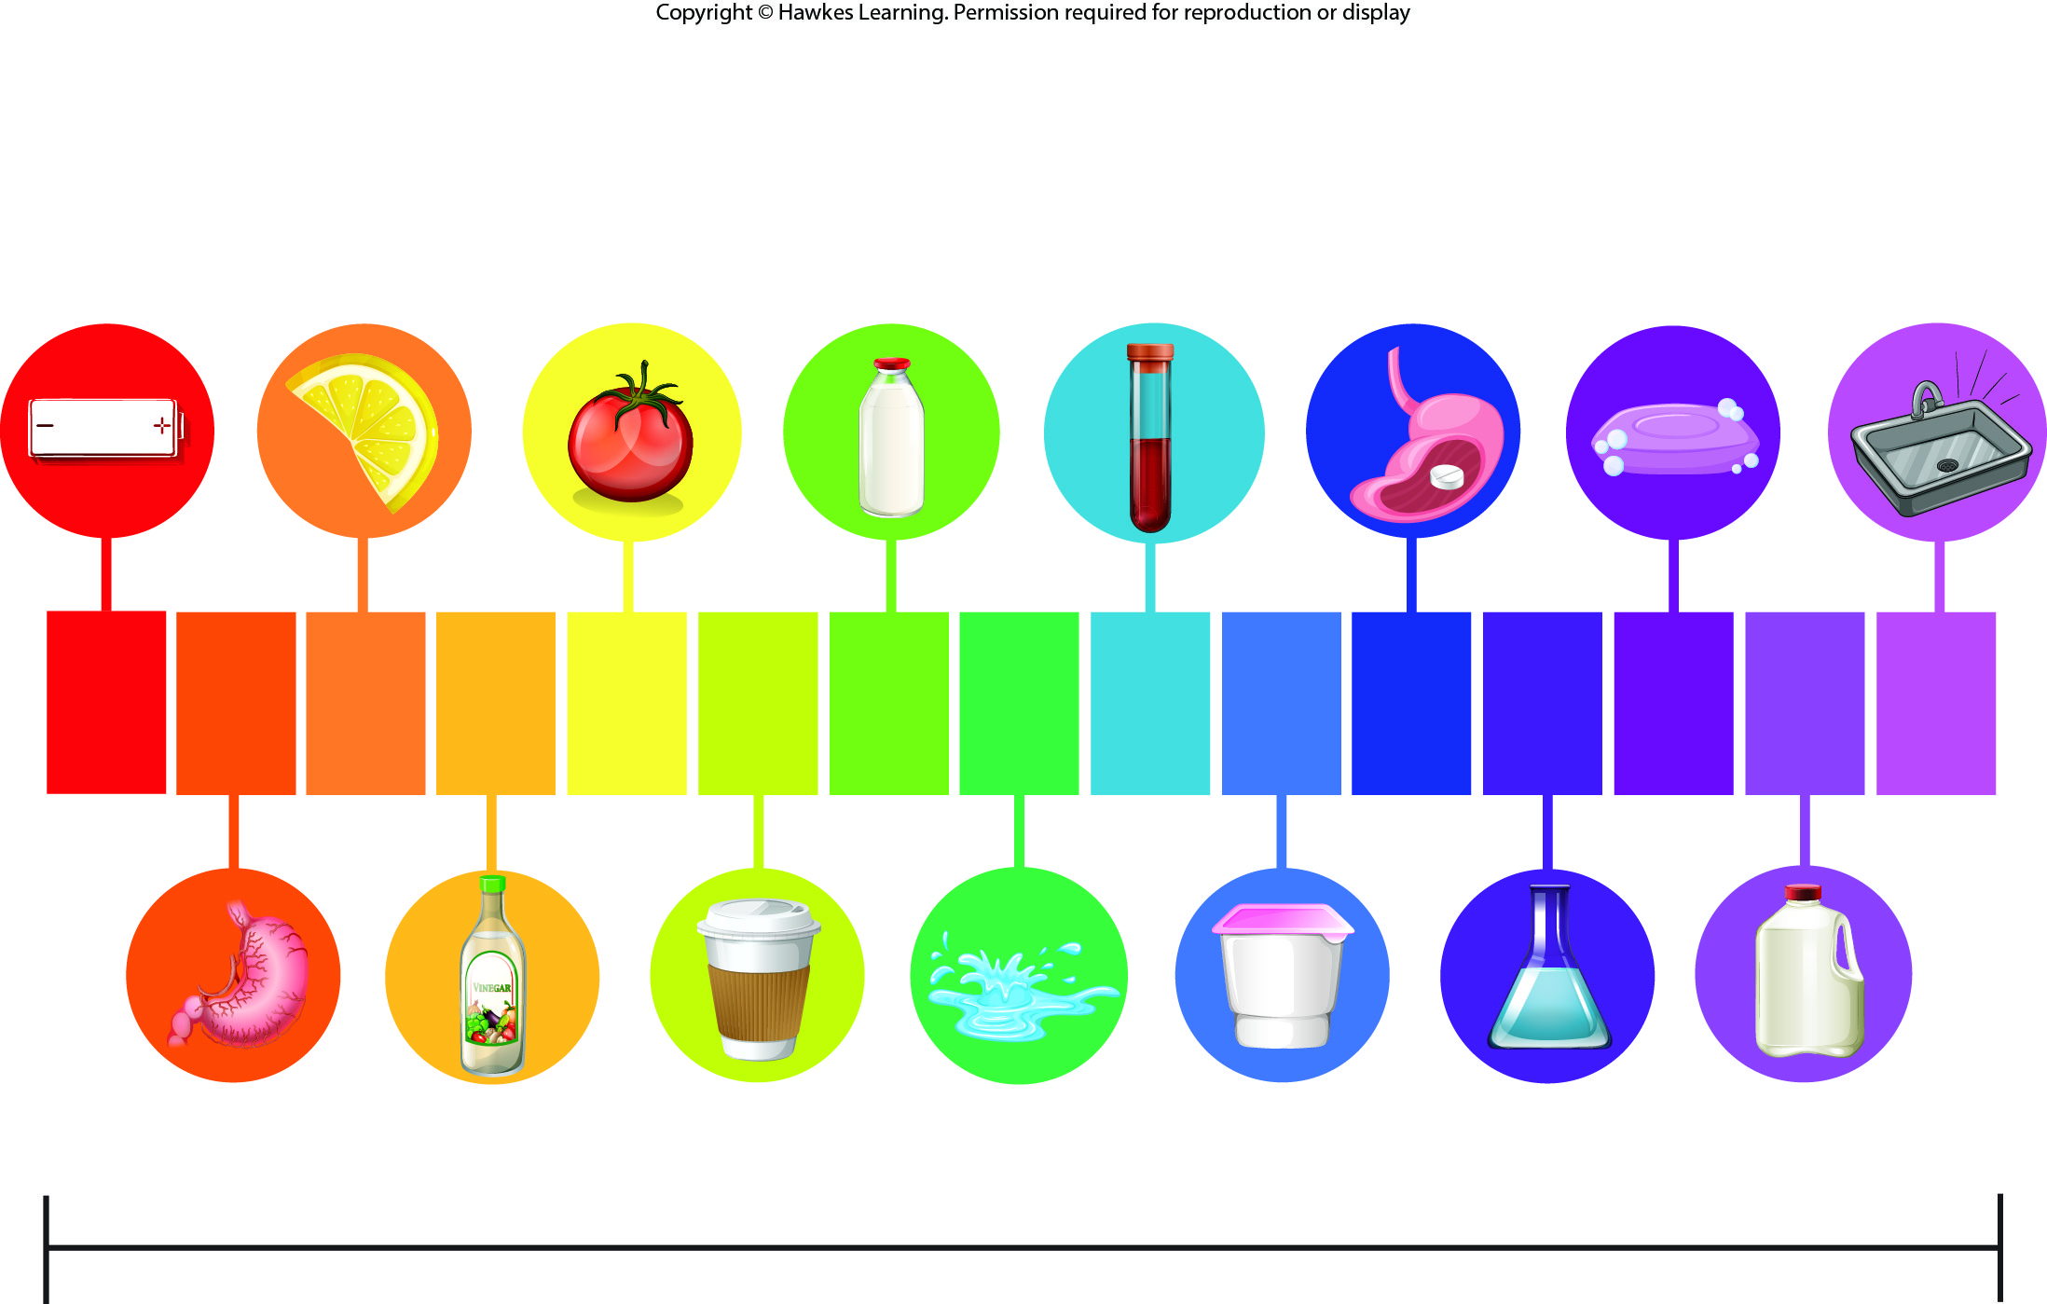
Lesson 2.2 Figure 8

Slide 40
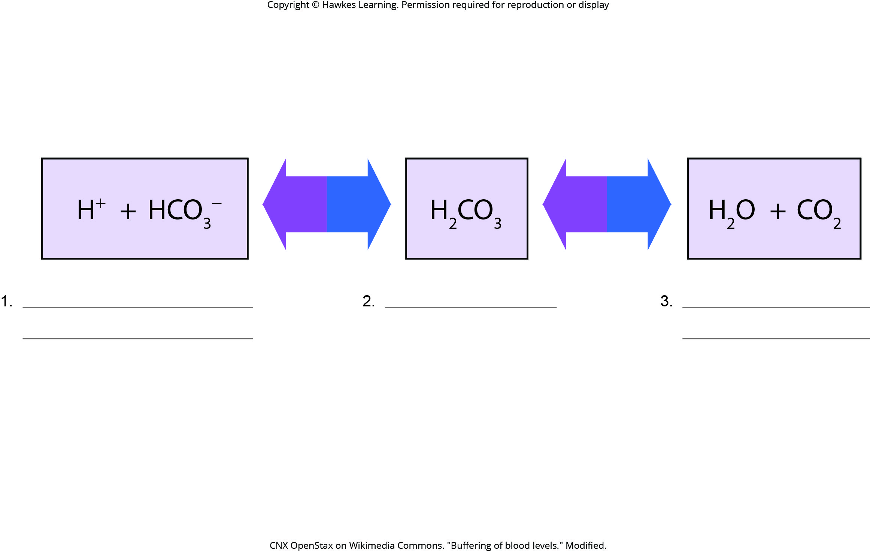
Lesson 2.2 Figure 9 - Numbered

Slide 41
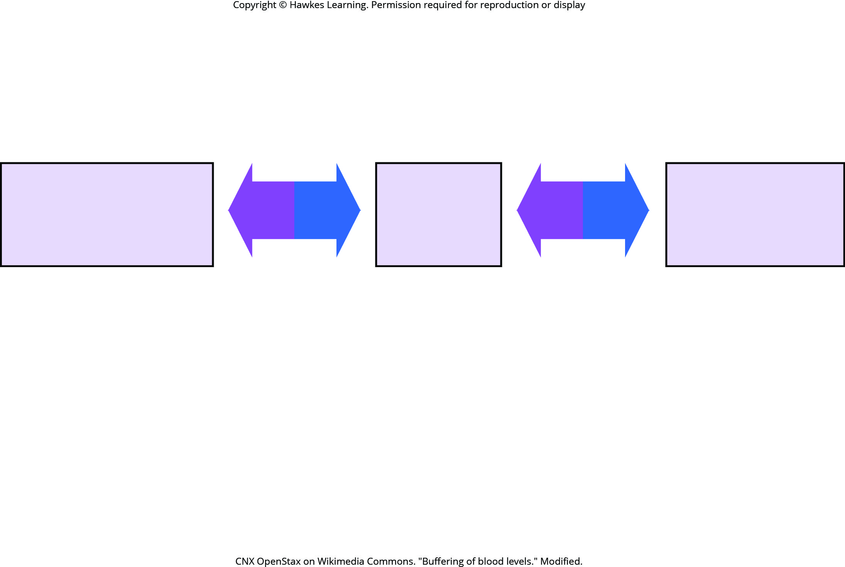
Lesson 2.2 Figure 9

Slide 42
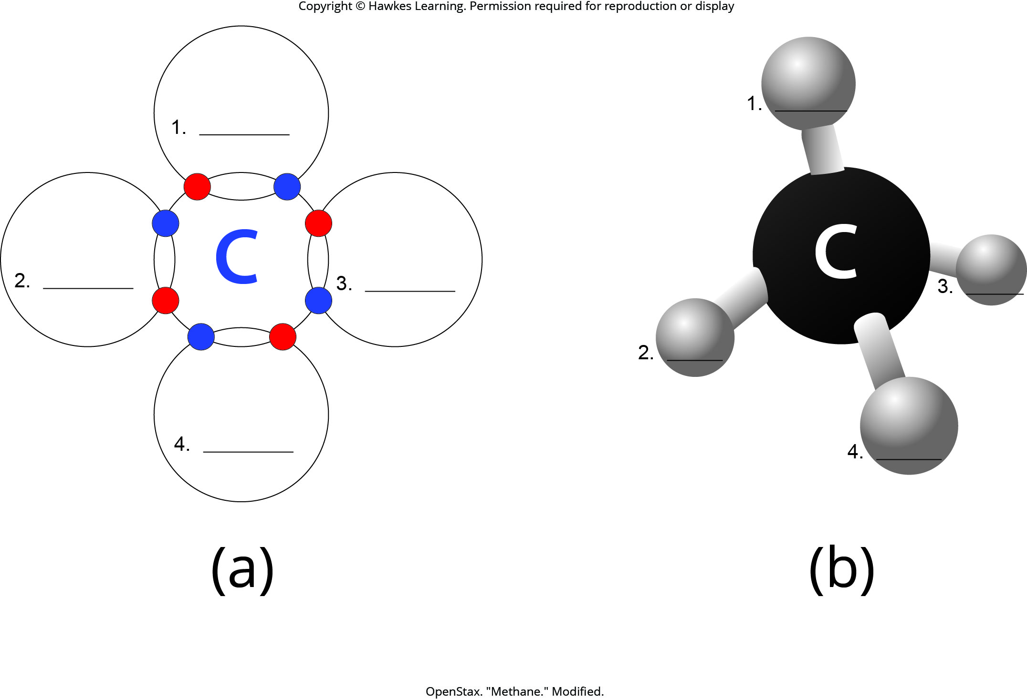
Lesson 2.3 Figure 2 - Numbered

Slide 43
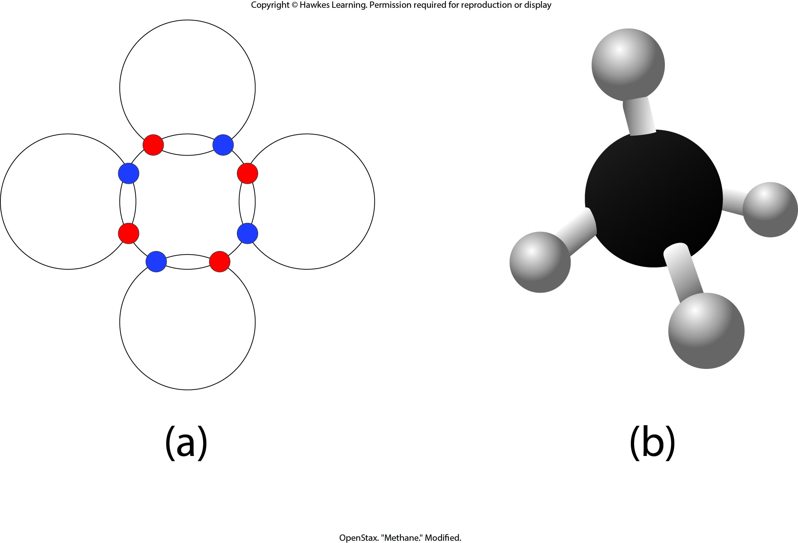
Lesson 2.3 Figure 2

Slide 44
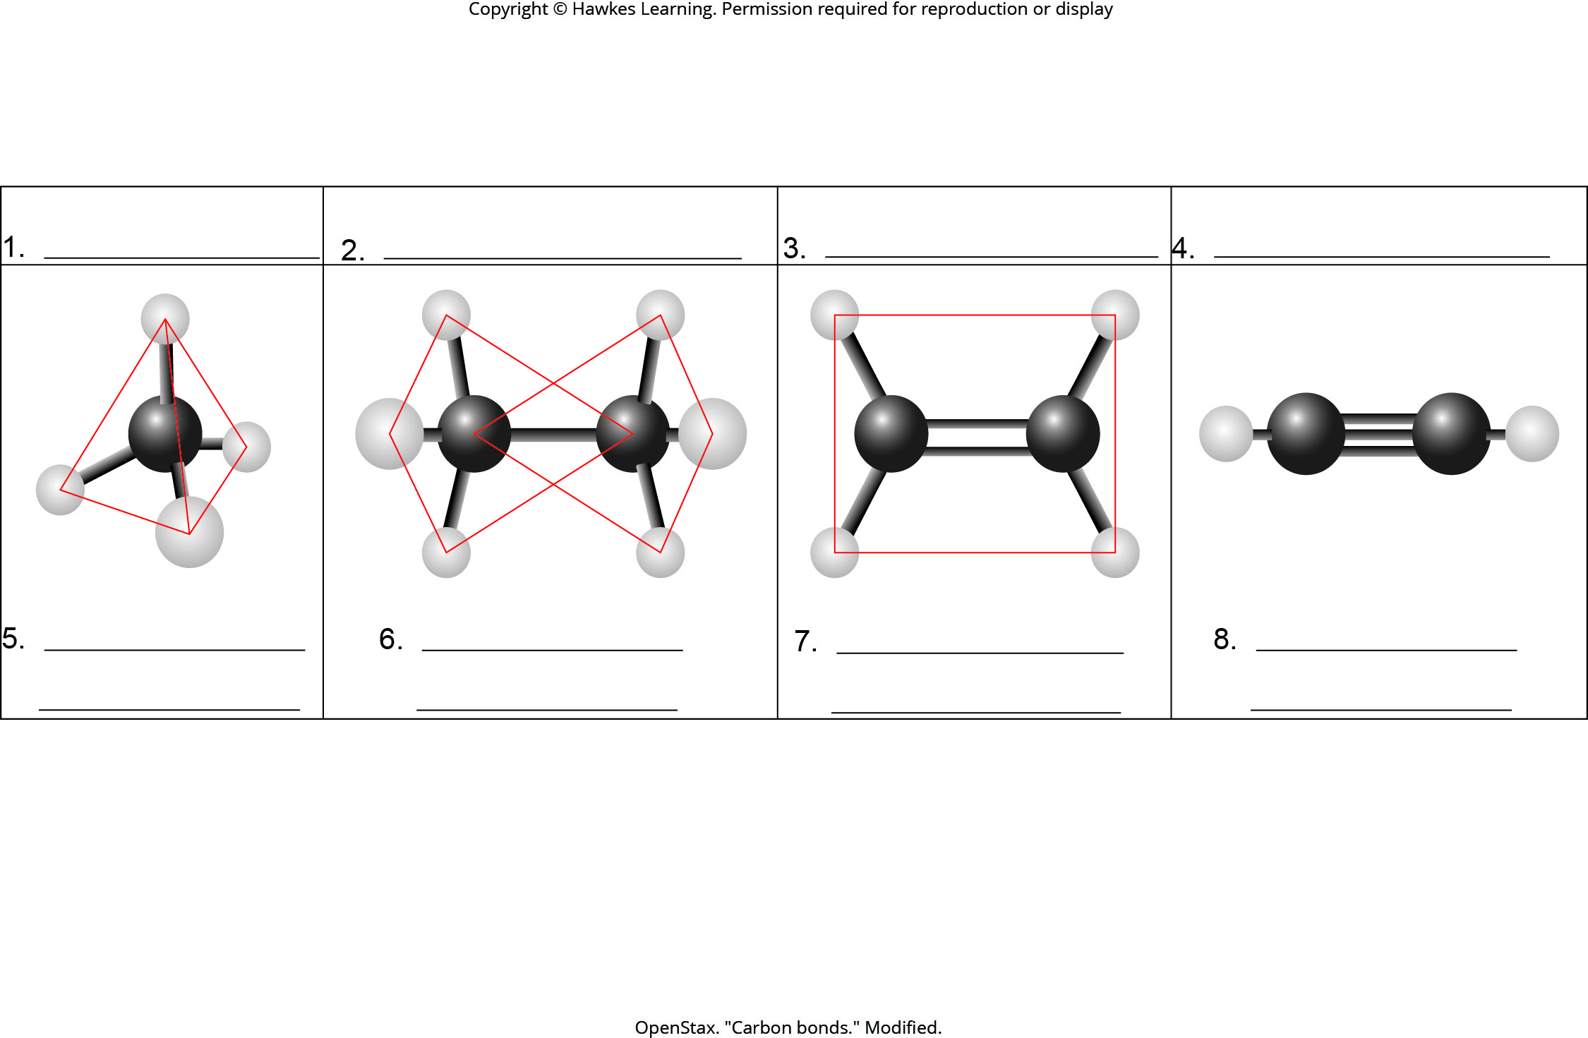
Lesson 2.3 Figure 5 - Numbered

Slide 45

Lesson 2.3 Figure 5

Slide 46
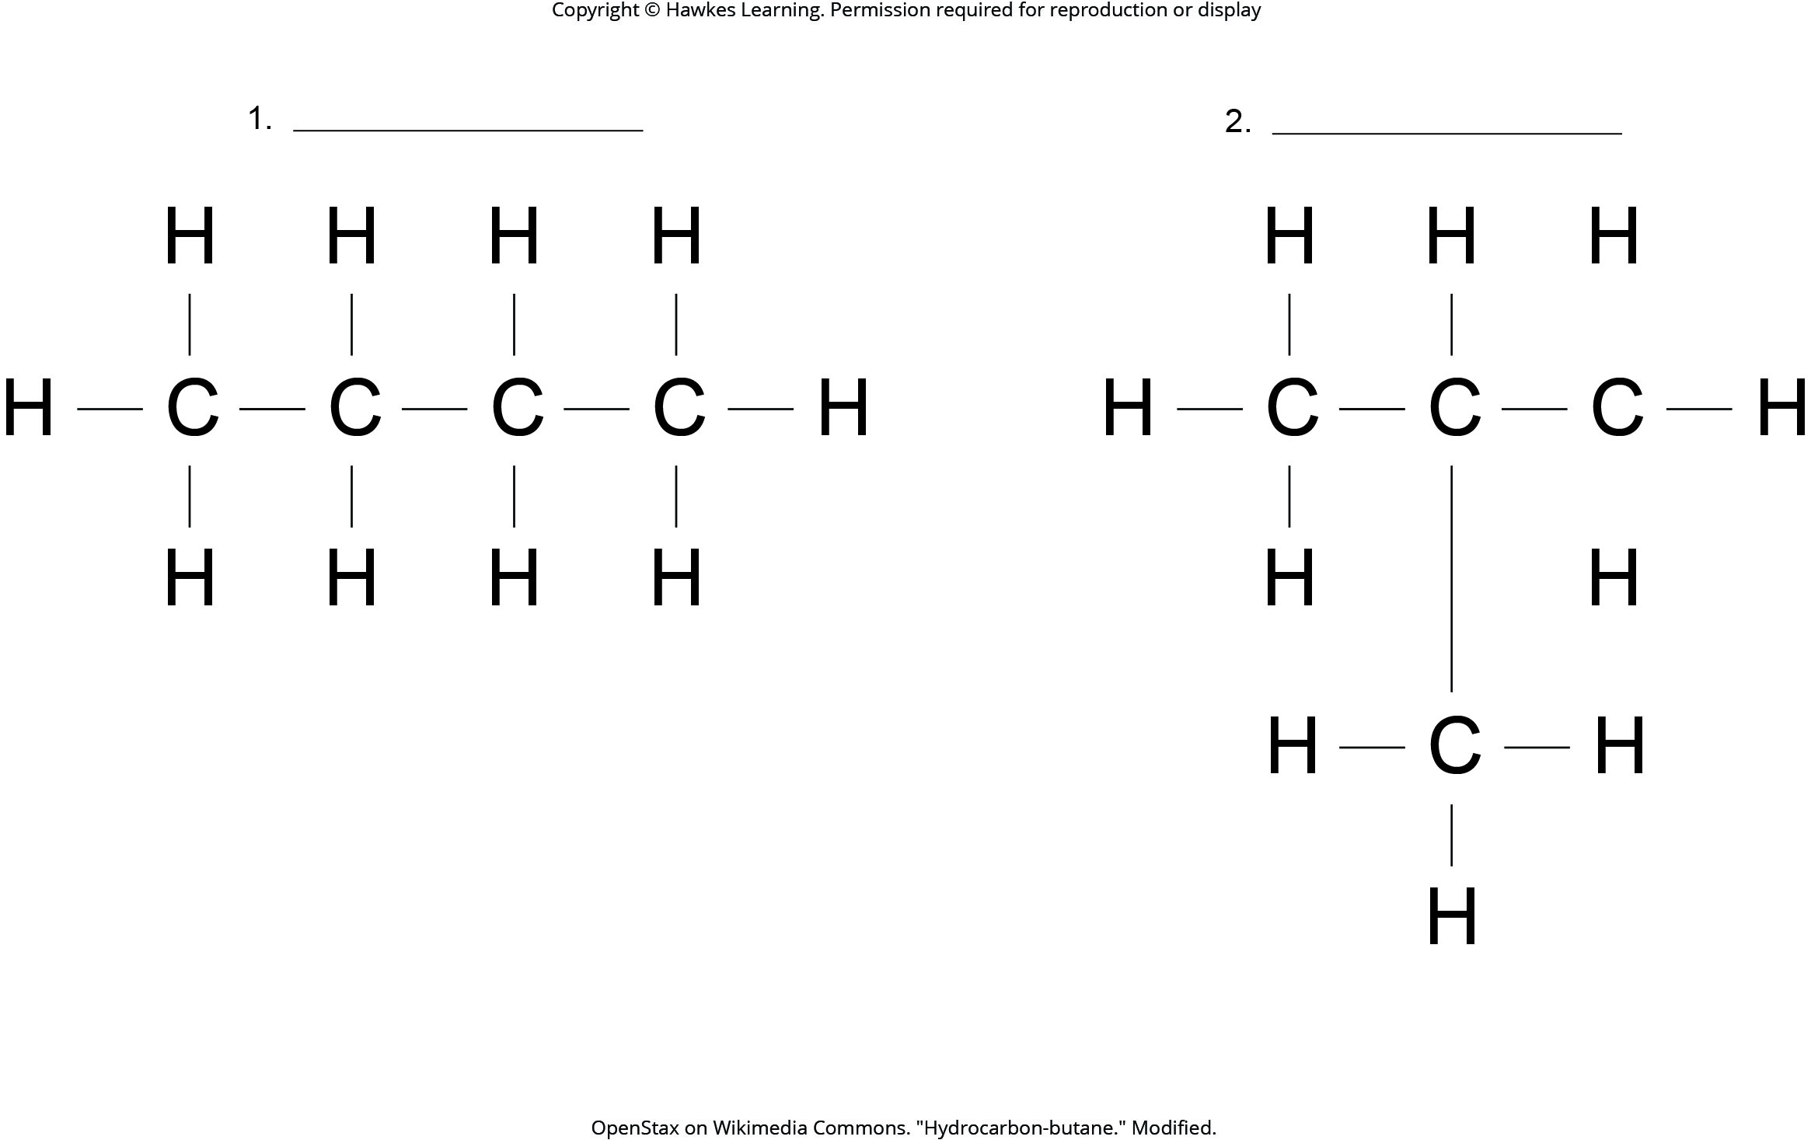
Lesson 2.3 Figure 7 - Numbered

Slide 47
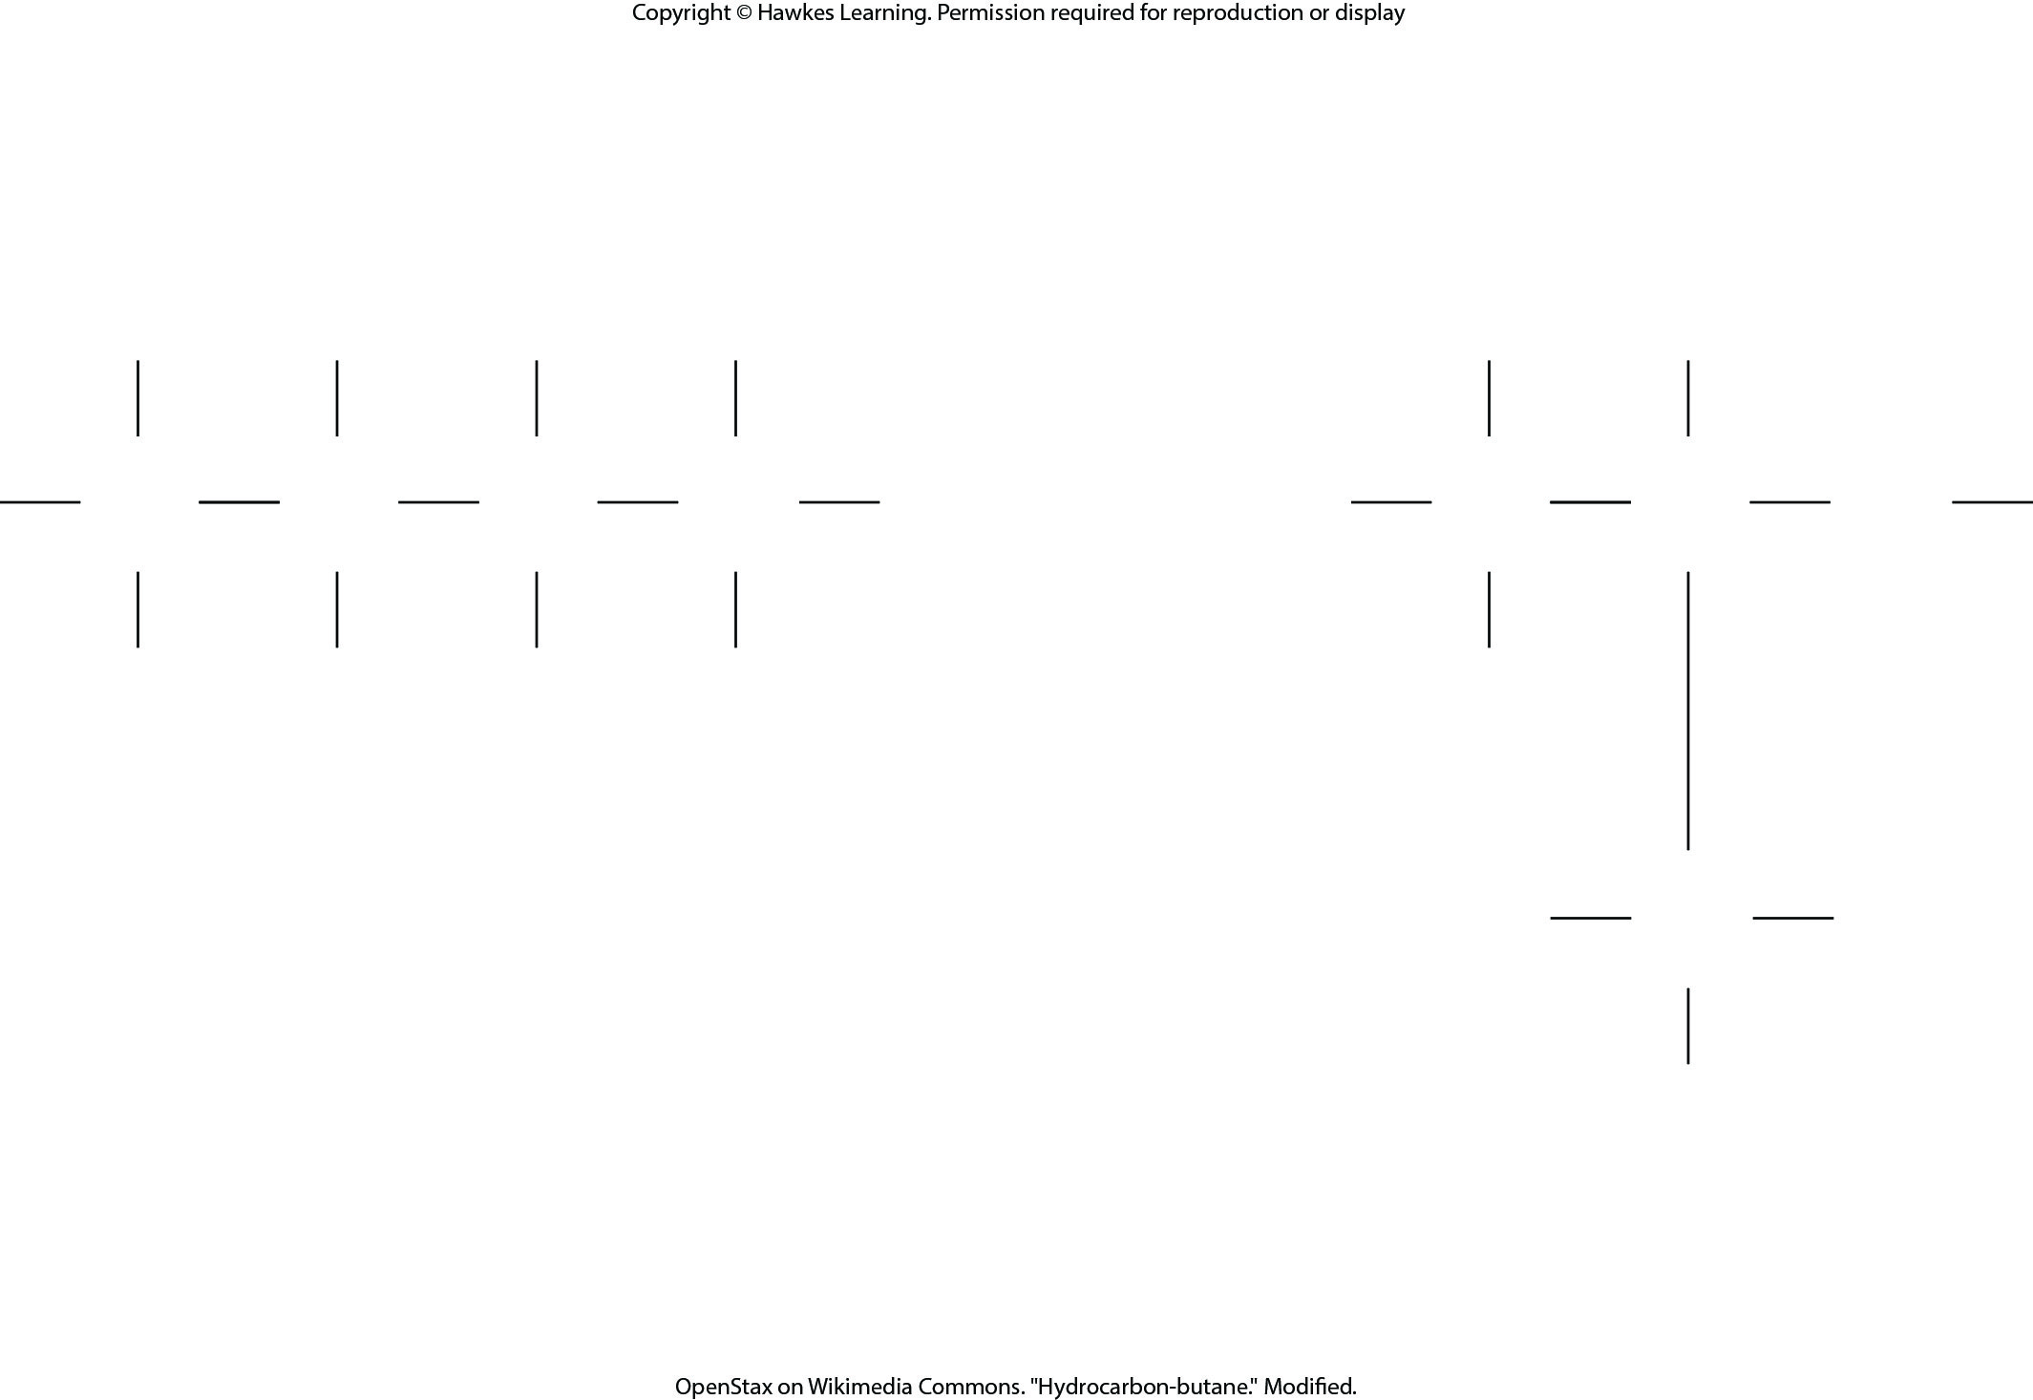
Lesson 2.3 Figure 7

Slide 48
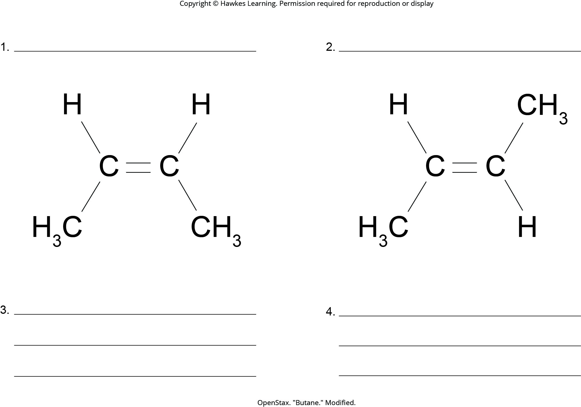
Lesson 2.3 Figure 8 - Numbered

Slide 49
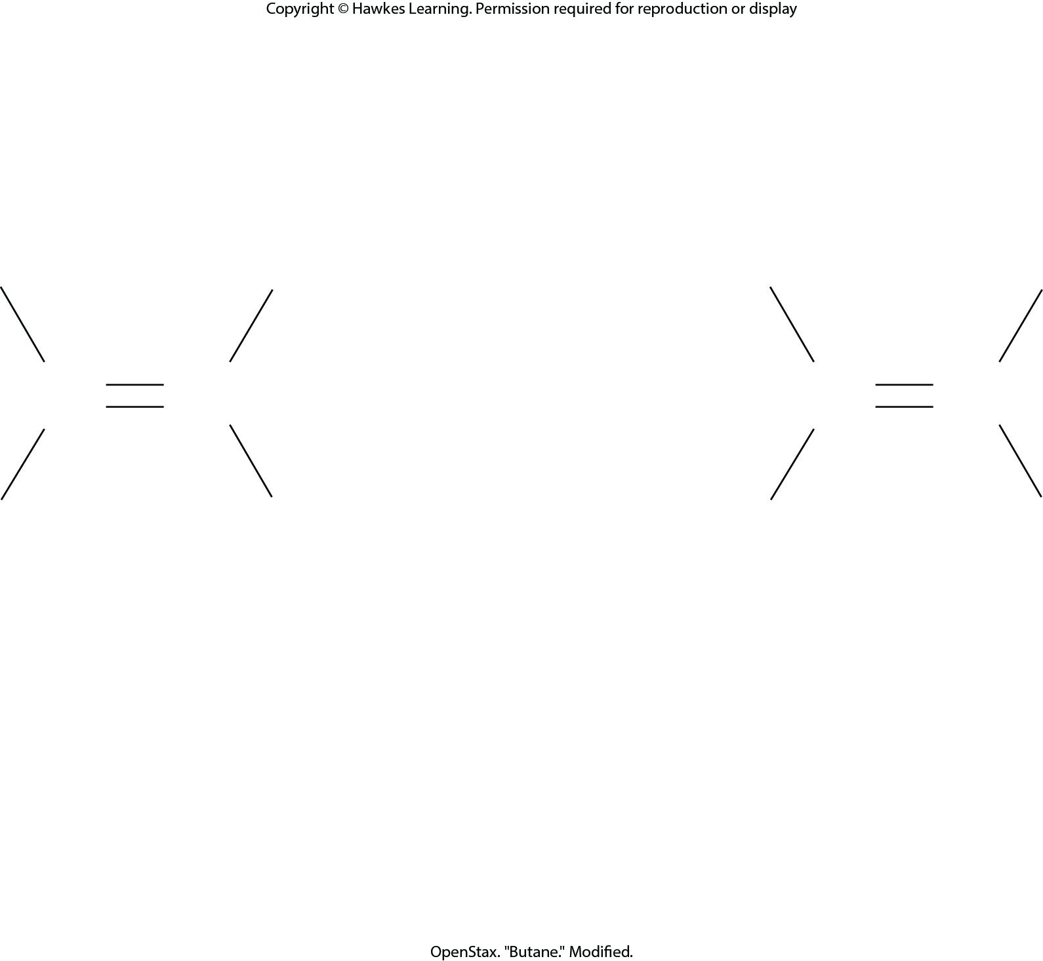
Lesson 2.3 Figure 8

Slide 50
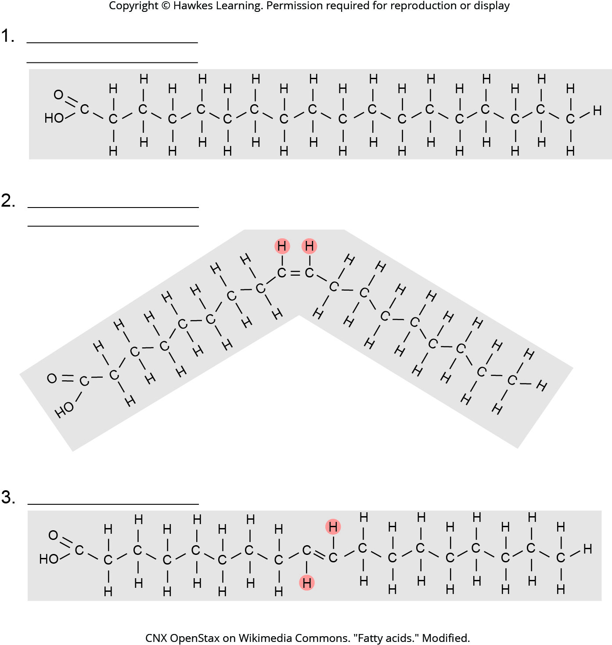
Lesson 2.3 Figure 9 - Numbered

Slide 51
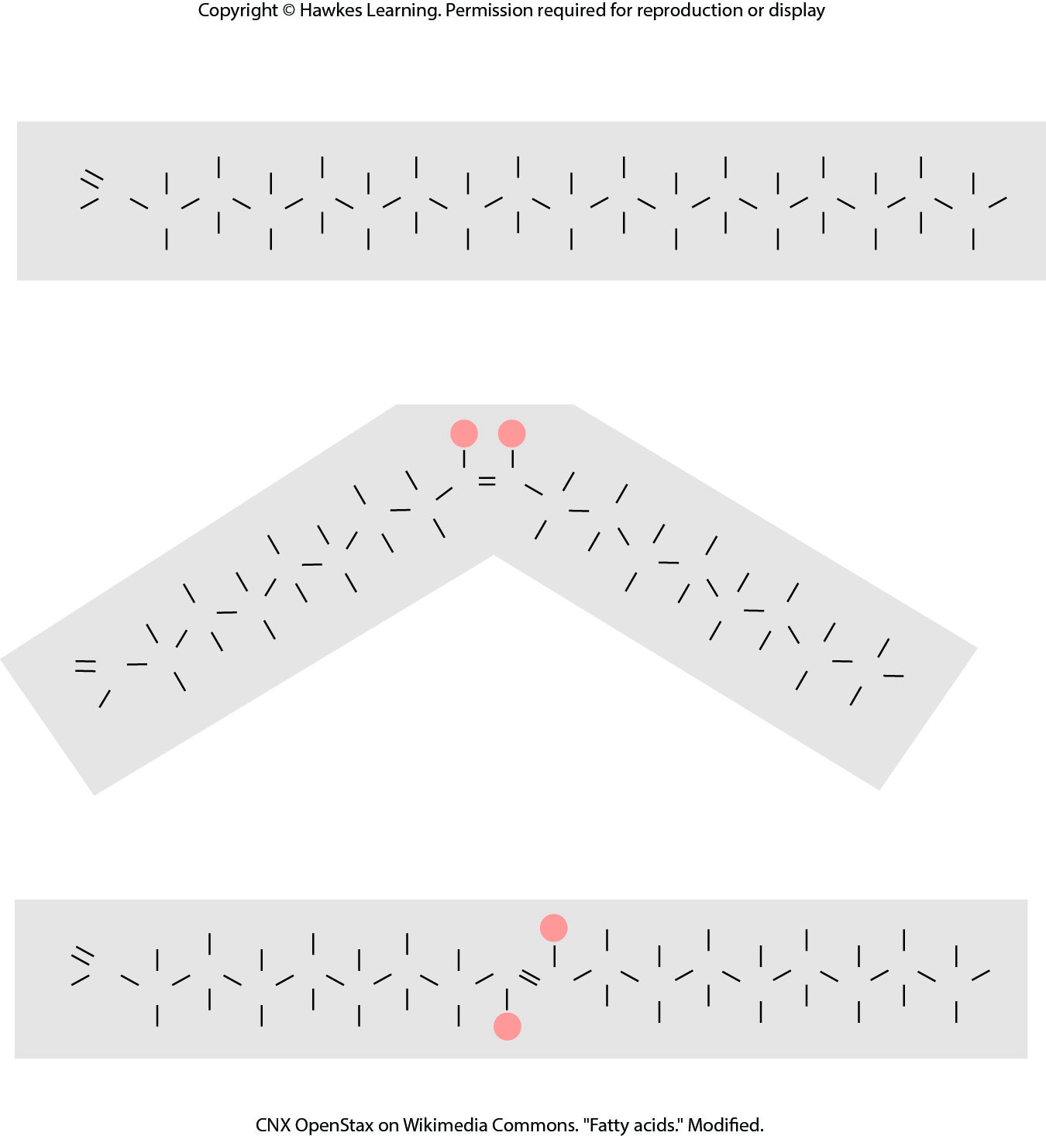
Lesson 2.3 Figure 9

Slide 52
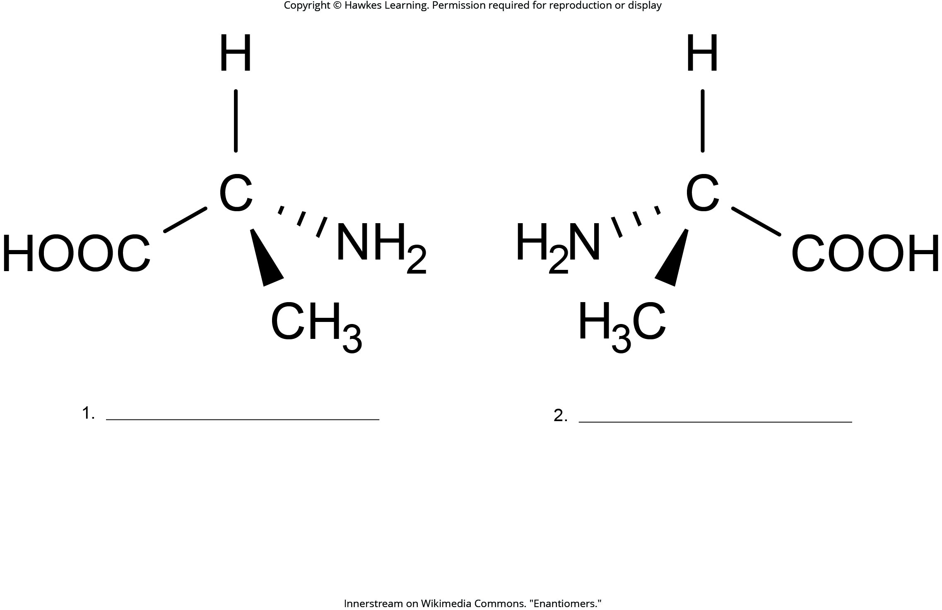
Lesson 2.3 Figure 10 - Numbered

Slide 53
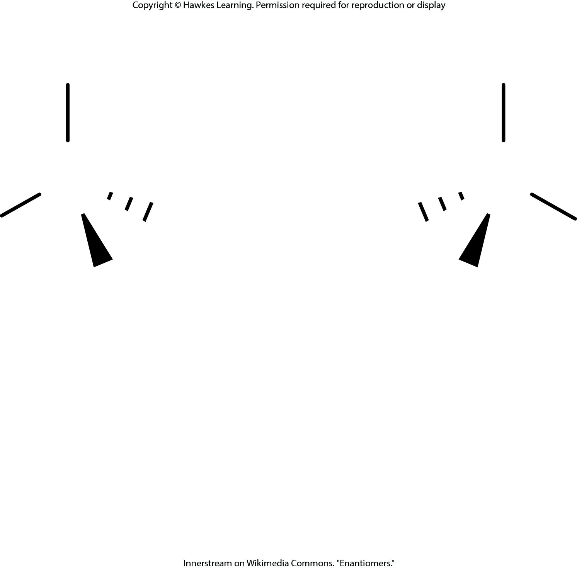
Lesson 2.3 Figure 10

Slide 54
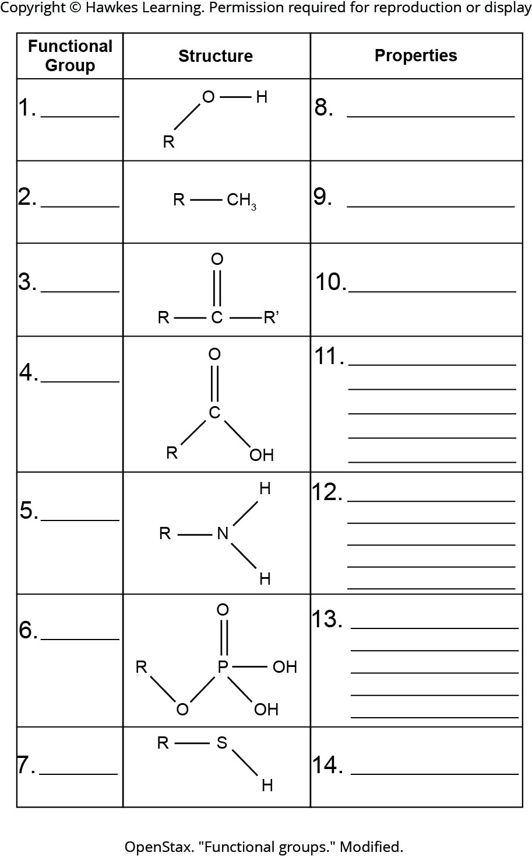
Lesson 2.3 Figure 12 - Numbered

Slide 55
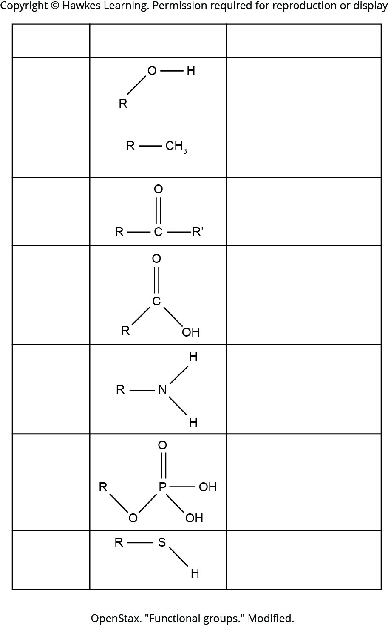
Lesson 2.3 Figure 12

Slide 56
Hawkes Learning – End of PowerPoint

