Slide 1
Chapter 20
The Tree of Life and
Phylogenetics

Slide 2
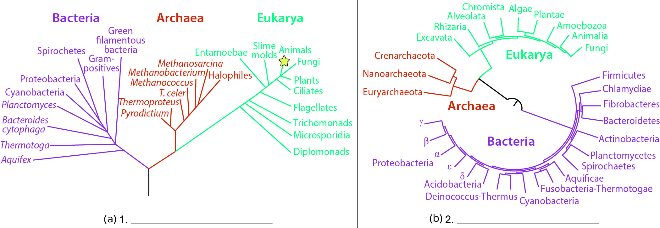
Lesson 20.1 Figure 2 - Numbered

Slide 3
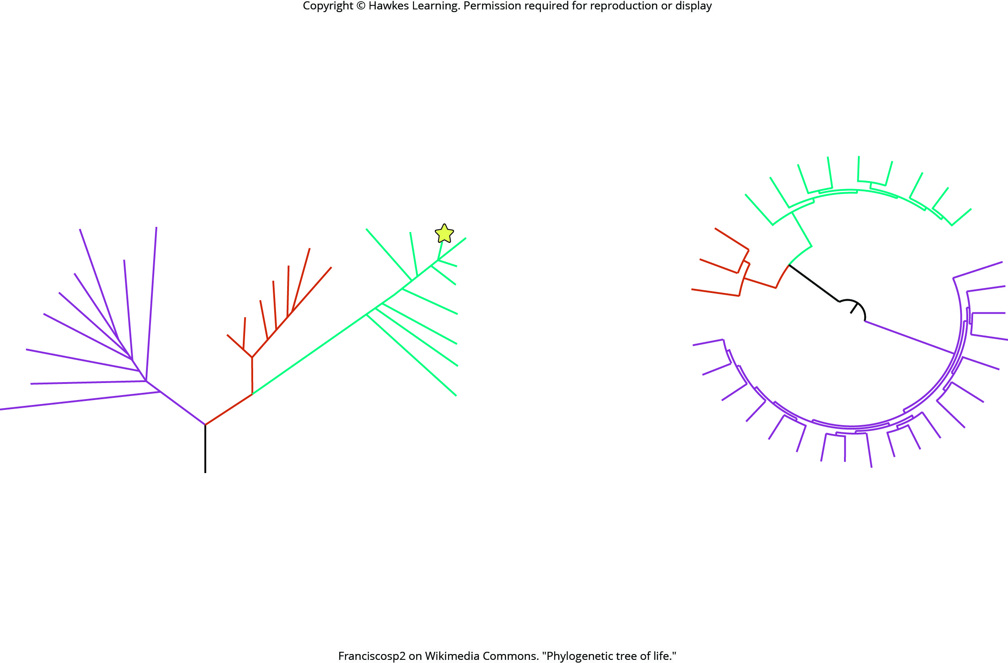
Lesson 20.1 Figure 2

Slide 4
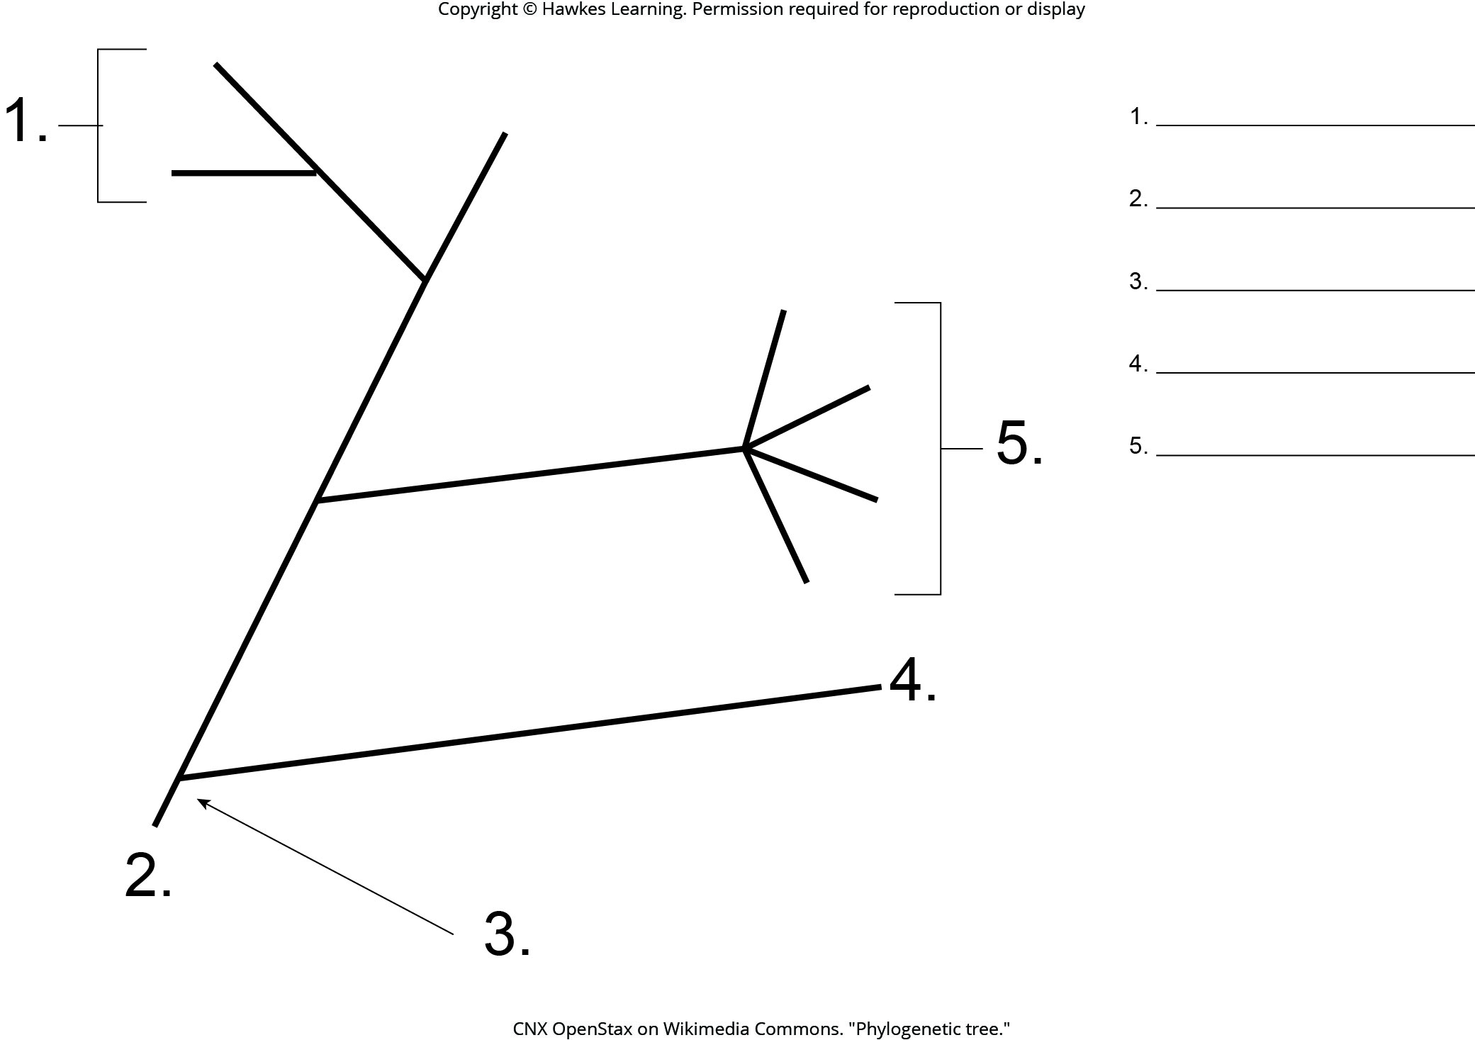
Lesson 20.1 Figure 3 - Numbered

Slide 5
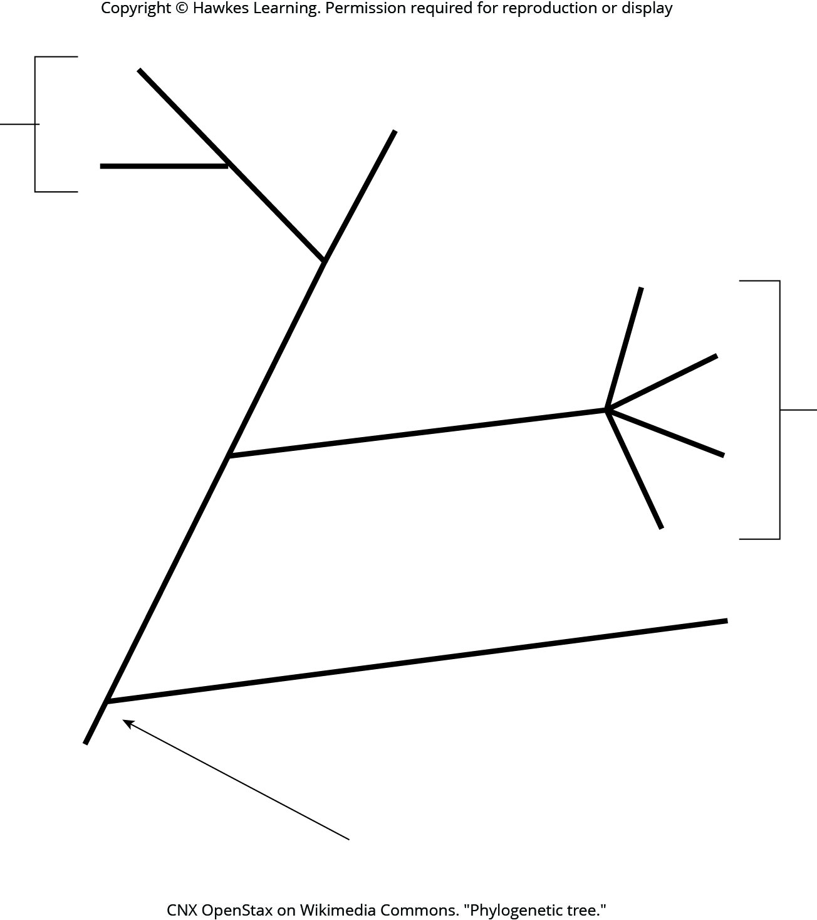
Lesson 20.1 Figure 3

Slide 6
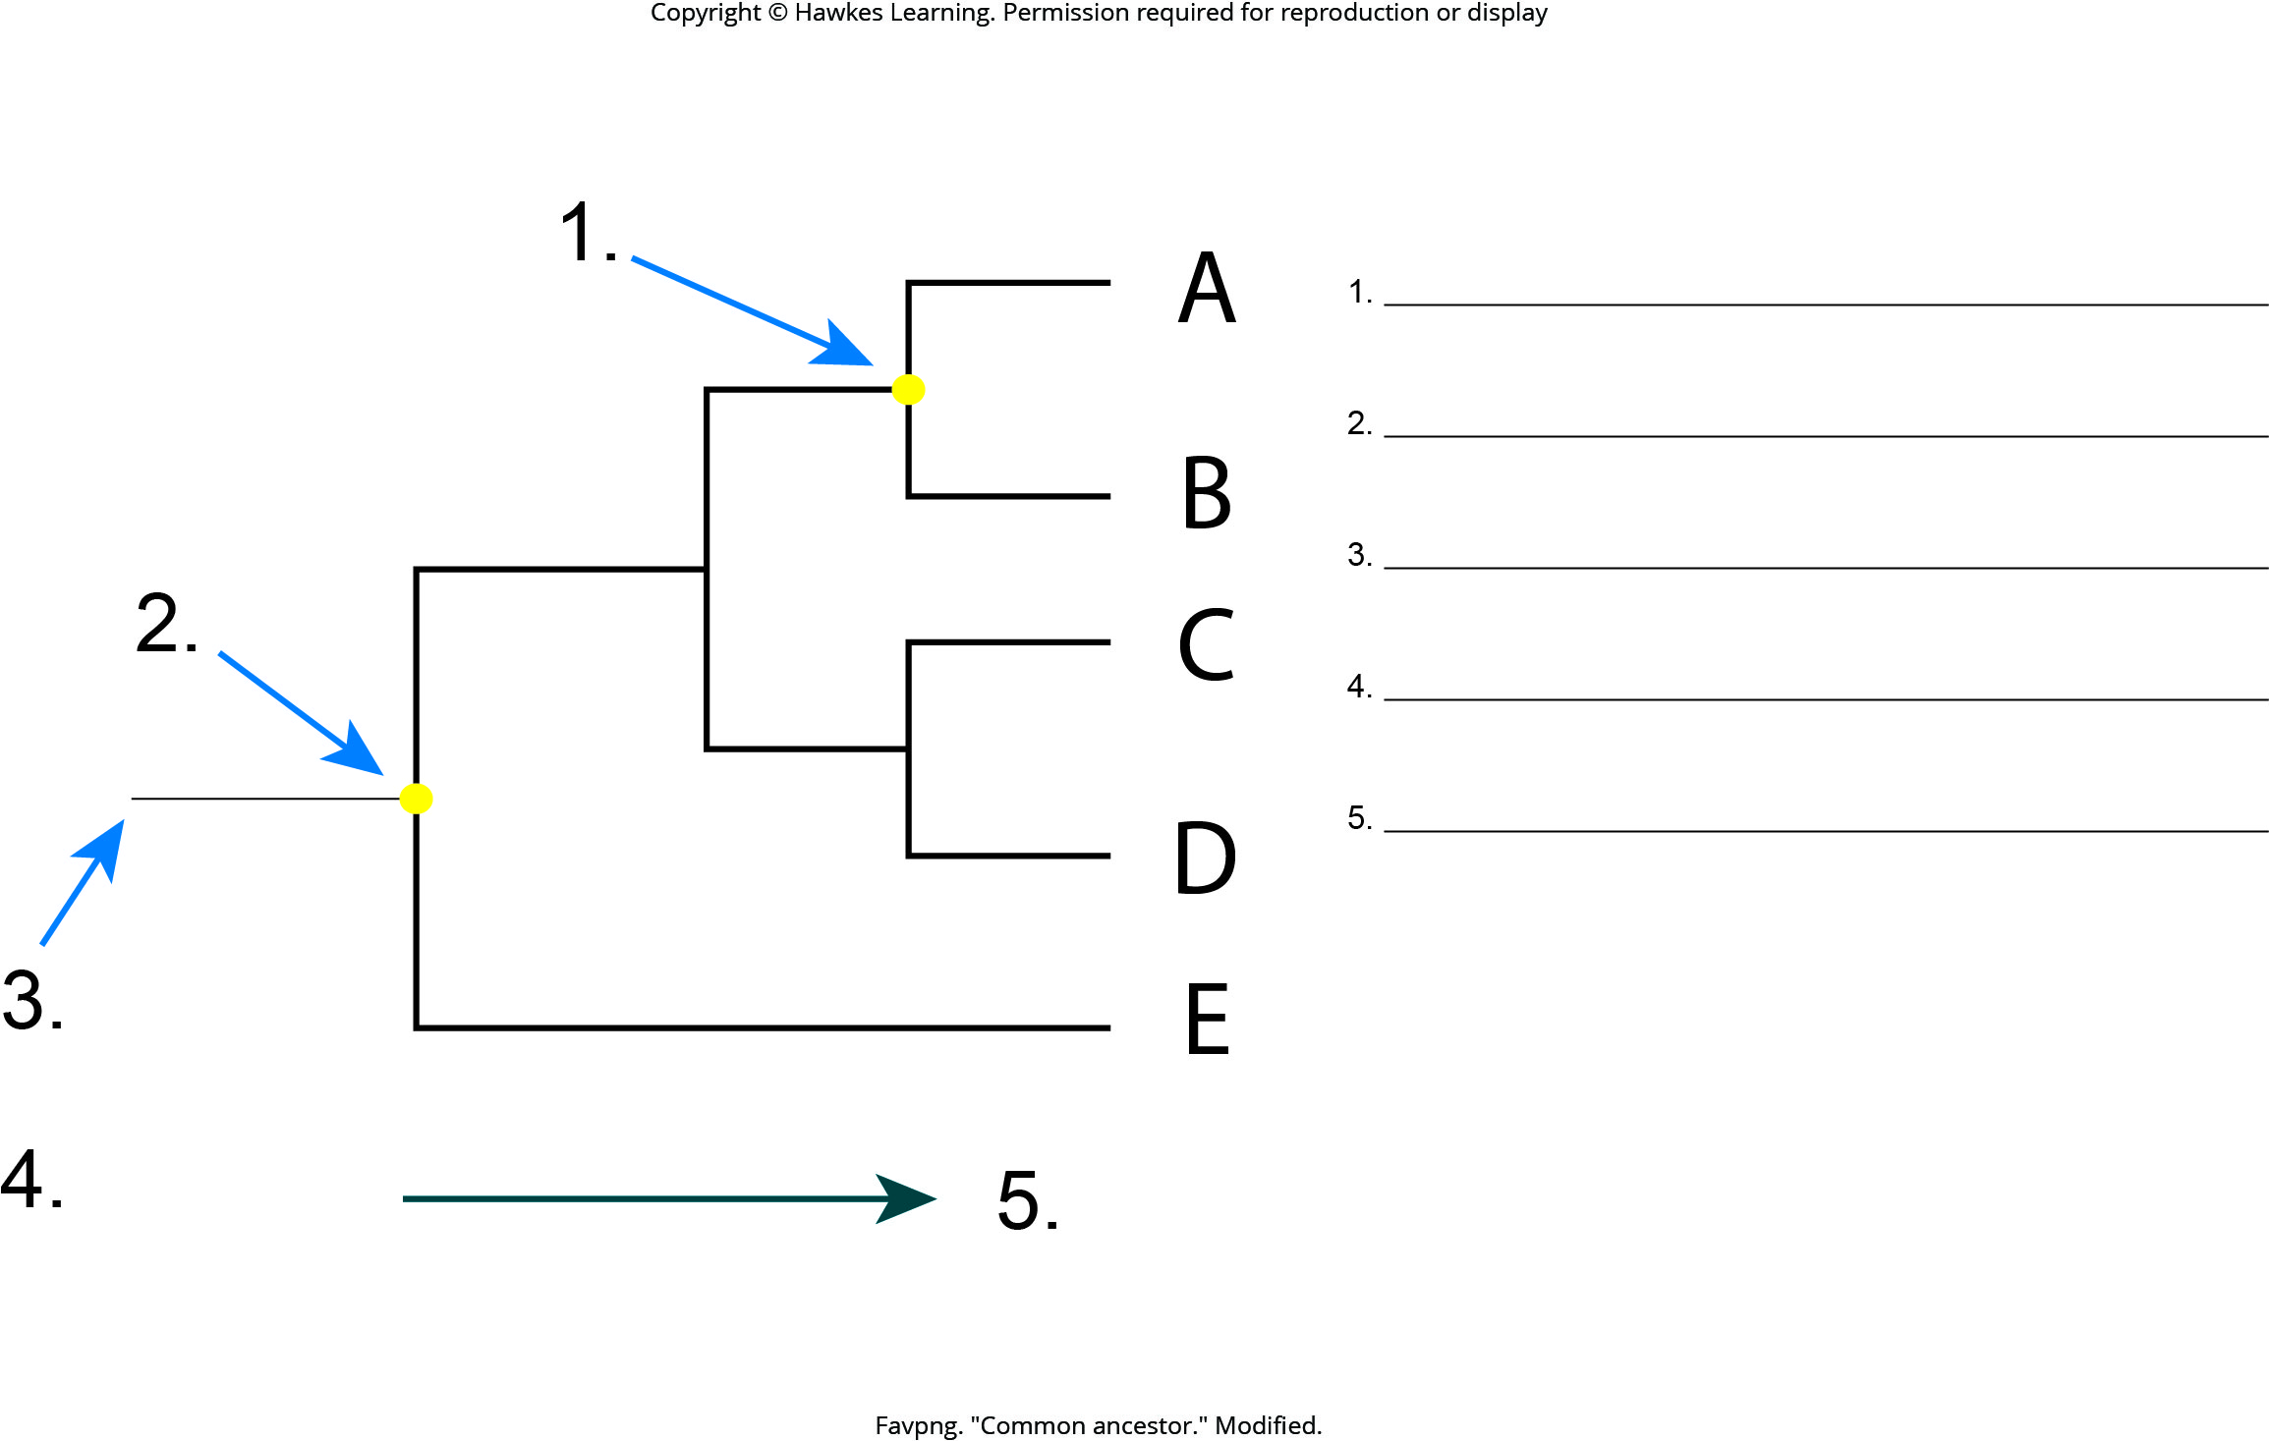
Lesson 20.1 Figure 4 - Numbered

Slide 7
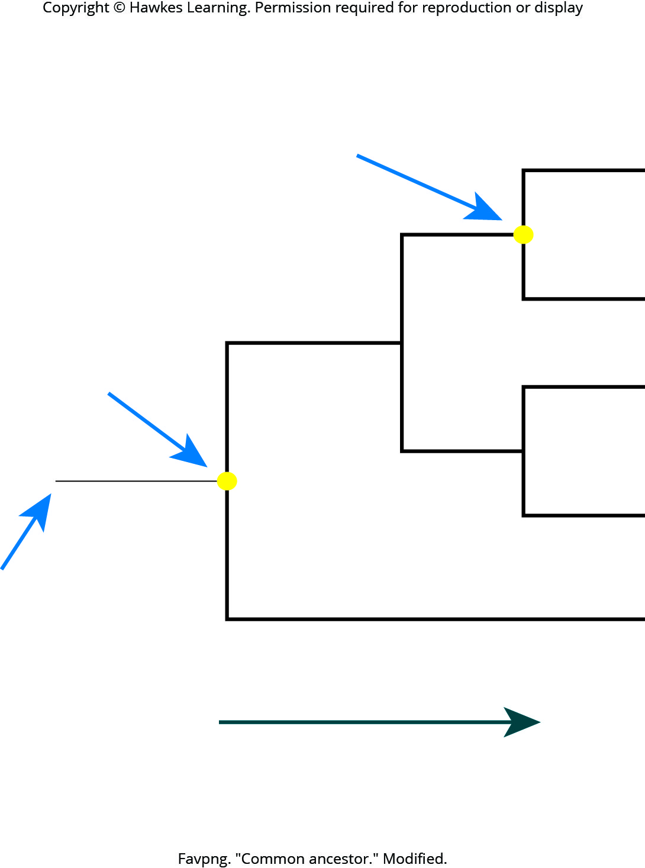
Lesson 20.1 Figure 4

Slide 8
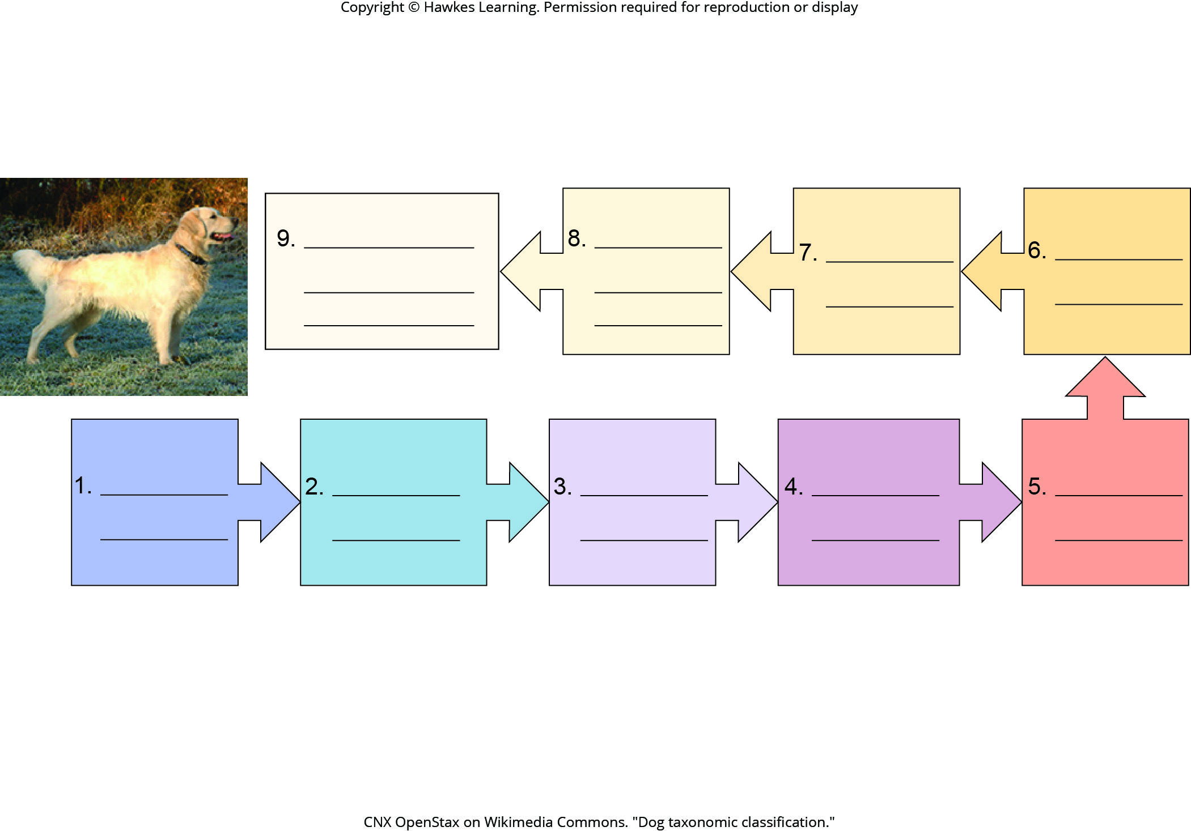
Lesson 20.1 Figure 7 - Numbered

Slide 9

Lesson 20.1 Figure 7

Slide 10
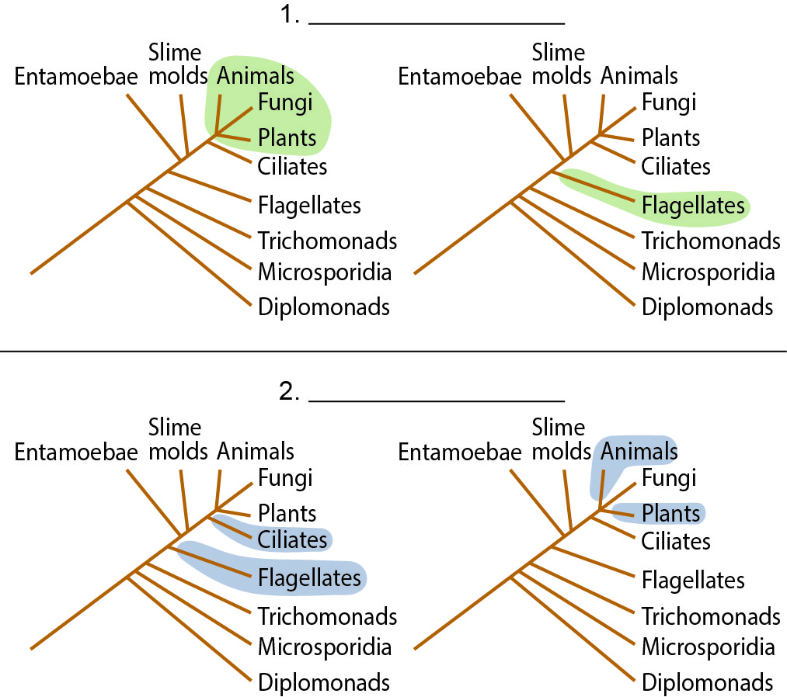
Lesson 20.2 Figure 4 - Numbered

Slide 11
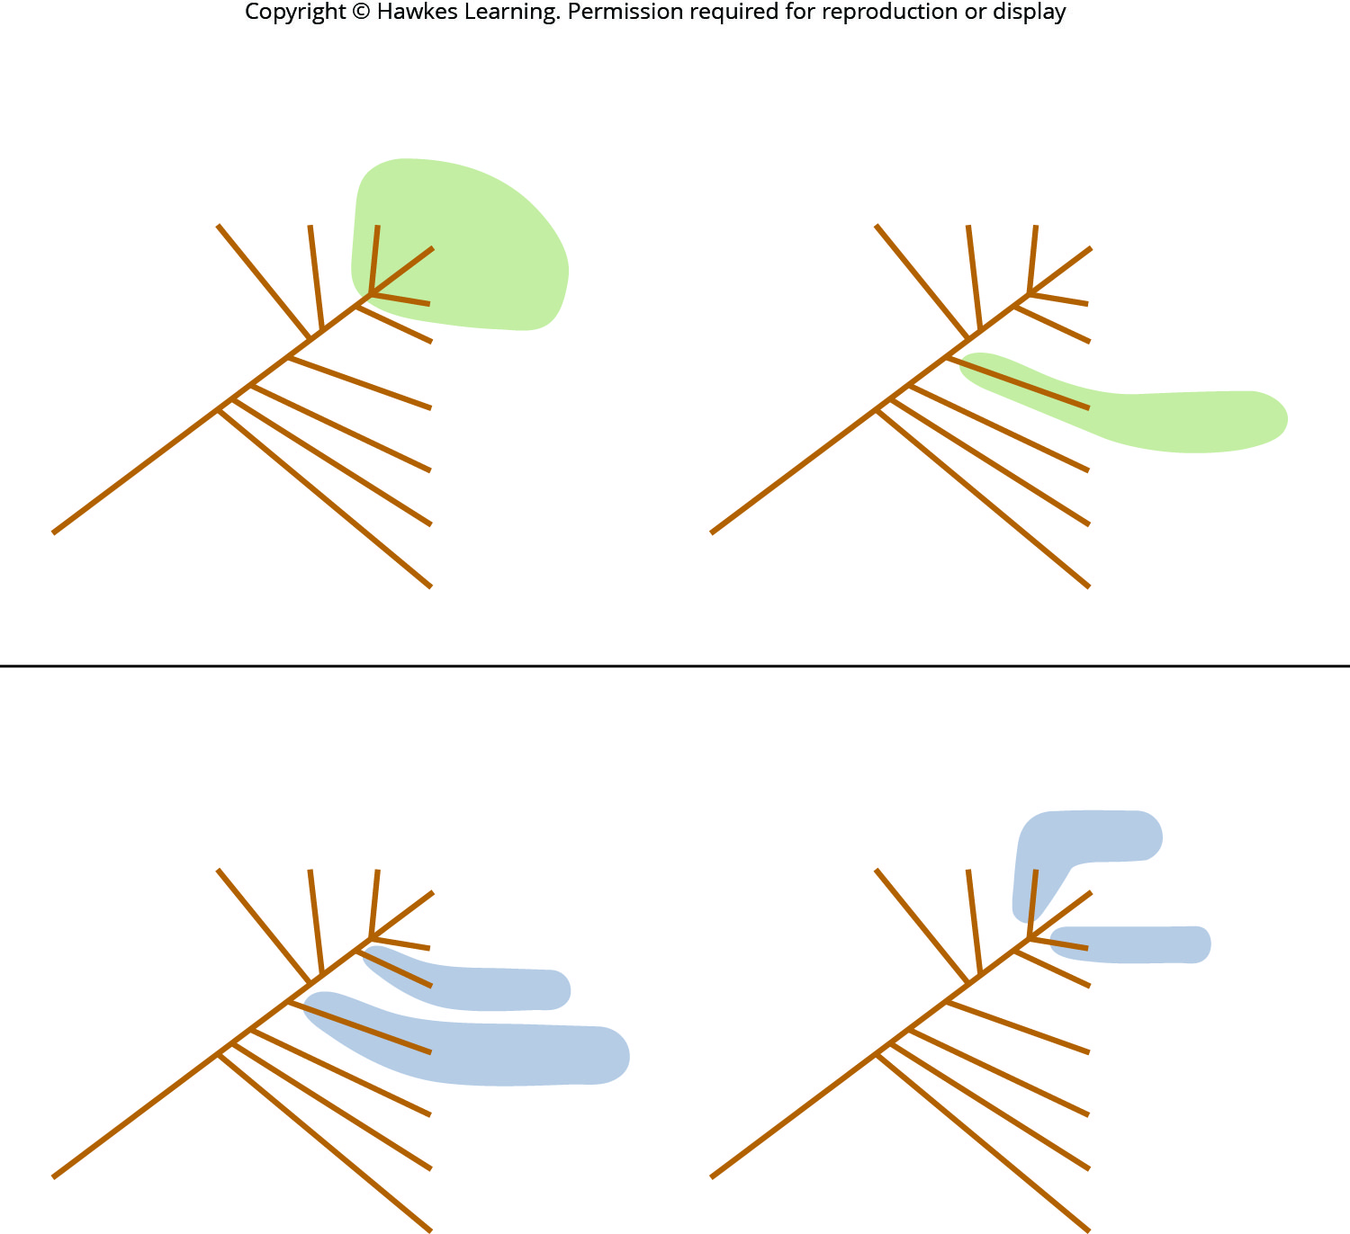
Lesson 20.2 Figure 4

Slide 12
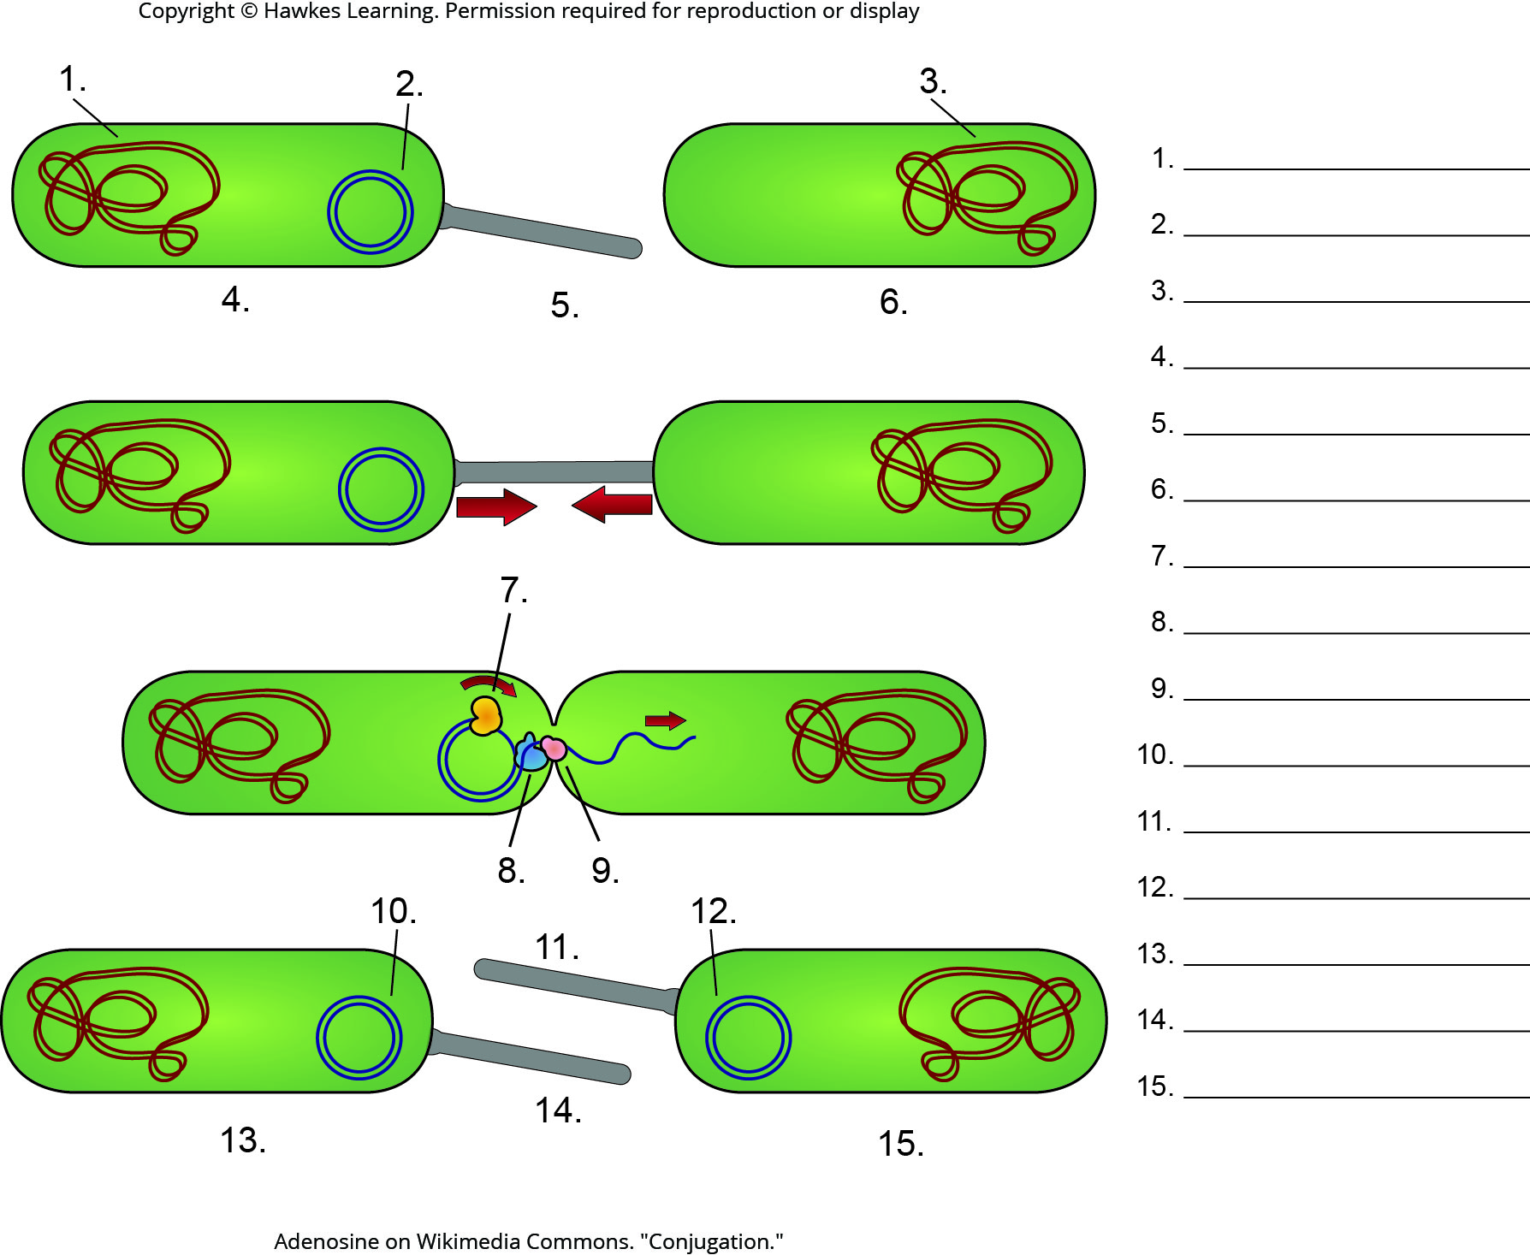
Lesson 20.3 Figure 2 - Numbered

Slide 13
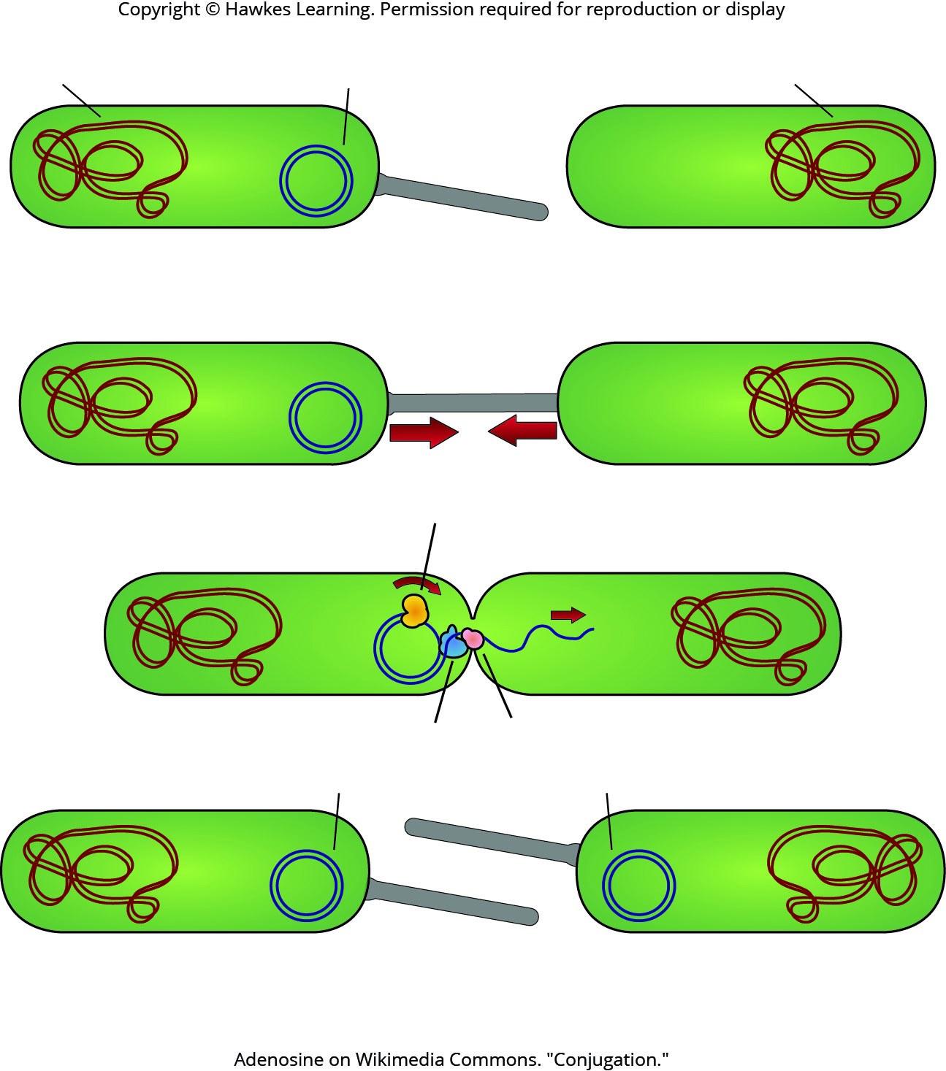
Lesson 20.3 Figure 2

Slide 14
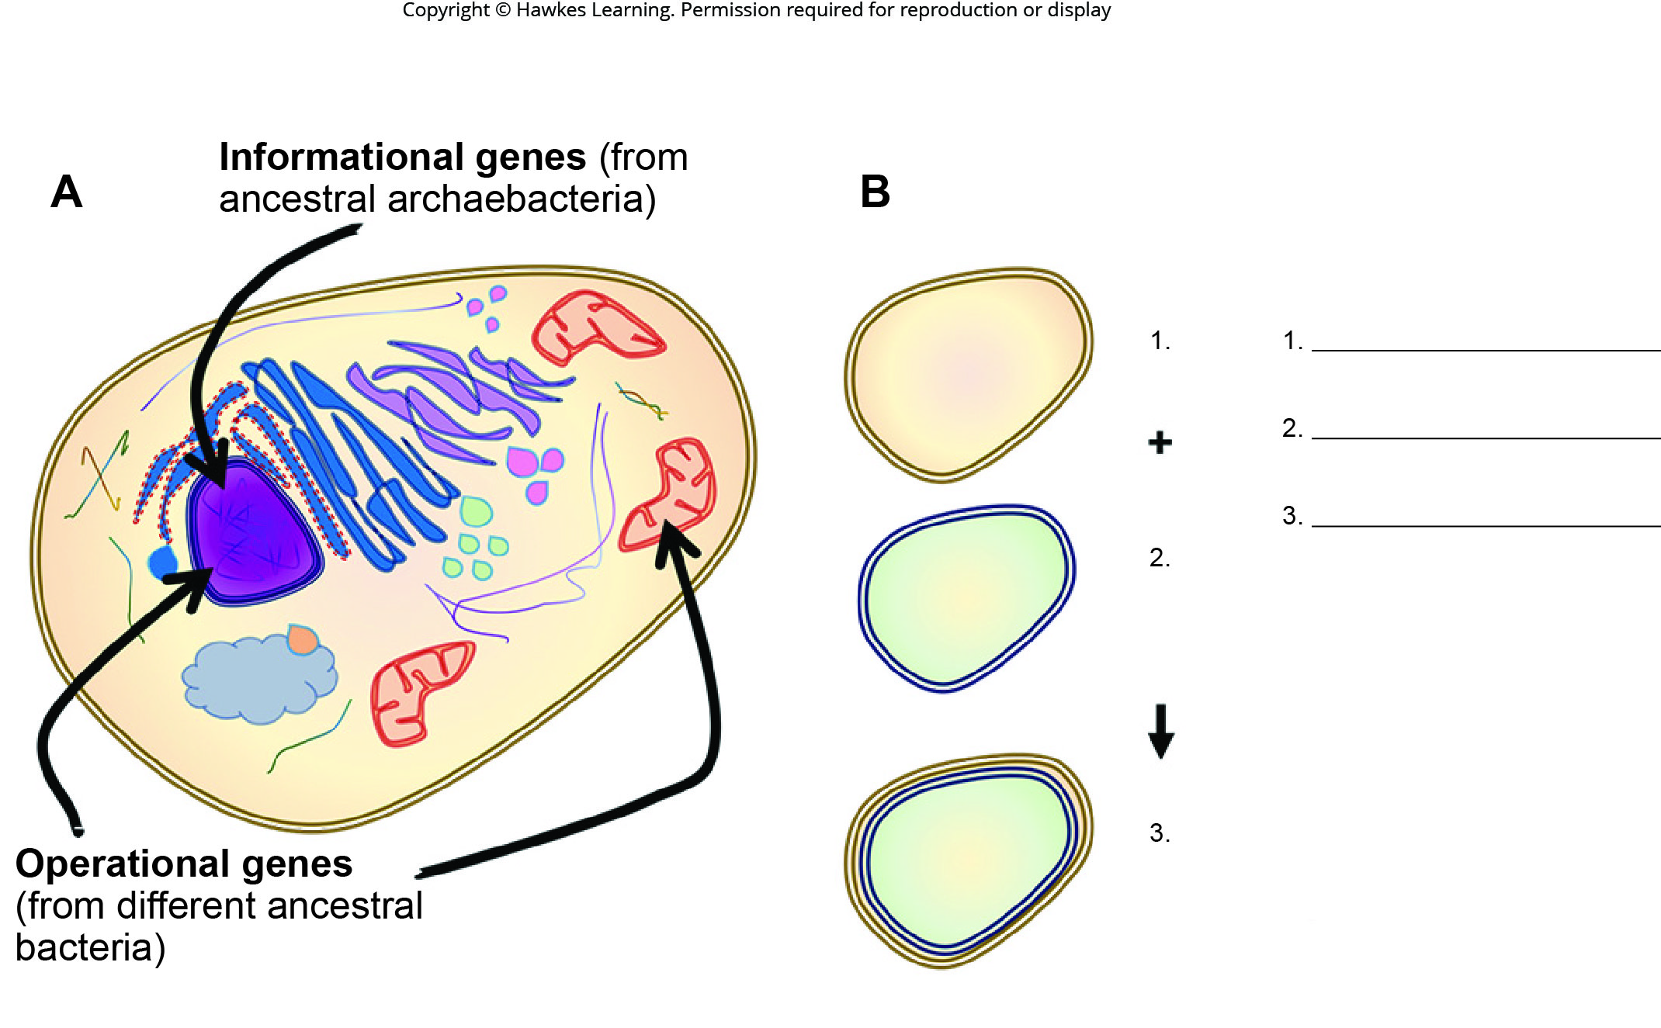
Lesson 20.3 Figure 5 - Numbered

Slide 15
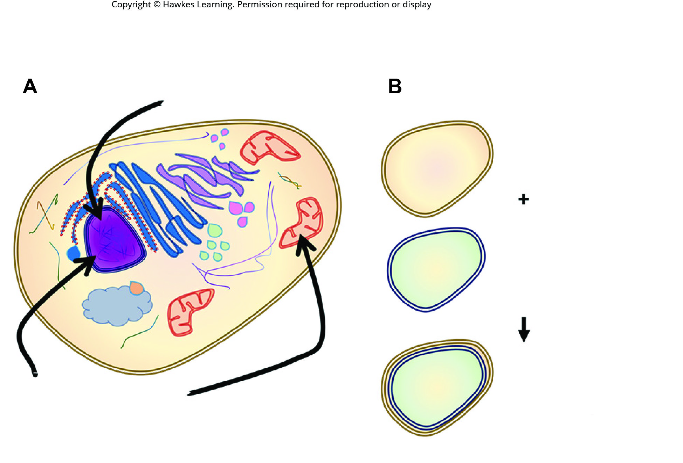
Lesson 20.3 Figure 5

Slide 16
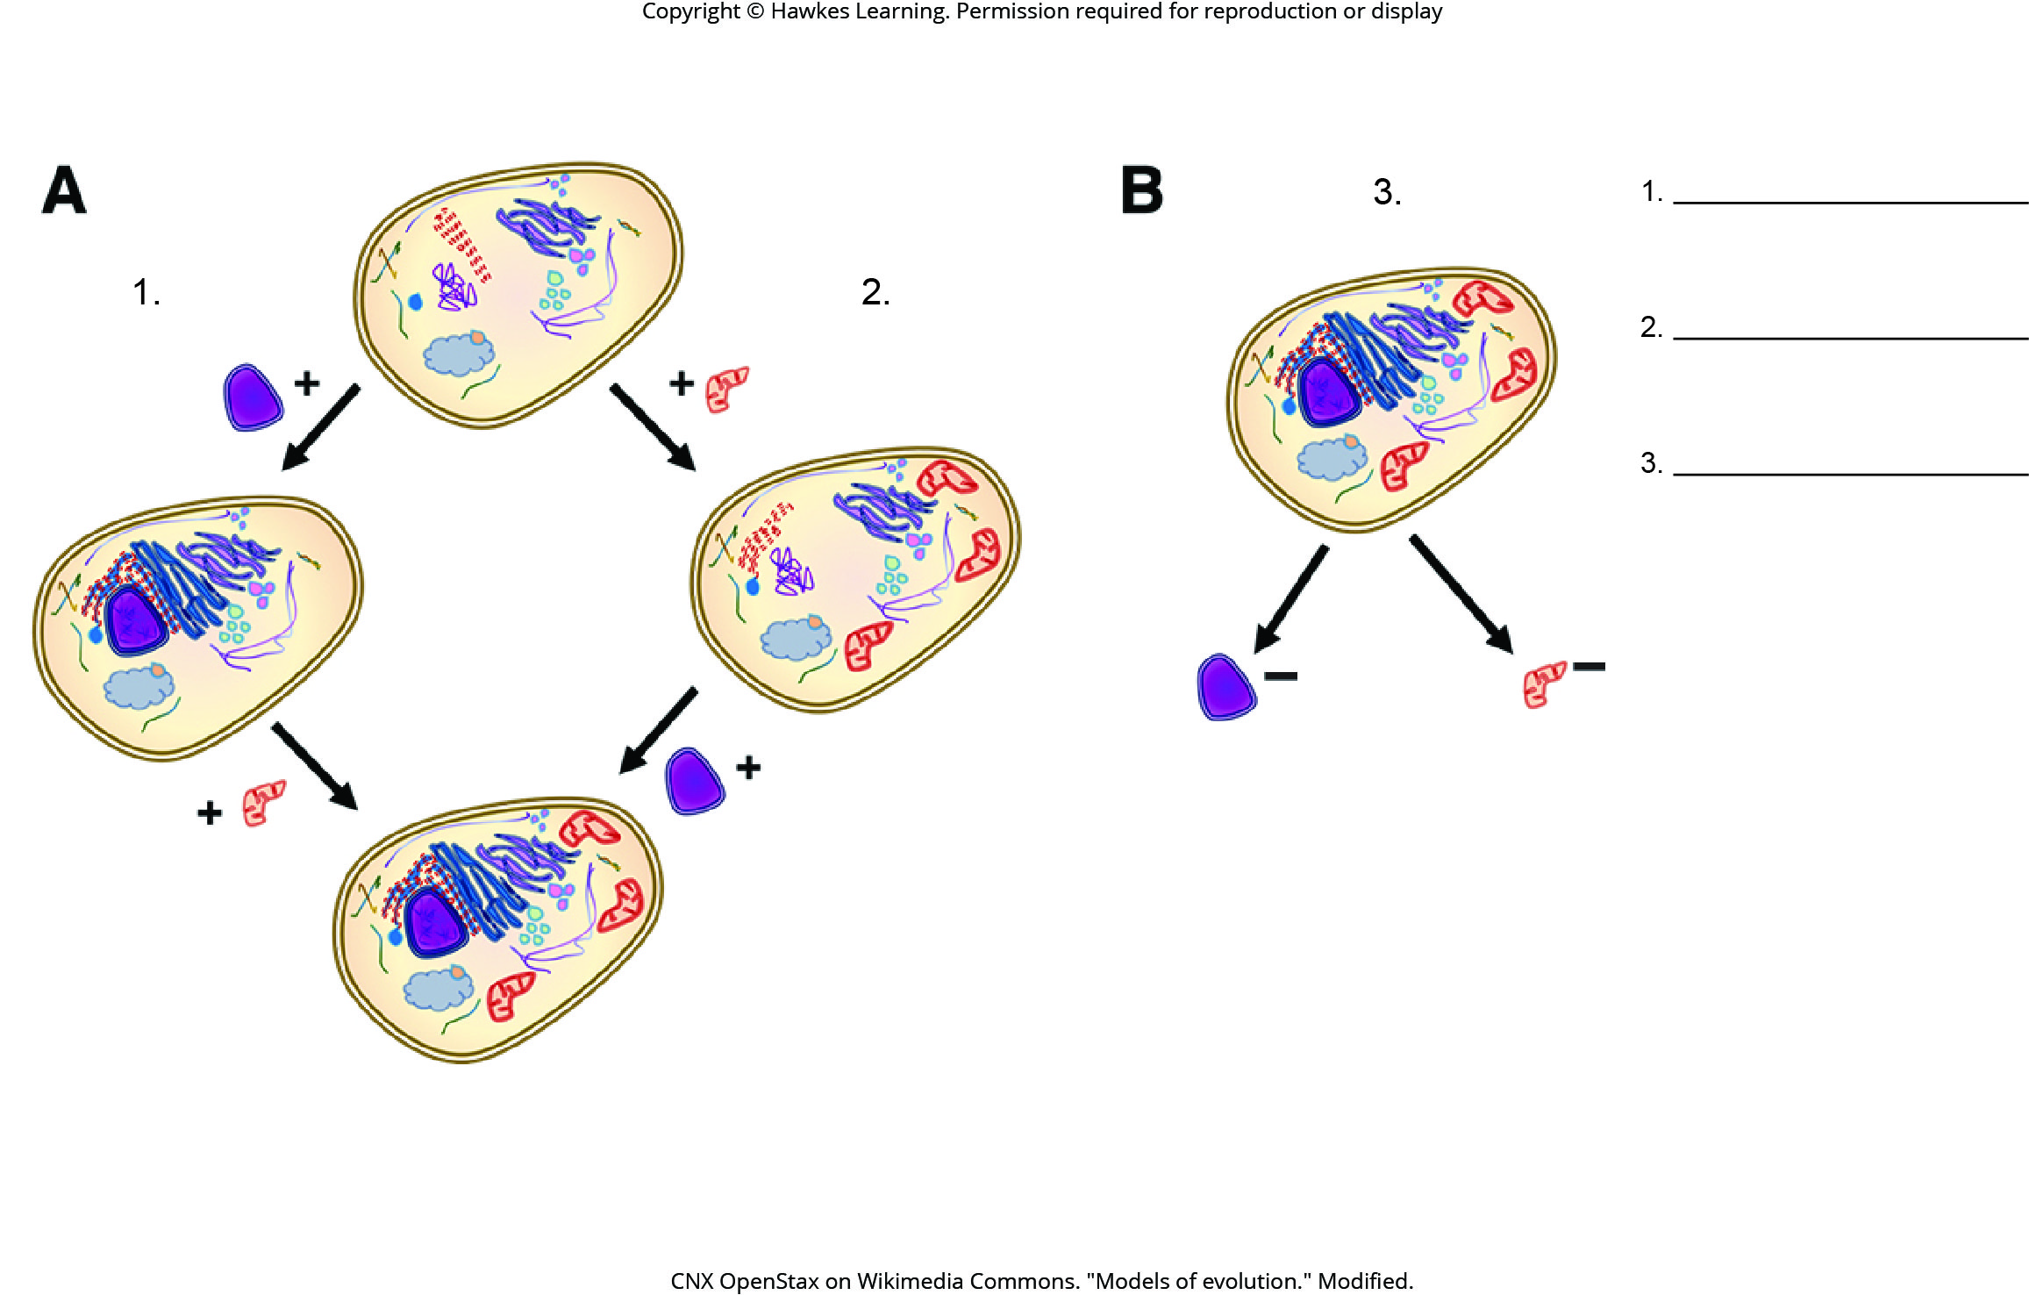
Lesson 20.3 Figure 6 - Numbered

Slide 17
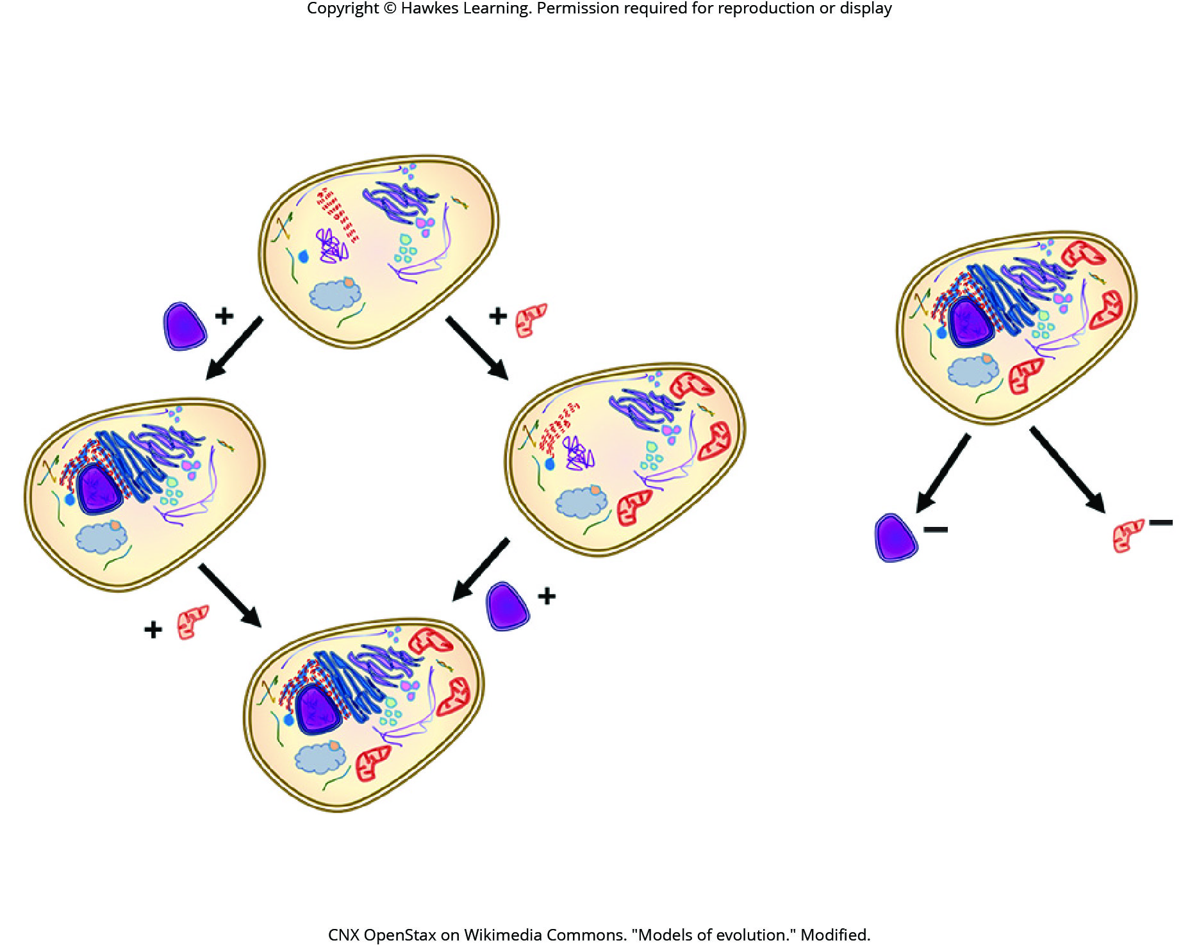
Lesson 20.3 Figure 6

Slide 18
Hawkes Learning – End of PowerPoint

