Slide 1
Chapter 21
Viruses

Slide 2
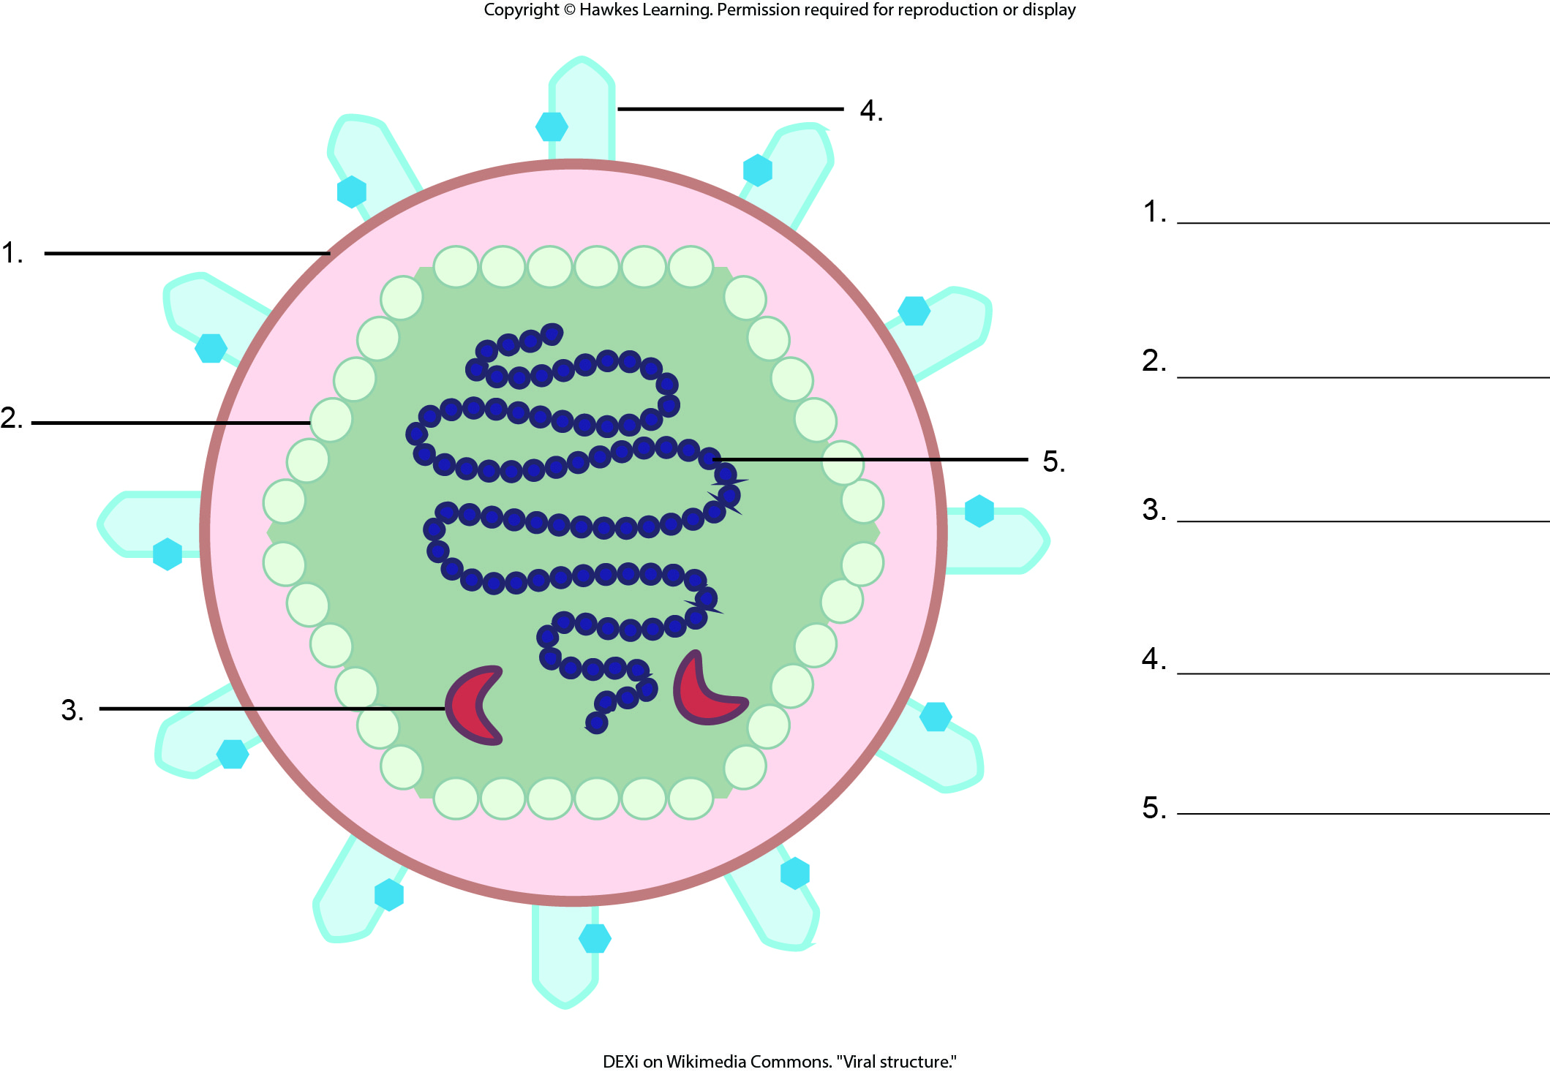
Lesson 21.1 Figure 3 - Numbered

Slide 3
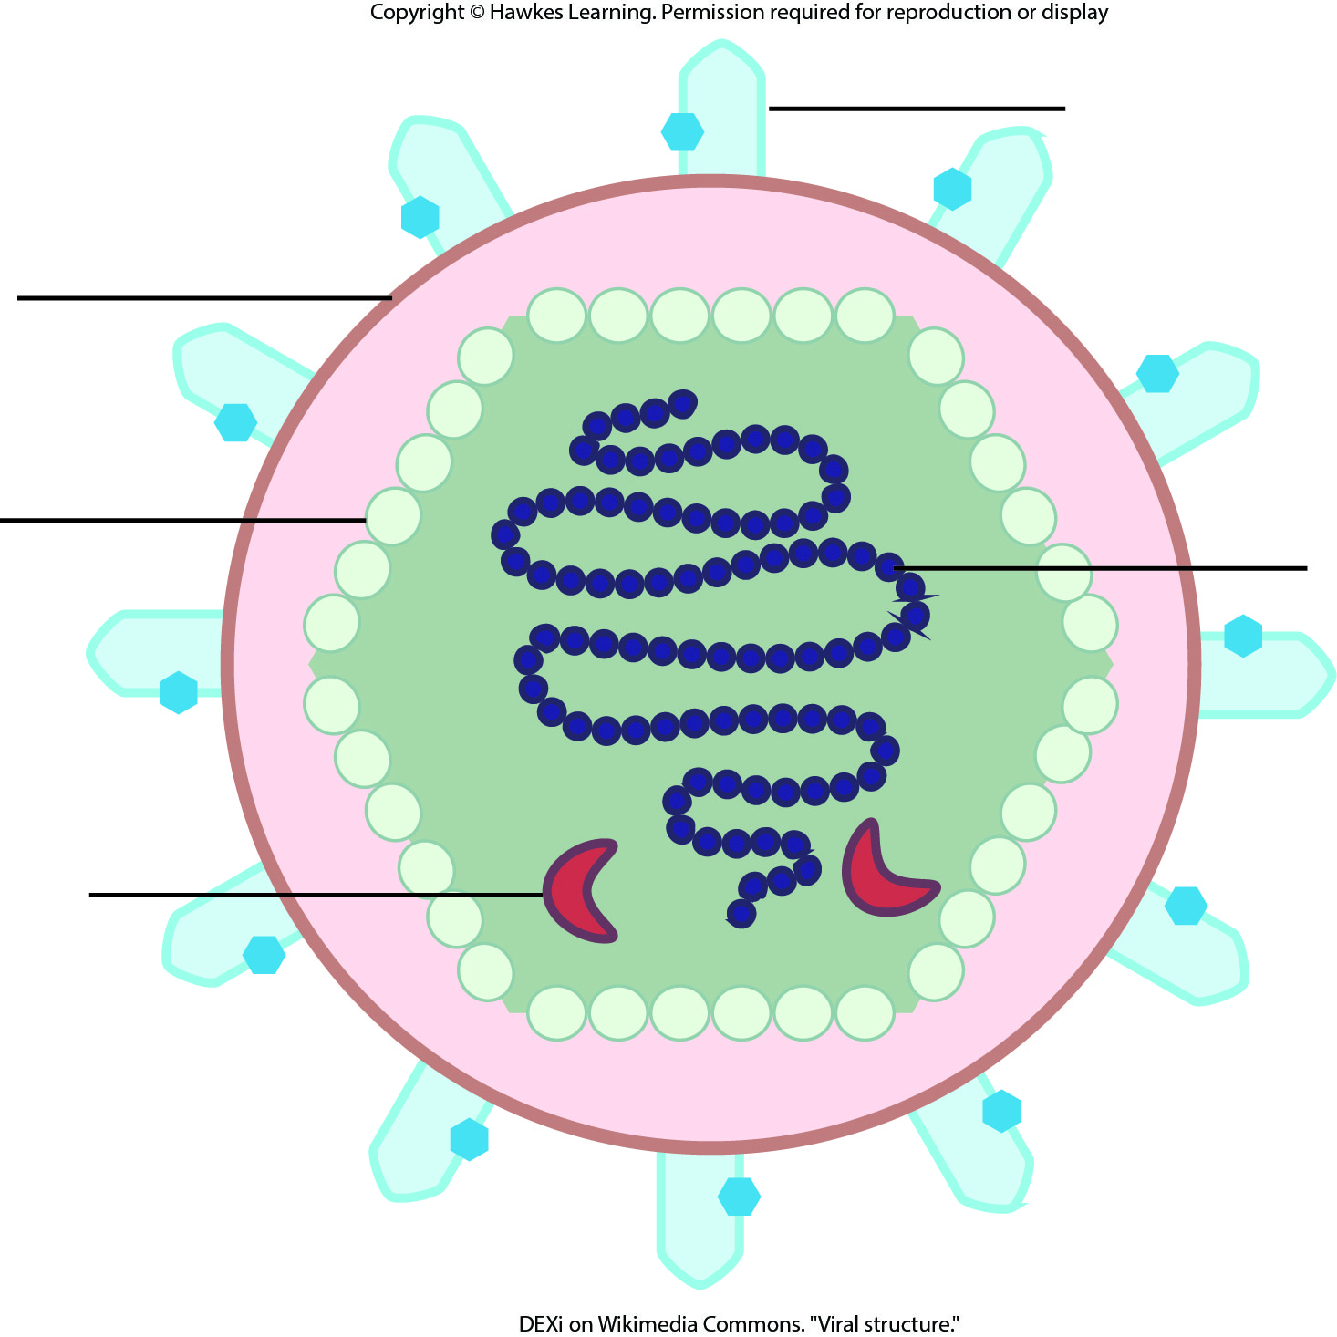
Lesson 21.1 Figure 3

Slide 4
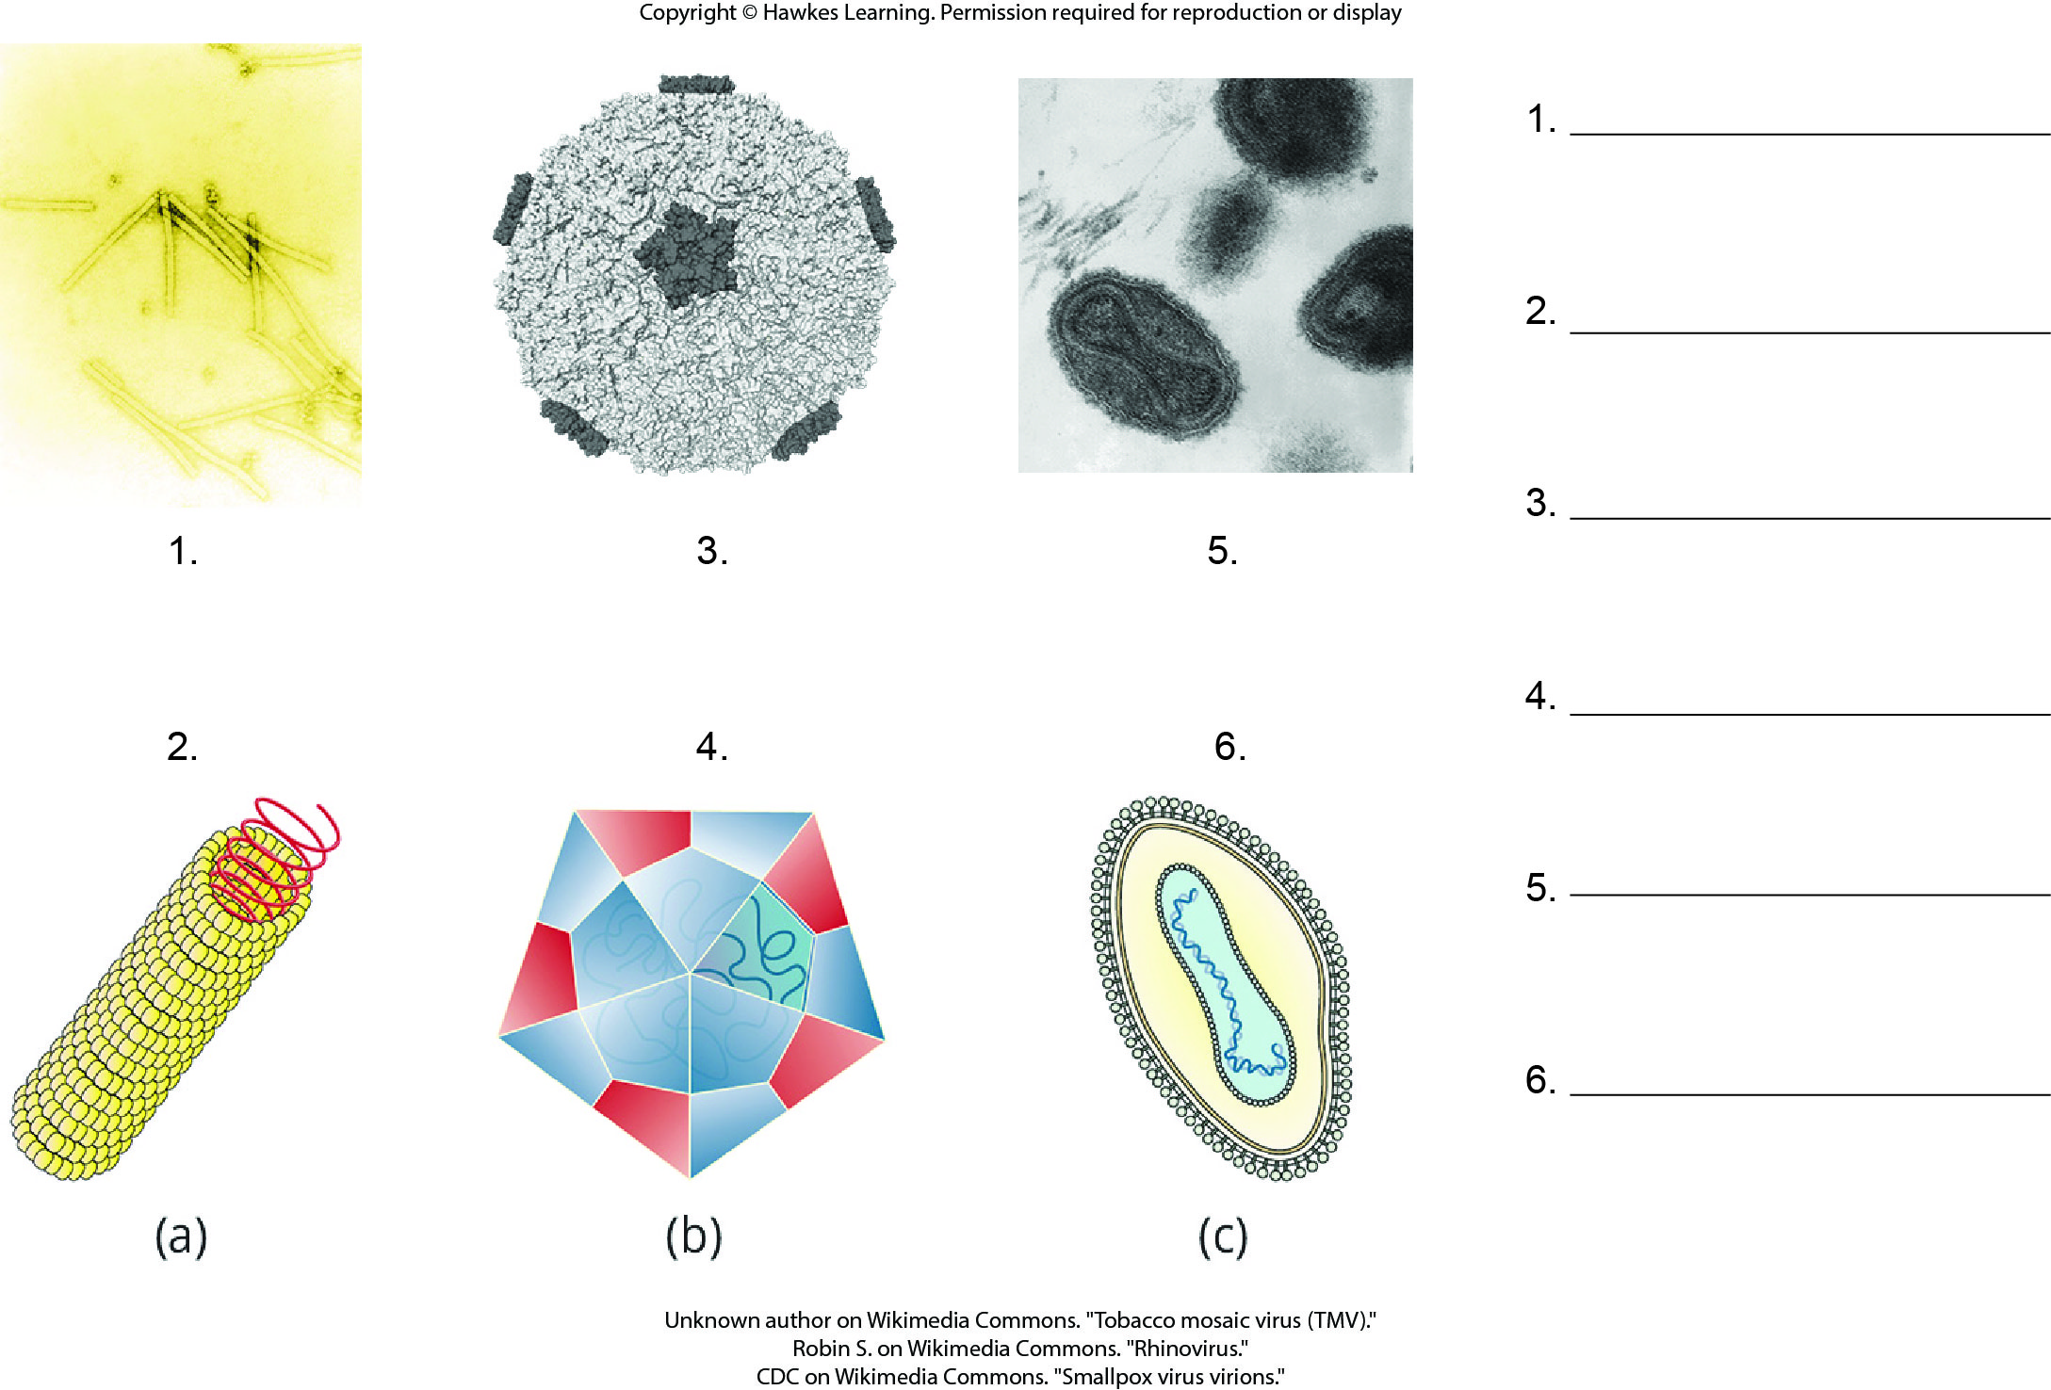
Lesson 21.1 Figure 4 - Numbered

Slide 5
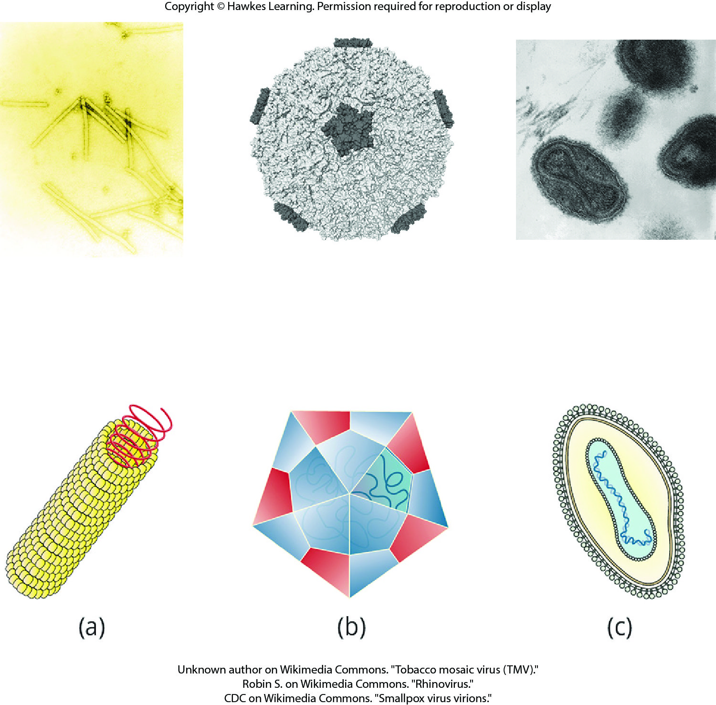
Lesson 21.1 Figure 4

Slide 6
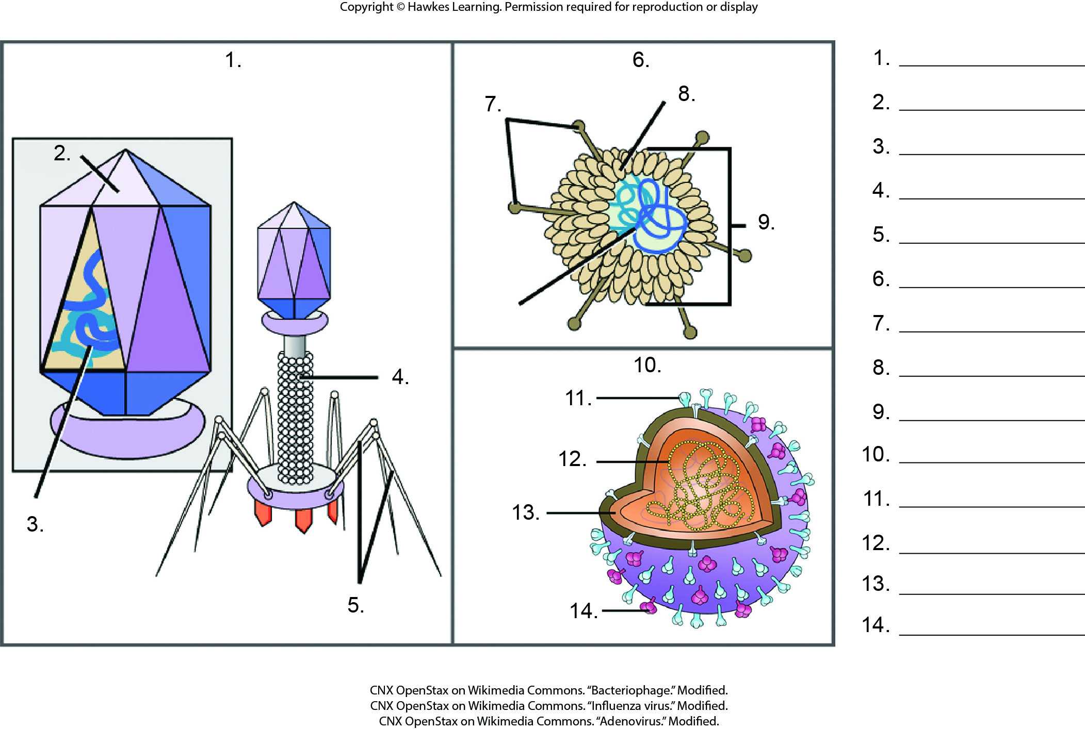
Lesson 21.1 Figure 7 - Numbered

Slide 7
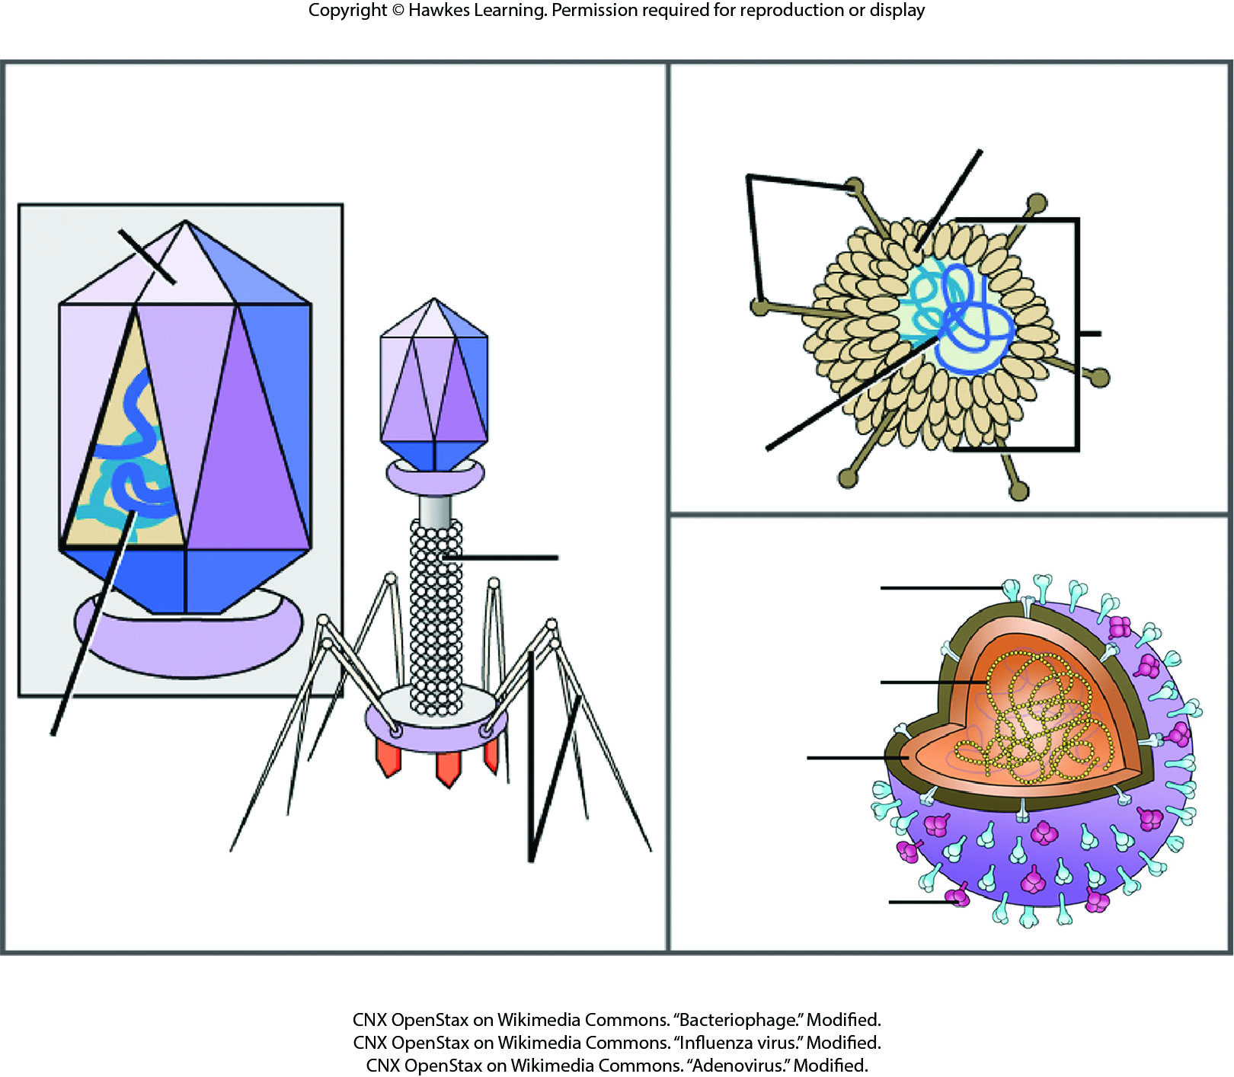
Lesson 21.1 Figure 7

Slide 8
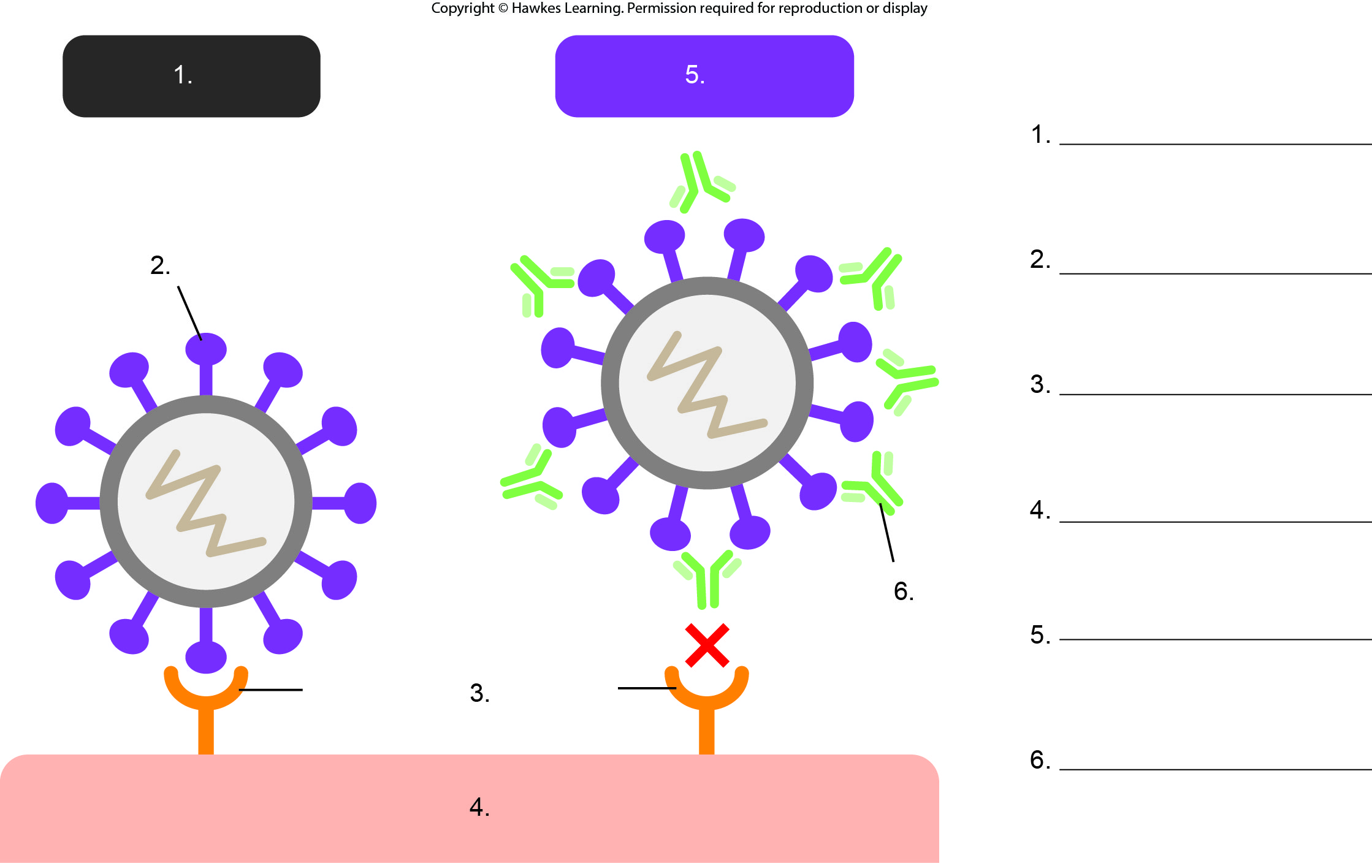
Lesson 21.2 Figure 2 - Numbered

Slide 9
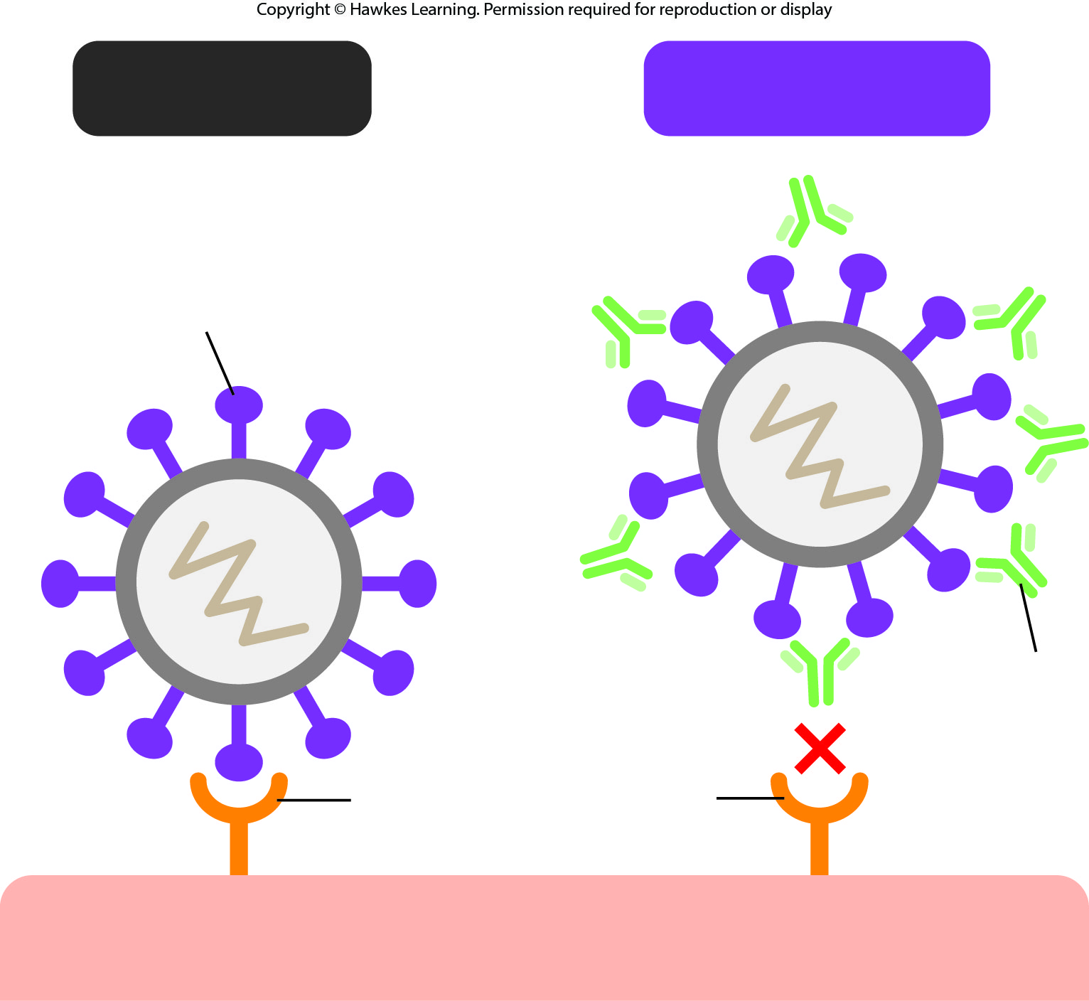
Lesson 21.2 Figure 2

Slide 10
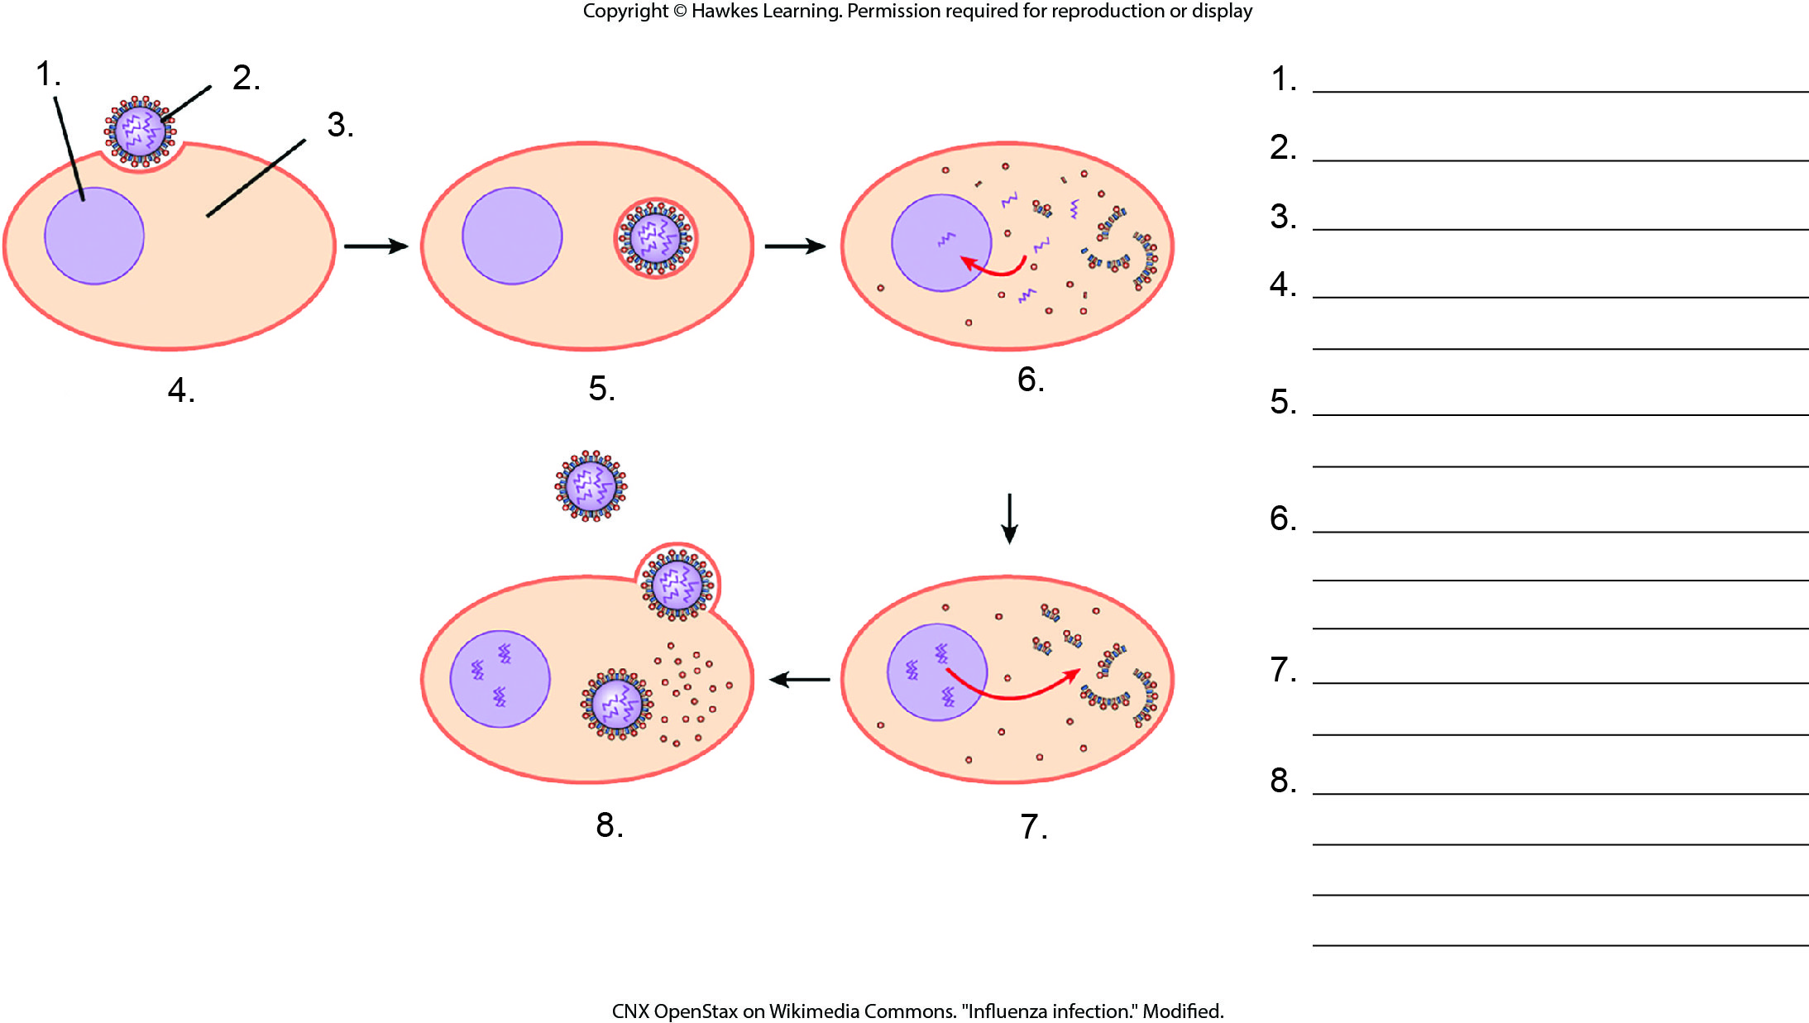
Lesson 21.2 Figure 3 - Numbered

Slide 11
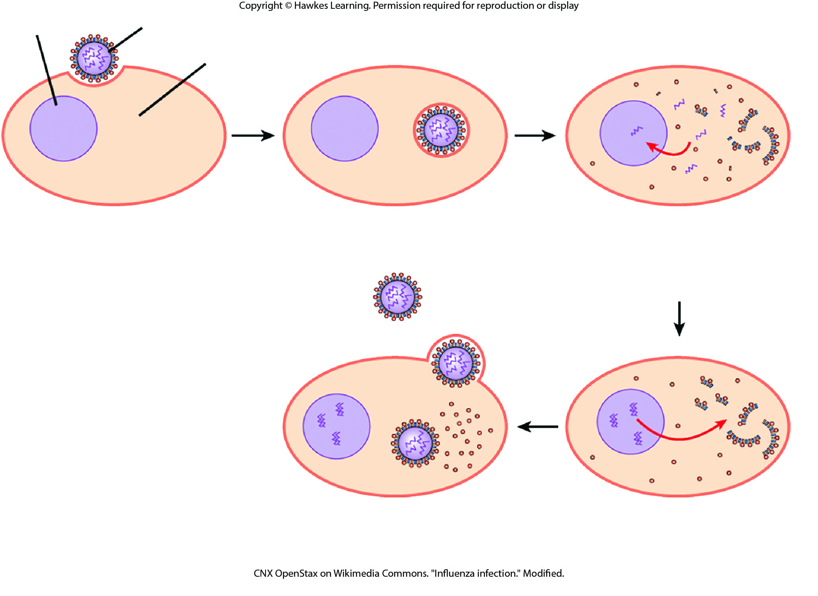
Lesson 21.2 Figure 3

Slide 12
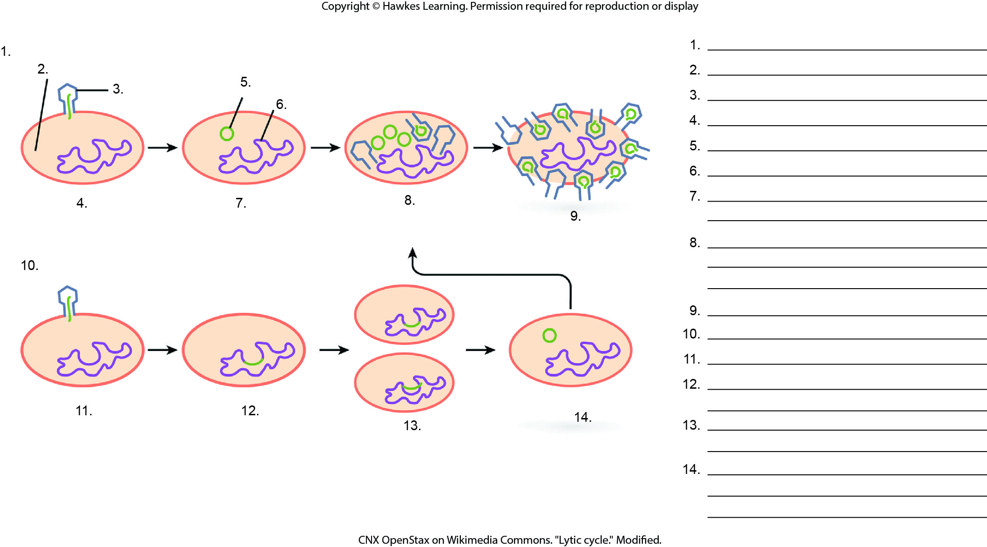
Lesson 21.2 Figure 5 - Numbered

Slide 13
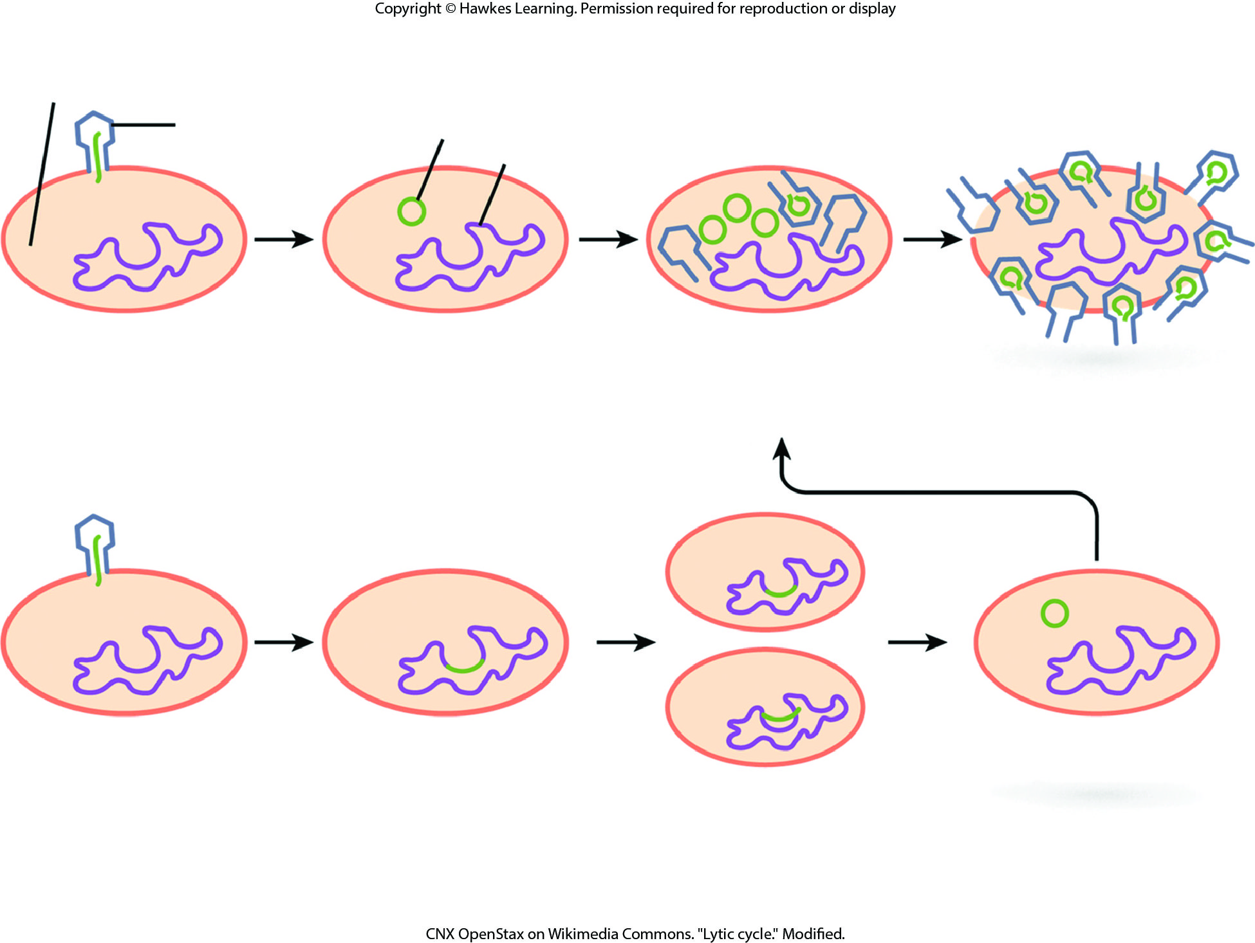
Lesson 21.2 Figure 5

Slide 14
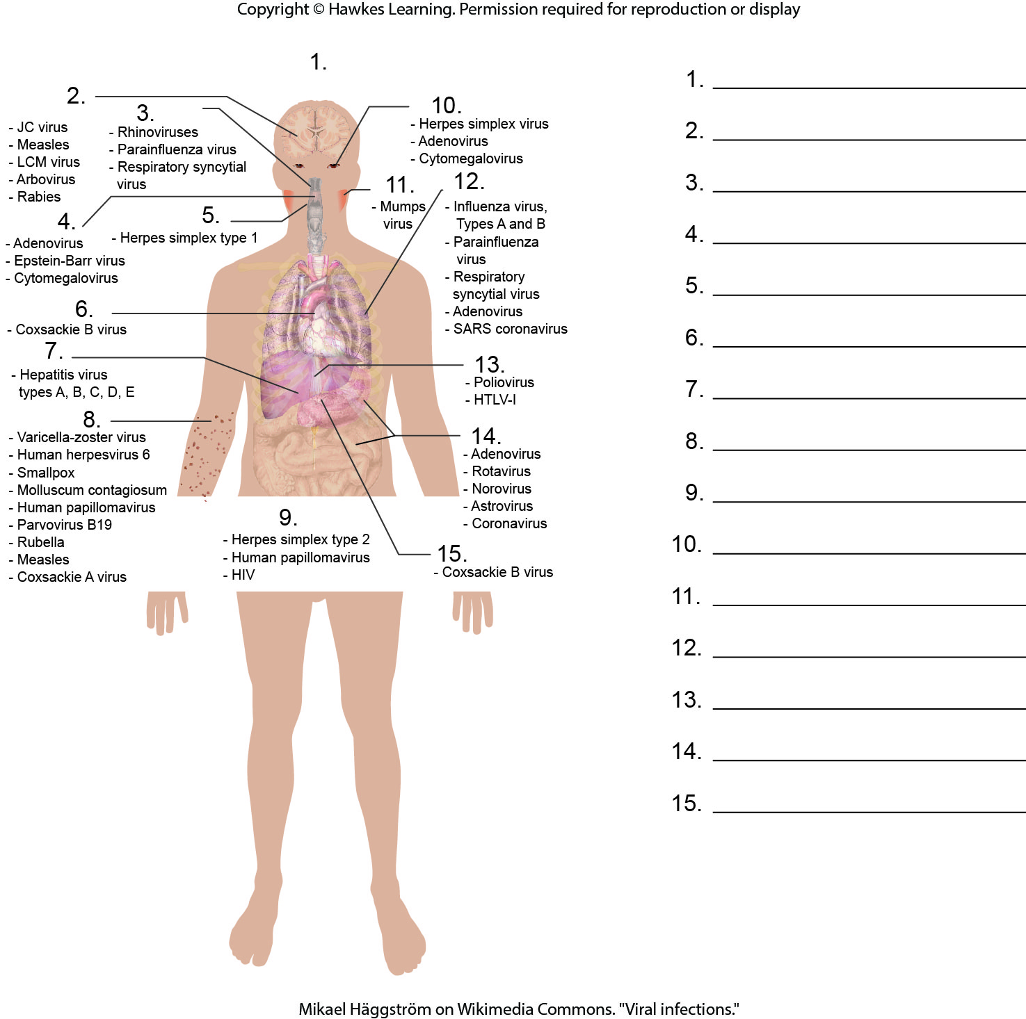
Lesson 21.3 Figure 1 - Numbered

Slide 15
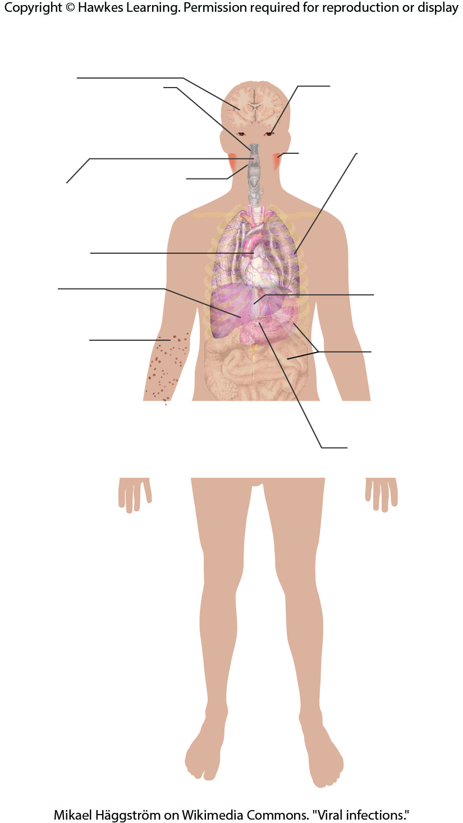
Lesson 21.3 Figure 1

Slide 16
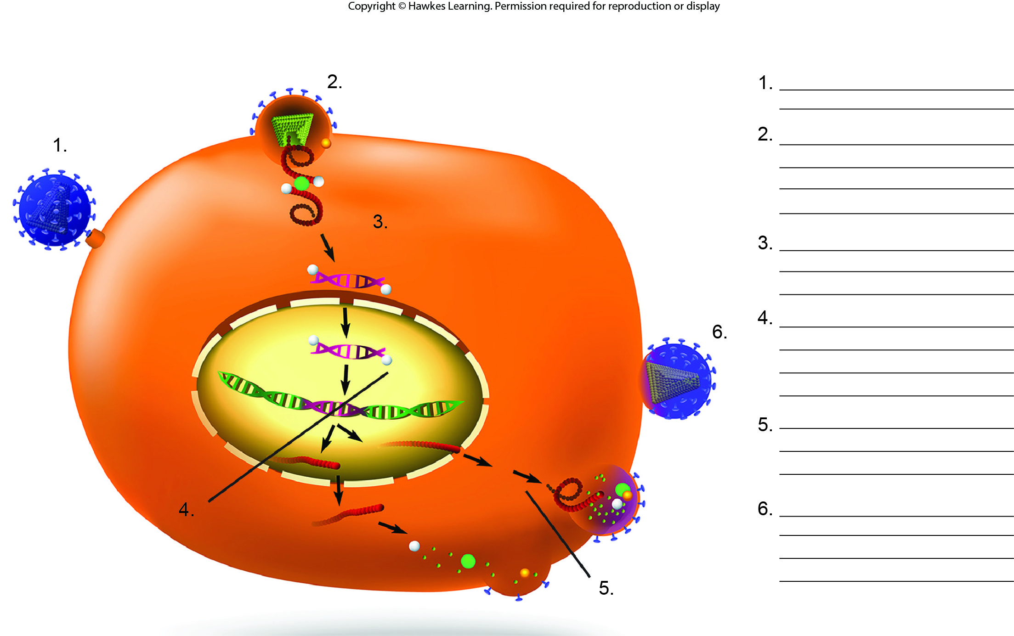
Lesson 21.3 Figure 6 - Numbered

Slide 17
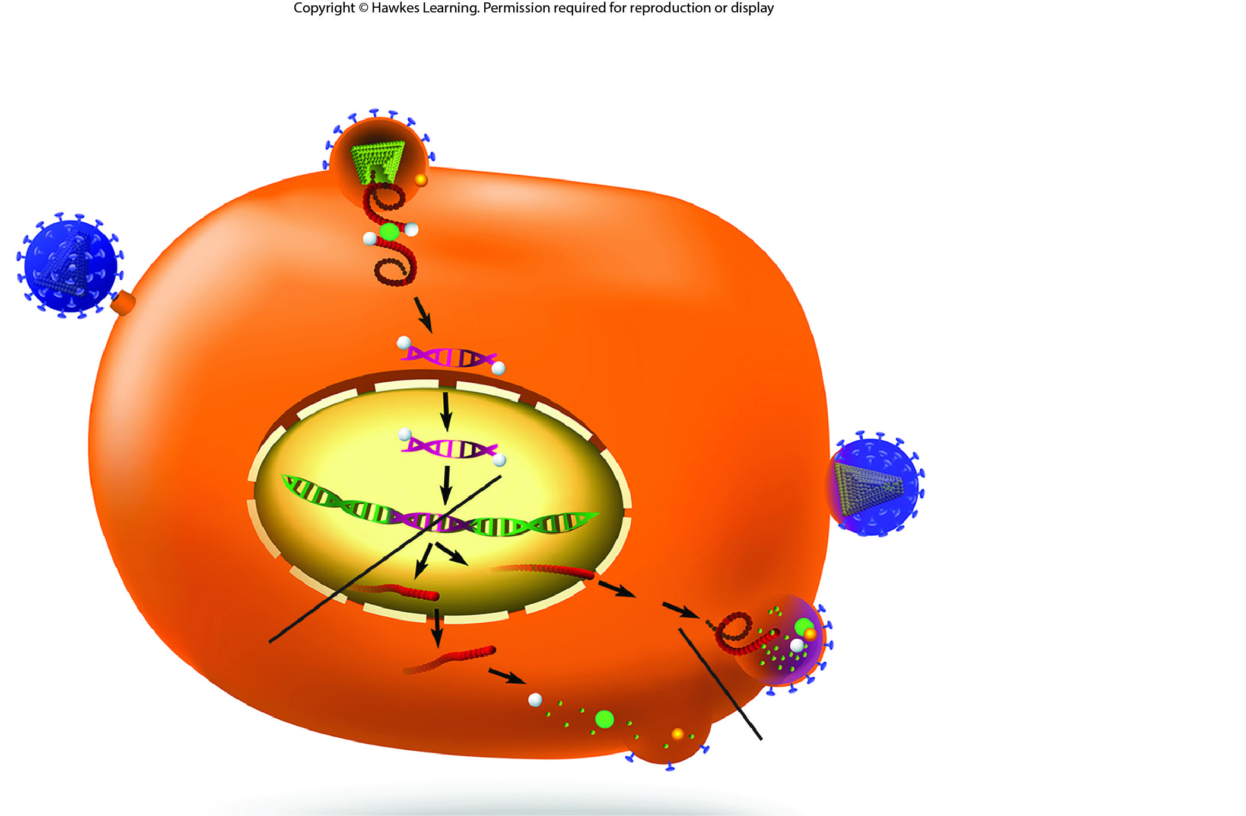
Lesson 21.3 Figure 6

Slide 18
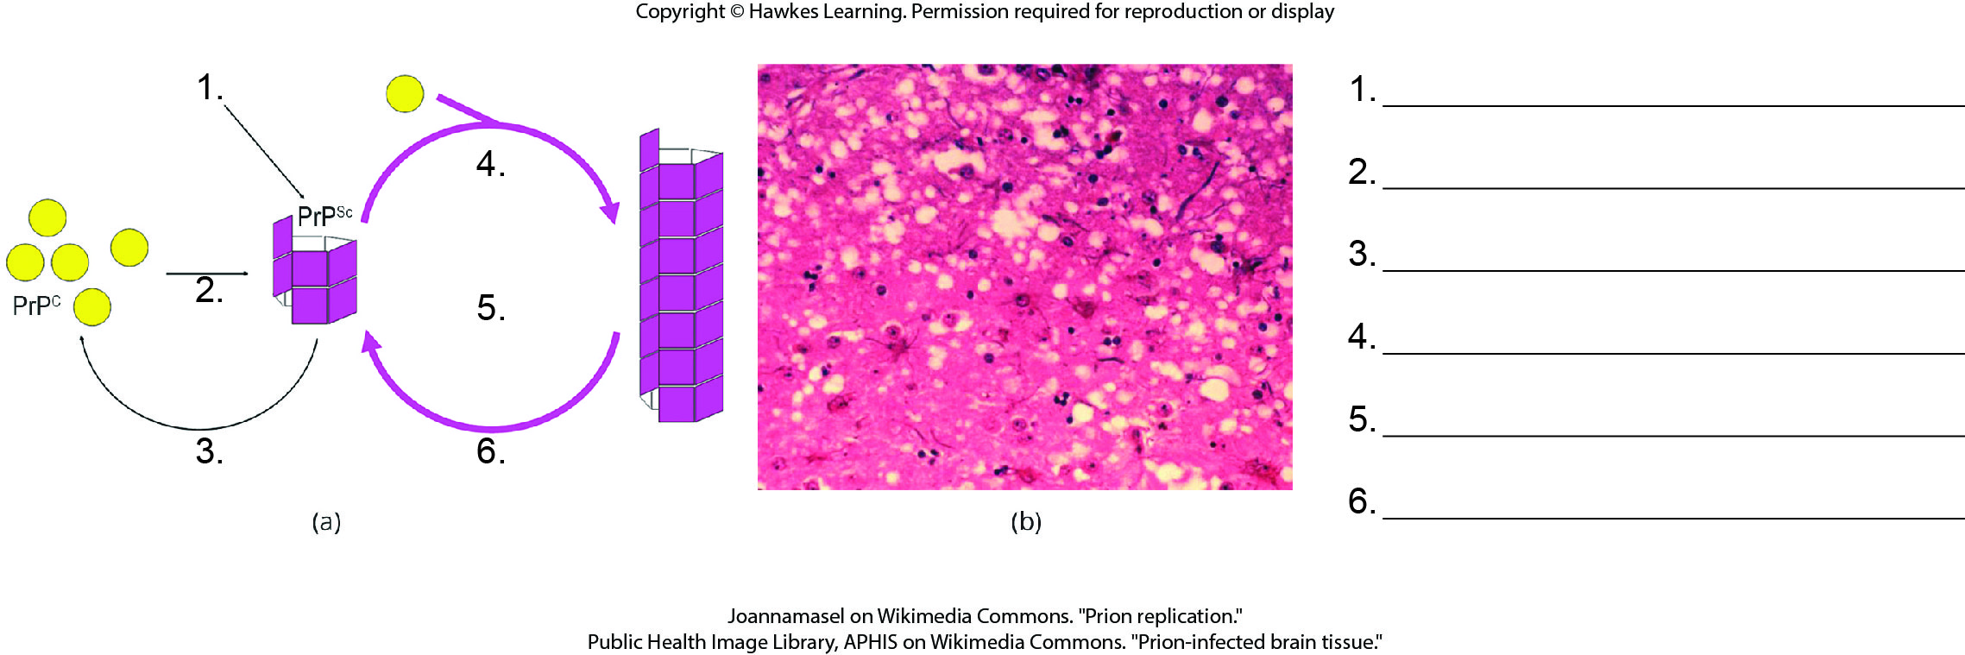
Lesson 21.4 Figure 2 - Numbered

Slide 19
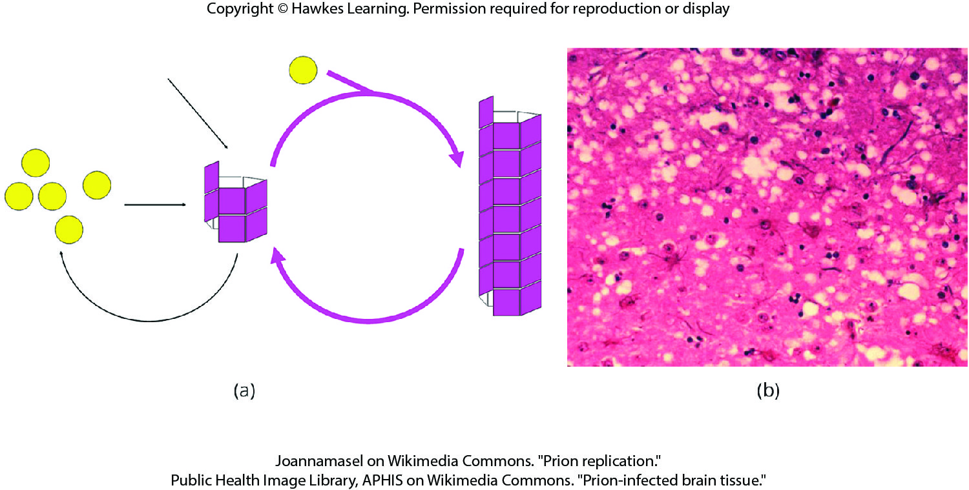
Lesson 21.4 Figure 2

Slide 20
Hawkes Learning – End of PowerPoint

