Slide 1
Chapter 22
Prokaryotes: Bacteria and Archaea

Slide 2
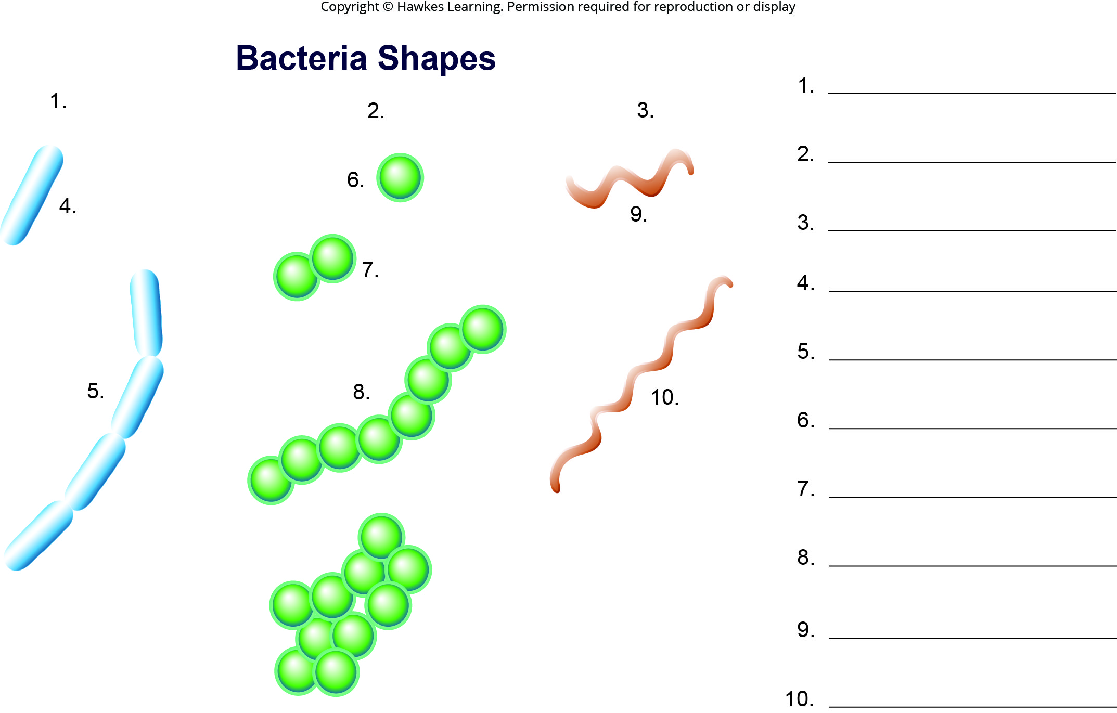
Lesson 22.2 Figure 1 - Numbered

Slide 3
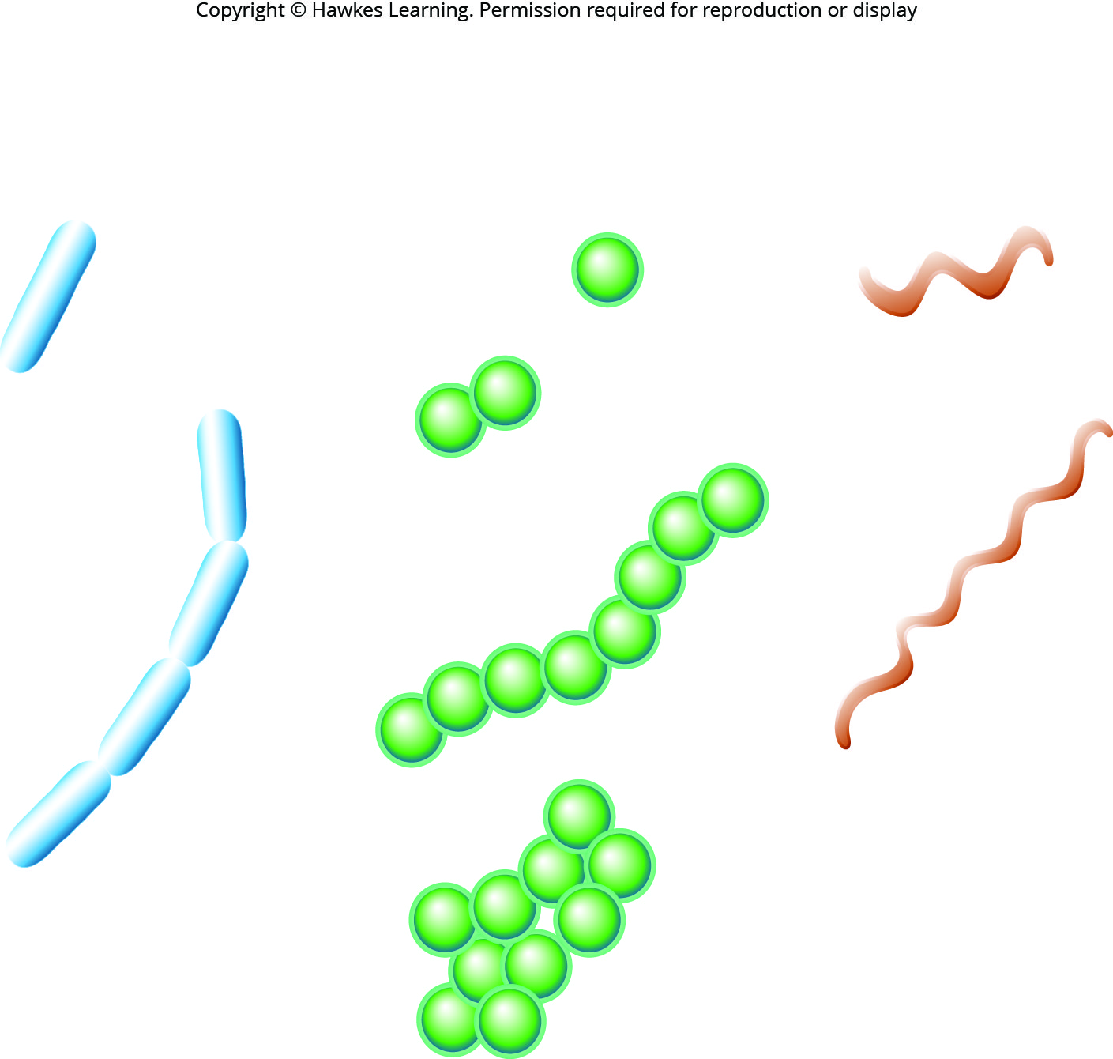
Lesson 22.2 Figure 1

Slide 4
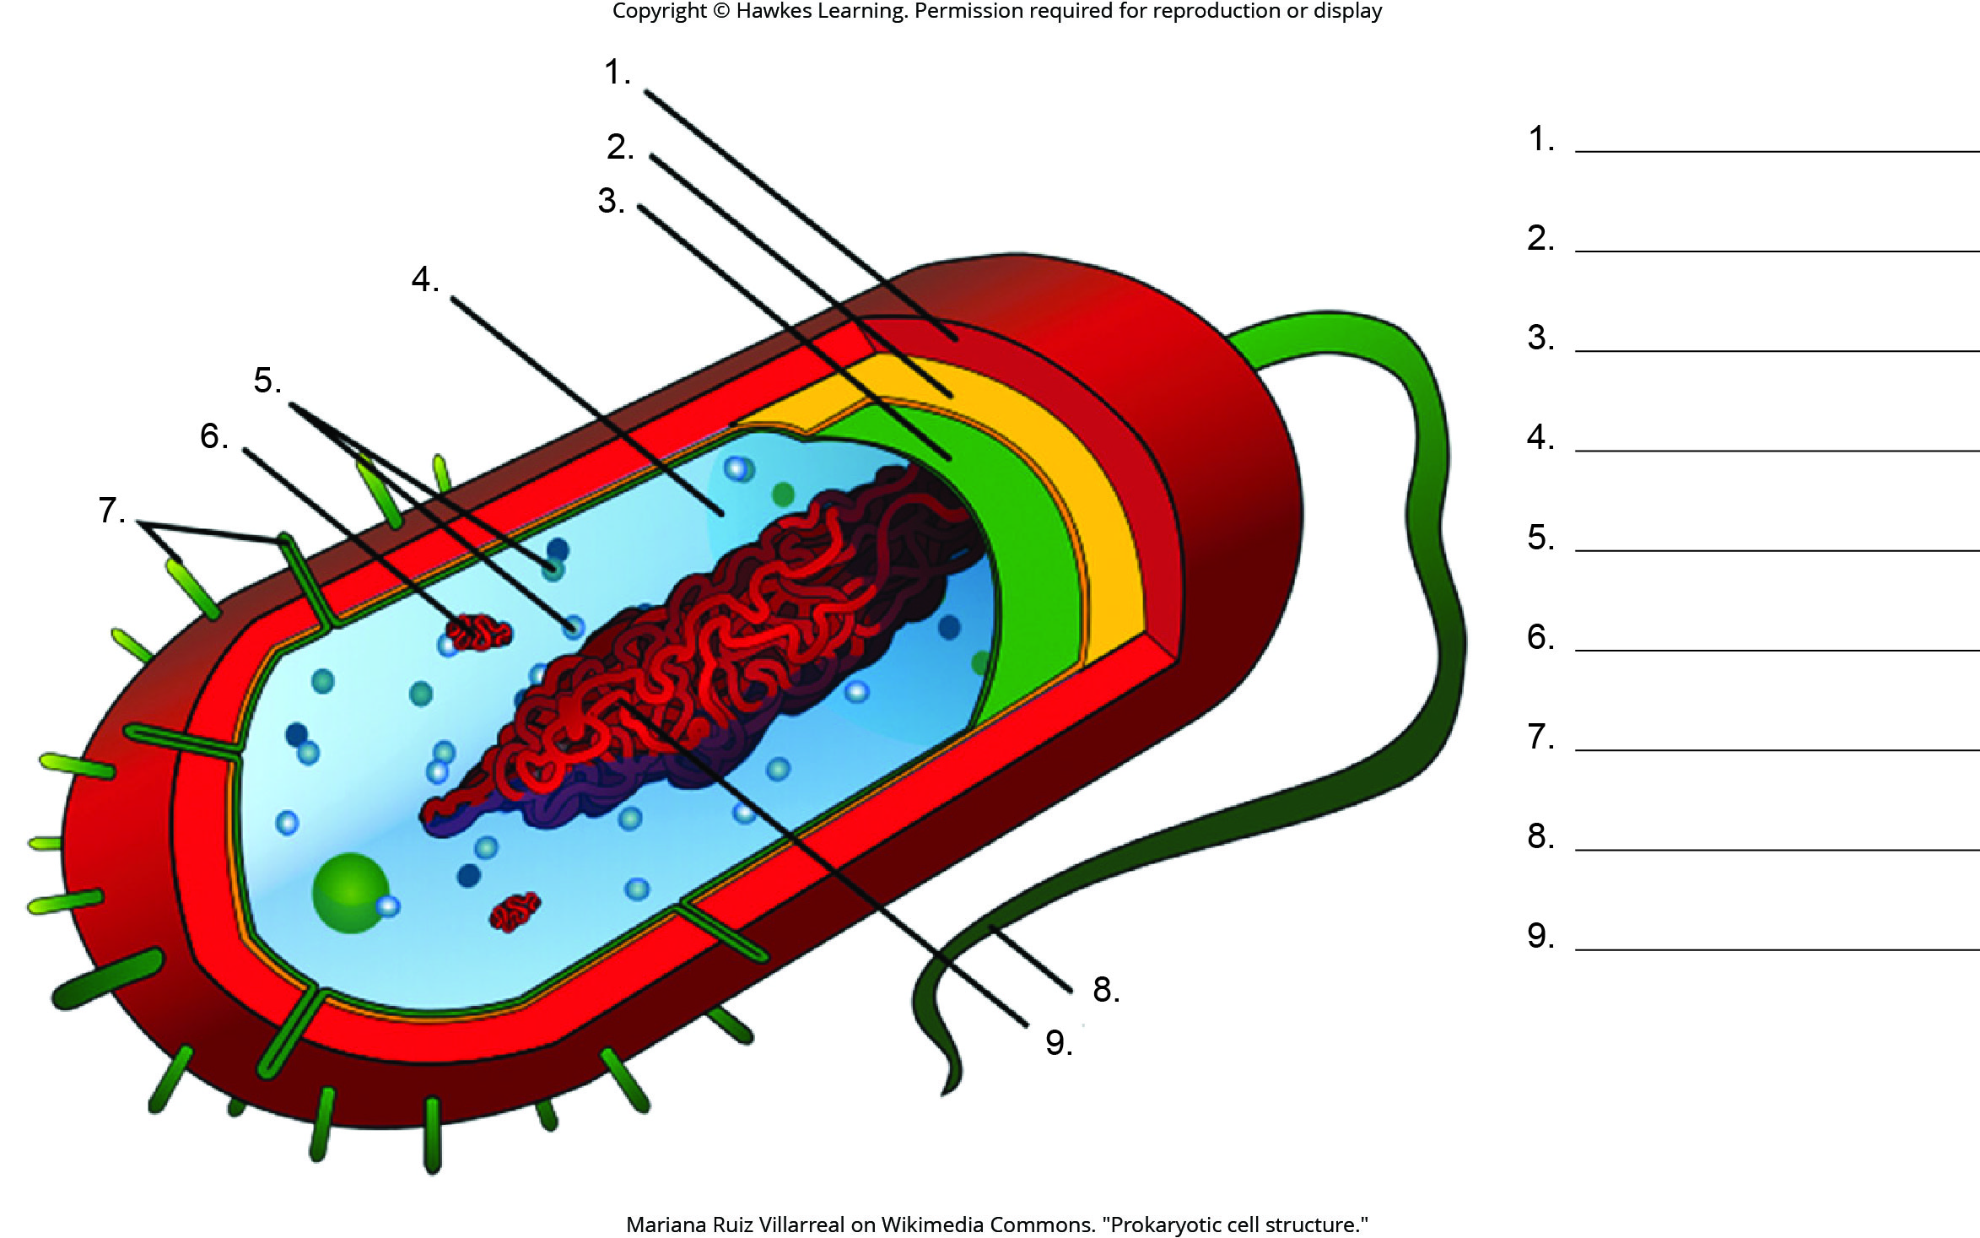
Lesson 22.2 Figure 2 - Numbered

Slide 5
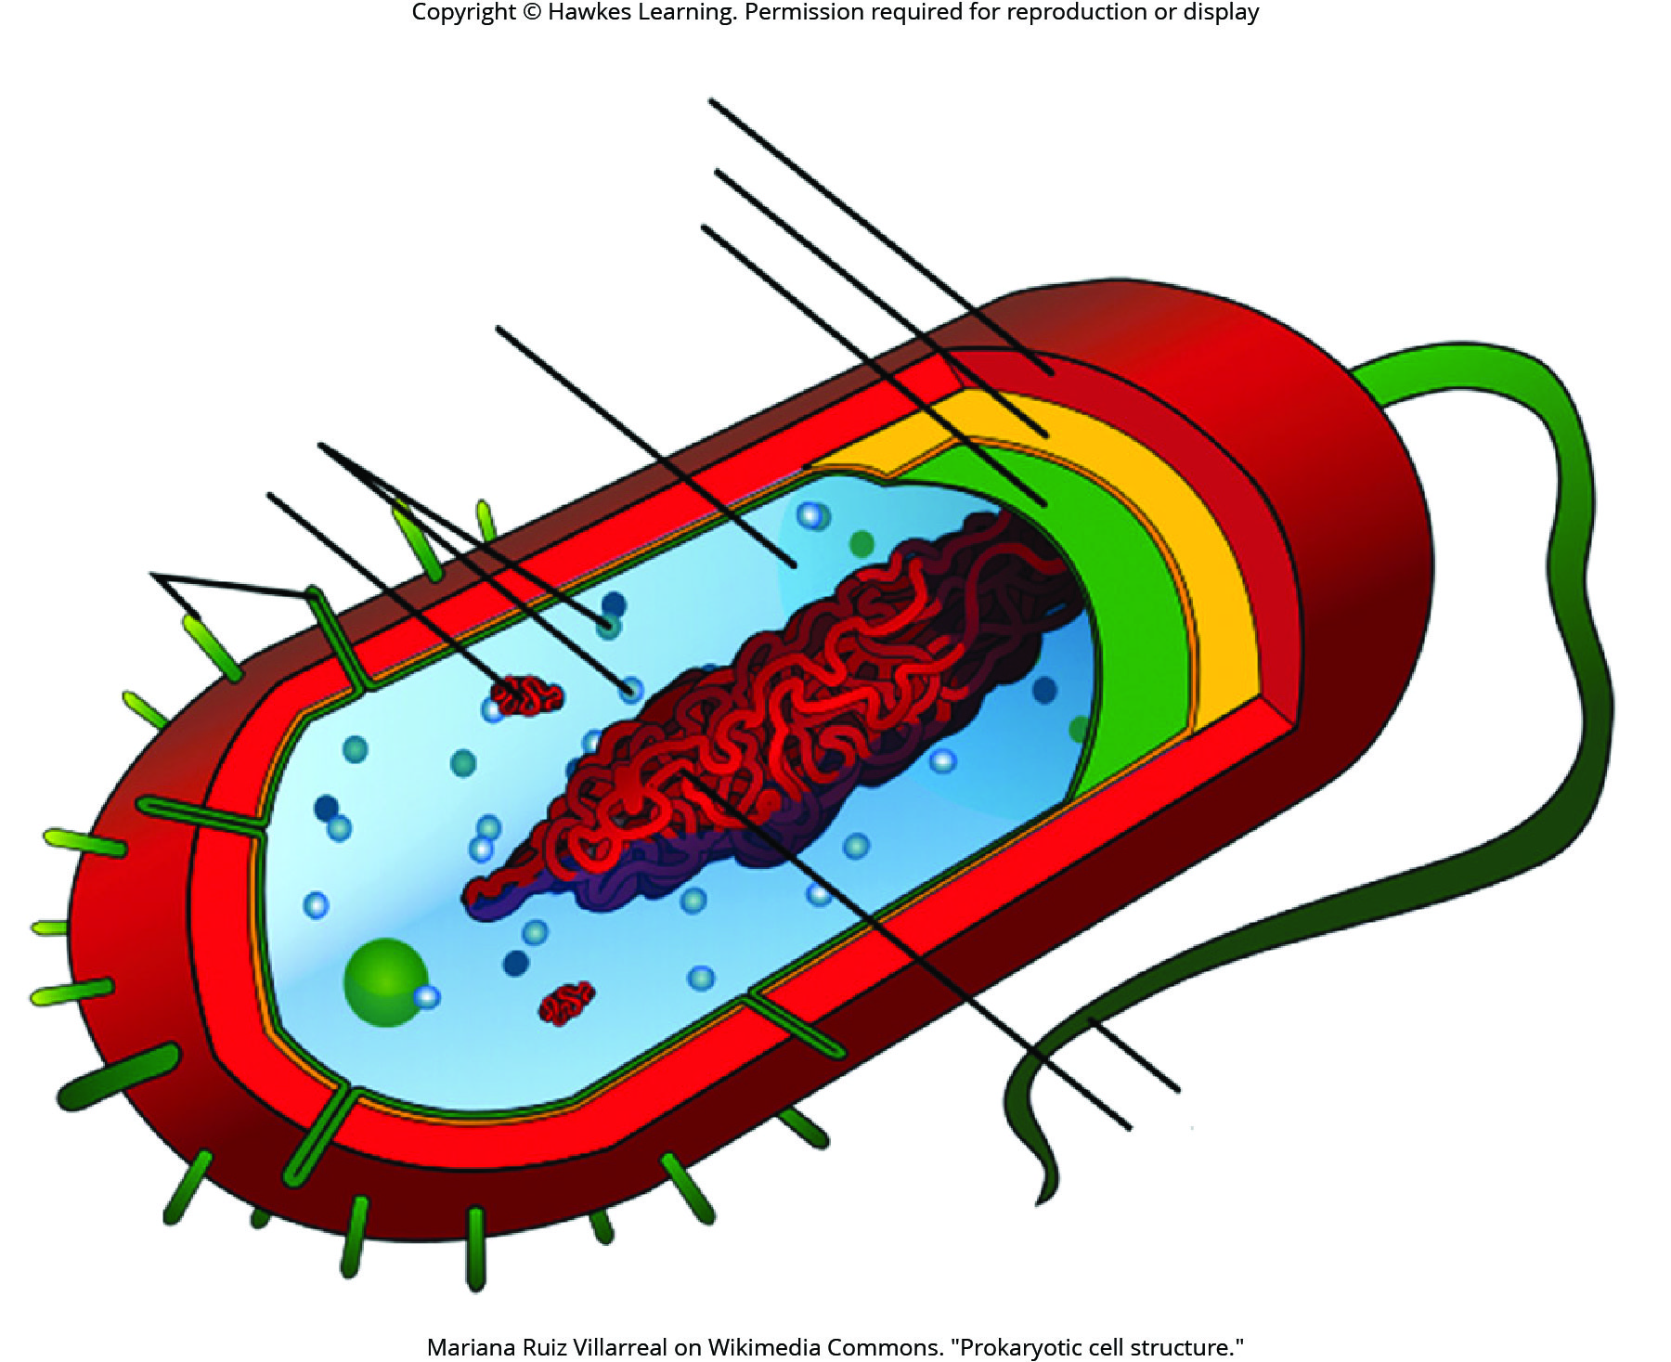
Lesson 22.2 Figure 2

Slide 6
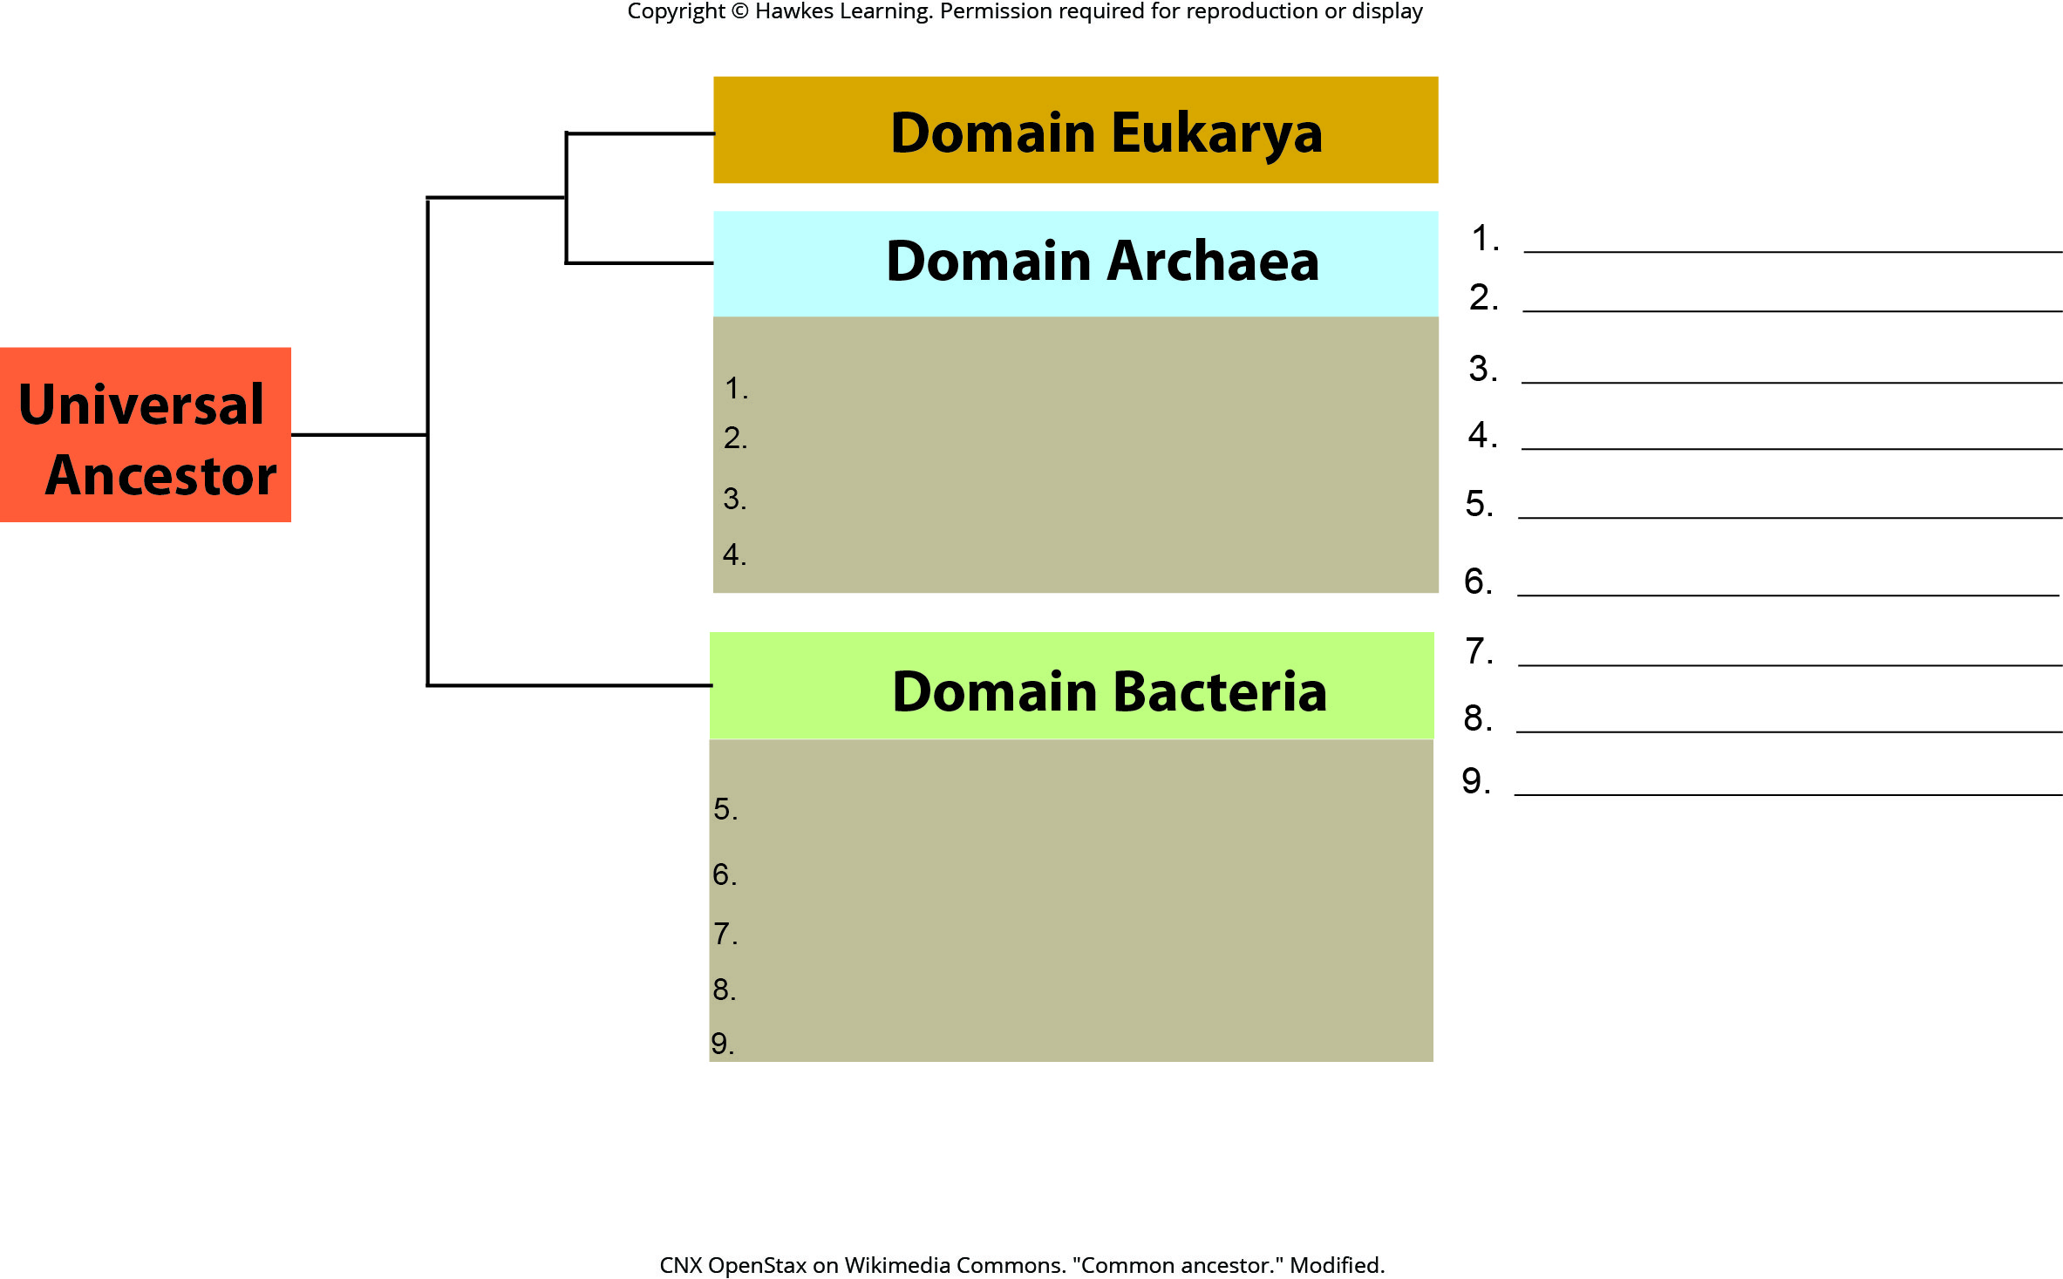
Lesson 22.2 Figure 3 - Numbered

Slide 7
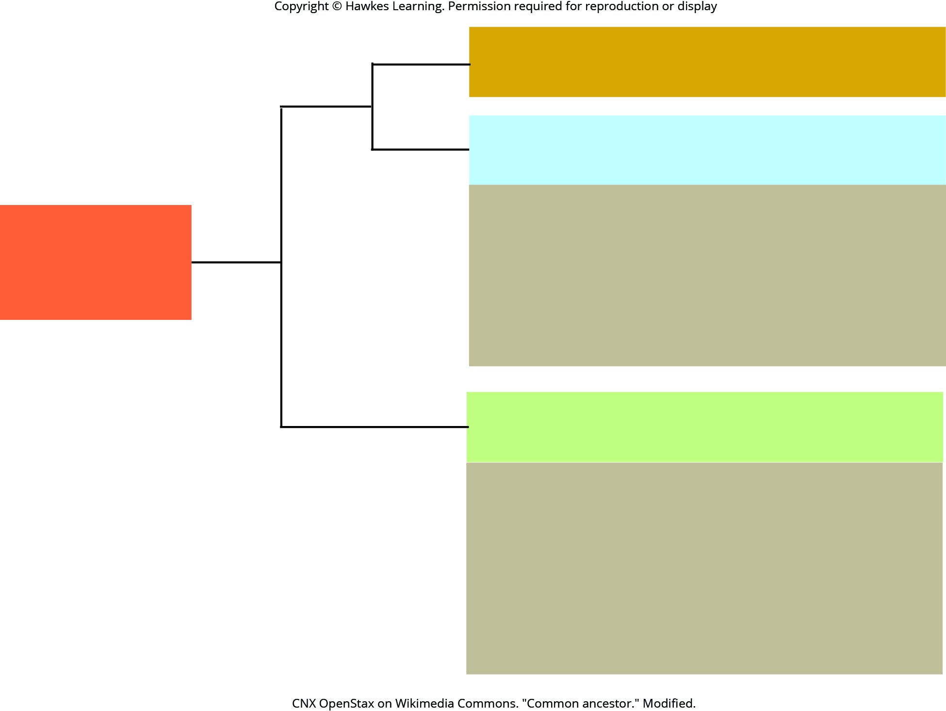
Lesson 22.2 Figure 3

Slide 8
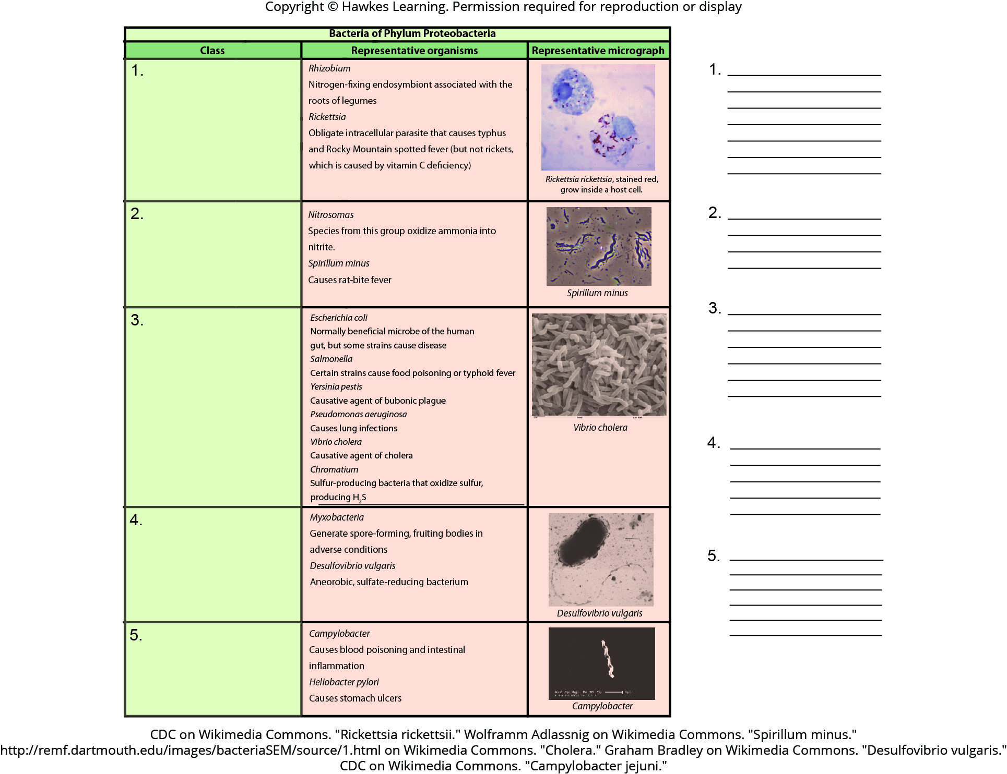
Lesson 22.2 Figure 4 - Numbered

Slide 9
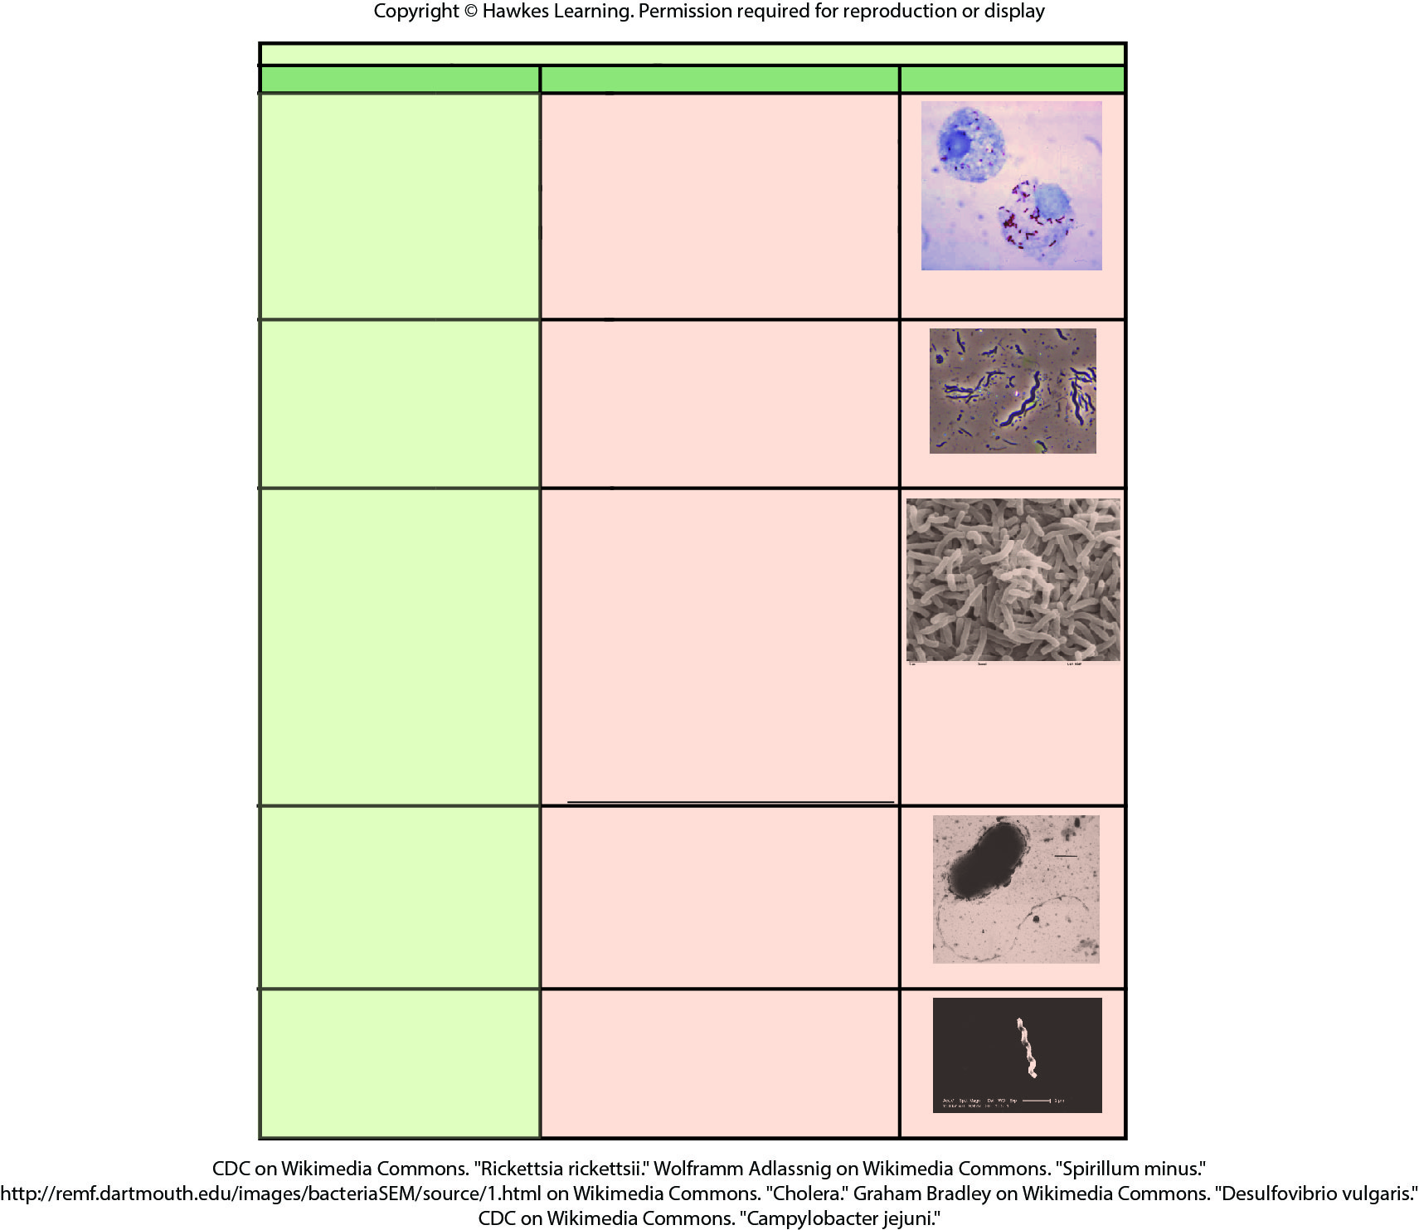
Lesson 22.2 Figure 4

Slide 10
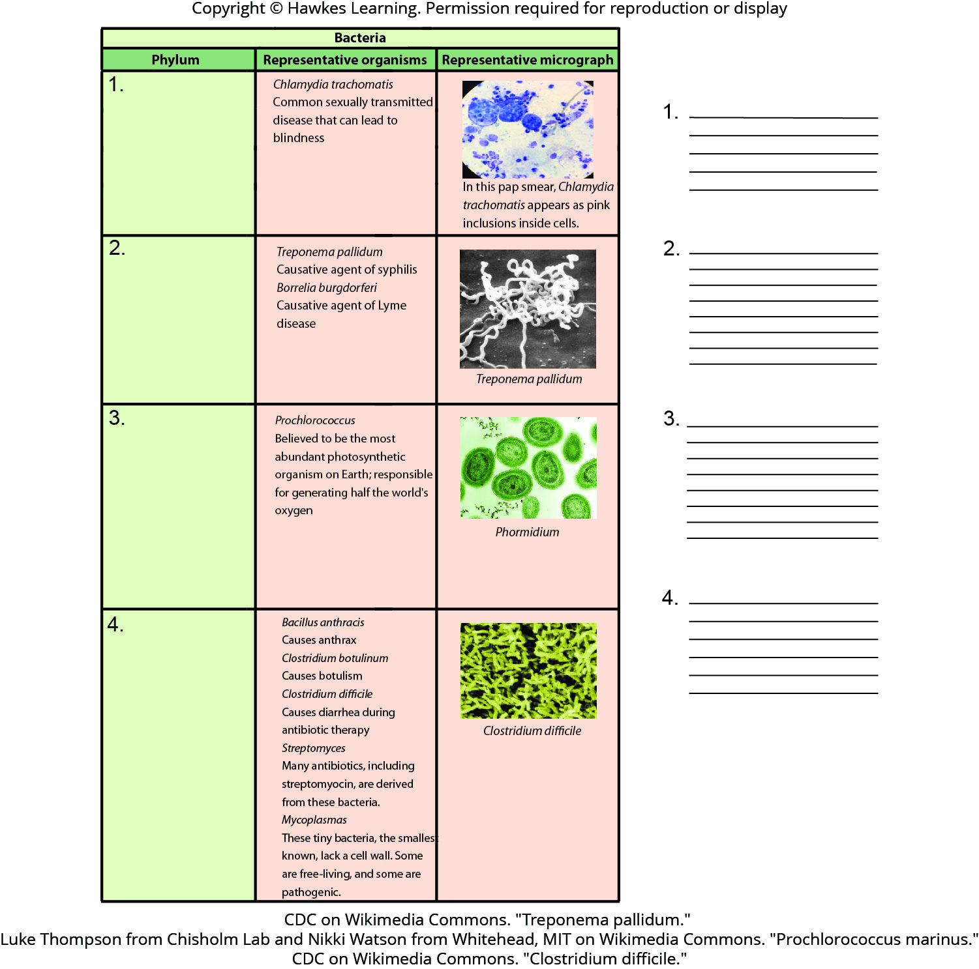
Lesson 22.2 Figure 5 - Numbered

Slide 11
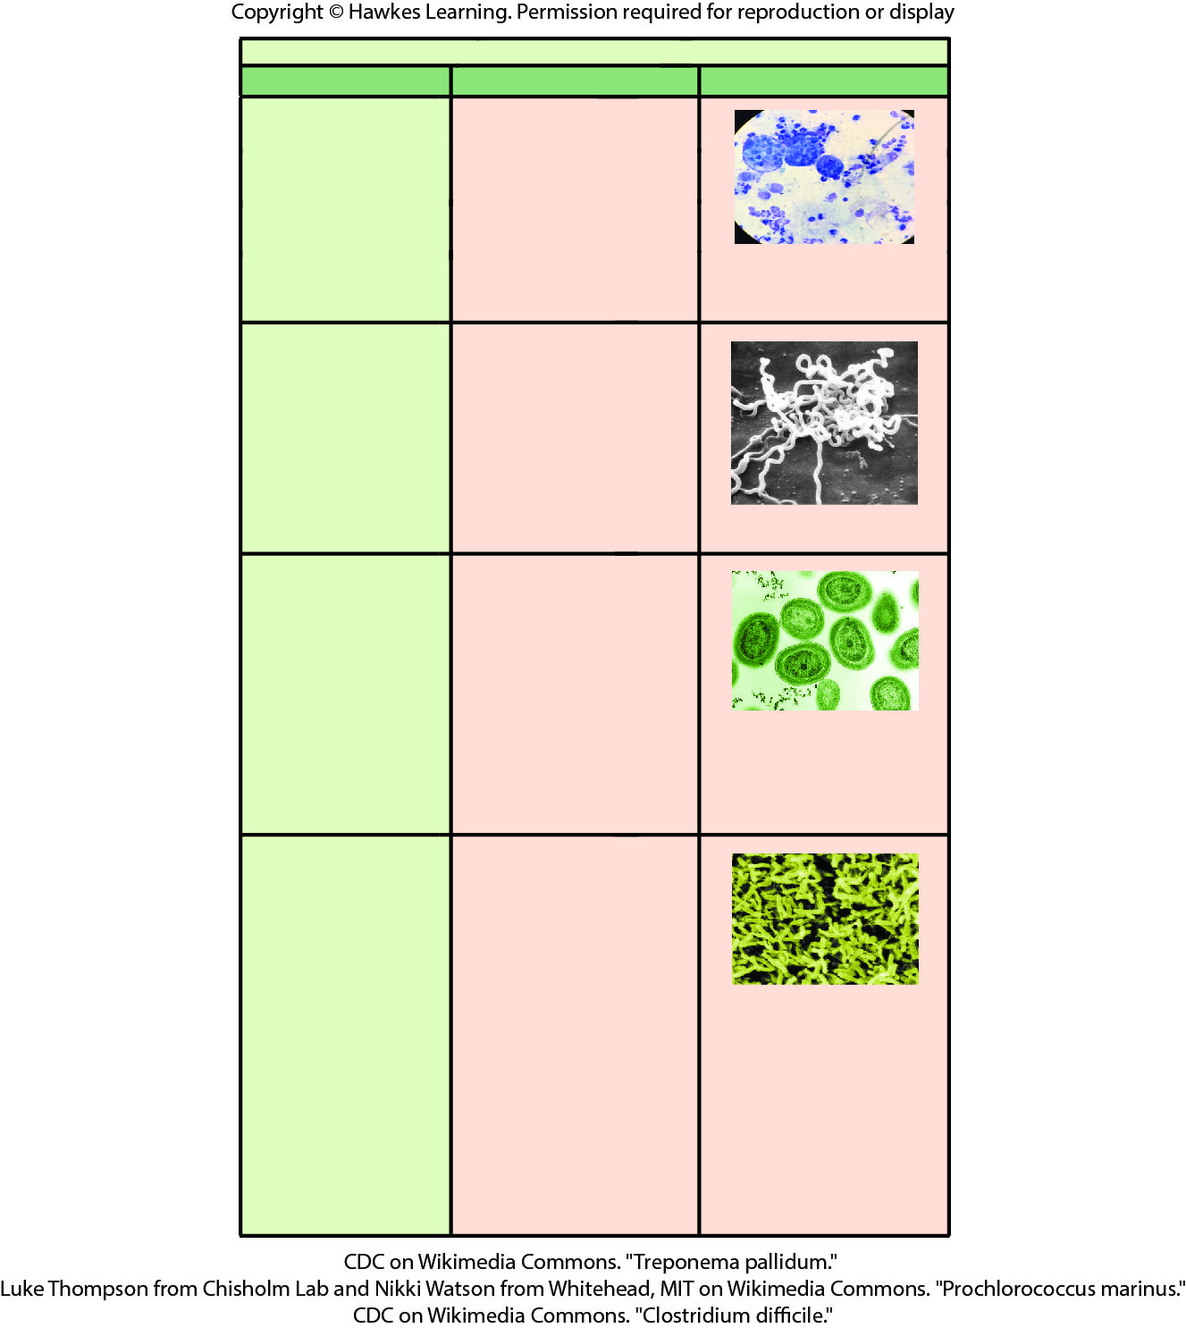
Lesson 22.2 Figure 5

Slide 12
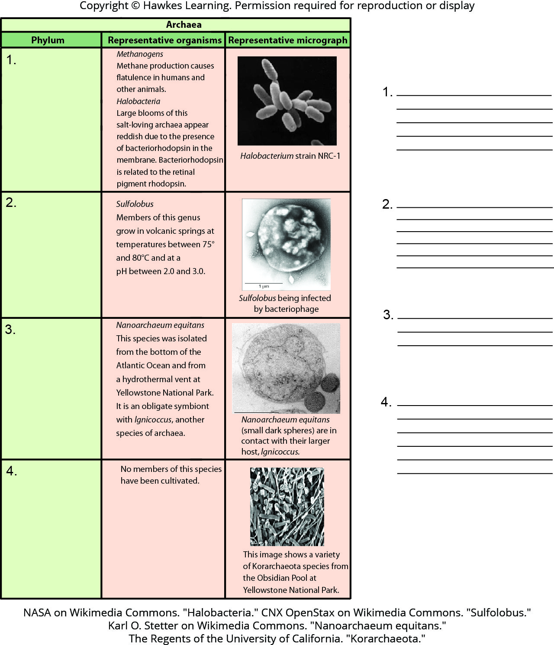
Lesson 22.2 Figure 6 - Numbered

Slide 13
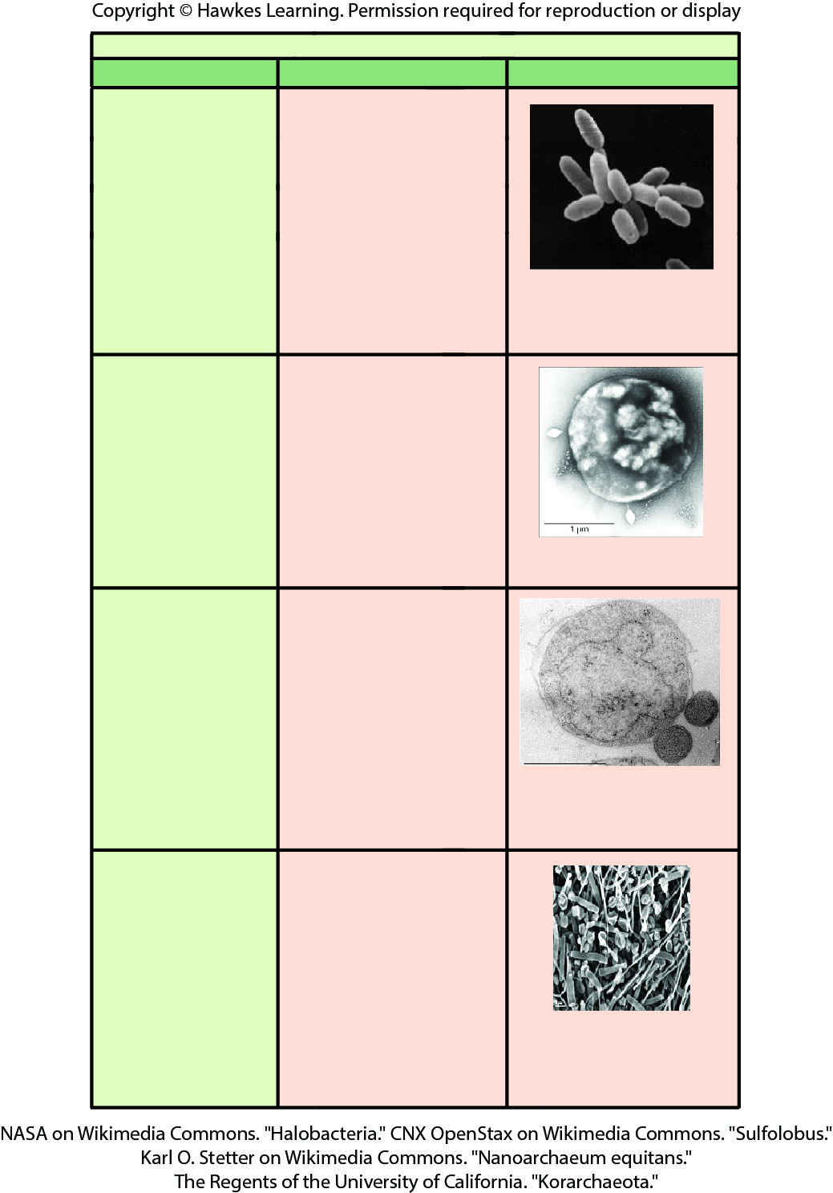
Lesson 22.2 Figure 6

Slide 14
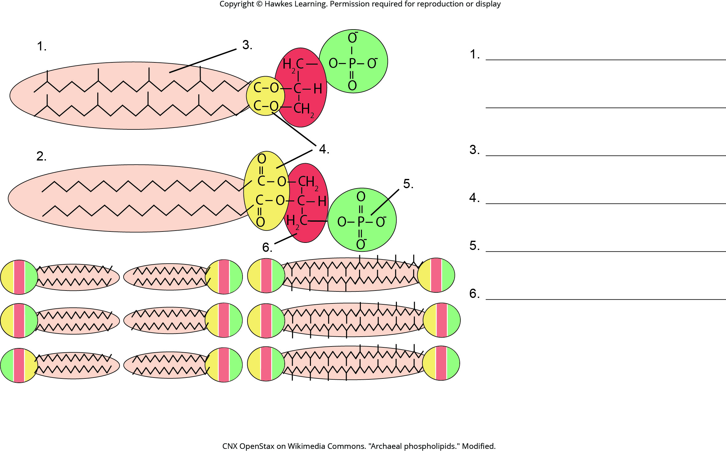
Lesson 22.2 Figure 7 - Numbered

Slide 15
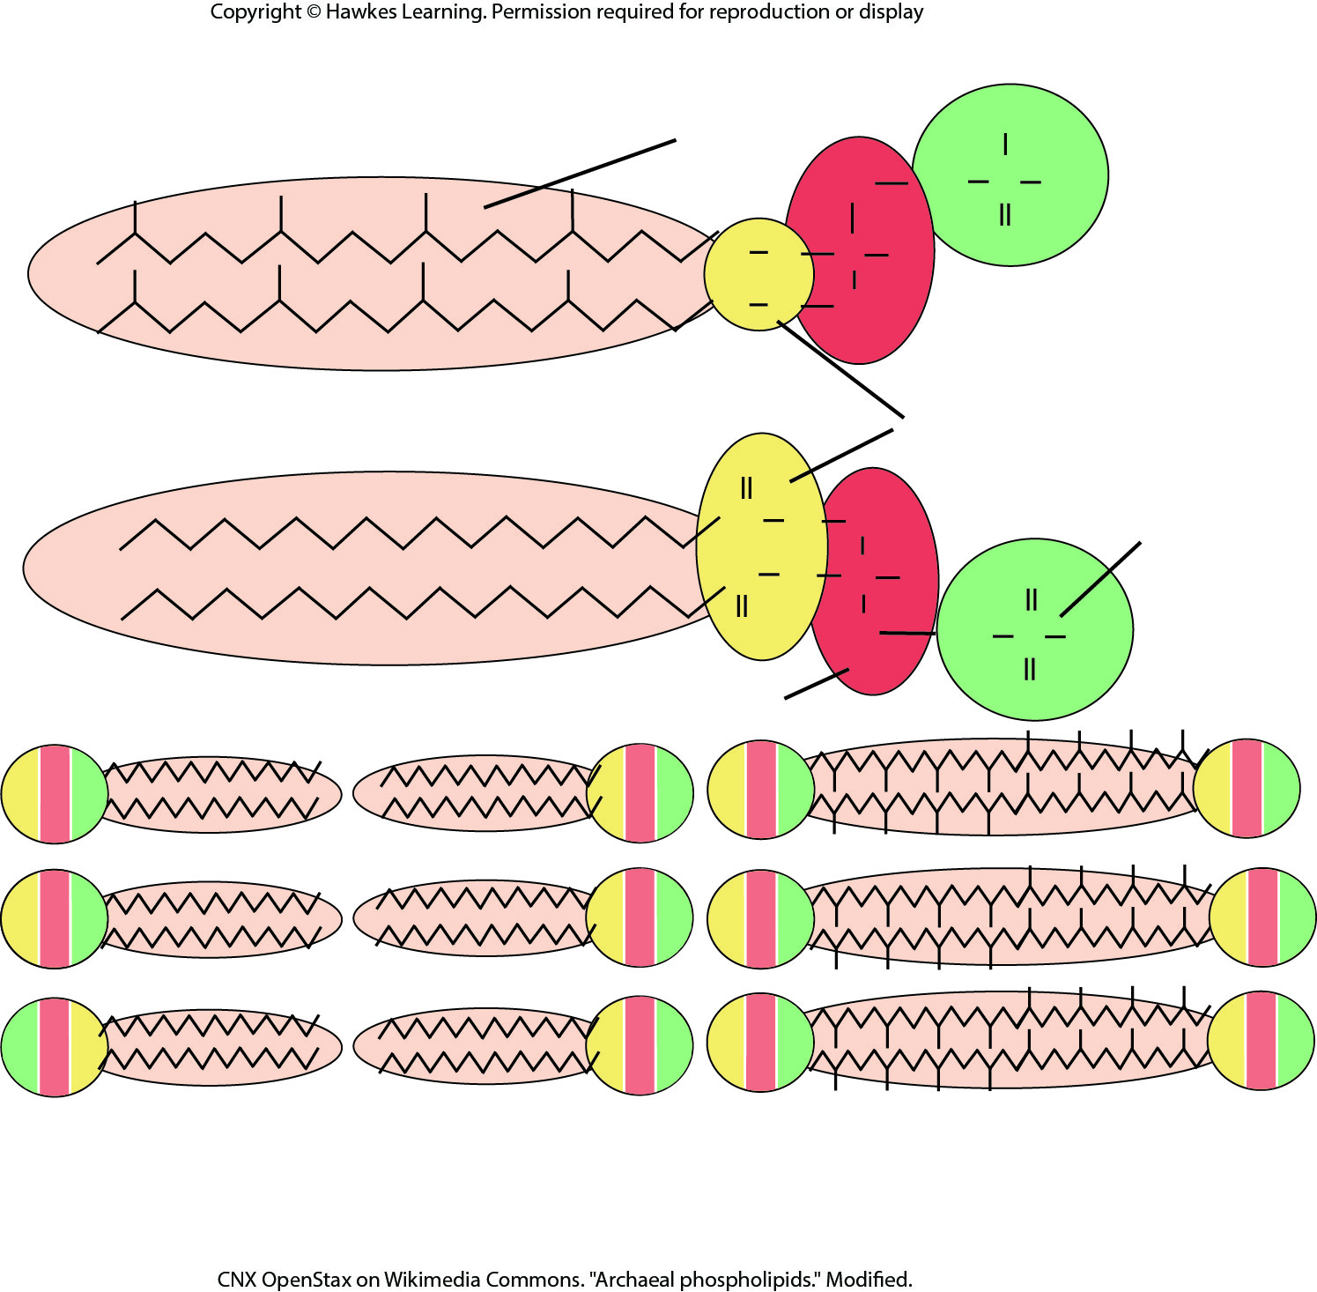
Lesson 22.2 Figure 7

Slide 16
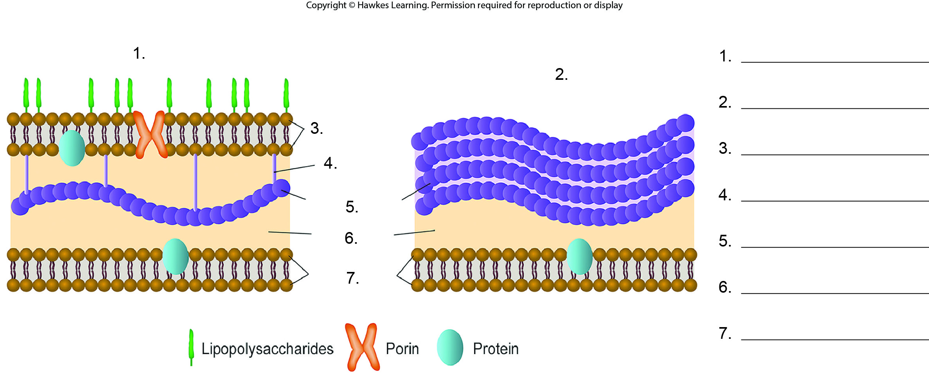
Lesson 22.2 Figure 8 - Numbered

Slide 17
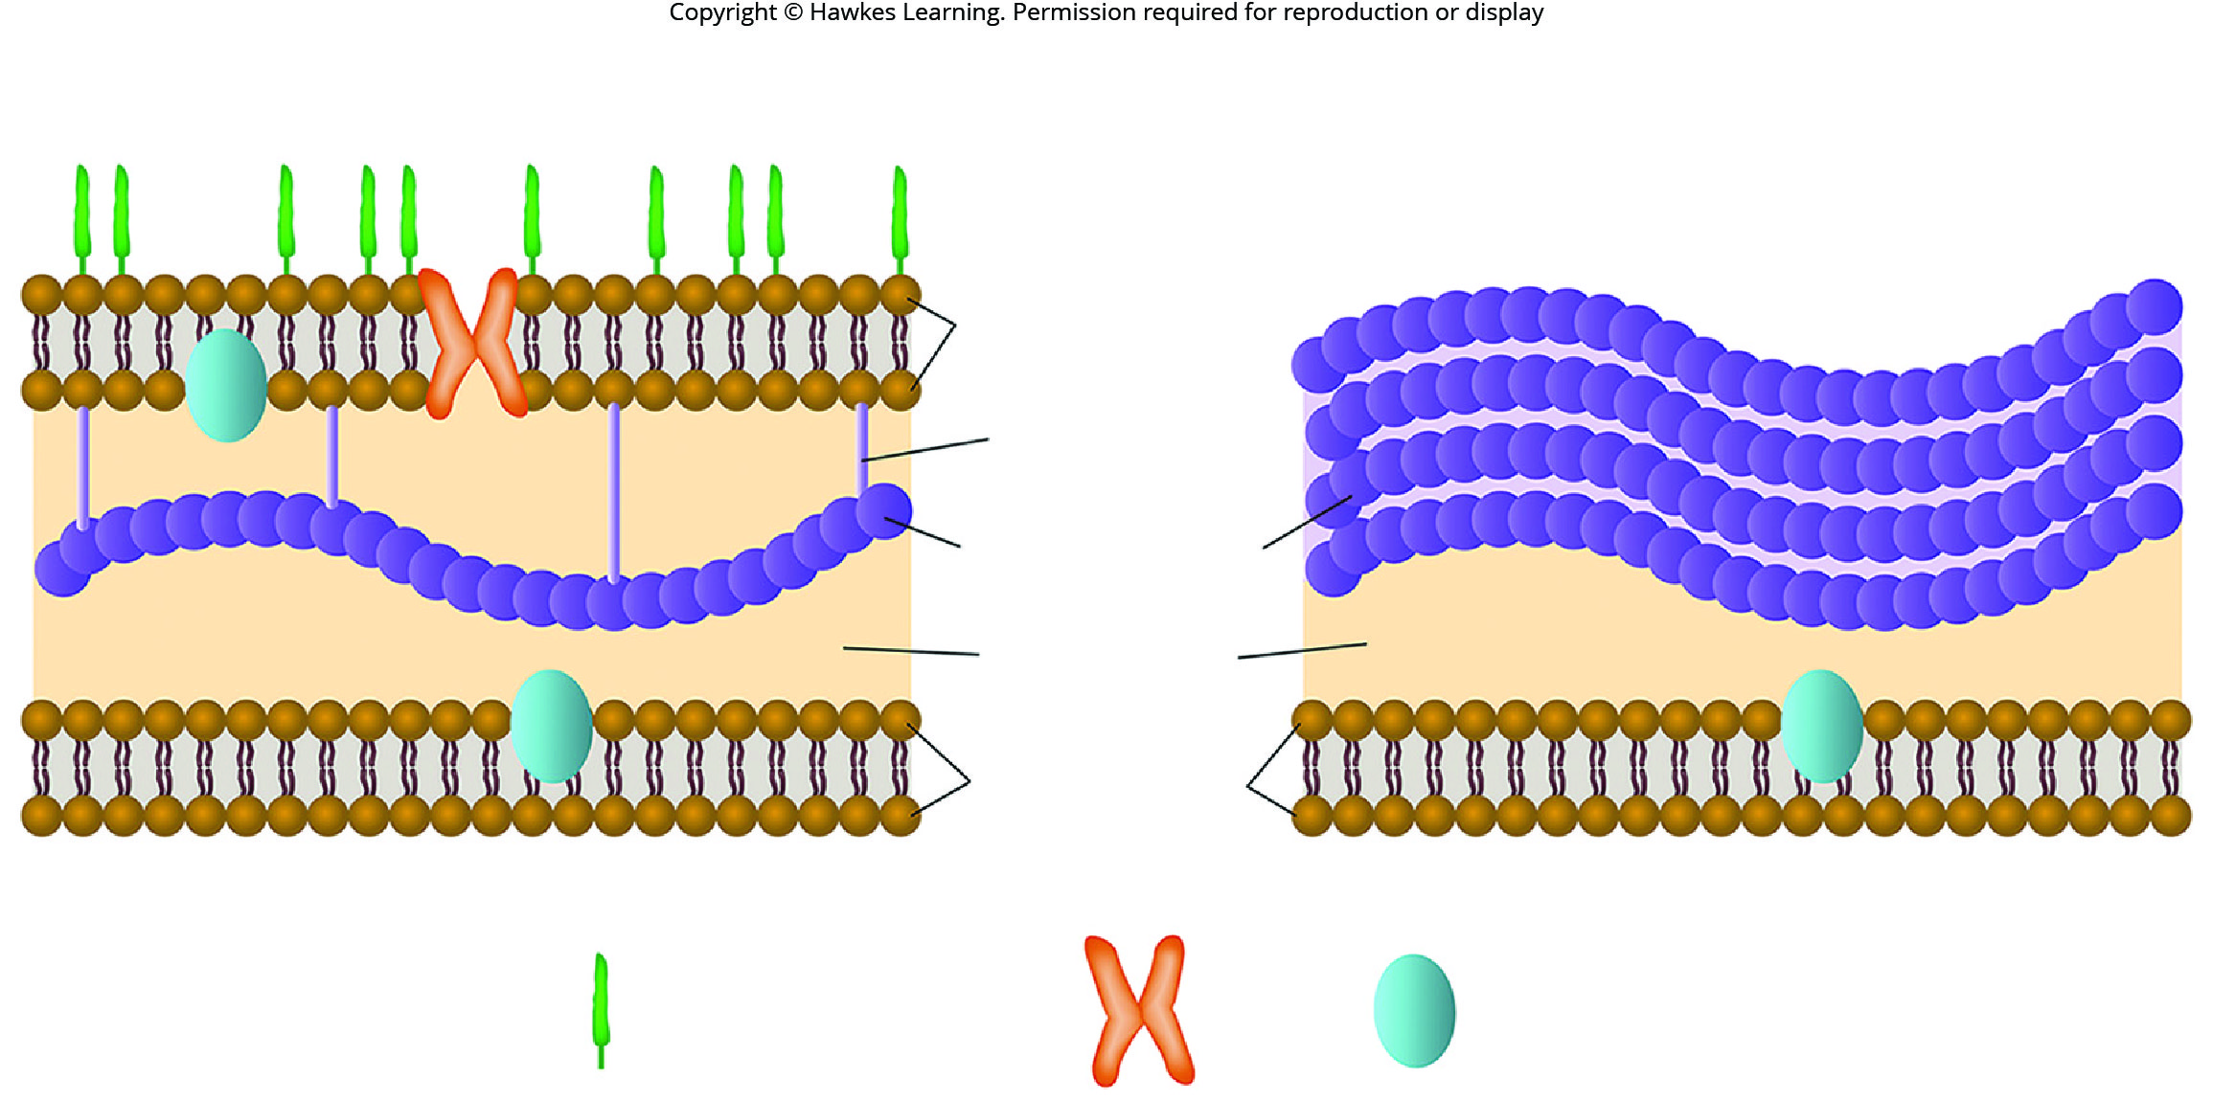
Lesson 22.2 Figure 8

Slide 18
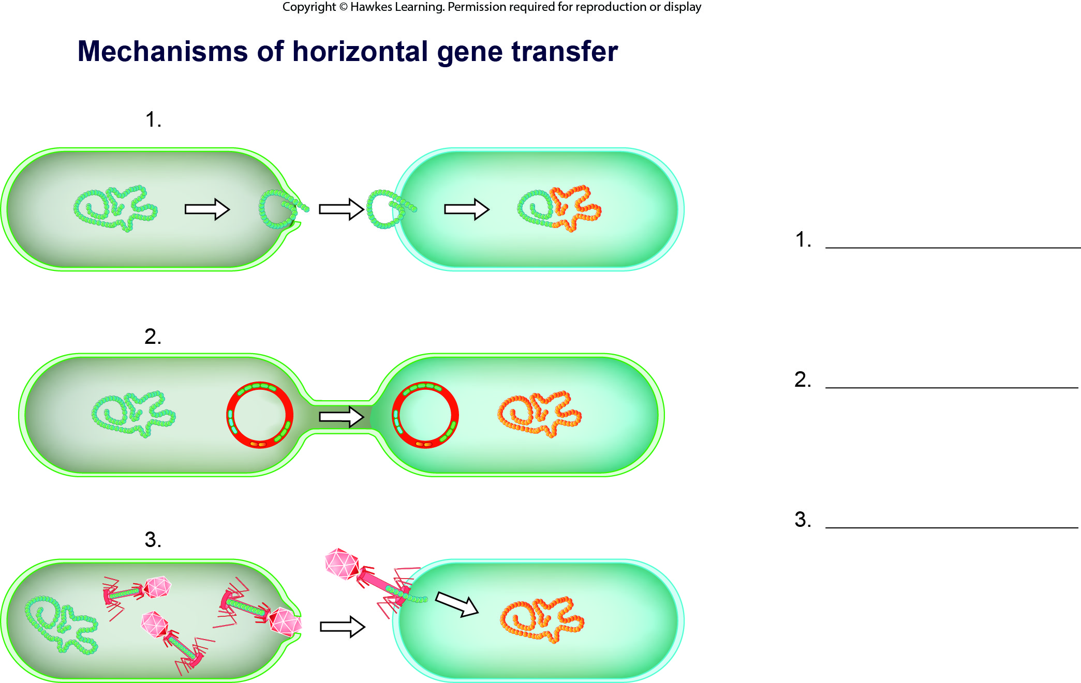
Lesson 22.2 Figure 9 - Numbered

Slide 19
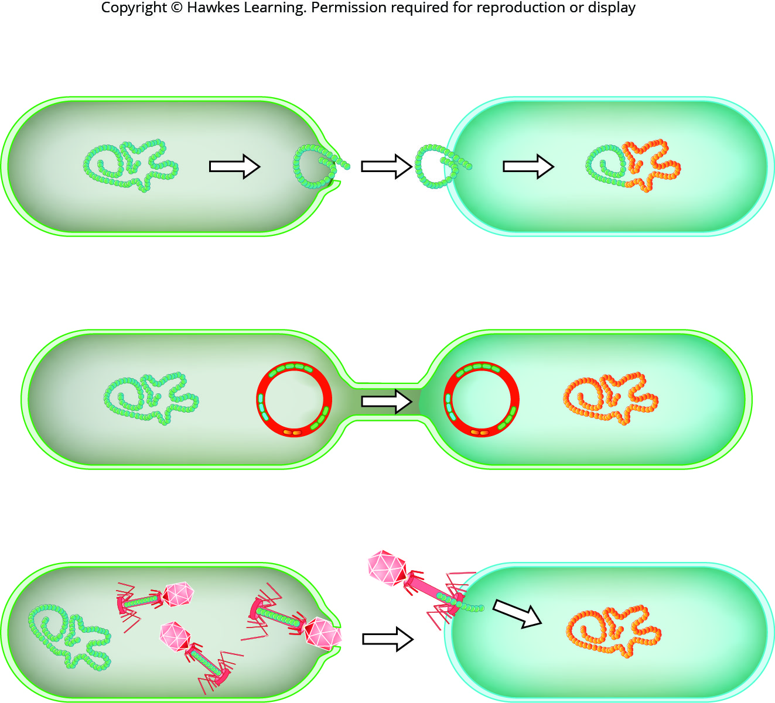
Lesson 22.2 Figure 9

Slide 20
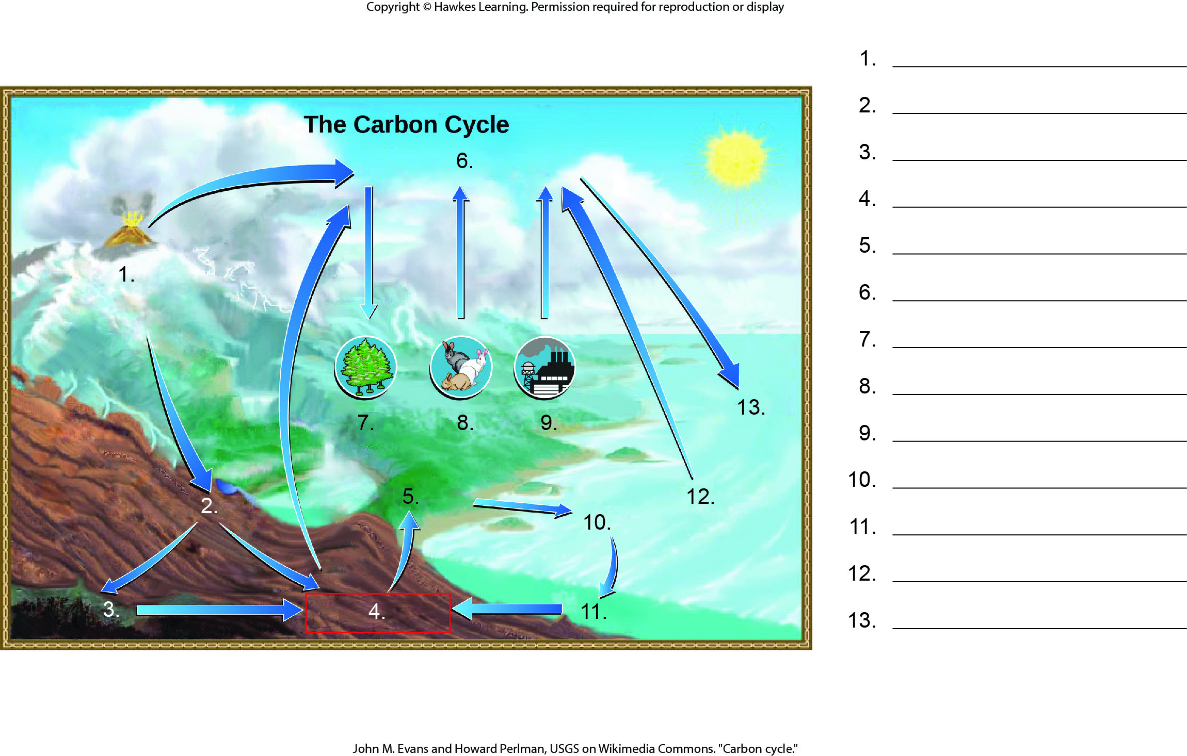
Lesson 22.3 Figure 1 - Numbered

Slide 21
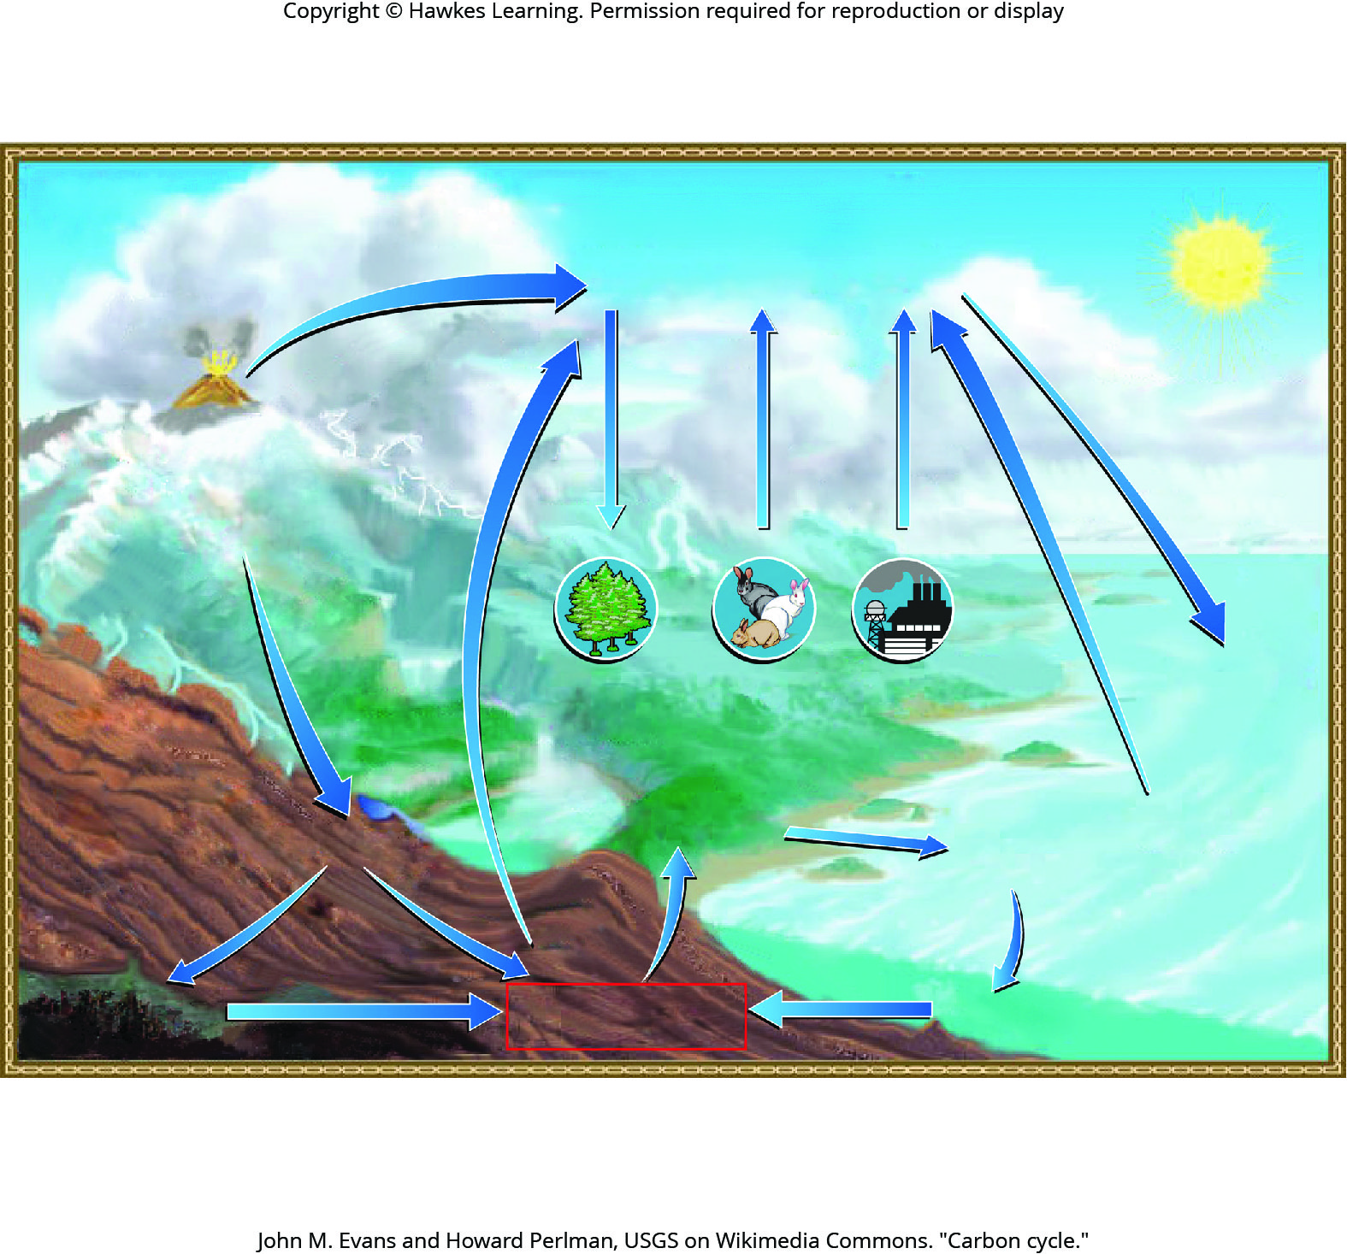
Lesson 22.3 Figure 1

Slide 22
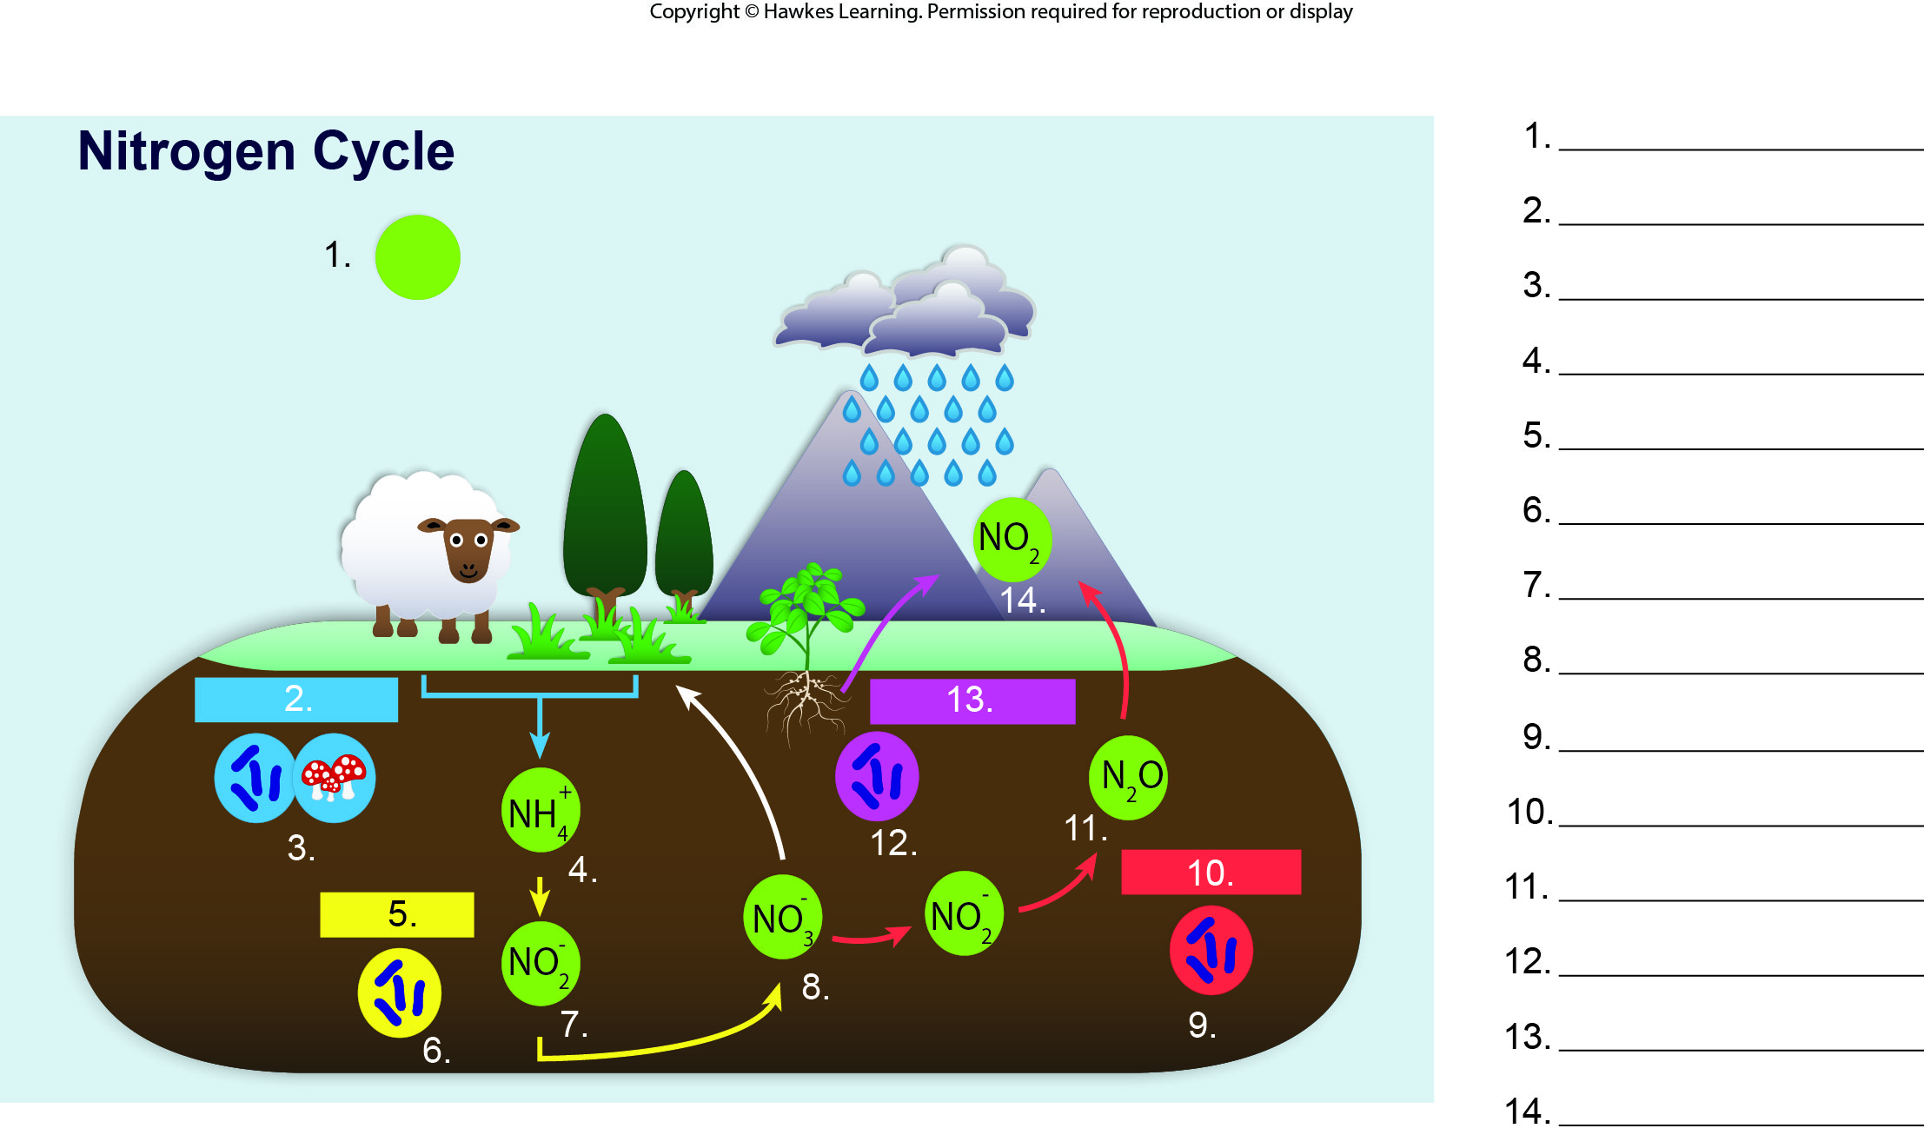
Lesson 22.3 Figure 3 - Numbered

Slide 23
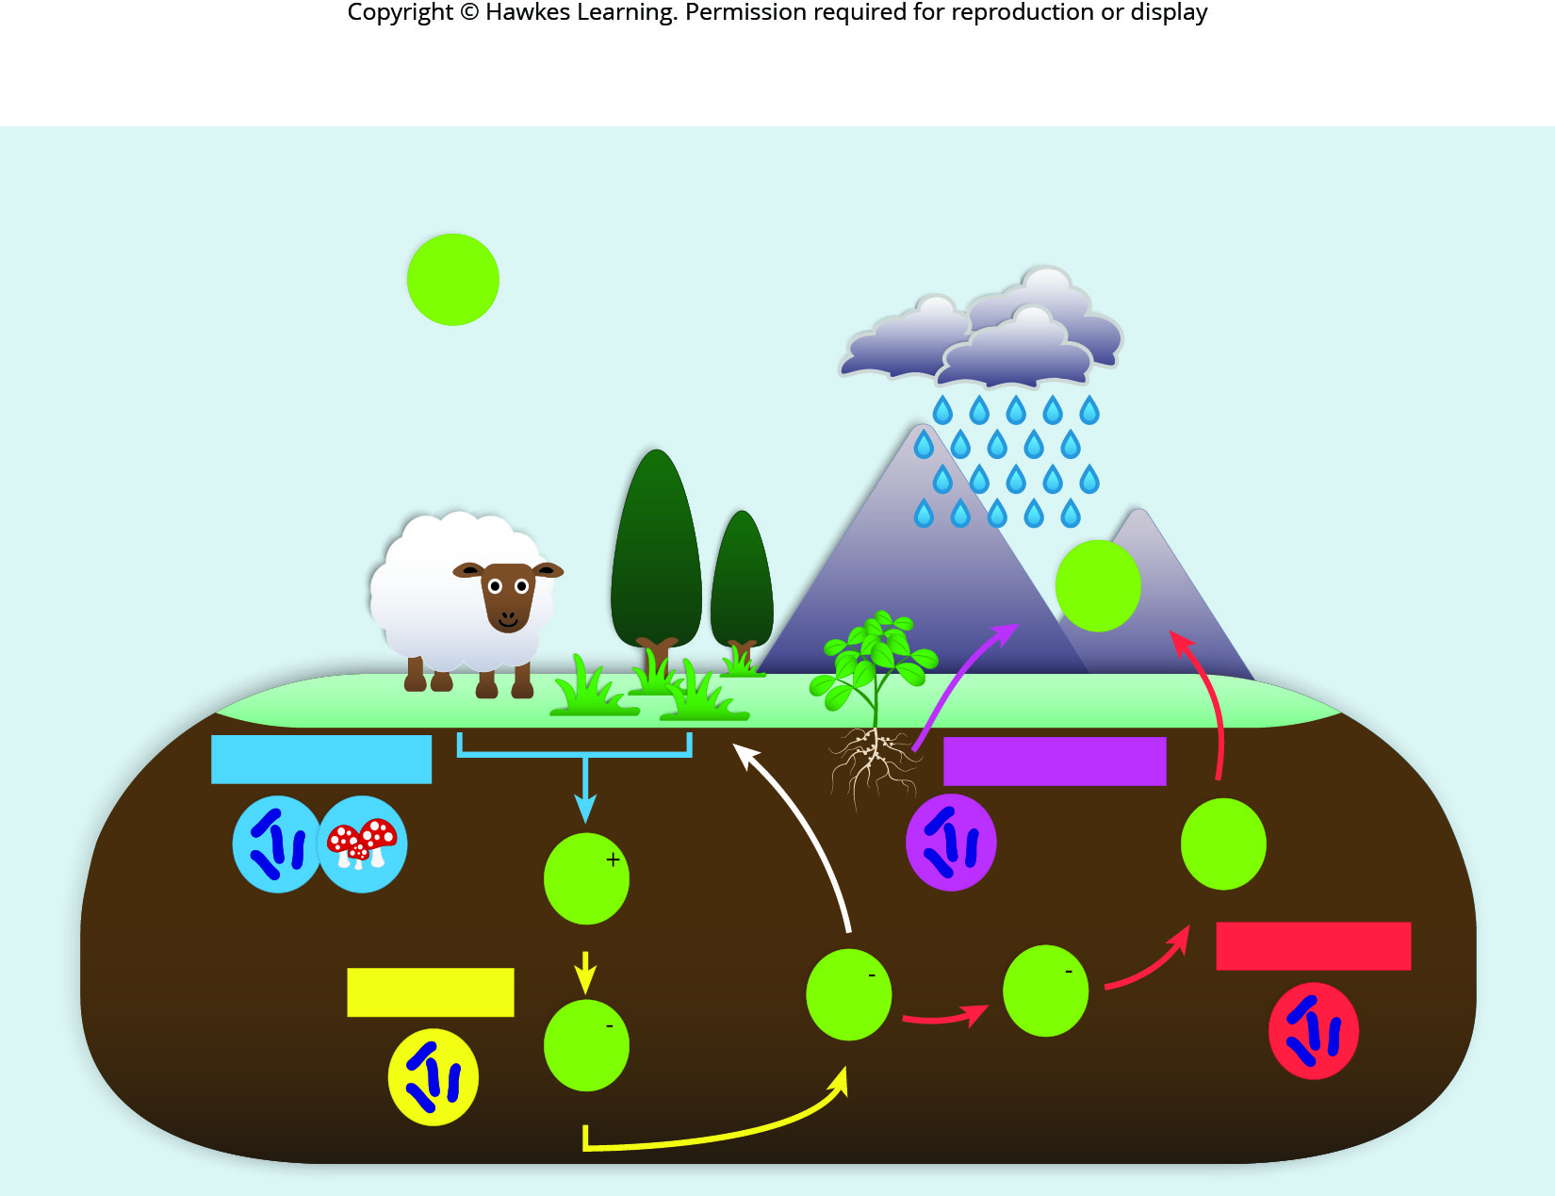
Lesson 22.3 Figure 3

Slide 24
Hawkes Learning – End of PowerPoint

