Slide 1
Chapter 23
Protists

Slide 2
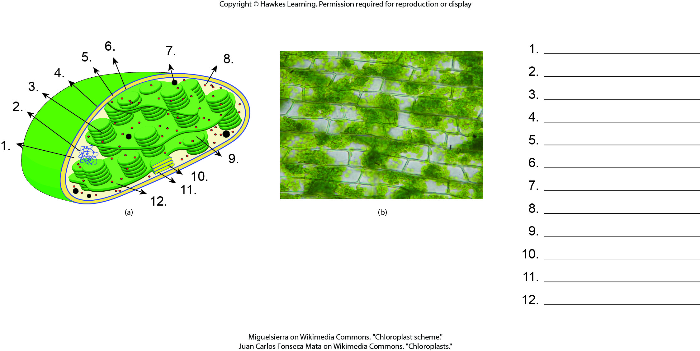
Lesson 23.1 Figure 4 - Numbered

Slide 3
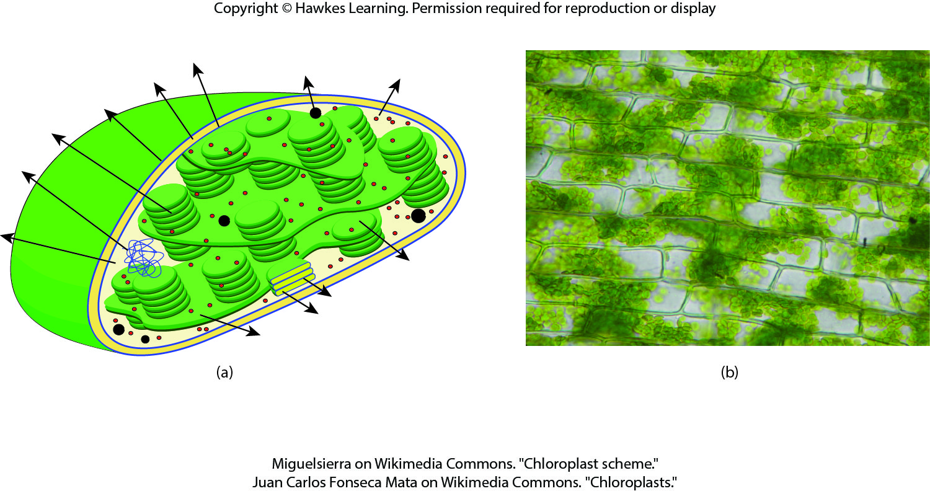
Lesson 23.1 Figure 4

Slide 4
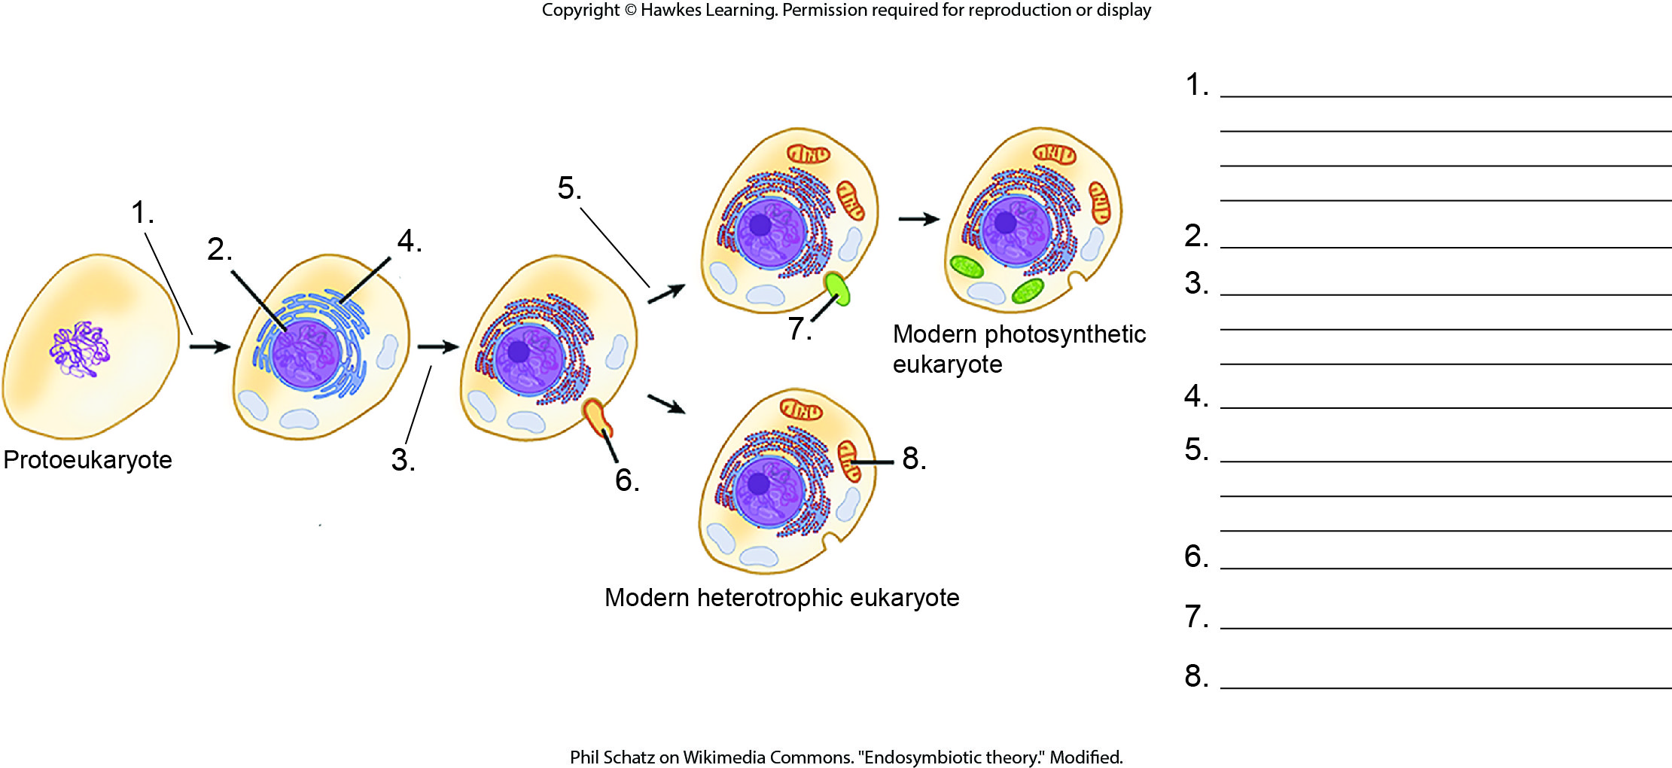
Lesson 23.1 Figure 7 - Numbered

Slide 5
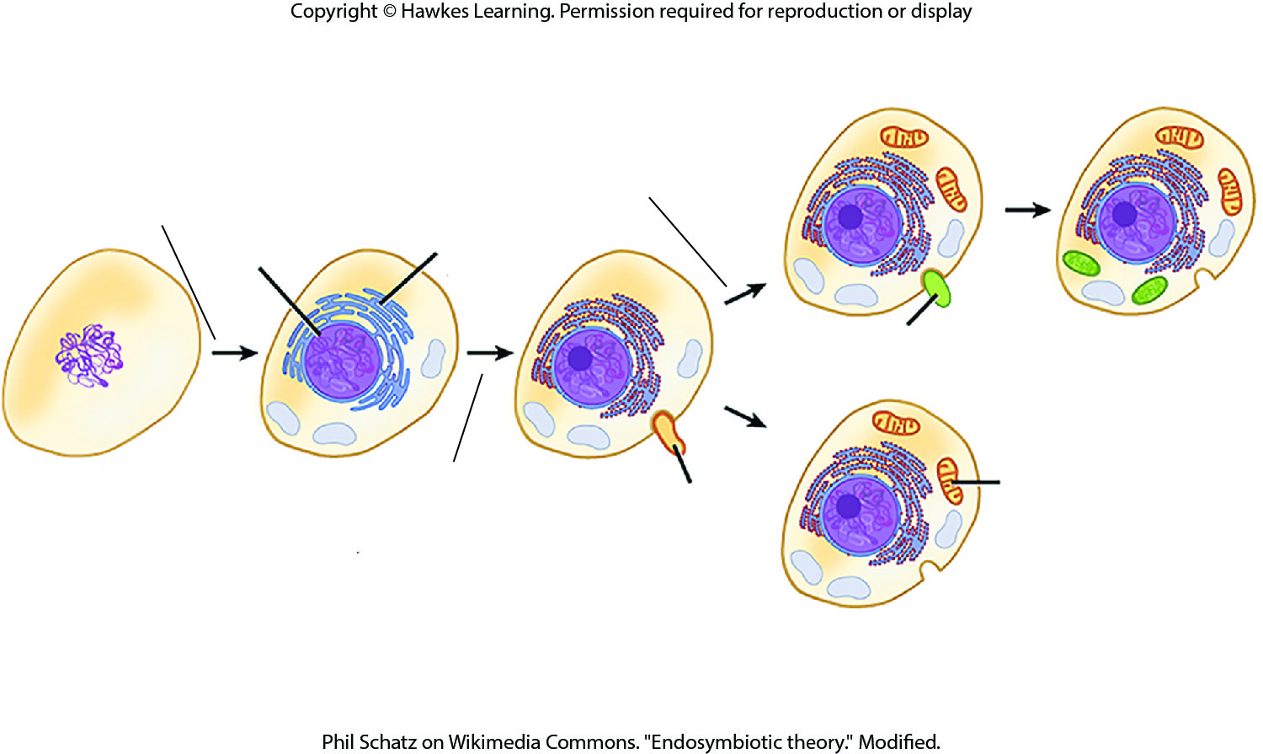
Lesson 23.1 Figure 7

Slide 6
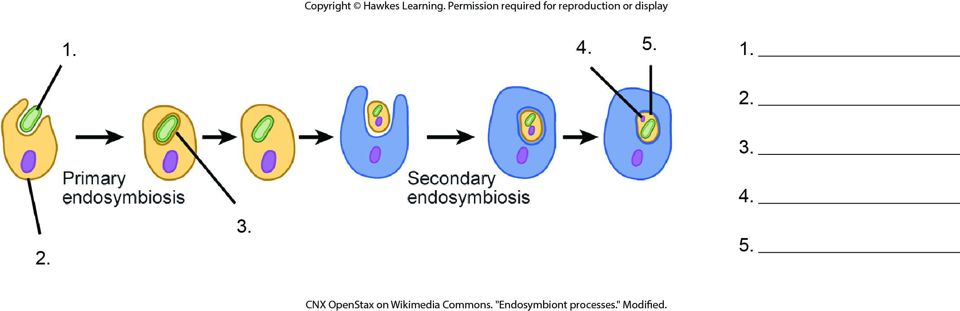
Lesson 23.1 Figure 8 - Numbered

Slide 7
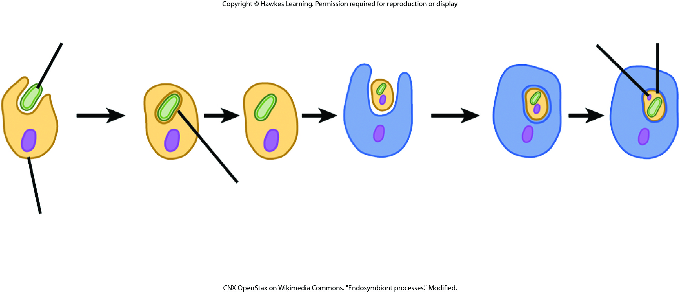
Lesson 23.1 Figure 8

Slide 8
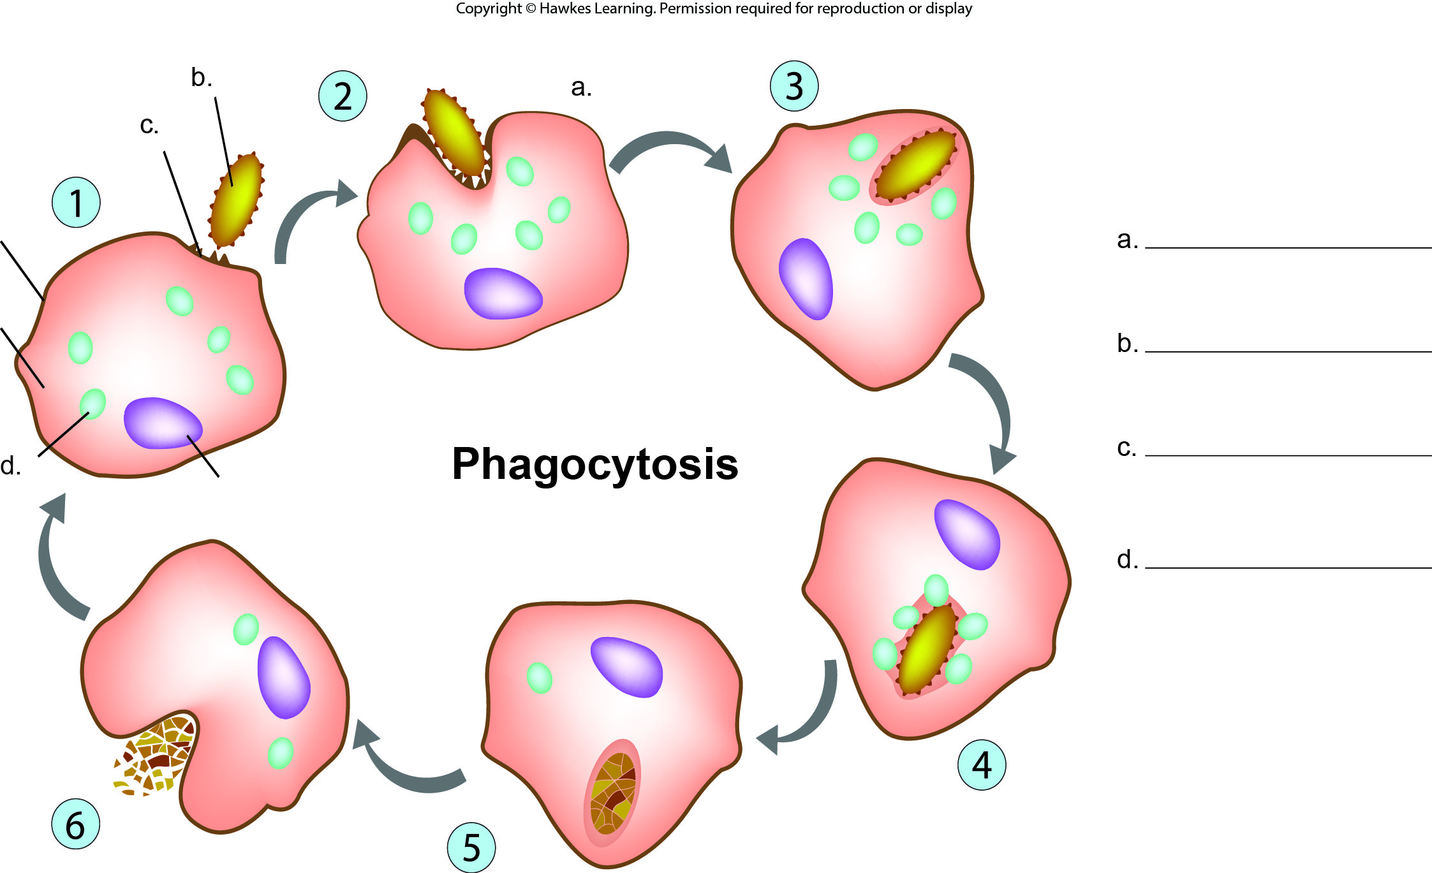
Lesson 23.2 Figure 2 - Numbered

Slide 9
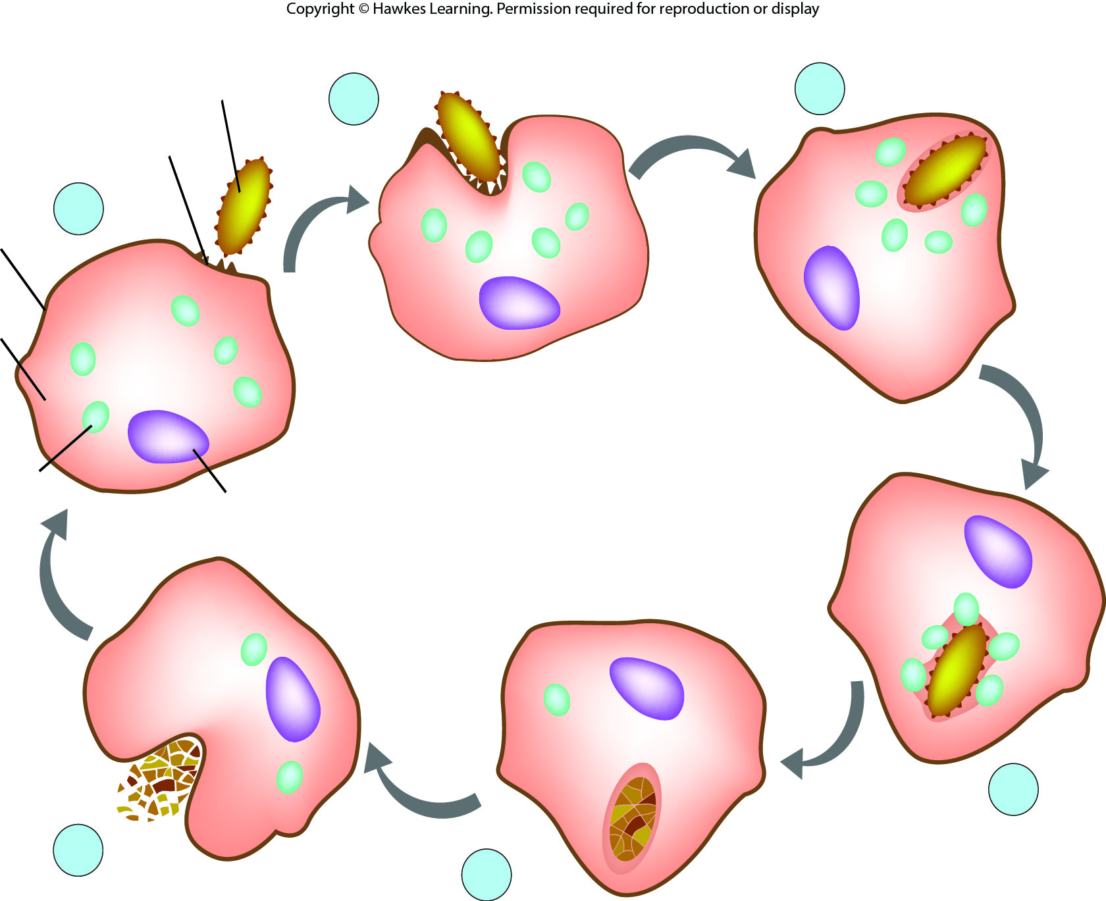
Lesson 23.2 Figure 2

Slide 10
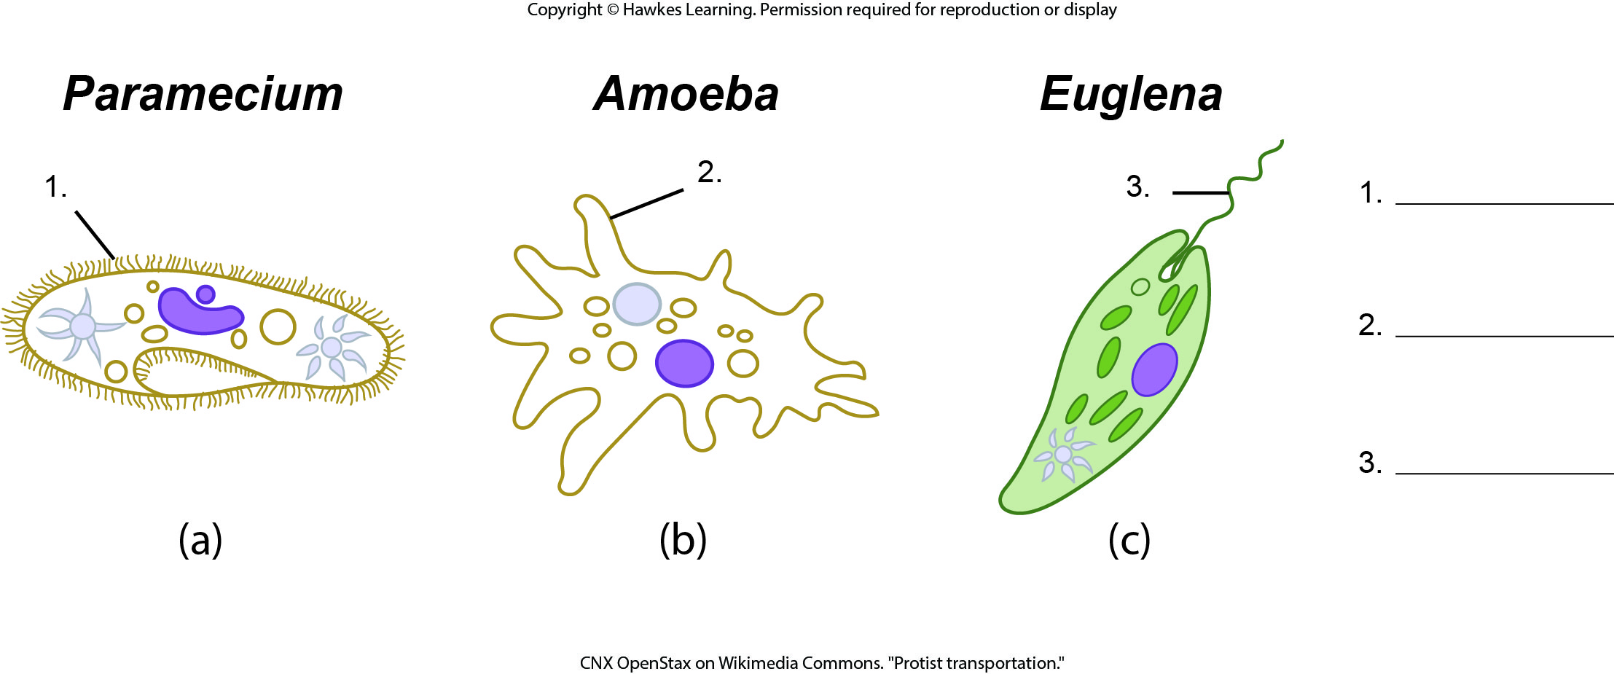
Lesson 23.2 Figure 3 - Numbered

Slide 11
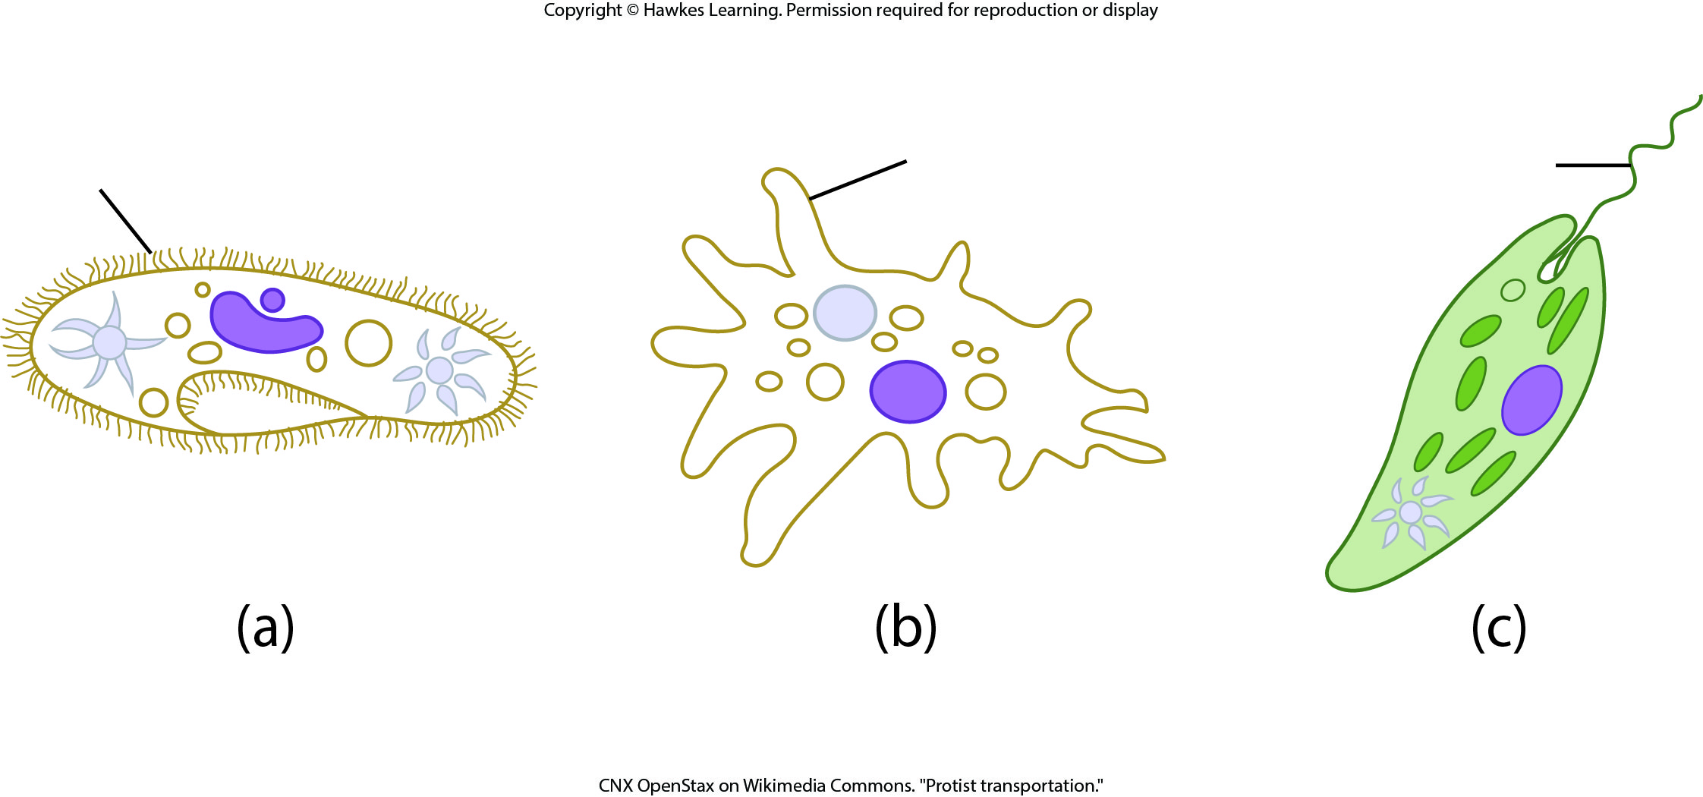
Lesson 23.2 Figure 3

Slide 12
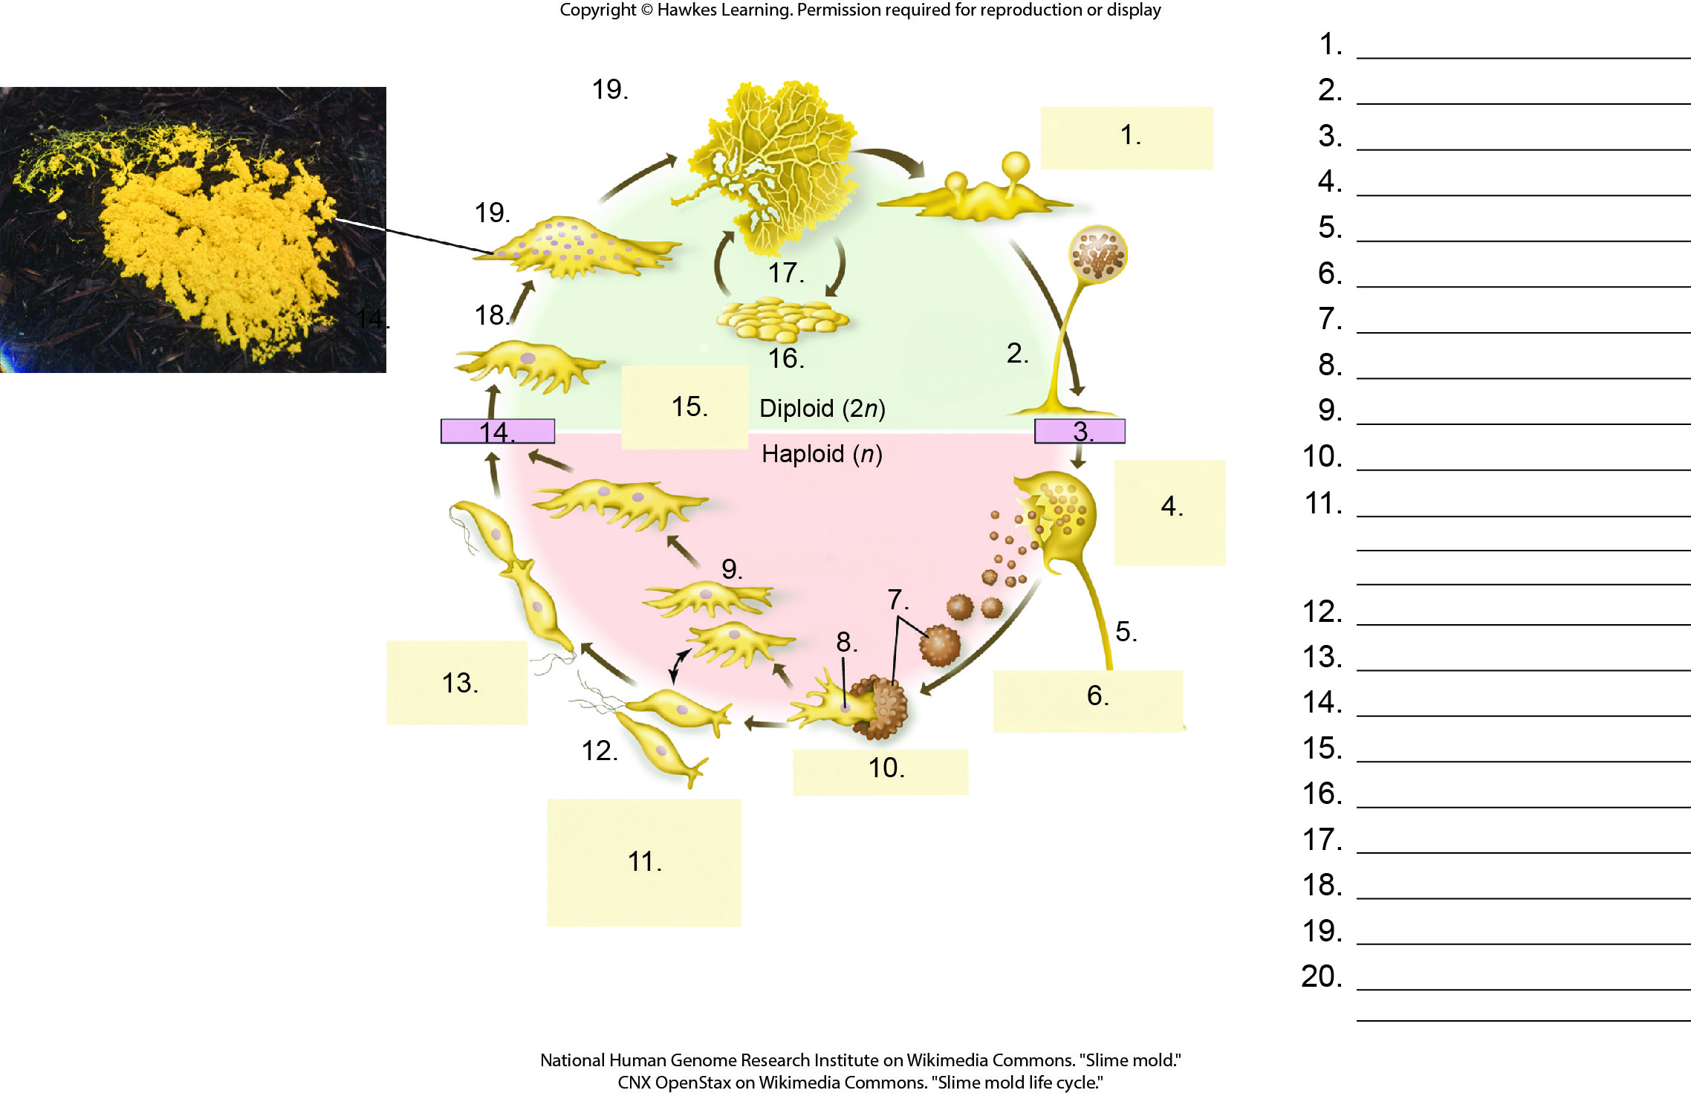
Lesson 23.2 Figure 9 - Numbered

Slide 13
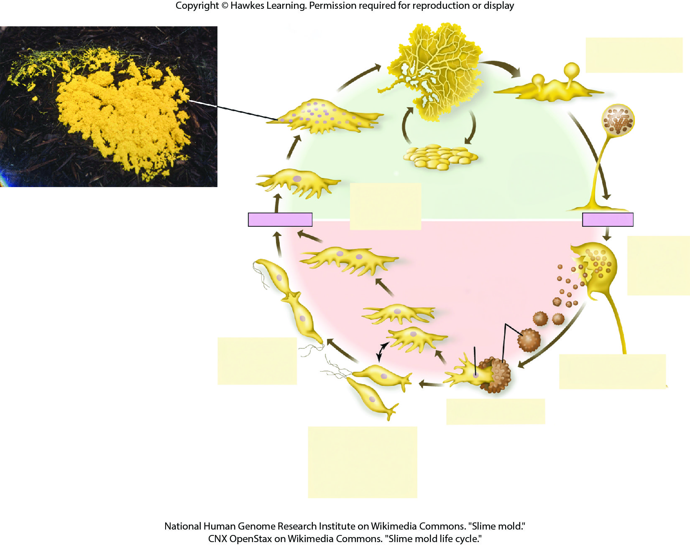
Lesson 23.2 Figure 9

Slide 14
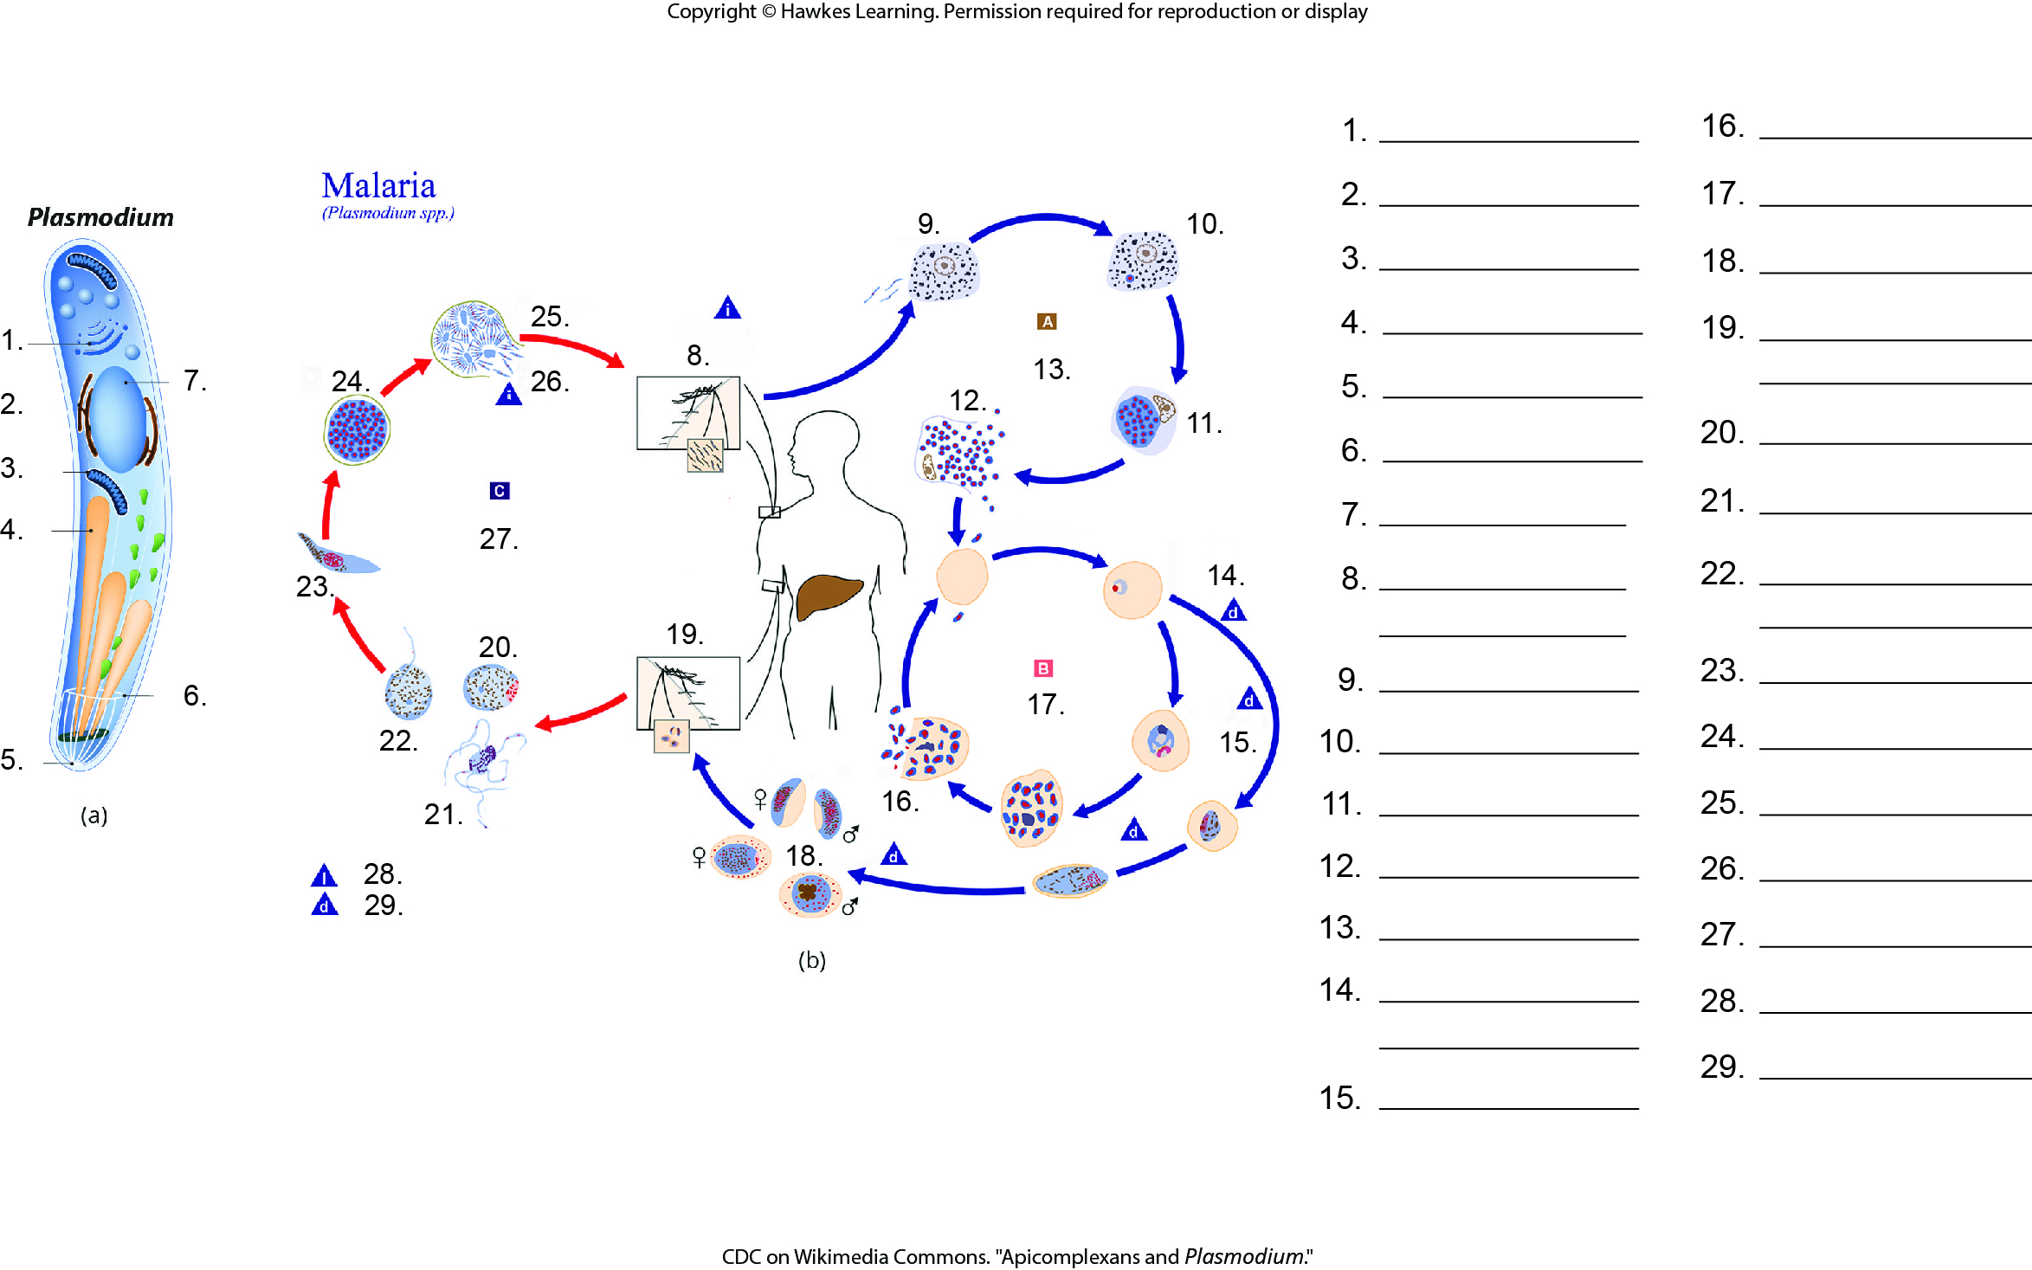
Lesson 23.2 Figure 19 - Numbered

Slide 15
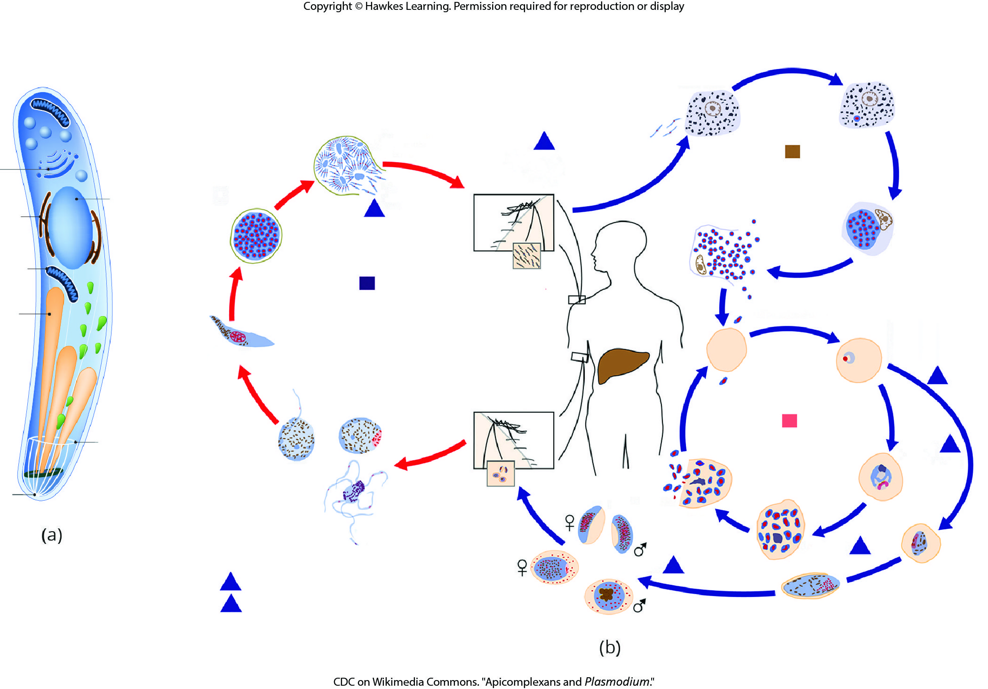
Lesson 23.2 Figure 19

Slide 16
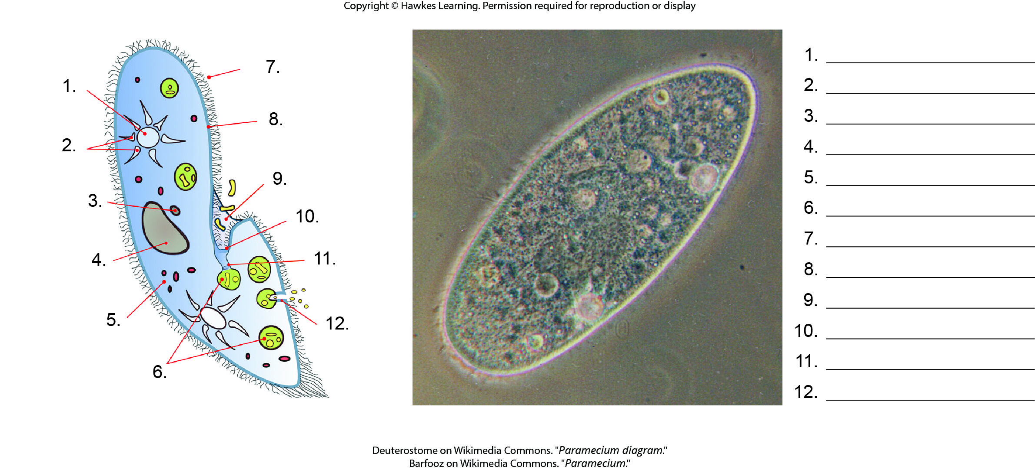
Lesson 23.2 Figure 20 - Numbered

Slide 17
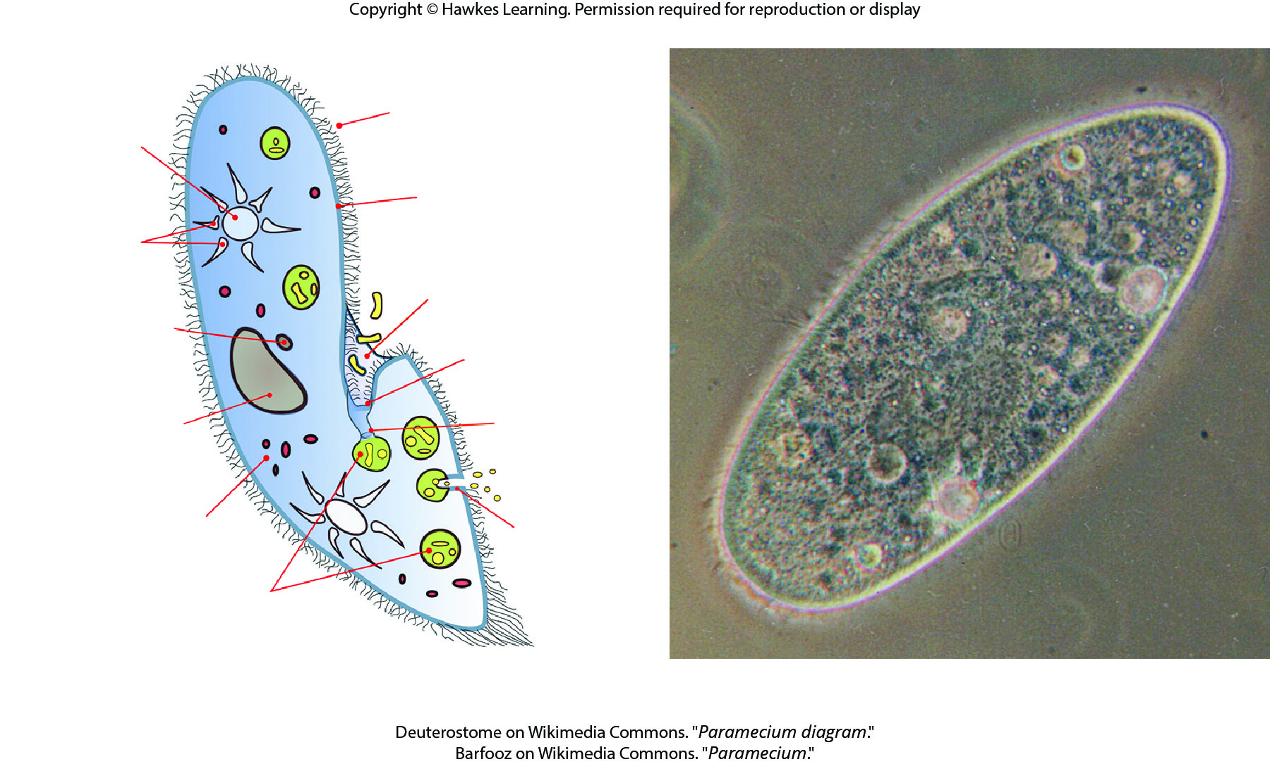
Lesson 23.2 Figure 20

Slide 18
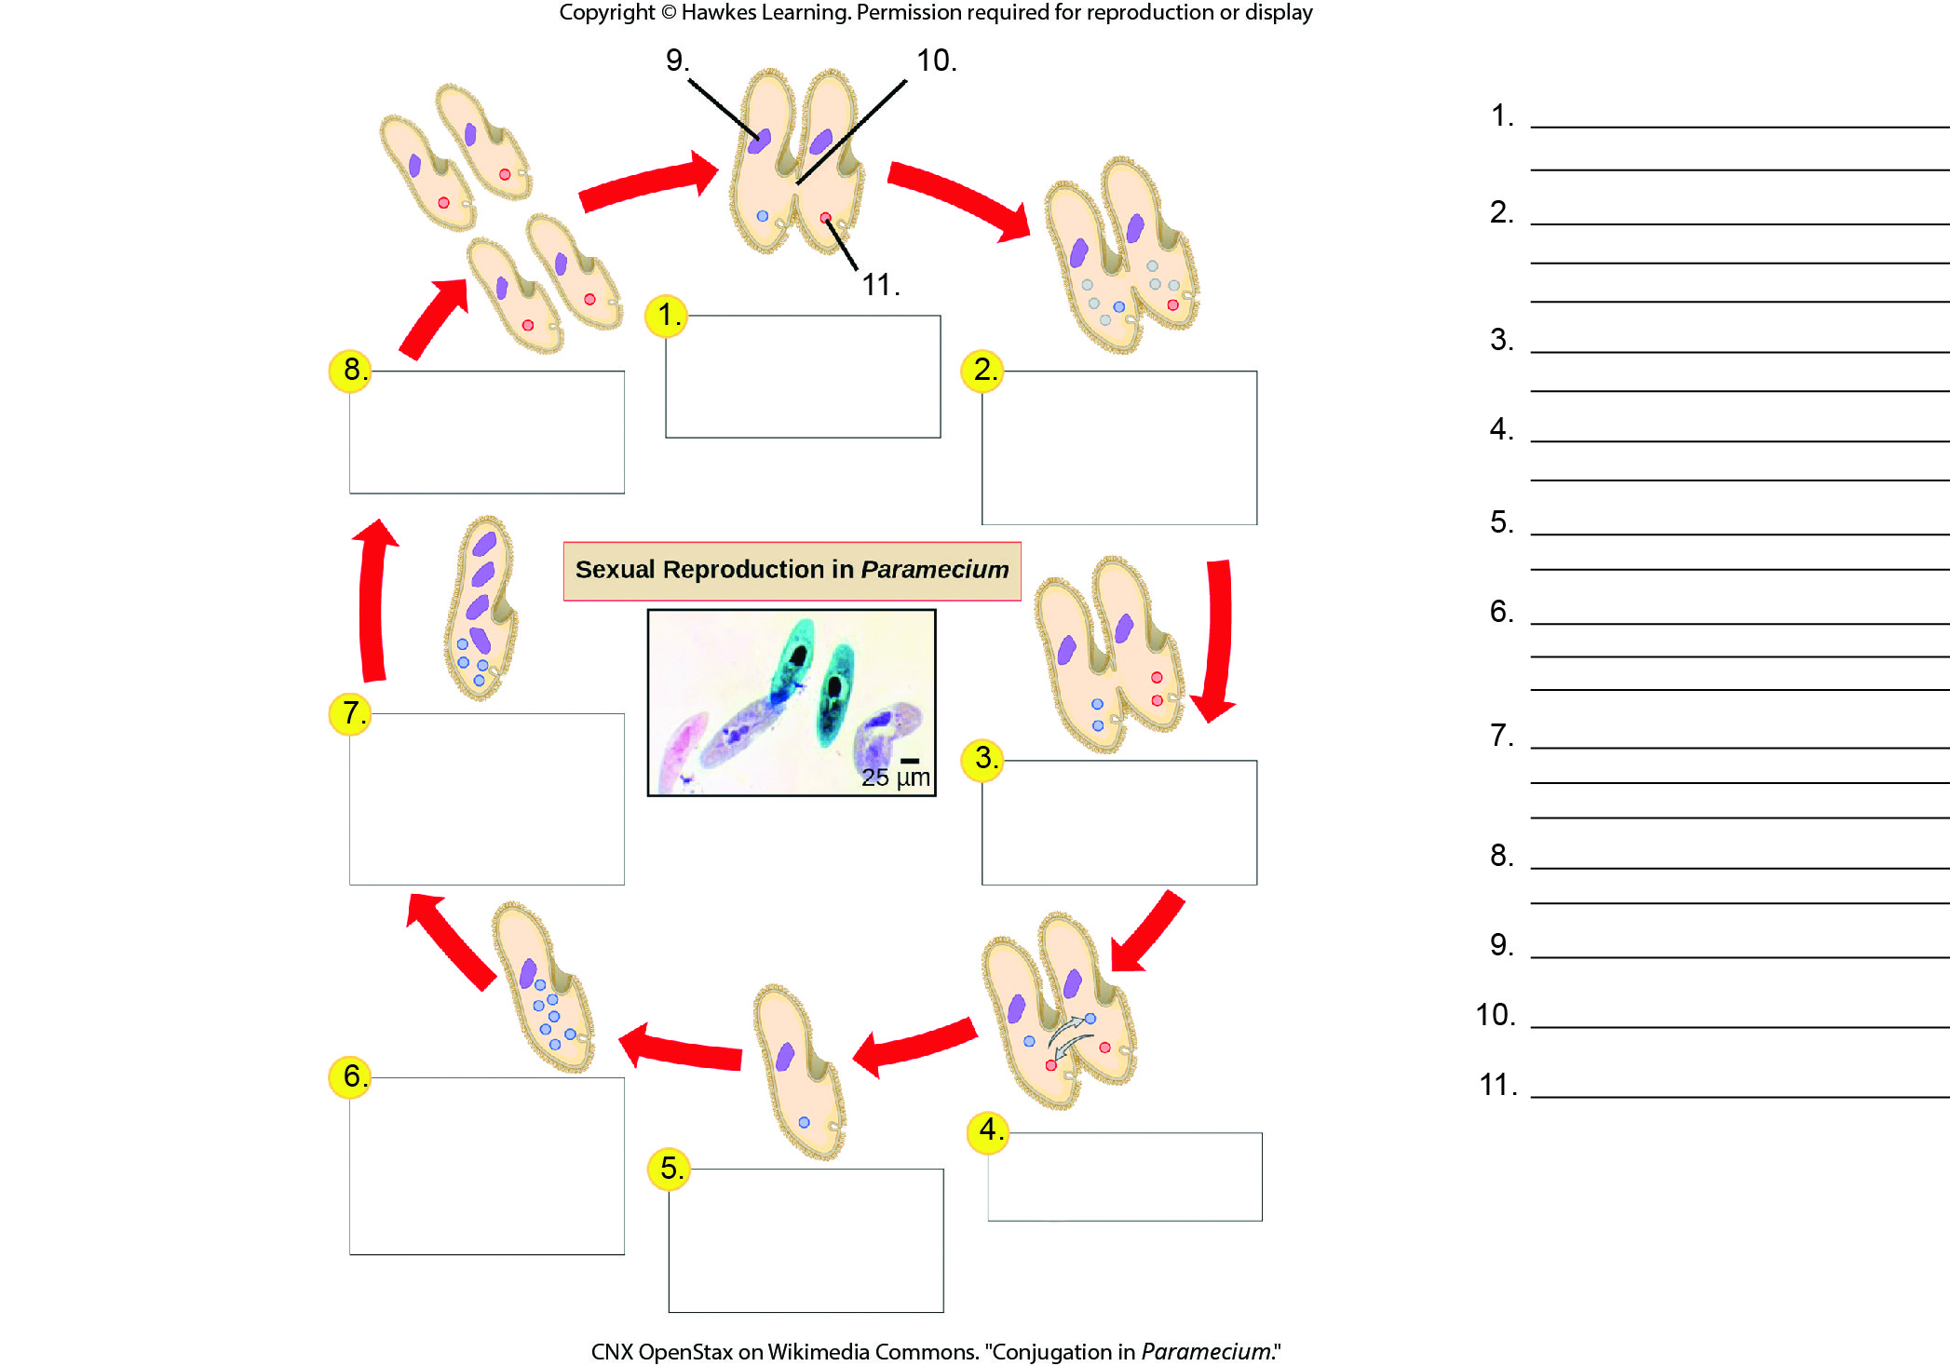
Lesson 23.2 Figure 21 - Numbered

Slide 19
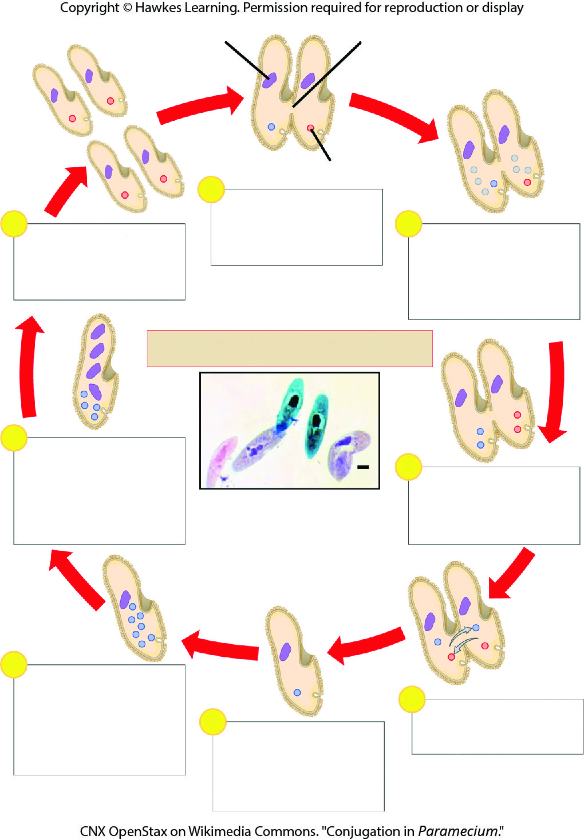
Lesson 23.2 Figure 21

Slide 20
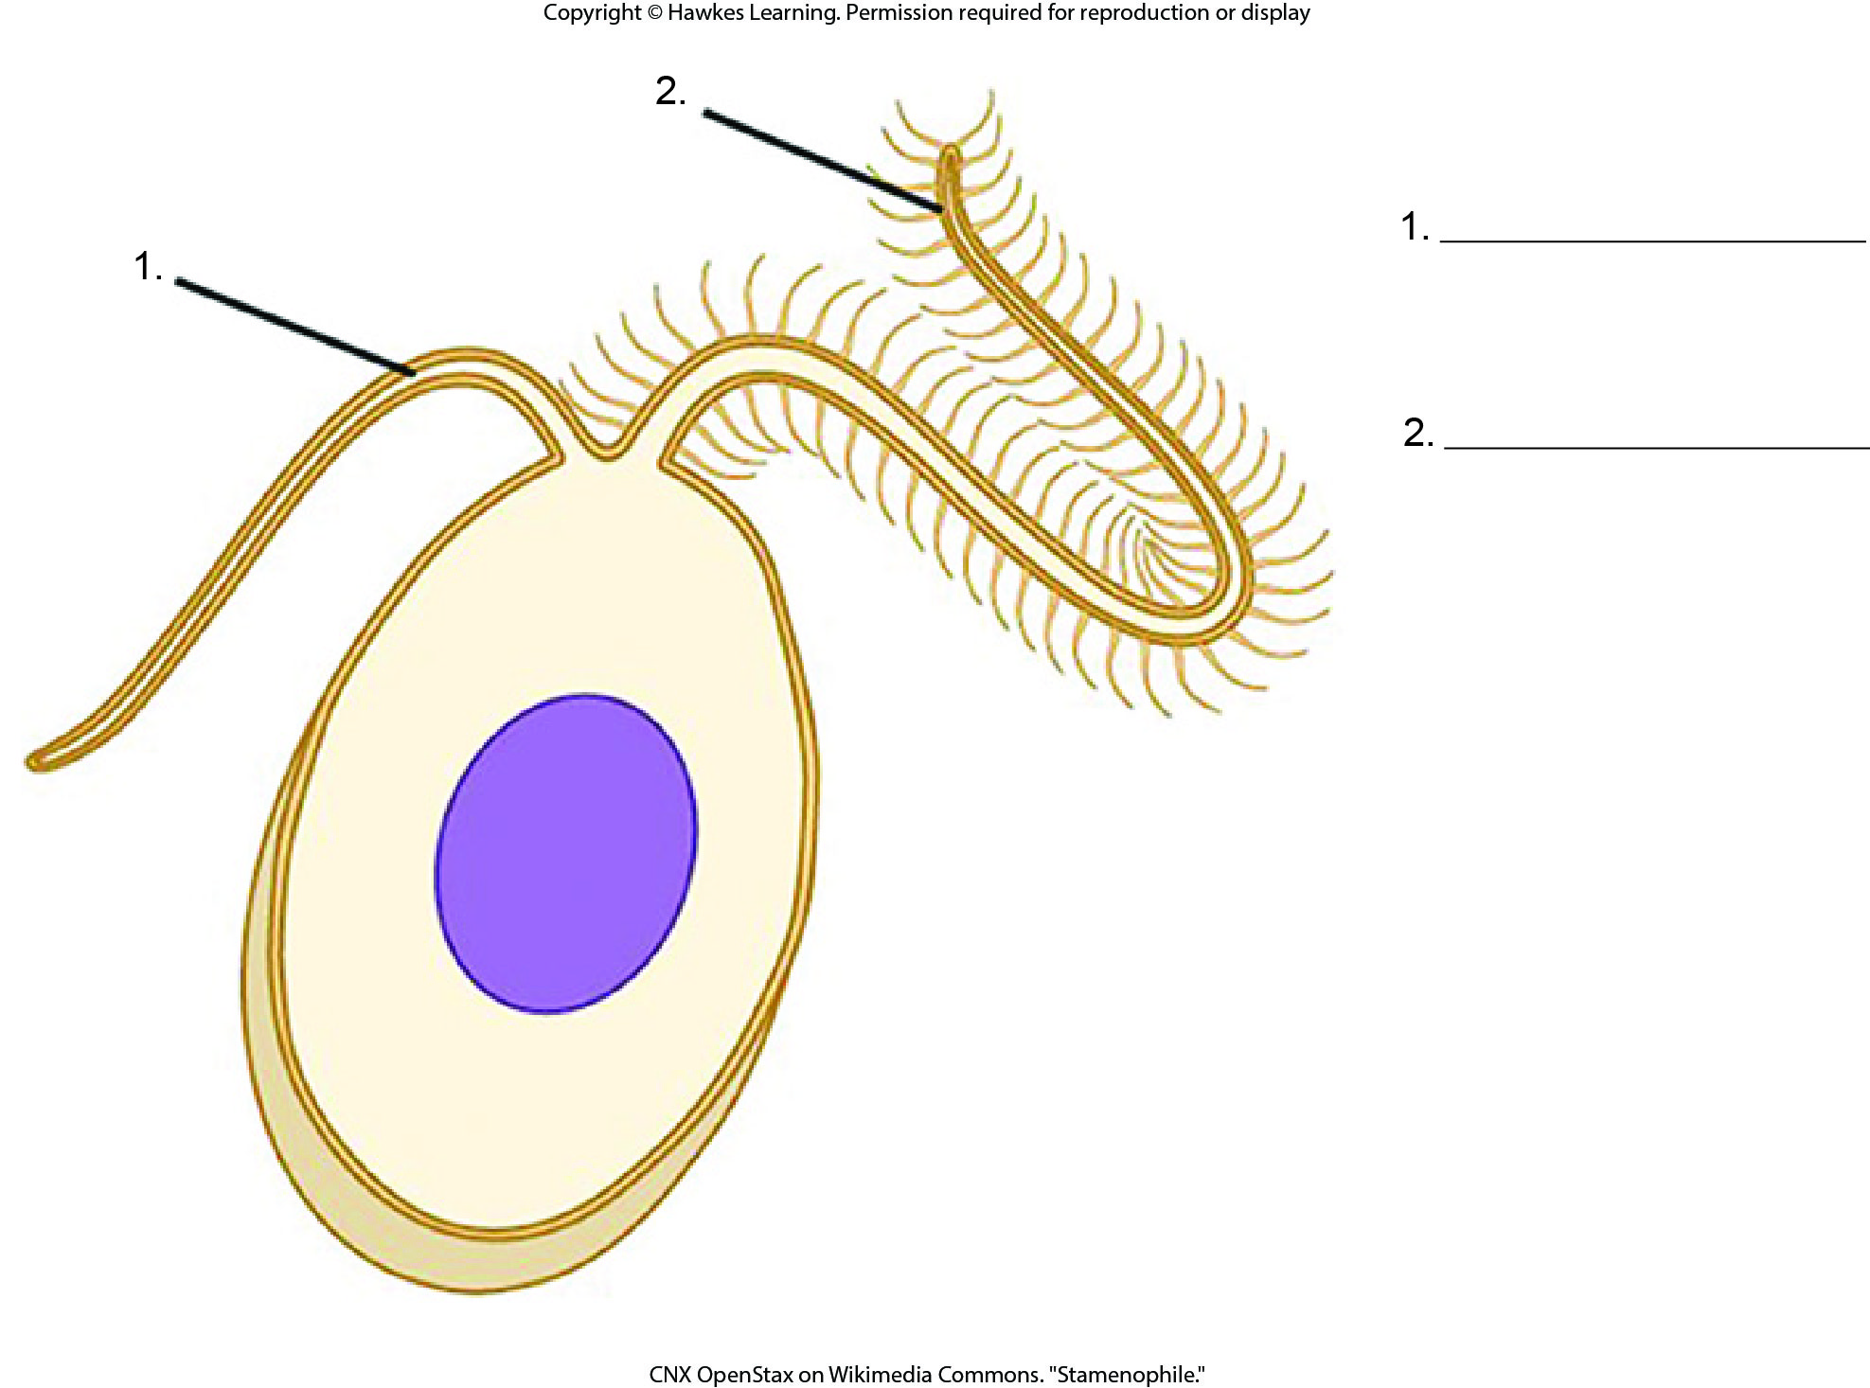
Lesson 23.2 Figure 22 - Numbered

Slide 21
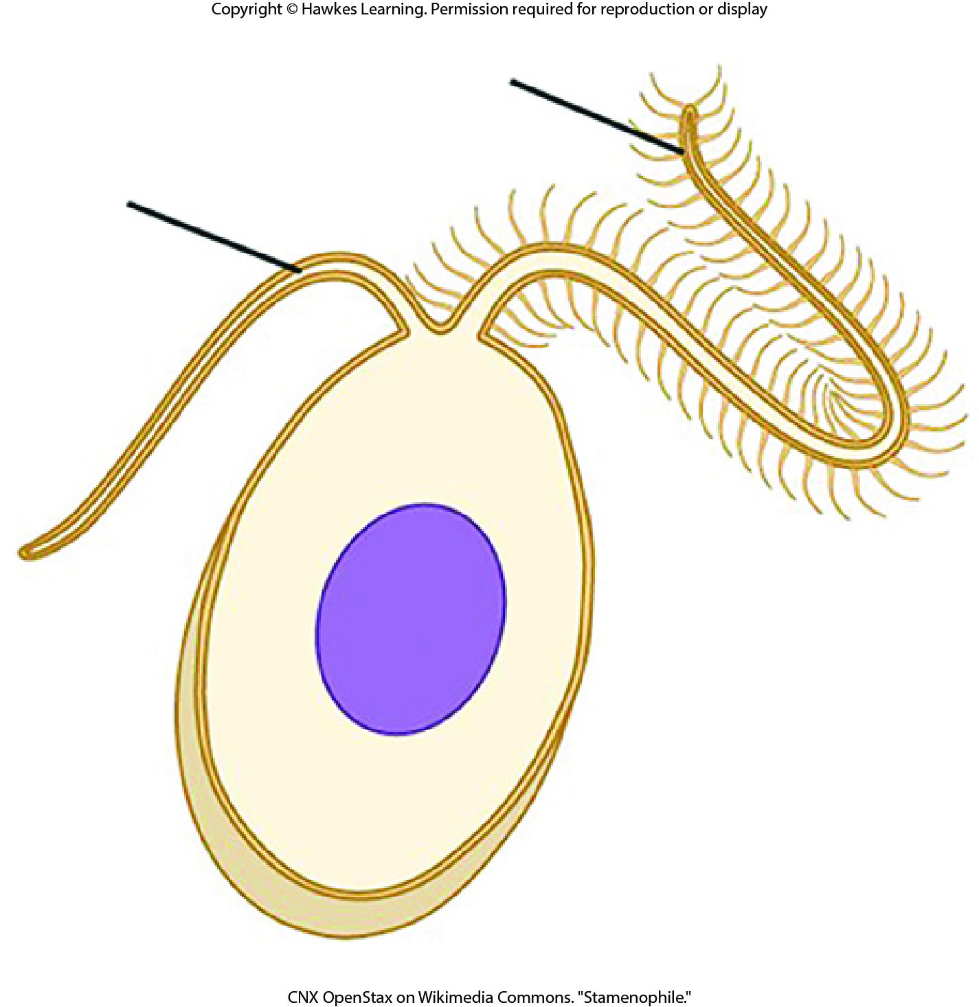
Lesson 23.2 Figure 22

Slide 22
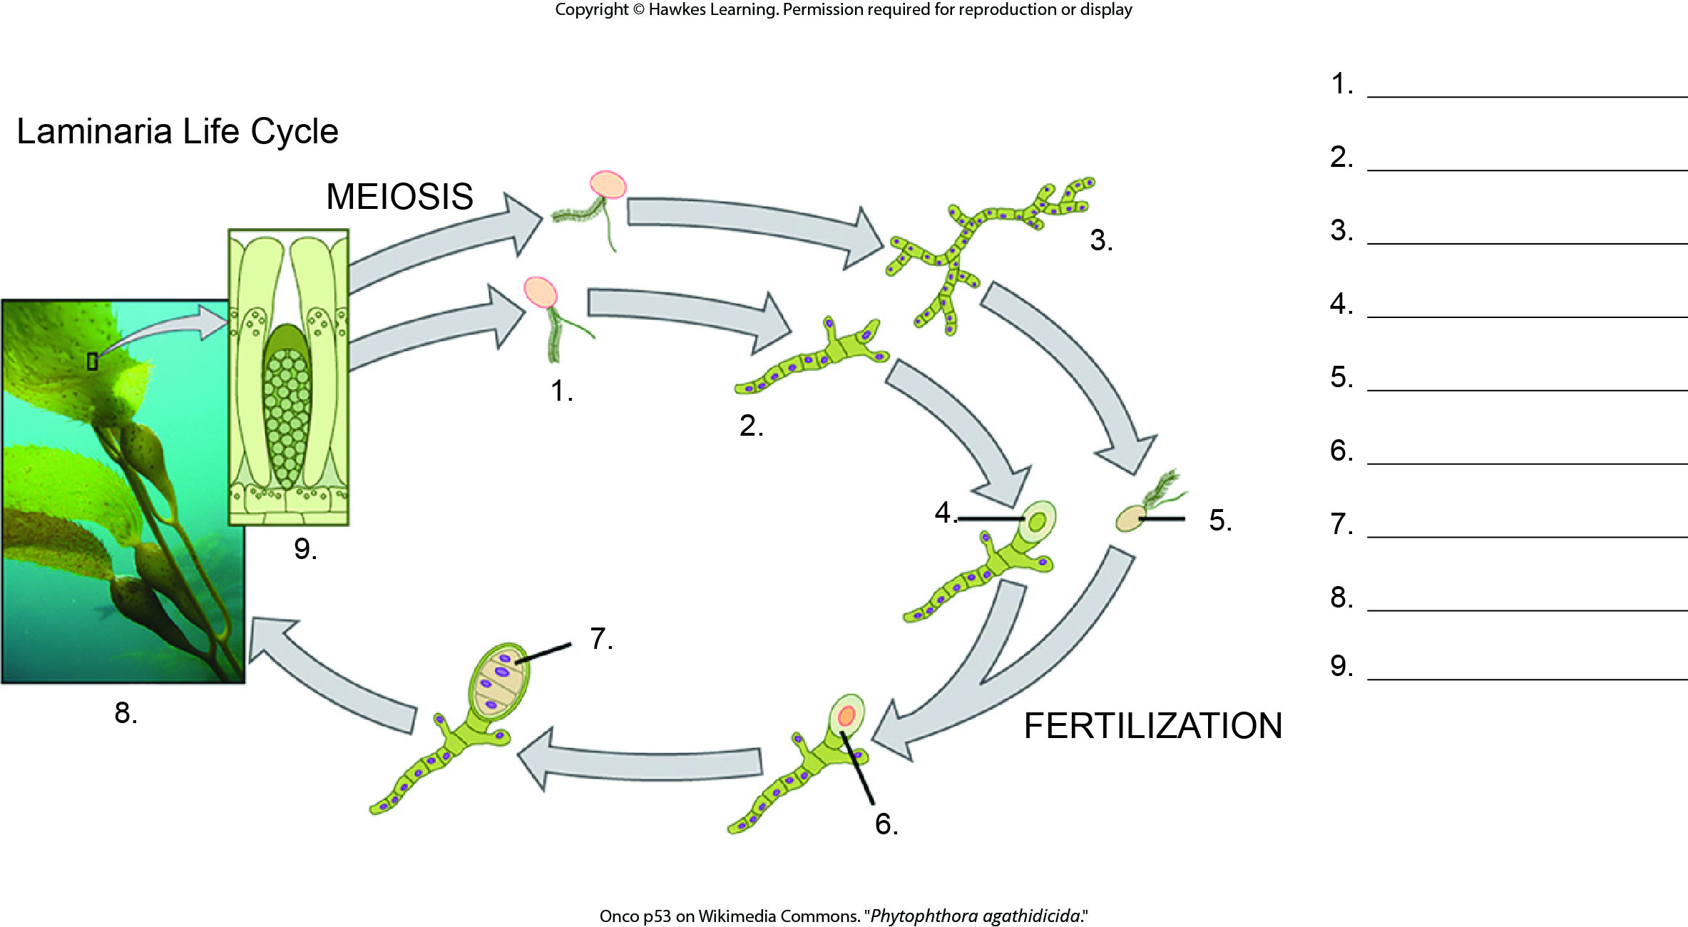
Lesson 23.2 Figure 25 - Numbered

Slide 23
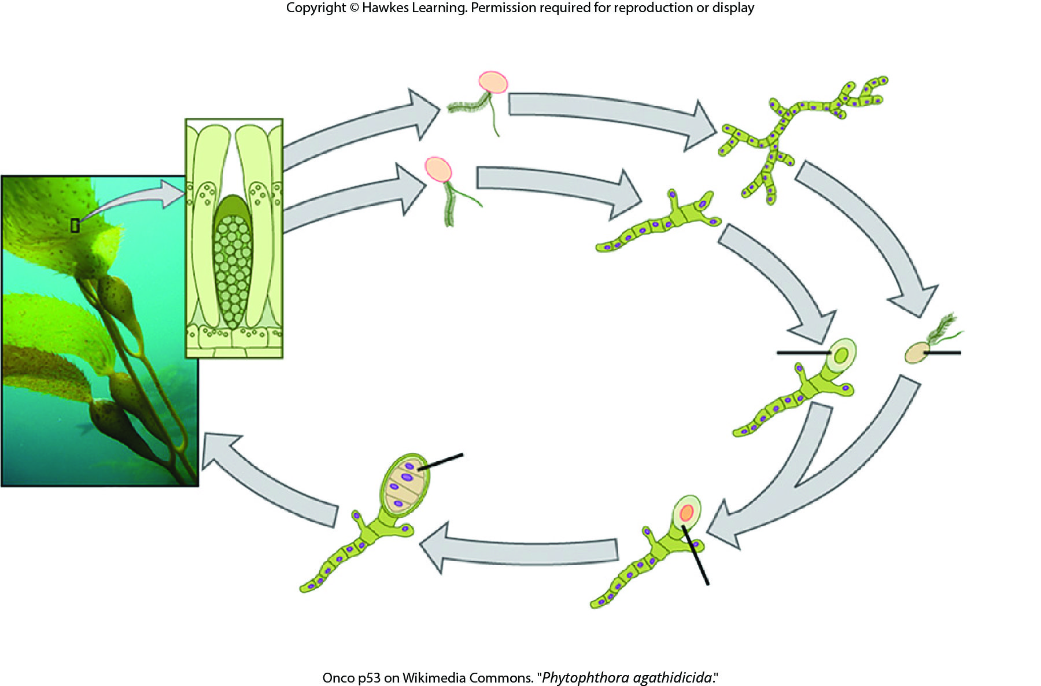
Lesson 23.2 Figure 25

Slide 24
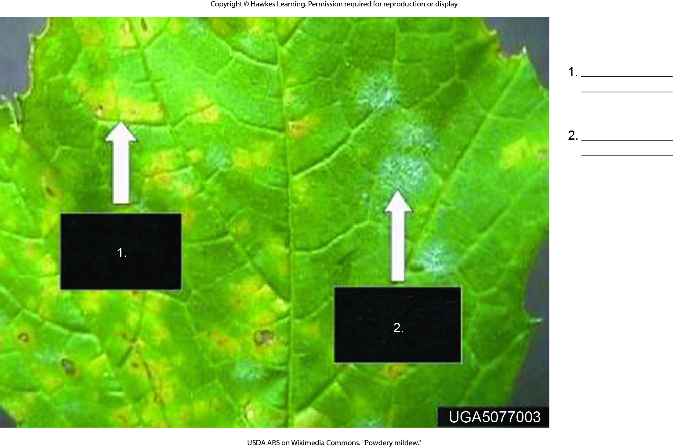
Lesson 23.3 Figure 6 - Numbered

Slide 25
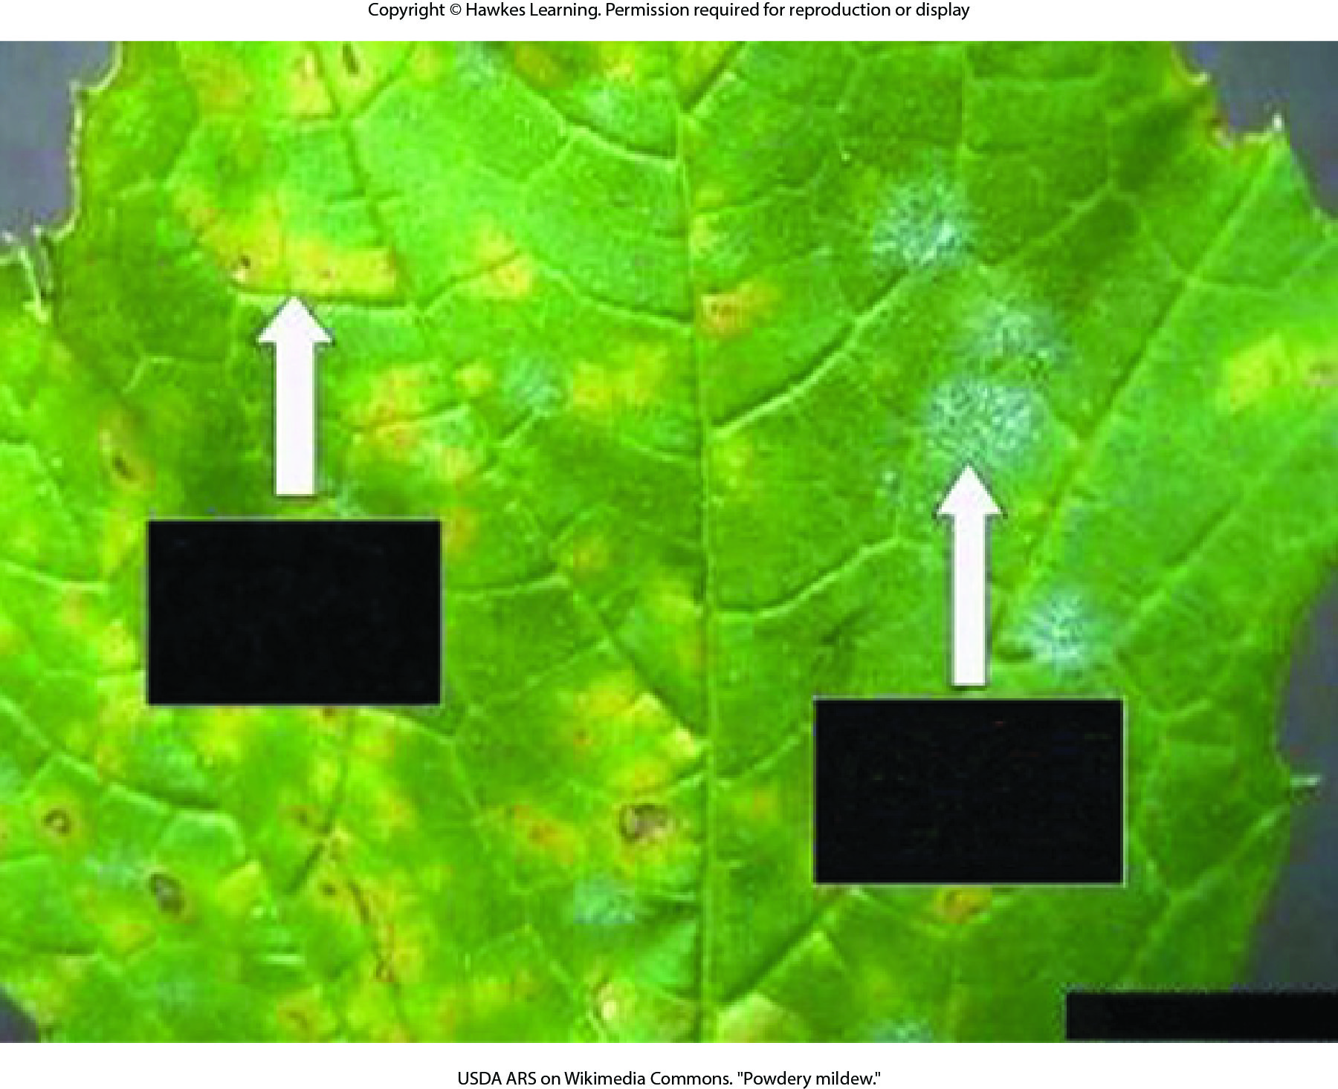
Lesson 23.3 Figure 6

Slide 26
Hawkes Learning – End of PowerPoint

