Slide 1
Chapter 24
Fungi

Slide 2
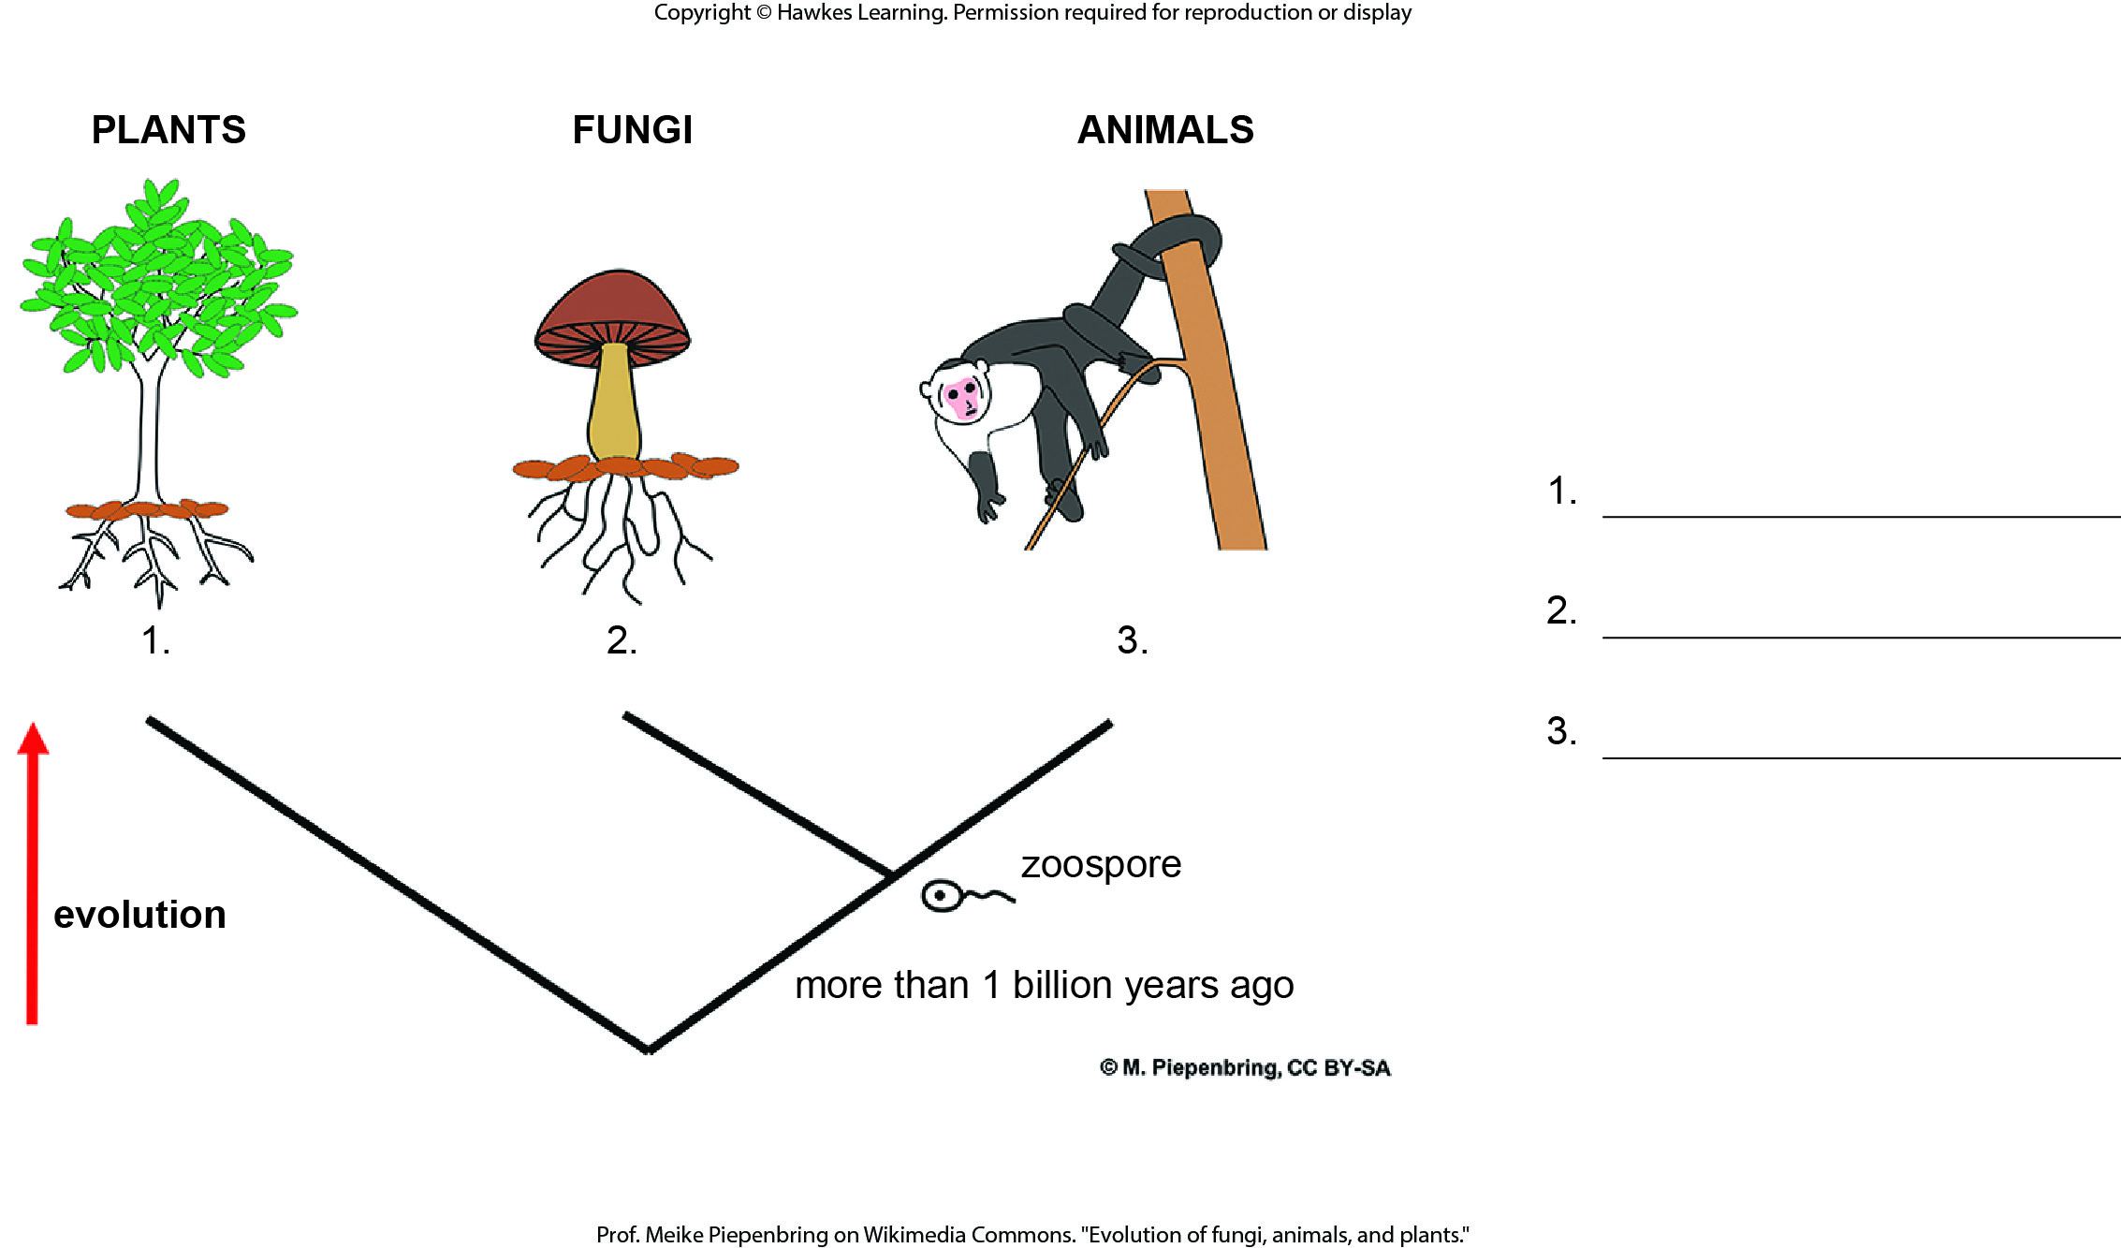
Lesson 24.1 Figure 2 - Numbered

Slide 3
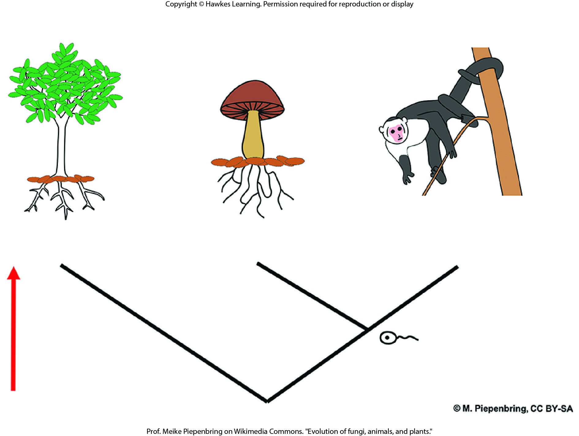
Lesson 24.1 Figure 3

Slide 4
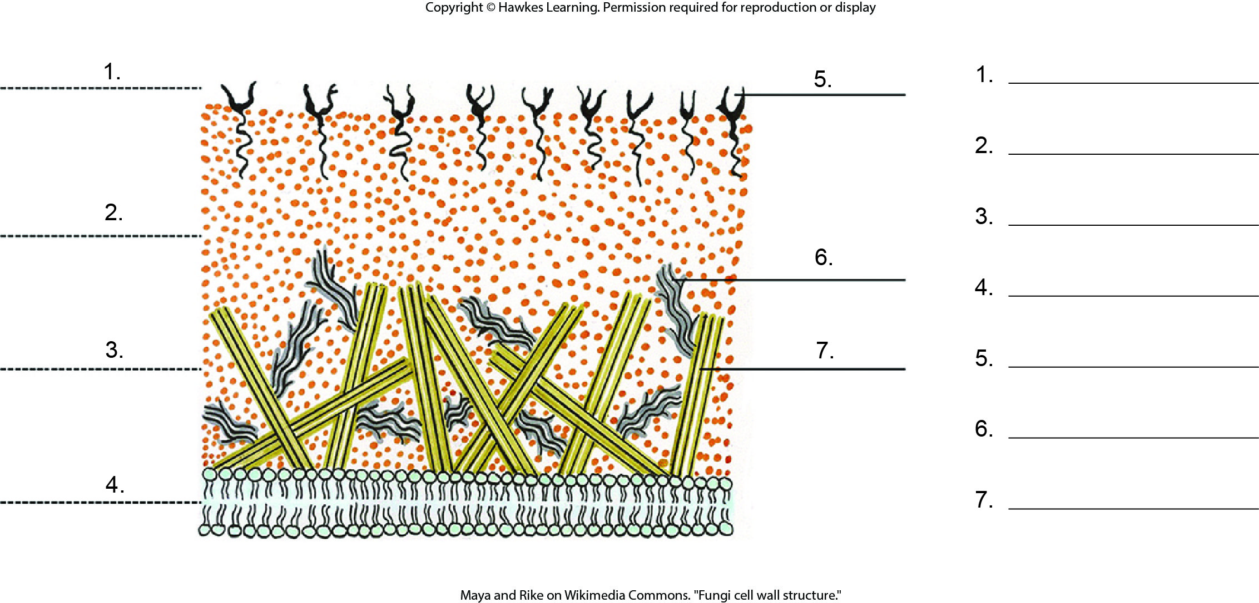
Lesson 24.1 Figure 6 - Numbered

Slide 5
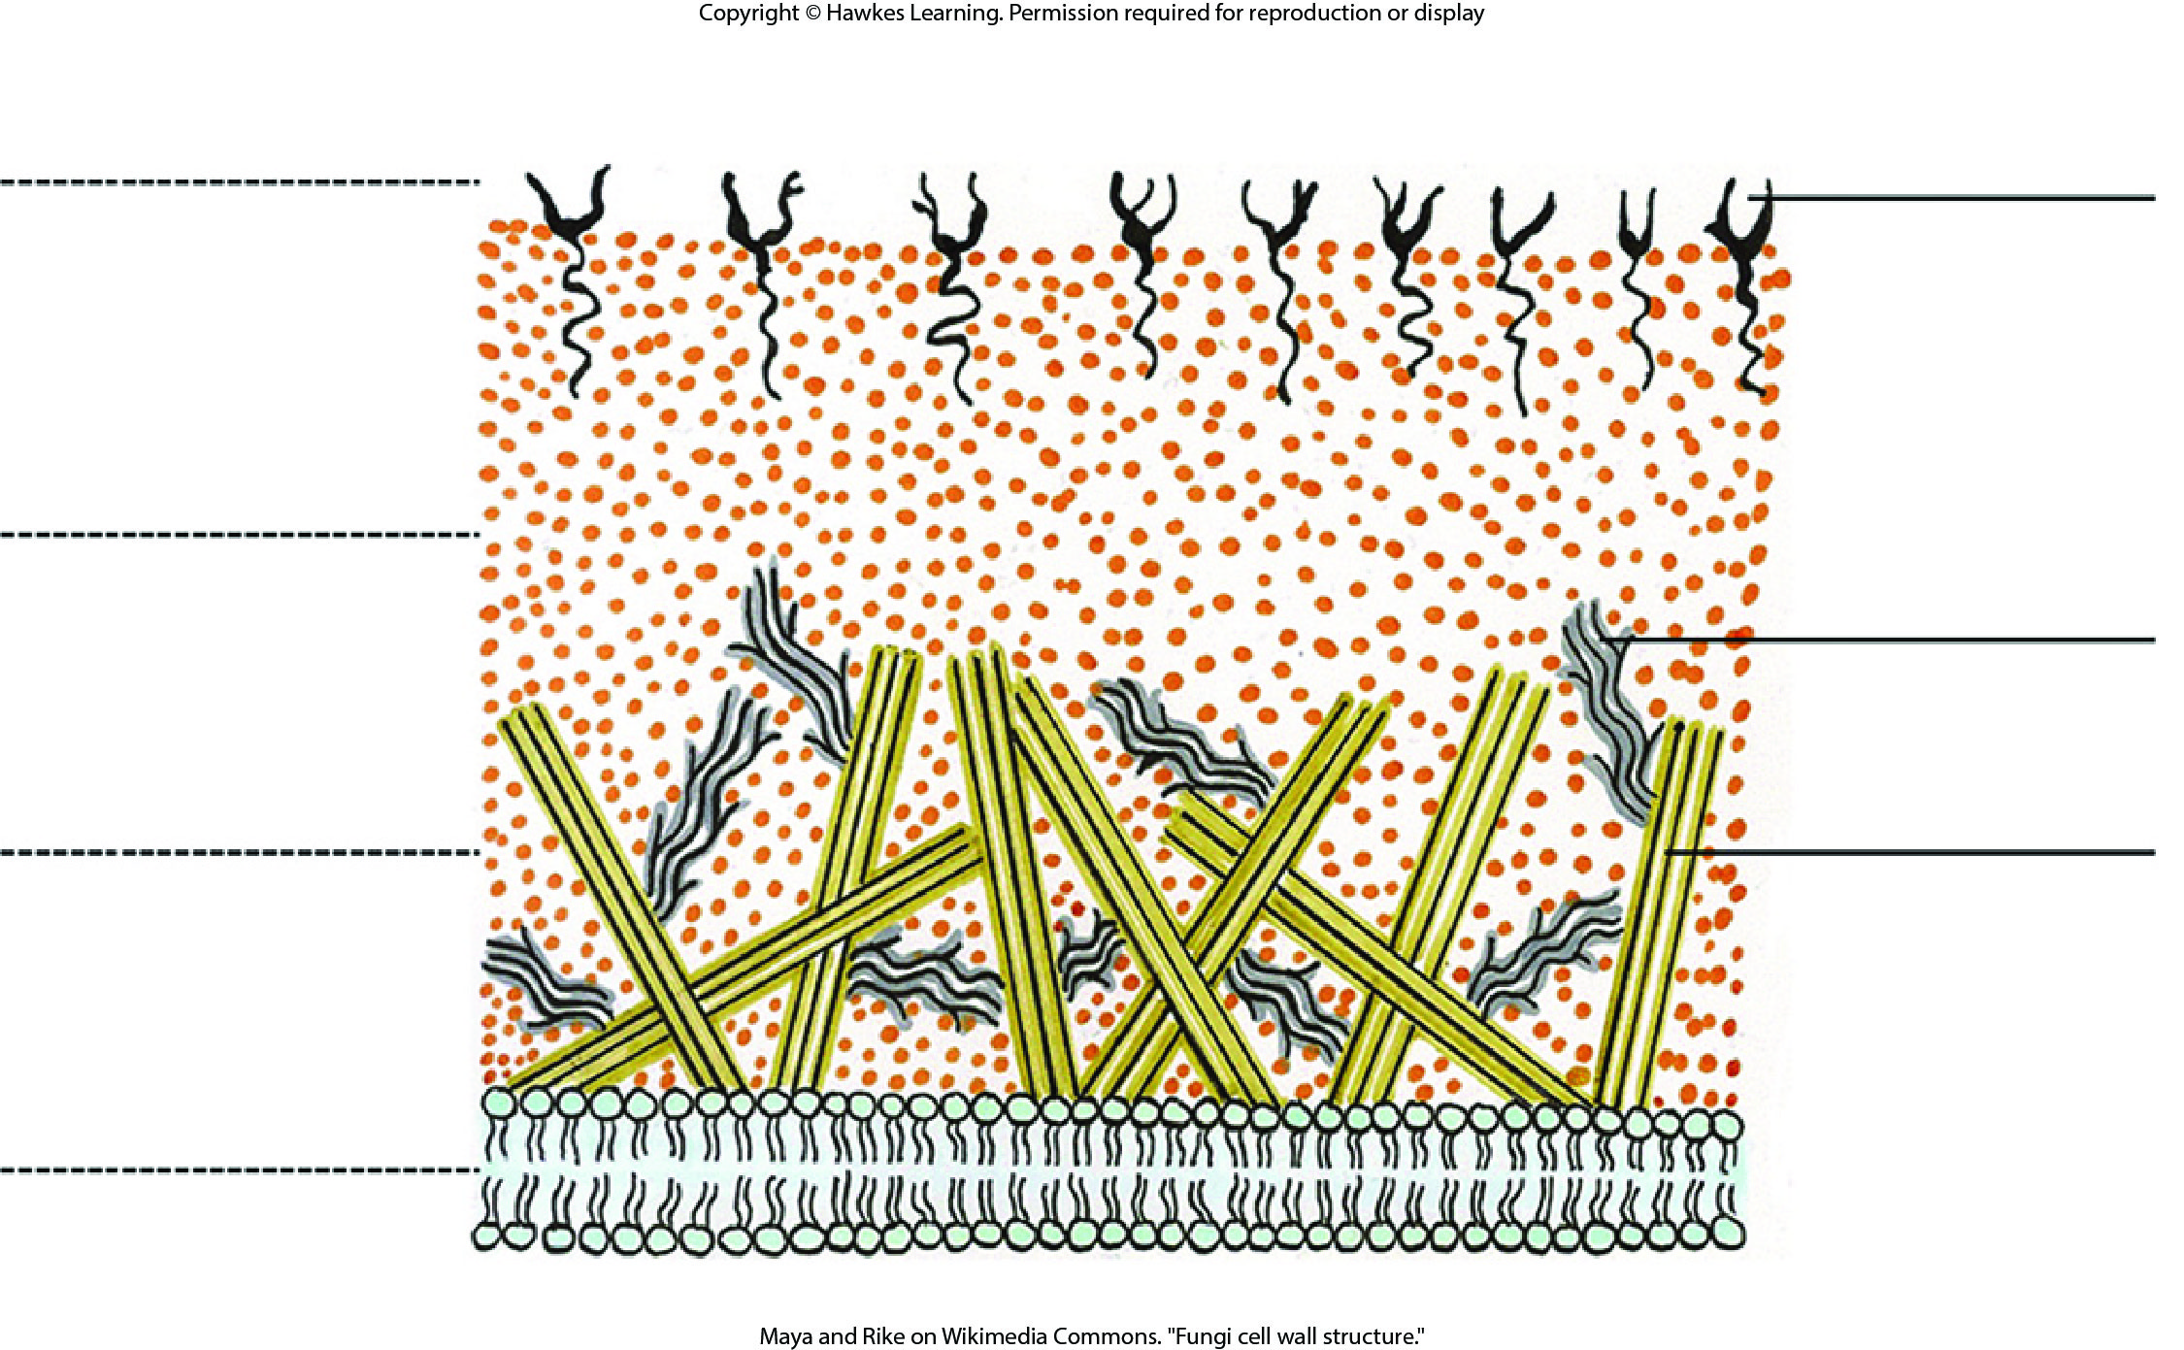
Lesson 24.1 Figure 6

Slide 6
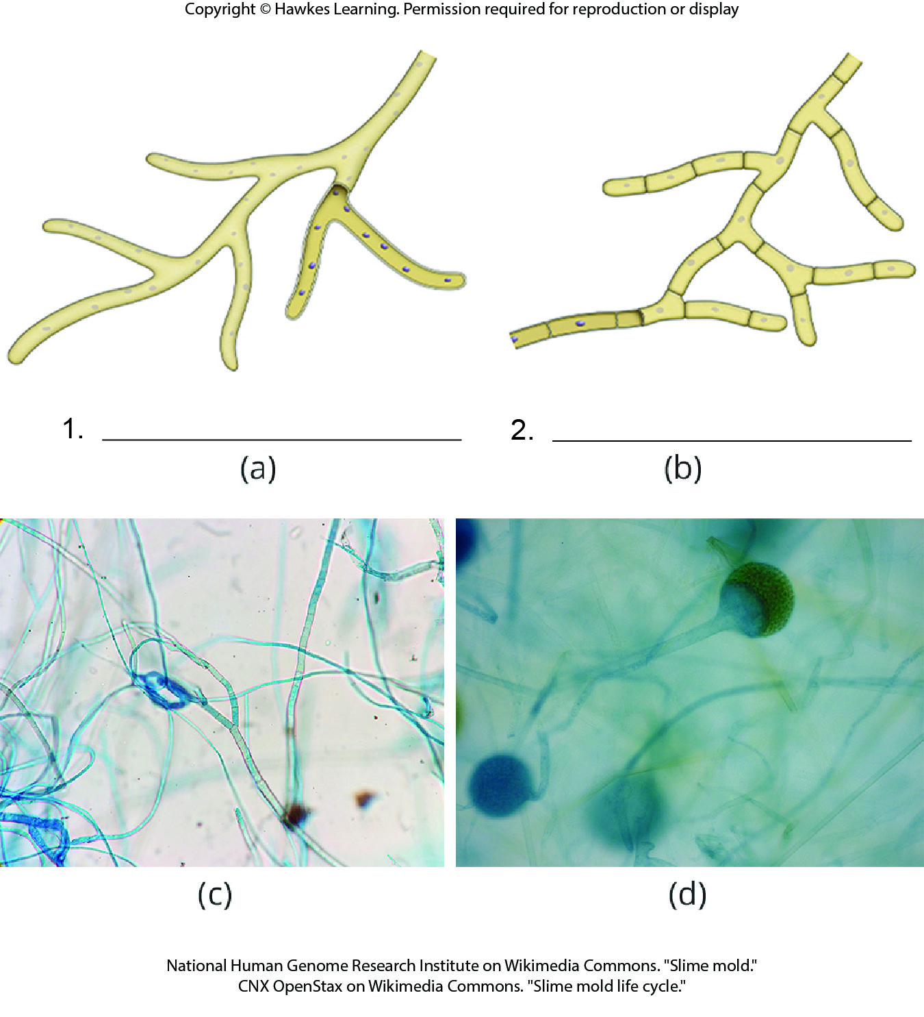
Lesson 24.1 Figure 9 - Numbered

Slide 7
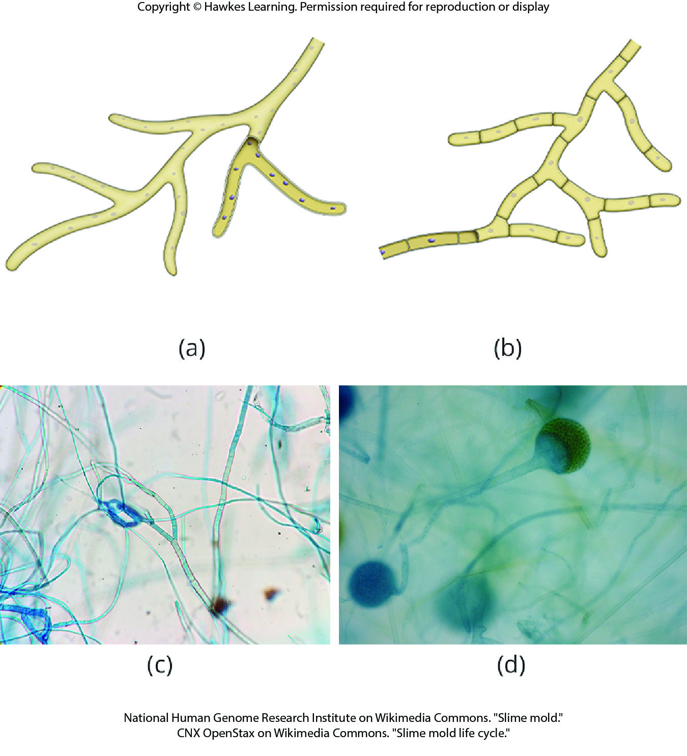
Lesson 24.1 Figure 9

Slide 8
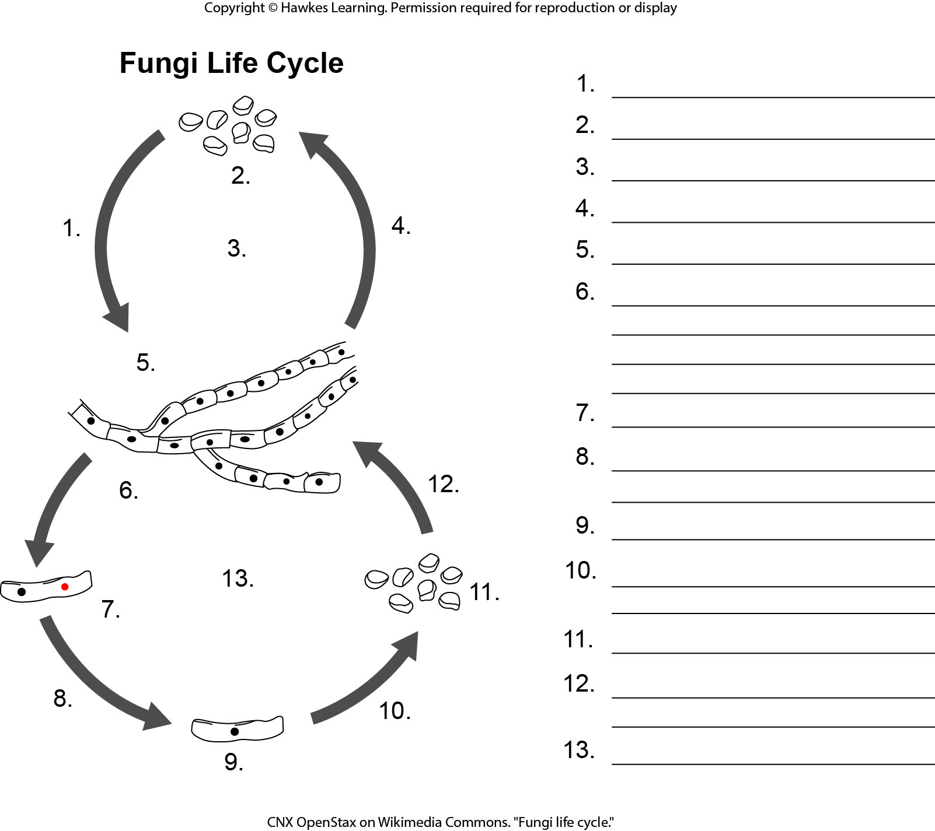
Lesson 24.1 Figure 14 - Numbered

Slide 9
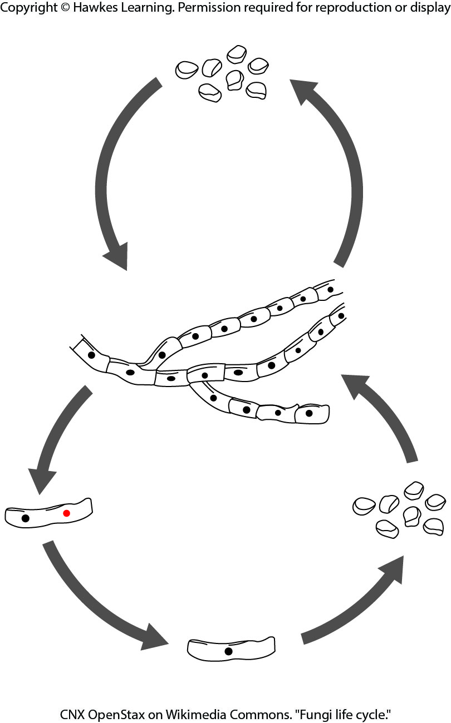
Lesson 24.1 Figure 14

Slide 10
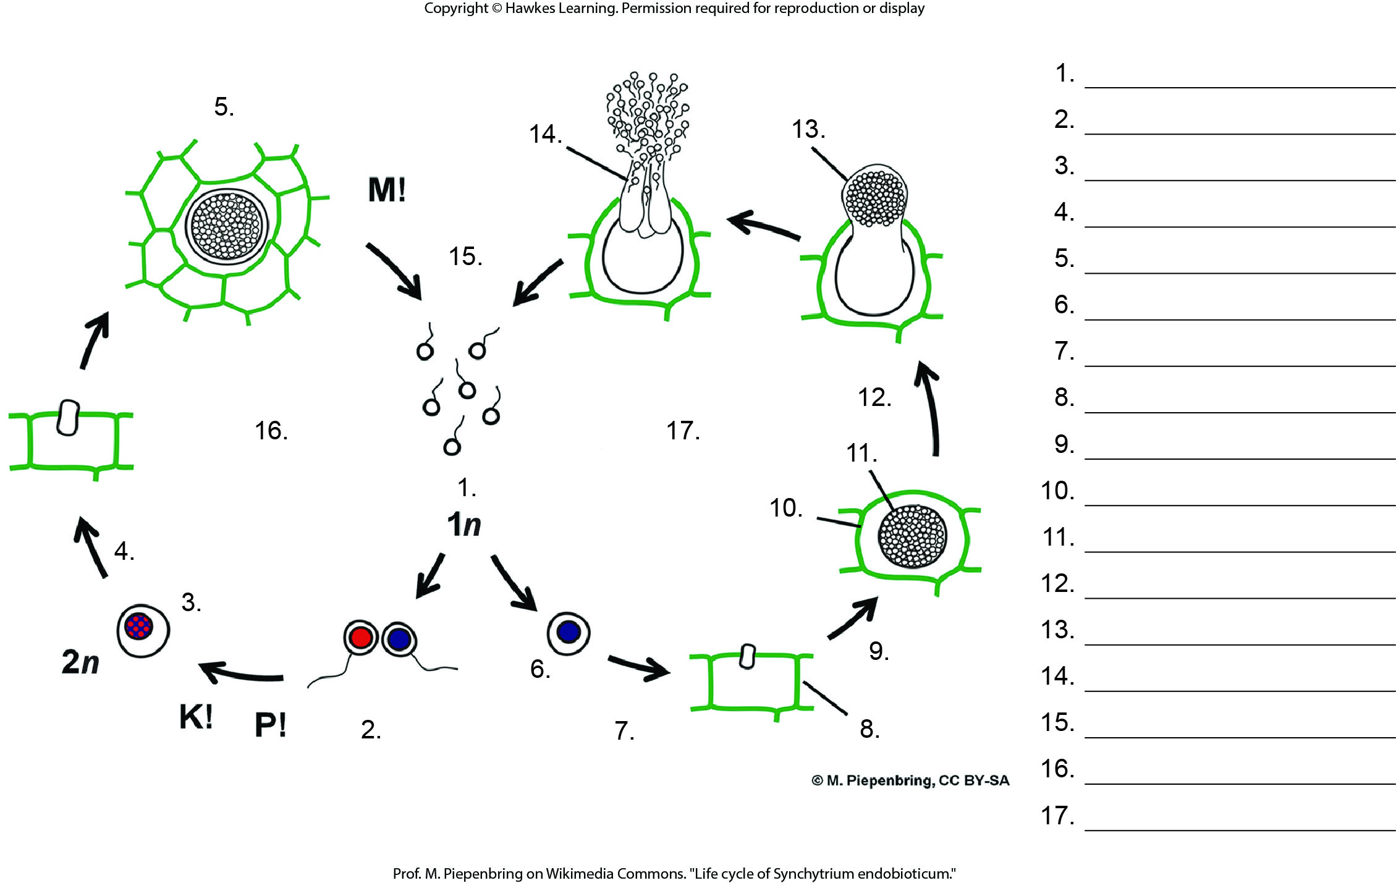
Lesson 24.2 Figure 3 - Numbered

Slide 11
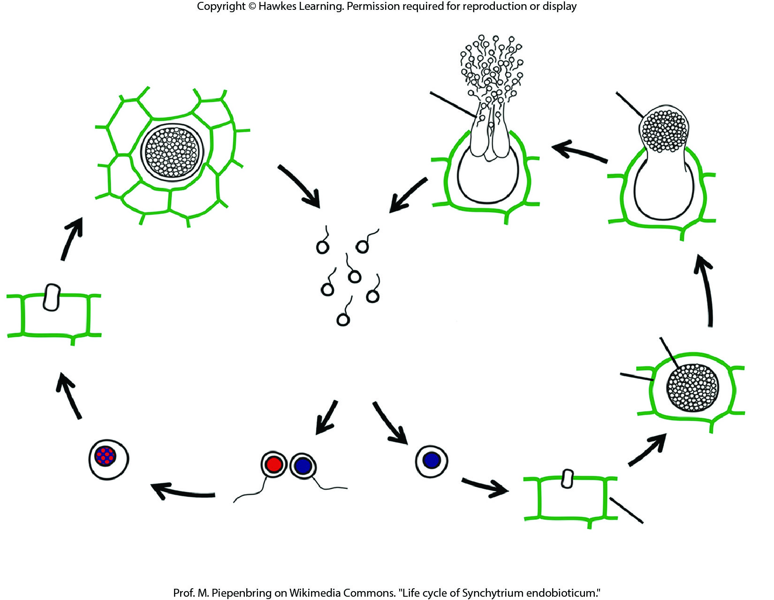
Lesson 24.2 Figure 3

Slide 12
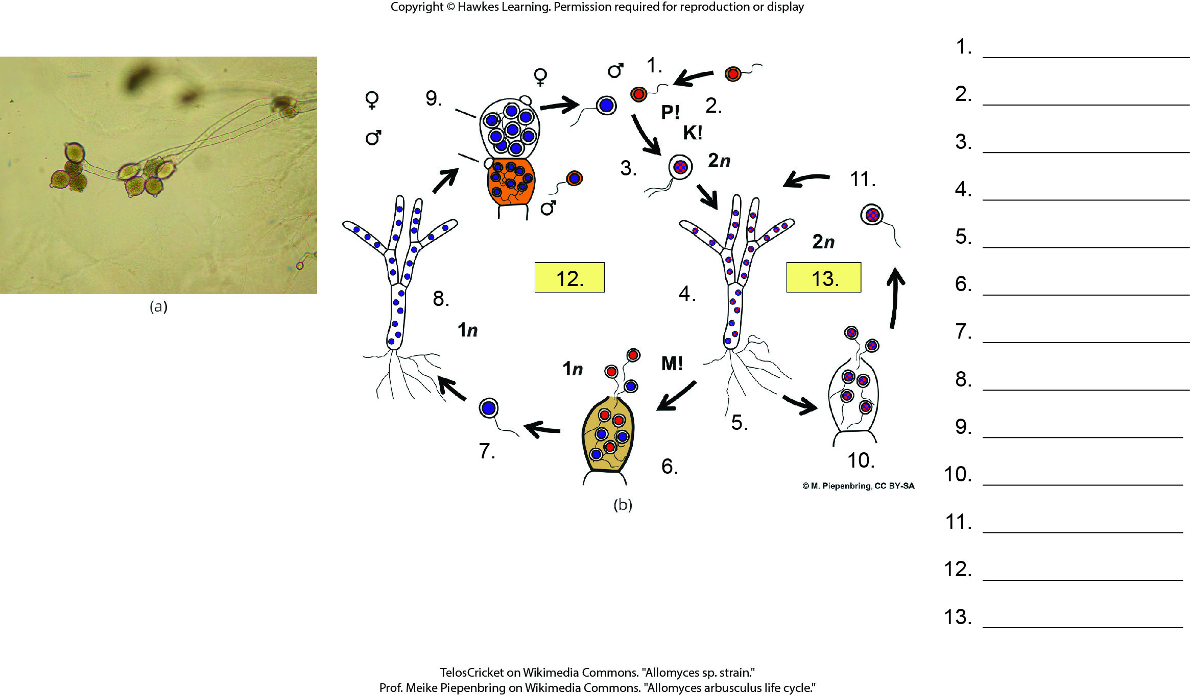
Lesson 24.2 Figure 4 - Numbered

Slide 13
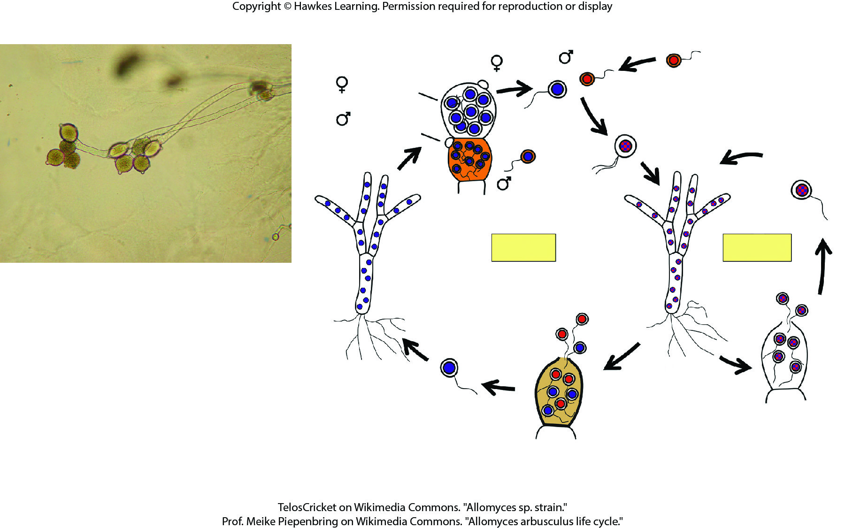
Lesson 24.2 Figure 4

Slide 14
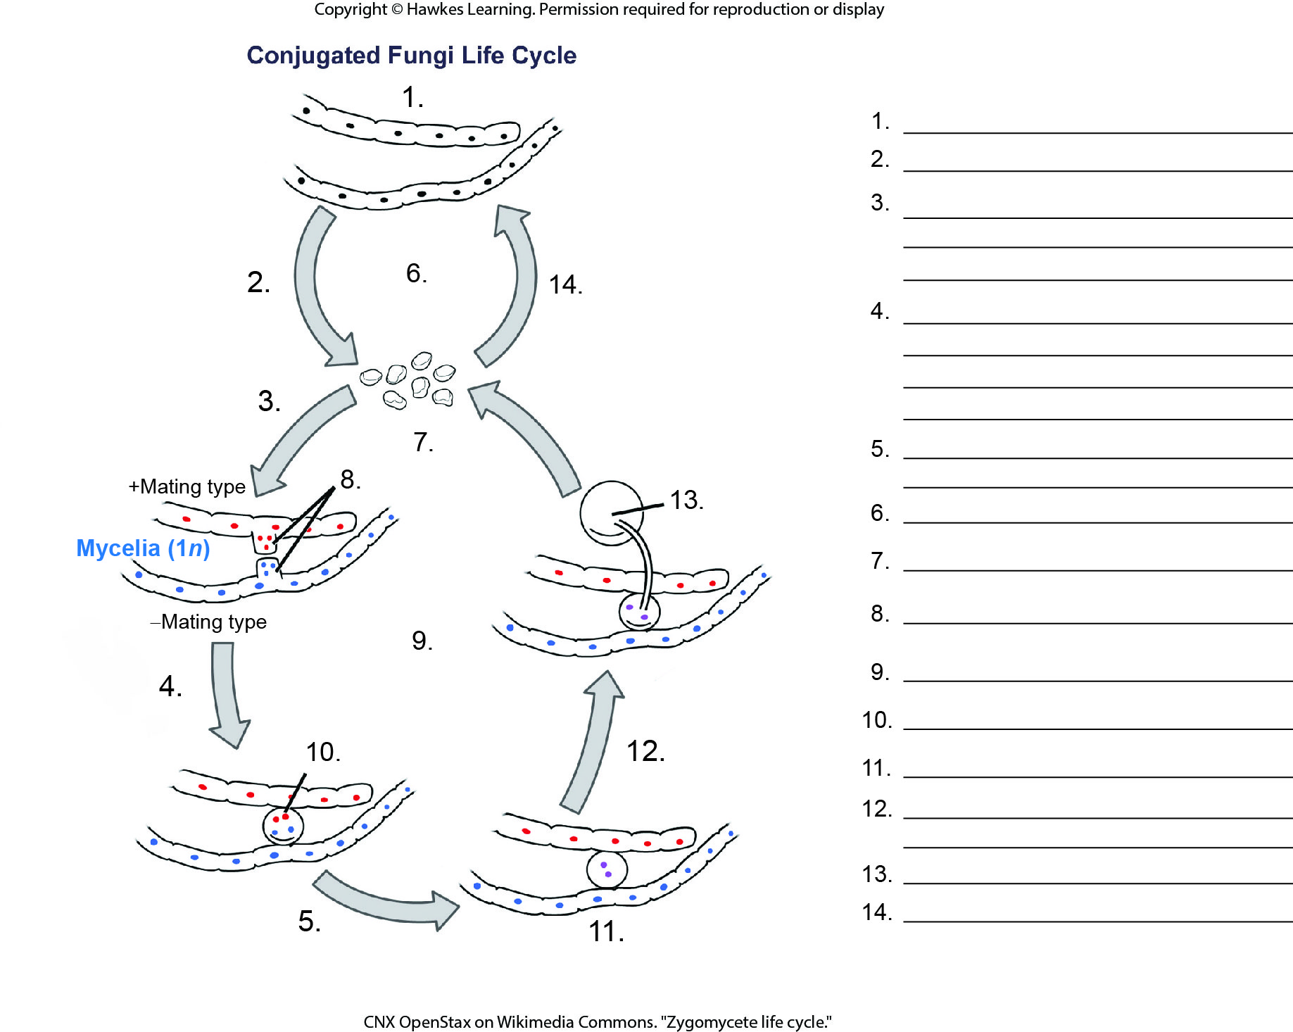
Lesson 24.2 Figure 6 - Numbered

Slide 15
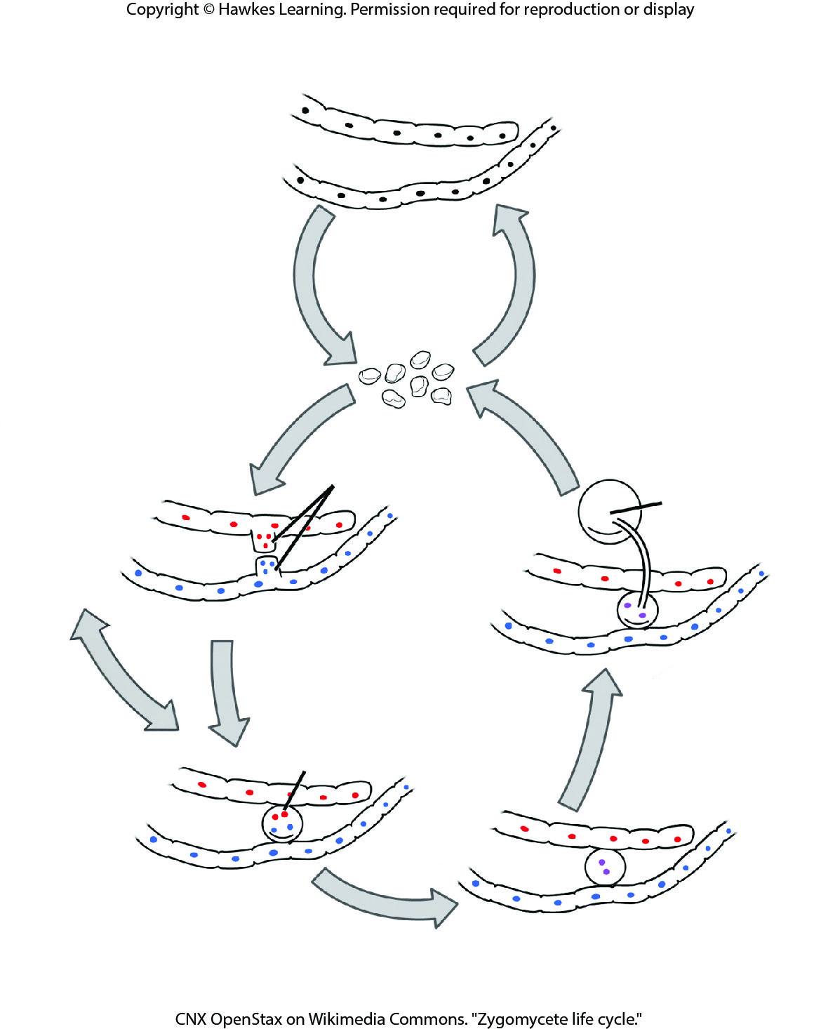
Lesson 24.2 Figure 6

Slide 16
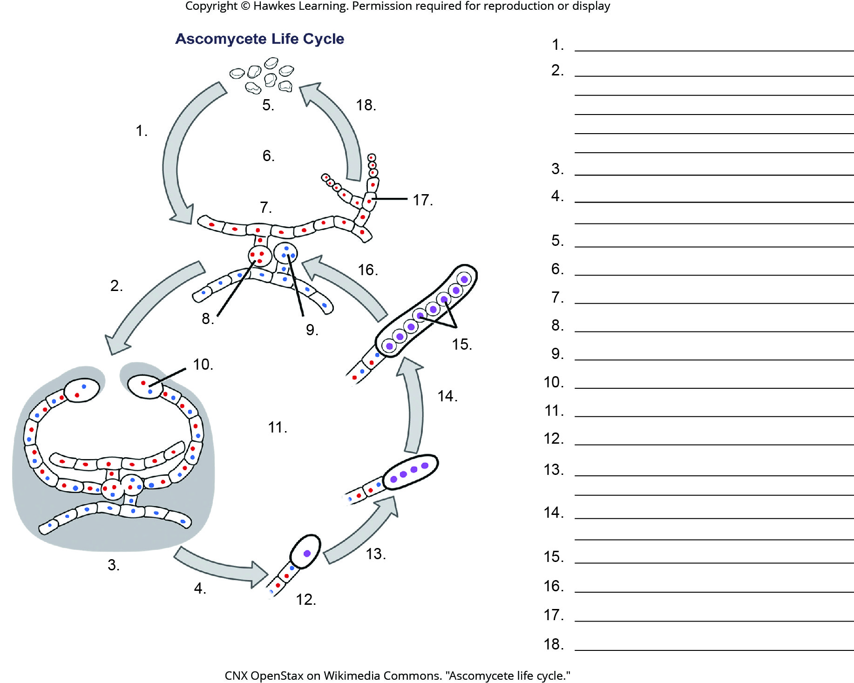
Lesson 24.2 Figure 9 - Numbered

Slide 17
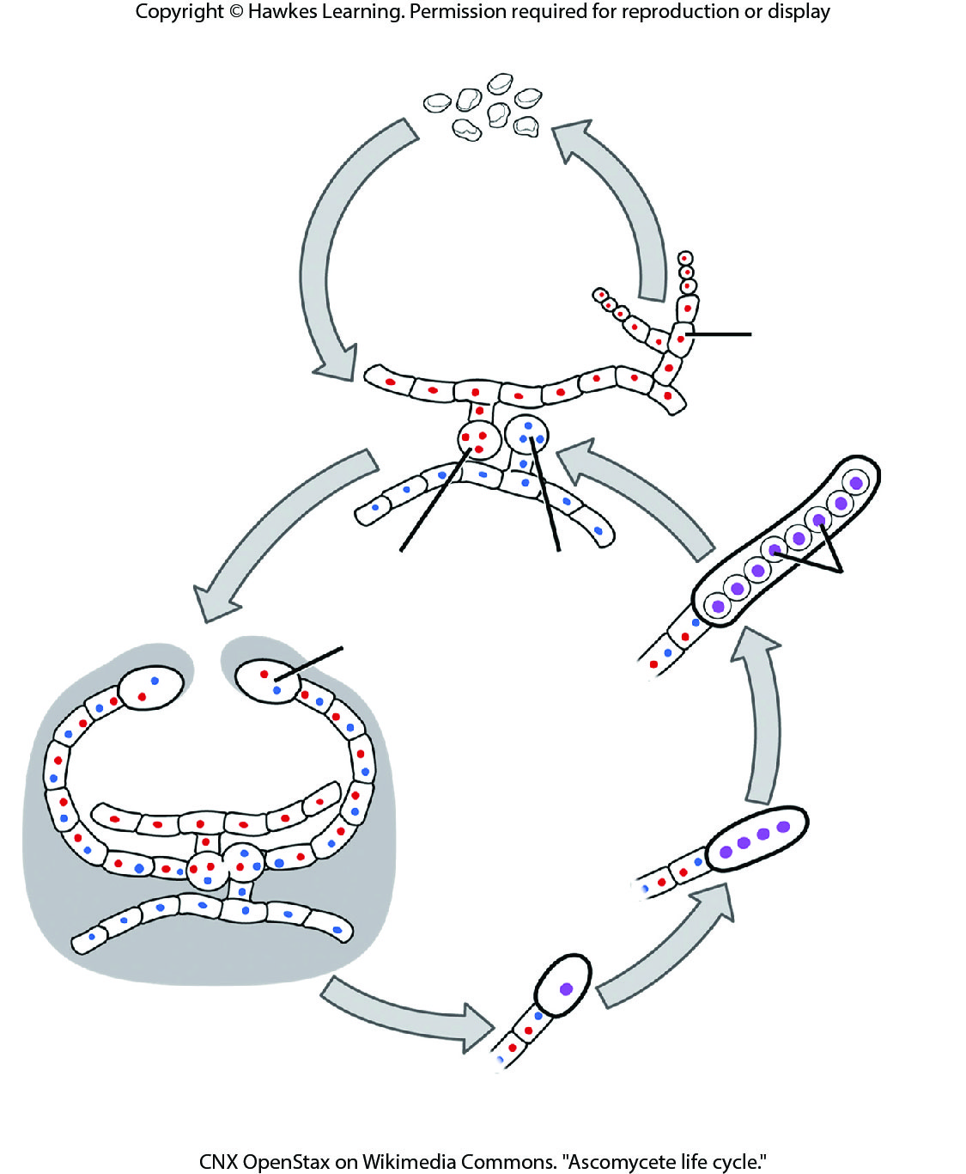
Lesson 24.2 Figure 9

Slide 18
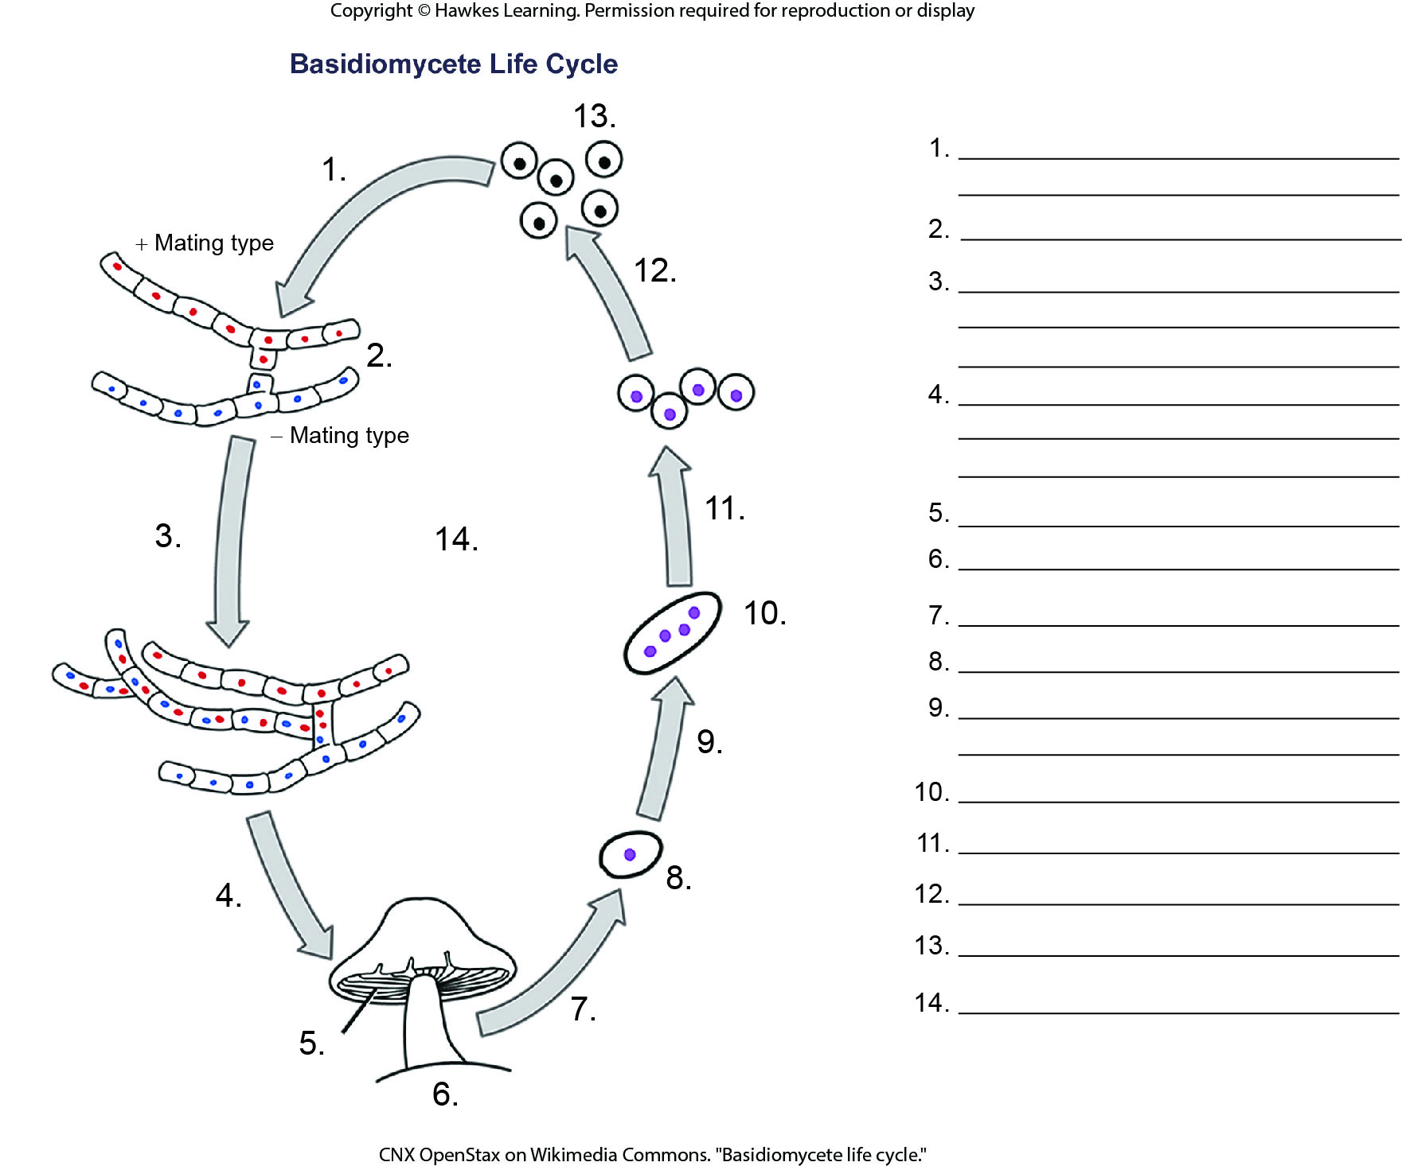
Lesson 24.2 Figure 13 - Numbered

Slide 19
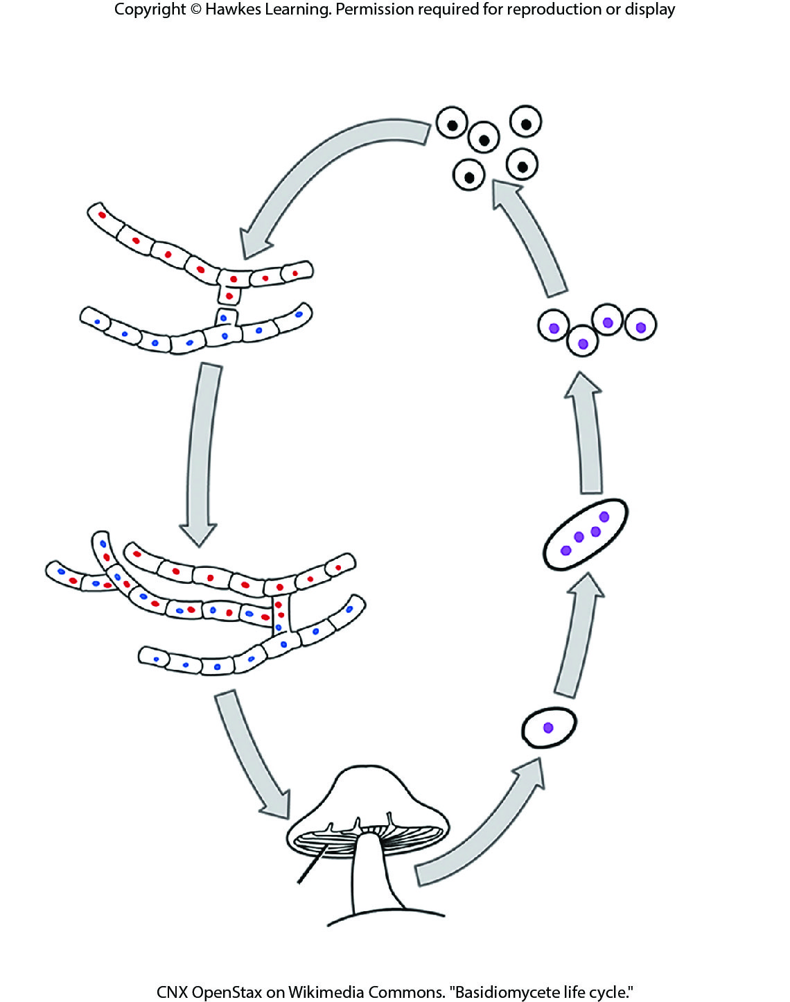
Lesson 24.2 Figure 13

Slide 20
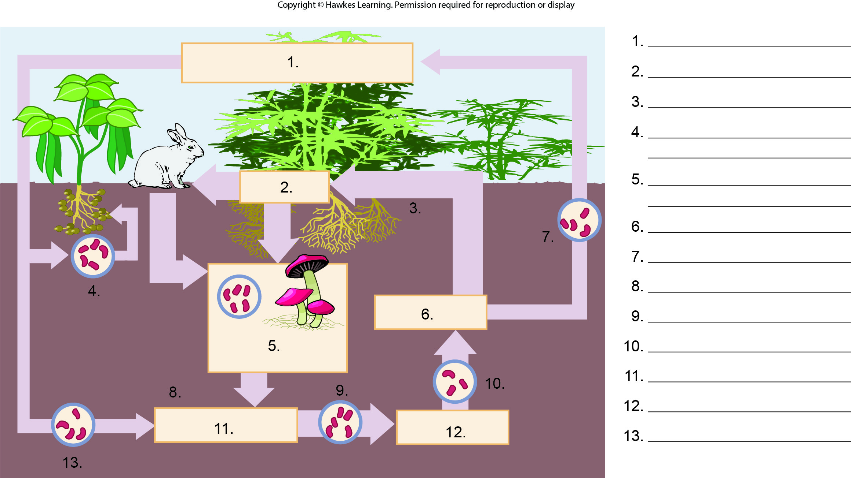
Lesson 24.3 Figure 4 - Numbered

Slide 21
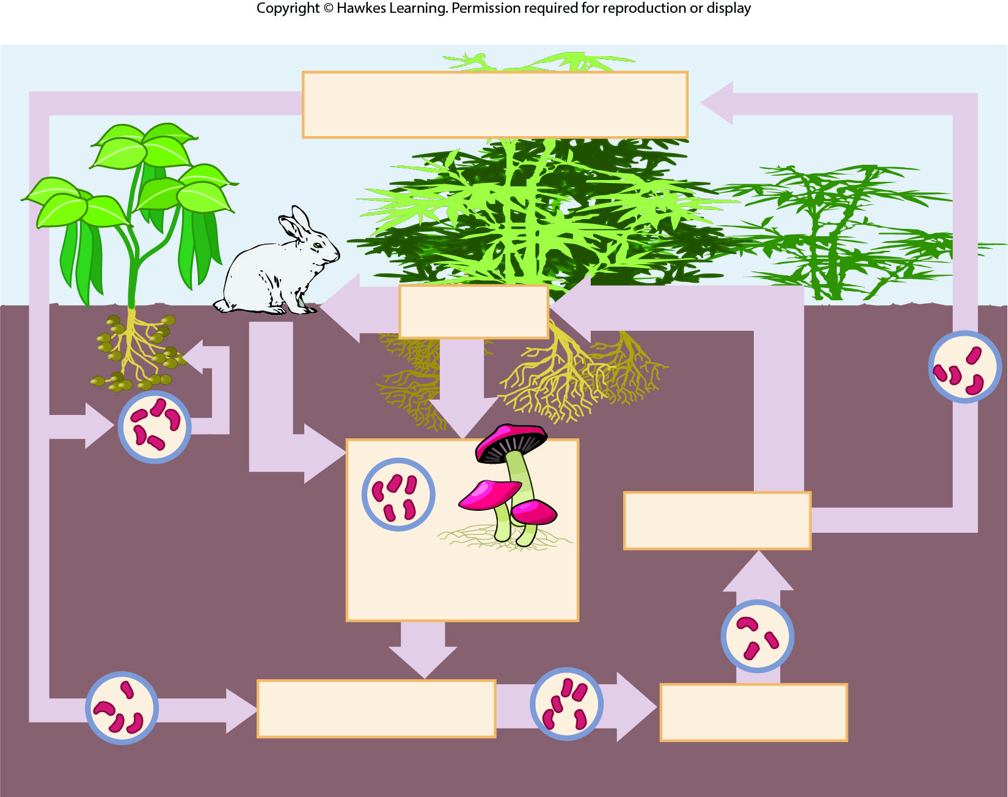
Lesson 24.3 Figure 4

Slide 22
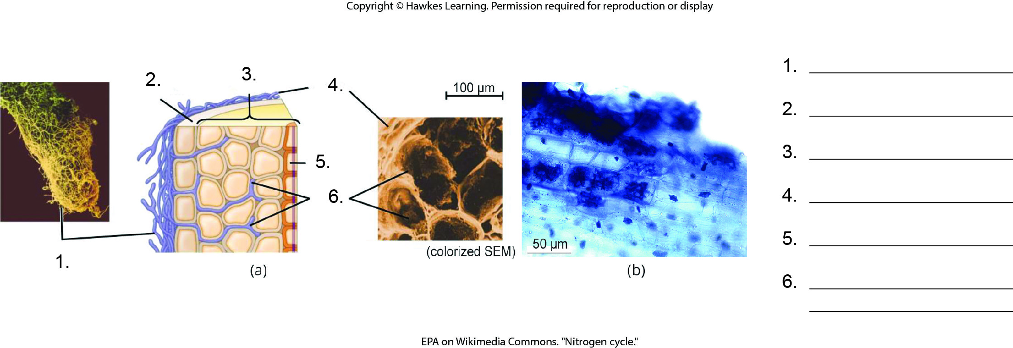
Lesson 24.3 Figure 6 - Numbered

Slide 23
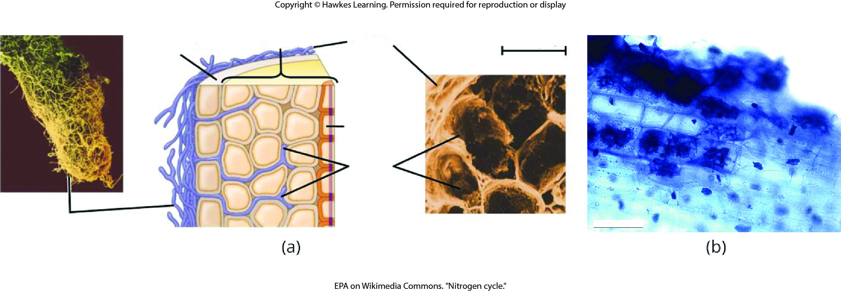
Lesson 24.3 Figure 6

Slide 24
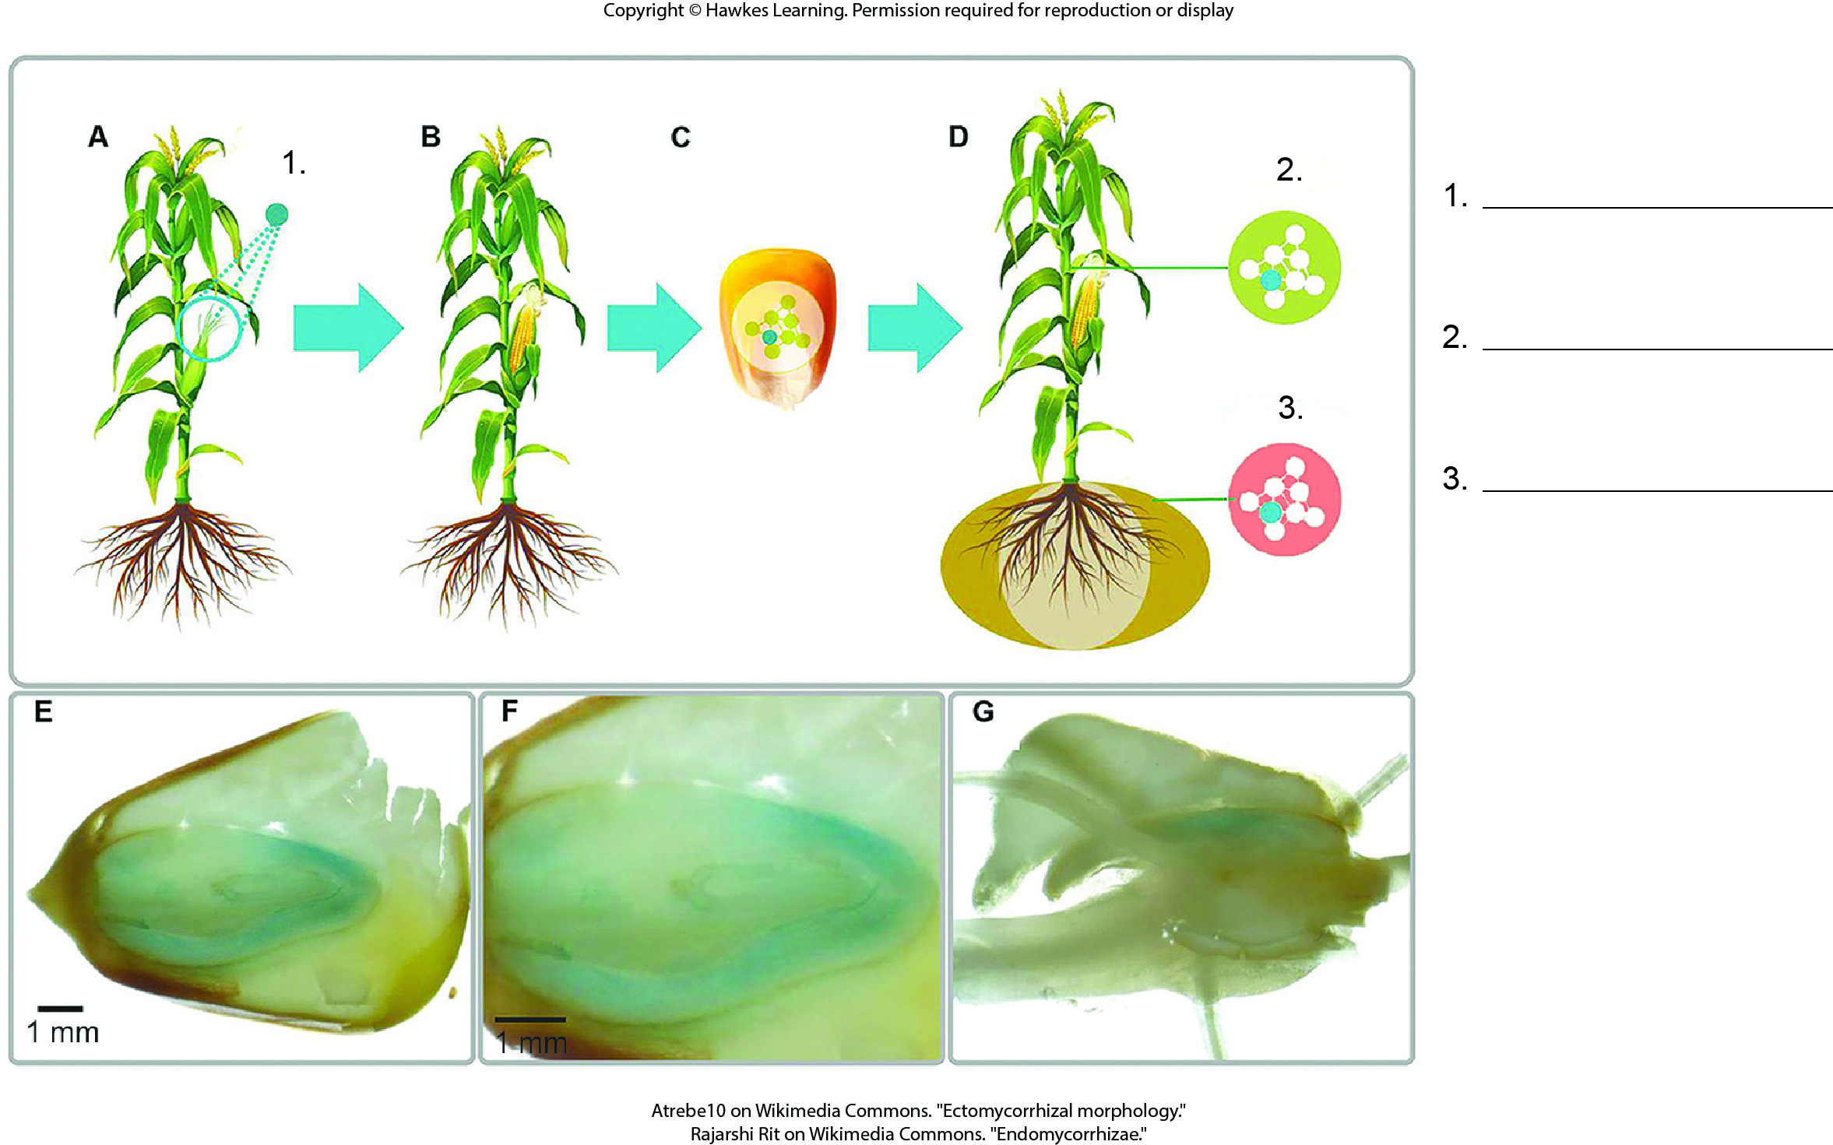
Lesson 24.3 Figure 8 - Numbered

Slide 25
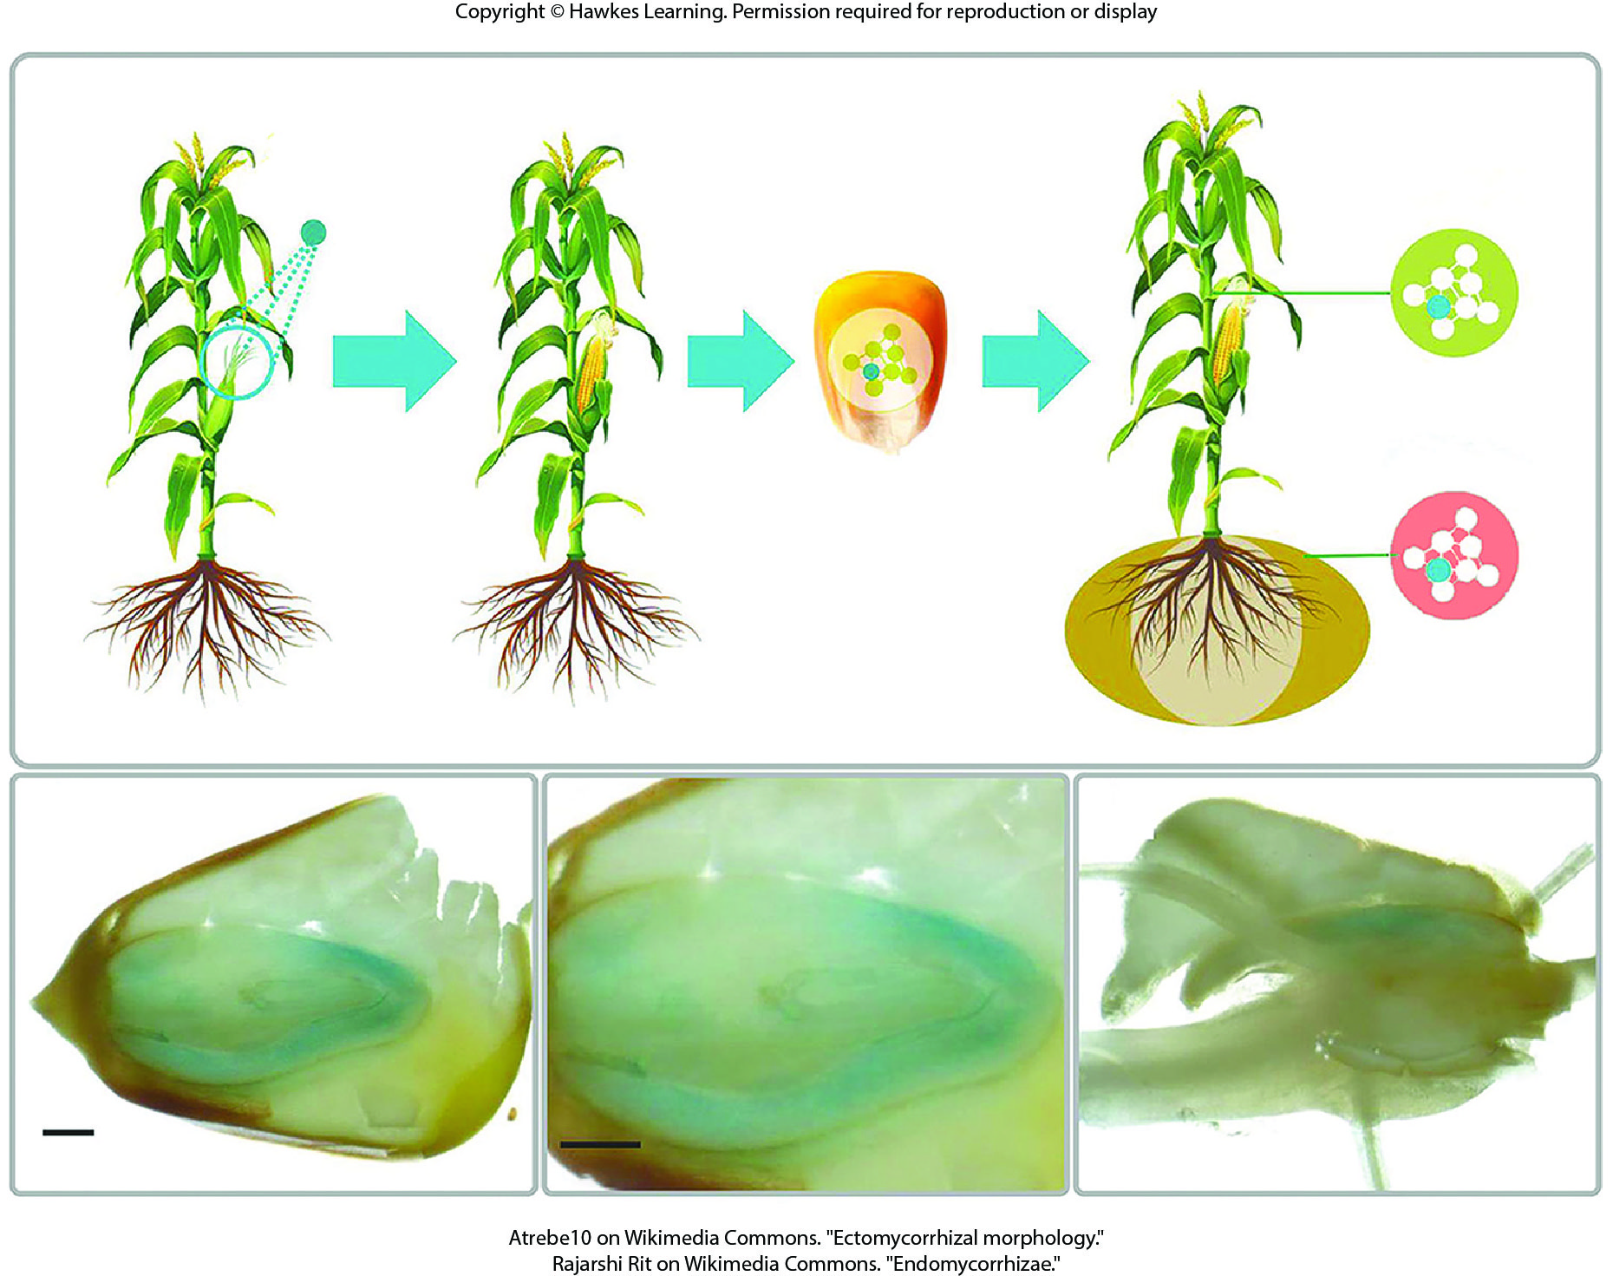
Lesson 24.3 Figure 8

Slide 26
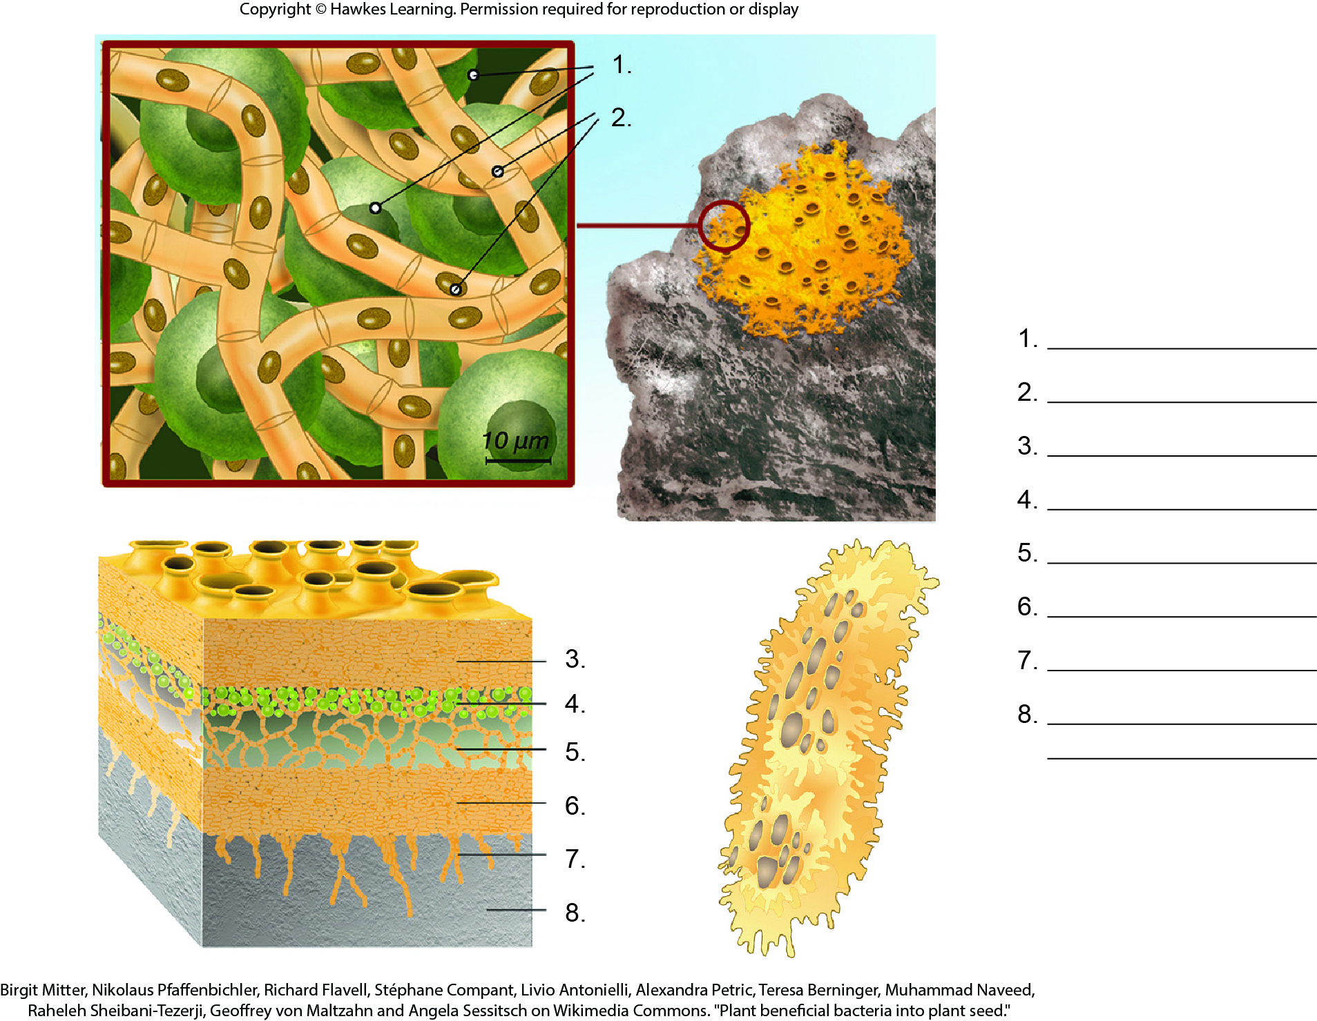
Lesson 24.3 Figure 10 - Numbered

Slide 27
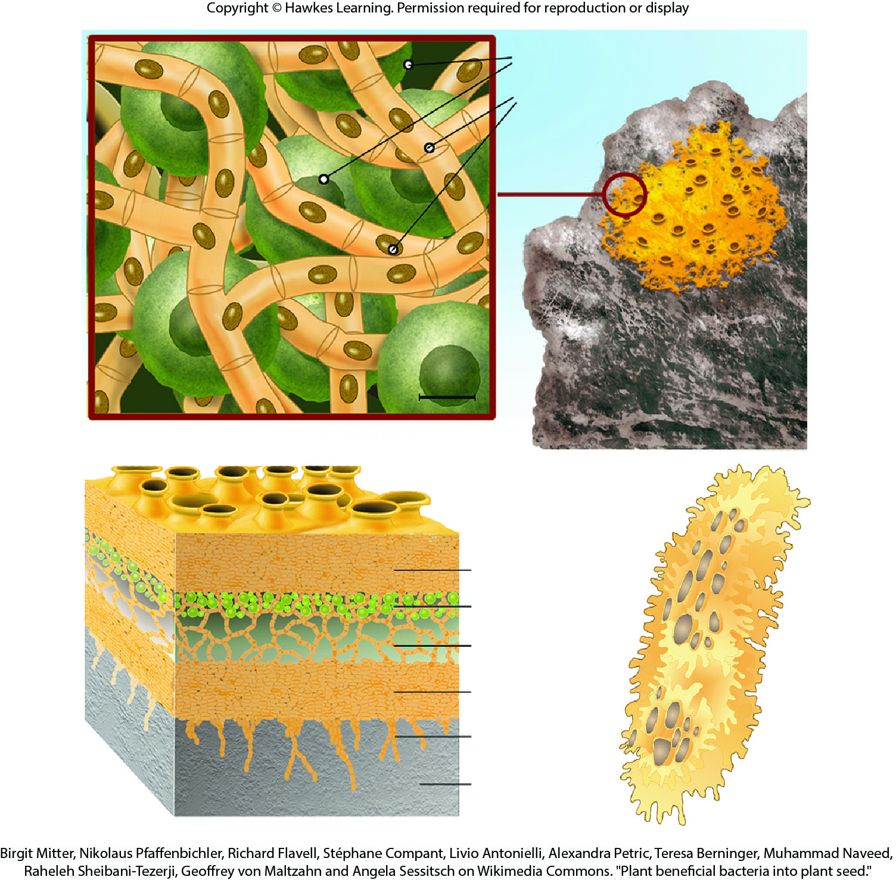
Lesson 24.3 Figure 10

Slide 28
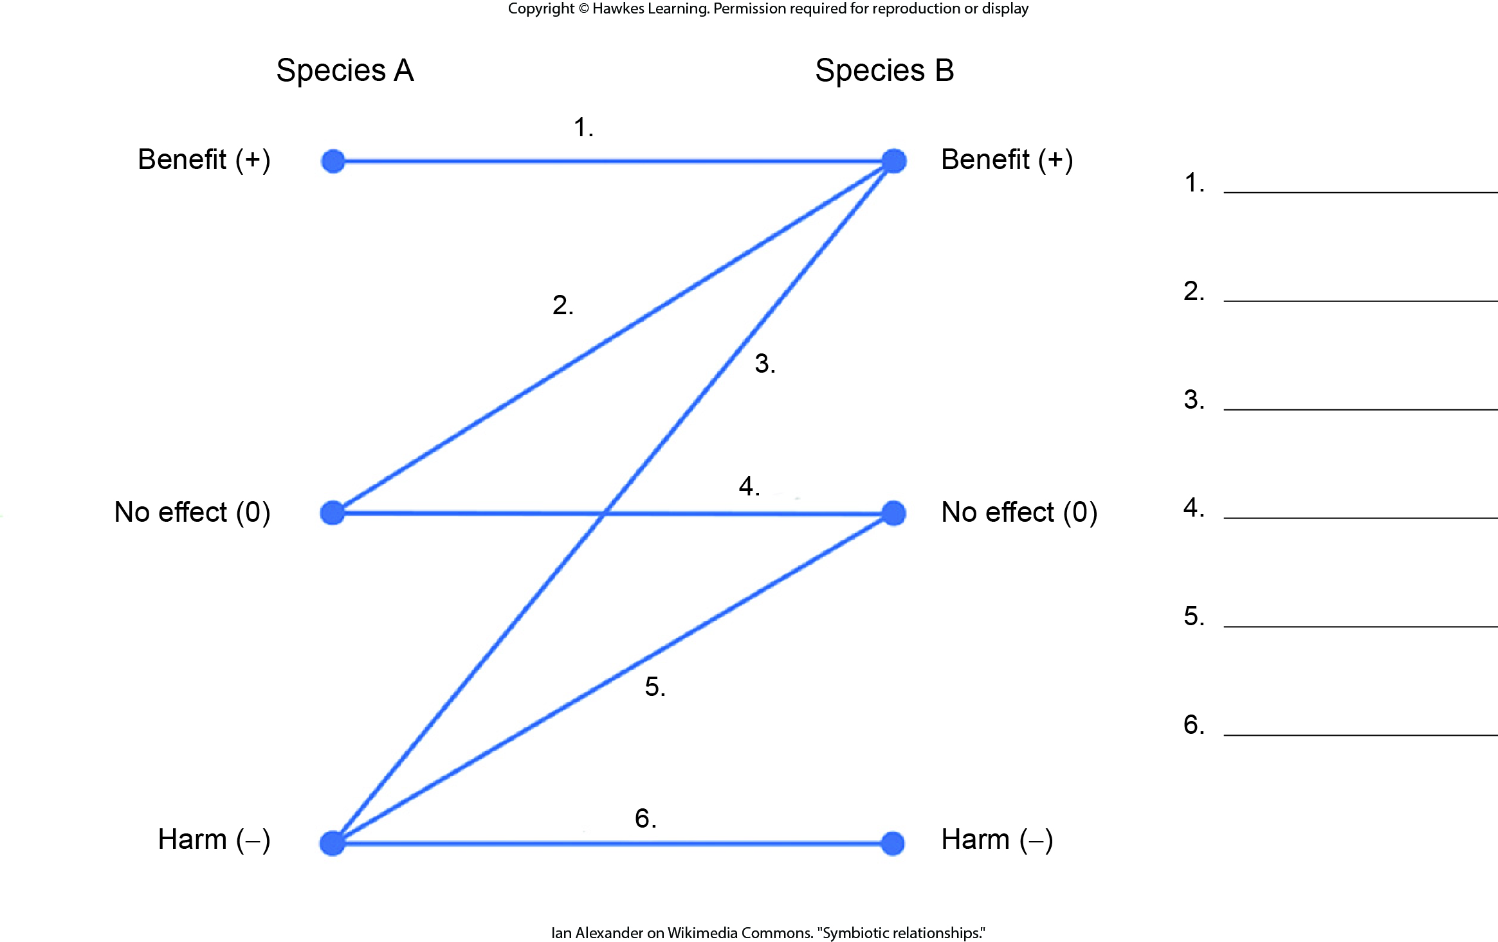
Lesson 24.3 Figure 14 - Numbered

Slide 29
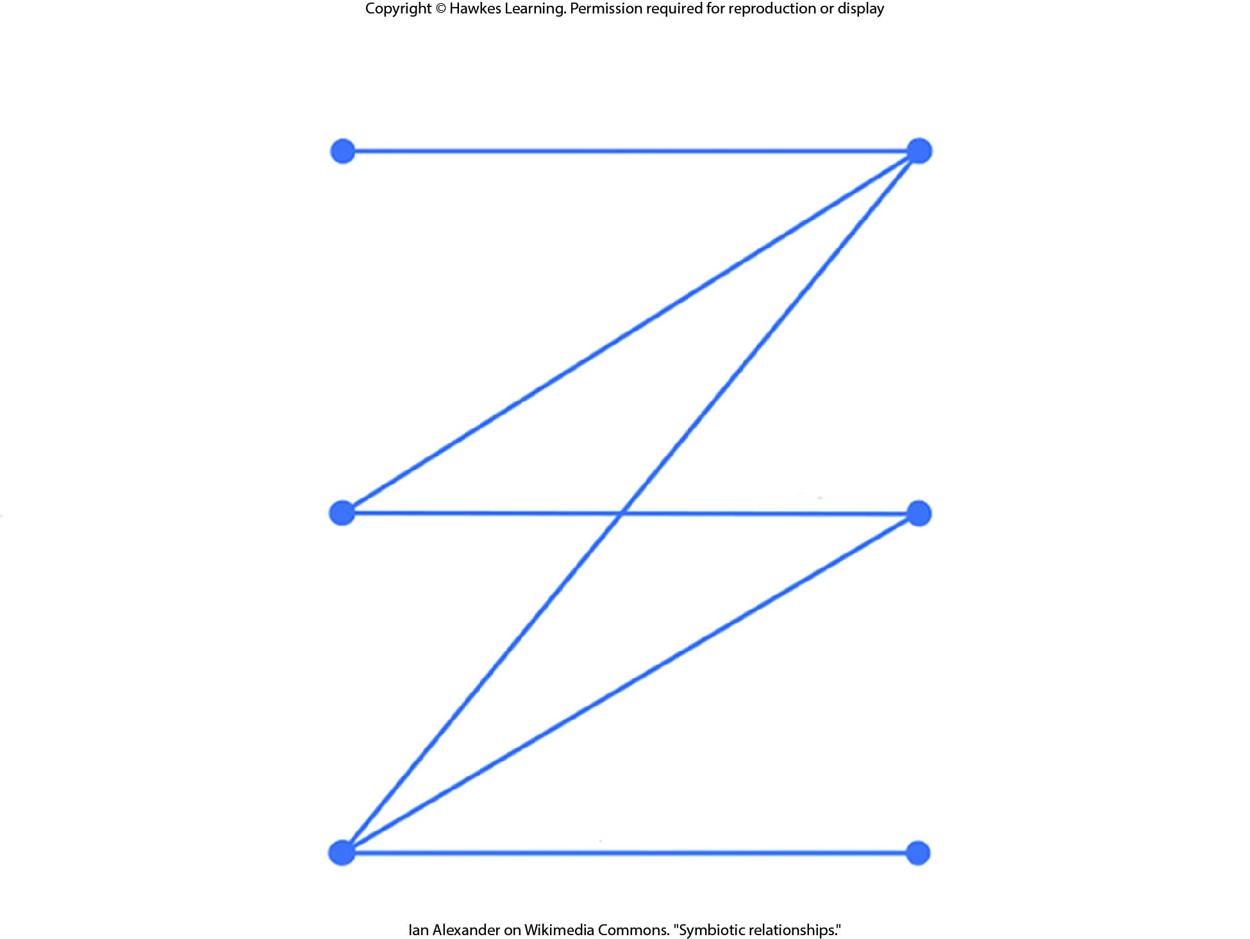
Lesson 24.3 Figure 14

Slide 30
Hawkes Learning – End of PowerPoint

