Slide 1
Chapter 25
Seedless Plants

Slide 2
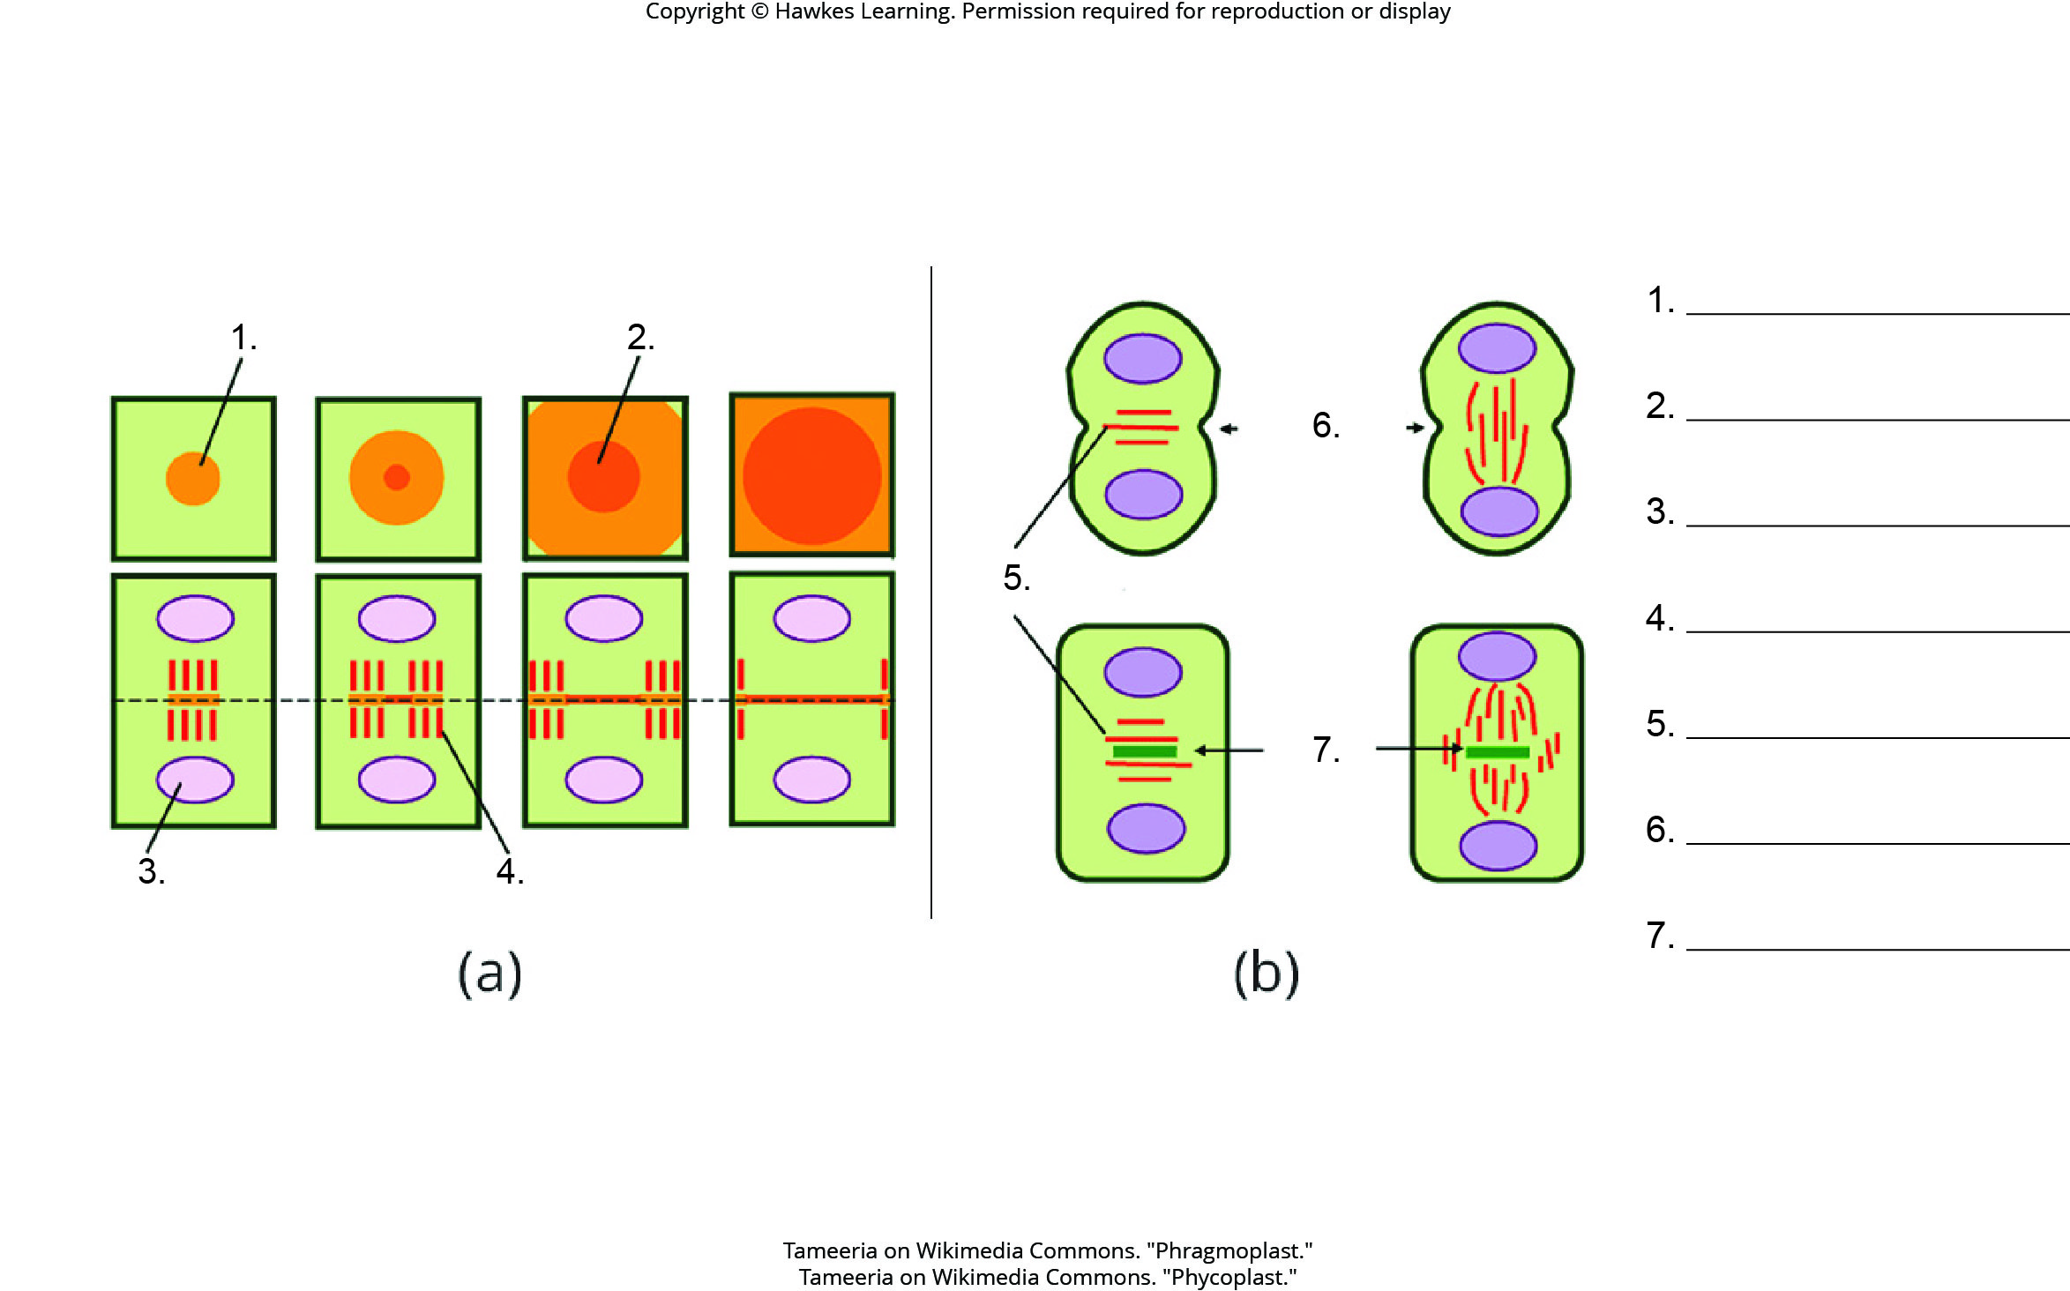
Lesson 25.1 Figure 3 - Numbered

Slide 3
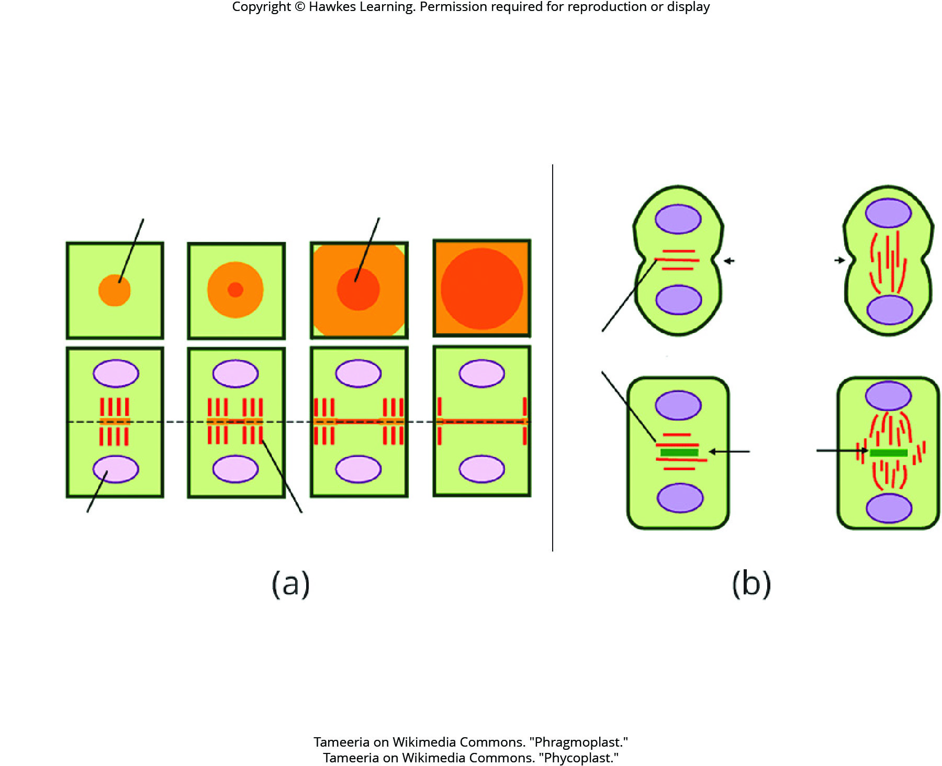
Lesson 14.1 Figure 5

Slide 4
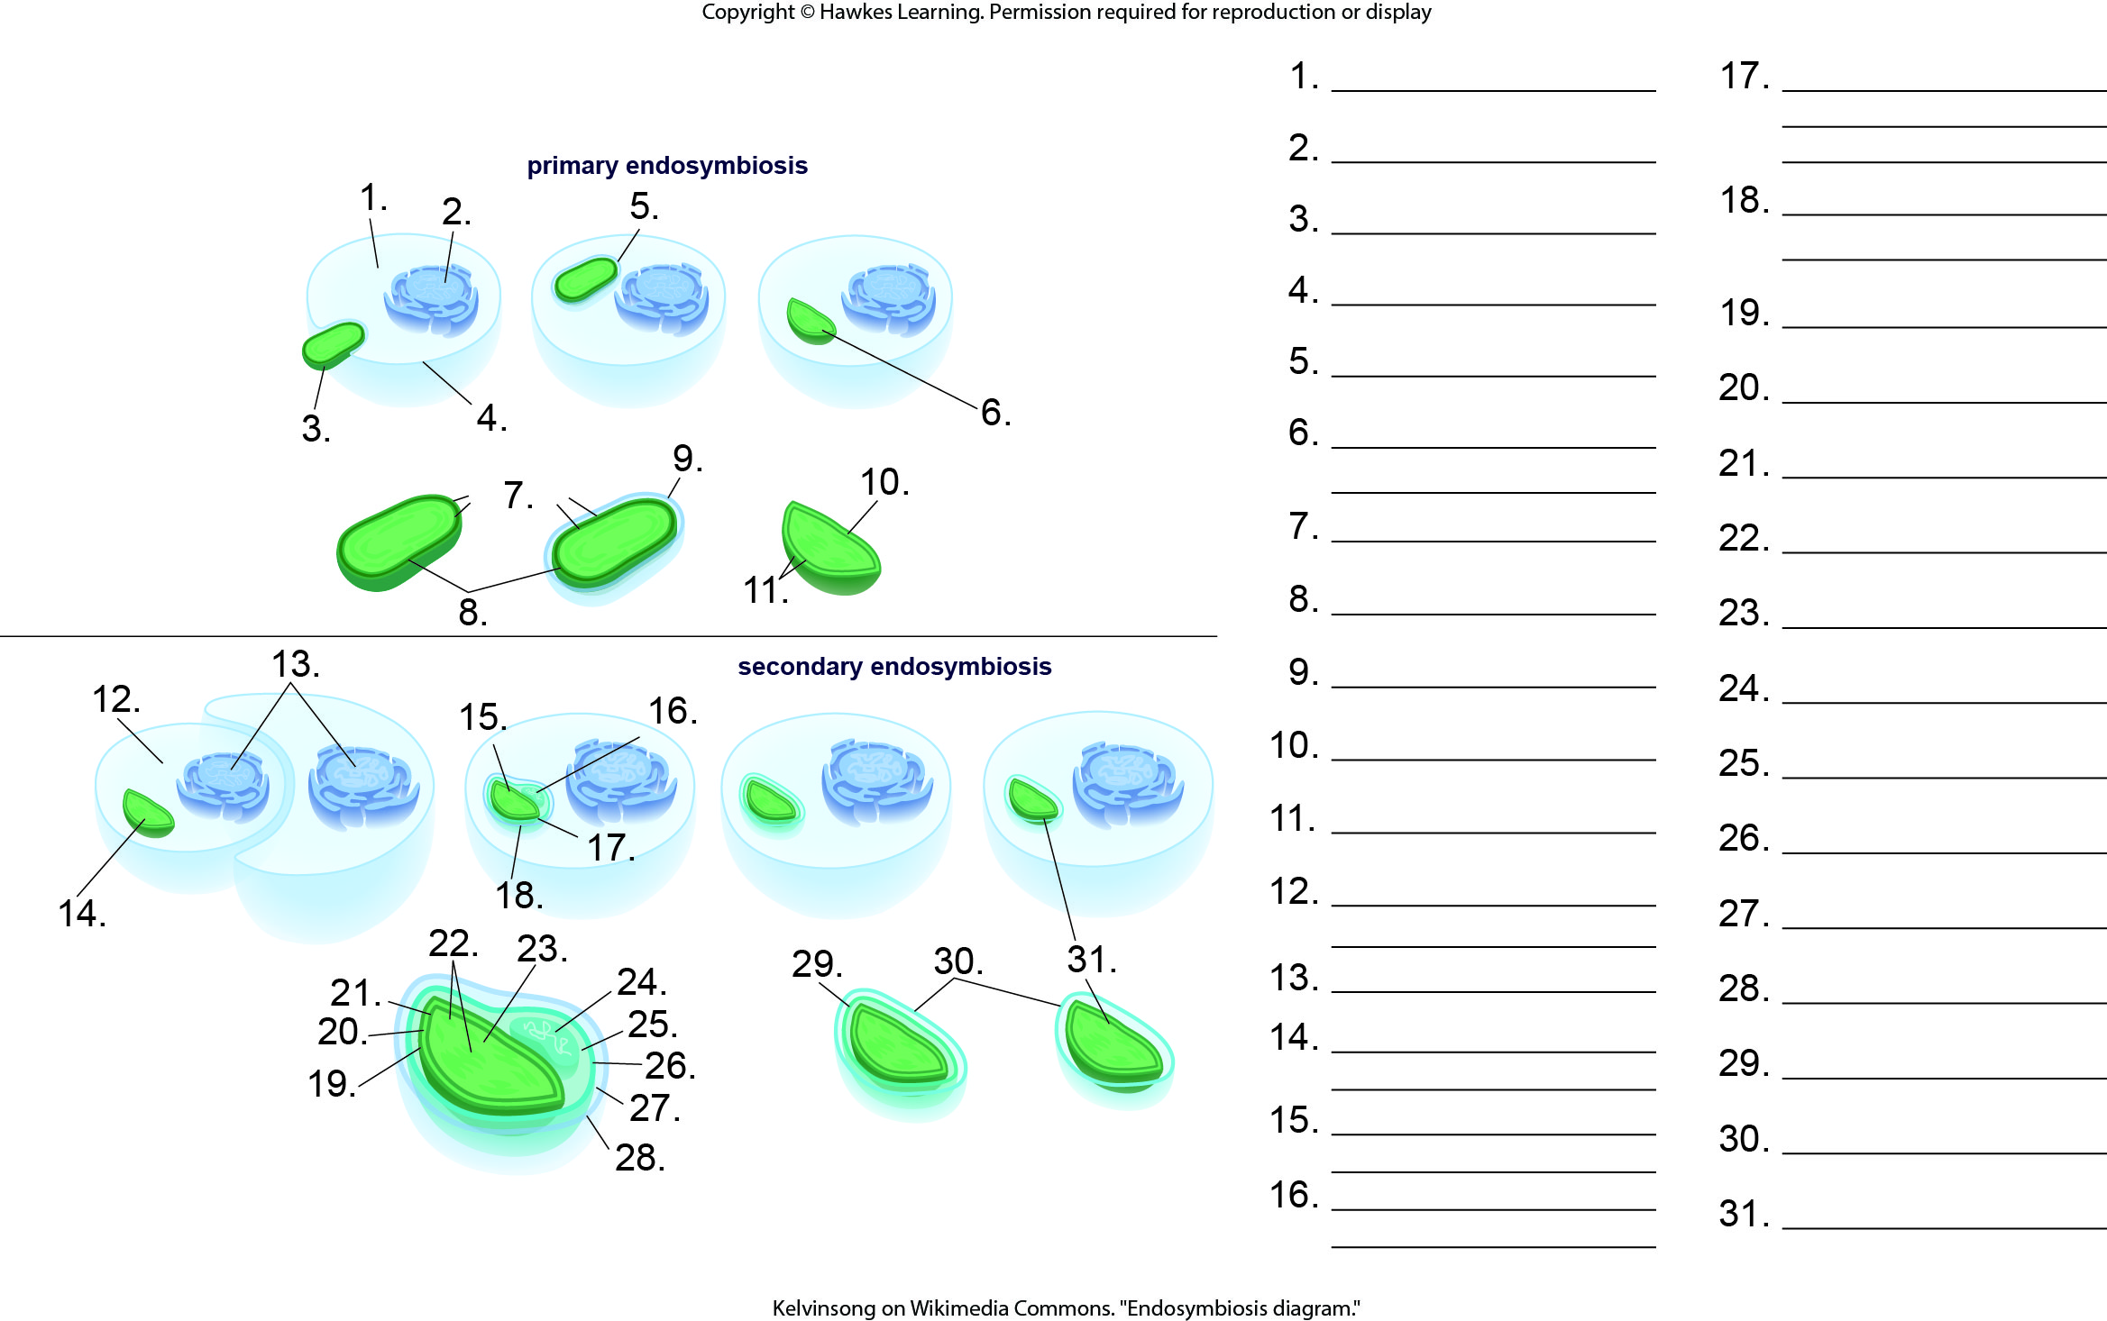
Lesson 25.1 Figure 5 - Numbered

Slide 5
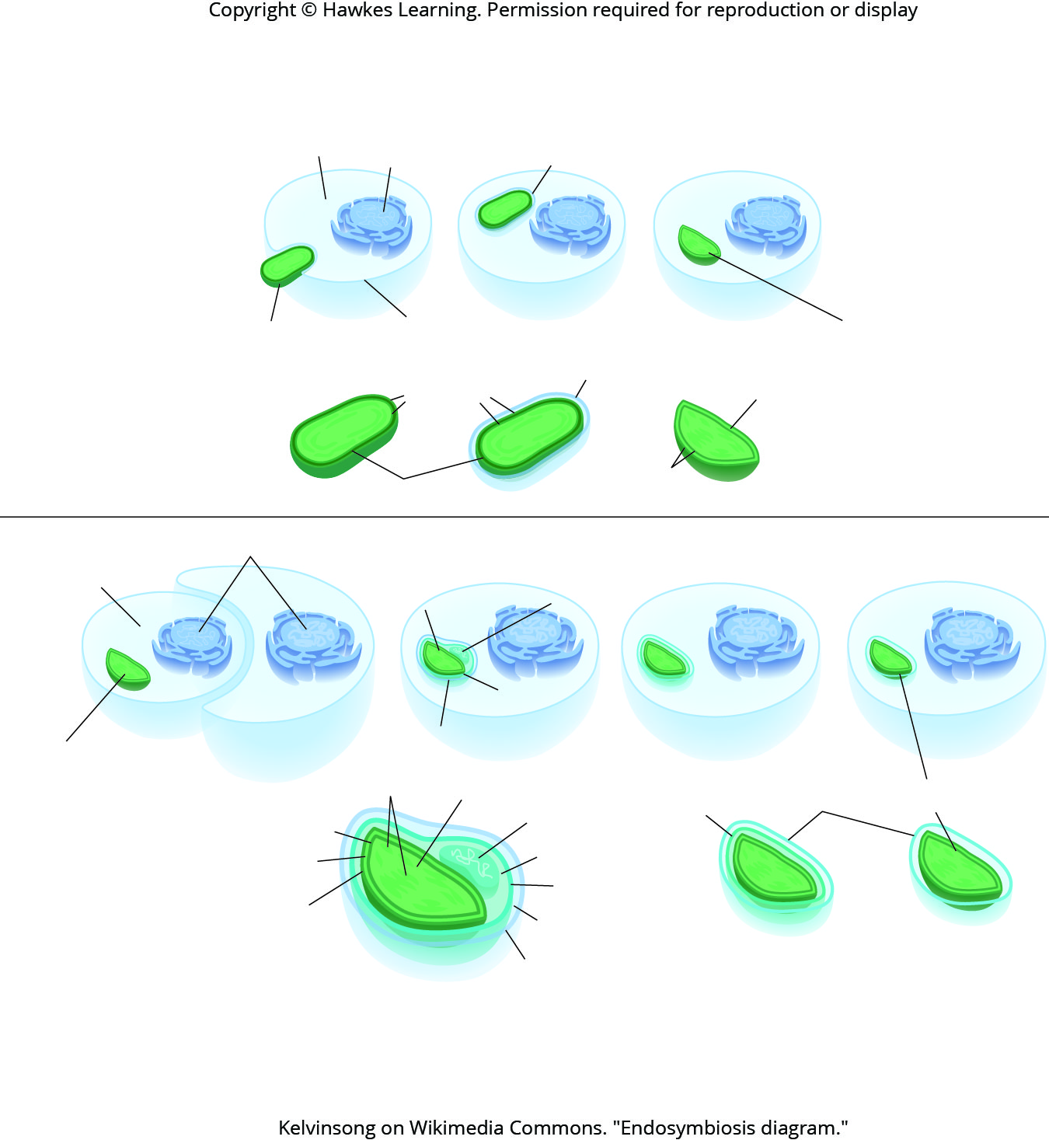
Lesson 25.1 Figure 5

Slide 6
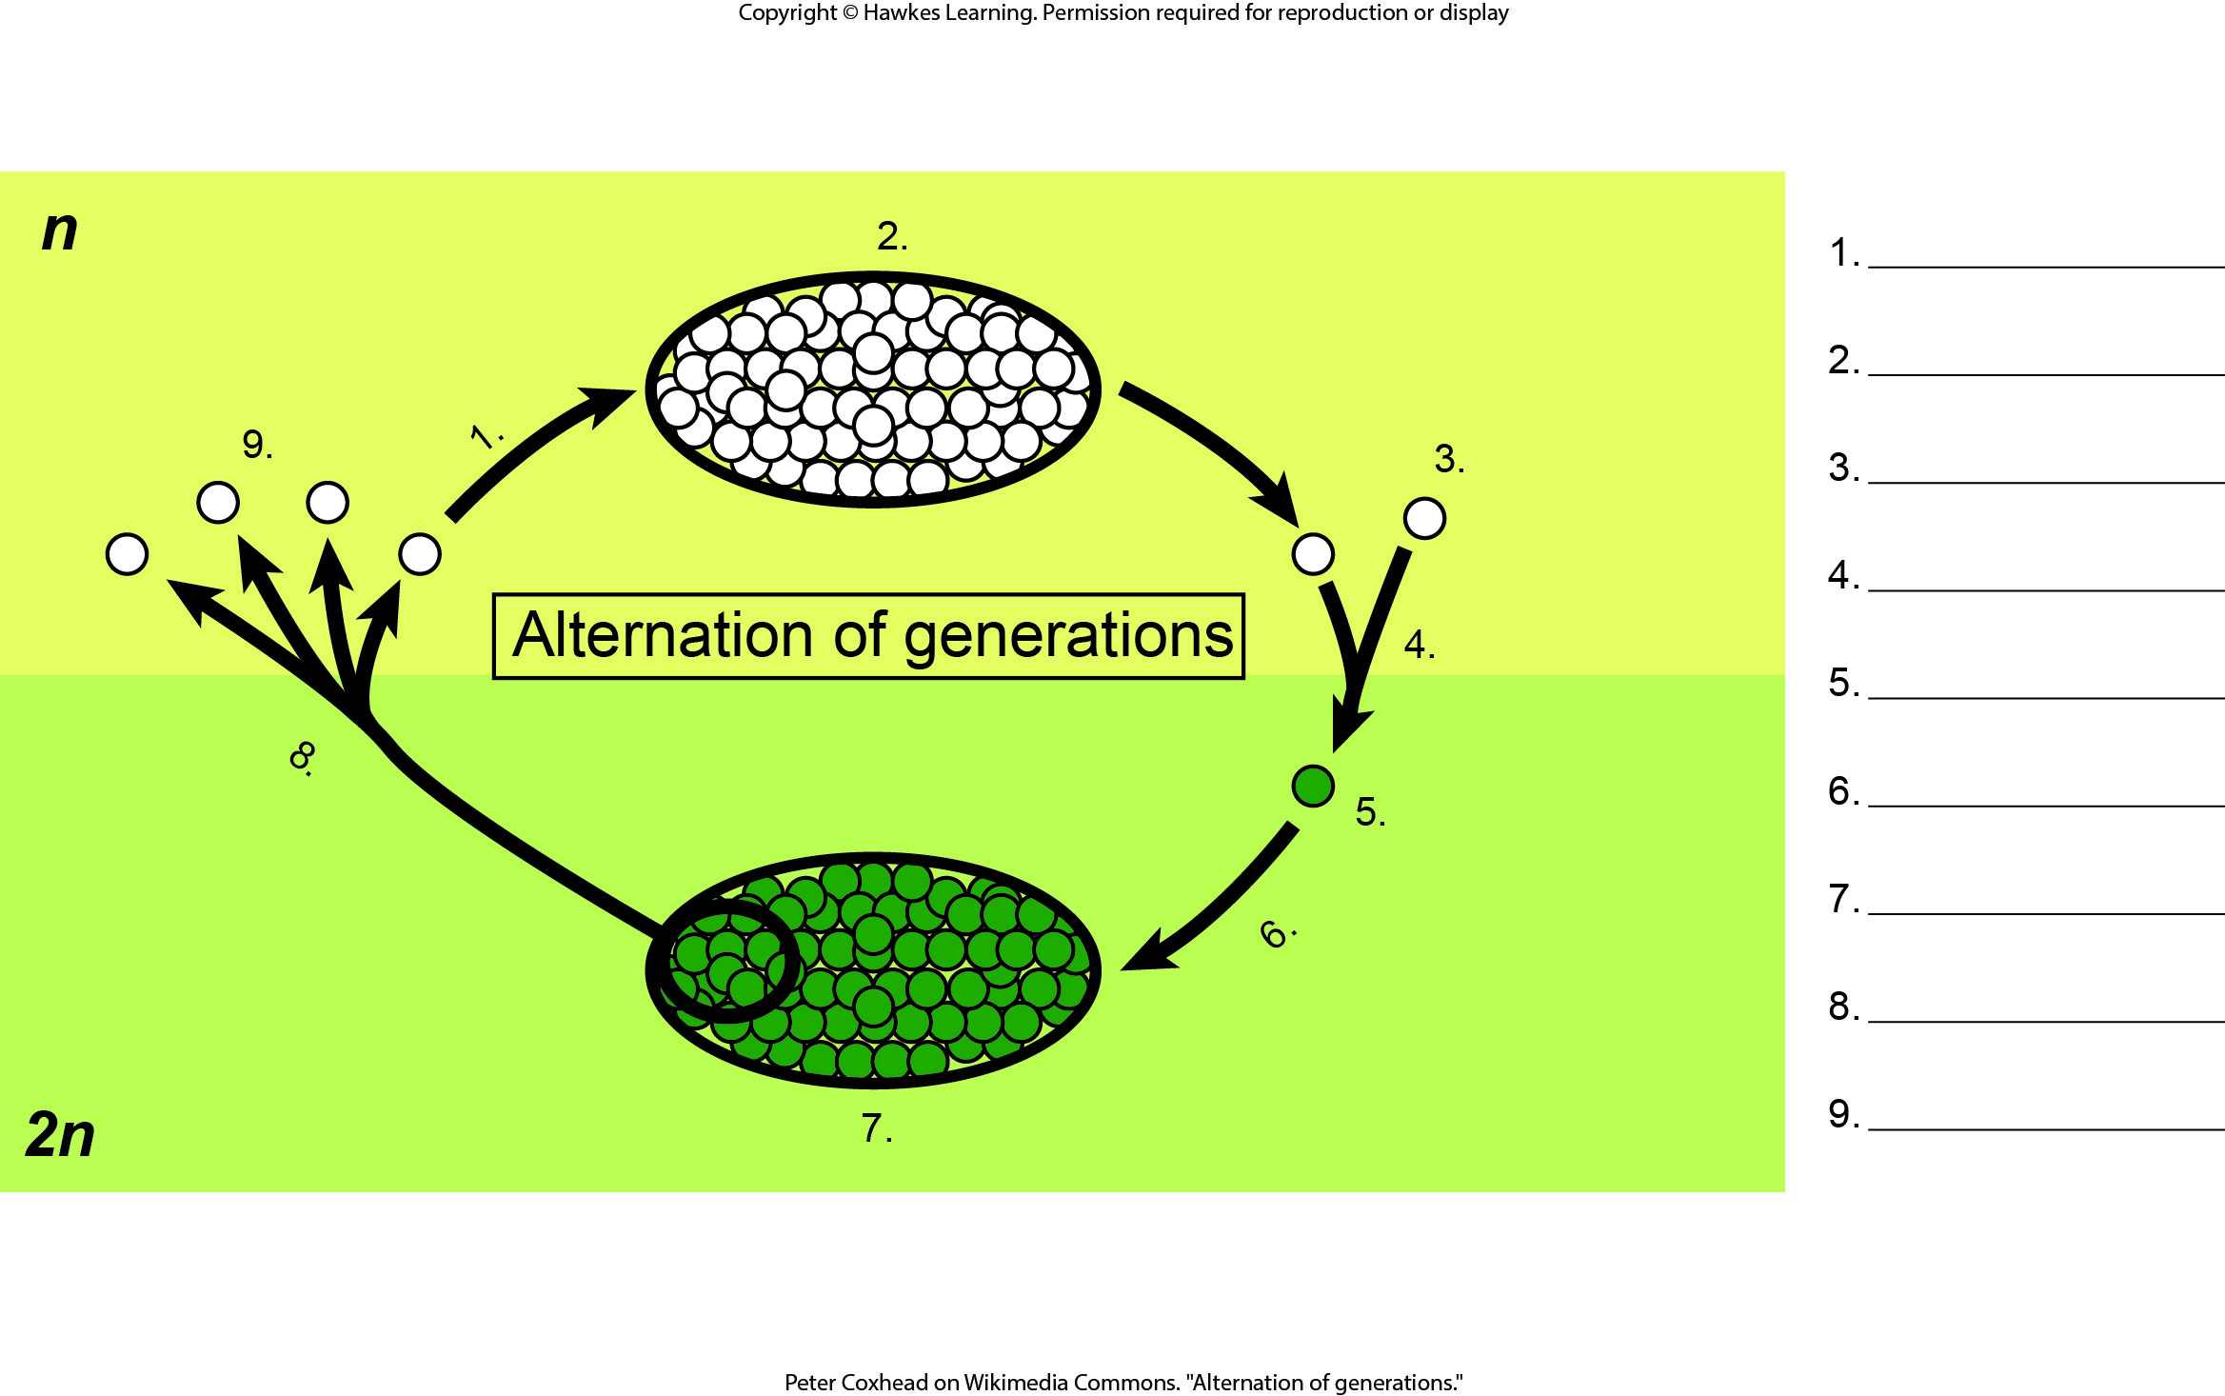
Lesson 25.1 Figure 7 - Numbered

Slide 7
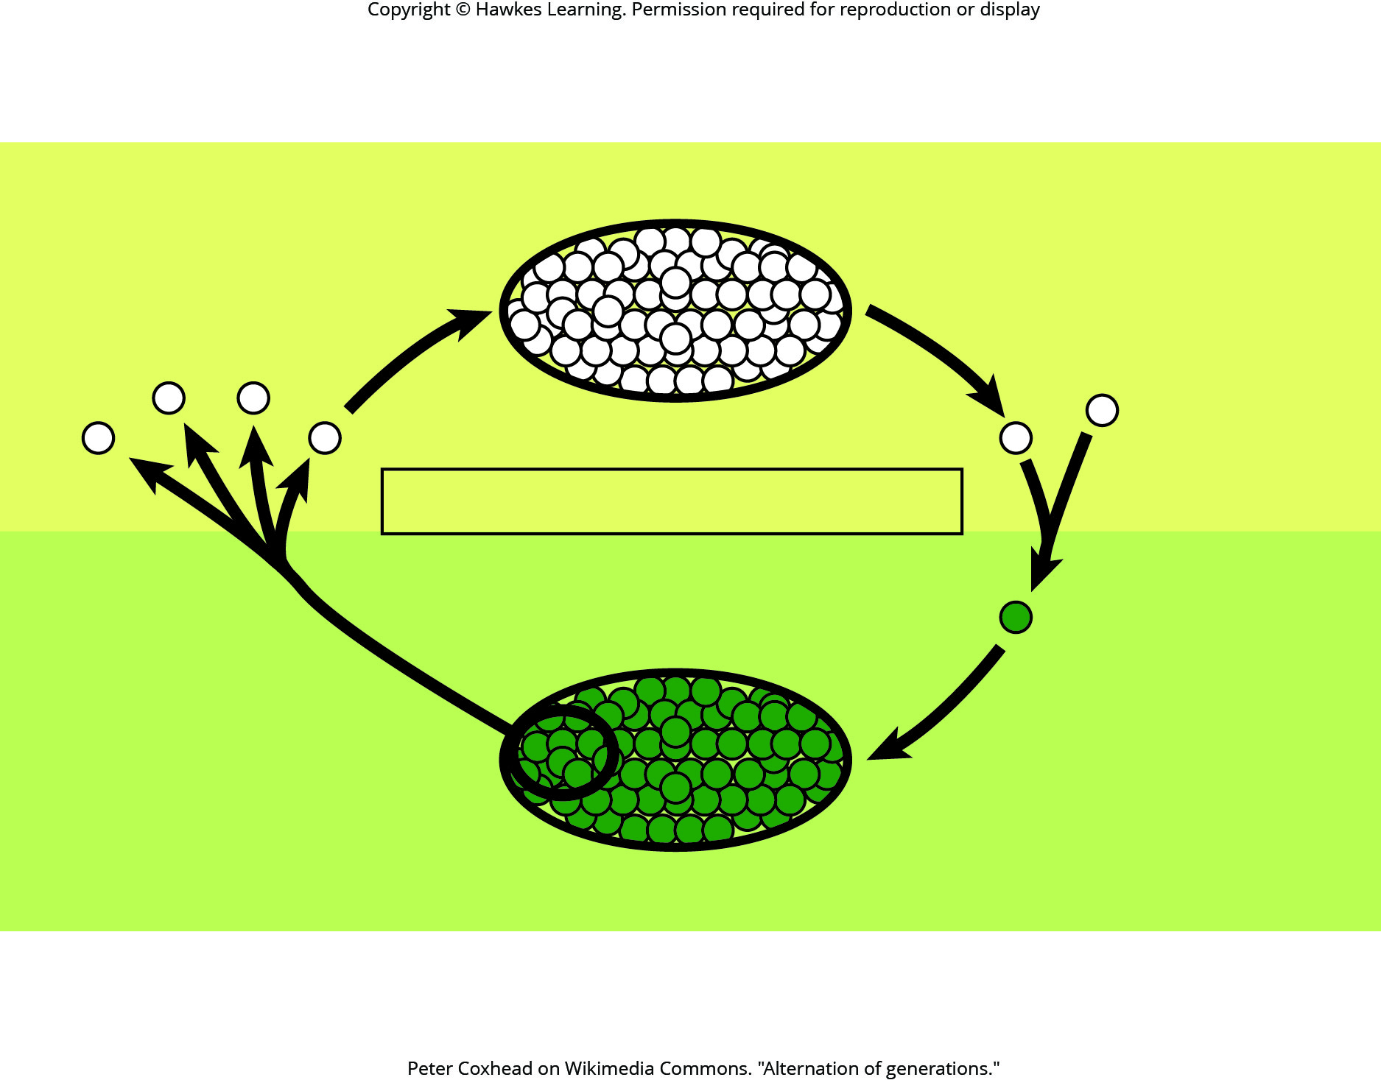
Lesson 25.1 Figure 7

Slide 8
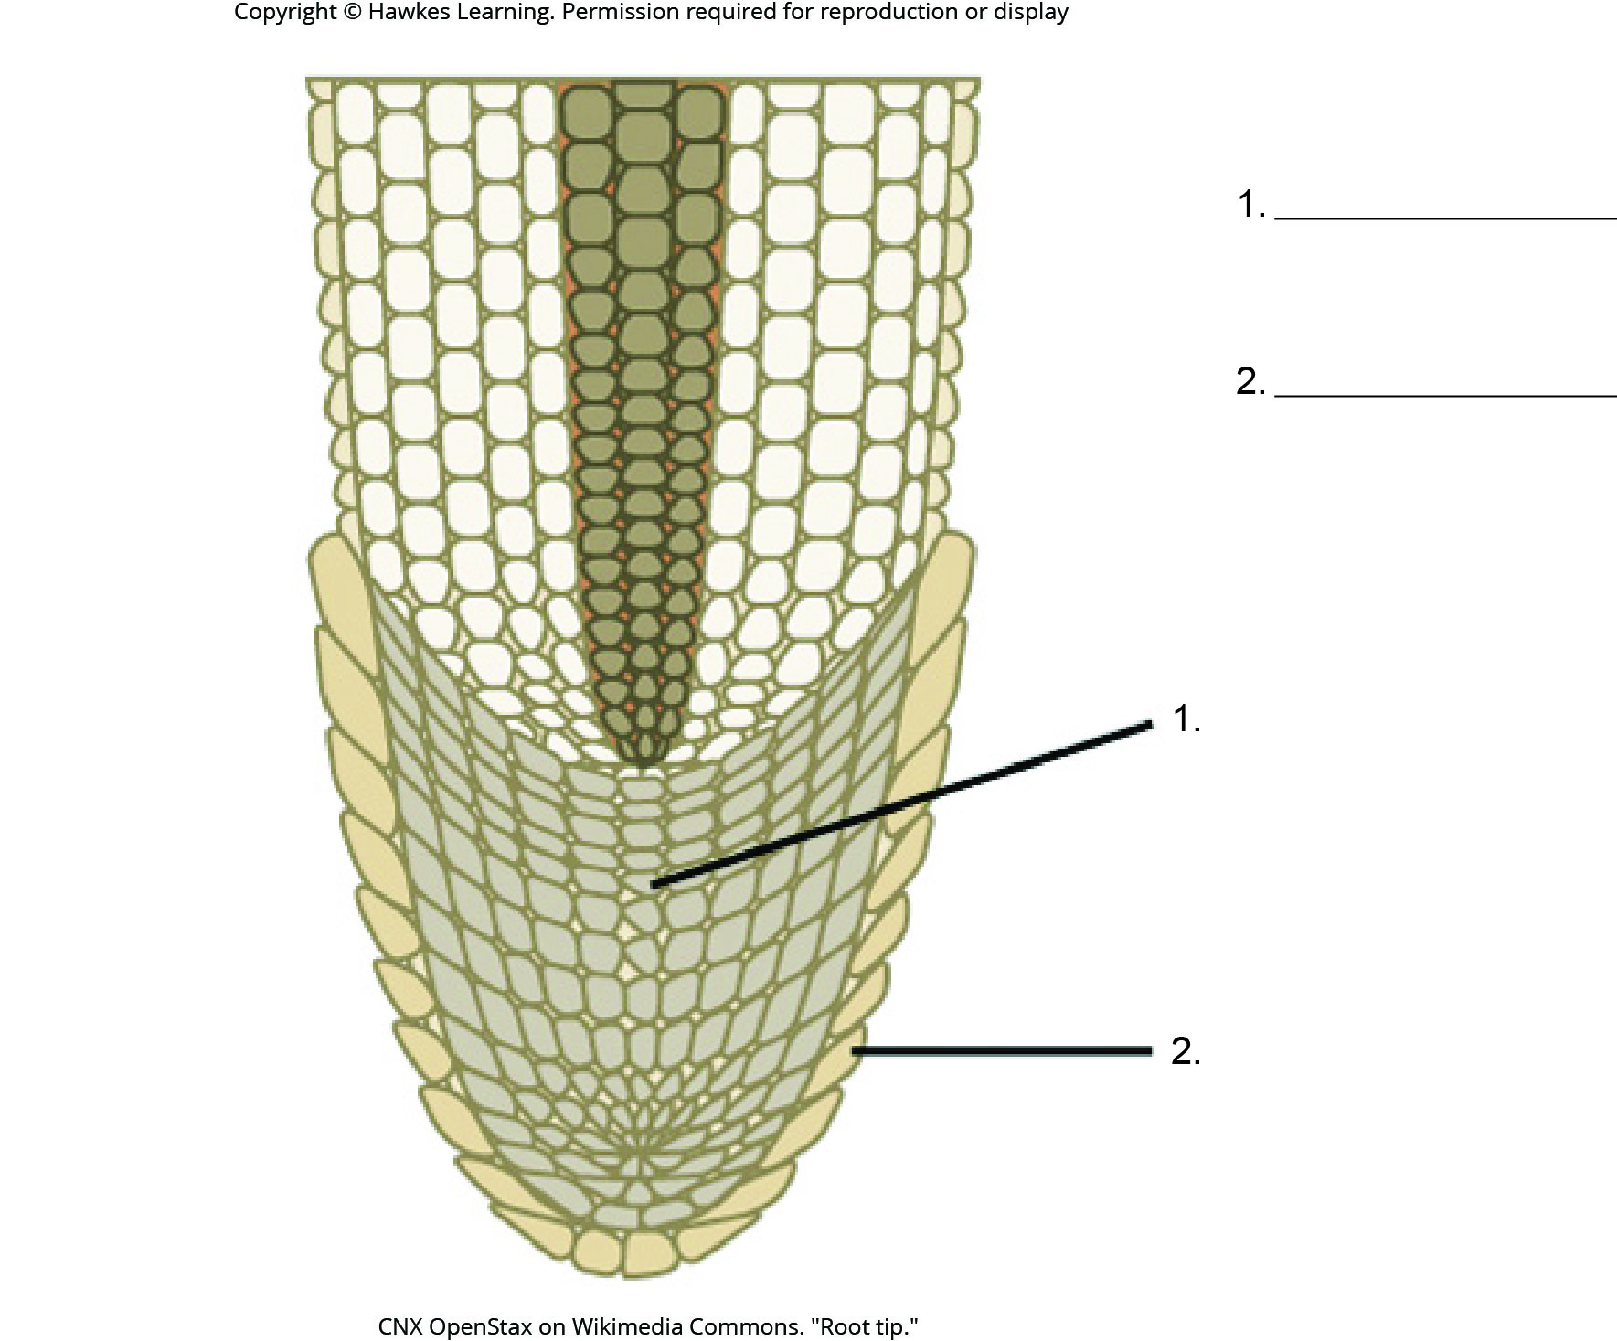
Lesson 25.1 Figure 9 - Numbered

Slide 9
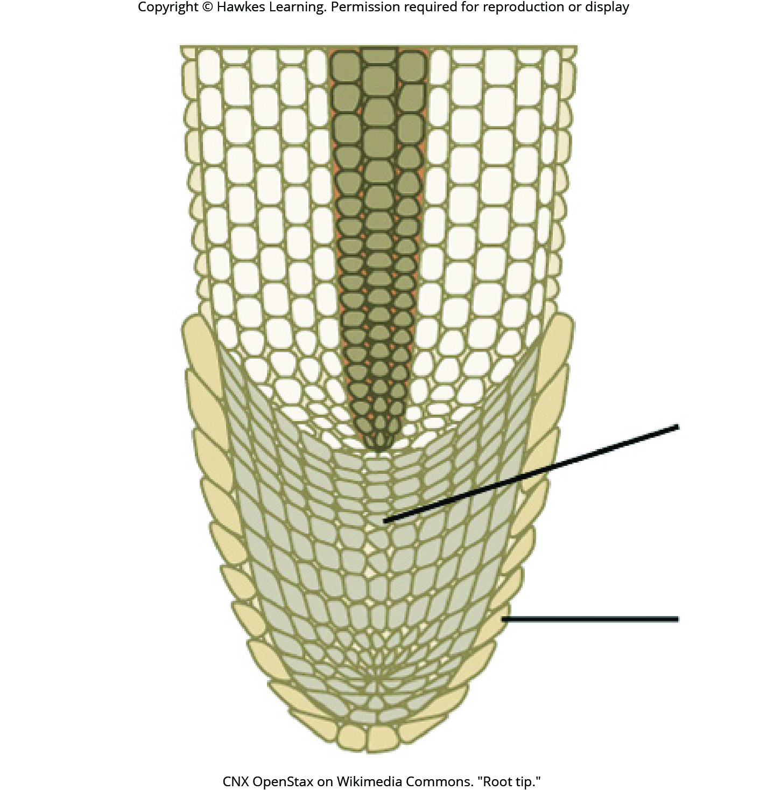
Lesson 25.1 Figure 9

Slide 10
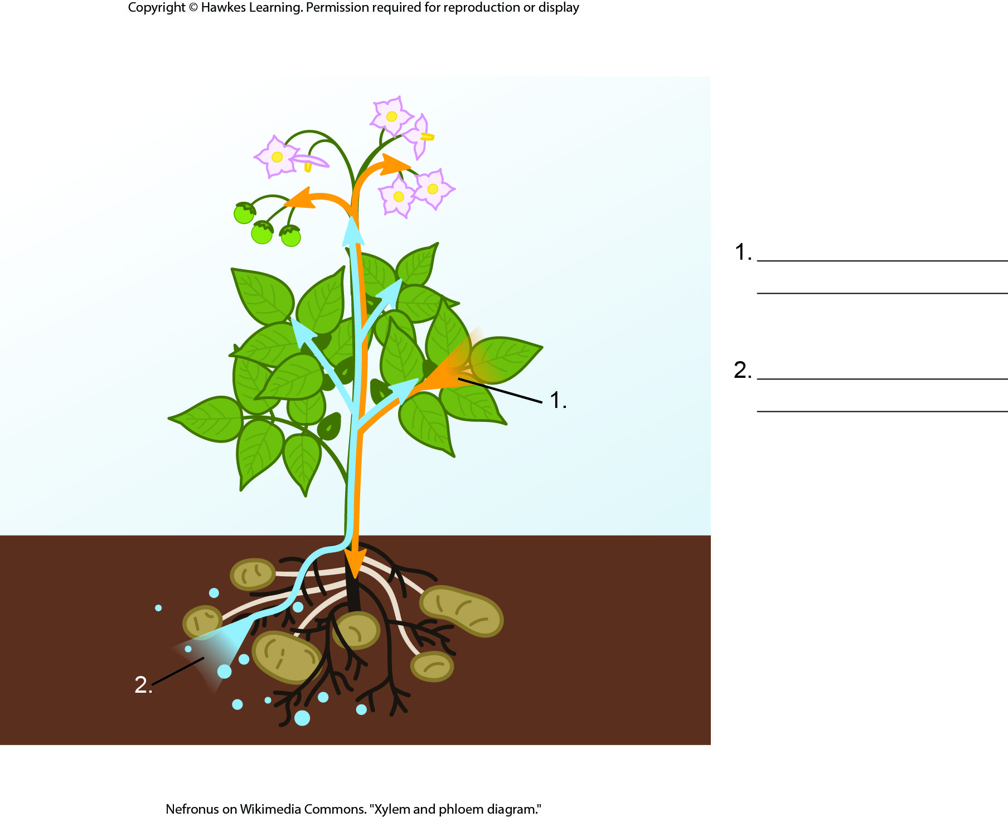
Lesson 25.1 Figure 10 - Numbered

Slide 11
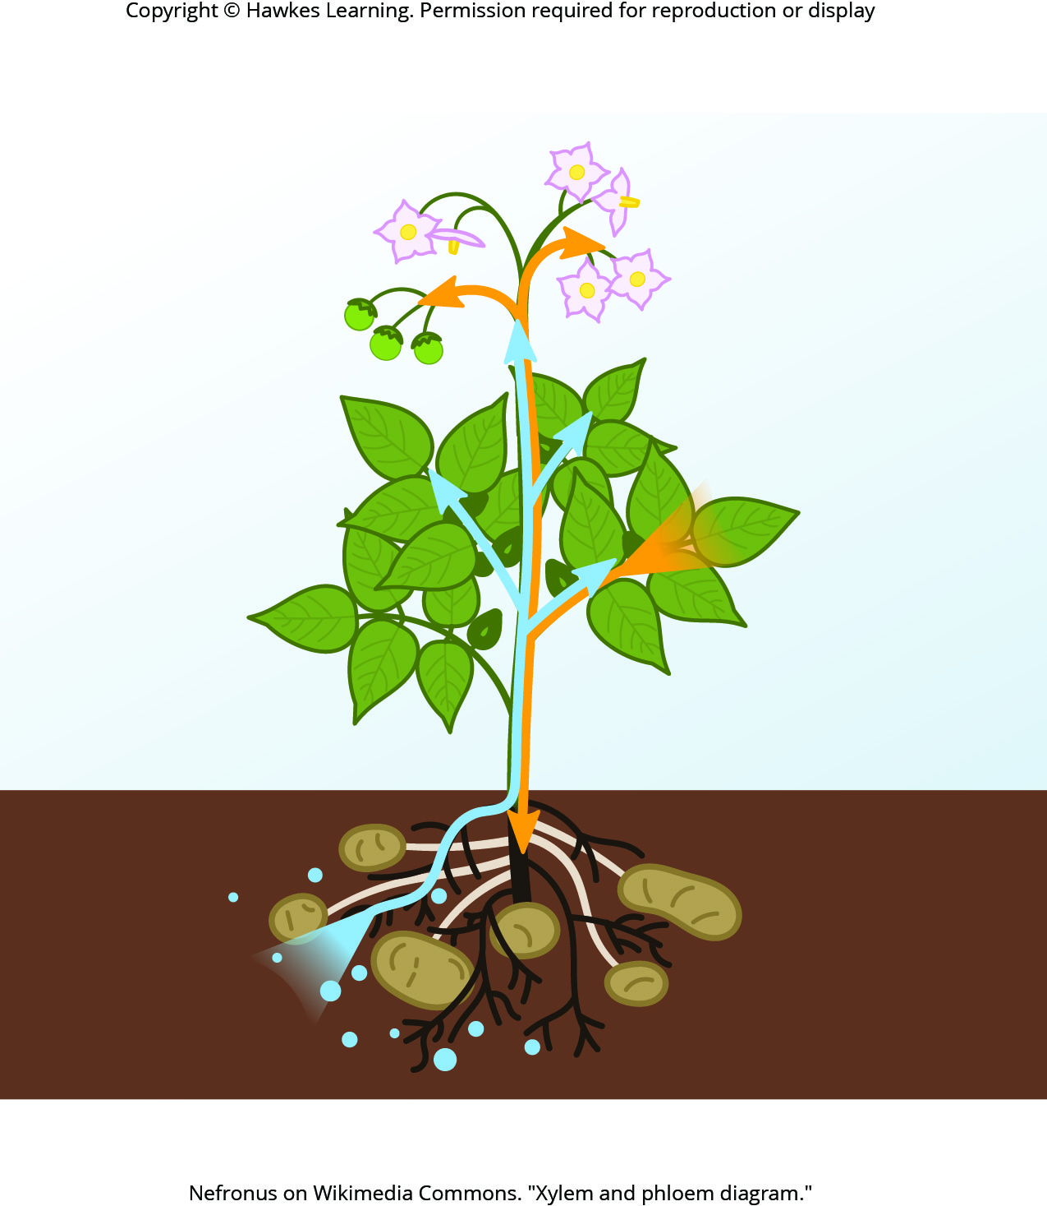
Lesson 25.1 Figure 10

Slide 12
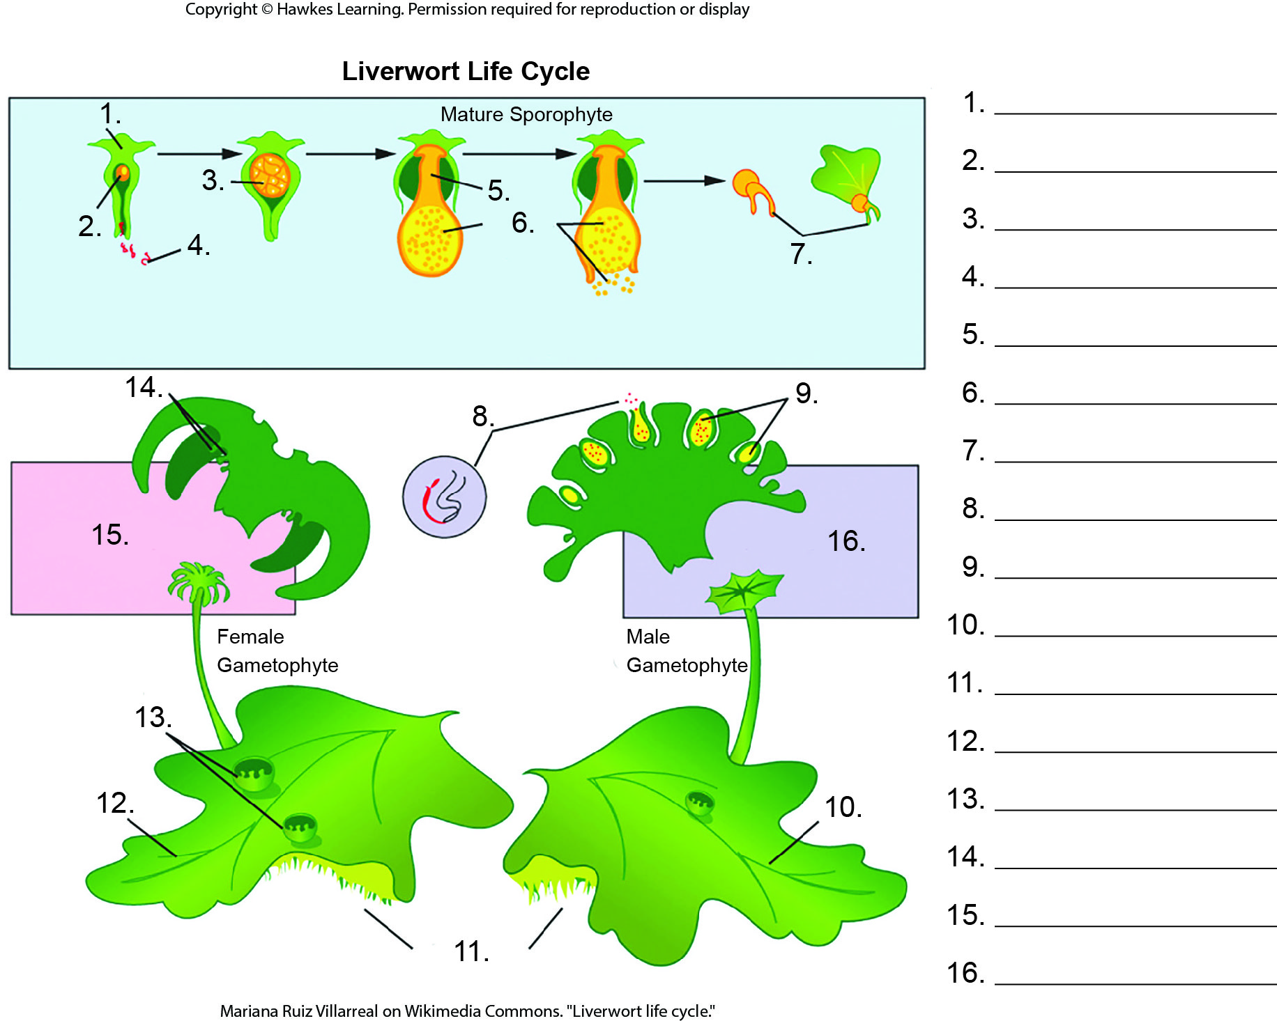
Lesson 25.2 Figure 5 - Numbered

Slide 13
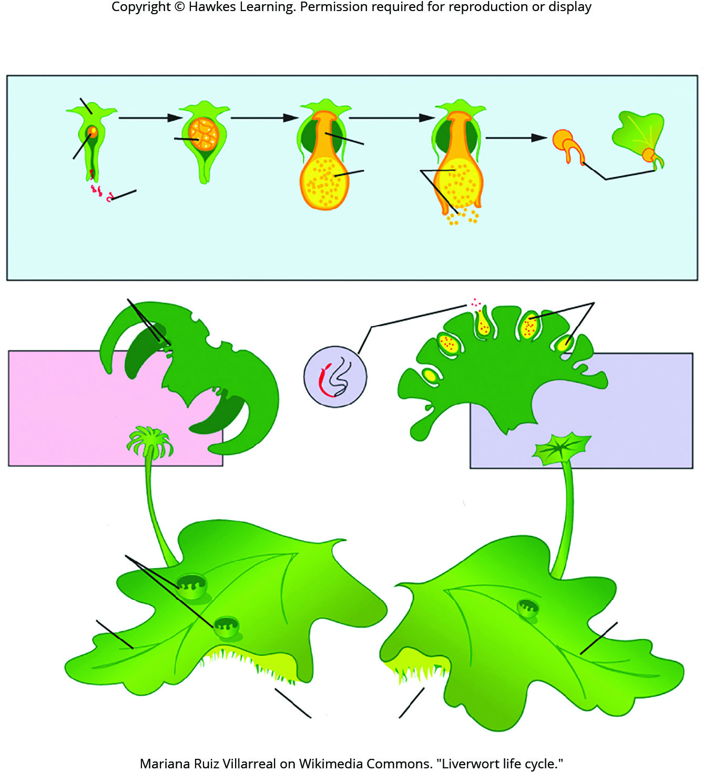
Lesson 25.2 Figure 5

Slide 14
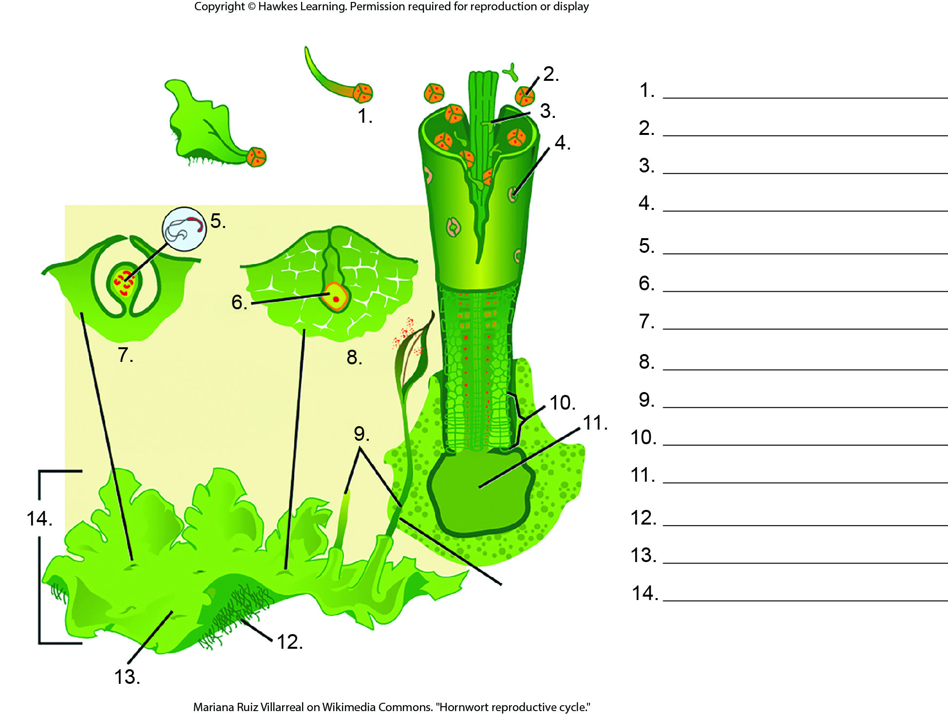
Lesson 25.2 Figure 7 - Numbered

Slide 15
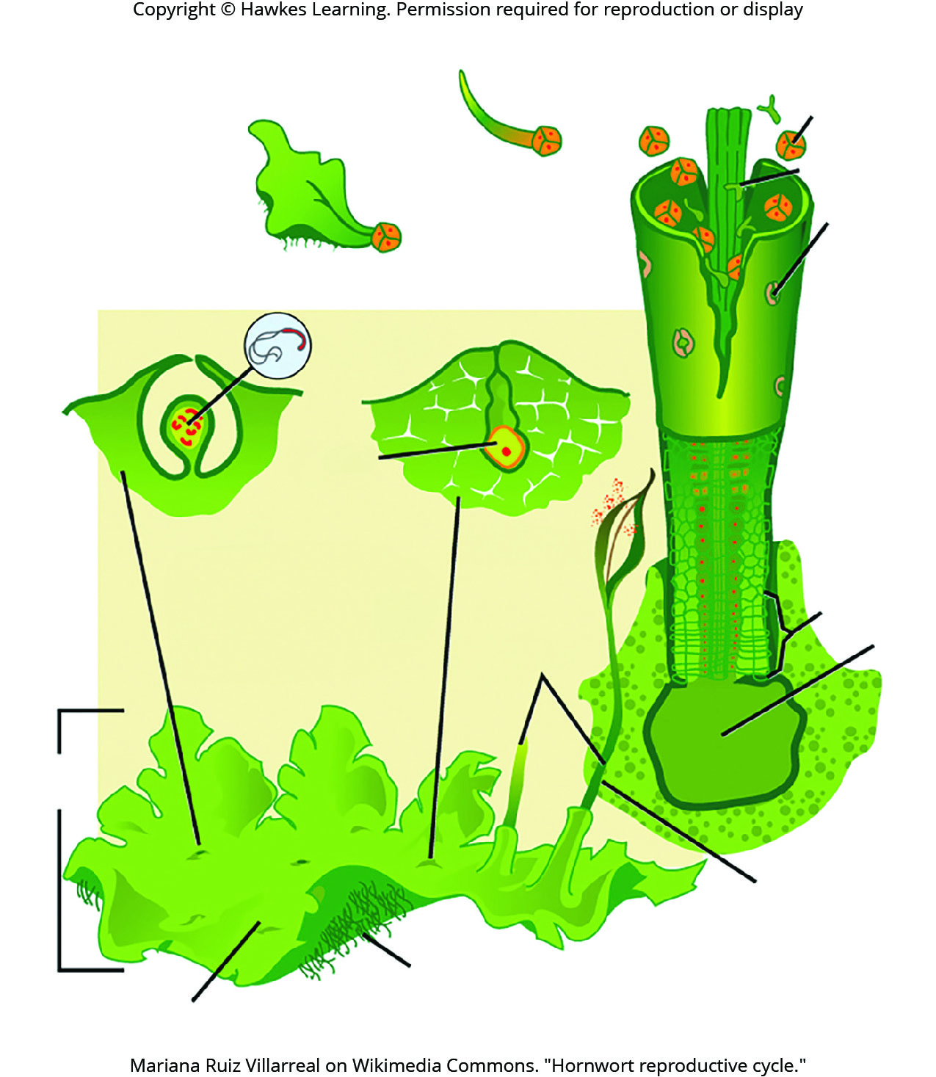
Lesson 25.2 Figure 7

Slide 16
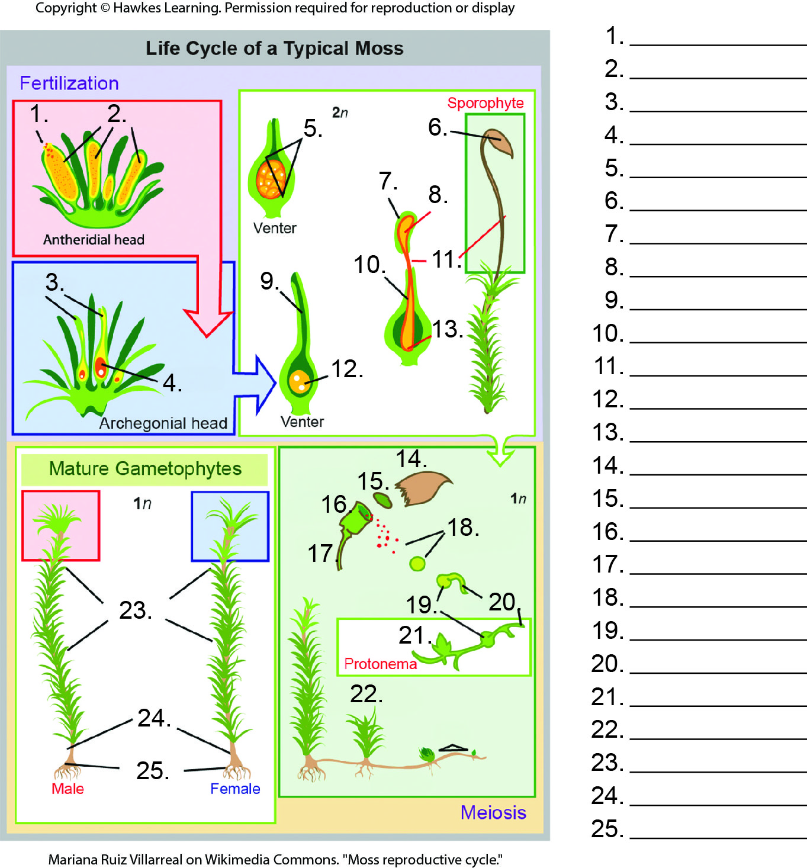
Lesson 25.2 Figure 9 - Numbered

Slide 17
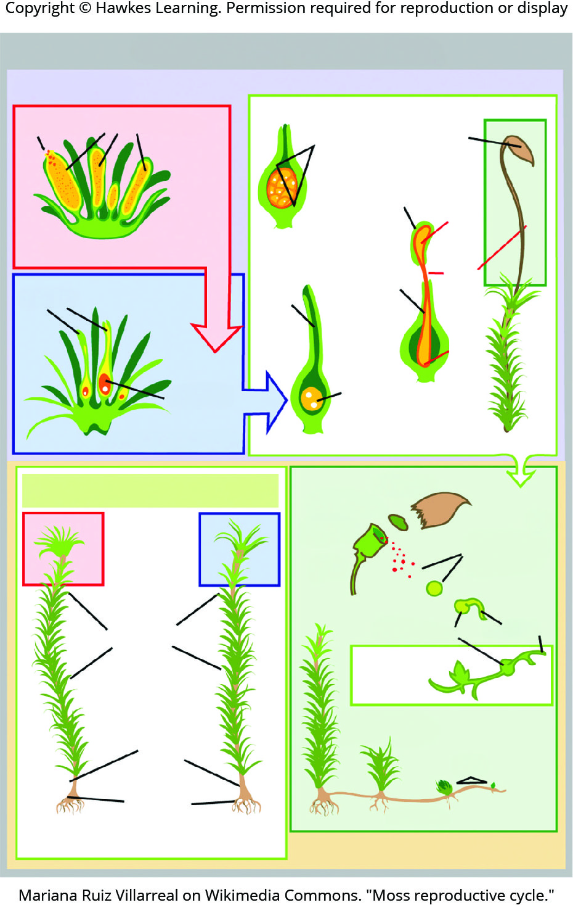
Lesson 25.2 Figure 9

Slide 18
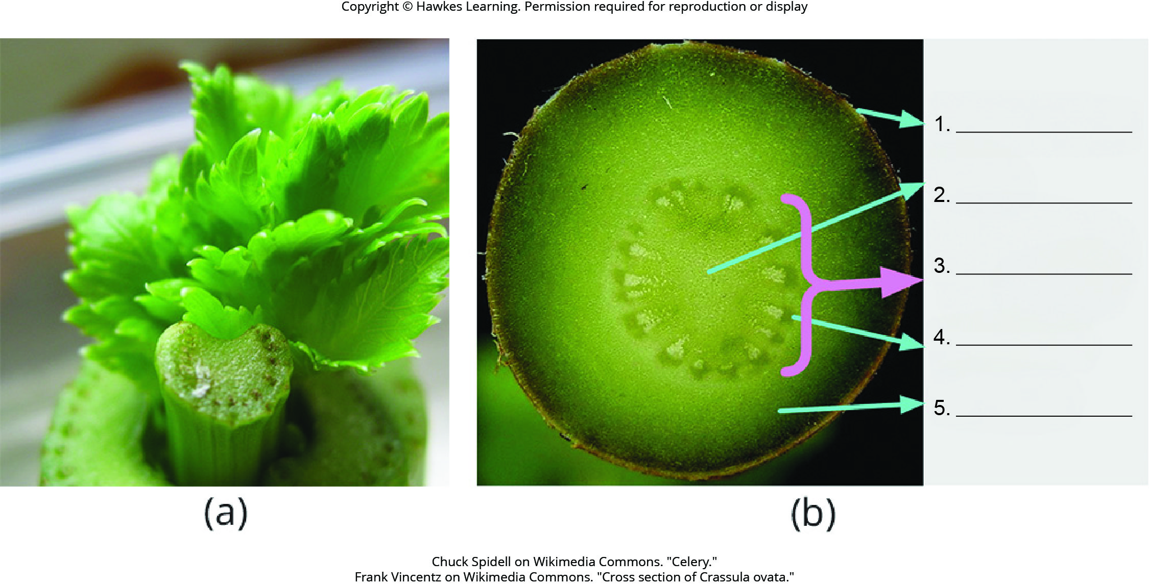
Lesson 25.3 Figure 2 - Numbered

Slide 19
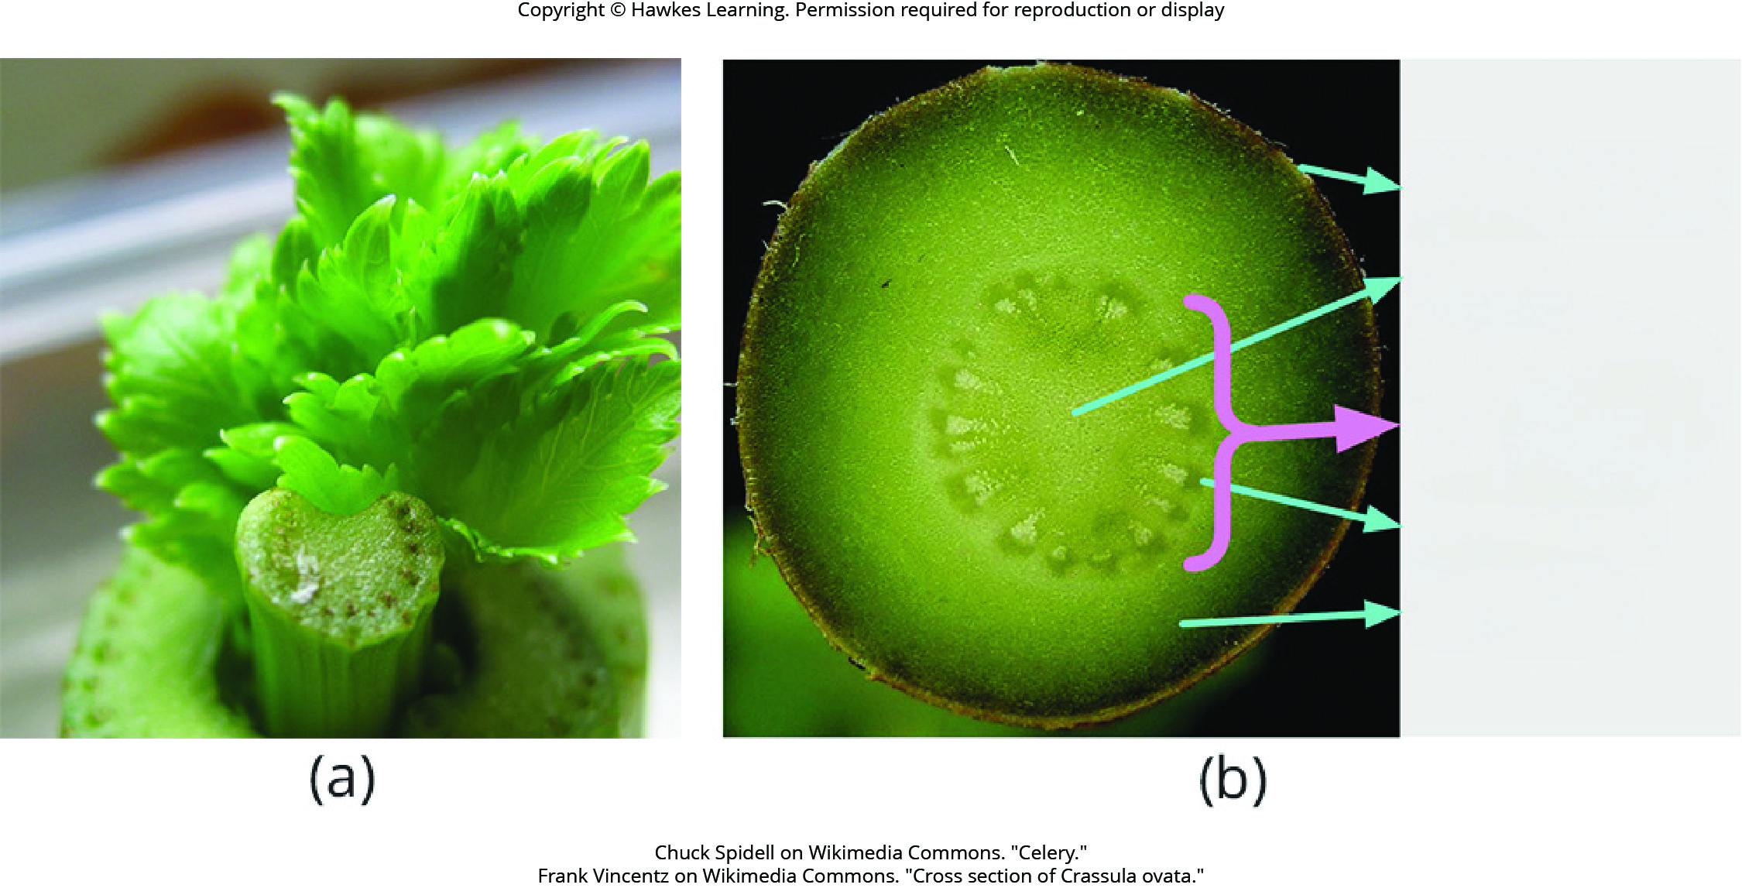
Lesson 25.3 Figure 2

Slide 20
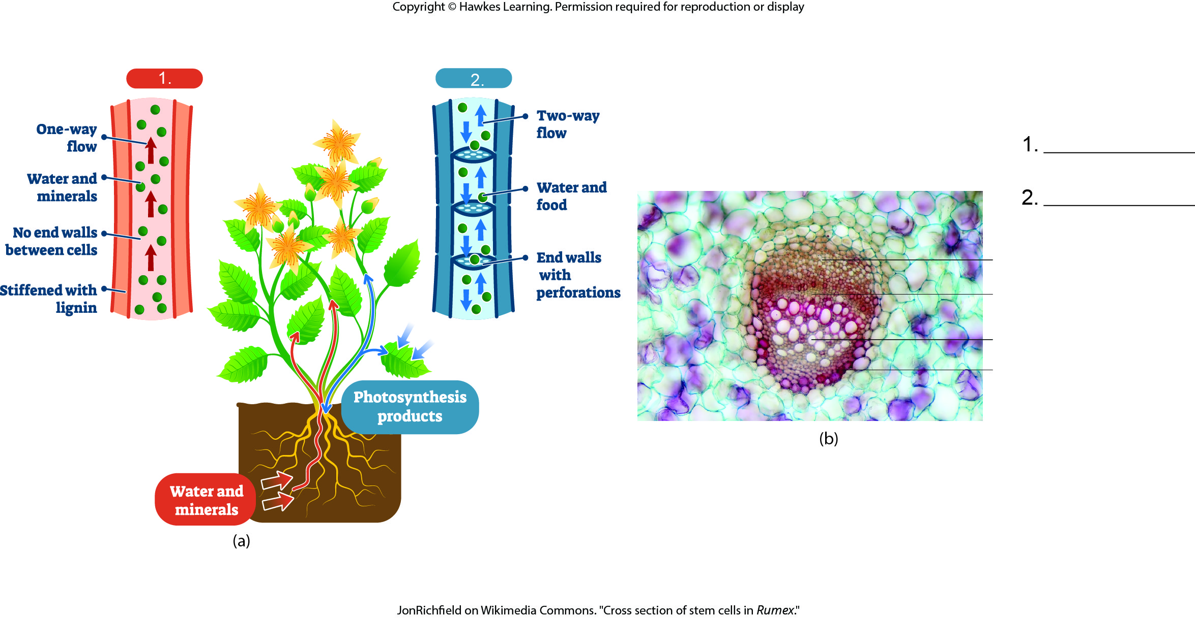
Lesson 25.3 Figure 4 - Numbered

Slide 21
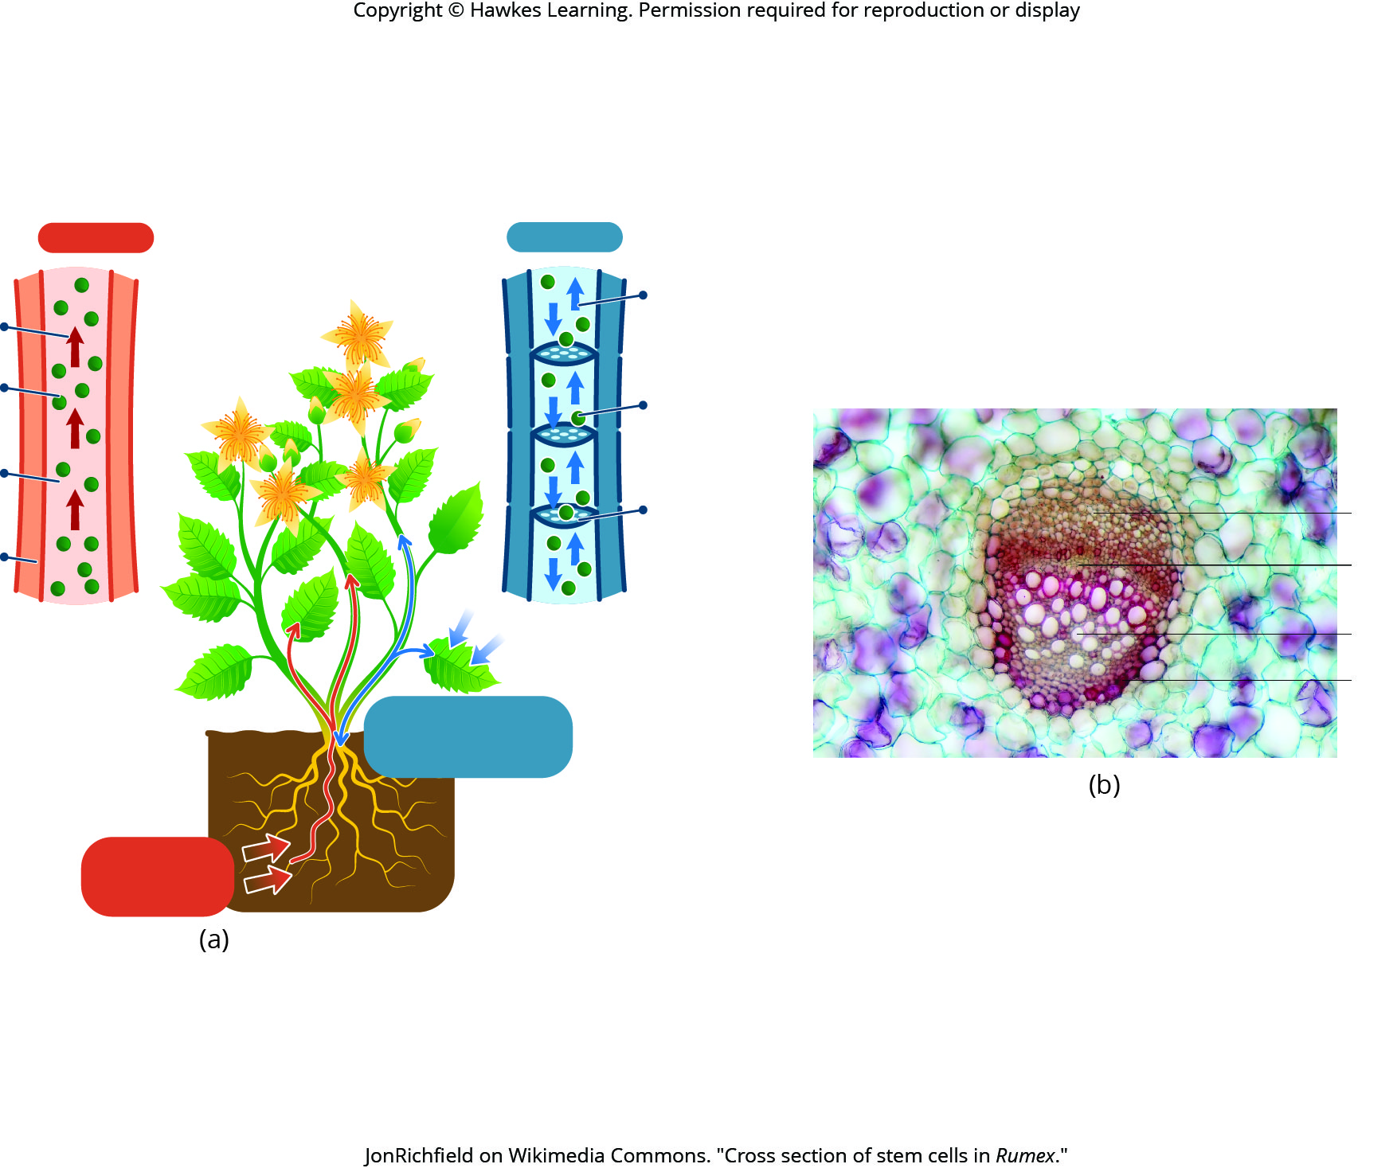
Lesson 25.3 Figure 4

Slide 22
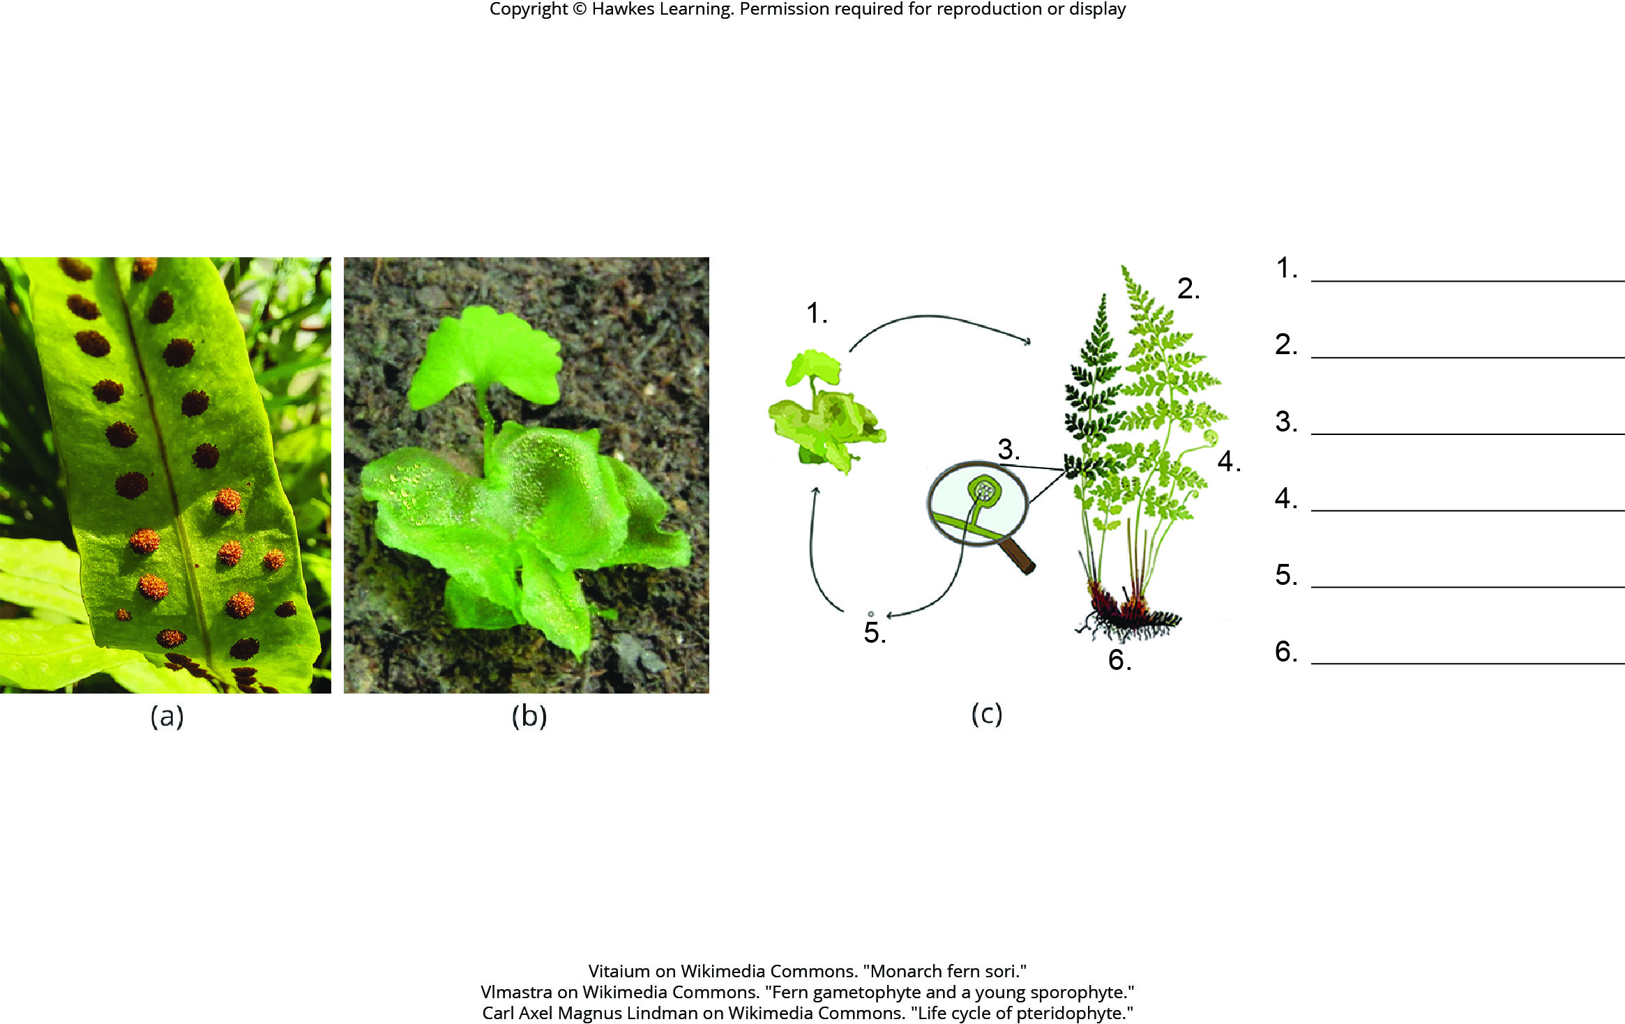
Lesson 25.3 Figure 12 - Numbered

Slide 23
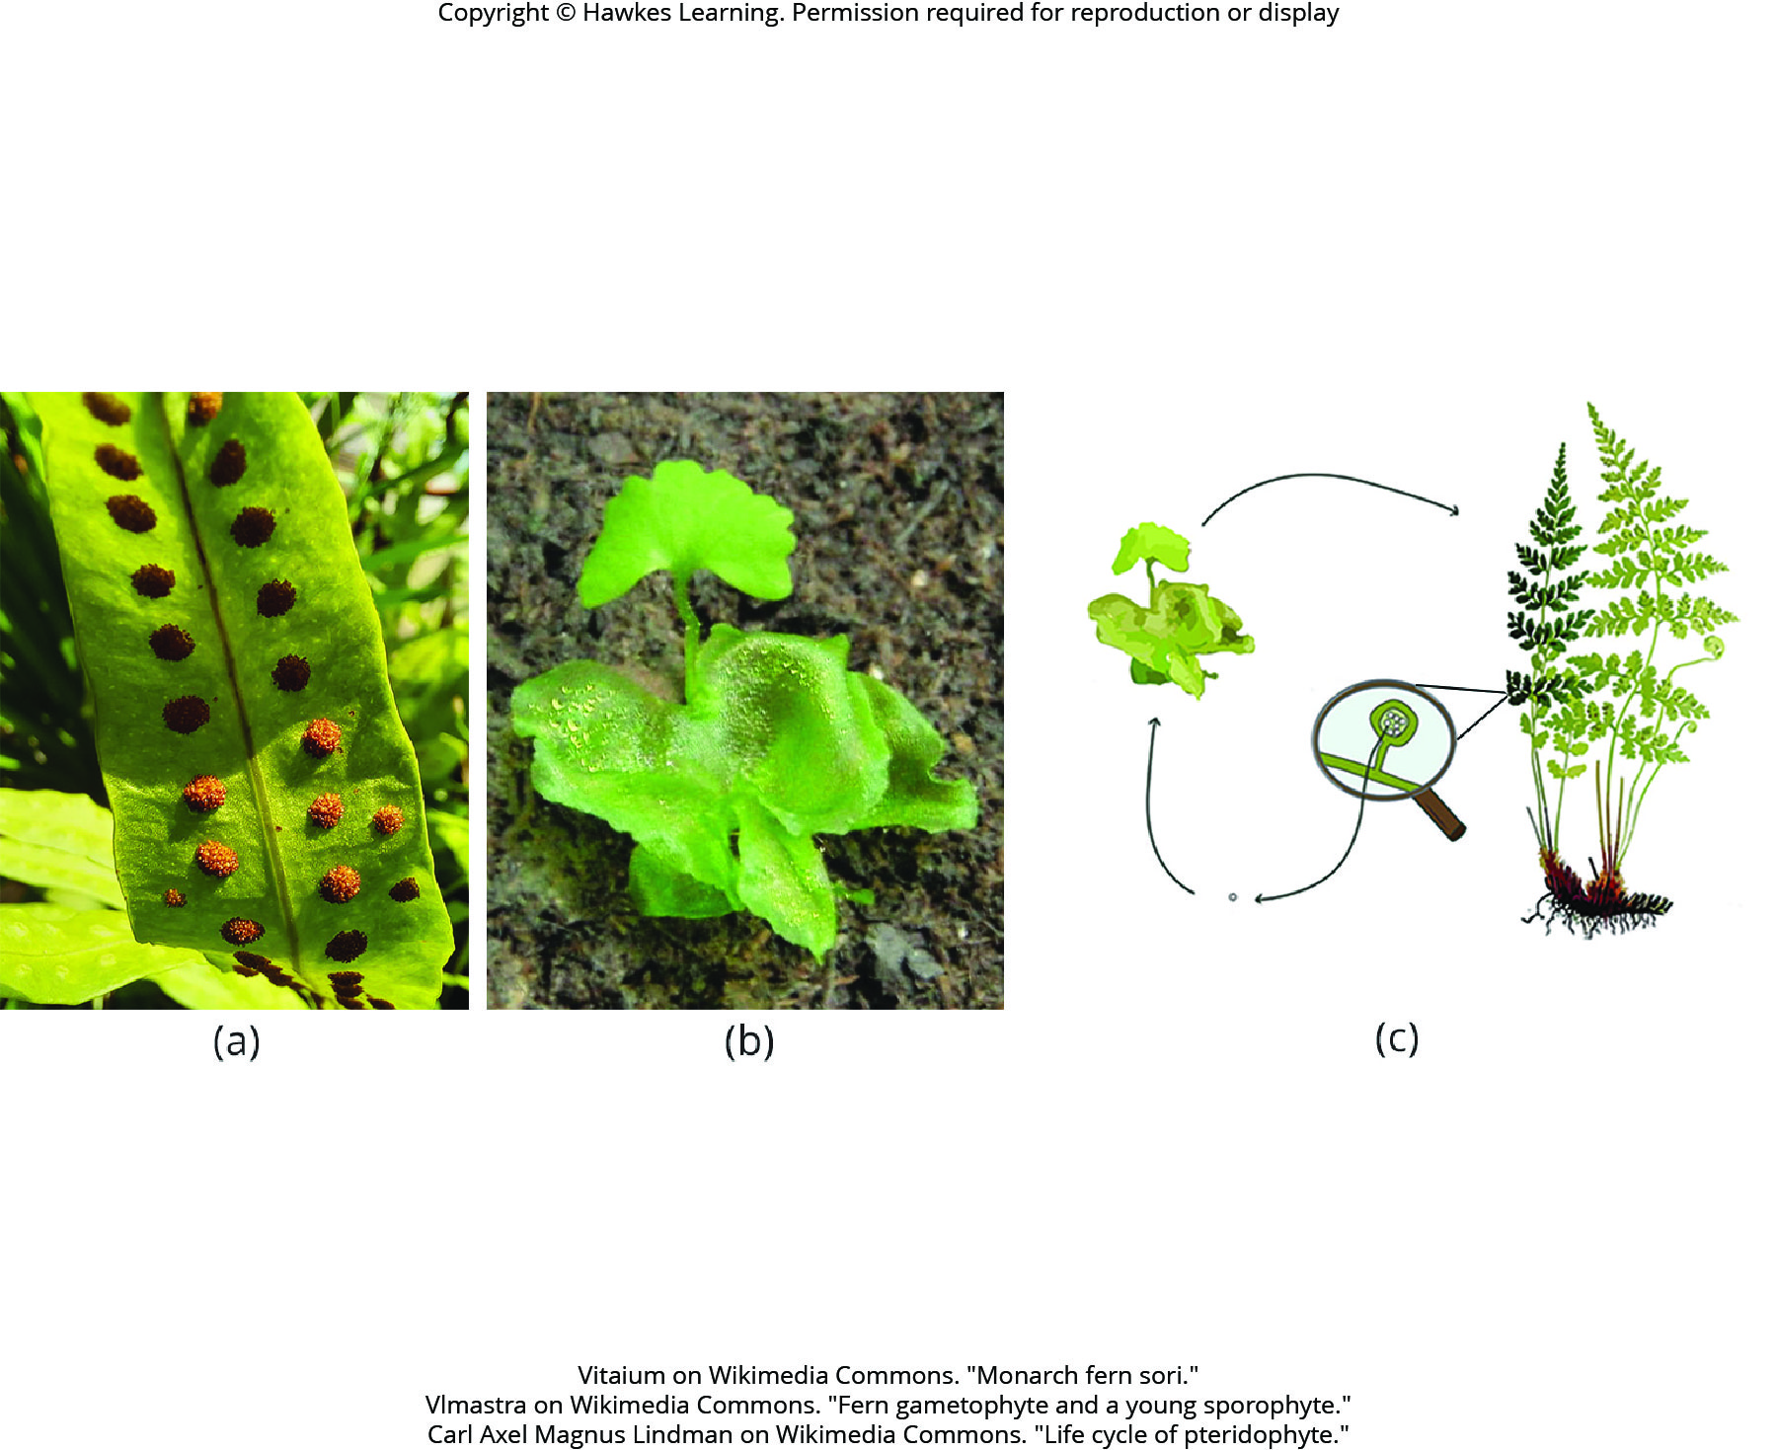
Lesson 25.3 Figure 12

Slide 24
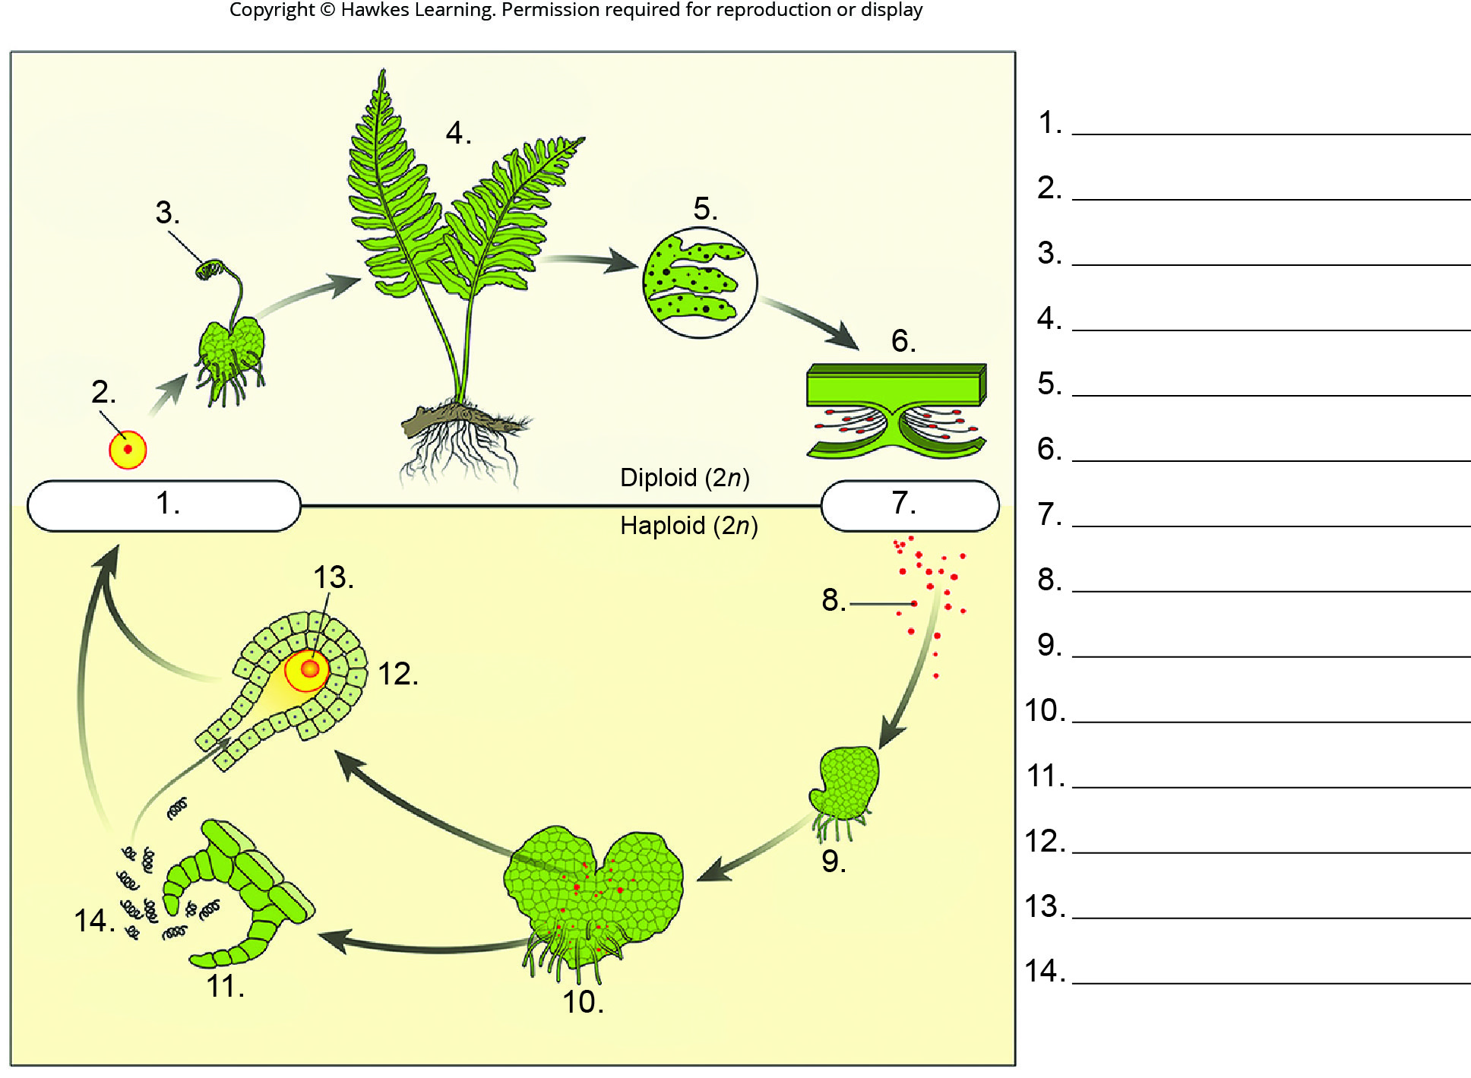
Lesson 25.3 Figure 13 - Numbered

Slide 25
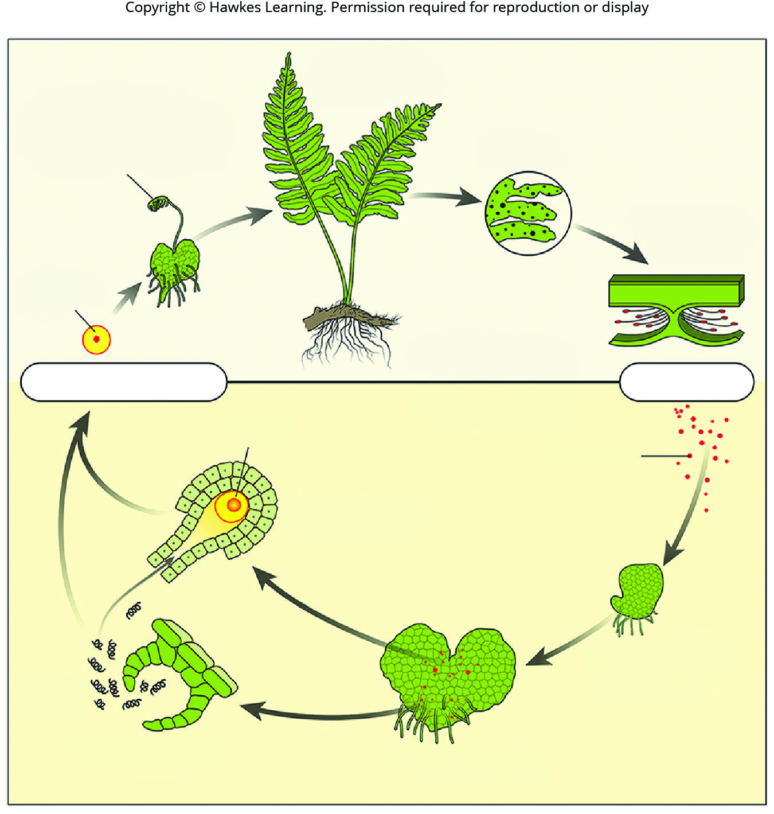
Lesson 25.3 Figure 13

Slide 26
Hawkes Learning – End of PowerPoint

