Slide 1
Chapter 26
Seed Plants

Slide 2
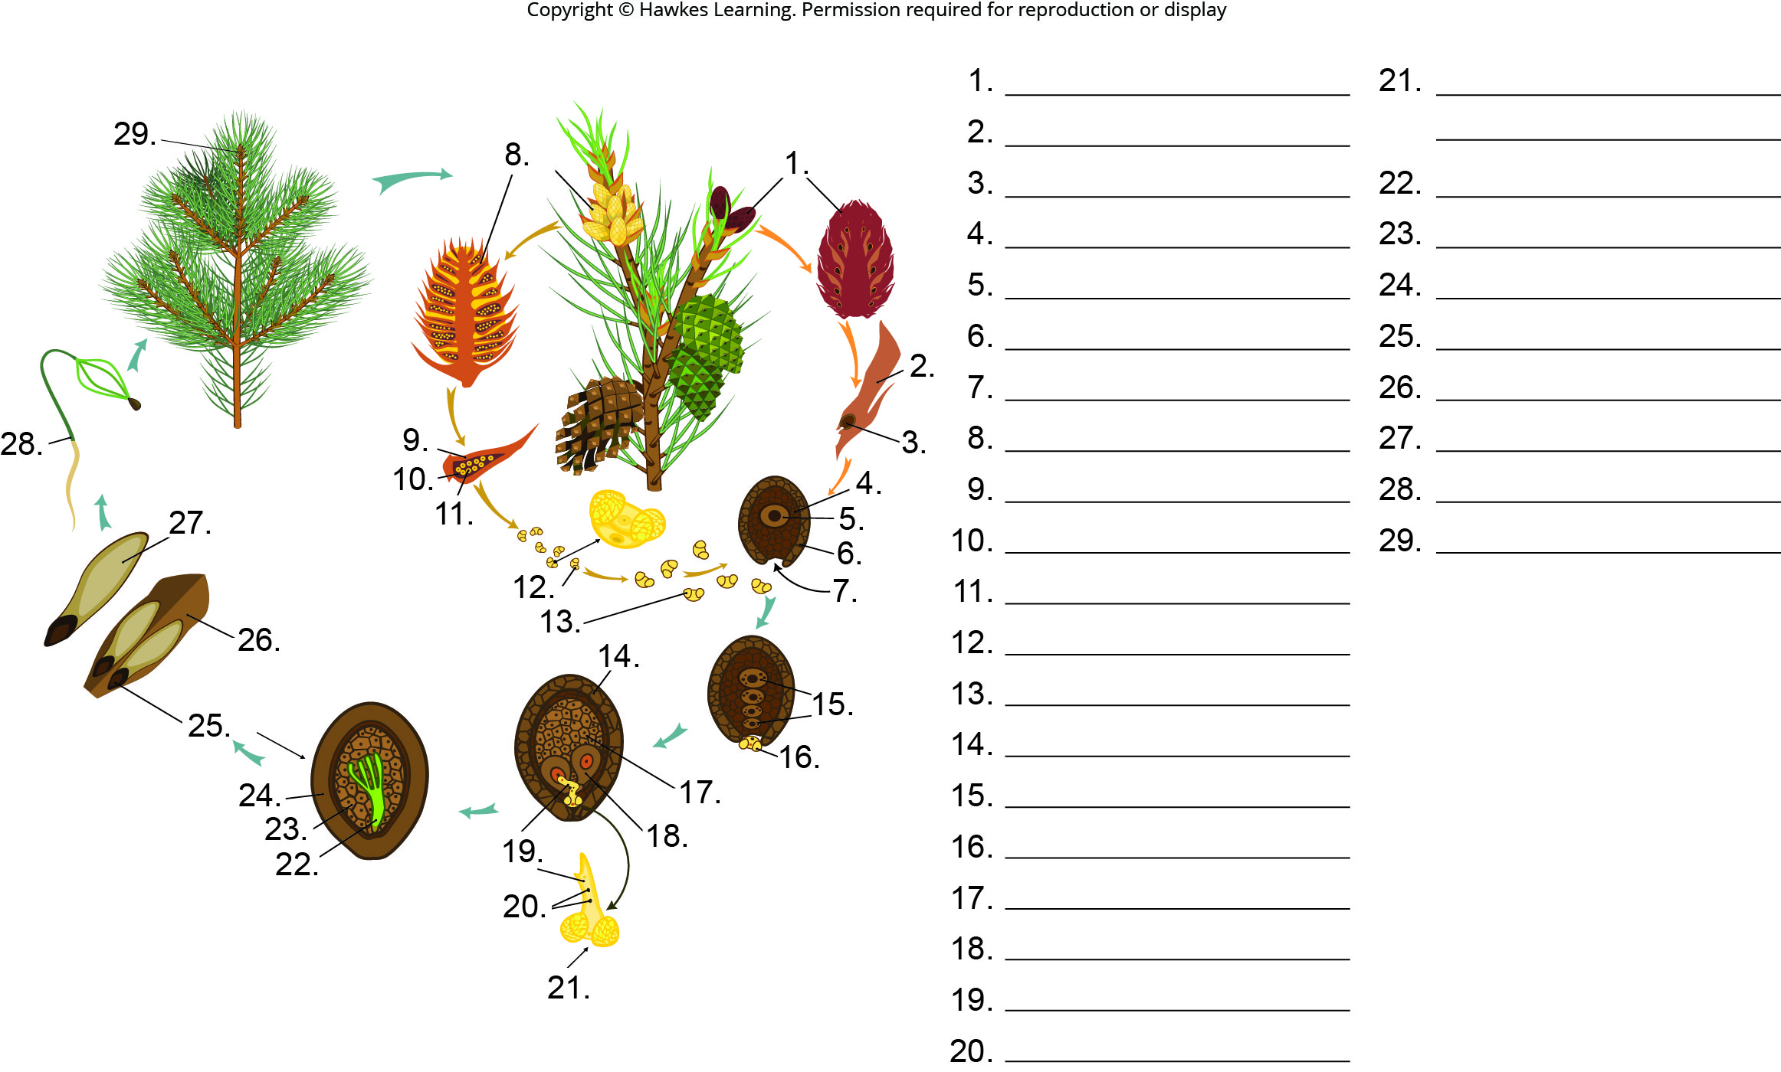
Lesson 26.2 Figure 3 - Numbered

Slide 3
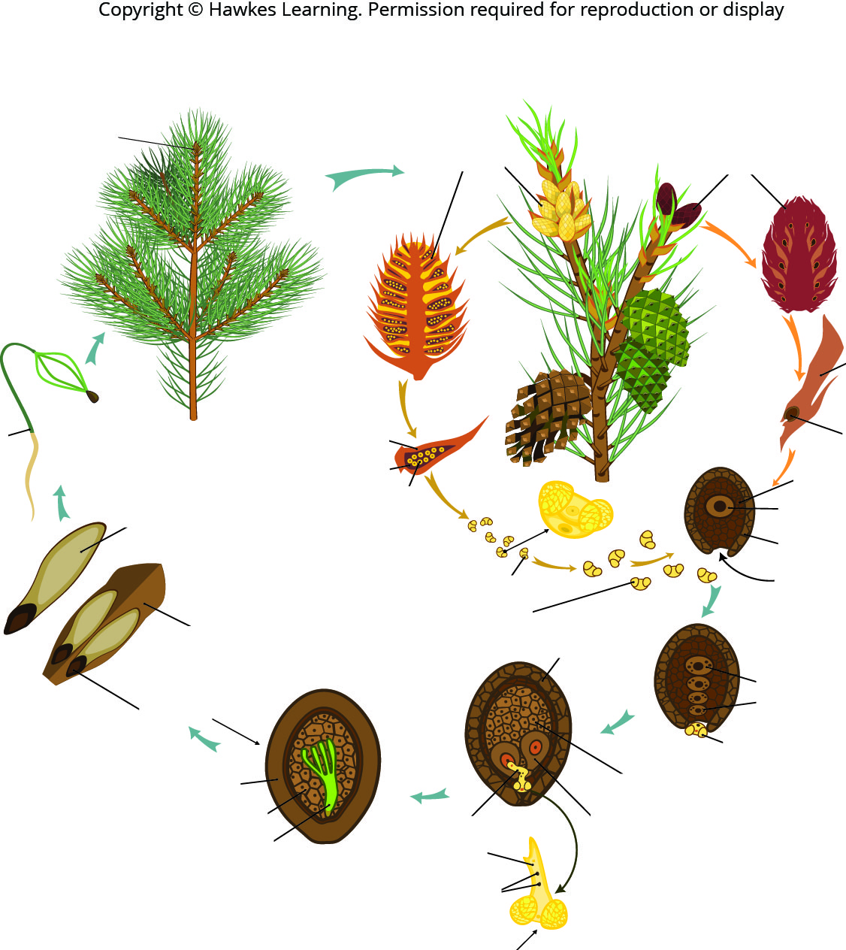
Lesson 26.2 Figure 3

Slide 4
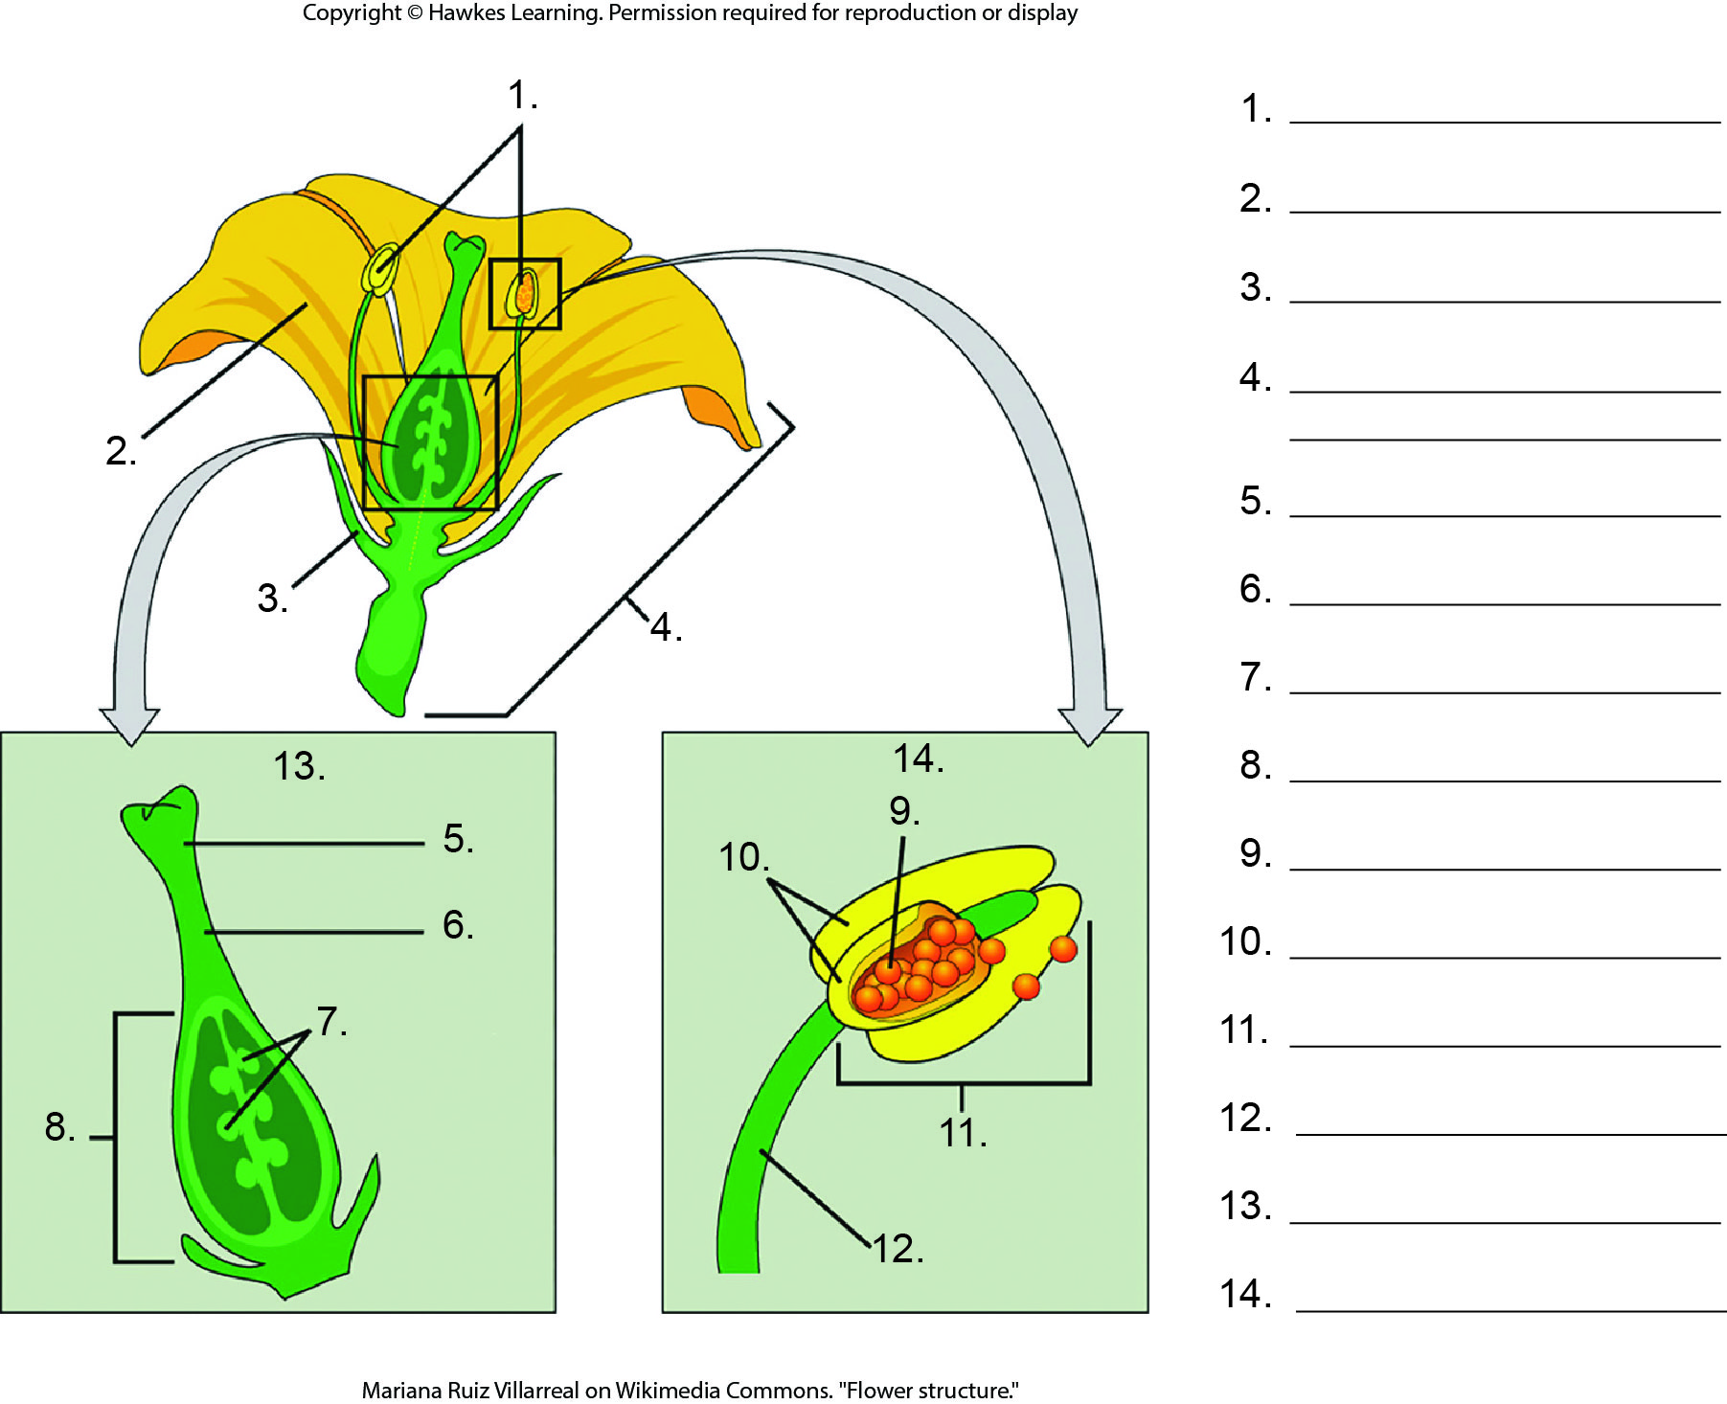
Lesson 26.3 Figure 2 - Numbered

Slide 5
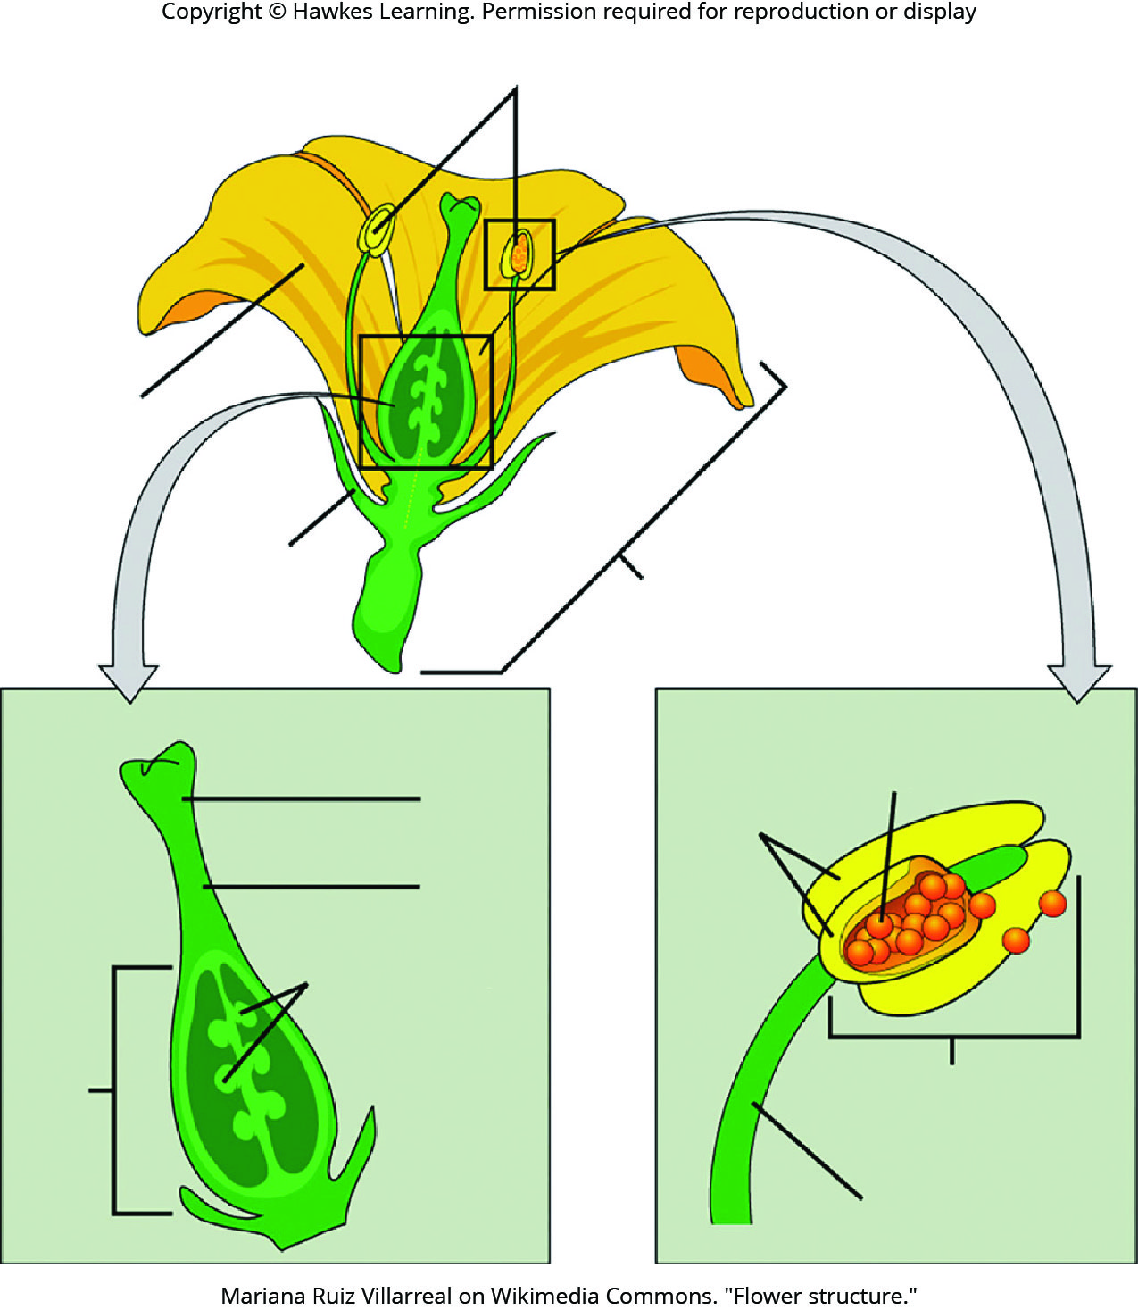
Lesson 26.3 Figure 2

Slide 6
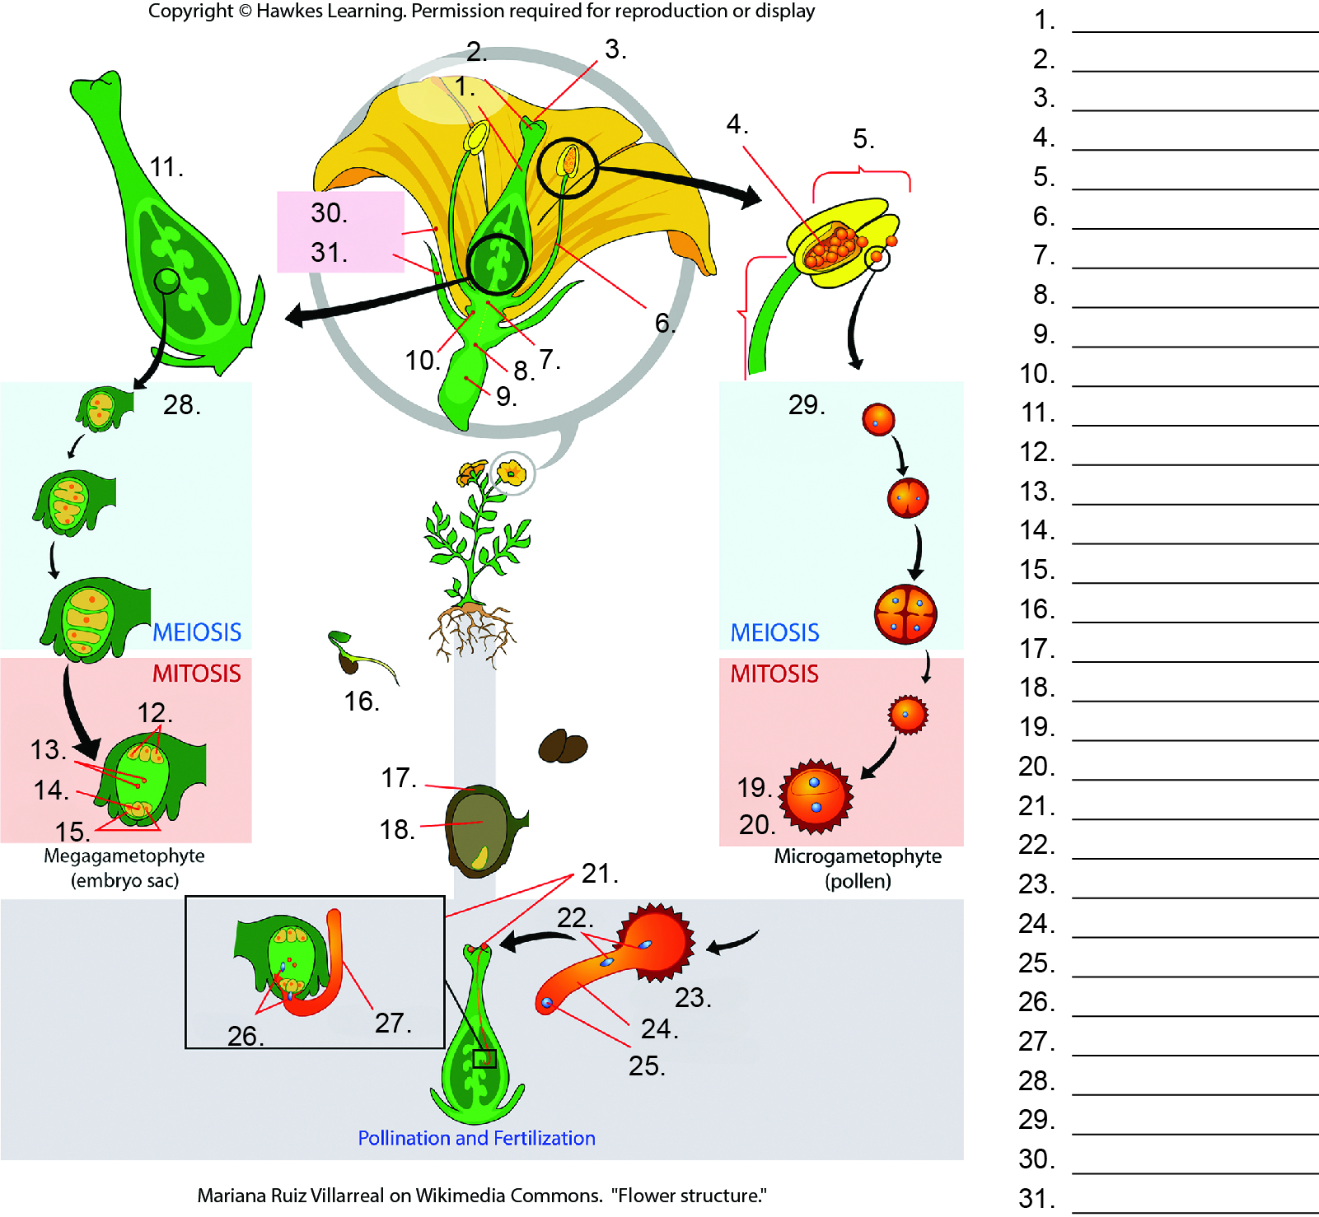
Lesson 26.3 Figure 3 - Numbered

Slide 7
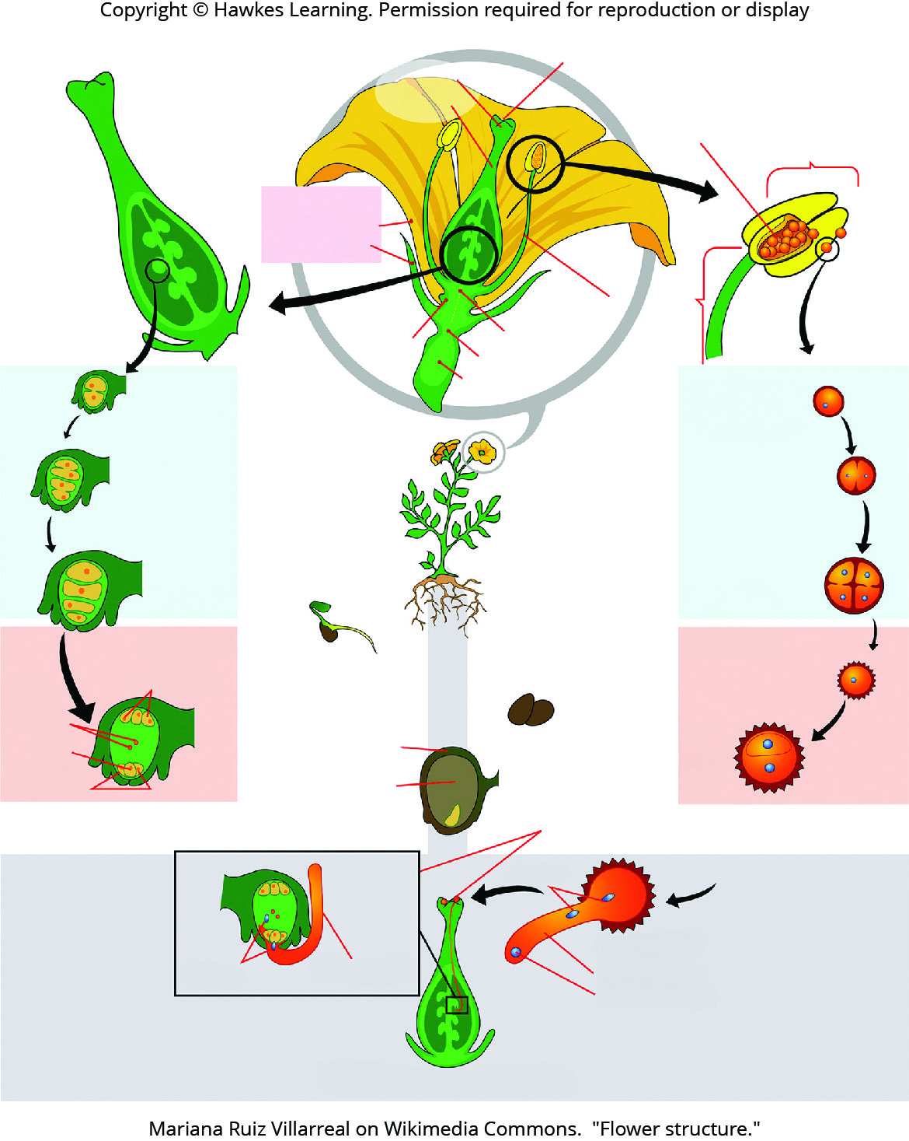
Lesson 26.3 Figure 3

Slide 8
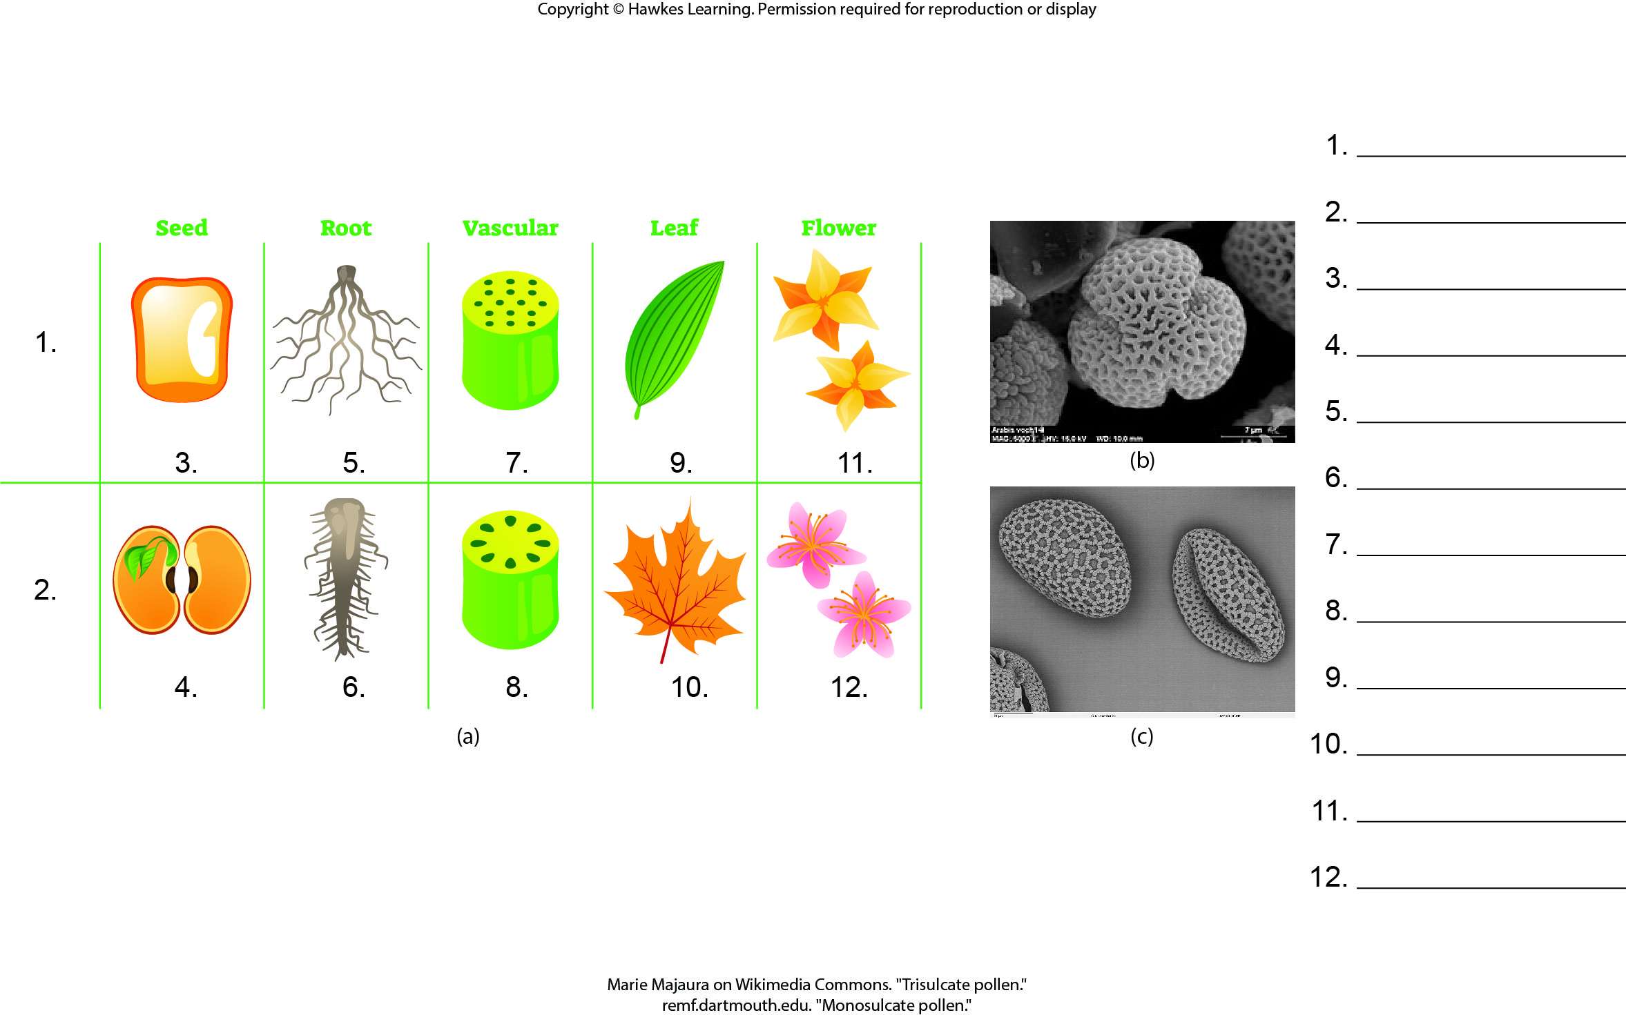
Lesson 26.3 Figure 11 - Numbered

Slide 9
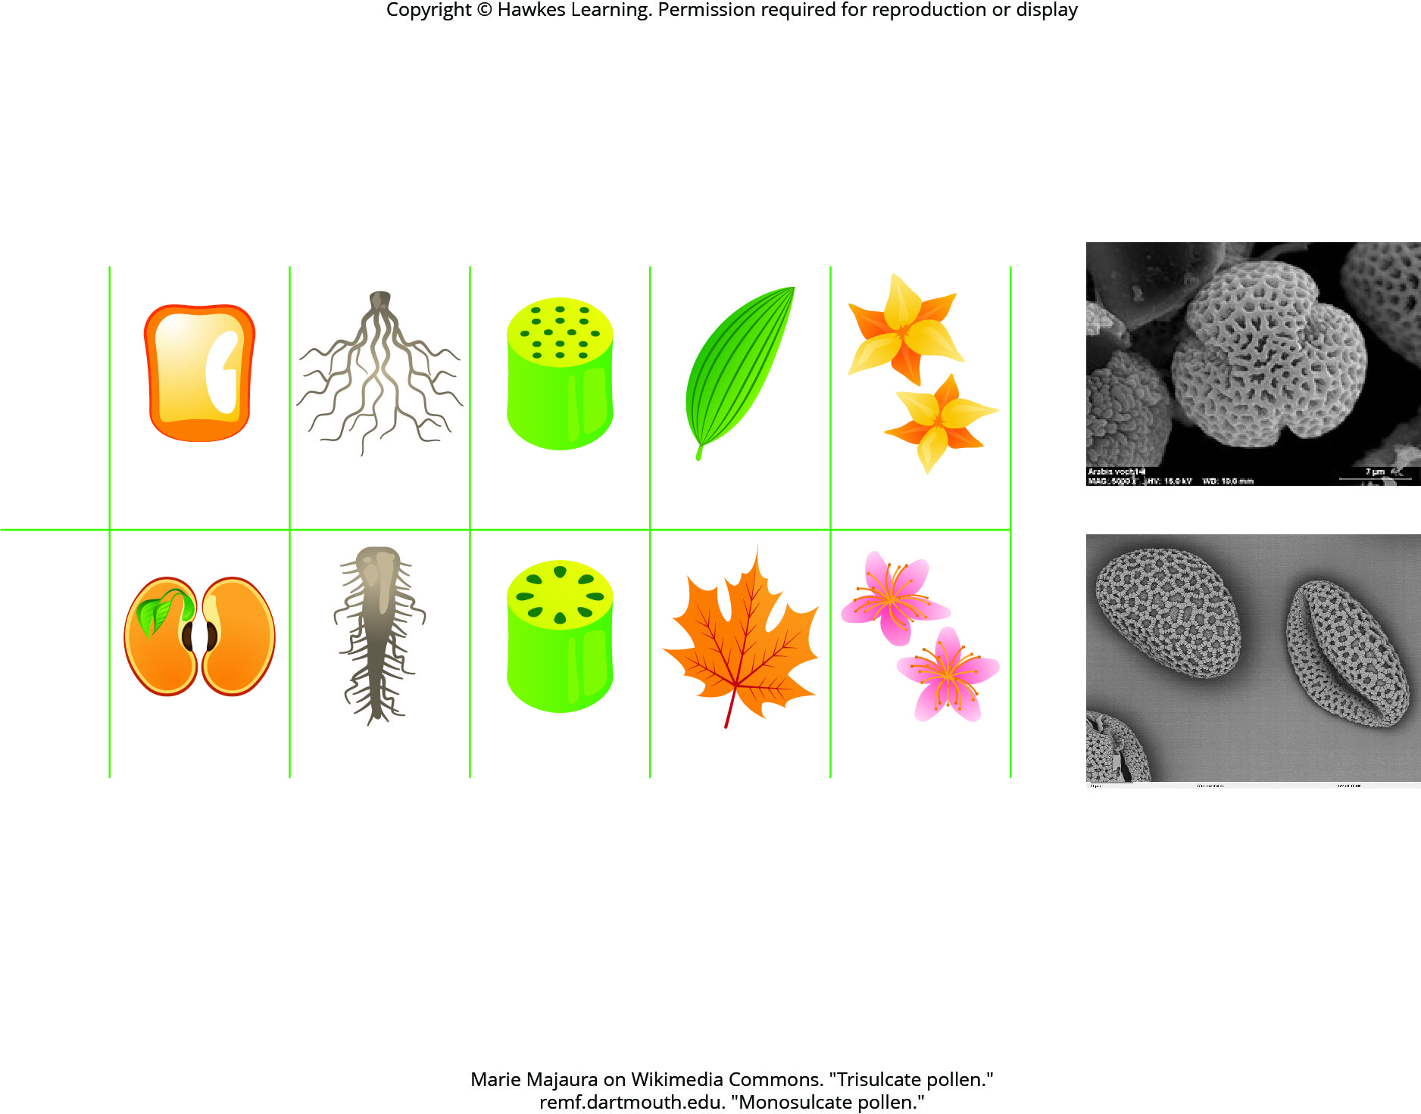
Lesson 26.3 Figure 11

Slide 10
Hawkes Learning – End of PowerPoint

