Slide 1
Chapter 27
Introduction to Animal Diversity

Slide 2
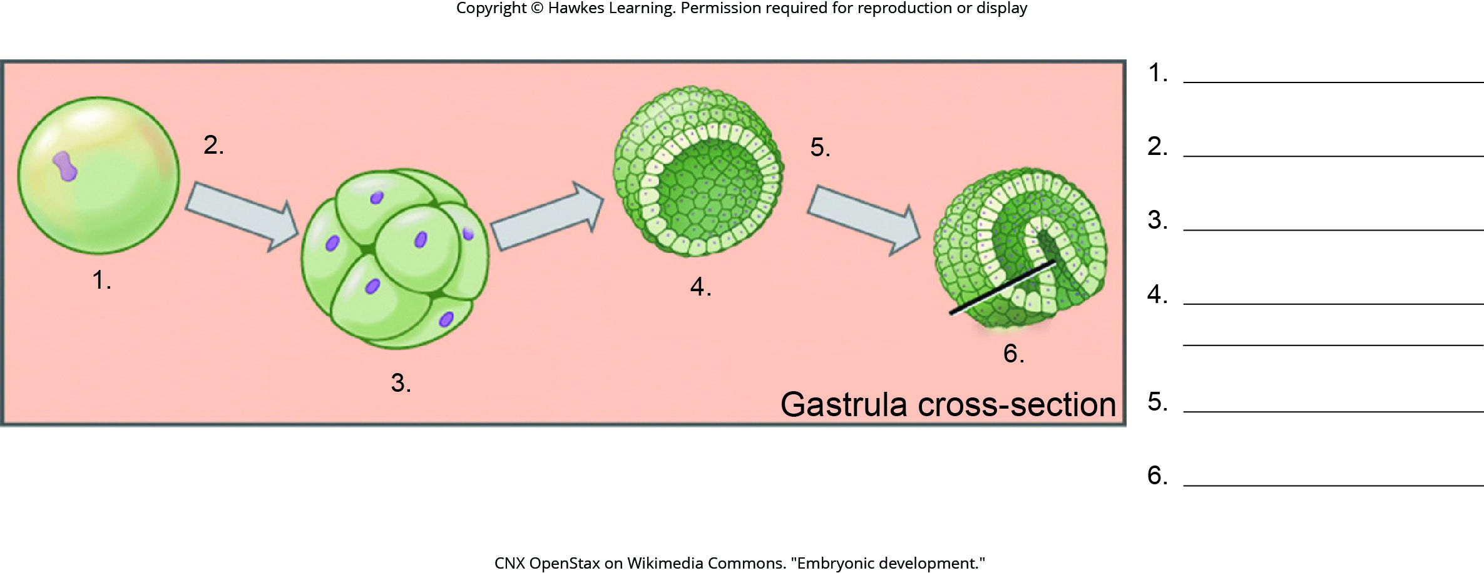
Lesson 27.1 Figure 6 - Numbered

Slide 3
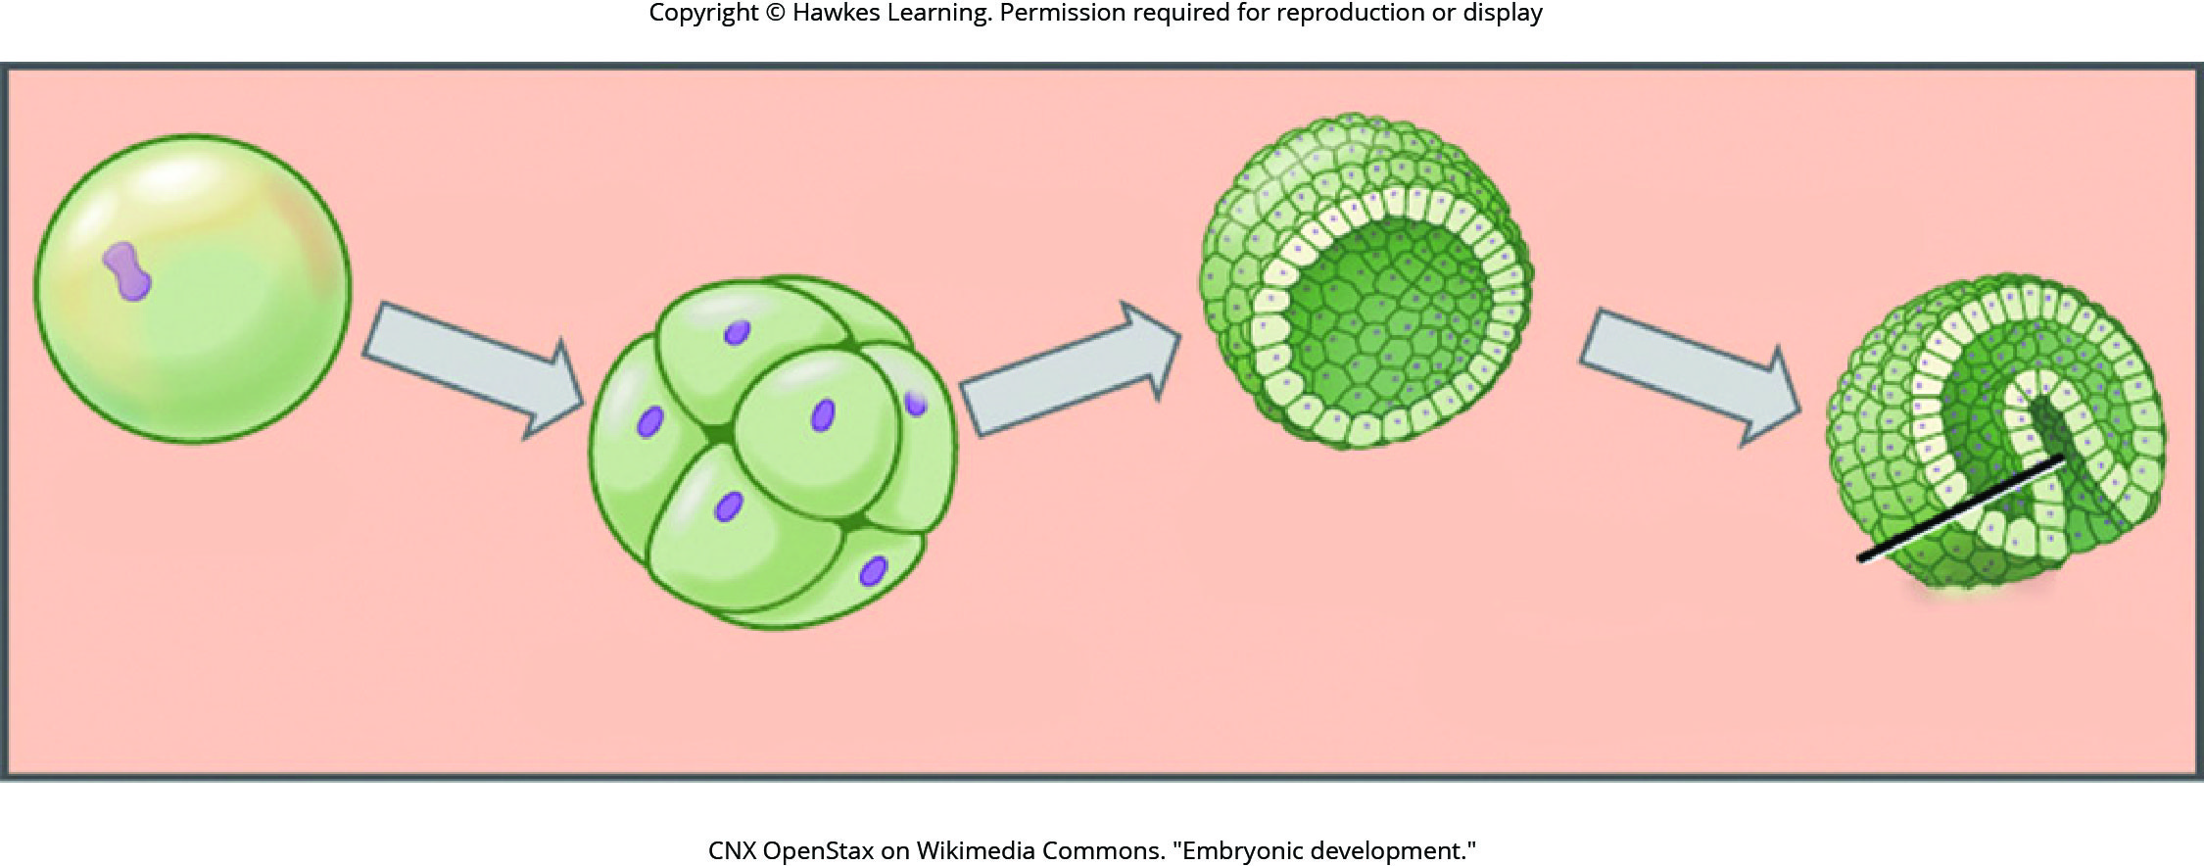
Lesson 27.1 Figure 6

Slide 4
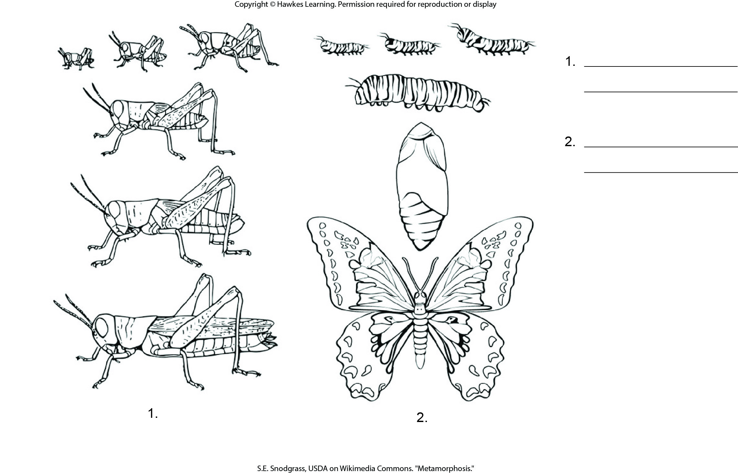
Lesson 27.1 Figure 7 - Numbered

Slide 5
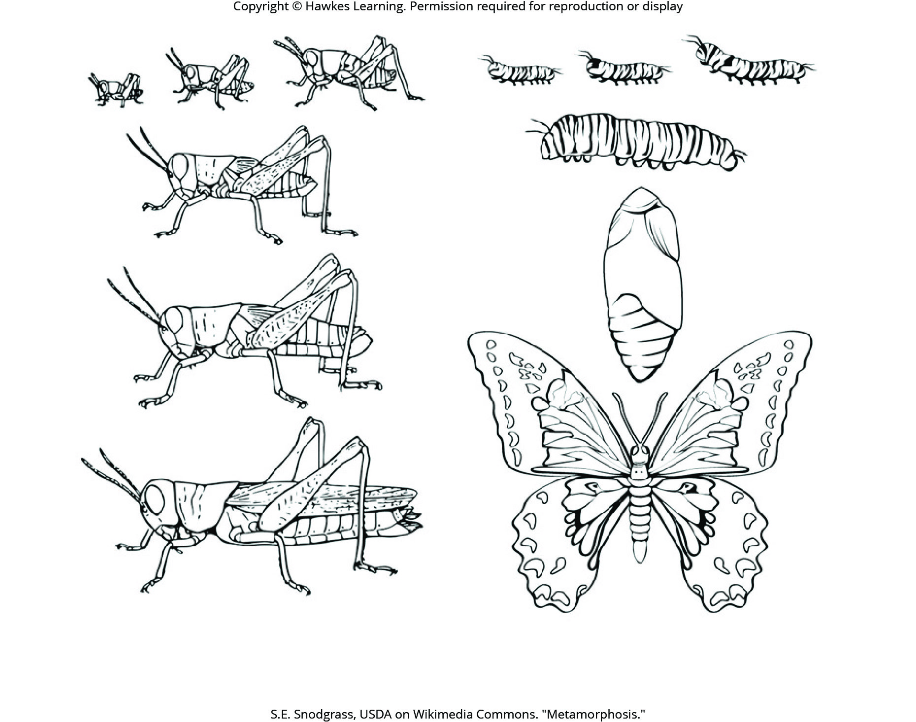
Lesson 27.1 Figure 7

Slide 6
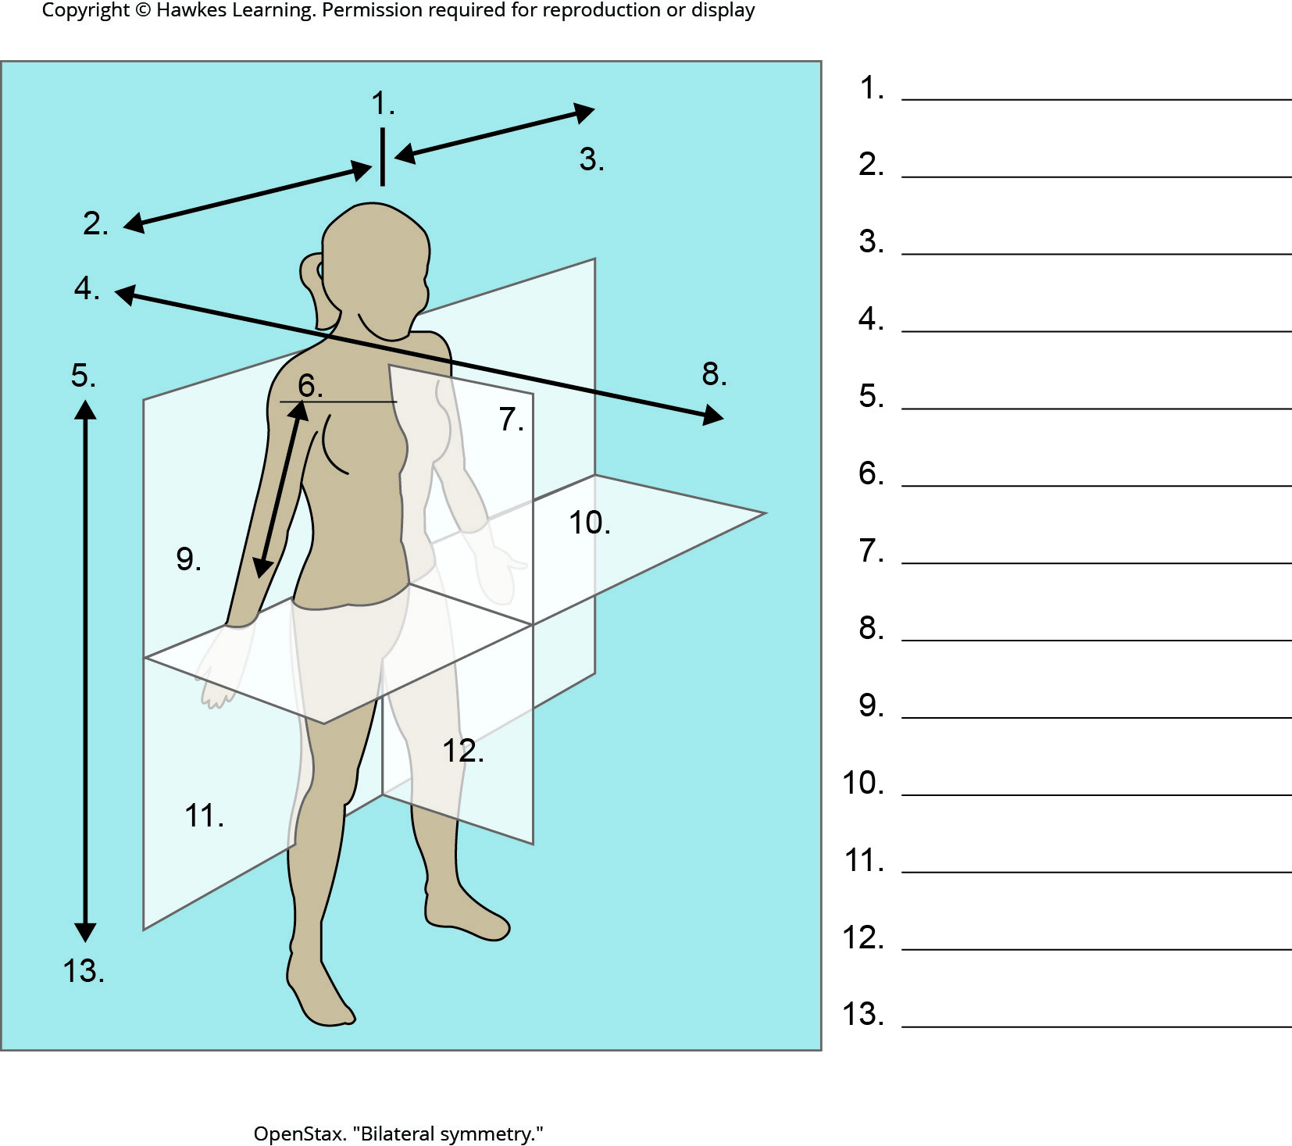
Lesson 27.2 Figure 3 - Numbered

Slide 7
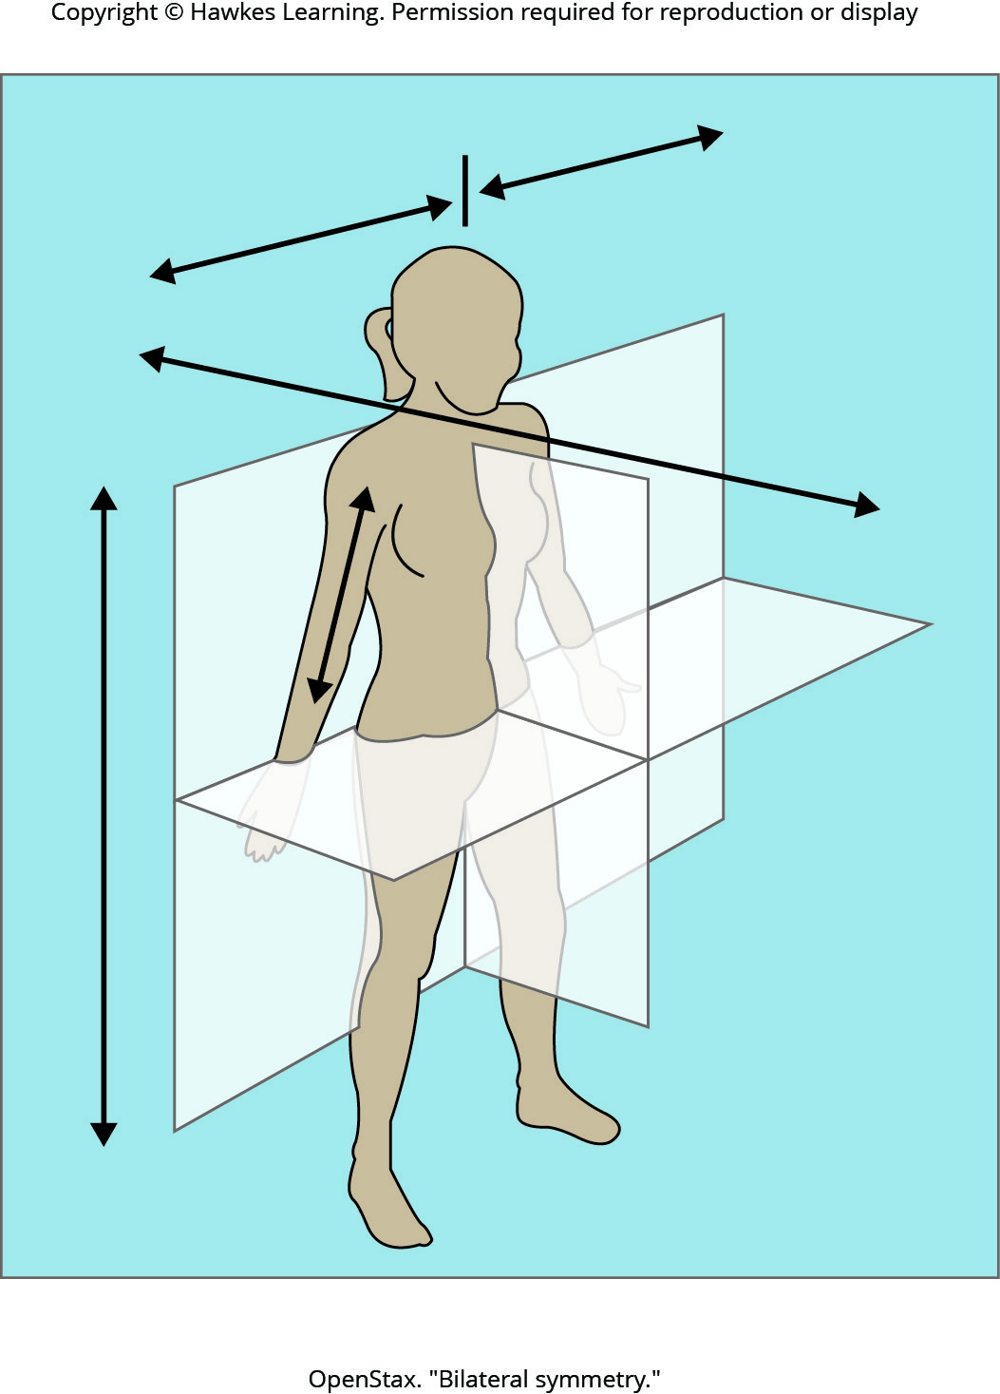
Lesson 27.2 Figure 3

Slide 8
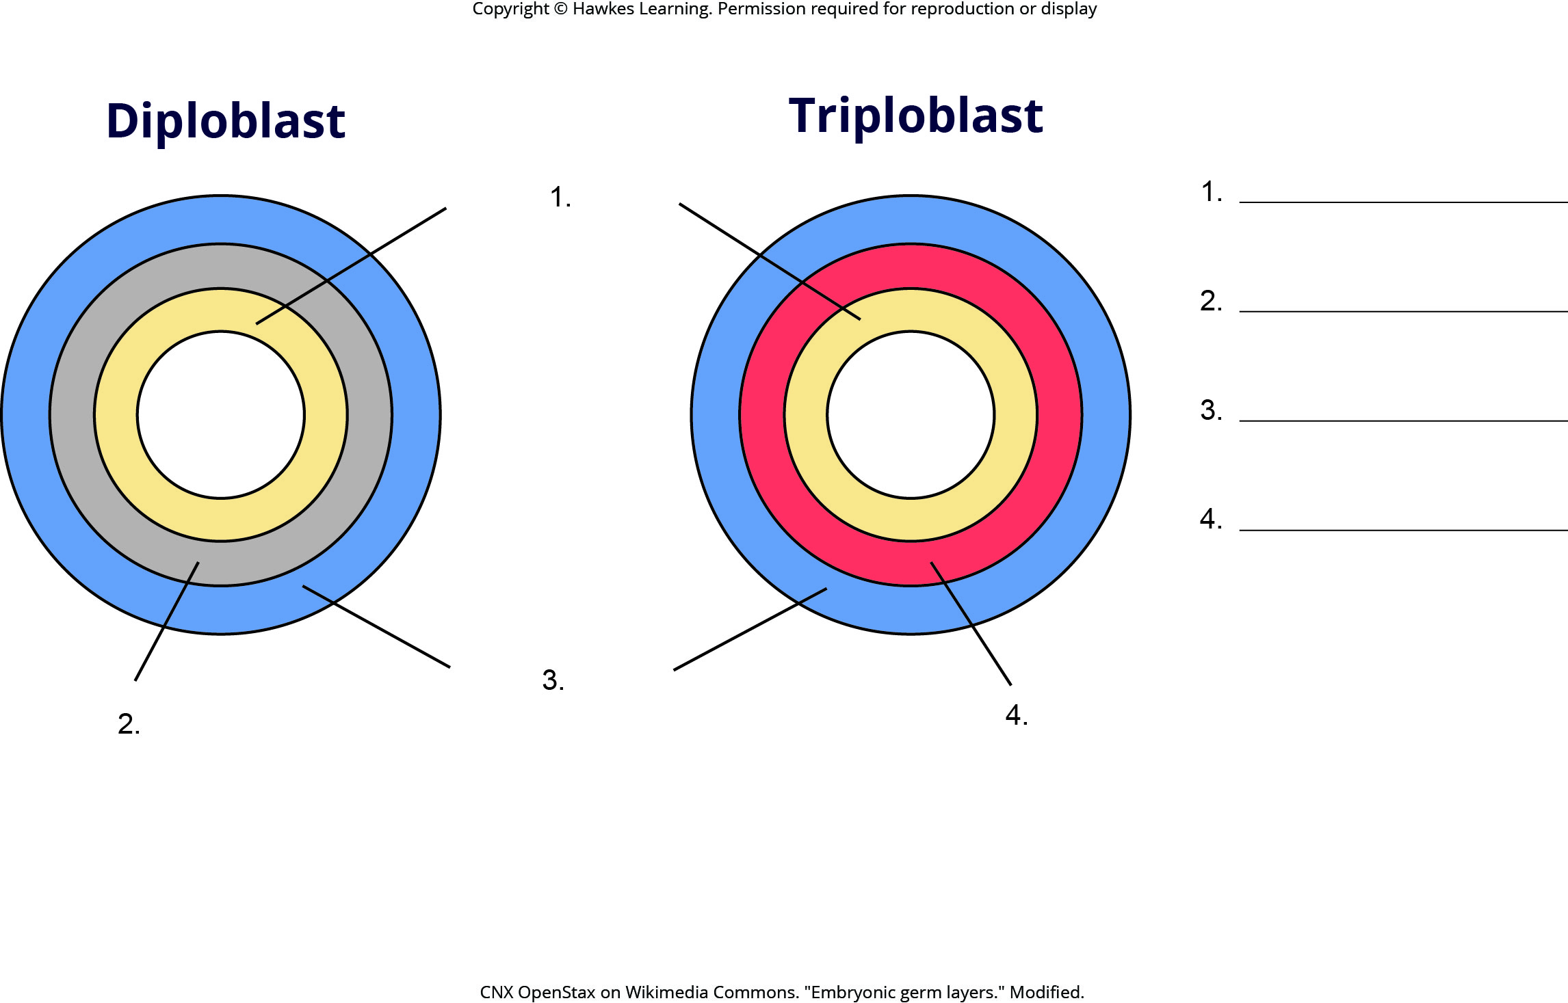
Lesson 27.2 Figure 4 - Numbered

Slide 9
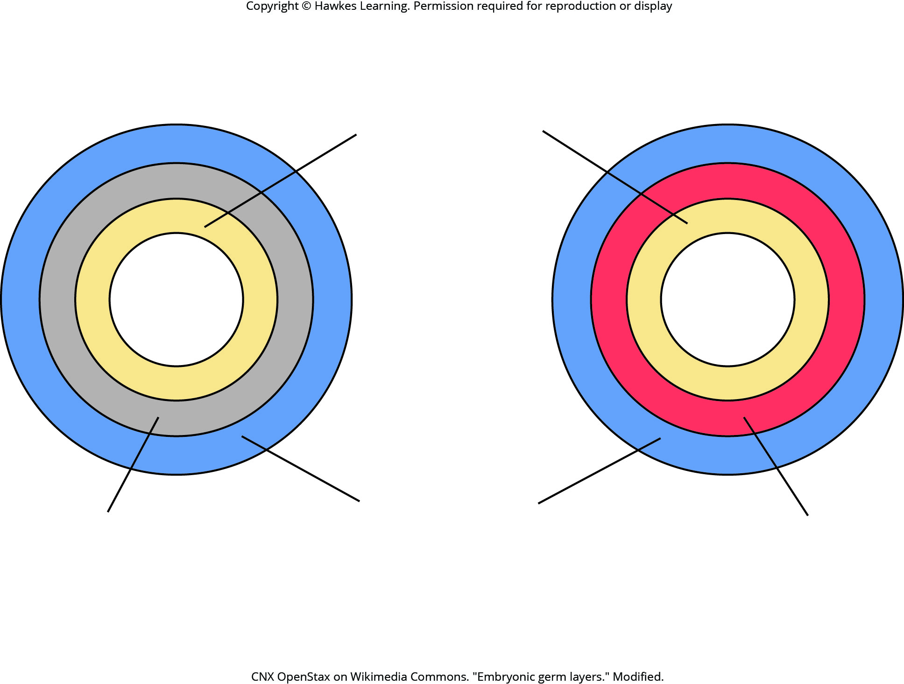
Lesson 27.2 Figure 4

Slide 10
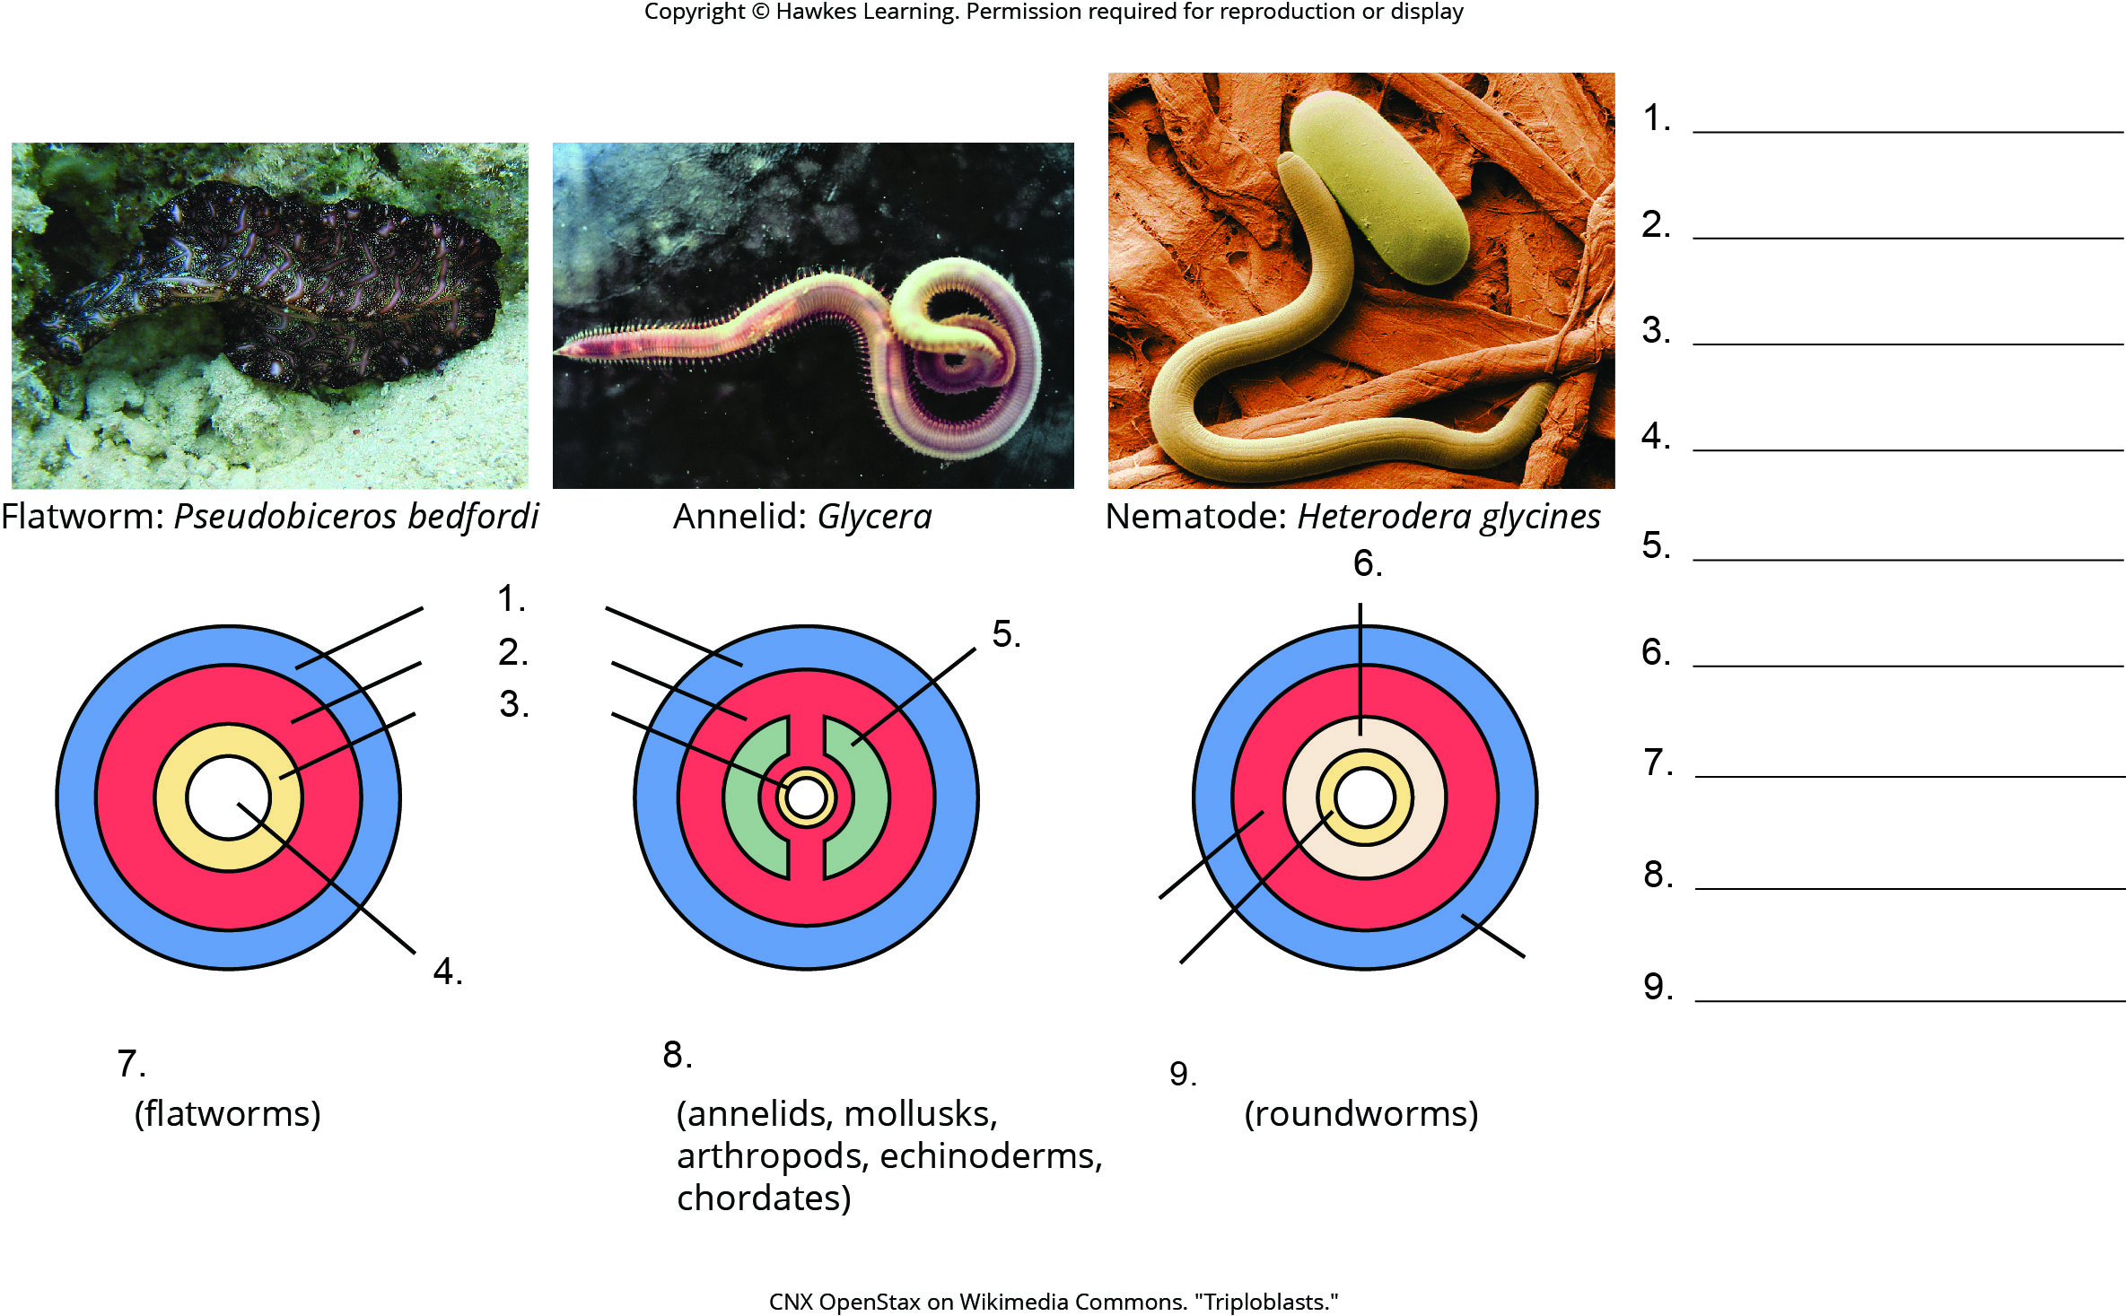
Lesson 27.2 Figure 6 - Numbered

Slide 11
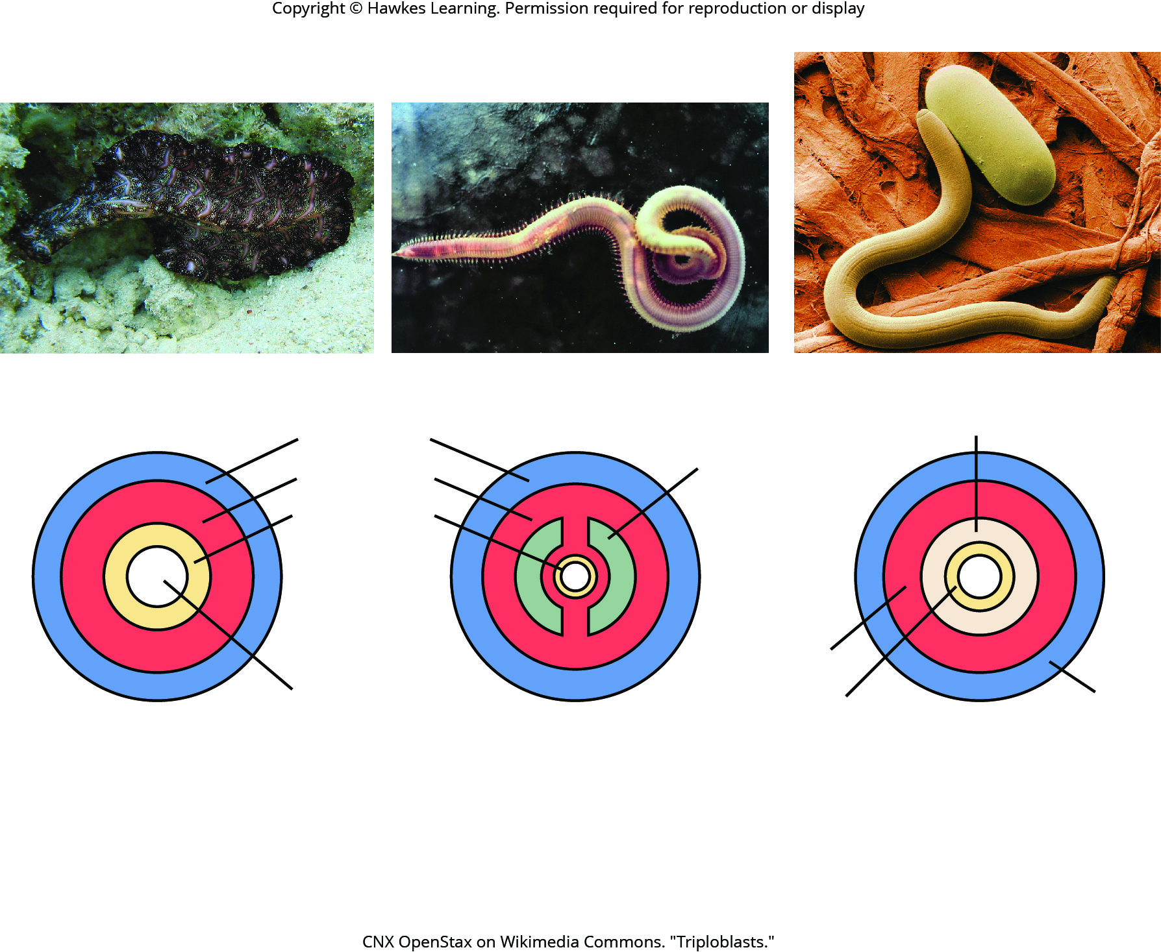
Lesson 27.2 Figure 6

Slide 12
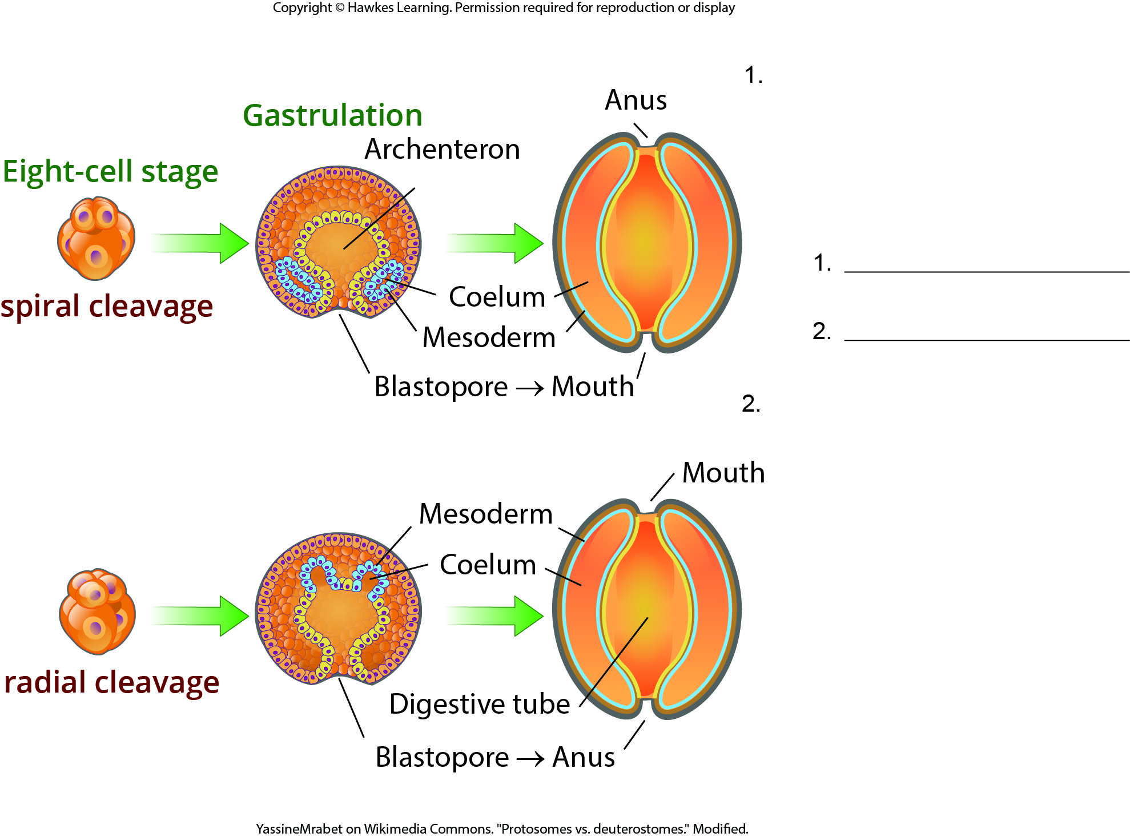
Lesson 27.2 Figure 8 - Numbered

Slide 13
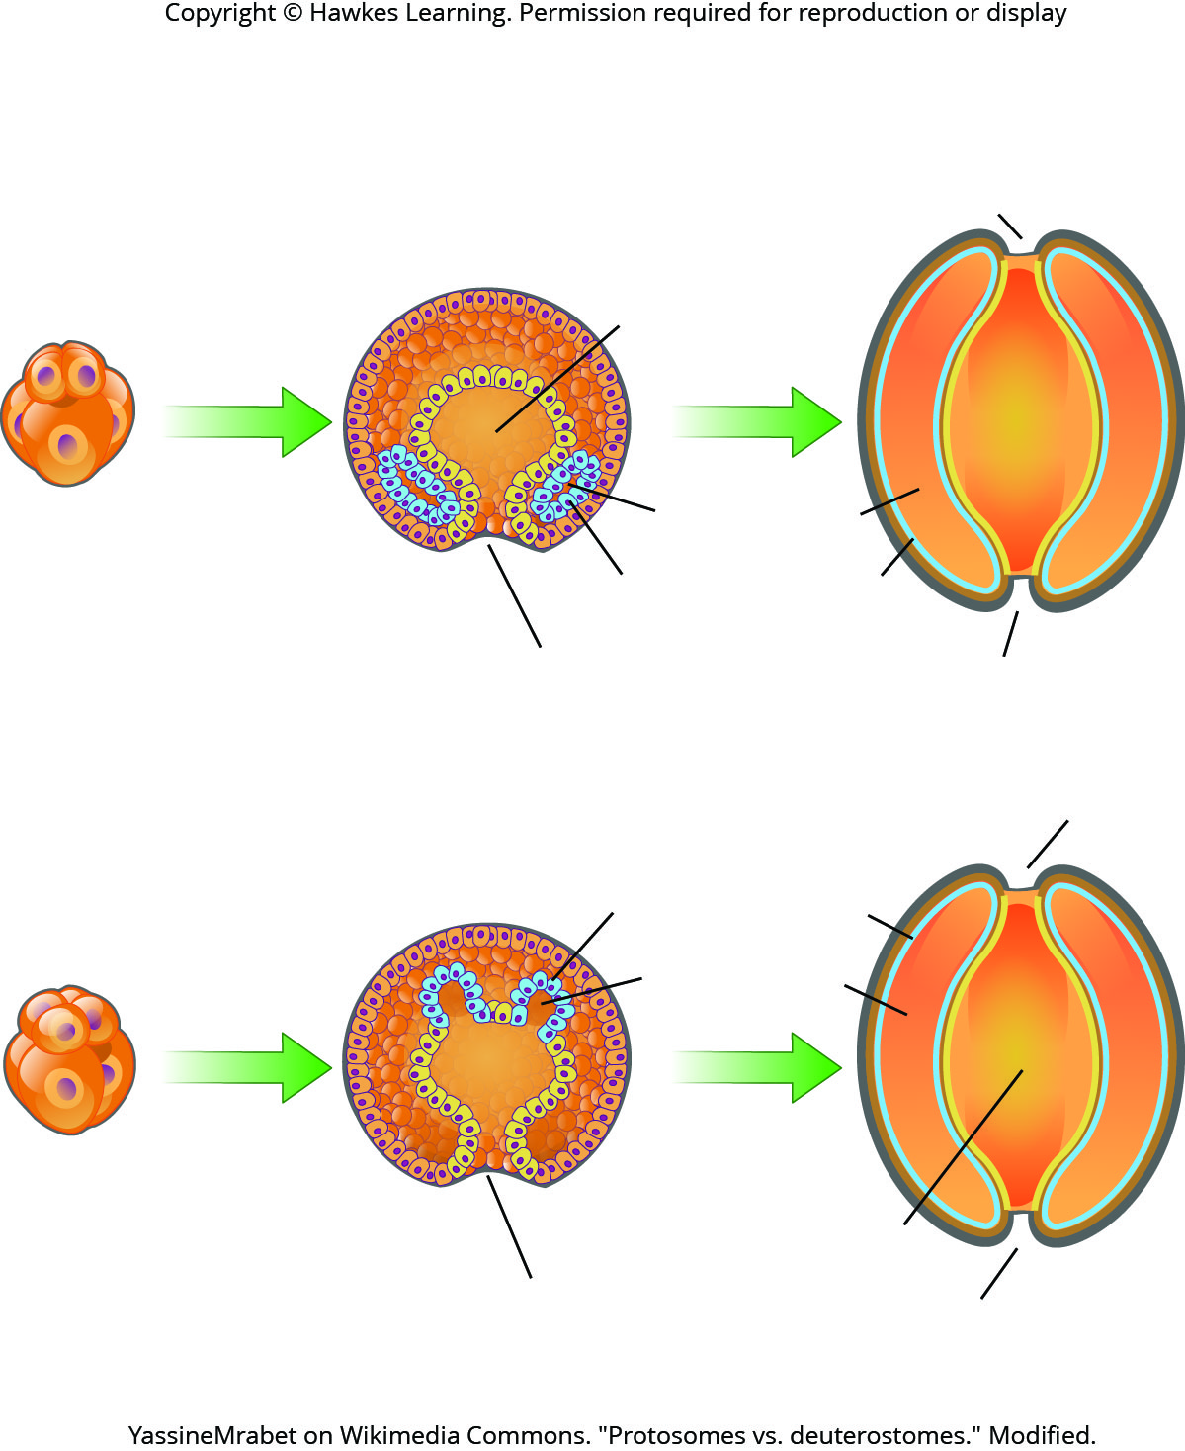
Lesson 27.2 Figure 8

Slide 14
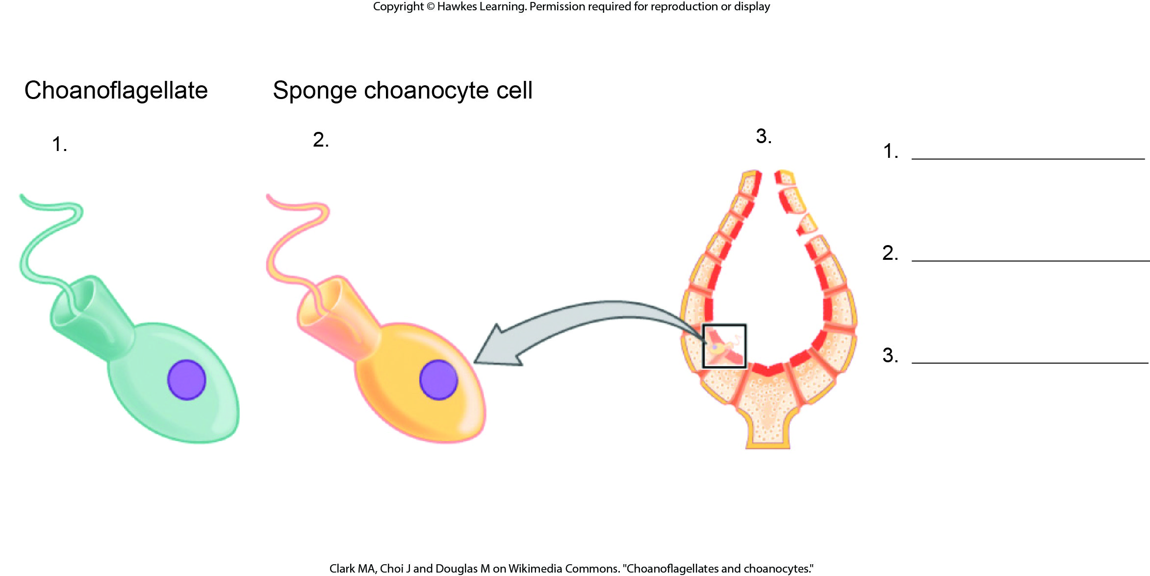
Lesson 27.3 Figure 1 - Numbered

Slide 15
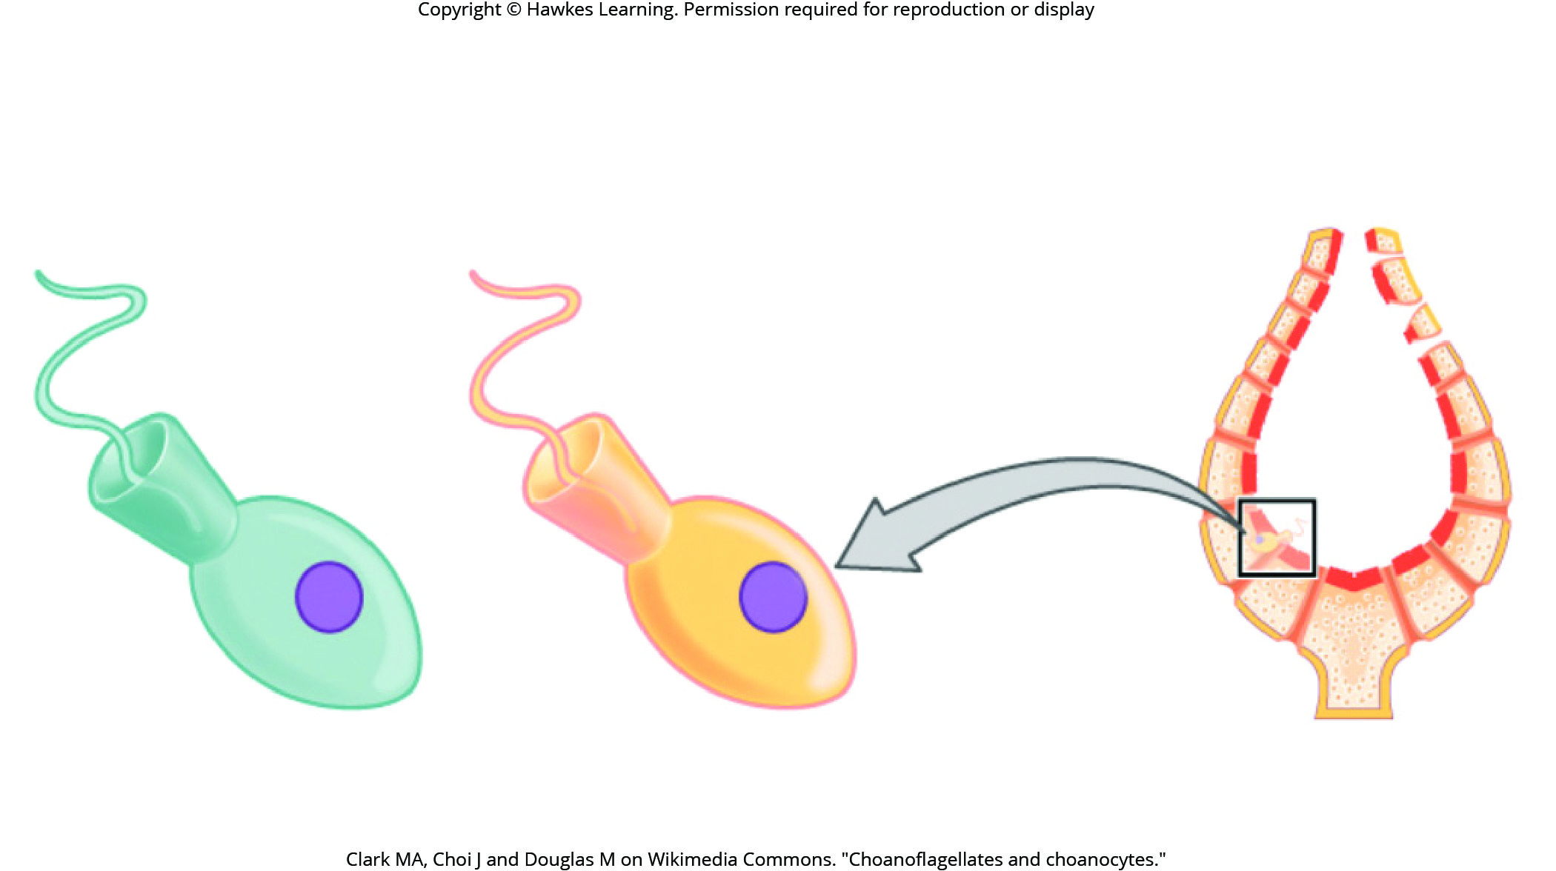
Lesson 27.3 Figure 1

Slide 16
Hawkes Learning – End of PowerPoint

