Slide 1
Chapter 28
Invertebrates

Slide 2
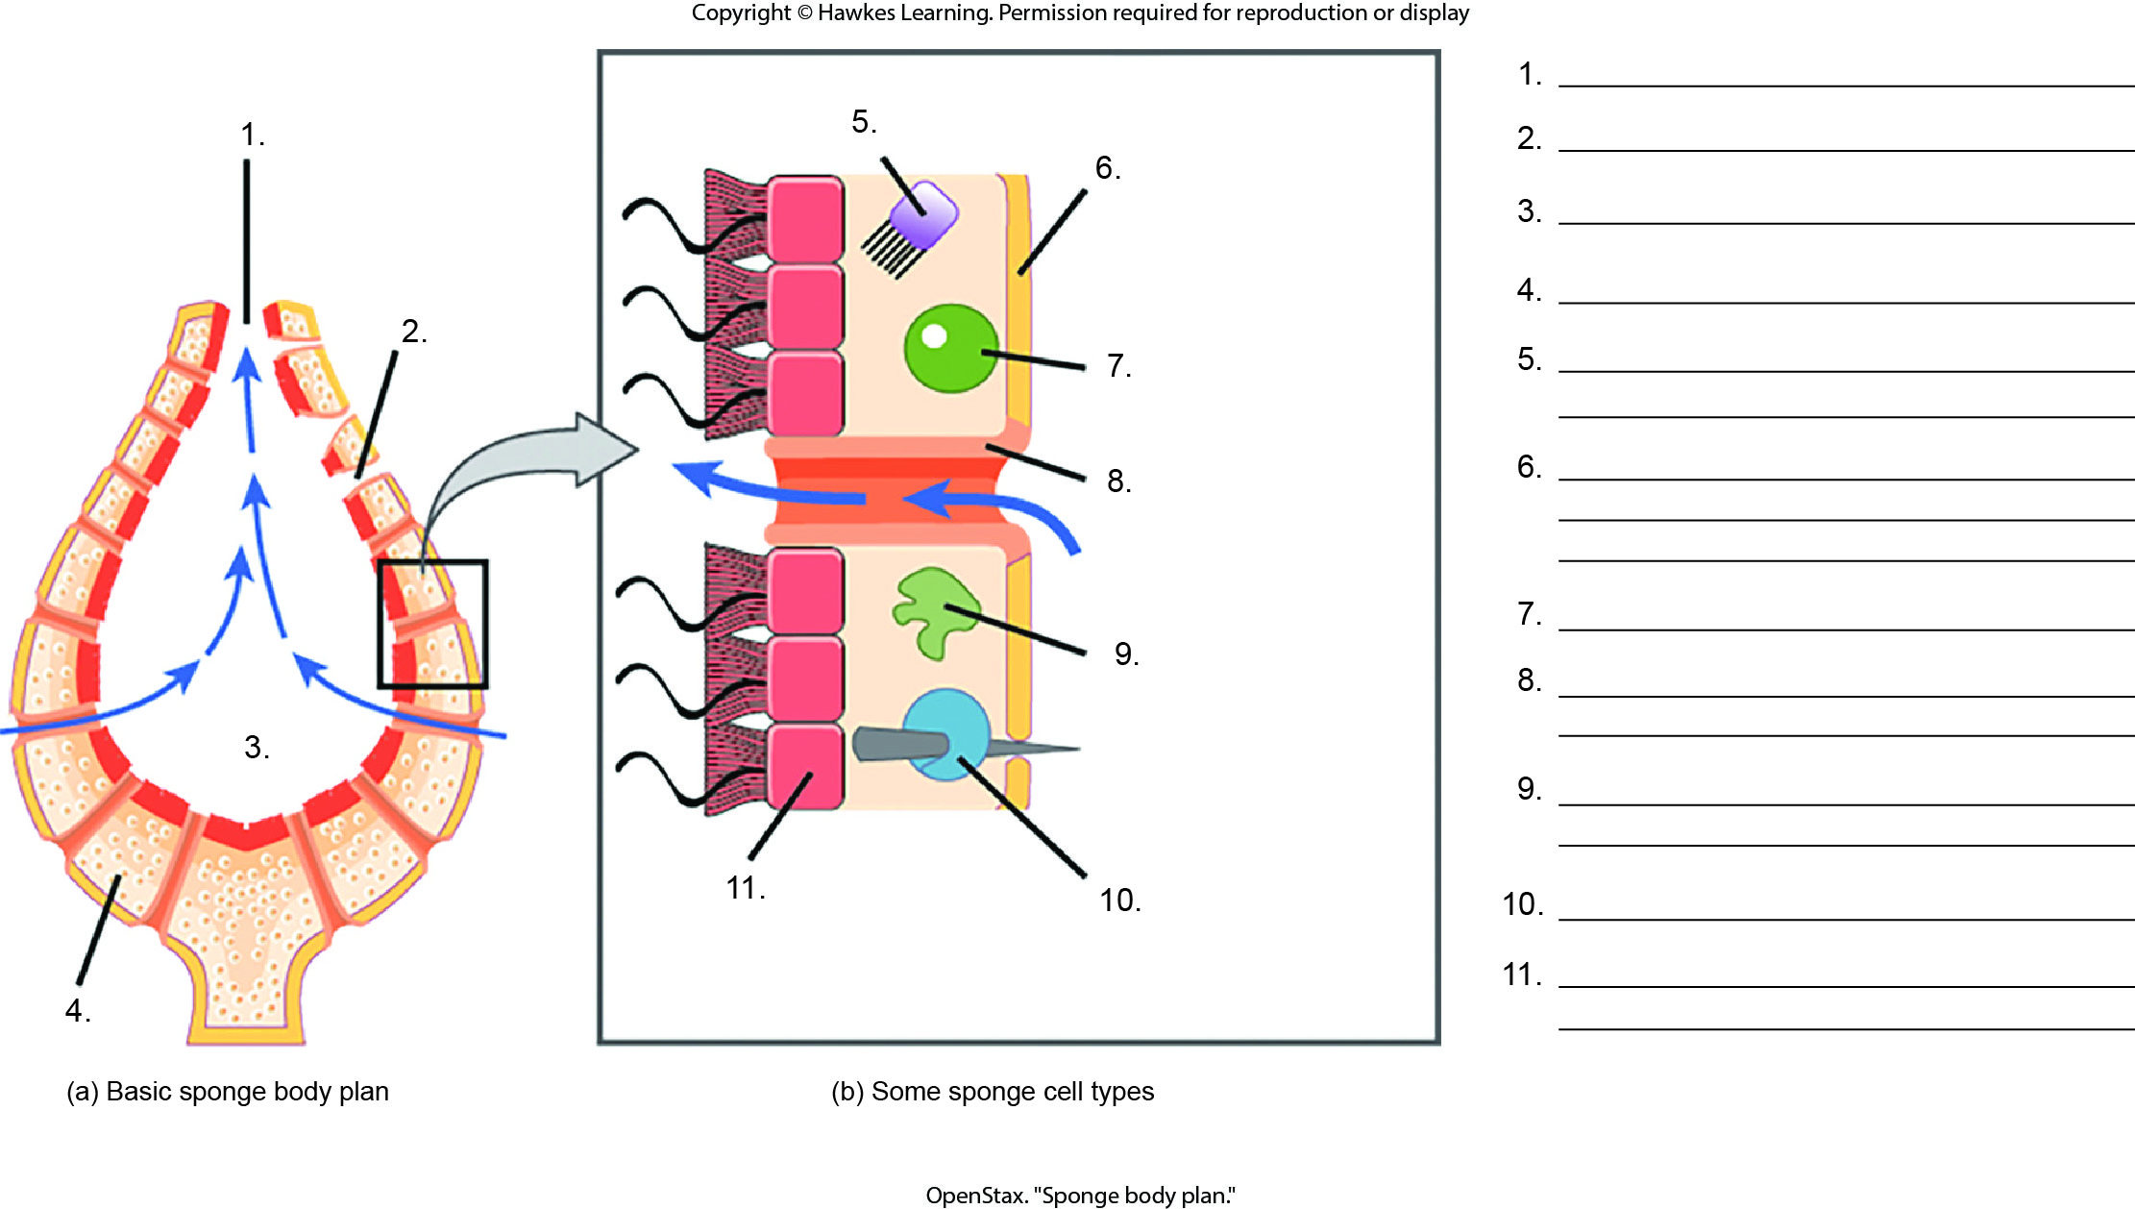
Lesson 28.1 Figure 4 - Numbered

Slide 3
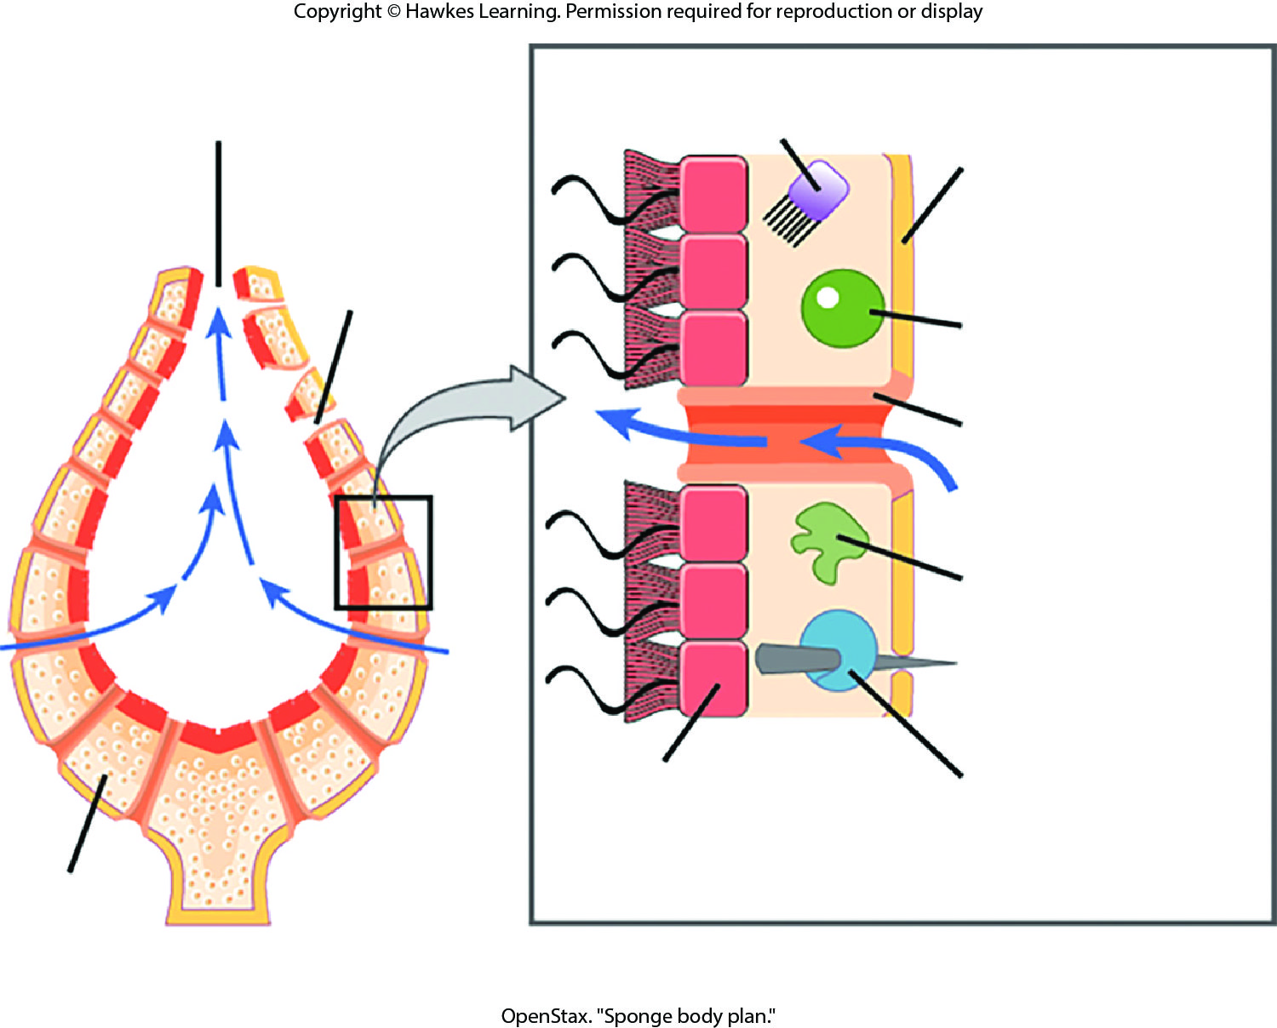
Lesson 28.1 Figure 4

Slide 4
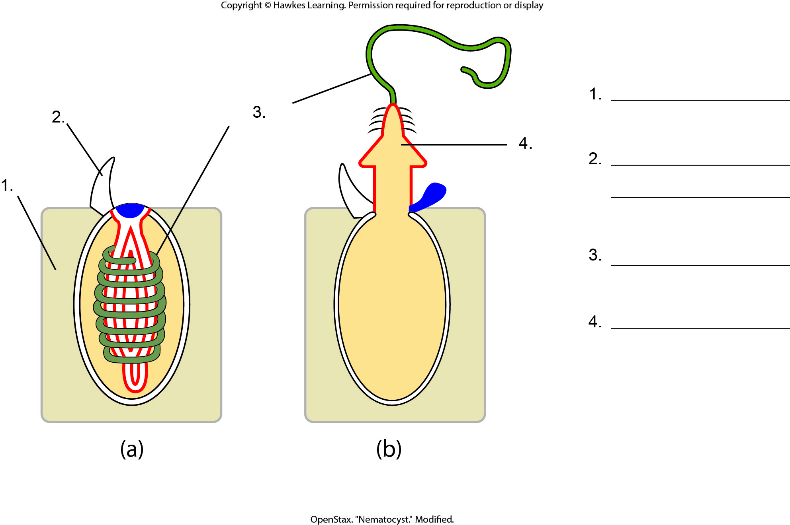
Lesson 28.2 Figure 1 - Numbered

Slide 5
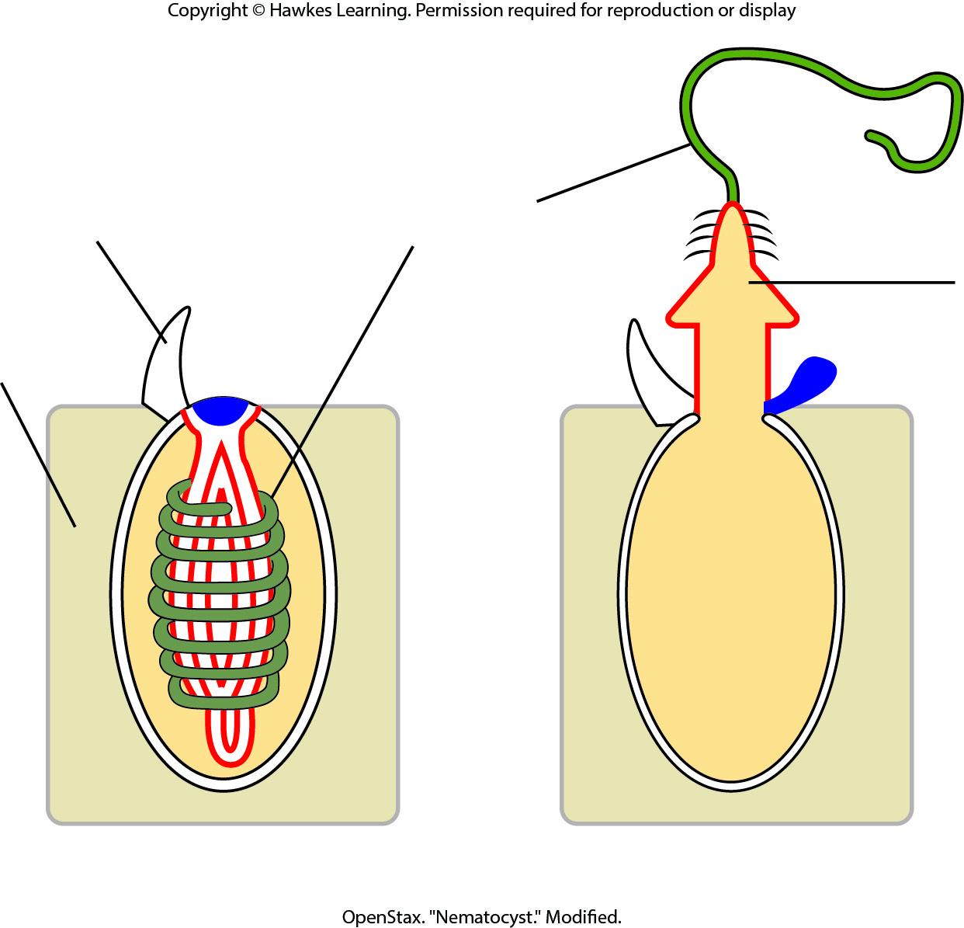
Lesson 28.2 Figure 1

Slide 6
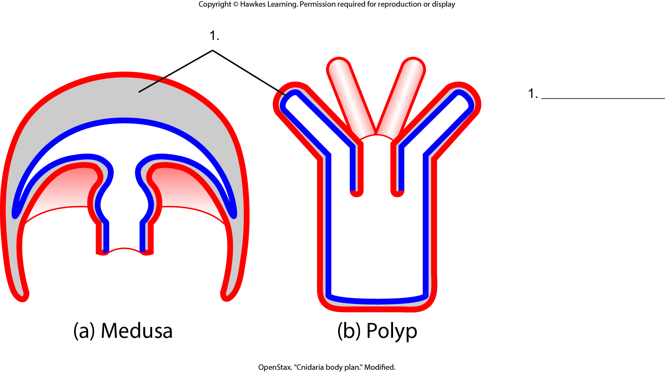
Lesson 28.2 Figure 2 - Numbered

Slide 7
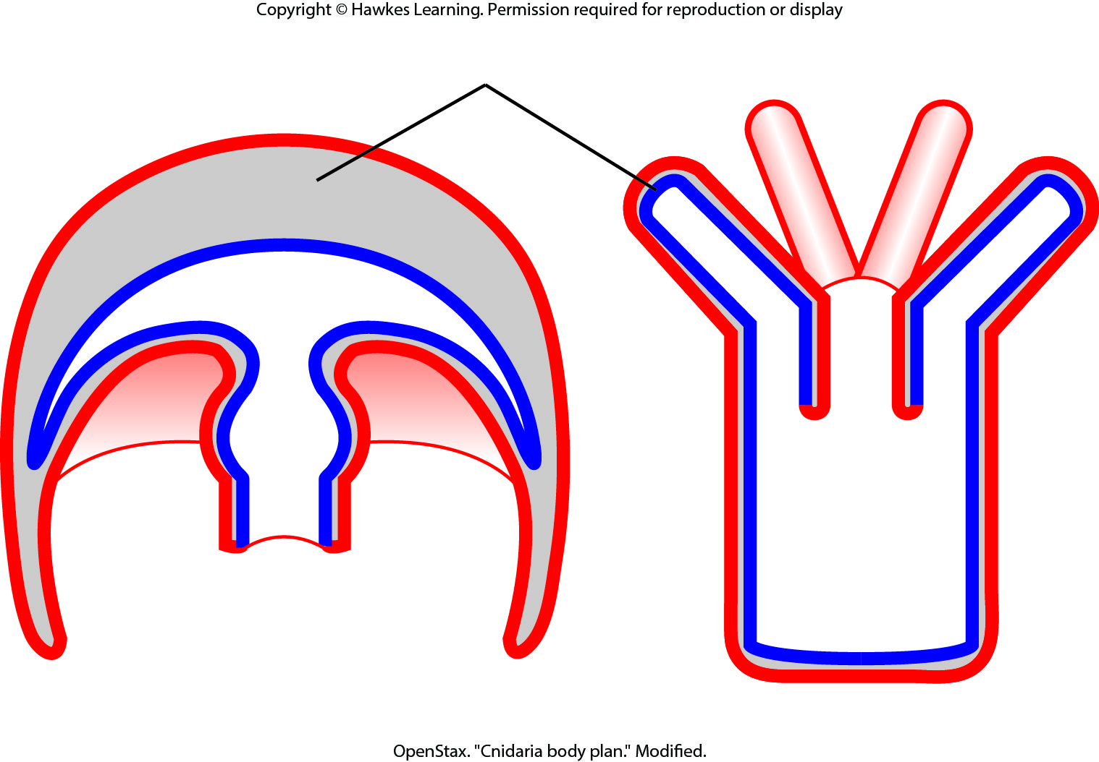
Lesson 28.2 Figure 2

Slide 8
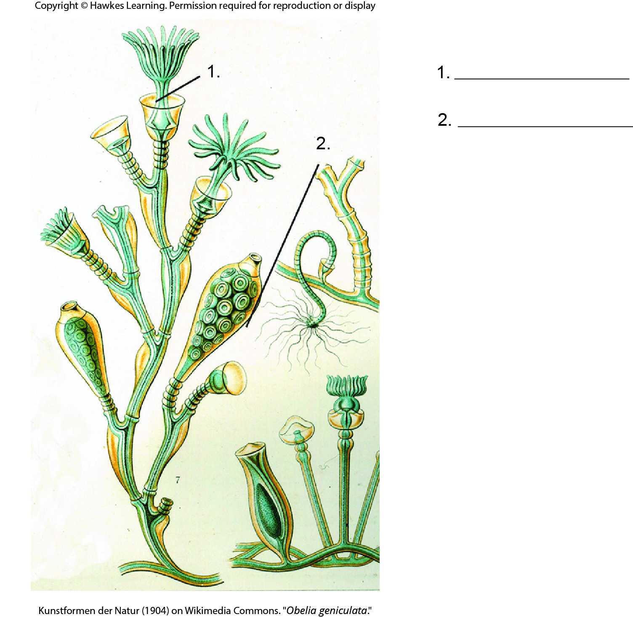
Lesson 28.2 Figure 3 - Numbered

Slide 9
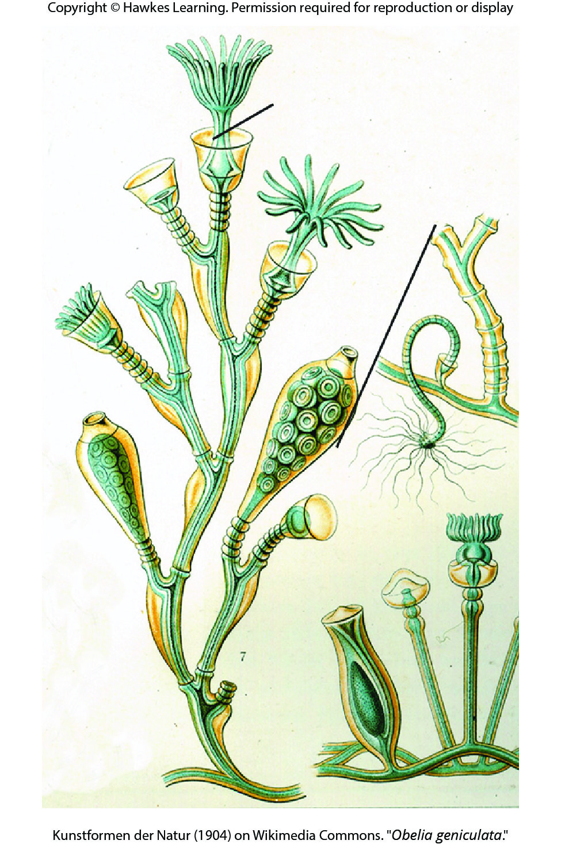
Lesson 28.2 Figure 3

Slide 10
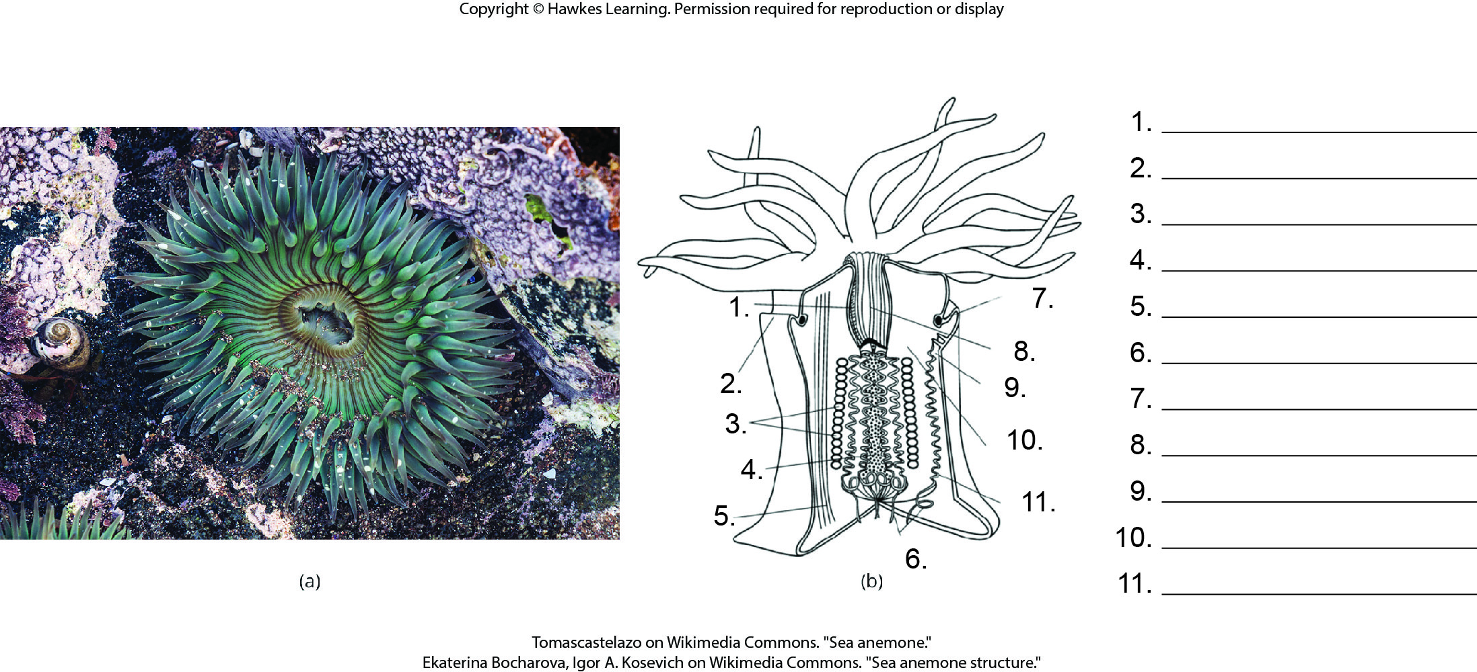
Lesson 28.2 Figure 4 - Numbered

Slide 11
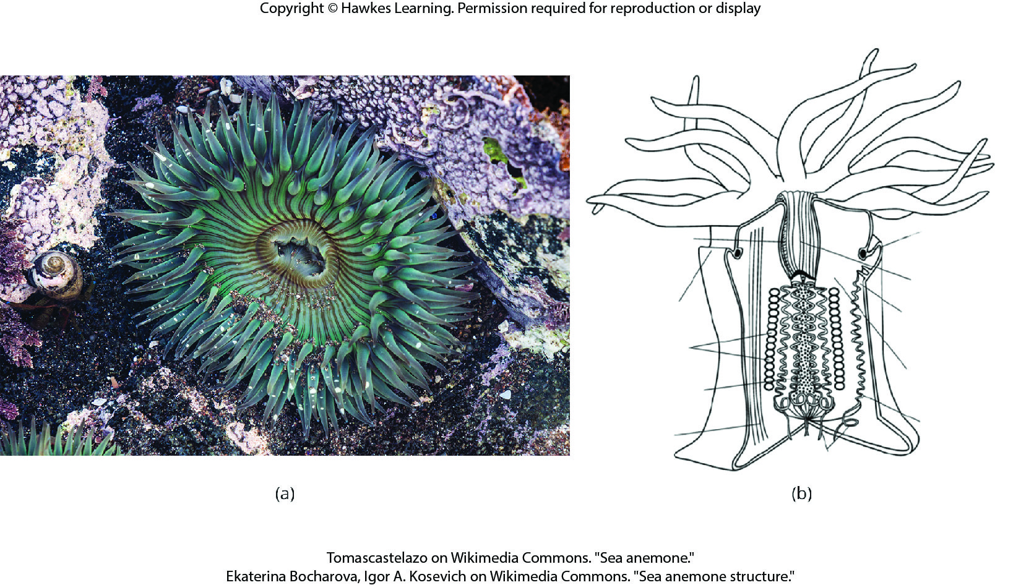
Lesson 28.2 Figure 4

Slide 12
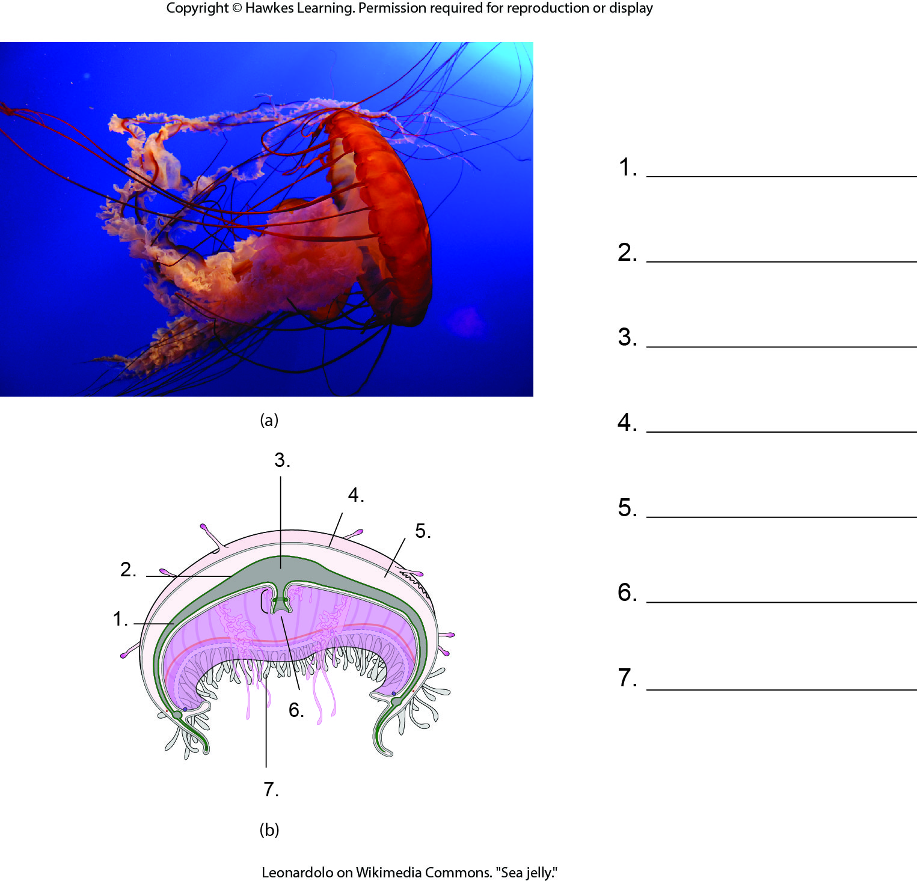
Lesson 28.2 Figure 6 - Numbered

Slide 13
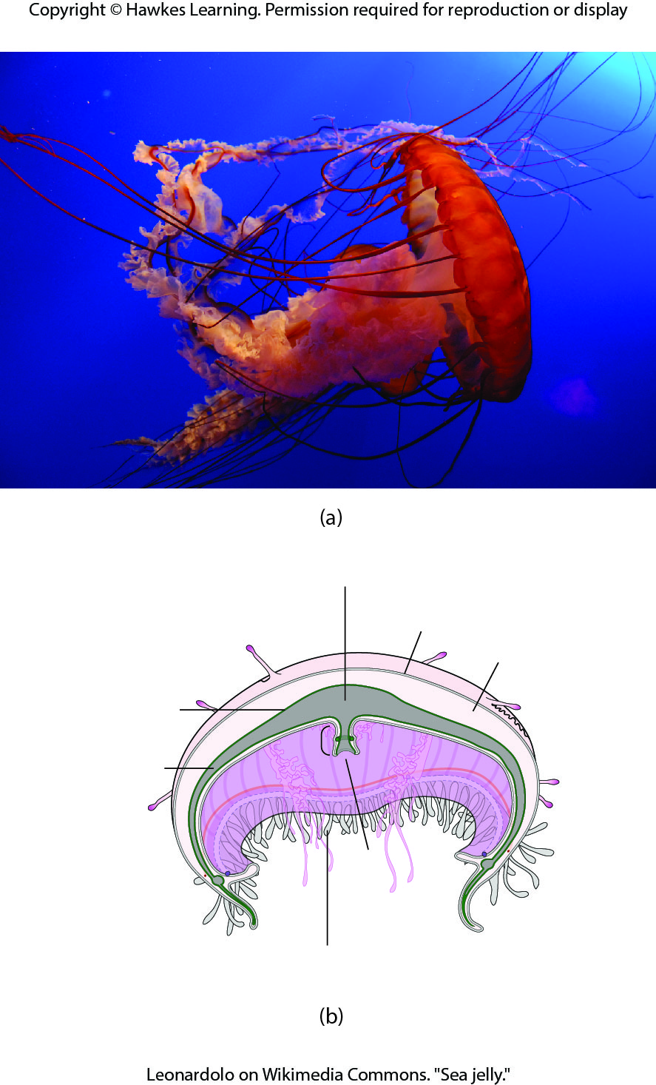
Lesson 28.2 Figure 6

Slide 14
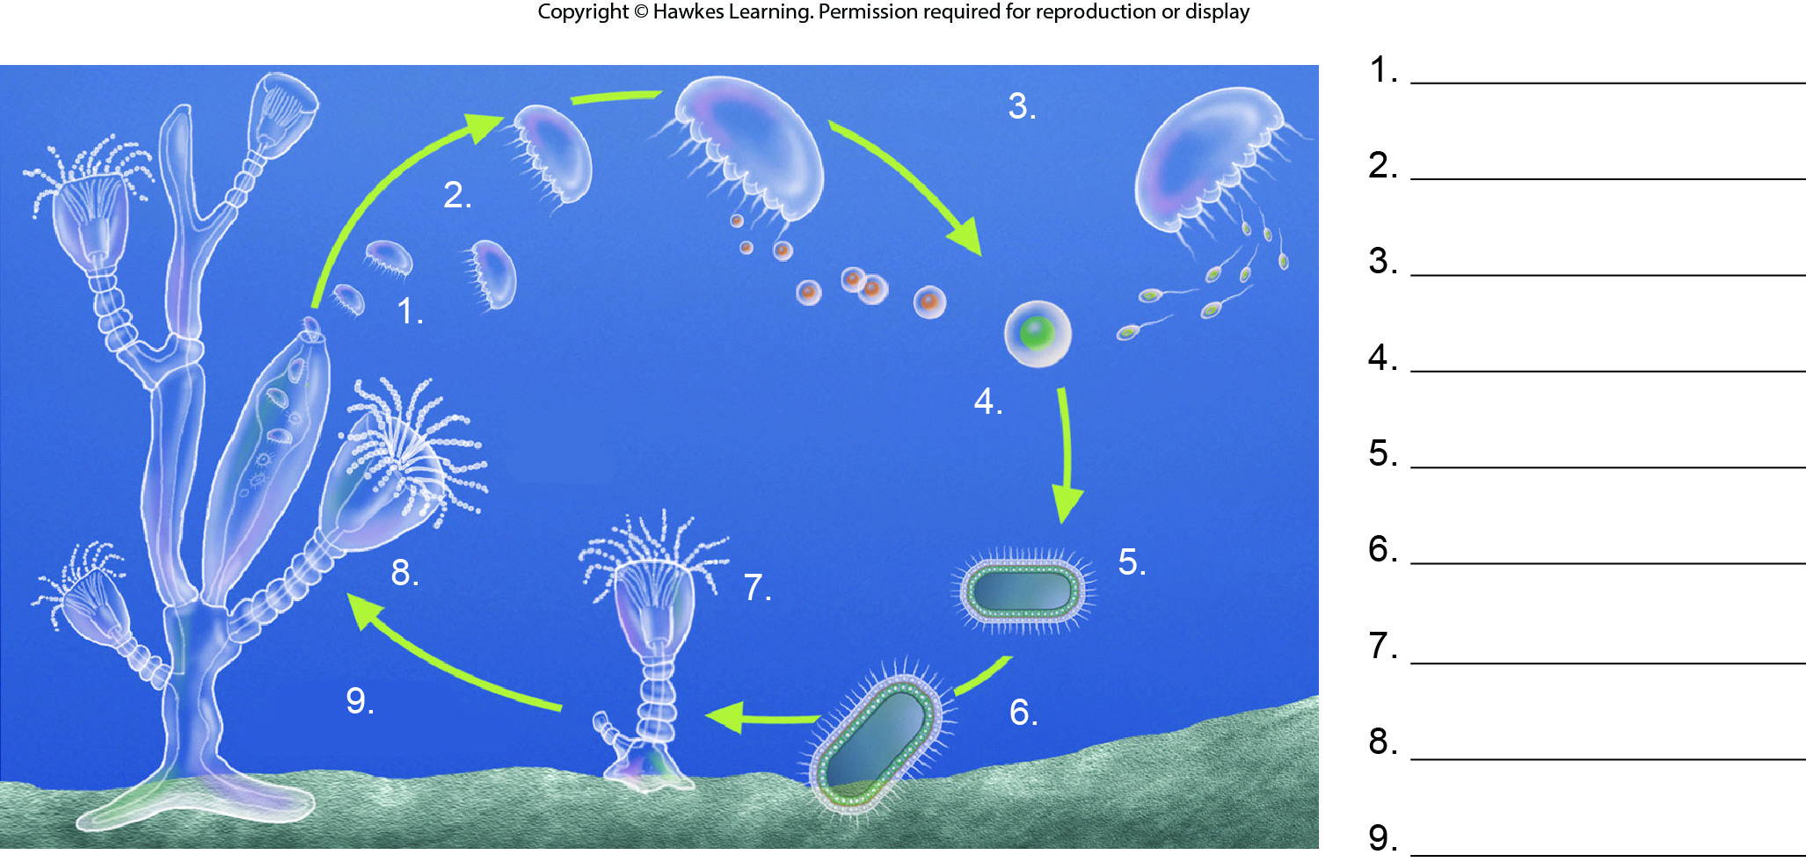
Lesson 28.2 Figure 7 - Numbered

Slide 15
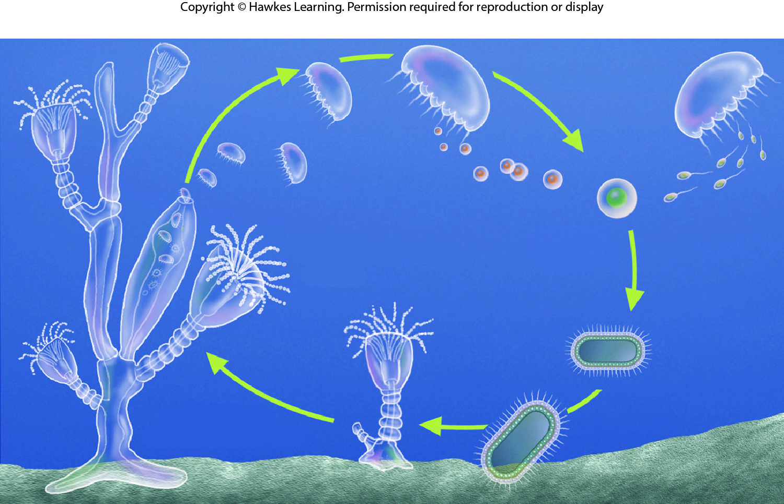
Lesson 28.2 Figure 7

Slide 16
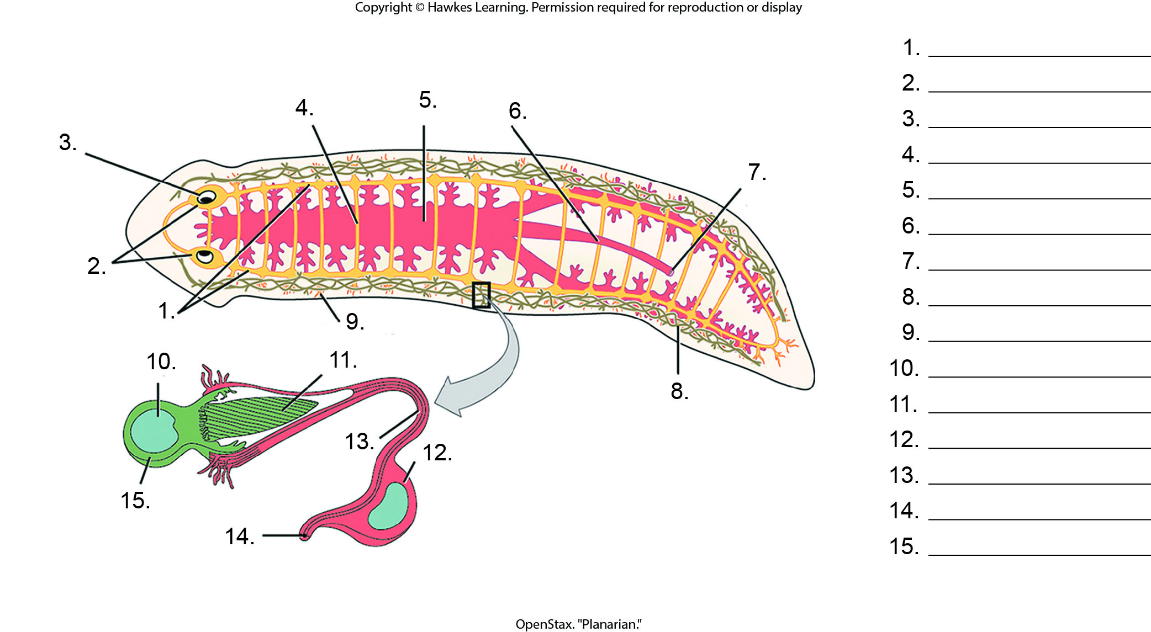
Lesson 28.3 Figure 3 - Numbered

Slide 17
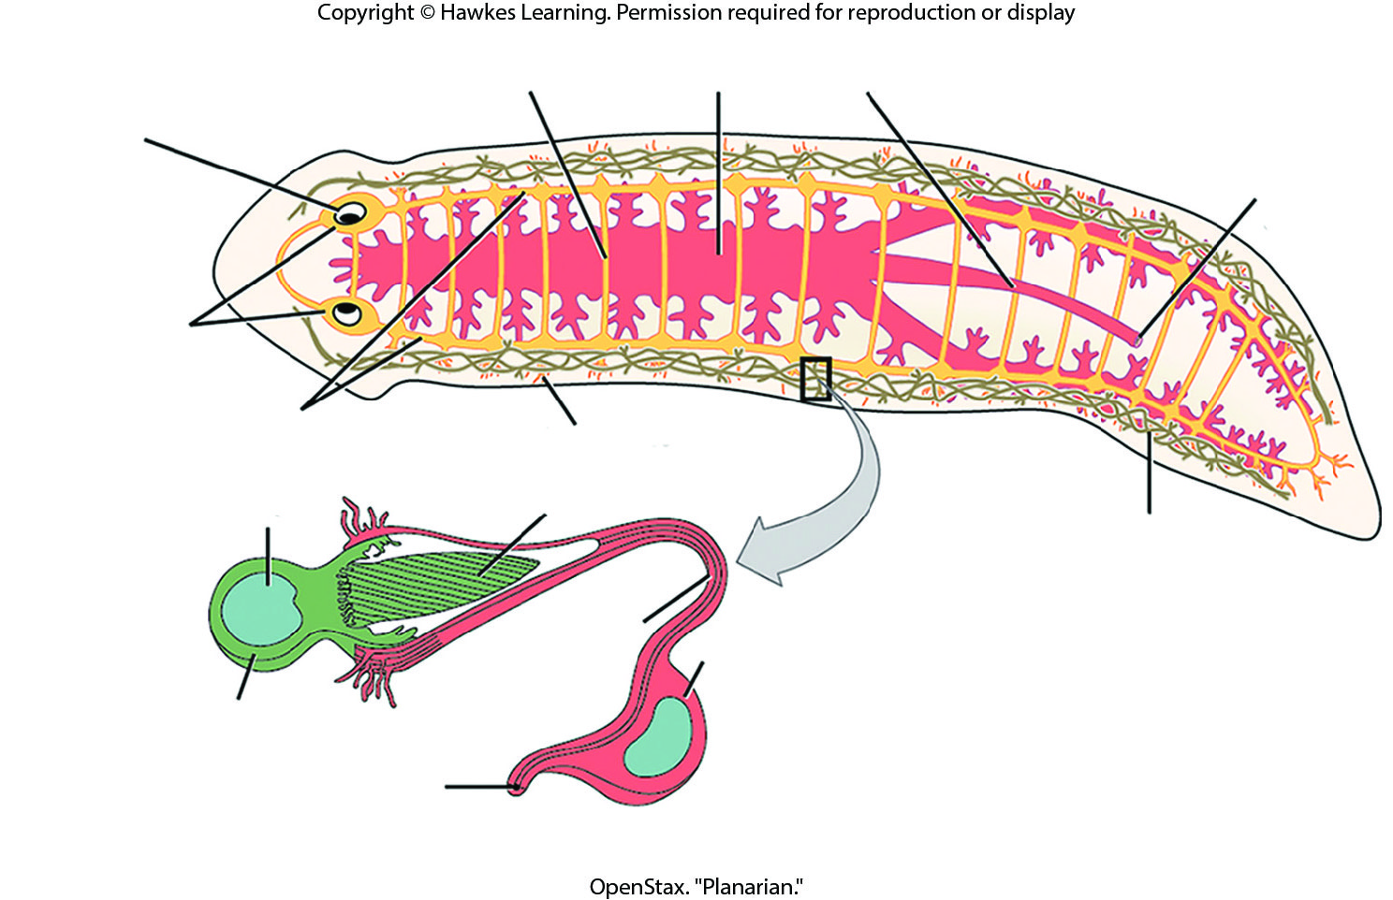
Lesson 28.3 Figure 3

Slide 18
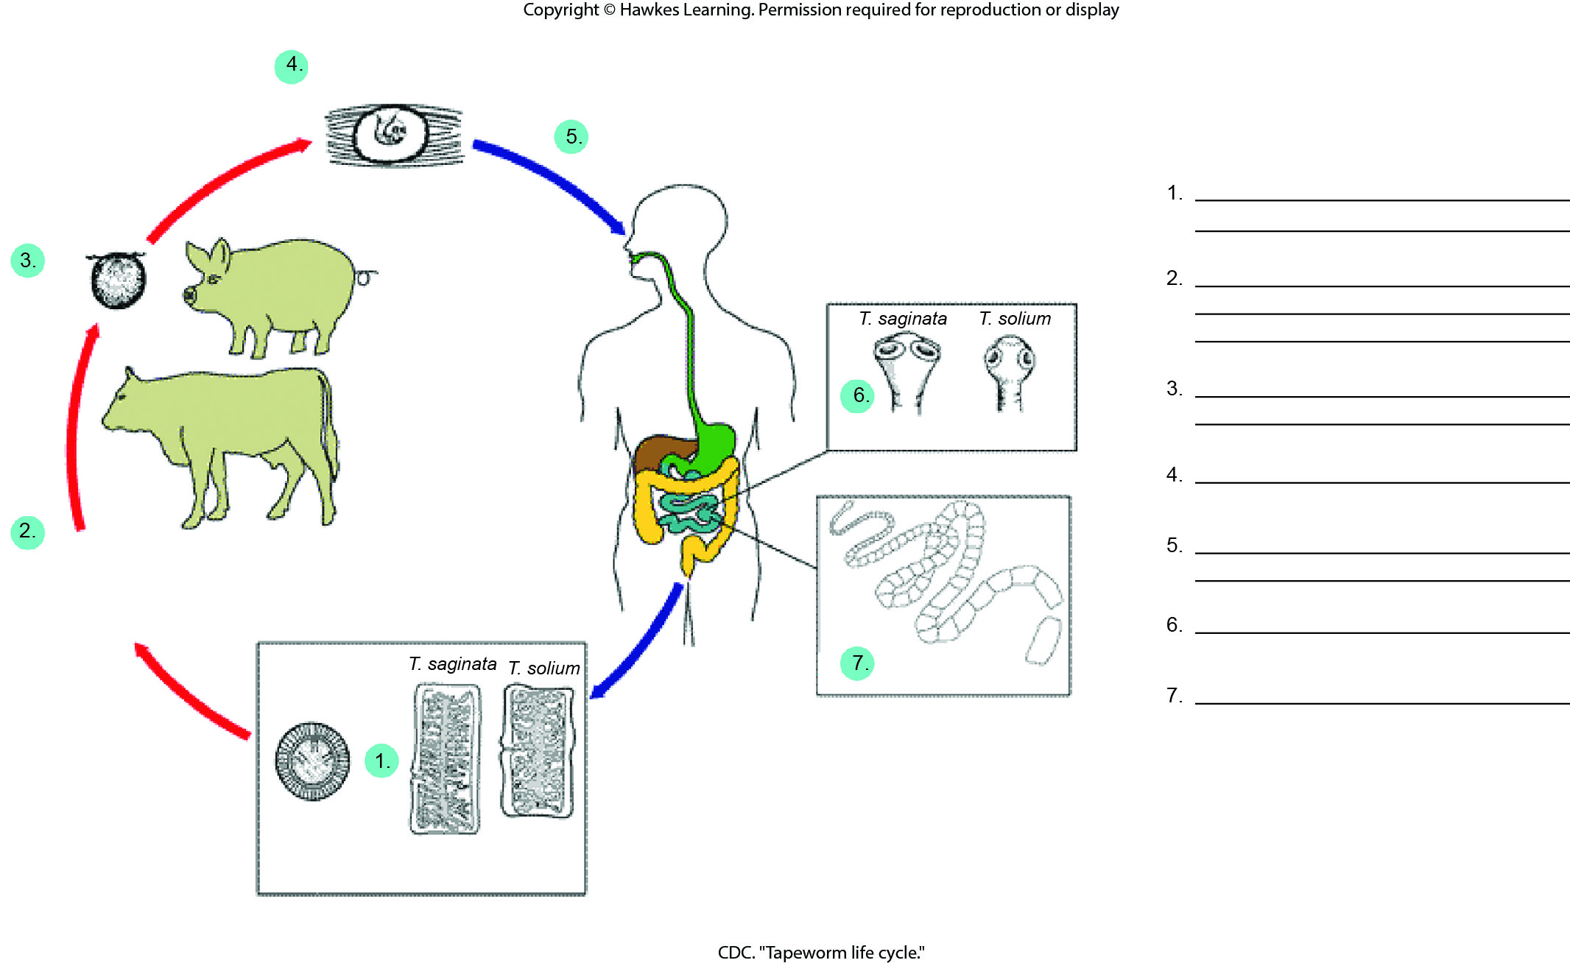
Lesson 28.3 Figure 5 - Numbered

Slide 19
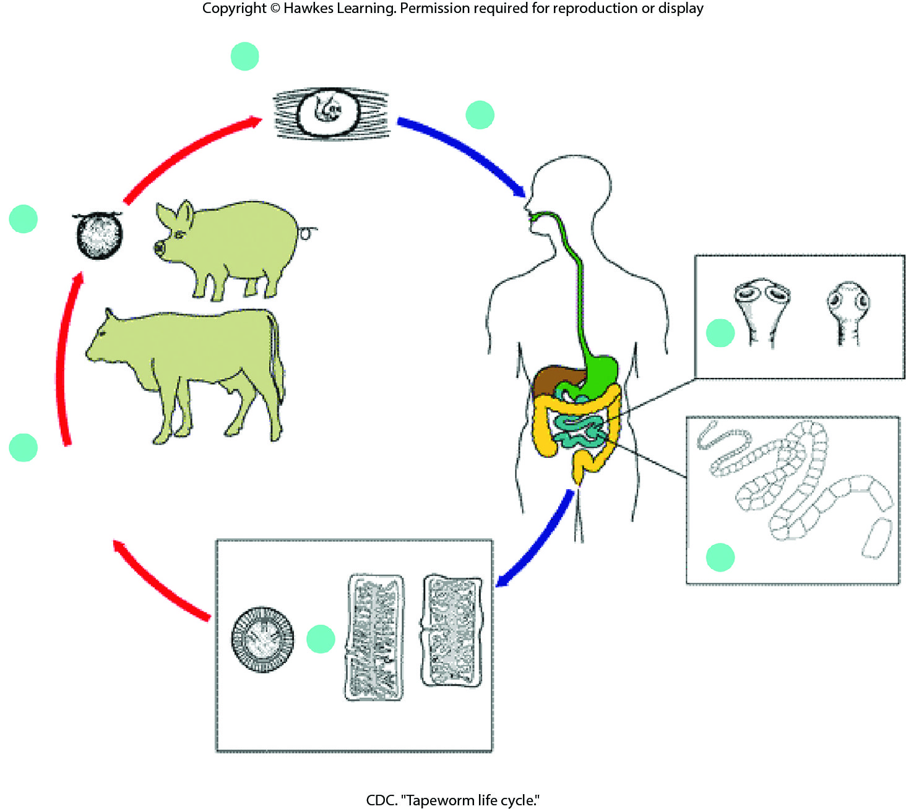
Lesson 28.3 Figure 5

Slide 20
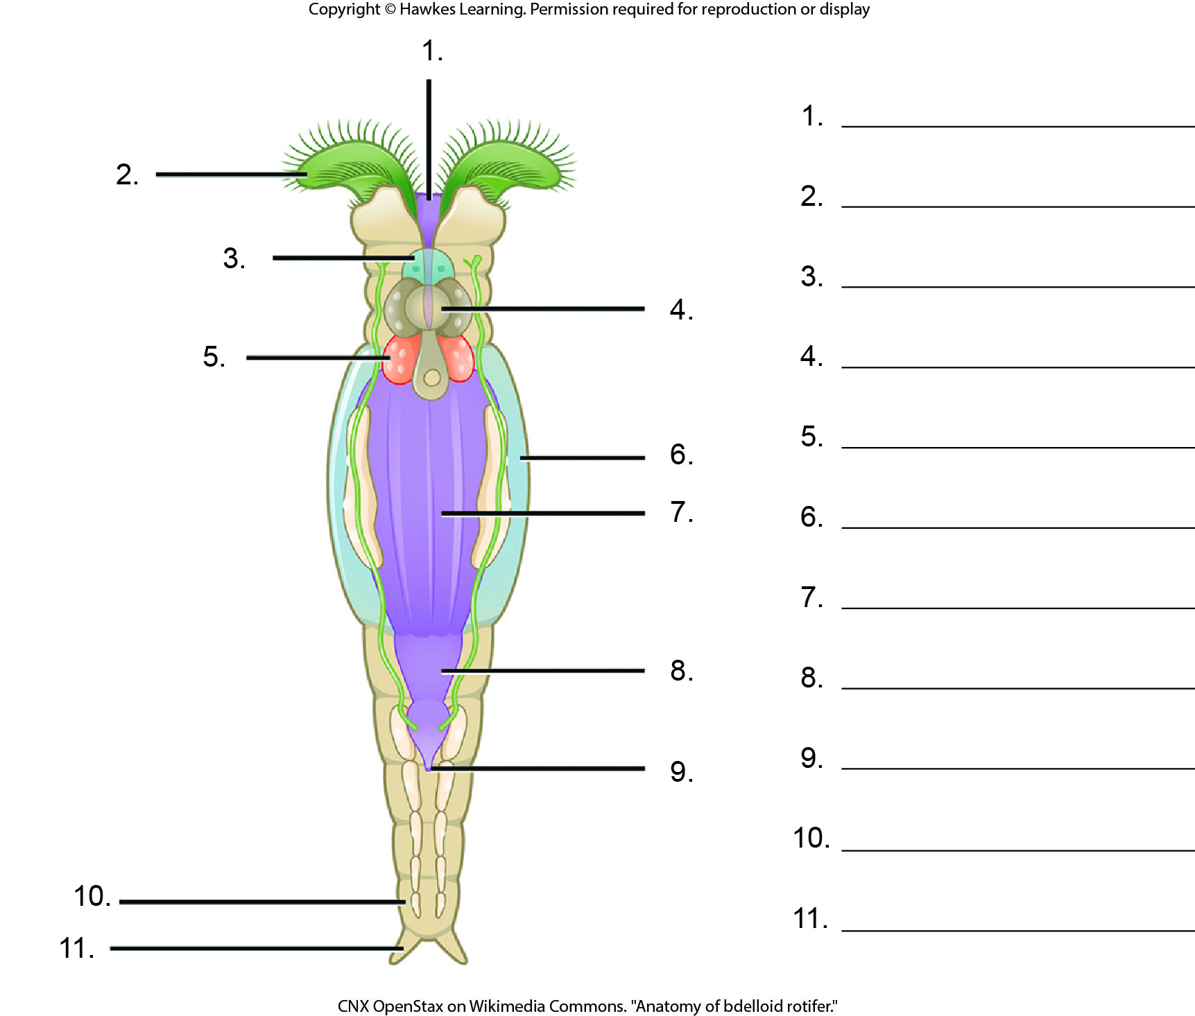
Lesson 28.3 Figure 7 - Numbered

Slide 21
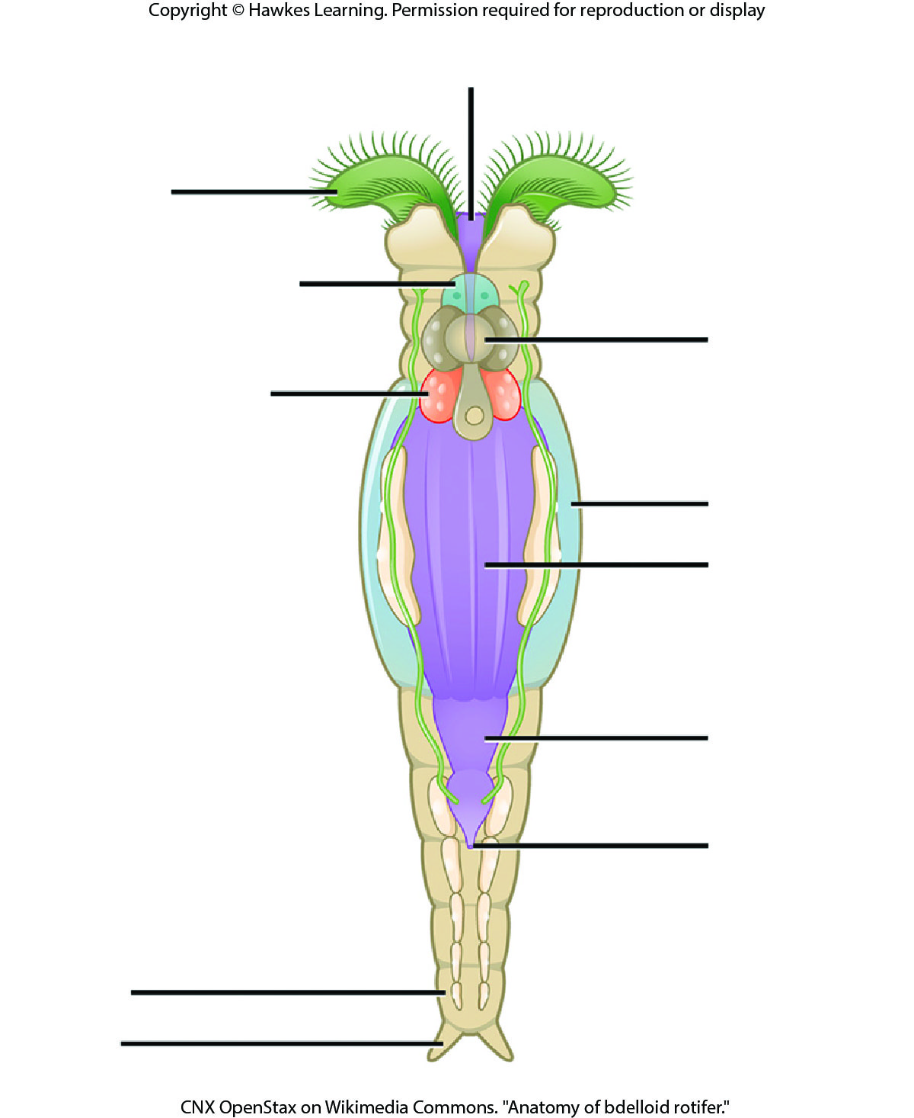
Lesson 28.3 Figure 7

Slide 22
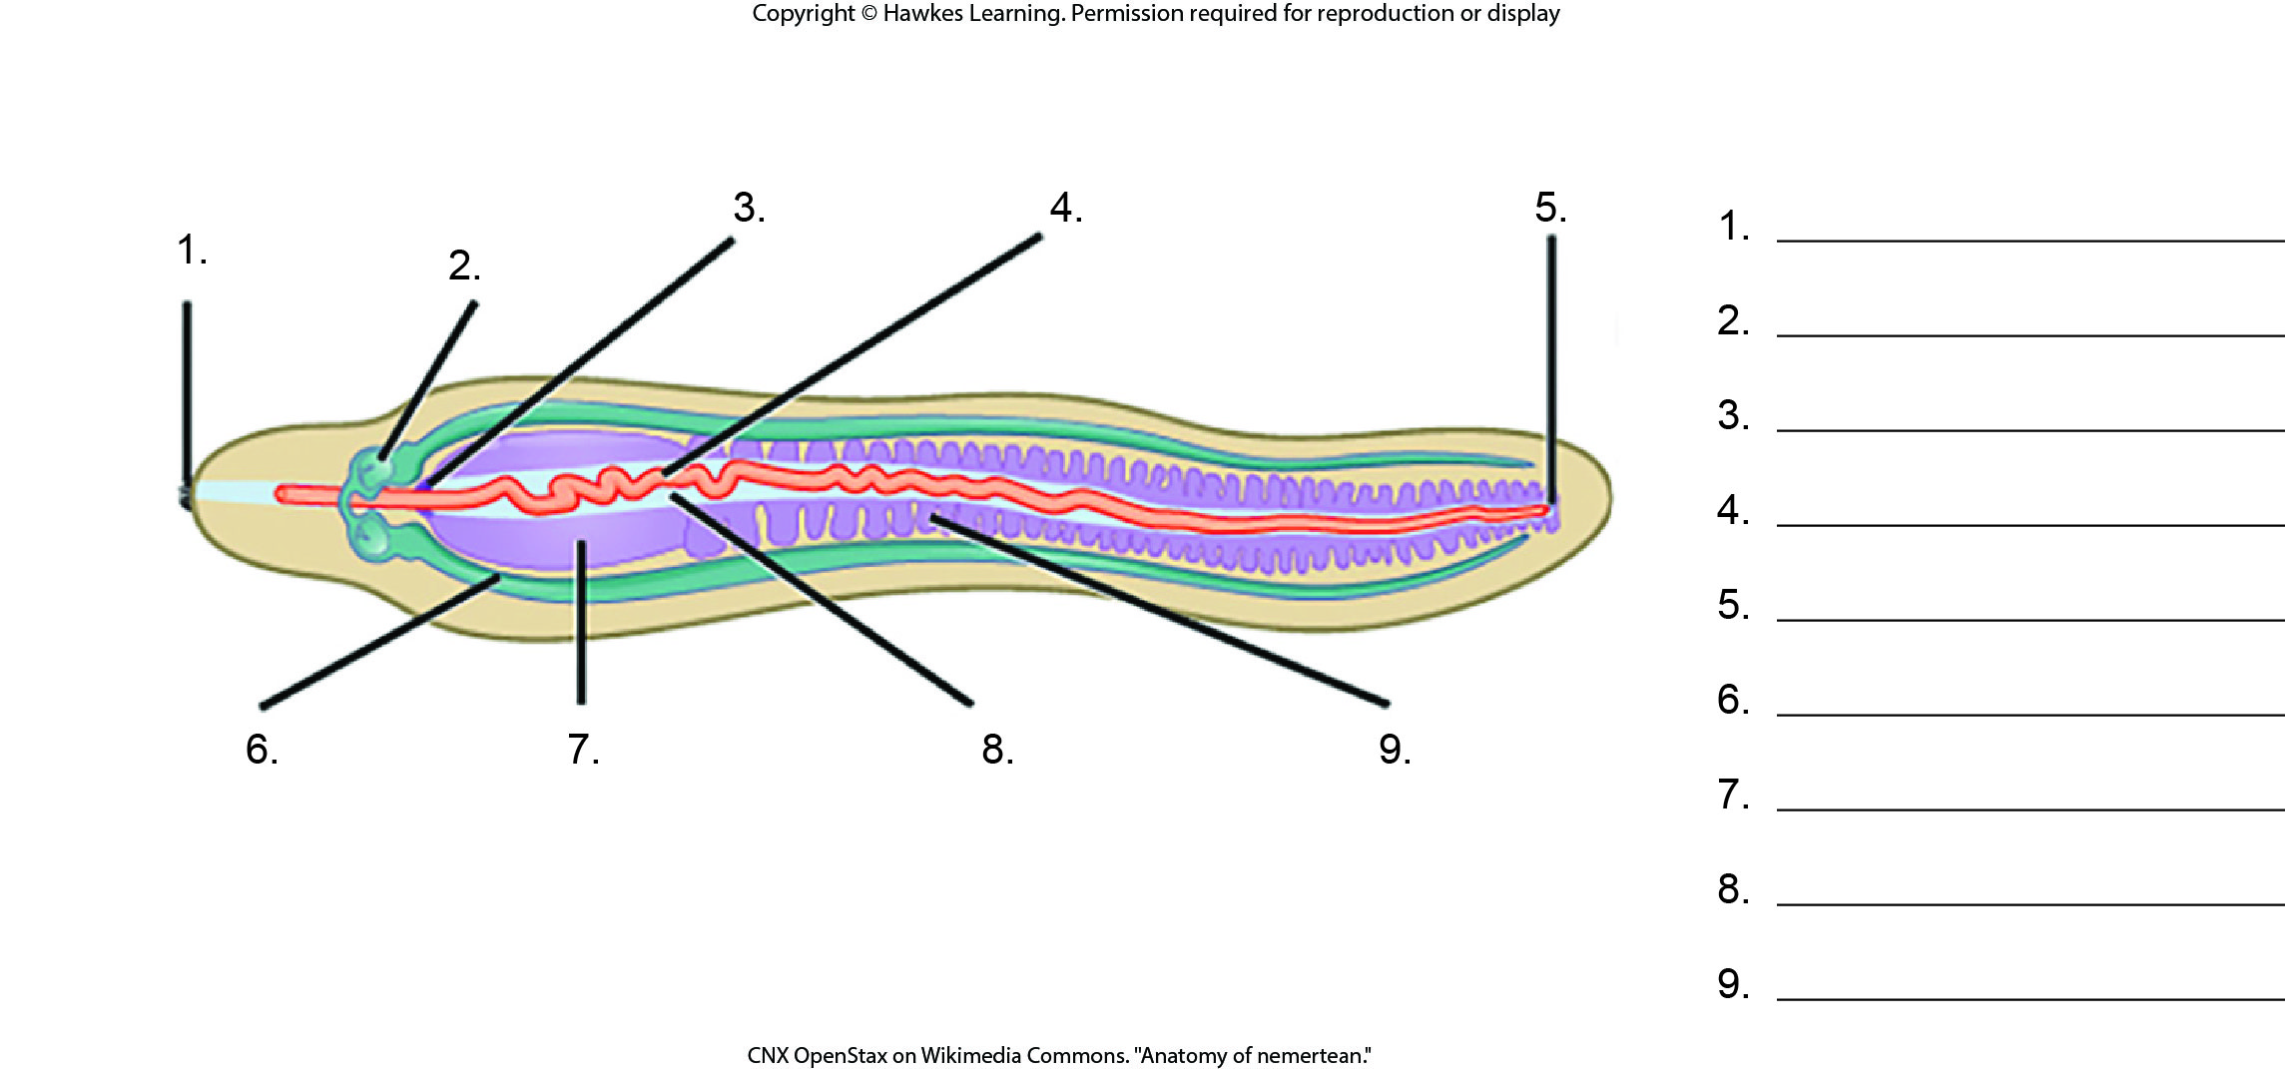
Lesson 28.3 Figure 10 - Numbered

Slide 23
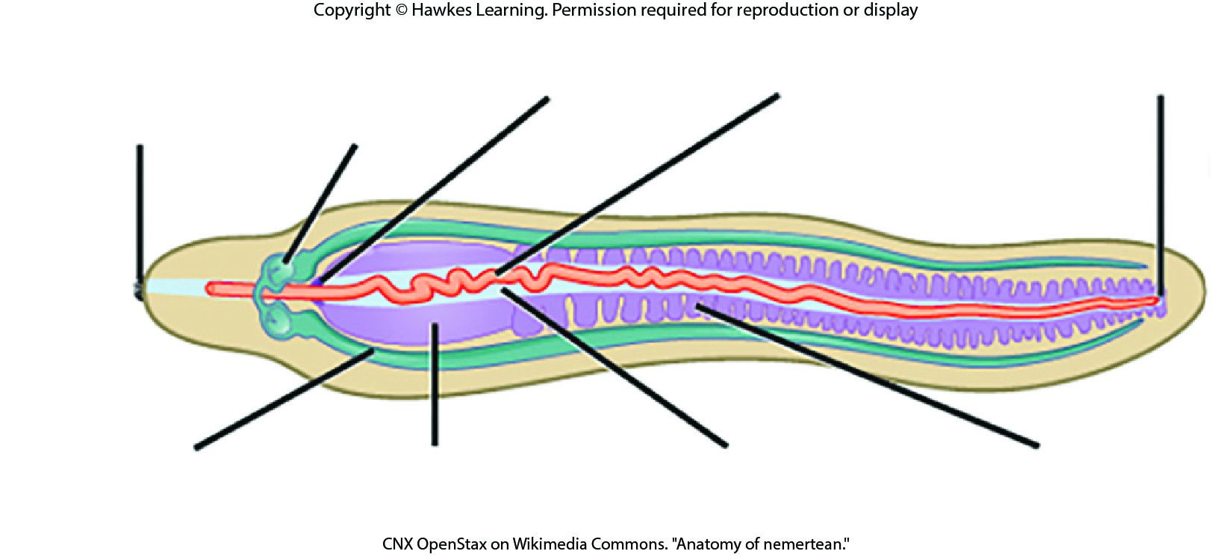
Lesson 28.3 Figure 10

Slide 24
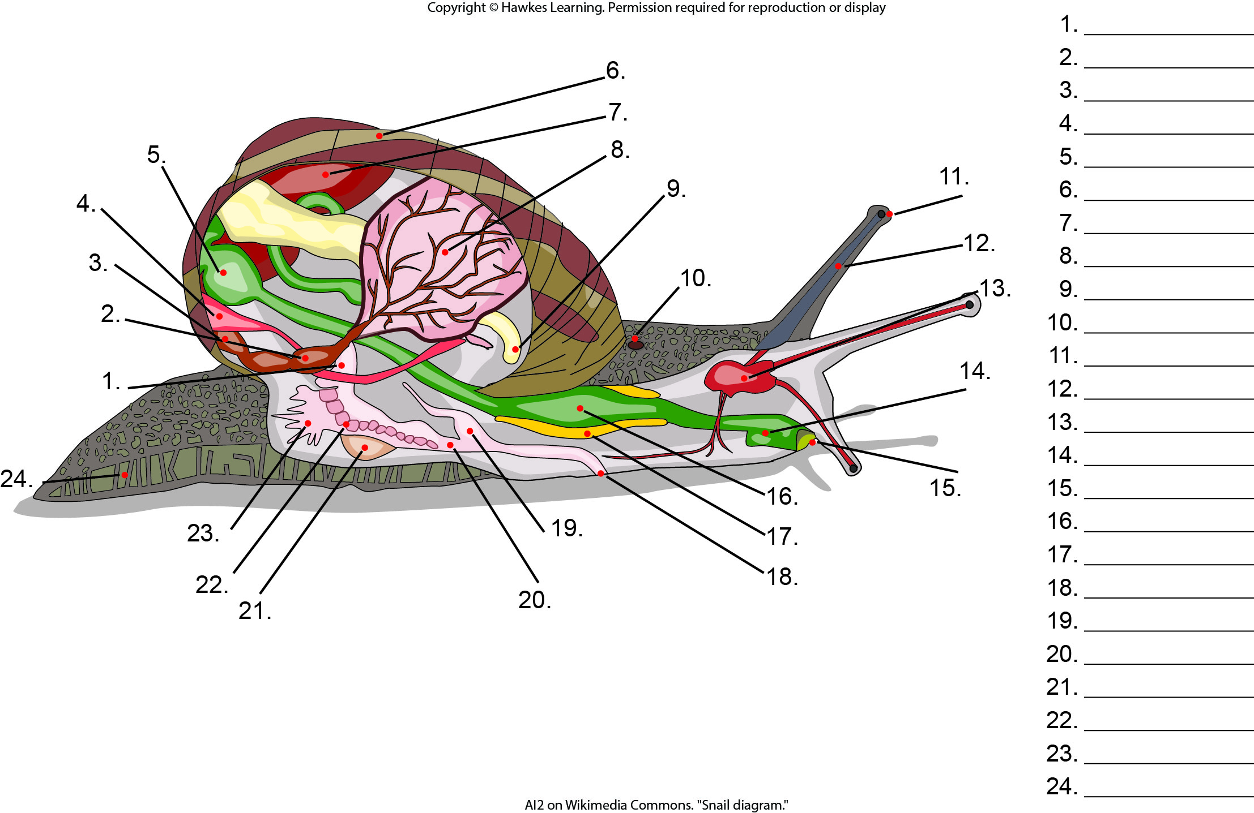
Lesson 28.4 Figure 1 - Numbered

Slide 25
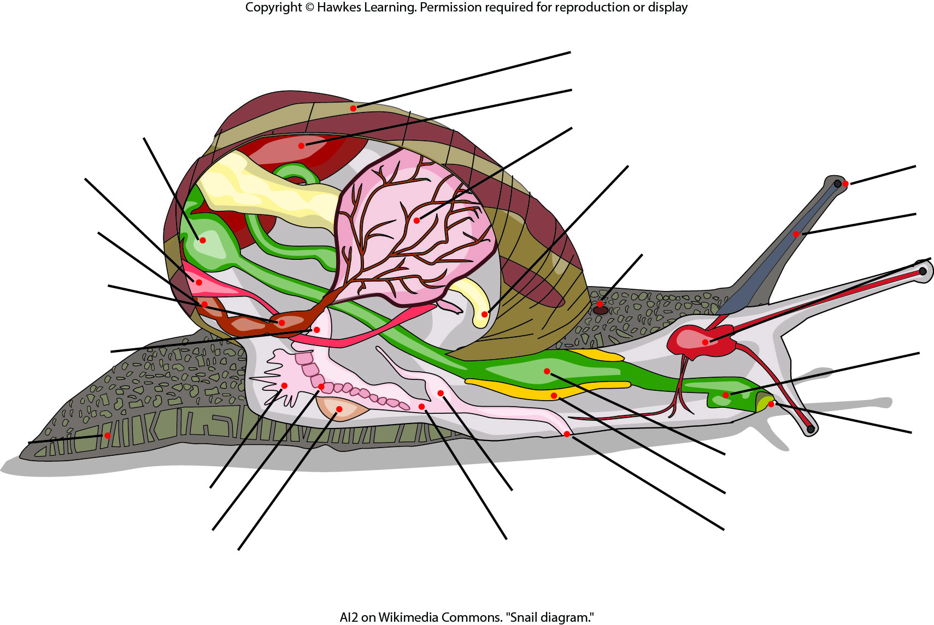
Lesson 28.4 Figure 1

Slide 26
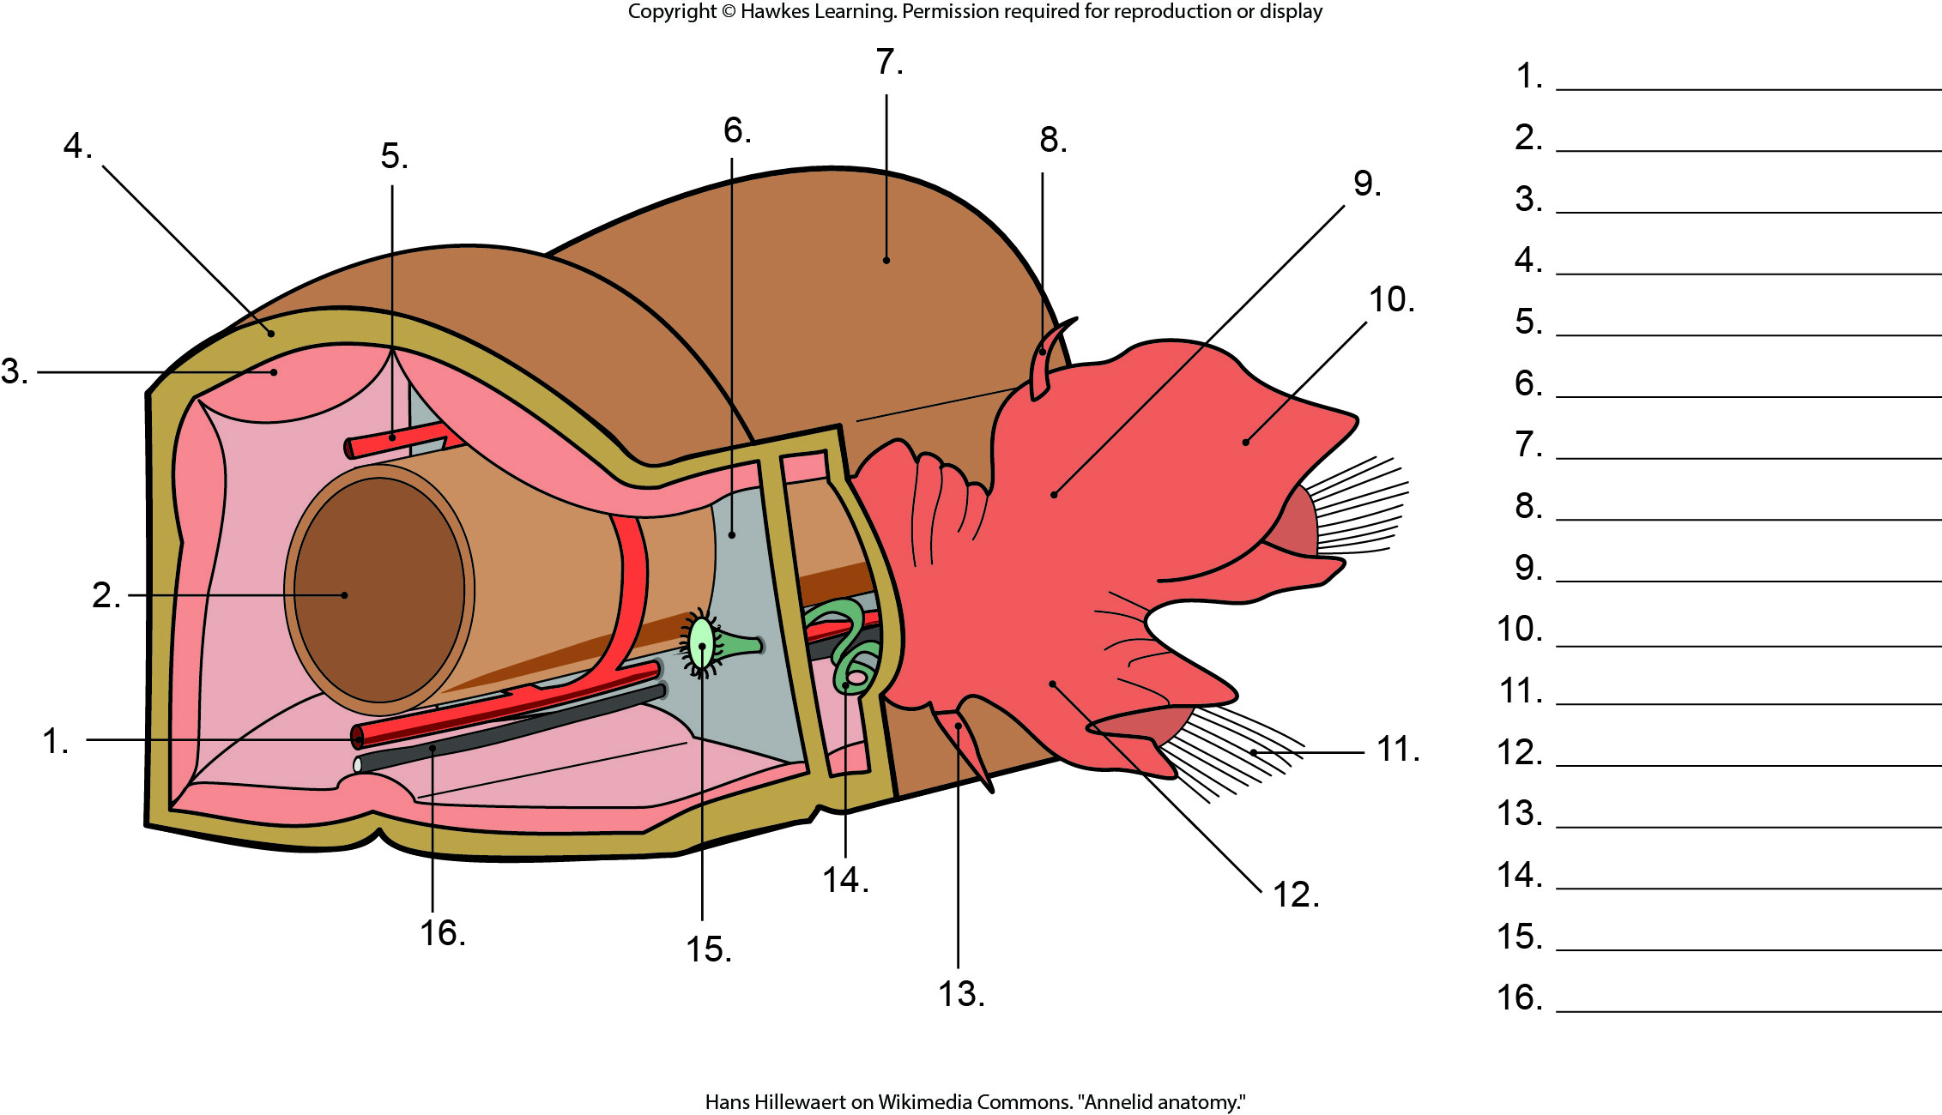
Lesson 28.4 Figure 12 - Numbered

Slide 27
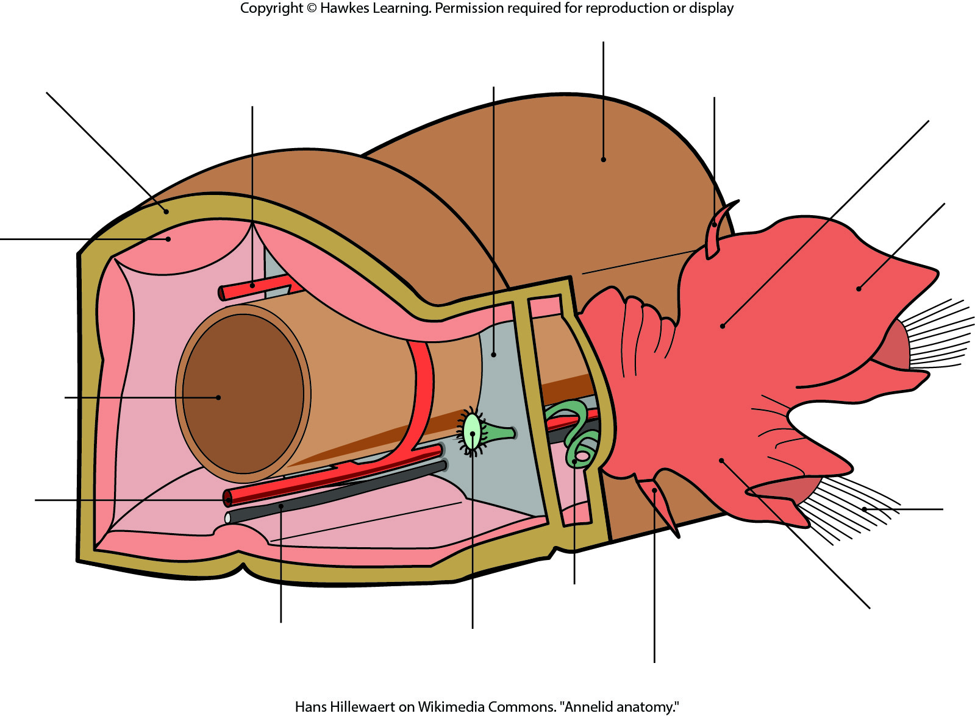
Lesson 28.4 Figure 12

Slide 28
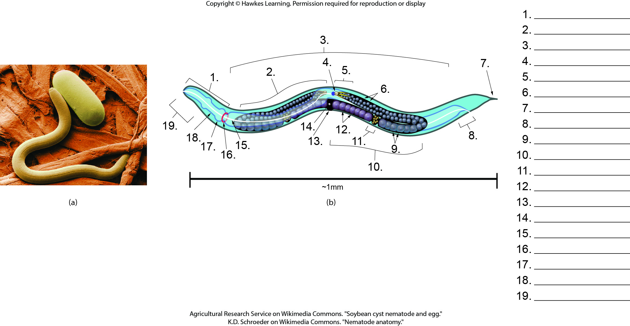
Lesson 28.5 Figure 1 - Numbered

Slide 29
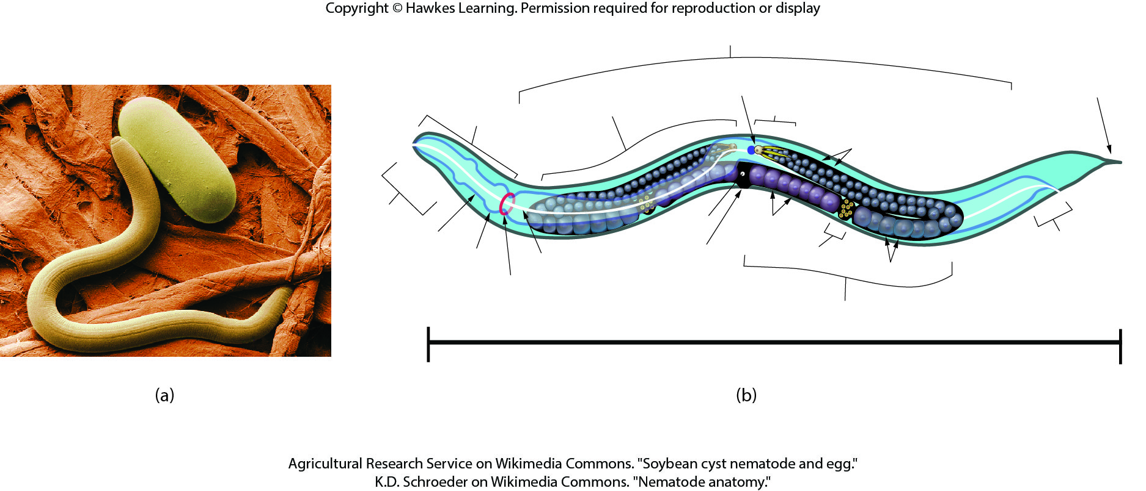
Lesson 28.5 Figure 1

Slide 30
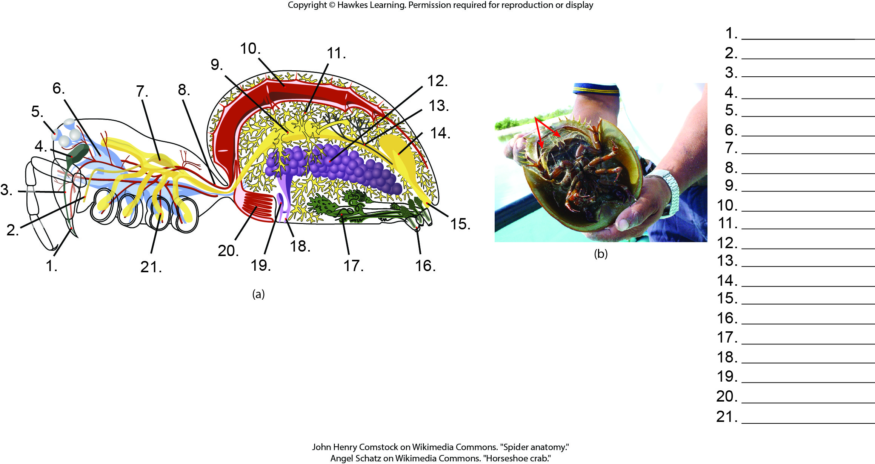
Lesson 28.6 Figure 2 - Numbered

Slide 31
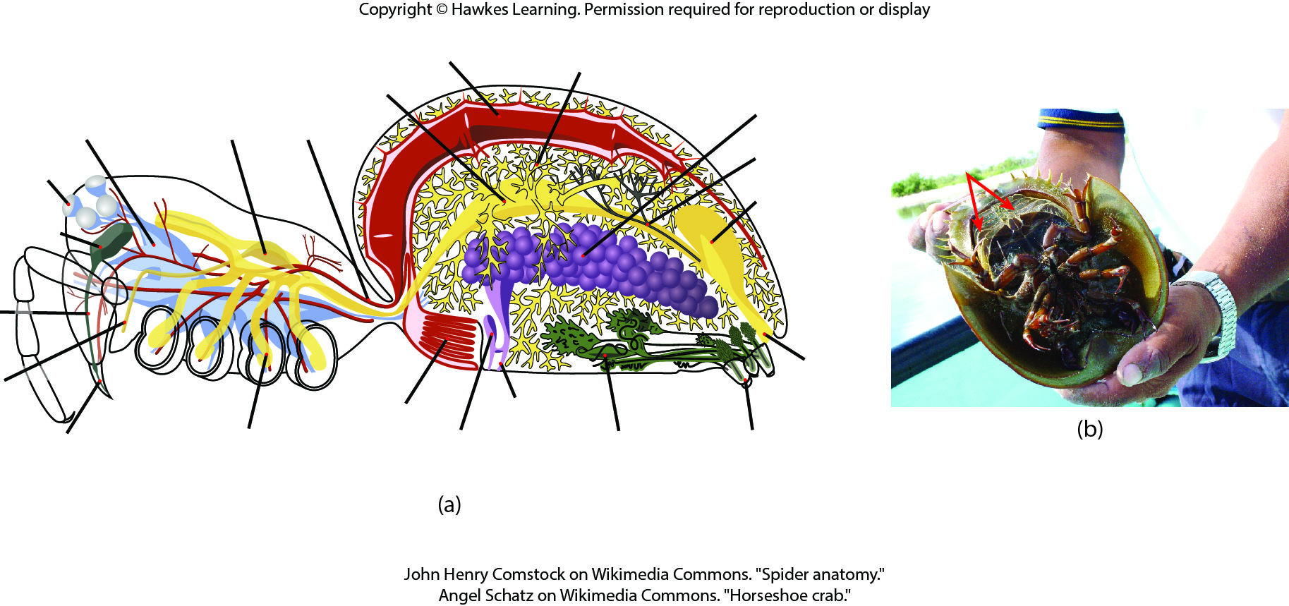
Lesson 28.6 Figure 2

Slide 32
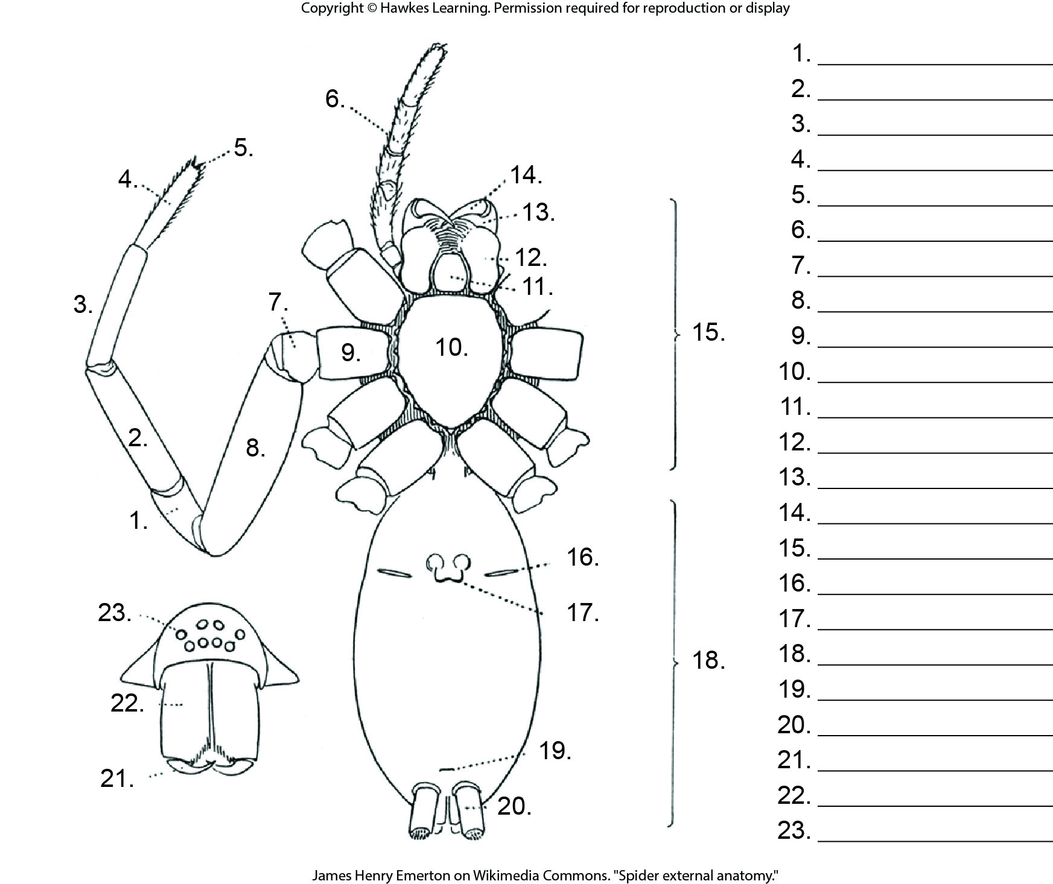
Lesson 28.6 Figure 3 - Numbered

Slide 33
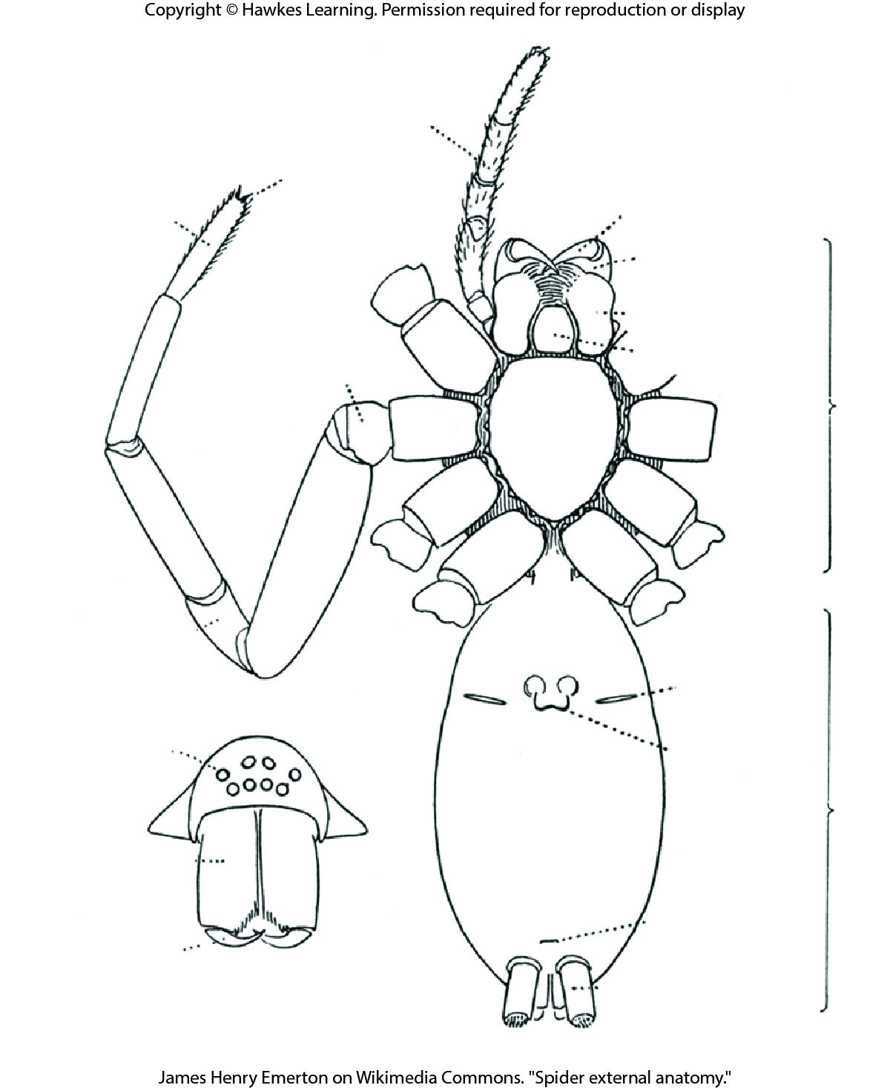
Lesson 28.6 Figure 3

Slide 34
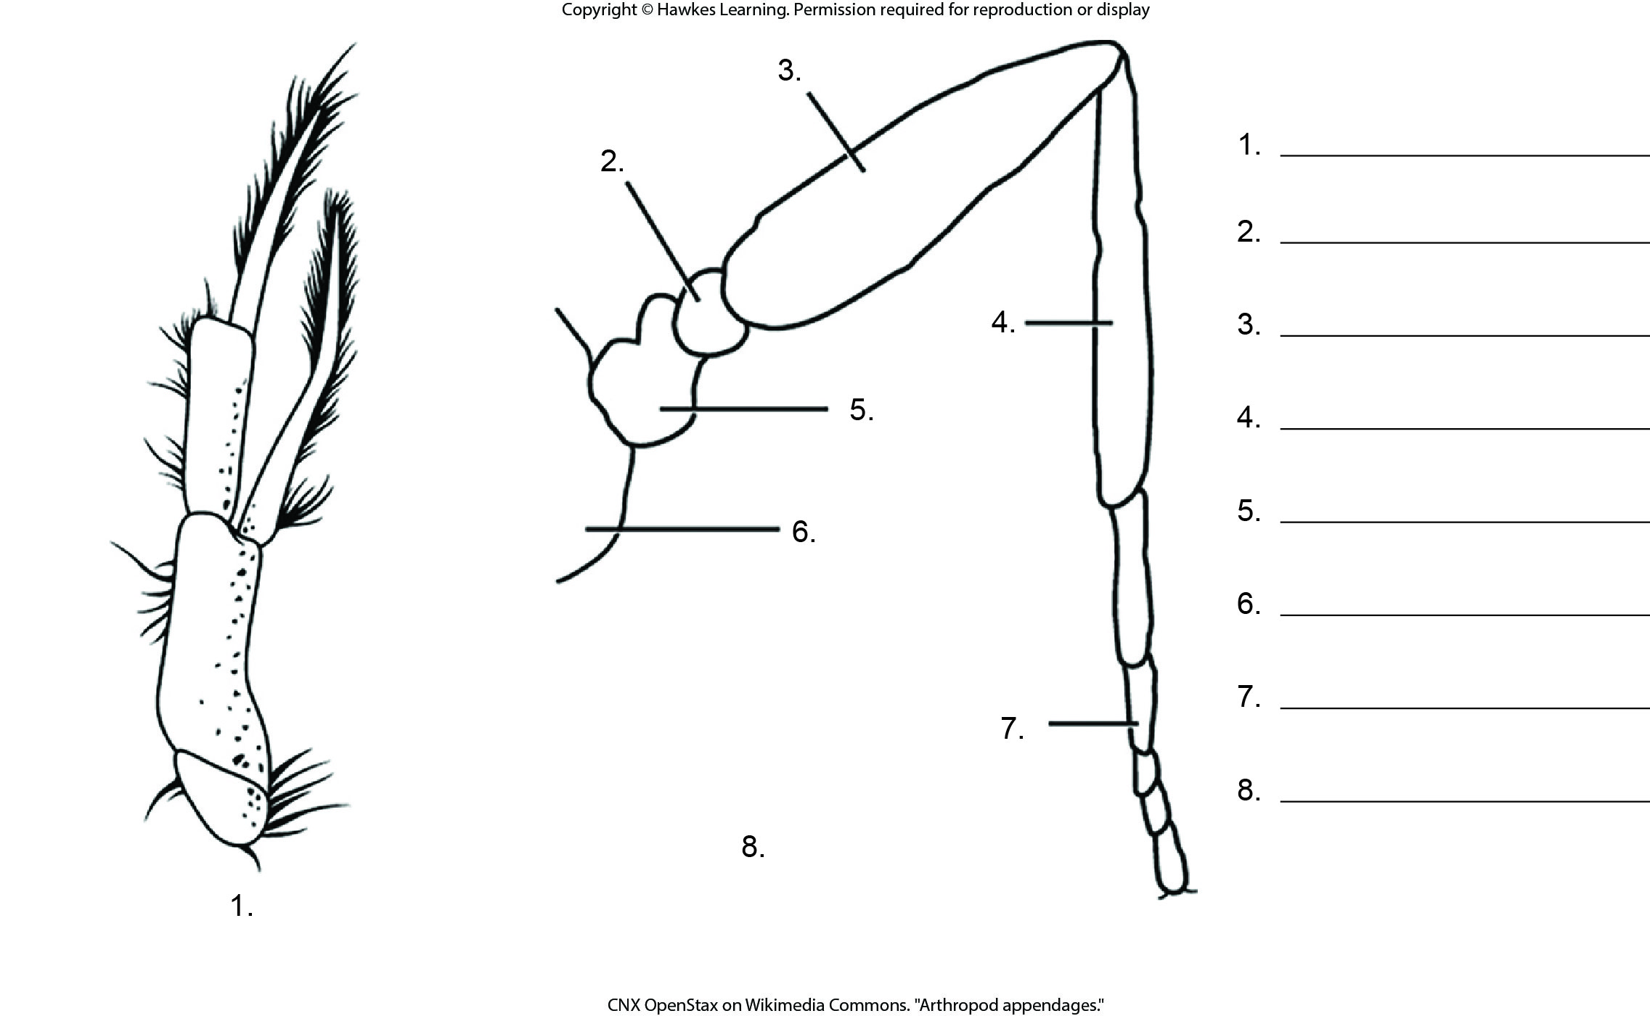
Lesson 28.6 Figure 8 - Numbered

Slide 35
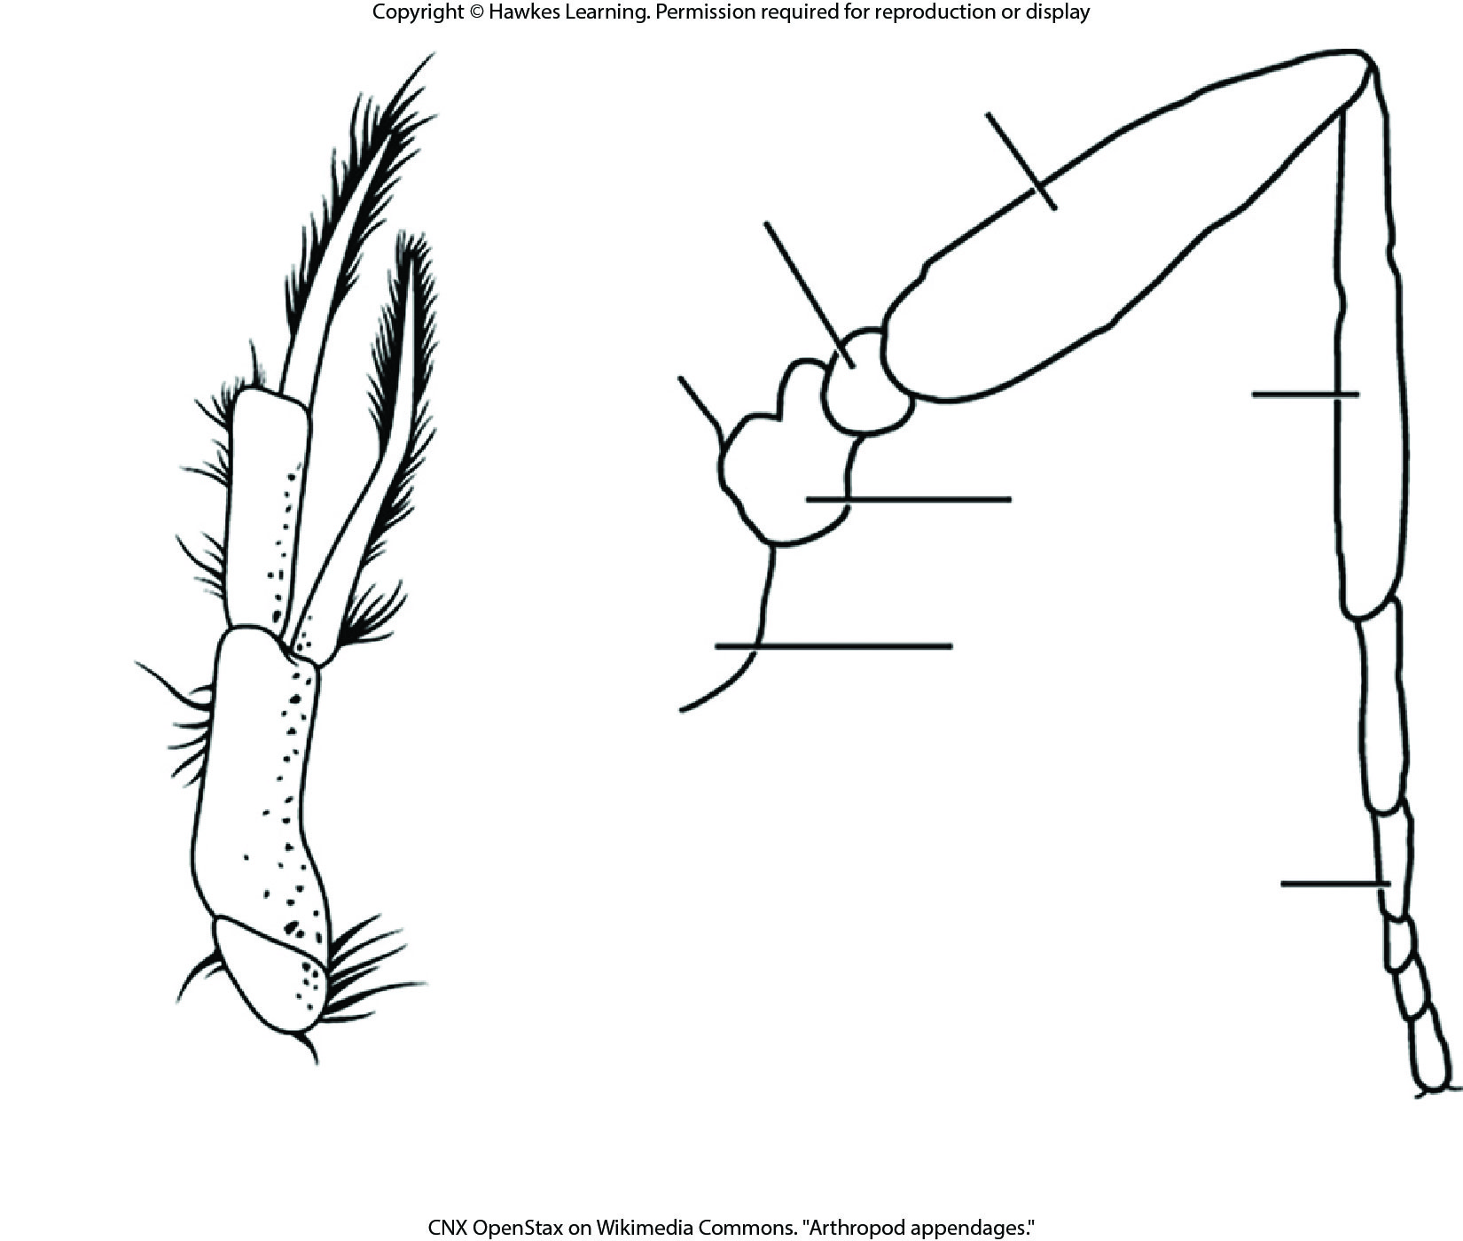
Lesson 28.6 Figure 8

Slide 36
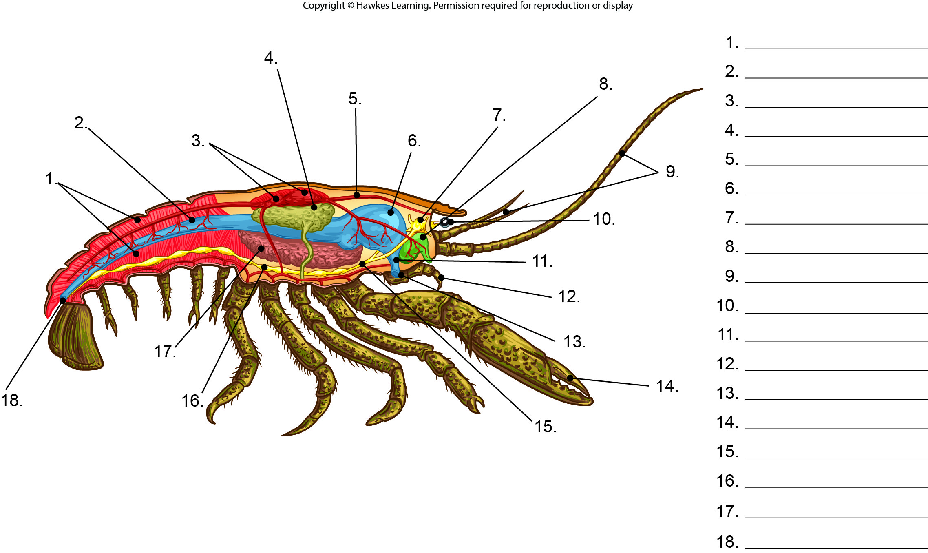
Lesson 28.6 Figure 9 - Numbered

Slide 37
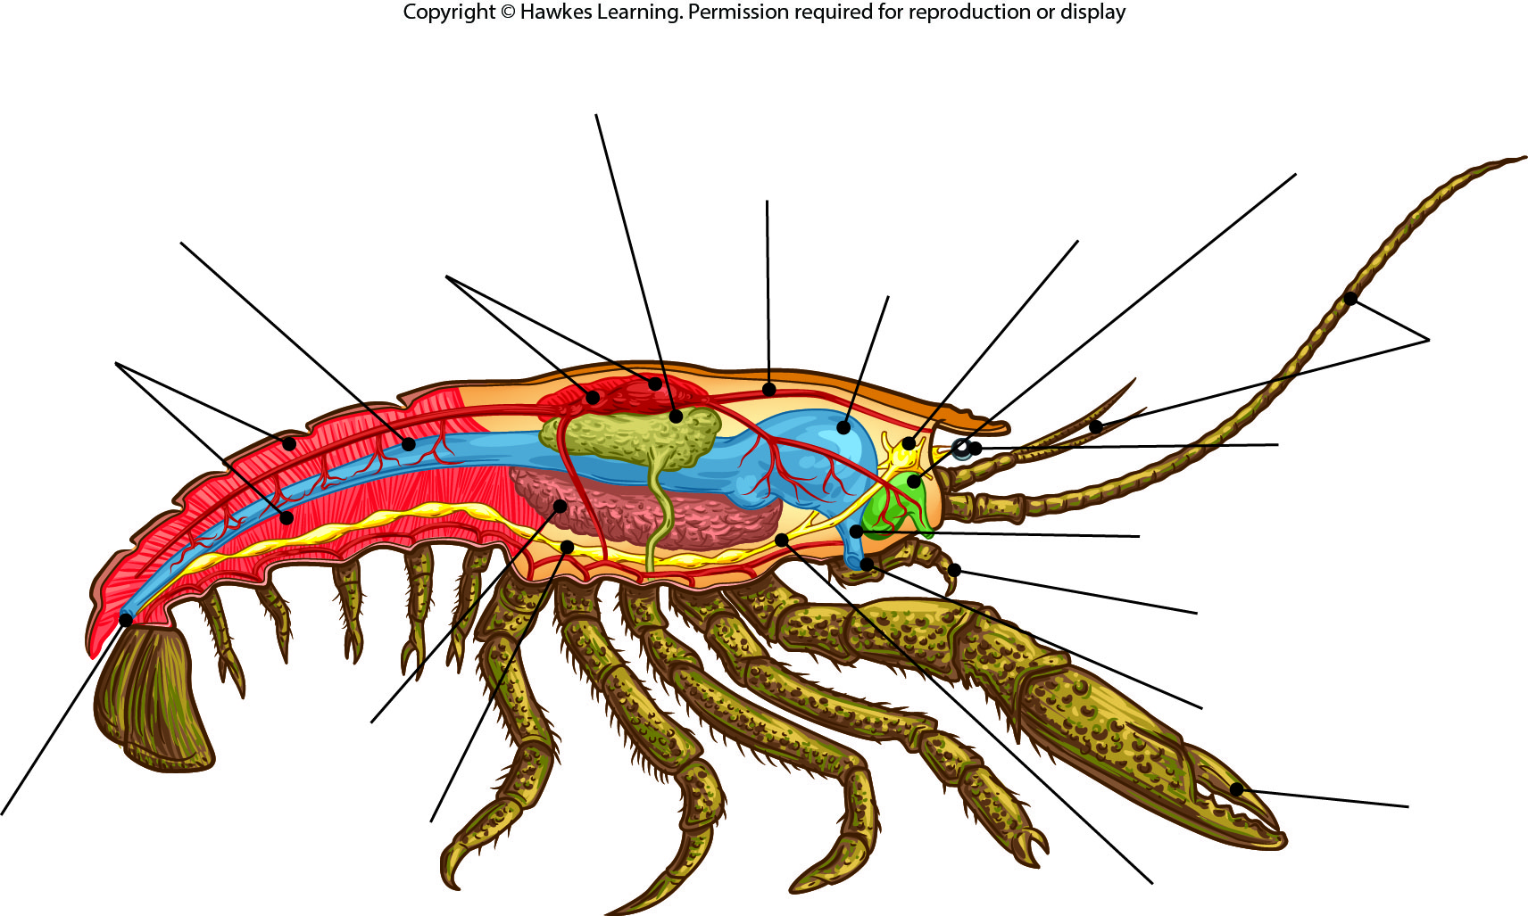
Lesson 28.6 Figure 9

Slide 38
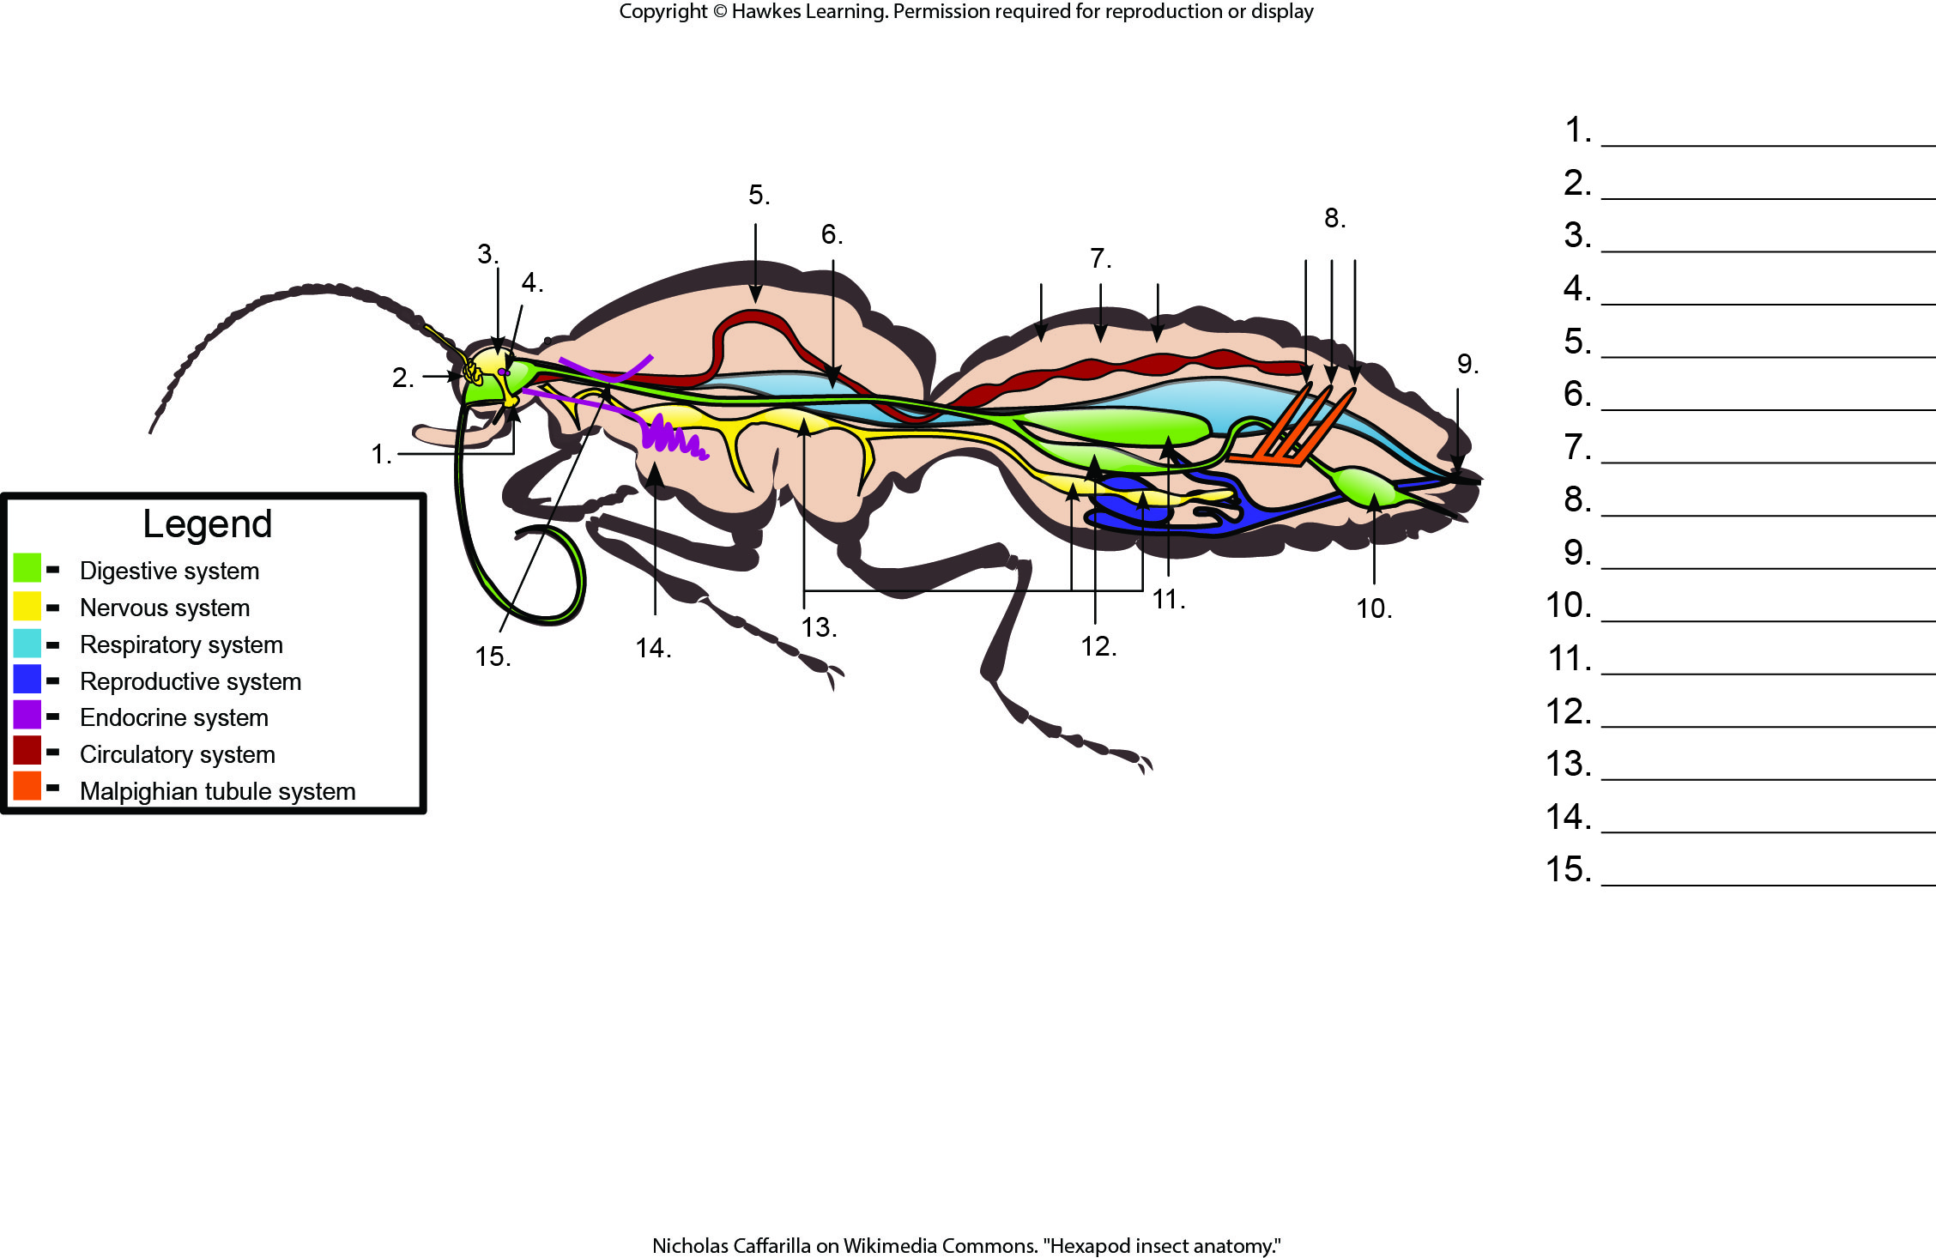
Lesson 28.6 Figure 12 - Numbered

Slide 39
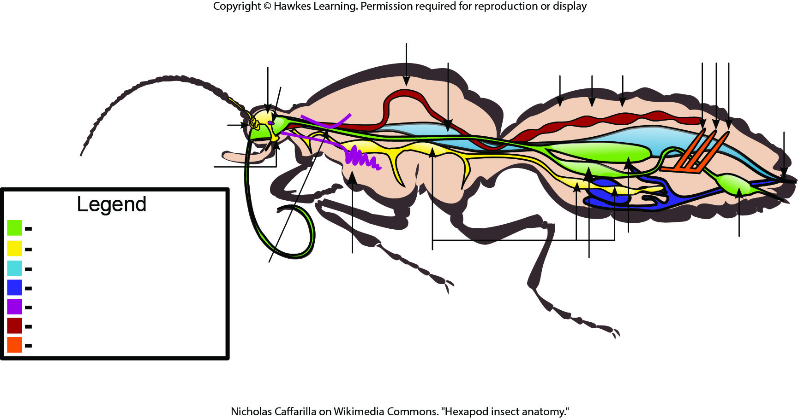
Lesson 28.6 Figure 12

Slide 40
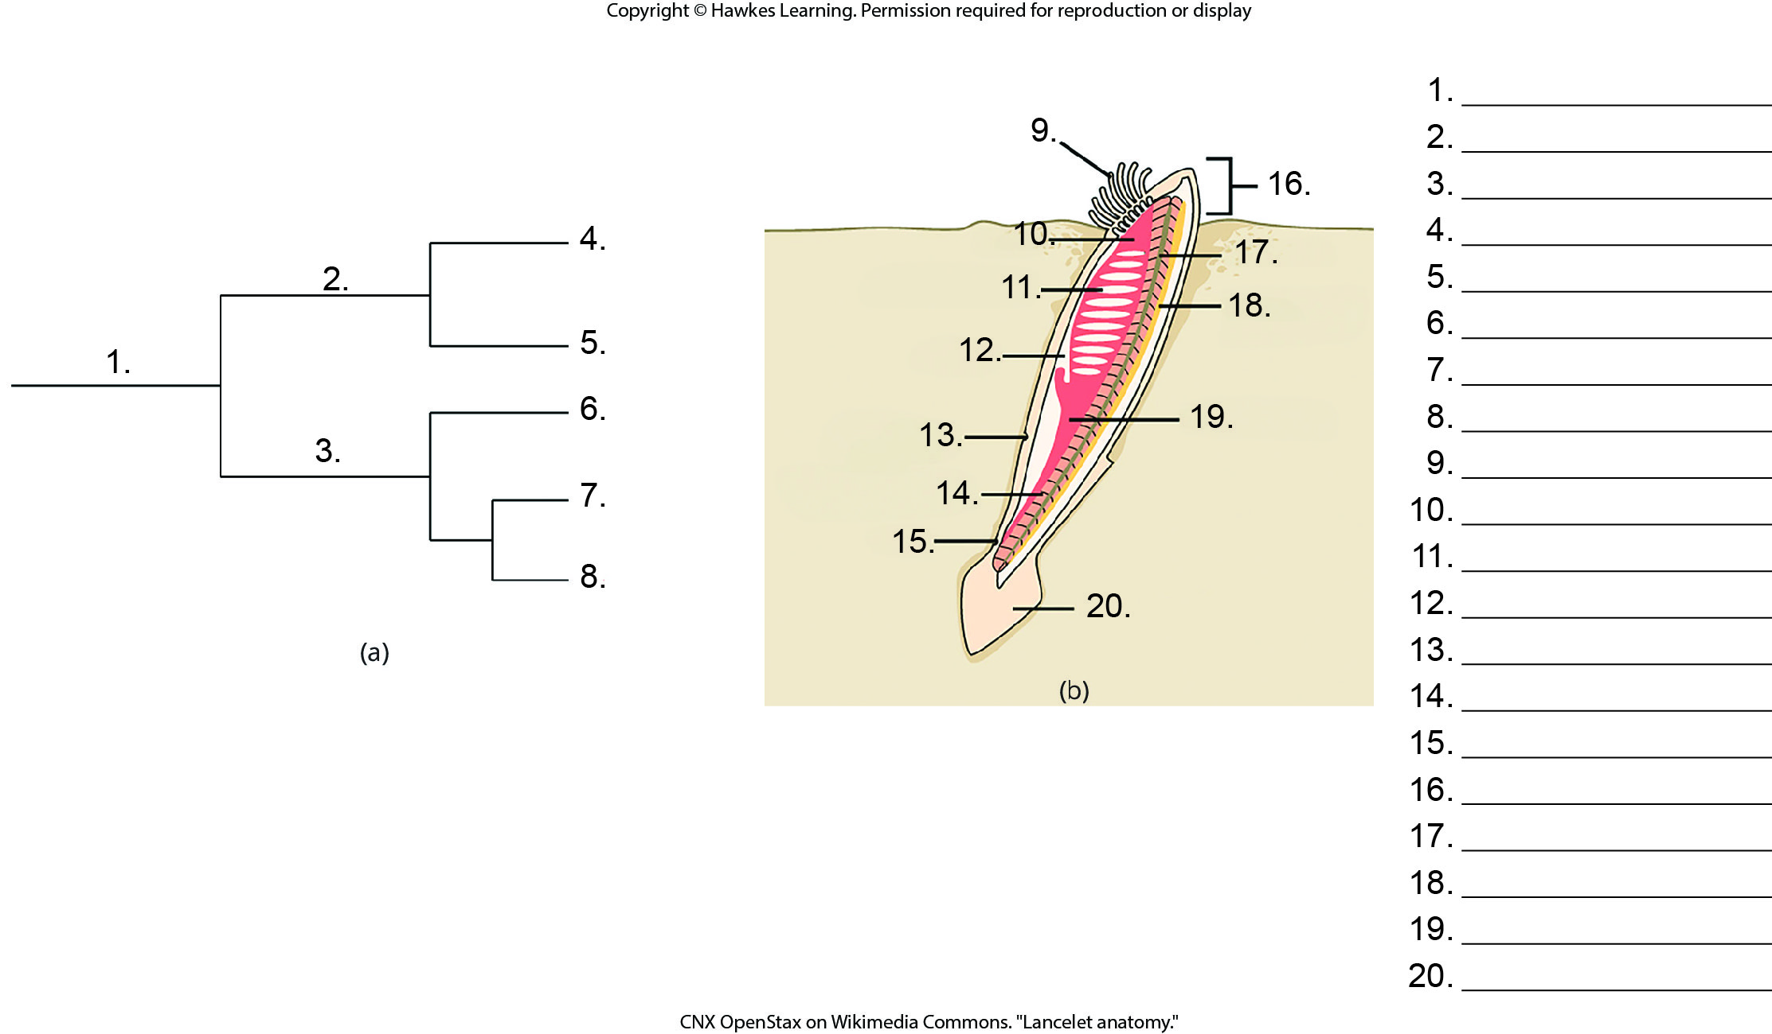
Lesson 28.7 Figure 1 - Numbered

Slide 41
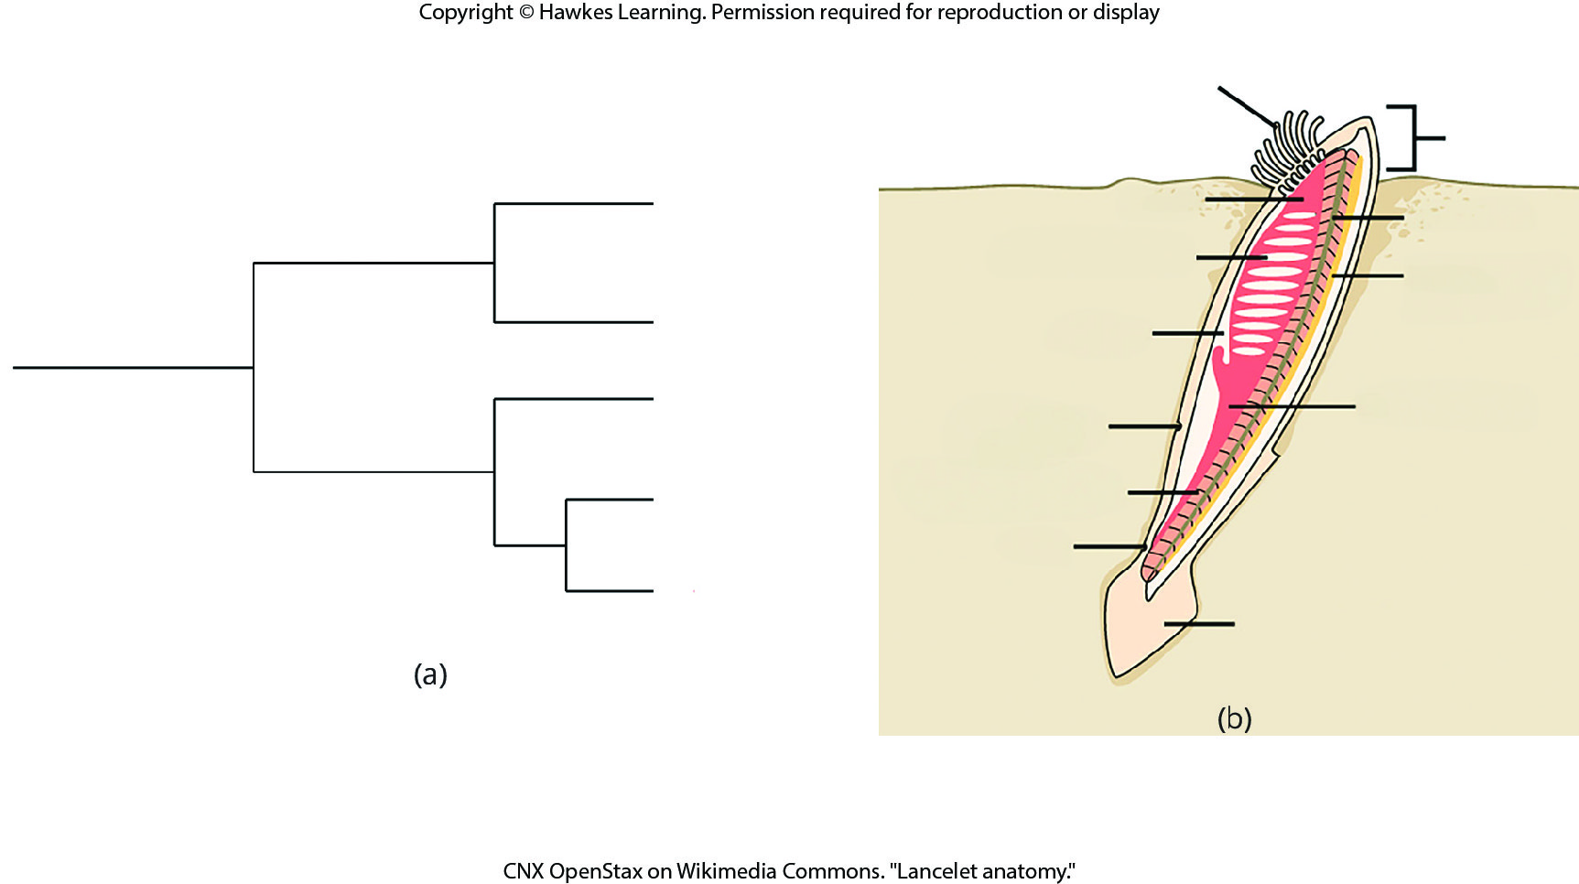
Lesson 28.7 Figure 1

Slide 42
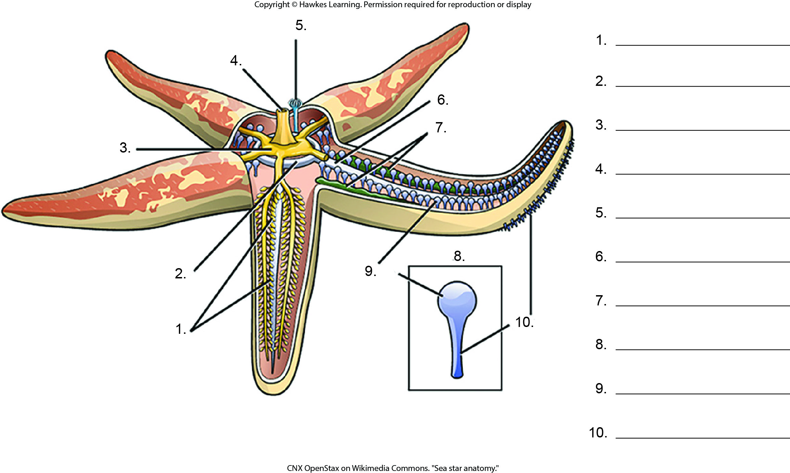
Lesson 28.7 Figure 2 - Numbered

Slide 43
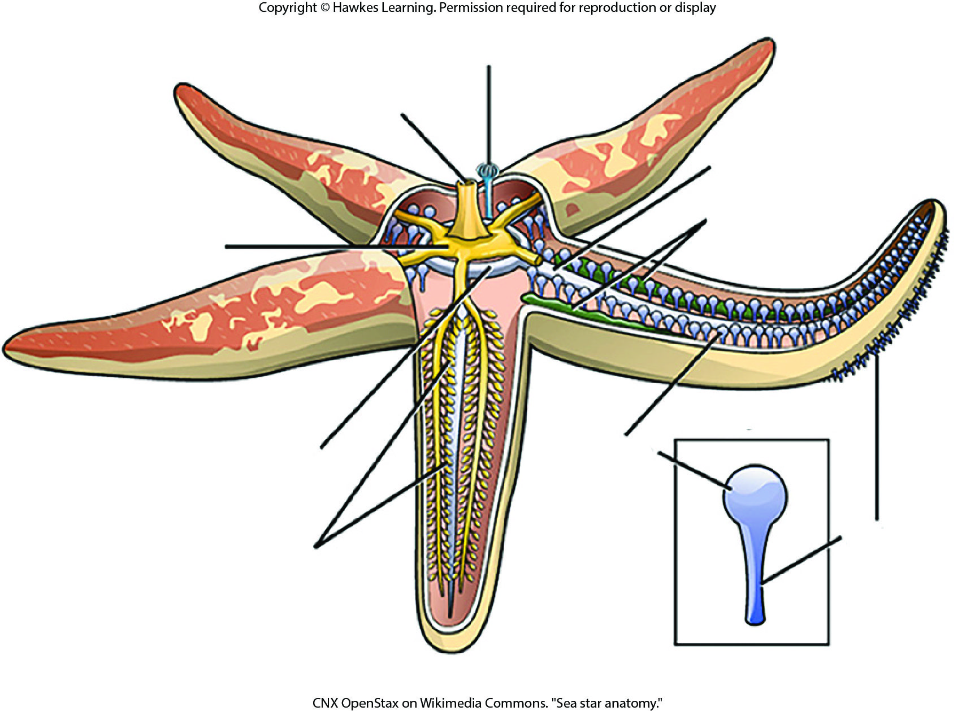
Lesson 28.7 Figure 2

Slide 44
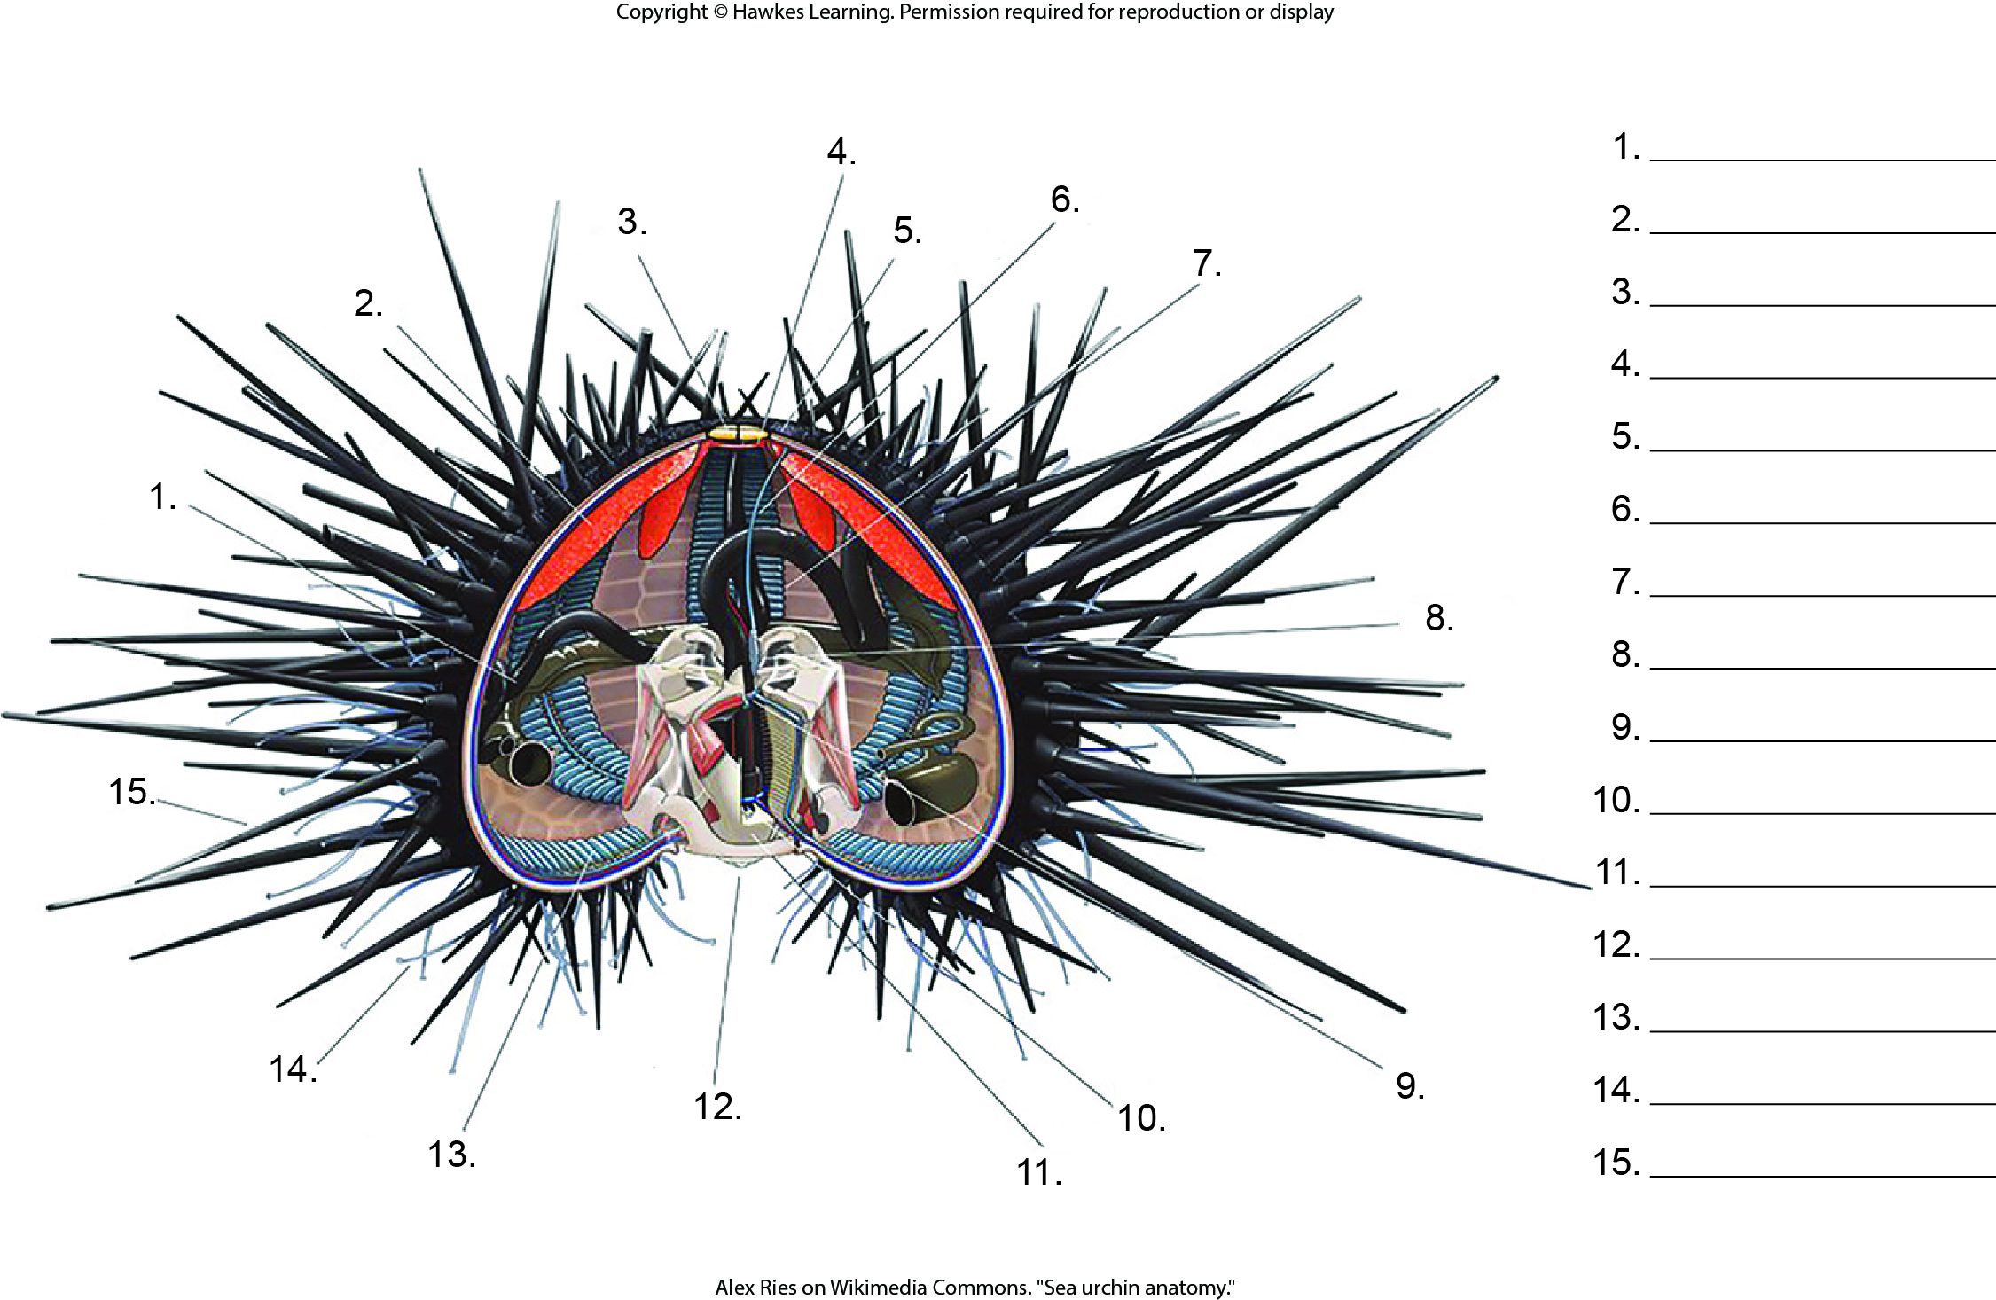
Lesson 28.7 Figure 3 - Numbered

Slide 45
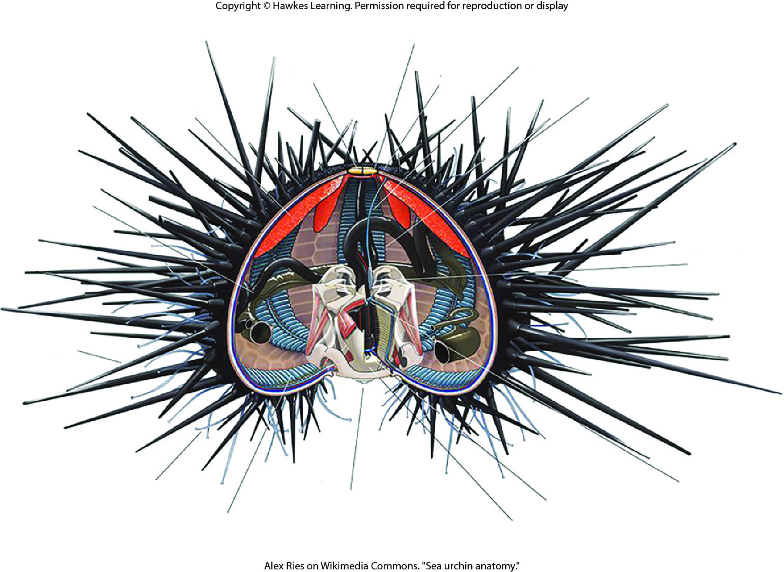
Lesson 28.7 Figure 3

Slide 46
Hawkes Learning – End of PowerPoint

