Slide 1
Chapter 29
Vertebrates

Slide 2
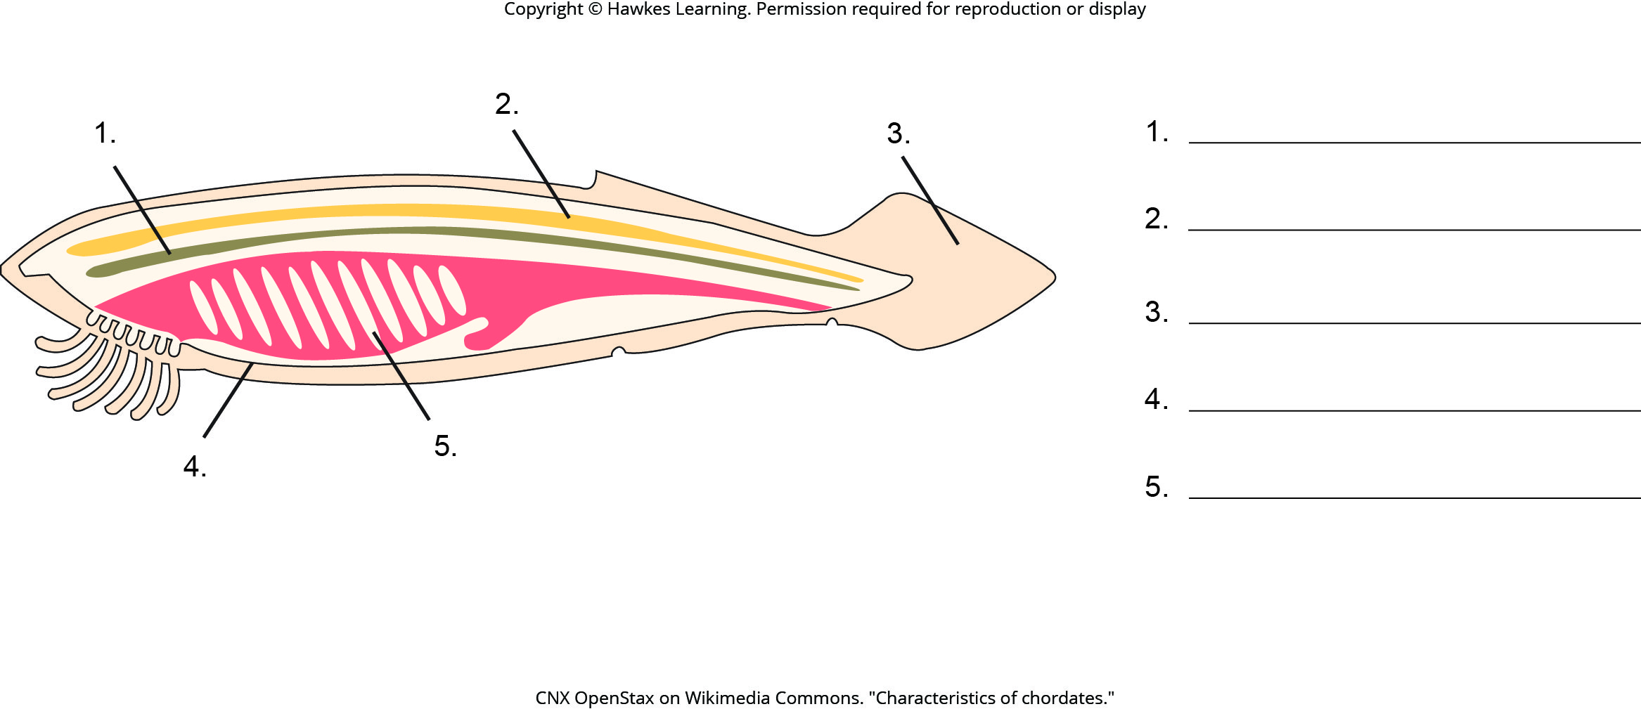
Lesson 29.1 Figure 3 - Numbered

Slide 3
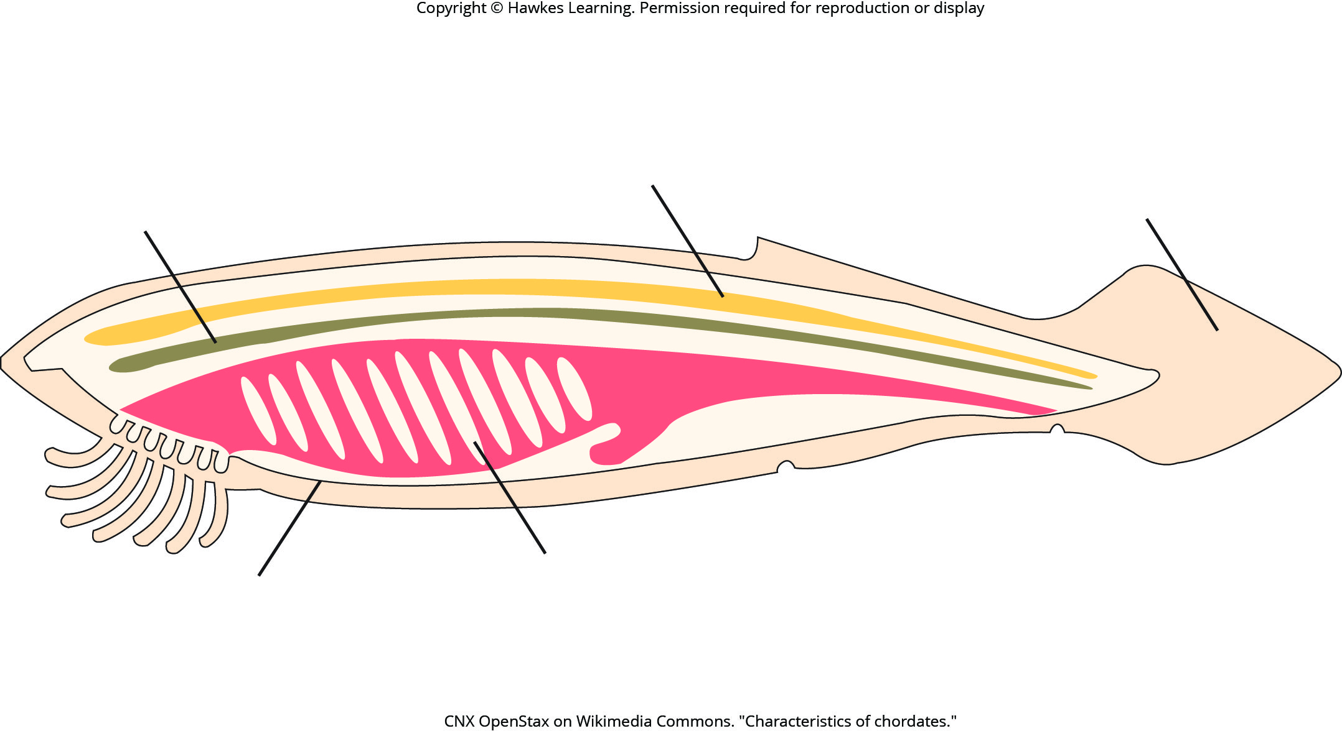
Lesson 29.1 Figure 3

Slide 4
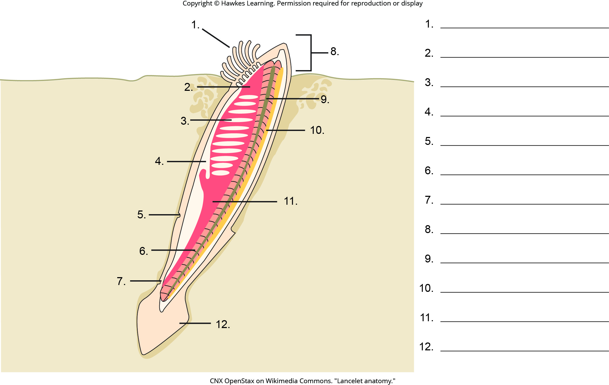
Lesson 29.1 Figure 5 - Numbered

Slide 5
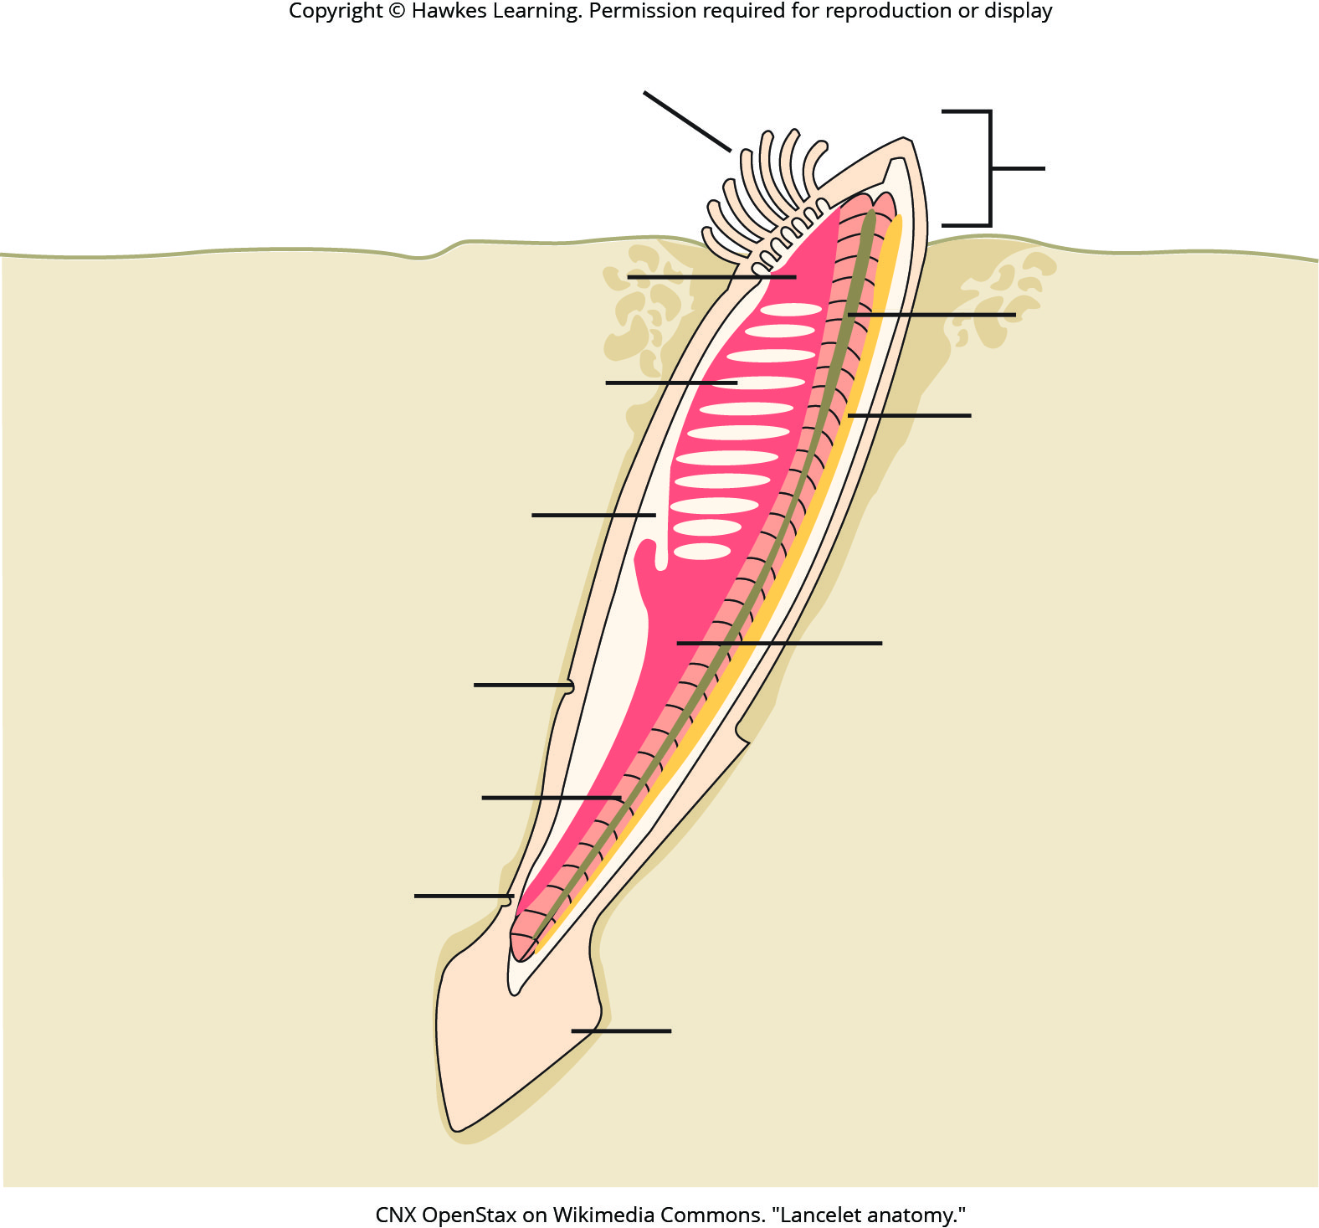
Lesson 29.1 Figure 5

Slide 6
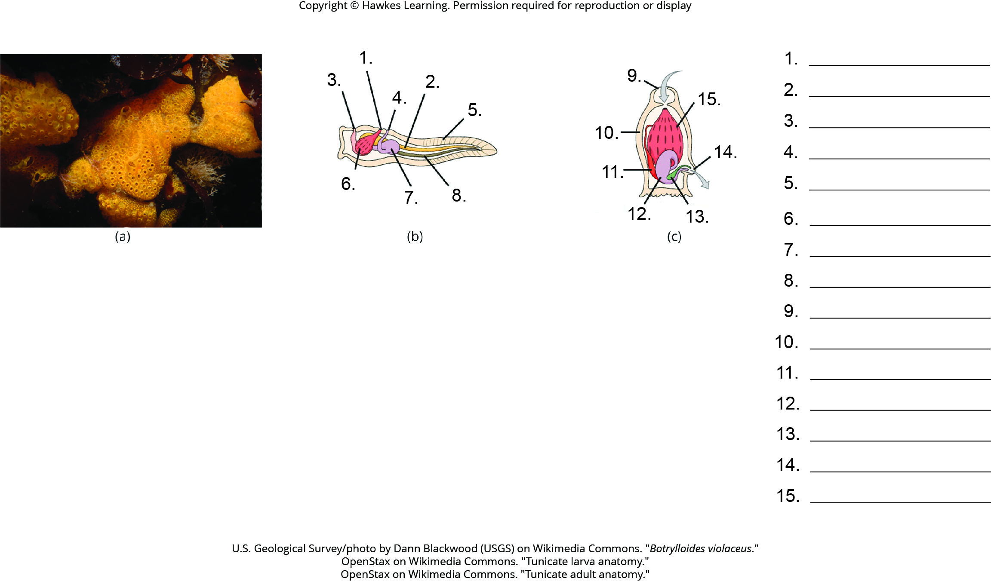
Lesson 29.1 Figure 6 - Numbered

Slide 7
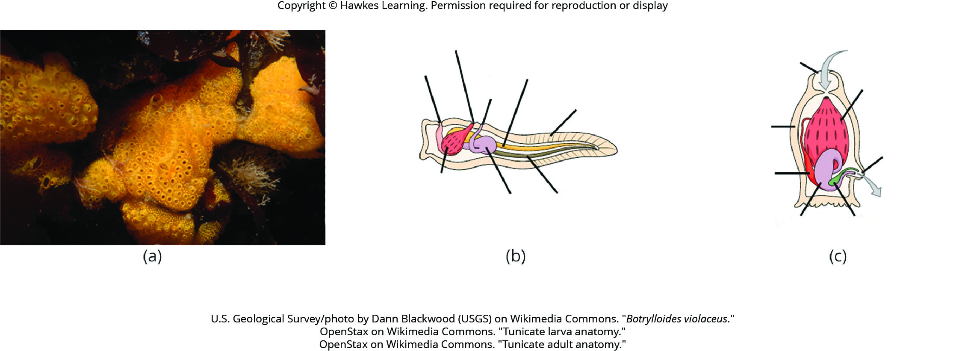
Lesson 29.1 Figure 6

Slide 8
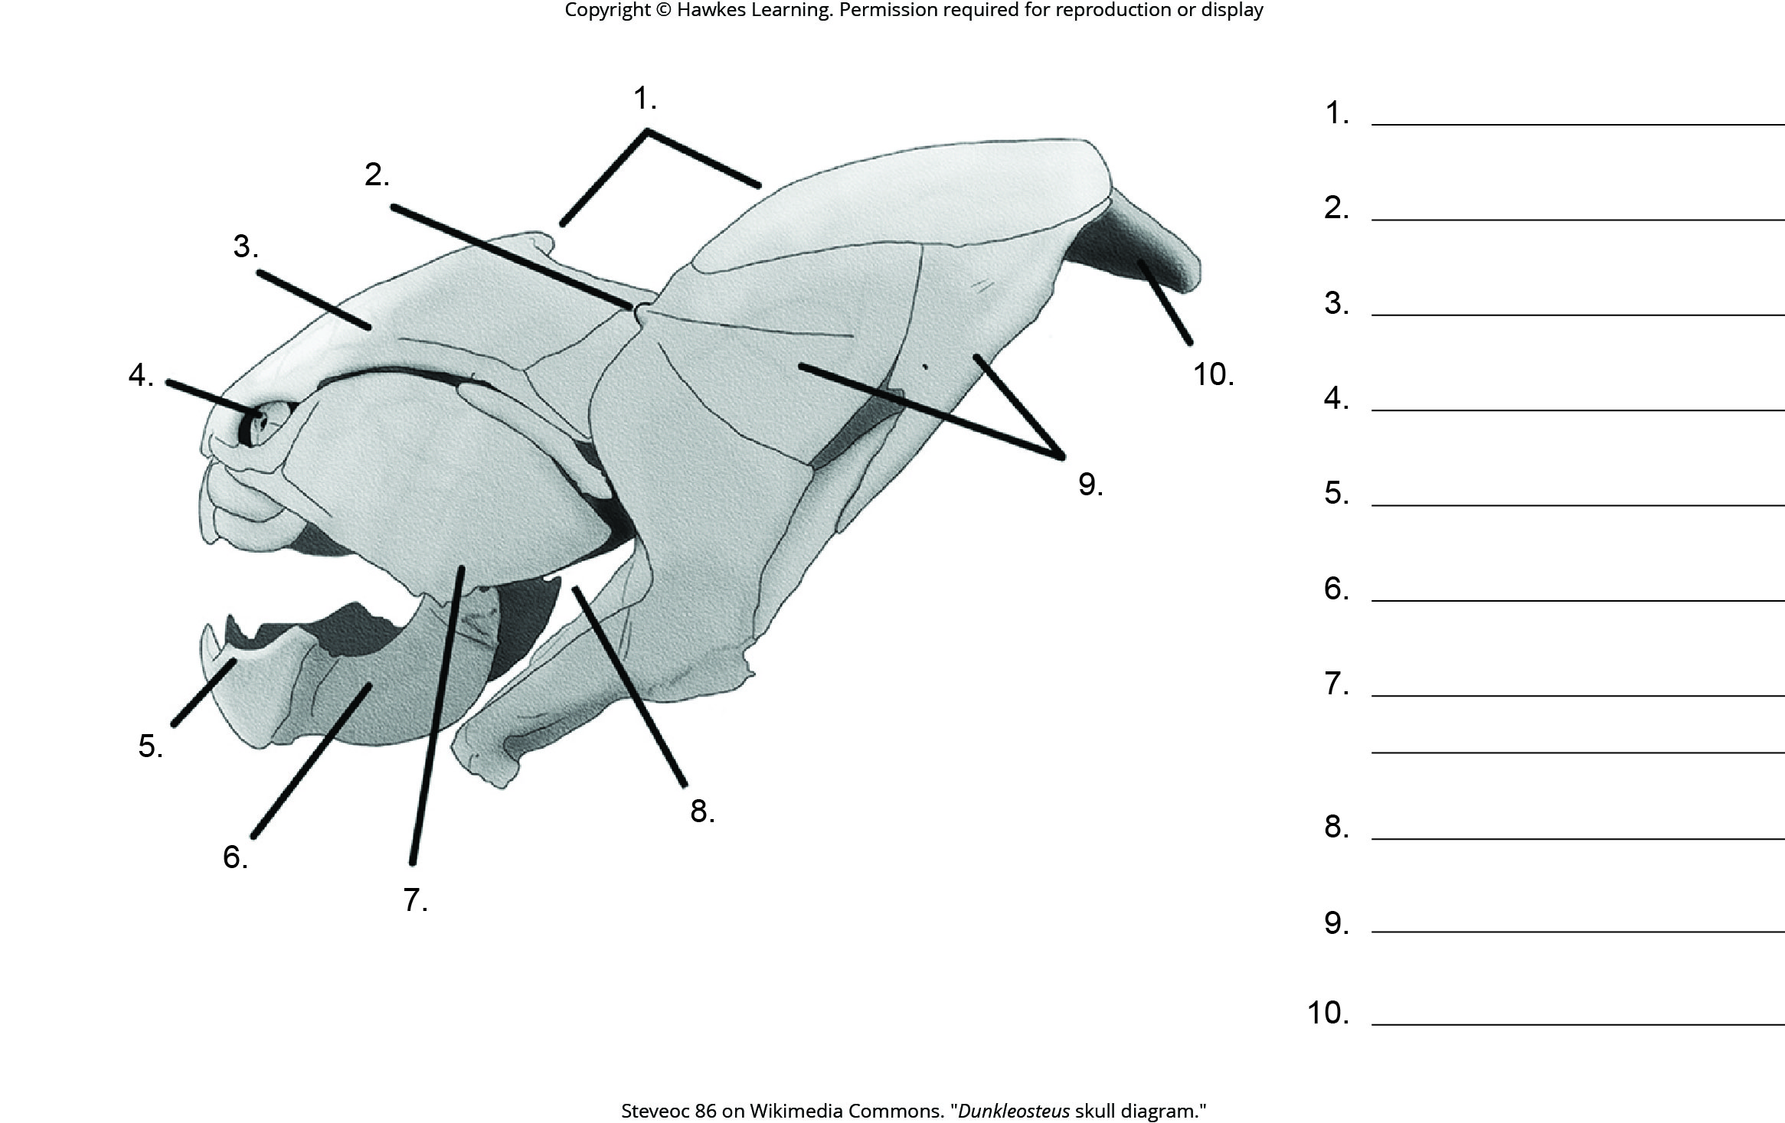
Lesson 29.1 Figure 8 - Numbered

Slide 9
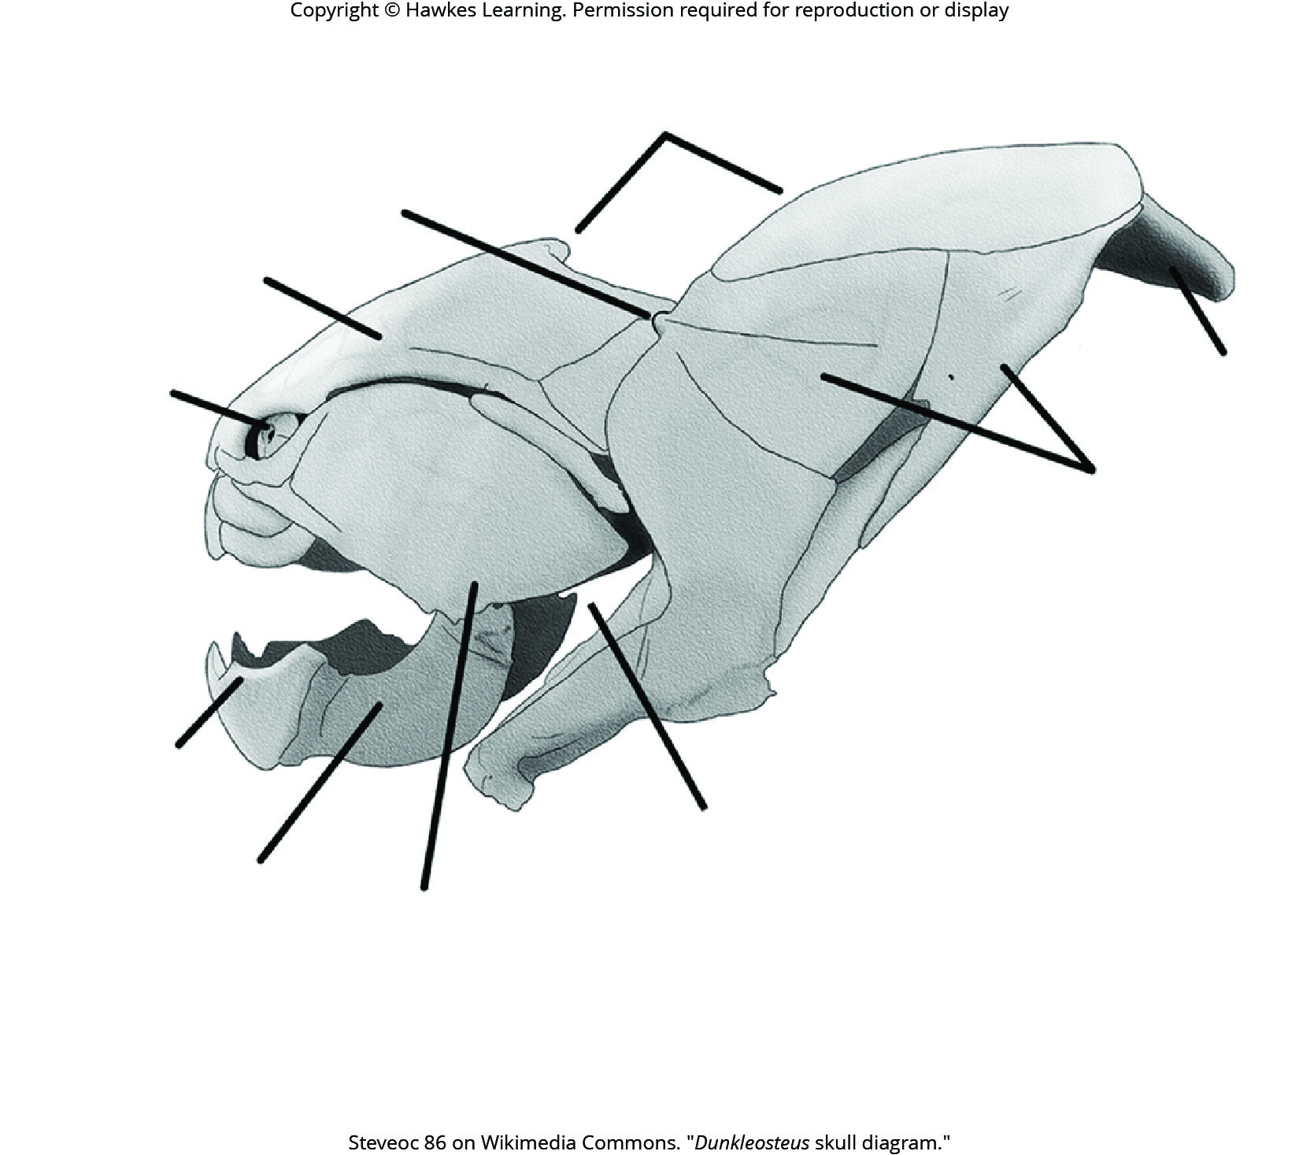
Lesson 29.1 Figure 8

Slide 10
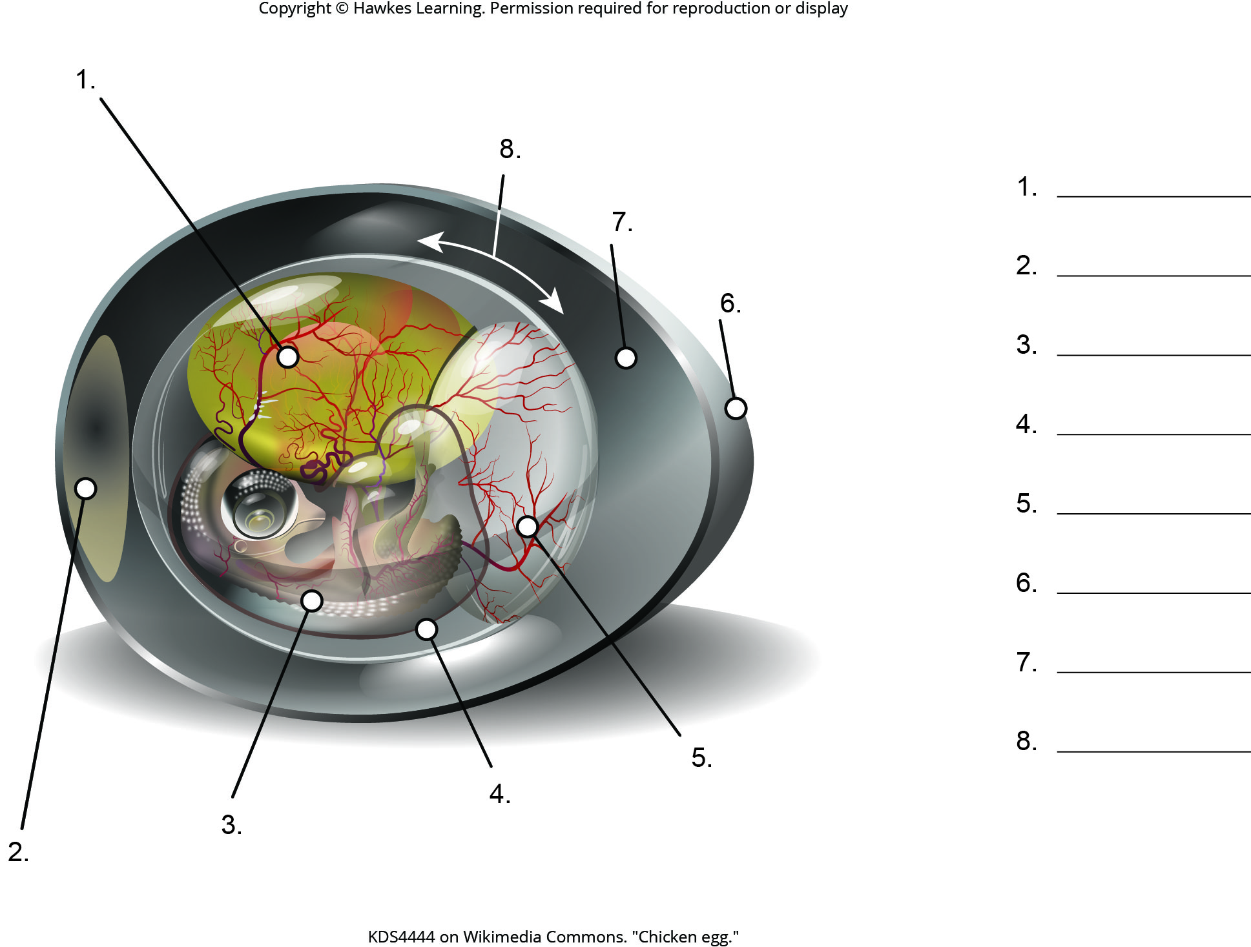
Lesson 29.4 Figure 1 - Numbered

Slide 11
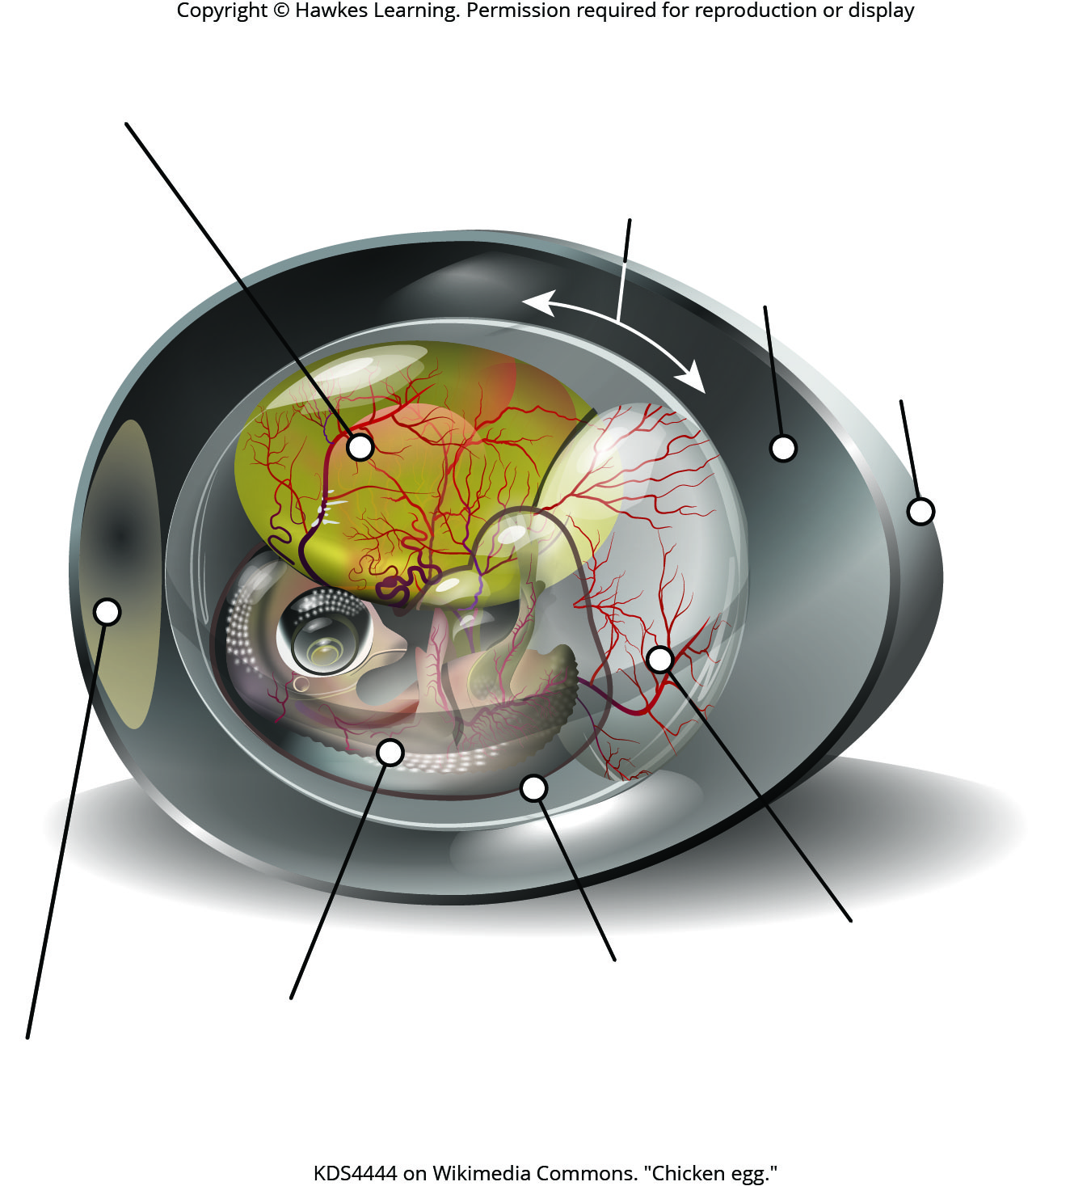
Lesson 29.4 Figure 1

Slide 12
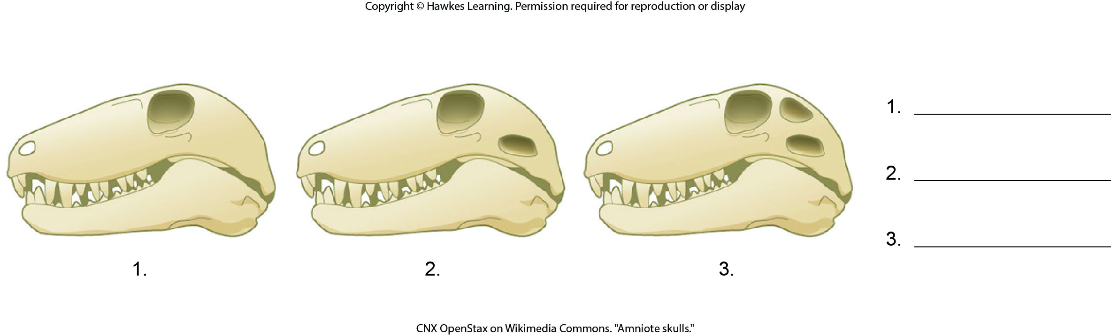
Lesson 29.4 Figure 2 - Numbered

Slide 13
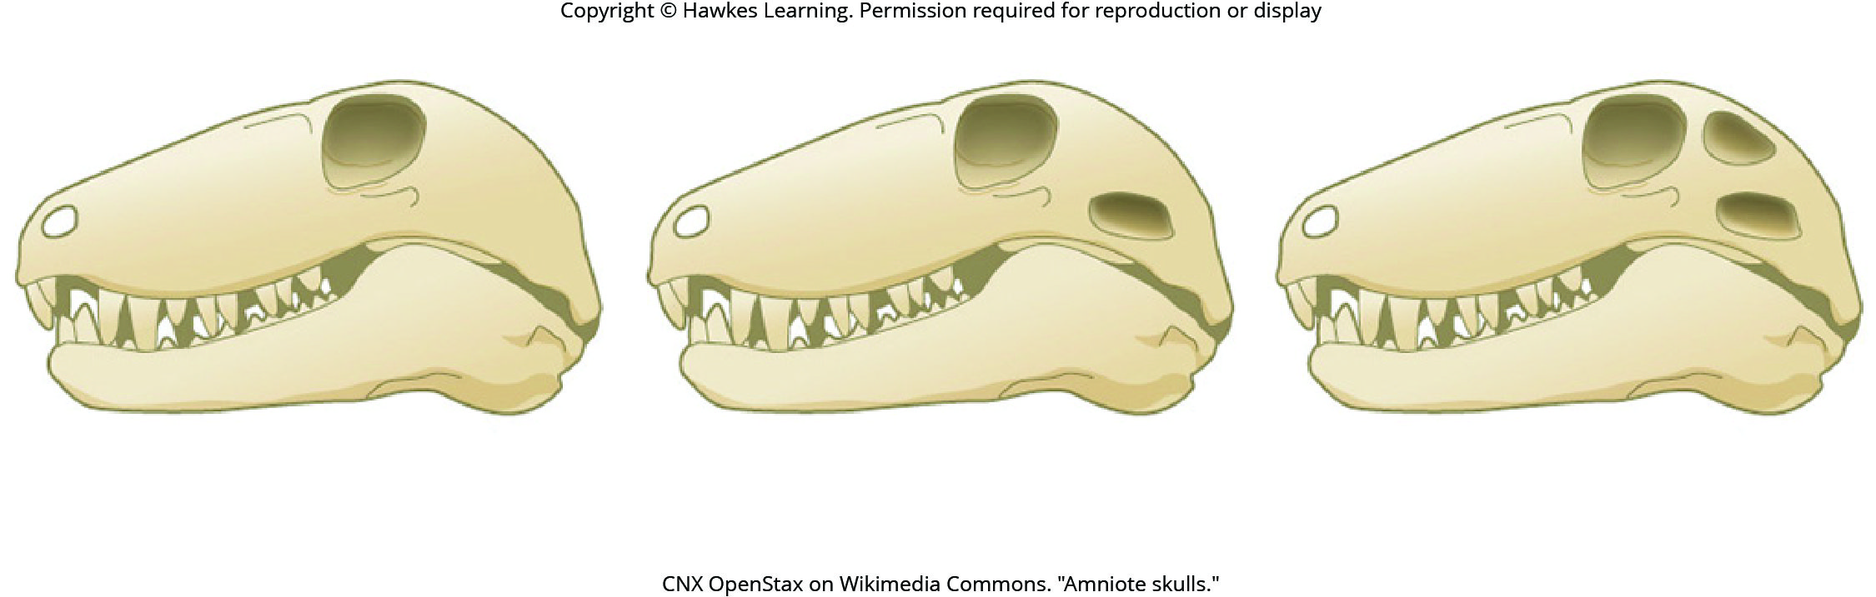
Lesson 29.4 Figure 2

Slide 14
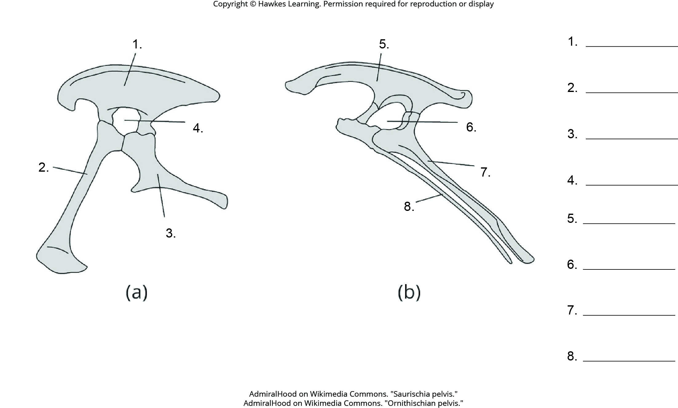
Lesson 29.4 Figure 7 - Numbered

Slide 15
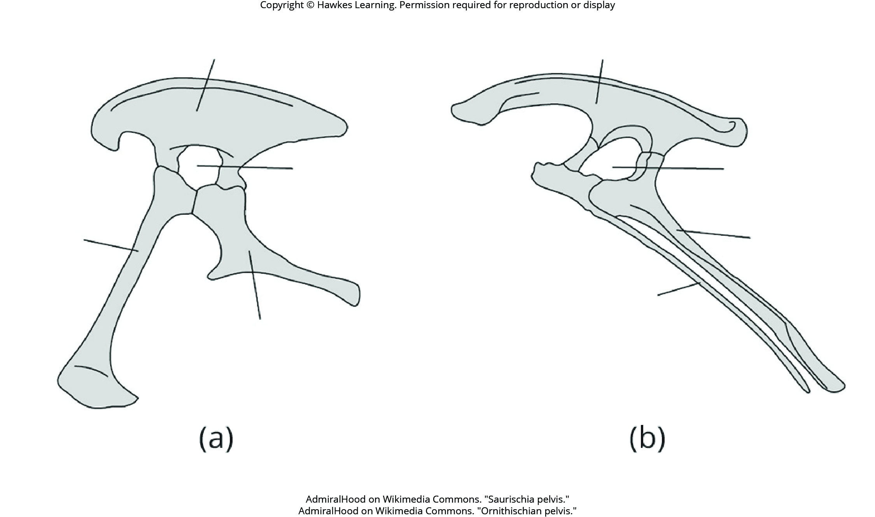
Lesson 29.4 Figure 7

Slide 16
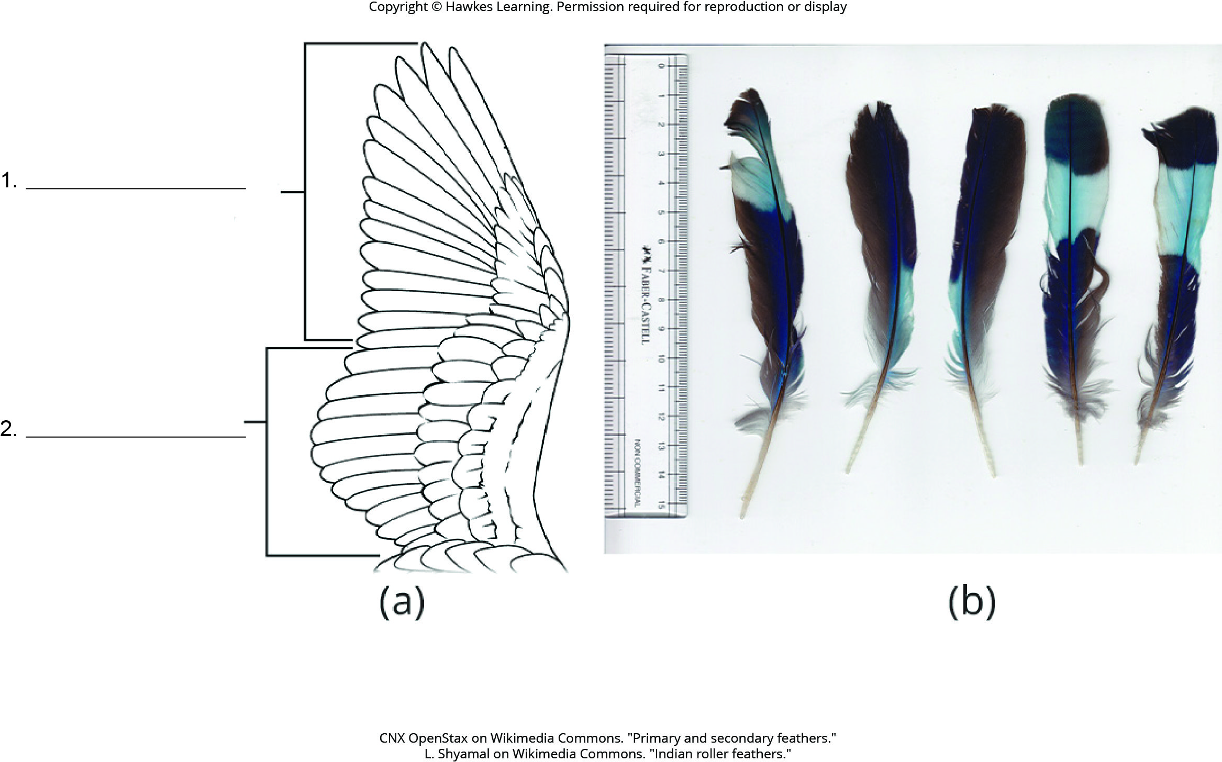
Lesson 29.4 Figure 14 - Numbered

Slide 17
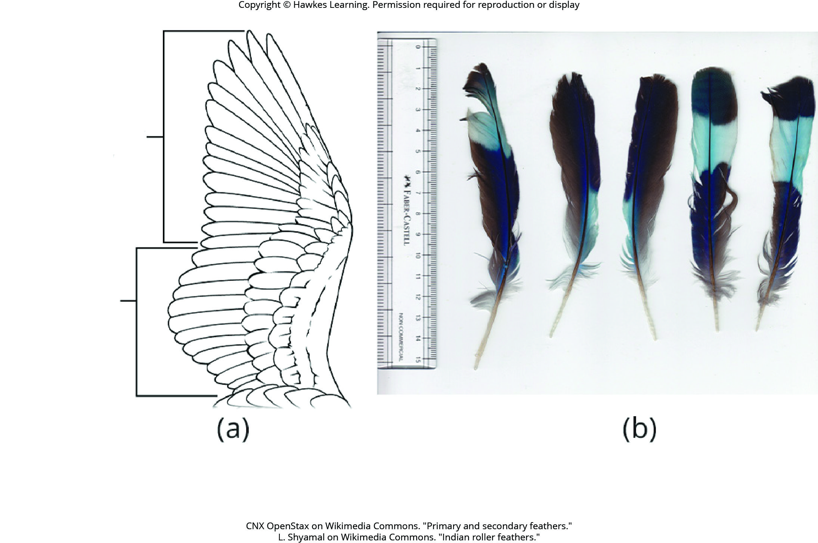
Lesson 29.4 Figure 14

Slide 18
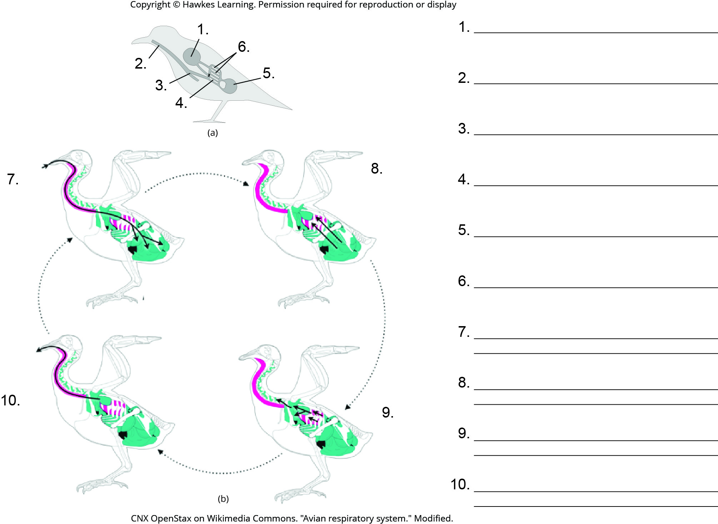
Lesson 29.4 Figure 16 - Numbered

Slide 19
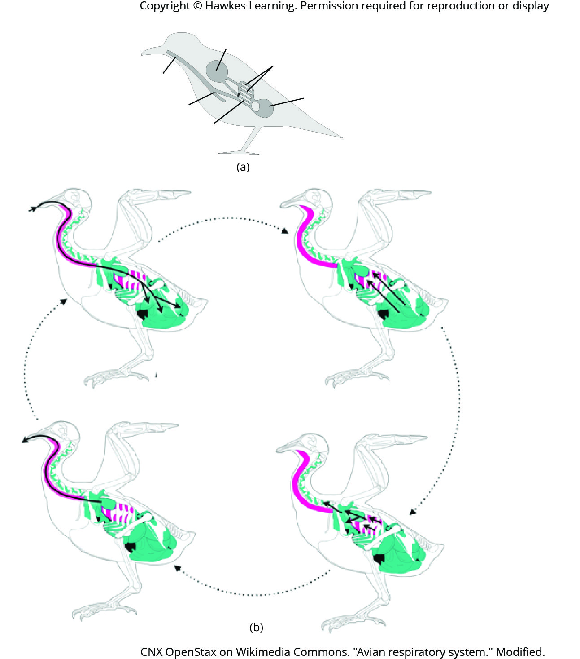
Lesson 29.4 Figure 16

Slide 20
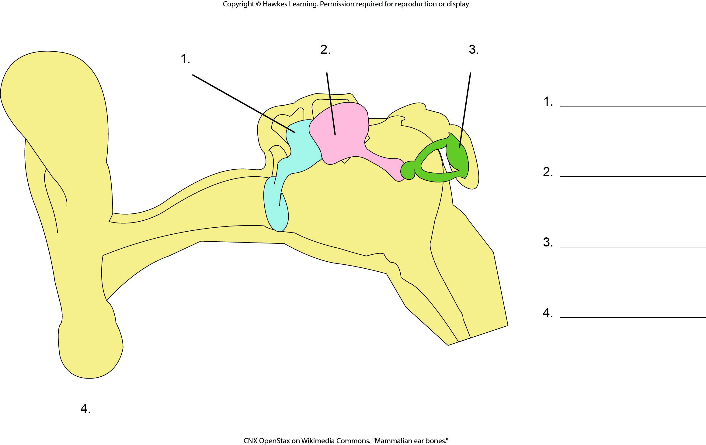
Lesson 29.5 Figure 1 - Numbered

Slide 21
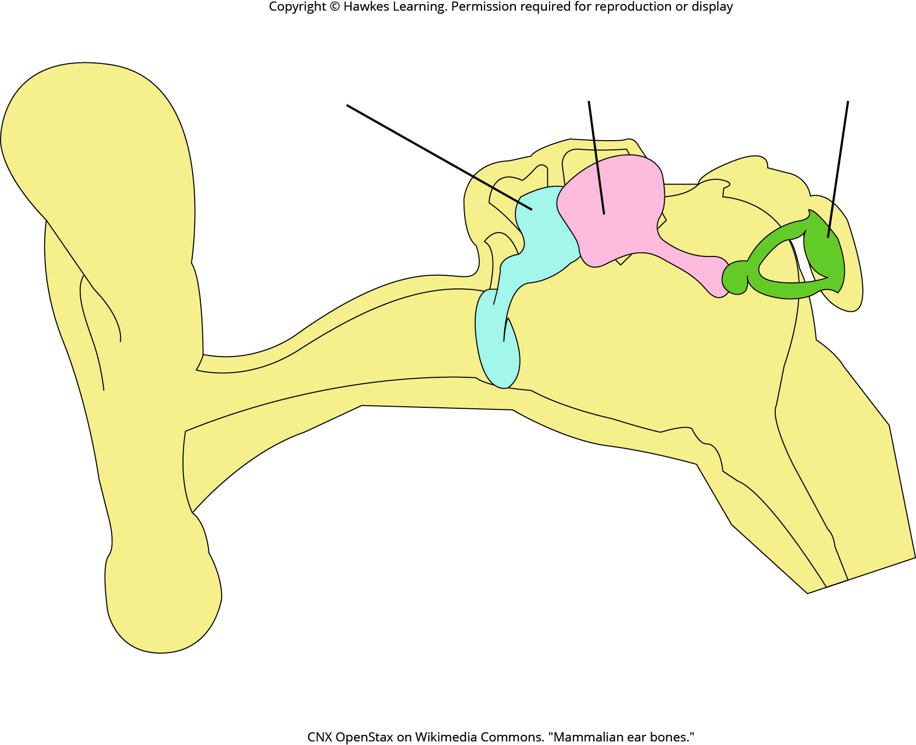
Lesson 29.5 Figure 1

Slide 22
Hawkes Learning – End of PowerPoint

