Slide 1
Chapter 3
Cell Reproduction and Genetics

Slide 2
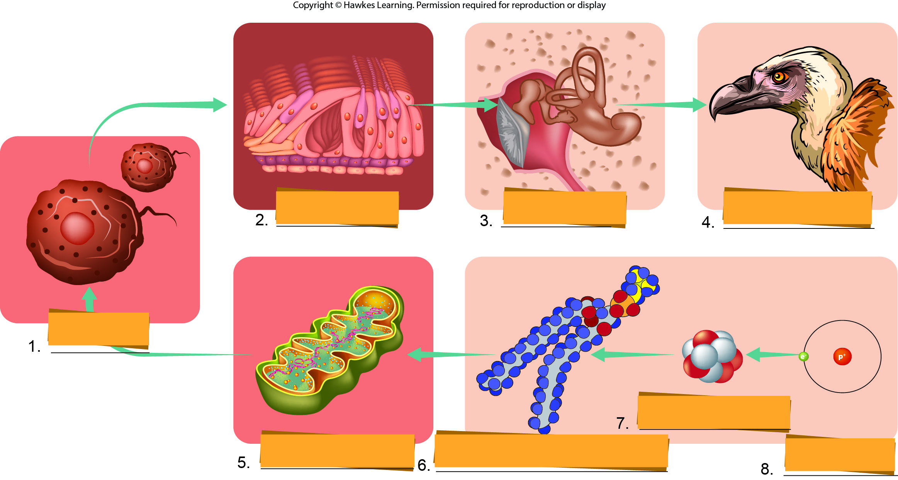
Lesson 3.1 Figure 2 - Numbered

Slide 3
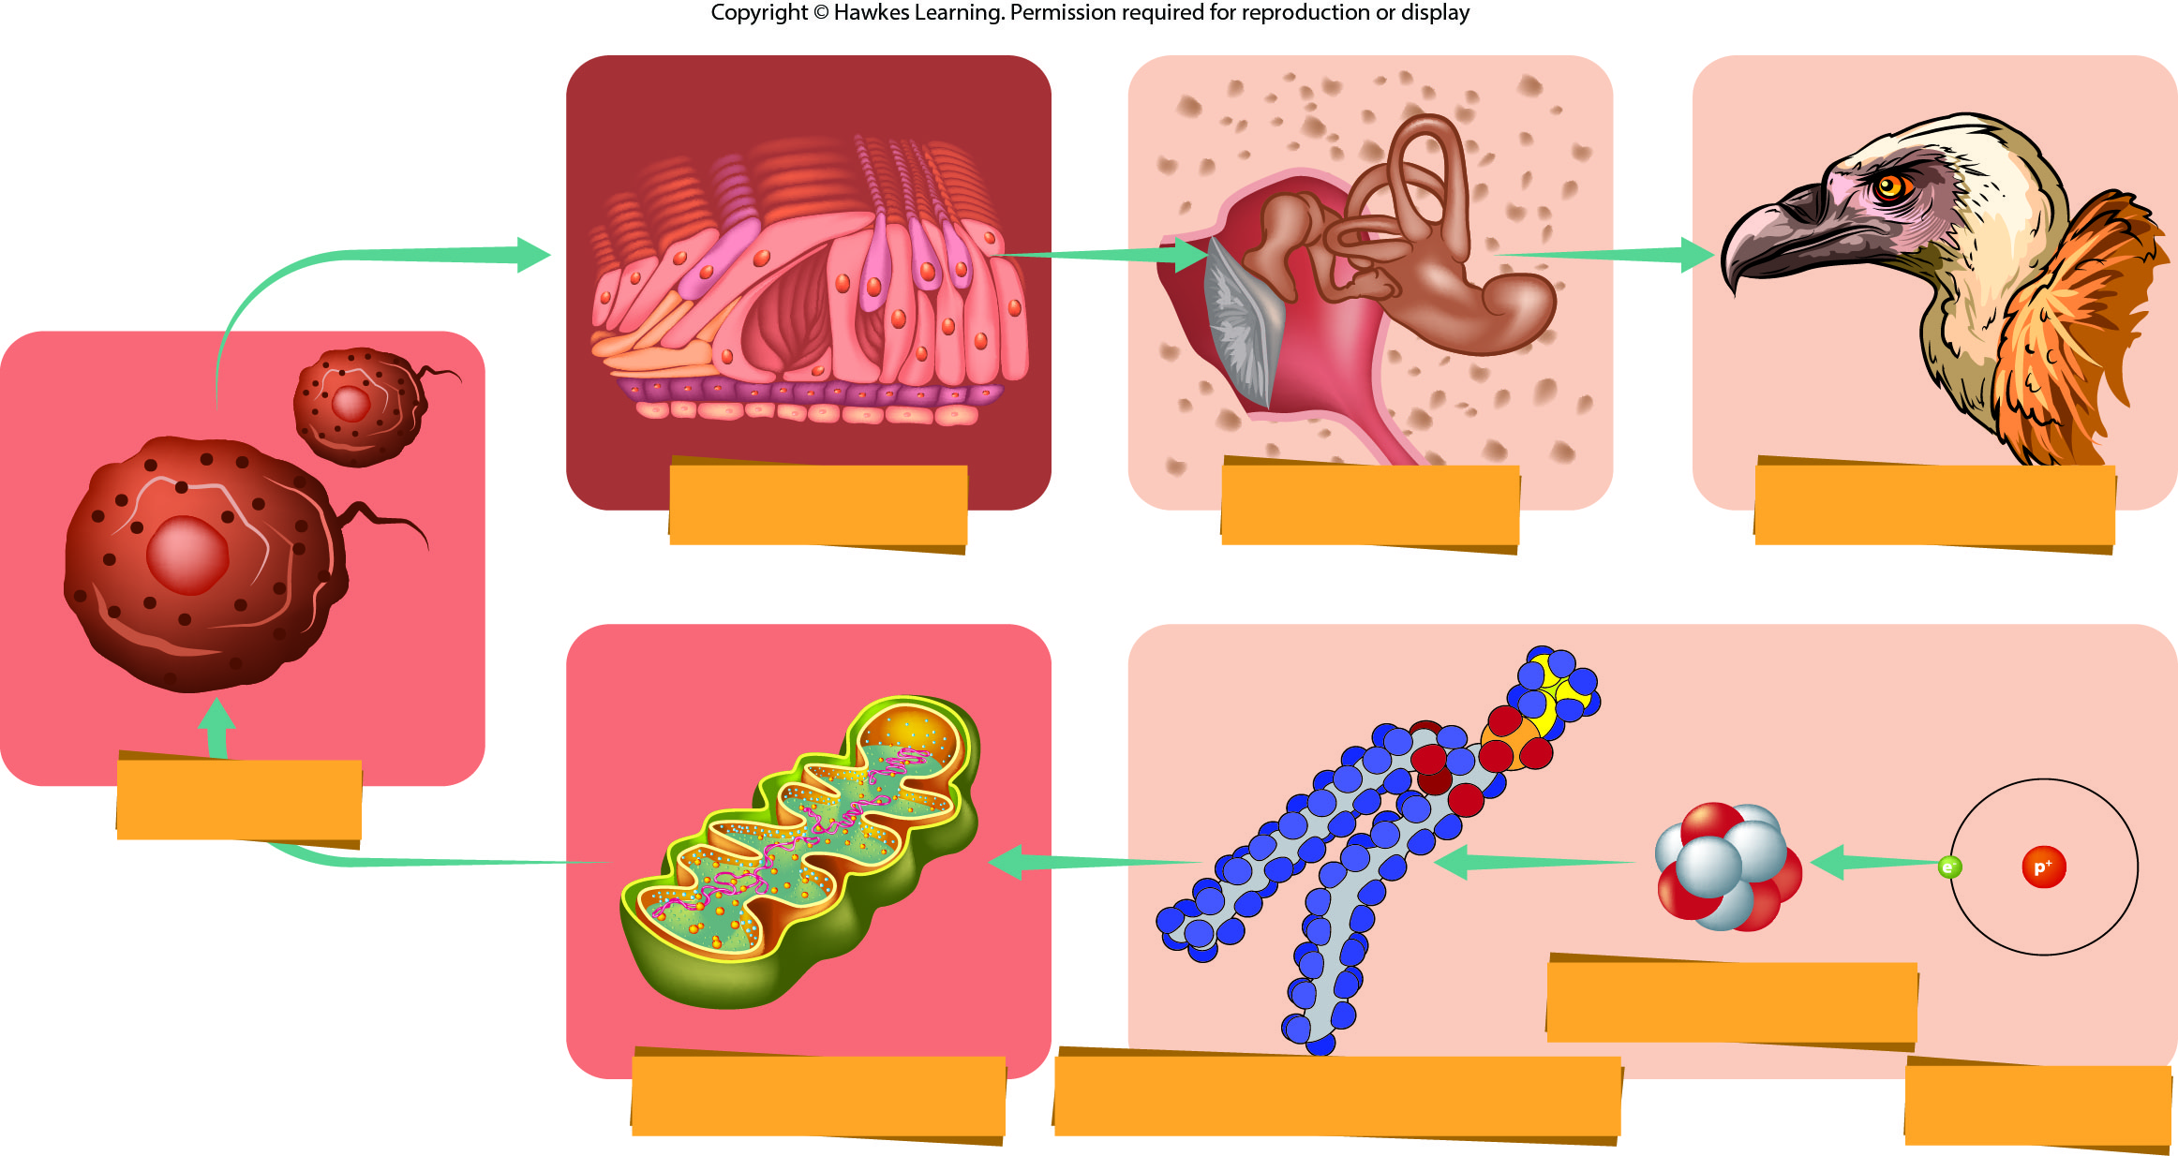
Lesson 3.1 Figure 2

Slide 4
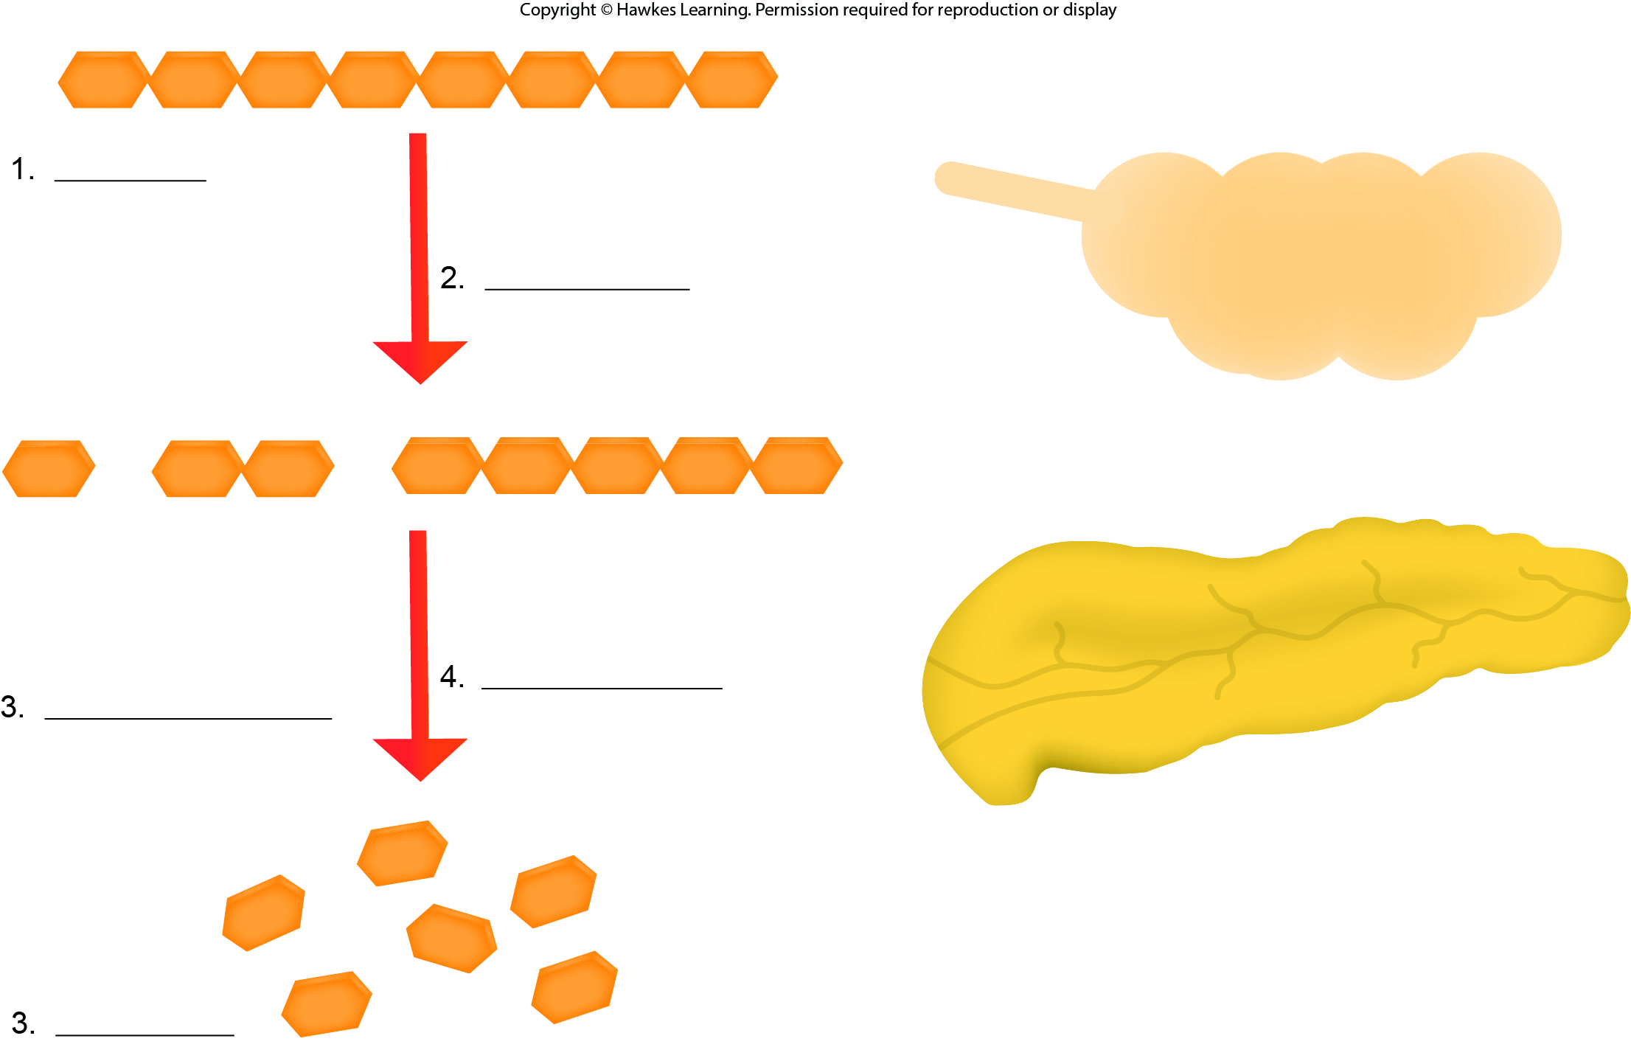
Lesson 3.1 Figure 5 - Numbered

Slide 5

Lesson 3.1 Figure 5

Slide 6
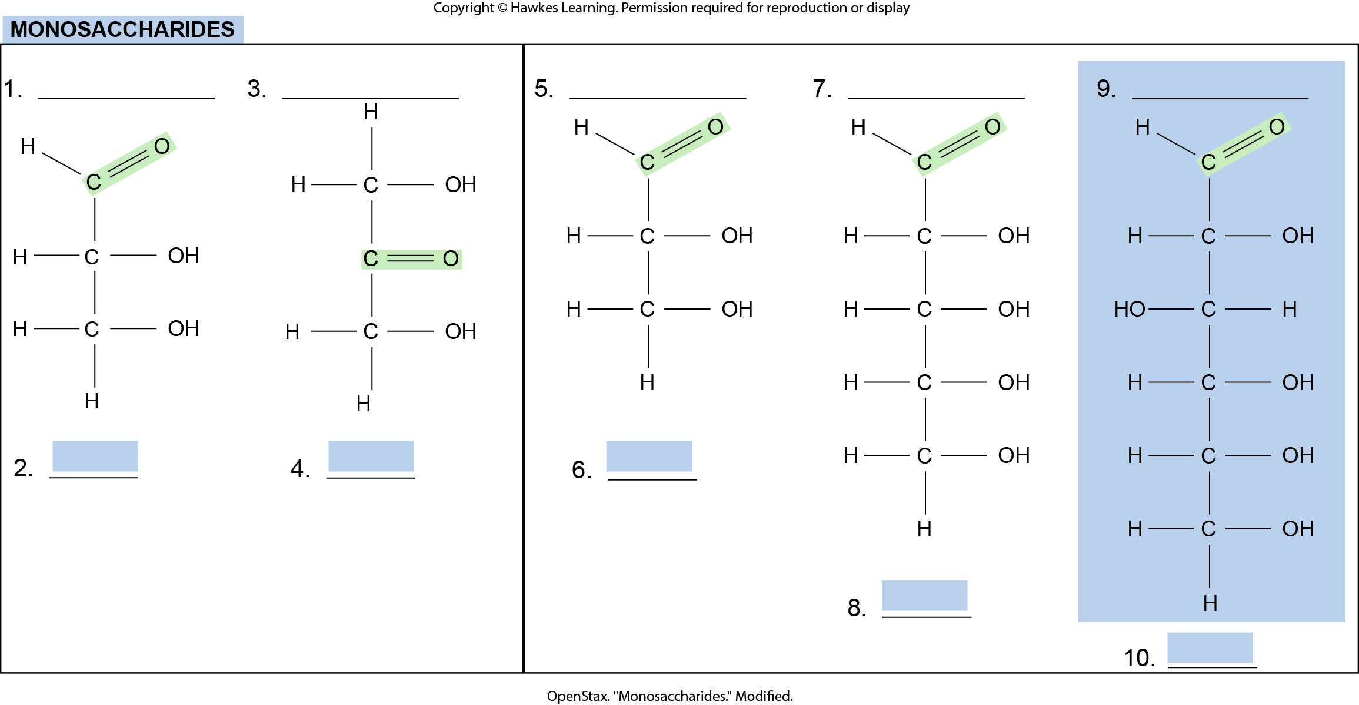
Lesson 3.2 Figure 2 - Numbered

Slide 7
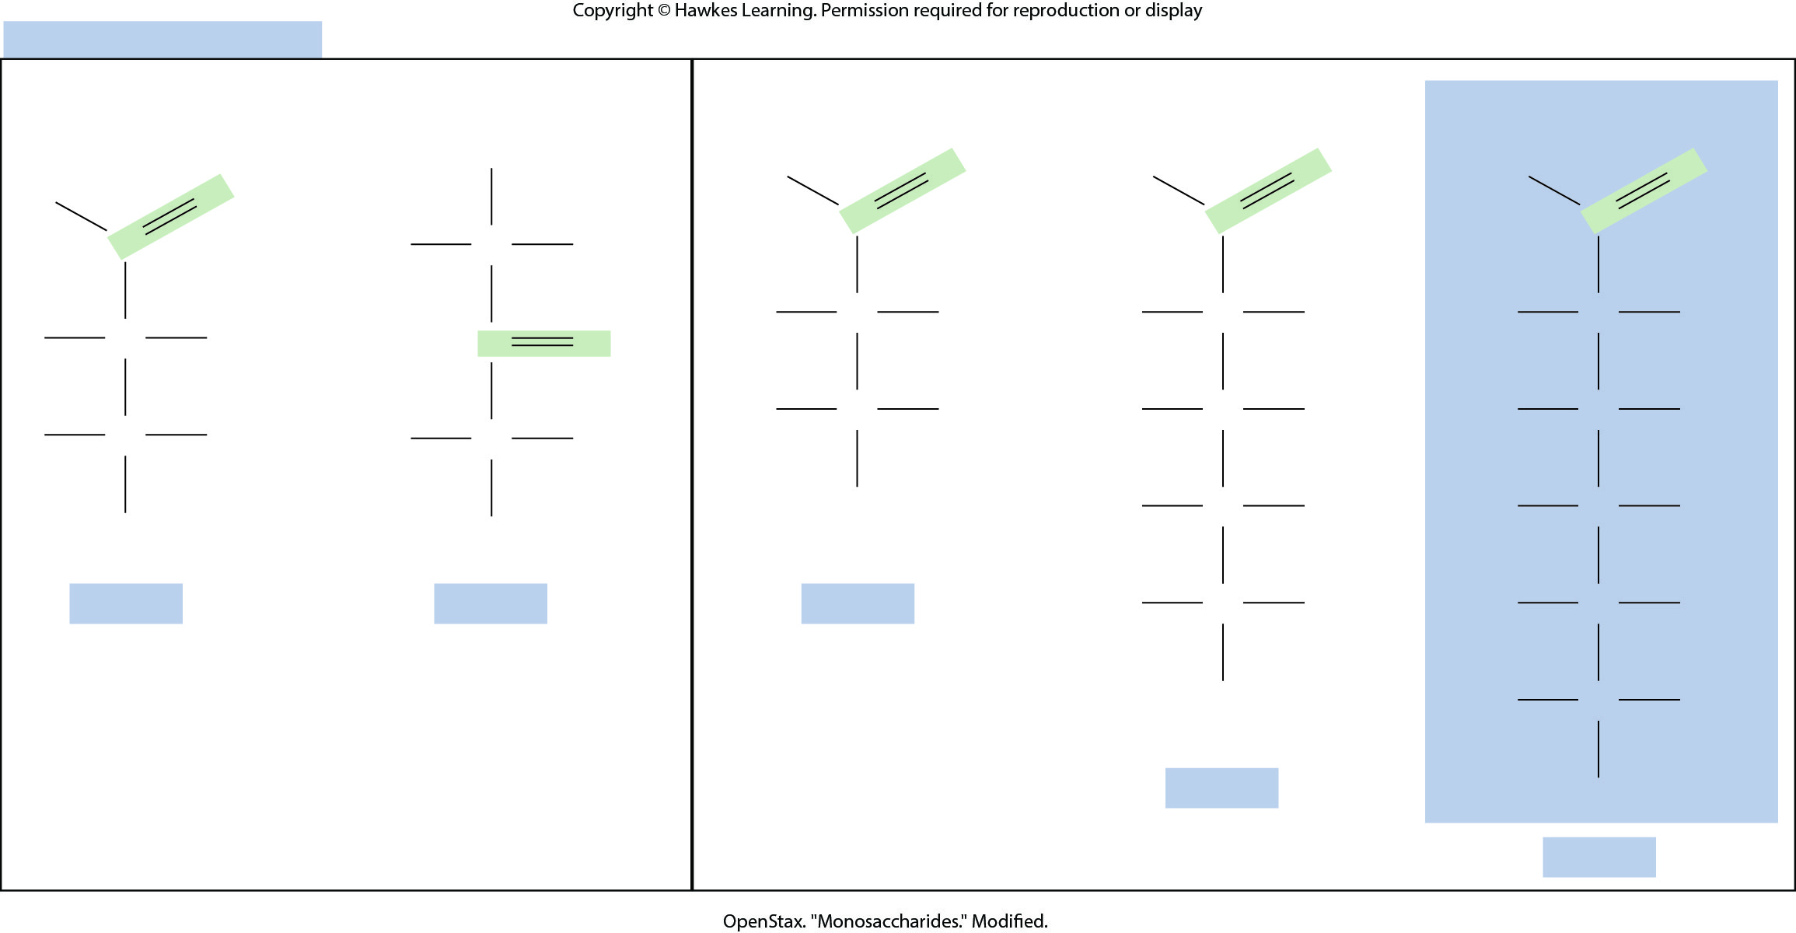
Lesson 3.2 Figure 2

Slide 8
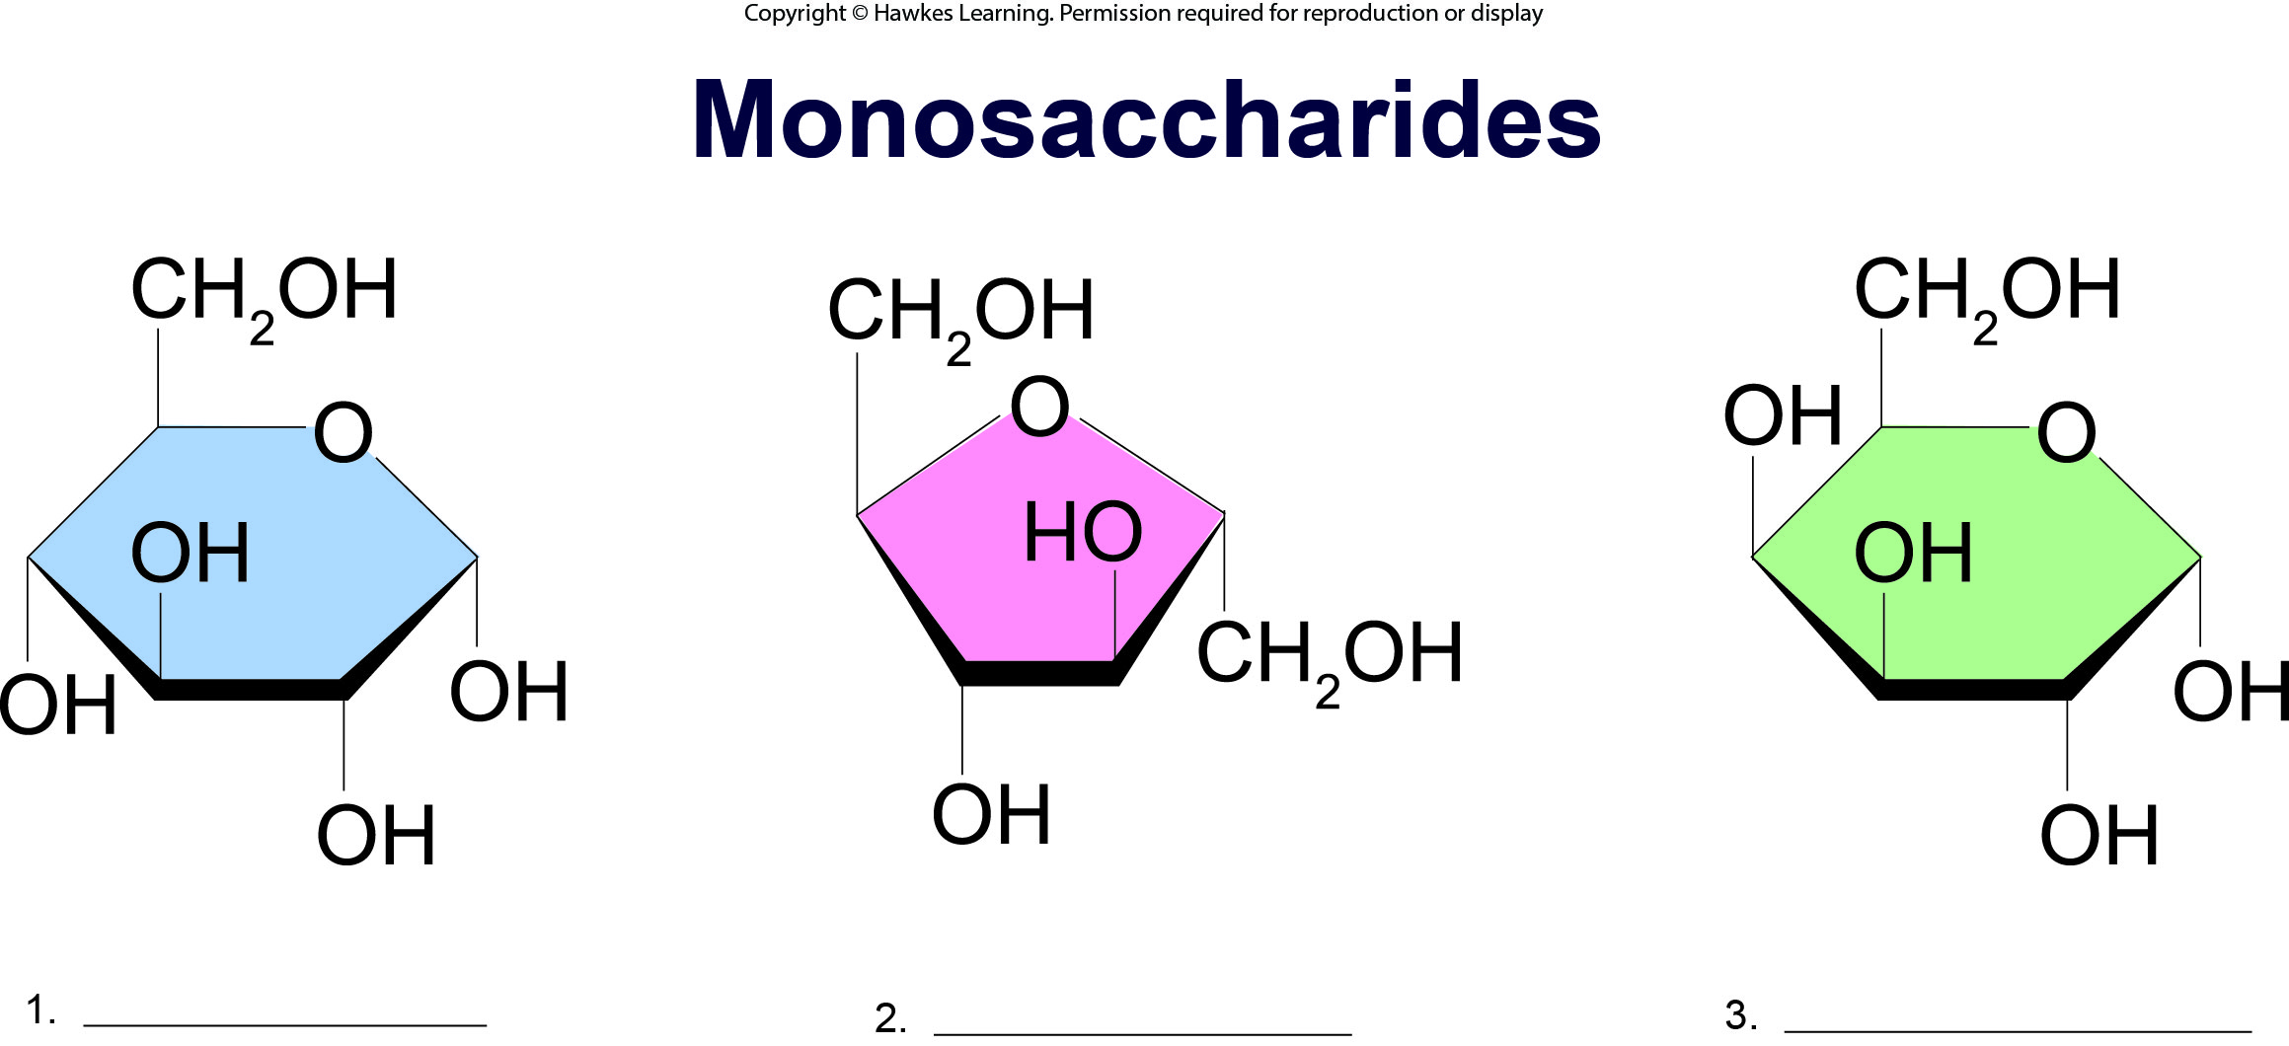
Lesson 3.2 Figure 3 - Numbered

Slide 9
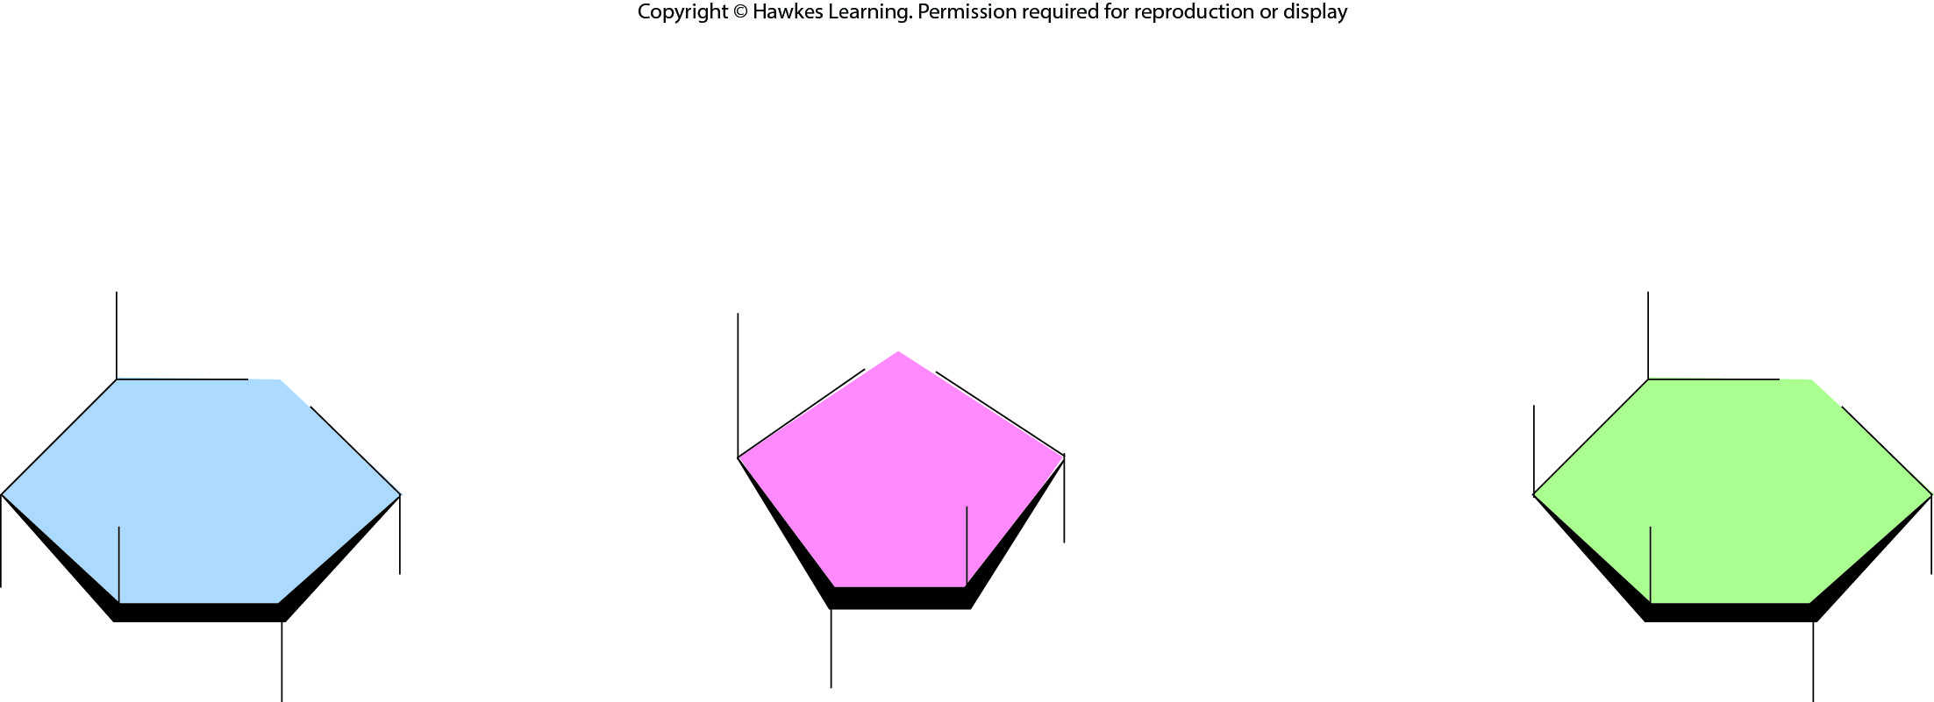
Lesson 3.2 Figure 3

Slide 10
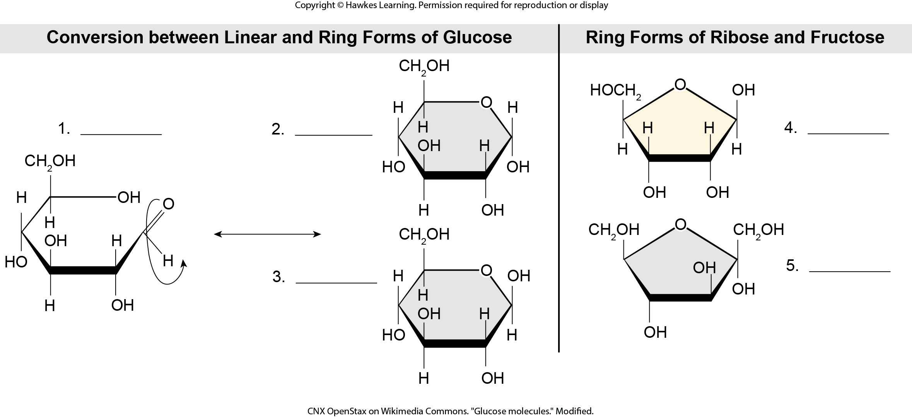
Lesson 3.2 Figure 4 - Numbered

Slide 11
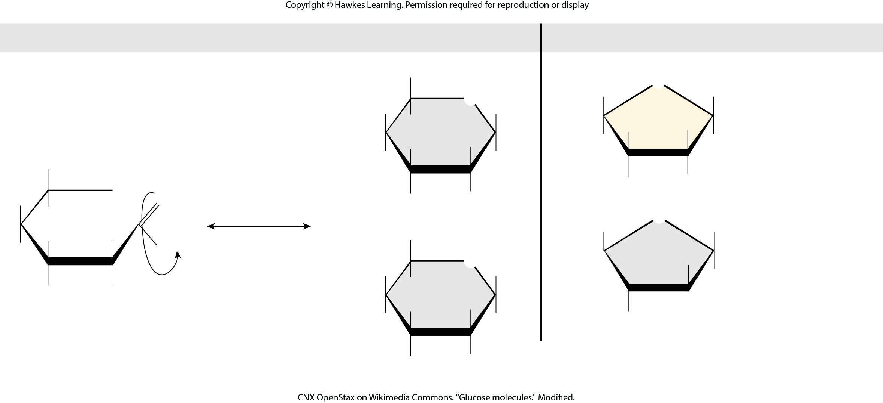
Lesson 3.2 Figure 4

Slide 12
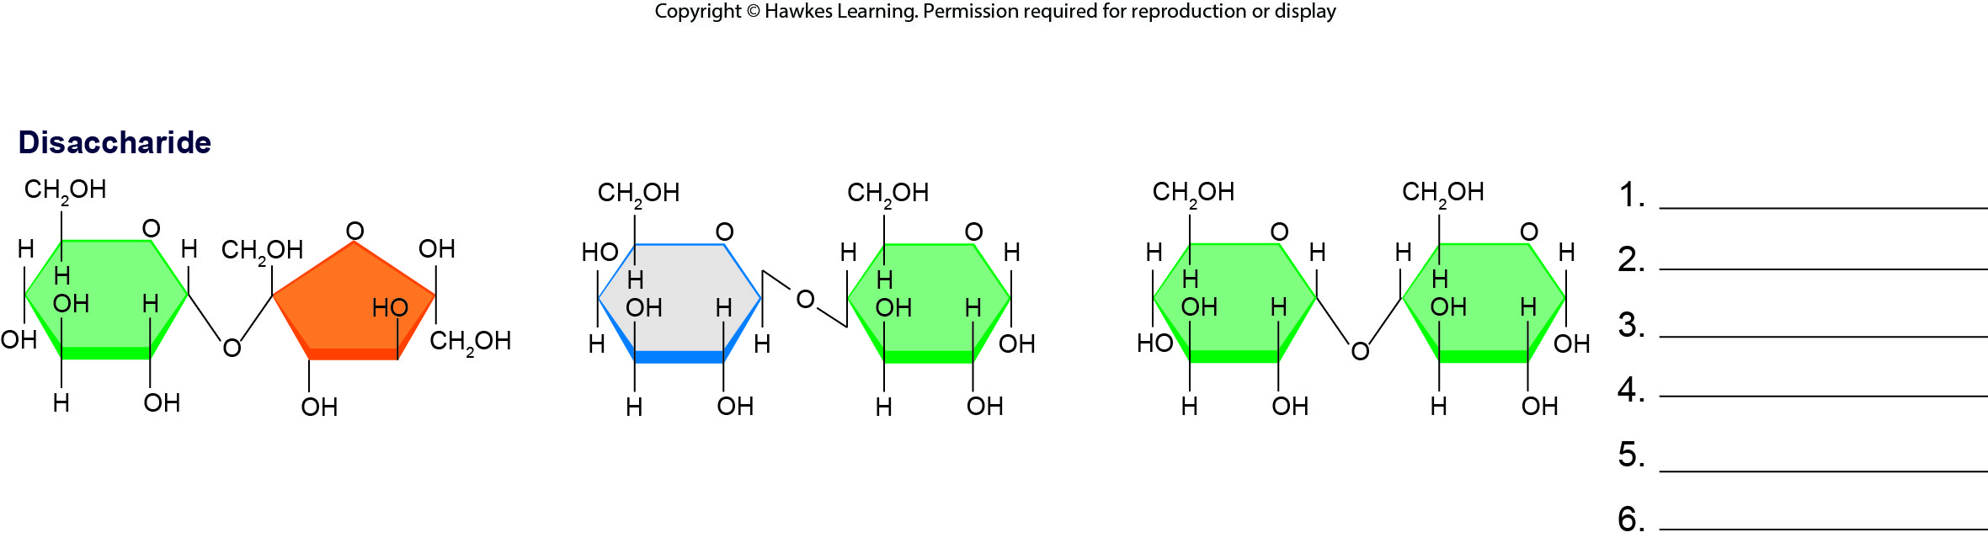
Lesson 3.2 Figure 6 - Numbered

Slide 13
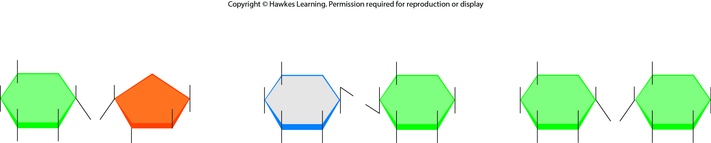
Lesson 3.2 Figure 6

Slide 14
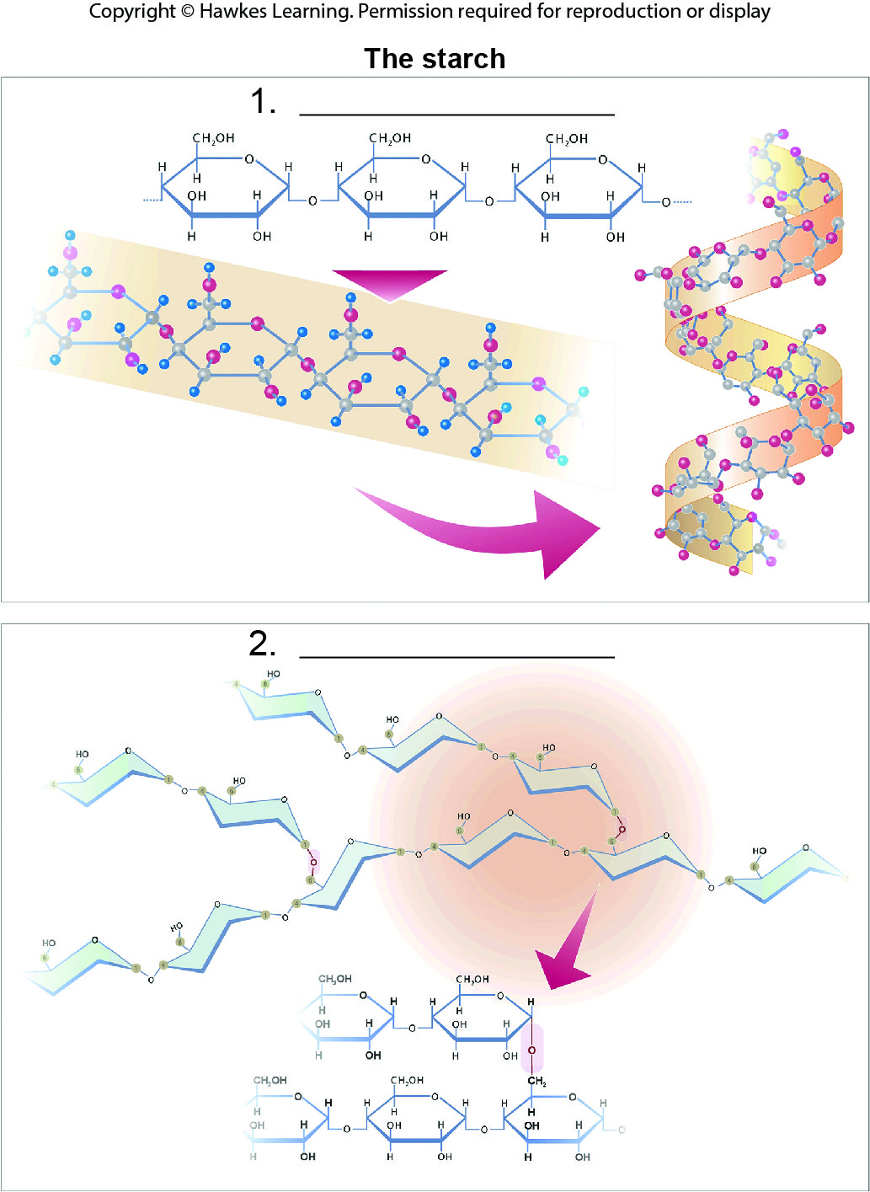
Lesson 3.2 Figure 8 - Numbered

Slide 15
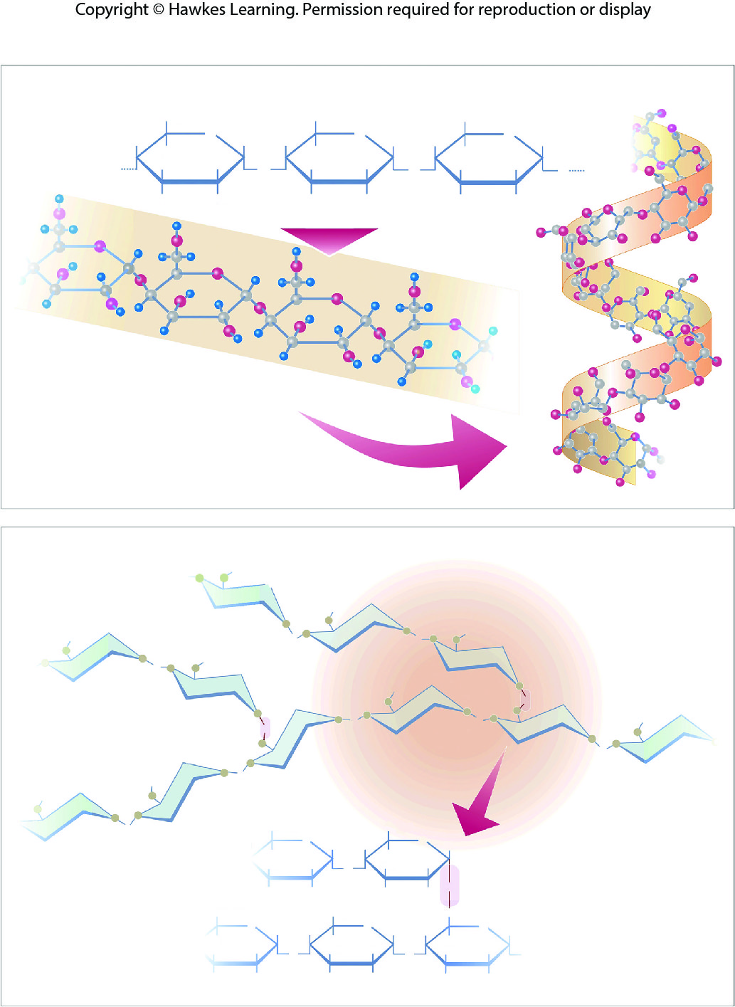
Lesson 3.2 Figure 8

Slide 16
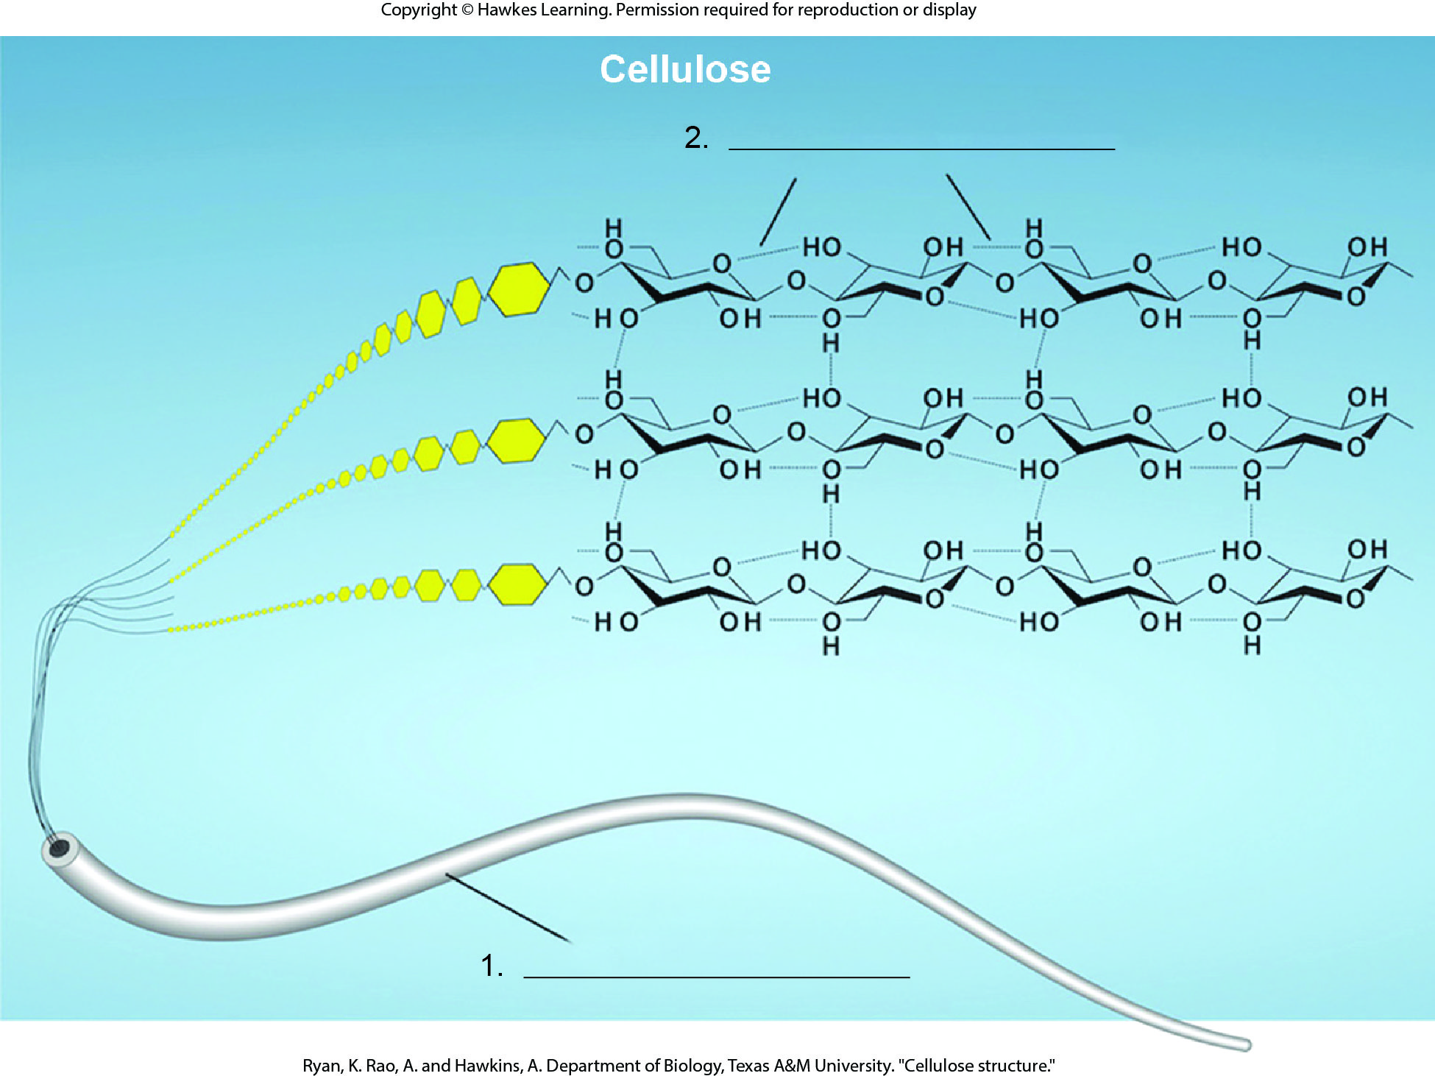
Lesson 3.2 Figure 9 - Numbered

Slide 17
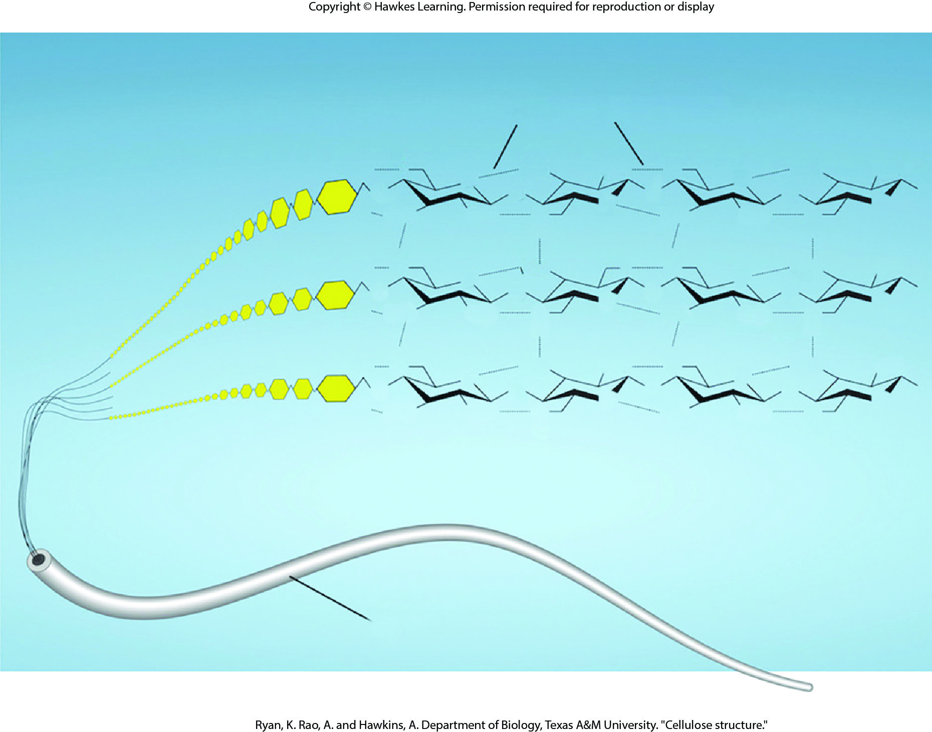
Lesson 3.2 Figure 9

Slide 18
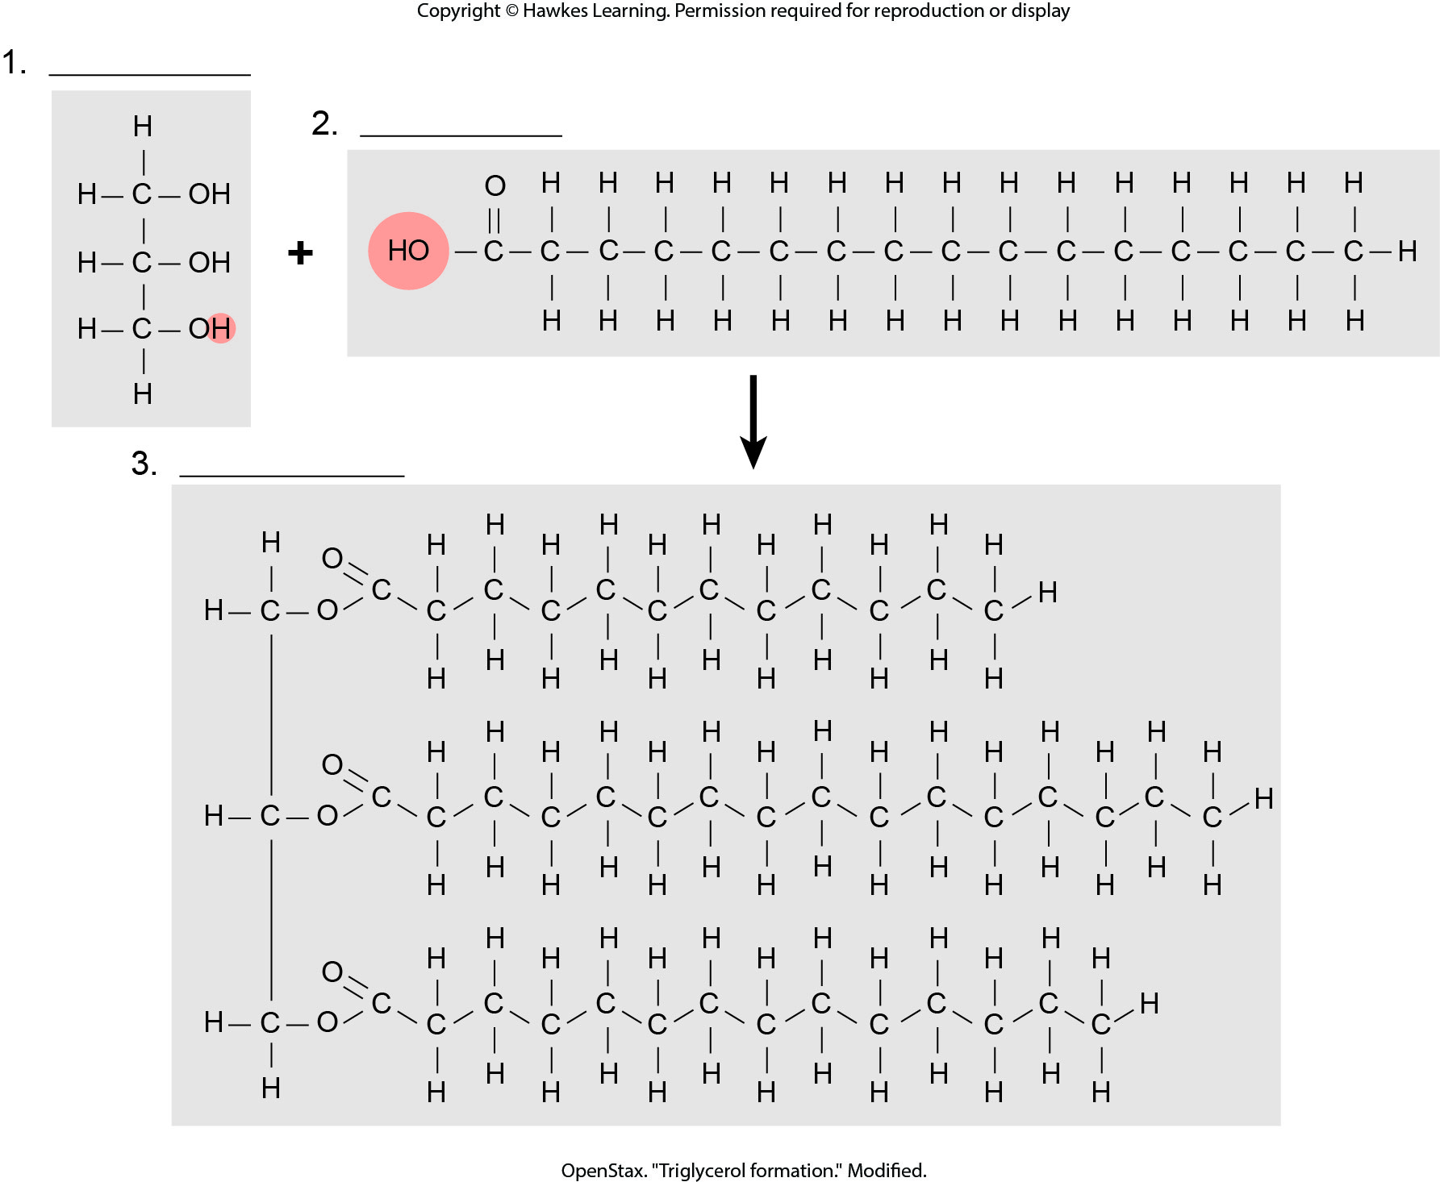
Lesson 3.3 Figure 2 - Numbered

Slide 19
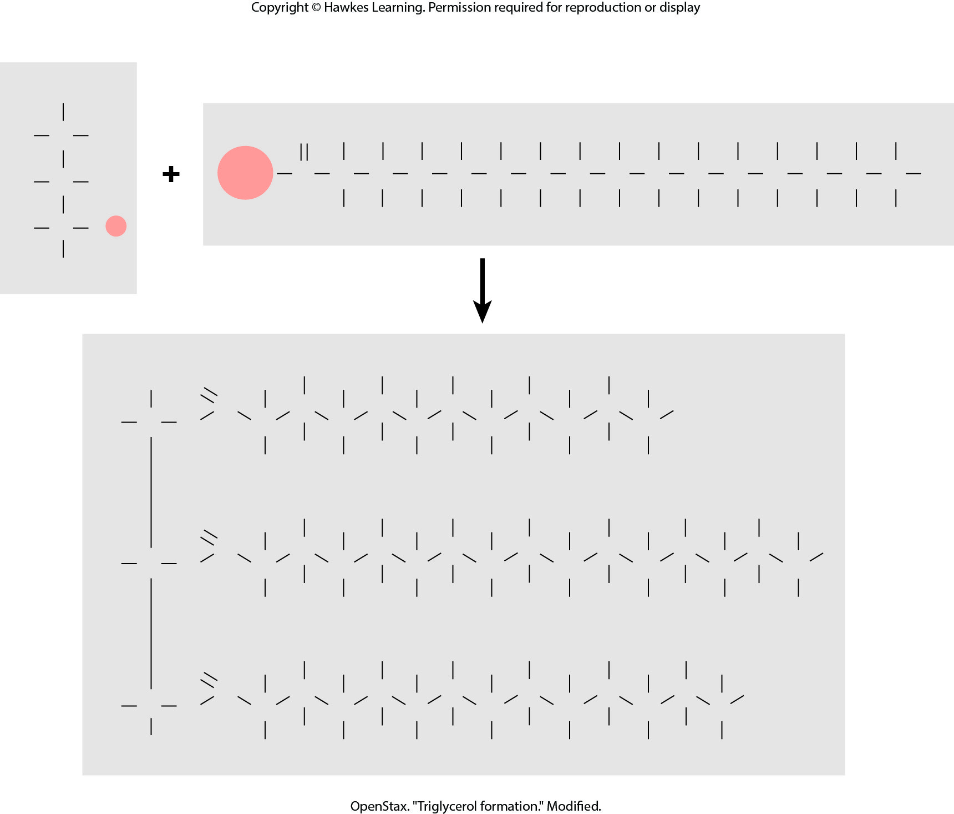
Lesson 3.3 Figure 2

Slide 20
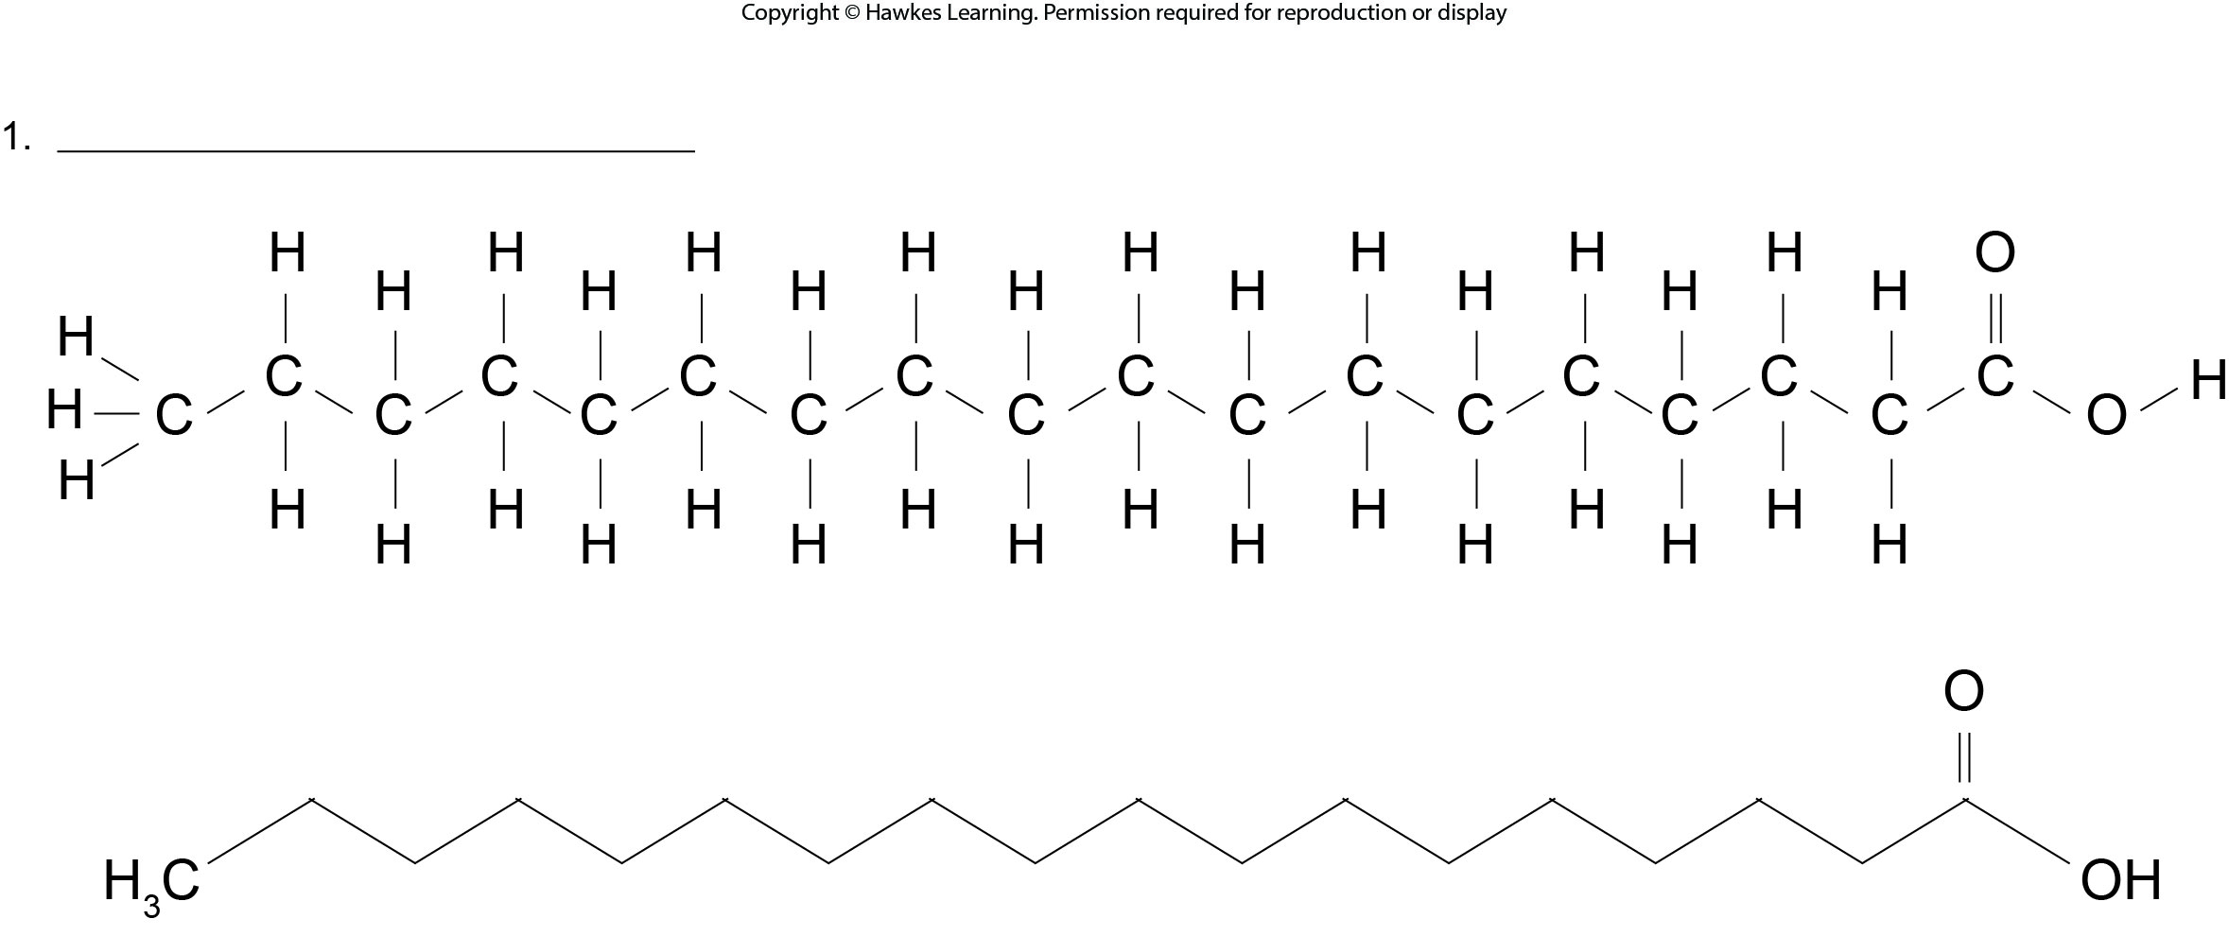
Lesson 3.3 Figure 3 - Numbered

Slide 21
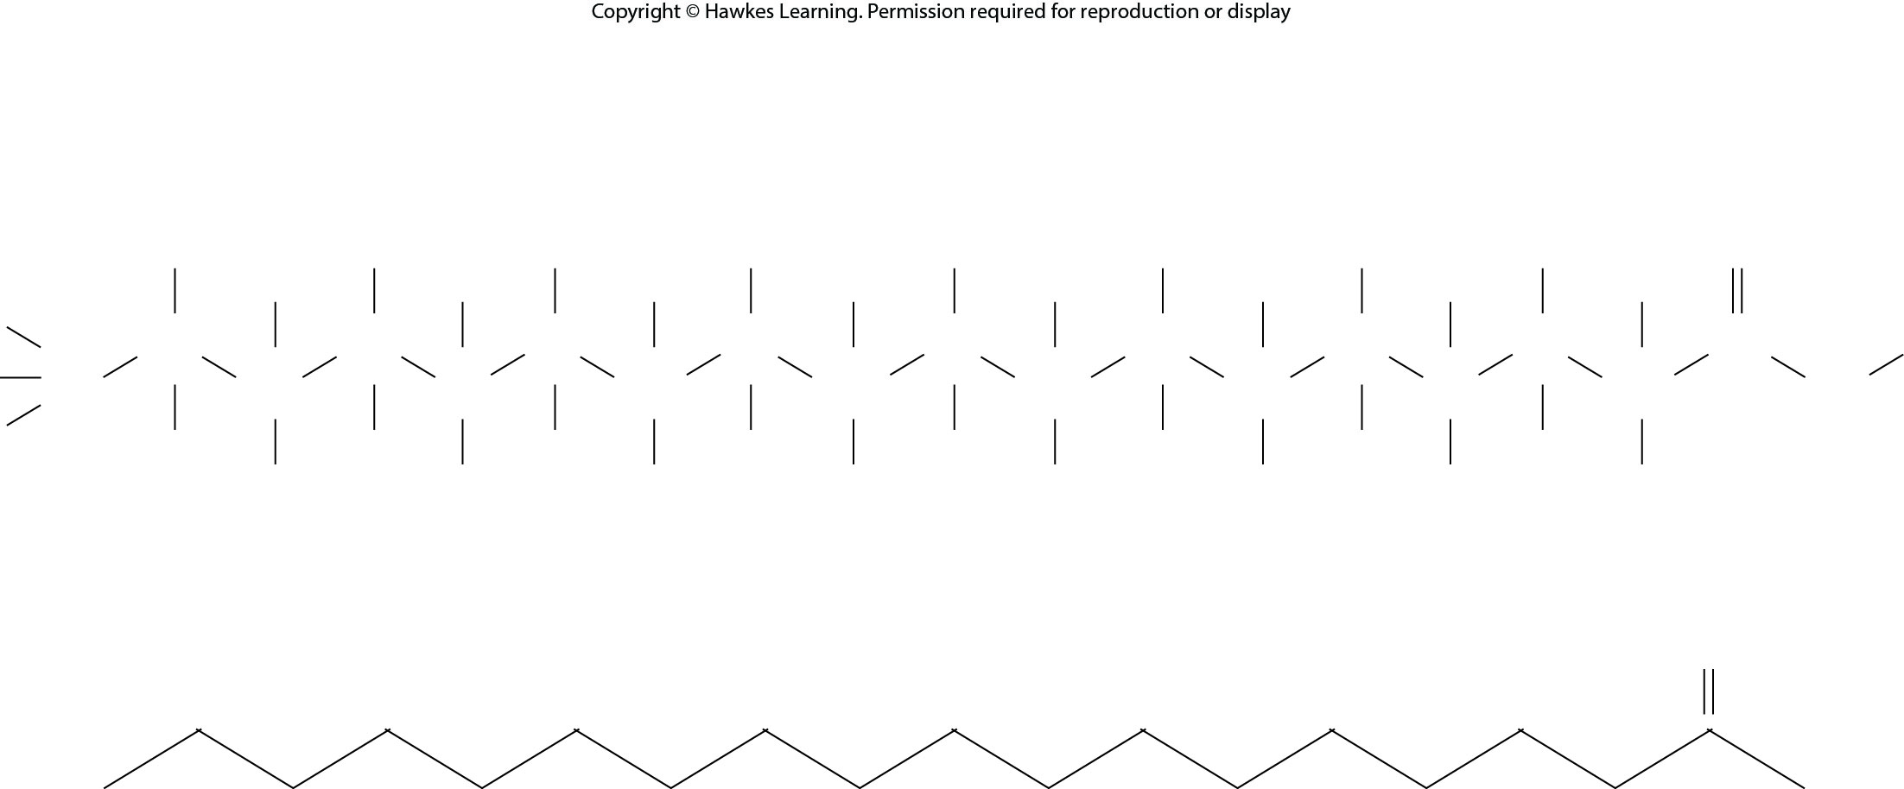
Lesson 3.3 Figure 3

Slide 22
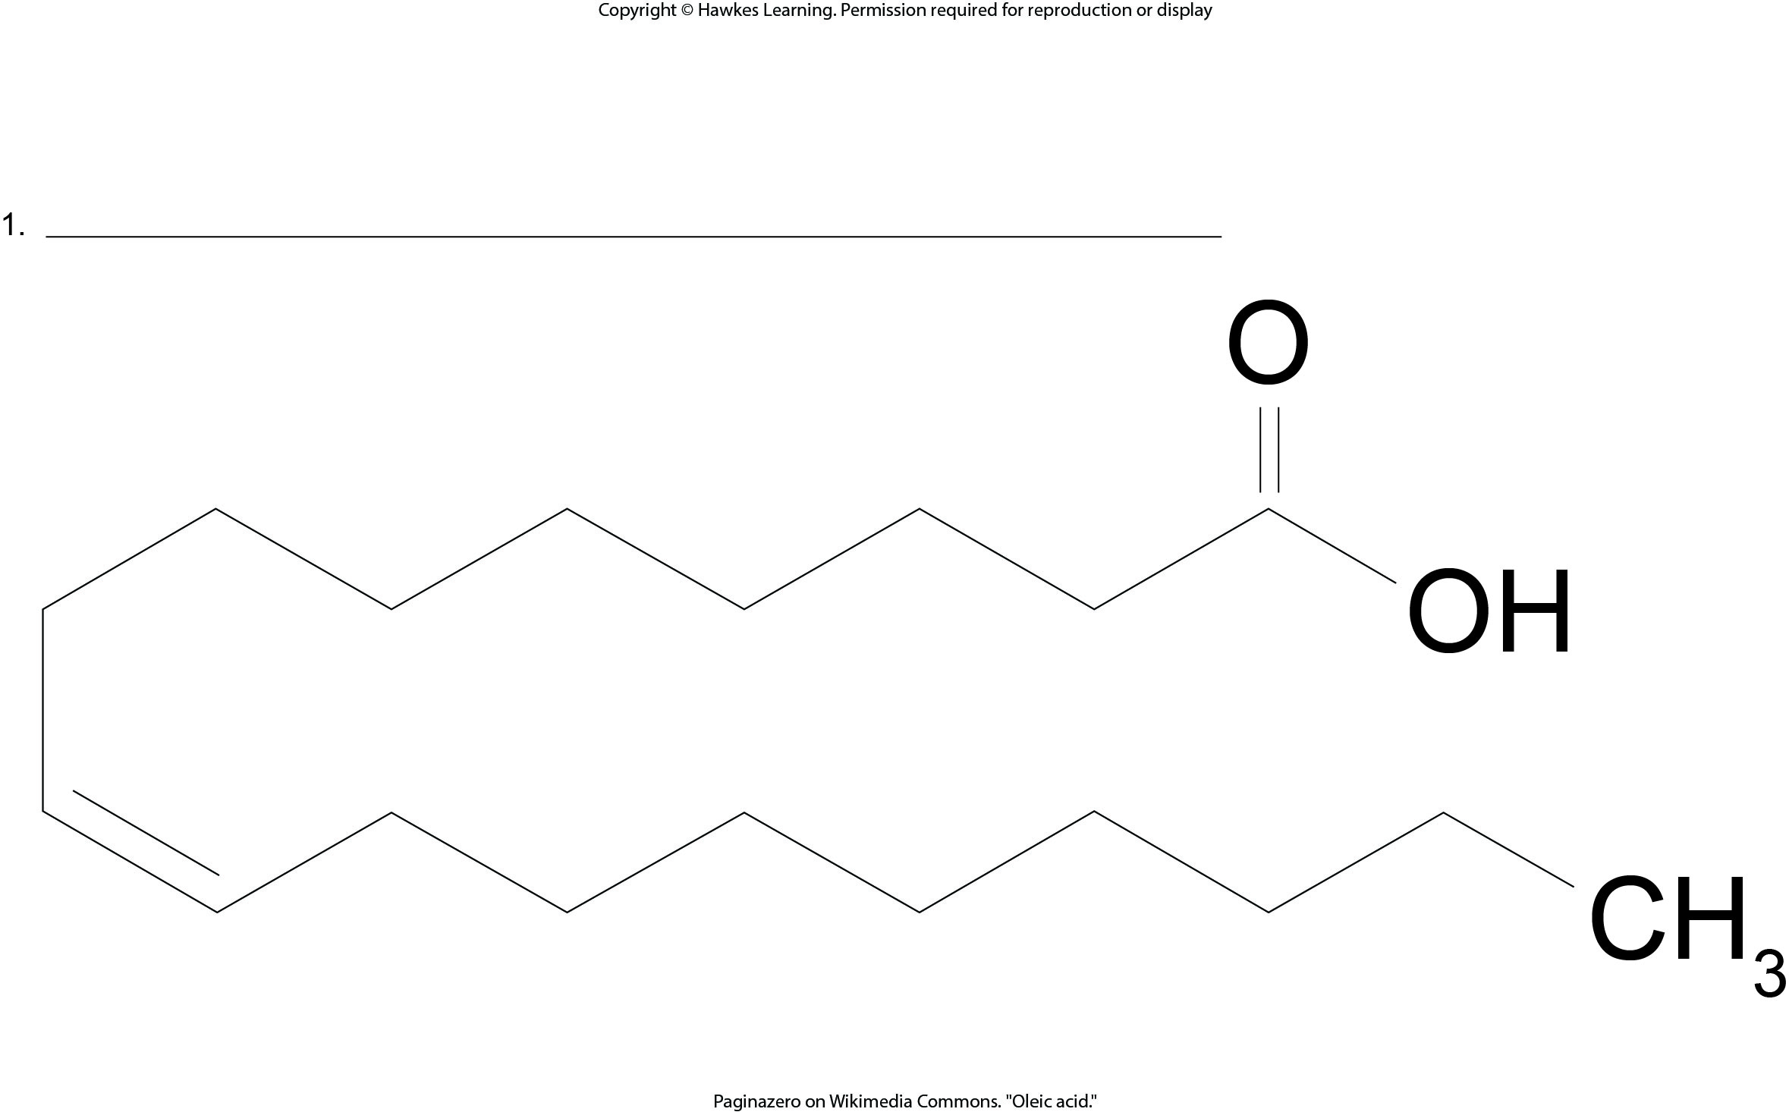
Lesson 3.3 Figure 4 - Numbered

Slide 23
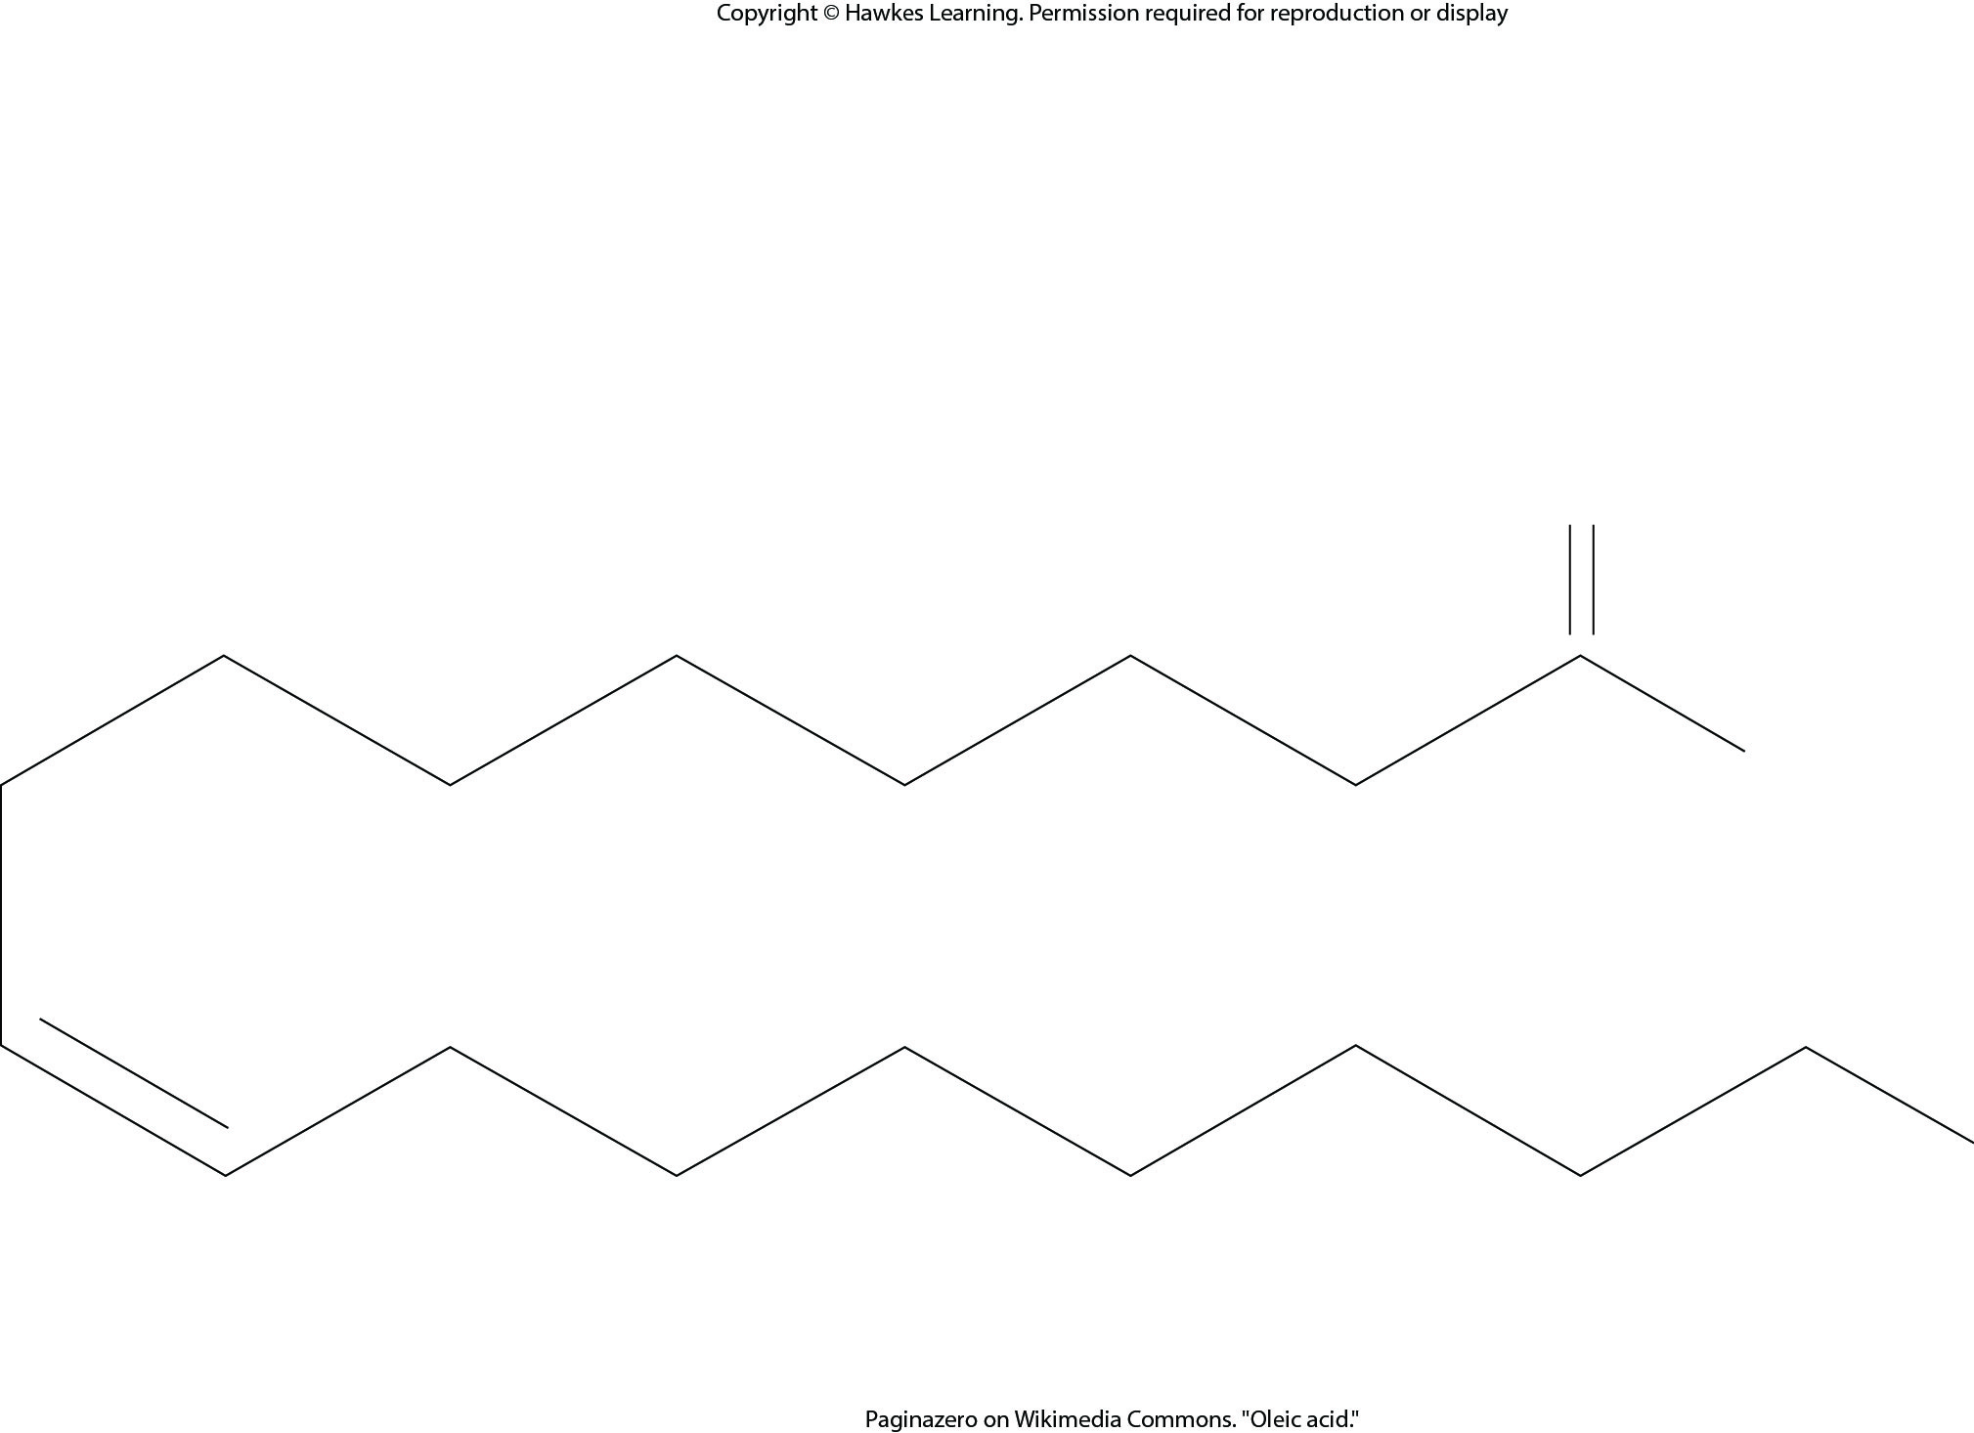
Lesson 3.3 Figure 4

Slide 24
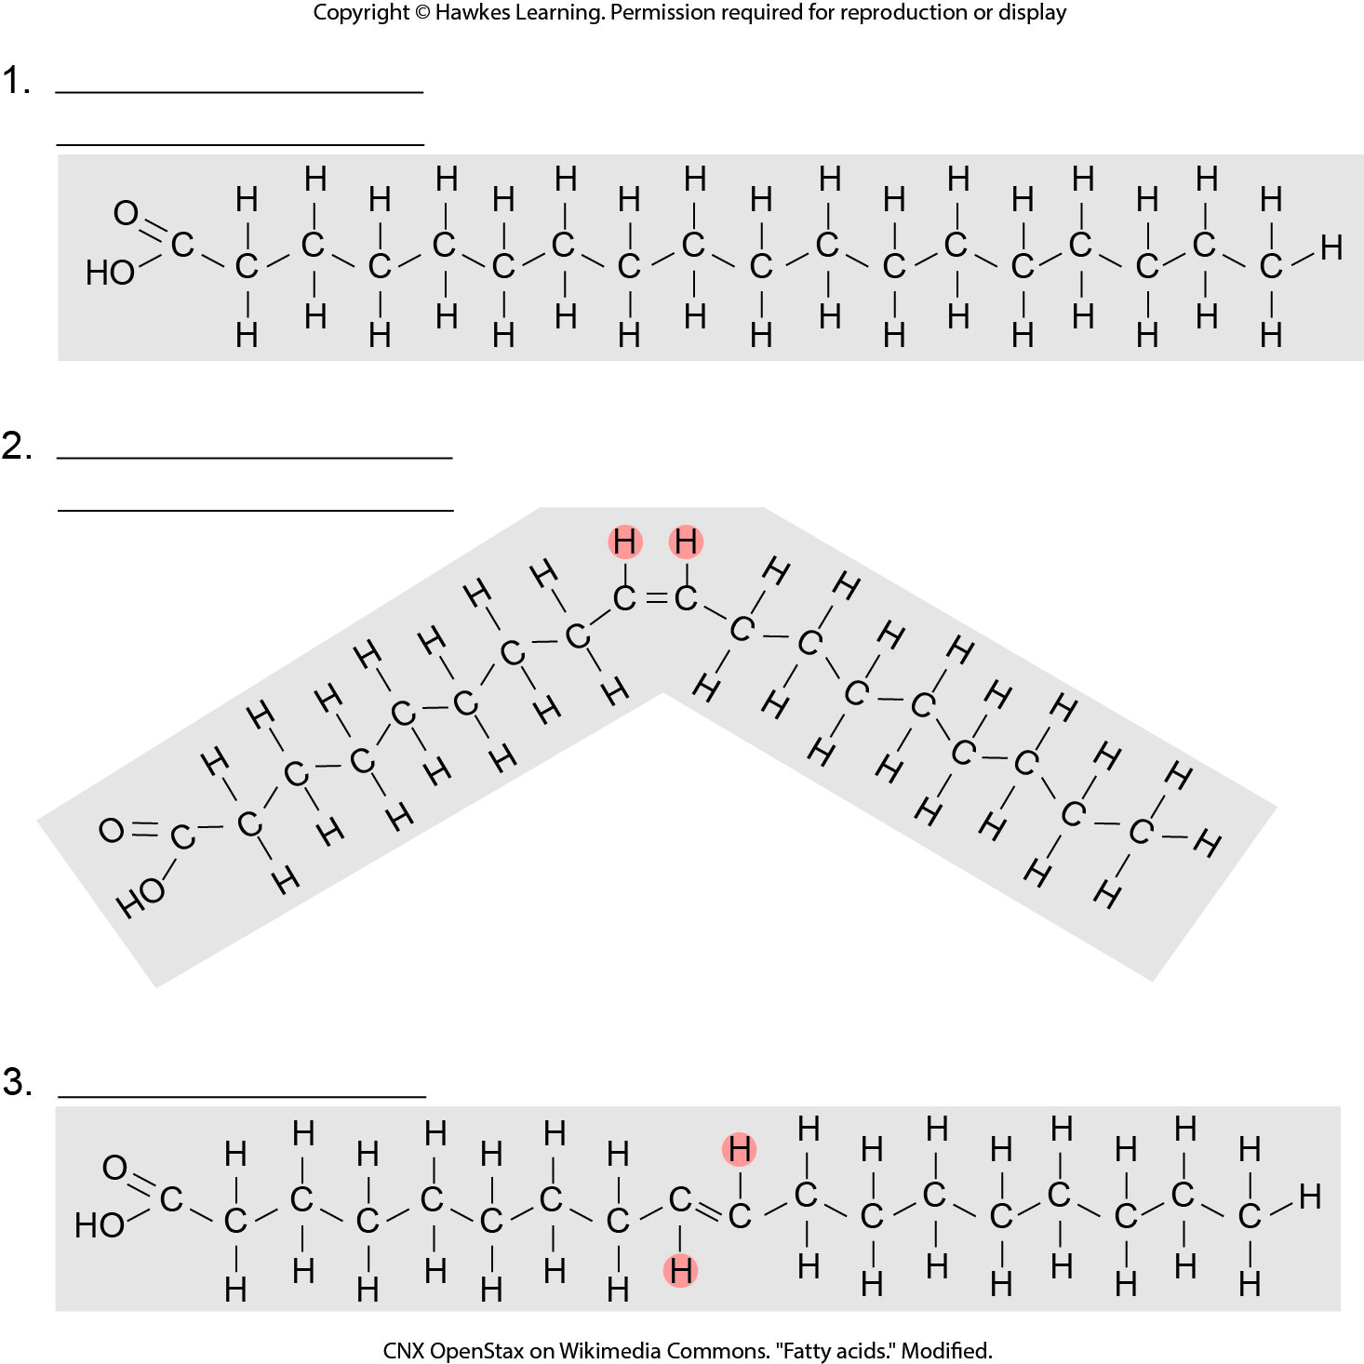
Lesson 3.3 Figure 5 - Numbered

Slide 25
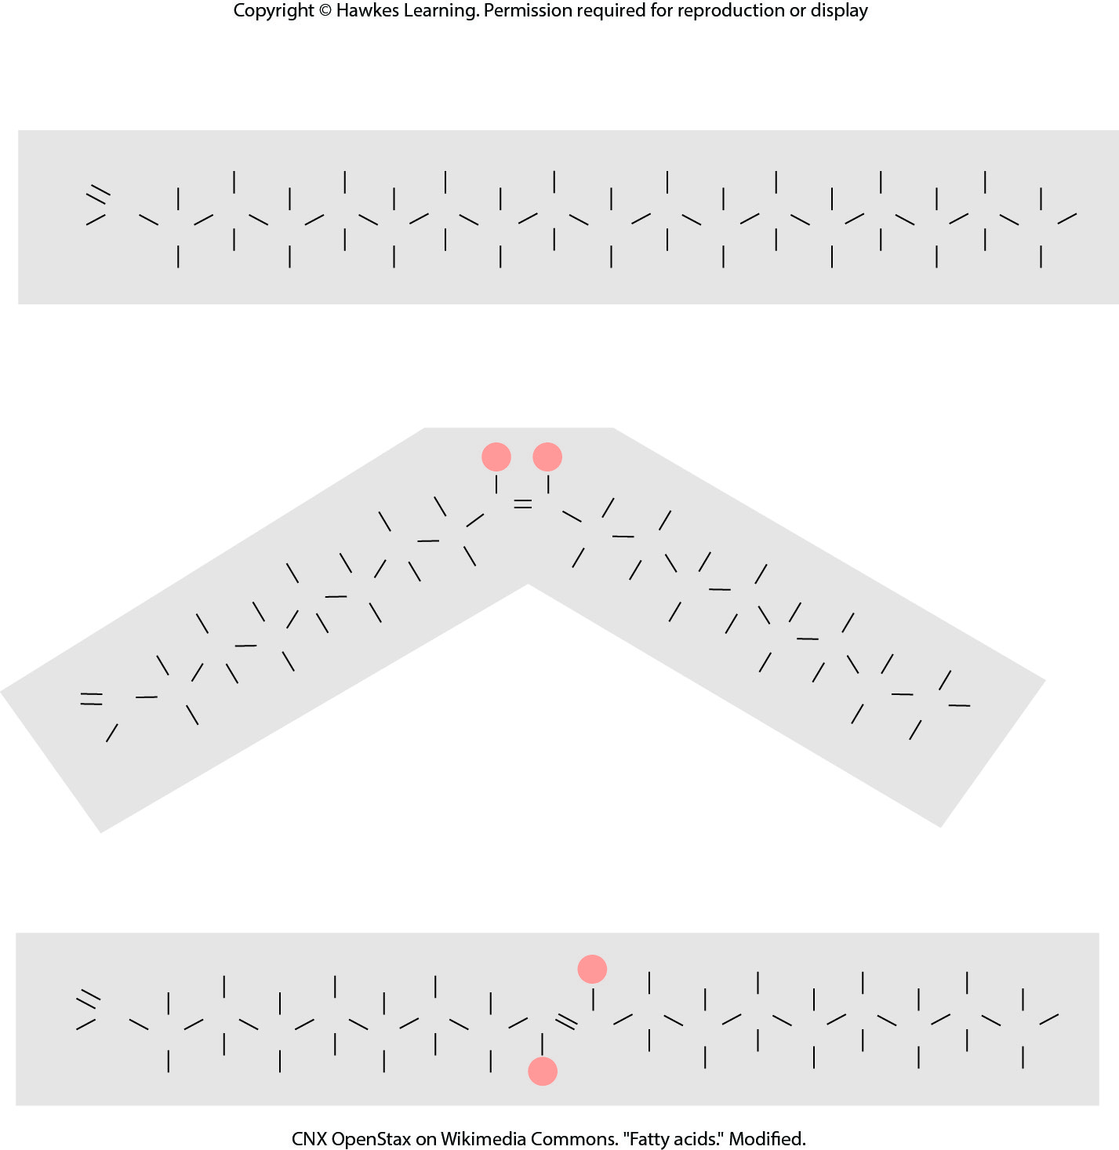
Lesson 3.3 Figure 5

Slide 26
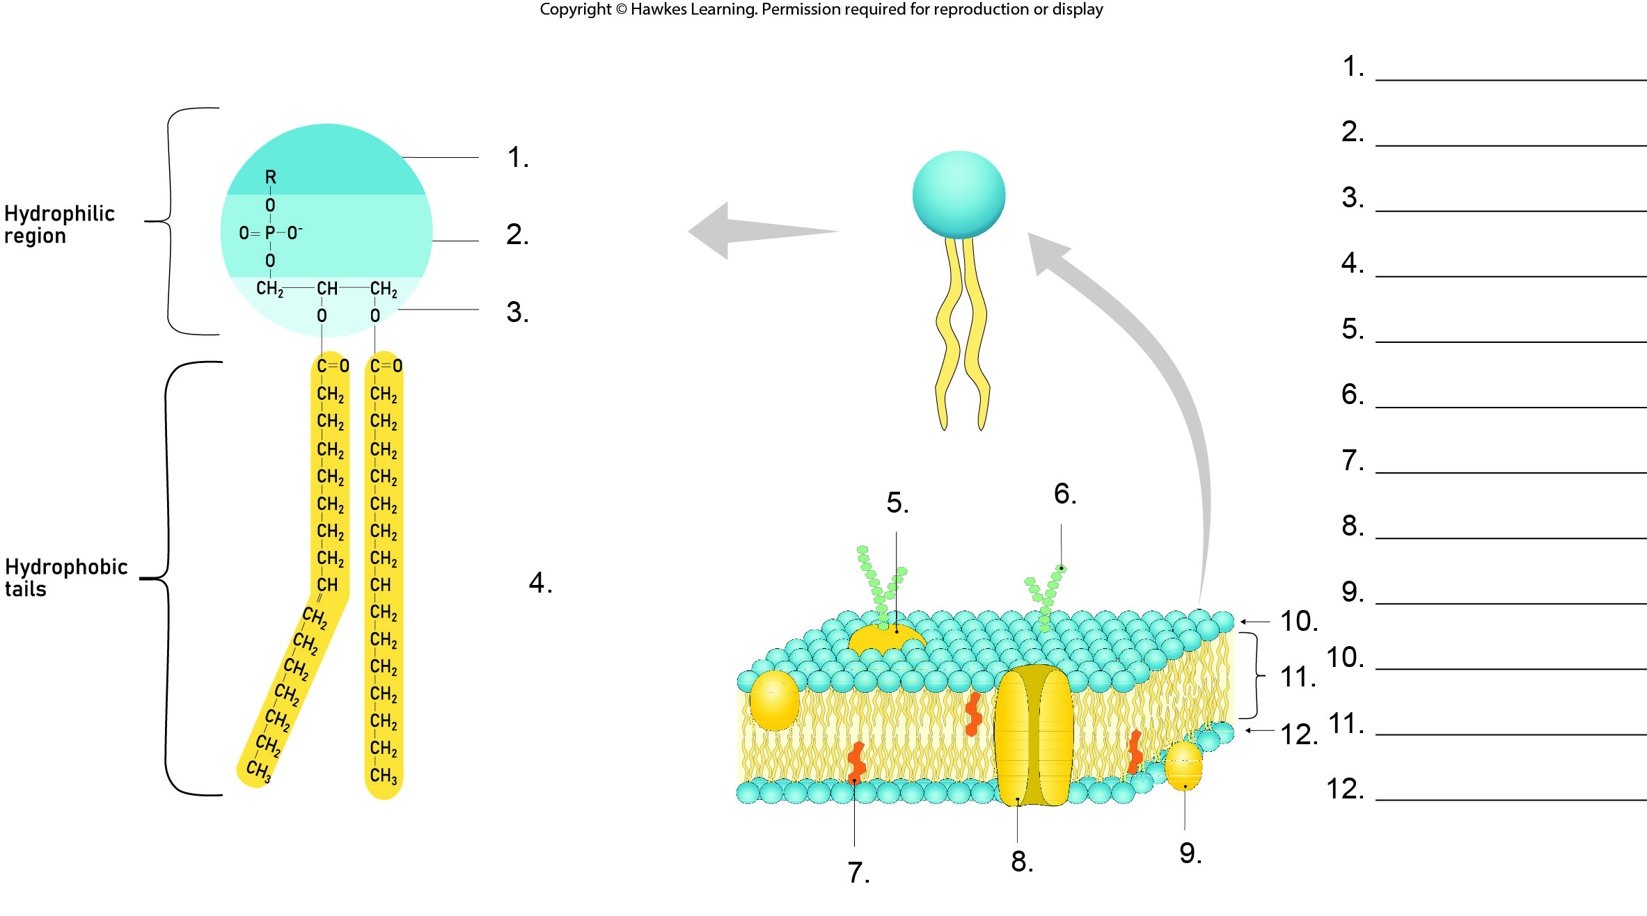
Lesson 3.3 Figure 9 - Numbered

Slide 27
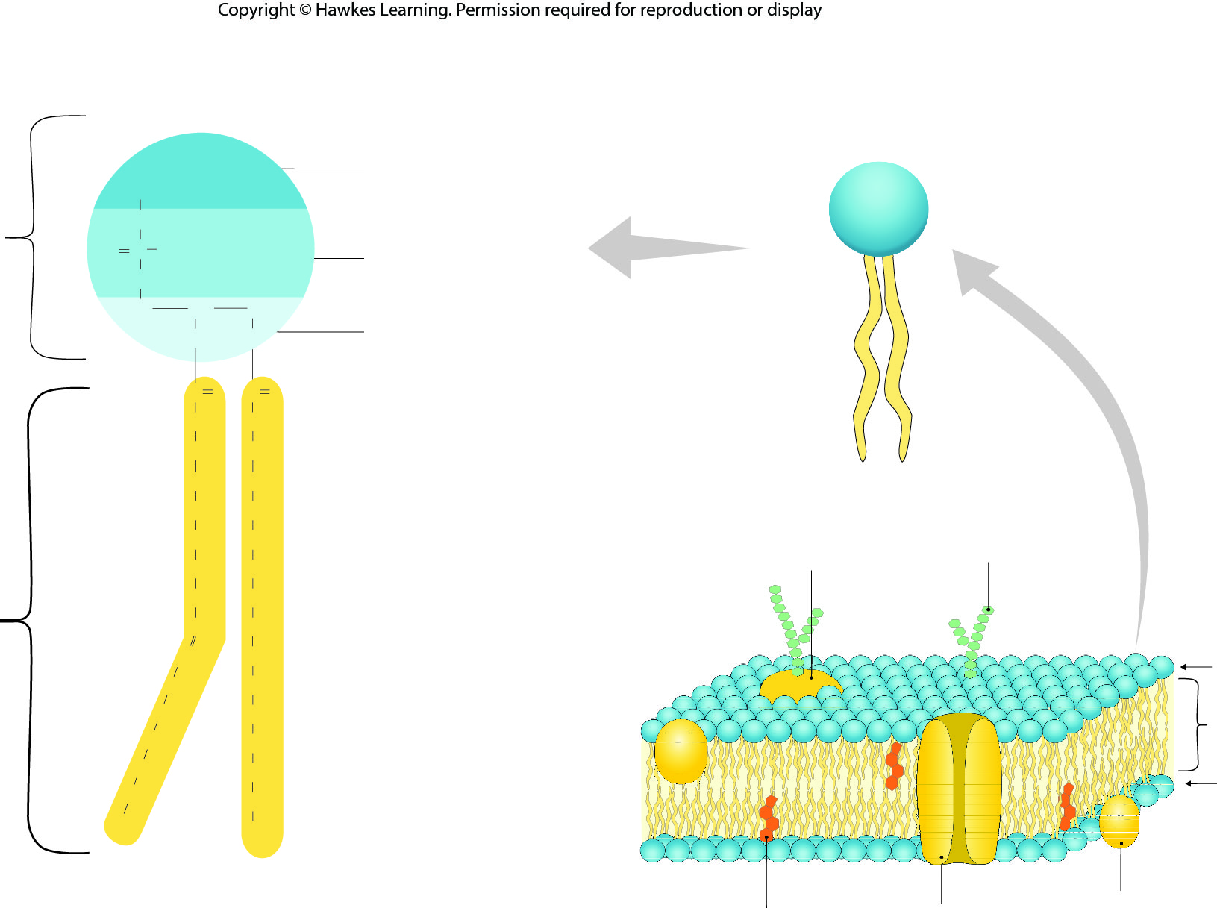
Lesson 3.3 Figure 9

Slide 28
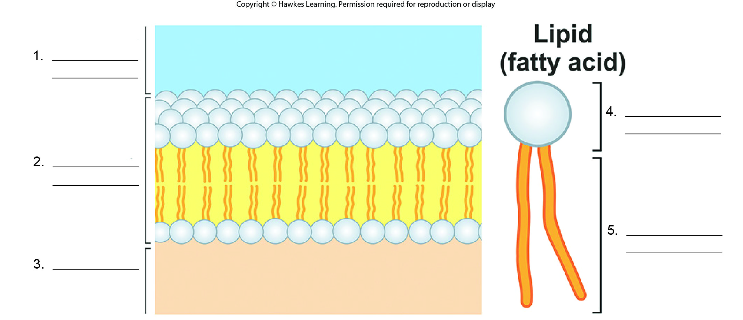
Lesson 3.3 Figure 10 - Numbered

Slide 29
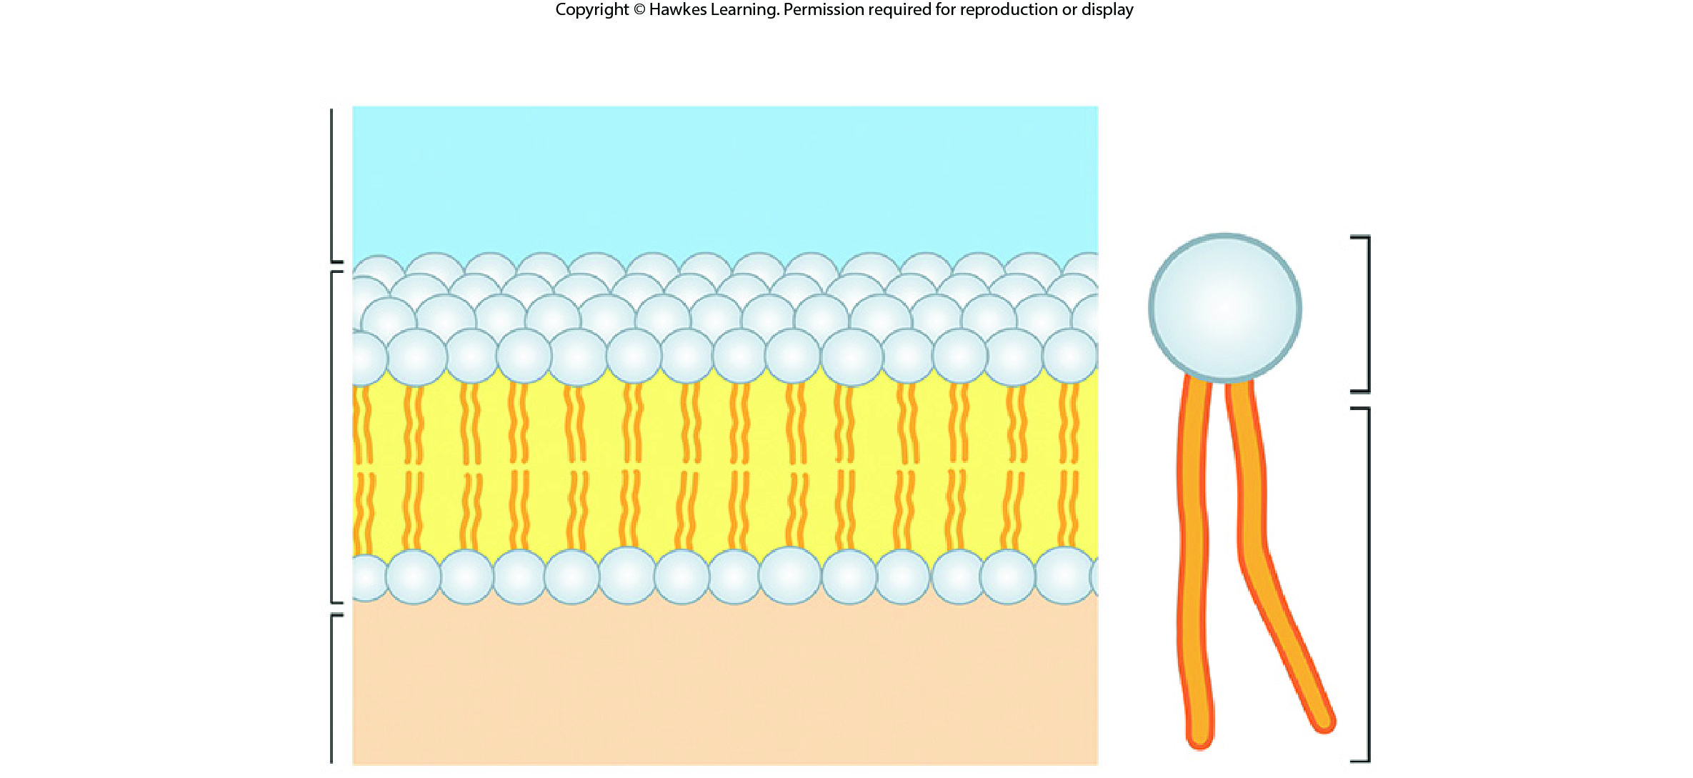
Lesson 3.3 Figure 10

Slide 30
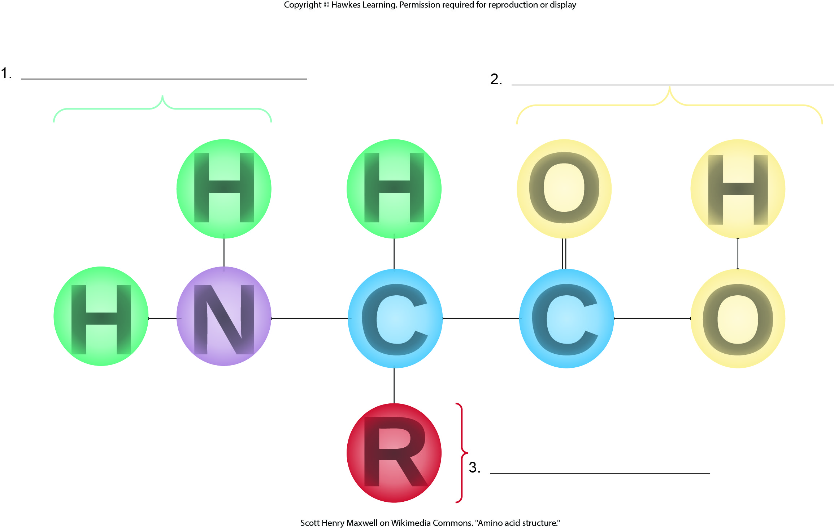
Lesson 3.4 Figure 1 - Numbered

Slide 31
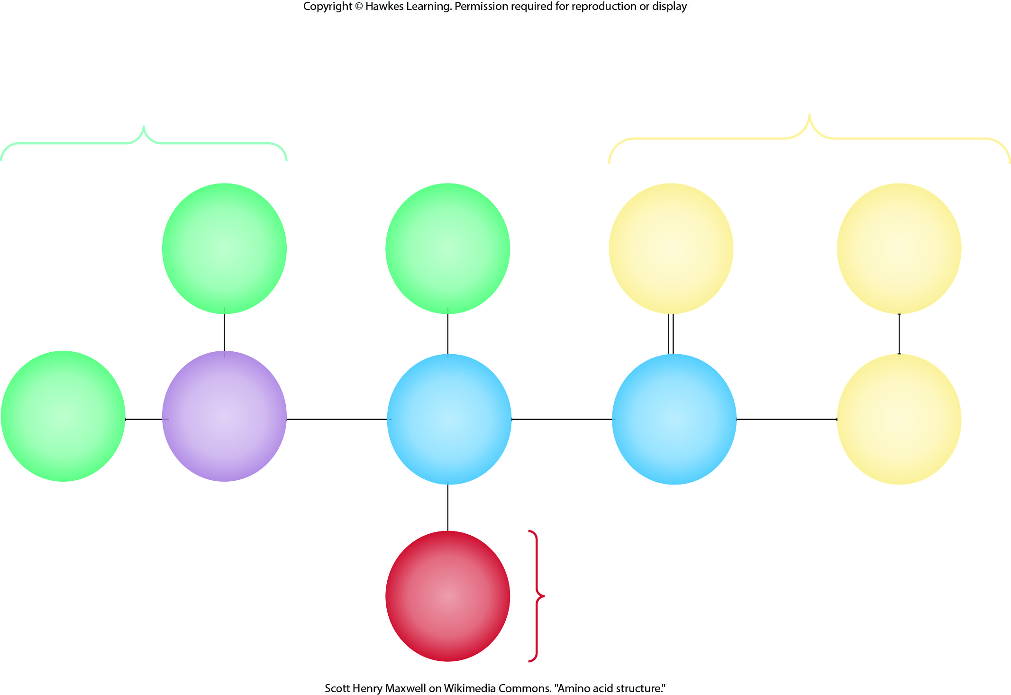
Lesson 3.4 Figure 1

Slide 32
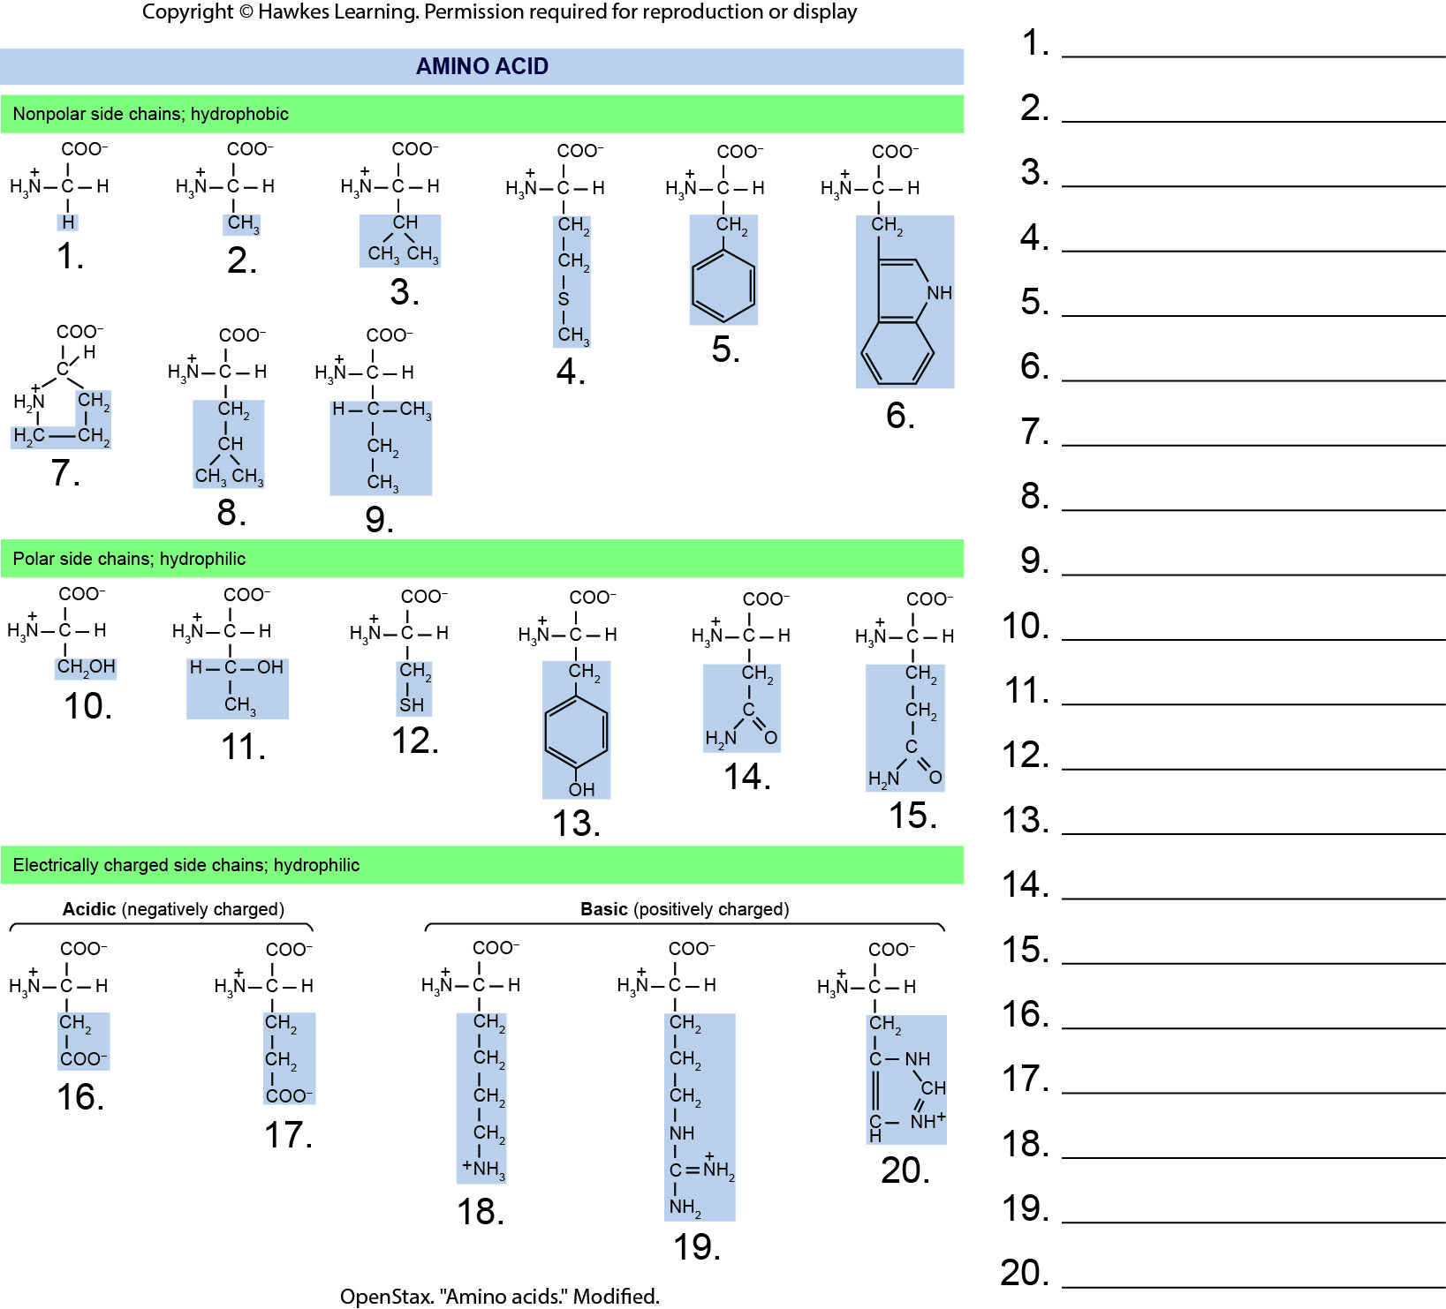
Lesson 3.4 Figure 2 - Numbered

Slide 33
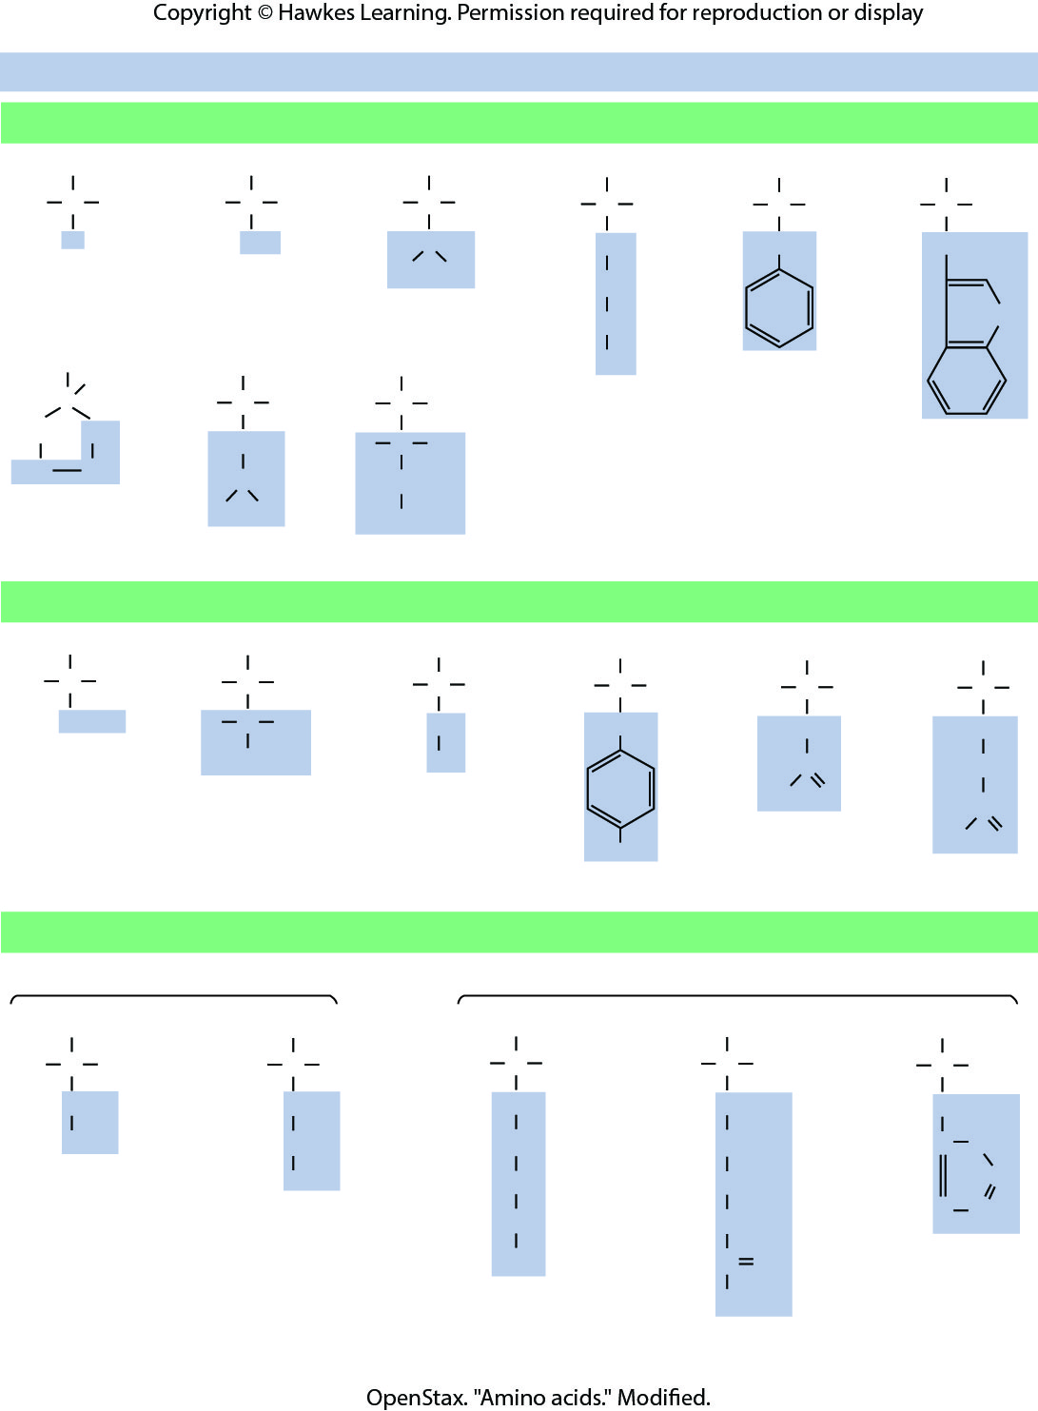
Lesson 3.4 Figure 2

Slide 34
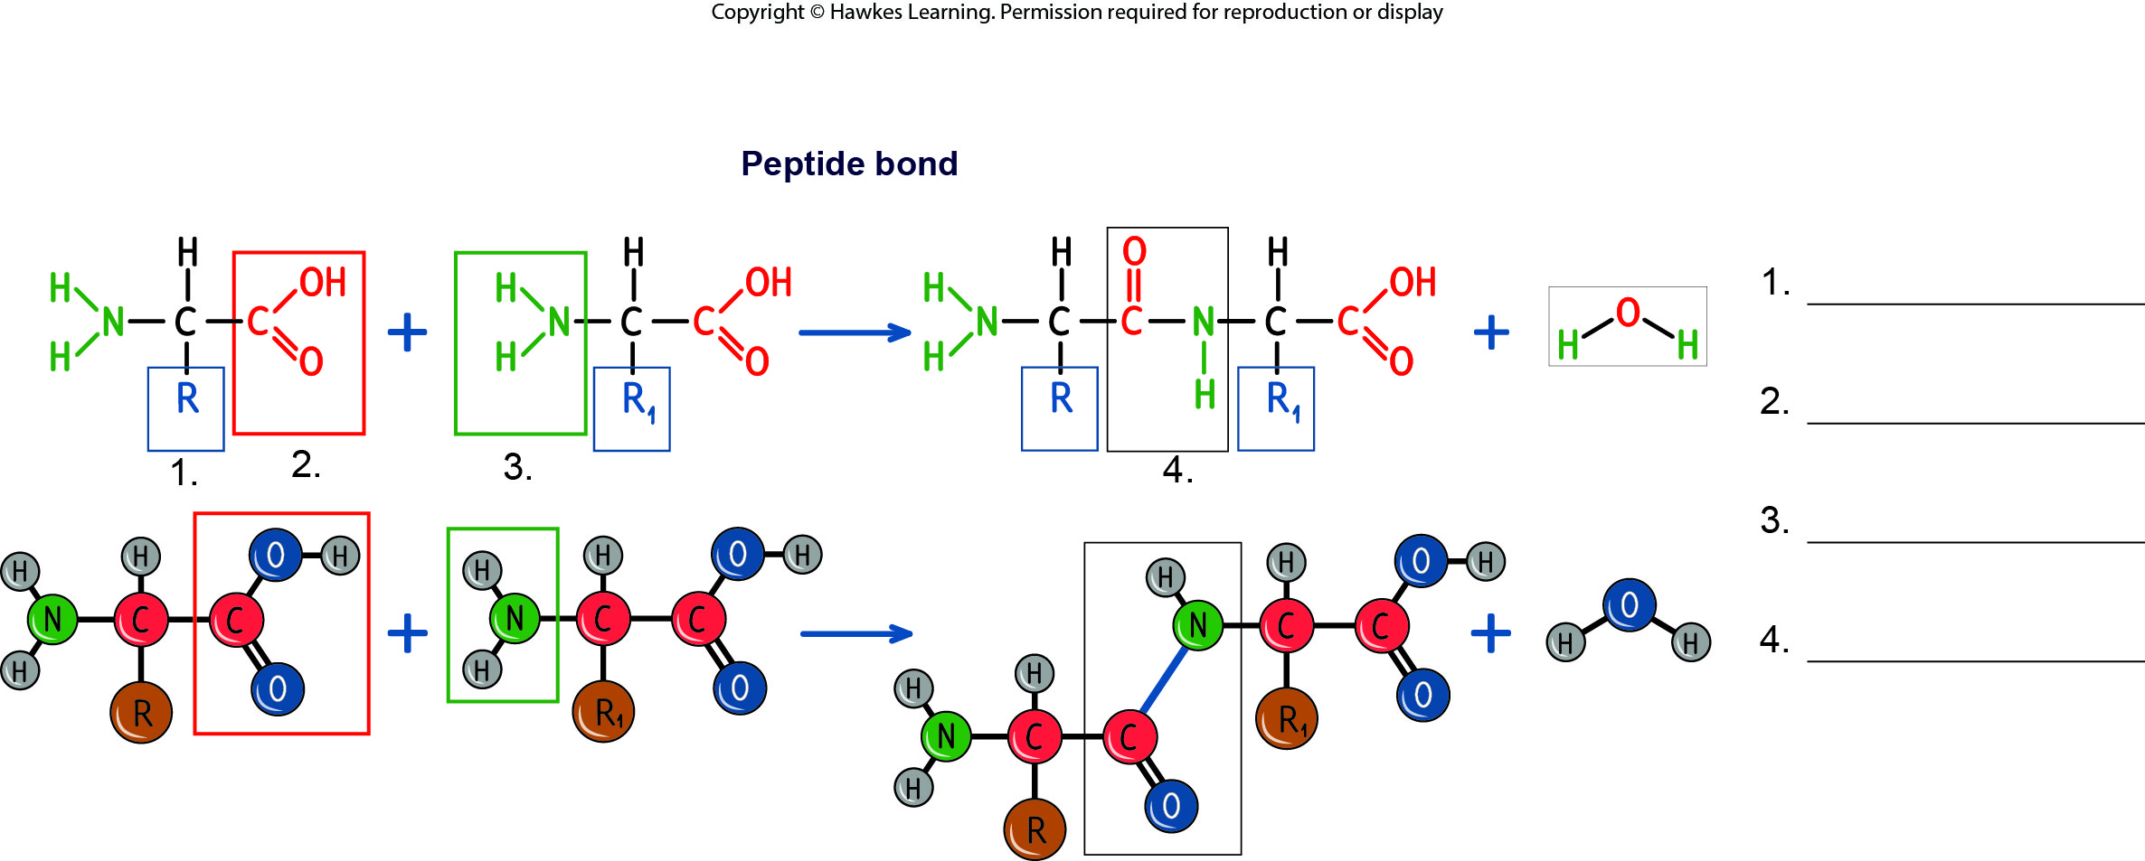
Lesson 3.4 Figure 3 - Numbered

Slide 35
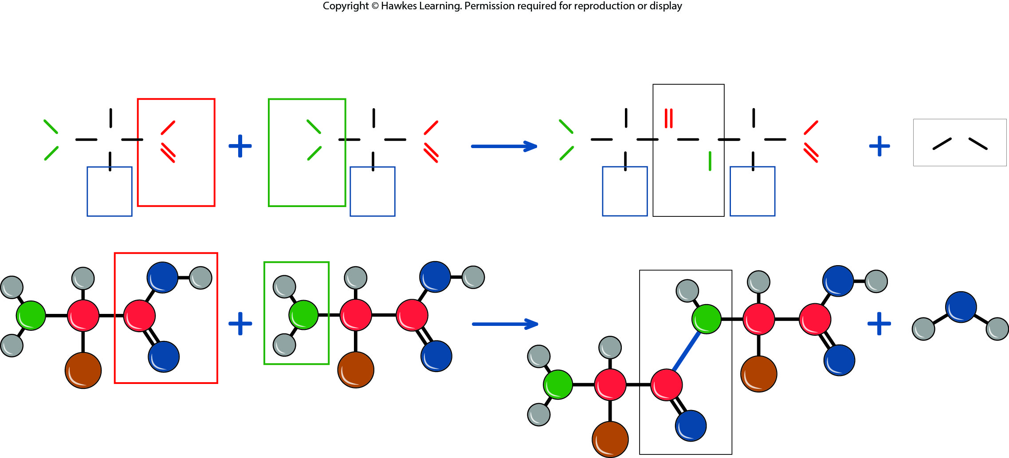
Lesson 3.4 Figure 3

Slide 36
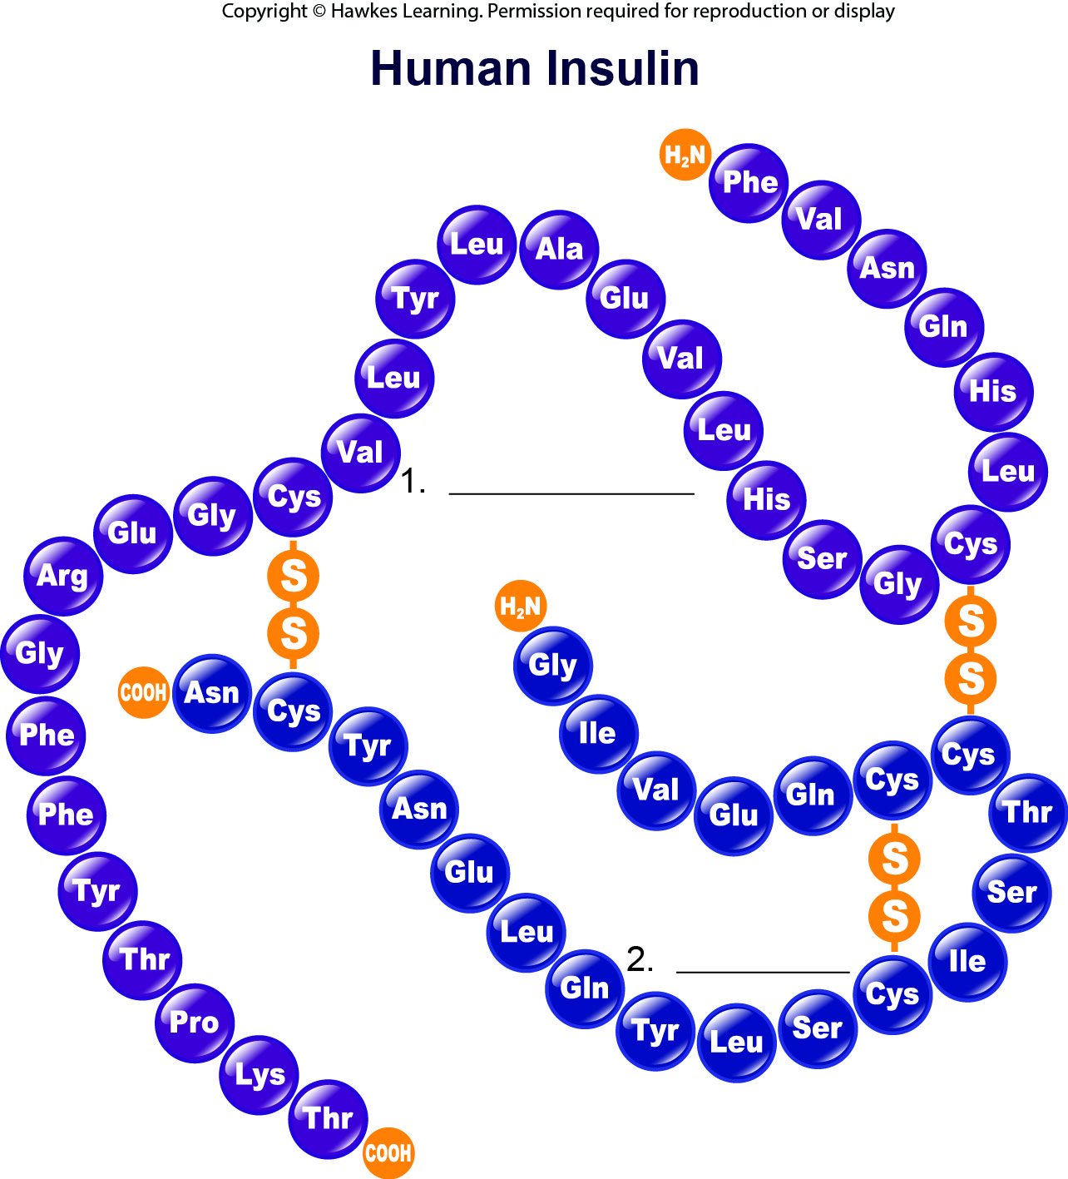
Lesson 3.4 Figure 4 - Numbered

Slide 37
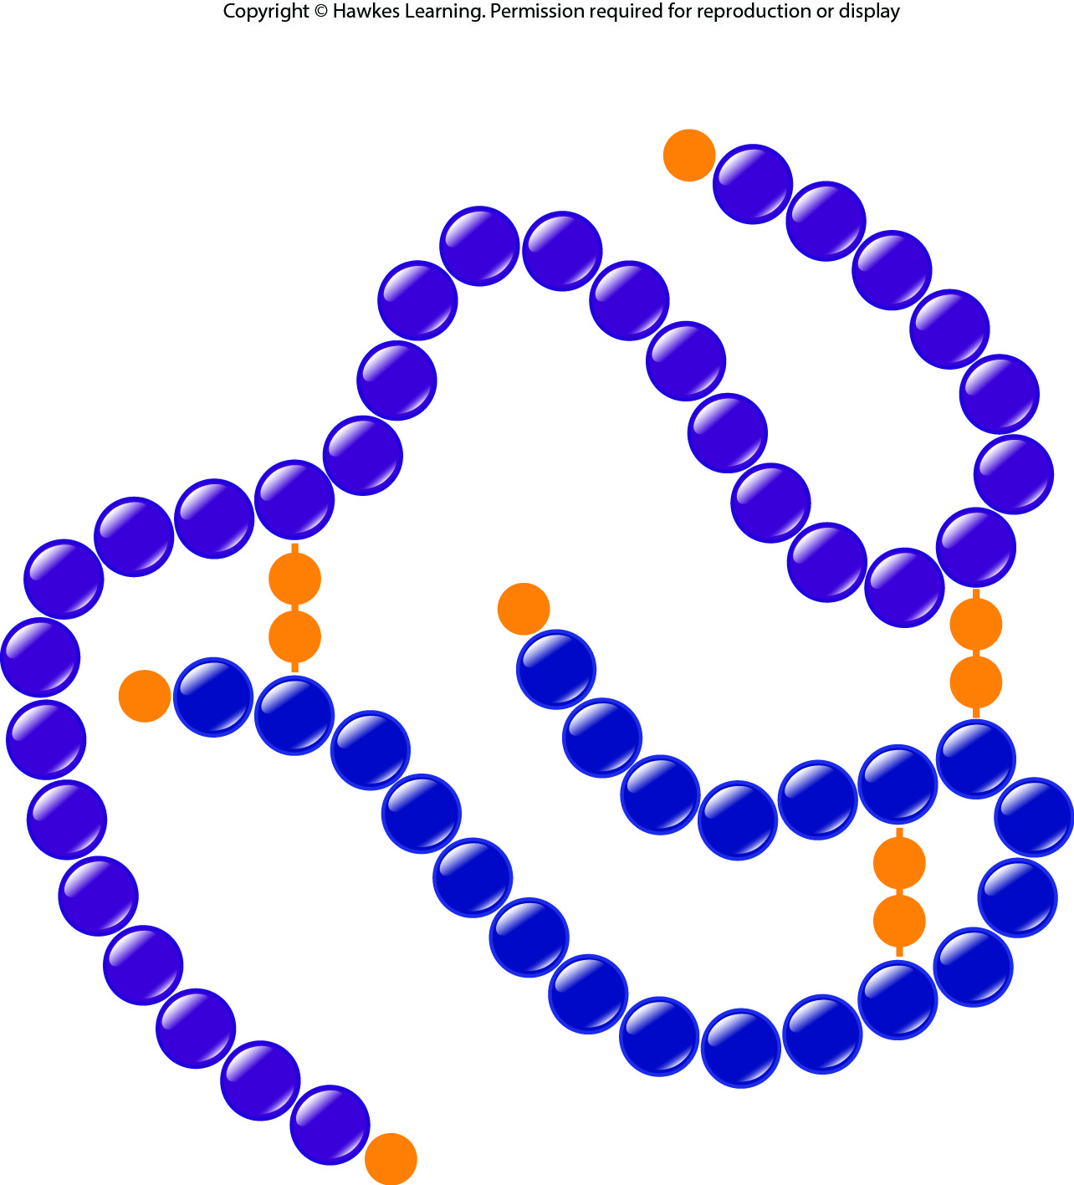
Lesson 3.4 Figure 4

Slide 38
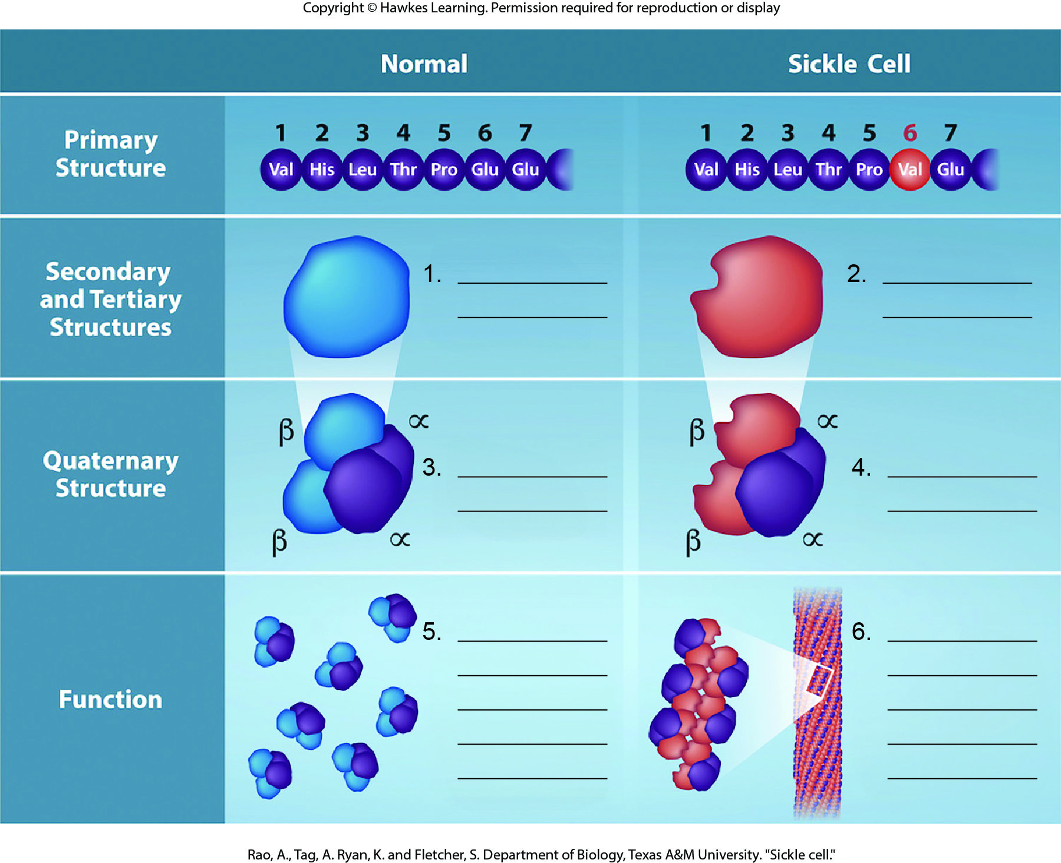
Lesson 3.4 Figure 5 - Numbered

Slide 39
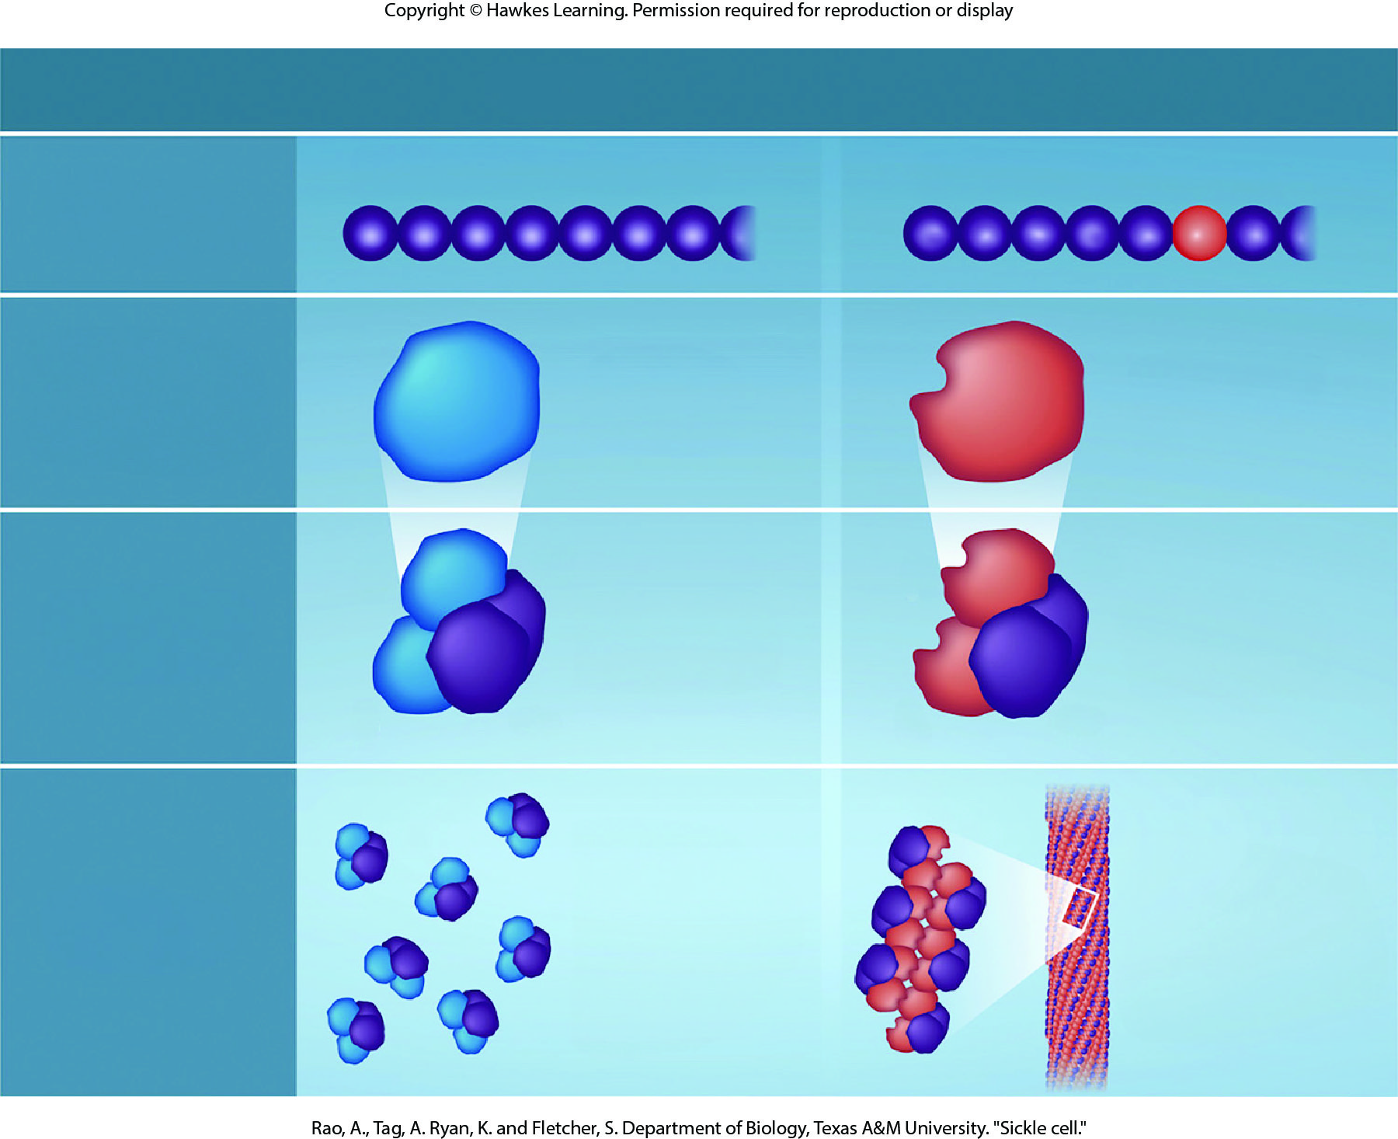
Lesson 3.4 Figure 5

Slide 40
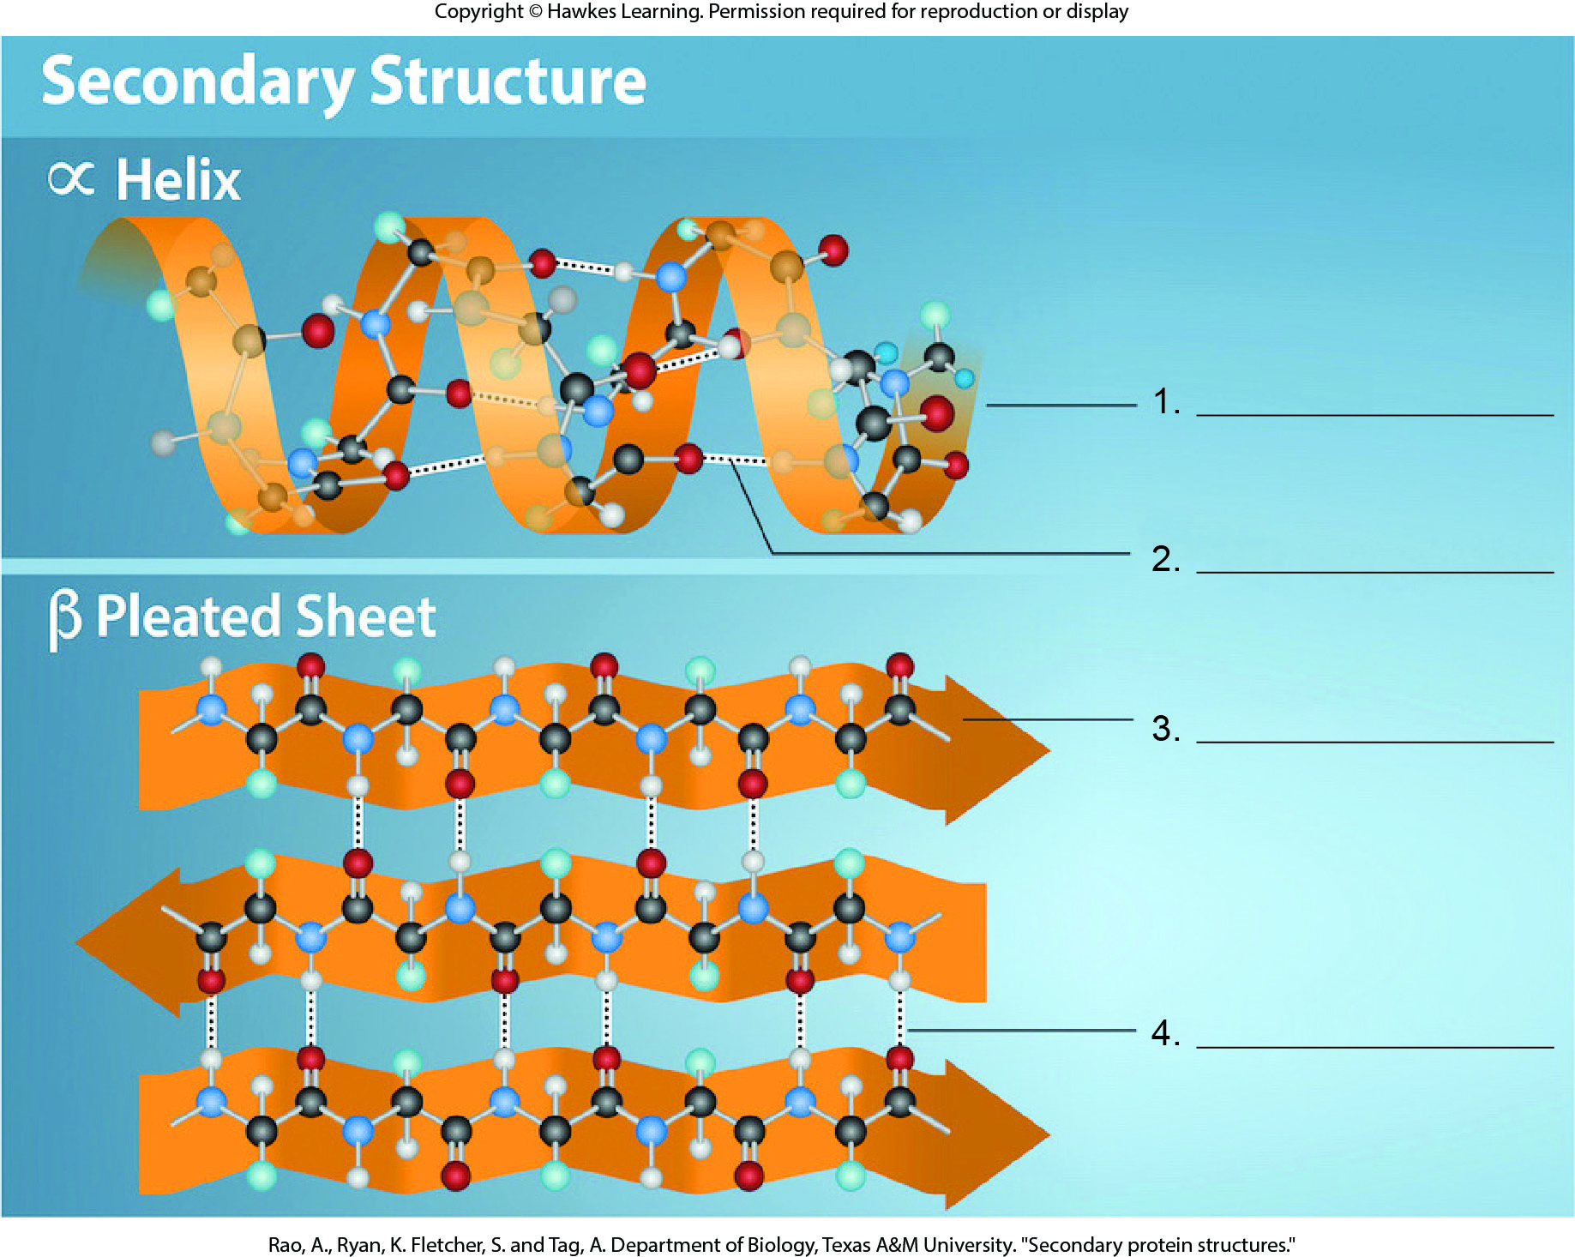
Lesson 3.4 Figure 7 - Numbered

Slide 41
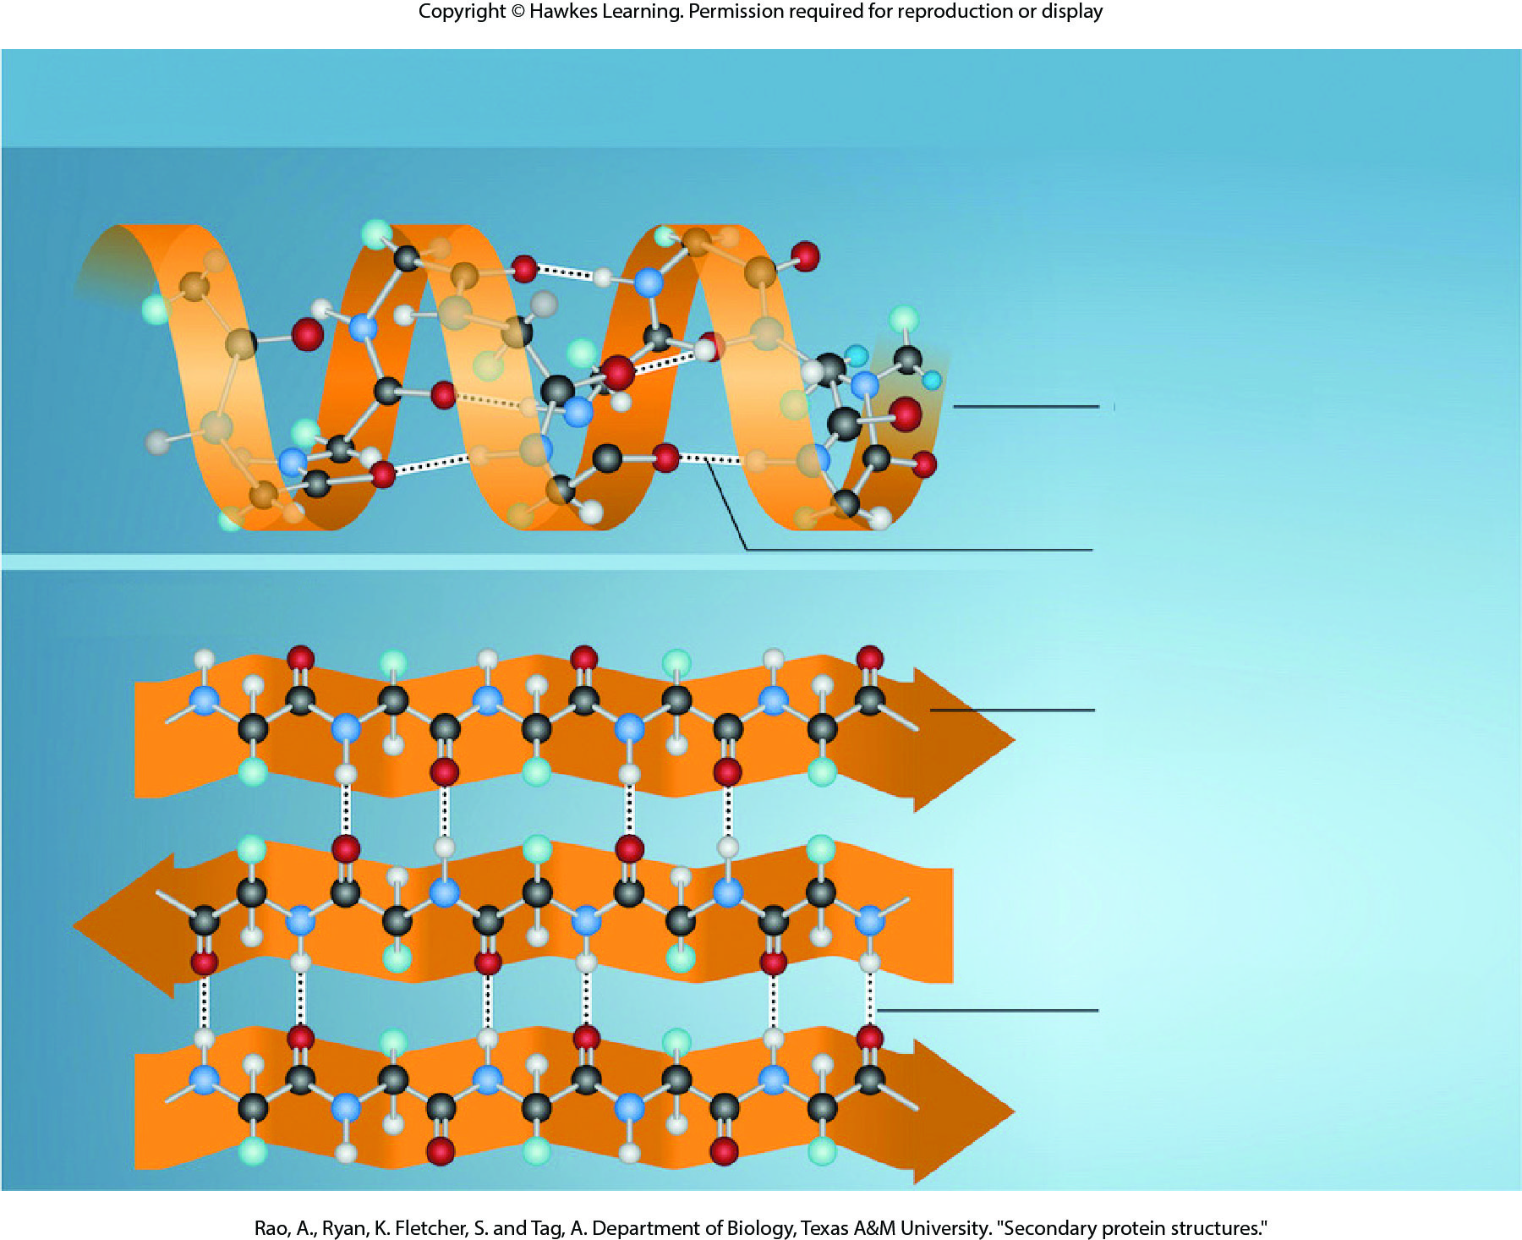
Lesson 3.4 Figure 7

Slide 42
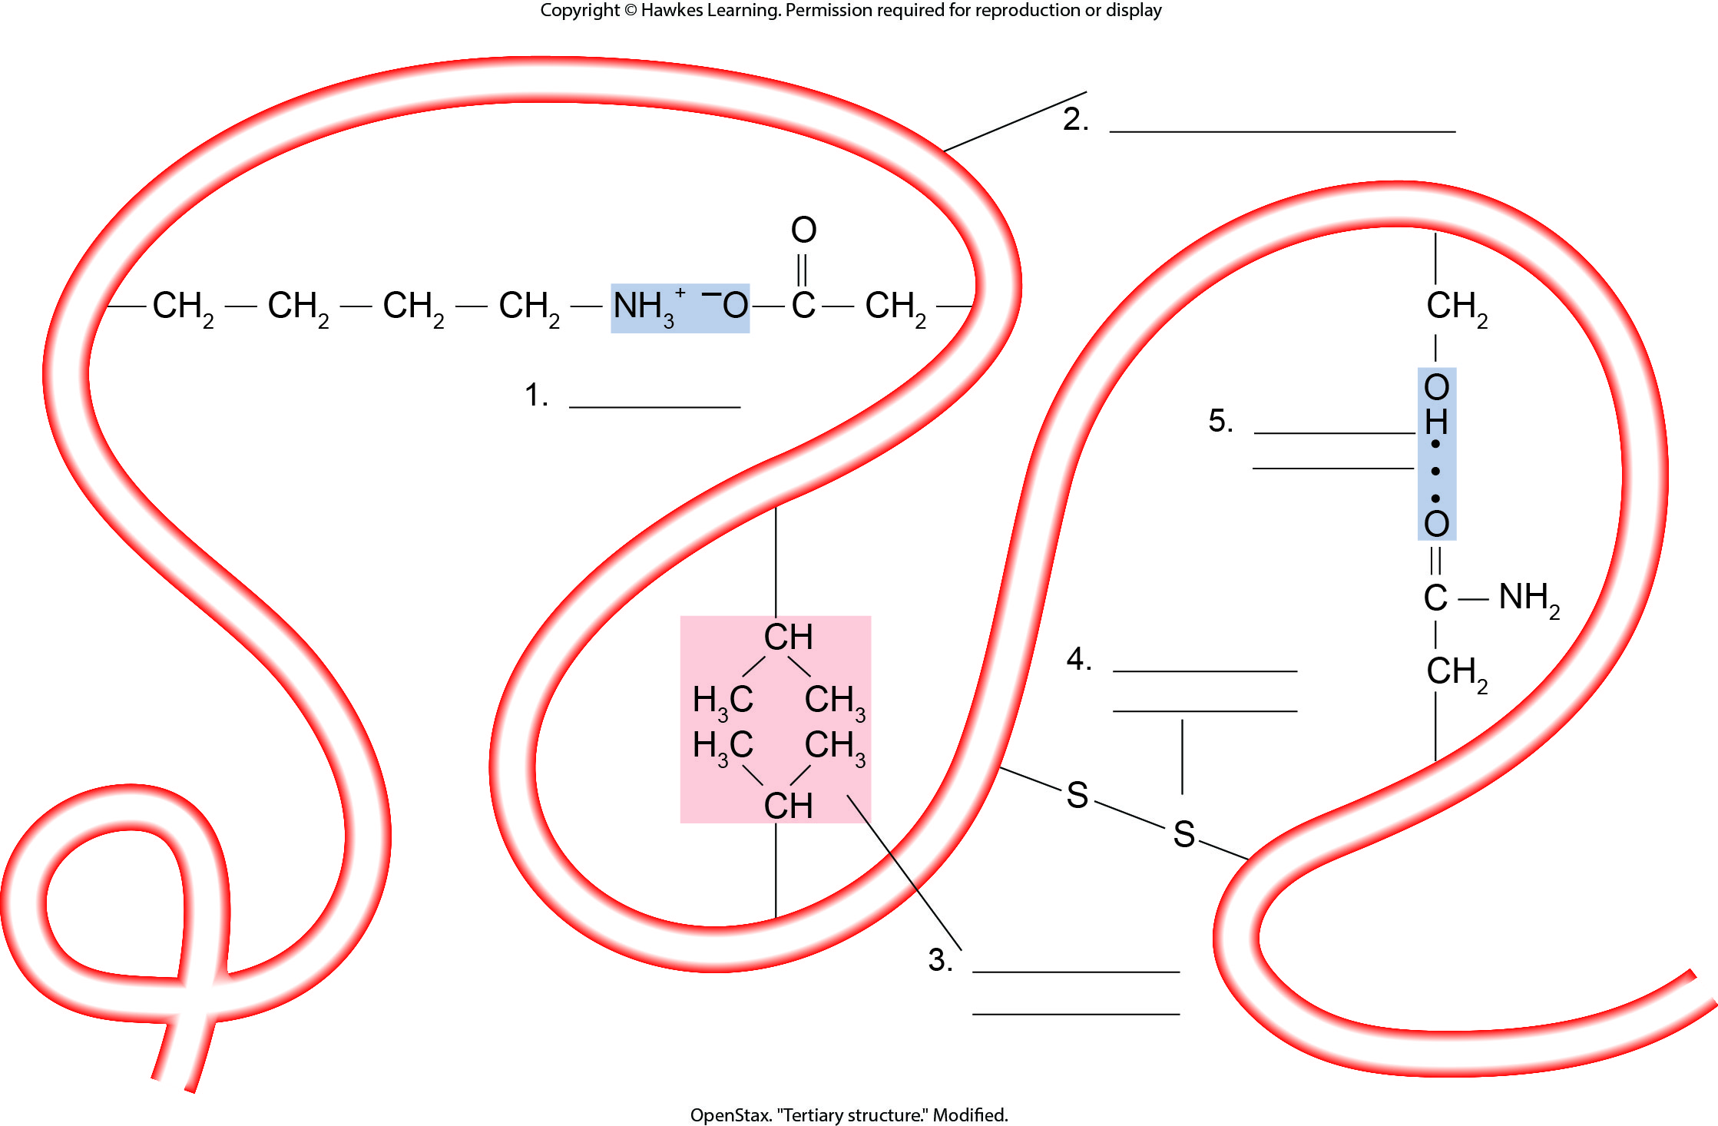
Lesson 3.4 Figure 9 - Numbered

Slide 43
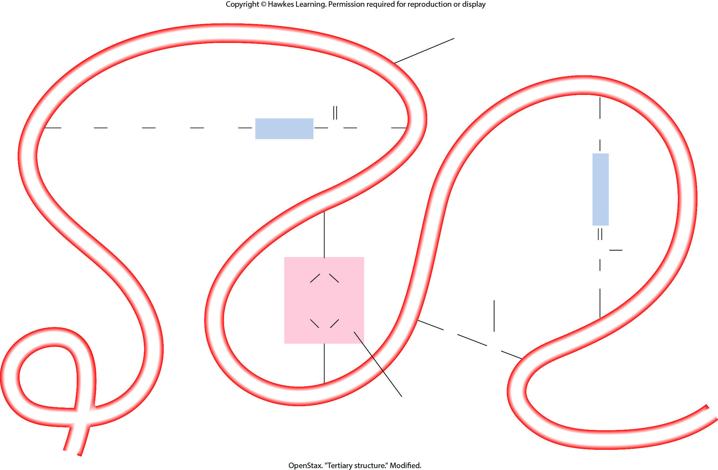
Lesson 3.4 Figure 9

Slide 44
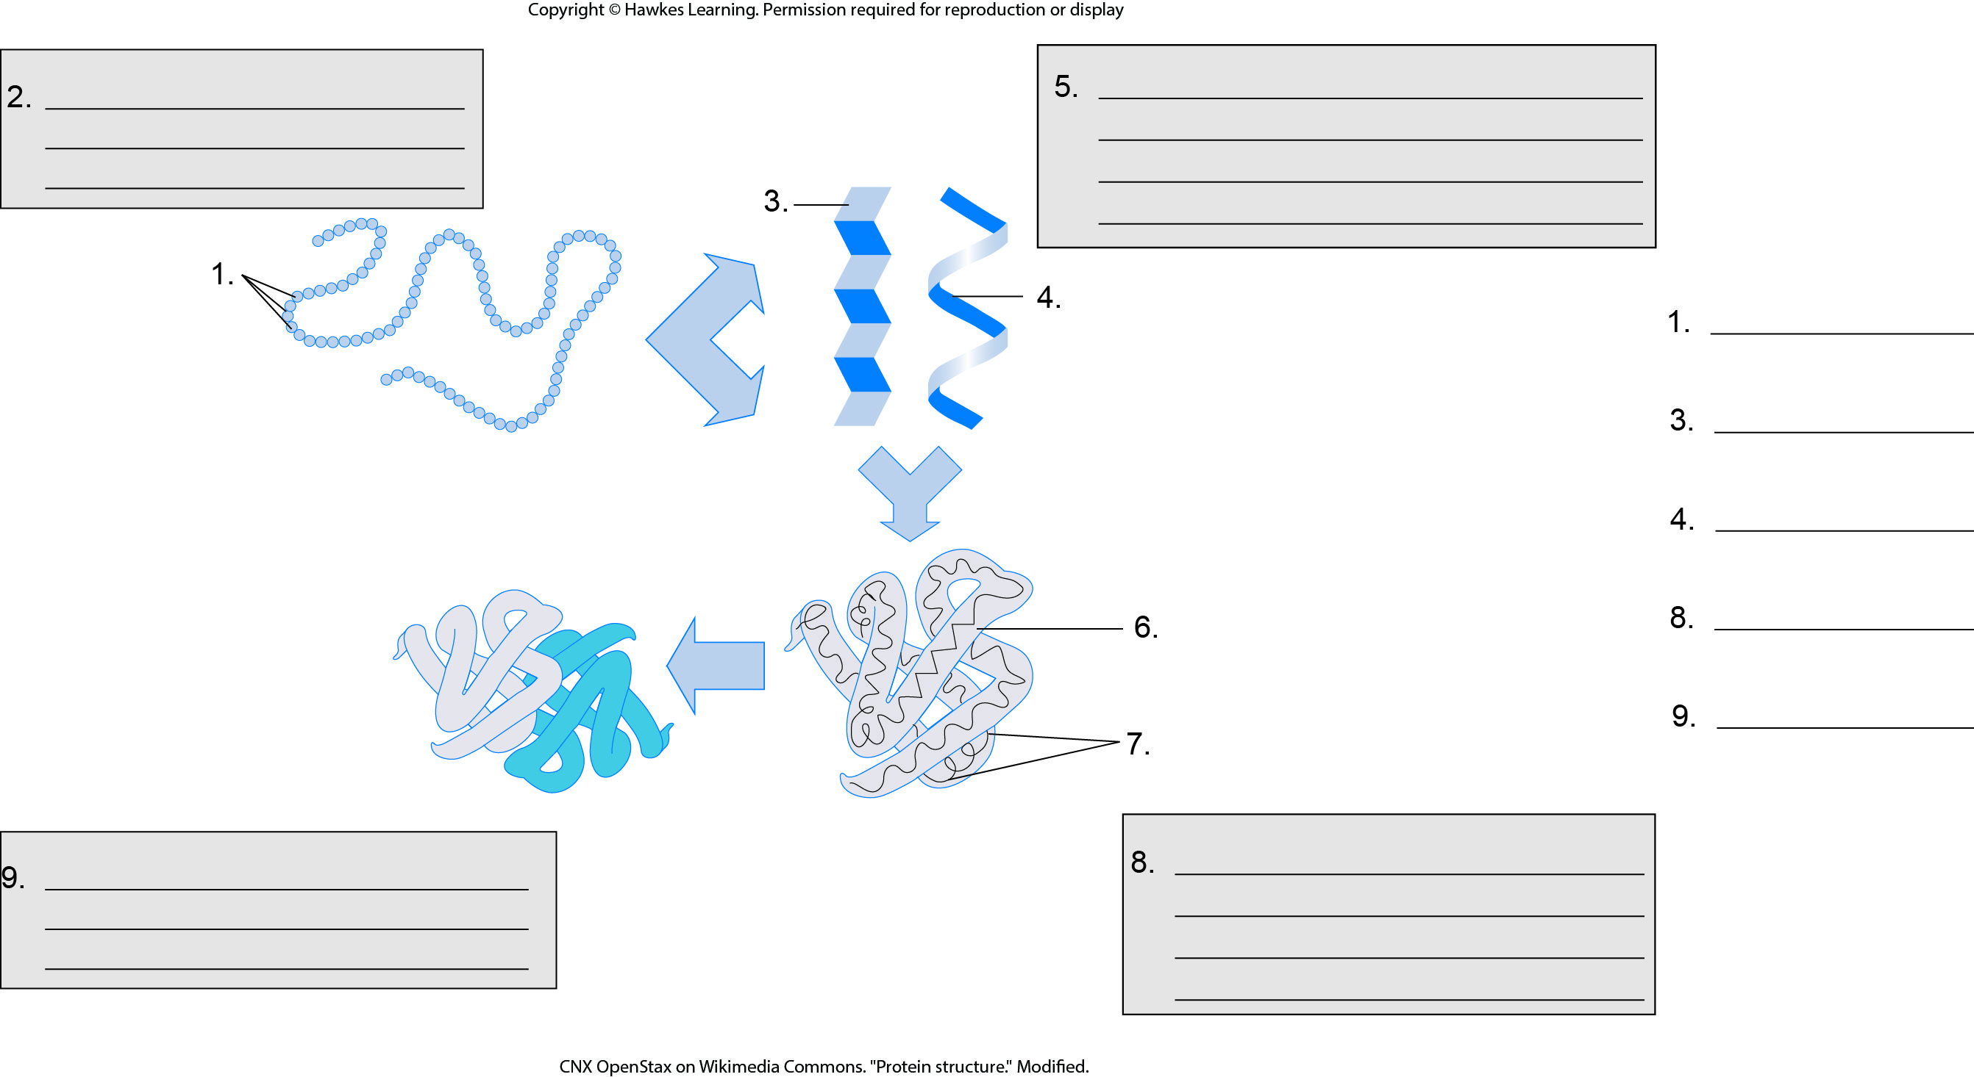
Lesson 3.4 Figure 10 - Numbered

Slide 45
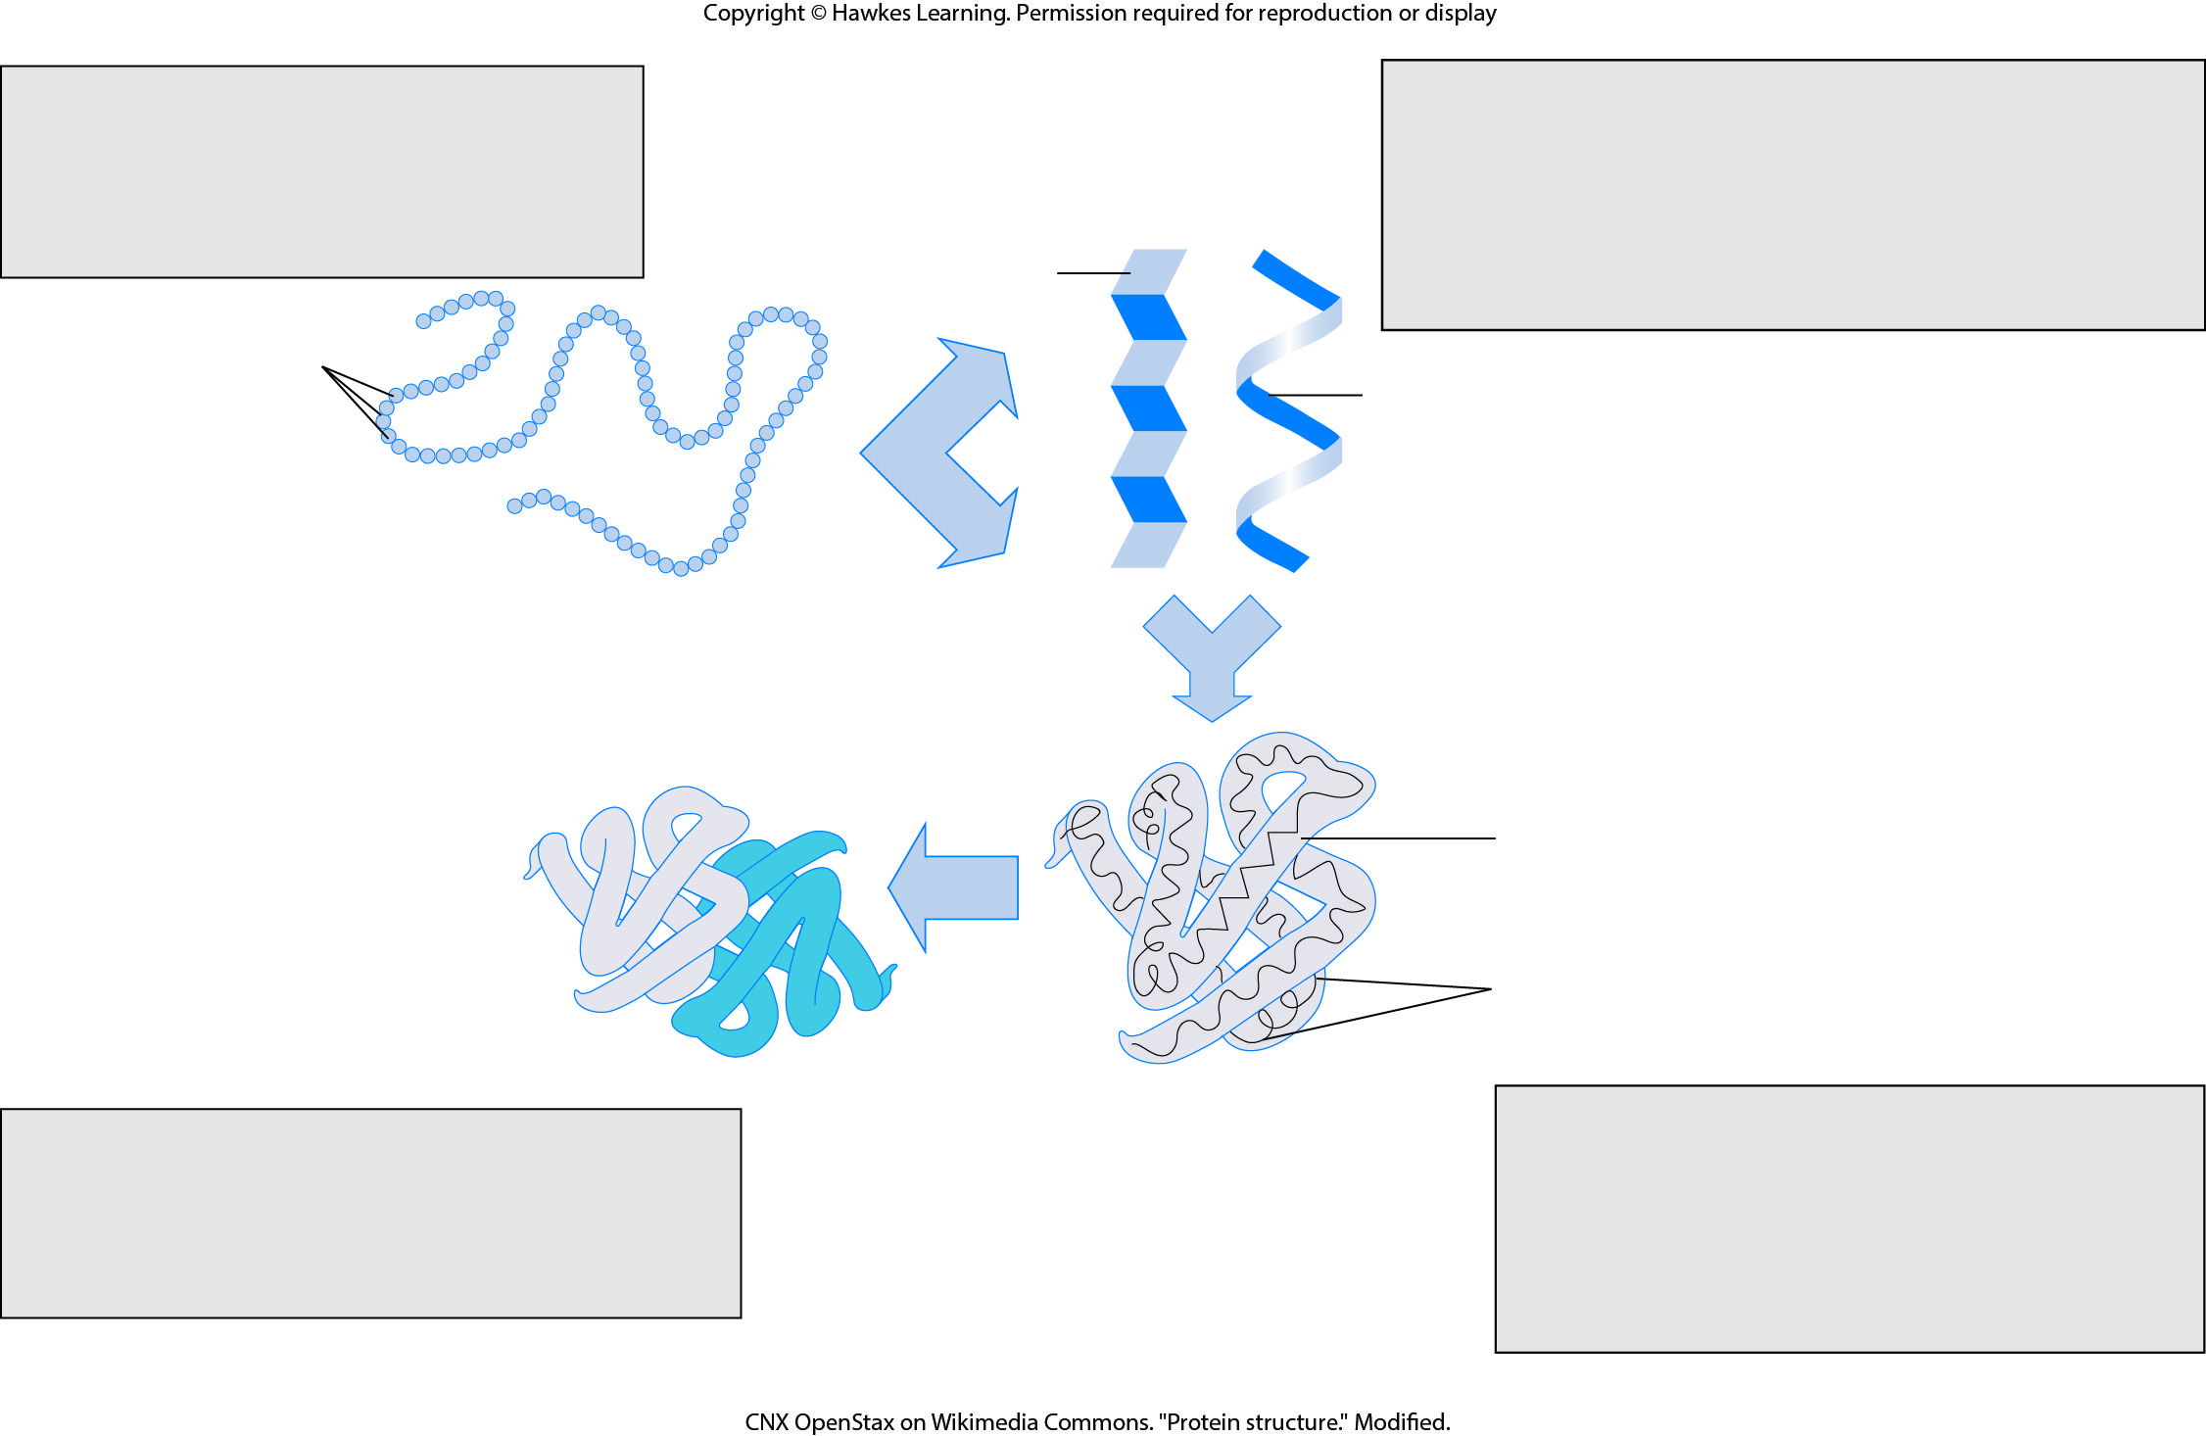
Lesson 3.4 Figure 10

Slide 46
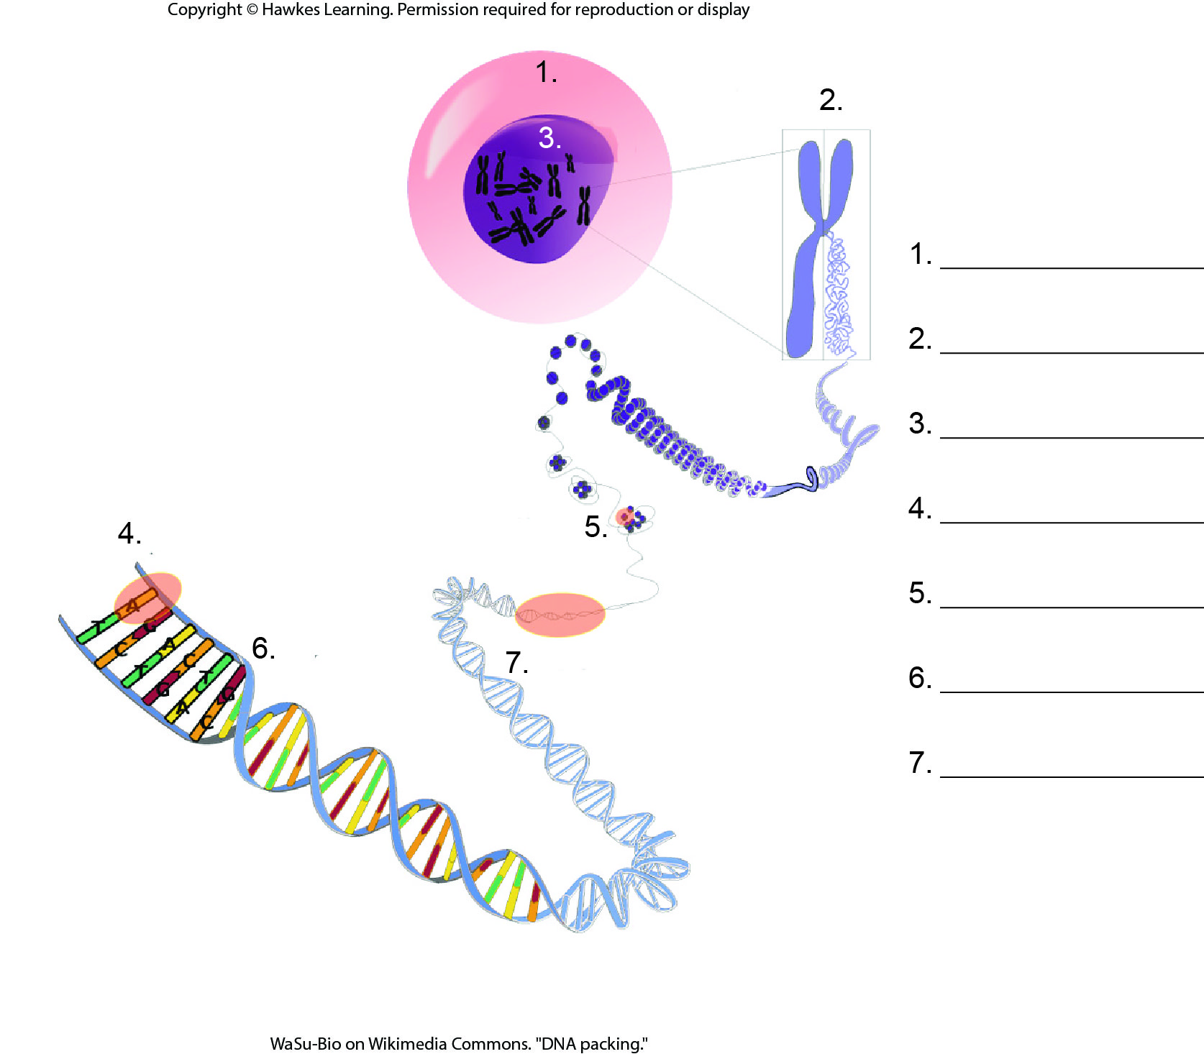
Lesson 3.5 Figure 1 - Numbered

Slide 47
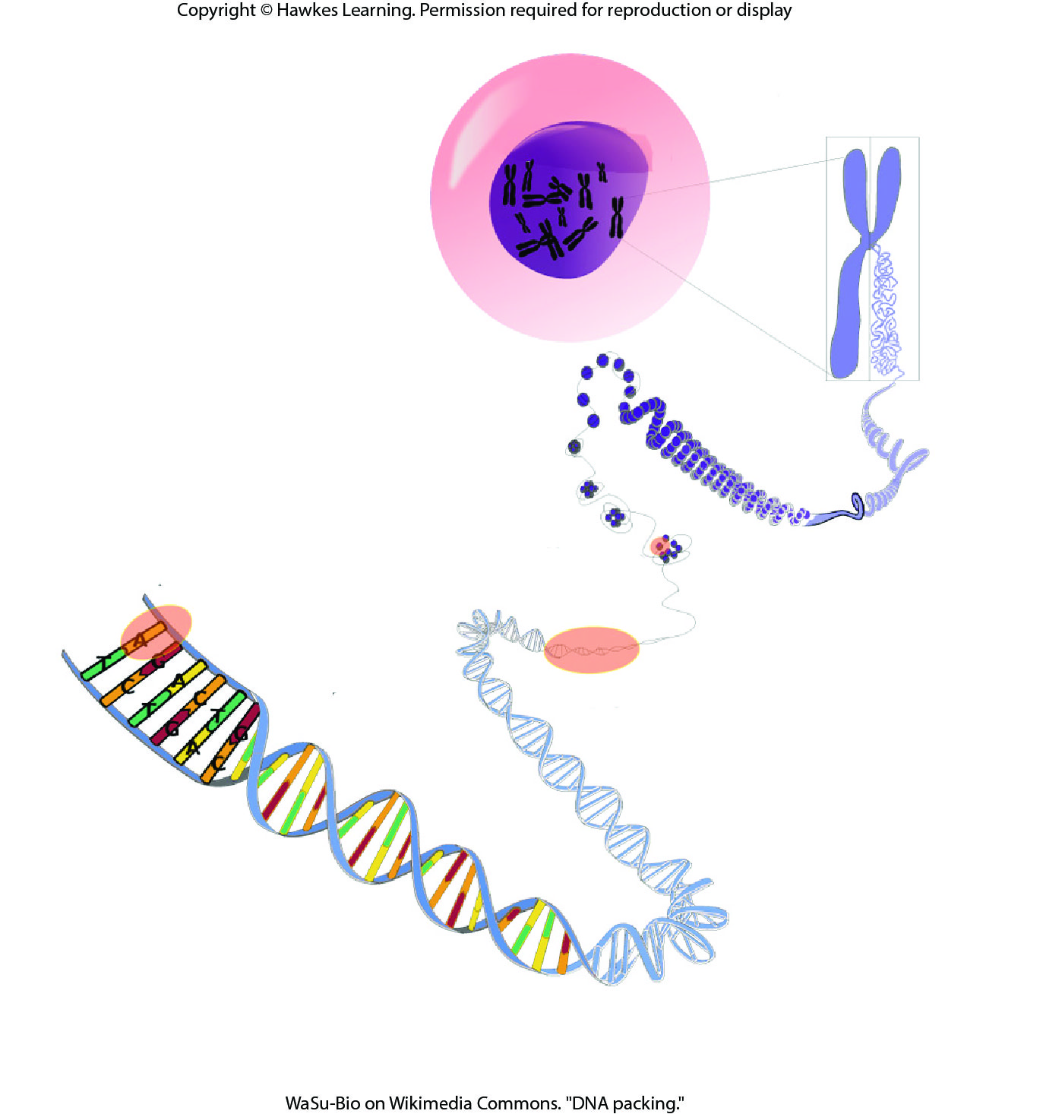
Lesson 3.5 Figure 1

Slide 48
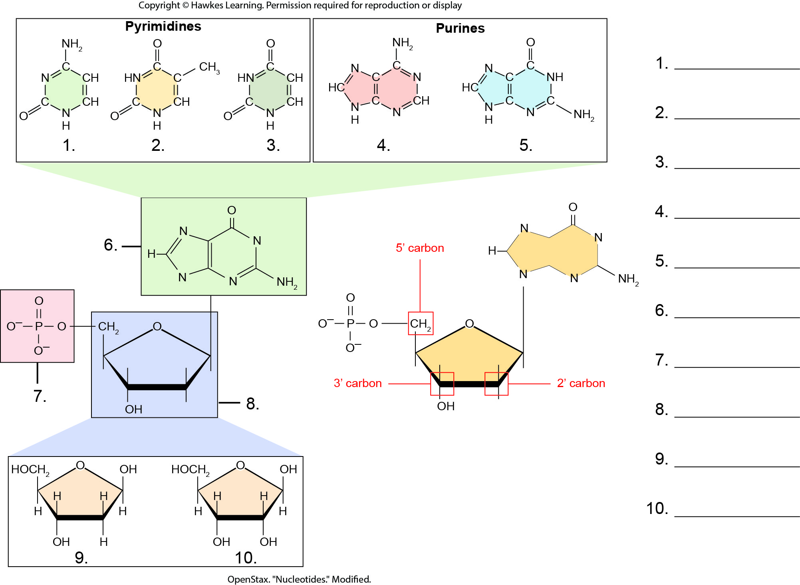
Lesson 3.5 Figure 2 - Numbered

Slide 49
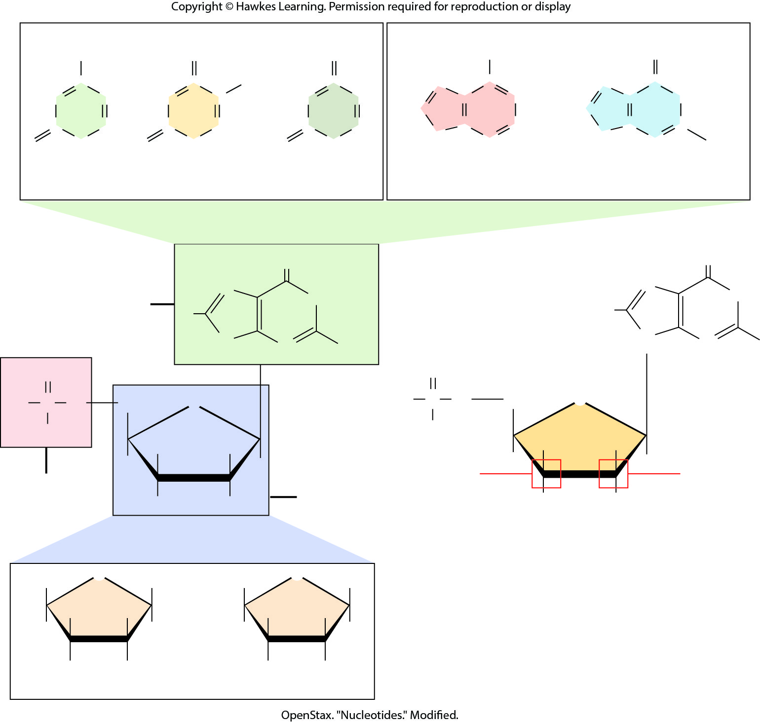
Lesson 3.5 Figure 2

Slide 50
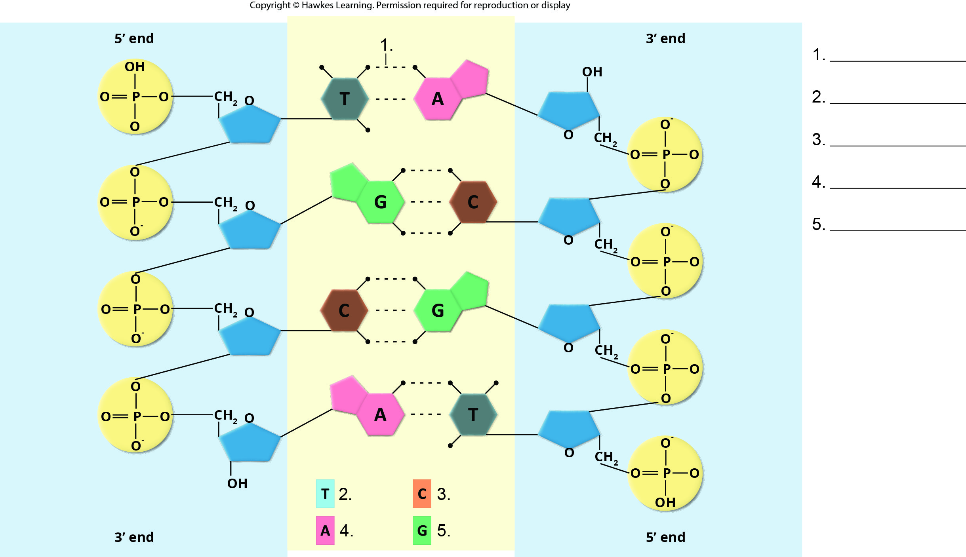
Lesson 3.5 Figure 4 - Numbered

Slide 51
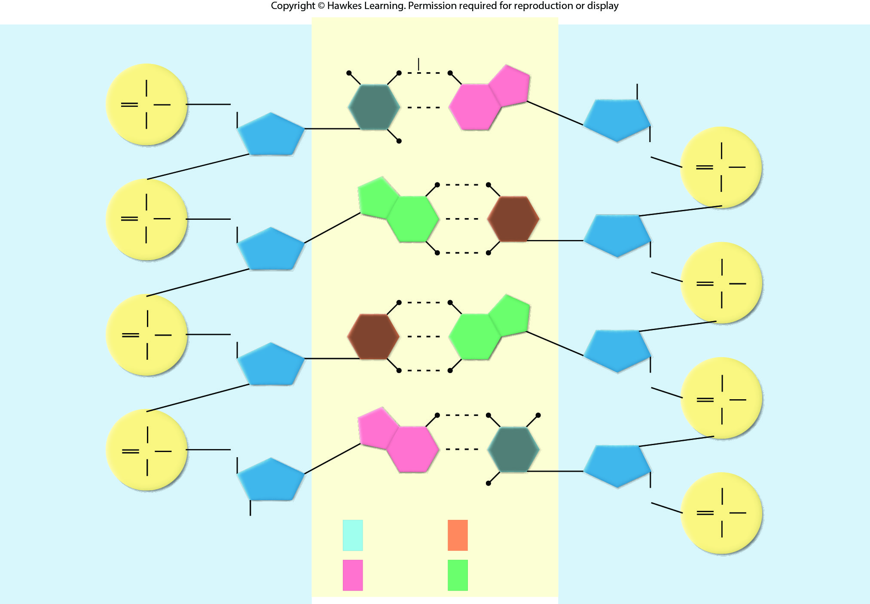
Lesson 3.5 Figure 4

Slide 52
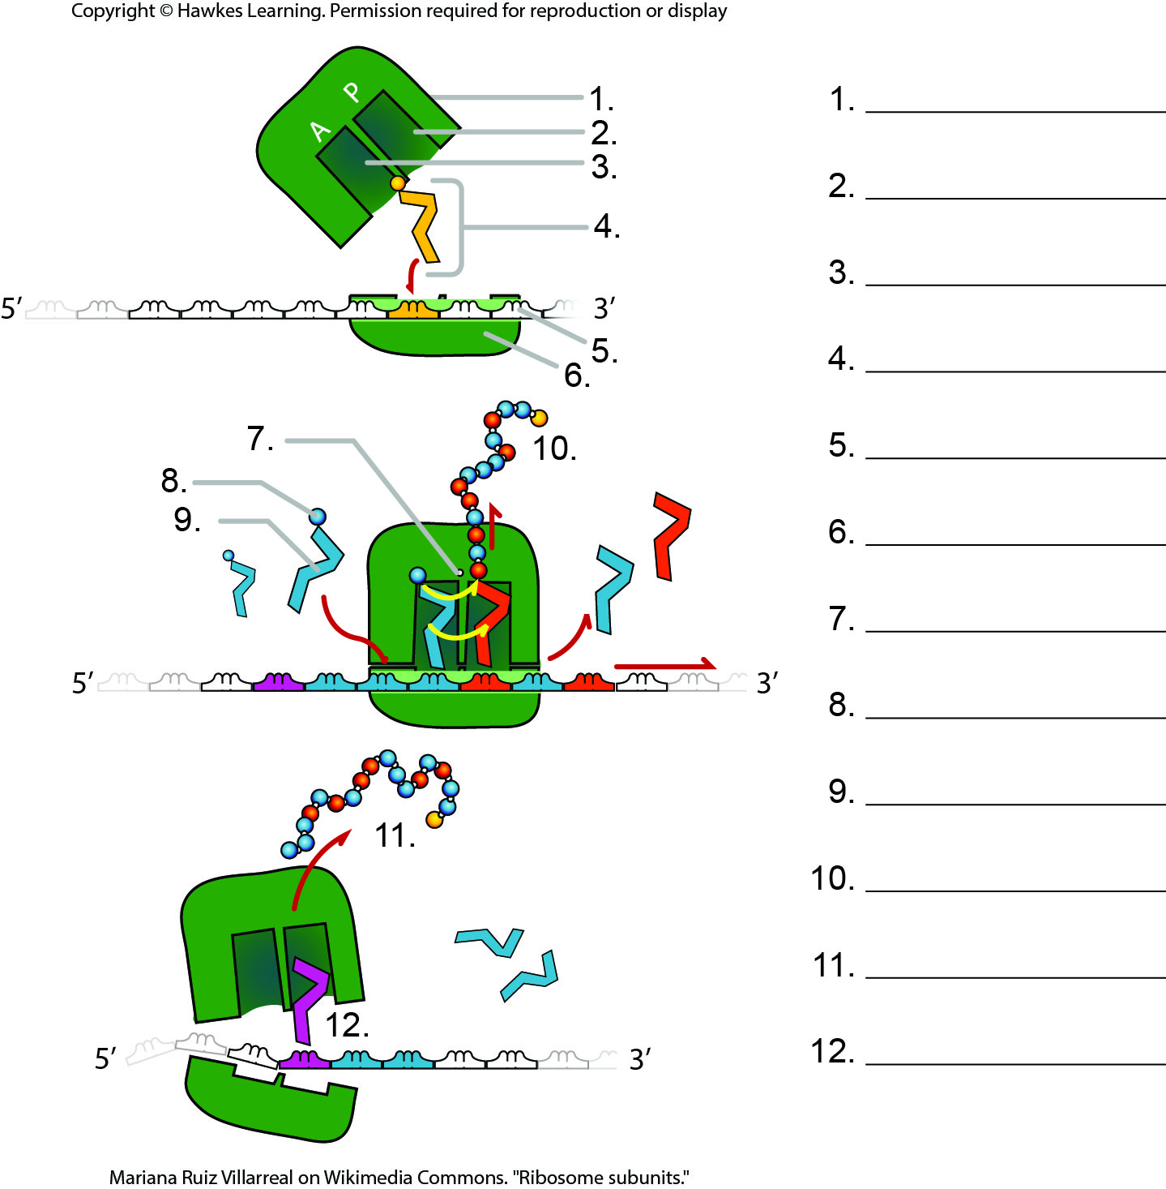
Lesson 3.5 Figure 5 - Numbered

Slide 53

Lesson 3.5 Figure 5

Slide 54
Hawkes Learning – End of PowerPoint

