Slide 1
Chapter 30
Plant Physiology

Slide 2
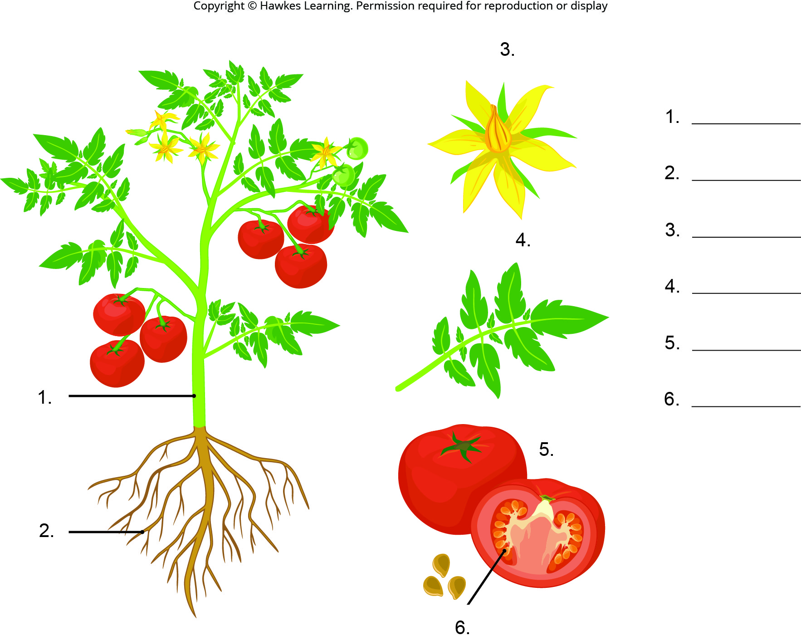
Lesson 30.1 Figure 2 - Numbered

Slide 3
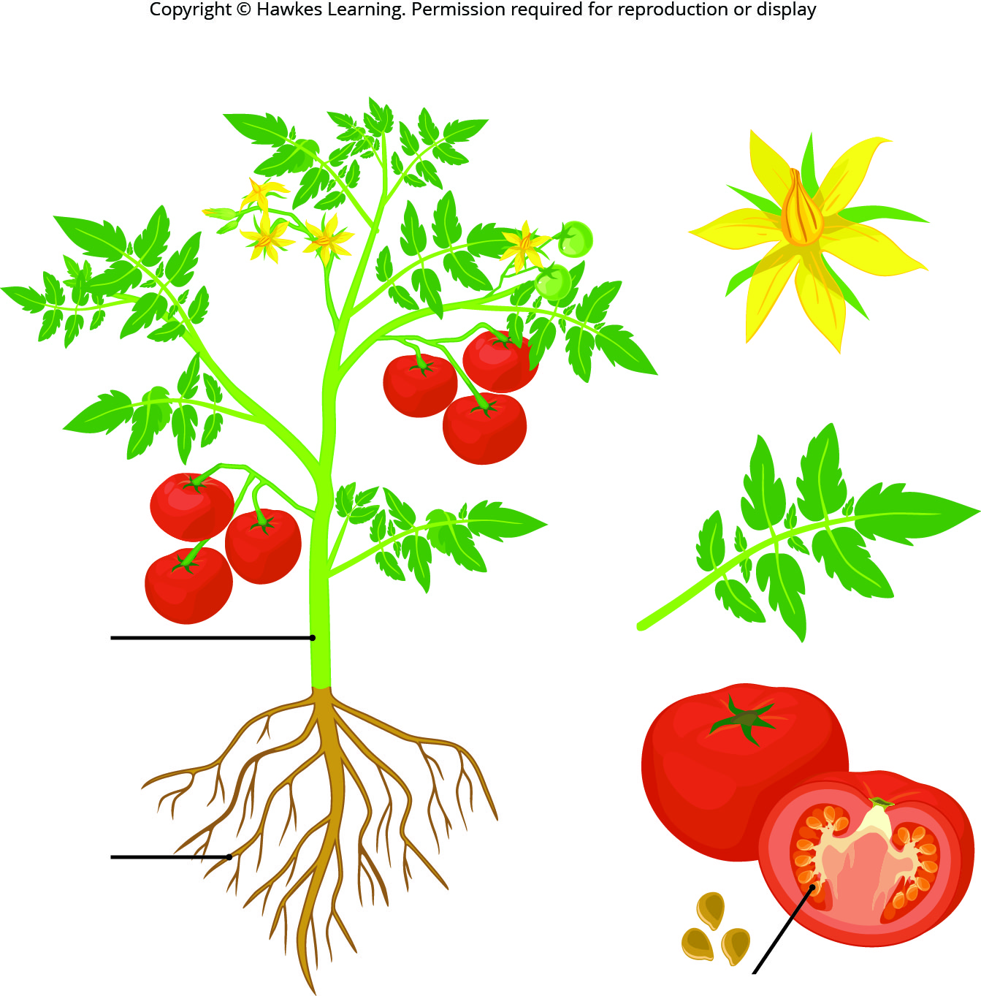
Lesson 30.1 Figure 2

Slide 4
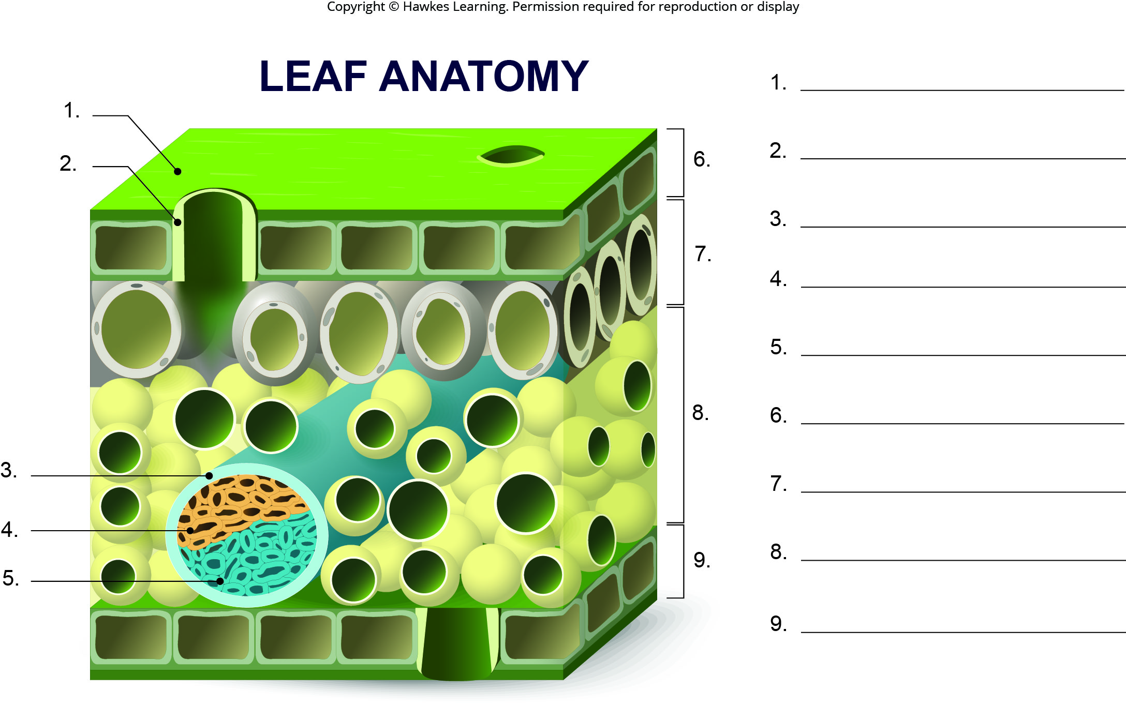
Lesson 30.1 Figure 4 - Numbered

Slide 5
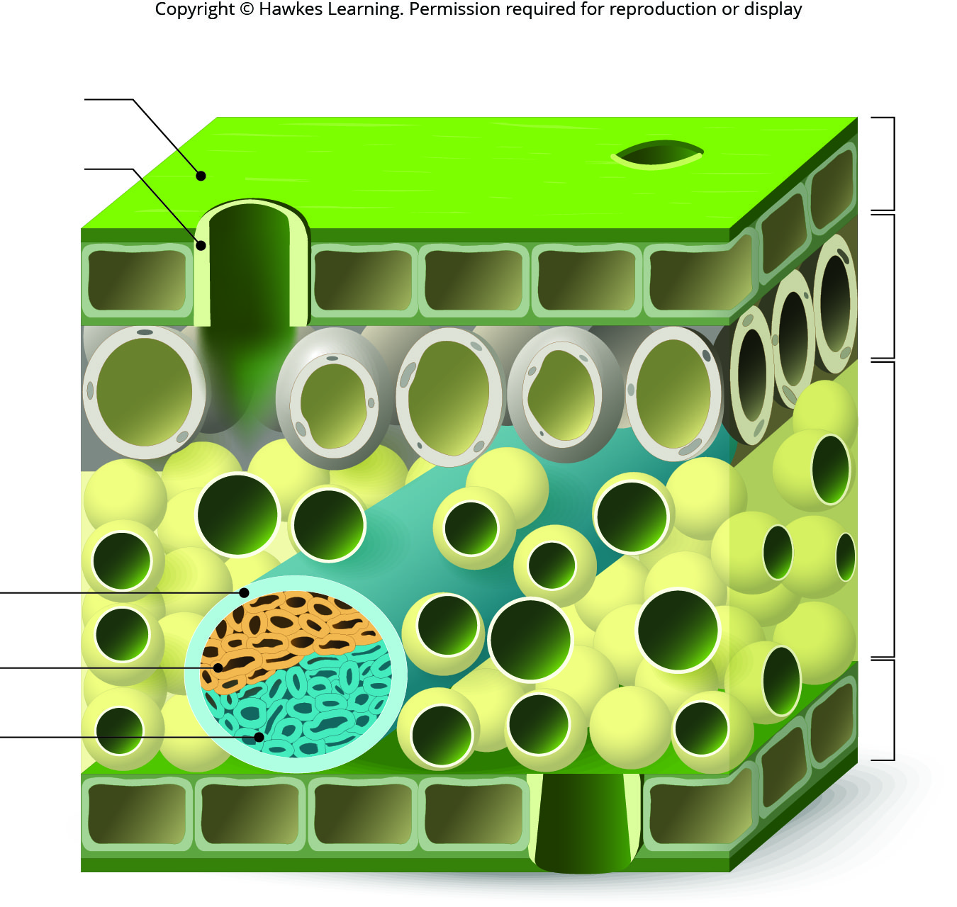
Lesson 30.1 Figure 4

Slide 6
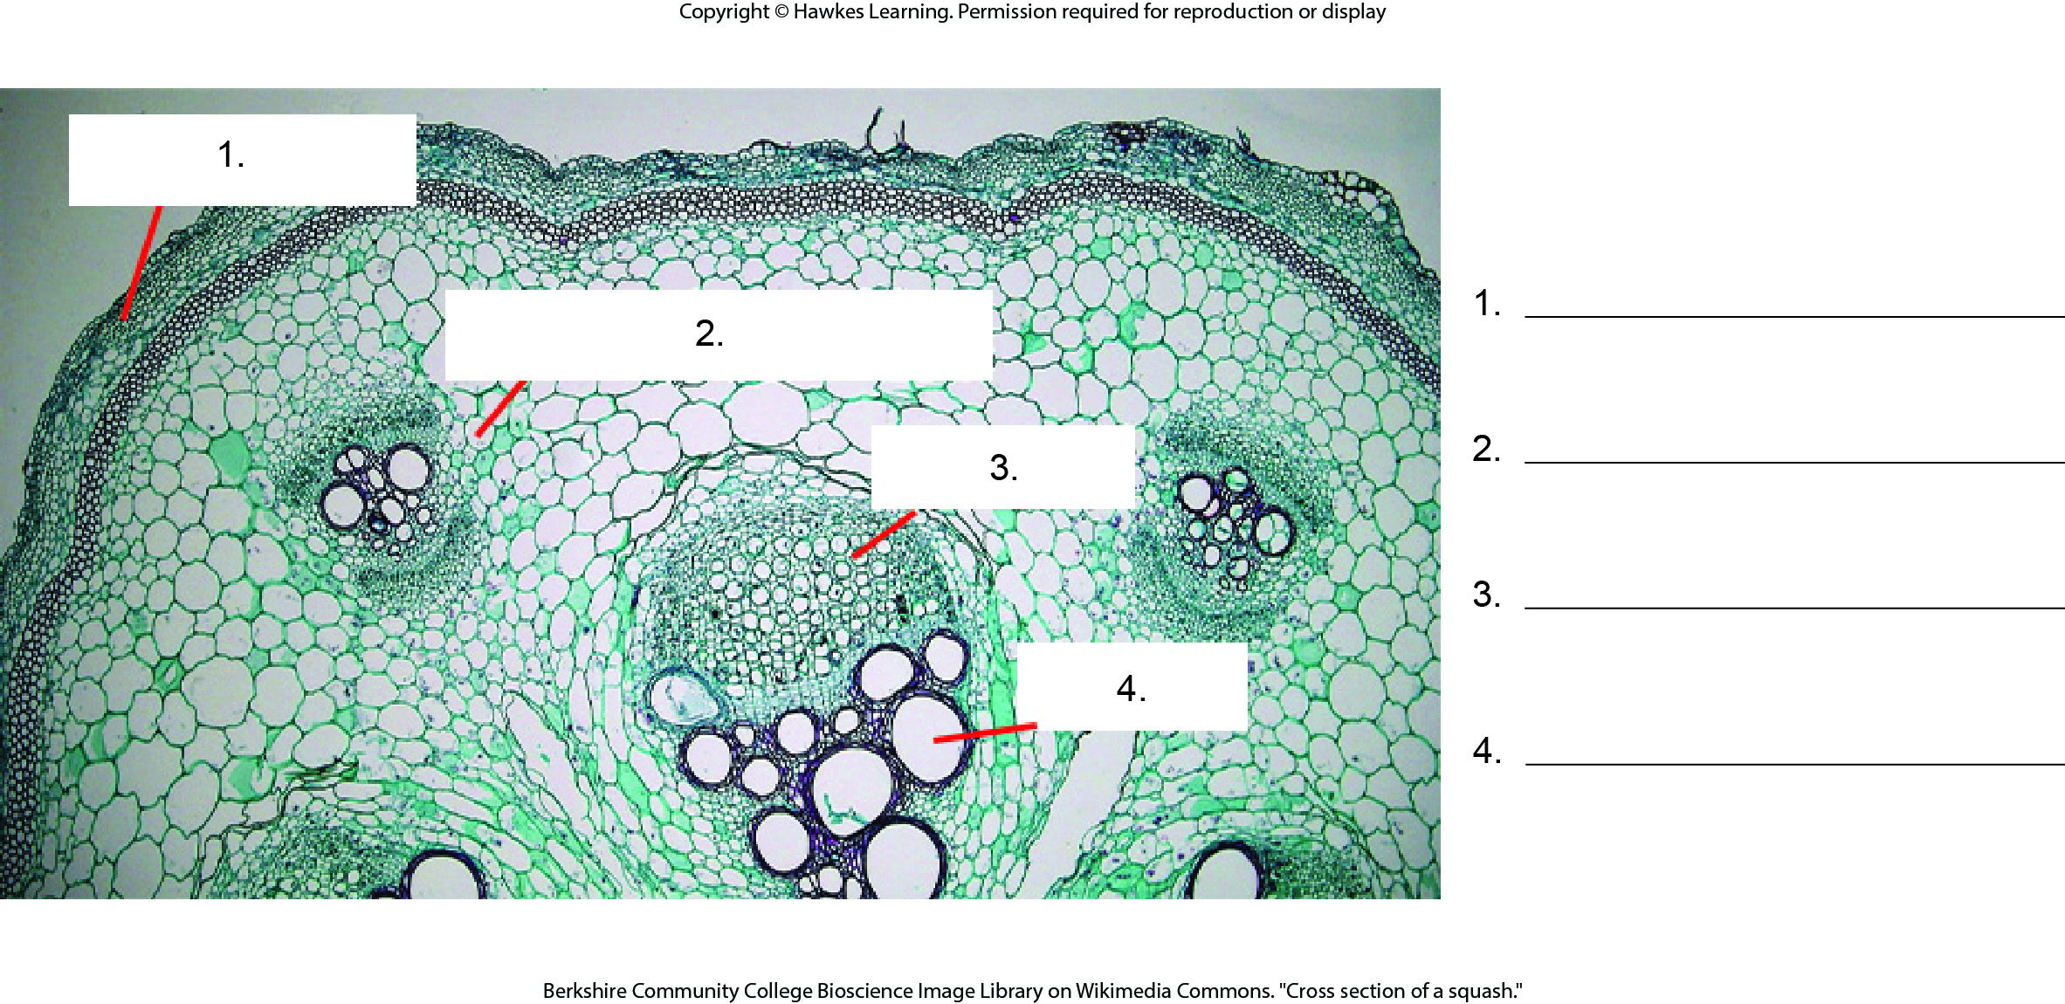
Lesson 30.1 Figure 5 - Numbered

Slide 7
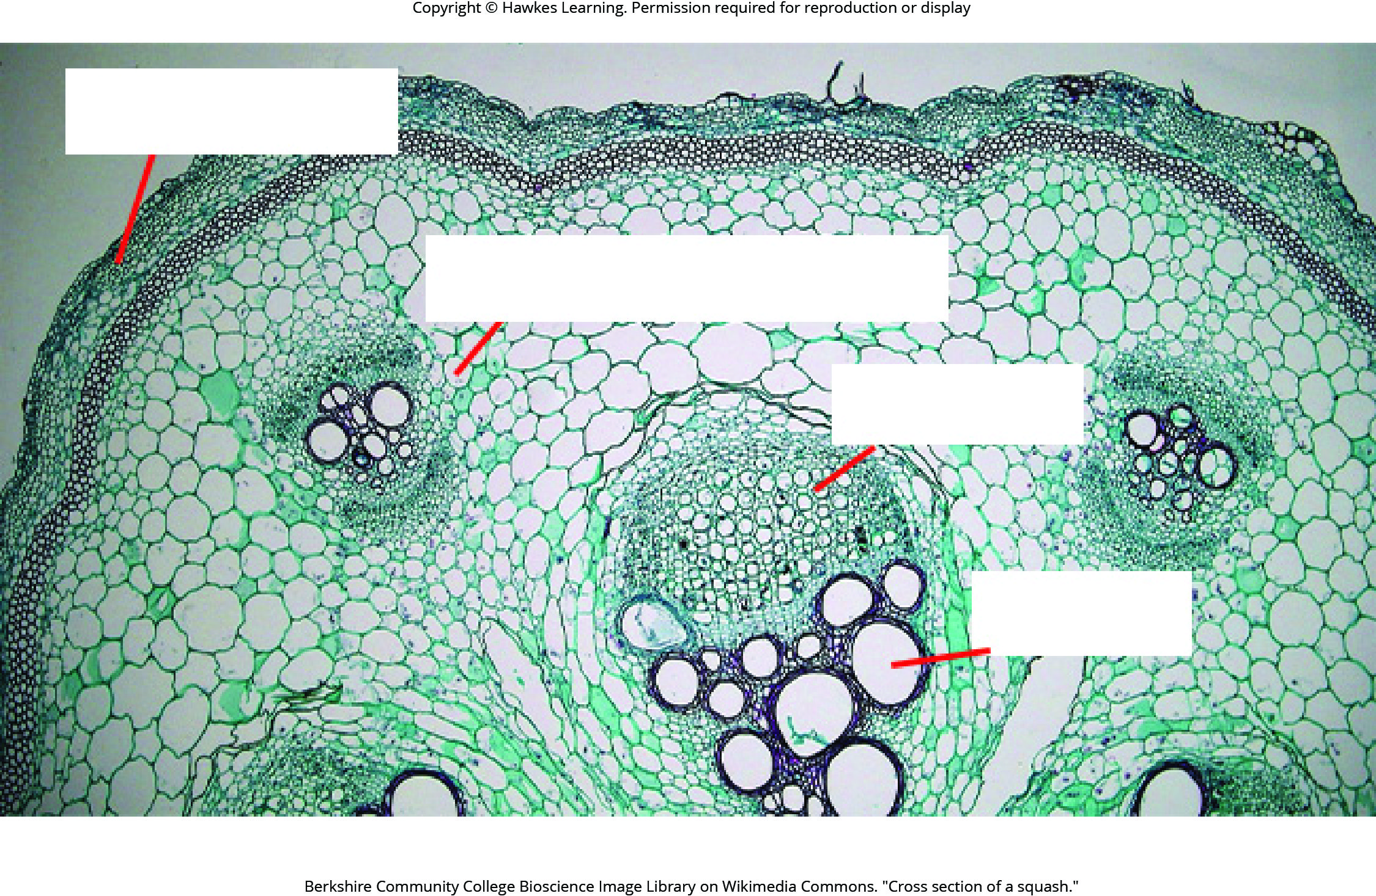
Lesson 30.1 Figure 5

Slide 8
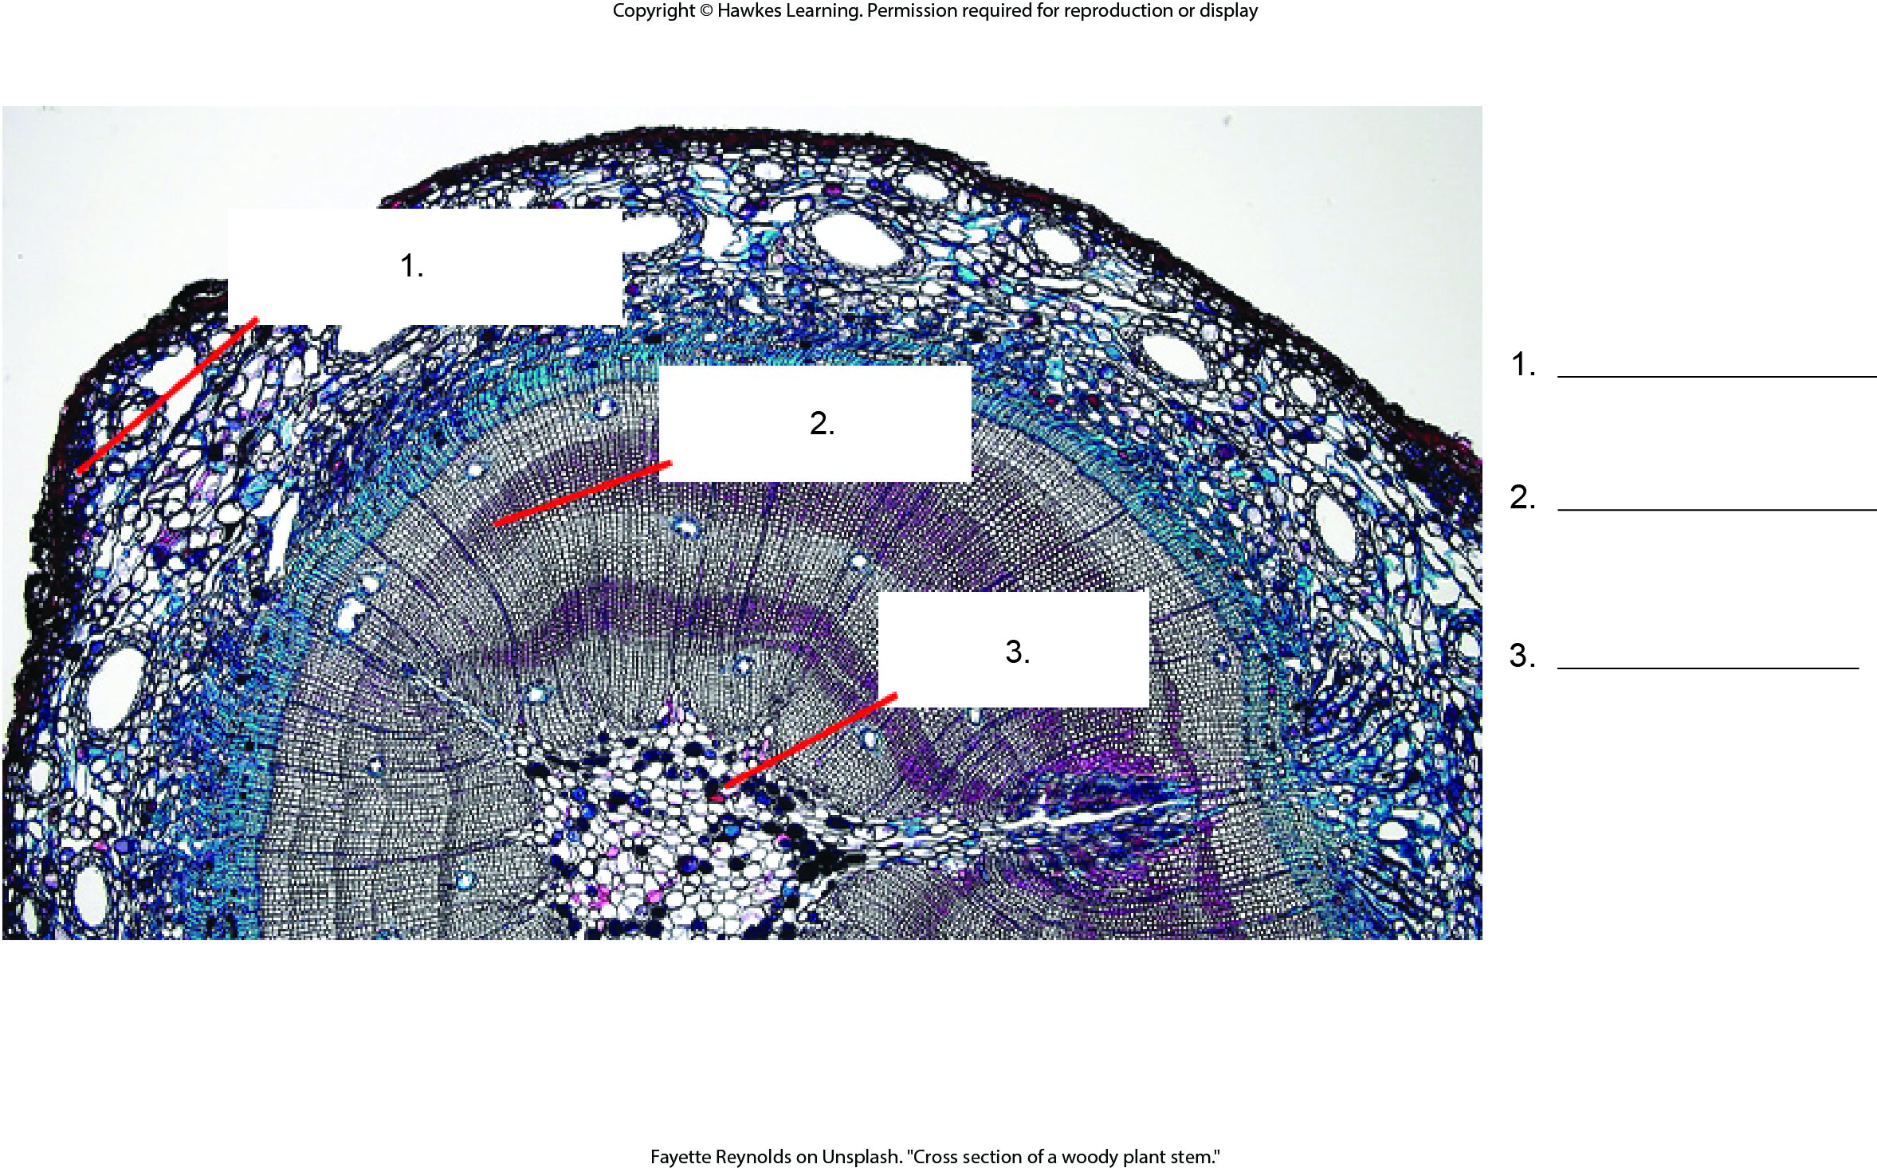
Lesson 30.1 Figure 6 - Numbered

Slide 9
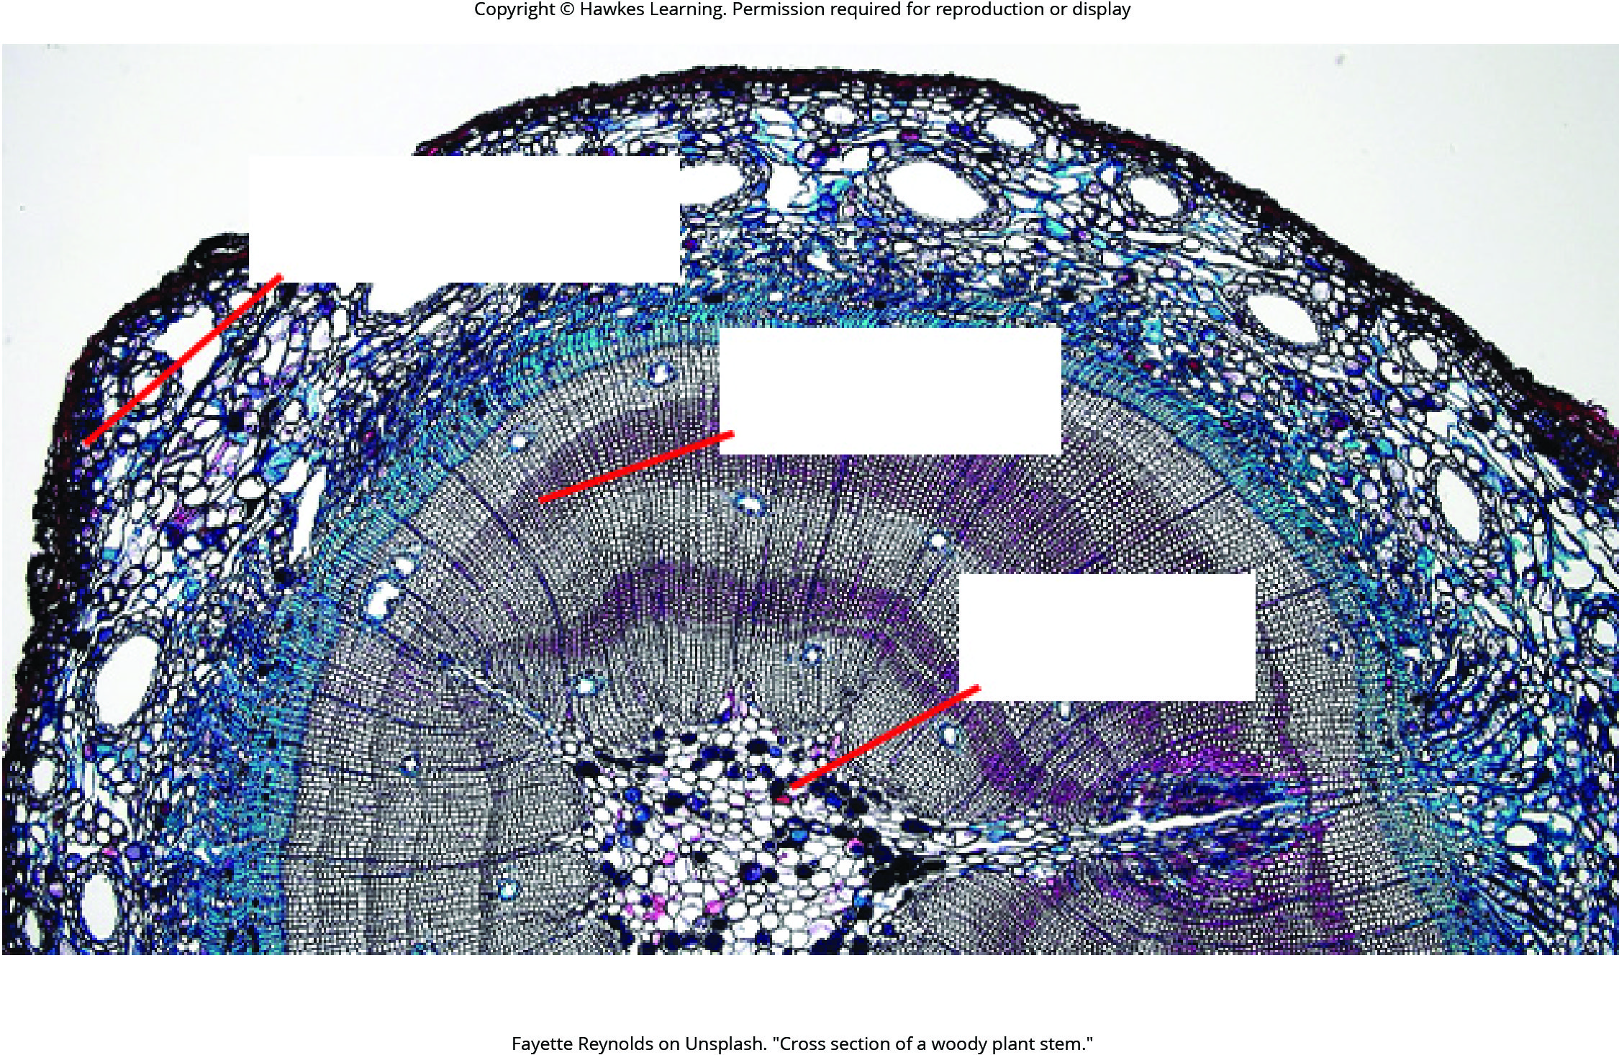
Lesson 30.1 Figure 6

Slide 10
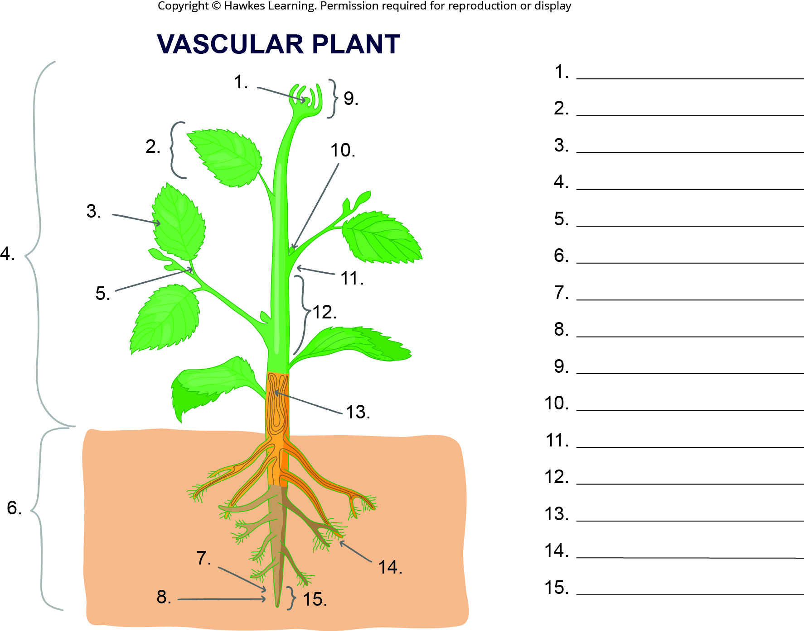
Lesson 30.2 Figure 1 - Numbered

Slide 11
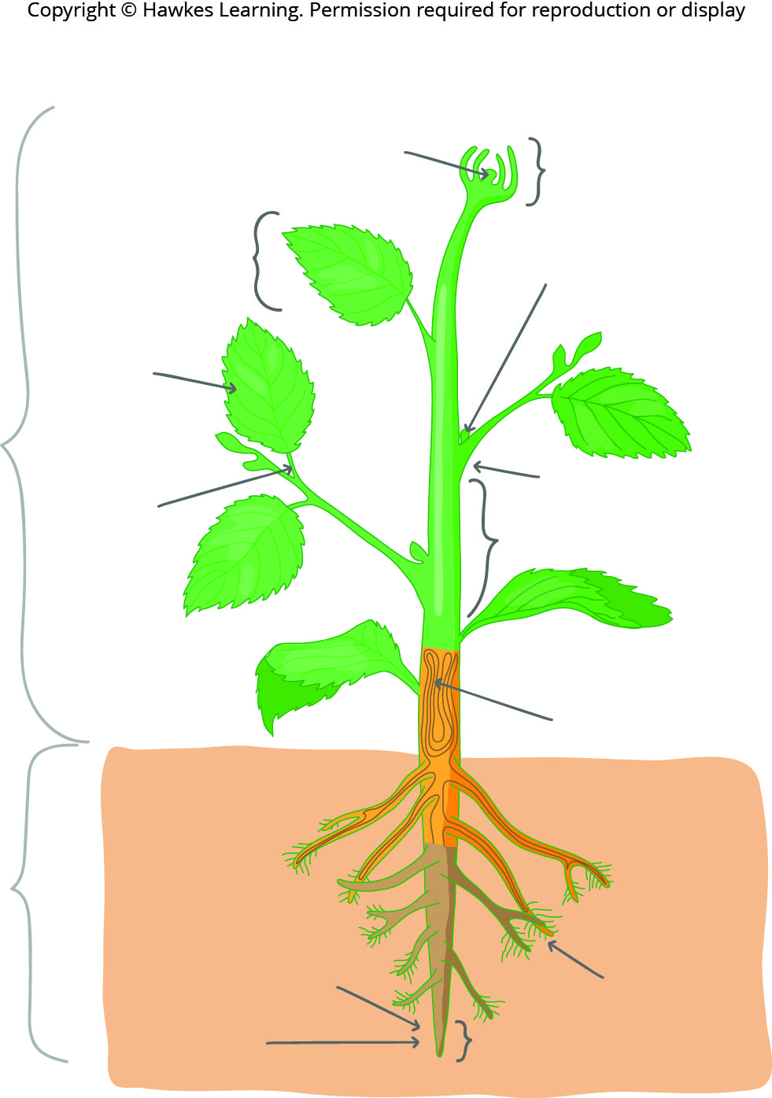
Lesson 30.2 Figure 1

Slide 12
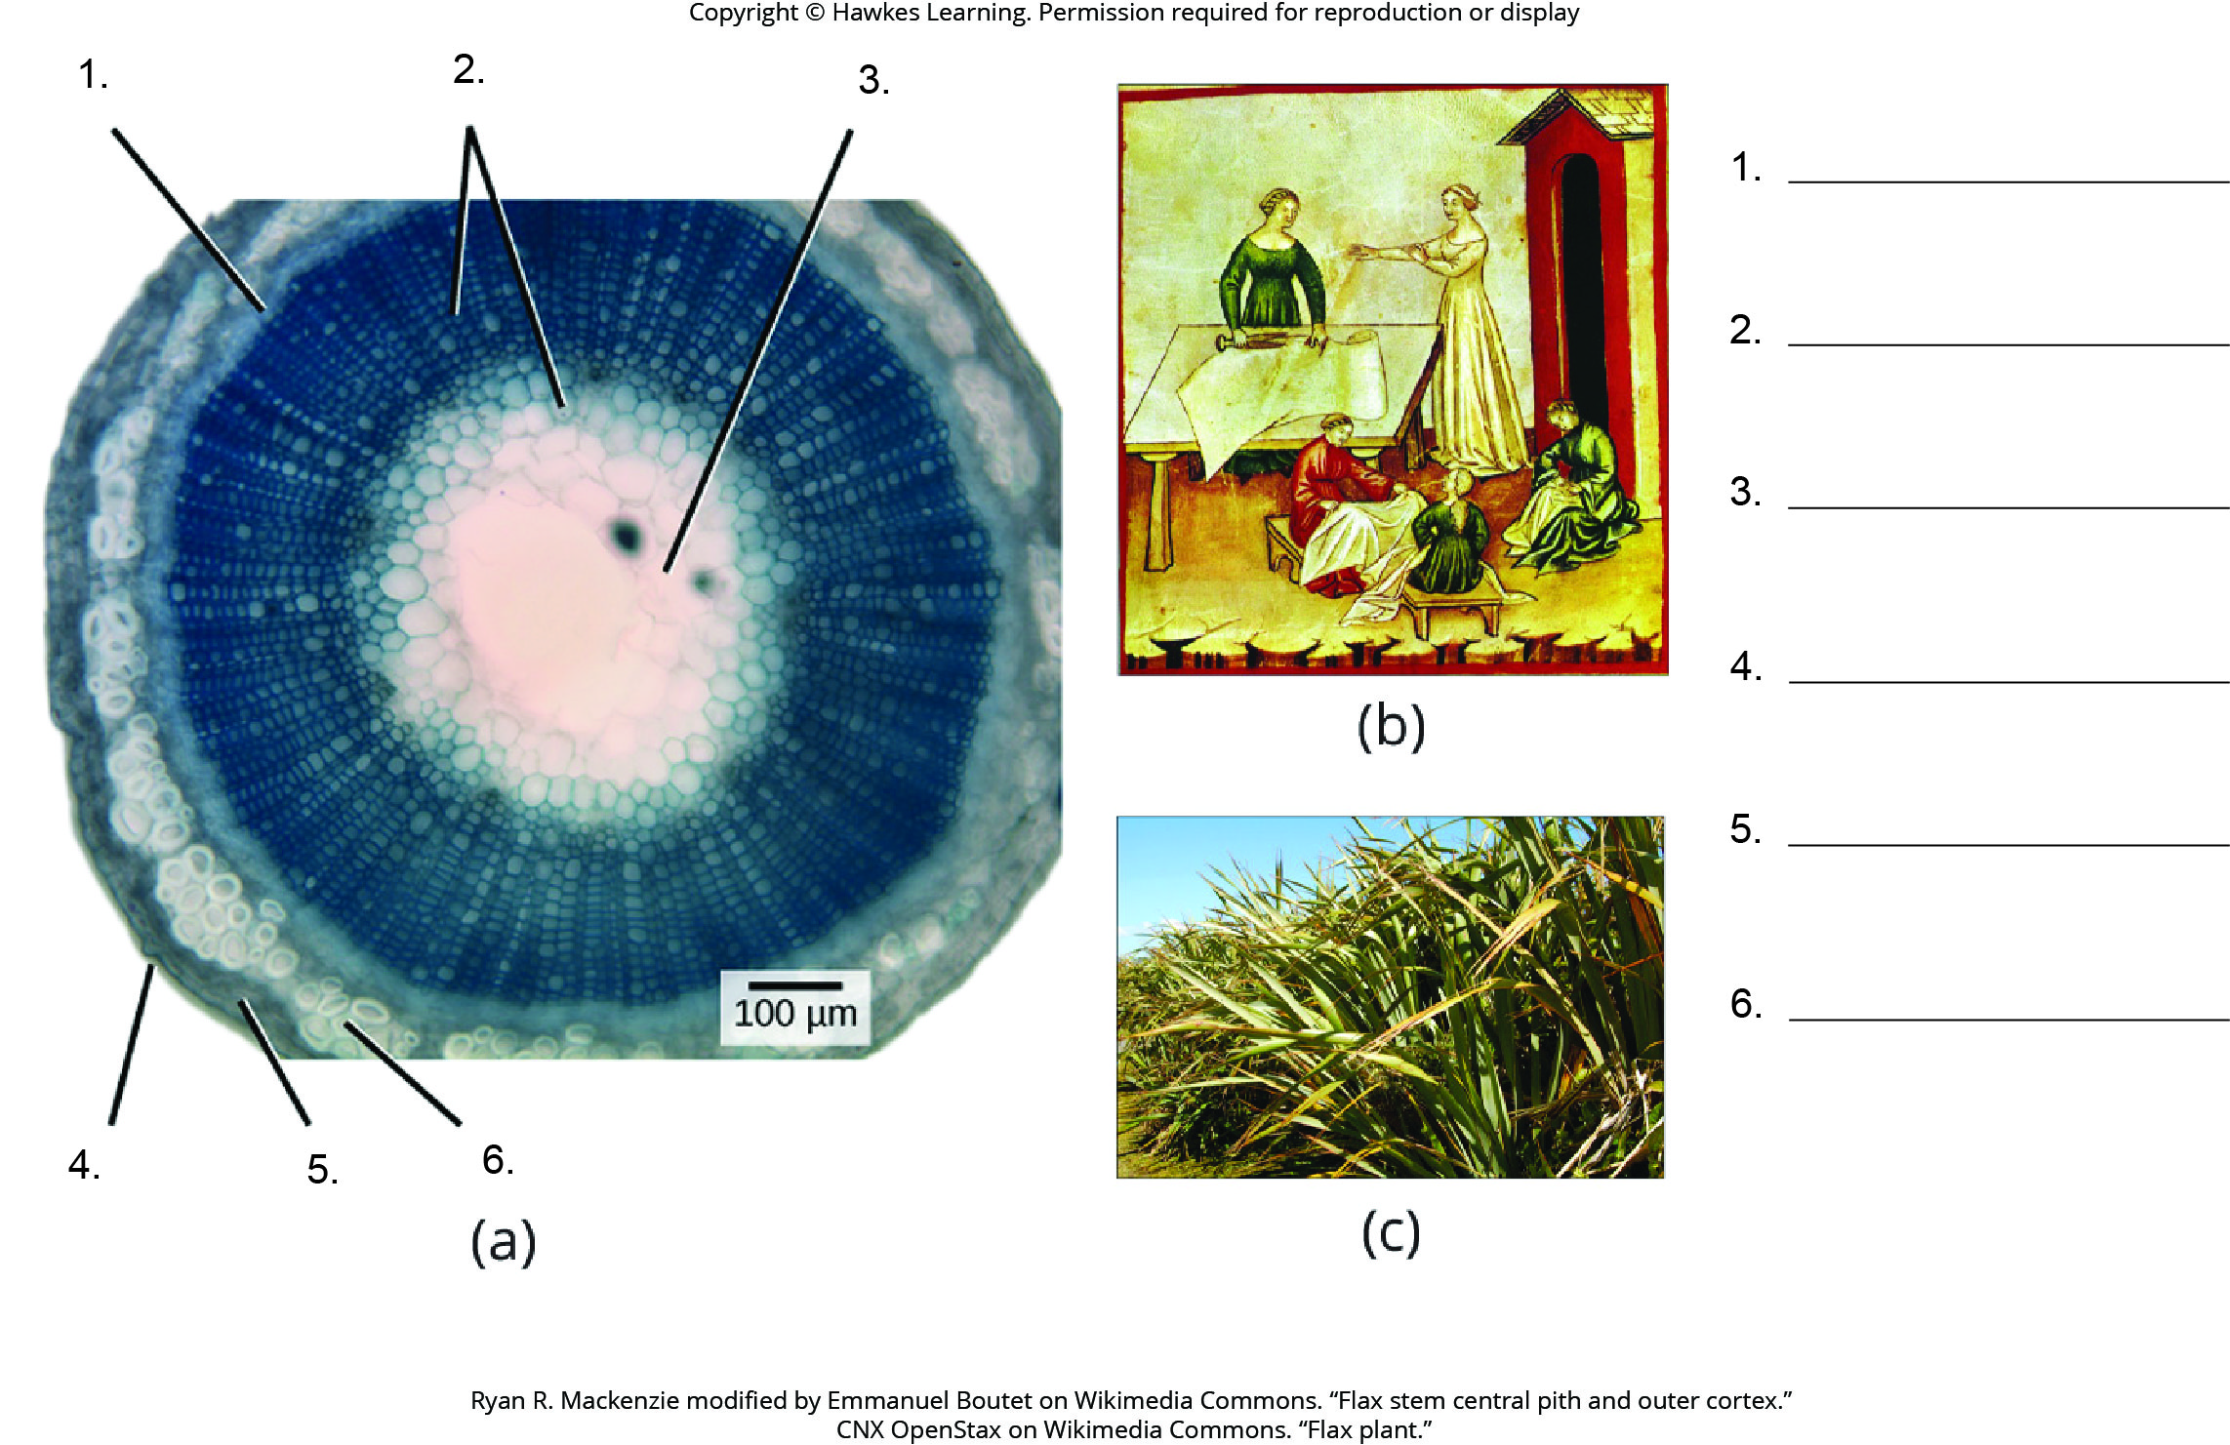
Lesson 30.2 Figure 4 - Numbered

Slide 13
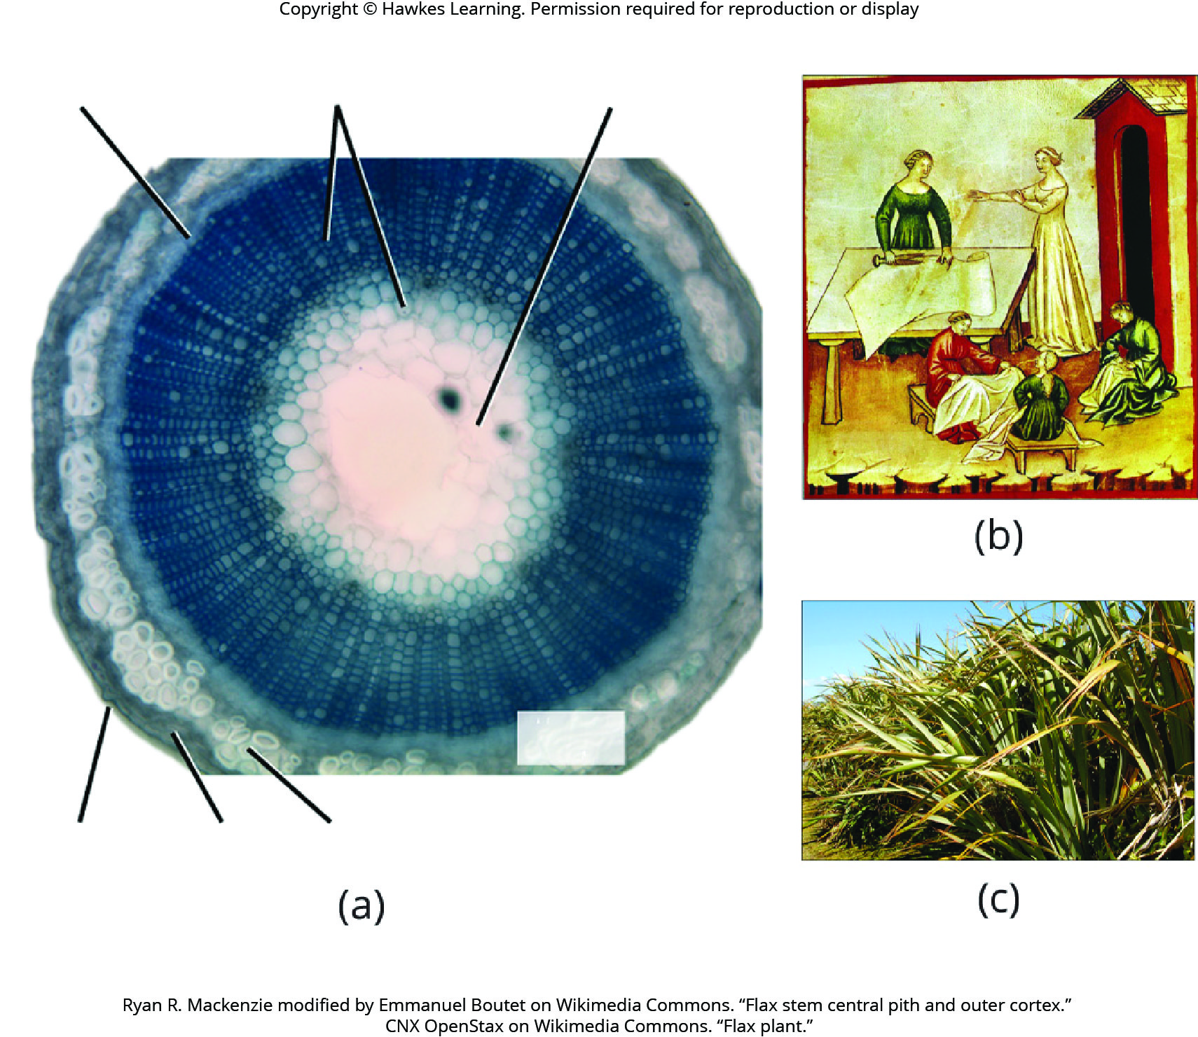
Lesson 30.2 Figure 4

Slide 14
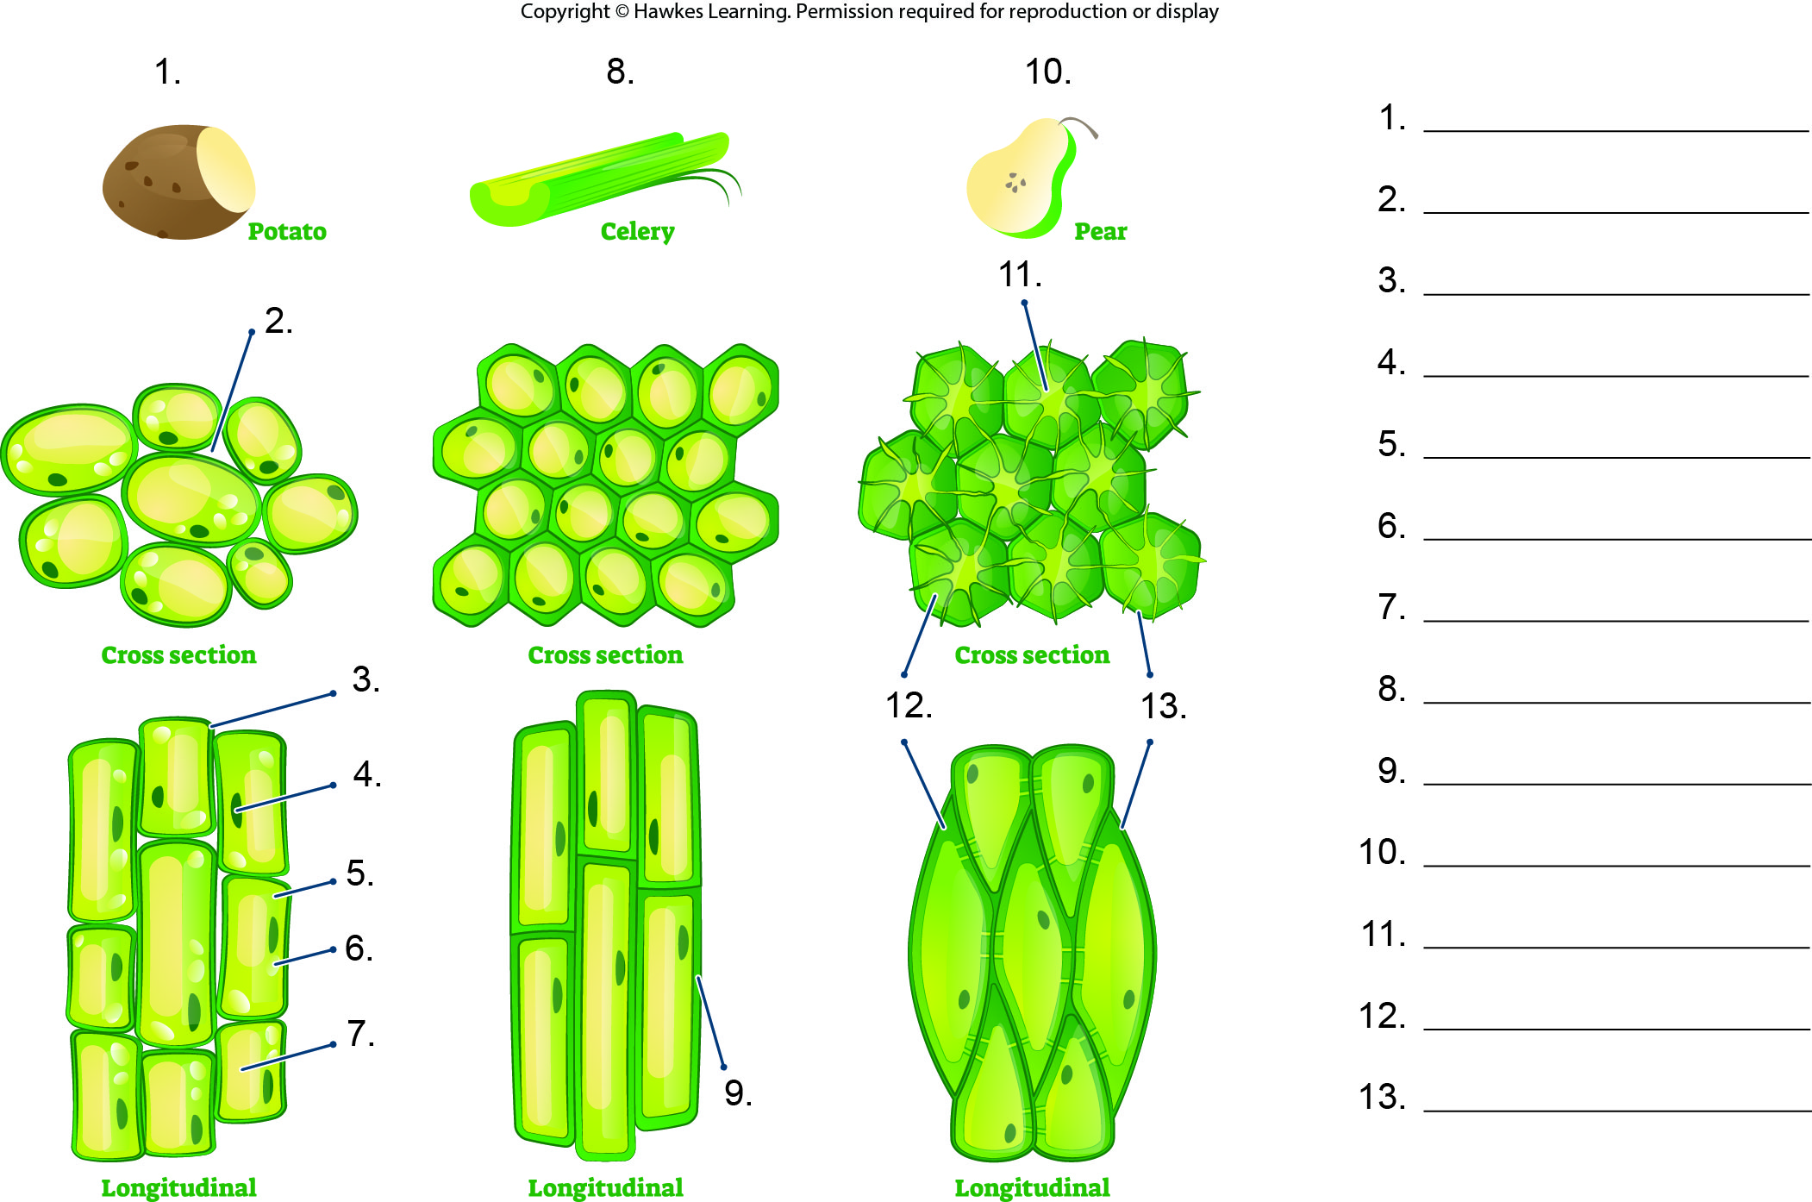
Lesson 30.2 Figure 5 - Numbered

Slide 15
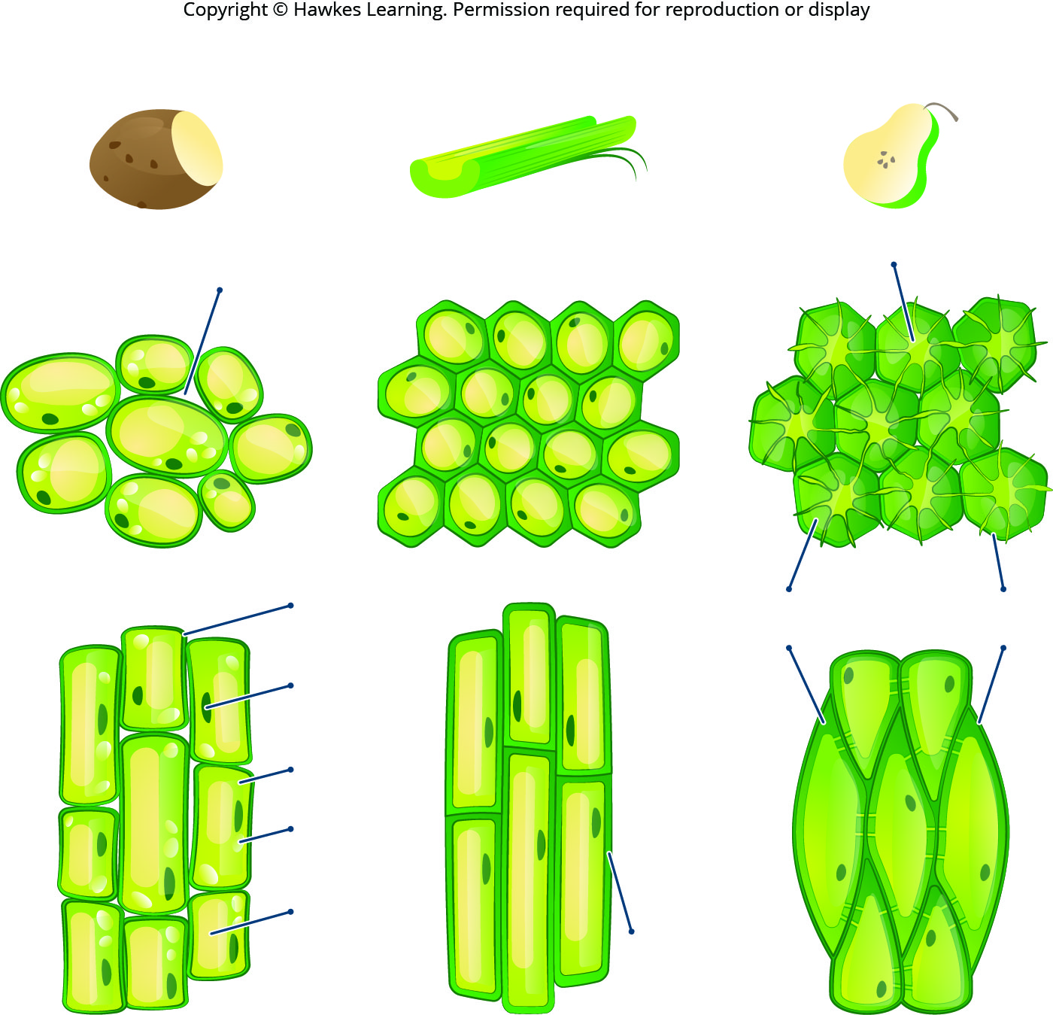
Lesson 30.2 Figure 5

Slide 16
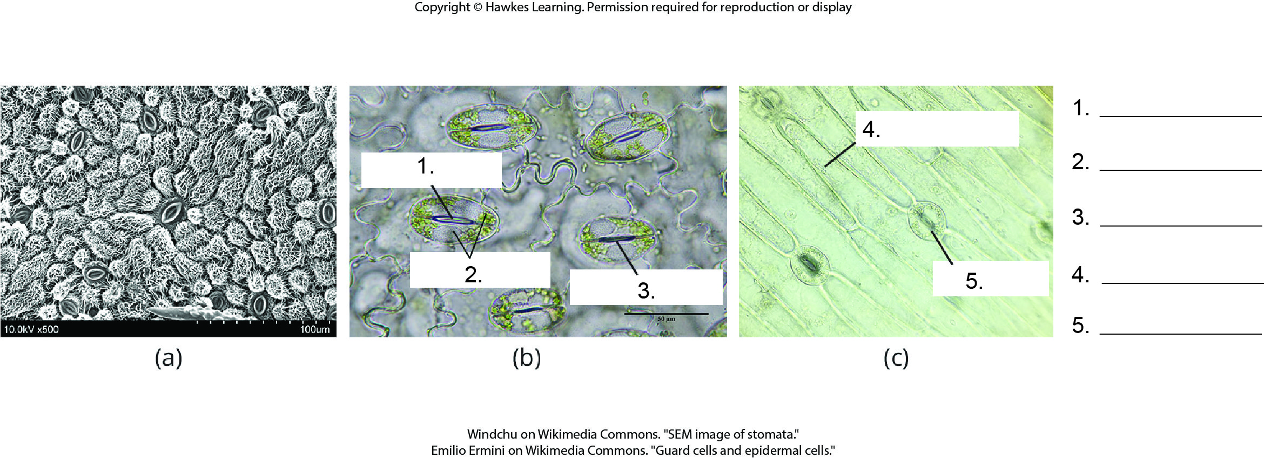
Lesson 30.2 Figure 6 - Numbered

Slide 17
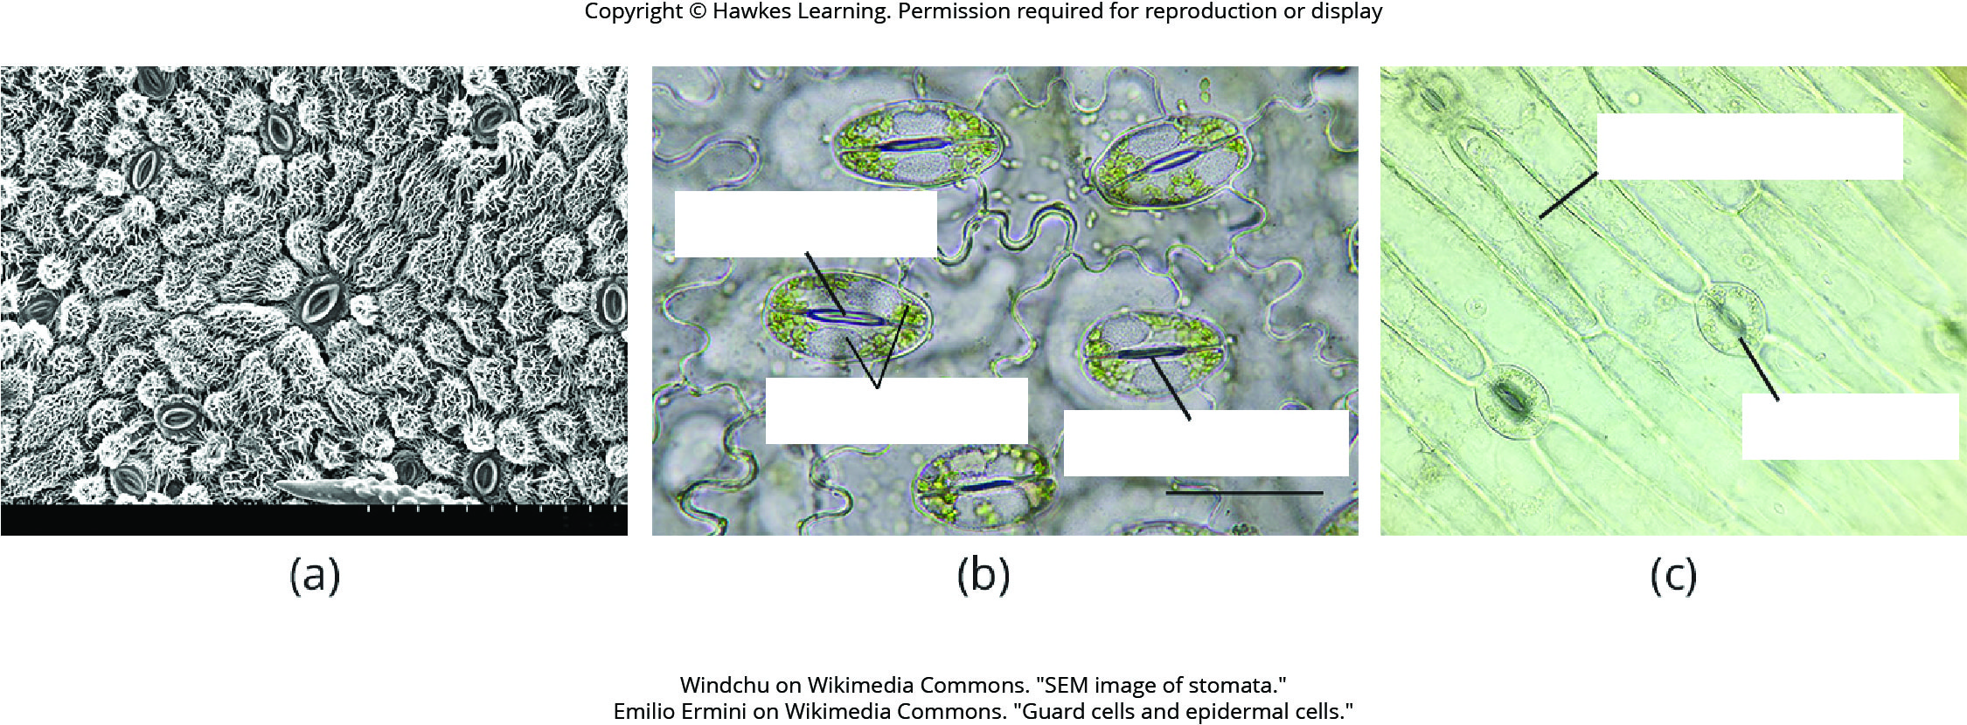
Lesson 30.2 Figure 6

Slide 18
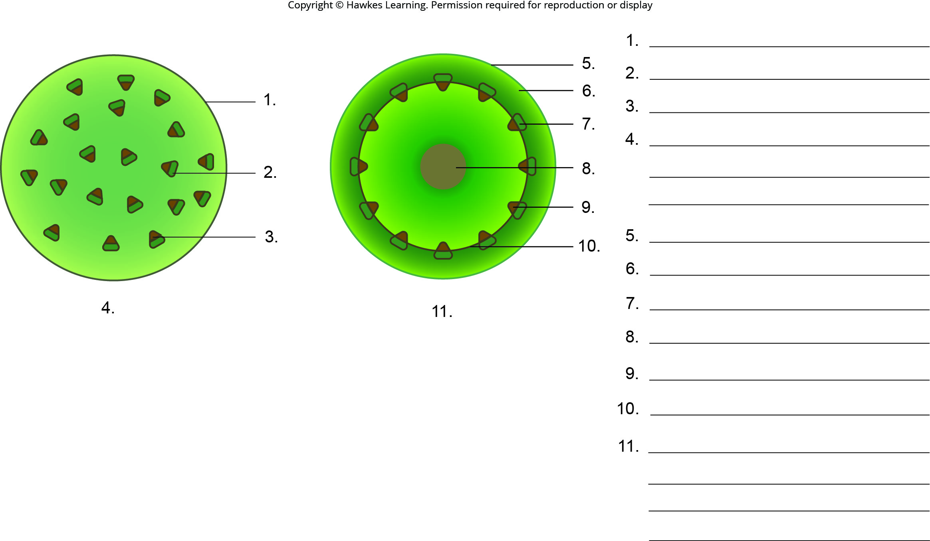
Lesson 30.2 Figure 7 - Numbered

Slide 19
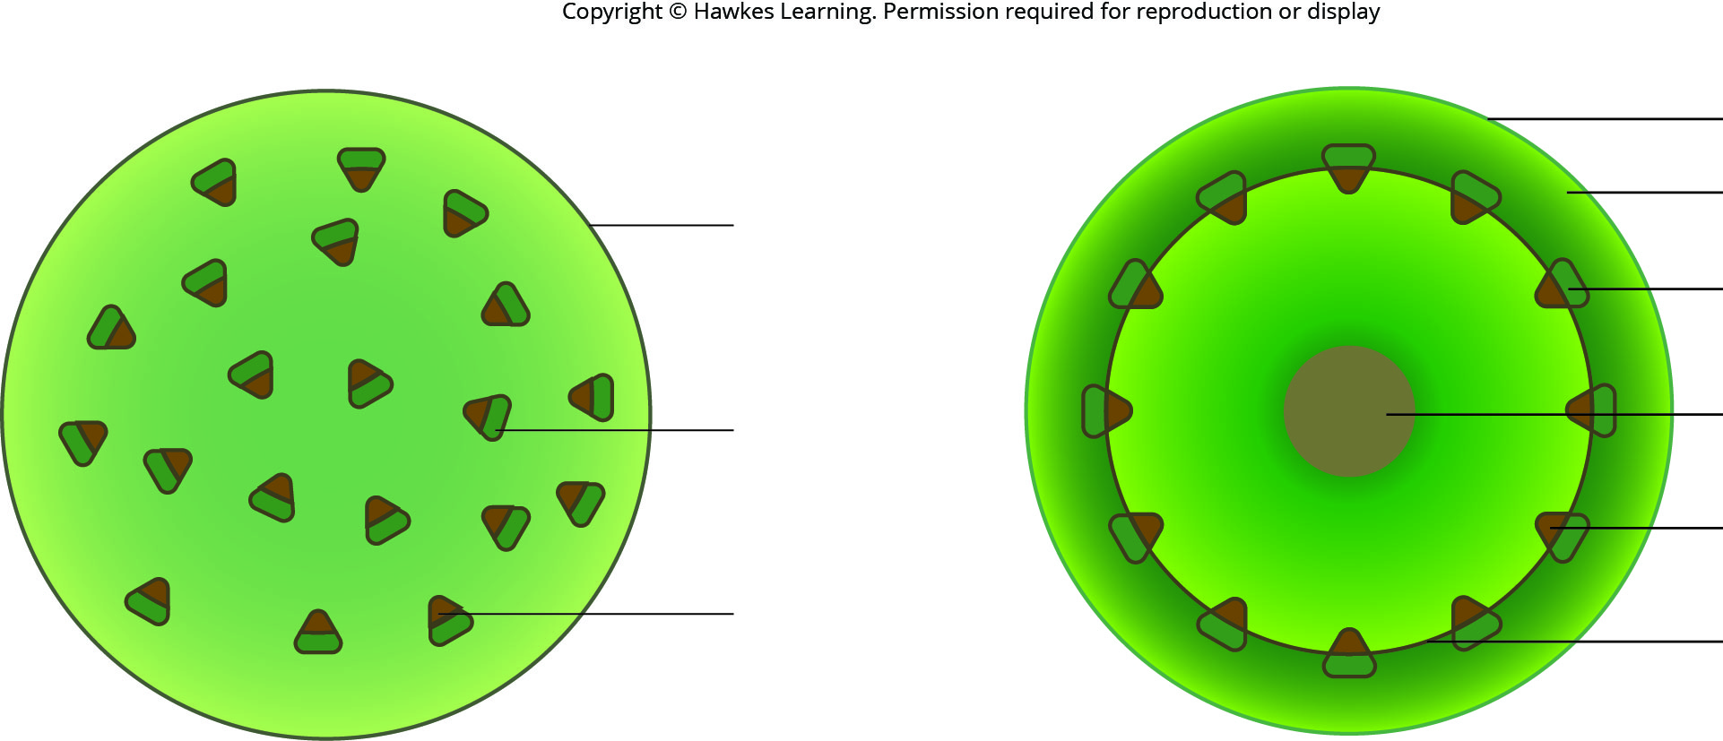
Lesson 30.2 Figure 7

Slide 20
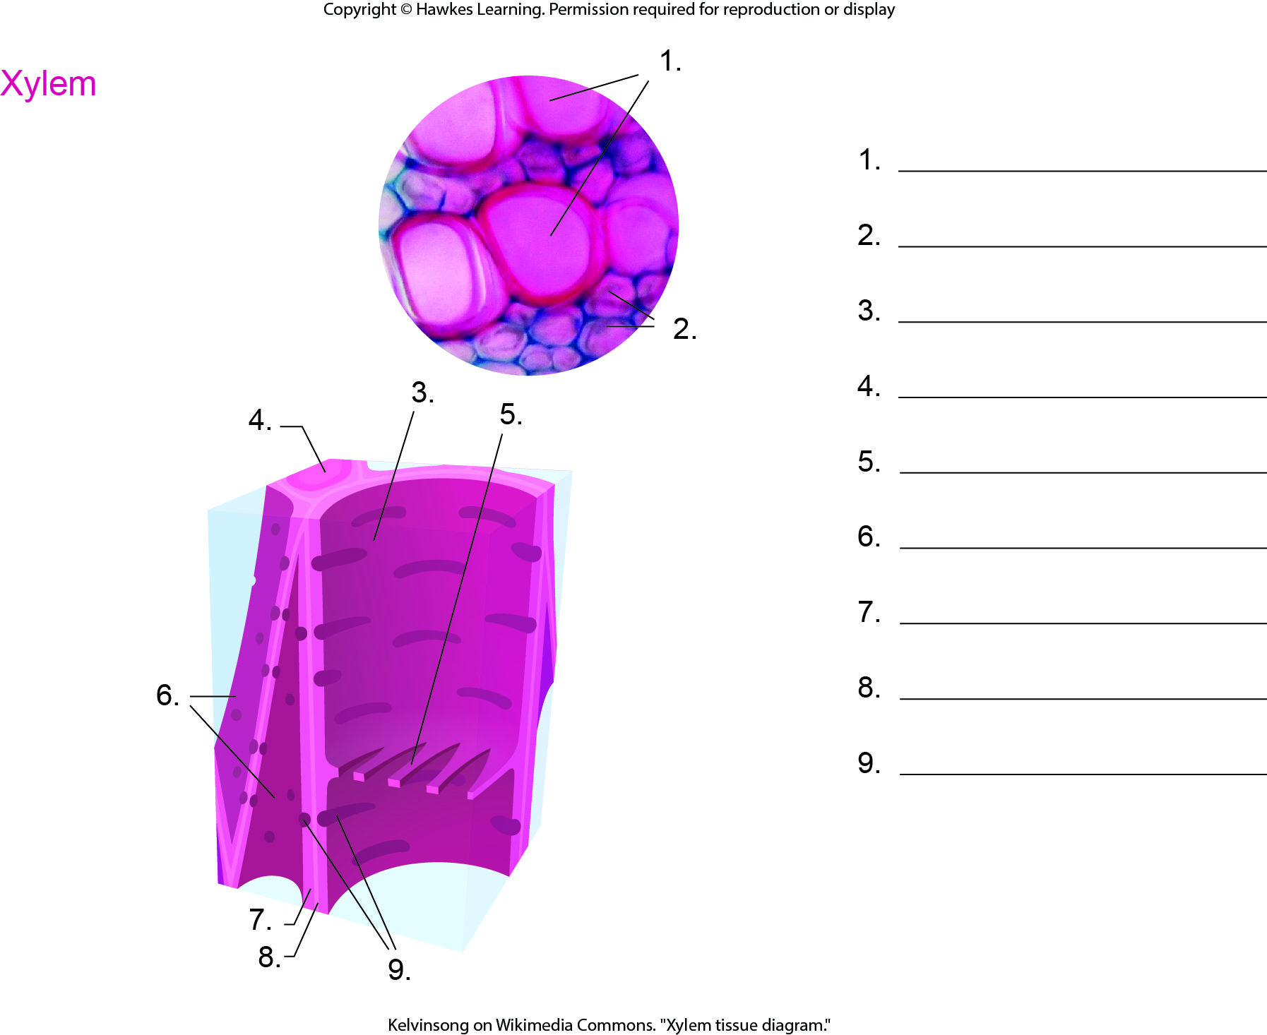
Lesson 30.2 Figure 8 - Numbered

Slide 21
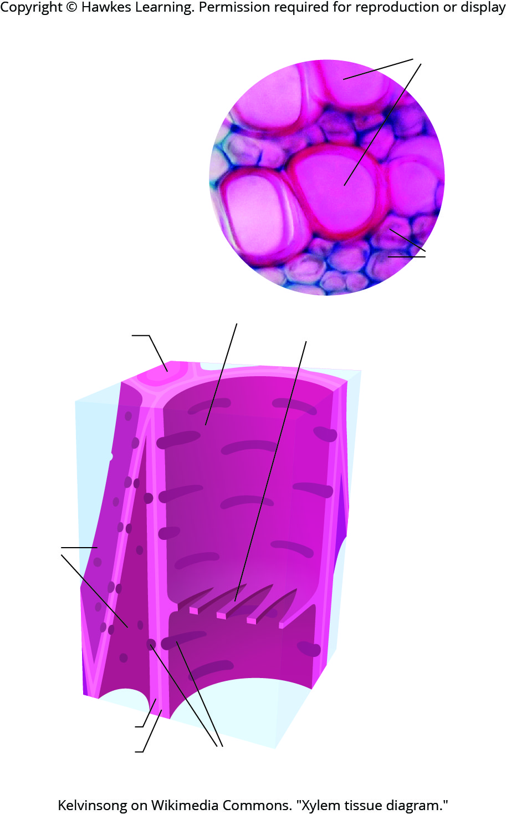
Lesson 30.2 Figure 8

Slide 22
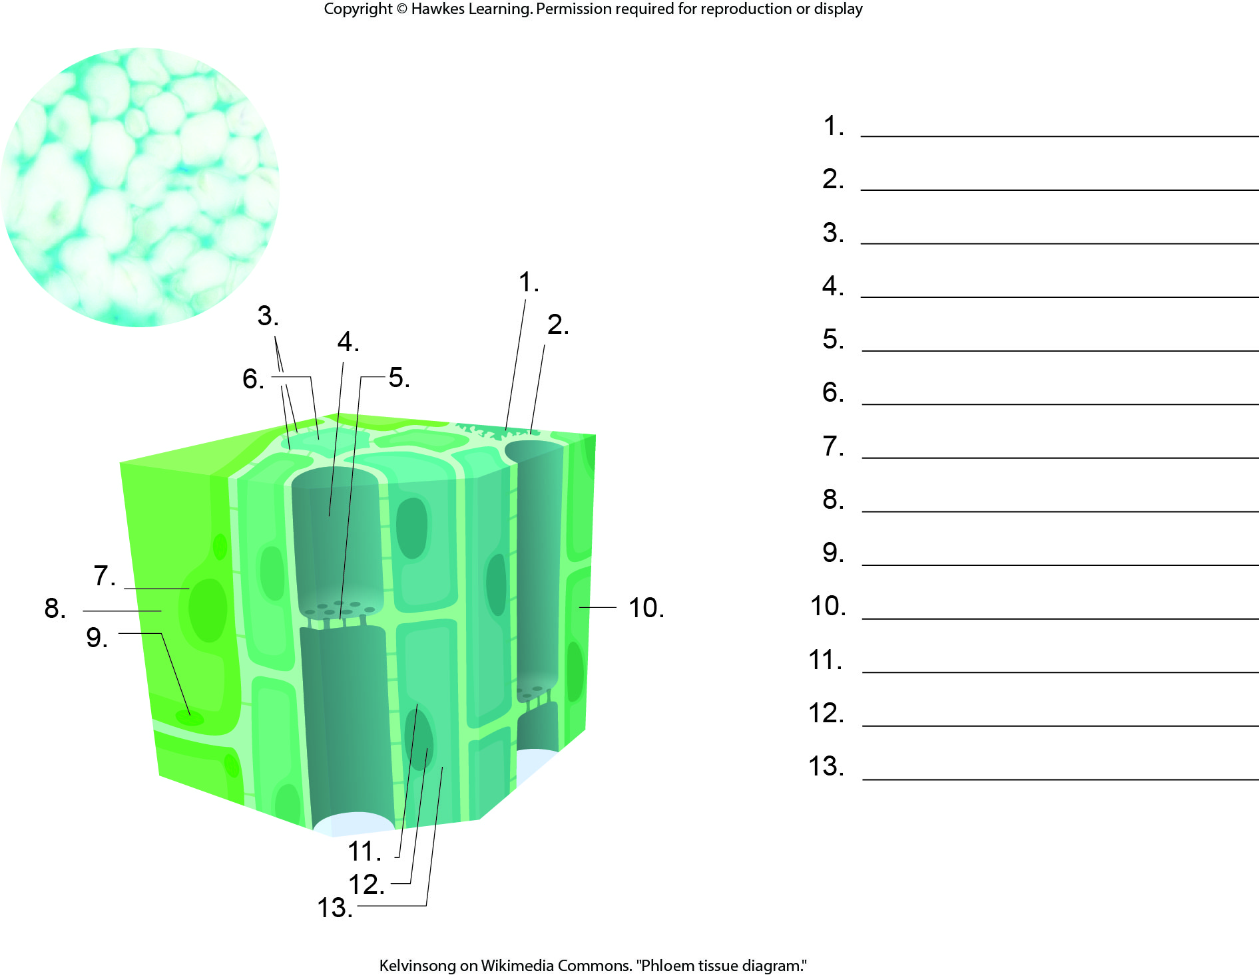
Lesson 30.2 Figure 9 - Numbered

Slide 23
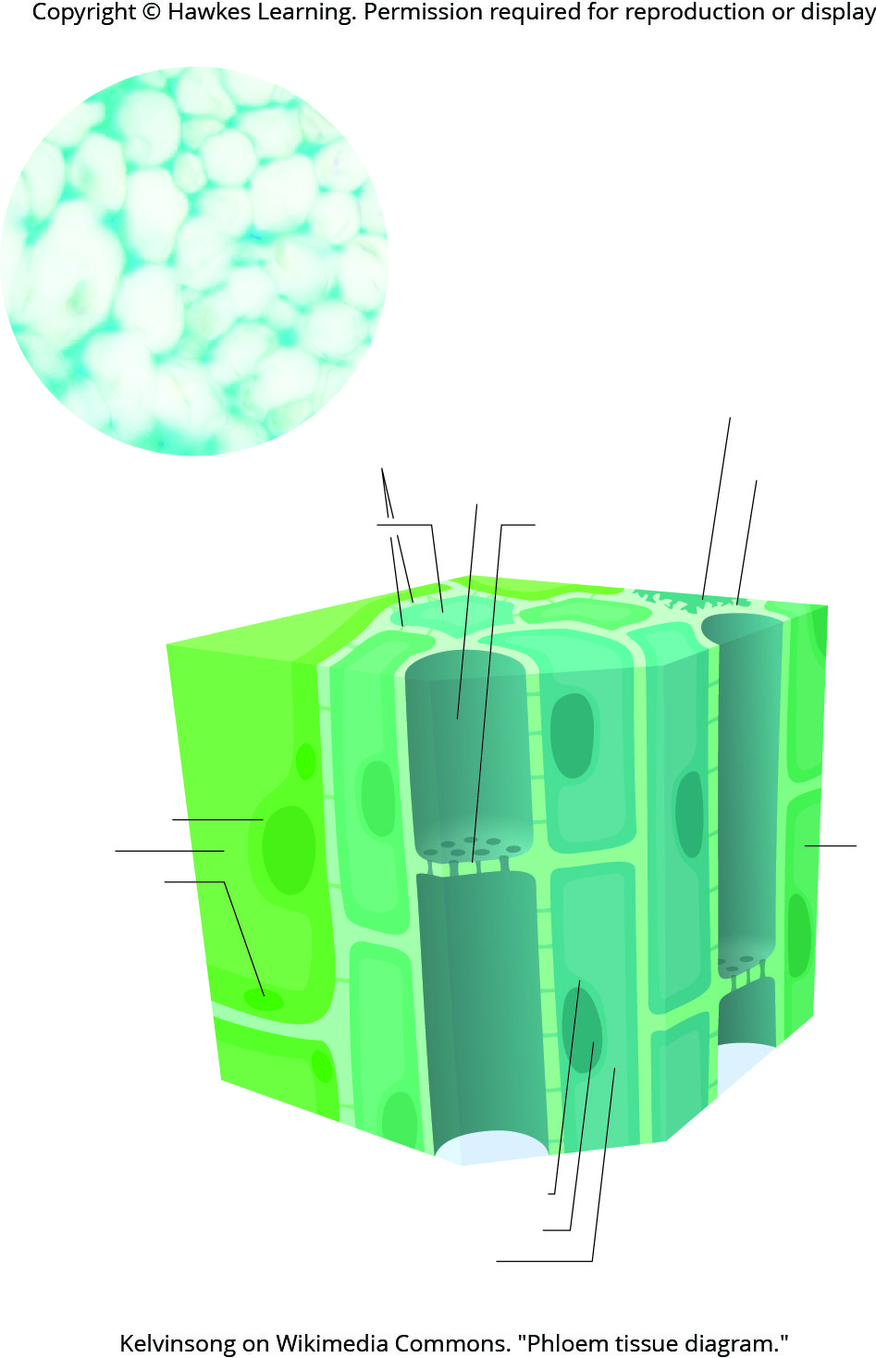
Lesson 30.2 Figure 9

Slide 24
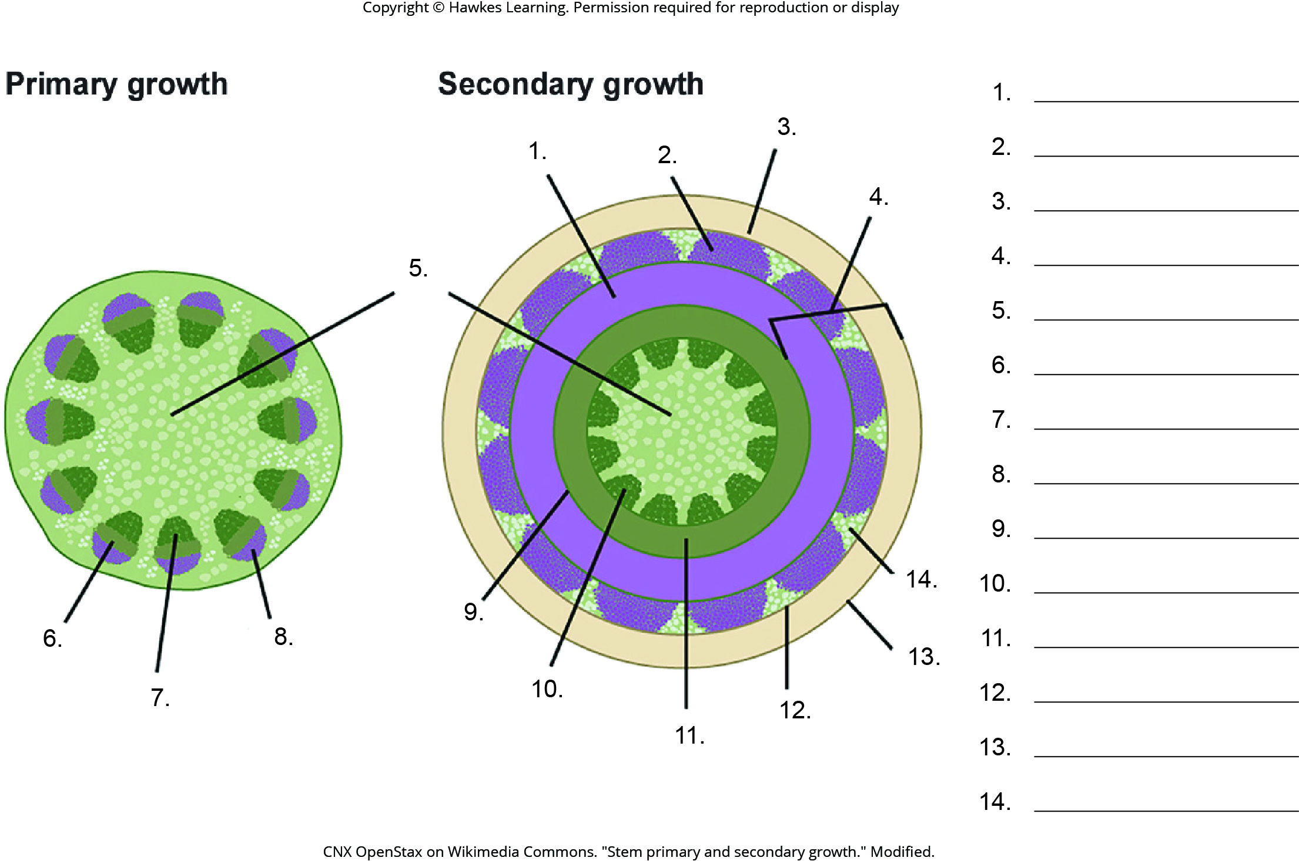
Lesson 30.2 Figure 10 - Numbered

Slide 25
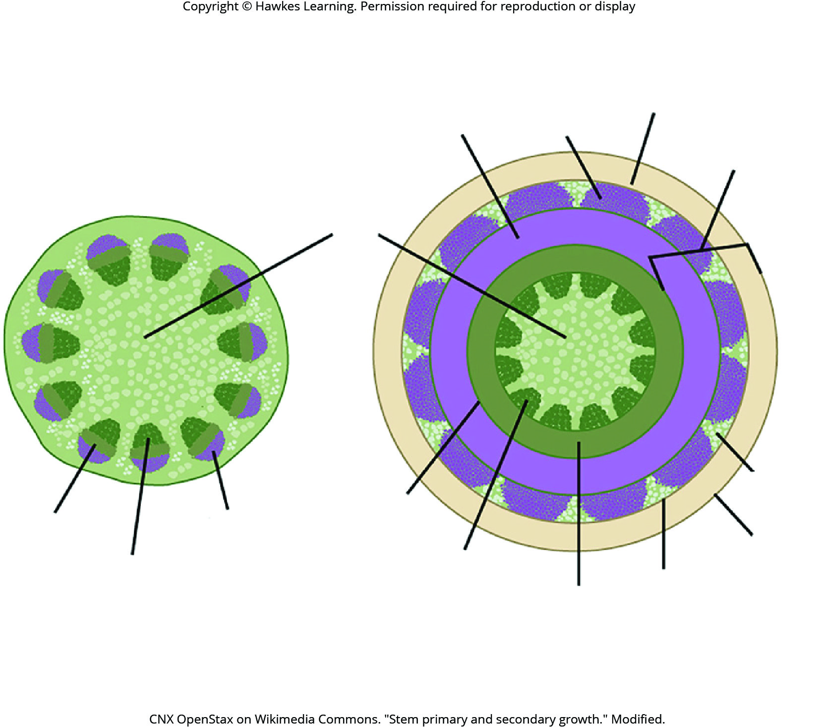
Lesson 30.2 Figure 10

Slide 26
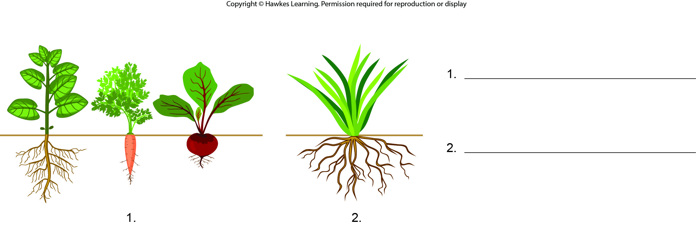
Lesson 30.3 Figure 1 - Numbered

Slide 27
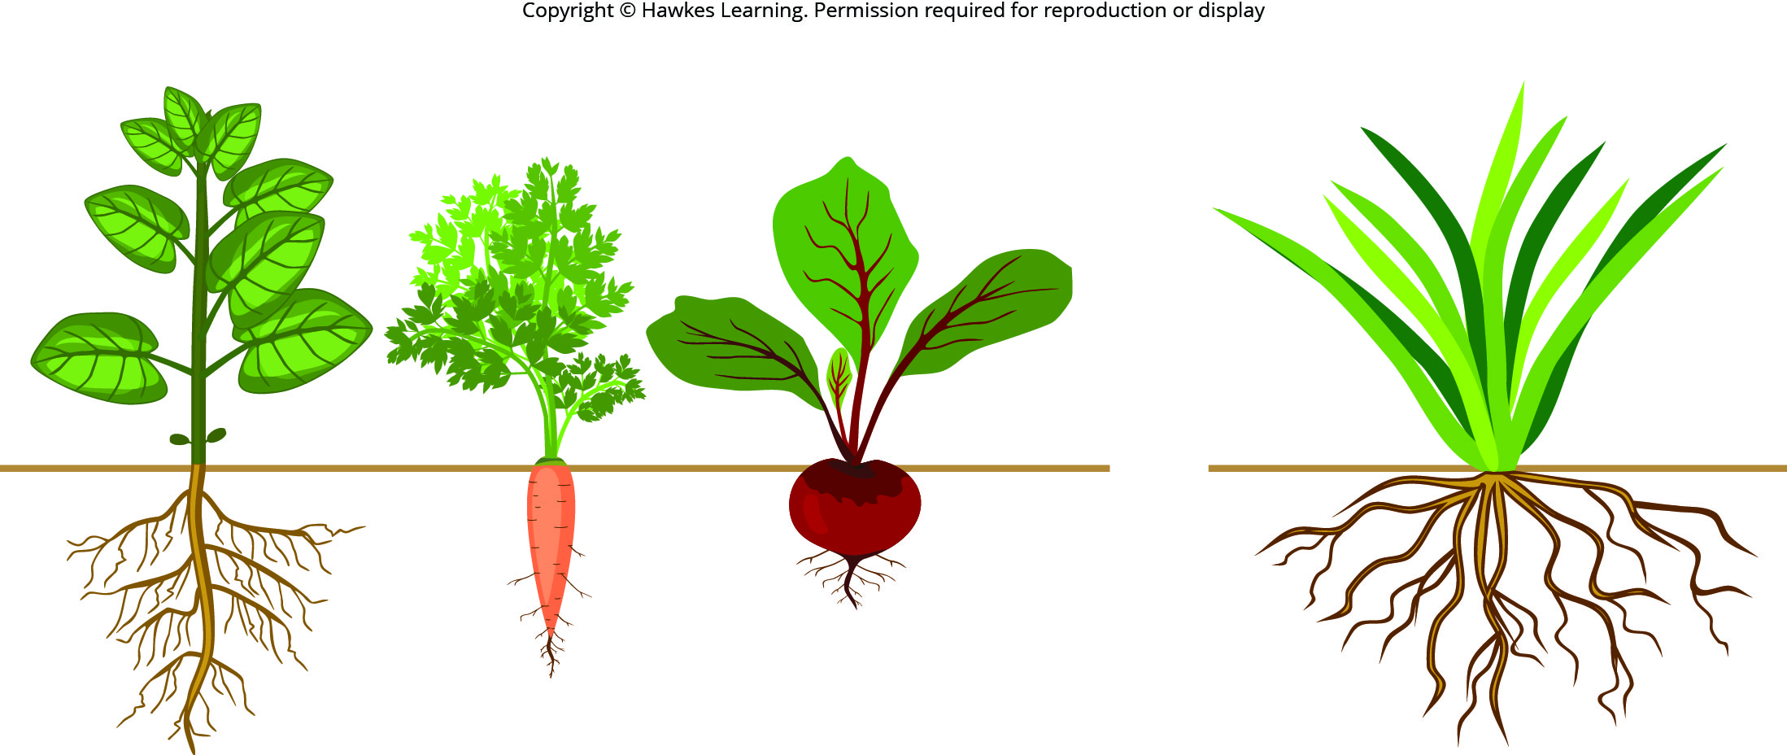
Lesson 30.3 Figure 1

Slide 28
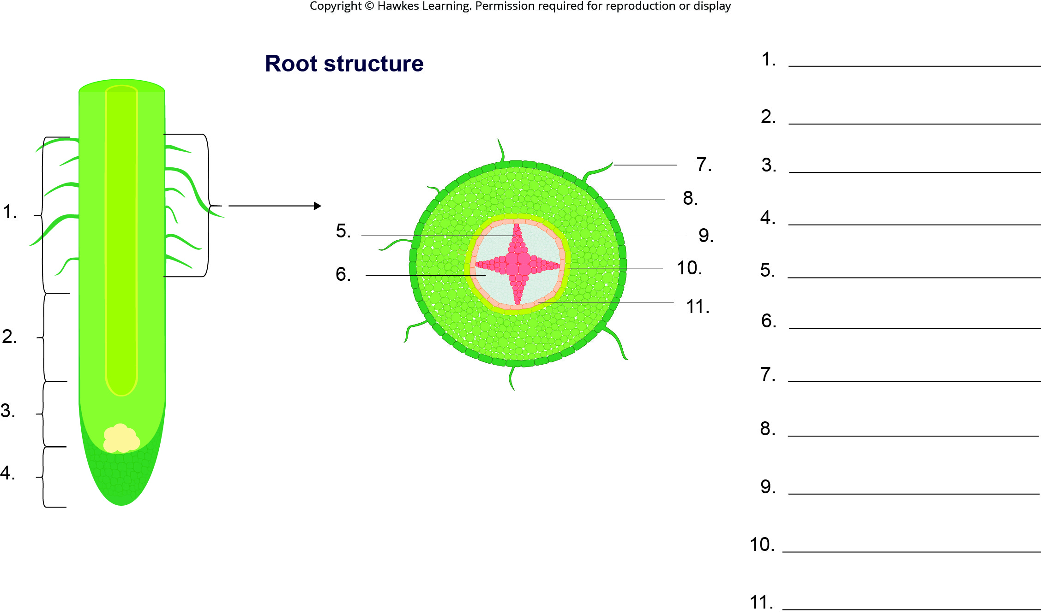
Lesson 30.3 Figure 2 - Numbered

Slide 29
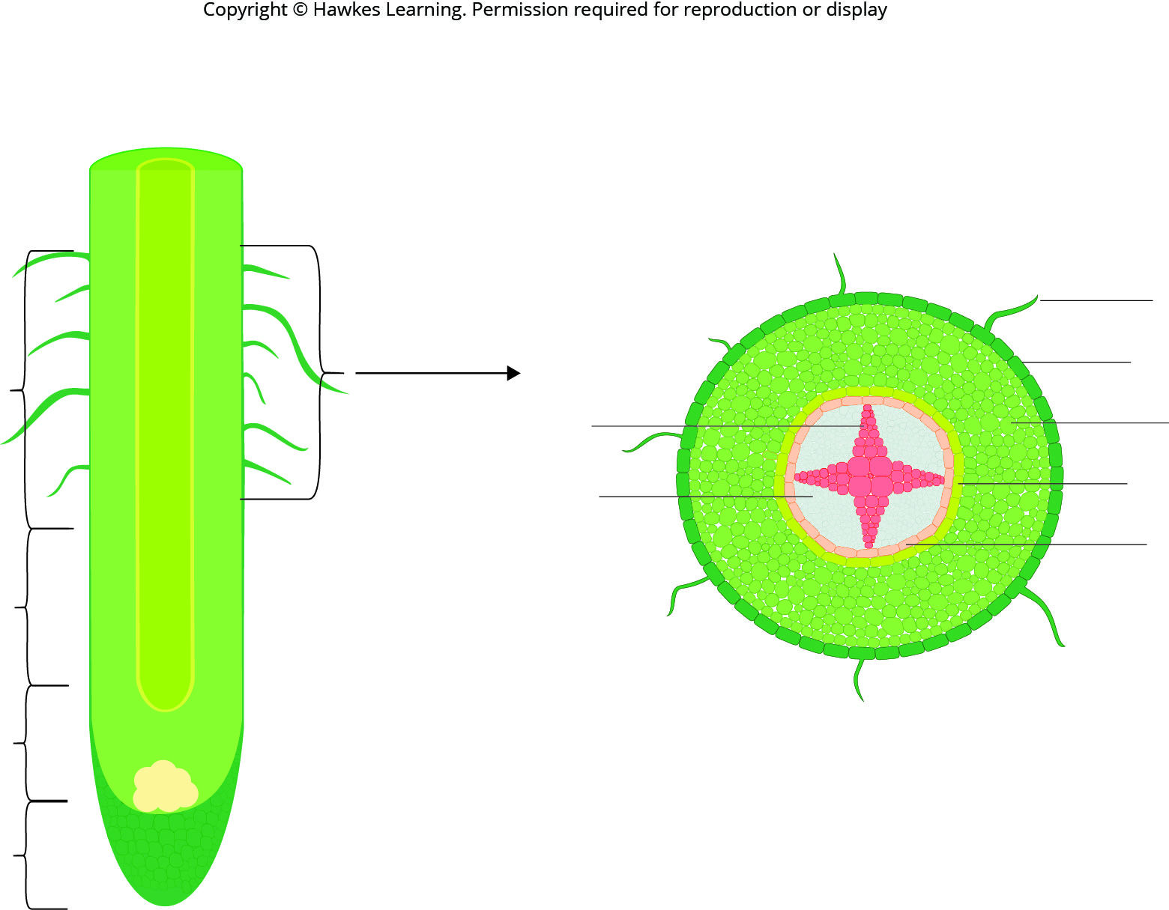
Lesson 30.3 Figure 2

Slide 30
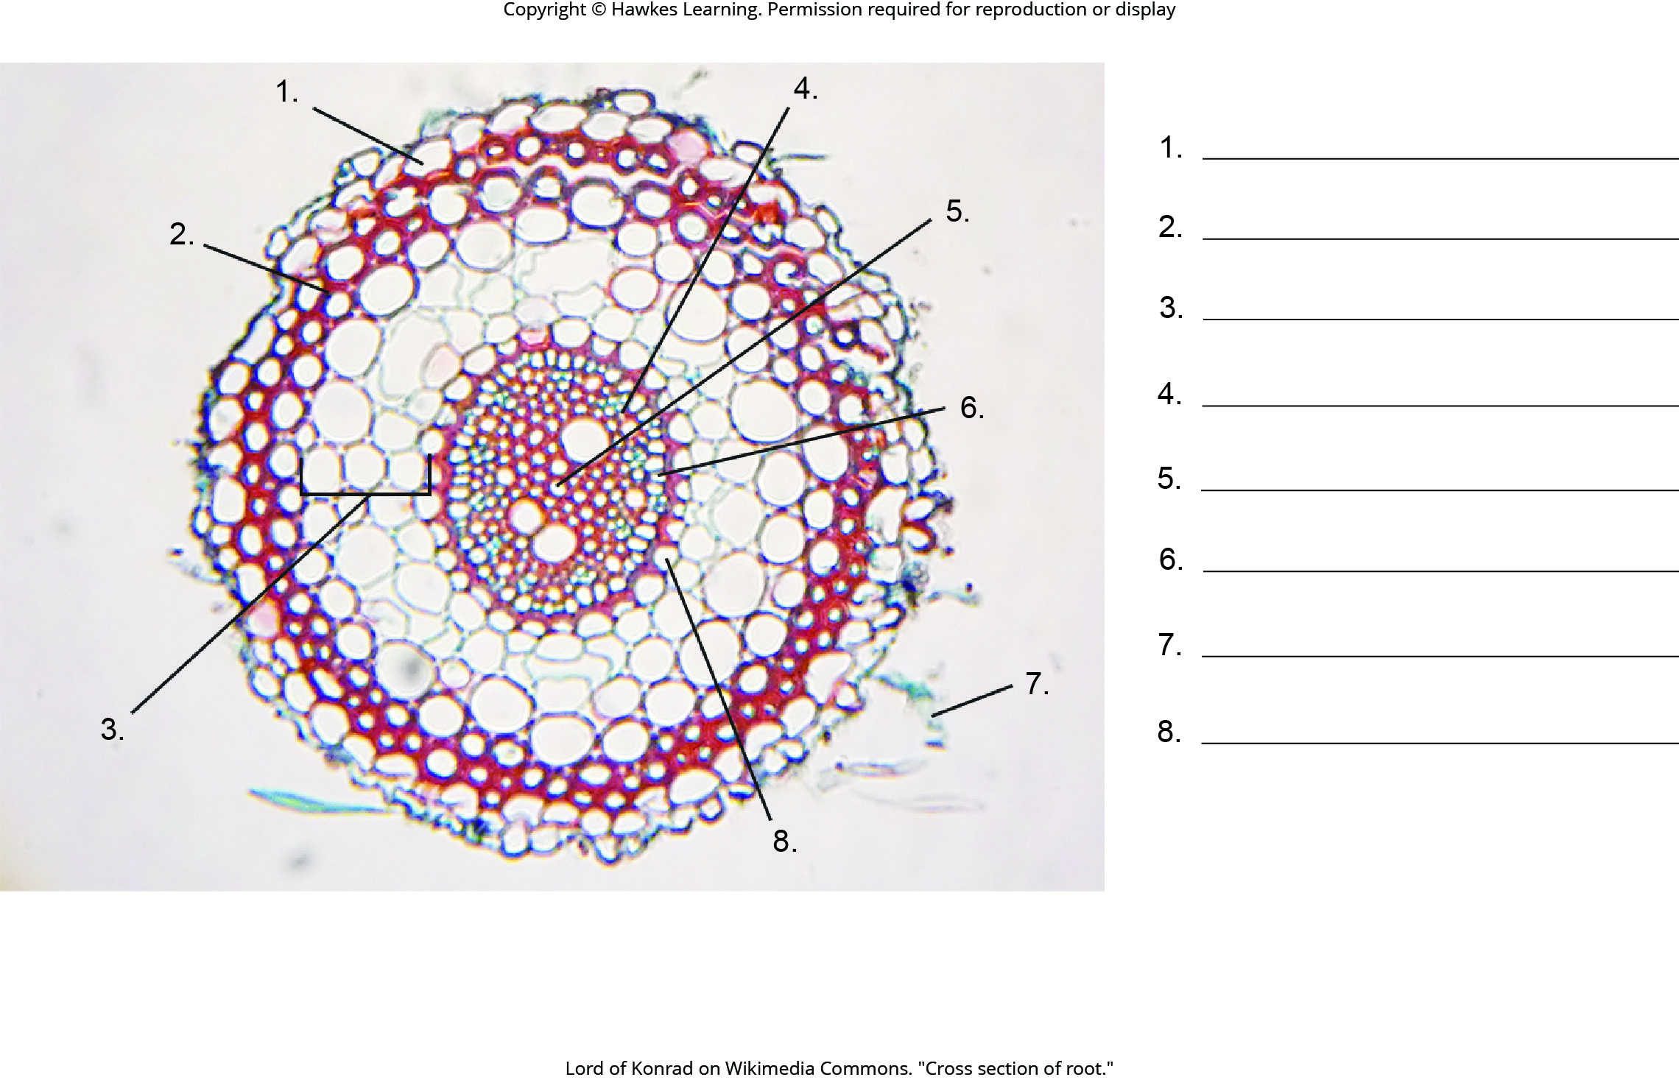
Lesson 30.3 Figure 3 - Numbered

Slide 31
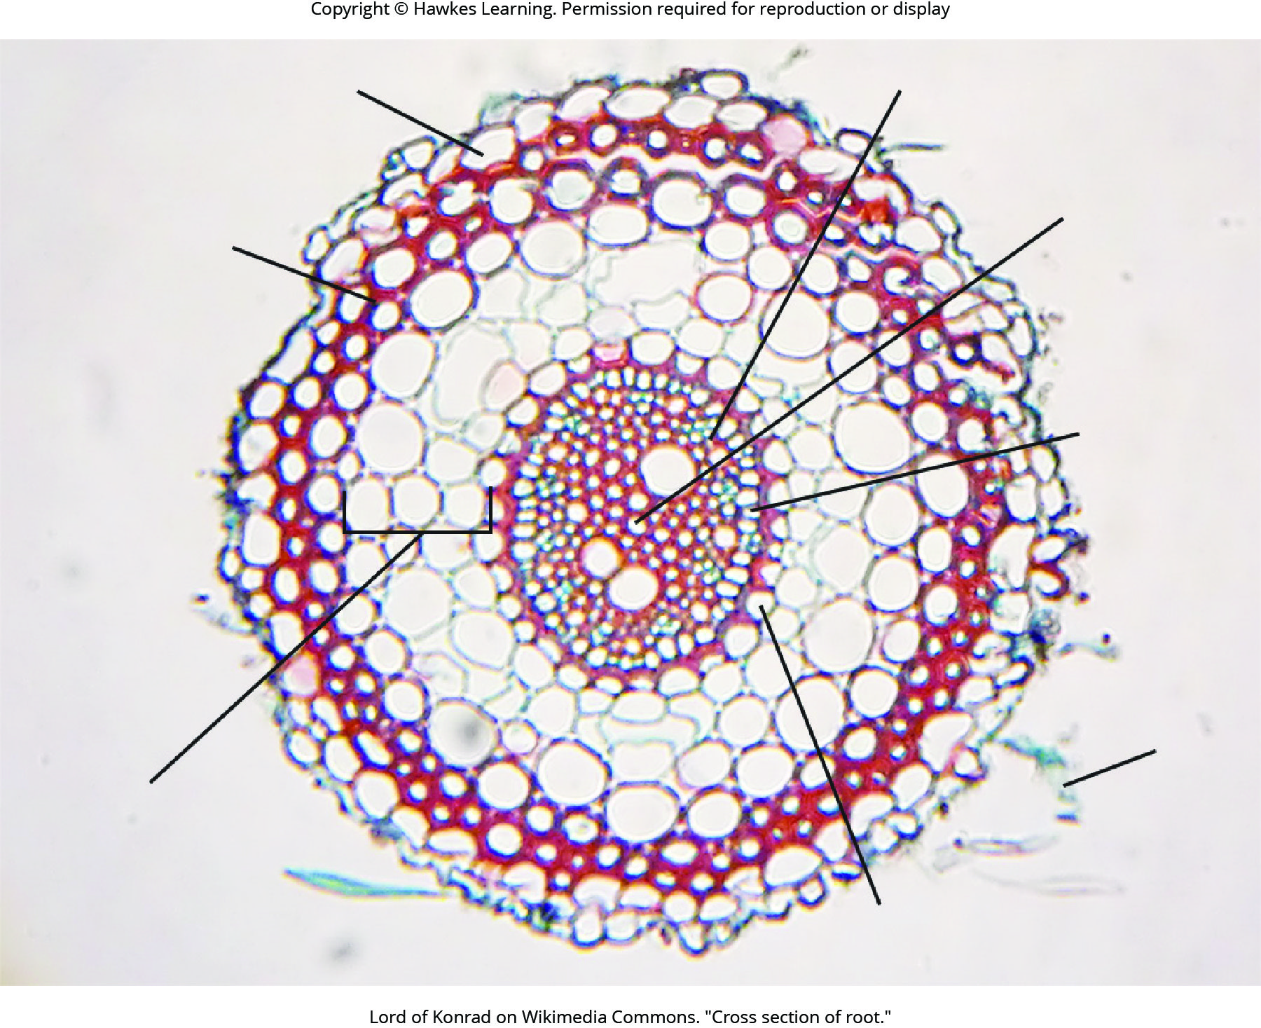
Lesson 30.3 Figure 3

Slide 32
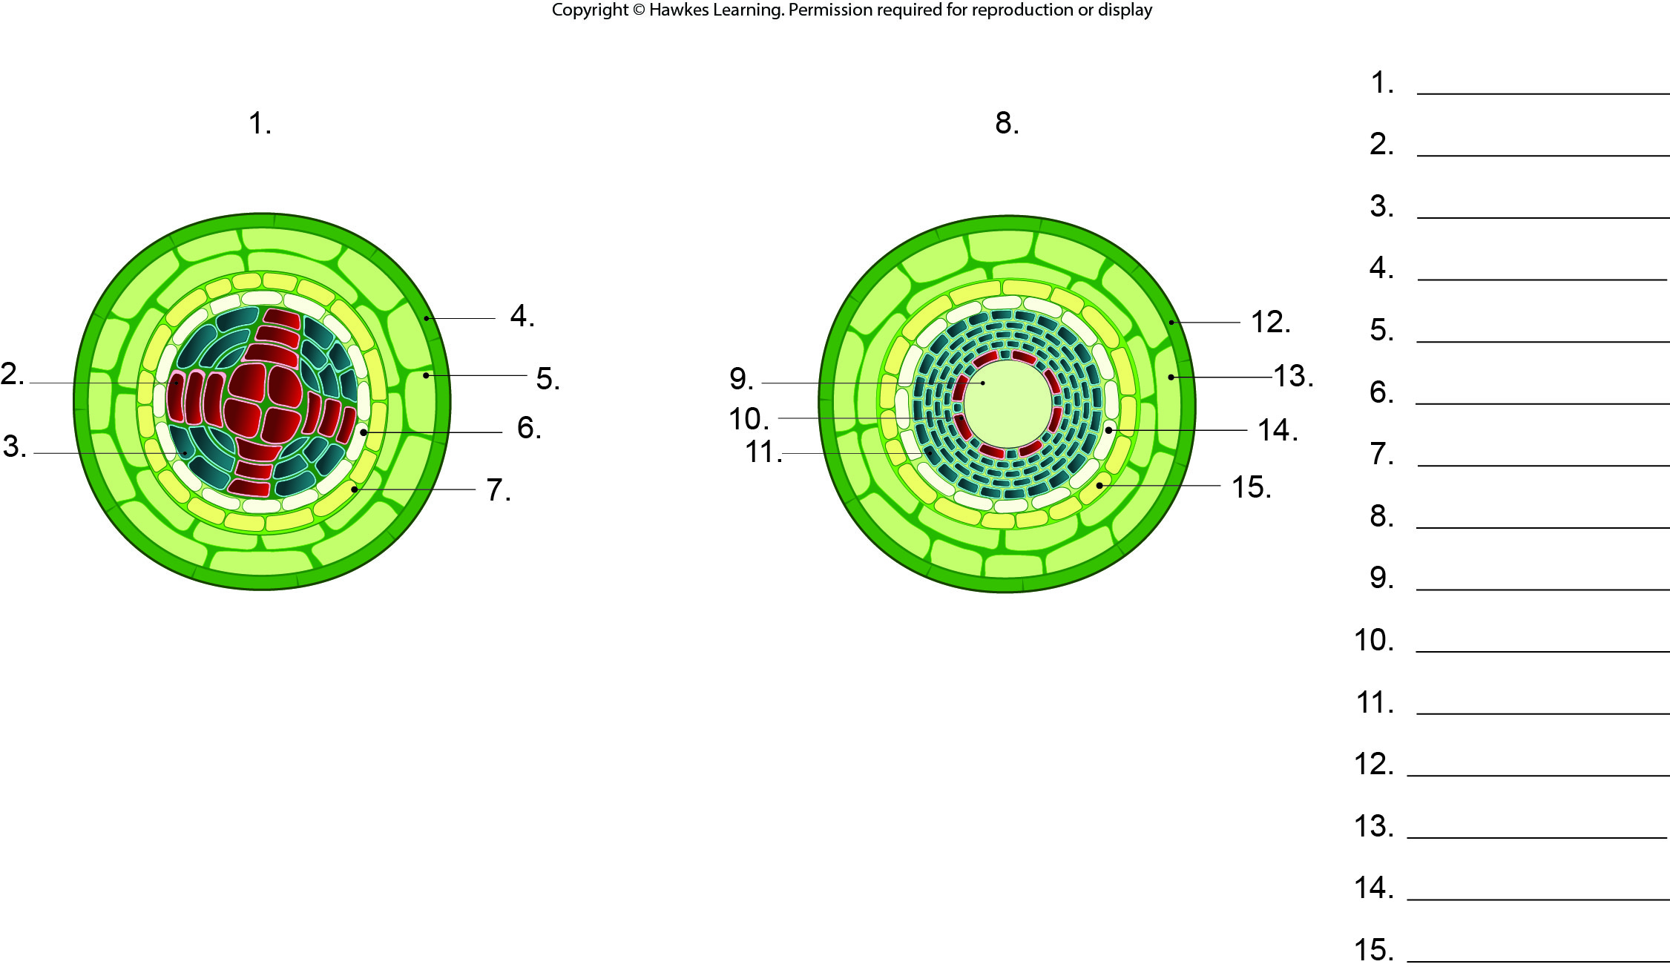
Lesson 30.3 Figure 4 - Numbered

Slide 33
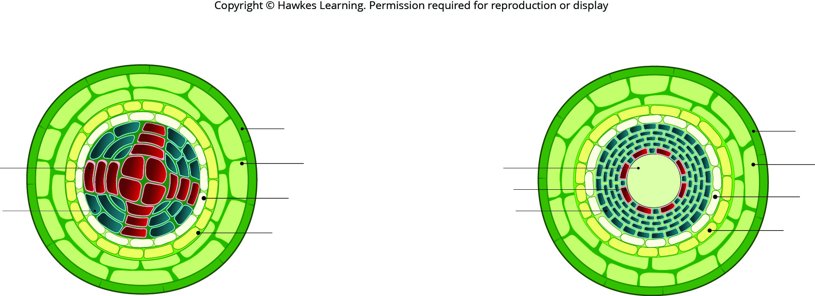
Lesson 30.3 Figure 4

Slide 34
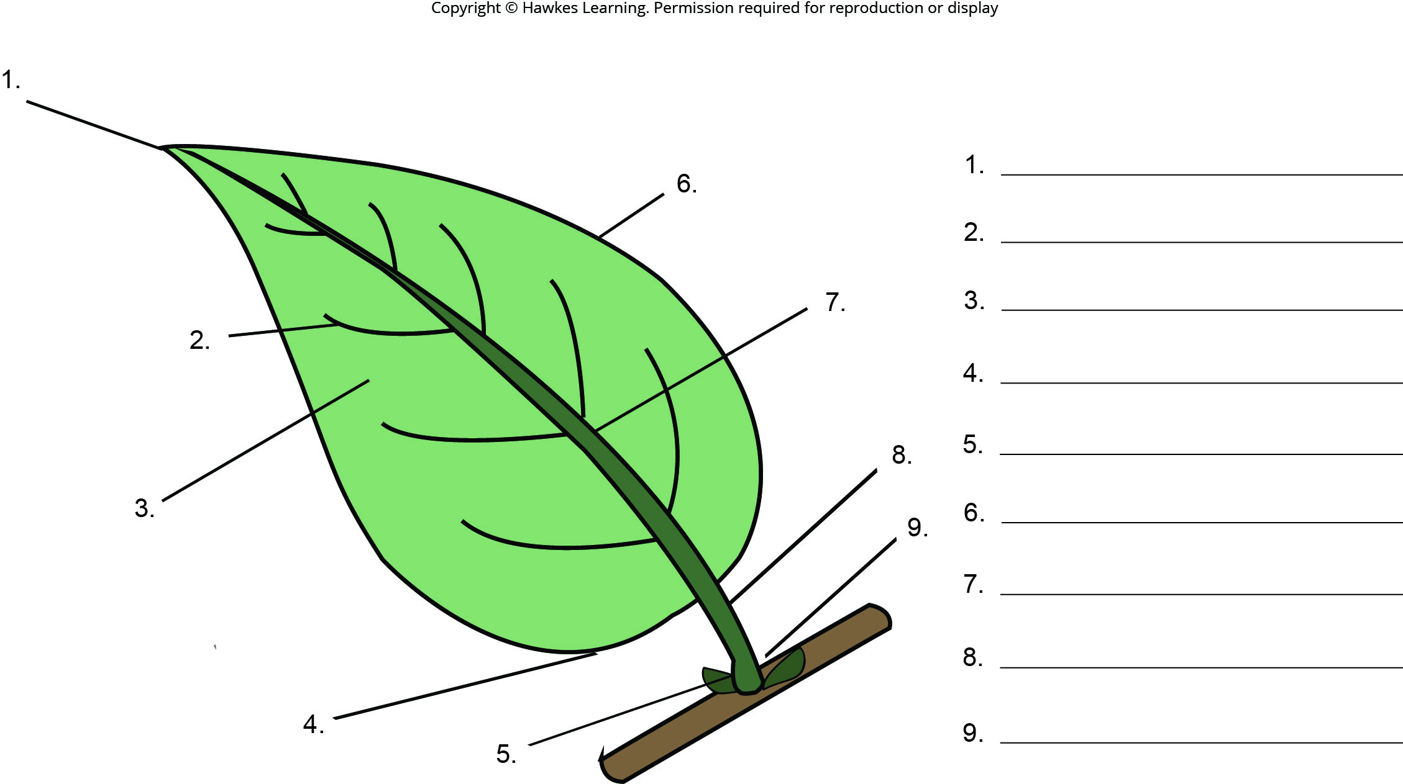
Lesson 30.4 Figure 1 - Numbered

Slide 35
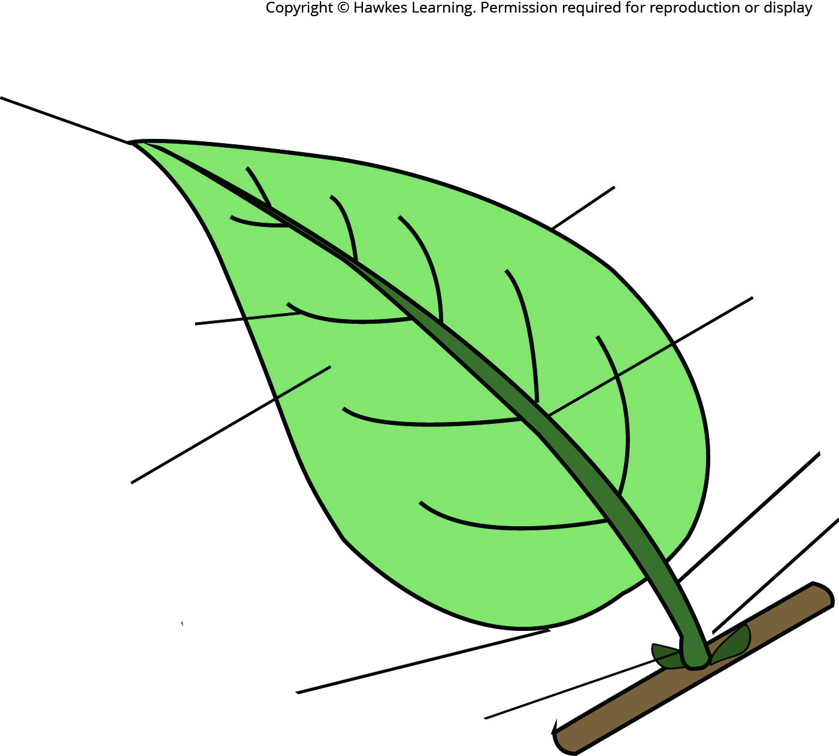
Lesson 30.4 Figure 1

Slide 36
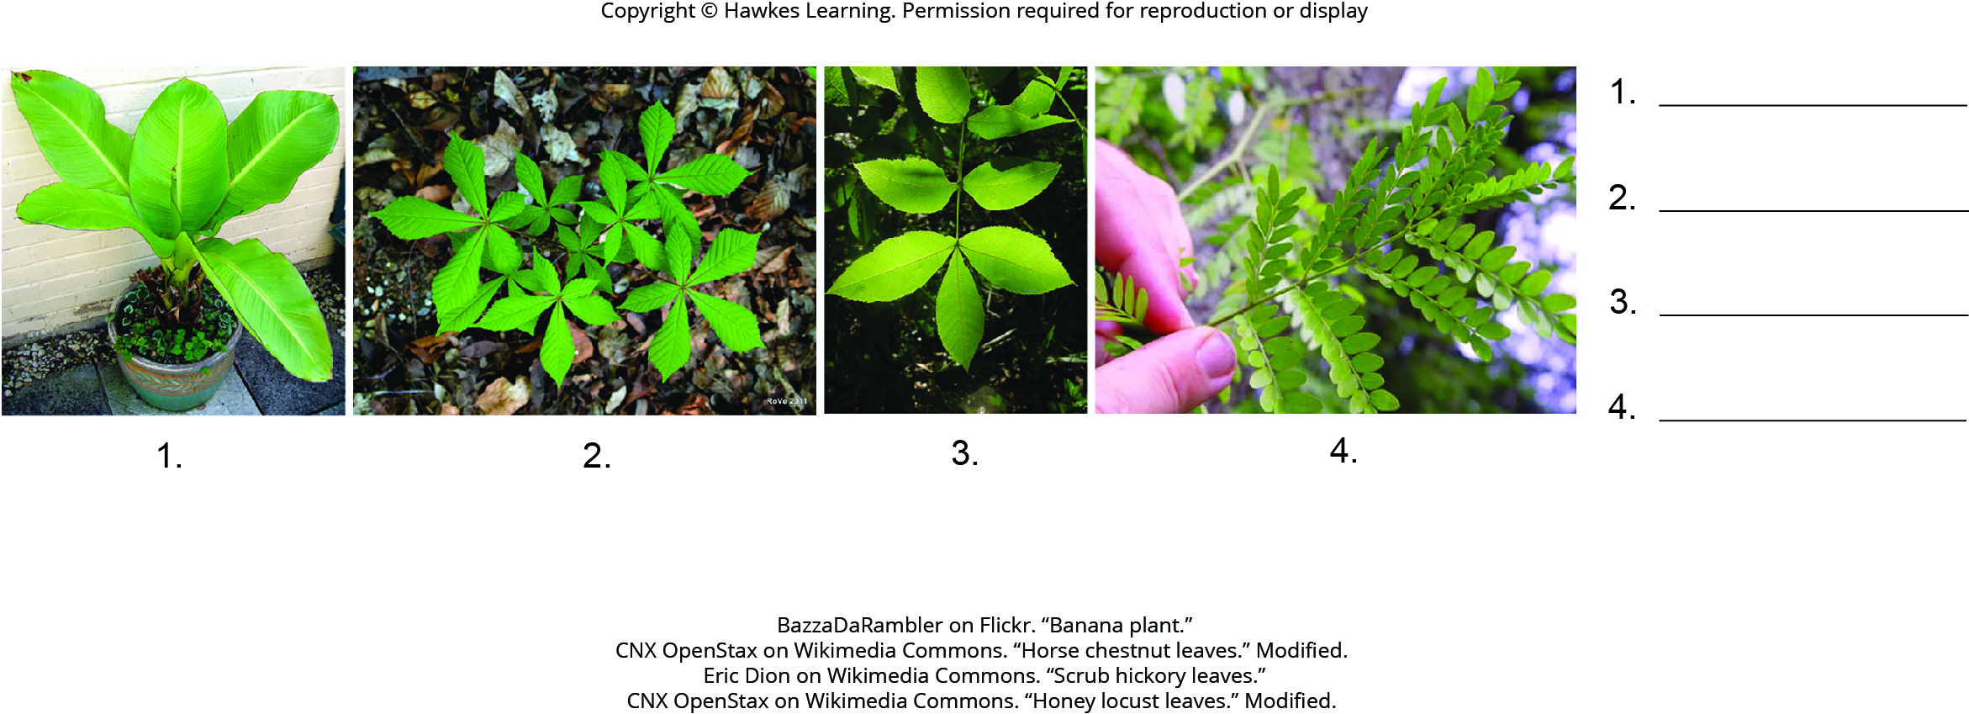
Lesson 30.4 Figure 4 - Numbered

Slide 37
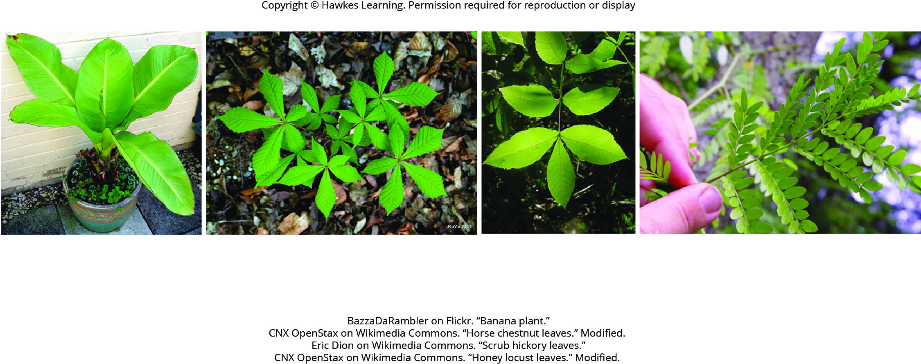
Lesson 30.4 Figure 4

Slide 38
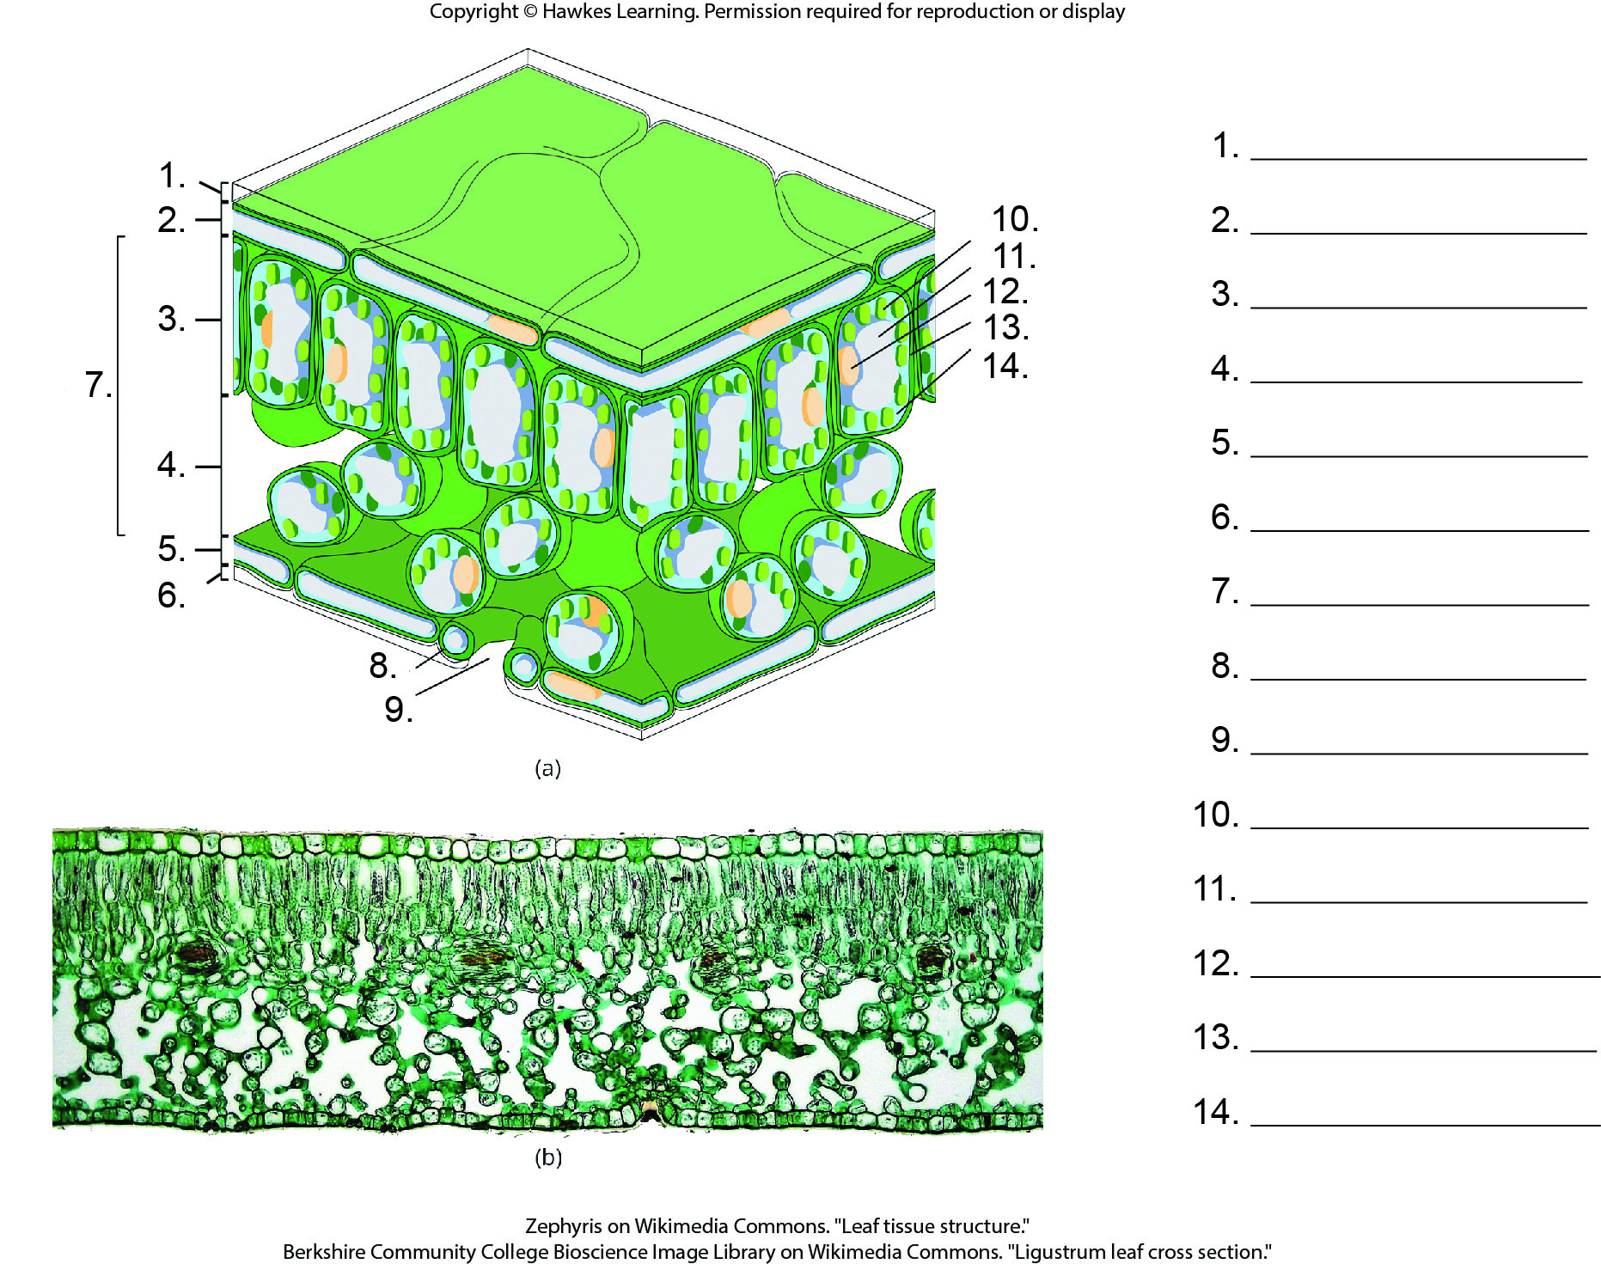
Lesson 30.4 Figure 7 - Numbered

Slide 39
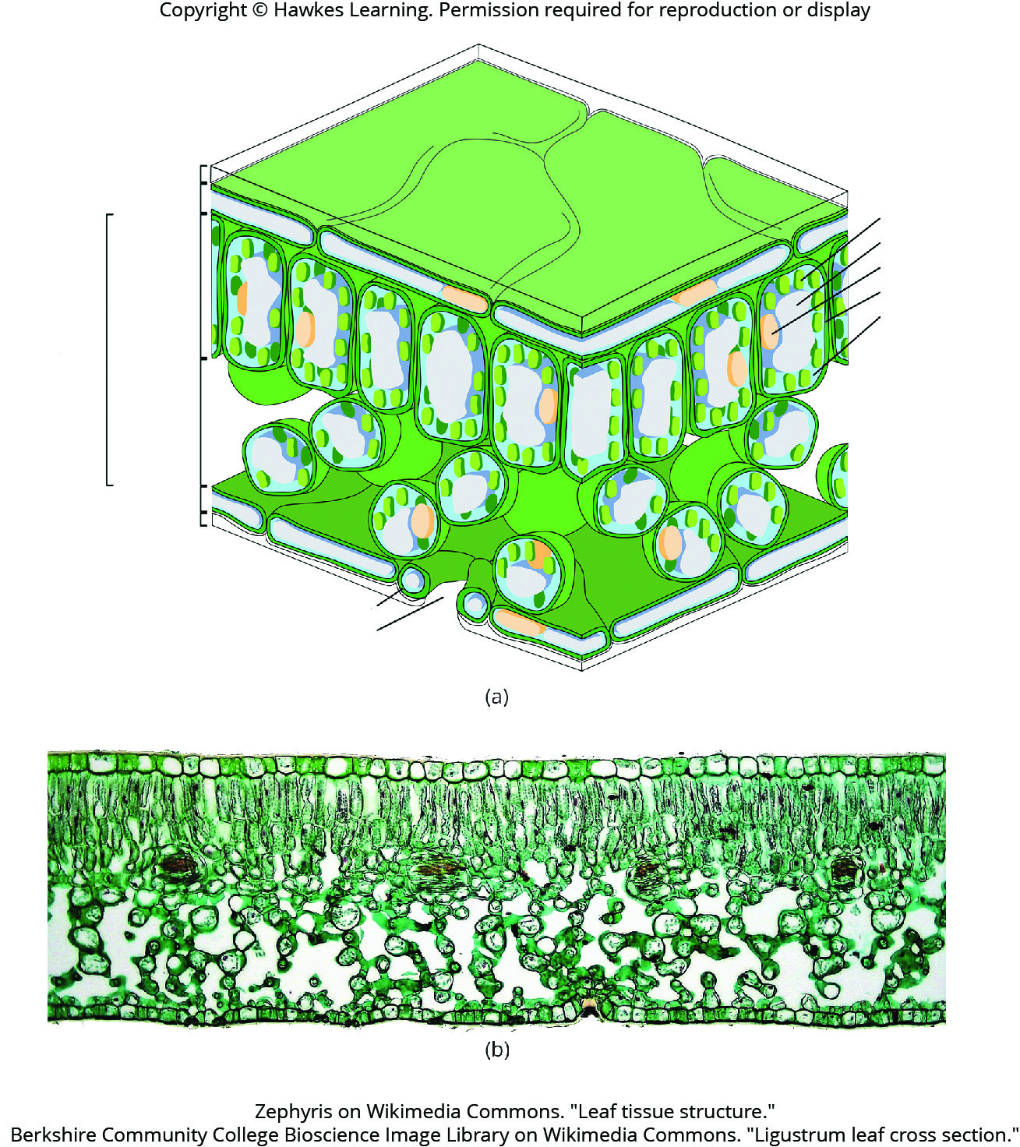
Lesson 30.4 Figure 7

Slide 40
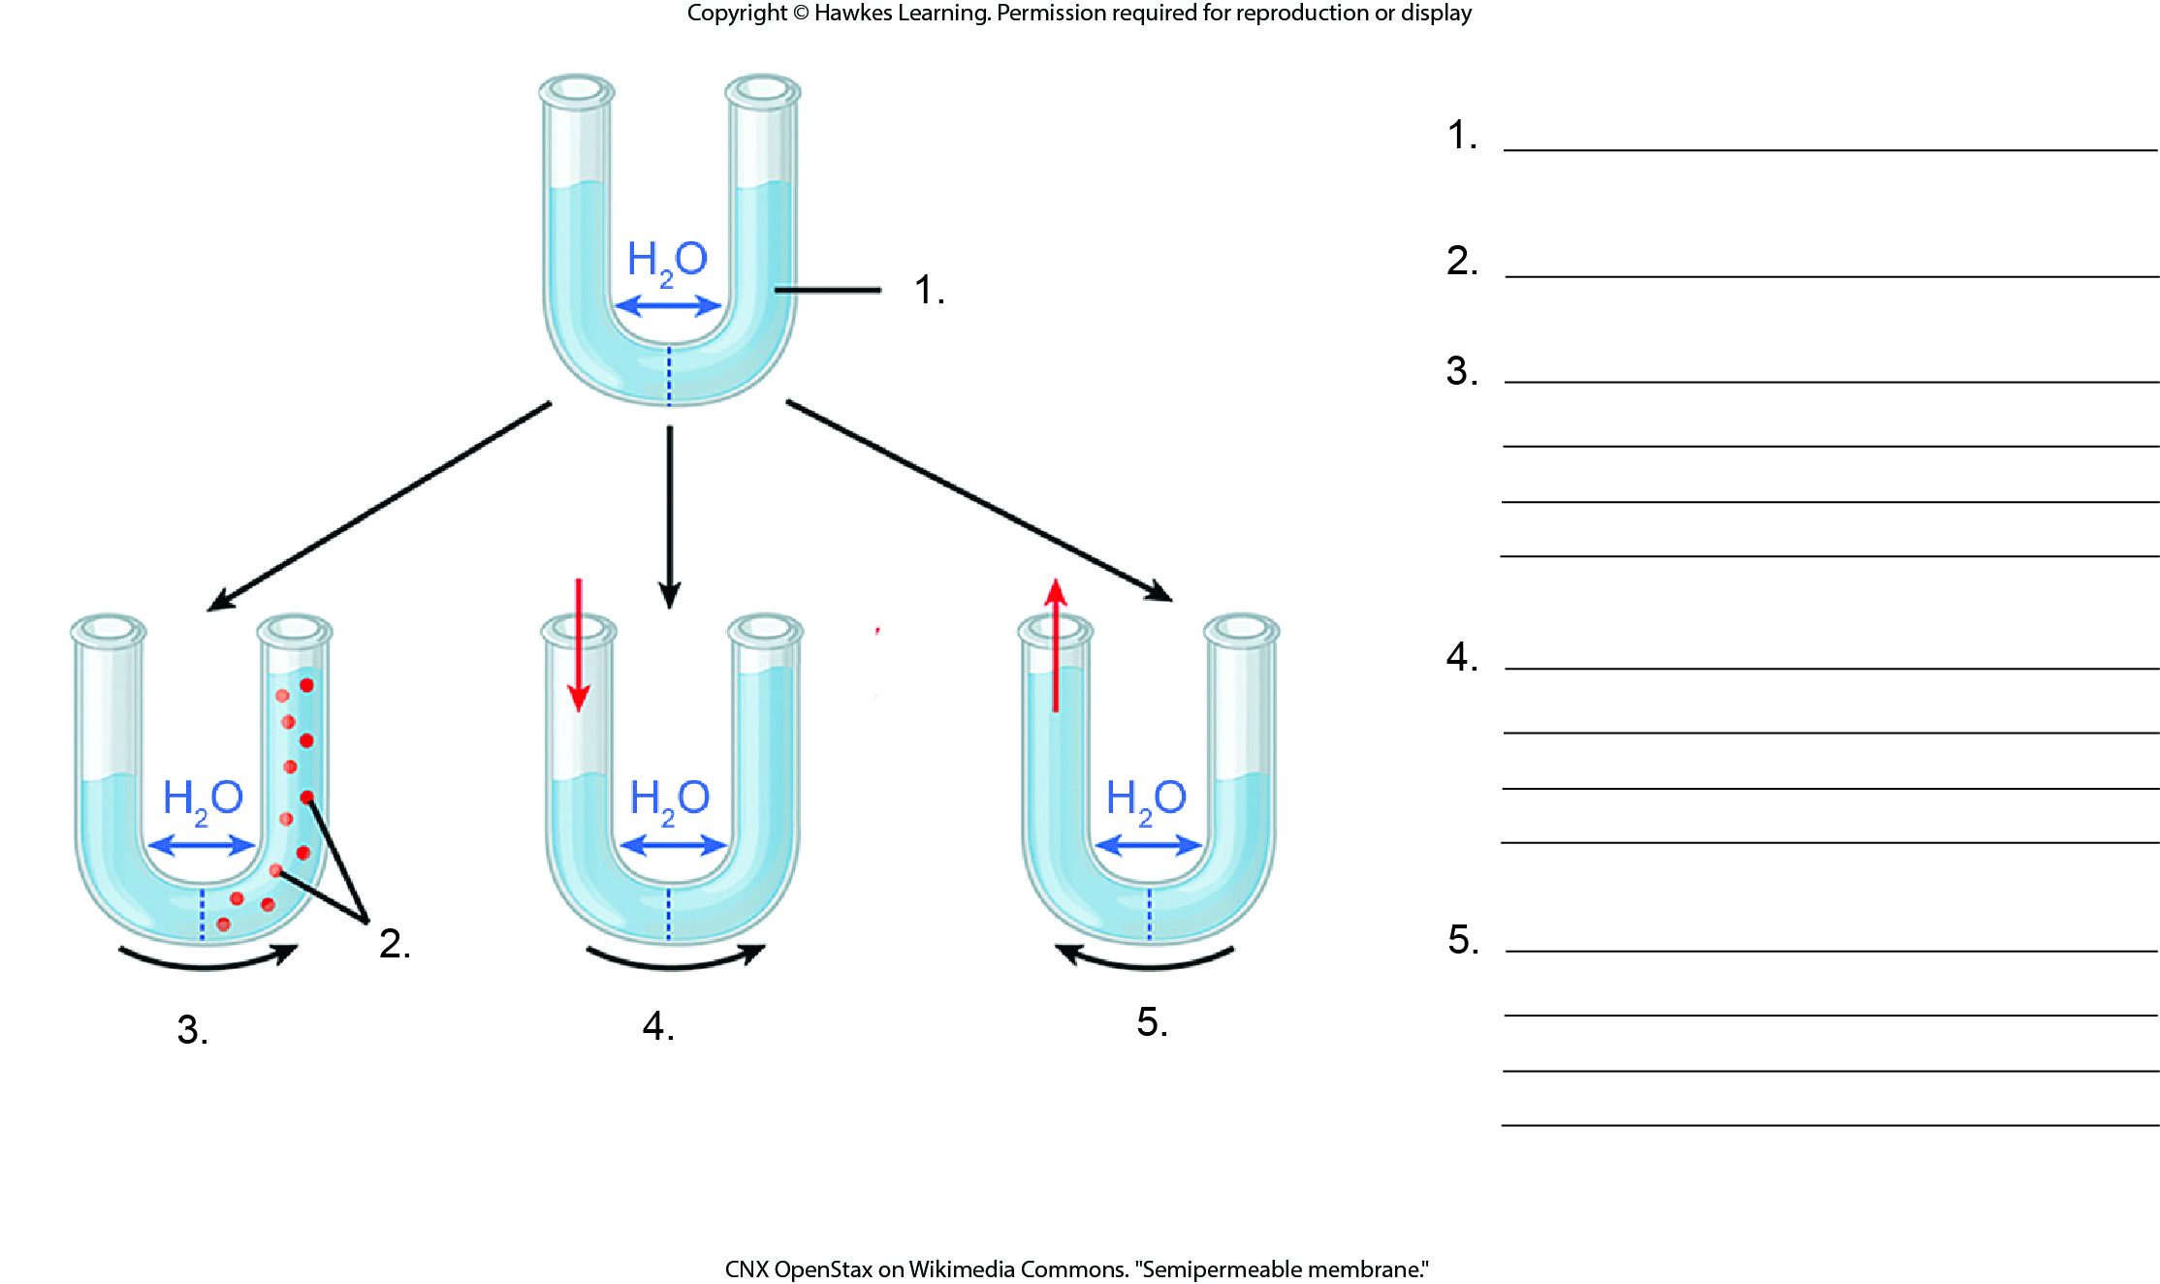
Lesson 30.5 Figure 2 - Numbered

Slide 41
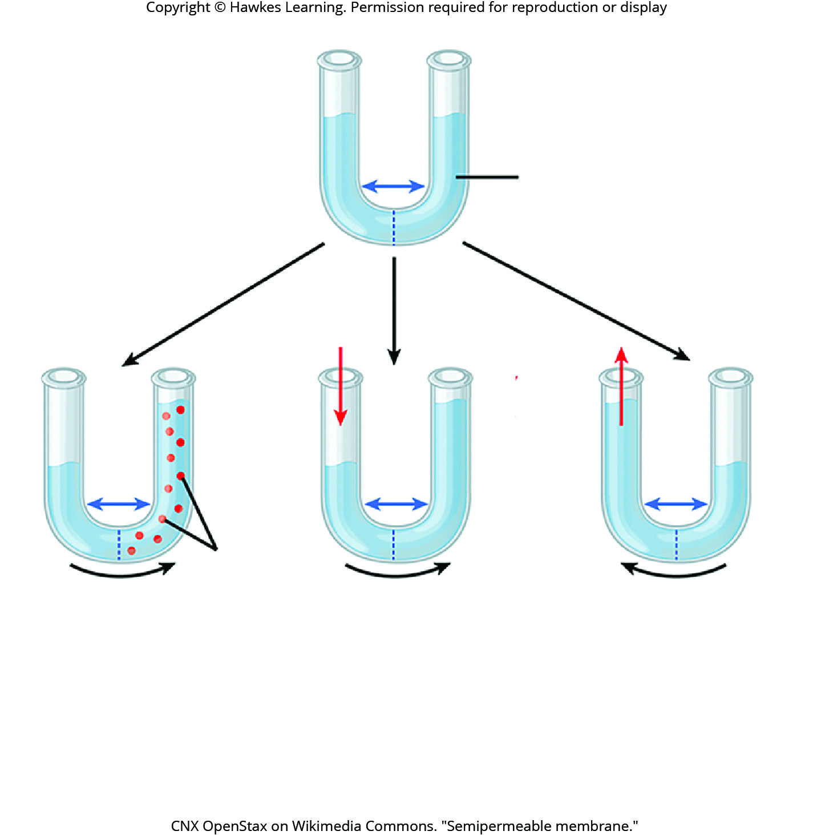
Lesson 30.5 Figure 2

Slide 42
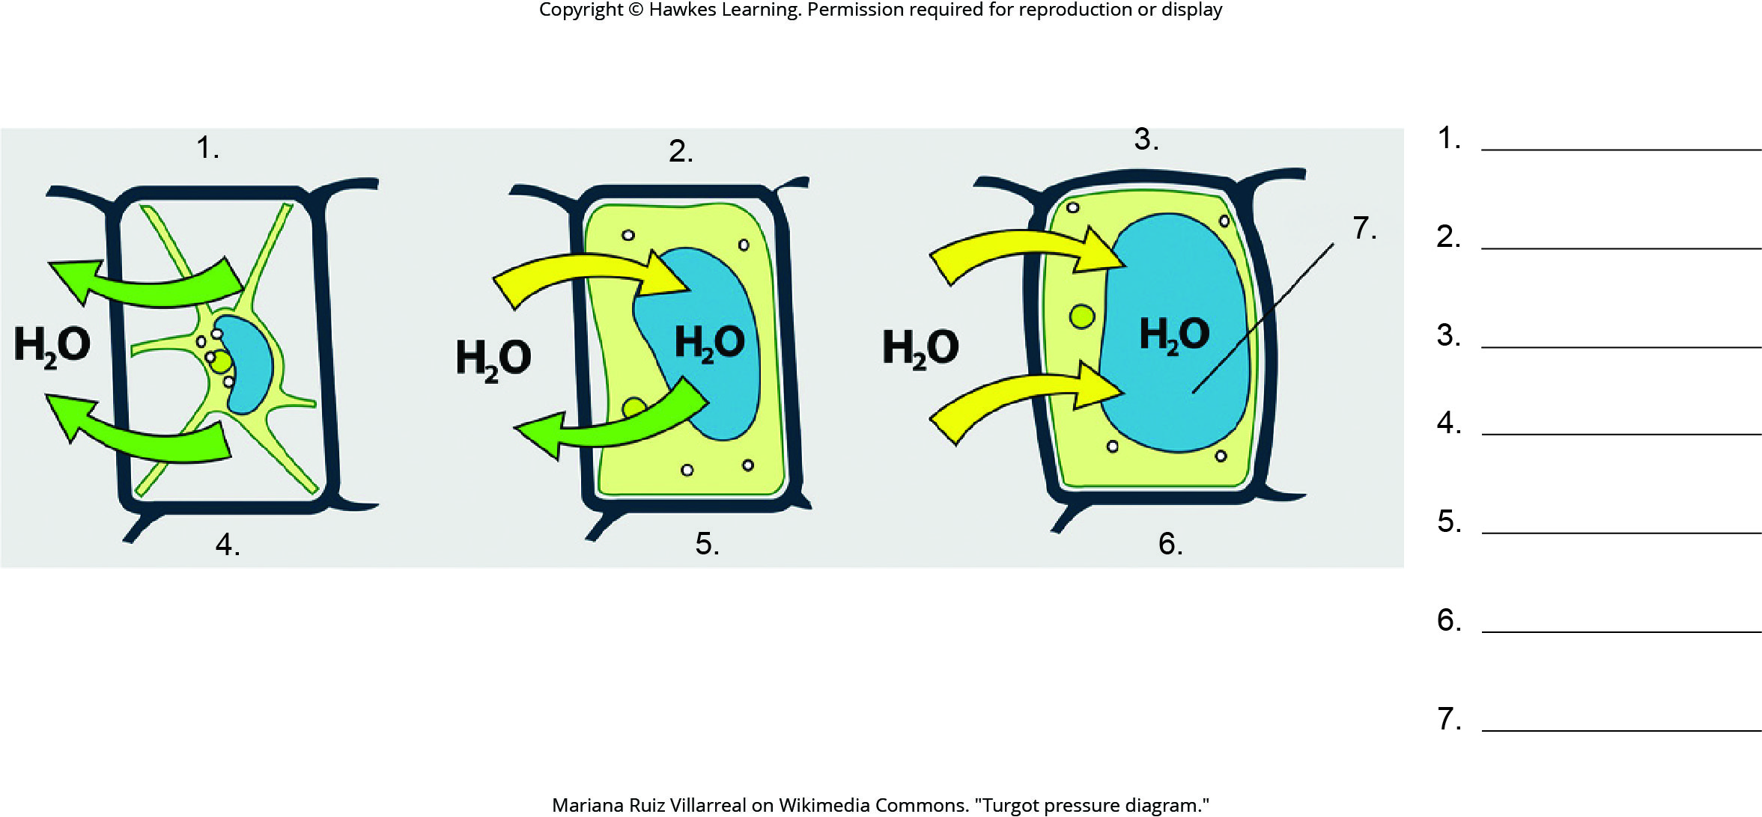
Lesson 30.5 Figure 4 - Numbered

Slide 43
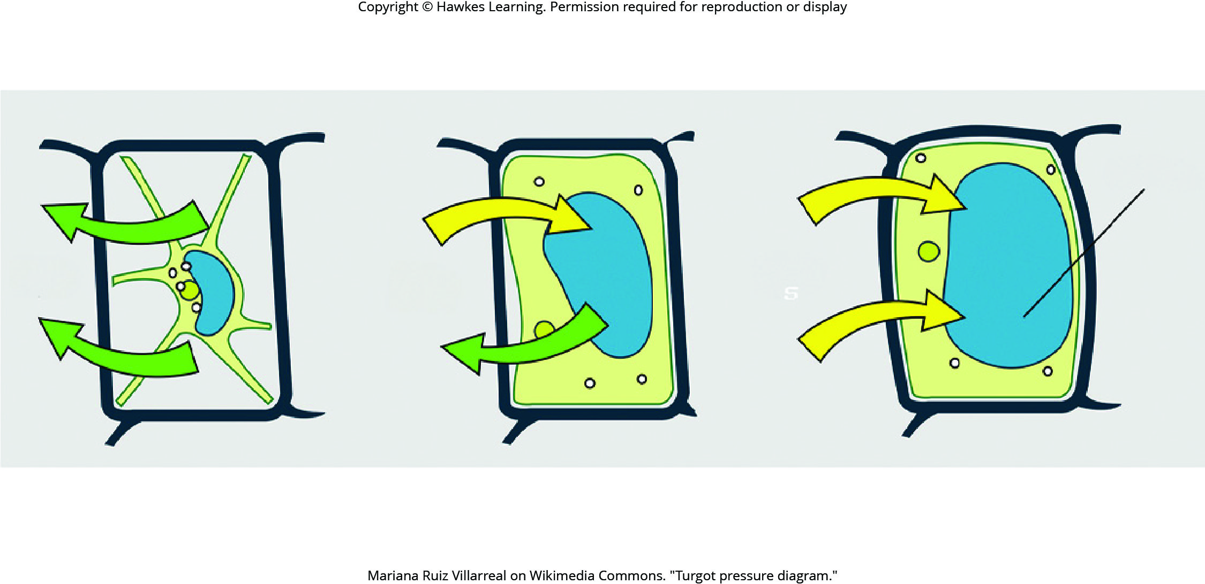
Lesson 30.5 Figure 4

Slide 44
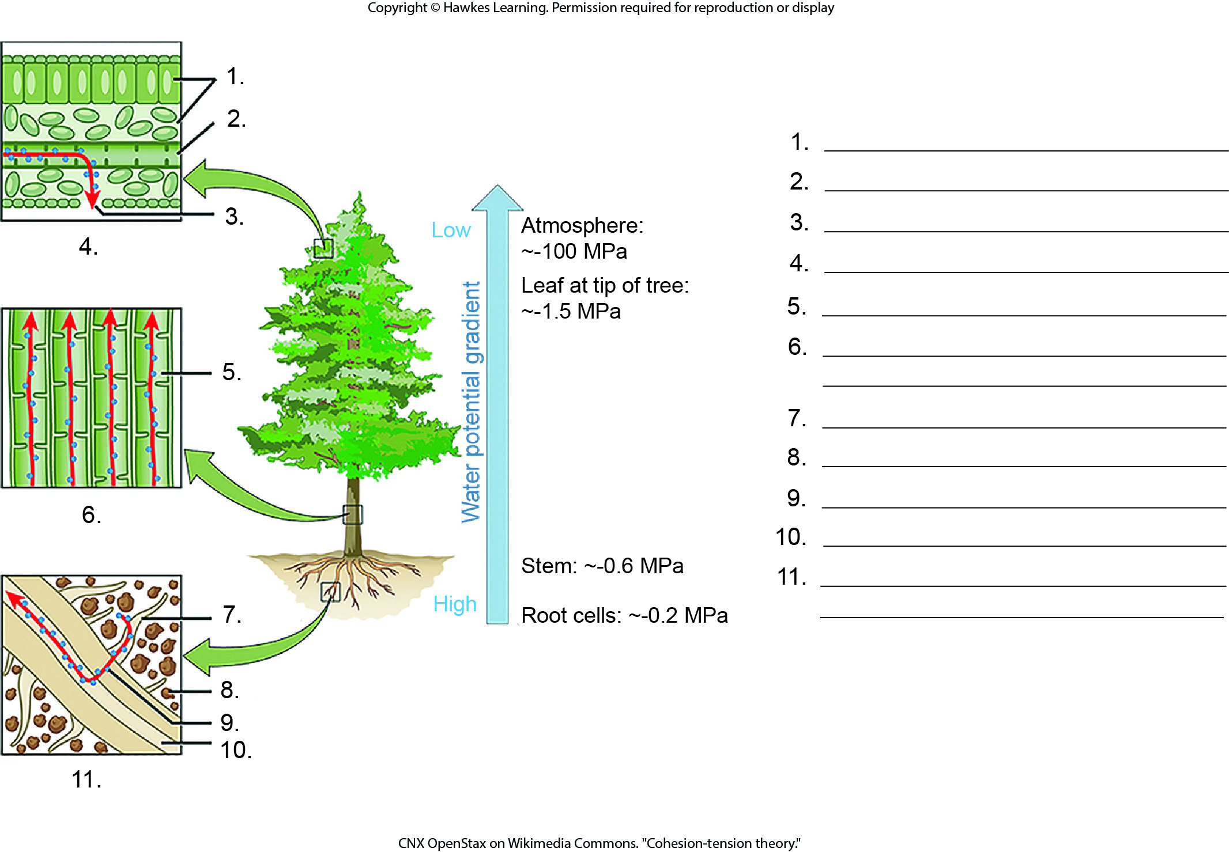
Lesson 30.5 Figure 5 - Numbered

Slide 45
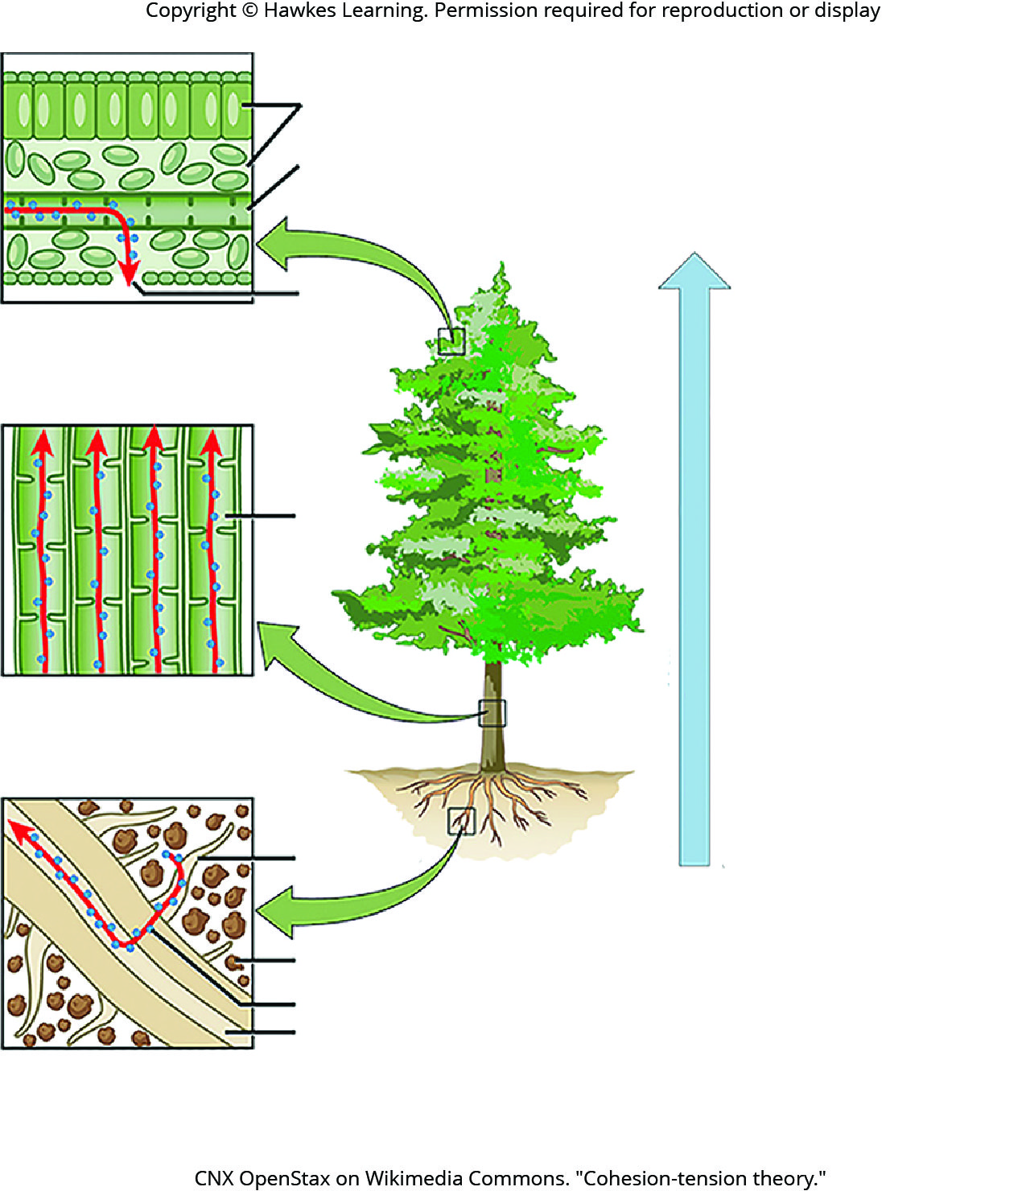
Lesson 30.5 Figure 5

Slide 46
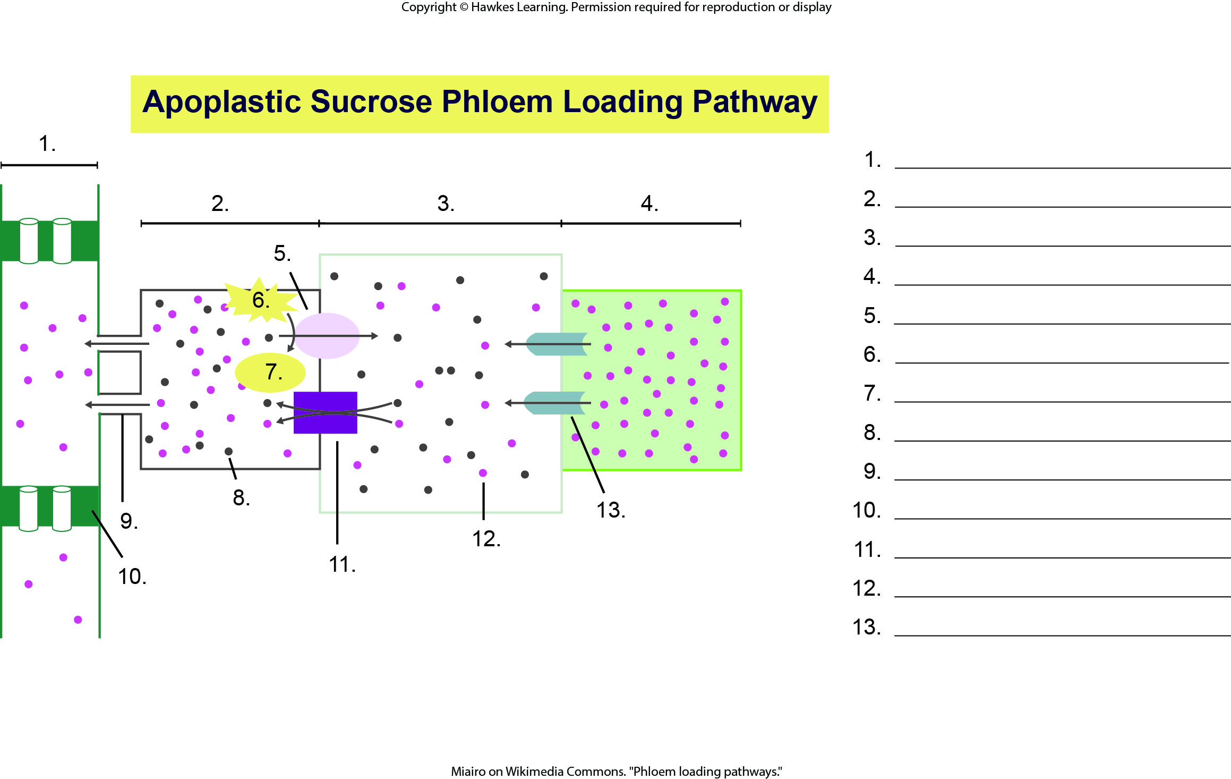
Lesson 30.5 Figure 7 - Numbered

Slide 47
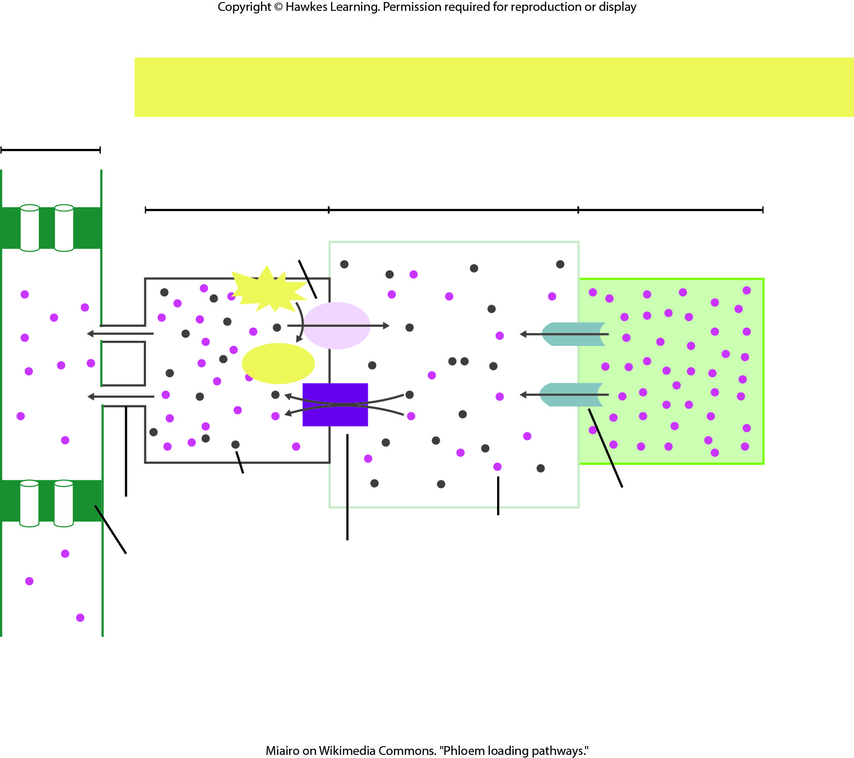
Lesson 30.5 Figure 7

Slide 48
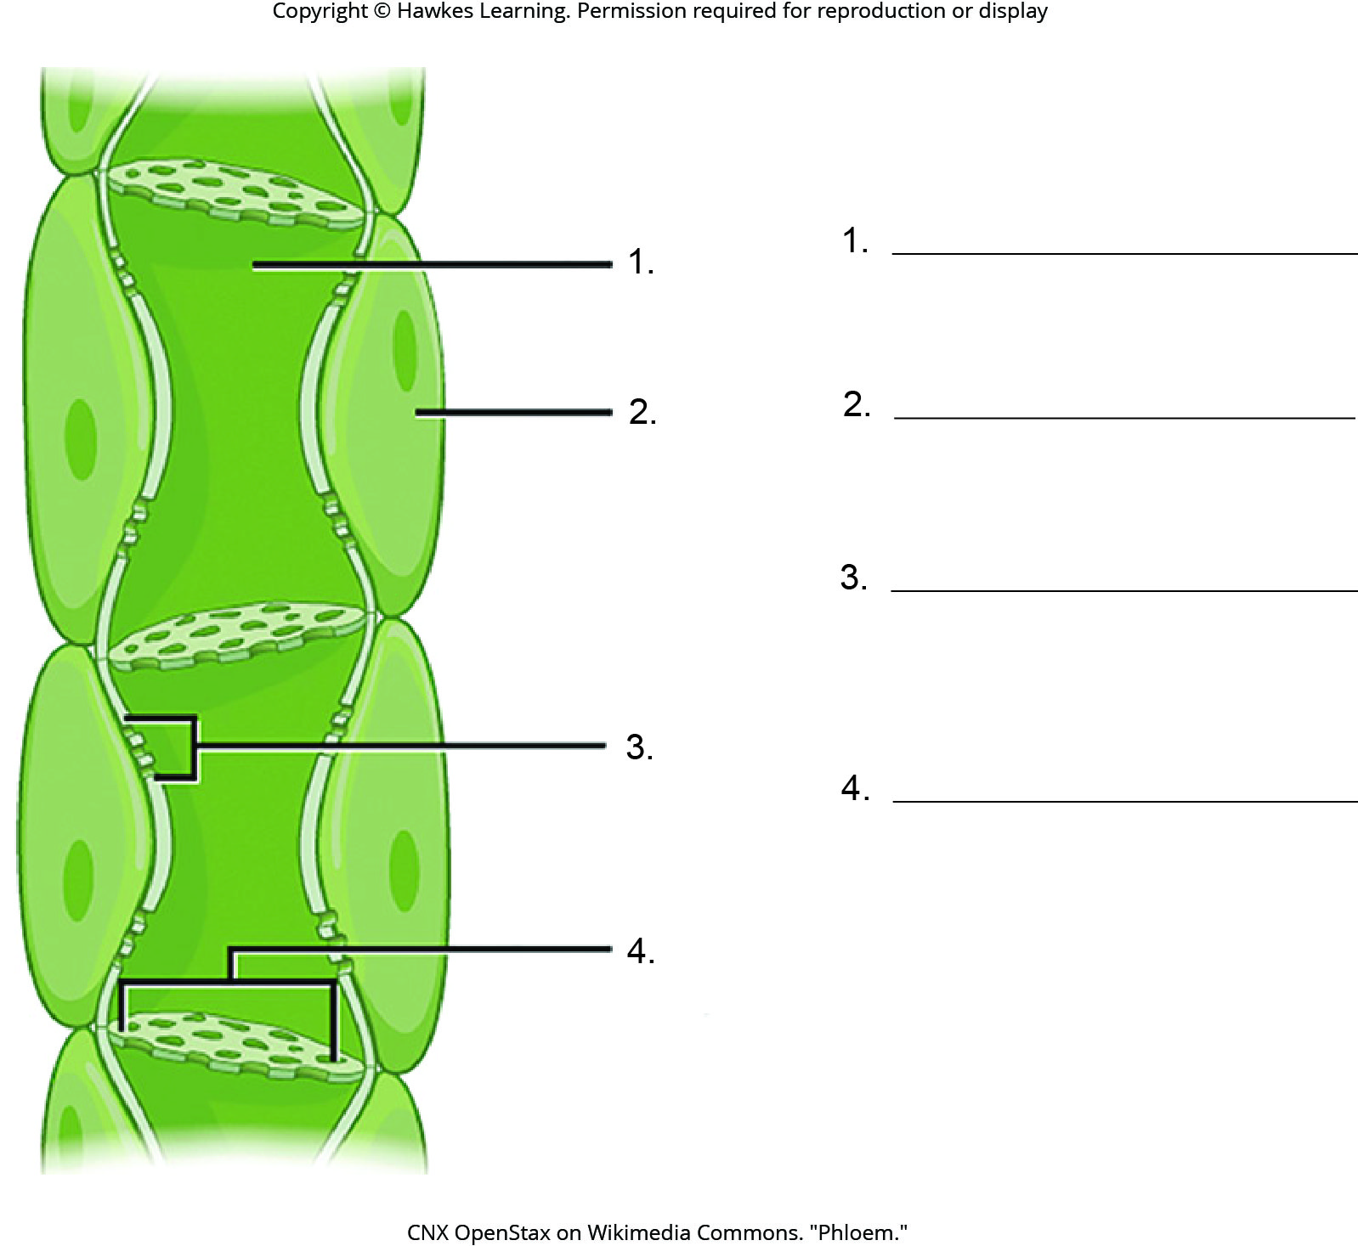
Lesson 30.5 Figure 8 - Numbered

Slide 49
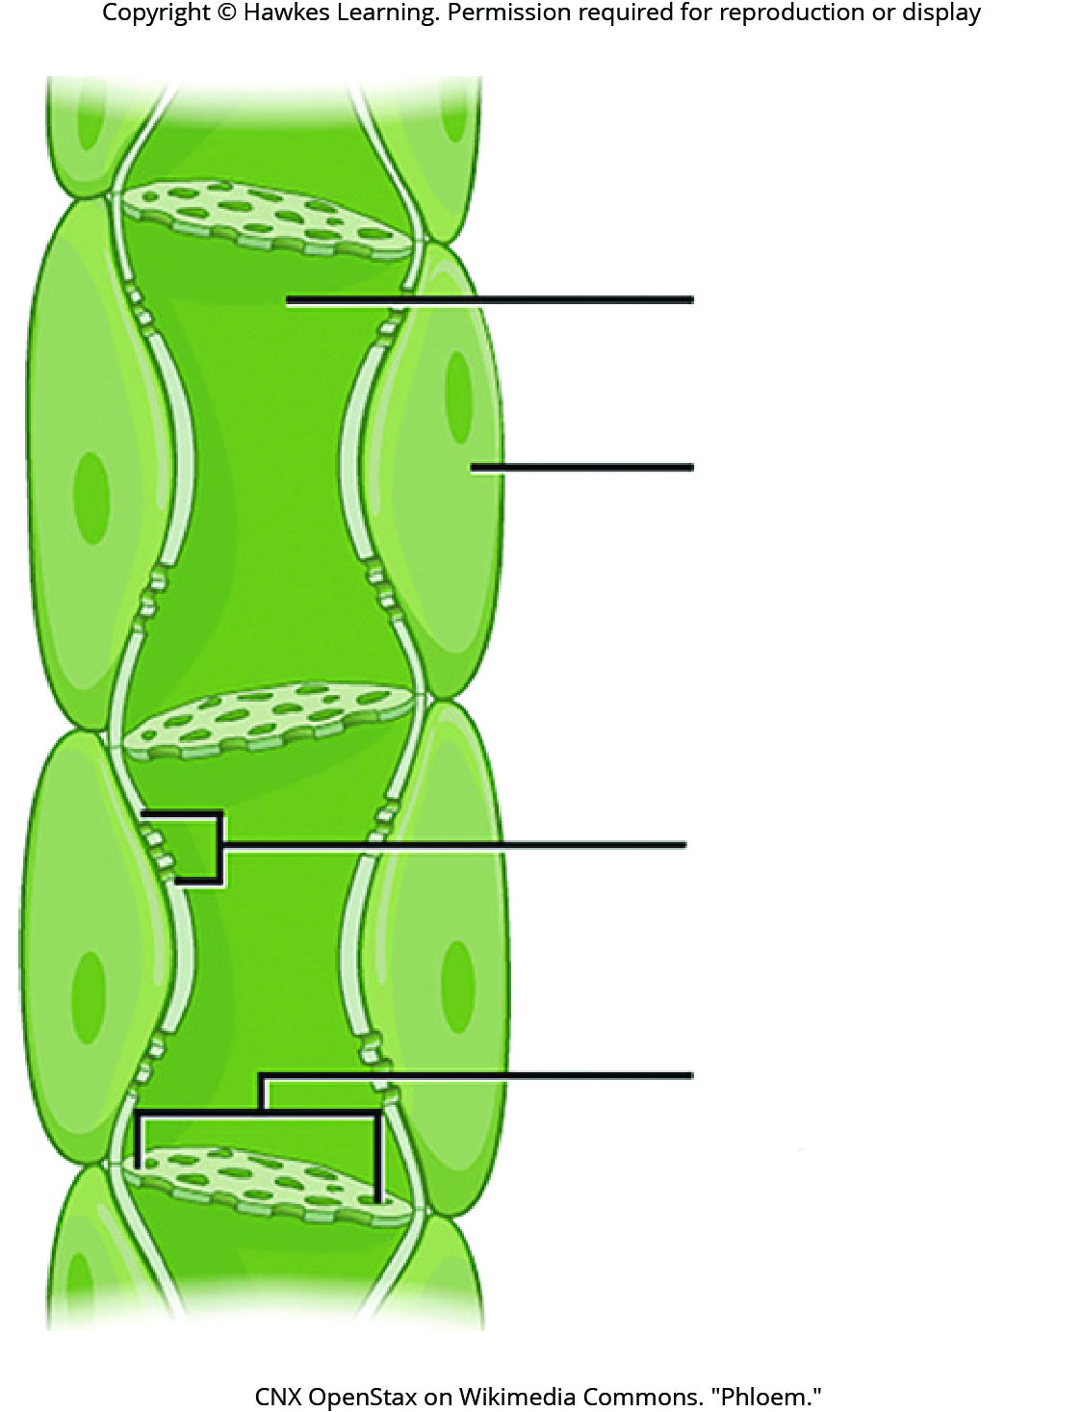
Lesson 30.5 Figure 8

Slide 50
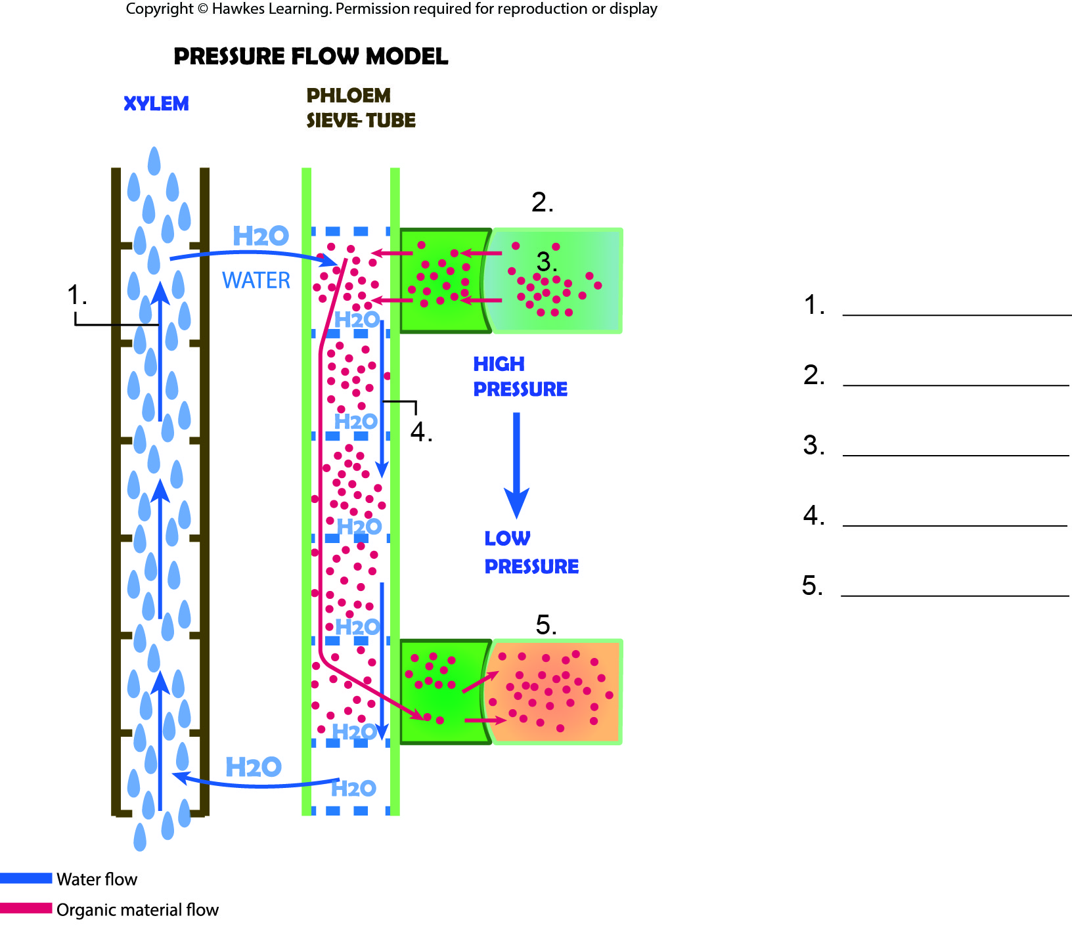
Lesson 30.5 Figure 9 - Numbered

Slide 51
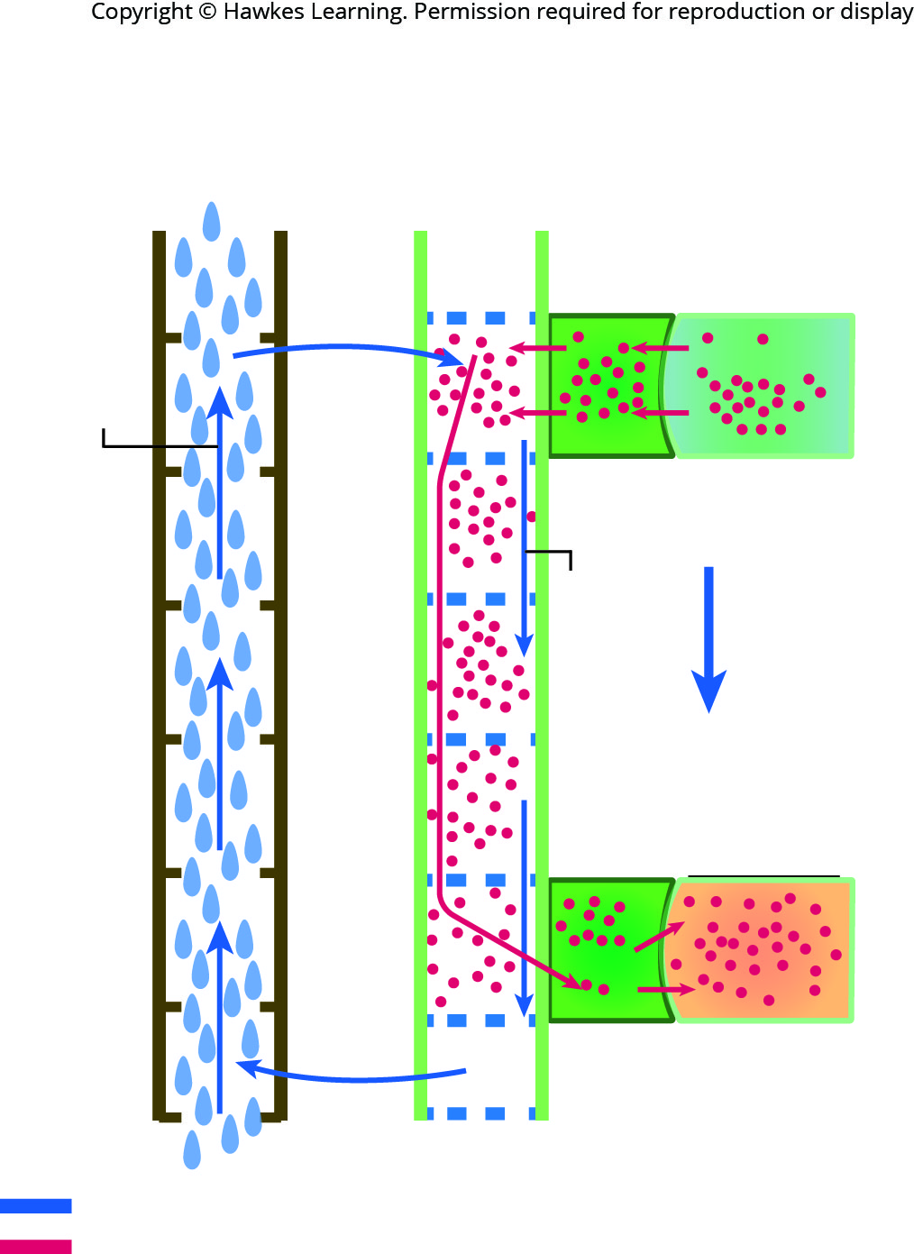
Lesson 30.5 Figure 9

Slide 52

Lesson 30.6 Figure 1 - Numbered

Slide 53

Lesson 30.6 Figure 1

Slide 54
Hawkes Learning – End of PowerPoint

