Slide 1
Chapter 31
Soil and Plant Nutrition

Slide 2
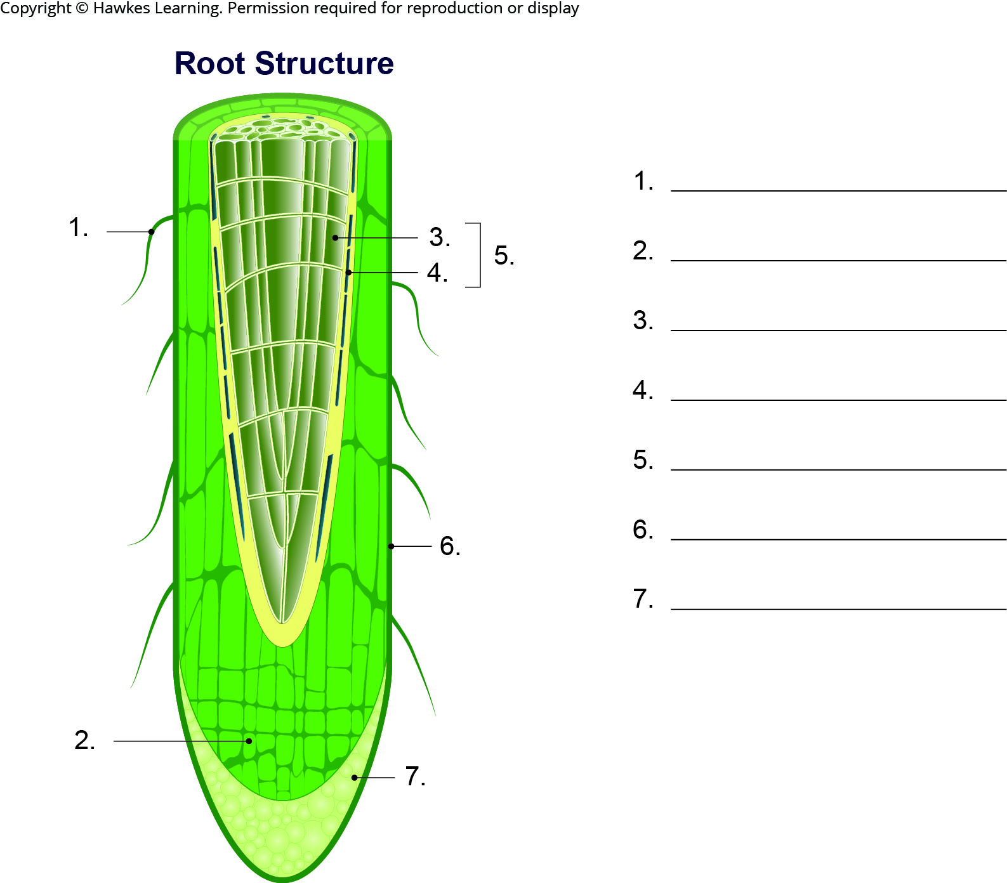
Lesson 31.1 Figure 2 - Numbered

Slide 3
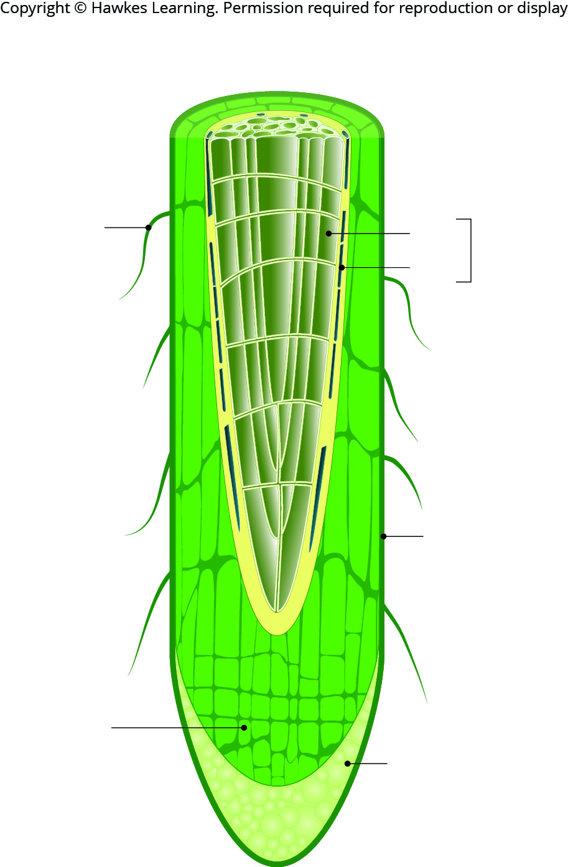
Lesson 31.1 Figure 2

Slide 4
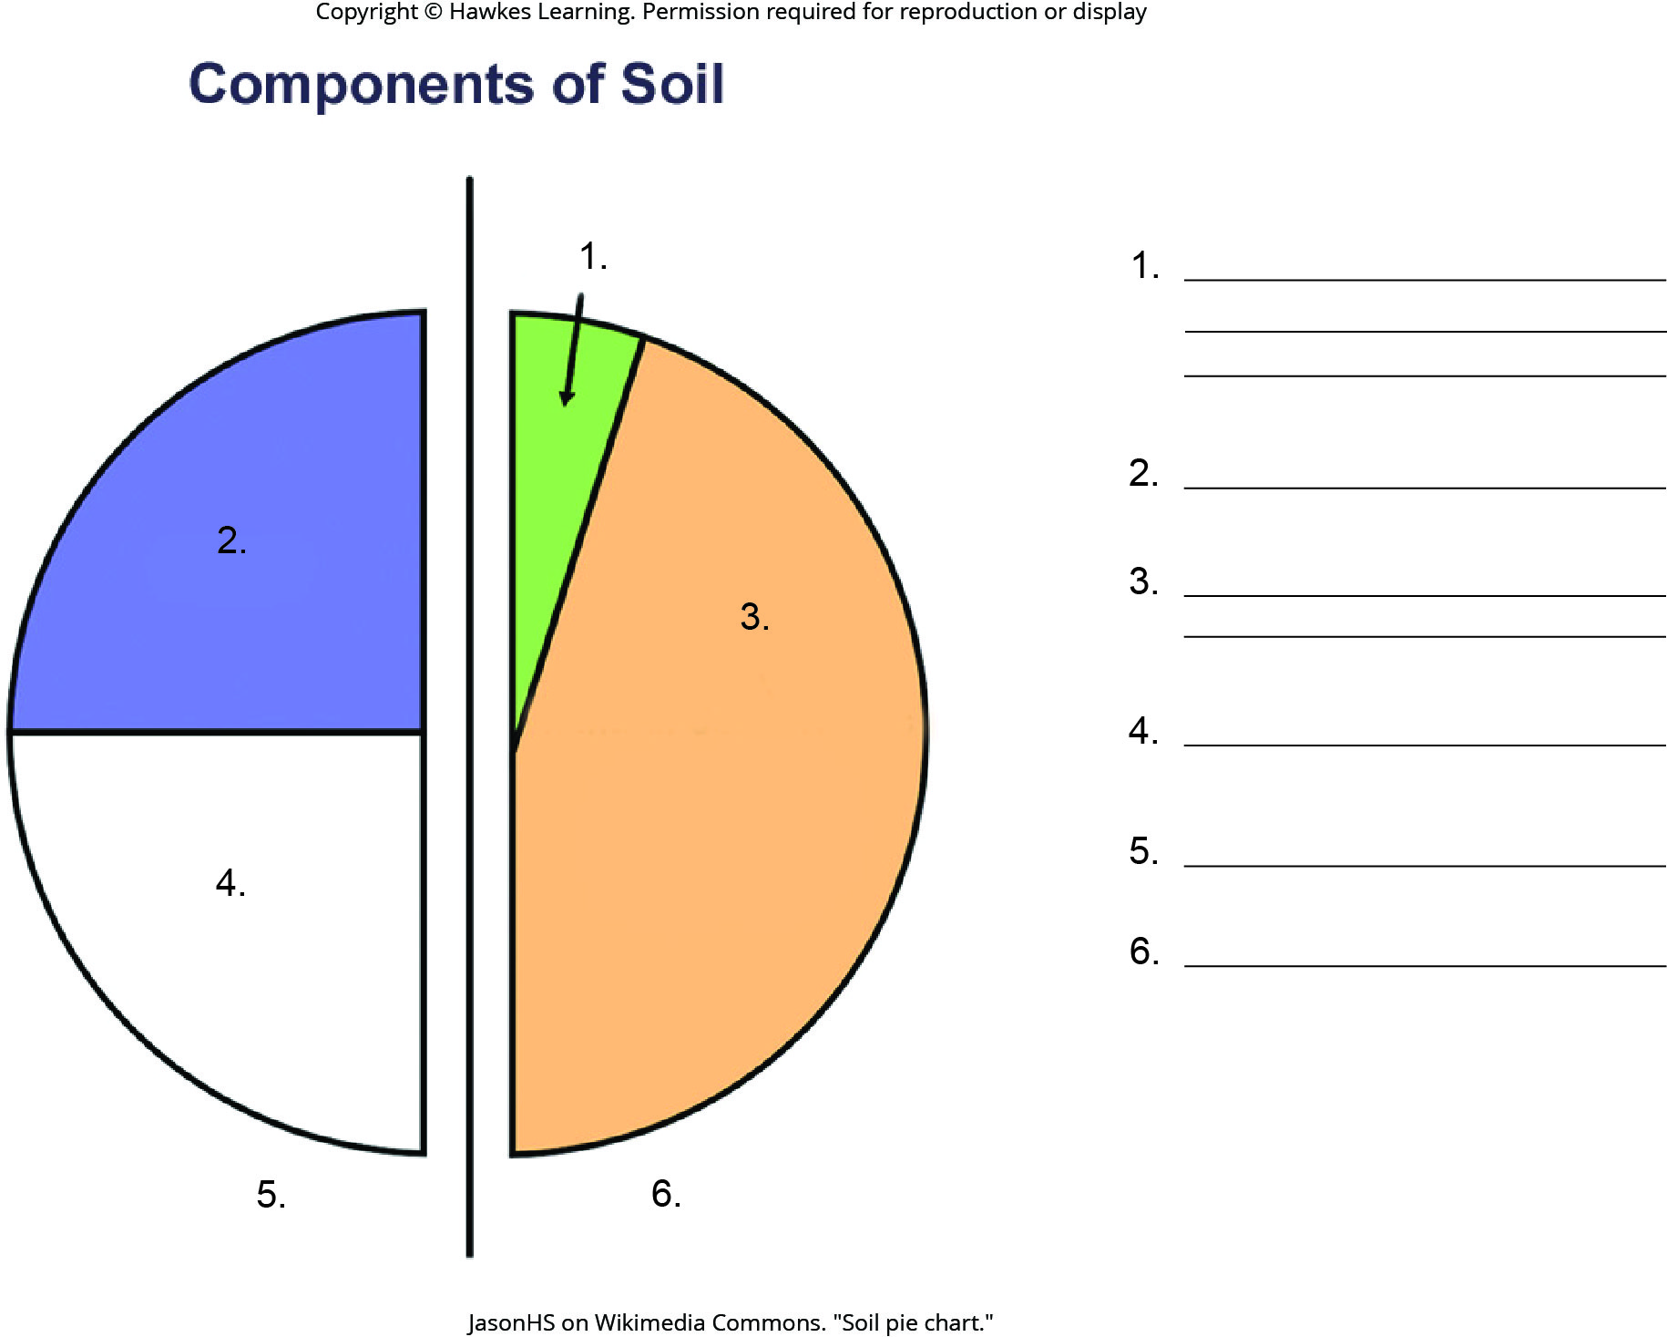
Lesson 31.1 Figure 7 - Numbered

Slide 5
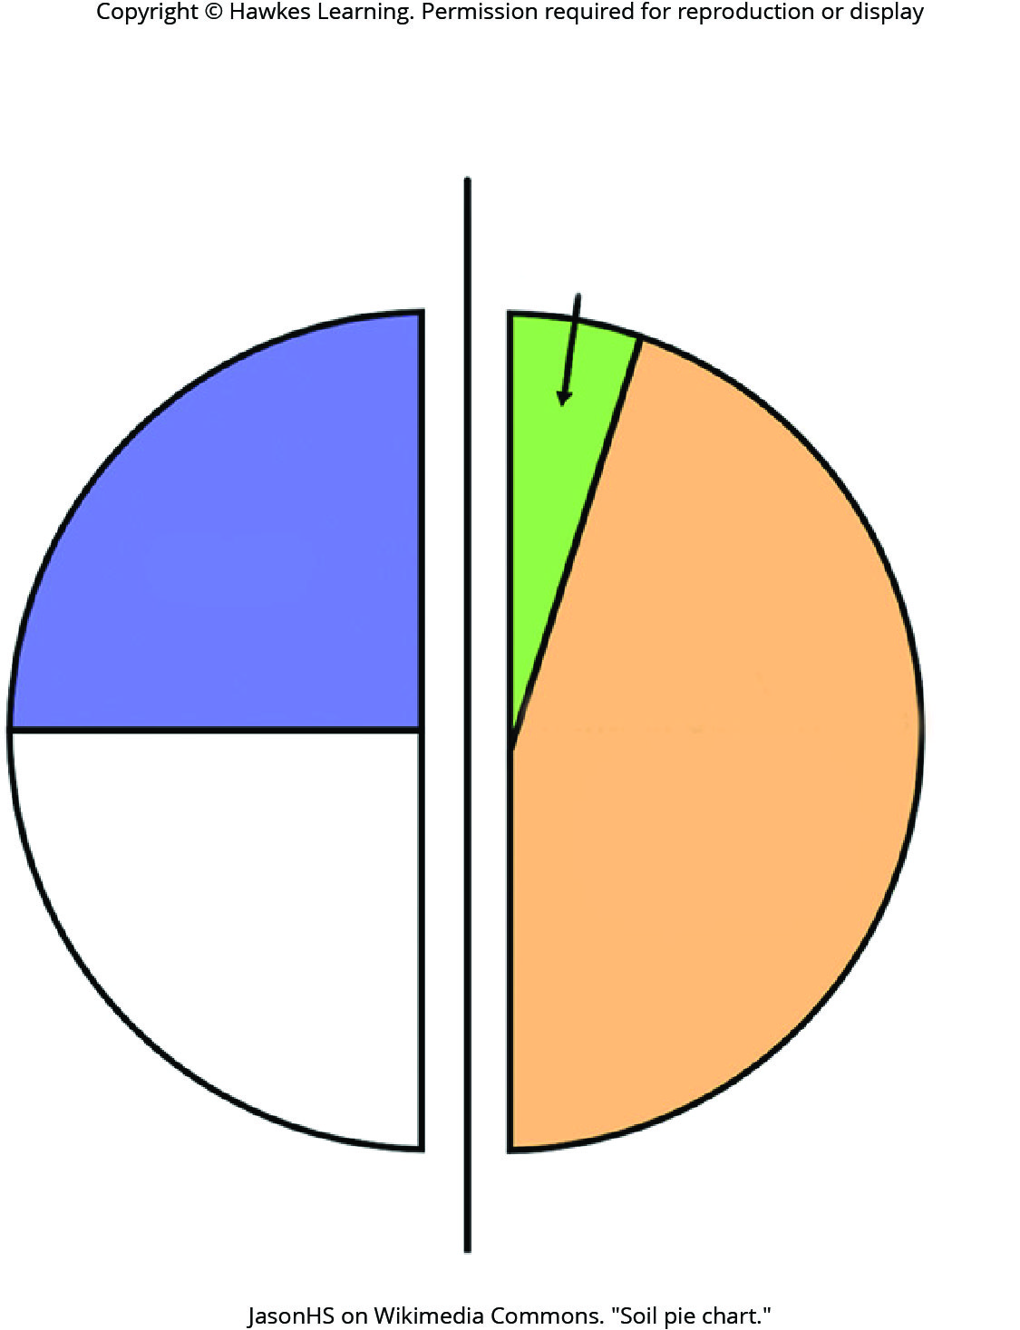
Lesson 31.1 Figure 7

Slide 6
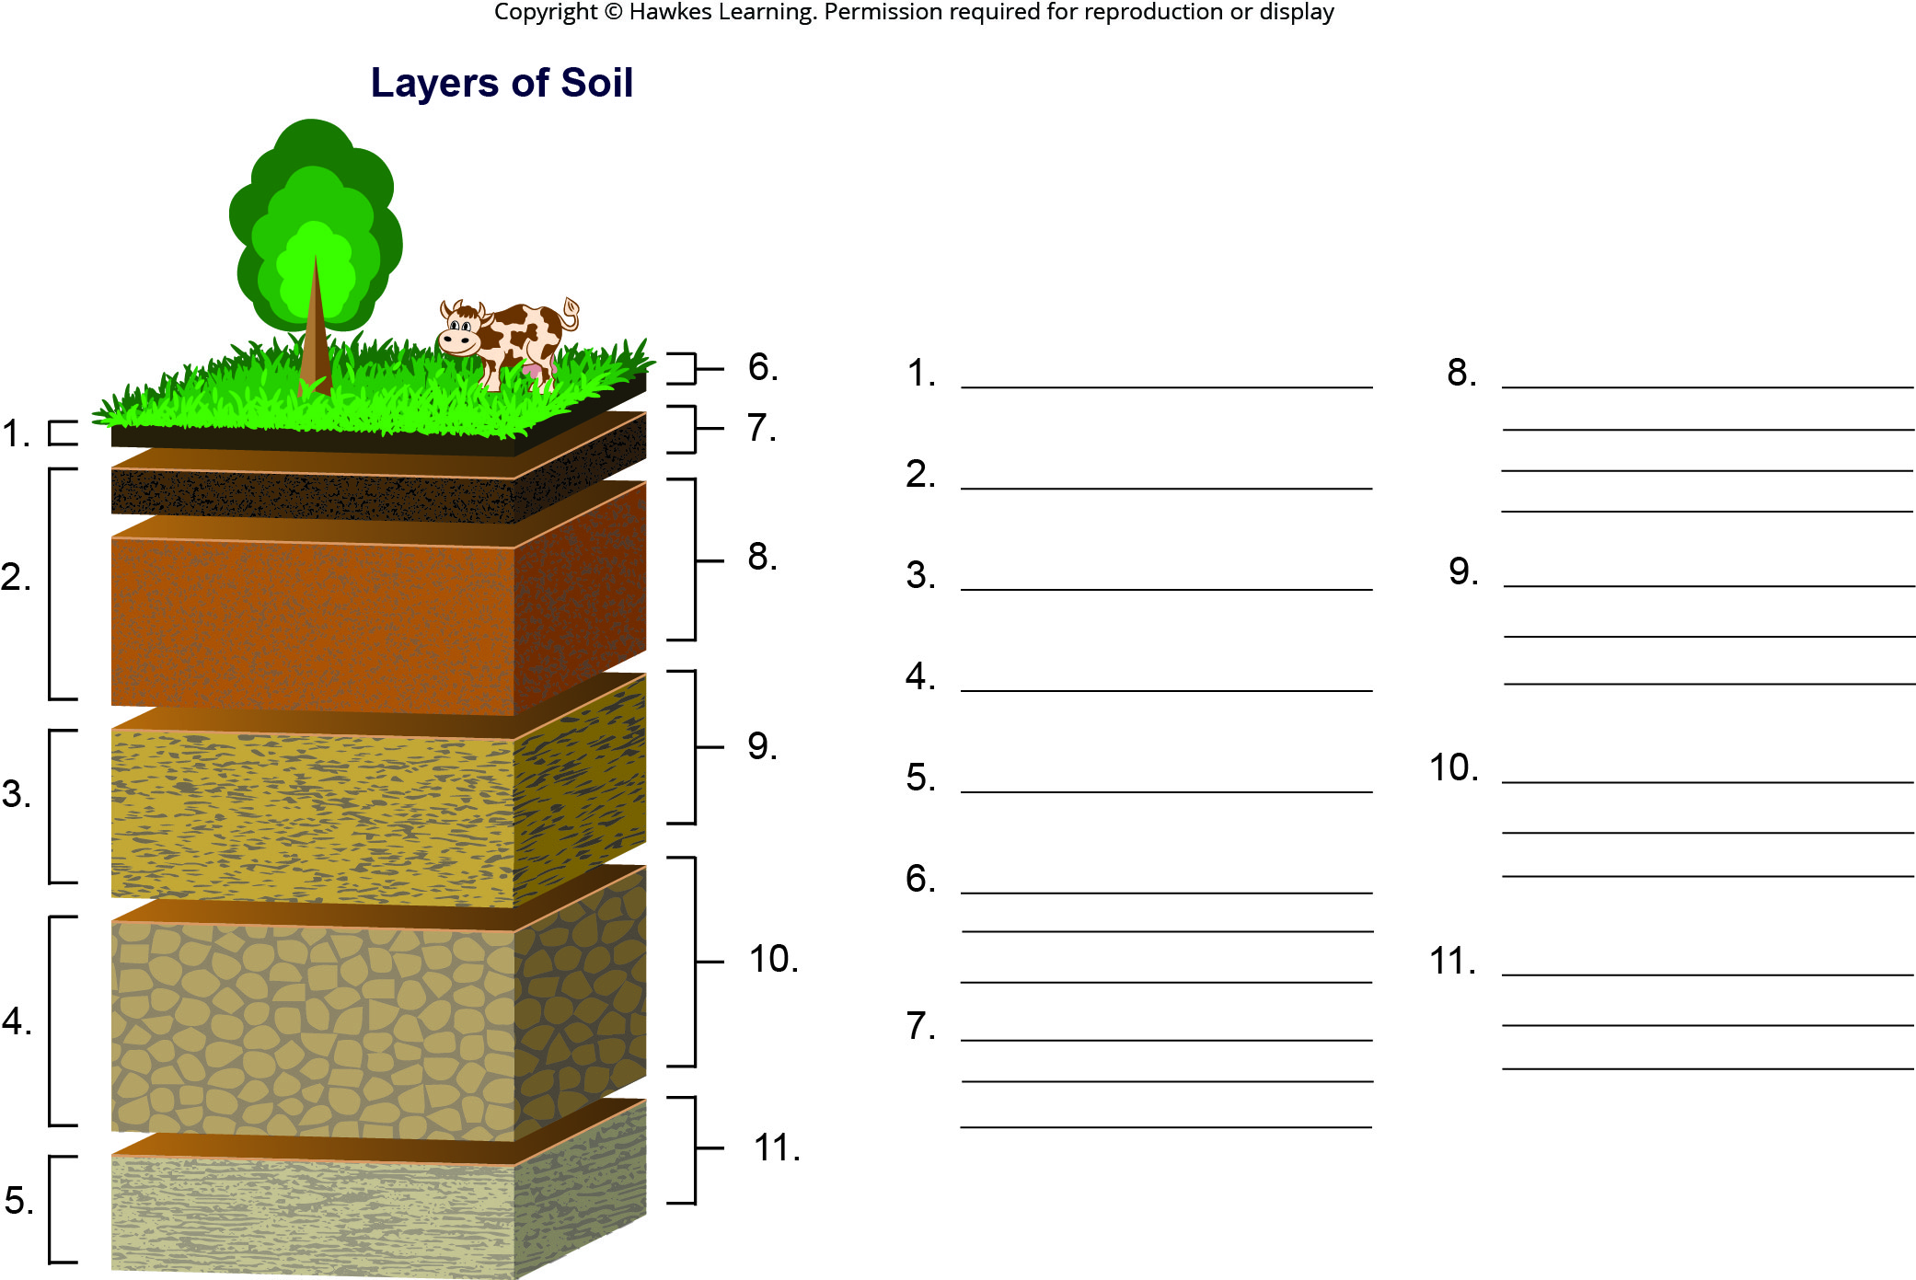
Lesson 31.1 Figure 9 - Numbered

Slide 7
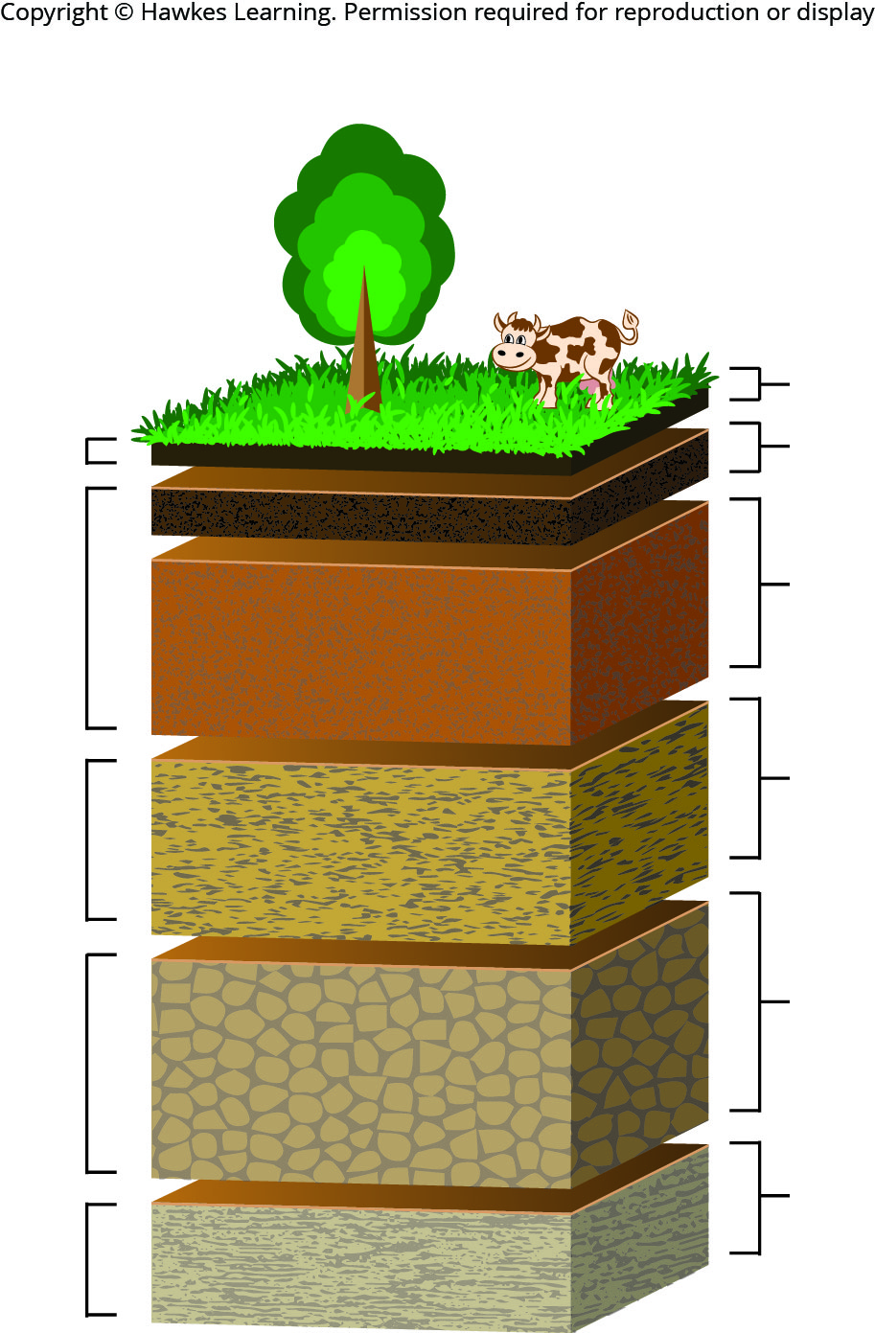
Lesson 31.1 Figure 9

Slide 8
Hawkes Learning – End of PowerPoint

