Slide 1
Chapter 32
Plant Reproduction

Slide 2
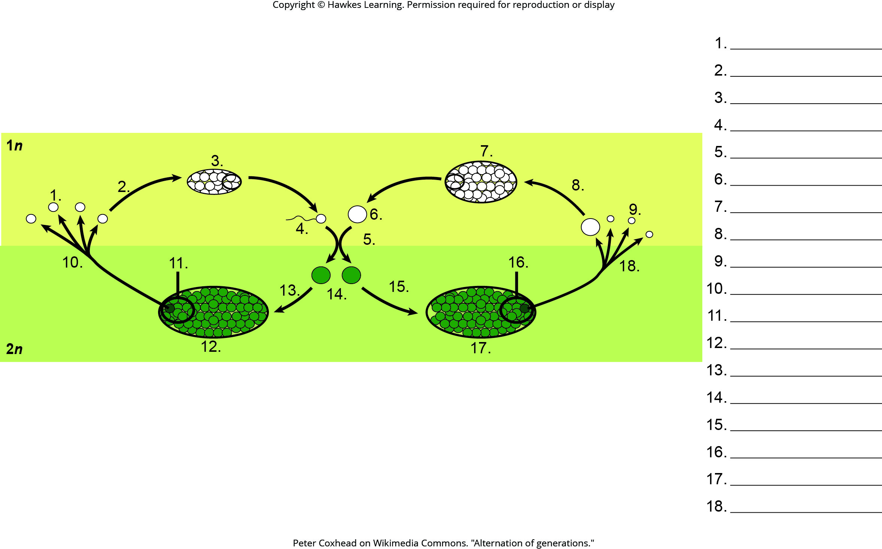
Lesson 32.1 Figure 2 - Numbered

Slide 3
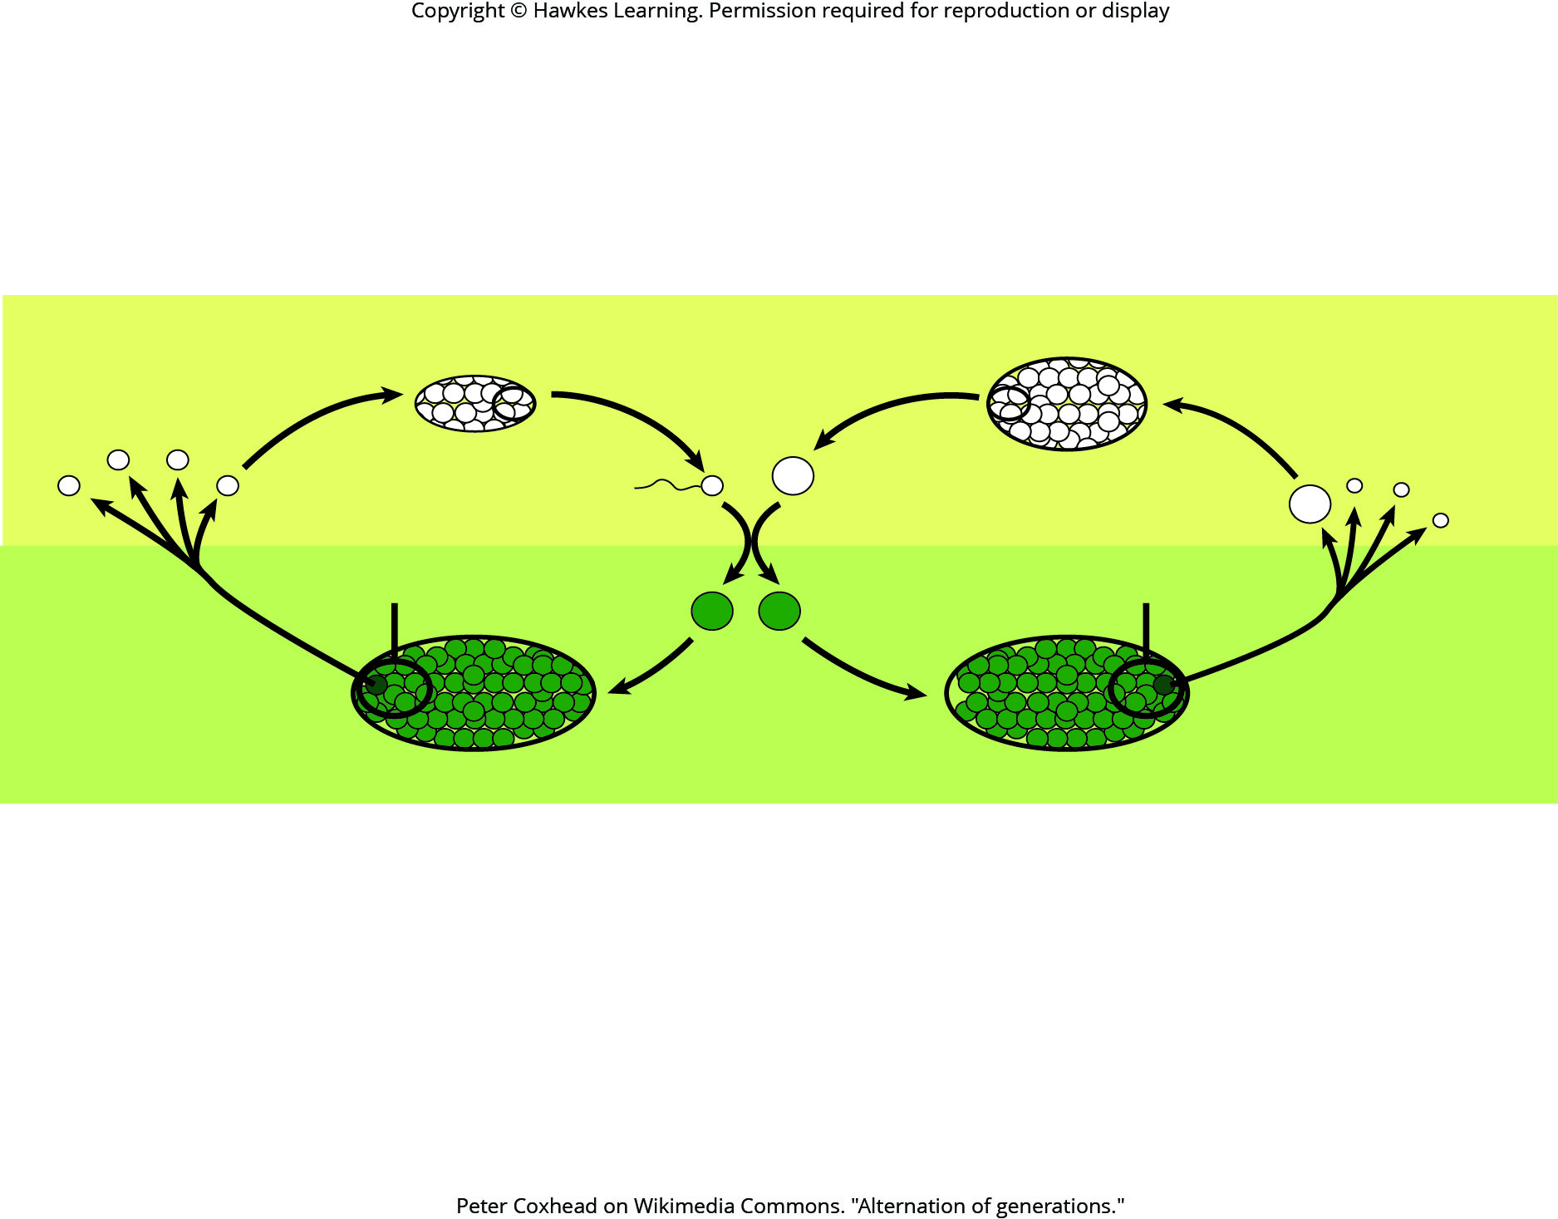
Lesson 32.1 Figure 2

Slide 4
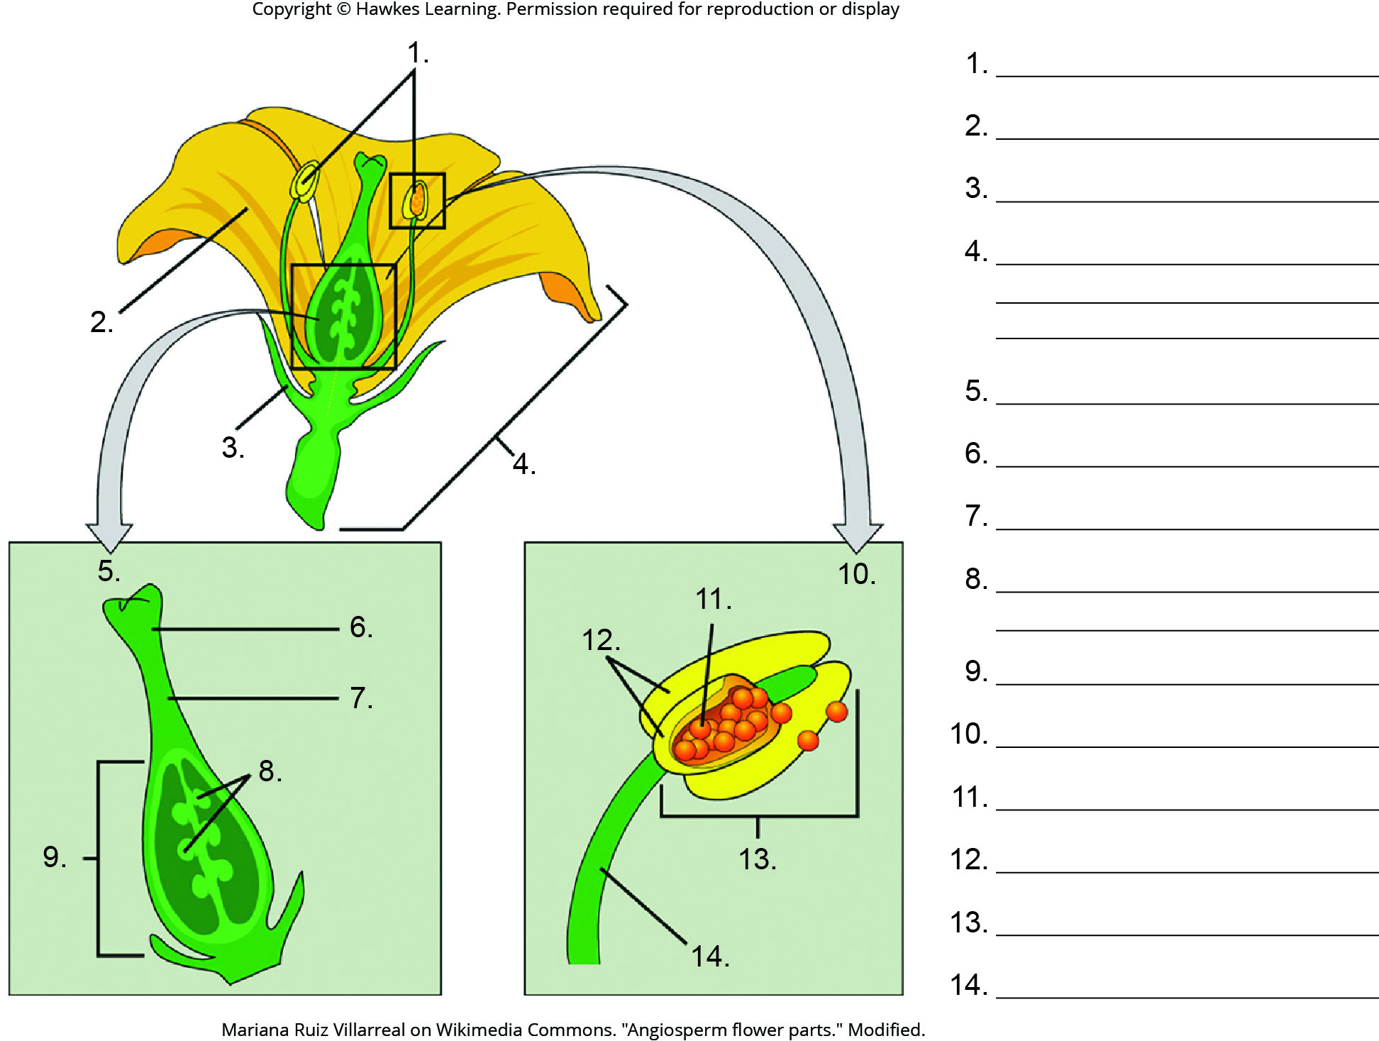
Lesson 32.1 Figure 3 - Numbered

Slide 5
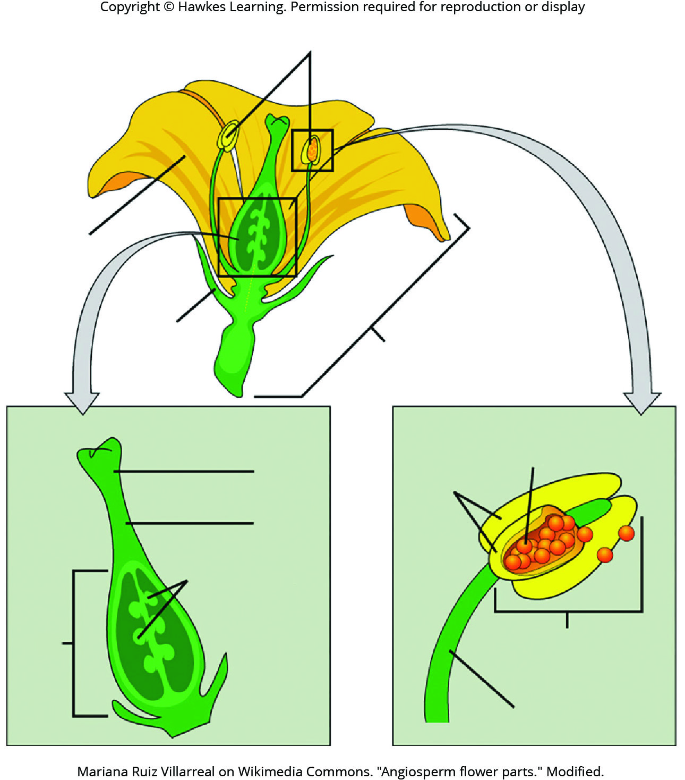
Lesson 32.2 Figure 3

Slide 6
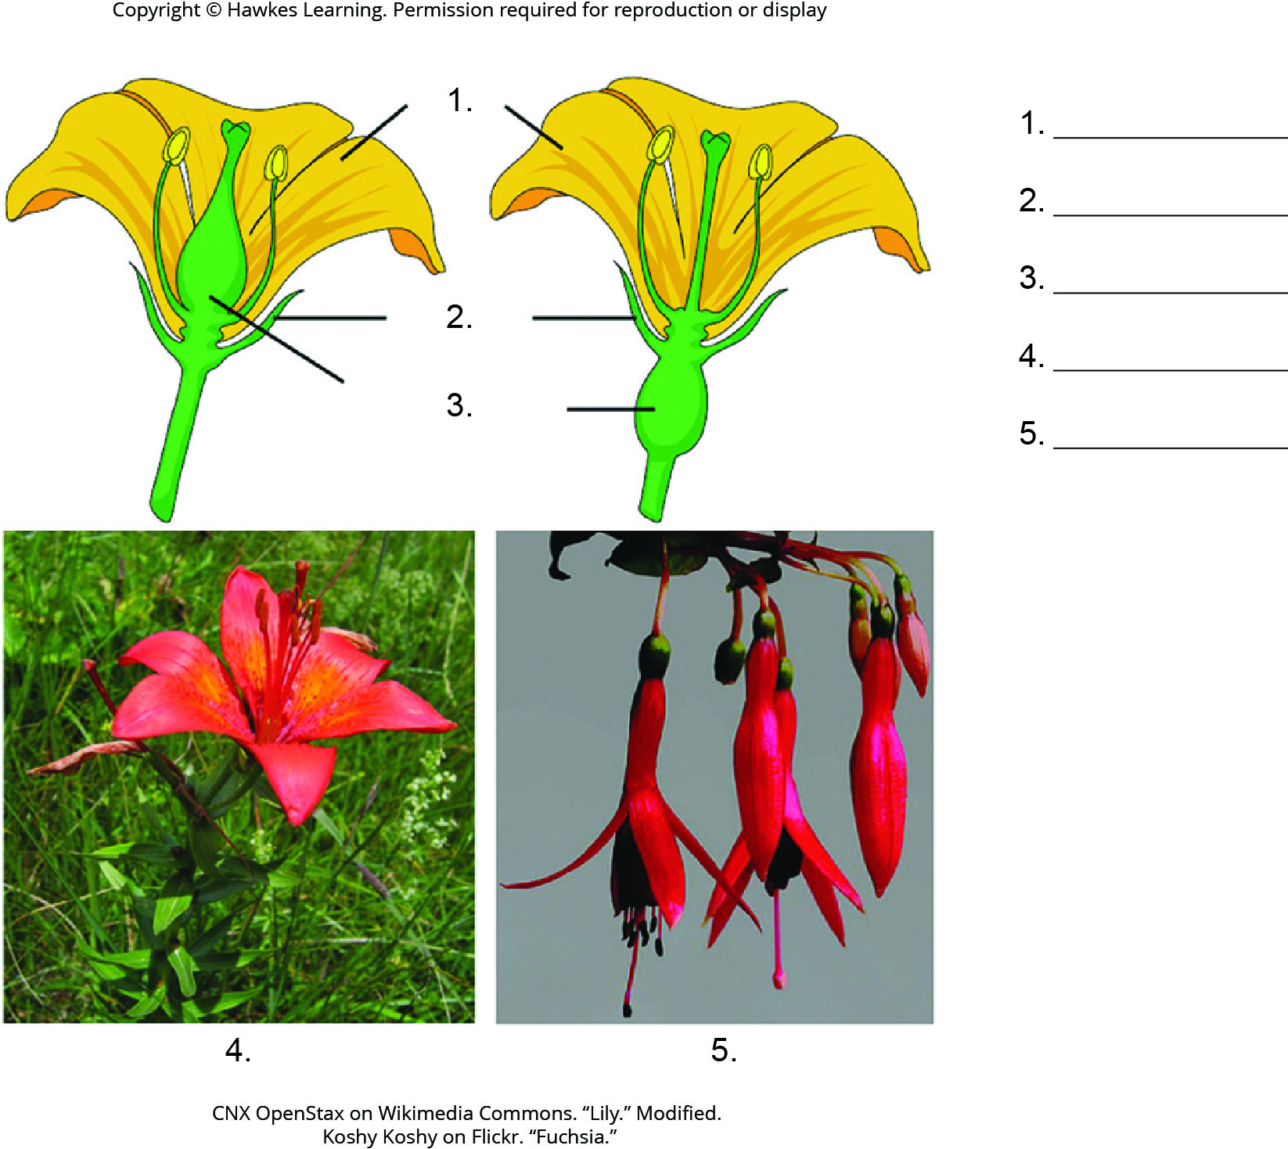
Lesson 32.1 Figure 6 - Numbered

Slide 7
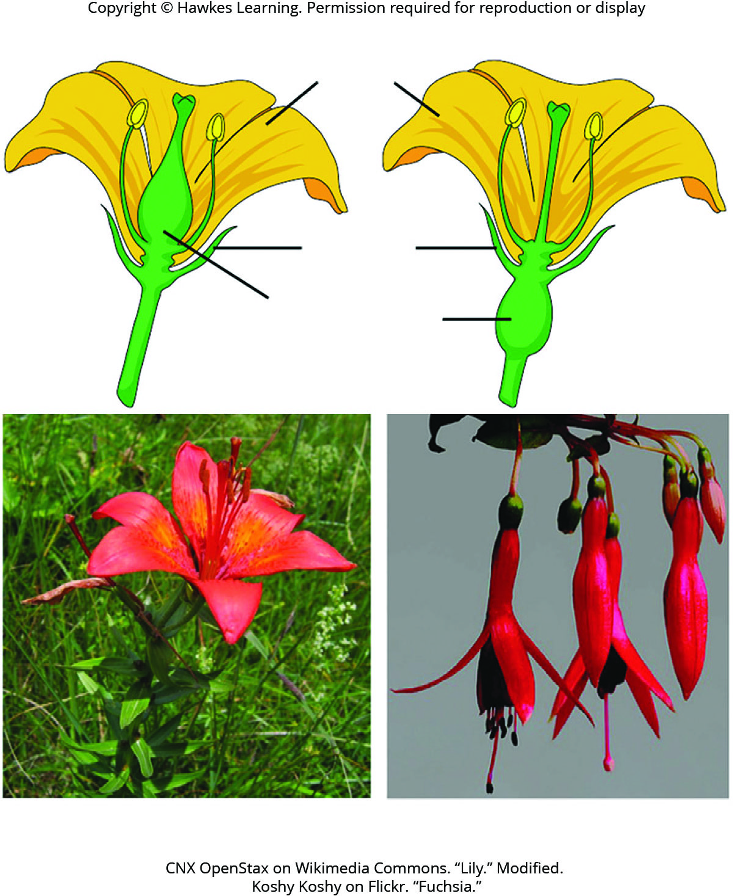
Lesson 32.1 Figure 6

Slide 8
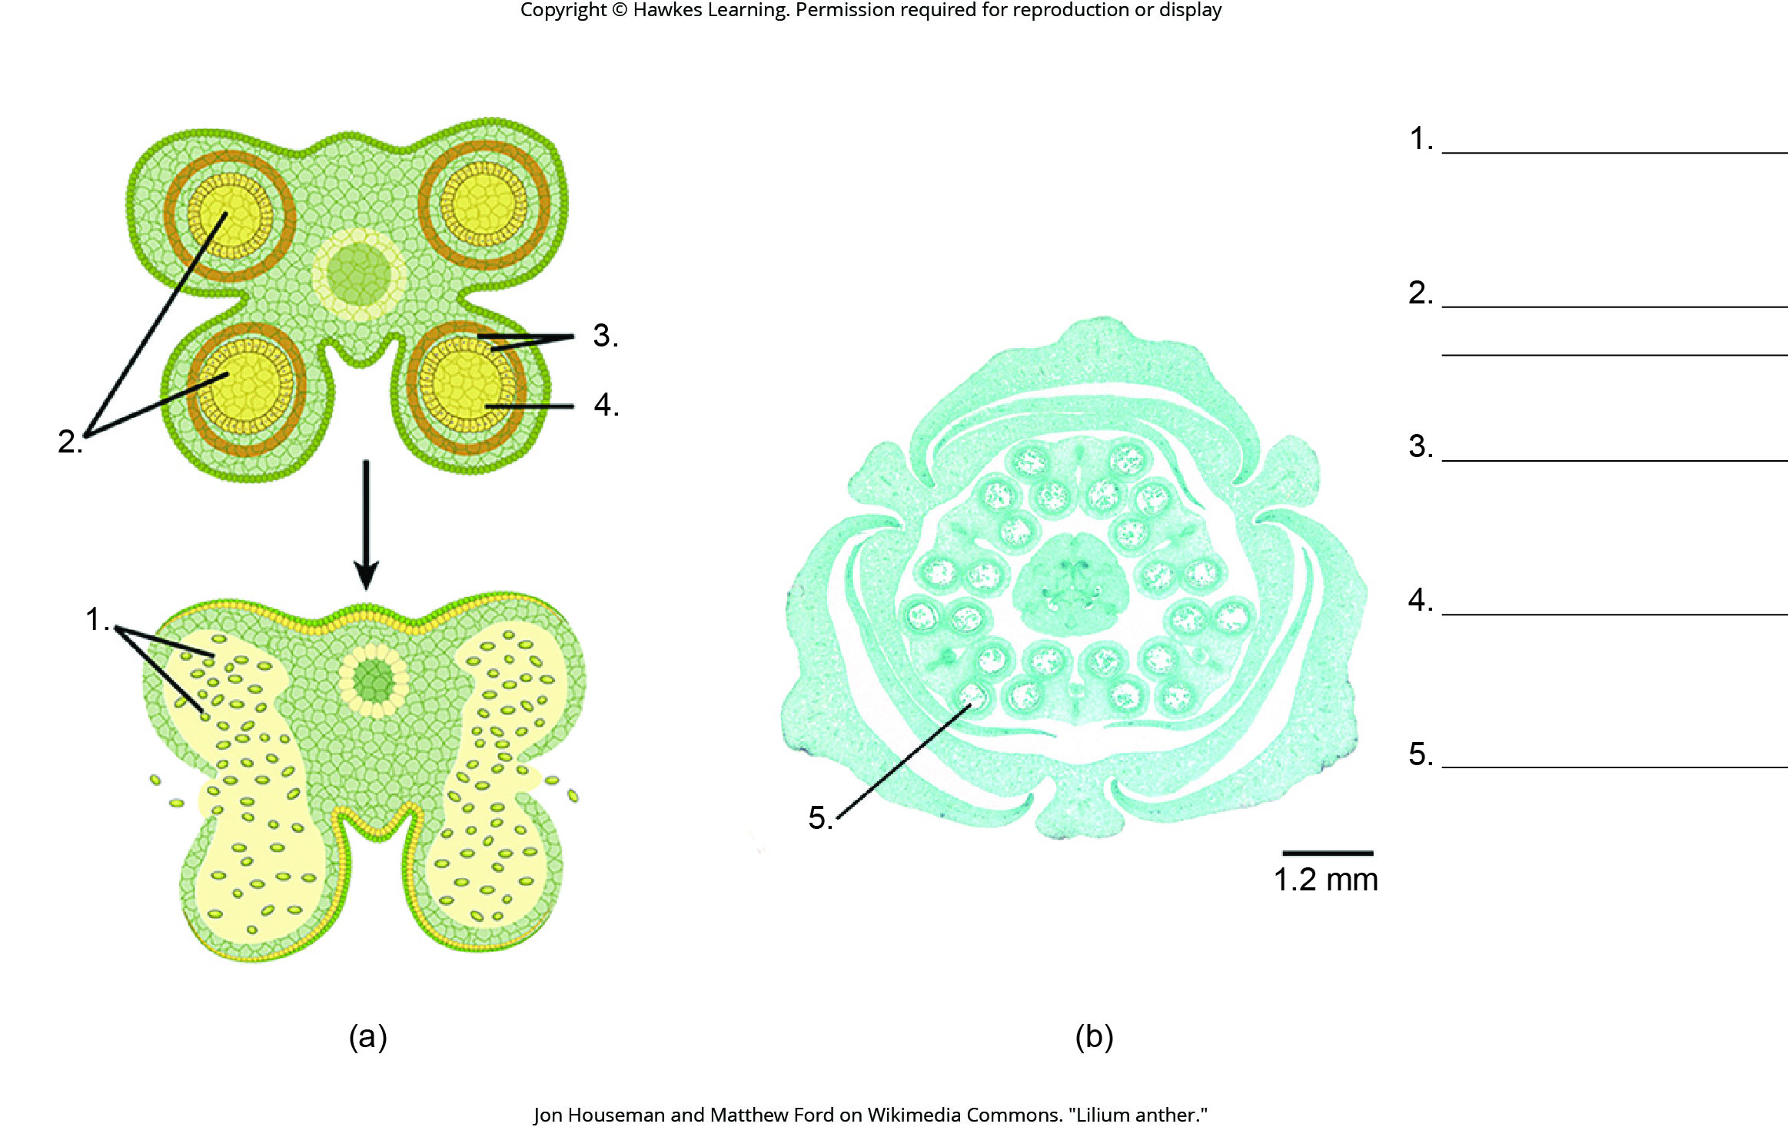
Lesson 32.1 Figure 7 - Numbered

Slide 9
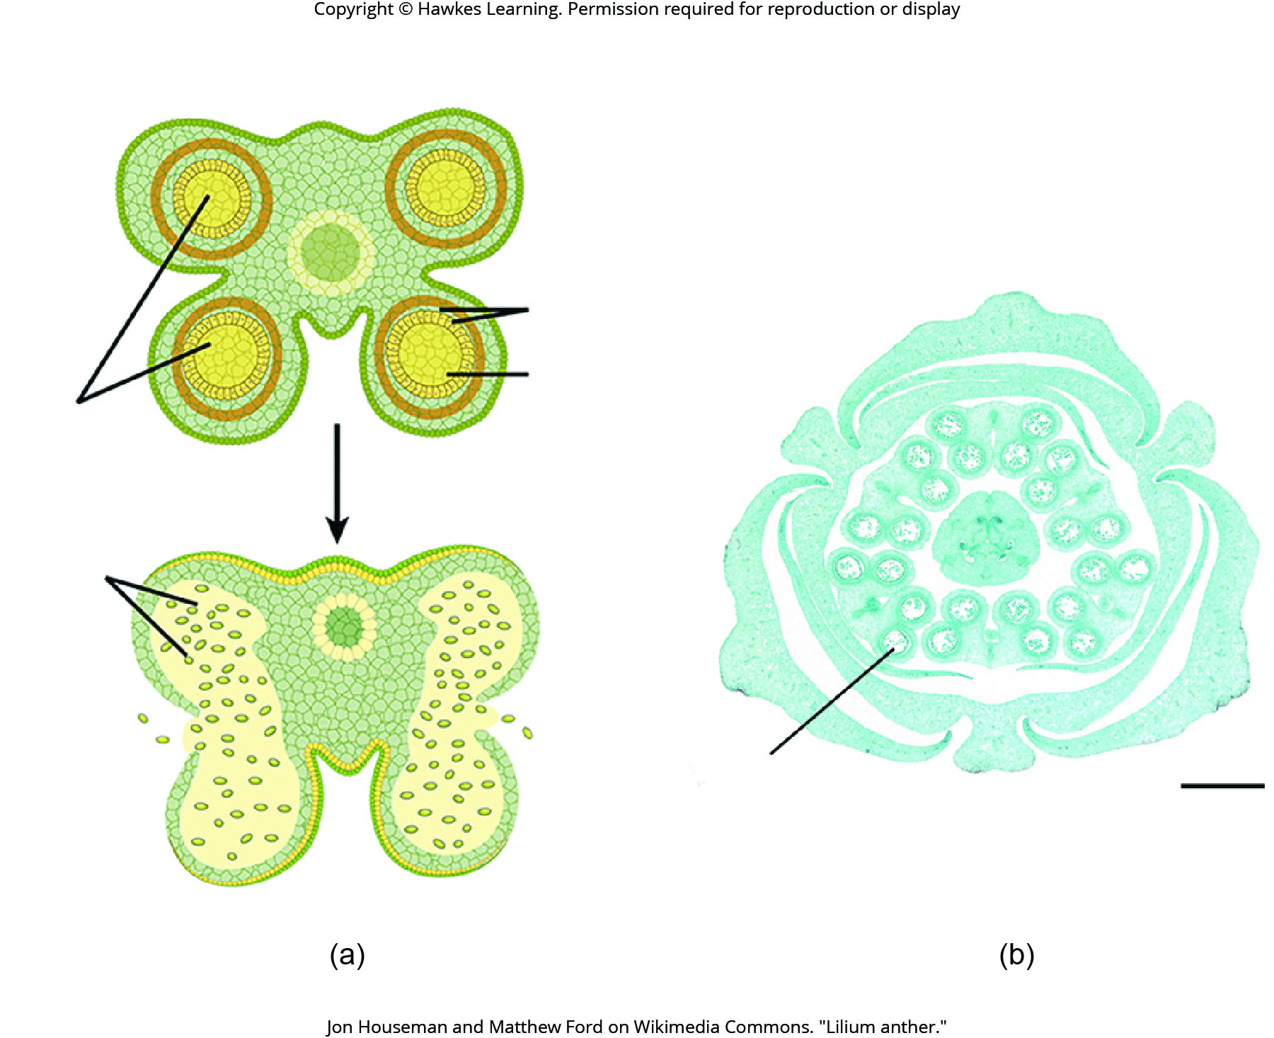
Lesson 32.1 Figure 7

Slide 10
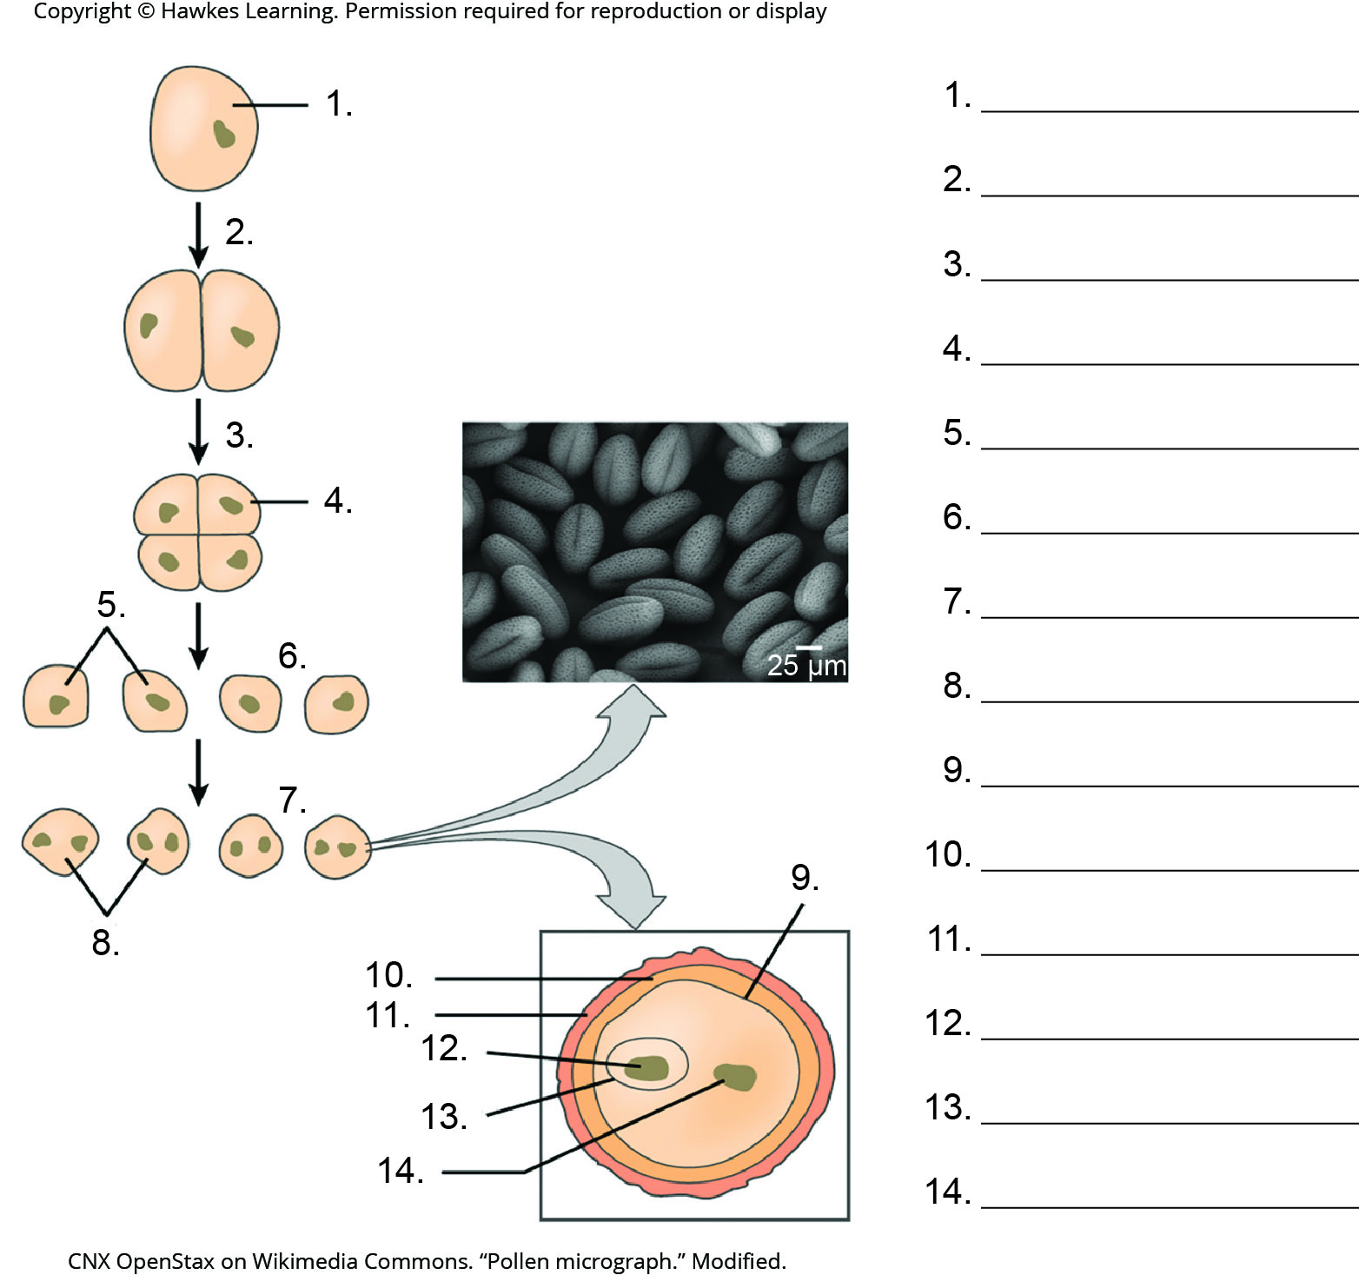
Lesson 32.1 Figure 8 - Numbered

Slide 11
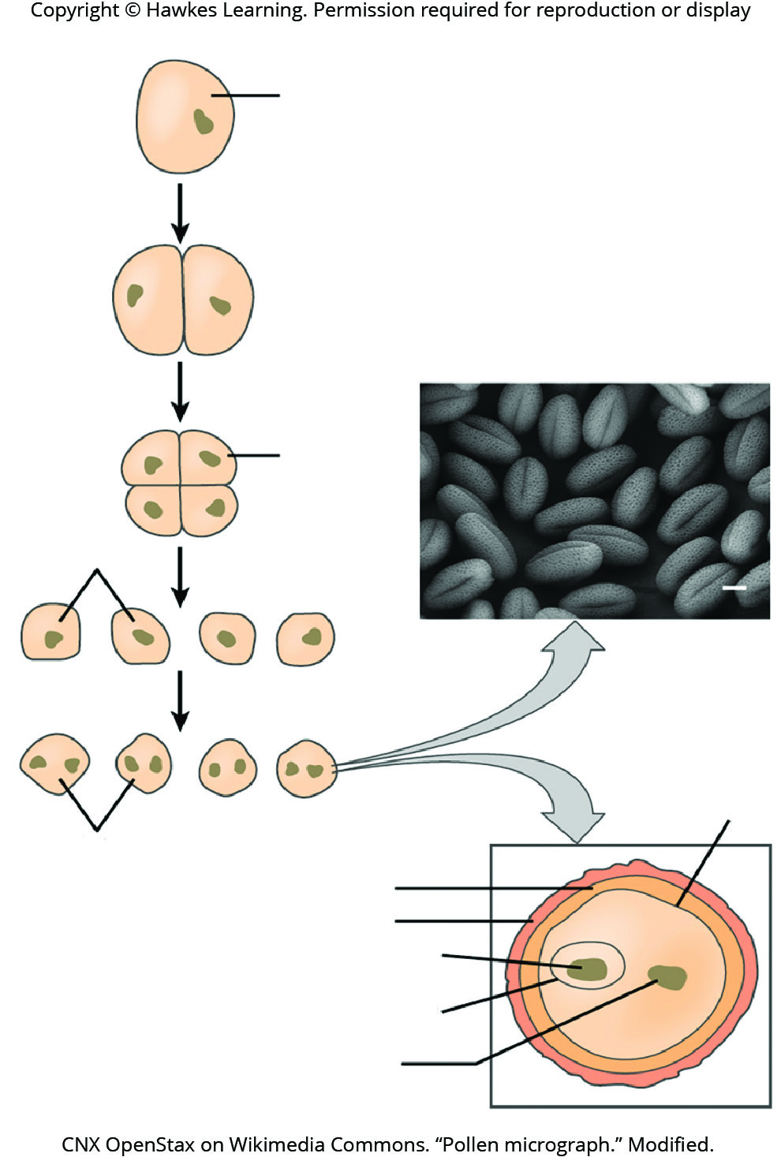
Lesson 32.1 Figure 8

Slide 12
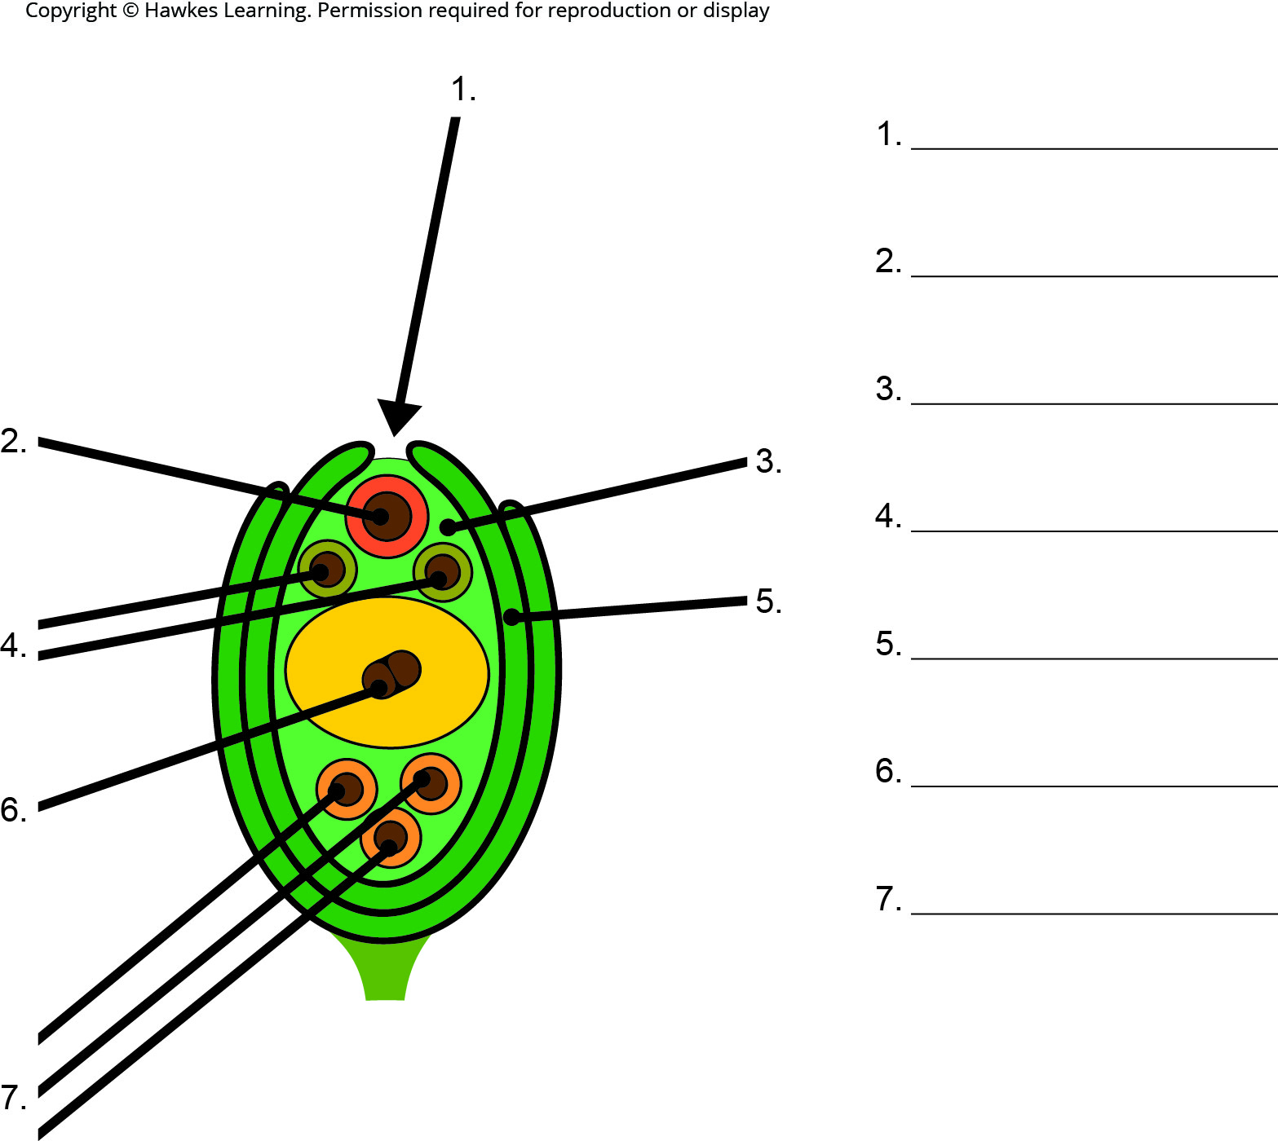
Lesson 32.1 Figure 9 - Numbered

Slide 13
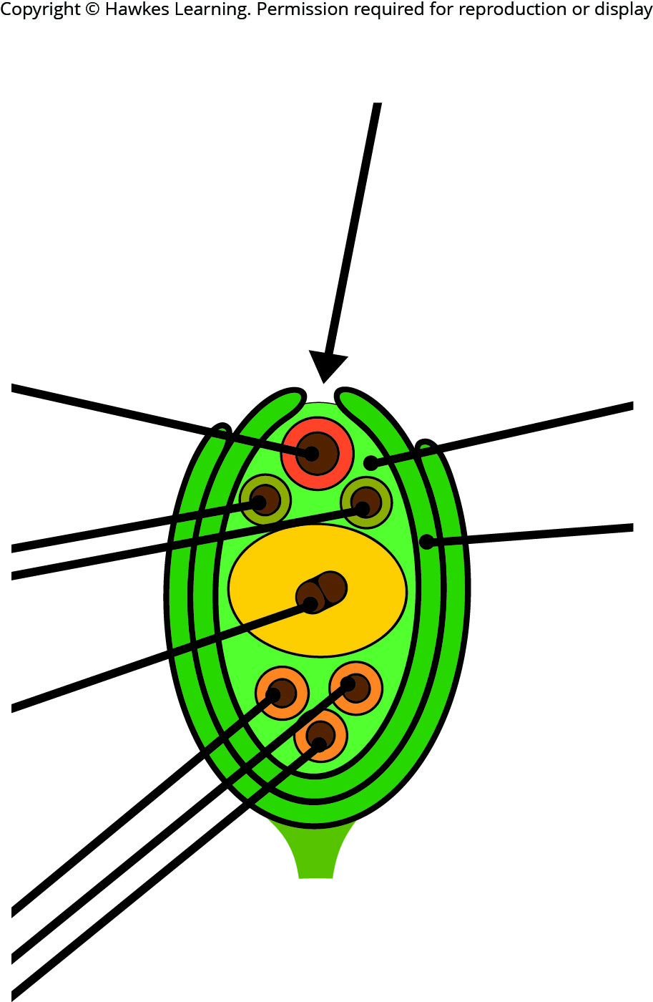
Lesson 32.1 Figure 9

Slide 14
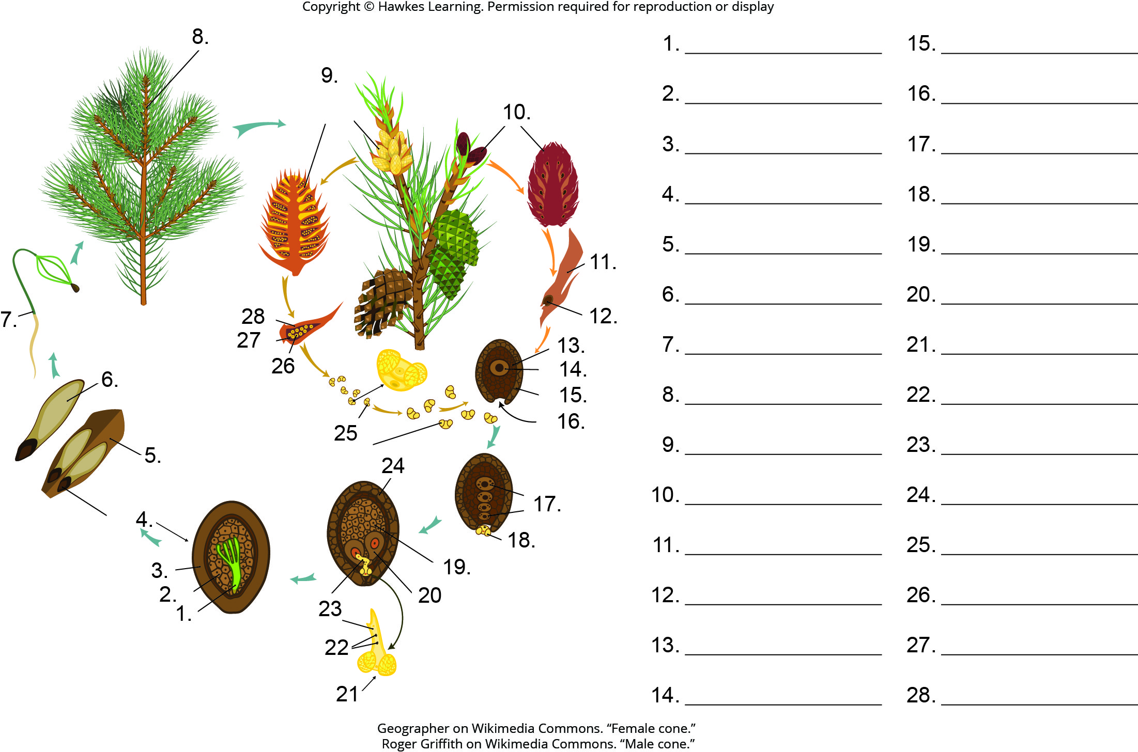
Lesson 32.1 Figure 10 - Numbered

Slide 15
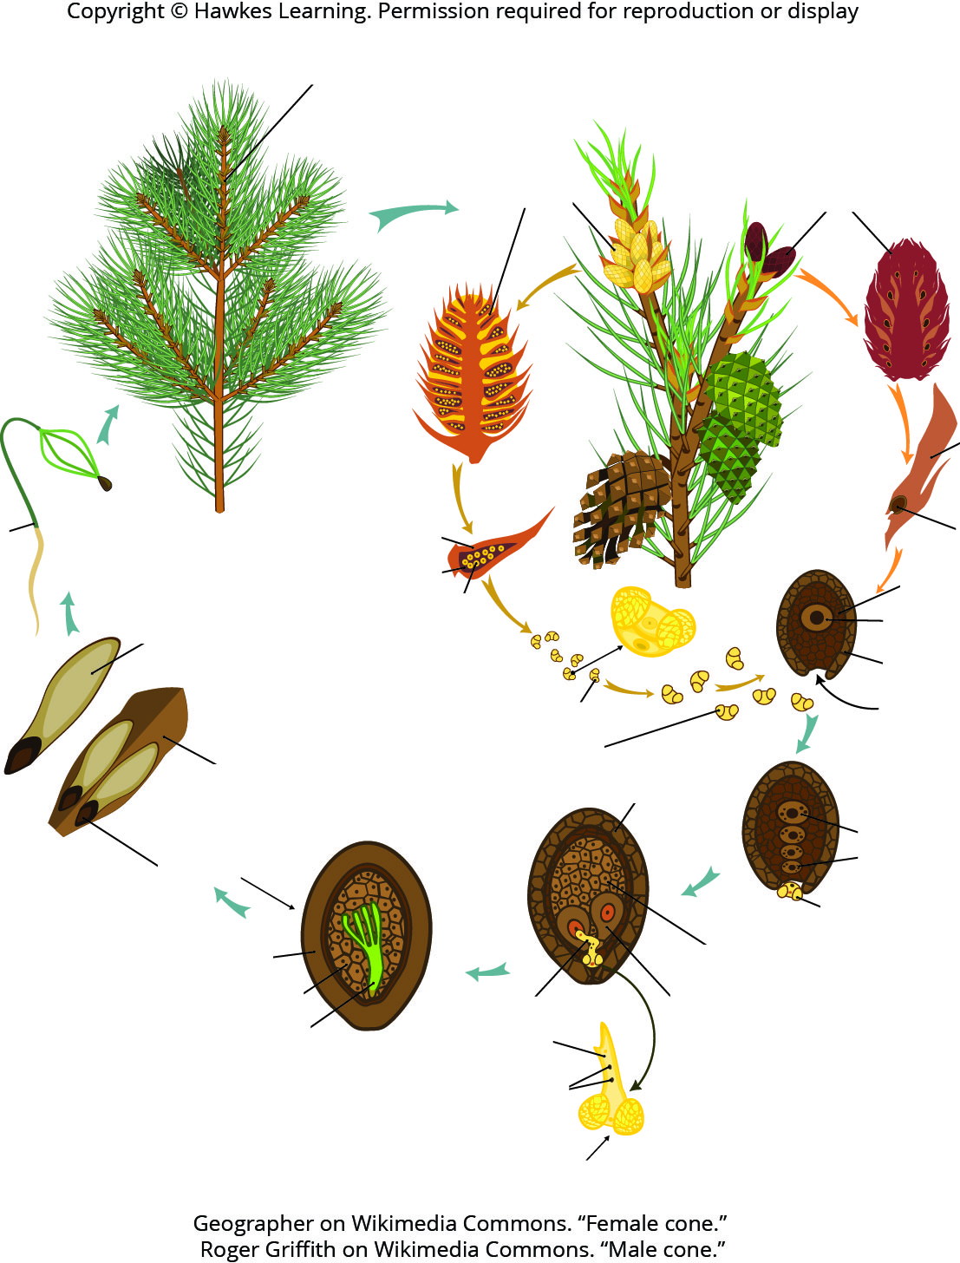
Lesson 32.1 Figure 10

Slide 16
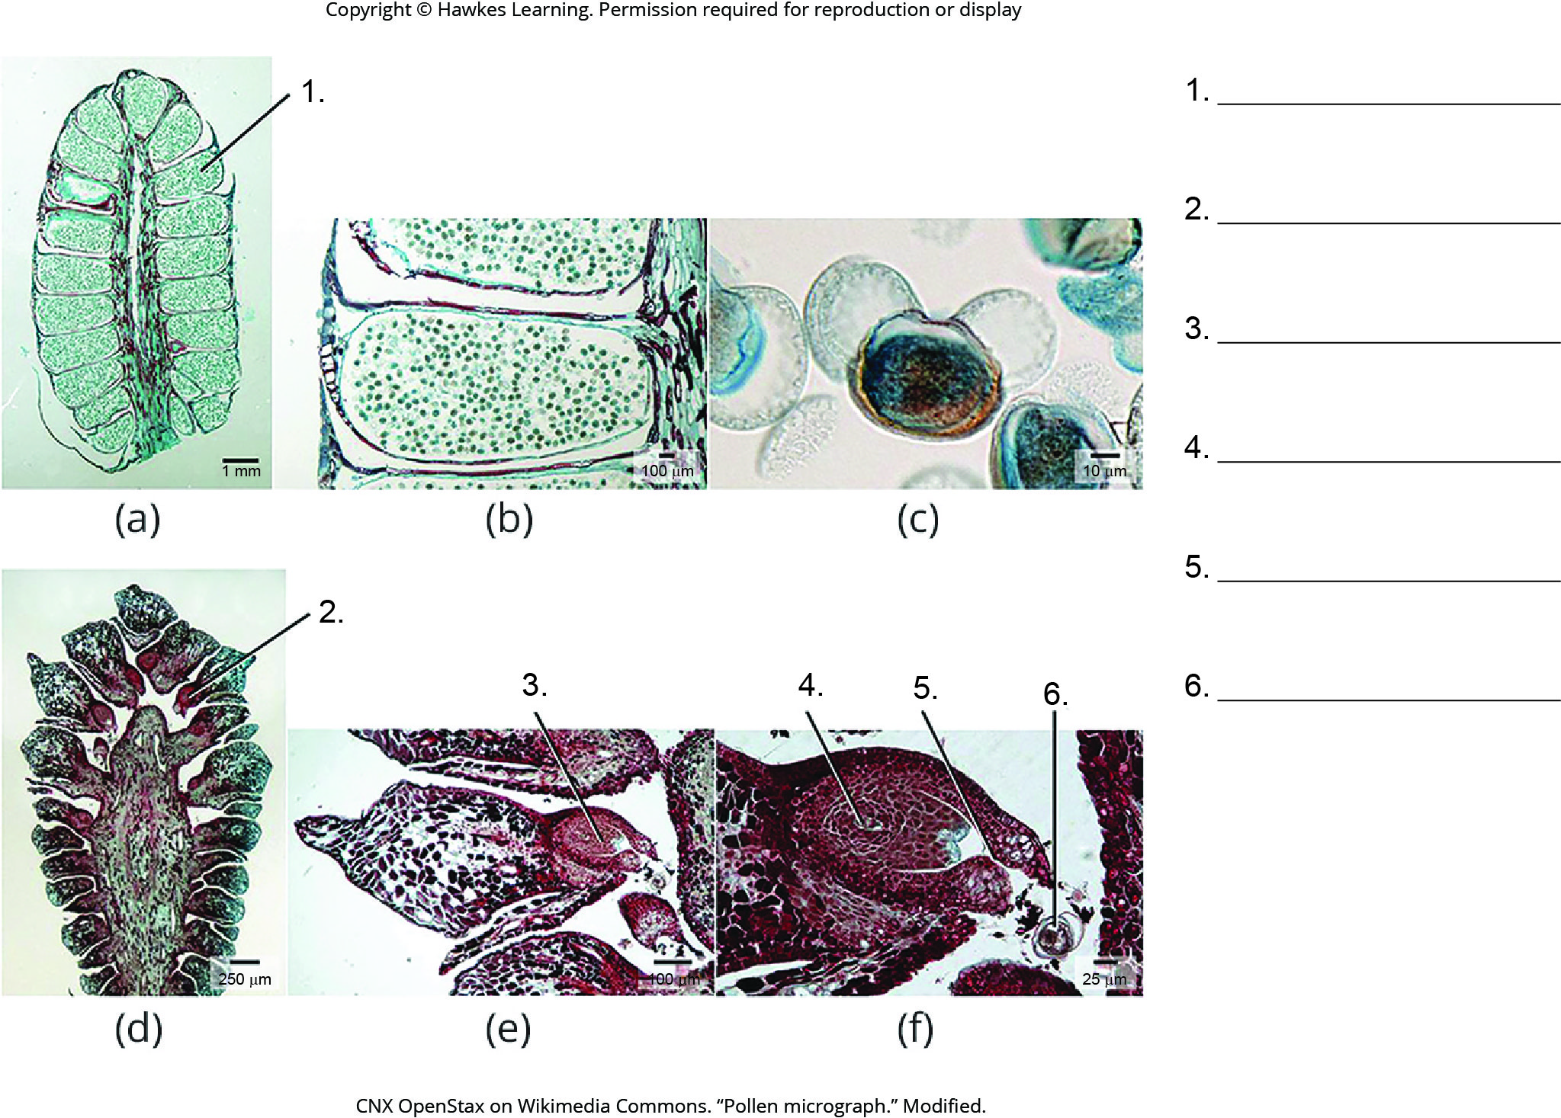
Lesson 32.1 Figure 11 - Numbered

Slide 17
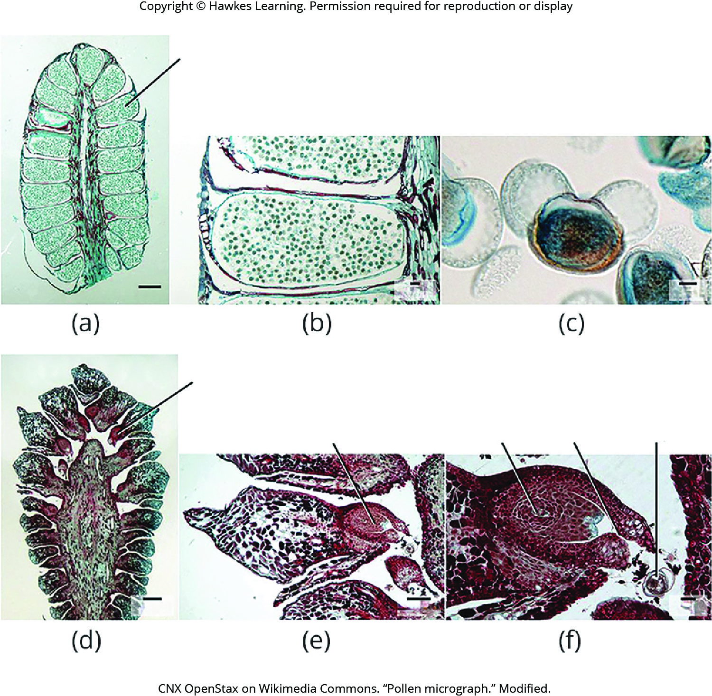
Lesson 32.1 Figure 11

Slide 18
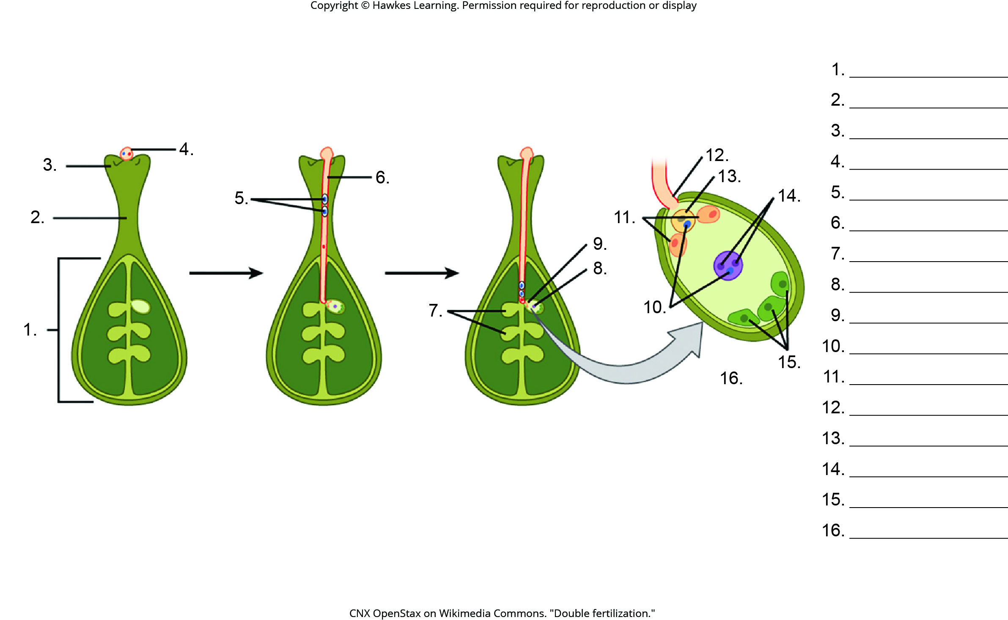
Lesson 32.2 Figure 7 - Numbered

Slide 19
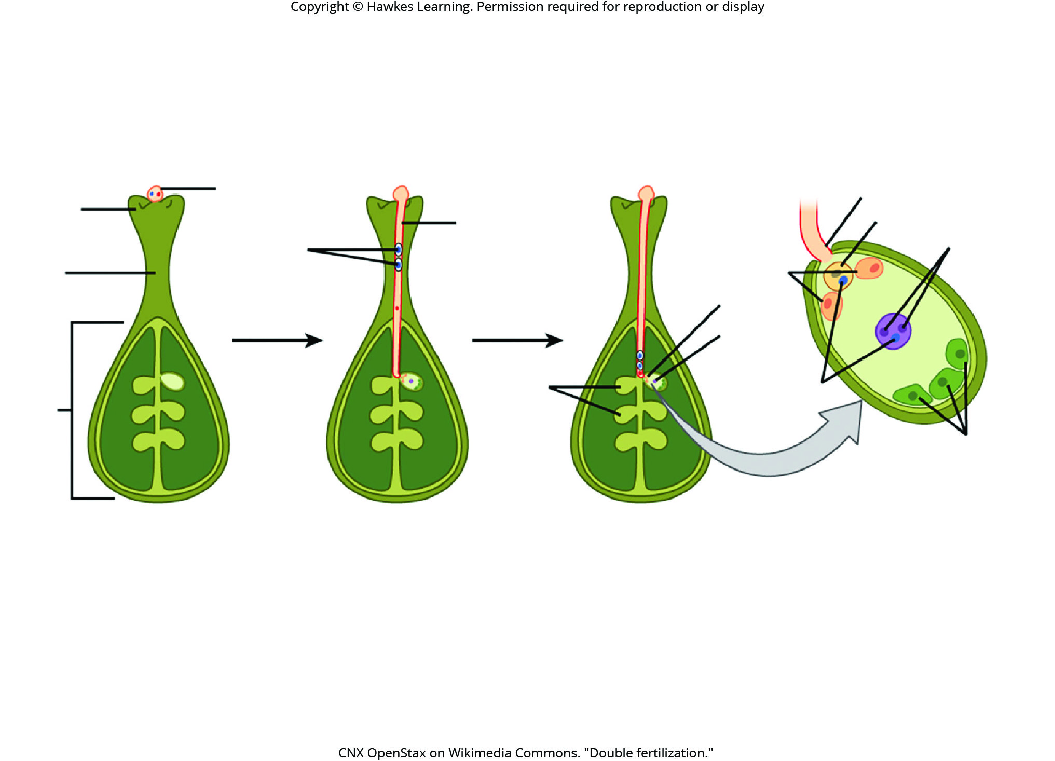
Lesson 32.2 Figure 7

Slide 20
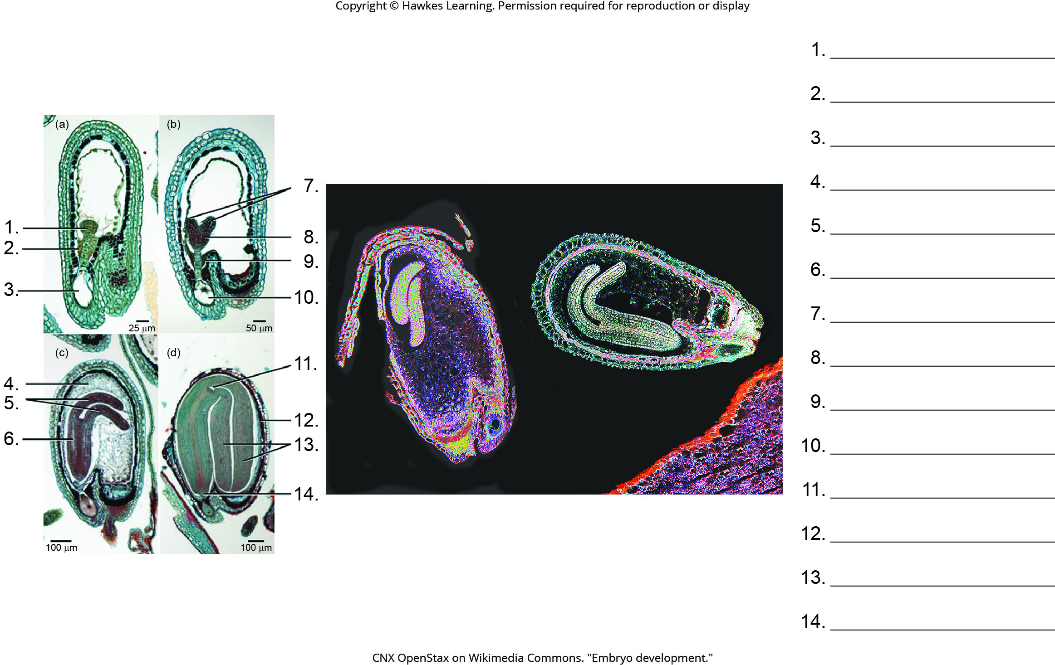
Lesson 32.2 Figure 8 - Numbered

Slide 21
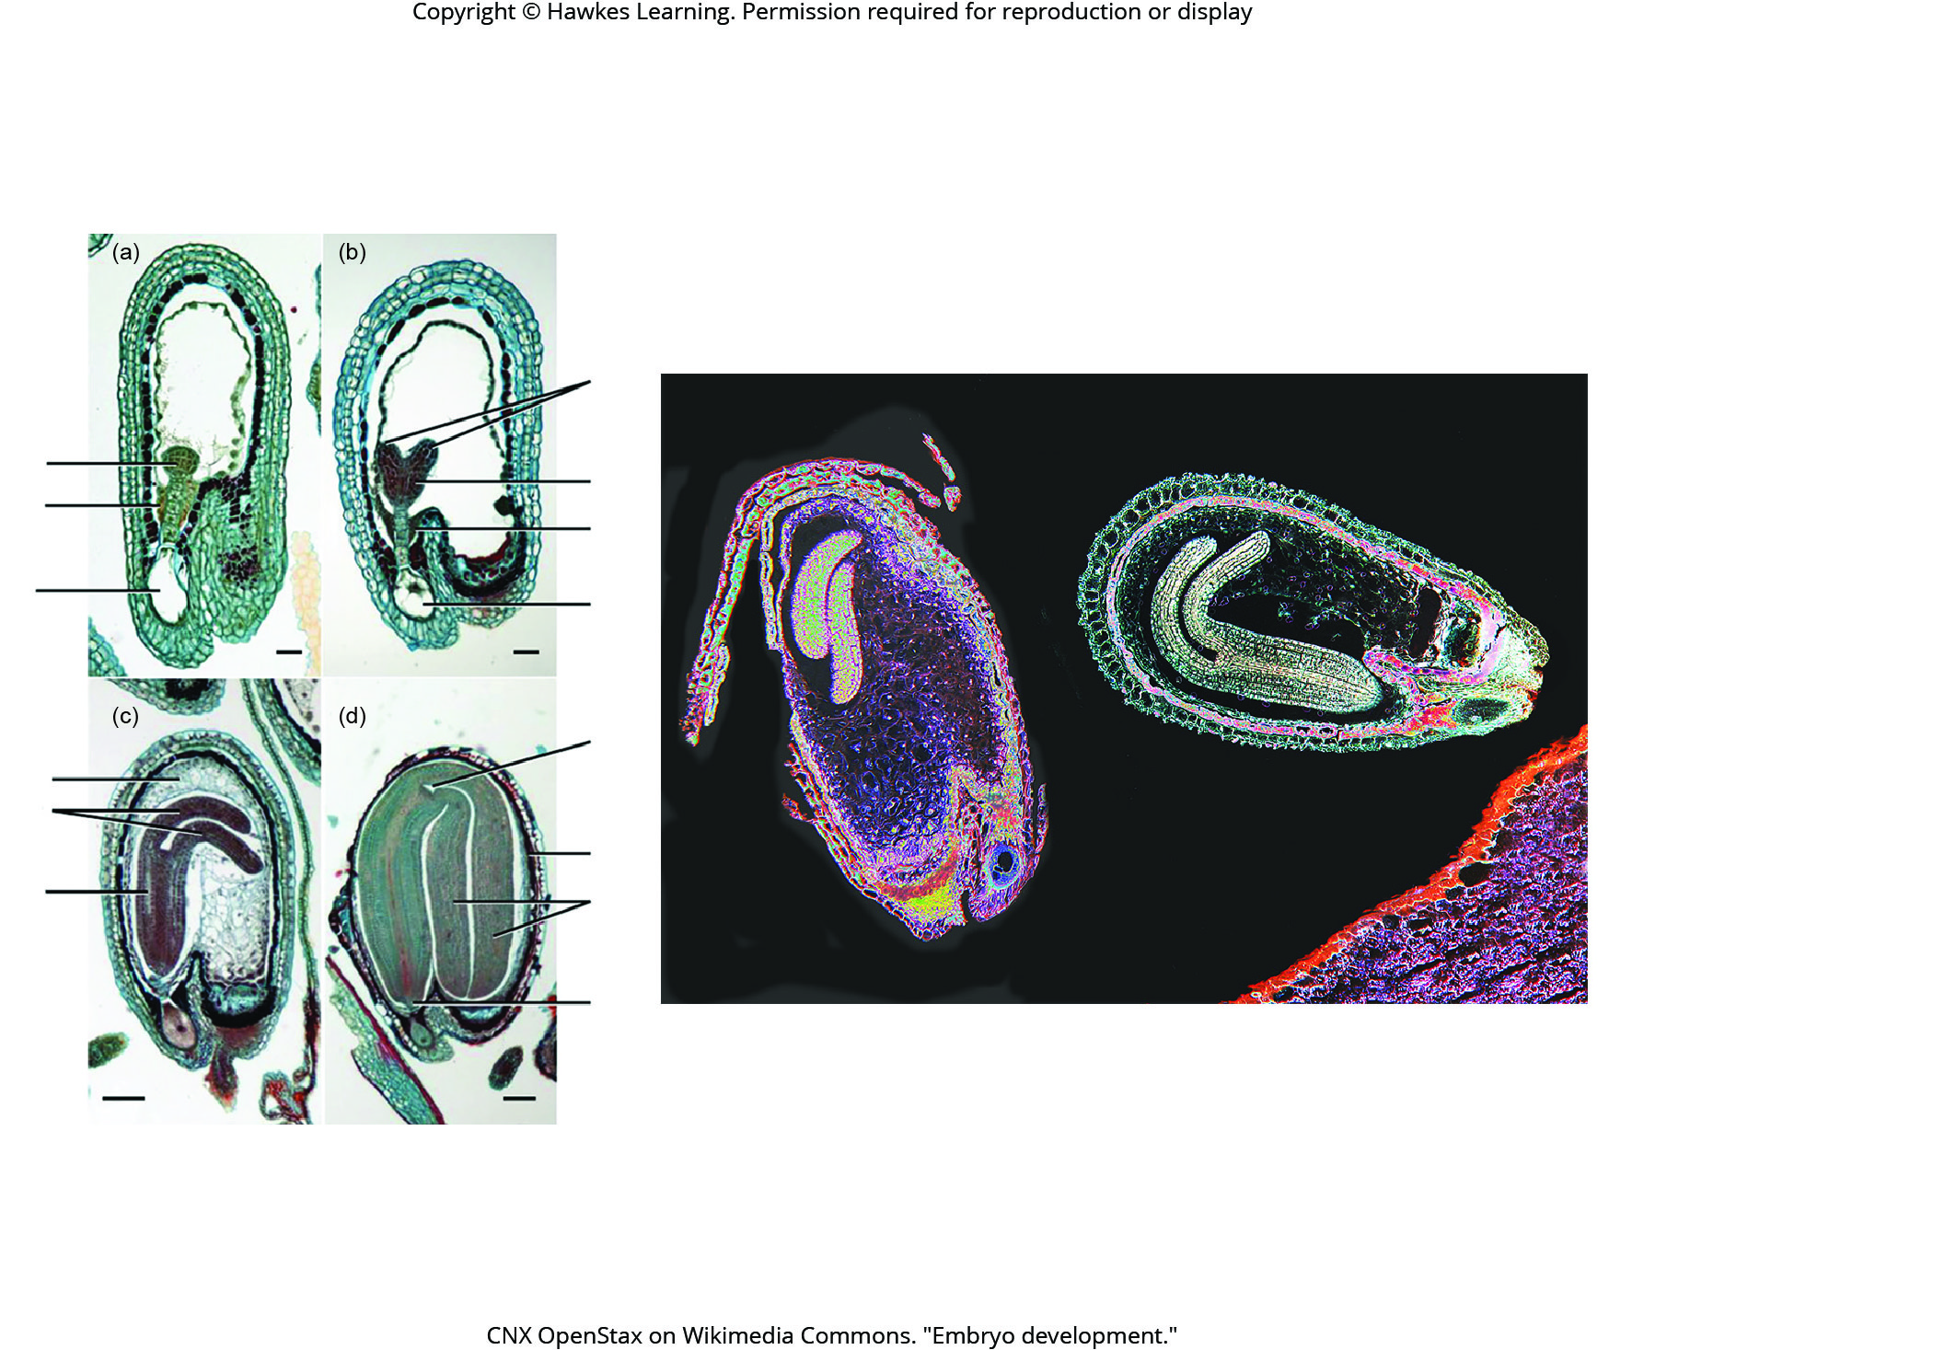
Lesson 32.2 Figure 8

Slide 22
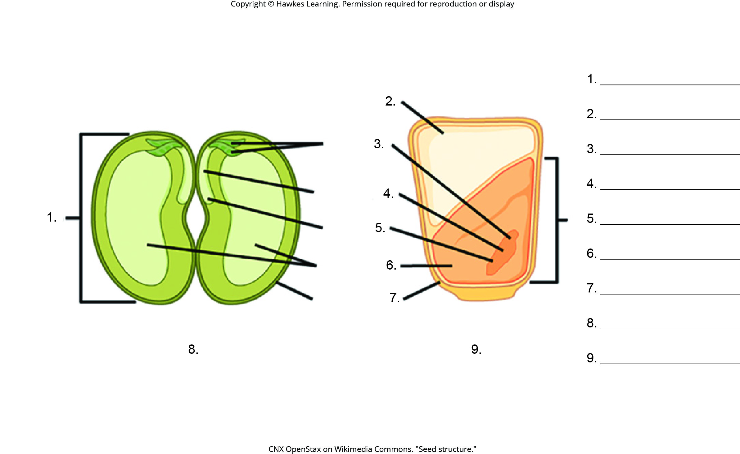
Lesson 32.2 Figure 9 - Numbered

Slide 23
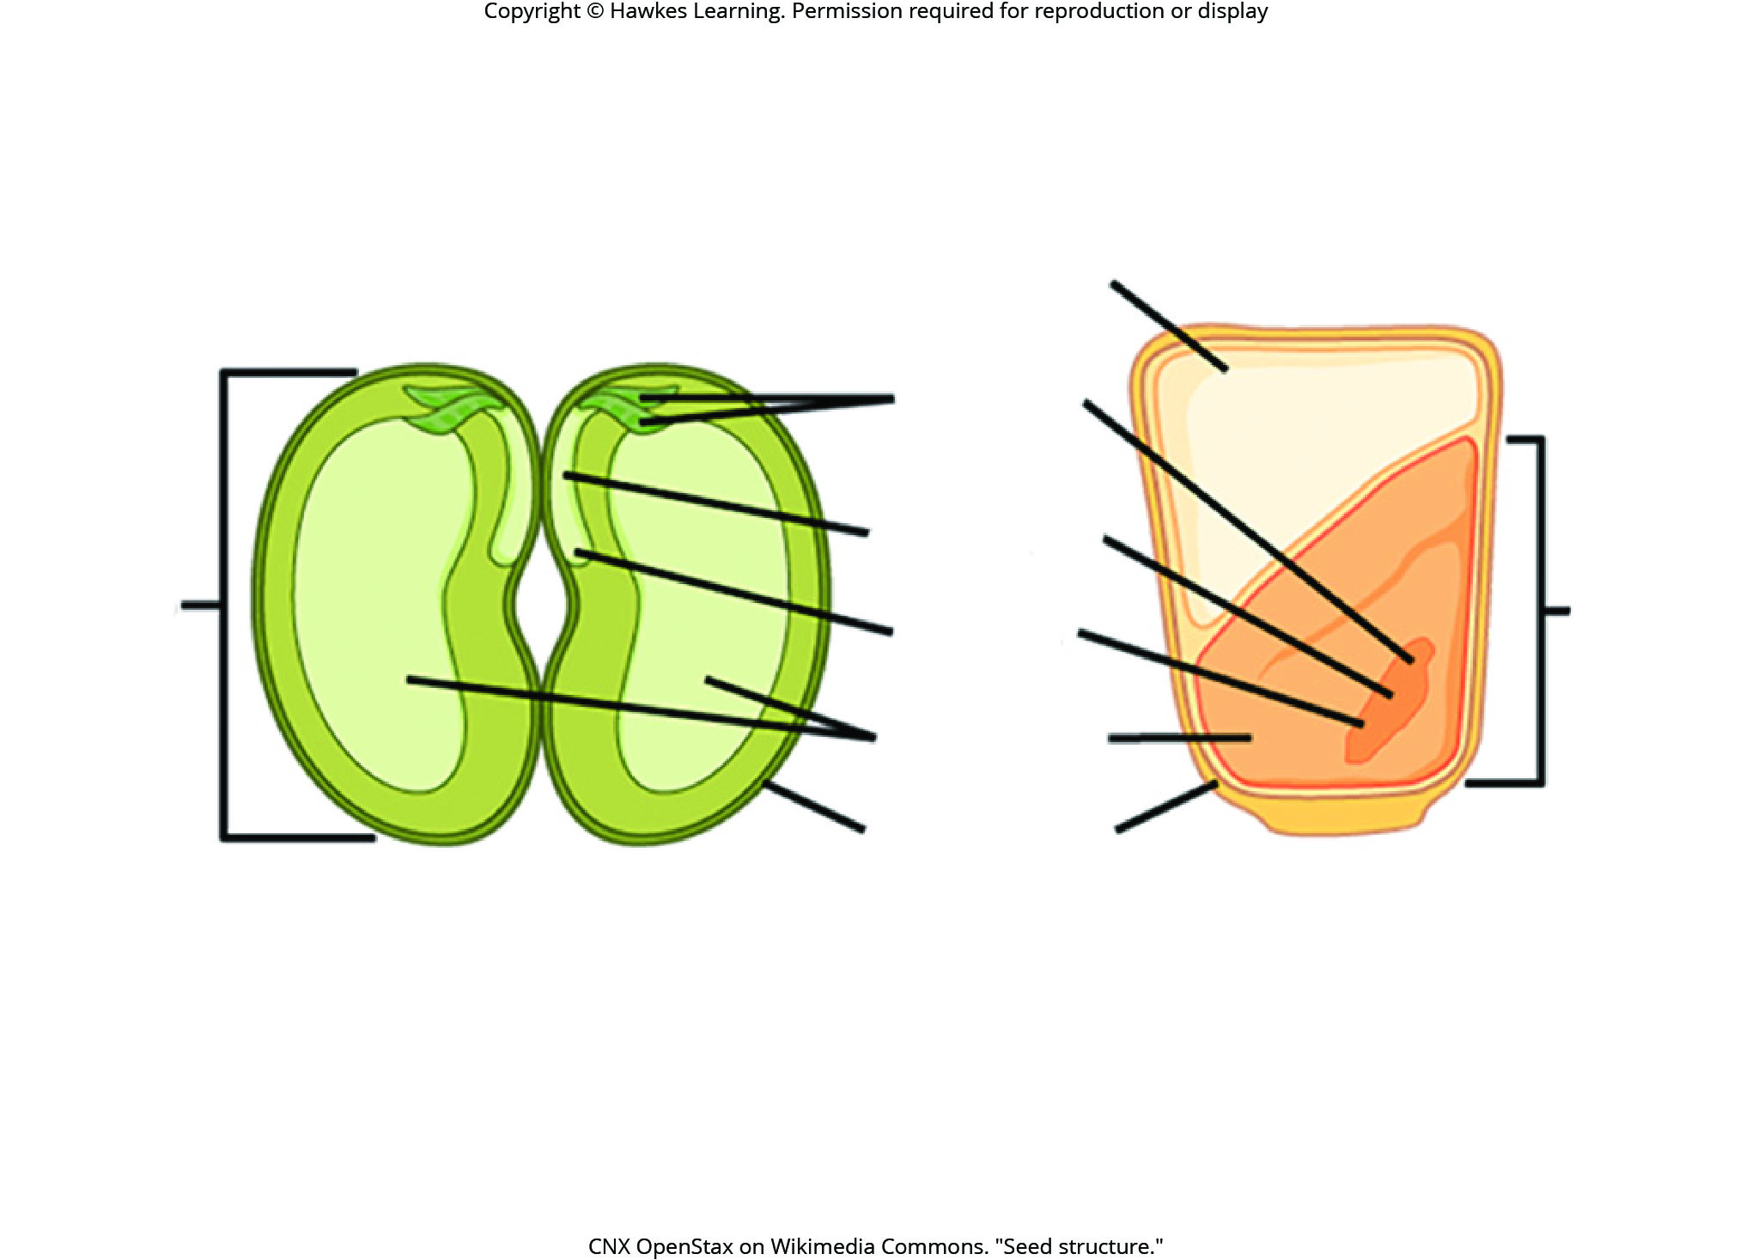
Lesson 32.2 Figure 9

Slide 24
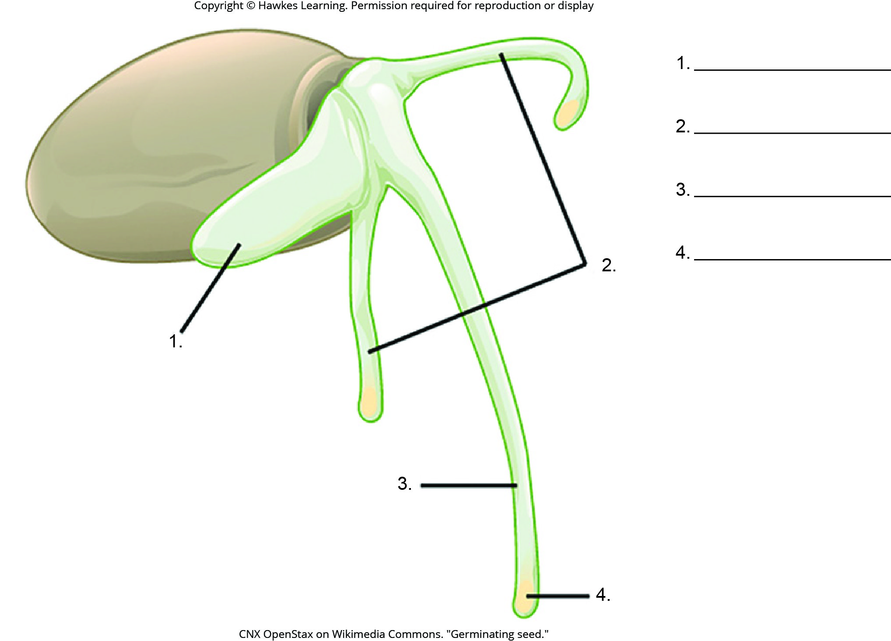
Lesson 32.2 Figure 10 - Numbered

Slide 25
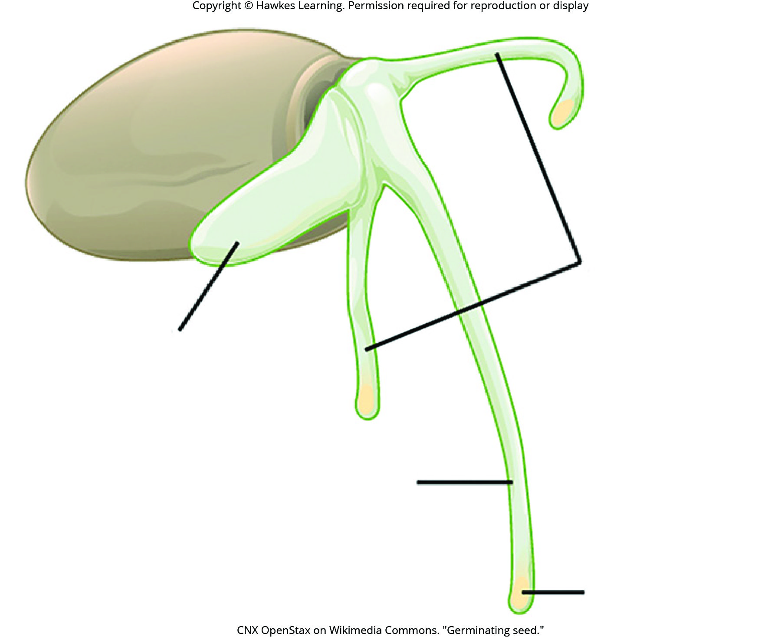
Lesson 32.2 Figure 10

Slide 26
Hawkes Learning – End of PowerPoint

