Slide 1
Chapter 33
The Animal Body

Slide 2
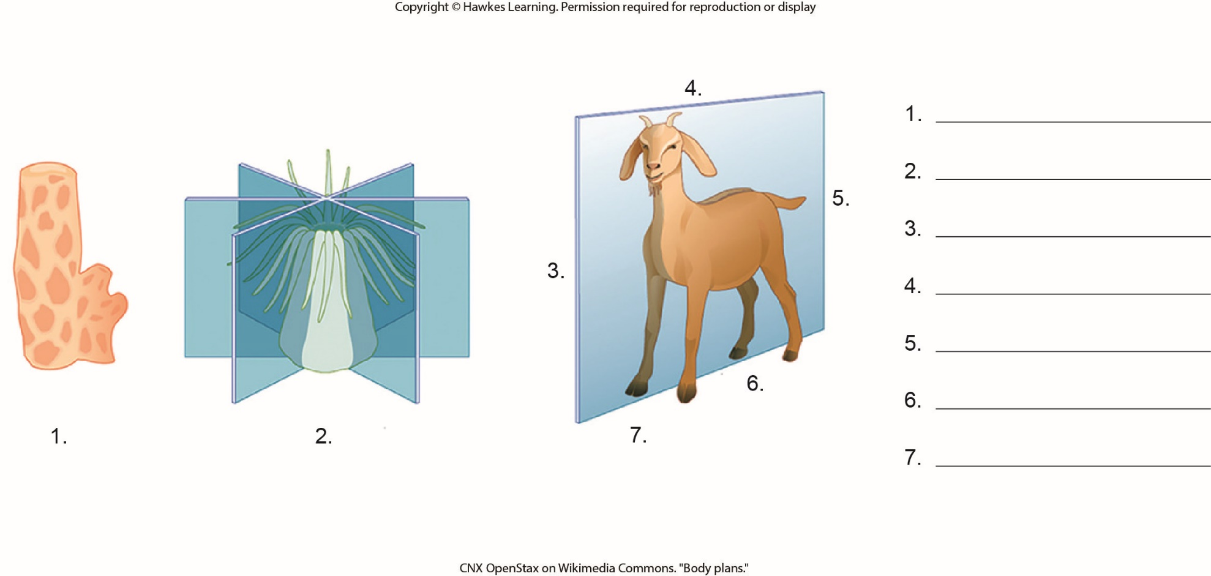
Lesson 33.1 Figure 2 - Numbered

Slide 3
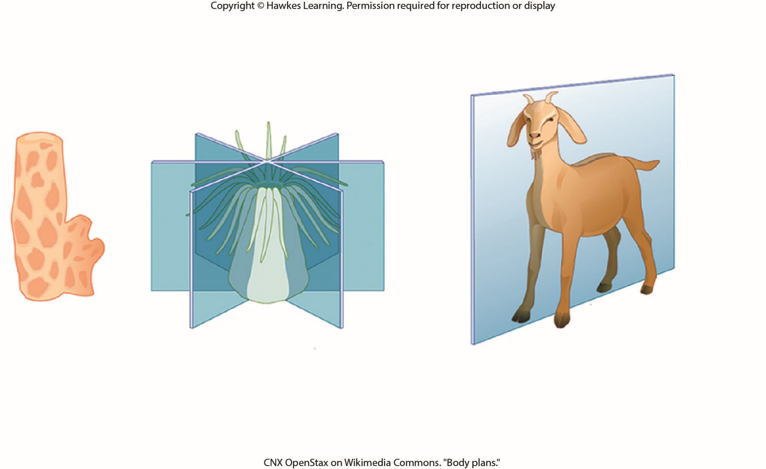
Lesson 33.1 Figure 2

Slide 4
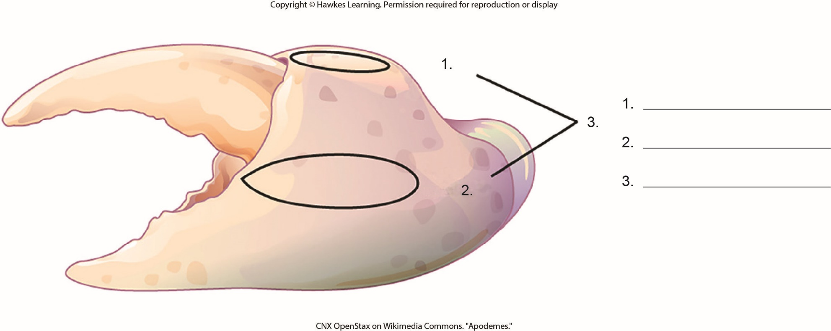
Lesson 33.1 Figure 4 - Numbered

Slide 5
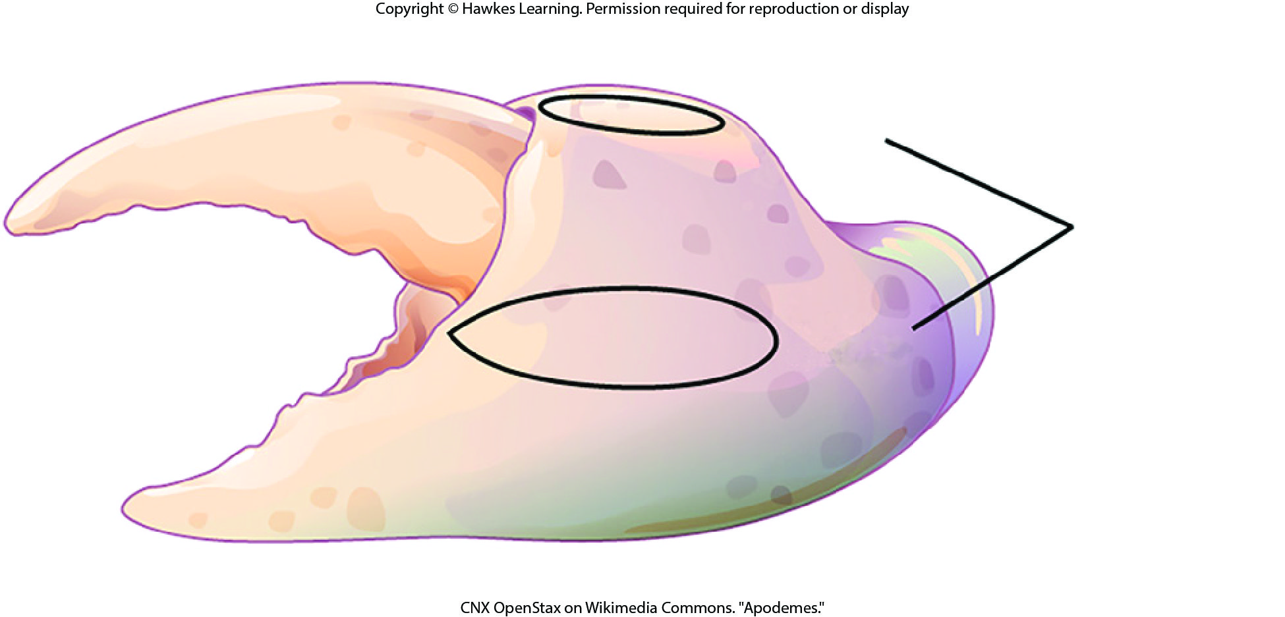
Lesson 33.1 Figure 4

Slide 6
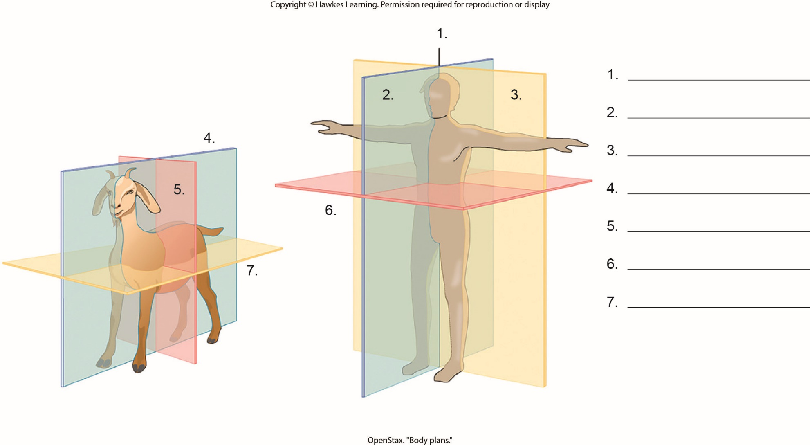
Lesson 33.1 Figure 7 - Numbered

Slide 7
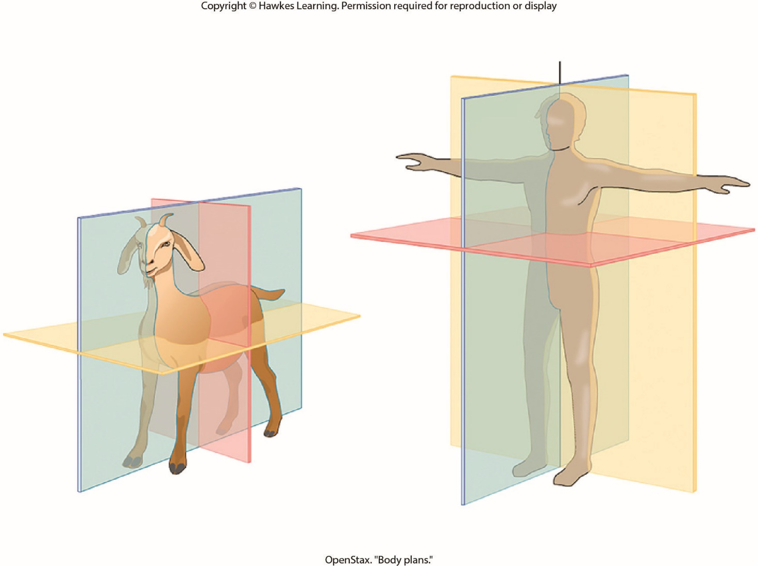
Lesson 33.1 Figure 7

Slide 8
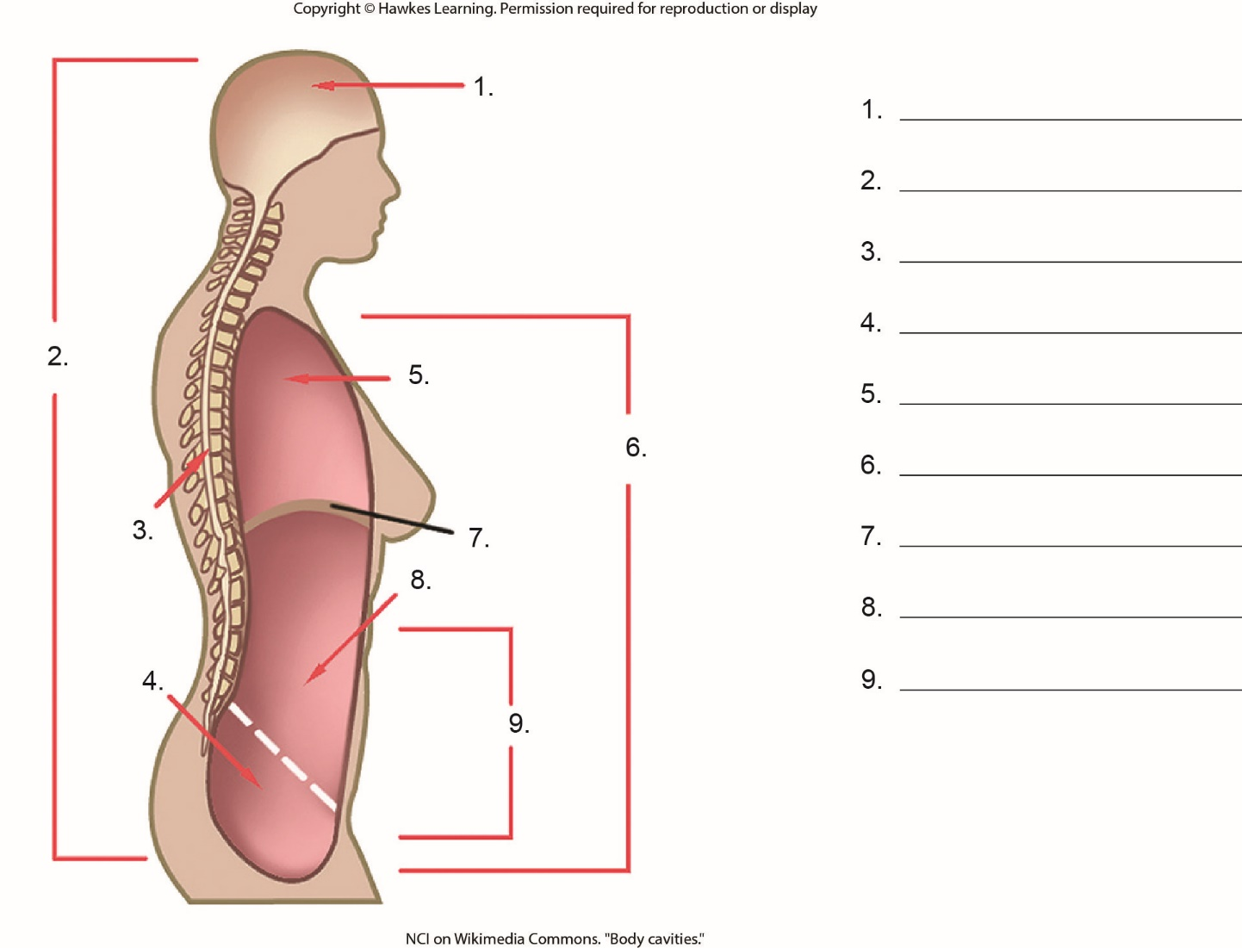
Lesson 33.1 Figure 8 - Numbered

Slide 9
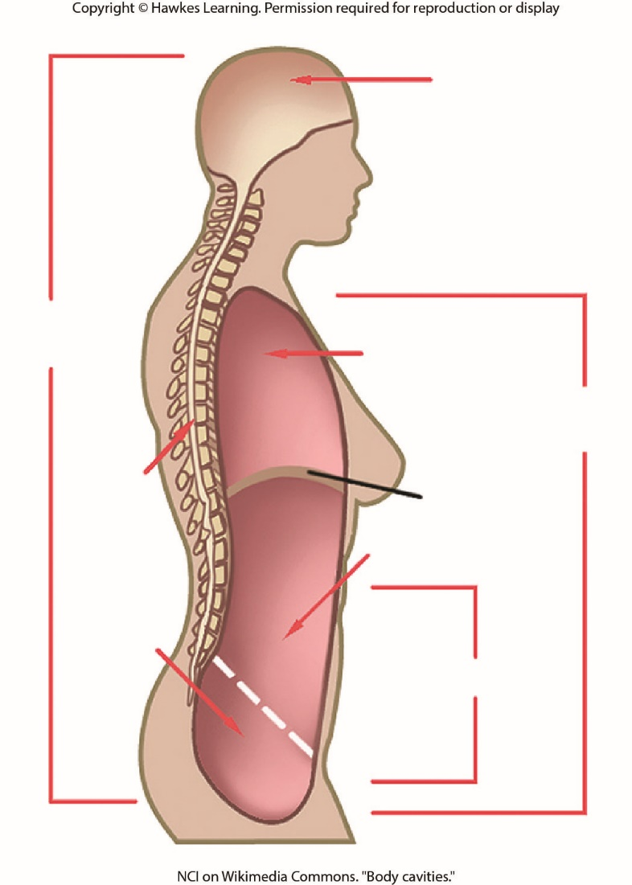
Lesson 33.1 Figure 8

Slide 10
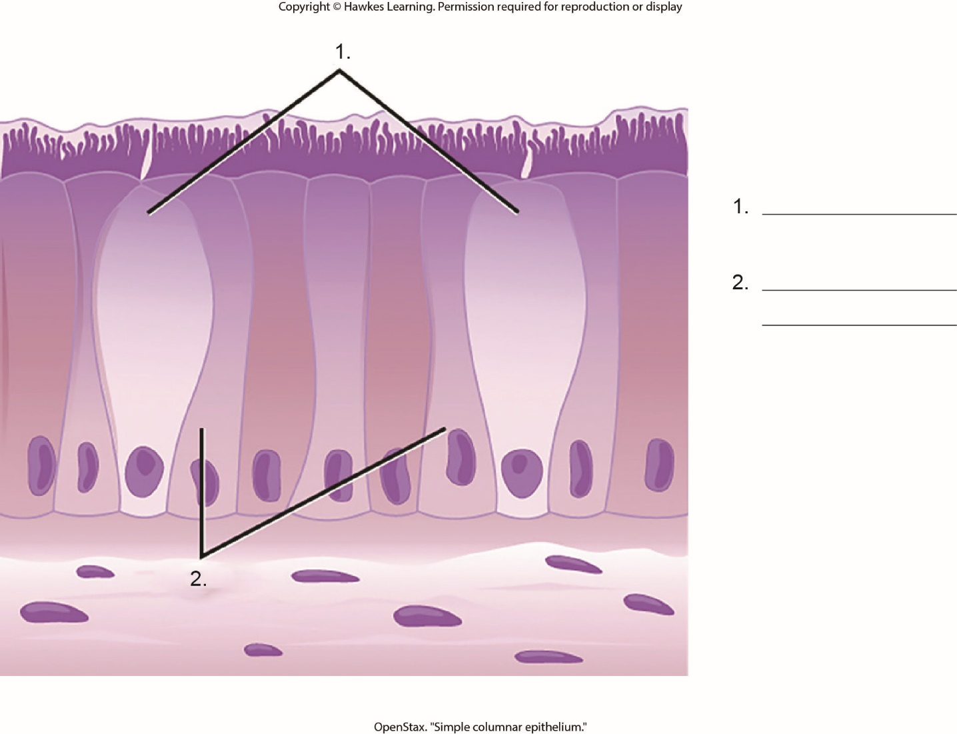
Lesson 33.2 Figure 3 - Numbered

Slide 11
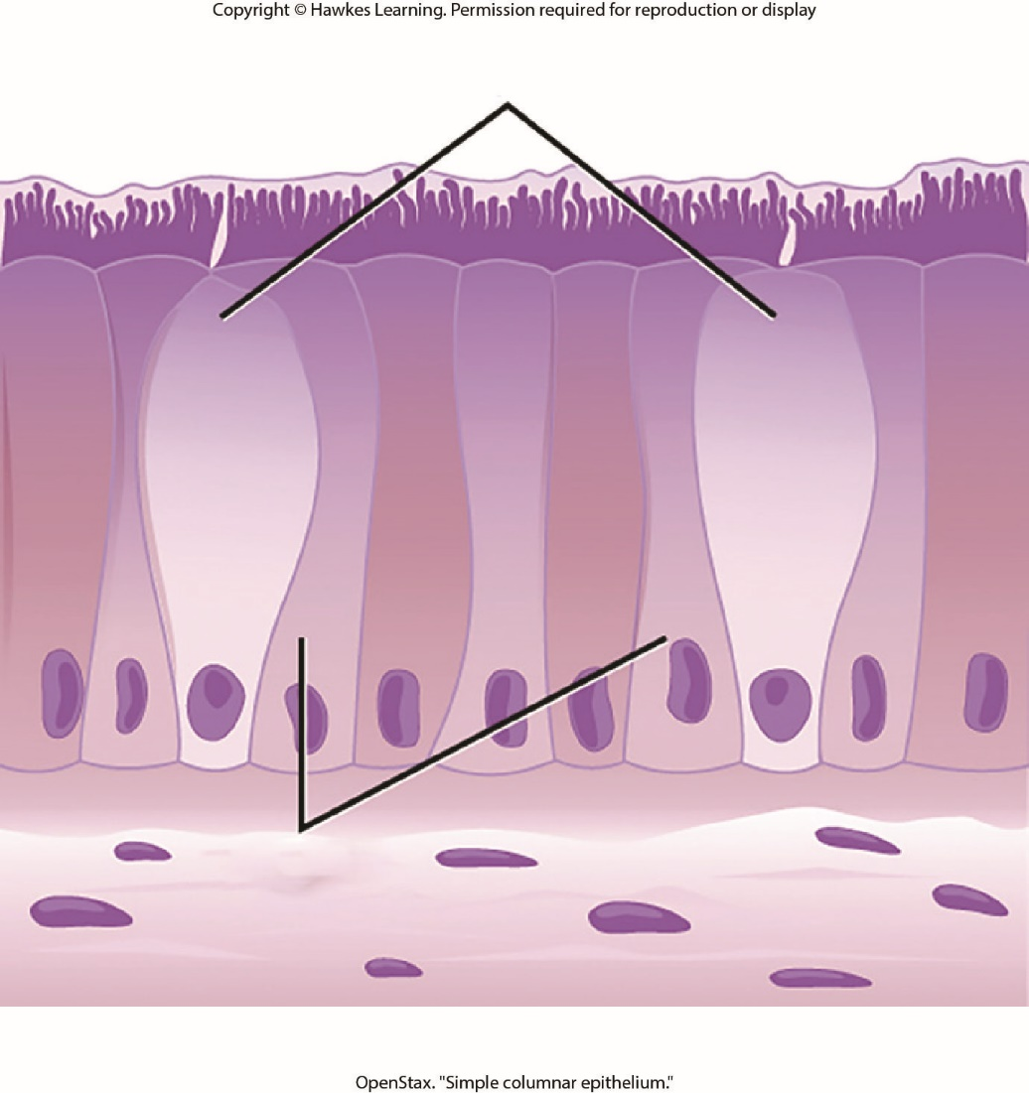
Lesson 33.2 Figure 3

Slide 12
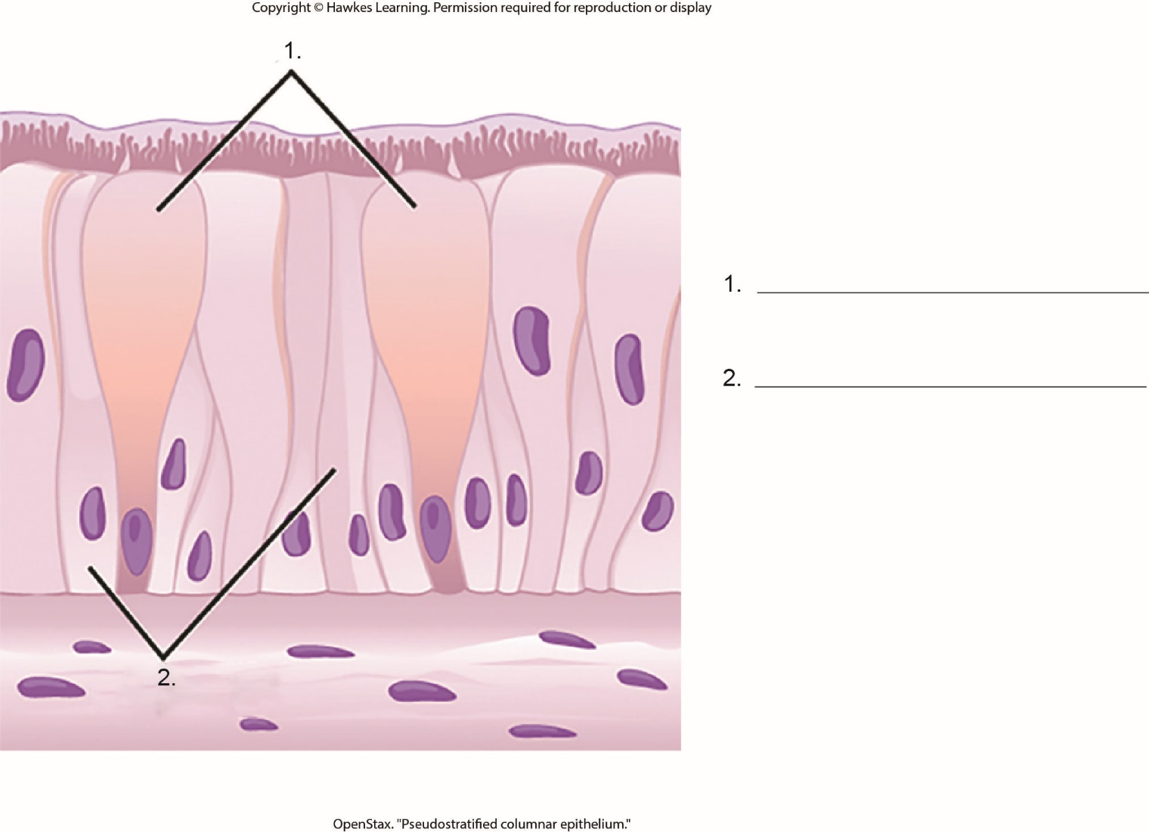
Lesson 33.2 Figure 4 - Numbered

Slide 13
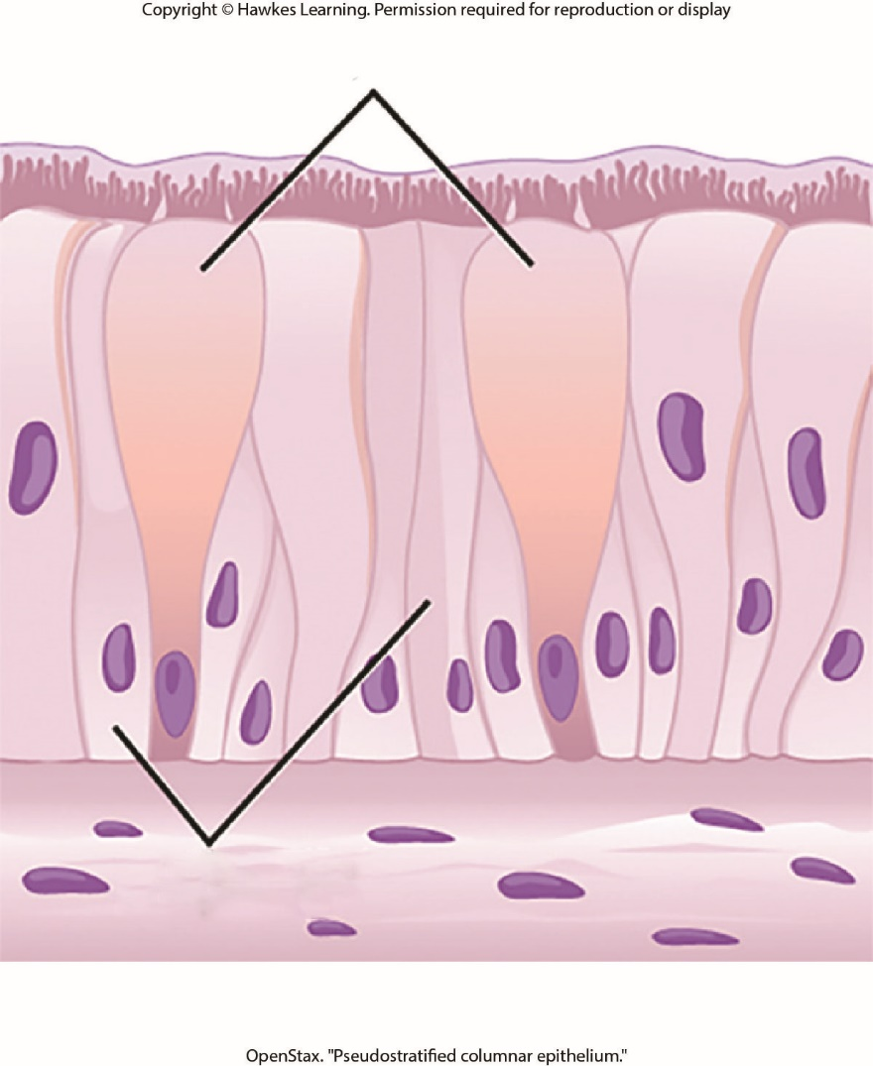
Lesson 33.2 Figure 4

Slide 14
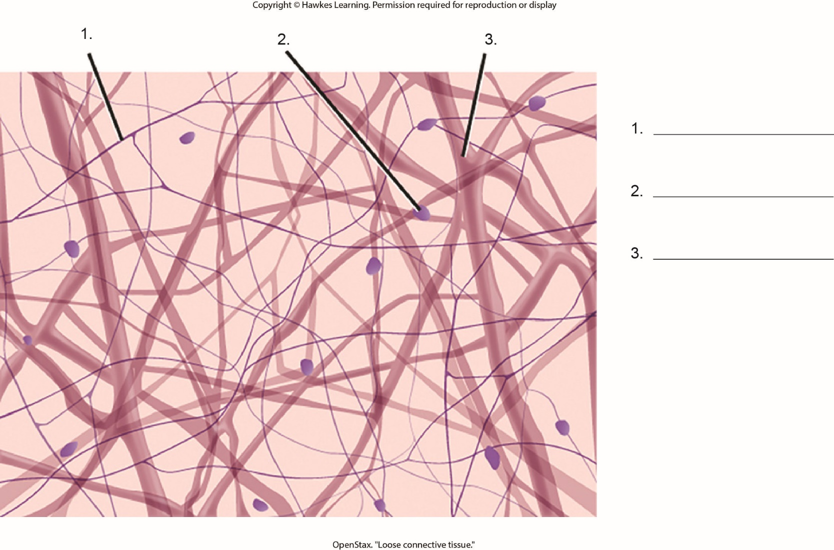
Lesson 33.2 Figure 6 - Numbered

Slide 15
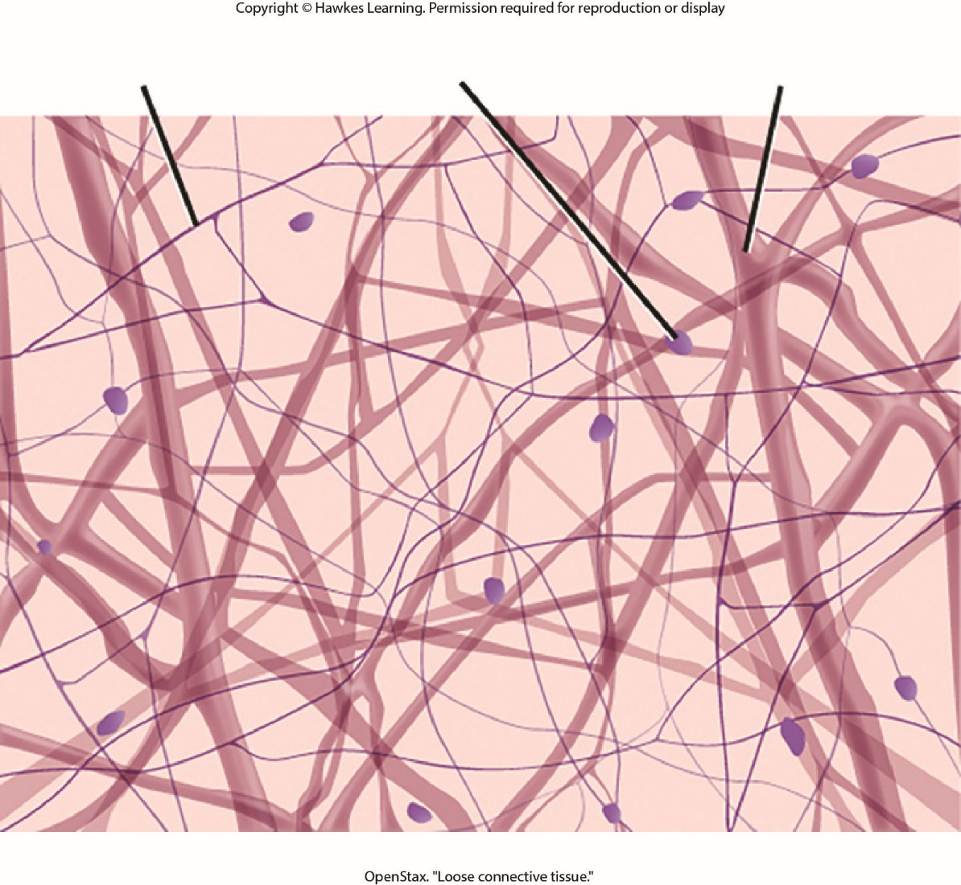
Lesson 33.2 Figure 6

Slide 16
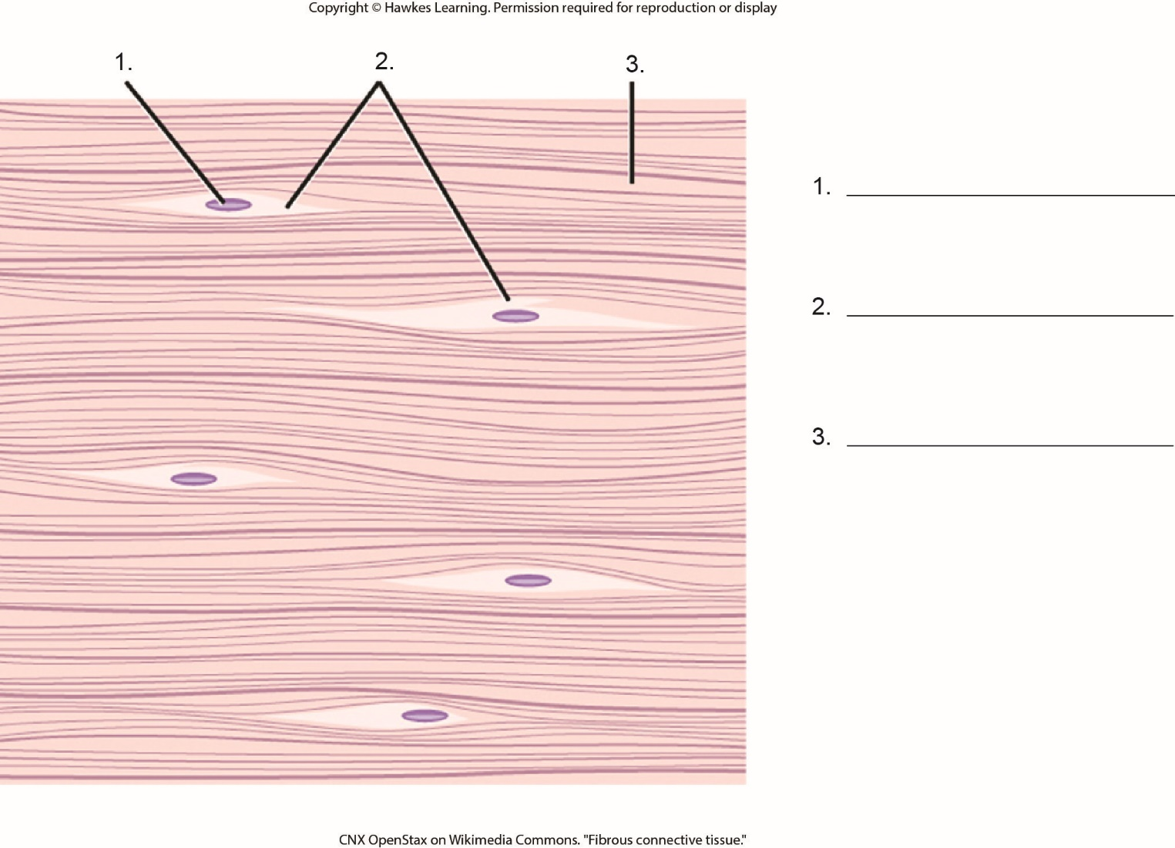
Lesson 33.2 Figure 7 - Numbered

Slide 17
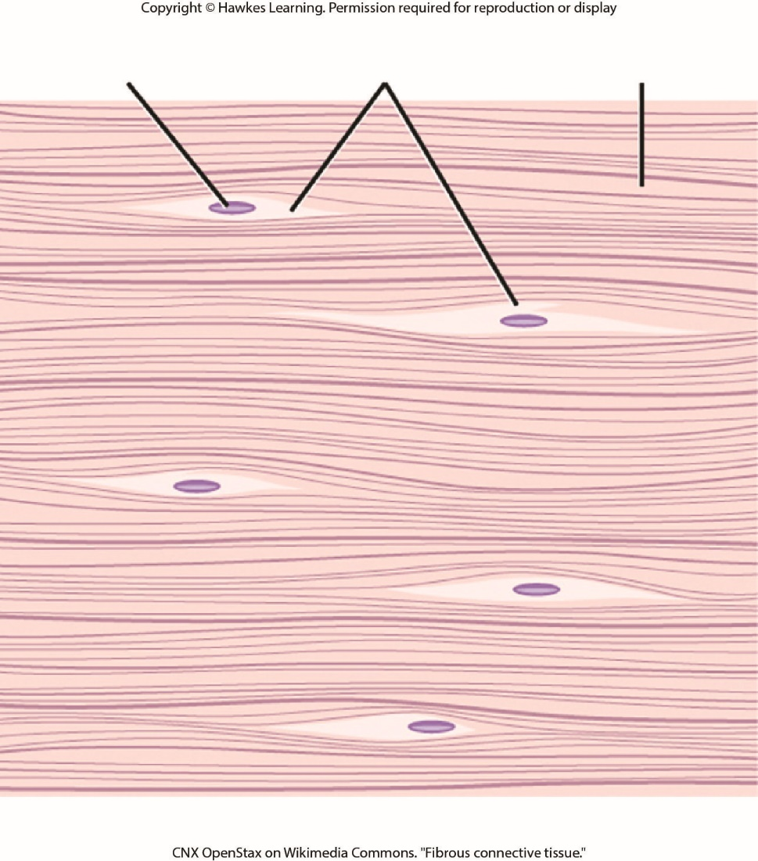
Lesson 33.2 Figure 7

Slide 18
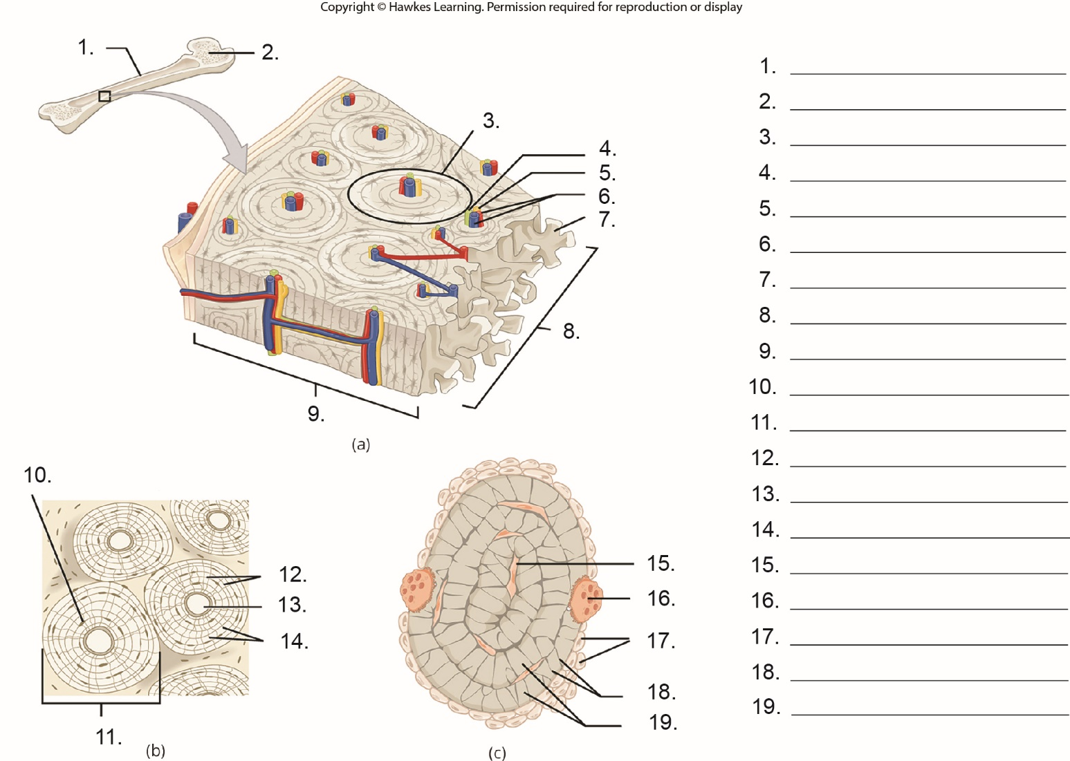
Lesson 33.2 Figure 9 - Numbered

Slide 19
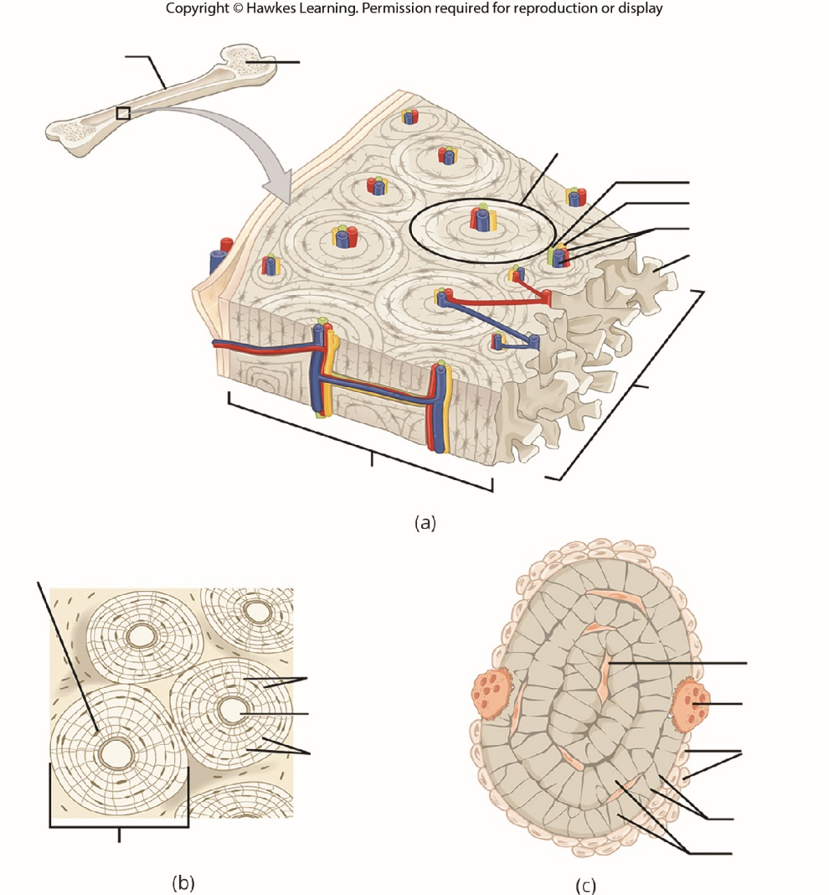
Lesson 33.2 Figure 9

Slide 20
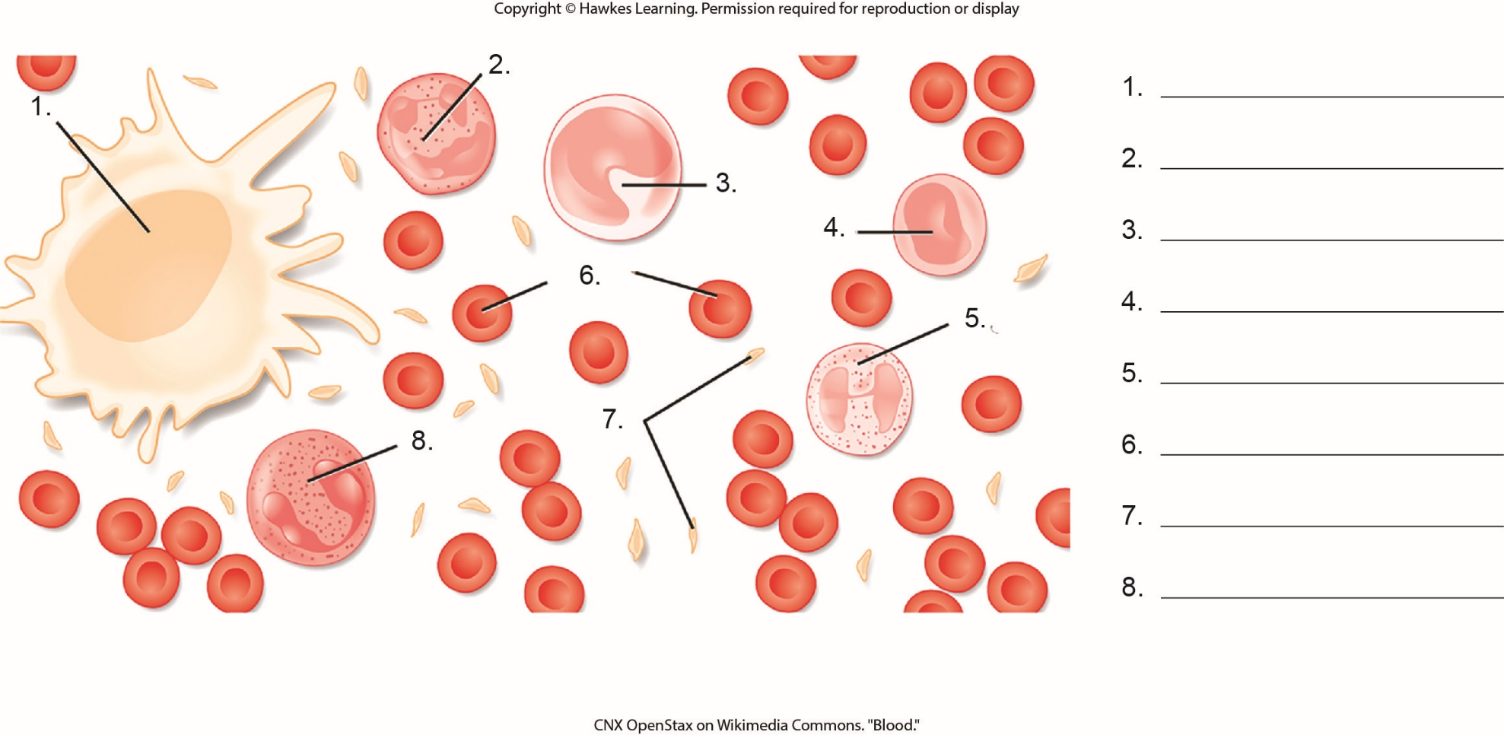
Lesson 33.2 Figure 11 - Numbered

Slide 21
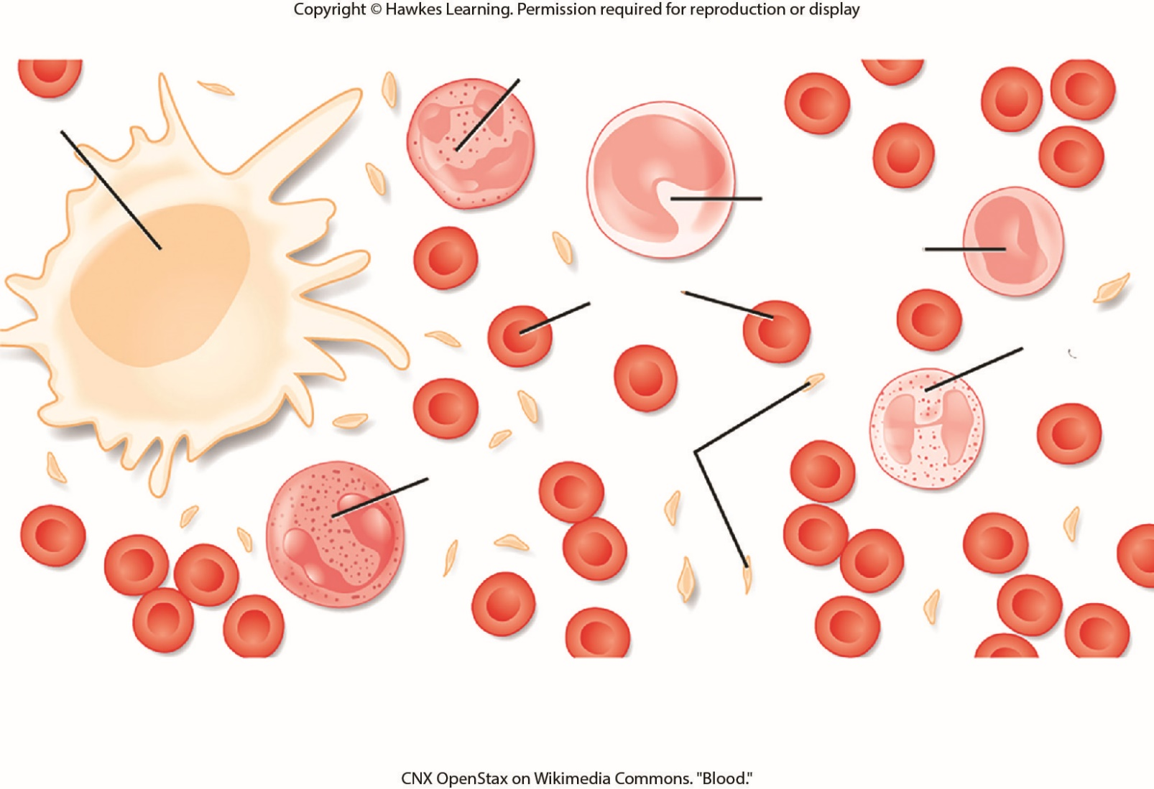
Lesson 33.2 Figure 11

Slide 22
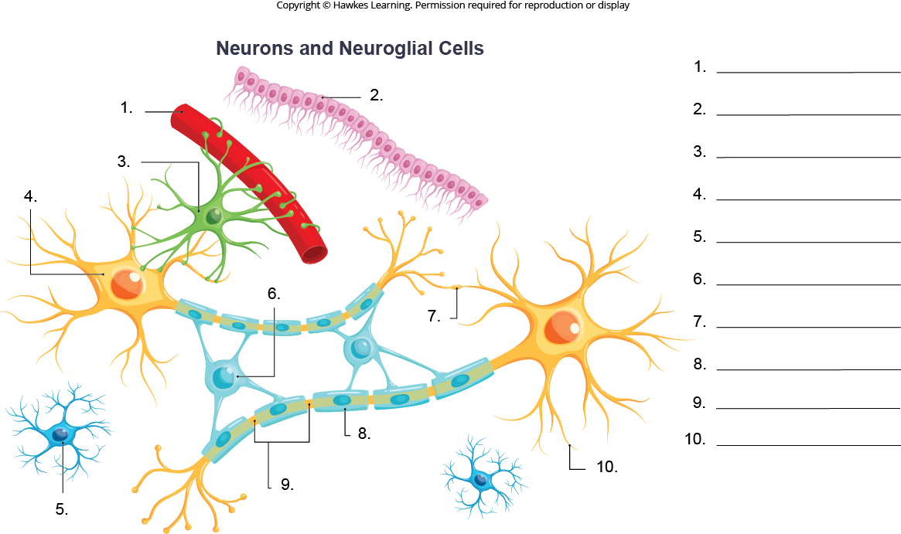
Lesson 33.2 Figure 14 - Numbered

Slide 23
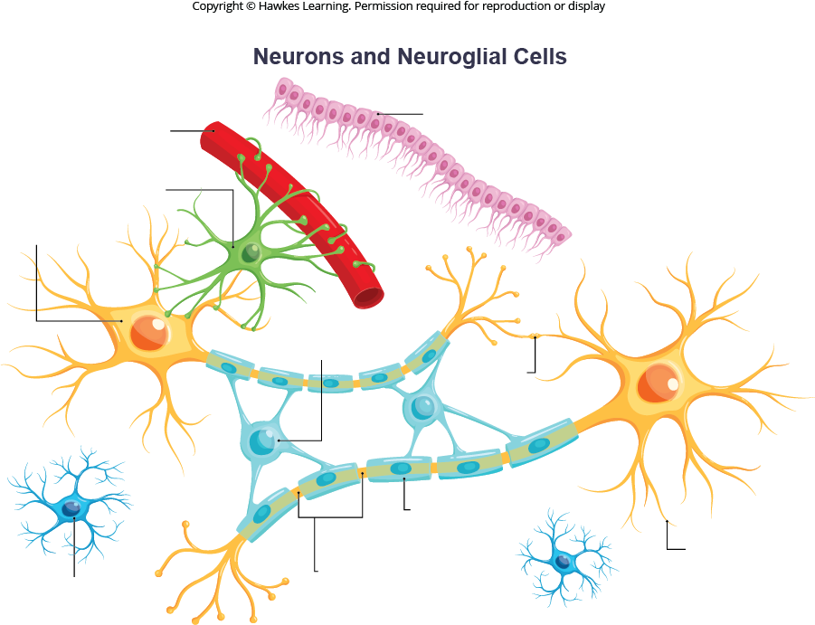
Lesson 33.2 Figure 14

Slide 24
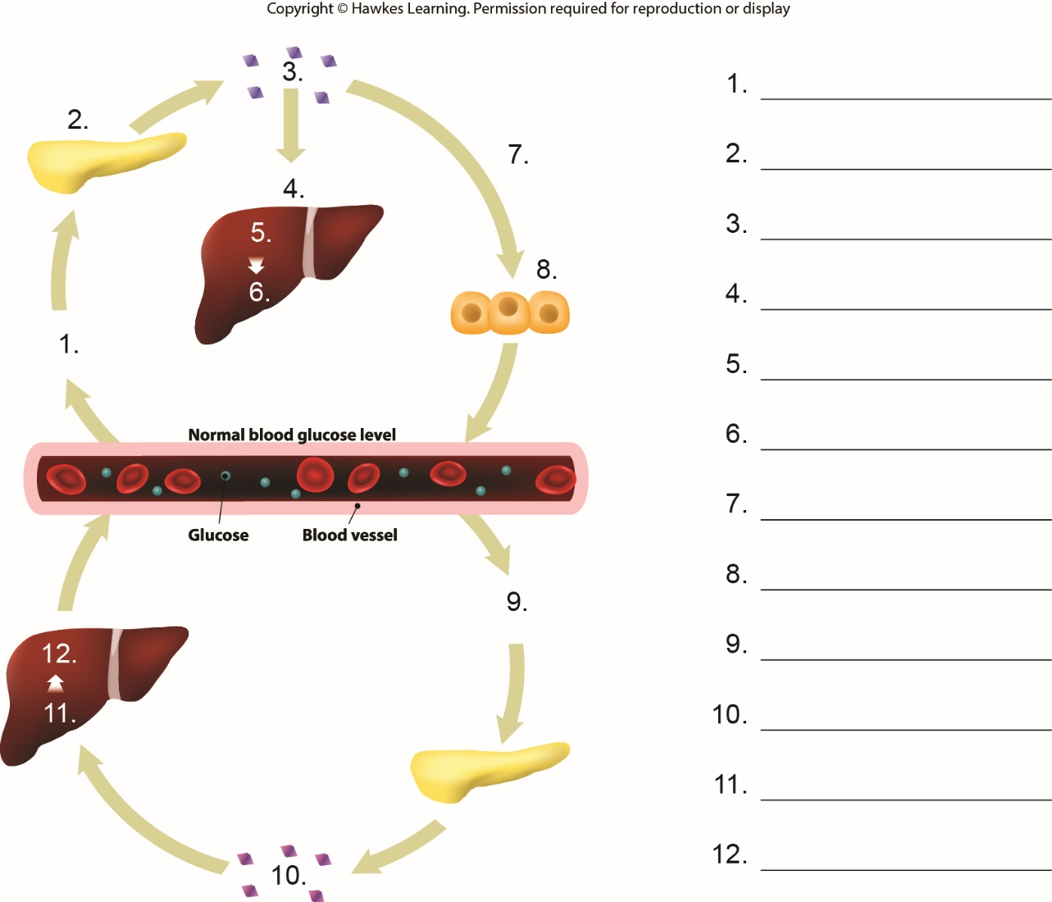
Lesson 33.3 Figure 1 - Numbered

Slide 25
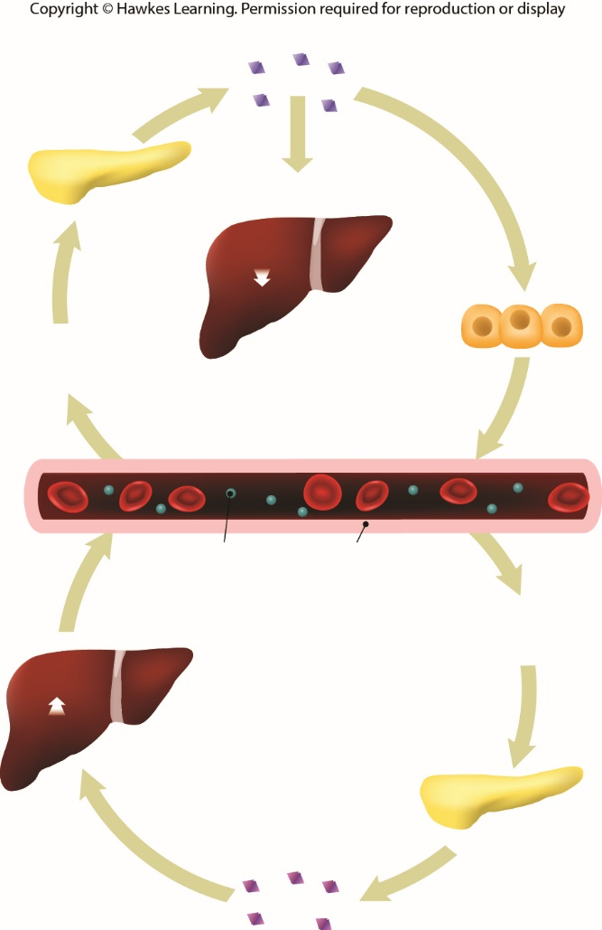
Lesson 33.3 Figure 1

Slide 26
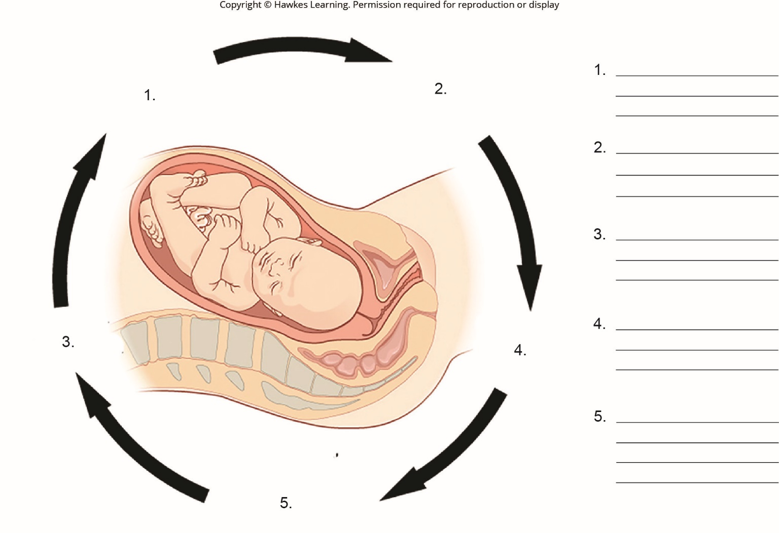
Lesson 33.3 Figure 2 - Numbered

Slide 27
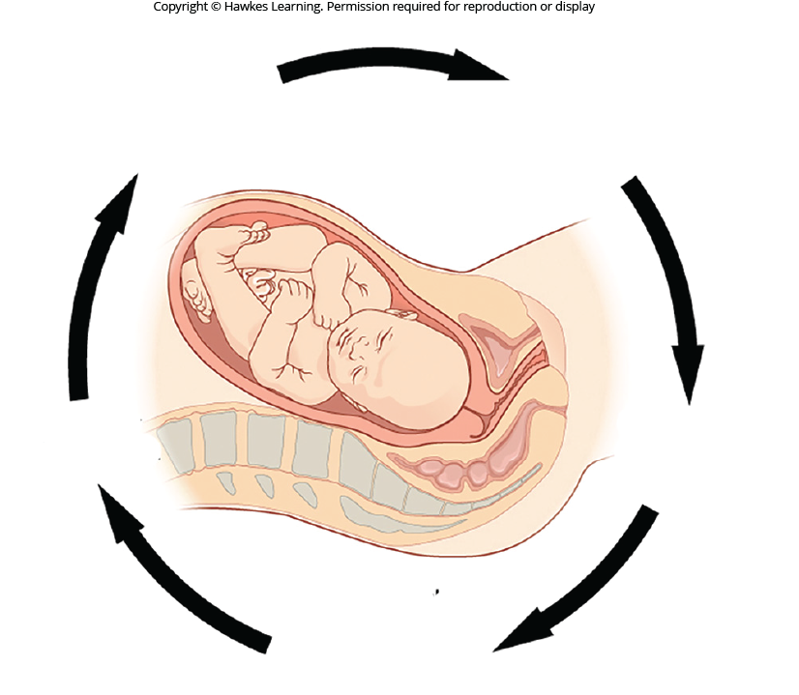
Lesson 33.3 Figure 2

Slide 28
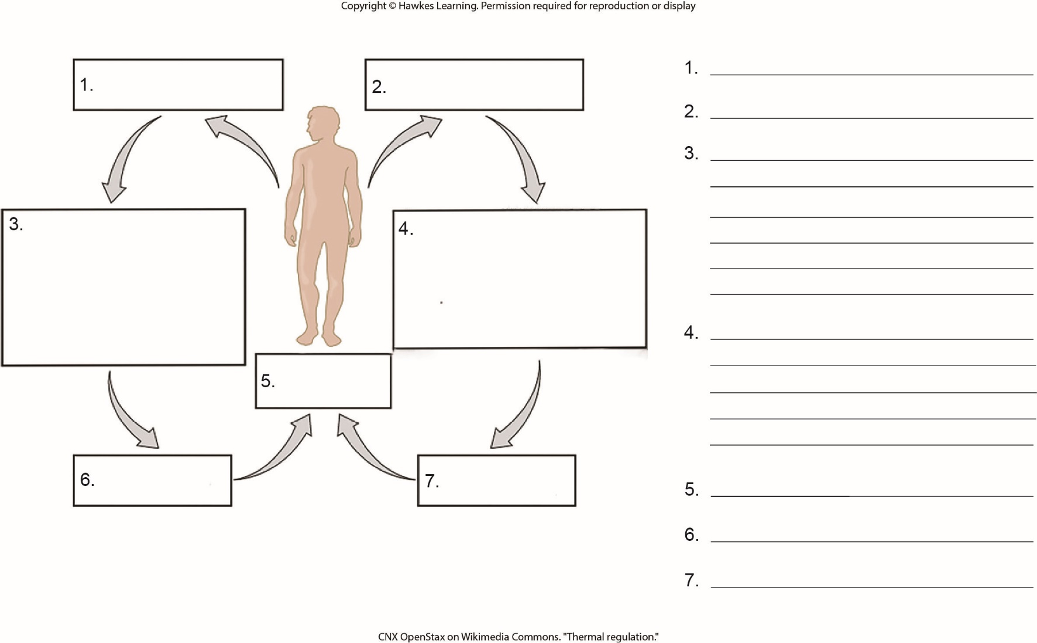
Lesson 33.3 Figure 6 - Numbered

Slide 29
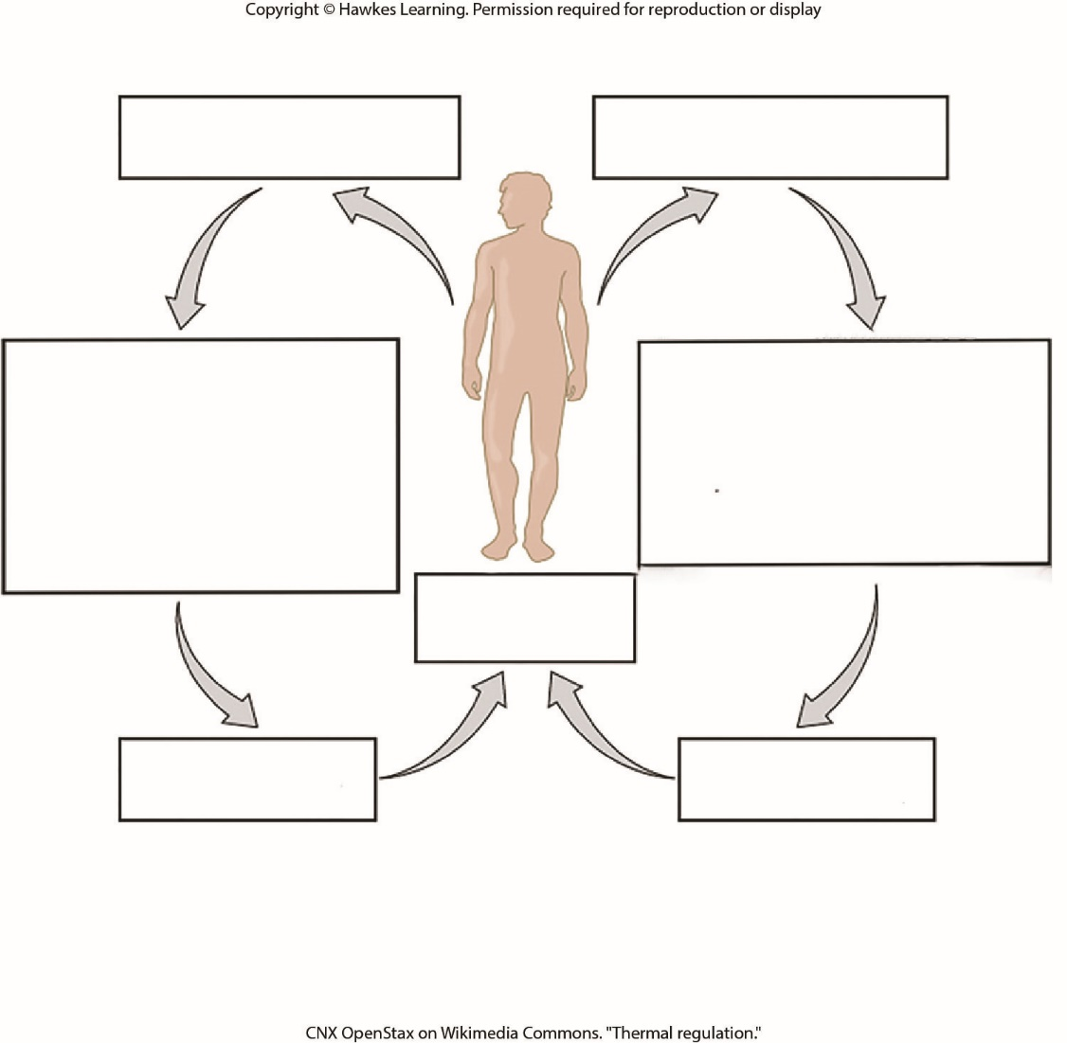
Lesson 33.3 Figure 6

Slide 30
Hawkes Learning – End of PowerPoint

