Slide 1
Chapter 34
The Digestive System

Slide 2
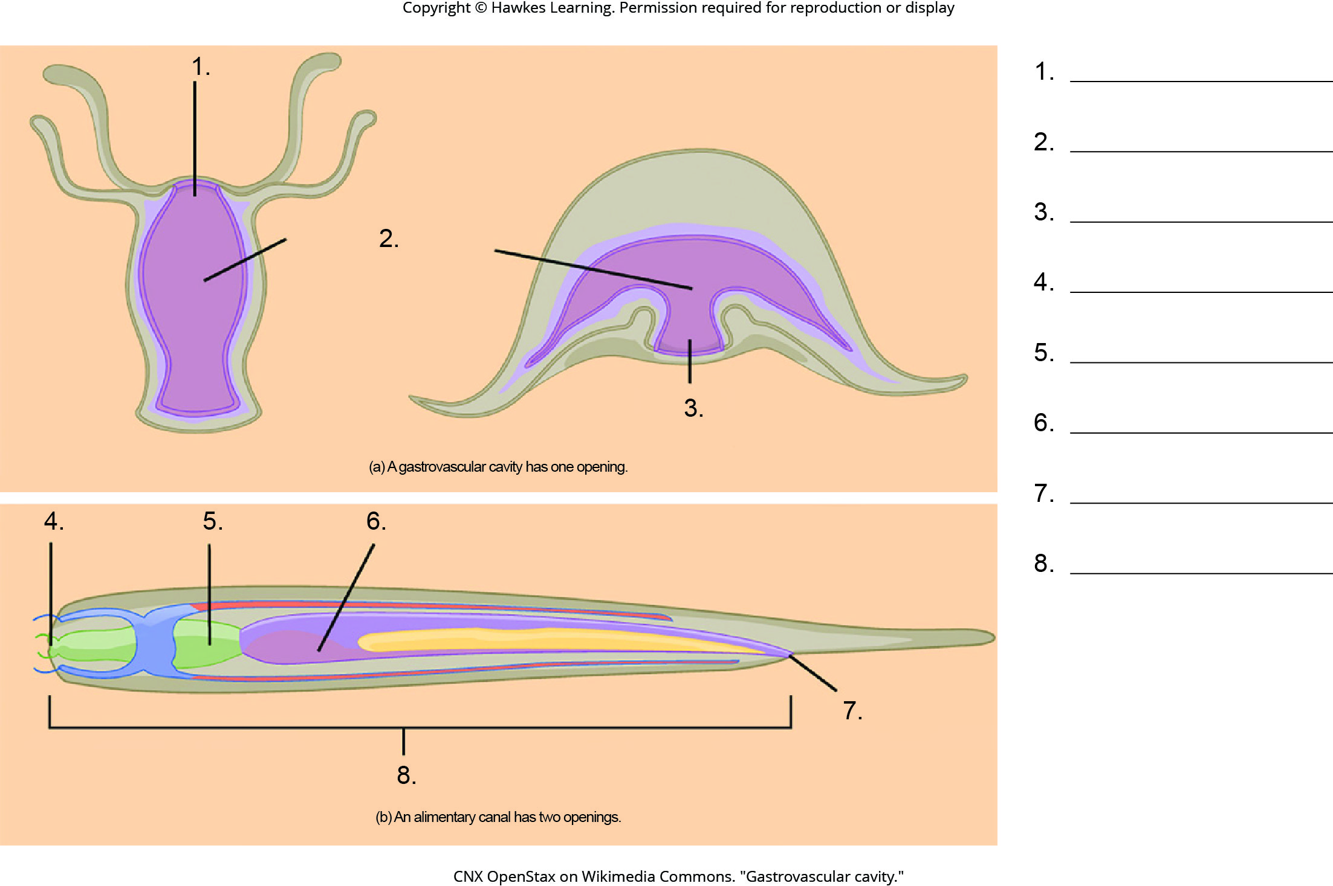
Lesson 34.1 Figure 5 - Numbered

Slide 3
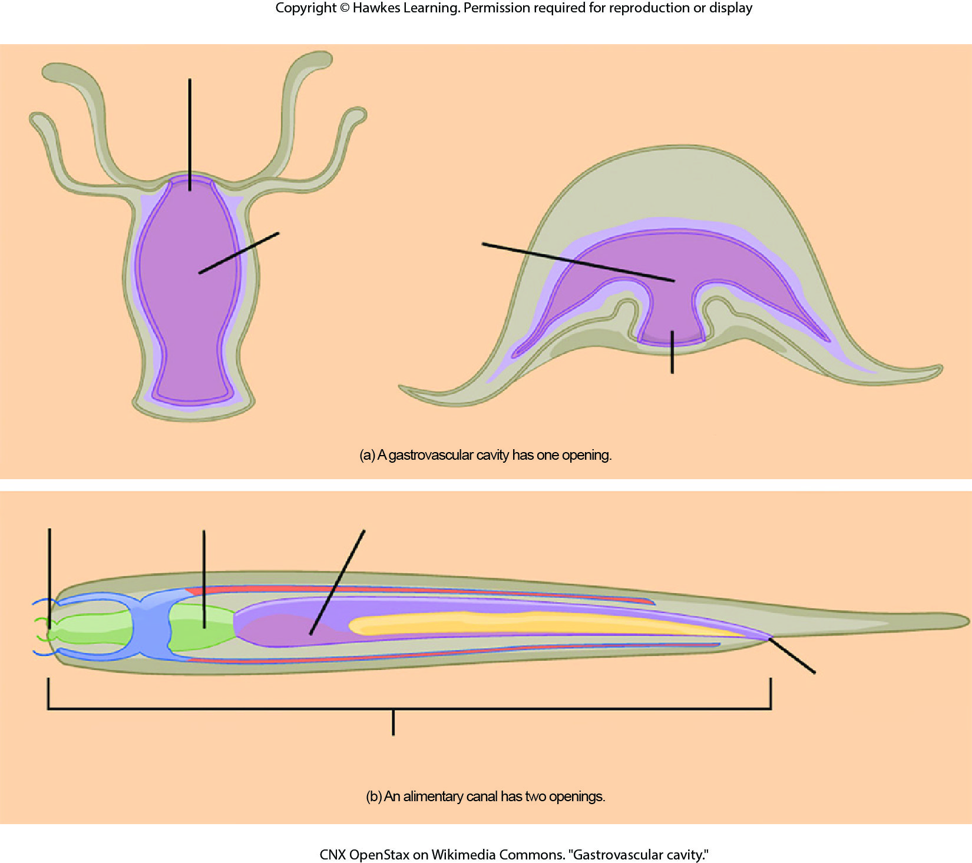
Lesson 34.1 Figure 5

Slide 4
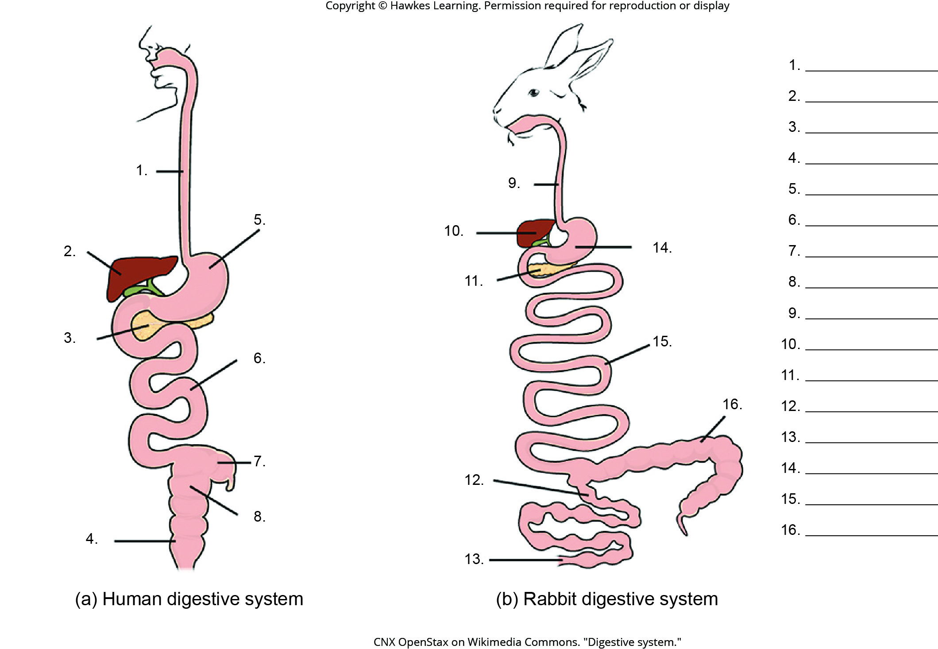
Lesson 34.1 Figure 6 - Numbered

Slide 5
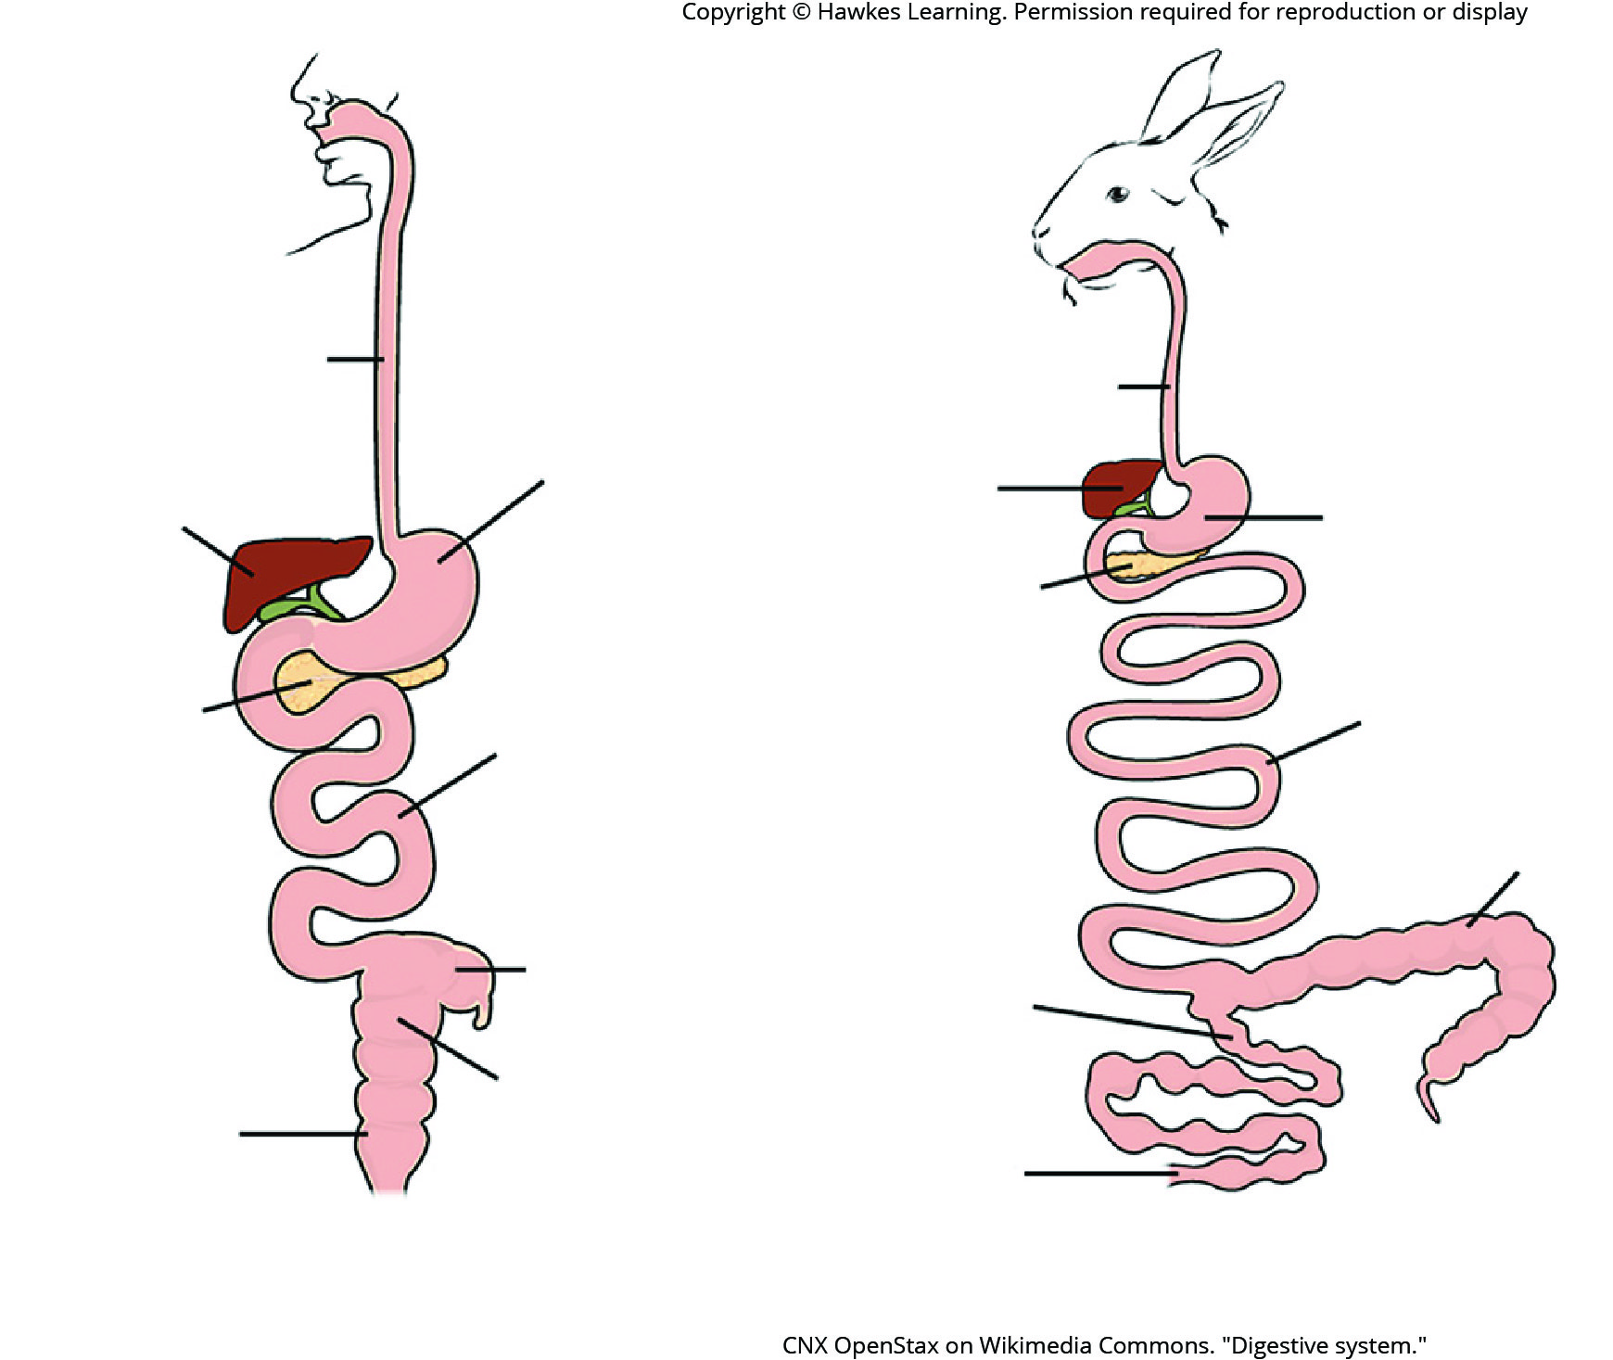
Lesson 34.1 Figure 6

Slide 6
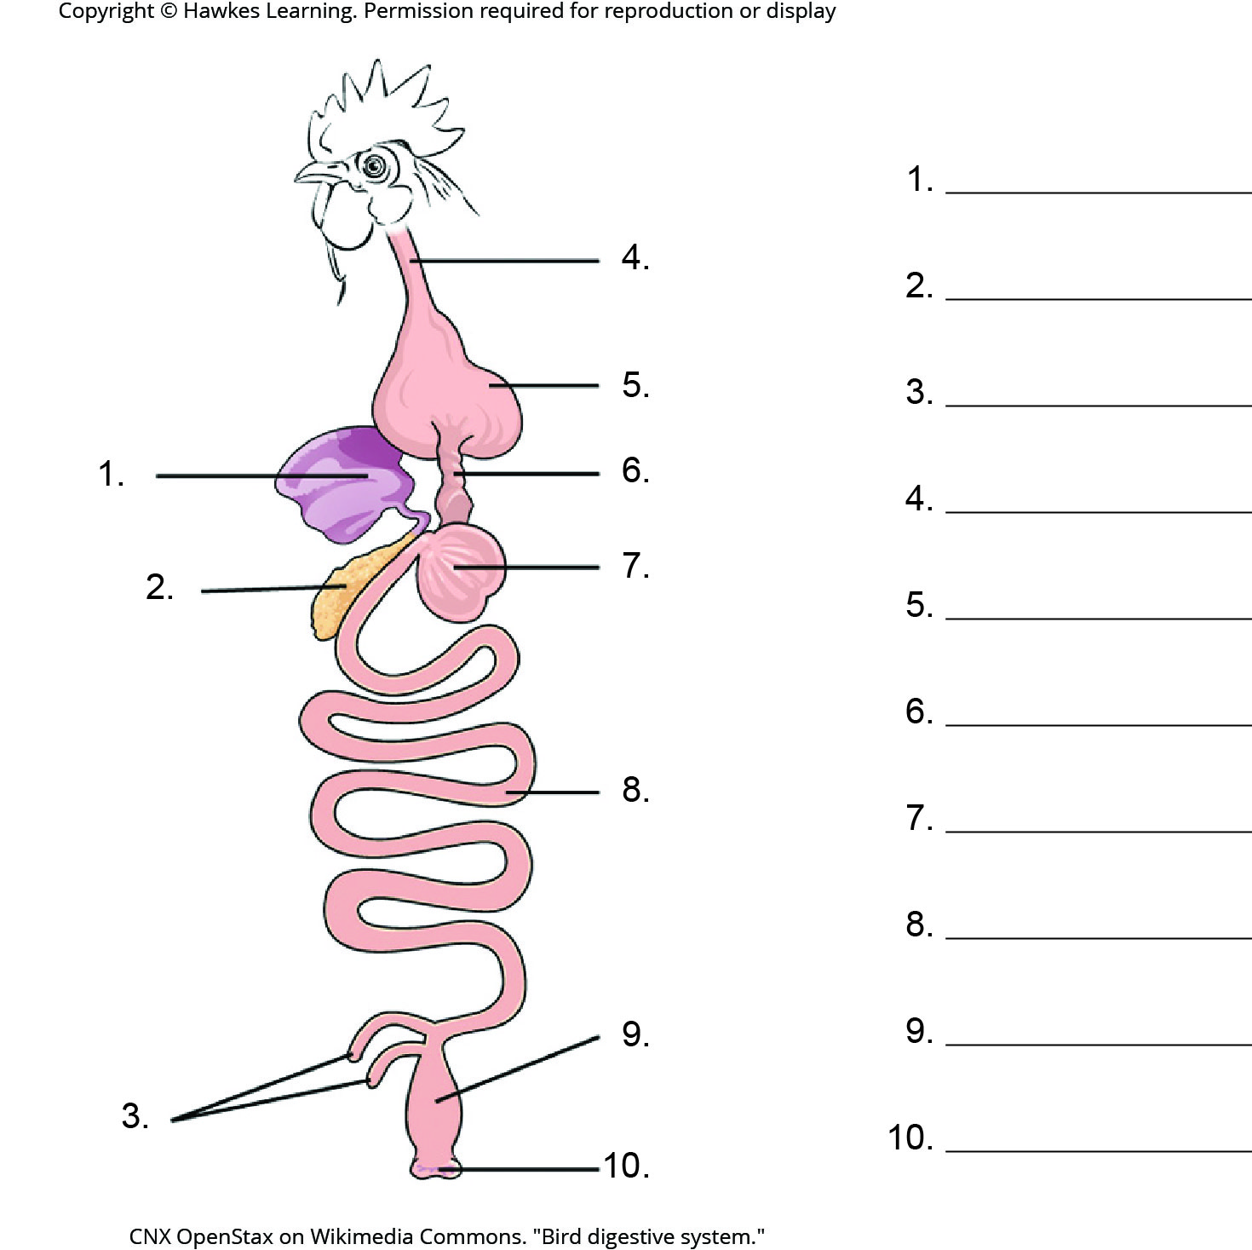
Lesson 34.1 Figure 7 - Numbered

Slide 7
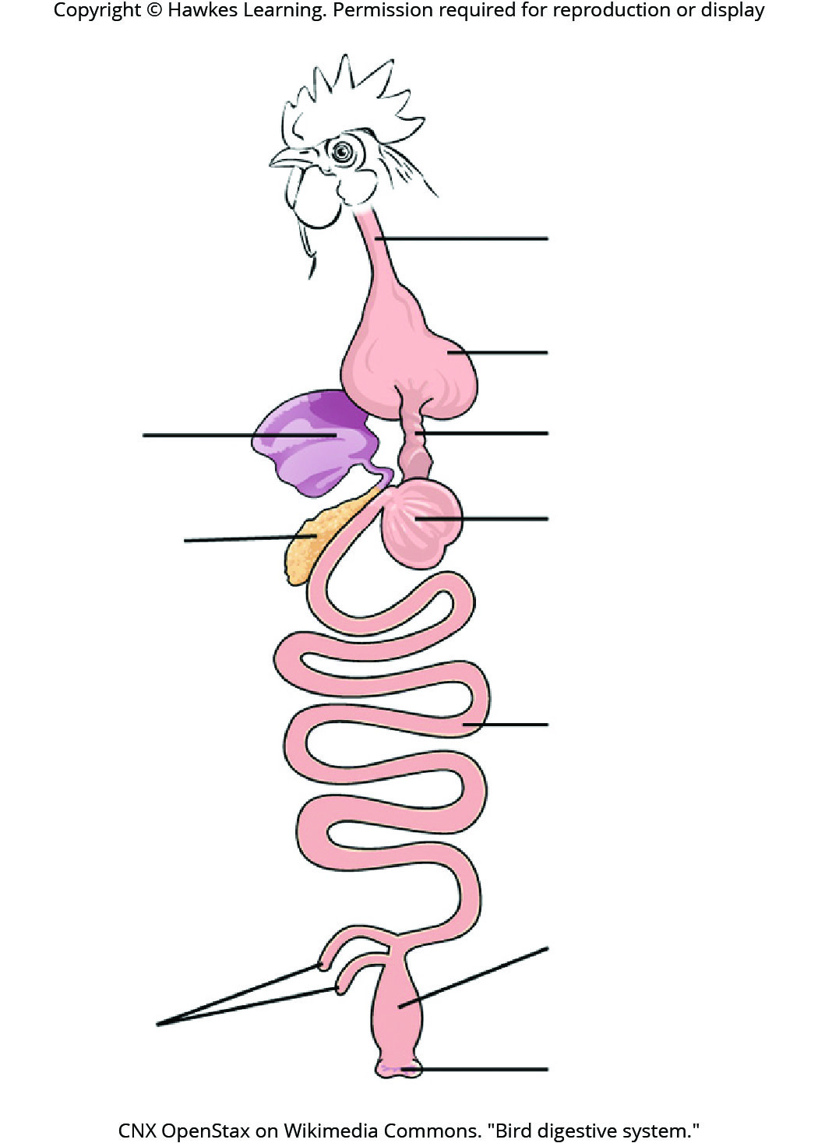
Lesson 34.1 Figure 7

Slide 8
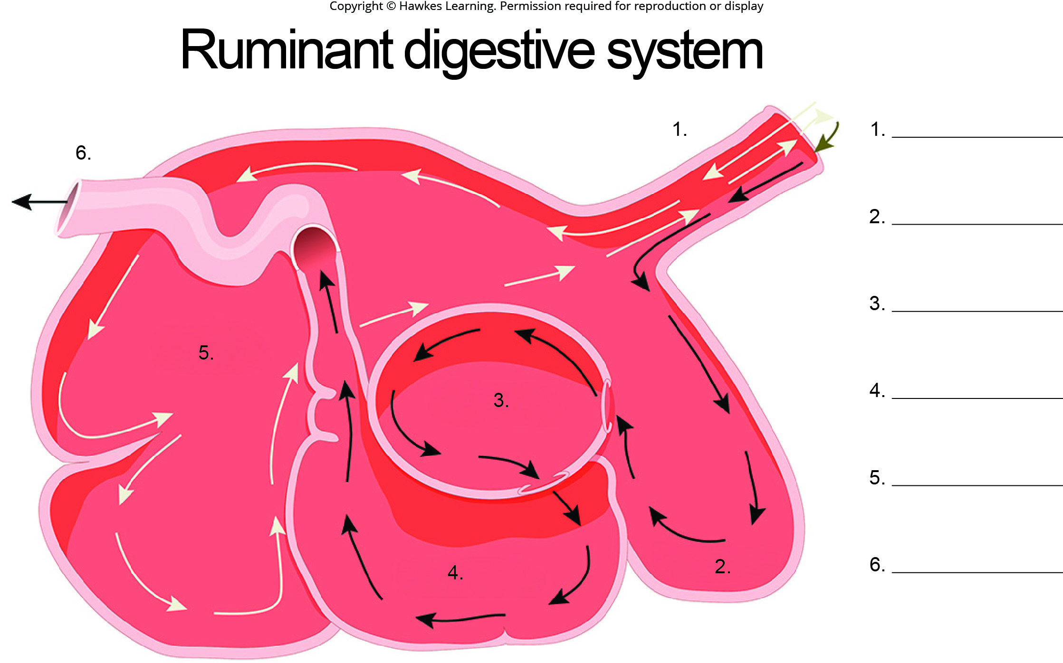
Lesson 34.1 Figure 8 - Numbered

Slide 9
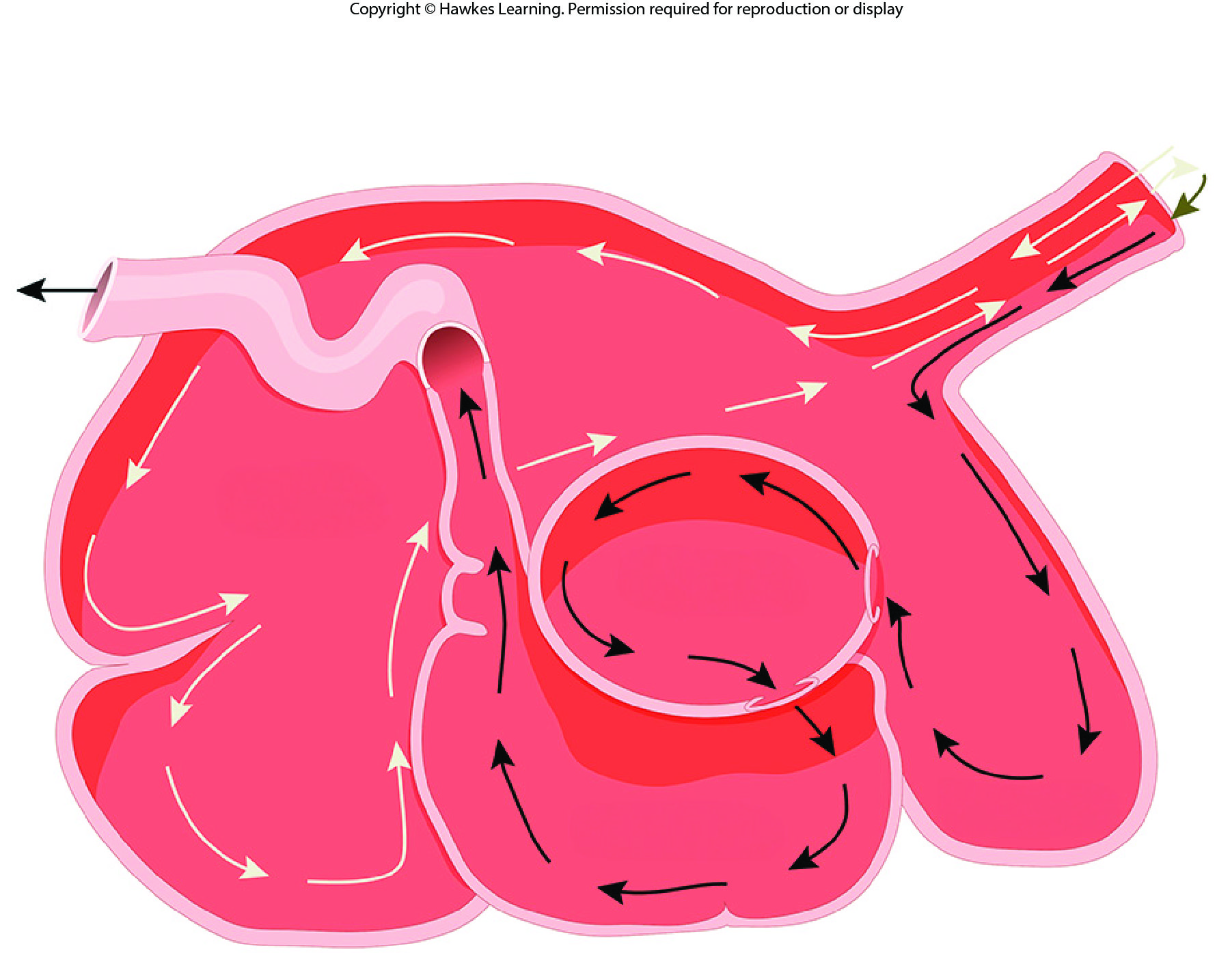
Lesson 34.1 Figure 8

Slide 10
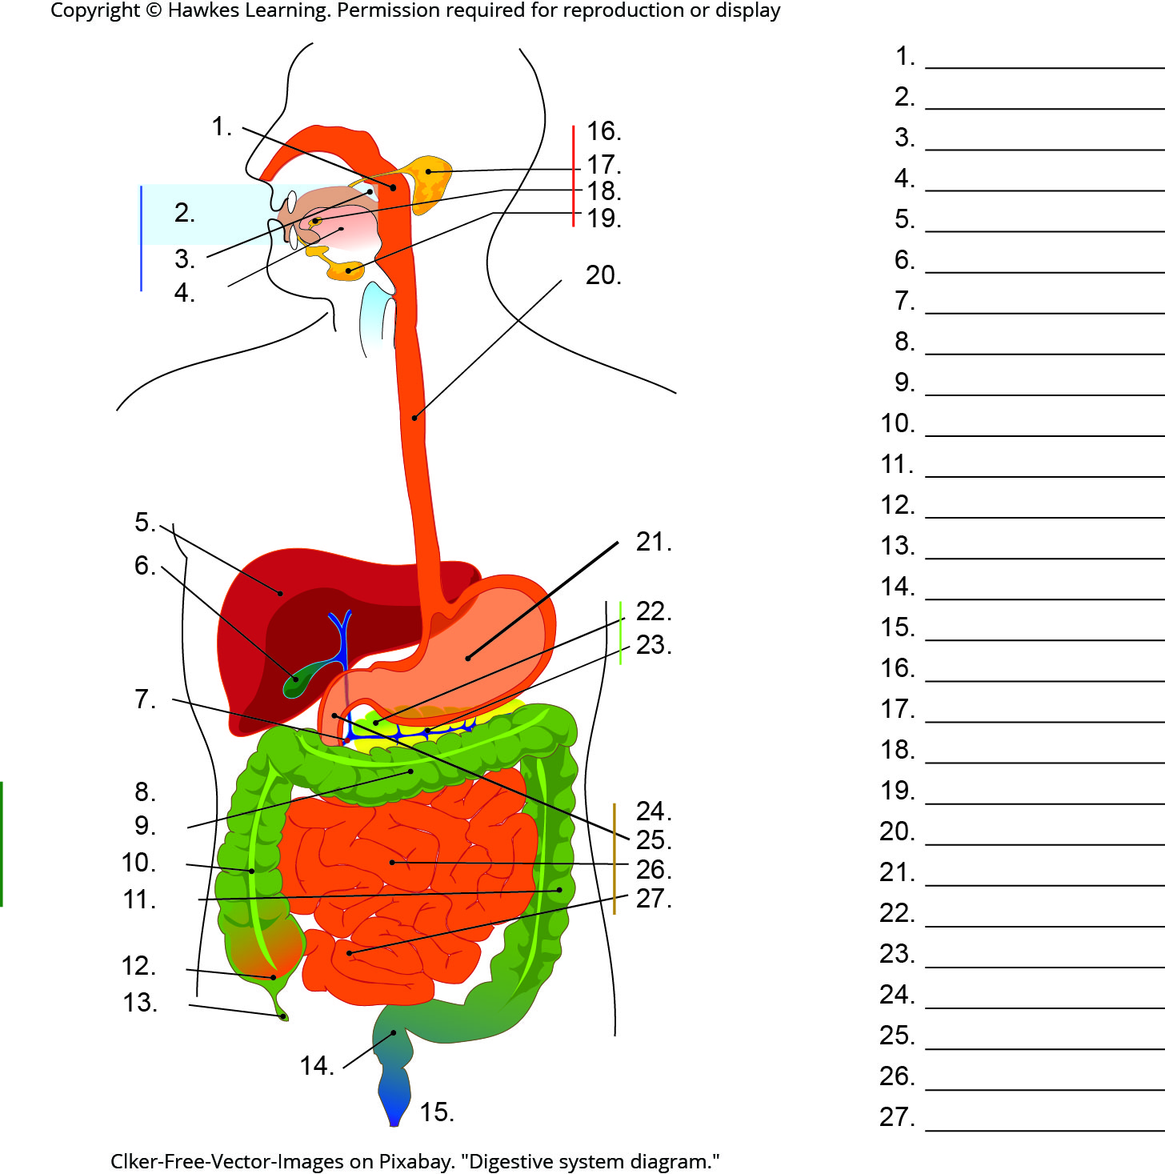
Lesson 34.1 Figure 9 - Numbered

Slide 11
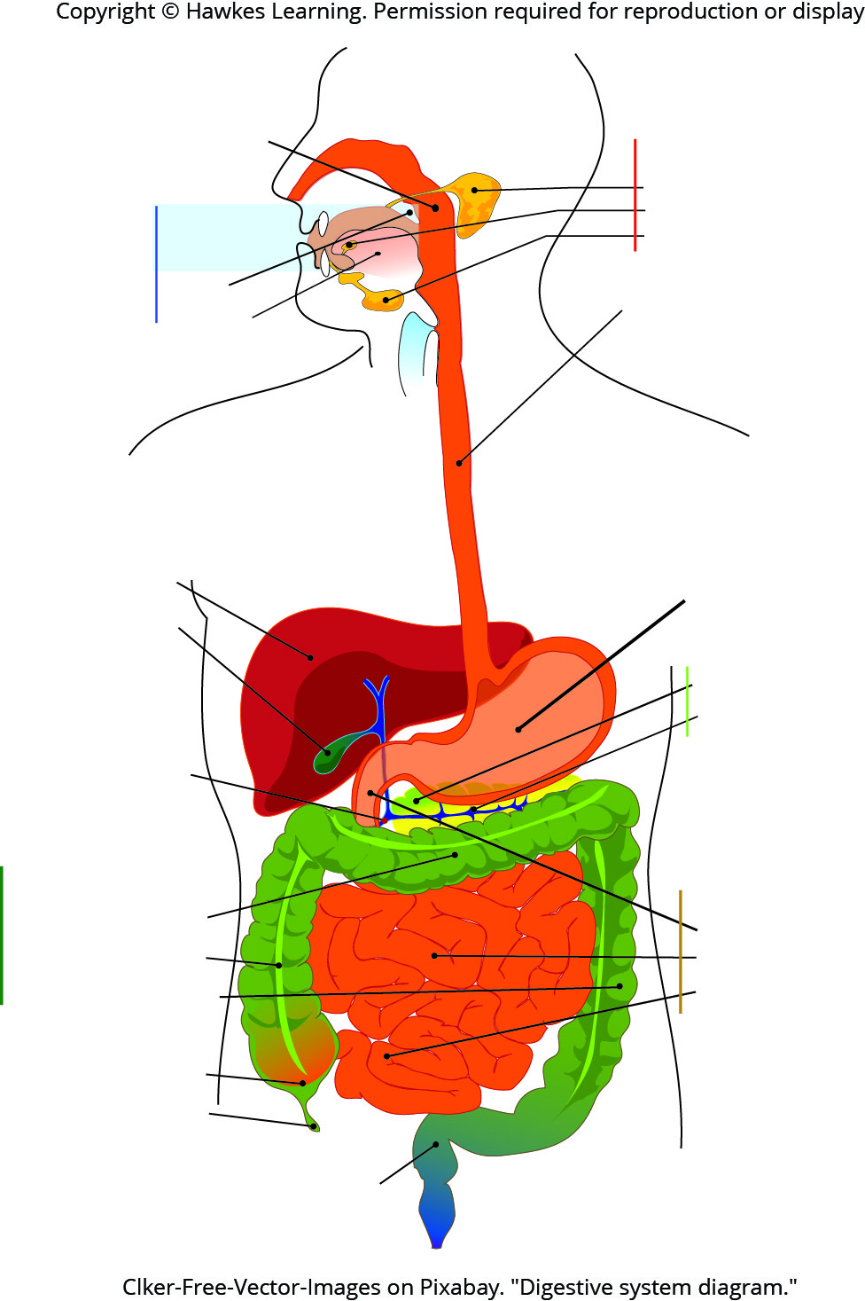
Lesson 34.1 Figure 9

Slide 12
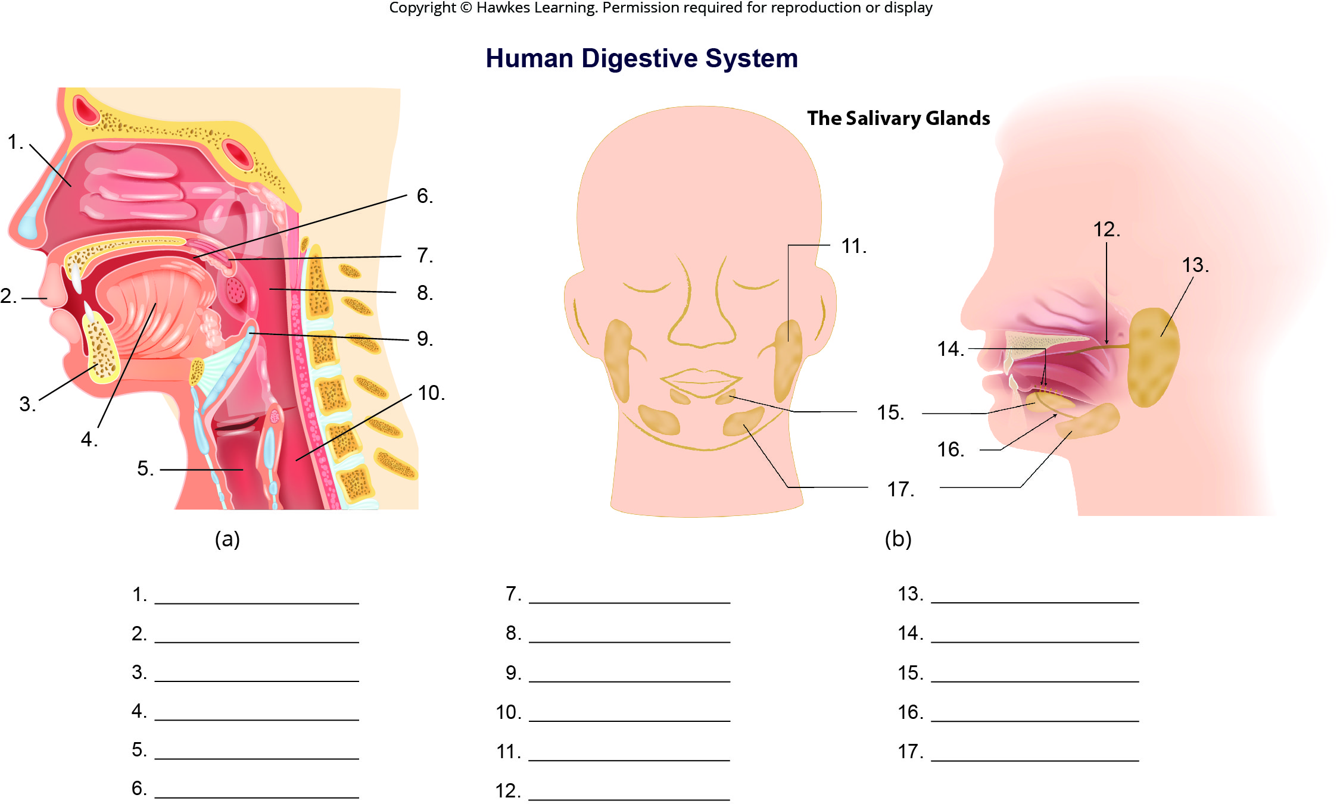
Lesson 34.1 Figure 10 - Numbered

Slide 13
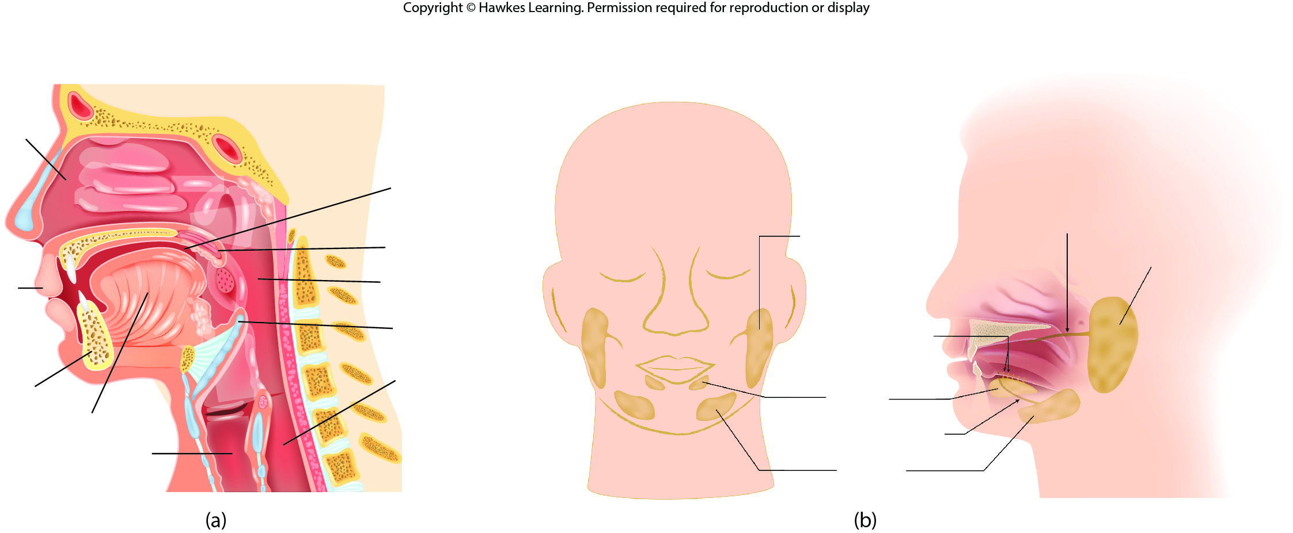
Lesson 34.1 Figure 10

Slide 14
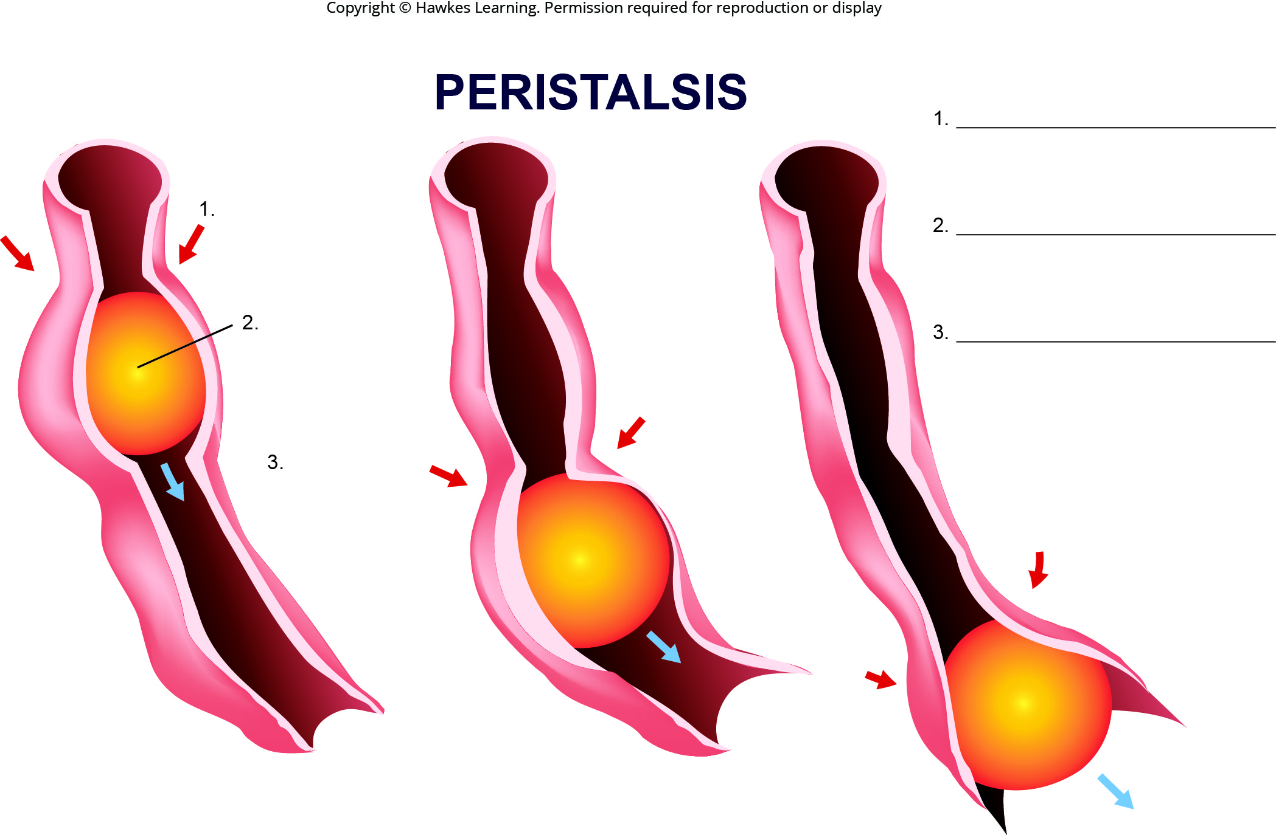
Lesson 34.1 Figure 11 - Numbered

Slide 15
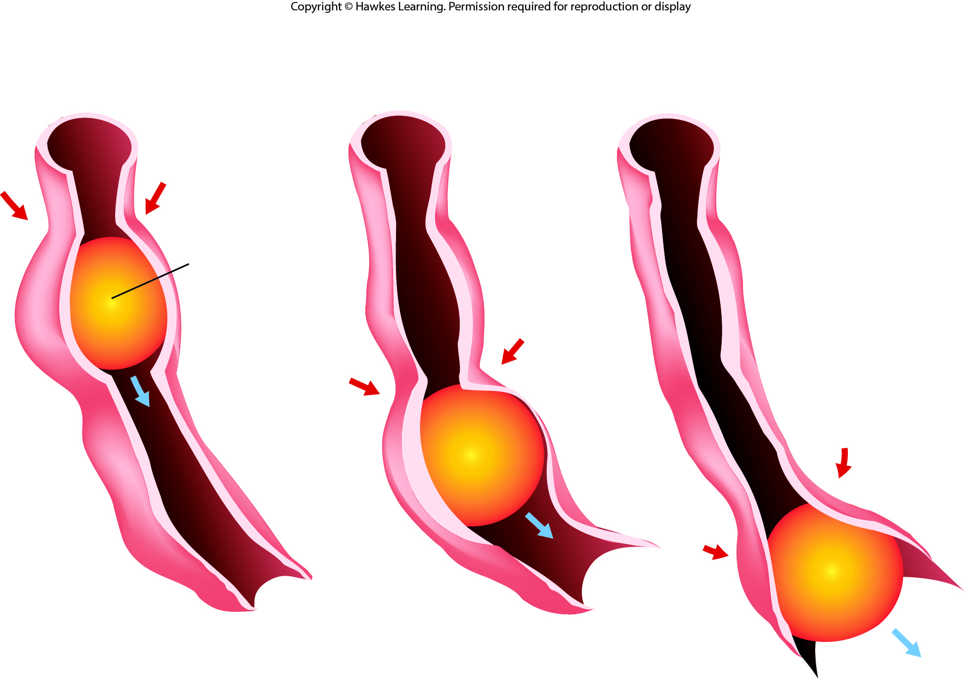
Lesson 34.1 Figure 11

Slide 16
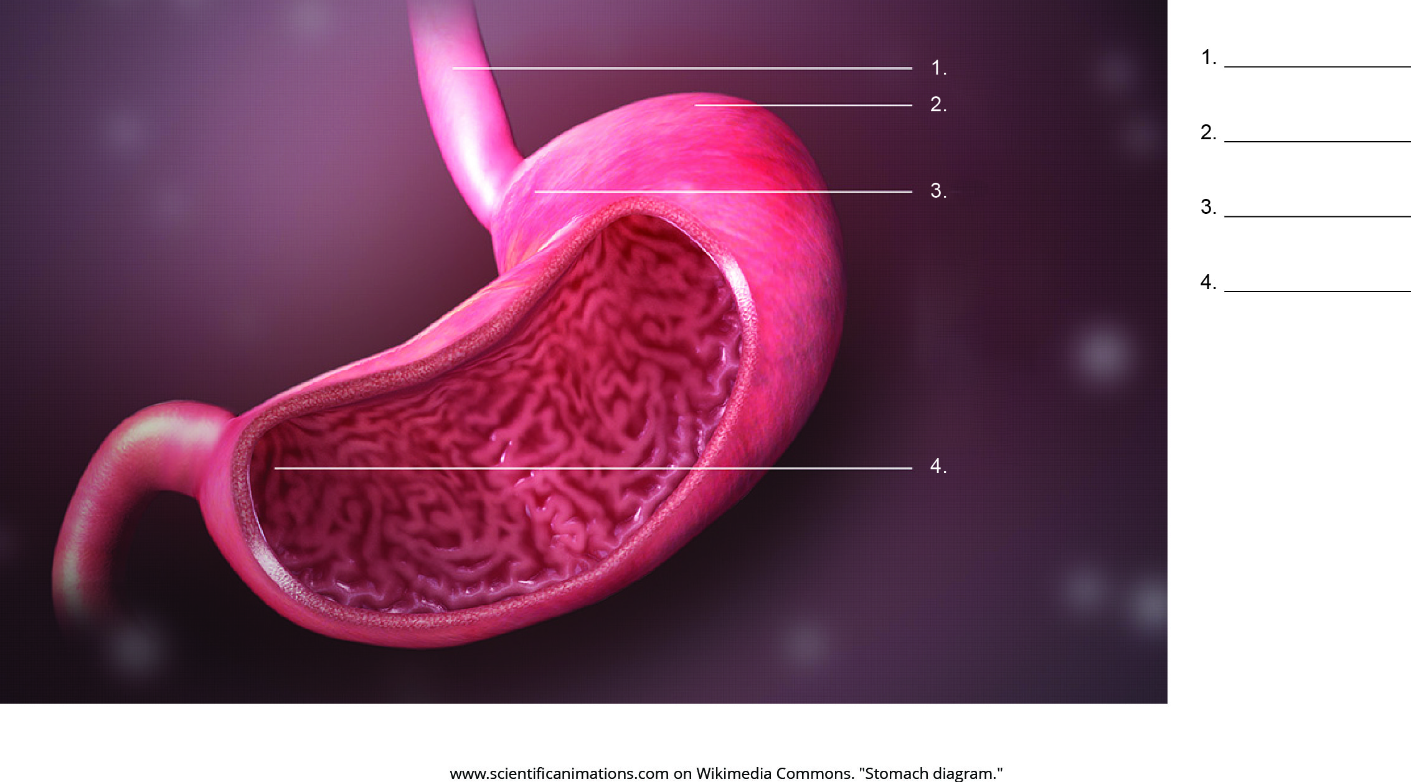
Lesson 34.1 Figure 12 - Numbered

Slide 17
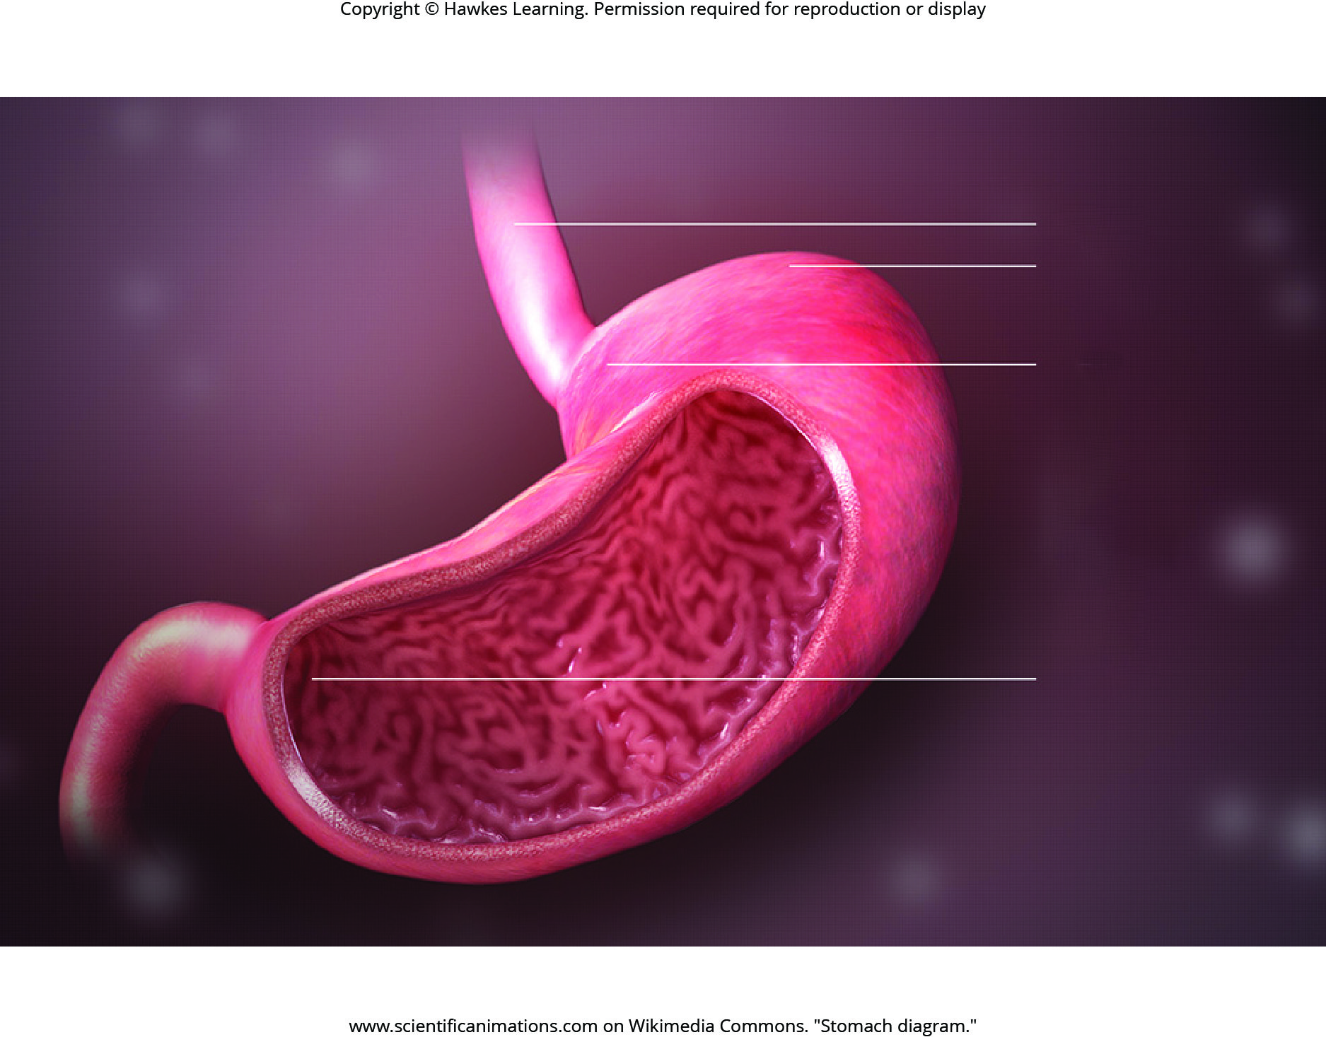
Lesson 34.1 Figure 12

Slide 18
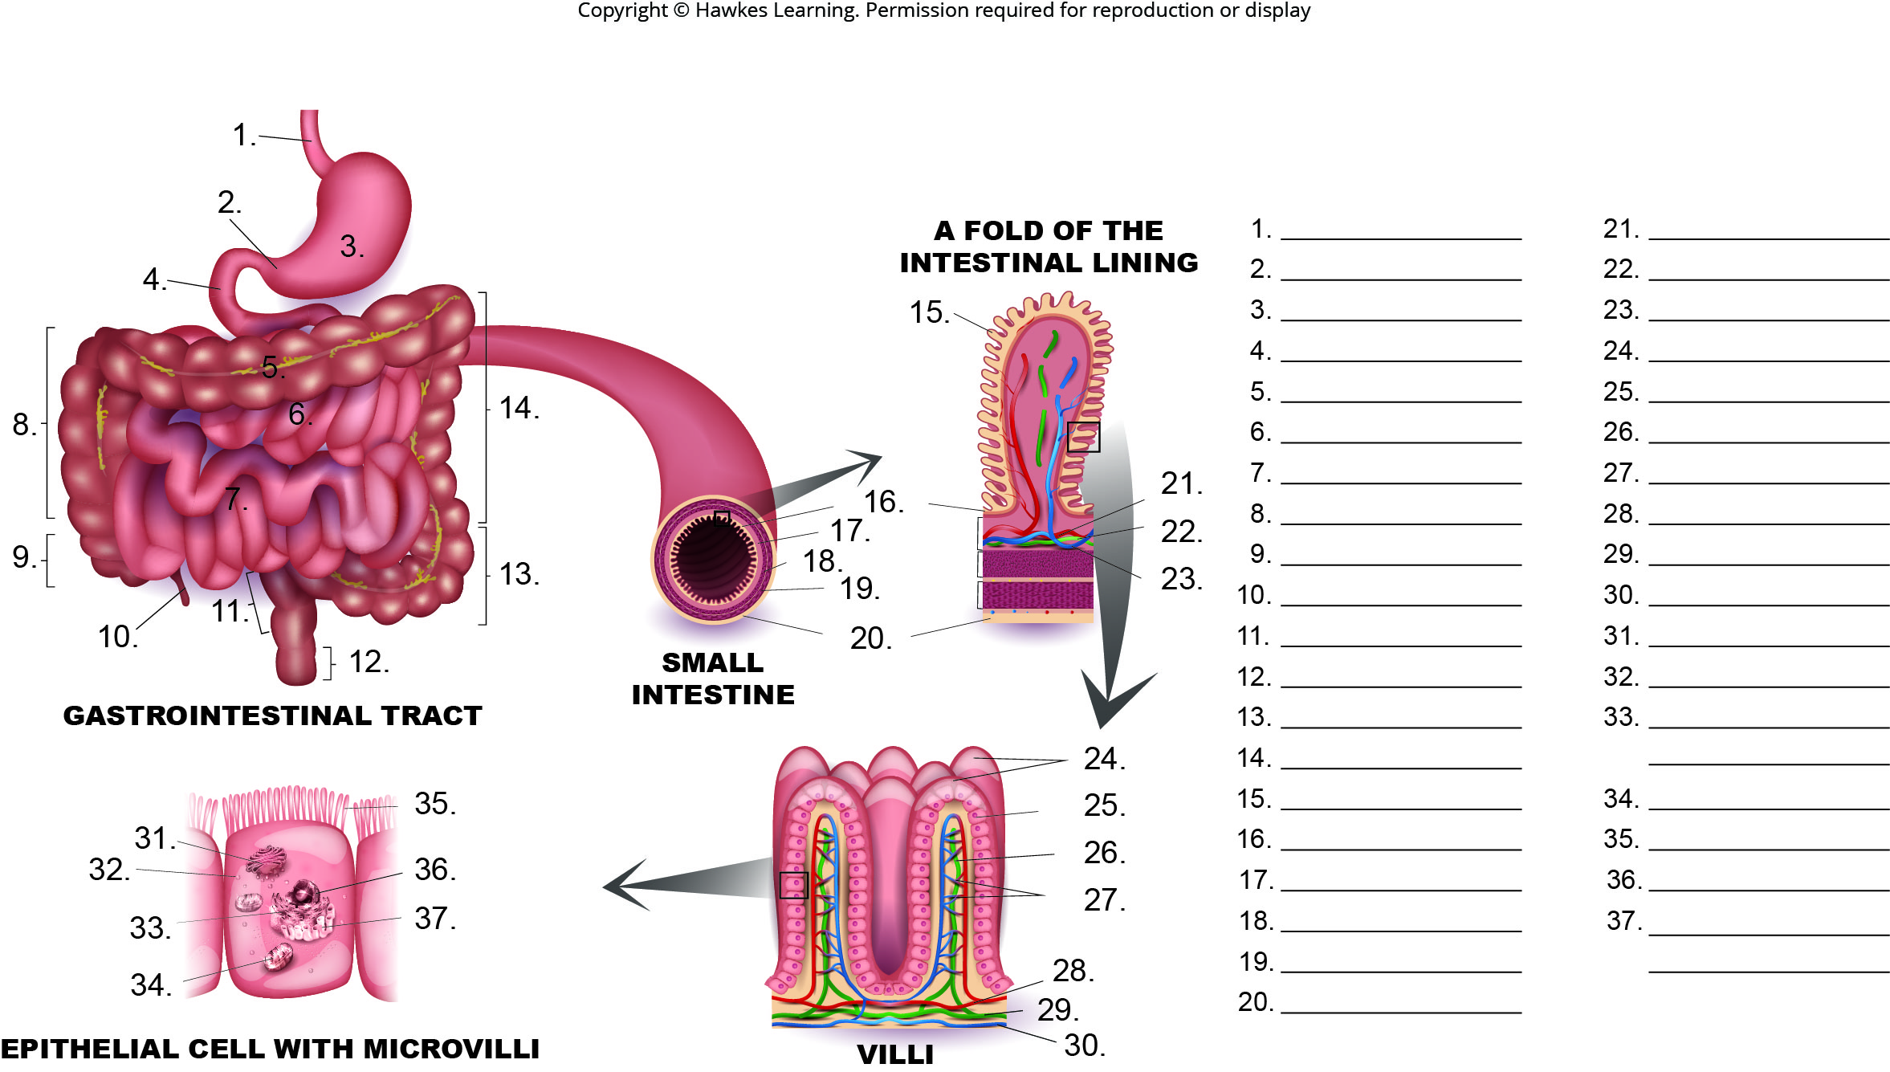
Lesson 34.1 Figure 13 - Numbered

Slide 19
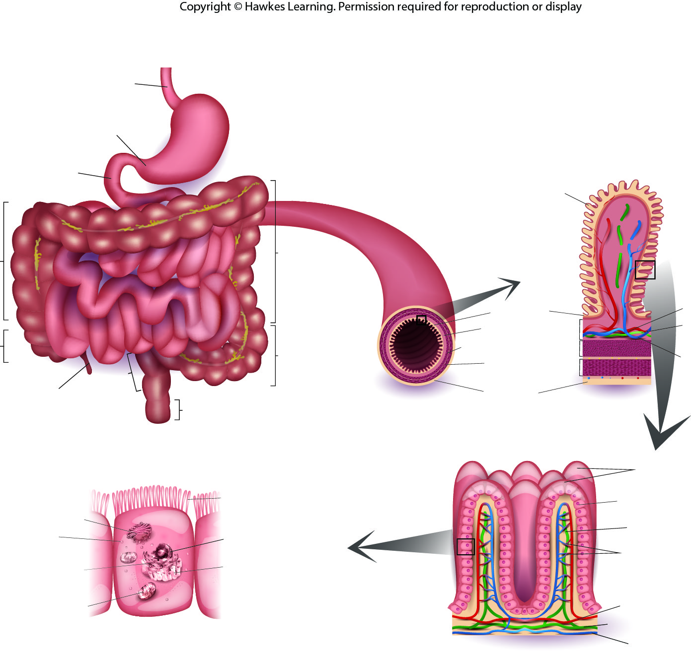
Lesson 34.1 Figure 13

Slide 20
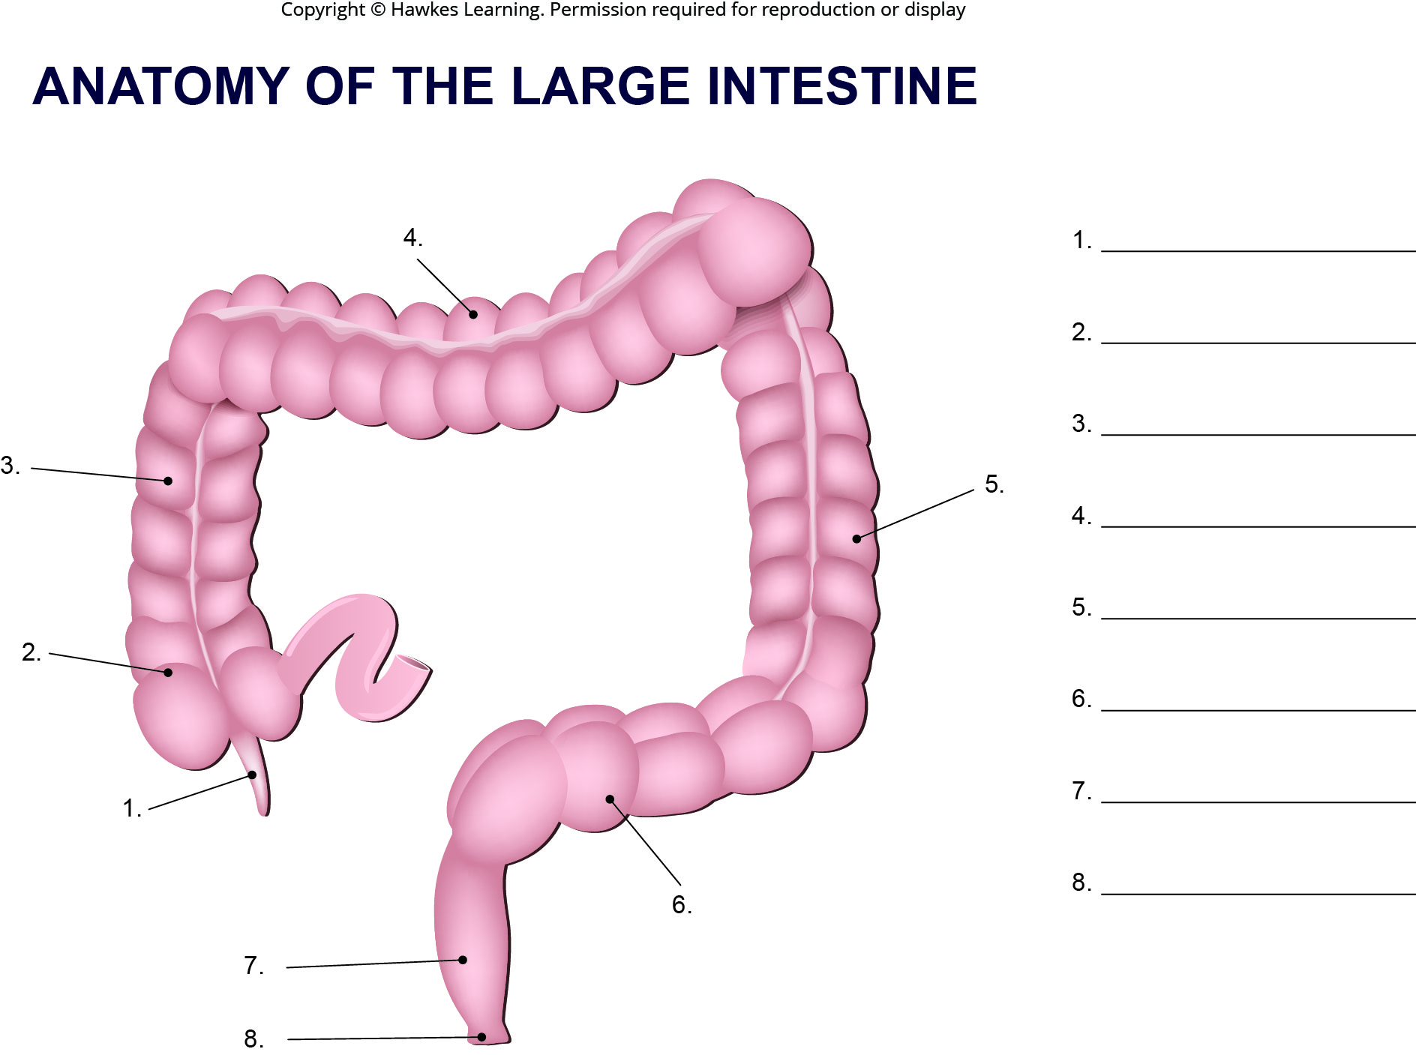
Lesson 34.1 Figure 14 - Numbered

Slide 21
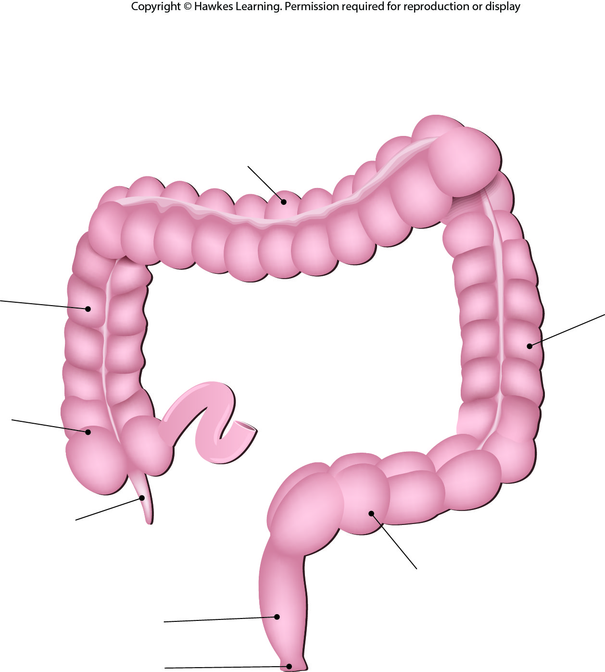
Lesson 34.1 Figure 14

Slide 22
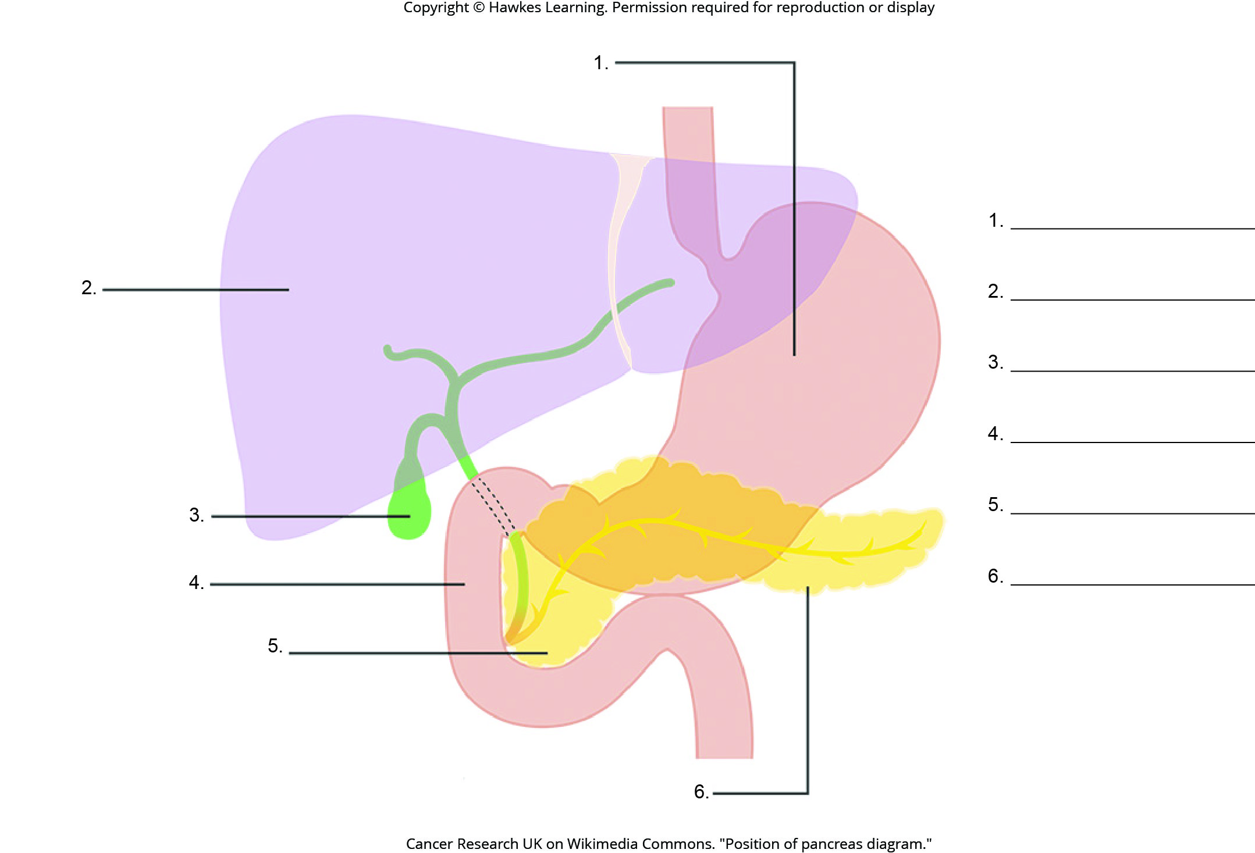
Lesson 34.1 Figure 15 - Numbered

Slide 23
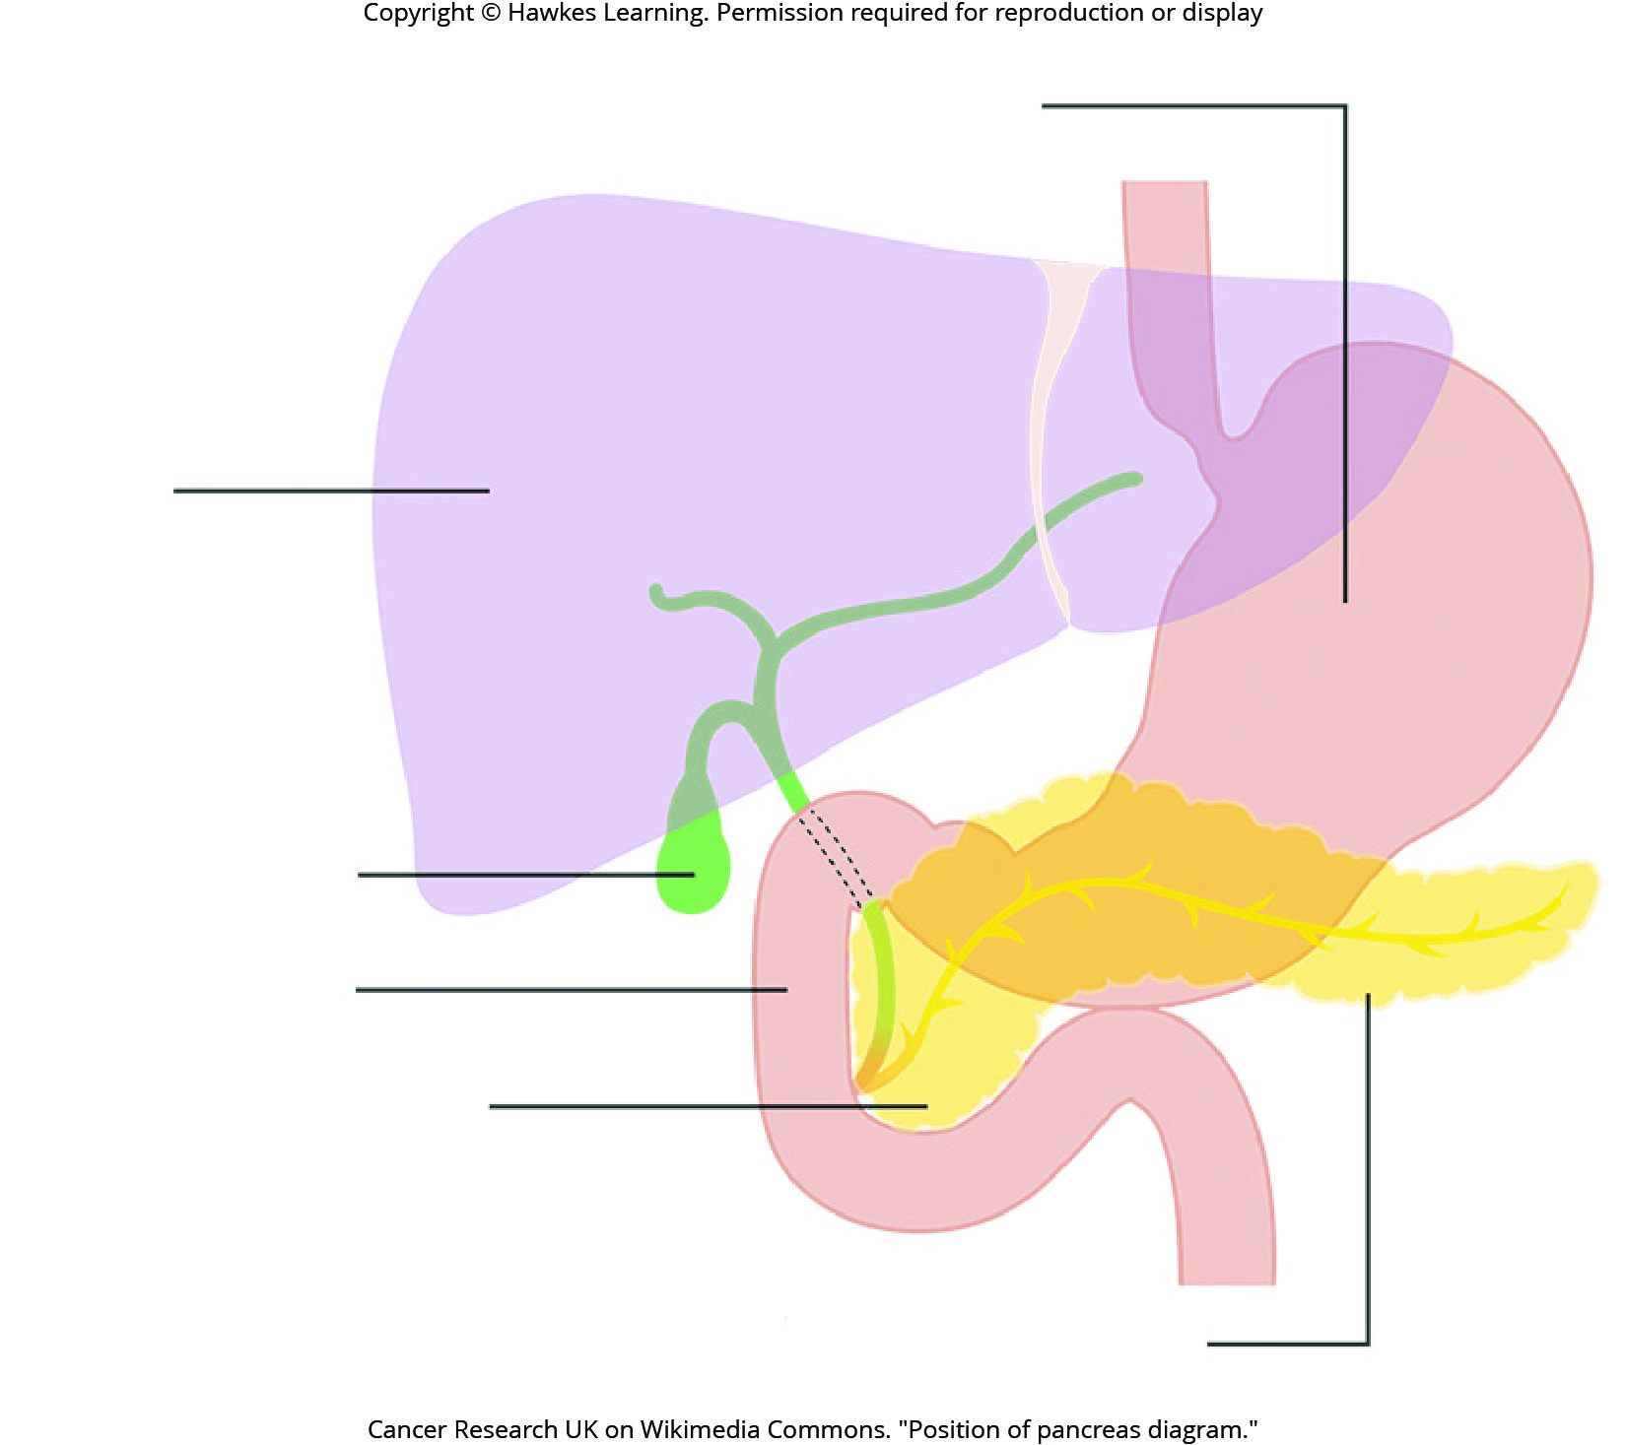
Lesson 34.1 Figure 15

Slide 24
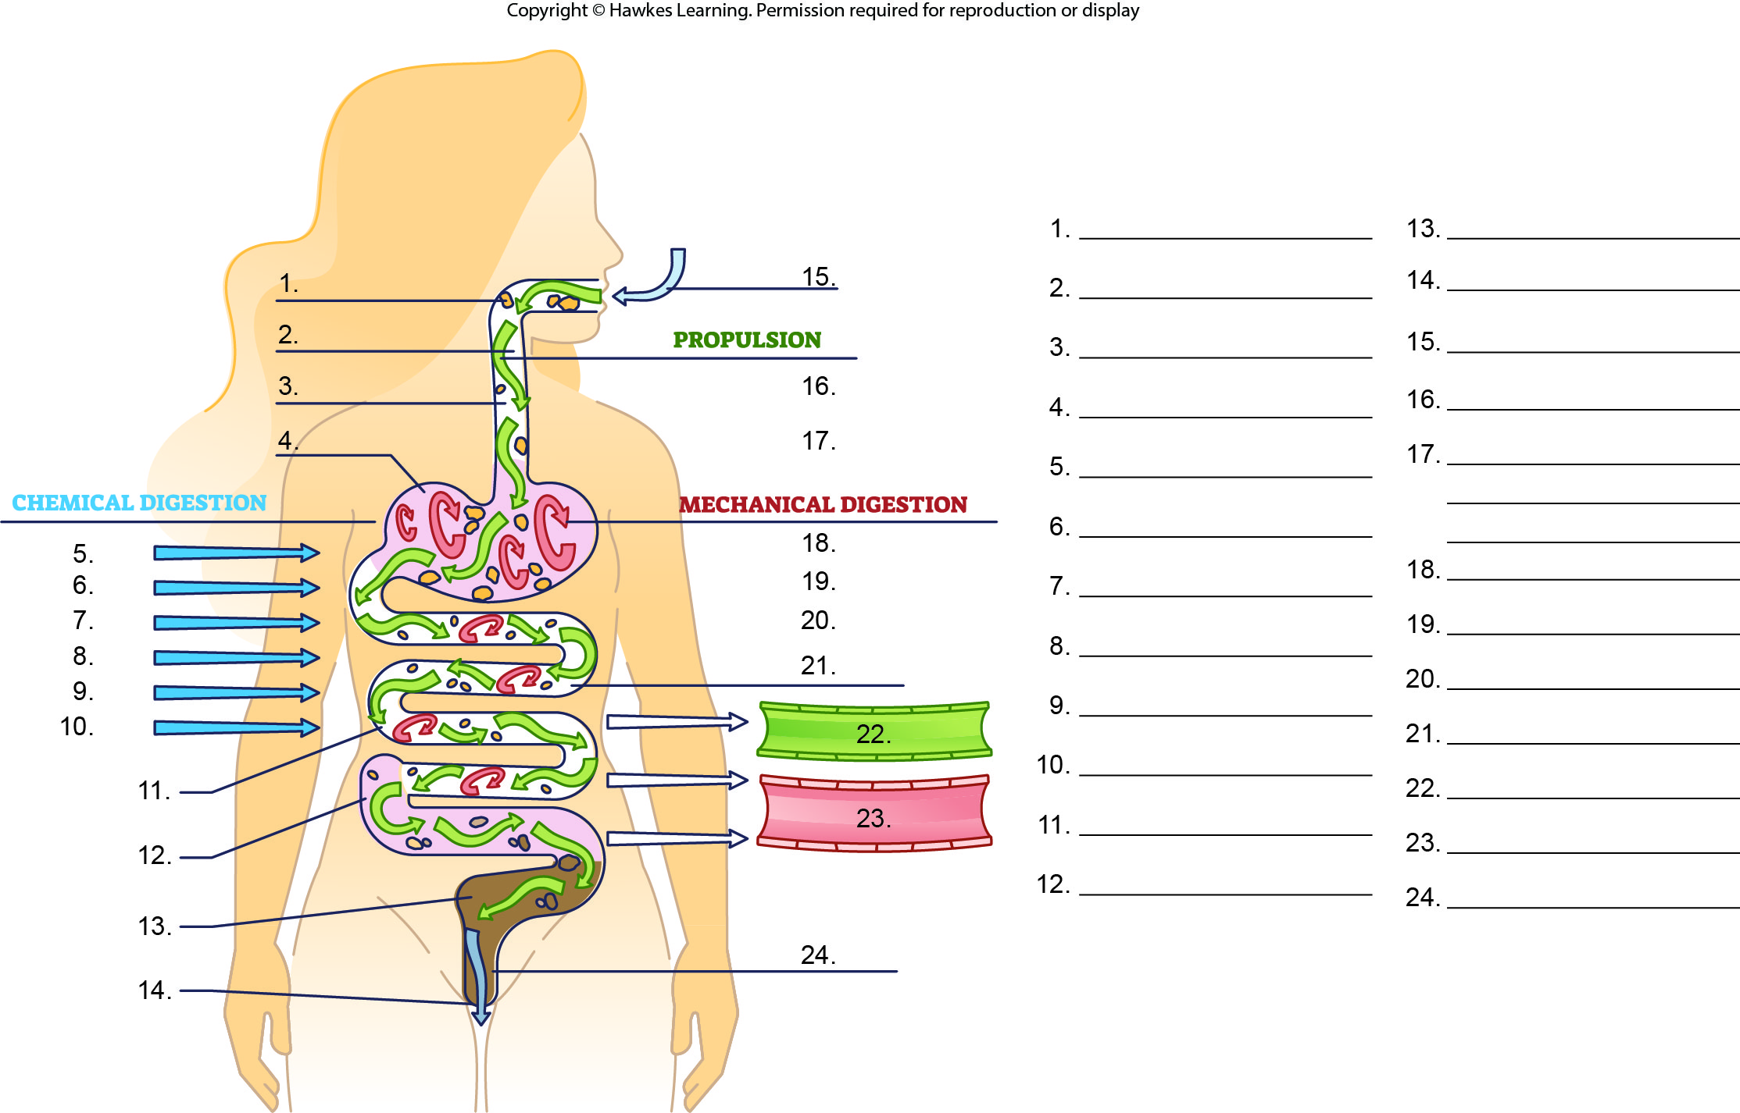
Lesson 34.3 Figure 1 - Numbered

Slide 25
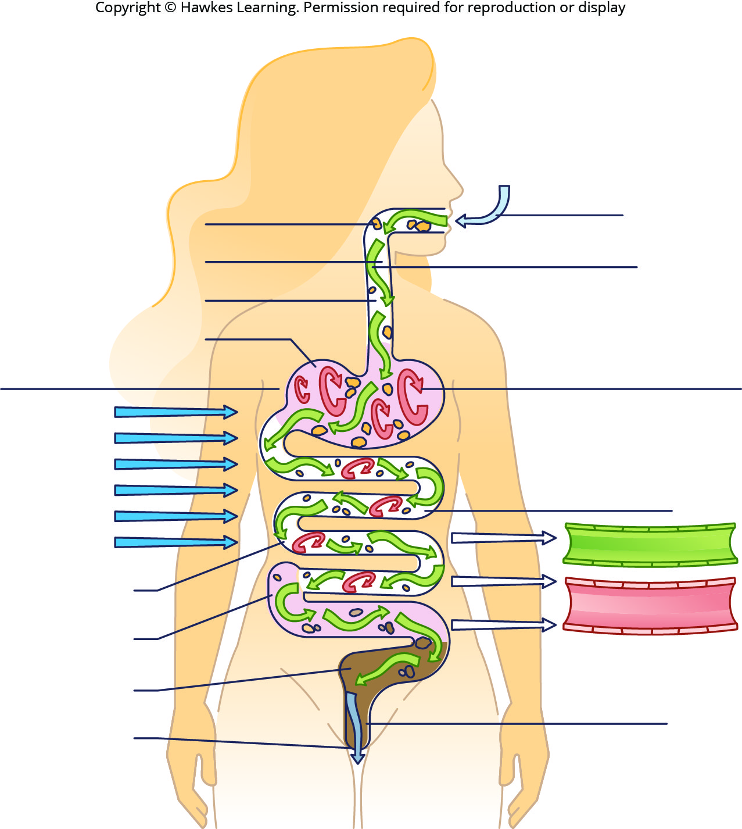
Lesson 34.3 Figure 1

Slide 26
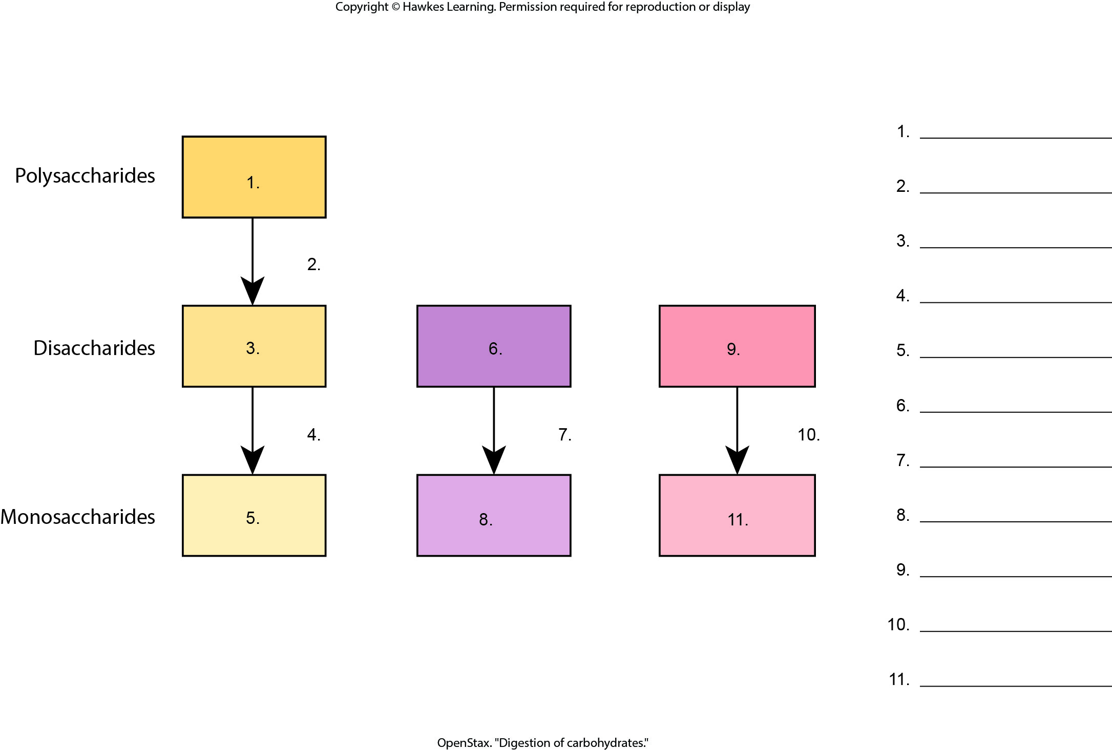
Lesson 34.3 Figure 2 - Numbered

Slide 27
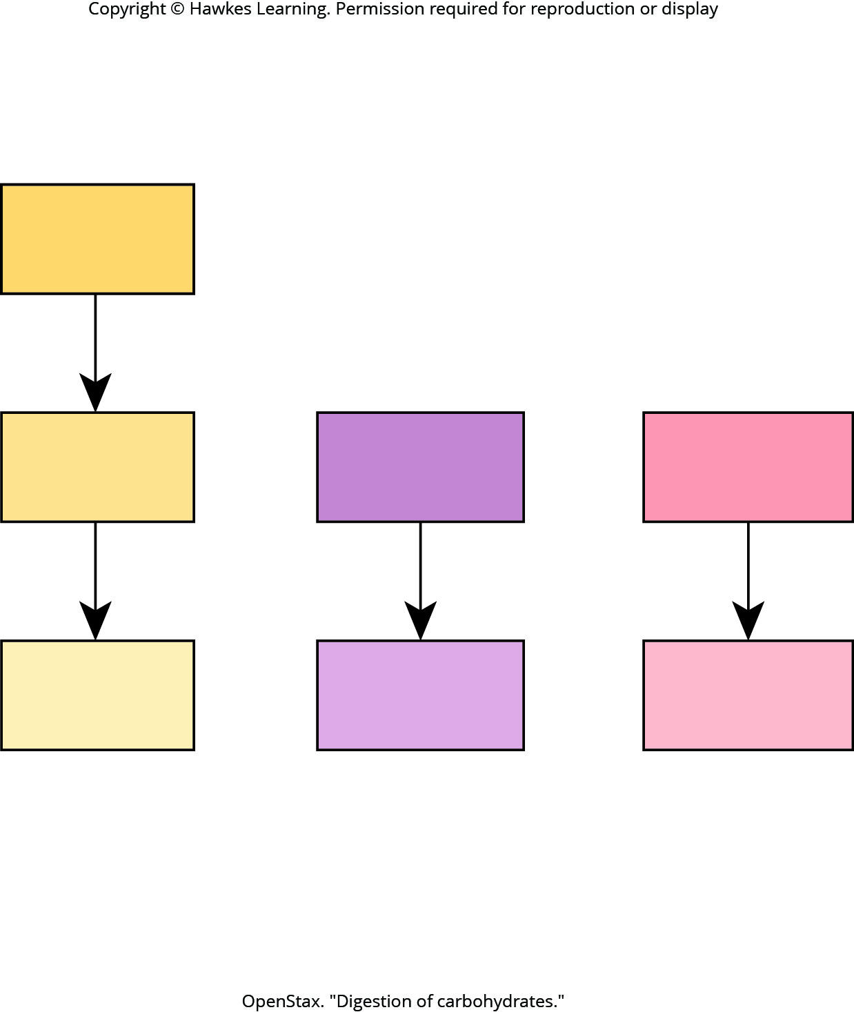
Lesson 34.3 Figure 2

Slide 28
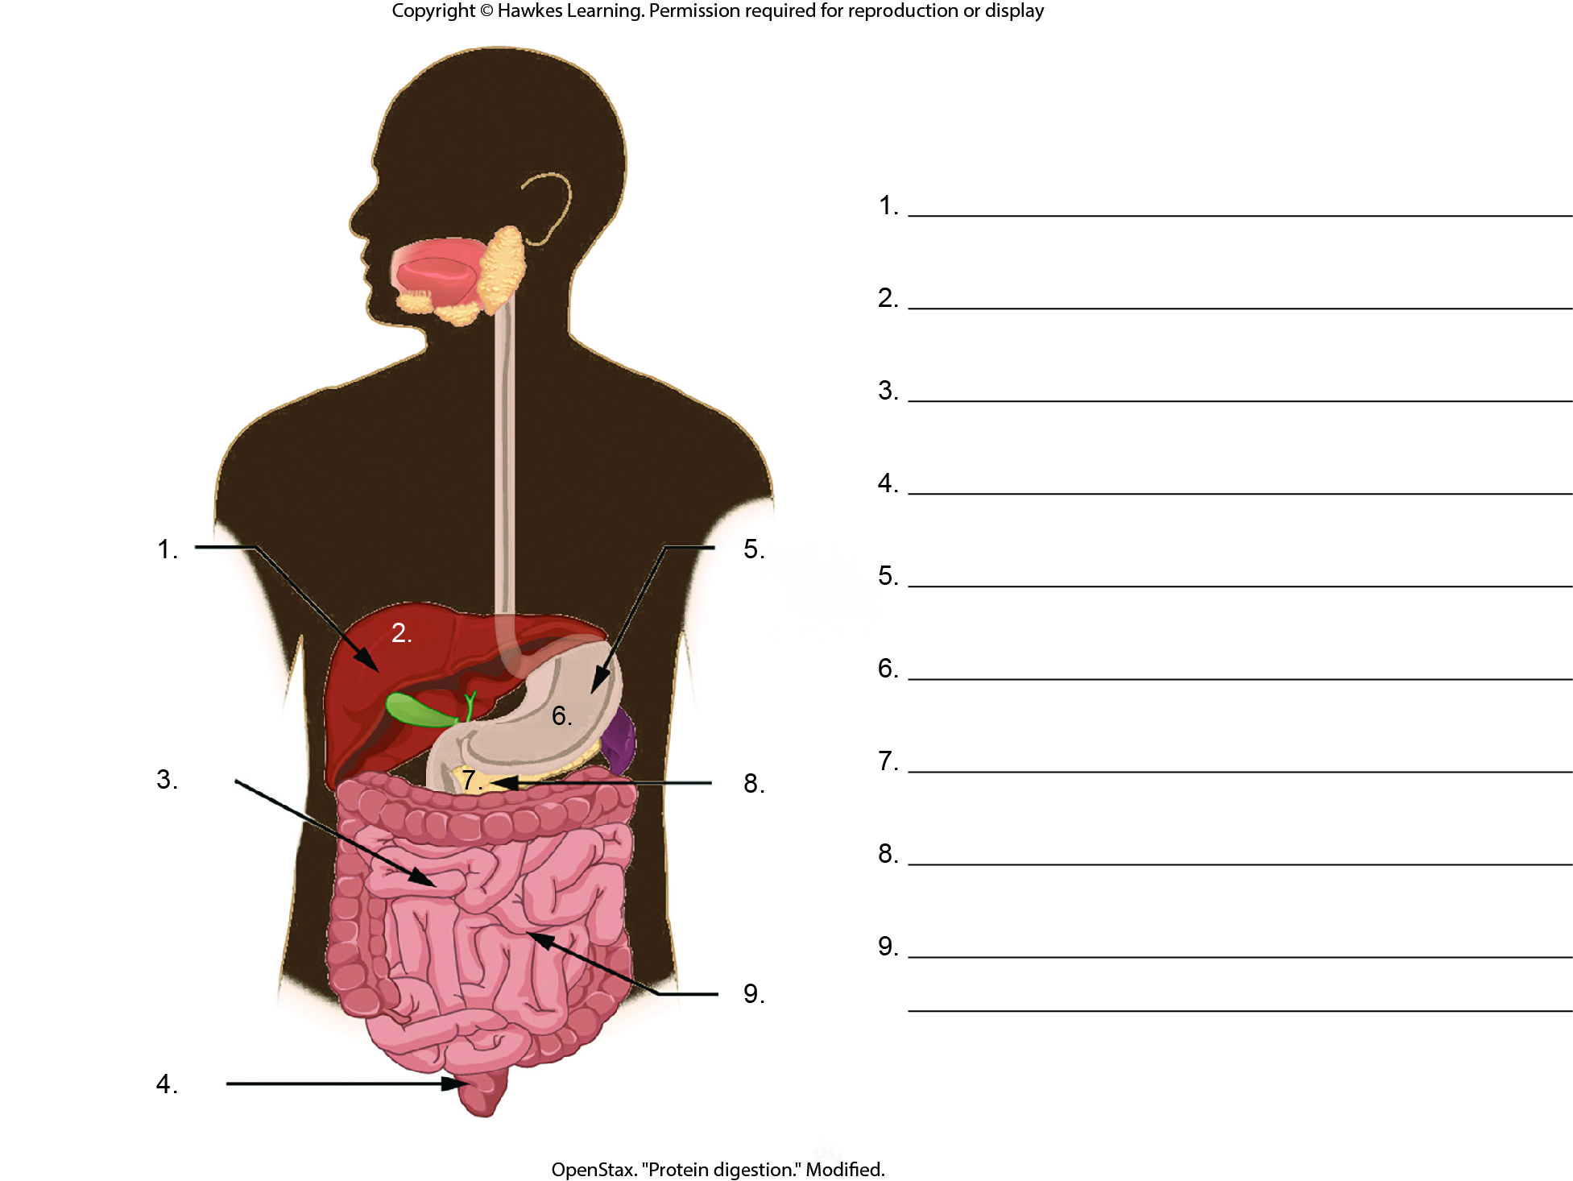
Lesson 34.3 Figure 3 - Numbered

Slide 29
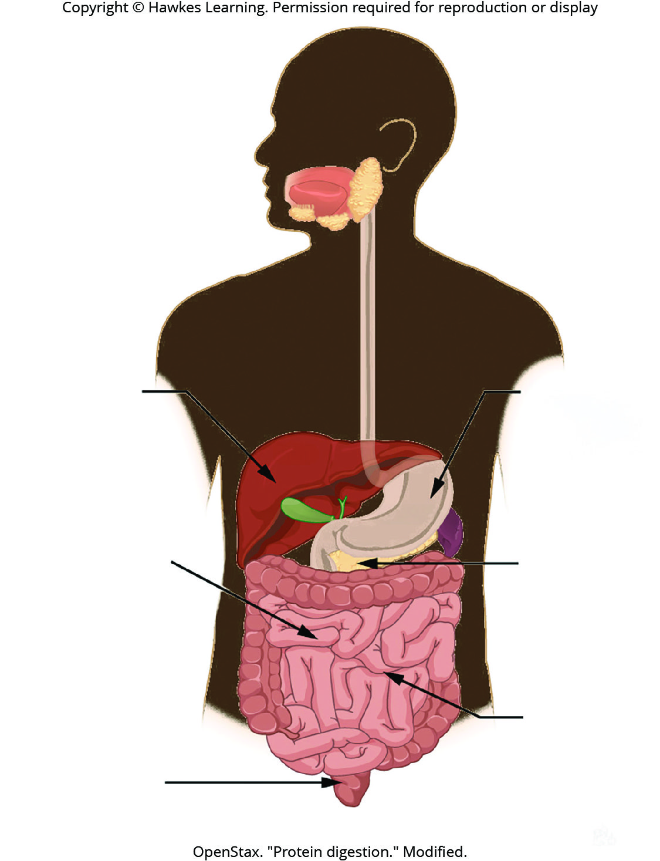
Lesson 34.3 Figure 3

Slide 30
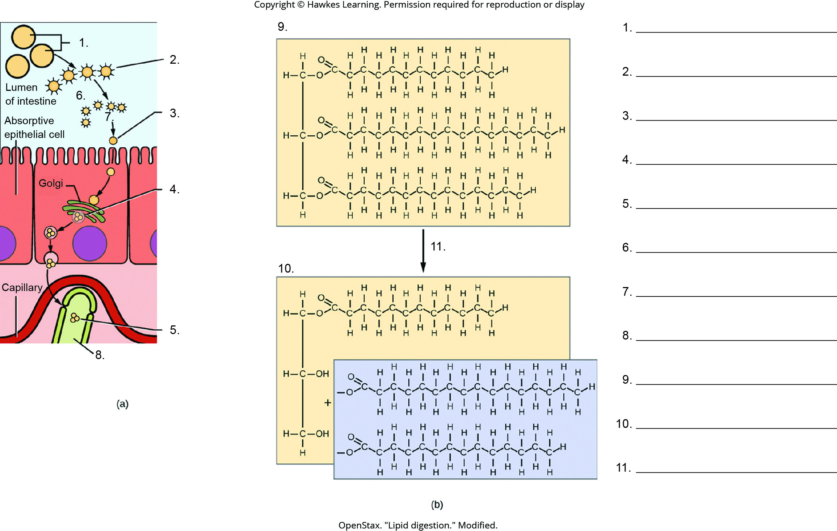
Lesson 34.3 Figure 4 - Numbered

Slide 31
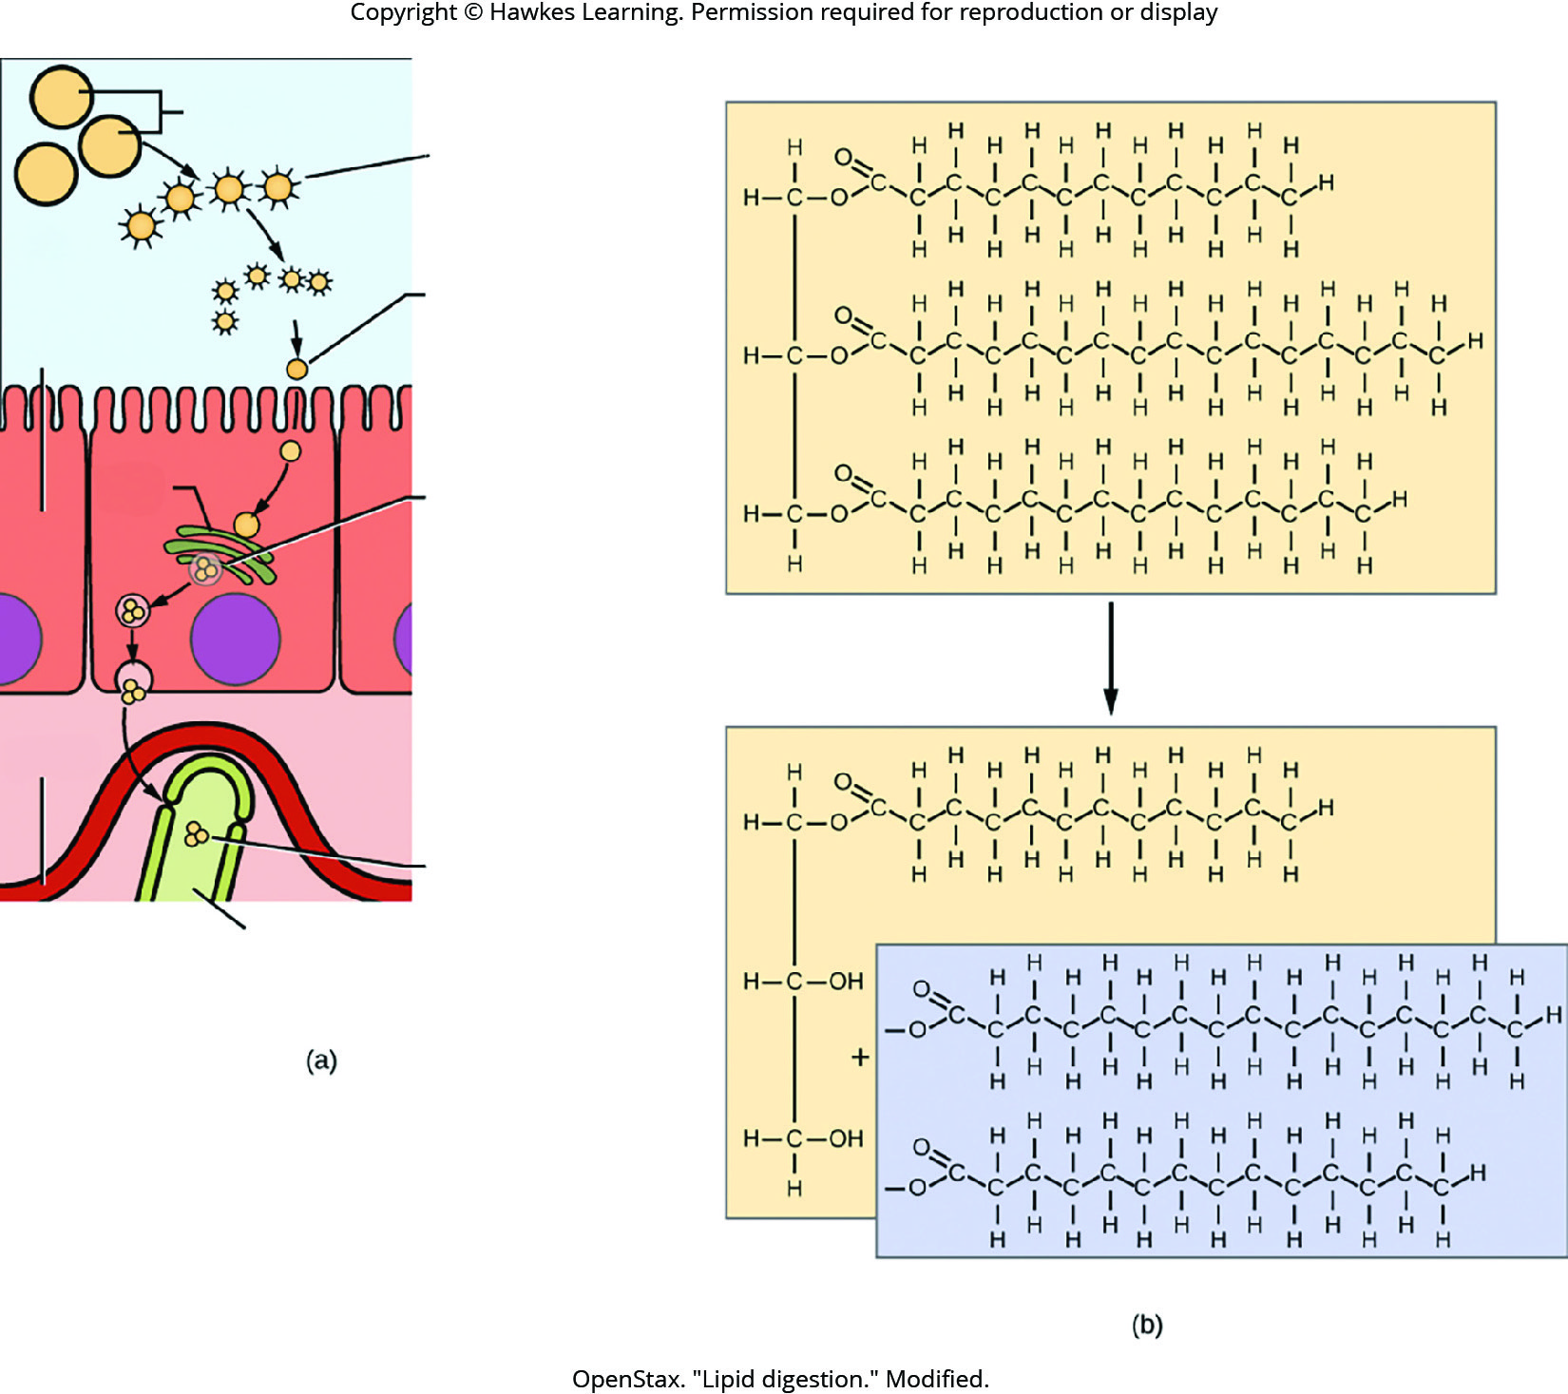
Lesson 34.3 Figure 4

Slide 32
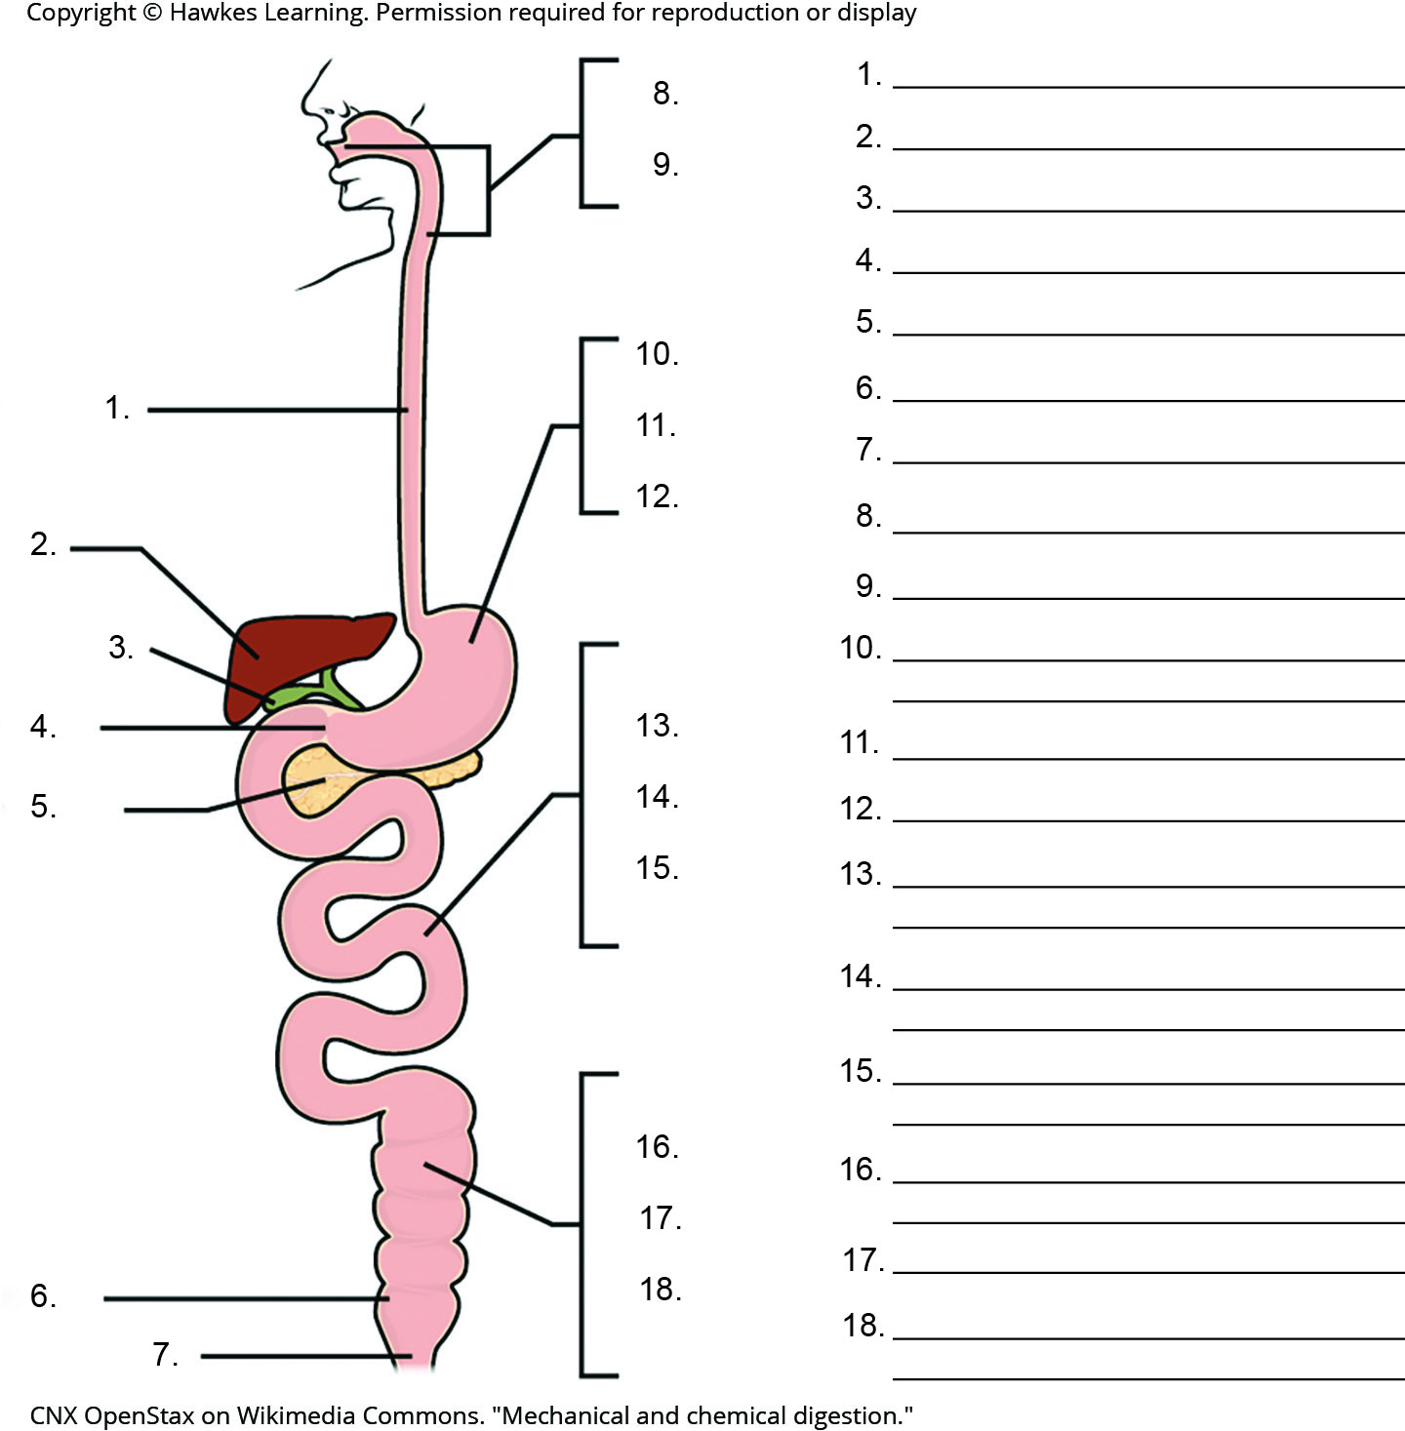
Lesson 34.3 Figure 5 - Numbered

Slide 33
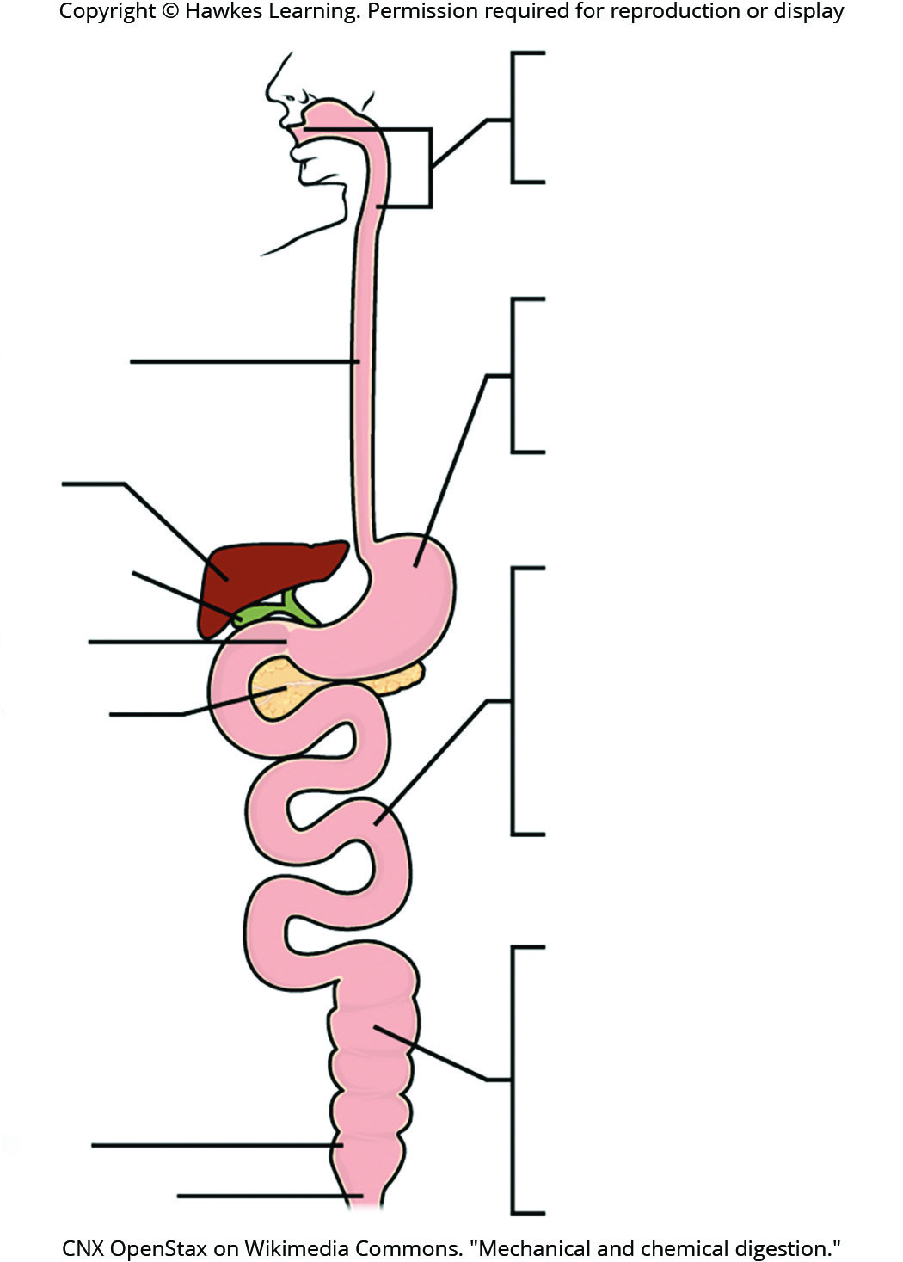
Lesson 34.3 Figure 5

Slide 34
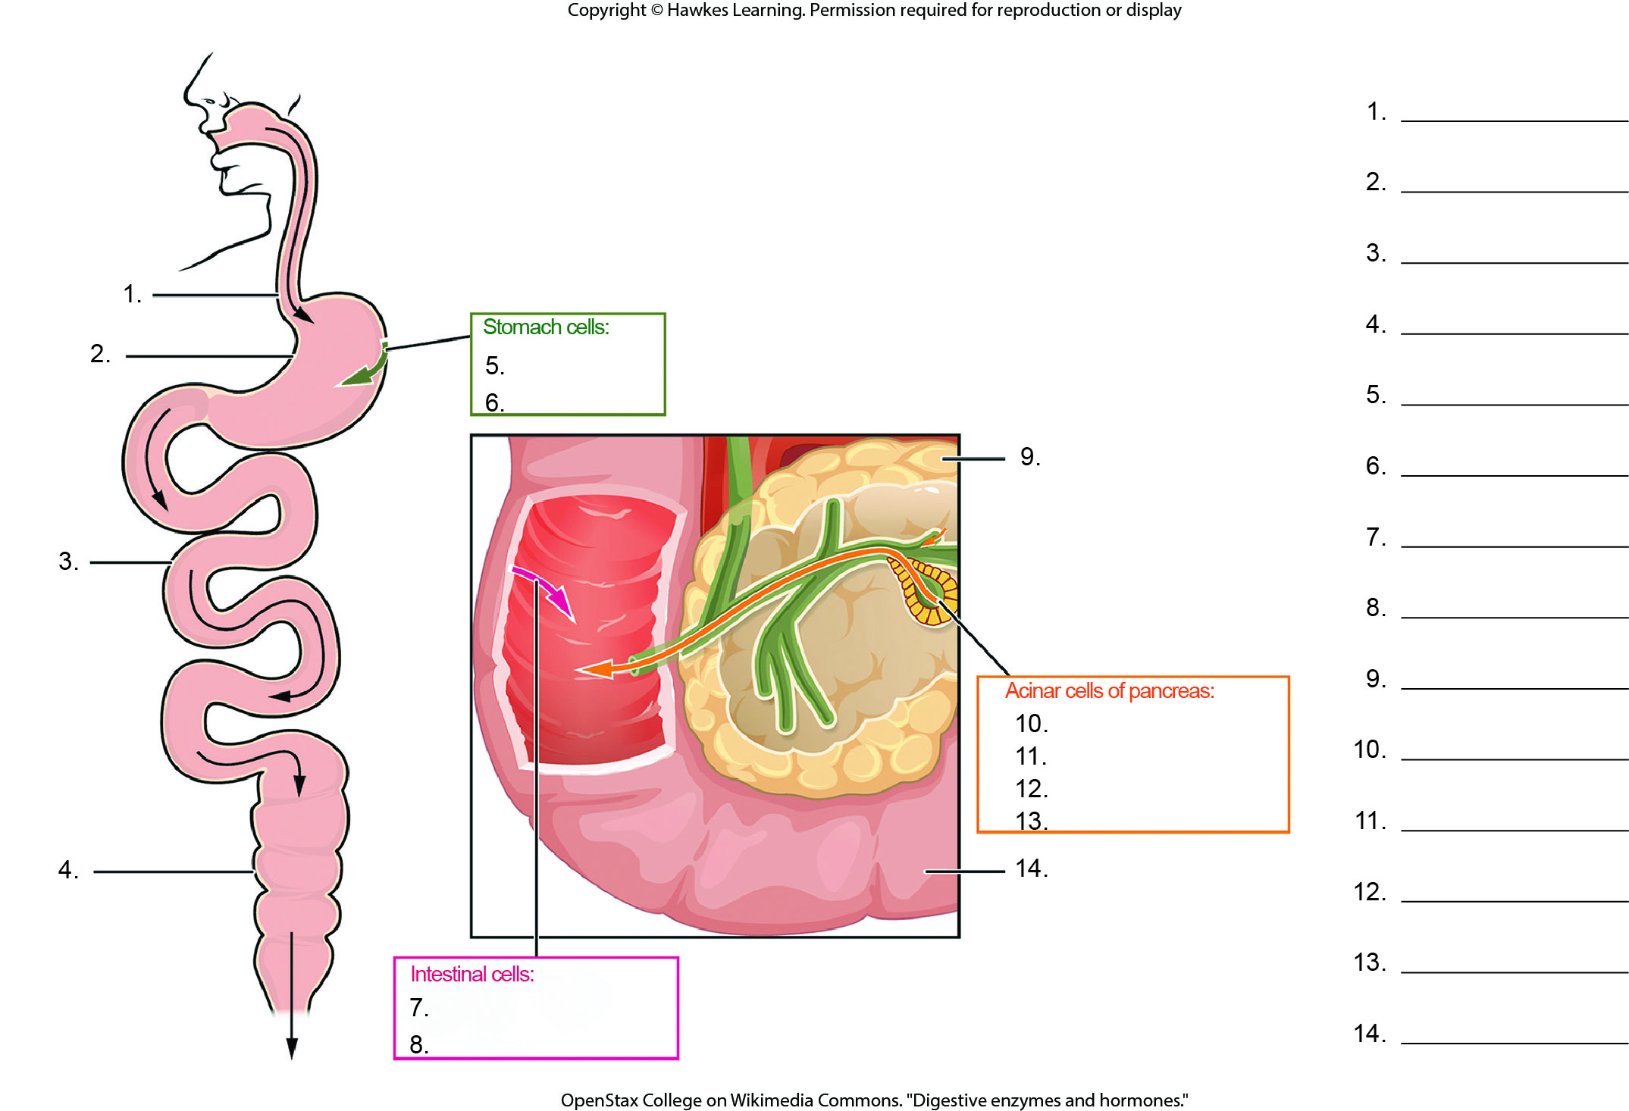
Lesson 34.3 Figure 8 - Numbered

Slide 35
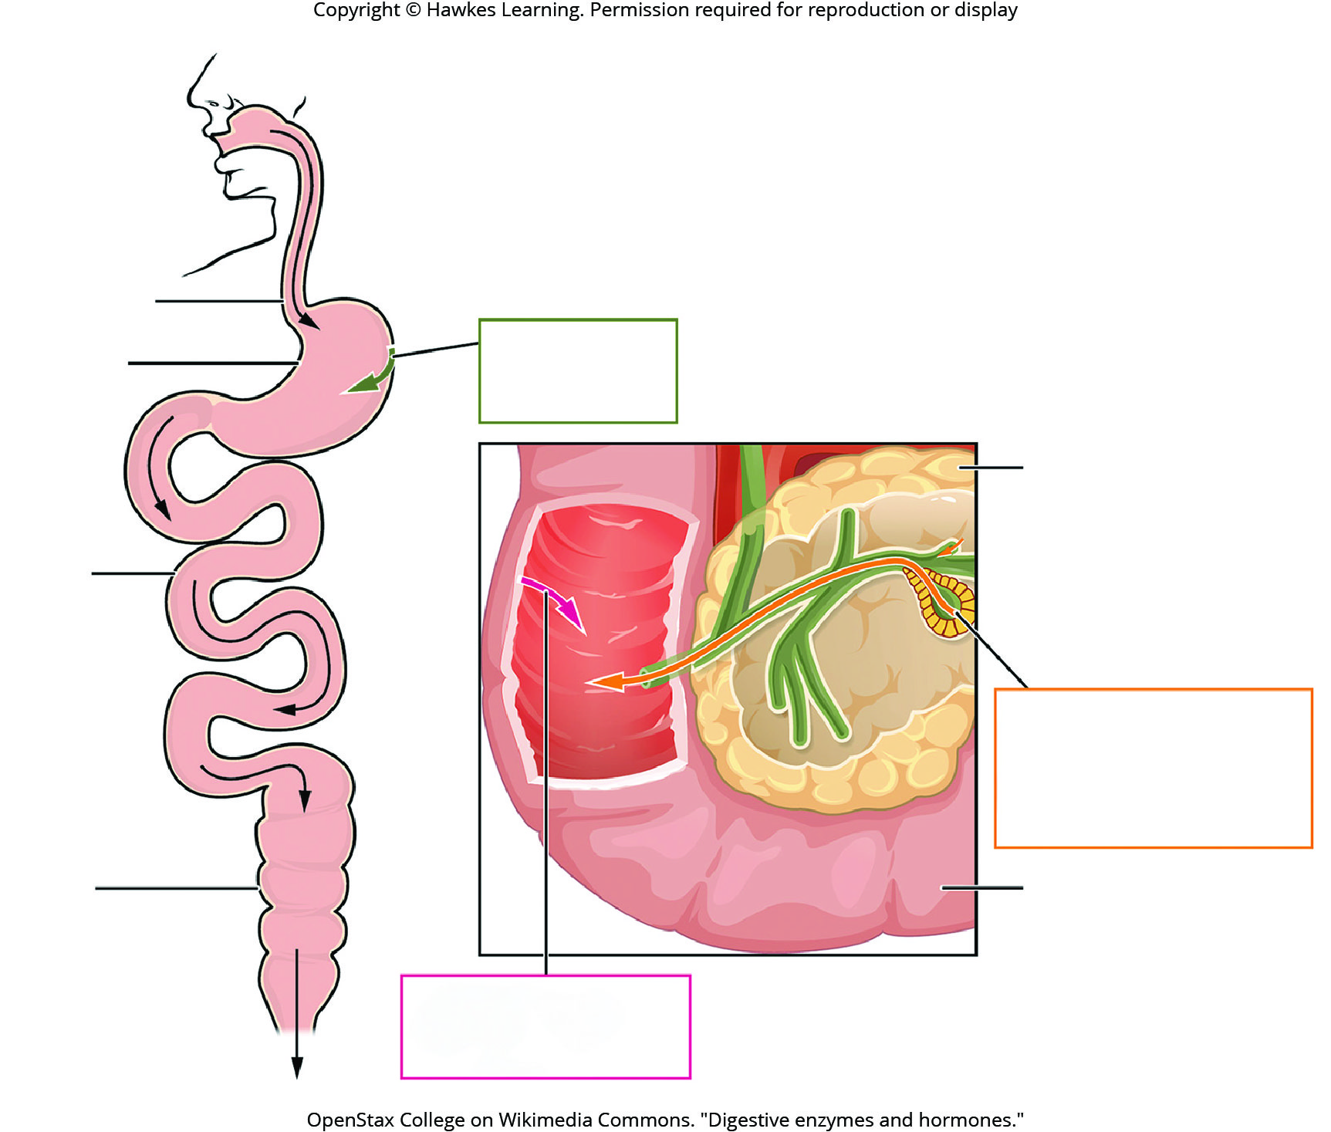
Lesson 34.3 Figure 8

Slide 36
Hawkes Learning – End of PowerPoint

