Slide 1
Chapter 36
The Respiratory System

Slide 2
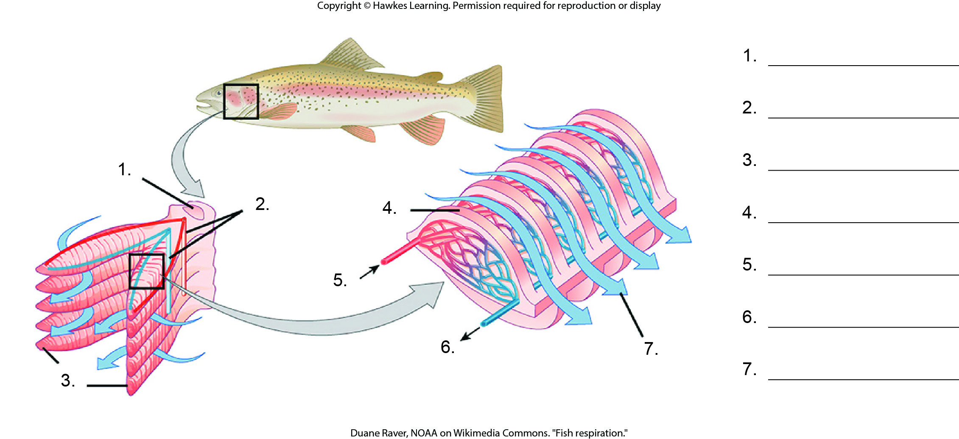
Lesson 36.1 Figure 5 - Numbered

Slide 3
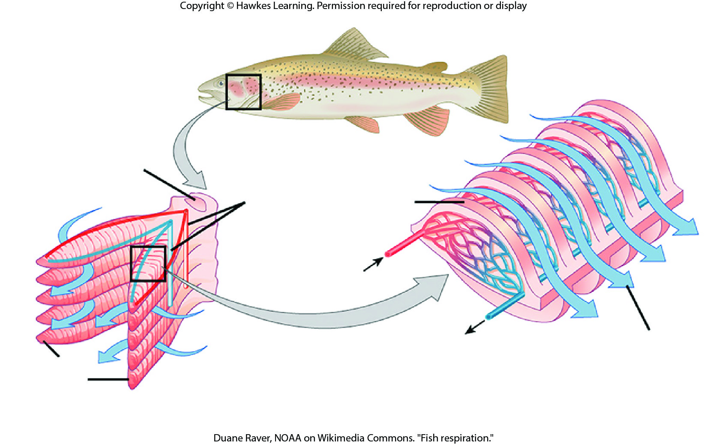
Lesson 36.1 Figure 5

Slide 4
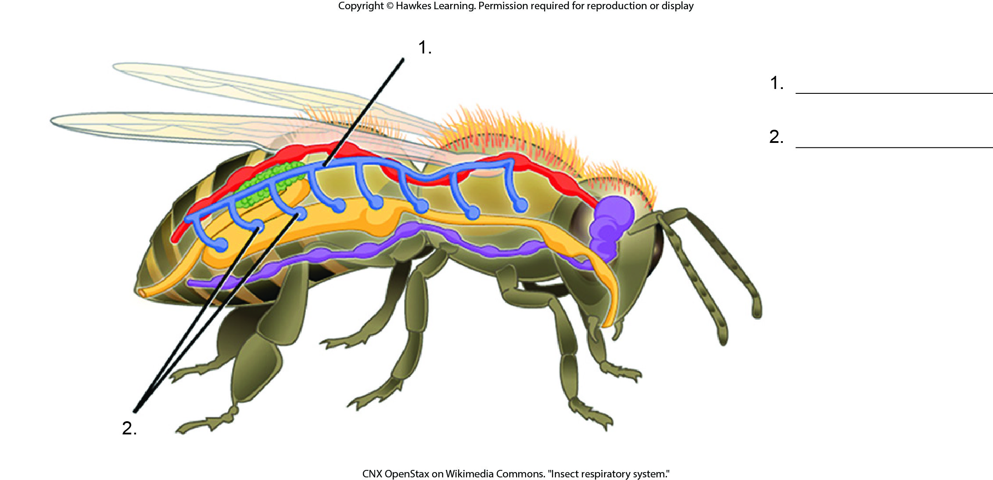
Lesson 36.1 Figure 7 - Numbered

Slide 5
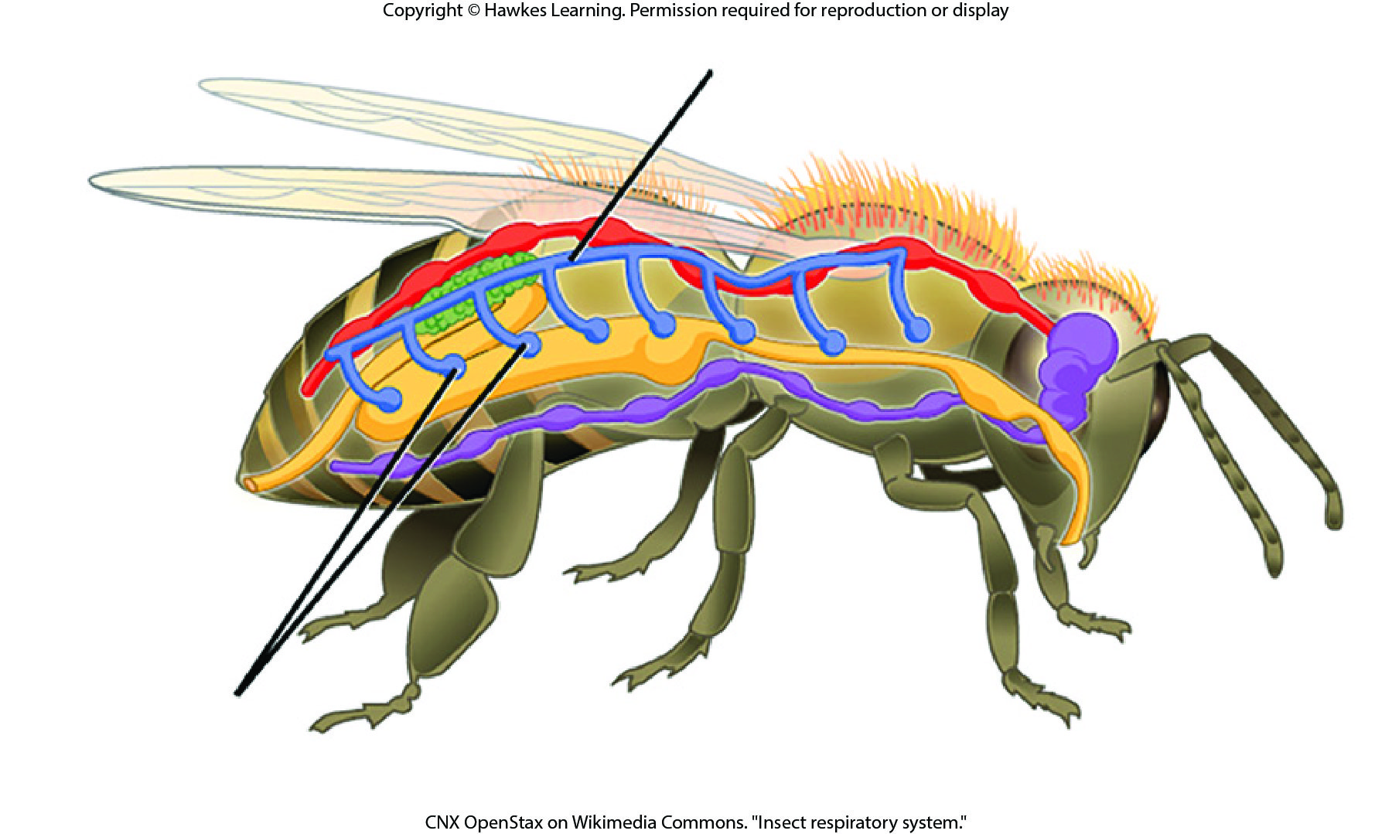
Lesson 36.1 Figure 7

Slide 6
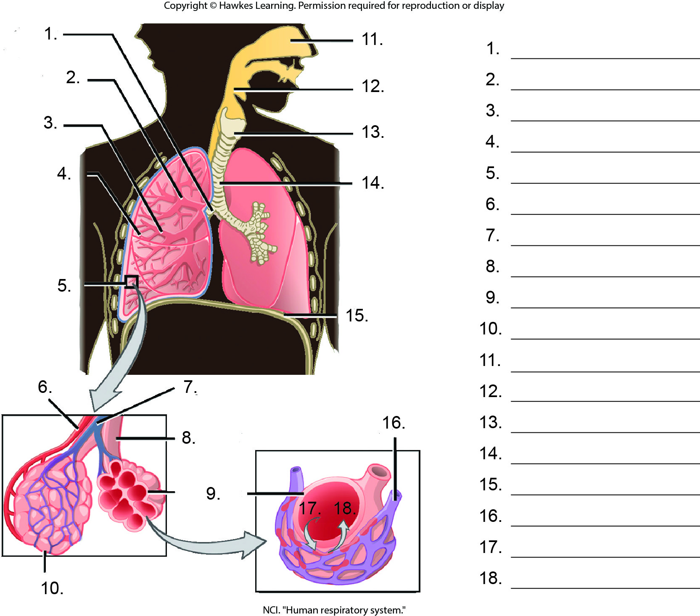
Lesson 36.1 Figure 8 - Numbered

Slide 7
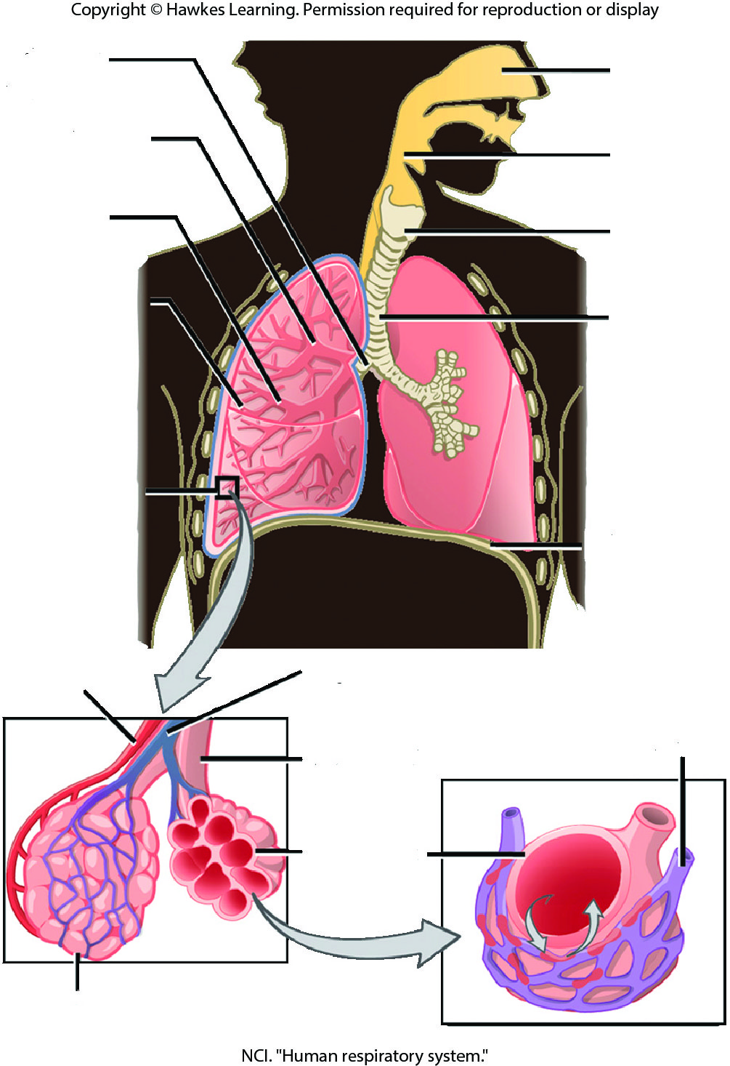
Lesson 36.1 Figure 8

Slide 8
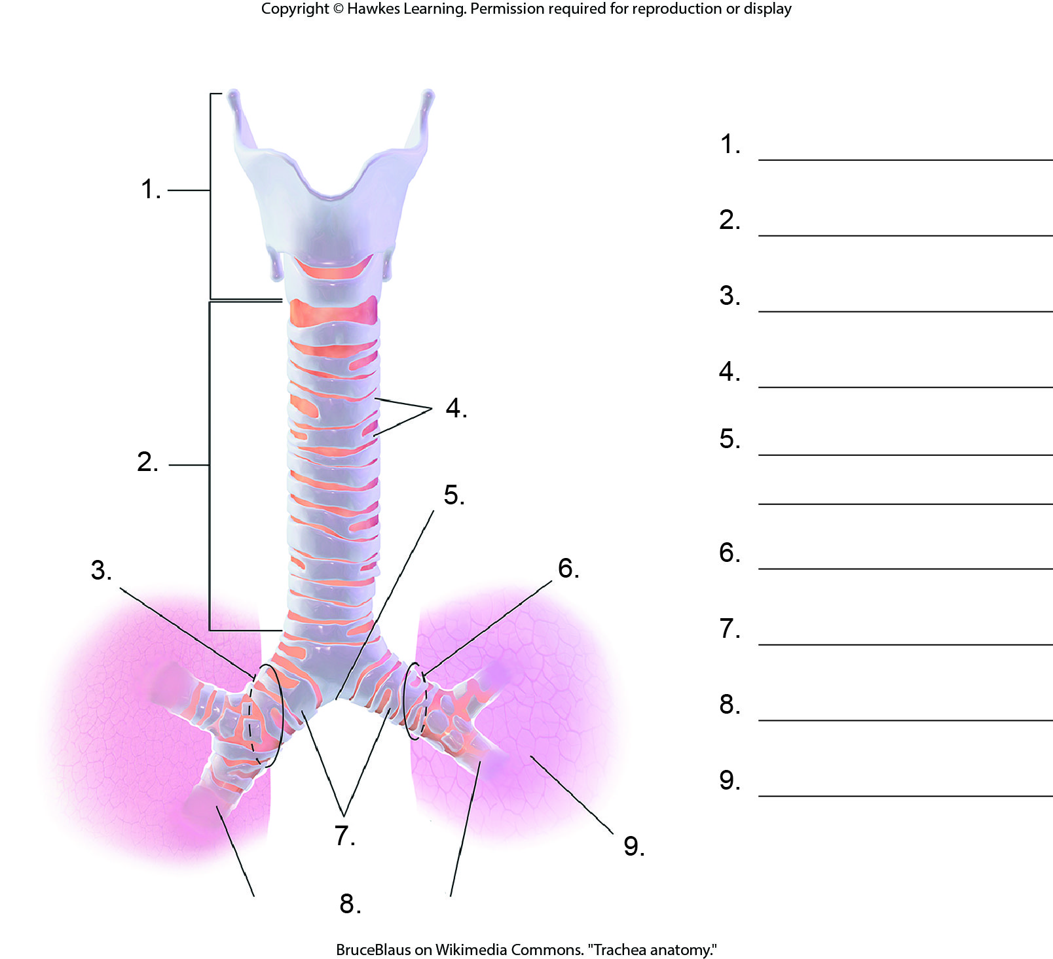
Lesson 36.1 Figure 9 - Numbered

Slide 9
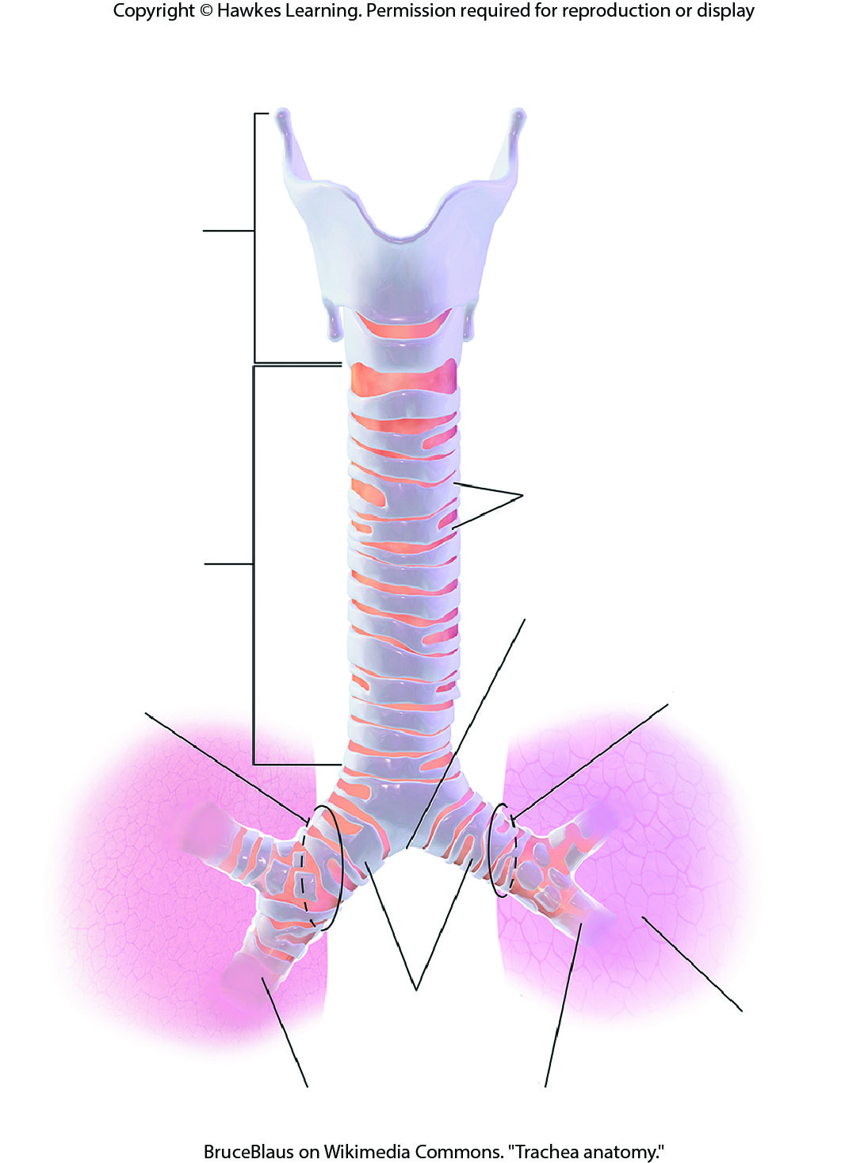
Lesson 36.1 Figure 9

Slide 10
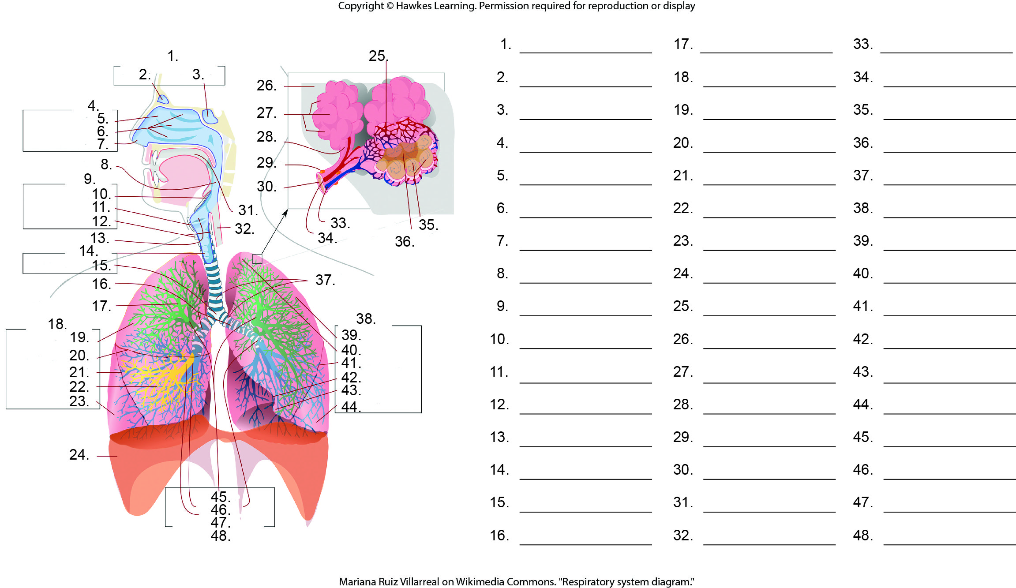
Lesson 36.1 Figure 10 - Numbered

Slide 11
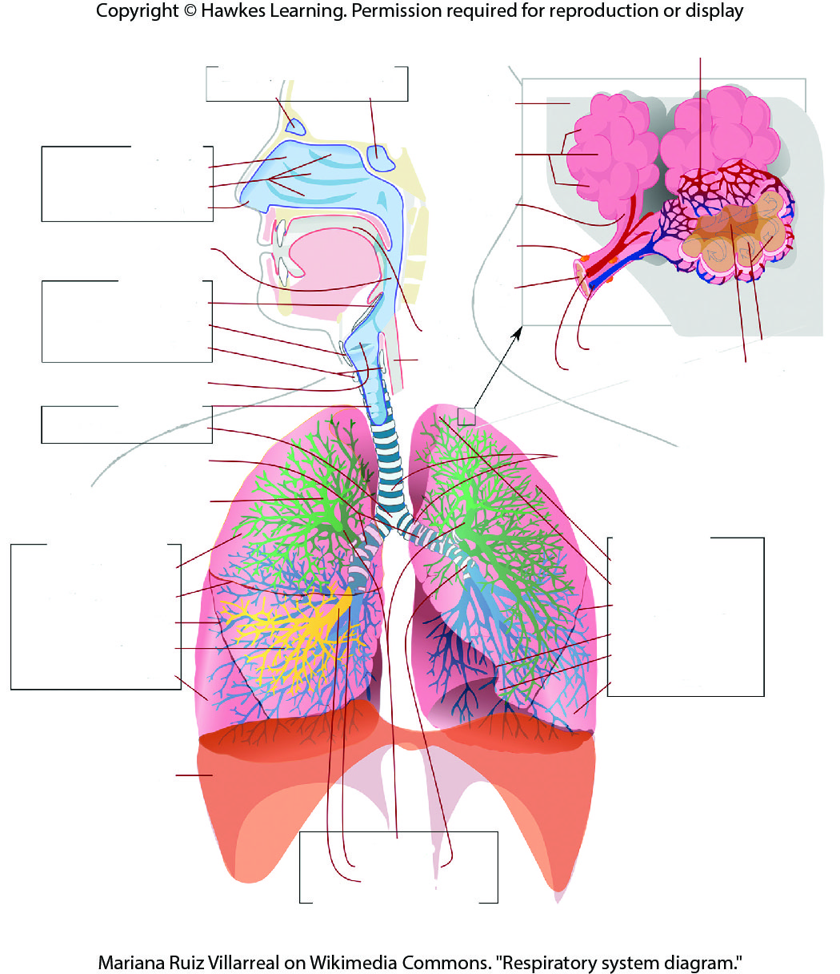
Lesson 36.1 Figure 10

Slide 12
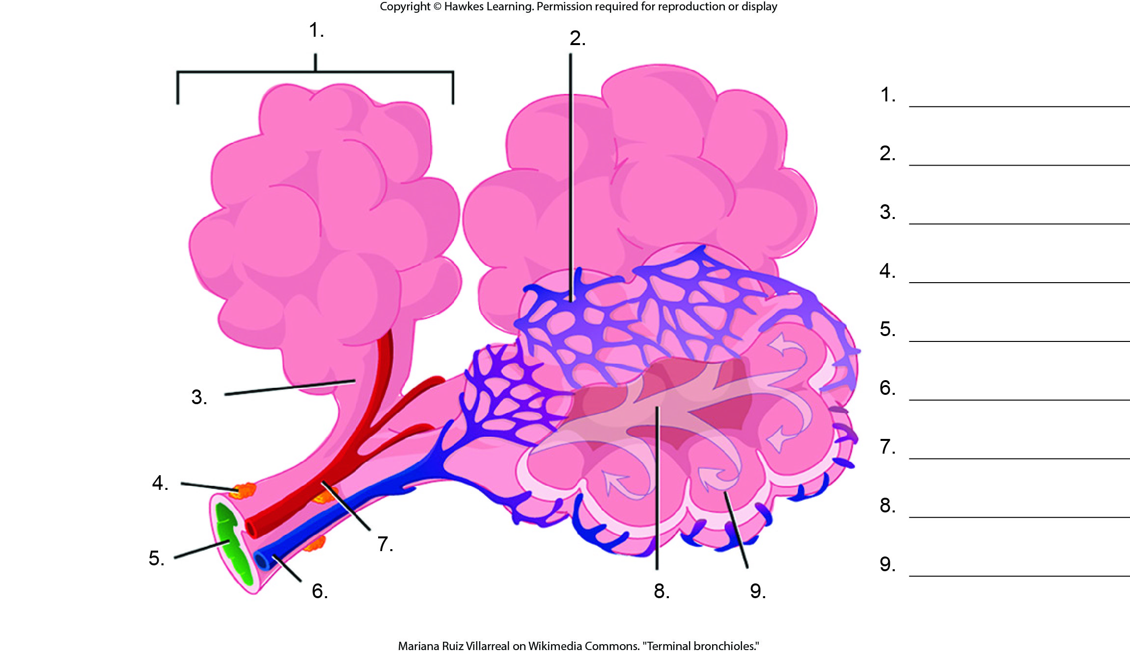
Lesson 36.1 Figure 12 - Numbered

Slide 13
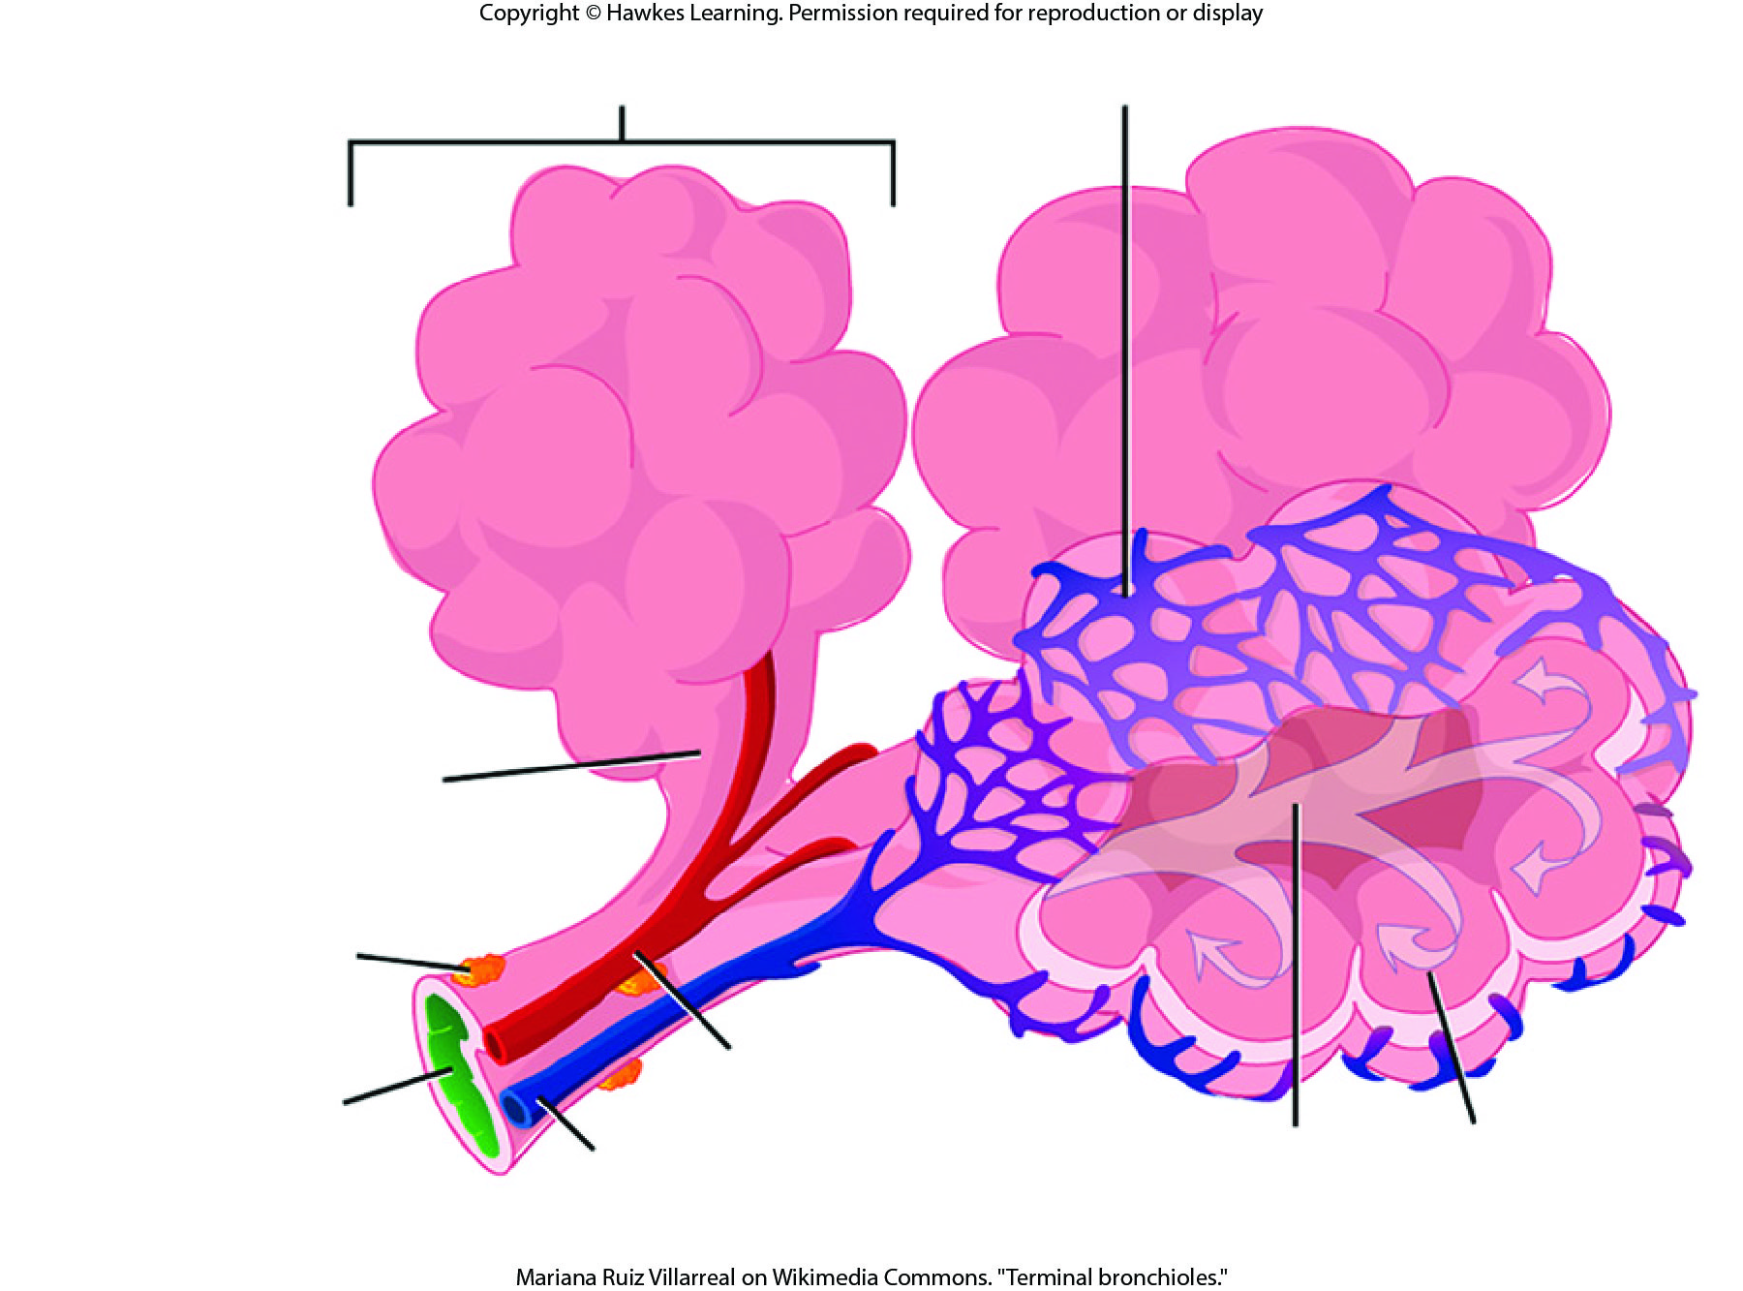
Lesson 36.1 Figure 12

Slide 14
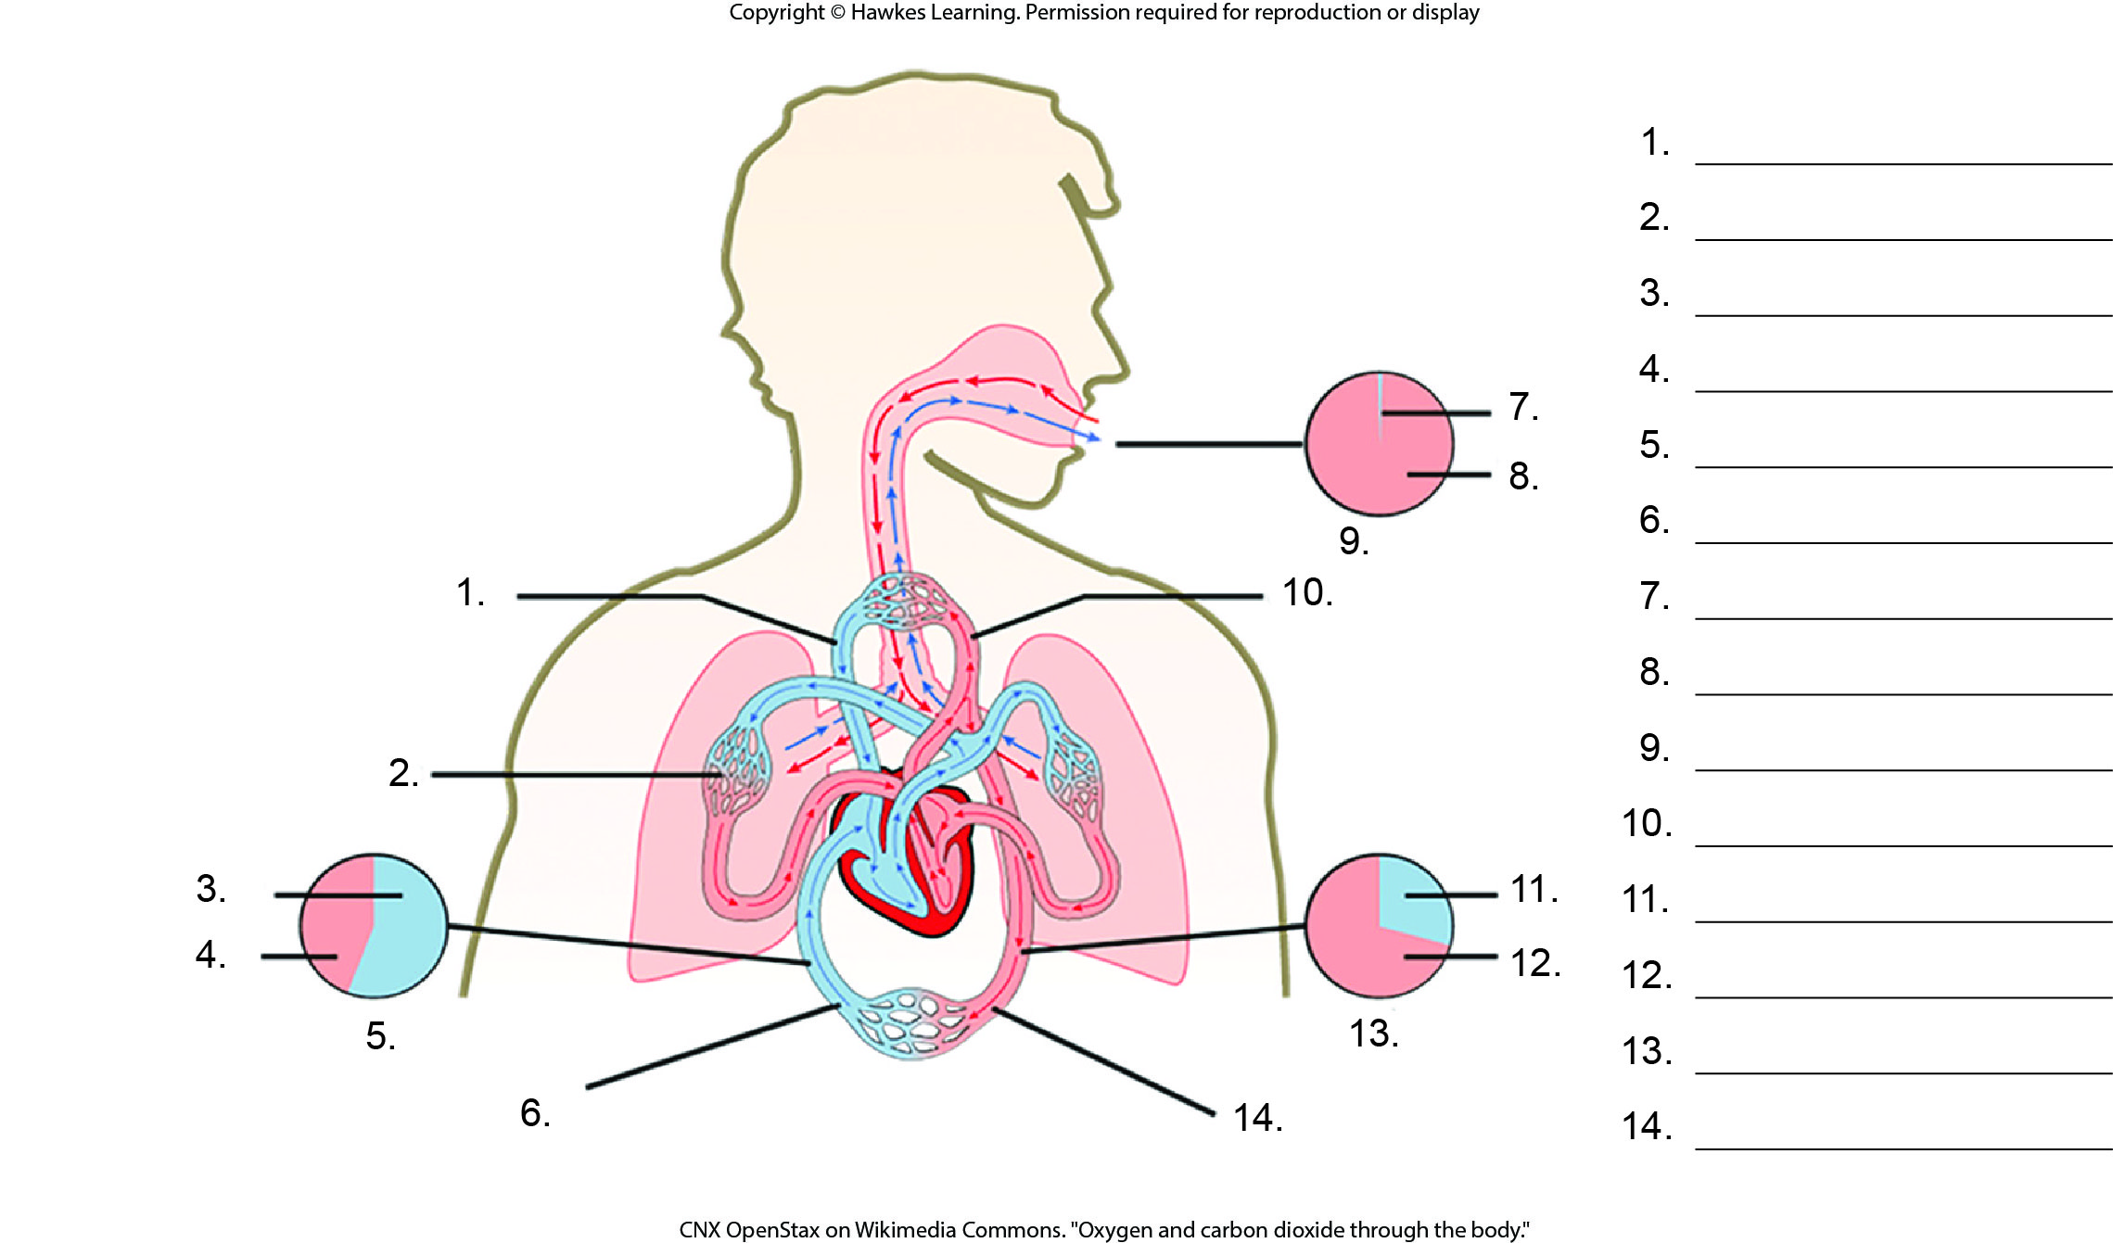
Lesson 36.2 Figure 5 - Numbered

Slide 15
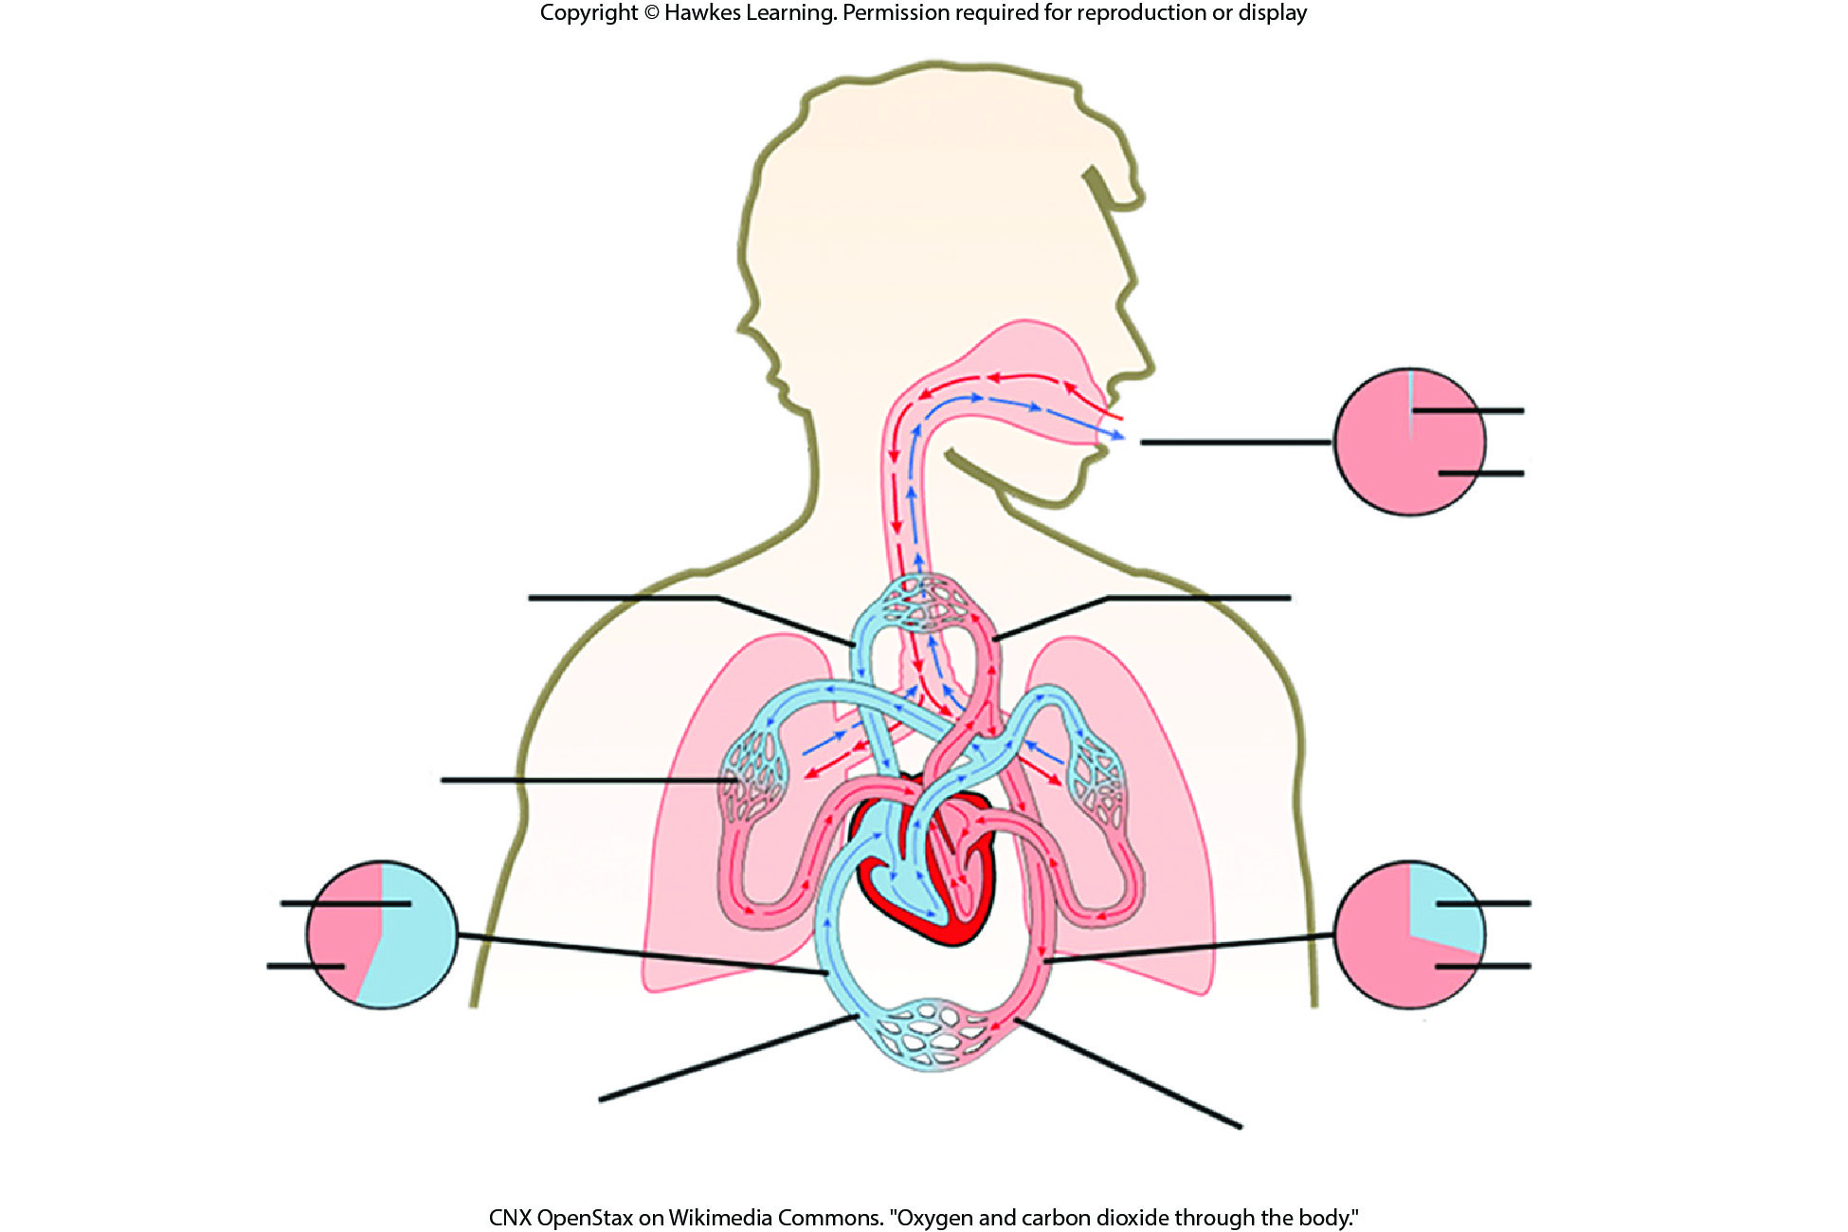
Lesson 36.2 Figure 5

Slide 16
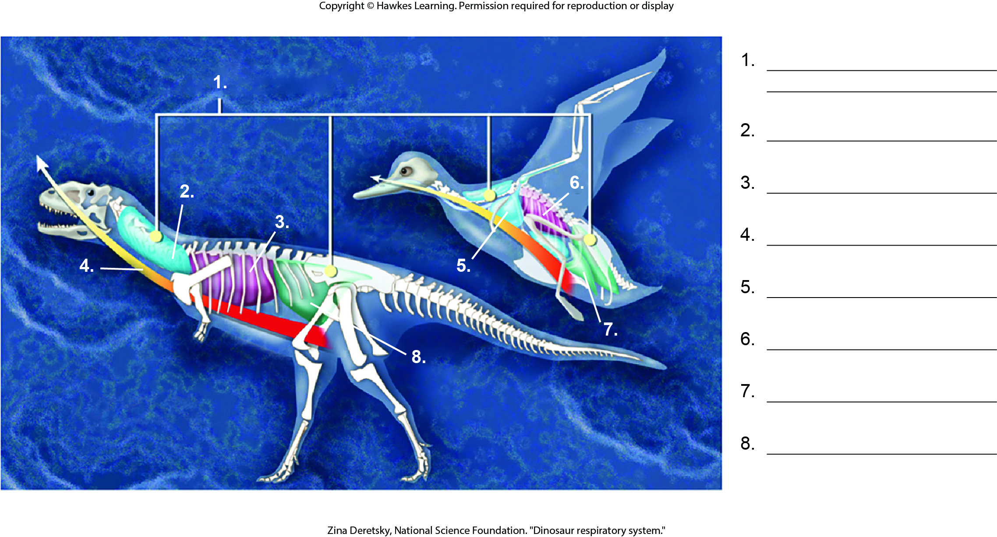
Lesson 36.3 Figure 3 - Numbered

Slide 17
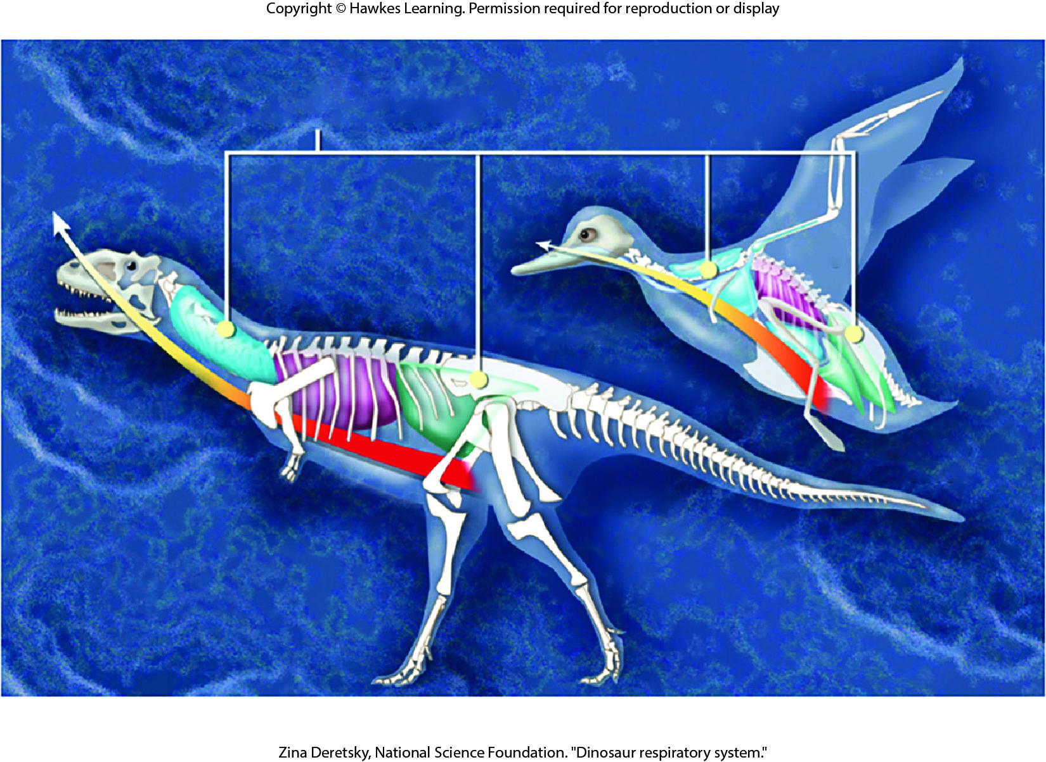
Lesson 36.3 Figure 3

Slide 18
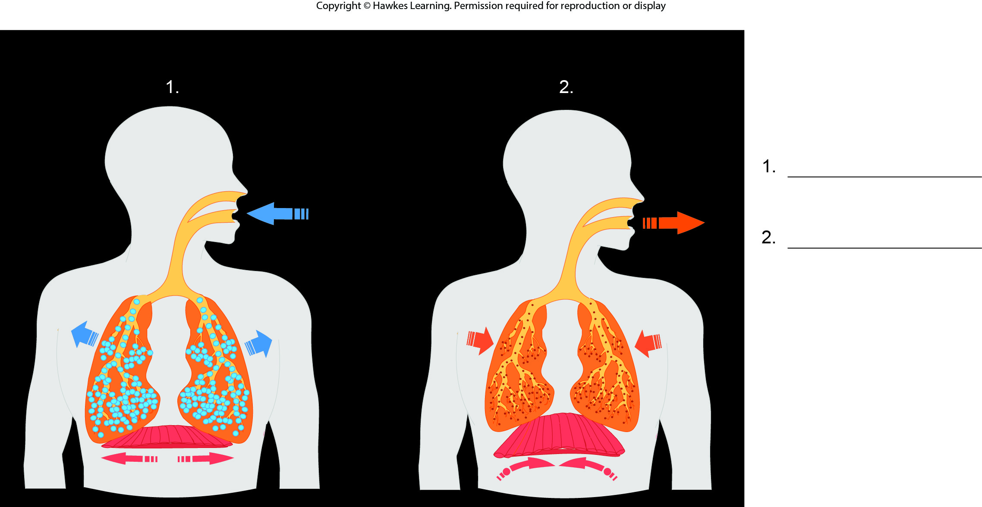
Lesson 36.3 Figure 5 - Numbered

Slide 19
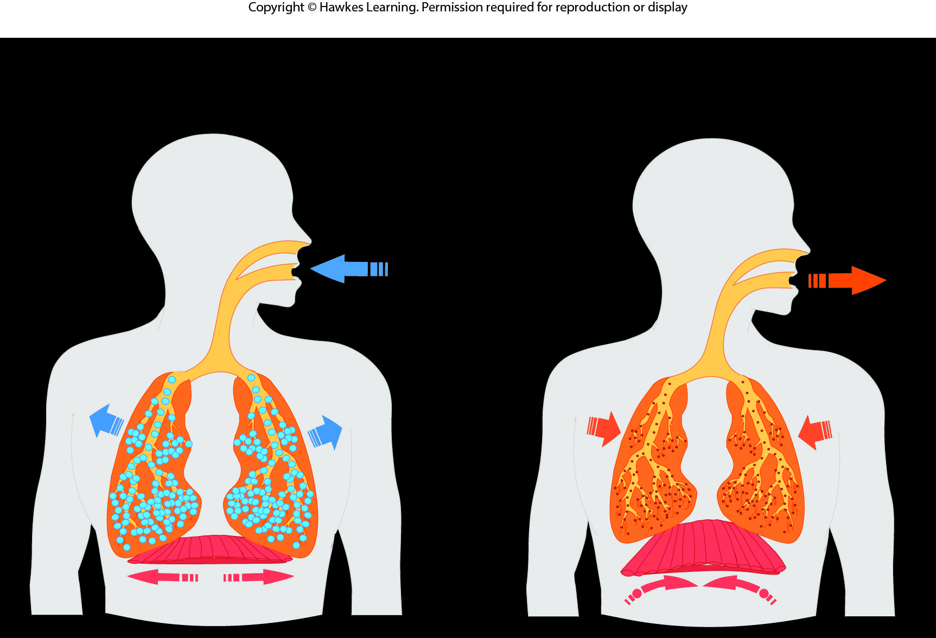
Lesson 36.3 Figure 5

Slide 20
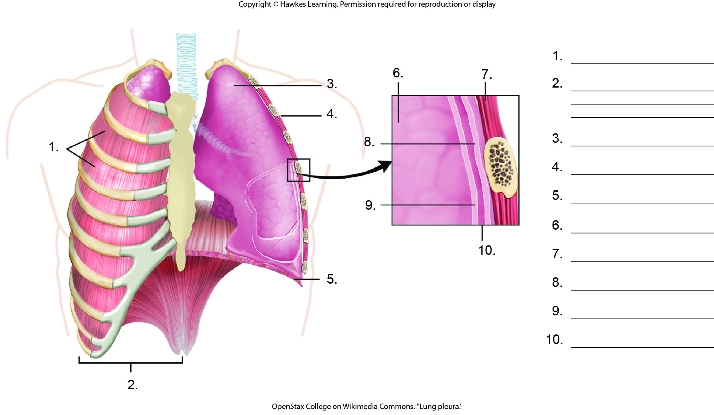
Lesson 36.3 Figure 6 - Numbered

Slide 21
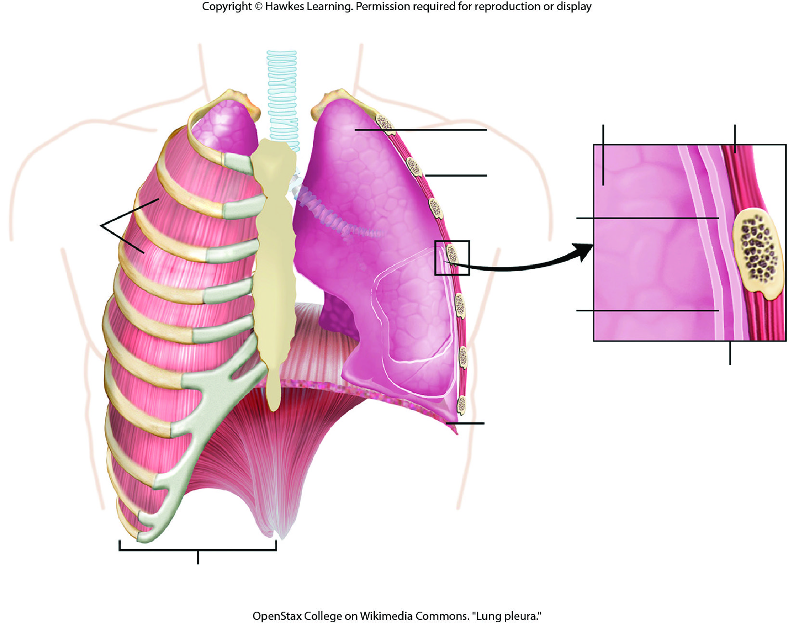
Lesson 36.3 Figure 6

Slide 22
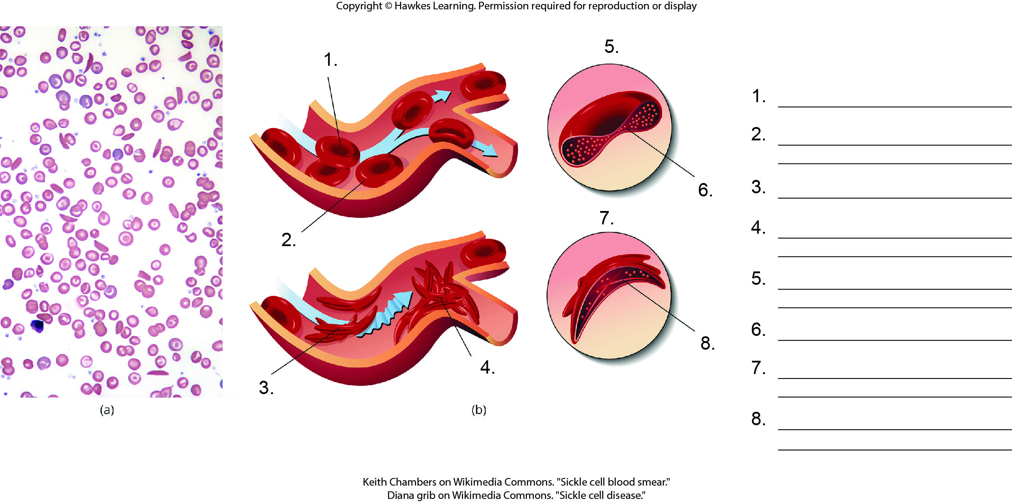
Lesson 36.4 Figure 4 - Numbered

Slide 23
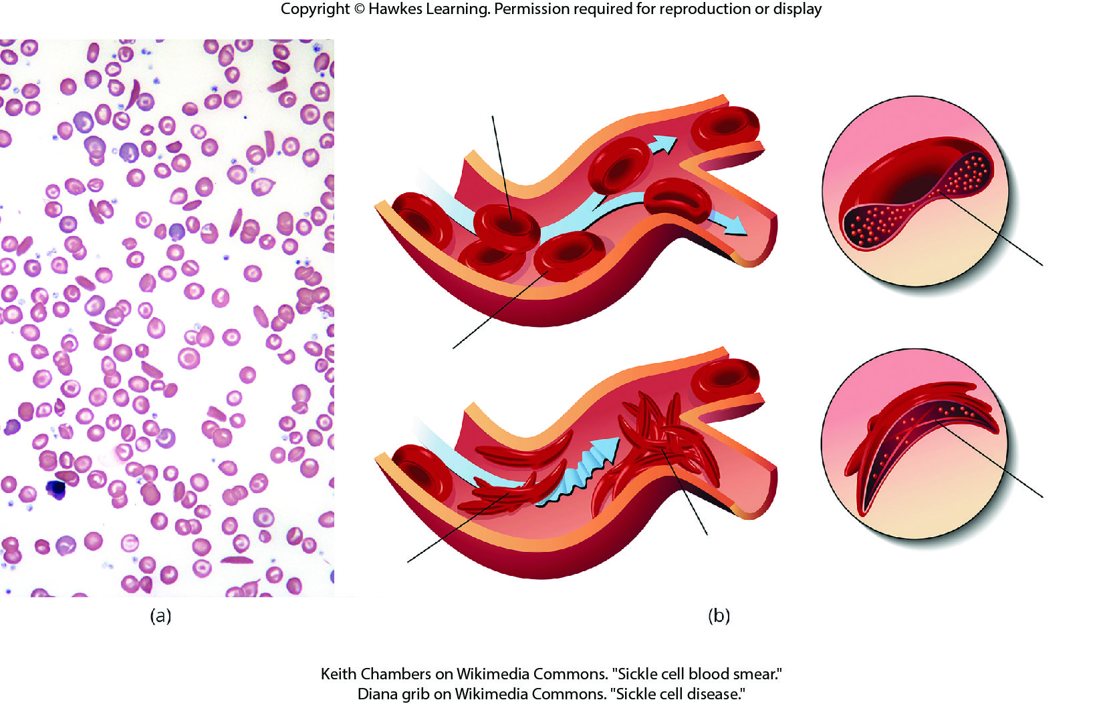
Lesson 36.4 Figure 4

Slide 24
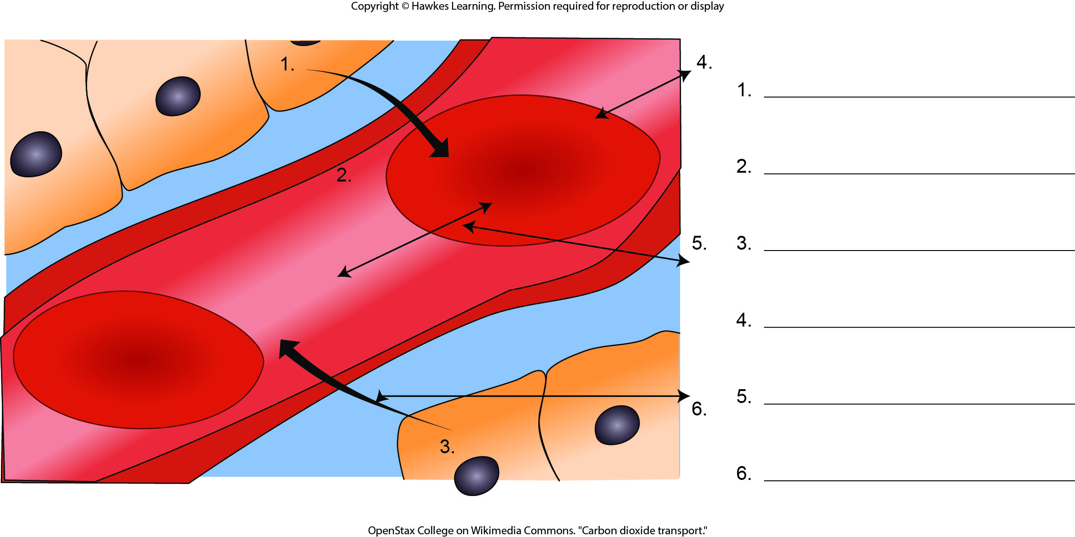
Lesson 36.4 Figure 5 - Numbered

Slide 25
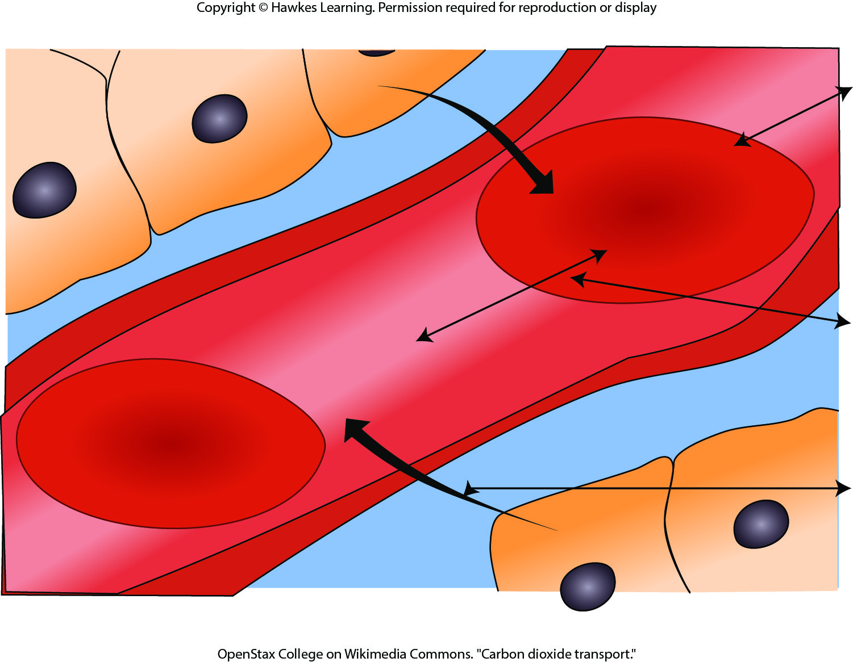
Lesson 36.4 Figure 5

Slide 26
Hawkes Learning – End of PowerPoint

