Slide 1
Chapter 37
The Immune System

Slide 2
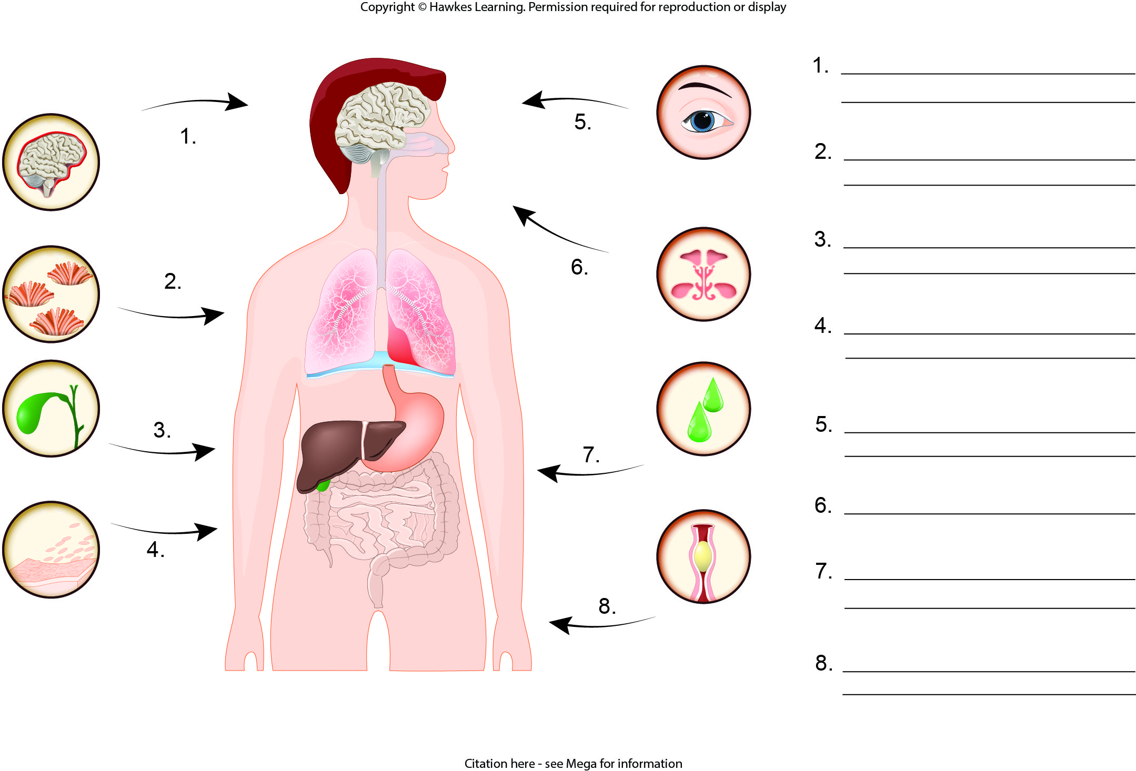
Lesson 37.1 Figure 2 - Numbered

Slide 3
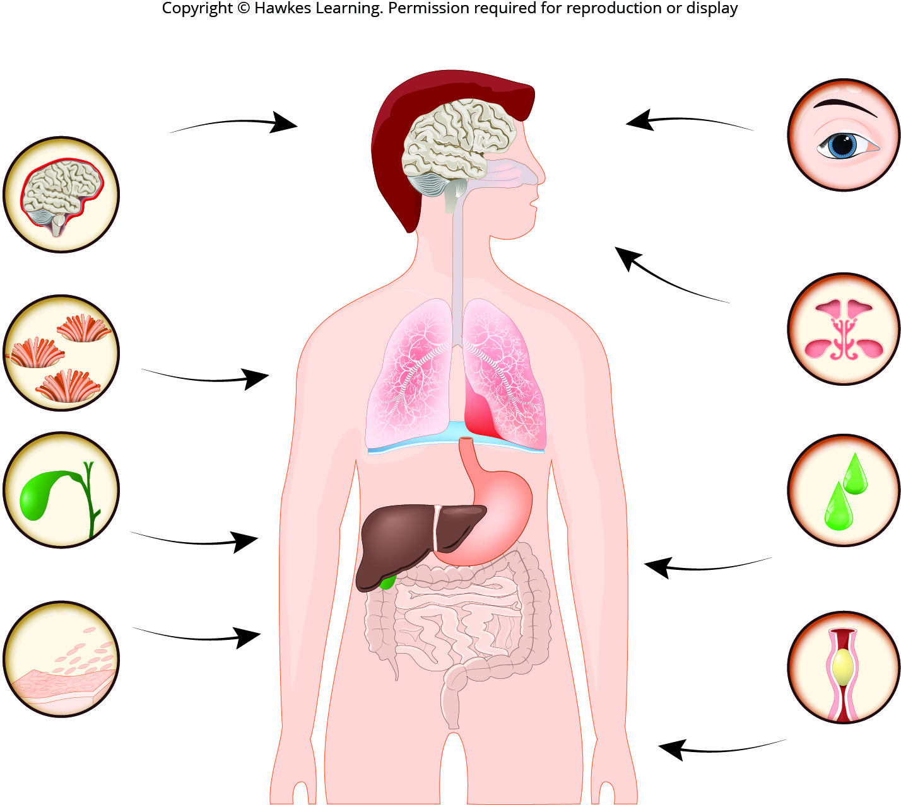
Lesson 37.1 Figure 2

Slide 4
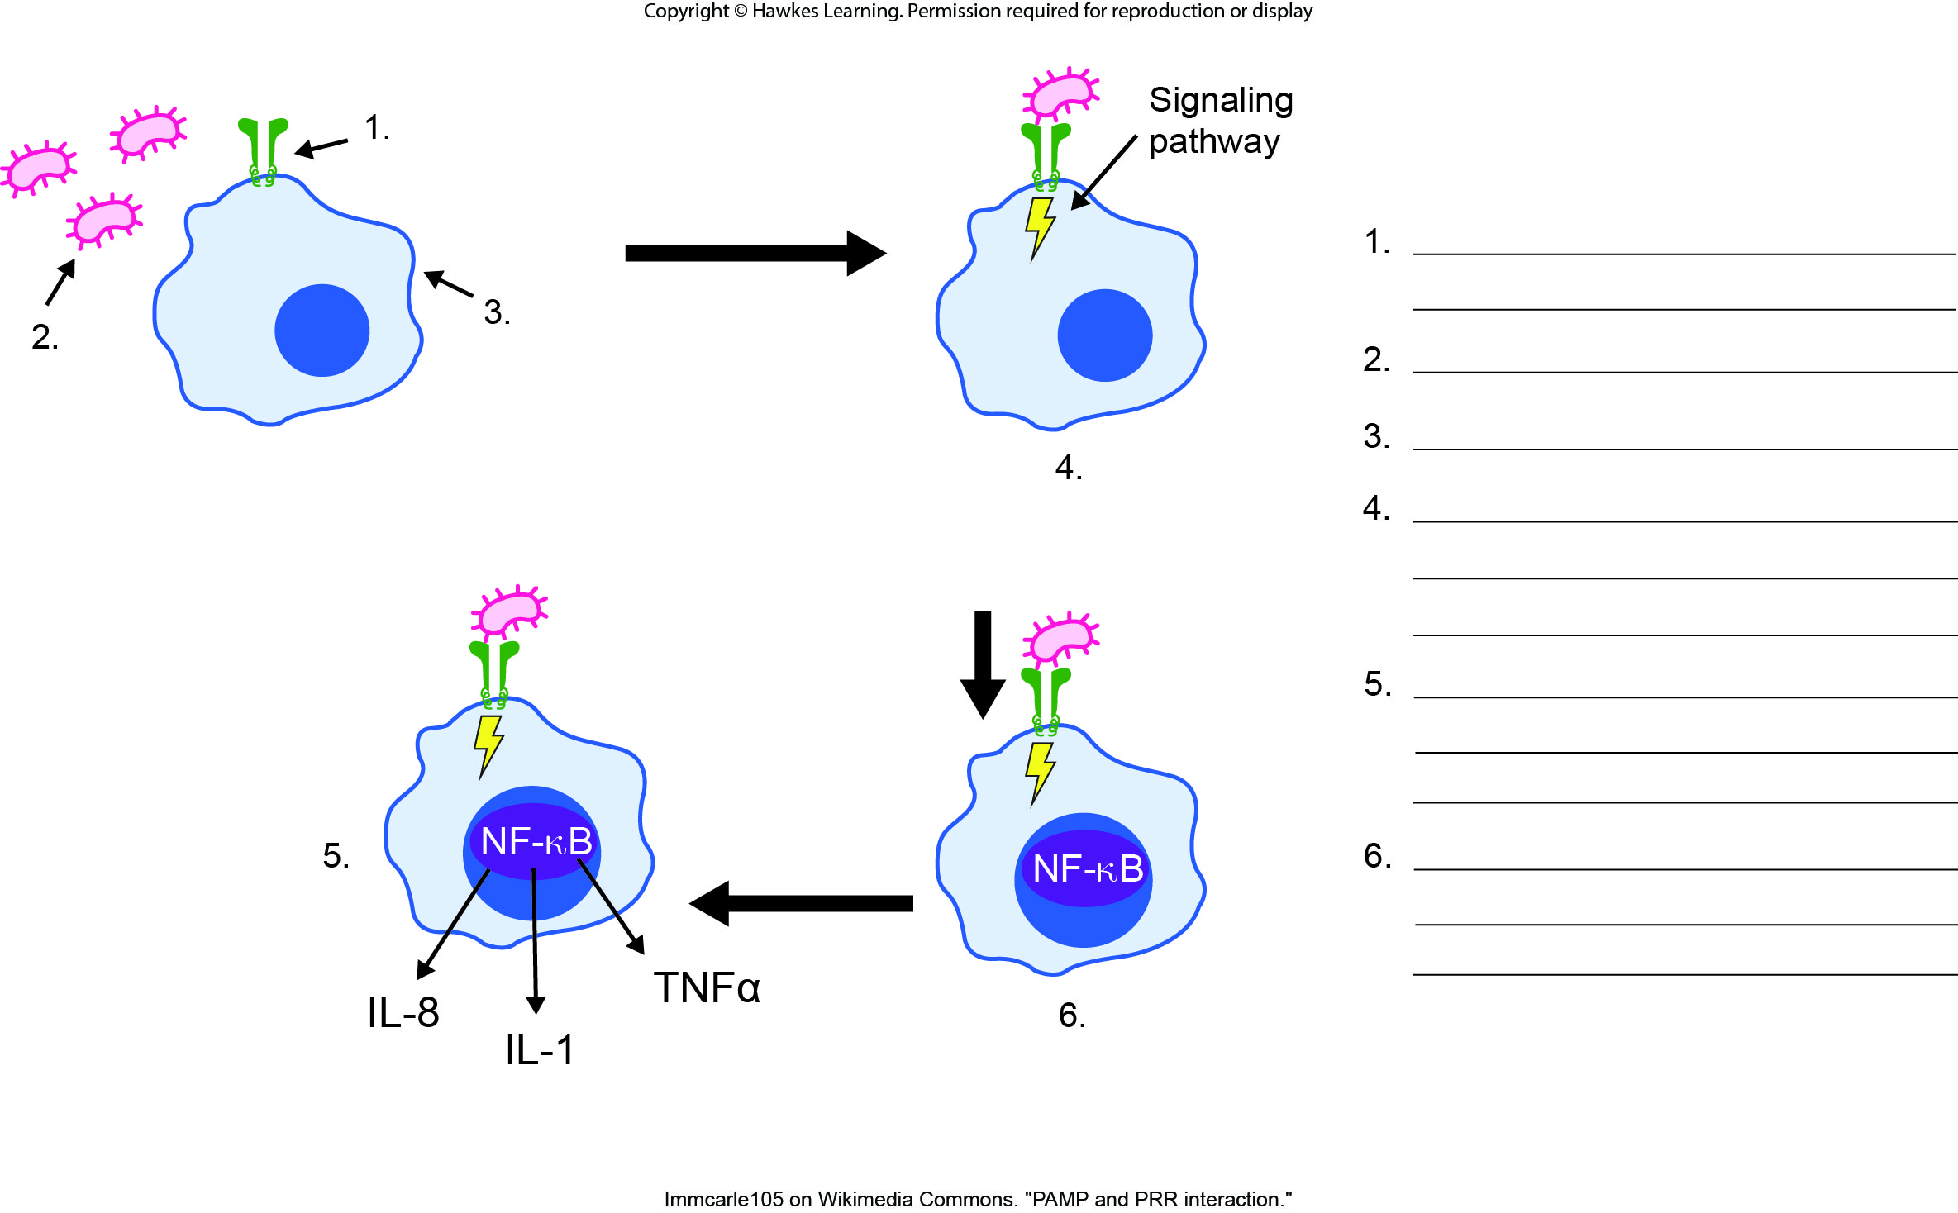
Lesson 37.1 Figure 5 - Numbered

Slide 5
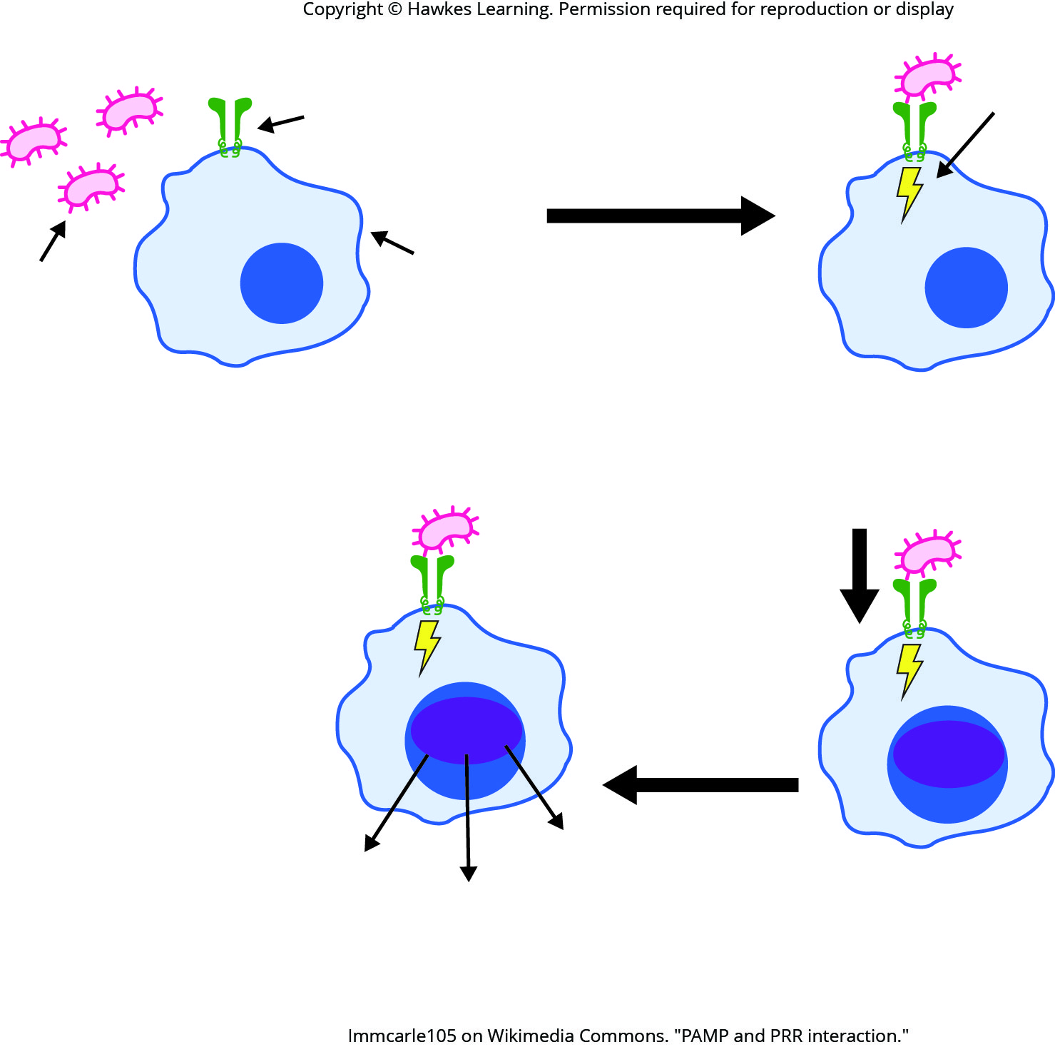
Lesson 37.1 Figure 5

Slide 6
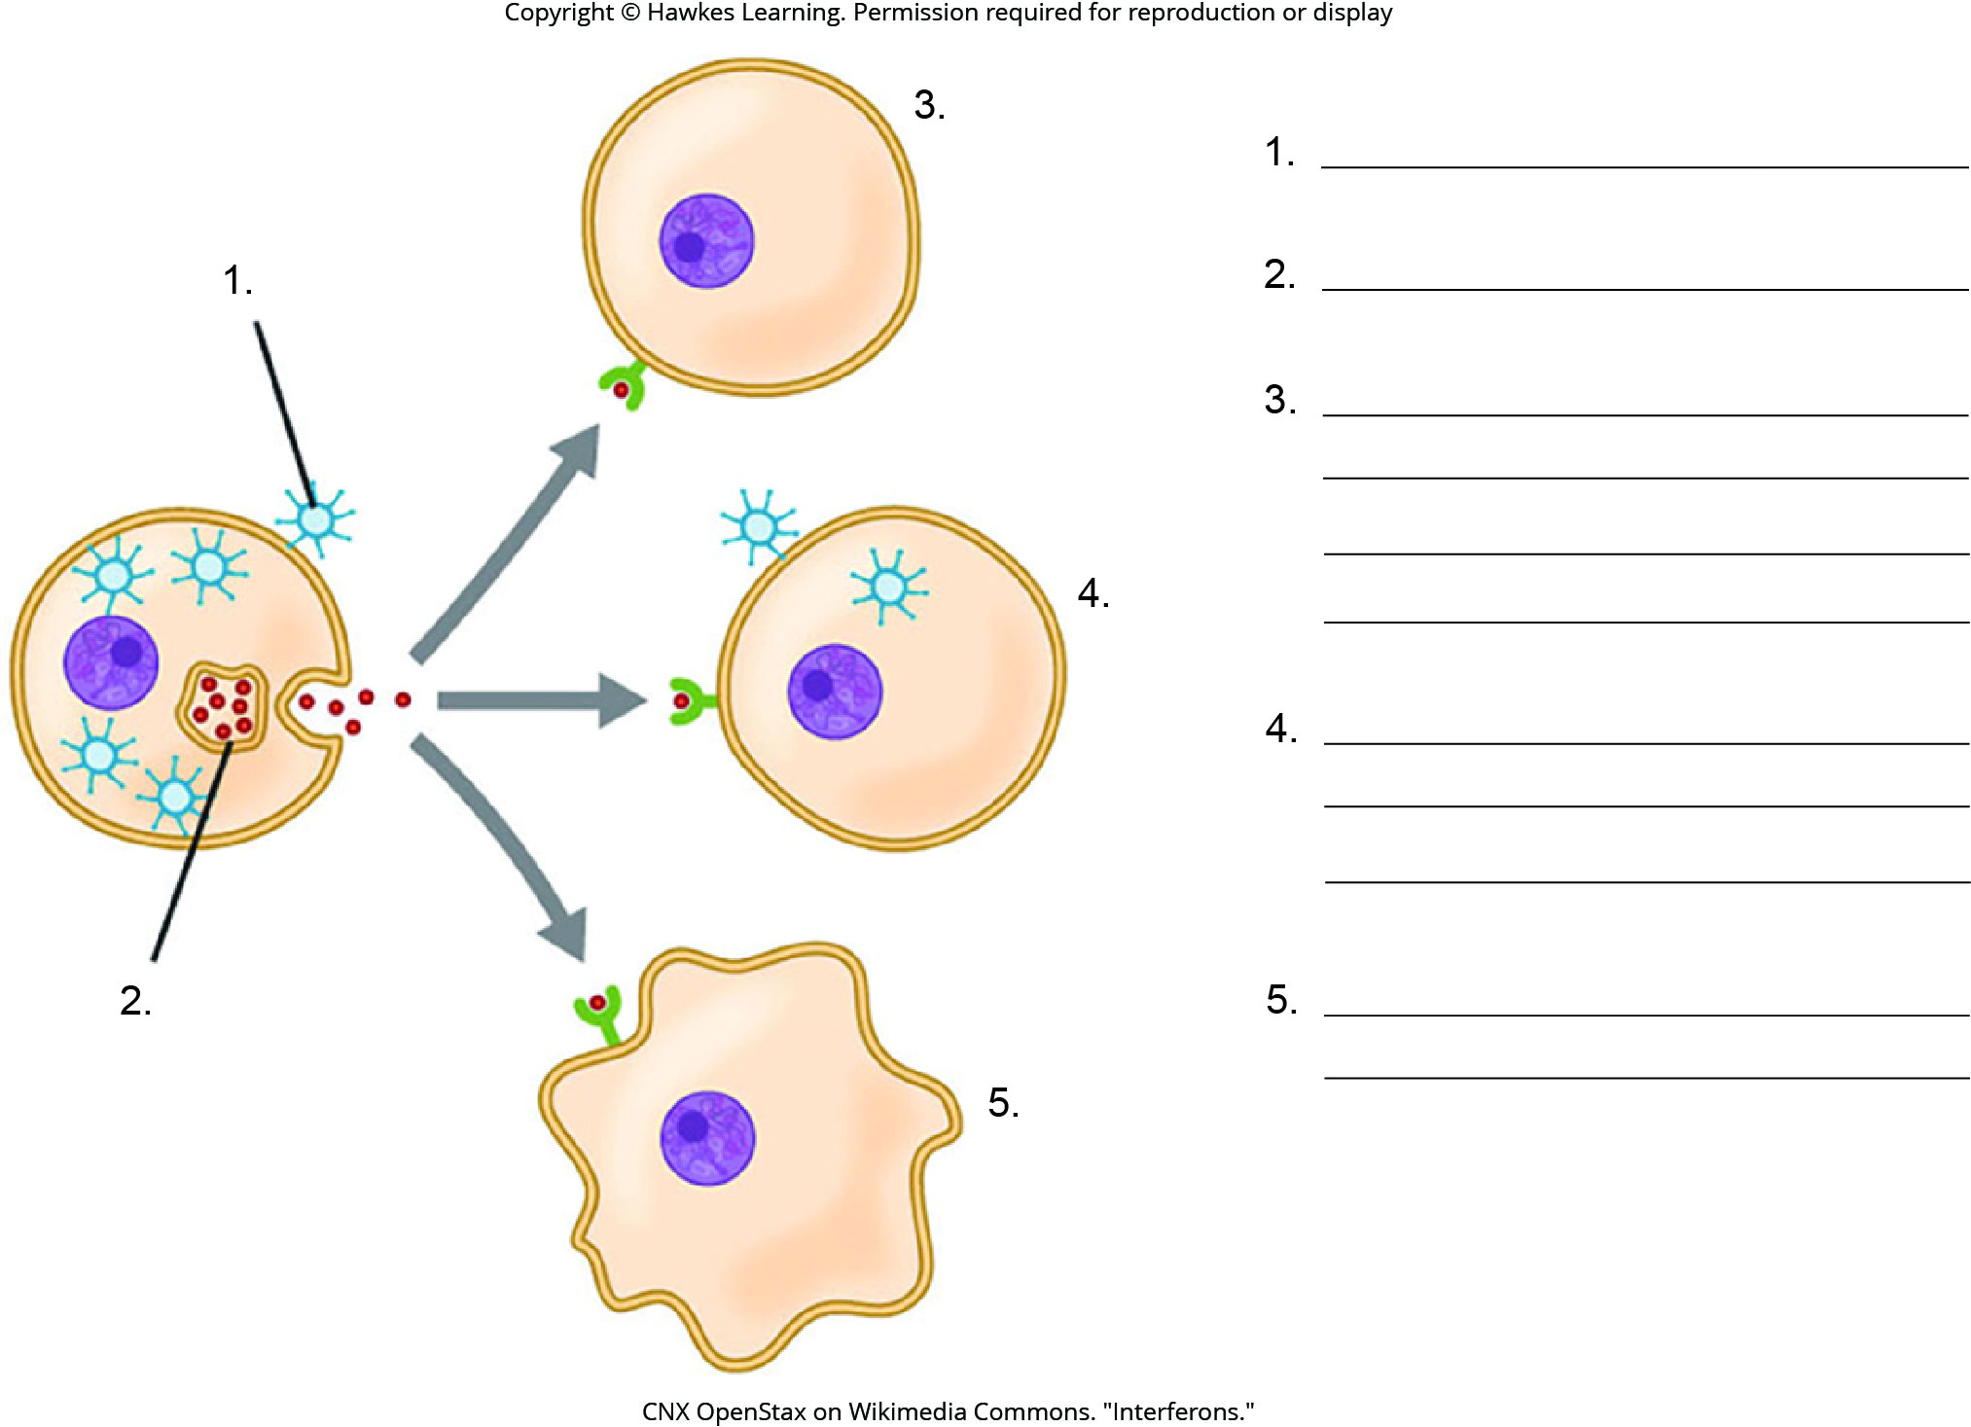
Lesson 37.1 Figure 6 - Numbered

Slide 7
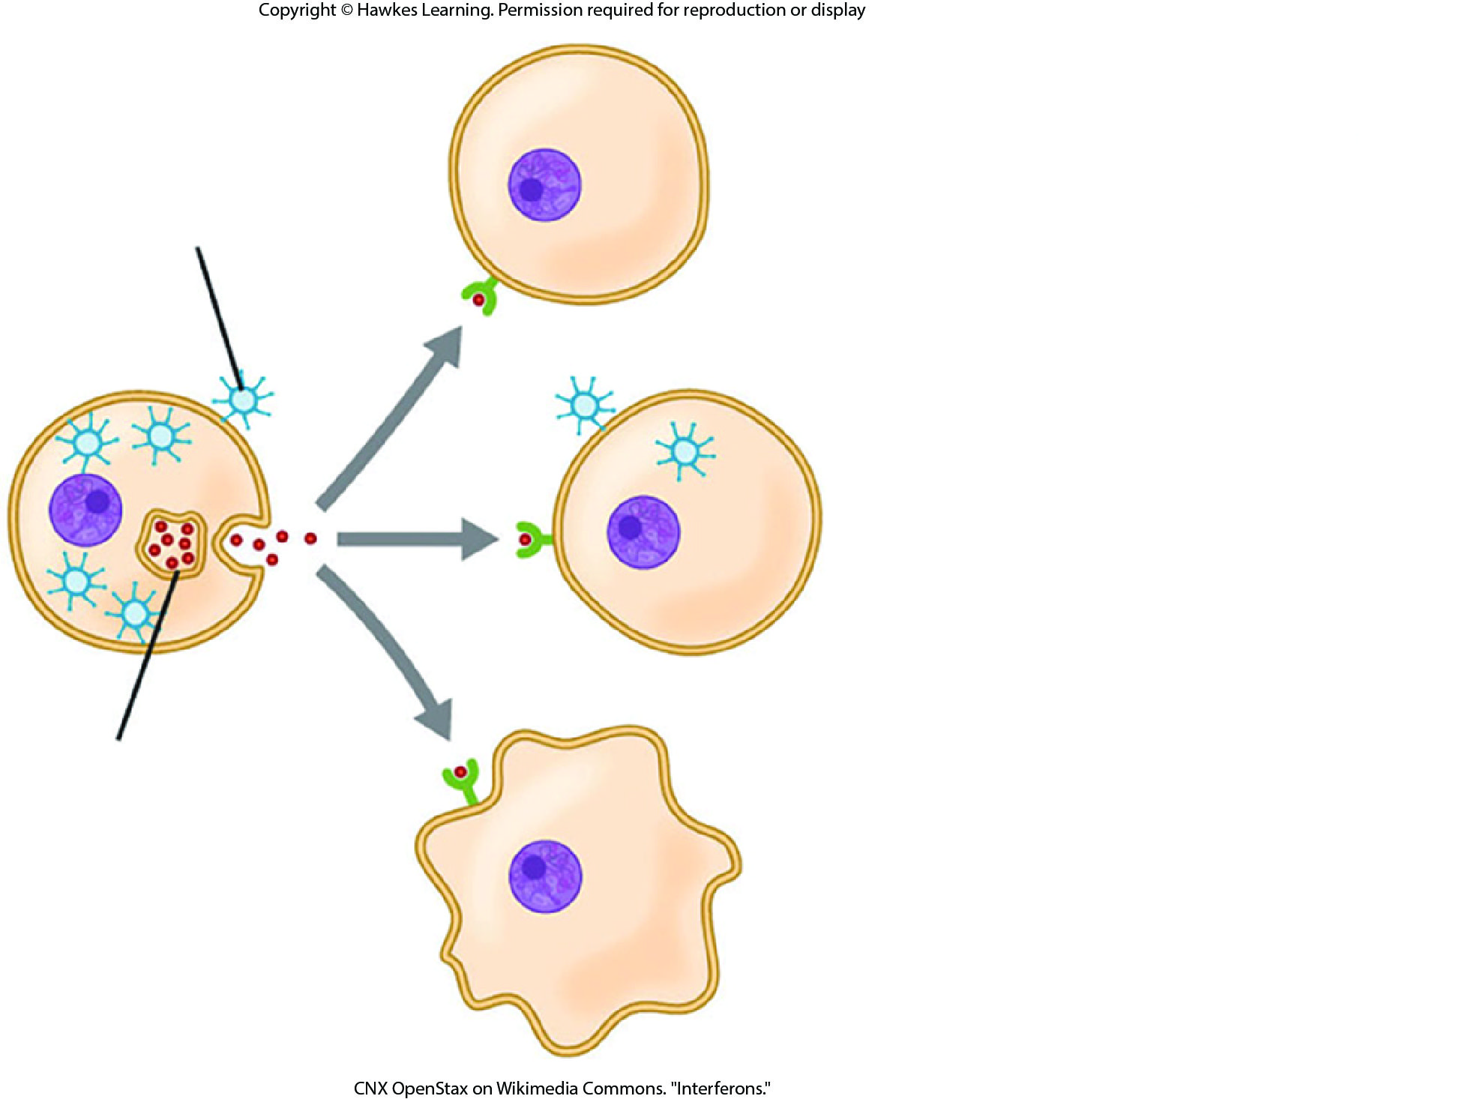
Lesson 37.1 Figure 6

Slide 8
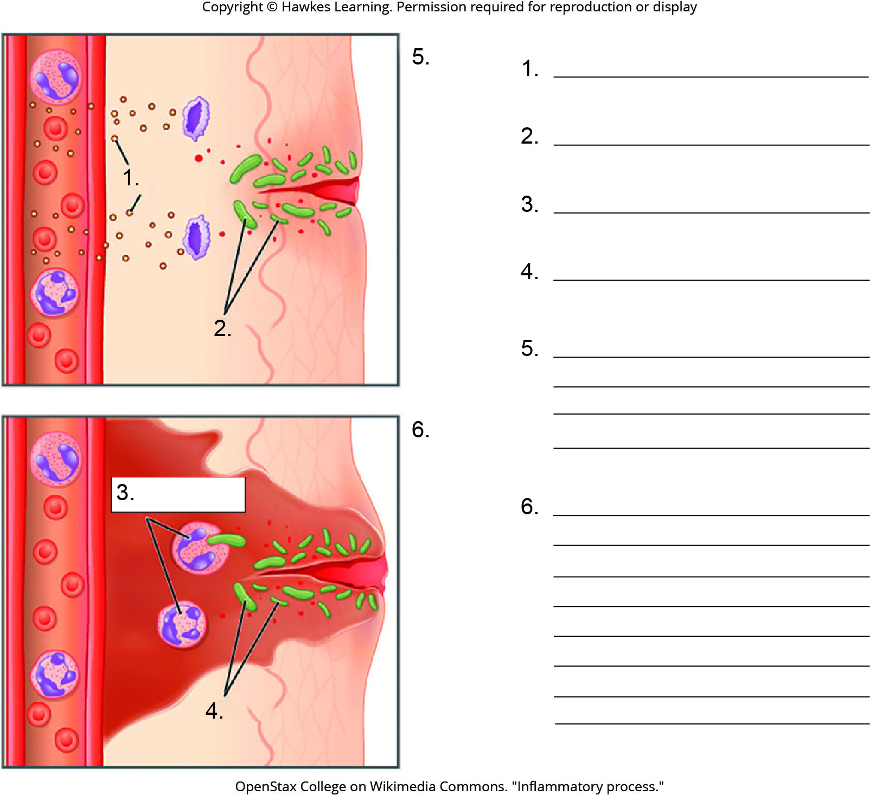
Lesson 37.1 Figure 7 - Numbered

Slide 9
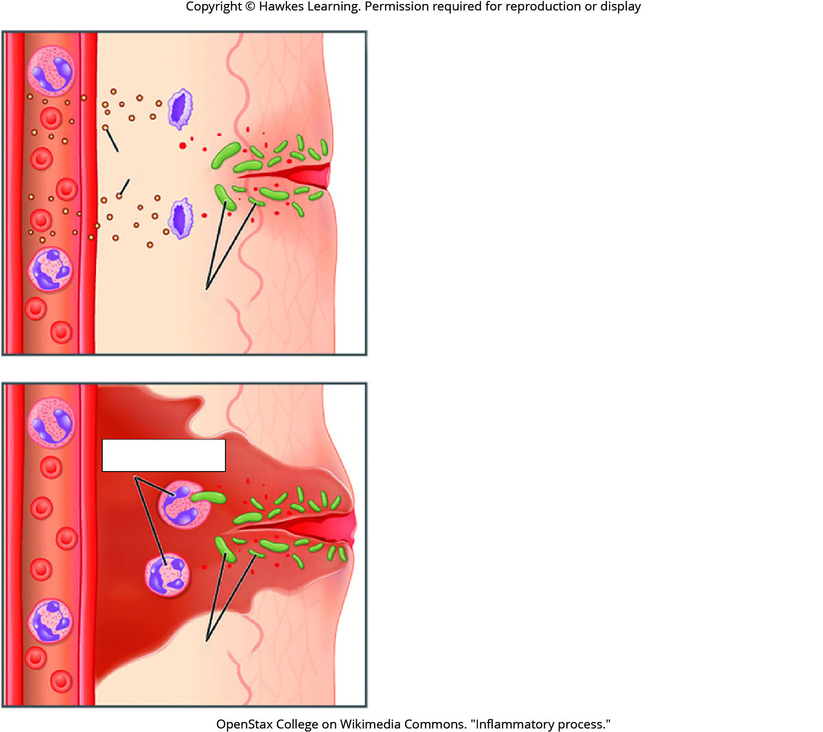
Lesson 37.1 Figure 7

Slide 10
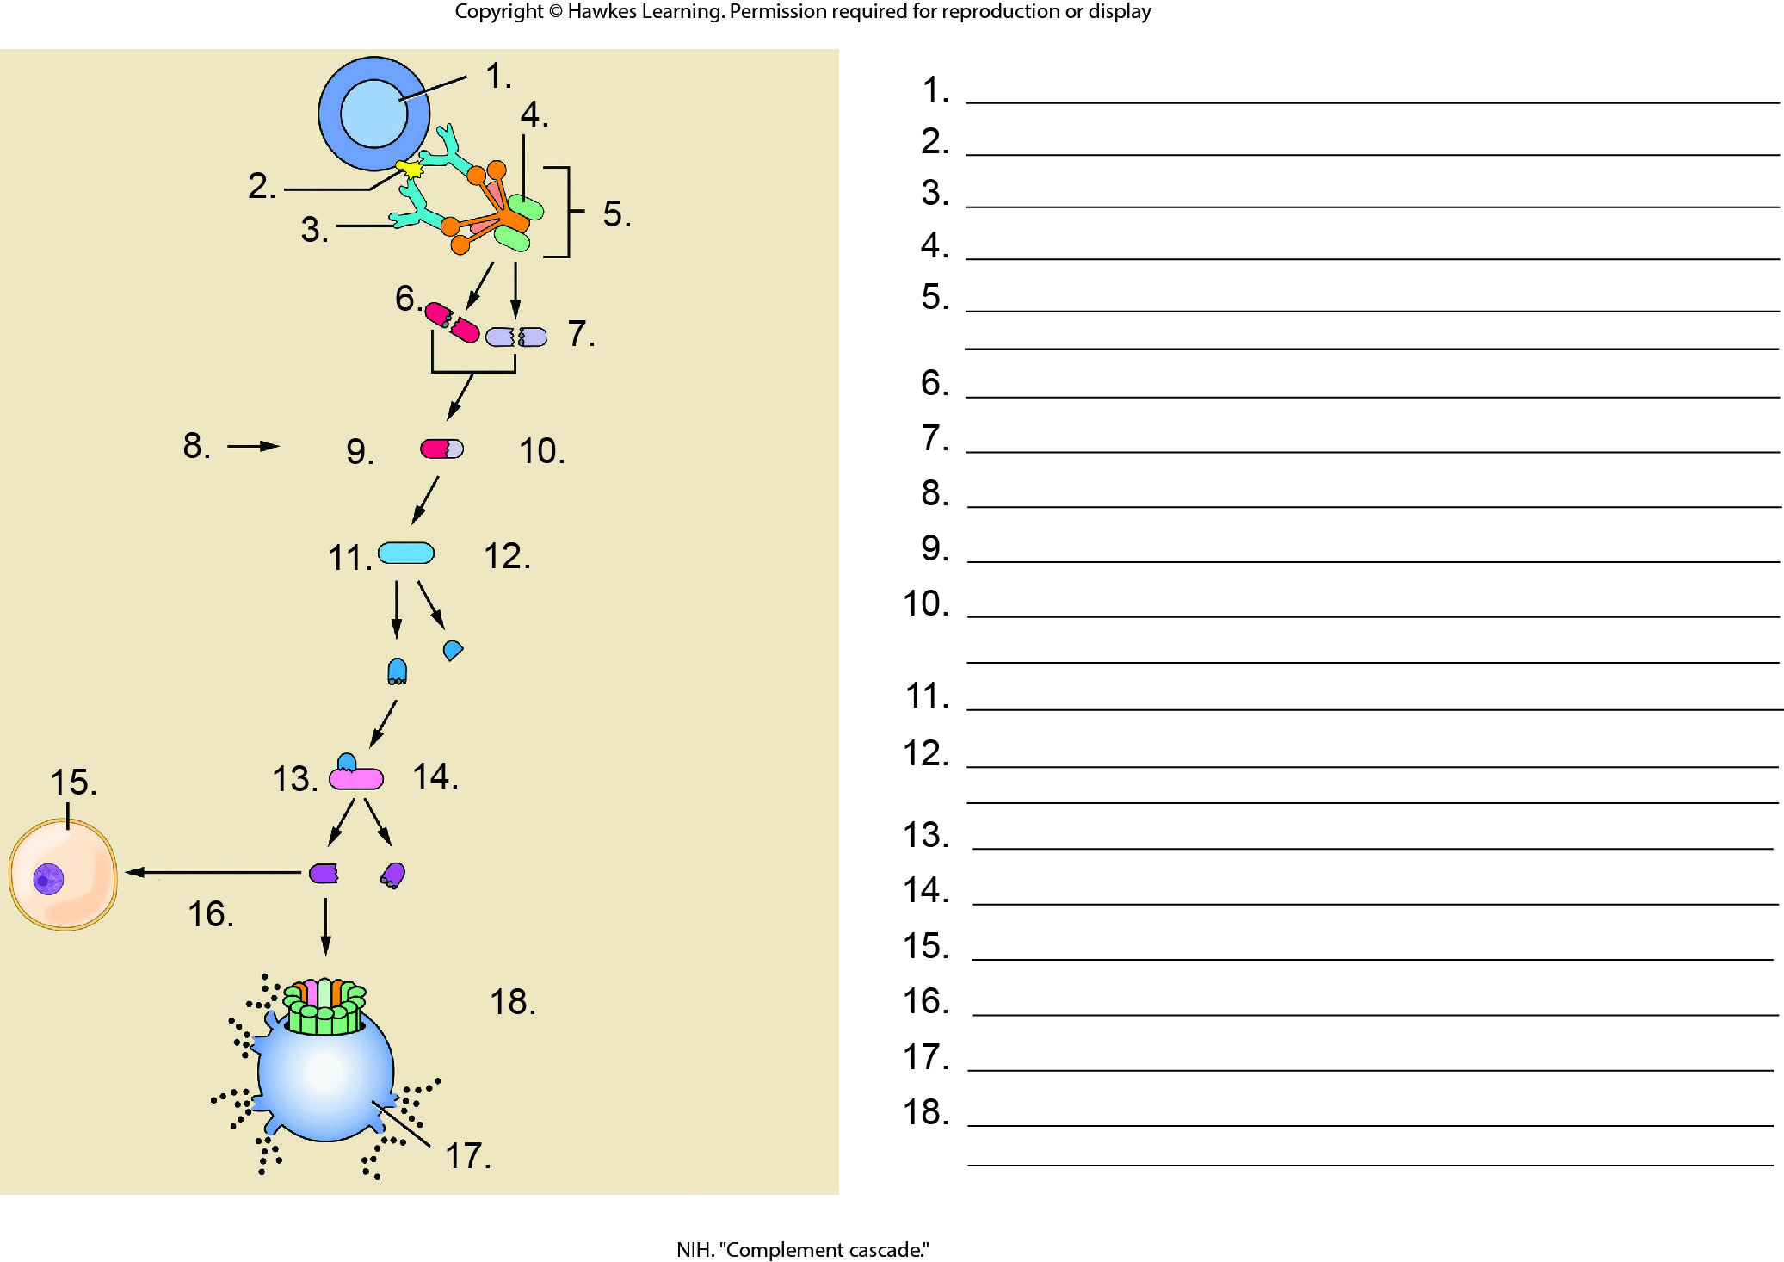
Lesson 37.1 Figure 9 - Numbered

Slide 11
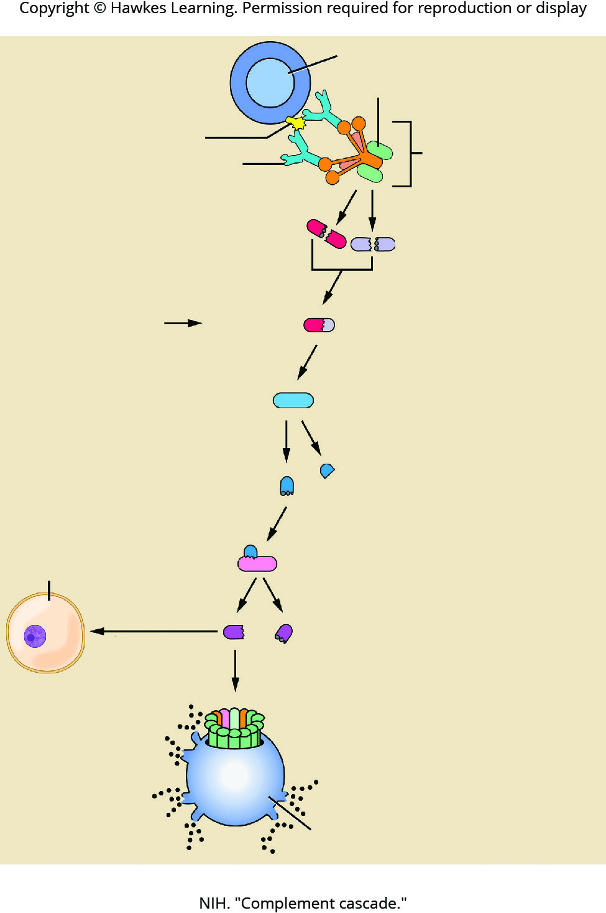
Lesson 37.1 Figure 9

Slide 12
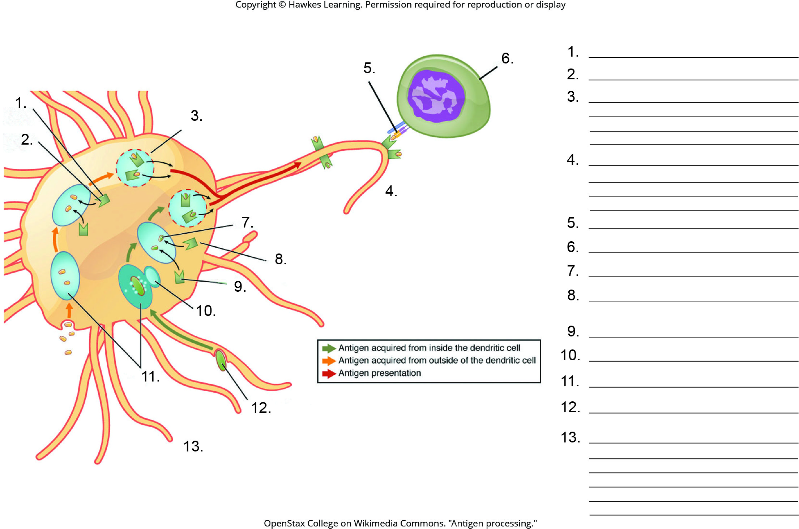
Lesson 37.2 Figure 1 - Numbered

Slide 13
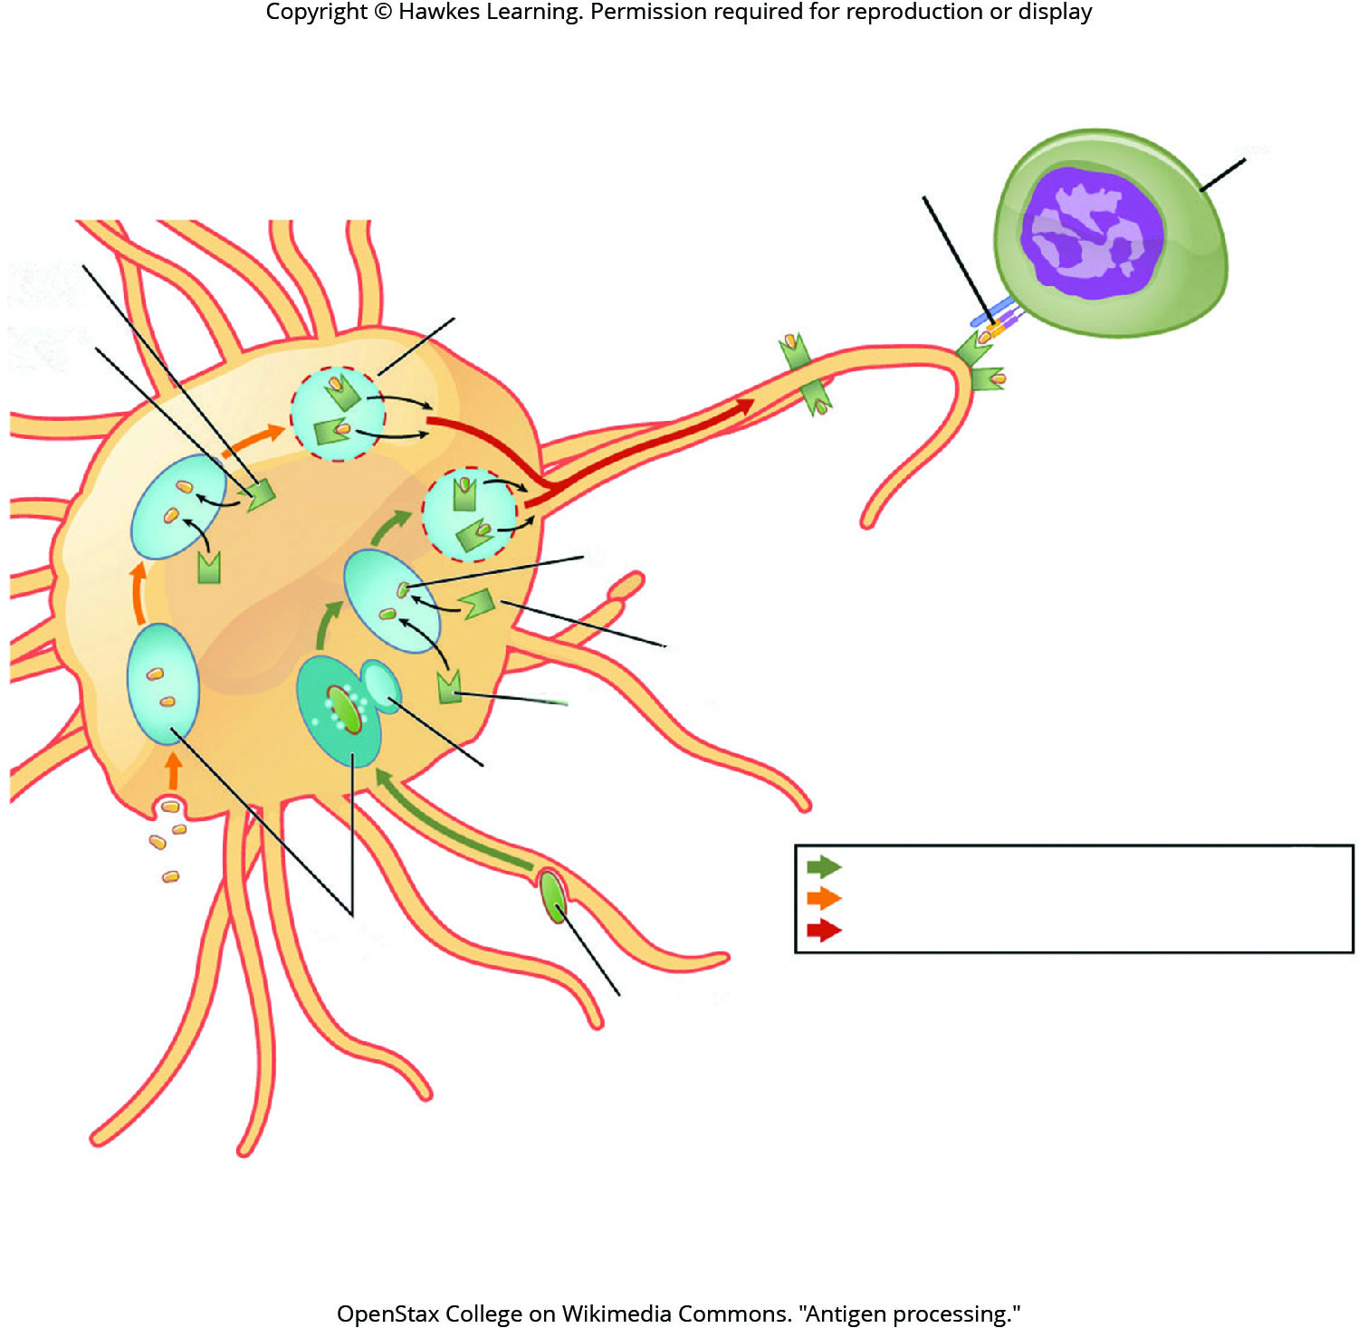
Lesson 37.2 Figure 1

Slide 14
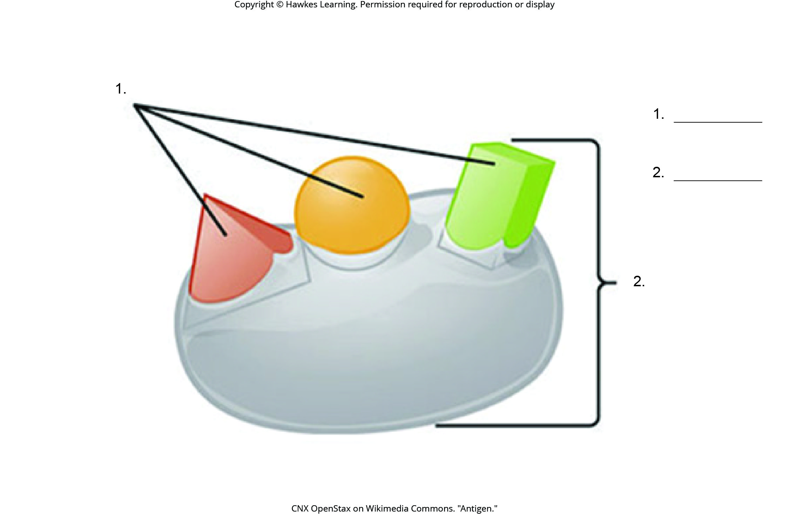
Lesson 37.2 Figure 3 - Numbered

Slide 15

Lesson 37.2 Figure 3

Slide 16
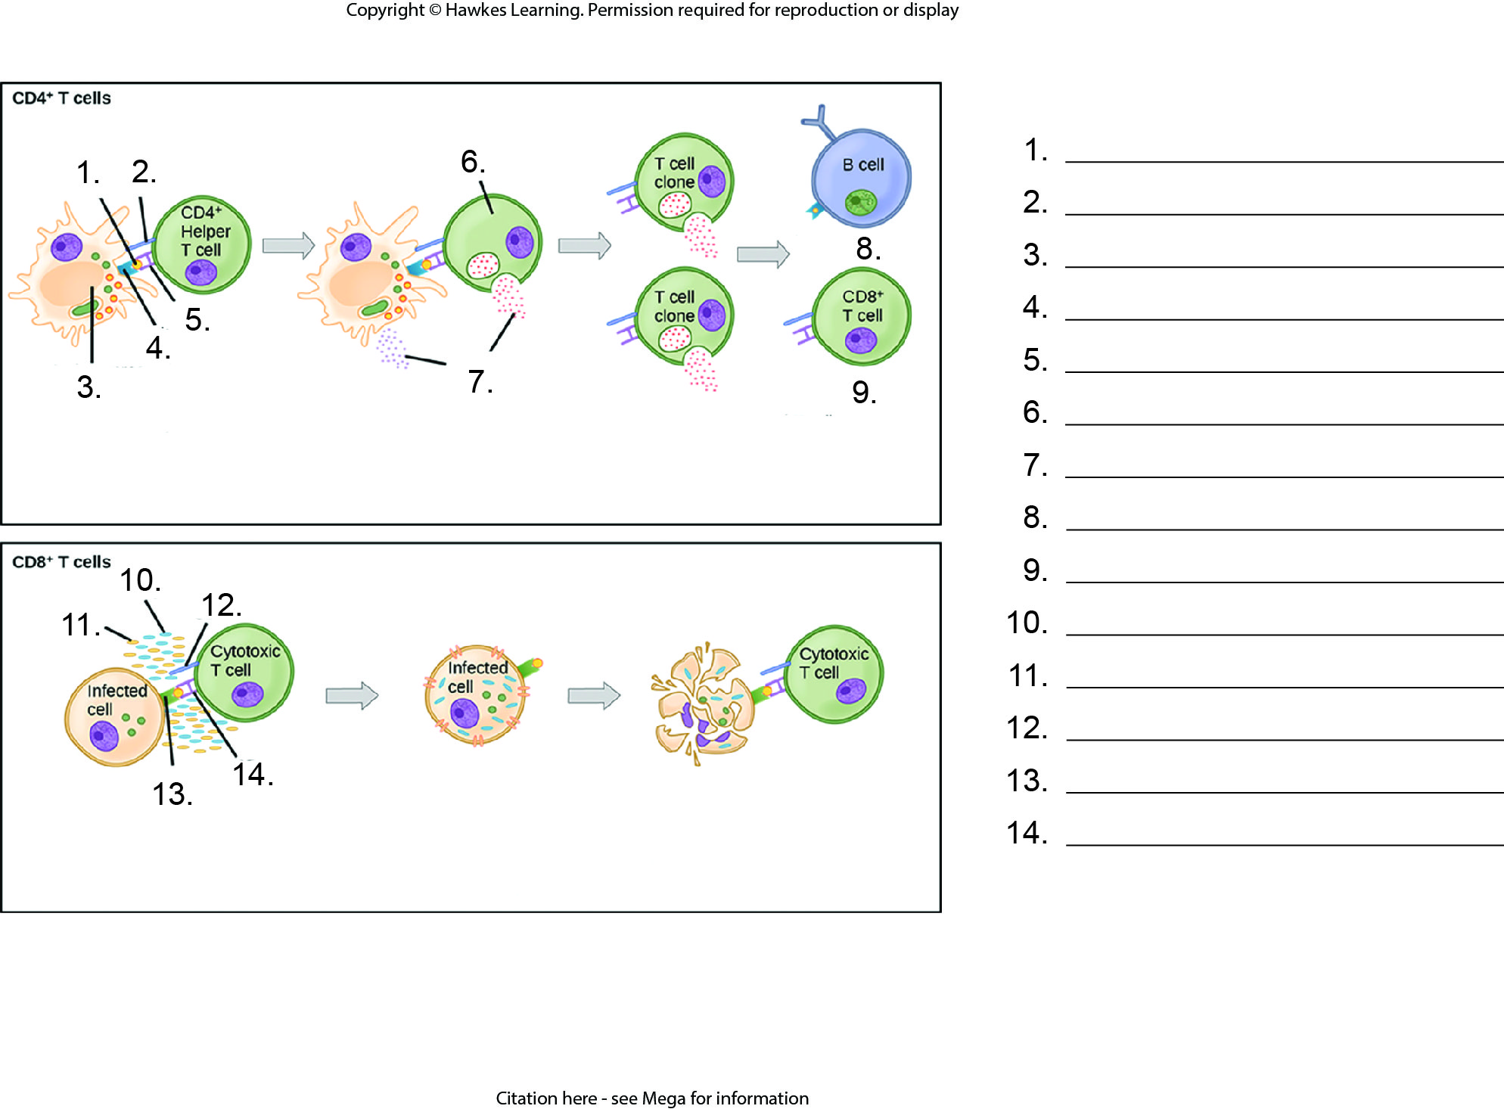
Lesson 37.2 Figure 4 - Numbered

Slide 17
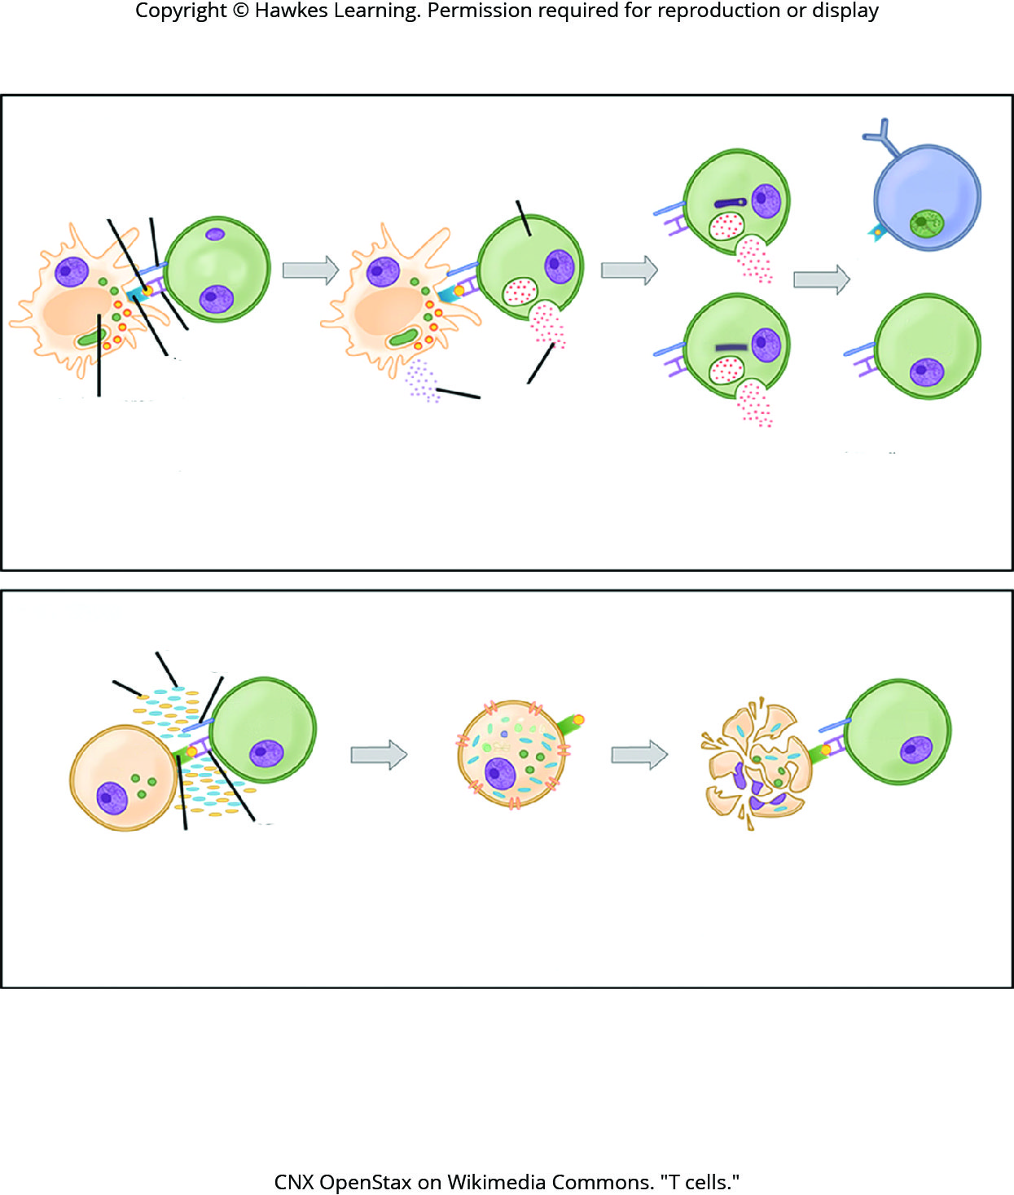
Lesson 37.2 Figure 4

Slide 18
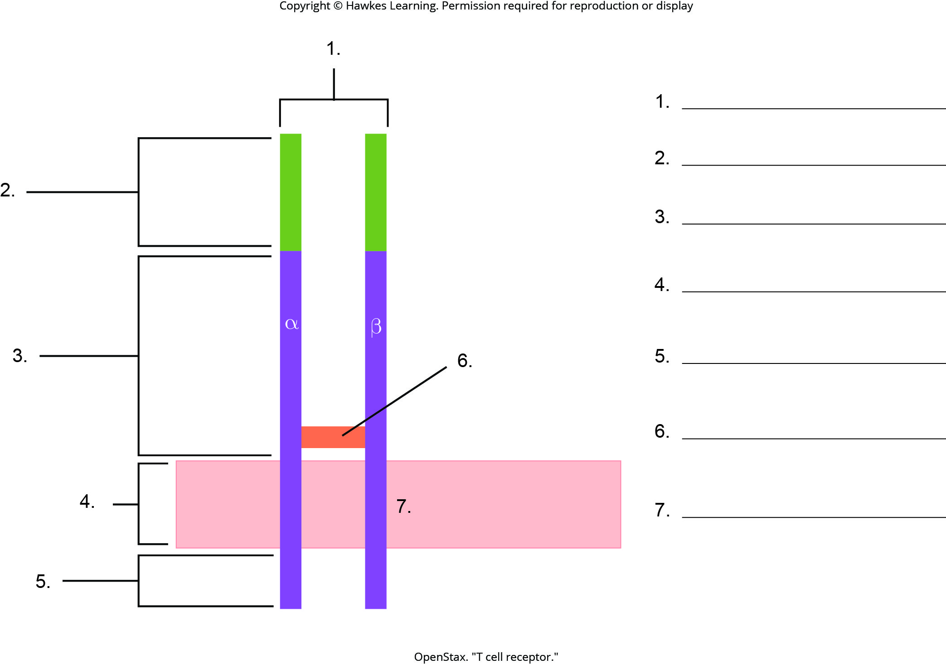
Lesson 37.2 Figure 5 - Numbered

Slide 19
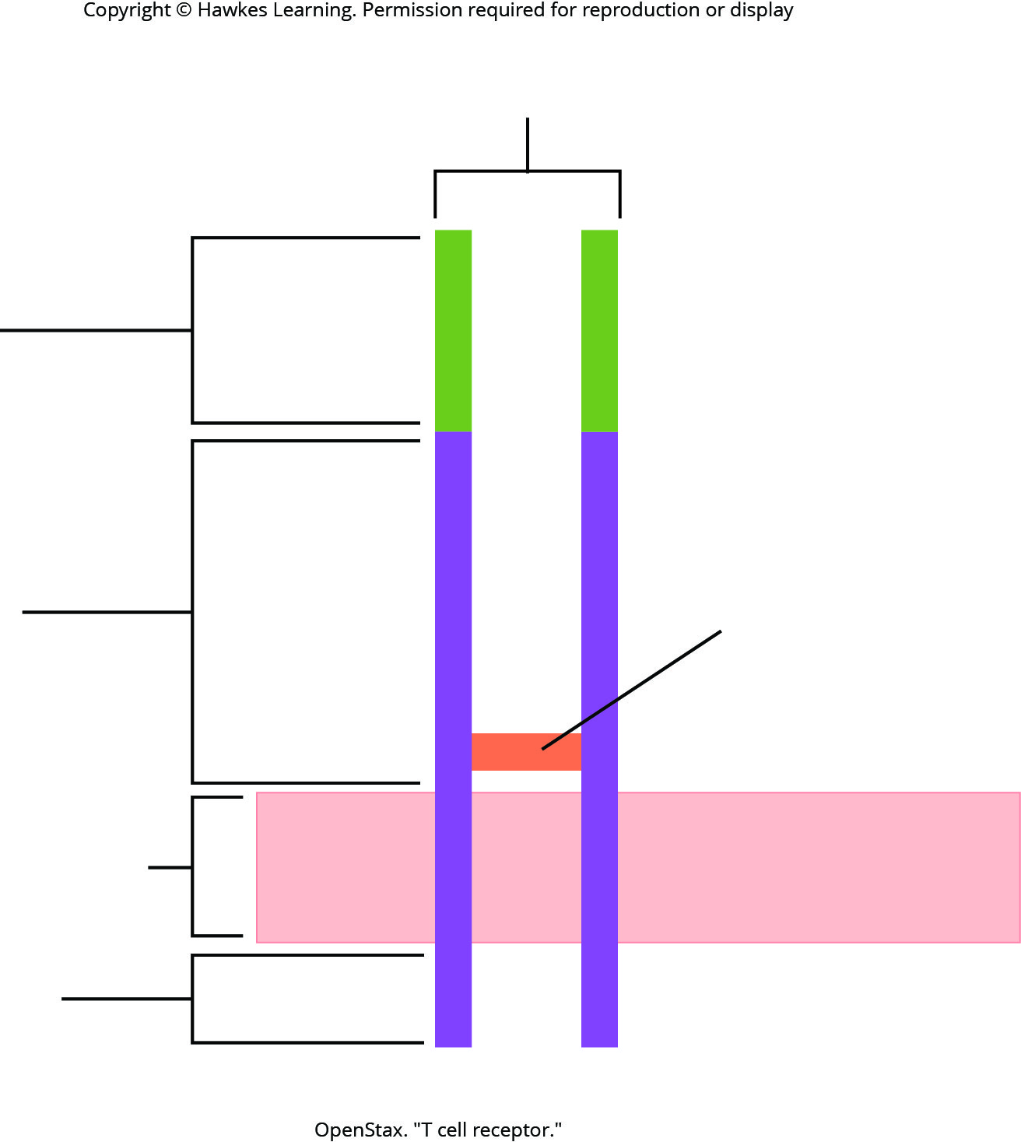
Lesson 37.2 Figure 5

Slide 20
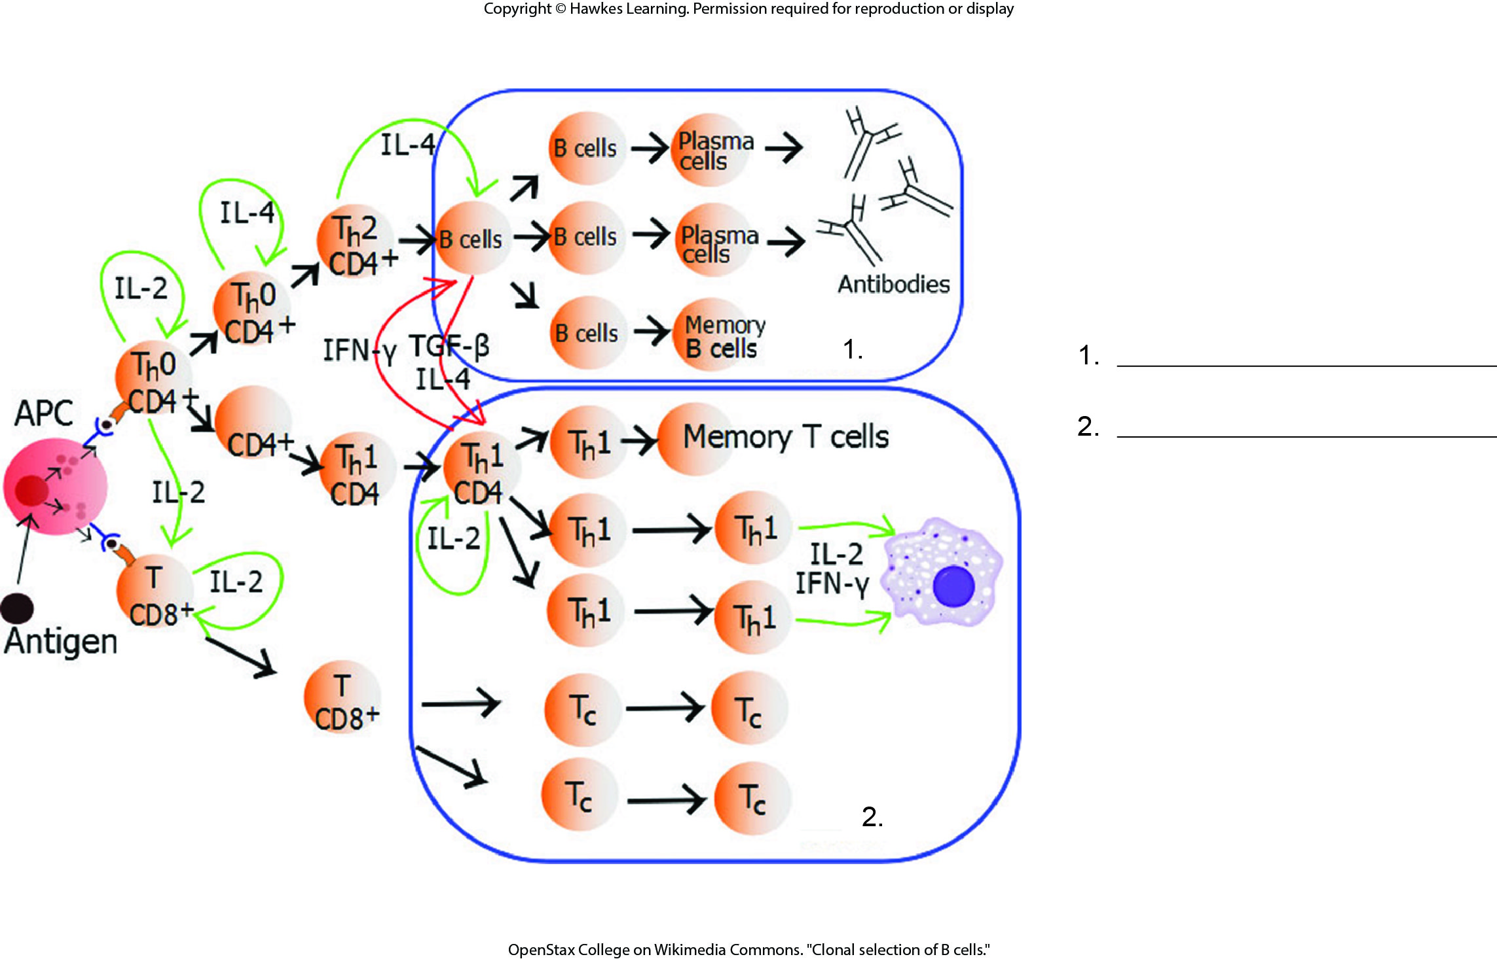
Lesson 37.2 Figure 6 - Numbered

Slide 21
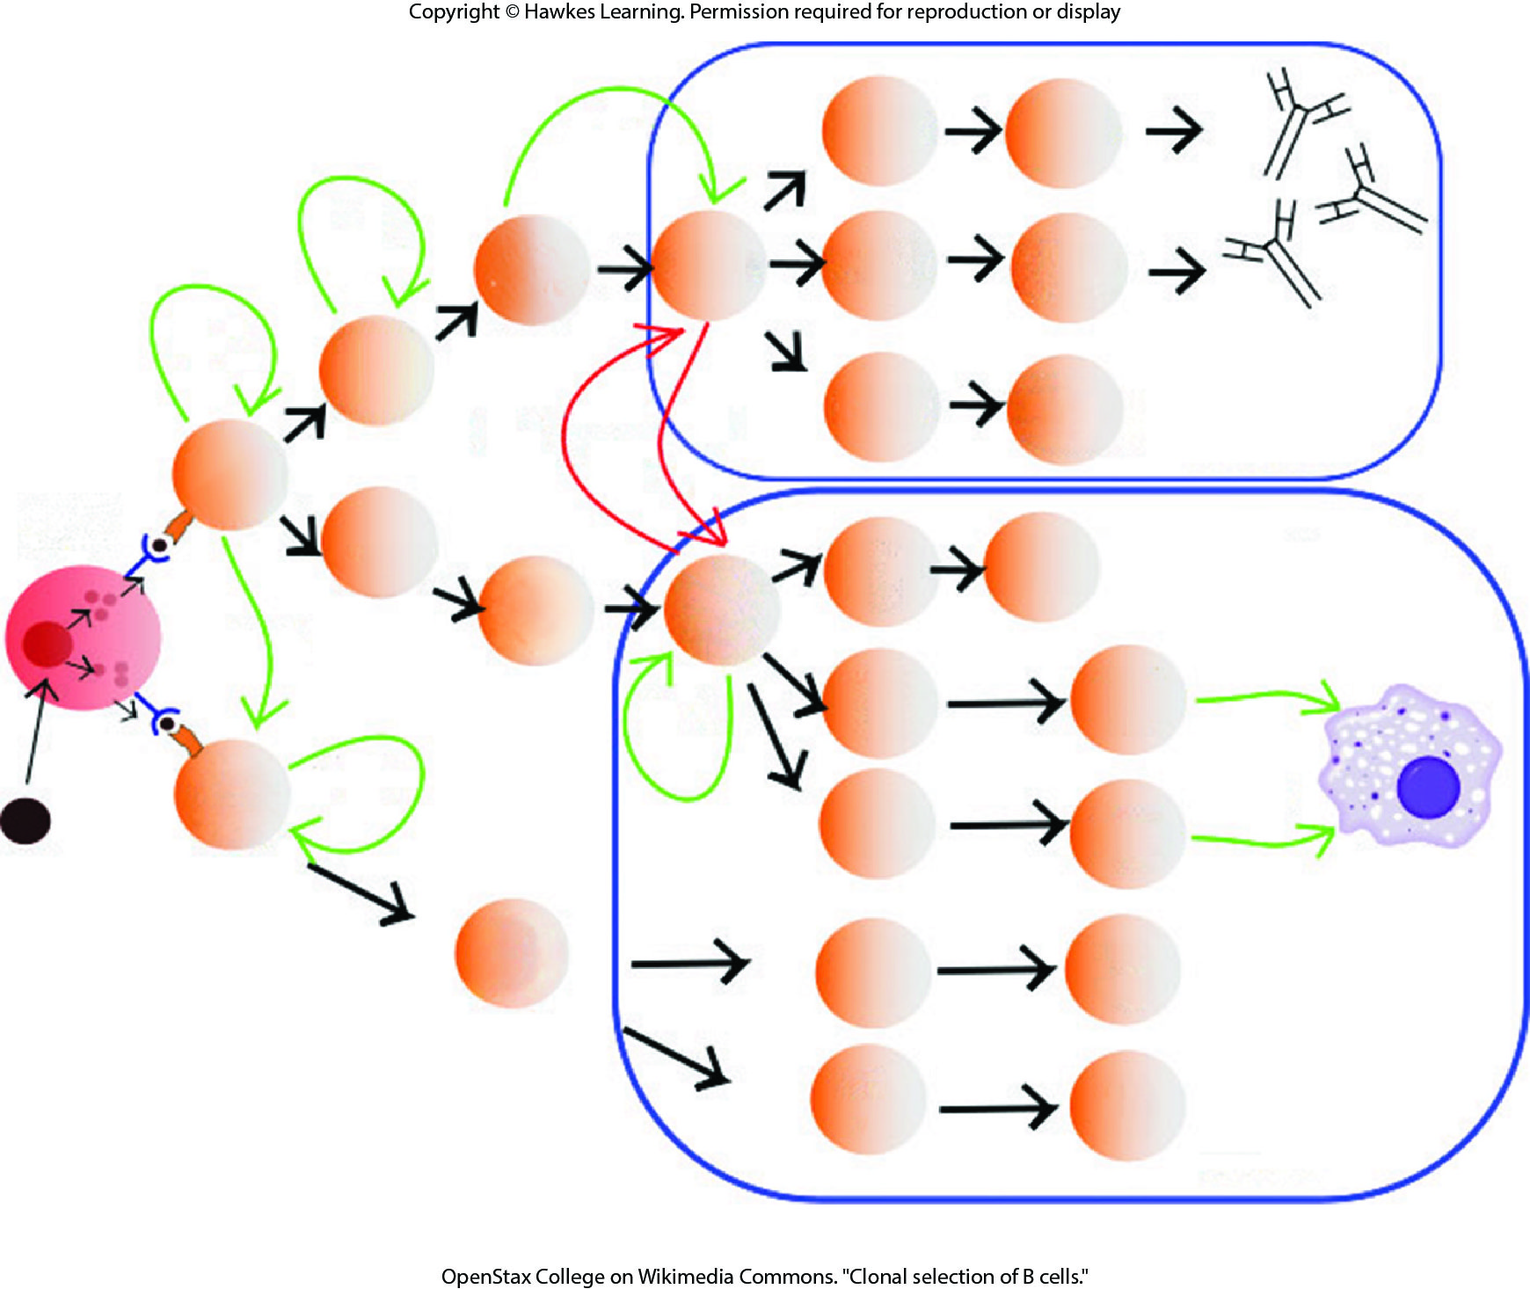
Lesson 37.2 Figure 6

Slide 22
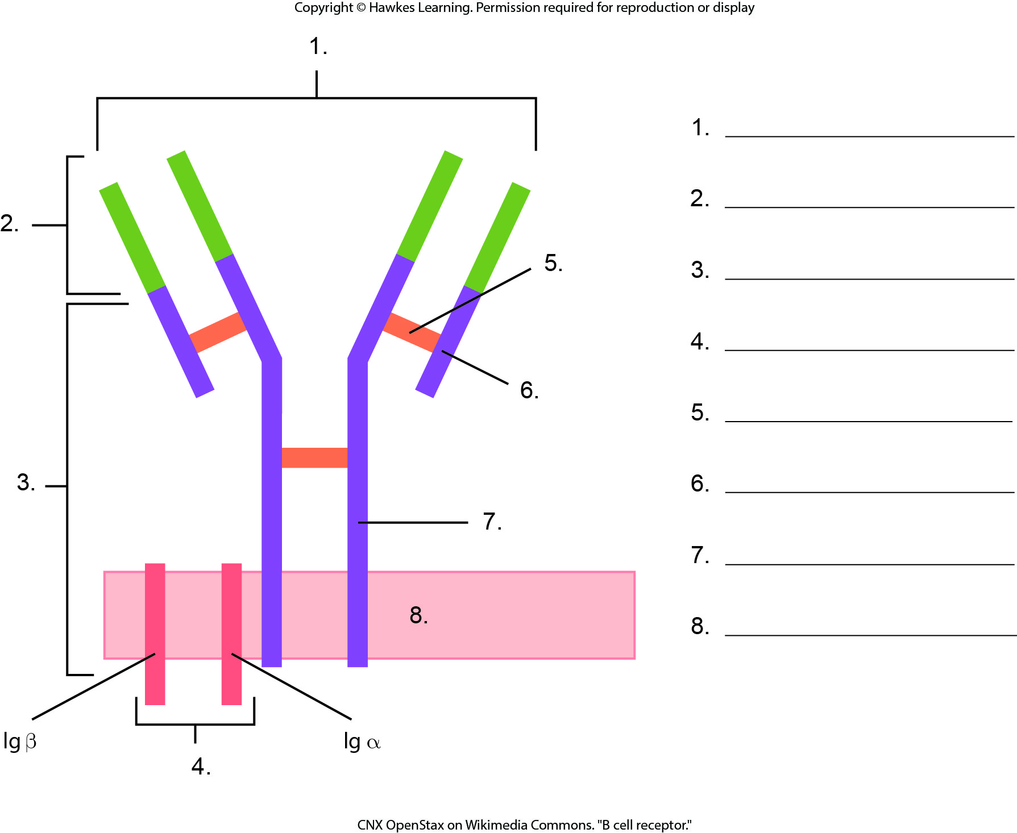
Lesson 37.2 Figure 7 - Numbered

Slide 23
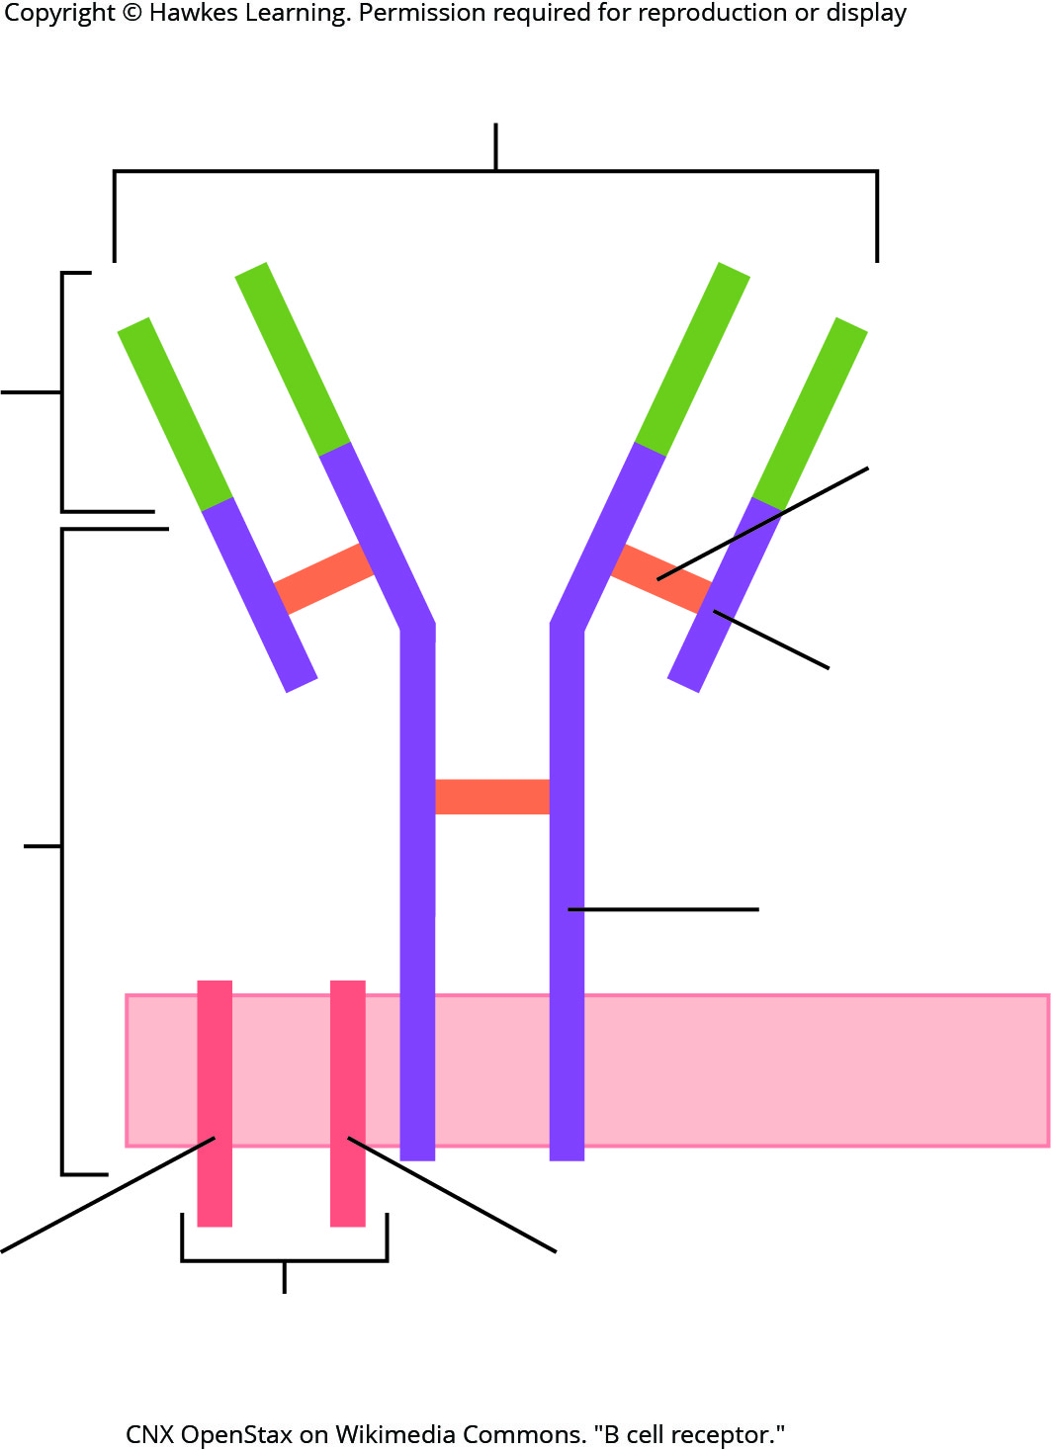
Lesson 37.2 Figure 7

Slide 24
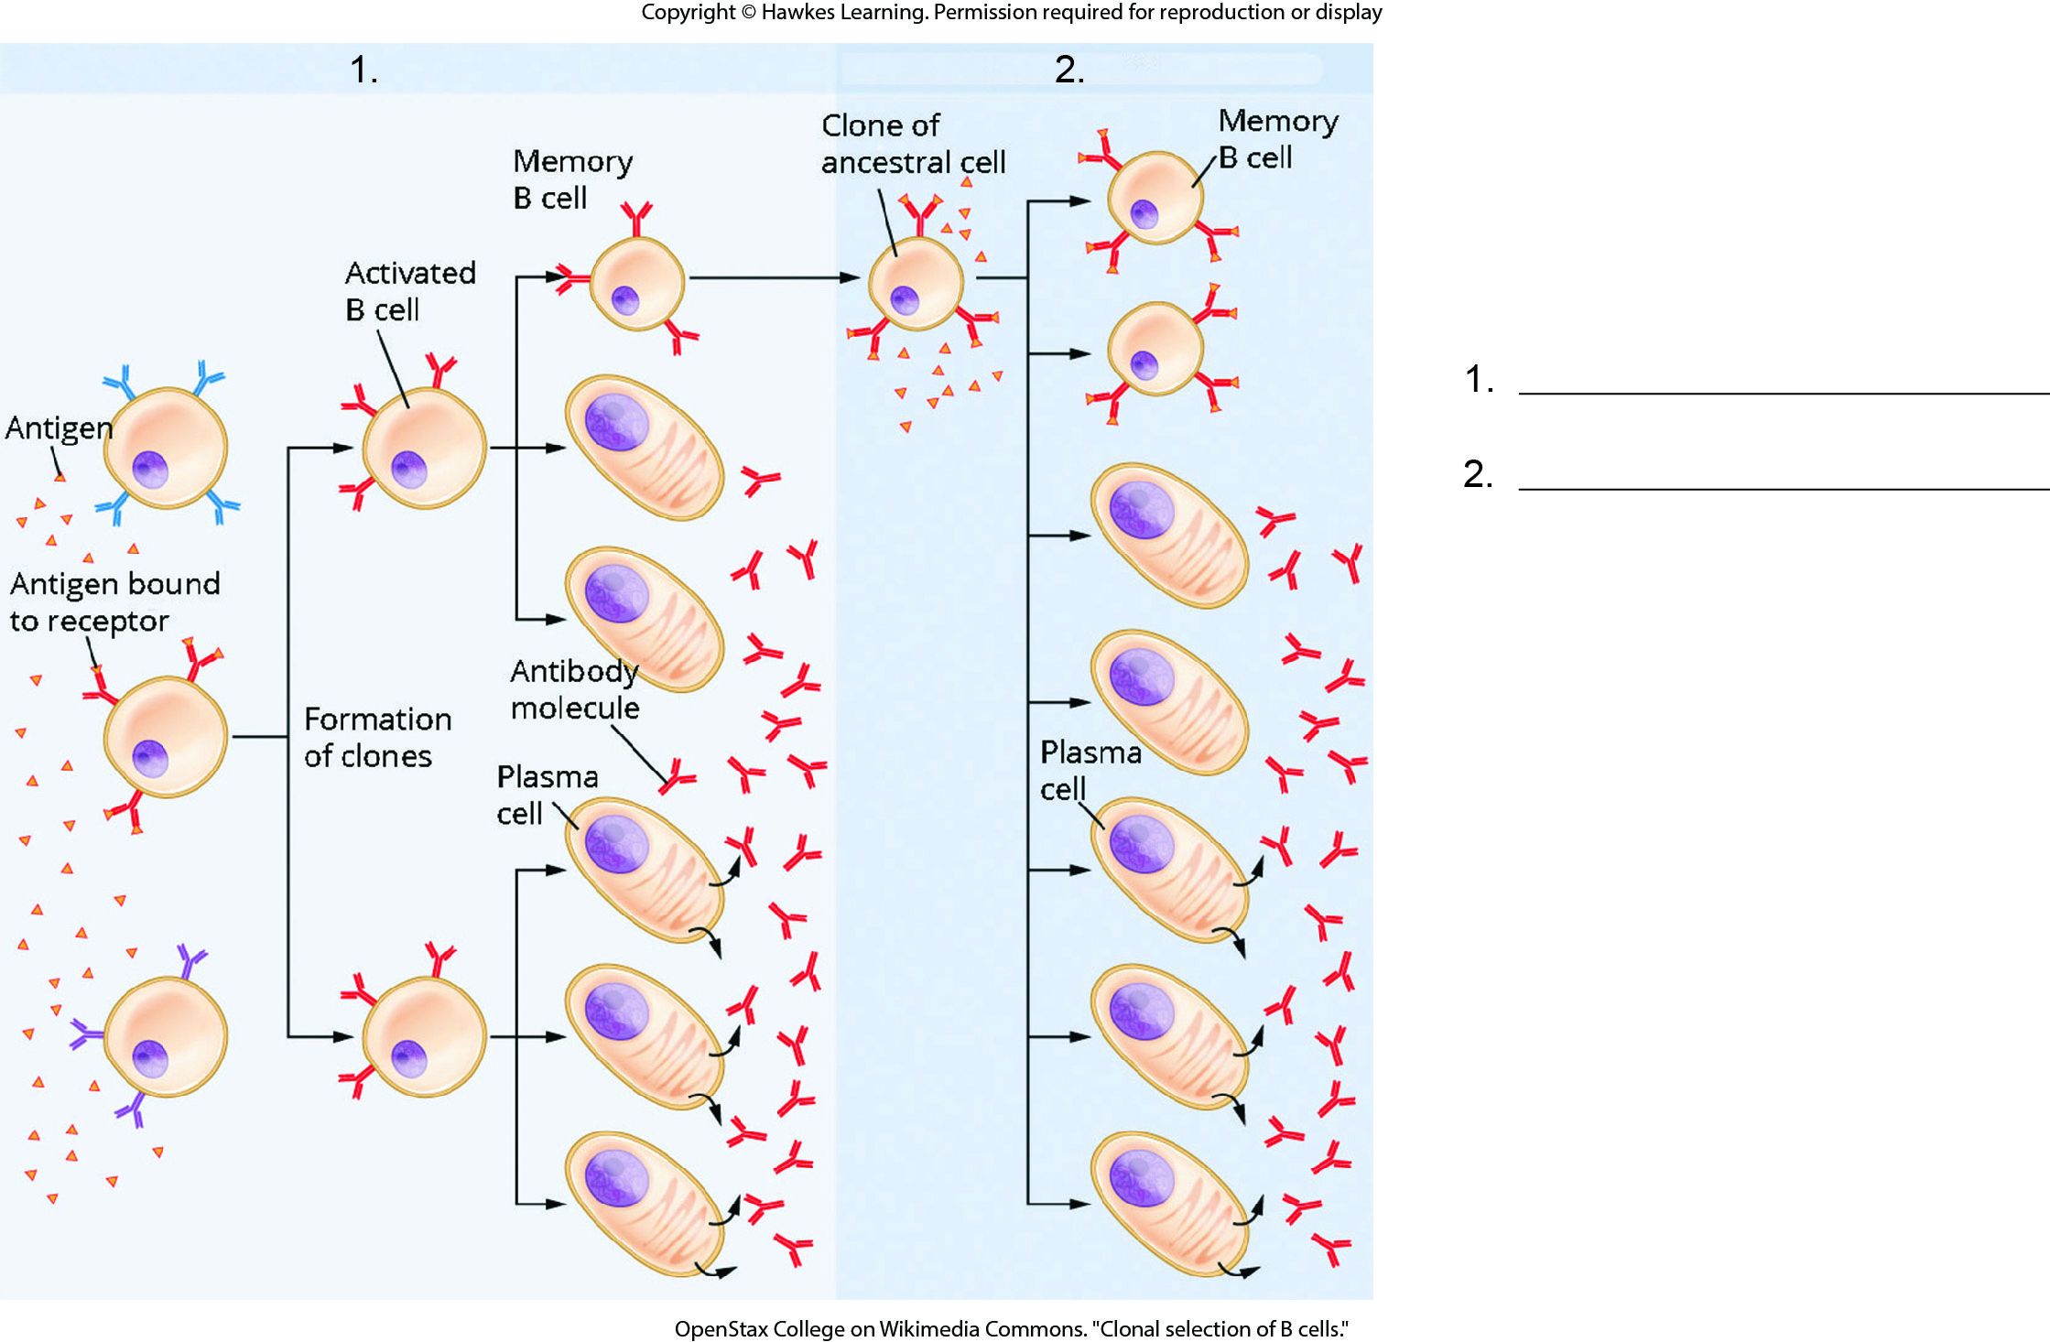
Lesson 37.2 Figure 8 - Numbered

Slide 25
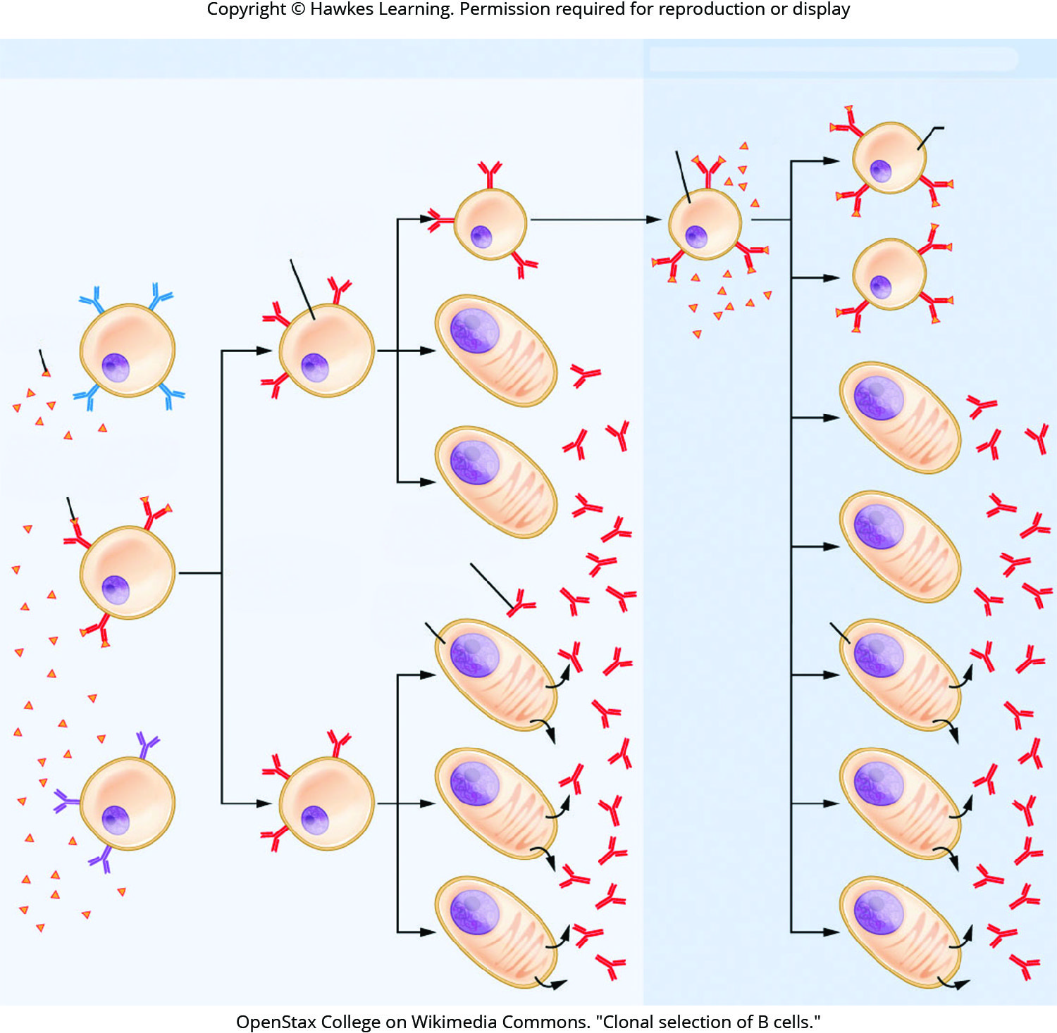
Lesson 37.2 Figure 8

Slide 26
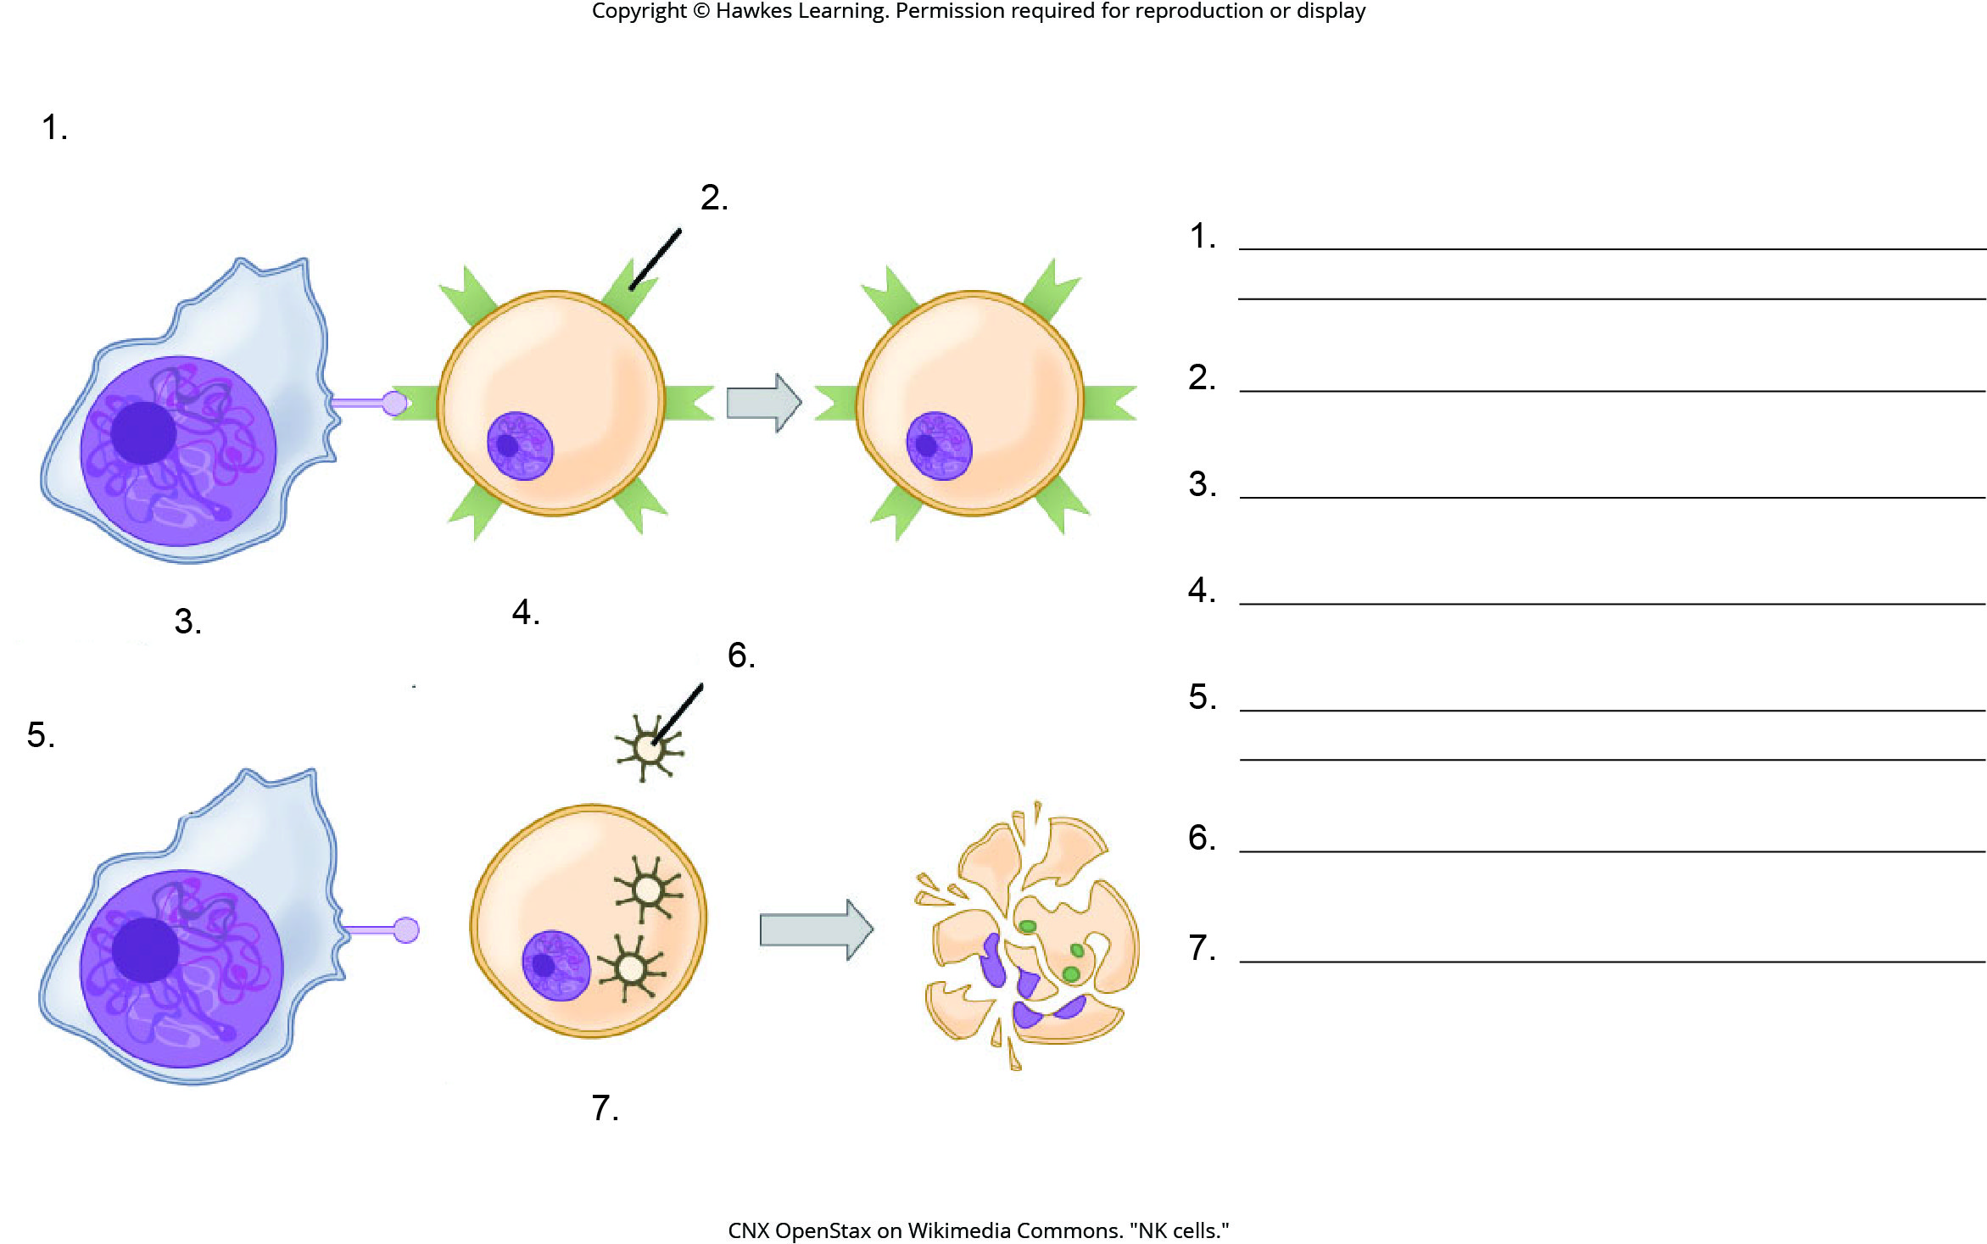
Lesson 37.2 Figure 9 - Numbered

Slide 27
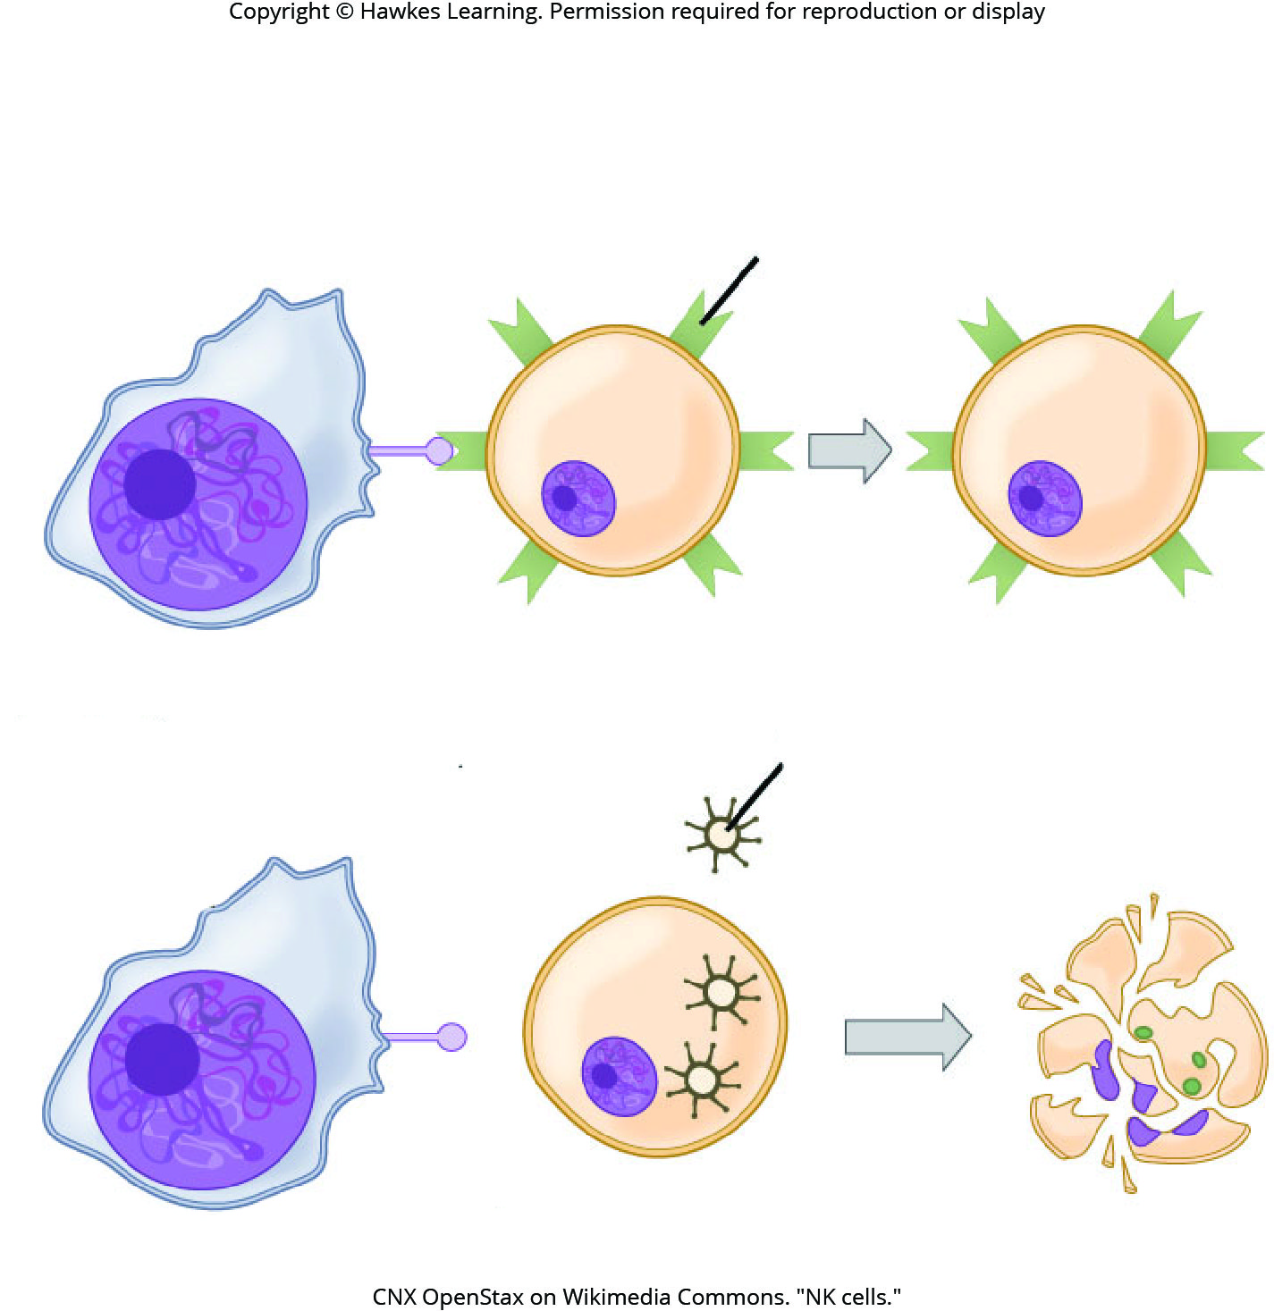
Lesson 37.2 Figure 9

Slide 28
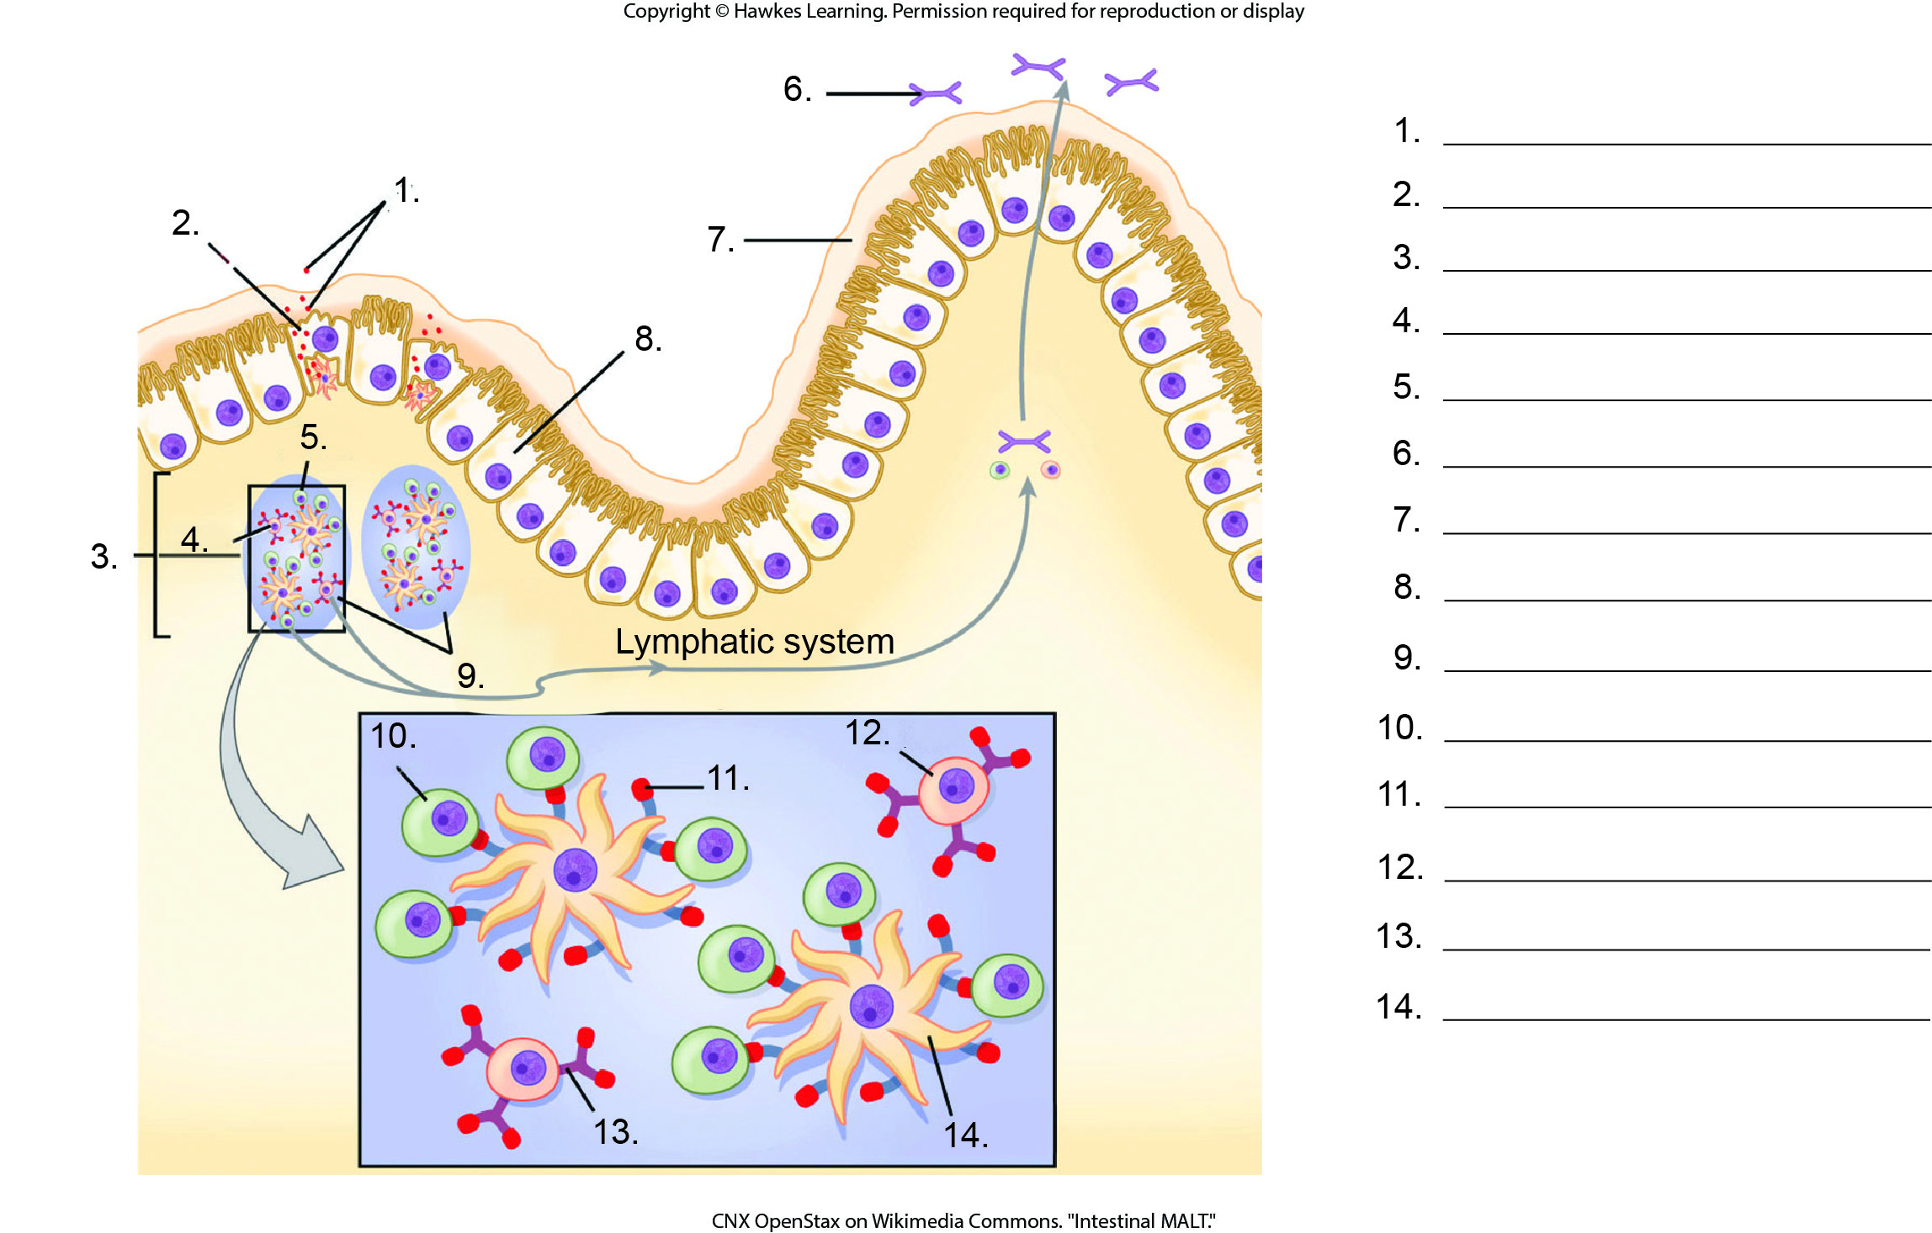
Lesson 37.2 Figure 10 - Numbered

Slide 29
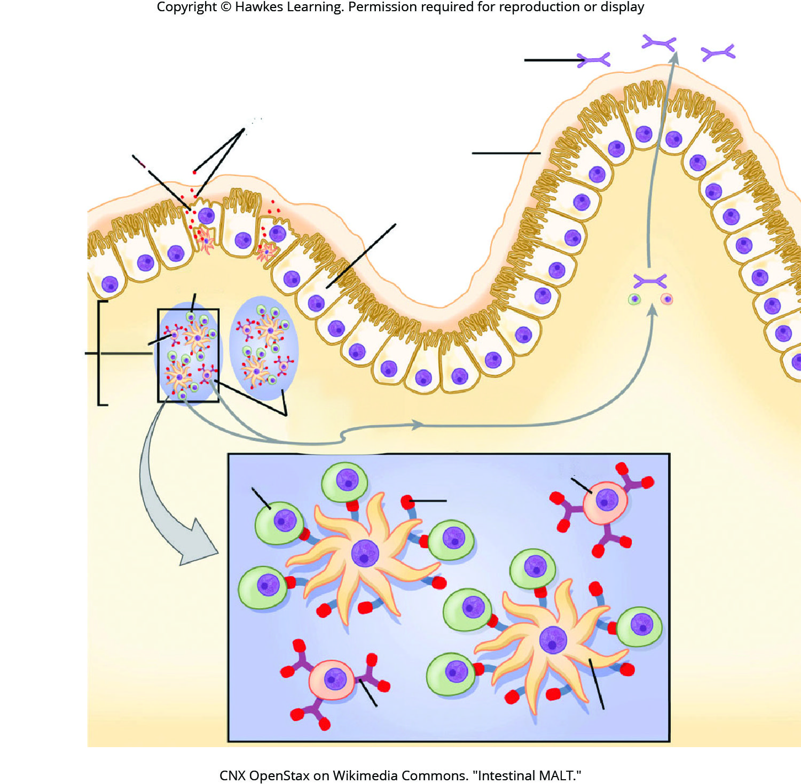
Lesson 37.2 Figure 10

Slide 30
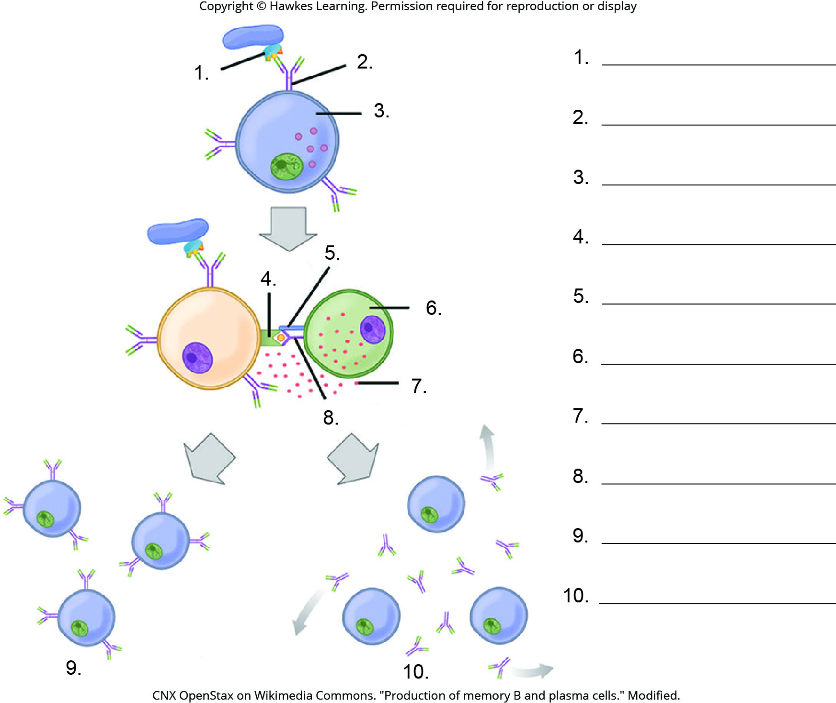
Lesson 37.2 Figure 11 - Numbered

Slide 31
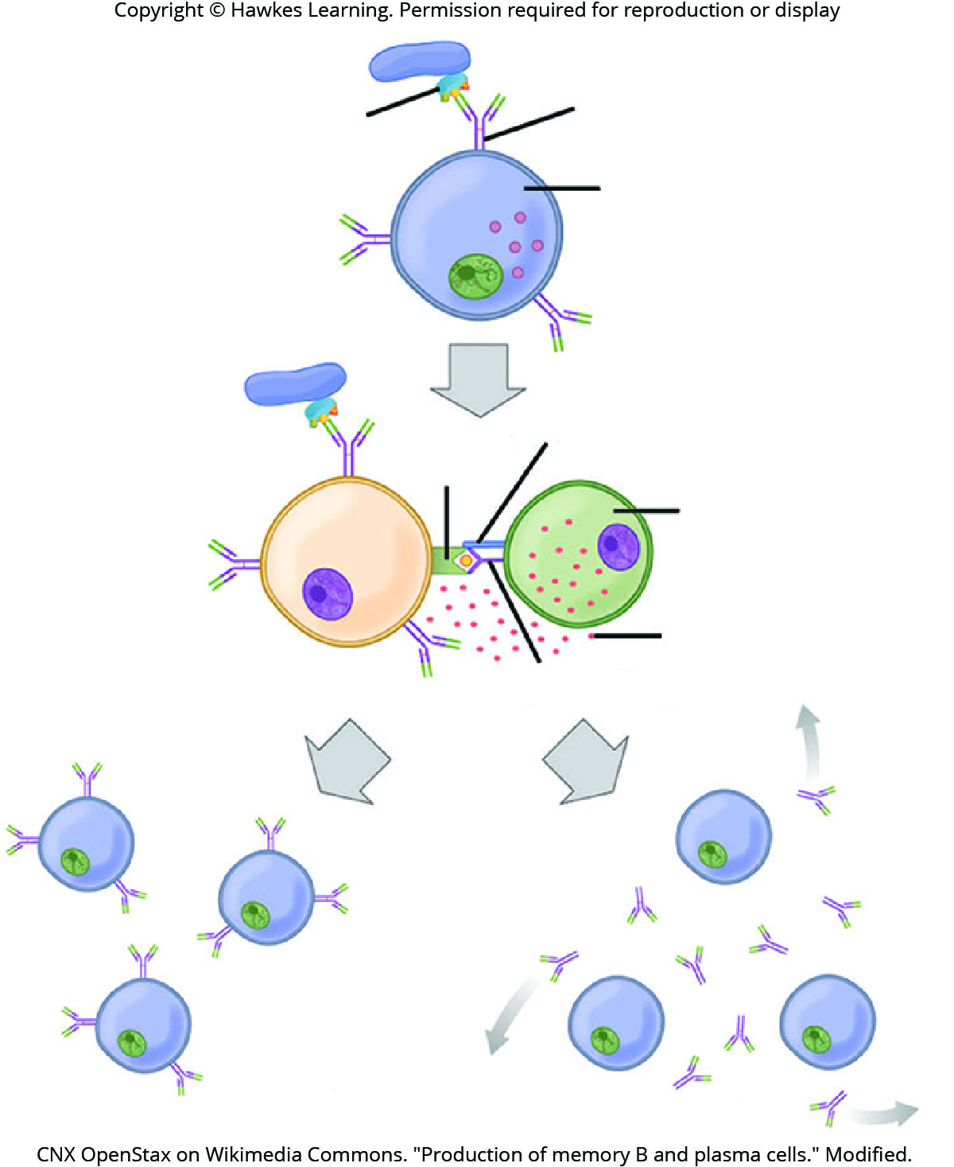
Lesson 37.2 Figure 11

Slide 32
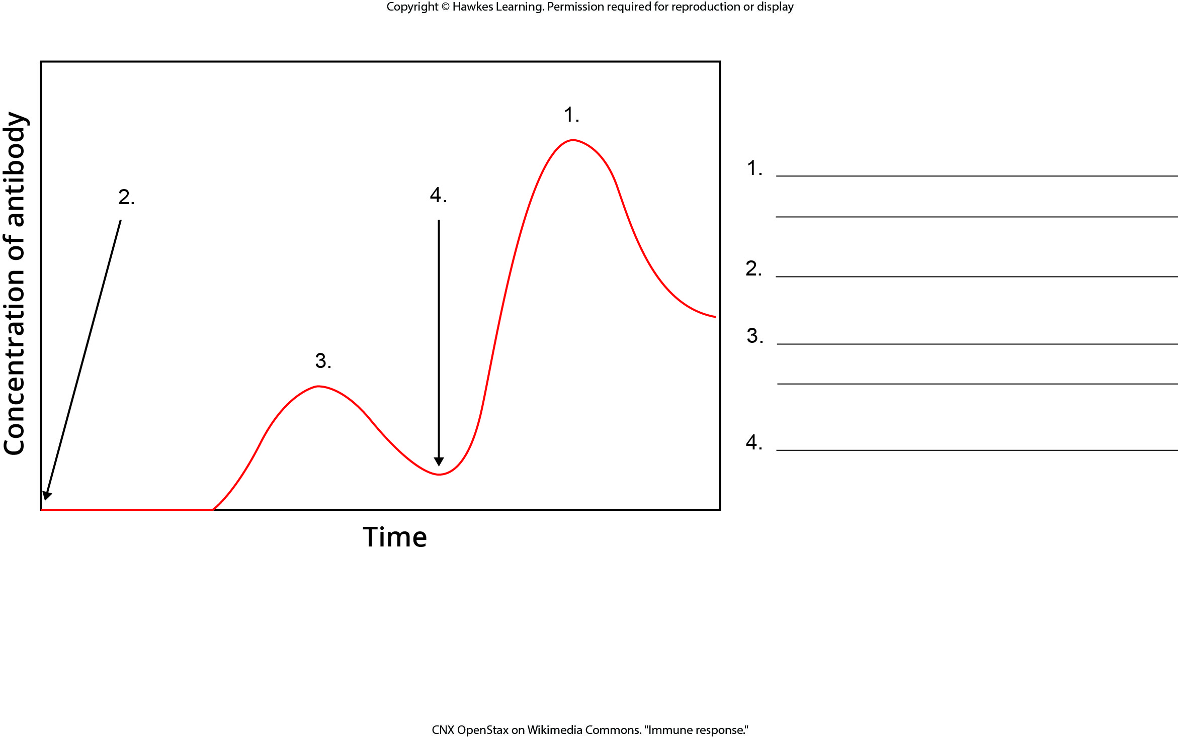
Lesson 37.2 Figure 12 - Numbered

Slide 33
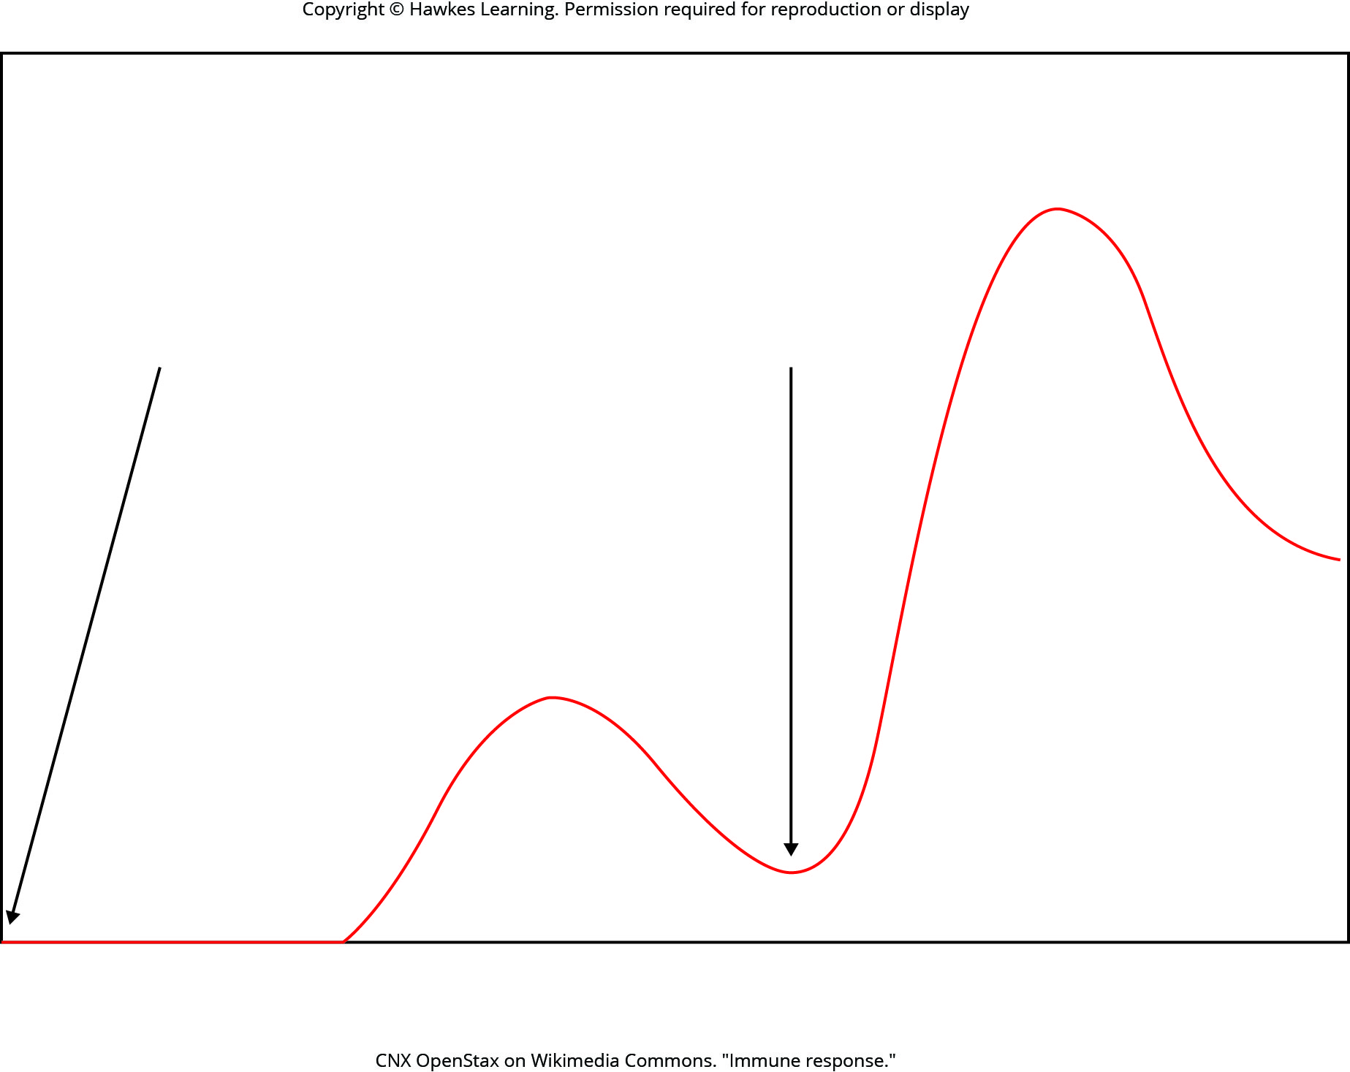
Lesson 37.2 Figure 12

Slide 34
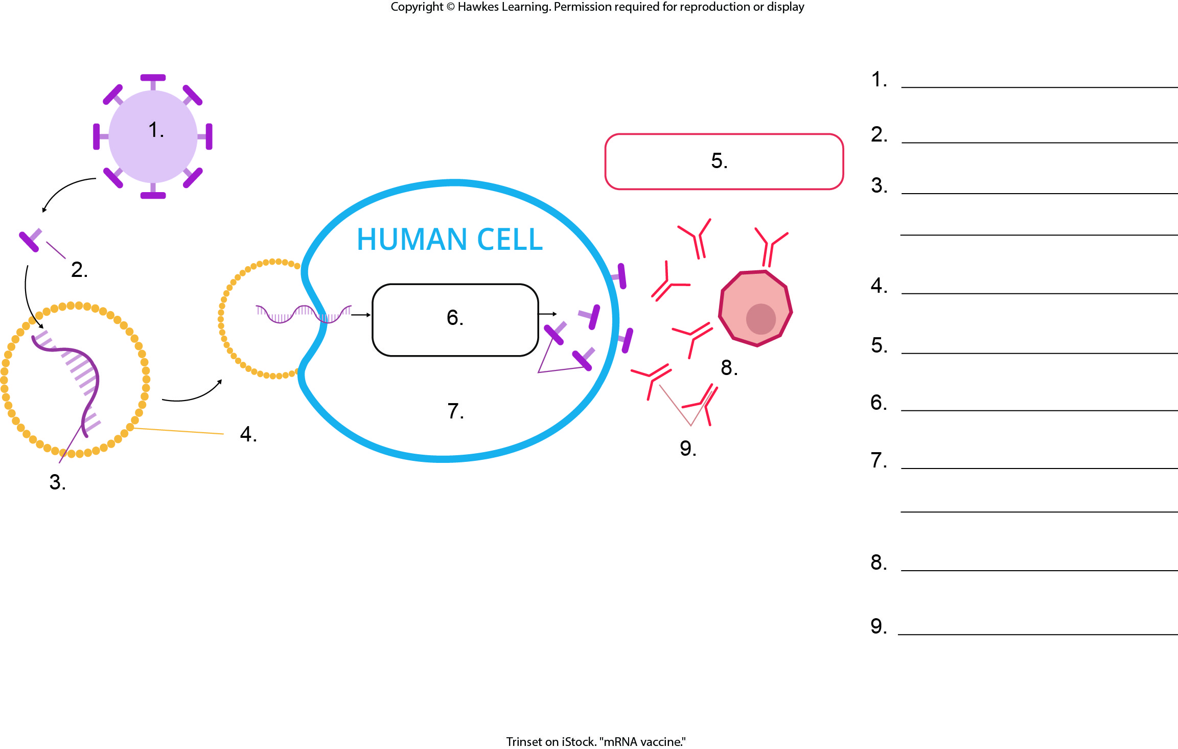
Lesson 37.2 Figure 13 - Numbered

Slide 35
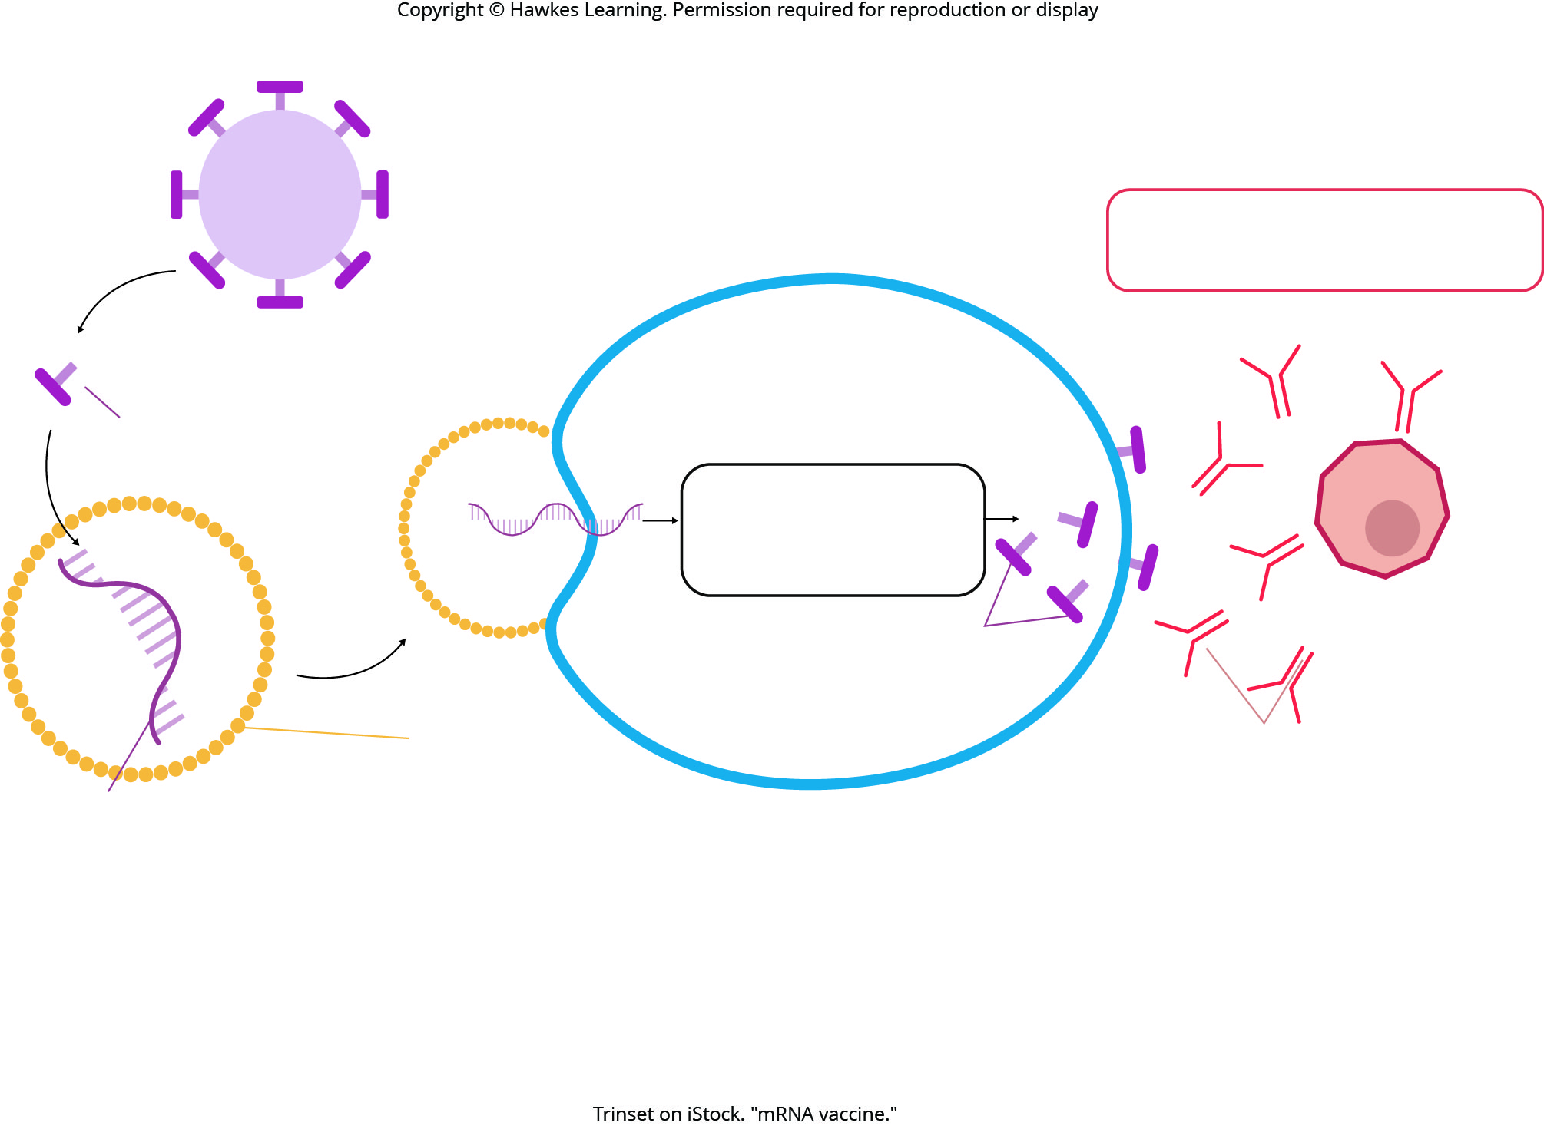
Lesson 37.2 Figure 13

Slide 36
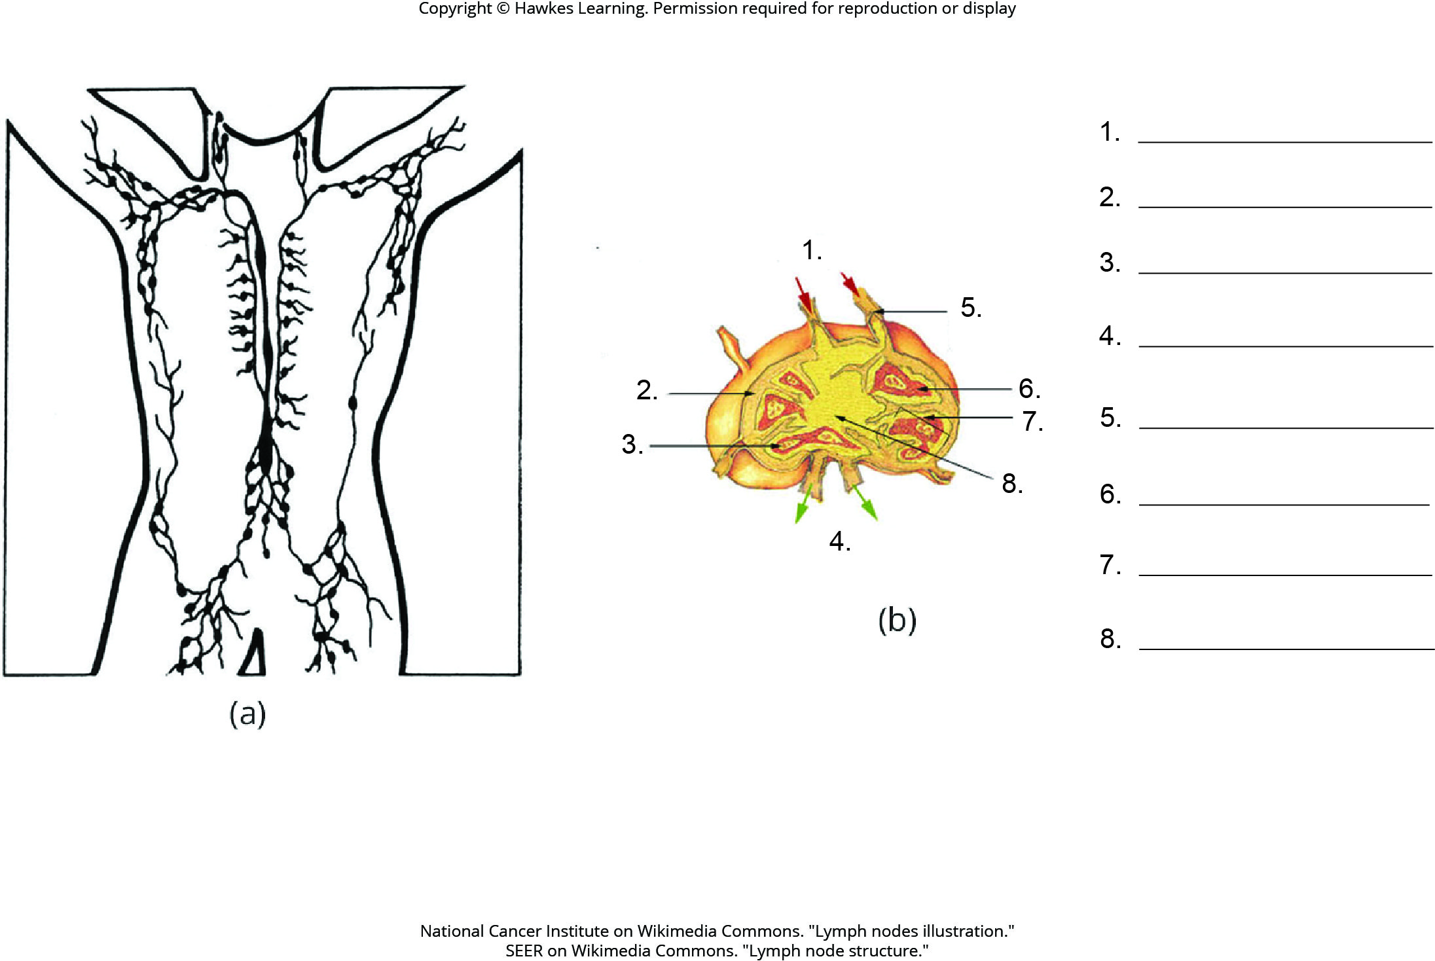
Lesson 37.2 Figure 16 - Numbered

Slide 37
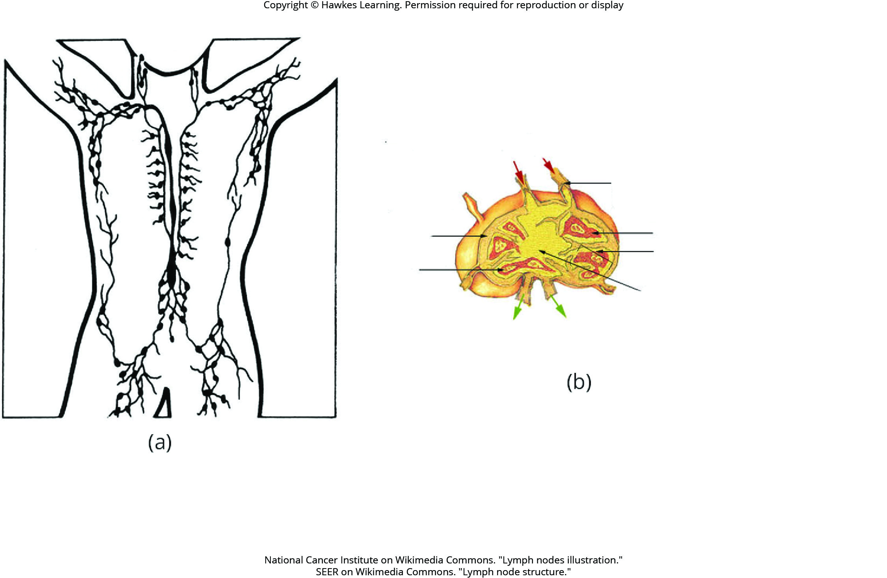
Lesson 37.2 Figure 16

Slide 38
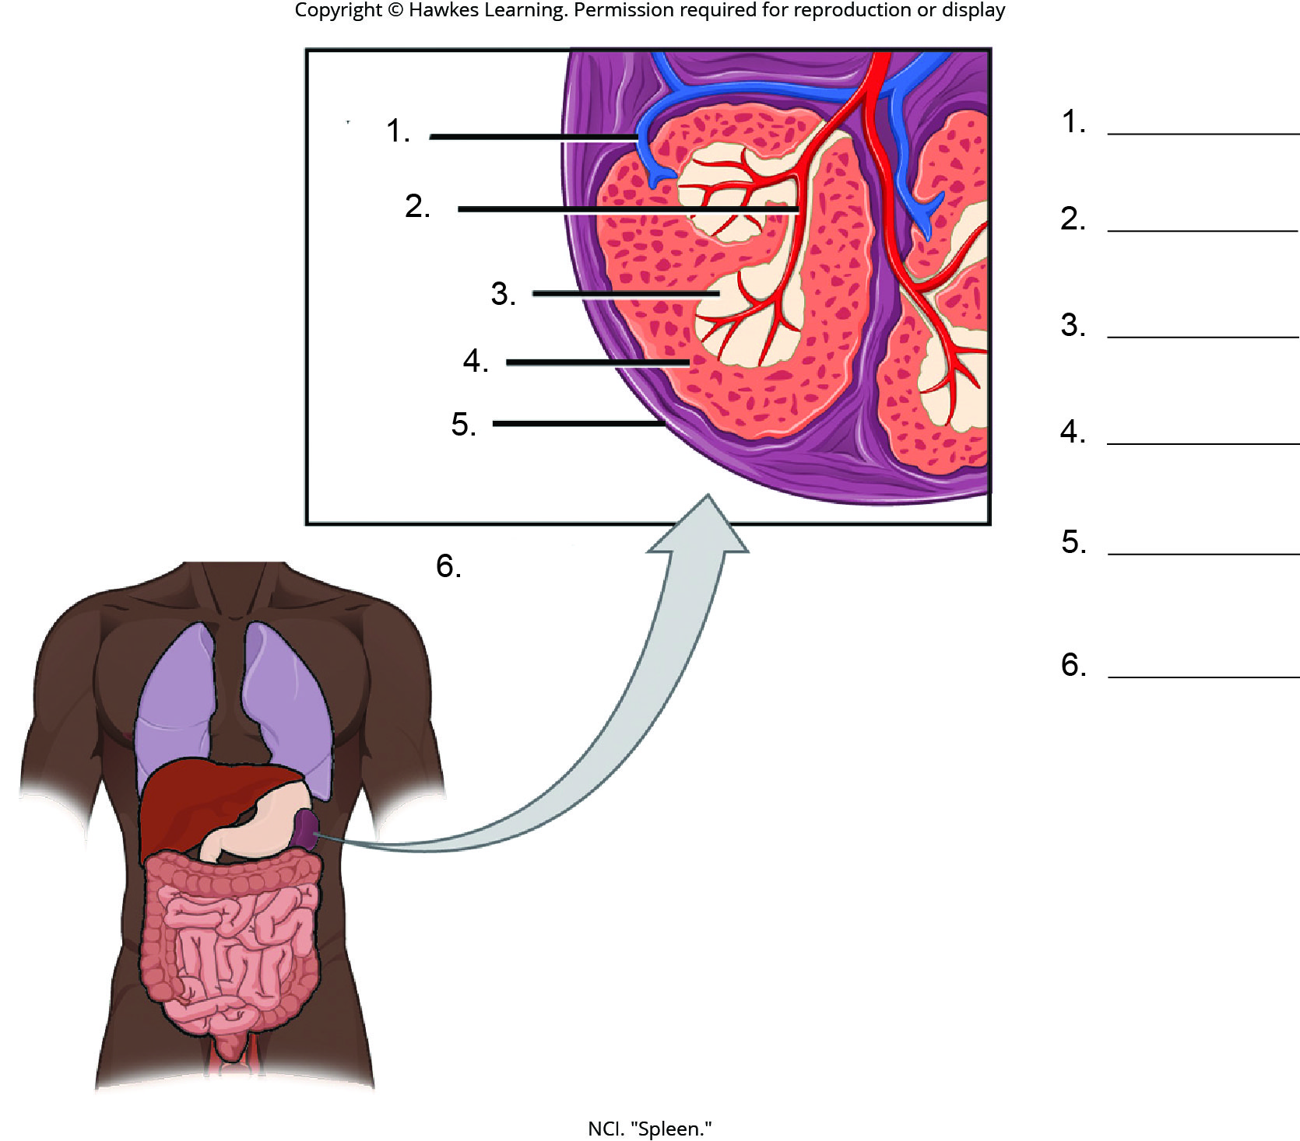
Lesson 37.2 Figure 17 - Numbered

Slide 39
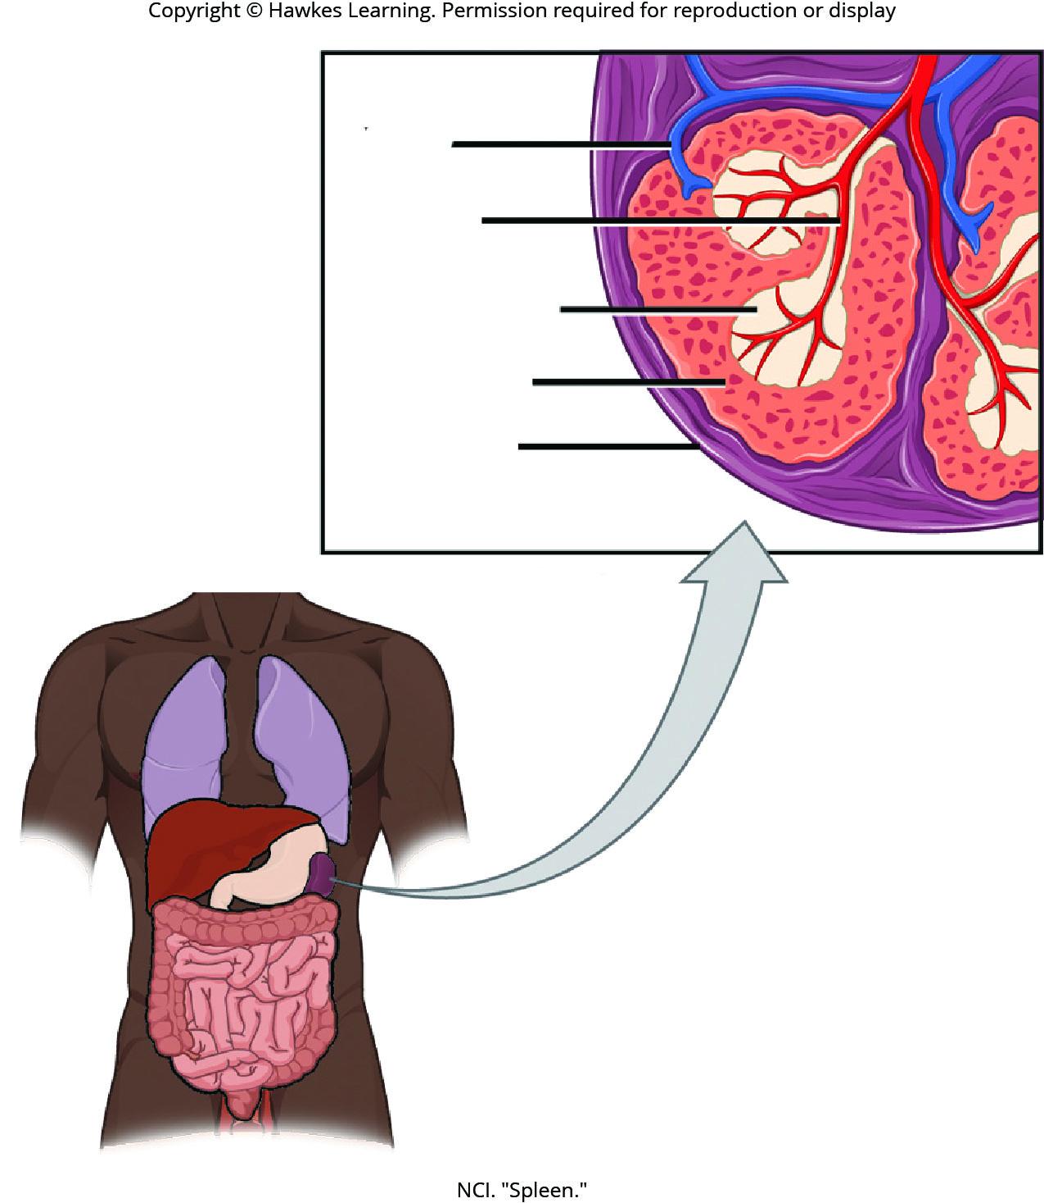
Lesson 37.2 Figure 17

Slide 40
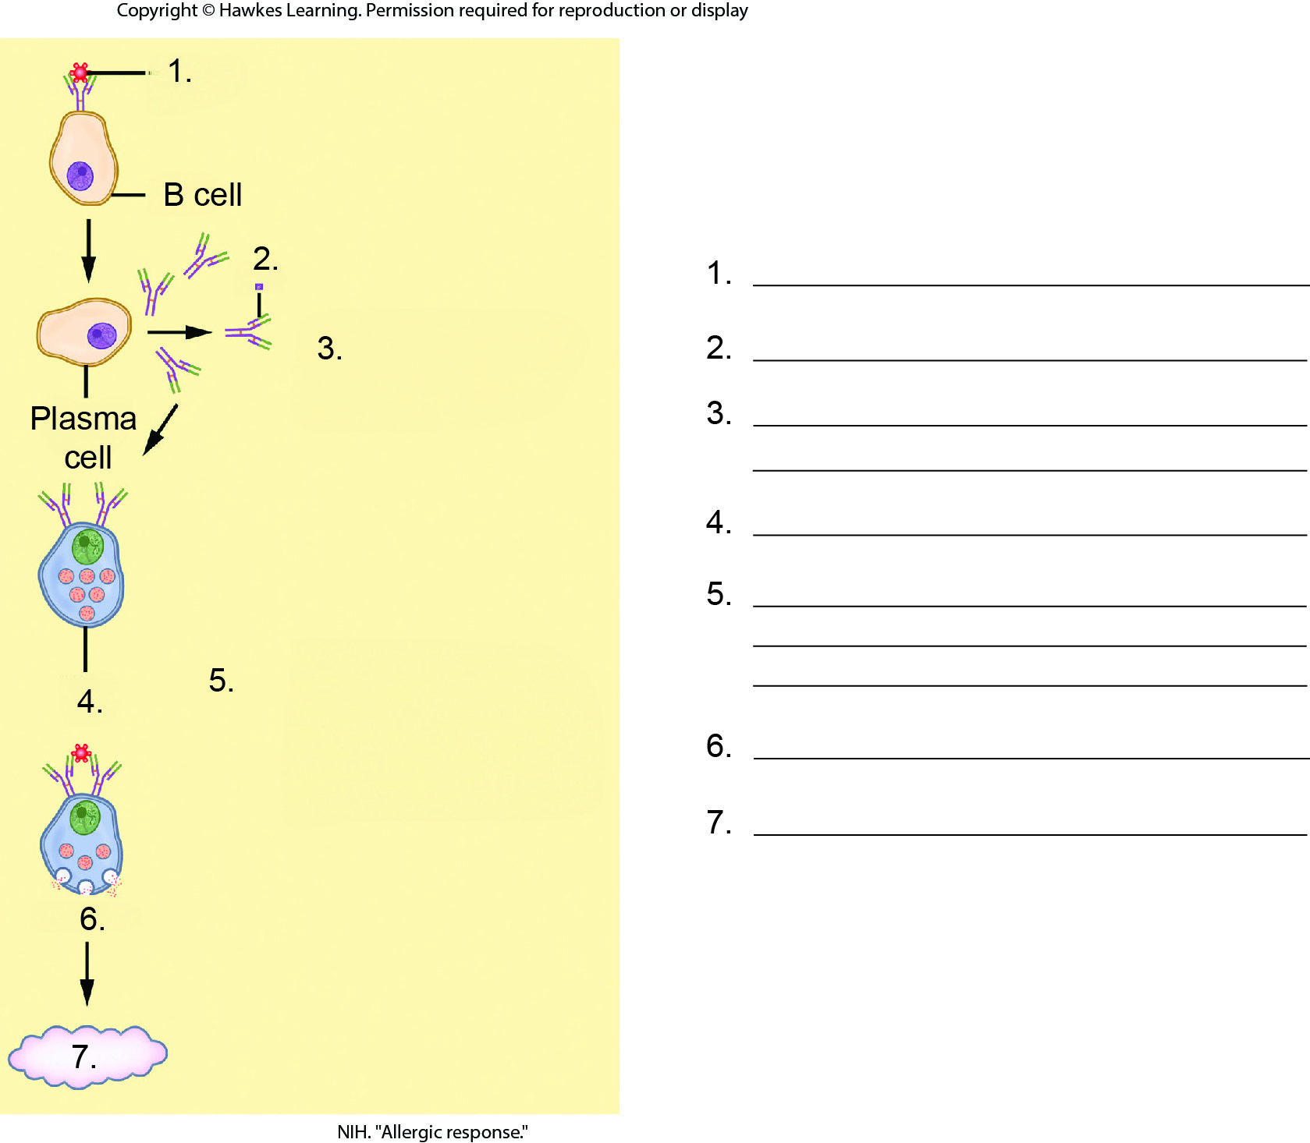
Lesson 37.2 Figure 18 - Numbered

Slide 41
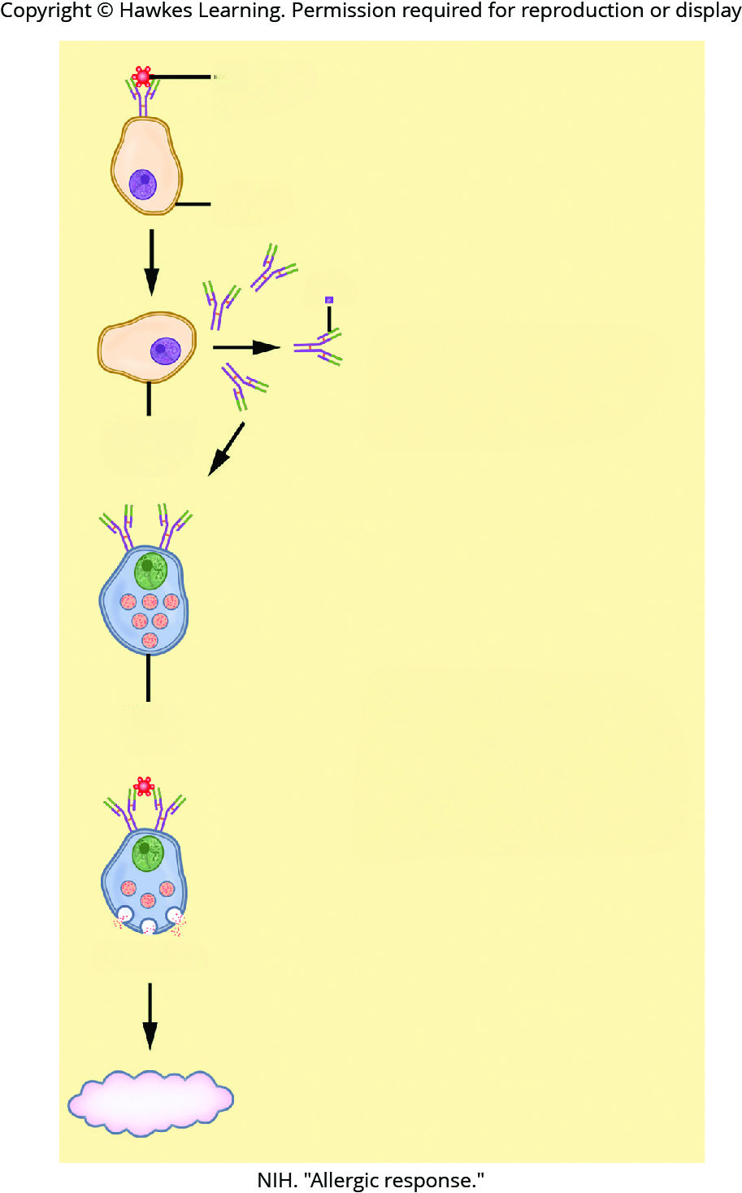
Lesson 37.2 Figure 18

Slide 42
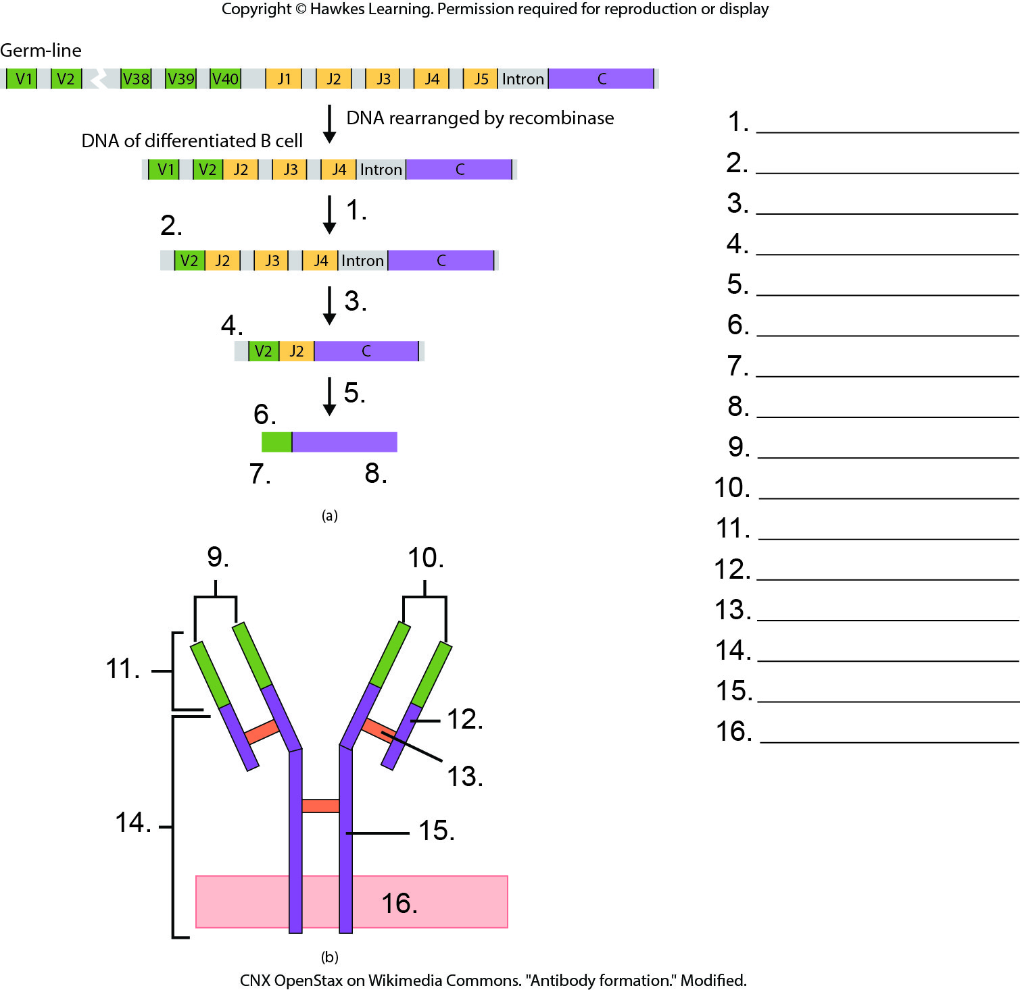
Lesson 37.3 Figure 1 - Numbered

Slide 43
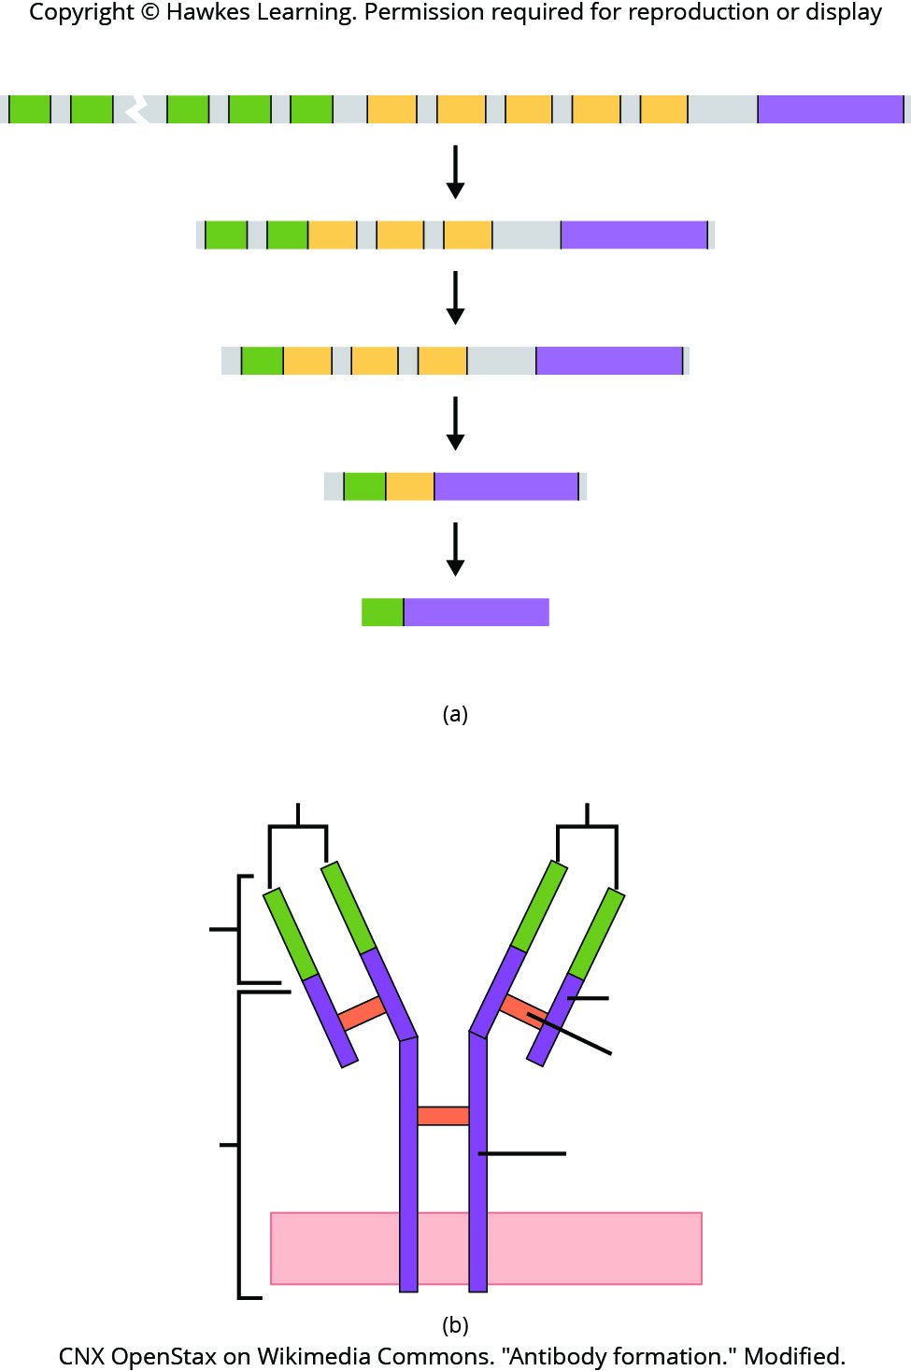
Lesson 37.3 Figure 1

Slide 44
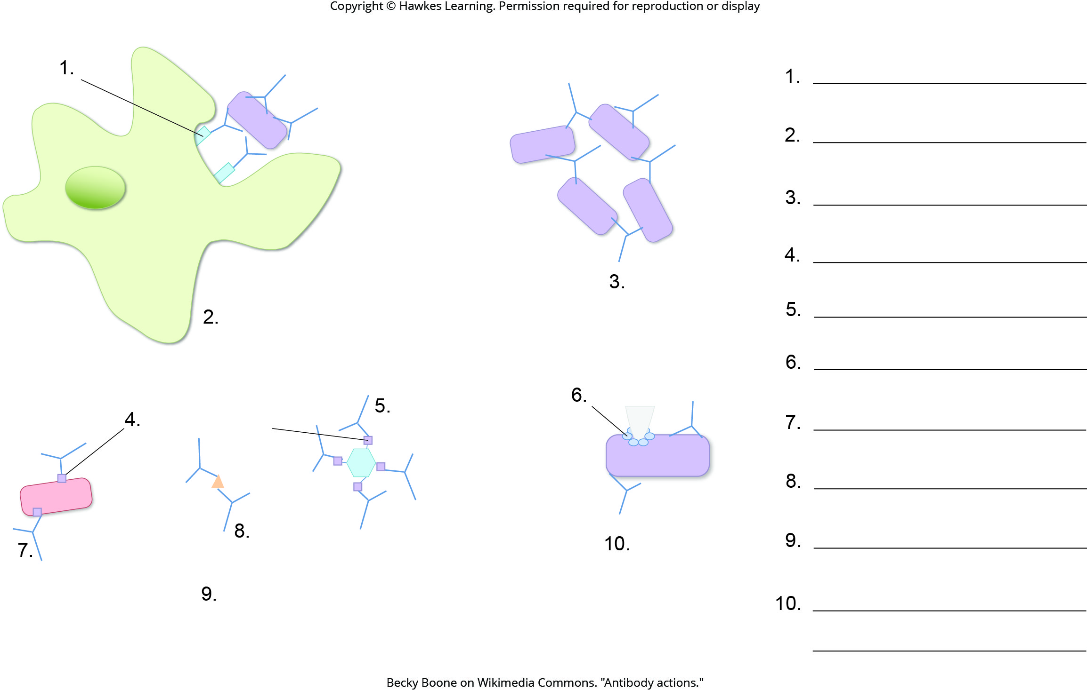
Lesson 37.3 Figure 3 - Numbered

Slide 45
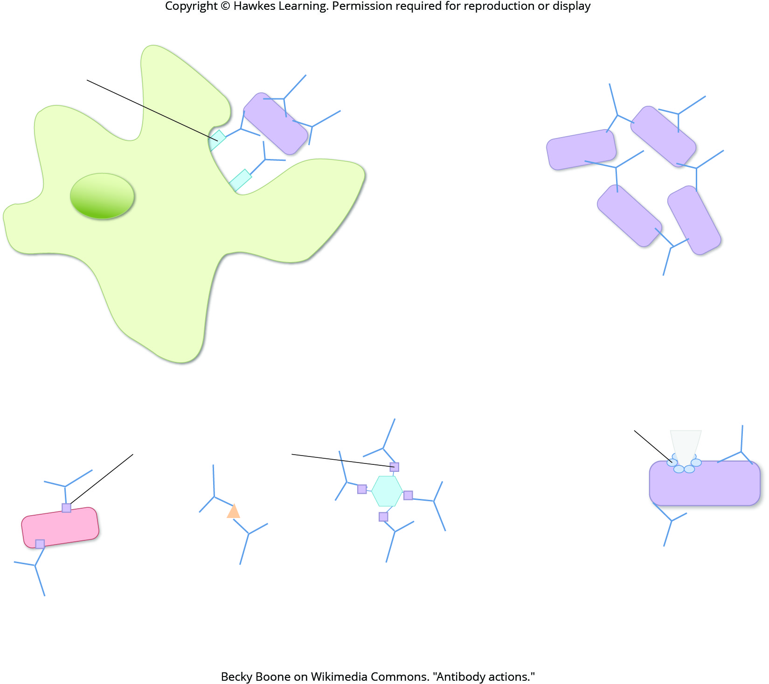
Lesson 37.3 Figure 3

Slide 46
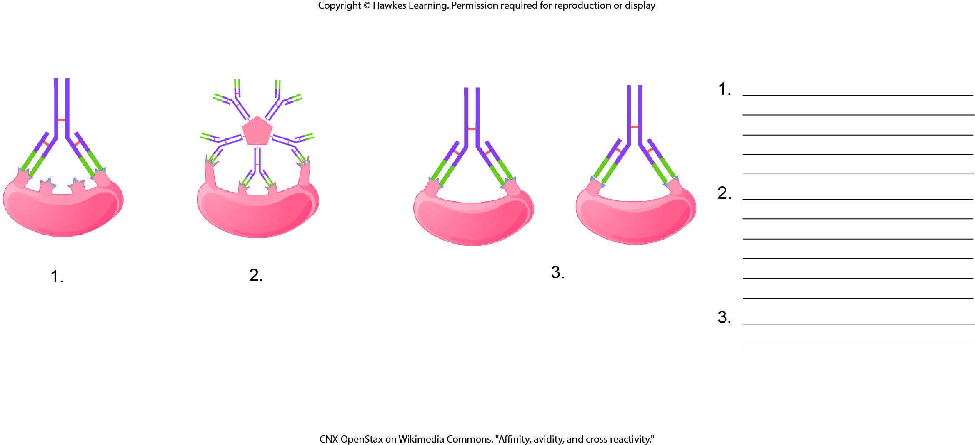
Lesson 37.3 Figure 4 - Numbered

Slide 47
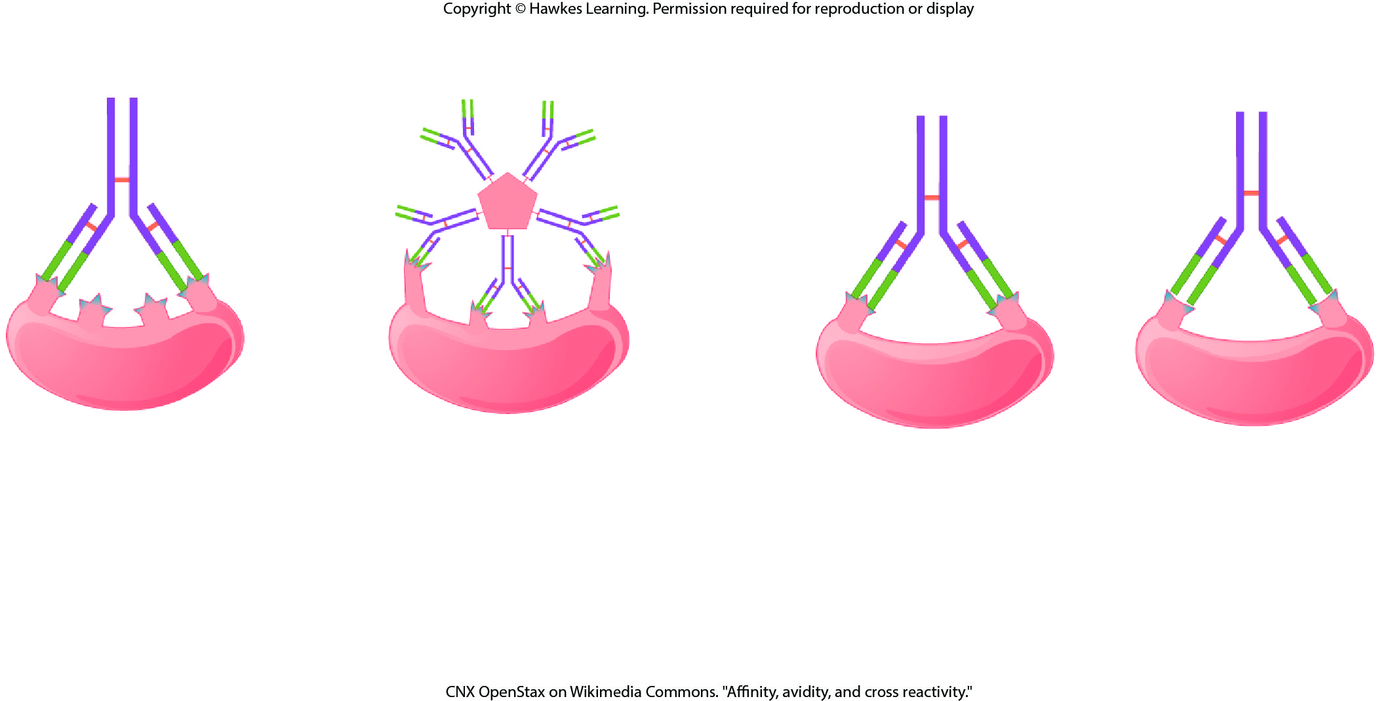
Lesson 37.3 Figure 4

Slide 48
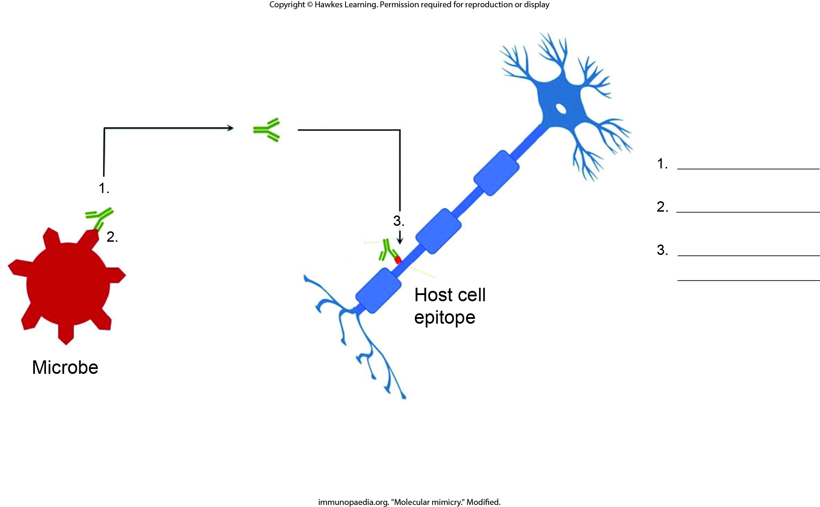
Lesson 37.3 Figure 5 - Numbered

Slide 49
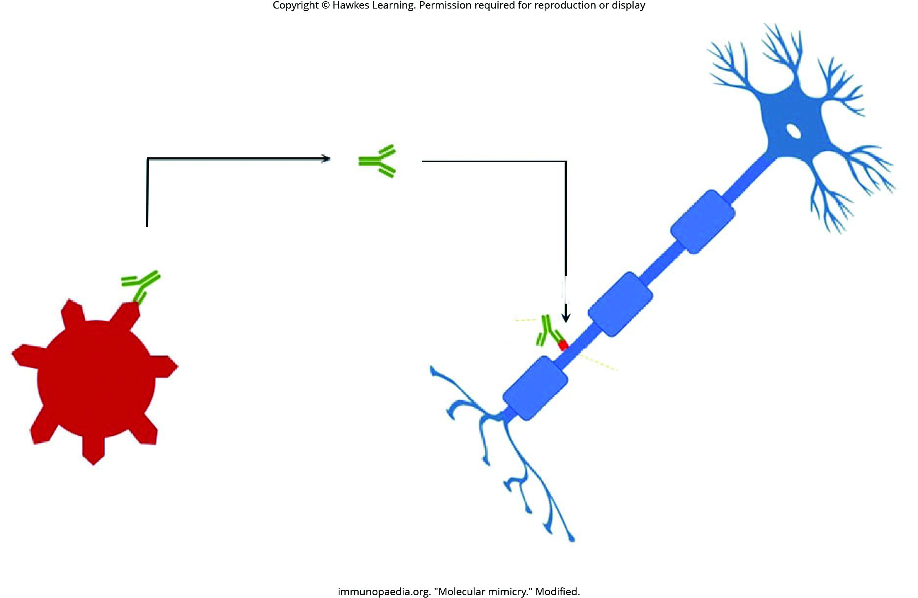
Lesson 37.3 Figure 5

Slide 50
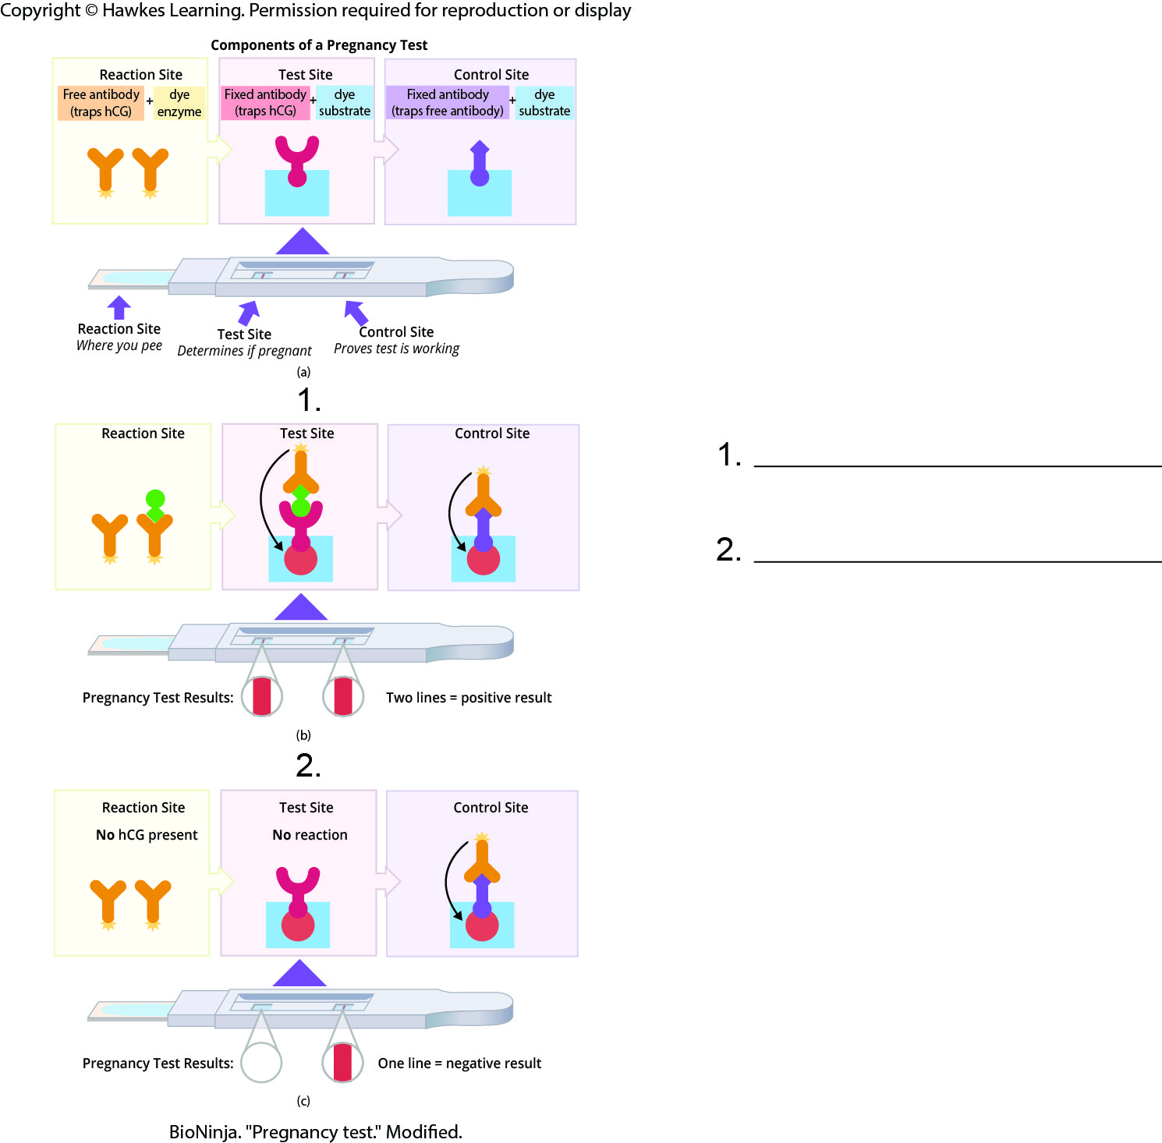
Lesson 37.3 Figure 7 - Numbered

Slide 51
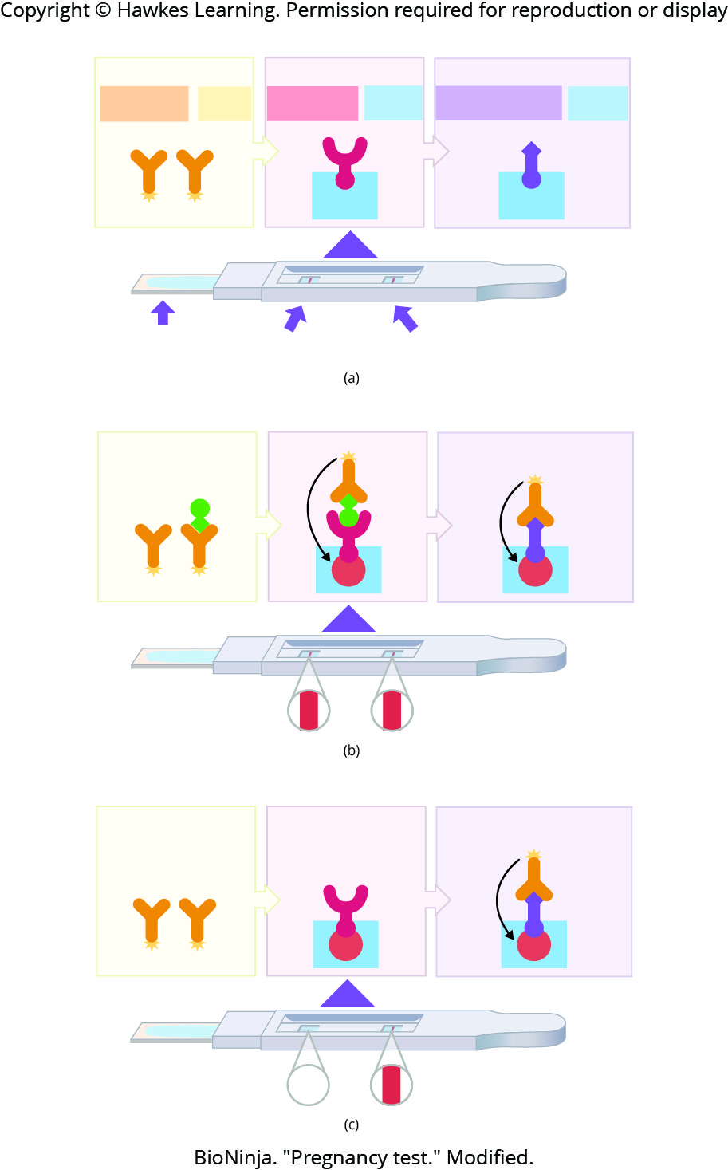
Lesson 37.3 Figure 7

Slide 52
Hawkes Learning – End of PowerPoint

