Slide 1
Chapter 39
The Endocrine System

Slide 2
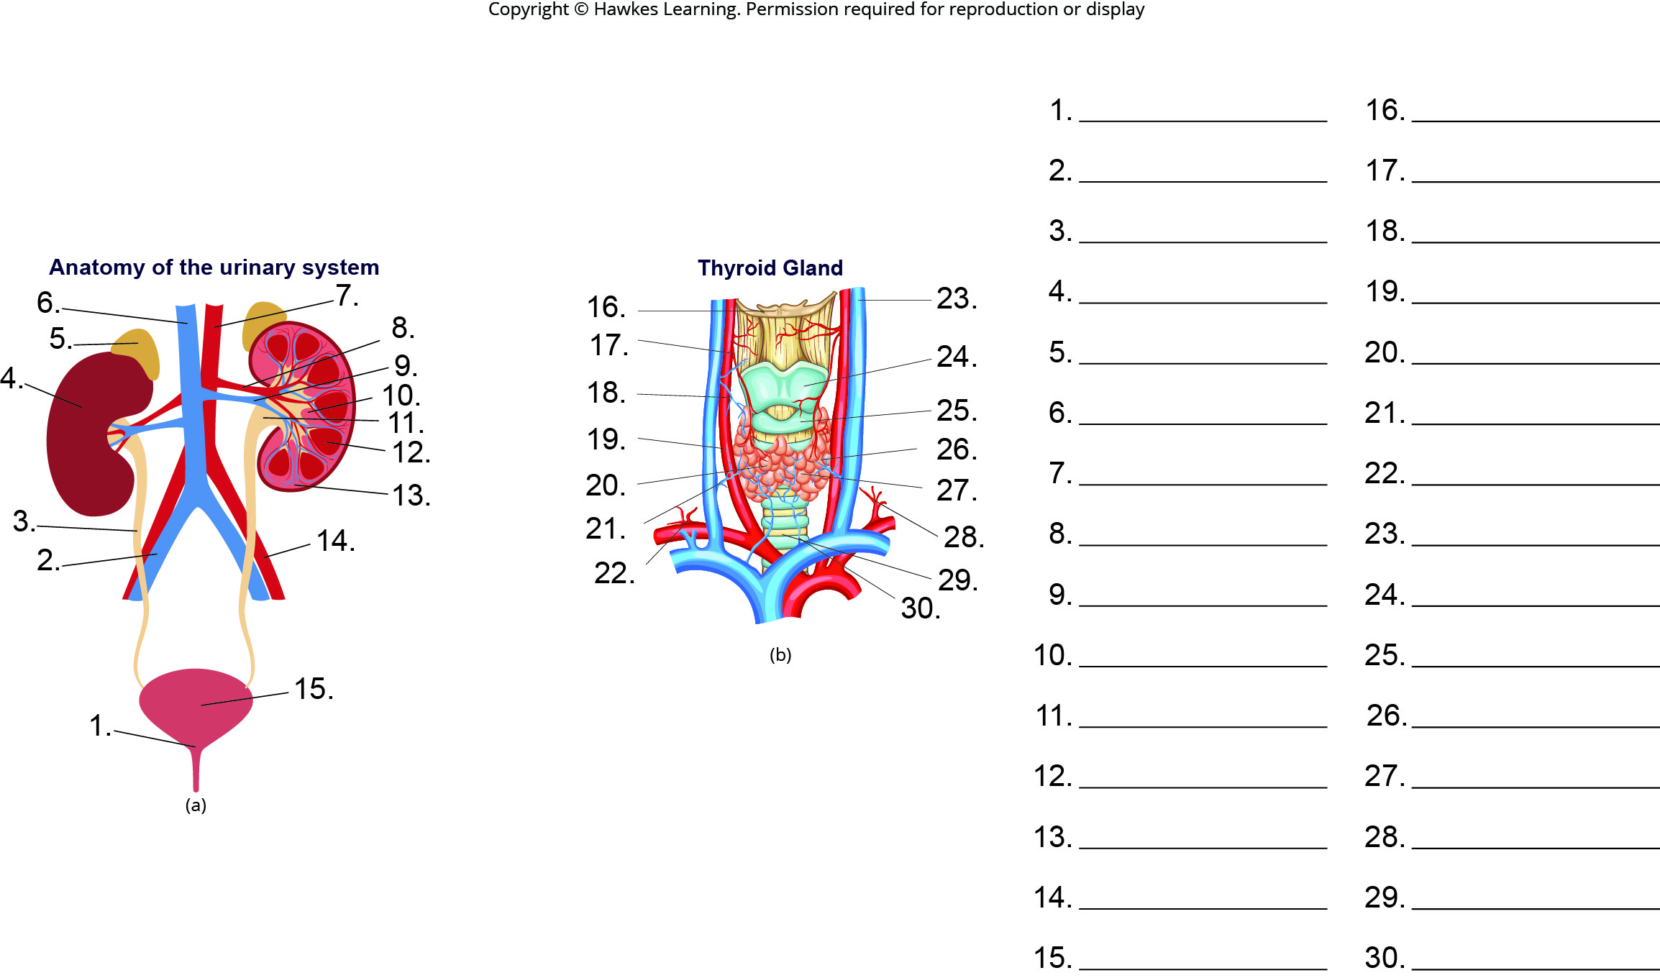
Lesson 39.1 Figure 2 - Numbered

Slide 3
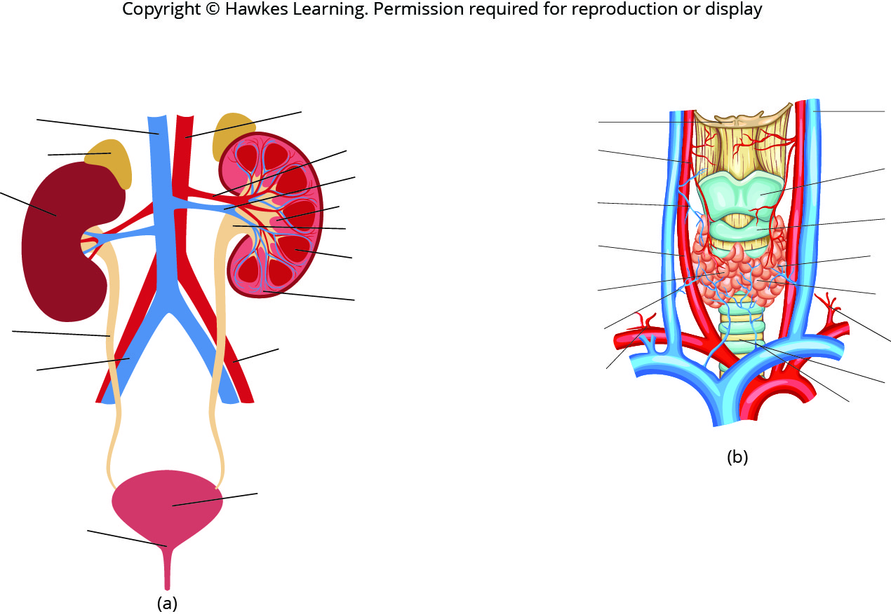
Lesson 39.1 Figure 2

Slide 4
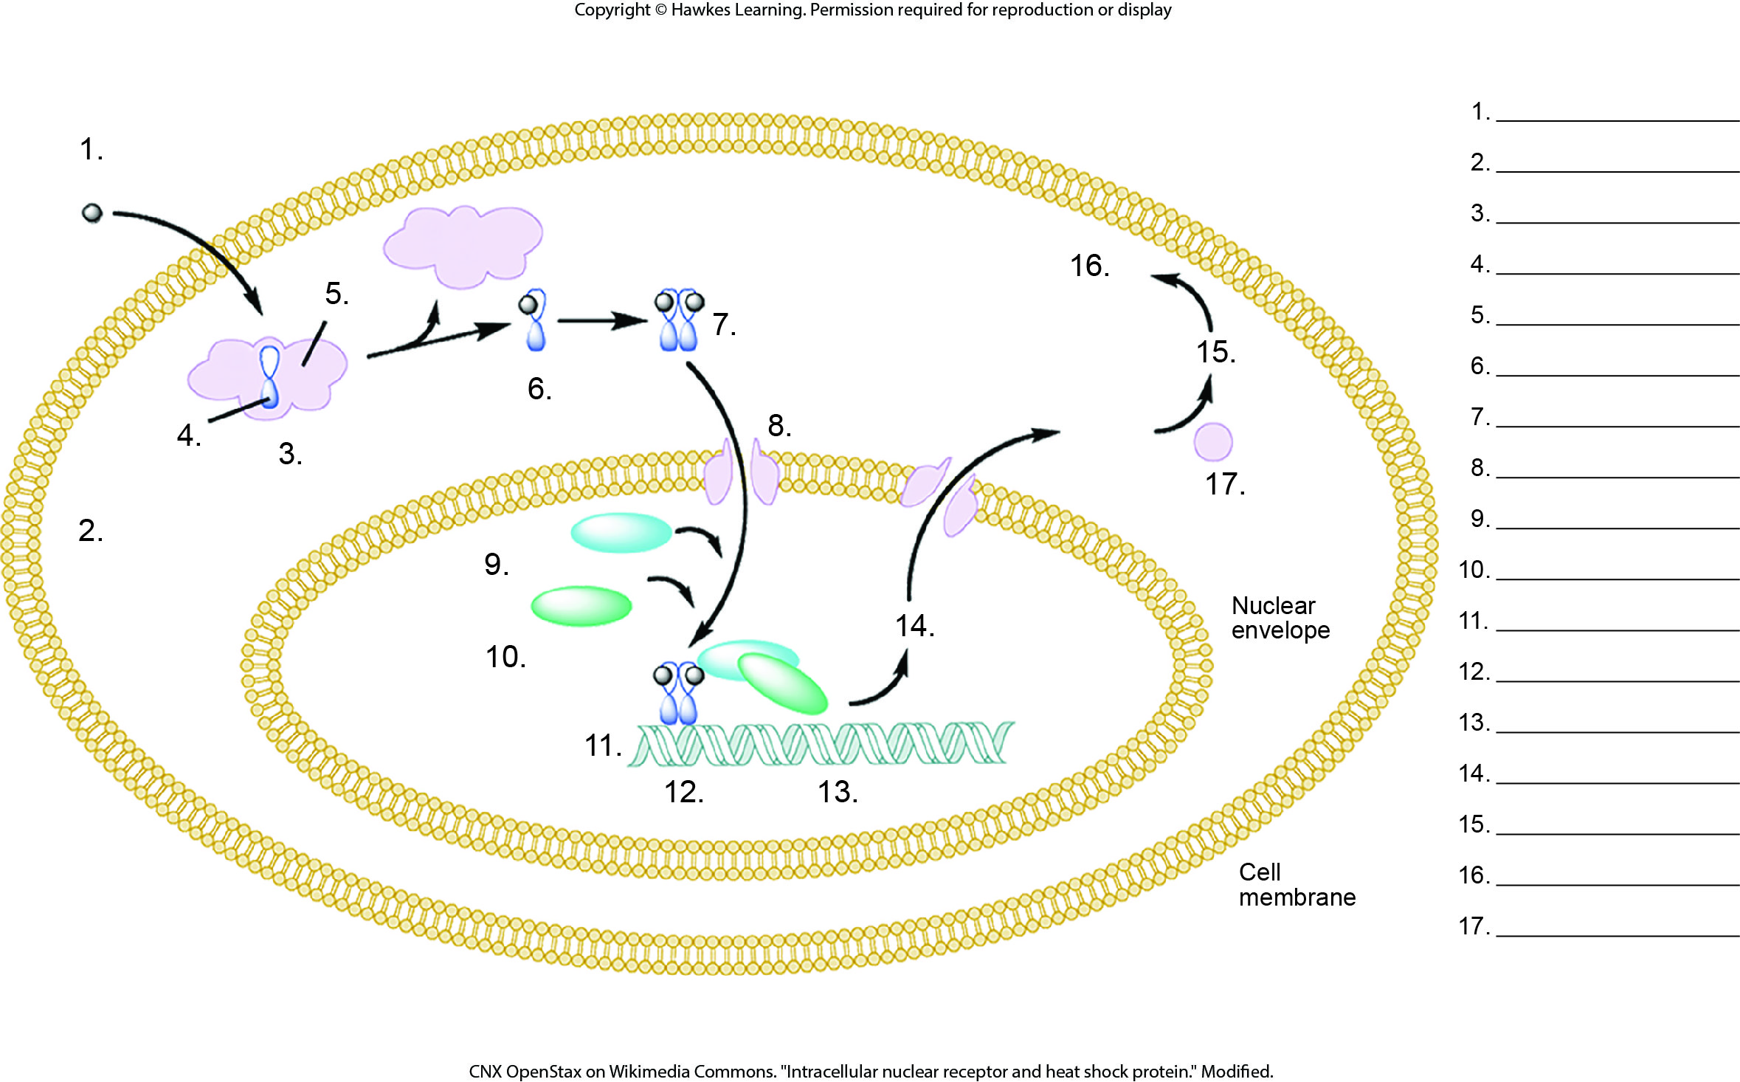
Lesson 39.1 Figure 7 - Numbered

Slide 5
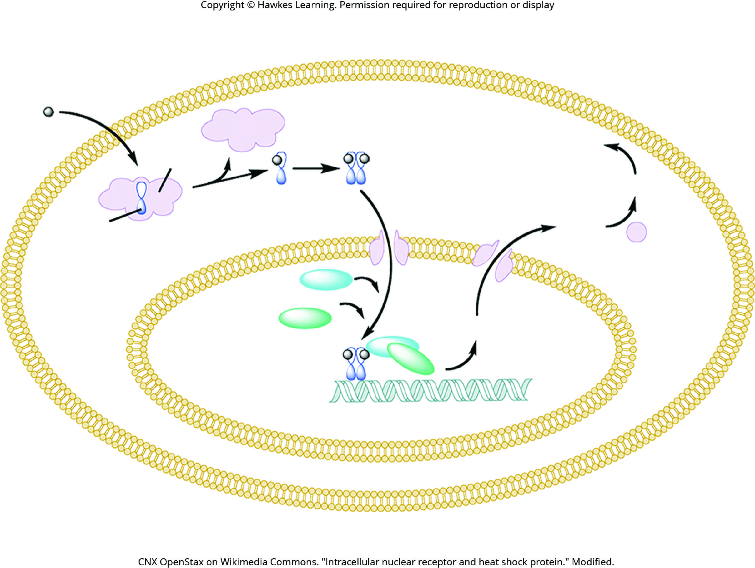
Lesson 39.1 Figure 7

Slide 6
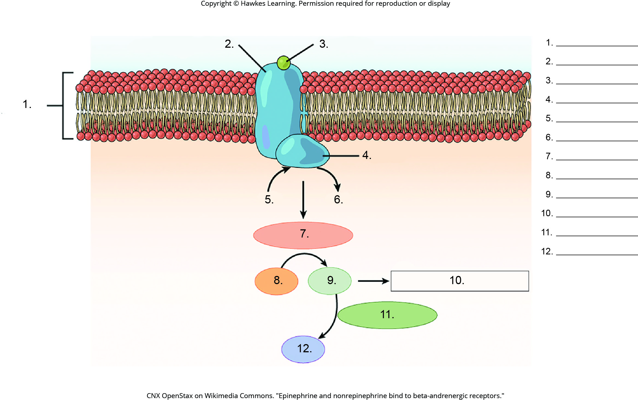
Lesson 39.1 Figure 8 - Numbered

Slide 7
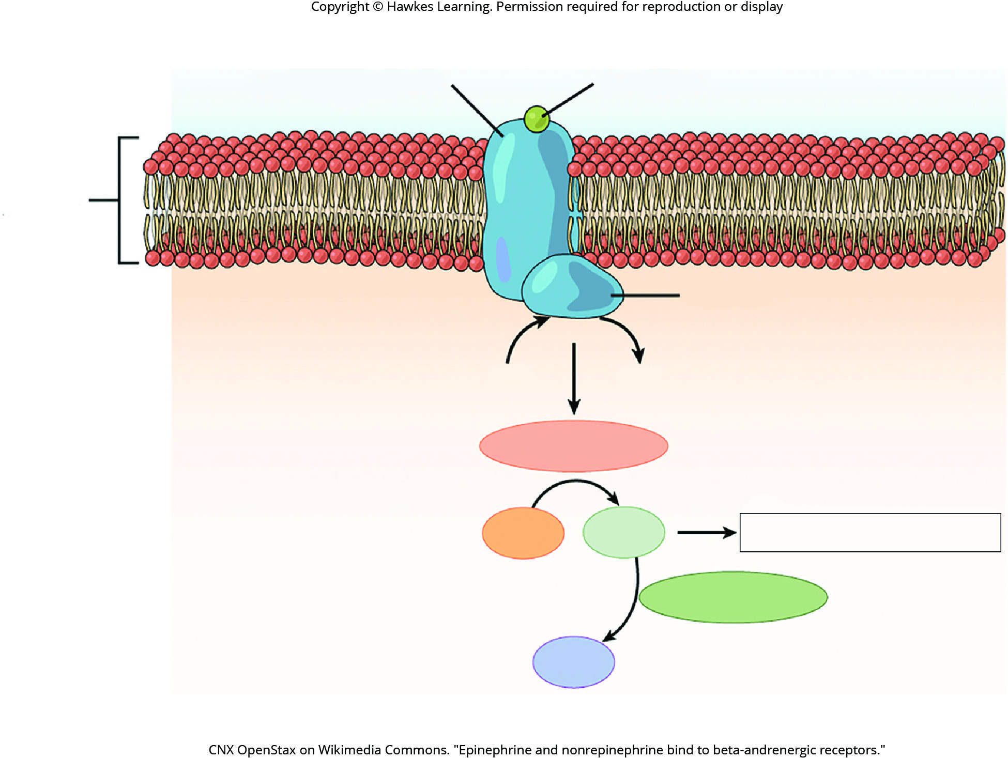
Lesson 39.1 Figure 8

Slide 8
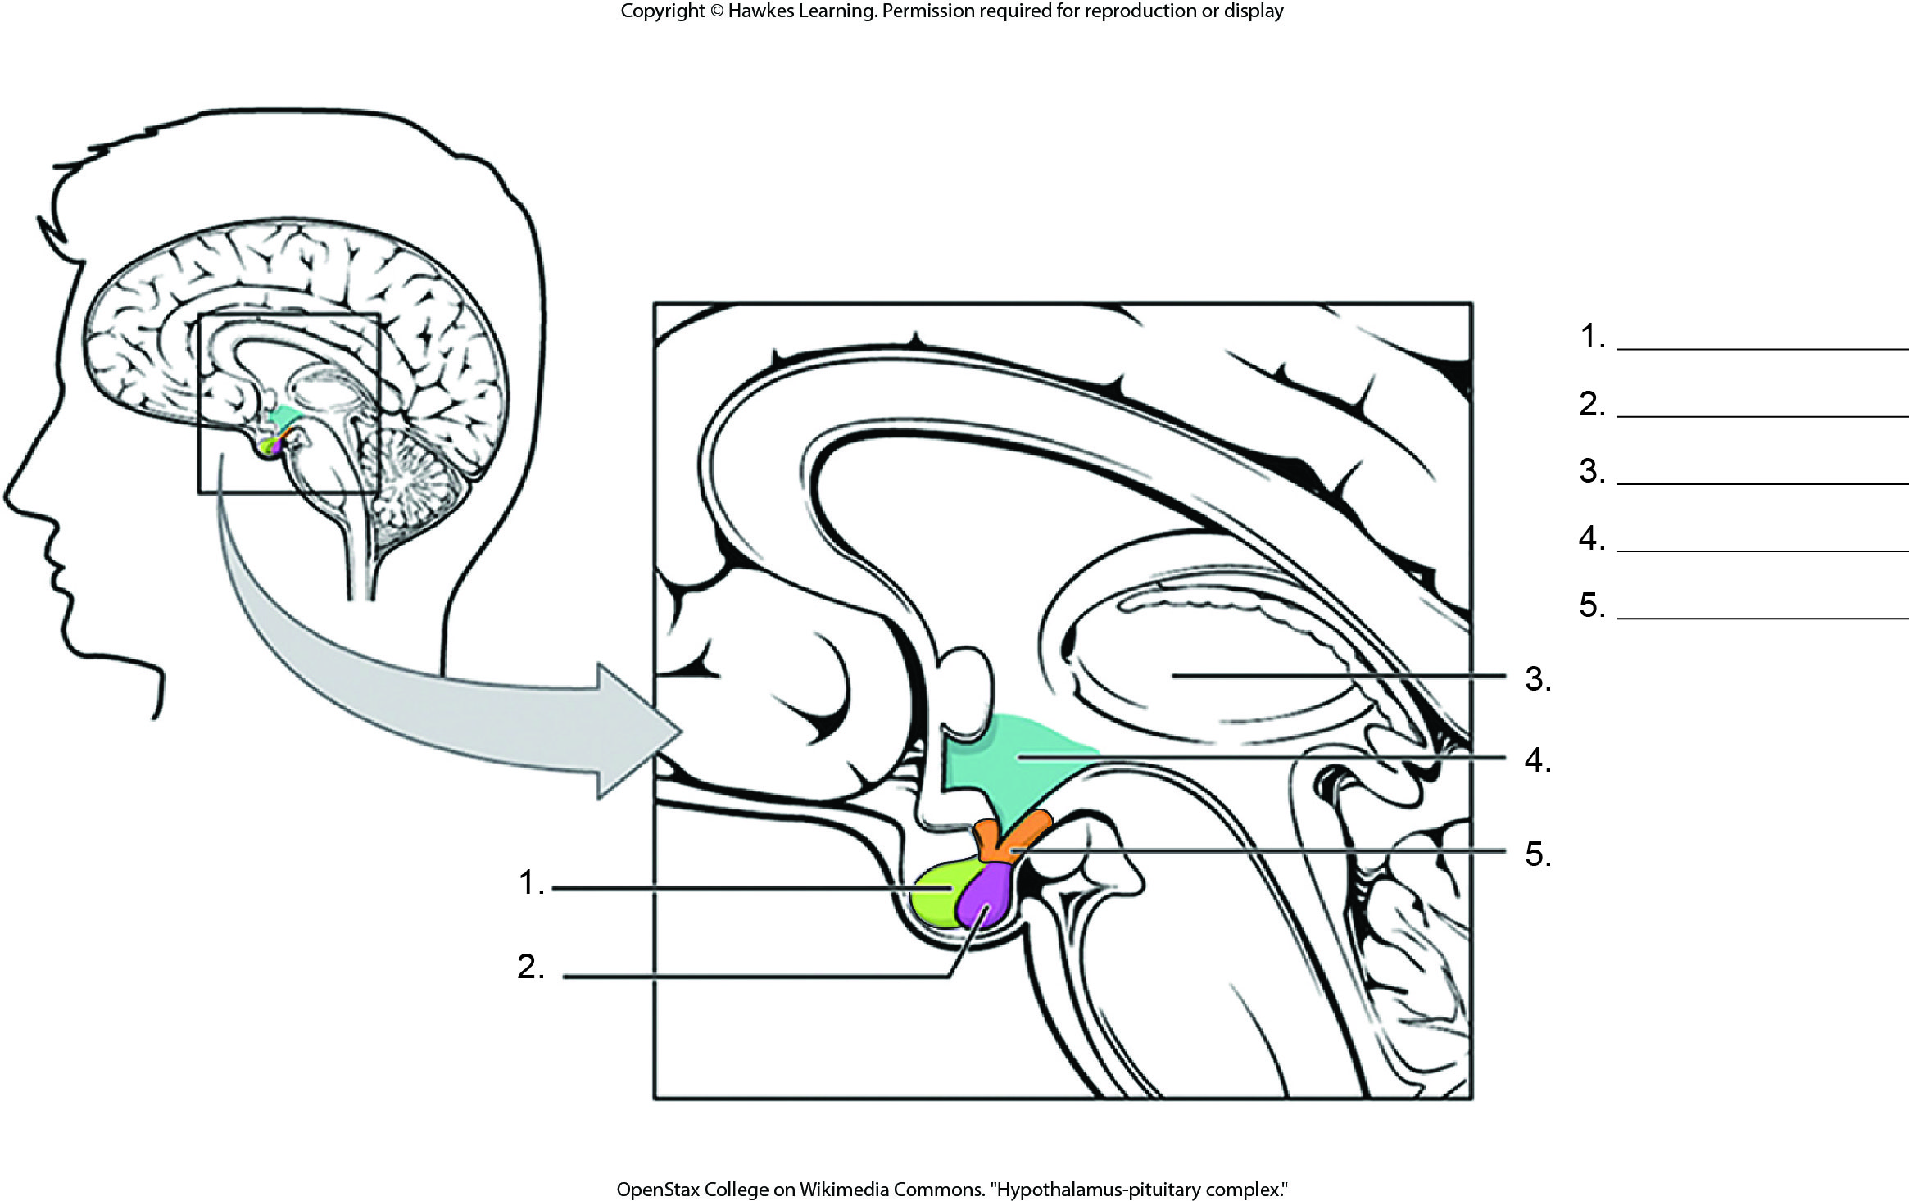
Lesson 39.2 Figure 1 - Numbered

Slide 9
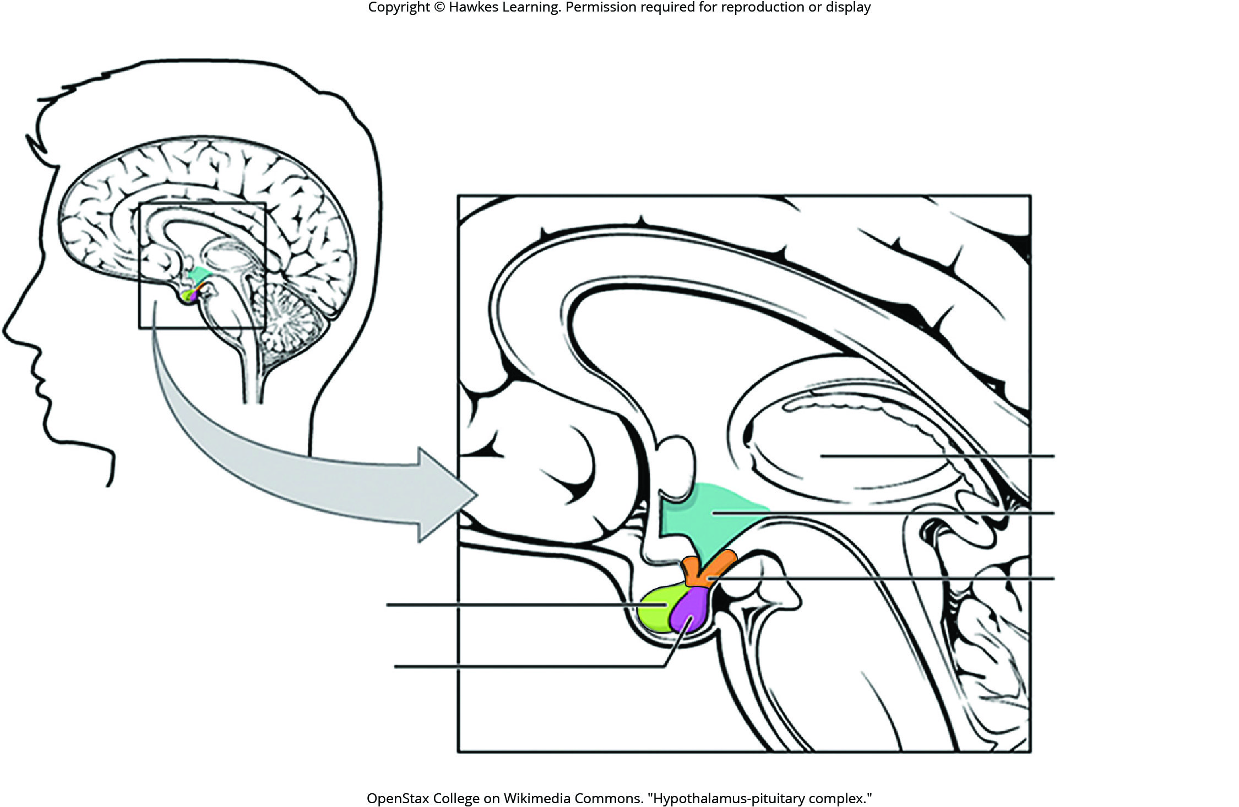
Lesson 39.2 Figure 1

Slide 10
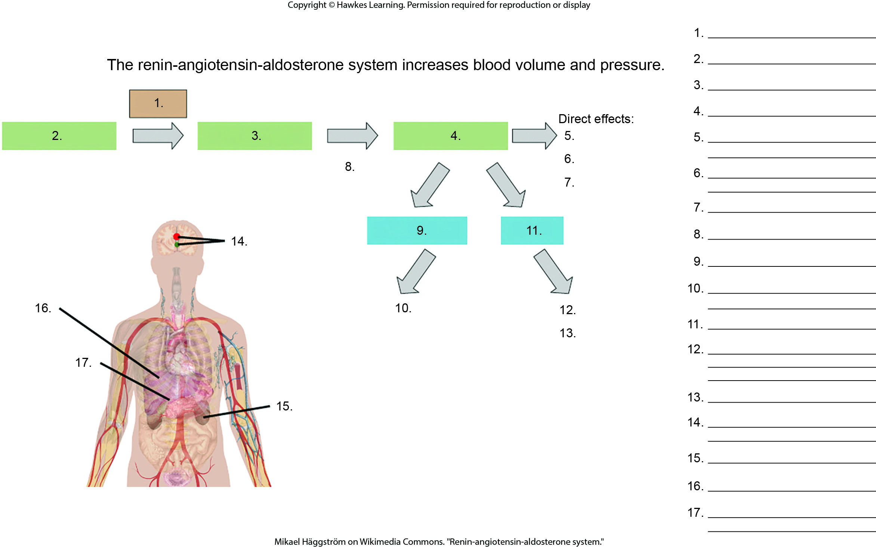
Lesson 39.2 Figure 2 - Numbered

Slide 11
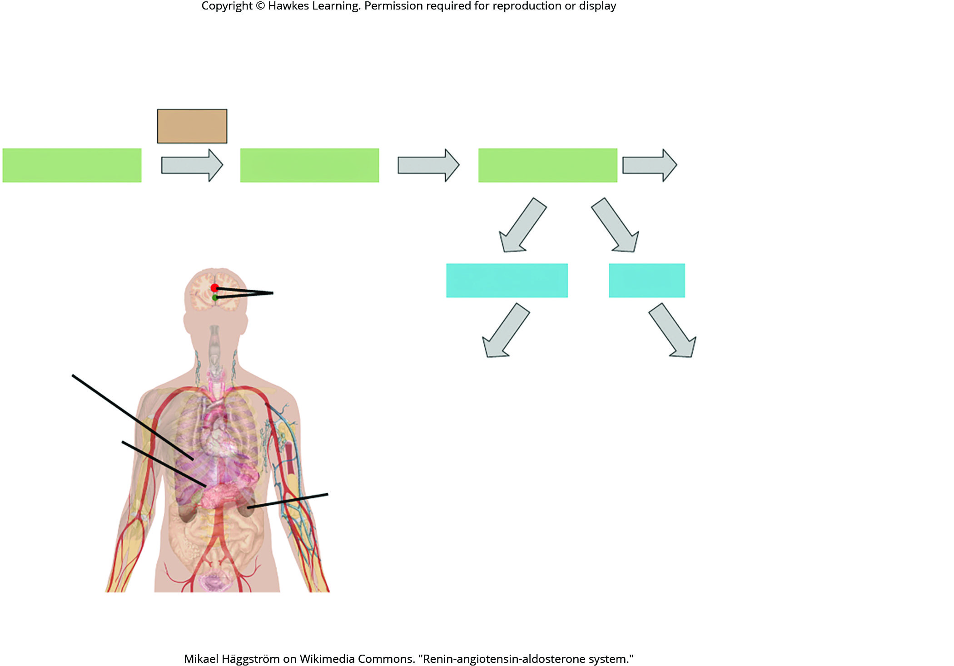
Lesson 39.2 Figure 2

Slide 12
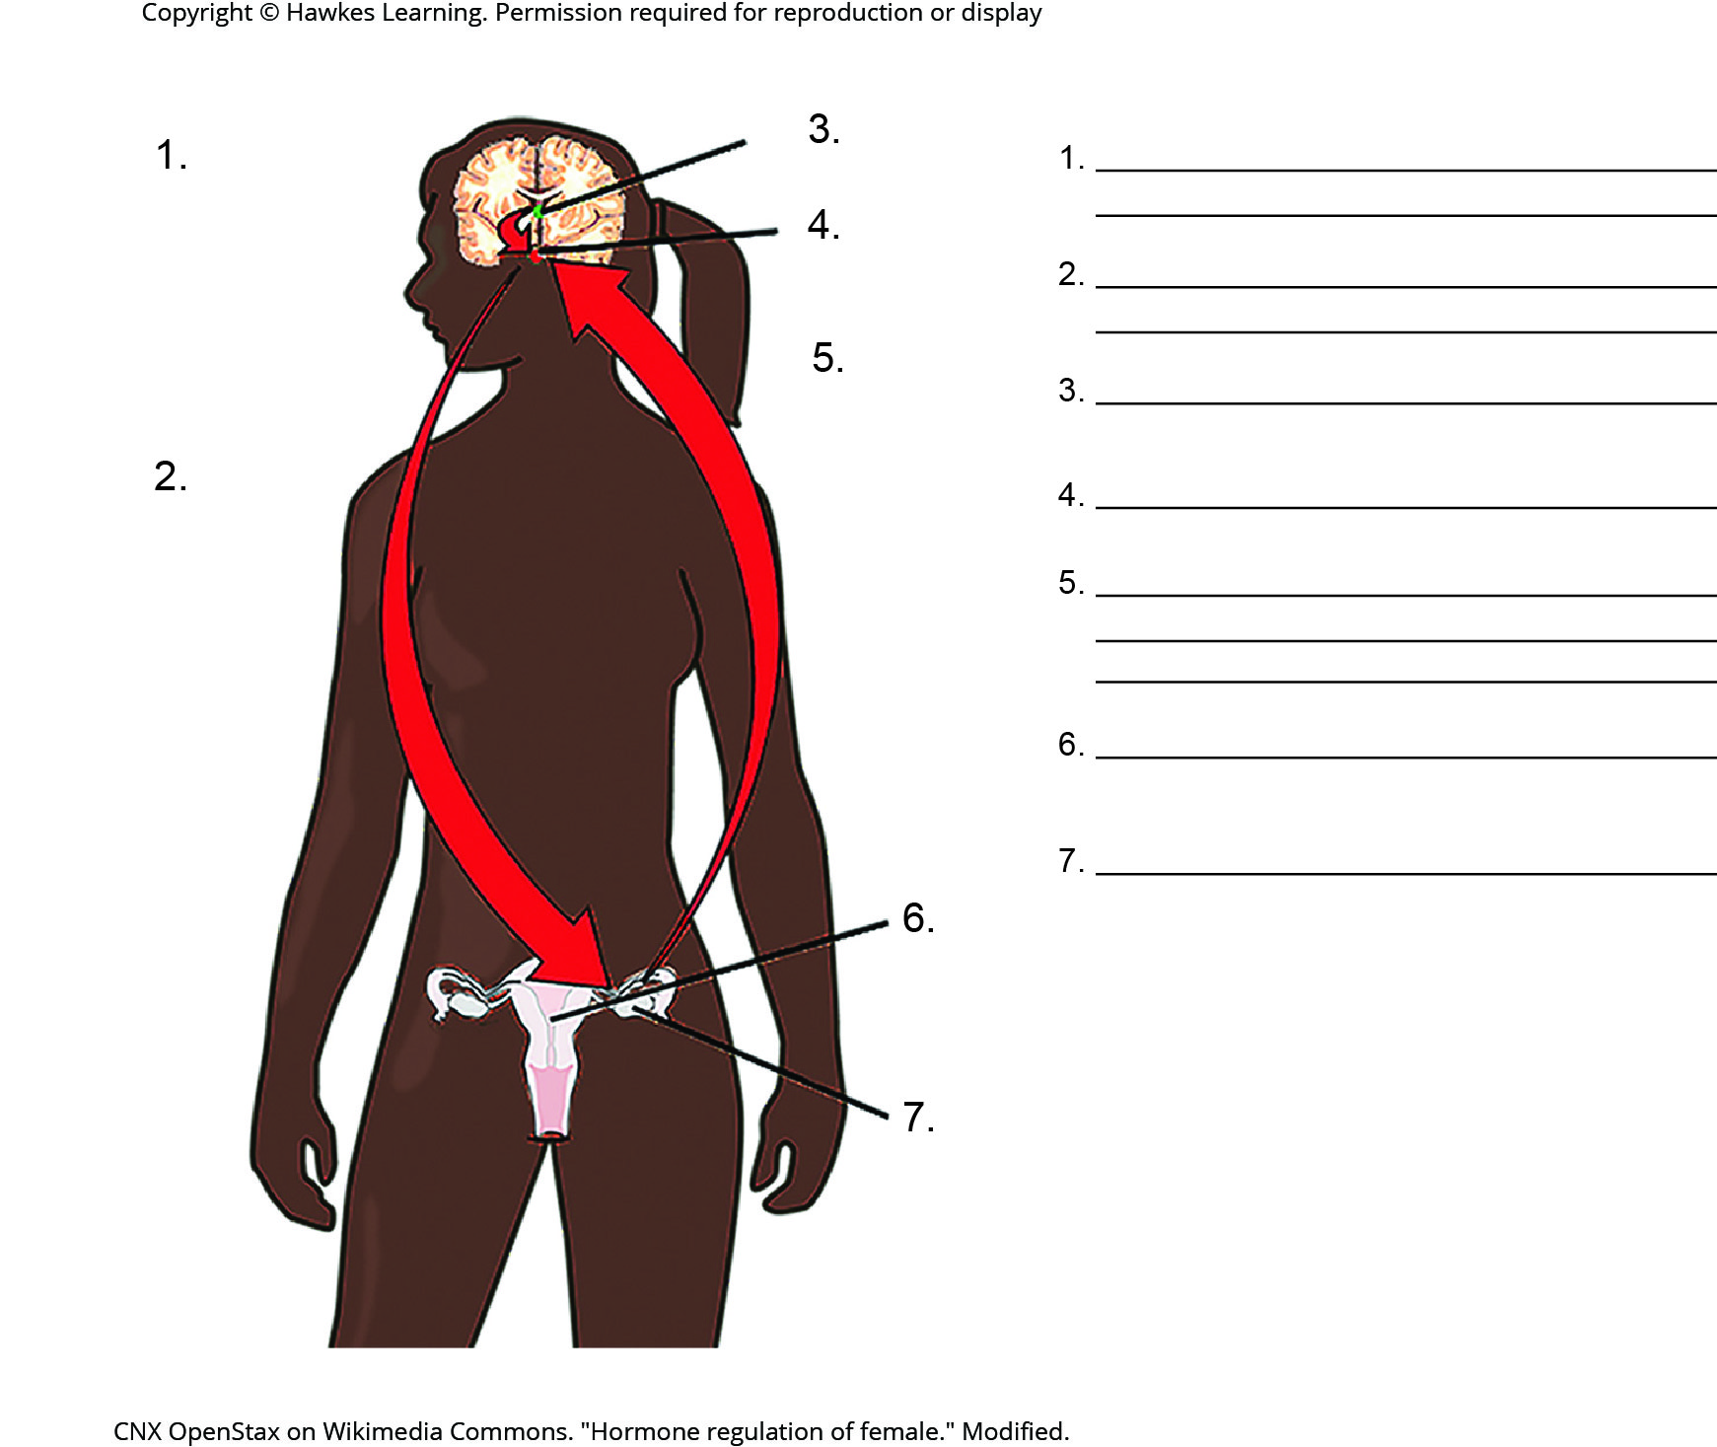
Lesson 39.2 Figure 4 - Numbered

Slide 13
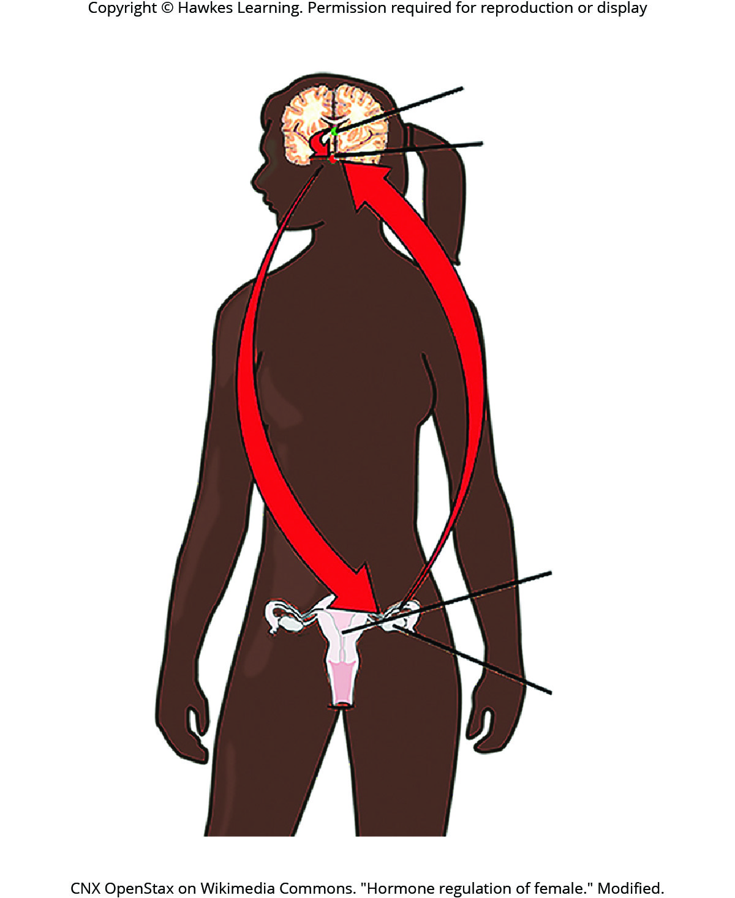
Lesson 39.2 Figure 4

Slide 14
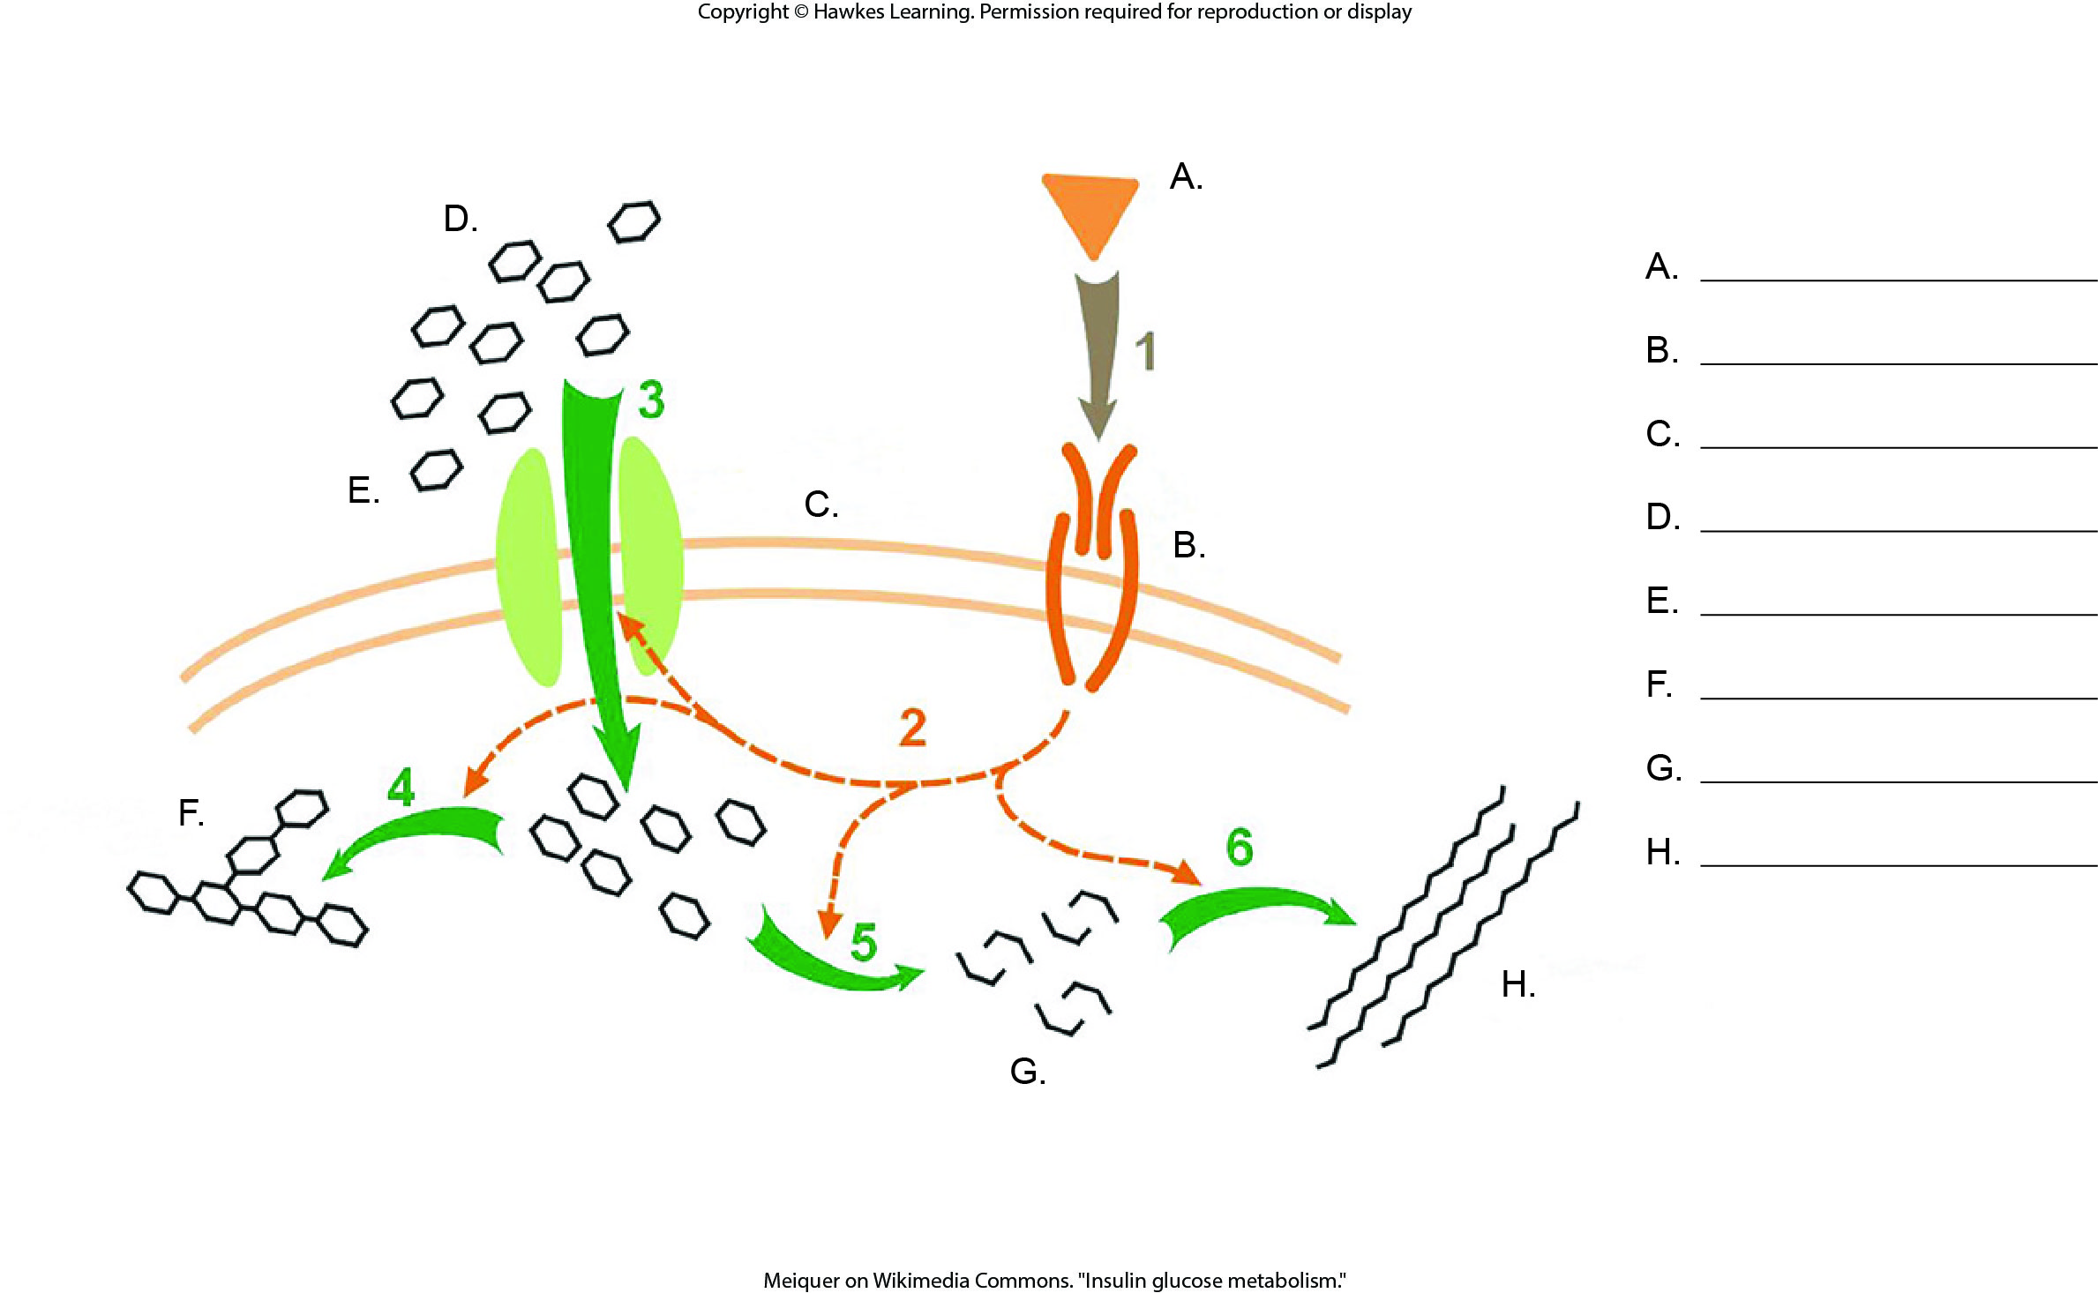
Lesson 39.2 Figure 5 - Numbered

Slide 15
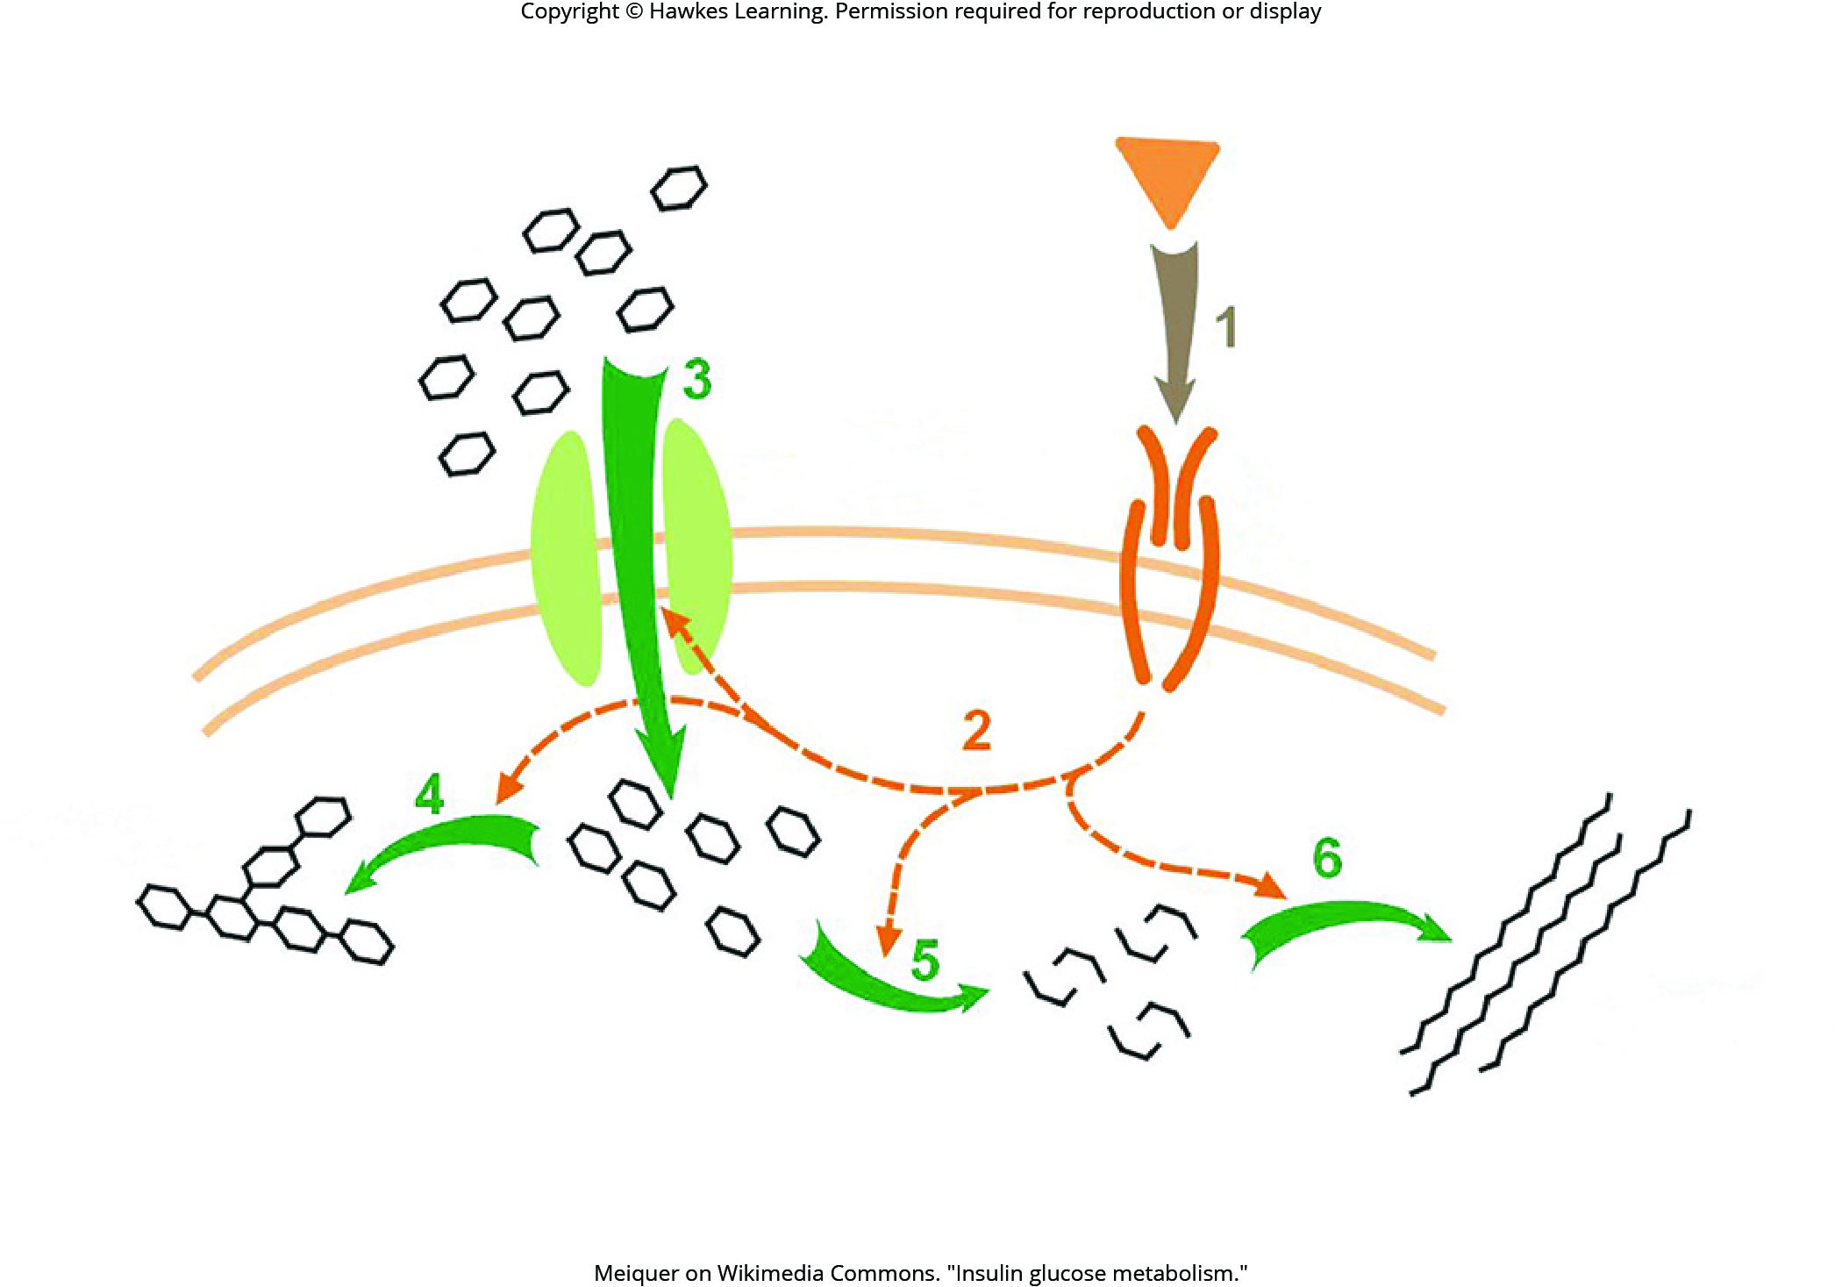
Lesson 39.2 Figure 5

Slide 16
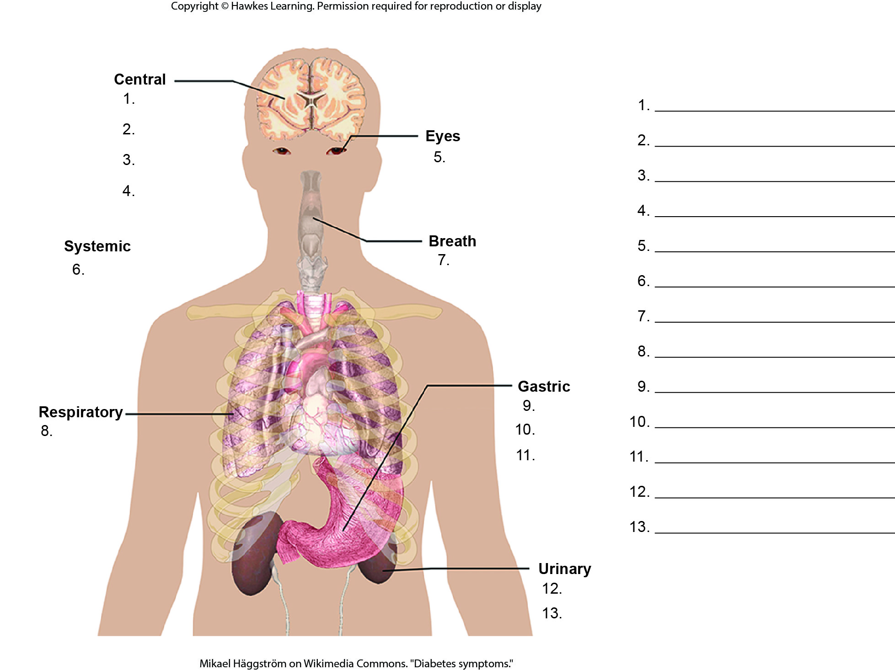
Lesson 39.2 Figure 6 - Numbered

Slide 17
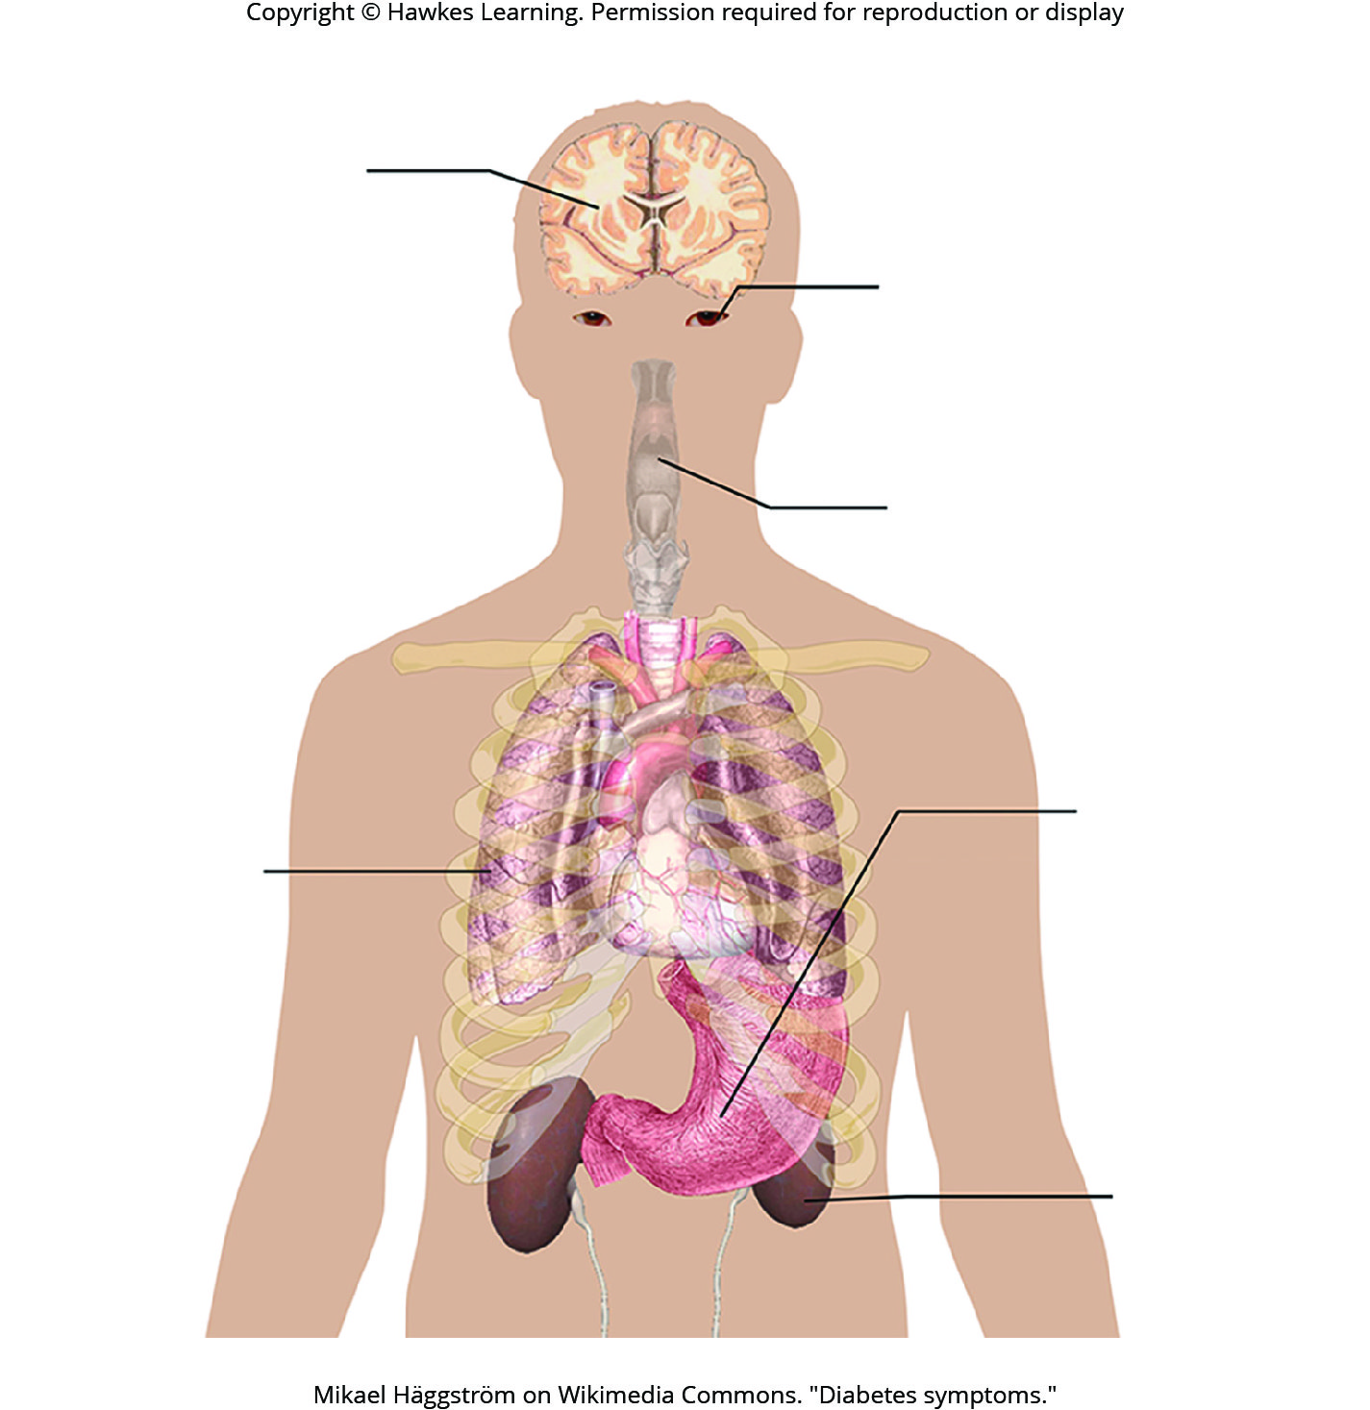
Lesson 39.2 Figure 6

Slide 18
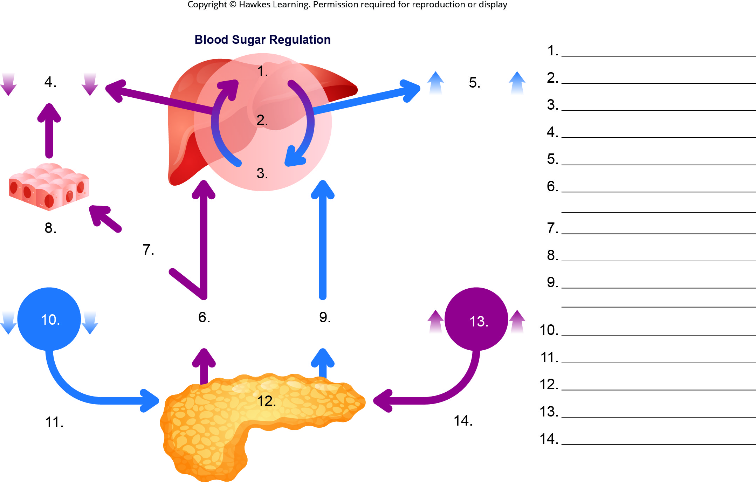
Lesson 39.2 Figure 7 - Numbered

Slide 19
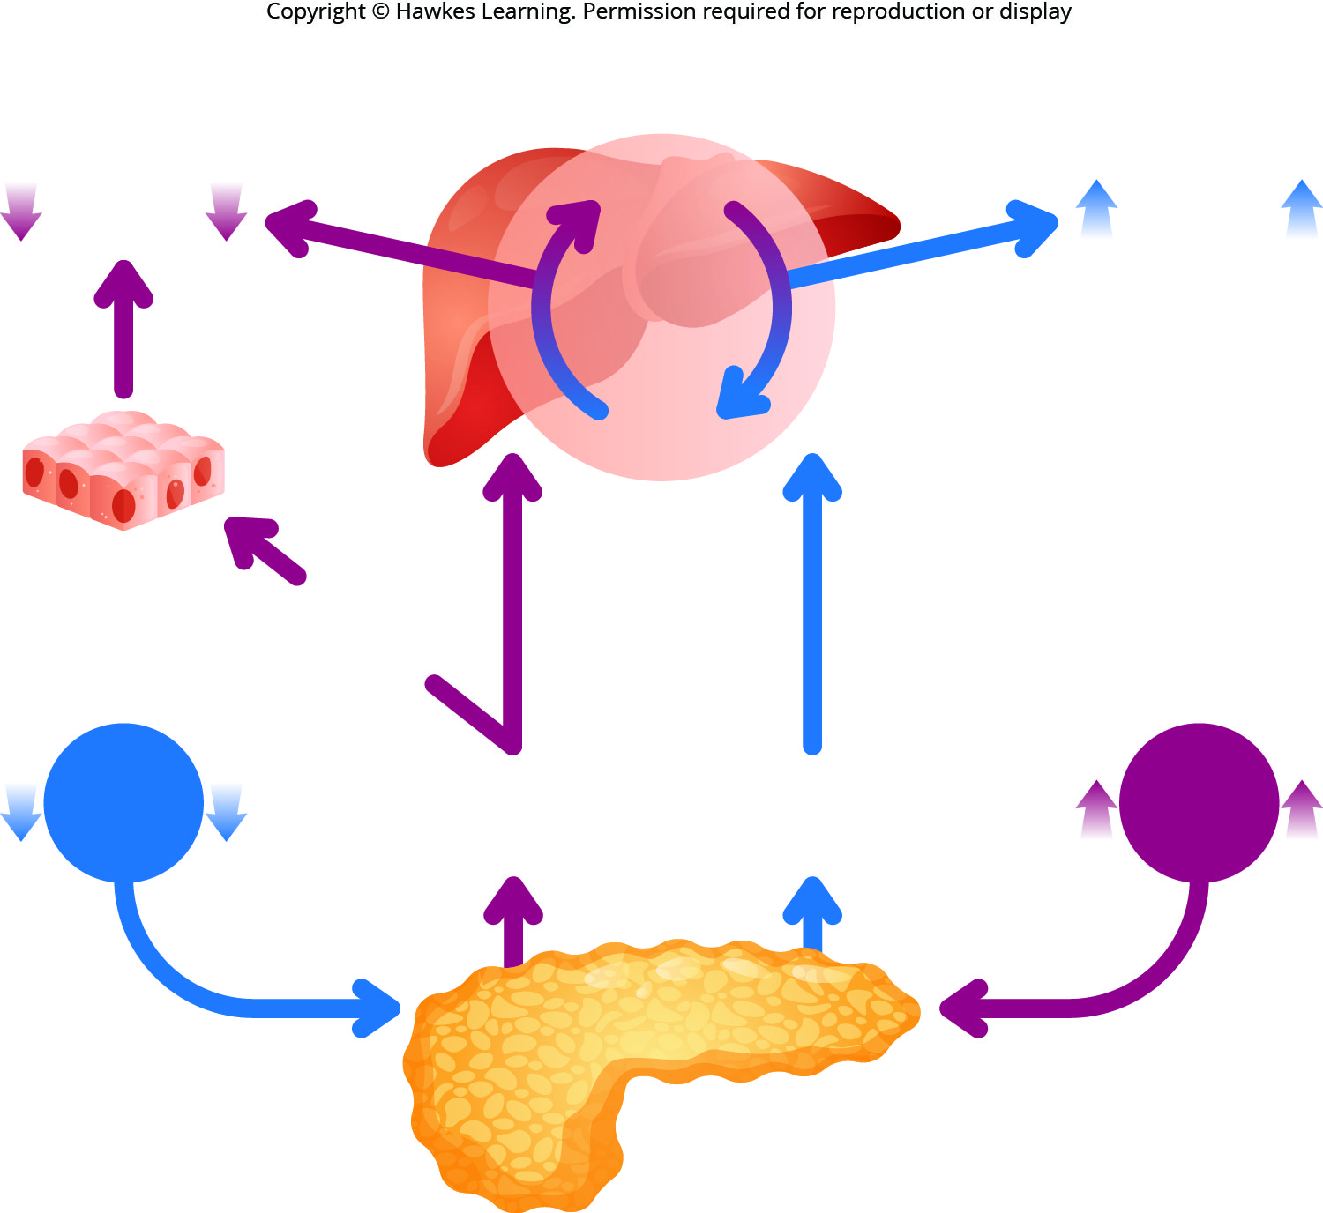
Lesson 39.2 Figure 7

Slide 20
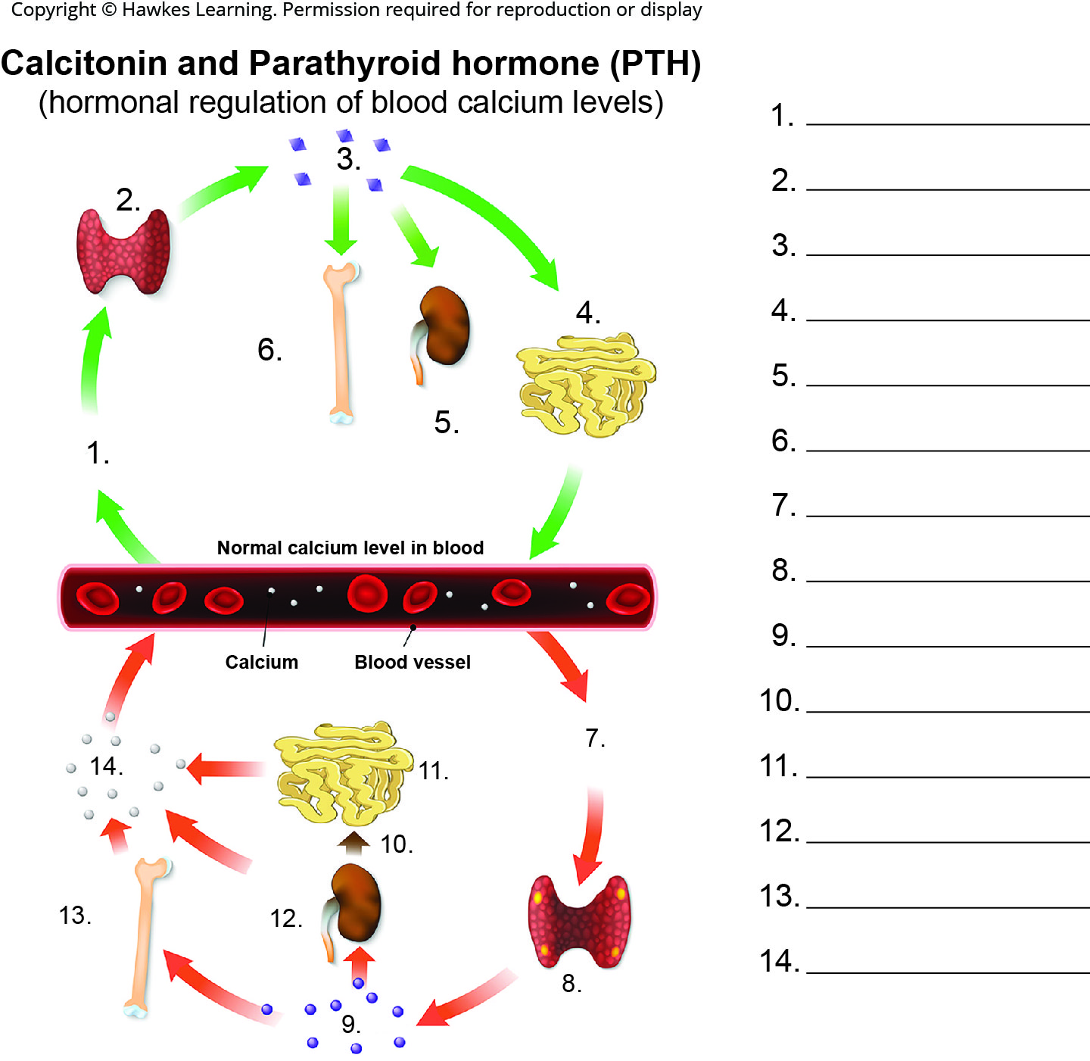
Lesson 39.2 Figure 9 - Numbered

Slide 21
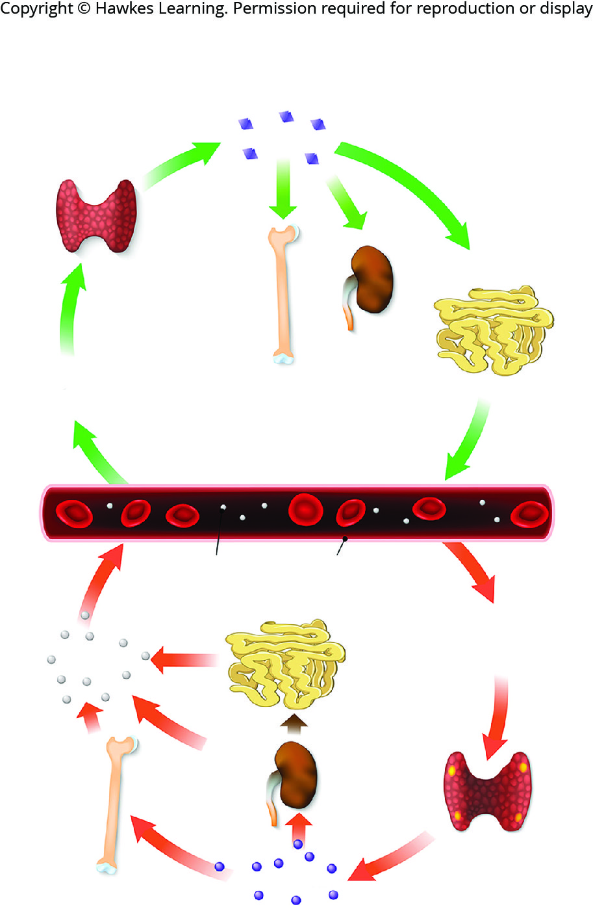
Lesson 39.2 Figure 9

Slide 22
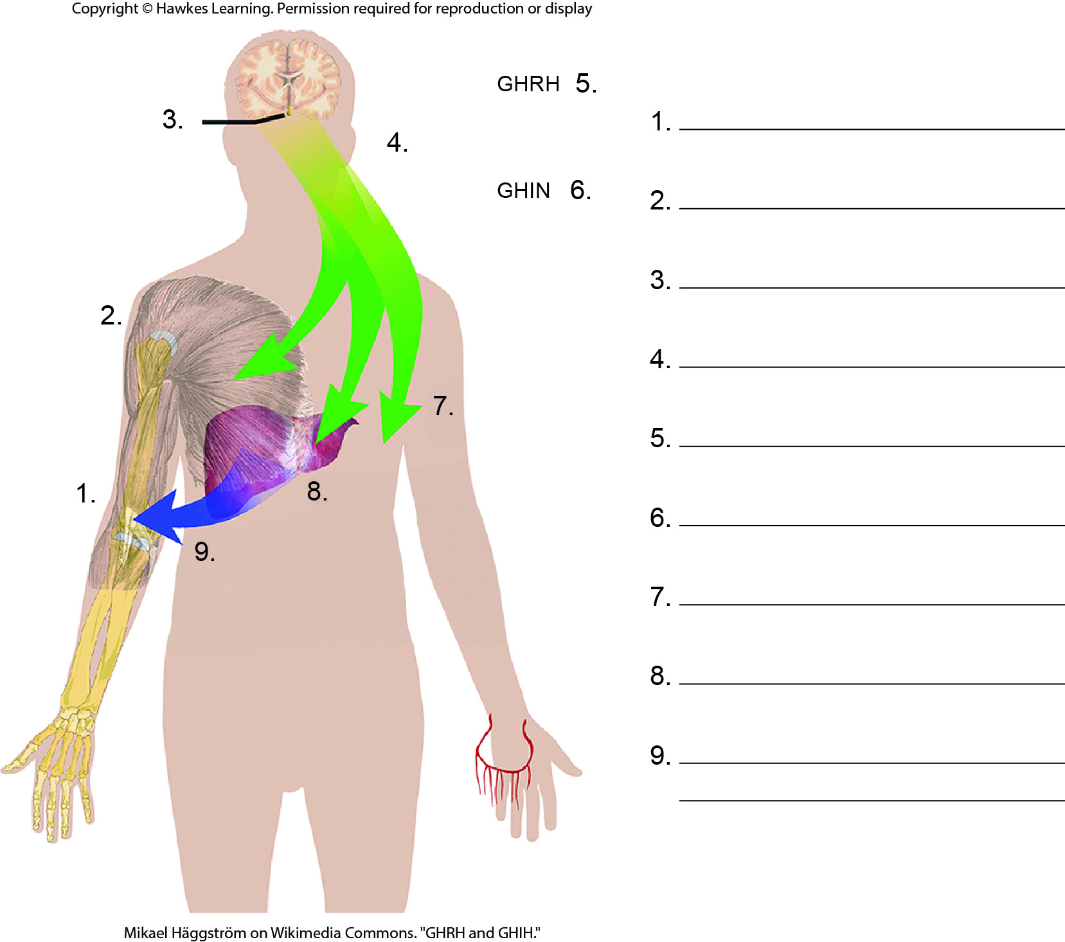
Lesson 39.2 Figure 10 - Numbered

Slide 23
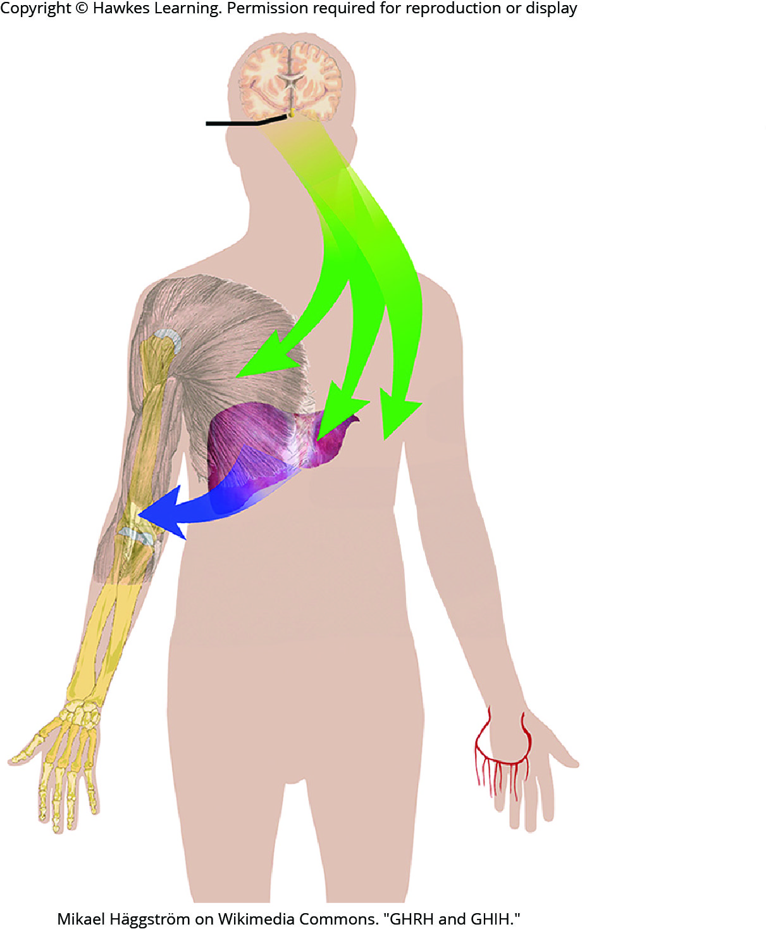
Lesson 39.2 Figure 10

Slide 24
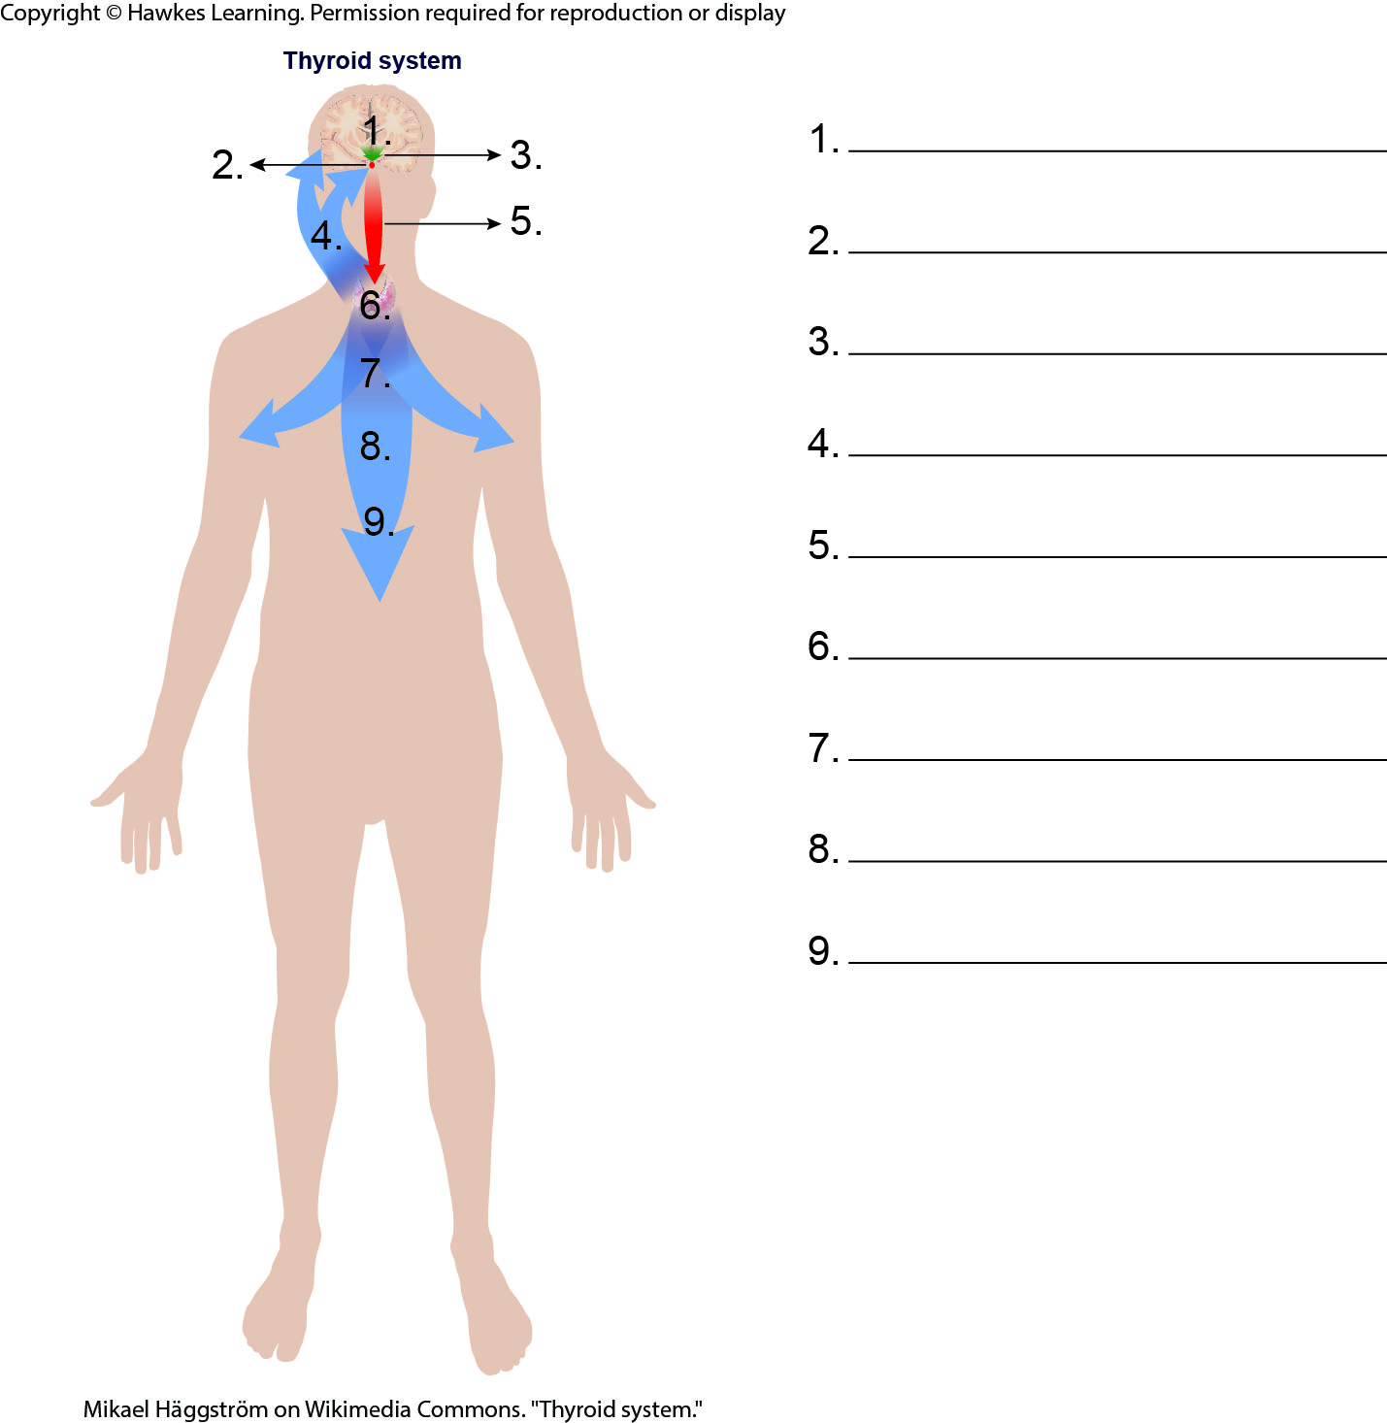
Lesson 39.2 Figure 11 - Numbered

Slide 25
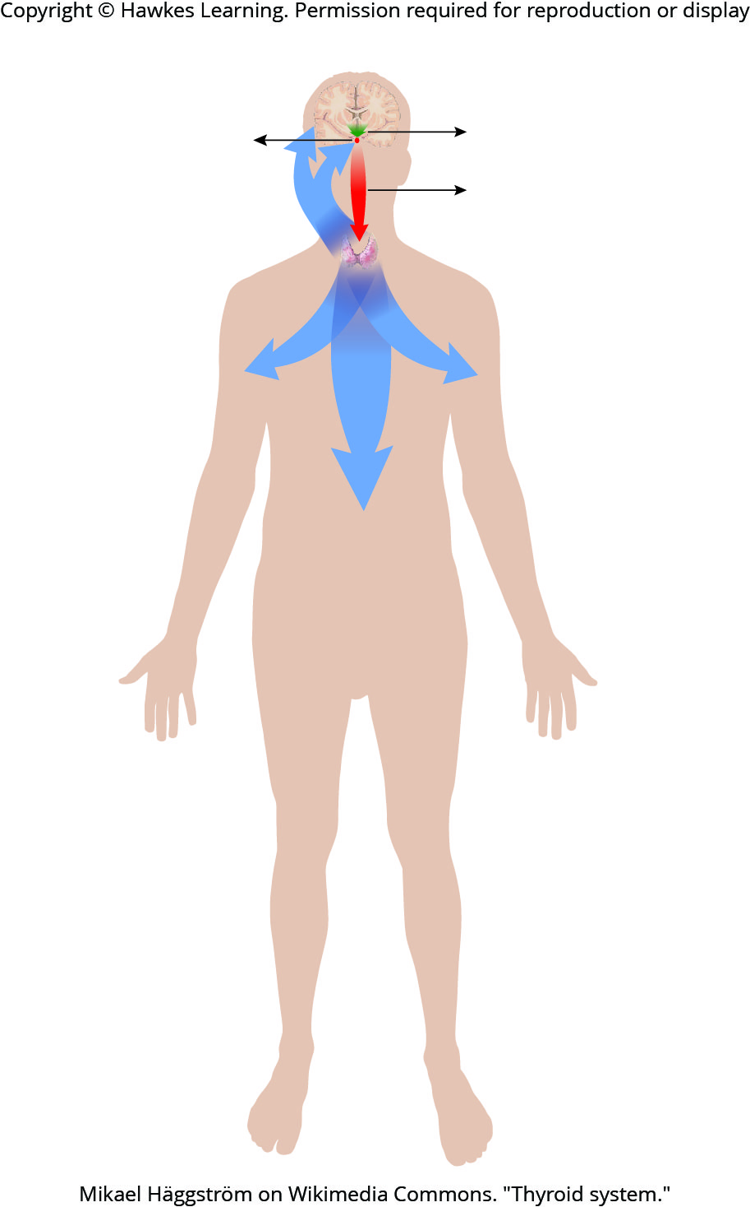
Lesson 39.2 Figure 11

Slide 26
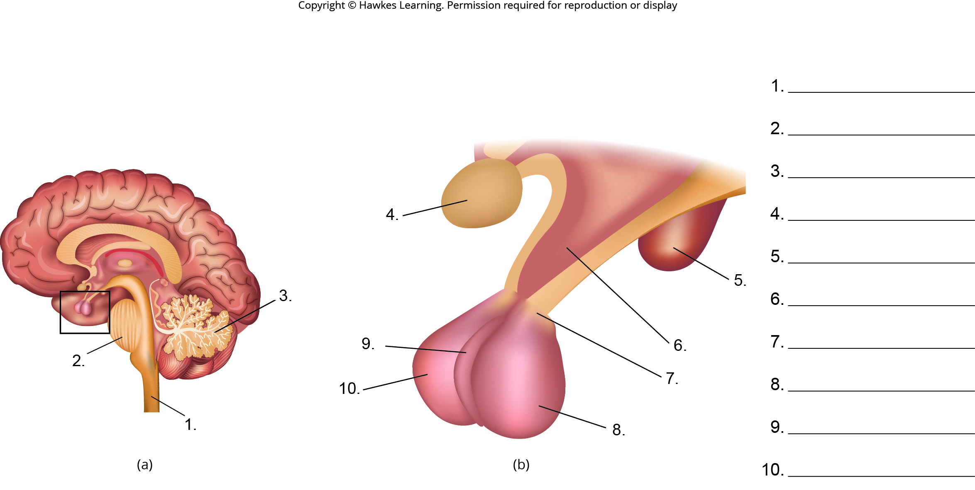
Lesson 39.3 Figure 3 - Numbered

Slide 27
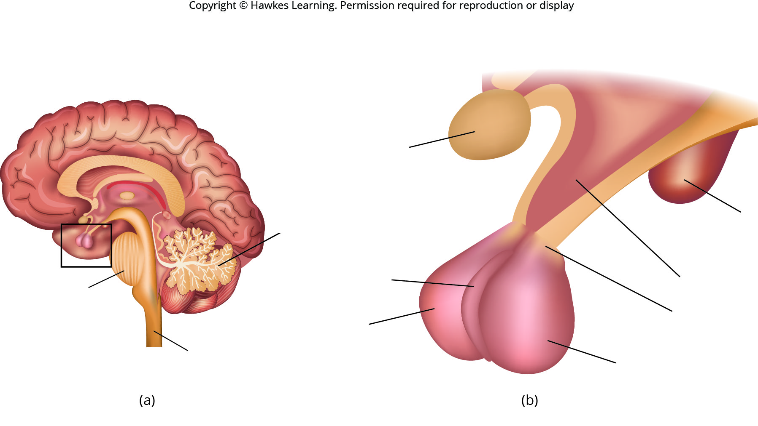
Lesson 39.3 Figure 3

Slide 28
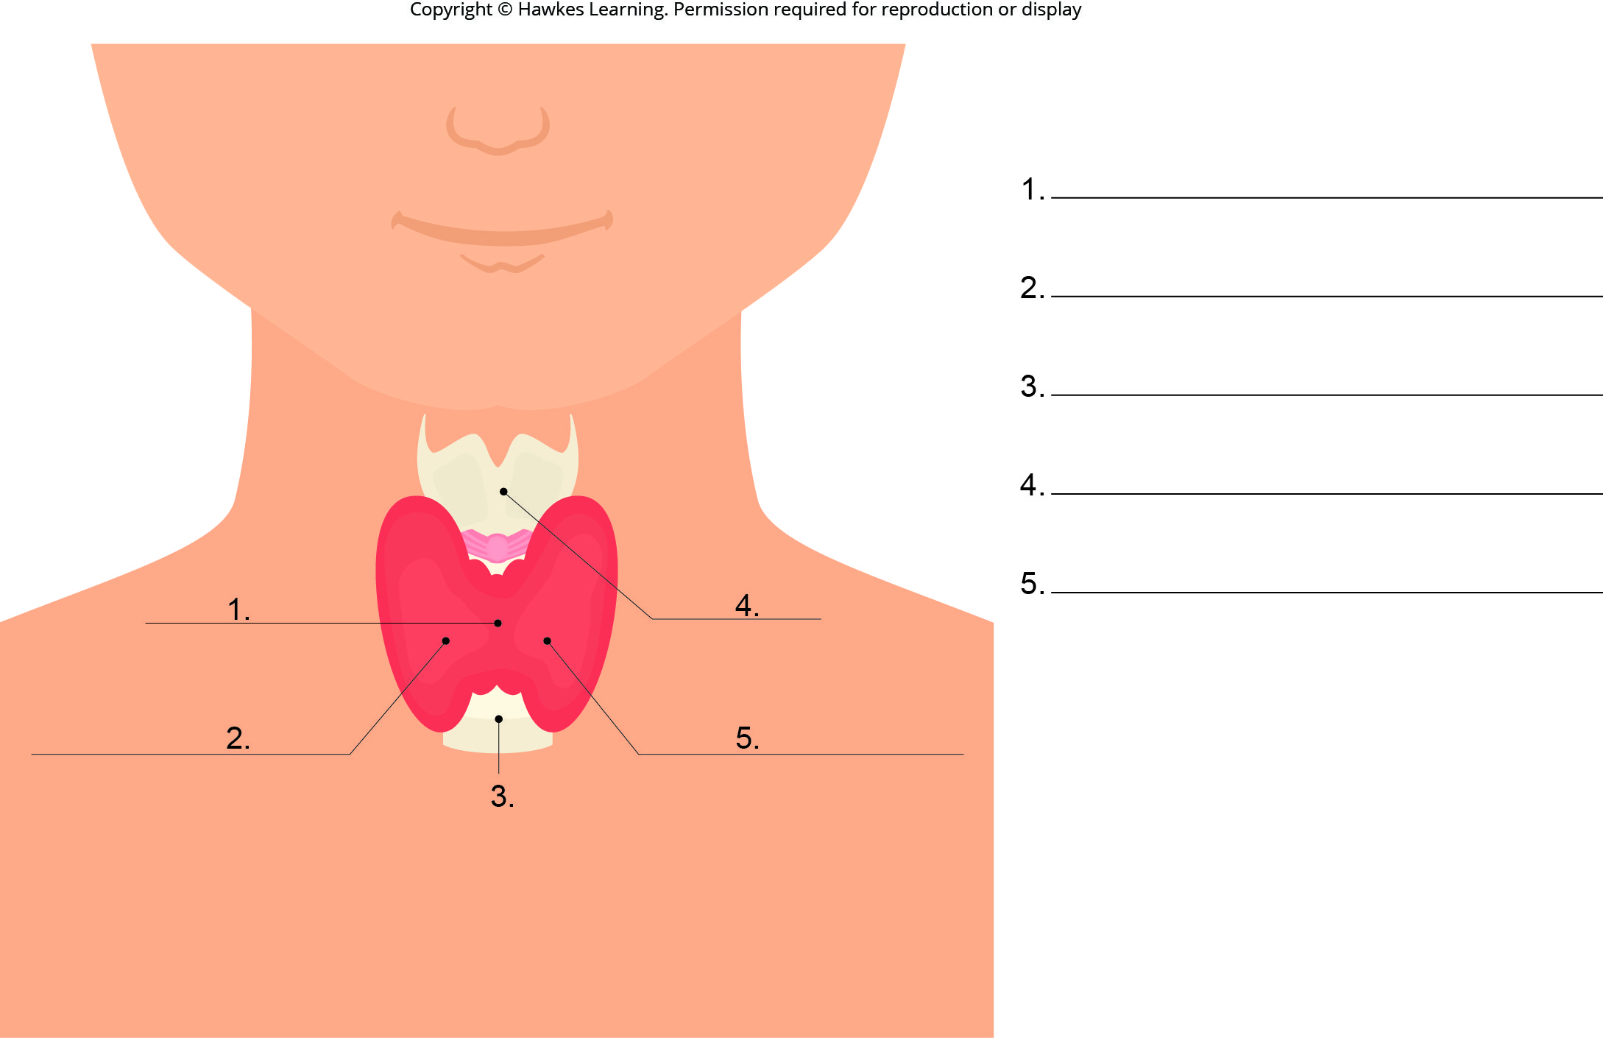
Lesson 39.3 Figure 4 - Numbered

Slide 29
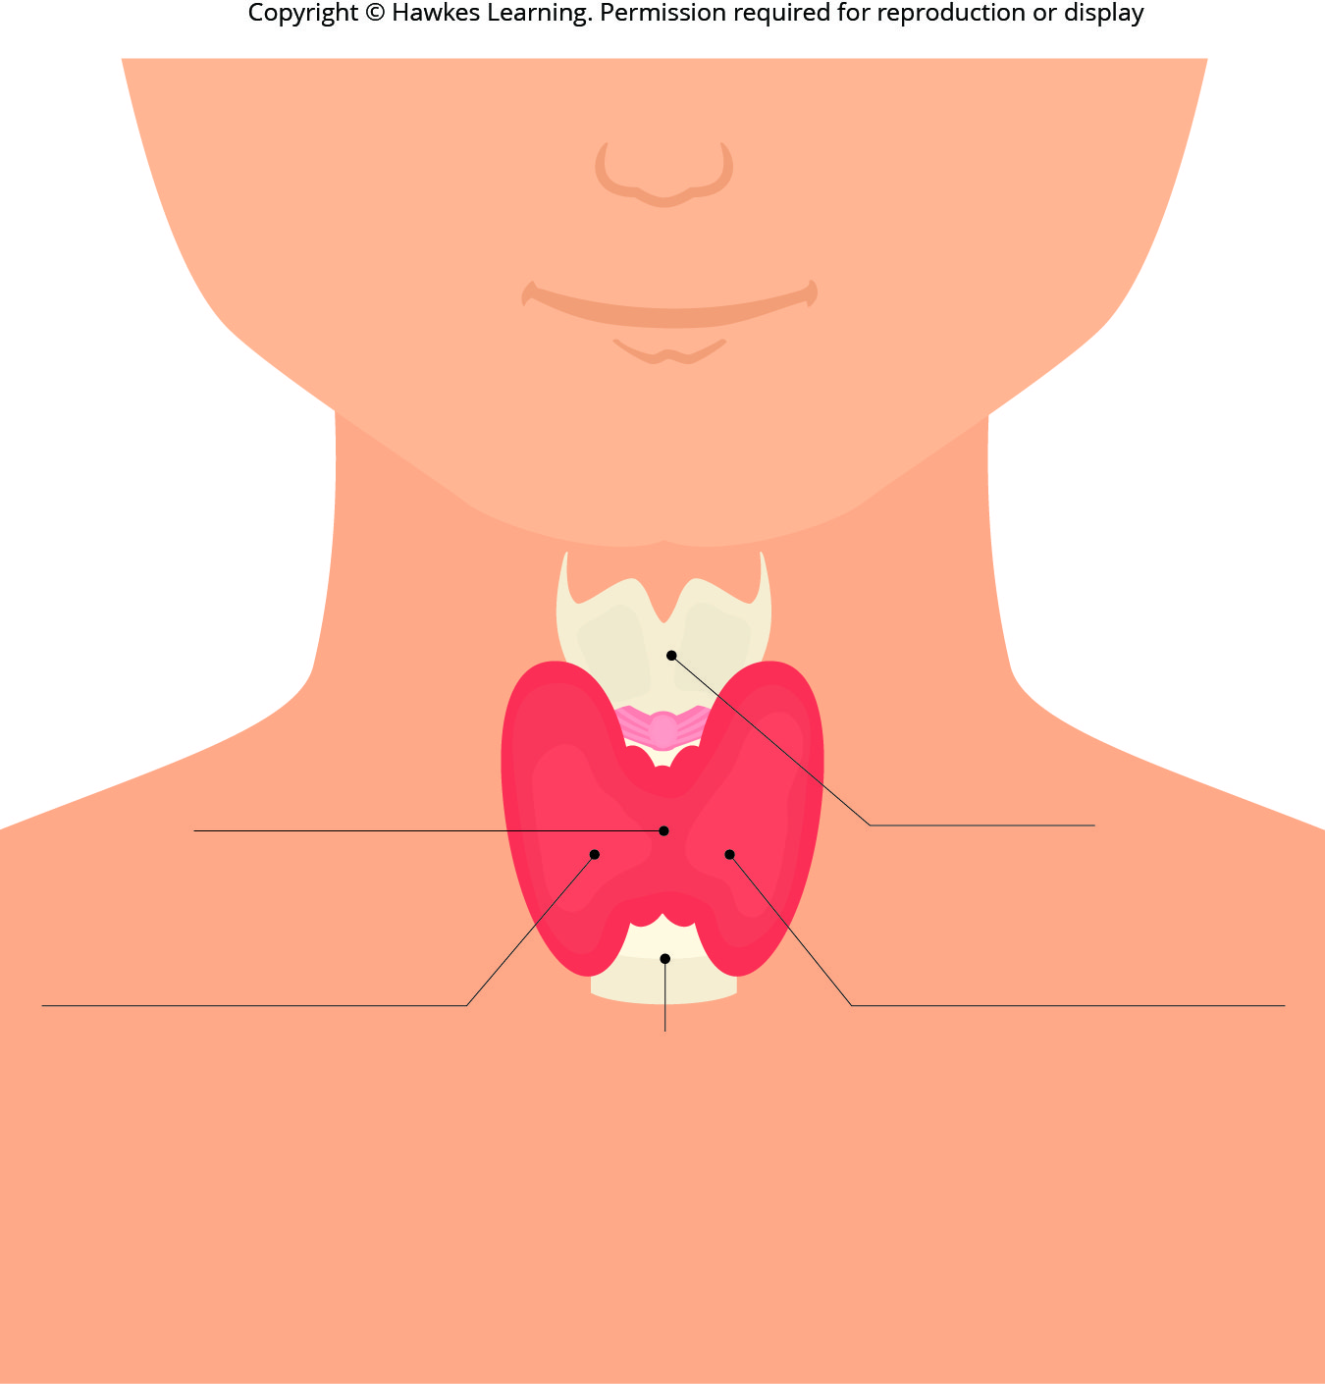
Lesson 39.3 Figure 4

Slide 30
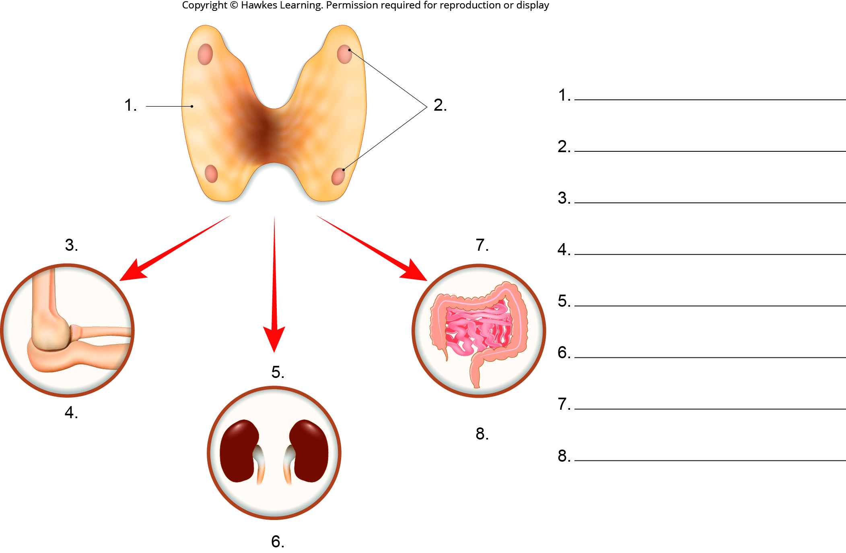
Lesson 39.3 Figure 5 - Numbered

Slide 31
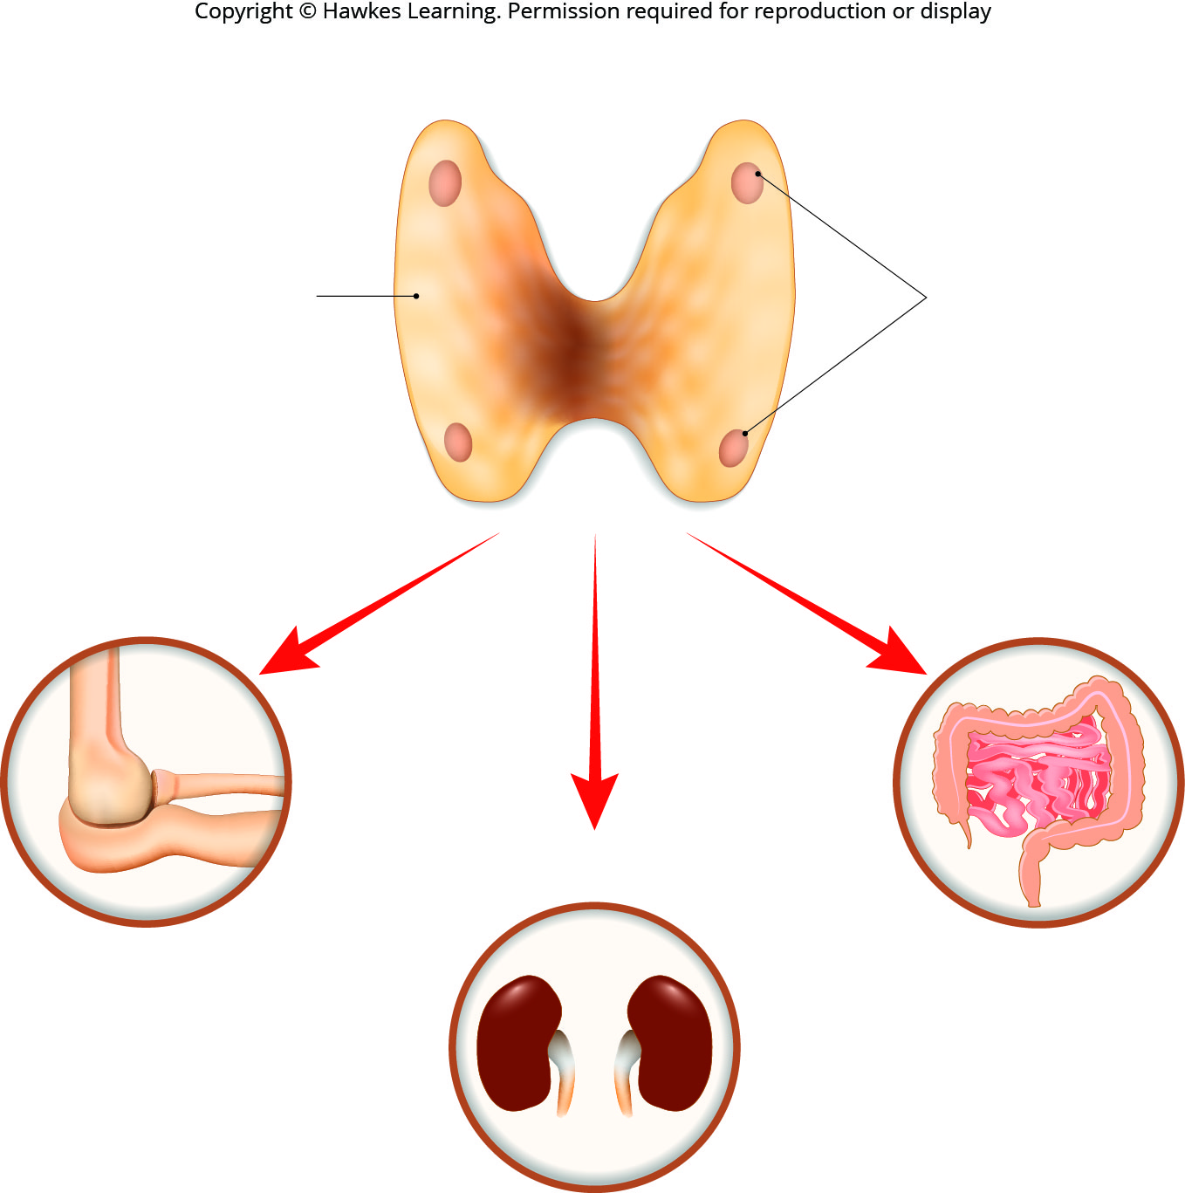
Lesson 39.3 Figure 5

Slide 32
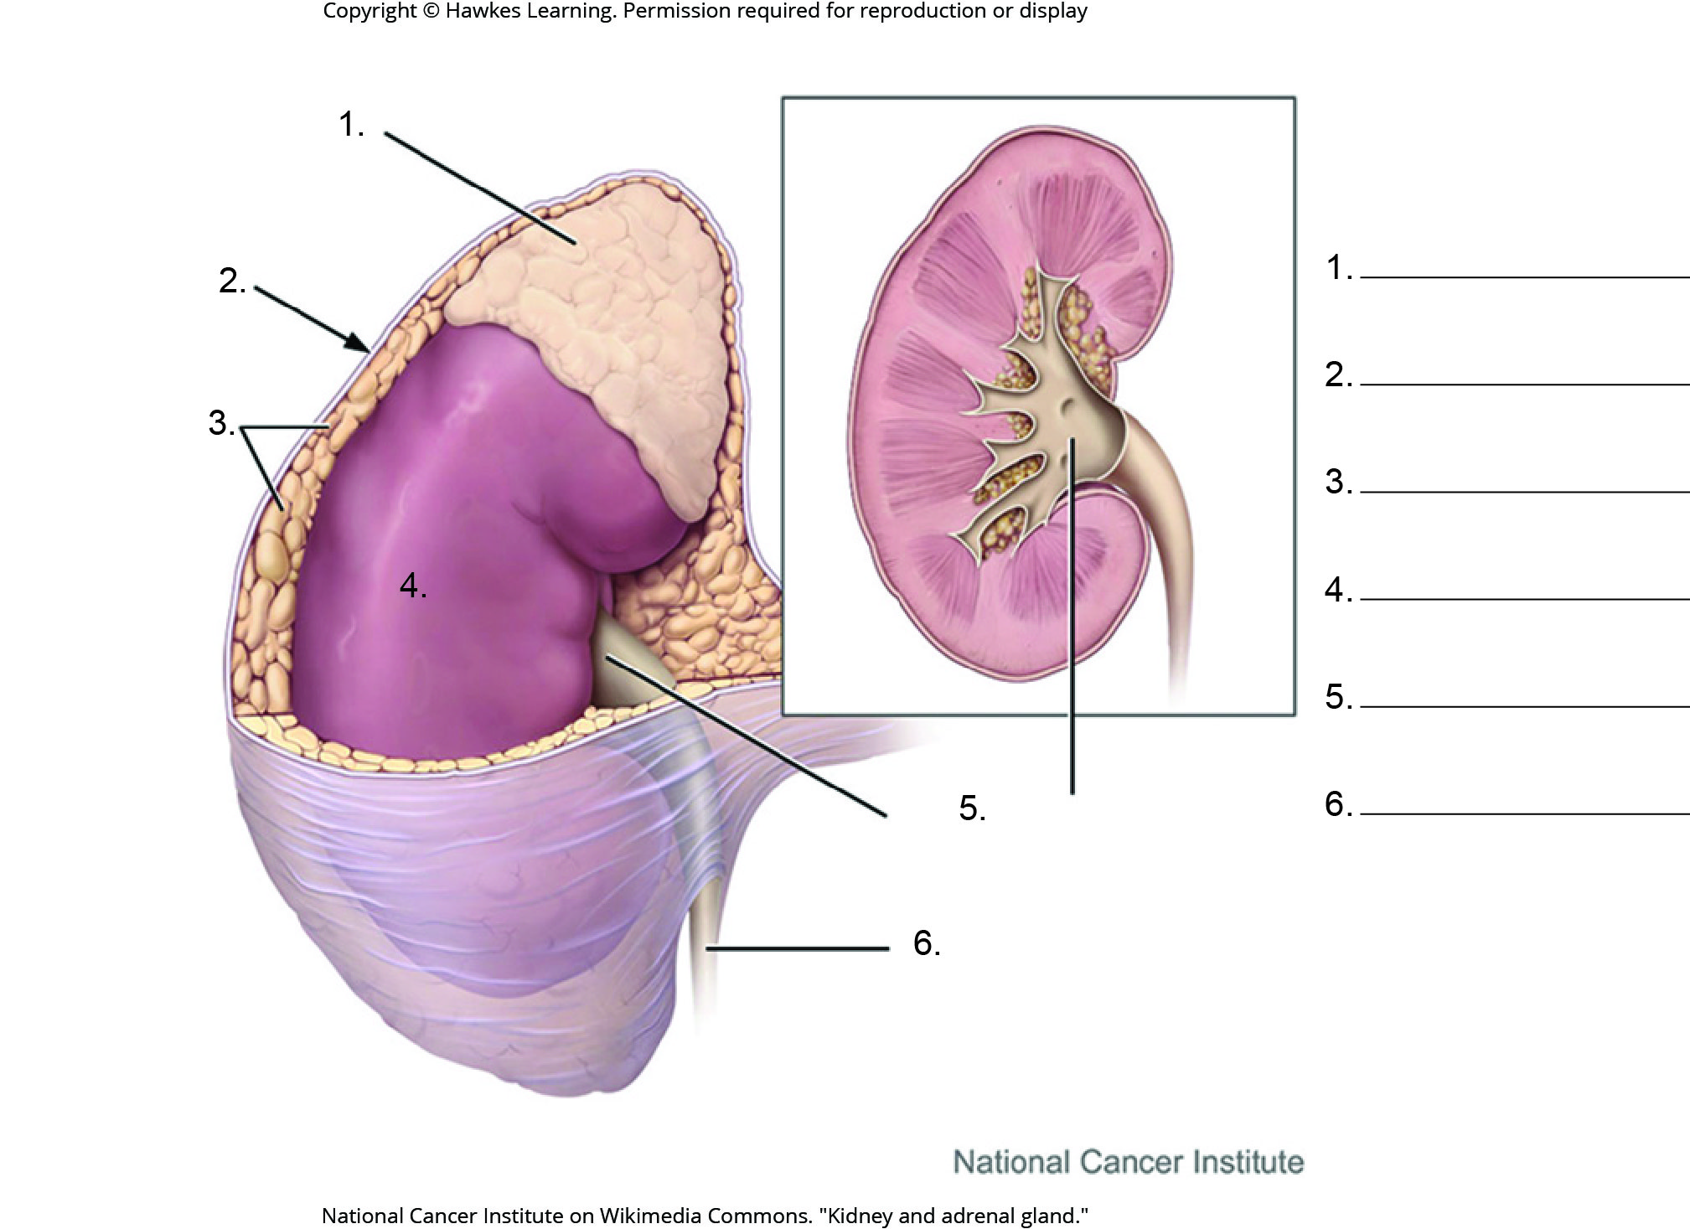
Lesson 39.3 Figure 6 - Numbered

Slide 33
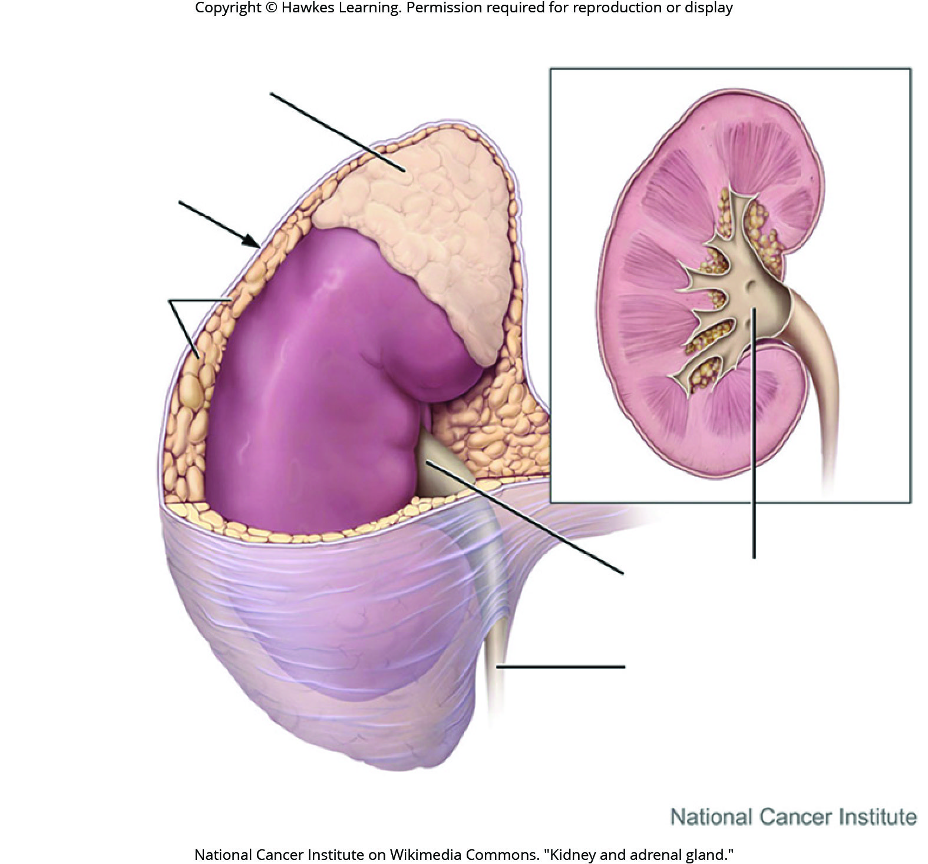
Lesson 39.3 Figure 6

Slide 34
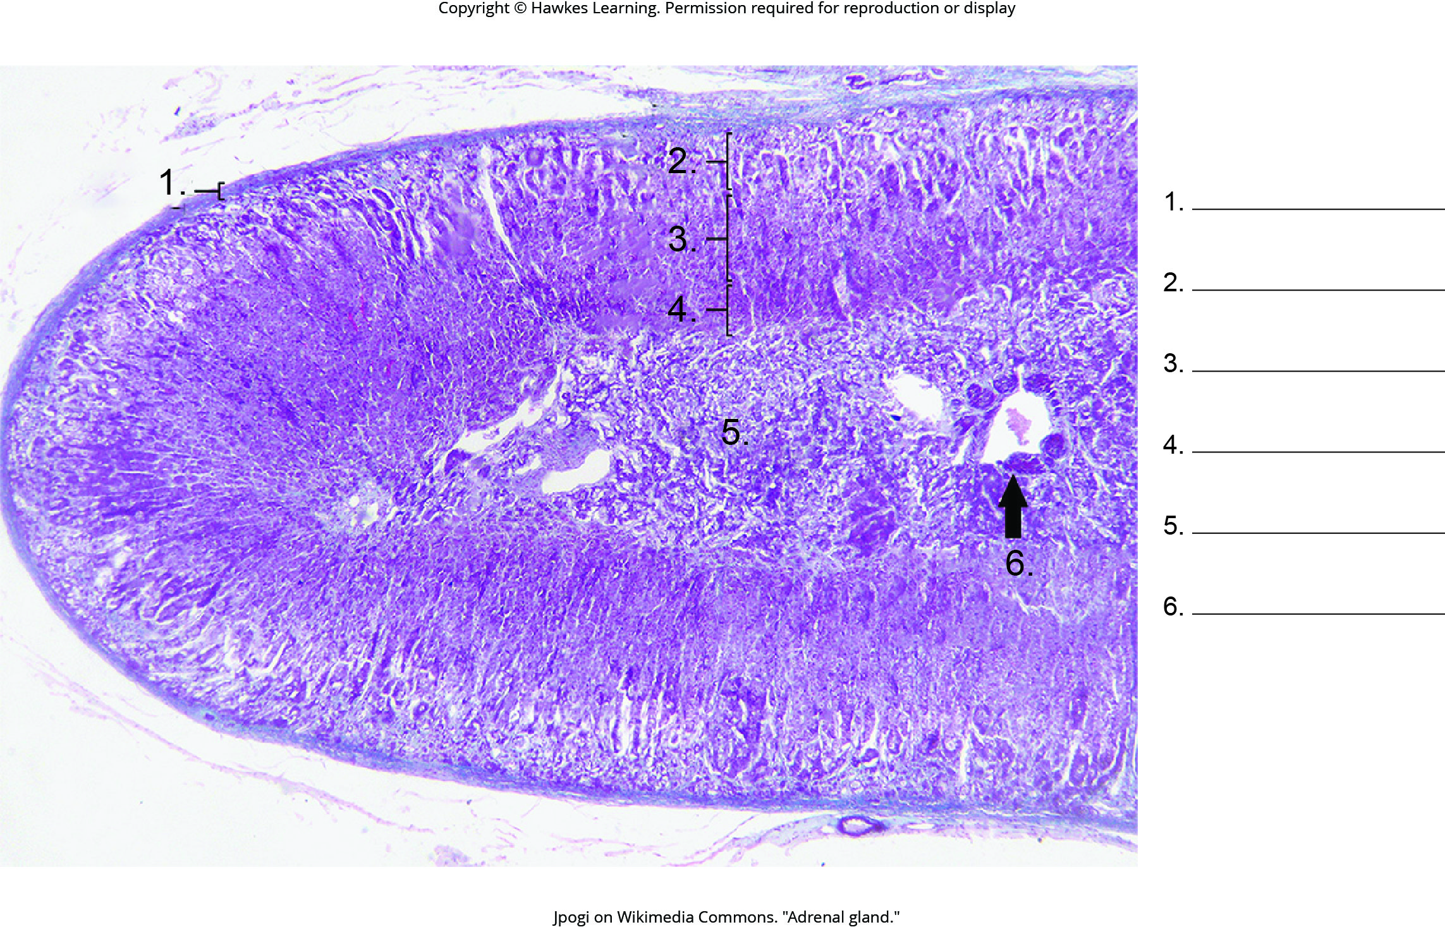
Lesson 39.3 Figure 7 - Numbered

Slide 35
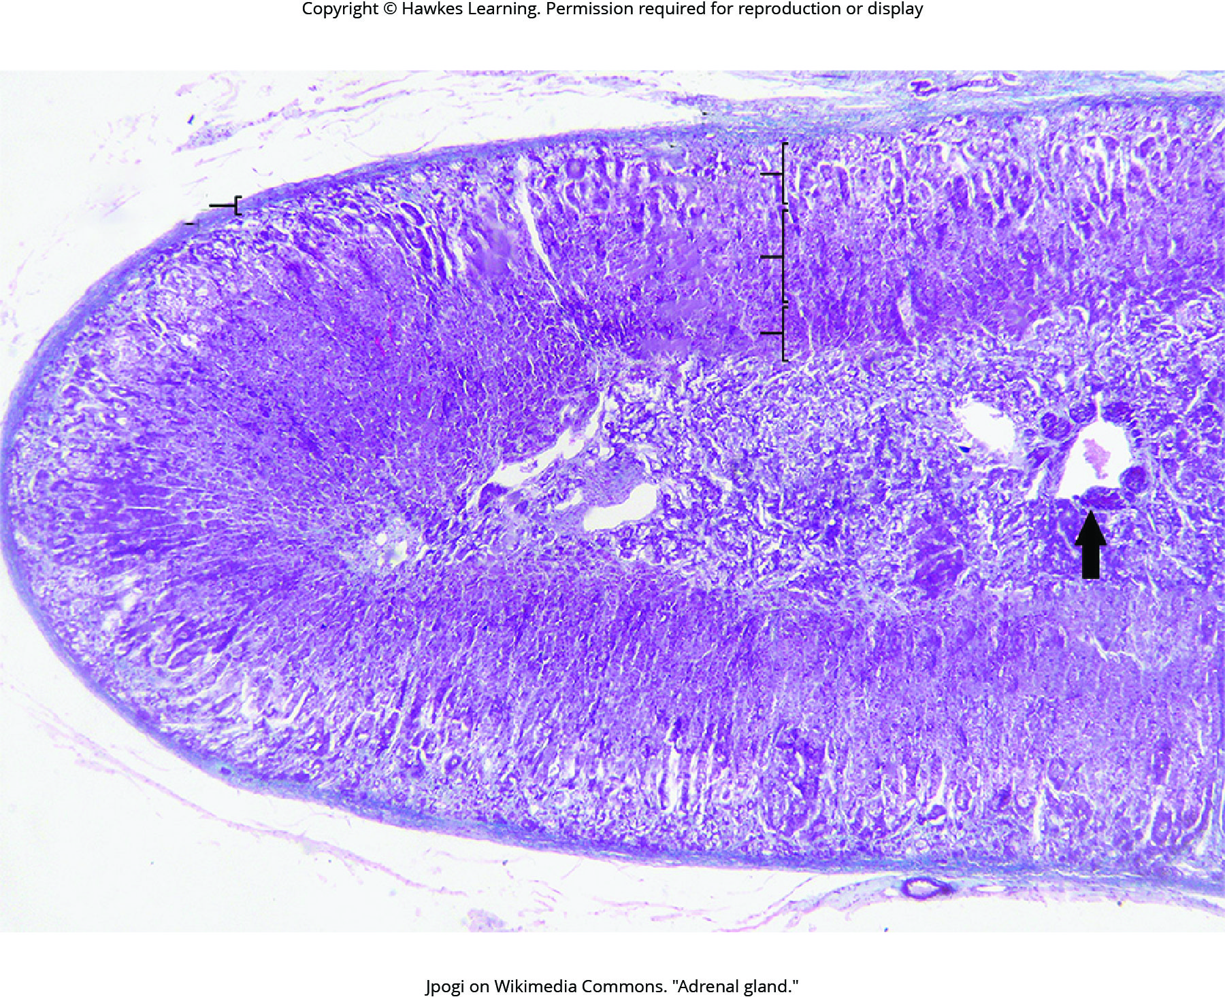
Lesson 39.3 Figure 7

Slide 36
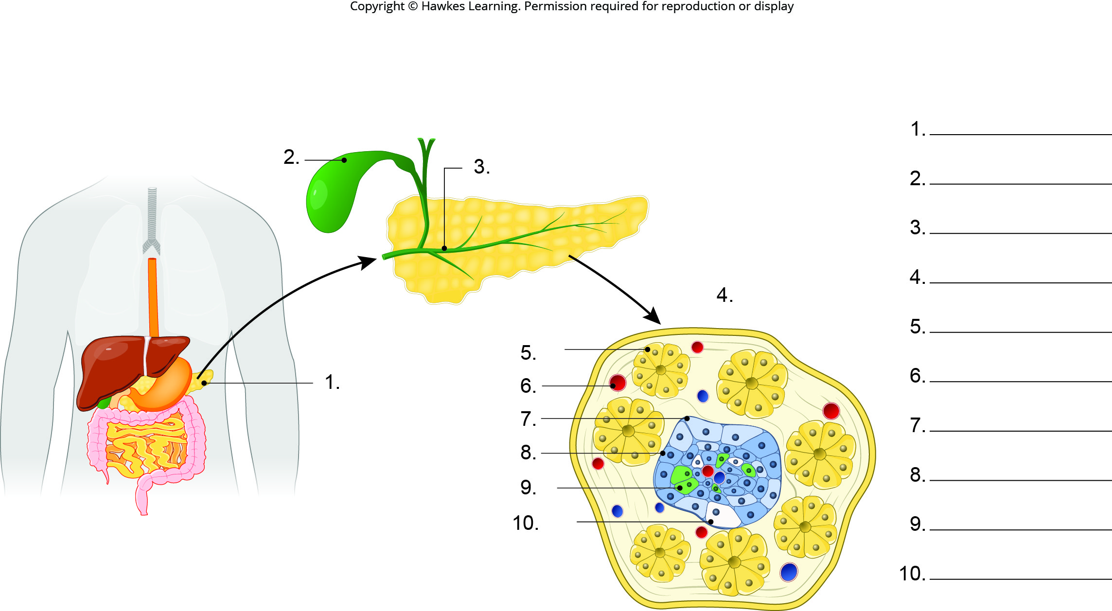
Lesson 39.3 Figure 8 - Numbered

Slide 37
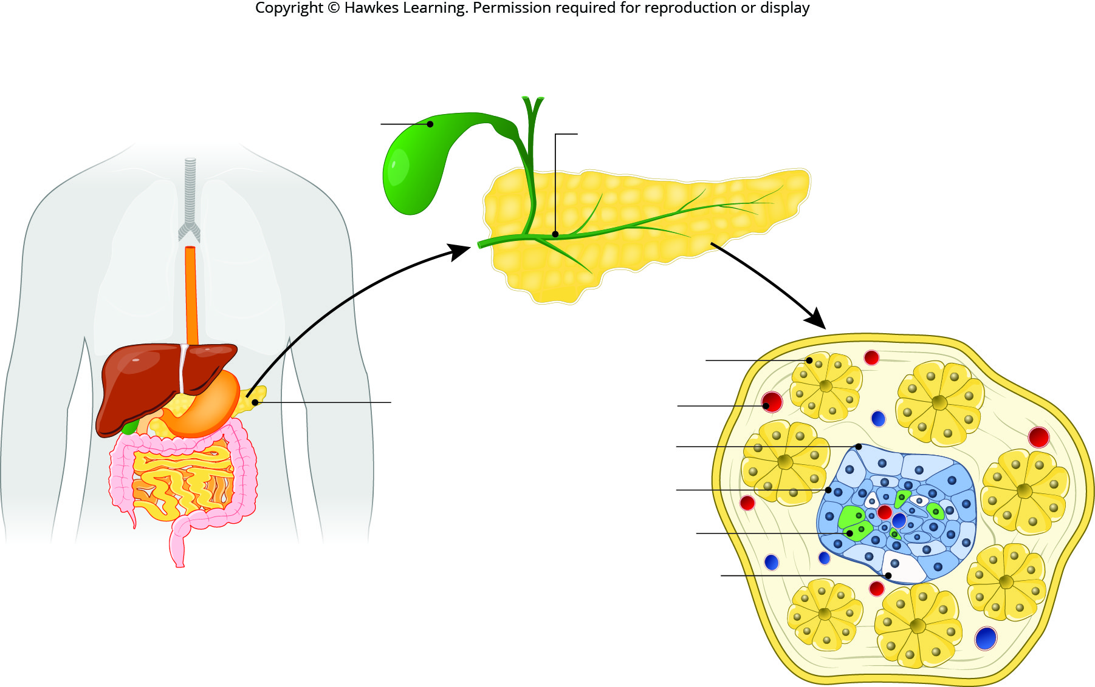
Lesson 39.3 Figure 8

Slide 38
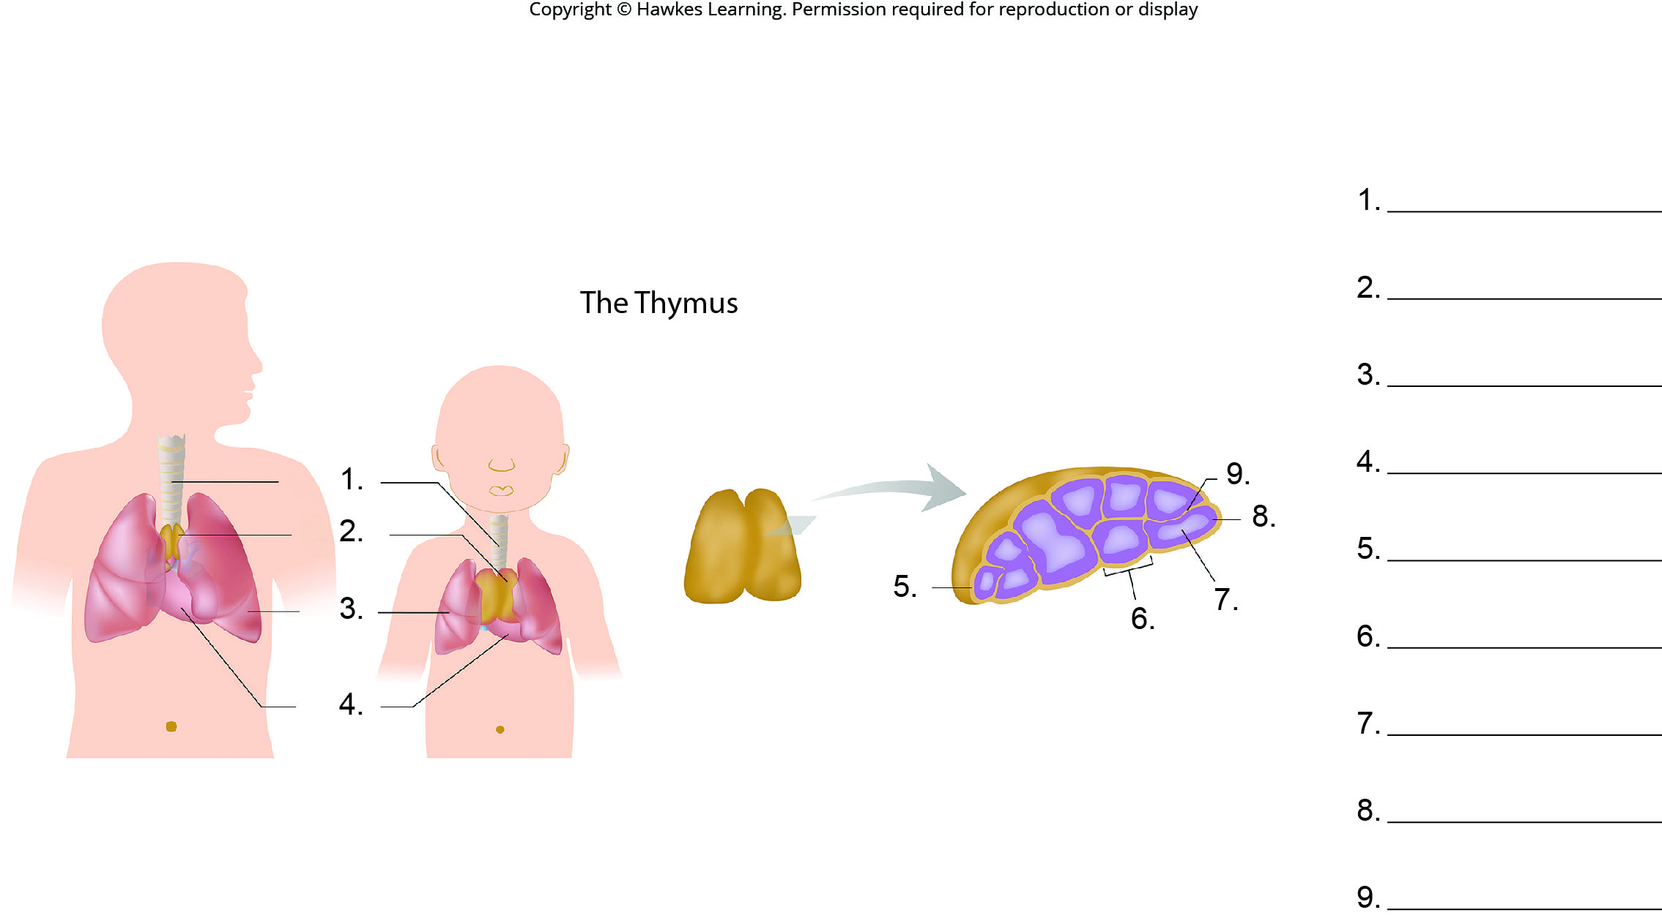
Lesson 39.3 Figure 11 - Numbered

Slide 39
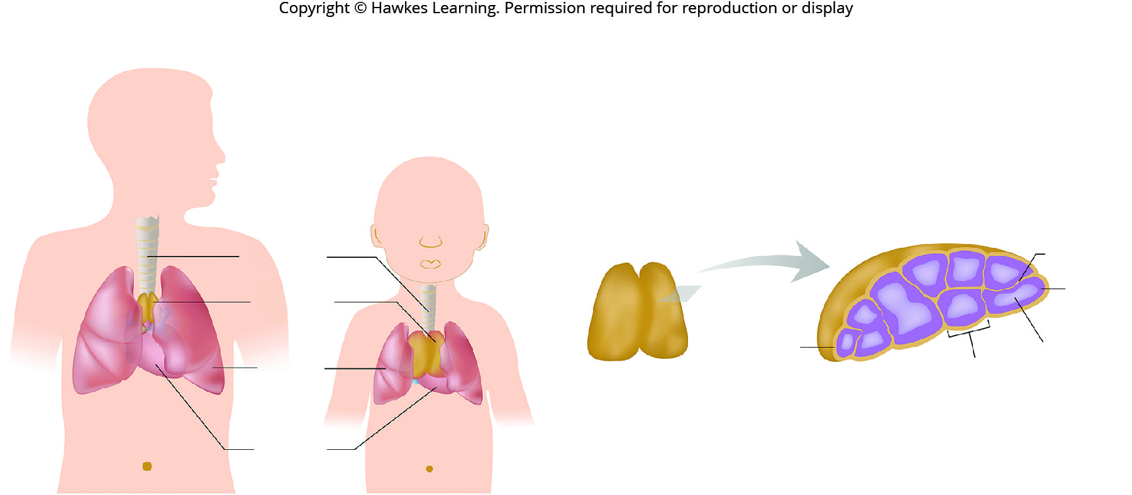
Lesson 39.3 Figure 11

Slide 40
Hawkes Learning – End of PowerPoint

