Slide 1
Chapter 4
Cell Structure

Slide 2
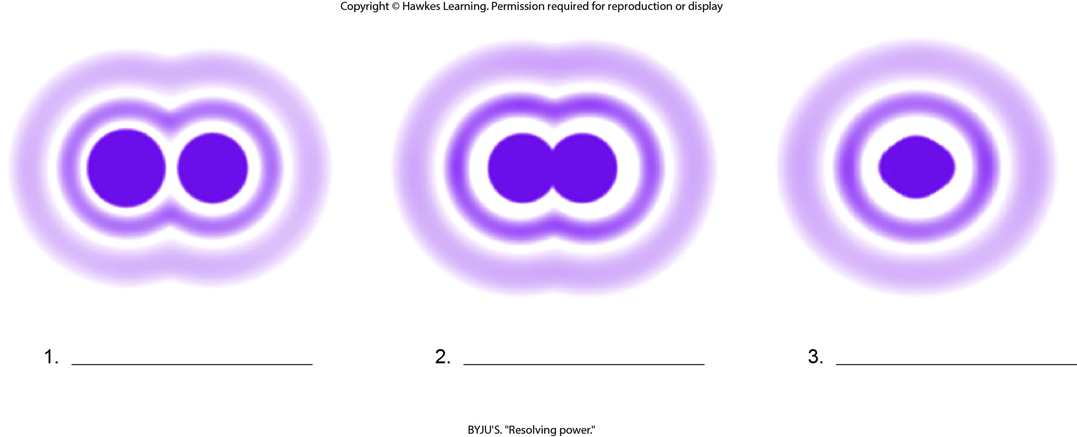
Lesson 4.1 Figure 4 - Numbered

Slide 3
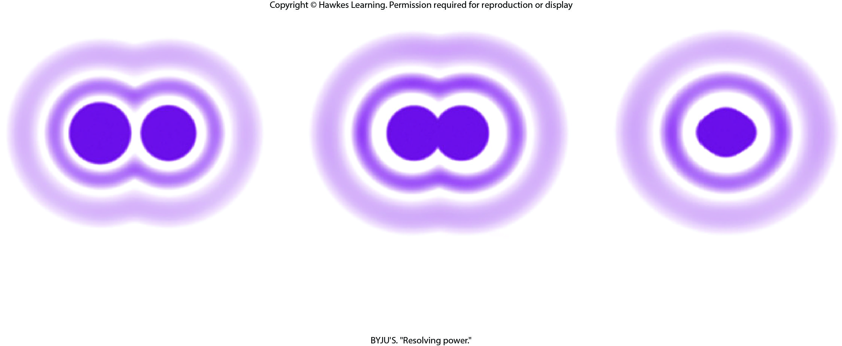
Lesson 4.1 Figure 4

Slide 4
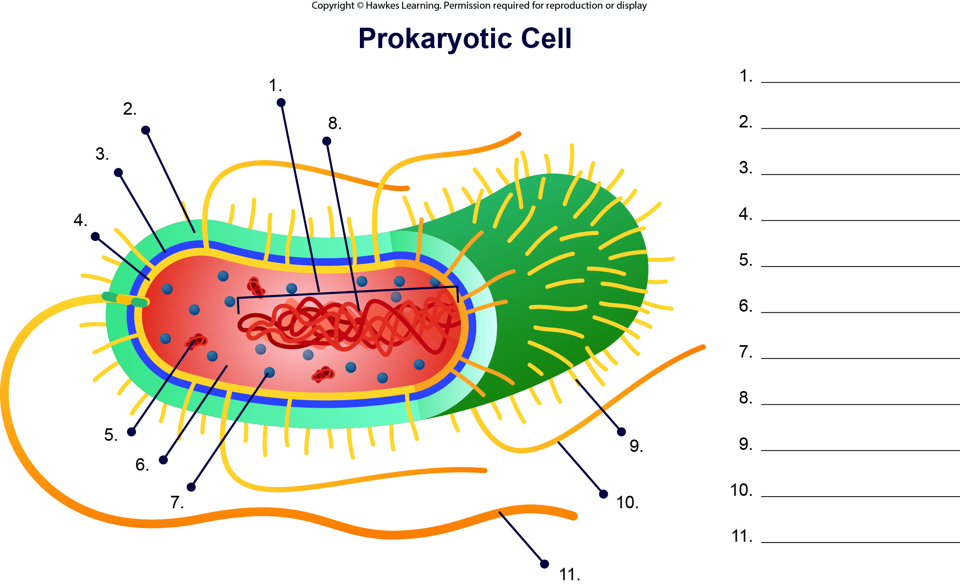
Lesson 4.1 Figure 7 - Numbered

Slide 5
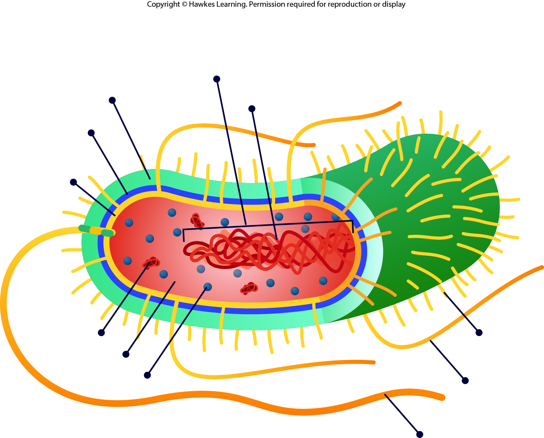
Lesson 4.1 Figure 7

Slide 6
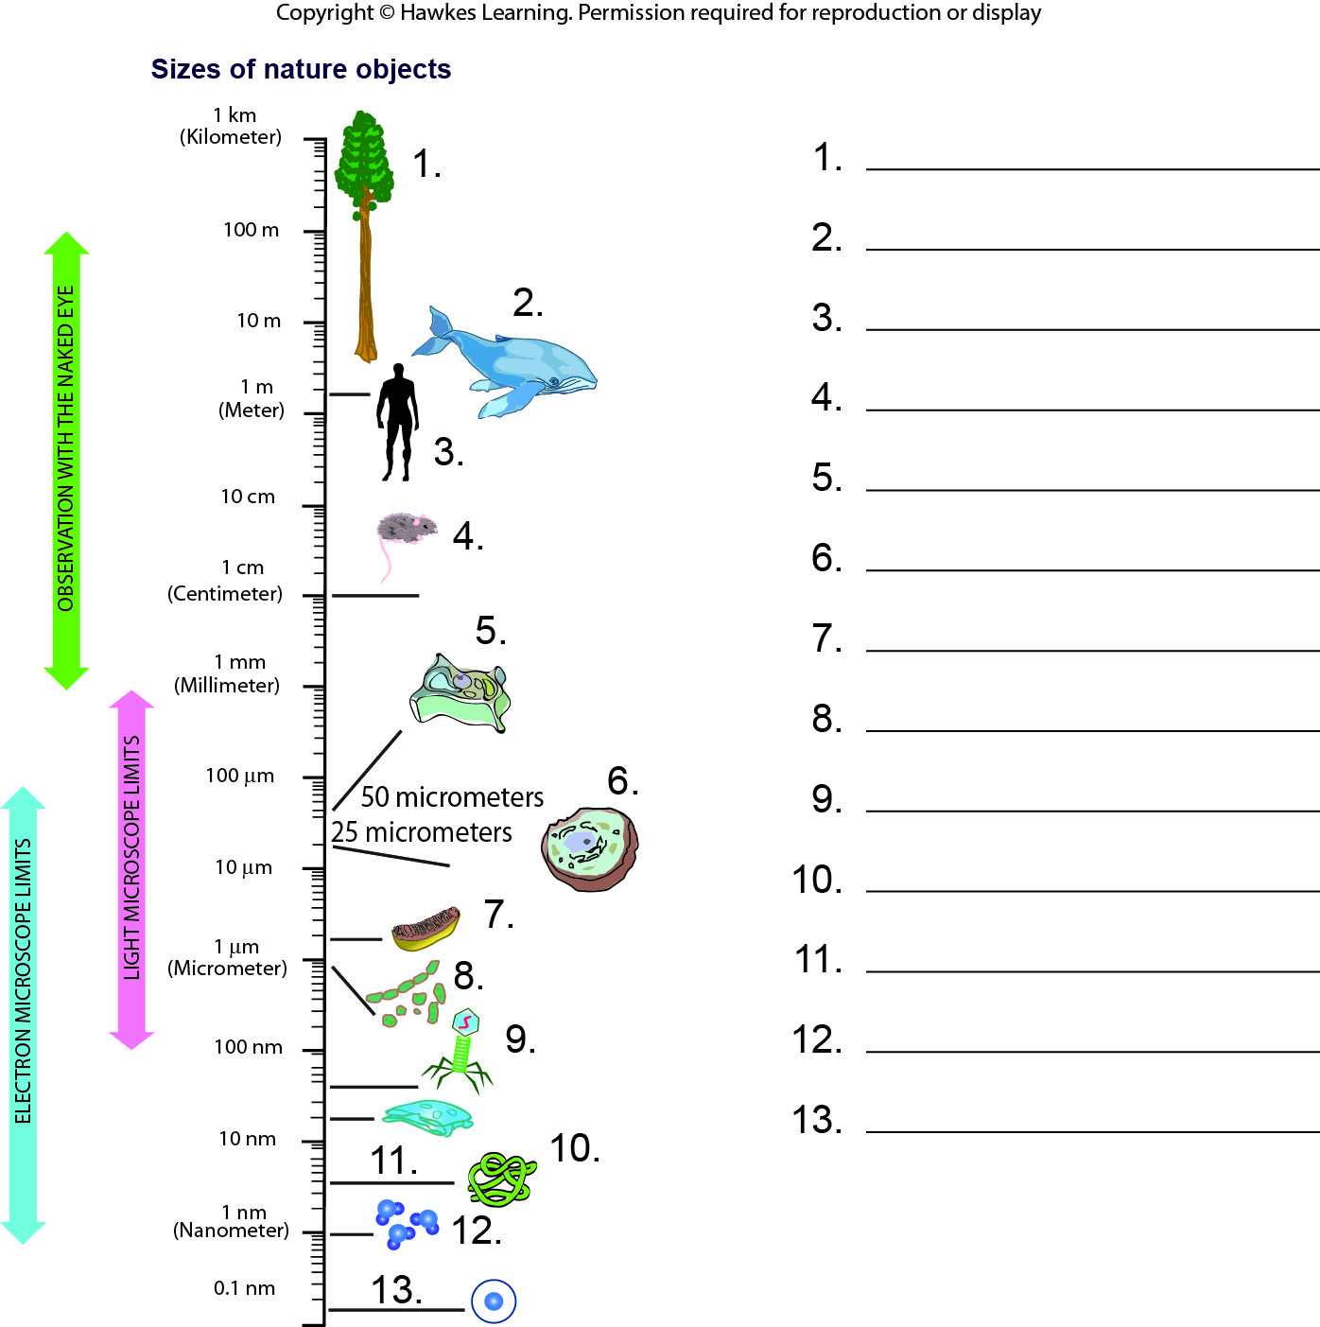
Lesson 4.1 Figure 8 - Numbered

Slide 7
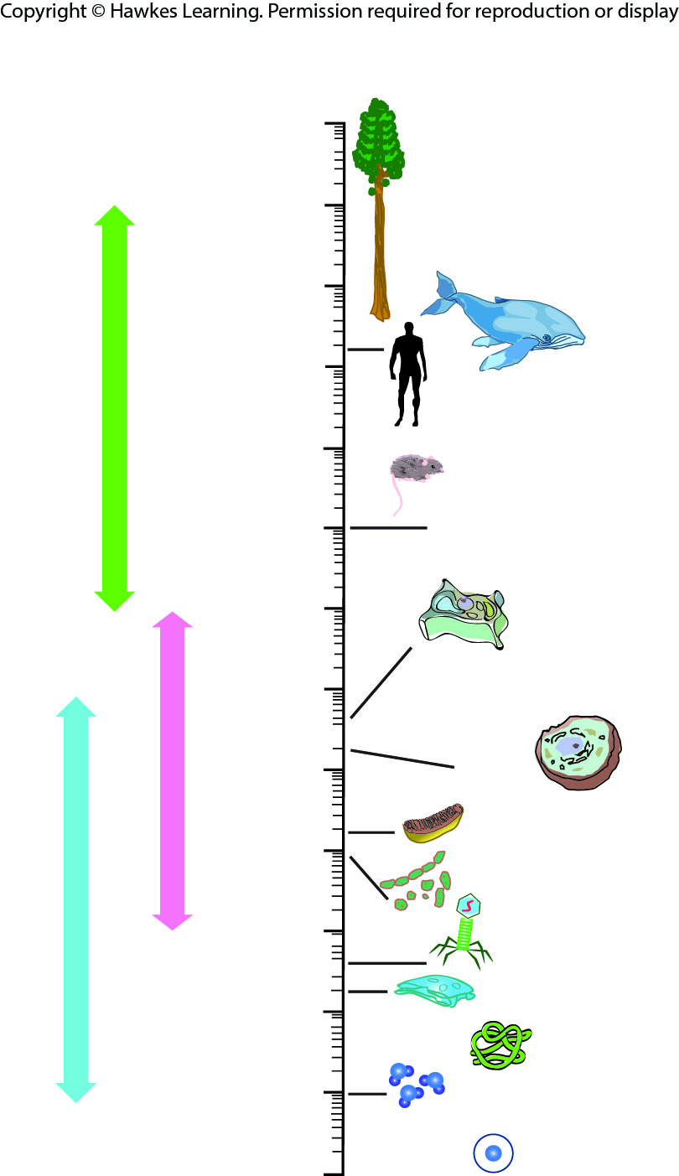
Lesson 4.1 Figure 8

Slide 8
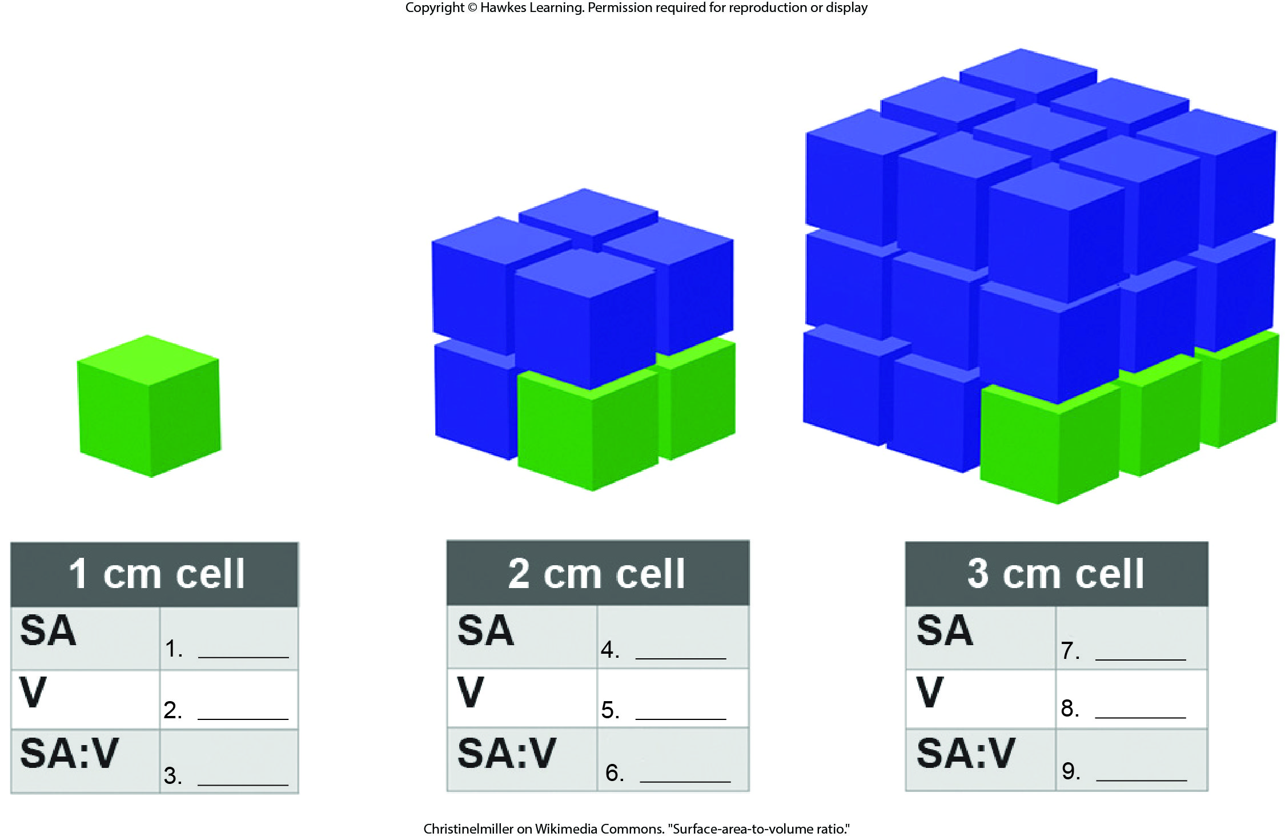
Lesson 4.1 Figure 9 - Numbered

Slide 9
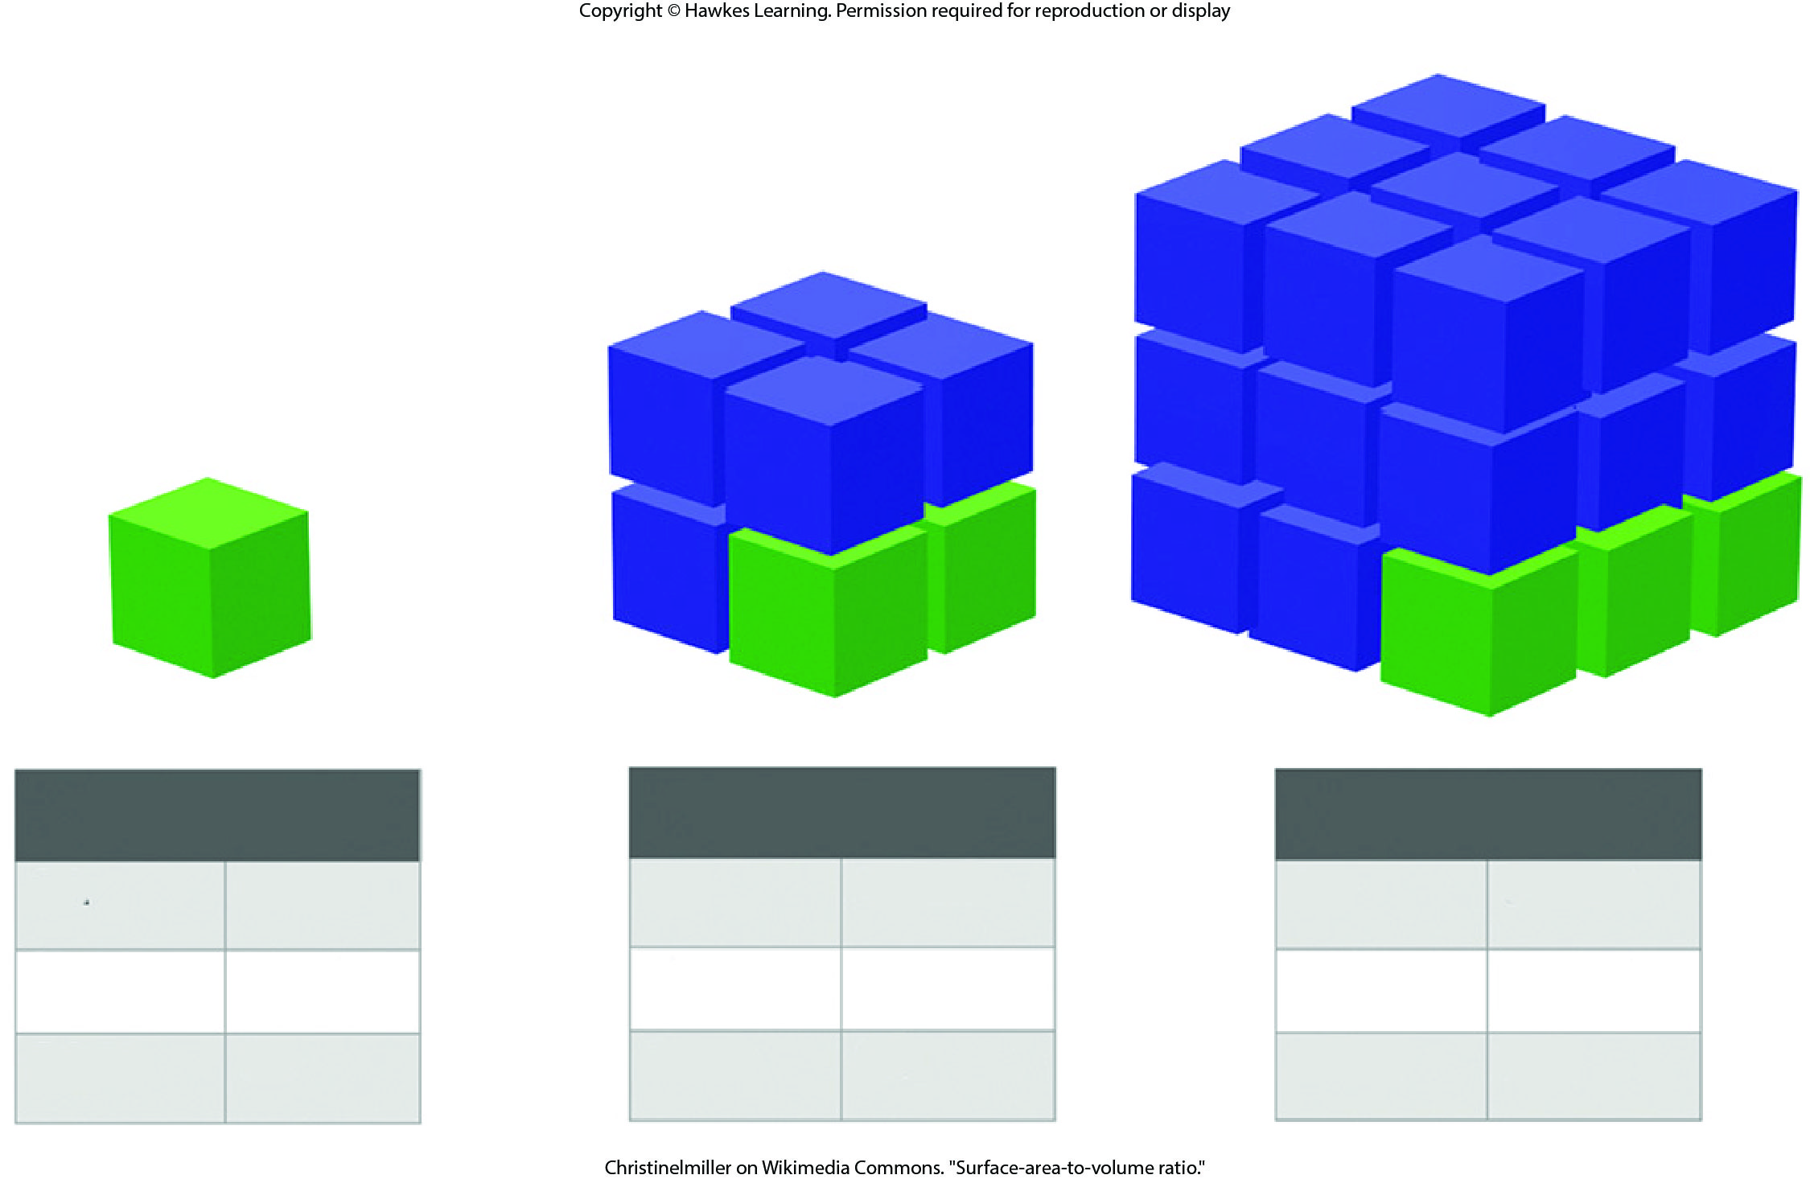
Lesson 4.1 Figure 9

Slide 10
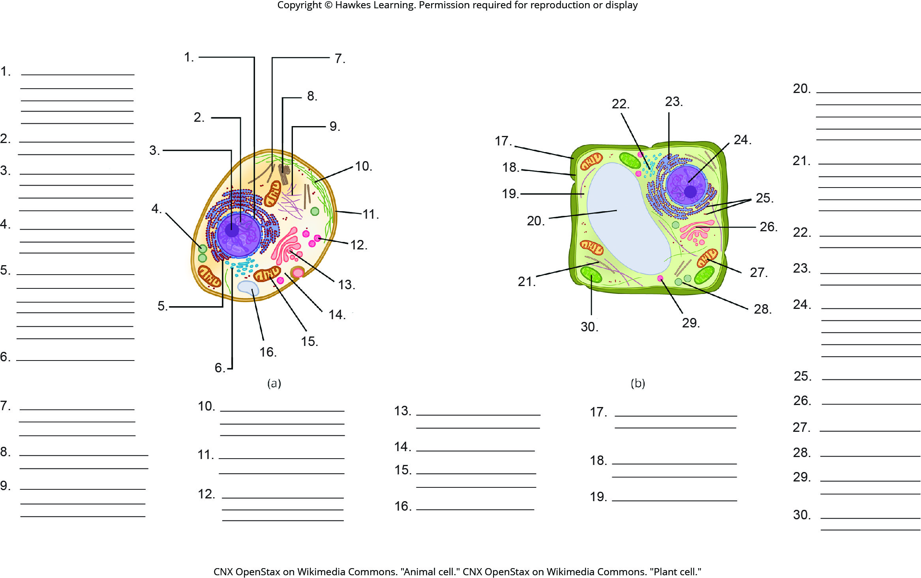
Lesson 4.2 Figure 2 - Numbered

Slide 11
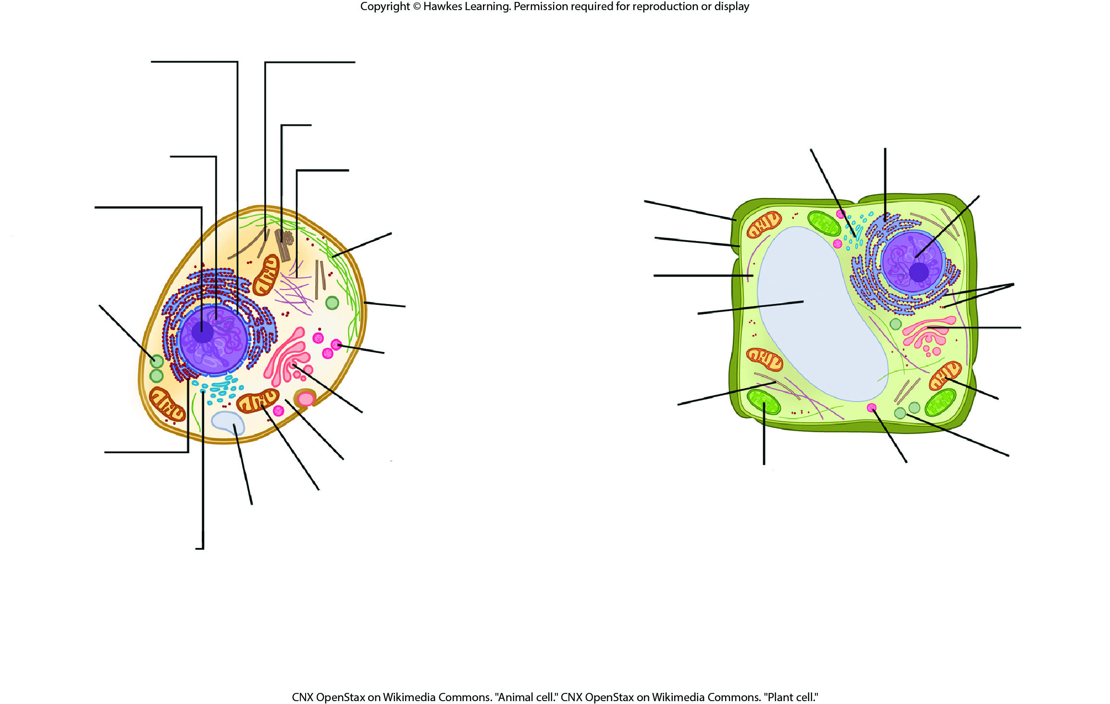
Lesson 4.2 Figure 2

Slide 12
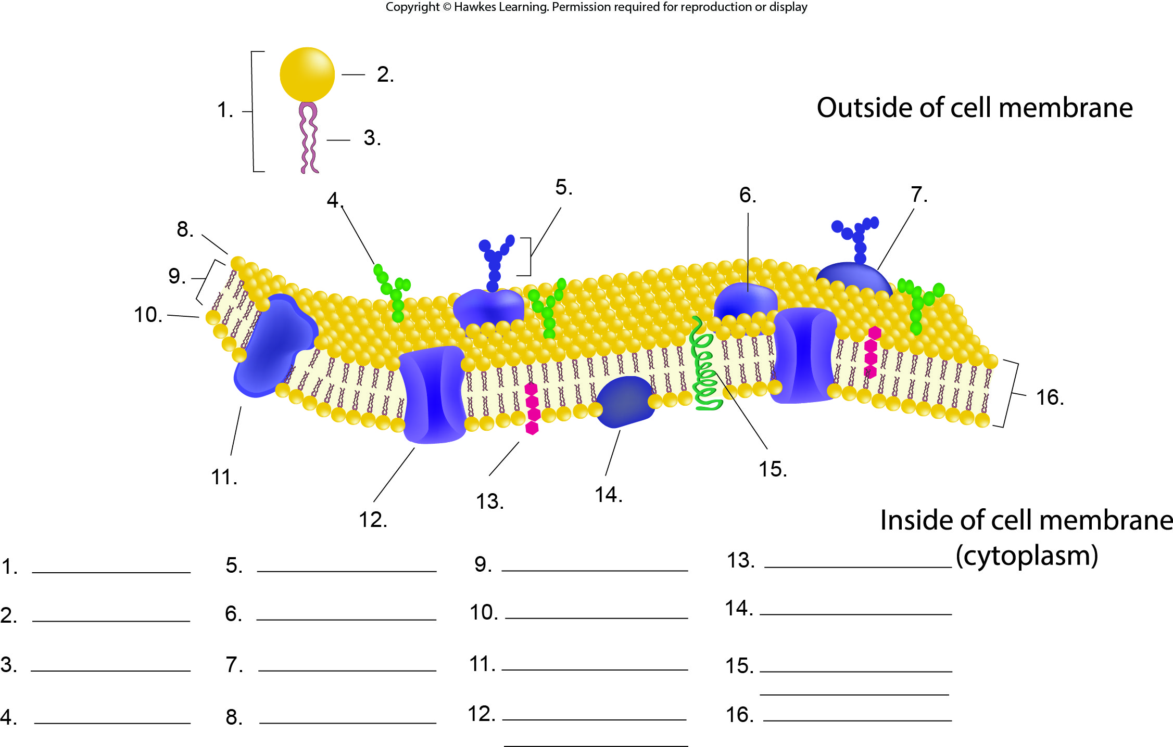
Lesson 4.2 Figure 3 - Numbered

Slide 13
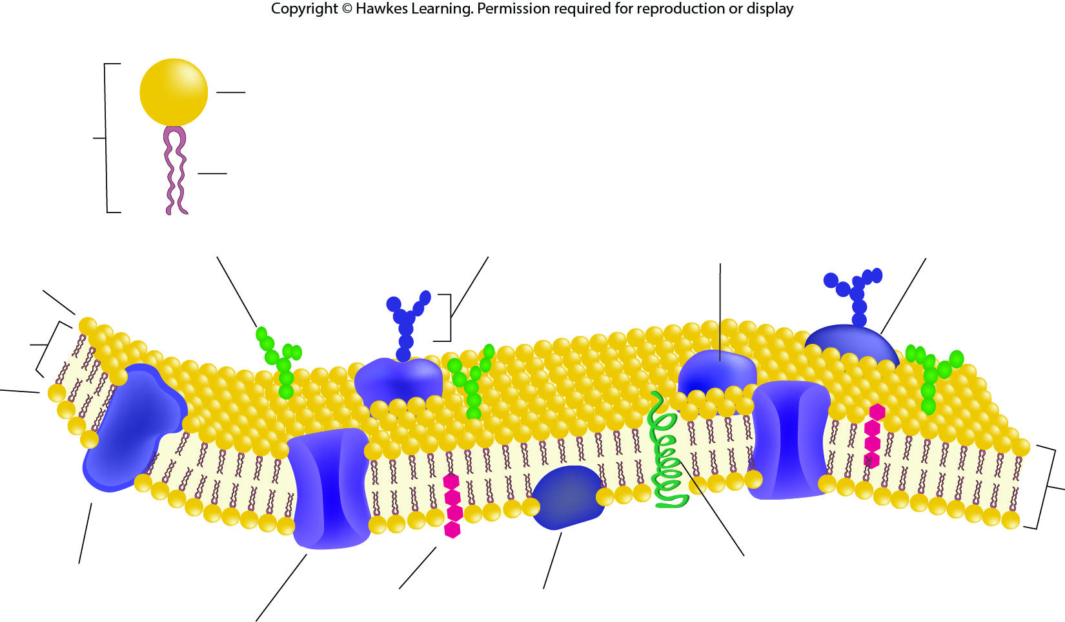
Lesson 4.2 Figure 3

Slide 14
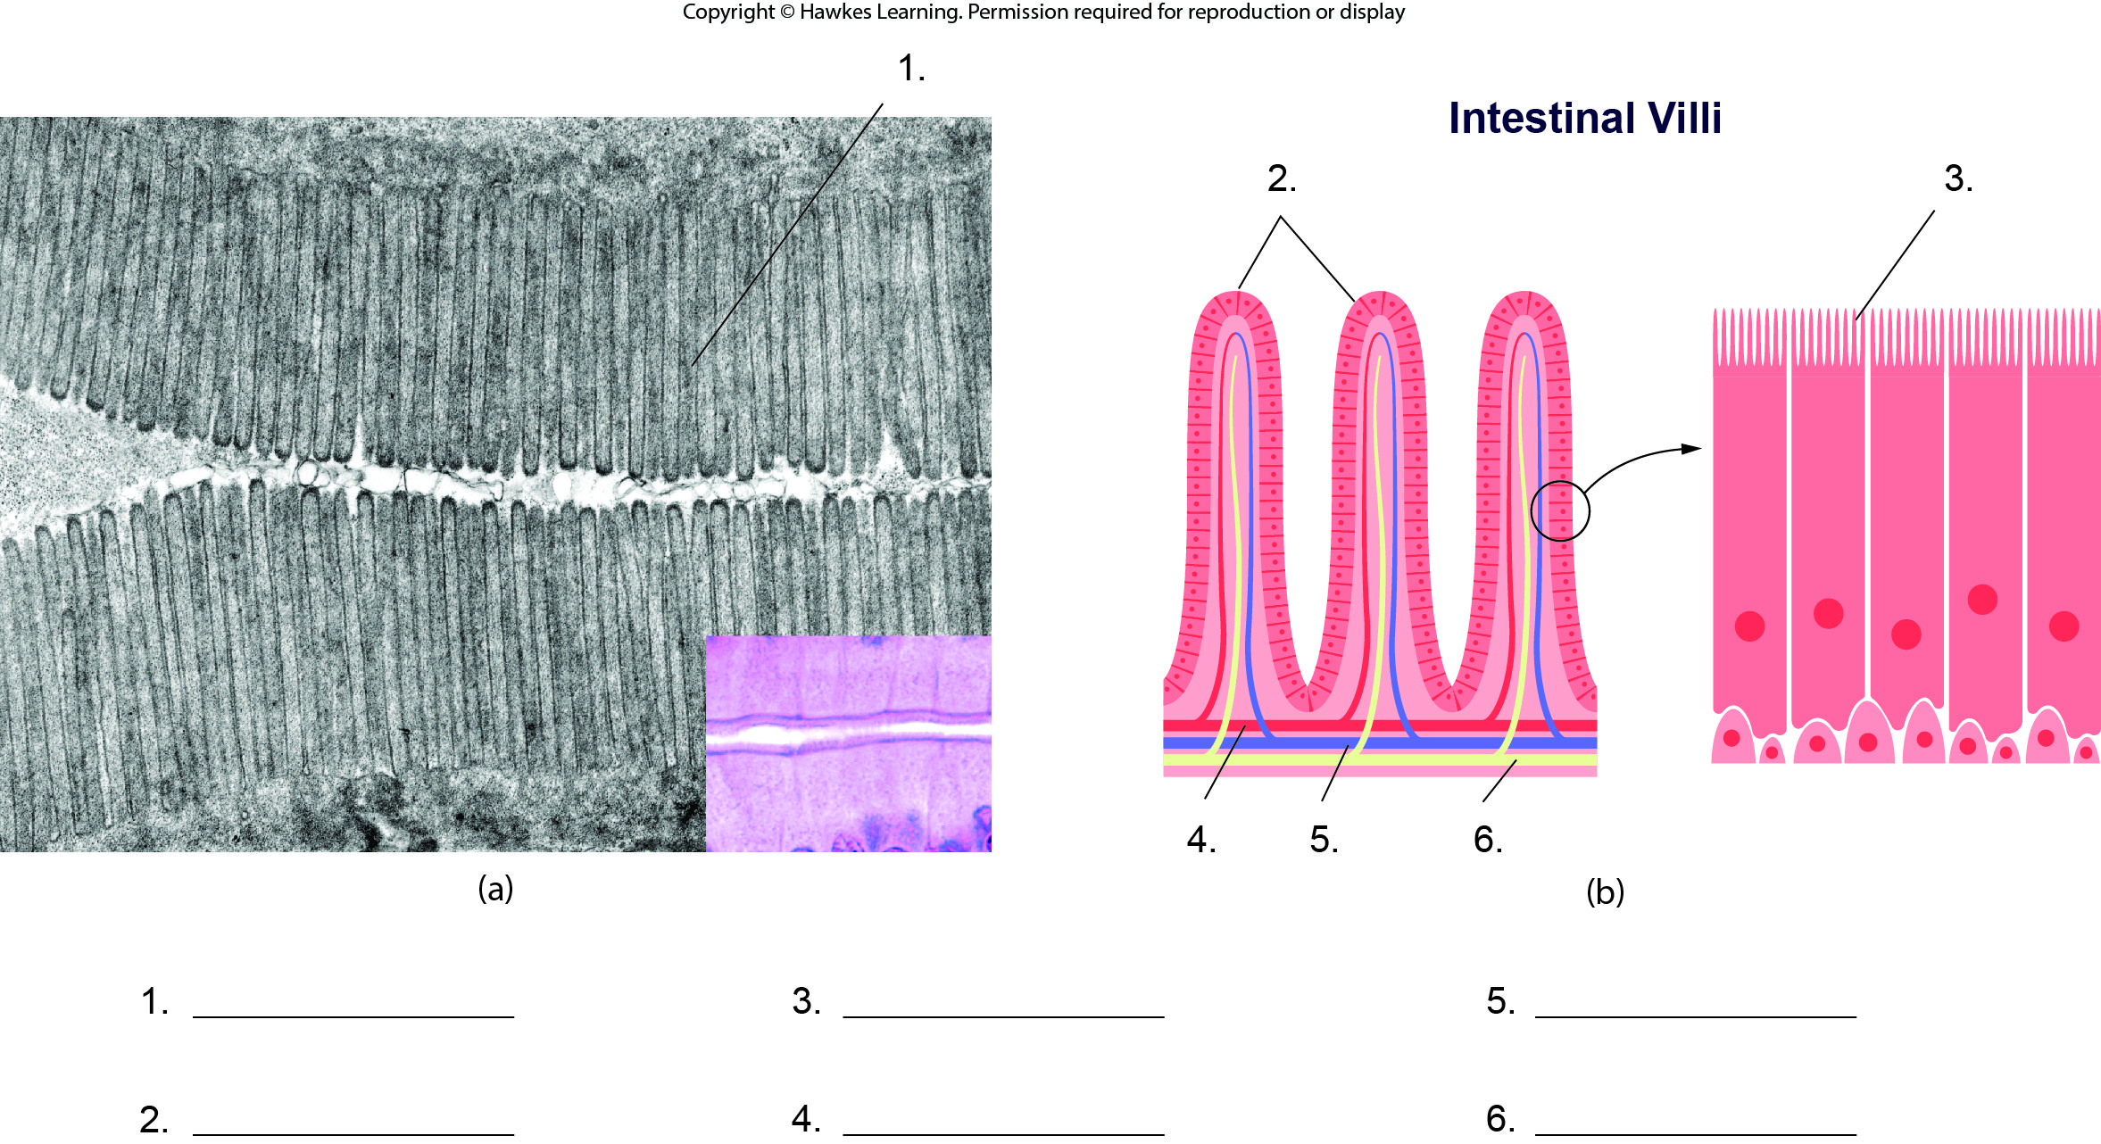
Lesson 4.2 Figure 4 - Numbered

Slide 15
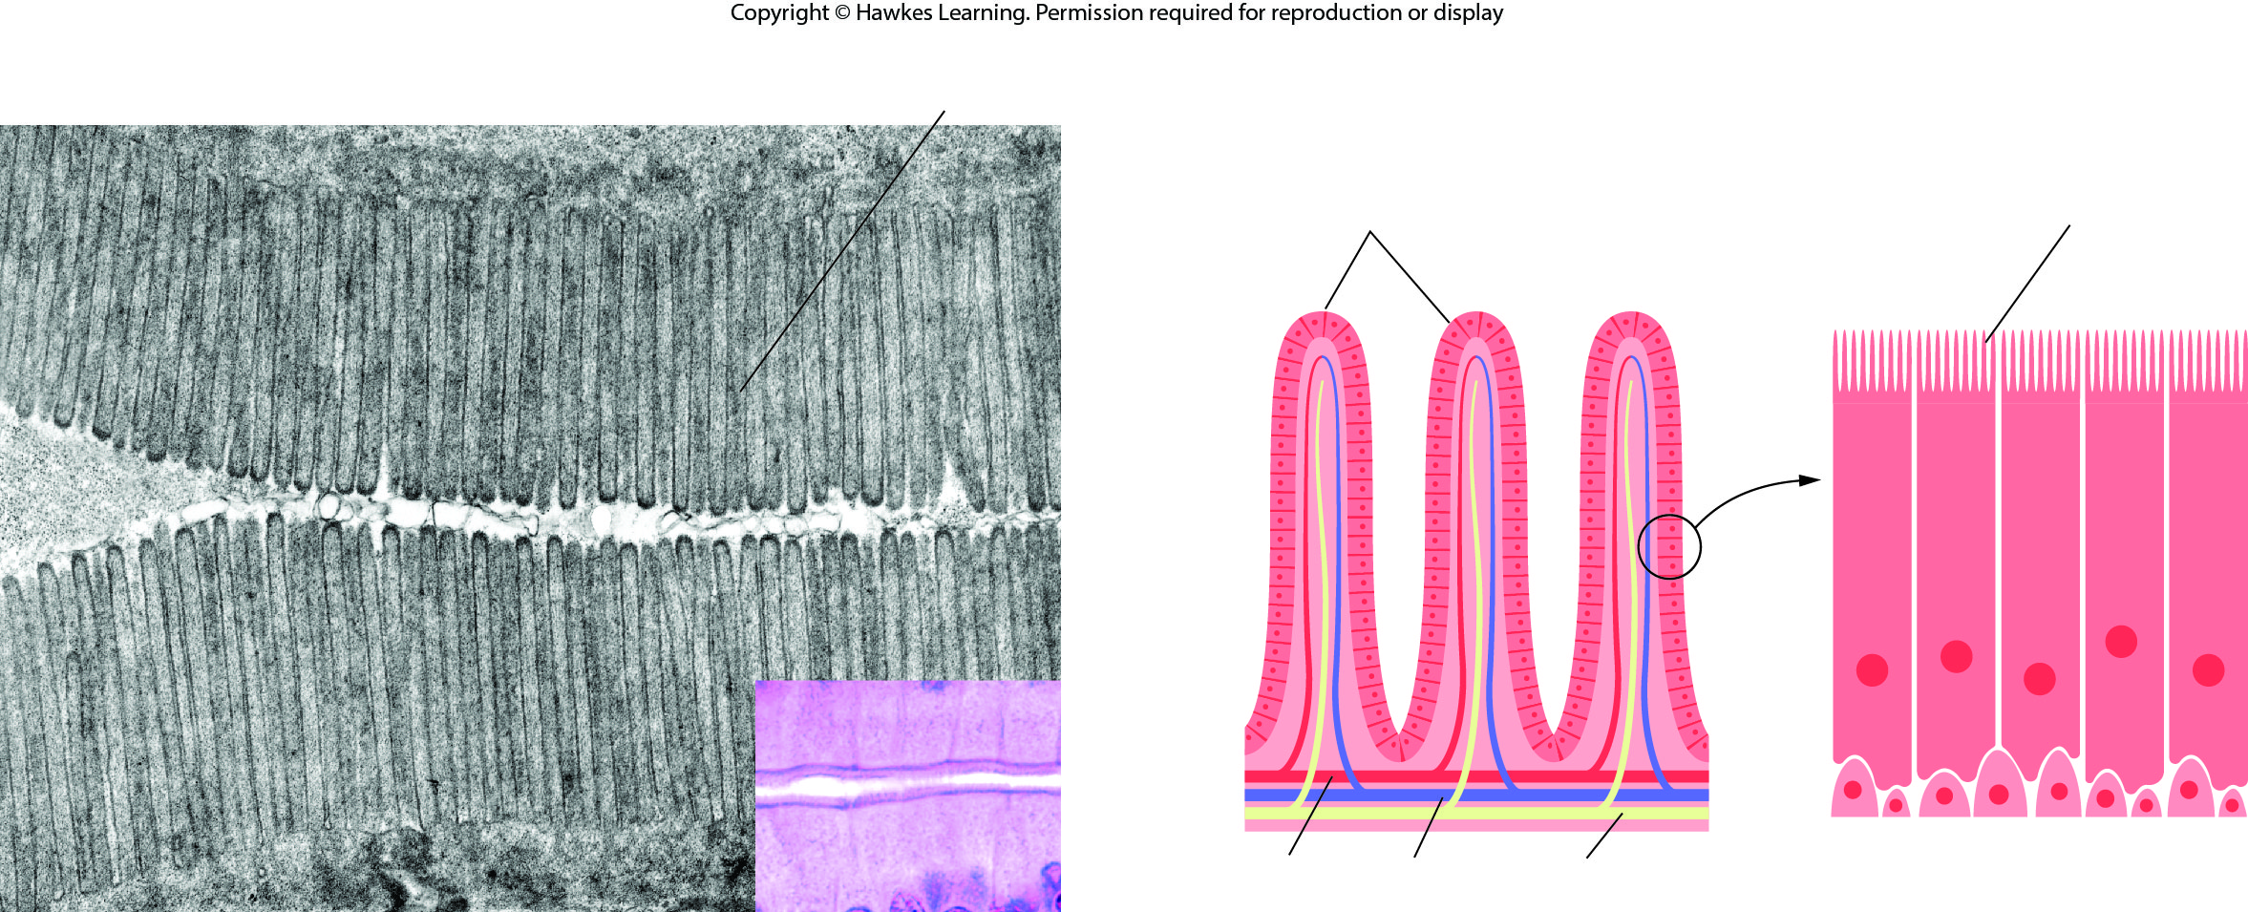
Lesson 4.2 Figure 4

Slide 16
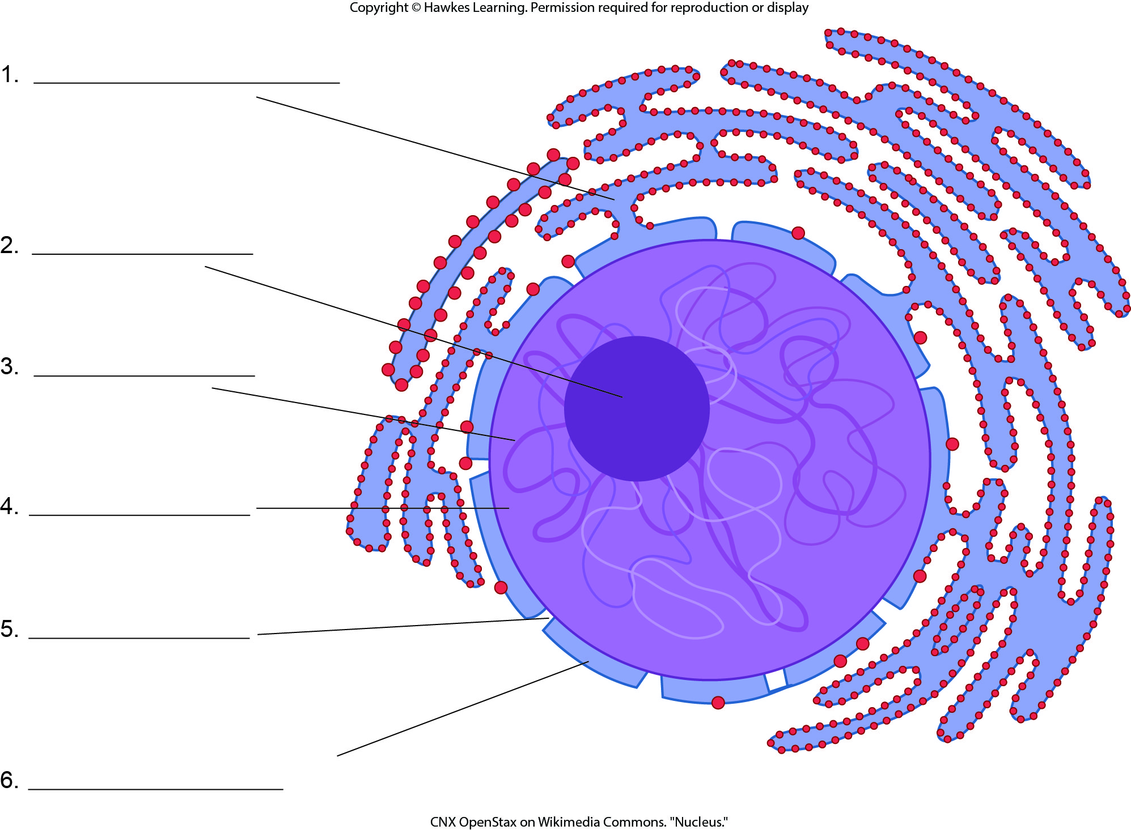
Lesson 4.2 Figure 5 - Numbered

Slide 17
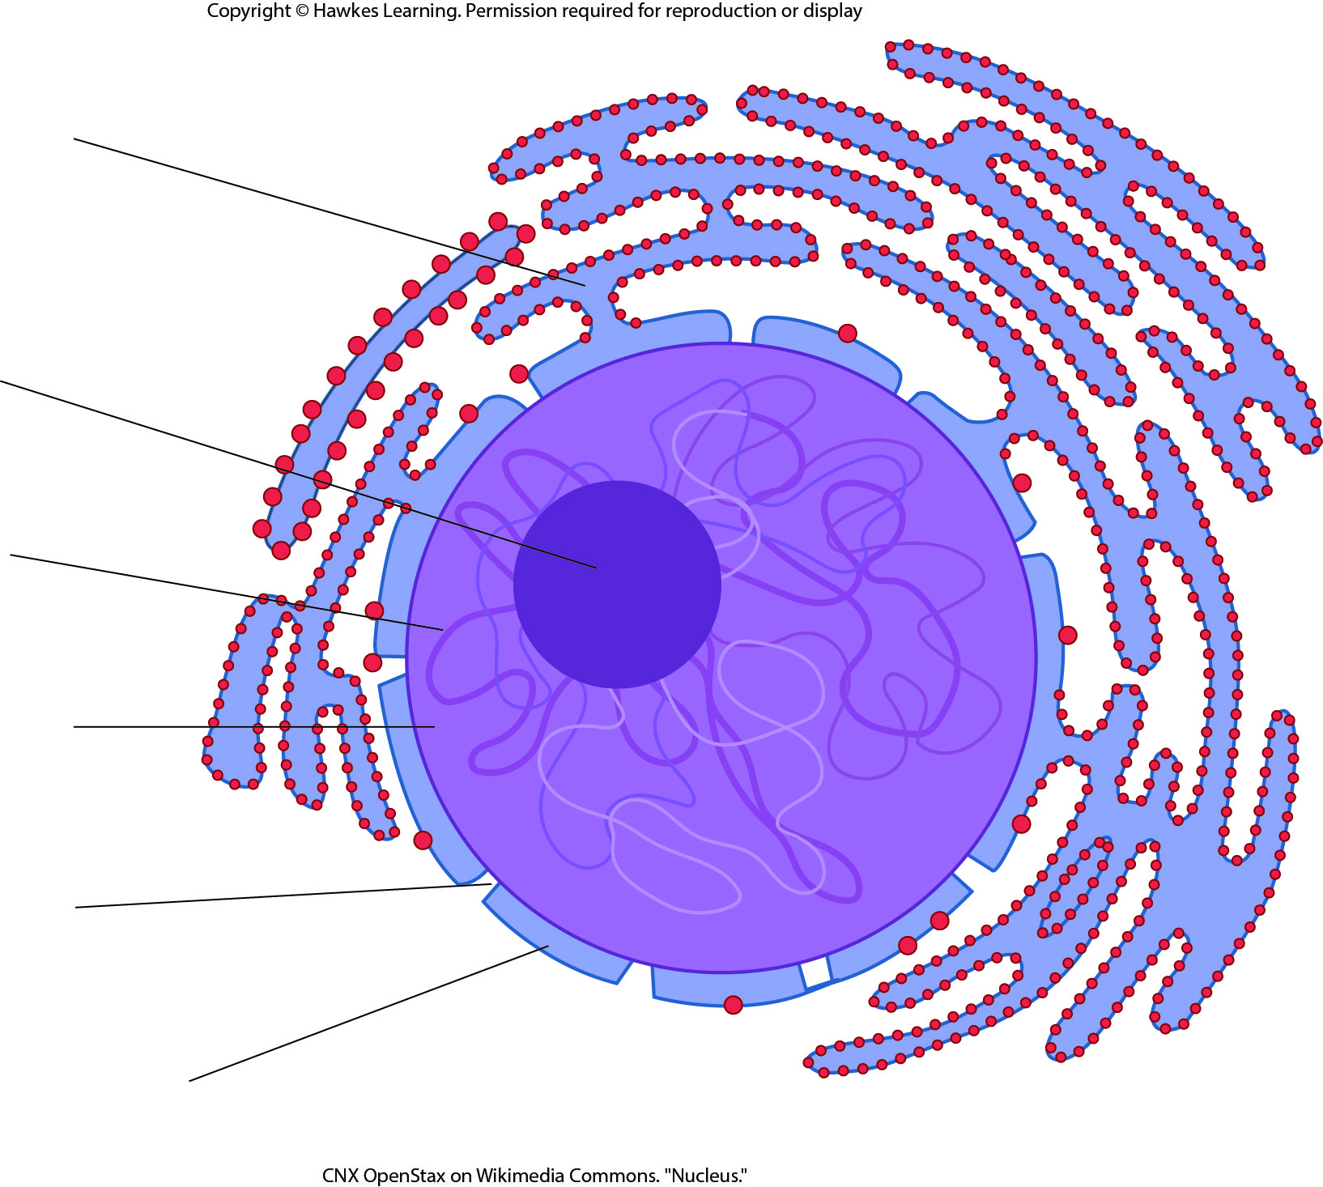
Lesson 4.2 Figure 5

Slide 18
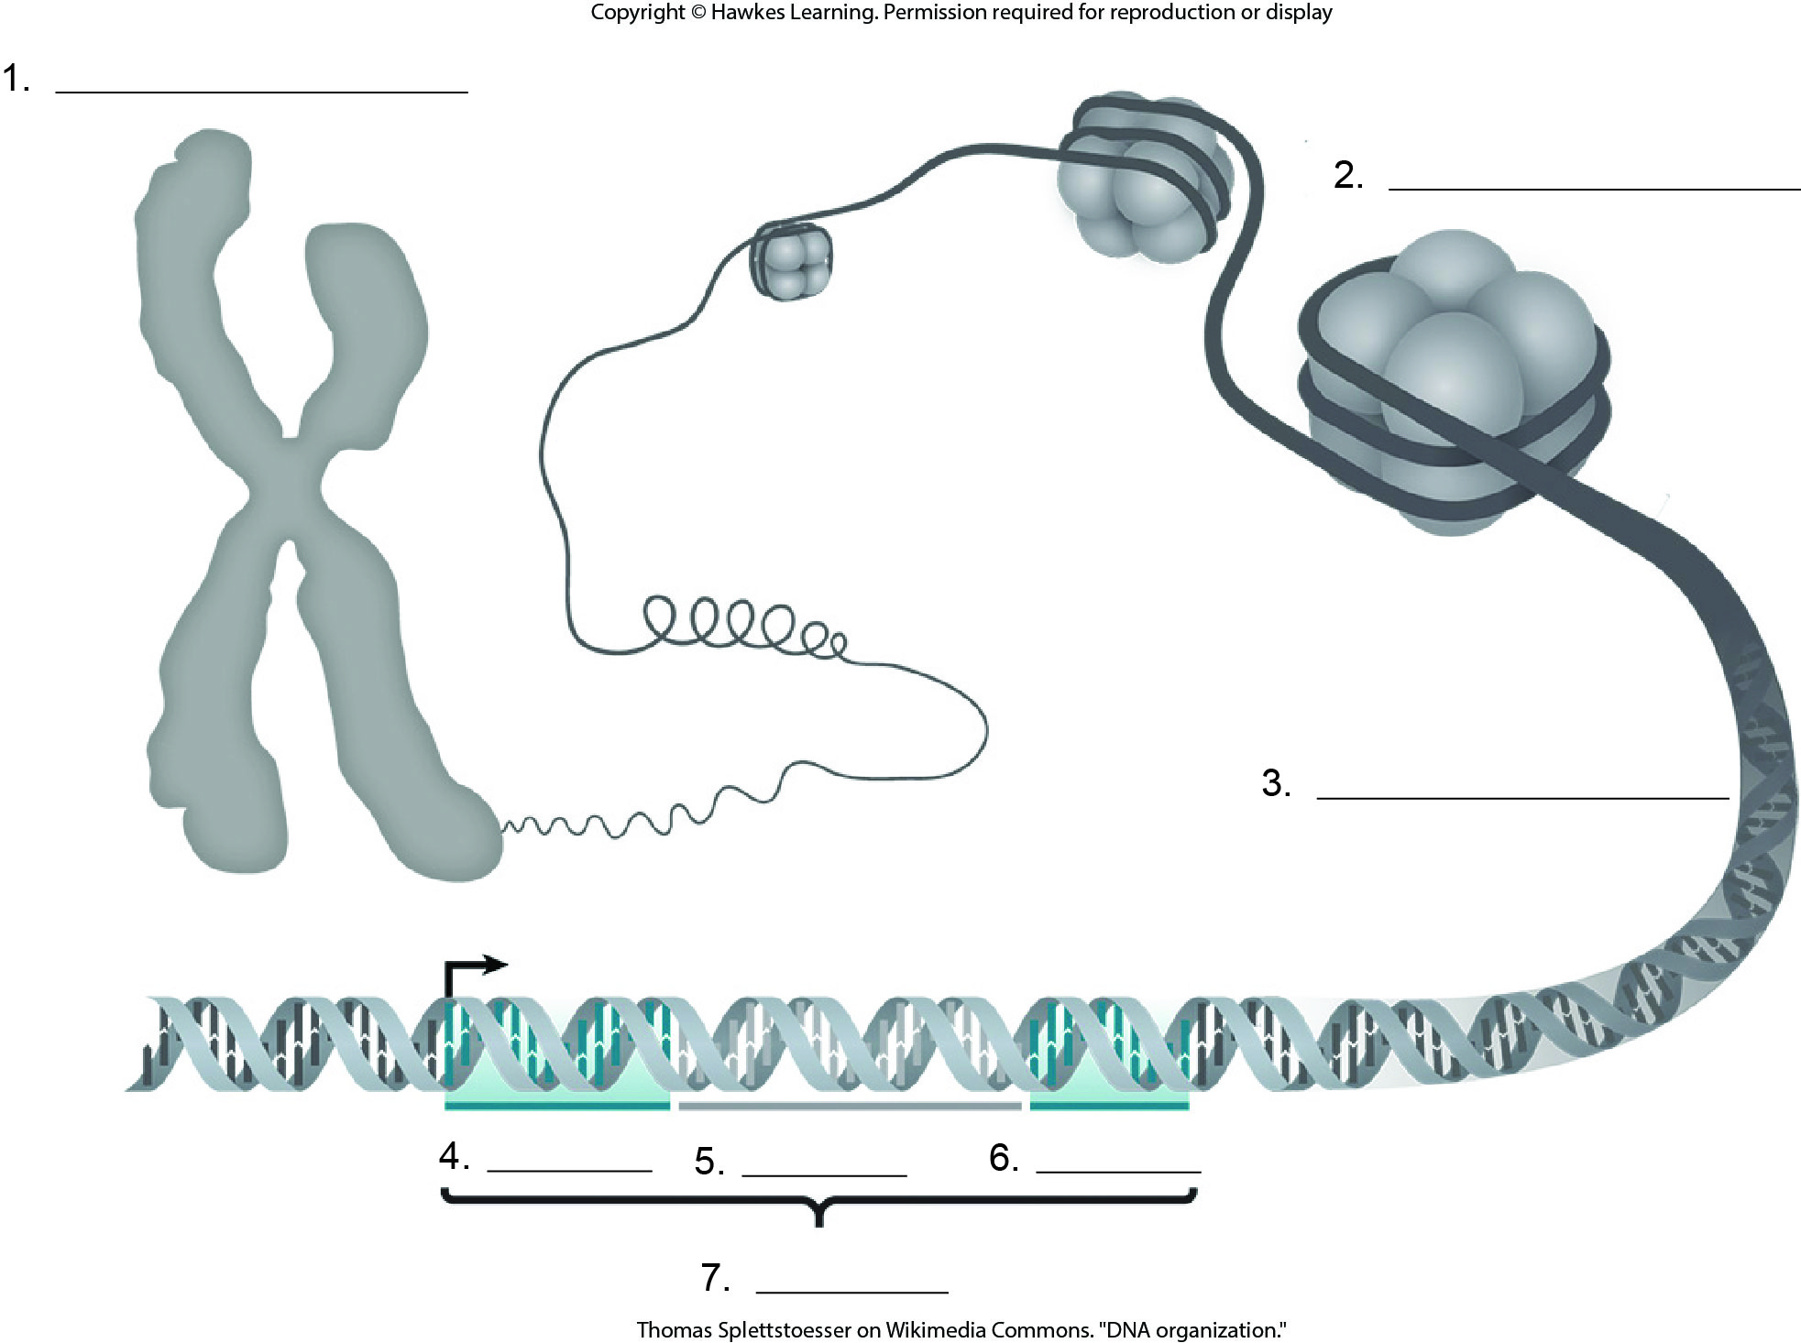
Lesson 4.2 Figure 7 - Numbered

Slide 19
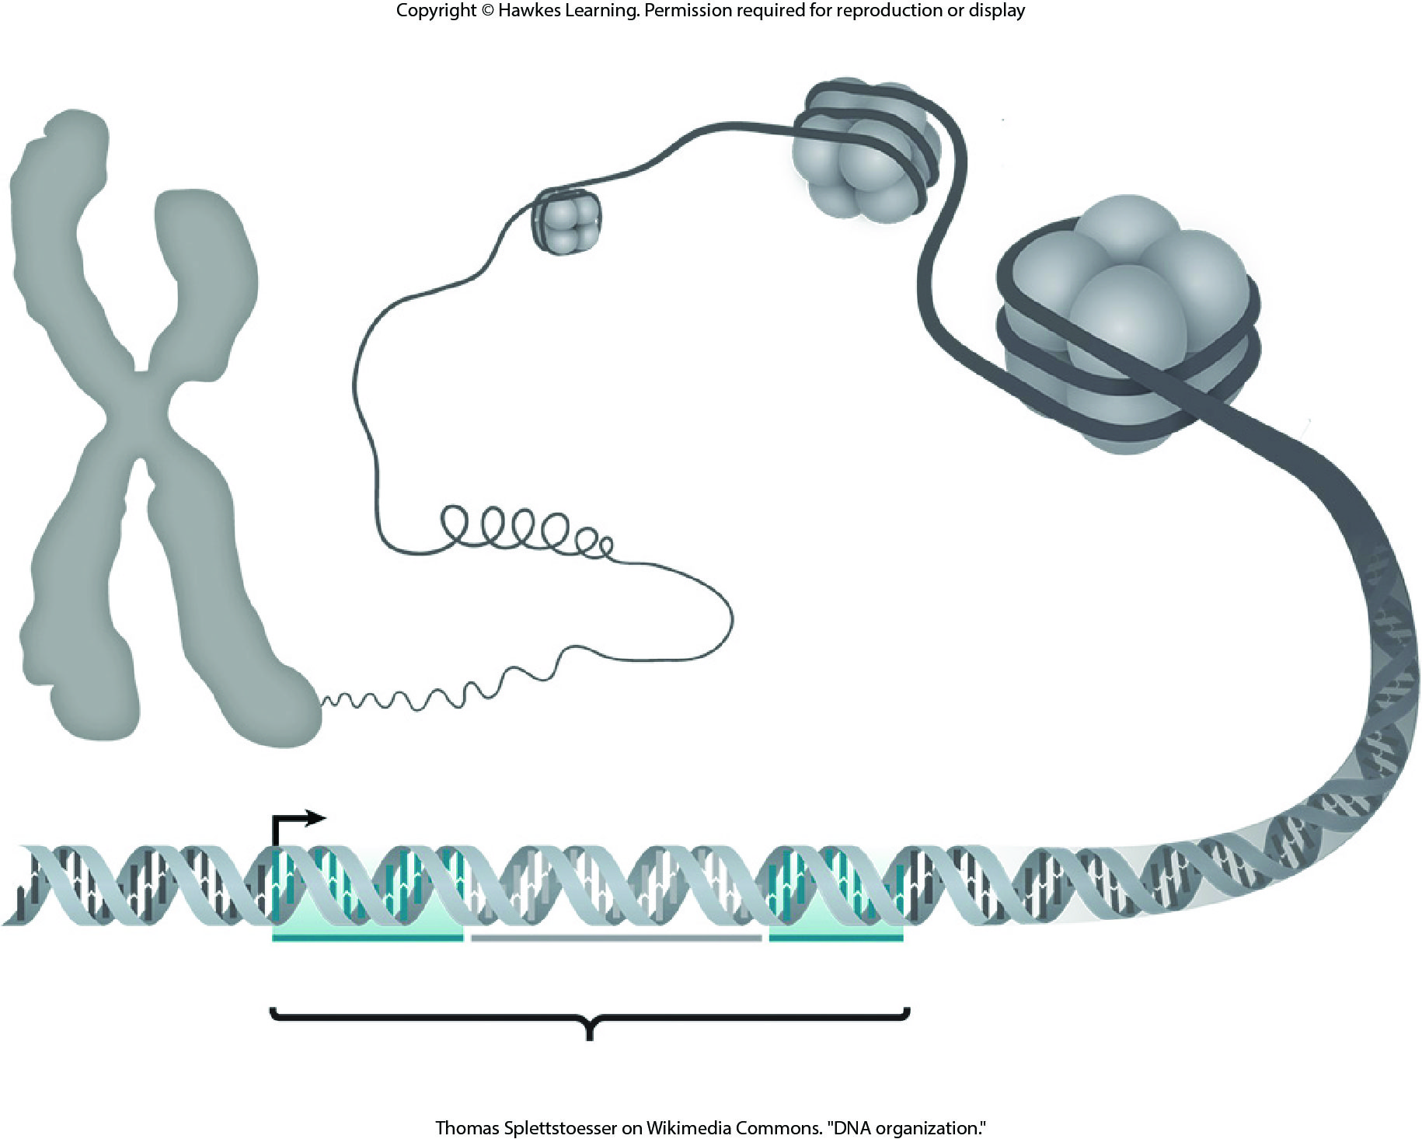
Lesson 4.2 Figure 7

Slide 20
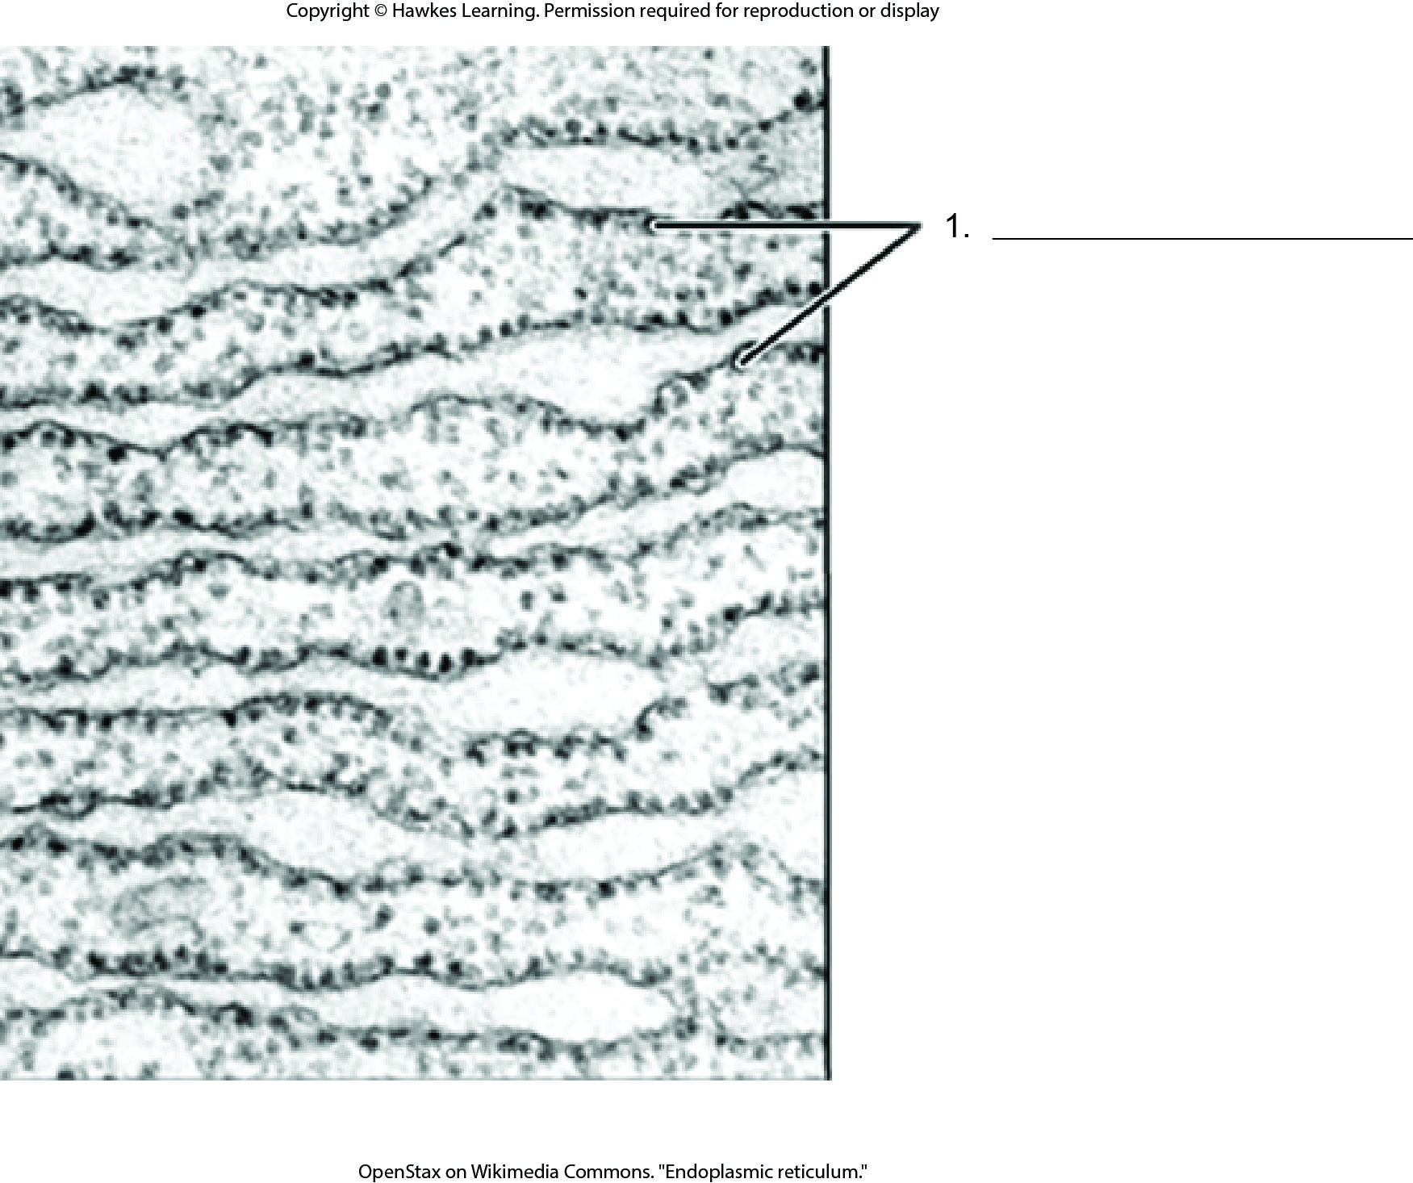
Lesson 4.2 Figure 8 - Numbered

Slide 21
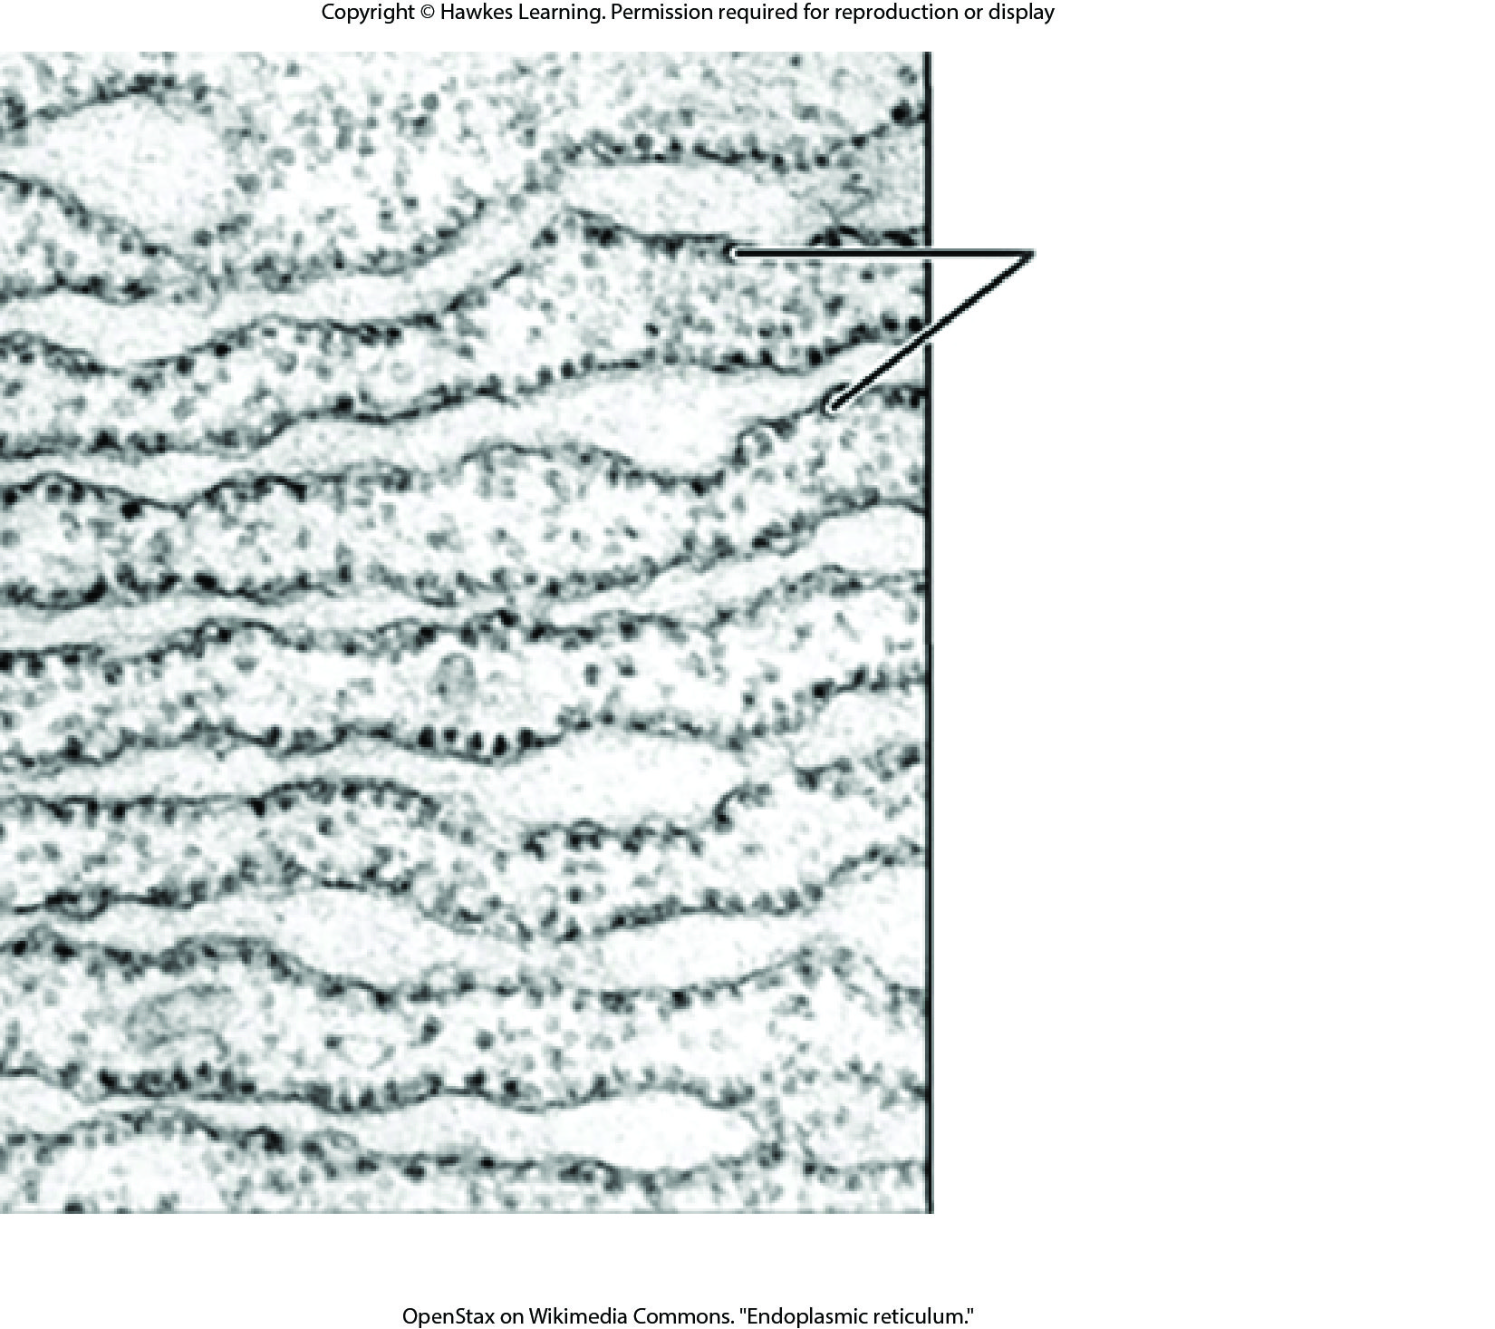
Lesson 4.2 Figure 8

Slide 22
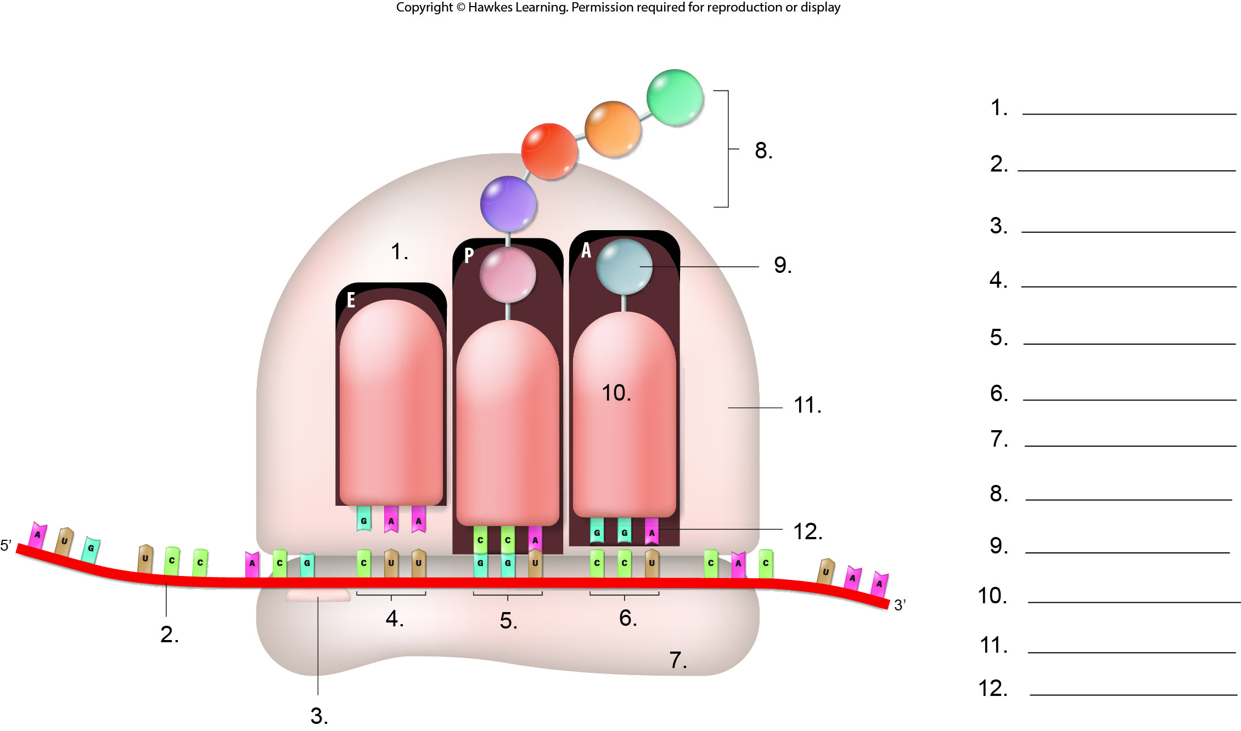
Lesson 4.2 Figure 9 - Numbered

Slide 23
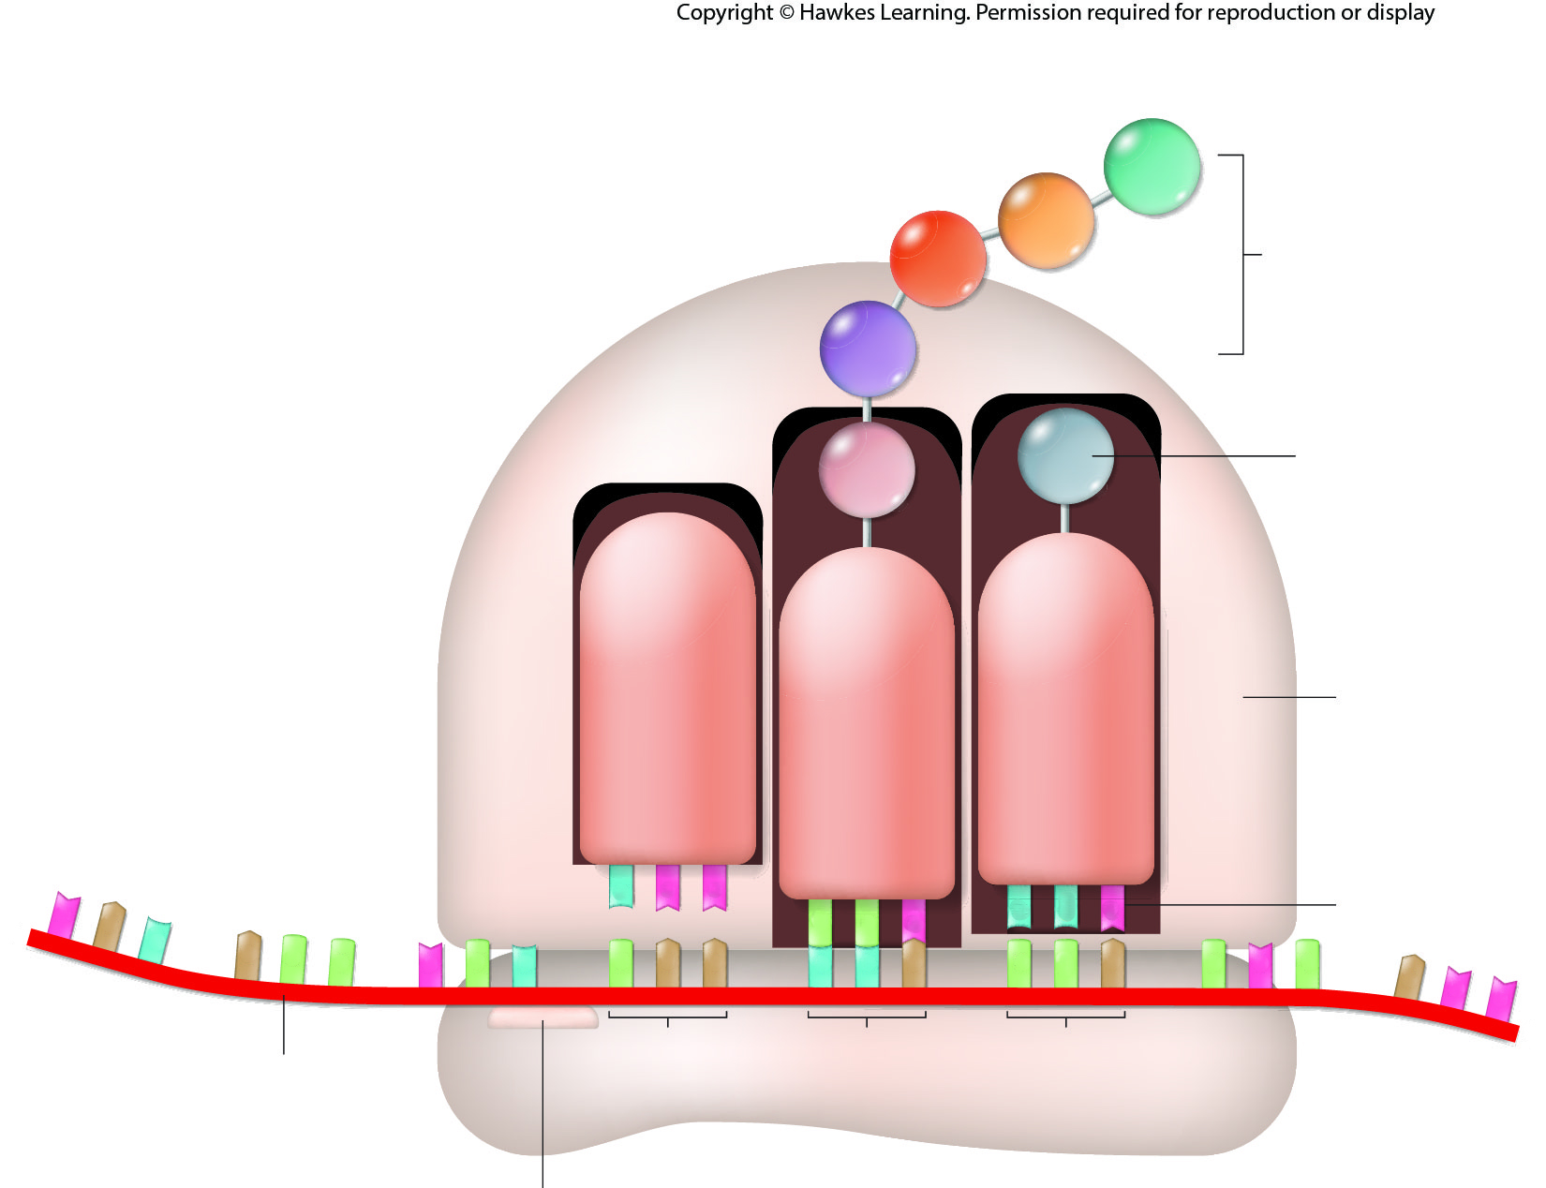
Lesson 4.2 Figure 9

Slide 24
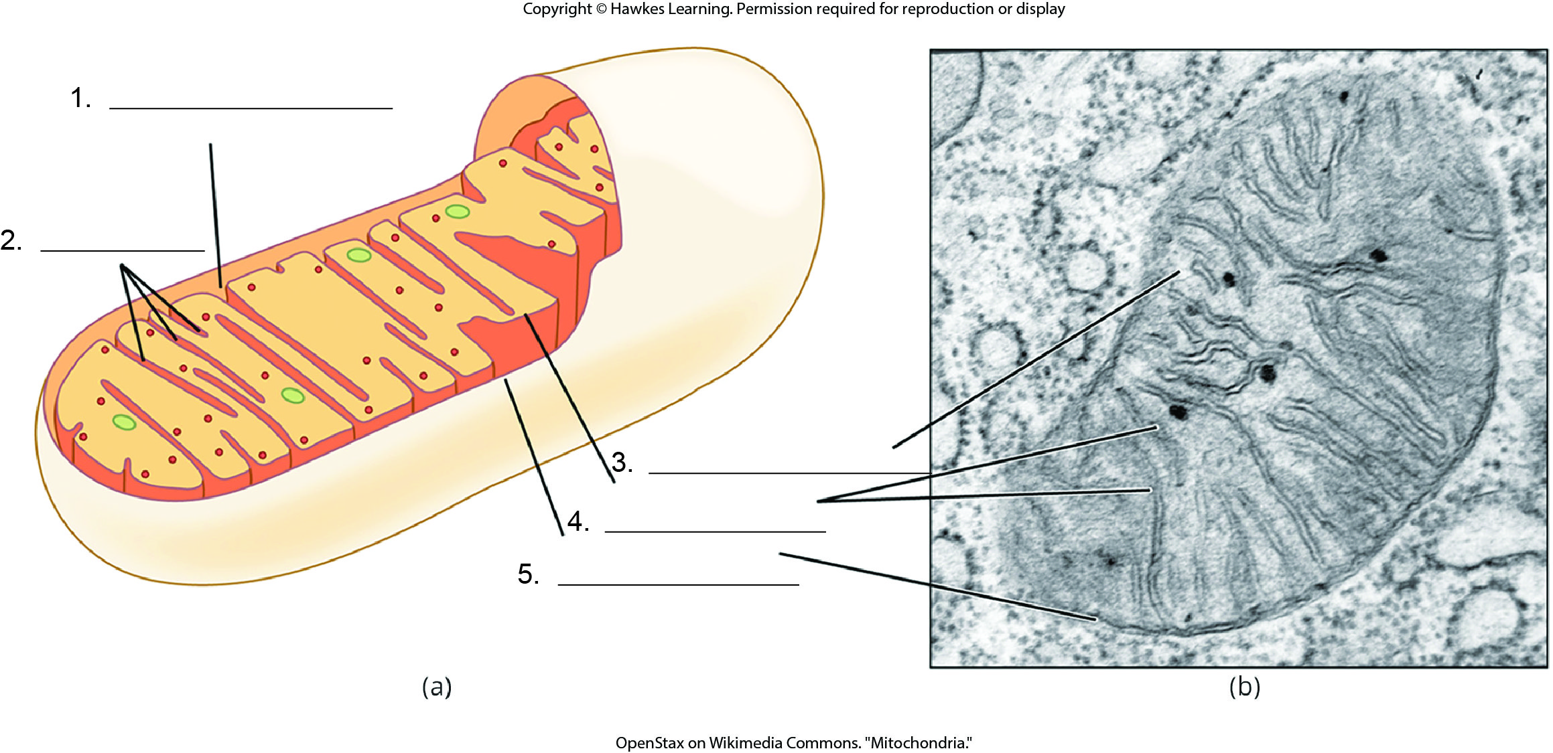
Lesson 4.2 Figure 10 - Numbered

Slide 25
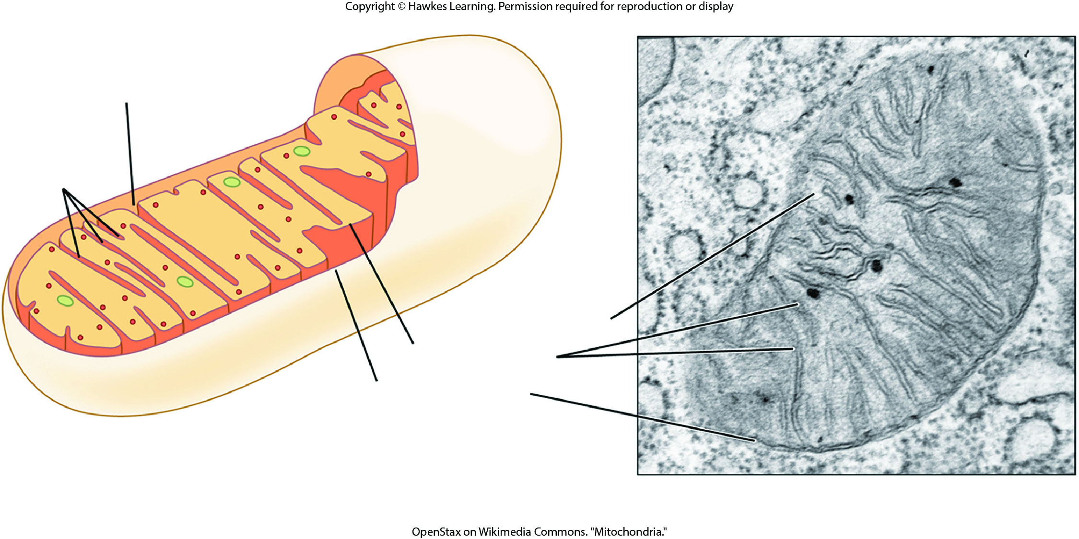
Lesson 4.2 Figure 10

Slide 26
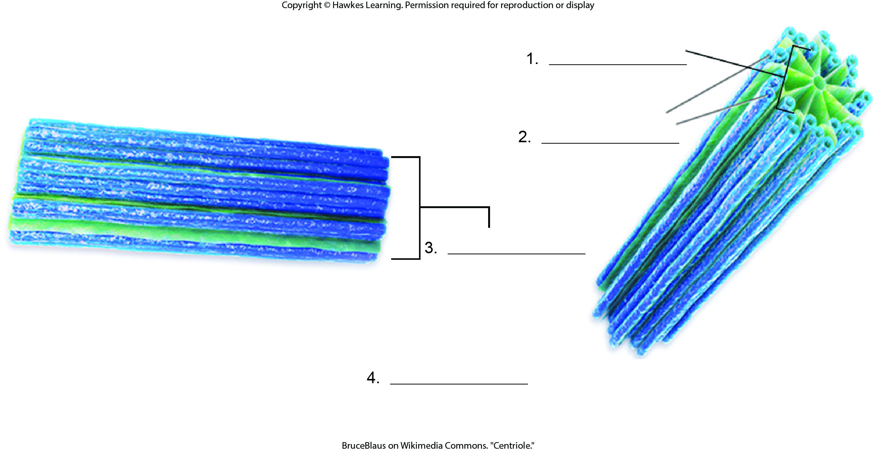
Lesson 4.2 Figure 12 - Numbered

Slide 27
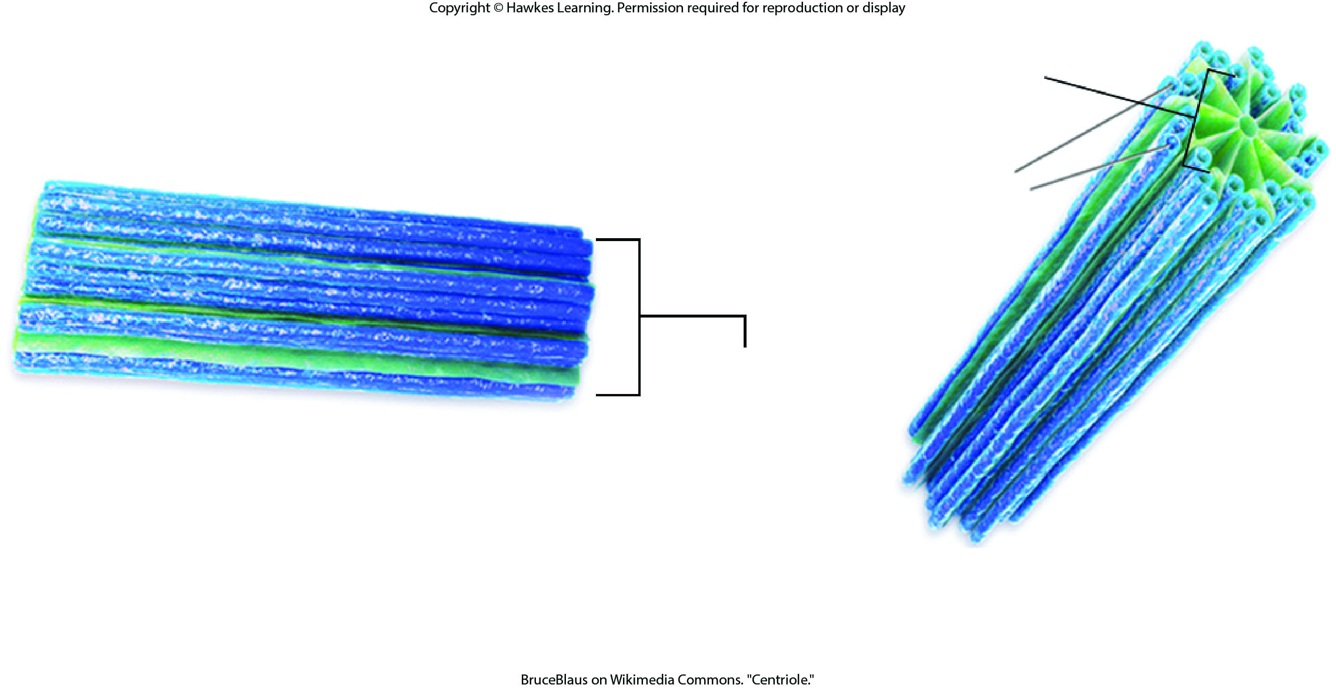
Lesson 4.2 Figure 12

Slide 28
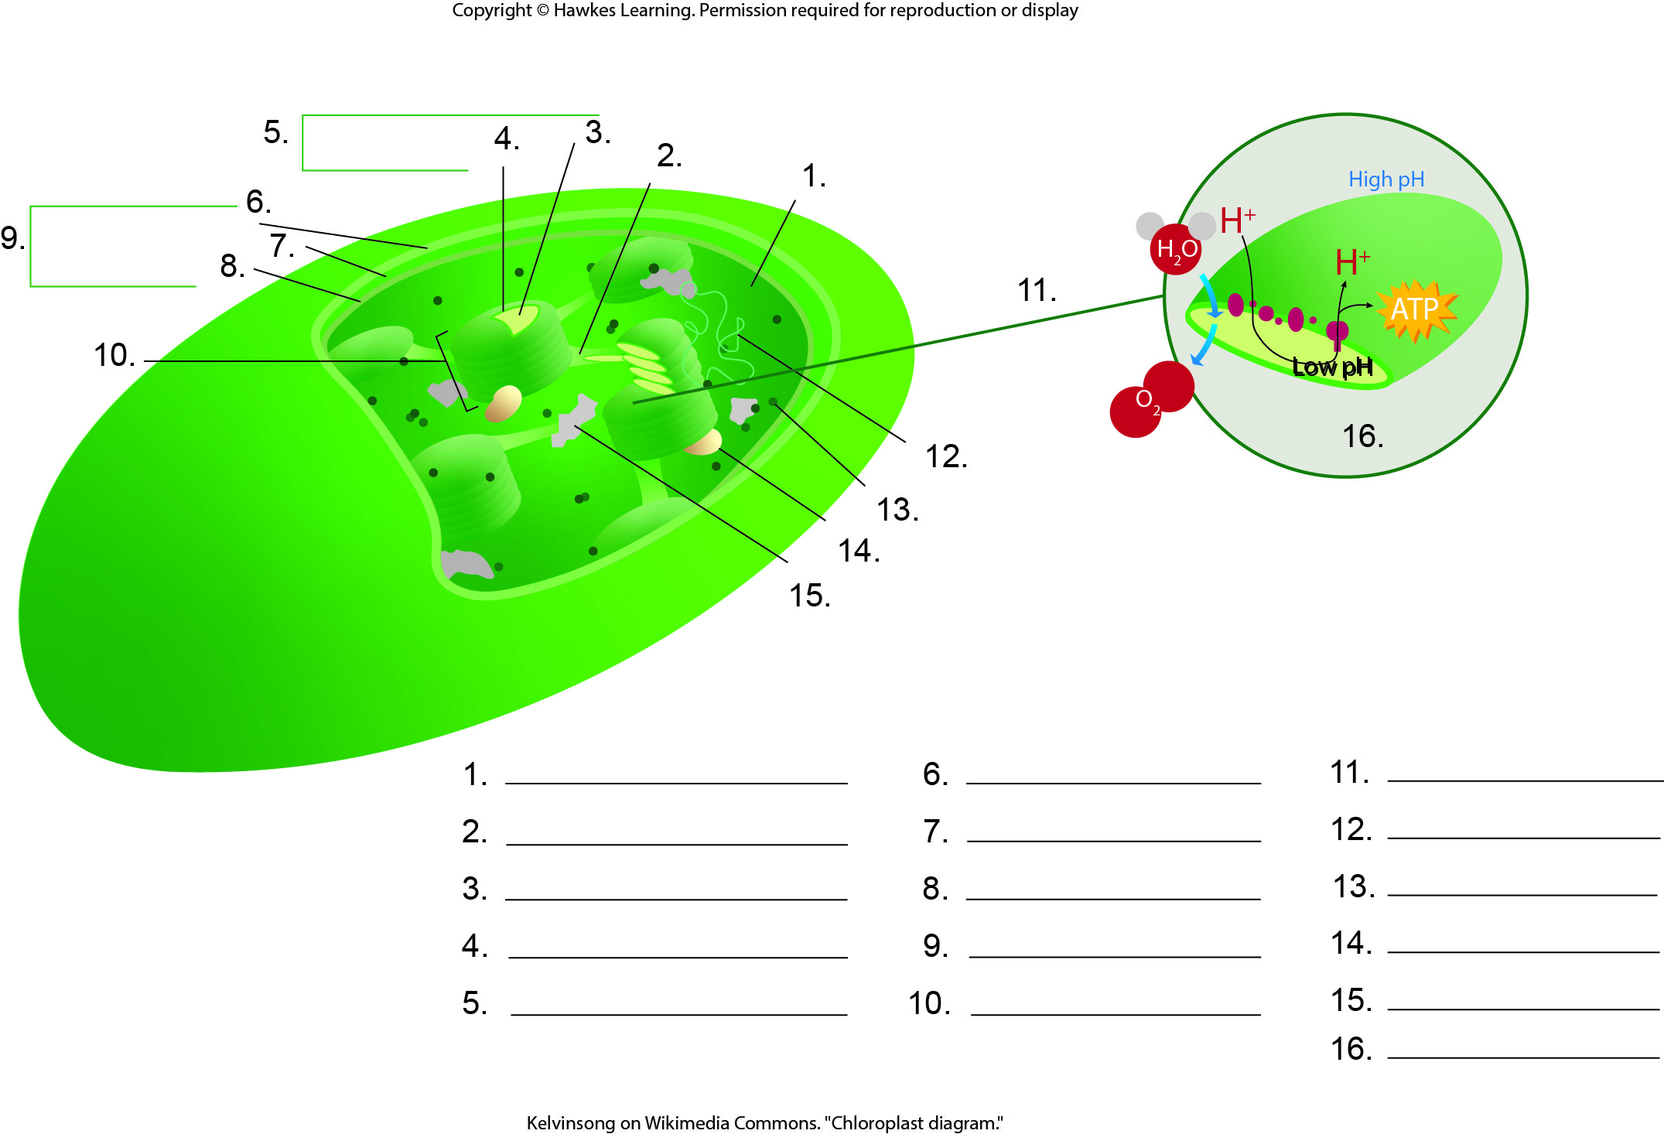
Lesson 4.2 Figure 15 - Numbered

Slide 29
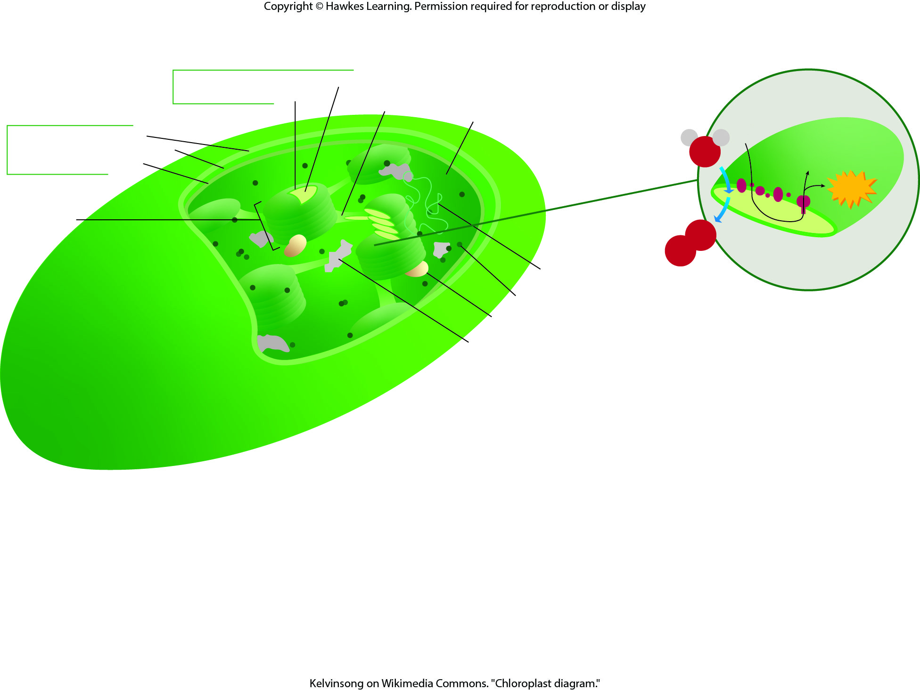
Lesson 4.2 Figure 15

Slide 30
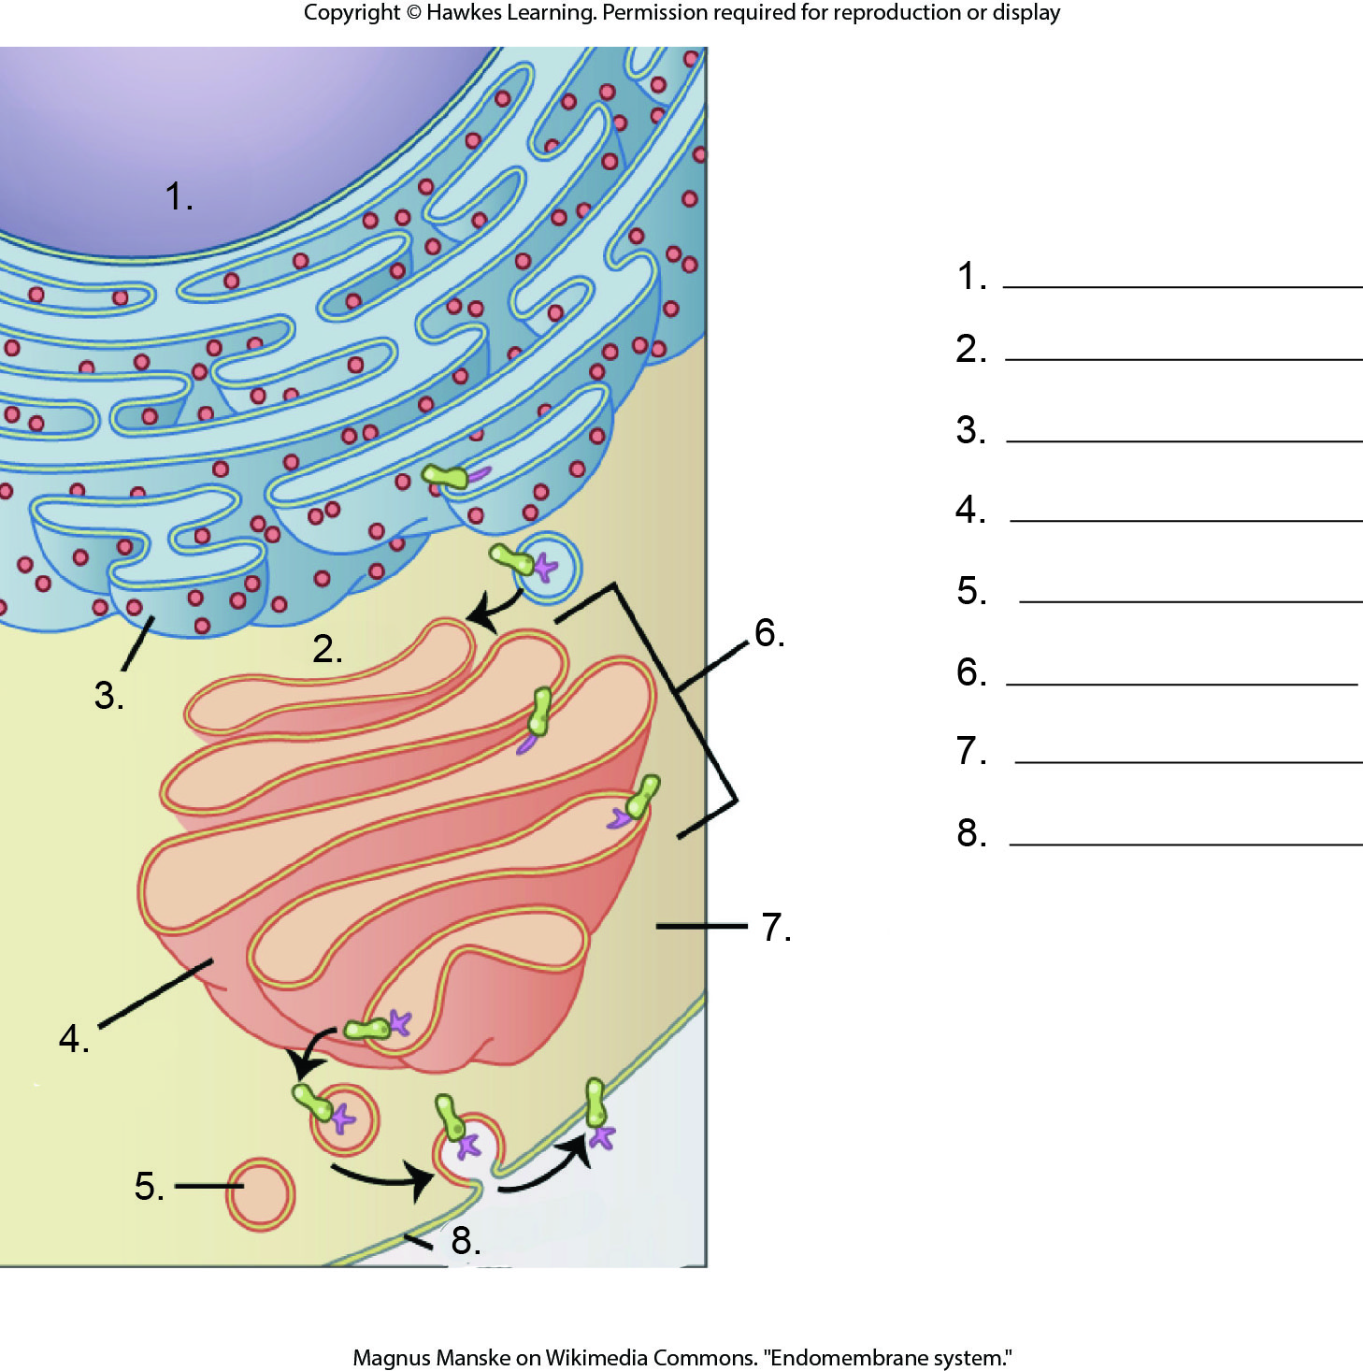
Lesson 4.3 Figure 1 - Numbered

Slide 31
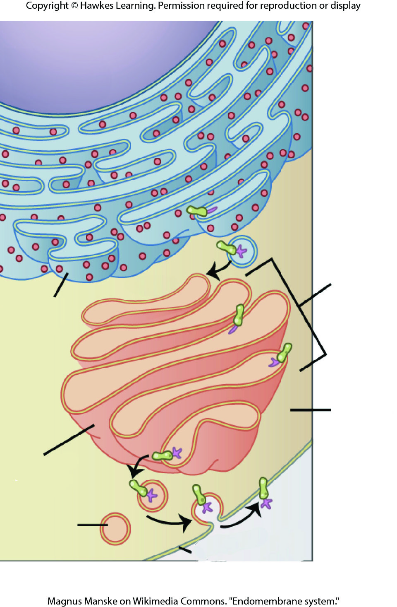
Lesson 4.3 Figure 1

Slide 32
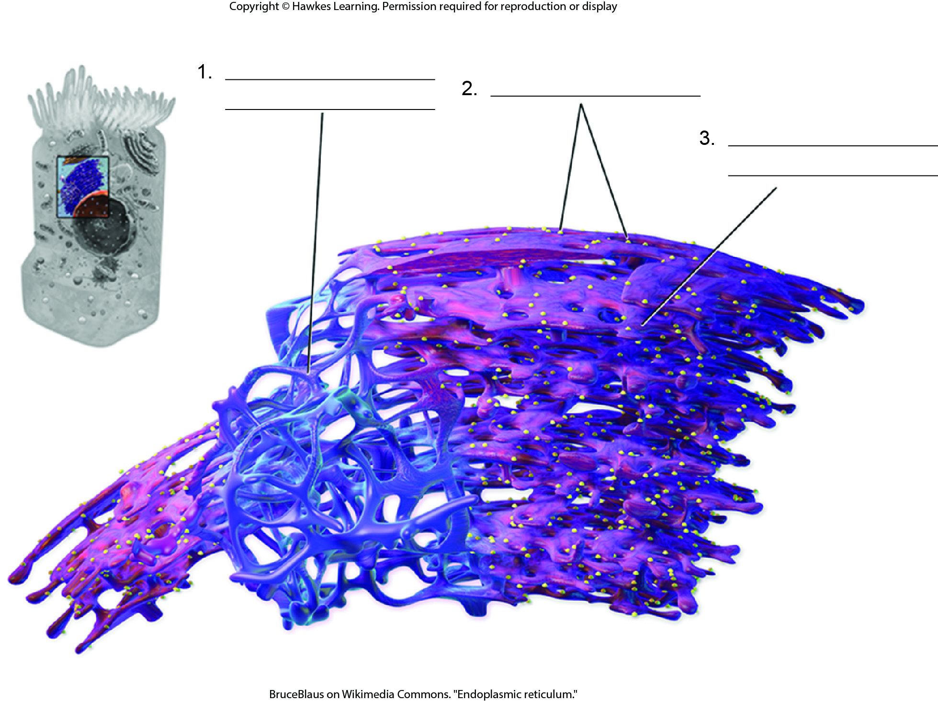
Lesson 4.3 Figure 2 - Numbered

Slide 33
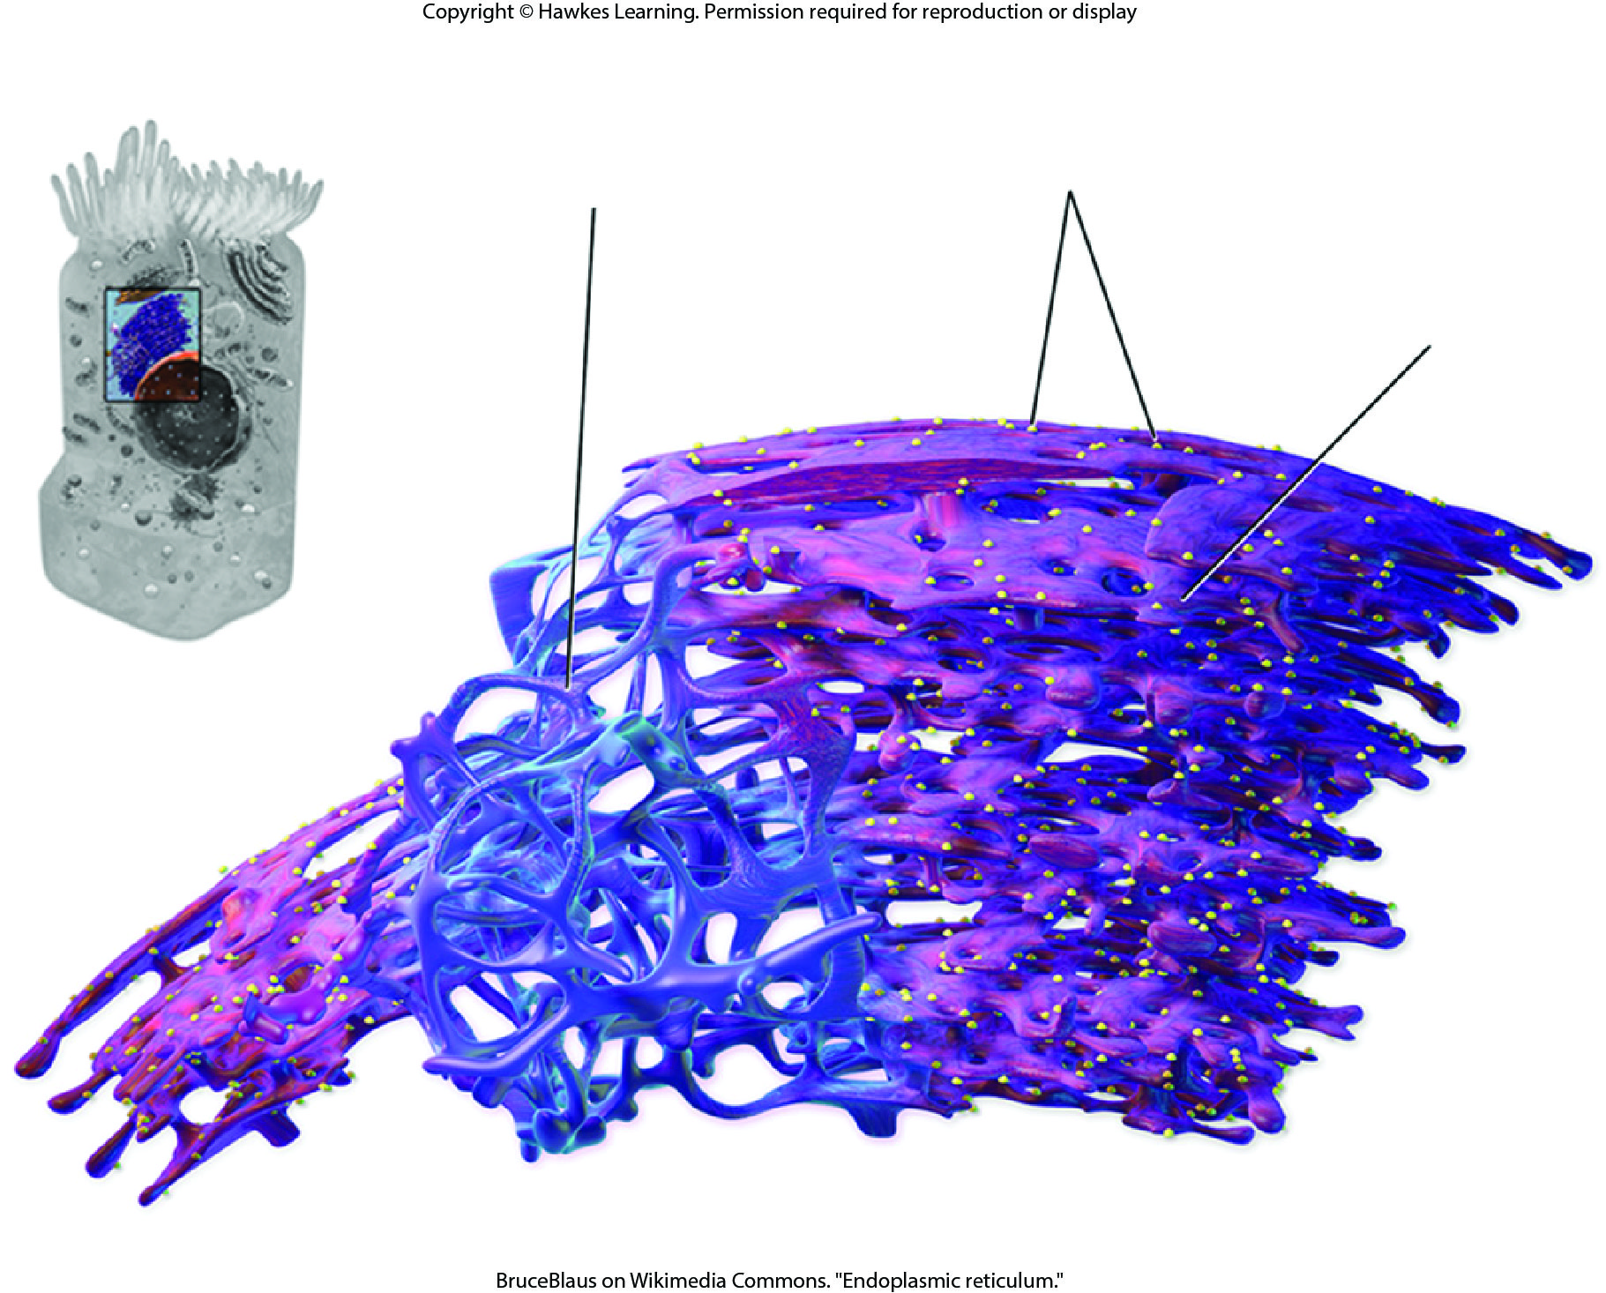
Lesson 4.3 Figure 2

Slide 34
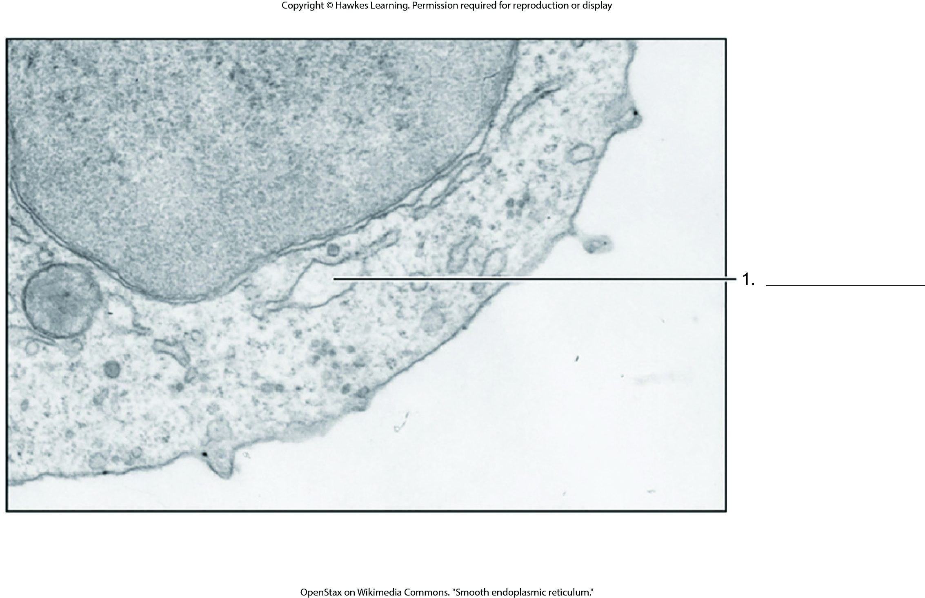
Lesson 4.3 Figure 4 - Numbered

Slide 35
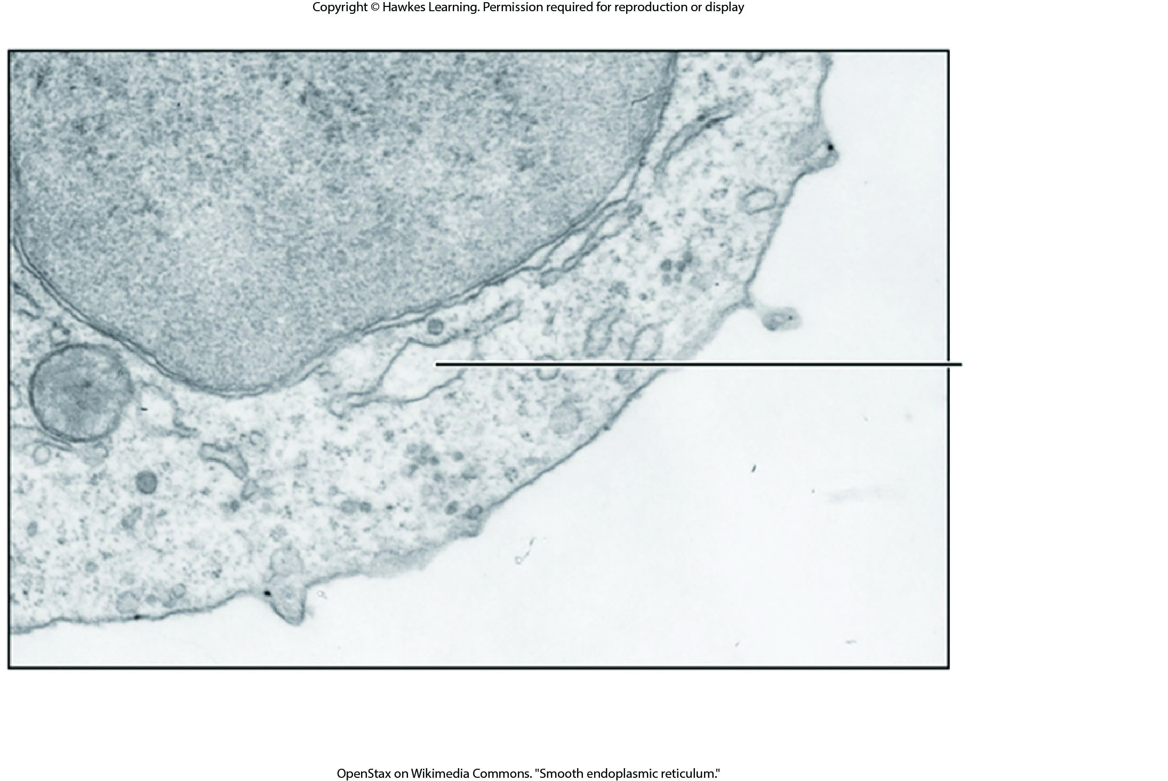
Lesson 4.3 Figure 4

Slide 36
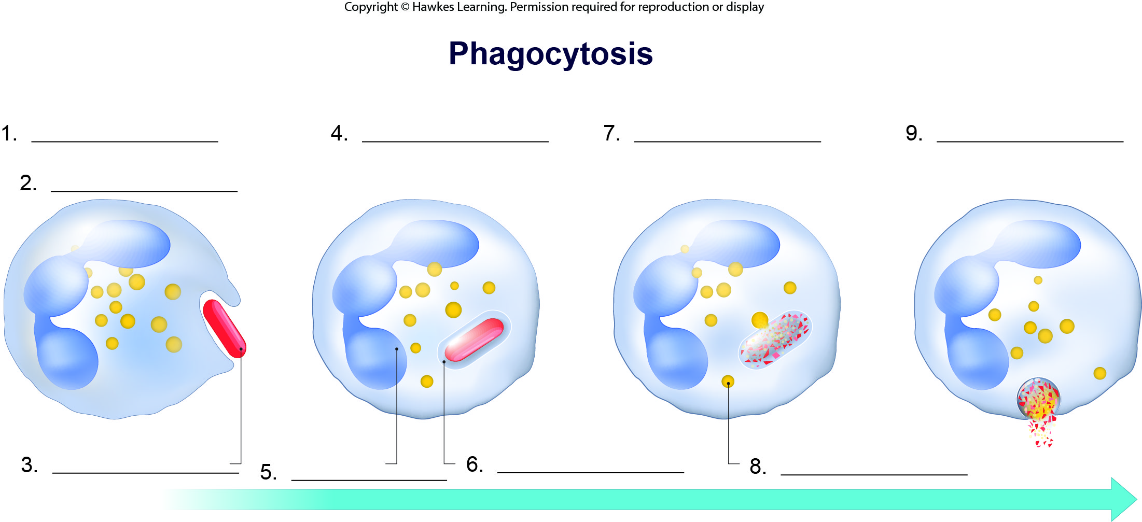
Lesson 4.3 Figure 7 - Numbered

Slide 37
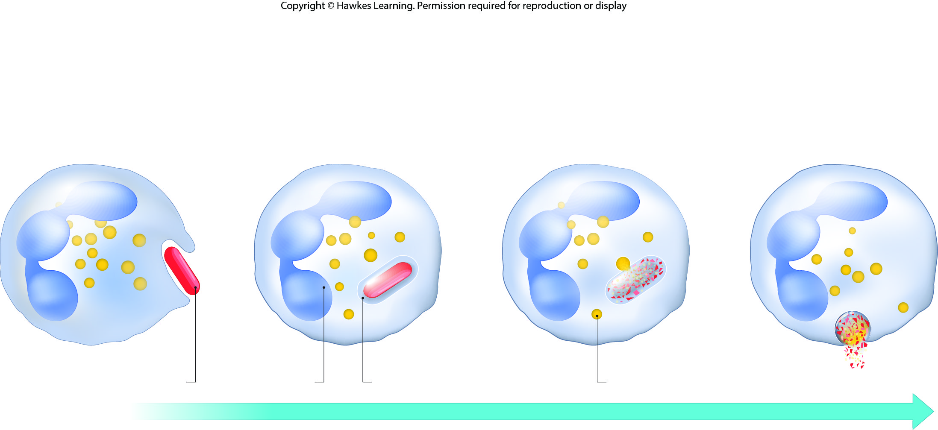
Lesson 4.3 Figure 7

Slide 38
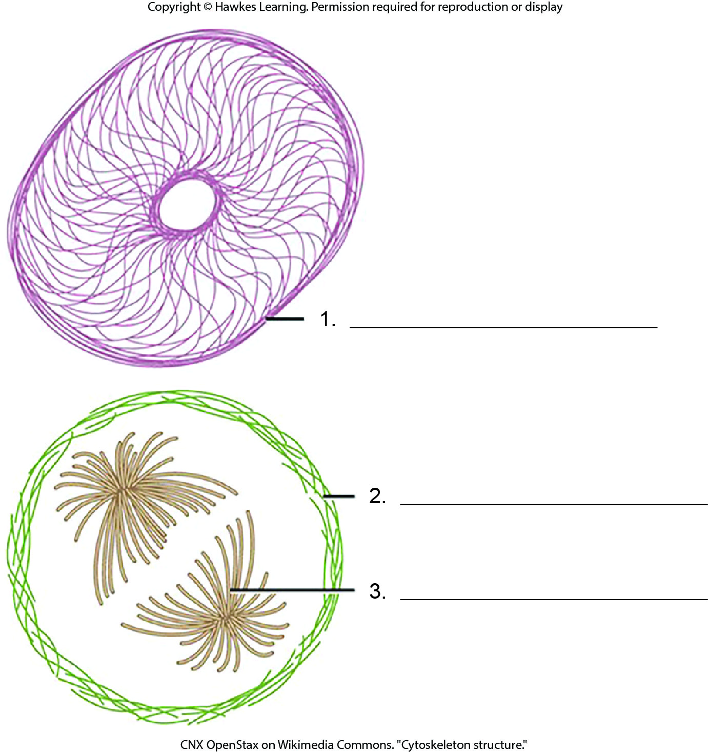
Lesson 4.4 Figure 1 - Numbered

Slide 39
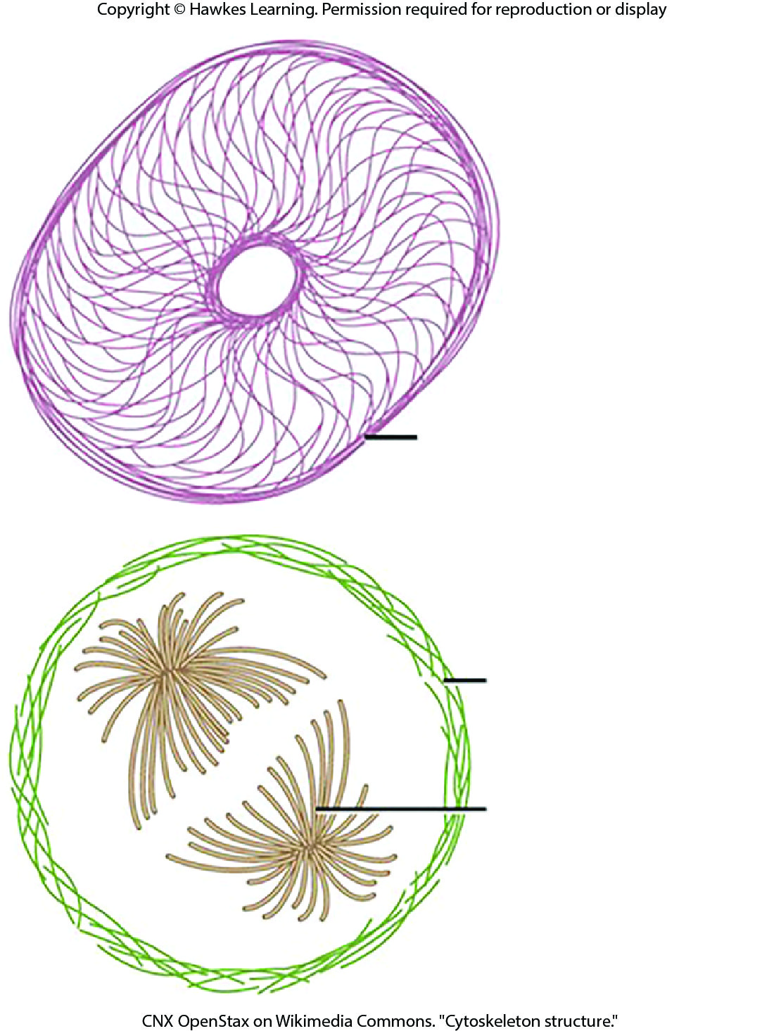
Lesson 4.4 Figure 1

Slide 40
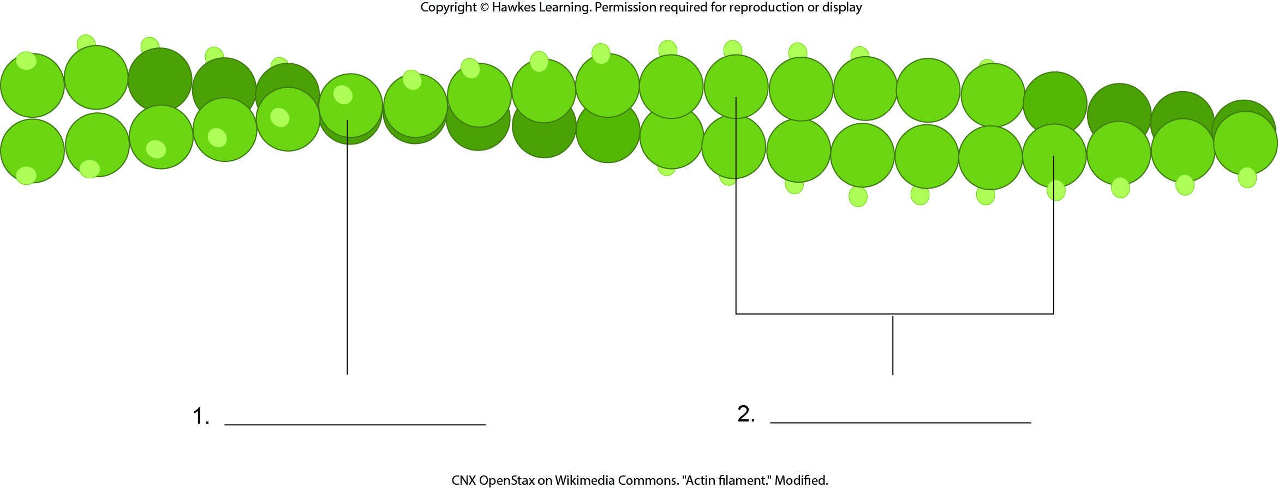
Lesson 4.4 Figure 2 - Numbered

Slide 41

Lesson 4.4 Figure 2

Slide 42
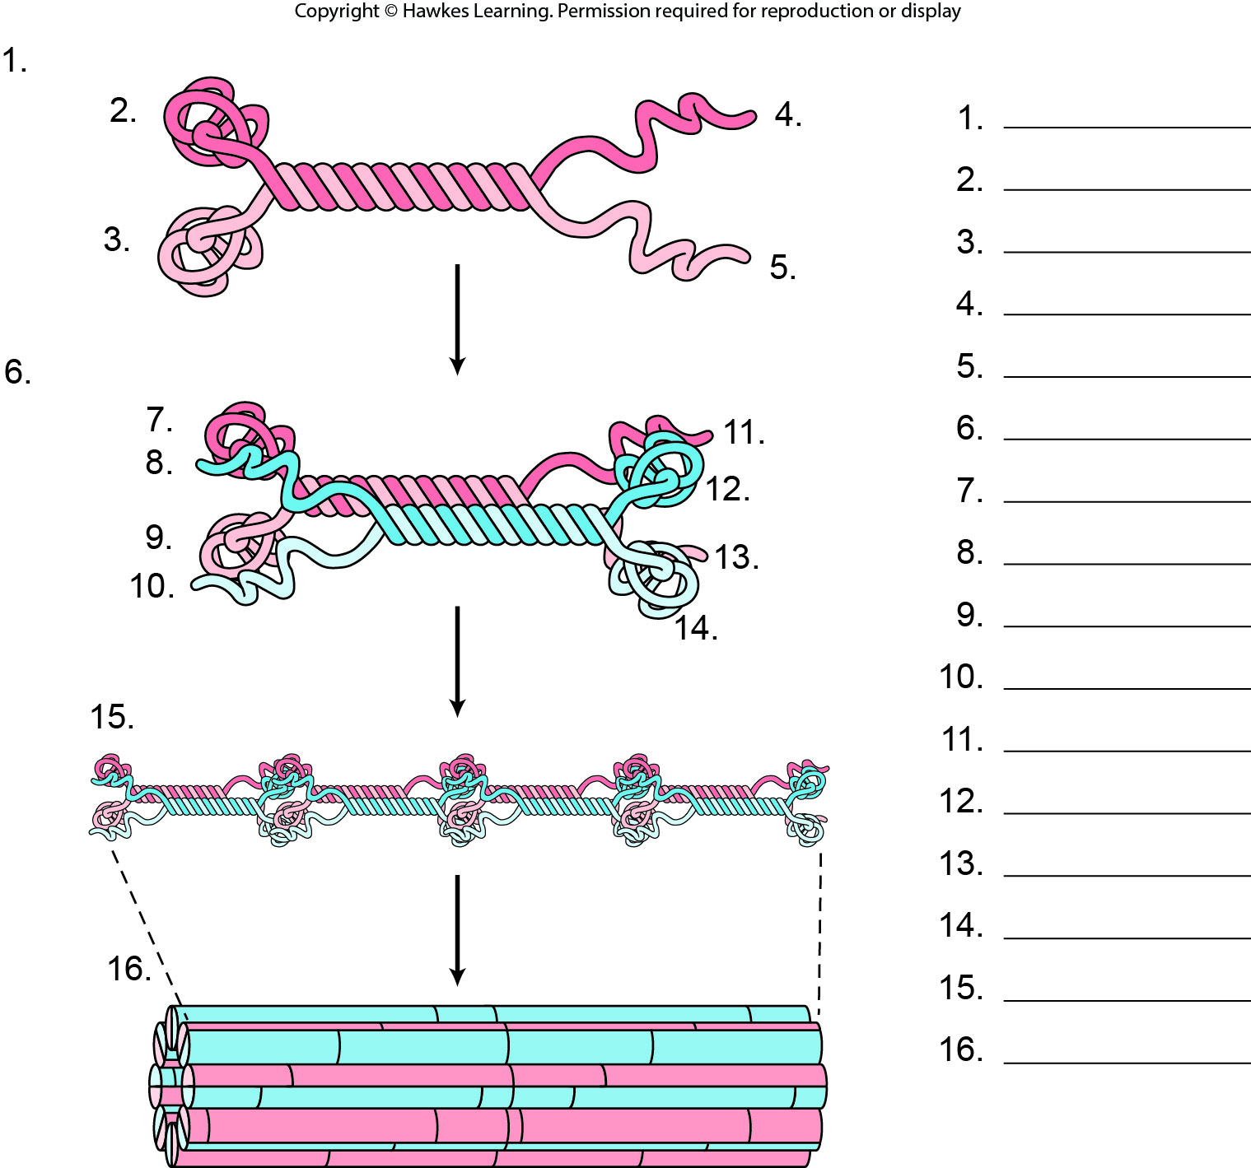
Lesson 4.4 Figure 4 - Numbered

Slide 43
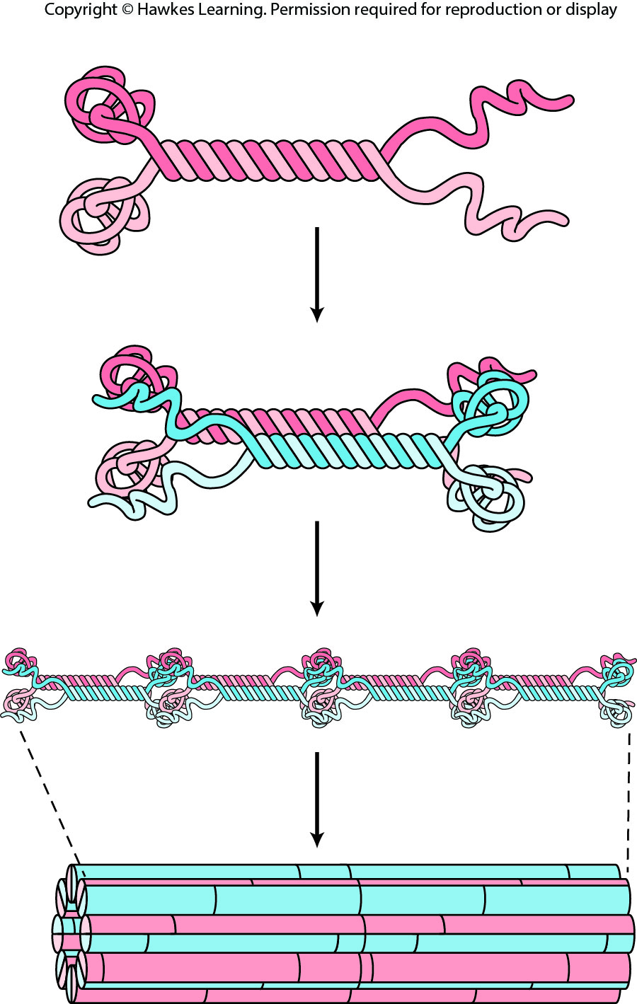
Lesson 4.4 Figure 4

Slide 44
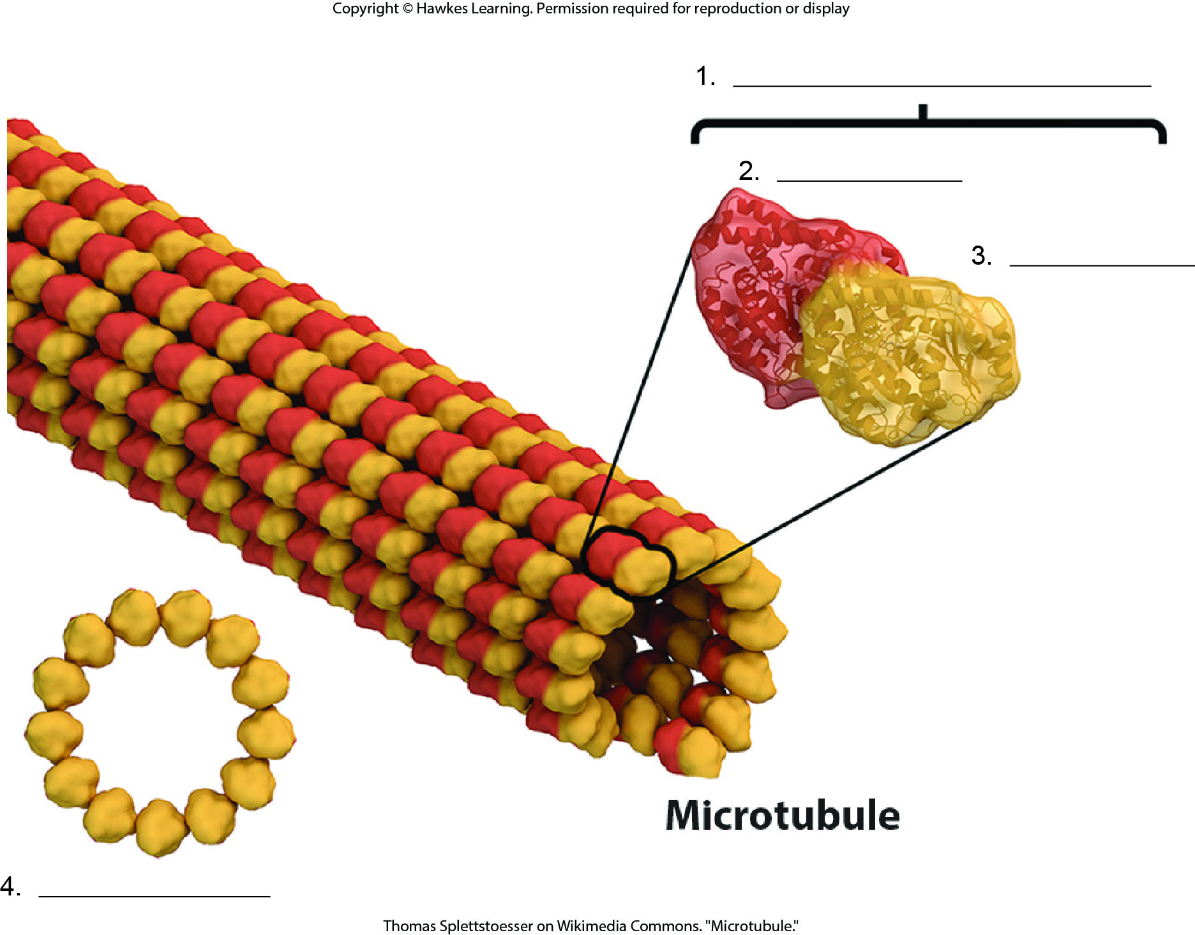
Lesson 4.4 Figure 5 - Numbered

Slide 45
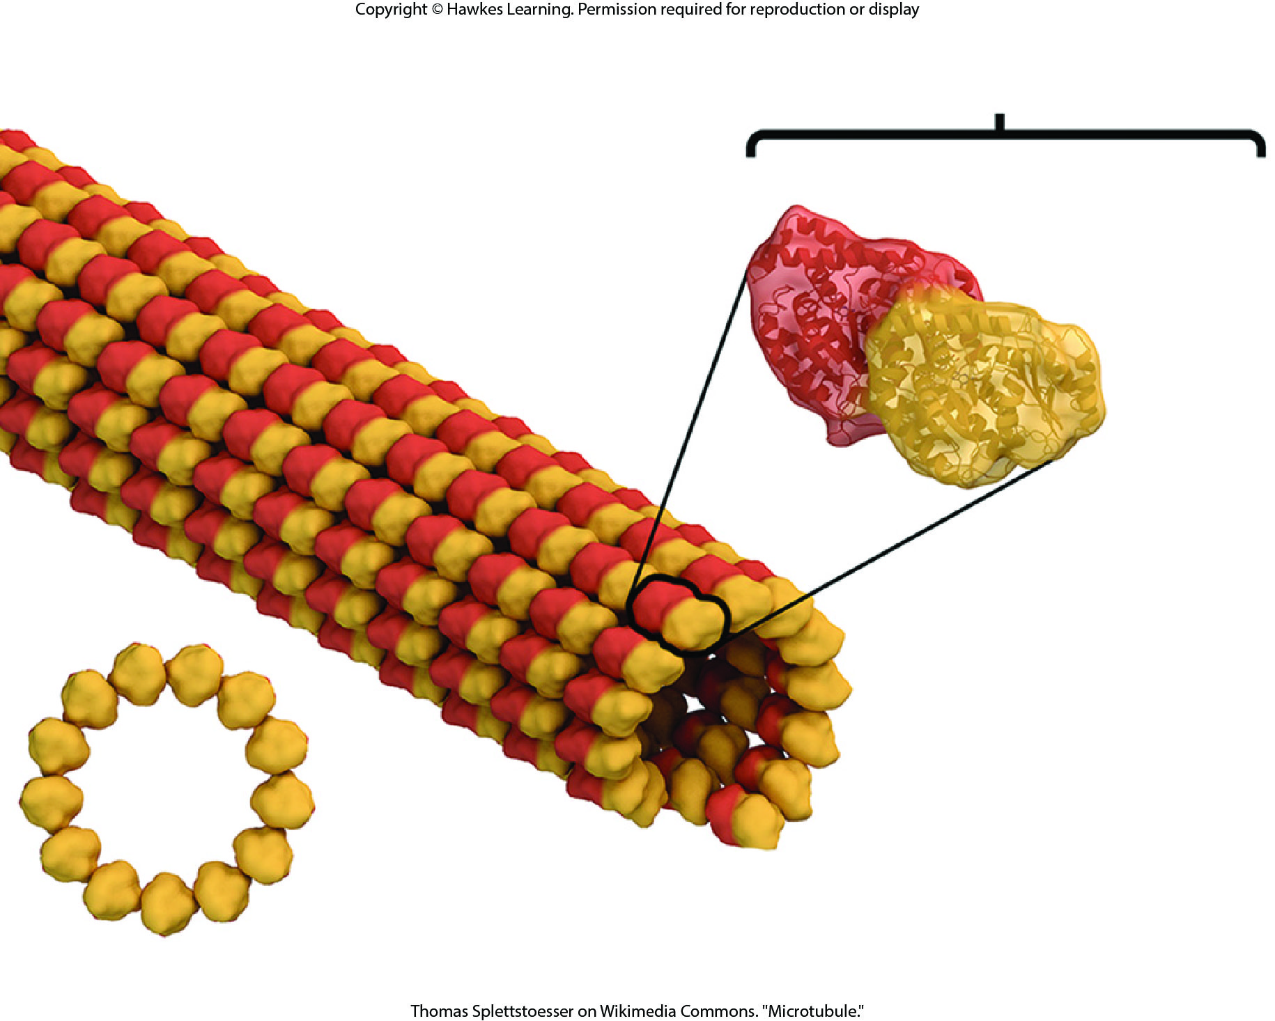
Lesson 4.4 Figure 5

Slide 46
Hawkes Learning – End of PowerPoint

