Slide 1
Chapter 42
The Nervous System

Slide 2
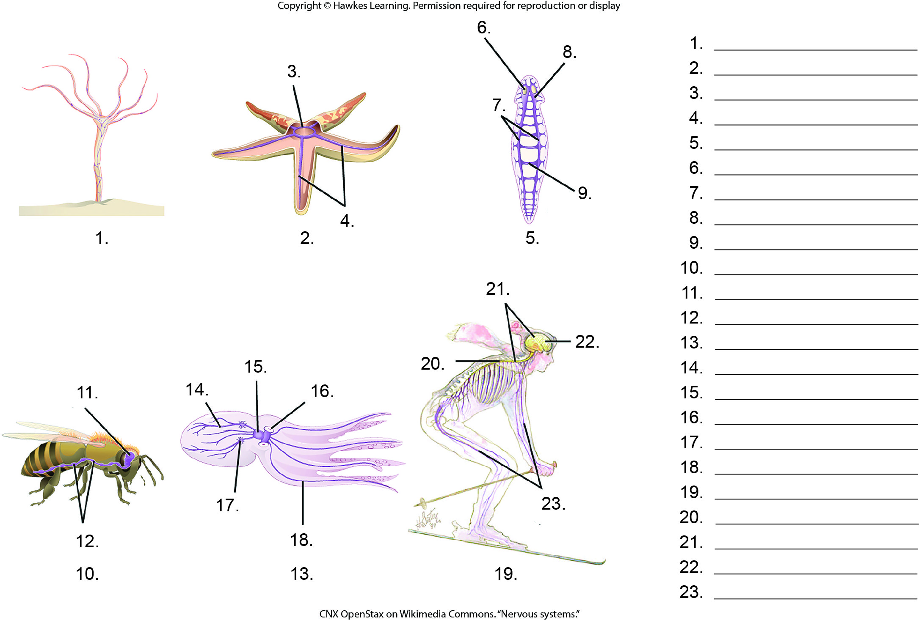
Lesson 42.1 Figure 2 - Numbered

Slide 3
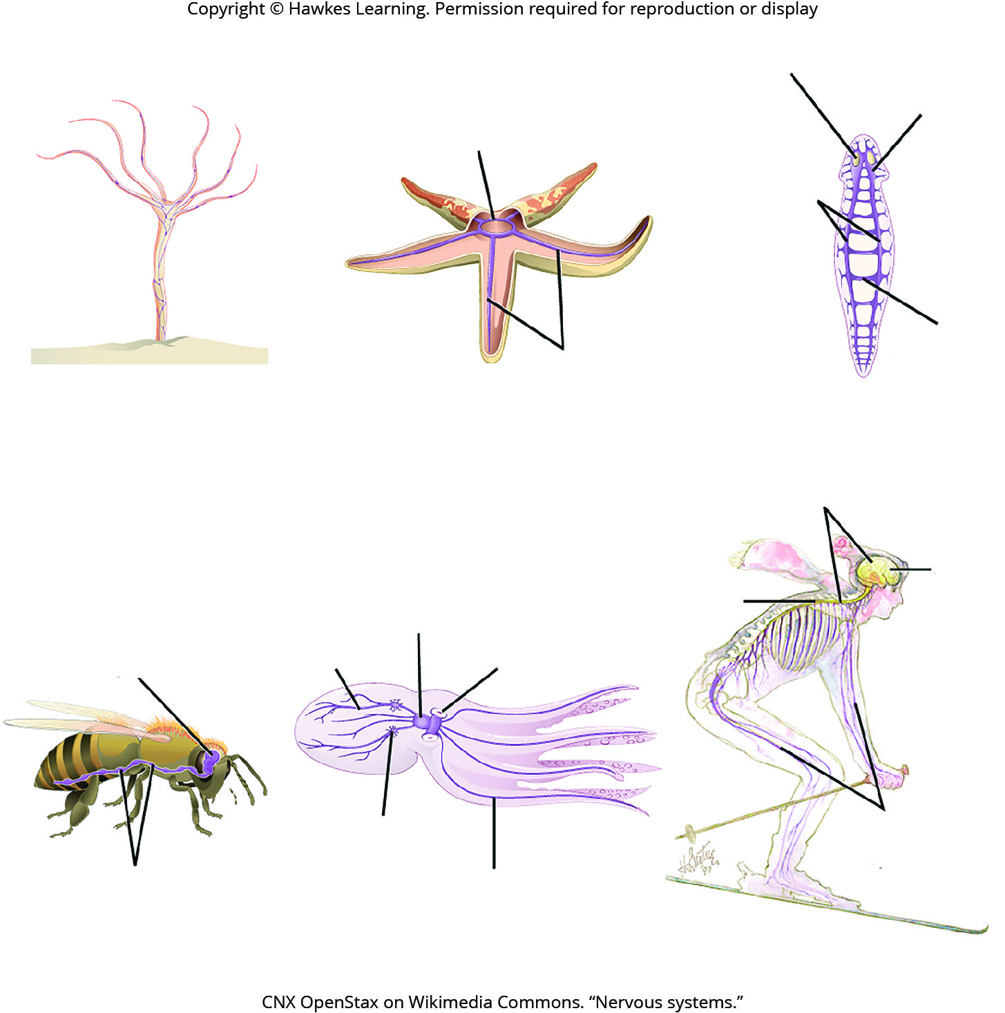
Lesson 42.1 Figure 2

Slide 4
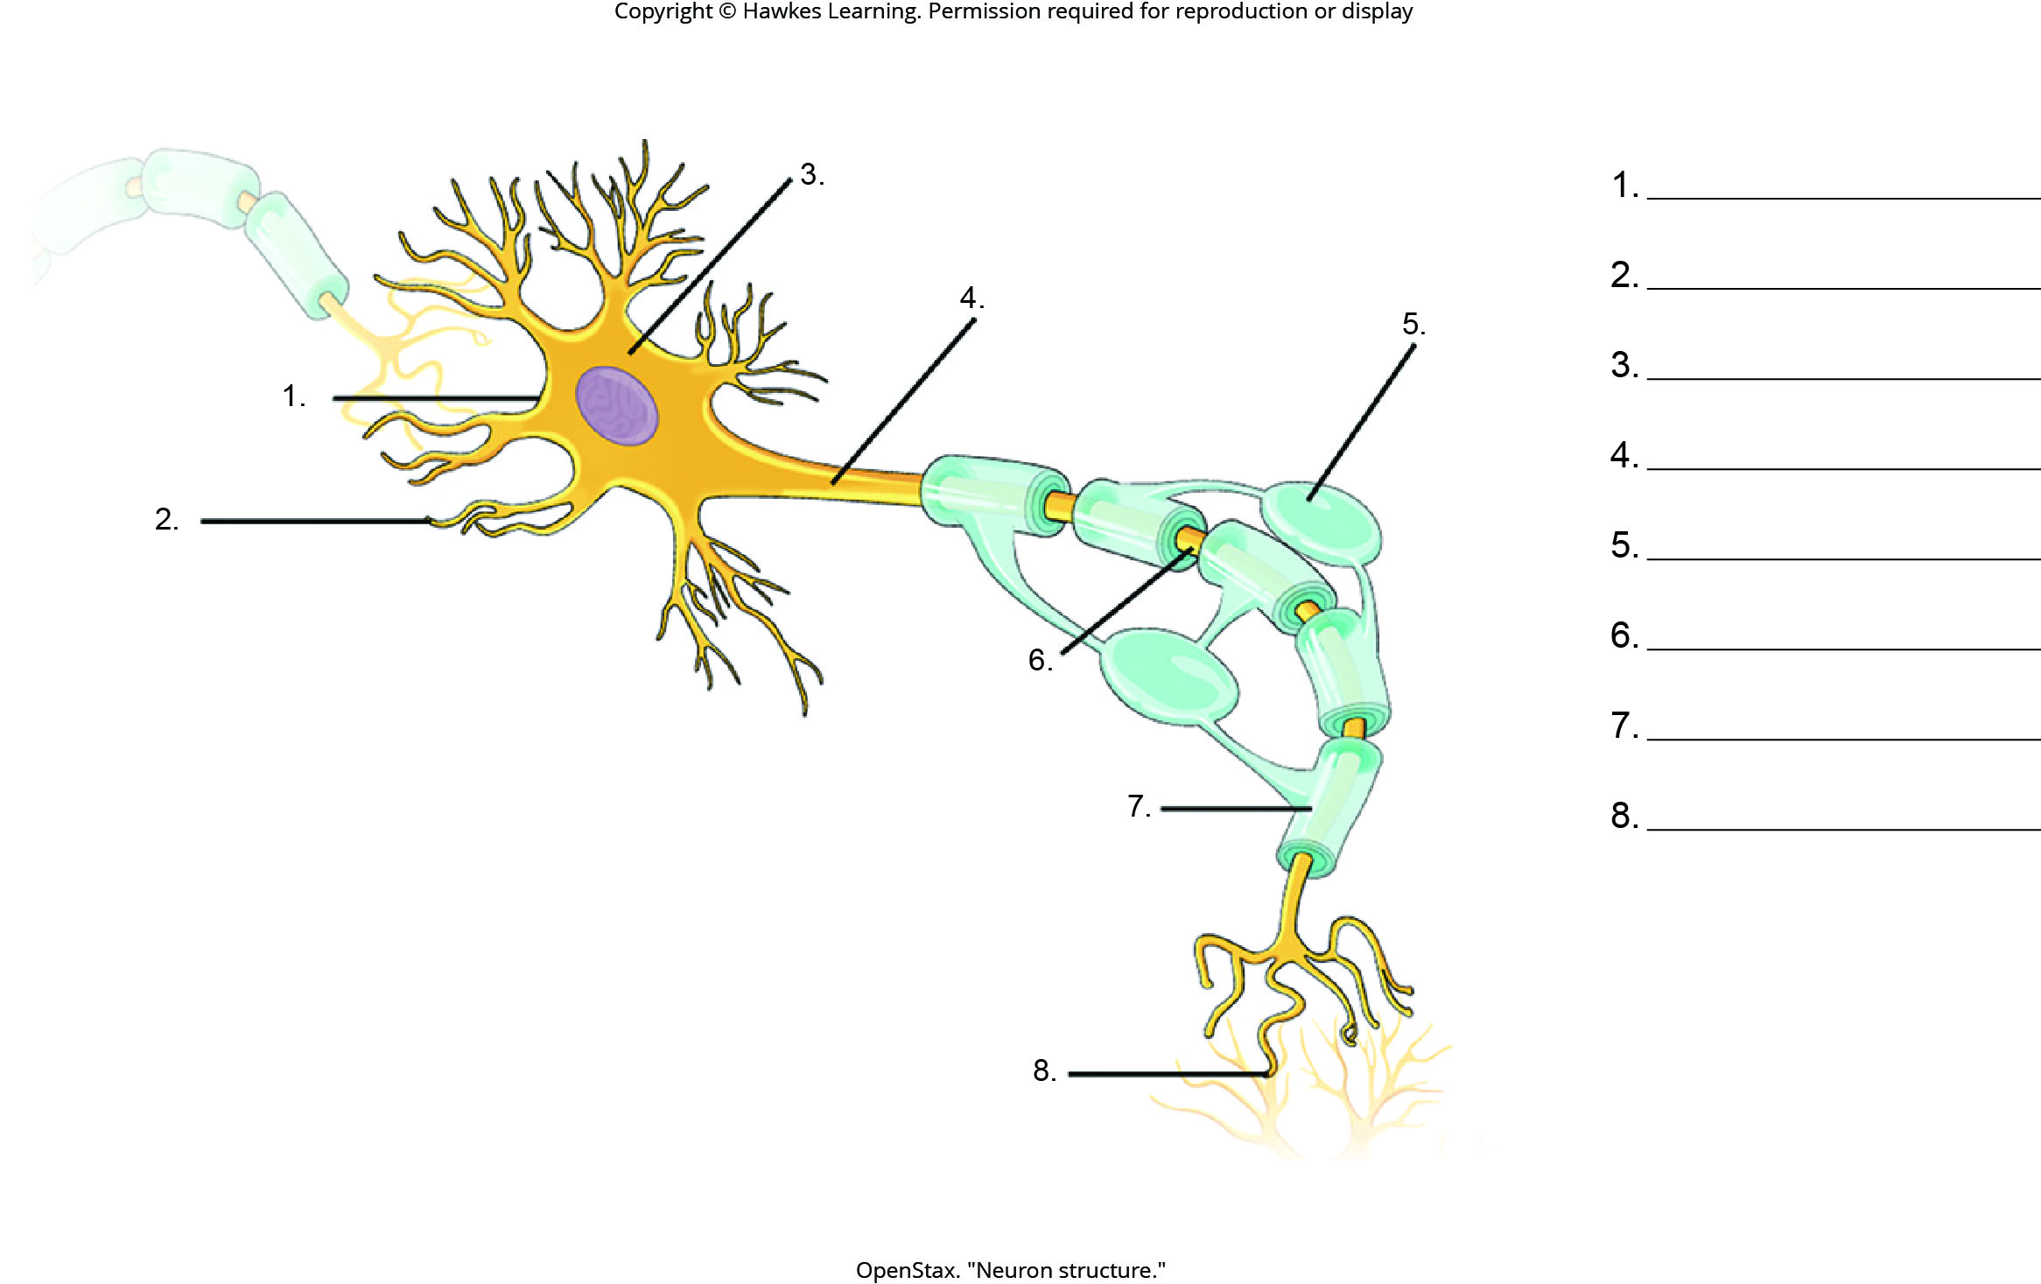
Lesson 42.1 Figure 3 - Numbered

Slide 5
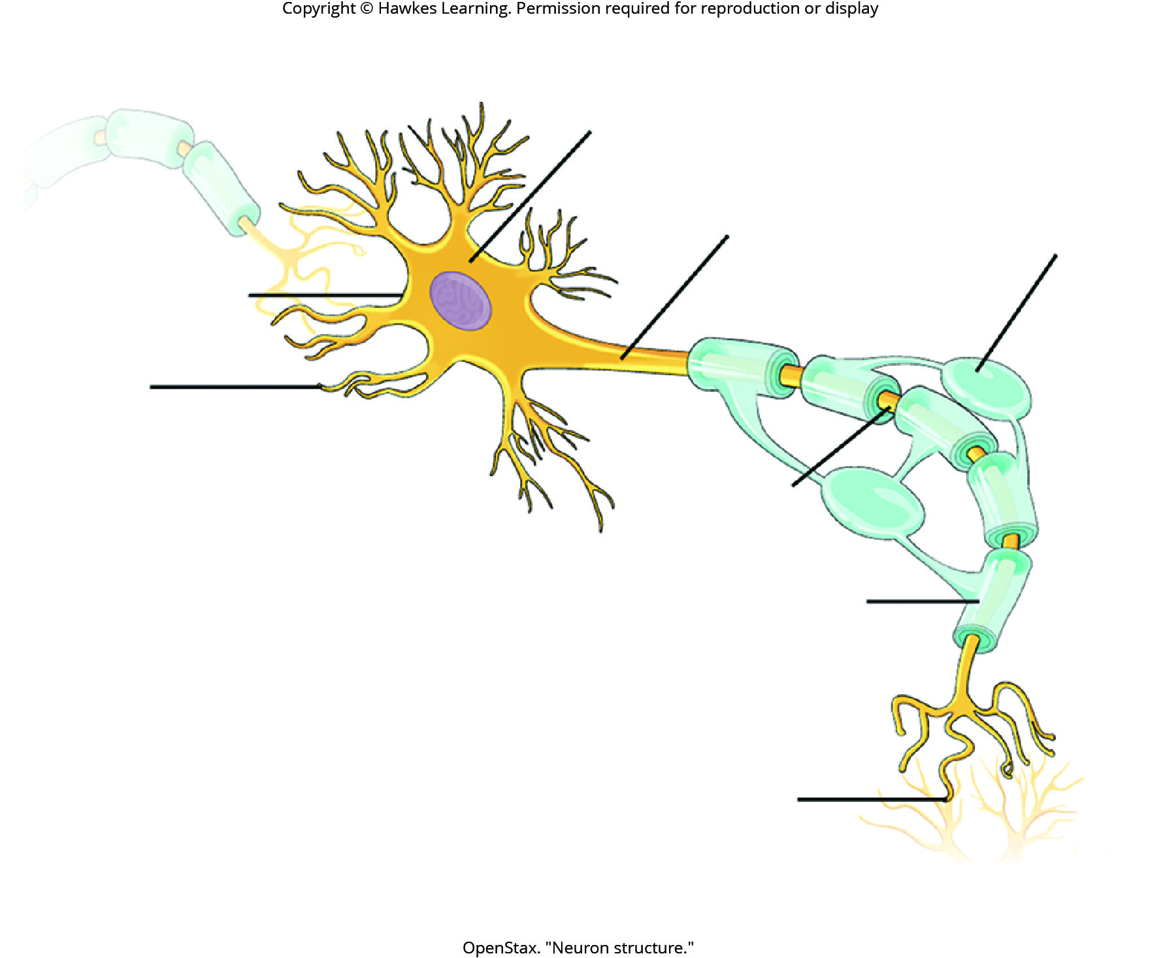
Lesson 42.1 Figure 3

Slide 6
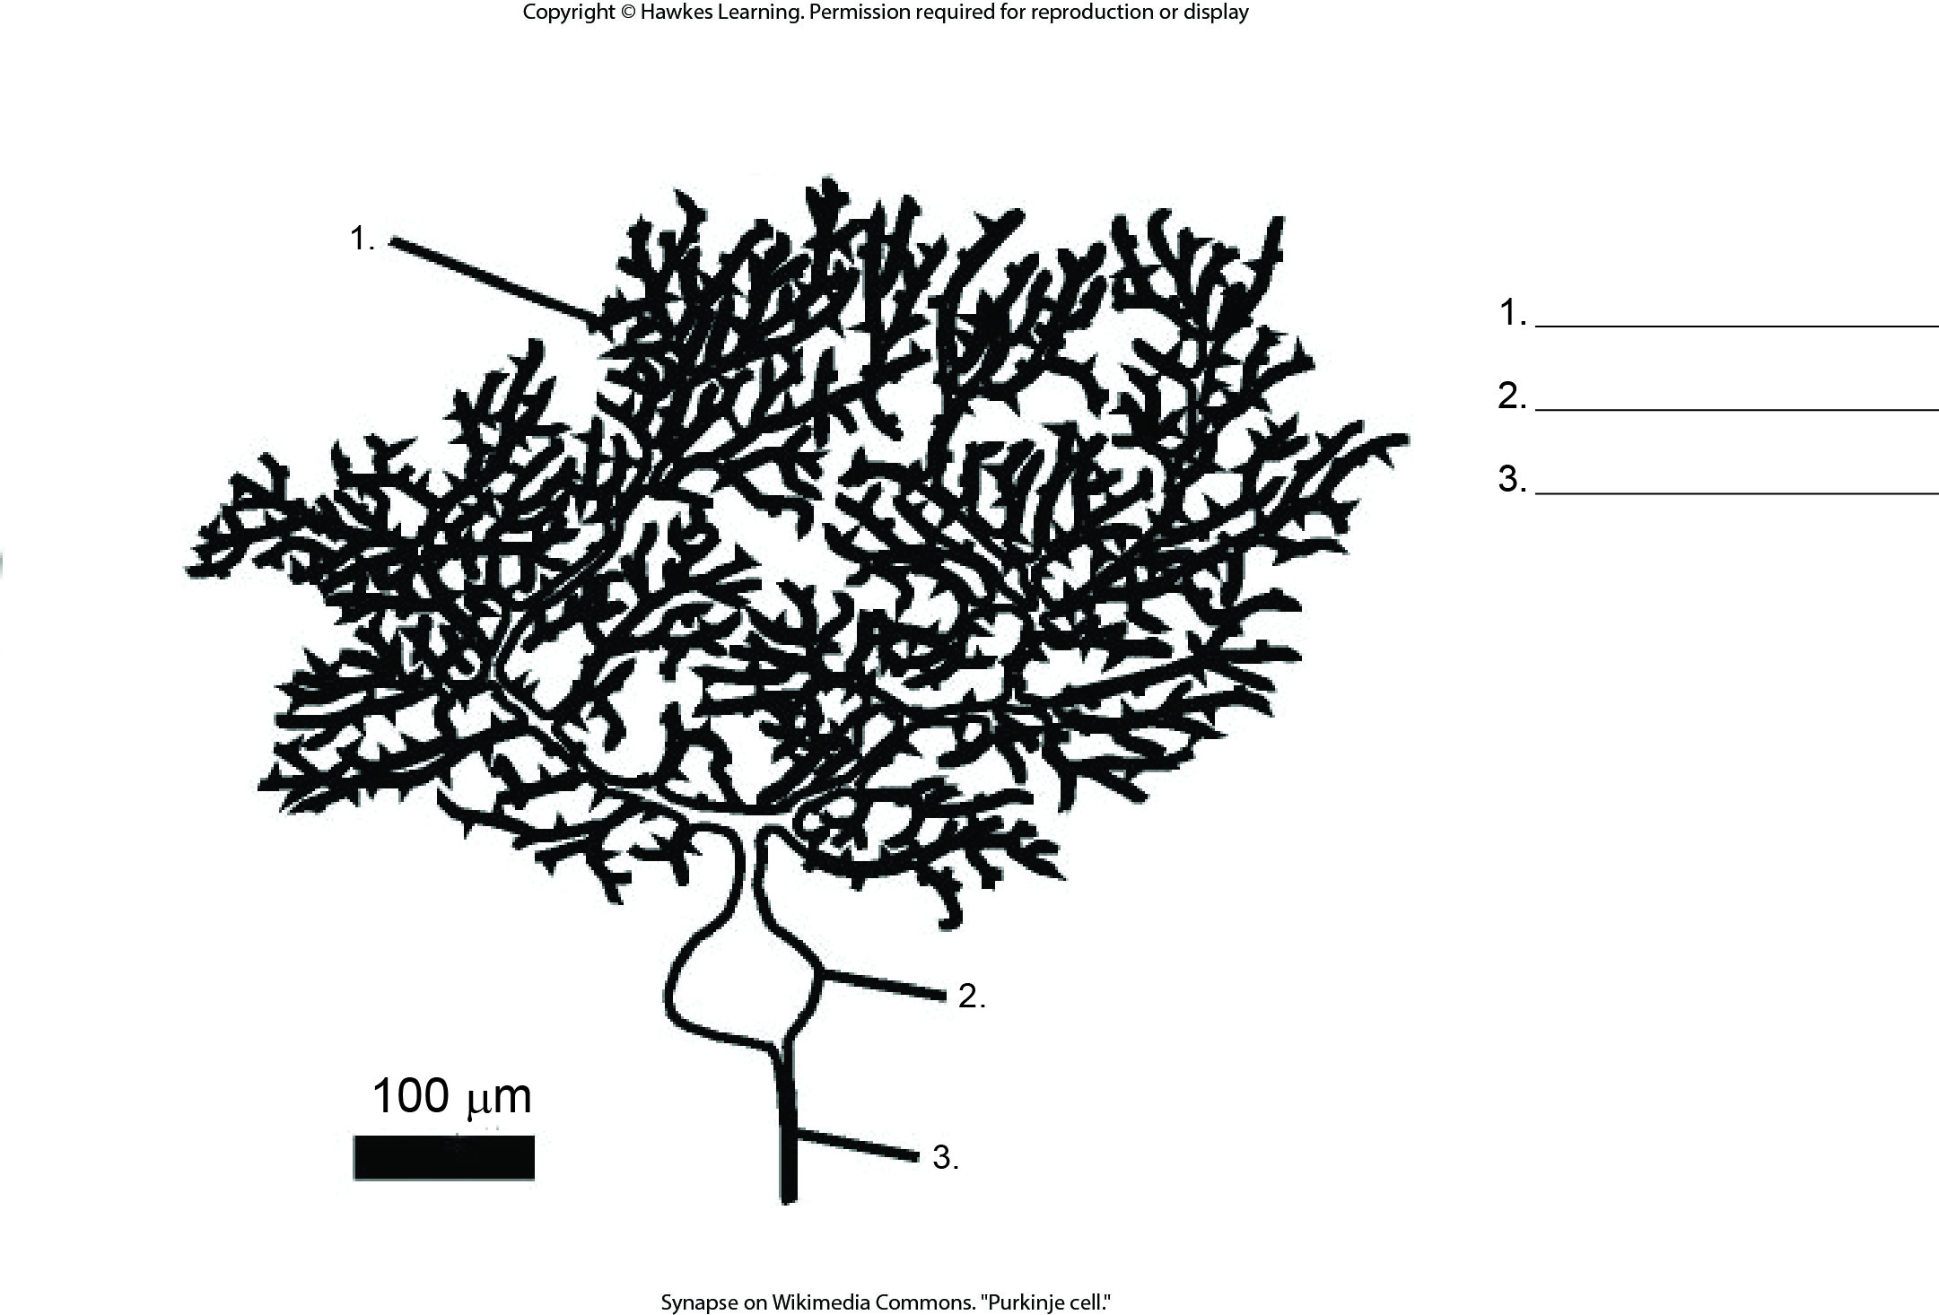
Lesson 42.1 Figure 4 - Numbered

Slide 7
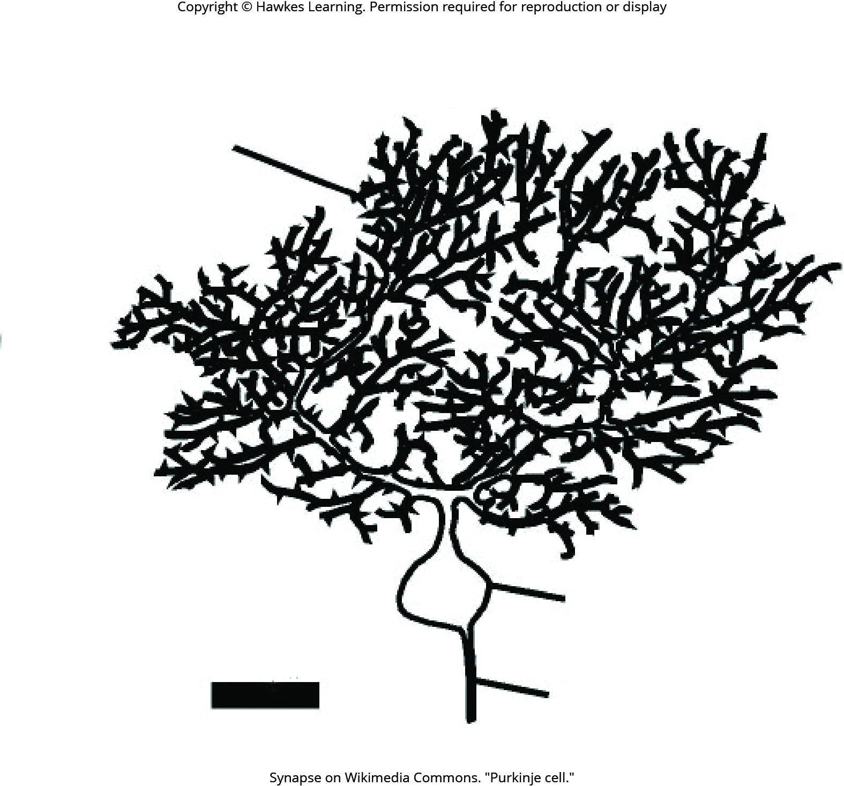
Lesson 42.1 Figure 4

Slide 8
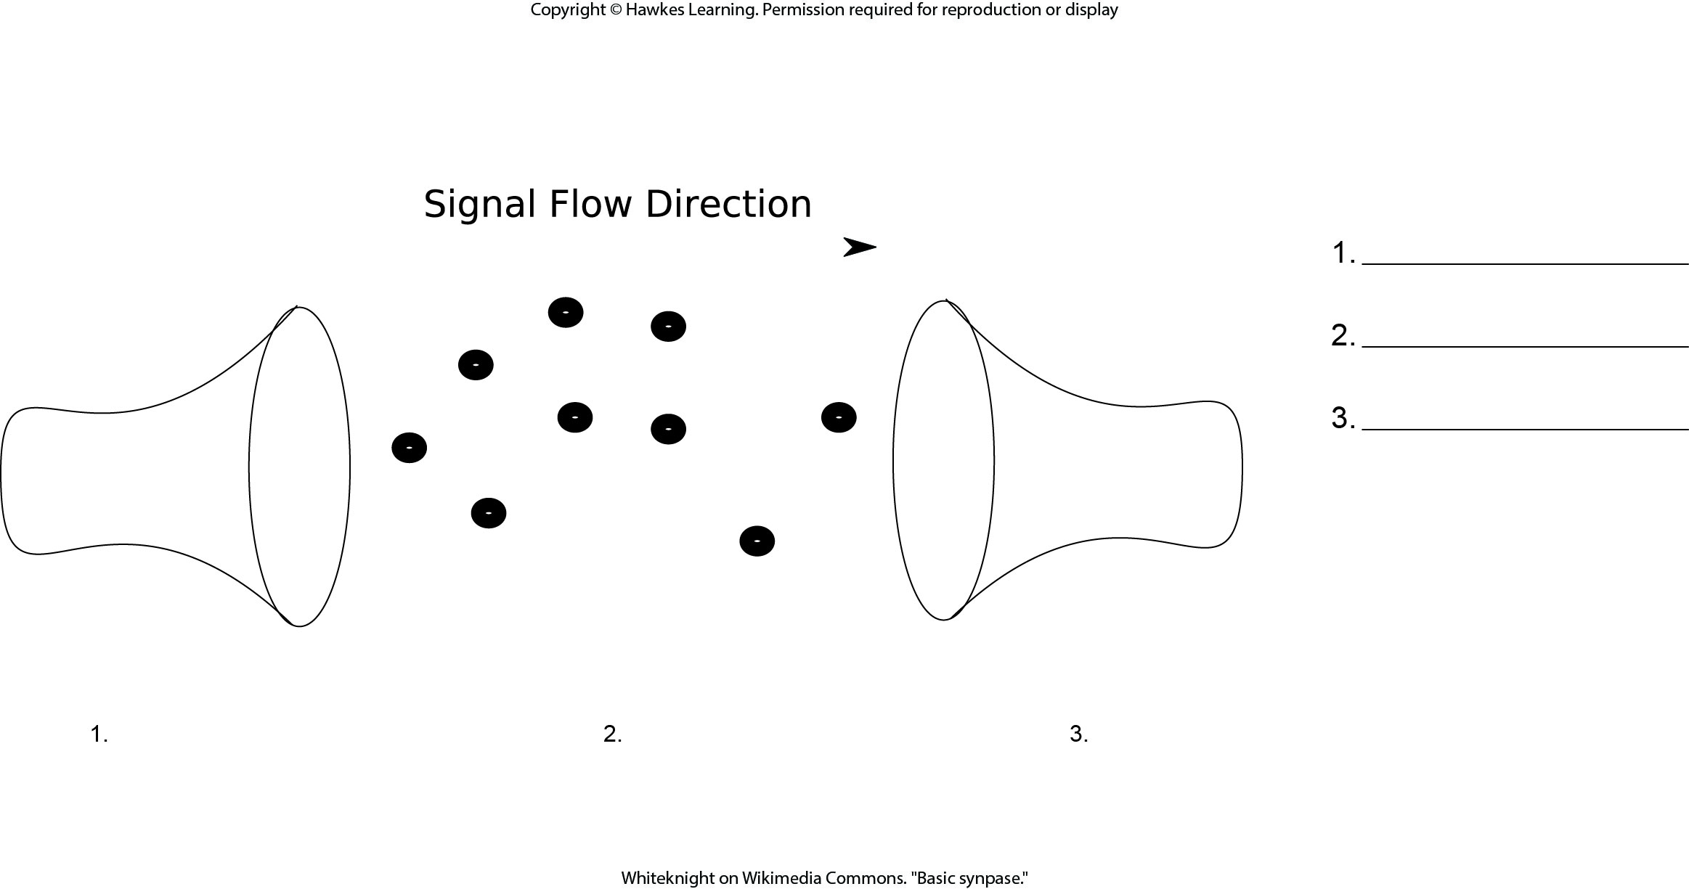
Lesson 42.1 Figure 5 - Numbered

Slide 9
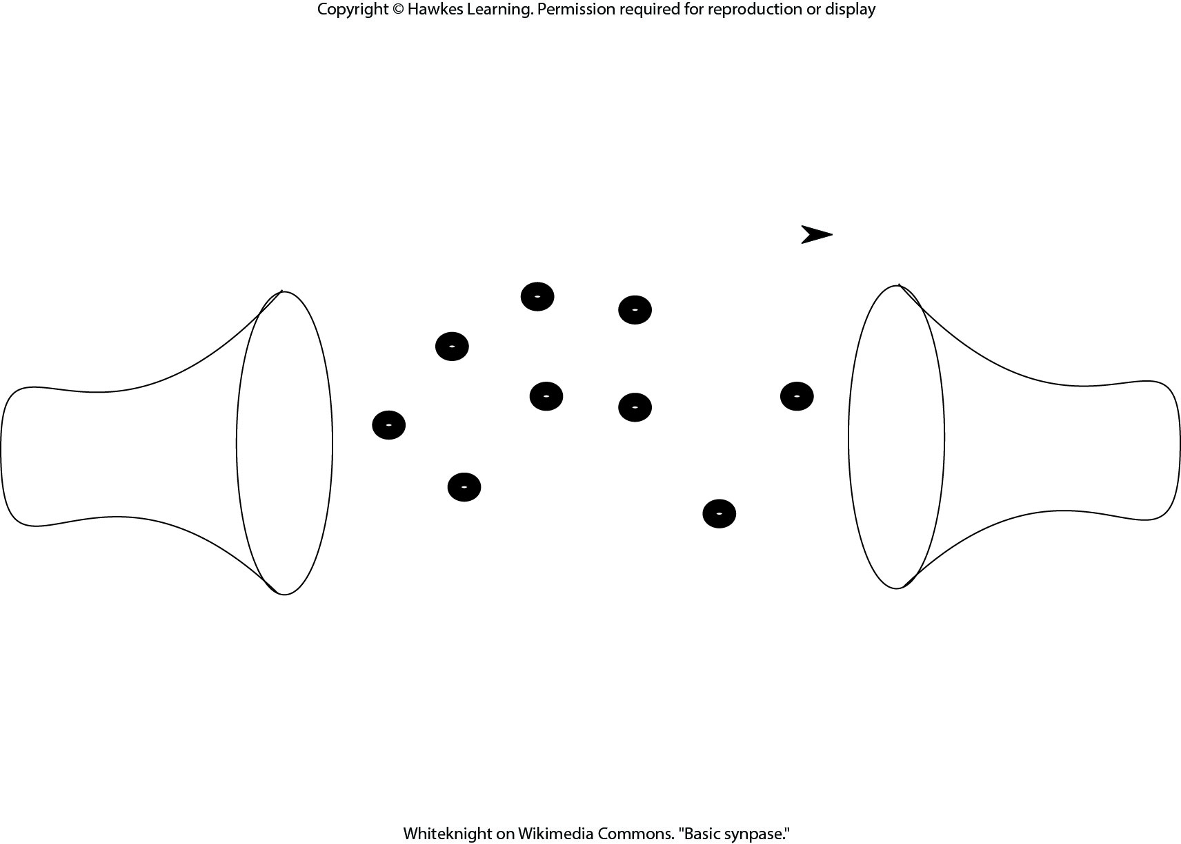
Lesson 42.1 Figure 5

Slide 10
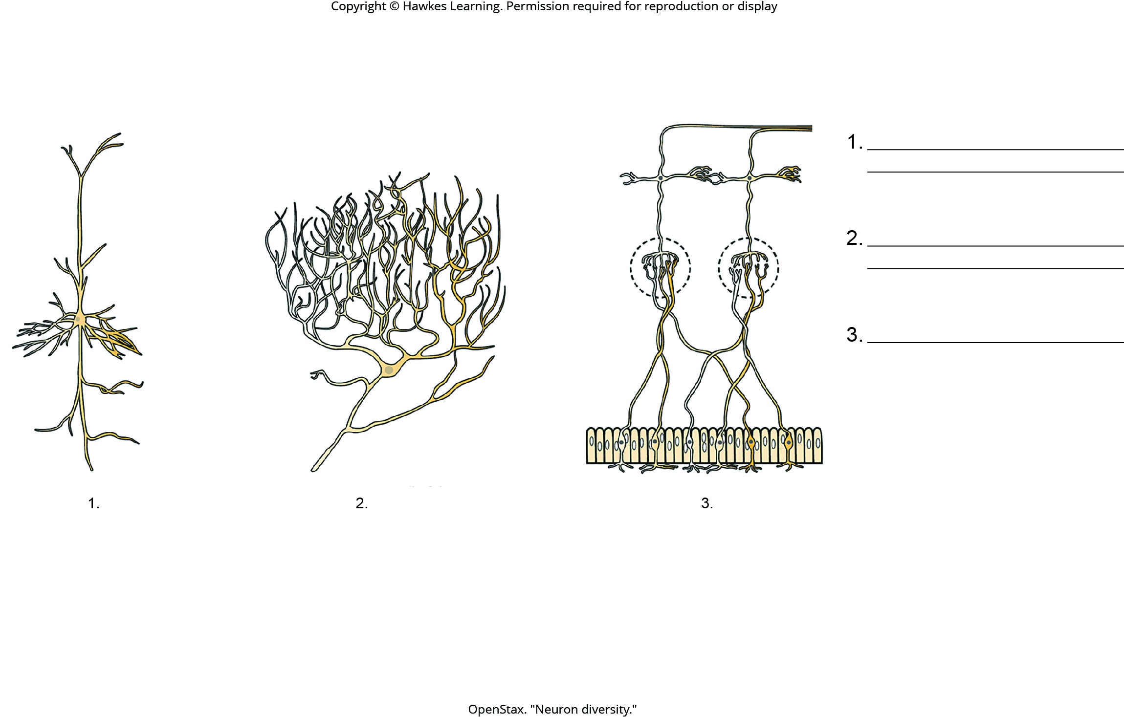
Lesson 42.1 Figure 6 - Numbered

Slide 11
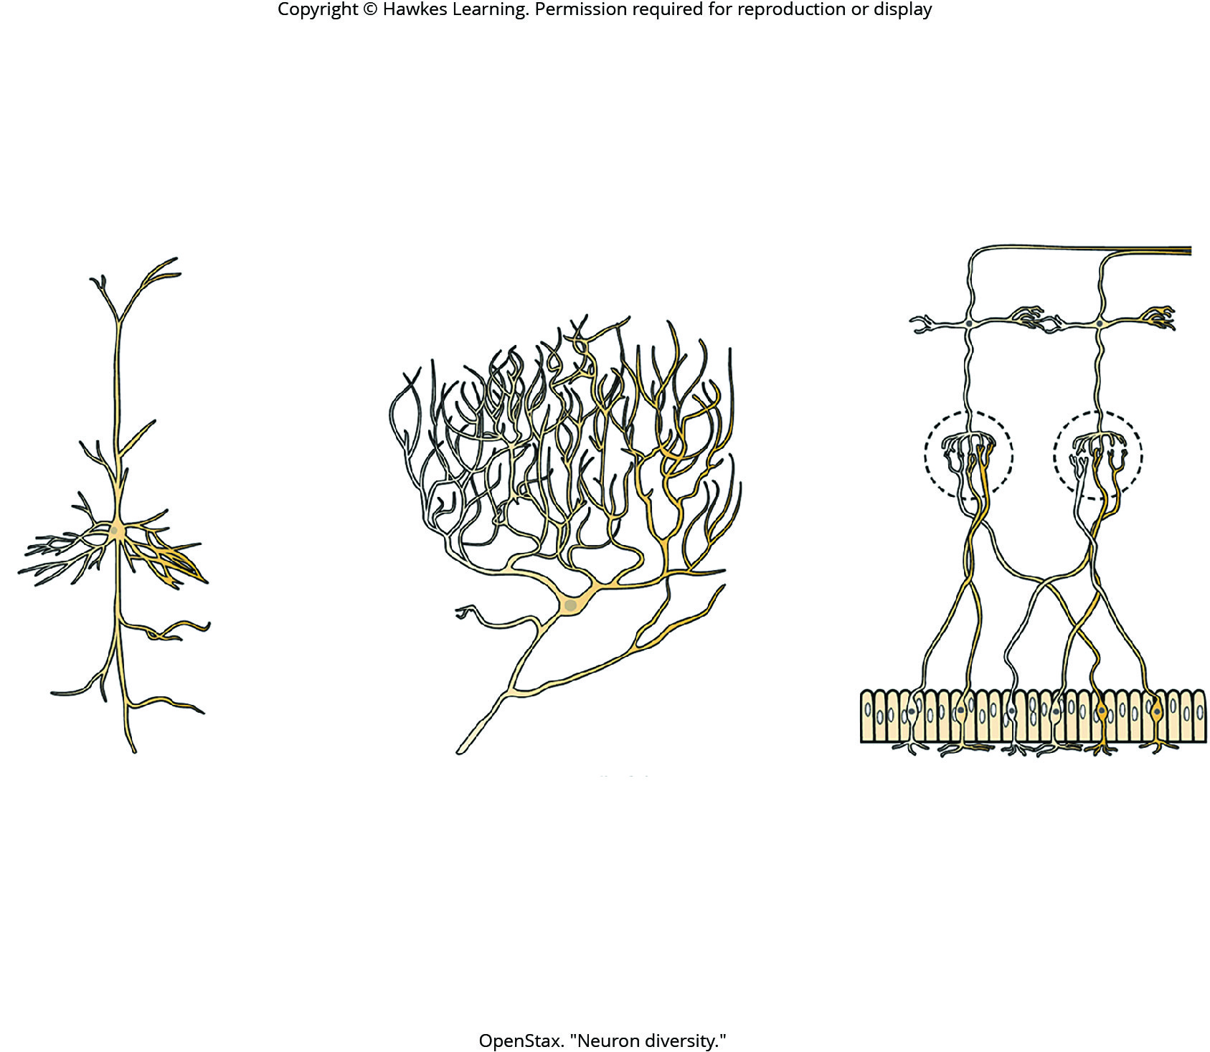
Lesson 42.1 Figure 6

Slide 12
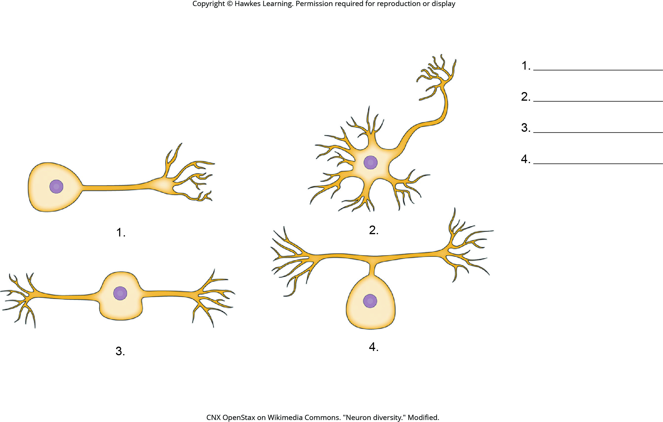
Lesson 42.1 Figure 7 - Numbered

Slide 13
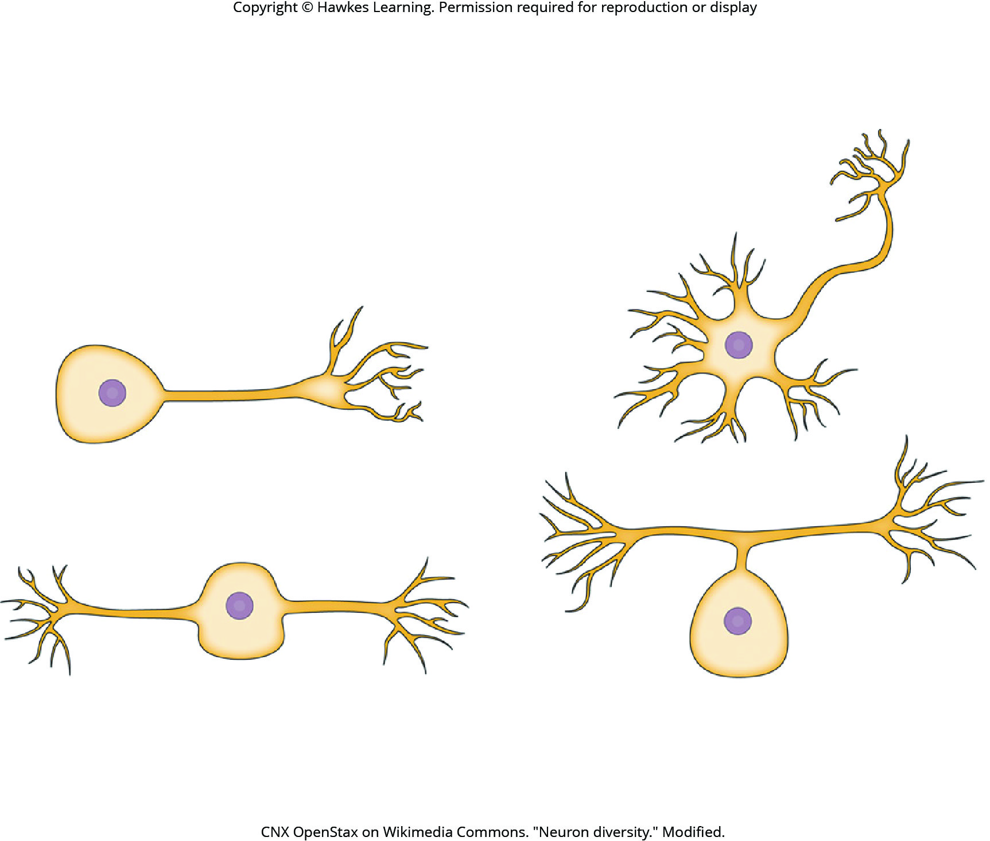
Lesson 42.1 Figure 7

Slide 14
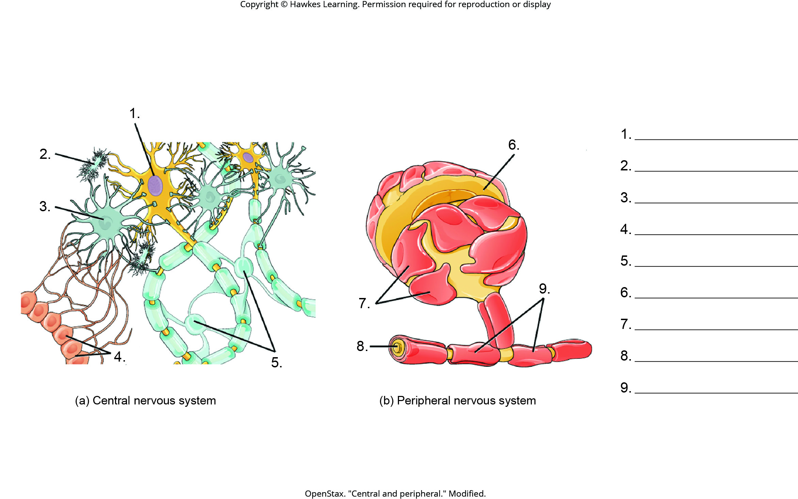
Lesson 42.1 Figure 9 - Numbered

Slide 15
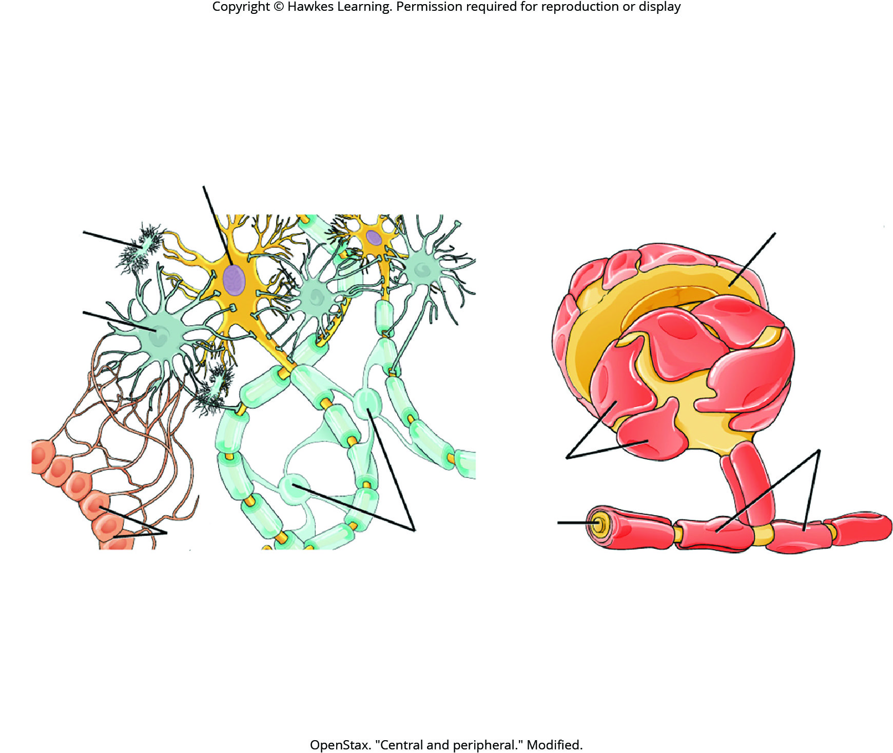
Lesson 42.1 Figure 9

Slide 16
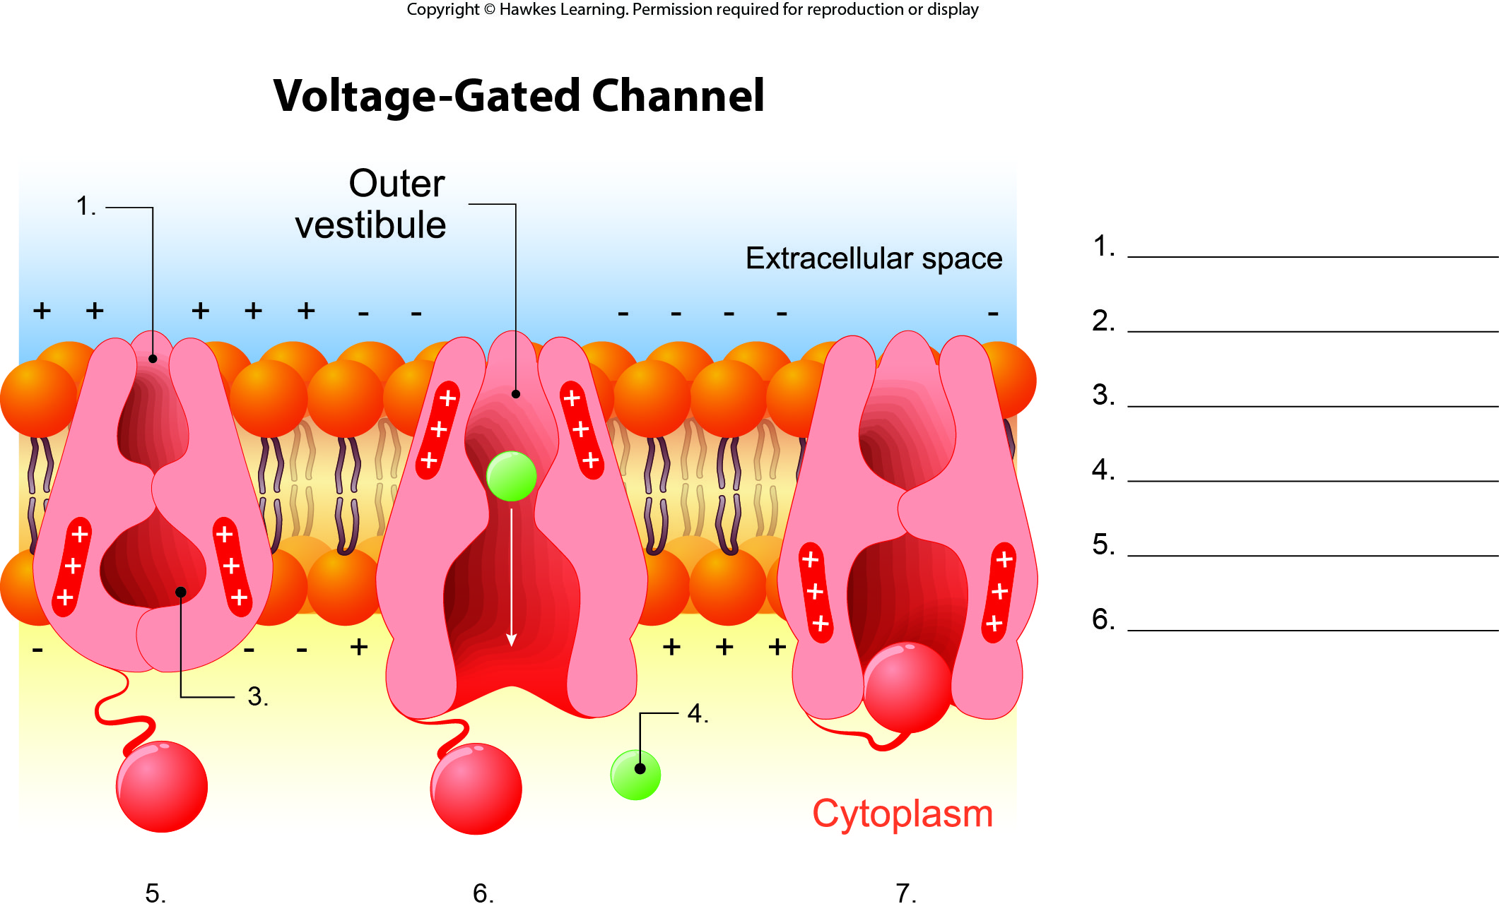
Lesson 42.2 Figure 1 - Numbered

Slide 17
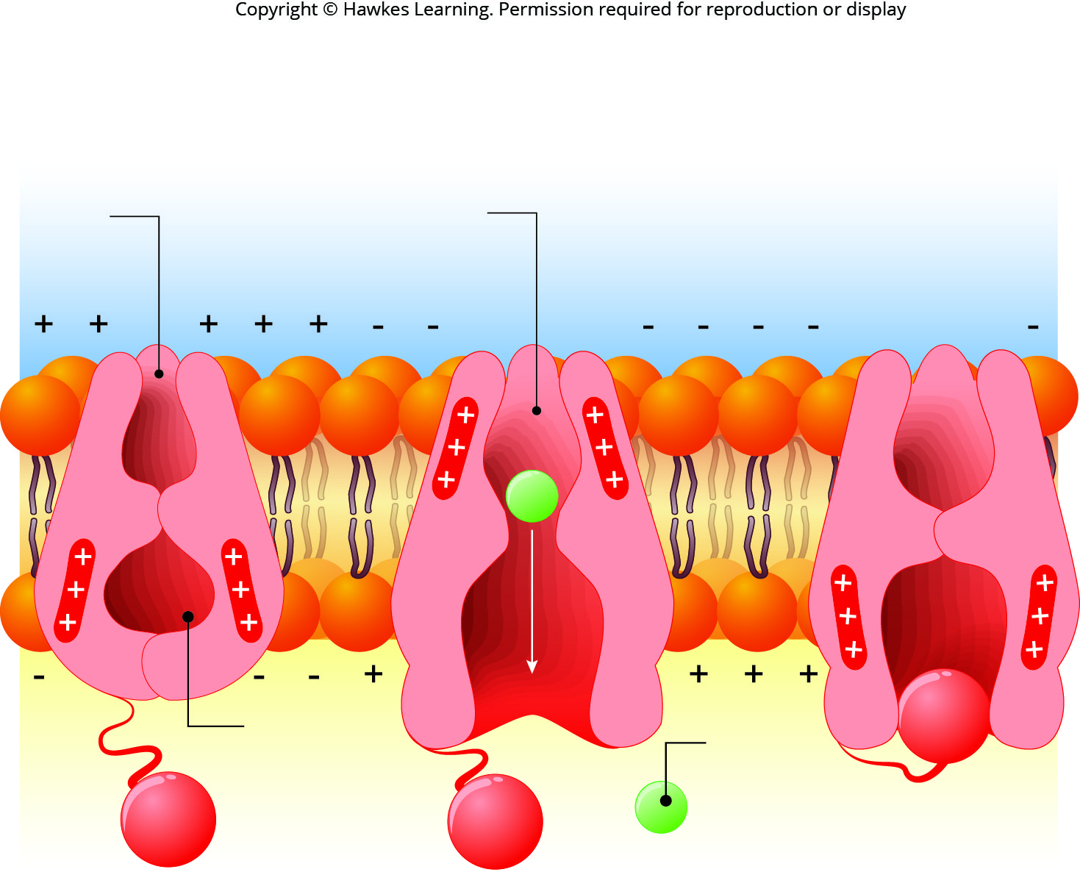
Lesson 42.2 Figure 1

Slide 18
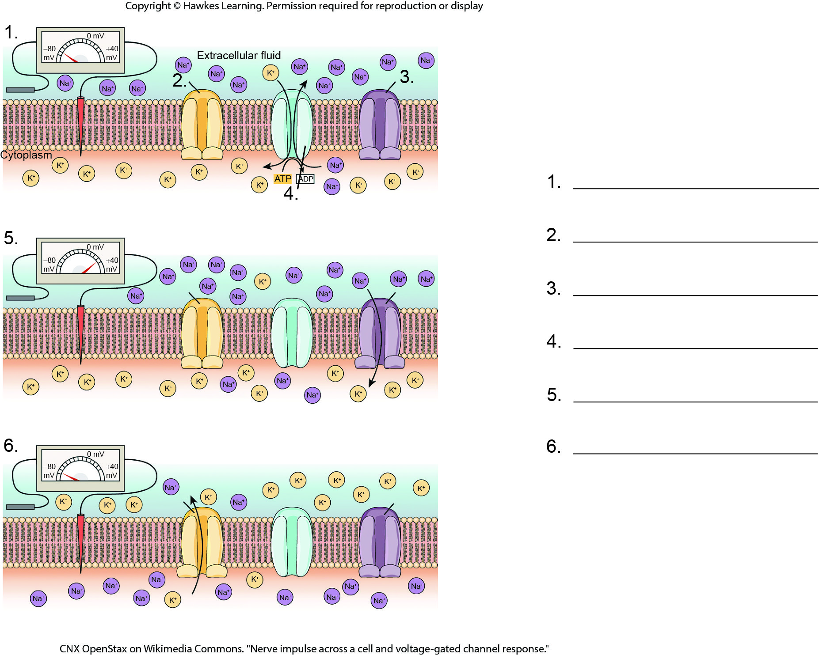
Lesson 42.2 Figure 2 - Numbered

Slide 19
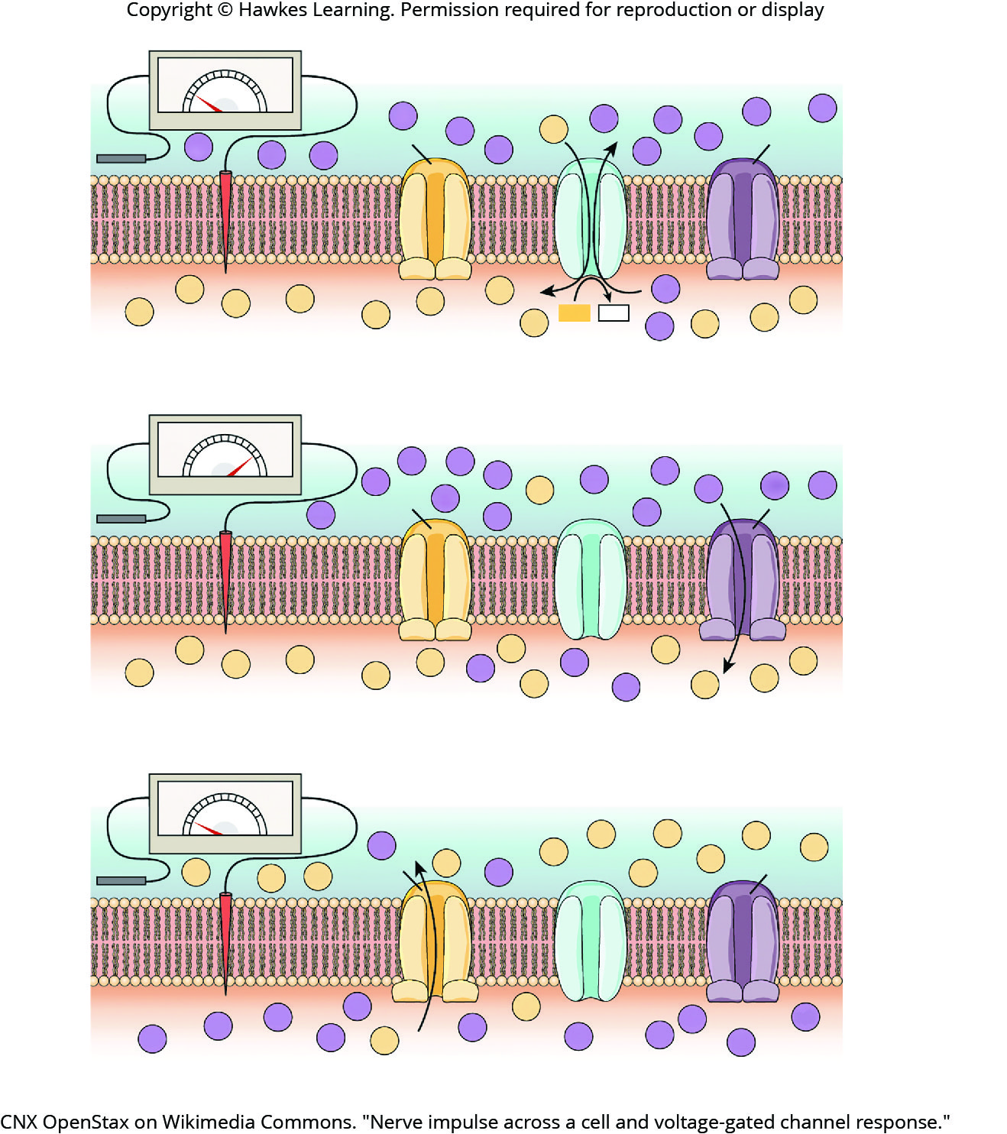
Lesson 42.2 Figure 2

Slide 20
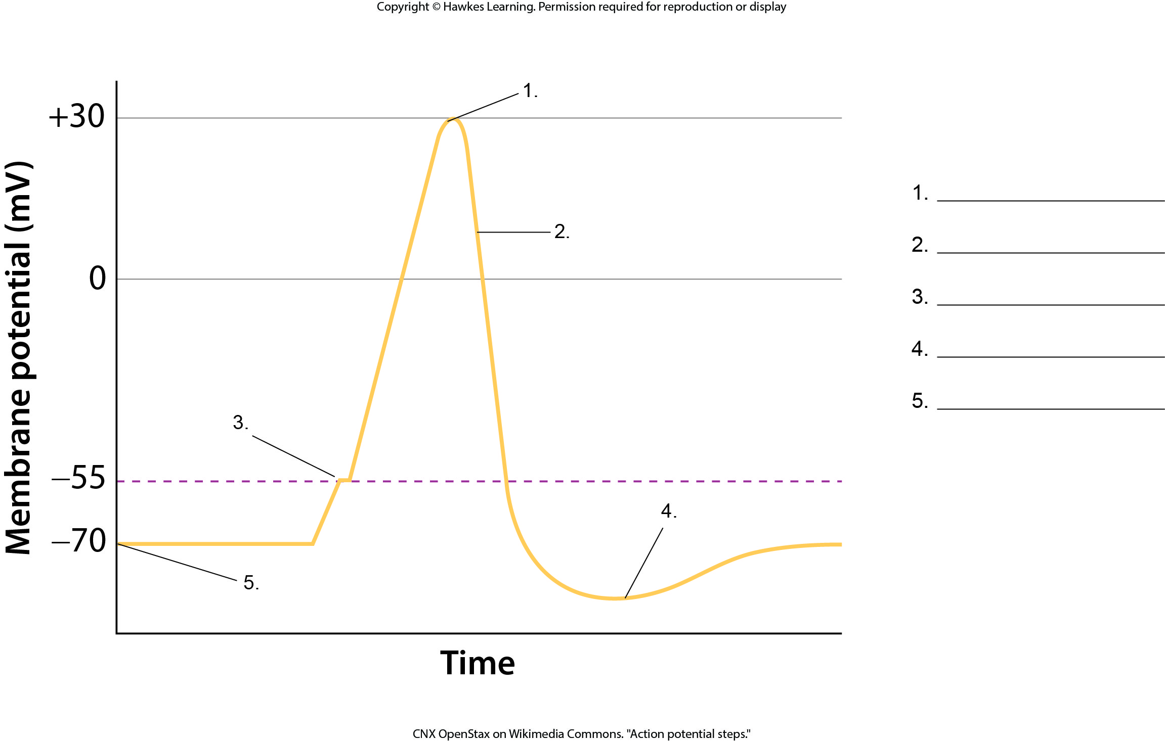
Lesson 42.2 Figure 3 - Numbered

Slide 21
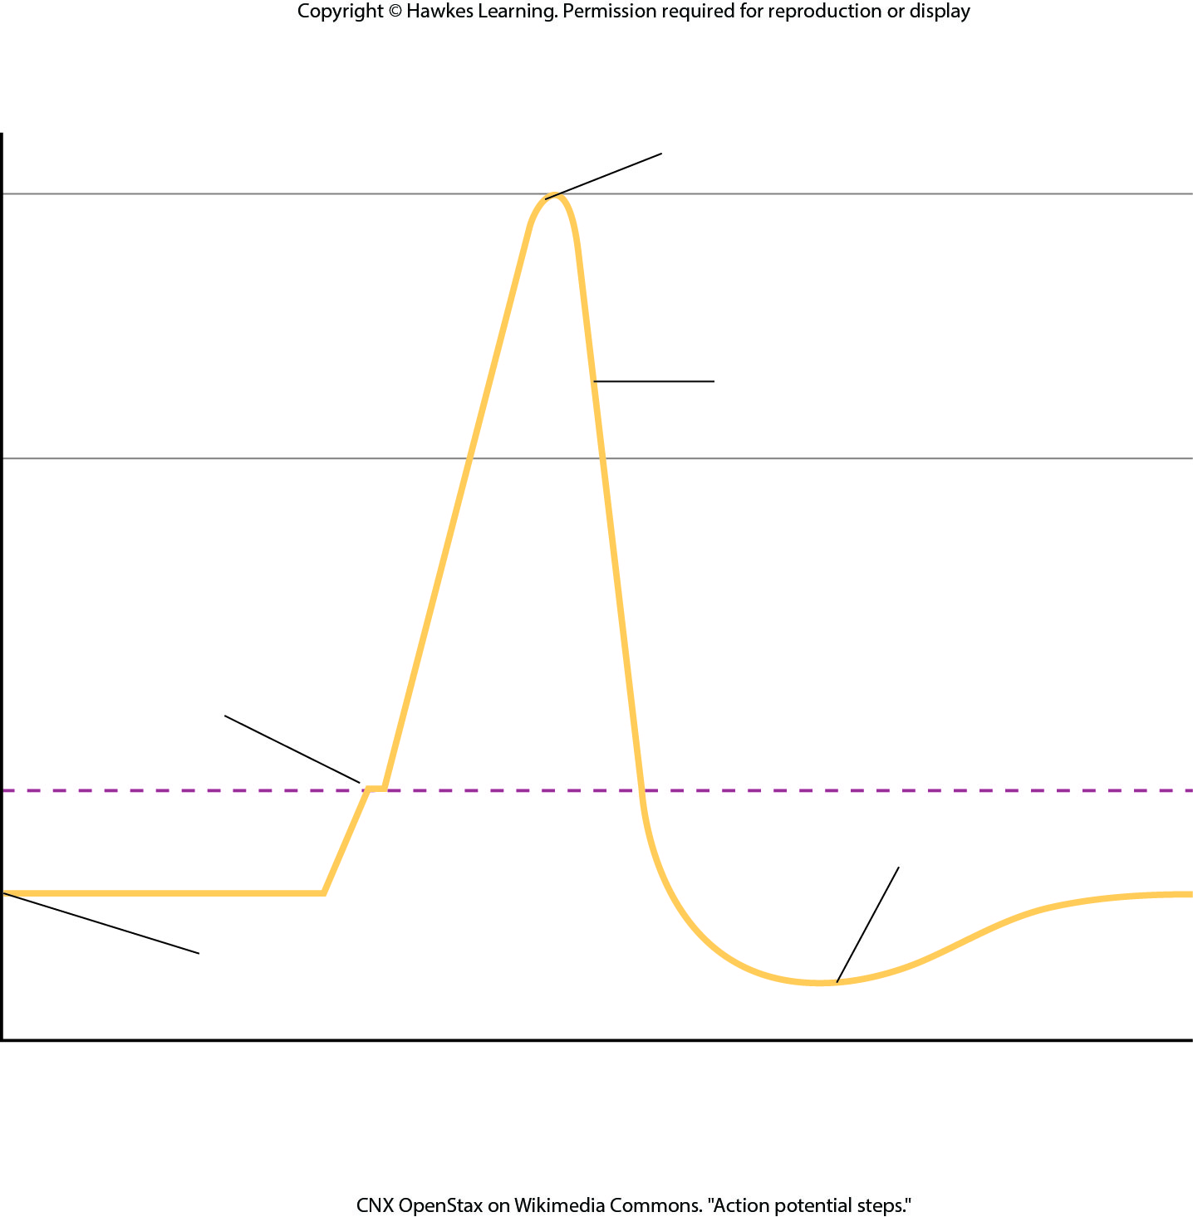
Lesson 42.2 Figure 3

Slide 22
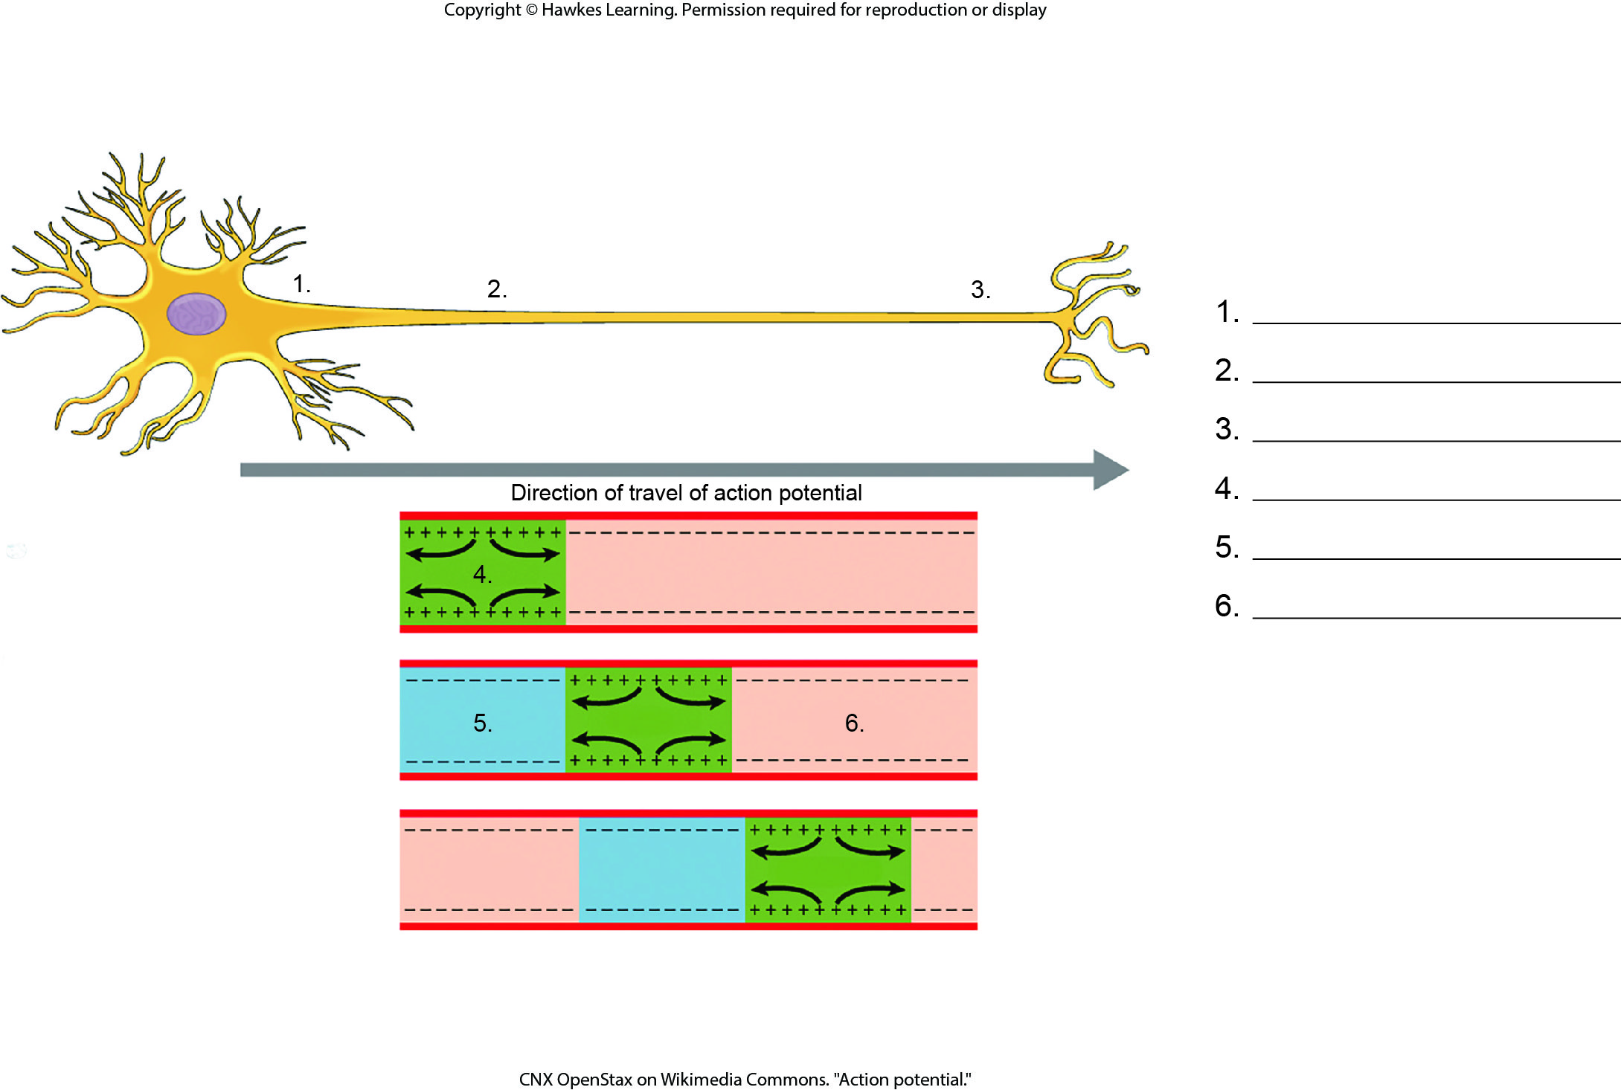
Lesson 42.2 Figure 4 - Numbered

Slide 23
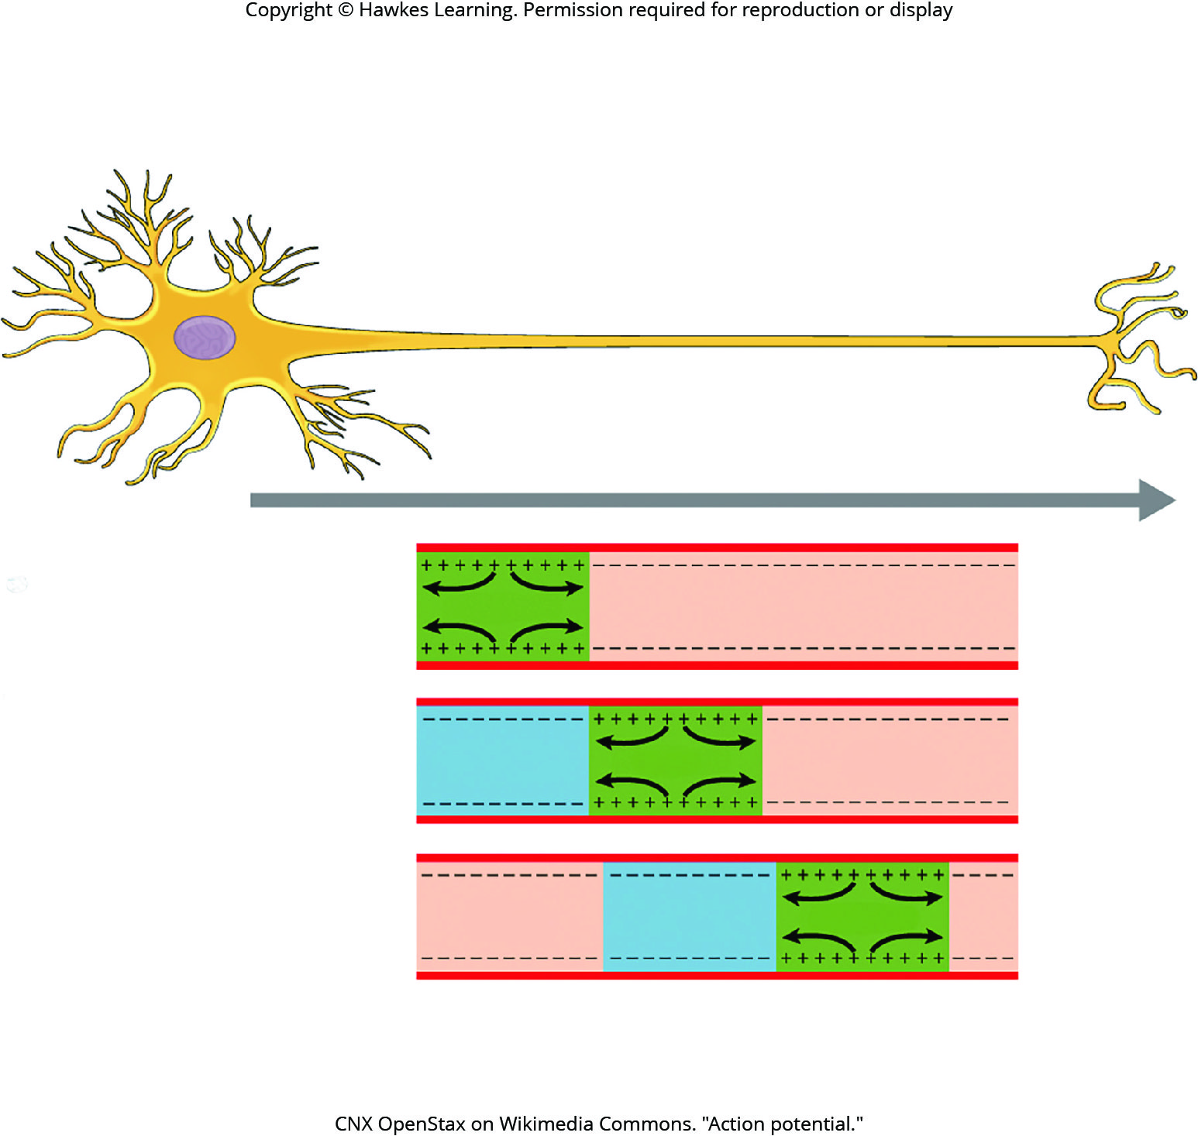
Lesson 42.2 Figure 4

Slide 24
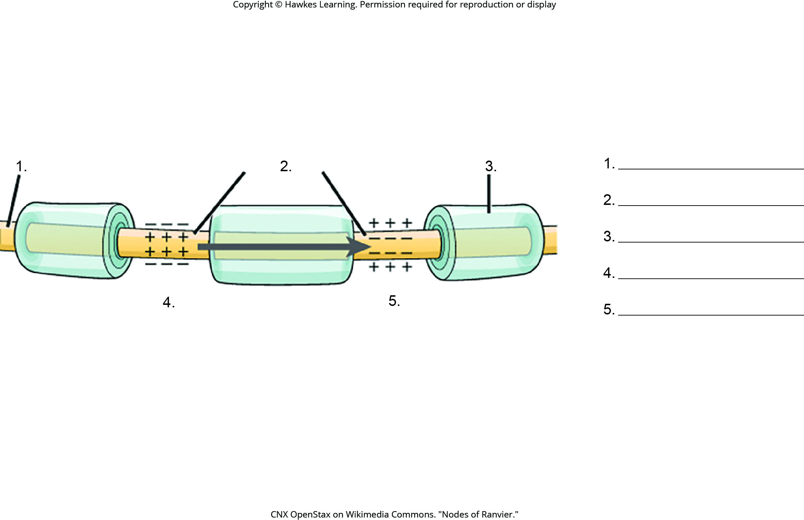
Lesson 42.2 Figure 5 - Numbered

Slide 25
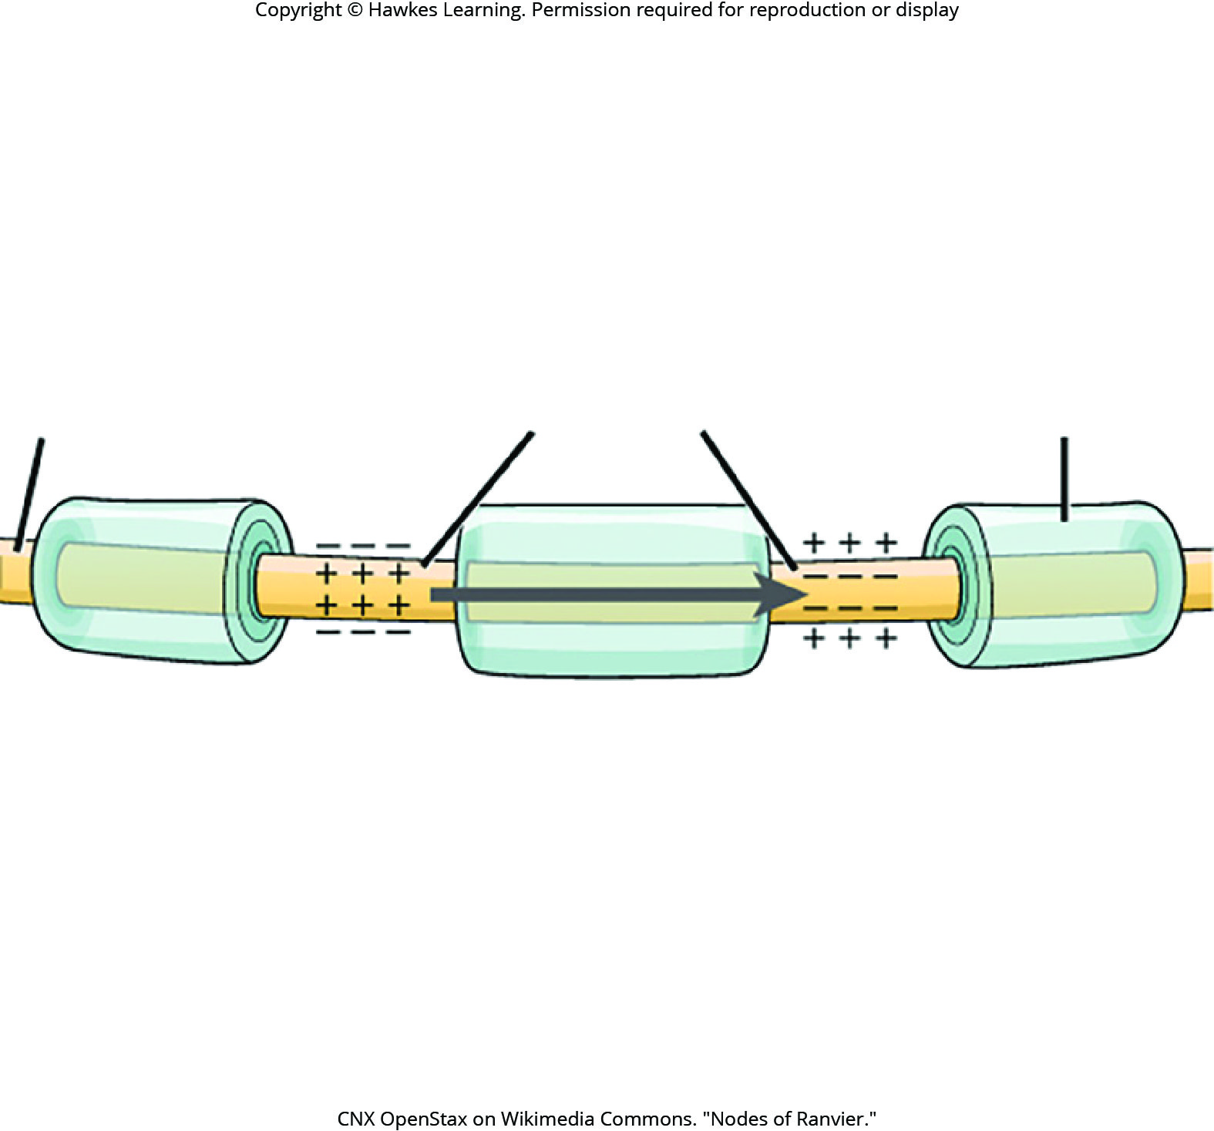
Lesson 42.2 Figure 5

Slide 26
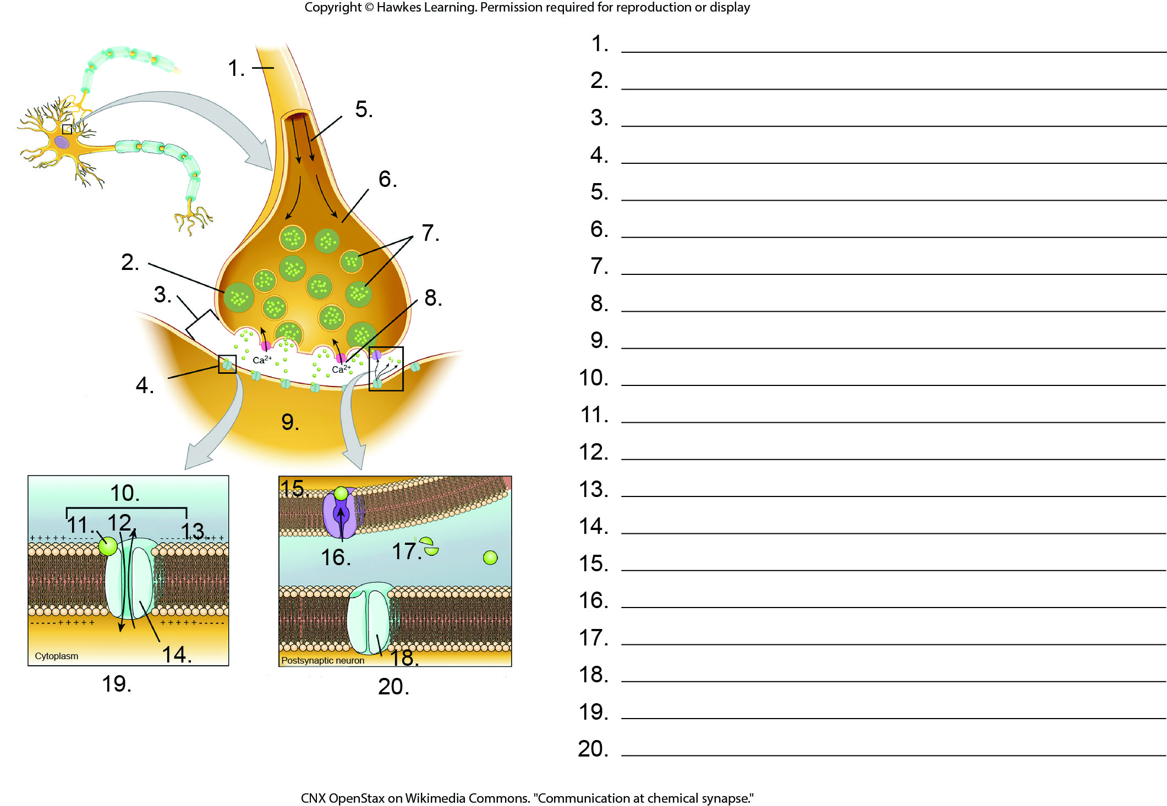
Lesson 42.2 Figure 7 - Numbered

Slide 27
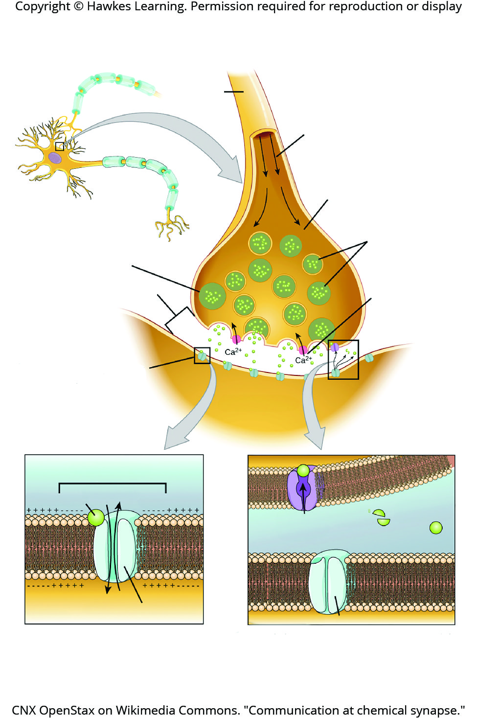
Lesson 42.2 Figure 7

Slide 28
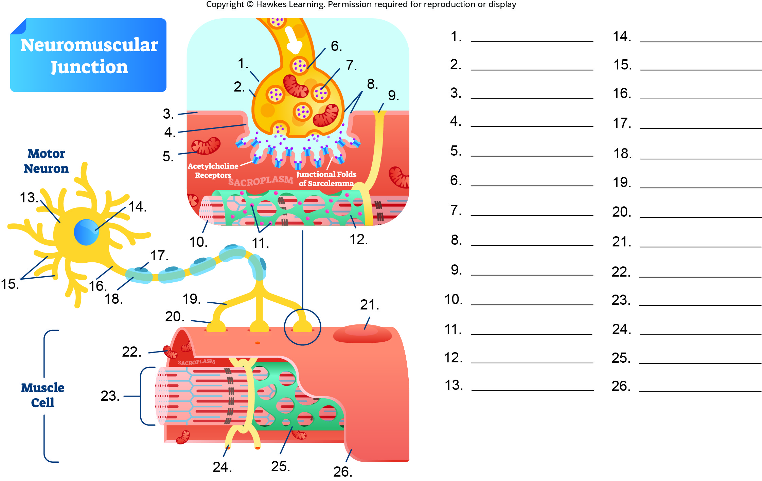
Lesson 42.2 Figure 8 - Numbered

Slide 29
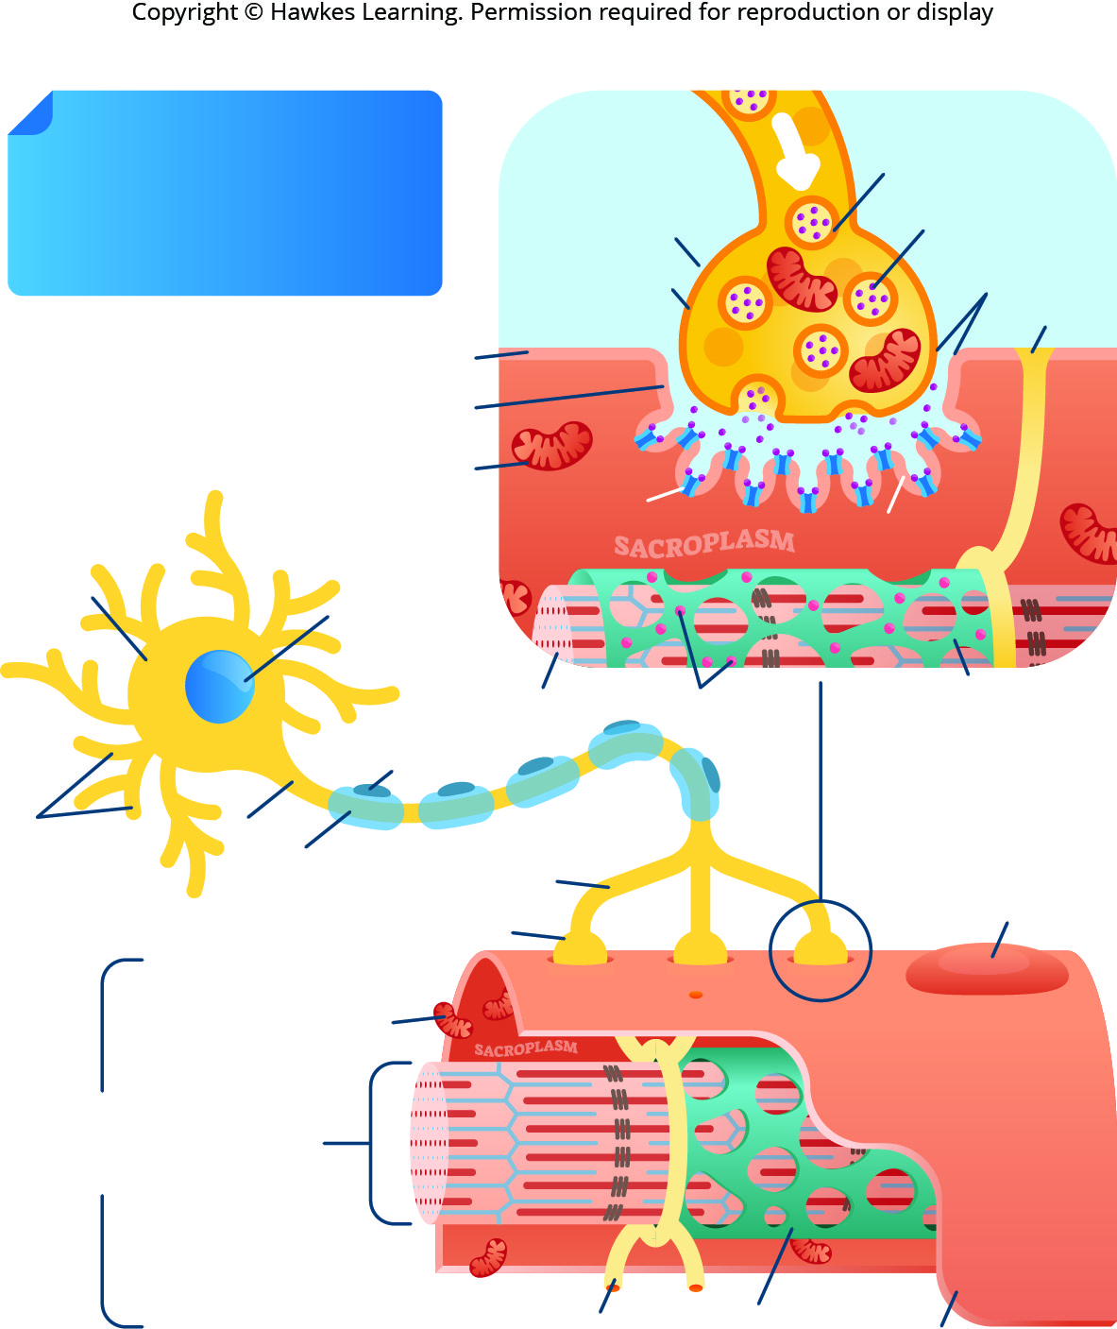
Lesson 42.2 Figure 8

Slide 30
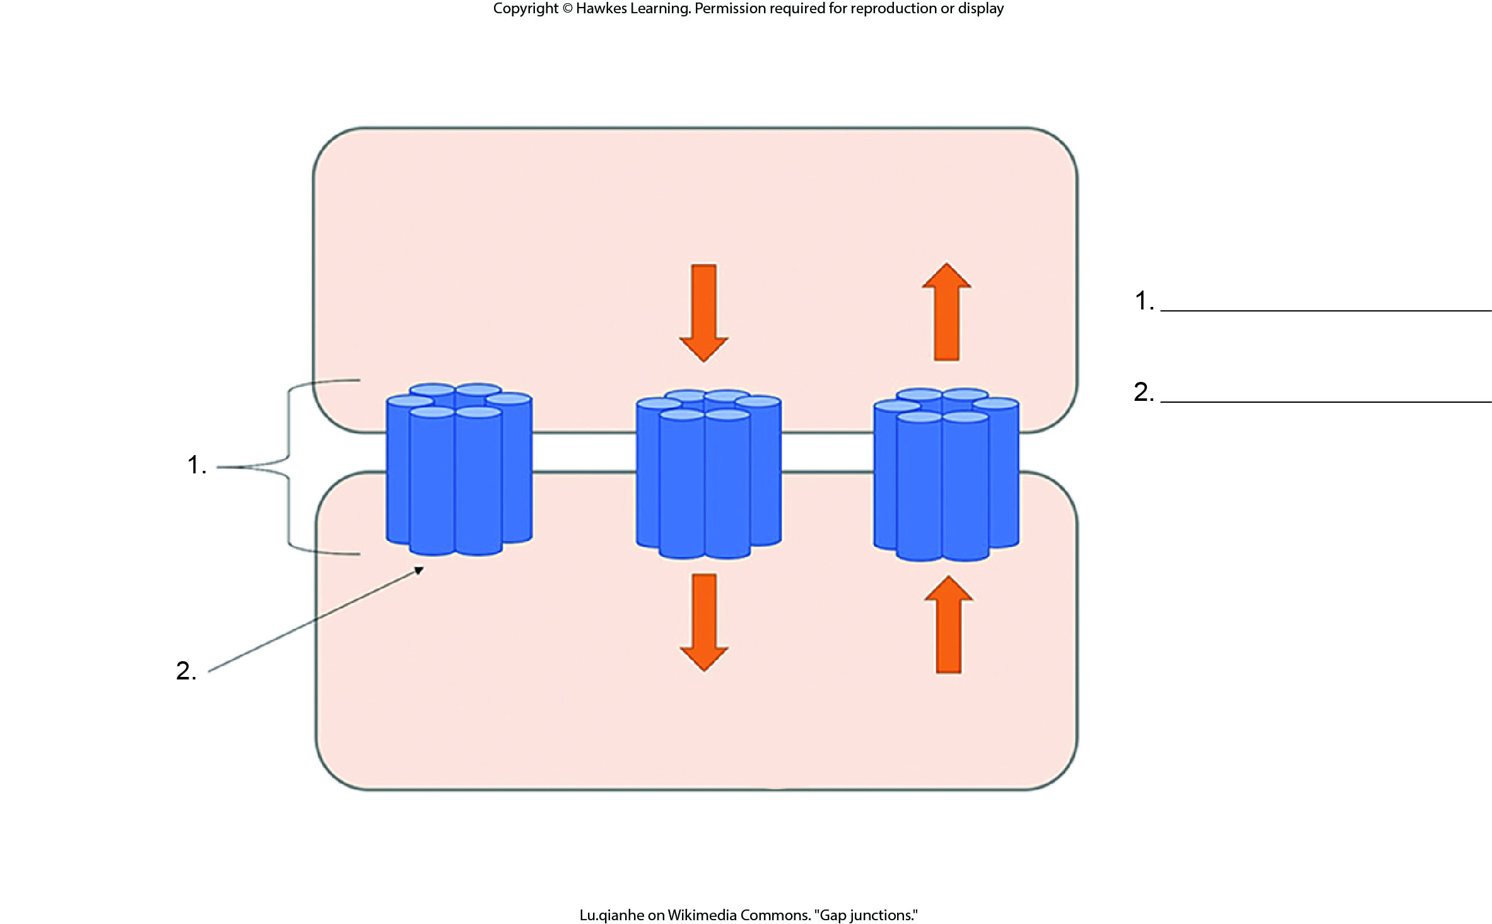
Lesson 42.2 Figure 9 - Numbered

Slide 31
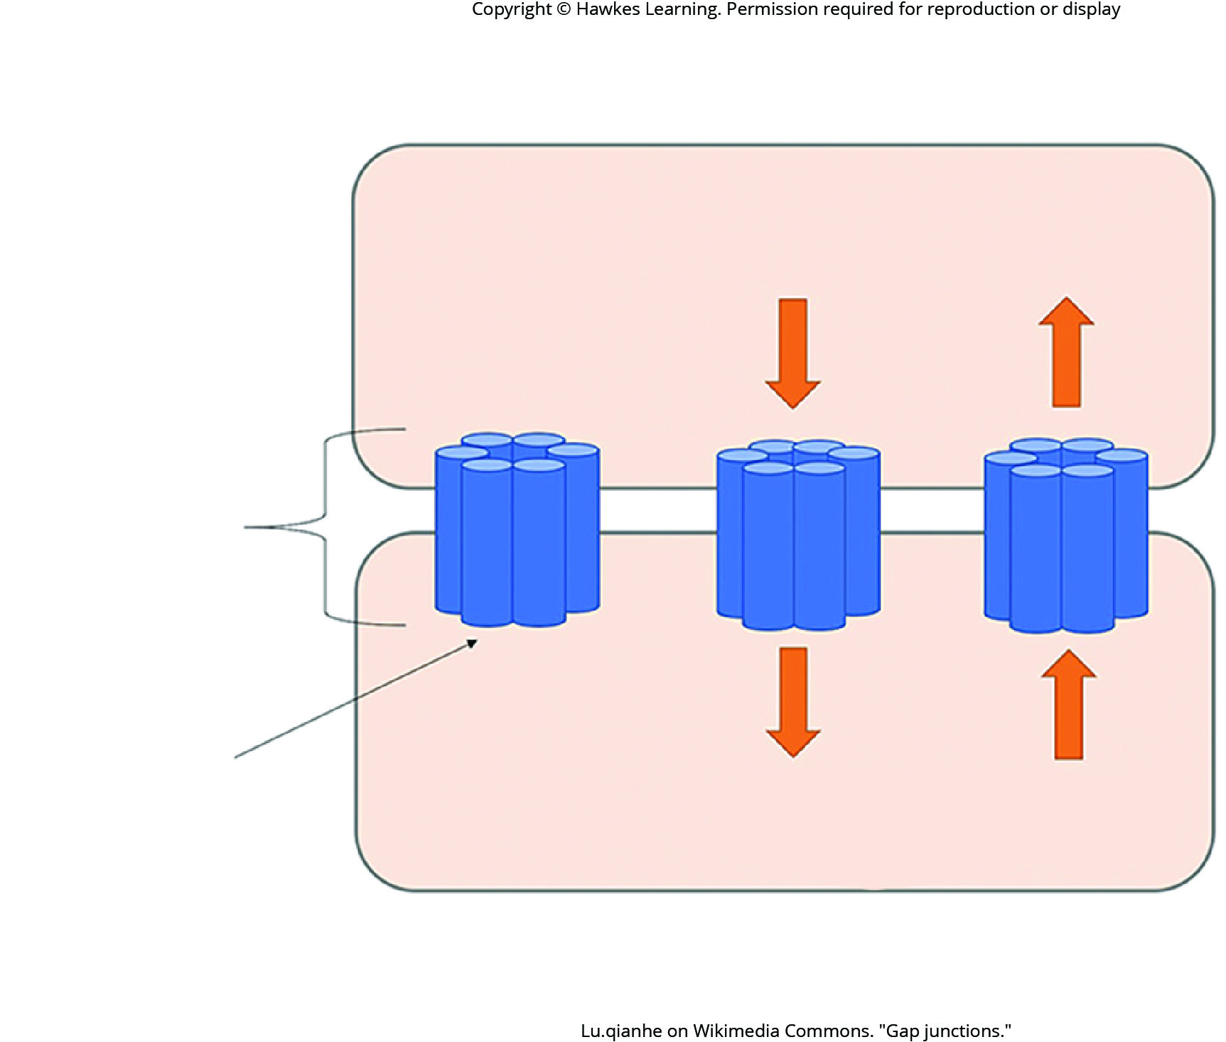
Lesson 42.2 Figure 9

Slide 32
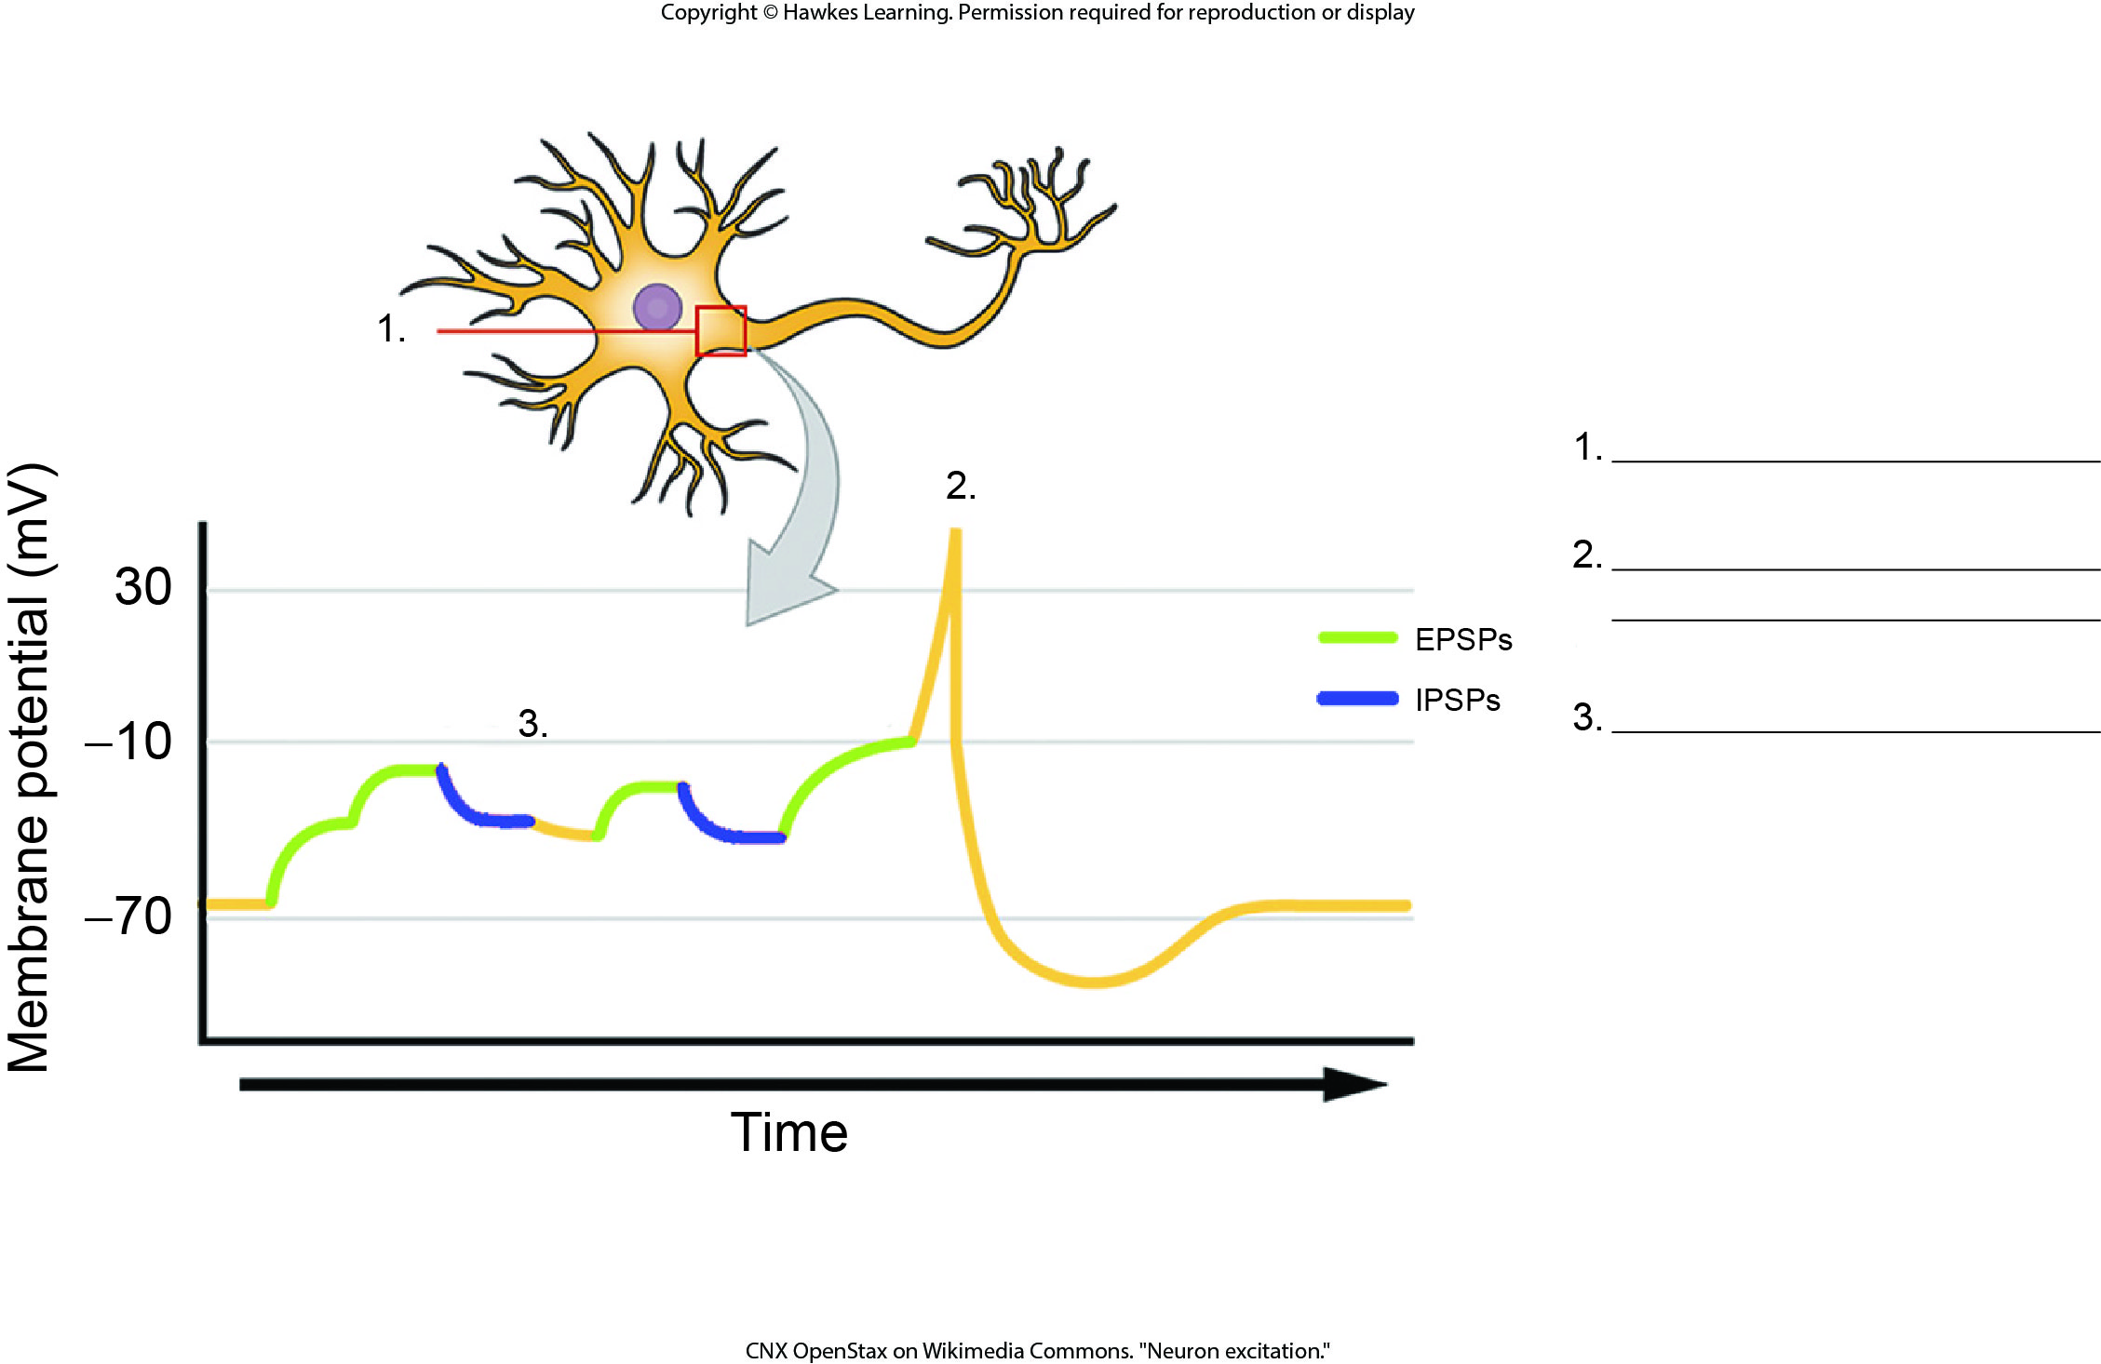
Lesson 42.2 Figure 10 - Numbered

Slide 33
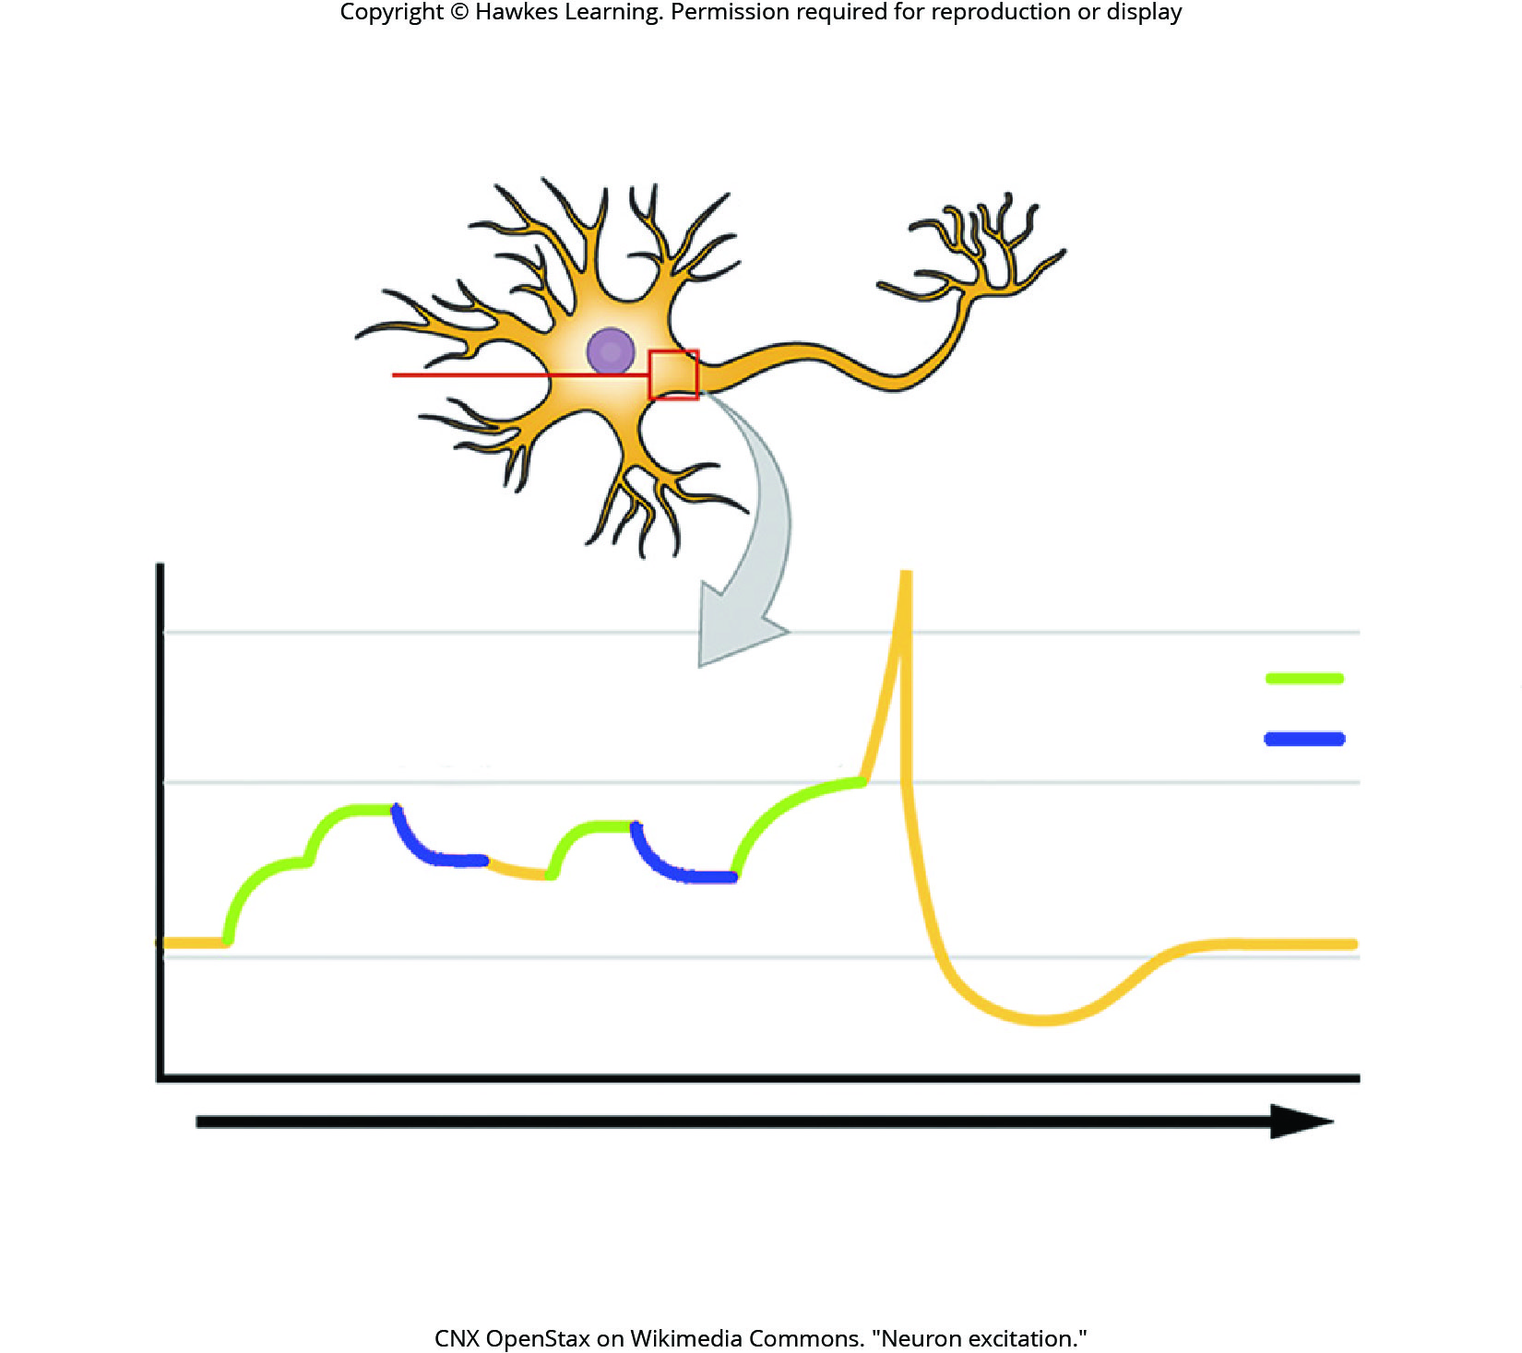
Lesson 42.2 Figure 10

Slide 34
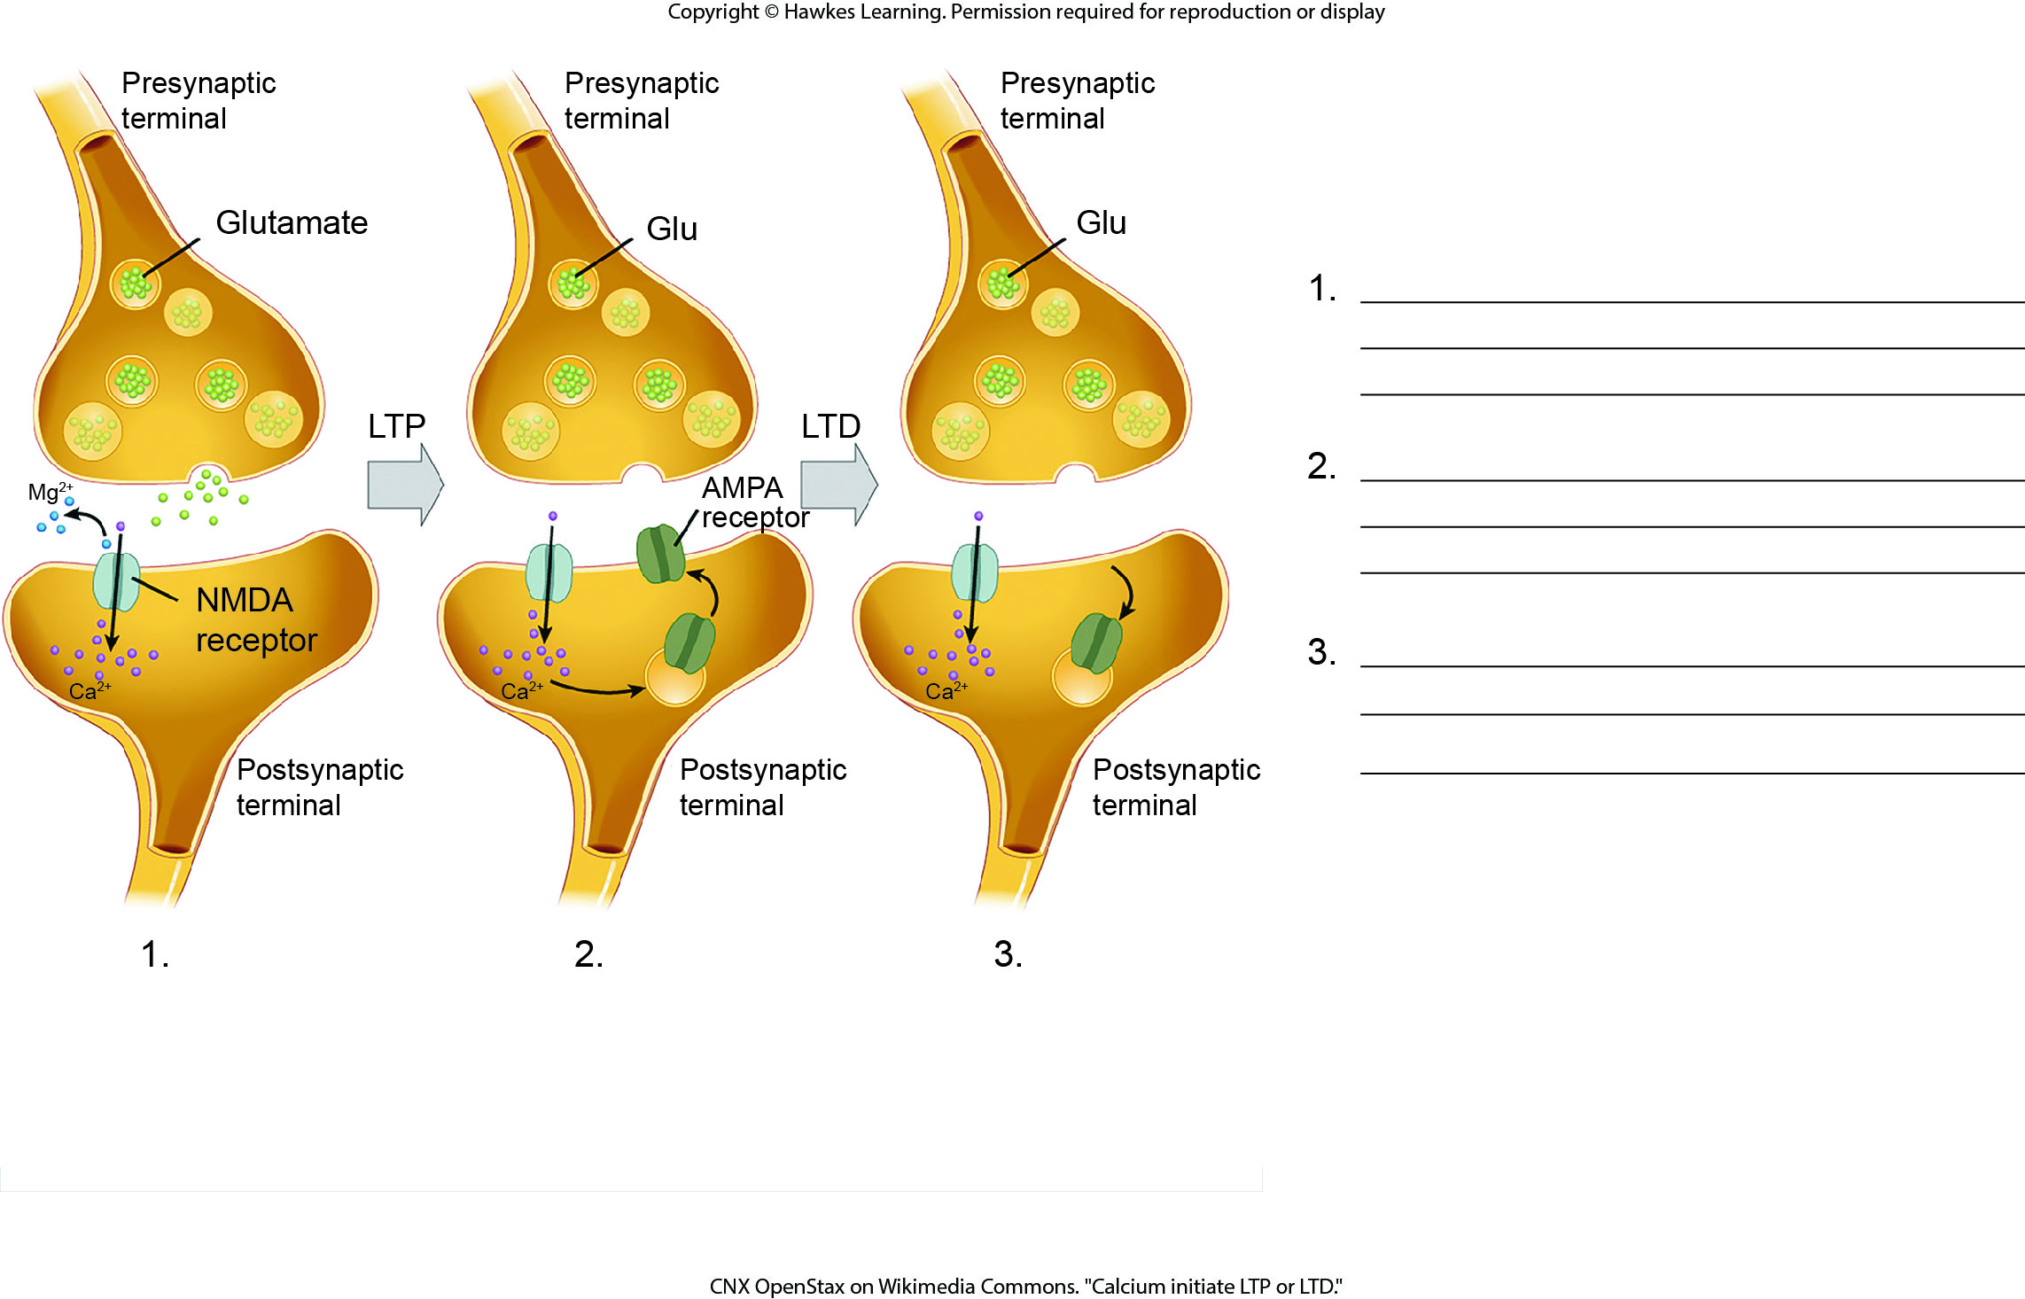
Lesson 42.2 Figure 12 - Numbered

Slide 35
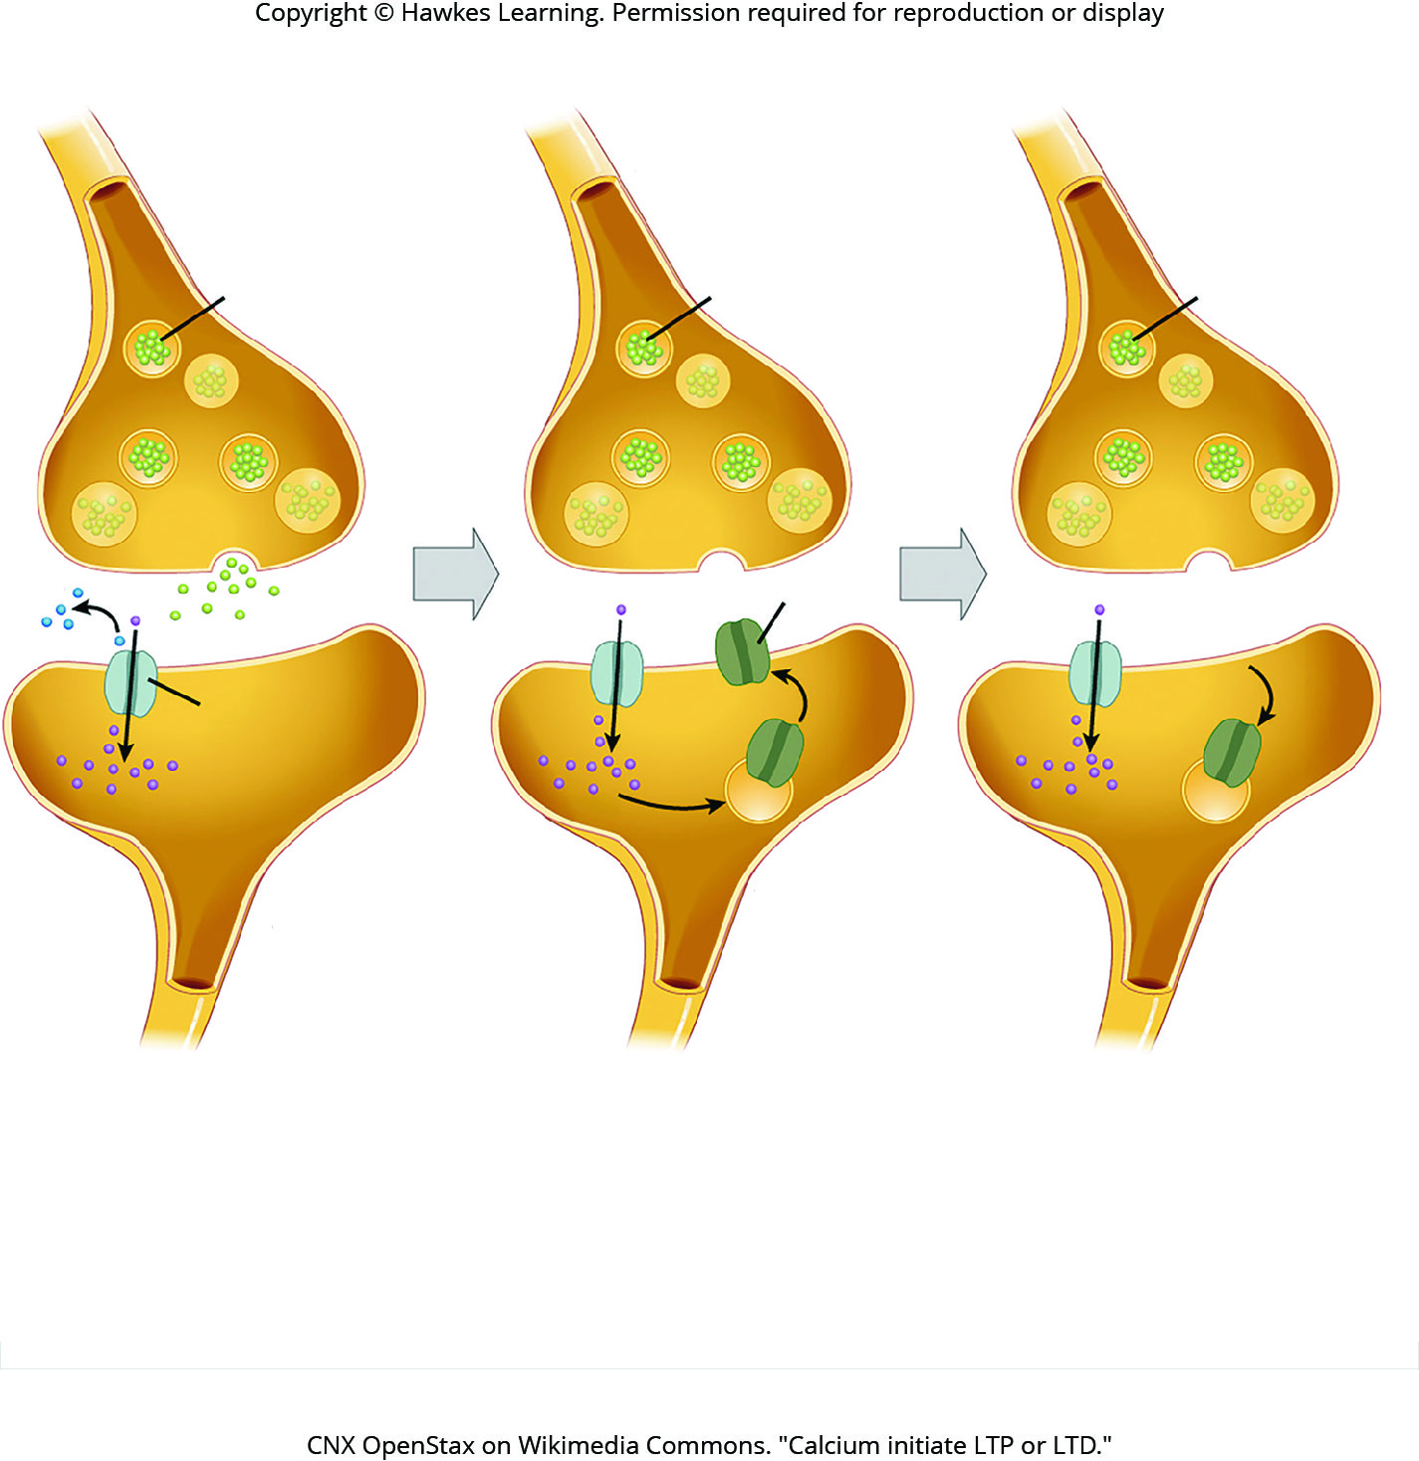
Lesson 42.2 Figure 12

Slide 36
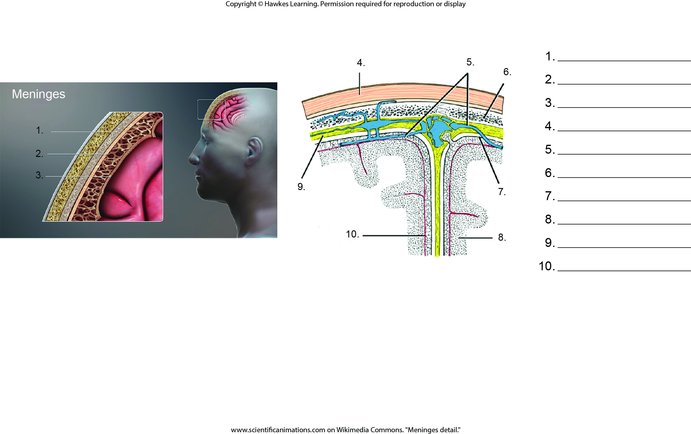
Lesson 42.3 Figure 1 - Numbered

Slide 37
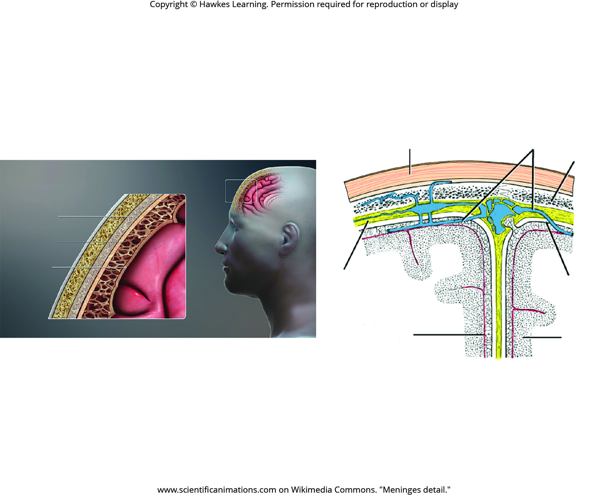
Lesson 42.3 Figure 1

Slide 38
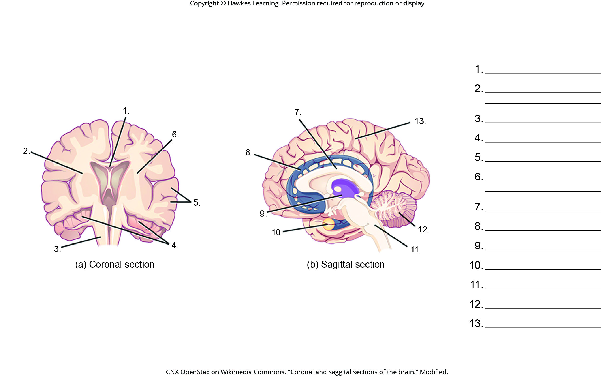
Lesson 42.3 Figure 2 - Numbered

Slide 39
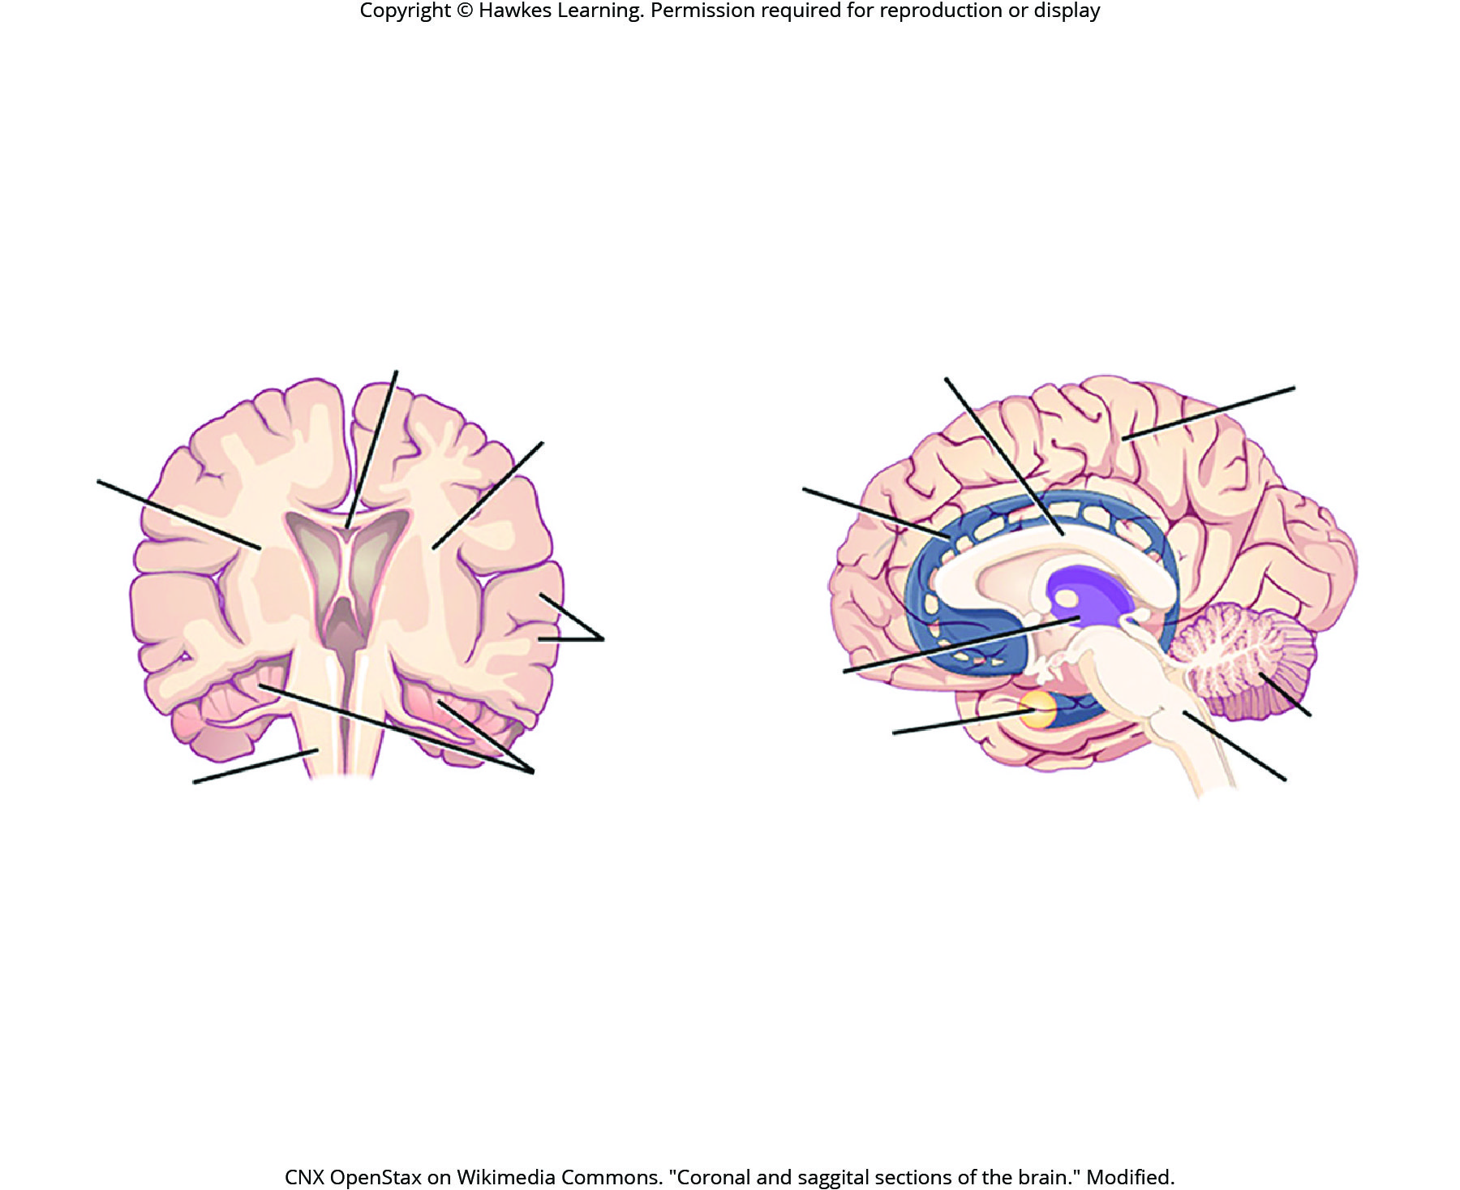
Lesson 42.3 Figure 2

Slide 40
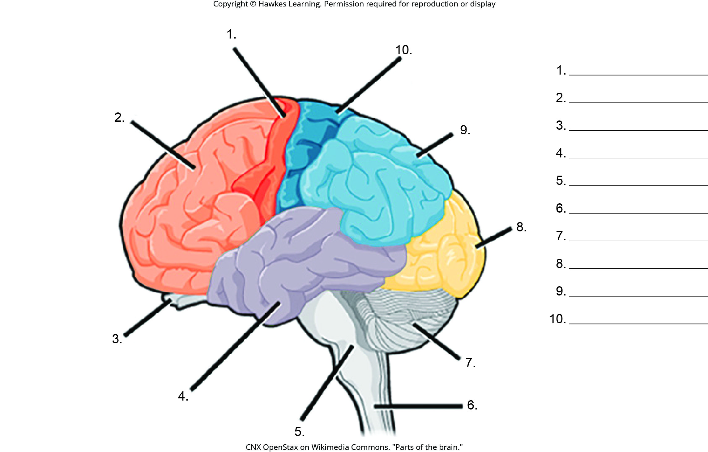
Lesson 42.3 Figure 4 - Numbered

Slide 41
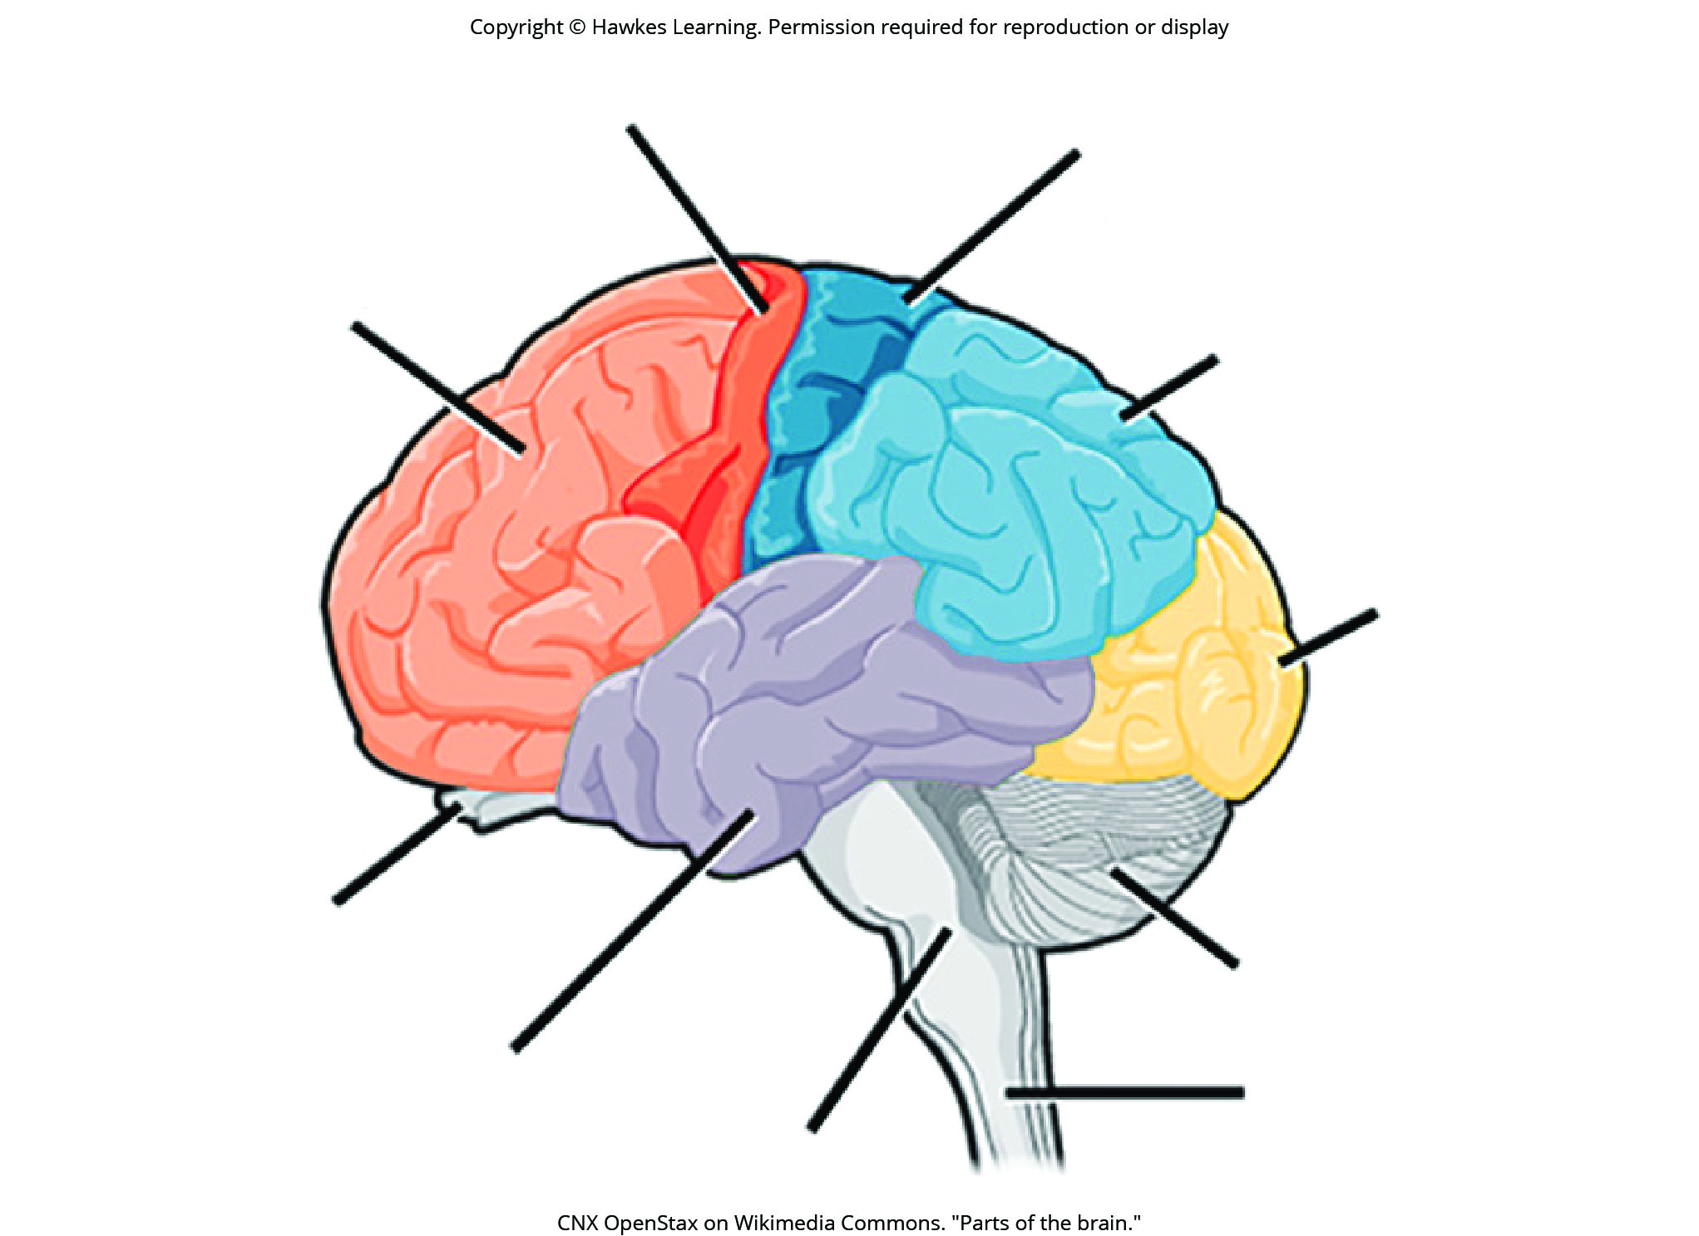
Lesson 42.3 Figure 4

Slide 42
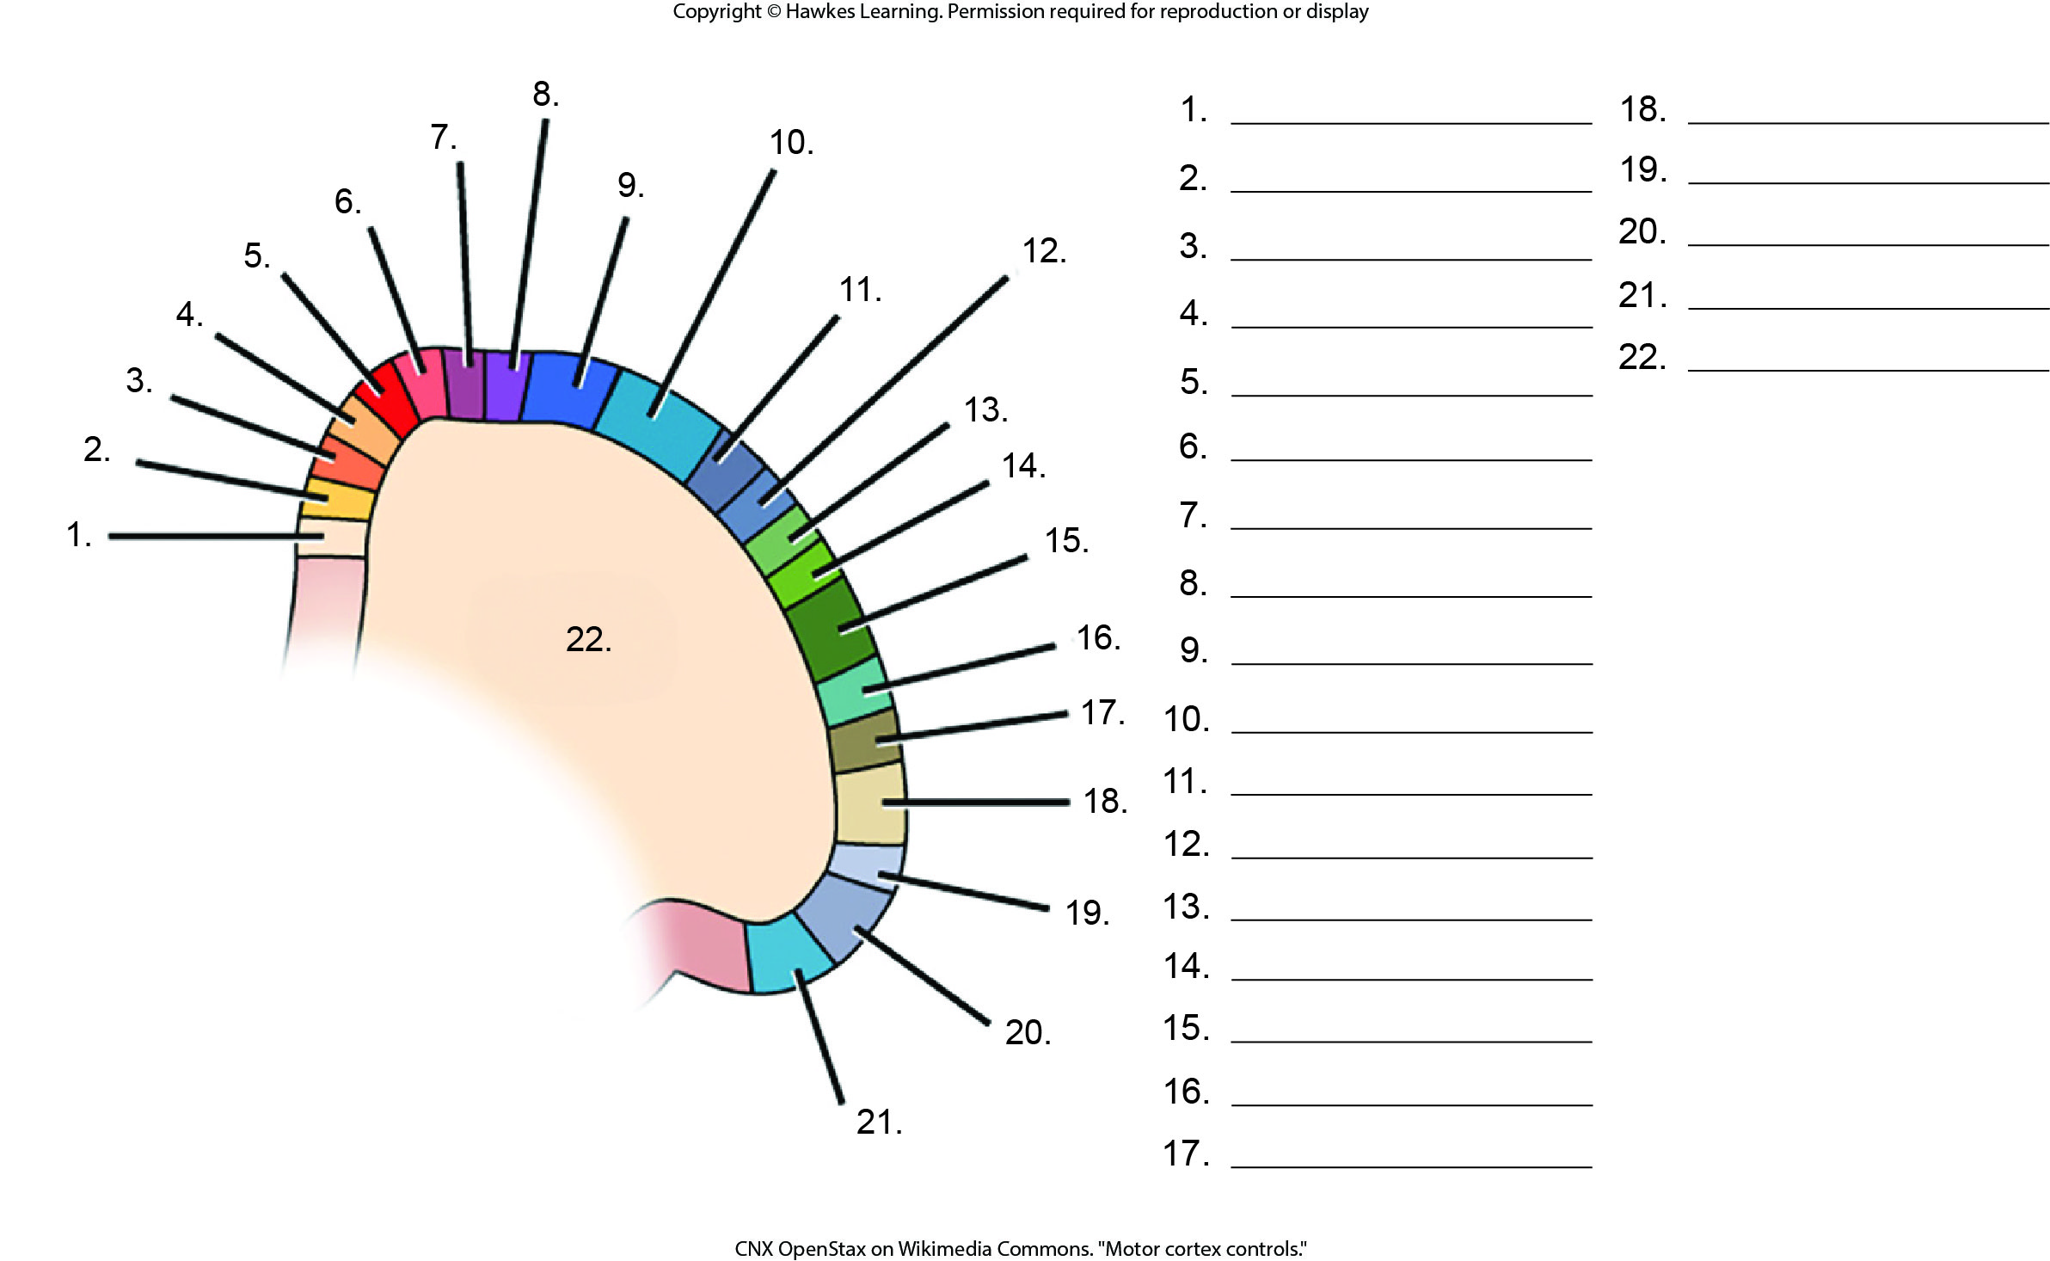
Lesson 42.3 Figure 5 - Numbered

Slide 43
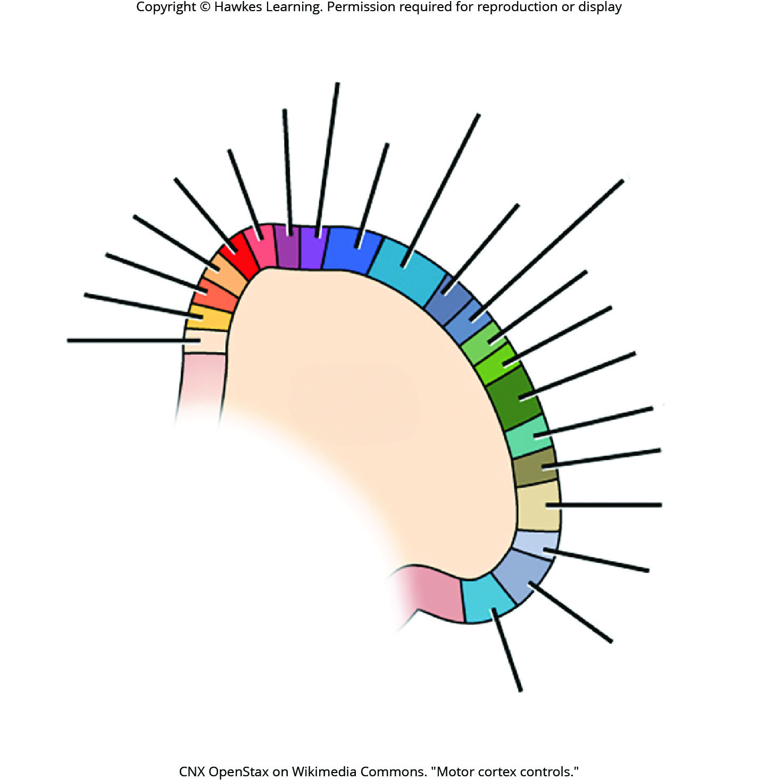
Lesson 42.3 Figure 5

Slide 44
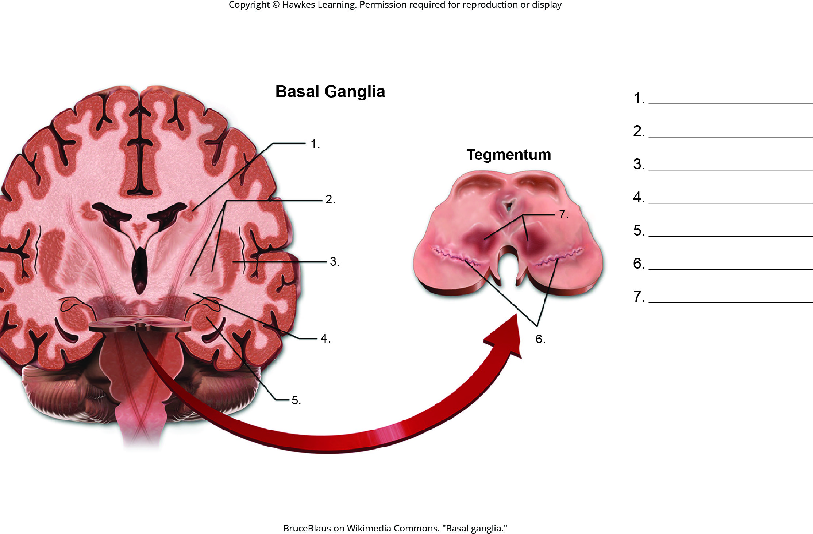
Lesson 42.3 Figure 7 - Numbered

Slide 45
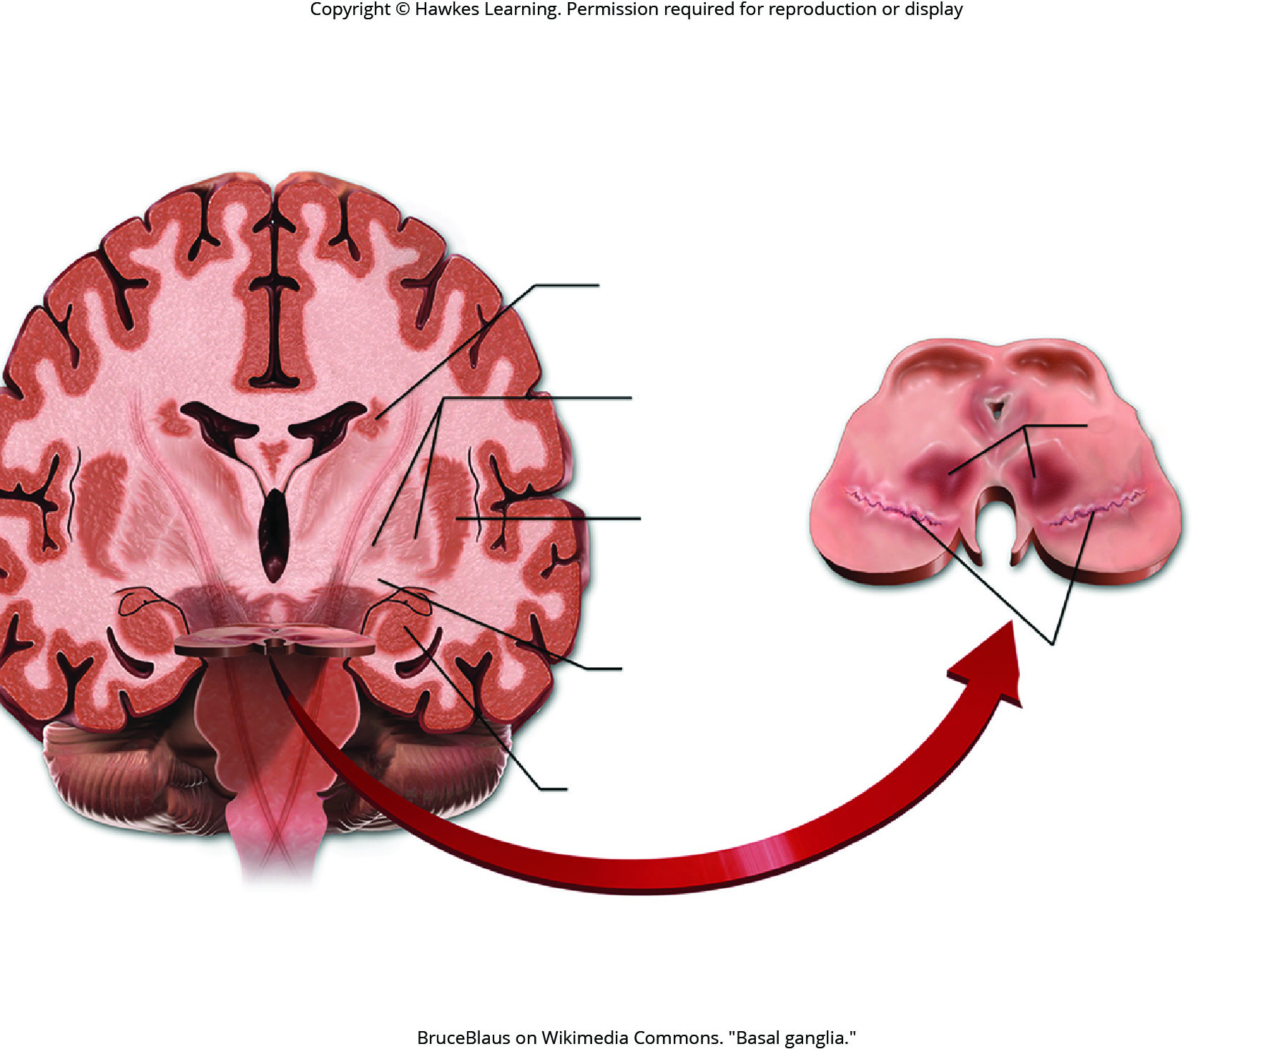
Lesson 42.3 Figure 7

Slide 46
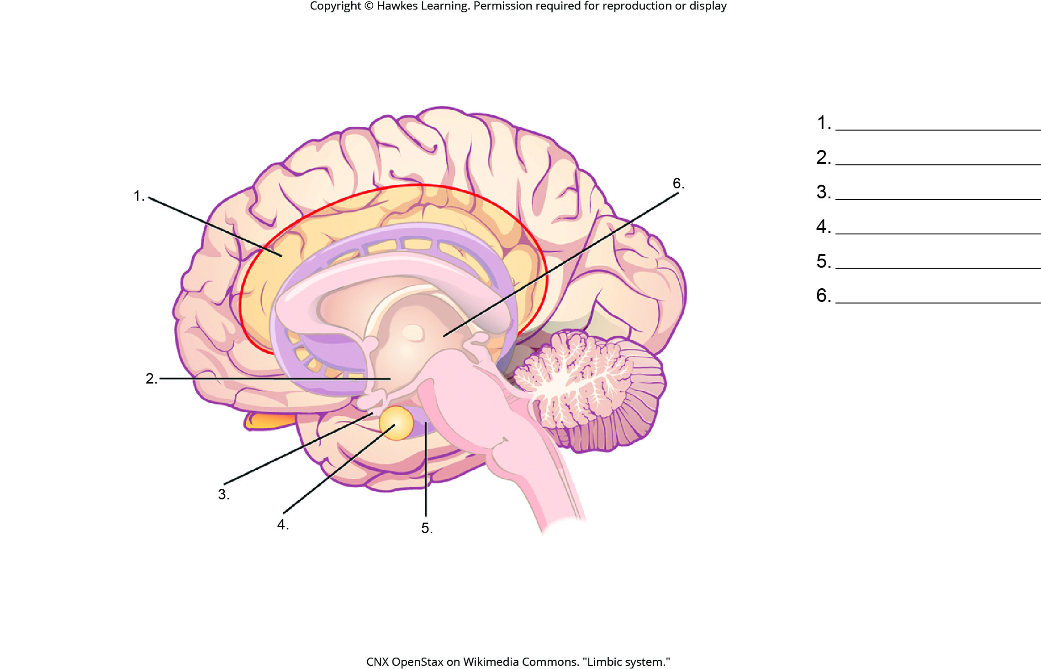
Lesson 42.3 Figure 8 - Numbered

Slide 47
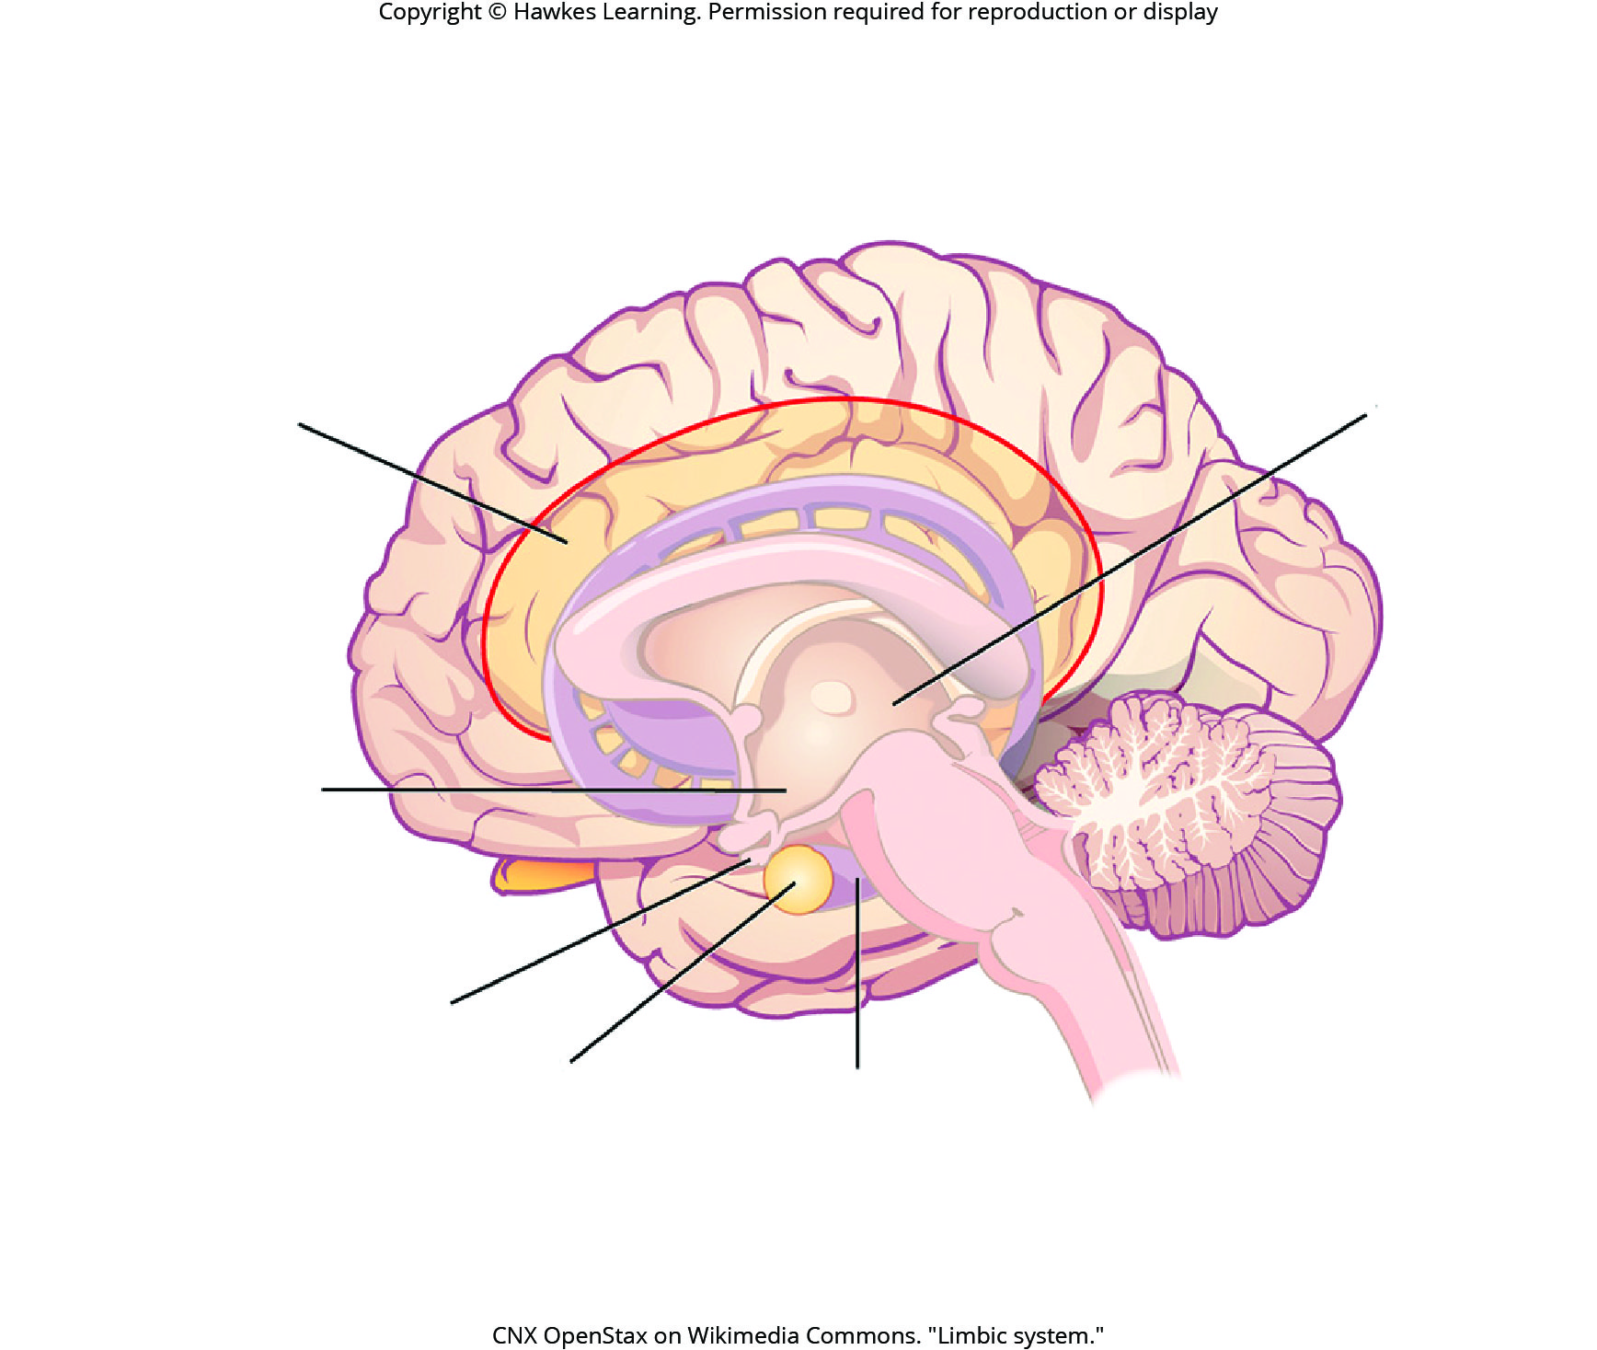
Lesson 42.3 Figure 8

Slide 48
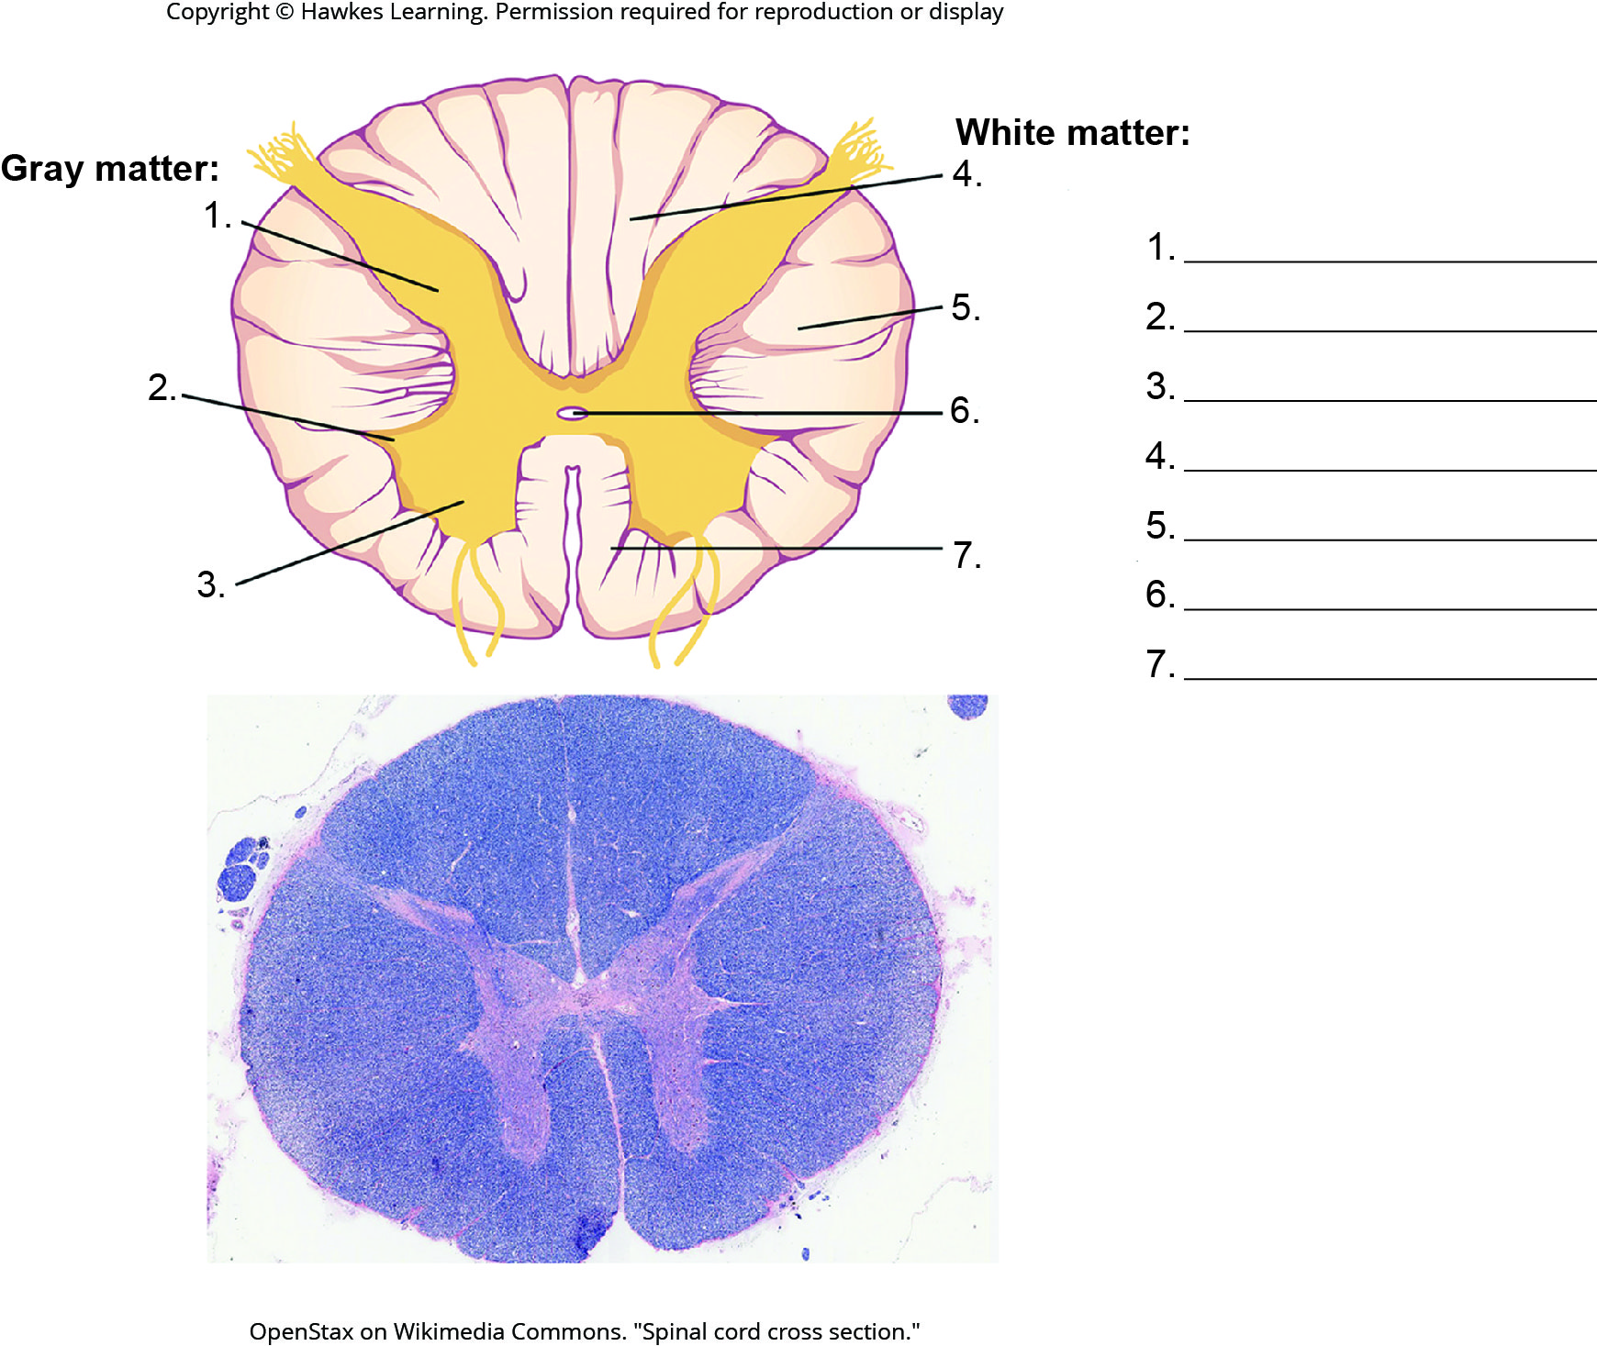
Lesson 42.3 Figure 9 - Numbered

Slide 49
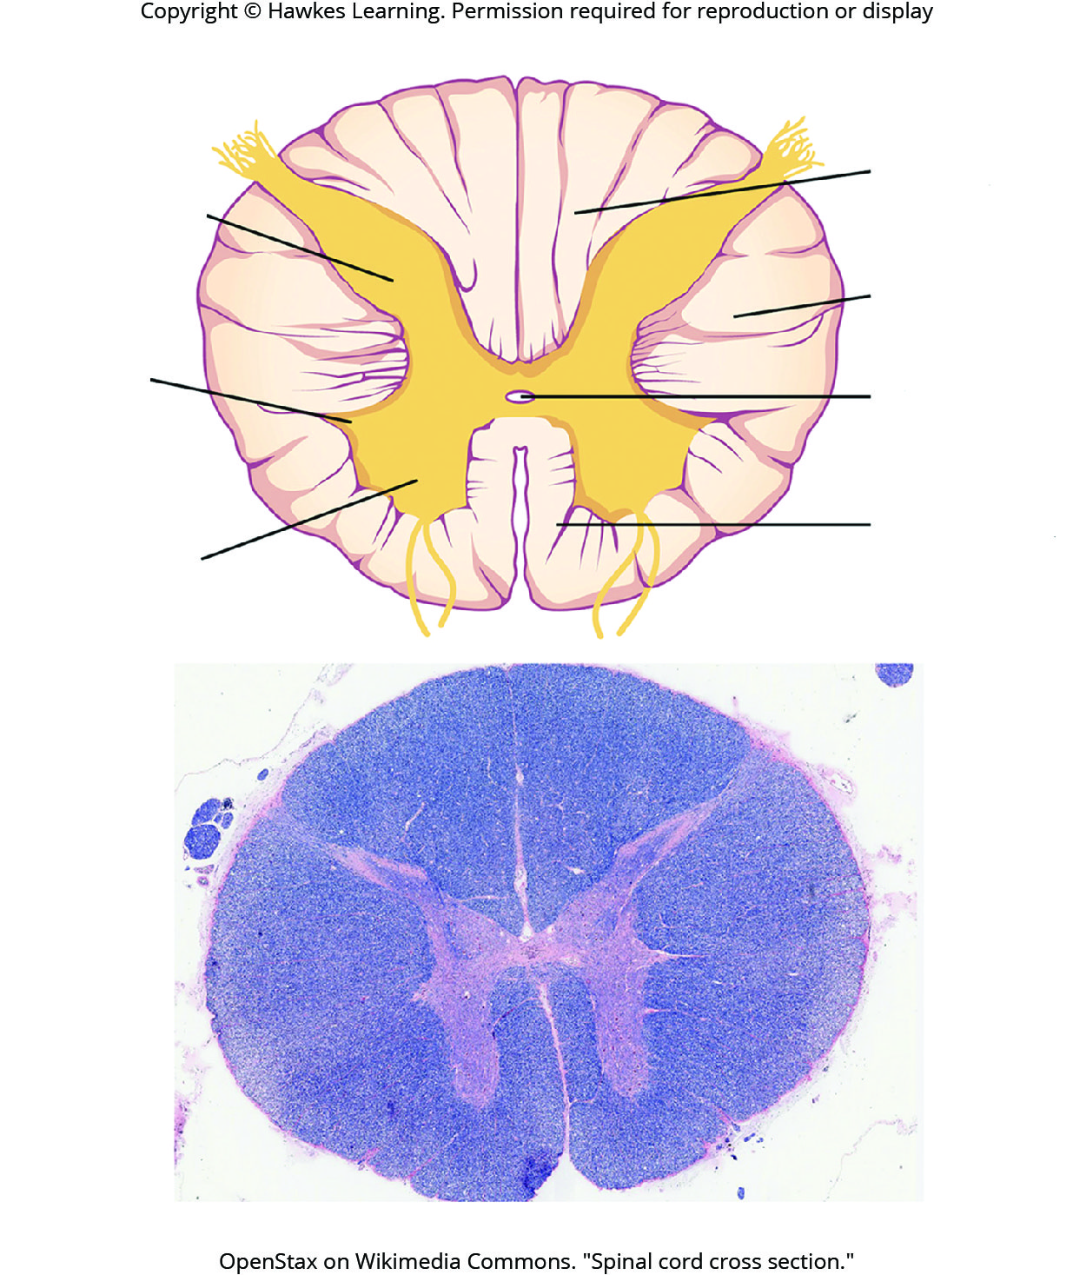
Lesson 42.3 Figure 9

Slide 50
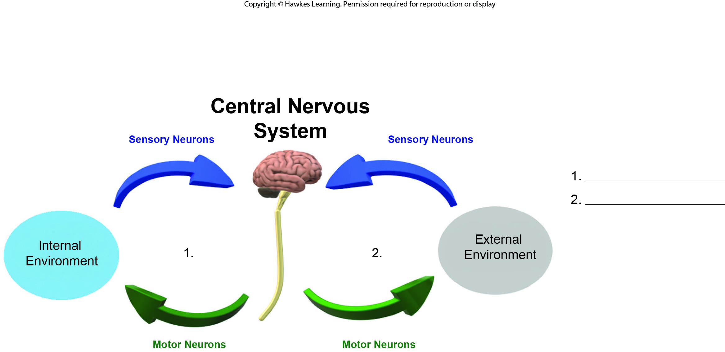
Lesson 42.4 Figure 1 - Numbered

Slide 51
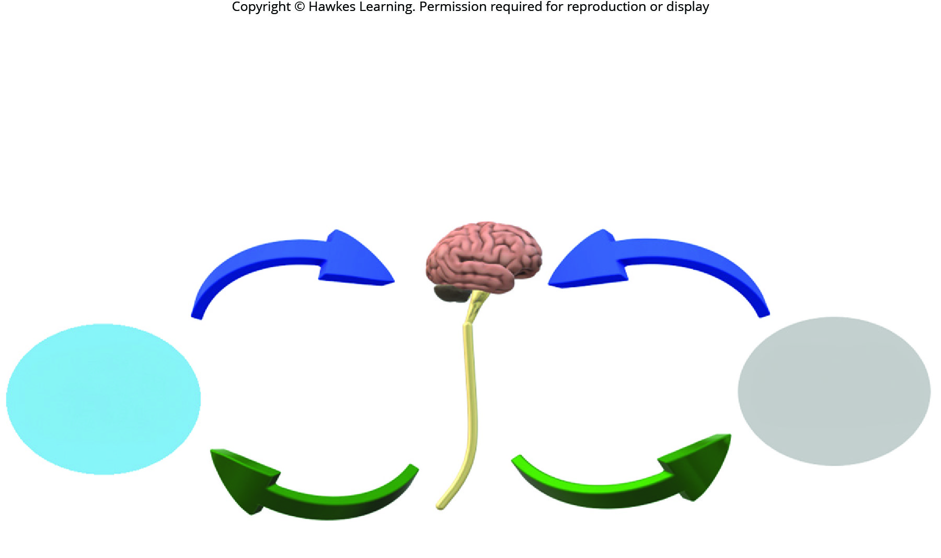
Lesson 42.4 Figure 1

Slide 52

Lesson 42.4 Figure 2 - Numbered

Slide 53

Lesson 42.4 Figure 2

Slide 54

Lesson 42.4 Figure 4 - Numbered

Slide 55

Lesson 42.4 Figure 4

Slide 56

Lesson 42.4 Figure 5 - Numbered

Slide 57

Lesson 42.4 Figure 5

Slide 58

Lesson 42.4 Figure 6 - Numbered

Slide 59

Lesson 42.4 Figure 6

Slide 60

Lesson 42.5 Figure 1 - Numbered

Slide 61

Lesson 42.5 Figure 1

Slide 62
Hawkes Learning – End of PowerPoint

