Slide 1
Chapter 44
Ecology and the Biosphere

Slide 2
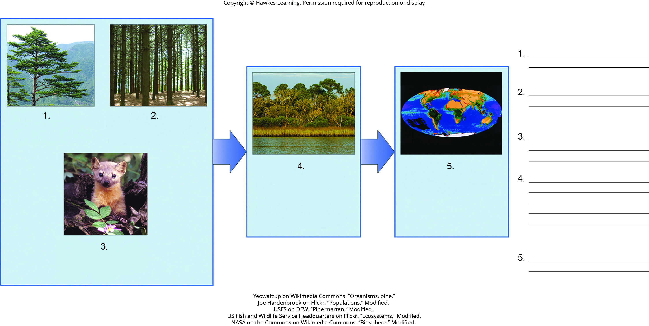
Lesson 44.1 Figure 2 - Numbered

Slide 3
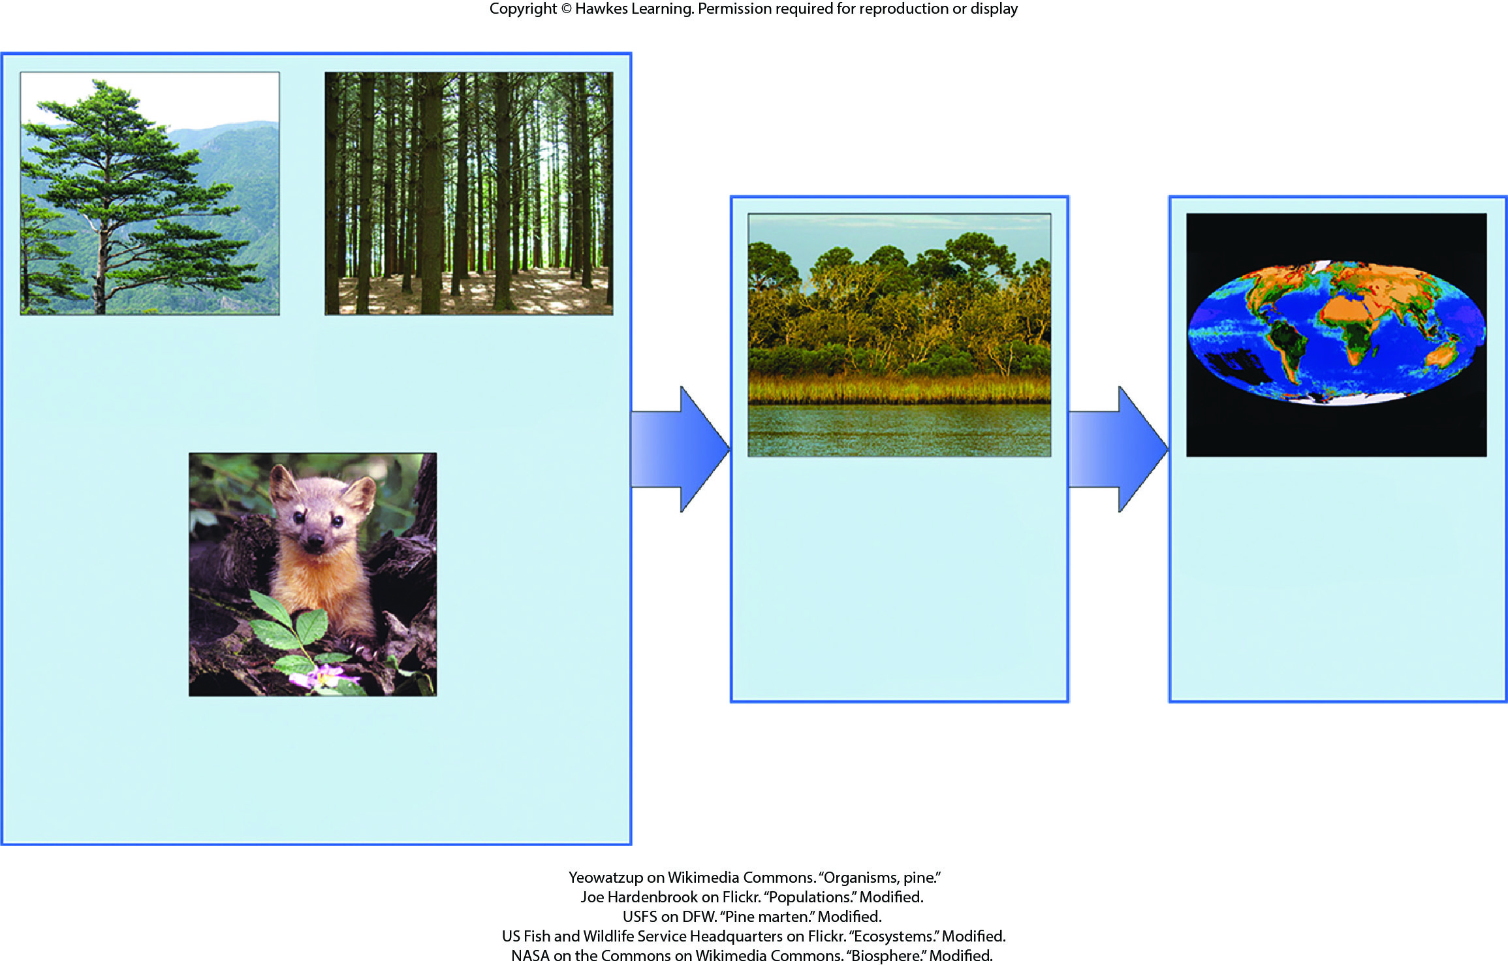
Lesson 44.1 Figure 2

Slide 4
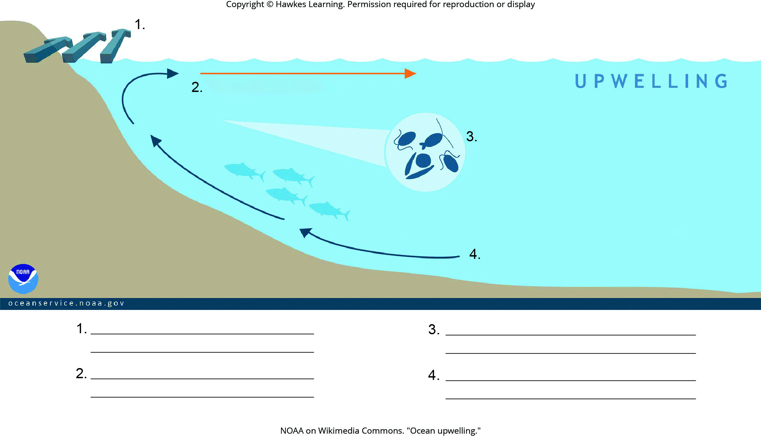
Lesson 44.2 Figure 5 - Numbered

Slide 5
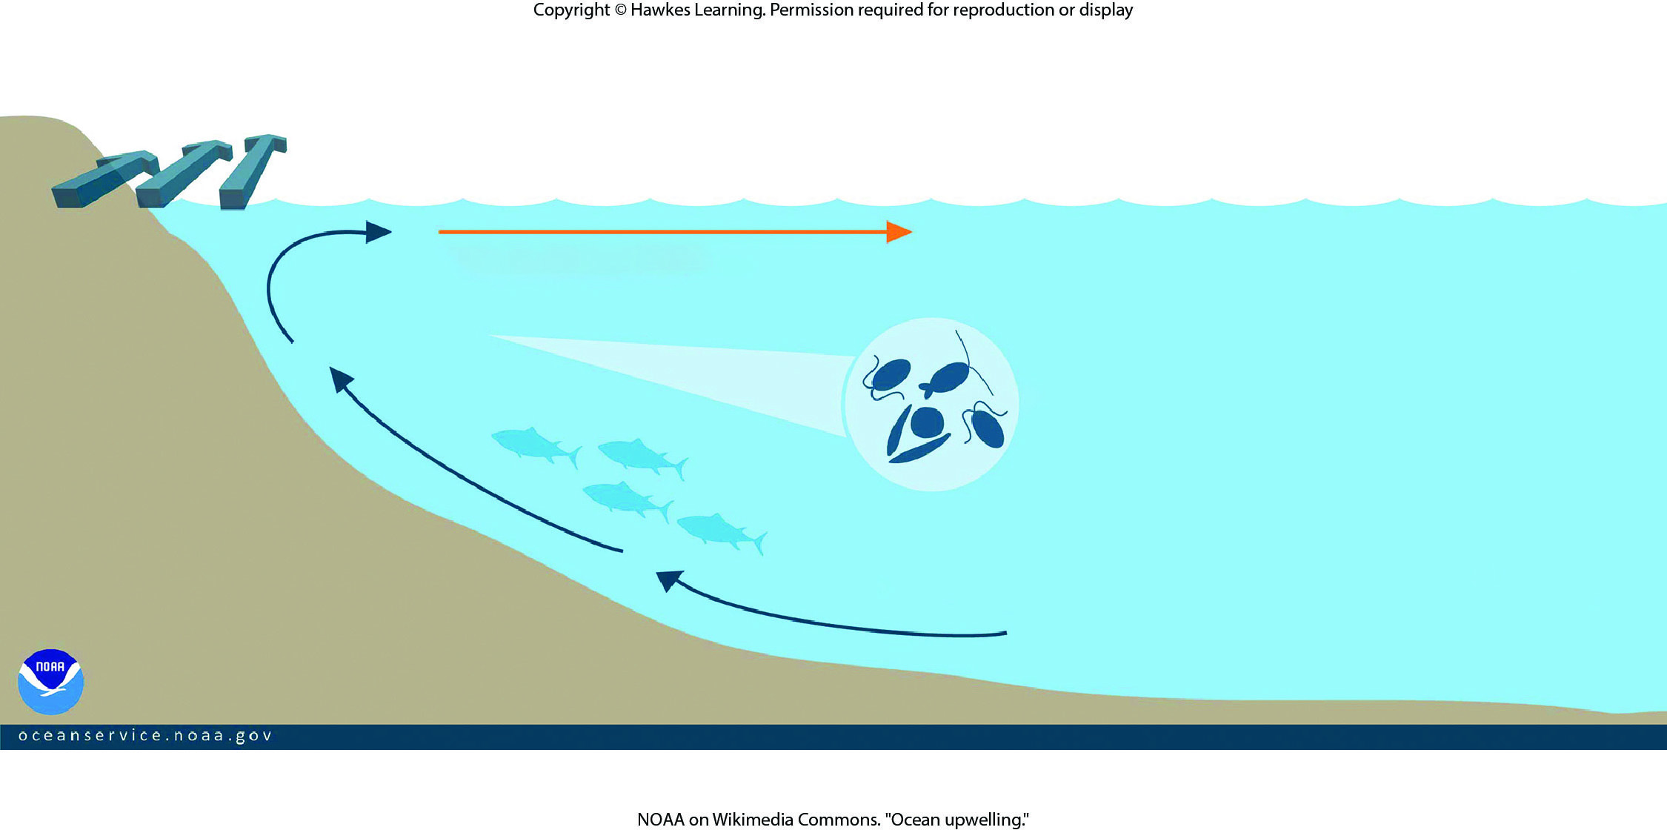
Lesson 44.2 Figure 5

Slide 6
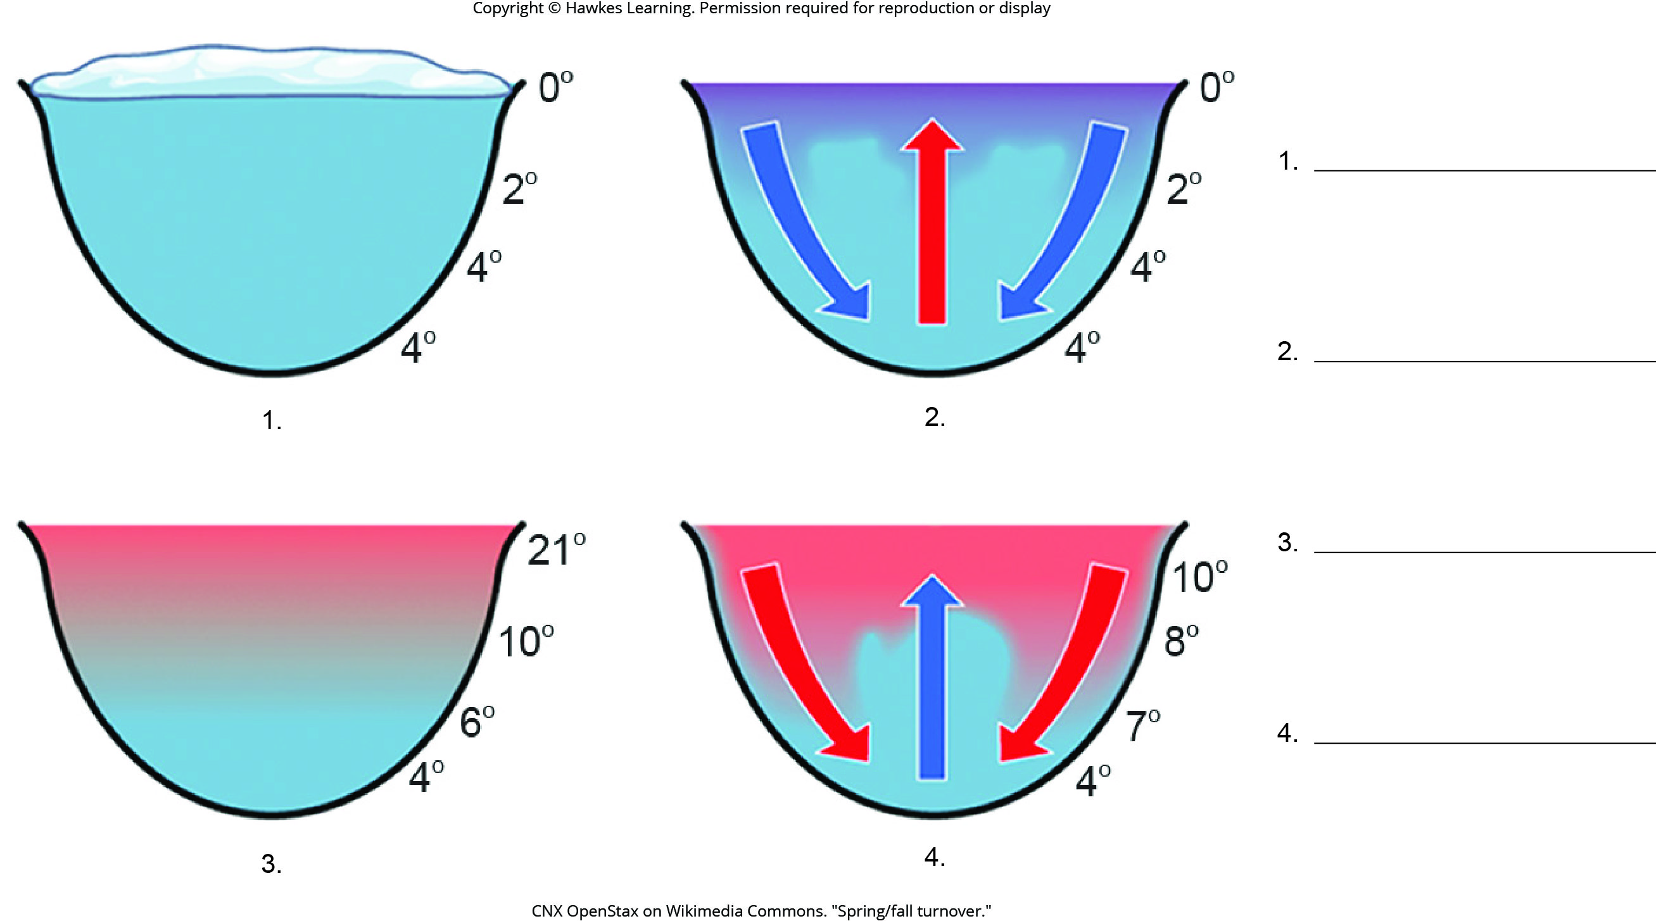
Lesson 44.2 Figure 6 - Numbered

Slide 7
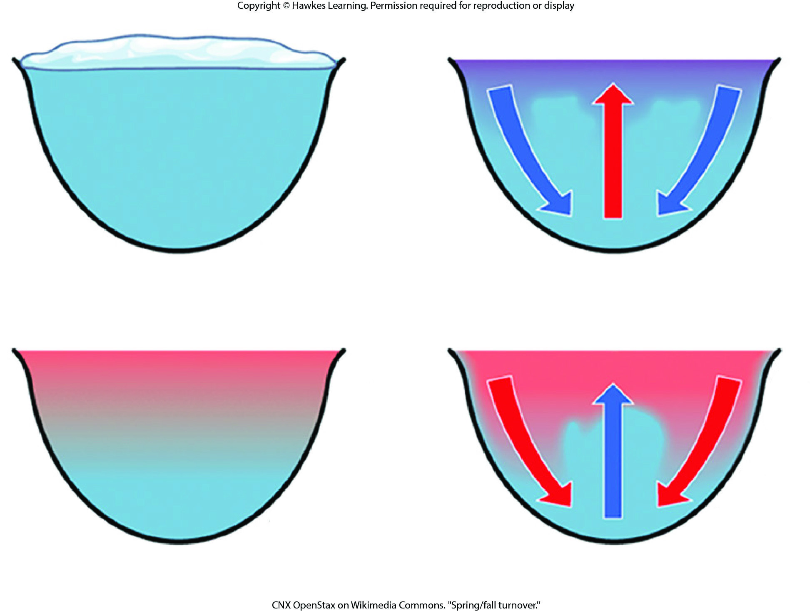
Lesson 44.2 Figure 6

Slide 8
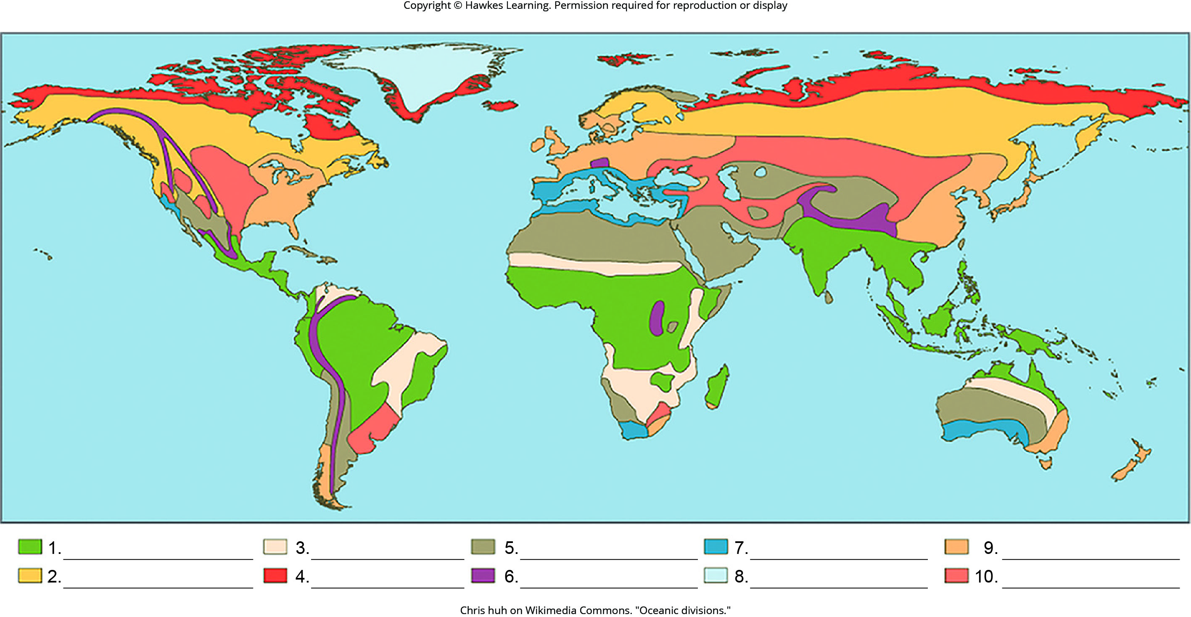
Lesson 44.3 Figure 1 - Numbered

Slide 9

Lesson 44.3 Figure 1

Slide 10
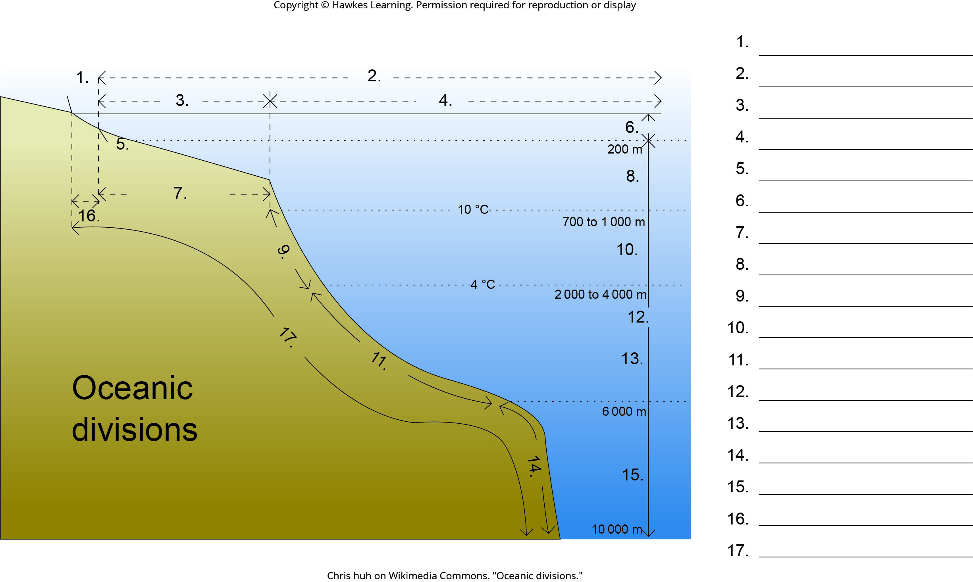
Lesson 44.4 Figure 1 - Numbered

Slide 11
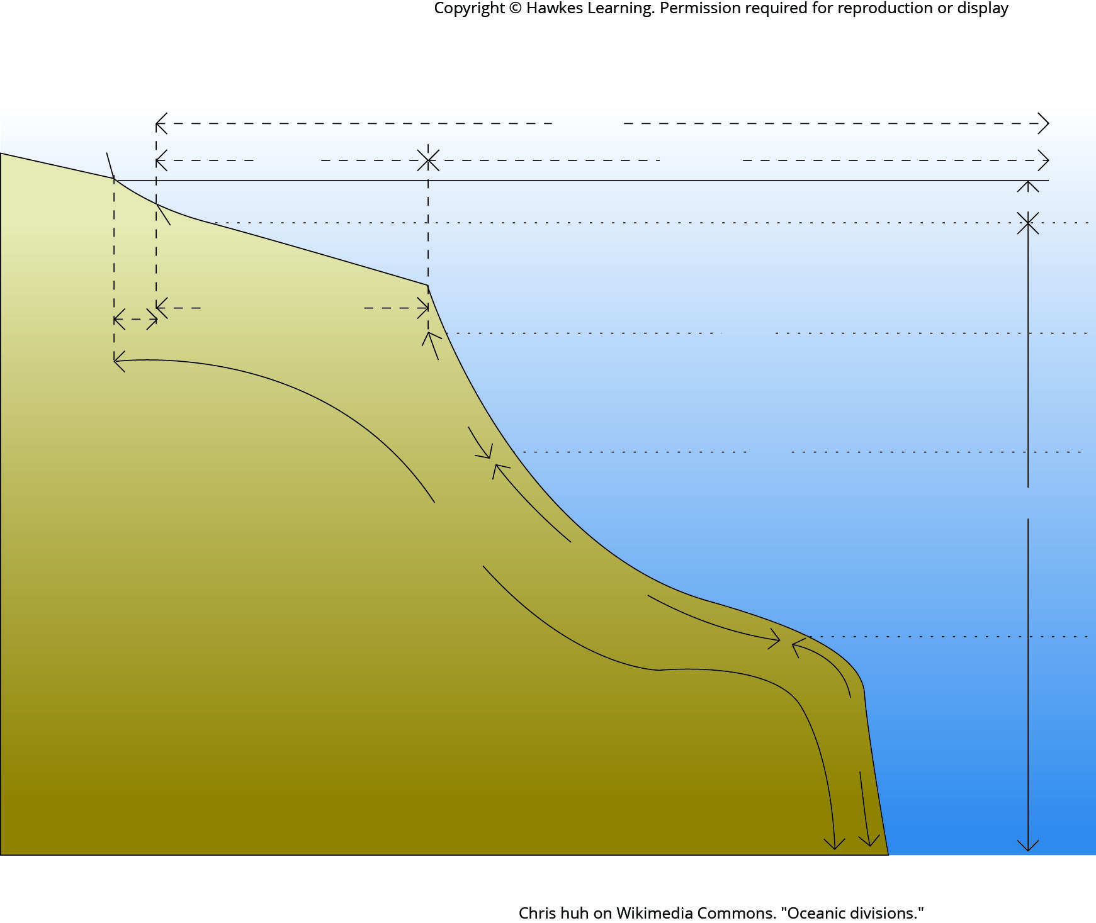
Lesson 44.4 Figure 1

Slide 12
Hawkes Learning – End of PowerPoint

