Slide 1
Chapter 45
Population and Community Ecology

Slide 2
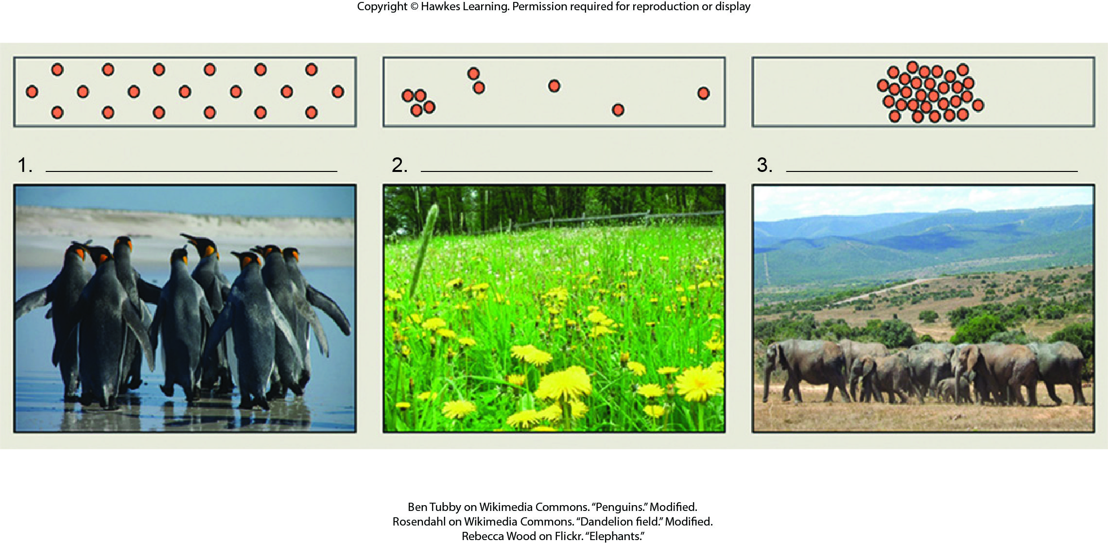
Lesson 45.1 Figure 5 - Numbered

Slide 3

Lesson 45.1 Figure 5

Slide 4
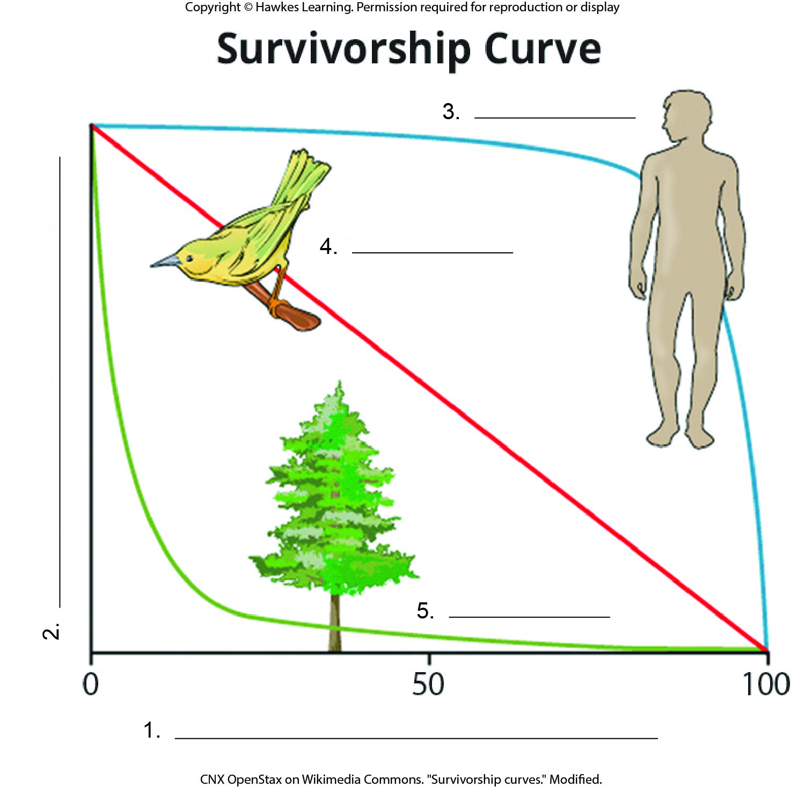
Lesson 45.1 Figure 7 - Numbered

Slide 5
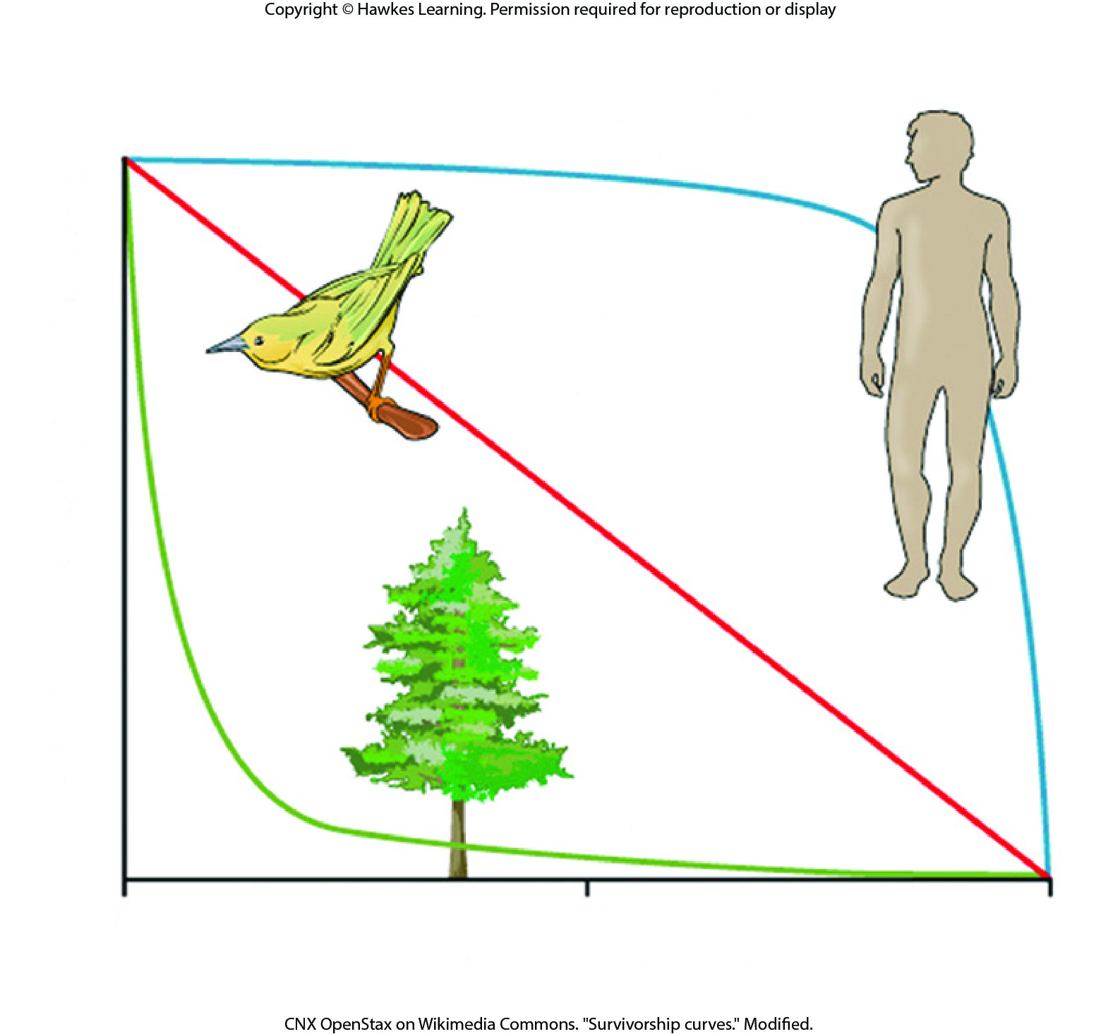
Lesson 45.1 Figure 7

Slide 6
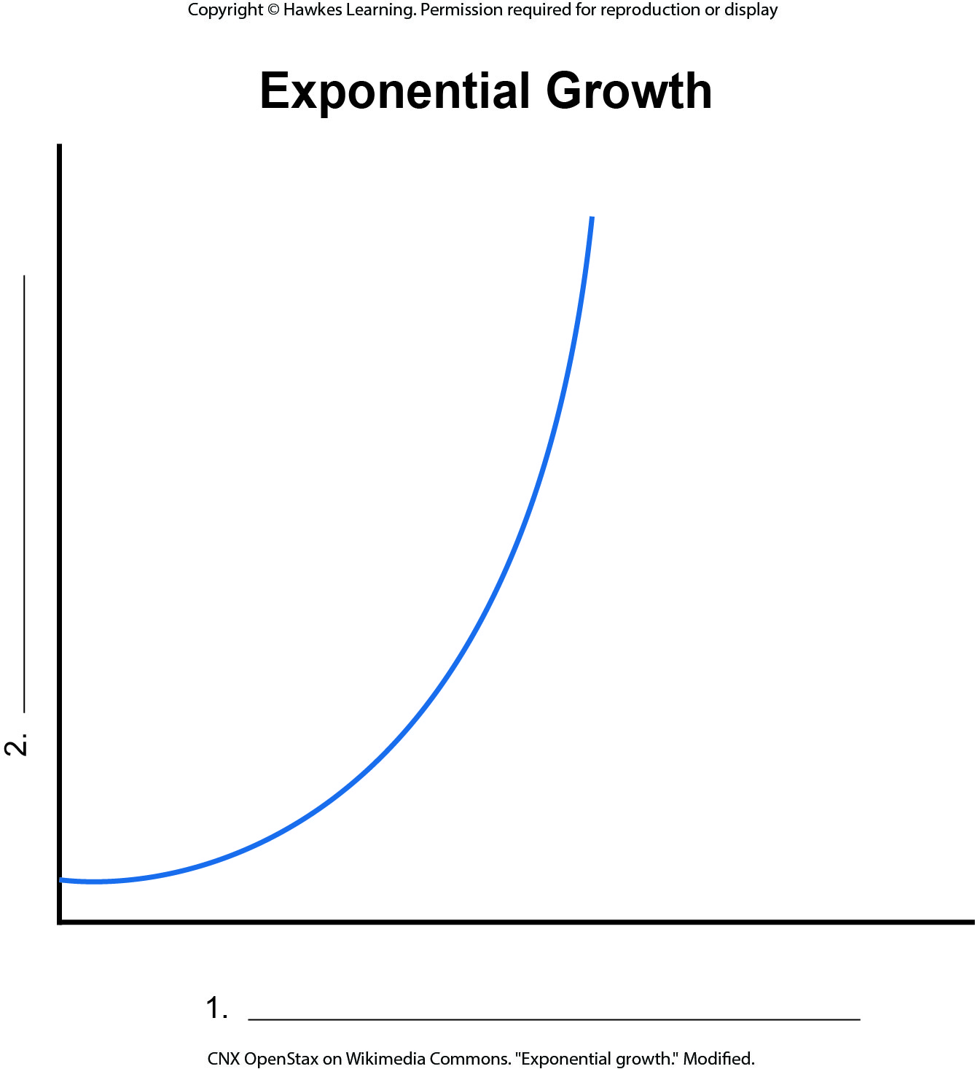
Lesson 45.3 Figure 2 - Numbered

Slide 7
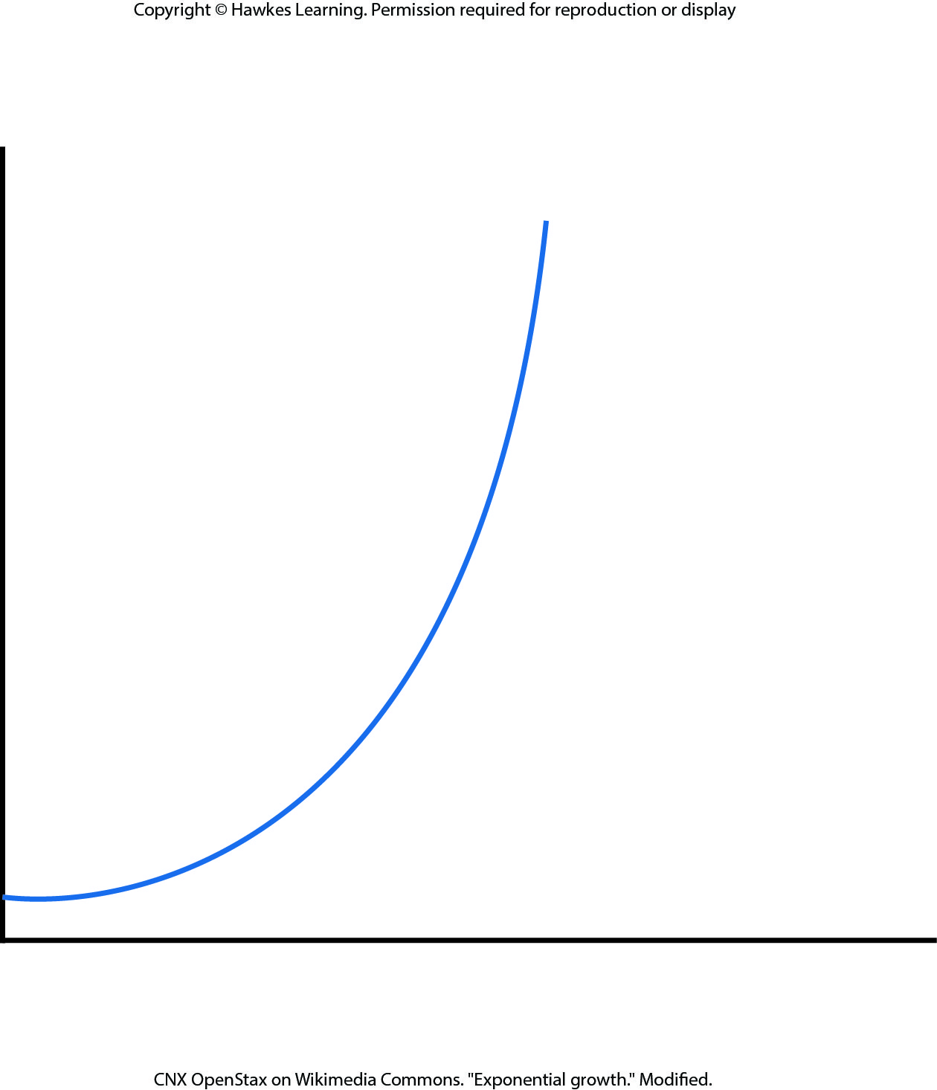
Lesson 45.3 Figure 2

Slide 8
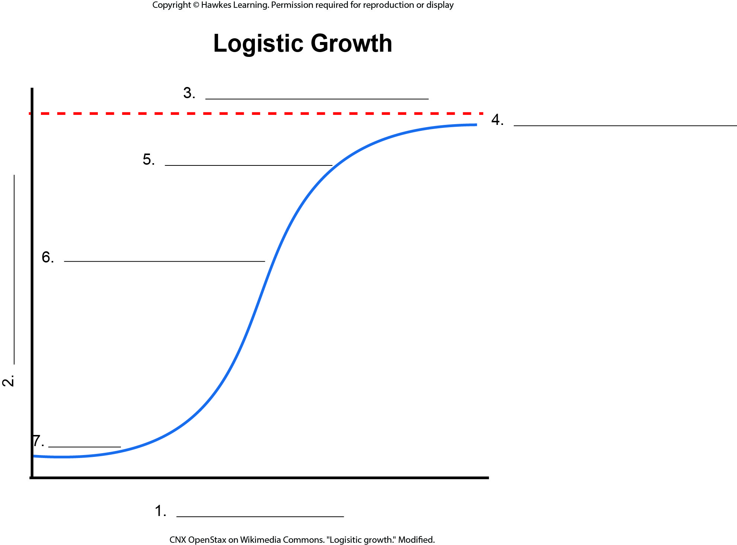
Lesson 45.3 Figure 3 - Numbered

Slide 9
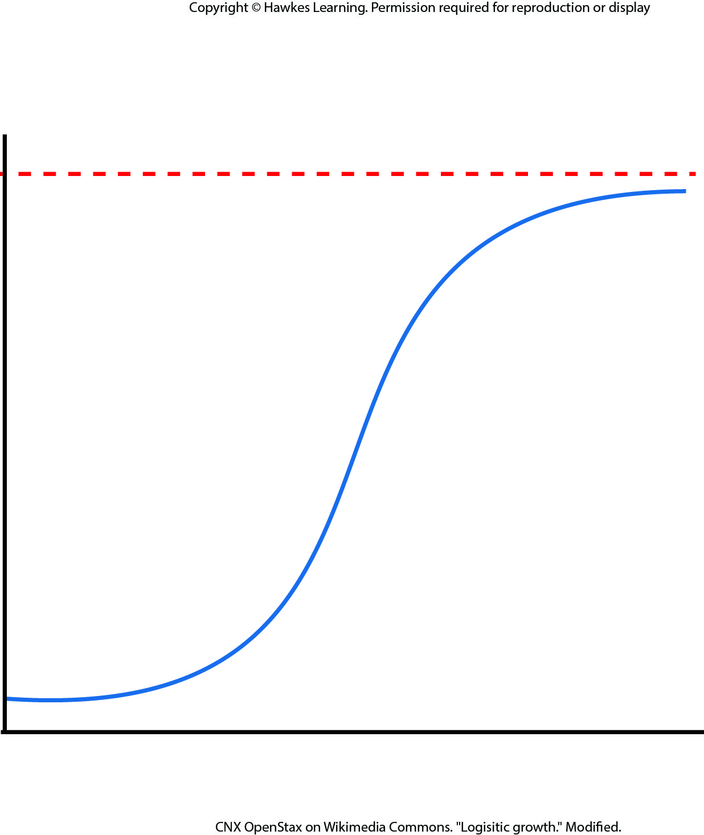
Lesson 45.3 Figure 3

Slide 10
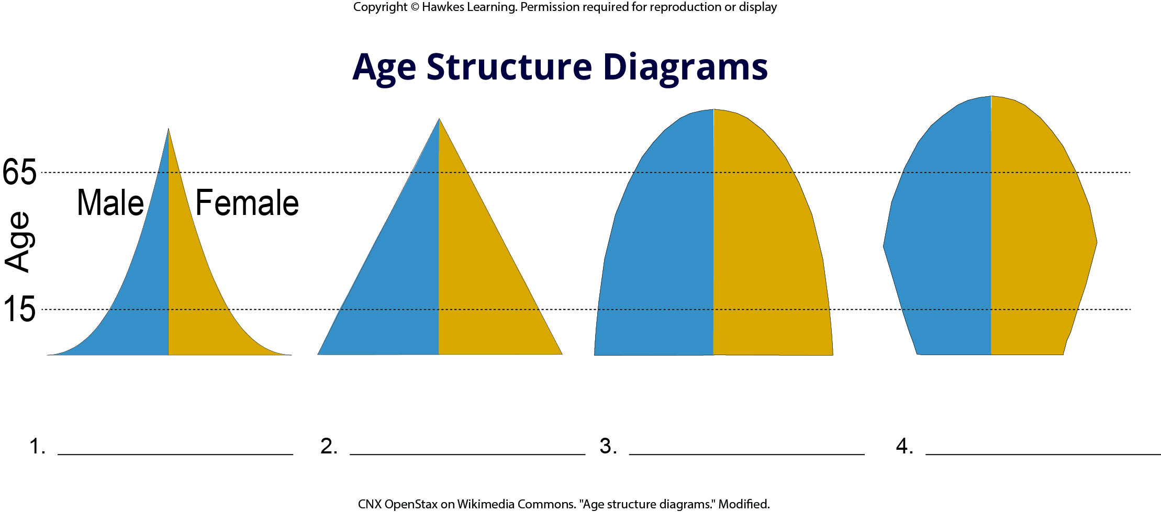
Lesson 45.3 Figure 13 - Numbered

Slide 11
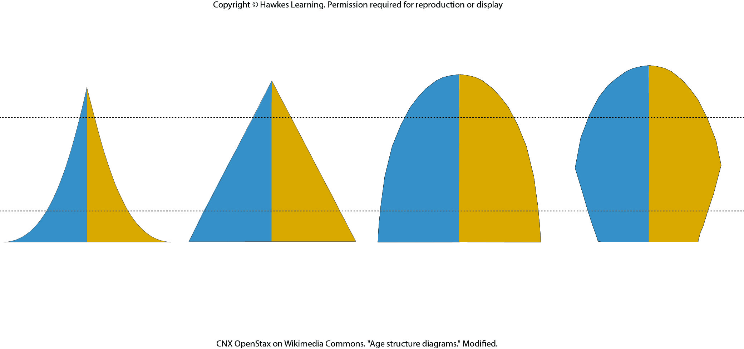
Lesson 45.3 Figure 13

Slide 12
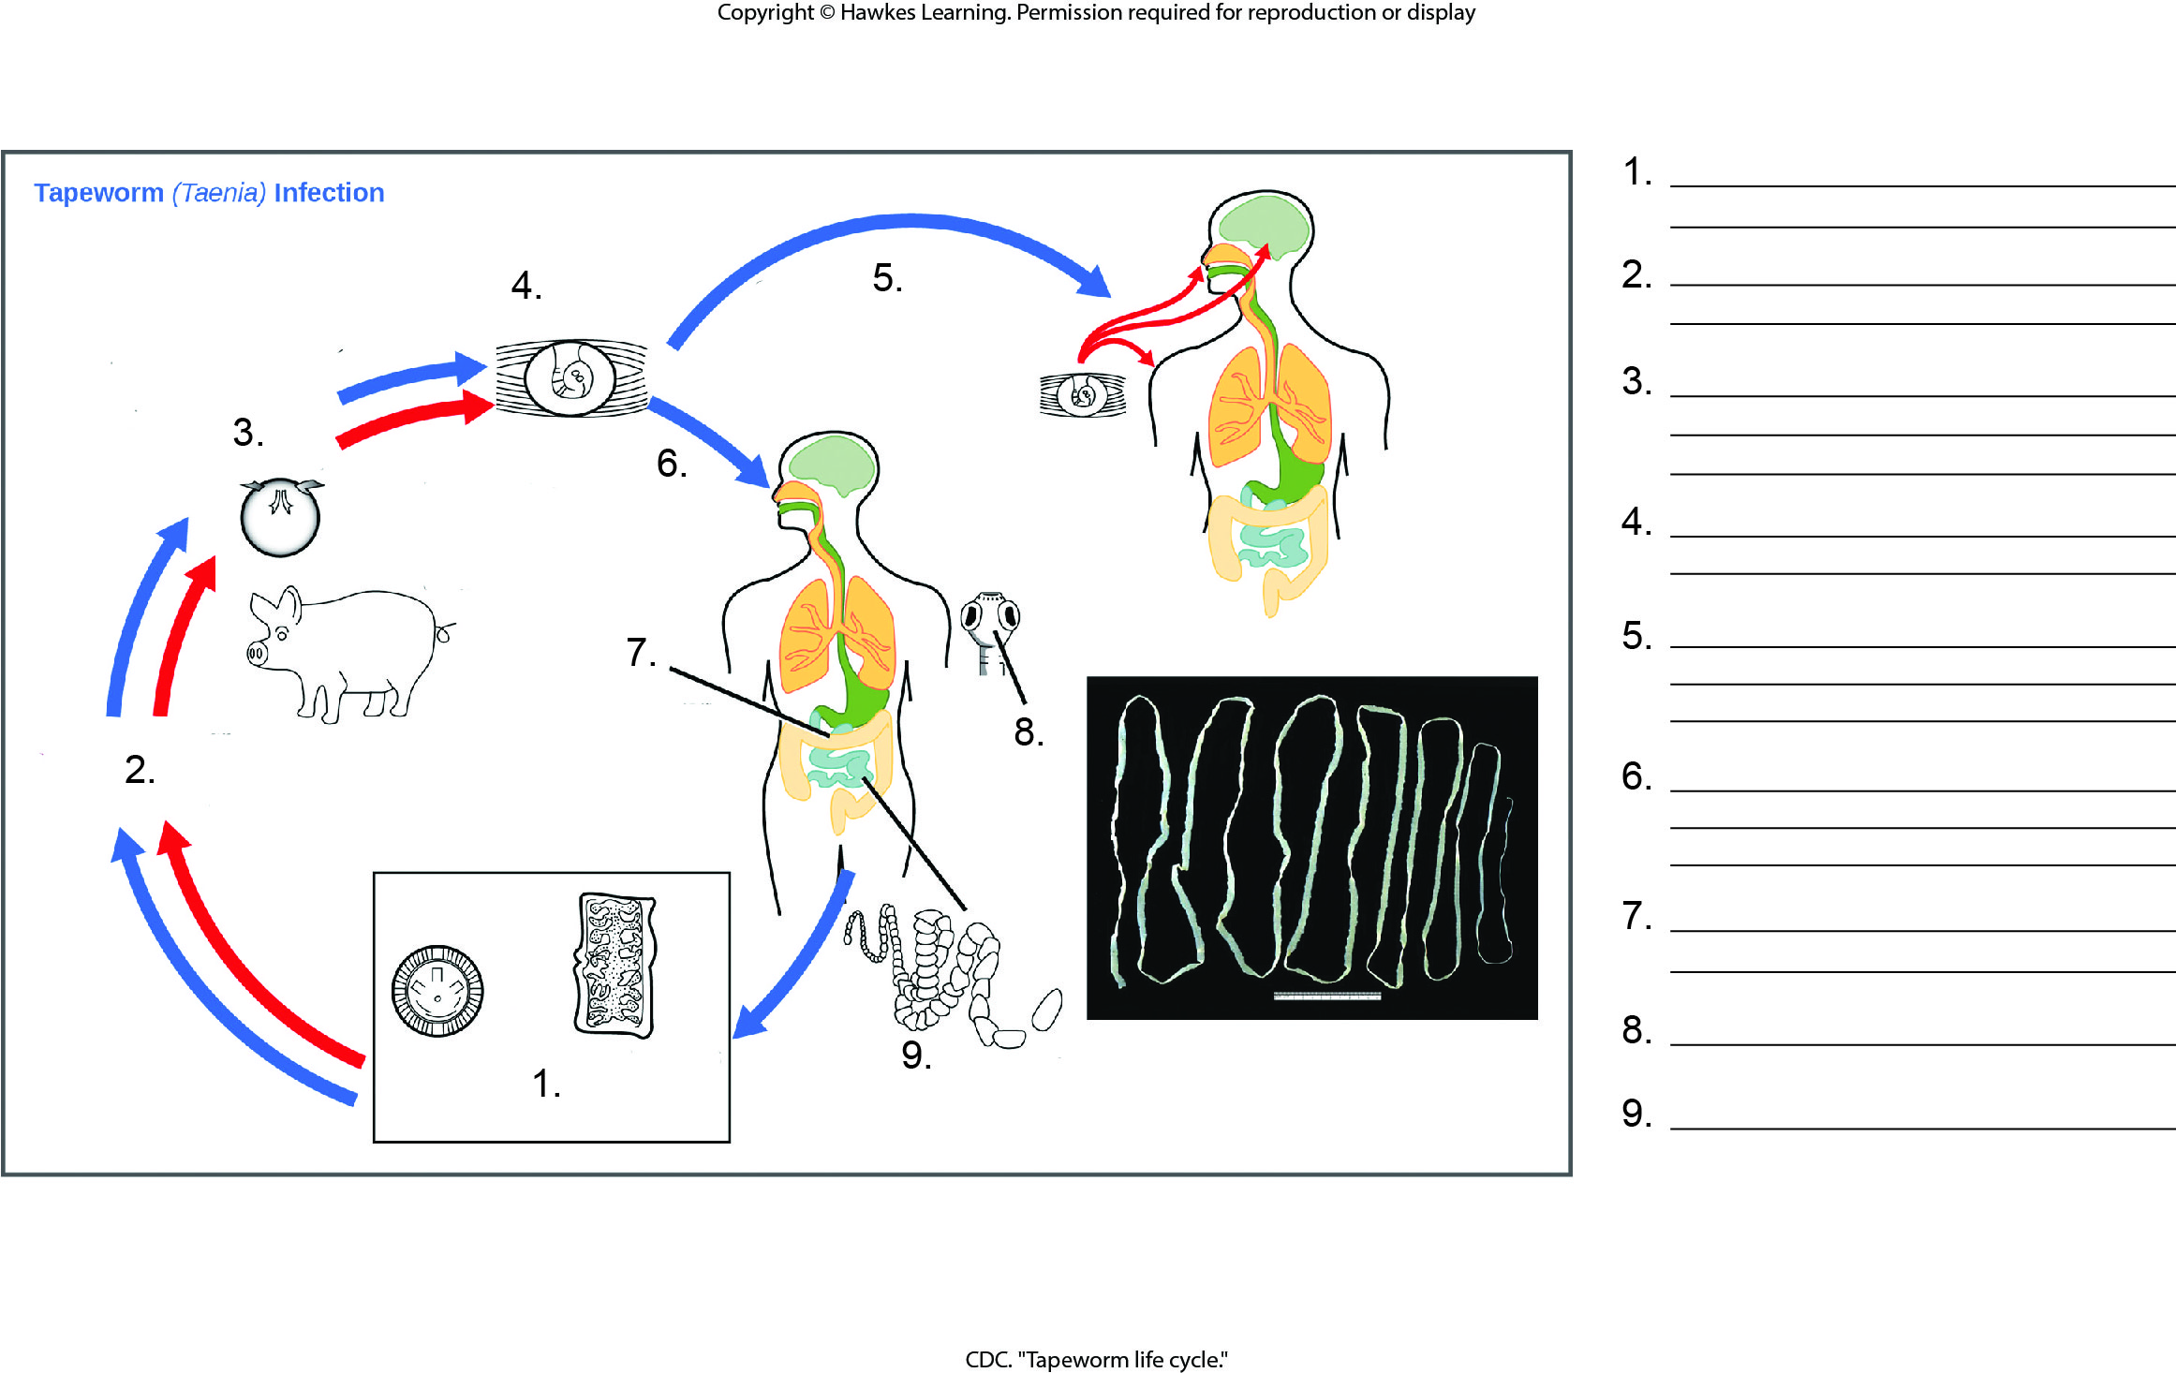
Lesson 45.4 Figure 10 - Numbered

Slide 13
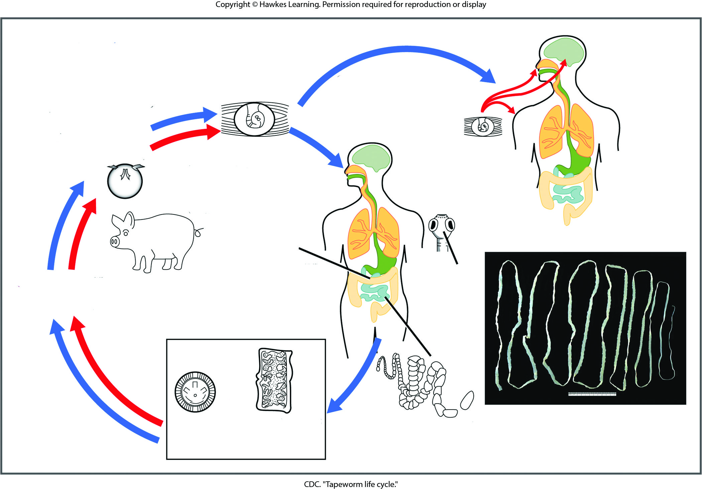
Lesson 45.4 Figure 10

Slide 14
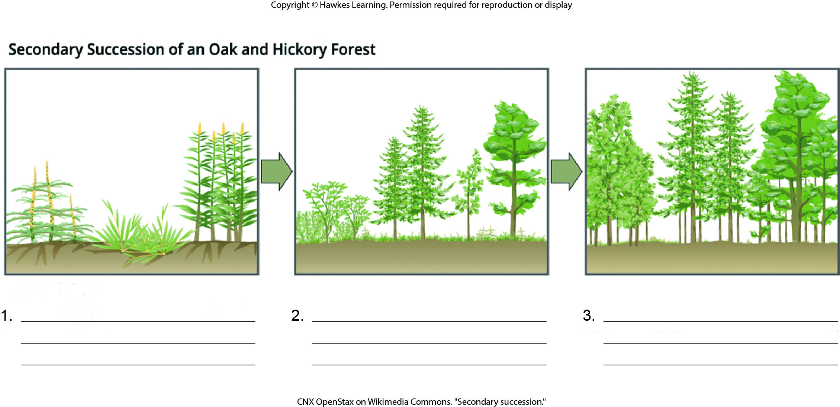
Lesson 45.4 Figure 16 - Numbered

Slide 15
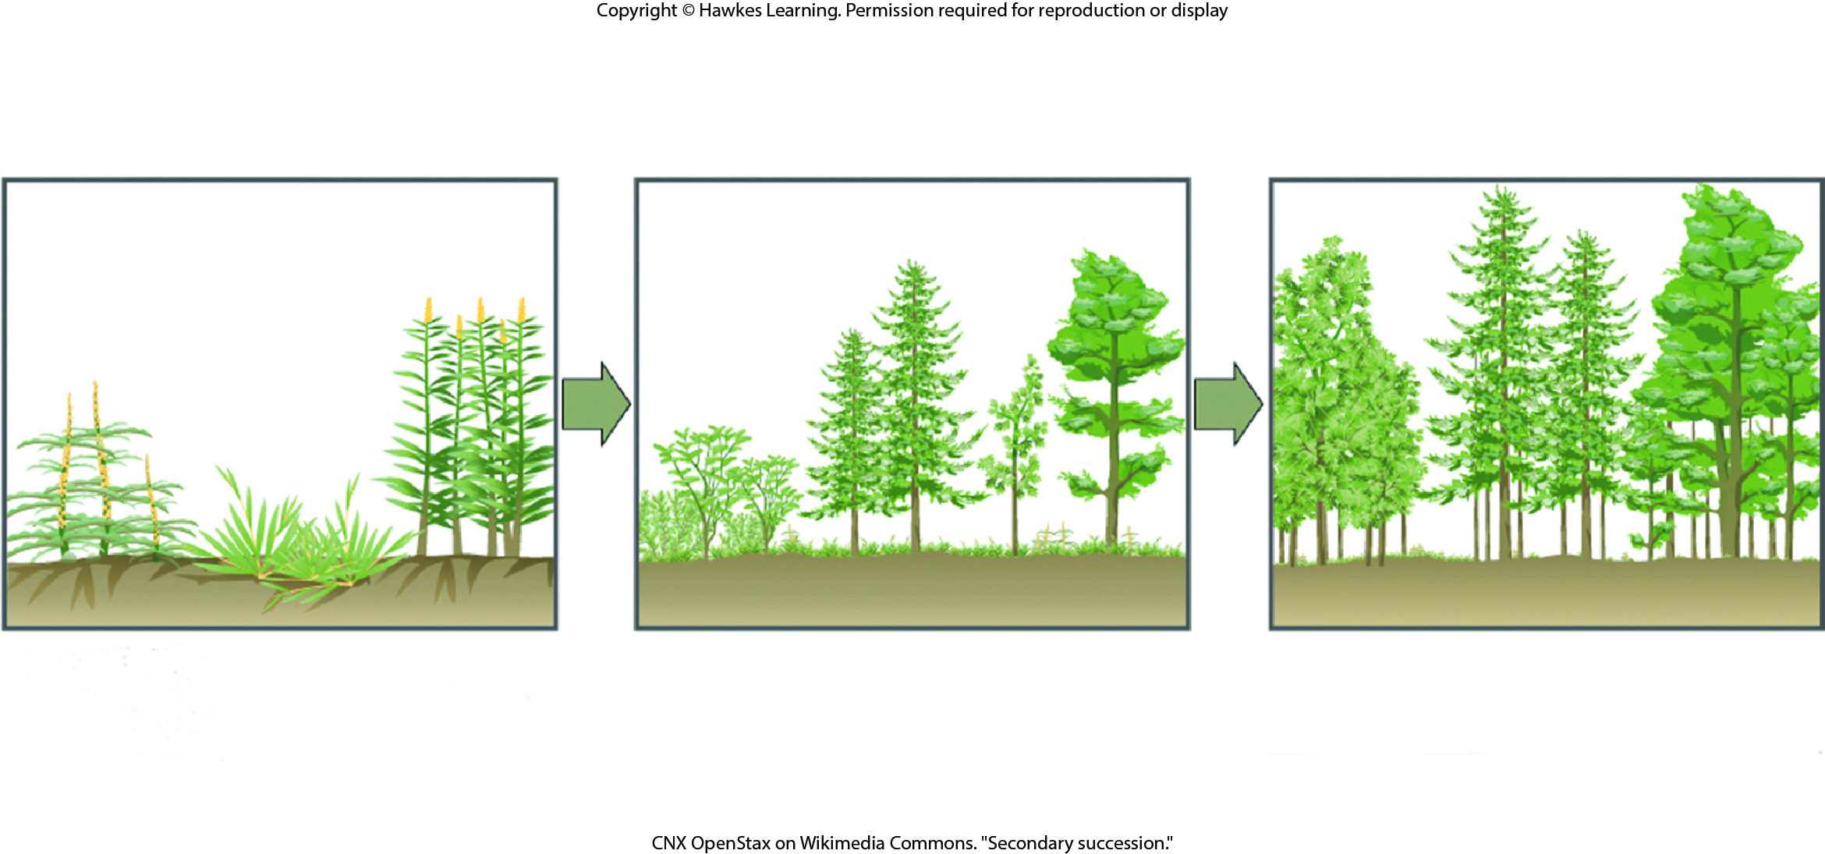
Lesson 45.4 Figure 16

Slide 16
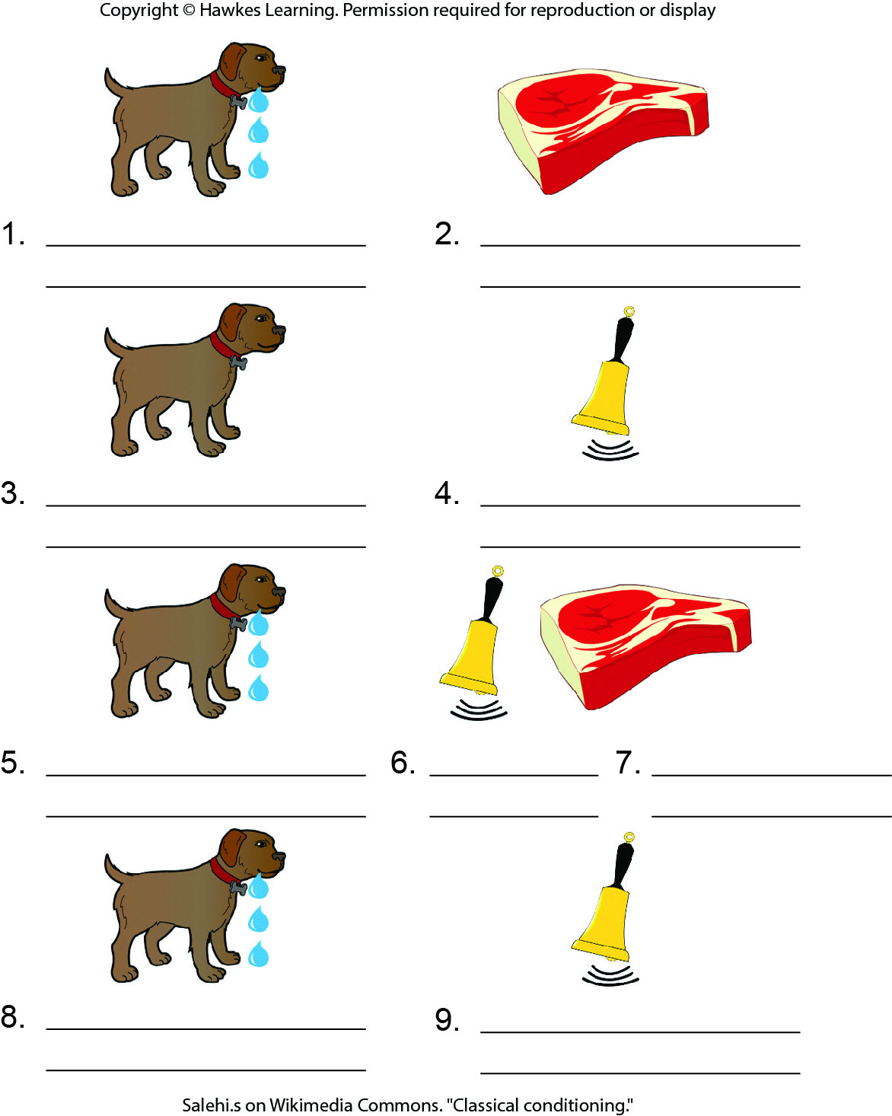
Lesson 45.5 Figure 10 - Numbered

Slide 17
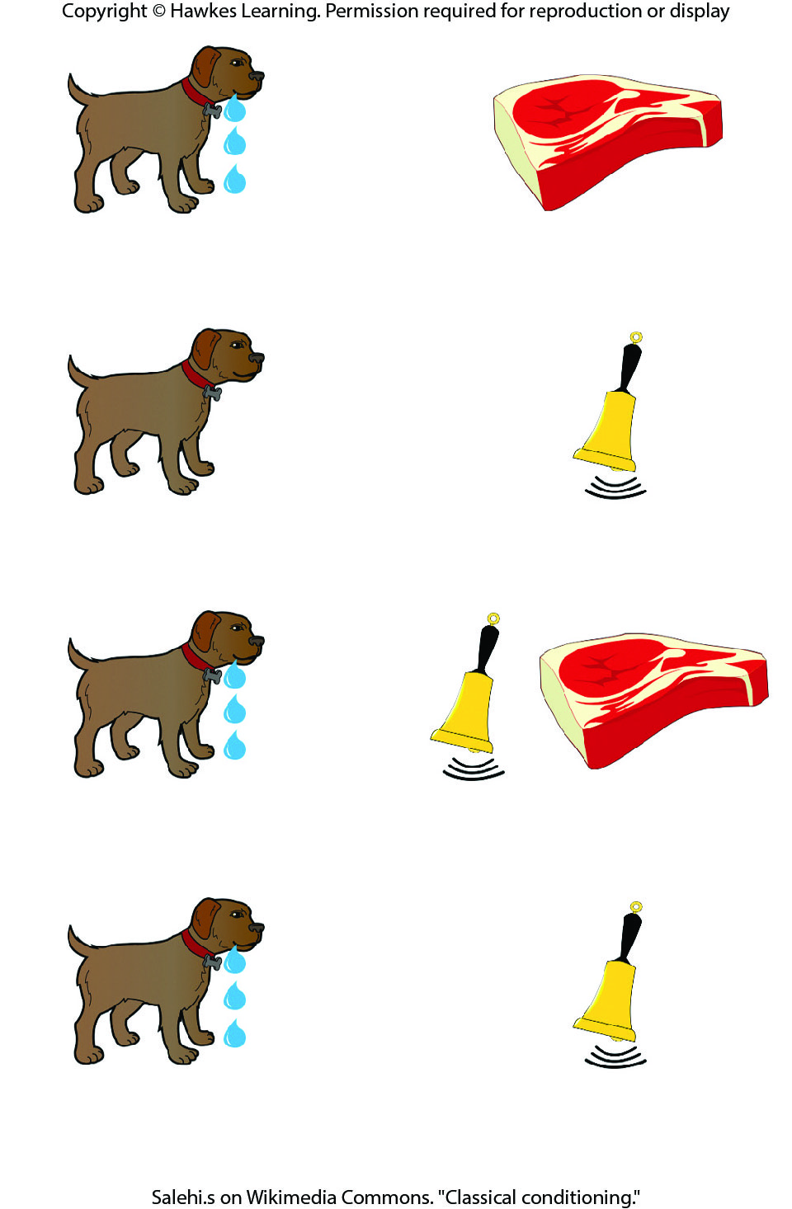
Lesson 45.5 Figure 10

Slide 18
Hawkes Learning – End of PowerPoint

