Slide 1
Chapter 46
Ecosystems

Slide 2
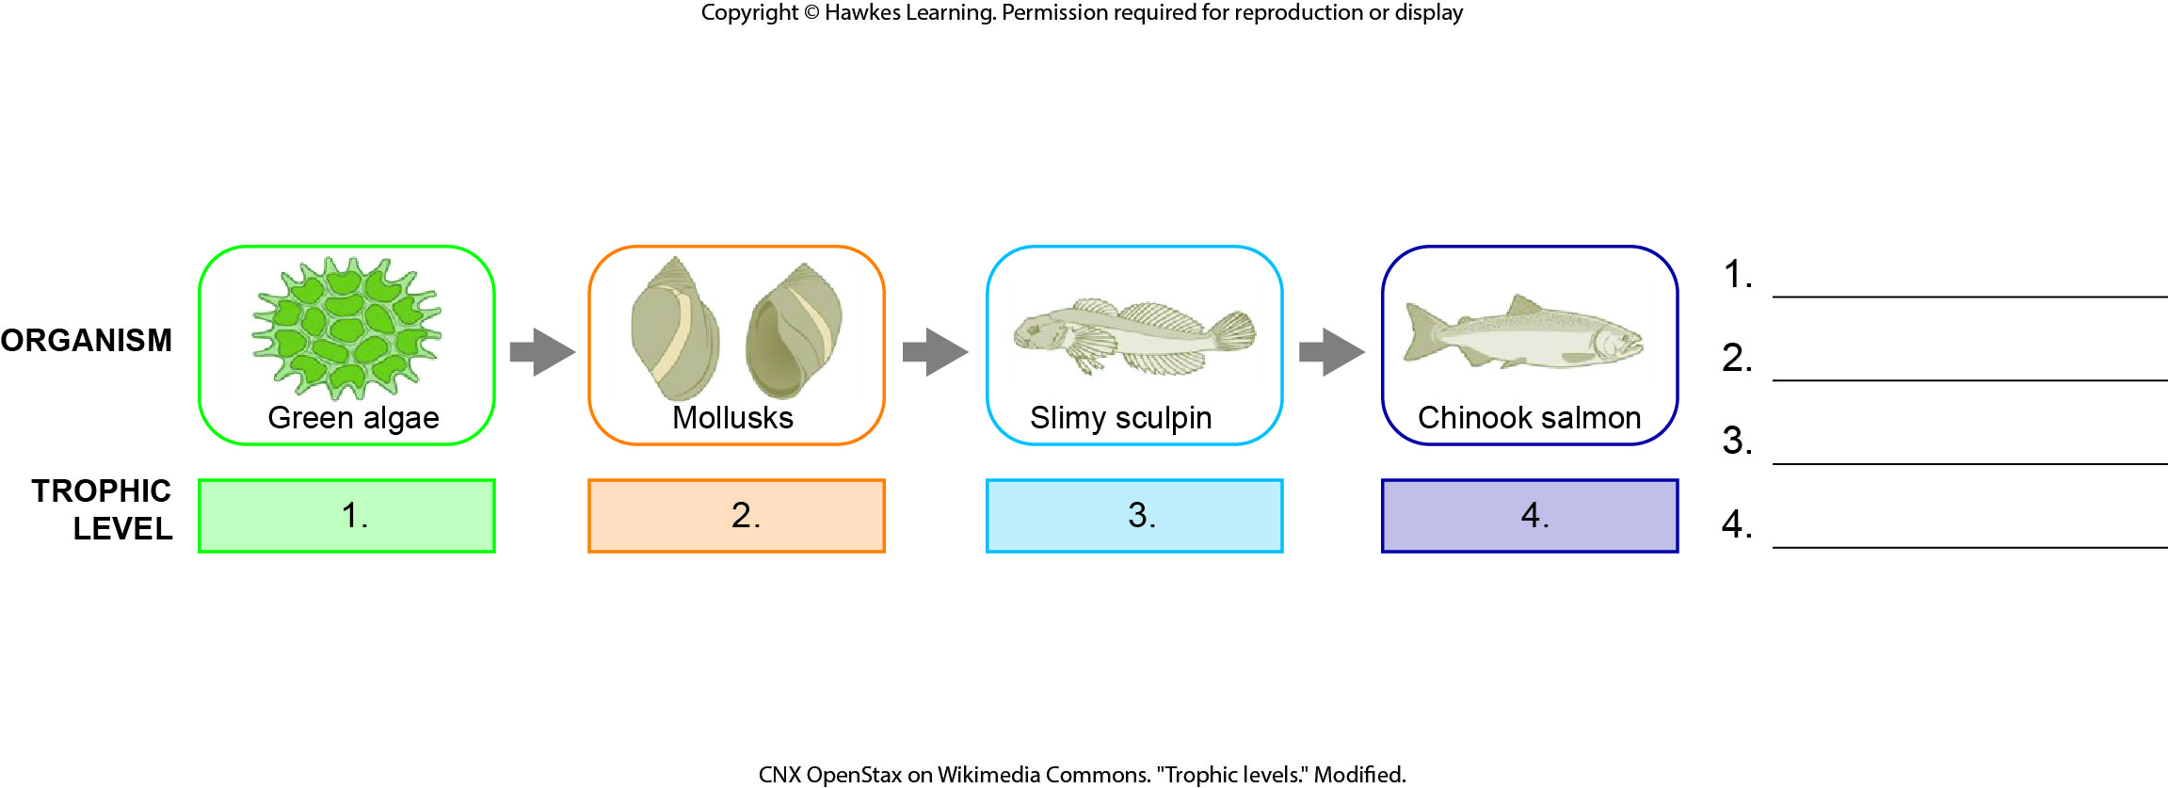
Lesson 46.1 Figure 5 - Numbered

Slide 3
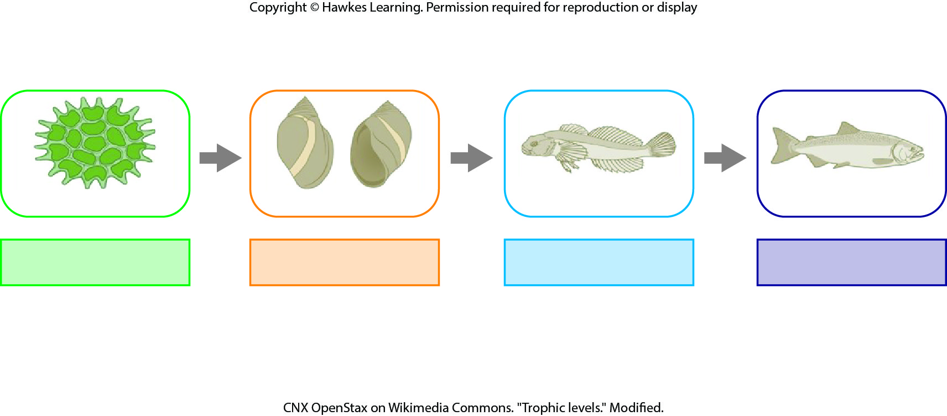
Lesson 46.1 Figure 5

Slide 4
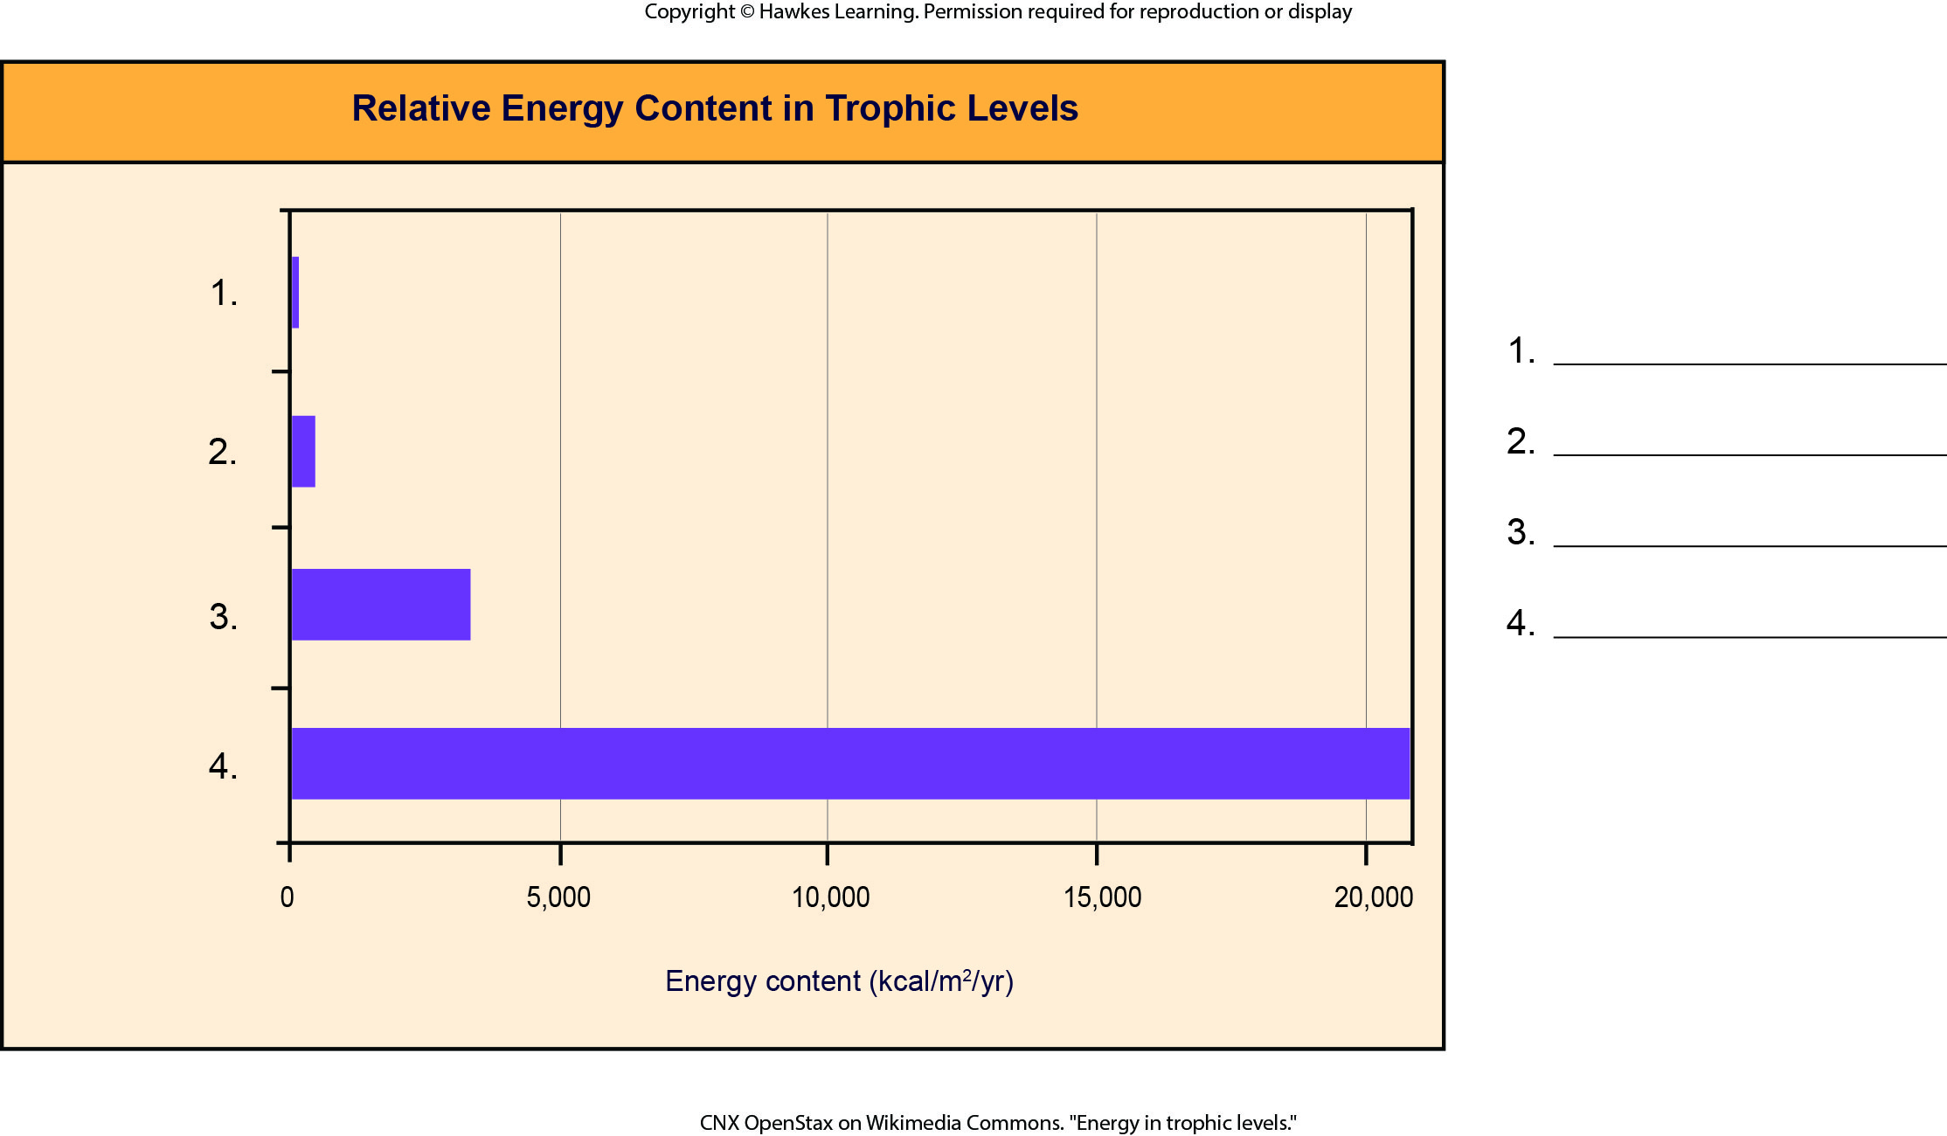
Lesson 46.1 Figure 6 - Numbered

Slide 5
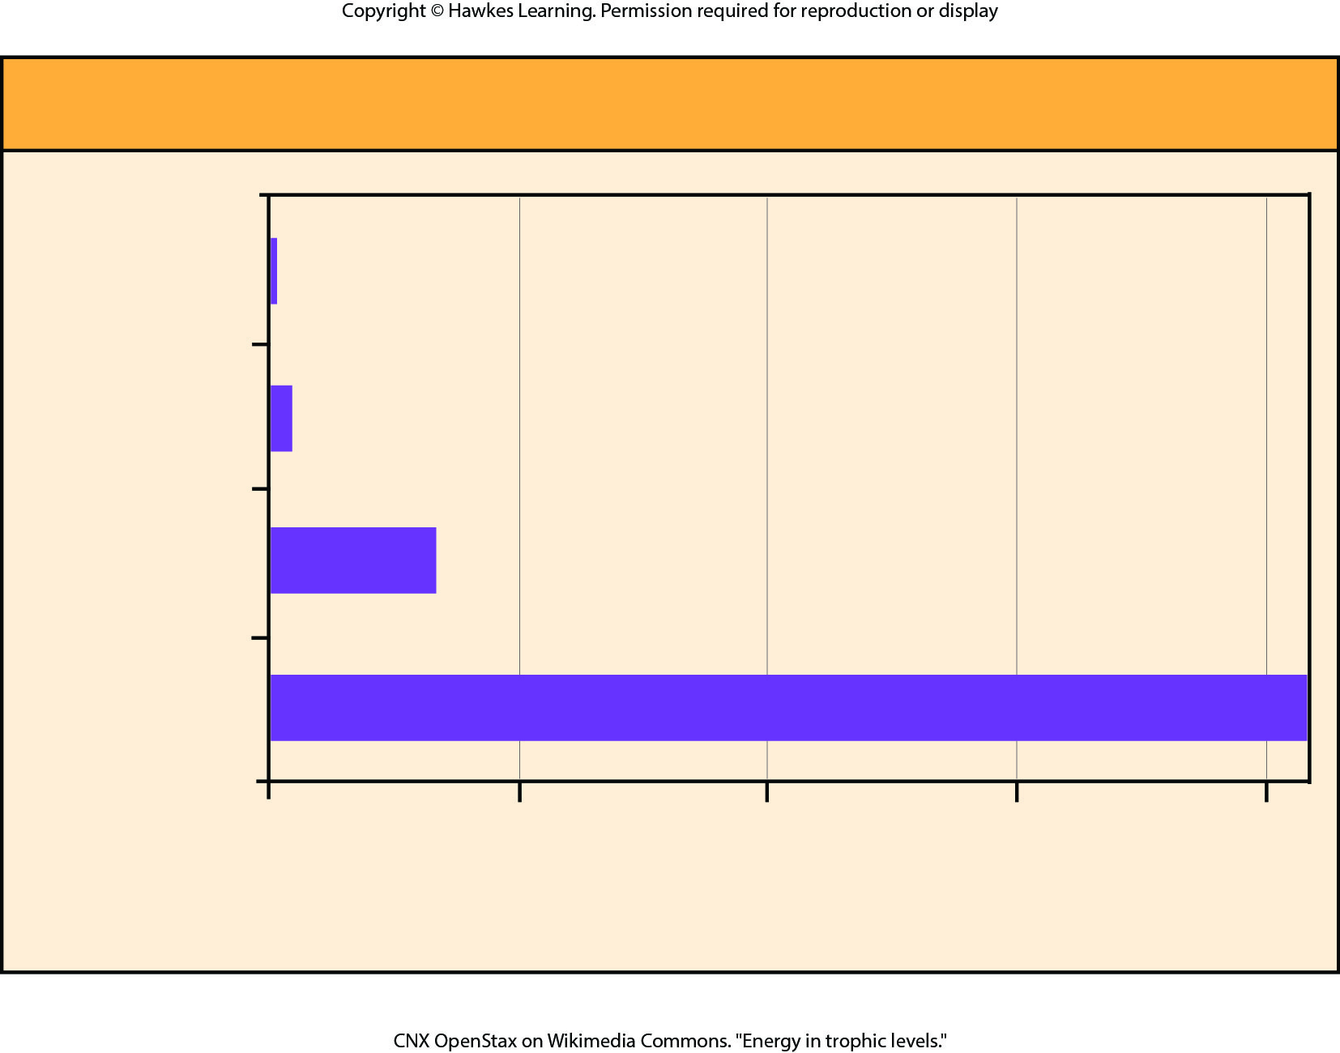
Lesson 46.1 Figure 6

Slide 6
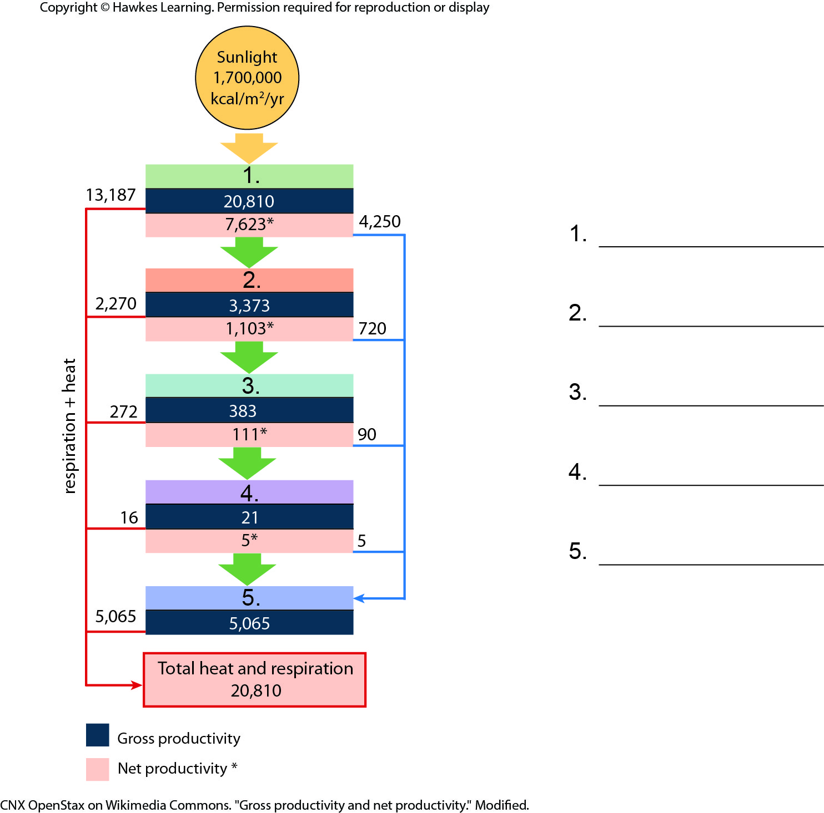
Lesson 46.1 Figure 9 - Numbered

Slide 7
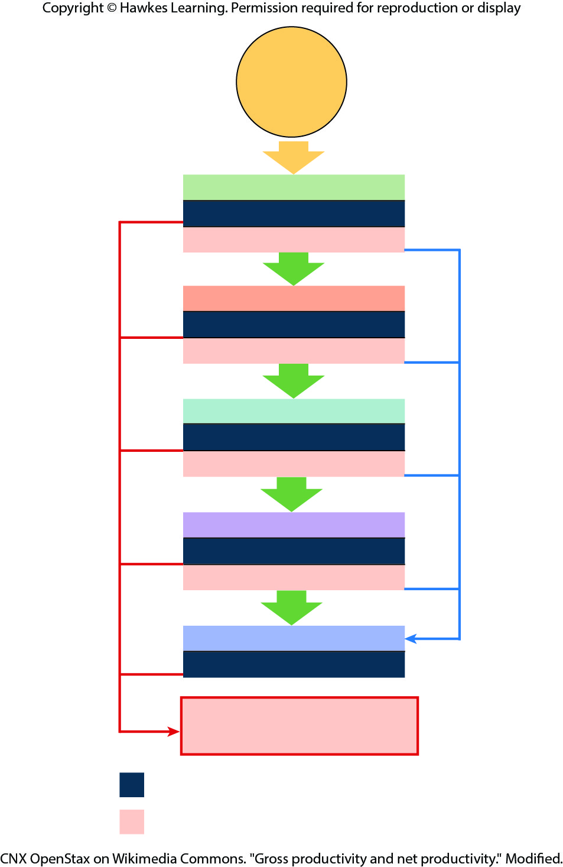
Lesson 46.1 Figure 9

Slide 8
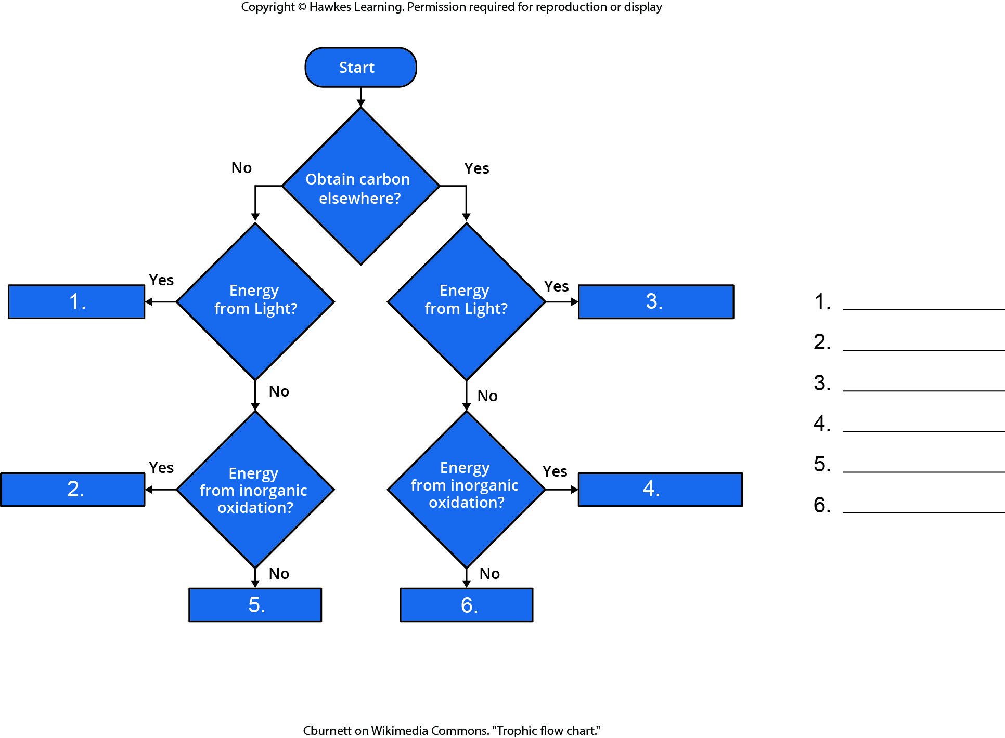
Lesson 46.2 Figure 1 - Numbered

Slide 9
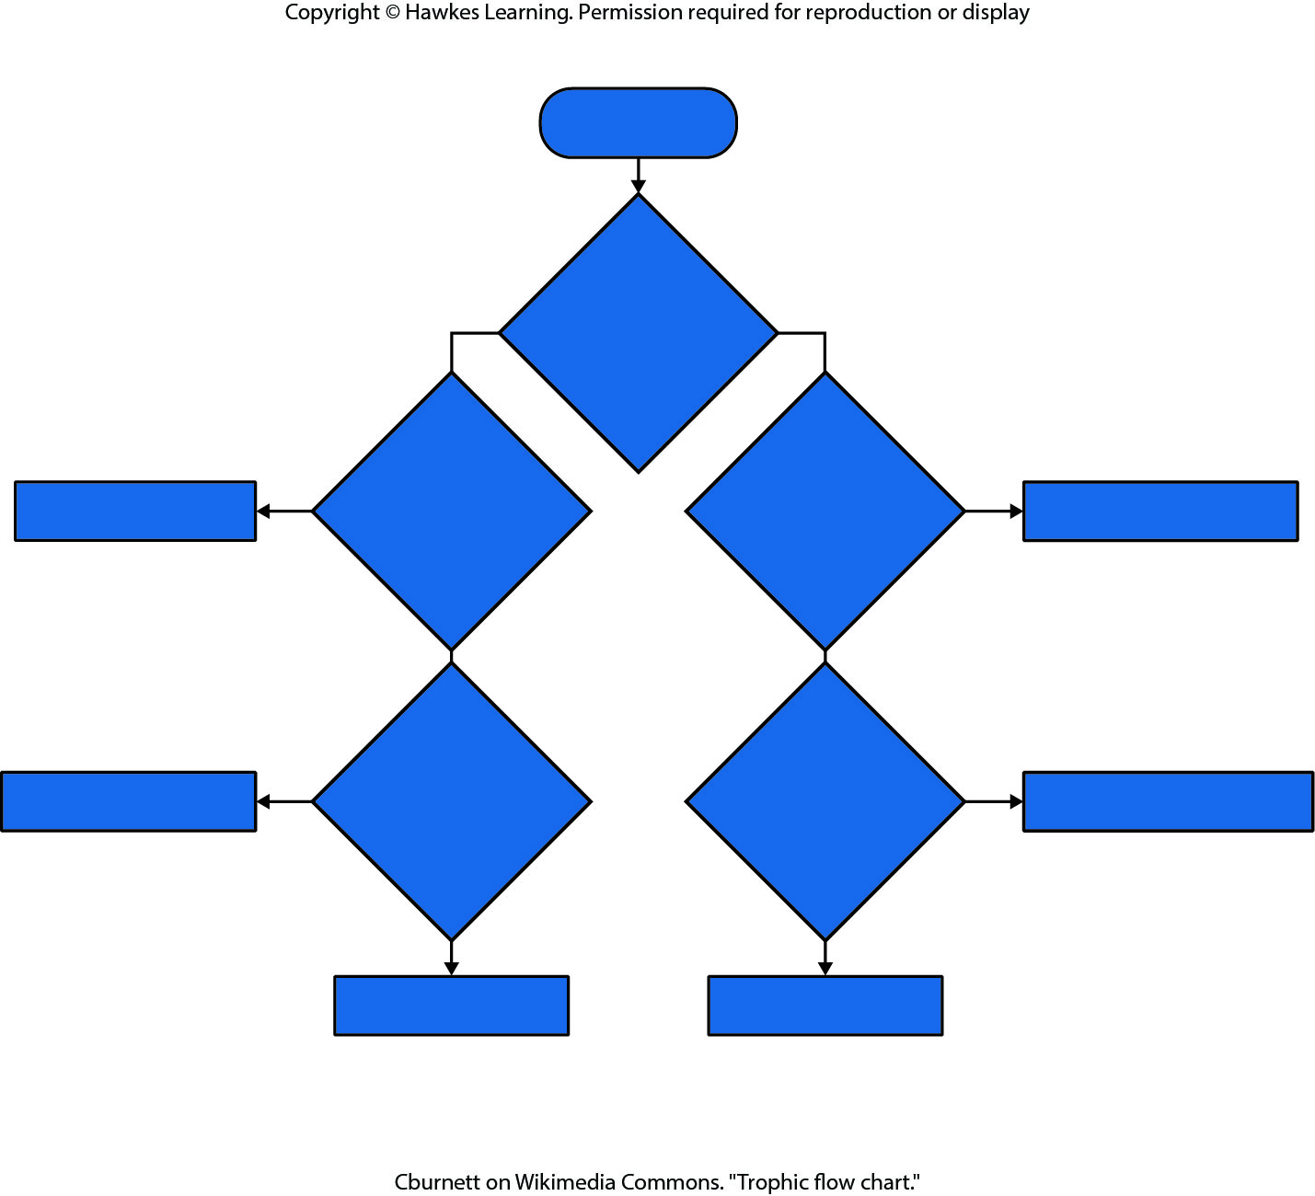
Lesson 46.2 Figure 1

Slide 10
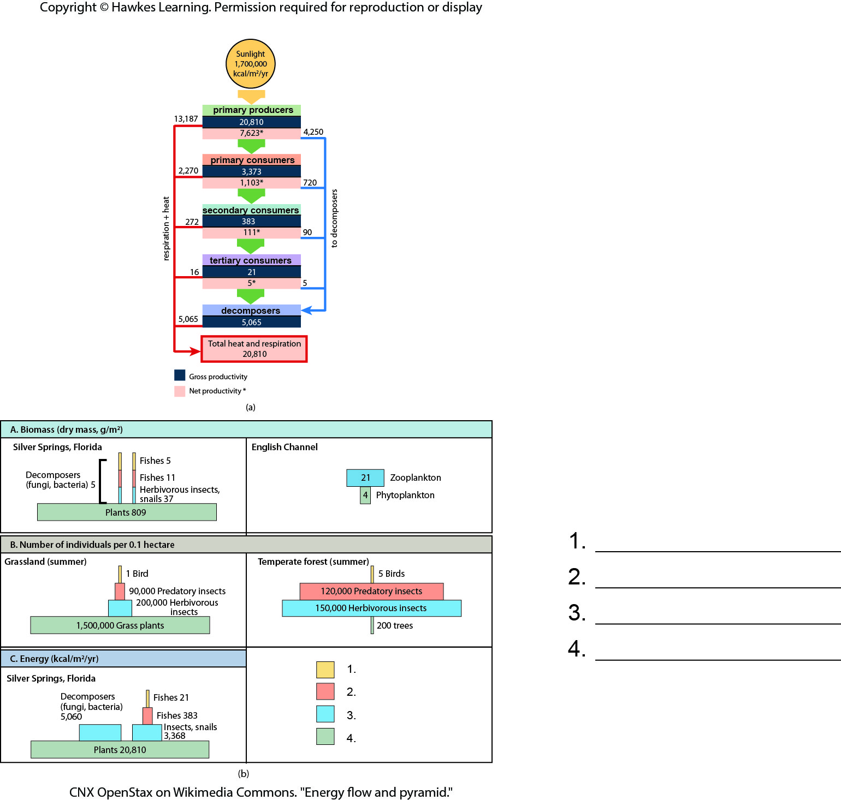
Lesson 46.2 Figure 3 - Numbered

Slide 11
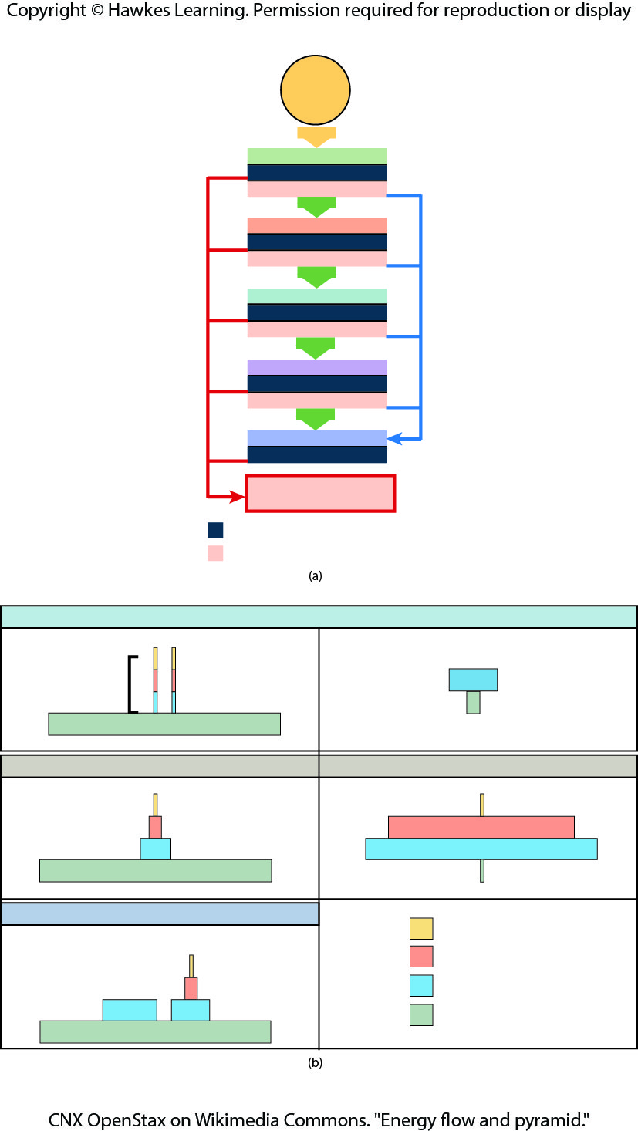
Lesson 46.2 Figure 3

Slide 12
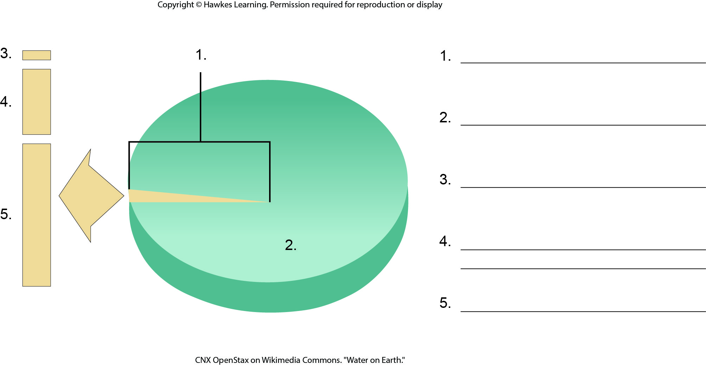
Lesson 46.3 Figure 1 - Numbered

Slide 13
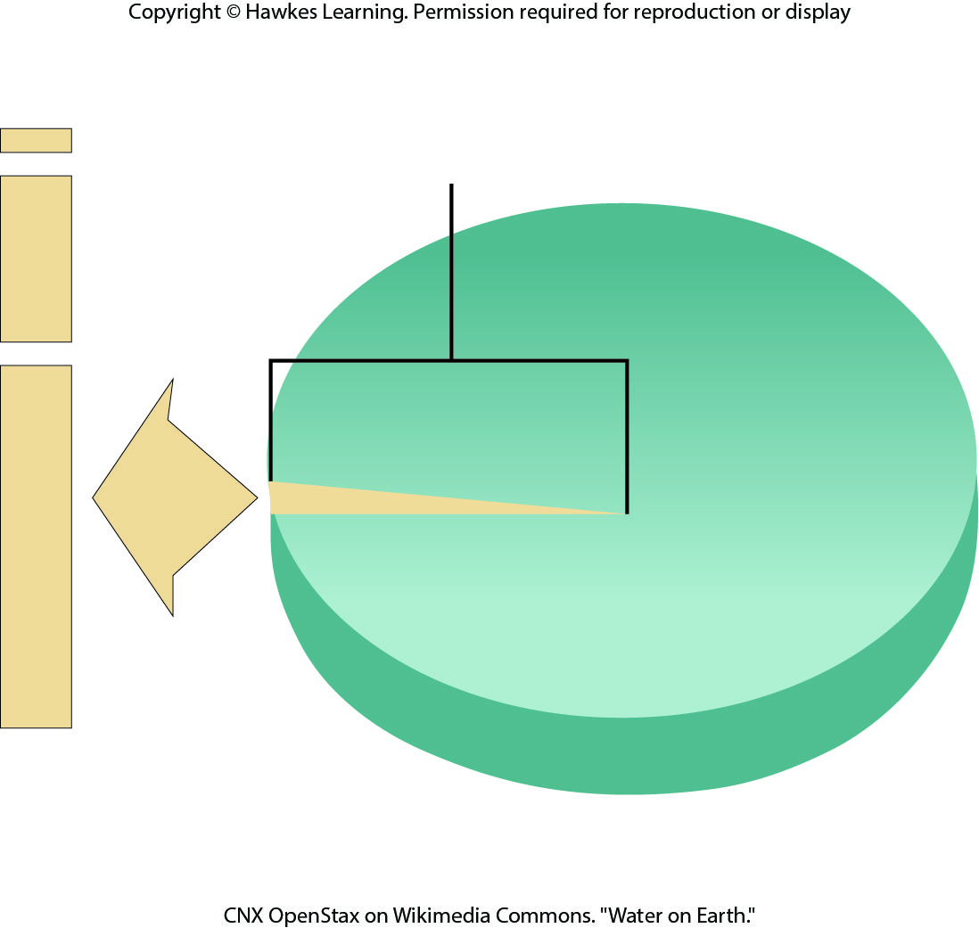
Lesson 46.3 Figure 1

Slide 14
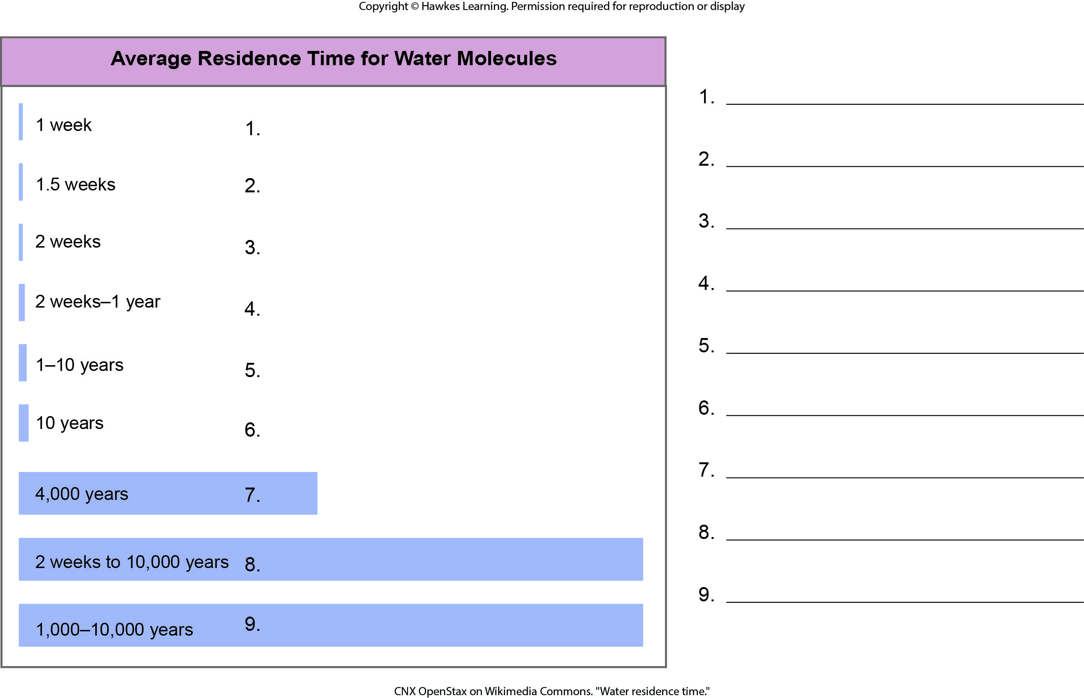
Lesson 46.3 Figure 2 - Numbered

Slide 15

Lesson 46.3 Figure 2

Slide 16
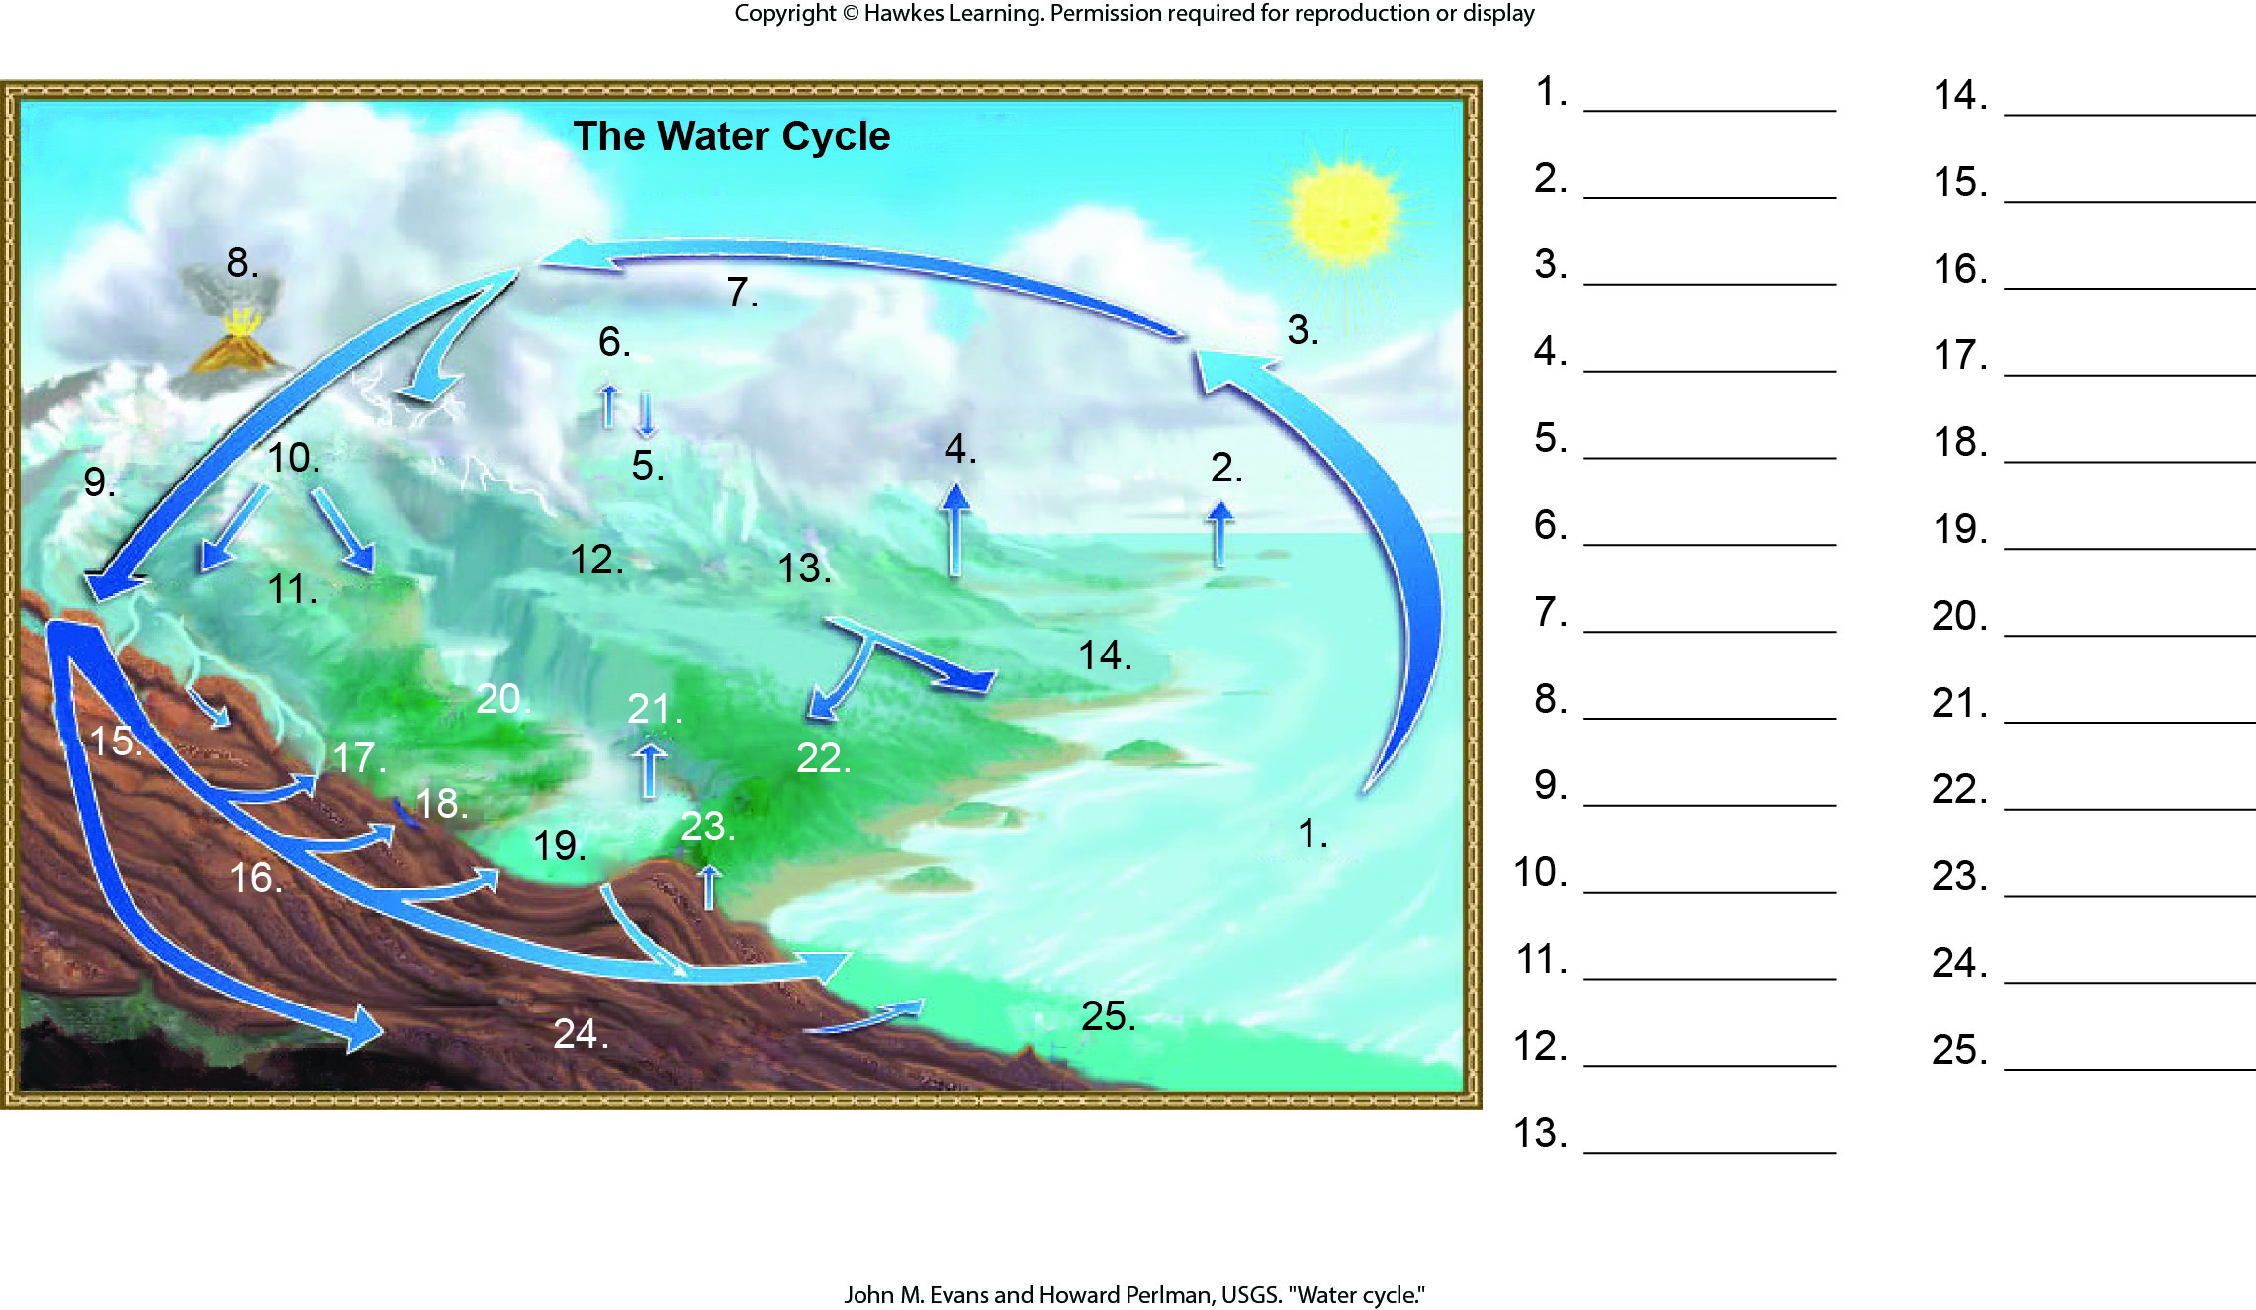
Lesson 46.3 Figure 3 - Numbered

Slide 17
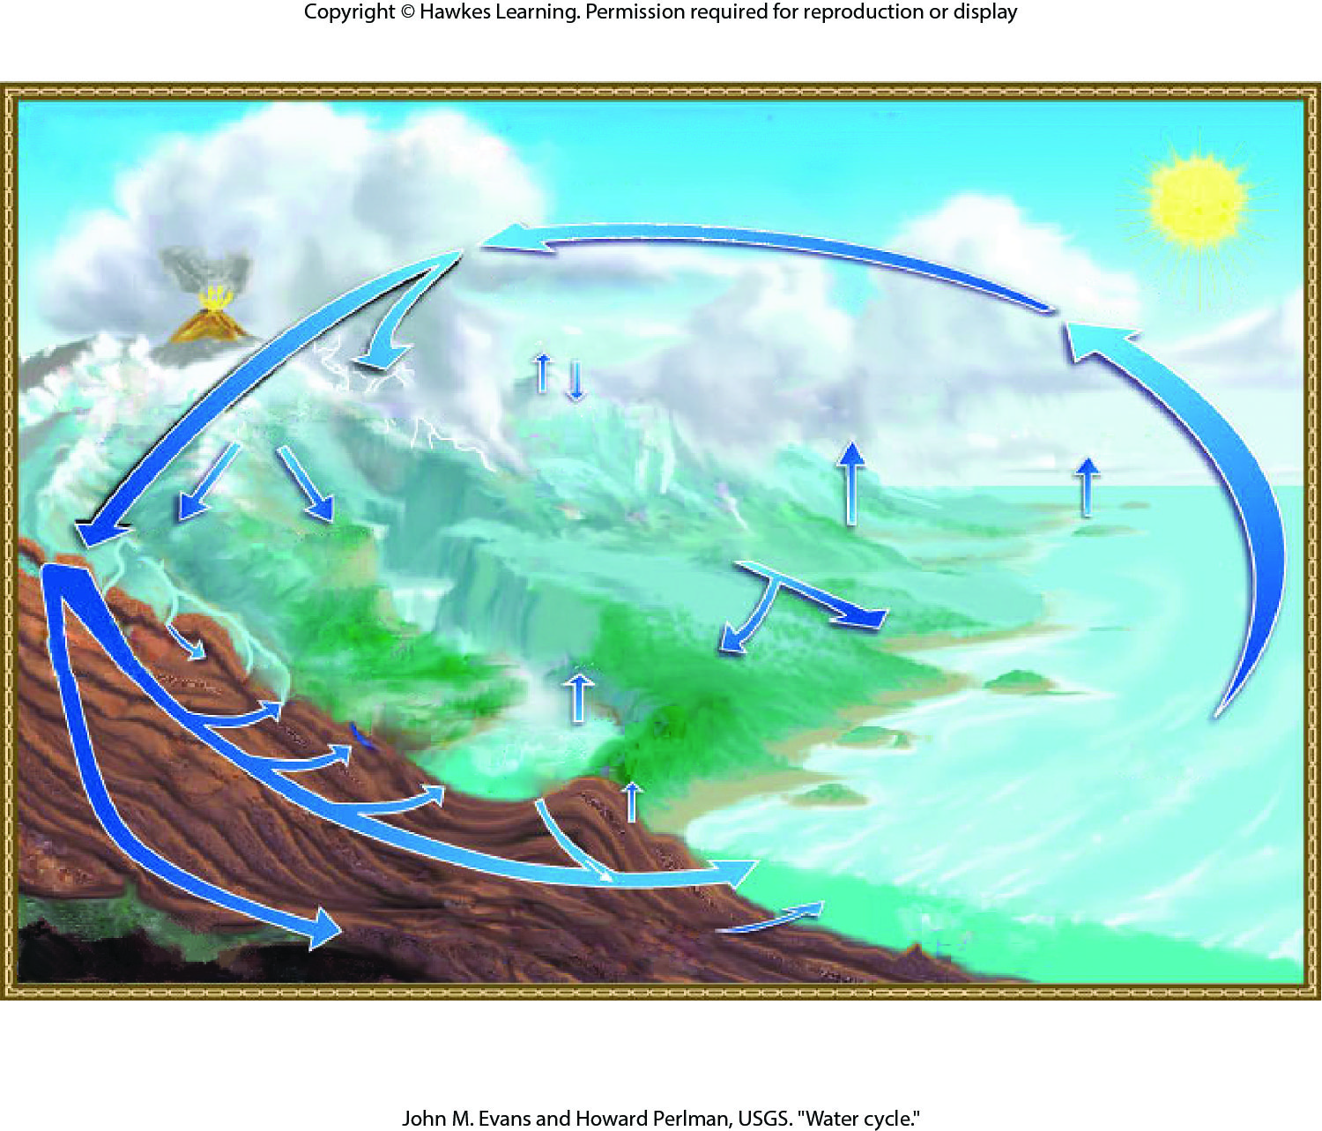
Lesson 46.3 Figure 3

Slide 18
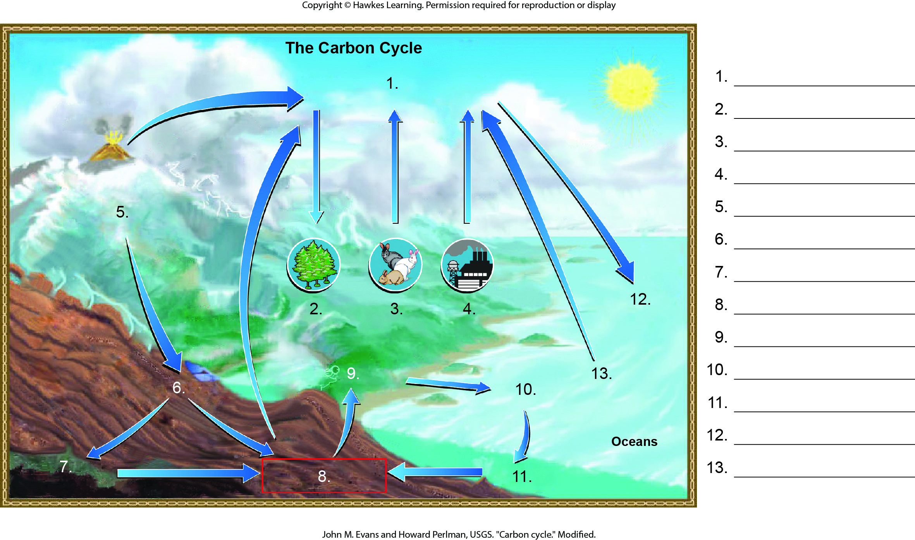
Lesson 46.3 Figure 4 - Numbered

Slide 19
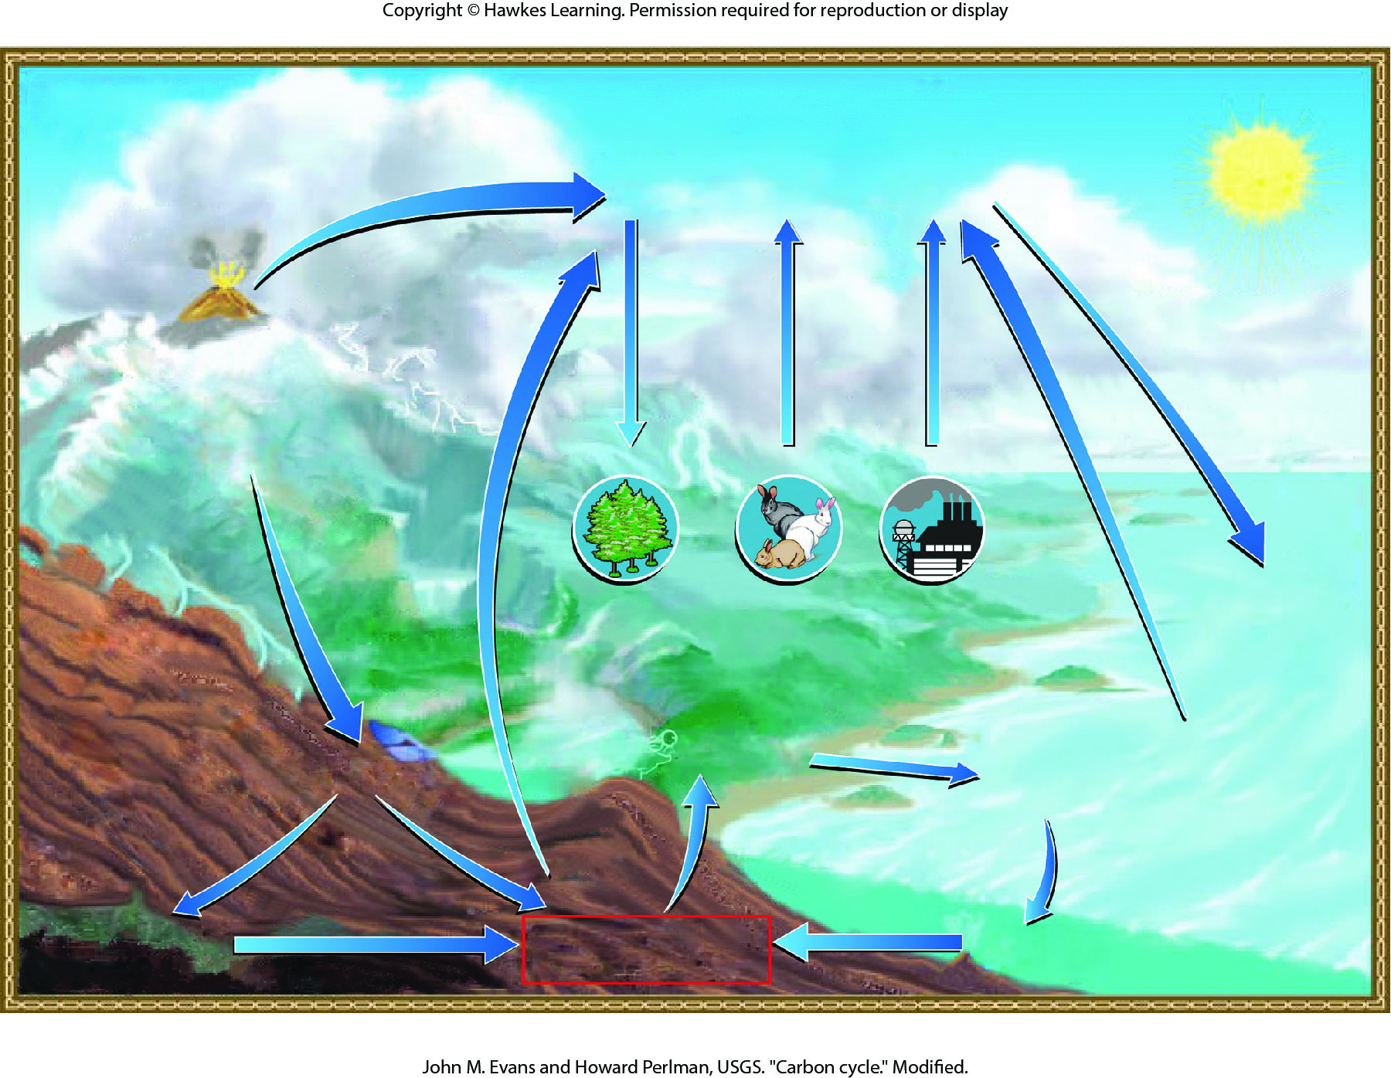
Lesson 46.3 Figure 4

Slide 20
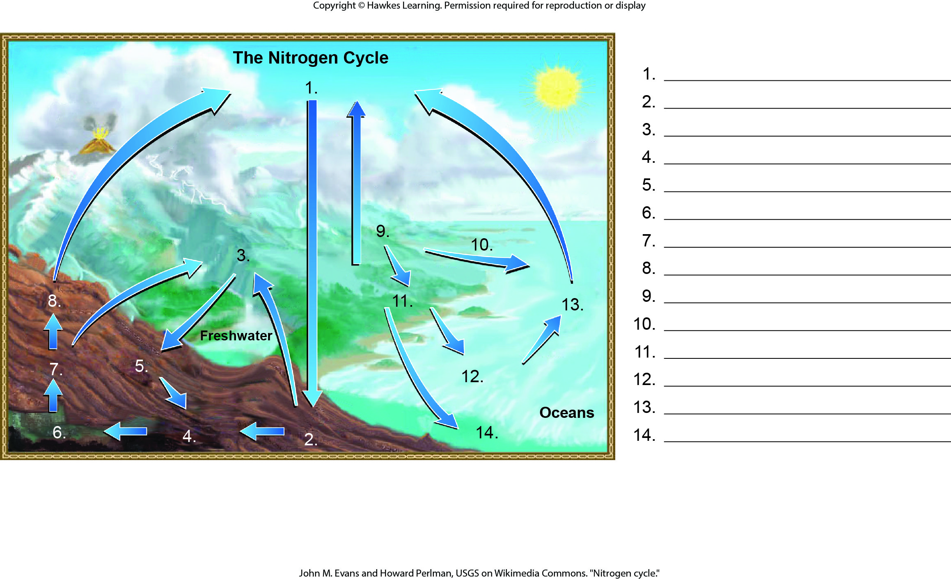
Lesson 46.3 Figure 7 - Numbered

Slide 21
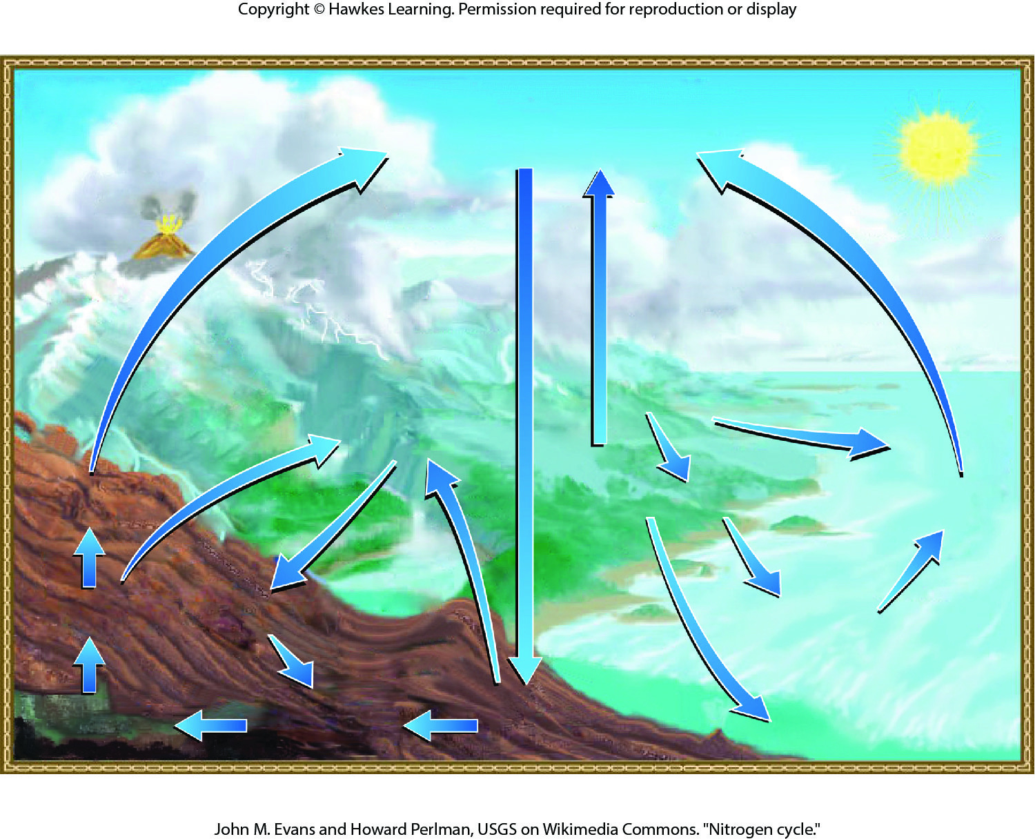
Lesson 46.3 Figure 7

Slide 22
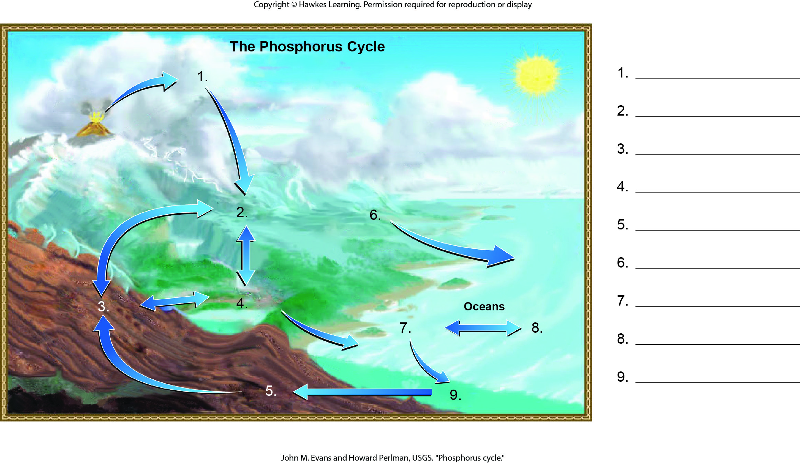
Lesson 46.3 Figure 8 - Numbered

Slide 23
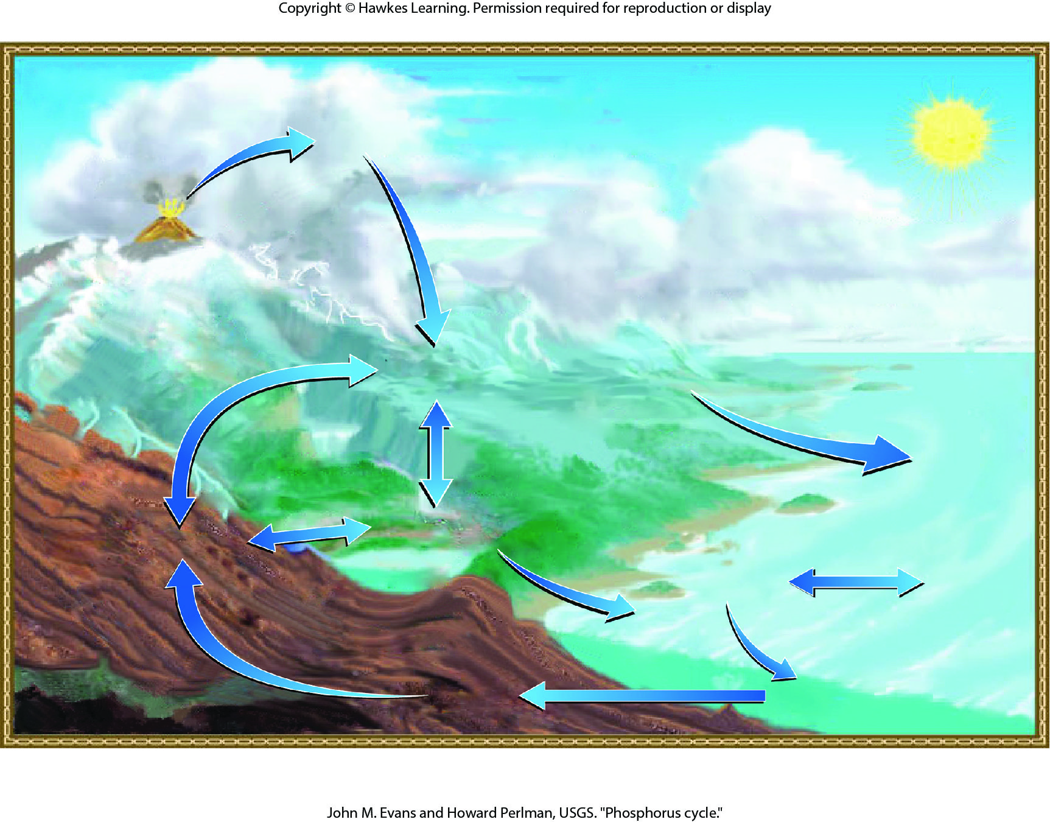
Lesson 46.3 Figure 8

Slide 24
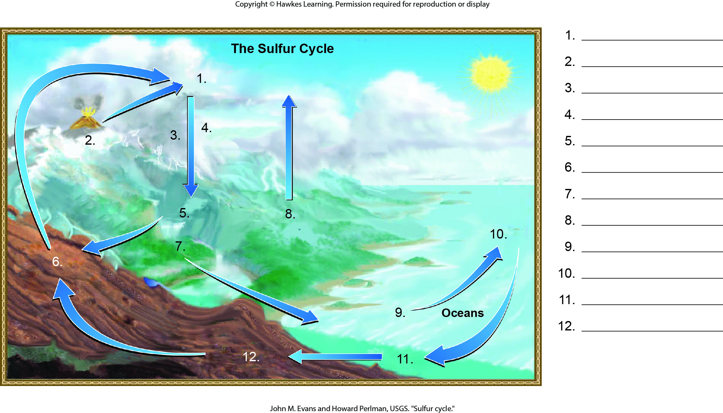
Lesson 46.3 Figure 11 - Numbered

Slide 25
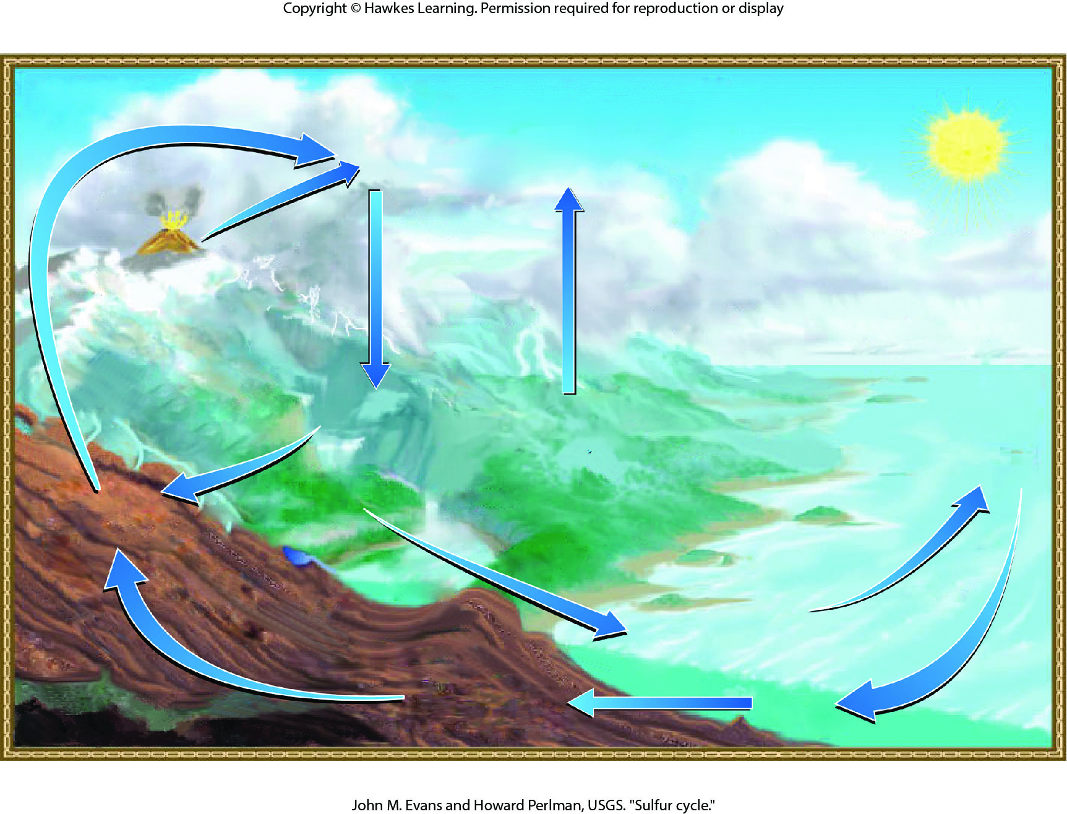
Lesson 46.3 Figure 11

Slide 26
Hawkes Learning – End of PowerPoint

