Slide 1
Chapter 47
Conservation Biology and Biodiversity

Slide 2
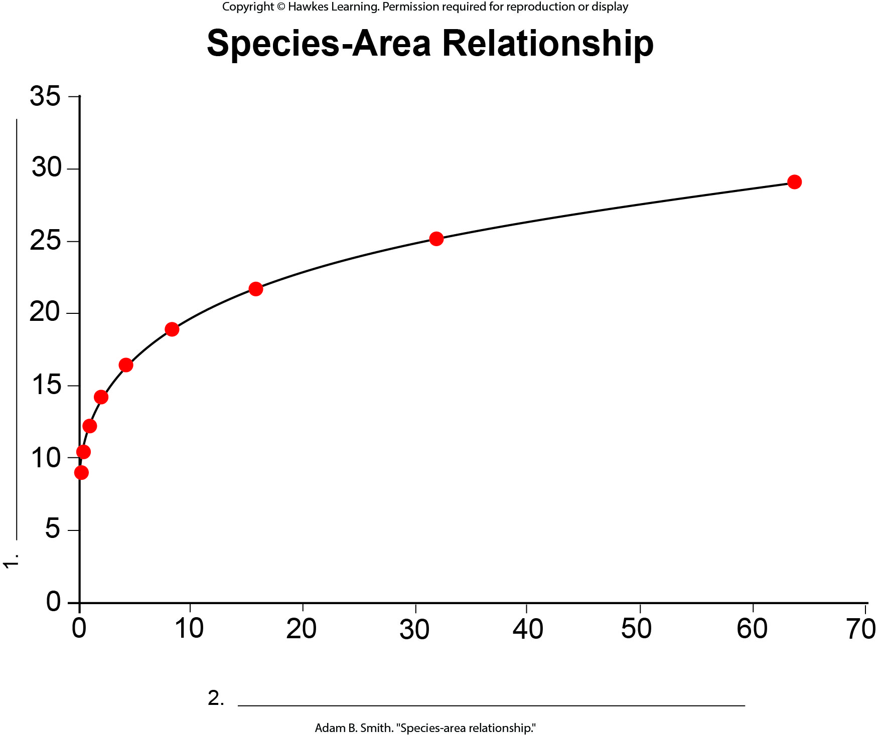
Lesson 47.1 Figure 10 - Numbered

Slide 3
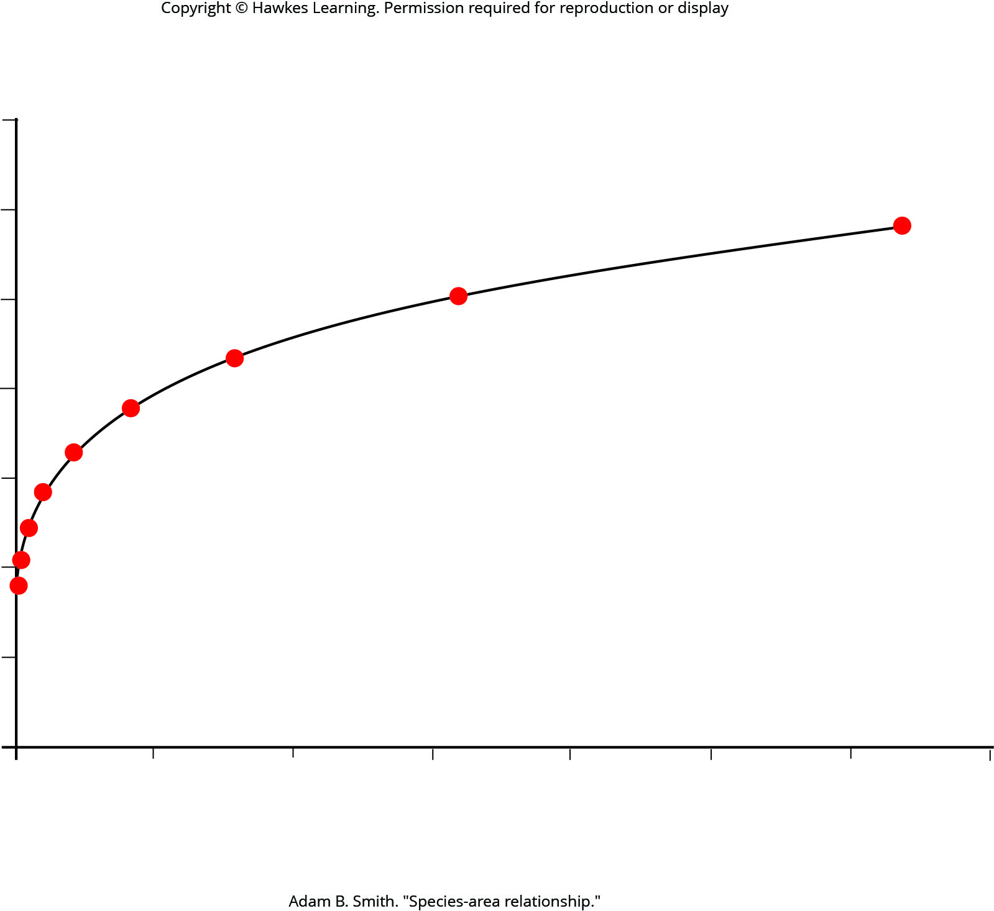
Lesson 47.1 Figure 10

Slide 4
Hawkes Learning – End of PowerPoint

