Slide 1
Chapter 5
Structure and Function of Membranes

Slide 2
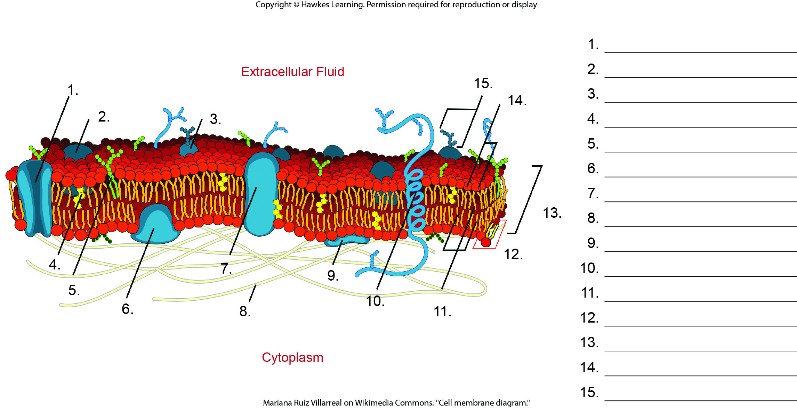
Lesson 5.1 Figure 2 - Numbered

Slide 3
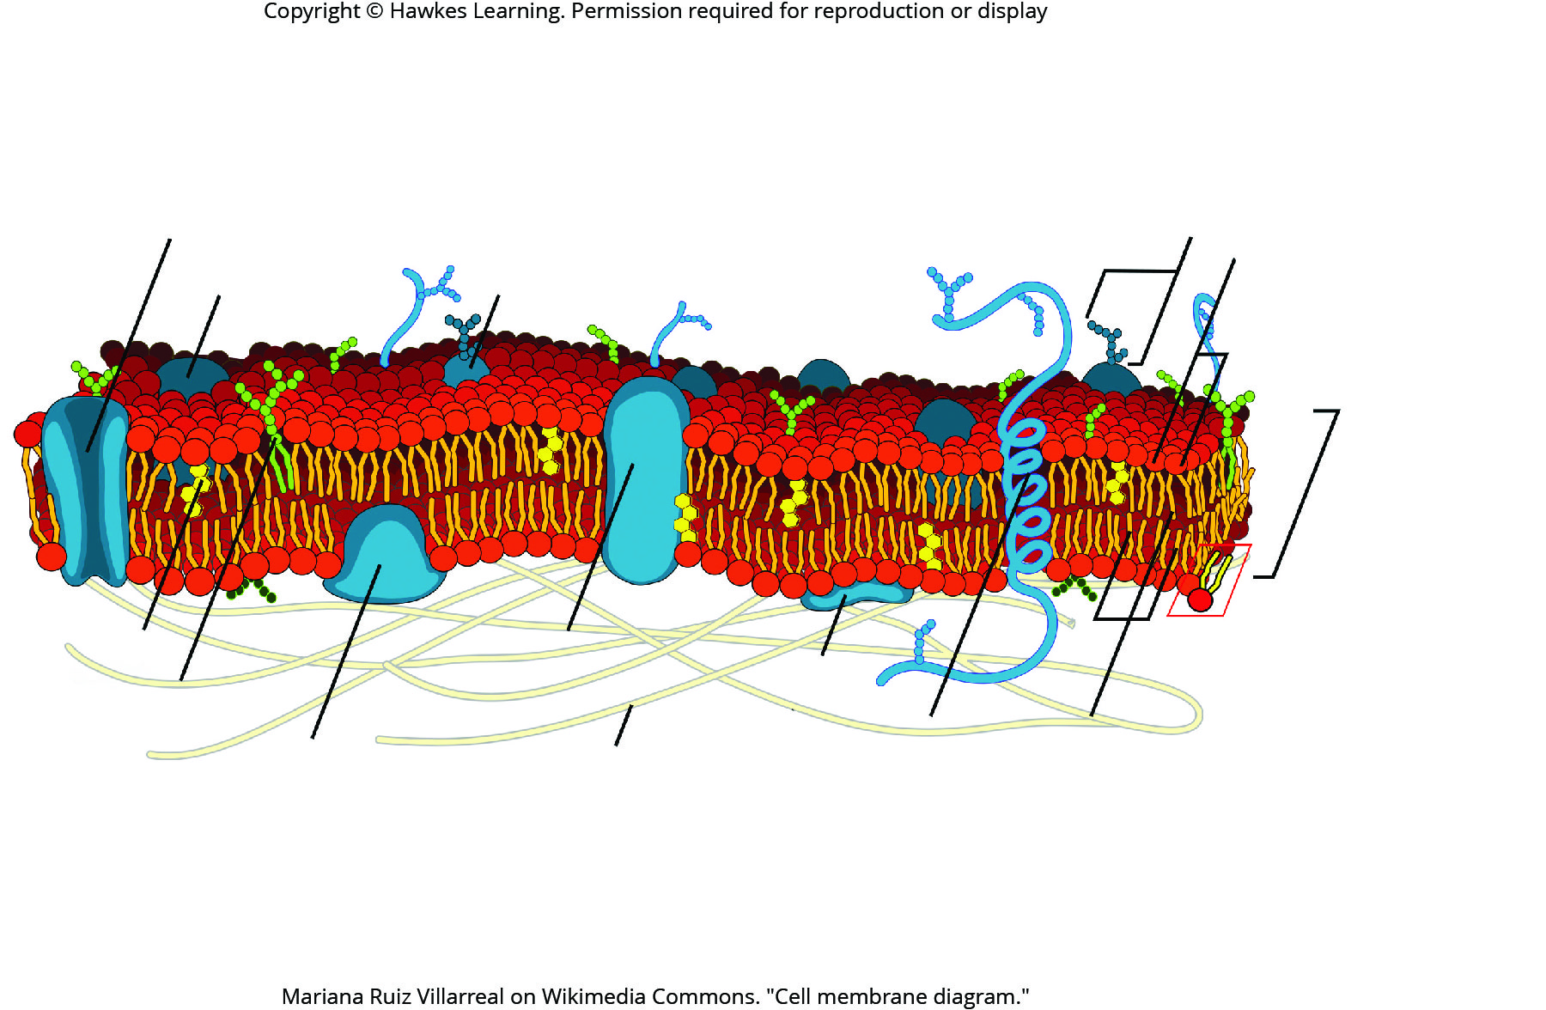
Lesson 5.1 Figure 2

Slide 4
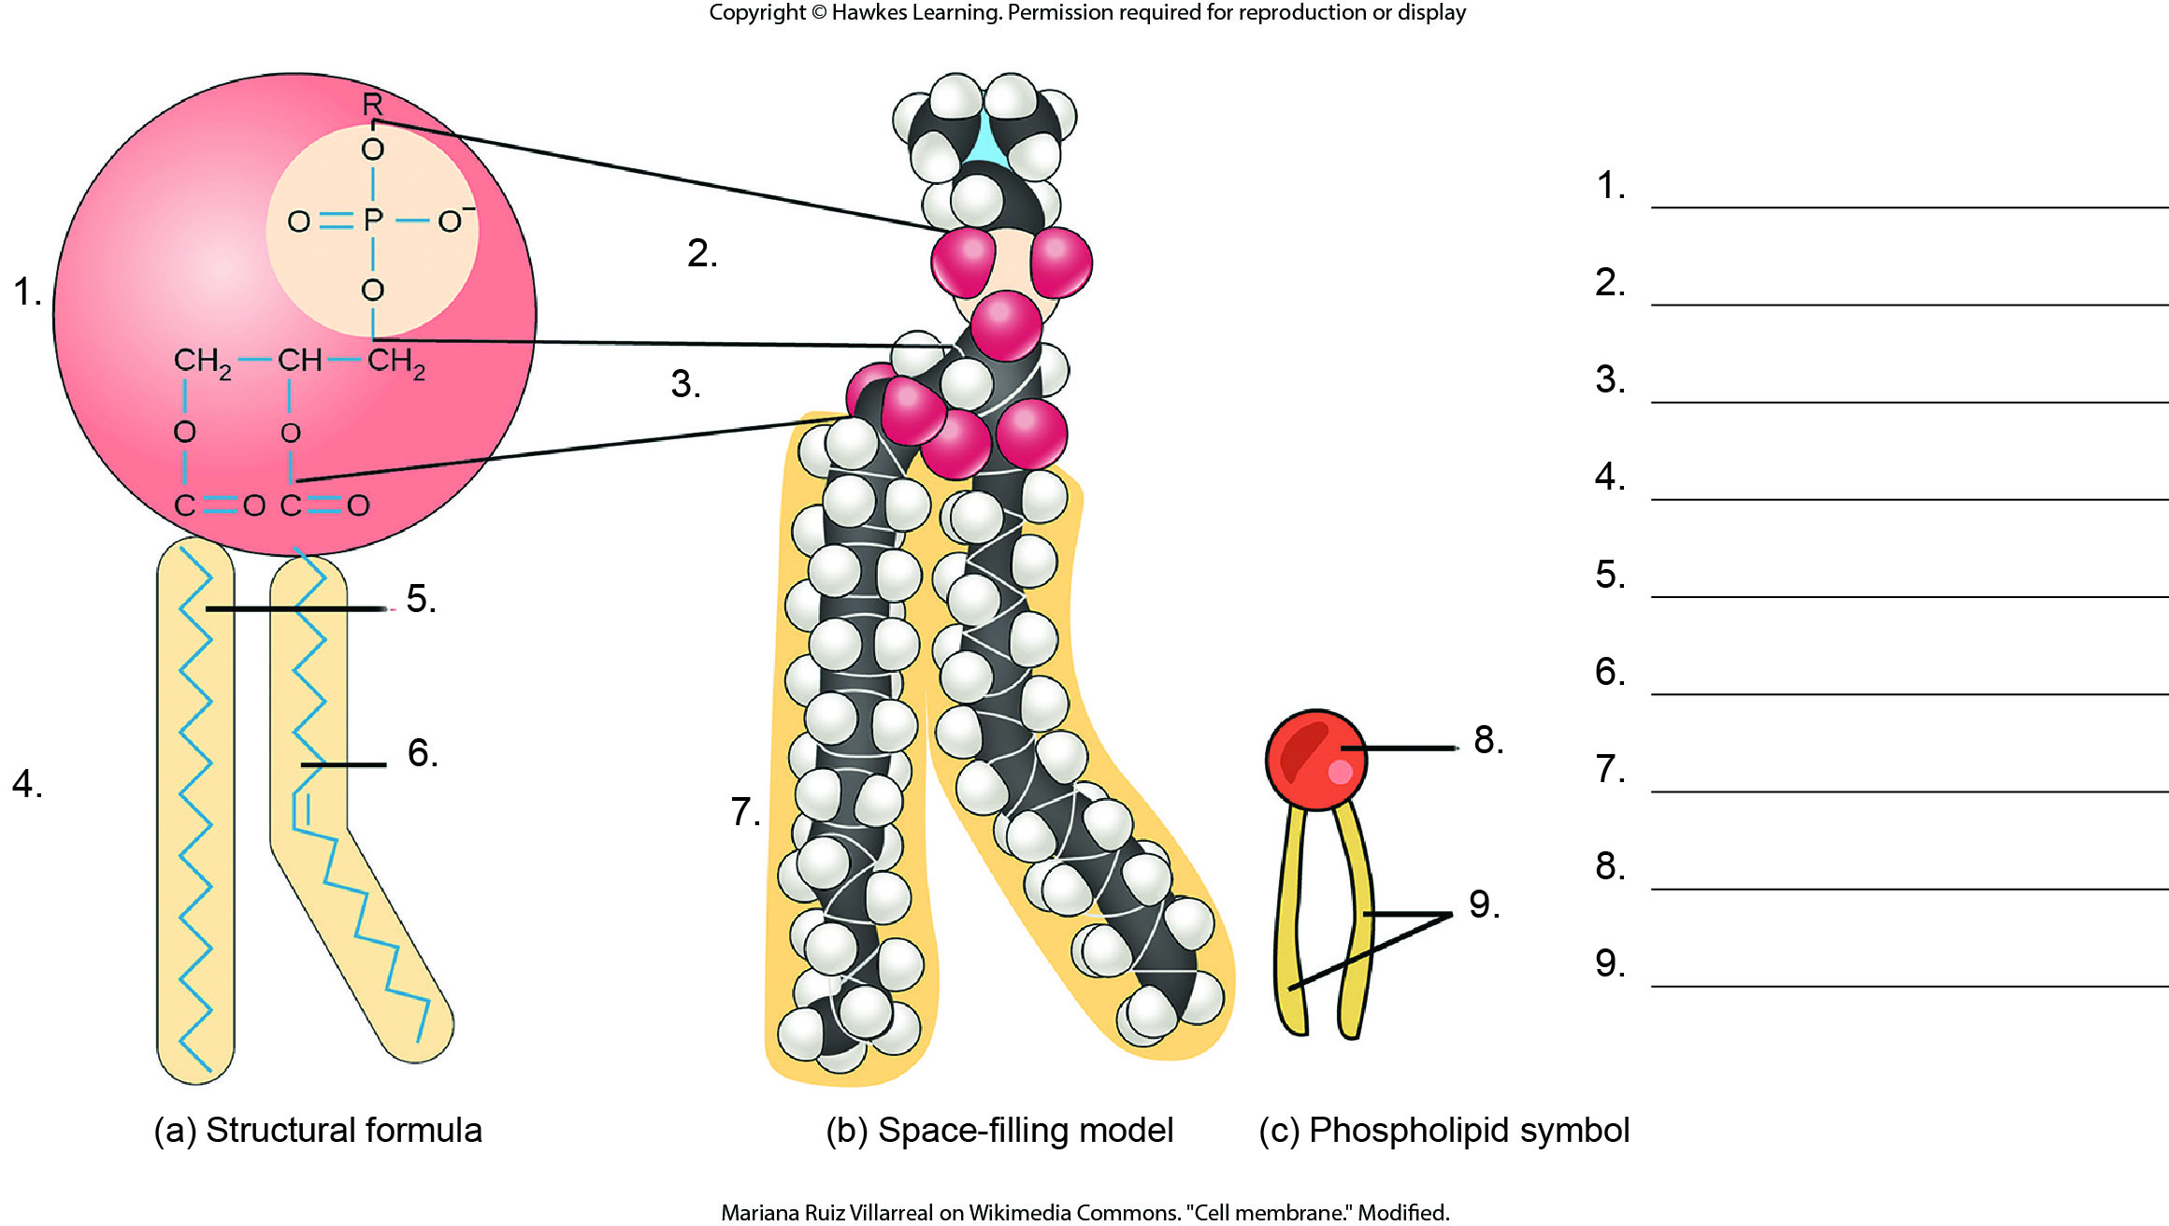
Lesson 5.1 Figure 3 - Numbered

Slide 5
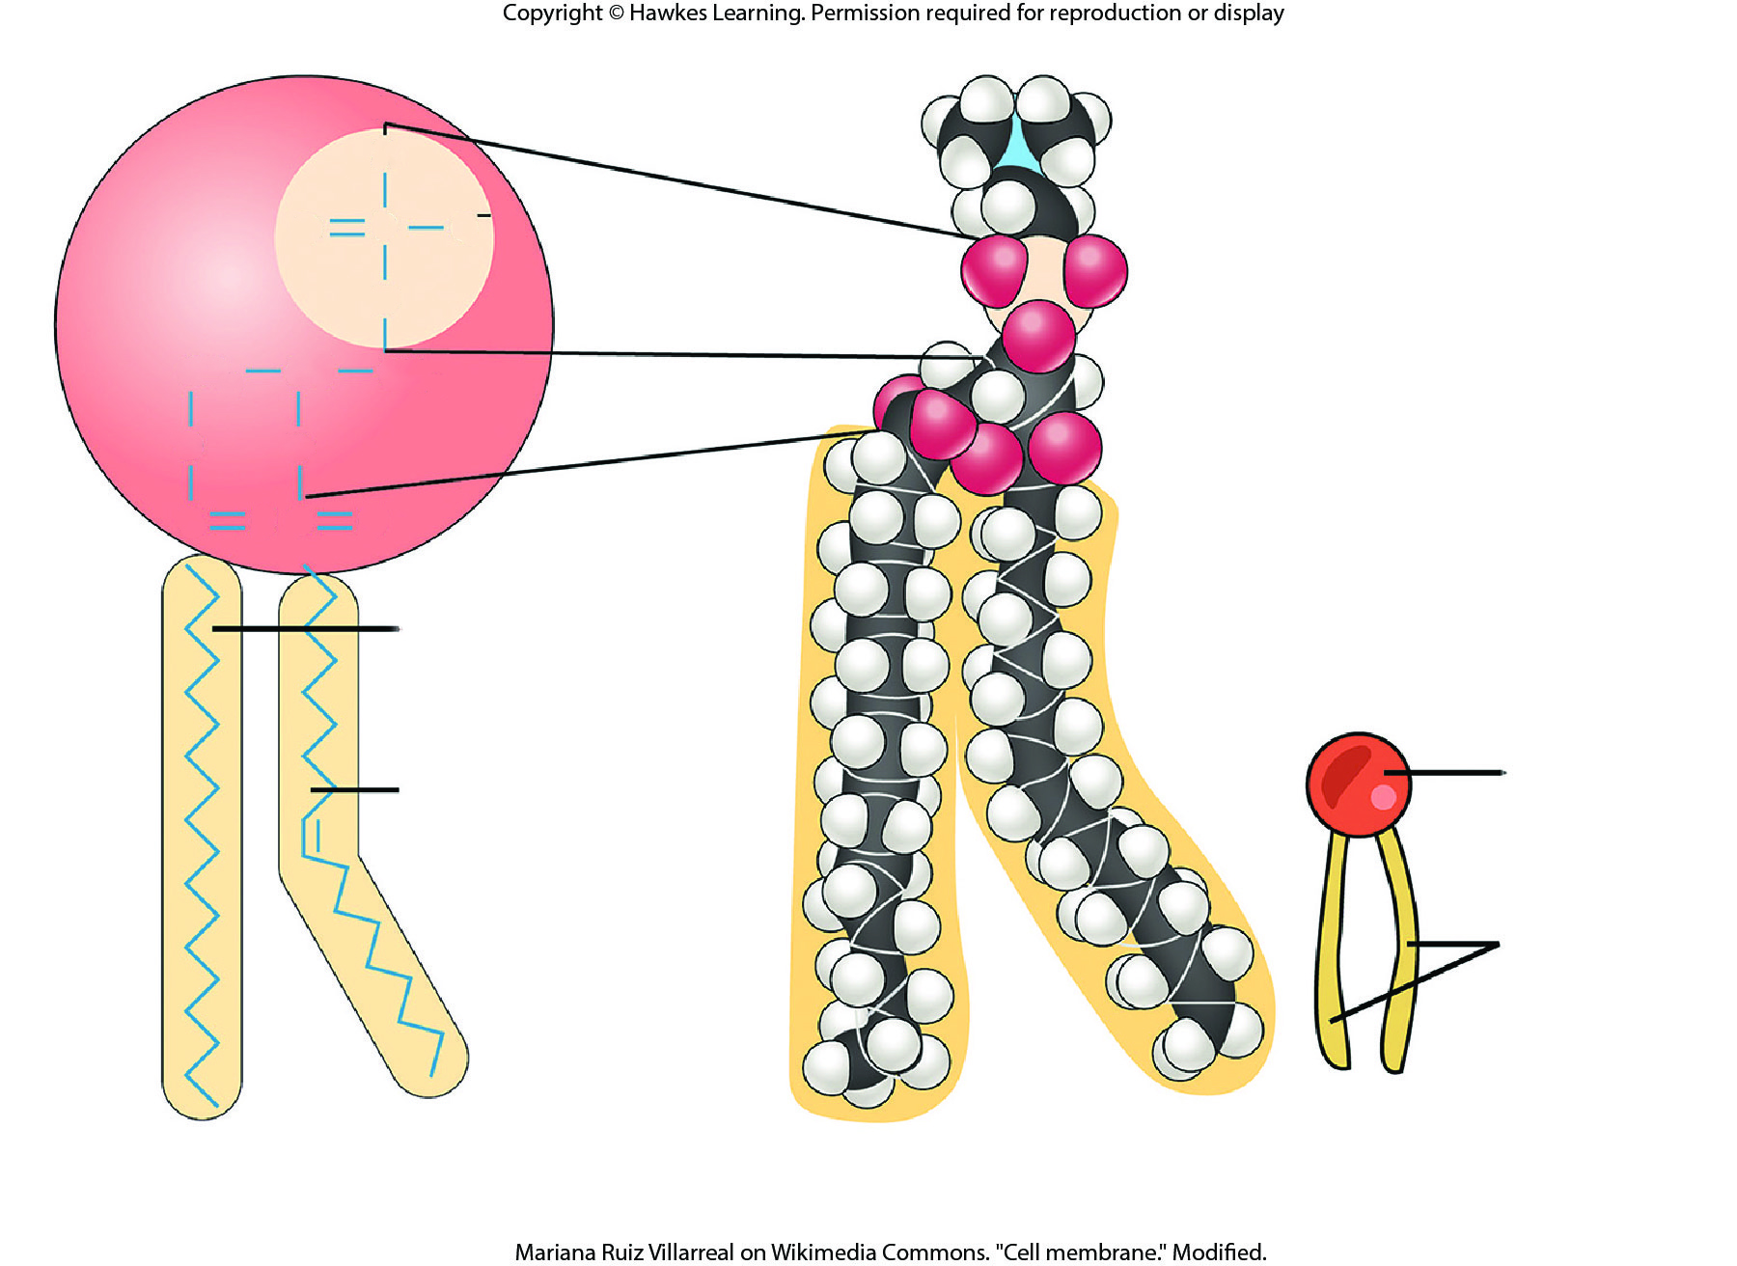
Lesson 5.1 Figure 3

Slide 6
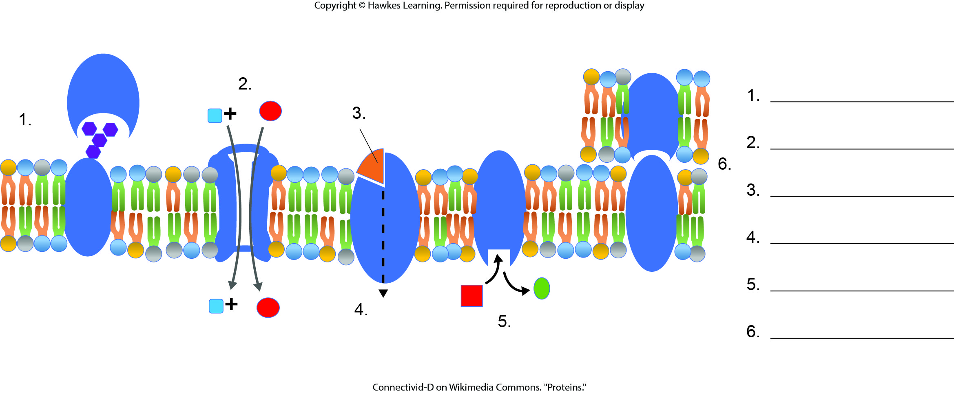
Lesson 5.1 Figure 5 - Numbered

Slide 7
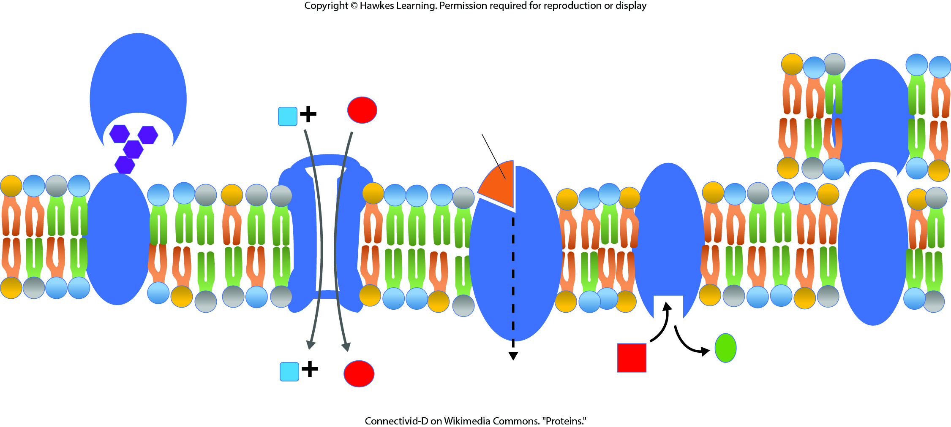
Lesson 5.1 Figure 5

Slide 8
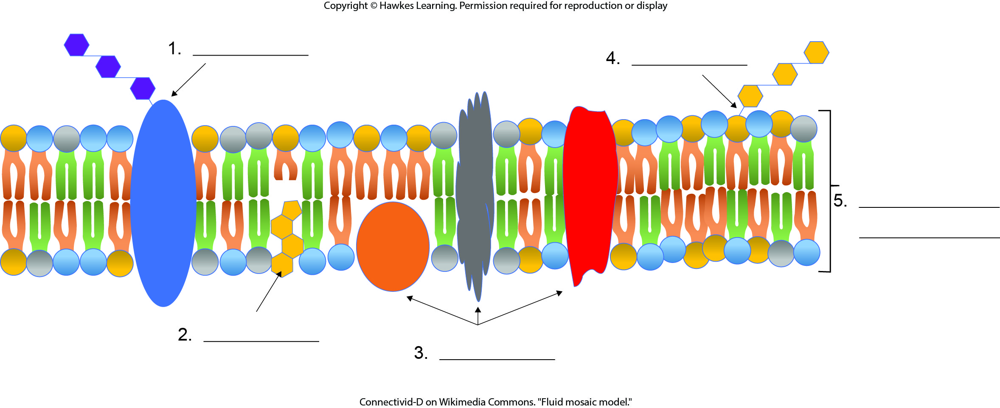
Lesson 5.1 Figure 7 - Numbered

Slide 9
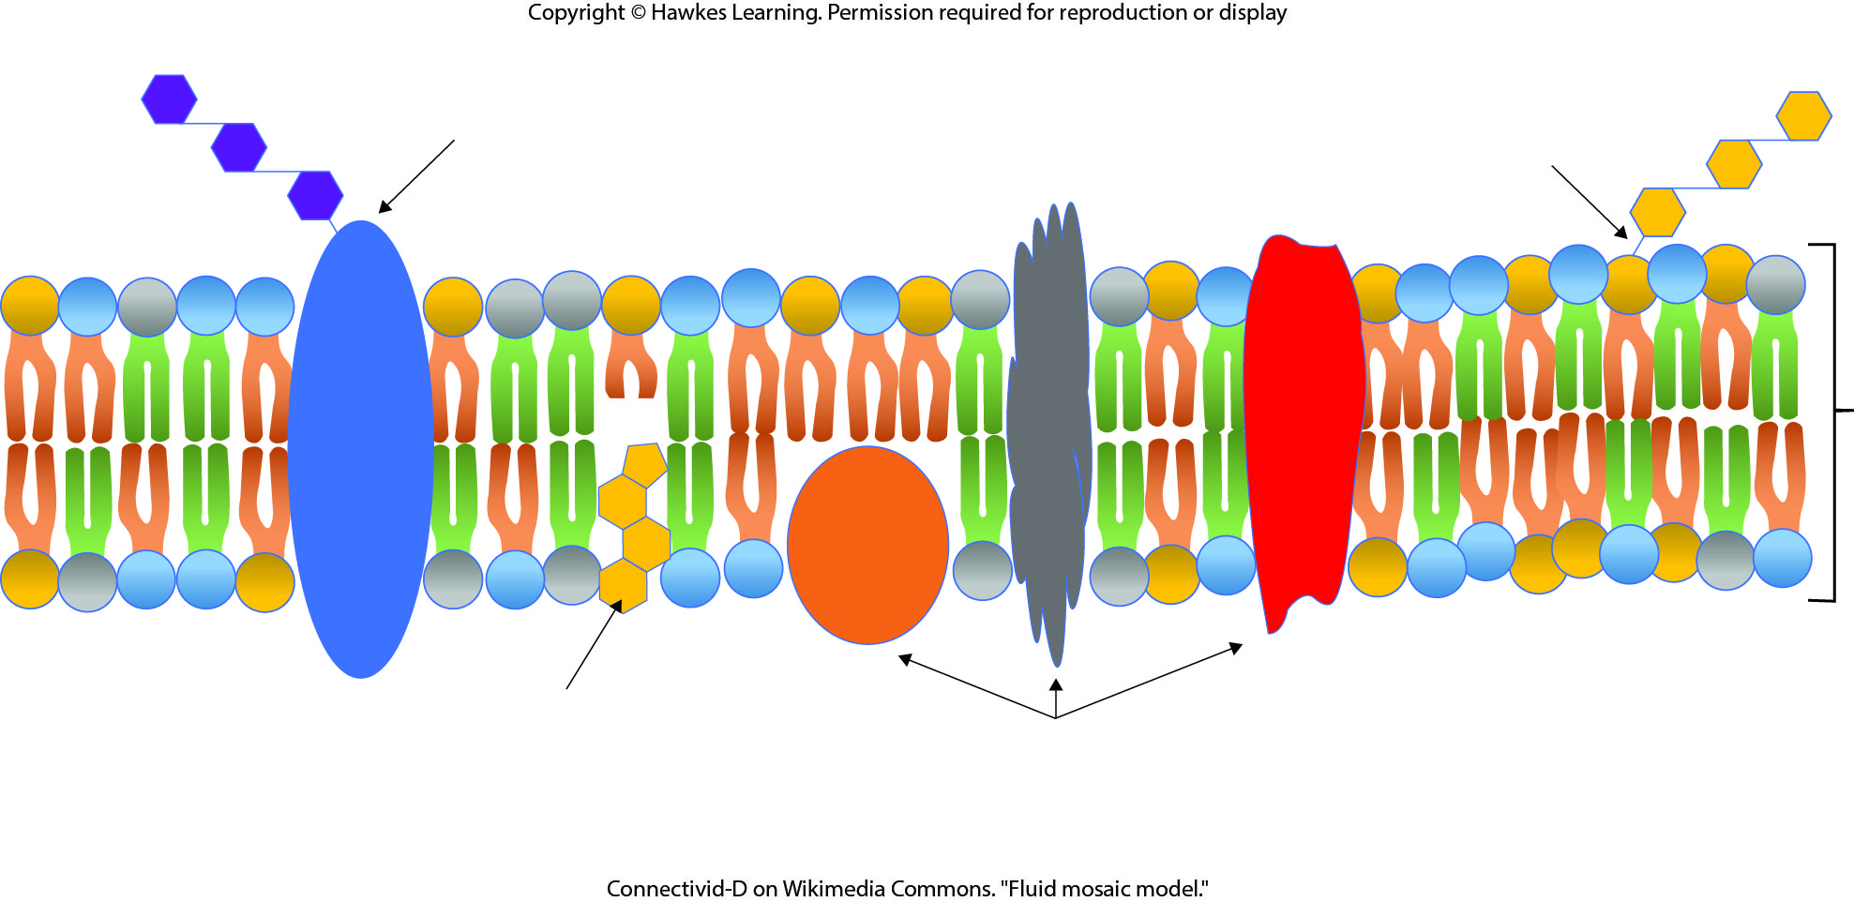
Lesson 5.1 Figure 7

Slide 10
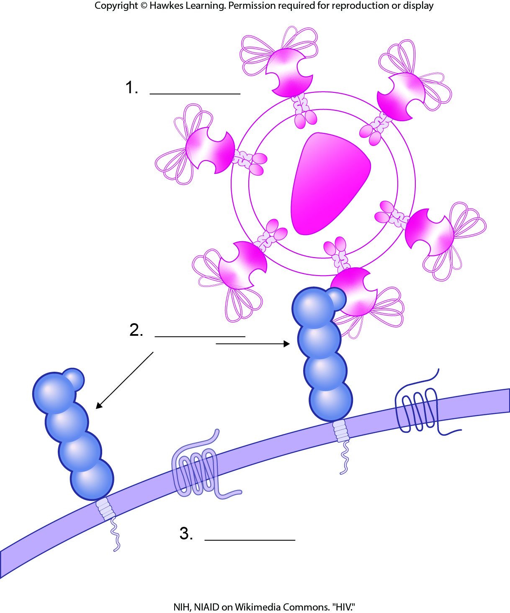
Lesson 5.1 Figure 8 - Numbered

Slide 11

Lesson 5.1 Figure 8

Slide 12
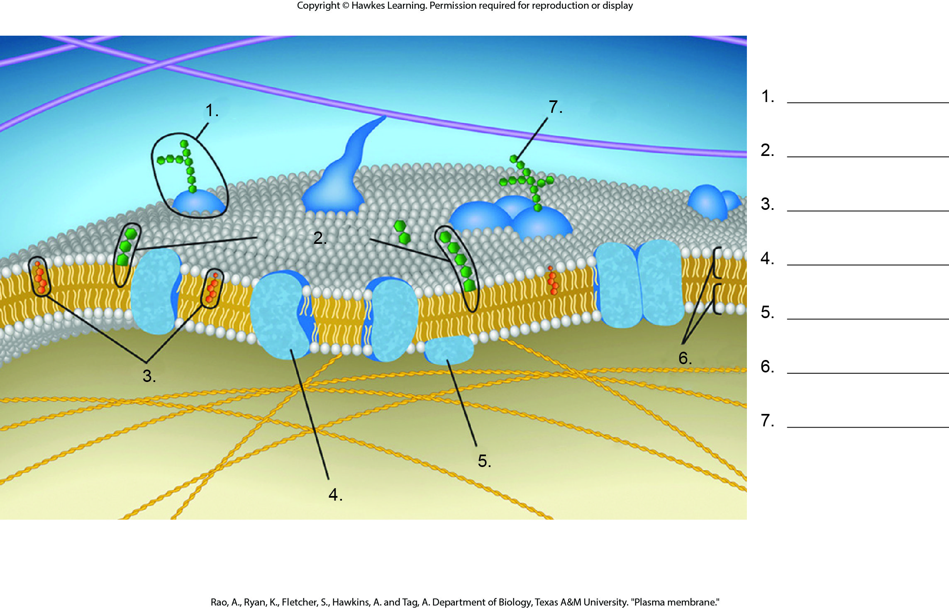
Lesson 5.2 Figure 1 - Numbered

Slide 13
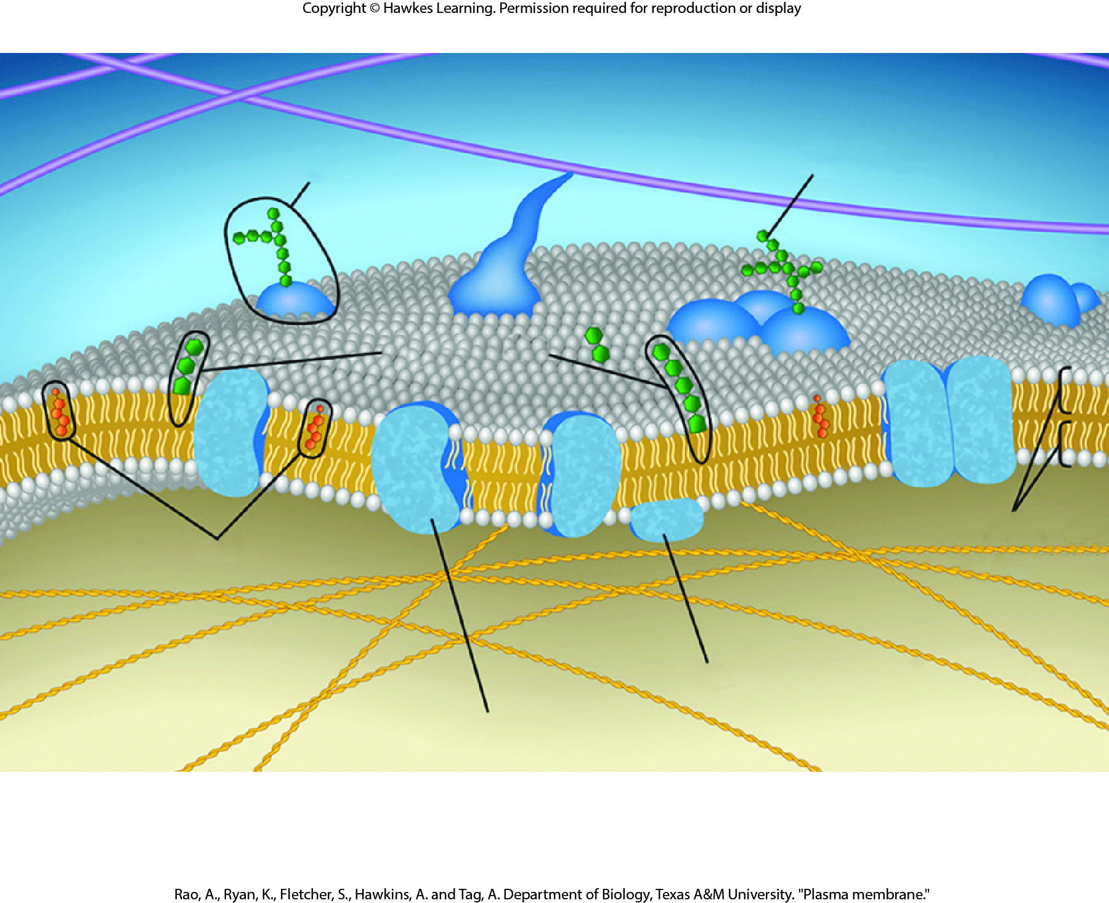
Lesson 5.2 Figure 1

Slide 14
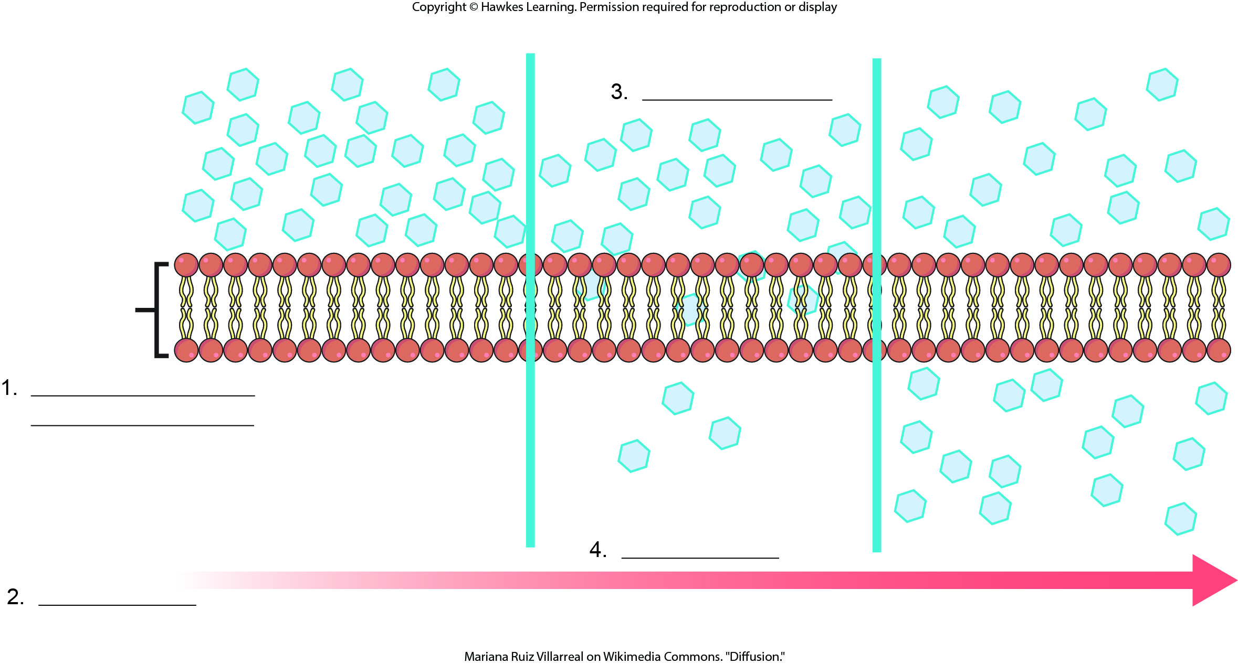
Lesson 5.2 Figure 3 - Numbered

Slide 15
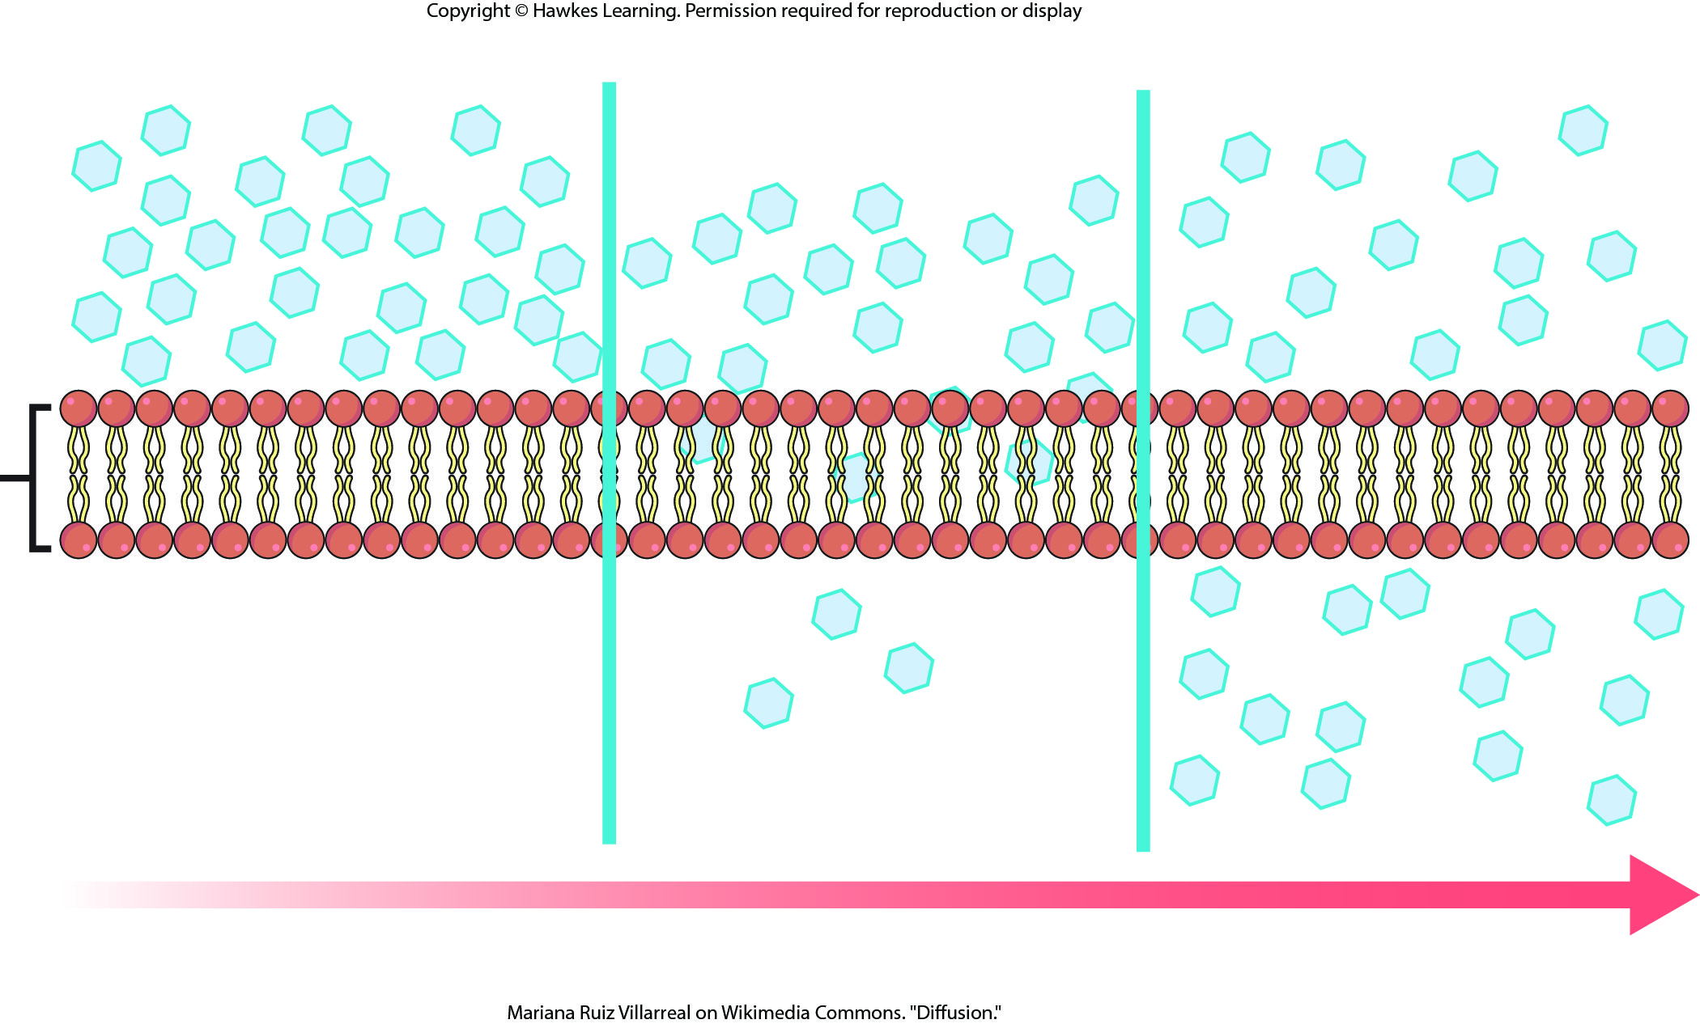
Lesson 5.2 Figure 3

Slide 16
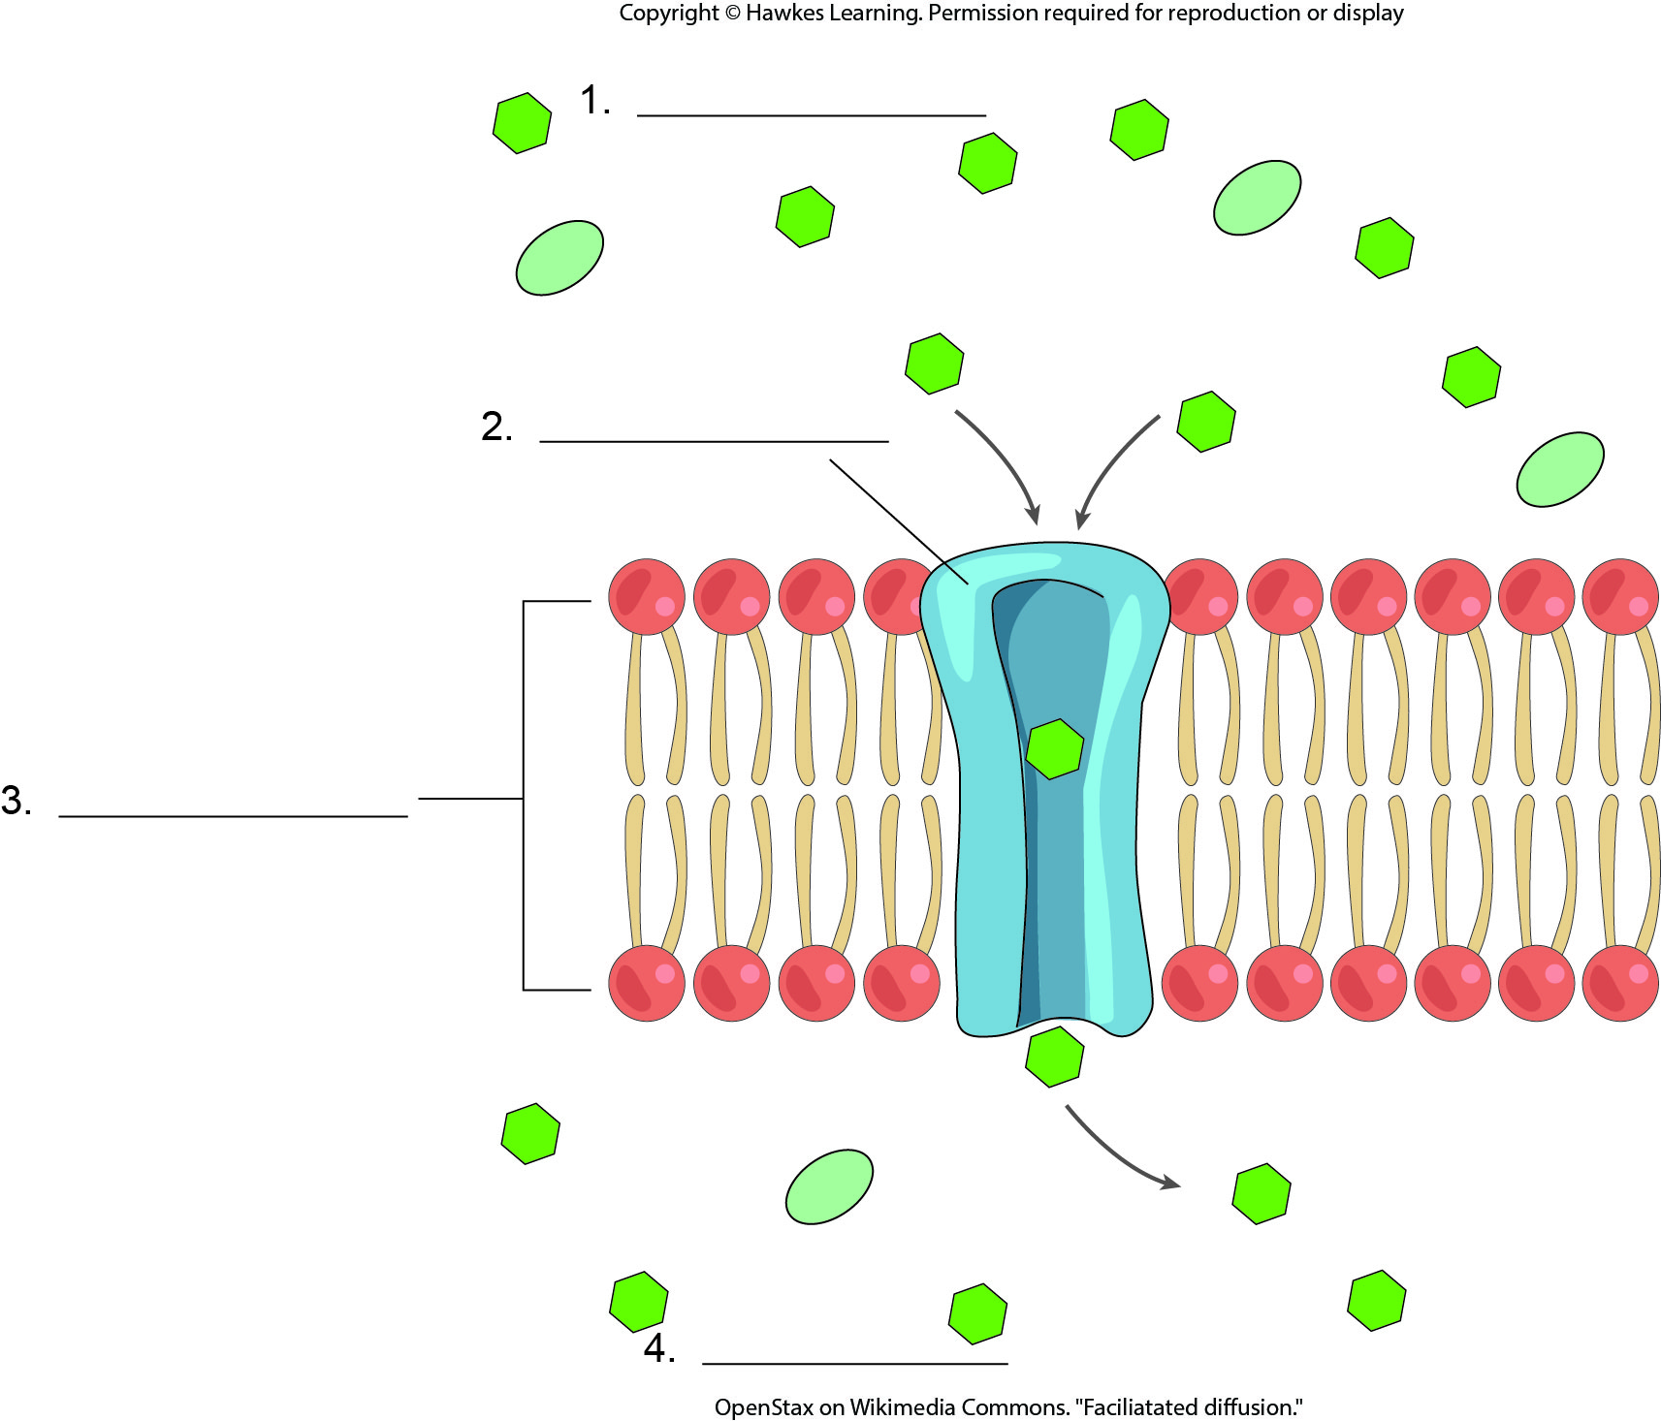
Lesson 5.2 Figure 5 - Numbered

Slide 17
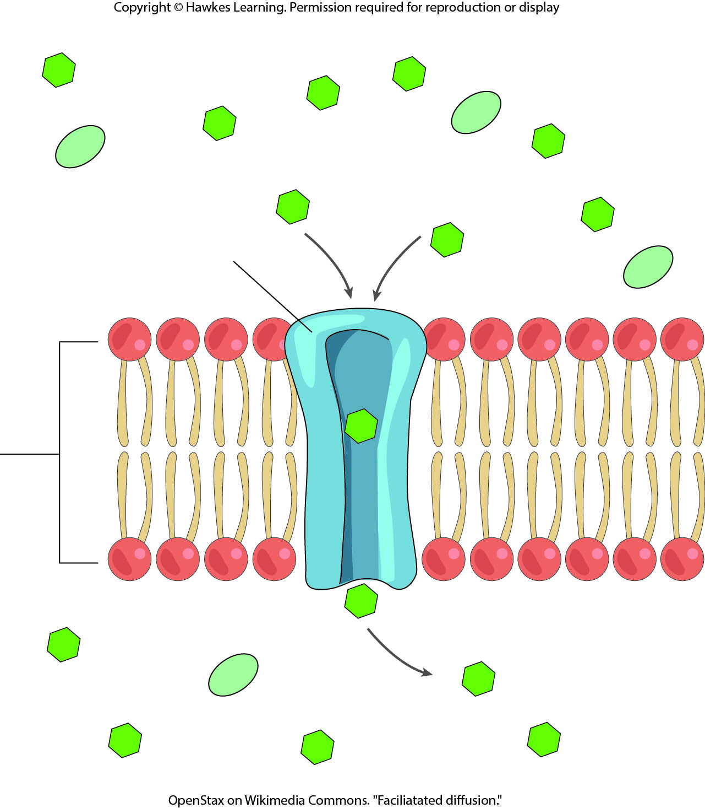
Lesson 5.2 Figure 5

Slide 18
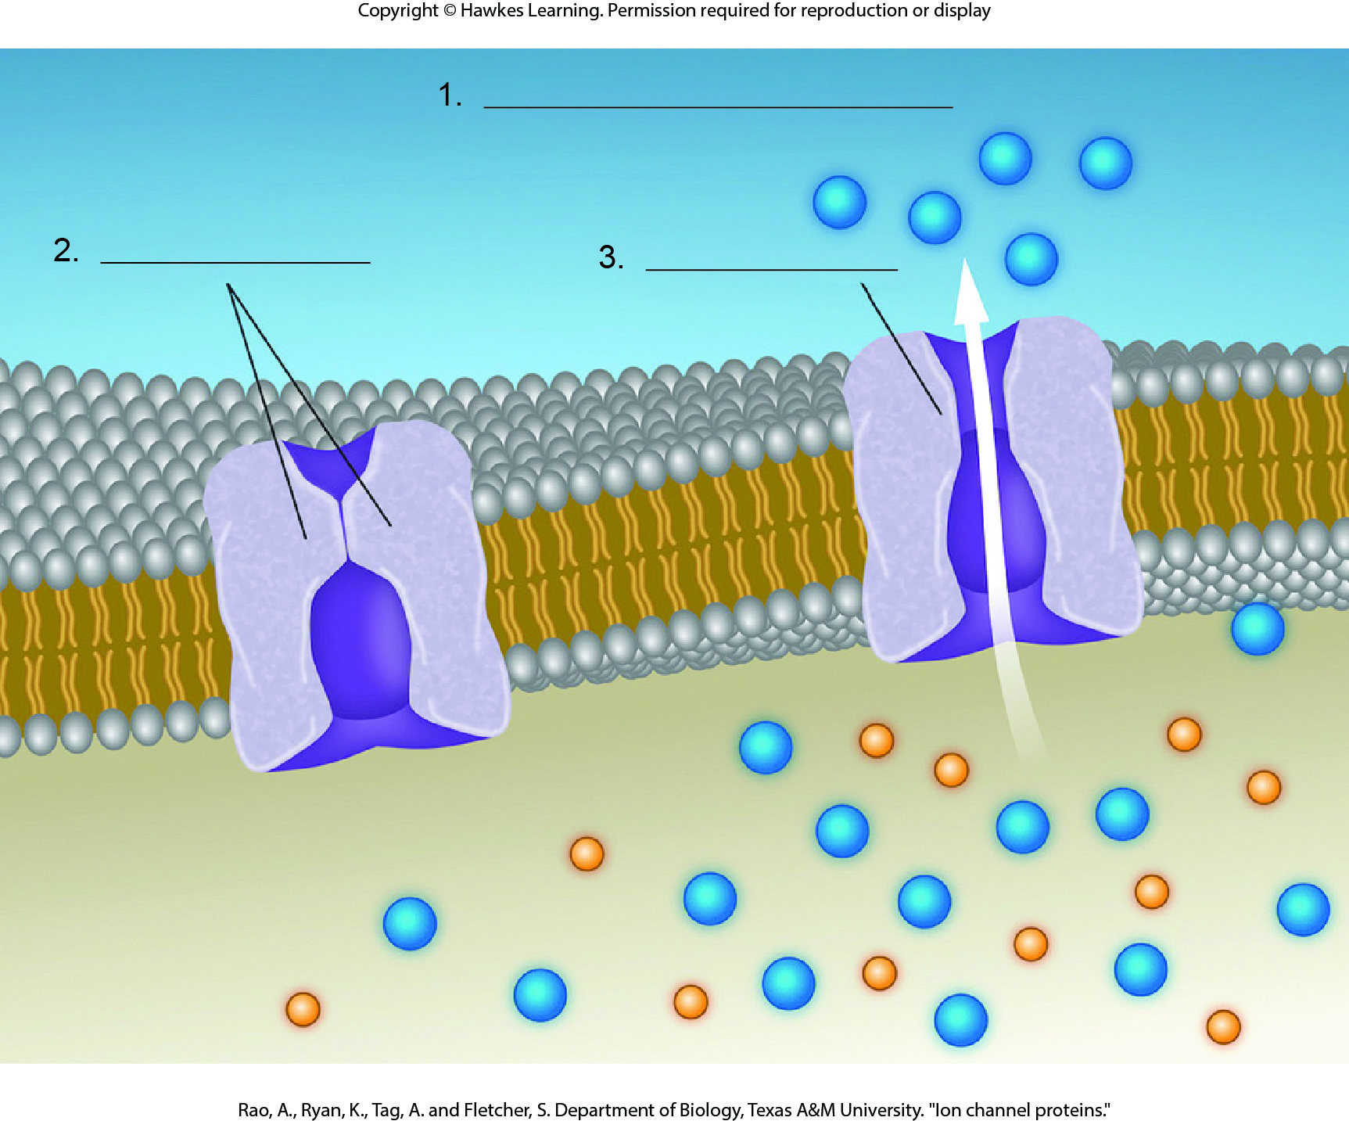
Lesson 5.2 Figure 6 - Numbered

Slide 19
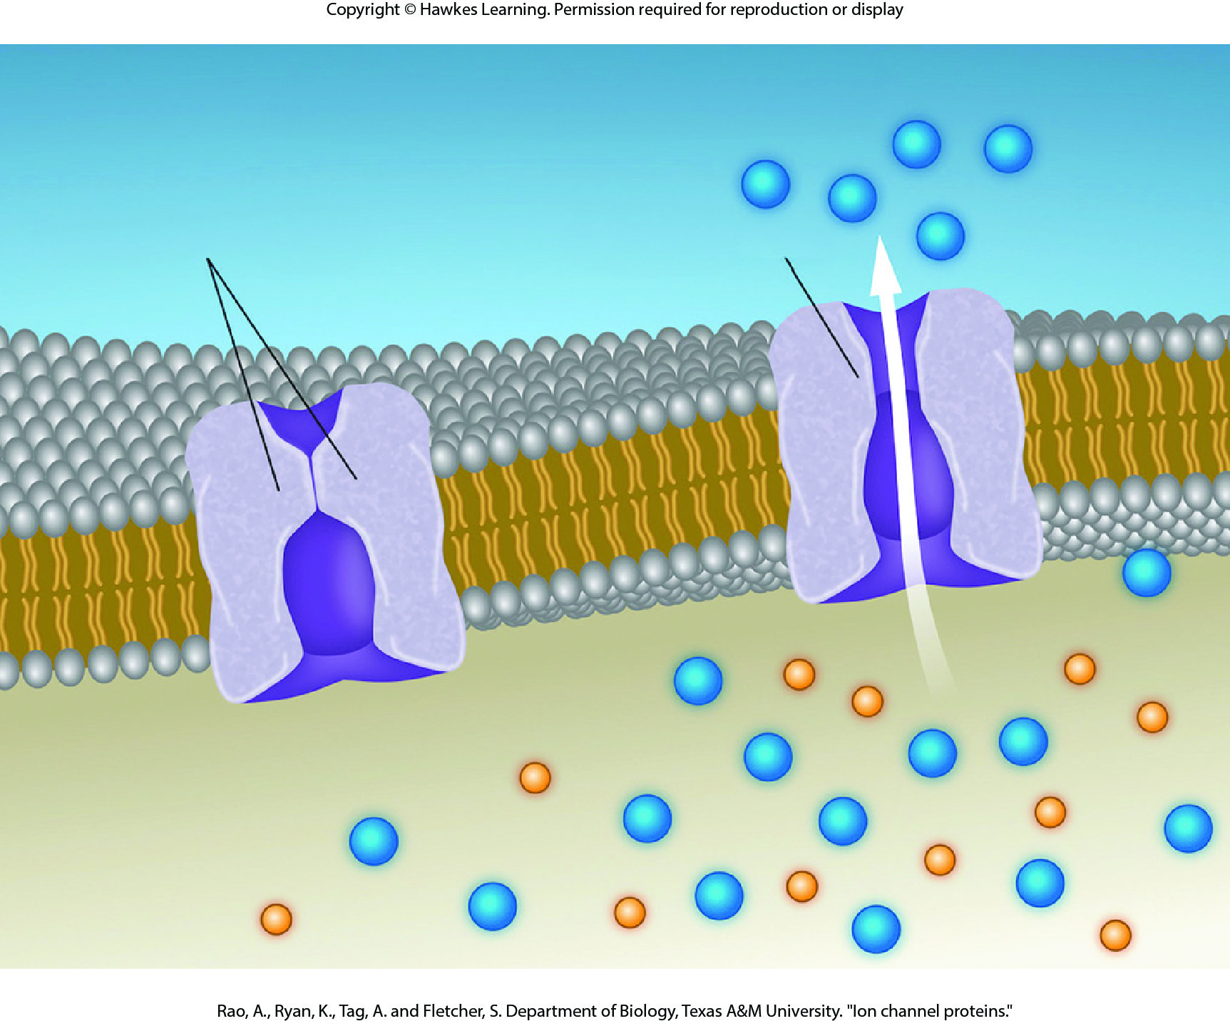
Lesson 5.2 Figure 6

Slide 20
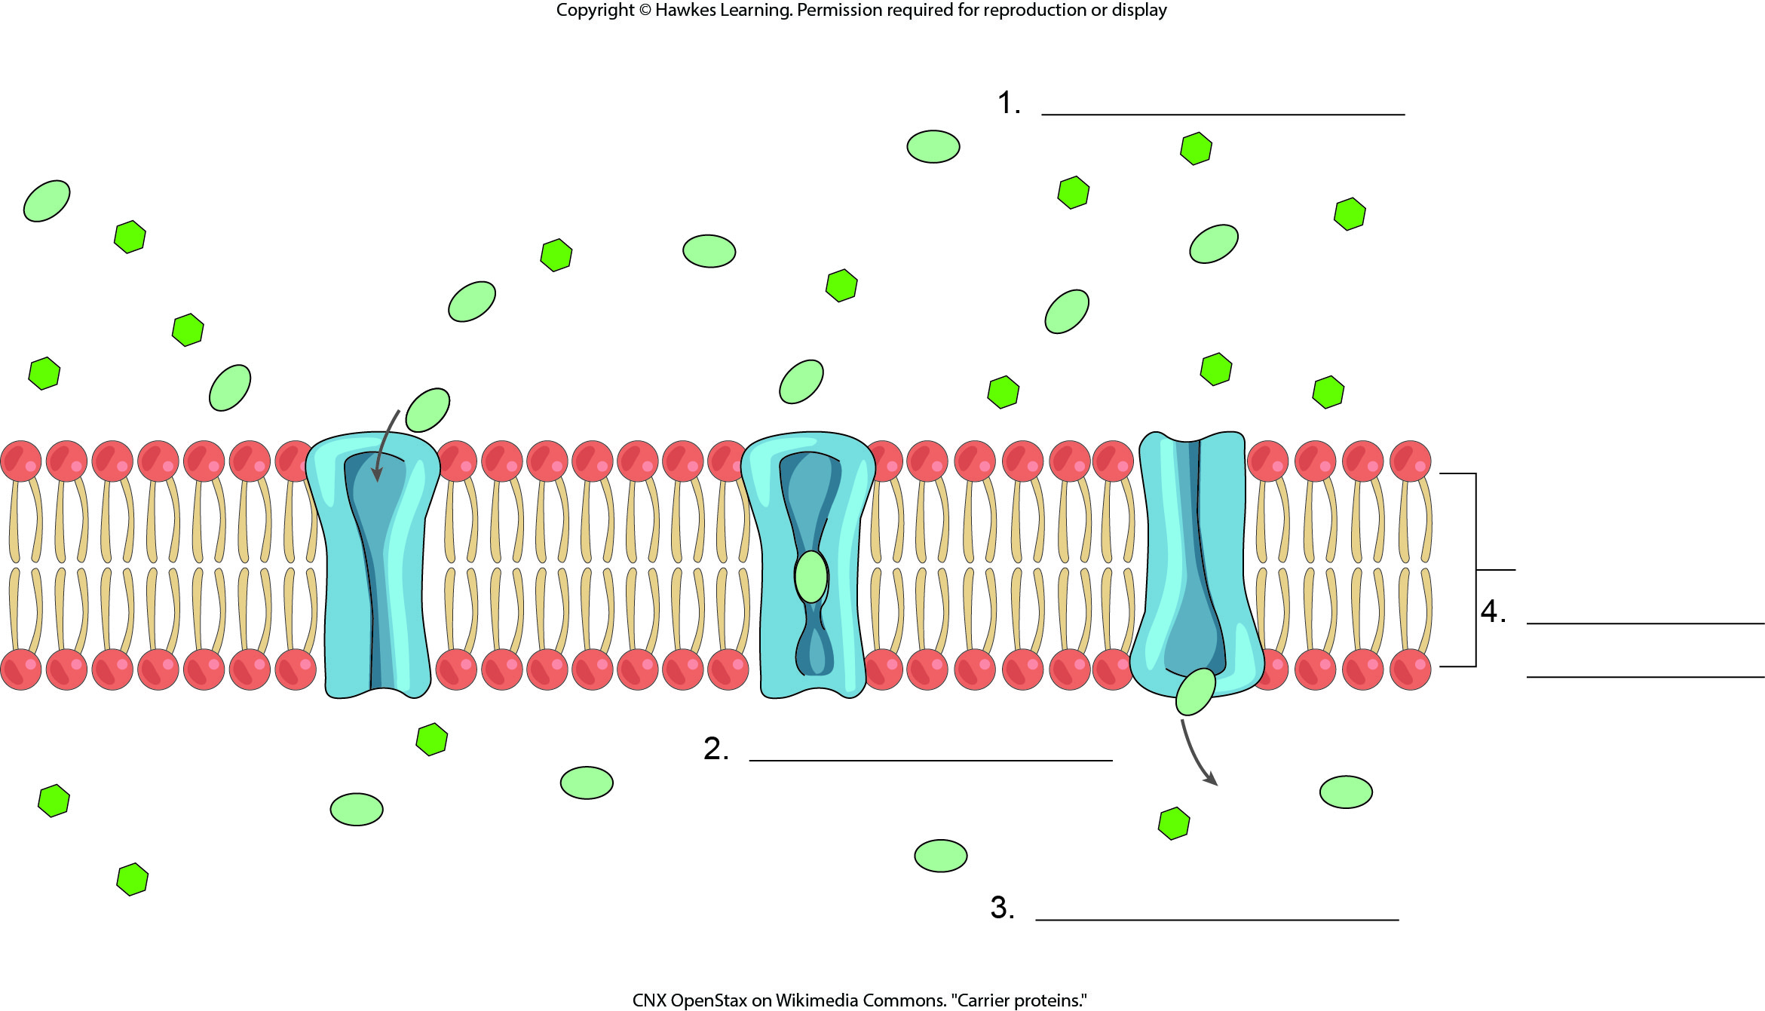
Lesson 5.2 Figure 7 - Numbered

Slide 21
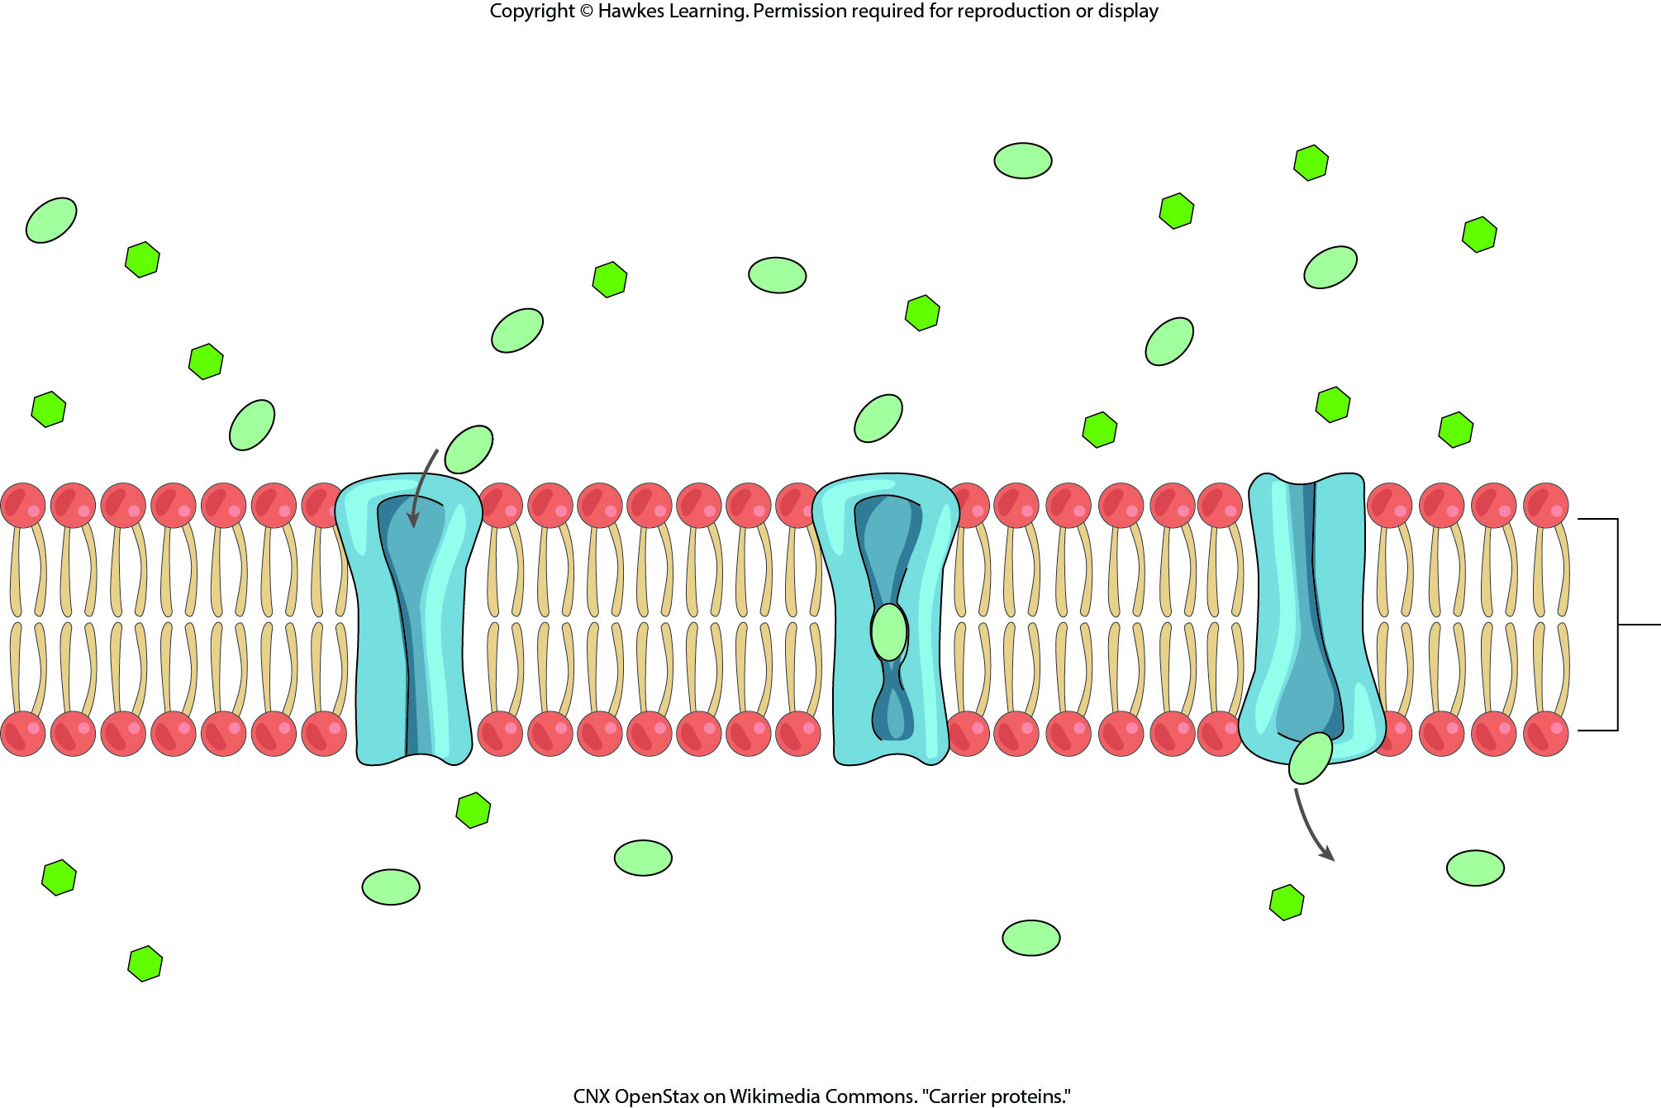
Lesson 5.2 Figure 7

Slide 22
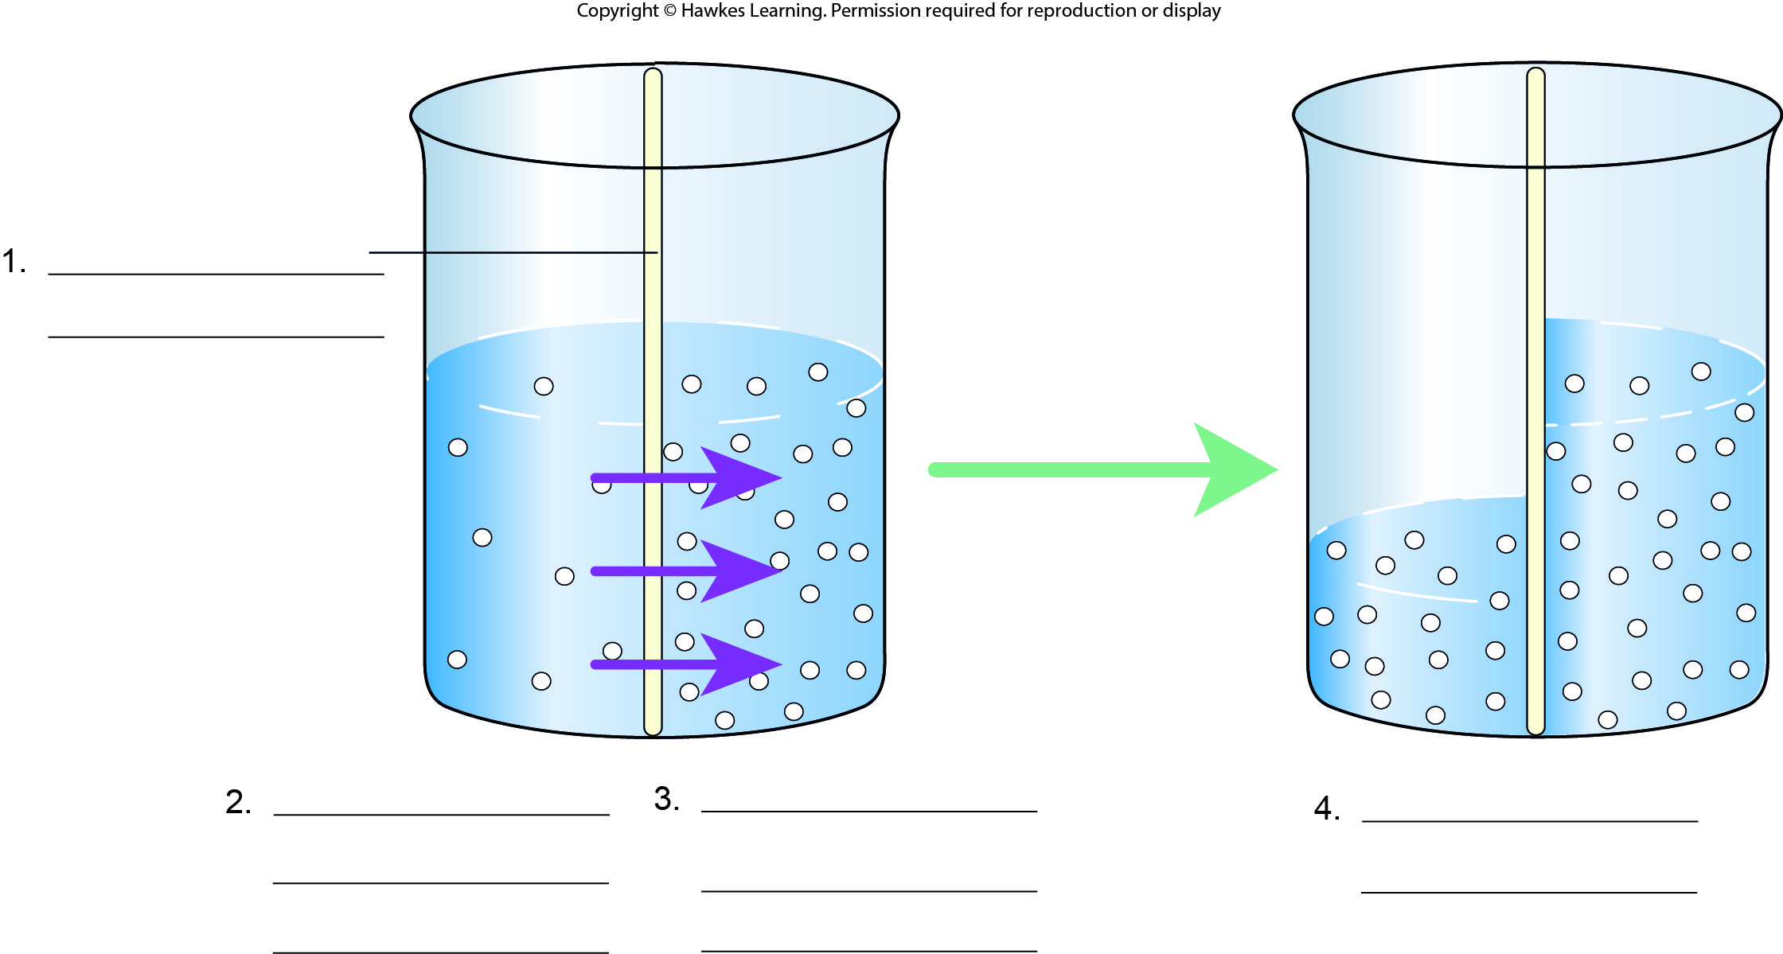
Lesson 5.2 Figure 8 - Numbered

Slide 23
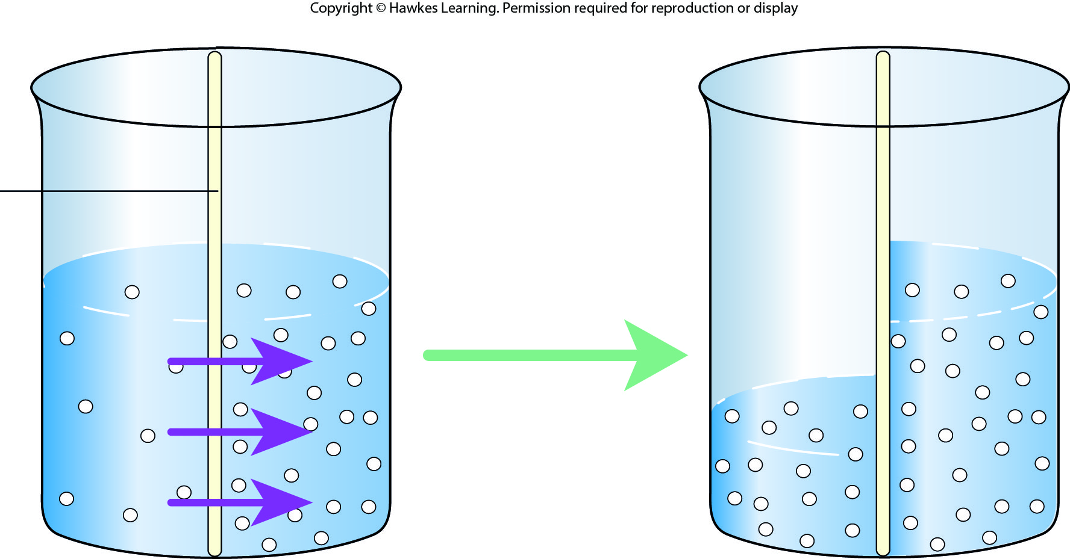
Lesson 5.2 Figure 8

Slide 24
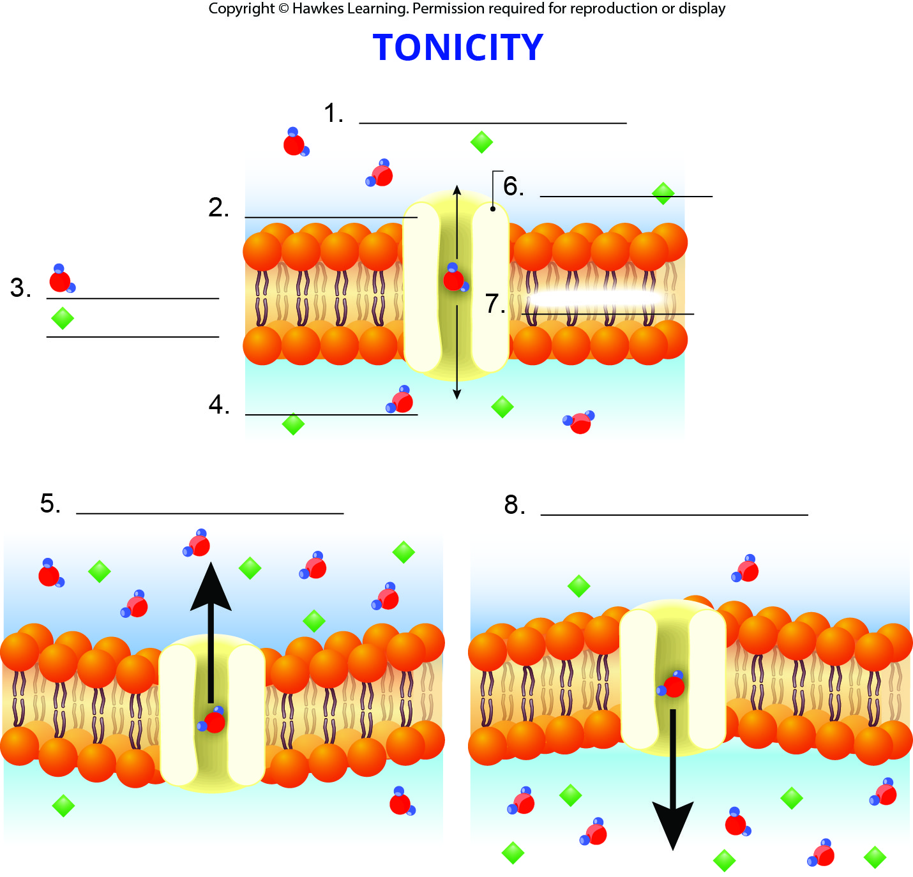
Lesson 5.2 Figure 9 - Numbered

Slide 25
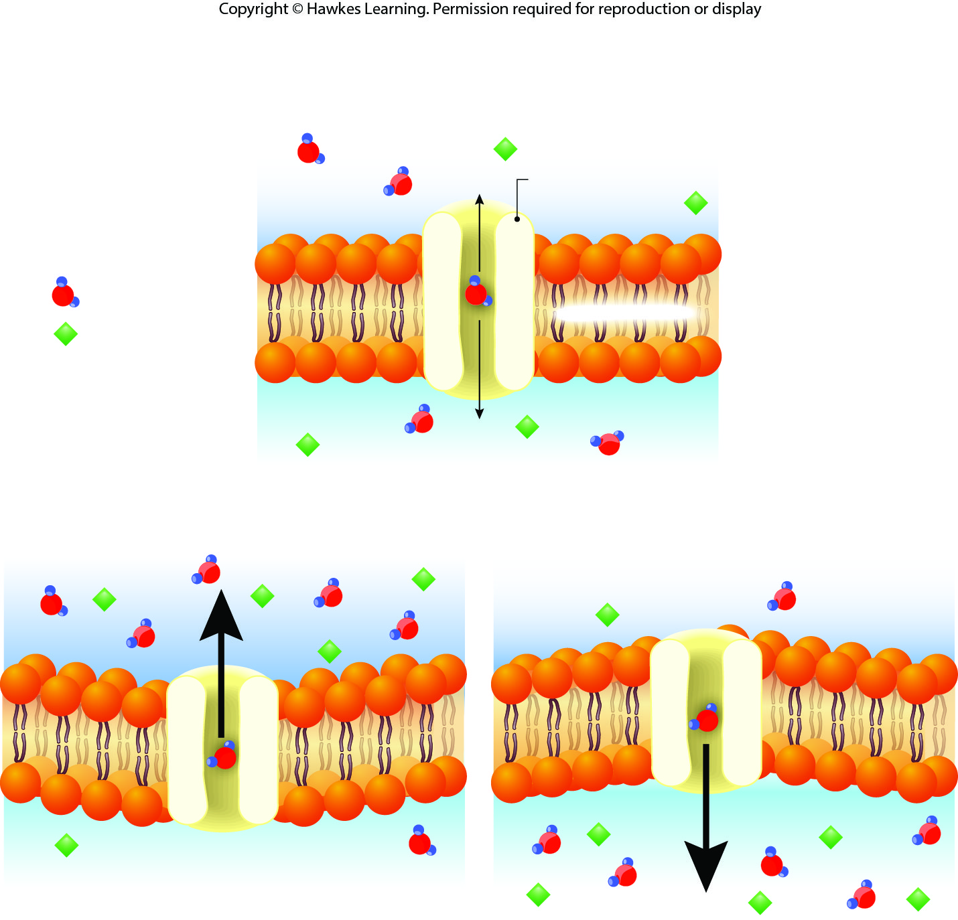
Lesson 5.2 Figure 9

Slide 26
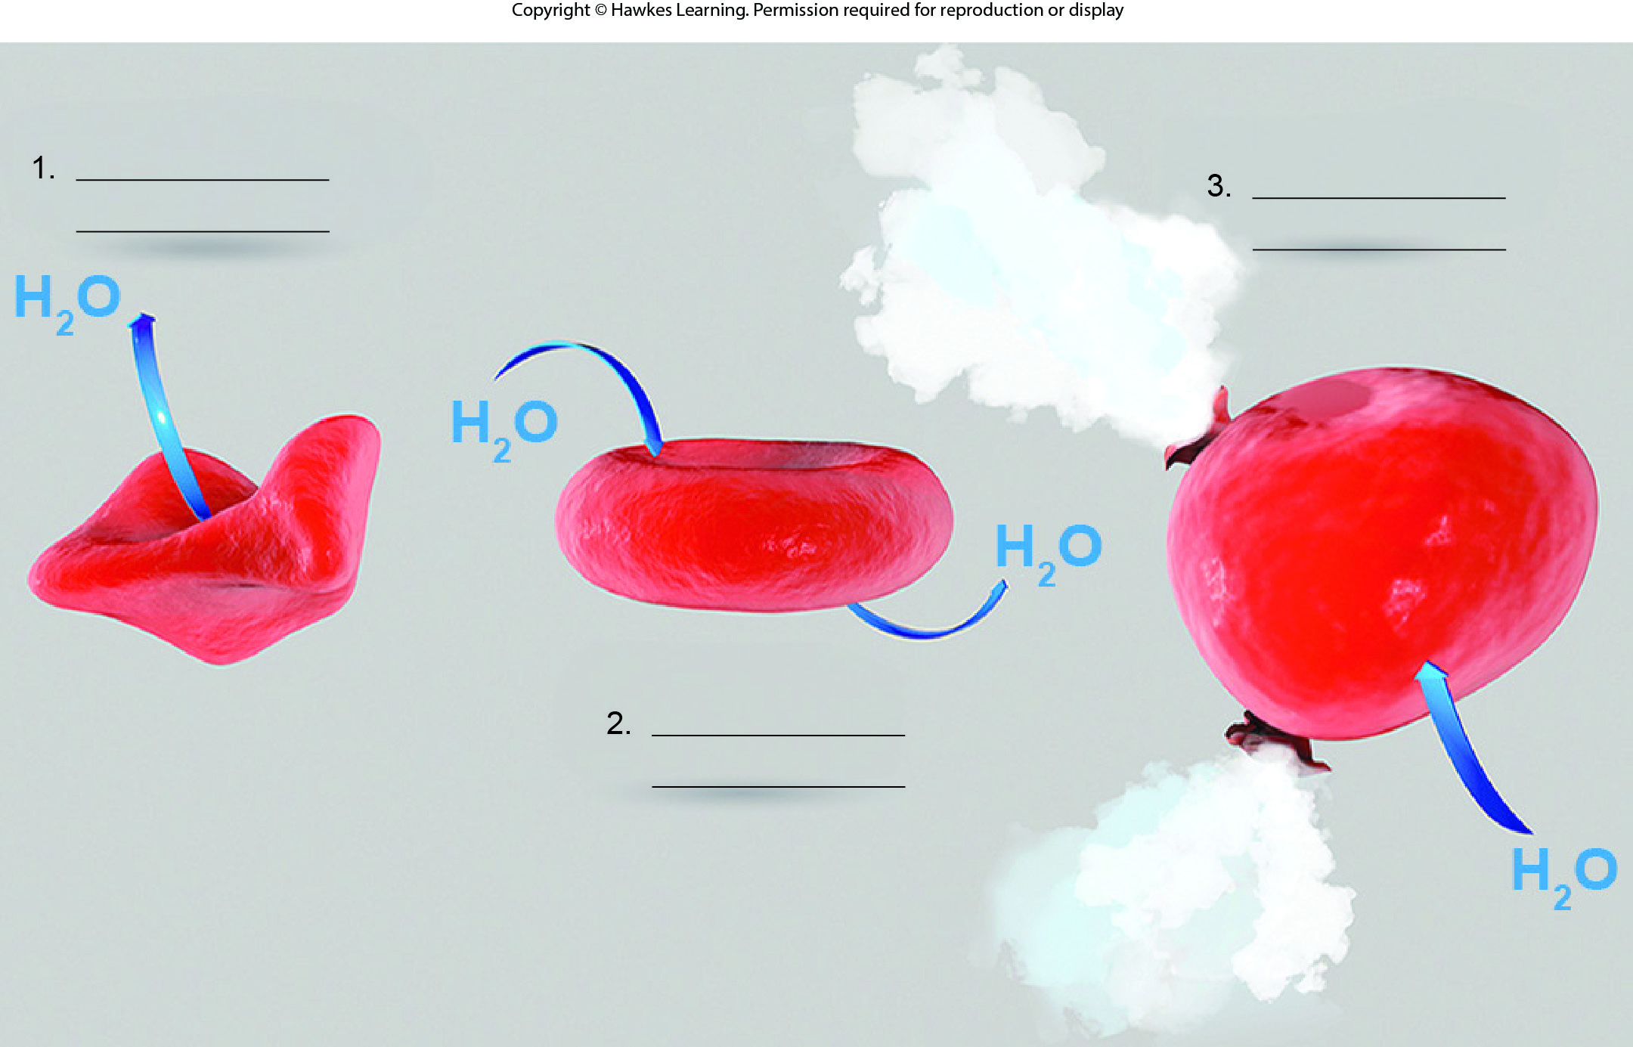
Lesson 5.2 Figure 10 - Numbered

Slide 27
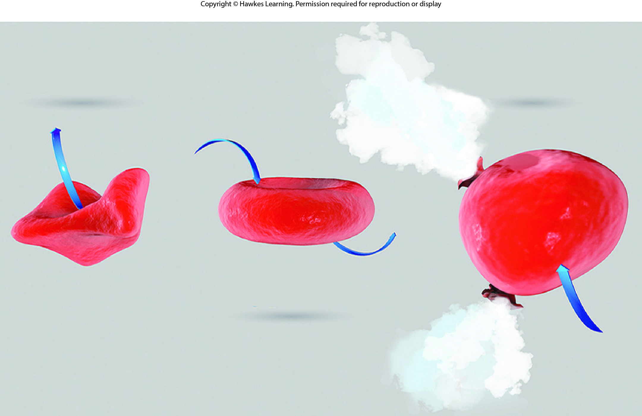
Lesson 5.2 Figure 10

Slide 28
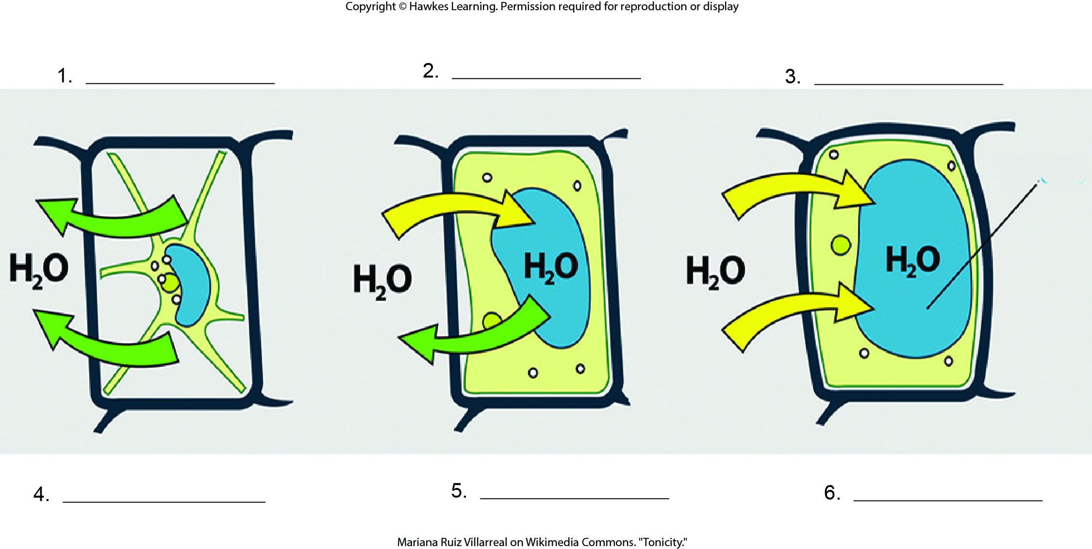
Lesson 5.2 Figure 11 - Numbered

Slide 29
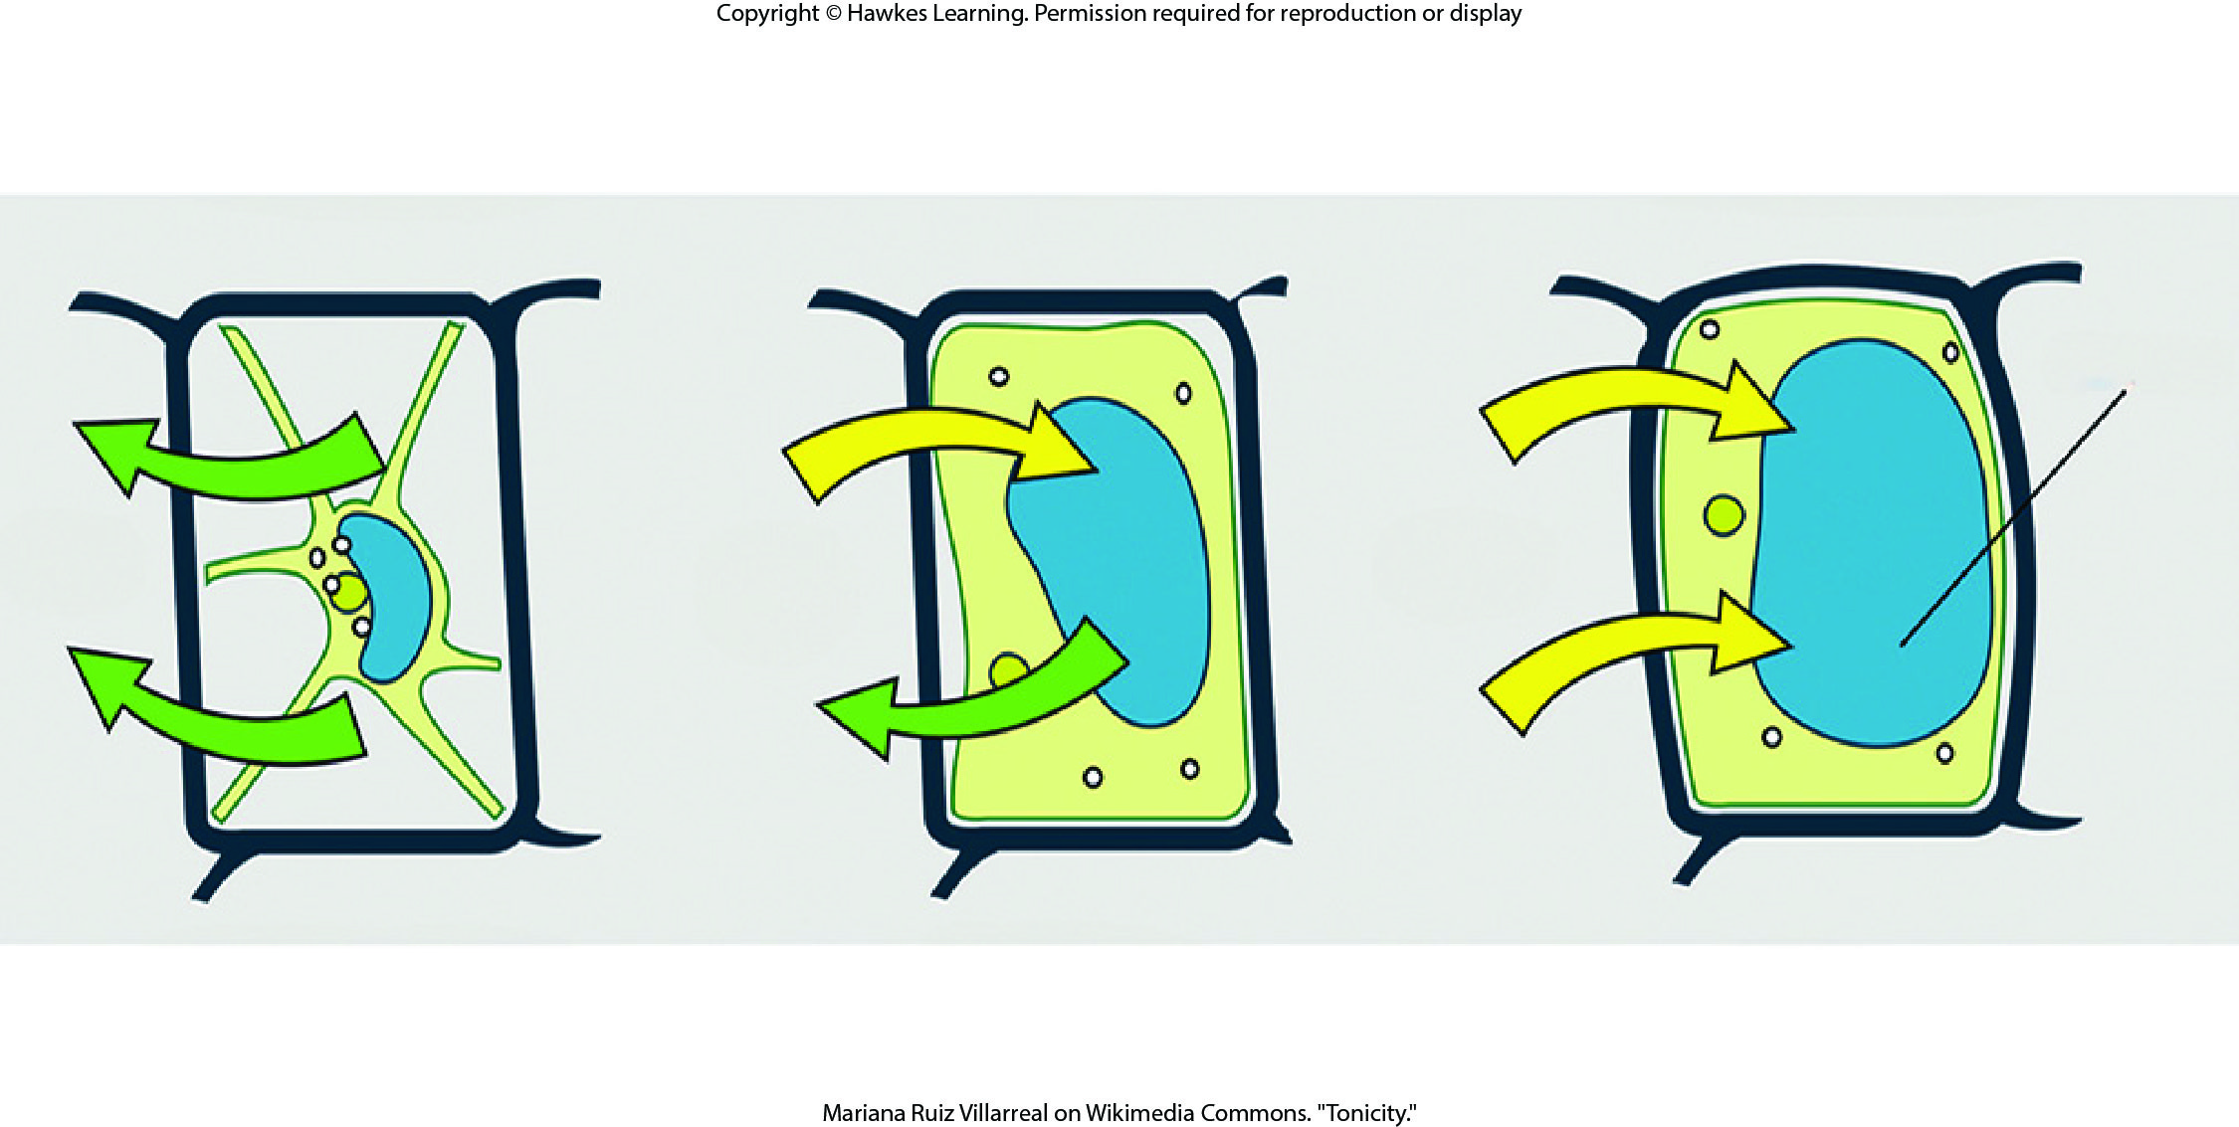
Lesson 5.2 Figure 11

Slide 30
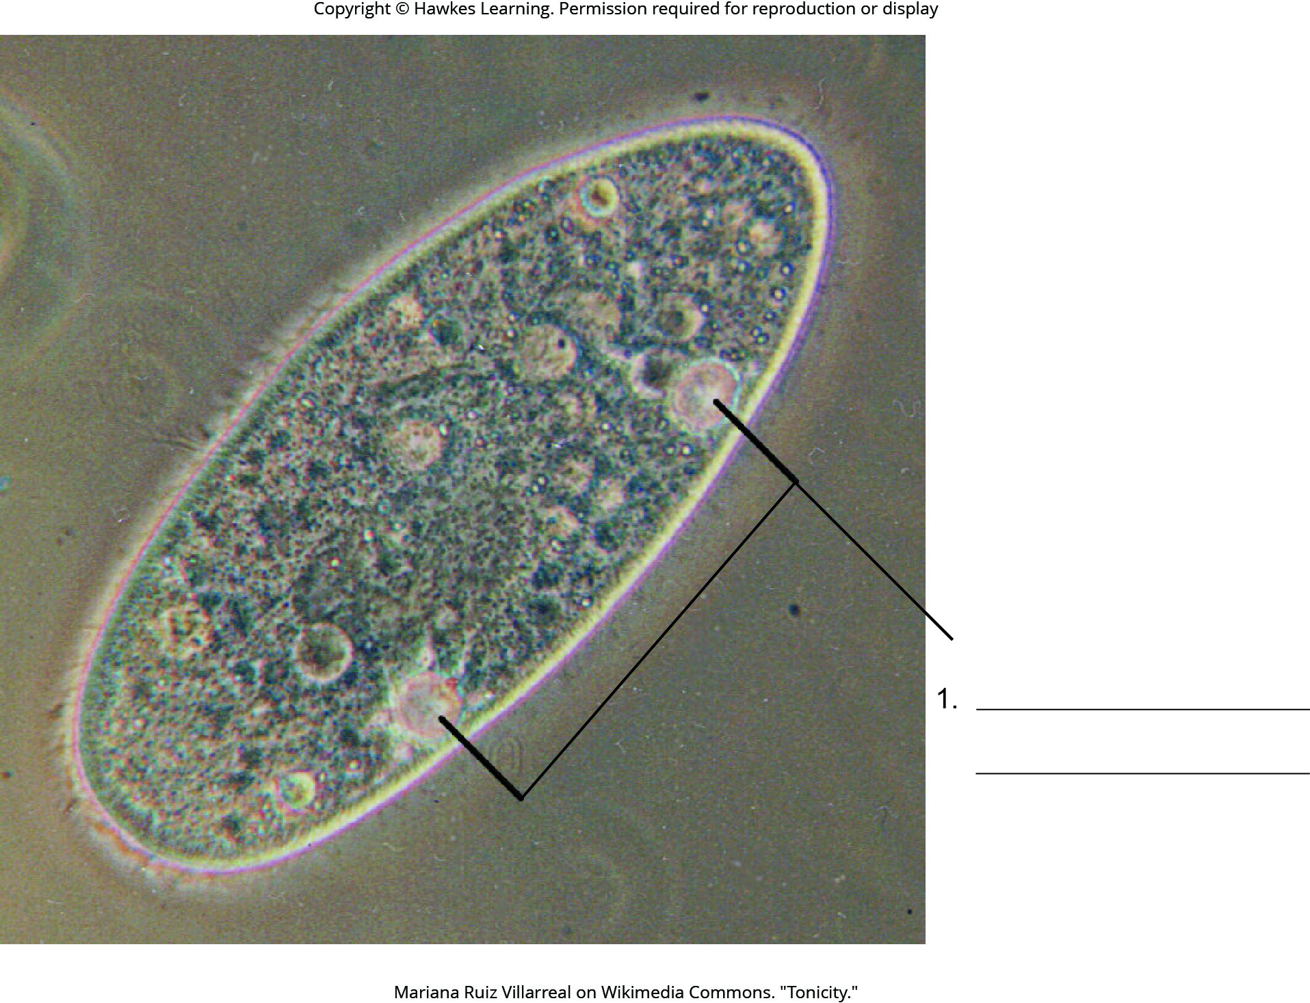
Lesson 5.2 Figure 13 - Numbered

Slide 31
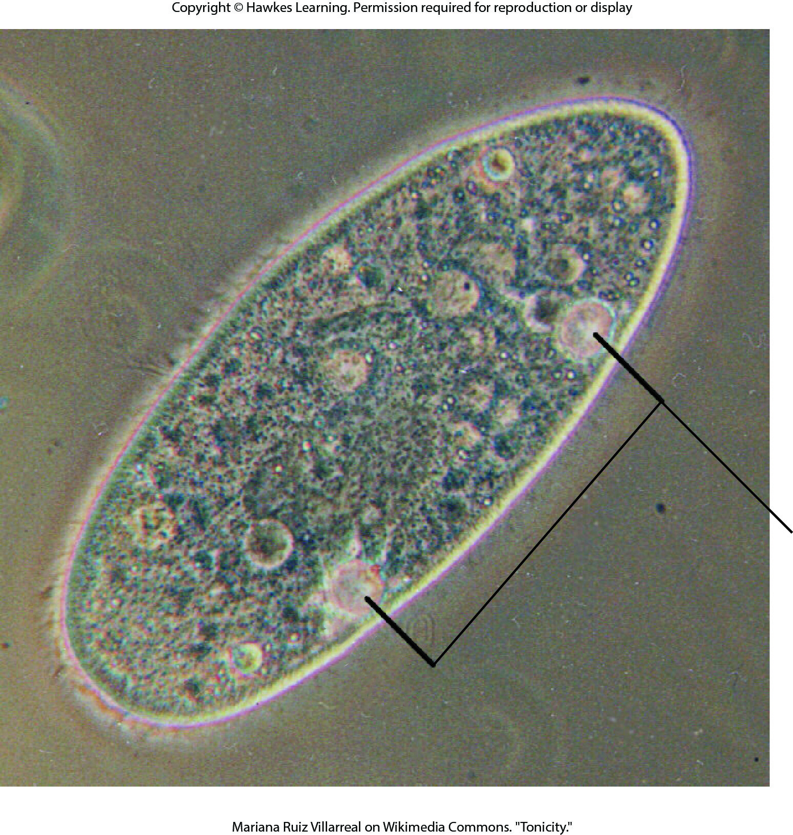
Lesson 5.2 Figure 13

Slide 32
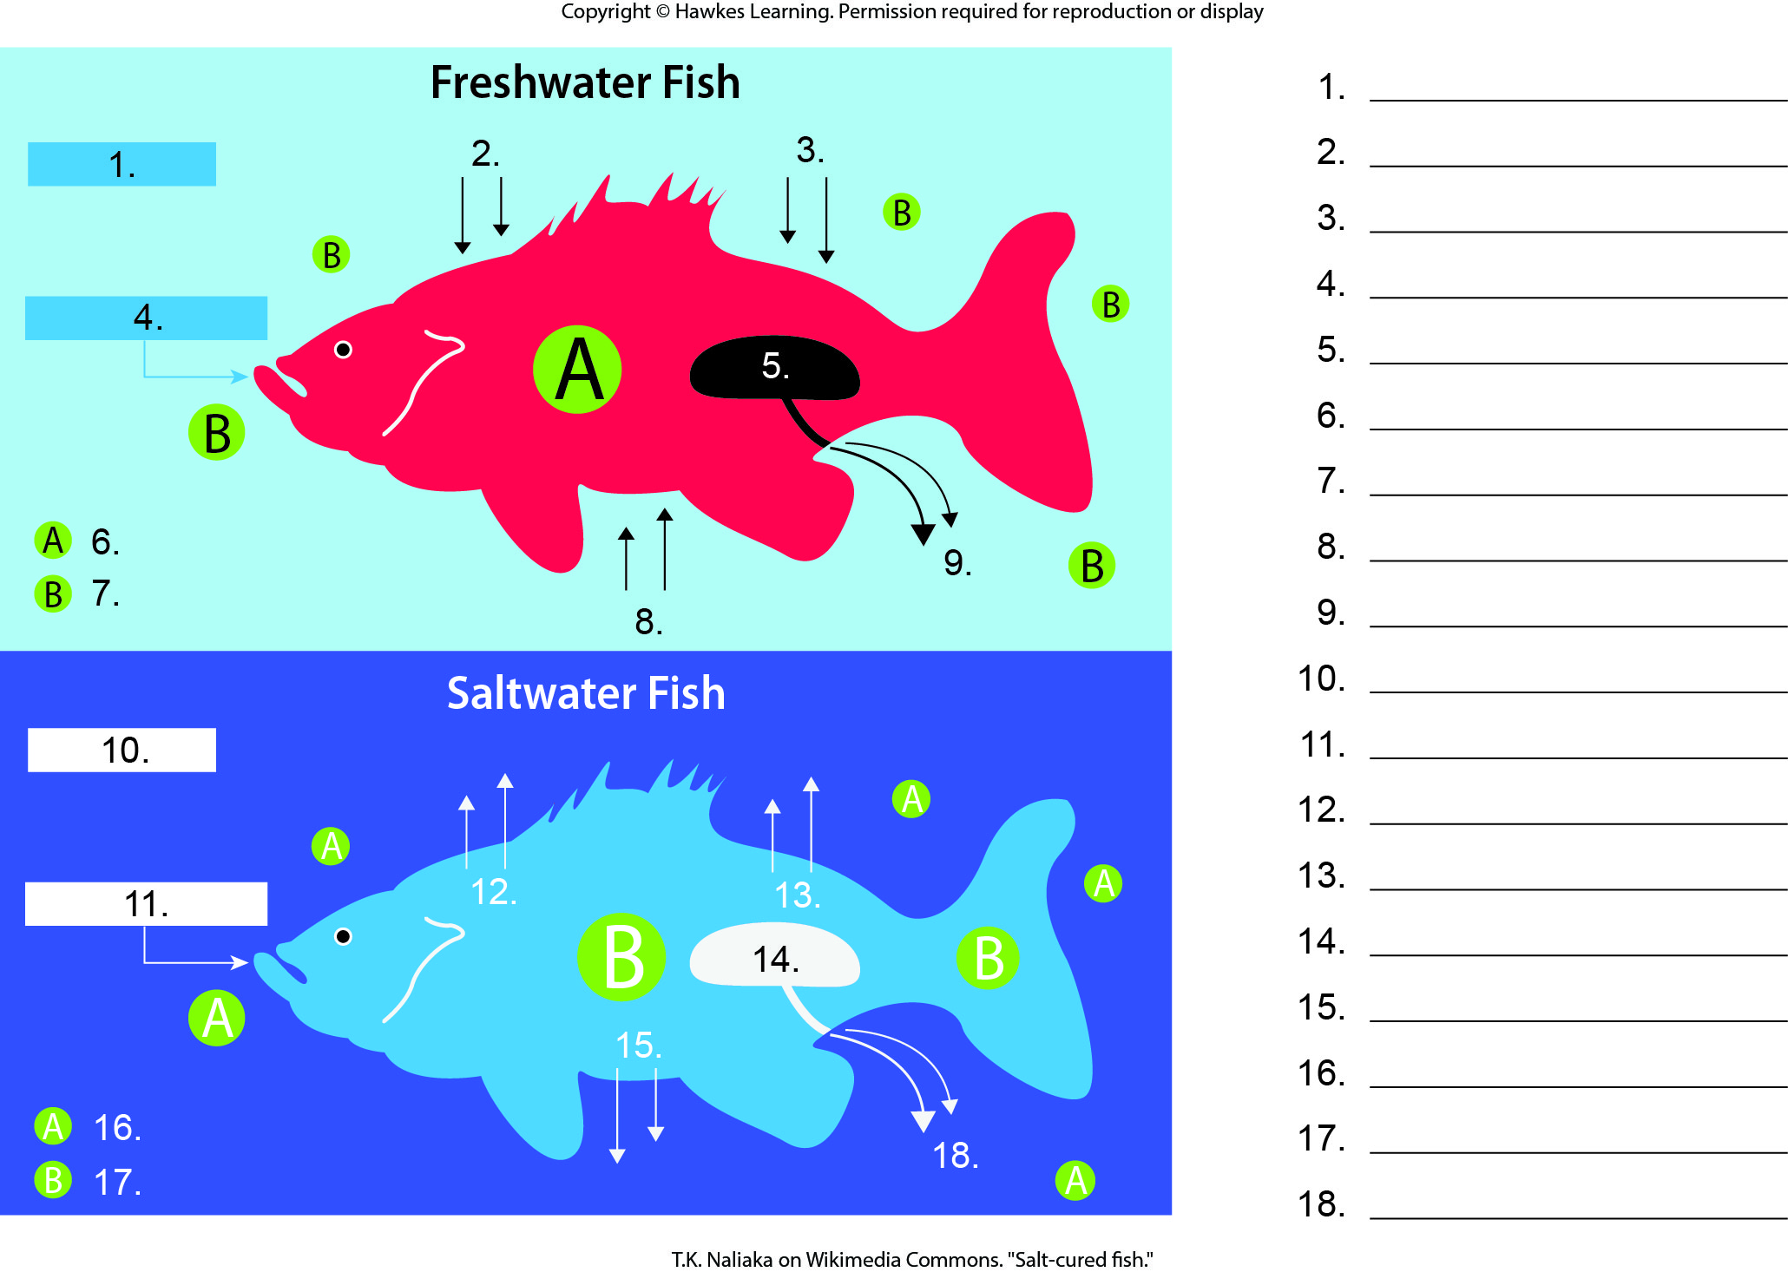
Lesson 5.2 Figure 14 - Numbered

Slide 33
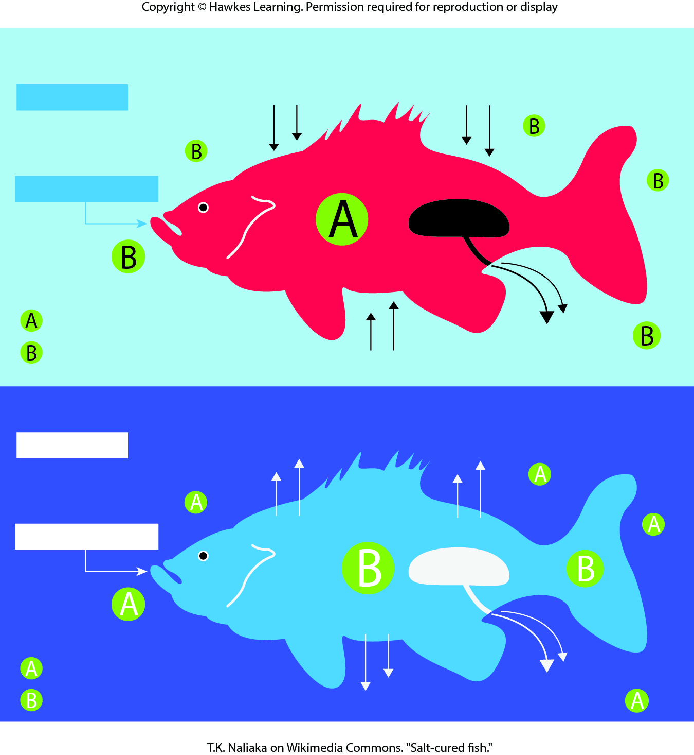
Lesson 5.2 Figure 14

Slide 34
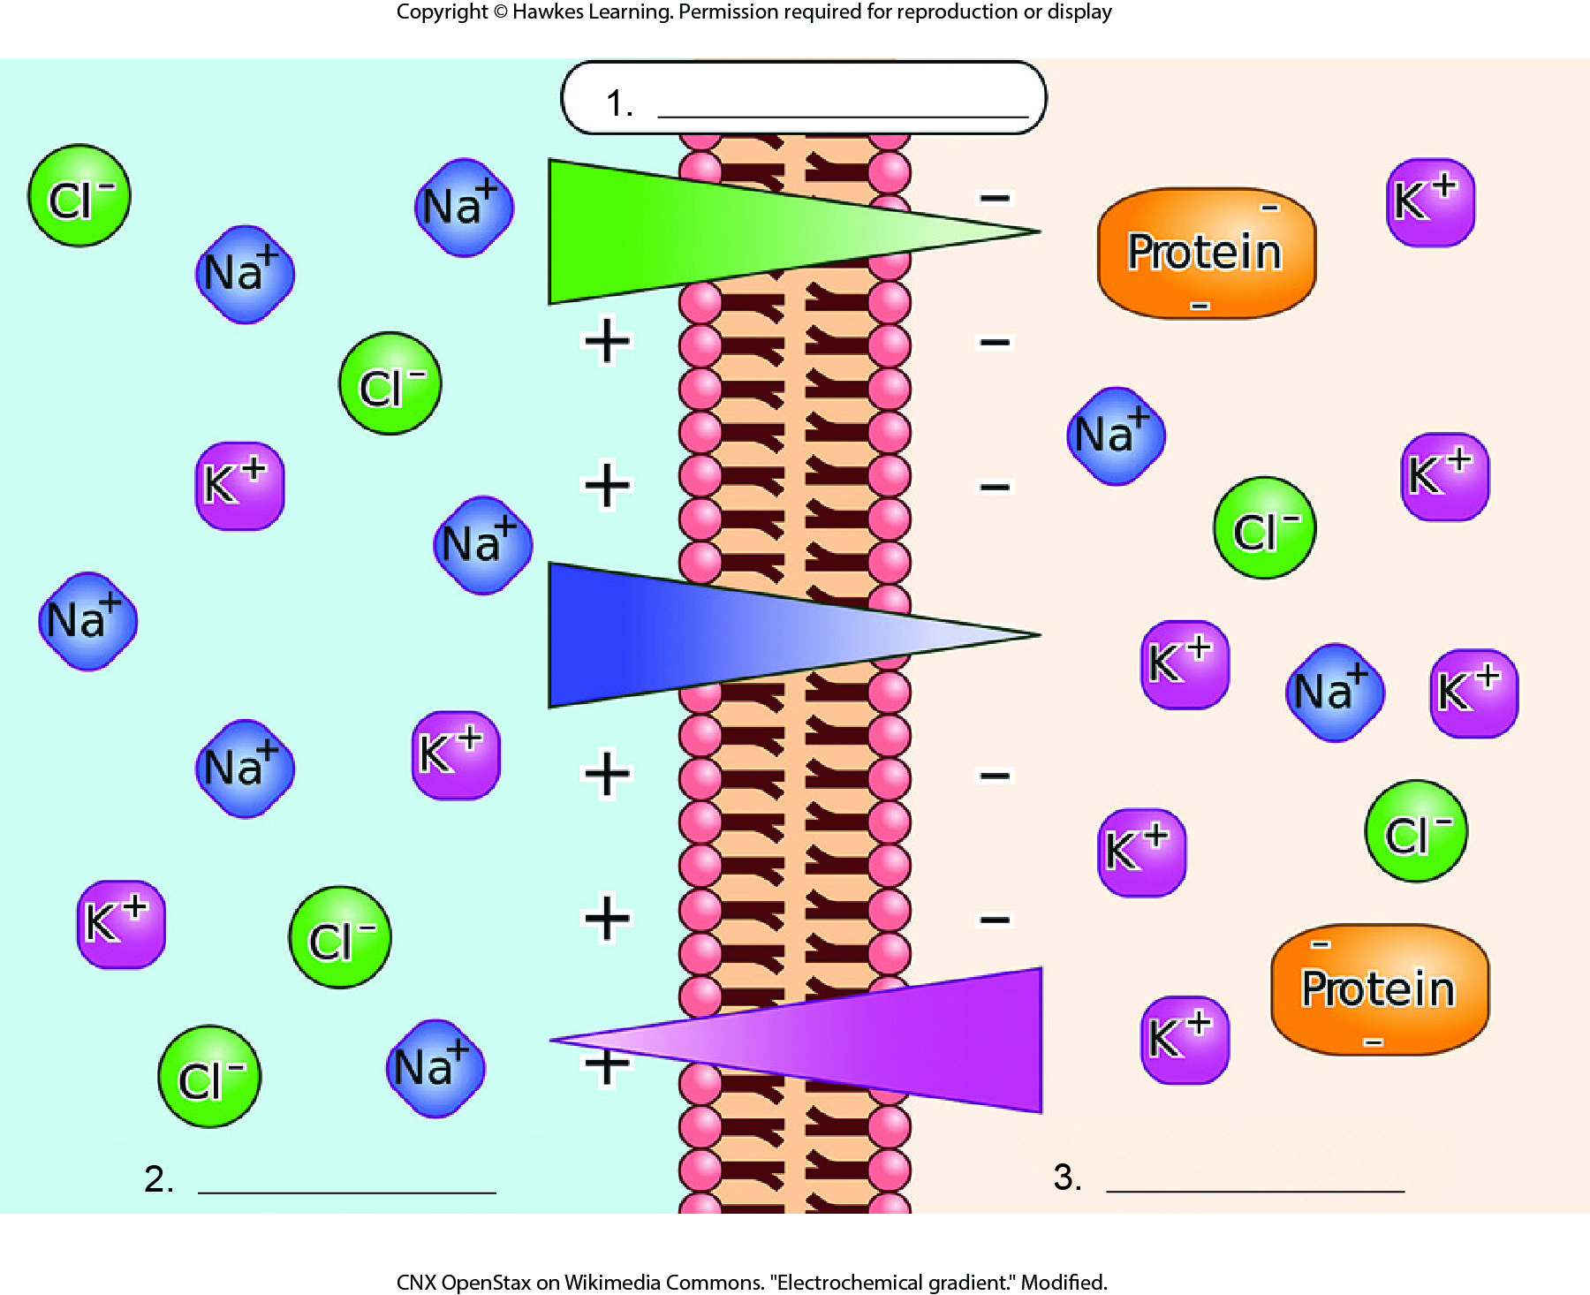
Lesson 5.3 Figure 2 - Numbered

Slide 35
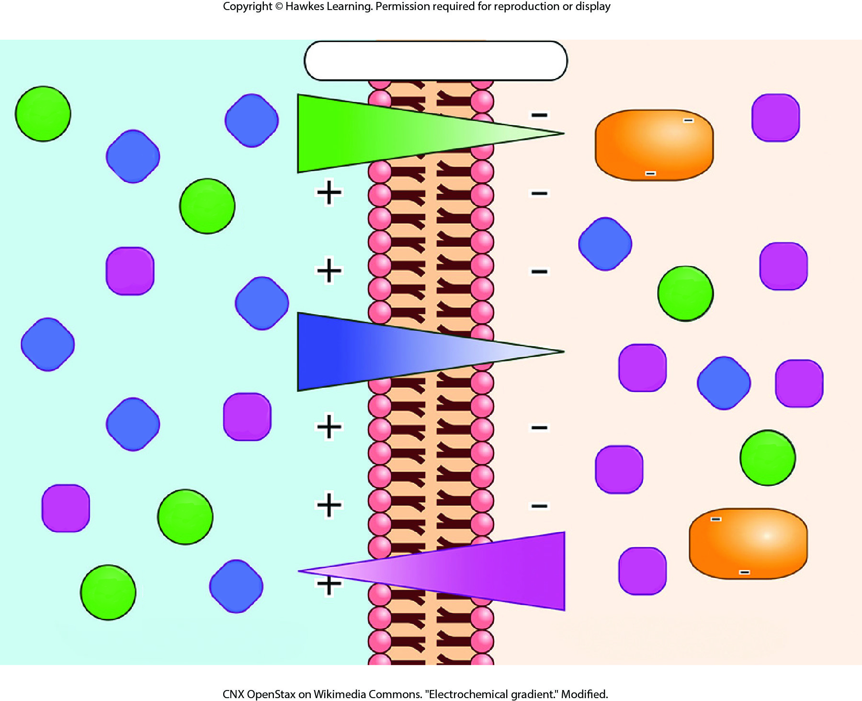
Lesson 5.3 Figure 2

Slide 36
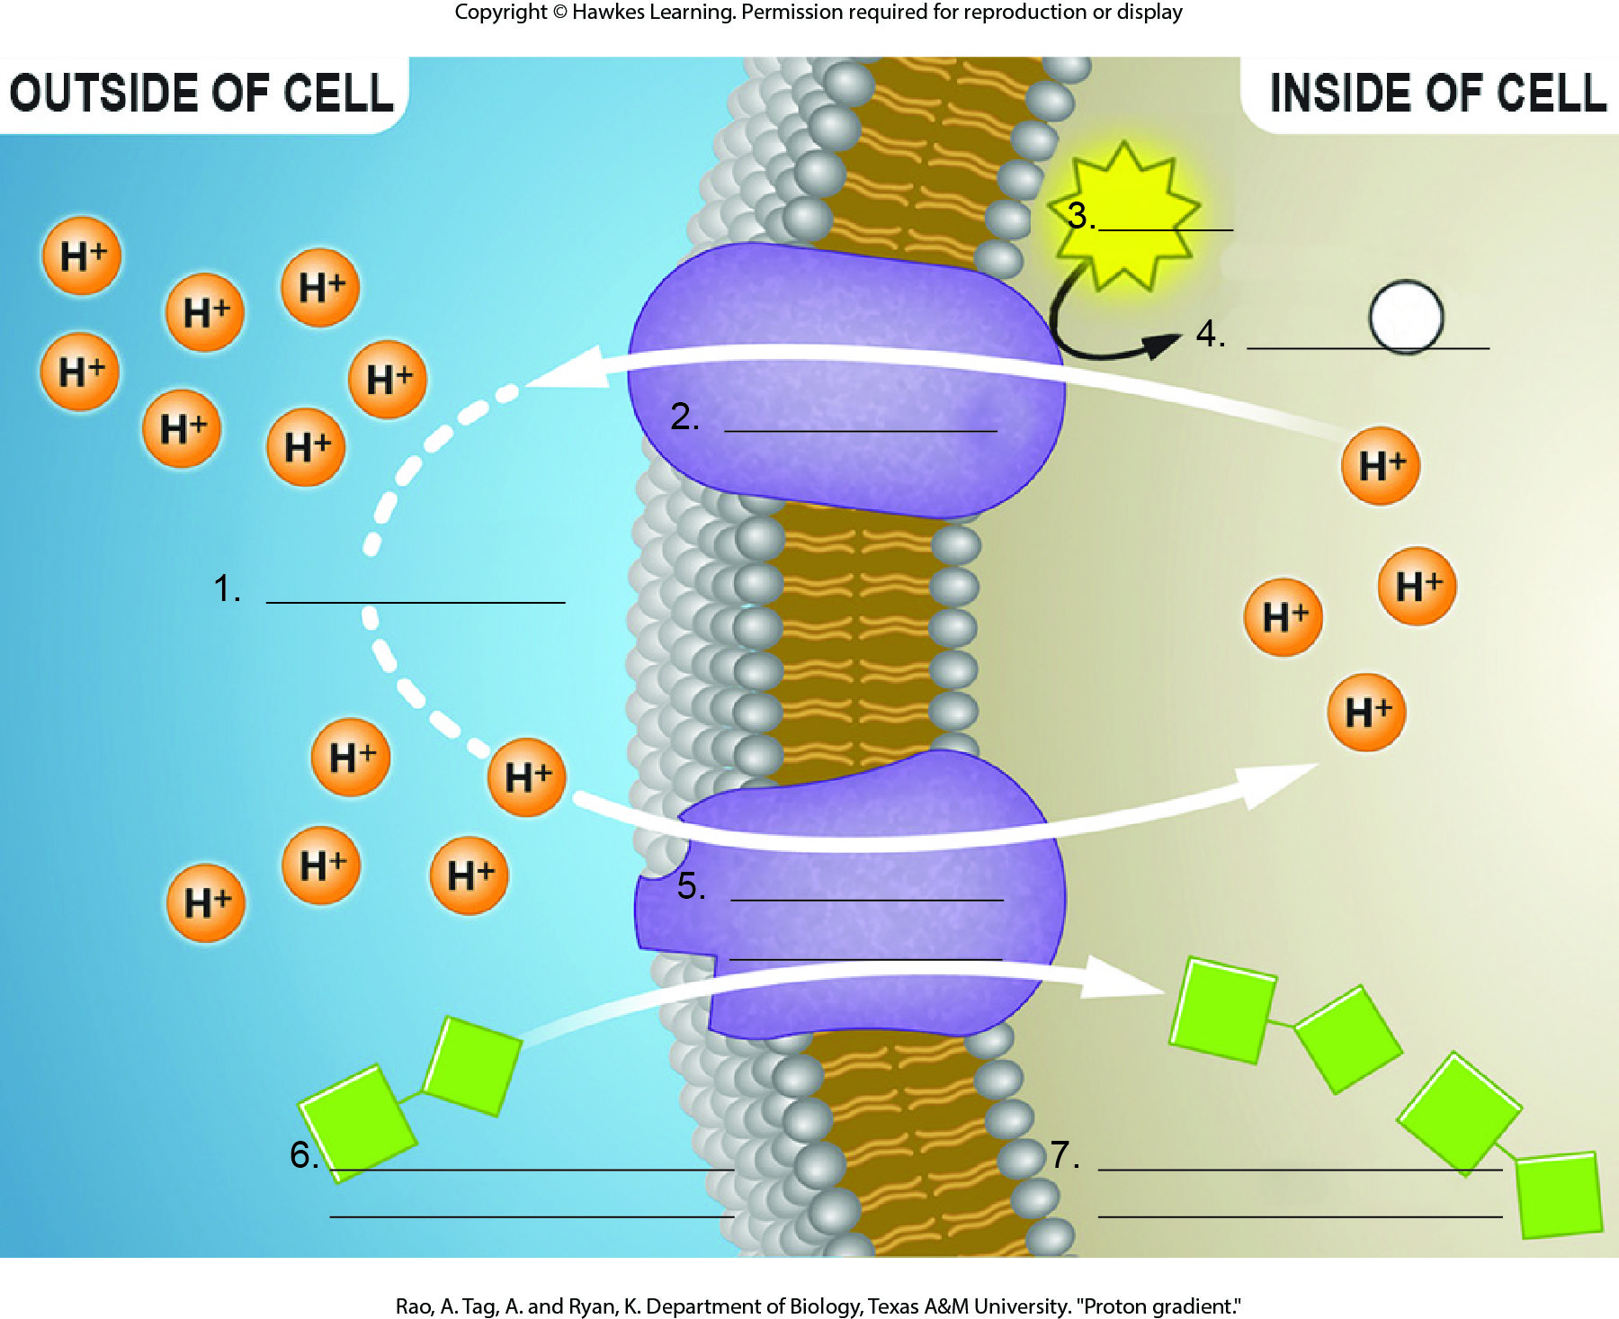
Lesson 5.3 Figure 3 - Numbered

Slide 37
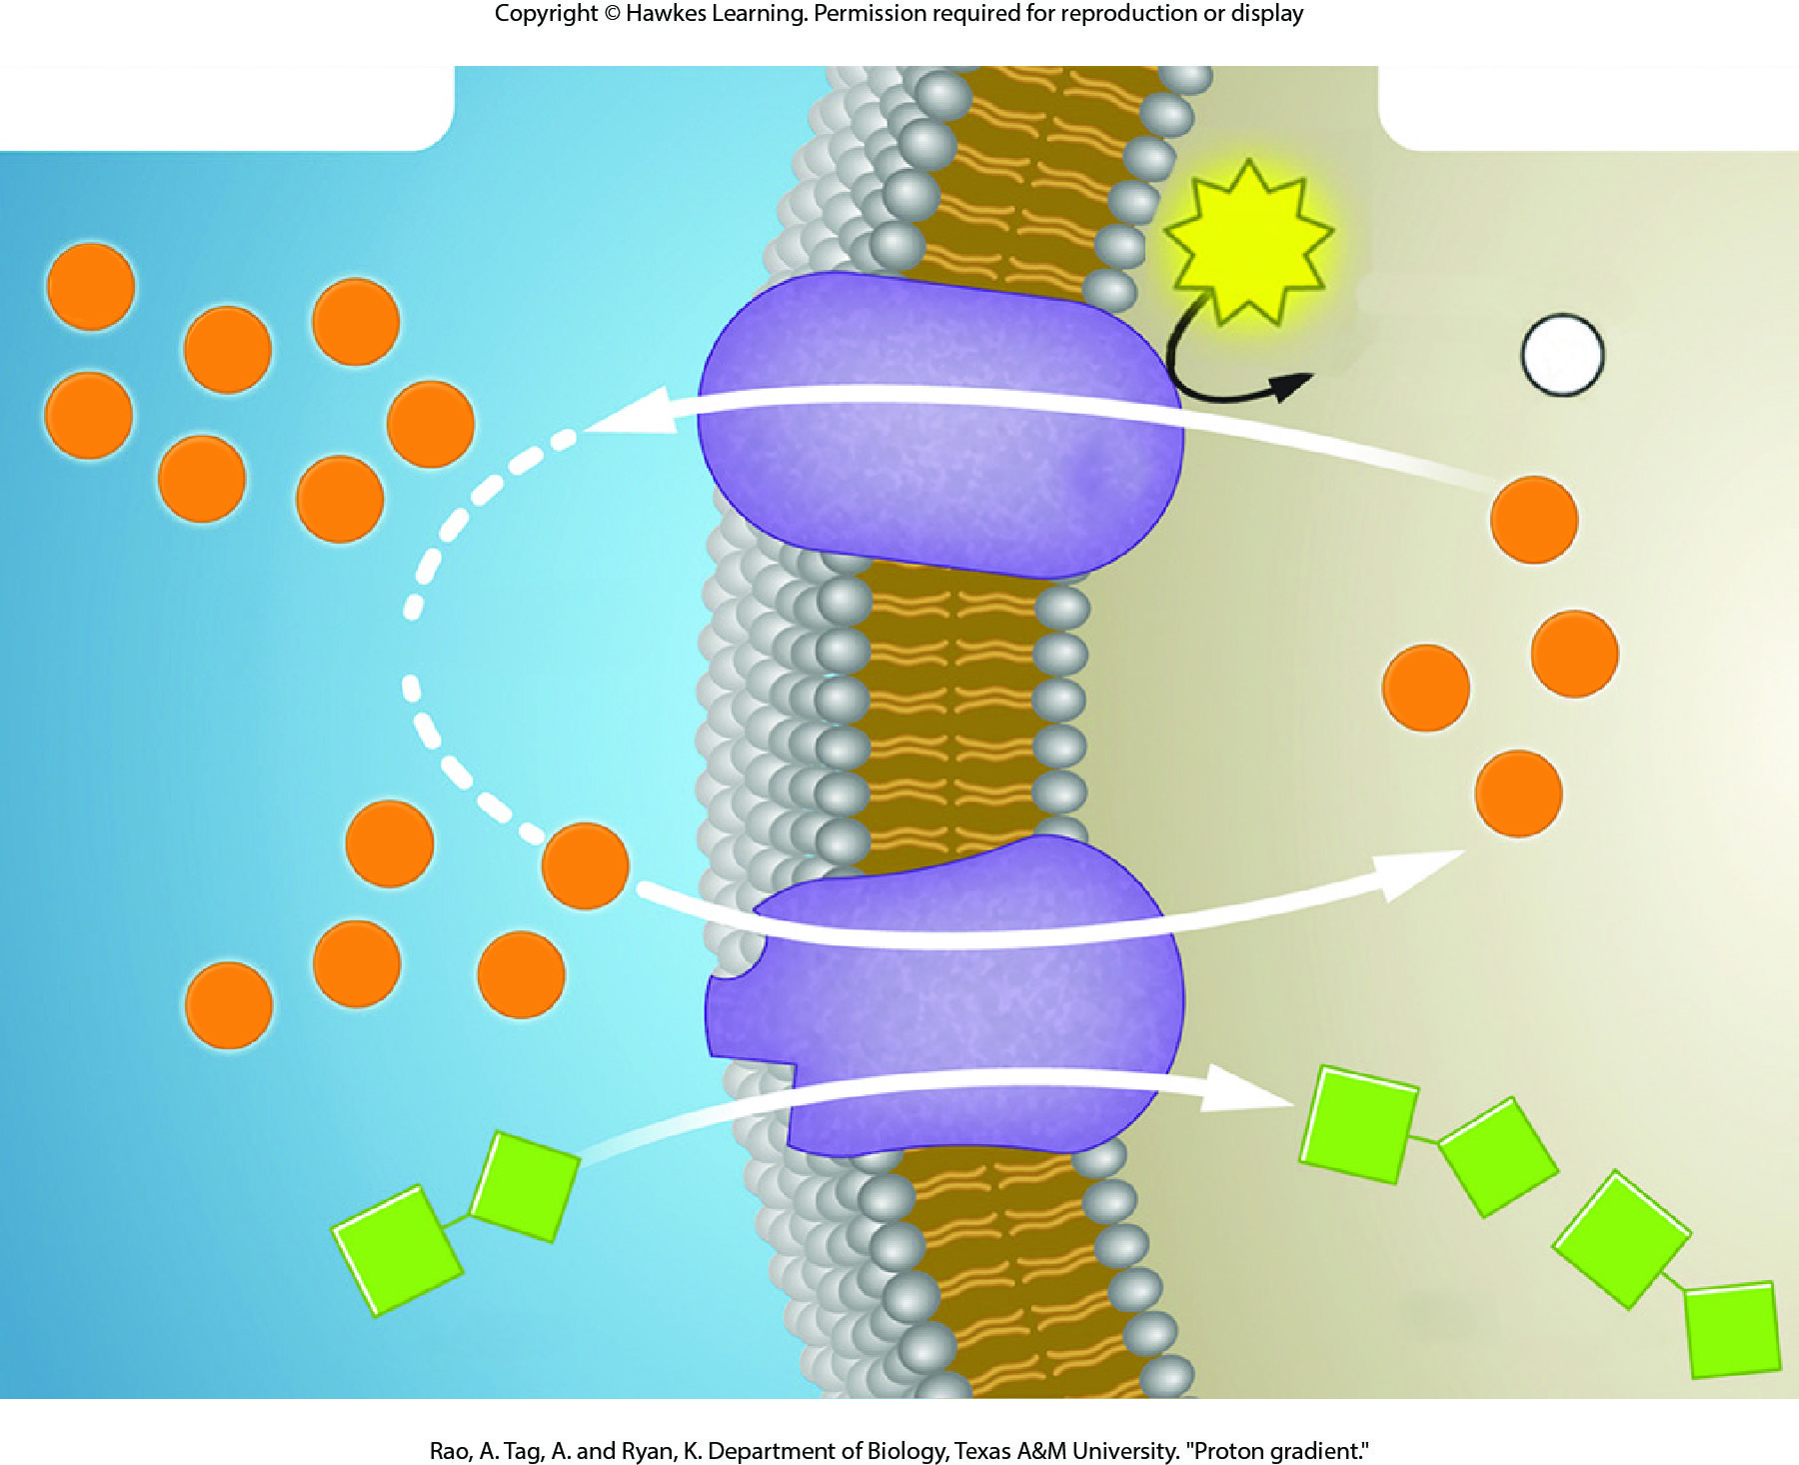
Lesson 5.3 Figure 3

Slide 38
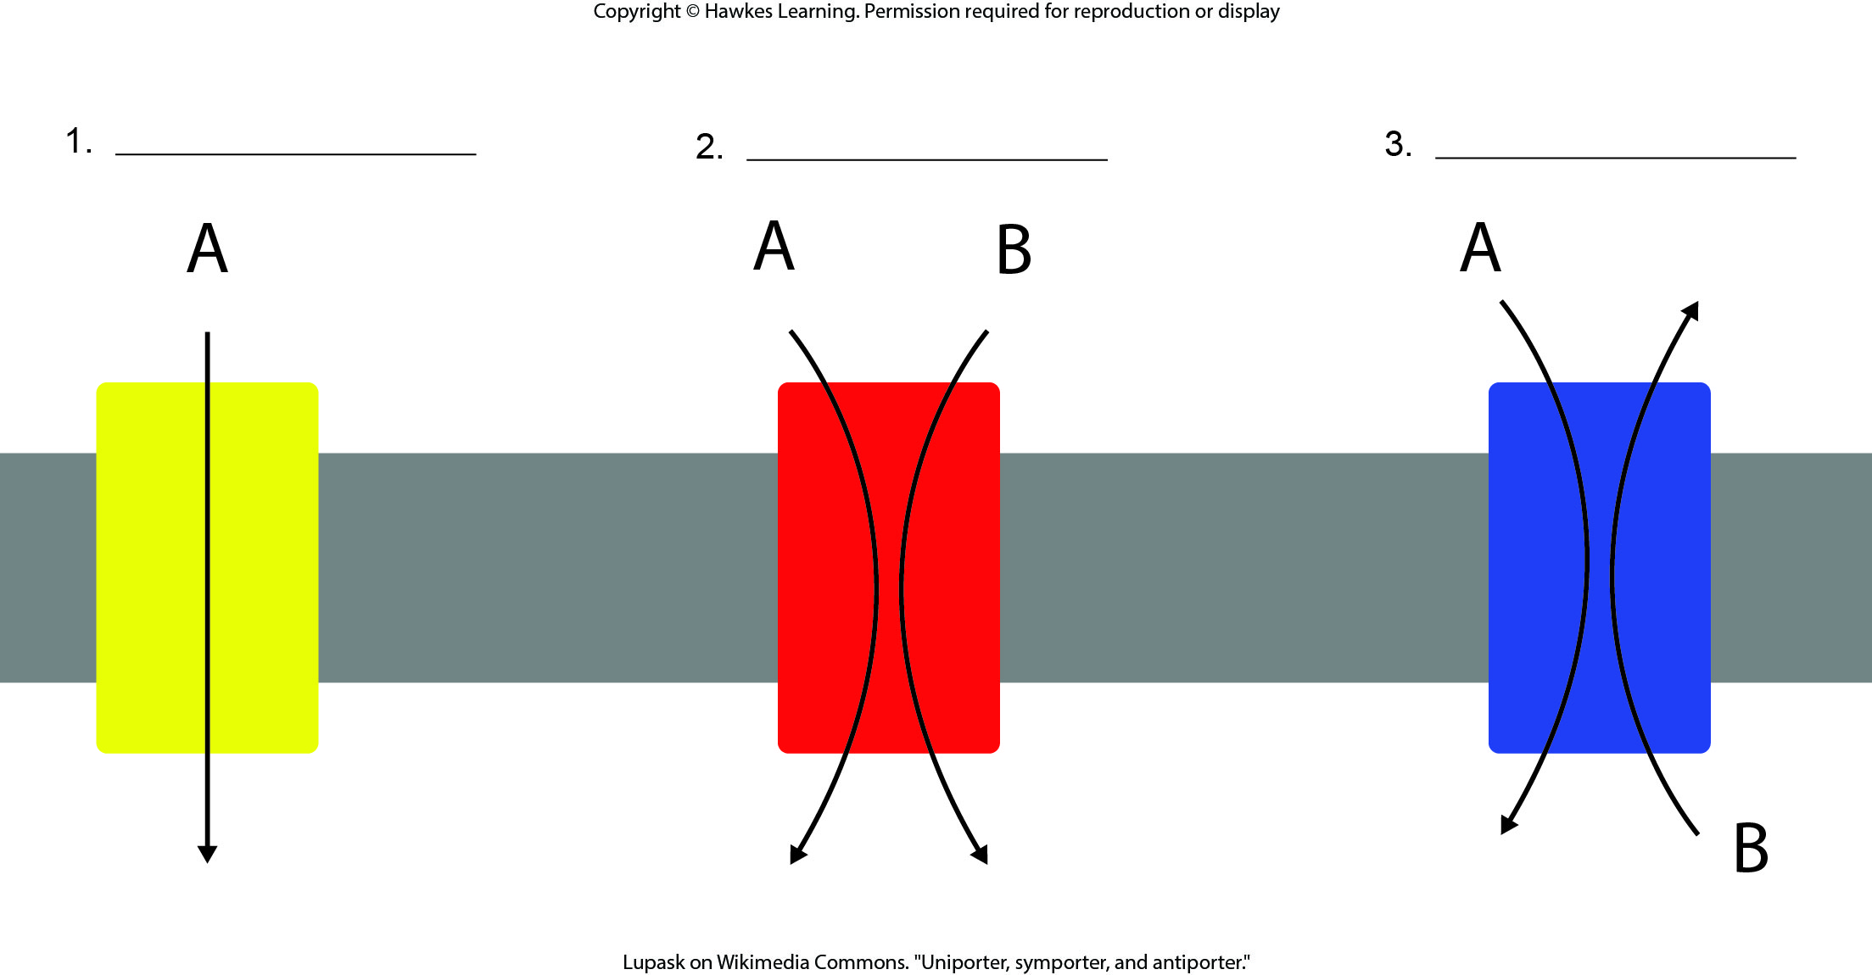
Lesson 5.3 Figure 4 - Numbered

Slide 39
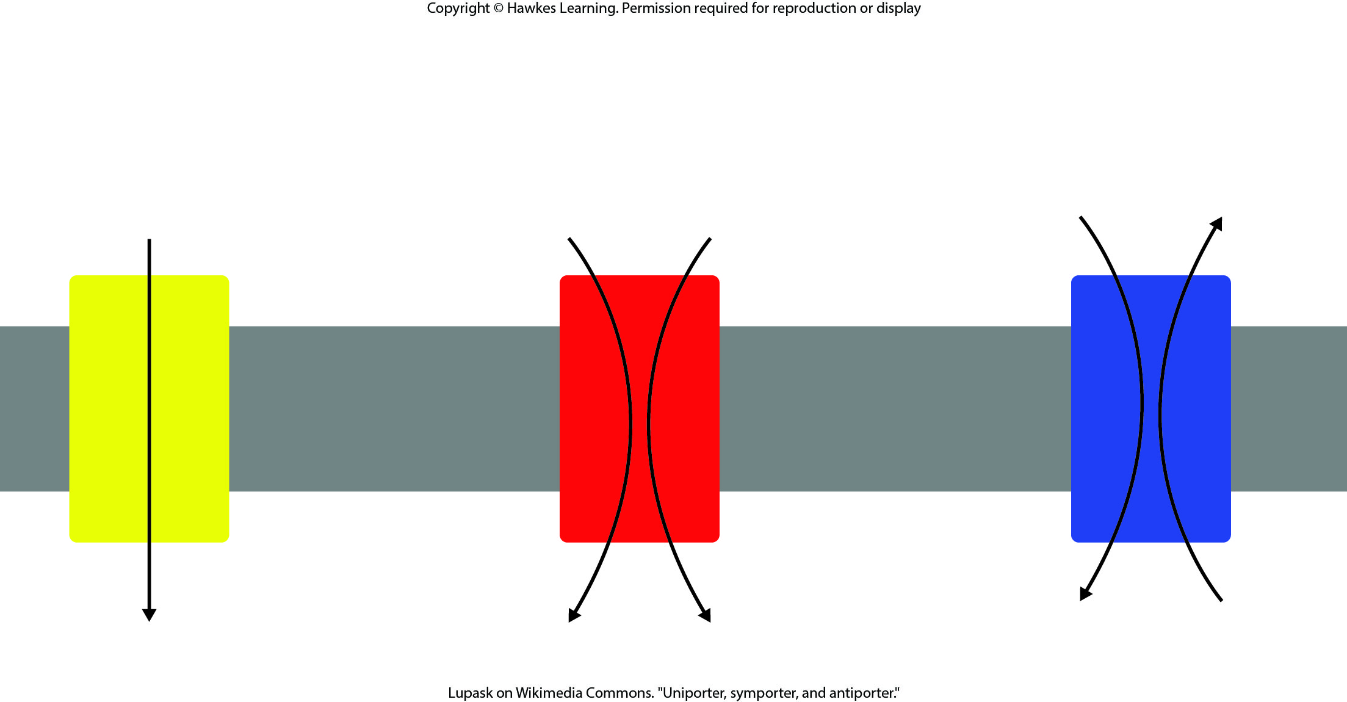
Lesson 5.3 Figure 4

Slide 40
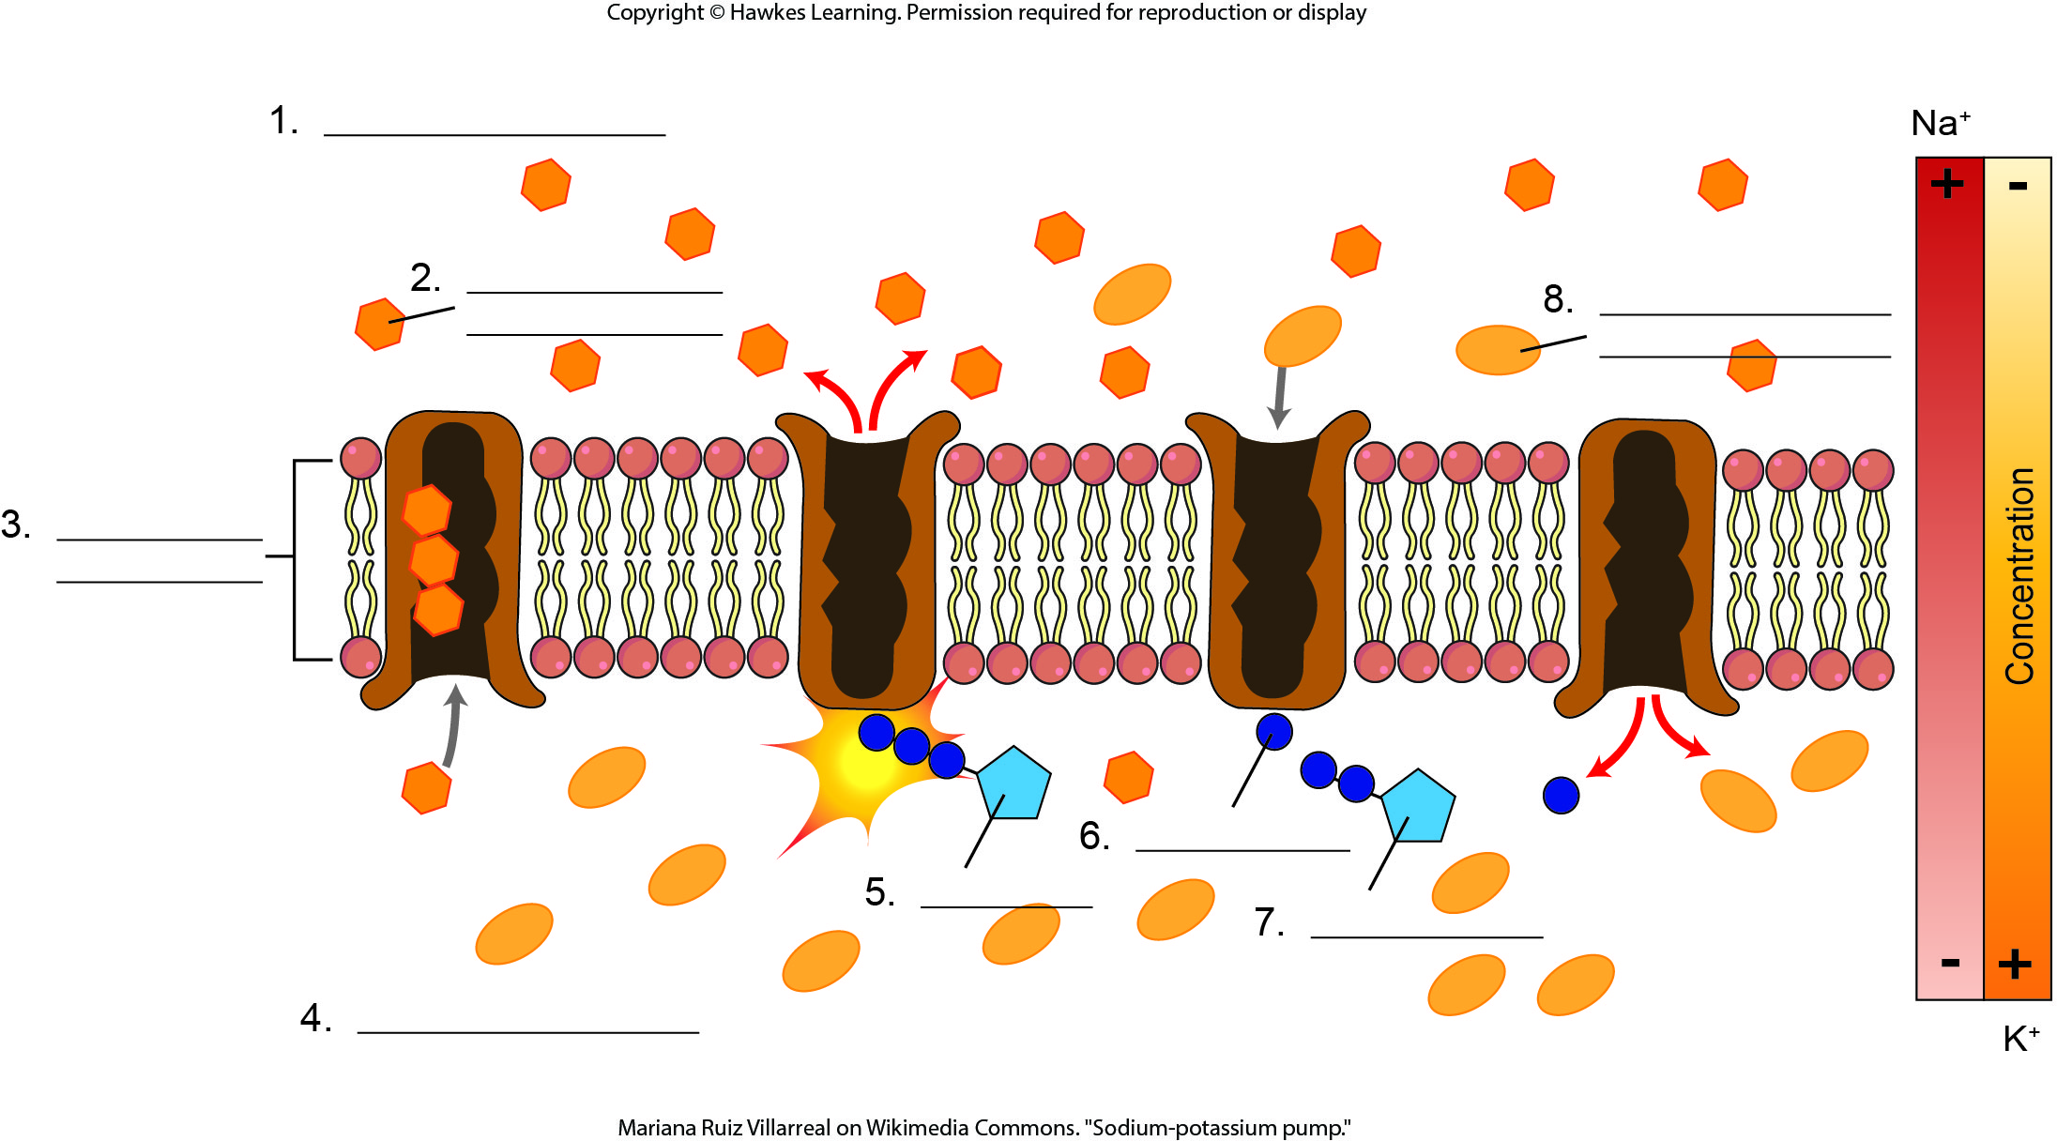
Lesson 5.3 Figure 5 - Numbered

Slide 41
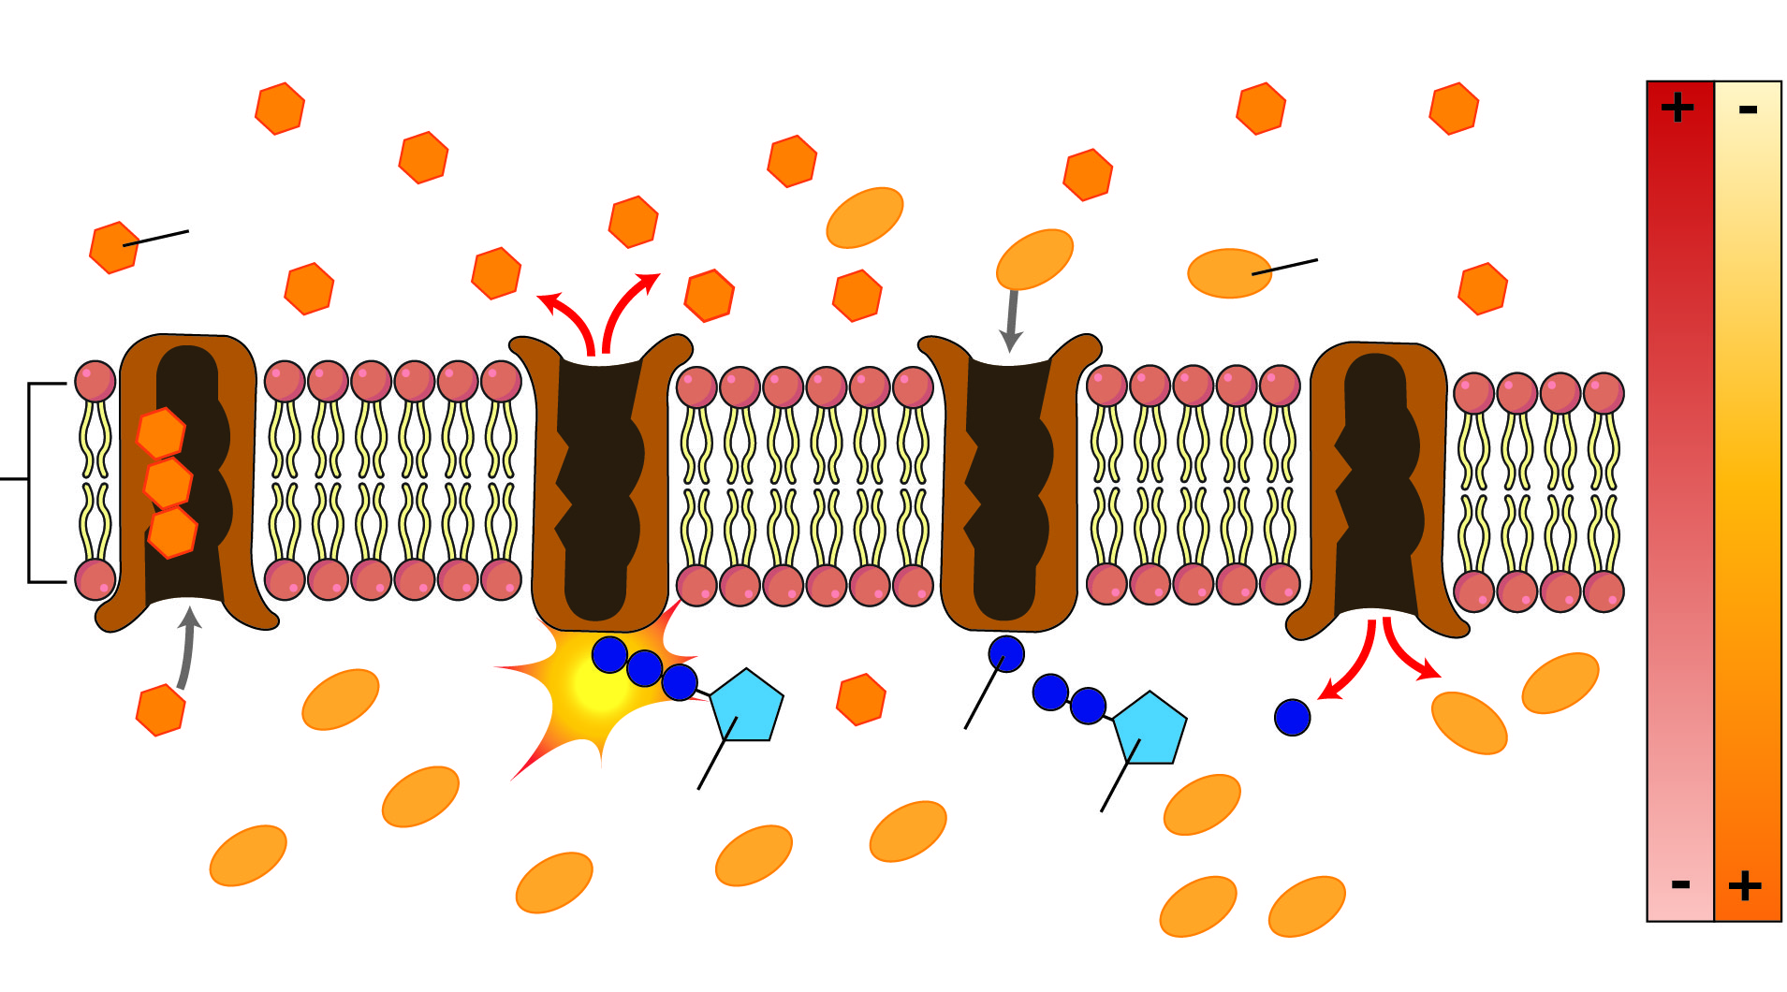
Lesson 5.3 Figure 5

Slide 42
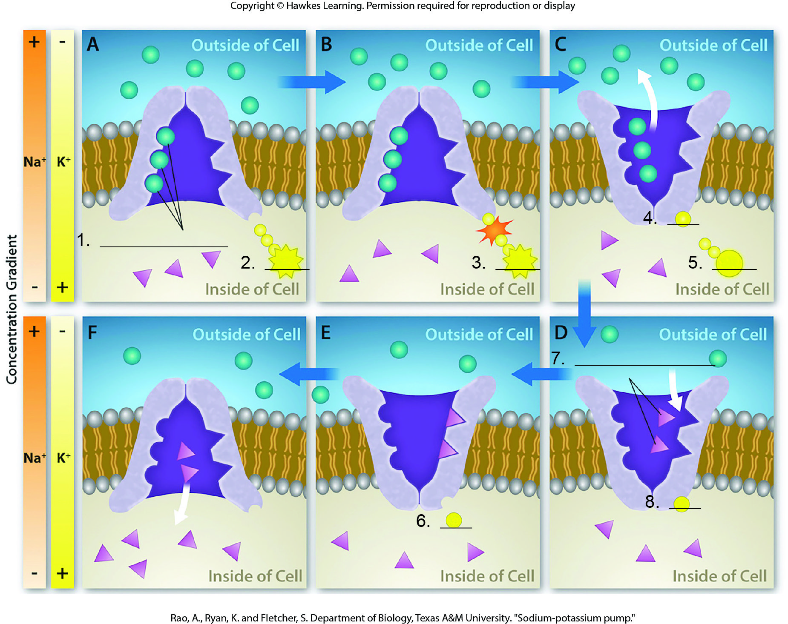
Lesson 5.3 Figure 6 - Numbered

Slide 43
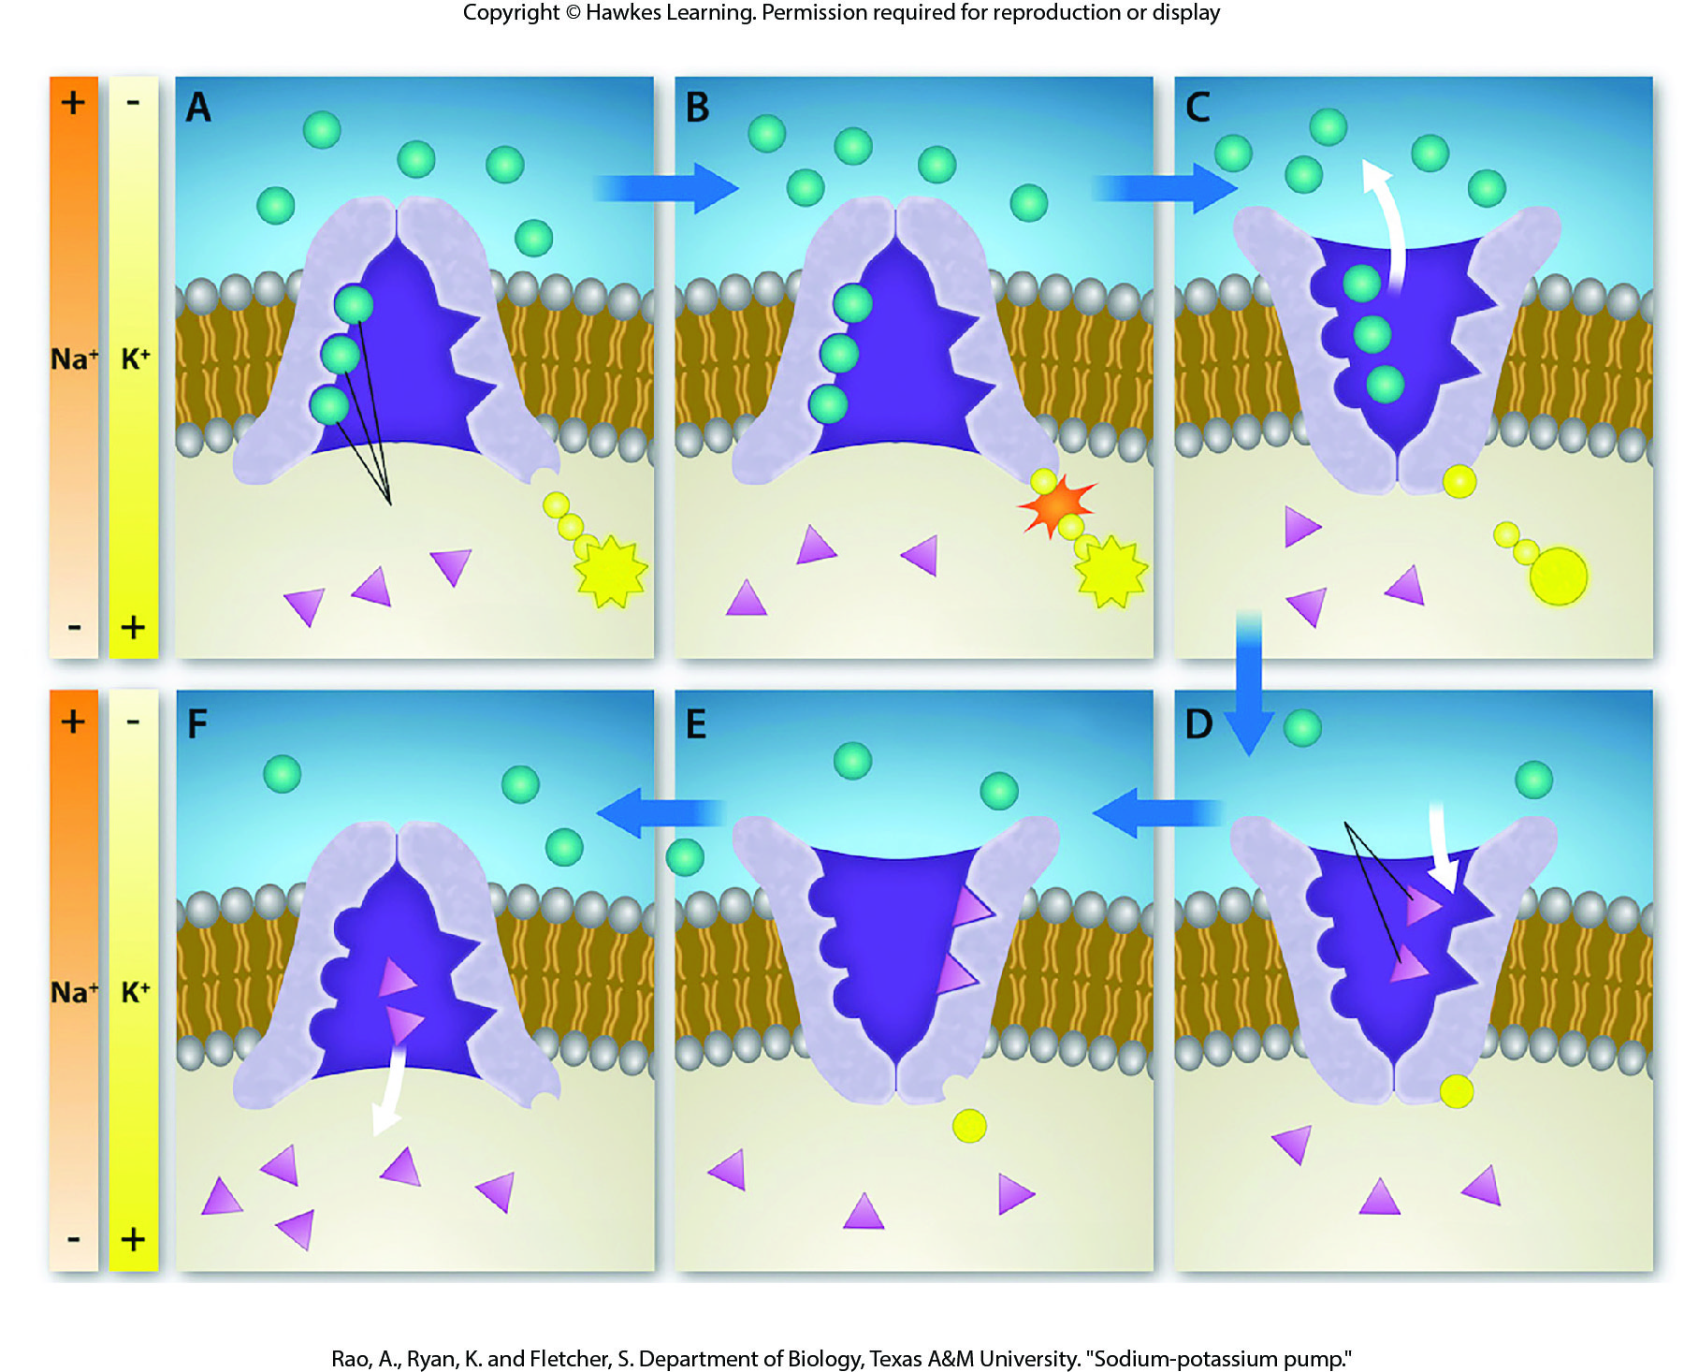
Lesson 5.3 Figure 6

Slide 44
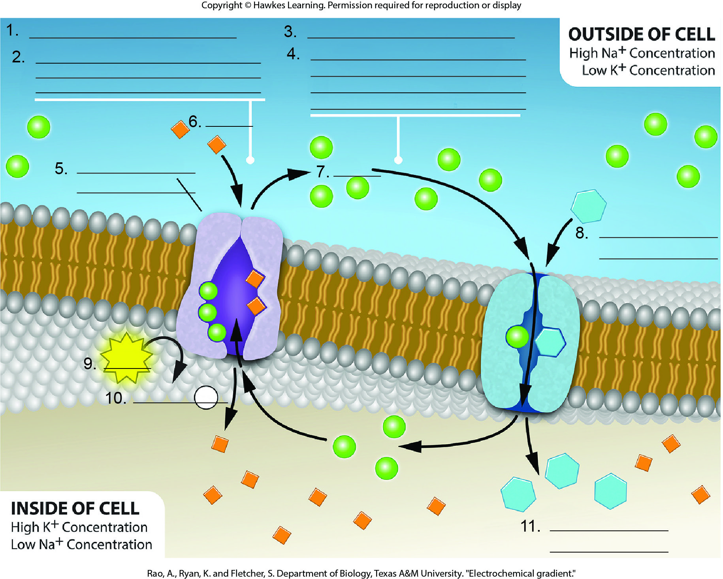
Lesson 5.3 Figure 7 - Numbered

Slide 45
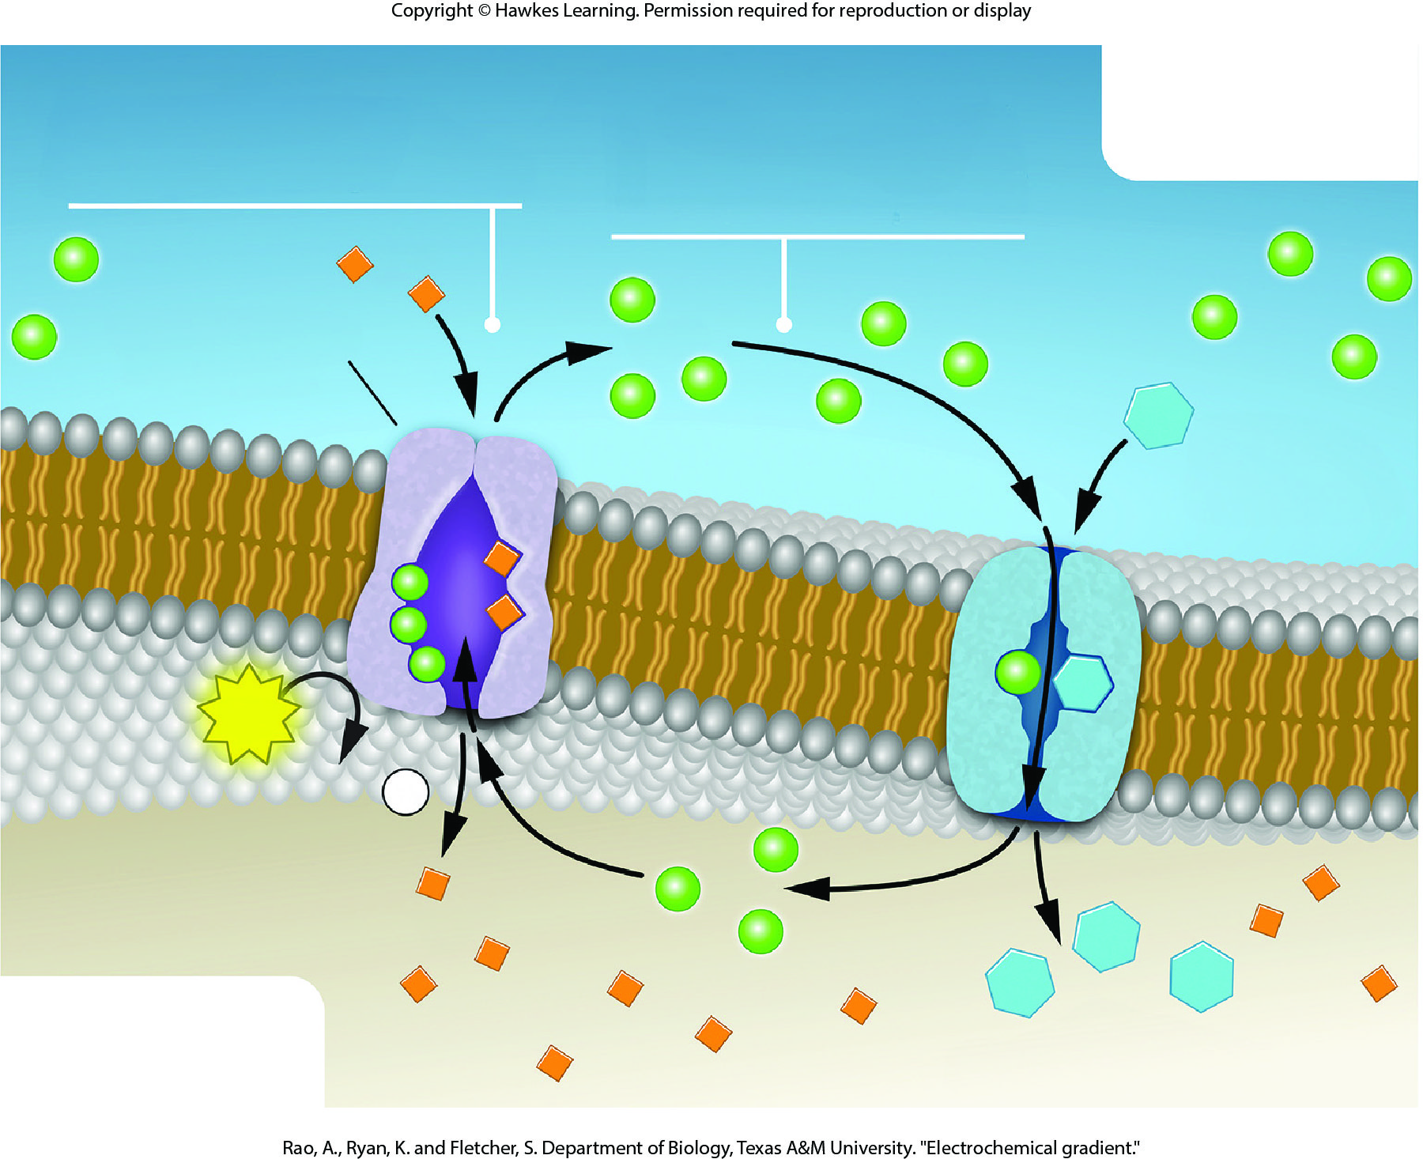
Lesson 5.3 Figure 7

Slide 46
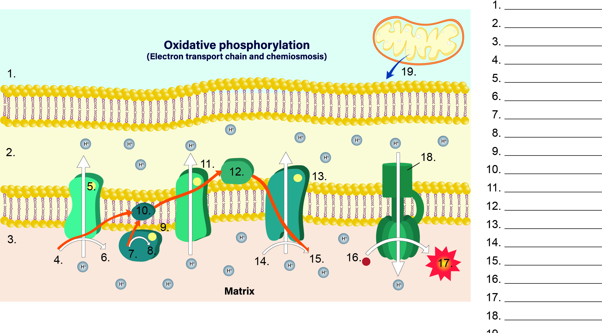
Lesson 5.3 Figure 8 - Numbered

Slide 47
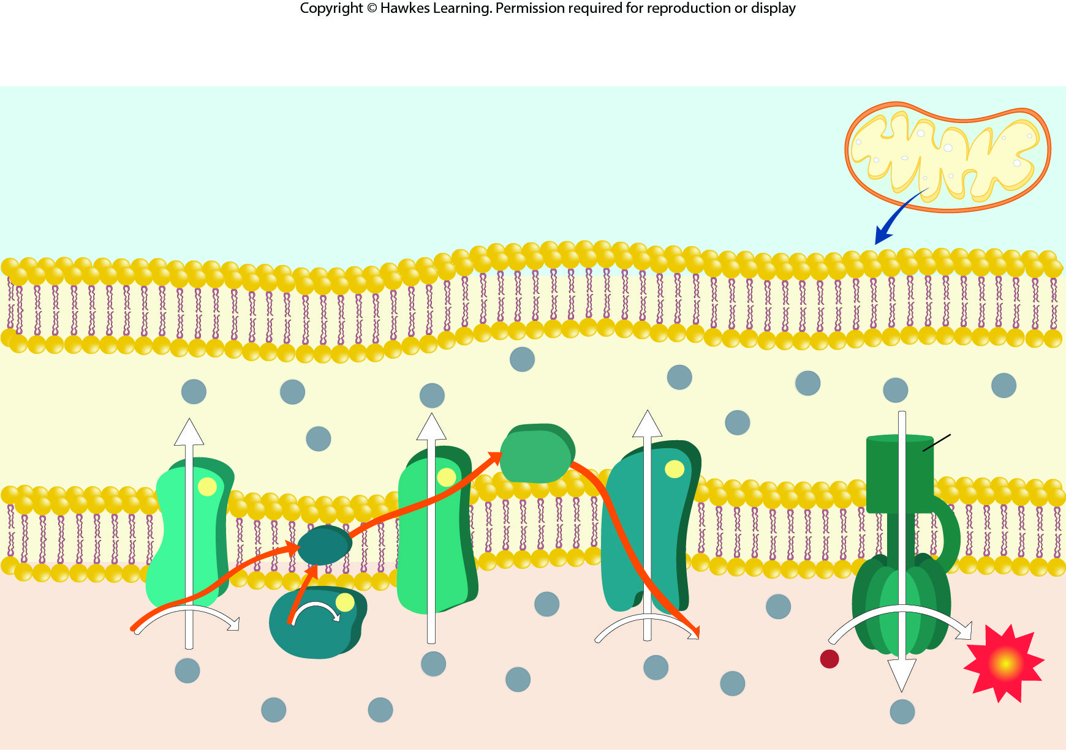
Lesson 5.3 Figure 8

Slide 48
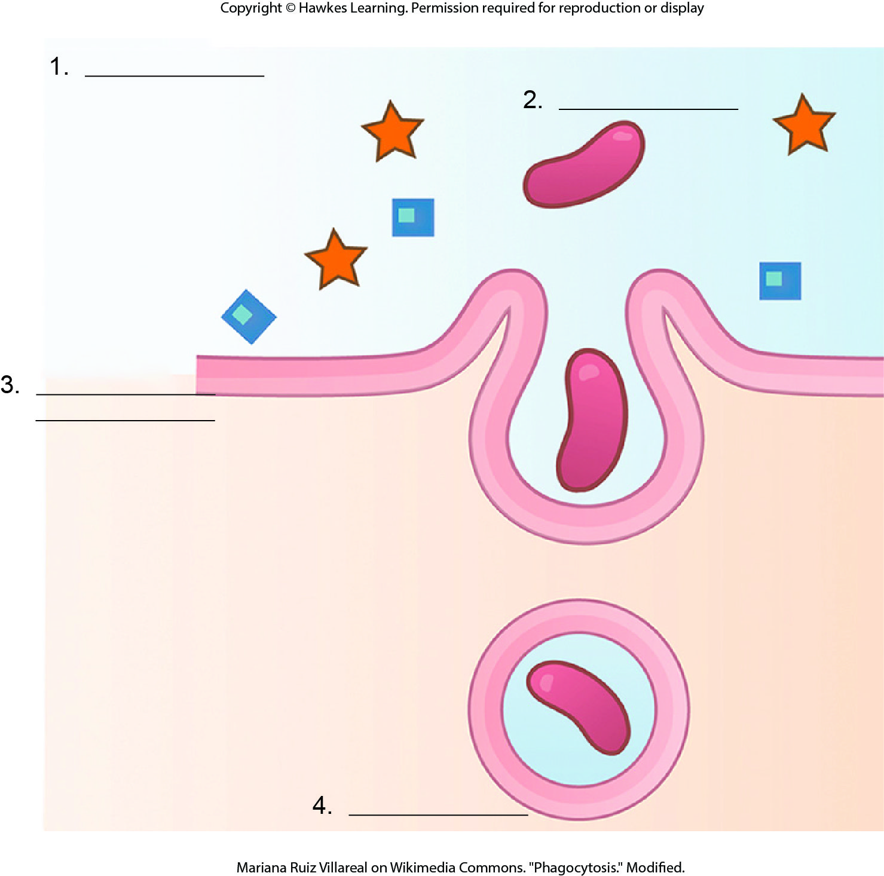
Lesson 5.4 Figure 1 - Numbered

Slide 49
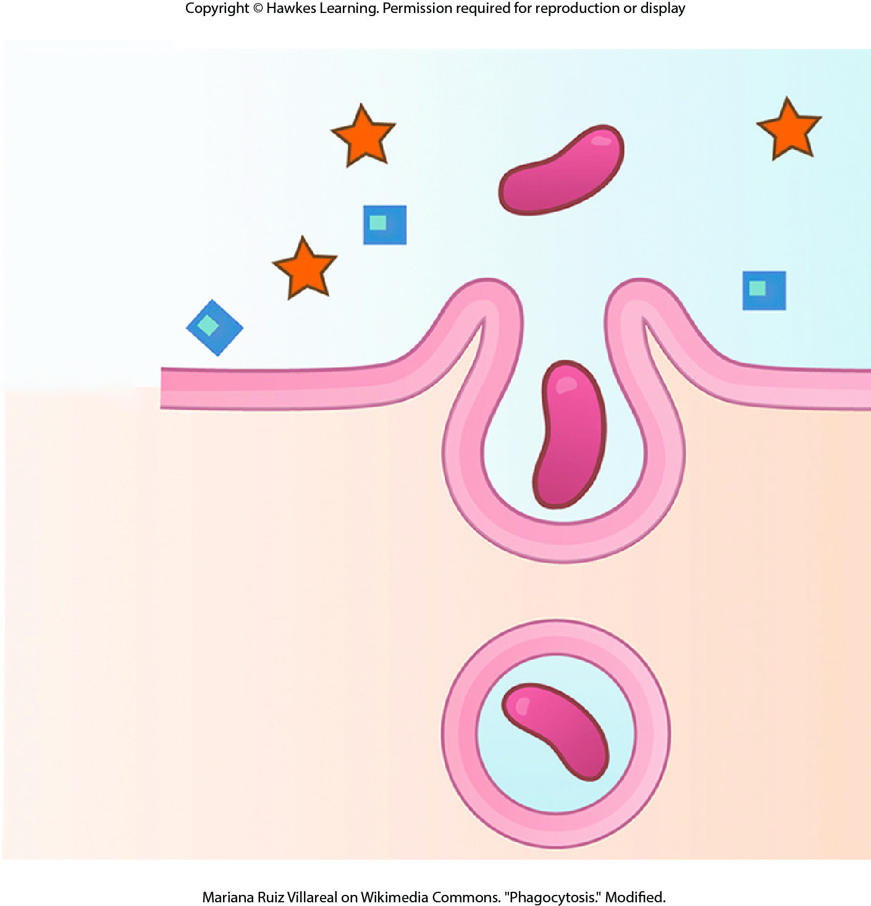
Lesson 5.4 Figure 1

Slide 50
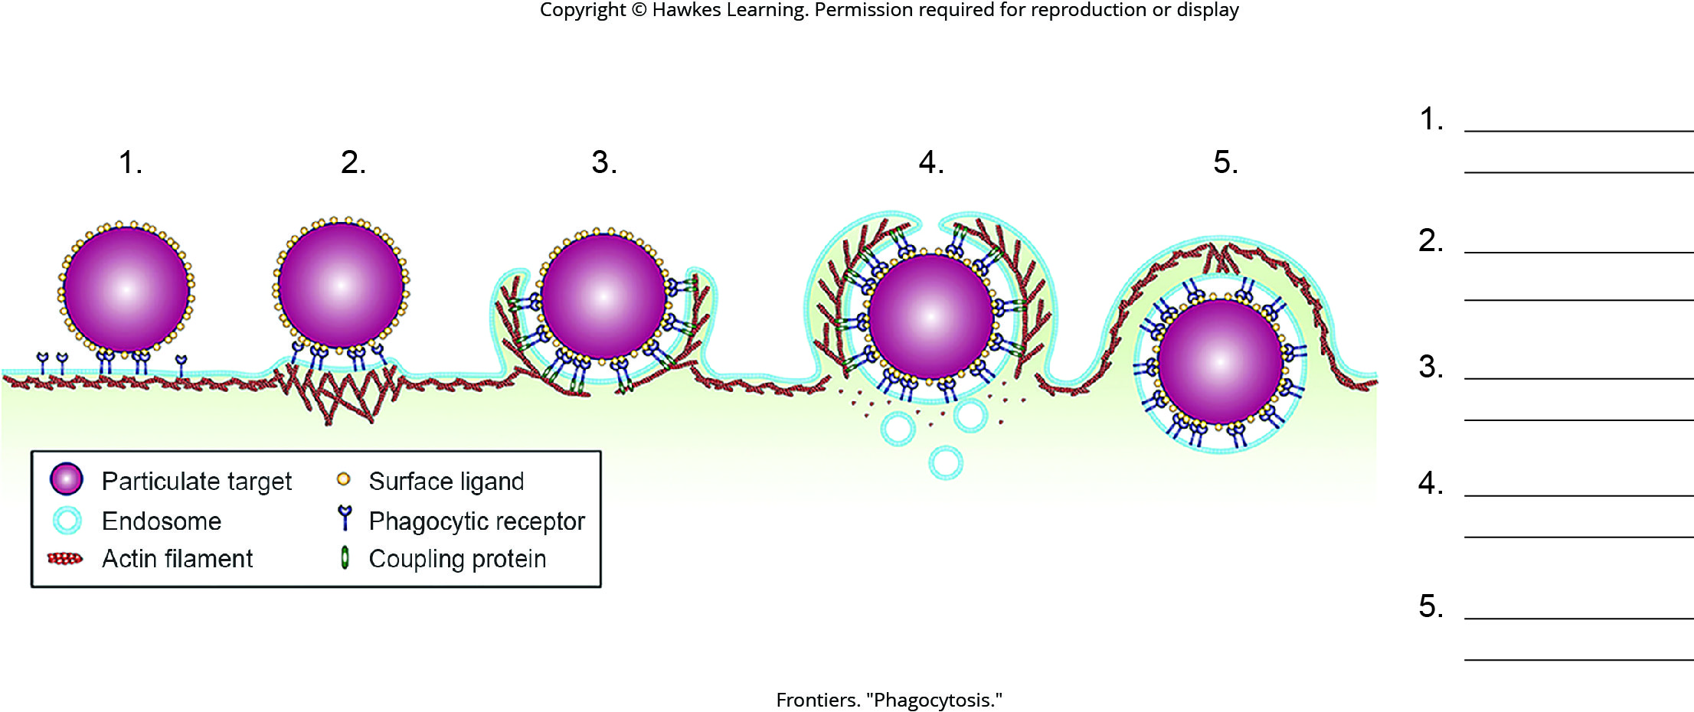
Lesson 5.4 Figure 2 - Numbered

Slide 51
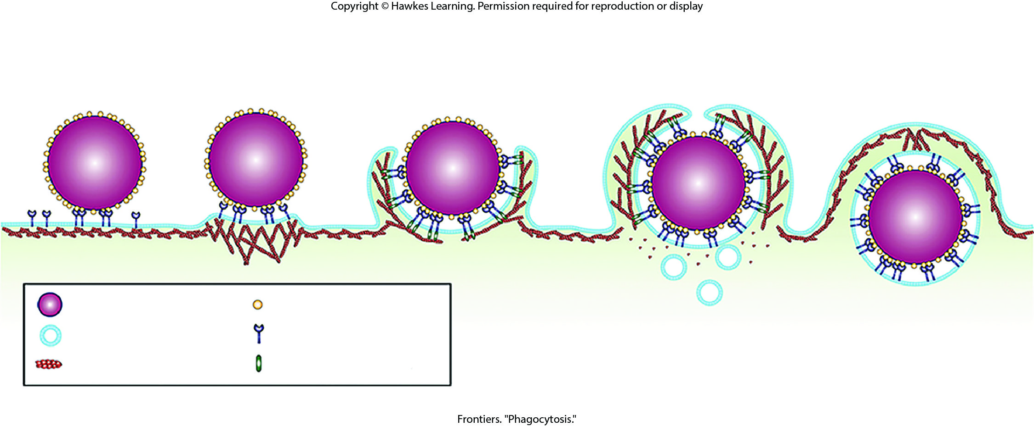
Lesson 5.4 Figure 2

Slide 52
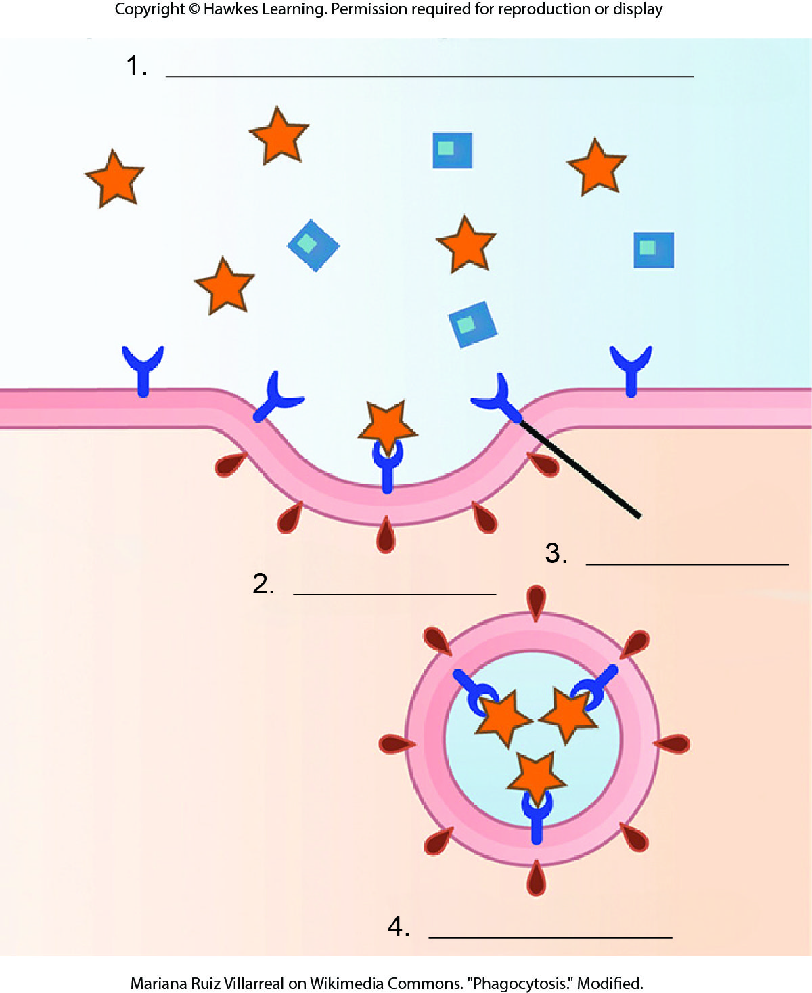
Lesson 5.4 Figure 3 - Numbered

Slide 53

Lesson 5.4 Figure 3

Slide 54

Lesson 5.4 Figure 4 - Numbered

Slide 55

Lesson 5.4 Figure 4

Slide 56

Lesson 5.4 Figure 5 - Numbered

Slide 57

Lesson 5.4 Figure 5

Slide 58

Lesson 5.4 Figure 6 - Numbered

Slide 59

Lesson 5.4 Figure 6

Slide 60

Lesson 5.4 Figure 7 - Numbered

Slide 61

Lesson 5.4 Figure 7

Slide 62

Lesson 5.5 Figure 1 - Numbered

Slide 63

Lesson 5.5 Figure 1

Slide 64

Lesson 5.5 Figure 2 - Numbered

Slide 65

Lesson 5.5 Figure 2

Slide 66

Lesson 5.5 Figure 3 - Numbered

Slide 67

Lesson 5.5 Figure 3

Slide 68

Lesson 5.5 Figure 4 - Numbered

Slide 69

Lesson 5.5 Figure 4

Slide 70

Lesson 5.5 Figure 5 - Numbered

Slide 71

Lesson 5.5 Figure 5

Slide 72

Lesson 5.5 Figure 6 - Numbered

Slide 73

Lesson 5.5 Figure 6

Slide 74
Hawkes Learning – End of PowerPoint

