Slide 1
Chapter 8
Photosynthesis

Slide 2
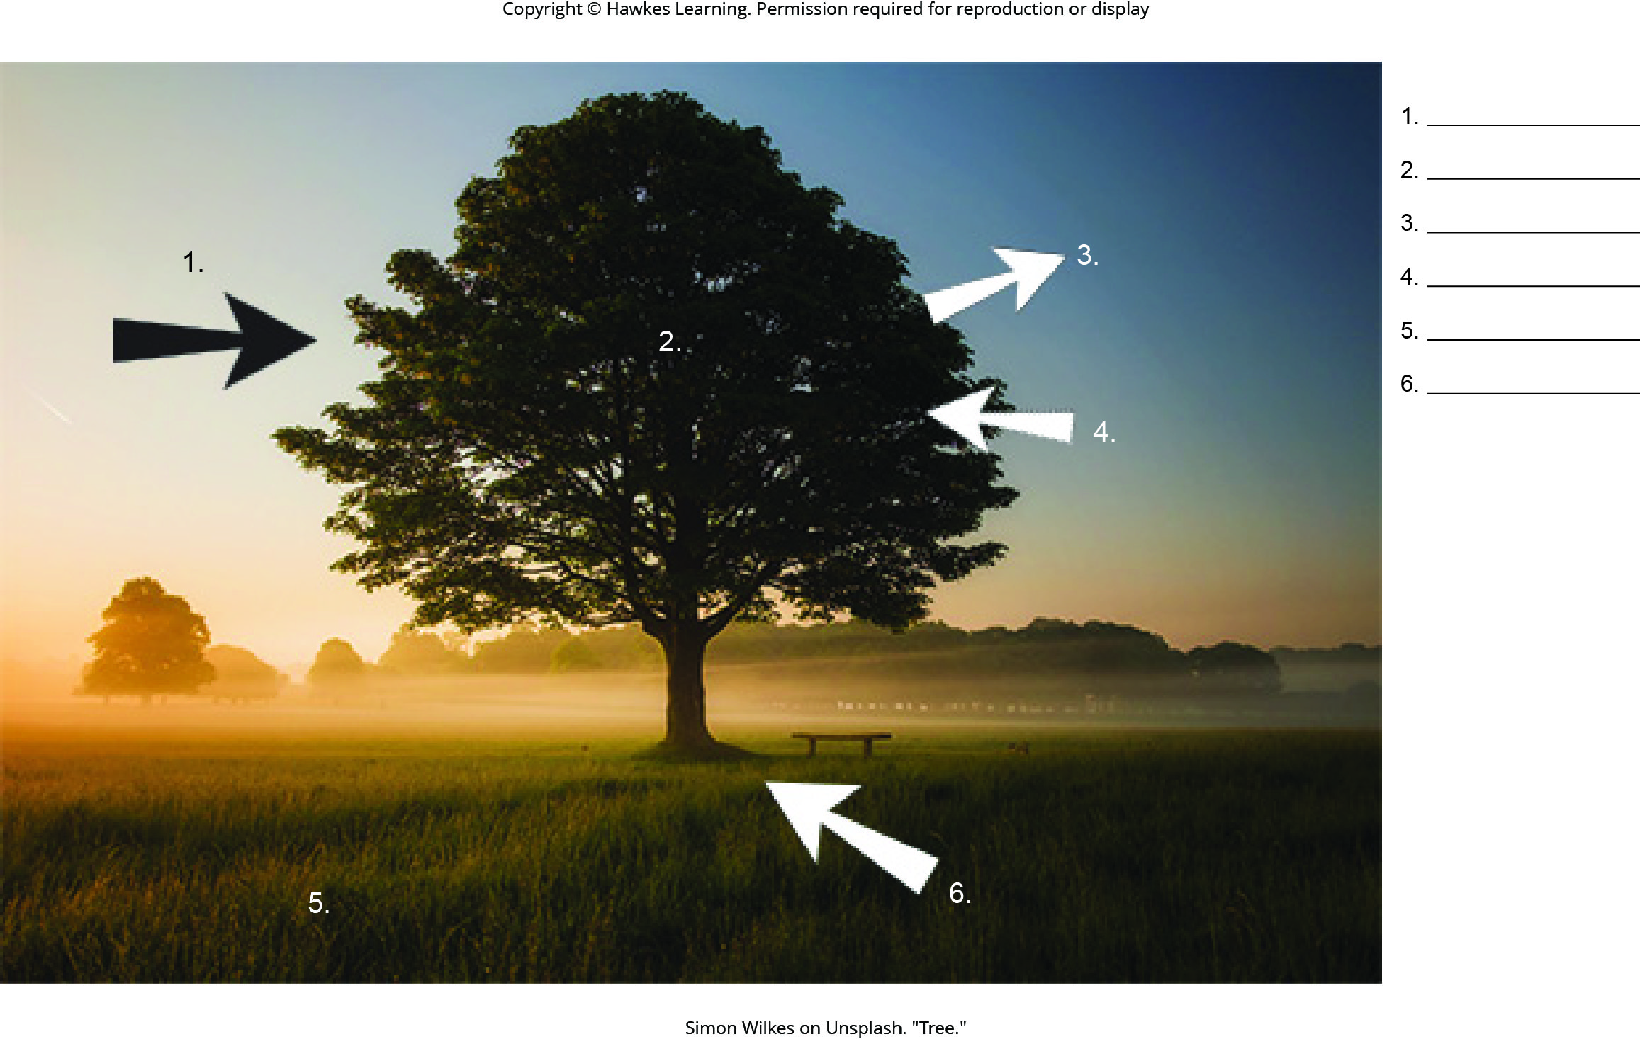
Lesson 8.1 Figure 5 - Numbered

Slide 3
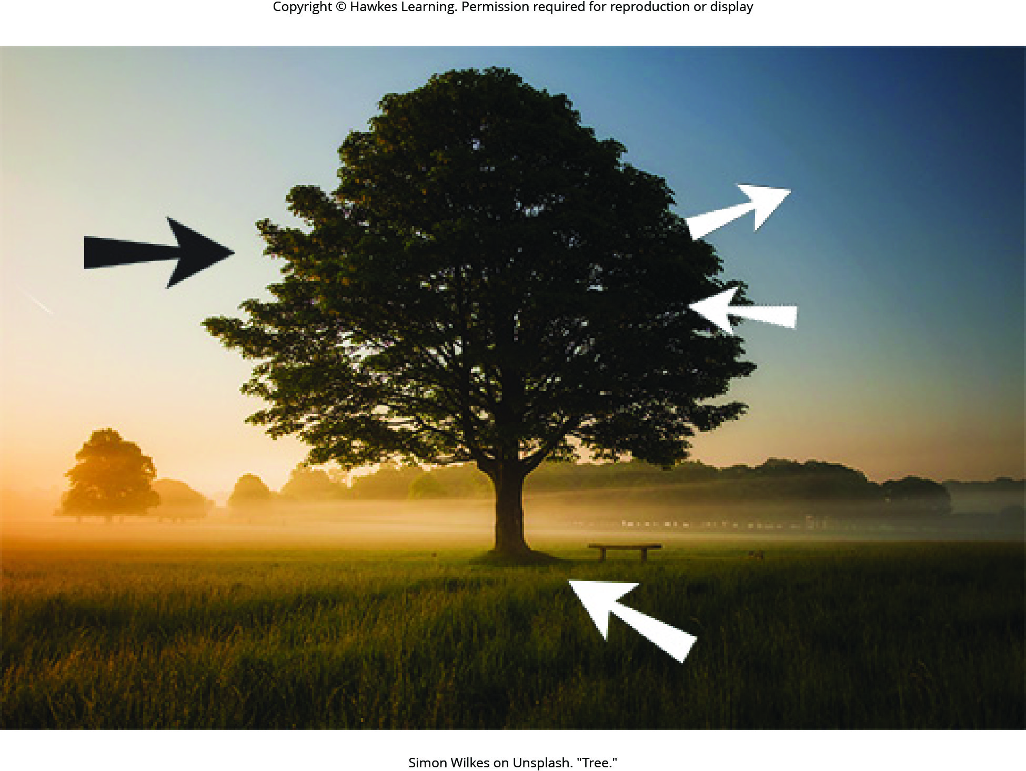
Lesson 8.1 Figure 5

Slide 4
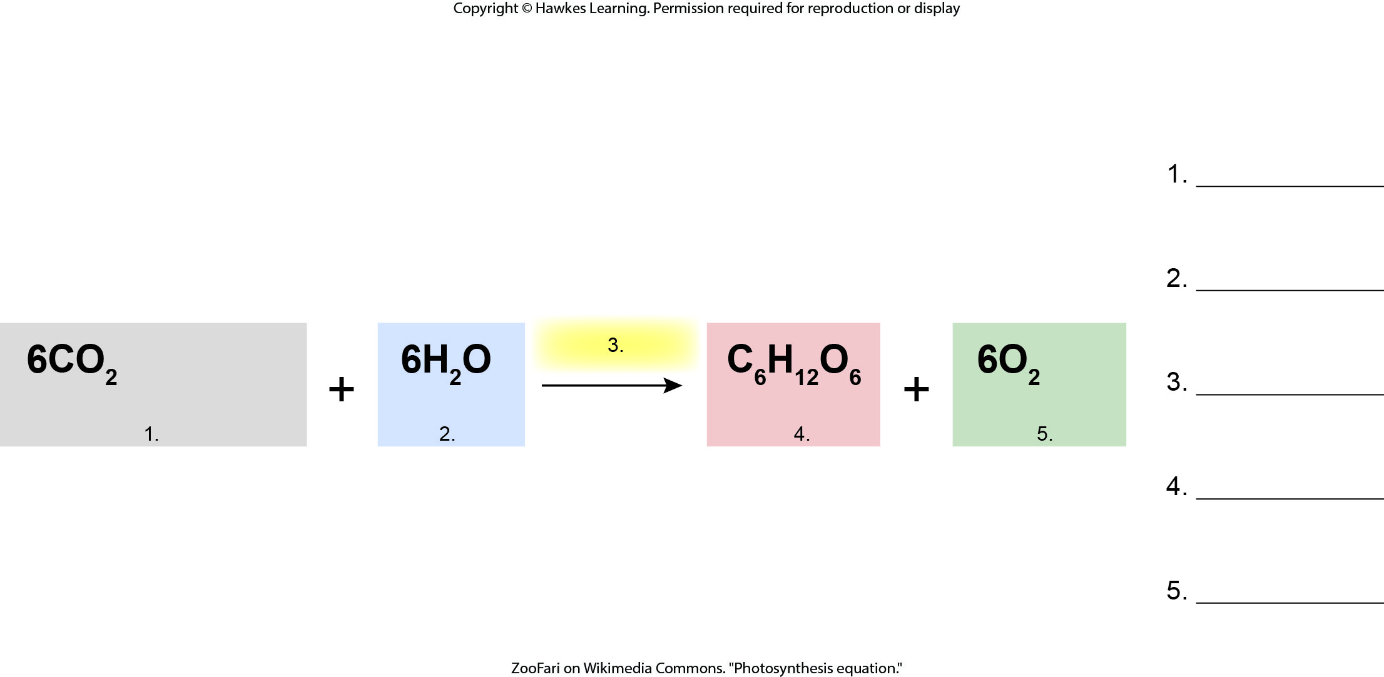
Lesson 8.1 Figure 6 - Numbered

Slide 5

Lesson 8.1 Figure 6

Slide 6
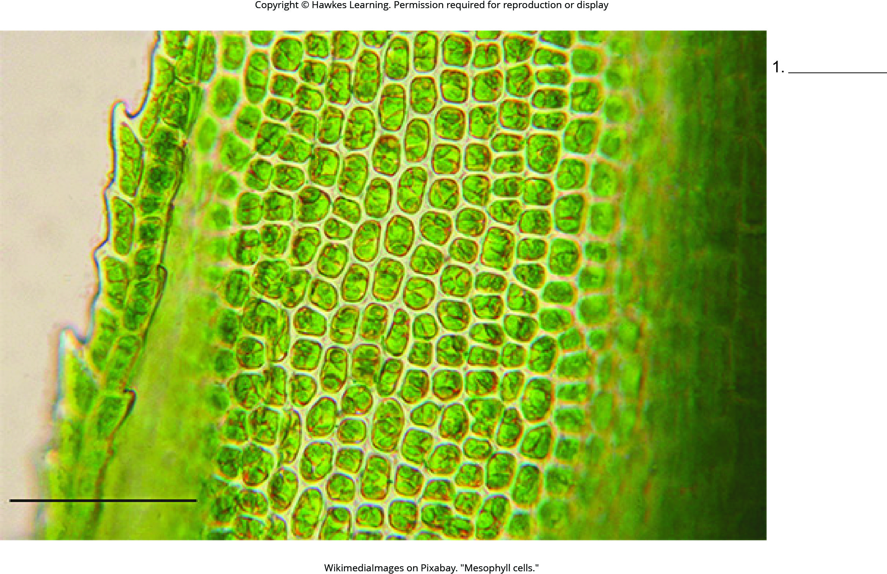
Lesson 8.1 Figure 7 - Numbered

Slide 7
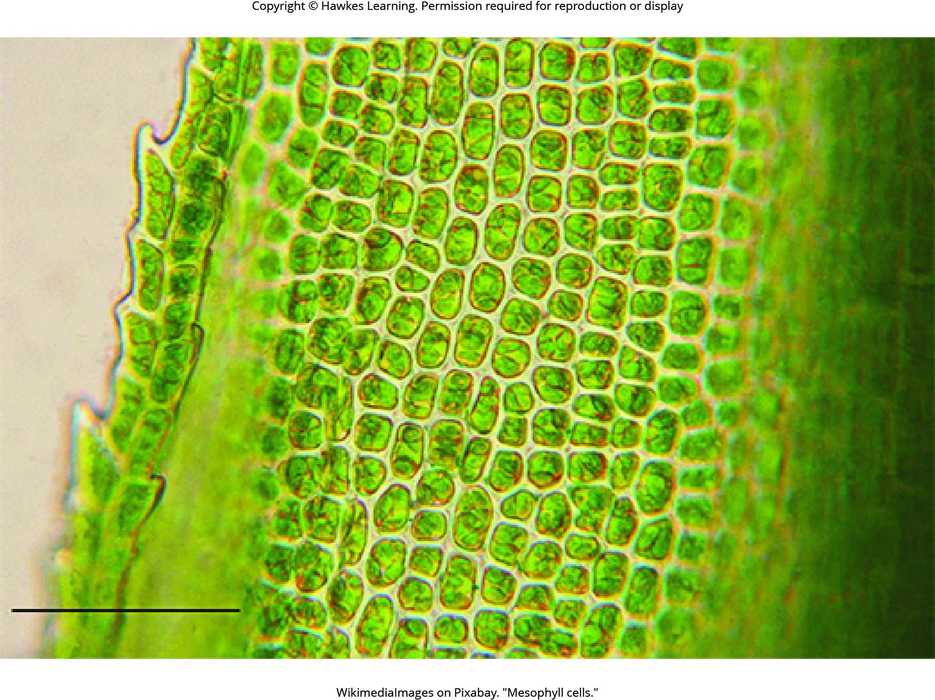
Lesson 8.1 Figure 7

Slide 8
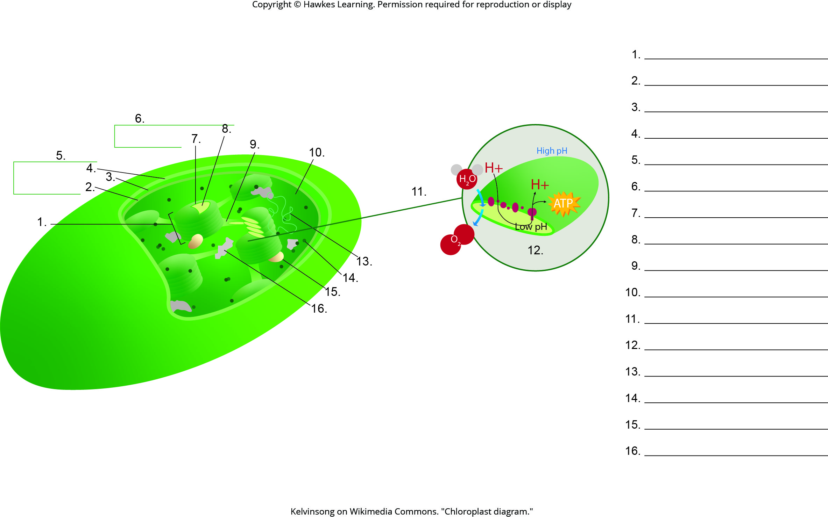
Lesson 8.1 Figure 8 - Numbered

Slide 9
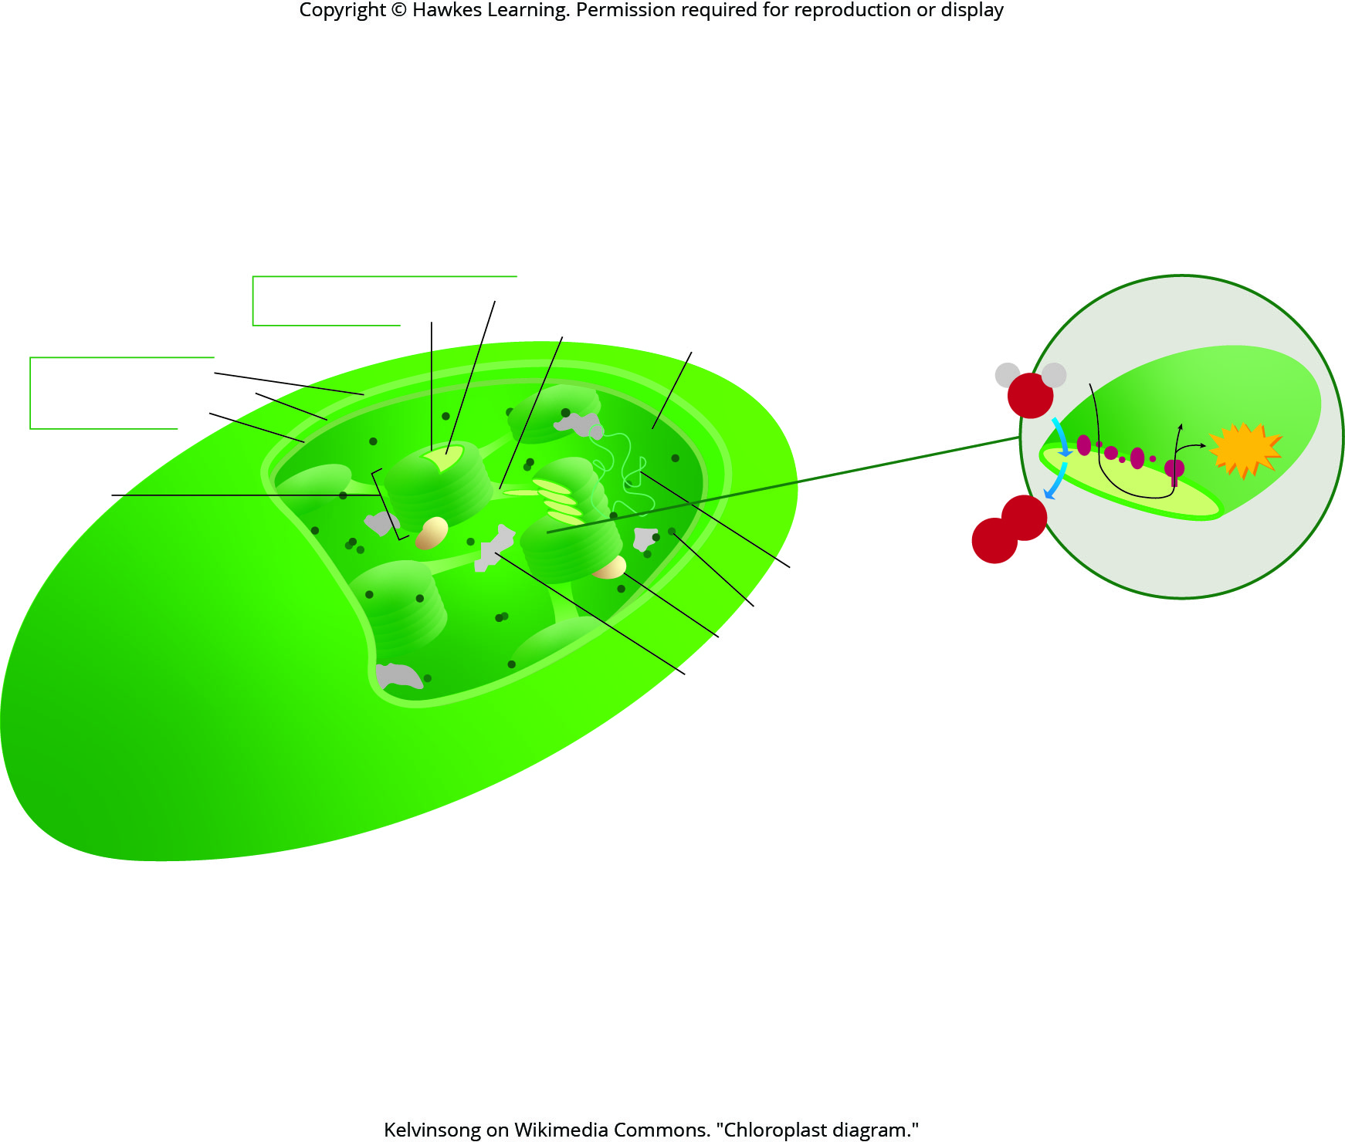
Lesson 8.1 Figure 8

Slide 10
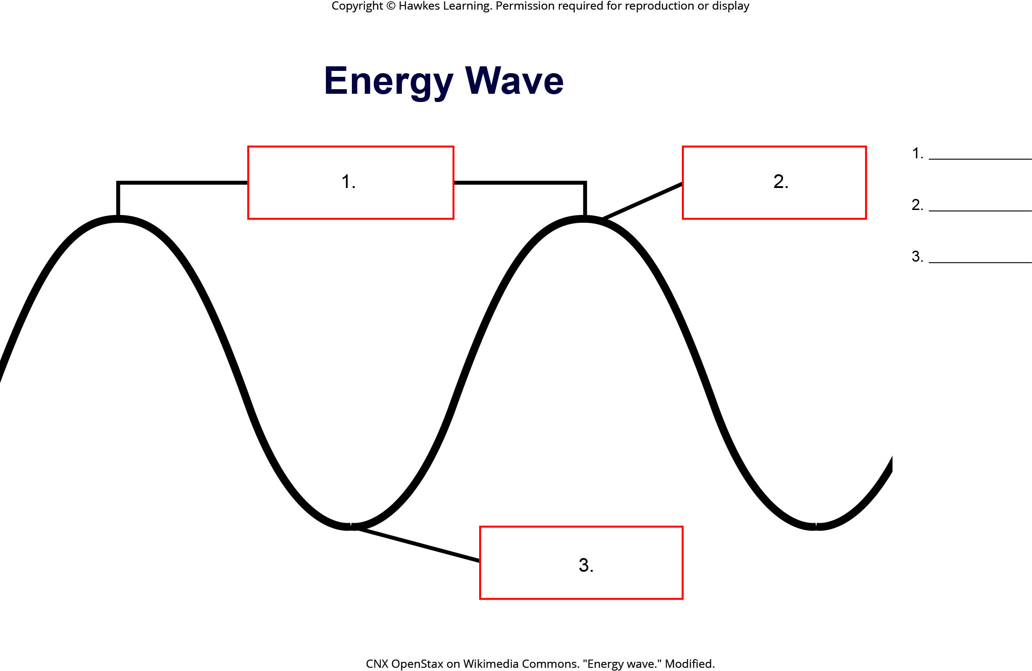
Lesson 8.2 Figure 2 - Numbered

Slide 11
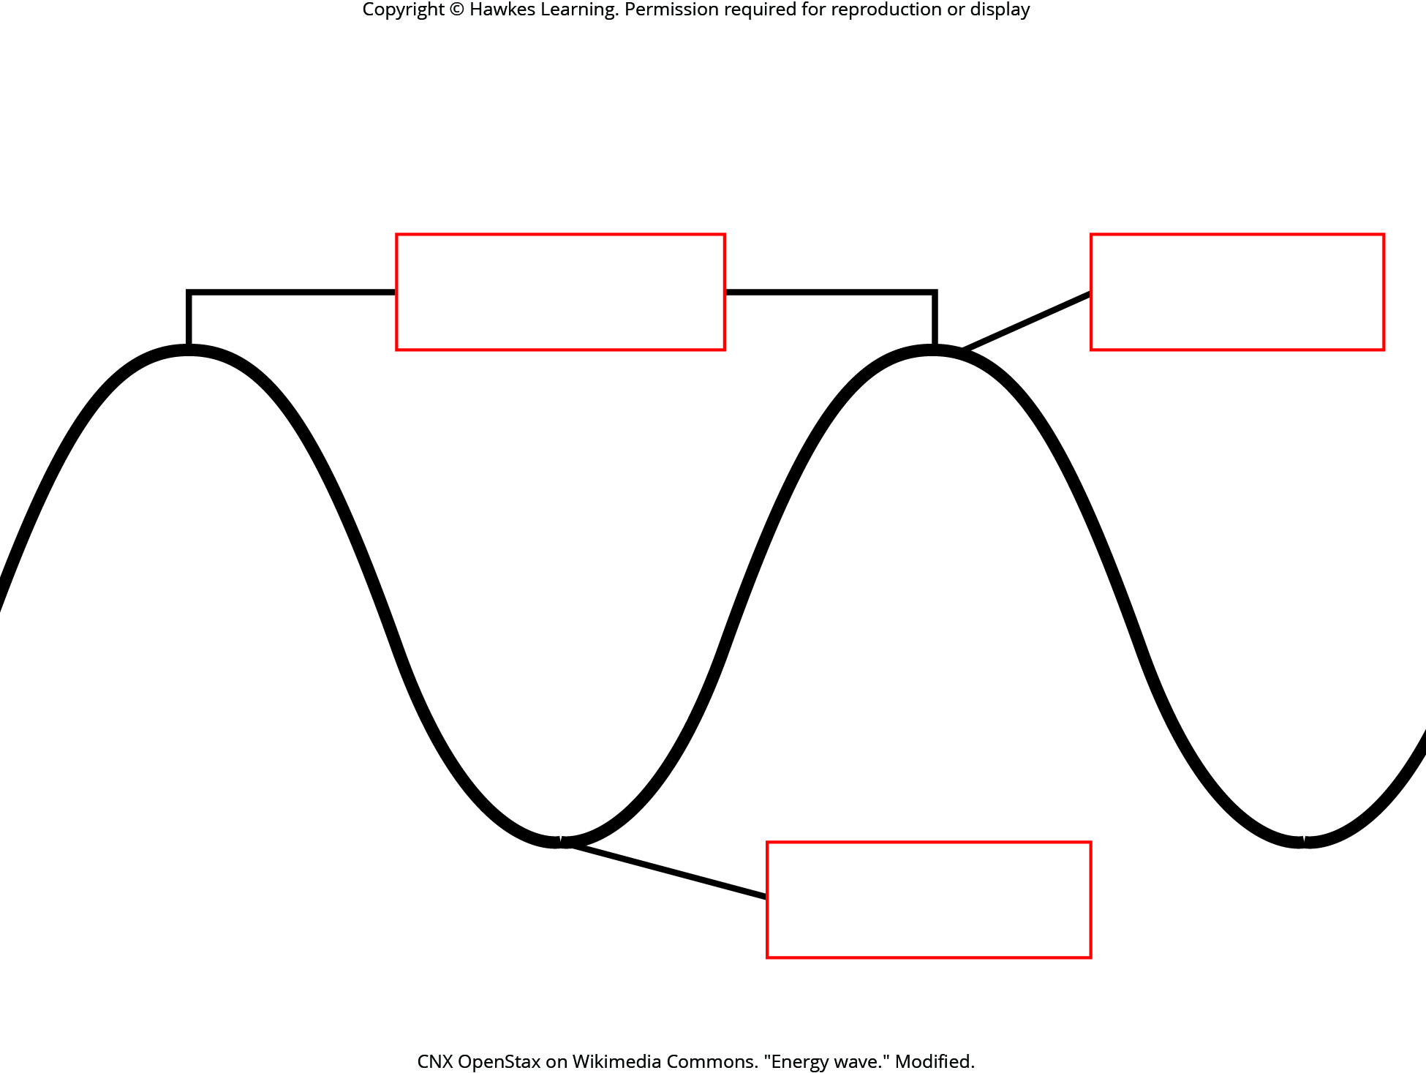
Lesson 8.2 Figure 2

Slide 12
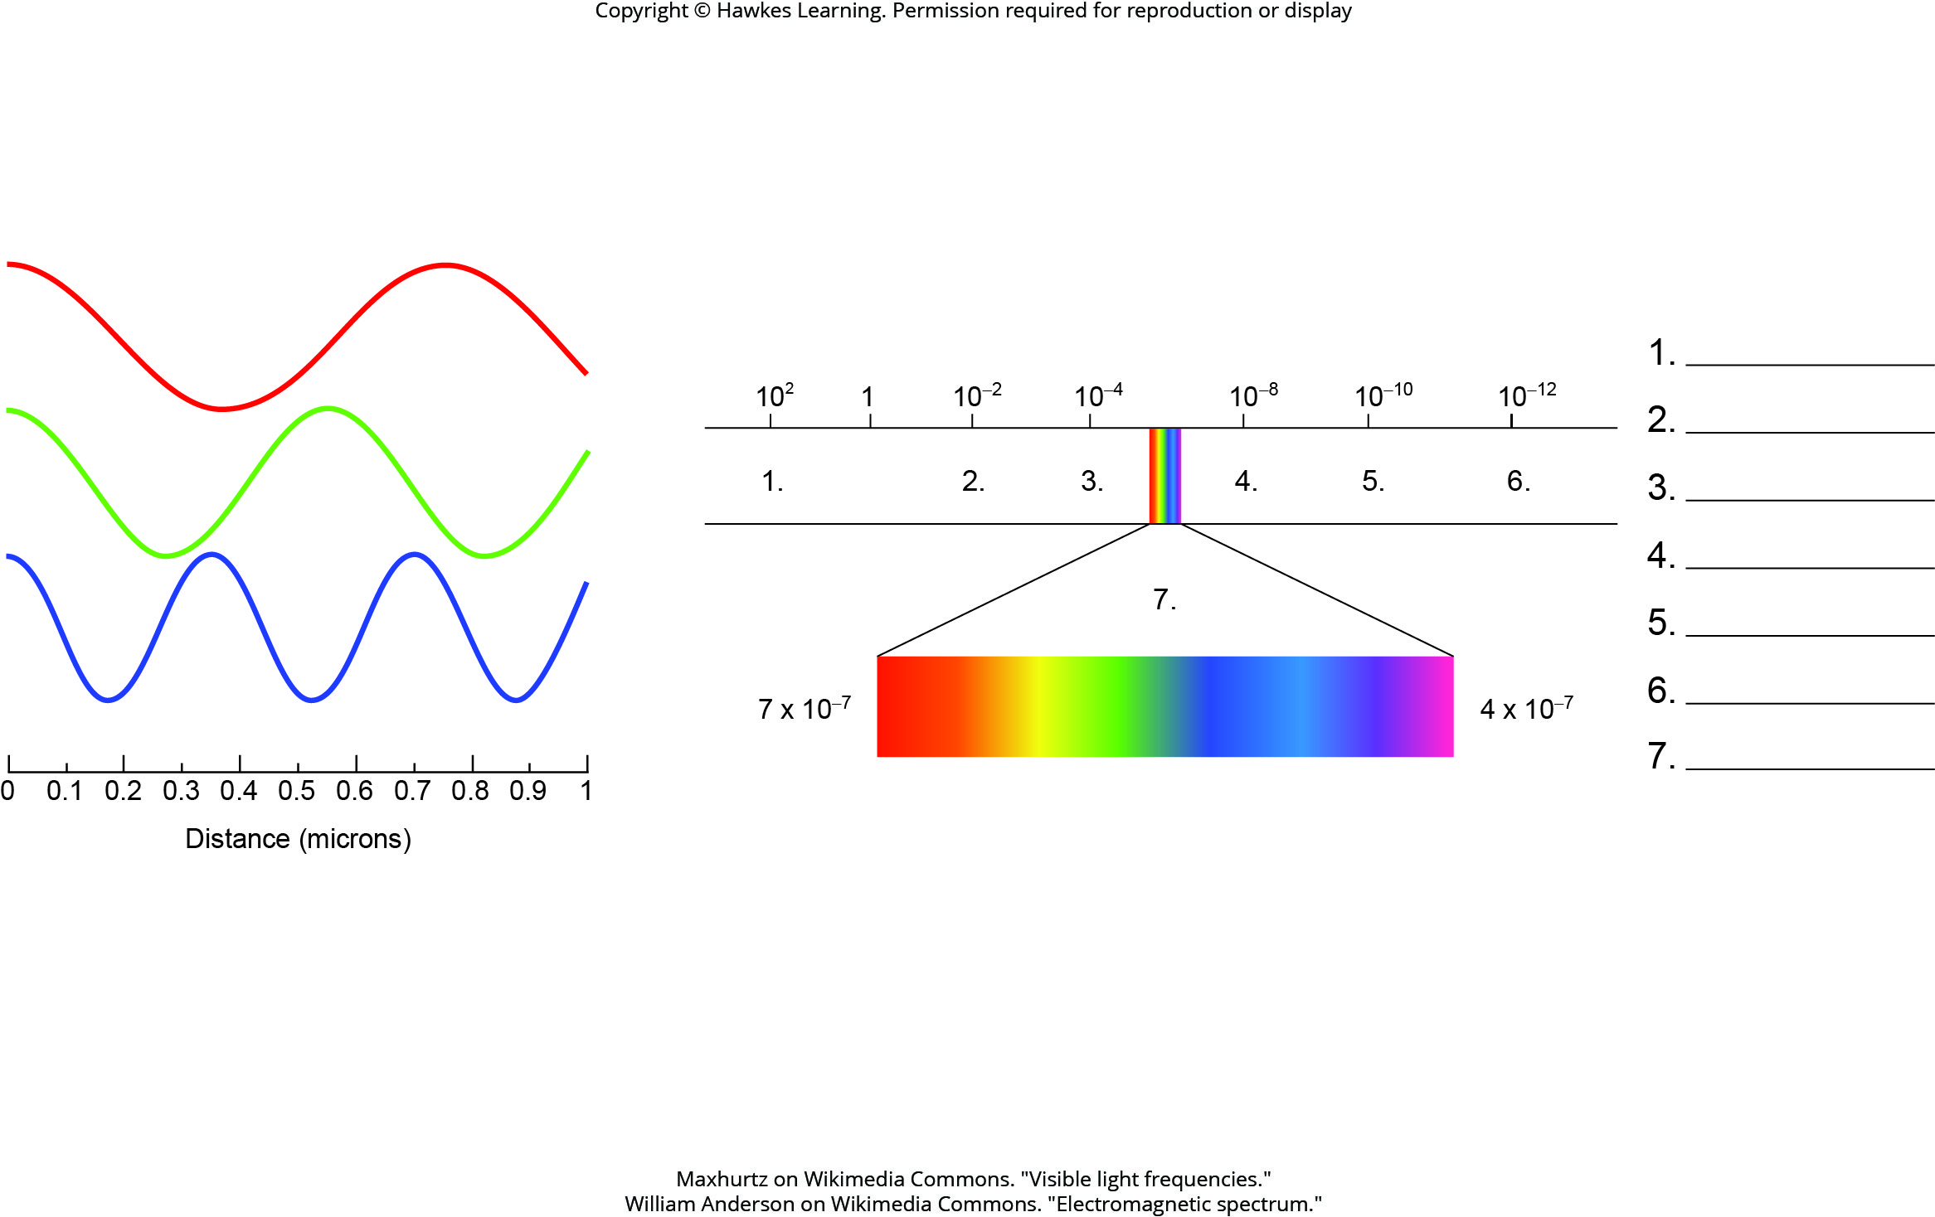
Lesson 8.2 Figure 5 - Numbered

Slide 13
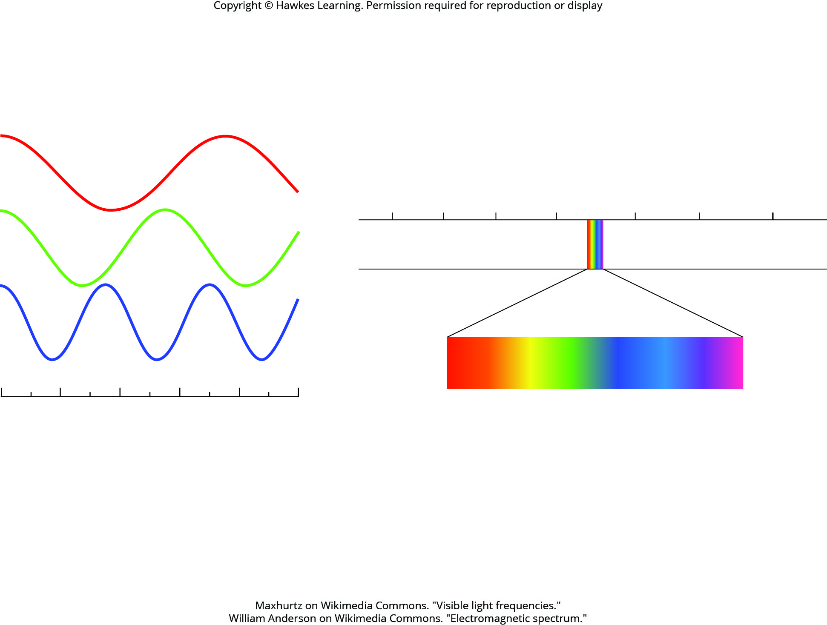
Lesson 8.2 Figure 5

Slide 14
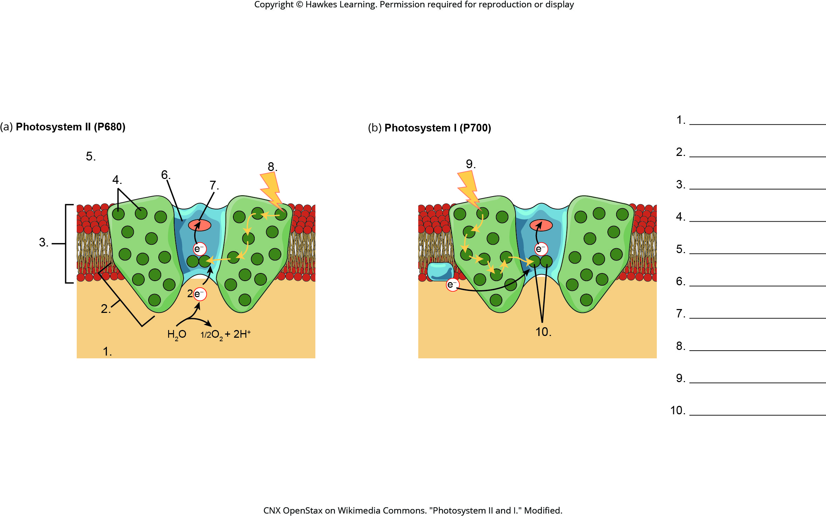
Lesson 8.2 Figure 9 - Numbered

Slide 15
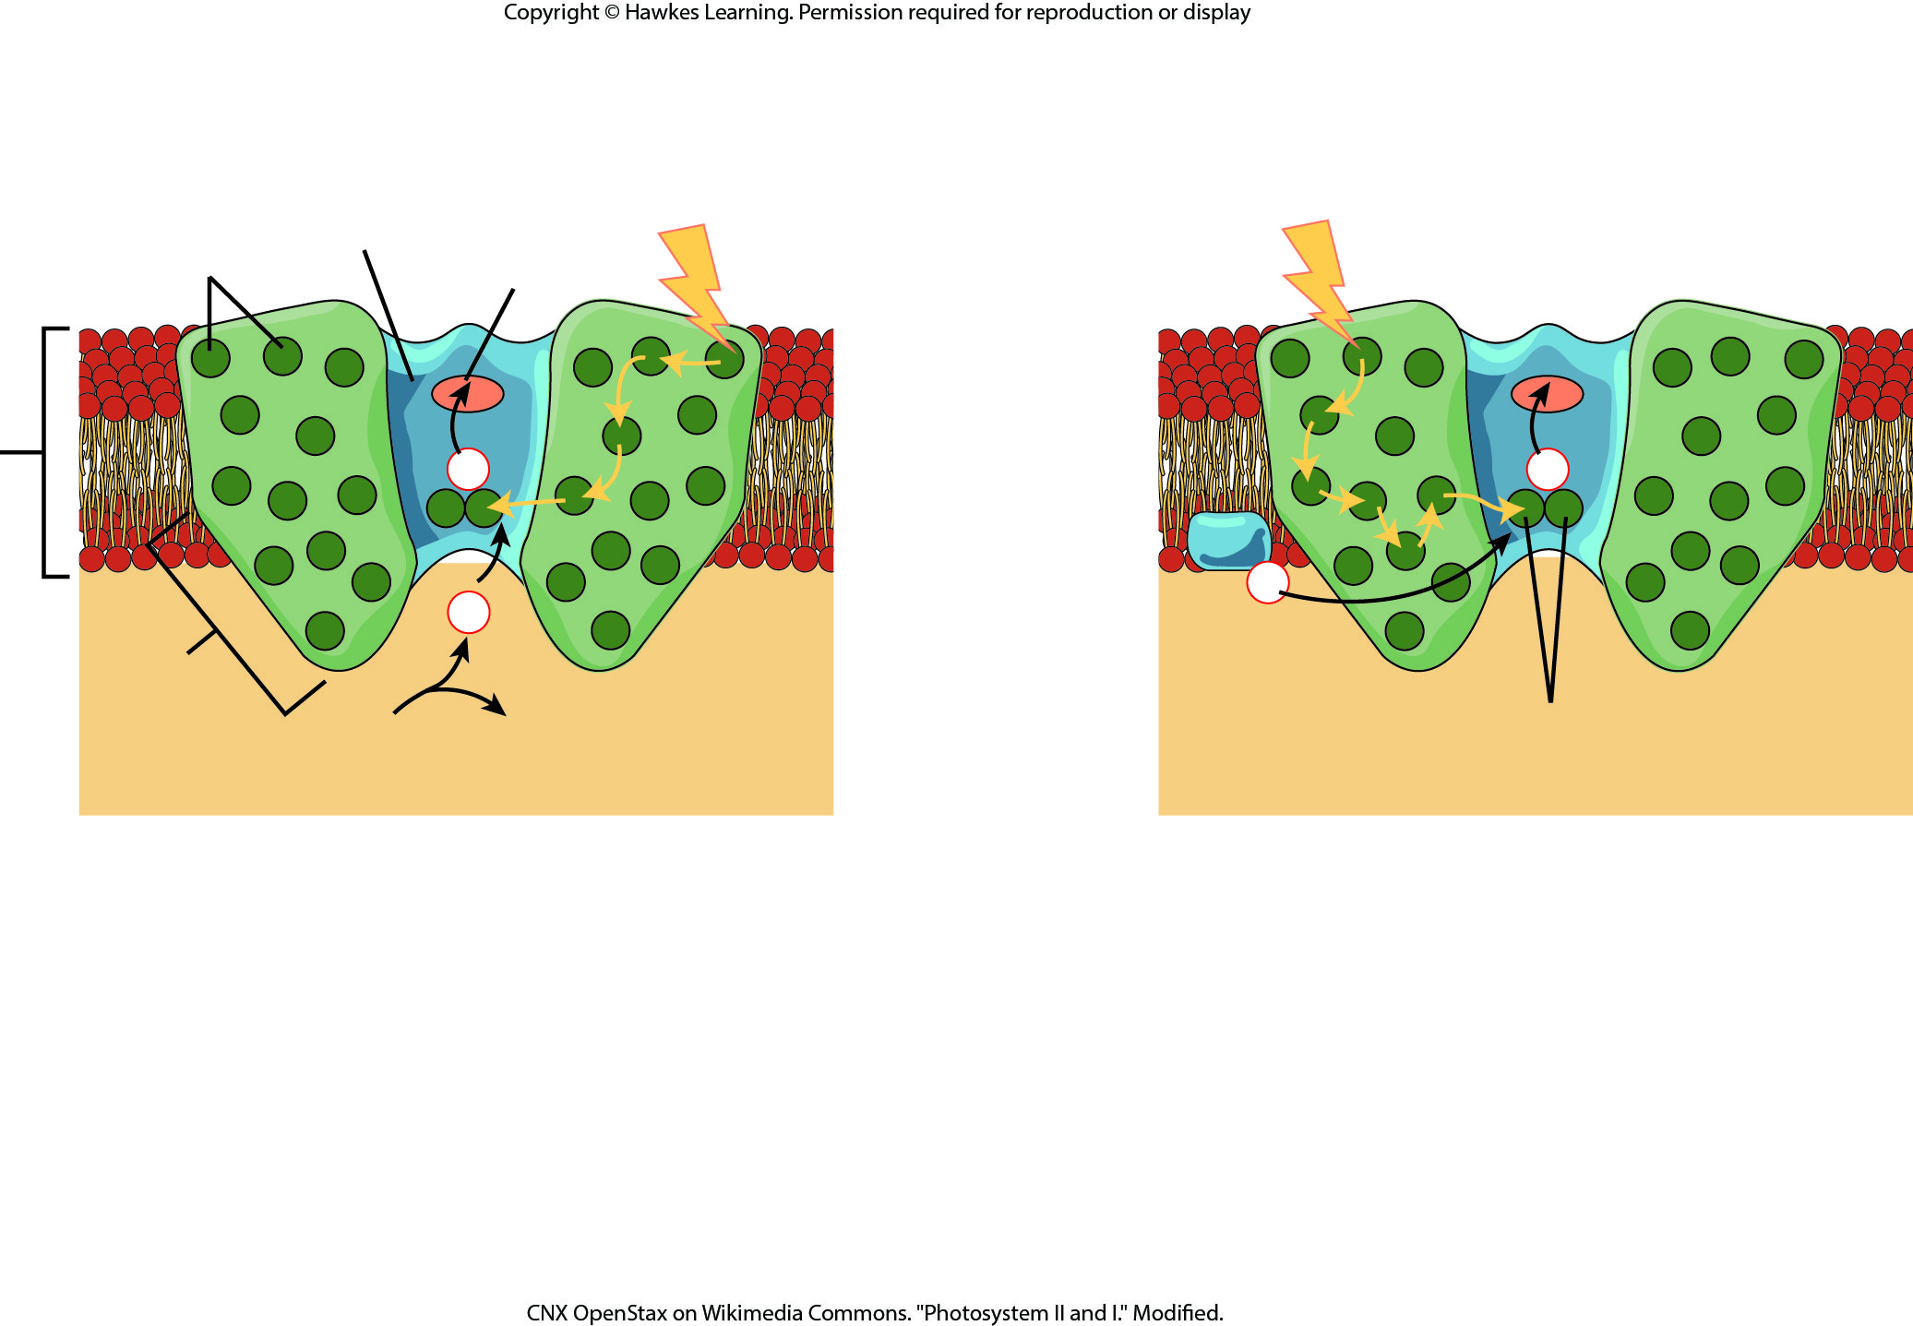
Lesson 8.2 Figure 9

Slide 16
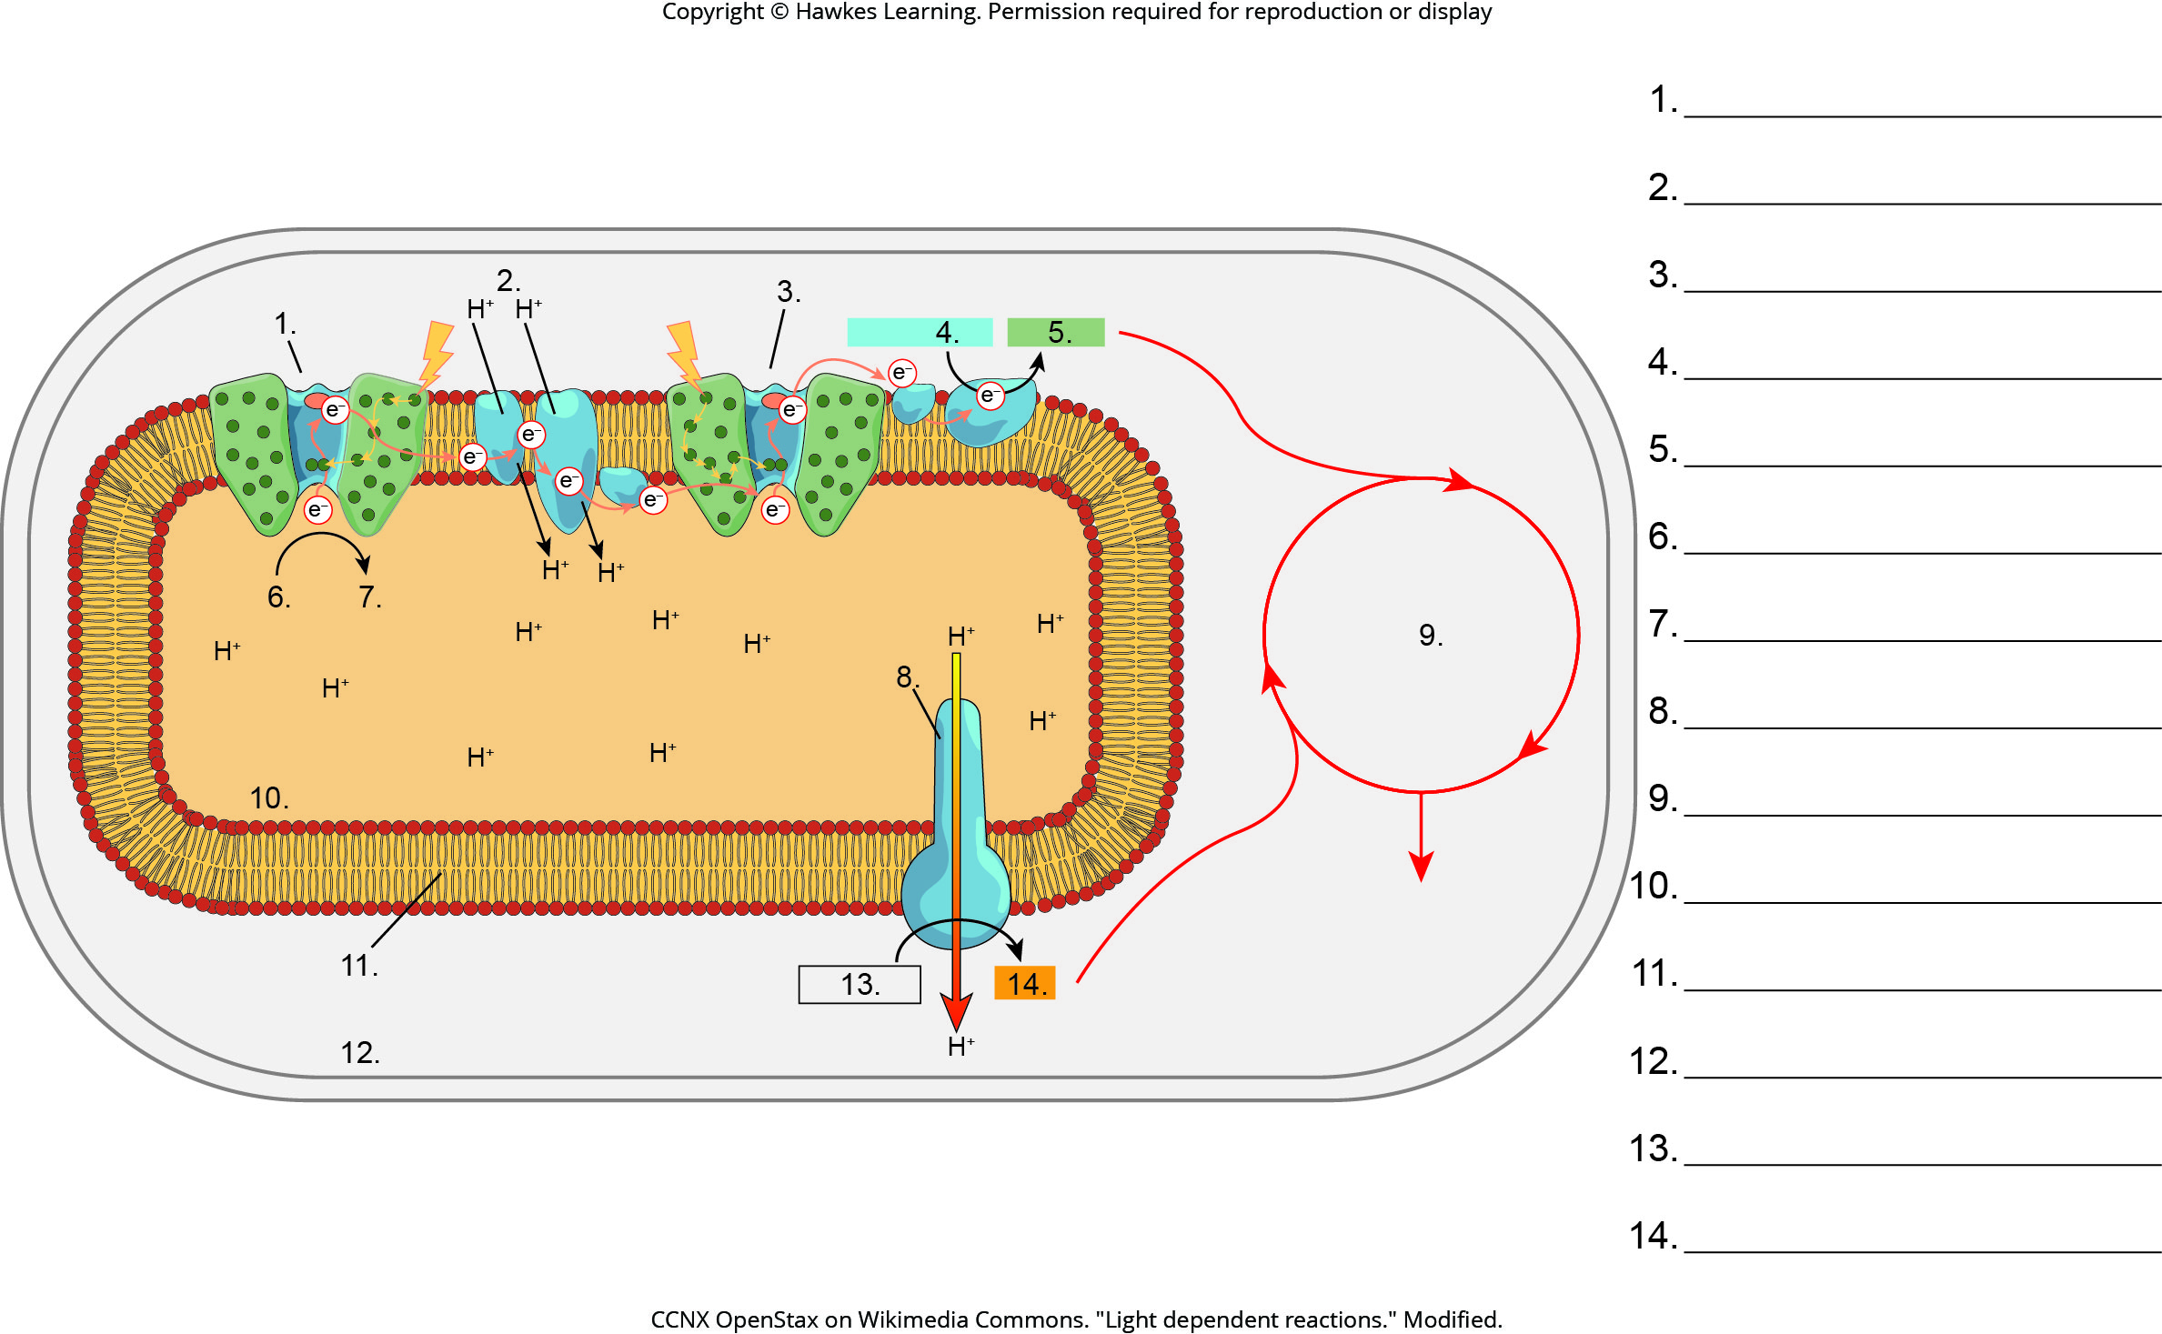
Lesson 8.2 Figure 10 - Numbered

Slide 17
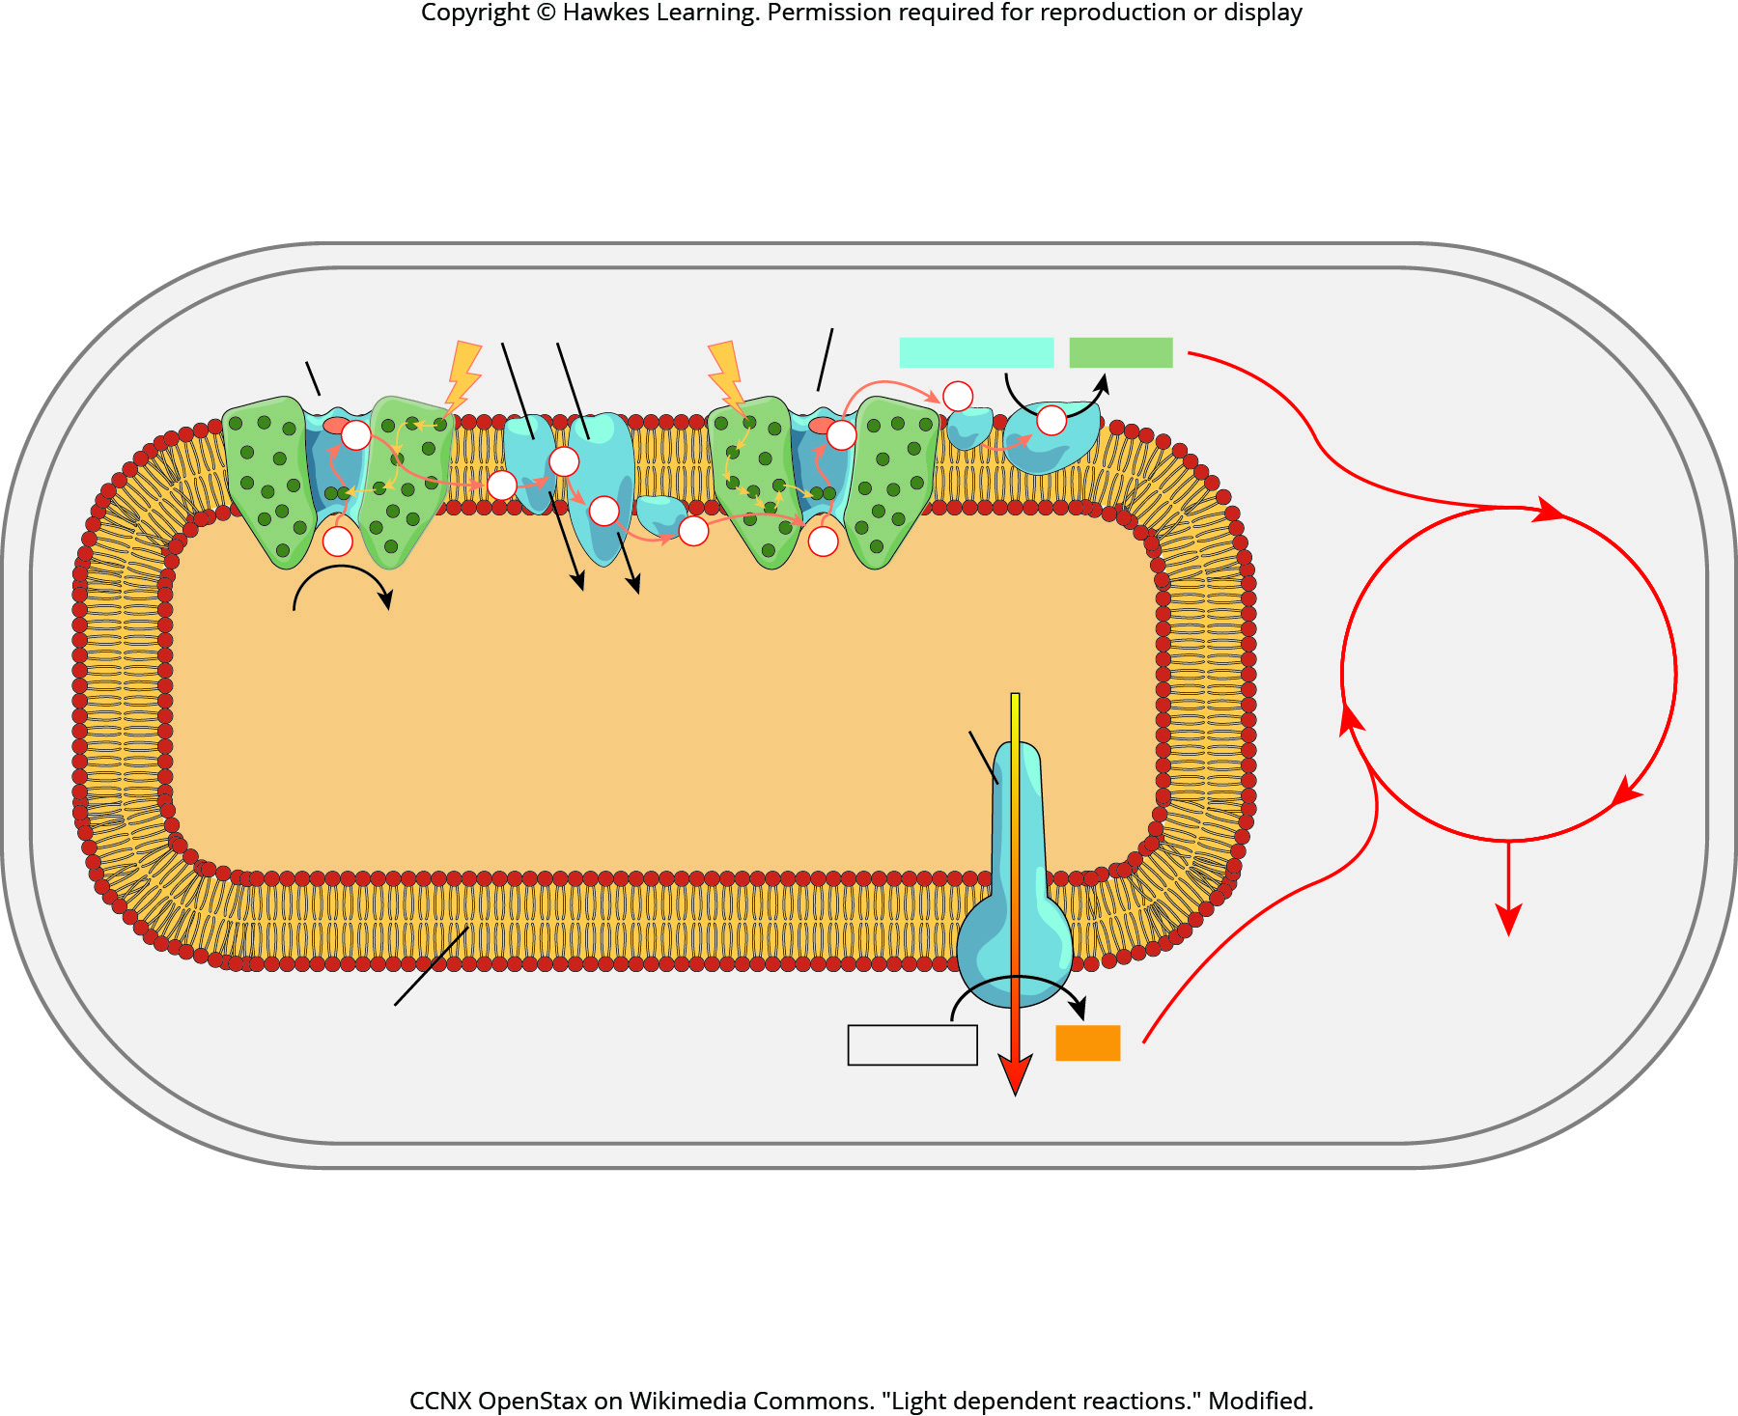
Lesson 8.2 Figure 10

Slide 18
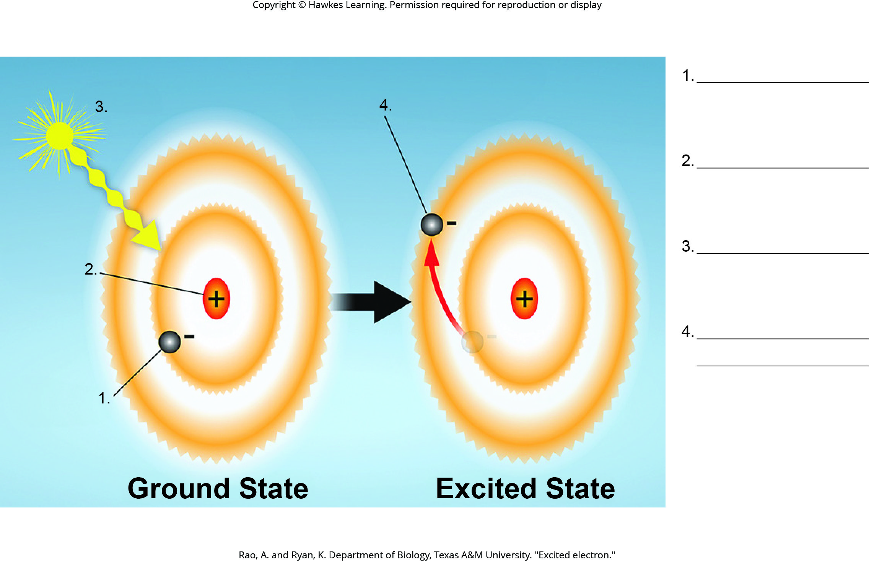
Lesson 8.2 Figure 11 - Numbered

Slide 19
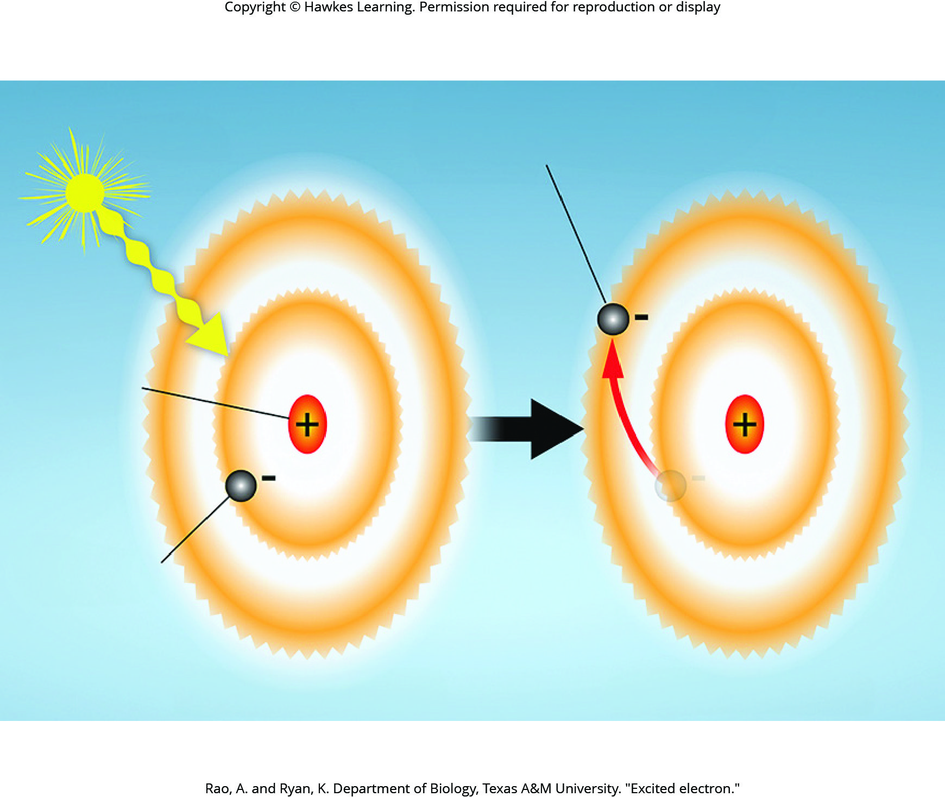
Lesson 8.2 Figure 11

Slide 20
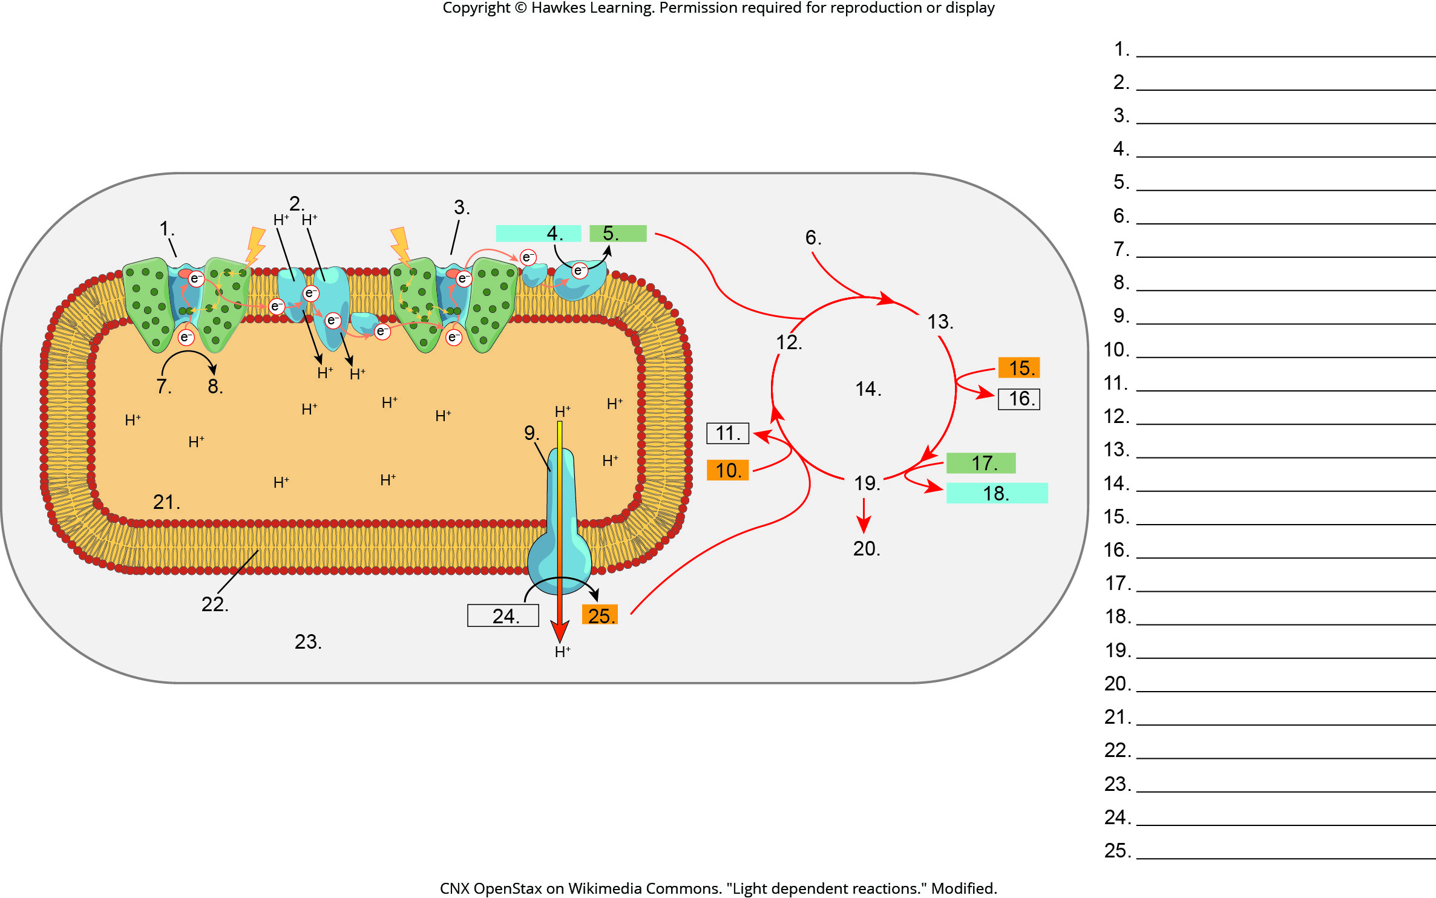
Lesson 8.3 Figure 2 - Numbered

Slide 21
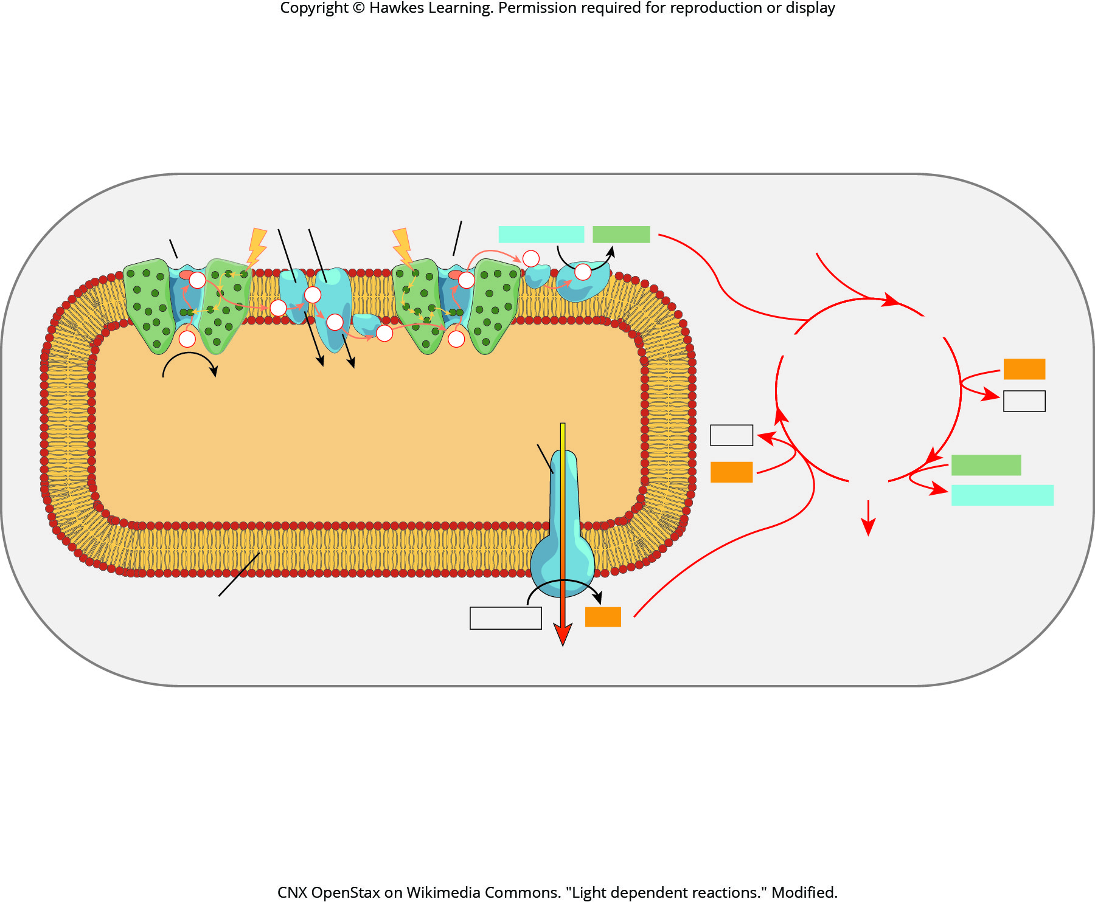
Lesson 8.3 Figure 2

Slide 22
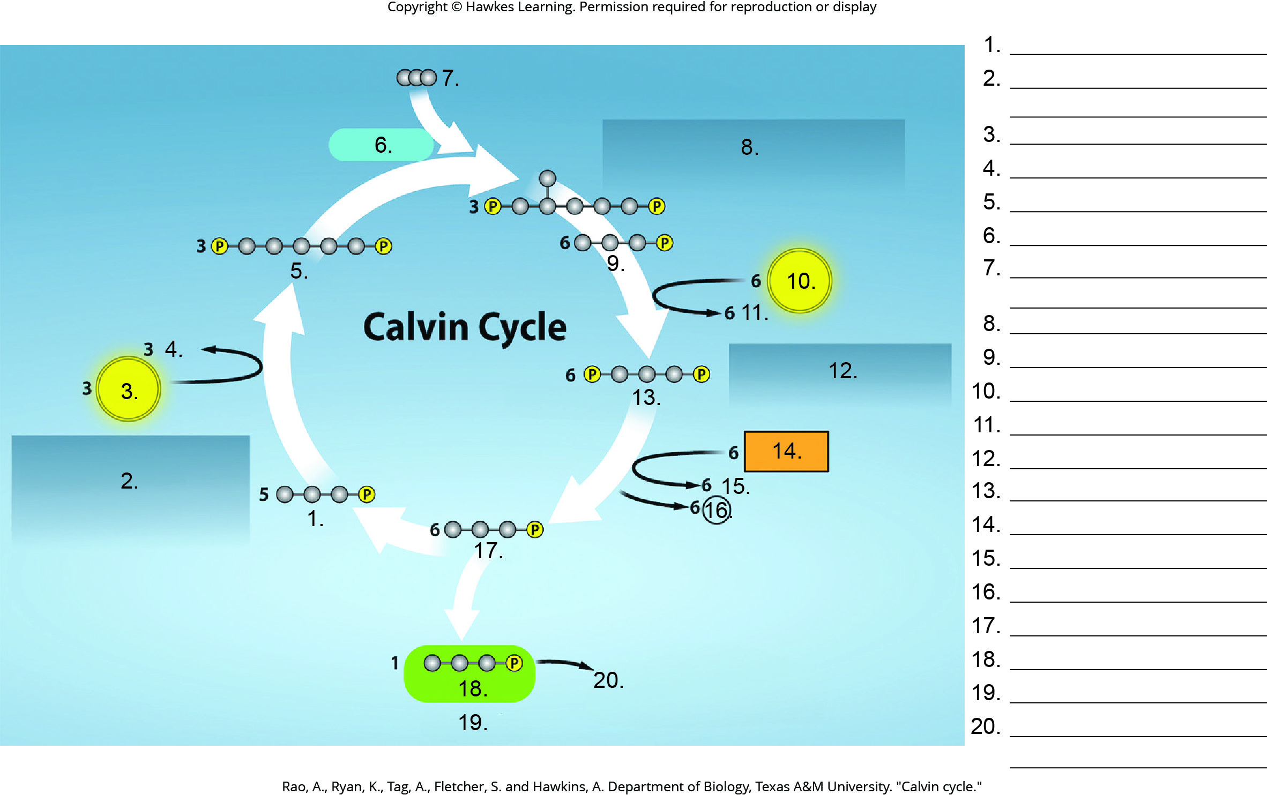
Lesson 8.3 Figure 3 - Numbered

Slide 23
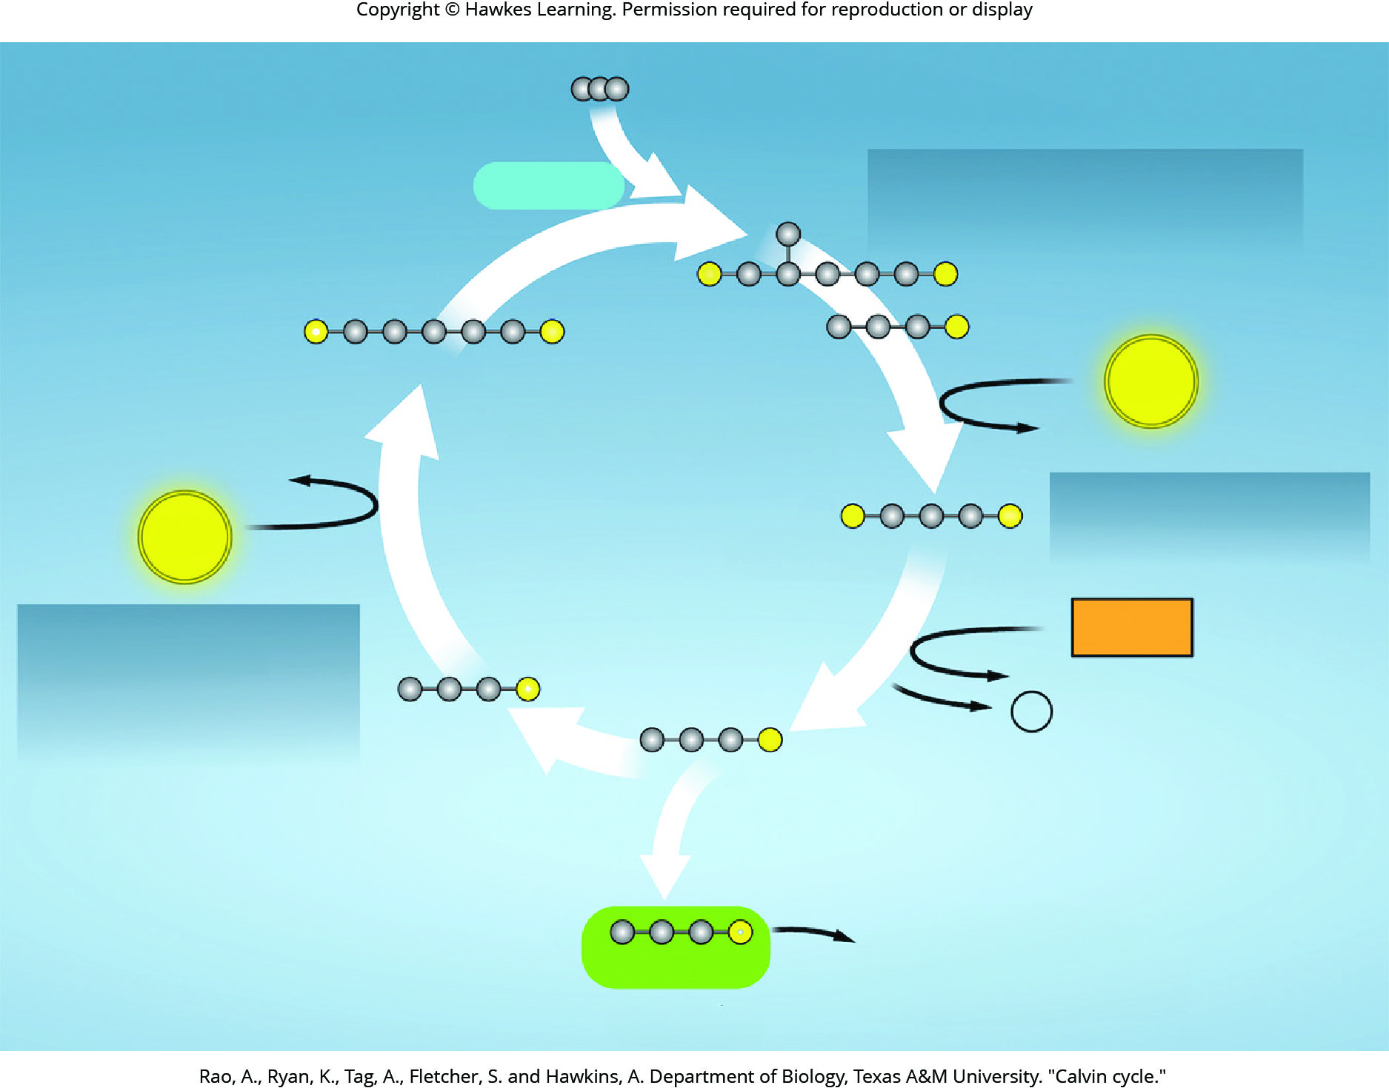
Lesson 8.3 Figure 3

Slide 24
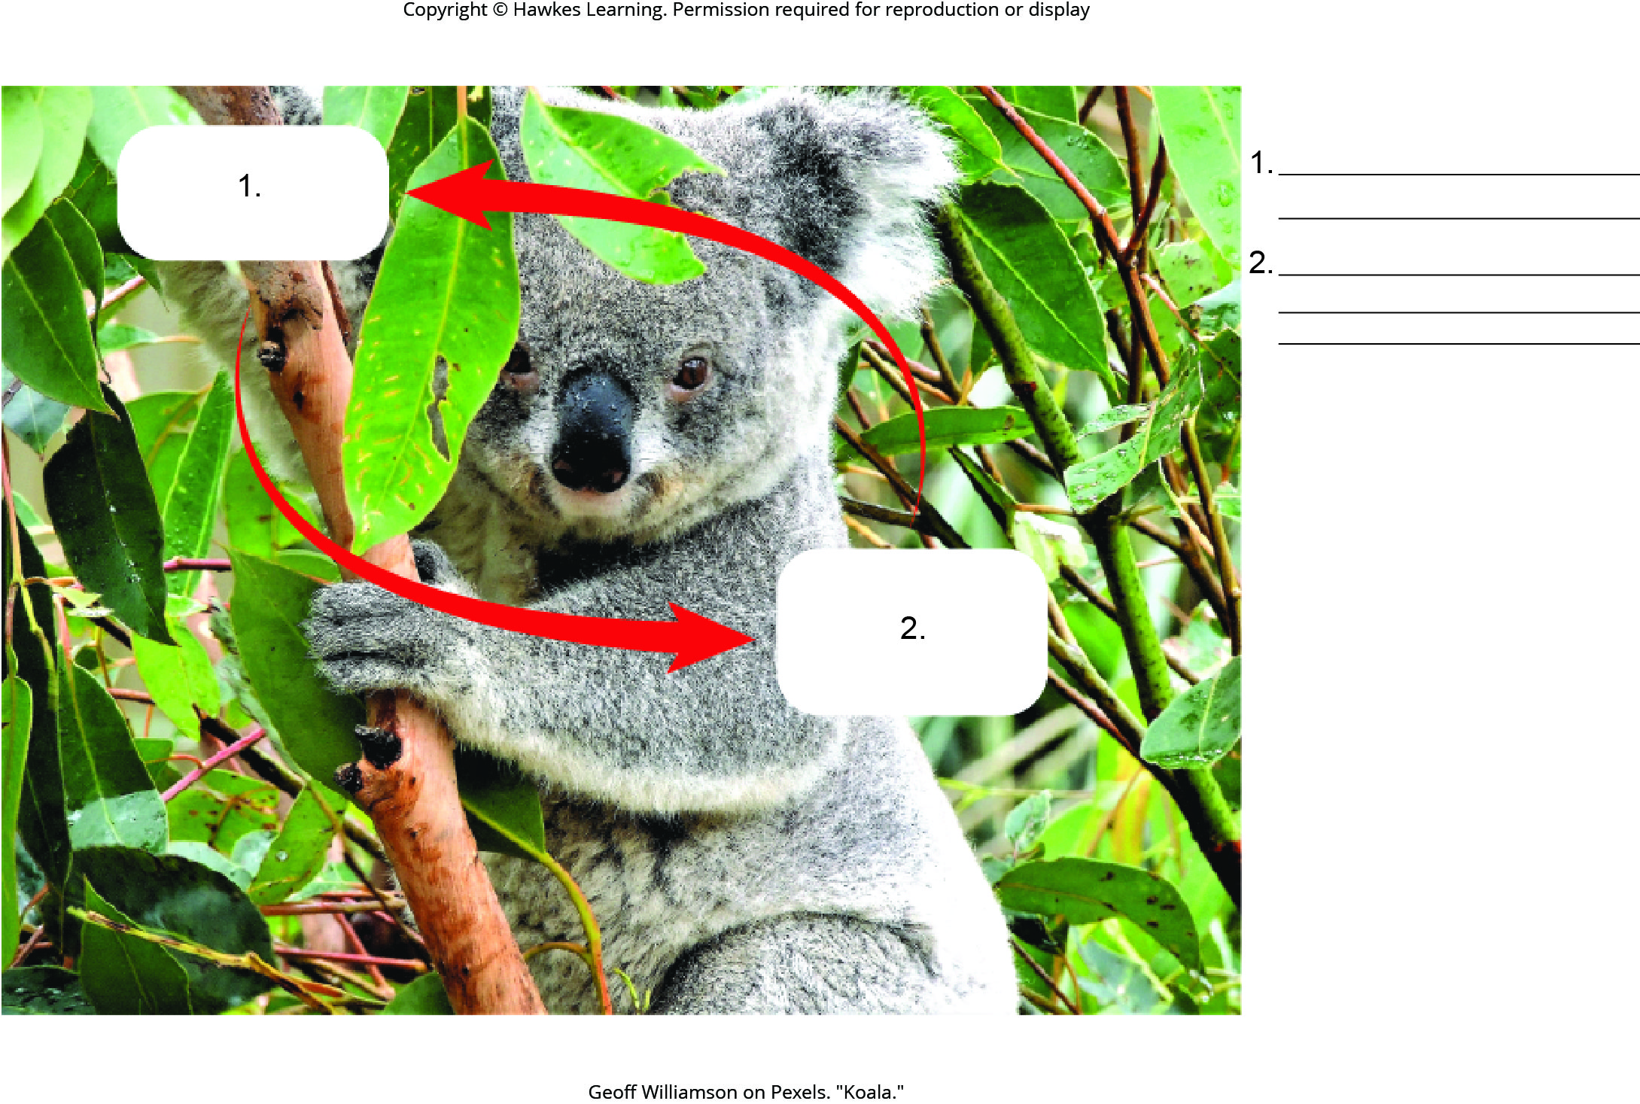
Lesson 8.3 Figure 6 - Numbered

Slide 25
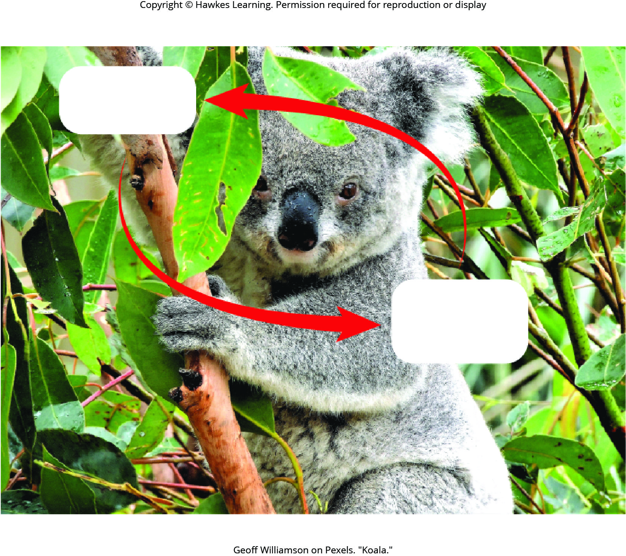
Lesson 8.3 Figure 6

Slide 26
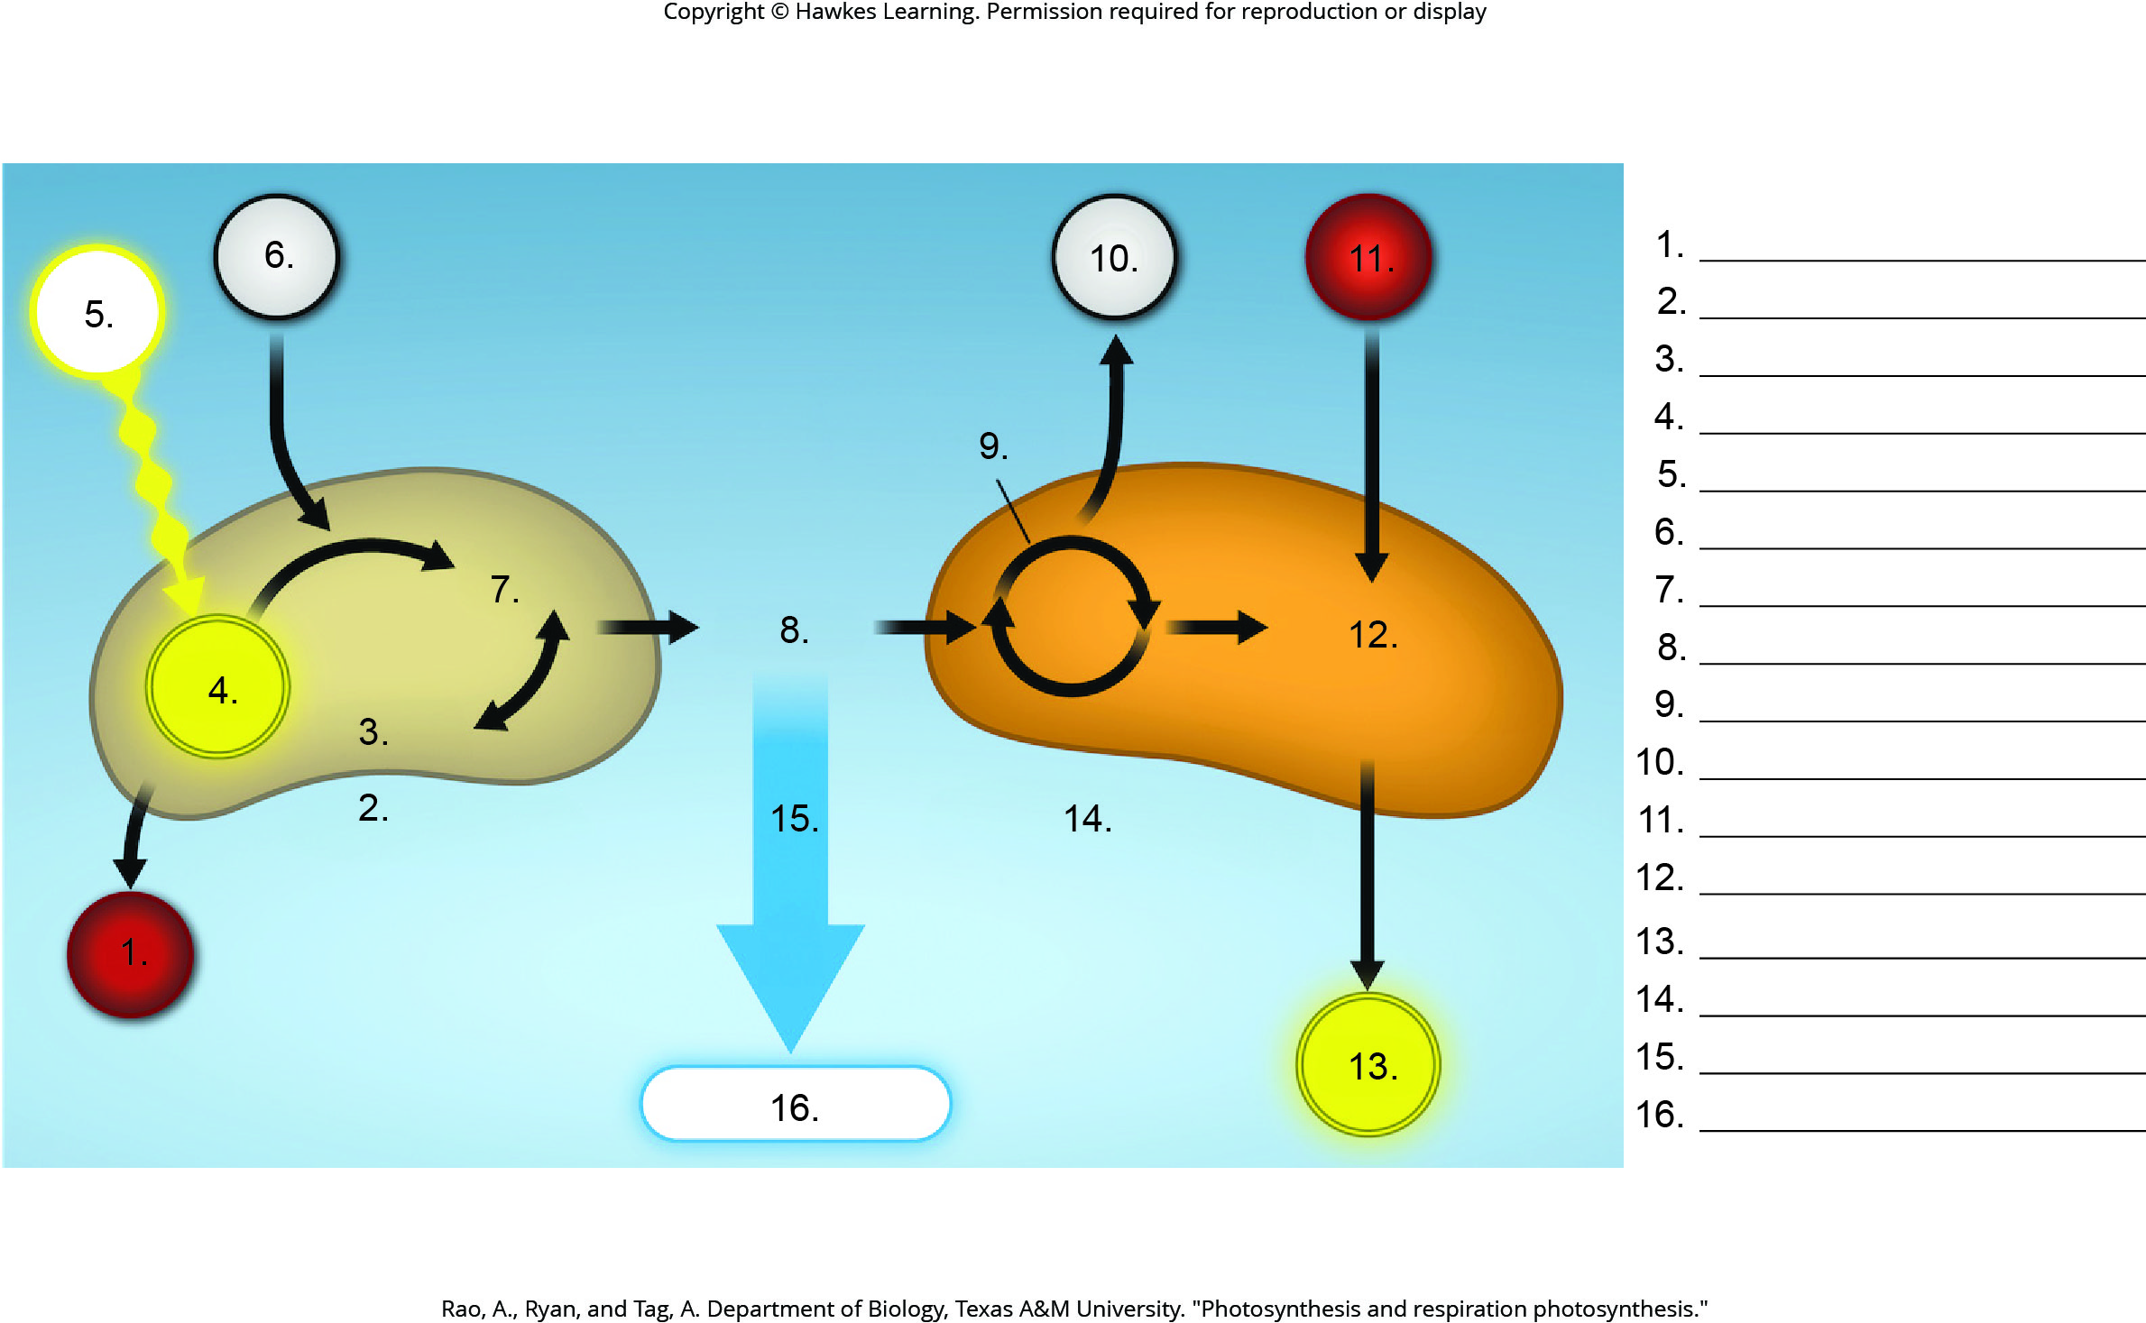
Lesson 8.3 Figure 8 - Numbered

Slide 27
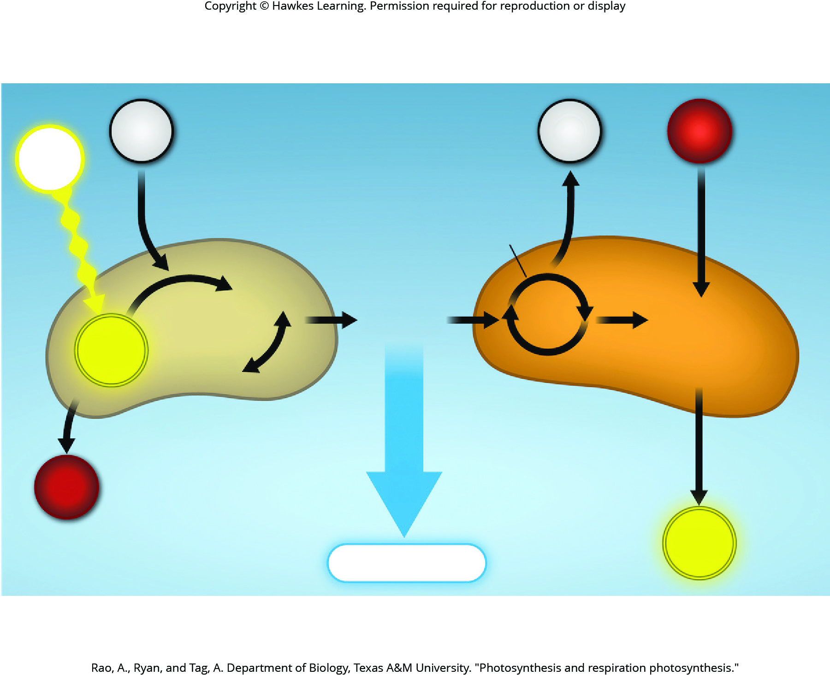
Lesson 8.3 Figure 8

Slide 28
Hawkes Learning – End of PowerPoint

