Slide 1
Chapter 9
Cell Communication

Slide 2
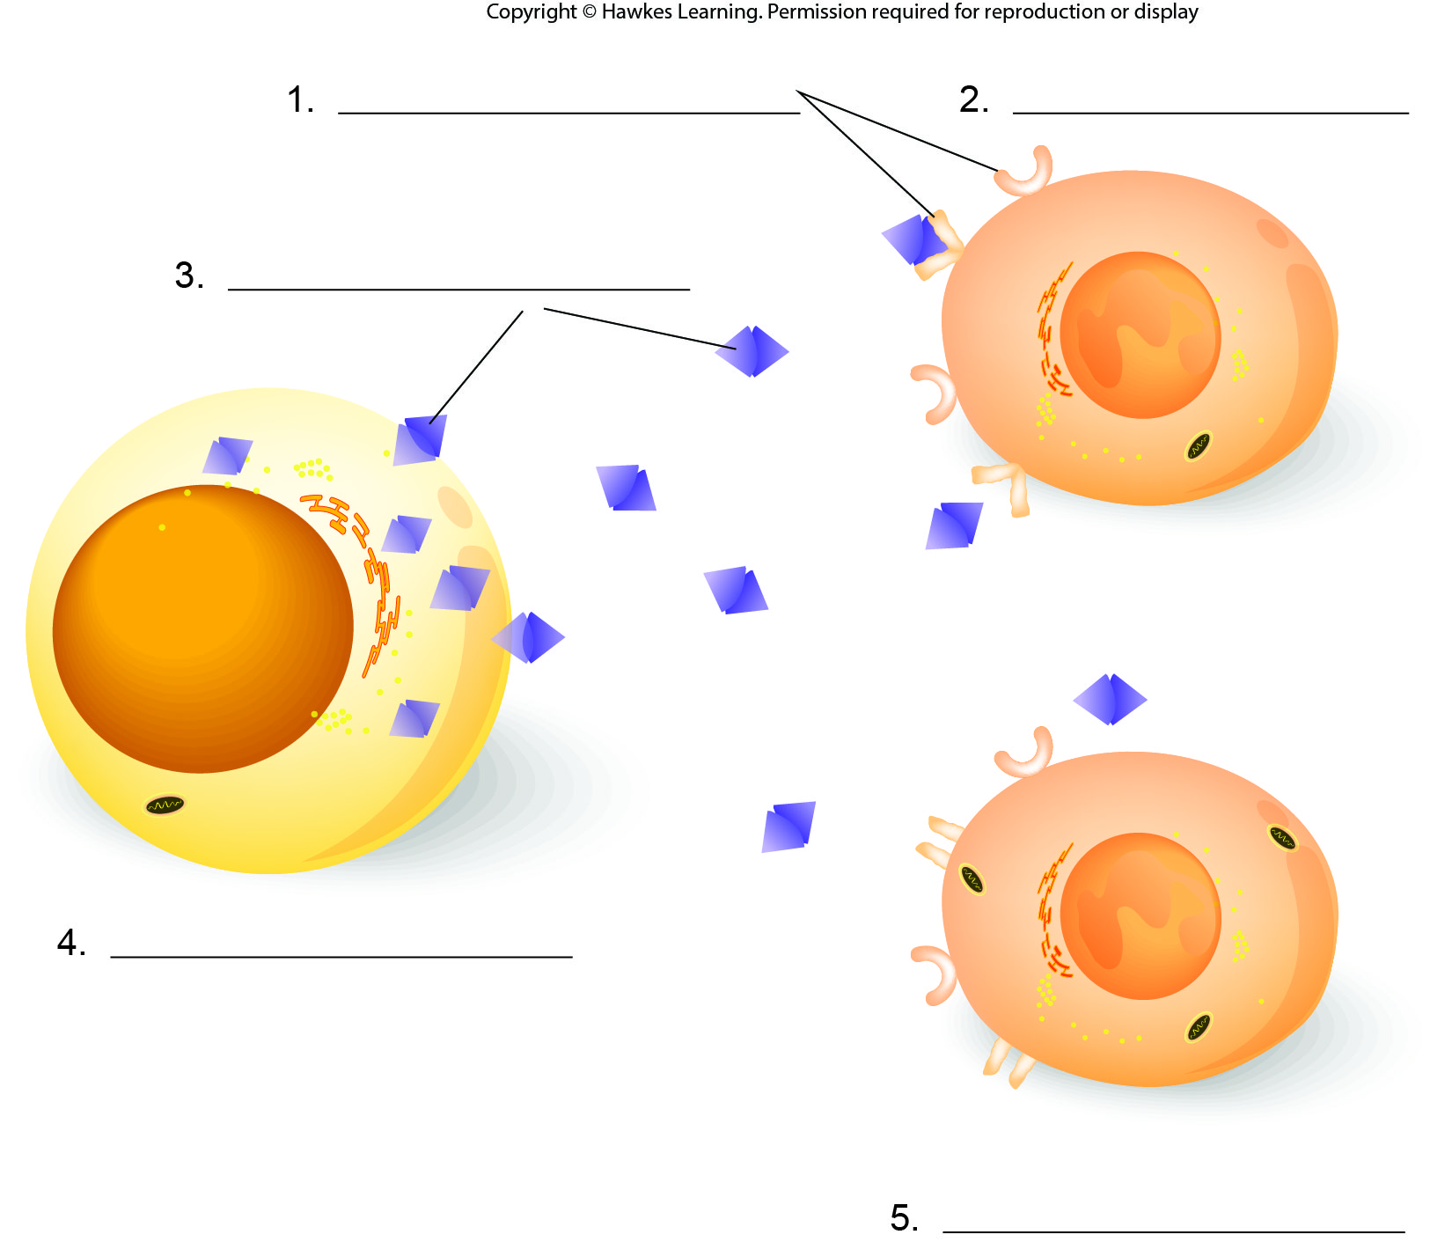
Lesson 9.1 Figure 2 - Numbered

Slide 3
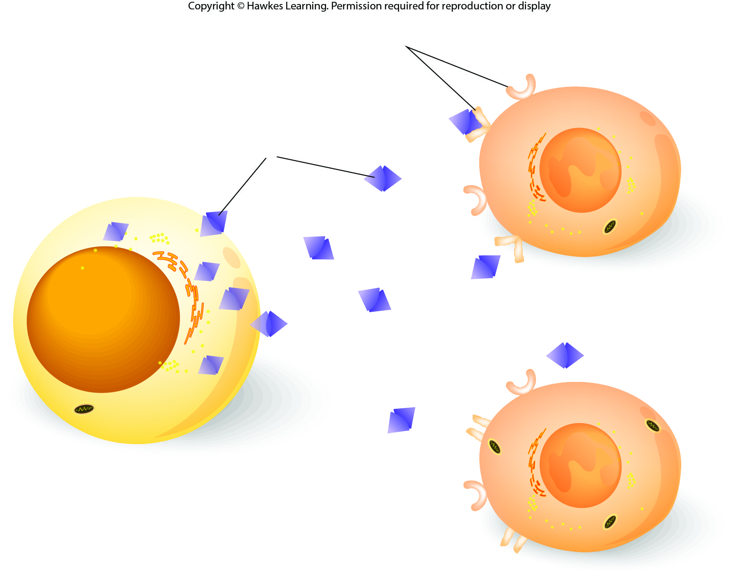
Lesson 9.1 Figure 2

Slide 4
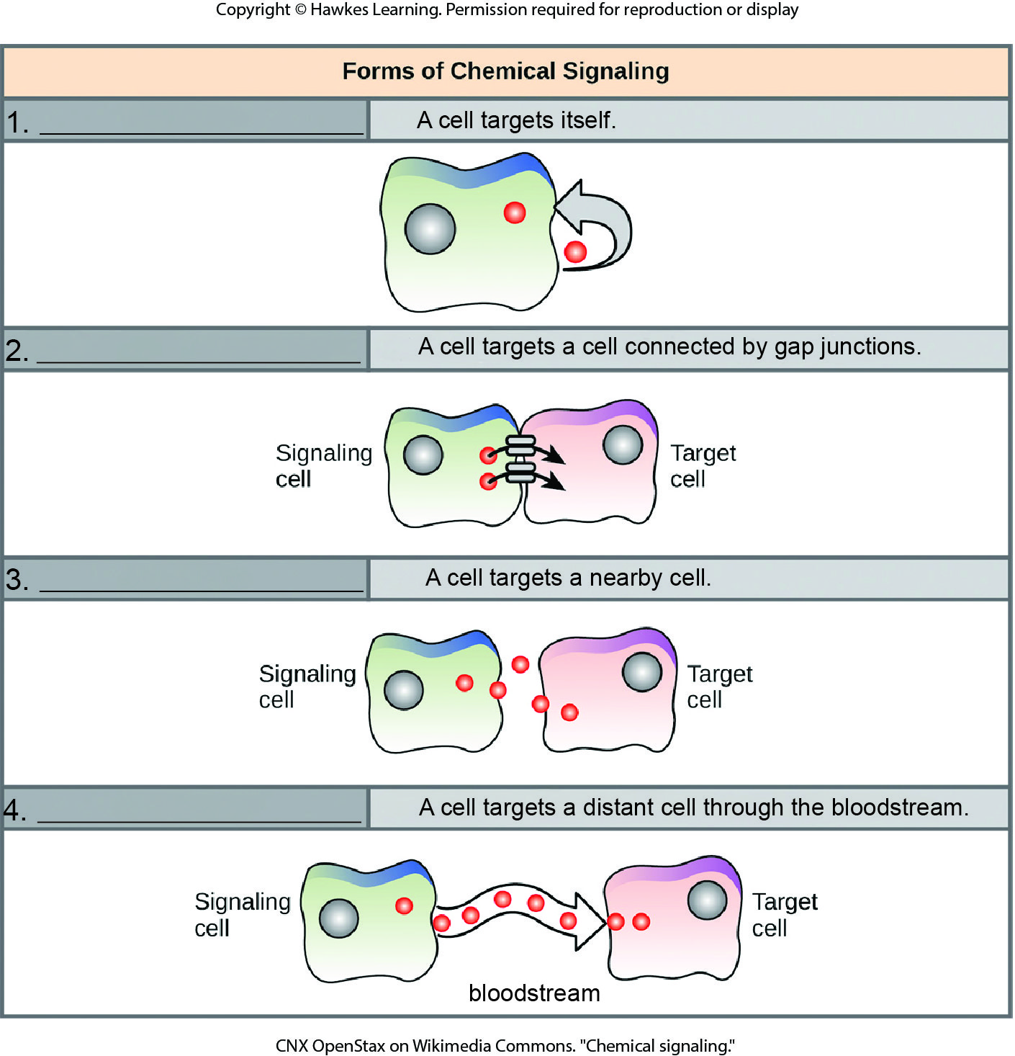
Lesson 9.1 Figure 3 - Numbered

Slide 5
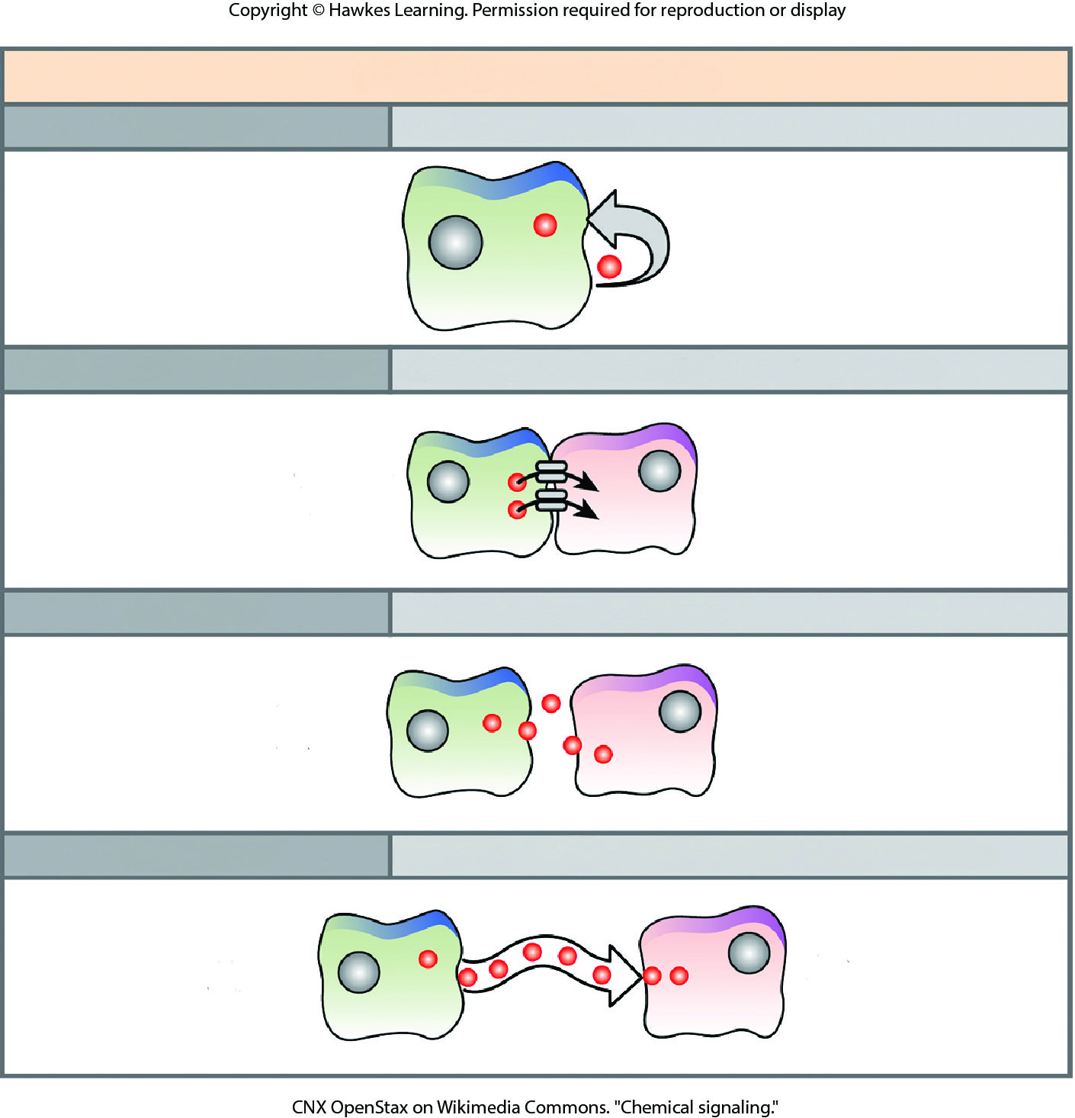
Lesson 9.1 Figure 3

Slide 6
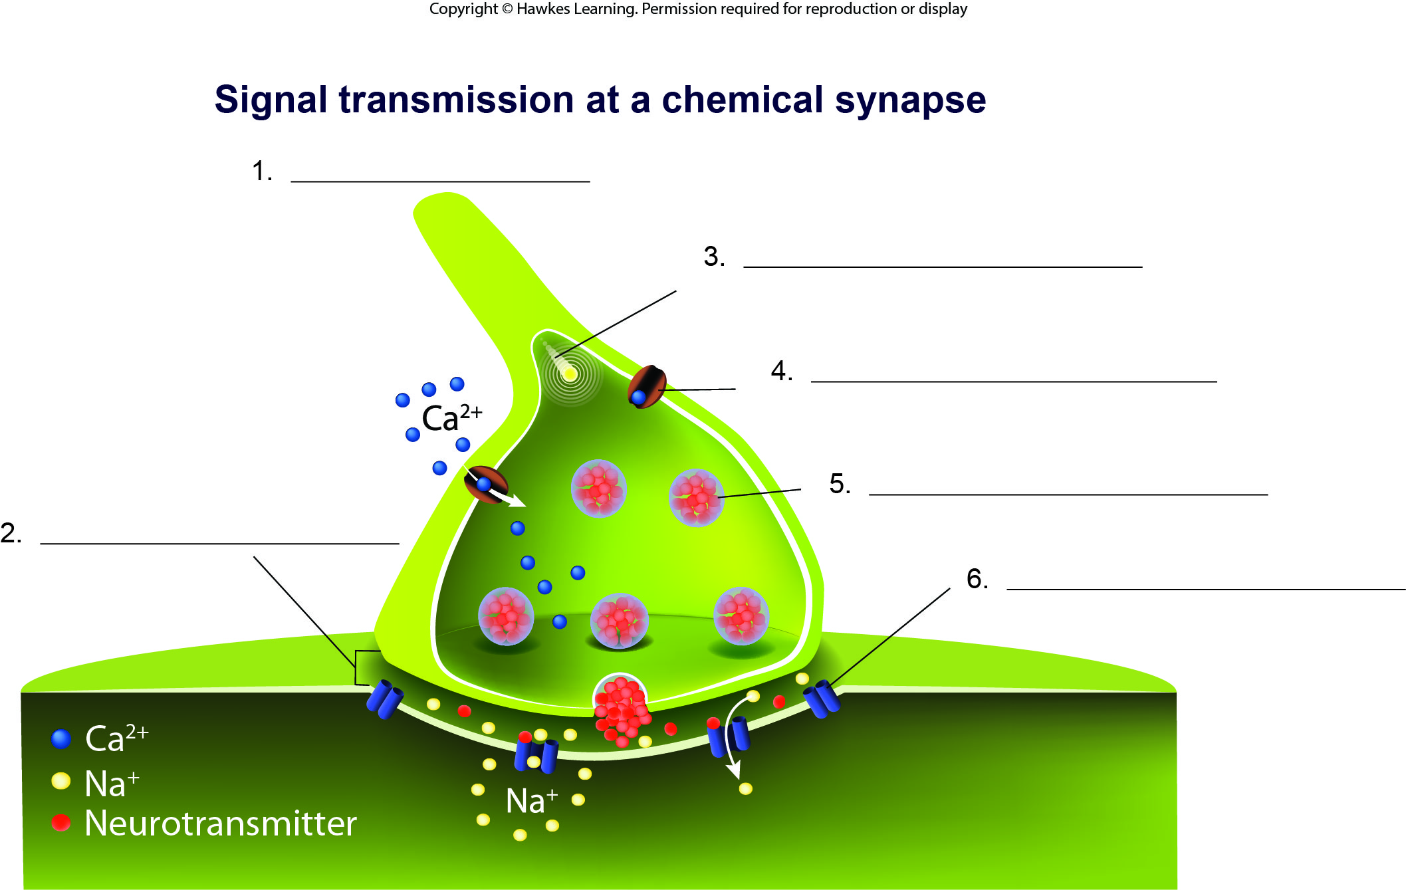
Lesson 9.1 Figure 4 - Numbered

Slide 7
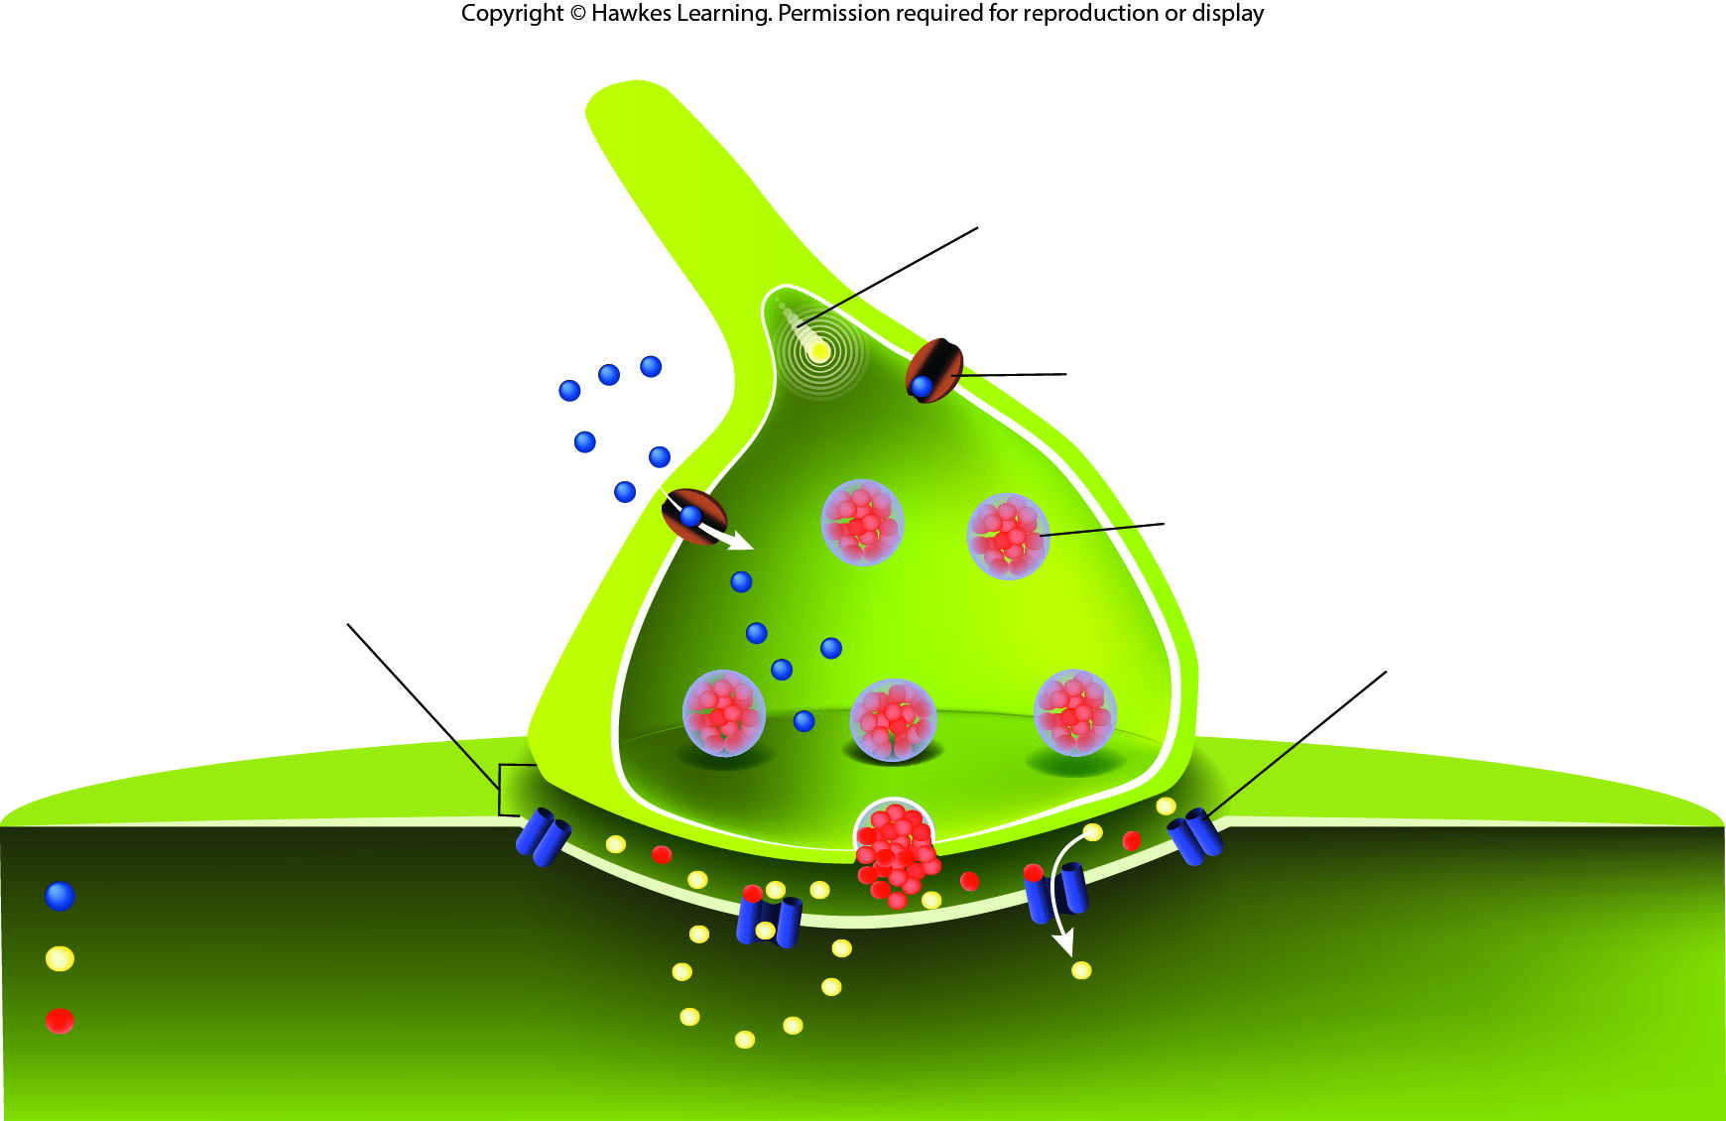
Lesson 9.1 Figure 4

Slide 8
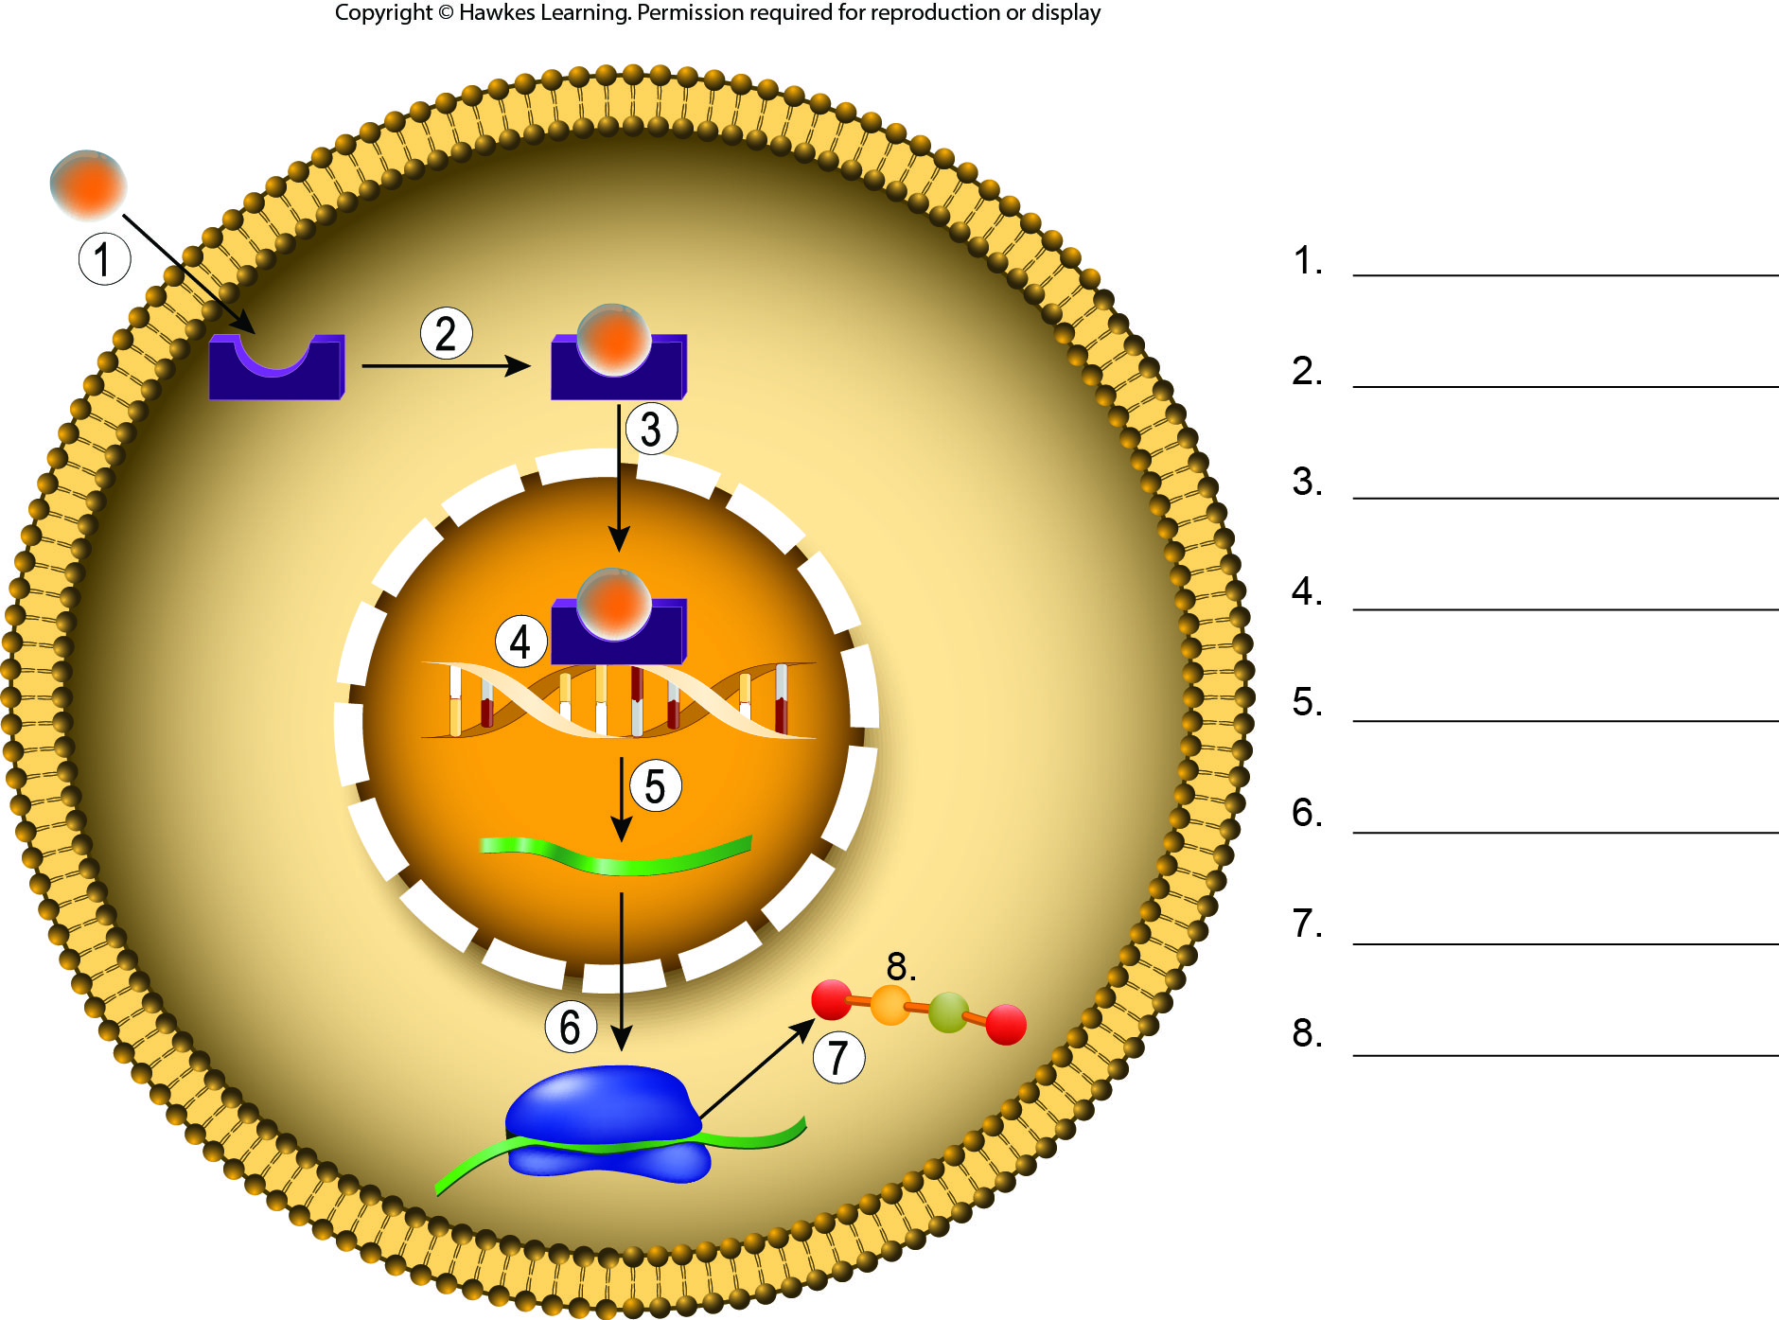
Lesson 9.1 Figure 6 - Numbered

Slide 9
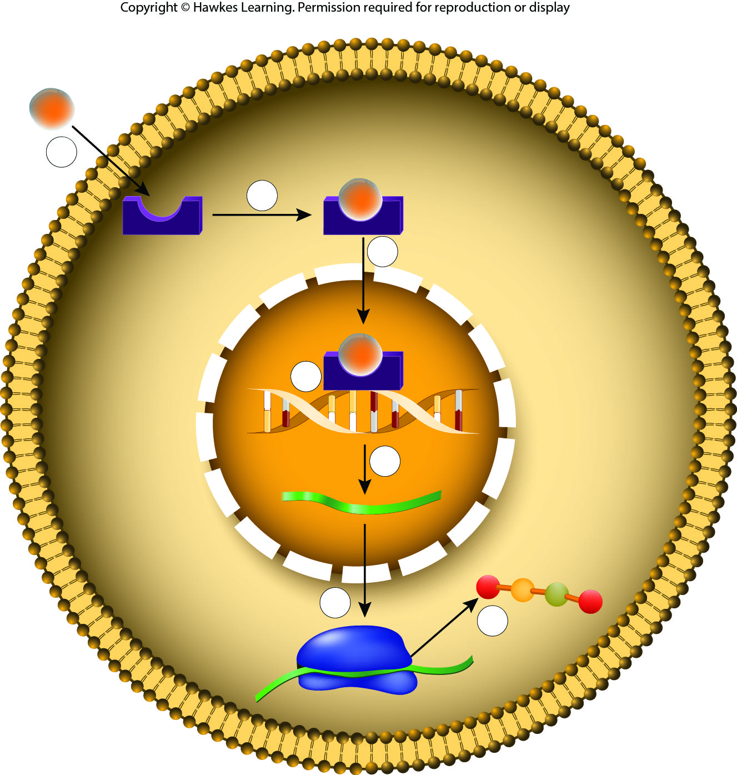
Lesson 9.1 Figure 6

Slide 10
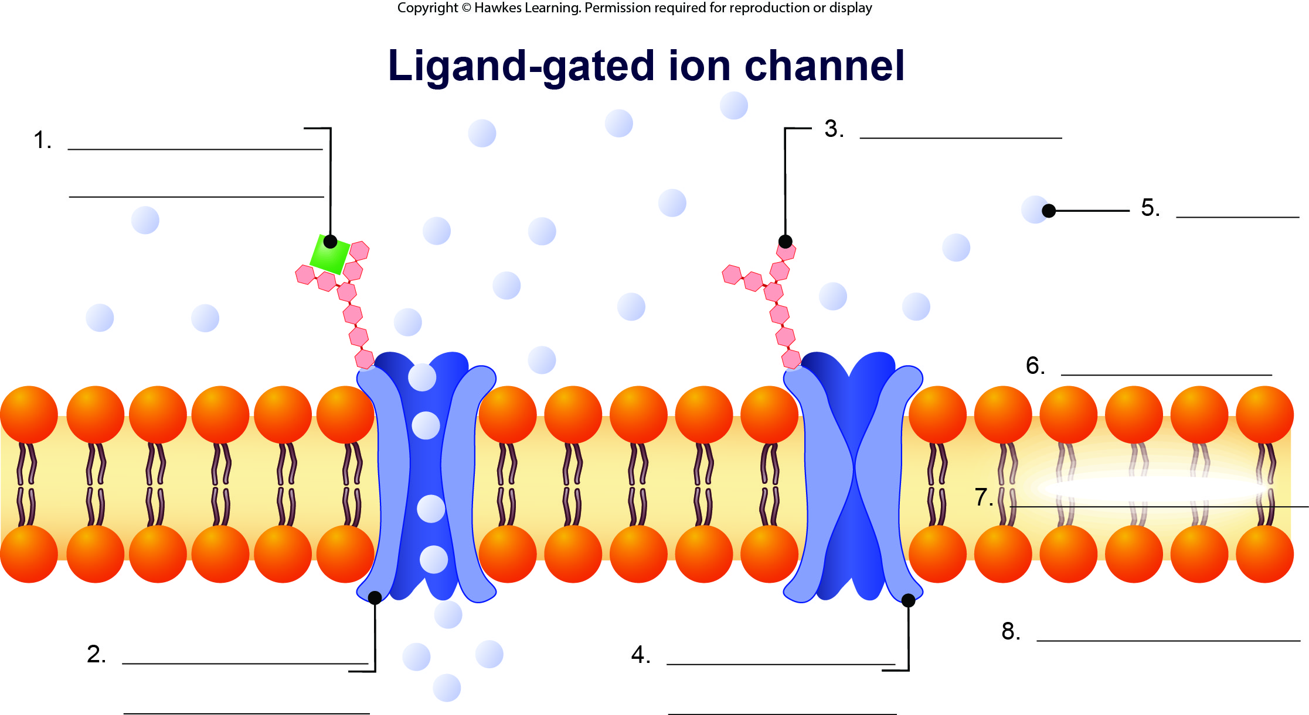
Lesson 9.1 Figure 7 - Numbered

Slide 11
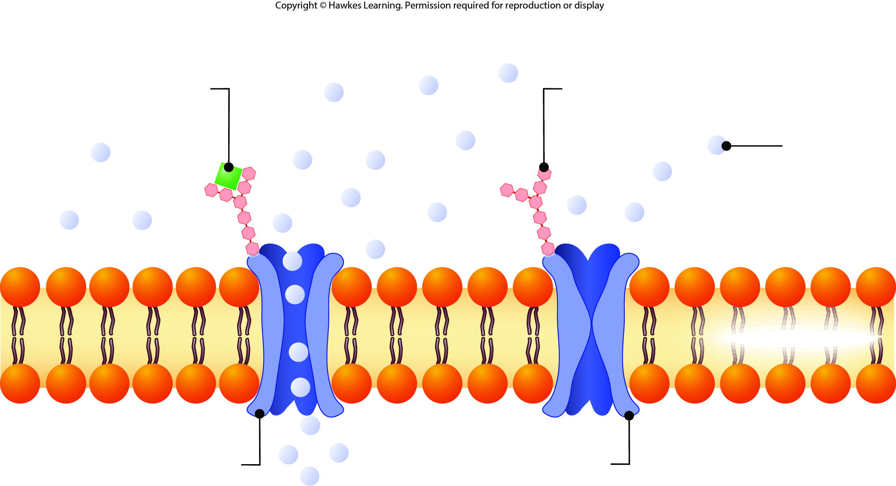
Lesson 9.1 Figure 7

Slide 12
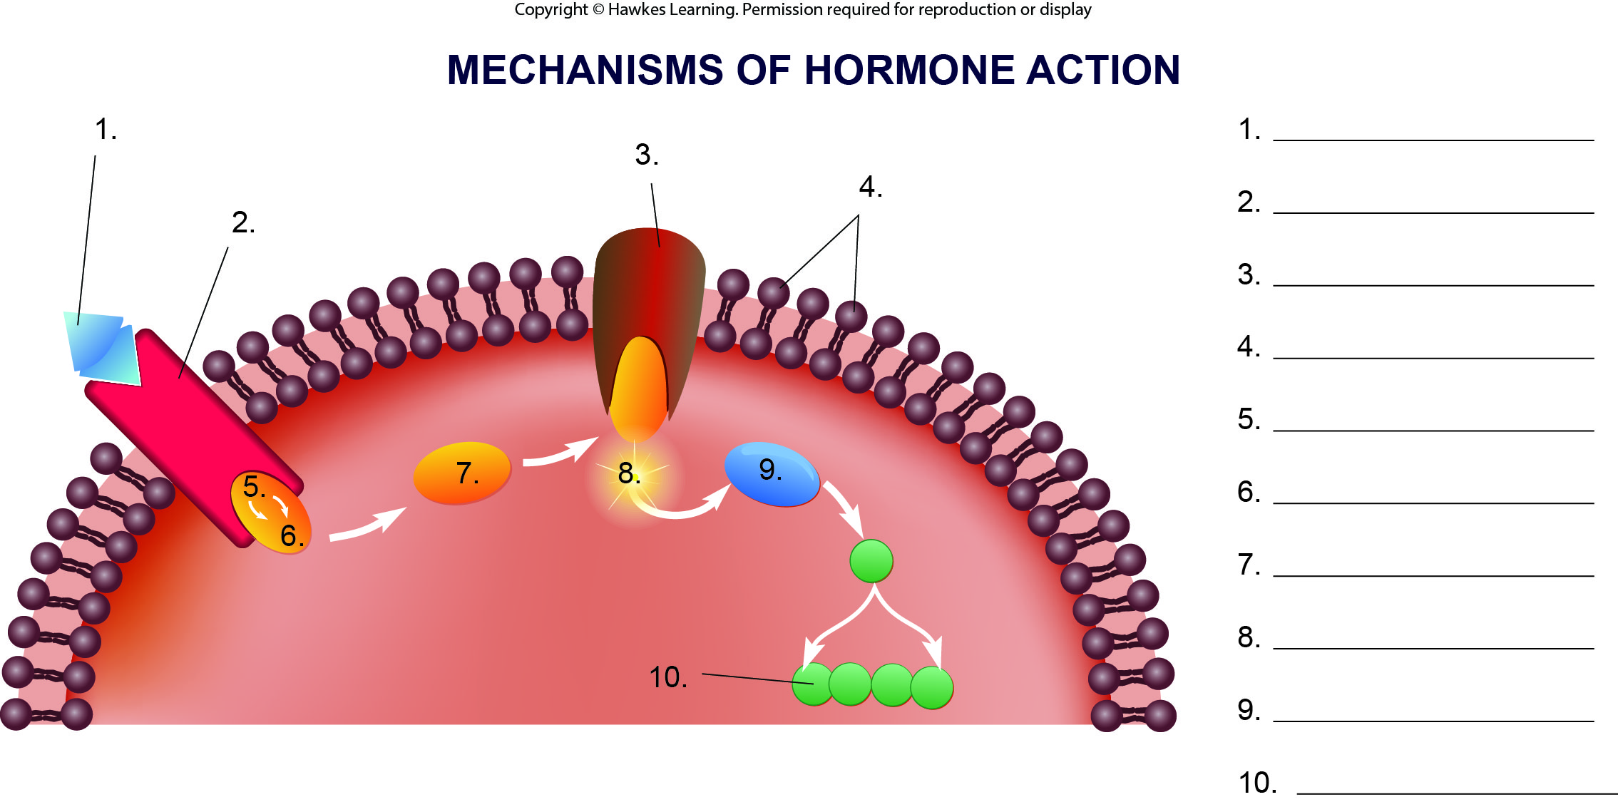
Lesson 9.1 Figure 9 - Numbered

Slide 13
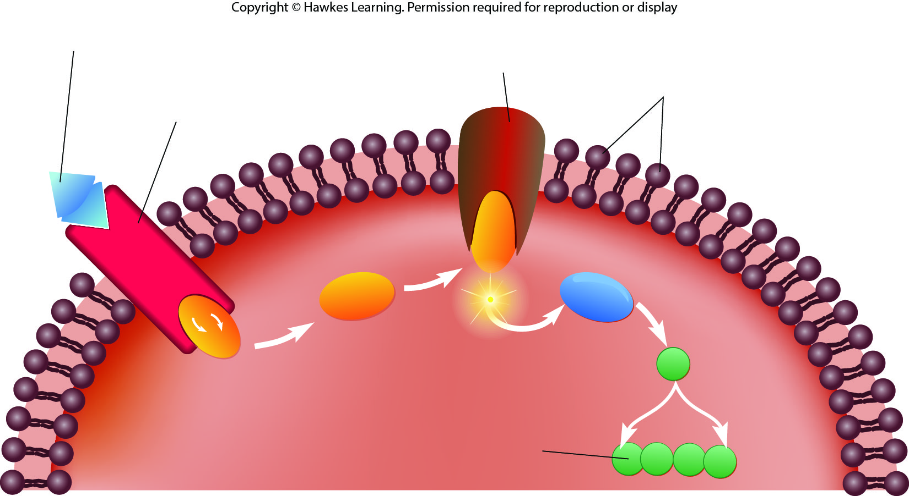
Lesson 9.1 Figure 9

Slide 14
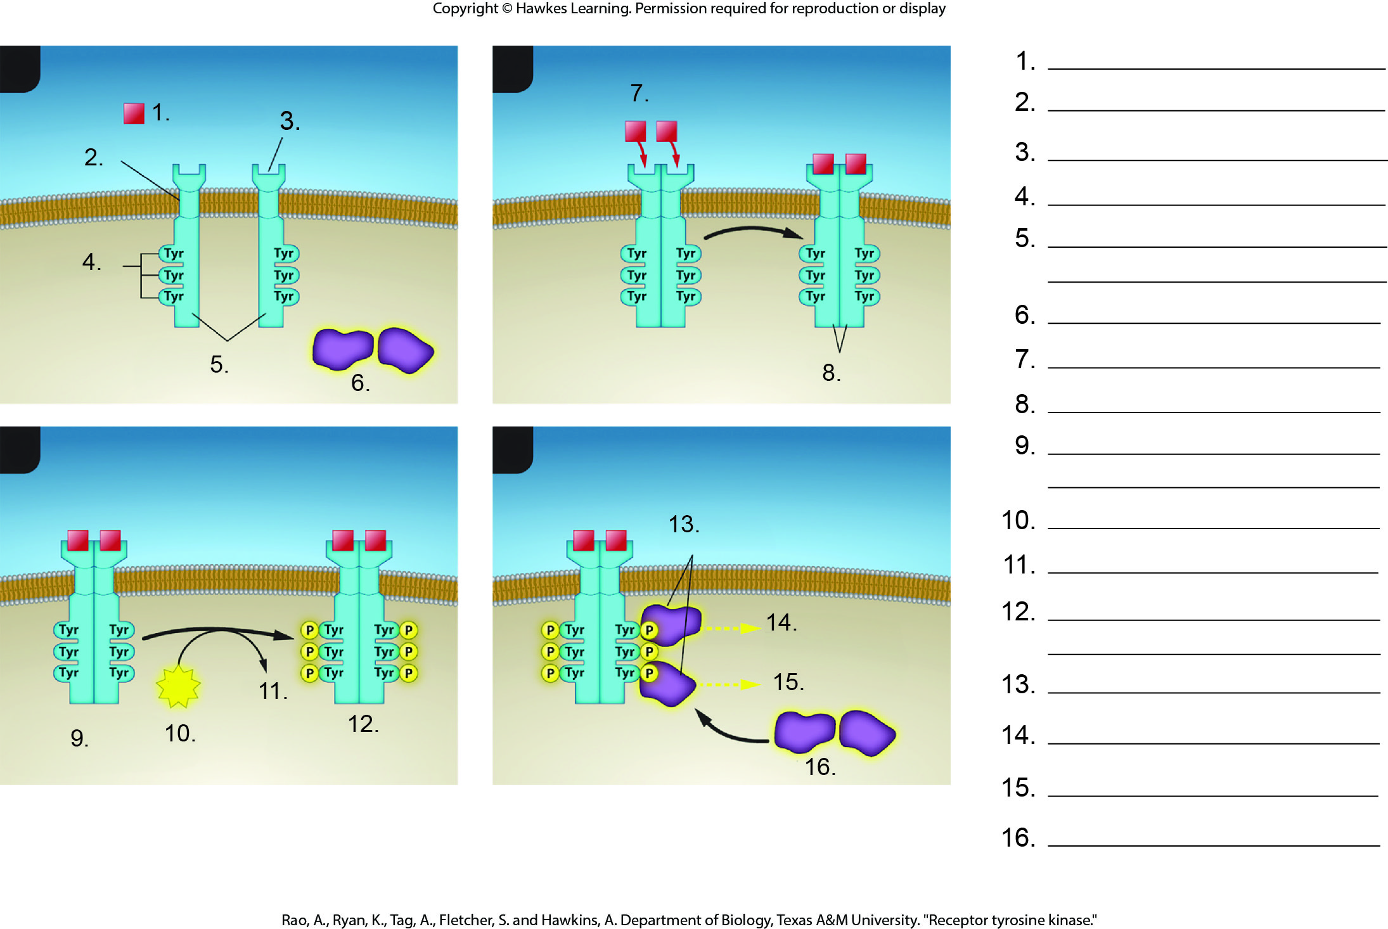
Lesson 9.1 Figure 11 - Numbered

Slide 15
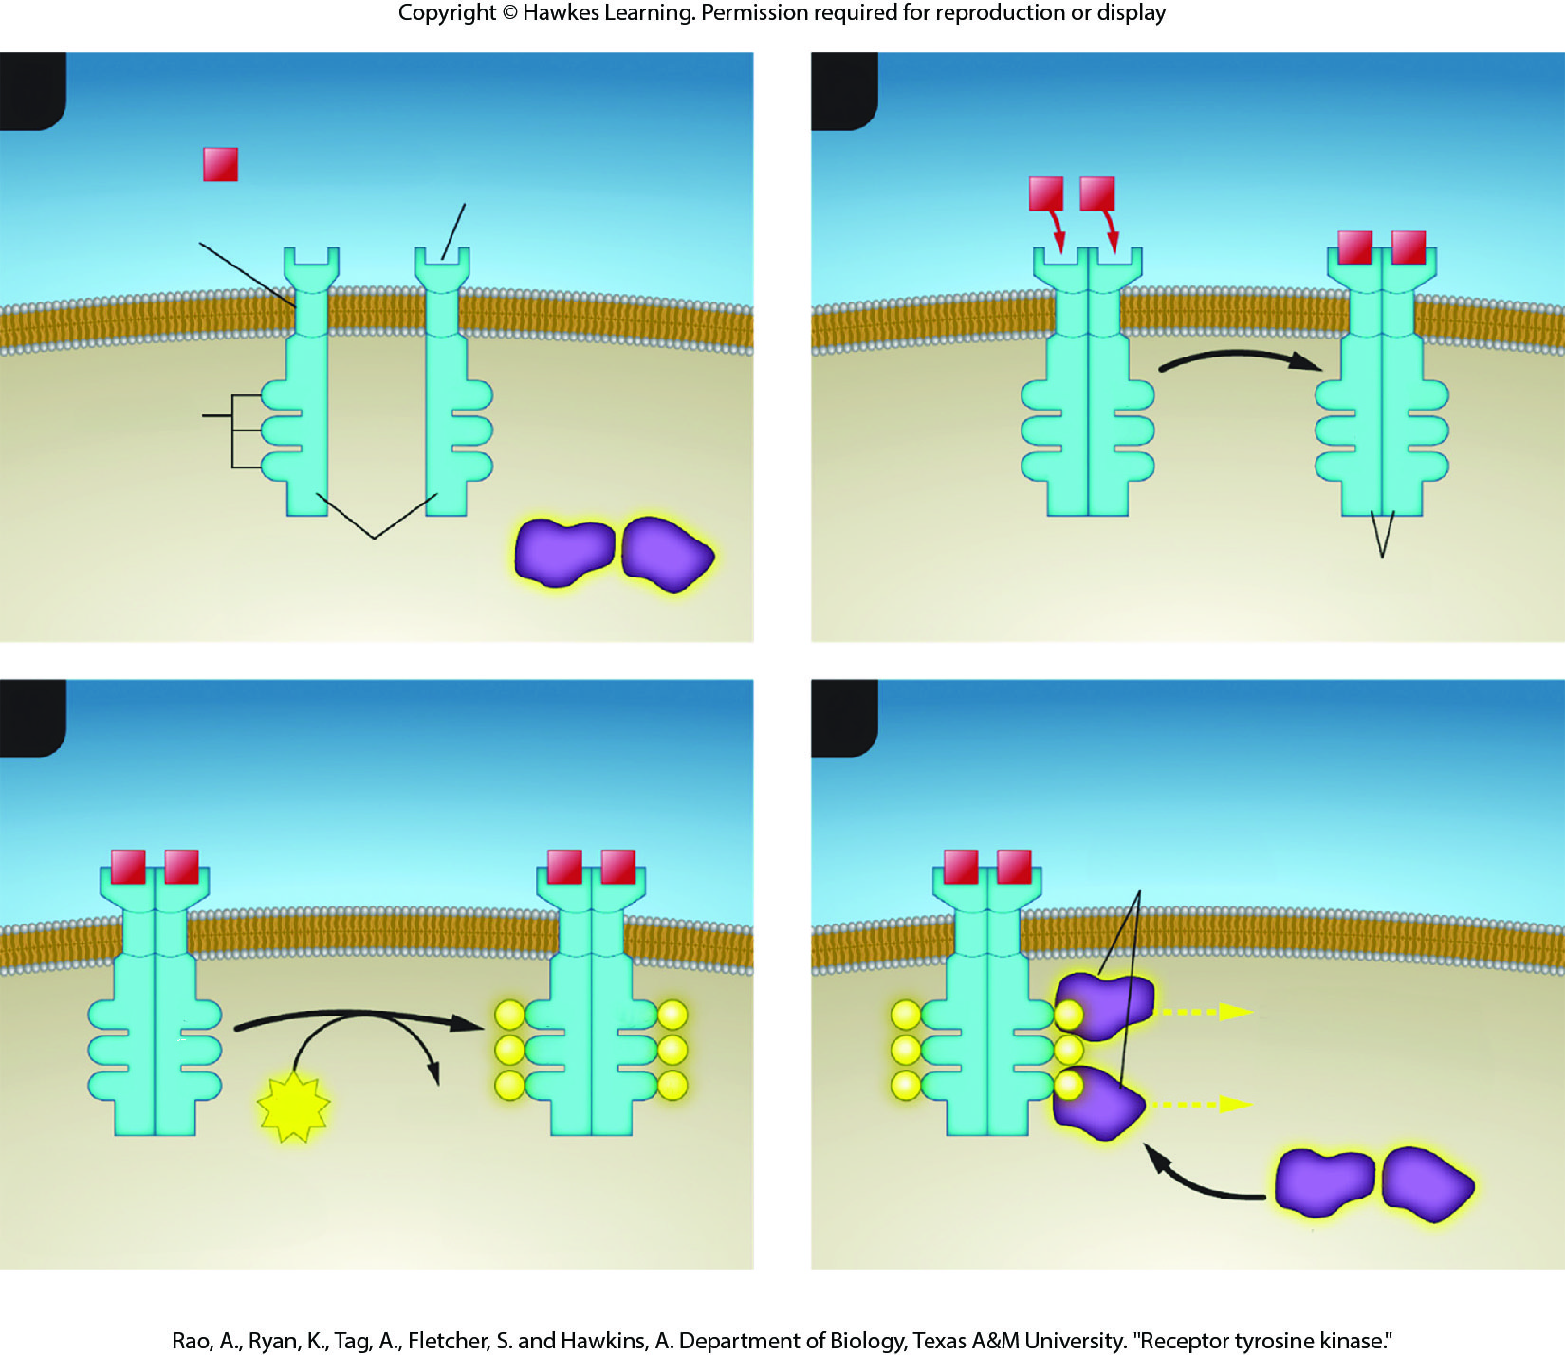
Lesson 9.1 Figure 11

Slide 16
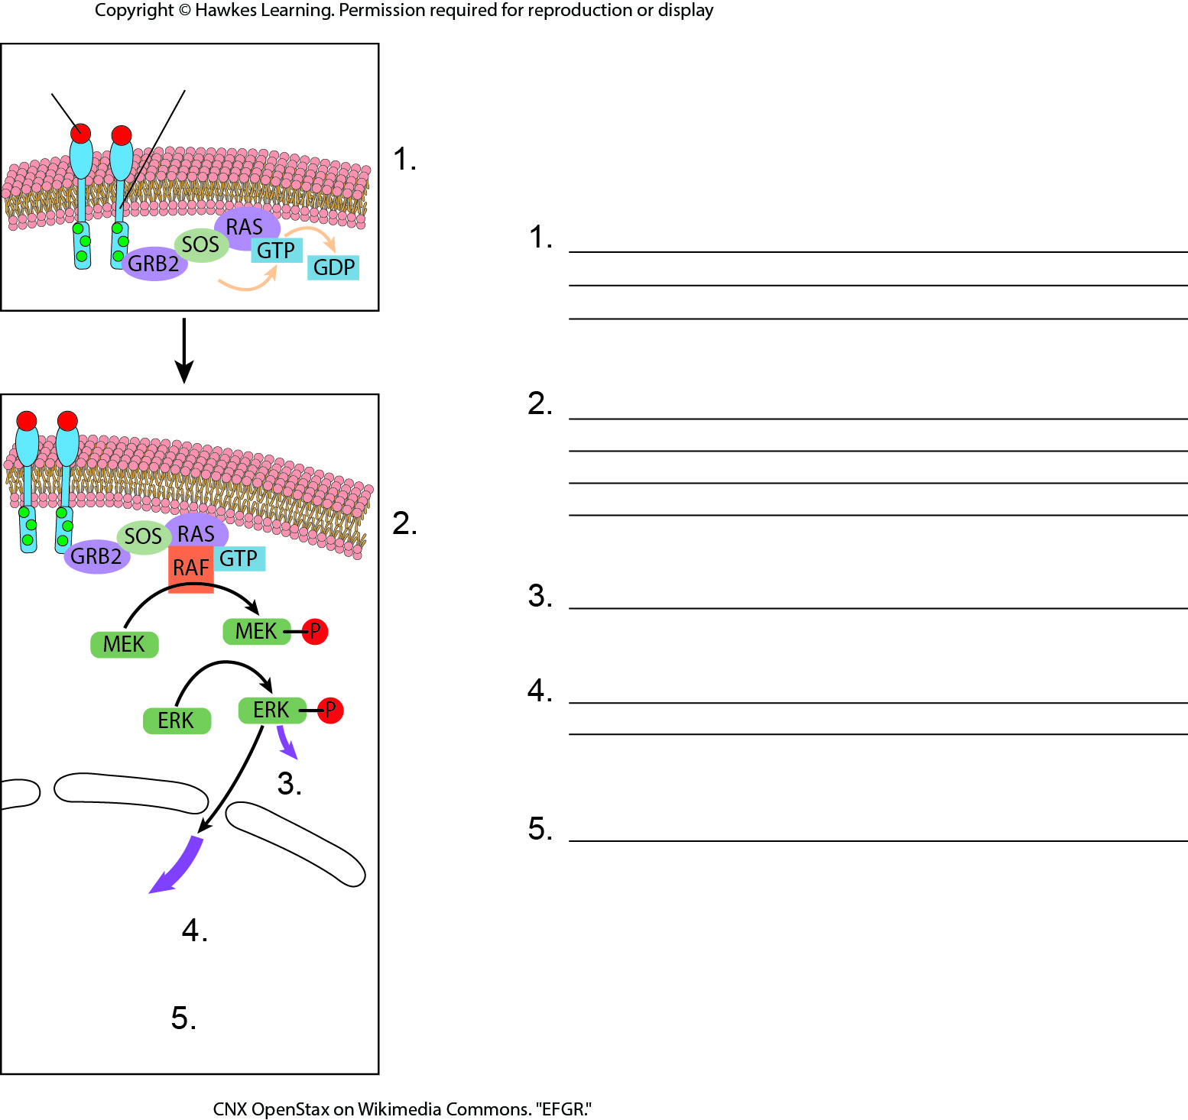
Lesson 9.2 Figure 2 - Numbered

Slide 17
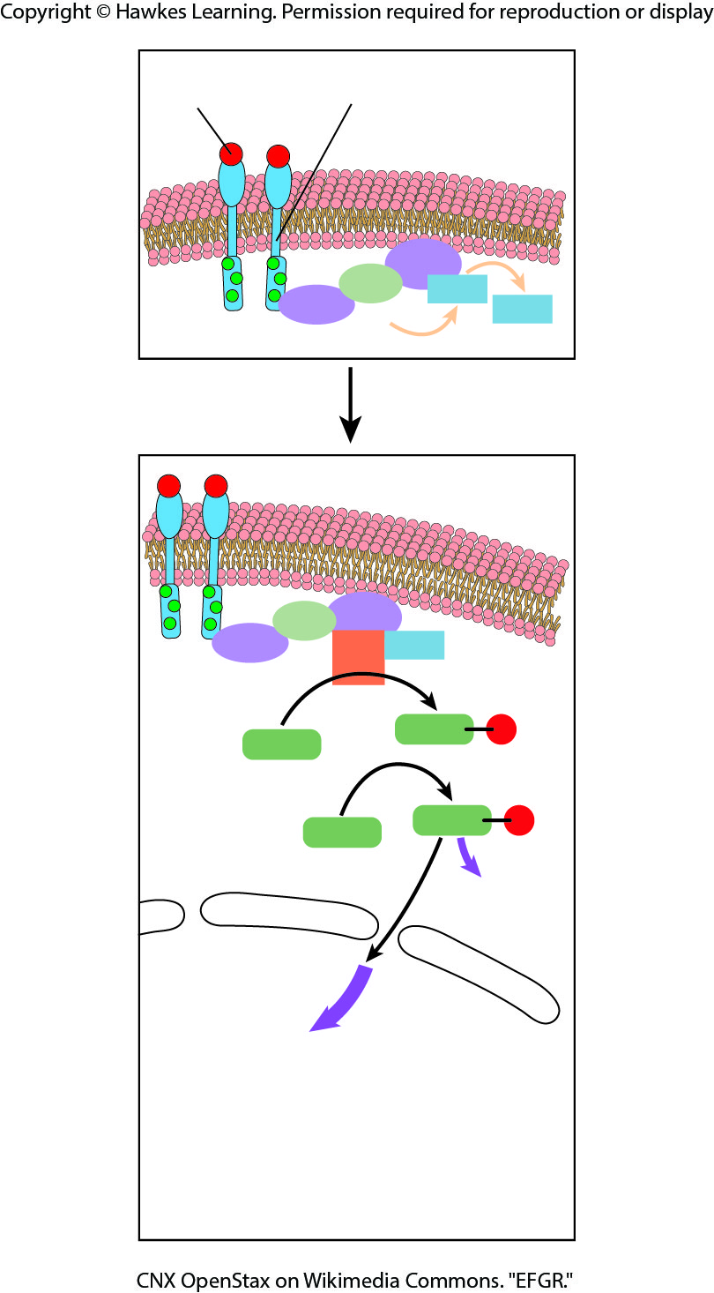
Lesson 9.2 Figure 2

Slide 18
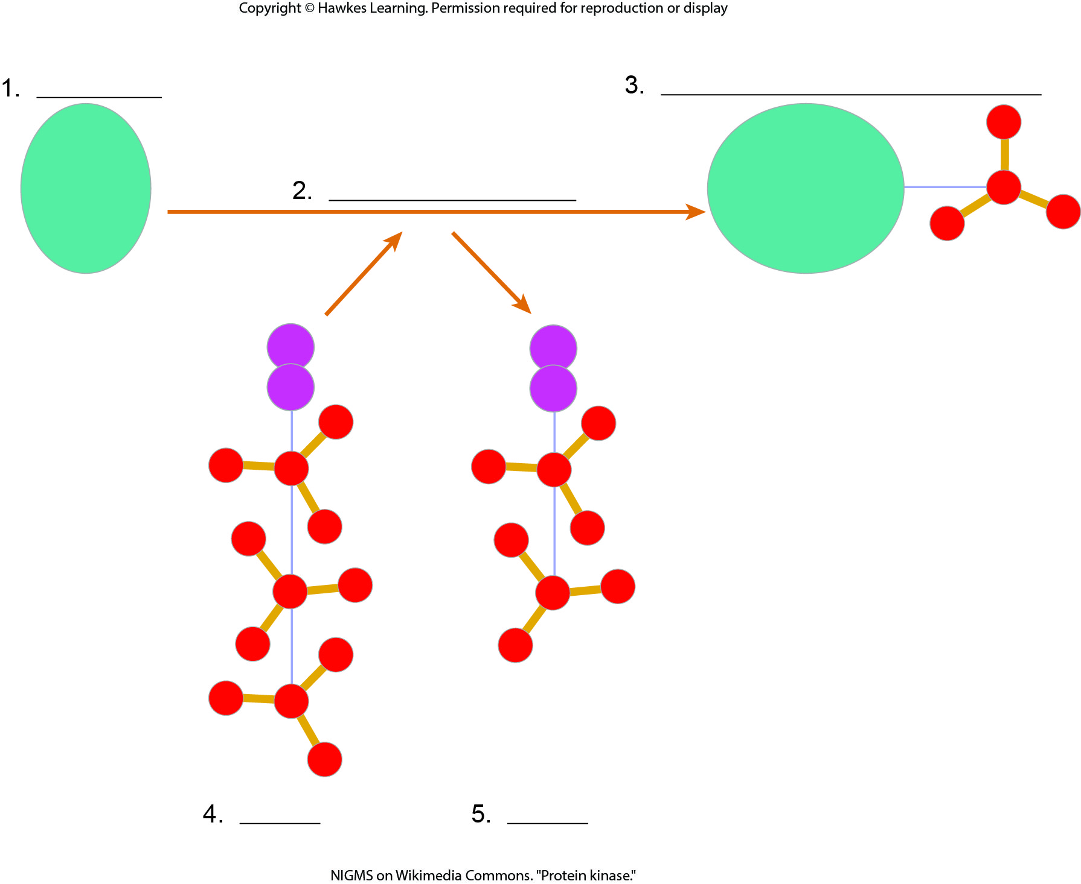
Lesson 9.2 Figure 3 - Numbered

Slide 19
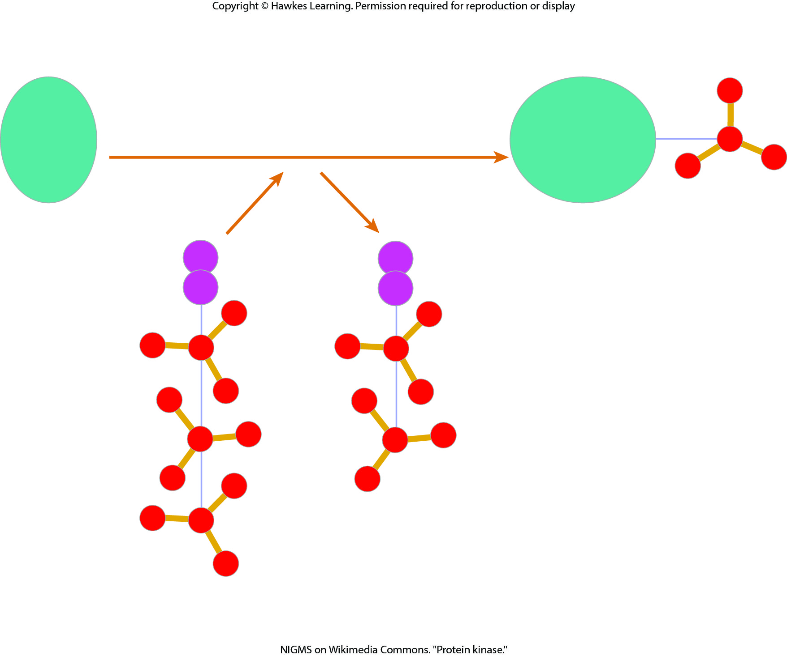
Lesson 9.2 Figure 3

Slide 20
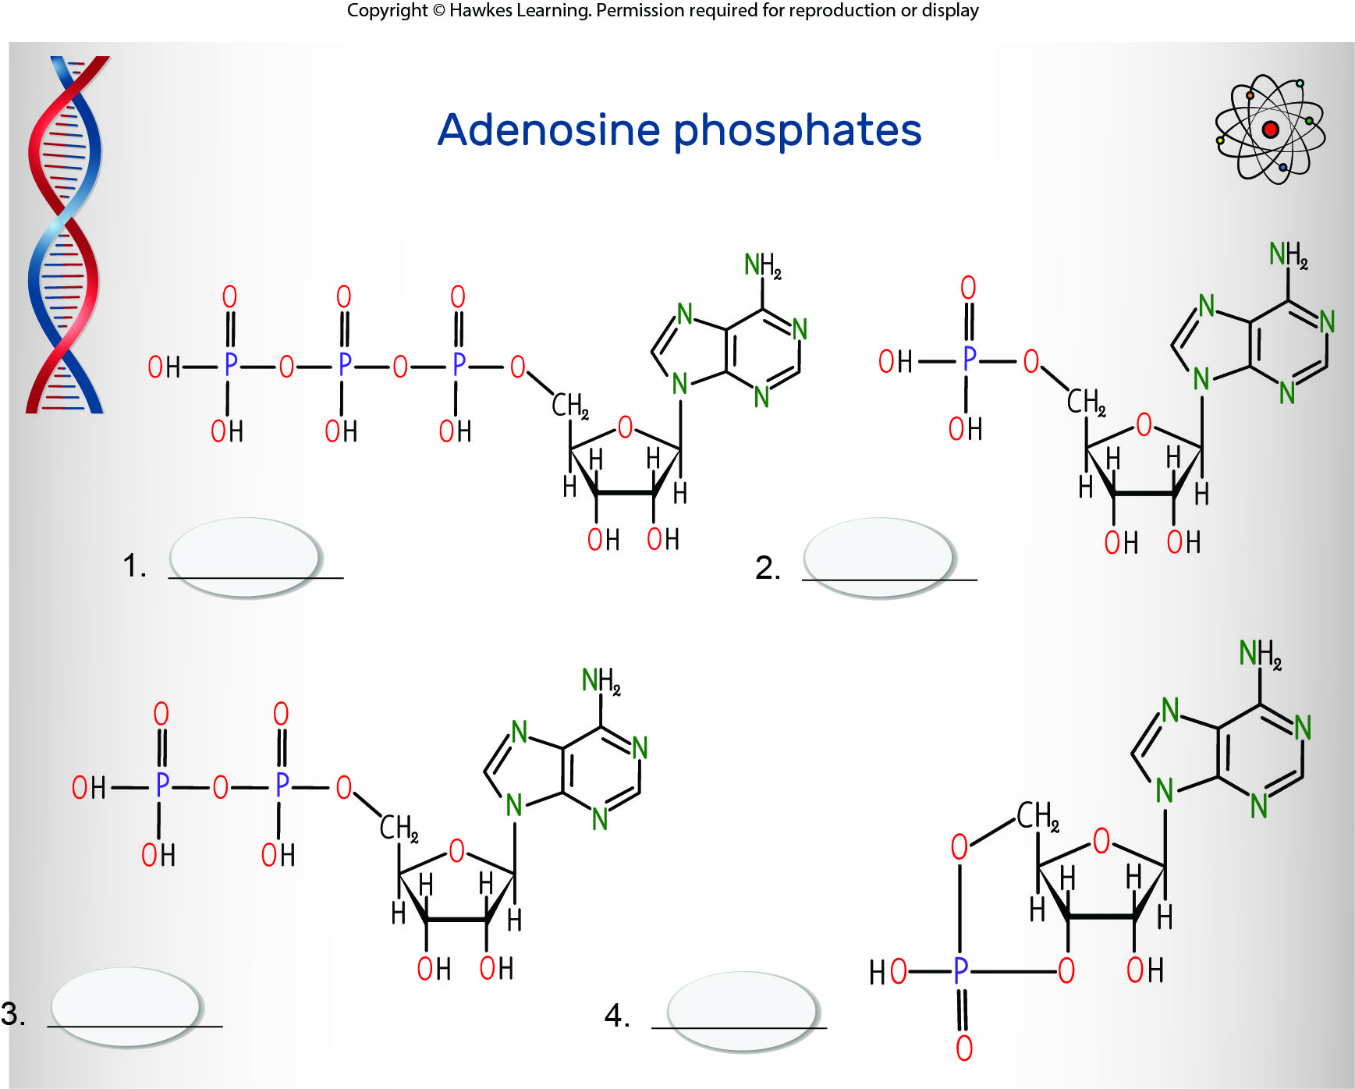
Lesson 9.2 Figure 4 - Numbered

Slide 21
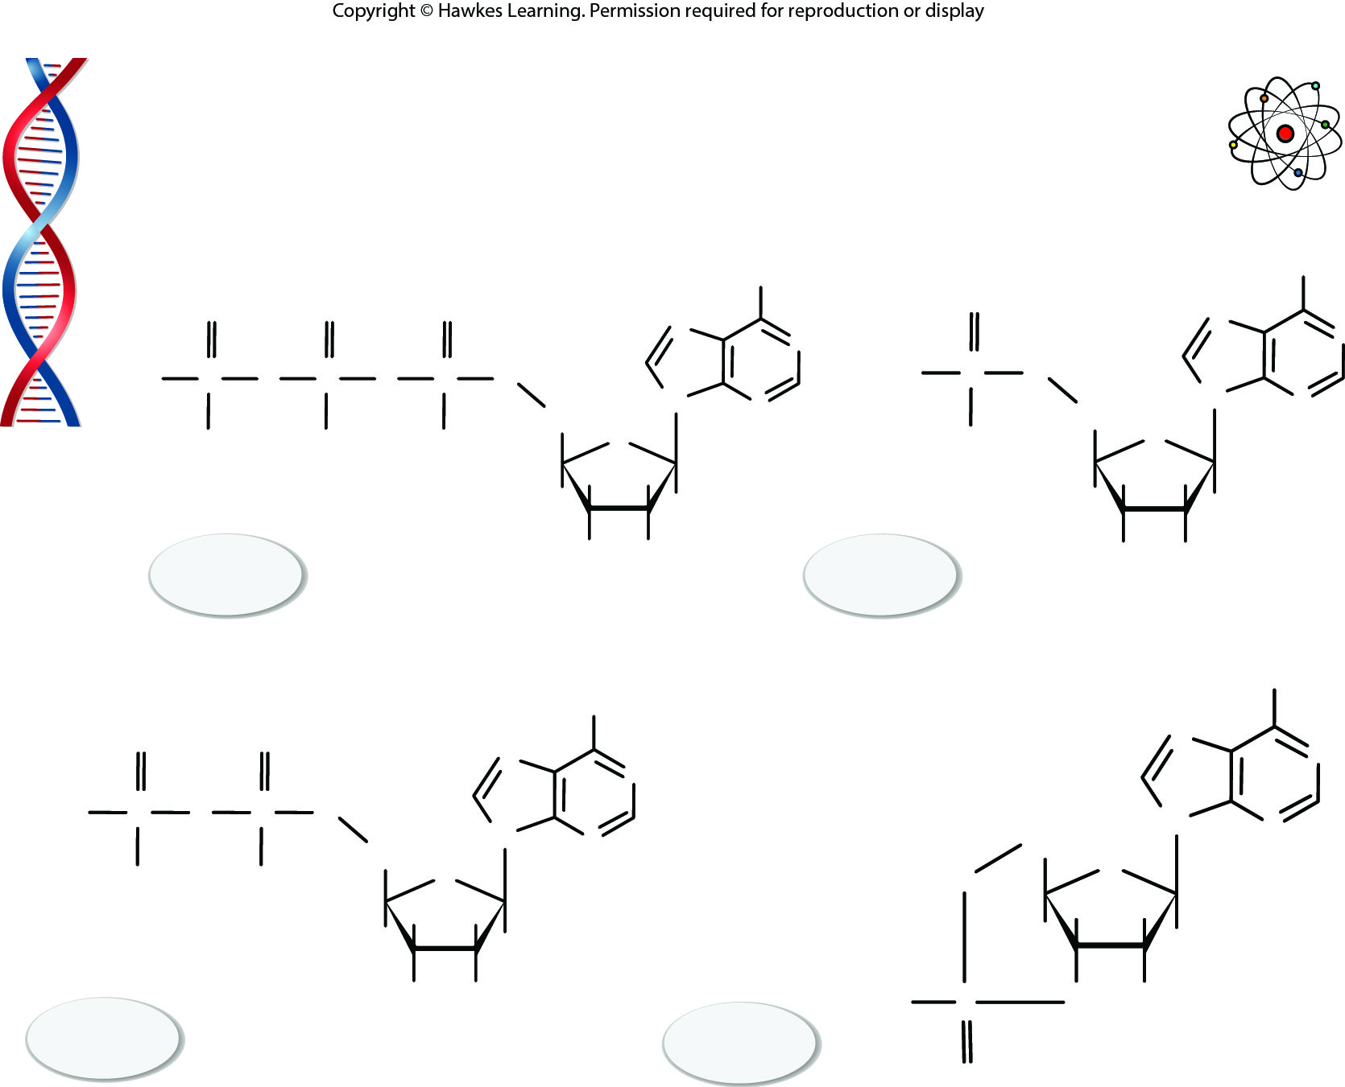
Lesson 9.2 Figure 4

Slide 22
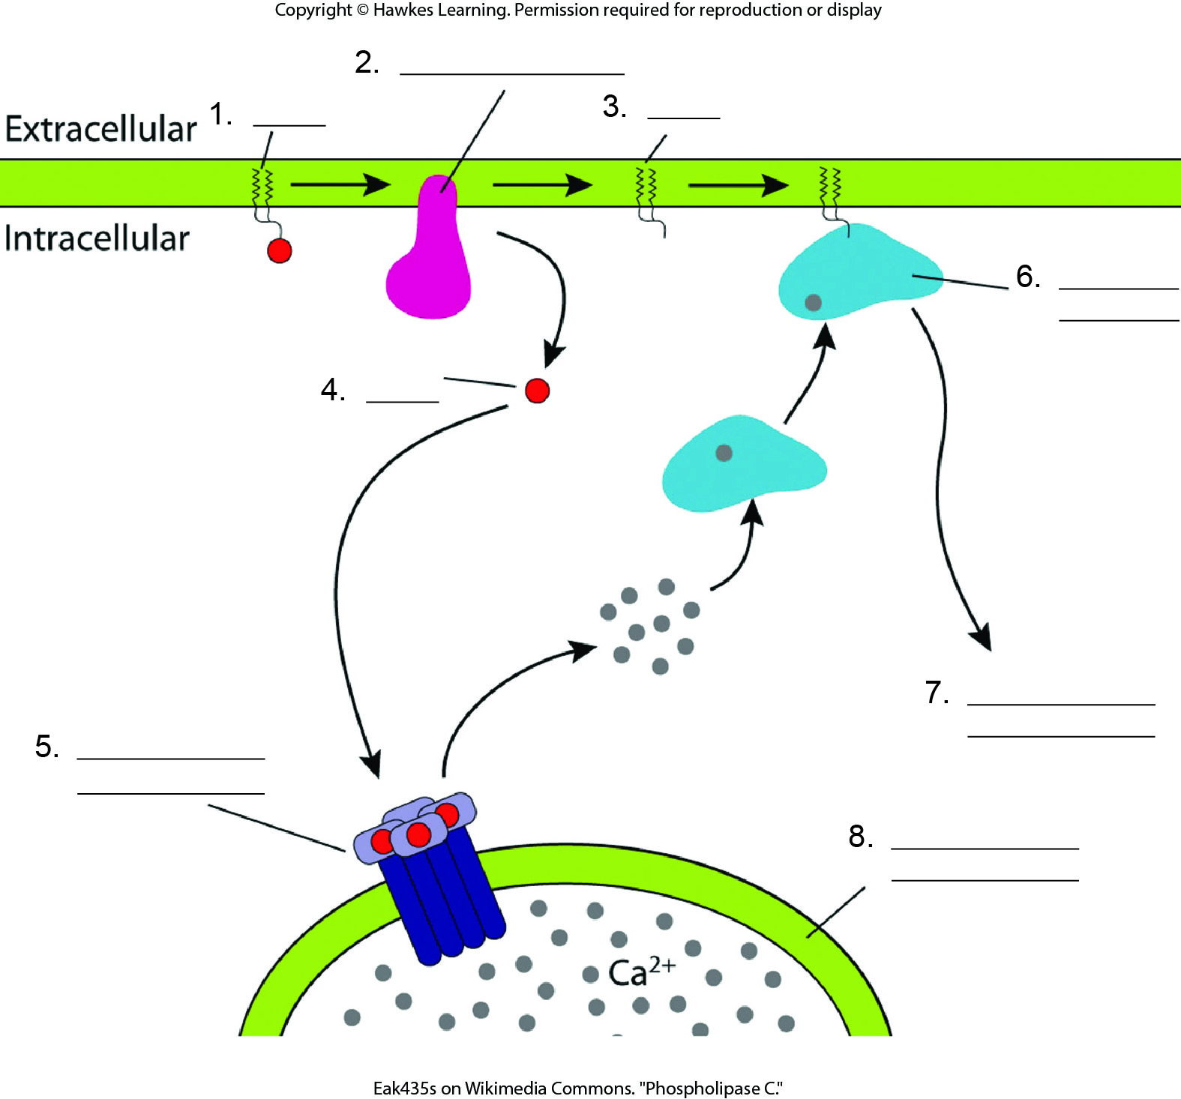
Lesson 9.2 Figure 5 - Numbered

Slide 23
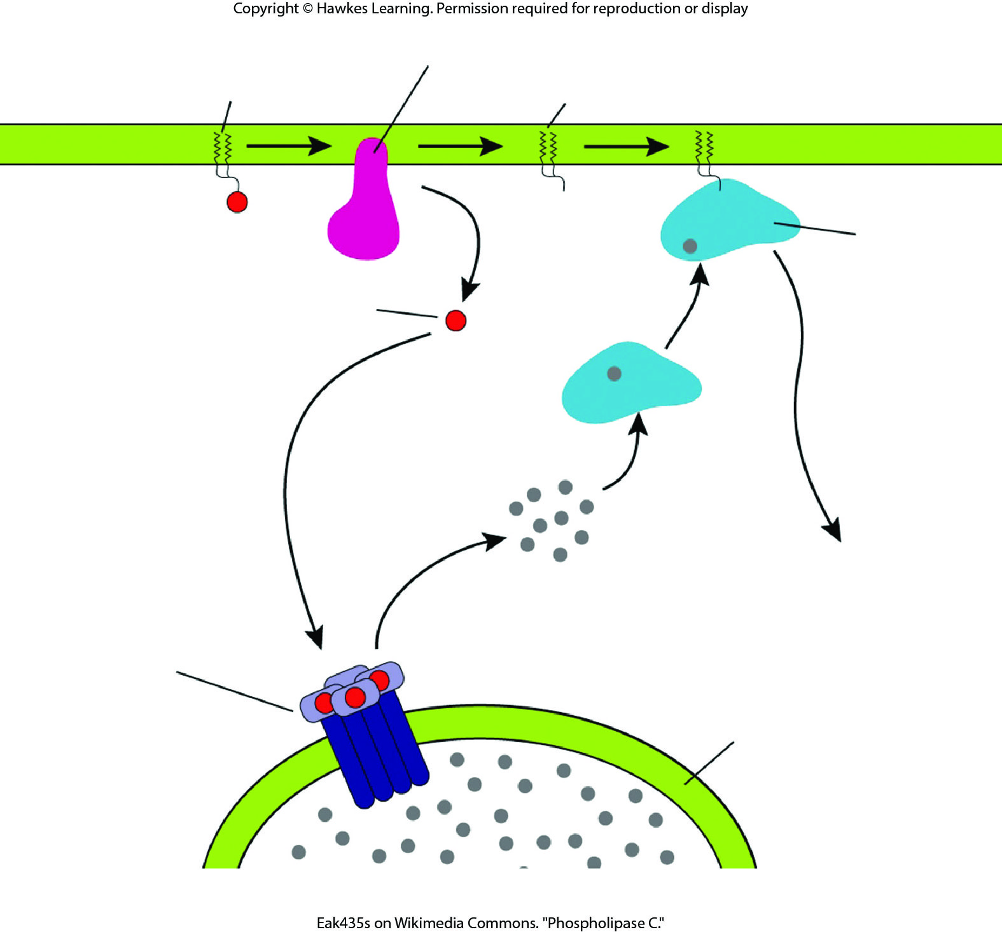
Lesson 9.2 Figure 5

Slide 24
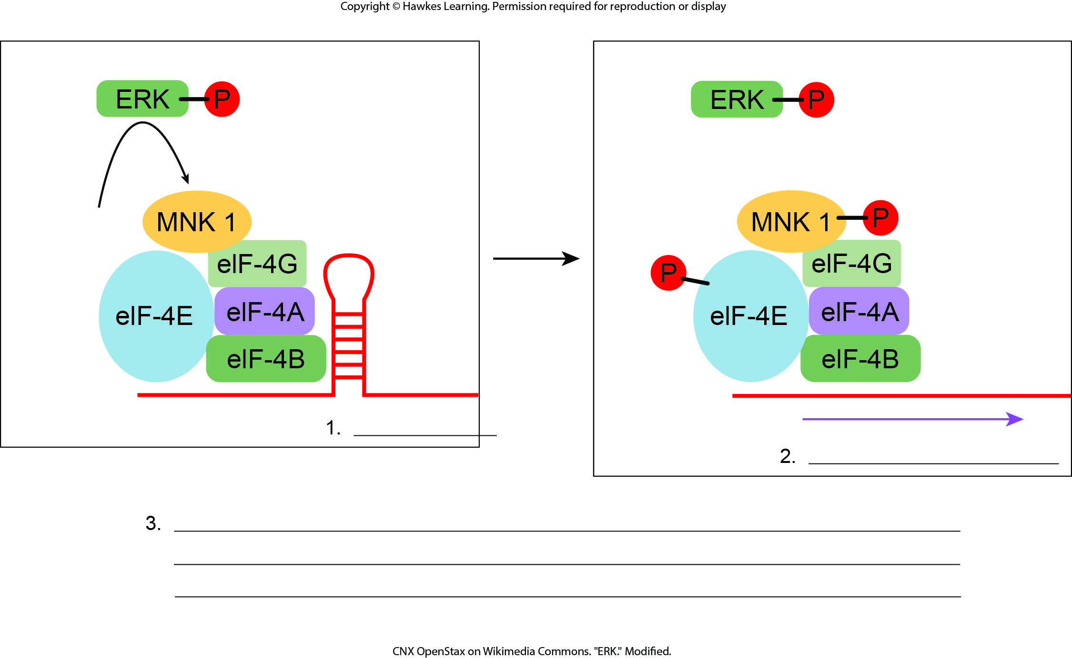
Lesson 9.3 Figure 1 - Numbered

Slide 25
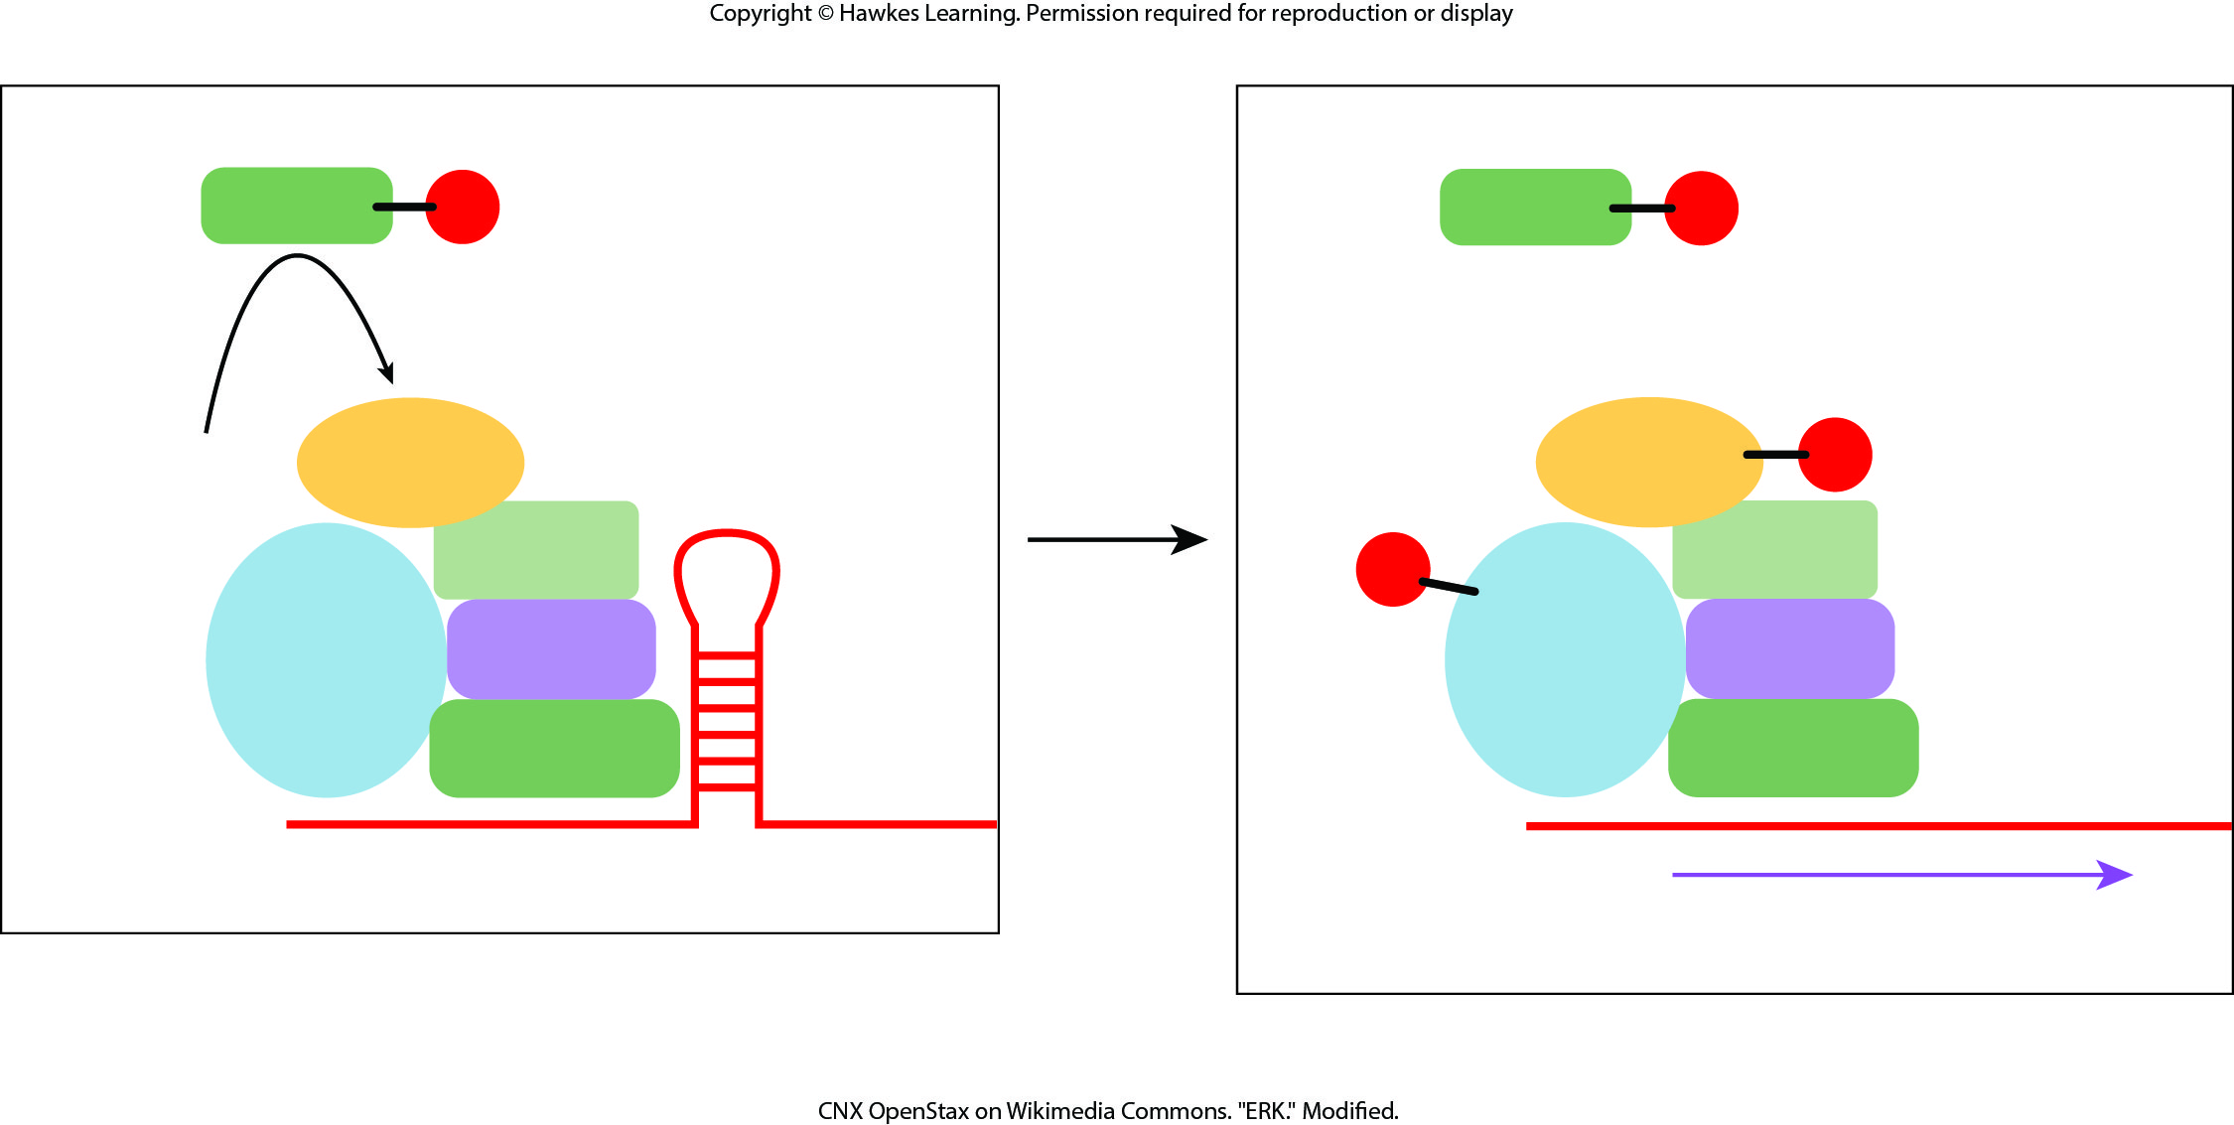
Lesson 9.3 Figure 1

Slide 26
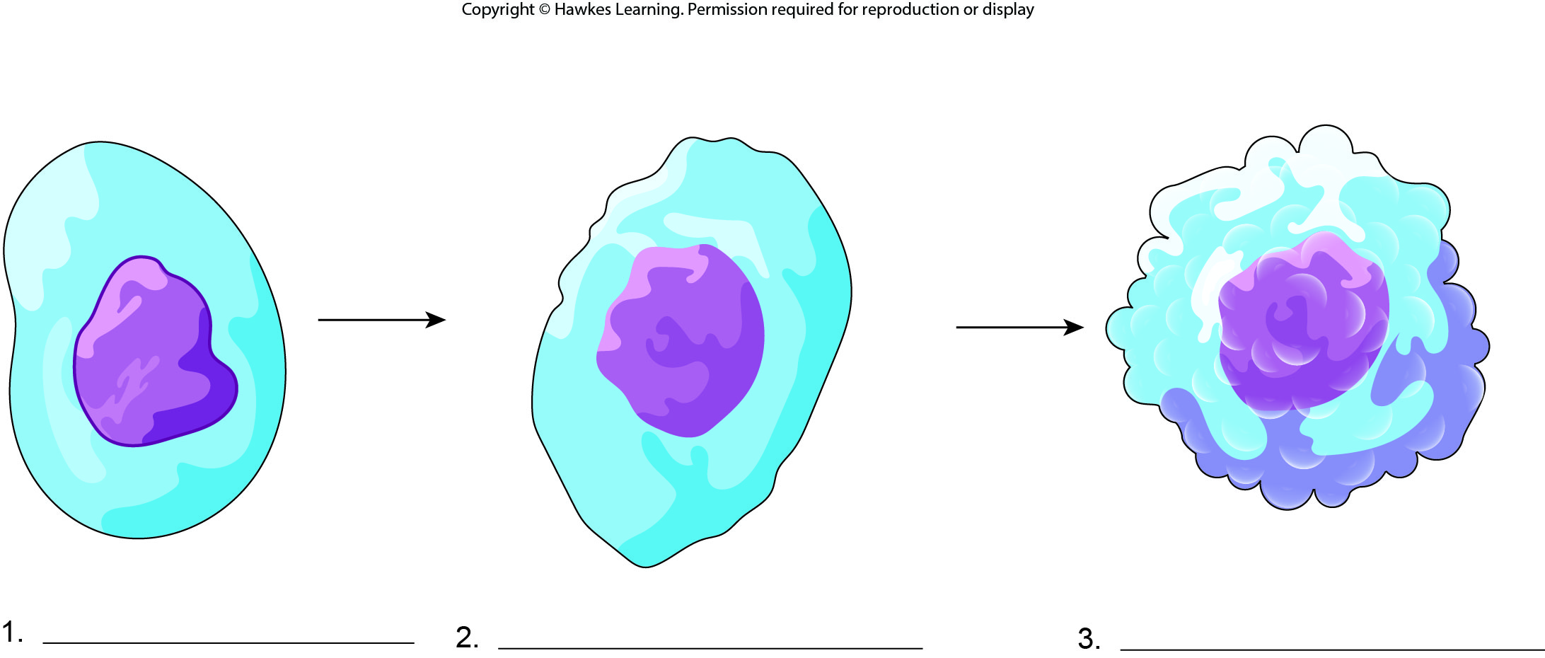
Lesson 9.3 Figure 2 - Numbered

Slide 27
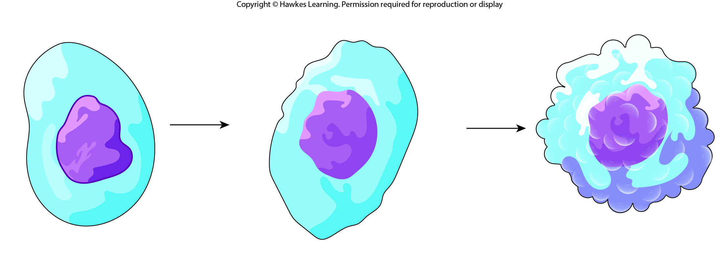
Lesson 9.3 Figure 2

Slide 28
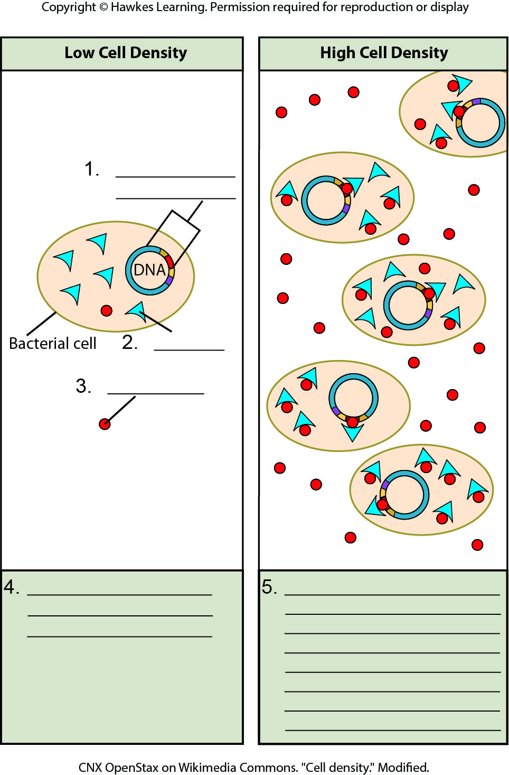
Lesson 9.4 Figure 3 - Numbered

Slide 29
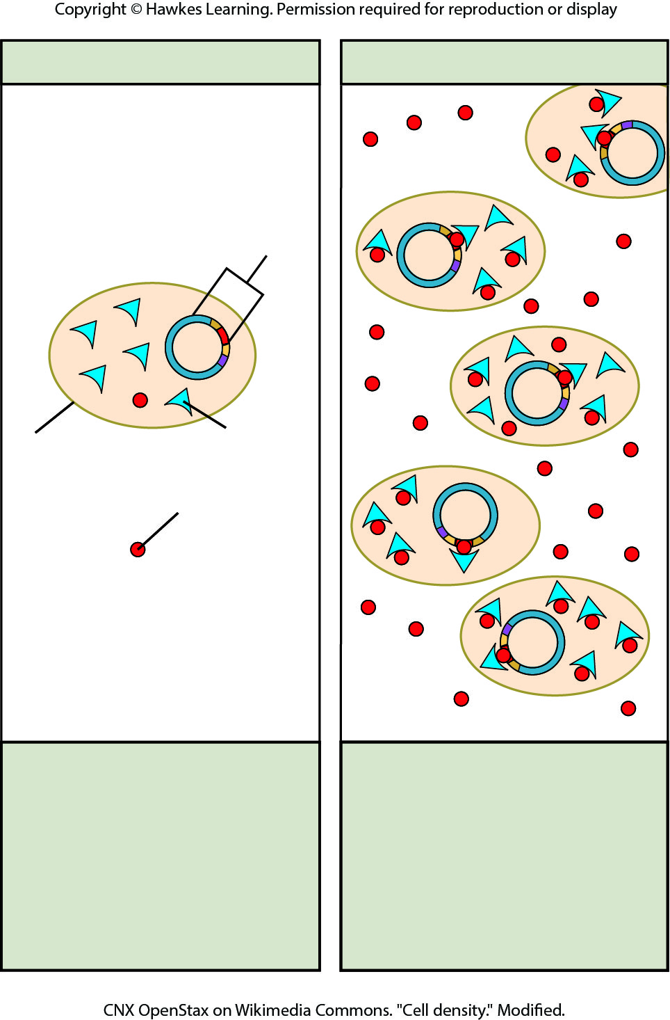
Lesson 9.4 Figure 3

Slide 30
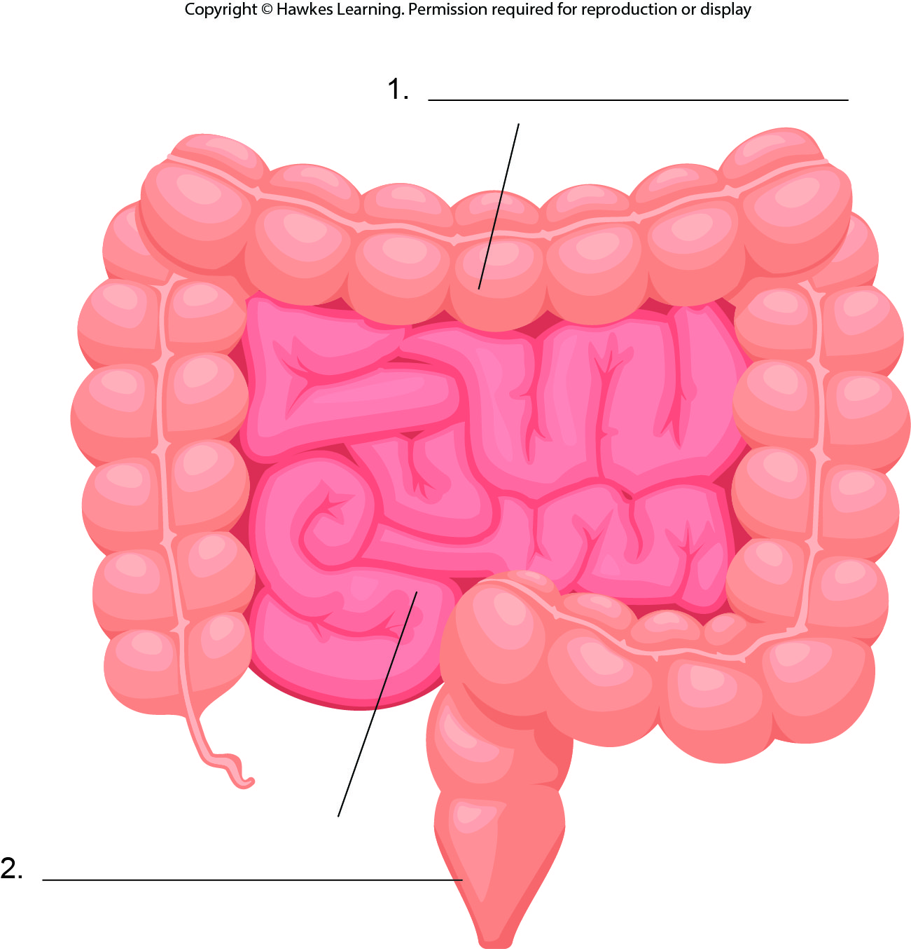
Lesson 9.4 Figure 4 - Numbered

Slide 31
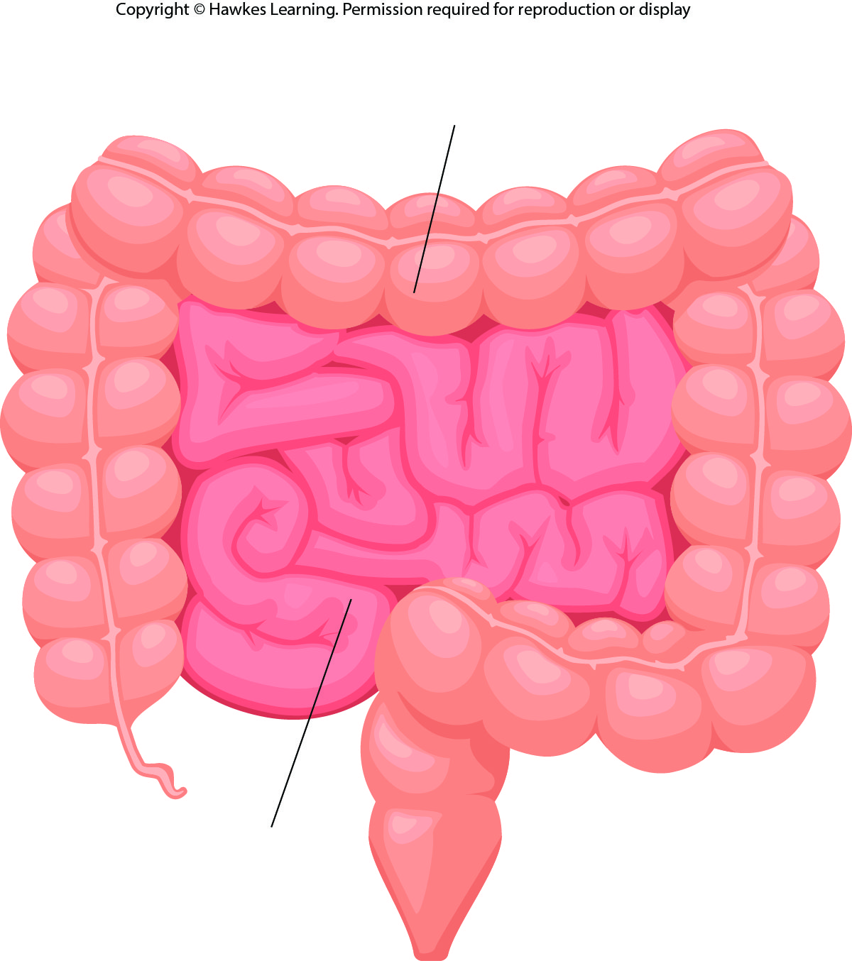
Lesson 9.4 Figure 4

Slide 32
Hawkes Learning – End of PowerPoint

