Slide 1
Lesson 1.1 Thinking Like a Biologist
Lesson 1.1
Thinking Like a Biologist

Slide 2
Objectives
Compare inductive reasoning with deductive reasoning
Describe the goals of basic science and applied science
Identify the shared characteristics of the natural sciences
Summarize the steps of the scientific method

Slide 3
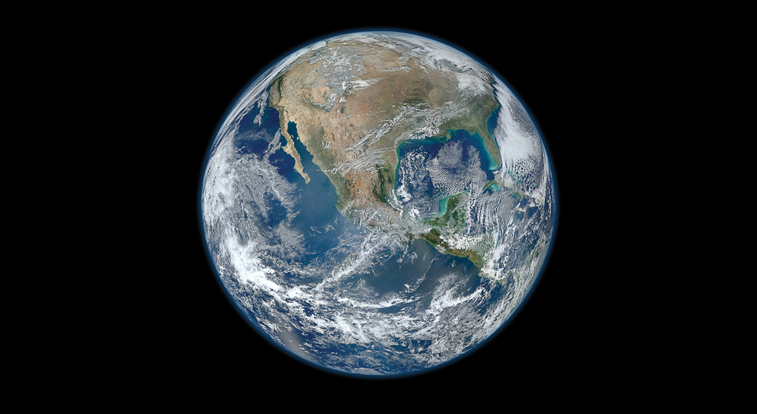
The Nature of Biology
Life on Earth exhibits immense diversity across many forms.
The earliest life consisted of microorganisms for billions of years.
Plants and animals emerged 130-250 million years ago.
The human genus Homo appeared 2.5 million years ago, but modern humans didn't appear until 300,000 years ago.
1.1 Figure 1
J Garget on Pixabay. "Seedlings."

Slide 4
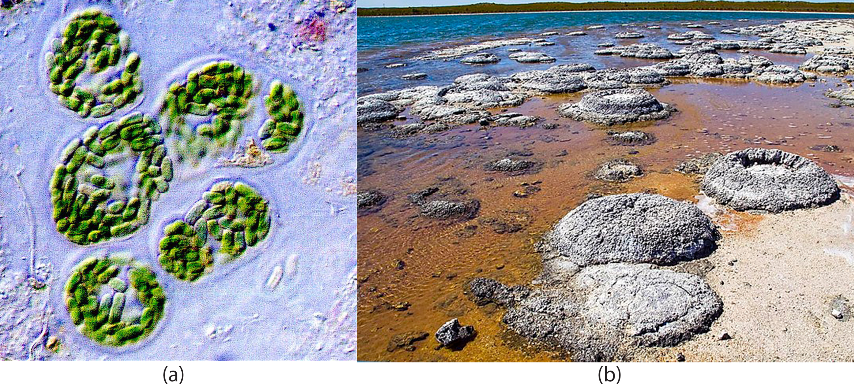
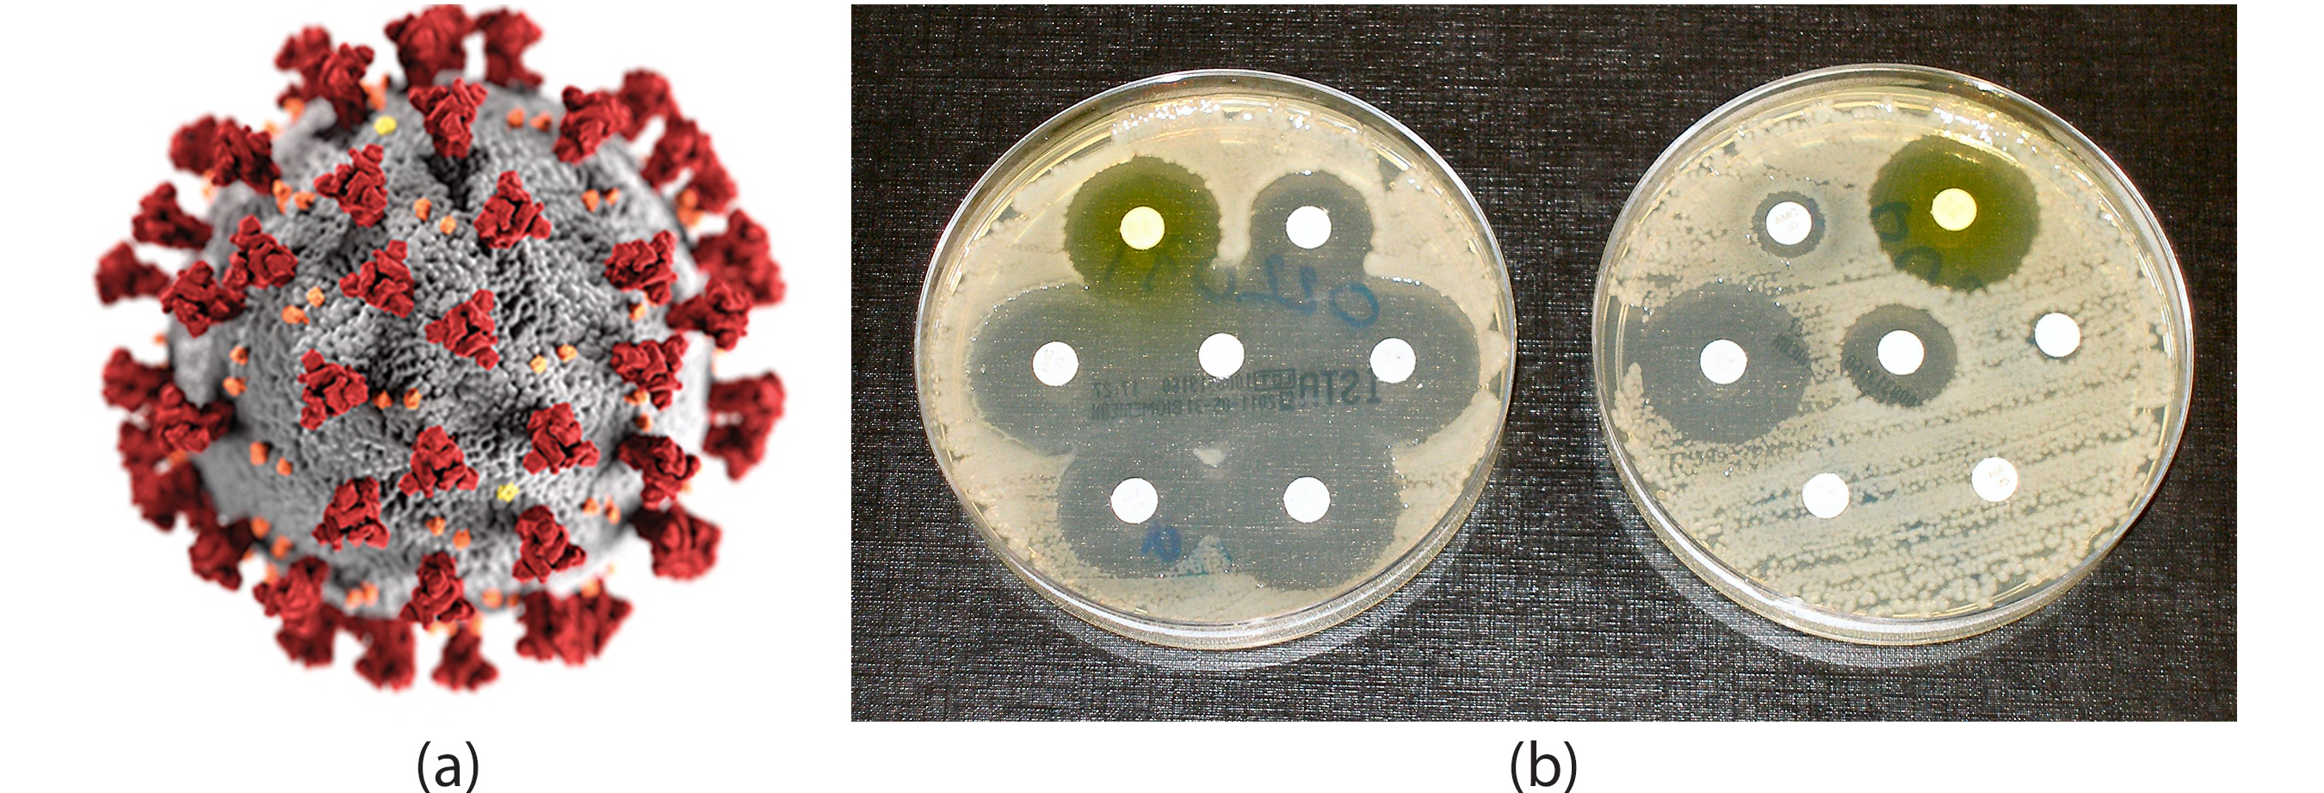
Thinking Like a Biologist
Biology is the study of life — from microscopic cells to ecosystems and the whole planet.
Major research areas include:
COVID-19 pandemic
Curing diseases like AIDS, Alzheimer's, and cancer
Climate change solutions
1.1 Figure 2: a) Cyanobacteria are some of Earth's oldest life forms. These (b) Stromatolites are formed by layers of cyanobacteria and sediment.
NASA on Wikimedia Commons. "Cyanobacteria."
Ruth Ellison on Wikimedia Commons. "Stromatolites at Lake Thetis."
1.1 Figure 3: (a) SARS-CoV-2 is the virus that causes COVID-19 (b) Here, each paper disk is impregnated with a different antibiotic. Some bacteria are sensitive to many different antibiotics, as indicated by the zones of clearing around each disk.
Alissa Eckert, MS; Dan Higgins, MAM on Wikimedia Commons. "SARS-CoV-2 virus in 3D."
Dr. Graham Beards on Wikimedia Commons. "Antibiotic sensitivity and resistance."

Slide 5
Defining Science
Science is knowledge of general truths/laws acquired through the scientific method.
Aims to comprehend the nature of the universe
Applies the scientific method

Slide 6
The Process of Science
The scientific method involves experimentation, observation, and analysis of results.
A hypothesis is a suggested explanation for an event that can be tested.
The scientific method tests hypotheses through repeatable experiments that either support or contradict the hypothesis.
Some scientific disciplines are easier to apply the scientific method to than others.
Lack or repeatable experiments: Archaeologists hypothesize ancient culture from pottery findings.
A theory is a tested and confirmed explanation for observations.

Slide 7
Reflection Question
How does the scientific definition of a theory differ from society's notion of a theory? What issues result from these differences?
Notes:
The reflection question is included here to use as a talking point or for a think-pair-share activity.

Slide 8
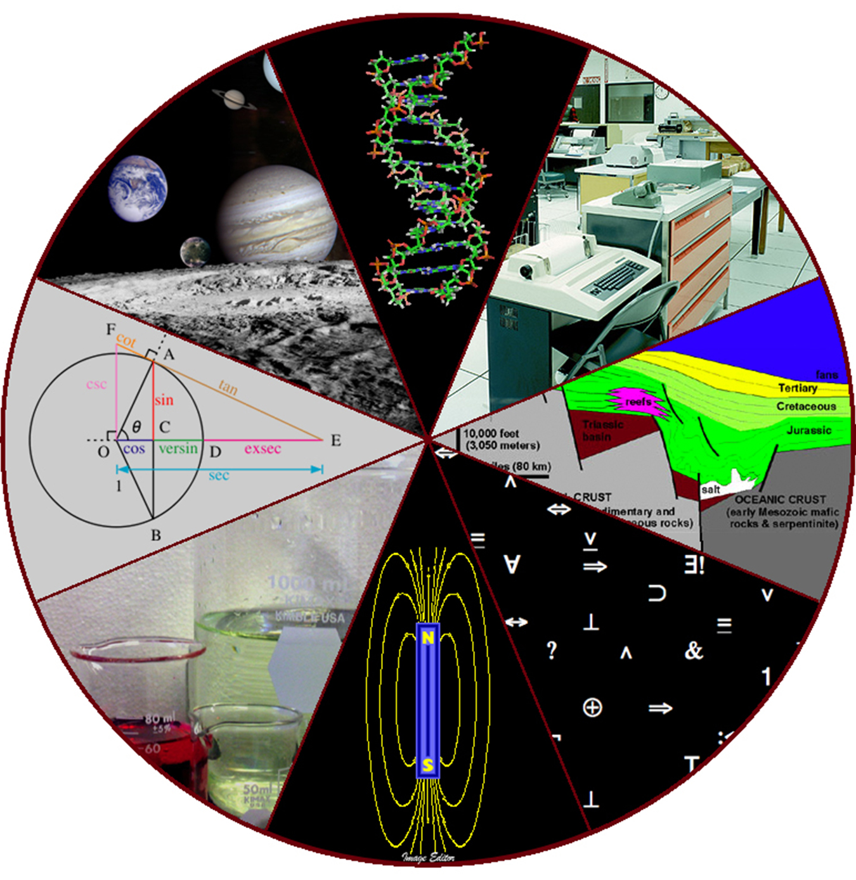
Natural Sciences
Natural sciences include diverse fields like astronomy, biology, geology, physics, chemistry.
Divided into life sciences (biology) and physical sciences (physics, chemistry, astronomy).
Relies on quantitative data and is known as "hard science"
Biology has many branches like cell biology, anatomy, physiology, botany, zoology.
Some disciplines, like biochemistry, are interdisciplinary, combining life and physical sciences.
1.1 Figure 4
Image Editor on Flickr. "Diversity of scientific fields."

Slide 9
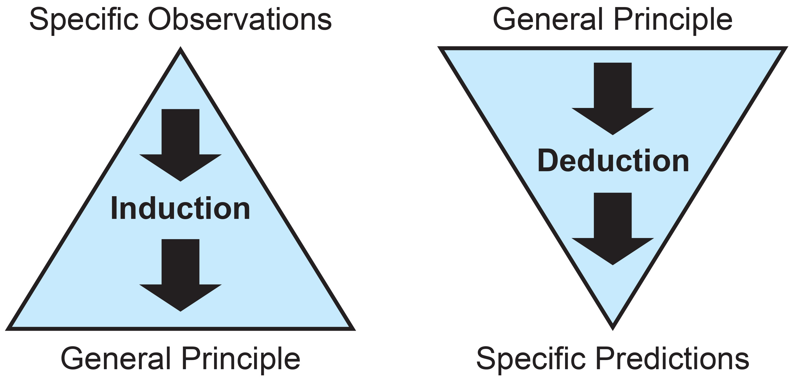
Scientific Reasoning
Science aims "to know" through curiosity and inquiry. Uses inductive and deductive reasoning.
Inductive reasoning draws general conclusions from a series of observations and data.
Example: Brain imaging studies observe active brain areas for specific stimuli.
Inductive conclusions have some uncertainty, as observations cannot cover every individual.
While supported by evidence, inductive inferences are not guaranteed absolute truth.
1.1 Figure 5

Slide 10
Deductive Reasoning in Science
Deductive reasoning is the type of logic primarily used in hypothesis-based science.
Uses general principles or laws
Applies logic to deduce conclusions or predict specific results
Future evidence may challenge validity of current premises.
Conclusions from inductive reasoning often become premises for deductive reasoning.
Used in tandem for study design

Slide 11
Deductive Reasoning Examples
Example of simple deductive reasoning:
Major premise: All mammals have hair.
Minor premise: Whales are mammals.
Conclusion: Whales have hair.
Studies on ecosystem change illustrate deductive reasoning:
Major premise: Bees are primary pollinators of flowering plants.
Minor premise: The bee population has decreased.
Conclusion: The decline in bees will decrease the pollination of flowering plants.

Slide 12
Logical Thinking in Scientific Study
Descriptive science aims to observe, explore, and discover through inductive reasoning.
Hypothesis-based science relies on deductive reasoning to predict specific results from a premise.
Most studies combine both descriptive and hypothesis-based science.

Slide 13
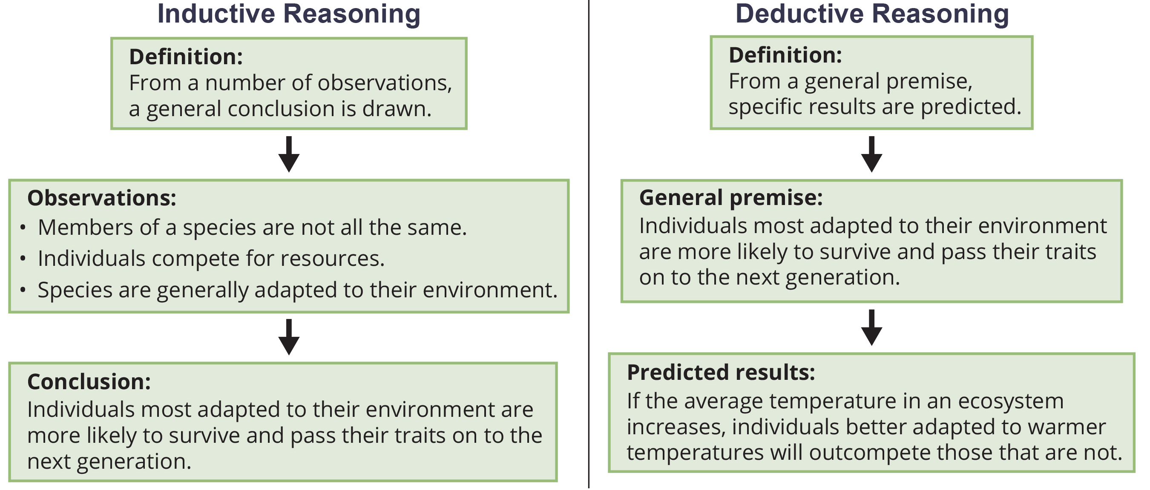
1.1 Figure 6
CNX OpenStax on Wikimedia Commons. "Inductive and deductive reasoning." Modified.

Slide 14
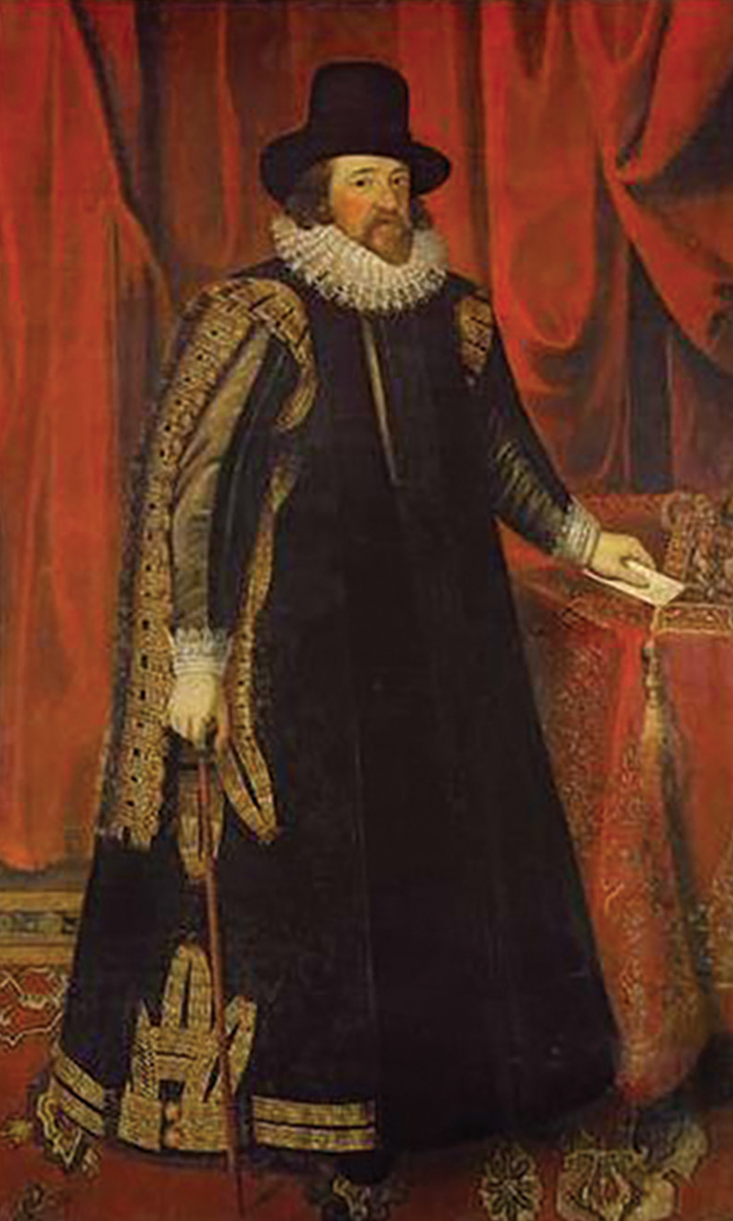
The Scientific Method
Biologists study life using the scientific method.
Seeks science-based answers to questions
Refined over time to rely primarily on deductive reasoning
Applies logical problem-solving across fields
1.1 Figure 7: Sir Francis Bacon first defined the scientific method.
After Paul van Somer I on Wikimedia Commons. "Sir Francis Bacon."

Slide 15
Proposing a Hypothesis
A hypothesis is a testable suggested explanation.
Multiple hypotheses can be proposed for a problem.
Example: The classroom is warm because the AC isn't on.
A prediction takes "If...then..." format based on hypothesis.
Example: "If the AC is turned on, then the classroom won't be warm."

Slide 16
Testing a Hypothesis
A valid hypothesis must be testable and falsifiable, meaning the experimental results can disprove it.
Experiments include one or more variables (parts that can change) and one or more controls (groups experiencing the same conditions except for the tested variable).
Rejecting one hypothesis does not mean accepting another.
Science aims to modify understandings based on further information, not to "prove" anything definitively.

Slide 17
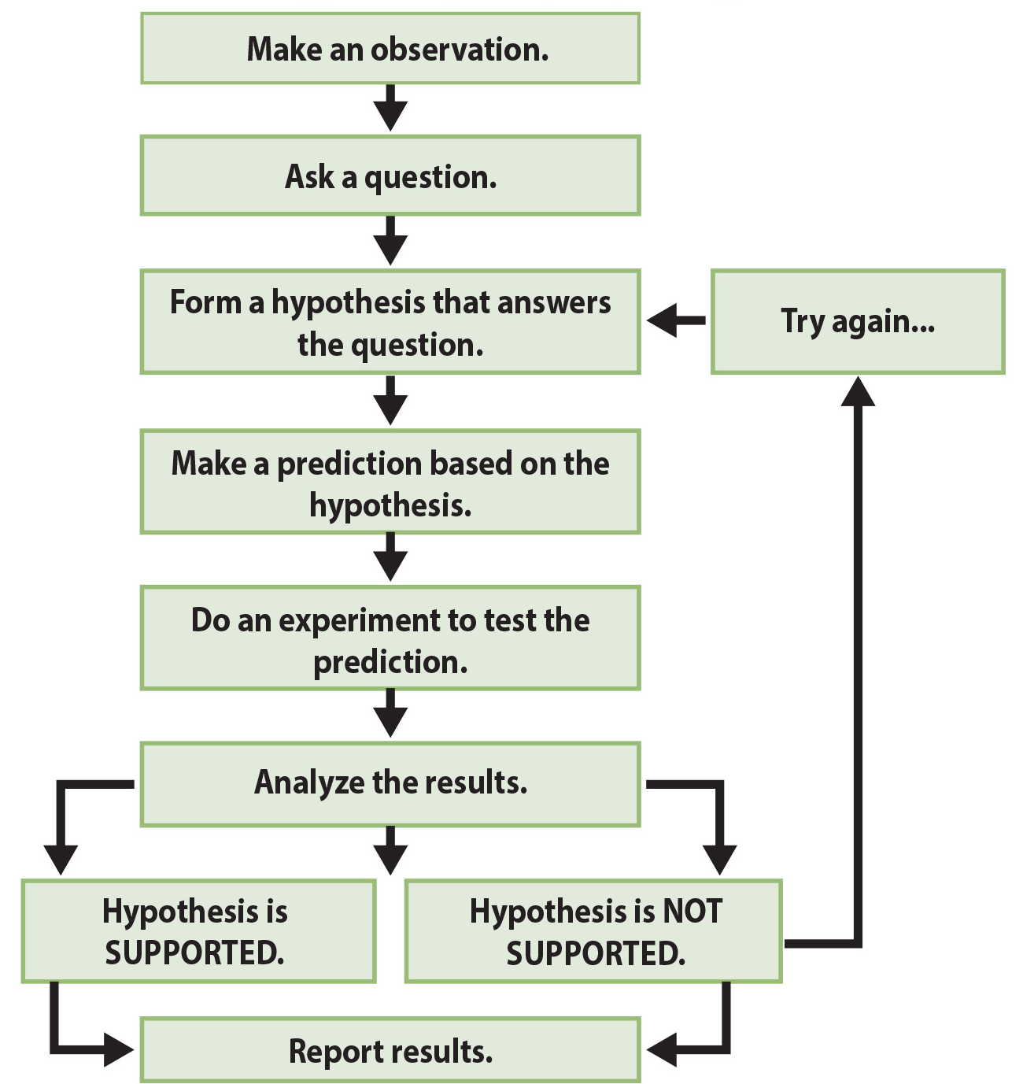
1.1 Figure 8
CNX OpenStax on Wikimedia Commons. "Scientific method."
Notes:
The scientific method consists of a series of well-defined steps. If a hypothesis is not supported by experimental data, one can propose a new hypothesis.

Slide 18
Flexibility and Evolution of the Scientific Method
Experiments may lead to changing approaches or new questions.
Science is often non-linear, due to drawing inferences and finding patterns.
Scientific reasoning is more complex than the scientific method suggests.
Scientific processes subject to revision as new technologies develop.

Slide 19
Basic Science vs. Applied Science
Basic science expands knowledge without immediate application. Applied science solves real-world problems.
Basic science is often seen as "useless." But it provides the foundation for remarkable applications.
Applied science relies on basic science results. Deep understanding is needed before developing applications.
Both approaches are valid. Some problems need urgent solutions. But solutions often stem from basic science knowledge.

Slide 20
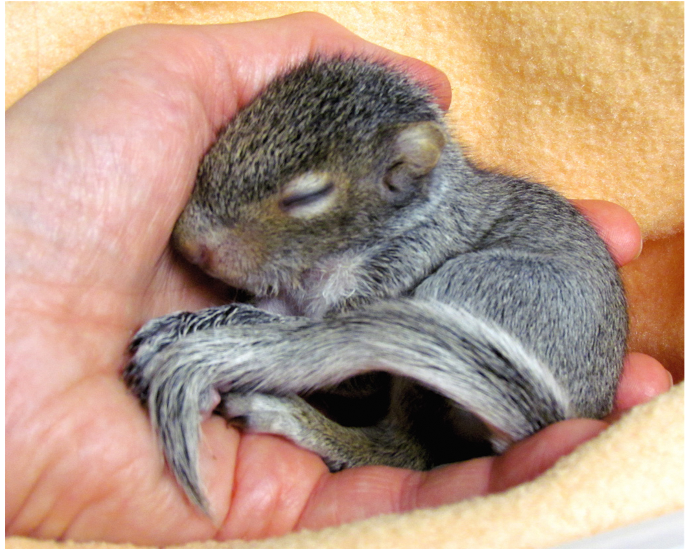
Basic and Applied Science Examples
Discovery of DNA structure led to the understanding of DNA replication.
The Human Genome Project mapped human chromosomes and genes.
Relied on basic research with simpler organisms first
Then applied data to diagnose and treat genetic diseases
1.1 Figure 9: Thanks to applied science, scientists know how to rehabilitate the squirrels.
Audrey from Central Pennsylvania, USA on Wikimedia Commons. "Baby squirrel sleeping in hand."

Slide 21
Think It Through
Was sequencing the human genome an example of descriptive science or hypothesis-based science?
Notes:
Originally an On Your Own. This is included here to use as a talking point or for a think-pair-share activity.

Slide 22
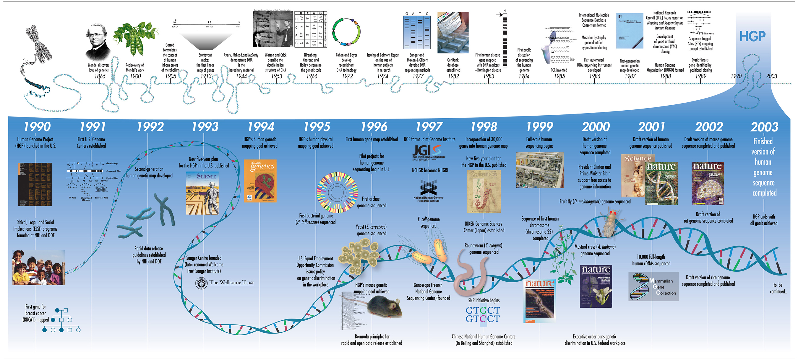
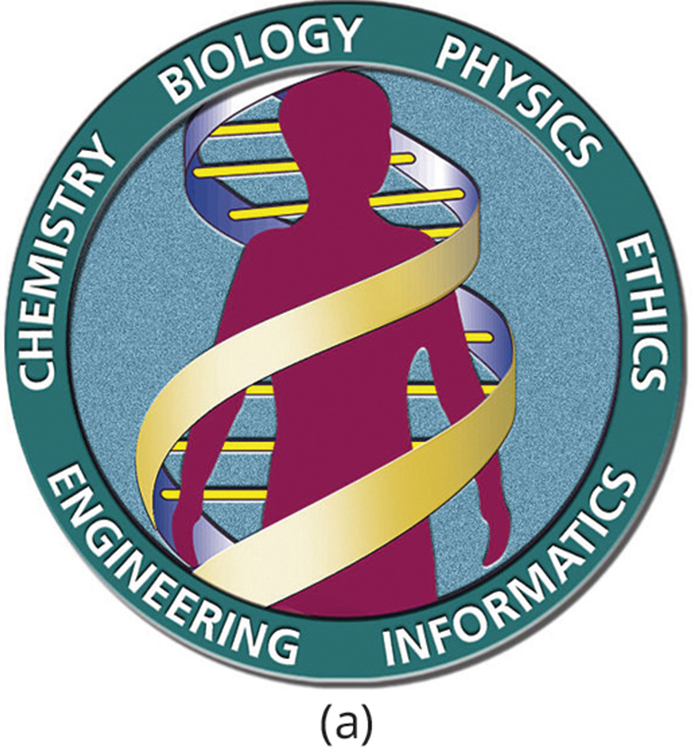
1.1 Figure 10
(a) The Human Genome Project was a collaborative effort among researchers working in several different science fields. (b) Researchers completed the 13-year project, which sequenced the entire human genome, in 2003.
U.S. Department of Energy, Human Genome Project on Wikimedia Commons. "Human Genome Project logo."
National Human Genome Research Institute (NHGRI) from Bethesda, MD, USA on Wikimedia Commons. "Human Genome Project timeline."

Slide 23
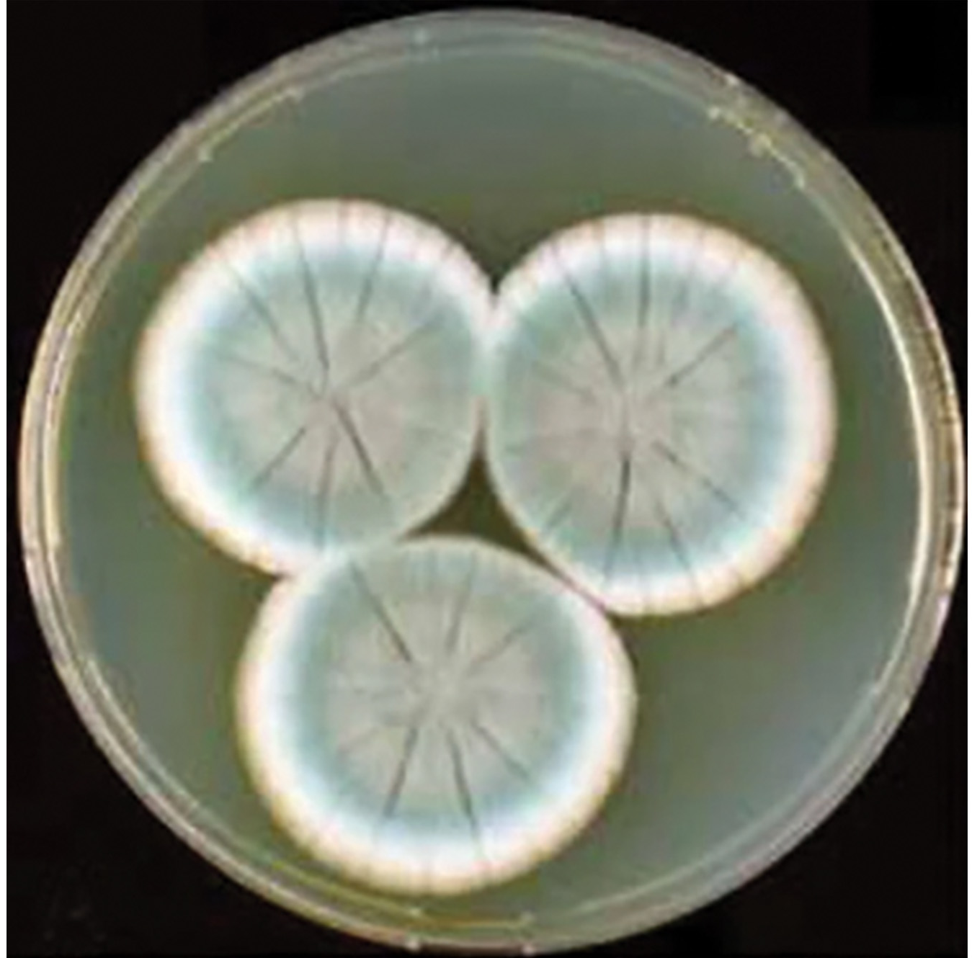
The Role of Serendipity in Scientific Discoveries
Serendipity (a fortunate accident or a lucky surprise) can lead to discoveries.
Penicillin was discovered by accident when Alexander Fleming left a petri dish open, and a mold formed that killed bacteria.
1.1 Figure 11
Houbraken, J., Frisvad, J.C. & Samson, R.A on Wikimedia Commons. "Penicillium rubens."

Slide 24
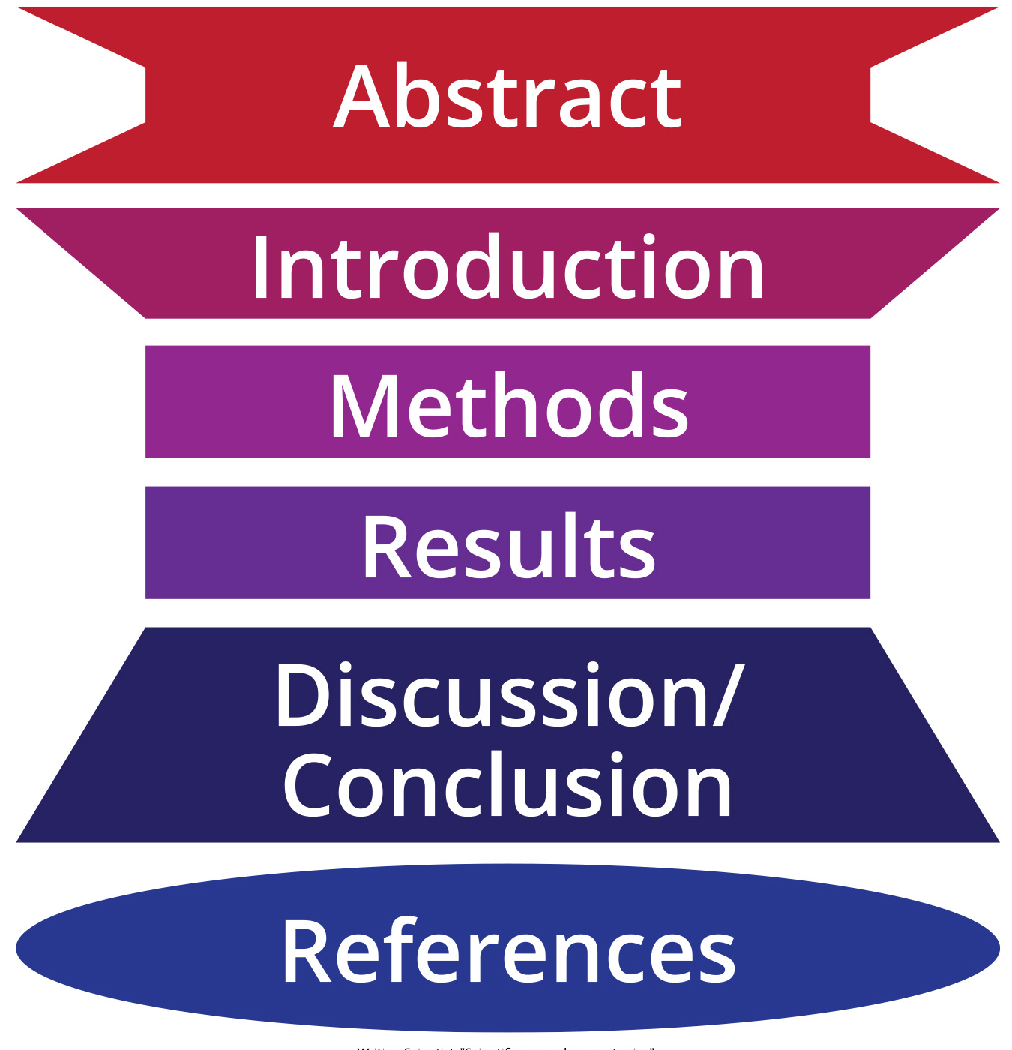
Reporting Scientific Work
Peer review ensures scientific work is original, significant, and logical.
Scientific papers have structure: abstract, intro, methods, results, and discussion.
The introduction provides background, rationale, and hypotheses. It cites previous work to avoid plagiarism.
Materials and methods is a complete description of the materials and methods used to gather data.
The results section presents findings objectively, while the discussion interprets and contextualizes the results with existing literature.
Review articles summarize and comment on previously published primary literature.
1.1 Figure 12
Writing Scientist. "Scientific research paper topics."

Slide 25
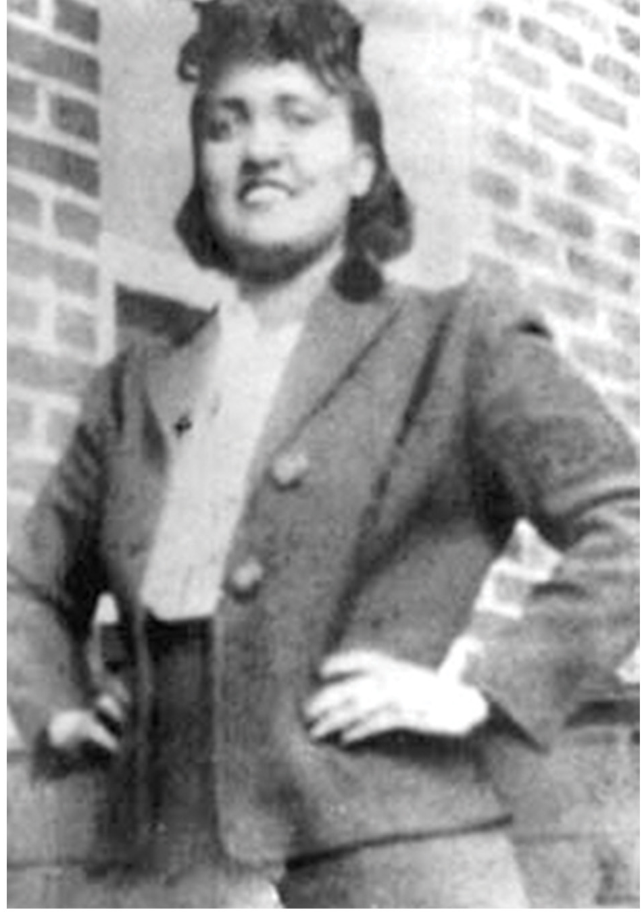
Scientific Ethics
Scientists must prevent harm, avoid bias, and balance legal and safety considerations.
Bioethics examines ethical implications of emerging technologies like gene editing.
Bioethicists establish guidelines on complex issues.
Historical studies like the Tuskegee syphilis study violated human dignity.
Henrietta Lacks' (right) cells were used without consent or recognition.
1.1 Figure 13
Photo courtesy of the Lacks family on Wikimedia Commons. "Henrietta Lacks."

Slide 26
Summary
Biology studies life, interactions, and environments. Science understands the universe through the natural sciences.
Basic science expands knowledge. Applied research solves practical problems.
Science uses inductive reasoning (specific to general) and deductive reasoning (general to specific). The scientific method: observe, hypothesize, test, and conclude.
Scientific papers have introductions, methods, results, and a discussion. Review papers summarize research over time.
Science is guided by ethics.

Slide 27
End of Hawkes Learning PowerPoint

