Slide 1
Lesson 1.2
Themes in Biology

Slide 2
Objectives
Describe the levels of organization among living things.
Identify and describe the properties of life.
List examples of different subdisciplines in biology.
Recognize and interpret a phylogenetic tree.

Slide 3
The Challenge of Defining Life
Defining "life" in biology has been a long-standing challenge.
Certain entities like viruses exhibit some living characteristics but lack others.
Some biologists study pre-life events, which could be considered non-biological.

Slide 4
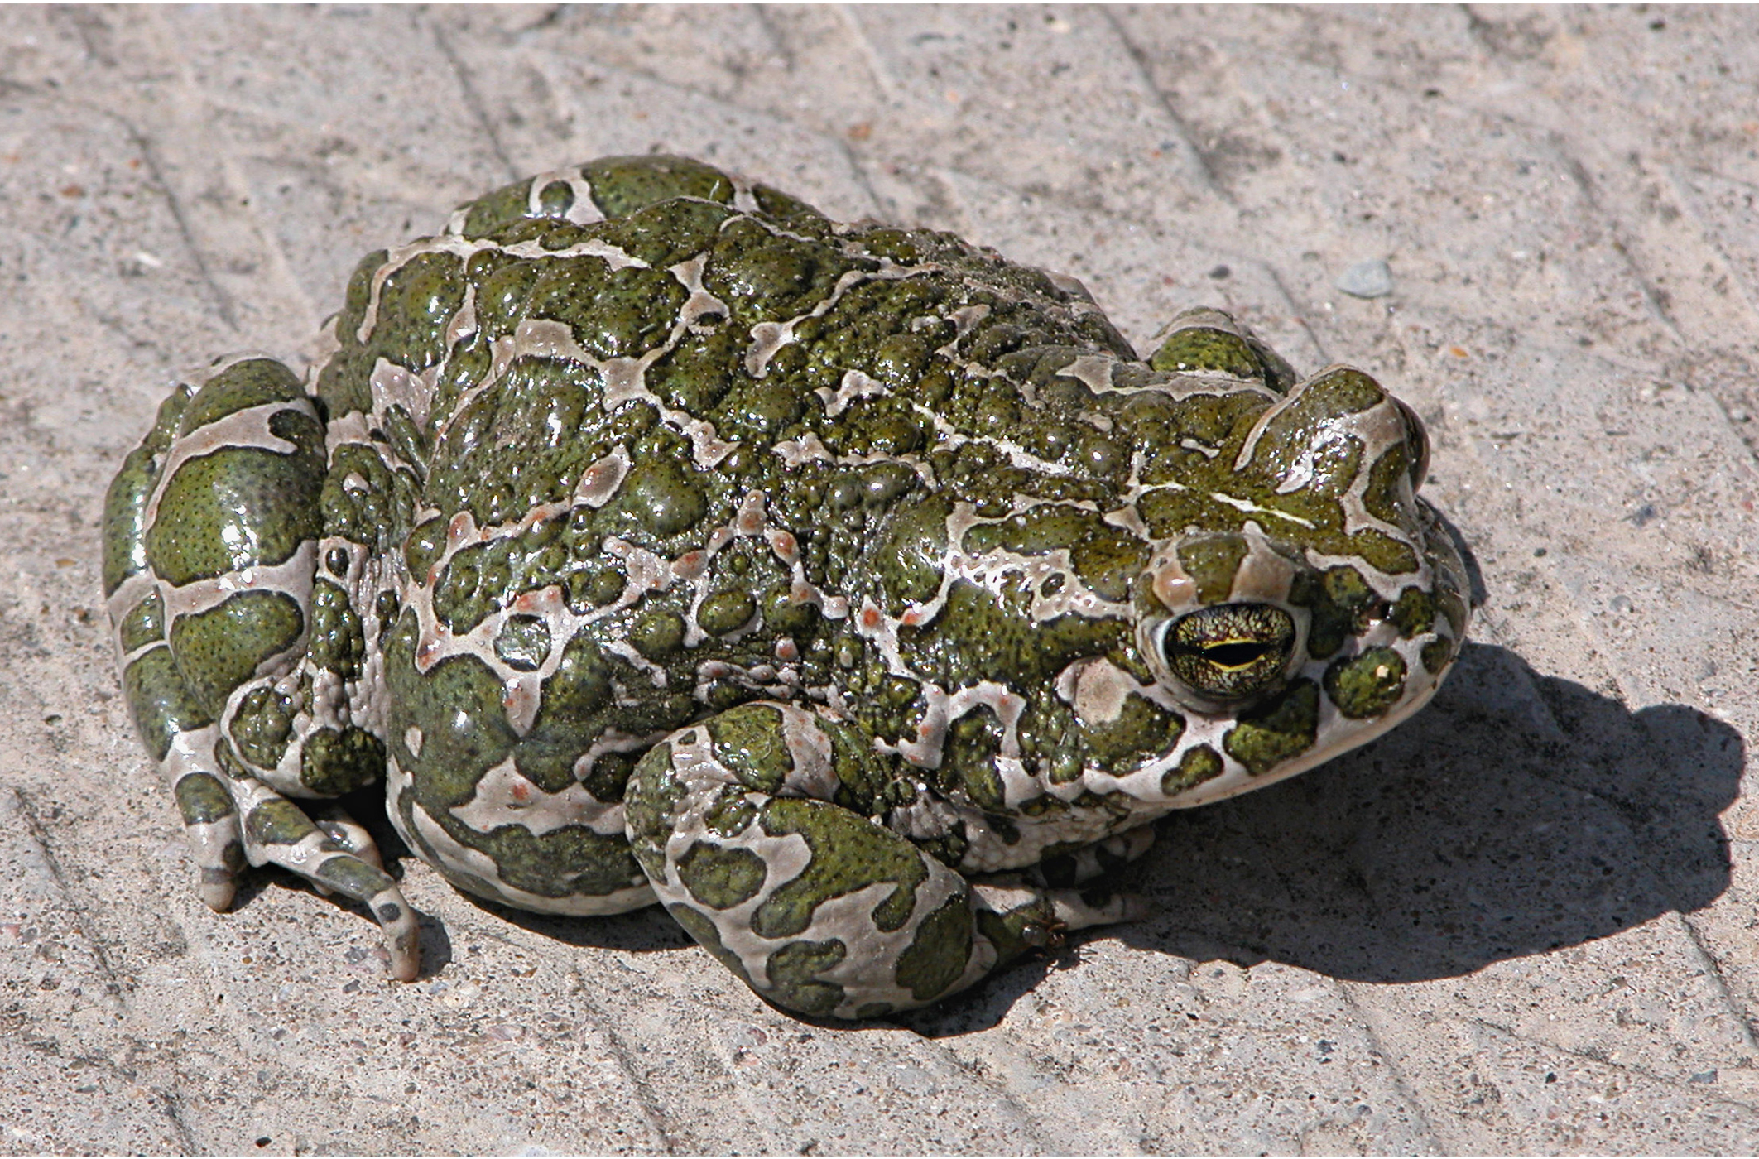
Properties of Life: Order
Living things exhibit organized complexity from the molecular to the organismal level.
Cells are the fundamental units, with atoms forming molecules, molecules making organelles/structures
1.2 Figure 1: A toad represents a highly organized structure
consisting of cells, tissues, organs, and organ systems.
Ivengo(RUS) on Wikimedia Commons. "Bufo viridis."

Slide 5
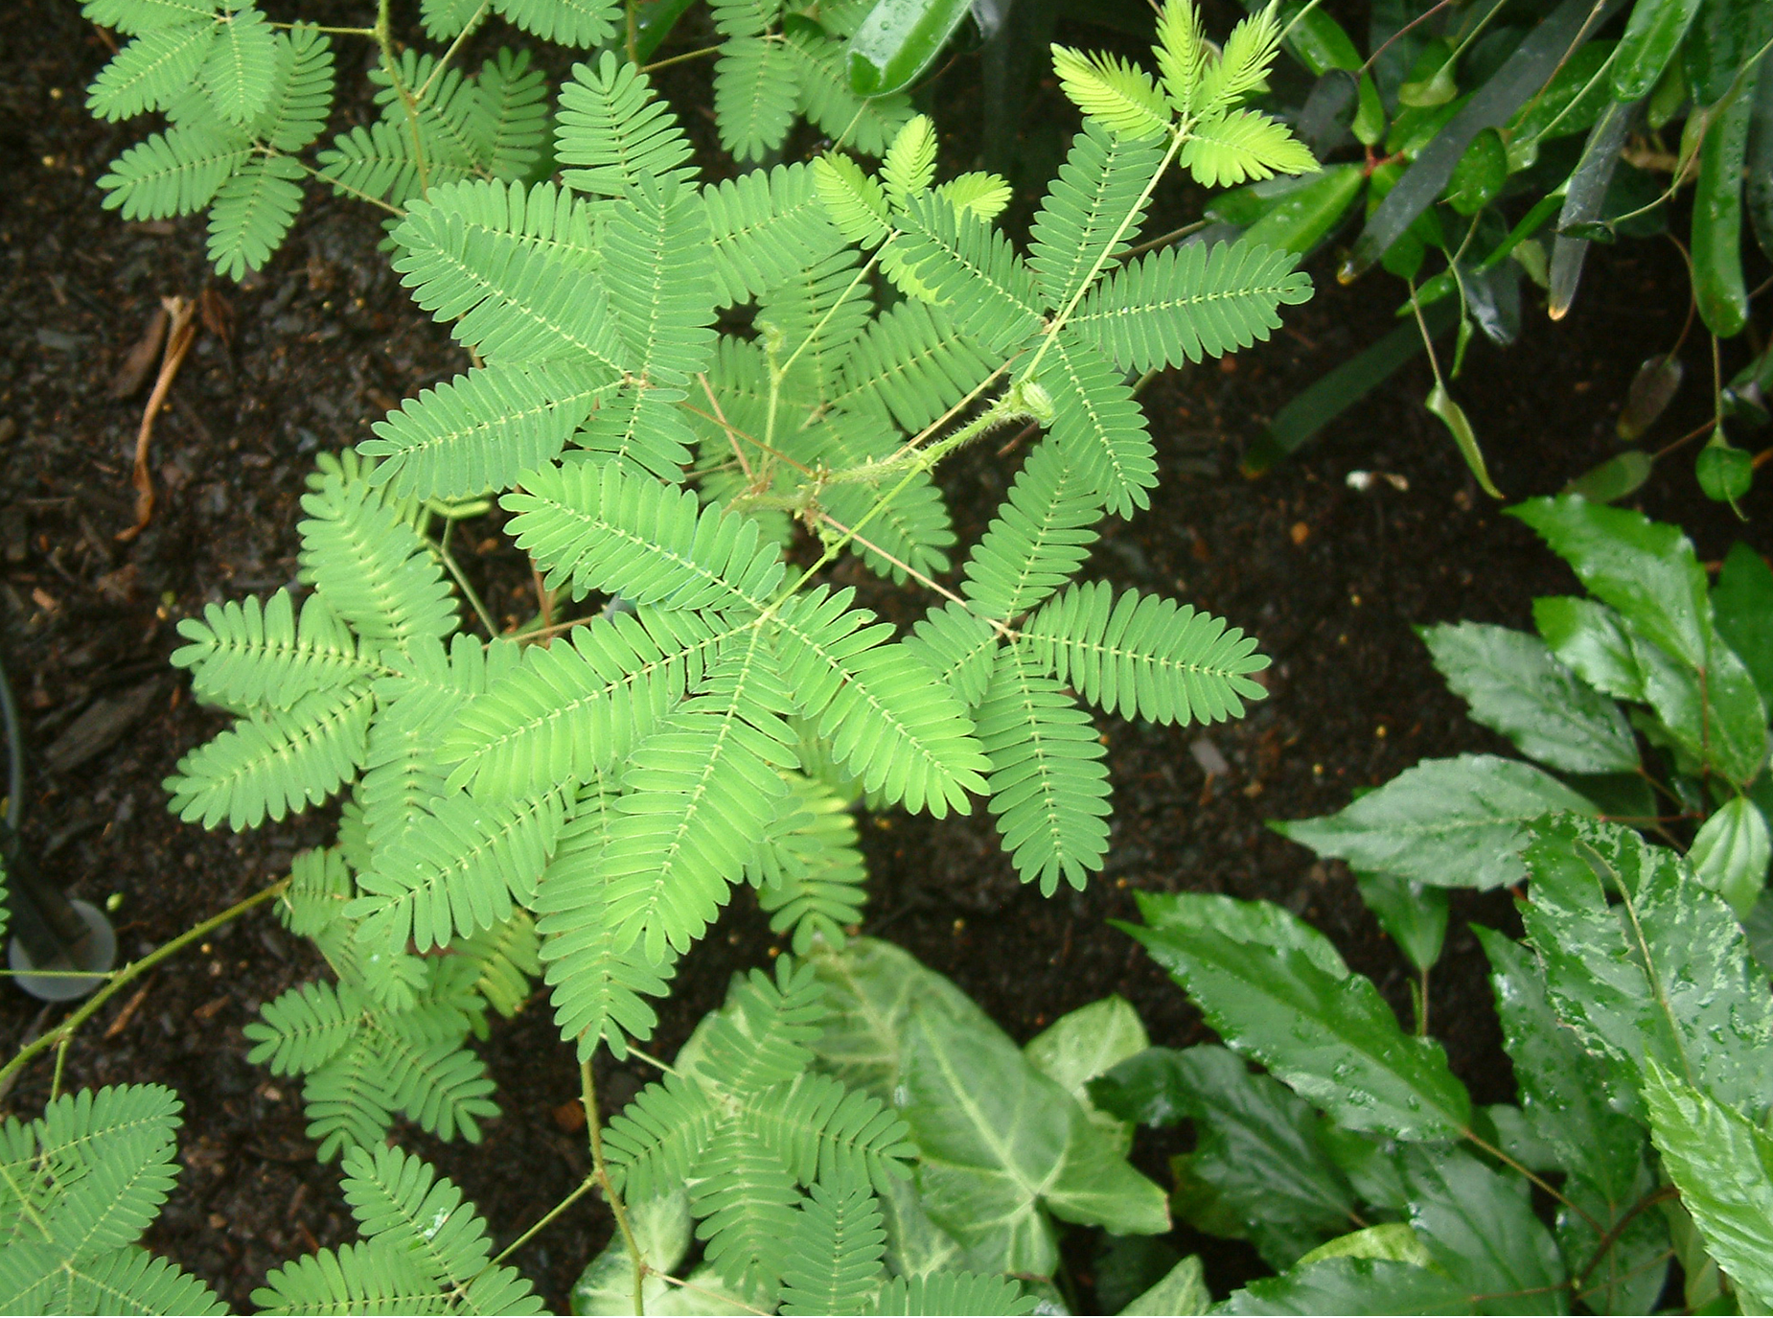
Properties of Life: Sensitivity or Response to Stimuli
Organisms can detect and respond to various environmental stimuli
Responses can be positive (toward stimulus) or negative (away from stimulus)
1.2 Figure 2: The leaves of this sensitive plant (Mimosa pudica)
will instantly droop and fold when touched.
Alex Lomas on Wikimedia Commons. "Mimosa pudica."

Slide 6
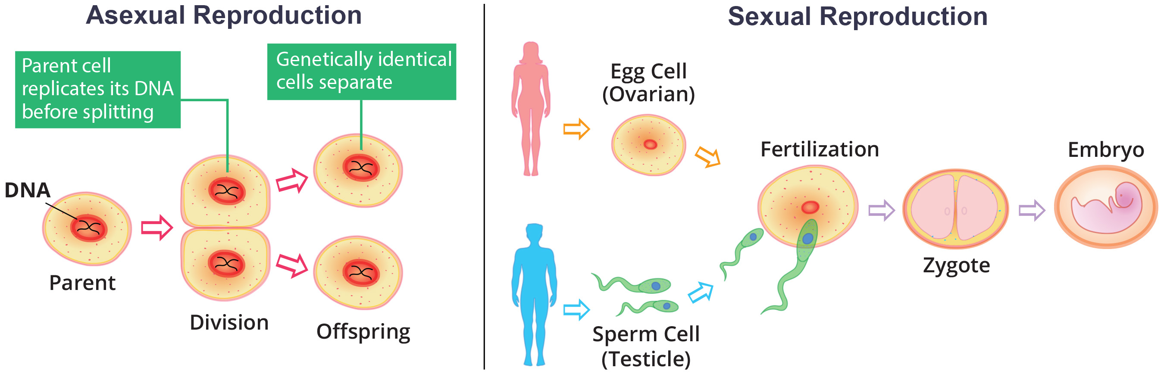
Properties of Life: Reproduction
Single-celled organisms reproduce by cell division after duplicating DNA.
Multicellular organisms produce specialized reproductive cells for sexual reproduction.
1.2 Figure 3

Slide 7
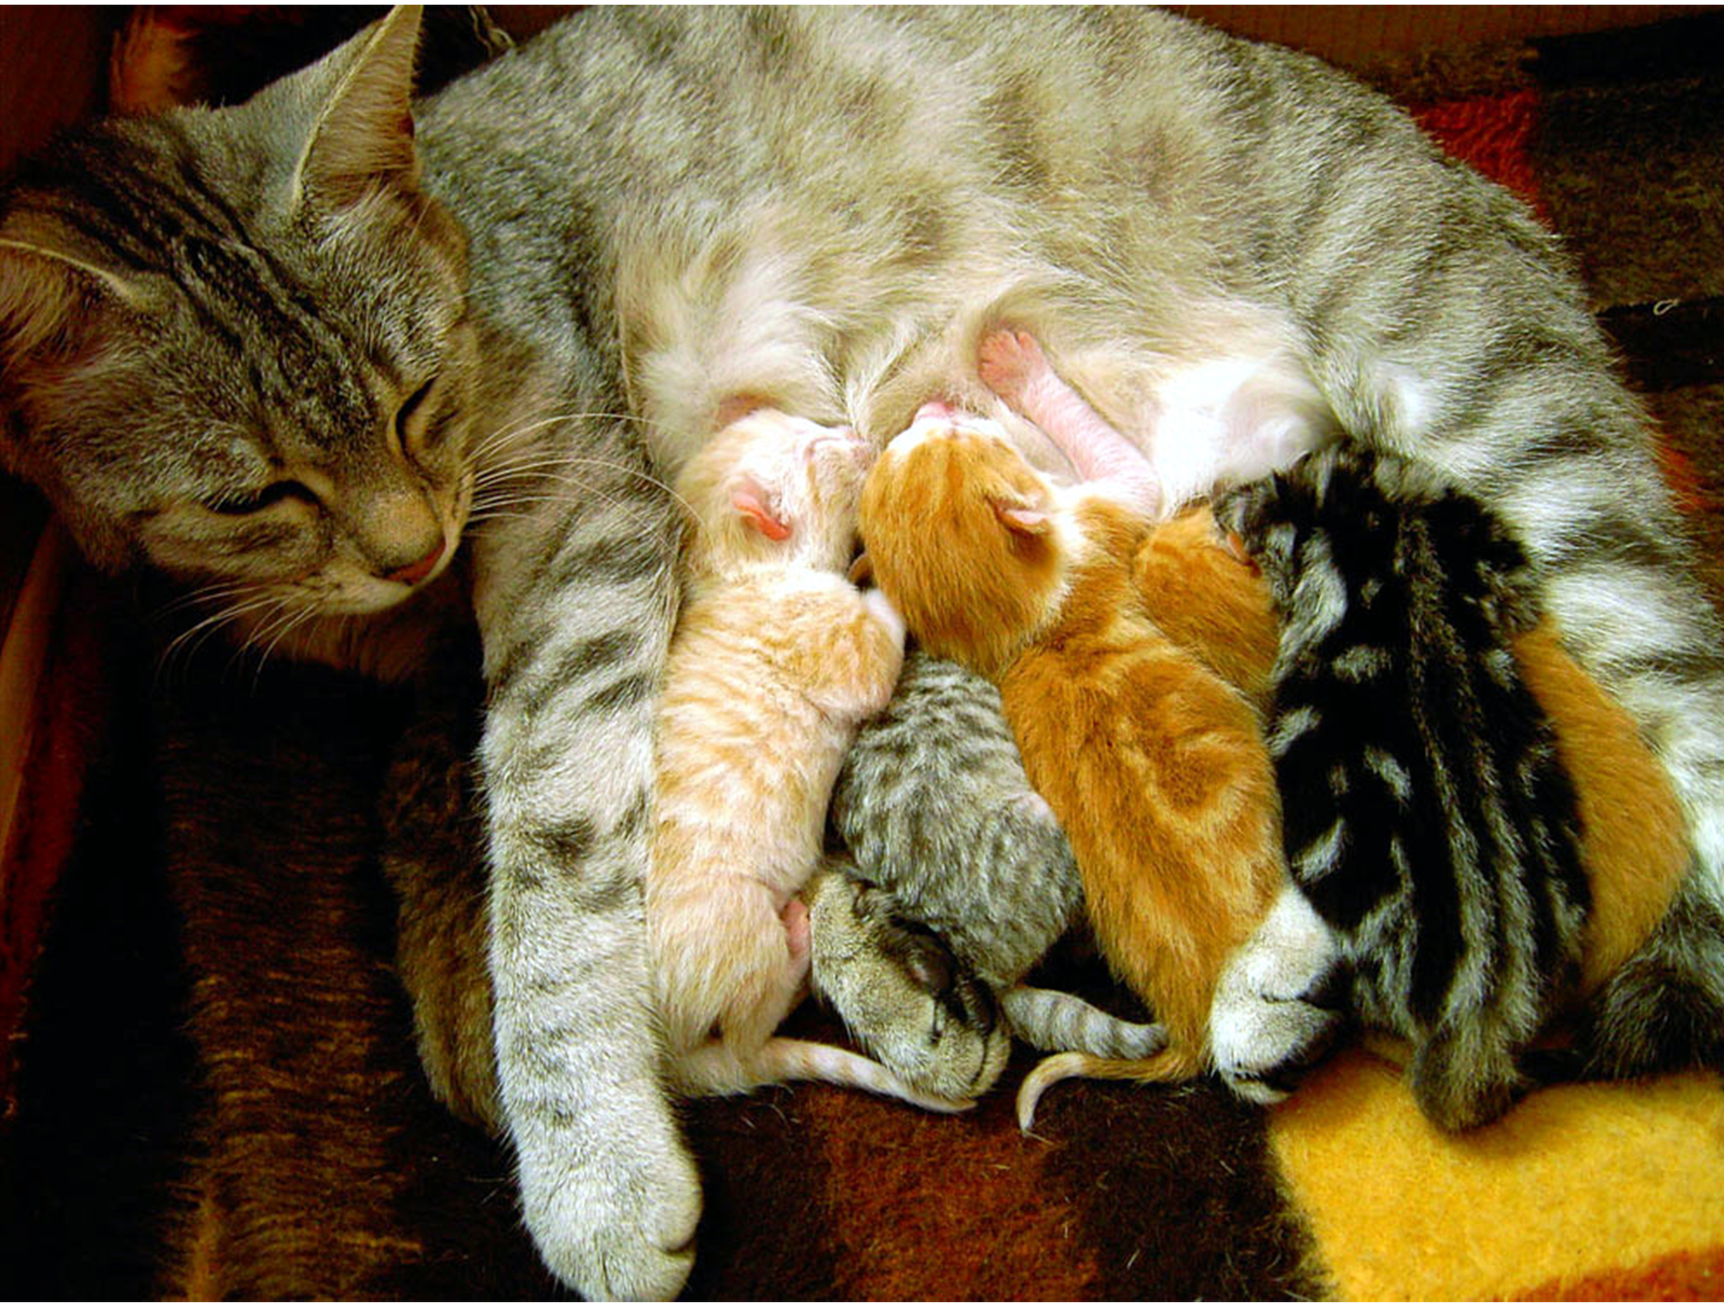
Properties of Life: Growth and Development
An increase in size, cellular growth, and organized changes occur during development.
Genetic instructions guide growth and developmental processes.
1.2 Figure 4
Stephanb on Wikimedia Commons. "Mother cat nursing."

Slide 8
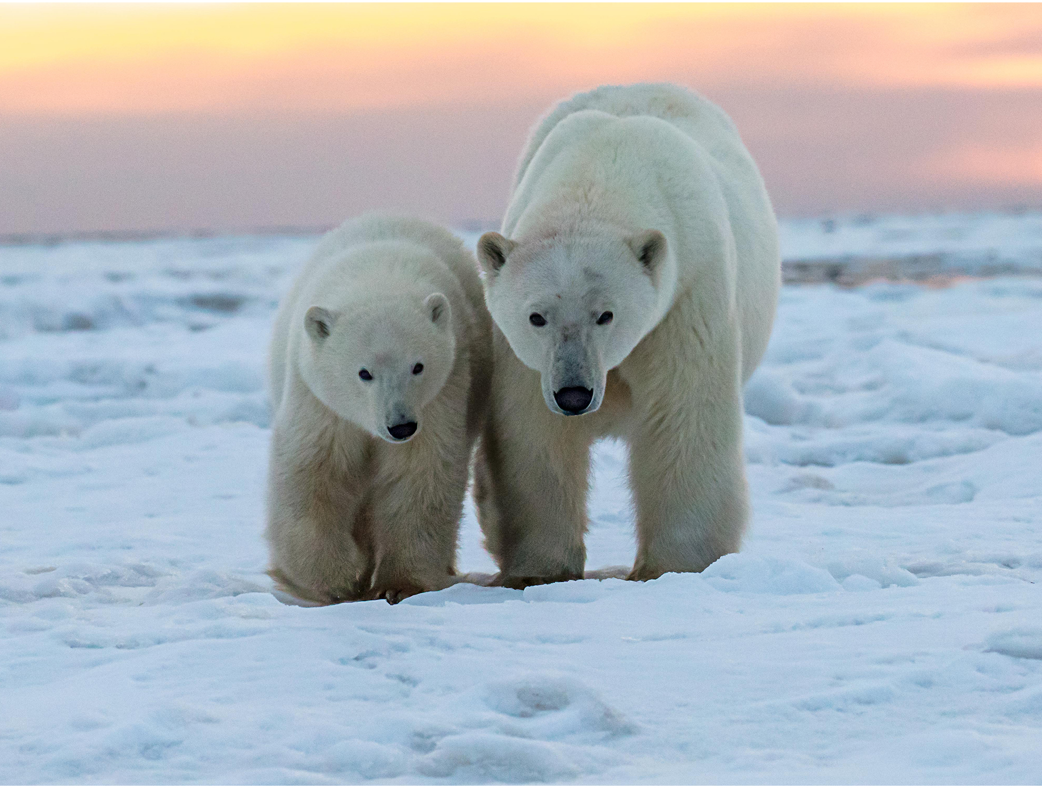
Properties of Life: Regulation/Homeostasis
Regulatory mechanisms maintain stable internal conditions (homeostasis).
Examples include nutrient transport, temperature regulation, and waste removal.
1.2 Figure 5: Polar bears maintain their body
temperature by generating heat and reducing heat loss.
Marko Dimitrijevic on Wikimedia Commons. "Polar bears."

Slide 9
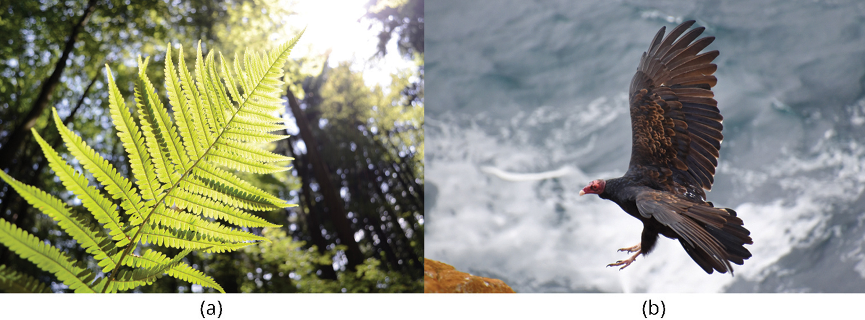
Properties of Life: Energy Processing
Organisms require energy sources to fuel metabolic activities.
Energy can come from sunlight (photosynthesis) or chemical compounds (food).
1.2 Figure 6: (a) Plants capture light energy from the sun and convert it into chemical energy. (b) The California condor uses chemical energy derived from food.
Arthur Gamsa on Wikimedia Commons. "Plant growing towards the sun."

Slide 10
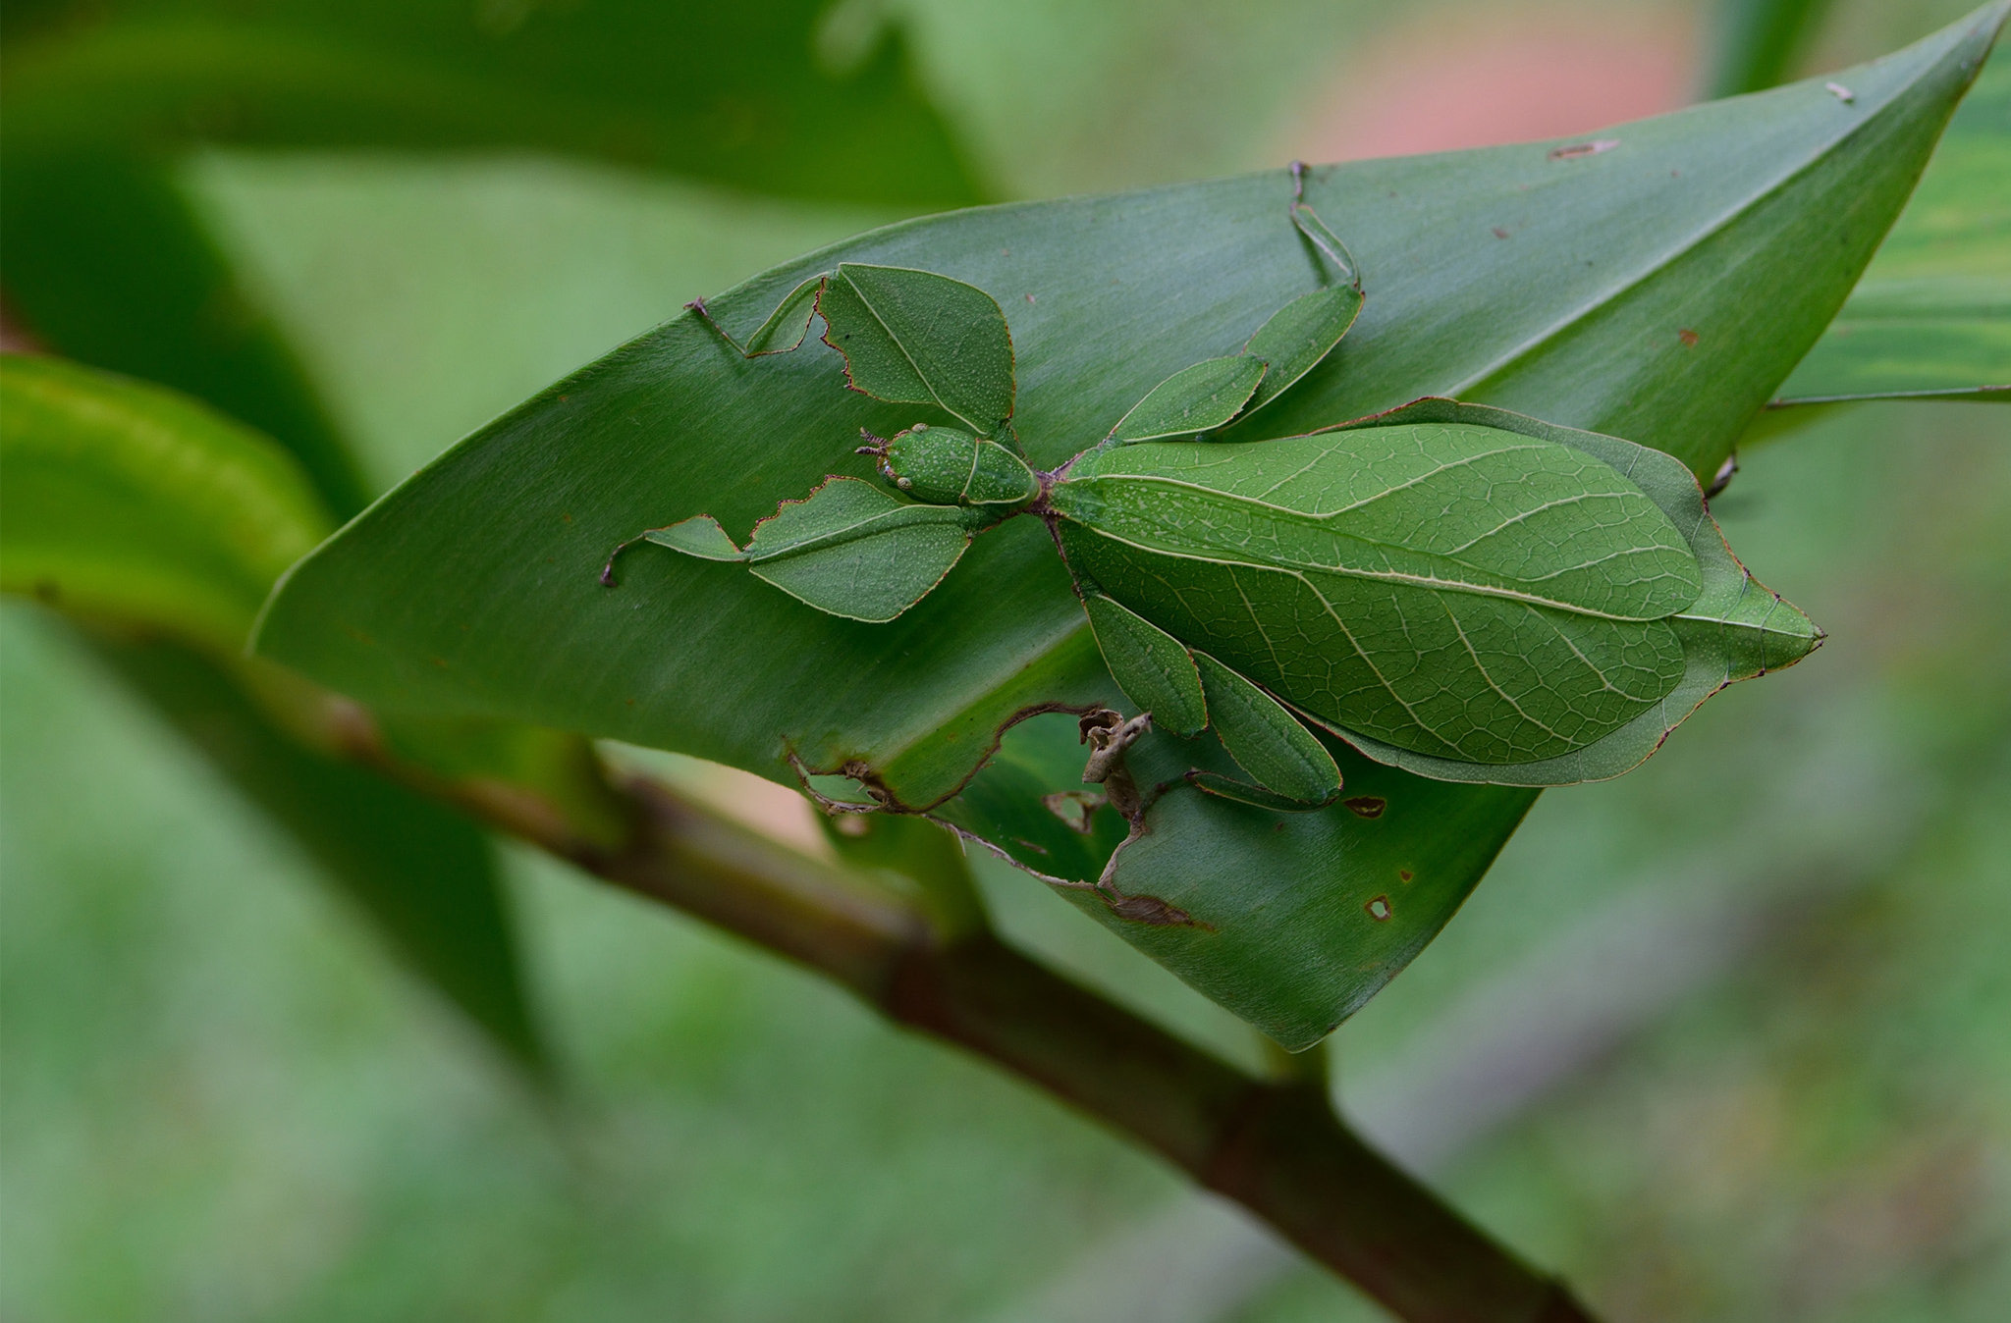
Properties of Life: Adaptation
Inherited traits can enhance an organism's fitness and survival in its environment.
Adaptations result from natural selection acting on genetic variation.
1.2 Figure 7: The praying mantis has
adeptly adapted to its environment through camouflage.

Slide 11
Properties of Life: Evolution
Evolution is the change in the characteristics and genetic makeup of a population over time. Occurs through processes like natural selection and genetic mutations
  Driving force behind the diversity of life on Earth

Slide 12
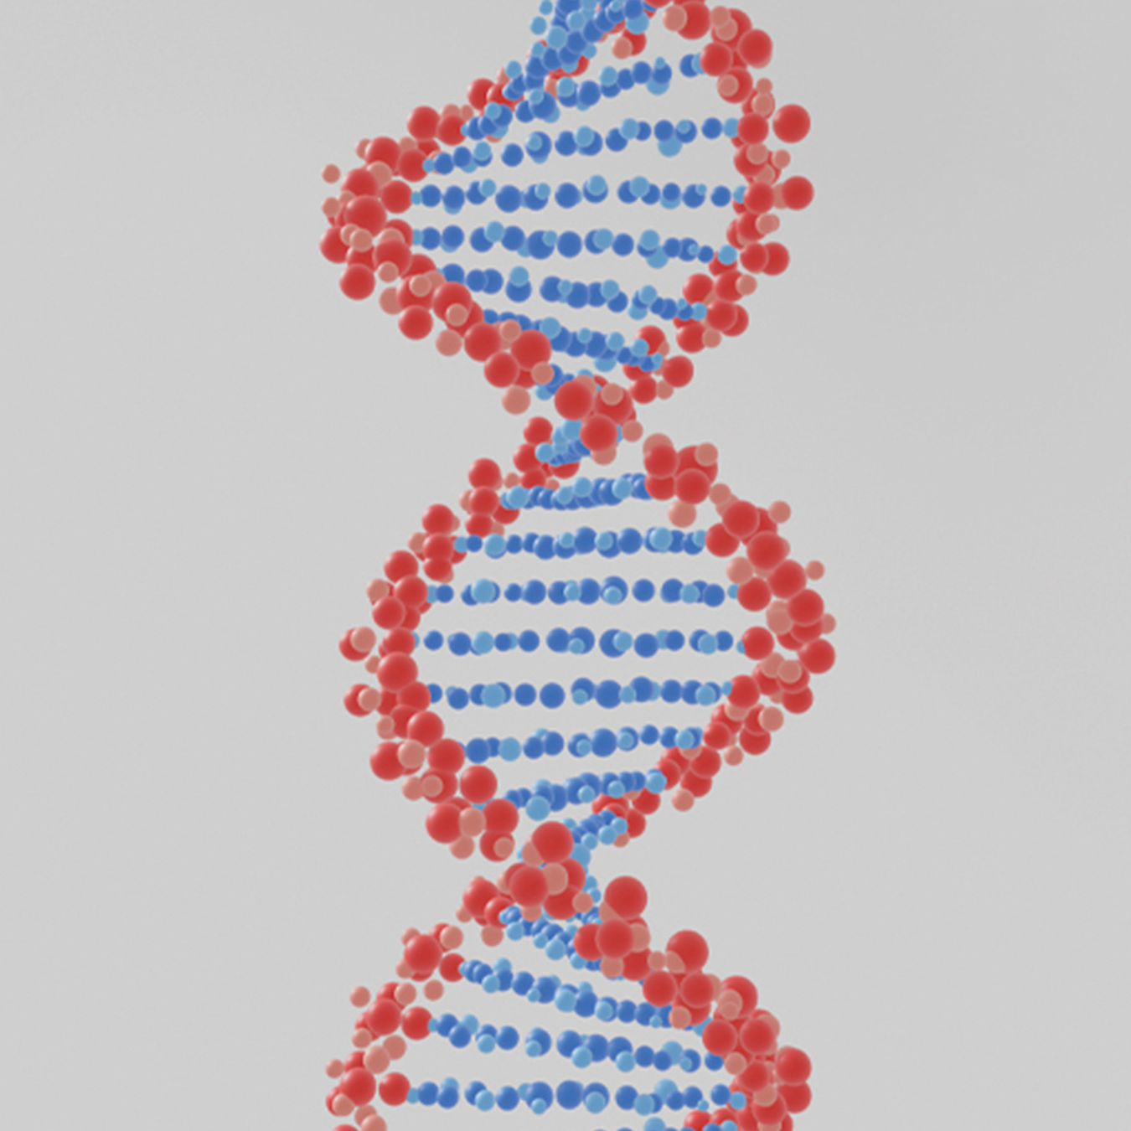
Levels of Organization of Living Things₁
Living things are organized hierarchically from small to large.
  Atoms form molecules, including large macromolecules like DNA.
Cells are fundamental units with membrane-bound organelles.
  Organelles like mitochondria and chloroplasts perform essential functions.
1.2 Figure 8
Alexander Antropov on Pixabay. "DNA structure."

Slide 13
Levels of Organization of Living Things₂
Single-celled and multicellular organisms are classified as prokaryotic or eukaryotic.
In larger organisms, cells combine to make tissues.
Organs are collections of tissues grouped to perform a common function.
All the individuals of a species living in an area are a population.
A community is the sum of populations inhabiting an area.
An ecosystem consists of all living things in an area.
The biosphere is the collection of all ecosystems.

Slide 14
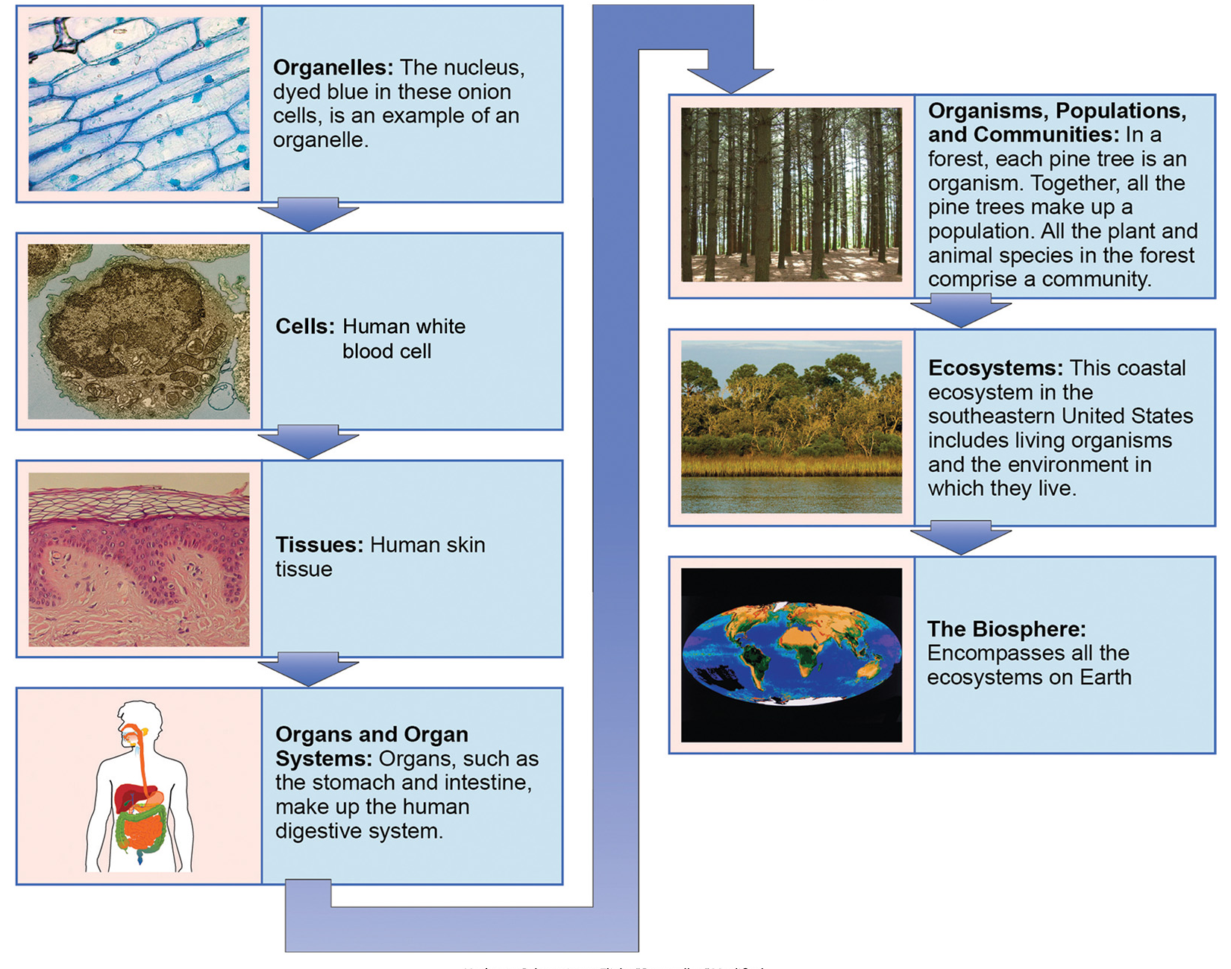
1.2 Figure 9
Umberto Salvagnin on Flickr. "Organelles." Modified.
Julie Caldwell/National Center for Advancing Translational Science on Flickr. "Cells." Modified.
Fama Clamosa on Wikimedia Commons. "Tissues." Modified.
Mariana Ruiz Villarreal on Wikimedia Commons. "Organs." Modified.
Joe Hardenbrook on Flickr. "Organisms." Modified.
US Fish and Wildlife Service Headquarters on Flickr. "Ecosystems." Modified.
NASA on the Commons on Wikimedia Commons. "Biosphere." Modified.
Notes:
This image shows the biological levels of organization of living things. From a single organelle to the entire biosphere, living organisms are parts of a highly structured hierarchy.

Slide 15
Group Activity
As a group, choose one biological level of organization. Then, brainstorm several examples of that level. Next, choose one example and build all the way up through biosphere, building from your example. Then, using the same example, move backwards to the lower (smaller) levels of organization from the point of your example.

Slide 16
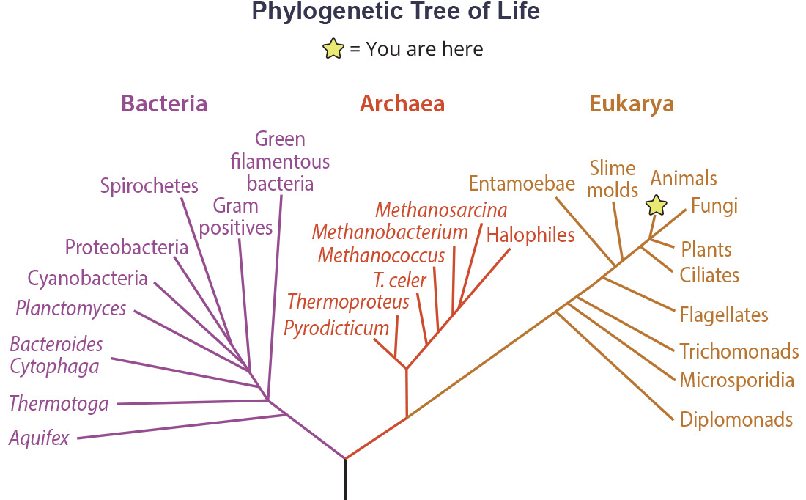
The Diversity of Life
Biology's vast scope is due to the immense diversity of life on Earth
  Diversity arises from evolution
  Evolutionary biologists study evolution across all scales
Phylogenetic trees summarize evolutionary relationships among taxa.
  Based on genetic and physical trait similarities and differences
  Nodes represent common ancestors and branches show lineage splits.
  Branch lengths are proportional to the amount of time elapsed since divergence.
1.2 Figure 10
CNX OpenStax on Wikimedia Commons. "Phylogenetic tree."

Slide 17
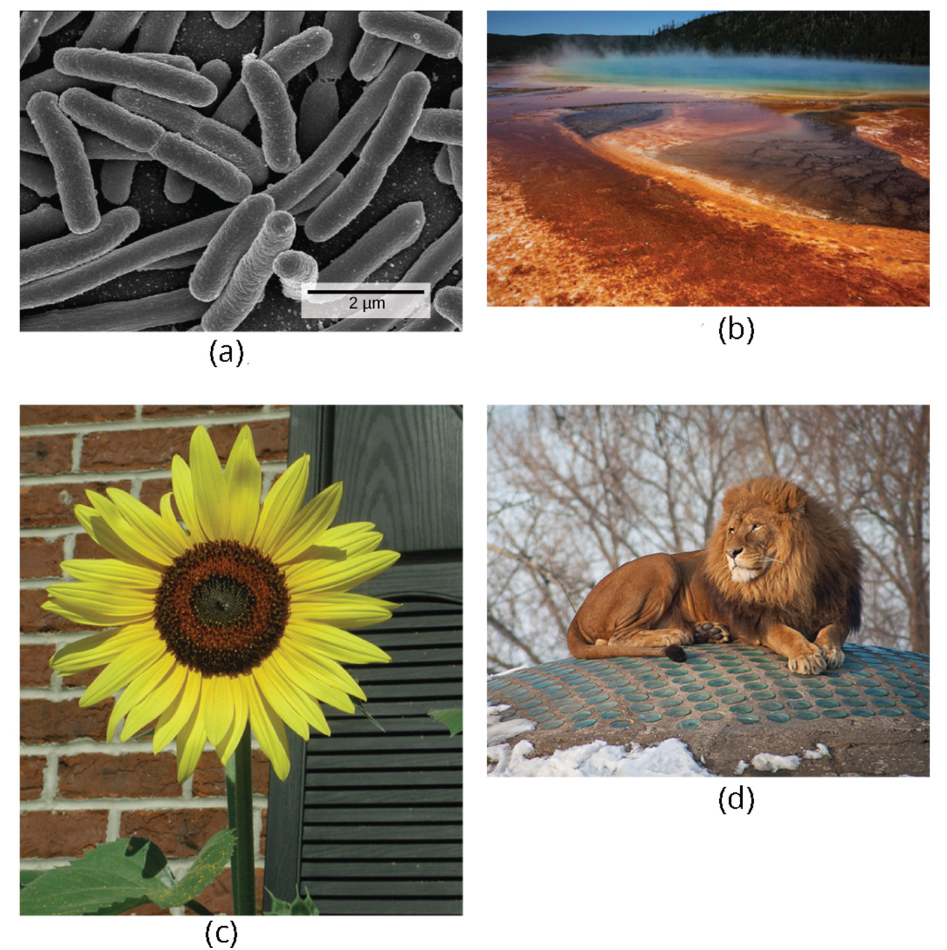
Carl Woese and the Phylogenetic Tree
Past classification of organisms in the five kingdoms was based on physical features, not molecular data.
Woese determined there are three domains: Bacteria, Archaea (with extremophiles), Eukarya (protists, fungi, plants, animals).
Woese compared conserved genes for ribosomal RNA revealing the need to separate prokaryotes into the Bacteria and Archaea domains.
1.2 Figure 11: The (a) bacteria in the domain Bacteria, (b) extremophiles (not visible) living in this hot vent belong to domain Archaea. Both the
(c) sunflower and (d) lion are part of domain Eukarya.
NIAID on Wikimedia Commons. "Domain Bacteria." Modified.
Steve Jurvetson on Flickr. "Extremeophiles." Modified.
OpenStax. "Sunflower." Modified.
OpenStax. "Lion." Modified.

Slide 18
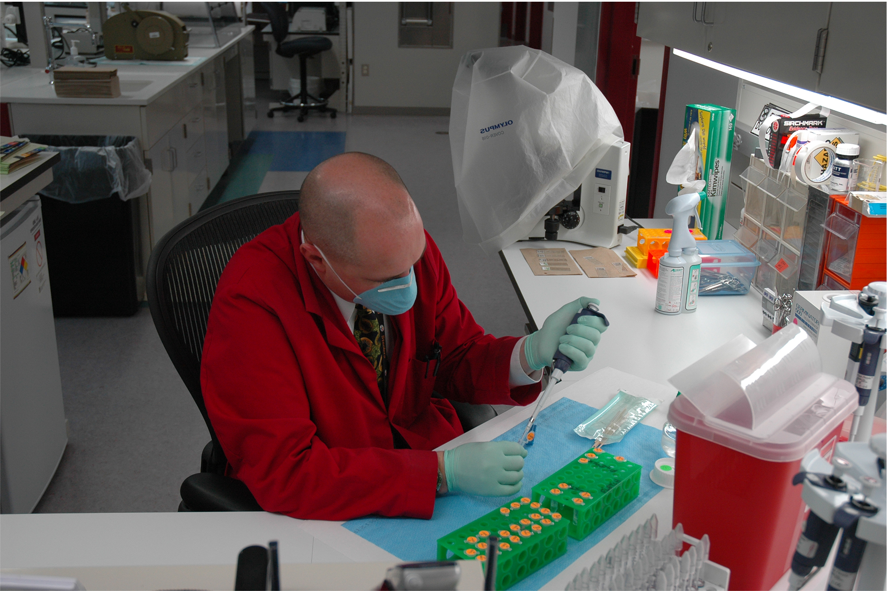
Branches of Biological Study
Molecular biology and biochemistry study biological processes at the molecular and chemical level.
Microbiology studies structure and function of microorganisms like bacteria.
Neurobiology studies the nervous system using interdisciplinary approaches.
Other branches include paleontology (fossils), zoology (animals), botany (plants), biotechnology, ecology, physiology, and more specialized fields.
1.2 Figure 12
CID Command Public Affairs on Wikimedia Commons. "Person pipetting."

Slide 19
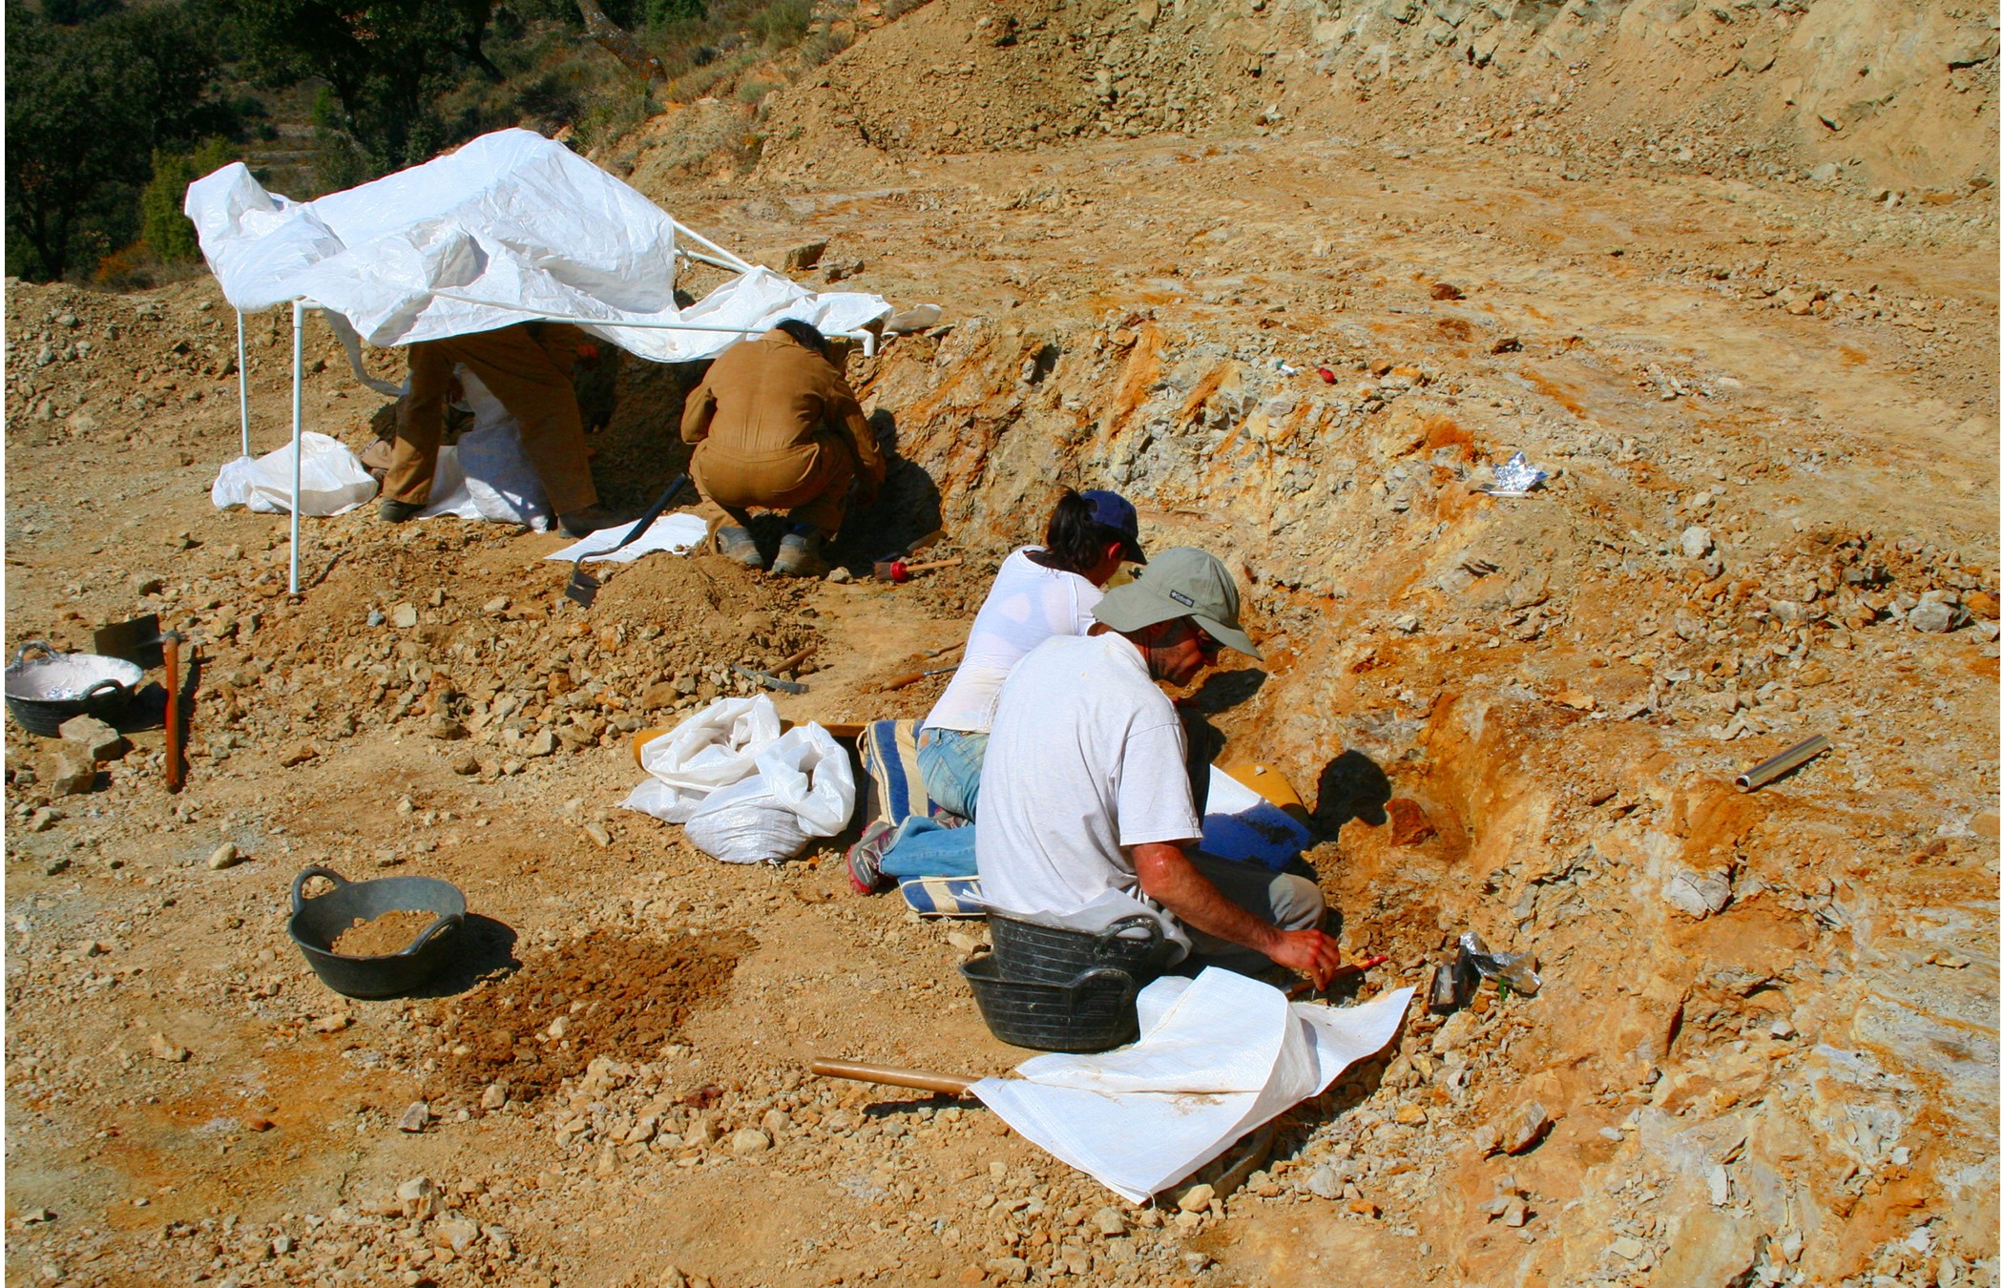
Science and You
Career: Forensic Scientist
Applies science to answer law-related questions, providing scientific evidence for courts
Examines trace materials associated with
crimes, like hair, blood, body fluids, and DNA
Analyzes biological evidence left at crime
scenes, such as insect larvae and pollen grains
Requires coursework in chemistry,
biology, and intensive math for this
interdisciplinary career.
1.2 Figure 13
Mario Modesto Mata on Wikimedia Commons. "Excavations at the site of Ana."
Notes:
This is included as a relevant application for this topic.

Slide 20
Summary
Biology studies the diverse phenomena of life, organized from atoms to the biosphere.
All living things share fundamental properties that distinguish them from the non-living.
Evolution has generated the remarkable diversity of life through genetic changes over time.
Biology encompasses many specialized branches studying different aspects of living systems.

Slide 21
Hawkes Learning – End of PowerPoint

