Slide 1
Lesson 10.1
Components of Genomes

Slide 2
Objectives
Describe the mechanisms of chromosome compaction.
Describe the structure of prokaryotic and eukaryotic genomes.
Distinguish between chromosomes, genes, and traits.

Slide 3
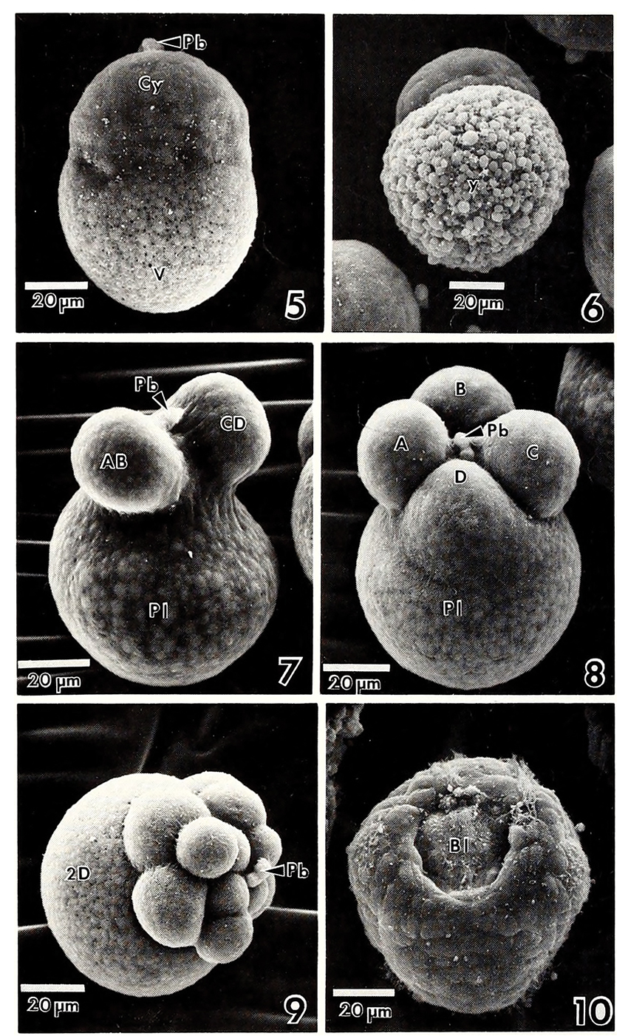
Cell Reproduction
A human begins life as a fertilized egg or zygote.
Billions of cell divisions must occur in a controlled way to produce a multicellular human with trillions of cells.
Continued division is necessary for growth, maintenance, and repair.
  Failure to regulate properly is life-threatening.
10.1 Figure 1: A mollusk cell dividing.
Internet Archive Book Images on Flickr. "Mollusk zygote dividing."

Slide 4
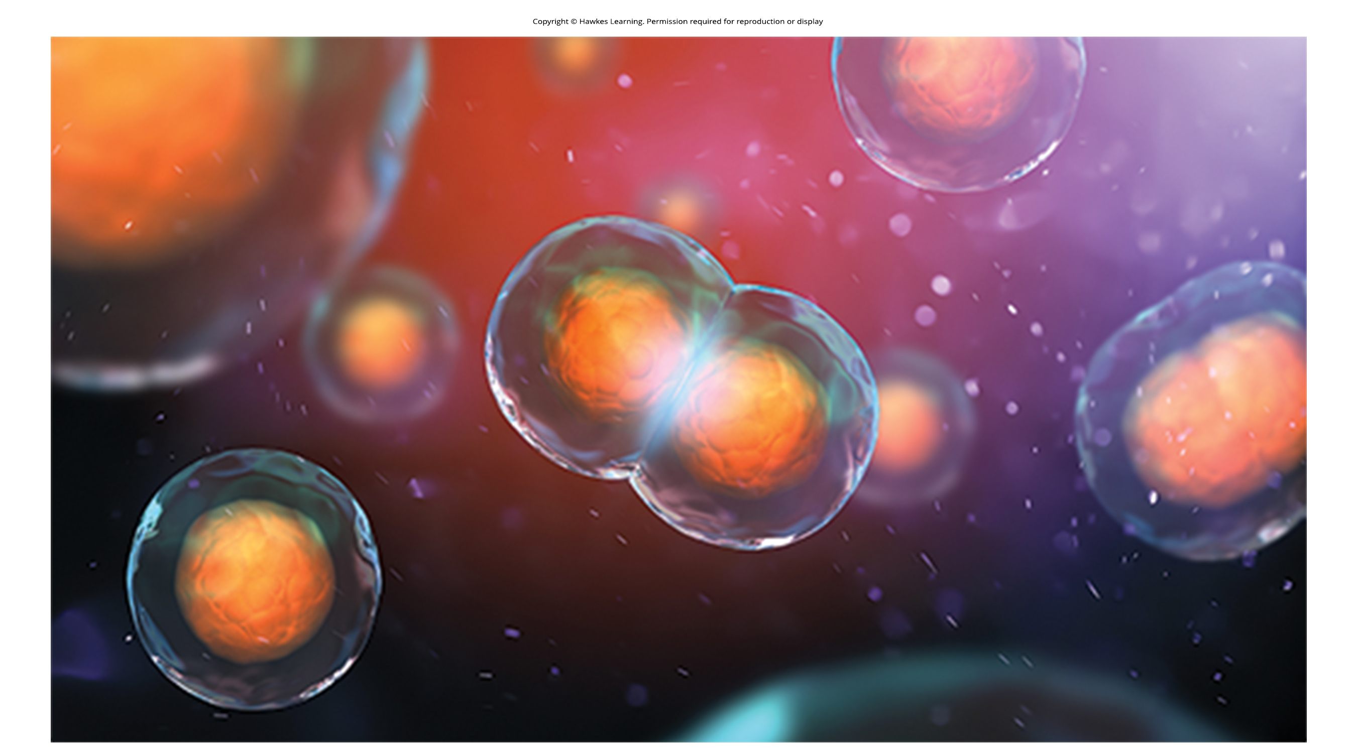
Components of Genomes
Cell cycle is vital process for proper cell reproduction.
  Is an orderly sequence of events that describes the stages of a cell's life.
10.1 Figure 2

Slide 5
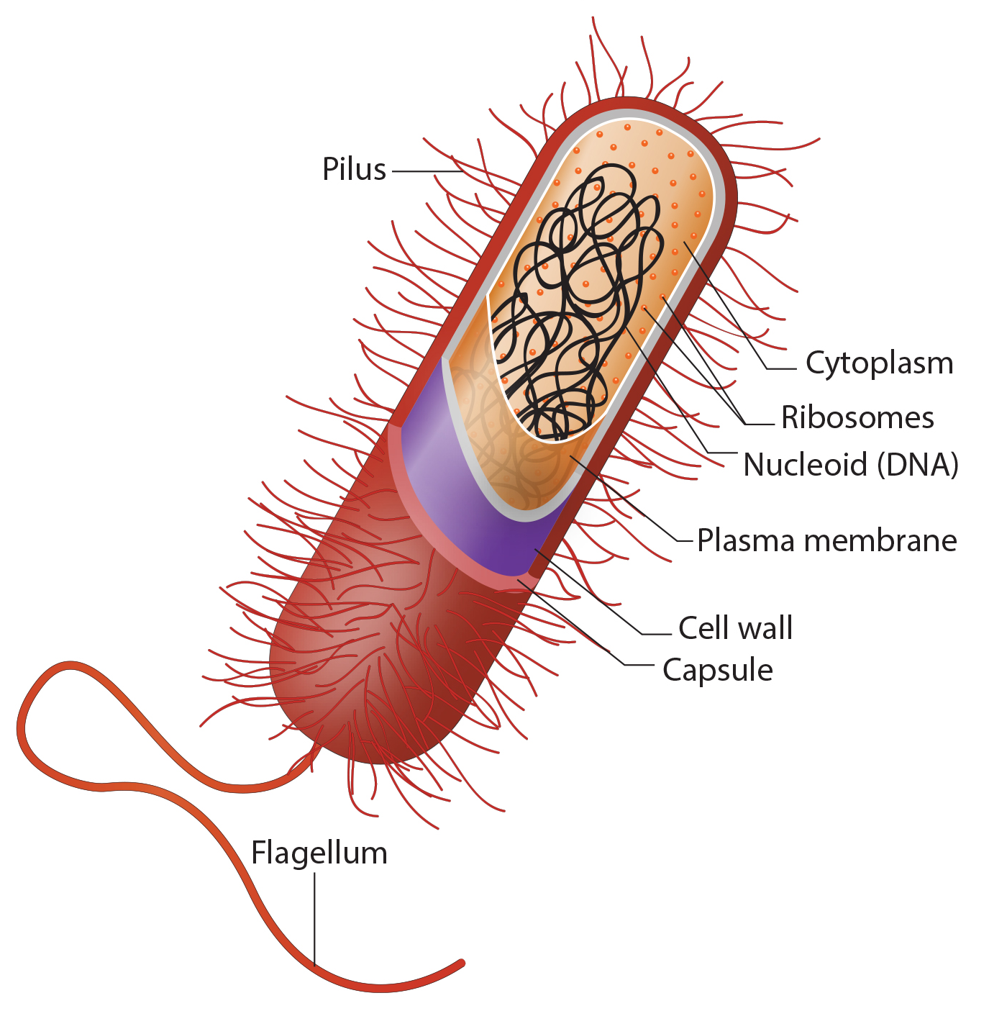
Genomic DNA₁
Cells must replicate and divide their genome (DNA) before cell division.
In prokaryotes, the genome is single, circular, double-stranded DNA.
  Some cells contain additional small DNA loops (plasmids) that can transfer non-essential genes between cells, such as antibiotic resistance.
10.1 Figure 3
Ali Zifan on Wikimedia Commons. "Prokaryote diagram."

Slide 6
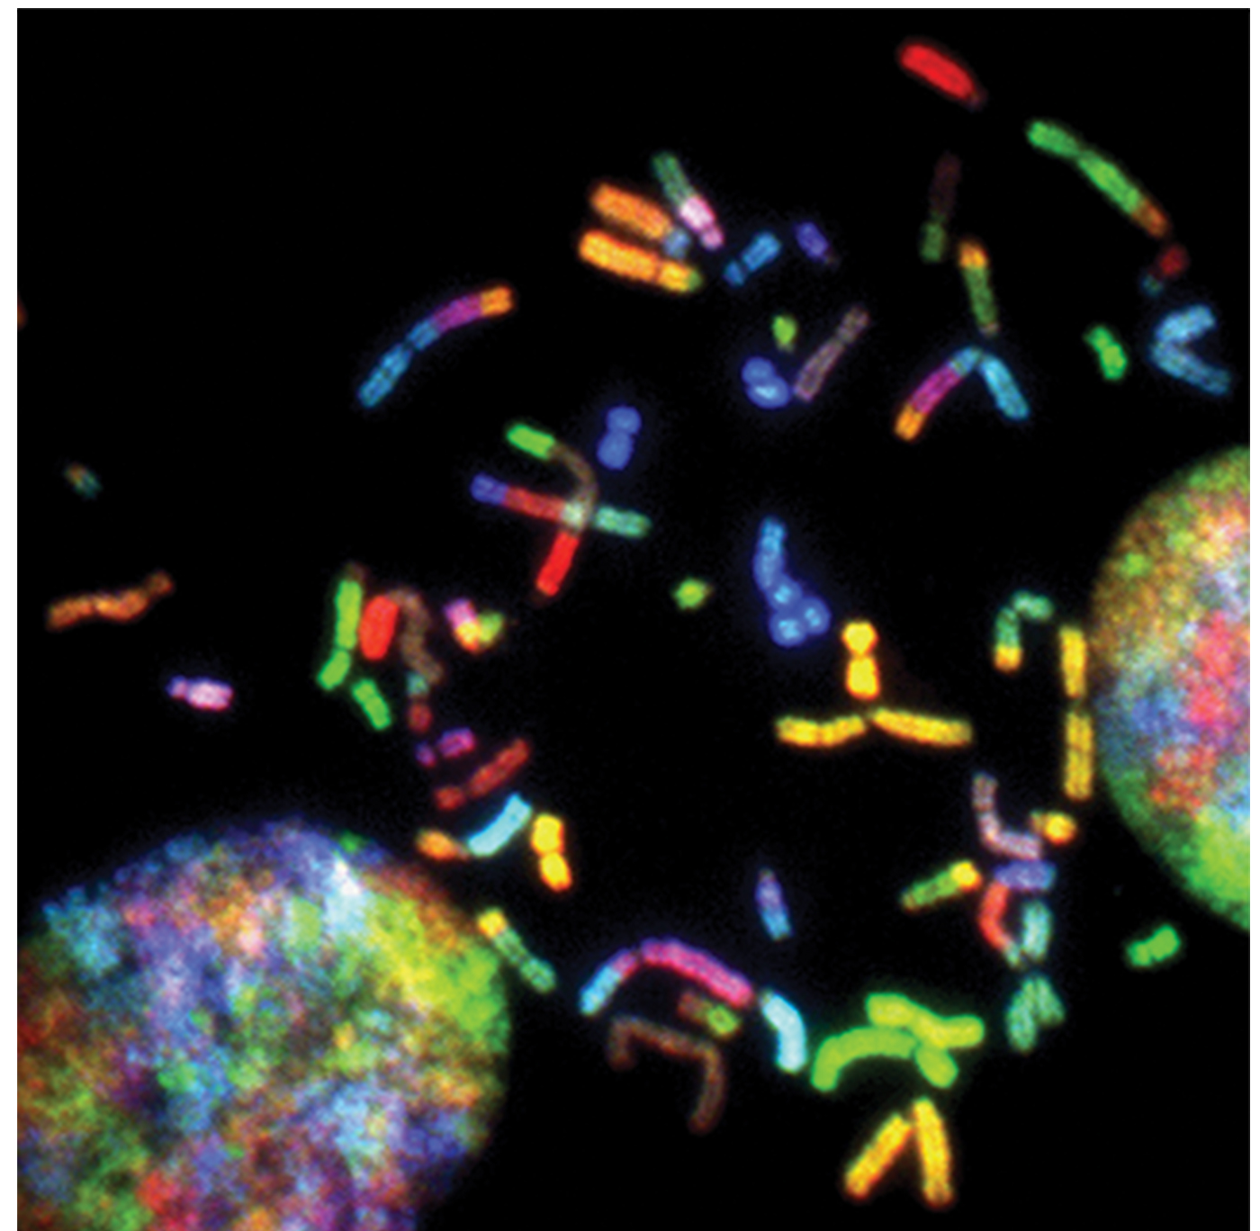
Genomic DNA₂
Eukaryotic genome consists of multiple linear DNA molecules organized into chromosomes.
Human body cells are diploid (contain two matching sets of chromosomes, one from each parent).
Human gametes (eggs and sperm) are haploid with 23 chromosomes each.
10.1 Figure 4
National Cancer Institute on Unsplash. "Spectral karyotyping."

Slide 7
Think It Through
Complete the following chart by providing either the diploid or haploid number for each of the following species.
Species | Haploid Number (n) | Diploid Number (2n) | Gamete Chromosome # | Somatic Chromosome #
Human (Homo sapiens) |  |  | 23 | 46
Mouse (Mus musculus) | 20 |  |  | 40
Donkey (Equus asinus) |  |  |  | 62
Silkworm (Bombyx mori) |  |  | 27

Slide 8
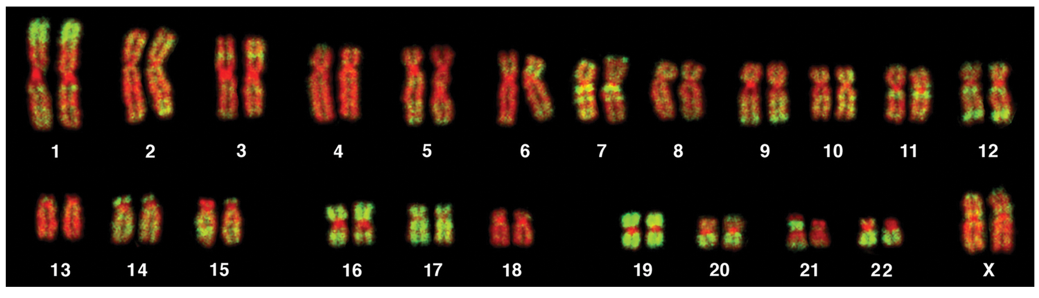
Genomic DNA₃
Homologous chromosomes are matched pairs of chromosomes that are the same length and have genes at the same location or locus.
Genes are the functional units of chromosomes that determine specific characteristics by coding for specific proteins.
Gene alleles from parents cause trait variation within species.
  Excluding X and Y chromosomes, homologous chromosomes differ less than 1%.
10.1 Figure 5
Andreas Bolzer, Gregor Kreth, Irina Solovei, Daniela Koehler, Kaan Saracoglu, Christine Fauth, Stefan Müller, Roland Eils, Christoph Cremer, Michael R. Speicher, Thomas Cremer on Wikimedia Commons. "Karyotype."

Slide 9
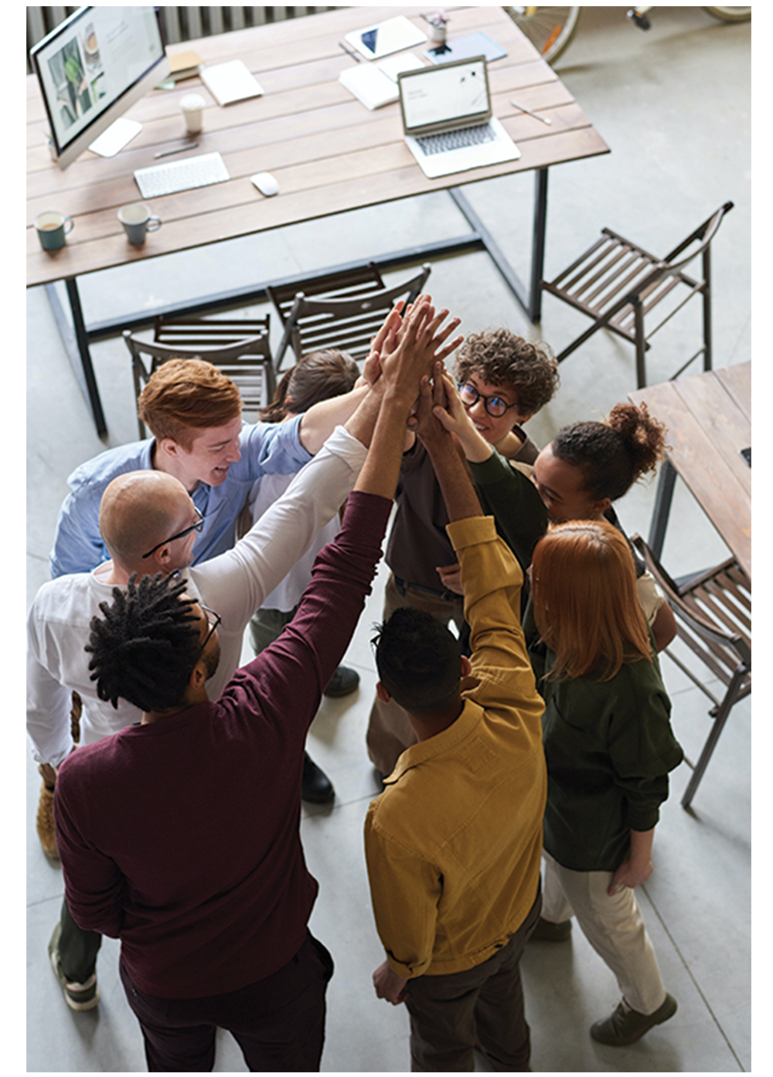
Genomic DNA₄
Minor trait variations contribute to natural diversity within human species.
Some examples of variation include, skin, hair, and eye color, blood type, and handedness.
These variations stem from different allele combinations inherited from parents.
  There are three possible genes that code for blood type (A, B, and O).
10.1 Figure 6
fauxels on Pexels. "High five."

Slide 10
Eukaryotic Chromosomal Structure and Compaction₁
DNA in human cells is tightly packaged into compact chromosomes to fit inside nucleus. There are three levels of compaction:
DNA wraps around a core of eight structural histone proteins forming nucleosomes (histone-DNA complexes). DNA connecting the nucleosomes is linker DNA.
Nucleosomes and linker DNA compact and coil into chromatin fibers.
Fibrous proteins are used to pack the chromatin and ensure that each chromosome stays in a particular area.

Slide 11
Eukaryotic Chromosomal Structure and Compaction₂
DNA replicates during the S phase of interphase, which precedes but is not part of mitosis.
After replication, chromosomes are composed of two linked sister chromatids.
When fully compact, the pairs of identical chromosomes are bound together by cohesin proteins and are connected most closely at the centromere region.
  The centromeric region is highly condensed and appears as a constricted area.

Slide 12
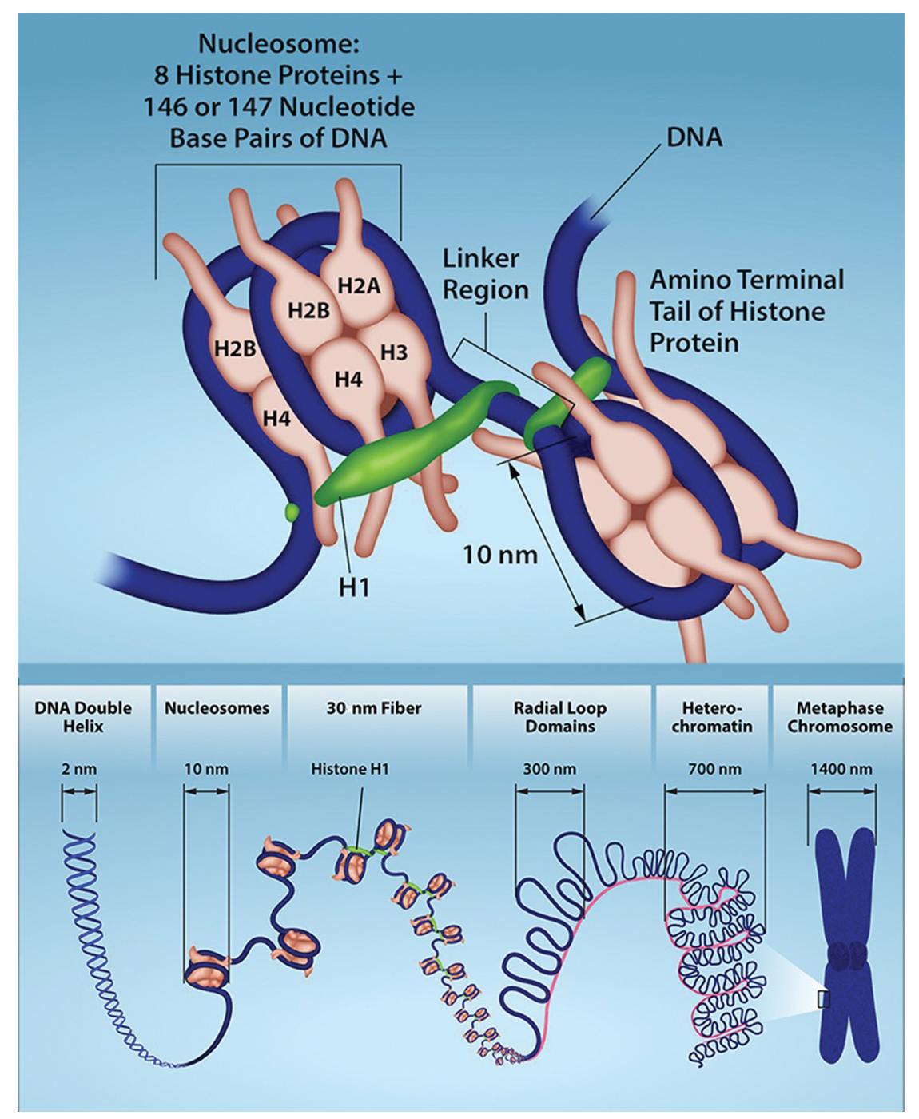
10.1 Figure 7
Rao, A., Ryan, K. Fletcher, S. Hawkins, A. and Tag, A. Department of Biology, Texas A&M University. "Chromosome packing."
Notes:
Each linear chromosome in a eukaryotic cell is packaged into chromatin, a combination of DNA and proteins. The double-stranded DNA helix associates with the core histones to form nucleosomes. These nucleosomes are further organized into a 30 nm fiber by the linker histone, H1. The linker histone sits on top of the nucleosome and helps keep the DNA wrapped around the nucleosome in place; it also binds to the linker DNA to stabilize the chromatin. The fiber then associates with additional proteins to form loops and higher-order heterochromatin packing. DNA packing reaches its most condensed state during metaphase in mitosis in preparation for chromosome separation. Chromatin packing is dynamic and undergoes reversible changes in response to changes in gene expression and the cell cycle.

Slide 13
Reflection Question
A cell must be able to both tightly package and readily access its DNA. How might a household chore, such as doing laundry, provide an analogy for the storage and condensation of DNA?
Notes:
The reflection question is included here to use as a talking point or for a think-pair-share activity.

Slide 14
Group Activity
Work in small groups to build a working model of DNA organization from common materials. Ensure that your model can demonstrate all three levels of DNA compaction.

Slide 15
Summary
Prokaryotes have a single, circular chromosome and eukaryotes have multiple linear chromosomes composed of chromatin wrapped around histones, surrounded by a nuclear membrane.
Human somatic cells are diploid and have 46 chromosomes (22 autosome pairs and 1 sex chromosome pair).
Human gametes are haploid and only have 23 chromosomes.
Genes are DNA segments coding for proteins or RNA and determine inherited traits.

Slide 16


End of Hawkes Learning PowerPoint

