Slide 1
Lesson 10.2
The Cell Cycle and Mitosis

Slide 2
Objectives
Define the quiescent G₀ phase.
Describe the three stages of interphase.
Discuss the behavior of chromosomes during mitosis and karyokinesis.
Explain how the cytoplasmic content is divided during cytokinesis.

Slide 3
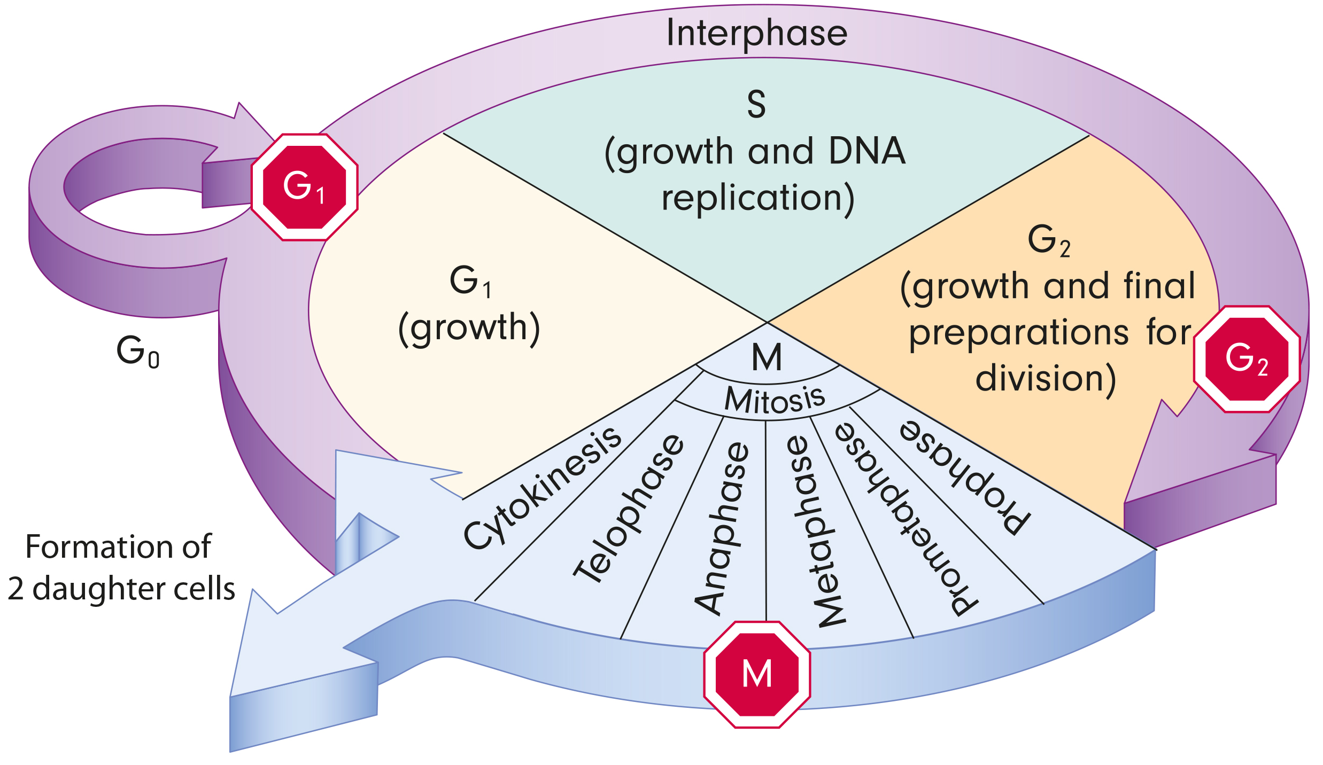
The Cell Cycle and Mitosis
The cell cycle is an ordered series of events involving cell growth and cell division that produces two new daughter cells. Has two main phases:
Interphase: cell growth and DNA replication.
Mitotic phase: DNA division and cytoplasm separates (cytokinesis)
10.2 Figure 1

Slide 4
Interphase: G₁ Phase (First Gap)
During interphase, the cell prepares for cell division.
The cell undergoes normal growth processes.
Many internal and external conditions must be met to move into the mitotic phase.
The three stages of interphase are G₁, S, and G₂.
In the G₁ phase, the cell accumulates building blocks for DNA replication and energy reserves.

Slide 5
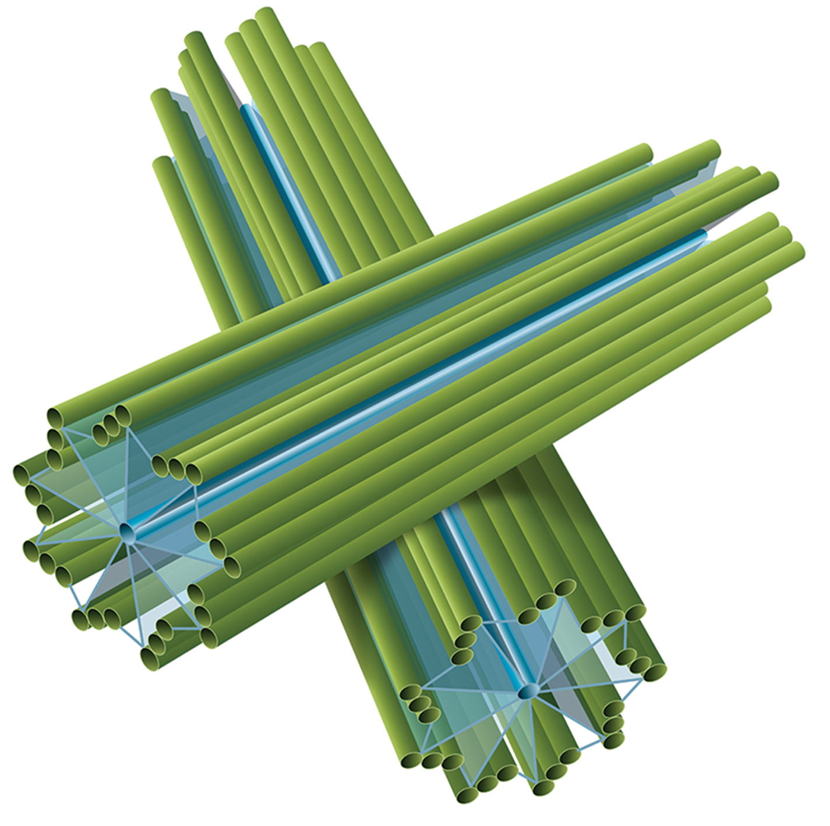
Interphase: S Phase (Synthesis of DNA)
During interphase, nuclear DNA remains semi-condensed.
In S phase, DNA replication forms sister chromatids, attached at centromeres.
Centromeres are attached to mitotic spindle.
Centrosomes are composed of centrioles which organize cell division in animal cells but are absent in plants and fungi.
10.2 Figure 2

Slide 6
Interphase: G₂ Phase (Second Gap)
The cell replenishes energy stores and synthesizes proteins necessary for chromosomes manipulation. replenishment, protein synthesis for chromosomes.
Duplicates organelles
Dismantles cytoskeleton for mitosis resources

Slide 7
The Mitotic Phase
The mitotic phase is a multistep process that aligns, separates, and moves duplicated chromosomes into two new, identical daughter cells.
The first portion is called mitosis (karyokinesis) or nuclear division.
Prophase, prometaphase, metaphase, anaphase, and telophase
The second portion is called cytokinesis, which is the physical separation of cytoplasmic components into the two daughter cells.

Slide 8
Prophase
Nuclear envelope fragments.
Organelles disperse.
Chromosomes condense with the aid of condensin proteins.

Slide 9
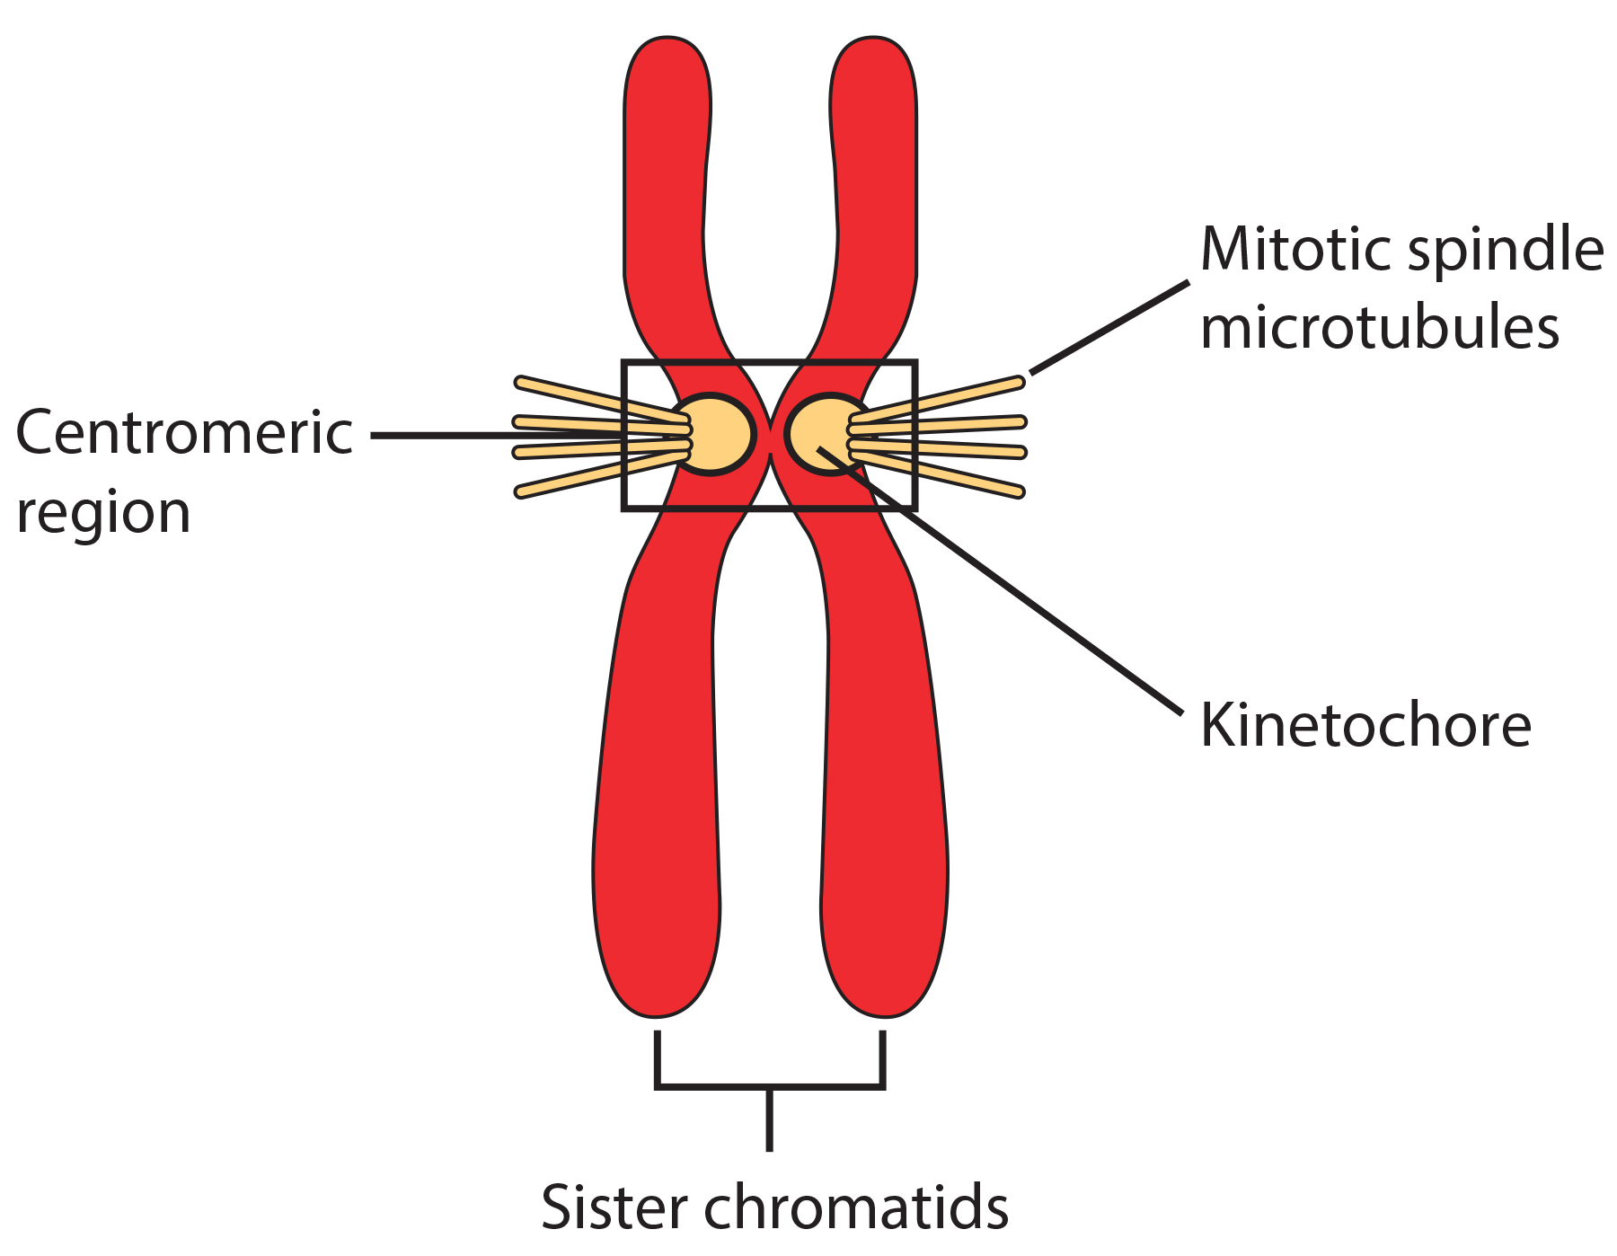
Prometaphase
Mitotic spindle forms.
Sister chromatids each develop a kinetochore at the centromeric region that attaches to the mitotic spindle.
Polar microtubules promote cell elongation.
10.2 Figure 4
CNX OpenStax on Wikimedia Commons. "Chromatid."

Slide 10
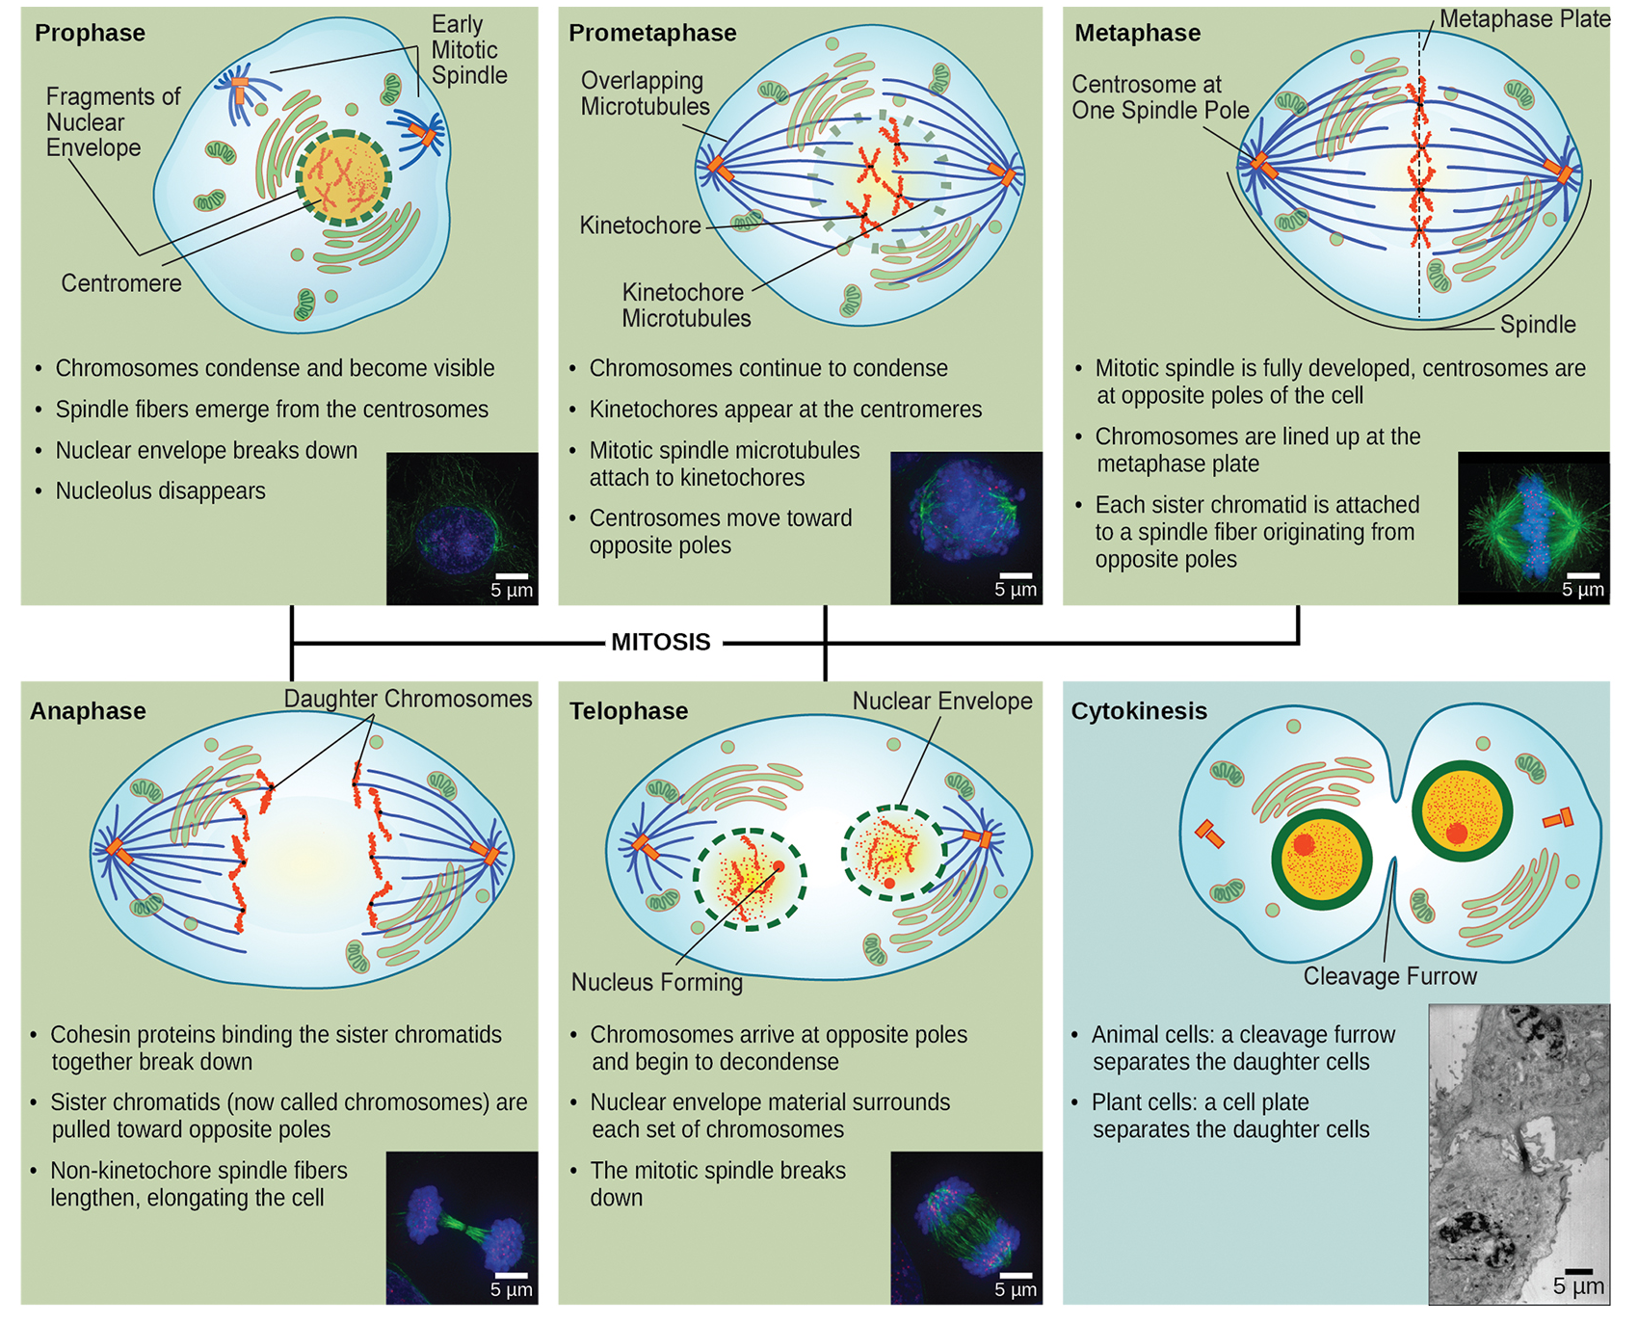
10.2 Figure 3
CNX OpenStax on Wikimedia Commons. "Mitosis stages." Modified.
Notes:
Mitosis (or karyokinesis) is divided into five stages: prophase, prometaphase, metaphase, anaphase, and telophase. The pictures in the bottom right corner of each stage of mitosis were taken by fluorescence microscopy and show cells artificially stained by fluorescent dyes.

Slide 11
Metaphase
Mitotic spindle is fully developed.
Centrosomes are at opposite poles.
Sister chromatids are lined up at the metaphase plate (equatorial plate of the cell).

Slide 12
Anaphase
Cohesin proteins degrade so sister chromatids can separate.
Sister chromatids are pulled toward the poles.
Cell is visibly elongated due to polar microtubules.

Slide 13
Telophase
Chromosomes reach opposite poles and decondense.
Mitotic spindles are depolymerized into tubulin monomers.
Nuclear envelope forms.

Slide 14
Think It Through₁
Which mitotic phase do the following events occur during?
Sister chromatids line up at the equatorial plane of the cell.
The kinetochore becomes attached to the mitotic spindle.
The chromosomes decondense and the nucleus reforms.
The nucleolus disappears and sister chromatids become visible by light microscopy.
Cohesin proteins break down and the sister chromatids separate.
Notes:
Originally an On Your Own. This is included here to use as a talking point or for a think-pair-share activity.

Slide 15
Cytokinesis
Cytokinesis (cell motion) separates the cytoplasm into daughter cells:
In animal cells, a contractile actin ring forms a cleavage furrow at the metaphase plate. The ring contracts, eventually cleaving the membrane.
In plant cells, a new cell wall must form between daughter cells.
Golgi apparatus accumulates enzymes, structural proteins, and glucose and then breaks into vesicles that travel on microtubules forming phragmoplasts.
Vesicles fuse at the metaphase plate to form a cell plate.
Enzymes use glucose to build the cell wall and the Golgi membranes become part of the plasma membrane.

Slide 16
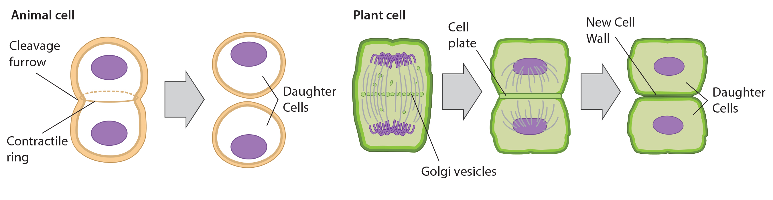
10.2 Figure 5
CNX OpenStax on Wikimedia Commons. "Cytokinesis." Modified.
Notes:
Figure 5: During cytokinesis in animal cells, a ring of actin filaments forms at the metaphase plate. The ring contracts, forming a cleavage furrow, which divides the cell in two. In plant cells, Golgi vesicles coalesce at the former metaphase plate, forming a phragmoplast. A cell plate formed by the fusion of the vesicles of the phragmoplast grows from the center toward the cell walls, and the membranes of the vesicles fuse to form a plasma membrane that divides the cell in two.

Slide 17
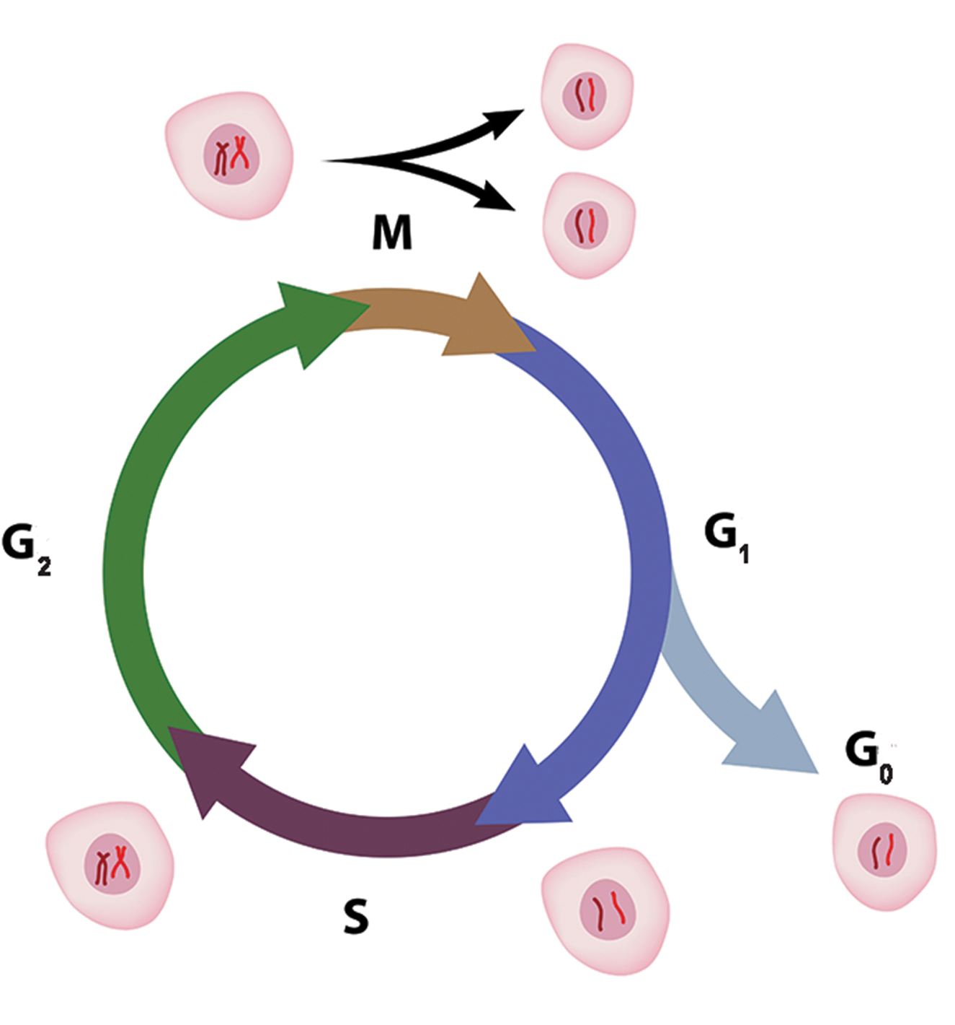
G₀ Phase
G₀ phase is the quiescent, non-dividing state.
Cells are not preparing to divide.
Temporary for some cells, permanent for others like mature muscle and nerve cells.
10.2 Figure 6

Slide 18
Think It Through₂
For each phase of the cell cycle, briefly describe what is happening to each chromosome's composition and the overall chromosome number.
G₁ phase
S phase
G₂ phase
Mitotic phase
Notes:
Originally an On Your Own. This is included here to use as a talking point or for a think-pair-share activity.

Slide 19
Reflection Question
Consider various types of cells in a human adult, including skin cells, intestinal cells, bone cells, and kidney cells. Which phase(s) of the cell cycle (interphase, mitotic phase, or G₀) do you think various cell types are most typically in? Why?
Notes:
The reflection question is included here to use as a talking point or for a think-pair-share activity.

Slide 20
Group Activity
Determine the Time Spent in Cell-Cycle Stages
As a group, complete the following activity.
Problem: How long does a cell spend in interphase compared to each phase of mitosis?

Slide 21
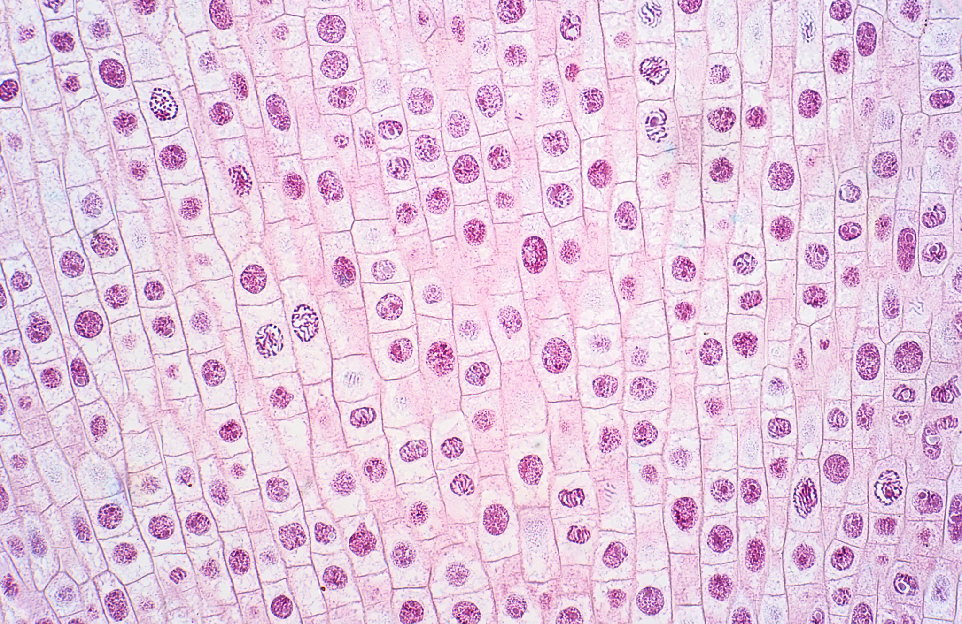
Group Activity (Continued)₁
Background: An image of an onion root tip shows cells arrested in various phases of the cell cycle (Figure 7). Note that it is not visually possible to separate the phases of interphase from each other, but the mitotic phases are readily identifiable. If 100 cells are examined, the number of cells in each identifiable cell-cycle phase will give an estimate of the time it takes for the cell to complete that stage.
10.2 Figure 7

Slide 22
Group Activity (Continued)₂
Problem Statement: Given the events included in all of interphase and those that take place in each phase of mitosis, estimate the length of each phase, based on a 12-hour cell cycle. Before proceeding, state your hypothesis.
Test Your Hypothesis: Test your hypothesis by doing the following:
Practice identifying the various phases of the cell cycle, using the drawings of the phases in Figure 3 as a guide.
Once you are confident about your identification, record the phase of each cell you encounter as you scan top to bottom and left to right across the rows of onion root tip cells, not skipping any cells as you go.
Keep a tally of your observations and stop when you reach 100 cells identified.
Record Your Observations: Make a table similar to Table 1 within which to record your observations.

Slide 23
Group Activity (Continued)₃
Table 1: Results of Cell Phase Identification
Analyze Your Data/Report Your Results: To find the length of time onion root tip cells spend in each phase, multiply the percent (recorded as a decimal) by 12 hours. Make a table similar to Table 2 to illustrate your data.
Phase | Individual Totals | Group Totals | Percent (Decimal)
Interphase
Prophase
Prometaphase
Metaphase
Anaphase
Telophase
Cytokinesis
Totals | 100 | 100 | 100% (1.00)

Slide 24
Group Activity (Continued)₄
Table 2: Estimate of Cell Phase Length
Draw a Conclusion: Did your results support your estimated times? Were any of the outcomes unexpected? If so, discuss those events in that phase that may have contributed to the calculated time.
Phase | Percent as Decimal | Time in This Phase (Hours)
Interphase
Prophase
Prometaphase
Metaphase
Anaphase
Telophase
Cytokinesis

Slide 25
Summary
The cell cycle is an orderly sequence of events.
Interphase is a preparatory period including the G₁, S, and G₂ phases for cell growth and chromosome replication.
The mitotic phase includes mitosis (prophase, prometaphase, metaphase, anaphase, telophase) and cytokinesis.
Cytokinesis separates cytoplasmic components into daughter cells by actin ring or cell plate.
The G₀ phase includes cells that are not actively dividing, which can be a temporary or permanent phase.

Slide 26


End of Hawkes Learning PowerPoint

