Slide 1
Lesson 10.3
Regulation of the Cell Cycle

Slide 2
Objectives
Describe the molecules that control the cell cycle through positive and negative regulation.
Explain how the three internal "control checkpoints" occur at the end of G₁, at the G₂ and M transition, and during metaphase.
Understand how the cell cycle of eukaryotes is controlled by mechanisms that are both internal and external to the cell.

Slide 3
Regulation of the Cell Cycle
The length of the cell cycle and phases is variable in eukaryotes.
In humans, ranges from hours in embryos to a lifetime in neurons and muscle cells
Fruit fly embryos complete the cell cycle rapidly in 8 minutes.
Timing is controlled by internal and external mechanisms in invertebrates and vertebrates.

Slide 4
Regulation of the Cell Cycle by External Events
Initiation and inhibition of cell division is triggered by external events.
Includes cell death, release of specific hormones hormones (human growth hormone (HGH or hGH)), and increased cell density
HGH deficiency causes dwarfism, while an excess leads to gigantism.
A cell's size can initiate division due to the inefficiency of large cells due to their surface-to-volume ratio.

Slide 5
Reflection Question₁
Why do you think a cell becomes physiologically inefficient as it increases in size? What might cause this?
Notes:
The reflection question is included here to use as a talking point or for a think-pair-share activity.

Slide 6
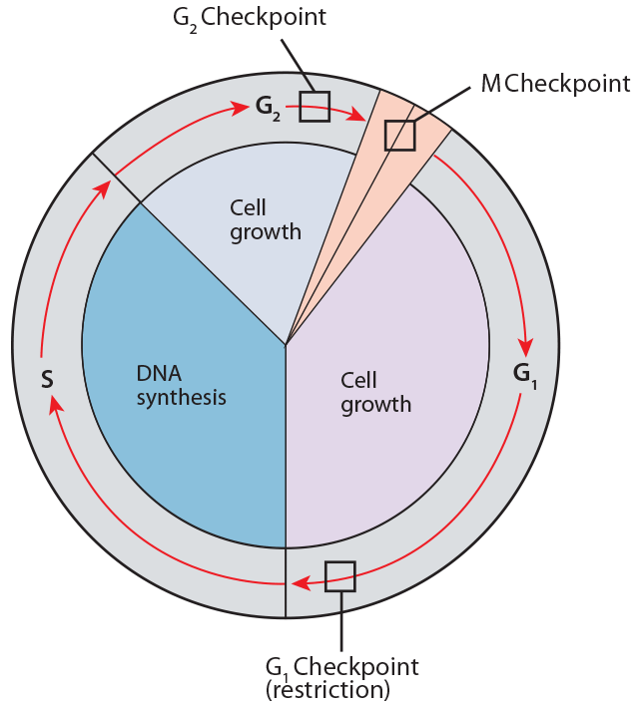
Regulation at Internal Checkpoints
Daughter cells must be exact duplicates of the parent cell to avoid mutations.
Internal controls at three main cell-cycle checkpoints.
Points in the cell cycle where cell progression can be halted until conditions are favorable
10.3 Figure 1

Slide 7
The G₁ Checkpoint
The G₁ checkpoint (restriction point) determines if conditions are favorable for division.
The point at which the cell irreversibly commits to the cell division process.
The cell checks for adequate proteins, fuel, size, and any DNA damage before moving to the S phase.
Halting progress allows the cell to fix the issues or enter G₀.

Slide 8
The G₂ Checkpoint
The G₂ checkpoint prevents entry into the mitotic phase if certain conditions are not met.
Checks cell size and protein reserves like G₁ checkpoint
Ensures all chromosomes were replicated without DNA damage
If there is an issue, the cycle halts to complete DNA replication or repair damage.

Slide 9
The M Checkpoint
The M checkpoint (spindle checkpoint) occurs near the end of metaphase.
Checks if all sister chromatids are correctly attached to spindle microtubules.
This ensures that sister chromatids will divide correctly during anaphase.

Slide 10
Think It Through₁
For each scenario, provide the cell-cycle checkpoint at which the cell cycle will be halted.
There was an error in DNA replication and one of the chromosomes was not duplicated.
There is a growth factor deficiency, which results in the cell being too small.
A pair of associated sister chromatids is attached to only one spindle fiber.
Exposure of a cell to ultraviolet radiation results in DNA damage.
Notes:
Originally an On Your Own. This is included here to use as a talking point or for a think-pair-share activity.

Slide 11
Reflection Question₂
Why do you think the cell commonly has more than one mechanism controlling progression through a single cell-cycle checkpoint? What might have been the more likely outcome if the cell did not have multiple mechanisms in place?
Notes:
The reflection question is included here to use as a talking point or for a think-pair-share activity.

Slide 12
Regulator Molecules of the Cell Cycle
Two groups of intracellular molecules regulate the cell cycle: positive regulation promotes progression and negative regulation halts it.
Regulators can act individually or influence the activity or production of other regulatory proteins.
Failure of a single regulator may have almost no effect on the cell cycle, especially if more than one mechanism controls the same event or can have a fatal affect if multiple processes are affected.

Slide 13
Positive Regulation of the Cell Cycle₁
Cyclins and cyclin-dependent kinases (Cdks) are positive regulators driving cell cycle progression.
Four cyclin protein levels fluctuate predictably, increasing due to internal and external signals.
Cyclins from each stage degrade after the cell transitions to the next stage.

Slide 14
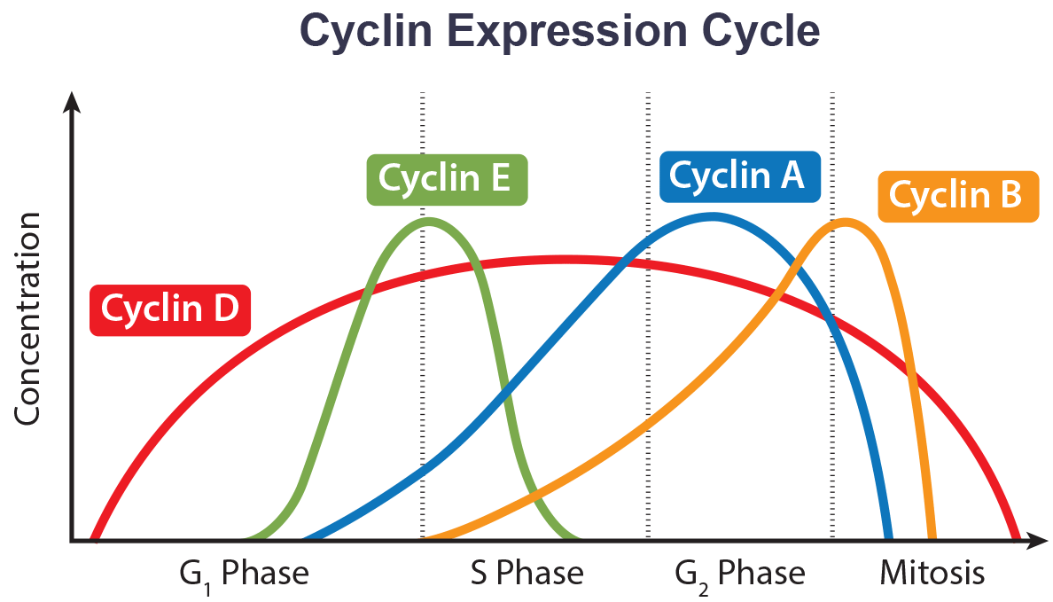
10.3 Figure 2
WikiMiMa on Wikimedia Commons. "Cyclin expression cycle."
Notes:
The concentrations of cyclin proteins change throughout the cell cycle. There is a direct correlation between cyclin accumulation and the three major cell-cycle checkpoints. Also note the sharp decline of the levels of cyclins E, A, and B following each checkpoint (the transition between phases of the cell cycle) as cyclin is degraded by cytoplasmic enzymes.

Slide 15
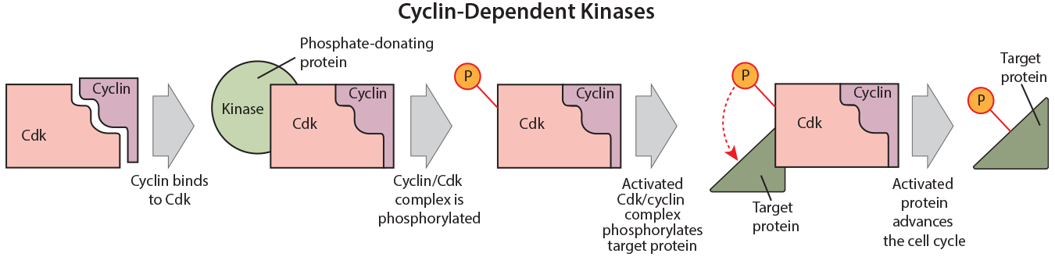
Positive Regulation of the Cell Cycle₂
Cyclins control cycle by binding Cdks in phosphorylated complexes.
Cdk phosphorylation causes a conformational change that activates it.
The different cyclins and Cdks bind at specific points in the cell cycle and, thus, regulate different checkpoints.
10.3 Figure 3
CNX OpenStax on Wikimedia Commons. "Cyclin-dependent kinases." Modified.

Slide 16
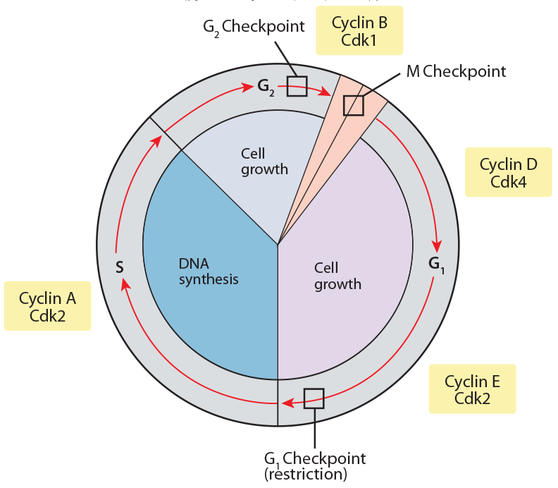
Positive Regulation of the Cell Cycle₃
Cell cycle is regulated by Cdks or Cdk/cyclin complexes that must be present at certain levels.
Cdk inhibitors block Cdks, preventing the progression of the cell cycle until the particular cell-cycle event is finished.
10.3 Figure 4
OpenStax on Wikimedia Commons. "Cyclin/Cdk within cell cycle."

Slide 17
Negative Regulation of the Cell Cycle
Negative regulators stop the cell cycle. Examples are retinoblastoma protein (Rb), p53, and p21, a group of tumor-suppressor proteins.
They act mainly at the G₁ checkpoint; p53 halts the cell for DNA repair or apoptosis, while p21 inhibits Cdk and cyclin complexes to stop the cell from progressing.
Rb binds to transcription factors like E2F, blocking the production of proteins necessary for G₁/S transition until the cell size increases.
For the cell to move past each of the checkpoints, all positive regulators must be "turned on," and all negative regulators must be "turned off."

Slide 18
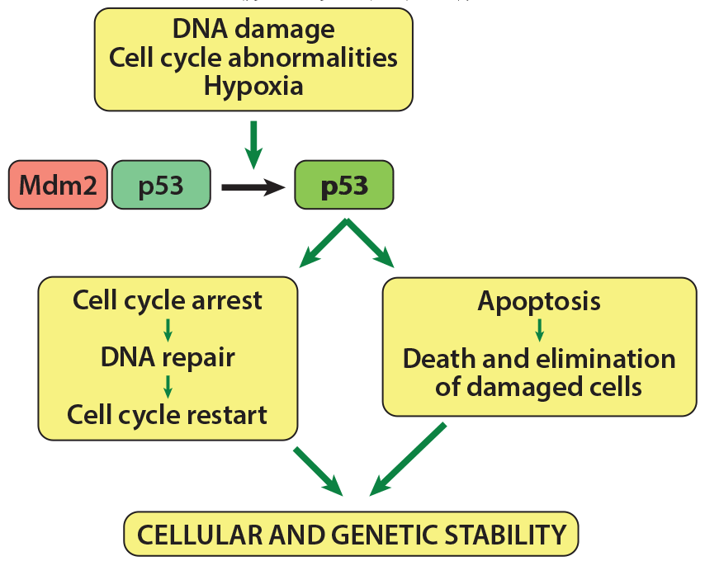
10.3 Figure 5
Thierry Soussi on Wikimedia Commons. "Pathways of the p53 protein."
Notes:
p53 controls movement through the G1 checkpoint. If the necessary conditions for growth are met (the DNA is not damaged, there are no cell cycle abnormalities, and the cell is not experiencing hypoxia, or a lack of oxygen), then p53 remains bound to the Mdm2 protein and is inactive. However, if one of these conditions is not met, p53 is released from Mdm2 and becomes active, preventing movement through the G1 checkpoint (by activating p21) to give the cell time to repair its DNA. If the cell is unable to do so, then p53 promotes apoptosis, resulting in cell death.

Slide 19
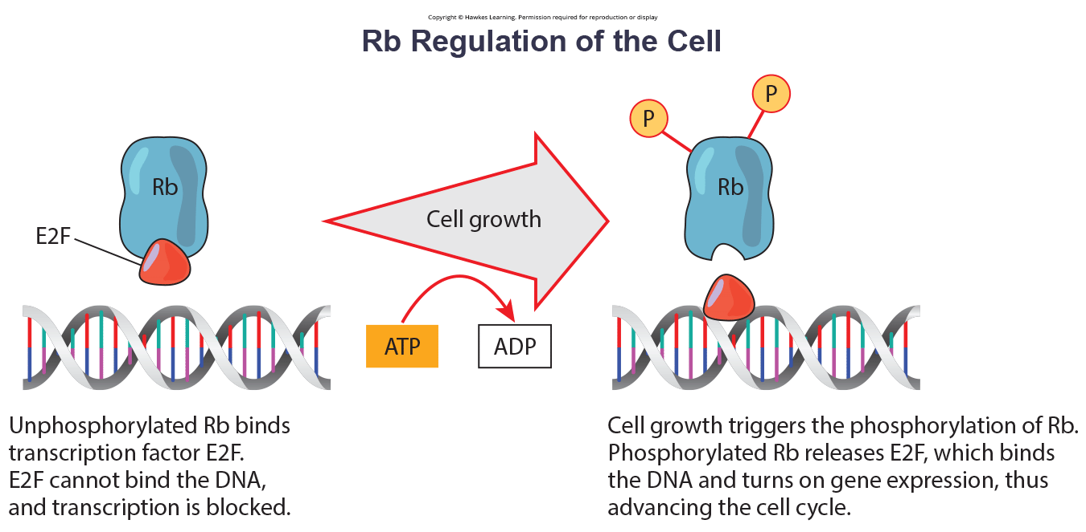
Think It Through₂
Rb and other proteins that negatively regulate the cell cycle are sometimes called tumor suppressors. Why do you think the name tumor suppressor might be appropriate for these proteins?
10.3 Figure 6
Notes:
Originally an On Your Own. This is included here to use as a talking point or for a think-pair-share activity.

Slide 20
Summary
Progression through the eukaryotic cell cycle is monitored by internal controls called checkpoints.
There are three major checkpoints: one near the end of G₁, a second at the G₂/M transition, and the third during metaphase.
Positive regulator molecules allow the cell cycle to advance to the next stage of cell division.
Negative regulator molecules monitor cellular conditions and can halt the cycle until specific requirements are met.

Slide 21


End of Hawkes Learning PowerPoint

